Slide 1
Statistics – O. R. 881 Object Oriented Data Analysis
Steve Marron
Dept. of Statistics and Operations Research
University of North Carolina

Slide 2
Current Sections in Textbook
Today:
Sections 14.2, 14.1
Next Class:
Sections 12.1, 12.2, 13.2

Slide 3
Last Class: HDLSS Asymptotics
Text: Sec. 14.2
Recall Various “Mysteries” about
High Dimension Low Sample Size Data
Natural Separation of $N_{1000}\left(0,I\right)$ Data
Strange behavior in HDLSS Classificat’n
GWAS Failure of Spherical PCA
Next Investigate Mathematics Of These
Notes:
3

Slide 4
Last Class: HDLSS Asymptotics
Modern Mathematical Statistics:
Based on asymptotic analysis
Real Reasons:
Approximation provides insights
Can find simple underlying structure
In complex situations
Thus various flavors are fine:
$$\lim_{n→∞}{} \lim_{d→∞}{} \lim_{n,d→∞}{} \lim_{σ→0}{}$$
Even desirable! (find additional insights)
Notes:
4

Slide 5
Last Class: HDLSS Paradoxes
As $d→∞$,
$$\left\|\tilde{z}\right\|=\sqrt{d}+O_{p}\left(1\right)$$
Data lie roughly on surface of sphere,
with radius $\sqrt{d}$
- Yet origin is point of highest density???
- Paradox resolved by:
density w. r. t. Lebesgue Measure
Notes:
5

Slide 6
Last Class: HDLSS Paradoxes
As $d→∞$, $\left\|\tilde{z}\right\|=\sqrt{d}+O_{p}\left(1\right)$
Important Philosophical Consequence:
$∄$“Average People”
Parents Lament:
Why Can’t I Have Average Children?
Theorem: Impossible (over many factors)!
Notes:
6

Slide 7
Last Class: HDLSS Paradoxes
For $d$ dim’al Standard Normal dist’n:
${\tilde{z}}_{1}$ indep. of ${\tilde{z}}_{2}\sim N_{d}\left(0,I_{d}\right)$
High dim’al Angles (as $d→∞$):
$$Angle\left({\underline{Z}}_{1},{\underline{Z}}_{2}\right)={90}^{°}+O_{p}\left(d^{−1/2}\right)$$
- Everything is orthogonal???
$\sqrt{2d}$
Note Pythagorean Theorem:
$\sqrt{d}$
${90}^{°}$
$\sqrt{d}$

Slide 8
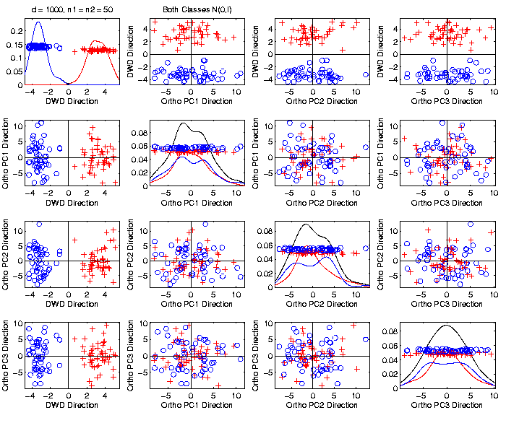
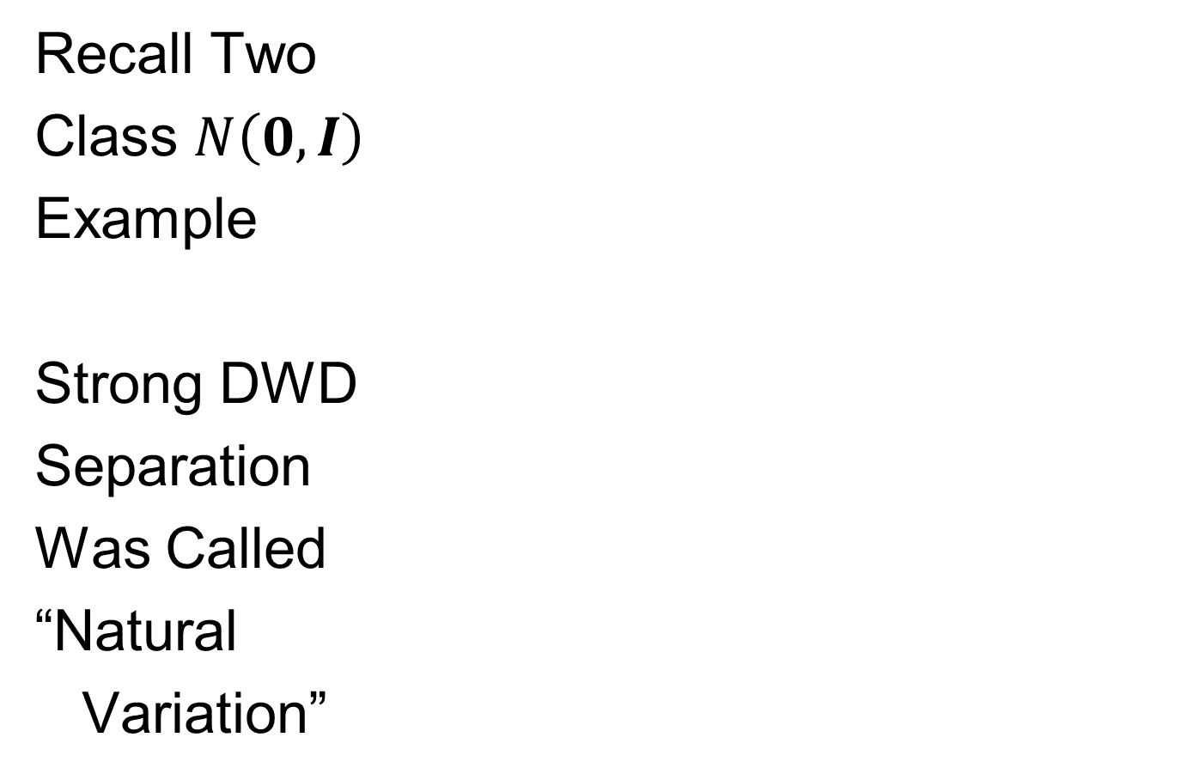
Last Class: HDLSS Explanation
Recall Two
Class $N\left(0,I\right)$
Example
Strong DWD
Separation
Was Called
“Natural
Variation”

Slide 9
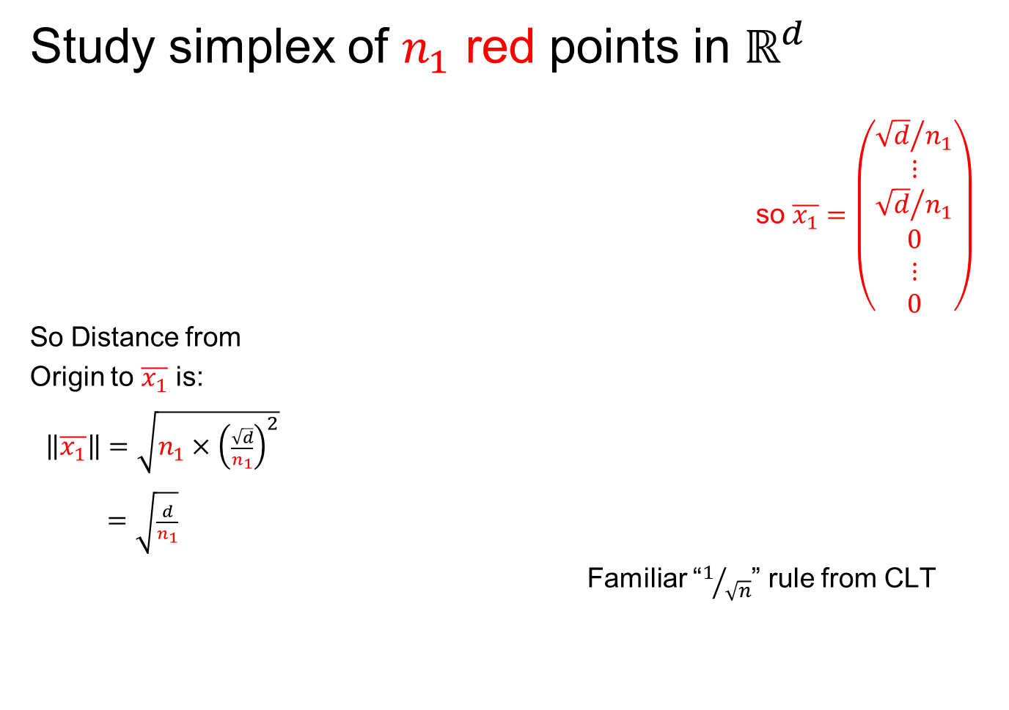
Last Class: HDLSS Explanation
Study simplex of $n_{1}$ red points in $ℝ^{d}$
so $\overline{x_{1}}=\left(\begin{matrix}\begin{matrix}{\sqrt{d}}/{n_{1}} \\ ⋮ \\ {\sqrt{d}}/{n_{1}}\end{matrix} \\ \begin{matrix}0 \\ ⋮ \\ 0\end{matrix}\end{matrix}\right)$
So Distance from
Origin to $\overline{x_{1}}$ is:
$\left\|\overline{x_{1}}\right\|=\sqrt{n_{1}×{\left(\frac{\sqrt{d}}{n_{1}}\right)}^{2}}$
$=\sqrt{\frac{d}{n_{1}}}$
Familiar “$1/{\sqrt{n}}$” rule from CLT

Slide 10

Last Class: HDLSS Explanation
Recall Two
Class $N\left(0,I\right)$
Example
$\left\|\overline{x_{1}}−\overline{x_{2}}\right\|$
$≈6.3$

Slide 11
Last Class: HDLSS History & Assum’ns
On Geometrical Representation
Major Papers:
Hall, Marron and Neeman (2005)
Ahn, Marron, Muller & Chi (2007)
Yata & Aoshima (2009, 2010a, 2010b, 2012, 2013)

Slide 12
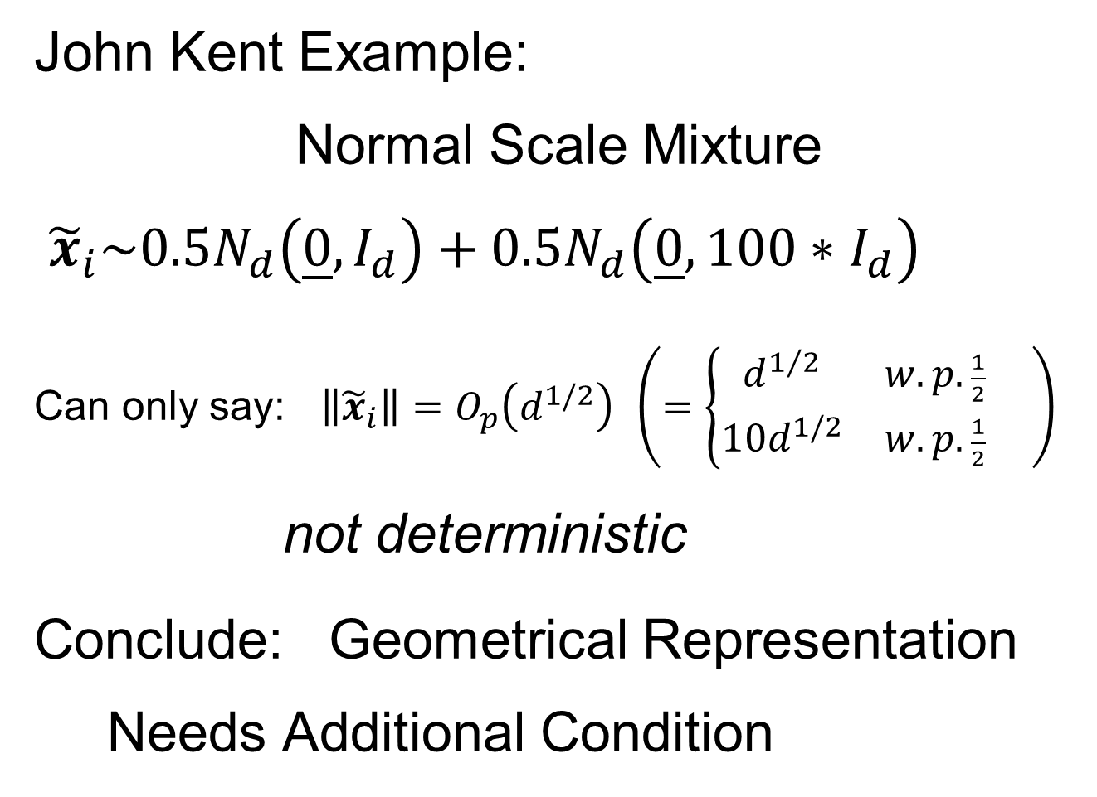
Last Class: HDLSS History & Assum’ns
John Kent Example:
Normal Scale Mixture
${\tilde{x}}_{i}\sim 0.5N_{d}\left(\underline{0},I_{d}\right)+0.5N_{d}\left(\underline{0},{100∗I}_{d}\right)$
Can only say: $\left\|{\tilde{x}}_{i}\right\|=O_{p}\left(d^{1/2}\right)$ $\left(=\left\{\begin{matrix}d^{1/2} & w.p.\frac{1}{2} \\ 10d^{1/2} & w.p.\frac{1}{2}\end{matrix}\right. \right)$
not deterministic
Conclude: Geometrical Representation Needs Additional Condition

Slide 13

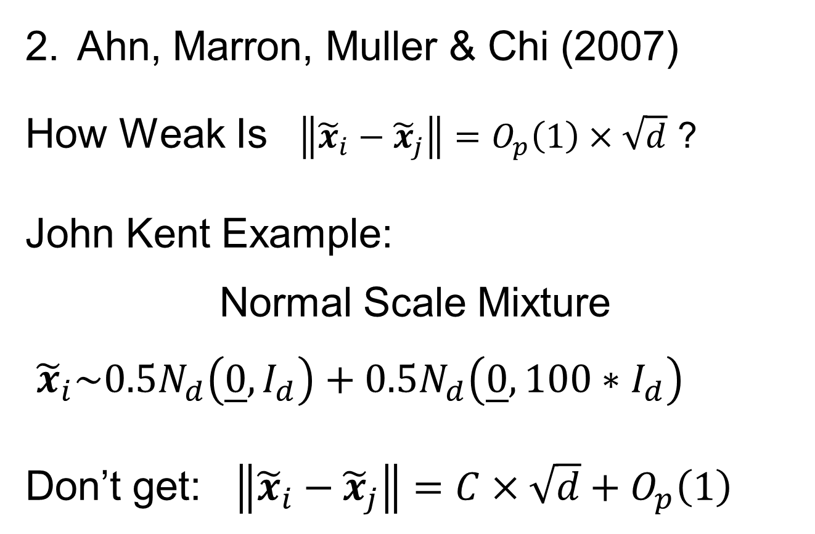
HDLSS Asy’s: History & Assumptions
Ahn, Marron, Muller & Chi (2007)
How Weak Is $\left\|{\tilde{x}}_{i}−{\tilde{x}}_{j}\right\|=O_{p}\left(1\right)×\sqrt{d}$ ?
John Kent Example:
Normal Scale Mixture
${\tilde{x}}_{i}\sim 0.5N_{d}\left(\underline{0},I_{d}\right)+0.5N_{d}\left(\underline{0},{100∗I}_{d}\right)$
Don’t get: $\left\|{\tilde{x}}_{i}−{\tilde{x}}_{j}\right\|=C×\sqrt{d}+O_{p}\left(1\right)$

Slide 14
HDLSS Asy’s: History & Assumptions
John Kent Example:
Normal Scale Mixture
${\tilde{x}}_{i}\sim 0.5N_{d}\left(\underline{0},I_{d}\right)+0.5N_{d}\left(\underline{0},{100∗I}_{d}\right)$
Can only say: $\left\|{\tilde{x}}_{i}\right\|=O_{p}\left(d^{1/2}\right)$ $\left(=\left\{\begin{matrix}d^{1/2} & w.p.\frac{1}{2} \\ 10d^{1/2} & w.p.\frac{1}{2}\end{matrix}\right. \right)$
not deterministic
Conclude: Geometrical Representation Needs Additional Condition

Slide 15


HDLSS Asy’s: History & Assumptions
Yata & Aoshima (2009, 2010a, 2010b, 2012, 2013)

Slide 16
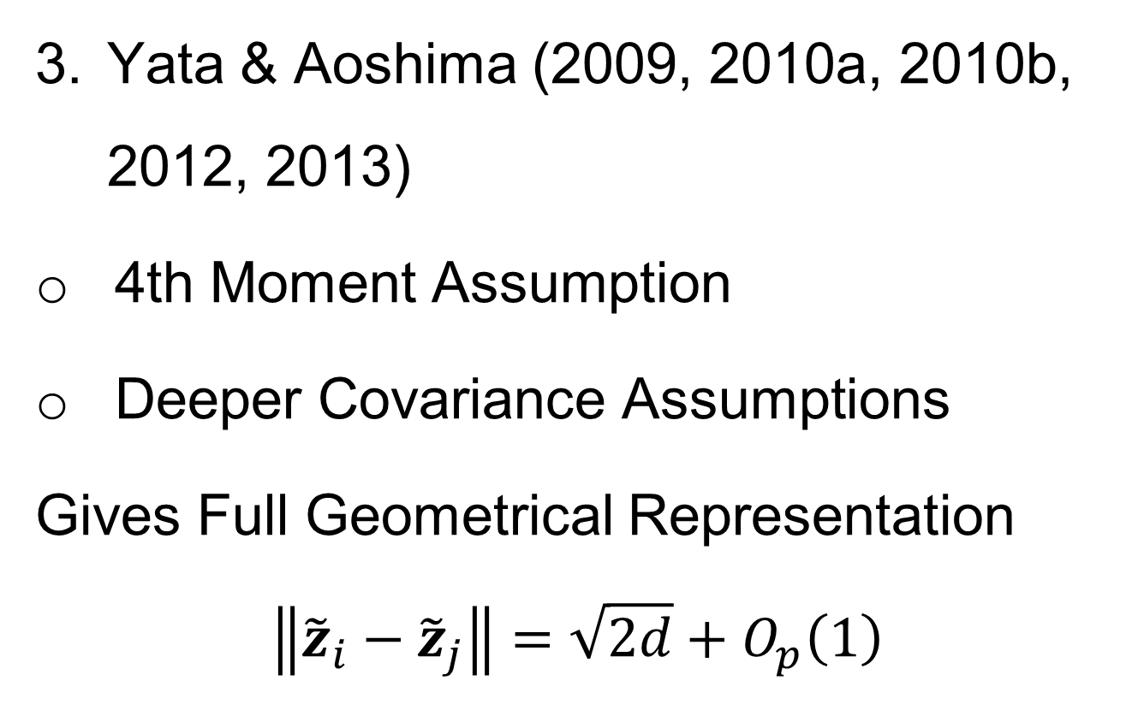
HDLSS Asy’s: History & Assumptions
Yata & Aoshima (2009, 2010a, 2010b, 2012, 2013)
4th Moment Assumption
Deeper Covariance Assumptions
Gives Full Geometrical Representation
$$\left\|{\tilde{z}}_{i}−{\tilde{z}}_{j}\right\|=\sqrt{2d}+O_{p}\left(1\right)$$

Slide 17
HDLSS Geometrical Representation
Personal Favorite Conditions:
Tricky Point: Classical Mixing Conditions
Require Notion of Time Ordering
Not Always Clear, e.g. Gene Expression

Slide 18

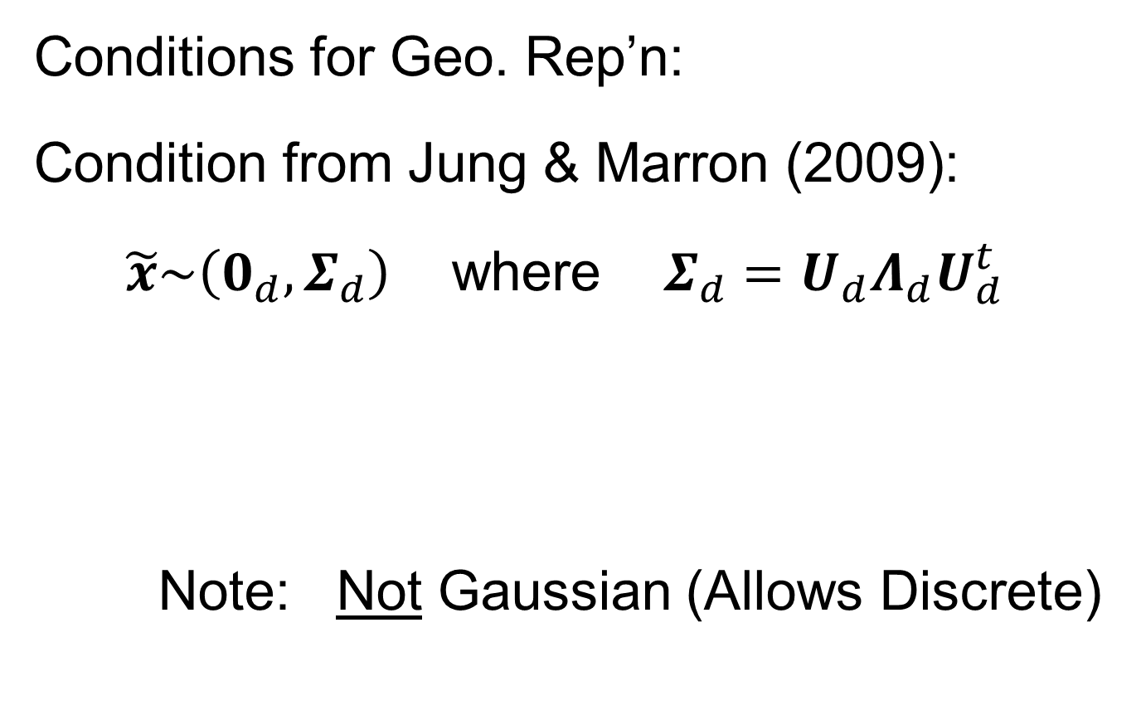
HDLSS Geometric Representation
Conditions for Geo. Rep’n:
Condition from Jung & Marron (2009):
$\tilde{x}\sim \left(0_{d},Σ_{d}\right)$ where $Σ_{d}=U_{d}Λ_{d}U_{d}^{t}$
Note: Not Gaussian (Allows Discrete)

Slide 19
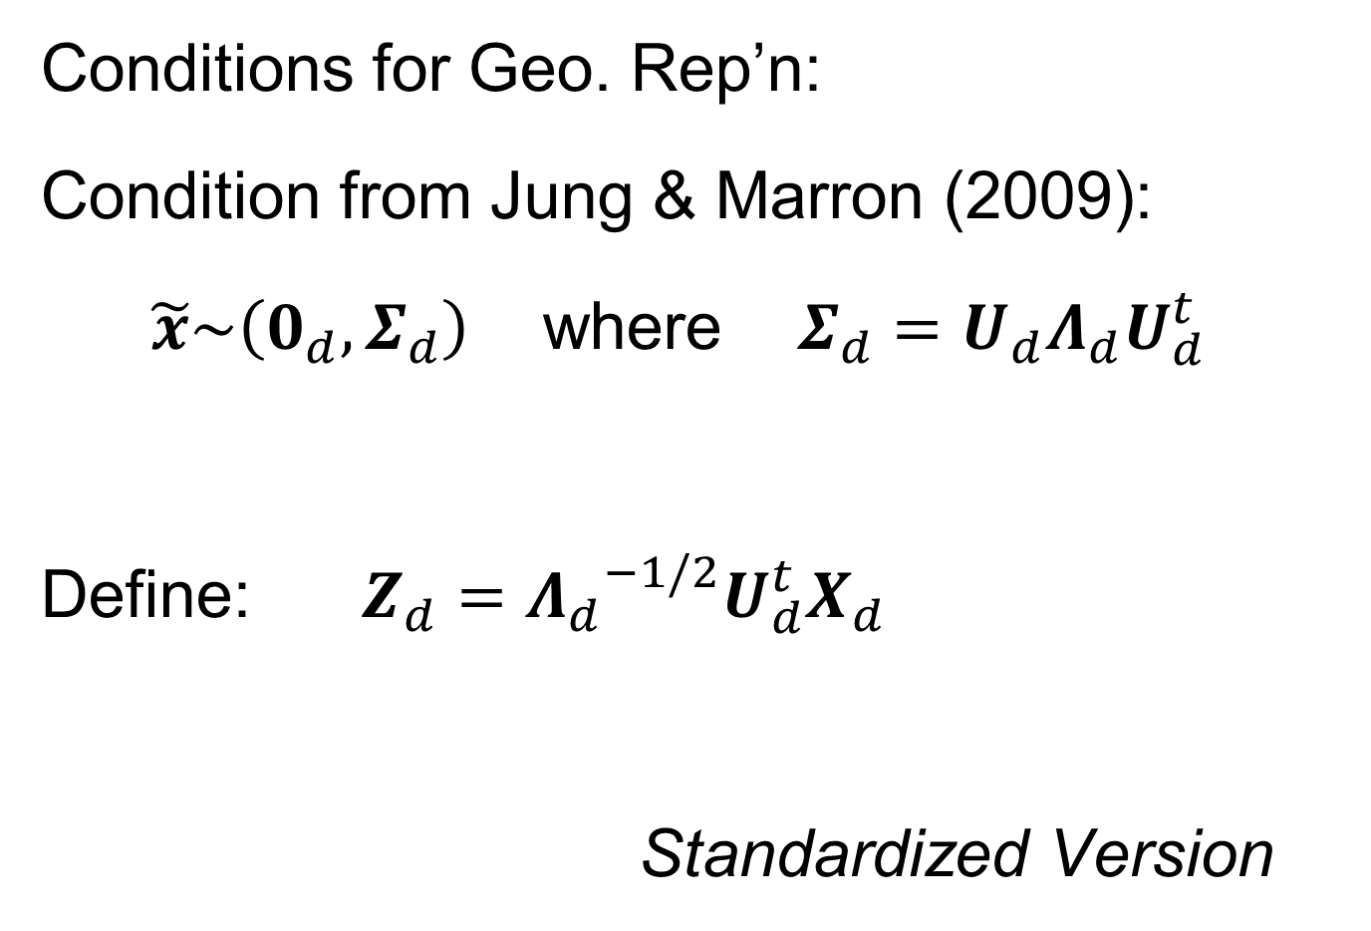

HDLSS Geometric Representation
Conditions for Geo. Rep’n:
Condition from Jung & Marron (2009):
$\tilde{x}\sim \left(0_{d},Σ_{d}\right)$ where $Σ_{d}=U_{d}Λ_{d}U_{d}^{t}$
Define: $Z_{d}={Λ_{d}}^{−1/2}U_{d}^{t}X_{d}$
Standardized Version
Only Mean $0$, Covariance $I$

Slide 20
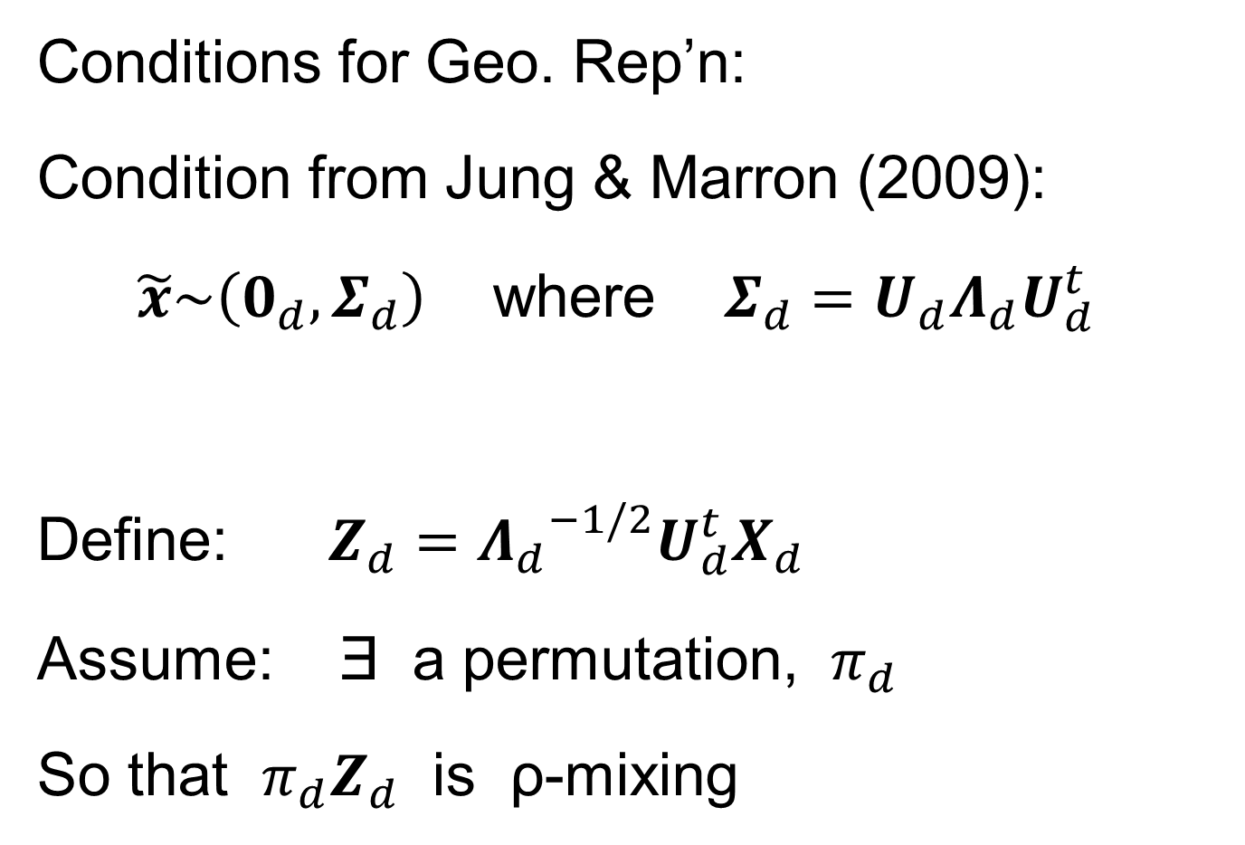
HDLSS Geometric Representation
Conditions for Geo. Rep’n:
Condition from Jung & Marron (2009):
$\tilde{x}\sim \left(0_{d},Σ_{d}\right)$ where $Σ_{d}=U_{d}Λ_{d}U_{d}^{t}$
Define: $Z_{d}={Λ_{d}}^{−1/2}U_{d}^{t}X_{d}$
Assume: Ǝ a permutation, $π_{d}$
So that $π_{d}Z_{d}$ is ρ-mixing

Slide 21
HDLSS Math. Stat. of PCA
HDLSS Analysis of PCA
from Jung & Marron (2009)

Slide 22
HDLSS Math. Stat. of PCA
Consistency & Strong Inconsistency
(Study Properties of PCA,
In Estimating Eigen-Directions & -Values)
[Assume Data are Mean Centered]

Slide 23

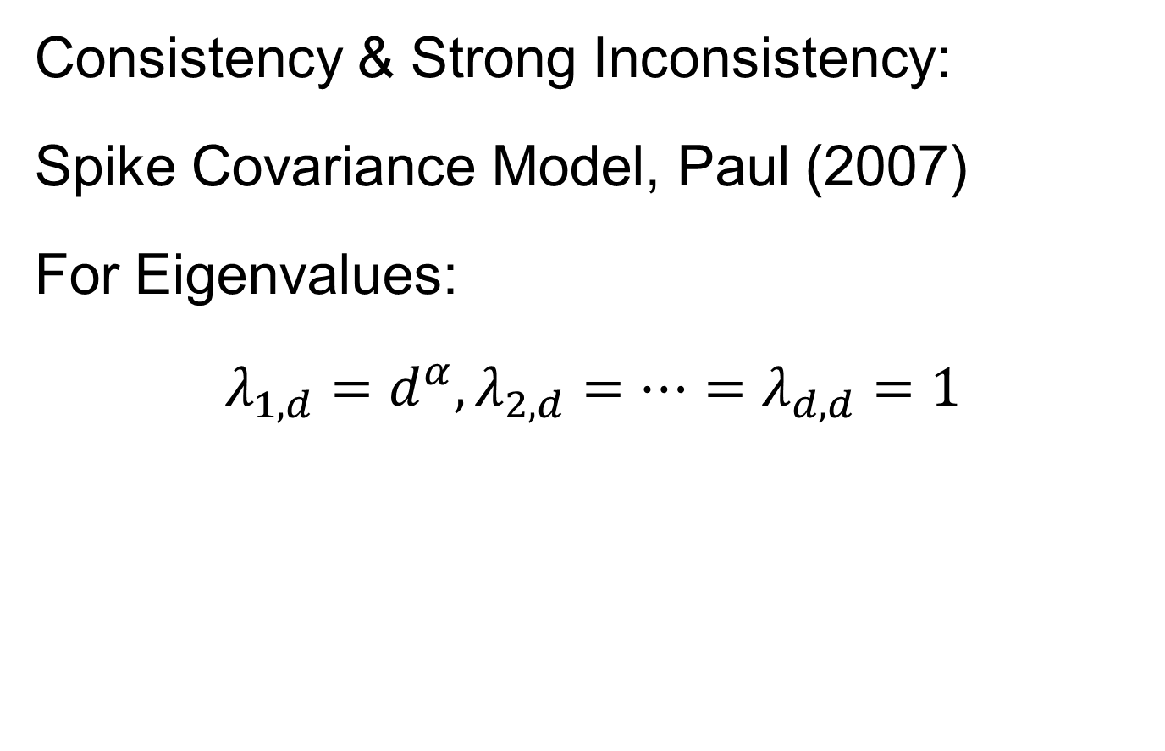

HDLSS Math. Stat. of PCA
Consistency & Strong Inconsistency:
Spike Covariance Model, Paul (2007)
For Eigenvalues:
$λ_{1,d}=d^{α},λ_{2,d}=⋯=λ_{d,d}=1$
Stretched Ellipsoidal Data
One direction growing with $d$
So can extend beyond HLDSS Sphere

Slide 24
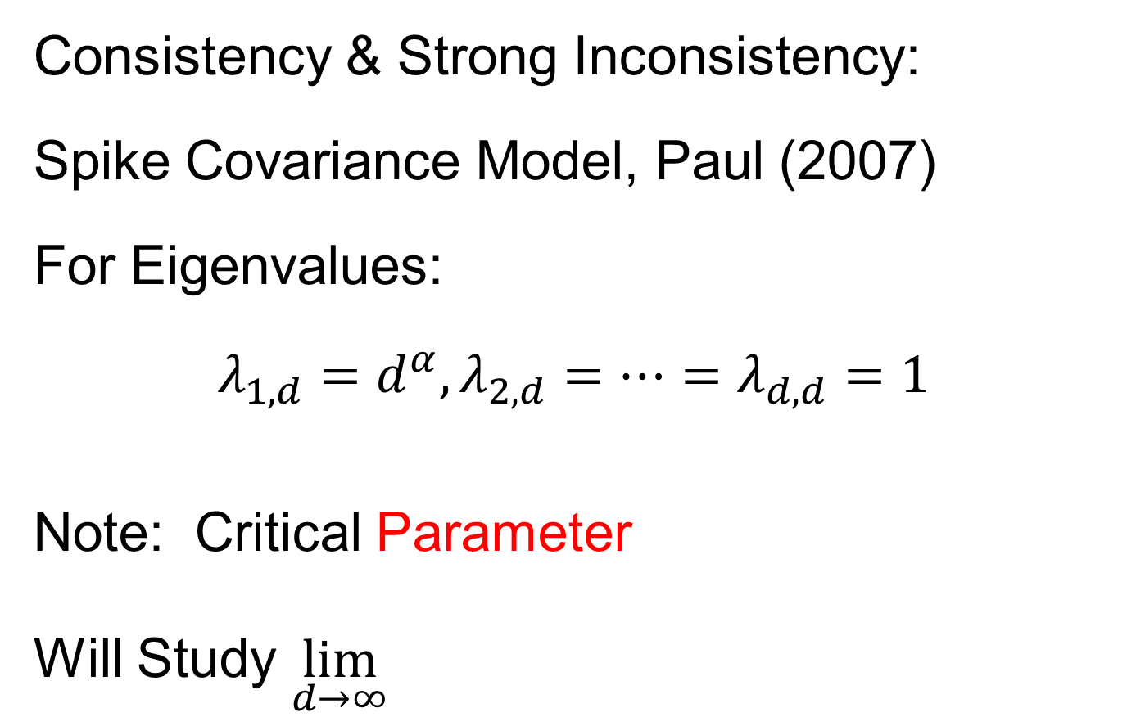
HDLSS Math. Stat. of PCA
Consistency & Strong Inconsistency:
Spike Covariance Model, Paul (2007)
For Eigenvalues:
$λ_{1,d}=d^{α},λ_{2,d}=⋯=λ_{d,d}=1$
Note: Critical Parameter
Will Study $\lim_{d→∞}{}$

Slide 25
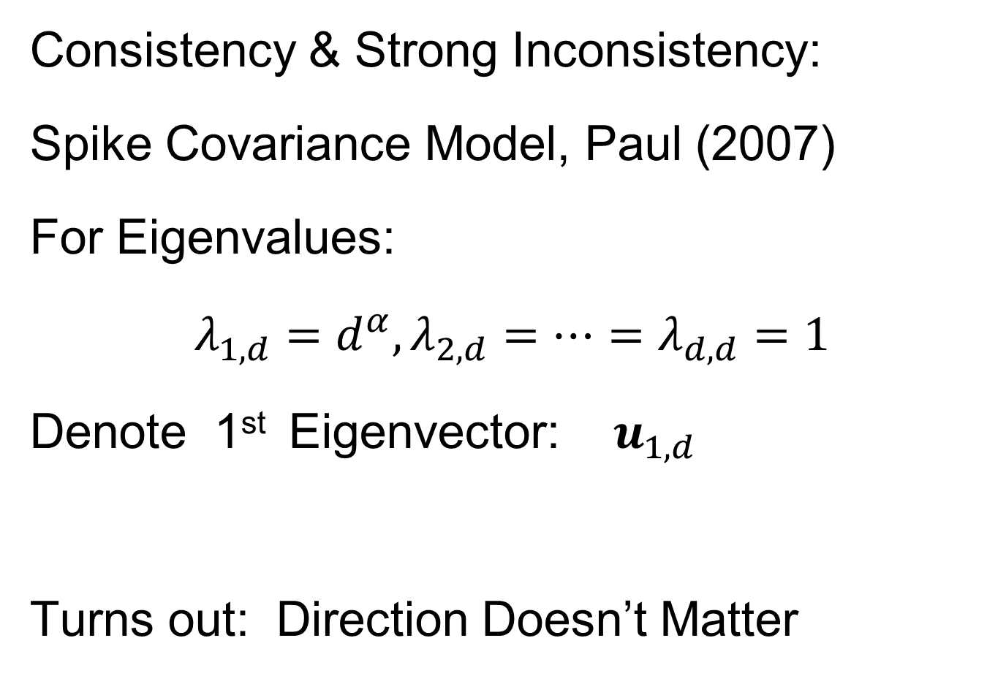
HDLSS Math. Stat. of PCA
Consistency & Strong Inconsistency:
Spike Covariance Model, Paul (2007)
For Eigenvalues:
$λ_{1,d}=d^{α},λ_{2,d}=⋯=λ_{d,d}=1$
Denote 1st Eigenvector: $u_{1,d}$
Turns out: Direction Doesn’t Matter

Slide 26
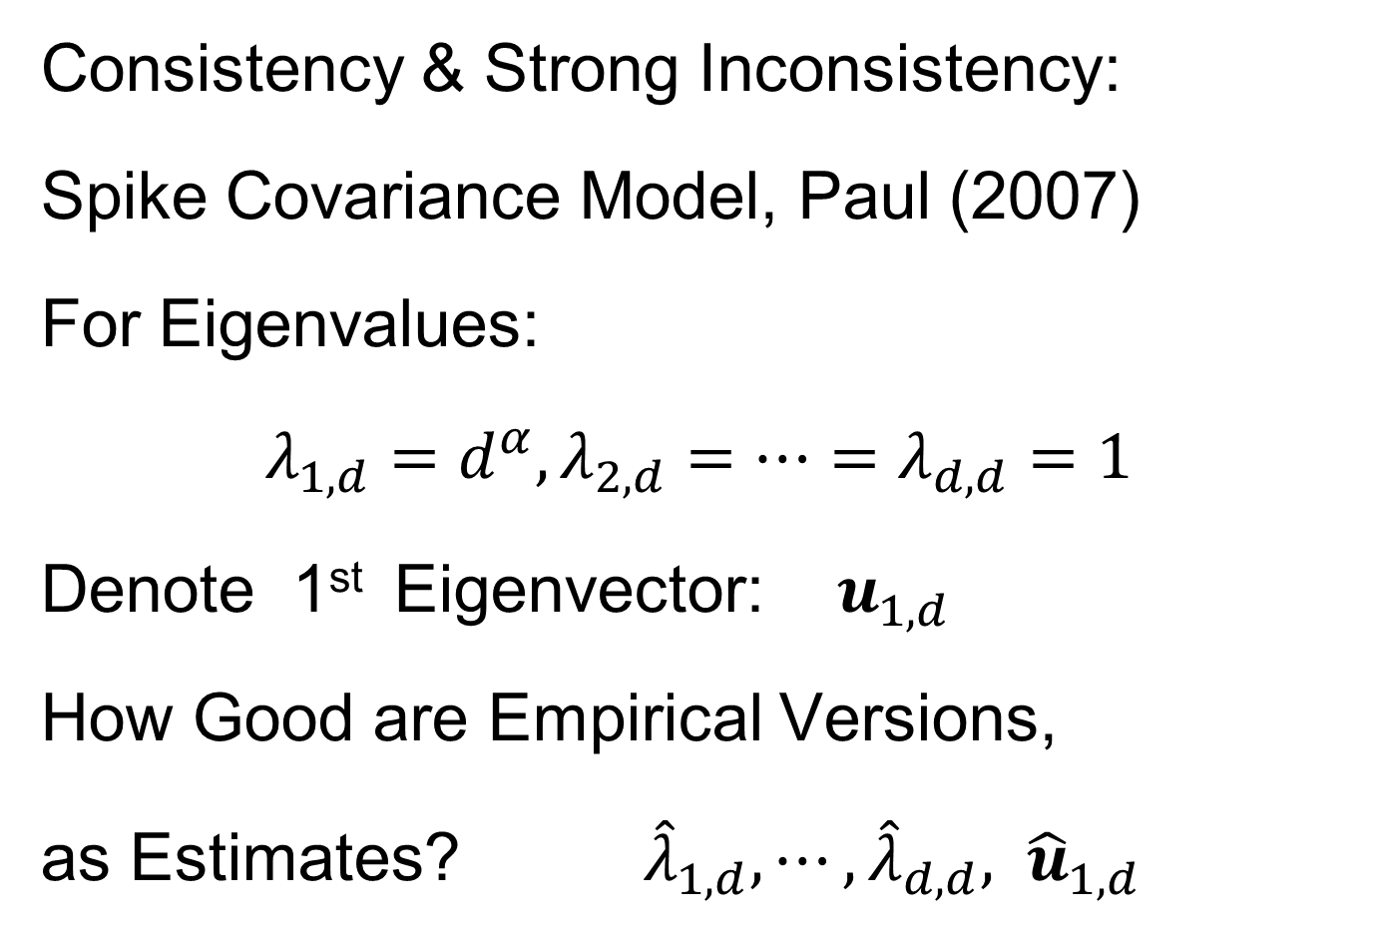
HDLSS Math. Stat. of PCA
Consistency & Strong Inconsistency:
Spike Covariance Model, Paul (2007)
For Eigenvalues:
$λ_{1,d}=d^{α},λ_{2,d}=⋯=λ_{d,d}=1$
Denote 1st Eigenvector: $u_{1,d}$
How Good are Empirical Versions,
as Estimates? ${\hat{λ}}_{1,d},⋯,{\hat{λ}}_{d,d}, {\hat{u}}_{1,d}$

Slide 27
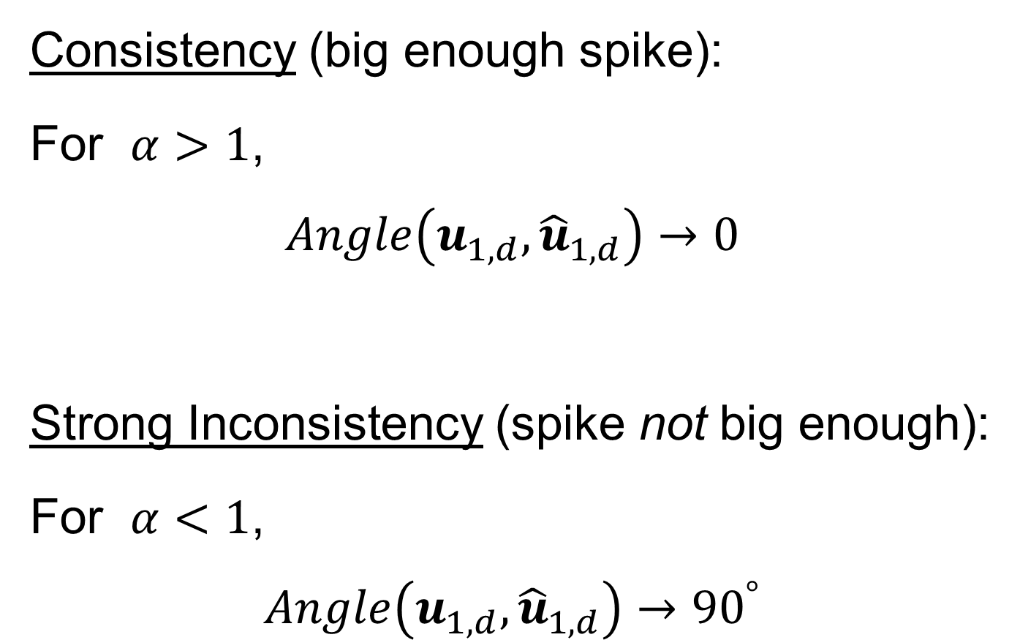
HDLSS Math. Stat. of PCA
Consistency (big enough spike):
For $α>1$,
$$Angle\left(u_{1,d},{\hat{u}}_{1,d}\right)→0$$
Strong Inconsistency (spike not big enough):
For $α<1$,
$$Angle\left(u_{1,d},{\hat{u}}_{1,d}\right)→{90}^{°}$$

Slide 28
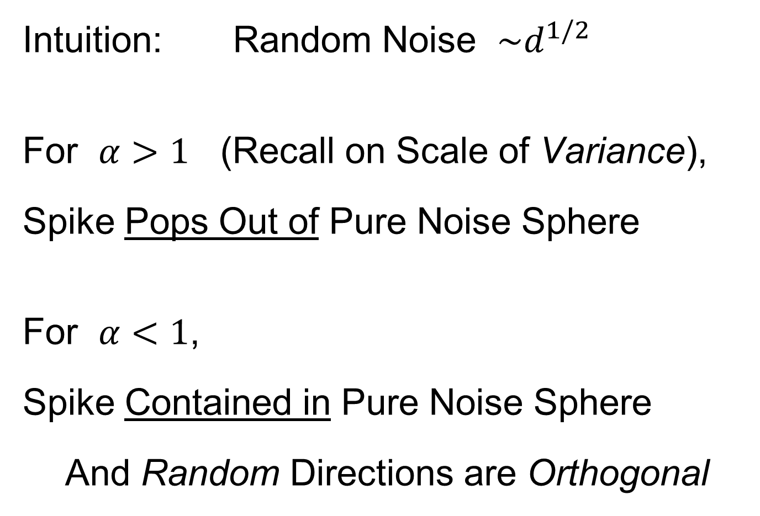
HDLSS Math. Stat. of PCA
Intuition: Random Noise $\sim d^{1/2}$
For $α>1$ (Recall on Scale of Variance),
Spike Pops Out of Pure Noise Sphere
For $α<1$,
Spike Contained in Pure Noise Sphere
And Random Directions are Orthogonal

Slide 29
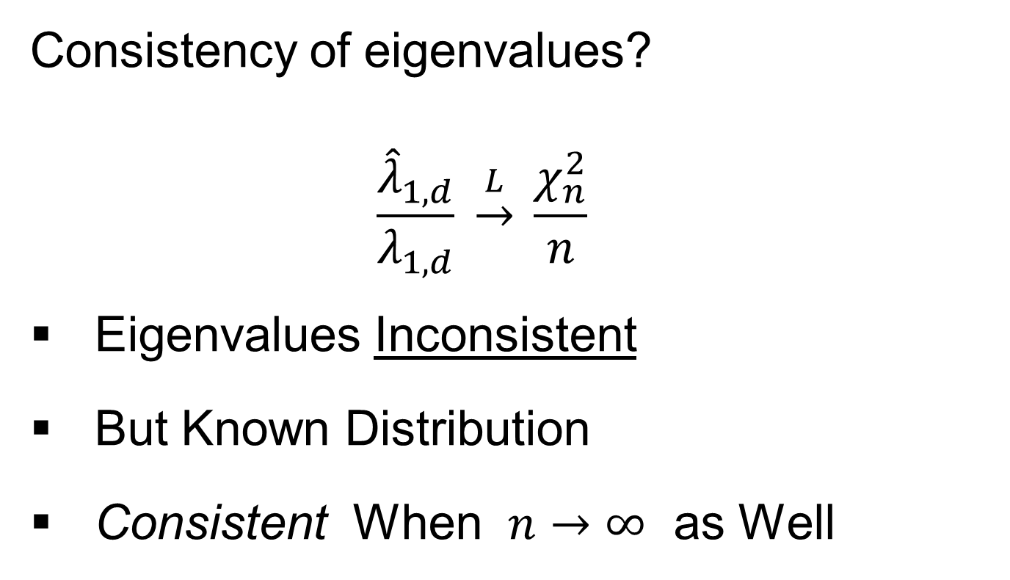
HDLSS Math. Stat. of PCA
Consistency of eigenvalues?
$$\frac{{\hat{λ}}_{1,d}}{λ_{1,d}} \underset{→}{L} \frac{χ_{n}^{2}}{n}$$
Eigenvalues Inconsistent
But Known Distribution
Consistent When $n→∞$ as Well
Consistency
Needs = 1

Slide 30

HDLSS Math. Stat. of PCA
Careful look at:
PCA Consistency - $α>1$ spike
(Reality Check, Suggested by Reviewer)

Slide 31
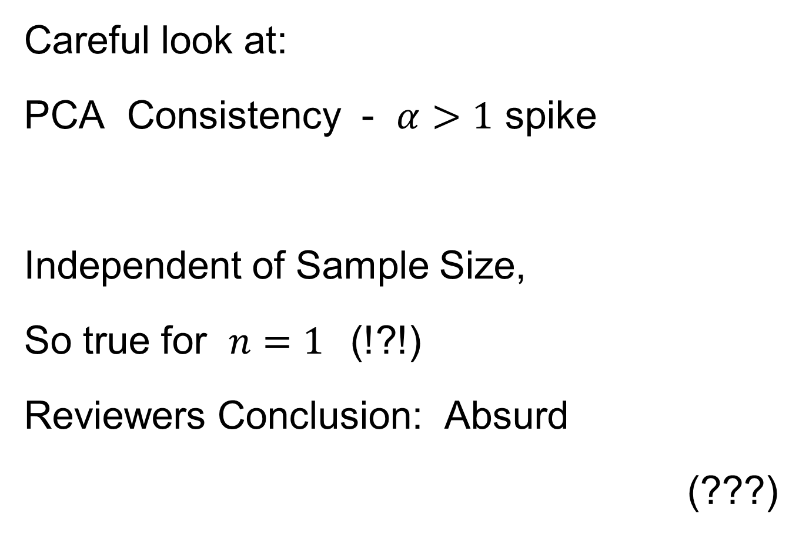
HDLSS Math. Stat. of PCA
Careful look at:
PCA Consistency - $α>1$ spike
Independent of Sample Size,
So true for $n=1$(!?!)
Reviewers Conclusion: Absurd
(???)
Shows assumption too strong for practice

Slide 32
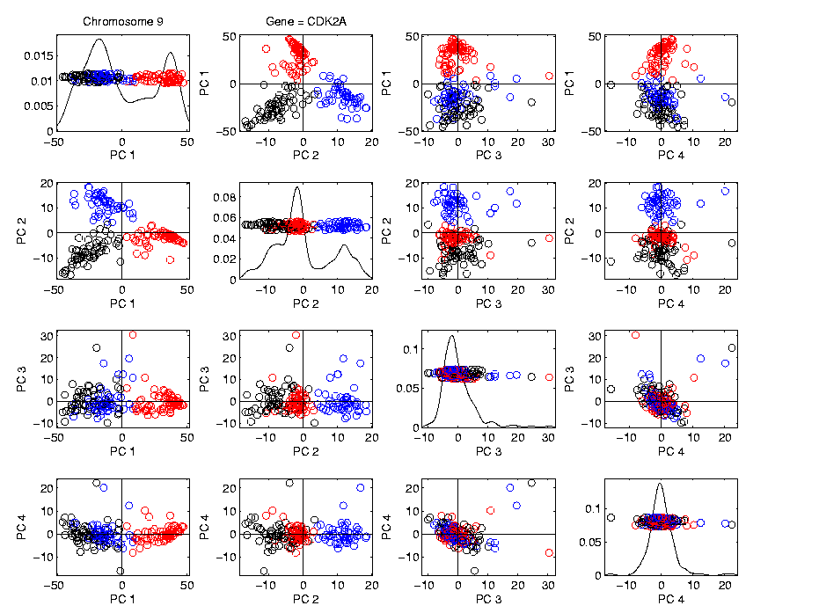
HDLSS Math. Stat. of PCA
HDLSS
PCA
Often
Finds
Signal,
Not Pure
Noise

Slide 33

HDLSS Math. Stat. of PCA
Recall
RNAseq
Example
$d\sim 1700$
$n=180$

Slide 34
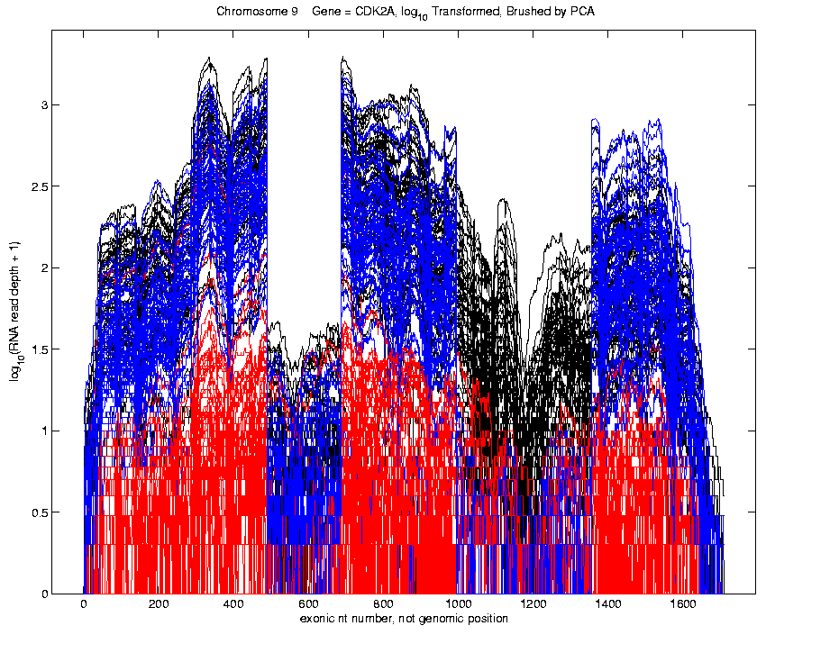
Functional Data Analysis
Manually
Brushed
Clusters
Clear
Alternate
Splicing
Not
Noise!

Slide 35
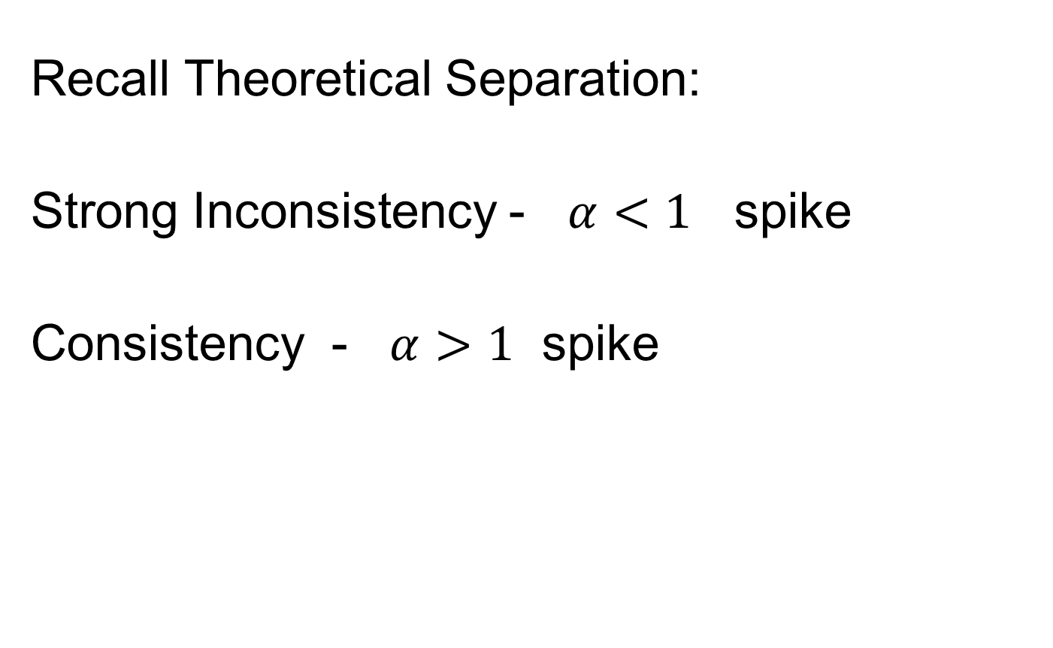
HDLSS Math. Stat. of PCA
Recall Theoretical Separation:
Strong Inconsistency - $α<1$ spike
Consistency - $α>1$ spike

Slide 36
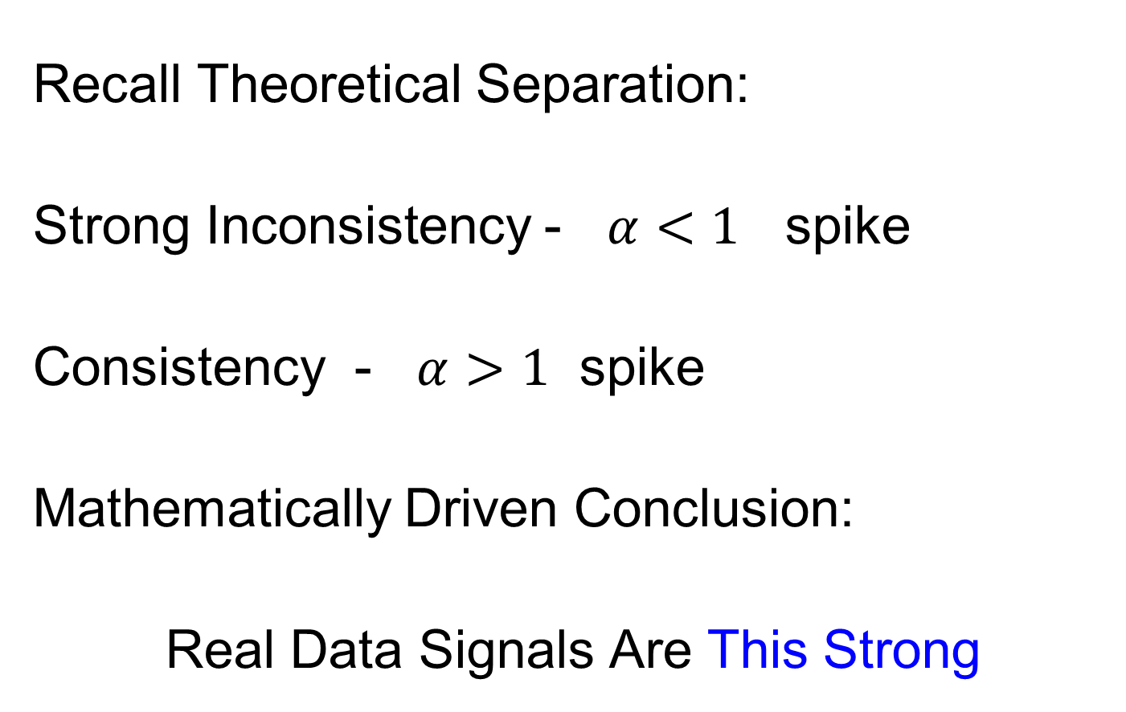
HDLSS Math. Stat. of PCA
Recall Theoretical Separation:
Strong Inconsistency - $α<1$ spike
Consistency - $α>1$ spike
Mathematically Driven Conclusion:
Real Data Signals Are This Strong

Slide 37
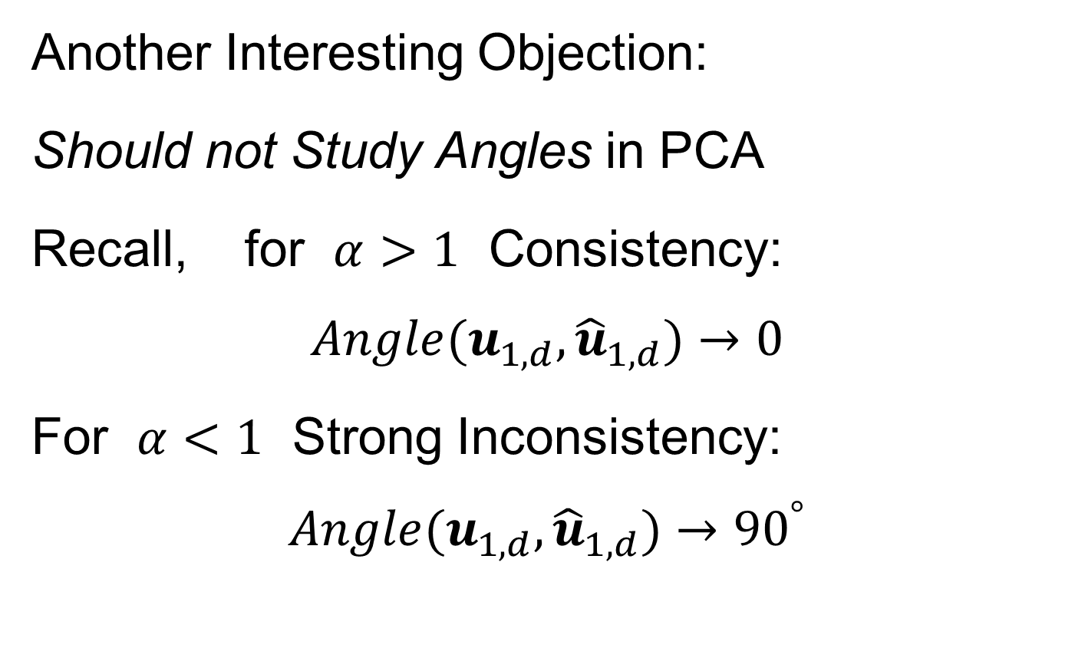
HDLSS Math. Stat. of PCA
Another Interesting Objection:
Should not Study Angles in PCA
Recall, for $α>1$ Consistency:
$$Angle(u_{1,d},{\hat{u}}_{1,d})→0$$
For $α<1$ Strong Inconsistency:
$$Angle(u_{1,d},{\hat{u}}_{1,d})→{90}^{°}$$

Slide 38
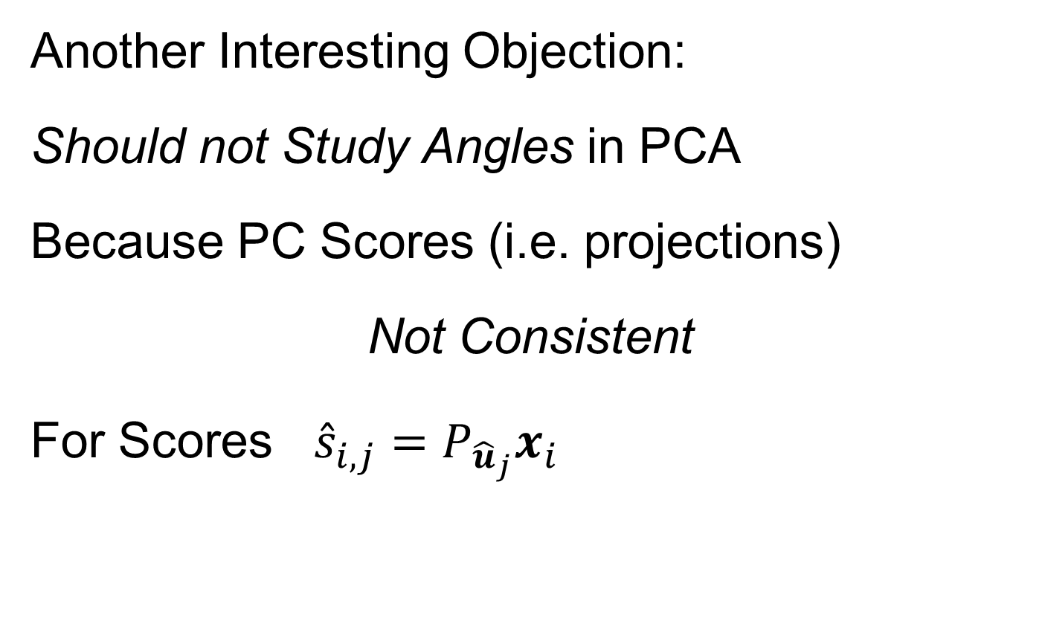
HDLSS Math. Stat. of PCA
Another Interesting Objection:
Should not Study Angles in PCA
Because PC Scores (i.e. projections)
Not Consistent
For Scores ${\hat{s}}_{i,j}=P_{{\hat{u}}_{j}}x_{i}$
What we study in PCA scatterplots

Slide 39
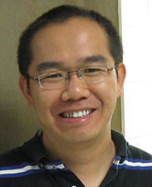
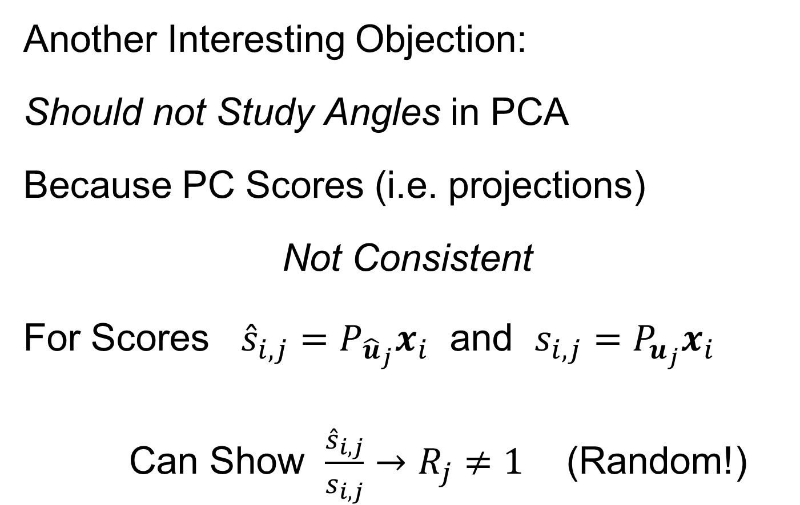
HDLSS Math. Stat. of PCA
Another Interesting Objection:
Should not Study Angles in PCA
Because PC Scores (i.e. projections)
Not Consistent
For Scores ${\hat{s}}_{i,j}=P_{{\hat{u}}_{j}}x_{i}$ and $s_{i,j}=P_{u_{j}}x_{i}$
Can Show $\frac{{\hat{s}}_{i,j}}{s_{i,j}}→R_{j}≠1$ (Random!)
Due to Dan Shen

Slide 40
HDLSS Math. Stat. of PCA
PC Scores (i.e. projections)
Not Consistent
So how can PCA find Useful Signals in Data?

Slide 41
HDLSS Math. Stat. of PCA
HDLSS
PCA
Often
Finds
Signal,
Not Pure
Noise

Slide 42
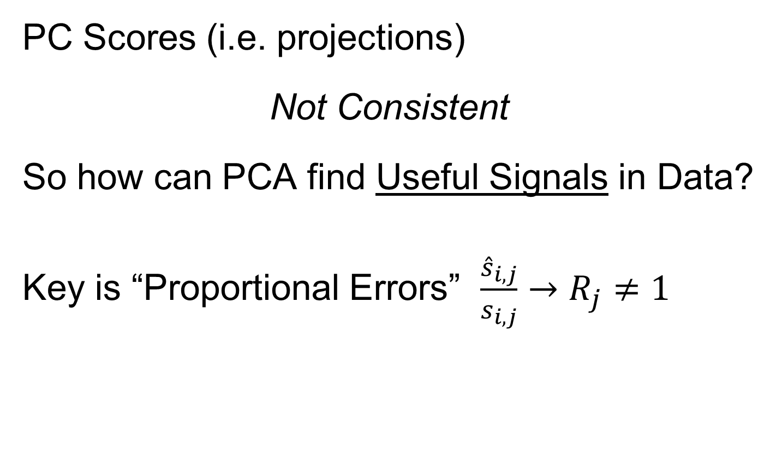
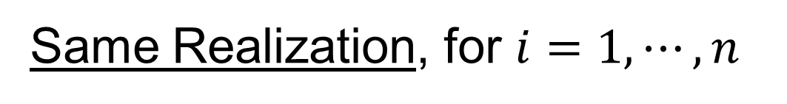
HDLSS Math. Stat. of PCA
PC Scores (i.e. projections)
Not Consistent
So how can PCA find Useful Signals in Data?
Key is “Proportional Errors” $\frac{{\hat{s}}_{i,j}}{s_{i,j}}→R_{j}≠1$
Same Realization, for $i=1,⋯,n$

Slide 43
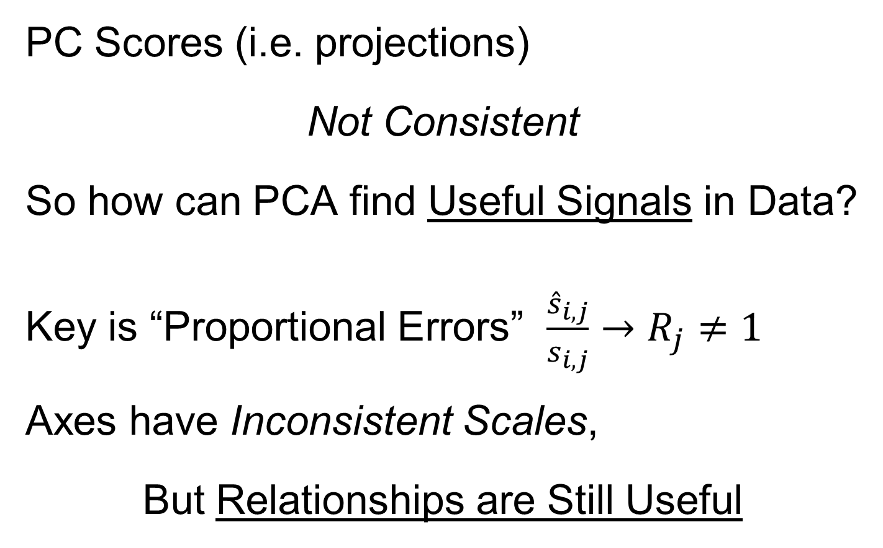
HDLSS Math. Stat. of PCA
PC Scores (i.e. projections)
Not Consistent
So how can PCA find Useful Signals in Data?
Key is “Proportional Errors” $\frac{{\hat{s}}_{i,j}}{s_{i,j}}→R_{j}≠1$
Axes have Inconsistent Scales,
But Relationships are Still Useful

Slide 44
HDLSS Math. Stat. of PCA
Numbers
On Axes
Are Wrong
But
Relationships
Are Right

Slide 45
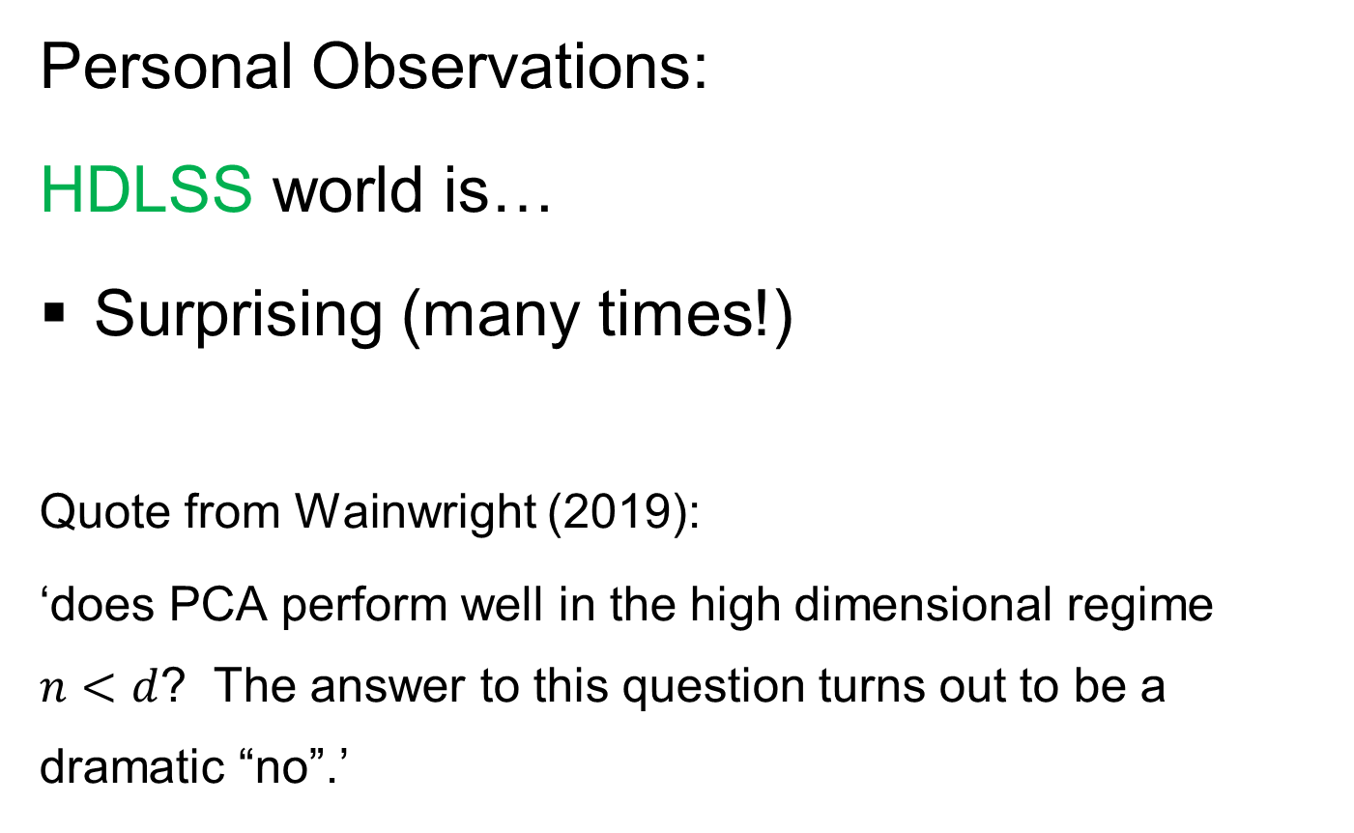
Recall Earlier Slide
Personal Observations:
HDLSS world is…
Surprising (many times!)
Quote from Wainwright (2019):
‘does PCA perform well in the high dimensional regime $n<d$? The answer to this question turns out to be a dramatic “no”.’
Thought Leader in
Machine Learning
High Dimensional Space is Slippery!

Slide 46
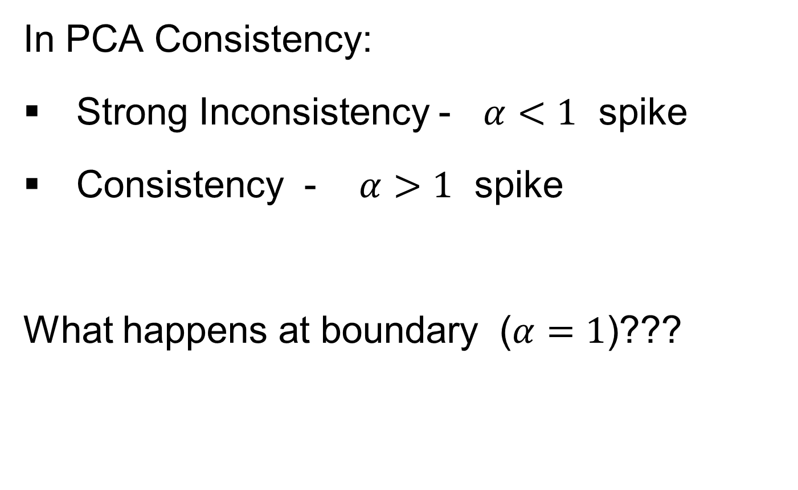
HDLSS Deep Open Problem
In PCA Consistency:
Strong Inconsistency - $α<1$ spike
Consistency - $α>1$ spike
What happens at boundary ($α=1$)???

Slide 47
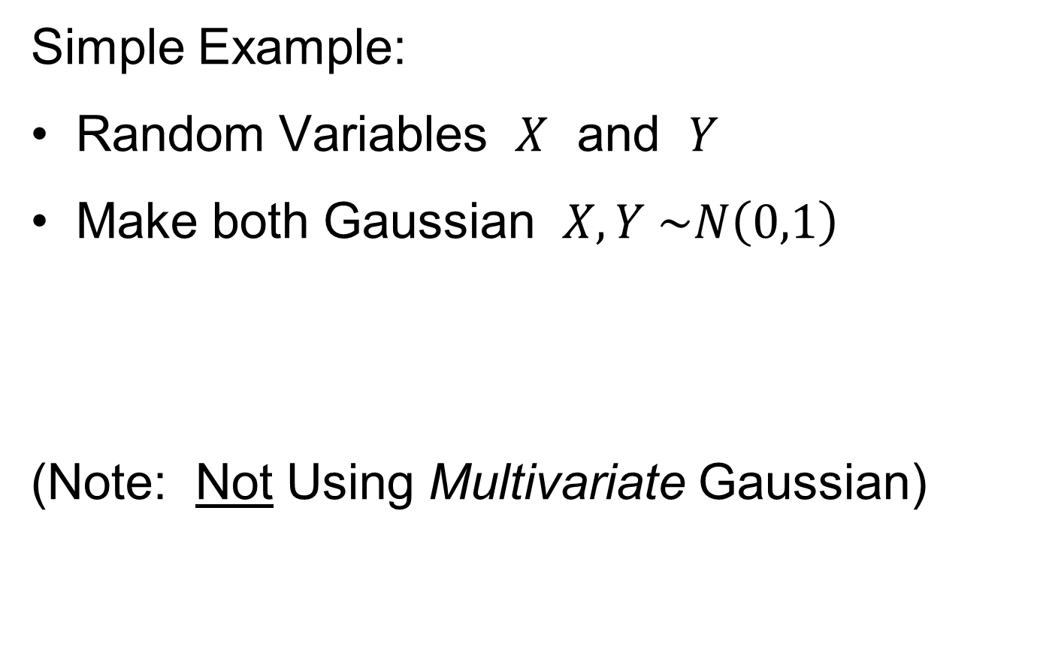
HDLSS Deep Open Problem
Result
In PCA Consistency:
Strong Inconsistency - $α<1$ spike
Consistency - $α>1$ spike
What happens at boundary ($α=1$)???
Ǝ interesting Limit Distn’s
Jung, Sen & Marron (2012)

Slide 48
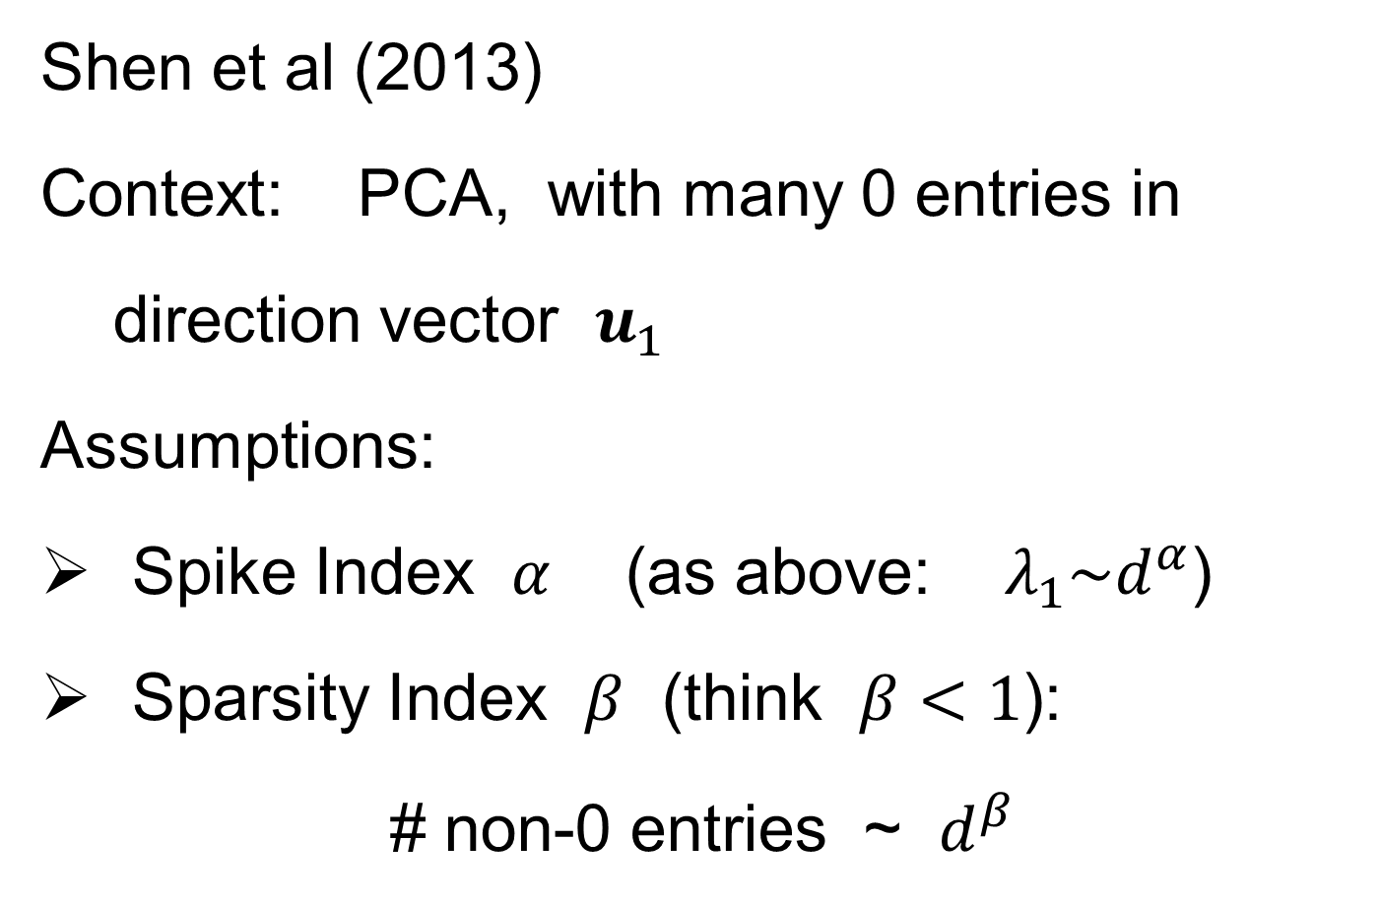
HDLSS & Sparsity
Shen et al (2013)
Context: PCA, with many 0 entries in
direction vector $u_{1}$
Assumptions:
Spike Index $α$ (as above: $λ_{1}\sim d^{α}$)
Sparsity Index $β$ (think $β<1$):
# non-0 entries ~ $d^{β}$

Slide 49
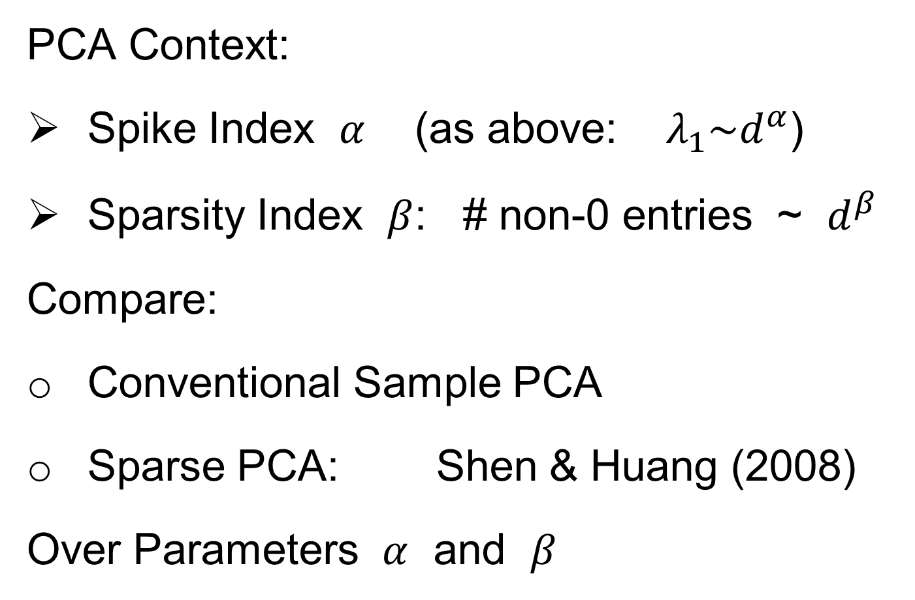
HDLSS & Sparsity
PCA Context:
Spike Index $α$ (as above: $λ_{1}\sim d^{α}$)
Sparsity Index $β$: # non-0 entries ~ $d^{β}$
Compare:
Conventional Sample PCA
Sparse PCA: Shen & Huang (2008)
Over Parameters $α$ and $β$

Slide 50
1
0≤ α < β ≤1
0.7
β
0≤ α = β ≤1
Sparsity Index
α>1
0 ≤ β ≤1
0.5
0.3
0≤β<α≤1
0.1
0
0
0.2
0.4
0.6
0.8
1
Jung and Marron
α
Spike Index
Regular PCA: Inconsistent & Consistent

Slide 51
1
0≤ α < β ≤1
0.7
β
0≤ α = β ≤1
Sparsity Index
α>1
0 ≤ β ≤1
0.5
0.3
0≤β<α≤1
0.1
0
0
0.2
0.4
0.6
0.8
1
Jung and Marron
α
Spike Index
Sparse PCA: Inconsistent & New Consistency Region

Slide 52
HDLSS & Sparsity
Sparse PCA Opens Up Whole New
Region of Consistency

Slide 53
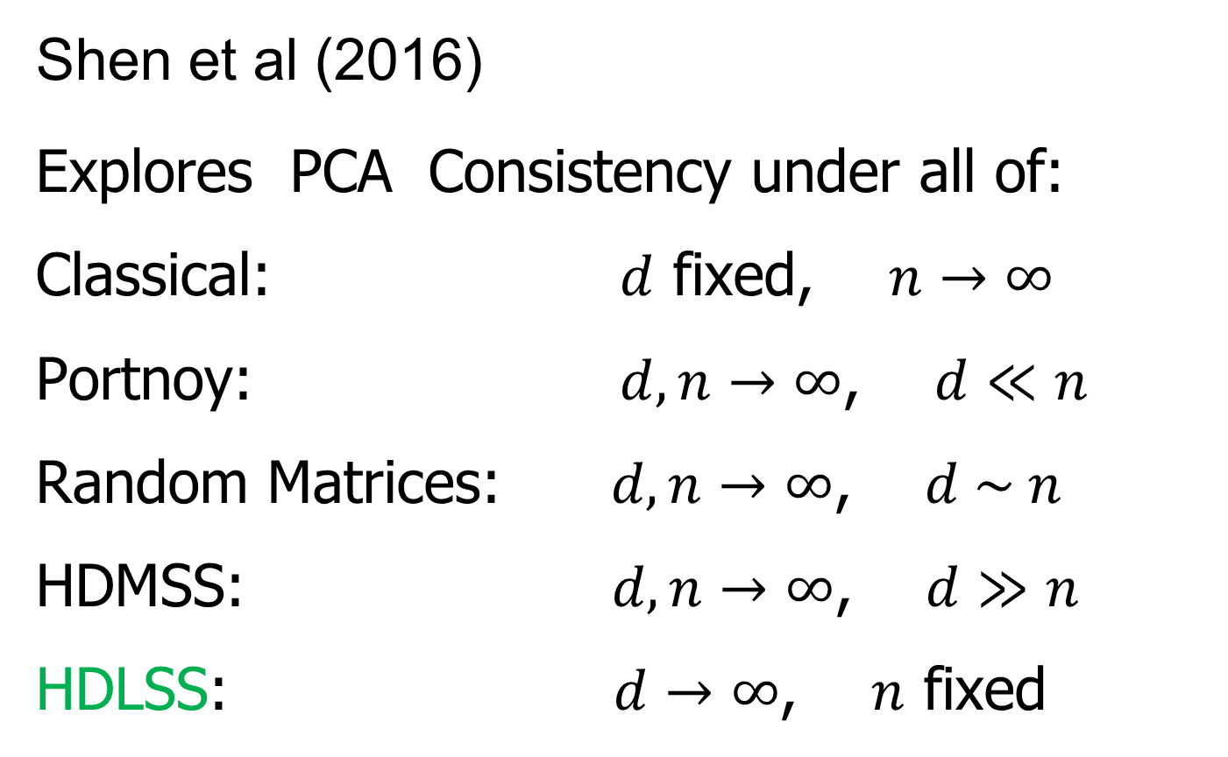
HDLSS & Other Asymptotics
Shen et al (2016)
Explores PCA Consistency under all of:
Classical: $d$ fixed, $n→∞$
Portnoy: $d, n→∞$, $d≪n$
Random Matrices: $d, n→∞$, $d \sim n$
HDMSS: $d, n→∞$, $d≫n$
HDLSS: $d→∞$, $n$ fixed

Slide 54
(A) Single Spike - Example 1.1
(B) Multi Spike - Example 1.2
Consistency
1
1
Sample Index
α + γ >1
γ
α + γ >1, γ >0
Sample Index (Johnstone and Lu (2009))
γ
Strong Inconsistency
0≤ α + γ <1
0≤ α + γ <1
(0,0)
Strong Inconsistency
1
Consistency
(0,0)
Strong Inconsistency
1
α
α
Subspace Consistency
Spike Index (Jung and Marron (2009))
Spike Index (Jung and Marron (2009))

Slide 55
(A) Single Spike - Example 1.1
(B) Multi Spike - Example 1.2
Consistency
1
1
Sample Index
α + γ >1
γ
α + γ >1, γ >0
Sample Index (Johnstone and Lu (2009))
γ
Strong Inconsistency
0≤ α + γ <1
0≤ α + γ <1
(0,0)
Strong Inconsistency
1
Consistency
(0,0)
Strong Inconsistency
1
α
α
Subspace Consistency
Spike Index (Jung and Marron (2009))
Spike Index (Jung and Marron (2009))

Slide 56

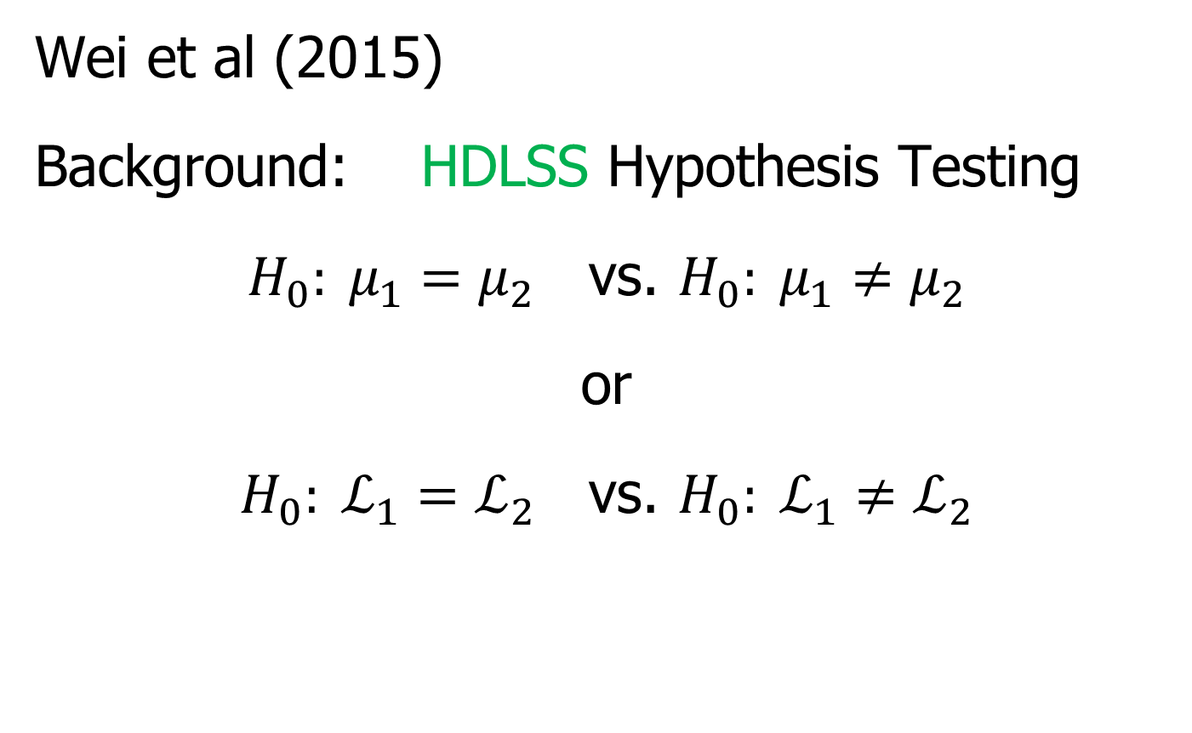
HDLSS Analysis of DiProPerm
Wei et al (2015)
Background: HDLSS Hypothesis Testing
$H_{0}: μ_{1}=μ_{2}$ vs. $H_{0}: μ_{1}≠μ_{2}$
or
$H_{0}: ℒ_{1}=ℒ_{2}$ vs. $H_{0}: ℒ_{1}≠ℒ_{2}$
Most Generally, But Test is Designed
for Maximal Power in Direction of Mean

Slide 57
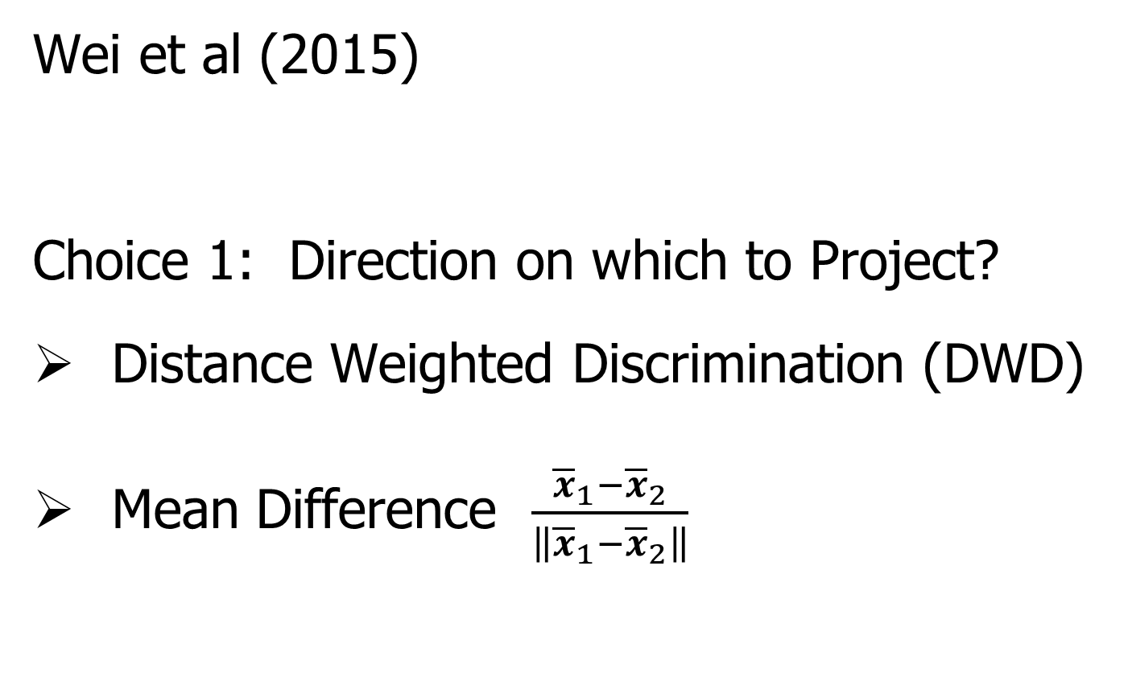
HDLSS Analysis of DiProPerm
Wei et al (2015)
Choice 1: Direction on which to Project?
Distance Weighted Discrimination (DWD)
Mean Difference $\frac{{\overline{x}}_{1}−{\overline{x}}_{2}}{\left\|{\overline{x}}_{1}−{\overline{x}}_{2}\right\|}$

Slide 58
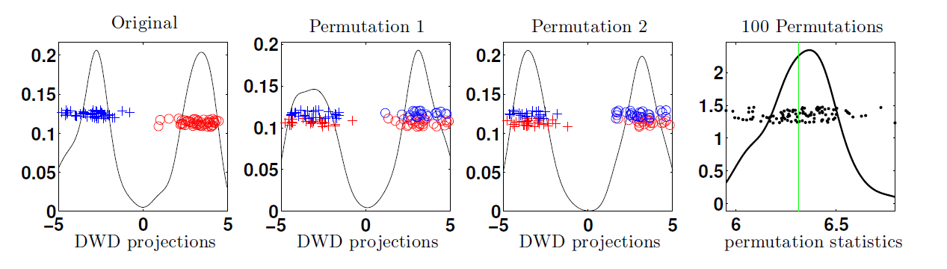
HDLSS Analysis of DiProPerm
Wei et al (2015)
Recall: N(0,1) data (both classes)

Slide 59
HDLSS Analysis of DiProPerm
Choice 2:
Which Statistic to Summarize Projections?
2 – Sample t statistic
Mean Difference

Slide 60
HDLSS Analysis of DiProPerm
Choice 2:
Which Statistic to Summarize Projections?
2 – Sample t statistic
Mean Difference
HDLSS Asymptotics, Wei et al. (2015):
Mean Difference is More Powerful

Slide 61


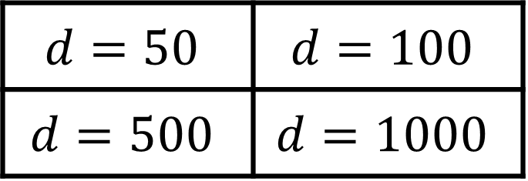

HDLSS Analysis of DiProPerm
Jack Prothero Simulations
$g=0$, $g=$1, $g=5$, $g=10$
$$N_{d}\left(\left(\begin{matrix}±g \\ ±g \\ \begin{matrix}0 \\ ⋮ \\ 0\end{matrix}\end{matrix}\right), I_{d}\right)$$
$$d=50$$ | $$d=100$$
$$d=500$$ | $$d=1000$$

Slide 62
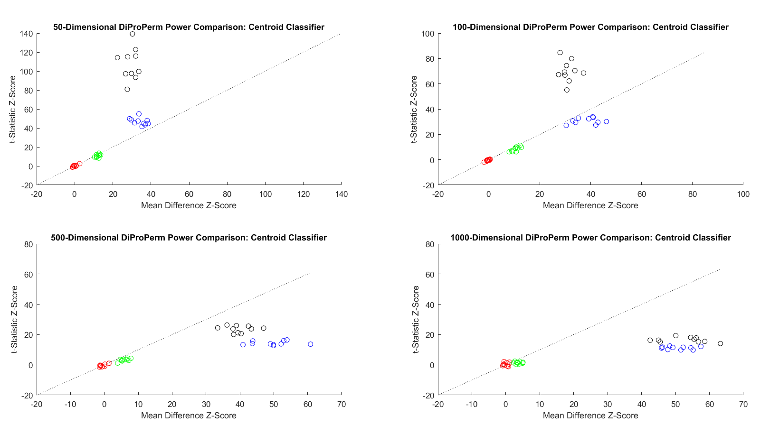
HDLSS Analysis of DiProPerm
Jack Prothero Simulations
Each Panel Compares
t-Statistic
With Mean Difference

Slide 63
HDLSS Analysis of DiProPerm
Jack Prothero Simulations
Over
Over Different Dimensions
All For The Centroid Direction

Slide 64


HDLSS Analysis of DiProPerm
Jack Prothero Simulations
T-Statistic Better for Lower $d$
Mean Difference Better for Higher $d$

Slide 65
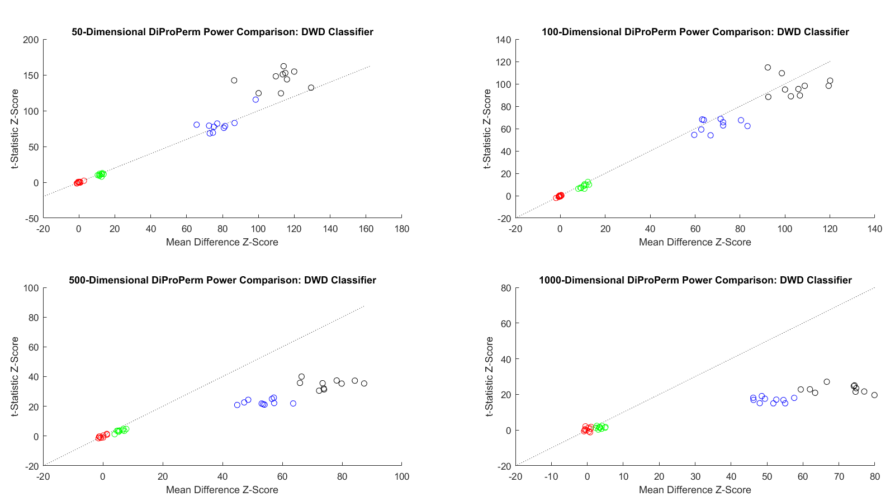


HDLSS Analysis of DiProPerm
Jack Prothero Simulations
Change to DWD Direction
Both Similar for Lower $d$
Mean Difference Better for Higher $d$

Slide 66
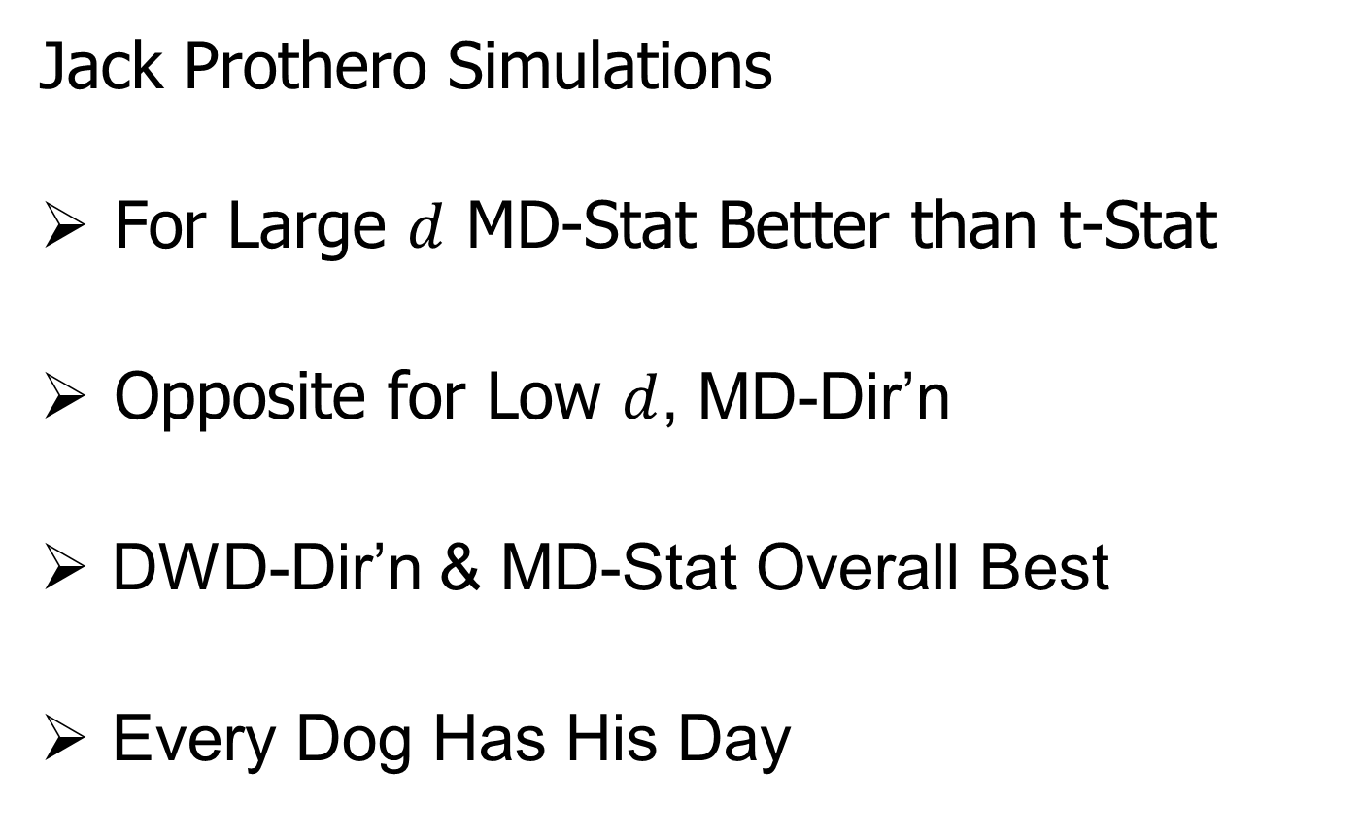
HDLSS Analysis of DiProPerm
Jack Prothero Simulations
For Large $d$ MD-Stat Better than t-Stat
Opposite for Low $d$, MD-Dir’n
DWD-Dir’n & MD-Stat Overall Best
Every Dog Has His Day

Slide 67
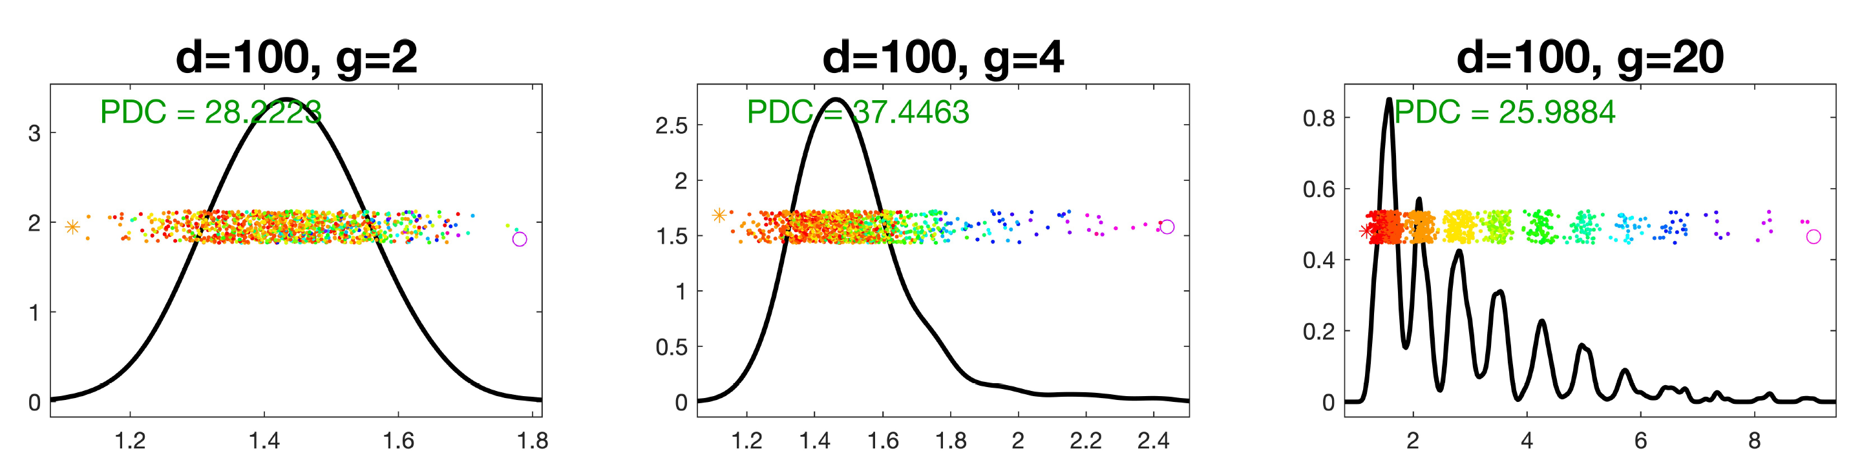
Deeper Look at DiProPerm
Recall Yang et al. (2023) Results:
Avoid Power Loss in High Dimensions Using
Balanced Permutations

Slide 68

HDLSS Asymptotics
Survey & Introductory Paper:
Aoshima, Shen, Shen, Yata, Zhou & Marron (2018) Australian & New Zealand Journal of Statistics, 60, 4-19.
Memorial to Peter G. Hall

Slide 69
HDLSS Asymptotics
Personal Observations:
HDLSS world is…
Surprising (many times!)
[Think I’ve got it, and then …]
Mathematically Beautiful (?)
Practically Relevant

Slide 70
The Future of HDLSS Asymptotics
“Contiguity” in Hypo Testing?
Rates of Convergence?
Improvements of DWD?
(e.g. other functions of distance than inverse)
Many Others?
It is still early days …

Slide 71
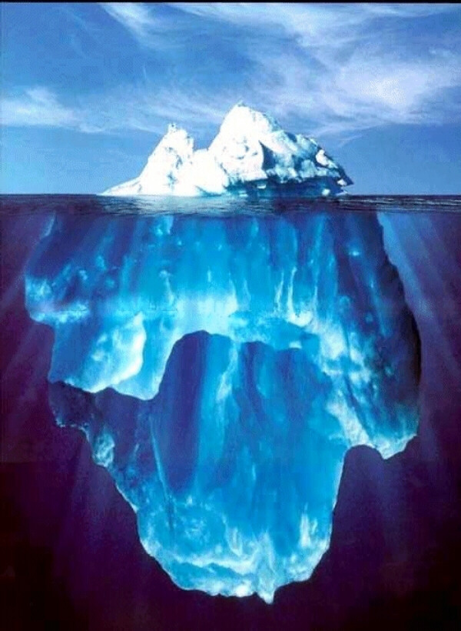
State of HDLSS Research?
Development
Of Methods
Mathematical
Assessment
…
(thanks to:
defiant.corban.edu/gtipton/net-fun/iceberg.html)

Slide 72
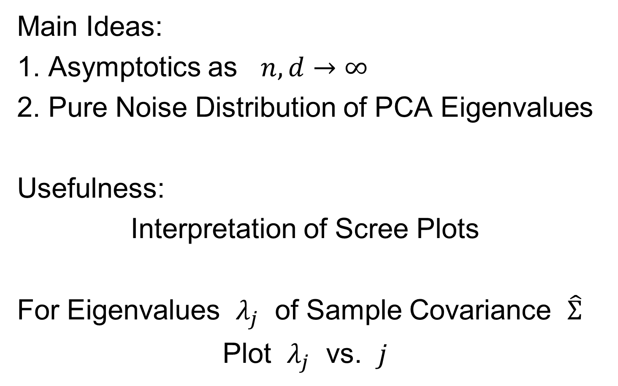
Random Matrix Theory
Text: Sec. 14.1
Main Ideas:
1. Asymptotics as $n,d→∞$
2. Pure Noise Distribution of PCA Eigenvalues
Usefulness:
Interpretation of Scree Plots
For Eigenvalues $λ_{j}$ of Sample Covariance $\hat{Σ}$
Plot $λ_{j}$ vs. $j$

Slide 73
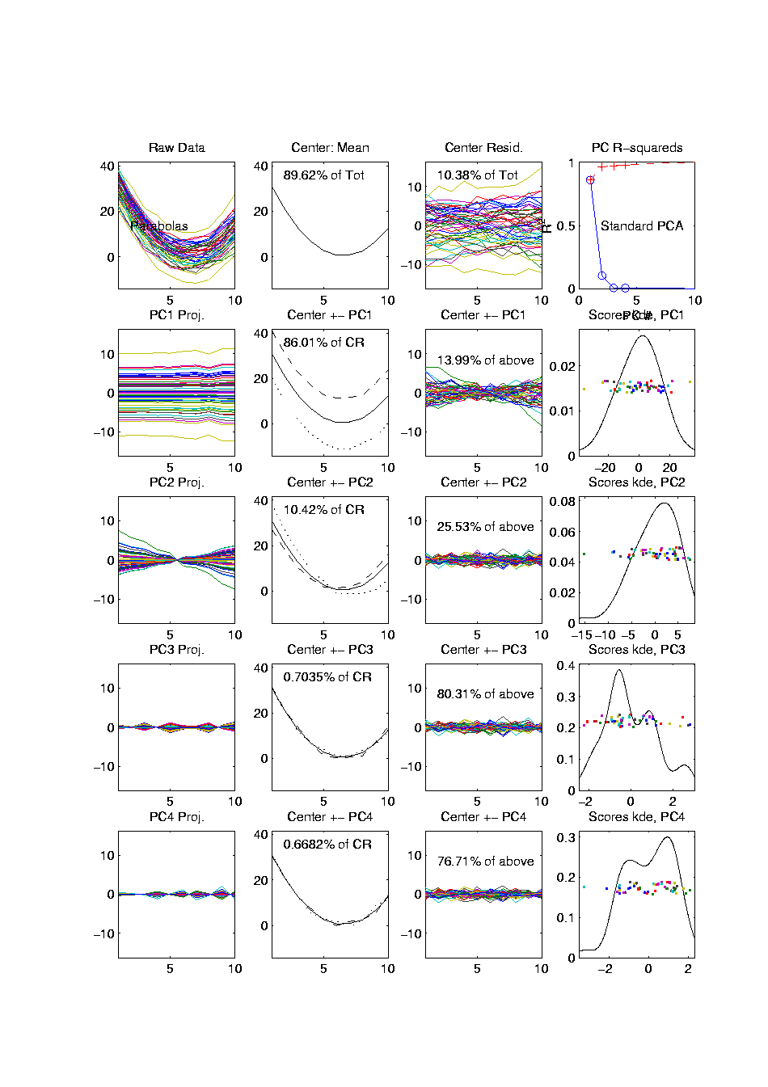
PCA Redist’n of Energy (Cont.)
Note, have already considered some of these Useful Plots:
Power Spectrum (as %s)
Cumulative Power Spectrum (%)
Common Terminology:
Power Spectrum is Called
“Scree Plot”
Kruskal (1964) Cattell (1966)
(all but name “scree”) (1st Appearance of name???)
Notes:
73

Slide 74
PCA Redist’n of Energy (Cont.)
Note, have already considered some of these Useful Plots:
Power Spectrum (as %s)
Cumulative Power Spectrum (%)
Large Values Reflect
Important Structure
Notes:
74

Slide 75
PCA Redist’n of Energy (Cont.)
Note, have already considered some of these Useful Plots:
Power Spectrum (as %s)
Cumulative Power Spectrum (%)
Zoom In & Characterize Noise
Notes:
75

Slide 76



Random Matrix Theory
Text, Sec. 14.1
Pure Noise Data Matrix:
$\tilde{X}=$
Defined as: Entries i.i.d. $N(0,1)$
$$d$$
Thinking of
Columns As
Data Objects
$$n$$

Slide 77


Random Matrix Theory
Clean Notation Version of Sample Covariance Matrix:
$$\tilde{Σ}=\frac{1}{n}\tilde{X}{\tilde{X}}^{t}$$
Simplified by:
No Mean Centering (using $N(0,1)$)
Roughly OK, By Usual Mean Centering
Also Standardize by $\frac{1}{n}$ not $\frac{1}{n−1}$
Easy & Sensible for No Mean Centering
Size = $d×d$

Slide 78

Random Matrix Theory
Eigenvalues are $\tilde{λ_{j}}$, diagonal entries of $Λ$ in
$$\tilde{Σ}=UΛU^{t}$$
(Eigen-analysis)
Distribution of $\tilde{λ_{j}}$?

Slide 79


Random Matrix Theory
For $d=100$, $n=1000$, Eigenvalues $≈1$
But There Is (Chance) Variation

Slide 80


Random Matrix Theory
Smaller $n=500$ Boosts Variation
(More Uncertainty)

Slide 81


Random Matrix Theory
Smaller $n=200$ Boosts Variation
(Even More Uncertainty)

Slide 82


Random Matrix Theory
Smaller $n=100$ Boosts Variation
But Can’t Go Negative
Although
Can Get
Large
Which Induces
Assymetry

Slide 83


Random Matrix Theory
Larger $n=10,000$ Reduces Variation

Slide 84


Random Matrix Theory
Larger $n=100,000$ Reduces Variation

Slide 85


Random Matrix Theory
Fix $y=\frac{d}{n}=\frac{1}{5}$, and let $d$, $n$ grow ($→∞$).

Slide 86


Random Matrix Theory
Fix $y=\frac{d}{n}=\frac{1}{5}$, and let $d$, $n$ grow ($→∞$).
Essentially
Same
Shape

Slide 87


Random Matrix Theory
Fix $y=\frac{d}{n}=\frac{1}{5}$, and let $d$, $n$ grow ($→∞$).
But Less
Sampling
Noise

Slide 88

Random Matrix Theory
Fix $y=\frac{d}{n}=\frac{1}{5}$, and let $d$, $n$ grow ($→∞$).
But Less
Sampling
Noise

Slide 89


Random Matrix Theory
Fix $y=\frac{d}{n}=\frac{1}{5}$, and let $d$, $n$ grow ($→∞$).
What
Is That
Distribution?

Slide 90

Random Matrix Theory
Shape is Captured by
Empirical Spectral Density
“Density”
Of These
Eigenvalues

Slide 91

Random Matrix Theory
Limiting Spectral Density
(in limit as $n, d→∞$, with $y=\frac{d}{n}$)
References:
Marčenko Pastur (1967)
Yao et al (2015)
Dobriban (2015)

Slide 92

Random Matrix Theory
Limiting Spectral Density
(in limit as $n, d→∞$, with $y=\frac{d}{n}$)
Limit Exists
No Closed Form
But Can Implicitly Define
(Using Integral Equations)
And Numerically Approximate

Slide 93


Random Matrix Theory
Limiting Spectral Density, for given $y=\frac{d}{n}$
Convenient Visualization Interface
By Hyo Young Choi

Slide 94

Random Matrix Theory
LSD:
Above
Case
$n=200,$
$d=100$

Slide 95


Random Matrix Theory
LSD:
Above
Case
$n=200,$
$d=100,$
$y=0.5$
$\log_{10}{y}=−0.301$

Slide 96

Random Matrix Theory
LSD
Note: These
Have Finite
Support
$⊂(0,∞)$

Slide 97


Random Matrix Theory
LSD
In Particular:
$$σ^{2}{\left(1−\sqrt{y}\right)}^{2}$$
$$σ^{2}{\left(1+\sqrt{y}\right)}^{2}$$

Slide 98


Random Matrix Theory
LSD:
Now Try Smaller
(More Negative log)
Values of $y=\frac{d}{n}$
Think Larger $n$

Slide 99


Random Matrix Theory
LSD:
Now Try Smaller
(More Negative log)
Values of $y=\frac{d}{n}$

Slide 100


Random Matrix Theory
LSD:
Now Try Smaller
(More Negative log)
Values of $y=\frac{d}{n}$
Note: Support
Points $→1$

Slide 101

Random Matrix Theory
LSD:
Now Try Smaller
(More Negative log)
Values of $y=\frac{d}{n}$

Slide 102



Random Matrix Theory
LSD:
Now Try Smaller
(More Negative log)
Values of $y=\frac{d}{n}$
Note: Increasing
Symmetry
Endpoints $σ^{2}{\left(1±\sqrt{y}\right)}^{2}$
Are Converging To 1

Slide 103

Random Matrix Theory
Larger $n=100,000$ Reduces Variation
Recall
Previous
Large $n$
Case,
LSD is
Zooming
In On This

Slide 104

Random Matrix Theory
Limiting Case:
$$\lim_{d→∞}{\lim_{n→∞}{}}$$
Called Medium Dimension High Sample Size
Resulting Density is “Semi-Circle”
$$f\left(x\right)=\frac{2}{πR^{2}}\sqrt{R^{2}−x^{2}}1_{\left[−R,R\right]}(x)$$
Called “Wigner Semi-Circle Distribution”

Slide 105

Random Matrix Theory
Summary:
Have Studied Data Matrix Shapes
Observed:
Convergence to 1
Increasing Symmetry
What About Other Direction (Larger $d$)?

Slide 106

Random Matrix Theory
Consider Growing $d$
Challenge:
Only $n$ Columns in $X$ (so rank $=n$)
Yet $\tilde{Σ}=\frac{1}{n}XX^{t}$ is $d×d$
So Have $d−n$ Eigenvalues $=0$

Slide 107


Random Matrix Theory
LSD:
Start With
$y=\frac{d}{n}≈1$
Case

Slide 108


Random Matrix Theory
LSD:
Now Try Larger
Values of $y=\frac{d}{n}$
Proportion of
0 Eigenvalues

Slide 109

Random Matrix Theory
LSD:
Now Try Larger
Values of $y=\frac{d}{n}$
Spectral Density of
Non-0 Eigenvalues

Slide 110

Random Matrix Theory
LSD:
Now Try Larger
Values of $y=\frac{d}{n}$

Slide 111

Random Matrix Theory
LSD:
Now Try Larger
Values of $y=\frac{d}{n}$

Slide 112

Random Matrix Theory
LSD:
Now Try Larger
Values of $y=\frac{d}{n}$
Again Heads
Towards Semi-Circle
But Small
Proportion

Slide 113

Random Matrix Theory
LSD:
Now Try Larger
Values of $y=\frac{d}{n}$
Note:
Shapes Seem Similar to Above

Slide 114

Random Matrix Theory
LSD: Dual Covariance Variation
Idea: Replace $\tilde{Σ}=\frac{1}{n}\tilde{X}{\tilde{X}}^{t}$ by $\frac{1}{d}{\tilde{X}}^{t}\tilde{X}$
Recall:
Rows as Data Objects
Inner Product of $\tilde{X}$
Different Normalization ($d$ not $n$)
N(0,1) Avoids Messy Centering Issues
Sometimes Called
Gram Matrix

Slide 115


Random Matrix Theory
LSD: Dual Covariance Variation
$y=\frac{d}{n}=100$ Is
Close to Semi-Circle

Slide 116

Random Matrix Theory
LSD: Dual Covariance Variation

Slide 117

Random Matrix Theory
LSD: Dual Covariance Variation
Seem to Follow
Similar Pattern

Slide 118

Random Matrix Theory
LSD: Dual Covariance Variation

Slide 119


Random Matrix Theory
LSD: Dual Covariance Variation
For $d<n$ Now
Get 0 Eignevalues

Slide 120

Random Matrix Theory
LSD: Dual Covariance Variation

Slide 121

Random Matrix Theory
LSD: Dual Covariance Variation

Slide 122

Random Matrix Theory
LSD: Dual Covariance Variation
Again Heads To
Semi-Circle

Slide 123

Random Matrix Theory
LSD: Primal & Dual
Overlaid For
Direct
Comparison
Notes:
Area = 1
Area = 1 - Bar

Slide 124

Random Matrix Theory
LSD: Primal & Dual

Slide 125


Random Matrix Theory
LSD: Primal & Dual
Very Close
For $d≈n$

Slide 126

Random Matrix Theory
LSD: Primal & Dual
Very Close
For $d≈n$

Slide 127

Random Matrix Theory
LSD: Primal & Dual

Slide 128

Random Matrix Theory
LSD: Primal & Dual

Slide 129

Random Matrix Theory
LSD: Primal & Dual

Slide 130


Random Matrix Theory
LSD: Rescaled
Primal & Dual
$\sqrt{y}×LSD$
(underneath)
$\frac{1}{\sqrt{y}}×Dual LSD$

Slide 131

Random Matrix Theory
LSD: Rescaled
Primal & Dual

Slide 132

Random Matrix Theory
LSD: Rescaled
Primal & Dual

Slide 133

Random Matrix Theory
LSD: Rescaled
Primal & Dual

Slide 134

Random Matrix Theory
LSD: Rescaled
Primal & Dual

Slide 135

Random Matrix Theory
LSD: Rescaled
Primal & Dual

Slide 136
Random Matrix Theory
Conclusion:
Family of Marcenko – Pastur Distributions
Has Several Interesting Symmetries

Slide 137
Random Matrix Theory
Important Parallel Theory:
Distribution of Largest Eigenvalue
(Assuming Matrix of i.i.d. N(0,1)s)
Tracey & Widom (1994)
Good Discussion of Statistical Implications
Johnstone (2008) & Yao et al. (2015)

Slide 138
Participant Presentation
Will Nenad:
Shape analysis of Breast Tumors
Next Class: Erin Ishikawa

