Slide 1
Statistics – O. R. 881 Object Oriented Data Analysis
Steve Marron
Dept. of Statistics and Operations Research
University of North Carolina

Slide 2
Current Sections in Textbook
Today:
Sections 12.1, 12.2
Next Class:
Sections 12.2, 13.2

Slide 3
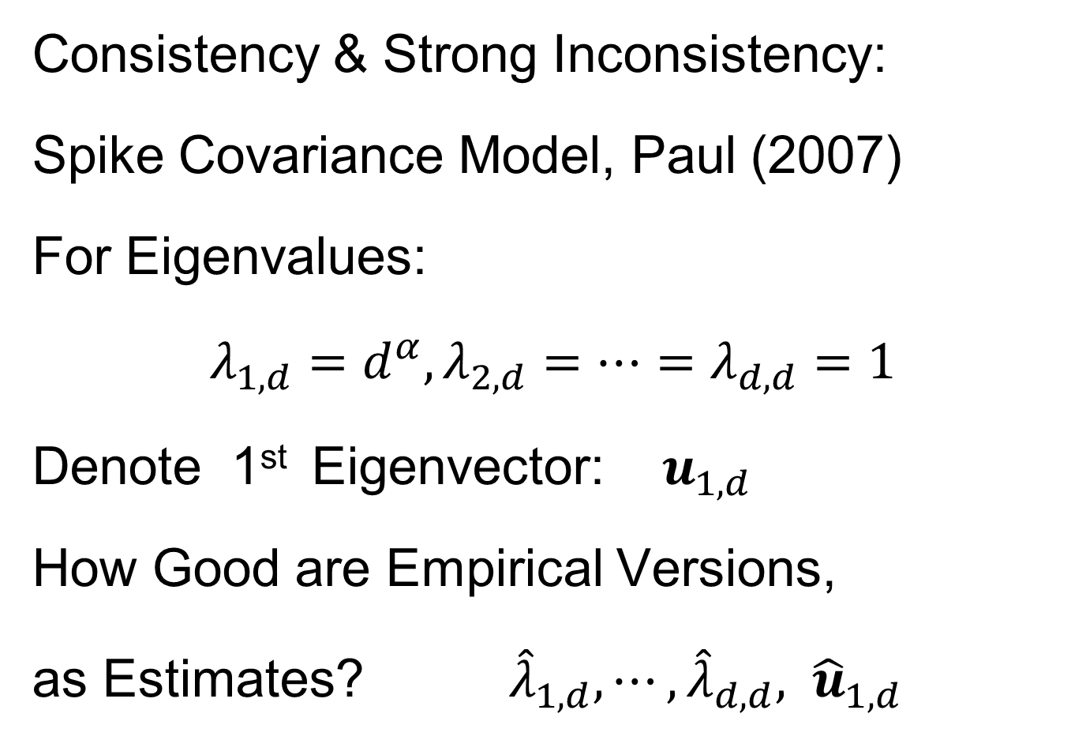
Last Class: HDLSS Math. Stat.
Consistency & Strong Inconsistency:
Spike Covariance Model, Paul (2007)
For Eigenvalues:
$λ_{1,d}=d^{α},λ_{2,d}=⋯=λ_{d,d}=1$
Denote 1st Eigenvector: $u_{1,d}$
How Good are Empirical Versions,
as Estimates? ${\hat{λ}}_{1,d},⋯,{\hat{λ}}_{d,d}, {\hat{u}}_{1,d}$

Slide 4
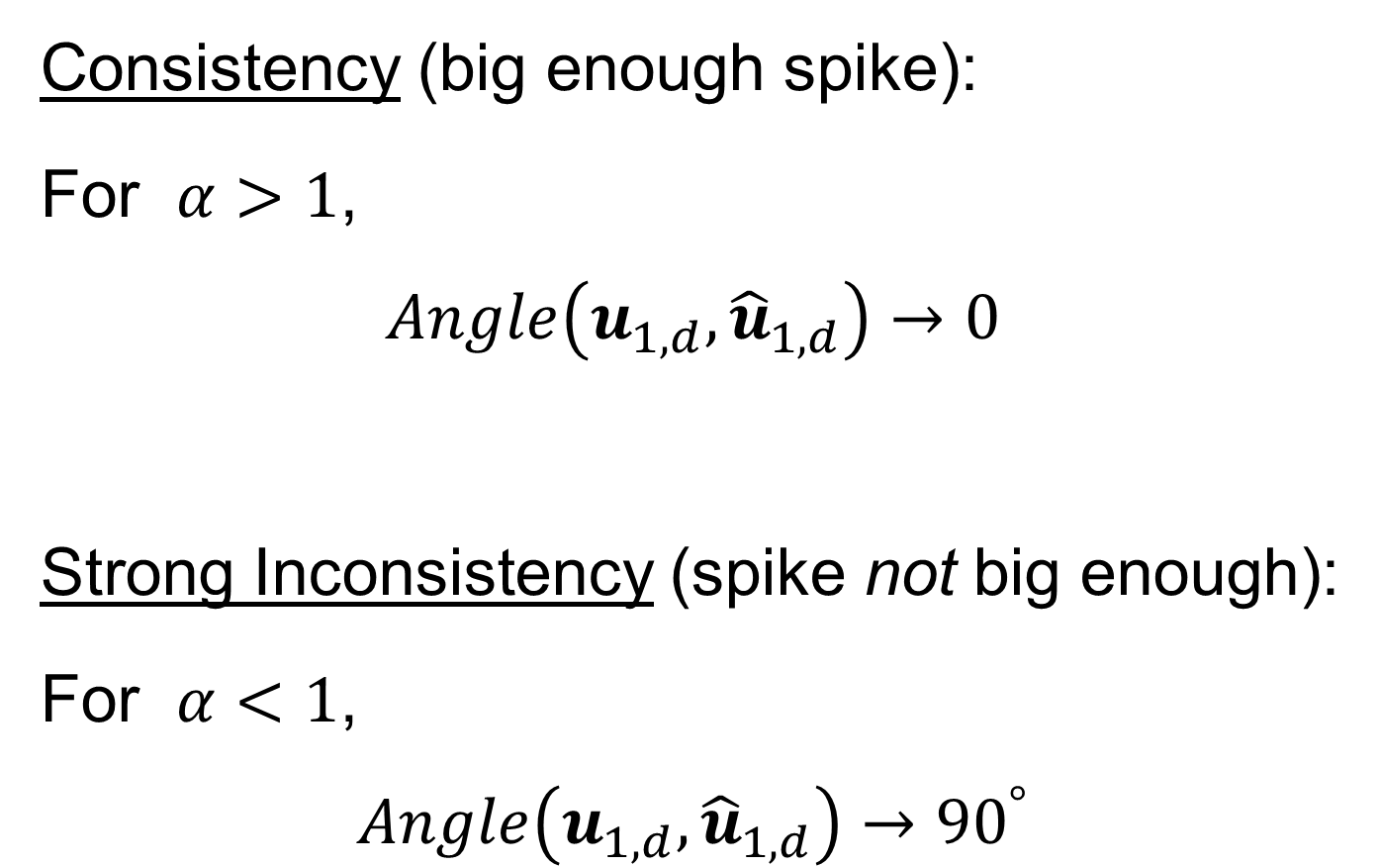
Last Class: HDLSS Math. Stat.
Consistency (big enough spike):
For $α>1$,
$$Angle\left(u_{1,d},{\hat{u}}_{1,d}\right)→0$$
Strong Inconsistency (spike not big enough):
For $α<1$,
$$Angle\left(u_{1,d},{\hat{u}}_{1,d}\right)→{90}^{°}$$

Slide 5
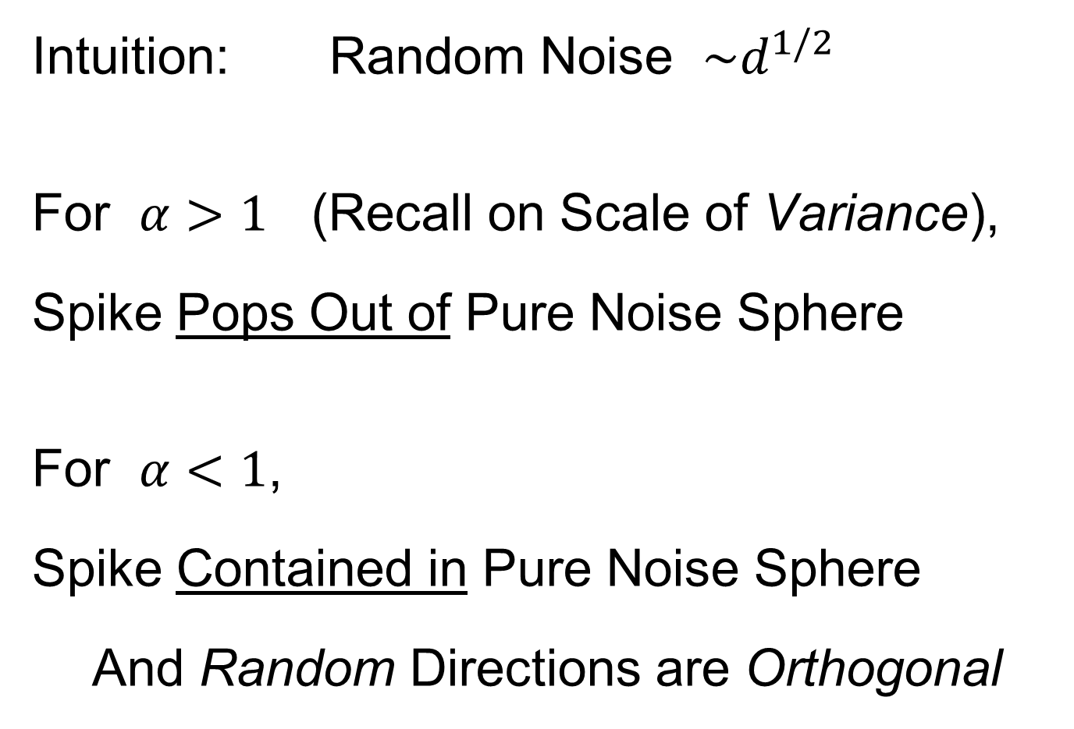
Last Class: HDLSS Math. Stat.
Intuition: Random Noise $\sim d^{1/2}$
For $α>1$ (Recall on Scale of Variance),
Spike Pops Out of Pure Noise Sphere
For $α<1$,
Spike Contained in Pure Noise Sphere
And Random Directions are Orthogonal

Slide 6
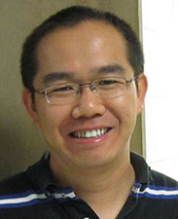
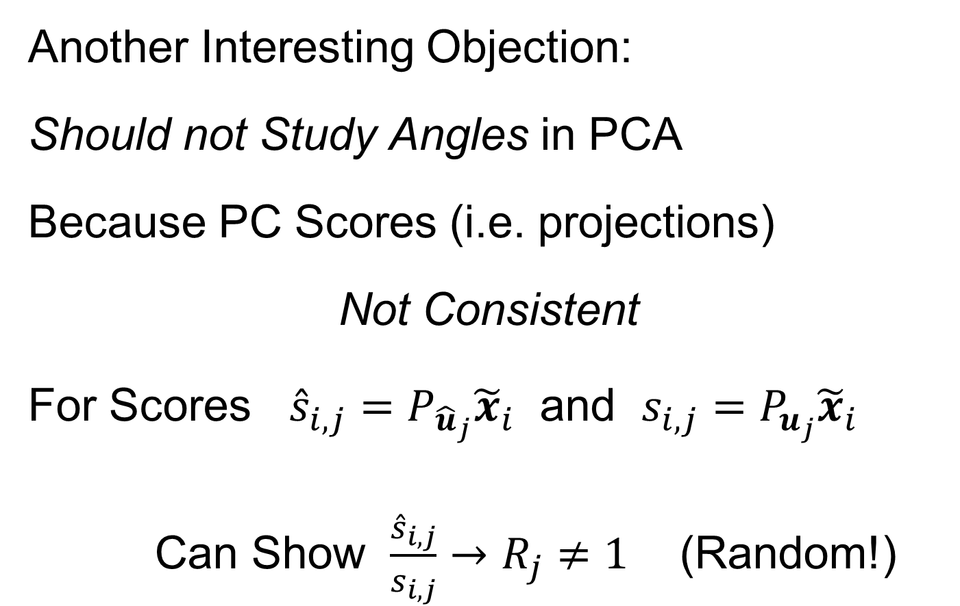
Last Class: HDLSS Math. Stat.
Another Interesting Objection:
Should not Study Angles in PCA
Because PC Scores (i.e. projections)
Not Consistent
For Scores ${\hat{s}}_{i,j}=P_{{\hat{u}}_{j}}{\tilde{x}}_{i}$ and $s_{i,j}=P_{u_{j}}{\tilde{x}}_{i}$
Can Show $\frac{{\hat{s}}_{i,j}}{s_{i,j}}→R_{j}≠1$ (Random!)
Due to Dan Shen

Slide 7
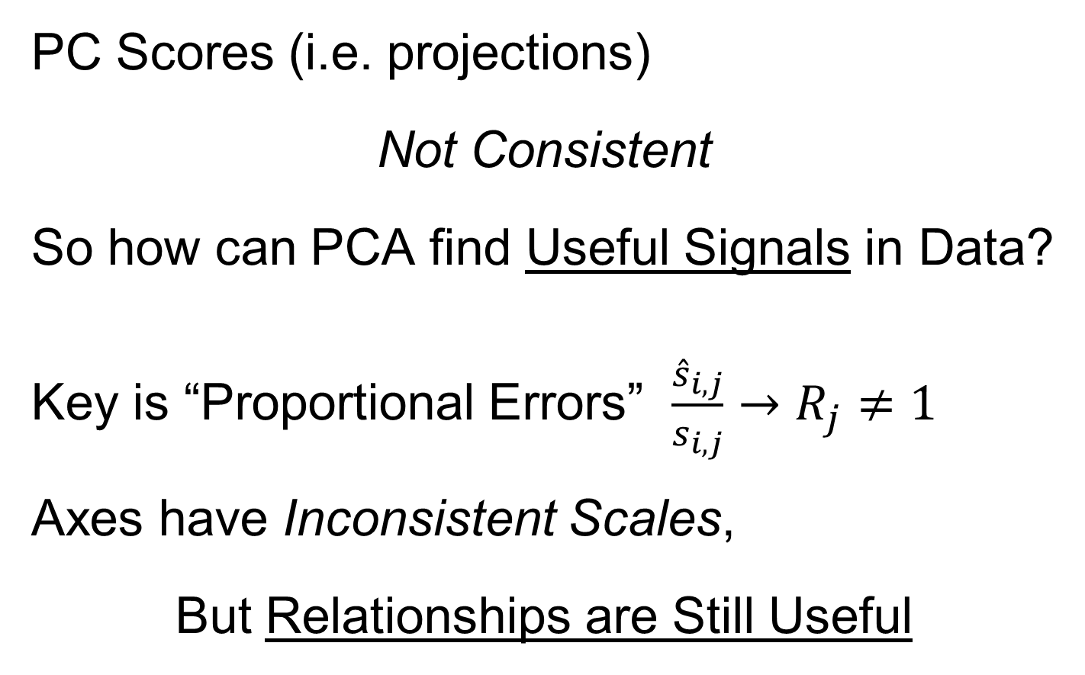
Last Class: HDLSS Math. Stat.
PC Scores (i.e. projections)
Not Consistent
So how can PCA find Useful Signals in Data?
Key is “Proportional Errors” $\frac{{\hat{s}}_{i,j}}{s_{i,j}}→R_{j}≠1$
Axes have Inconsistent Scales,
But Relationships are Still Useful

Slide 8
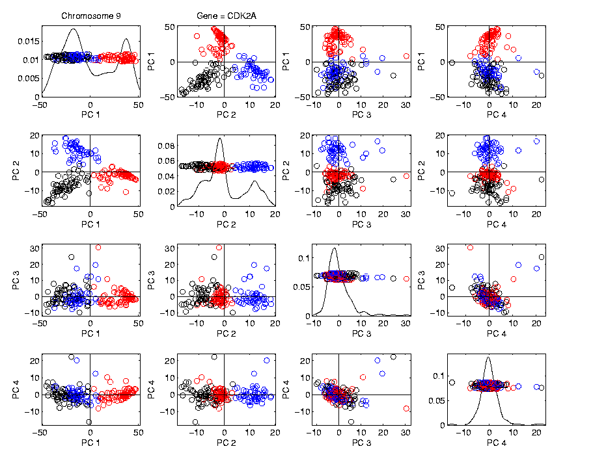
Last Class: HDLSS Math. Stat.
Numbers
On Axes
Are Wrong
But
Relationships
Are Right

Slide 9
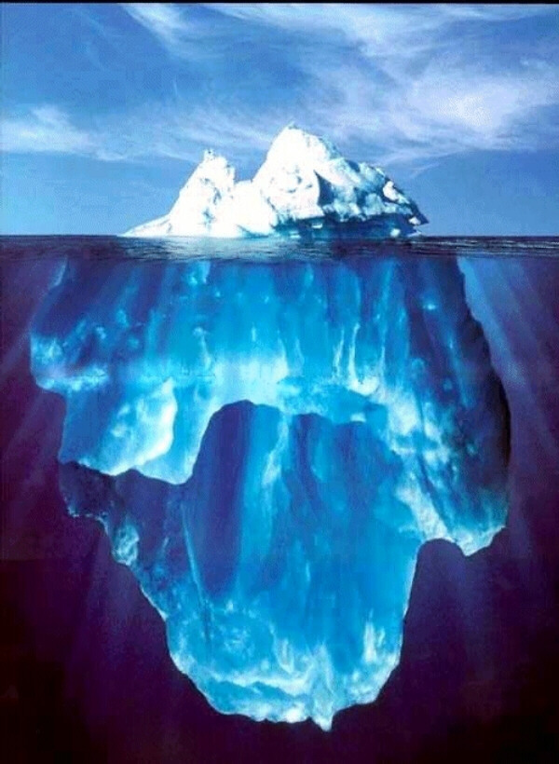
Last Class: HDLSS Research?
Development
Of Methods
Mathematical
Assessment
…
(thanks to:
defiant.corban.edu/gtipton/net-fun/iceberg.html)

Slide 10



Last Class: Random Matrix Th.
Text, Sec. 14.1
Pure Noise Data Matrix:
$X=$
Defined as: Entries i.i.d. $N(0,1)$
$$d$$
Thinking of
Columns As
Data Objects
$$n$$

Slide 11
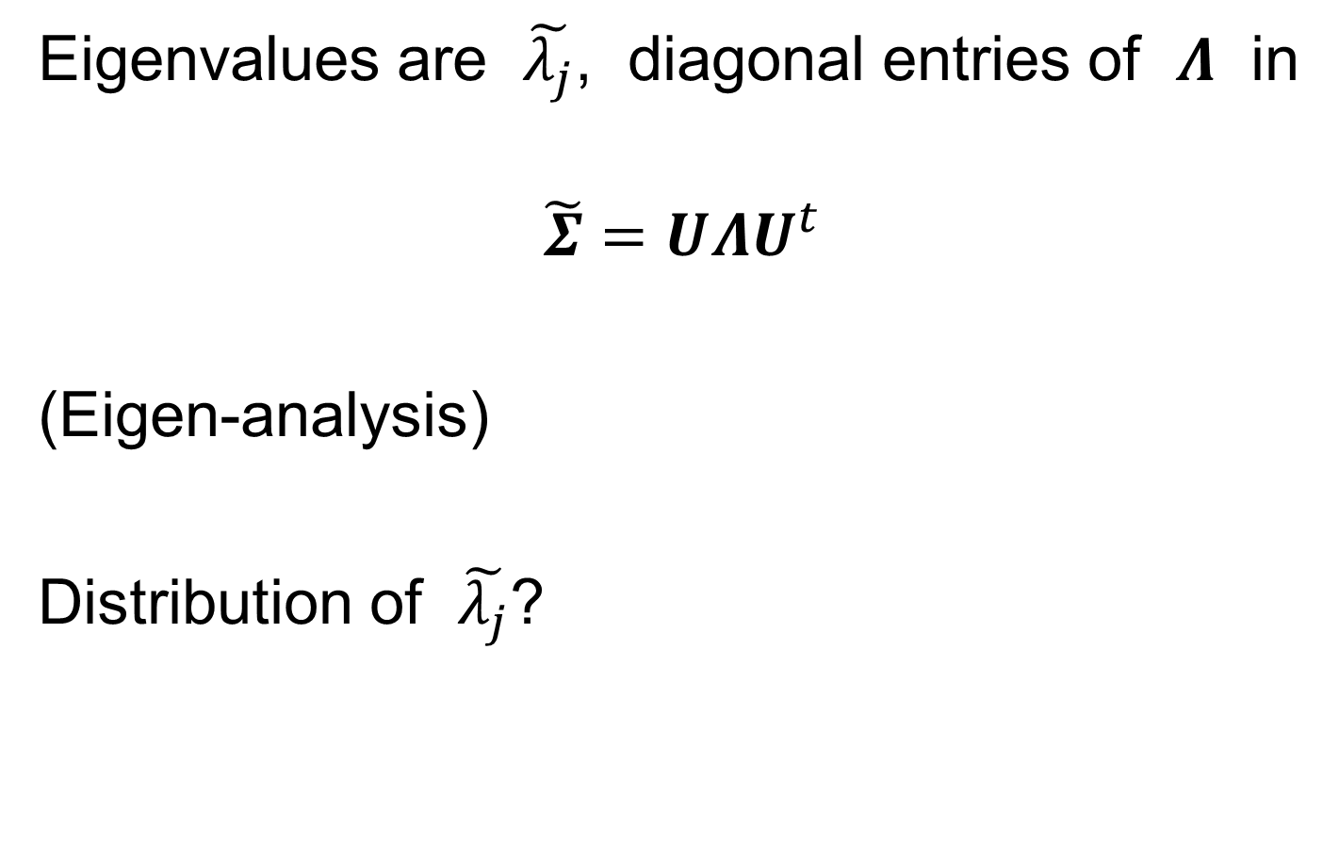
Last Class: Random Matrix Th.
Eigenvalues are $\tilde{λ_{j}}$, diagonal entries of $Λ$ in
$$\tilde{Σ}=UΛU^{t}$$
(Eigen-analysis)
Distribution of $\tilde{λ_{j}}$?

Slide 12
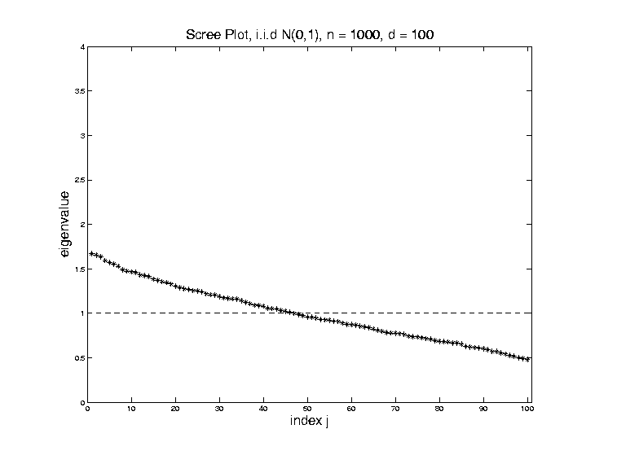

Last Class: Random Matrix Th.
For $d=100$, $n=1000$, Eigenvalues $≈1$
But There Is (Chance) Variation

Slide 13
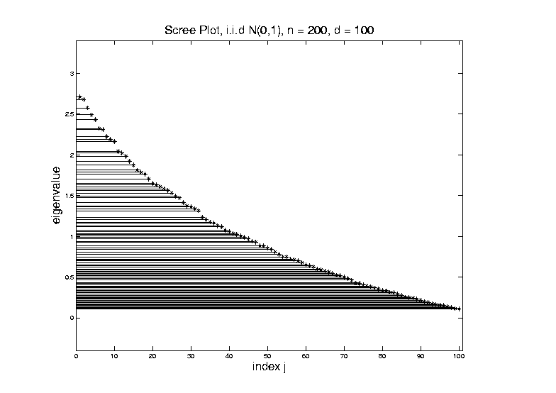

Last Class: Random Matrix Th.
LSD:
Above
Case
$n=200,$
$d=100$

Slide 14
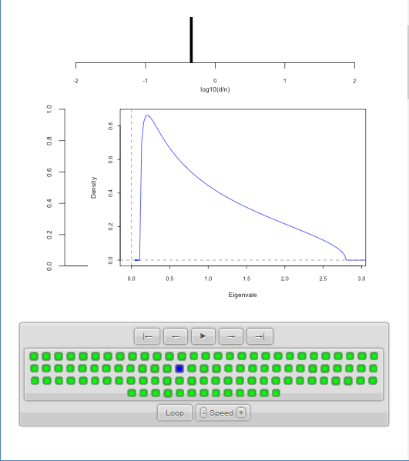

Last Class: Random Matrix Th.
LSD:
Above
Case
$n=200,$
$d=100,$
$y=0.5$
$\log_{10}{y}=−0.301$

Slide 15
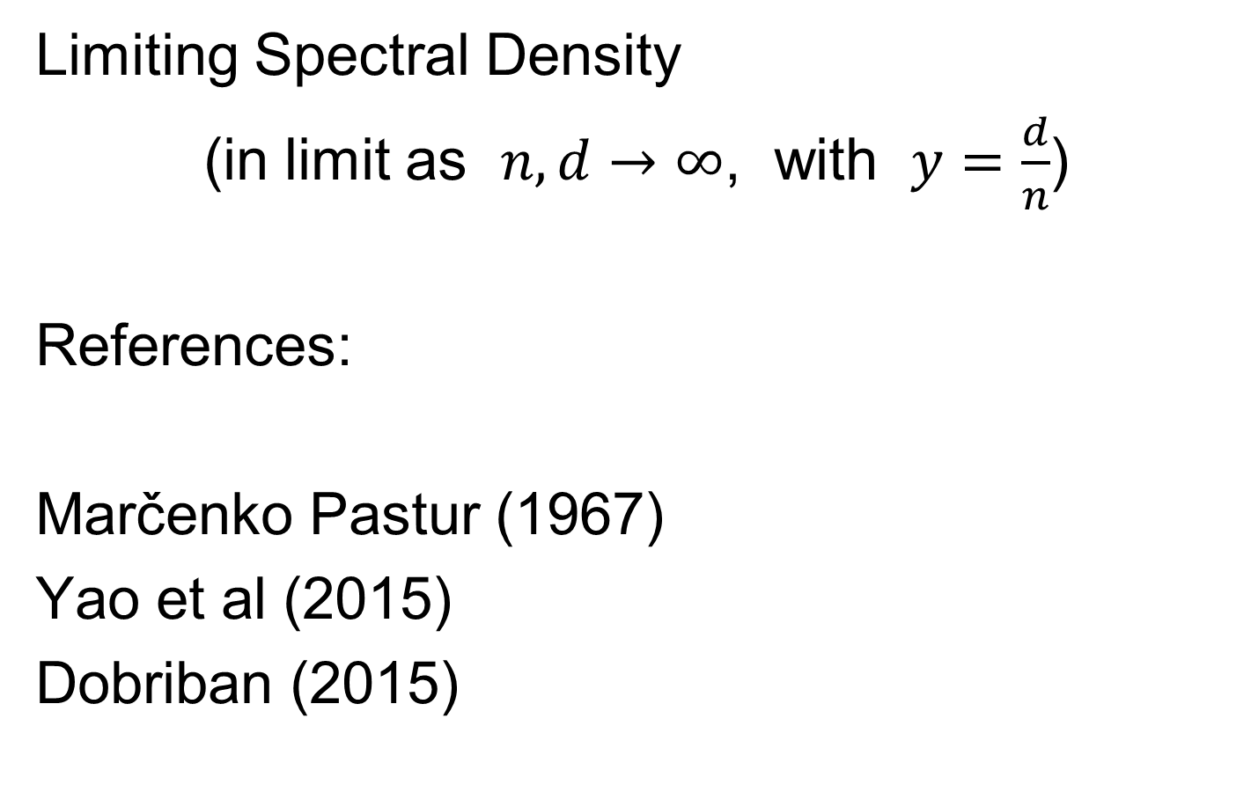
Last Class: Random Matrix Th.
Limiting Spectral Density
(in limit as $n, d→∞$, with $y=\frac{d}{n}$)
References:
Marčenko Pastur (1967)
Yao et al (2015)
Dobriban (2015)

Slide 16
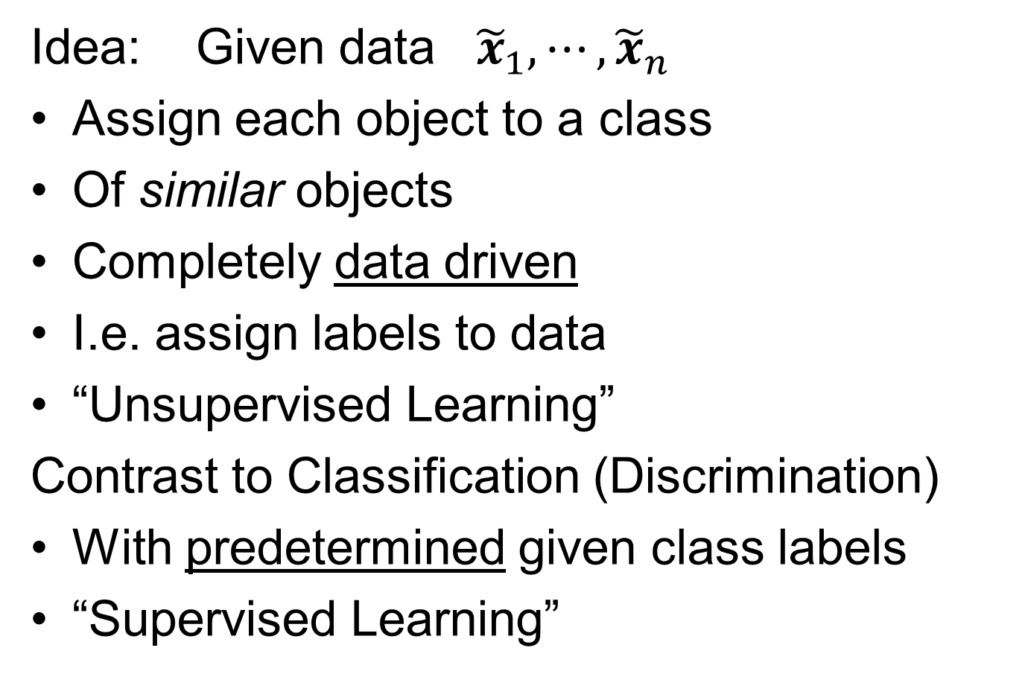
Clustering
Text:
Chp 12
Idea: Given data ${\tilde{x}}_{1},⋯,{\tilde{x}}_{n}$
Assign each object to a class
Of similar objects
Completely data driven
I.e. assign labels to data
“Unsupervised Learning”
Contrast to Classification (Discrimination)
With predetermined given class labels
“Supervised Learning”

Slide 17
Clustering
Important References:
MacQueen (1967)
Hartigan (1975)
Gersho and Gray (1992)
Kaufman and Rousseeuw (2005)
See Also: Wikipedia

Slide 18
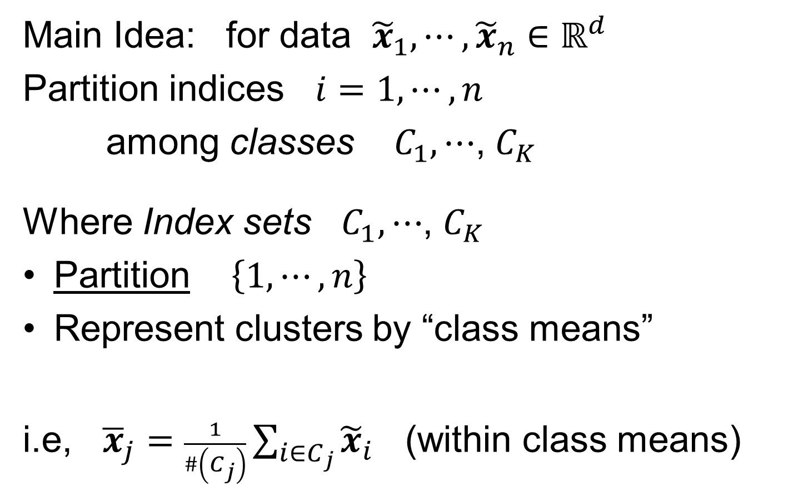
K-means Clustering
Main Idea: for data ${\tilde{x}}_{1},⋯,{\tilde{x}}_{n}∈ℝ^{d}$
Partition indices $i=1,⋯,n$
among classes $C_{1},⋯$, $C_{K}$
Where Index sets $C_{1},⋯$, $C_{K}$
Partition $\left\{1,⋯,n\right\}$
Represent clusters by “class means”
i.e, ${\overline{x}}_{j}=\frac{1}{\#\left(C_{j}\right)}\sum_{i∈C_{j}}{{\tilde{x}}_{i}}$ (within class means)
Each goes into
exactly 1 class

Slide 19
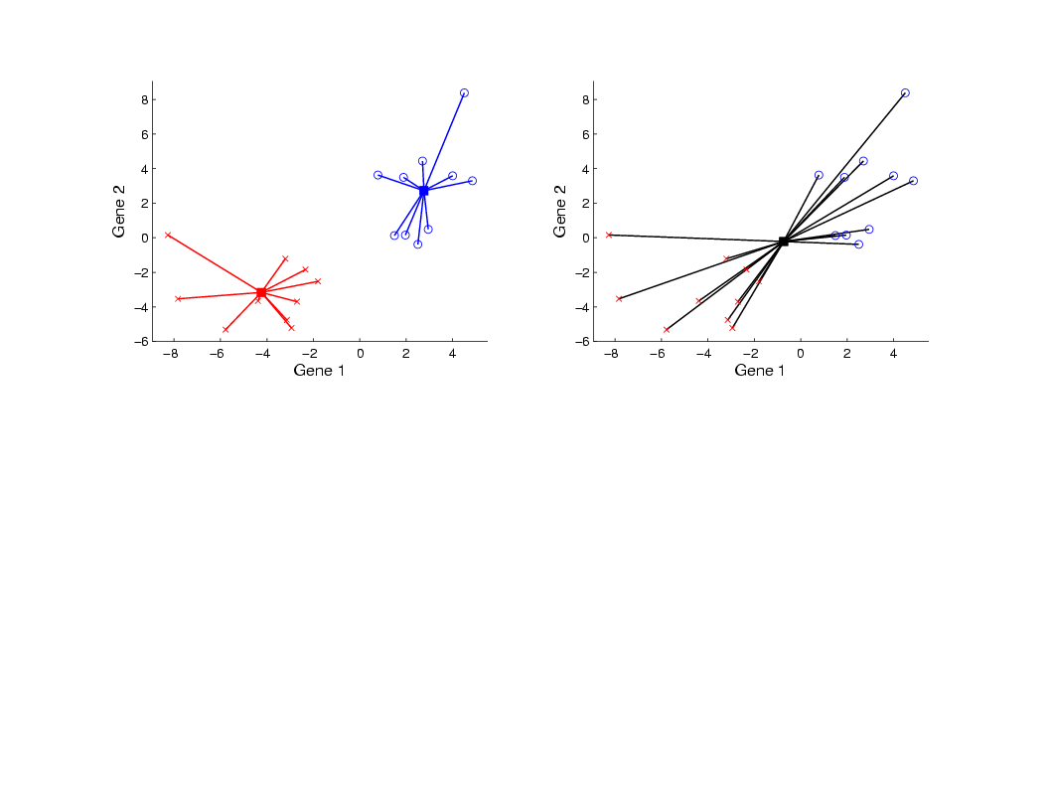
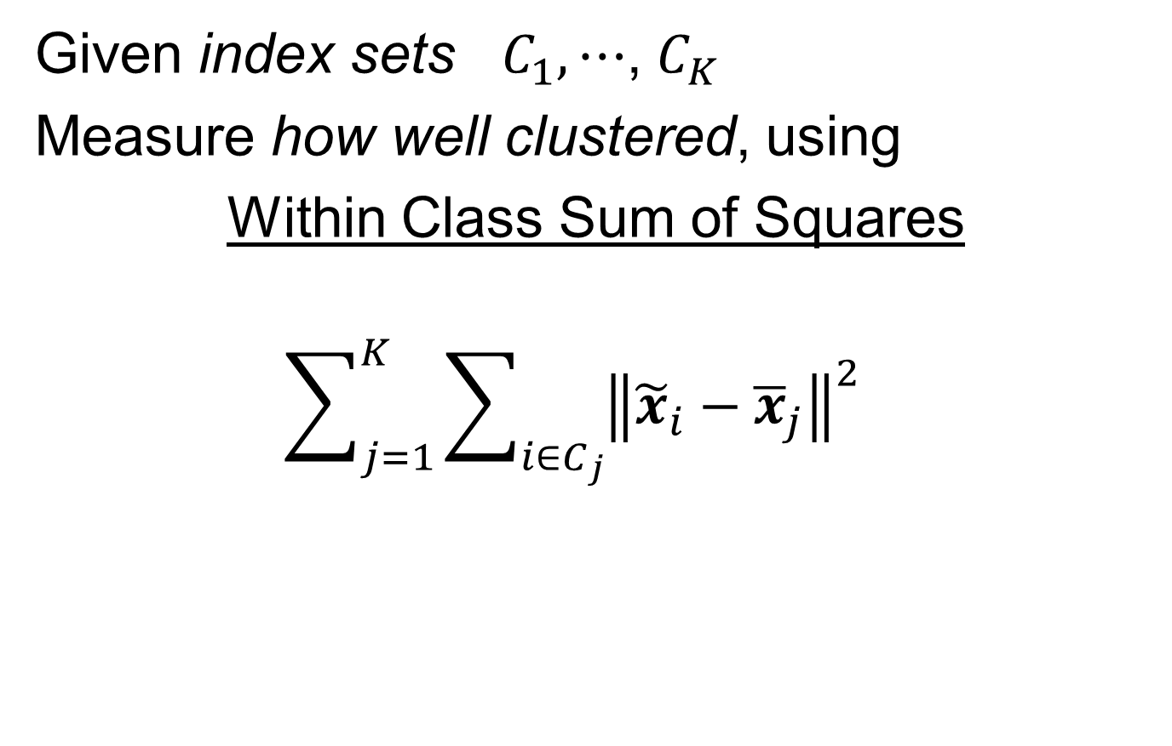
K-means Clustering
Given index sets $C_{1},⋯$, $C_{K}$
Measure how well clustered, using
Within Class Sum of Squares
$$\sum_{j=1}^{K}{\sum_{i∈C_{j}}{{\left\|{\tilde{x}}_{i}−{\overline{x}}_{j}\right\|}^{2}}}$$

Slide 20

K-means Clustering
Common Variation:
Put on scale of proportions (i.e. in [0,1])
By dividing “within class SS”
by “overall SS”
Gives Cluster Index:
$$CI\left(C_{1},⋯,C_{K}\right)=\frac{\sum_{j=1}^{K}{\sum_{i∈C_{j}}{{\left\|{\tilde{x}}_{i}−{\overline{x}}_{j}\right\|}^{2}}}}{\sum_{i=1}^{n}{{\left\|{\tilde{x}}_{i}−\overline{x}\right\|}^{2}}}$$

Slide 21
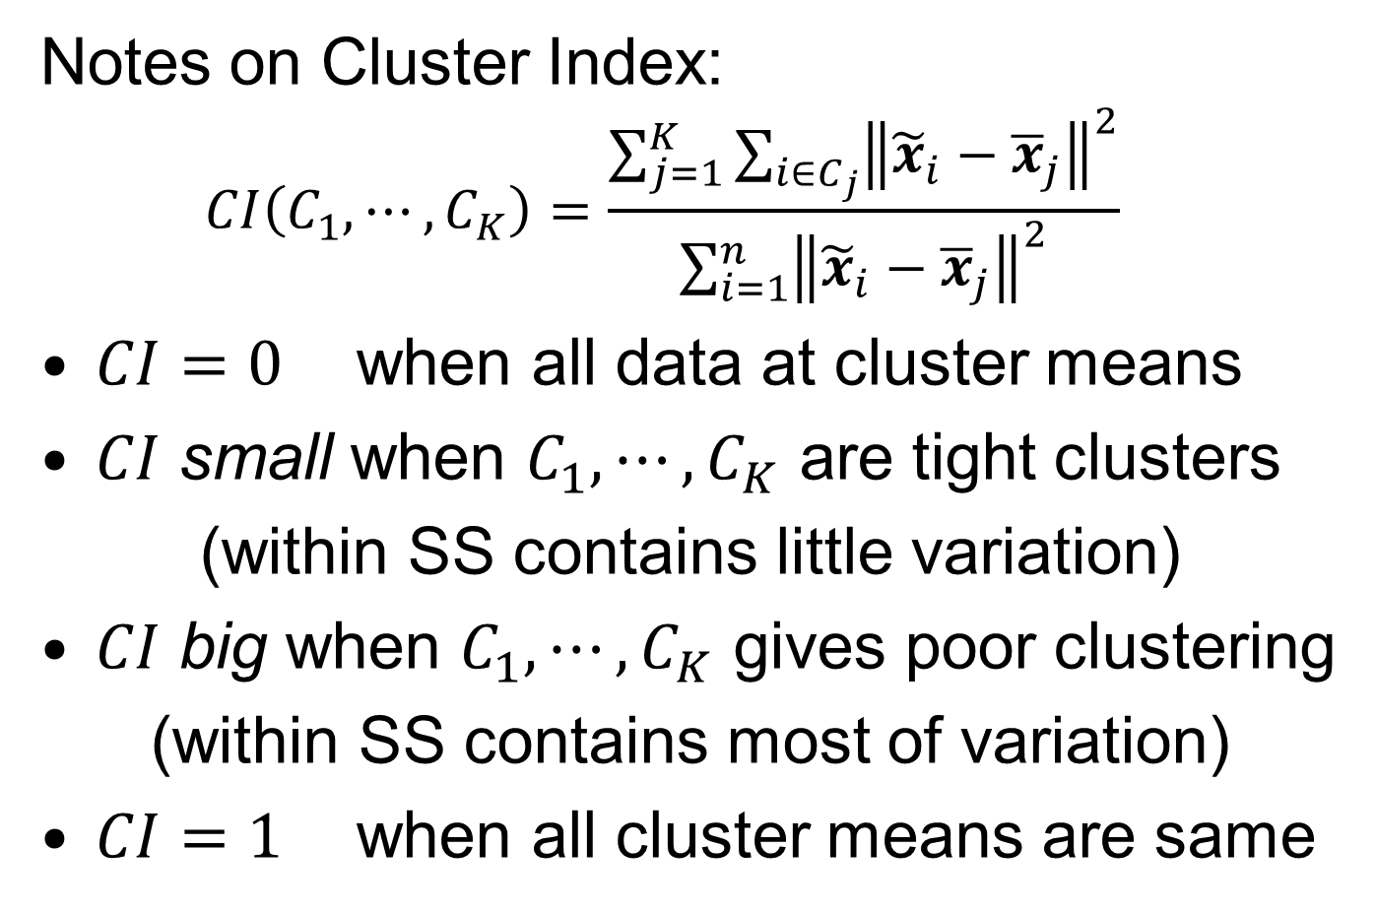
K-means Clustering
Notes on Cluster Index:
$$CI\left(C_{1},⋯,C_{K}\right)=\frac{\sum_{j=1}^{K}{\sum_{i∈C_{j}}{{\left\|{\tilde{x}}_{i}−{\overline{x}}_{j}\right\|}^{2}}}}{\sum_{i=1}^{n}{{\left\|{\tilde{x}}_{i}−{\overline{x}}_{j}\right\|}^{2}}}$$
$CI=0$ when all data at cluster means
$CI$ small when $C_{1},⋯,C_{K}$ are tight clusters
(within SS contains little variation)
$CI$ big when $C_{1},⋯,C_{K}$ gives poor clustering
(within SS contains most of variation)
$CI=1$ when all cluster means are same

Slide 22
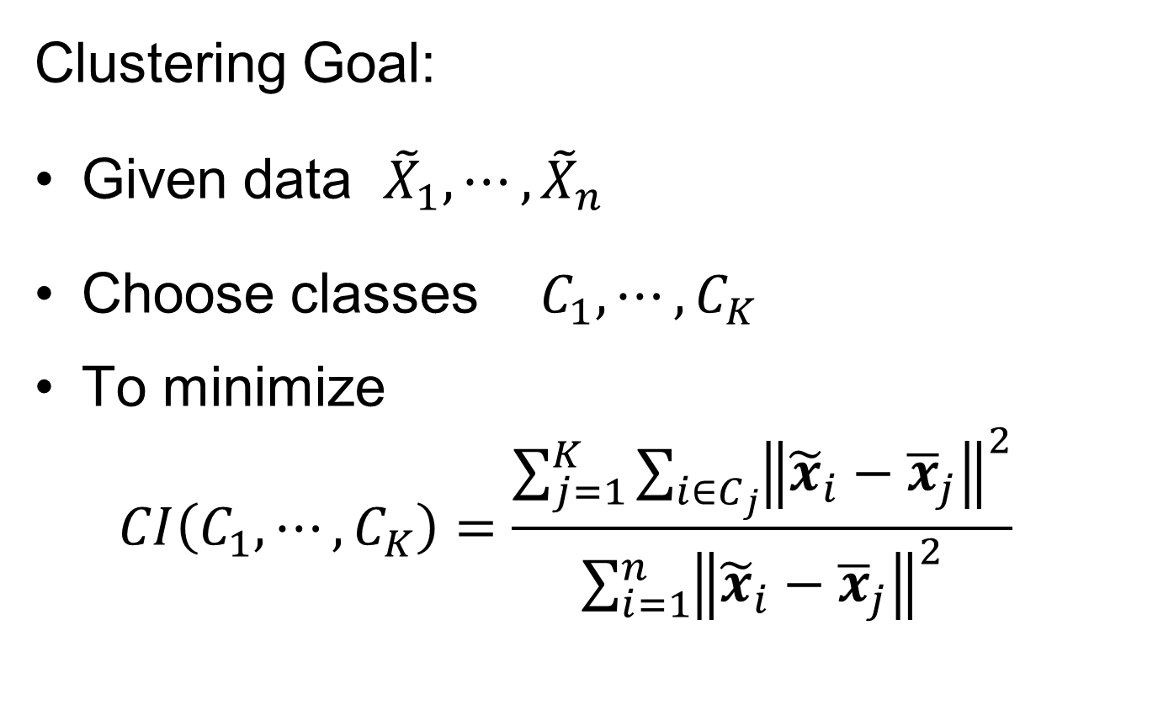
K-means Clustering
Clustering Goal:
Given data ${\tilde{X}}_{1},⋯,{\tilde{X}}_{n}$
Choose classes $C_{1},⋯,C_{K}$
To minimize
$$CI\left(C_{1},⋯,C_{K}\right)=\frac{\sum_{j=1}^{K}{\sum_{i∈C_{j}}{{\left\|{\tilde{x}}_{i}−{\overline{x}}_{j}\right\|}^{2}}}}{\sum_{i=1}^{n}{{\left\|{\tilde{x}}_{i}−{\overline{x}}_{j}\right\|}^{2}}}$$

Slide 23
2-means Clustering
Study CI, using simple 1-d examples
Varying Standard Deviation

Slide 24
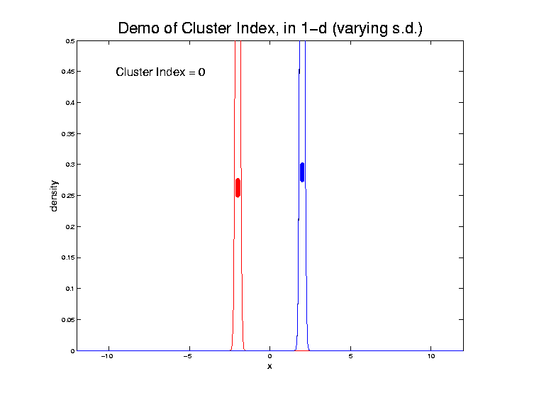
2-means Clustering

Slide 25
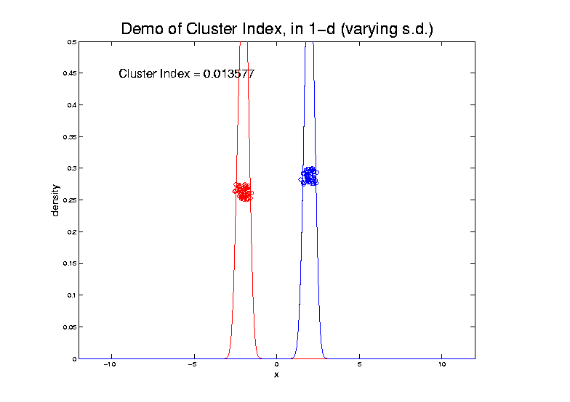
2-means Clustering

Slide 26
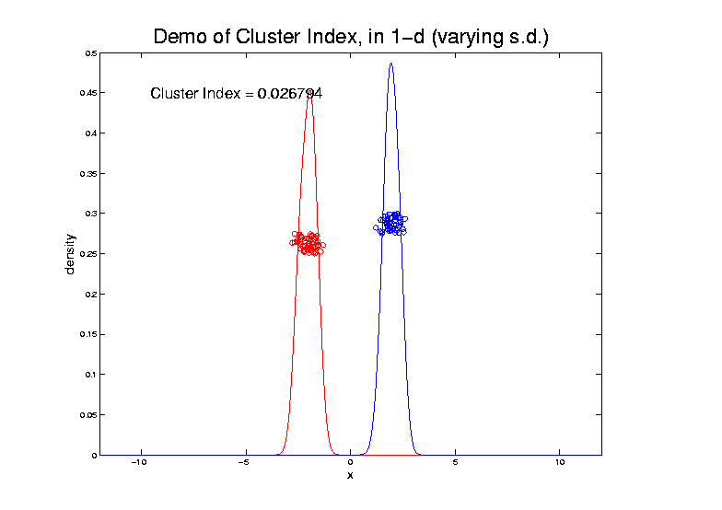
2-means Clustering

Slide 27
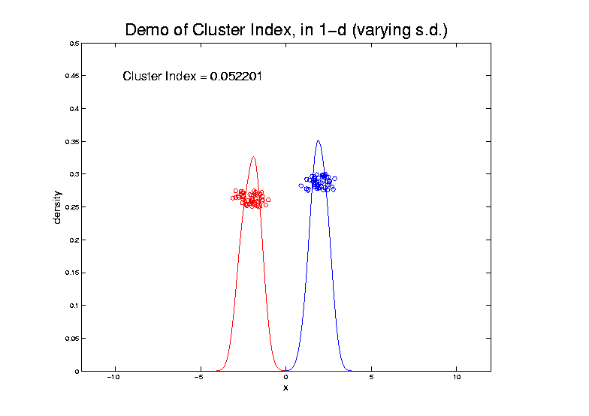
2-means Clustering

Slide 28
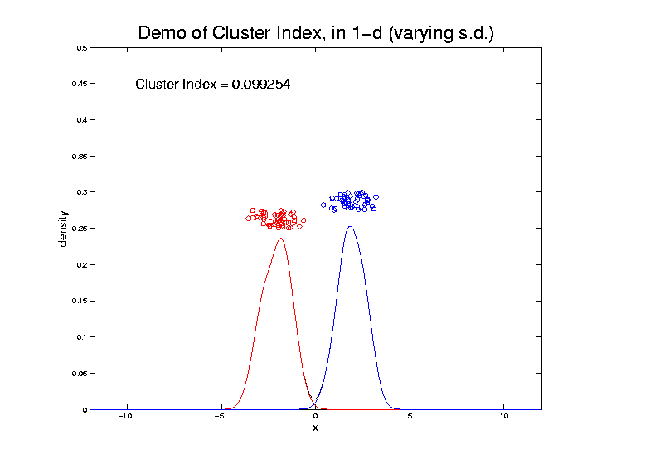
2-means Clustering

Slide 29
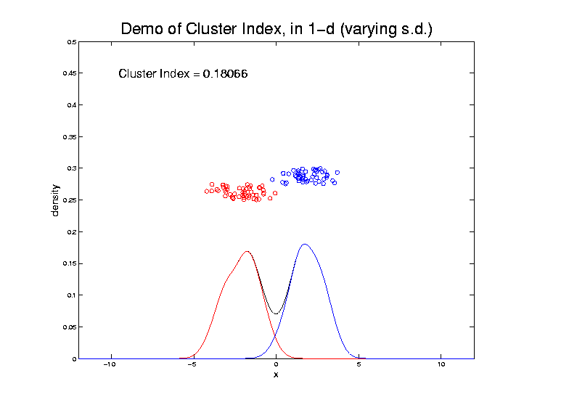
2-means Clustering

Slide 30
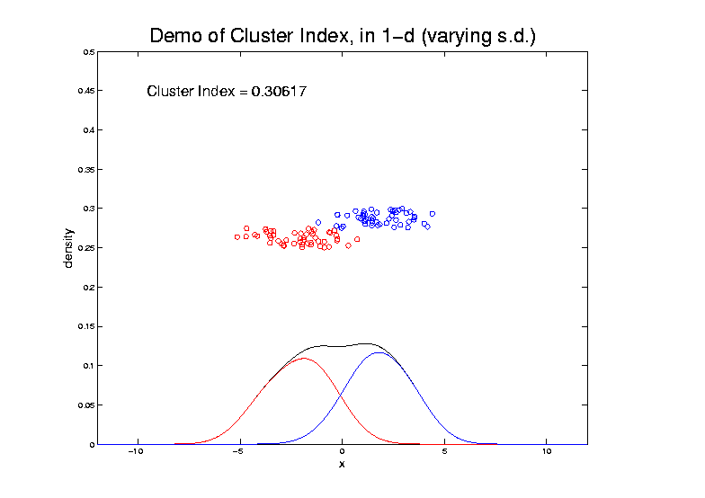
2-means Clustering

Slide 31
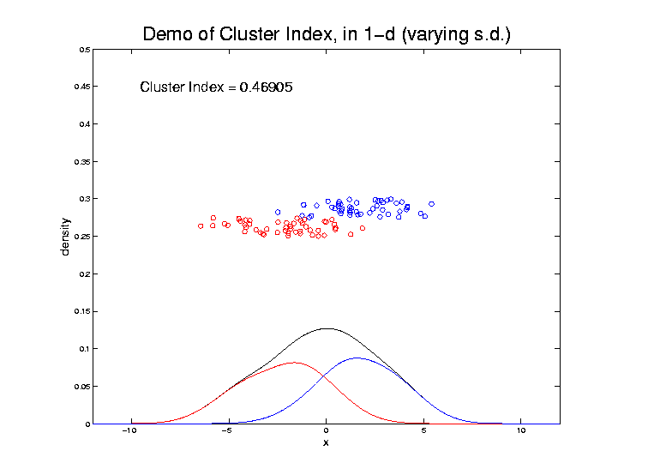
2-means Clustering

Slide 32
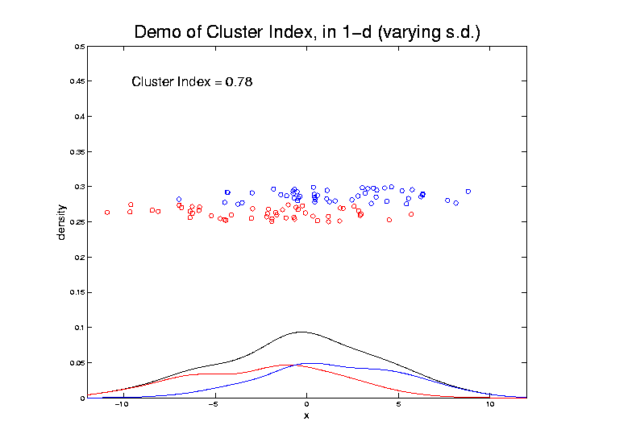
2-means Clustering

Slide 33
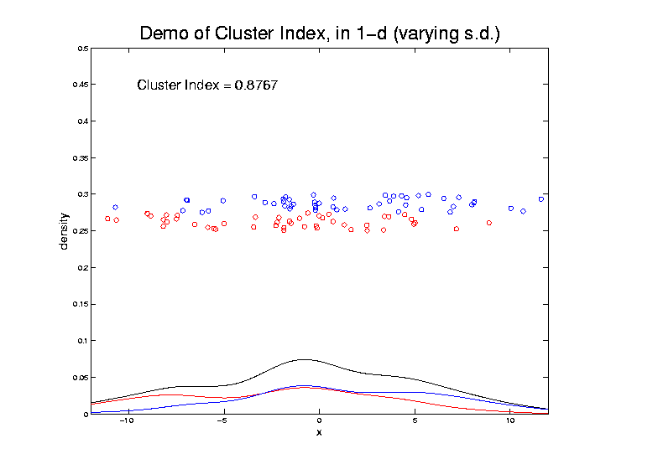
2-means Clustering

Slide 34
2-means Clustering
Study CI, using simple 1-d examples
Varying Standard Deviation
Varying Mean

Slide 35
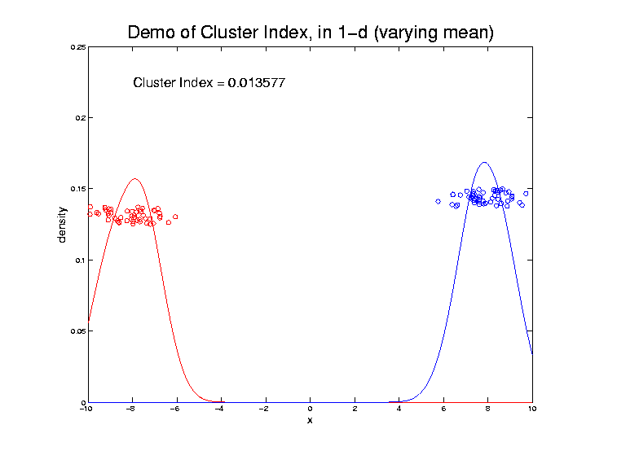
2-means Clustering

Slide 36
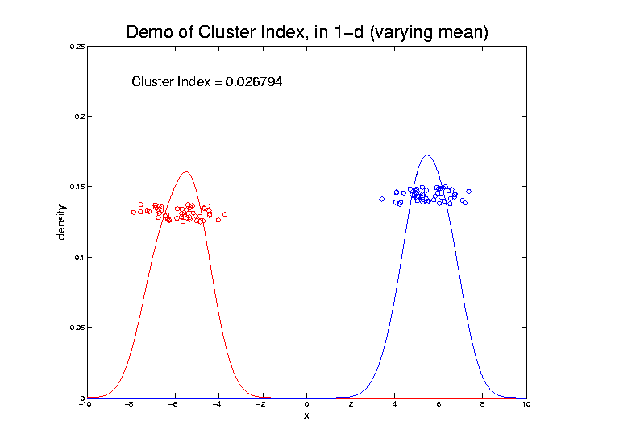
2-means Clustering

Slide 37
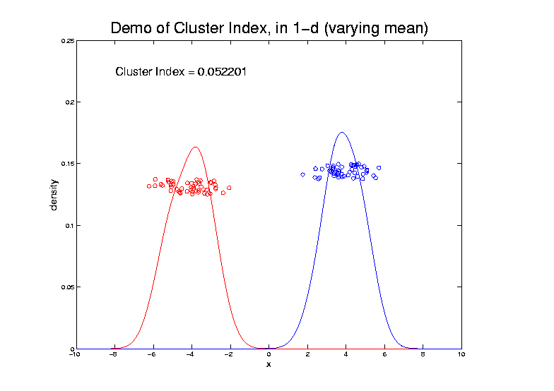
2-means Clustering

Slide 38
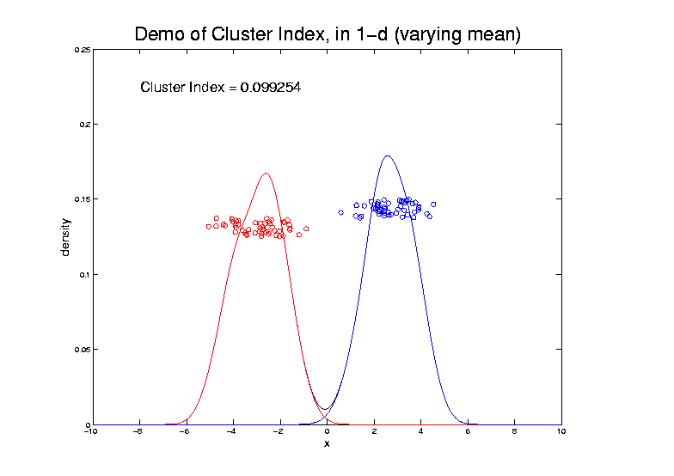
2-means Clustering

Slide 39
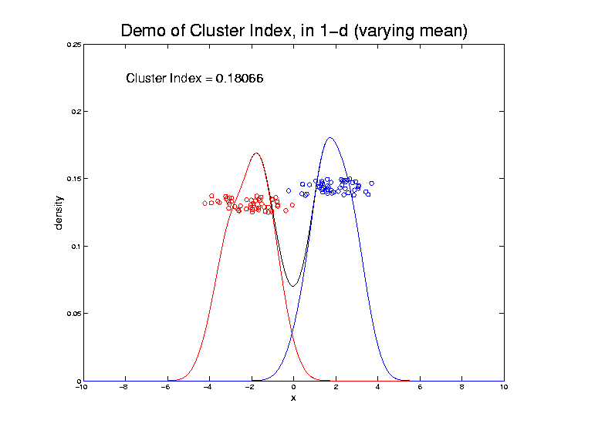
2-means Clustering

Slide 40
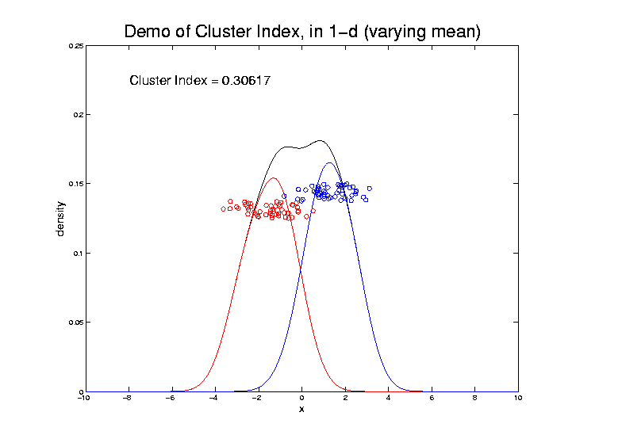
2-means Clustering

Slide 41
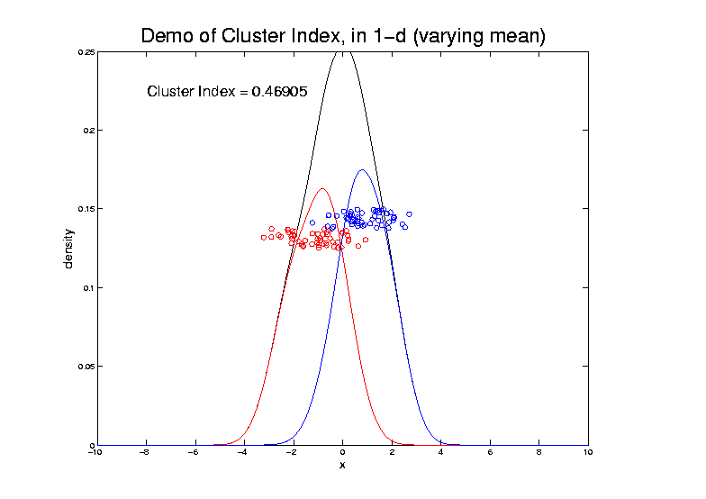
2-means Clustering

Slide 42
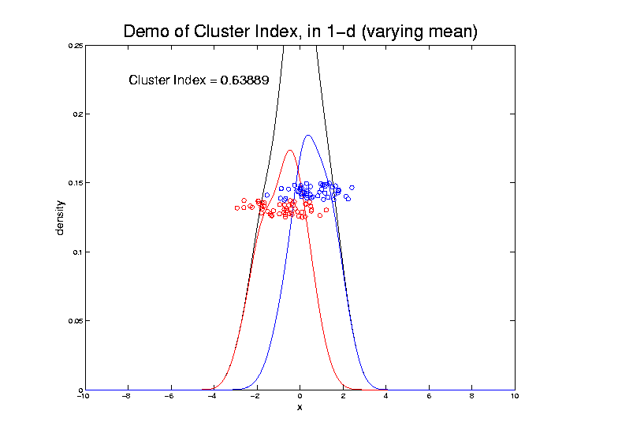
2-means Clustering

Slide 43
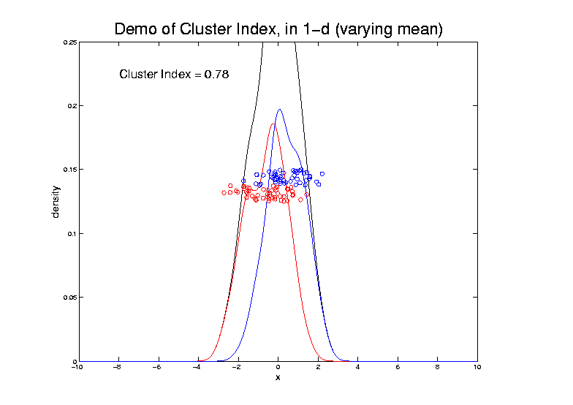
2-means Clustering

Slide 44
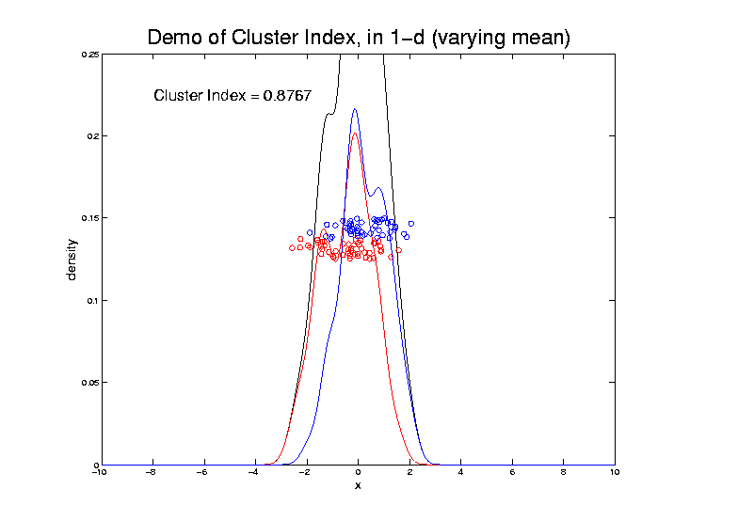
2-means Clustering

Slide 45
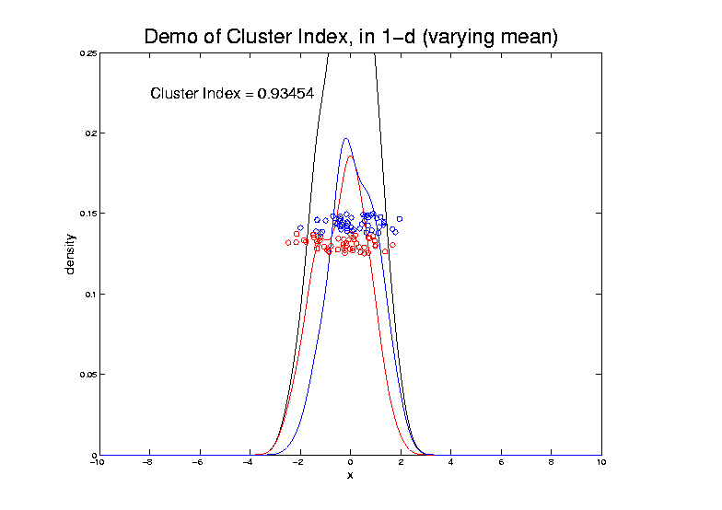
2-means Clustering

Slide 46
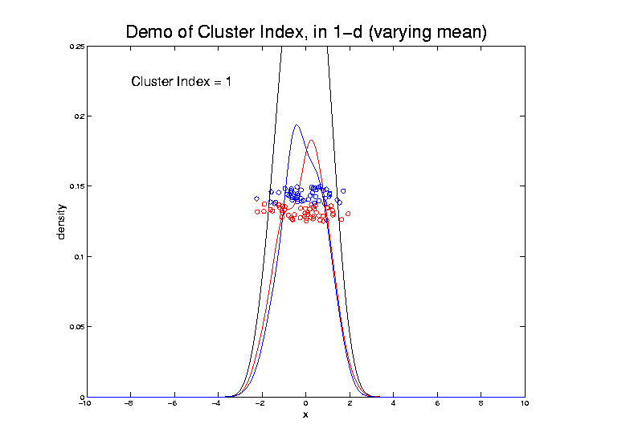
2-means Clustering

Slide 47
2-means Clustering
Study CI, using simple 1-d examples
Varying Standard Deviation
Varying Mean
Varying Proportion

Slide 48
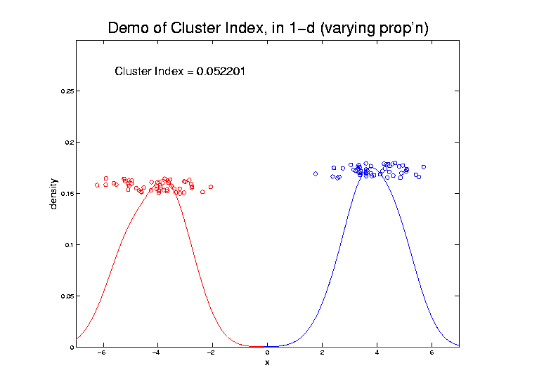
2-means Clustering

Slide 49
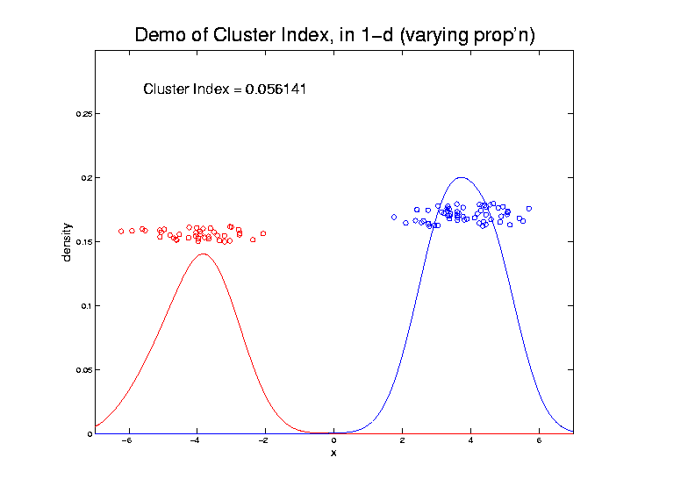
2-means Clustering

Slide 50
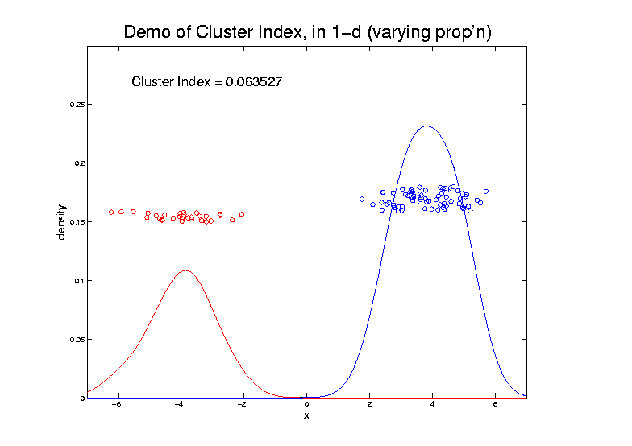
2-means Clustering

Slide 51
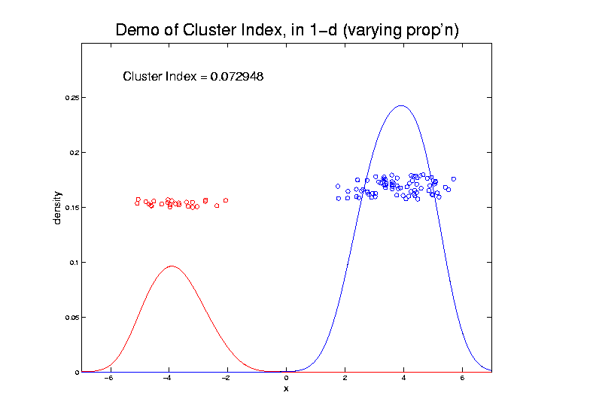
2-means Clustering

Slide 52

2-means Clustering

Slide 53

2-means Clustering

Slide 54

2-means Clustering

Slide 55

2-means Clustering

Slide 56

2-means Clustering

Slide 57

2-means Clustering

Slide 58

2-means Clustering

Slide 59

2-means Clustering

Slide 60

2-means Clustering

Slide 61

2-means Clustering
Important Point:
K-Means Dislikes
Small Clusters

Slide 62
2-means Clustering
Study CI, using simple 1-d examples
Over changing Classes (moving b’dry)

Slide 63

2-means Clustering

Slide 64

2-means Clustering

Slide 65

2-means Clustering

Slide 66

2-means Clustering
C. Index for
Clustering
Greens
& Blues

Slide 67

2-means Clustering

Slide 68

2-means Clustering

Slide 69

2-means Clustering

Slide 70

2-means Clustering

Slide 71

2-means Clustering

Slide 72

2-means Clustering
Curve Shows CI for Many
Reasonable Clusterings
Separated Local Minima!

Slide 73

2-means Clustering
Study CI, using simple 1-d examples
Over changing Classes (moving b’dry)
Multi-modal data → interesting effects
Multiple local minima in CI (large number)
Maybe disconnected
Optimization (over $C_{1},⋯$, $C_{K}$) can be tricky…
(even in 1 dimension, with $K=2$)

Slide 74

2-means Clustering
Shows Even More
Local Minima

Slide 75

2-means Clustering
Study CI, using simple 1-d examples
Over changing Classes (moving b’dry)
Multi-modal data → interesting effects
Can have 4 (or more) local mins
(even in 1 dimension, with $K=2$)

Slide 76

2-means Clustering
Shows True
Minimum May
Be Hard To Find

Slide 77

2-means Clustering
Study CI, using simple 1-d examples
Over changing Classes (moving b’dry)
Multi-modal data → interesting effects
Local mins can be hard to find
i.e. iterative procedures can “get stuck”
(even in 1 dimension, with $K=2$)
Common, But Slippery,
Approach: Many
Random Restarts

Slide 78
2-means Clustering
Study CI, using simple 1-d examples
Effect of a single outlier?

Slide 79

2-means Clustering
Minimum CI
Splits in Half

Slide 80

2-means Clustering
Move
Outlier
Farther
Out
Already Have
Local Minima

Slide 81

2-means Clustering

Slide 82

2-means Clustering
Global CI
Minimum
Now Here

Slide 83

2-means Clustering

Slide 84

2-means Clustering

Slide 85

2-means Clustering

Slide 86

2-means Clustering

Slide 87

2-means Clustering

Slide 88

2-means Clustering

Slide 89

2-means Clustering
Single Outlier Can Make CI Arbitrarily Small

Slide 90
2-means Clustering
Study CI, using simple 1-d examples
Effect of a single outlier?
Can create local minimum
Can also yield a global minimum
This gives a one point class
Can make CI arbitrarily small
(really a “good clustering”???)

Slide 91

K-Means Clustering
2-d Toy Example
Long Thin Cluster
Close Round Clusters
Outliers or Clusters???

Slide 92





K-Means Clustering
2-d Toy Example
$k=2$, Groups
All Small Ones
$k=3$, Splits
Round Ones
K-Means Can Be Slippery
$k=4$, Splits
Long Cluster
Local Minimum?
$k=5$, Splits
Outliers, Not
Round Ones?

Slide 93




K-Means Clustering
2-d Toy Example, More Careful Look
Recommendation: Visual Validation!
So Global Min’r
So Local Min’r
K-Means Can Be Slippery
$k=4$: $CI=0.091$
$k=5$, $CI=0.063$
$k=4$: Separated
Out Pair: $CI=0.161$
$k=5$: Split
Spheres $CI=0.059$

Slide 94
SWISS Score
Another Application of CI (Cluster Index)
Cabanski et al (2010)
Idea: Use CI in bioinformatics to
“measure quality of data preprocessing”
Philosophy: Clusters Are Scientific Goal
So Want to Accentuate Them

Slide 95


SWISS Score
Toy Examples (2-d):
Which are “More Clustered?”

Slide 96

SWISS Score
Toy Examples (2-d):
Which are “More Clustered?”

Slide 97

SWISS Score
SWISS =
Standardized Within class Sum of Squares
$$SWISS=CI\left(C_{1},⋯,C_{K}\right)=\frac{\sum_{j=1}^{K}{\sum_{i∈C_{j}}{{\left\|{\tilde{x}}_{i}−{\overline{x}}_{j}\right\|}^{2}}}}{\sum_{i=1}^{n}{{\left\|{\tilde{x}}_{i}−\overline{x}\right\|}^{2}}}$$

Slide 98
SWISS Score
SWISS =
Standardized Within class Sum of Squares
$$SWISS=CI\left(C_{1},⋯,C_{K}\right)=\frac{\sum_{j=1}^{K}{\sum_{i∈C_{j}}{{\left\|{\tilde{x}}_{i}−{\overline{x}}_{j}\right\|}^{2}}}}{\sum_{i=1}^{n}{{\left\|{\tilde{x}}_{i}−\overline{x}\right\|}^{2}}}$$

Slide 99
SWISS Score
SWISS =
Standardized Within class Sum of Squares
$$SWISS=CI\left(C_{1},⋯,C_{K}\right)=\frac{\sum_{j=1}^{K}{\sum_{i∈C_{j}}{{\left\|{\tilde{x}}_{i}−{\overline{x}}_{j}\right\|}^{2}}}}{\sum_{i=1}^{n}{{\left\|{\tilde{x}}_{i}−\overline{x}\right\|}^{2}}}$$

Slide 100

SWISS Score
Recall Graphical Introduction:
$$SWISS=CI\left(C_{1},⋯,C_{K}\right)=\frac{\sum_{j=1}^{K}{\sum_{i∈C_{j}}{{\left\|{\tilde{x}}_{i}−{\overline{x}}_{j}\right\|}^{2}}}}{\sum_{i=1}^{n}{{\left\|{\tilde{x}}_{i}−\overline{x}\right\|}^{2}}}$$

Slide 101
SWISS Score
Recall Graphical Introduction:
$$SWISS=CI\left(C_{1},⋯,C_{K}\right)=\frac{\sum_{j=1}^{K}{\sum_{i∈C_{j}}{{\left\|{\tilde{x}}_{i}−{\overline{x}}_{j}\right\|}^{2}}}}{\sum_{i=1}^{n}{{\left\|{\tilde{x}}_{i}−\overline{x}\right\|}^{2}}}$$

Slide 102
SWISS Score
Revisit Toy Examples (2-d):
Which are “More Clustered?”

Slide 103
SWISS Score
Toy Examples (2-d):
Which are “More Clustered?”

Slide 104

SWISS Score
Toy Examples (2-d):
Which are “More Clustered?”

Slide 105

SWISS Score
Now Consider $K>2$:
$$SWISS=CI\left(C_{1},⋯,C_{K}\right)=\frac{\sum_{j=1}^{K}{\sum_{i∈C_{j}}{{\left\|{\tilde{x}}_{i}−{\overline{x}}_{j}\right\|}^{2}}}}{\sum_{i=1}^{n}{{\left\|{\tilde{x}}_{i}−\overline{x}\right\|}^{2}}}$$
How well does it work?

Slide 106

SWISS Score
$K=3$, Toy Example:

Slide 107
SWISS Score
$K=3$, Toy Example:

Slide 108
SWISS Score
$K=3$, Toy Example:

Slide 109

SWISS Score
$K=3$, Toy Example:
But C
Seems
“Better
Clustered”

Slide 110
SWISS Score
K-Class SWISS:
Instead of using K-Class CI
Use Average of Pairwise SWISS Scores

Slide 111
SWISS Score
K-Class SWISS:
Instead of using K-Class CI
Use Average of Pairwise SWISS Scores
(Preserves [0,1] Range)

Slide 112
SWISS Score
Avg. Pairwise SWISS – Toy Examples

Slide 113
SWISS Score
Additional Feature:
Ǝ Hypothesis Tests:
H₁: SWISS₁ < 1
H₁: SWISS₁ < SWISS₂
Permutation Based
See Cabanski et al (2010)

Slide 114
Clustering
A Very Large Area
K-Means is Only One Approach
Has its Drawbacks
(Many Toy Examples of This)
Ǝ Many Other Approaches
Important (And Broad) Class
Hierarchical Clustering

Slide 115
Hierarchical Clustering
Idea: Consider Either:
Bottom Up Aggregation:
One by One Combine Data
Top Down Splitting:
All Data in One Cluster & Split
Through Entire Data Set, to get Dendogram
Text, Sec. 12.2
Important Differences From
Computational Perspective
Note: K-means is not hierarchical (not nested)

Slide 116

Hierarchical Clustering
Aggregate or Split, to get Dendogram
Thanks to US EPA: water.epa.gov

Slide 117
Hierarchical Clustering
Aggregate or Split, to get Dendogram
Aggregate:
Start With
Individuals

Slide 118
Hierarchical Clustering
Aggregate or Split, to get Dendogram
Aggregate:
Start With
Individuals,
Move Up
Join Pairs of Objects
That Are “Closest”

Slide 119
Hierarchical Clustering
Aggregate or Split, to get Dendogram
Aggregate:
Start With
Individuals,
Move Up
Also Join “Nearby” Clusters

Slide 120
Hierarchical Clustering
Aggregate or Split, to get Dendogram
Aggregate:
Start With
Individuals,
Move Up

Slide 121
Hierarchical Clustering
Aggregate or Split, to get Dendogram
Aggregate:
Start With
Individuals,
Move Up

Slide 122
Hierarchical Clustering
Aggregate or Split, to get Dendogram
Aggregate:
Start With
Individuals,
Move Up,
End Up With
All in 1 Cluster

Slide 123
Hierarchical Clustering
Aggregate or Split, to get Dendogram
Split:
Start With
All in 1 Cluster

Slide 124
Hierarchical Clustering
Aggregate or Split, to get Dendogram
Split:
Start With
All in 1 Cluster,
Move Down

Slide 125
Hierarchical Clustering
Aggregate or Split, to get Dendogram
Split:
Start With
All in 1 Cluster,
Move Down,
End With
Individuals

Slide 126
Hierarchical Clustering
Aggregate or Split, to get Dendogram
While Result
Is Same,
There Are
Computational
Considerations

Slide 127

Hierarchical Clustering
Vertical Axis in Dendogram:
Based on:
Distance Metric
(Ǝ many, e.g. $L^{2}$, $L^{1}$, $L^{∞}$, …)
Linkage Function
(Reflects Clustering Type)
A Lot of “Art” Involved
Personal 1st Choice
Since = Visual Distance

Slide 128
Hierarchical Clustering
Dendogram Interpretation
Branch
Length
Reflects
Cluster
Strength

Slide 129
Hierarchical Clustering
2-d Toy Example
Recall From Before
(When Studying
K-Means)
Long Thin Cluster
Close Round Clusters
Outliers or Clusters???

Slide 130

Hierarchical Clustering
2-d Toy Example, Euclidean Distance
Ward’s Linkage (Cut at 4 Clusters)
Likes
Balanced
Splits

Slide 131
Hierarchical Clustering
2-d Toy Example, Euclidean Distance
Linkages: Distances Between Clusters
Based on Pairwise Distances

Slide 132
Hierarchical Clustering
2-d Toy Example, Euclidean Distance
Complete Linkage
Idea: Cluster Distance = Max Pairwise Dist.
Feels Farthest Points in Clusters

Slide 133

Hierarchical Clustering
2-d Toy Example, Euclidean Distance
Complete Linkage (Cut at 4 Clusters)
Clusters Tend To
Avoid Far Away
Members

Slide 134
Hierarchical Clustering
2-d Toy Example, Euclidean Distance
Average Linkage
Idea: Cluster Distance = Avg. Pairwise Dist.
All Cluster Members Are “Involved”

Slide 135

Hierarchical Clustering
2-d Toy Example, Euclidean Distance
Average Linkage (Cut at 4 Clusters)
Allows Outliers
To Split Off
But Still Groups
Round Clusters

Slide 136
Hierarchical Clustering
2-d Toy Example, Euclidean Distance
Single Linkage
Idea: Cluster Distance = Min Pairwise Dist.
Feels Closest Points in Clusters,
Hence Gaps Between Clusters

Slide 137

Hierarchical Clustering
2-d Toy Example, Euclidean Distance
Single Linkage (Cut at 4 Clusters)
Gives Intuitively
Natural Result
Good 2-d
Performance
Human Eye
Likes Gaps

Slide 138

Hierarchical Clustering
2-d Toy Example, Euclidean Distance
Single Linkage Dendrogram
Reveals
Ordering
Of Clusters
Heights
Correspond
to Gaps
Because of

Slide 139

Hierarchical Clustering
2-d Toy Example, Euclidean Distance
Single Linkage (Cut at 3 Clusters)
Groups
Closest
Clusters

Slide 140

Hierarchical Clustering
2-d Toy Example, Euclidean Distance
Single Linkage (Cut at 5 Clusters)
Splits Long Cluster
But Finds Gap,
Not Cut In Half

Slide 141


Hierarchical Clustering
2-d Toy Example, $L^{1}$ Distance
Single Linkage (Cut at 4 Clusters)
Rather Similar
For This 2-d
Example

Slide 142

Hierarchical Clustering
2-d Toy Example, Spearman Distance
Single Linkage (Cut at 4 Clusters)
Yuck!
Distances Matter

Slide 143

Hierarchical Clustering
2-d Toy Example, Cosine Distance
Single Linkage (Cut at 4 Clusters)
Think “Angle In
Polar Coordinates”
Depends On Center
Poor Choice

Slide 144

Hierarchical Clustering
2-d Toy Example, Cosine Distance
Single Linkage (Cut at 4 Clusters)
Better When
Centering At
Mean
Still Not Great

Slide 145

Hierarchical Clustering
2-d Toy Example, Cosine Distance
Single Linkage (Cut at 4 Clusters)
Careful Choice
Gives Good
Result
Think Sectors in
Polar Coordinates

Slide 146
Hierarchical Clustering
2-d Toy Example, Cosine Distance
Single Linkage (Cut at 4 Clusters)
Revisit Mean
Centering
With Sectors

Slide 147
Hierarchical Clustering
2-d Toy Example, Cosine Distance
Single Linkage (Cut at 4 Clusters)
Revisit Bad
Centering
With Sectors

Slide 148

Hierarchical Clustering
Higher Dimensions, $d=500$, $n=30$, $N(0,I)$
Recall HDLSS Geometry
All Points $\sim \sqrt{d}$ From Origin
All Points $\sim \sqrt{2d}$ From Each Other
All Angles $\sim {90}^{°}$
(Expect A Different Story?)

Slide 149


Hierarchical Clustering
Higher Dimensions, $d=500$, $n=30$, $N(0,I)$
Euclidean Dist.
Single Linkage
Peels Off
Points One
At A Time
Usually Less
Useful
Explore These
Farthest Three

Slide 150


Hierarchical Clustering
Higher Dimensions, $d=500$, $n=30$, $N(0,I)$
Euclidean Dist.
Single Linkage
Visualize
With PCA
Blacks Are
Outliers?
No Clear Patterns?
“Larger Variation”
Dir’ns Feel Groups

Slide 151



Hierarchical Clustering
Higher Dimensions, $d=500$, $n=30$, $N(0,I)$
Euclidean Dist.
Single Linkage
Use Outlier
Data Dir’ns
Better
Impression
Of Outliers
Recall HDLSS Space Is Very Big
$∃$ Many Interesting Directions Besides PCs

Slide 152


Hierarchical Clustering
Higher Dimensions, $d=500$, $n=30$, $N(0,I)$
Euclidean Dist.
Average Linkage
Get More
Grouping,
Lower
Singletons

Slide 153


Hierarchical Clustering
Higher Dimensions, $d=500$, $n=30$, $N(0,I)$
Euclidean Dist.
Complete Linkage
Much More
Grouping,
Singletons
Much Lower

Slide 154


Hierarchical Clustering
Higher Dimensions, $d=500$, $n=30$, $N(0,I)$
Euclidean Dist.
Complete Linkage
Explore
With PCA
Some Patterns Visible
But Mostly in Higher PCs

Slide 155



Hierarchical Clustering
Higher Dimensions, $d=500$, $n=30$, $N(0,I)$
Euclidean Dist.
Complete Linkage
Visualize
With MDs
Good Separation
MD spread
$≪$PC spread

Slide 156


Hierarchical Clustering
Higher Dimensions, $d=500$, $n=30$, $N(0,I)$
Euclidean Dist.
Ward’s Linkage
Likes
Balanced
Cluster
Sizes
Note Sizes:
8
10
7
5

Slide 157


Hierarchical Clustering
Higher Dimensions, $d=500$, $n=30$, $N(0,I)$
Euclidean Dist.
Ward’s Linkage
Once Again
Not Very
Apparent
In PCA???

Slide 158


Hierarchical Clustering
Higher Dimensions, $d=500$, $n=30$, $N(0,I)$
Euclidean Dist.
Ward’s Linkage
Visualize
With Mean
Differences
Great Separation,
Slightly BetterThan Complete

Slide 159

Recall Earlier HDLSS Analysis
Used Simplex Calculation to Show:
Distance Between Cluster Means
of $n_{1}$ and $n_{2}$ is $\sqrt{\frac{d}{n_{1}}+\frac{d}{n_{2}}}$.
So have:
Cyan – Magenta: $\sqrt{\frac{500}{8}+\frac{500}{5}}≈12.7$
Green – Red: $\sqrt{\frac{500}{7}+\frac{500}{10}}≈11.0$

Slide 160



Hierarchical Clustering
Higher Dimensions, $d=500$, $n=30$, $N(0,I)$
Euclidean Dist.
Ward’s Linkage
Visualize
With Mean
Differences
$$≈12.7$$
$$≈11.0$$

Slide 161

Hierarchical Clustering
Linkage Observations:
Single Linkage
Visually Sensible in Low $d$
Peels Off Singleton’s in High $d$
Average Linkage
Generally In Between
Ward’s Linkage
Likes Balanced Cluster Sizes
Often Useful in High $d$
Every Dog Has His Day
Complete Linkage
Is Close, But Not
Quite as Good

Slide 162
Participant Presentation
Erin Ishikawa:
A Survey on the Hierarchical Nuclear Norm
Next Class: Srujay Patelu

