Slide 1
Statistics – O. R. 881
Object Oriented Data Analysis
Steve Marron
Dept. of Statistics and Operations Research
University of North Carolina

Slide 2
Current Sections in Textbook
Today:
Sections 15.4, 16.1, 16.2
Next Class:
Sections 16.2, 16.3, 11.1

Slide 3
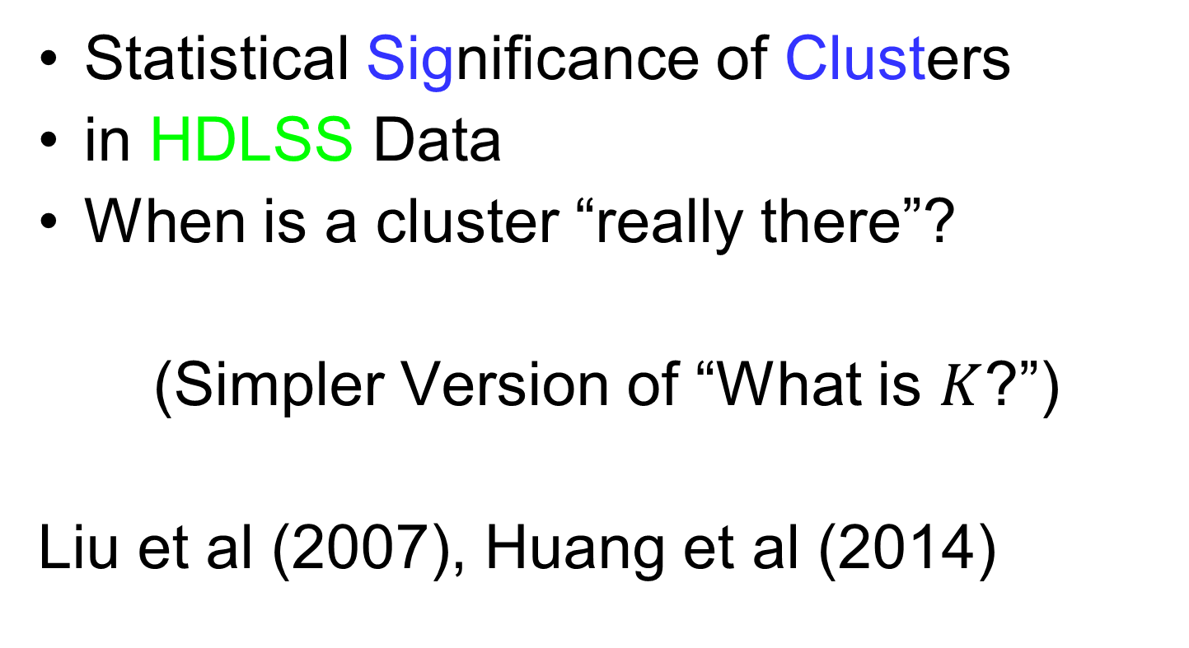
Last Class: SigClust
Statistical Significance of Clusters
in HDLSS Data
When is a cluster “really there”?
(Simpler Version of “What is $K$?”)
Liu et al (2007), Huang et al (2014)

Slide 4
Last Class: SigClust
Basis of SigClust Approach:
What defines: A Single Cluster?
  A Gaussian distribution (Sarle & Kou 1993)
So define SigClust test based on:
  2-means cluster index (measure) as statistic
  Gaussian null distribution
  Currently compute by simulation
  Possible to do this analytically???

Slide 5
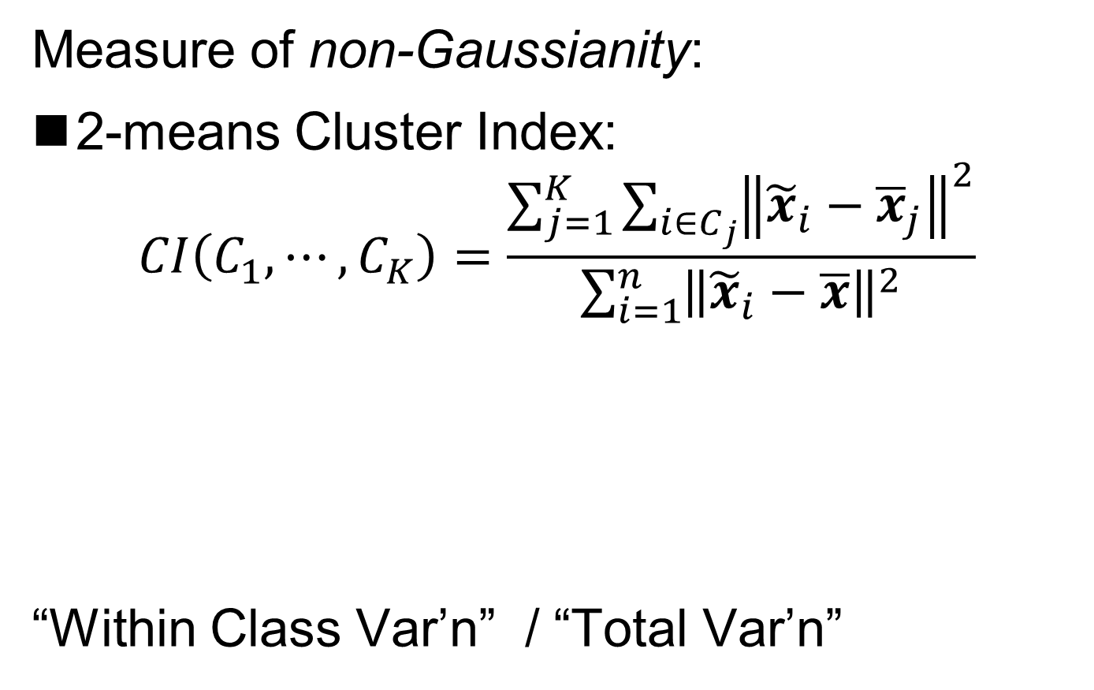
Last Class: SigClust Statistic
Measure of non-Gaussianity:
2-means Cluster Index:
$$CI\left(C_{1},⋯,C_{K}\right)=\frac{\sum_{j=1}^{K}{\sum_{i∈C_{j}}{{\left\|{\tilde{x}}_{i}−{\overline{x}}_{j}\right\|}^{2}}}}{\sum_{i=1}^{n}{{\left\|{\tilde{x}}_{i}−\overline{x}\right\|}^{2}}}$$
“Within Class Var’n” / “Total Var’n”
Recall Small for
“2 Strong Clusters”
Big for “Single Cluster”
Class Index Sets
Class Means

Slide 6
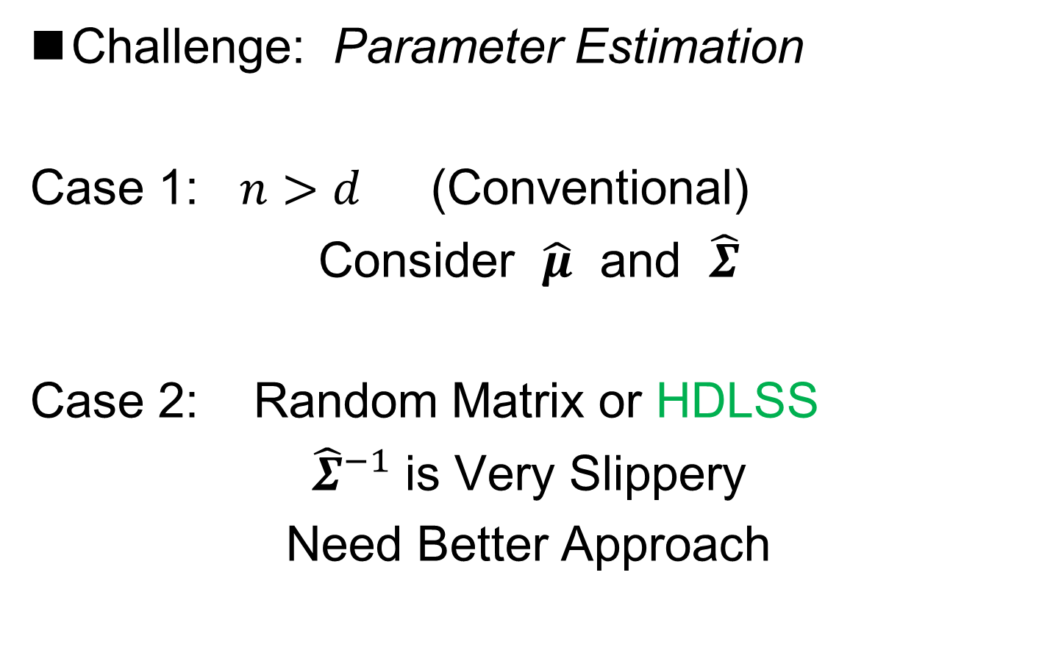
Last Class: SigClust Null
Challenge: Parameter Estimation
Case 1: $n>d$ (Conventional)
Consider $\hat{μ}$ and $\hat{Σ}$
Case 2: Random Matrix or HDLSS
${\hat{Σ}}^{−1}$ is Very Slippery
Need Better Approach
Can Always Do This
But Can Be Very
Conservative

Slide 7
Last Class: SigClust Null
Estimated Mean, $μ$ (of Gaussian dist’n)?
1st Key Idea: Can ignore this
By appealing to shift invariance of CI
  When Data are (rigidly) shifted
  CI remains the same
So enough to simulate with mean 0
Other uses of invariance ideas?

Slide 8
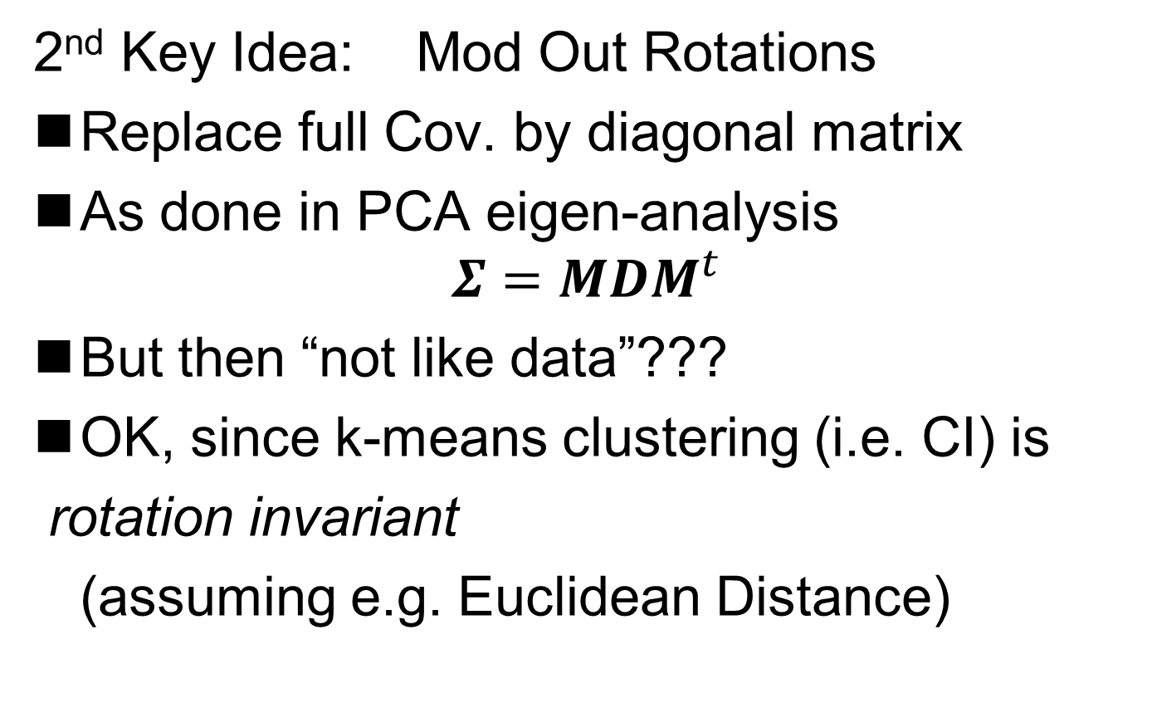
Last Class: SigClust Null
2nd Key Idea: Mod Out Rotations
Replace full Cov. by diagonal matrix
As done in PCA eigen-analysis
$$Σ=MDM^{t}$$
But then “not like data”???
OK, since k-means clustering (i.e. CI) is
rotation invariant
(assuming e.g. Euclidean Distance)

Slide 9
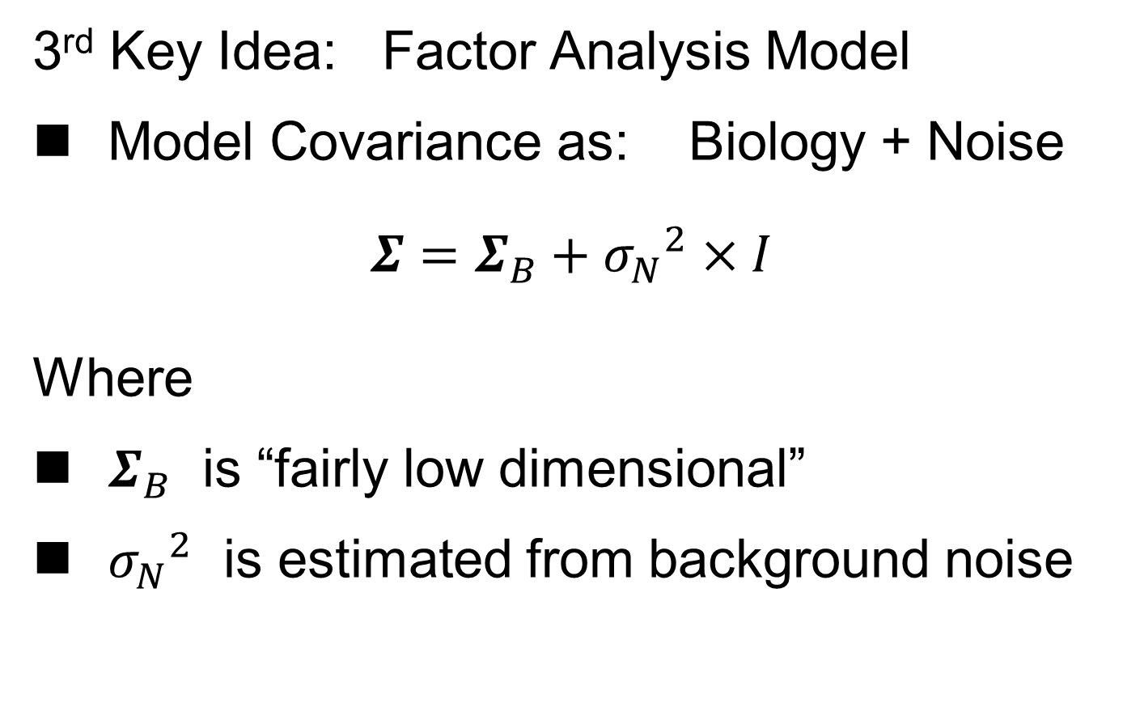
Last Class: SigClust Null
3rd Key Idea: Factor Analysis Model
Model Covariance as: Biology + Noise
$$Σ=Σ_{B}+{σ_{N}}^{2}×I$$
Where
$Σ_{B}$ is “fairly low dimensional”
${σ_{N}}^{2}$ is estimated from background noise

Slide 10
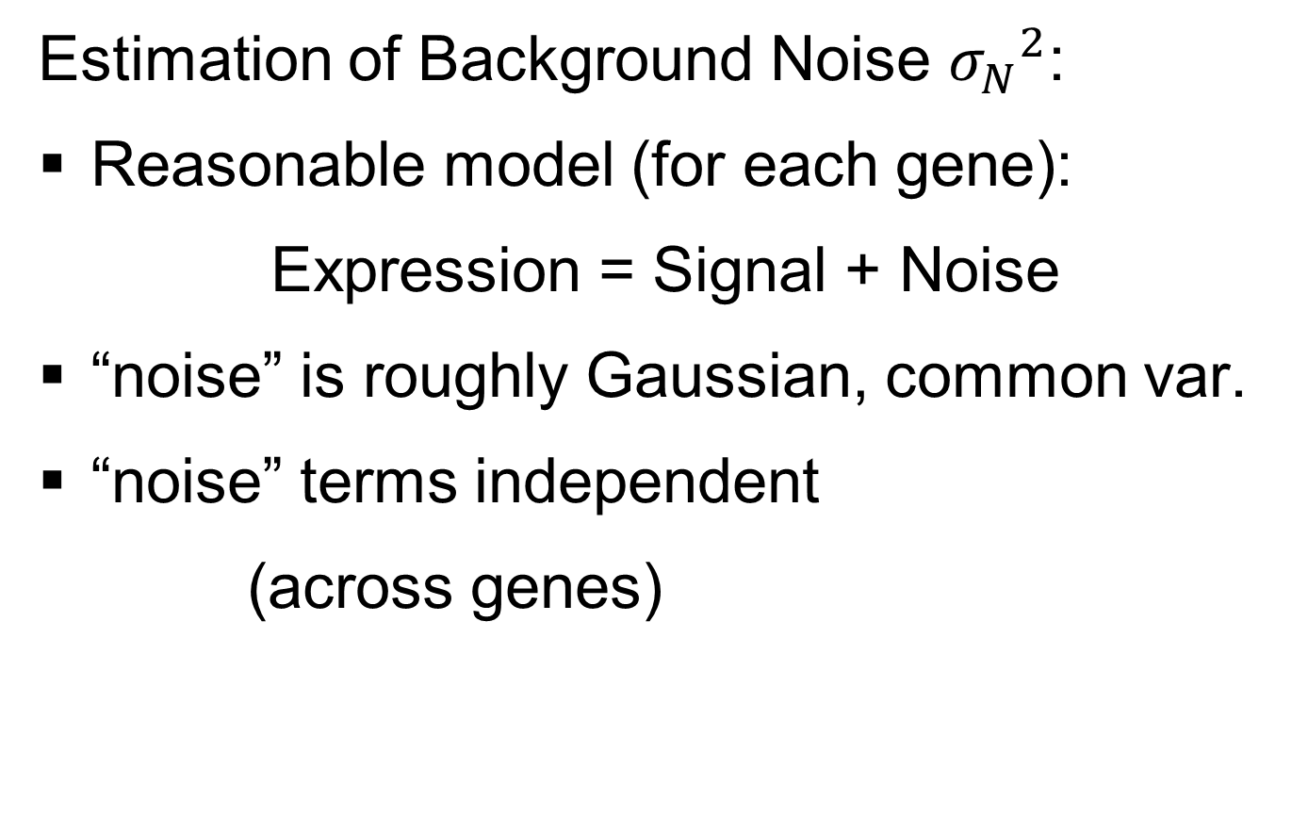
Last Class: SigClust Null
Estimation of Background Noise ${σ_{N}}^{2}$:
Reasonable model (for each gene):
Expression = Signal + Noise
“noise” is roughly Gaussian, common var.
“noise” terms independent
(across genes)

Slide 11
Last Class: SigClust Null
Estimation of Background Noise ${σ_{N}}^{2}$:
For all expression values (as numbers)
Use robust estimate of scale
Median Absolute Deviation (MAD)
(from the median)
Rescale to put on same scale as s. d.:
$$\hat{σ}=\frac{{MAD}_{data}}{{MAD}_{N\left(0,1\right)}}$$

Slide 12
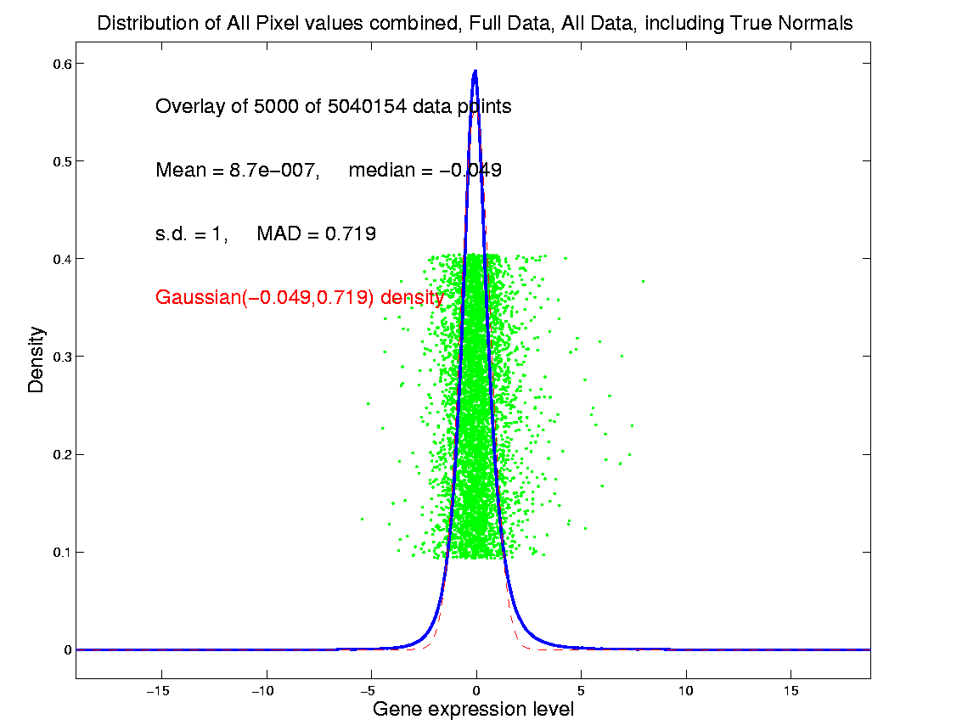
Last Class: SigClust Estimation of Background Noise
Hope: Most
Entries are
“Pure Noise,
(Gaussian)”
A Few (<< ¼)
Are Biological
Signal –
Outliers

Slide 13
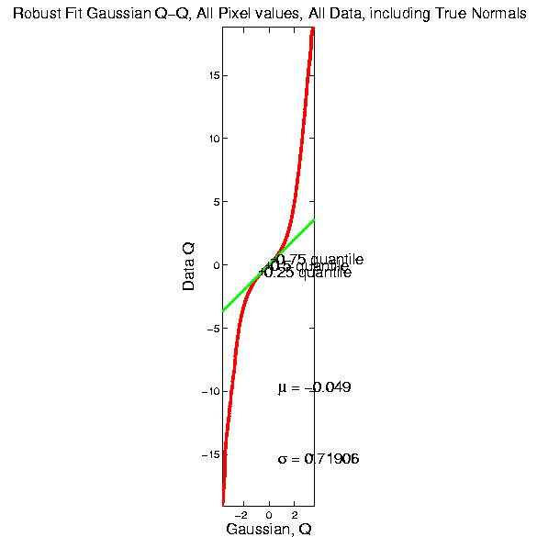
Last Class: SigClust Estimation of Background Noise

Slide 14
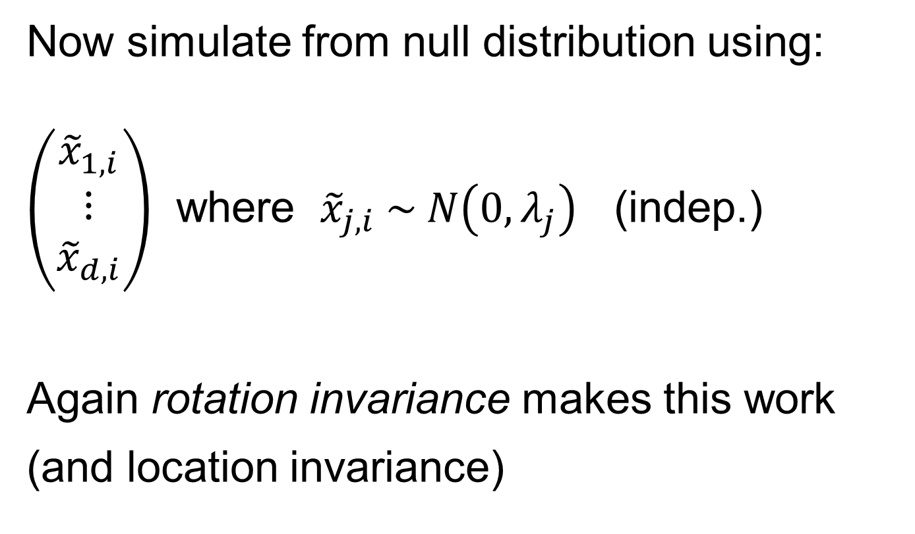
Last Class: SigClust Gaussian null distribution - Simulation
Now simulate from null distribution using:
$\left(\begin{matrix}{\tilde{x}}_{1,i} \\ ⋮ \\ {\tilde{x}}_{d,i}\end{matrix}\right)$ where ${\tilde{x}}_{j,i} \sim N\left(0,λ_{j}\right)$ (indep.)
Again rotation invariance makes this work
(and location invariance)

Slide 15
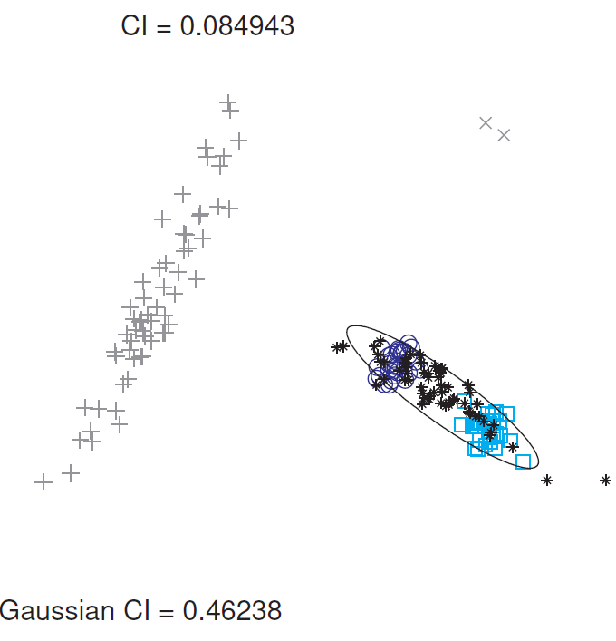
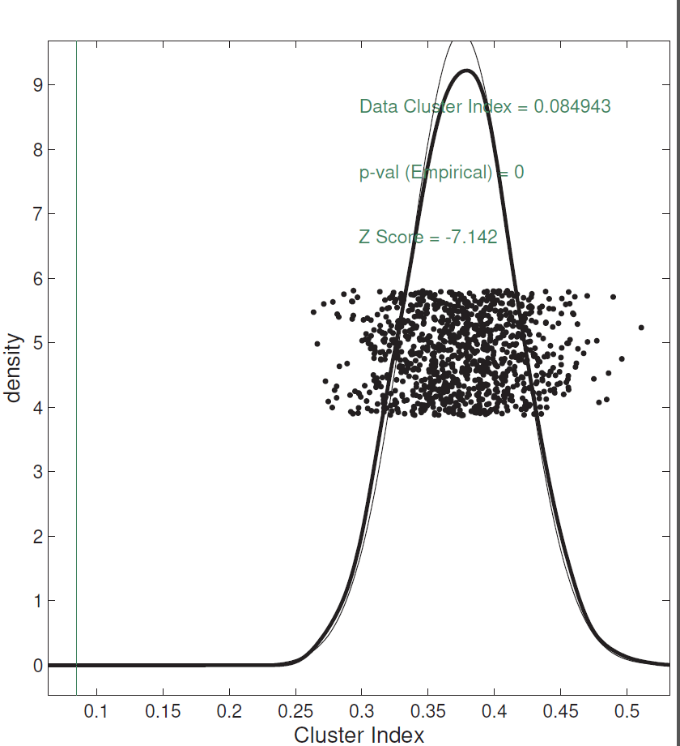
Last Class: SigClust Examples
Investigate Two Round Clusters
= Actual Data CI
Gray Out
(Ignore)
Others
Compare for Significance
Fit Gaussian to Data
Conclude Clusters
Strongly Significant
Simulate from Gaussian
Record in Diagnostic Plot

Slide 16
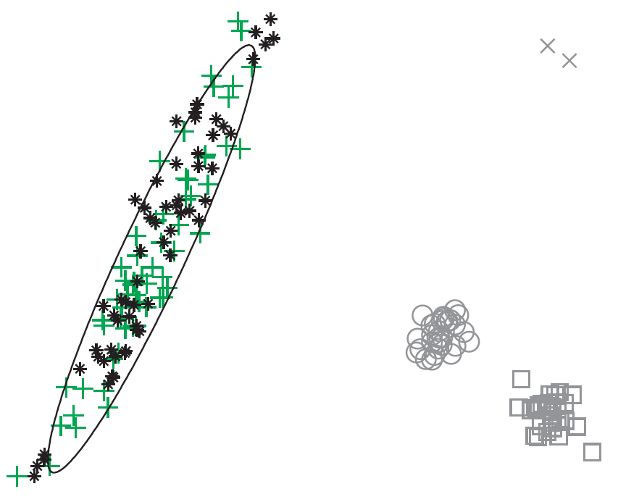
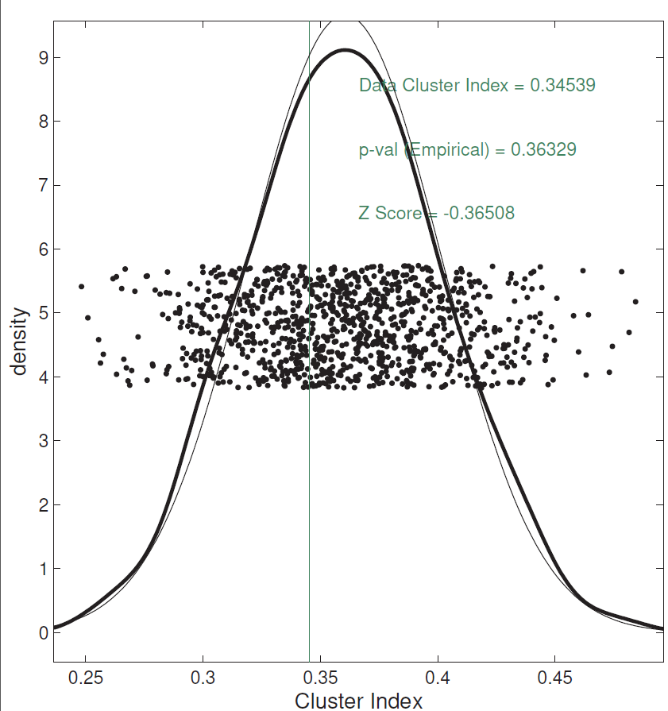
Last Class: SigClust Examples
Try to Split Long Green Cluster
Can NOT Conclude
Two Clusters,
Accept Gaussian Null

Slide 17
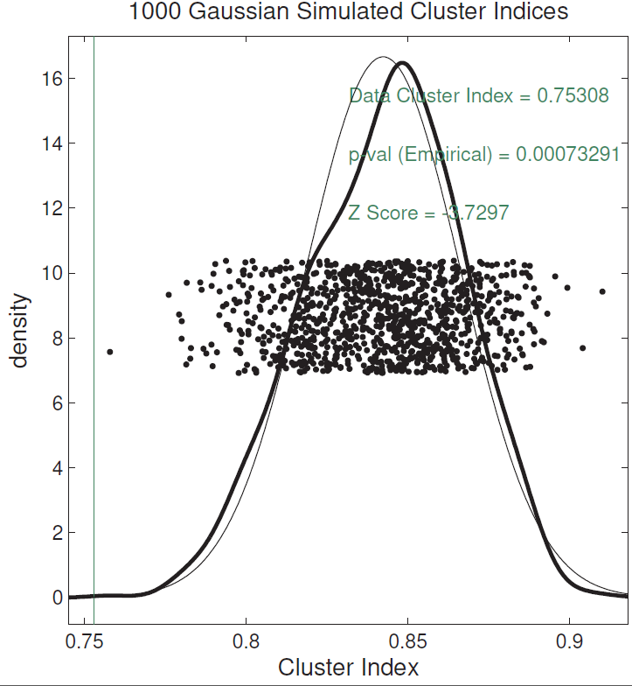
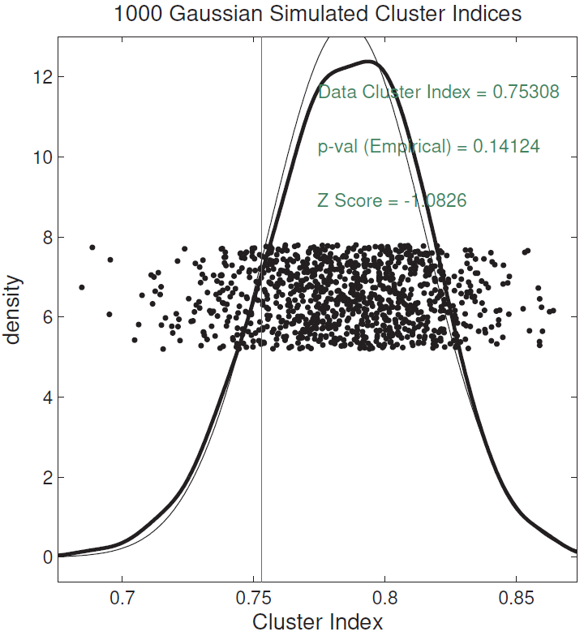
Last Class: SigClust Examples
Split KIRC Cases?
Yes, using Soft
Thresholded Cov. Est.
No, Using Sample Cov. Est.
Too Conservative

Slide 18
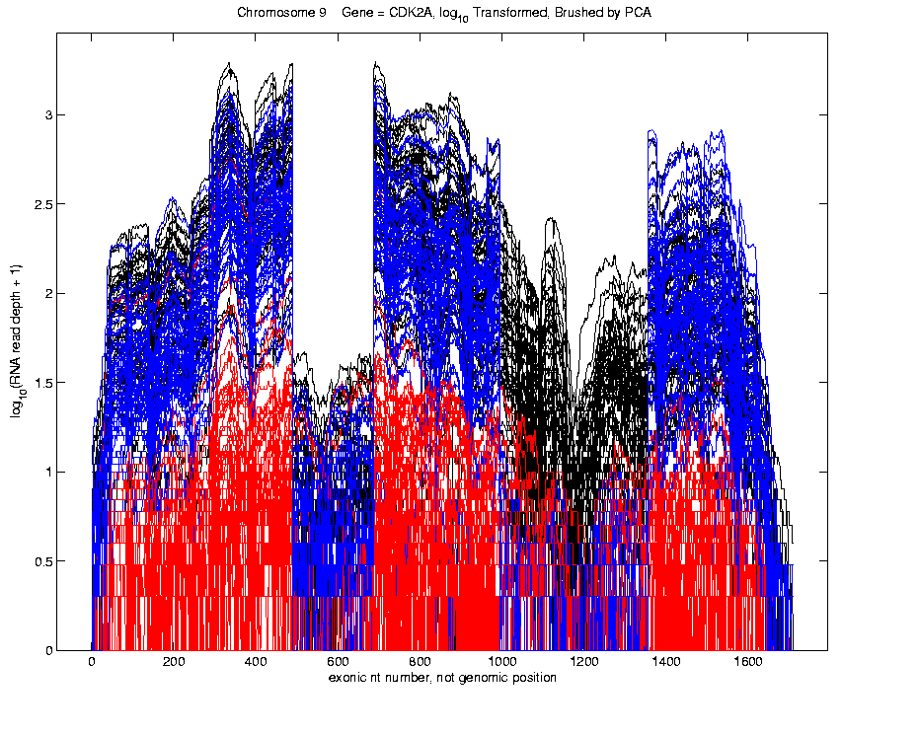
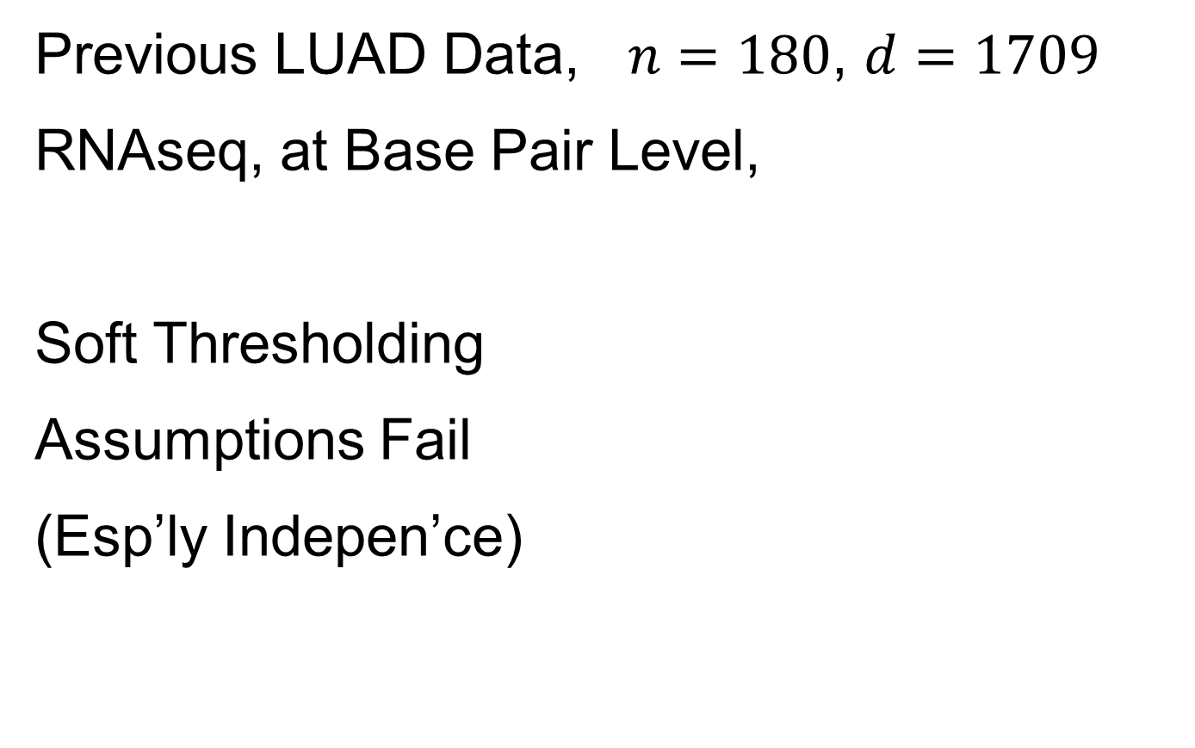
Last Class: SigClust Examples
Previous LUAD Data, $n=180$, $d=1709$
RNAseq, at Base Pair Level,
Soft Thresholding
Assumptions Fail
(Esp’ly Indepen’ce)

Slide 19
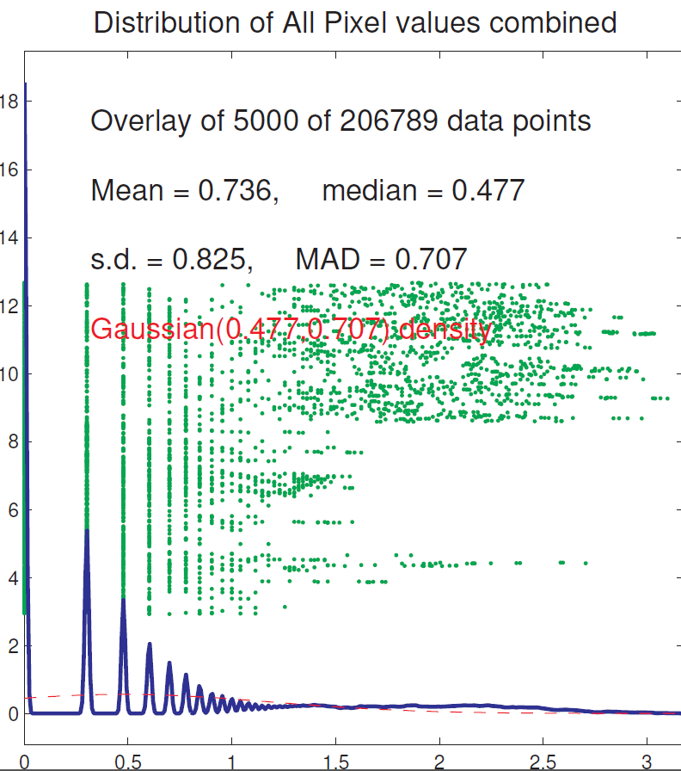
Last Class: SigClust Examples
Previous LUAD Data, Diagnostic
Far From
Few Large Pixels
& Gaussian
Background Noise
Use Sample Cov. Est.
Not Soft Threshold

Slide 20
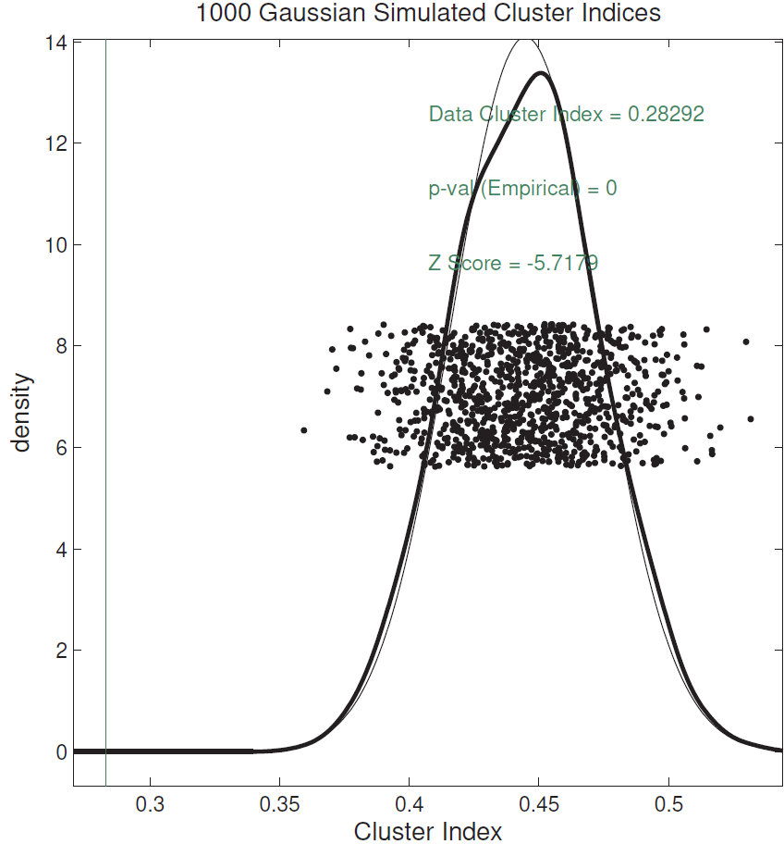
Last Class: SigClust Examples
Previous LUAD Data, Conclusion
Can Split LUAD
Strong Evidence
For Clusters
(Recall Seen in PCA)

Slide 21
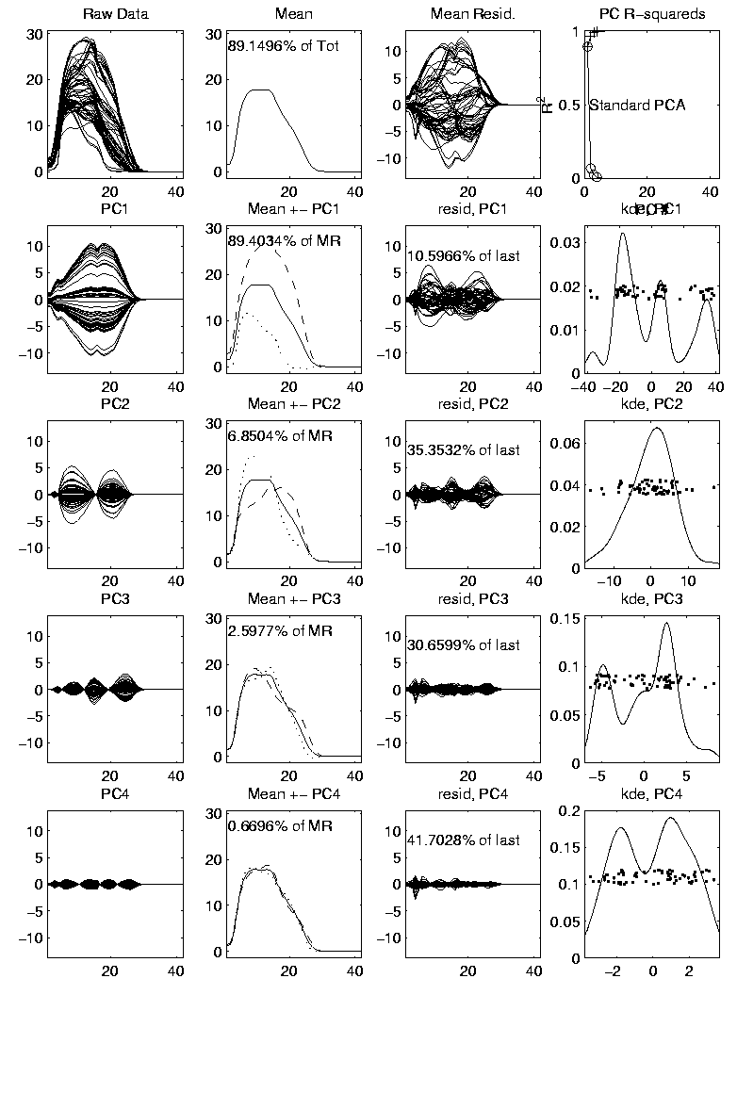

Last Class: Mass Flux Data
Mean Captures
Mountain Shape
PCA of Mass Flux Data:
PC1 is
Height
Variation
Impression
Enhanced
By Smooth
Histogram
Are Clusters “Really There”?
Shows Up Well
In Mean $±$ Panel
Discovery?
Noise Artifact?
Scores
Suggest
3 Clusters

Slide 22
Last Class: Mass Flux Data
Return to Investigation of PC1 Clusters:
Can see 3 bumps in smooth histogram
Main Question:
Important structure
or
sampling variability?
Approach: SiZer
(SIgnificance of ZERo crossings of deriv.)

Slide 23
Statistical Smoothing
In 1 Dimension
(Numbers as Data Objects)
Text: Chp. 15

Slide 24
Statistical Smoothing
In 1 Dimension, 2 Major Settings:
Density Estimation
“Histograms”
Nonparametric Regression
“Scatterplot Smoothing”
Text: Sec. 15.1
Text: Sec. 15.2

Slide 25

Density Estimation
E.g. Hidalgo Stamp Data
Thicknesses of Postage Stamps
Produced in Mexico
Over ~ 70 years
During 1800s
Paper produced in several factories?
How many factories? (Records lost)
Brought to statistical literature by:
Izenman and Sommer (1988)

Slide 26
Density Estimation
E.g. Hidalgo Stamp Data
Thicknesses of Postage Stamps
Produced in Mexico
Over ~ 70 years
During 1800s
Paper produced in several factories?
(Thicknesses vary by up to factor of 2)

Slide 27
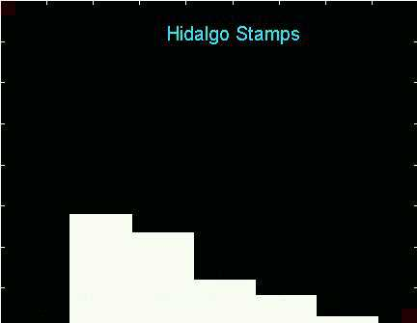
Density Estimation
E.g. Hidalgo Stamp Data
A histogram
“Oversmoothed”
Bin Width too
large?
Miss important
structure?
Hard to Say Much
About # of Factories

Slide 28
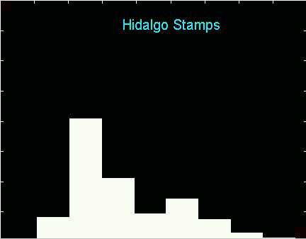
Density Estimation
E.g. Hidalgo Stamp Data
Another histogram
Smaller binwidth
Suggests 2 modes?
2 factories making
the paper?

Slide 29
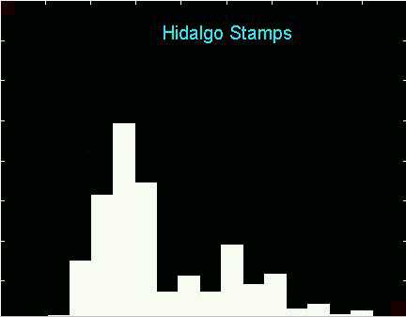
Density Estimation
E.g. Hidalgo Stamp Data
Another histogram
Smaller binwidth
Suggests 6 modes?
6 factories making
the paper?

Slide 30
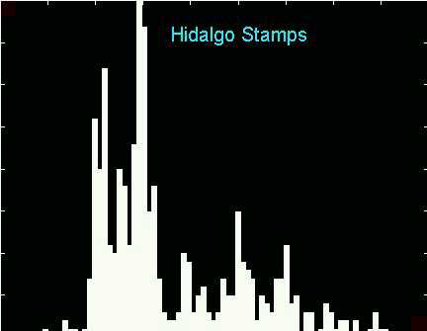
Density Estimation
E.g. Hidalgo Stamp Data
Another histogram
Even smaller binwidth
Suggests many modes?
Really believe
modes are “there”?
Or just sampling
variation?

Slide 31
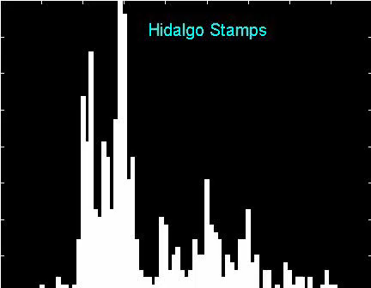
Density Estimation
E.g. Hidalgo Stamp Data
Critical Issue for histograms:
Choice of binwidth (well understood?)

Slide 32
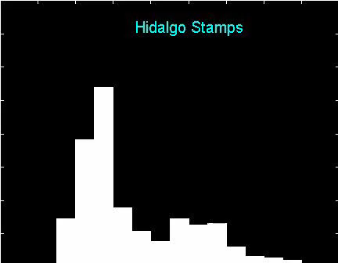
Histograms
Less Well Understood Issue:
Choice of bin location
Major impact on number of modes (2-7)
All for same binwidth

Slide 33
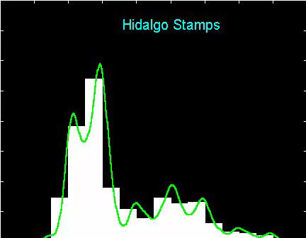
Histograms
Choice of bin location:
What is going on?
Compare with Average Histogram

Slide 34
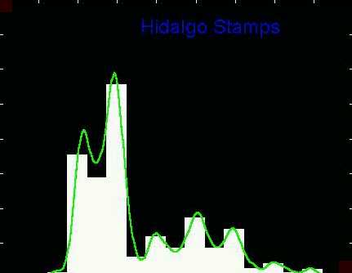
Density Estimation
Compare shifts with Average Histogram
For 7 mode shift
Peaks line up with bin centers
So shifted histo’s
find peaks

Slide 35
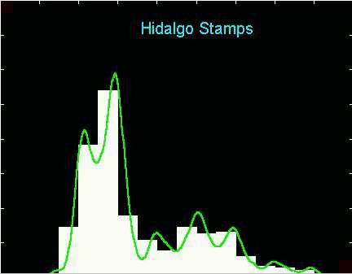
Density Estimation
Compare shifts with Average Histogram
For 2 (3?) mode shift
Peaks split between bins
So shifted histo’s
miss peaks
This Is Why Histograms
Were Not Used in Many
Displays of 1-d Dist’ns,
Earlier in Course

Slide 36
Density Estimation
Histogram Drawbacks:
Need to choose bin width
Need to choose bin location
But Average Histogram reveals structure
So should use that, instead of histo
Name: Kernel Density Estimate

Slide 37
Kernel Density Estimation
Chondrite Data:
Stony (metal) Meteorites (hit the earth)
So have a chunk of rock
Study “% of silica”
From how many sources?
Only 22 rocks…
Histogram hopeless?
Brought to statistical literature by:
Good and Gaskins (1980)

Slide 38
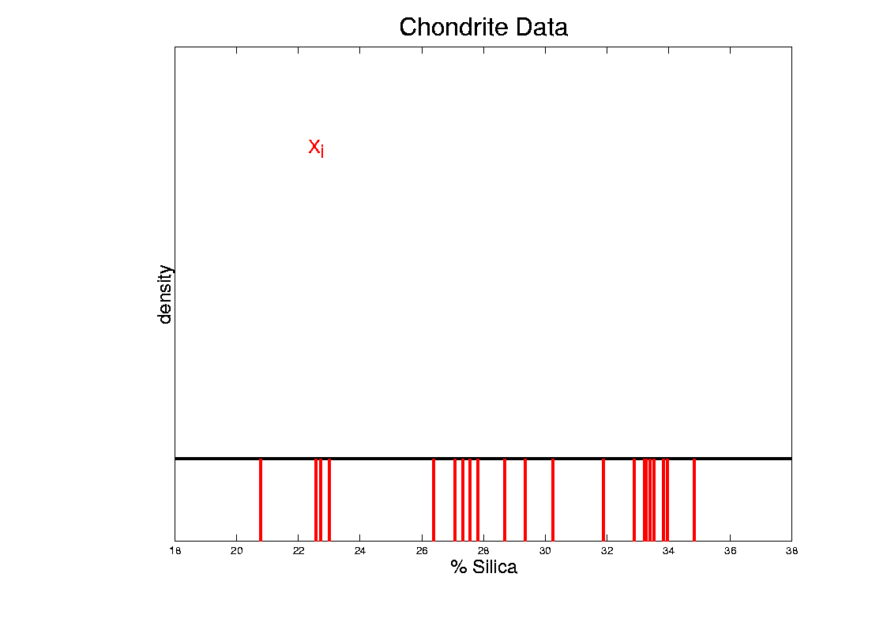
Kernel Density Estimation
Chondrite Data:
Represent points by red bars
Where are data “more dense”?

Slide 39
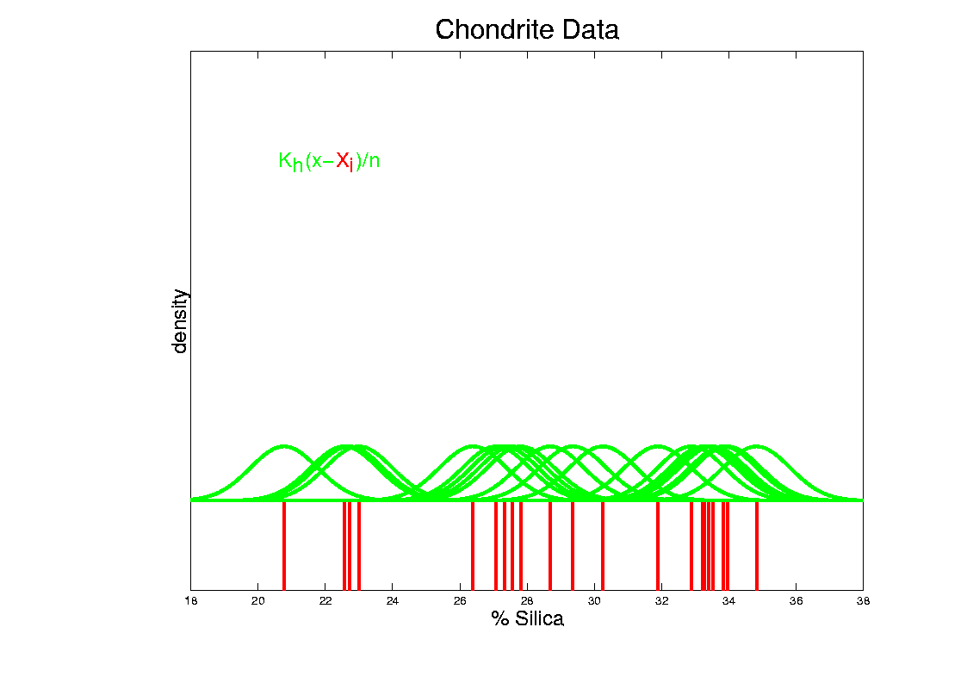
Kernel Density Estimation
Chondrite Data:
Put probability mass 1/n at each point
Smooth piece of “density”

Slide 40
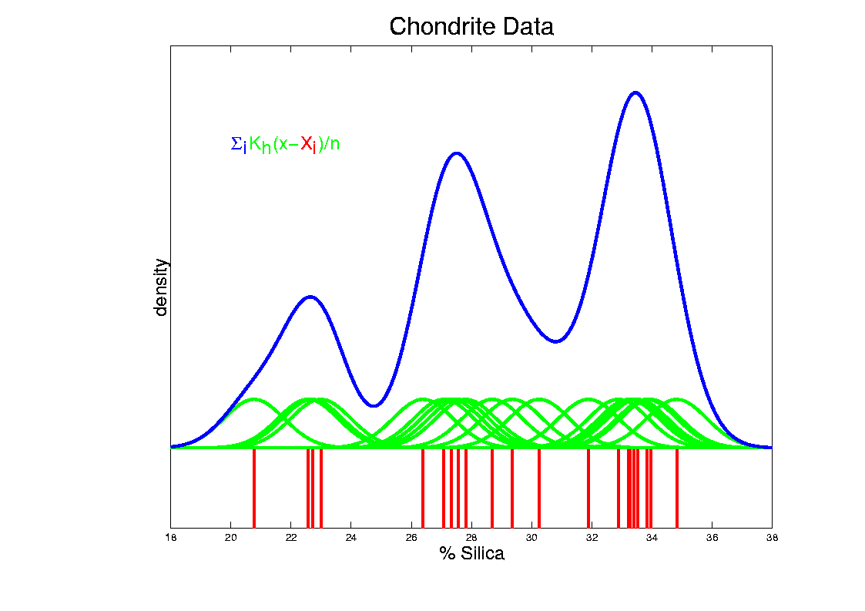
Kernel Density Estimation
Chondrite Data:
Sum pieces to estimate density
Suggests 3 modes (rock sources)

Slide 41
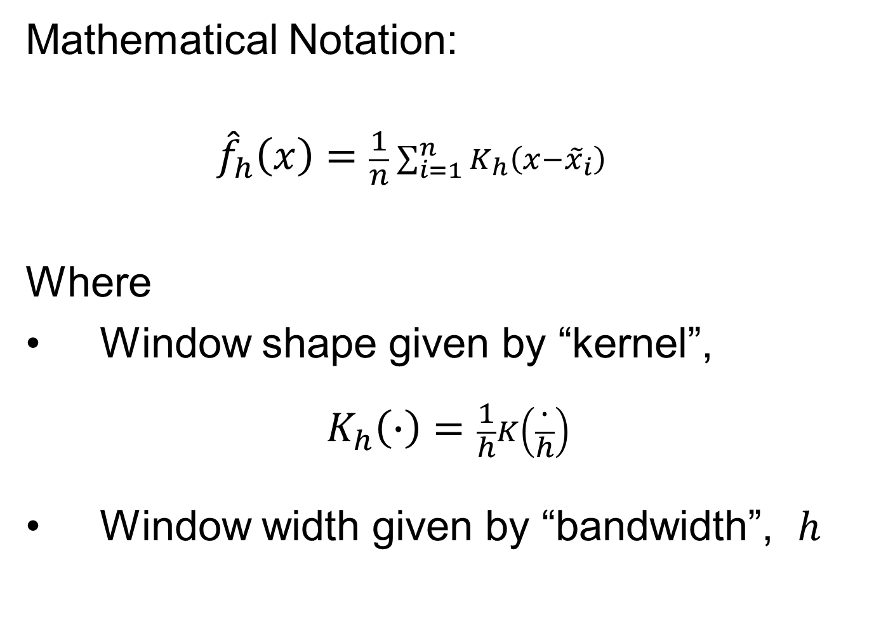
Kernel Density Estimation
Mathematical Notation:
$${\hat{f}}_{h}\left(x\right)=\frac{1}{n}\sum_{i=1}^{n}{K_{h}\left(x−{\tilde{x}}_{i}\right)}$$
Where
Window shape given by “kernel”,
$$K_{h}\left(∙\right)=\frac{1}{h}K\left(\frac{∙}{h}\right)$$
Window width given by “bandwidth”, $h$

Slide 42

Kernel Density Estimation
Mathematical Notation:
$${\hat{f}}_{h}\left(x\right)=\frac{1}{n}\sum_{i=1}^{n}{K_{h}\left(x−{\tilde{x}}_{i}\right)}$$
This
Was
Used
In PCA
Graphics

Slide 43
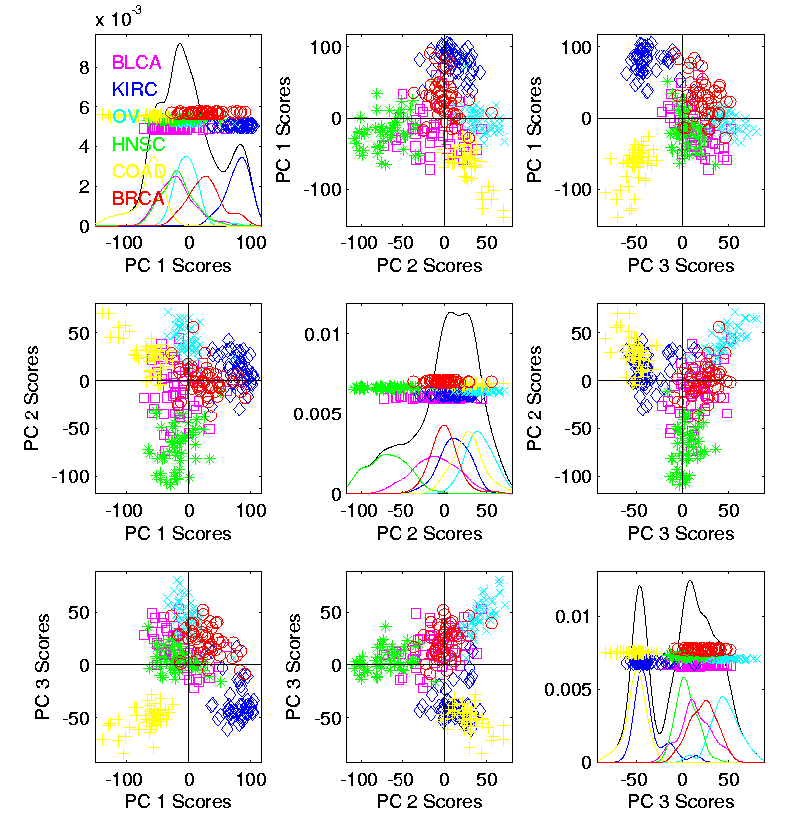

Kernel Density Estimation
Recall Subdensities For Different Groups
Black Curves
have Area = 1
Colored Curves
have Area = $\frac{n_{k}}{n}$
Use Same Window
Width, So They Sum

Slide 44
Kernel Density Estimation
Choice of kernel (window shape)?
Controversial issue
Want Computational Speed?
Want Statistical Efficiency?
Want Smooth Estimates?
There is more, but personal choice:
Gaussian
Good Overall Reference:
Wand and Jones (1994)
Looks the Best,
Minimal Distracting
Small Scale Noise

Slide 45
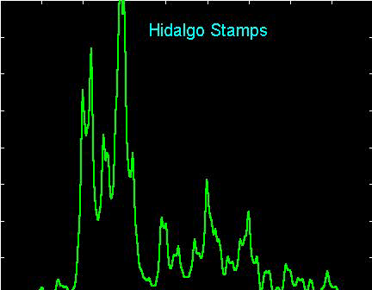
Kernel Density Estimation
Choice of bandwidth (window width)?
Very important to performance
Fundamental Issue:
Which modes are “really there”?

Slide 46
Density Estimation
How to use histograms if you must:
Undersmooth (minimizes bin edge effect)
Human eye is OK at “post-smoothing”

Slide 47
Statistical Smoothing
2 Major Settings:
Density Estimation
“Histograms”
Nonparametric Regression
“Scatterplot Smoothing”
Text: Sec. 15.2

Slide 48
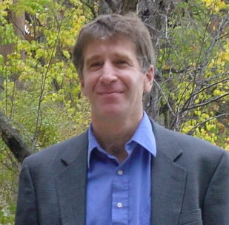
Scatterplot Smoothing
E.g. Bralower Fossil Data
Prof. of Geosciences
Penn. State Univ.

Slide 49
Scatterplot Smoothing
E.g. Bralower Fossil Data
Study Global Climate
Time scale of millions of years
Data points are fossil shells
Dated by surrounding material
Ratio of Isotopes of Strontium
Surrogate for Sea Level (Ice Ages)

Slide 50
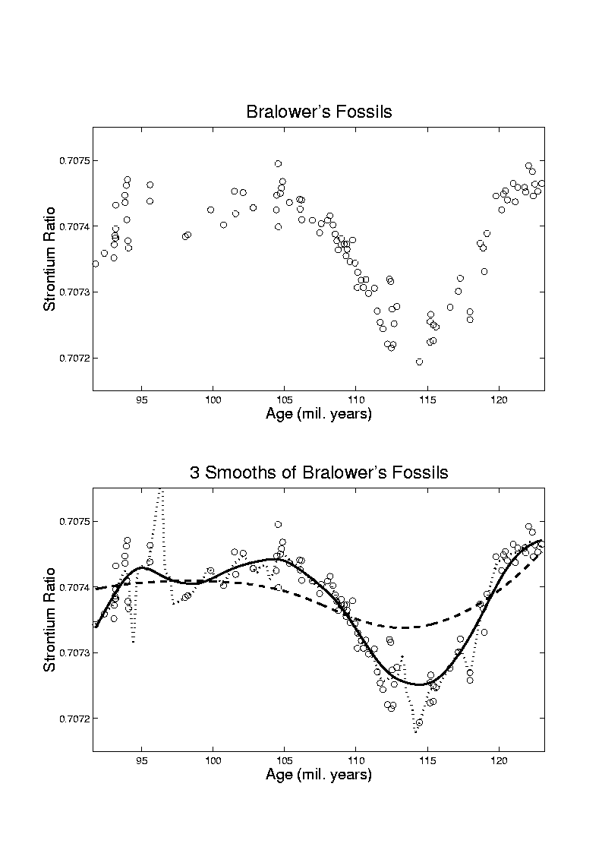
Scatterplot Smoothing
E.g. Bralower Fossil Data
Differences in 4th
Decimal Place!
No Parametric (e.g. Linear) Model
~50 m
Sea
Level
Diff.
Yet Clear
Systematic
Structure
Humans on Earth ~1mil. Years

Slide 51
Scatterplot Smoothing
E.g. Bralower Fossil Data
Way to bring out structure:
Smooth the data
Methods of smoothing?
  Local Averages
  Splines (several types)
  Fourier – trim high frequencies
  Other bases
  …
  Also controversial

Slide 52
Scatterplot Smoothing
E.g. Bralower Fossil Data – some smooths

Slide 53
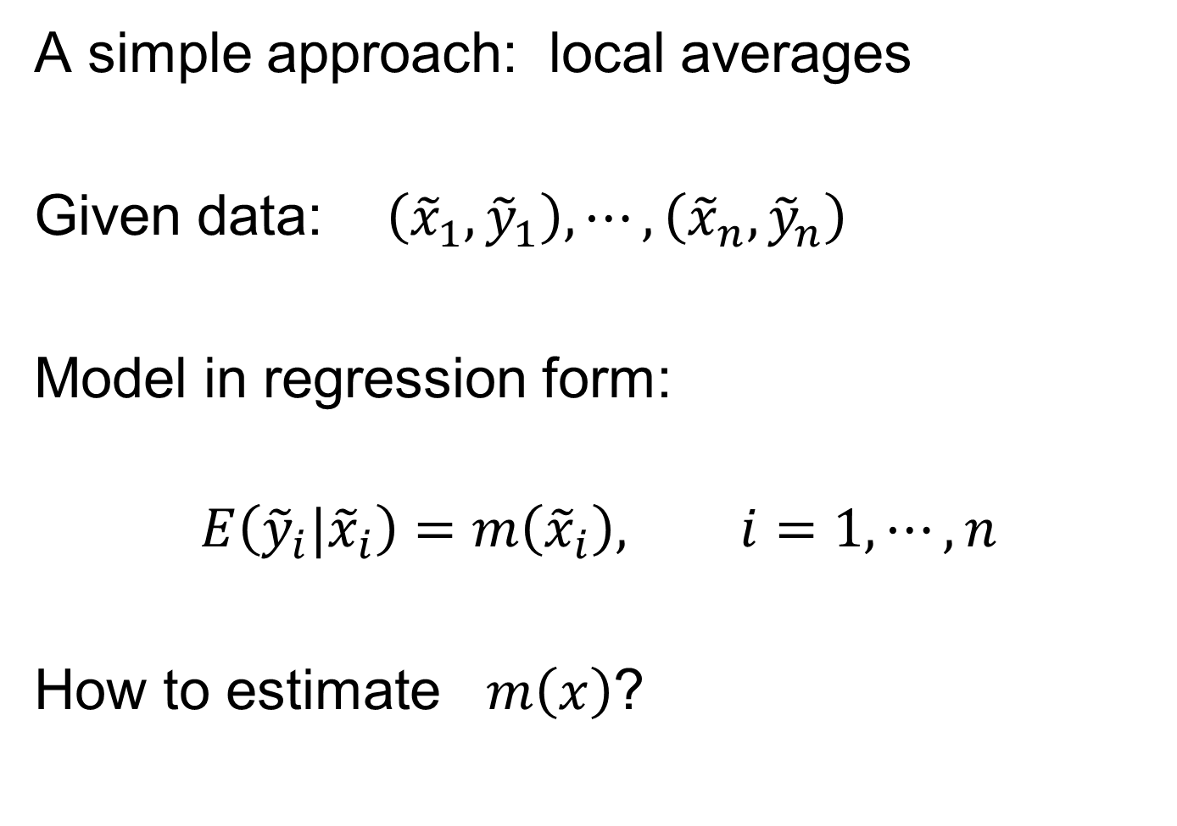
Scatterplot Smoothing
A simple approach: local averages
Given data: $\left({\tilde{x}}_{1},{\tilde{y}}_{1}\right),⋯,\left({\tilde{x}}_{n},{\tilde{y}}_{n}\right)$
Model in regression form:
$$E\left({\tilde{y}}_{i}|{\tilde{x}}_{i}\right)=m\left({\tilde{x}}_{i}\right), i=1,⋯,n$$
How to estimate $m\left(x\right)$?

Slide 54
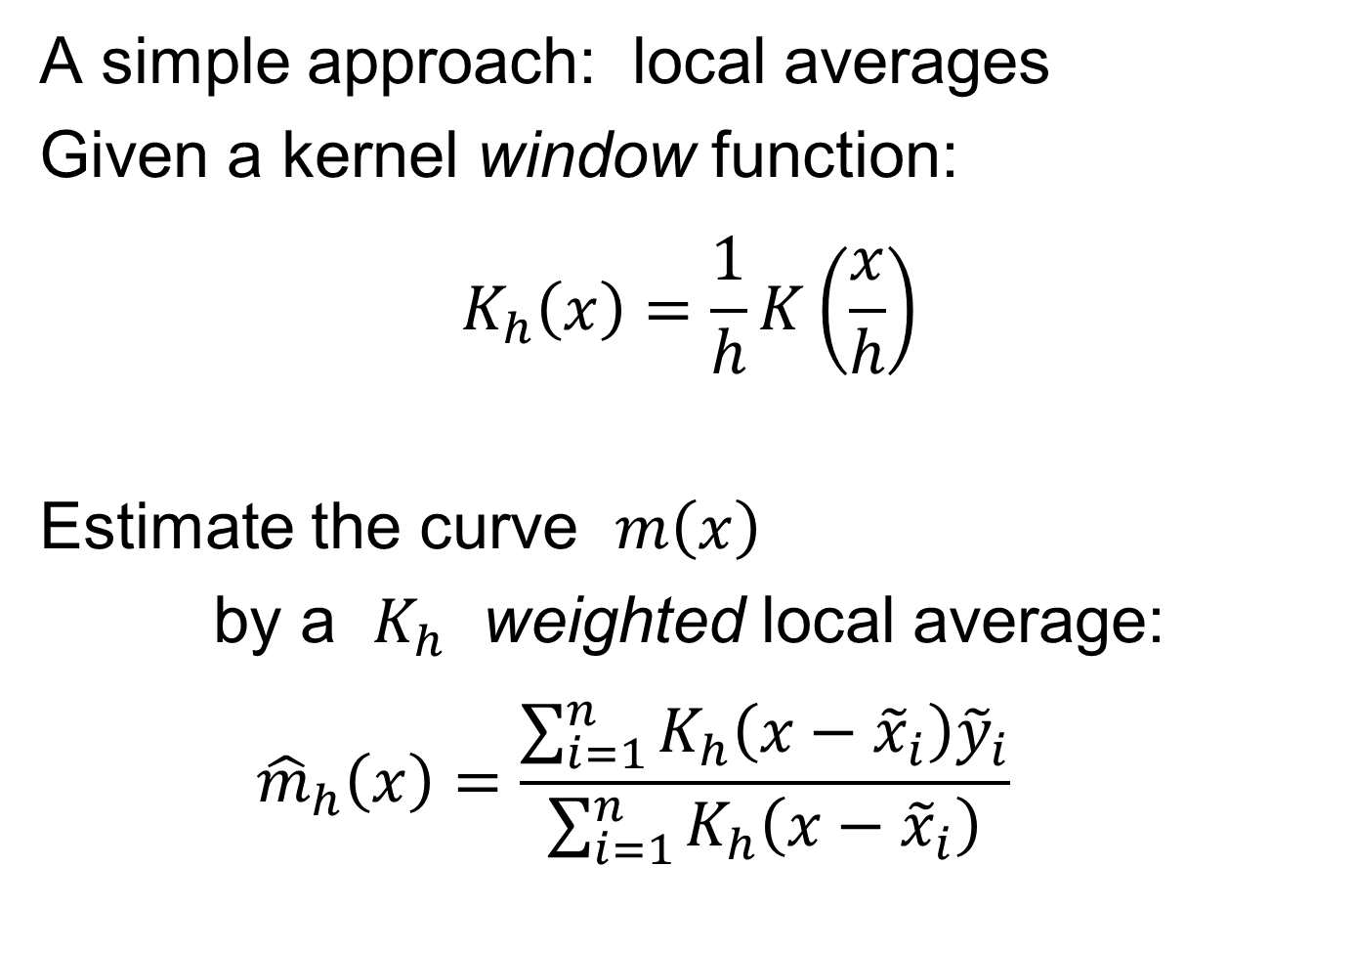
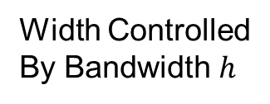
Scatterplot Smoothing
A simple approach: local averages
Given a kernel window function:
$$K_{h}\left(x\right)=\frac{1}{h}K\left(\frac{x}{h}\right)$$
Estimate the curve $m\left(x\right)$
by a $K_{h}$ weighted local average:
$${\hat{m}}_{h}\left(x\right)=\frac{\sum_{i=1}^{n}{K_{h}\left(x−{\tilde{x}}_{i}\right){\tilde{y}}_{i}}}{\sum_{i=1}^{n}{K_{h}\left(x−{\tilde{x}}_{i}\right)}}$$
Same Form As
Kernel Density
Width Controlled
By Bandwidth $h$
Makes
Weights
Sum to 1

Slide 55
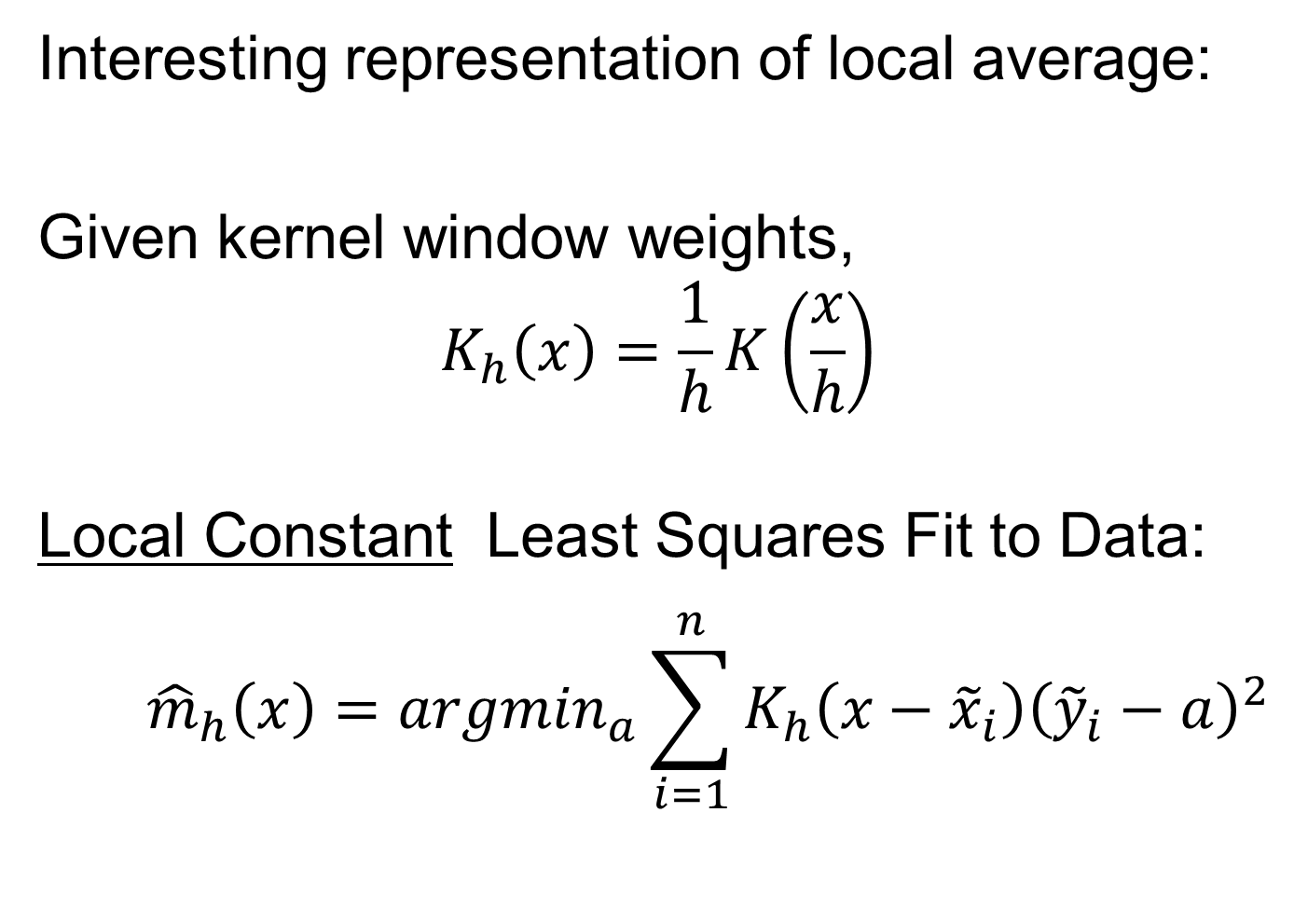
Scatterplot Smoothing
Interesting representation of local average:
Given kernel window weights,
$$K_{h}\left(x\right)=\frac{1}{h}K\left(\frac{x}{h}\right)$$
Local Constant Least Squares Fit to Data:
$${\hat{m}}_{h}\left(x\right)={argmin}_{a}\sum_{i=1}^{n}{K_{h}\left(x−{\tilde{x}}_{i}\right){\left({\tilde{y}}_{i}−a\right)}^{2}}$$
Kernel Weighted Fréchet Mean

Slide 56
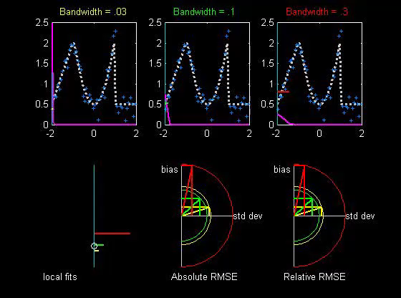

Scatterplot Smoothing
Local Constant Fits (visually):
“Moving Average”
Window width $h$ is critical (~ k.d.e.)
Goldilocks
Smoothing
Levels
Too Small
About Right
Too Big
Recommended
For Manual
Window Choice
Graphics Relevant to Smoothing Theory
Thanks to
Brad Davis

Slide 57
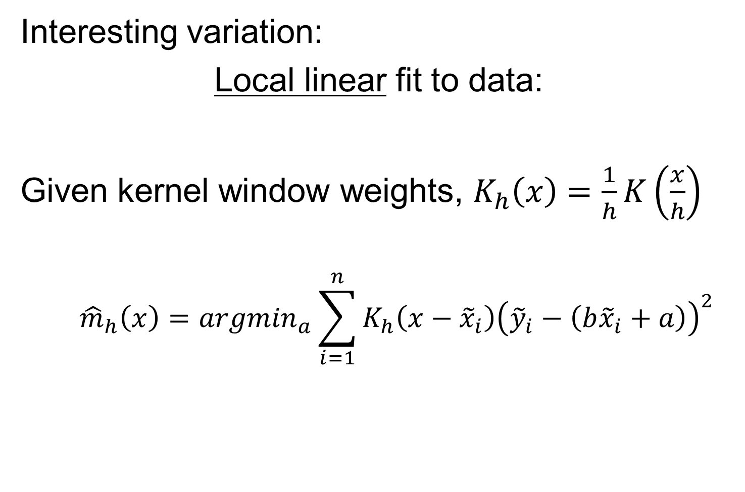
Scatterplot Smoothing
Interesting variation:
Local linear fit to data:
Given kernel window weights, $K_{h}\left(x\right)=\frac{1}{h}K\left(\frac{x}{h}\right)$
$${\hat{m}}_{h}\left(x\right)={argmin}_{a}\sum_{i=1}^{n}{K_{h}\left(x−{\tilde{x}}_{i}\right){\left({\tilde{y}}_{i}−\left(b{\tilde{x}}_{i}+a\right)\right)}^{2}}$$
Only Keep
Intercept
Kernel Weighted Least Squares Fit
Local Linear Value Added?

Slide 58
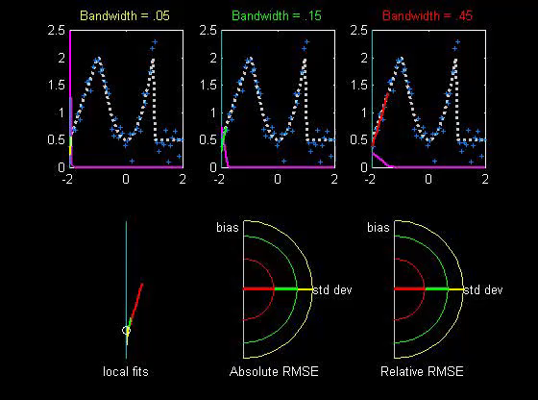


Scatterplot Smoothing
Local Linear Fits (visually):
“Intercept of Moving Fit Line”
Window width $h$ is critical (~ k.d.e.)
Main Difference at Boundary
And for Not Equally Spaced $x_{i}$

Slide 59
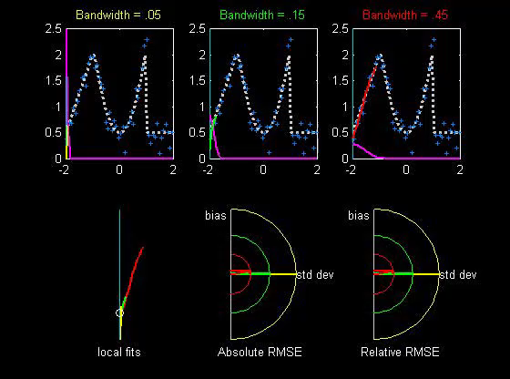

Scatterplot Smoothing
Another variation:
“Intercept of Moving Polynomial Fit”
Window width $h$ is critical (~ k.d.e.)
Higher Degree Gives More Flexible Fit

Slide 60
Scatterplot Smoothing
Local Polynomial Smoothing
What is best polynomial degree?
Once again controversial…
Advocates for all of 0, 1, 2, 3.
Depends on personal weighting of factors involved
Good reference:
  Fan & Gijbels (1995)
Personal choice: degree 1, local linear

Slide 61
Scatterplot Smoothing
E.g. Bralower Fossils – local linear smooths
Goldilocks Smoothing
Parameter Selection
Undersmoothed, Feels Sampling Variation
Oversmoothed,
Misses Important
Structure
Is This Valley Real?
About Right? Seems Good Balance?
Nicely Follows
Deep Valley

Slide 62
Scatterplot Smoothing
Smooths of Bralower Fossil Data:
Oversmoothed misses structure
Undersmoothed feels sampling noise?
About right shows 2 valleys:
  One seems clear
  Is other one really there?
  Same question as above…
Needs “Statistical Inference”,
i.e. Confirmatory Analysis

Slide 63
Kernel Density Estimation
Choice of bandwidth (window width)?
Very important to performance
Fundamental Issue:
Which modes are “really there”?

Slide 64
Kernel Density Estimation
Choice of bandwidth (window width)?
Very important to performance
Data Based Choice?
Controversial Issue
Many recommendations
Suggested Reference:
Jones, Marron & Sheather (1996)
Never a consensus…

Slide 65
Kernel Density Estimation
Choice of bandwidth (window width)?
Alternate Choice:
  Consider all of them!
  I.e. look at whole spectrum of smooths
  Can see different structure
  At different smoothing levels
  Connection to Scale Space
E.g. Stamps data
  How many modes?
  All answers are there….

Slide 66



Kernel Density Estimation
Rainbow Color
Scheme on $\log_{10}h$
1 Mode
Use $\log_{10}h$ Scaling
Since Bandwidth
Works Multiplicatively
2 Modes
5 Modes
7 Modes
More …

Slide 67
Statistical Smoothing
Fundamental Question
For both of
Density Estimation: “Histograms”
Regression: “Scatterplot Smoothing”
Which bumps are “really there”?
vs. “artifacts of sampling noise”?

Slide 68
SiZer Background
Scale Space – Idea from Computer Vision
Goal: Teach Computers to “See”
Modern Research:
Extract “Information” from Images
Text: Sec. 15.2
Early Theoretical work

Slide 69
SiZer Background
Scale Space – Idea from Computer Vision
Conceptual basis:
Oversmoothing = “view from afar”
(macroscopic)
Undersmoothing = “zoomed in view”
(microscopic)
Main idea: all smooths contain useful information, so study “full spectrum”
(i. e. all smoothing levels)
Recommended reference: Lindeberg (1994)

Slide 70

SiZer Background
Fun Scale Space Views
(of Family Incomes Data)

Slide 71


SiZer Background
Fun Scale Space Views (Incomes Data)
Spectrum Overlay
$∃$ Many Parametric Models
All Unimodal
Bimodality is Persistent, So Real???
Bimodality is a Major Discovery
PhD Dissertation, U. Bonn:
Confirmed Bimodality
By Stratification

Slide 72


SiZer Background
Fun Scale Space Views (Incomes Data)
Surface View
$\log_{10}h$ Scaling
Important Here

Slide 73
SiZer Background
Fun Scale Space Views
(of Family Incomes Data)
Note:
The scale space viewpoint makes
Data Dased Bandwidth Selection
Much less important
(than I once thought….)

Slide 74
SiZer Background
SiZer:
Significance of Zero crossings, of the derivative, in scale space
Combines:
  needed statistical inference
  novel visualization
To get: a powerful exploratory + confirmatory data analysis method
Main references:
Chaudhuri & Marron (1999)
Hannig & Marron (2006)

Slide 75
SiZer Background
Basic idea: a bump is characterized by:
an increase
followed by a decrease
Generalization:
Many features of interest captured
by sign of the slope of the smooth
Foundation of SiZer:
Statistical inference on slopes,
over scale space

Slide 76
SiZer Background
SiZer Visual presentation:
Color map over scale space:
Blue: slope significantly upwards
(derivative CI above 0)
Red: slope significantly downwards
(derivative CI below 0)
Purple: slope insignificant
(derivative CI contains 0)
Color Scheme
Motivated by
Economic Data
For Climatology Data: Reverse Colors, Erästö & Holmström (2005)

Slide 77

SiZer Background
SiZer analysis of Fossils data:

Slide 78
SiZer Background
SiZer analysis of Fossils data:
Upper Left: Scatterplot, family of smooths, 1 highlighted
Upper Right: Scale space rep’n of family, with SiZer colors
Lower Left: SiZer map, more easy to view
Lower Right: SiCon map – replace slope by curvature
Slider (in movie viewer) highlights different smoothing levels

Slide 79
SiZer Background
SiZer analysis of Fossils data (cont.):
Oversmoothed (top of SiZer map):
Decreases at left, not on right
Medium smoothed (middle of SiZer map):
Main valley significant, and left most increase
Smaller valley not statistically significant
Undersmoothed (bottom of SiZer map):
“noise wiggles” not significant
Additional SiZer color: gray - not enough data for inference

Slide 80
SiZer Background
SiZer analysis of Fossils data (cont.):
Common Question: Which is right?
Decreases on left, then flat
(top of SiZer map)
Up, then down, then up again
(middle of SiZer map)
No significant features
(bottom of SiZer map)
Answer: All are right
Just different scales of view,
i.e. levels of resolution of data

Slide 81
Participant Presentation
Ruiduo Jia
CosMX Data Analysis from 5 Samples
Next Class: Andrew Walker
Topological Data Analysis

