Slide 1
Statistics – O. R. 881
Object Oriented Data Analysis
Steve Marron
Dept. of Statistics and Operations Research
University of North Carolina

Slide 2
Current Sections in Textbook
Today:
Sections 16.2, 11.1
Next Class:
Sections 11.1, 11.2

Slide 3
Last Class: Statist’l Smoothing
In 1 Dimension, 2 Major Settings:
Density Estimation
“Histograms”
Nonparametric Regression
“Scatterplot Smoothing”

Slide 4
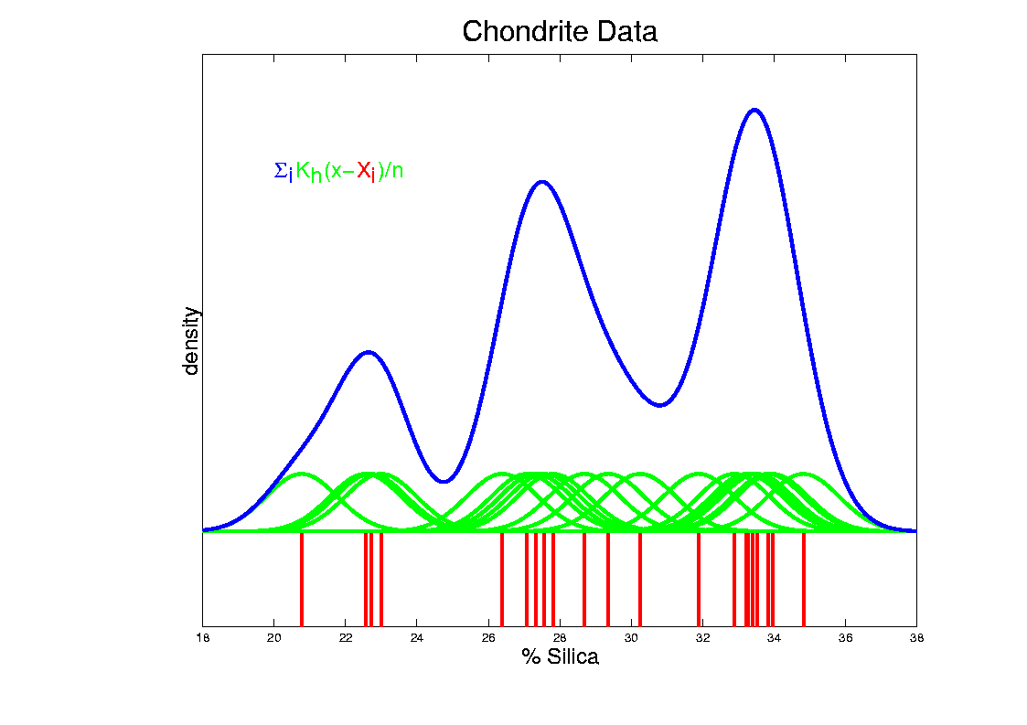
Last Class: Kernel Density Est.
Chondrite Data:
Sum pieces to estimate density
Suggests 3 modes (rock sources)

Slide 5
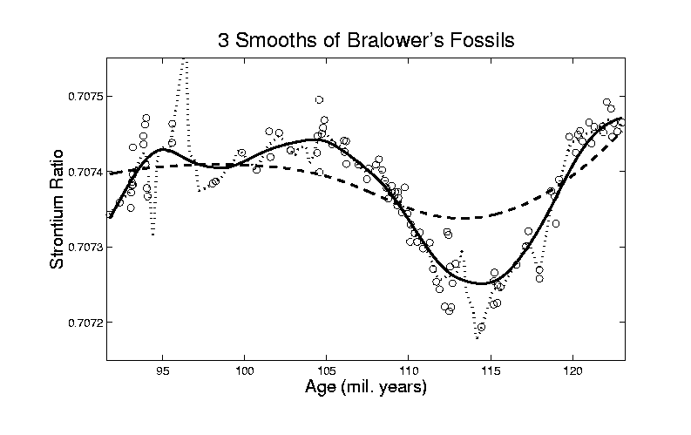
Last Class: Scatterplot Smoo.
E.g. Bralower Fossil Data – some smooths

Slide 6
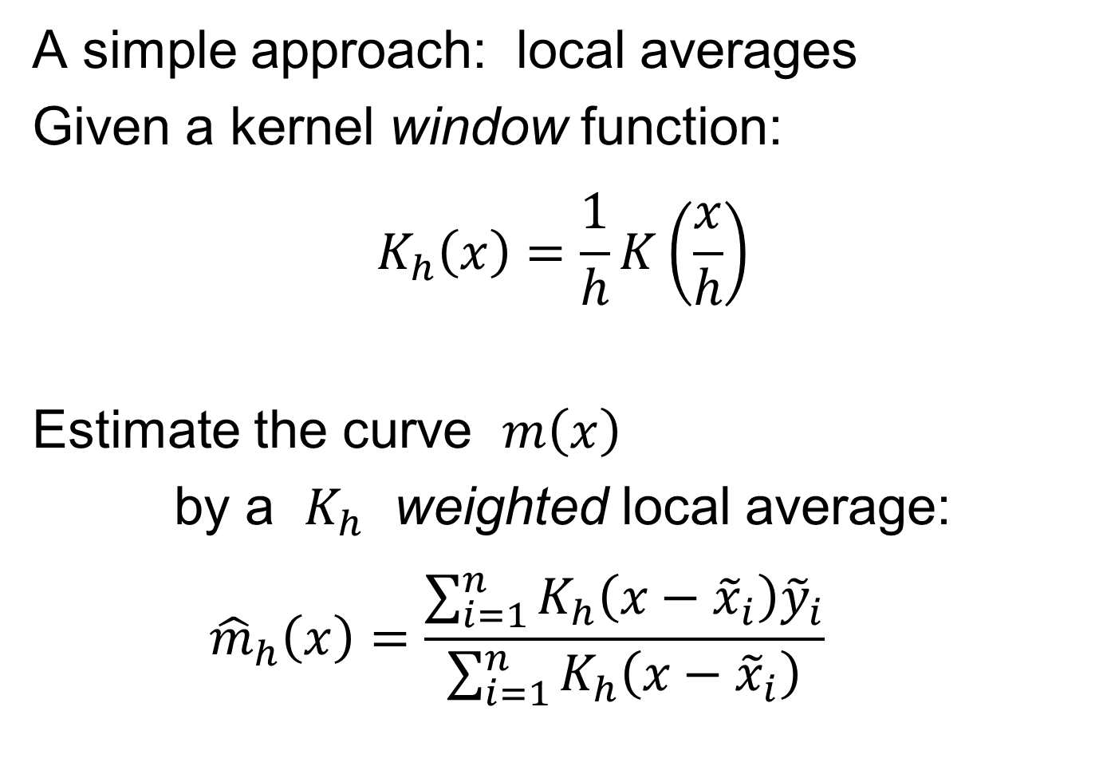
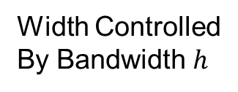
Last Class: Scatterplot Smoo.
A simple approach: local averages
Given a kernel window function:
$$K_{h}\left(x\right)=\frac{1}{h}K\left(\frac{x}{h}\right)$$
Estimate the curve $m\left(x\right)$
by a $K_{h}$ weighted local average:
$${\hat{m}}_{h}\left(x\right)=\frac{\sum_{i=1}^{n}{K_{h}\left(x−{\tilde{x}}_{i}\right){\tilde{y}}_{i}}}{\sum_{i=1}^{n}{K_{h}\left(x−{\tilde{x}}_{i}\right)}}$$
Same Form As
Kernel Density
Width Controlled
By Bandwidth $h$
Makes
Weights
Sum to 1

Slide 7
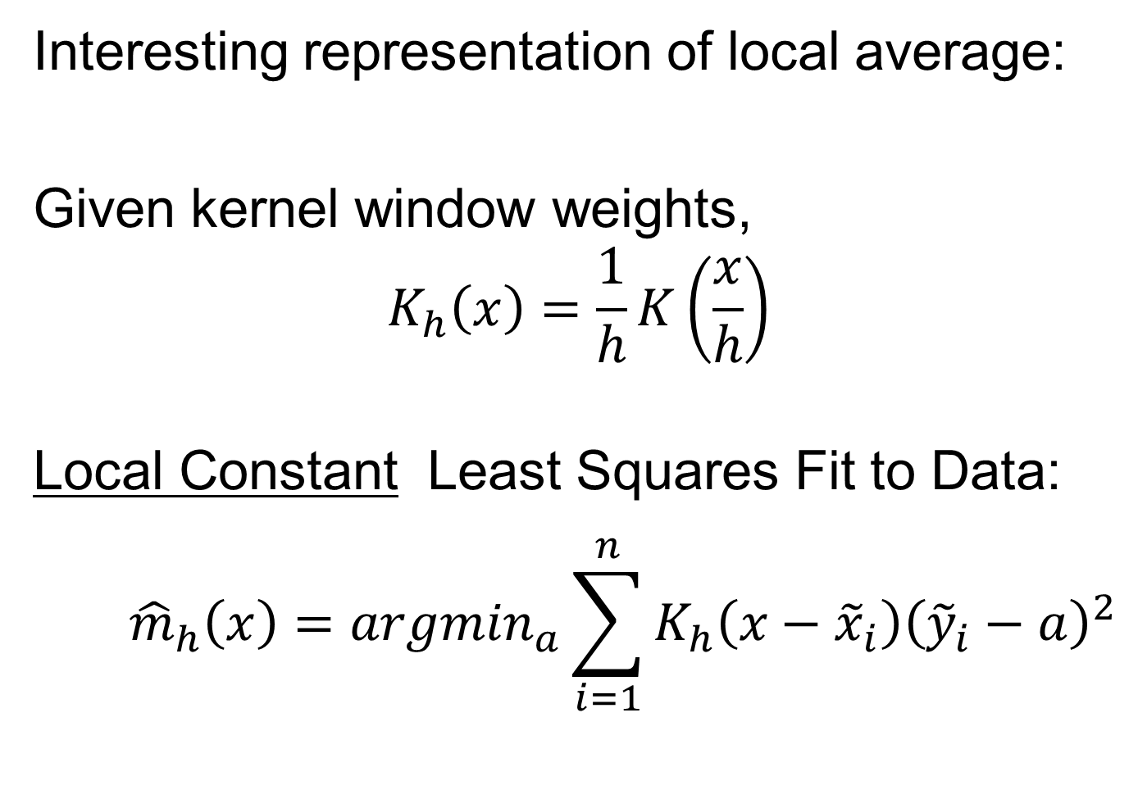
Last Class: Scatterplot Smoo.
Interesting representation of local average:
Given kernel window weights,
$$K_{h}\left(x\right)=\frac{1}{h}K\left(\frac{x}{h}\right)$$
Local Constant Least Squares Fit to Data:
$${\hat{m}}_{h}\left(x\right)={argmin}_{a}\sum_{i=1}^{n}{K_{h}\left(x−{\tilde{x}}_{i}\right){\left({\tilde{y}}_{i}−a\right)}^{2}}$$
Kernel Weighted Fréchet Mean

Slide 8
Last Class: Scatterplot Smoo.
E.g. Bralower Fossils – local linear smooths
Goldilocks Smoothing
Parameter Selection
Undersmoothed, Feels Sampling Variation
Oversmoothed,
Misses Important
Structure
Is This Valley Real?
About Right? Seems Good Balance?
Nicely Follows
Deep Valley

Slide 9
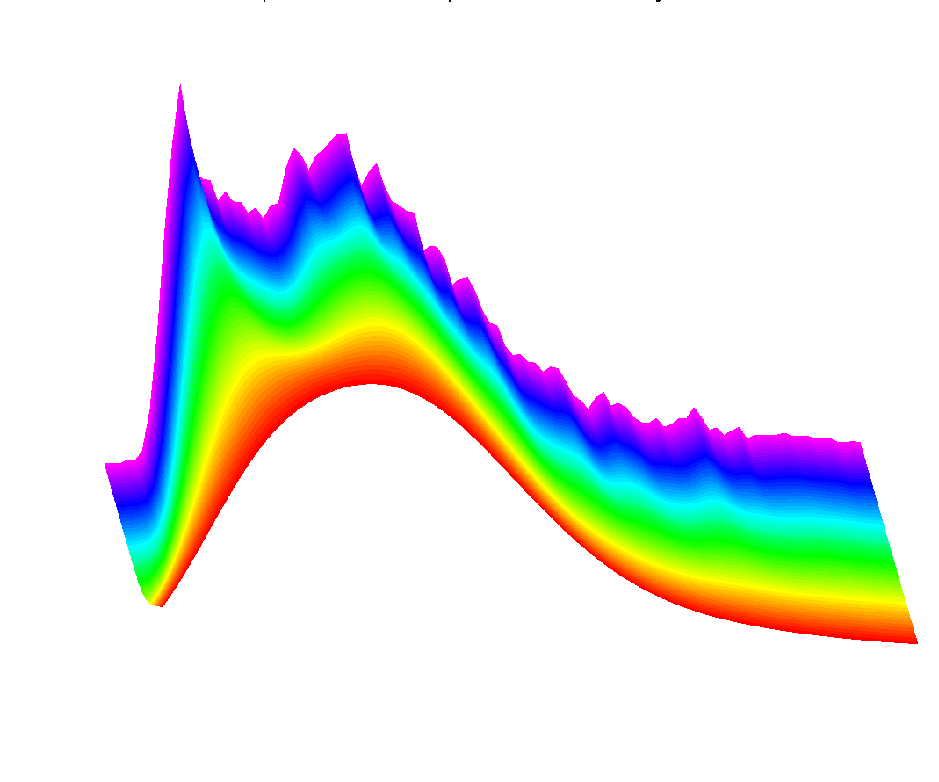
Last Class: SiZer Background
Fun Scale Space Views (Incomes Data)
Surface View

Slide 10
Last Class: SiZer Background
Basic idea: a bump is characterized by:
an increase
followed by a decrease
Generalization:
Many features of interest captured
by sign of the slope of the smooth
Foundation of SiZer:
Statistical inference on slopes,
over scale space

Slide 11
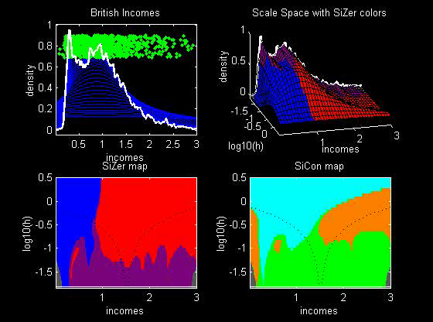
SiZer Background
SiZer analysis of British Incomes data:

Slide 12
SiZer Background
SiZer analysis of British Incomes data:
Oversmoothed: Only one mode
Medium smoothed: Two modes, statistically significant
Confirmed by Schmitz & Marron, (1992)
Undersmoothed: many noise wiggles, not significant
Again: all are correct,
just different scales

Slide 13
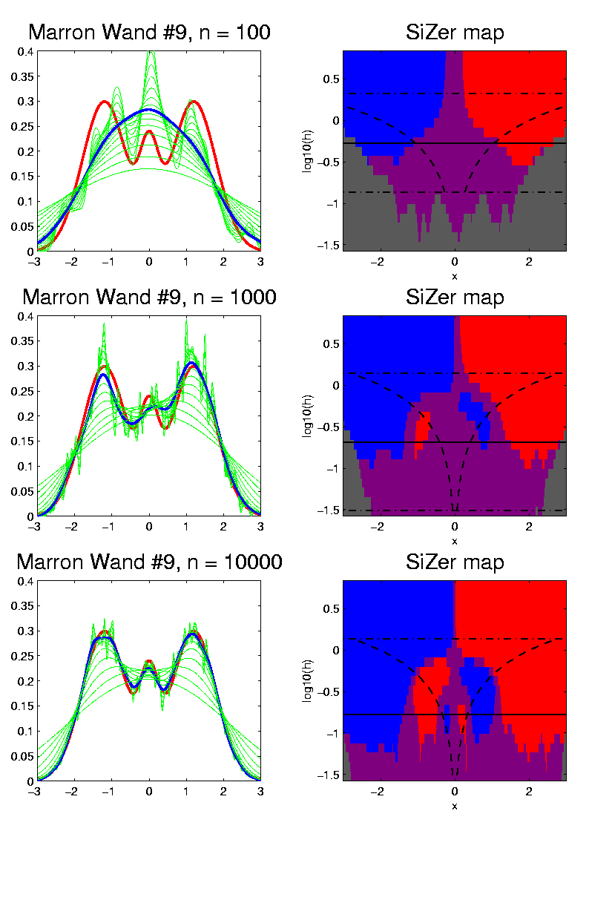

SiZer Background
E.g. - Marron & Wand (1992) Trimodal #9
Increasing $n$
Only 1 Signif’t Mode
Now 2 Signif’t Modes
Finally all 3 Modes

Slide 14
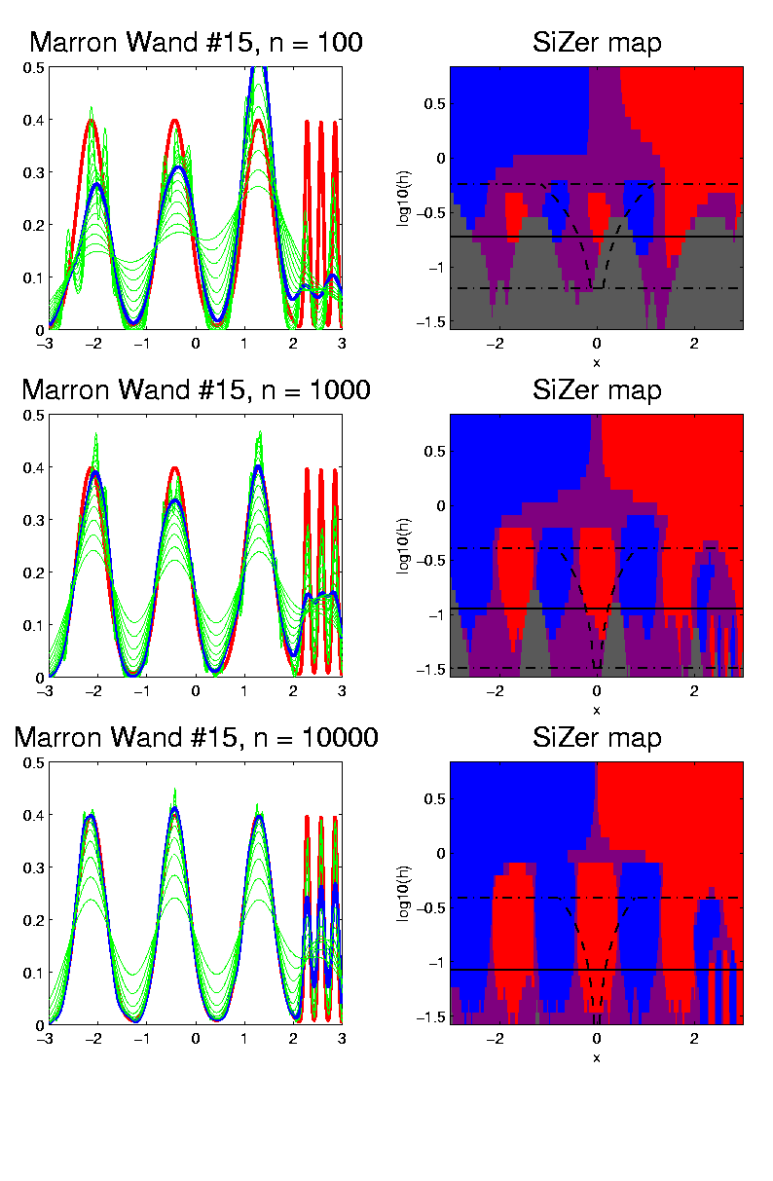

SiZer Background
E.g. - Marron & Wand Discrete Comb #15
Increasing $n$
Coarse Bumps Only
Now Fine bumps too
Someday: “draw” local
Bandwidth on SiZer map

Slide 15
SiZer Background
Historical Note & Acknowledgements:
Scale Space: S. M. Pizer
SiZer: Probal Chaudhuri
Main References:
Chaudhuri & Marron (1999)
Chaudhuri & Marron (2000)
Hannig & Marron (2006)
Gave Truly Valid Inference

Slide 16
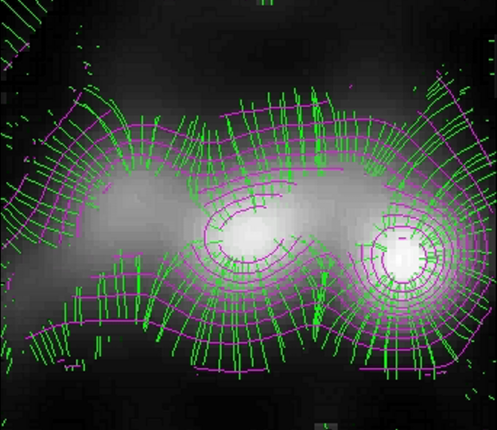
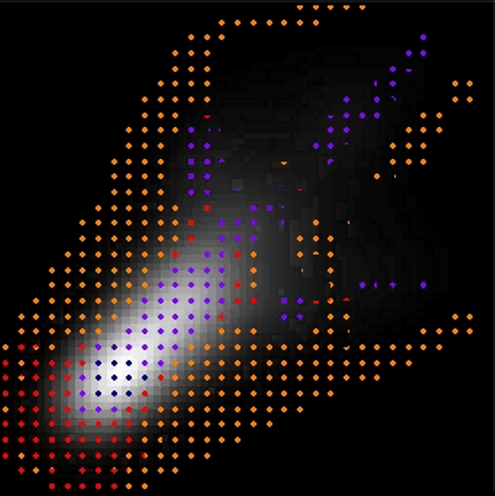
SiZer Background
Extension to 2-d:
Significance in Scale Space
Main Challenge: Visualization
References:
Godtliebsen et al (2002, 2004, 2006)
What Is Up and Down?
Significant
Gradients
& Contours
Significant
Curvature

Slide 17
SiZer Overview
Would you like to try smoothing & SiZer?
Marron Software Website as Before
In “Smoothing” Directory:
  kdeSM.m
  nprSM.m
  sizerSM.m
Recall: “>> help sizerSM” for usage

Slide 18
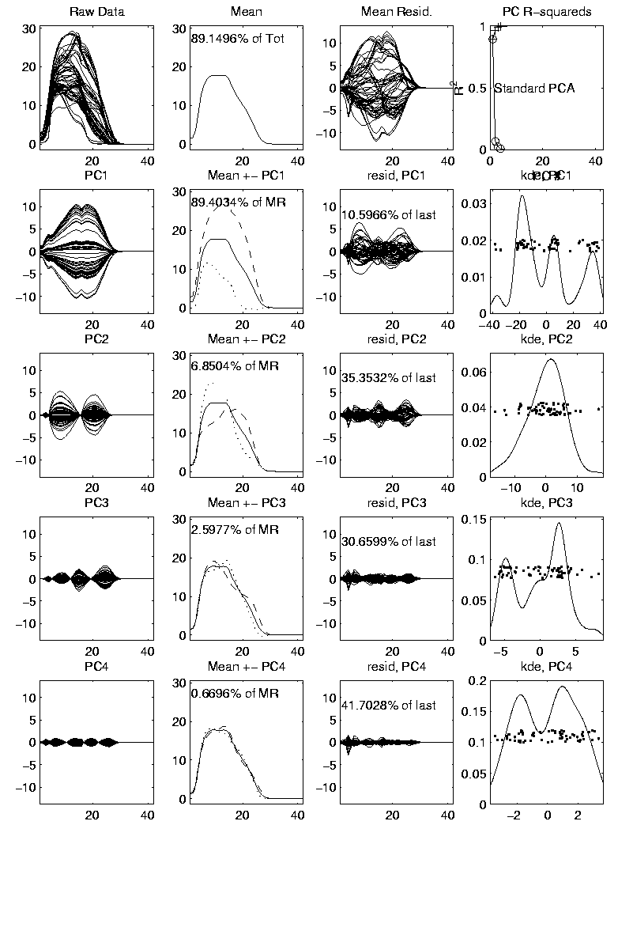
PCA to find clusters
Return to PCA of Mass Flux Data:
Big Question:
Are The
3 Clusters
Really There?
Notes:
MassFlux1d1p1.ps

Slide 19
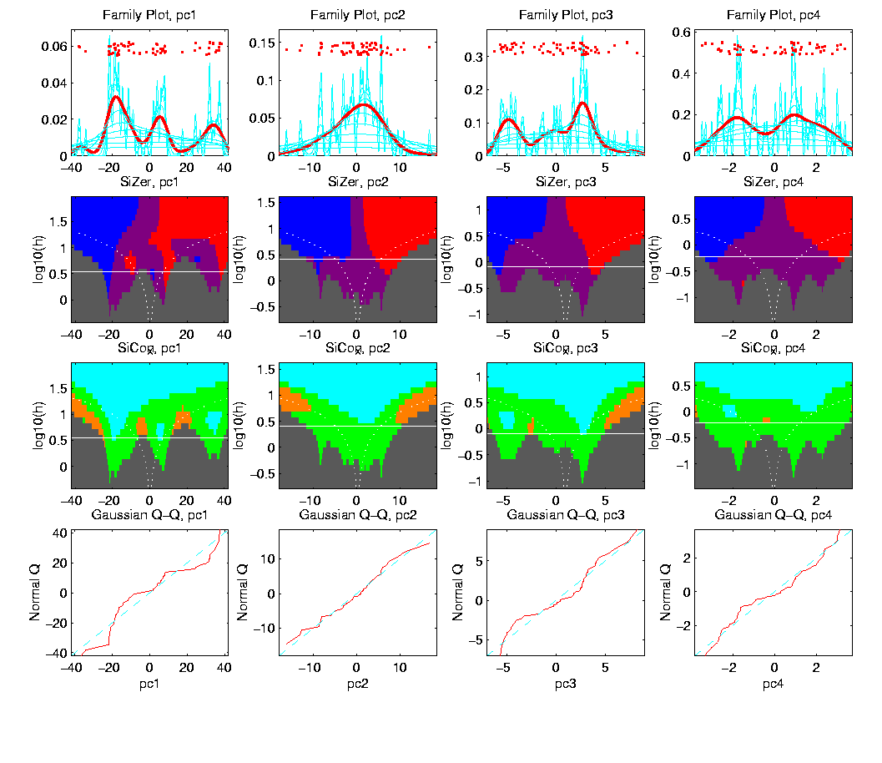
PCA to find clusters
SiZer analysis of Mass Flux, PC1
Notes:
MassFlux1d1p1s.ps

Slide 20
PCA to find clusters
SiZer analysis of Mass Flux, PC1
All 3
Signif’t
Notes:
MassFlux1d1p1s.ps

Slide 21
PCA to find clusters
SiZer analysis of Mass Flux, PC1
Also in
Curvature
Notes:
MassFlux1d1p1s.ps

Slide 22
PCA to find clusters
SiZer analysis of Mass Flux, PC1
And in
Other
Comp’s
Notes:
MassFlux1d1p1s.ps

Slide 23
PCA to find clusters
SiZer analysis of Mass Flux, PC1
Conclusion:
Found 3 significant clusters!
Worth deeper investigation
Correspond to 3 known “cloud types”

Slide 24
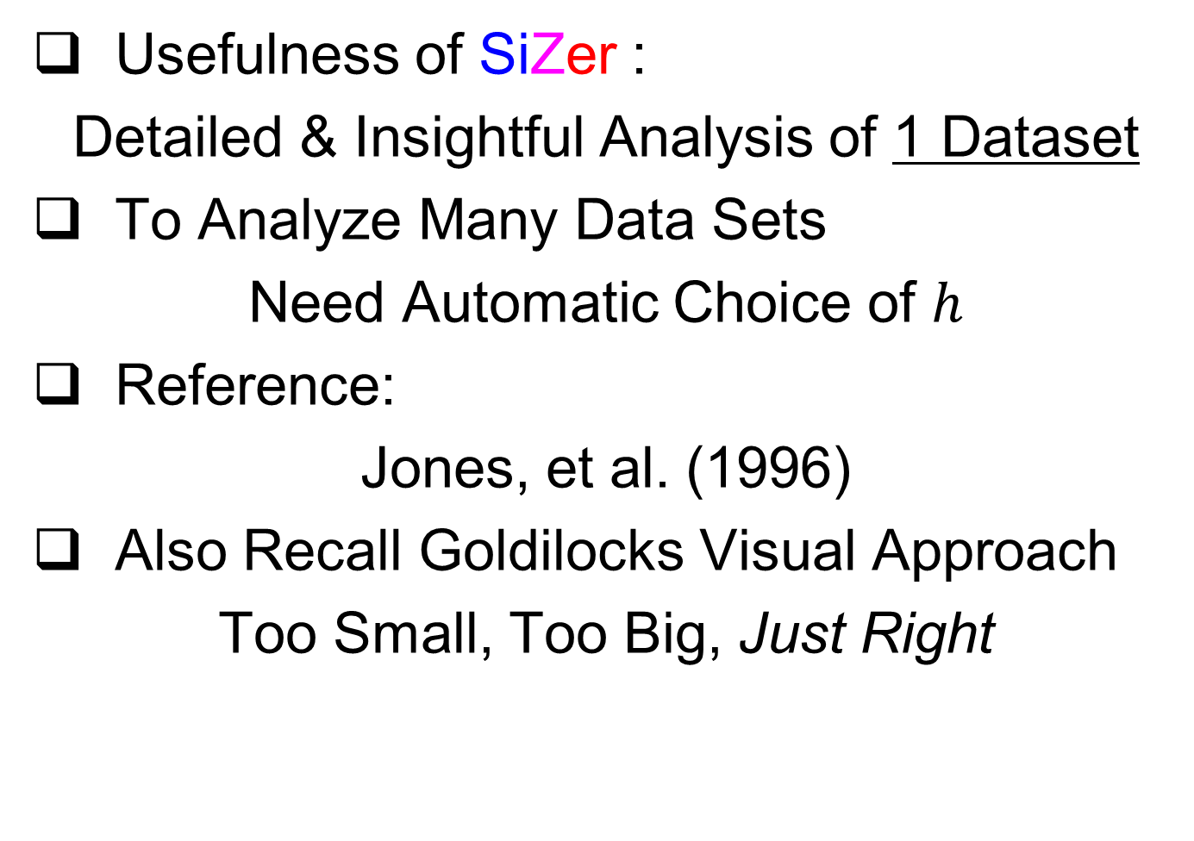
Statistical Smoothing
Usefulness of SiZer :
Detailed & Insightful Analysis of 1 Dataset
To Analyze Many Data Sets
Need Automatic Choice of $h$
Reference:
Jones, et al. (1996)
Also Recall Goldilocks Visual Approach
Too Small, Too Big, Just Right

Slide 25
Return to Big Picture
Main statistical goals of OODA:
Understanding population structure
  Low dim’al Projections, PCA …
Classification (i. e. Discrimination)
  Understanding 2+ populations
Time Series of Data Objects
  Chemical Spectra, Mortality Data
“Vertical Integration” of Data Types

Slide 26
Classification - Discrimination
Background: Two Class (Binary) version:
Using “training data” from
Class +1 and Class -1
Develop a “rule” for
assigning new data to a Class
Canonical Example: Disease Diagnosis
New Patients are “Healthy” or “Ill”
Determine based on measurements
Text, Chp 11

Slide 27
Classification - Discrimination
Important Distinction:
Classification vs. Clustering
Classification:
Class labels are known,
Goal: understand differences
Clustering:
Goal: Find class labels (to be similar)
Both are about clumps of similar data,
but much different goals

Slide 28
Classification - Discrimination
Important Distinction:
Classification vs. Clustering
Useful terminology:
Classification: supervised learning
Clustering: unsupervised learning

Slide 29
Classification - Discrimination
Terminology:
For statisticians, these are synonyms

Slide 30
Classification - Discrimination
Terminology:
For statisticians, these are synonyms
For biologists, classification means:
Constructing taxonomies
And sorting organisms into them
(maybe this is why discrimination
was used, until politically incorrect…)
Kingdom
Phylum
Class
Order
Genus
Species

Slide 31
Classification (i.e. discrimination)
There are a number of:
Approaches
Philosophies
Schools of Thought
Too often cast as:
Statistics vs. EE - CS

Slide 32
Classification (i.e. discrimination)
EE – CS variations:
Pattern Recognition
Artificial Intelligence
Neural Networks (Deep Learning)
Data Mining
Machine Learning

Slide 33
Classification (i.e. discrimination)
Early Differing Viewpoints:
Statistics
Model Classes with Probability Distribut’ns
Use to study class diff’s & find rules
EE – CS
Data are just Sets of Numbers
Optimize Separation Rules
Current thought: combine these

Slide 34
Classification (i.e. discrimination)
Important Overview Reference:
Duda, Hart and Stork (2001)
Too much about neural nets???
Pizer disagrees…
Update of Duda & Hart (1973)

Slide 35

Classification (i.e. discrimination)
For a more classical statistical view:
McLachlan (2004).
Gaussian Likelihood theory, etc.
Not well tuned to HDLSS data
Notes:
35

Slide 36
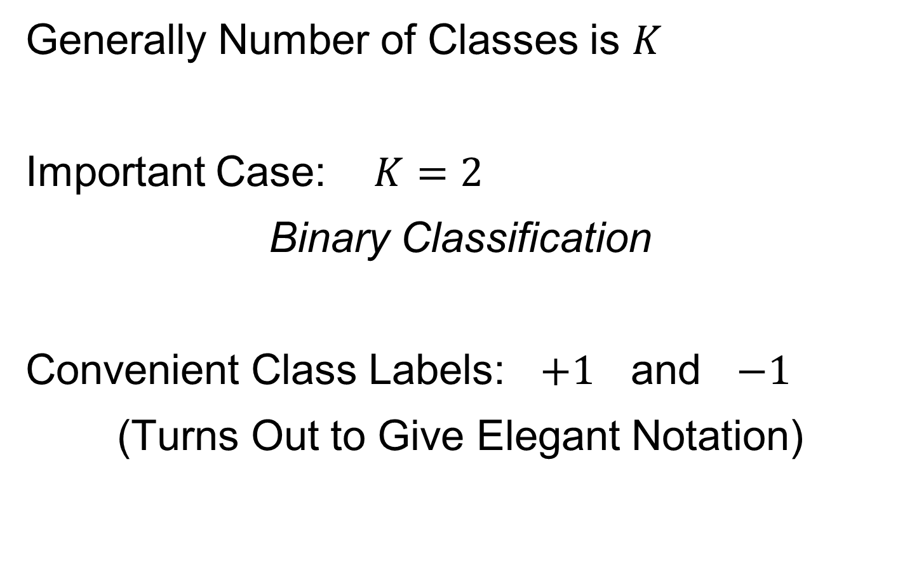
Classification Basics
Generally Number of Classes is $K$
Important Case: $K=2$
Binary Classification
Convenient Class Labels: $+1$ and $−1$
(Turns Out to Give Elegant Notation)
Notes:
HDLSStmbRaw.ps

Slide 37
Classification Basics
Binary Classification
Start with Training Data:
$$\left(x_{1},y_{1}\right),⋯,\left(x_{n},y_{n}\right)$$
Where $x_{i}∈ℝ^{d}$, $y_{i}∈\left\{+1,−1\right\}$ for $i=1,⋯,n$
Notes:
HDLSStmbRaw.ps

Slide 38
Classification Basics
Binary Classification
Goal: Use Training Data
$$\left(x_{1},y_{1}\right),⋯,\left(x_{n},y_{n}\right)$$
To Classify New Case: $\left(x_{0},y_{0}\right)$
I.e. Use $x_{0}∈ℝ^{d}$ to Predict $y_{0}∈\left\{+1,−1\right\}$
Notes:
HDLSStmbRaw.ps

Slide 39
Classification Basics
Statistical Approach:
Model $\left({\tilde{x}}_{1},{\tilde{y}}_{1}\right),⋯,\left({\tilde{x}}_{n},{\tilde{y}}_{n}\right)$ as i.i.d. from
Probability Density $f\left(x,y\right)$
General Classification Rule: $c:ℝ^{d}→\left\{+1,−1\right\}$
Use tildes to denote
random variables
Notes:
HDLSStmbRaw.ps

Slide 40
Classification Basics
Performance Measure of a Rule $c\left(x\right)$:
Bayes Risk $=P\left\{c\left(\tilde{x}\right)≠\tilde{y}\right\}$
Risk = Expected Loss (0 for right, 1 for wrong)
Notes:
HDLSStmbRaw.ps

Slide 41
Classification Basics
Bayes Risk Optimal Rule:
$$c_{LR}\left(x\right)=\left\{\begin{matrix}+1, & \frac{f\left(x,+1\right)}{f\left(x,−1\right)}≥1 \\ −1, & \frac{f\left(x,+1\right)}{f\left(x,−1\right)}<1\end{matrix}\right.$$
Called Likelihood Ratio Rule
Note: Need to Know $f$
(Can Consider Estimation)
Provides an
Important
Upper Bound
Notes:
HDLSStmbRaw.ps

Slide 42
Classification Basics
Very Simple, Yet Appealing, Method:
Nearest Neighbor
Use Label of Nearest Neighbor:
$$c\left(x\right)=y_{j^{∗}},$$
where $j^{∗}={argmin}_{j=1,⋯,n} δ\left(x_{j},x \right)$
Problem: High Variation
Notes:
HDLSStmbRaw.ps

Slide 43
Classification Basics
Important Class of Methods:
$k$ - Nearest Neighbors
Idea: Vote Among $k$ Nearest Neighbors of $x$
Challenge: Choice of $k$
Too Small: High Variation
Too Large: Creates Bias
Major Advantage:
Works in Any
Metric Space
Essentially a
Smoothing Problem
Notes:
HDLSStmbRaw.ps

Slide 44
Classification Basics
Important General Class:
Linear Classifiers
Given a Direction $w∈ℝ^{d}$ (i.e. ${\left\|w\right\|}_{2}=1$)
And an Intercept $β∈ℝ$,
Let $c_{w,β}\left(x\right)=1−2∙1_{\left\{w^{t}x<β\right\}}$
Separating Surface:
Hyperplane with Normal $w$ and Intercept $β$
Indicator Function
Notes:
HDLSStmbRaw.ps

Slide 45
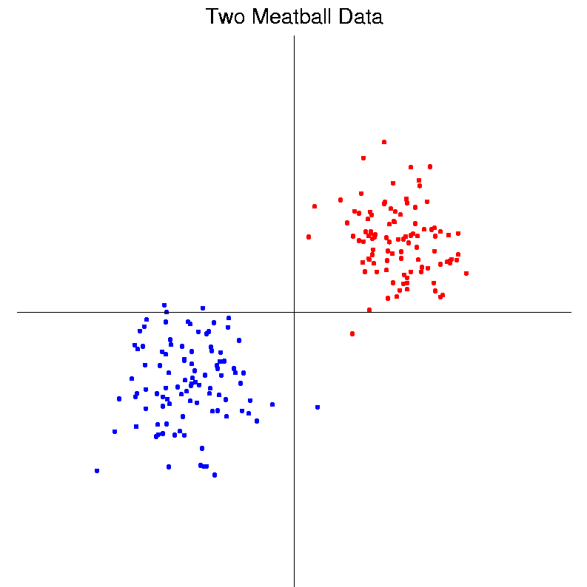
Classification Basics
Personal Viewpoint: Point Clouds
(In Data
Object
Space)
Notes:
HDLSStmbRaw.ps

Slide 46
Classification Basics
Simple and Natural Linear Classifier:
Mean Difference
a.k.a.
Centroid Method
Find “skewer through two meatballs”

Slide 47
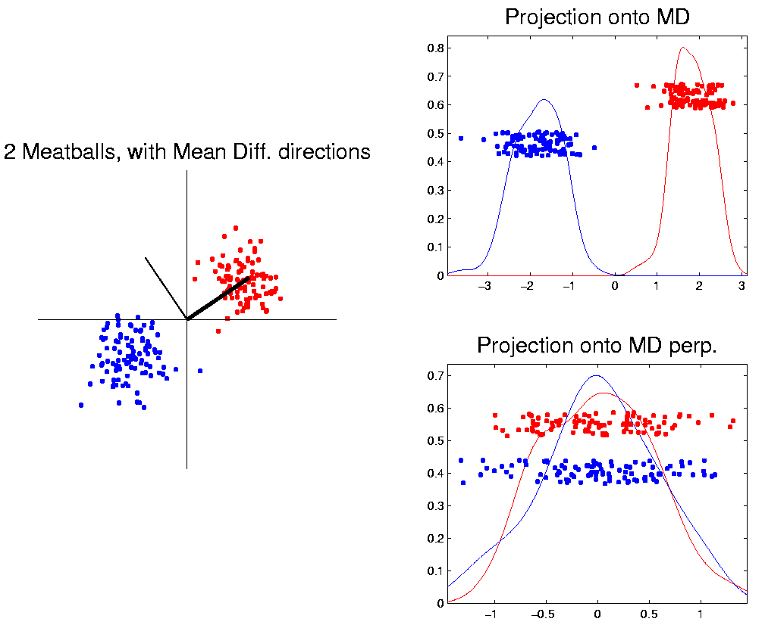
Classification Basics
For Simple Toy Example:
Project
On MD
& Split
at Center
(Assume Equal Numbers for Simplicity)
Notes:
HDLSStmbMdif.ps

Slide 48
Classification Basics
Note, for Shifts of the Standard Normal
MD is Bayes Risk Optimal
Since Likelihood Ratio Solution
(Either Theoretical or Estimated)

Slide 49
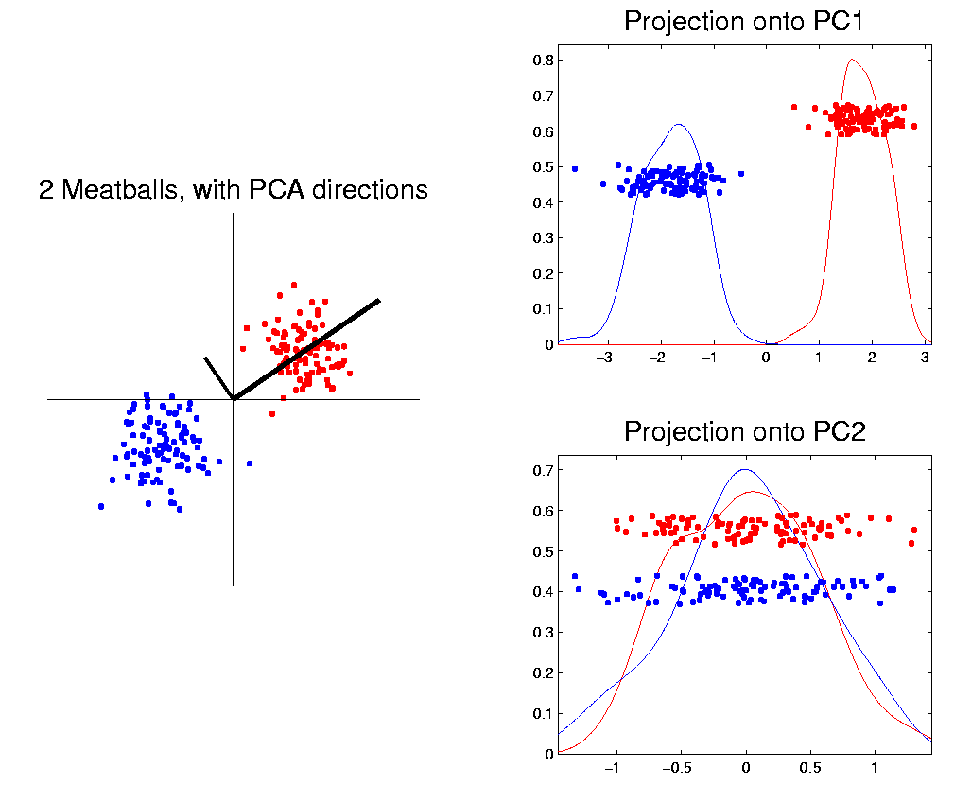
Classification Basics
Why not use PCA?
Reasonable
Result?
Doesn’t use
class labels…
Good?
Bad?
Notes:
HDLSStmbPCA.ps

Slide 50
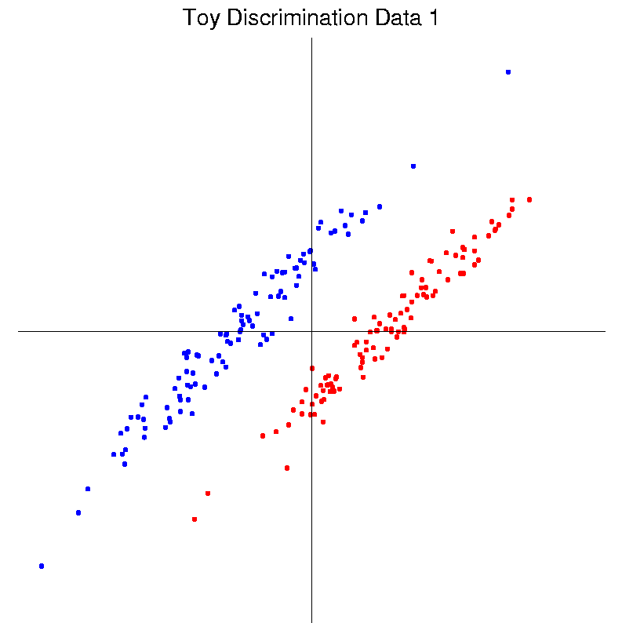
Classification Basics
Harder Example (slanted clouds):
Notes:
HDLSSod1Raw.ps

Slide 51
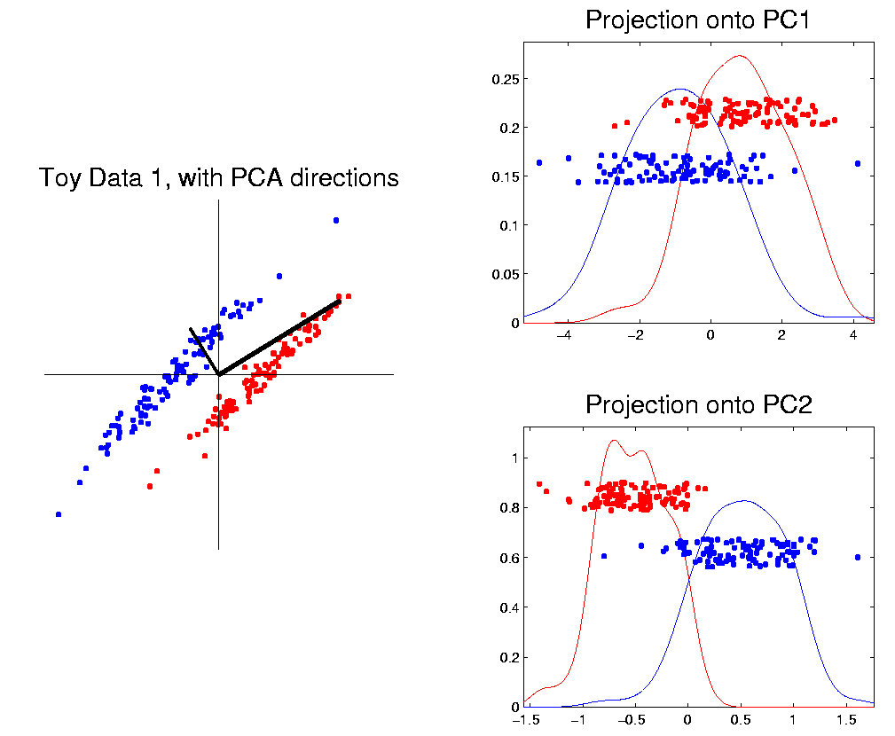
Classification Basics
PCA for slanted clouds:
PC1 terrible
PC2 better?
Still misses
right dir’n
Doesn’t use
Class Labels
Notes:
HDLSSod1PCA.ps

Slide 52
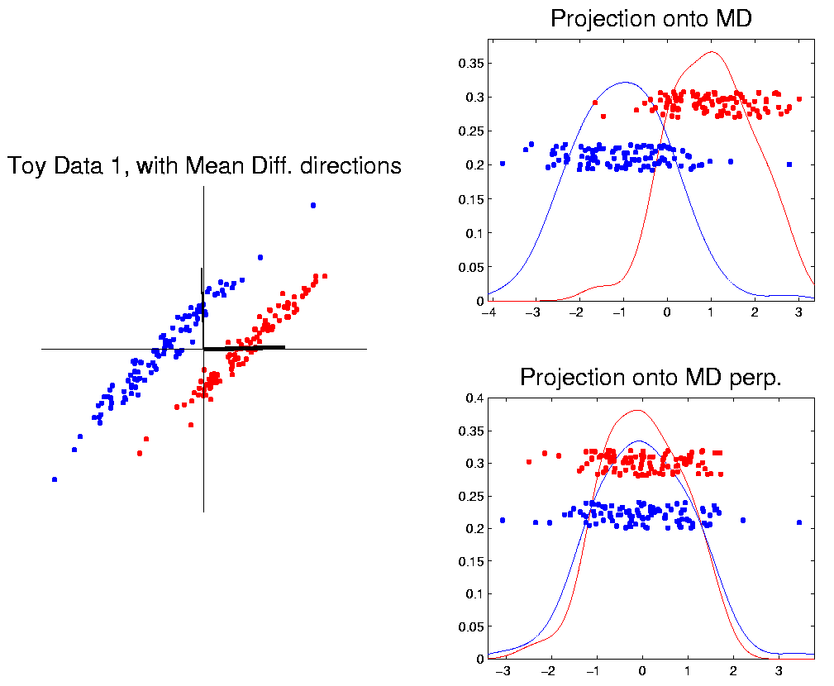
Classification Basics
Mean Difference for slanted clouds:
A little
better?
Still misses
right dir’n
Want to
account for
covariance
Notes:
HDLSSod1Mdif.ps

Slide 53
Classification Basics
Mean Difference & Covariance,
Simplest Approach:
Rescale (standardize) coordinate axes
i. e. replace (full) data matrix:
$$X=\left(\begin{matrix}x_{11} & ⋯ & x_{1n} \\ ⋮ & ⋱ & ⋮ \\ x_{d1} & ⋯ & x_{dn}\end{matrix}\right) → \left(\begin{matrix}\frac{1}{s_{1}} & ⋯ & 0 \\ ⋮ & ⋱ & ⋮ \\ 0 & ⋯ & \frac{1}{s_{d}}\end{matrix}\right)X=\left(\begin{matrix}\frac{x_{11}}{s_{1}} & ⋯ & \frac{x_{1n}}{s_{1}} \\ ⋮ & ⋱ & ⋮ \\ \frac{x_{d1}}{s_{d}} & ⋯ & \frac{x_{dn}}{s_{d}}\end{matrix}\right)$$
Then do Mean Difference
Called “Naïve Bayes Approach”
Name Seems to Be From Above MD Optimality

Slide 54
Classification Basics
Naïve Bayes Reference:
Domingos & Pazzani (1997)
Most sensible contexts:
Non-comparable data
E.g. different units

Slide 55
Classification Basics
Problem with Naïve Bayes:
Only adjusts
Variances
Not Covariances
Doesn’t solve
this problem
Notes:
HDLSSod1Raw.ps

Slide 56
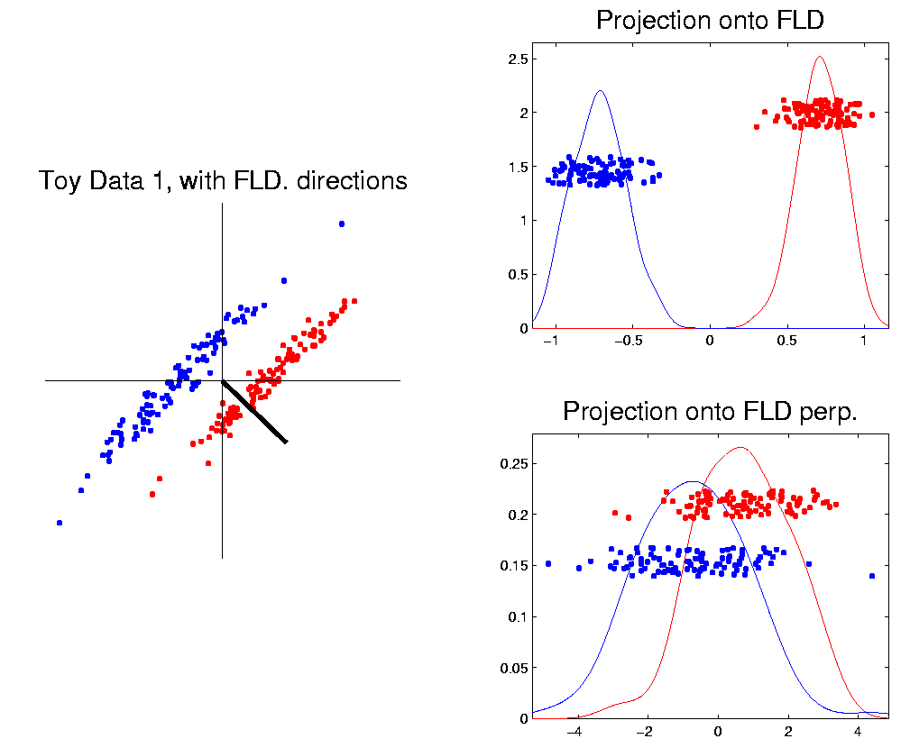
Classification Basics
Better Solution: Linear Discriminant Analysis
Gets the
right dir’n
How does
it work?
Notes:
HDLSSod1FLD.ps

Slide 57
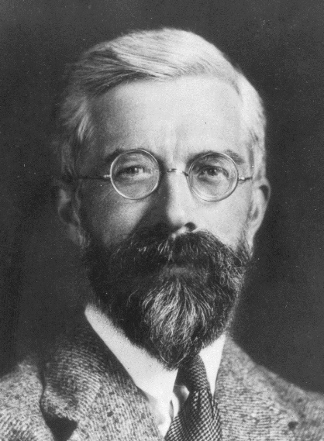
Linear Discriminant Analysis
Other common terminology (for LDA):
Fisher Linear Discrimination
Original Paper: Fisher (1936)
Same in Fisher-Rao, and popularized “p-value”
Published in Annals of Eugenics…
Founding Father of Both Statistics and Genetics, Now
Discredited Over Eugenics = Racist Pseudo-Science
(Also Tried to Disprove Evidence of Harm from Smoking)

Slide 58
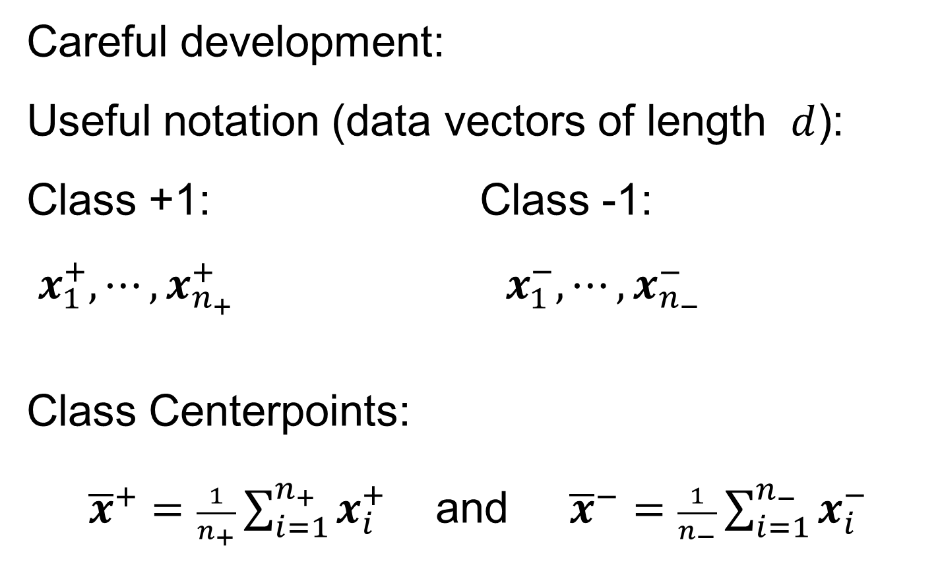
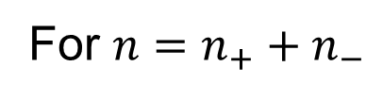
Linear Discriminant Analysis
Careful development:
Useful notation (data vectors of length $d$):
Class +1: Class -1:
$x_{1}^{+},⋯,x_{n_{+}}^{+} x_{1}^{−},⋯,x_{n_{−}}^{−}$
Class Centerpoints:
${\overline{x}}^{+}=\frac{1}{n_{+}}\sum_{i=1}^{n_{+}}{x_{i}^{+}}$ and ${\overline{x}}^{−}=\frac{1}{n_{−}}\sum_{i=1}^{n_{−}}{x_{i}^{−}}$
Text, Sec. 11.1
For $n=n_{+}+n_{−}$

Slide 59
Linear Discriminant Analysis
Covariances, ${\hat{Σ}}^{⨀}={\breve{X}}^{⨀}{{\breve{X}}^{⨀}}^{t}$ for $⨀$ = +,-
(outer products)
Based on centered, normalized data matrices:
$${\breve{X}}^{⨀}=\frac{1}{\sqrt{n_{⨀}}}\left(x_{1}^{⨀}−{\overline{x}}^{⨀},⋯,x_{n_{⨀}}^{⨀}−{\overline{x}}^{⨀}\right)$$
Column Object
Mean Centered
Note: use “MLE” version of estimated
covariance matrices, for simpler notation

Slide 60
Linear Discriminant Analysis
Fundamental LDA Assumption
Good estimate of (common) within class cov?
Pooled (weighted average) within class cov:
$${\hat{Σ}}^{w}=\frac{n_{+}{\hat{Σ}}^{+}+n_{−}{\hat{Σ}}^{−}}{n_{+}+n_{−}}=\breve{\breve{X}}{\breve{\breve{X}}}^{t}$$
Outer Product of combined full data matrix:
$\breve{\breve{X}}$=$\frac{1}{\sqrt{n_{+}+n_{−}}}\left(\sqrt{n_{+}}{\breve{X}}^{+} \sqrt{n_{−}}{\breve{X}}^{−}\right)$
For “Within Class”
Thinking About Similar, But Shifted Distributions
Note: Different Means

Slide 61
Linear Discriminant Analysis
Note: ${\hat{Σ}}^{w}$ is similar to $\hat{Σ}$ from before
I.e. covariance matrix ignoring class labels
Important Difference:
Class by Class Centering
Will be important later
Notes:
HDLSSod1Raw.ps

Slide 62
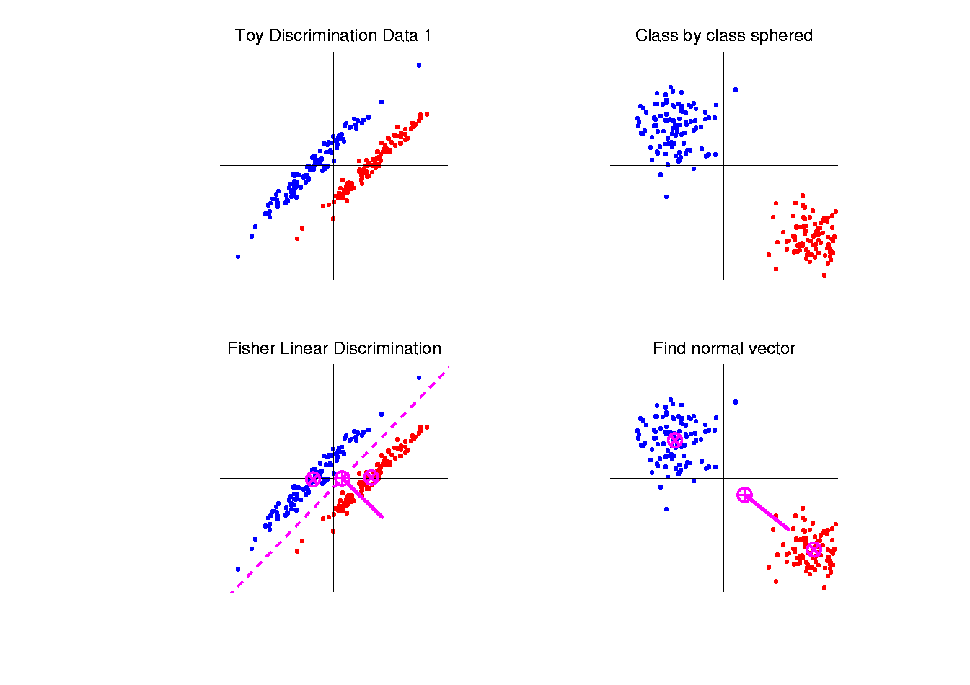
Linear Discriminant Analysis
Simple way to find “correct cov. adjustment”:
Individually transform subpopulations so
“spherical” about their means
For $⨀$ = +,- define $z_{i}^{⨀}={\left({\hat{Σ}}^{w}\right)}^{−1/2}x_{i}^{⨀}$
Notes:
HDLSSod1egFLD.ps

Slide 63
Linear Discriminant Analysis
For $⨀$ = +,- define $z_{i}^{⨀}={\left({\hat{Σ}}^{w}\right)}^{−1/2}x_{i}^{⨀}$
Note: This spheres the data, in the sense that
$$ZZ^{t}={\hat{Σ}}^{{−1}/2}\breve{X}{\left({\hat{Σ}}^{{−1}/2}\breve{X}\right)}^{t}=$$
$$={\hat{Σ}}^{{−1}/2}\breve{X}{\breve{X}}^{t}{\hat{Σ}}^{{−1}/2}=I$$
Notes:
HDLSSod1egFLD.ps

Slide 64
Linear Discriminant Analysis
Then:
In Transformed Space,
Best separating hyperplane
is
Perpendicular bisector of
line between means
Again Assuming Equal
Sample Sizes for Simplicity
Notes:
HDLSSod1egFLD.ps

Slide 65
Linear Discriminant Analysis
In Transformed Space,
Separating Hyperplane has:
Transformed Normal Vector:
$n_{TLDA}={\left({\hat{Σ}}^{w}\right)}^{−1/2}{\overline{x}}^{+}−{\left({\hat{Σ}}^{w}\right)}^{−1/2}{\overline{x}}^{−}$
$={\left({\hat{Σ}}^{w}\right)}^{−1/2}\left({\overline{x}}^{+}−{\overline{x}}^{−}\right)$
Notes:
HDLSSod1egFLD.ps

Slide 66
Linear Discriminant Analysis
In Transformed Space,
Separating Hyperplane has:
Transformed Normal Vector:
$n_{TLDA}={\left({\hat{Σ}}^{w}\right)}^{−1/2}{\overline{x}}^{+}−{\left({\hat{Σ}}^{w}\right)}^{−1/2}{\overline{x}}^{−}$
$={\left({\hat{Σ}}^{w}\right)}^{−1/2}\left({\overline{x}}^{+}−{\overline{x}}^{−}\right)$
Transformed Intercept:
$μ_{TLDA}={\frac{1}{2}\left({\hat{Σ}}^{w}\right)}^{−1/2}{\overline{x}}^{+}+\frac{1}{2}{\left({\hat{Σ}}^{w}\right)}^{−1/2}{\overline{x}}^{−}$
$={\left({\hat{Σ}}^{w}\right)}^{−1/2}\left(\frac{1}{2}{\overline{x}}^{+}+\frac{1}{2}{\overline{x}}^{−}\right)$
Notes:
HDLSSod1egFLD.ps

Slide 67
Linear Discriminant Analysis
In Transformed Space,
Separating Hyperplane has:
Transformed Normal Vector:
$n_{TLDA}={\left({\hat{Σ}}^{w}\right)}^{−1/2}{\overline{x}}^{+}−{\left({\hat{Σ}}^{w}\right)}^{−1/2}{\overline{x}}^{−}$
$={\left({\hat{Σ}}^{w}\right)}^{−1/2}\left({\overline{x}}^{+}−{\overline{x}}^{−}\right)$
Transformed Intercept:
$μ_{TLDA}={\frac{1}{2}\left({\hat{Σ}}^{w}\right)}^{−1/2}{\overline{x}}^{+}+\frac{1}{2}{\left({\hat{Σ}}^{w}\right)}^{−1/2}{\overline{x}}^{−}$
$={\left({\hat{Σ}}^{w}\right)}^{−1/2}\left(\frac{1}{2}{\overline{x}}^{+}+\frac{1}{2}{\overline{x}}^{−}\right)$
Separating Hyperplane Has Eqn.
$\left\{z:\left\langle z,n_{TLDA}\right\rangle =\left\langle μ_{TLDA},n_{TLDA}\right\rangle \right\}$
Notes:
HDLSSod1egFLD.ps

Slide 68
Linear Discriminant Analysis
Thus discrimination rule is:
Given a new data vector $x_{0}$,
Choose Class +1 when:
$$\left\langle {\left({\hat{Σ}}^{w}\right)}^{−1/2}x_{0},n_{TLDA}\right\rangle ≥\left\langle μ_{TLDA},n_{TLDA}\right\rangle$$
Using Boundary: $\left\{z:\left\langle z,n_{TLDA}\right\rangle =\left\langle μ_{TLDA},n_{TLDA}\right\rangle \right\}$

Slide 69
Linear Discriminant Analysis
Multiply and
Divide to Return
To Original Space
Thus discrimination rule is:
Given a new data vector $x_{0}$,
Choose Class +1 when:
$$\left\langle {\left({\hat{Σ}}^{w}\right)}^{−1/2}x_{0},n_{TLDA}\right\rangle ≥\left\langle μ_{TLDA},n_{TLDA}\right\rangle$$
i.e. (transforming back to original space)
$$\left\langle x_{0},{\left({\hat{Σ}}^{w}\right)}^{−1/2}n_{TLDA}\right\rangle ≥\left\langle {\left({\hat{Σ}}^{w}\right)}^{1/2}μ_{TLDA},{\left({\hat{Σ}}^{w}\right)}^{−1/2}n_{TLDA}\right\rangle$$
$$\left\langle x_{0},n_{LDA}\right\rangle ≥\left\langle μ_{LDA},n_{LDA}\right\rangle$$
where:
$$n_{LDA}={\left({\hat{Σ}}^{w}\right)}^{−1/2}n_{TLDA}={\left({\hat{Σ}}^{w}\right)}^{−1}\left({\overline{x}}^{+}−{\overline{x}}^{−}\right)$$
$$μ_{LDA}={\left({\hat{Σ}}^{w}\right)}^{1/2}μ_{TLDA}=\left(\frac{1}{2}{\overline{x}}^{+}+\frac{1}{2}{\overline{x}}^{−}\right)$$
Modified
Direction
But Same Center

Slide 70
Linear Discriminant Analysis
Thus discrimination rule is:
Classify $x_{0}$ to Class +1 when:
$$\left\langle x_{0}, {\underline{n}}_{LDA}\right\rangle ≥\left\langle {\underline{μ}}_{LDA}, {\underline{n}}_{LDA}\right\rangle$$
where:
$n_{LDA}={\left({\hat{Σ}}^{w}\right)}^{−1/2}n_{TLDA}={\left({\hat{Σ}}^{w}\right)}^{−1}\left({\overline{x}}^{+}−{\overline{x}}^{−}\right)$
$μ_{LDA}={\left({\hat{Σ}}^{w}\right)}^{1/2}μ_{TLDA}=\left(\frac{1}{2}{\overline{x}}^{+}+\frac{1}{2}{\overline{x}}^{−}\right)$
i.e.
${x_{0}}^{t}{\left({\hat{Σ}}^{w}\right)}^{−1}\left({\overline{x}}^{+}−{\overline{x}}^{−}\right)≥$
$≥{\frac{1}{2}\left({\overline{x}}^{+}+{\overline{x}}^{−}\right)}^{t}{\left({\hat{Σ}}^{w}\right)}^{−1}$ $\left({\overline{x}}^{+}−{\overline{x}}^{−}\right)$
Same Inner Product
Of Center Point
Inner Product of New Data
Point & Transf’d Direction

Slide 71
Linear Discriminant Analysis
So (in orig’l space) have separ’ting hyperplane with:
Normal vector: $n_{LDA}$
Intercept:$μ_{LDA}$
Notes:
HDLSSod1egFLD.ps

Slide 72
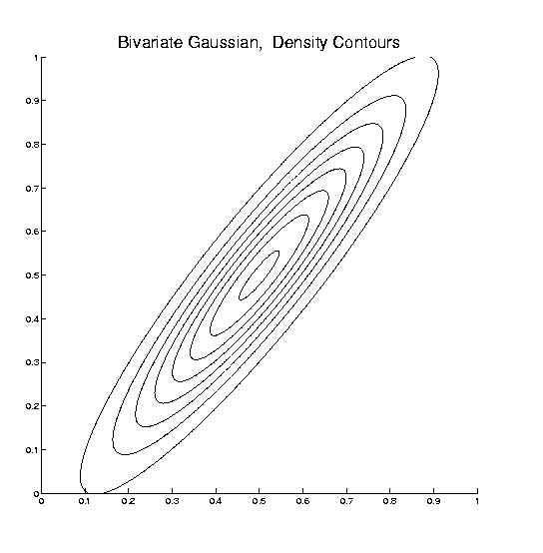
Linear Discriminant Analysis
Relationship to Mahalanobis distance
Idea: For $x_{1},x_{2}\sim N\left(μ,Σ\right)$, a natural distance
measure is: $d_{M}={\left[{\left(x_{1}−x_{2}\right)}^{t}Σ^{−1}\left(x_{1}−x_{2}\right)\right]}^{1/2}$
$$d_{1}=d_{2}$$

Slide 73
Linear Discriminant Analysis
Relationship to Mahalanobis distance
Idea: For $x_{1},x_{2}\sim N\left(μ,Σ\right)$, a natural distance
measure is: $d_{M}={\left[{\left(x_{1}−x_{2}\right)}^{t}Σ^{−1}\left(x_{1}−x_{2}\right)\right]}^{1/2}$
“unit free”, i.e. “standardized”
essentially mod out covariance structure
Euclidean dist. applied to $Σ^{−1/2}x_{1}$ & $Σ^{−1/2}x_{2}$
Same as key transformation for LDA
I.e. LDA is
mean difference in Mahalanobis space

Slide 74
Participant Presentation
Yikai Wang

