Slide 1
Statistics – O. R. 881 Object Oriented Data Analysis
Steve Marron
Dept. of Statistics and Operations Research
University of North Carolina

Slide 2
Current Sections in Textbook
Today:
Sections 16.2, 11.1
Next Class:
Sections 11.1, 11.2

Slide 3
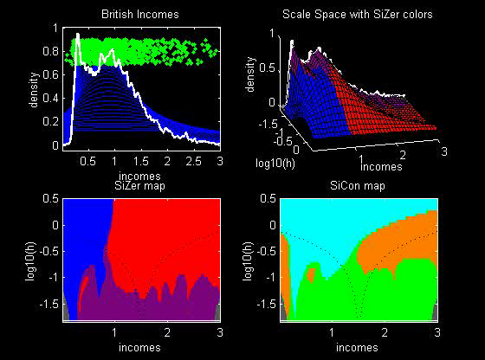
Last Class: SiZer Background
SiZer analysis of British Incomes data:

Slide 4
Last Class: SiZer Overview
Would you like to try smoothing & SiZer?
Marron Software Website as Before
In “Smoothing” Directory:
kdeSM.m
nprSM.m
sizerSM.m
Recall: “>> help sizerSM” for usage

Slide 5
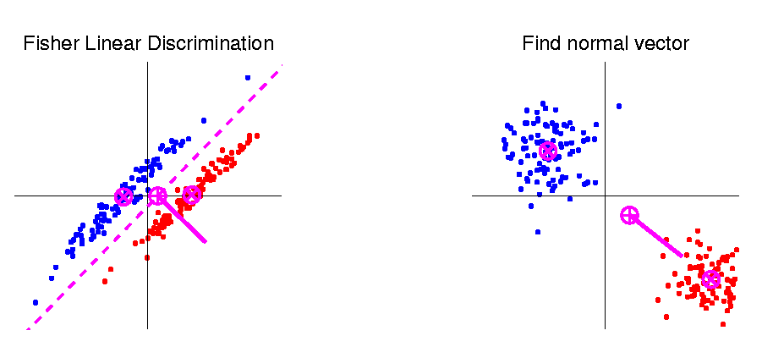
Last Class: Linear Disc. Anal.
So (in orig’l space) have separ’ting hyperplane with:
Normal vector: $n_{LDA}$
Intercept:$μ_{LDA}$
Notes:
HDLSSod1egFLD.ps

Slide 6
Classical Discrimination
Above derivation of LDA was:
Nonstandard
Not in any other textbooks(?)
Nonparametric (don’t need Gaussian data)
I.e. Used no probability distributions
More Machine Learning than Statistics
(but careful about HDLSS case)

Slide 7
Classical Discrimination
LDA Likelihood View
Assume:
Class distributions are multivariate
$N\left(μ^{⨀},Σ^{w}\right)$ for $⨀$ = +,-
strong distributional assumption
+ common covariance (Within Class)

Slide 8
Classical Discrimination
LDA Likelihood View (cont.)
At a location $x_{0}$, the likelihood ratio, for
choosing between Class +1 and Class -1, is:
$$LR\left(x_{0},μ^{+},μ^{−},Σ^{w}\right)={φ_{Σ^{w}}\left(x_{0}−μ^{+}\right)}/{φ_{Σ^{w}}\left(x_{0}−μ^{−}\right)}$$
where $φ_{Σ^{w}}$ is the Gaussian density,
with covariance $Σ^{w}$

Slide 9
Classical Discrimination
LDA Likelihood View (cont.)
Simplifying, using the Gaussian density:
$$φ_{Σ^{w}}\left(x\right)=\frac{1}{{\left(2π\right)}^{d/2}\left|Σ^{w}\right|}e^{{−\left(x^{t}{Σ^{w}}^{−1}x\right)}/2}$$
Gives (critically using common covariances):
$LR\left(x_{0},μ^{+},μ^{−},Σ^{w}\right)$=
$$=e^{{−\left[{\left(x_{0}−μ^{+}\right)}^{t}{Σ^{w}}^{−1}\left(x_{0}−μ^{+}\right)−{\left(x_{0}−μ^{−}\right)}^{t}{Σ^{w}}^{−1}\left(x_{0}−μ^{−}\right)\right]}/2}$$
$−2\log{LR\left(x_{0},μ^{+},μ^{−},Σ^{w}\right)}=$
$$=\left[{\left(x_{0}−μ^{+}\right)}^{t}{Σ^{w}}^{−1}\left(x_{0}−μ^{+}\right)−{\left(x_{0}−μ^{−}\right)}^{t}{Σ^{w}}^{−1}\left(x_{0}−μ^{−}\right)\right]$$

Slide 10
Classical Discrimination
LDA Likelihood View (cont.)
But: ${\left(x_{0}−μ^{⨀}\right)}^{t}{Σ^{w}}^{−1}\left(x_{0}−μ^{⨀}\right)=$
$$={x_{0}}^{t}{Σ^{w}}^{−1}x_{0}−2{x_{0}}^{t}{Σ^{w}}^{−1}μ^{⨀}+{μ^{⨀}}^{t}{Σ^{w}}^{−1}μ^{⨀}$$
for $⨀=−1, +1$

Slide 11
Classical Discrimination
LDA Likelihood View (cont.)
But: ${\left(x_{0}−μ^{⨀}\right)}^{t}{Σ^{w}}^{−1}\left(x_{0}−μ^{⨀}\right)=$
$$={x_{0}}^{t}{Σ^{w}}^{−1}x_{0}−2{x_{0}}^{t}{Σ^{w}}^{−1}μ^{⨀}+{μ^{⨀}}^{t}{Σ^{w}}^{−1}μ^{⨀}$$
so: $−2\log{LR\left(x_{0},μ^{+},μ^{−},Σ^{w}\right)}=$
$$=−2{x_{0}}^{t}{Σ^{w}}^{−1}\left(μ^{+}−μ^{−}\right)+{\left(μ^{+}+μ^{−}\right)}^{t}{Σ^{w}}^{−1}\left(μ^{+}−μ^{−}\right)$$
Note: same terms subtract off

Slide 12
Classical Discrimination
LDA Likelihood View (cont.)
But: ${\left(x_{0}−μ^{⨀}\right)}^{t}{Σ^{w}}^{−1}\left(x_{0}−μ^{⨀}\right)=$
$$={x_{0}}^{t}{Σ^{w}}^{−1}x_{0}−2{x_{0}}^{t}{Σ^{w}}^{−1}μ^{⨀}+{μ^{⨀}}^{t}{Σ^{w}}^{−1}μ^{⨀}$$
so: $−2\log{LR\left(x_{0},{\underline{μ}}^{+},{\underline{μ}}^{−},Σ^{w}\right)}=$
$$=−2{x_{0}}^{t}{Σ^{w}}^{−1}\left(μ^{+}−μ^{−}\right)+{\left(μ^{+}+μ^{−}\right)}^{t}{Σ^{w}}^{−1}\left(μ^{+}−μ^{−}\right)$$
Note: cross terms have ± cancellation
Seen in Above
Nonparametric
Derivation
Similar To
Above Center

Slide 13
Classical Discrimination
LDA Likelihood View (cont.)
But: ${\left(x_{0}−μ^{⨀}\right)}^{t}{Σ^{w}}^{−1}\left(x_{0}−μ^{⨀}\right)=$
$$={x_{0}}^{t}{Σ^{w}}^{−1}x_{0}−2{x_{0}}^{t}{Σ^{w}}^{−1}μ^{⨀}+{μ^{⨀}}^{t}{Σ^{w}}^{−1}μ^{⨀}$$
so: $−2\log{LR\left(x_{0},μ^{+},{\underline{μ}}^{−},Σ^{w}\right)}=$
$$=−2{x_{0}}^{t}{Σ^{w}}^{−1}\left(μ^{+}−μ^{−}\right)+{\left(μ^{+}+μ^{−}\right)}^{t}{Σ^{w}}^{−1}\left(μ^{+}−μ^{−}\right)$$
Thus $LR\left(x_{0},μ^{+},μ^{−},Σ^{w}\right)≥1$ when
$$−2\log{LR\left(x_{0},μ^{+},μ^{−},Σ^{w}\right)}≤0$$
i.e. ${x_{0}}^{t}{Σ^{w}}^{−1}\left(μ^{+}−μ^{−}\right)≥\frac{1}{2}{\left(μ^{+}+μ^{−}\right)}^{t}{Σ^{w}}^{−1}\left(μ^{+}−μ^{−}\right)$

Slide 14
Classical Discrimination
LDA Likelihood View (cont.)
Replacing $μ^{+}$, $μ^{−}$ and $Σ^{w}$
by maximum likelihood estimates:
${\overline{x}}^{+}$, ${\overline{x}}^{−}$and ${\hat{Σ}}^{w}$
Gives the likelihood ratio discrimination rule:
Choose Class +1, when
$${x_{0}}^{t}{{\hat{Σ}}^{w}}^{−1}\left({\overline{x}}^{+}−{\overline{x}}^{−}\right)≥\frac{1}{2}{\left({\overline{x}}^{+}+{\overline{x}}^{−}\right)}^{t}{{\hat{Σ}}^{w}}^{−1}\left({\overline{x}}^{+}−{\overline{x}}^{−}\right)$$
Same as above, so: LDA can be viewed as
Likelihood Ratio Rule
Inner Product of
Test Point & Adj’d
Mean Difference
Inner Product of
Mean of Means & Adj’d
Mean Difference

Slide 15
Classical Discrimination
LDA Generalization I
Gaussian Likelihood Ratio Discrimination
(a. k. a. “Nonlinear Discriminant Analysis”)
Idea: Assume
class distributions are $N\left(μ^{⨀},Σ^{⨀}\right)$
Different covariances!
Likelihood Ratio rule is straightf’d num’l calc.
(thus can easily implement, and do discrim’n)

Slide 16
Classical Discrimination
Gaussian Likelihood Ratio Discrim’n (cont.)
No longer have separ’g hyperplane repr’n
(instead regions determined by quadratics)
(fairly complicated case-wise calculations)
Graphical display: for grid of test points,
color as:
Yellow if assigned to Class +1
Cyan if assigned to Class -1
(intensity is strength of assignment)

Slide 17
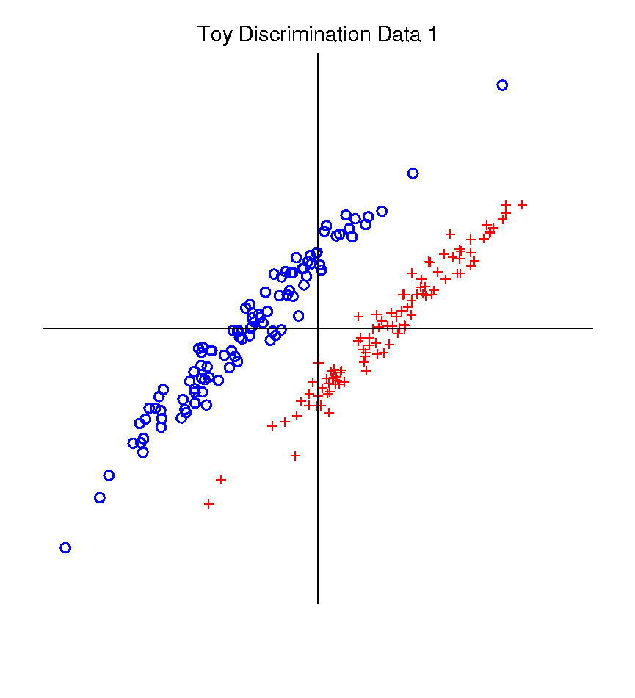
Classical Discrimination
Graphical Display of Classifiers
Use Yellow for Grid
Points Assigned
to Plus Class
Use Cyan for Grid
Points Assigned
to Minus Class
Notes:
PEod1FLDe1.ps

Slide 18
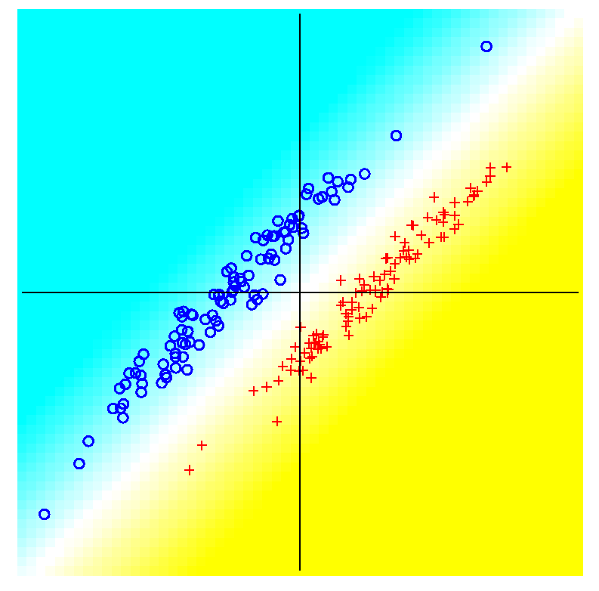
Classical Discrimination
LDA for Tilted Point Clouds – Works well
Notes:
PEod1FLDe1.ps

Slide 19
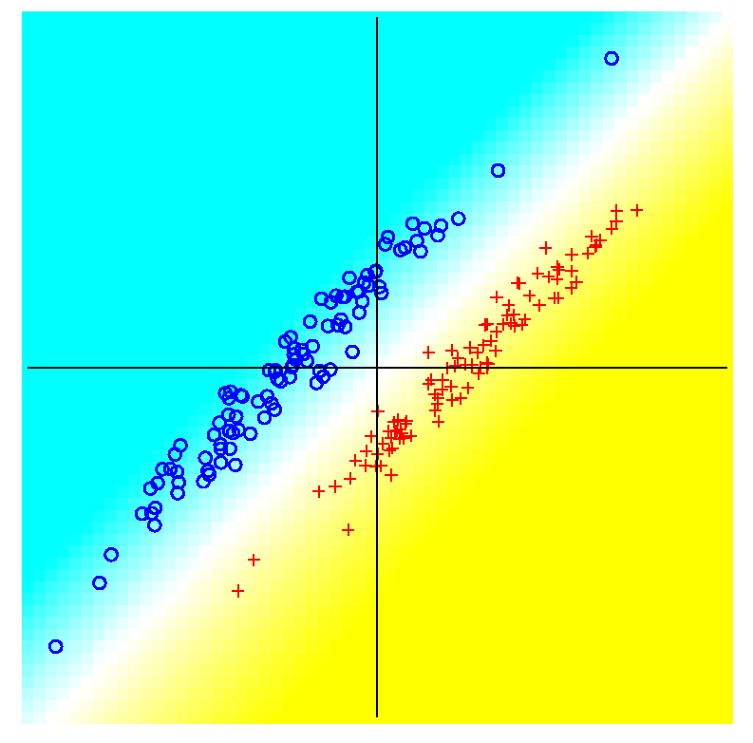
Classical Discrimination
GLR for Tilted Point Clouds – Works well
Notes:
PEod1GLRe1.ps

Slide 20
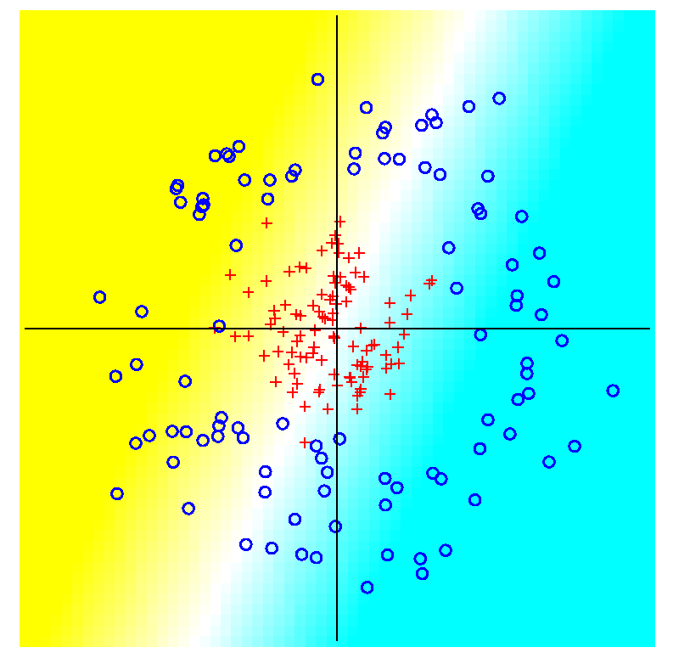
Classical Discrimination
LDA for Donut – Poor, no plane can work
Notes:
PEdonFLDe1.ps

Slide 21
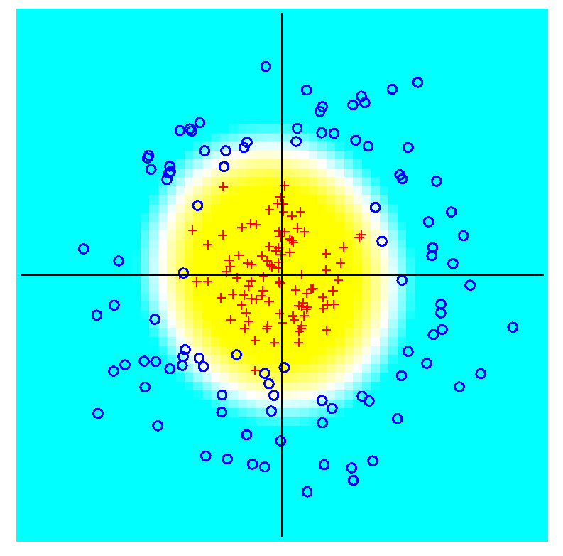
Classical Discrimination
GLR for Donut – Works well (good quadratic)
(Even
though
data not
Gaussian)
Notes:
PEdonGLRe1.ps

Slide 22
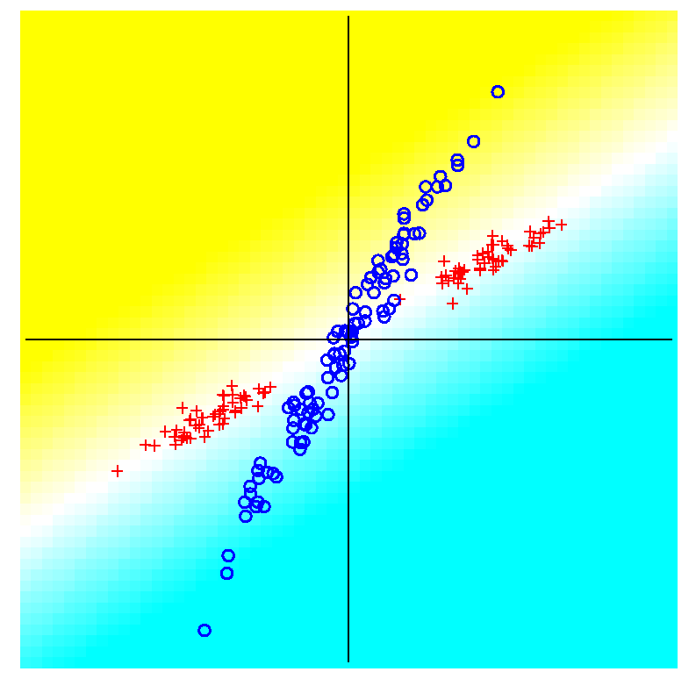
Classical Discrimination
LDA for X – Poor, no plane can work
Notes:
PExd3FLDe1.ps

Slide 23
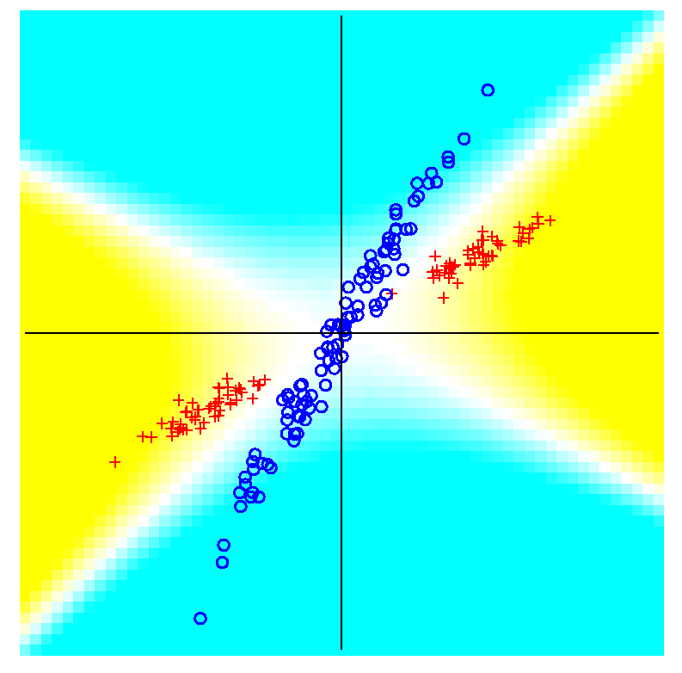
Classical Discrimination
GLR for X – Better, but not great
Notes:
PExd3GLRe1.ps

Slide 24
Classical Discrimination
Summary of LDA vs. GLR:
Tilted Point Clouds Data
LDA good
GLR good
Donut Data
LDA bad
GLR good
X Data
LDA bad
GLR OK, not great
Classical Conclusion: GLR generally better
(will see a different answer for HDLSS data)
High Dimension
Low Sample Size

Slide 25
Classical Discrimination
LDA Generalization II (Gen. I was GLR)
Different prior probabilities
Main idea:
Give different weights to 2 classes
I.e. assume not a priori equally likely
Canonical Example: Rare Disease Testing
(Often Train on Mostly Rare Cases)

Slide 26
Classical Discrimination
LDA Generalization II (Gen. I was GLR)
Different prior probabilities
Main idea:
Give different weights to 2 classes
I.e. assume not a priori equally likely
Development is “straightforward”
Modified likelihood
Change intercept in LDA
Won’t explore further here

Slide 27
Classical Discrimination
LDA Generalization III
Principal Discriminant Analysis
Also Called:
Multiple Discriminant Analysis
Duda, et al. (2001)
Canonical Variate Analysis
Mardia, et al. (1979)

Slide 28
Classical Discrimination
LDA Generalization III
Principal Discriminant Analysis
Idea: LDA-like approach to $K>2$ classes
Assumption: Class covariance matrices are the same (similar)
(but not Gaussian, same situation as for LDA)
Main idea:
Quantify “location of classes” by their means
$${\underline{μ}}^{(1)},{\underline{μ}}^{(2)},⋯,{\underline{μ}}^{(K)}$$
Analog of MD
For $K$ Classes

Slide 29
Classical Discrimination
Principal Discriminant Analysis (cont.)
Simple way to find “interesting directions” among the means:
PCA on set of means
(Think Analog of Mean Difference)

Slide 30
Classical Discrimination
Principal Discriminant Analysis (cont.)
Simple way to find “interesting directions” among the means:
PCA on set of means
i.e. Eigen-analysis of “between class covariance matrix” ${\hat{Σ}}^{B}=MM^{t}$
Where
$$M=\frac{1}{\sqrt{K}}\left(μ^{(1)}−\overline{μ} ⋯μ^{(K)}−\overline{μ}\right)$$
Aside: can show: overall $n\hat{Σ}=K{\hat{Σ}}^{B}+n{\hat{Σ}}^{w}$
Mean of Means

Slide 31
Classical Discrimination
Principal Discriminant Analysis (cont.)
But PCA only works like Mean Difference,
Expect can improve by
taking covariance into account.
(Recall Improvement of LDA over MD)

Slide 32
Classical Discrimination
Principal Discriminant Analysis (cont.)
But PCA only works like Mean Difference,
Expect can improve by
taking covariance into account.
Blind application of above ideas suggests eigen-analysis of: ${Σ^{w}}^{−1}Σ^{B}$
While Min’ing Within
Class Variation
Think Max’ing Between
Class Variation

Slide 33
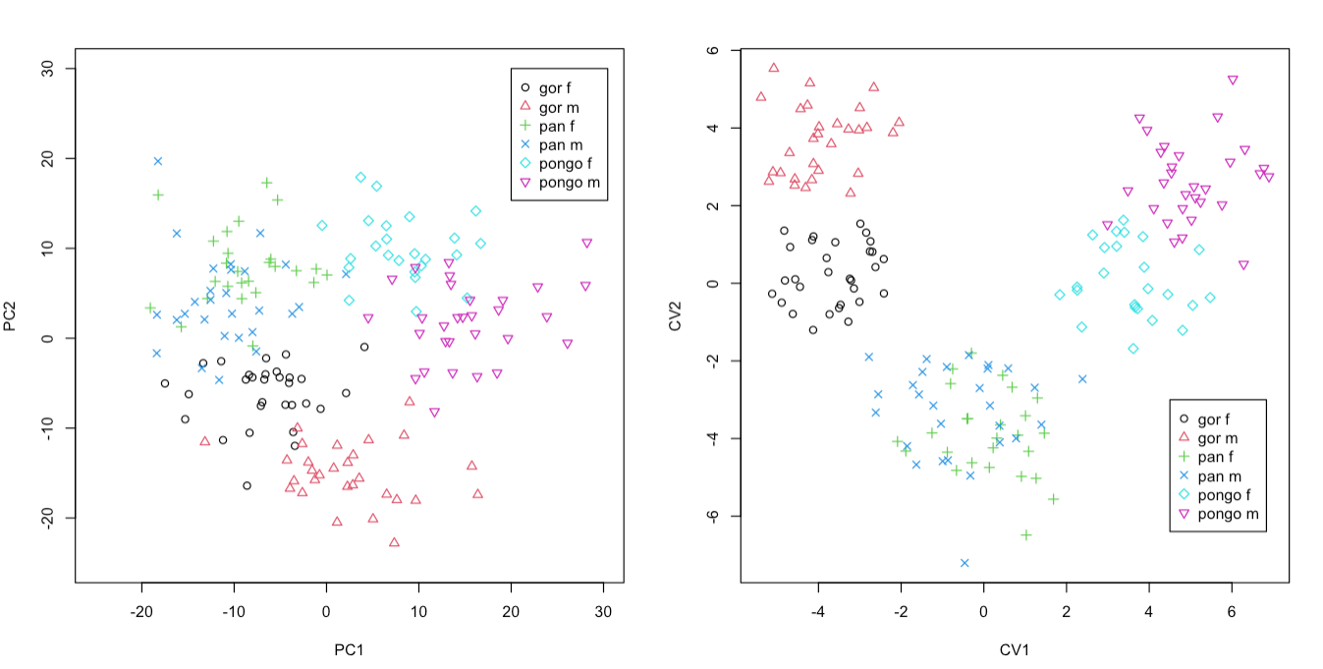
Classical Discrimination
Principal Discriminant Analysis Illustrated
Landmark Shapes of Great Ape Skulls
Text Figure 11.5

Slide 34
Classical Discrimination
Principal Discriminant Analysis Illustrated
Recall Synonyms
Principal Component Analysis
Canonical Variate Analysis
Classes Overlap
Much Better
Separation

Slide 35
Classical Discrimination
Principal Discriminant Analysis (cont.)
There are:
smarter ways to compute
(“generalized eigenvalue”)
other representations
(this solves optimization prob’s)
Special case: 2 classes,
reduces to standard LDA
Good reference for more: Section 3.8 of:
Duda et al. (2001)

Slide 36
Classical Discrimination
Recall Above Summary of Classical Ideas:
Among “Simple Methods”
MD and LDA sometimes similar
Sometimes LDA better
So LDA is preferred
Among Complicated Methods
GLR is best
So always use that?
Caution:
Story changes for HDLSS settings
Now Study This

Slide 37
HDLSS Discrimination
Main HDLSS issues:
Sample Size, $n$ < Dimension, $d$
Singular sample covariance matrix, $\hat{Σ}$
So can’t use matrix inverse
I.e. can’t standardize (sphere) the data
(requires root inverse covariance)
Can’t do classical multivariate analysis

Slide 38
HDLSS Discrimination
Main HDLSS issues:
Can’t do classical multivariate analysis
Key Idea: Standardize
Subtract Sample Mean
Sphere the Data (i.e. Multiply by ${\hat{Σ}}^{−1/2}$)
And use $N(0,I)$ dist’n for statistical inference

Slide 39
HDLSS Discrimination
An approach to non-invertible covariances:
Replace by generalized inverses
Sometimes called pseudo inverses
Note: there are several
Here use Moore Penrose inverse
As used by Matlab (pinv.m)
Often provides useful results
(but not always)

Slide 40
Moore Penrose Generalized Inverse
Based on Eigen-Analysis of $d×d$ Symmetric
Matrix $Σ$
$$Σ=UΛU^{t}$$
Where:
$U$ is an orthonormal basis matrix of $ℝ^{d}$
$Λ$ is a diagonal matrix of eigen-values:
$$λ_{1}≥⋯≥λ_{r}>0=⋯=0$$
$d−r$ is number
of $0$ eigen-values
Rank of $Σ$ is $r$

Slide 41
Moore Penrose Generalized Inverse
Let $Σ^{−}=UΛ^{−}U^{t}$
Where $Λ^{−}$ is the diagonal matrix with entries:
$$\frac{1}{λ_{1}},⋯,\frac{1}{λ_{r}},0,⋯,0$$
$Σ^{−}$ is a generalized inverse in the sense
$Σ^{−}=Σ^{−}ΣΣ^{−}$ and $Σ=ΣΣ^{−}Σ$
Property of Inverse Useful for Many Purposes

Slide 42
HDLSS Discrimination
Application of Generalized Inverse to LDA:
Direction (Normal) Vector:
$$n_{LDA}={\left({\hat{Σ}}^{w}\right)}^{−}\left({\overline{x}}^{+}−{\overline{x}}^{−}\right)$$
Intercept:
$$μ_{LDA}=\left(\frac{1}{2}{\overline{x}}^{+}+\frac{1}{2}{\overline{x}}^{−}\right)$$

Slide 43
HDLSS Discrimination
Application of Generalized Inverse to LDA:
Direction (Normal) Vector:
$$n_{LDA}={\left({\hat{Σ}}^{w}\right)}^{−}\left({\overline{x}}^{+}−{\overline{x}}^{−}\right)$$
Intercept:
$$μ_{LDA}=\left(\frac{1}{2}{\overline{x}}^{+}+\frac{1}{2}{\overline{x}}^{−}\right)$$
Have replaced ${\left({\hat{Σ}}^{w}\right)}^{−1}$ by ${\left({\hat{Σ}}^{w}\right)}^{−}$

Slide 44
HDLSS Discrimination
Toy Example: Increasing Dimension
$n_{+}=n_{−}=20$ data vectors:
Entry 1:
Class +1: $N\left(+2.2,1\right)$ Class –1: $N\left(−2.2,1\right)$
Other Entries: $N\left(0,1\right)$
All Entries Independent
Look through dimensions, $d=1, 2, ⋯, 1000$

Slide 45
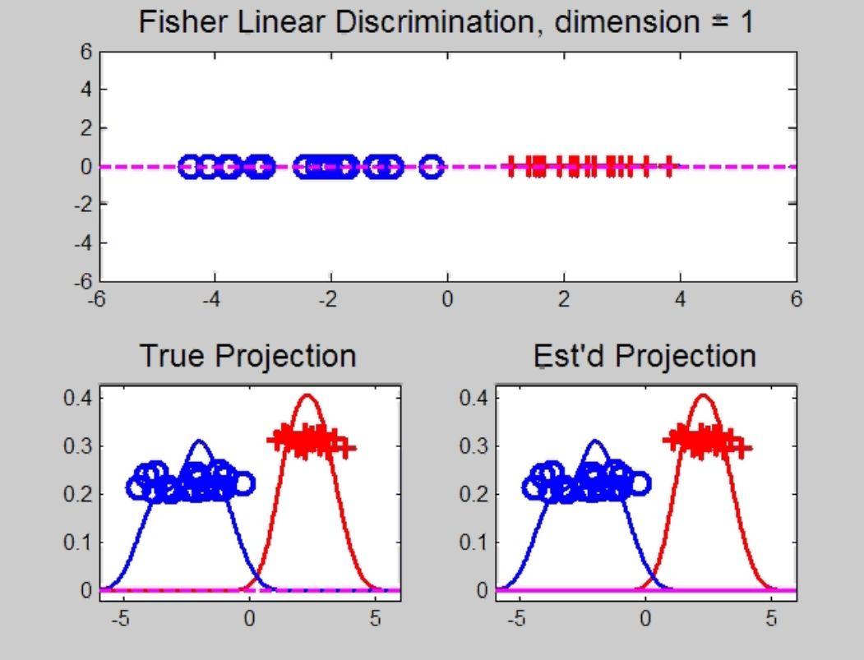
HDLSS Discrimination
Increasing Dimension Example
Project on
Optimal
Direction
Project on
LDA Direction
Project on
Both

Slide 46
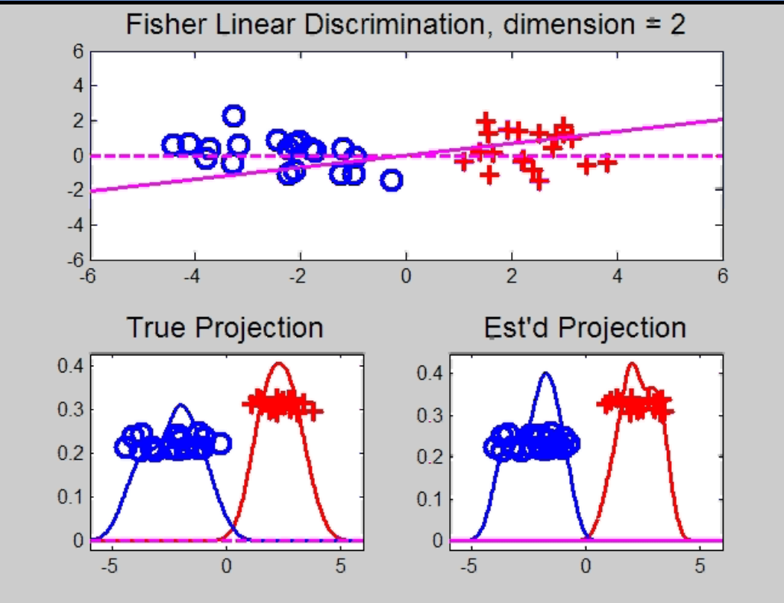
HDLSS Discrimination
Add a 2nd Dimension ($N\left(0,1\right)$ noise)
Same Projections on
Optimal Direction
Axes Here
Are Same As
Directions Here
Now See 2
Dimensions

Slide 47
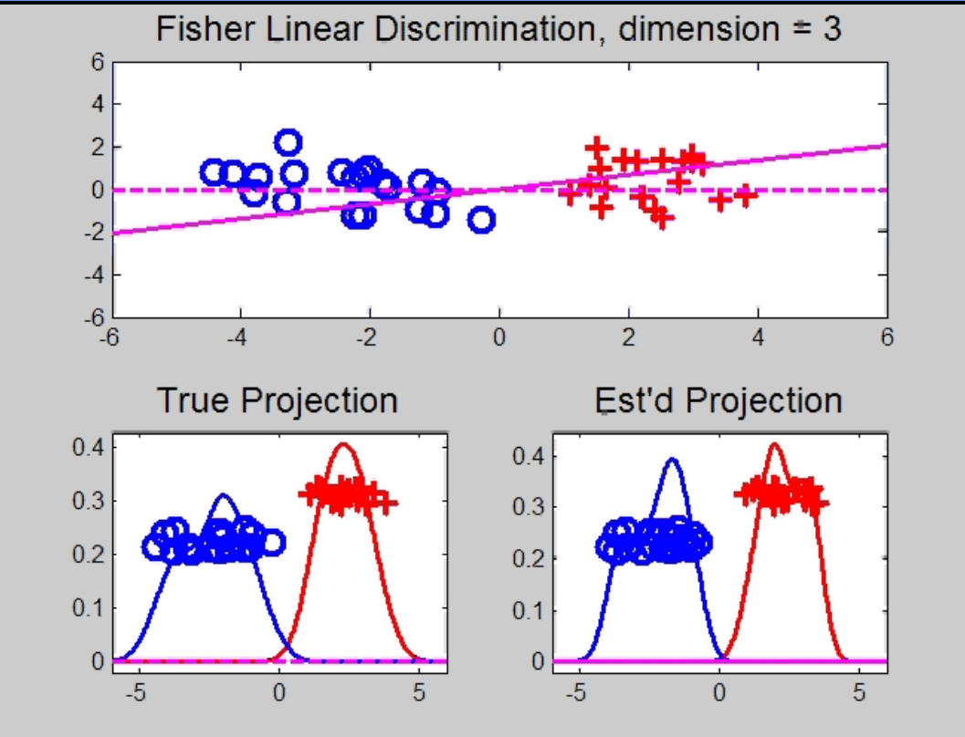
HDLSS Discrimination
Add a 3rd Dimension ($N\left(0,1\right)$ noise)
Project on
2-d subspace
generated
by optimal
dir’n & by
LDA dir’n

Slide 48
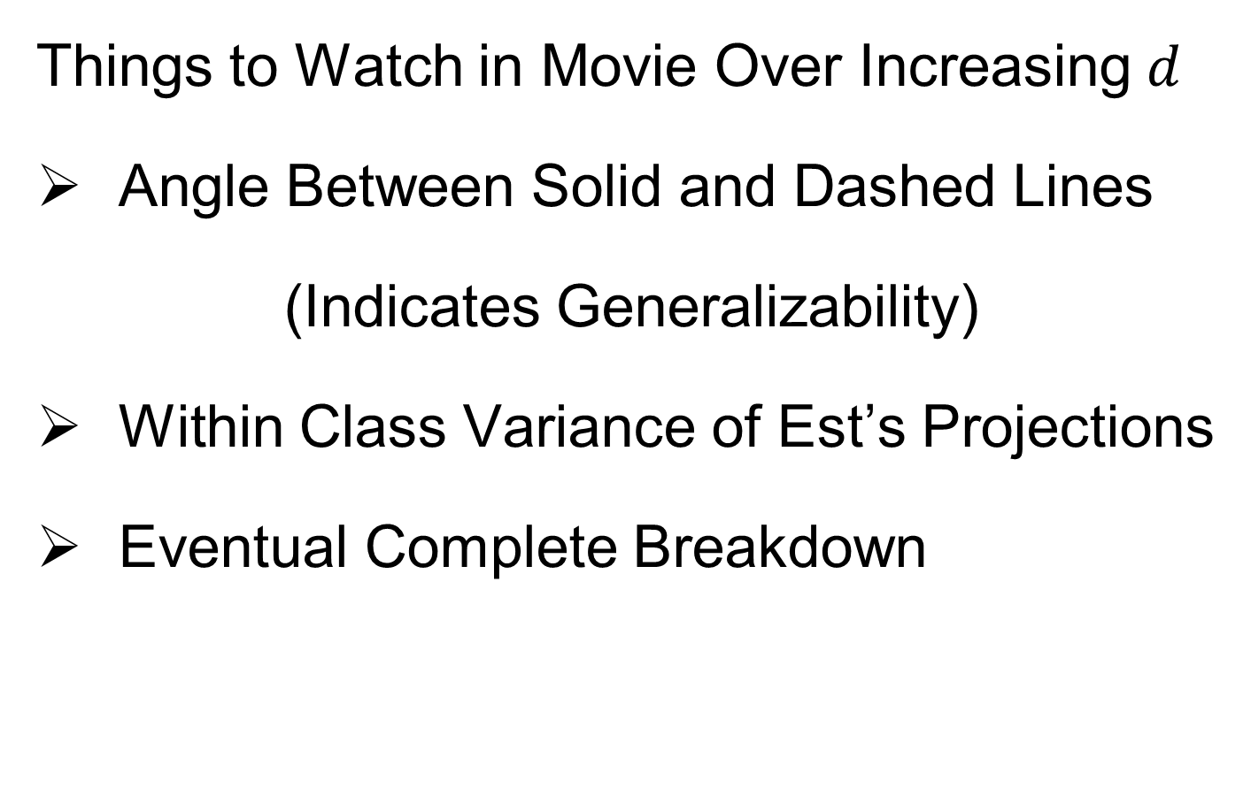
HDLSS Discrimination
Things to Watch in Movie Over Increasing $d$
Angle Between Solid and Dashed Lines
(Indicates Generalizability)
Within Class Variance of Est’s Projections
Eventual Complete Breakdown

Slide 49
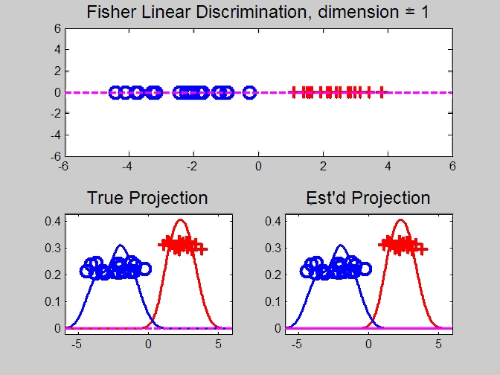
HDLSS Discrimination
Movie Through Increasing Dimensions

Slide 50
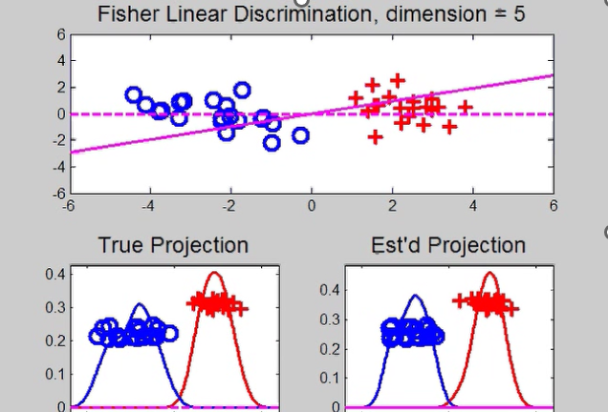
HDLSS Discrimination
LDA in Increasing Dimensions:
Low dimensions (d = 2-9):
Visually good separation
Small angle between LDA and Optimal
Good generalizability

Slide 51
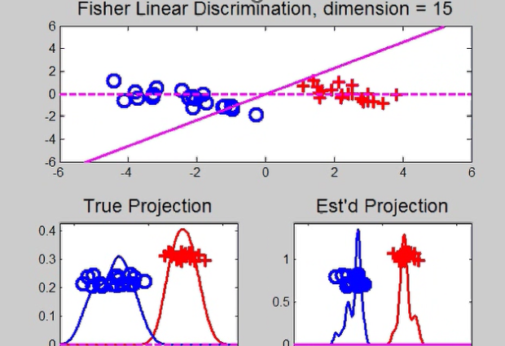
HDLSS Discrimination
LDA in Increasing Dimensions:
Medium Dimensions (d = 10-26):
Visual separation too good?!?
Larger angle between LDA and Optimal
Worse generalizability
Feel effect of sampling noise

Slide 52
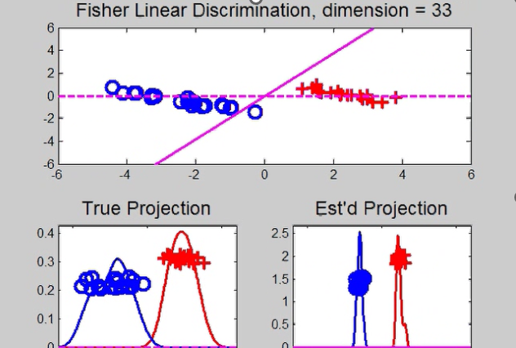
HDLSS Discrimination
LDA in Increasing Dimensions:
High Dimensions (d=27-37):
Much worse angle
Very poor generalizability
But very small within class variation
Poor separation between classes
Large separation / variation ratio

Slide 53
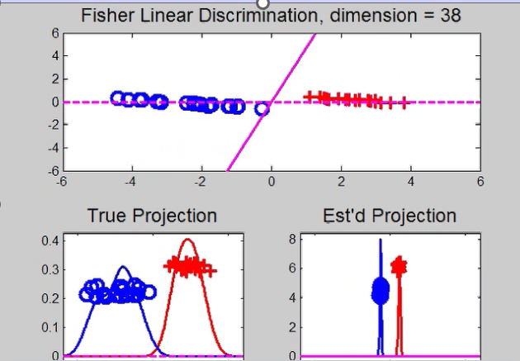
HDLSS Discrimination
LDA in Increasing Dimensions:
At HDLSS Boundary (d=38):
38 = degrees of freedom
(need to estimate 2 class means)
Within class variation = 0 ?!?
Data pile up, on just two points
Perfect separation / variation ratio?
But only feels microscopic noise aspects
So likely not generalizable
Angle to optimal very large

Slide 54
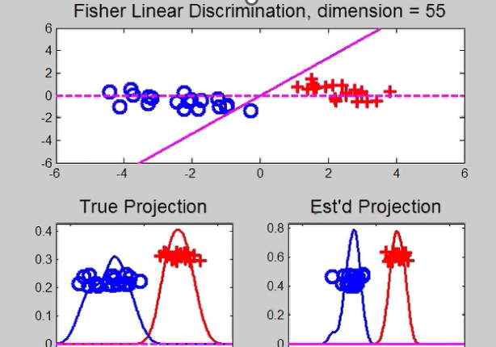
HDLSS Discrimination
LDA in Increasing Dimensions:
Just beyond HDLSS boundary (d=39-70):
Improves with higher dimension?!?
Angle gets better
Improving generalizability?
More noise helps classification?!?

Slide 55
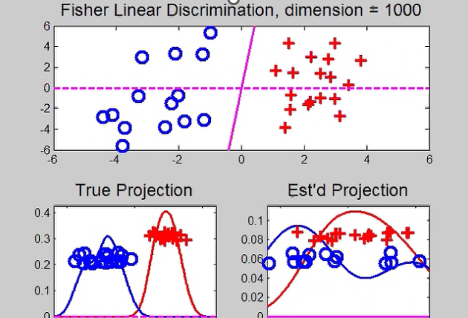

HDLSS Discrimination
LDA in Increasing Dimensions:
Far beyond HDLSS boun’ry (d=70-1000):
Quality degrades
Projections look terrible
(populations overlap)
And Generalizability falls apart, as well
Asymptotics worked out by Bickel & Levina (2004)
Problem is estimation of $d×d$ covariance matrix

Slide 56
HDLSS Discrimination
Simple Solution:
Mean Difference (Centroid) Method
Recall not classically recommended
Usually no better than LDA
Sometimes worse
But avoids estimation of covariance
Means are very stable
Expect less HDLSS problem

Slide 57
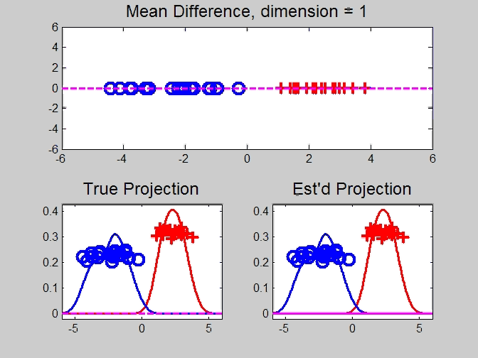
HDLSS Discrimination
Mean Difference (Centroid) Method
Same
Data,
Movie
over
dim’s

Slide 58
HDLSS Discrimination
Mean Difference (Centroid) Method
Far more stable over dimensions
Because is likelihood ratio solution
(for known variance - Gaussians)
Doesn’t feel HDLSS boundary
Eventually becomes too good?!?
Widening gap between clusters?!?
Careful: angle to optimal grows
So lose generalizability (since noise inc’s)
HDLSS data present some odd effects…

Slide 59
HDLSS Discrimination
Mean Difference (Centroid) Method
Same
Data,
Movie
over
dim’s

Slide 60
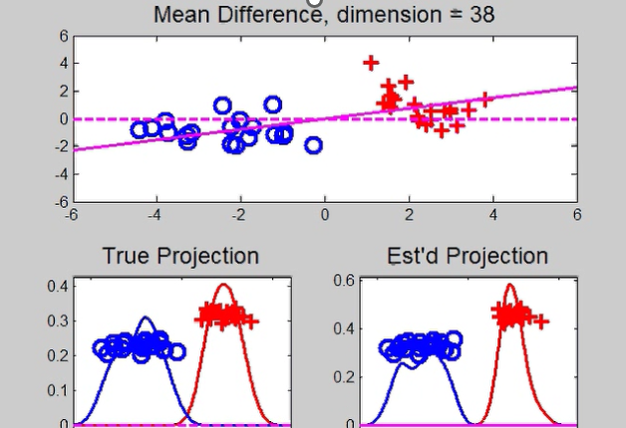
HDLSS Discrimination
Mean Difference (Centroid) Method
Far more stable over dimensions
Because is likelihood ratio solution
(for known variance - Gaussians)
Doesn’t feel HDLSS boundary

Slide 61
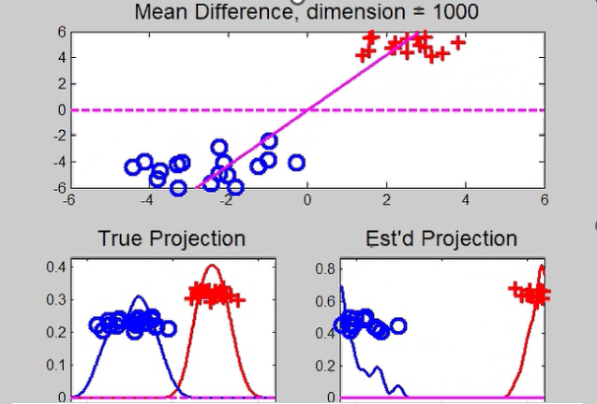
HDLSS Discrimination
Mean Difference (Centroid) Method
Eventually becomes too good?!?
Widening gap between clusters?!?
Careful: angle to optimal grows
So lose generalizability (since noise inc’s)
HDLSS data present some odd effects…

Slide 62
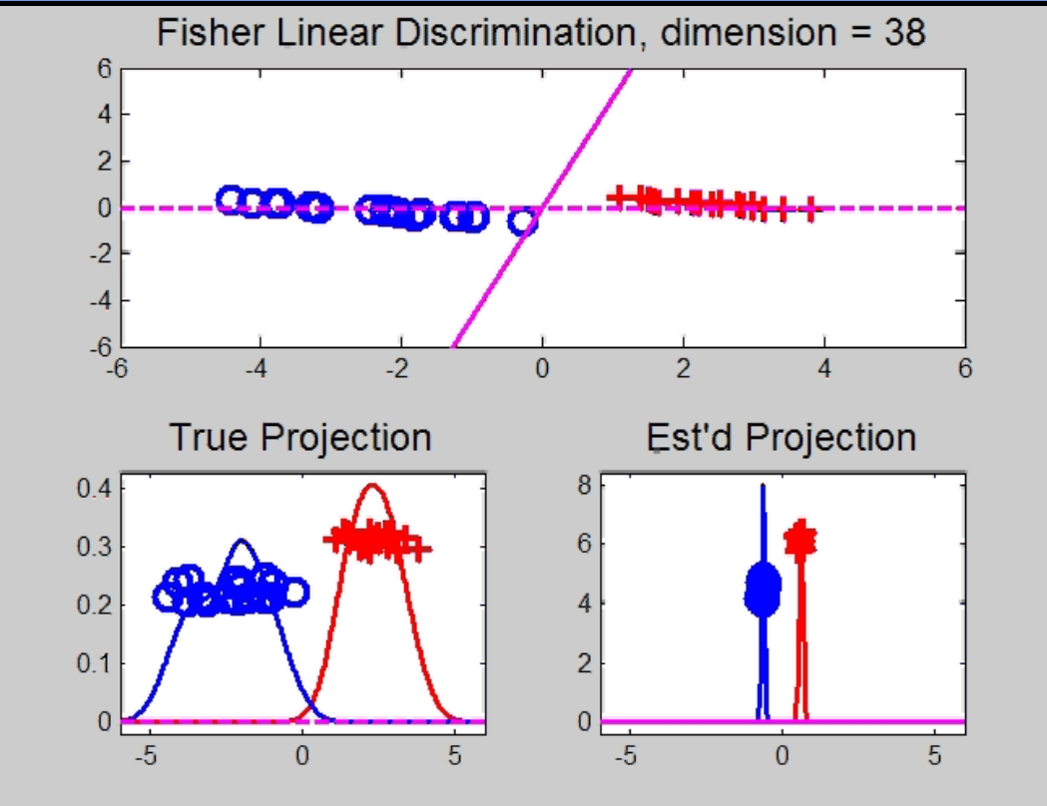
Maximal Data Piling
Text, Sec. 11.1
Strange LDA effect at HDLSS boundary:
Data Piling:
For each class,
all data
project to
single
value

Slide 63
Maximal Data Piling
What is happening?
Hard to imagine
Since our intuition is 3-dim’al
Came from our ancestors…
Try to understand data piling with
some simple examples

Slide 64

Maximal Data Piling
Simple example (Ahn & Marron 2010):
$n_{+}=n_{−}=2$ in $ℝ^{3}$
Let ${ \tilde{H}}_{+}$ be the hyperplane:
Generated by Class +1
Which has dimension = 1
I.e. line containing the 2 points
Similarly, let ${\tilde{H}}_{−}$ be the hyperplane
Generated by Class -1

Slide 65
Maximal Data Piling
Simple example: $n_{+}=n_{−}=2$ in $ℝ^{3}$
Let $H_{+}$, $H_{−}$ be
Parallel shifts of ${\tilde{H}}_{+}$, ${\tilde{H}}_{−}$
So that they pass through the origin
Still have dimension 1
But now are subspaces

Slide 66
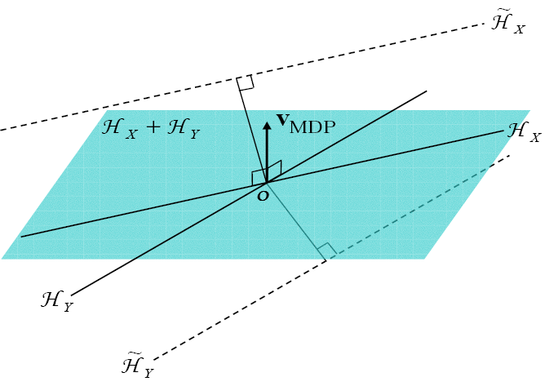
Maximal Data Piling
Simple example: $n_{+}=n_{−}=2$ in $ℝ^{3}$
Notes:
C:\Documents and Settings\J S Marron\My Documents\Research\ComplexPopn\MaxDataPiling\dppic2_2.pdf

Slide 67
Maximal Data Piling
Simple example: $n_{+}=n_{−}=2$ in $ℝ^{3}$
Construction 1:
Let $H_{+}+H_{−}$ be
Subspace generated by $H_{+}$ & $H_{−}$
Two dimensional
Shown as cyan plane

Slide 68
Maximal Data Piling
Simple example: $n_{+}=n_{−}=2$ in $ℝ^{3}$
Construction 1 (cont.):
Let $v_{MDP}$ be
Direction orthogonal to $H_{+}+H_{−}$
One dimensional
Makes Class +1 Data project to one point
And Class -1 Data project to one point
Called Maximal Data Piling Direction

Slide 69
Maximal Data Piling
Simple example: $n_{+}=n_{−}=2$ in $ℝ^{3}$
Notes:
C:\Documents and Settings\J S Marron\My Documents\Research\ComplexPopn\MaxDataPiling\dppic2_2.pdf

Slide 70
Maximal Data Piling
Simple example: $n_{+}=n_{−}=2$ in $ℝ^{3}$
Construction 2:
Let ${H_{+}}^{⊥}$ & ${H_{−}}^{⊥}$ be
Subspaces orthogonal to $H_{+}$ & $H_{−}$
(respectively)
${H_{+}}^{⊥}$ Projection collapses Class +1
${H_{−}}^{⊥}$ Projection collapses Class -1
Both are 2-d (planes)

Slide 71
Maximal Data Piling
Simple example: $n_{+}=n_{−}=2$ in $ℝ^{3}$
Construction 2 (cont.):
Let intersection of ${H_{+}}^{⊥}$ & ${H_{−}}^{⊥}$ be $v_{MDP}$
Same Maximal Data Piling Direction
Projection collapses both
Class +1 and Class -1
Intersection of 2-d (planes) is 1-d dir’n

Slide 72
Maximal Data Piling
General Case: $n_{+}$,$n_{−}$ in $ℝ^{d}$ with $d≥n_{+}+n_{−}$
Let ${\tilde{H}}_{+}$ & ${\tilde{H}}_{−}$ be
Hyperplanes generated by Classes
Of Dimensions $n_{+}−1$, $n_{−}−1$ (resp.)
Let $H_{+}$ & $H_{−}$ be
Parallel subspaces
I.e. shifts to origin
Of Dimensions $n_{+}−1$, $n_{−}−1$ (resp.)

Slide 73
Maximal Data Piling
General Case: $n_{+}$,$n_{−}$ in $ℝ^{d}$ with $d≥n_{+}+n_{−}$
Let ${H_{+}}^{⊥}$ & ${H_{−}}^{⊥}$ be
Orthogonal Subspaces
Of Dim’ns $d−n_{+}+1$, $d−n_{−}+$1 (resp.)
Where
Proj’n in ${H_{+}}^{⊥}$ Dir’ns Collapse Class +1
Proj’n in ${H_{−}}^{⊥}$ Dir’ns Collapse Class -1
Expect $d−n_{+}−n_{−}+2$ intersection

Slide 74
Maximal Data Piling
General Case: $n_{+}$,$n_{−}$ in $ℝ^{d}$ with $d≥n_{+}+n_{−}$
Can show (Ahn & Marron 2010):
Most dir’ns in intersection collapse all to 0
But there is a great circle of directions
(within subspace generated by data)

Slide 75
Maximal Data Piling
General Case: $n_{+}$,$n_{−}$ in $ℝ^{d}$ with $d≥n_{+}+n_{−}$
Can show (Ahn & Marron 2010):
Most dir’ns in intersection collapse all to 0
But there is a great circle of directions,
Where Classes collapse to different points
(Gap changes along great circle,
including sign flips)

Slide 76
Maximal Data Piling
General Case: $n_{+}$,$n_{−}$ in $ℝ^{d}$ with $d≥n_{+}+n_{−}$
Can show (Ahn & Marron 2010):
Most dir’ns in intersection collapse all to 0
But there is a great circle of directions,
Where Classes collapse to different points
Distance is max’ed in 2 direct’ns: $±v_{MDP}$
Called Maximal Data Piling direction(s)
Unique (up to $±$) in subspace of data

Slide 77
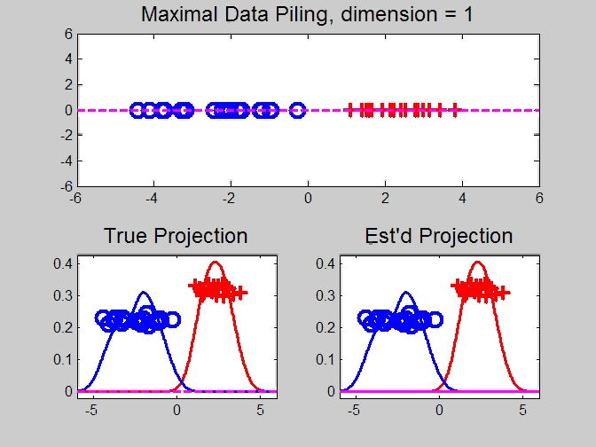
Maximal Data Piling
Movie Through Increasing Dimensions

Slide 78
Maximal Data Piling
MDP in Increasing Dimensions:
Sub HDLSS dimensions (d = 1-37):
Looks similar to LDA?!?
Reason for this?
At HDLSS Boundary (d = 38):
Again similar to LDA…

Slide 79
Maximal Data Piling
MDP in Increasing Dimensions:
For HDLSS dimensions (d = 39-1000):
Always have data piling
Gap between grows for larger n
Even though noise increases?
Angle (gen’bility) first improves, d = 39–180
Then worsens, d = 200-1000
Eventually noise dominates
Trade-off is where gap near optimal diff’nce

Slide 80
Maximal Data Piling
How to compute $v_{MDP}$?
Can show (Ahn & Marron 2010):
$$v_{MDP}={\hat{Σ}}^{−}\left({\overline{x}}^{+}−{\overline{x}}^{−}\right)$$
Recall LDA formula:
$$v_{LDA}={\left({\hat{Σ}}^{w}\right)}^{−}\left({\overline{x}}^{+}−{\overline{x}}^{−}\right)$$
Only difference is global vs. within class
Covariance Estimates!

Slide 81
Maximal Data Piling
Historical Note:
Discovery of MDP
Came from a programming error
Forgetting to use within class covariance
In LDA…

Slide 82
Maximal Data Piling
Visual similarity of ${\underline{v}}_{MDP}$ & ${\underline{v}}_{LDA}$?
Can show (Ahn & Marron 2010),
for $d≤n−2$:
$${{\underline{v}}_{MDP}}/{\left\|{\underline{v}}_{MDP}\right\|}={{\underline{v}}_{LDA}}/{\left\|{\underline{v}}_{LDA}\right\|}$$
I.e. directions are the same!
How can this be?
Note lengths are different…
Study from transformation viewpoint

Slide 83
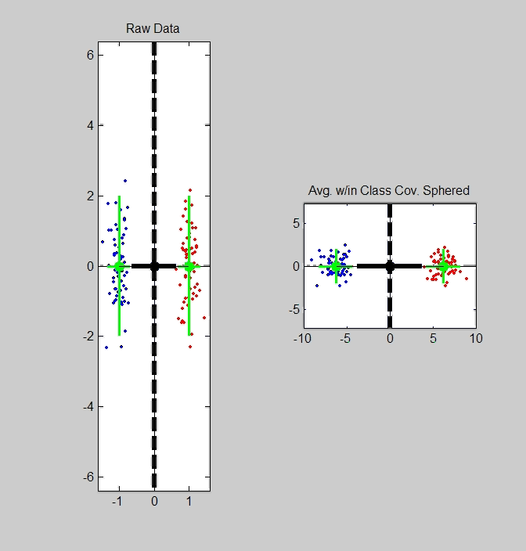
Maximal Data Piling
Recall
Transfo’
view of
LDA:

Slide 84
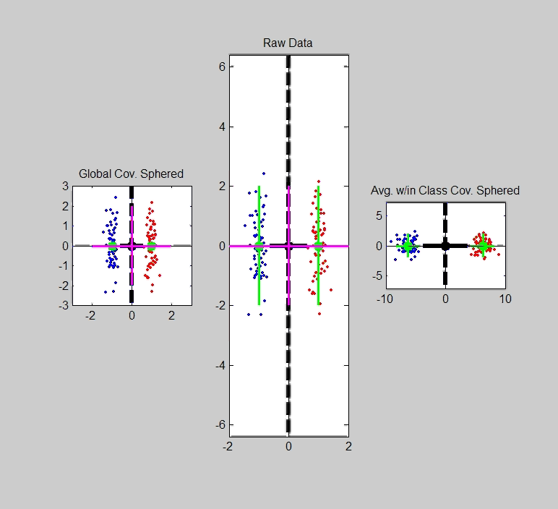
Maximal Data Piling
Include
Corres-
ponding
MDP
Transfo’:
Both give
Same
Result!

Slide 85
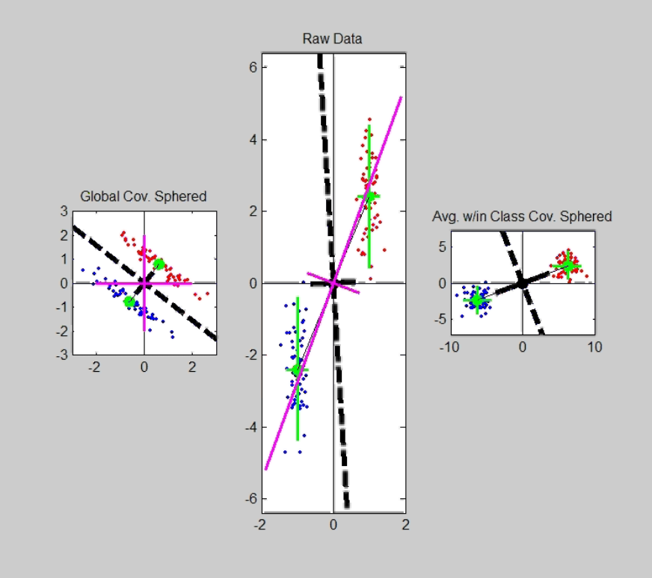
Maximal Data Piling
Details:
LDA & MDP:
Separating Plane
Normal Vector
Computed in Each
Transformed Space,
Shown in Original
Space

Slide 86
Maximal Data Piling
Details:
LDA & MDP:
Separating Plane
Normal Vector
Within Class:
PC1
PC2
Computed for Each
Class Separately

Slide 87
Maximal Data Piling
Details:
LDA & MDP:
Separating Plane
Normal Vector
Within Class:
PC1
PC2
Global:
PC1
PC2
Computed
Globally

Slide 88

Maximal Data Piling
Acknowledgement:
This viewpoint
I.e. insight into why LDA = MDP
(for low dim’al data)
Suggested by Daniel Peña

Slide 89
Maximal Data Piling
Another Viewpoint on:
$${v_{MDP}}/{\left\|v_{MDP}\right\|}={v_{LDA}}/{\left\|v_{LDA}\right\|}$$
for $d<n$
I.e. directions are the same
Study from optimization viewpoint

Slide 90
Maximal Data Piling
Alternate approach: Optimization Viewpoint
For a direction vector, $v$ ($\left\|v\right\|=1$),
and for $⨀$ = +,- define
$\overline{P_{v}X^{⨀}}=Avg\left(v^{t}x^{⨀}\right)$ = Average Proj’n
$V_{v}^{⨀}=var(v^{t}x^{⨀})$ = Variance of Proj’ns
Consider:
$\max_{v}{\frac{{\left(\overline{P_{v}X^{+}}−\overline{P_{v}X^{−}}\right)}^{2}}{V_{v}^{+}+V_{v}^{−}}}$
Between Class
Variation
Within Class
Variation

Slide 91
Maximal Data Piling
Consider Optimization:
$$\max_{v}{\frac{{\left(\overline{P_{v}X^{+}}−\overline{P_{v}X^{−}}\right)}^{2}}{V_{v}^{+}+V_{v}^{−}}}$$
Seems Sensible and Useful?
“MD² / Variation” is Basis of F-Test?
Study in Context of Visualizations
(HDLSS Contexts Require Caution)

Slide 92
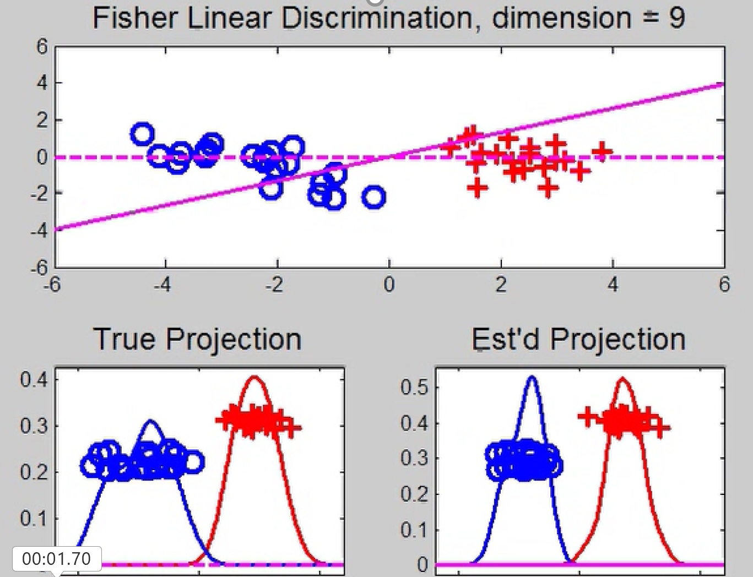
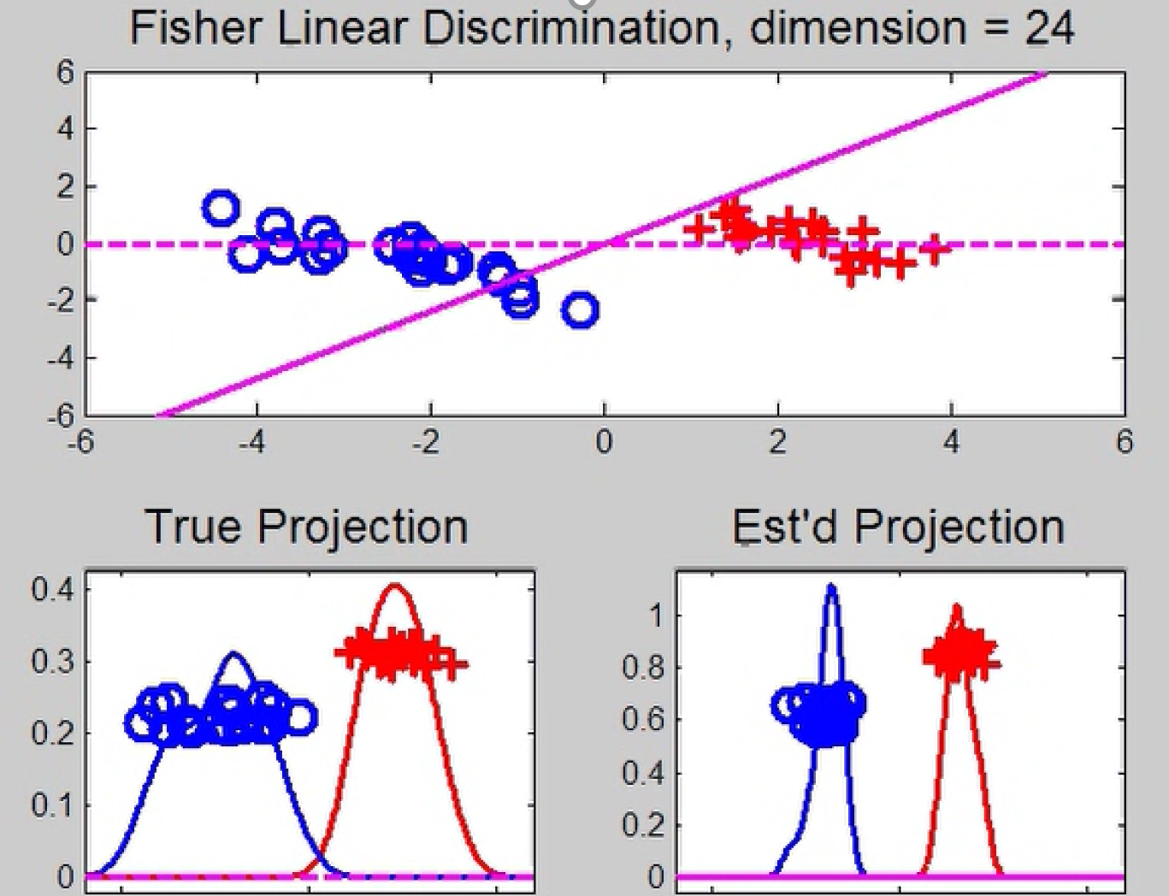
Maximal Data Piling
Now Relate Visualizations to Optimization:
$\max_{v}{\frac{{\left(\overline{P_{v}X^{+}}−\overline{P_{v}X^{−}}\right)}^{2}}{V_{v}^{+}+V_{v}^{−}}}$
Yet Lower $d$
Is More
Generalizable
This is Better
For Higher $d$

Slide 93
Maximal Data Piling
Alternate approach: Optimization Viewpoint
Find a direction vector, $v$ ($\left\|v\right\|=1$), to
$\max_{v}{\frac{{\left(\overline{P_{v}X^{+}}−\overline{P_{v}X^{−}}\right)}^{2}}{V_{v}^{+}+V_{v}^{−}}}$
Case 1: $d≤n−2$
Solutions are:
$$v_{LDA}∝{\left({\hat{Σ}}^{w}\right)}^{−}\left({\overline{X}}^{+}−{\overline{X}}^{−}\right)$$
$$v_{MDP}∝{\hat{Σ}}^{−}\left({\overline{X}}^{+}−{\overline{X}}^{−}\right)$$
E.g. Sec. 3.8.2 of
Duda et al (2001)
Common
Practice In
Literature:
Assume
This, But
Not Make It
Very Clear

Slide 94
Maximal Data Piling
$\max_{v}{\frac{{\left(\overline{P_{v}X^{+}}−\overline{P_{v}X^{−}}\right)}^{2}}{V_{v}^{+}+V_{v}^{−}}}$
Case 2: $d≥n−1$
Solution is:
$v_{MDP}={\hat{Σ}}^{−}\left({\overline{X}}^{+}−{\overline{X}}^{−}\right)$
But not:
$v_{LDA}={\left({\hat{Σ}}^{w}\right)}^{−}\left({\overline{X}}^{+}−{\overline{X}}^{−}\right)$
Point
Not Made
Anywhere
Else???

Slide 95
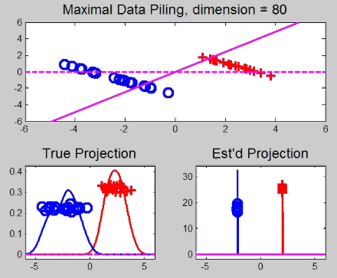
Maximal Data Piling
A point of terminology (Ahn & Marron 2010):
MDP is “maximal” in 2 senses:
# of data piled
Size of gap
(within subspace
gen’d by data)

Slide 96
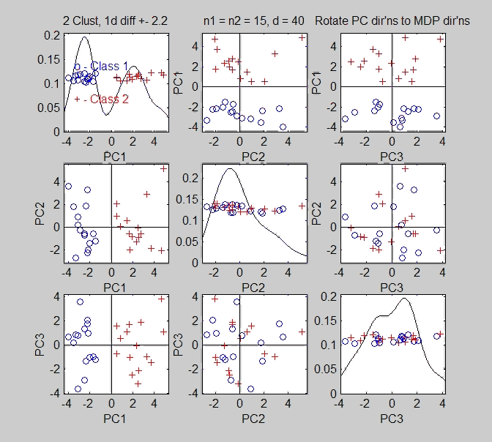
Maximal Data Piling
Fun e.g:
rotate
from PCA
to MDP
dir’ns

Slide 97
Maximal Data Piling
MDP for other class labellings:
Always exists
Separation bigger for natural clusters
Could be used for clustering
Consider all pairwise MDP directions
Find one that makes largest gap
Very hard optimization problem
Over 2^{n-2} possible directions
Ahn, et al. (2012)
Major Challenge:
Fast Computation?

Slide 98
Maximal Data Piling
Usefulness for Classification?
First Glance: Terrible, not generalizable
HDLSS View: Maybe OK?
Simulation Result:
Good Performance for
Autocorrelated Errors
Every Dog
Has His Day
Reason: Induces Stretch in Data - Miao (2015)

Slide 99
Maximal Data Piling
Recurring, over-arching, issue:
HDLSS space is a weird place

Slide 100
Kernel Embedding
Aizerman, Braverman and Rozoner (1964)
Motivating idea:
Extend scope of linear discrimination,
By adding nonlinear components to data
(embedding in a higher dim’al space)
Better use of name:
nonlinear discrimination?
Text: Sec. 11.2

Slide 101
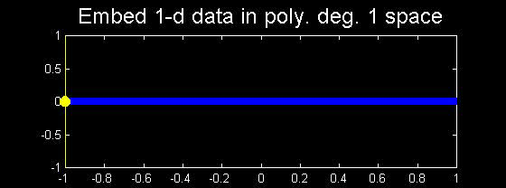
Kernel Embedding
Toy Examples:
In 1d, linear separation splits the domain
$\left\{x:x∈ℝ\right\}$ into only 2 parts

Slide 102
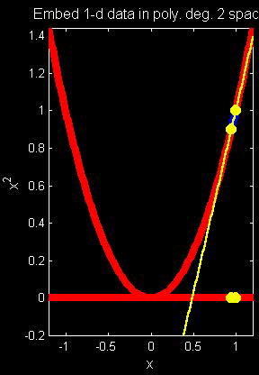
Kernel Embedding
But in the “quadratic
embedded domain”,
$\left\{{\left(x,x^{2}\right)}^{t}:x∈ℝ\right\}⊂ℝ^{2}$
linear separation
can give 3 parts

Slide 103
Kernel Embedding
But in the quadratic embedded domain
$\left\{{\left(x,x^{2}\right)}^{t}:x∈ℝ\right\}⊂ℝ^{2}$
Linear separation can give 3 parts
original data space lies in 1d manifold
very sparse region of $ℝ^{2}$
curvature of manifold gives:
better linear separation
can have any 2 break points
(2 points $⟹$ line)

Slide 104
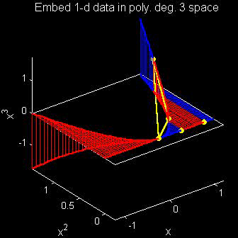
Kernel Embedding
Stronger effects for
higher order
polynomial embedding:
E.g. for cubic,
$\left\{{\left(x,x^{2},x^{3}\right)}^{t}:x∈ℝ\right\}⊂ℝ^{3}$
linear separation
can give 4 parts
(or fewer)

Slide 105
Kernel Embedding
Stronger effects - high. ord. poly. embedding:
original space lies in 1-d manifold,
even sparser in $ℝ^{3}$
higher $d$ curvature gives:
improved linear separation
can have any 3 break points
(3 points $⟹$ plane)?
Note: relatively few
“interesting separating planes”

Slide 106
Kernel Embedding
General View: for original data matrix:
$$\left(\begin{matrix}x_{11} & ⋯ & x_{1n} \\ ⋮ & ⋱ & ⋮ \\ x_{d1} & ⋯ & x_{dn}\end{matrix}\right)$$
add rows:
i.e. embed in
Higher
Dimensional
space
$$\left(\begin{matrix}\begin{matrix}x_{11} \\ ⋮ \\ x_{d1}\end{matrix} & & \begin{matrix}x_{1n} \\ ⋮ \\ x_{dn}\end{matrix} \\ \begin{matrix}x_{11}^{2} \\ ⋮ \\ x_{d1}^{2}\end{matrix} & ⋯ & \begin{matrix}x_{1n}^{2} \\ ⋮ \\ x_{dn}^{2}\end{matrix} \\ \begin{matrix}x_{11}x_{21} \\ ⋮\end{matrix} & & \begin{matrix}x_{1d}x_{2d} \\ ⋮\end{matrix}\end{matrix}\right)$$

Slide 107
Kernel Embedding
Embedded Linear Discriminant Analysis:
Choose Class +1, for any ${\underline{x}}^{0}∈ℝ^{d}$ when:
$${x^{0}}^{t}{{\hat{Σ}}^{w}}^{−1}\left({\overline{x}}^{+}−{\overline{x}}^{−}\right)≥\frac{1}{2}{{{\left({\overline{x}}^{+}+{\overline{x}}^{−}\right)}^{t}\hat{Σ}}^{w}}^{−1}\left({\overline{x}}^{+}−{\overline{x}}^{−}\right)$$
in embedded space.
Image of class boundaries in original space is nonlinear
Allows more complicated class regions
Can also do Gaussian Lik. Rat. (or others)
Compute image by classifying points from original space

Slide 108
Kernel Embedding
Visualization for Toy Examples:
Have Linear Disc. In Embedded Space
Study Effect in Original Data Space
Via Implied Nonlinear Regions
Challenge: Hard to Explicitly Compute

Slide 109
Kernel Embedding
Visualization for Toy Examples:
Have Linear Disc. In Embedded Space
Study Effect in Original Data Space
Via Implied Nonlinear Regions
Approach:
Use Test Set in Original Space
(dense equally spaced grid)
Apply embedded discrimination Rule
Color Using the Result

Slide 110
Kernel Embedding
Recall Classifier Display Device:
Parallel Clouds
Use Yellow for Grid
Points Assigned
to Plus Class
Use Cyan for Grid
Points Assigned
to Minus Class
Notes:
PEod1Raw.ps

Slide 111
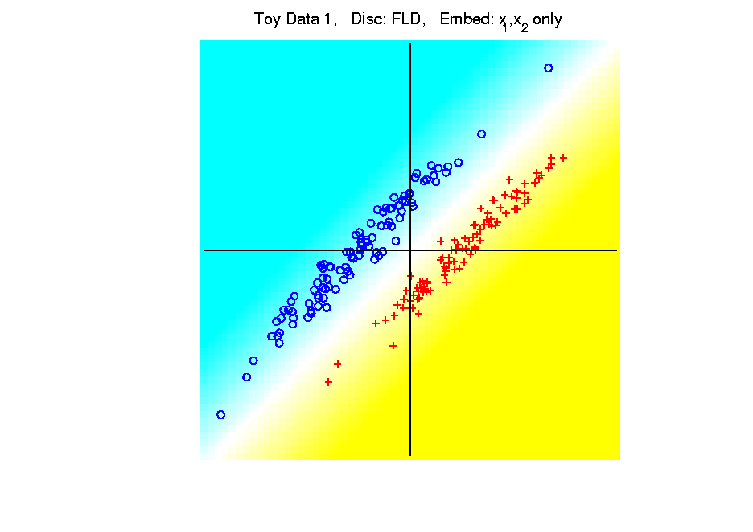
Kernel Embedding
Polynomial Embedding, Toy Example 1:
Parallel Clouds
LDA
Original
Data
Notes:
PEod1Raw.ps

Slide 112
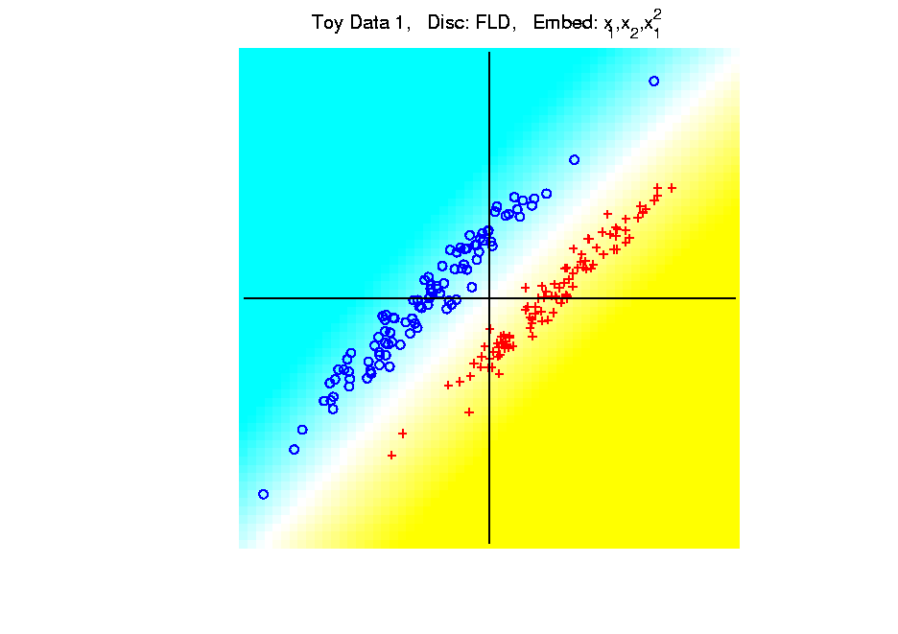
Kernel Embedding
Polynomial Embedding, Toy Example 1:
Parallel Clouds
LDA
Notes:
PEod1Raw.ps

Slide 113
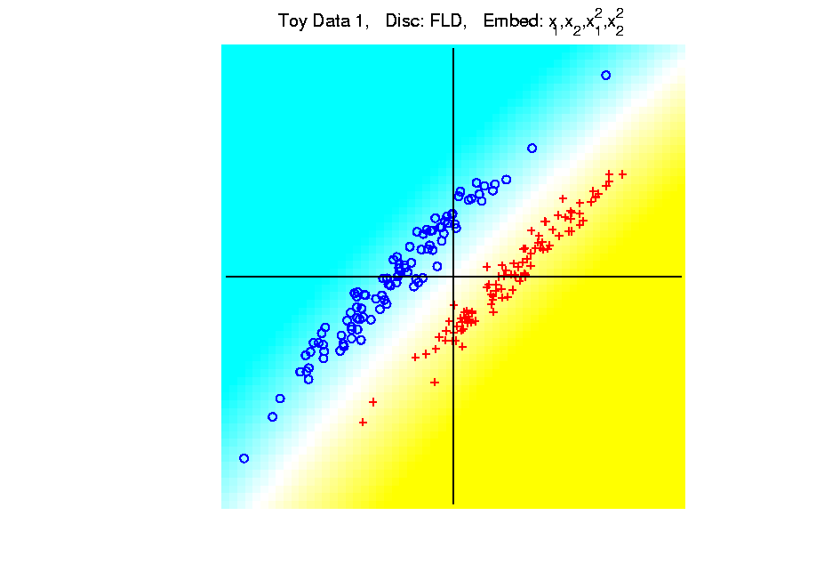
Kernel Embedding
Polynomial Embedding, Toy Example 1:
Parallel Clouds
LDA
Notes:
PEod1Raw.ps

Slide 114
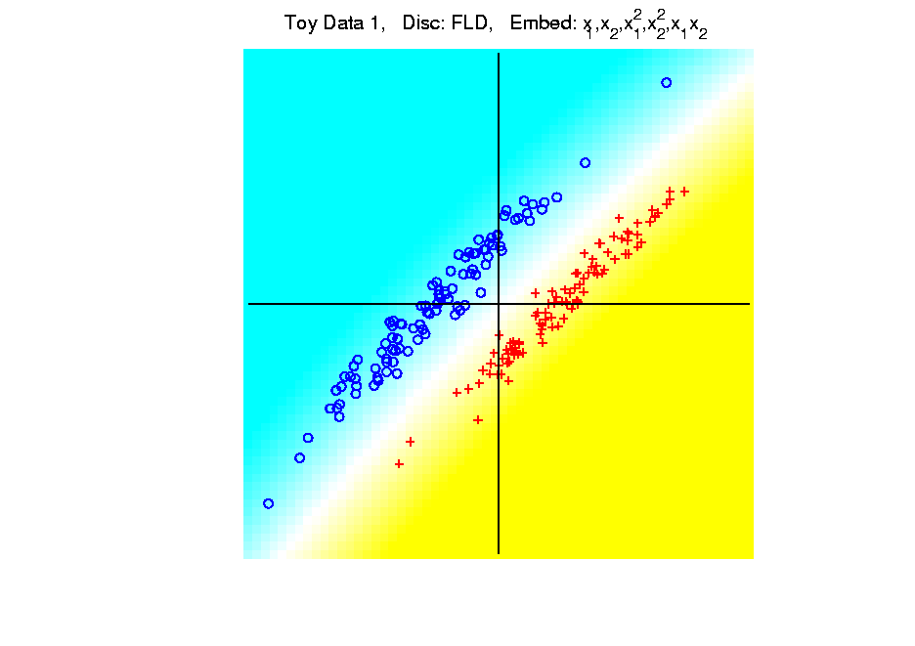
Kernel Embedding
Polynomial Embedding, Toy Example 1:
Parallel Clouds
LDA
Notes:
PEod1Raw.ps

Slide 115
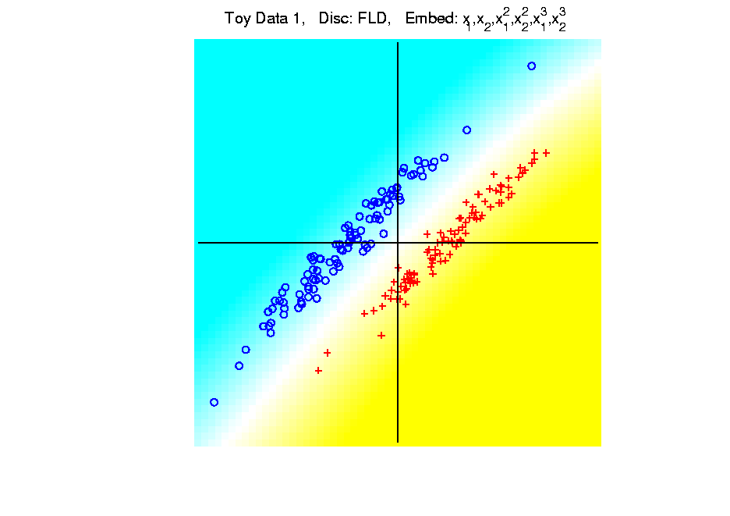
Kernel Embedding
Polynomial Embedding, Toy Example 1:
Parallel Clouds
LDA
All Stable
& Very Good
Since No Better
Separation in
Embedded Space
Notes:
PEod1Raw.ps

Slide 116

Kernel Embedding
Polynomial Embedding, Toy Example 1:
Parallel Clouds
GLR
Original
Data
Notes:
PEod1Raw.ps

Slide 117
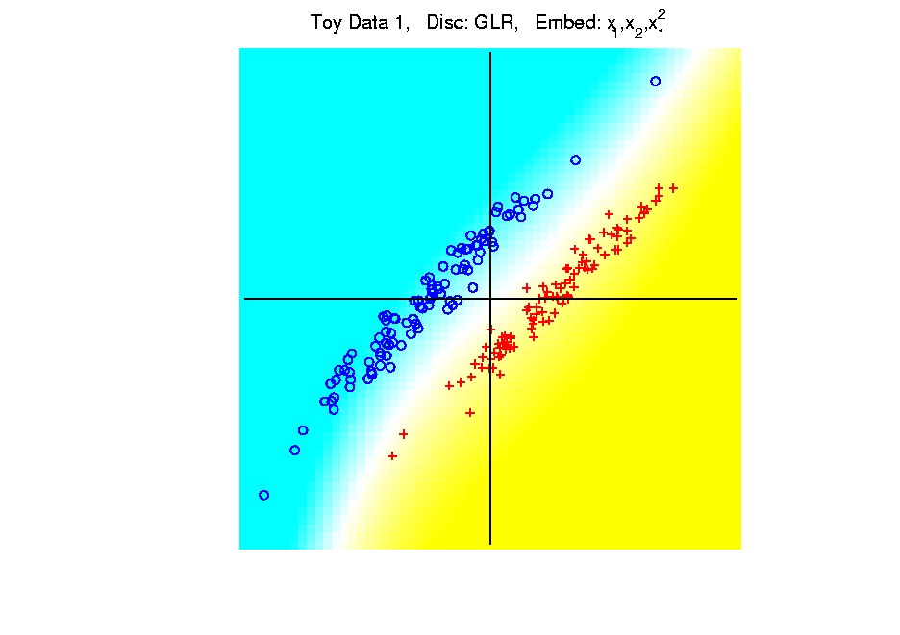
Kernel Embedding
Polynomial Embedding, Toy Example 1:
Parallel Clouds
GLR
Notes:
PEod1Raw.ps

Slide 118
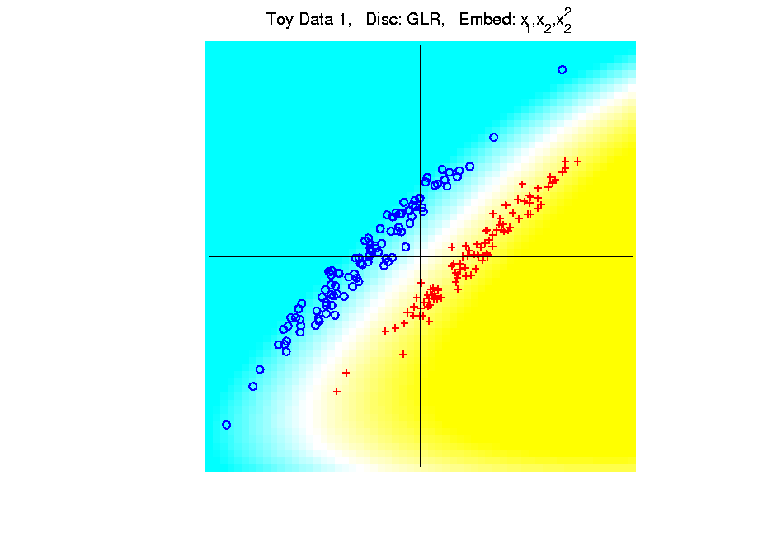
Kernel Embedding
Polynomial Embedding, Toy Example 1:
Parallel Clouds
GLR
Notes:
PEod1Raw.ps

Slide 119
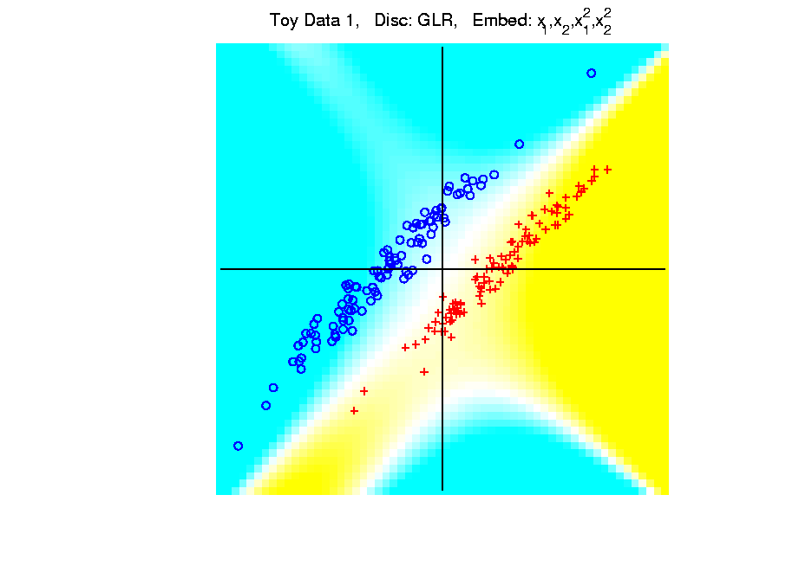
Kernel Embedding
Polynomial Embedding, Toy Example 1:
Parallel Clouds
GLR
Notes:
PEod1Raw.ps

Slide 120
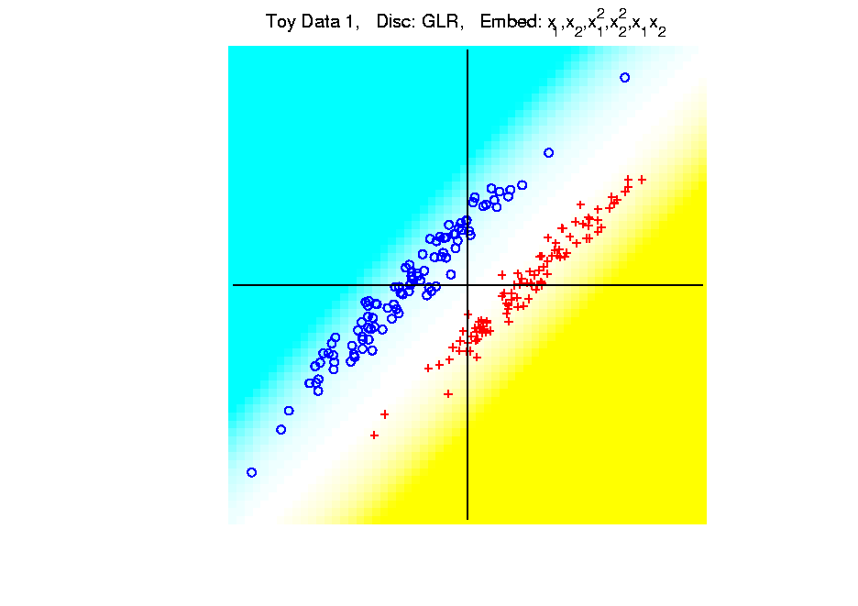
Kernel Embedding
Polynomial Embedding, Toy Example 1:
Parallel Clouds
GLR
Notes:
PEod1Raw.ps

Slide 121
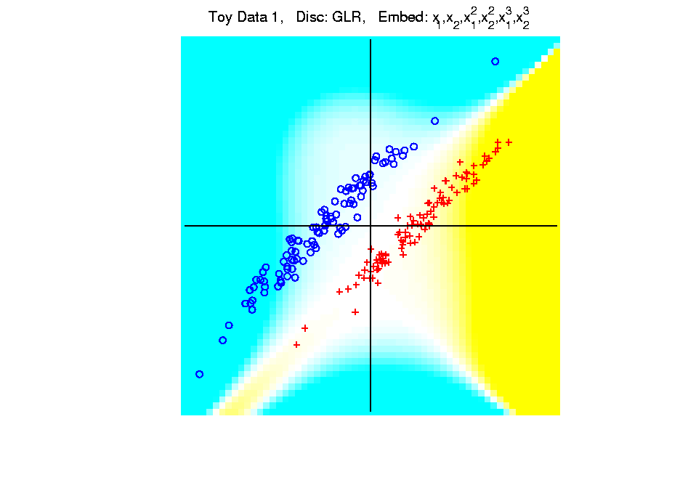
Kernel Embedding
Polynomial Embedding, Toy Example 1:
Parallel Clouds
GLR
Unstable
Subject to
Overfitting
Too Much Flexibility
In Embedded Space
Notes:
PEod1Raw.ps

Slide 122
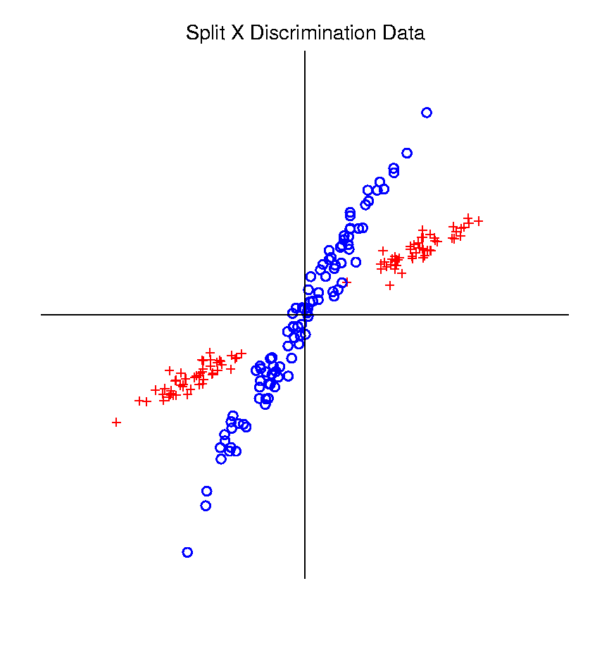
Kernel Embedding
Polynomial Embedding, Toy Example 2:
Split X
Very Challenging
For Linear
Approaches
Notes:
PEod1Raw.ps

Slide 123
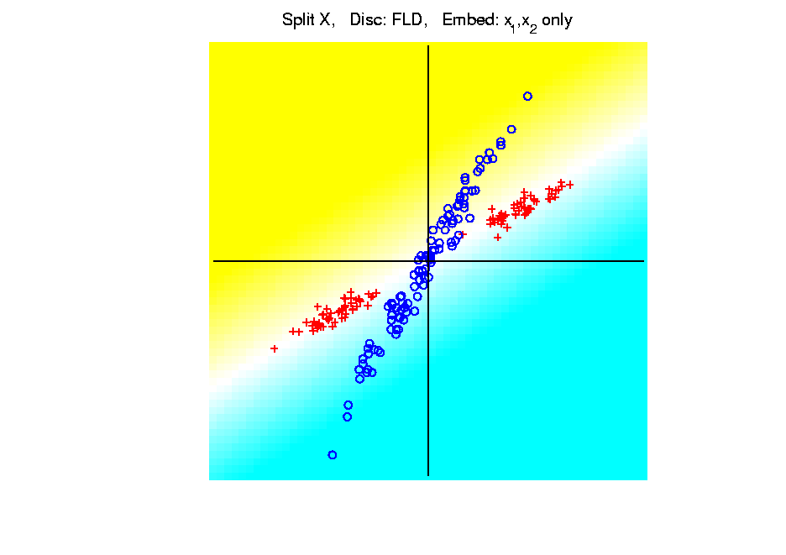
Kernel Embedding
Polynomial Embedding, Toy Example 2:
Split X
LDA
Original
Data
Notes:
PEod1Raw.ps

Slide 124

Kernel Embedding
Polynomial Embedding, Toy Example 2:
Split X
LDA
Slightly
Better
Notes:
PEod1Raw.ps

Slide 125

Kernel Embedding
Polynomial Embedding, Toy Example 2:
Split X
LDA
Notes:
PEod1Raw.ps

Slide 126

Kernel Embedding
Polynomial Embedding, Toy Example 2:
Split X
LDA
Very Good
Effective
Hyperbola
Notes:
PEod1Raw.ps

Slide 127

Kernel Embedding
Polynomial Embedding, Toy Example 2:
Split X
LDA
Notes:
PEod1Raw.ps

Slide 128

Kernel Embedding
Polynomial Embedding, Toy Example 2:
Split X
LDA
Robust
Against
Overfitting
Notes:
PEod1Raw.ps

Slide 129

Kernel Embedding
Polynomial Embedding, Toy Example 2:
Split X
GLR
Original
Data
Looks
Very
Good
Notes:
PEod1Raw.ps

Slide 130

Kernel Embedding
Polynomial Embedding, Toy Example 2:
Split X
GLR
Notes:
PEod1Raw.ps

Slide 131

Kernel Embedding
Polynomial Embedding, Toy Example 2:
Split X
GLR
Reasonably
Stable
Never Ellipse
Around Blues
Notes:
PEod1Raw.ps

Slide 132

Kernel Embedding
Polynomial Embedding, Toy Example 3:
Donut
Very Challenging
For Any Linear
Approach
Notes:
PEod1Raw.ps

Slide 133

Kernel Embedding
Polynomial Embedding, Toy Example 3:
Donut
LDA
Original
Data
Very
Bad
Notes:
PEod1Raw.ps

Slide 134

Kernel Embedding
Polynomial Embedding, Toy Example 3:
Donut
LDA
Somewhat
Better
(Parabolic Fold)
Notes:
PEod1Raw.ps

Slide 135

Kernel Embedding
Polynomial Embedding, Toy Example 3:
Donut
LDA
Somewhat
Better
(Other Fold)
Notes:
PEod1Raw.ps

Slide 136

Kernel Embedding
Polynomial Embedding, Toy Example 3:
Donut
LDA
Good
Performance
(Slice of
Paraboloid)
Notes:
PEod1Raw.ps

Slide 137

Kernel Embedding
Polynomial Embedding, Toy Example 3:
Donut
LDA
Robust
Against
Overfitting
Notes:
PEod1Raw.ps

Slide 138

Kernel Embedding
Polynomial Embedding, Toy Example 3:
Donut
GLR
Original
Data
Best With
No Embedding?
Notes:
PEod1Raw.ps

Slide 139

Kernel Embedding
Polynomial Embedding, Toy Example 3:
Donut
GLR
Notes:
PEod1Raw.ps

Slide 140

Kernel Embedding
Polynomial Embedding, Toy Example 3:
Donut
GLR
Notes:
PEod1Raw.ps

Slide 141

Kernel Embedding
Polynomial Embedding, Toy Example 3:
Donut
GLR
Overfitting
Gives Square
Shape?
Notes:
PEod1Raw.ps

Slide 142
Kernel Embedding
Drawbacks to polynomial embedding:
Too many extra terms create spurious structure
i.e. have “overfitting”
Too much flexibility
HDLSS problems typically get worse
Iain D Carmichael <idc9@uw.edu>
Iain D Carmichael <idc9@uw.edu>

Slide 143
Kernel Embedding
Important Variation: “Kernel Machines”
Idea: replace polynomials by
other nonlinear functions
e.g. 1: sigmoid functions from neural nets
e.g. 2: radial basis functions
Gaussian kernels
Related to “kernel density estimation”
(studied previously)

Slide 144
Kernel Embedding
Radial Basis Functions:
Note: there are several ways to embed:
Naïve Embedding (equally spaced grid)
Explicit Embedding (evaluate at data)
Implicit Embedding (inner prod. based)
(everybody currently does the latter)

Slide 145
Kernel Embedding
Naïve Embedding, Radial basis functions:
At some “grid points” $g_{1}⋯,g_{k}$,
For a “bandwidth” (i.e. standard dev’n) $σ$,
Consider ($d$ dim’al) functions:
$$φ_{σ}\left(x−g_{1}\right),⋯,φ_{σ}\left(x−g_{k}\right)$$
$N_{d}\left(0,σ^{2}I\right)$ Probability Density

Slide 146
Kernel Embedding
Naïve Embedding, Radial basis functions:
At some “grid points” $g_{1}⋯,g_{k}$,
For a “bandwidth” (i.e. standard dev’n) $σ$,
Consider ($d$ dim’al) functions:
$$φ_{σ}\left(x−g_{1}\right),⋯,φ_{σ}\left(x−g_{k}\right)$$
Replace data matrix with:
“Kernel Trick”:
Work in Space
of Linear Combos
of these kernels
$$\left(\begin{matrix}φ_{σ}\left(x_{1}−g_{1}\right) & ⋯ & φ_{σ}\left(x_{n}−g_{1}\right) \\ ⋮ & ⋱ & ⋮ \\ φ_{σ}\left(x_{1}−g_{k}\right) & ⋯ & φ_{σ}\left(x_{n}−g_{k}\right)\end{matrix}\right)$$
“Reproducing
Kernel
Hilbert
Space”

Slide 147
Kernel Embedding
Naïve Embedding, Radial basis functions:
For discrimination: work in radial basis space, With new data vector $x_{0}$,
represented by: $\left(\begin{matrix}φ_{σ}\left(x_{0}−g_{1}\right) \\ ⋮ \\ φ_{σ}\left(x_{0}−g_{k}\right)\end{matrix}\right)$

Slide 148

Kernel Embedding
Naïve Embedd’g, Toy E.g. 1: Parallel Clouds
Good
at data
Poor
outside

Slide 149

Kernel Embedding
Naïve Embedd’g, Toy E.g. 2: Split X
OK at
data
Strange
outside

Slide 150

Kernel Embedding
Naïve Embedd’g, Toy E.g. 3: Donut
Mostly
good
Slight
mistake
for one
kernel

Slide 151
Kernel Embedding
Naïve Embedding, Radial basis functions:
Toy Example, Main lessons:
Generally good in regions with data,
Unpredictable where data are sparse

Slide 152

Kernel Embedding
Toy Example 4: Checkerboard
Very
Challenging!
Linear
Method?
Polynomial
Embedding?
Notes:
PEod1Raw.ps

Slide 153

Kernel Embedding
Toy Example 4: Checkerboard
Very
Challenging!
LDA
Linear Is
Hopeless
Notes:
PEod1Raw.ps

Slide 154

Kernel Embedding
Toy Example 4: Checkerboard
Very
Challenging!
LDA
Notes:
PEod1Raw.ps

Slide 155

Kernel Embedding
Toy Example 4: Checkerboard
Very
Challenging!
LDA
Notes:
PEod1Raw.ps

Slide 156

Kernel Embedding
Toy Example 4: Checkerboard
Very
Challenging!
LDA
Notes:
PEod1Raw.ps

Slide 157

Kernel Embedding
Toy Example 4: Checkerboard
Very
Challenging!
LDA
Notes:
PEod1Raw.ps

Slide 158

Kernel Embedding
Toy Example 4: Checkerboard
Very
Challenging!
LDA
Embedding
Gets Better
But Still
Not Great
Notes:
PEod1Raw.ps

Slide 159
Kernel Embedding
Toy Example 4: Checkerboard
Very
Challenging!
Polynomials
Don’t Have
Needed
Flexiblity
Notes:
PEod1Raw.ps

Slide 160

Kernel Embedding
Toy Example 4: Checkerboard
Radial
Basis
Embedding
+ LDA
Is
Excellent!
Notes:
PEod1Raw.ps

Slide 161
Support Vector Machines
Motivation:
Find a linear classification method that “works well” for embedded data
Note: Embedded data are
very non-Gaussian
Classical Statistics: “Use Prob. Dist’n”
Looks Hopeless
Text, Sec. 11.3
Not Even
Absolutely
Continuous
With Respect
To Lebesgue
Measure

Slide 162
Support Vector Machines
Motivation:
Find a linear classification method that “works well” for embedded data
Note: Embedded data are
very non-Gaussian
Suggests value of
really new approach

Slide 163
Support Vector Machines
Classical References:
Vapnik (1982)
Boser, Guyon & Vapnik (1992)
Vapnik (1995)

Slide 164
Support Vector Machines
Recommended tutorial:
Burges (1998)
Early Monographs:
Cristianini & Shawe-Taylor (2000)
Schölkopf & Smola (2002)
More Recent Monographs:
Hastie et al (2001, 2005)
Bishop (2006)

Slide 165

Support Vector Machines
Graphical View, using Toy Example:

Slide 166
Support Vector Machines
Graphical View, using Toy Example:
Find separating plane
To maximize distances from data to plane

Slide 167

Support Vector Machines
Graphical View, using Toy Example:

Slide 168

Support Vector Machines
Graphical View, using Toy Example:

Slide 169
Support Vector Machines
Graphical View, using Toy Example:
Find separating plane
To maximize distances from data to plane

Slide 170

Support Vector Machines
Graphical View, using Toy Example:

Slide 171
Support Vector Machines
Graphical View, using Toy Example:
Find separating plane
To maximize distances from data to plane
In particular smallest distance
Data points closest are called
support vectors
Gap between is called margin
Caution: For some “margin” is different
Hence the Name

Slide 172


SVMs, Optimization Viewpoint
Formulate Optimization problem, based on:
Data (feature) vectors $x_{1},⋯,x_{n}$
Class Labels $y_{i}=±1$
Need to Find:
Normal Vector of Separating Plane $w$
Location (determines intercept) $b$
Useful Input:
Residuals (right side) $r_{i}=y_{i}\left({x_{i}}^{t}w+b\right)$
$y_{i}=±1$ Notation Very Useful Here

Slide 173
SVMs, Optimization Viewpoint
Simple Case: Separable Classes
There Is A
Separating
Plane
Want “Best”
Separating Plane

Slide 174



SVMs, Optimization Viewpoint
Given a Separating Direction $w$,
Choose $b$ To Give The “Middle Plane”
Between
Support
Vectors
Define the Margin Using $\left\|w\right\|$ (length)
Note: $w$ is no
longer just a
direction, but
also captures
gap between
classes
(Thanks to
Wikipedia)`

Slide 175



SVMs, Optimization Viewpoint
Choose $\left\|w\right\|$ to Put Support Vectors on
“Margin Lines”
SVM Goal: Maximize $\frac{1}{\left\|w\right\|}$, i.e. Minimize $\left\|w\right\|$
So Margin
Is $\frac{2}{\left\|w\right\|}$
Blue Equation Is:
$$\frac{w}{\left\|w\right\|}∗x−\frac{b}{\left\|w\right\|}=\frac{1}{\left\|w\right\|}$$

Slide 176


SVMs, Optimization Viewpoint
(Separable) Formal Optimization Problem:
Minimize Over $w∈ℝ^{d}$ and $b∈ℝ$
$$\frac{1}{2}{\left\|w\right\|}^{2}$$
Subject To:
$y_{i}\left(w^{t}x_{i}−b\right)≥1$ for $i=1,⋯,n$
Hard
Margin
SVM
Constrains Data to Be Outside Margin
$y_{i}=±1$ Notation Again Very Useful

Slide 177

SVMs, Optimization Viewpoint
For Not Necessarily Separable Data, Add:
A Tuning Parameter $C≥0$
Slack Variables $ξ_{i}≥0,$ for $i=1,⋯,n$
(Allowing Points on Wrong Side)

Slide 178


SVMs, Optimization Viewpoint
Overall Formal Optimization Problem:
Minimize Over $w∈ℝ^{d}$ and $b∈ℝ$
$$\frac{1}{2}{\left\|w\right\|}^{2}+C\sum_{i=1}^{n}{ξ_{i}}$$
Subject To:
$y_{i}\left(w^{t}x_{i}−b\right)≥1−ξ_{i}$ for $i=1,⋯,n$
$ξ_{i}≥0,$ for $i=1,⋯,n$
Soft
Margin
SVM
Relax Margin by $ξ_{i}$
At Corresponding Cost

Slide 179

SVMs, Optimization Viewpoint
Impact of Tuning Parameter $C$:
$C$ Large → Minimize Violations of Margin
$C$ Small → Weak Enforcement of Violations

Slide 180

SVMs, Tuning Parameter
Study Regularization Parameter $C$:
Controls penalty for violation
I.e. lying on wrong side of plane
Appears in slack variables
Affects performance of SVM
Study Toy Example:
$d=50$, Spherical Gaussian data

Slide 181


SVMs, Tuning Parameter
Toy Example: $d=50$, Sph’l Gaussian data
Often No
Change
Followed
By Rapid
Change
Nicely
Separable
Example
2-d Subspace
Generated by
Bayes Rule
And SVM

Slide 182

SVMs, Tuning Parameter
Toy Example: $d=50$, Sph’l Gaussian data
For Large Values of C
Lots of Data Piling
Large Angle to Optimal
Thus Less Generalizable
(For This Data Set)
But Big
Margin
Called Hard Margin SVM

Slide 183


SVMs, Tuning Parameter
Toy Example: $d=50$, Sph’l Gaussian data
For Small Values of C
No Apparent Data Piling
Smaller Angle to Optimal
So More Generalizable
Yet Smaller
Margin $\frac{1}{\left\|w\right\|}$
Connection to MD?
Add MD Axis to Plot

Slide 184


SVMs, Tuning Parameter
Toy Example: $d=50$, Sph’l Gaussian data
Put MD on horizontal axis
Note:
For C Small
SVM Dir’n =
= MD Dir’n

Slide 185

SVMs, Tuning Parameter
Toy Example: $d=50$, Sph’l Gaussian data
Put MD on horizontal axis
For Large Values of C
SVM not MD
Hard Margin SVM
Clearly Different
Yet Same for Small C!
(For This Data Set)

Slide 186

SVMs, Tuning Parameter
Toy Example: $d=50$, Sph’l Gaussian data
Mathematics Behind This:
Carmichael & Marron (2021)
Small C in General: Trimmed Mean
Small Range Between That & Hard Margin
Established Useful Bounds on Ends
Very Useful for Coding Cross-Validation

Slide 187
Support Vector Machines
Important Extension:
Multi-Class SVMs
Hsu & Lin (2002)
Lee, Lin, & Wahba (2002)
Defined for “implicit” version
“Direction Based” variation???

Slide 188
Support Vector Machines
SVM Tuning Parameter Selection:
Joachims (2000)
Wahba et al. (1999, 2003)
Basic Idea: Cross-Validation
Leave Some Out – Train – Assess
Then Average Error Rates

