Slide 1
Statistics – O. R. 881 Object Oriented Data Analysis
Steve Marron
Dept. of Statistics and Operations Research
University of North Carolina

Slide 2
Current Sections in Textbook
Today:
Sections 16.2, 11.1
Next Class:
Sections 11.1, 11.2

Slide 3
Last Class: Classical Discr’n
LDA Likelihood View (cont.)
Replacing $μ^{+}$, $μ^{−}$ and $Σ^{w}$
by maximum likelihood estimates:
${\overline{x}}^{+}$, ${\overline{x}}^{−}$and ${\hat{Σ}}^{w}$
Gives the likelihood ratio discrimination rule:
Choose Class +1, when
$${x_{0}}^{t}{{\hat{Σ}}^{w}}^{−1}\left({\overline{x}}^{+}−{\overline{x}}^{−}\right)≥\frac{1}{2}{\left({\overline{x}}^{+}+{\overline{x}}^{−}\right)}^{t}{{\hat{Σ}}^{w}}^{−1}\left({\overline{x}}^{+}−{\overline{x}}^{−}\right)$$
Same as above, so: LDA can be viewed as
Likelihood Ratio Rule

Slide 4
Last Class: Classical Discr’n
LDA Generalization I
Gaussian Likelihood Ratio Discrimination
(a. k. a. “Nonlinear Discriminant Analysis”)
Idea: Assume
class distributions are $N\left(μ^{⨀},Σ^{⨀}\right)$
Different covariances!
Likelihood Ratio rule is straightf’d num’l calc.
(thus can easily implement, and do discrim’n)

Slide 5
Last Class: Classical Discr’n
LDA Generalization II (Gen. I was GLR)
Different prior probabilities
Main idea:
Give different weights to 2 classes
I.e. assume not a priori equally likely
Canonical Example: Rare Disease Testing
(Often Train on Mostly Rare Cases)

Slide 6
Last Class: Classical Discr’n
LDA Generalization III
Principal Discriminant Analysis
Idea: LDA-like approach to $K>2$ classes
Assumption: Class covariance matrices are the same (similar)
(but not Gaussian, same situation as for LDA)
Main idea:
Quantify “location of classes” by their means
$${\underline{μ}}^{(1)},{\underline{μ}}^{(2)},⋯,{\underline{μ}}^{(K)}$$
Analog of MD
For $K$ Classes

Slide 7
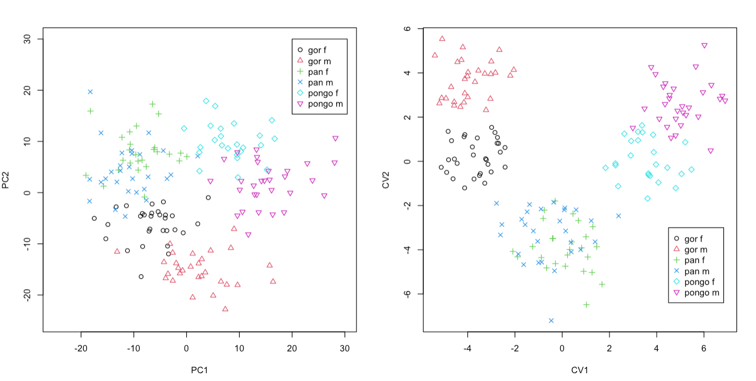
Last Class: Classical Discr’n
Principal Discriminant Analysis Illustrated
Recall Synonyms
Principal Component Analysis
Canonical Variate Analysis
Classes Overlap
Much Better
Separation

Slide 8
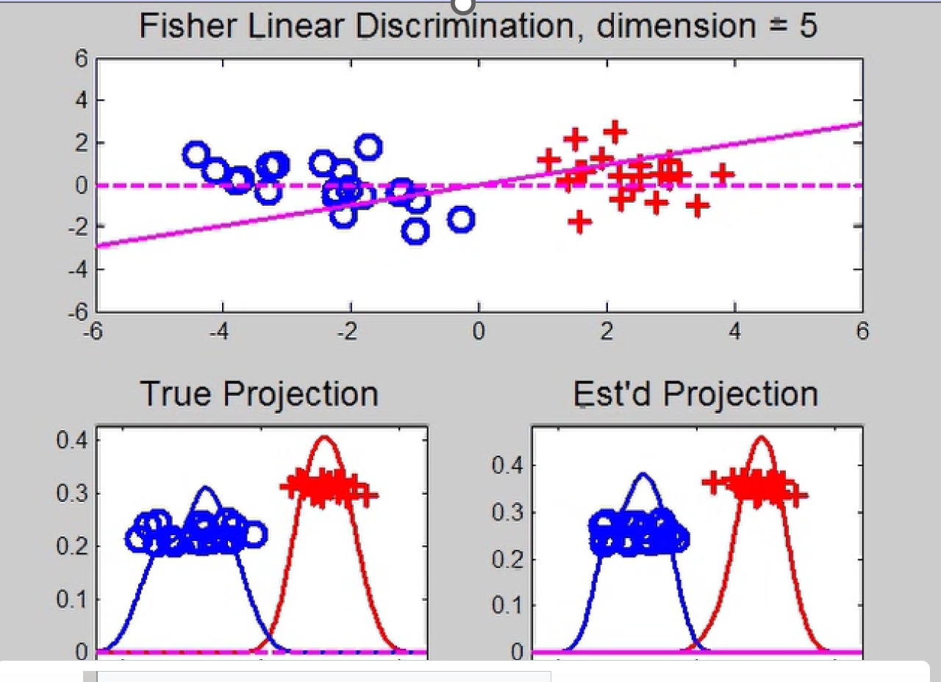
Last Class: HDLSS Discrimi’n
Movie Through Increasing Dimensions
LDA Performs
Well In Low
Dimensions

Slide 9
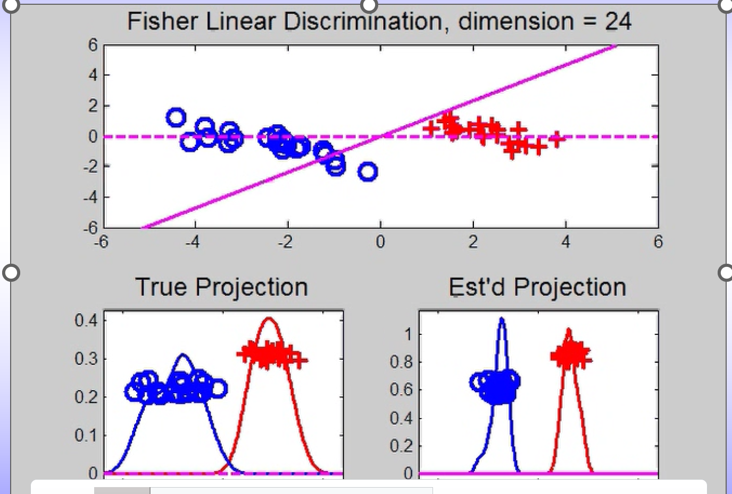
Last Class: HDLSS Discrimi’n
Movie Through Increasing Dimensions
Less Well
In Higher
Dimensions
LDA Direction
Farther From
Optimal

Slide 10
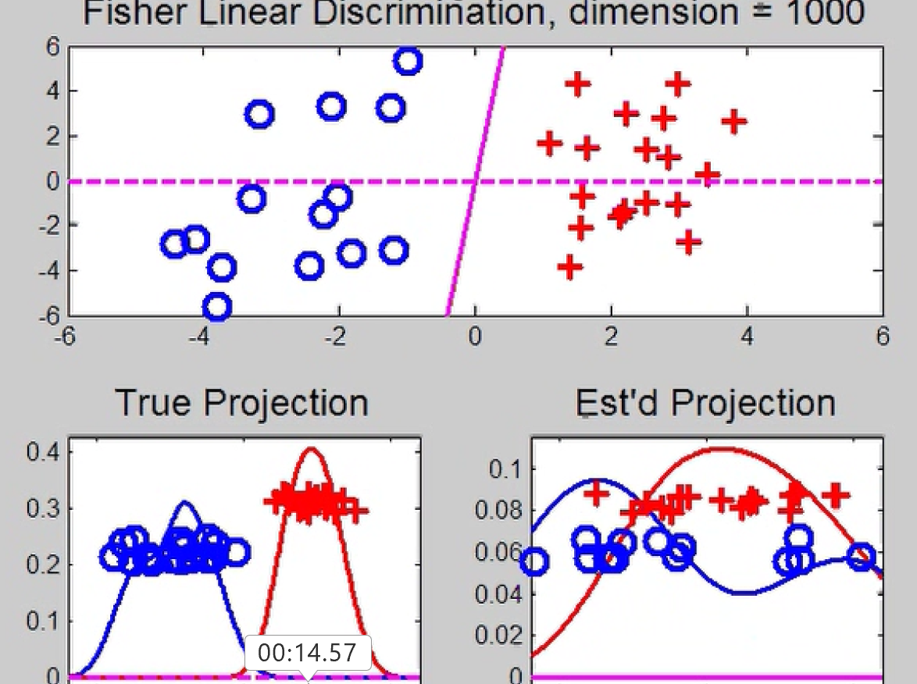
Last Class: HDLSS Discrimi’n
Movie Through Increasing Dimensions
Falls Apart
Completely
In Very High
Dimensions

Slide 11
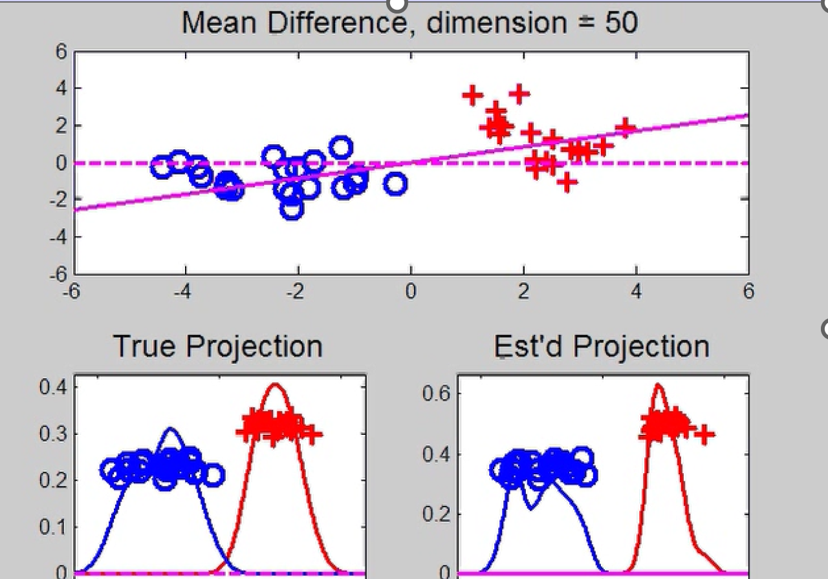
Last Class: HDLSS Discrimi’n
Mean Difference (Centroid) Method
Same
Data,
Movie
over
dim’s
Much Better
Performance
Covariance
Estimation
Has A Cost
In High Dim’n

Slide 12
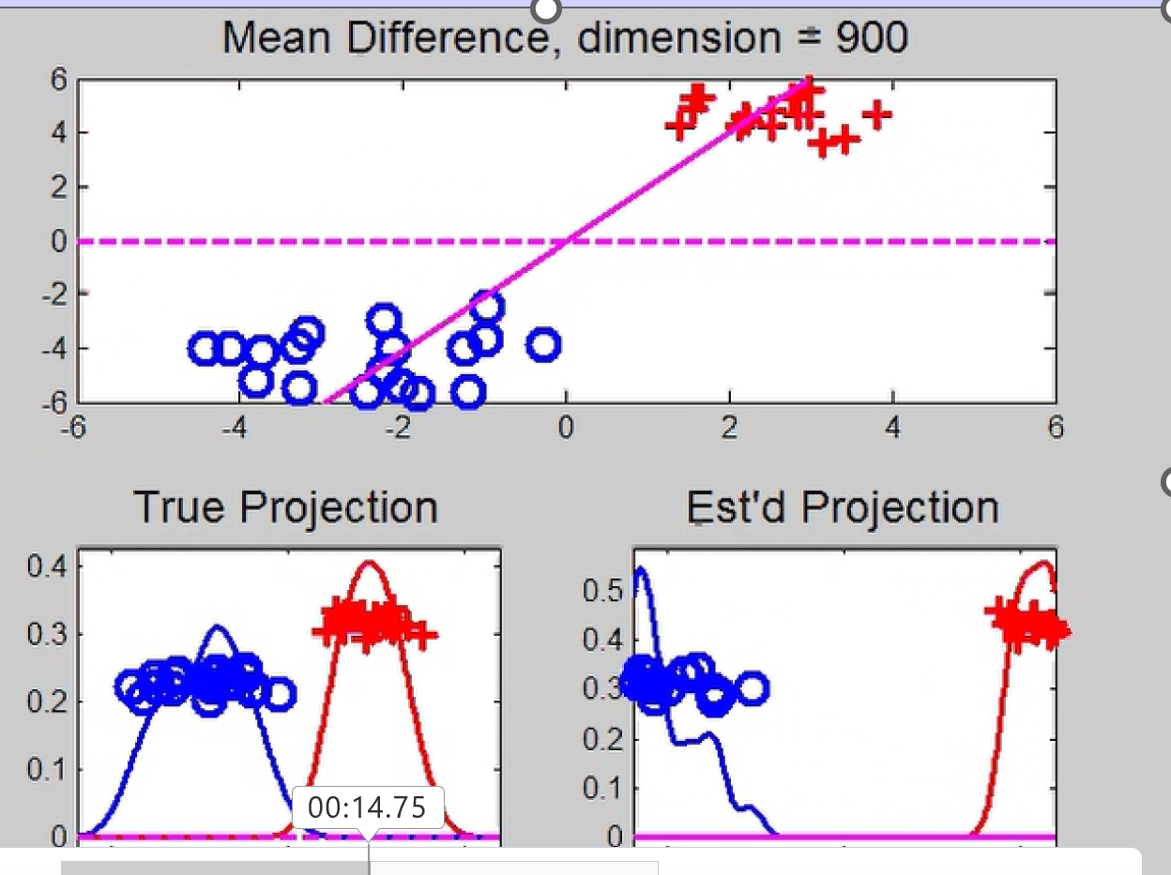
Last Class: HDLSS Discrimi’n
Mean Difference (Centroid) Method
Same
Data,
Movie
over
dim’s
Good Even
in Very
High Dim’n
Among
HDLSS
Effects

Slide 13
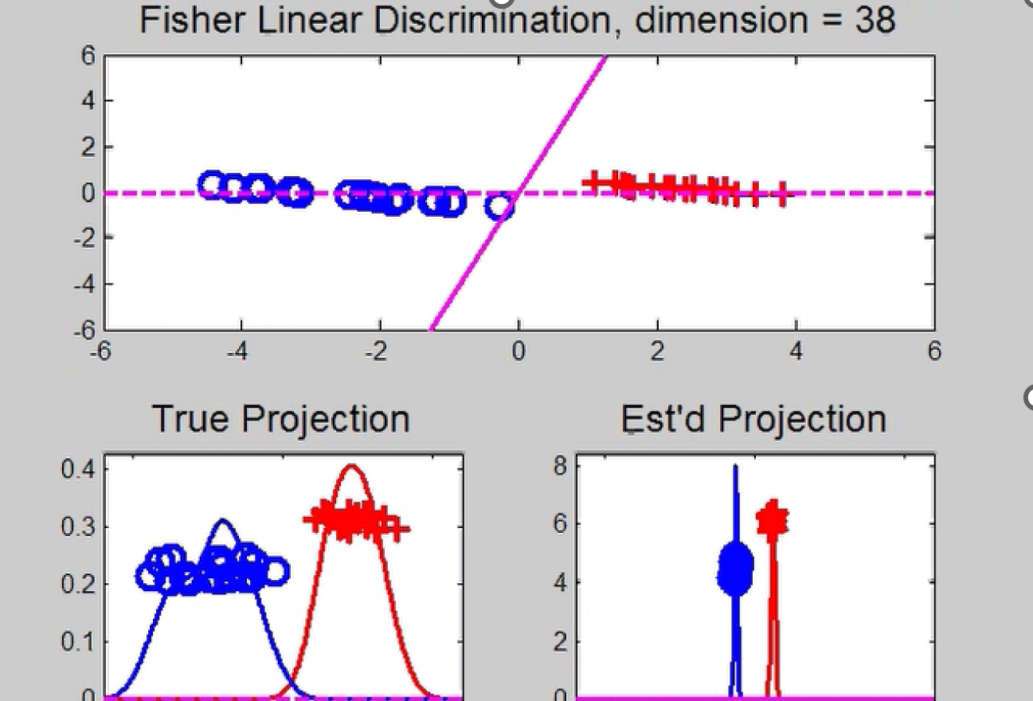
Last Class: HDLSS Discrimi’n
Movie Through Increasing Dimensions
Strange Behavior in Between

Slide 14
Last Class: Max’al Data Piling
General Case: $n_{+}$,$n_{−}$ in $ℝ^{d}$ with $d≥n_{+}+n_{−}$
Can show (Ahn & Marron 2010):
Most dir’ns in intersection collapse all to 0
But there is a great circle of directions,
Where Classes collapse to different points
Distance is max’ed in 2 direct’ns: $±v_{MDP}$
Called Maximal Data Piling direction(s)
Unique (up to $±$) in subspace of data

Slide 15
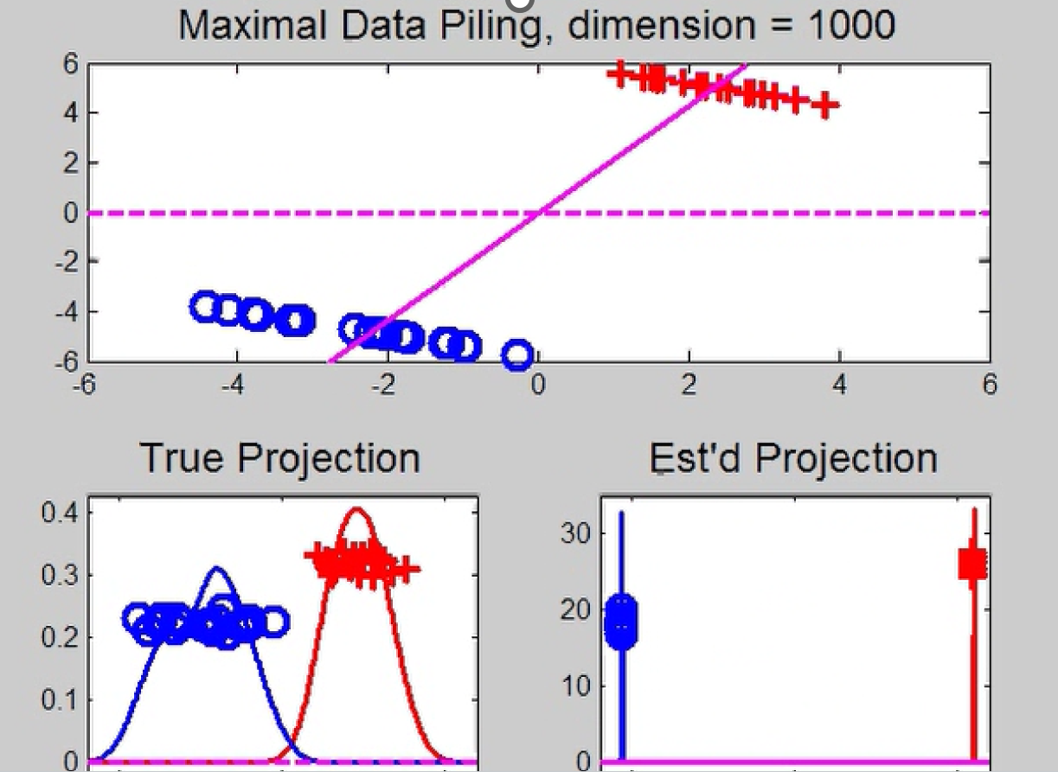
Last Class: Max’al Data Piling
Movie Through Increasing Dimensions

Slide 16
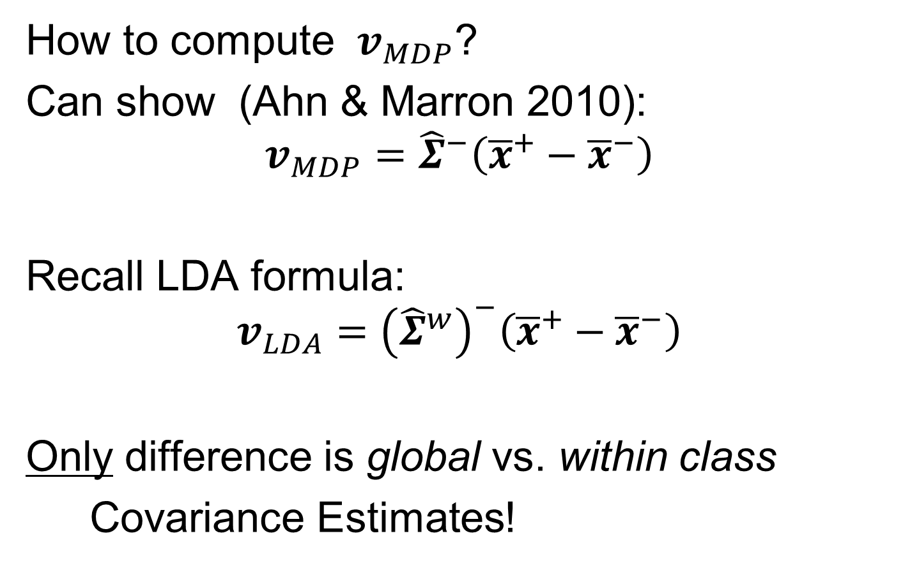
Last Class: Max’al Data Piling
How to compute $v_{MDP}$?
Can show (Ahn & Marron 2010):
$$v_{MDP}={\hat{Σ}}^{−}\left({\overline{x}}^{+}−{\overline{x}}^{−}\right)$$
Recall LDA formula:
$$v_{LDA}={\left({\hat{Σ}}^{w}\right)}^{−}\left({\overline{x}}^{+}−{\overline{x}}^{−}\right)$$
Only difference is global vs. within class
Covariance Estimates!

Slide 17
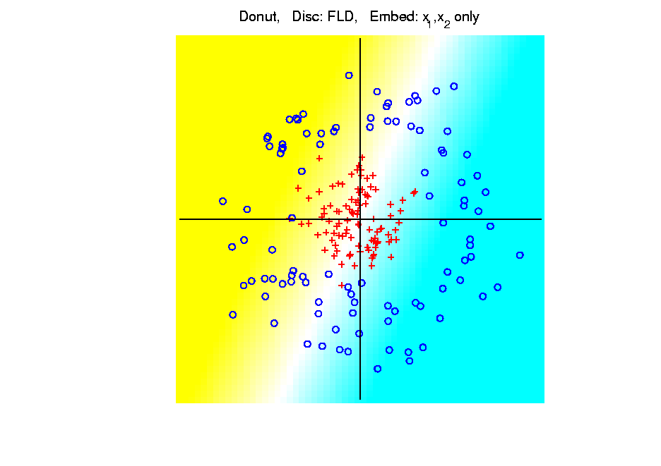
Last Class: Kernel Embedding
Polynomial Embedding, Toy Example 3:
Donut
LDA
Original
Data
Very
Bad
Notes:
PEod1Raw.ps

Slide 18
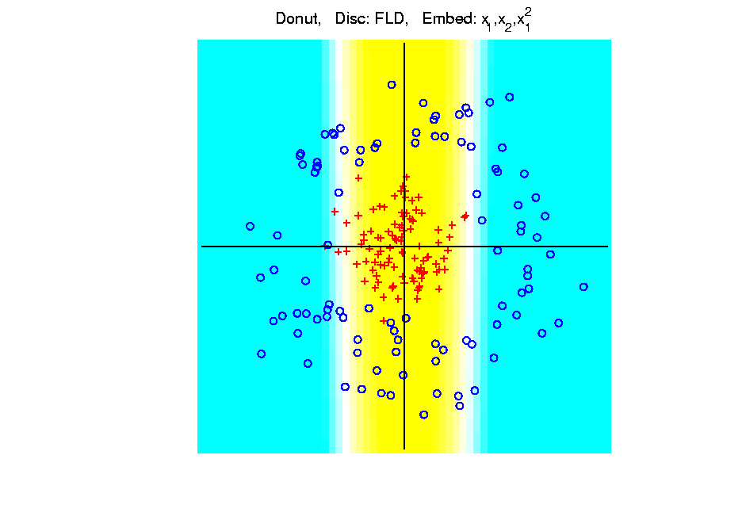
Last Class: Kernel Embedding
Polynomial Embedding, Toy Example 3:
Donut
LDA
Somewhat
Better
(Parabolic Fold)
Notes:
PEod1Raw.ps

Slide 19
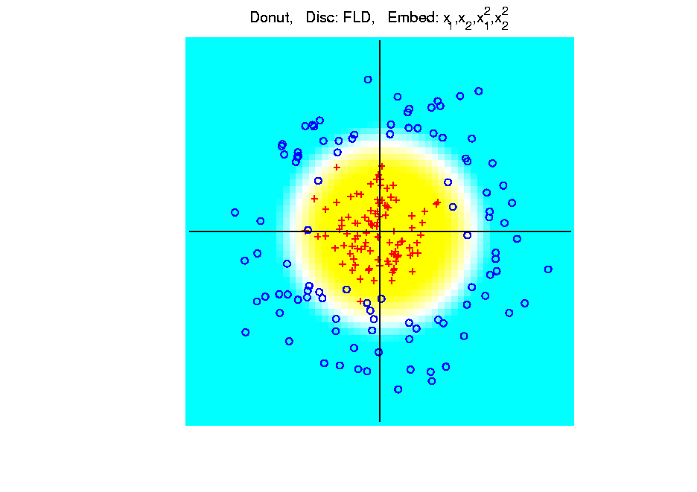
Last Class: Kernel Embedding
Polynomial Embedding, Toy Example 3:
Donut
LDA
Good
Performance
(Slice of
Paraboloid)
Notes:
PEod1Raw.ps

Slide 20
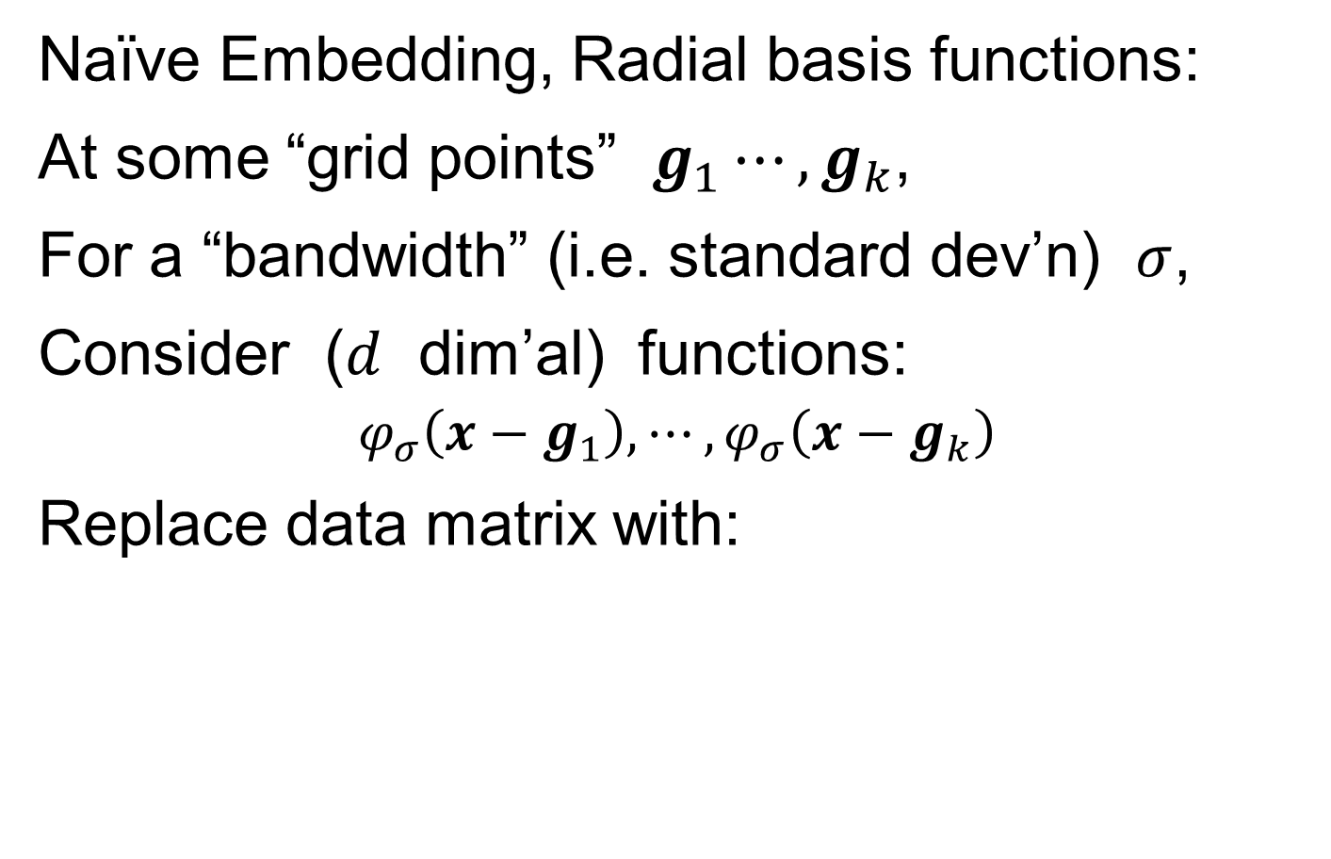
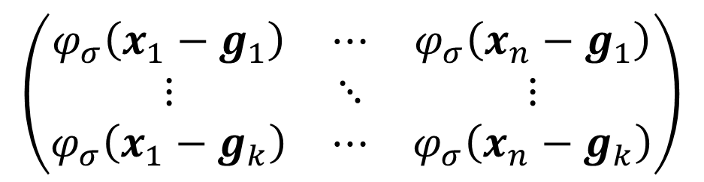
Last Class: Kernel Embedding
Naïve Embedding, Radial basis functions:
At some “grid points” $g_{1}⋯,g_{k}$,
For a “bandwidth” (i.e. standard dev’n) $σ$,
Consider ($d$ dim’al) functions:
$$φ_{σ}\left(x−g_{1}\right),⋯,φ_{σ}\left(x−g_{k}\right)$$
Replace data matrix with:
$$\left(\begin{matrix}φ_{σ}\left(x_{1}−g_{1}\right) & ⋯ & φ_{σ}\left(x_{n}−g_{1}\right) \\ ⋮ & ⋱ & ⋮ \\ φ_{σ}\left(x_{1}−g_{k}\right) & ⋯ & φ_{σ}\left(x_{n}−g_{k}\right)\end{matrix}\right)$$

Slide 21
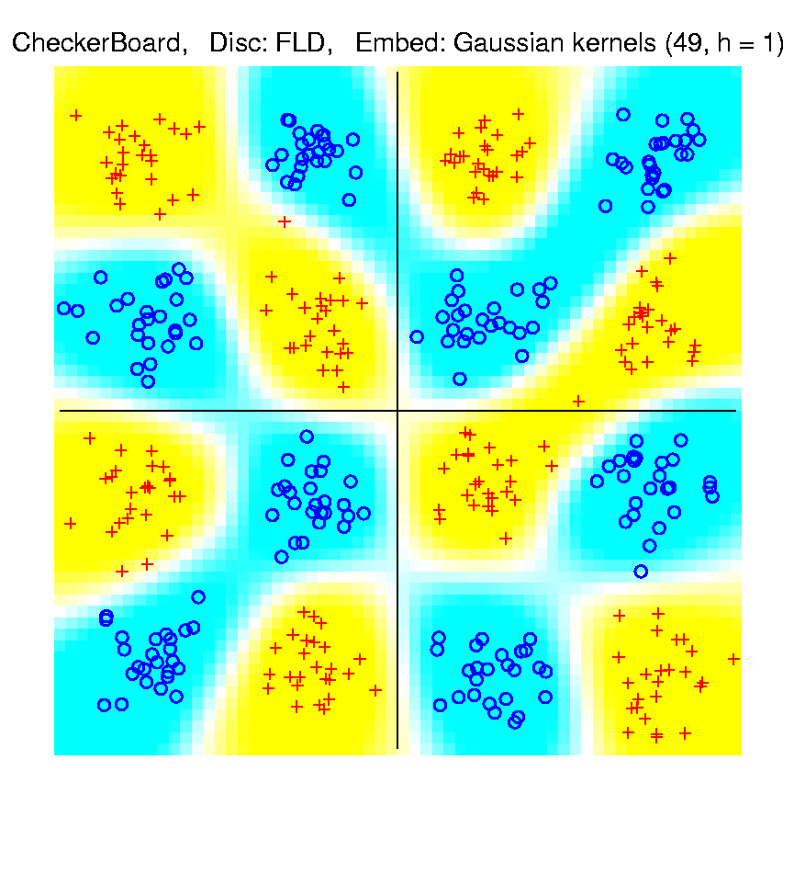
Last Class: Kernel Embedding
Toy Example 4: Checkerboard
Radial
Basis
Embedding
+ LDA
Is
Excellent!
Notes:
PEod1Raw.ps

Slide 22
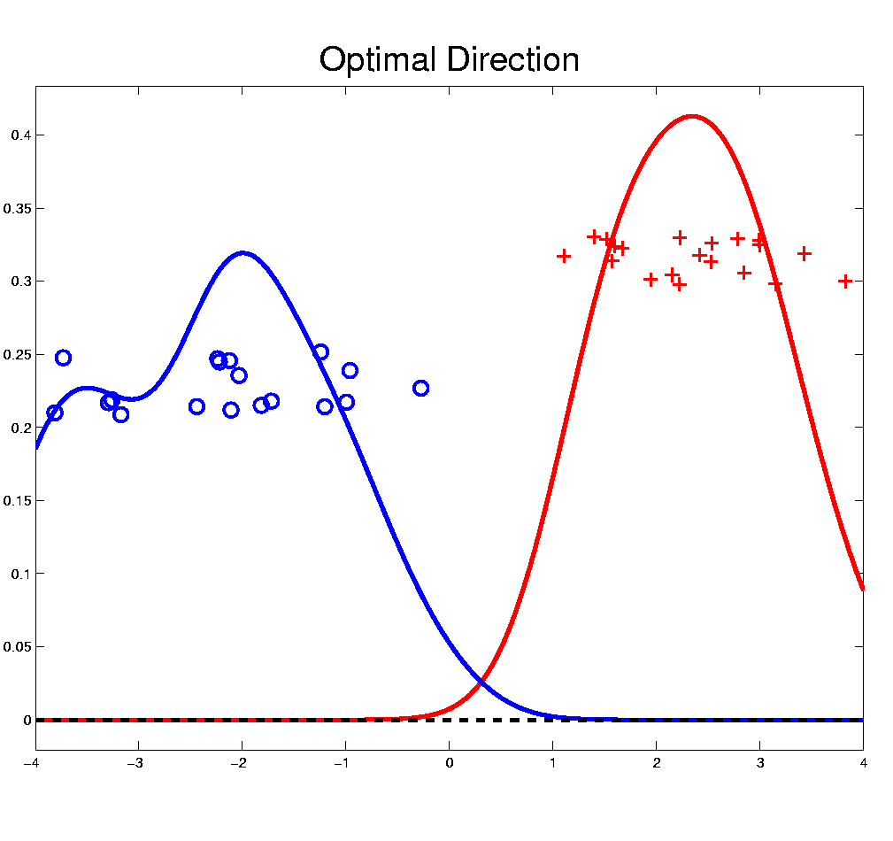

Distance Weighted Discrim’n
Improvement of SVM for HDLSS Data
Toy e.g.
$d=50$
indep. $N\left(0,1\right)$
$μ_{1}=±2$
$n_{+}=n_{−}=20$
(similar to
earlier movies)
Text, Sec. 11.4

Slide 23
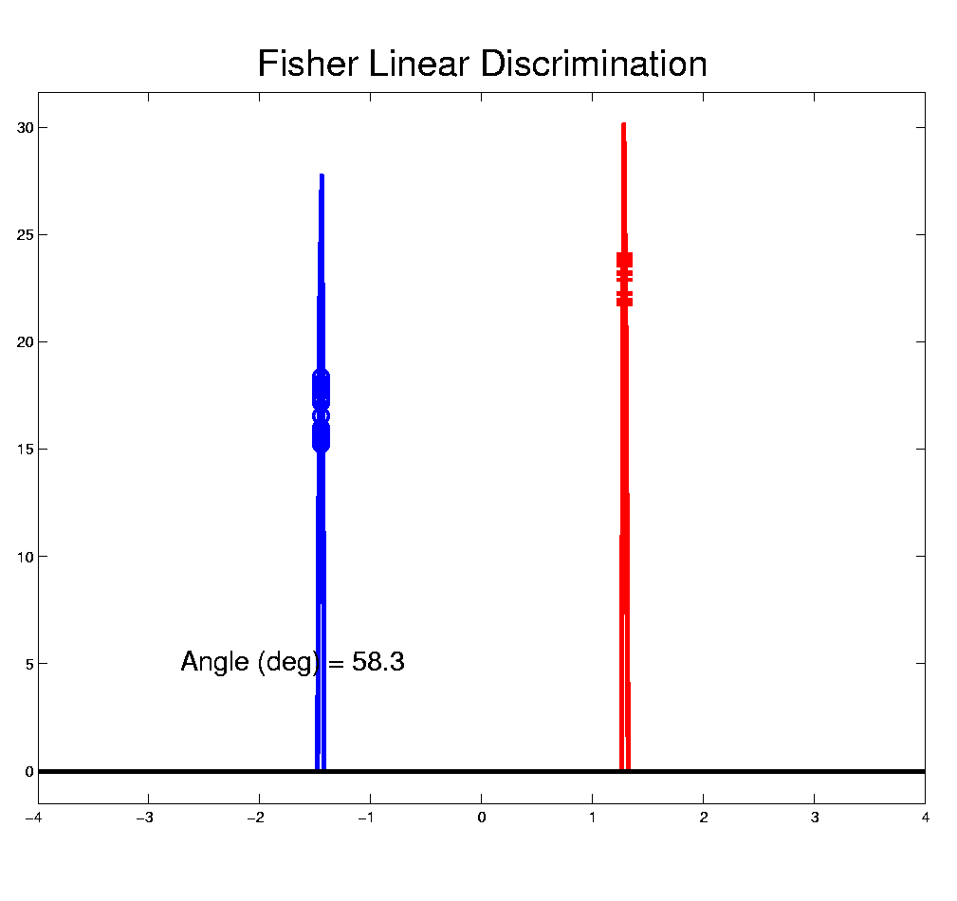
Distance Weighted Discrim’n
Toy e.g.: Maximal Data Piling Direction
- Perfect
Separation
- Gross
Overfitting
- Large Angle
- Poor
Gen’ability
MDP
Feels Small Scale
Noise Artifacts

Slide 24
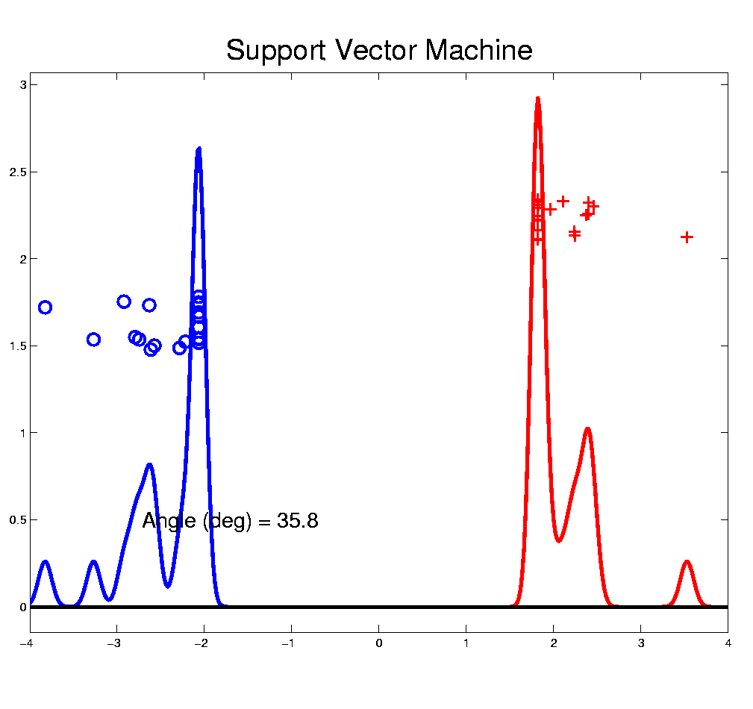
Distance Weighted Discrim’n
Toy e.g.: Hard Margin SVM Direction
- Bigger Gap
- Smaller Angle
- Better
Gen’ability
- Feels support
vectors too
strongly???
- Ugly subpops?
- Improvement?
Similarly Feels Small
Scale Noise Artifacts

Slide 25
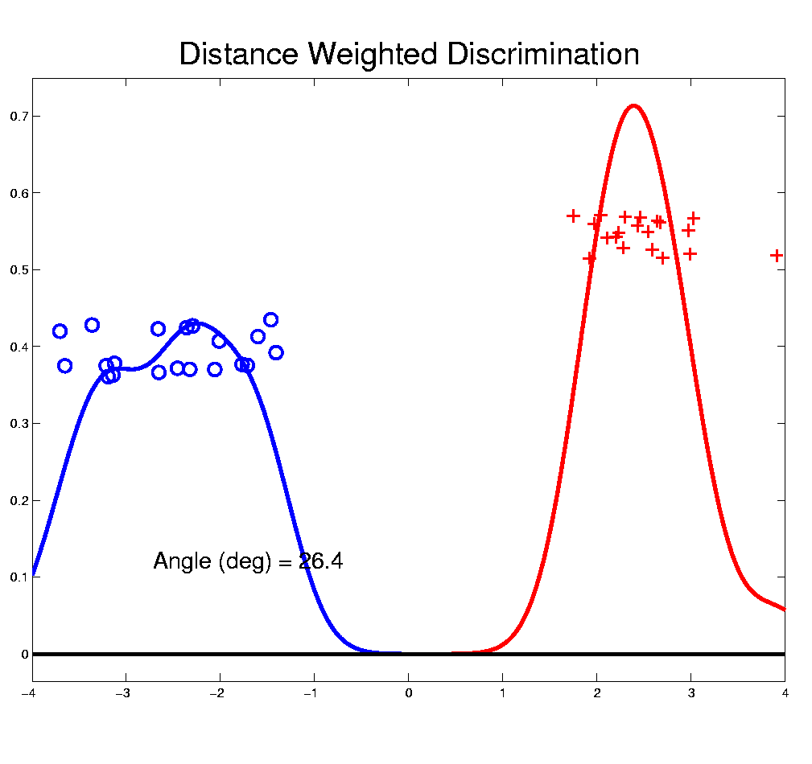
Distance Weighted Discrim’n
Toy e.g.: Distance Weighted Discrimination
- Addresses
these issues
- Smaller Angle
- Better
Gen’ability
- Nice subpops
- Replaces
min dist. by
avg. dist.

Slide 26
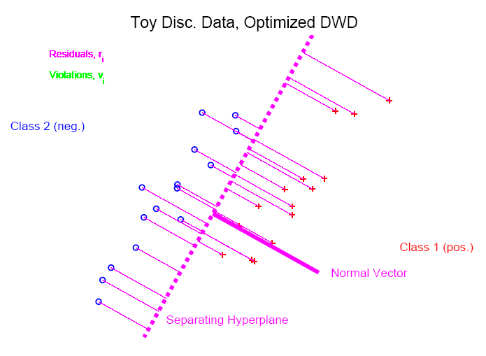
Distance Weighted Discrim’n
Based on Optimization Problem:
For “Residuals”:

Slide 27
Distance Weighted Discrim’n
Based on Optimization Problem:
Uses “poles” to push plane away from data

Slide 28
Distance Weighted Discrim’n
Based on Optimization Problem:
More precisely:
Work in appropriate penalty for violations
Optimization Method:
Second Order Cone Programming
“Still convex” gen’n of quad’c program’g
Allows fast greedy solution
Can use available fast software
(SDP3, Michael Todd, et al)

Slide 29
Distance Weighted Discrim’n
References for more on DWD:
Main paper:
Marron, Todd and Ahn (2007)
Links to more papers:
Ahn (2006)
R Implementation of DWD:
CRAN (2014)
SDPT3 Software:
Toh et al (1999)
Sparse DWD: Wang & Zou (2016)
Notes:
29

Slide 30
Distance Weighted Discrim’n
References for more on DWD:
Faster Version:
Lam et al. (2018)
Robust (Against Heterogeneity) Version:
Wang & Zou (2016)
Approach: three-block
semiproximal alternating
direction method of
multipliers
May Discuss
More Later
Notes:
30

Slide 31
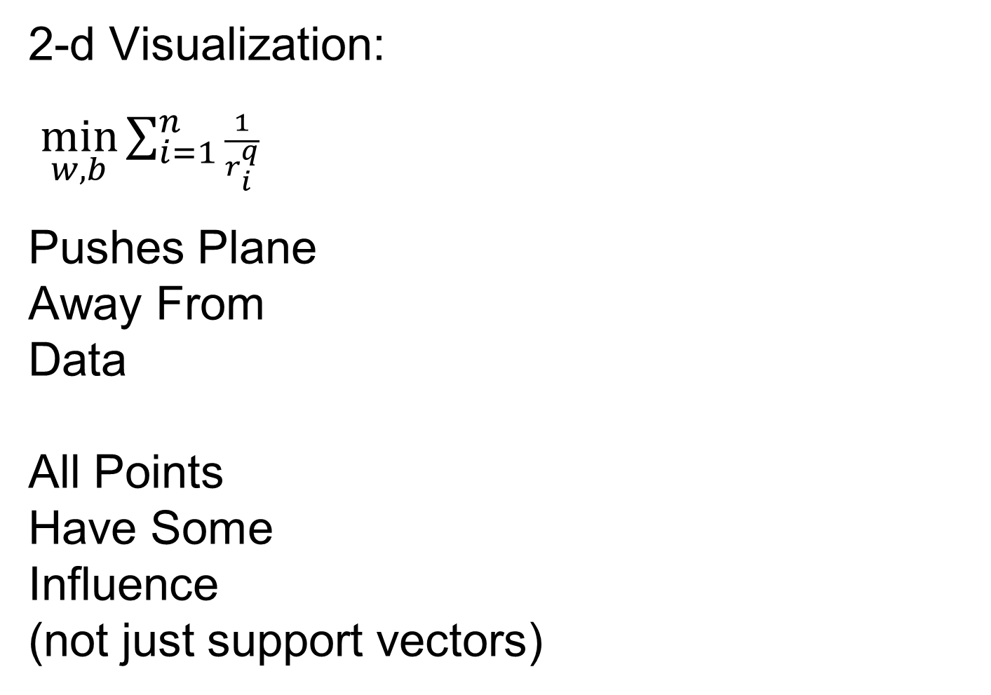
Distance Weighted Discrim’n
2-d Visualization:
$\min_{w,b}{\sum_{i=1}^{n}{\frac{1}{r_{i}^{q}}}}$
Pushes Plane
Away From
Data
All Points
Have Some
Influence
(not just support vectors)

Slide 32
Next Time
Purpose of above slide not Clear
Especially with q for Generalizd DWD

Slide 33
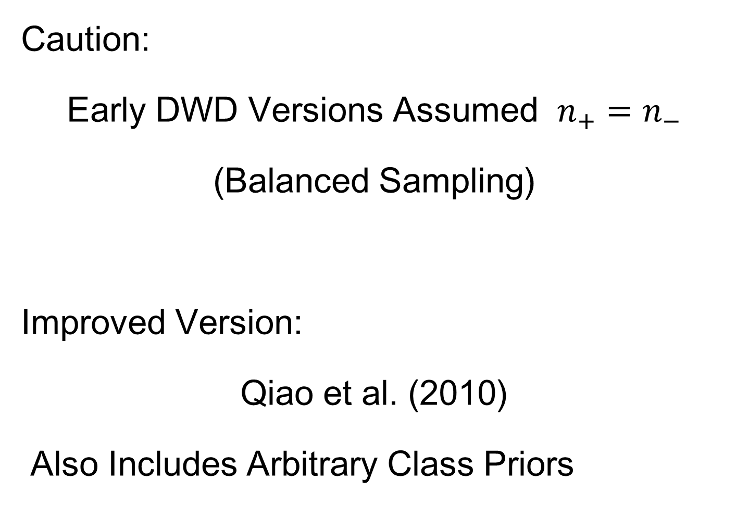
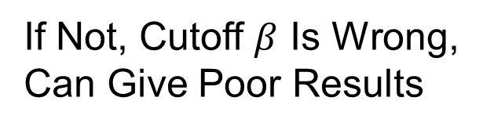
Distance Weighted Discrim’n
Caution:
Early DWD Versions Assumed $n_{+}=n_{−}$
(Balanced Sampling)
Improved Version:
Qiao et al. (2010)
Also Includes Arbitrary Class Priors
If Not, Cutoff $β$ Is Wrong,
Can Give Poor Results
Notes:
33

Slide 34
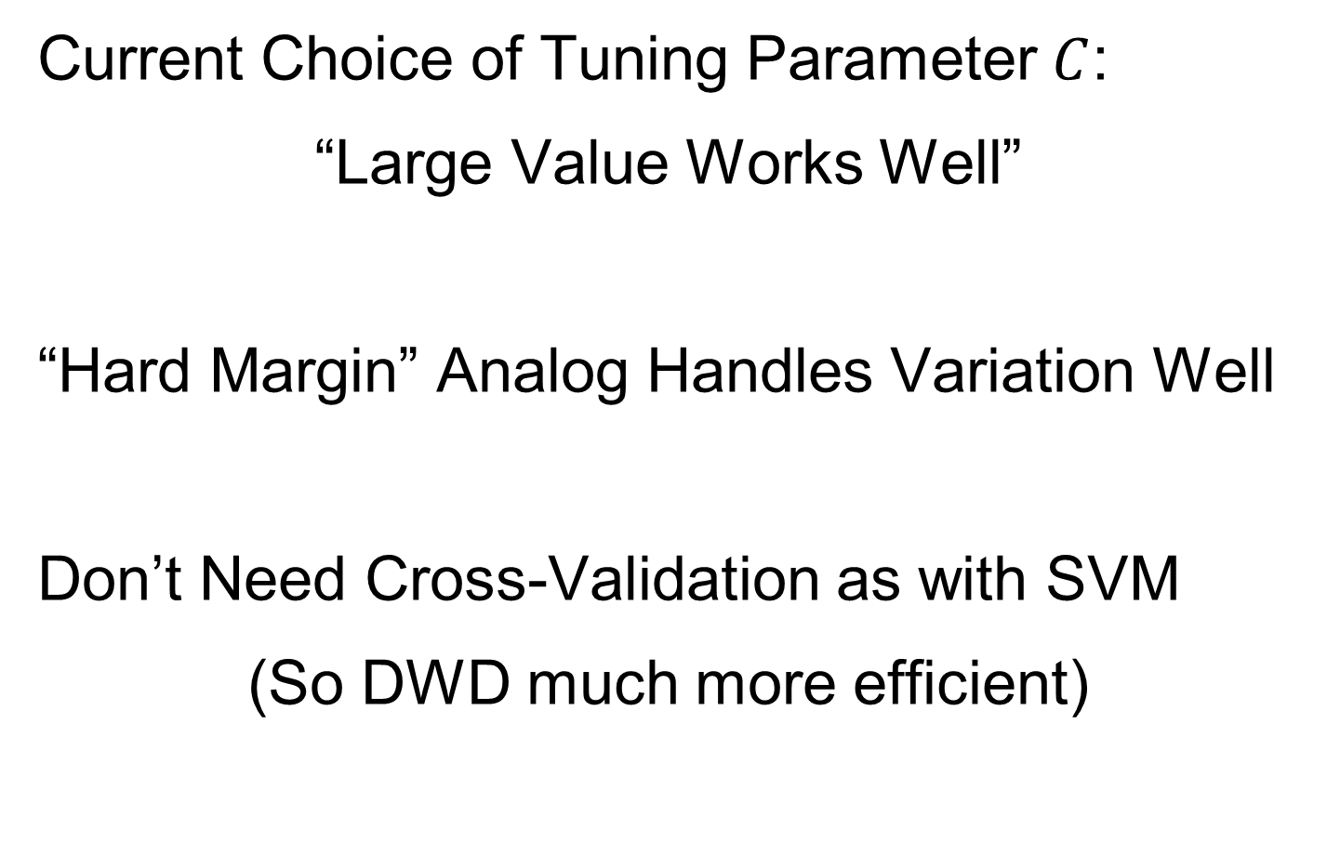
Distance Weighted Discrim’n
Current Choice of Tuning Parameter $C$:
“Large Value Works Well”
“Hard Margin” Analog Handles Variation Well
Don’t Need Cross-Validation as with SVM
(So DWD much more efficient)

Slide 35
Distance Weighted Discrim’n
Interesting Open Problem:
Analyze DWD from Viewpoint of:
Carmichael and Marron (2021)

Slide 36


Recall: High $d$ Asymptotics & Kernels
Recall
Flexibility
From
Kernel
Embedding
Idea

Slide 37
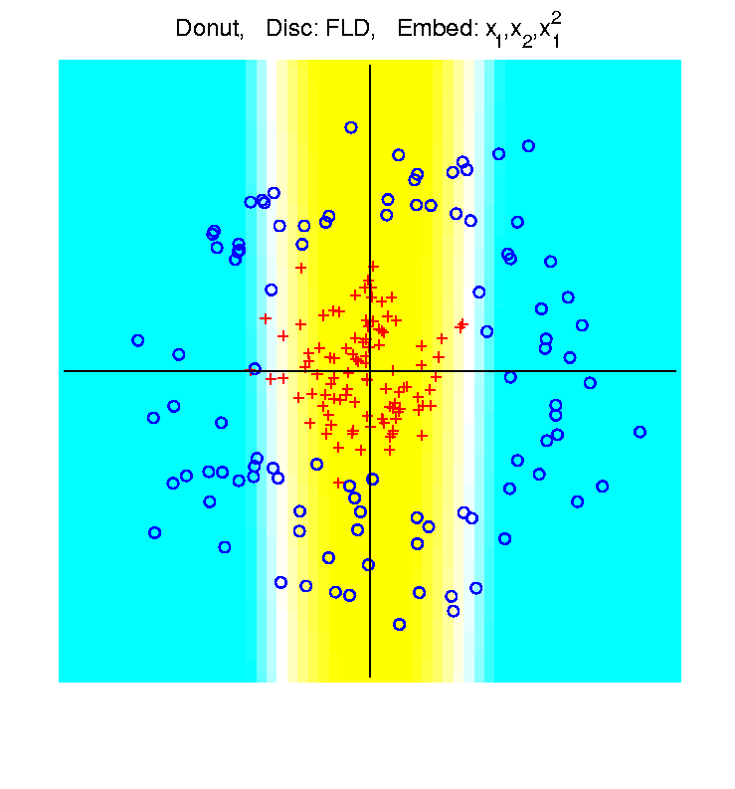
Recall: High $d$ Asymptotics & Kernels
Recall
Flexibility
From
Kernel
Embedding
Idea

Slide 38
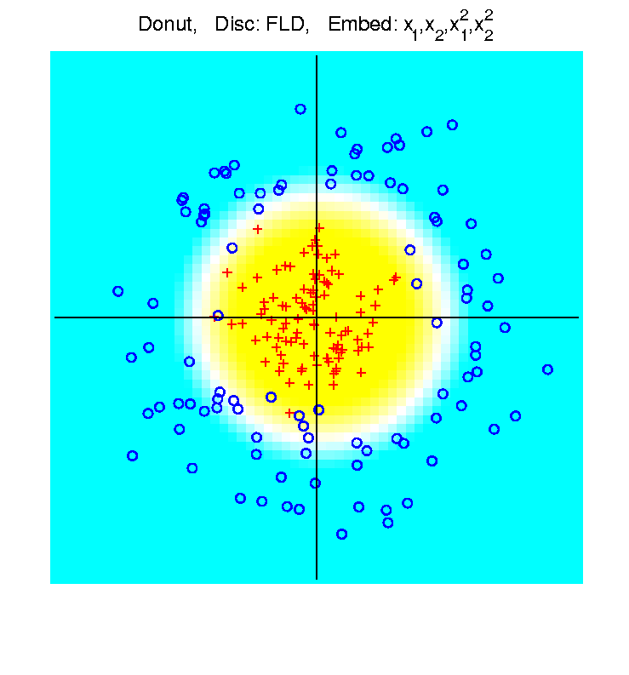
Recall: High $d$ Asymptotics & Kernels
Recall
Flexibility
From
Kernel
Embedding
Idea

Slide 39

Recall: High $d$ Asymptotics & Kernels
Interesting Question:
Behavior in Very High Dimensions?
Answer: El Karoui (2010)
In Random Matrix Limit, $n\sim d→∞$
Kernel Embedded Classifiers ~
~ Linear Classifiers

Slide 40
Recall: High $d$ Asymptotics & Kernels
In Random Matrix Limit, $n\sim d→∞$
Kernel Embedded Classifiers ~
~ Linear Classifiers
Intuitively Sensible?
High Dimensional Space is Very Big
Recall HDLSS Geometric Represent’n
Linear Methods: “Enough Room to Work”

Slide 41
Recall: High $d$ Asymptotics & Kernels
Interesting Question:
Behavior in Very High Dimensions?
Implications for DWD:
Recall Main Advantage is for High d
So Not Clear Embedding Helps
Thus Not Yet Implemented in DWD

Slide 42
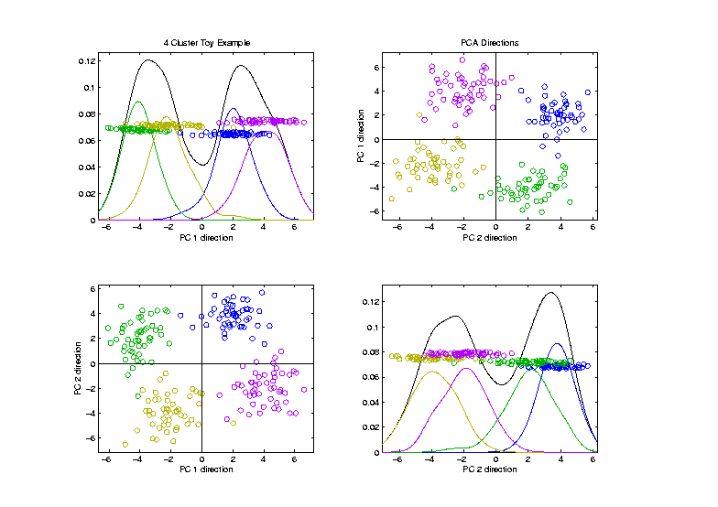

Visualization by DWD, SVM, MD
Toy Example:
4 Clusters,
Symmetric
Gaussians,
$d=200$

Slide 43
Visualization by DWD, SVM, MD
Toy Example:
Train DWD
On These
2 Classes

Slide 44
Visualization by DWD, SVM, MD
Toy Example:
Train SVM & MD
On These
2 Classes

Slide 45
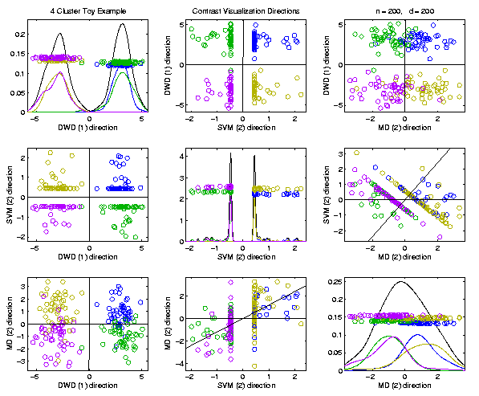
Visualization by DWD, SVM, MD
Toy Example:
Use Those
Directions
In Scatterplot
Matrix View
SVM Data Piling Leaves Lines in Plots

Slide 46
Visualization by DWD, SVM, MD
Toy Example:
MD Has
Strong
Overlap
200 Dim’al Noise
Impacts Means
DWD Gives Superior Visualization
Optimization Less Sensitive to 200 Dim’al Noise

Slide 47
Batch and Source Adjustment
Important Application
of
Distance Weighted Discrimination

Slide 48
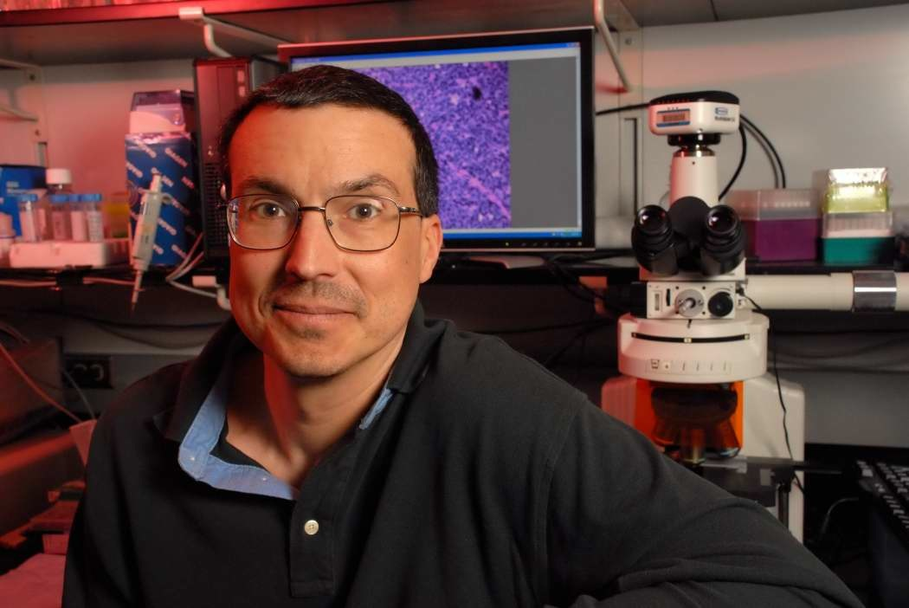
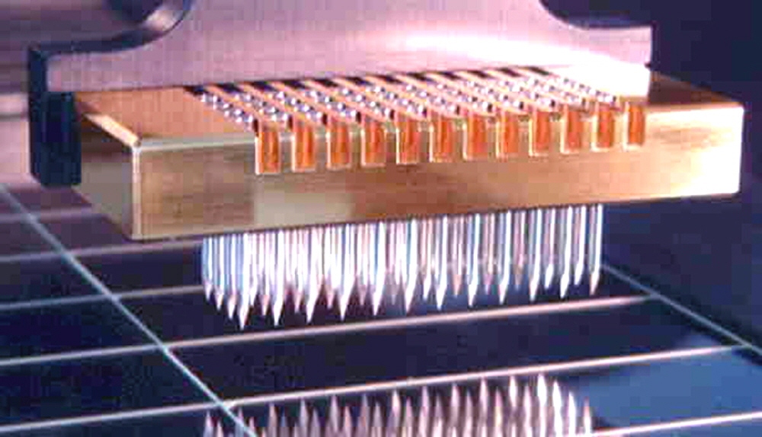
Batch and Source Adjustment
For Stanford Breast Cancer Data
From Perou et al (2000)
Microarray for Measuring Gene Expression
Old Style: Arrays Printed in Lab

Slide 49
Batch and Source Adjustment
For Stanford Breast Cancer Data
From Perou et al (2000)
Analysis in Benito et al (2004)
Adjust for Source Effects
Different sources of mRNA
Adjust for Batch Effects
Arrays fabricated at different times

Slide 50
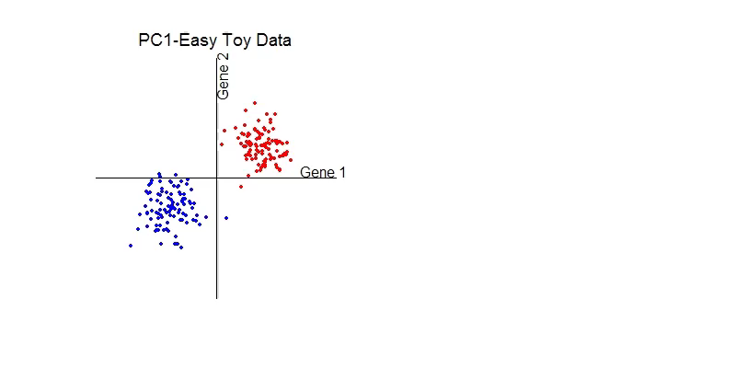
Idea Behind Adjustment
Early Approach: Alter et al (2000)
Squash Out PC1 direction
Eliminates variation in that direction

Slide 51
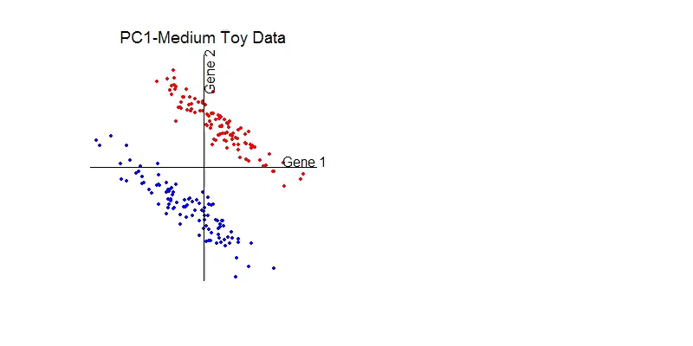
DWD: Why not PC1?
PC 1 Direction feels variation, not classes
Also eliminates (important?) within class variation

Slide 52
DWD: Why not PC1?
Direction driven by classes
“Sliding” maintains (important?) within class variation

Slide 53
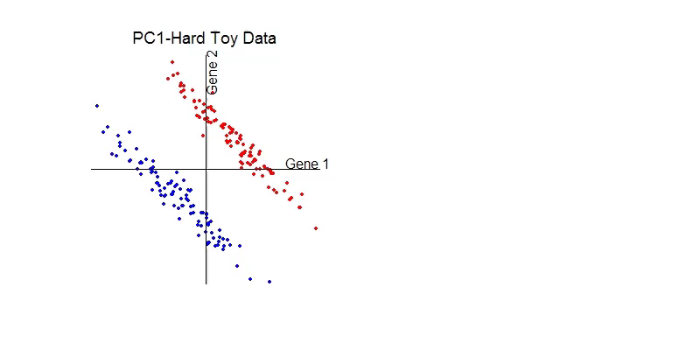
E. g. even worse for PCA
PC1 direction is worst possible

Slide 54
But easy for DWD
Since DWD uses class label information

Slide 55
Next Time
Reconsider order of these slides

Slide 56
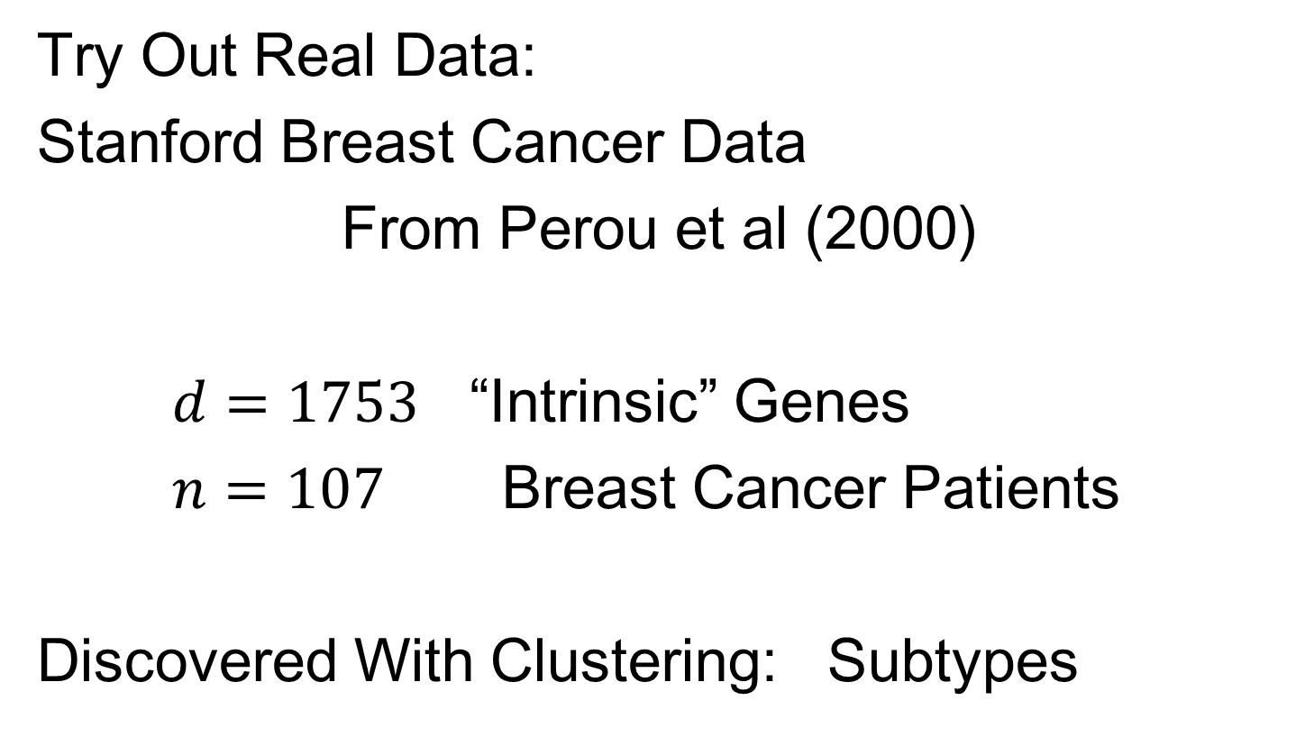
Batch and Source Adjustment
Try Out Real Data:
Stanford Breast Cancer Data
From Perou et al (2000)
$d=1753$ “Intrinsic” Genes
$n=107$ Breast Cancer Patients
Discovered With Clustering: Subtypes

Slide 57
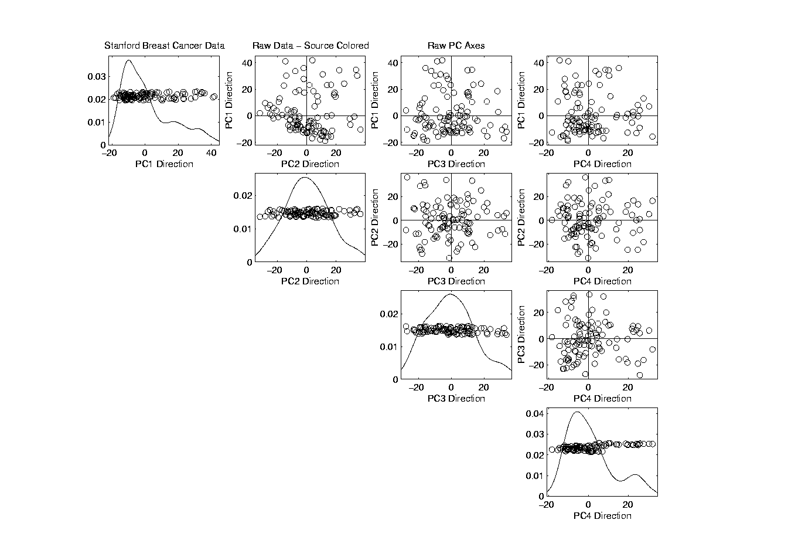
Source Batch Adj: Raw Breast Cancer data
See Some
Clusters?

Slide 58
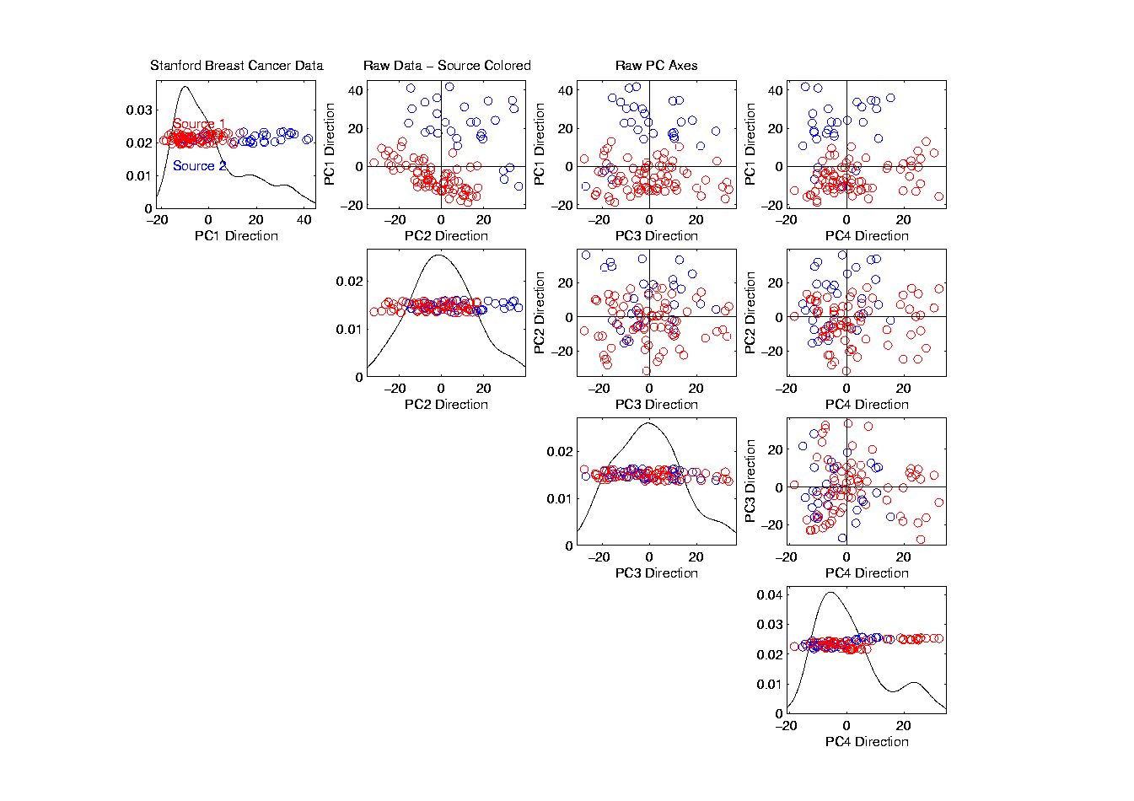
Source Batch Adj: Source Colors
Color By Ink Used
to Print Chips
Bad News, Since
This Dominates PC1
Squishing PC1
Not So Good
Since PC2
Also Involved
Yet Want to Find
Cancer Subtypes

Slide 59
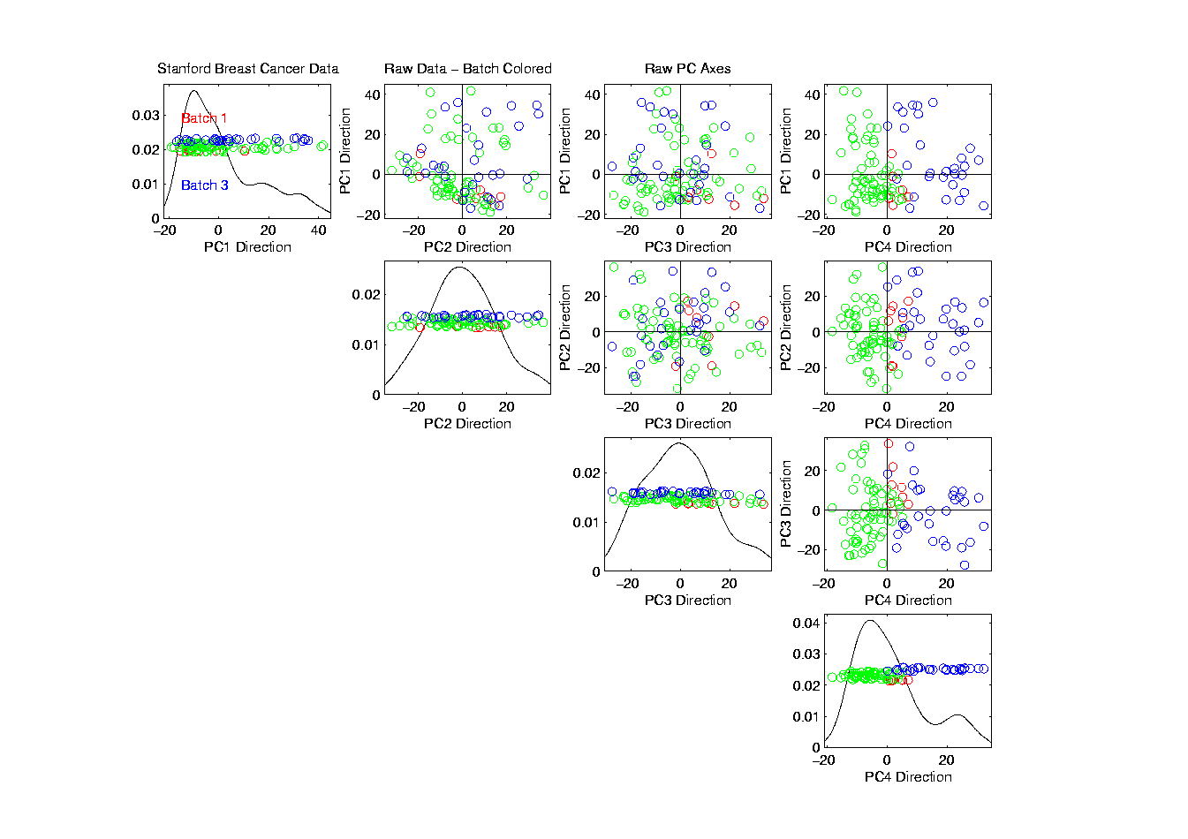
Source Batch Adj: Batch Colors
Color By
Fabrication
Batch
This
Dominates
PC4
Is There
Any Biology
In This Data?

Slide 60
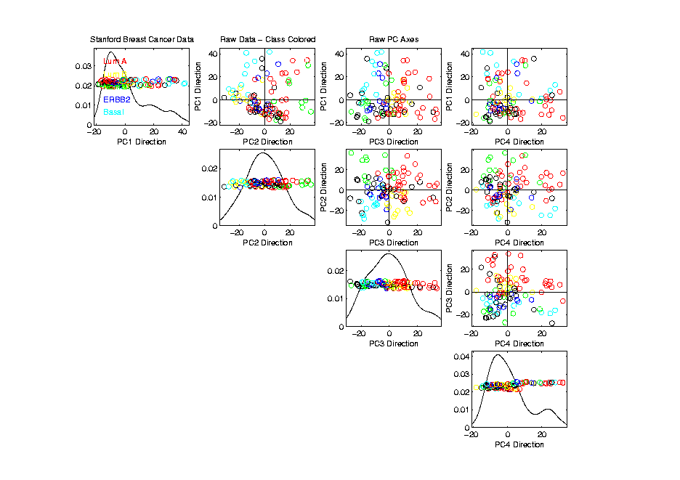
Source Batch Adj: Biological Class Colors
Color By
Cancer
Subtypes
Important Biology
Appears in PCs 2 & 3
Strongly Motivates
Adjustment of Data

Slide 61
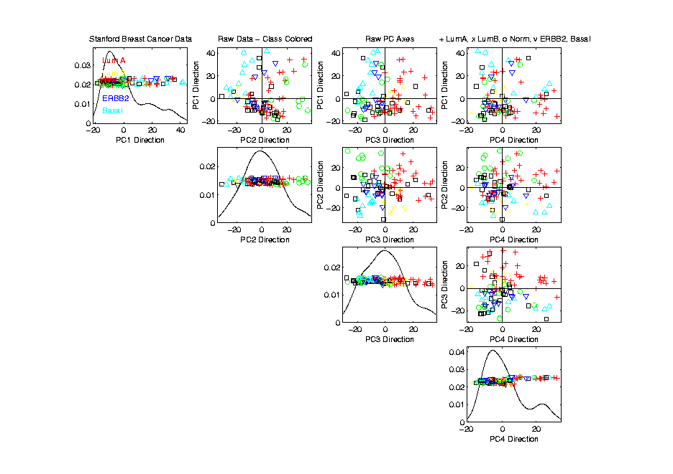
Source Batch Adj: Biological Class Col. & Symbols
Follow Subtypes
Using Symbols

Slide 62
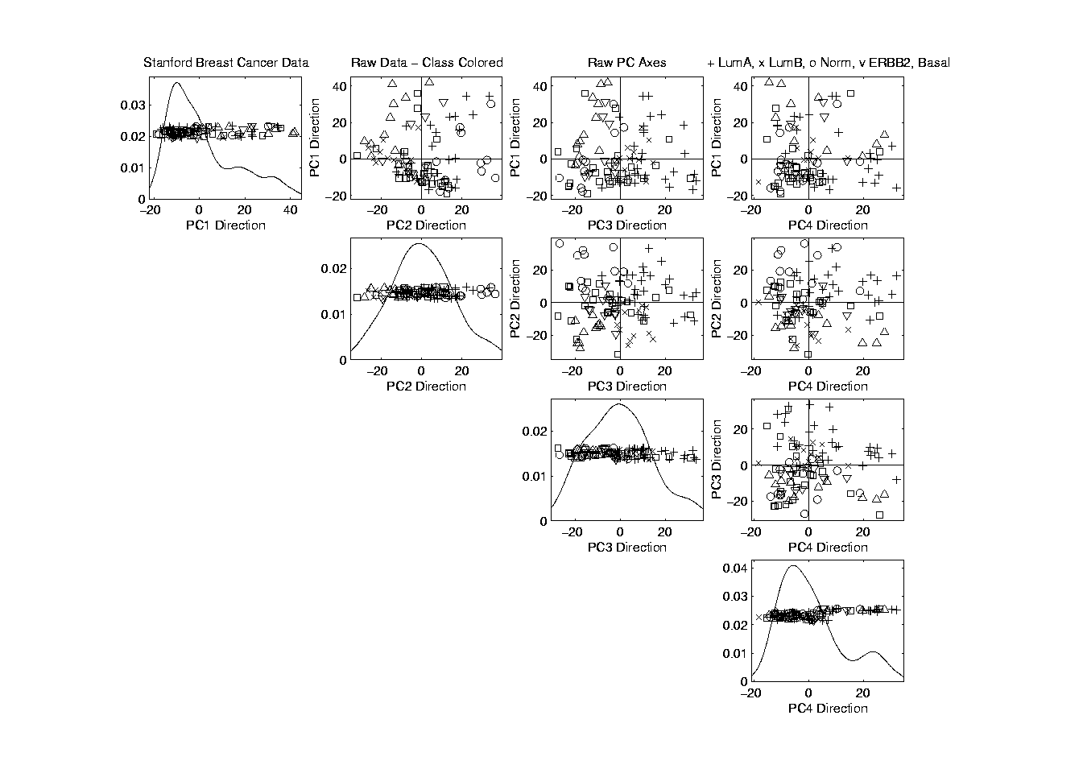
Source Batch Adj: Biological Class Symbols
Switch Off
Subtype
Colors

Slide 63
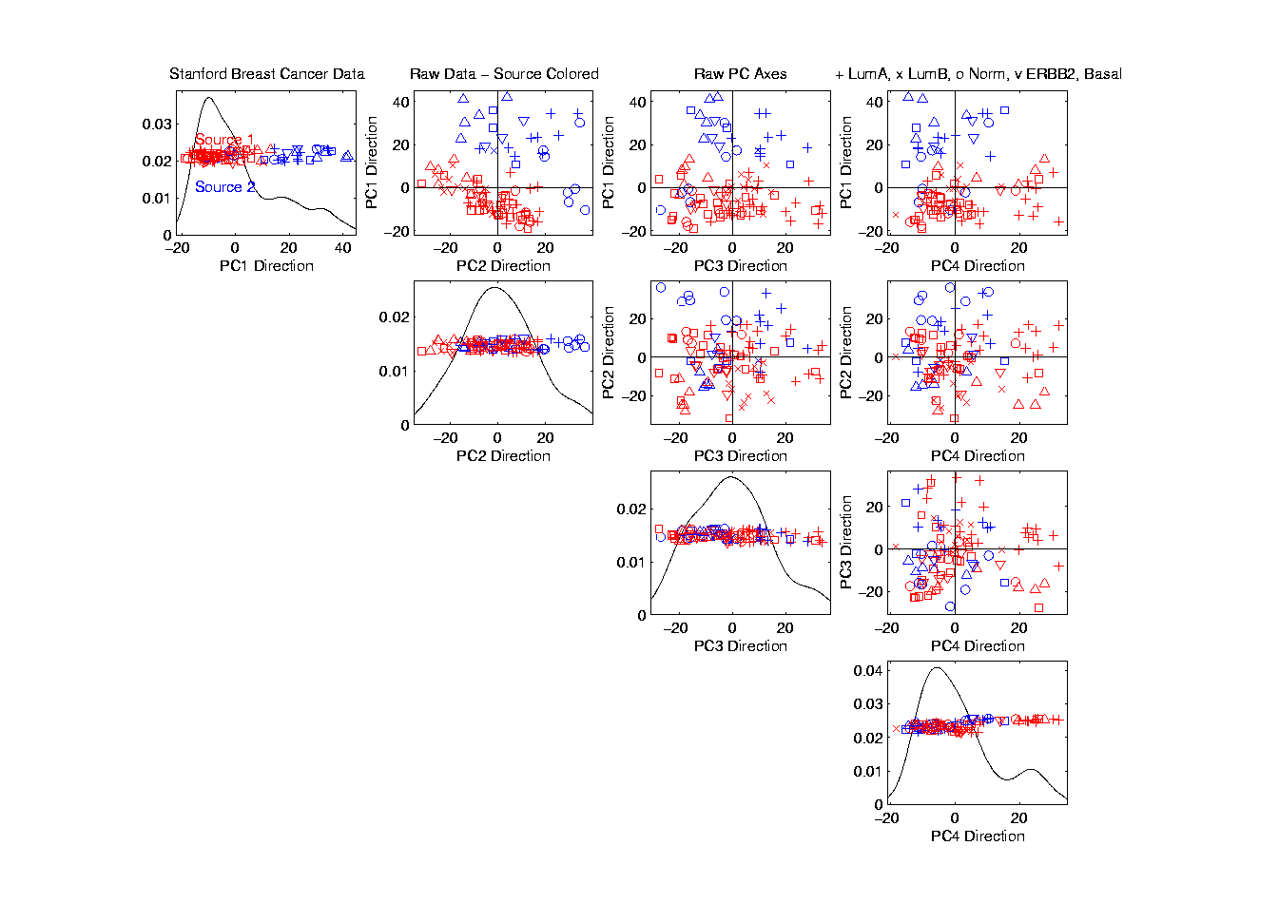
Source Batch Adj: Source Colors
Return to
Source
Colors

Slide 64
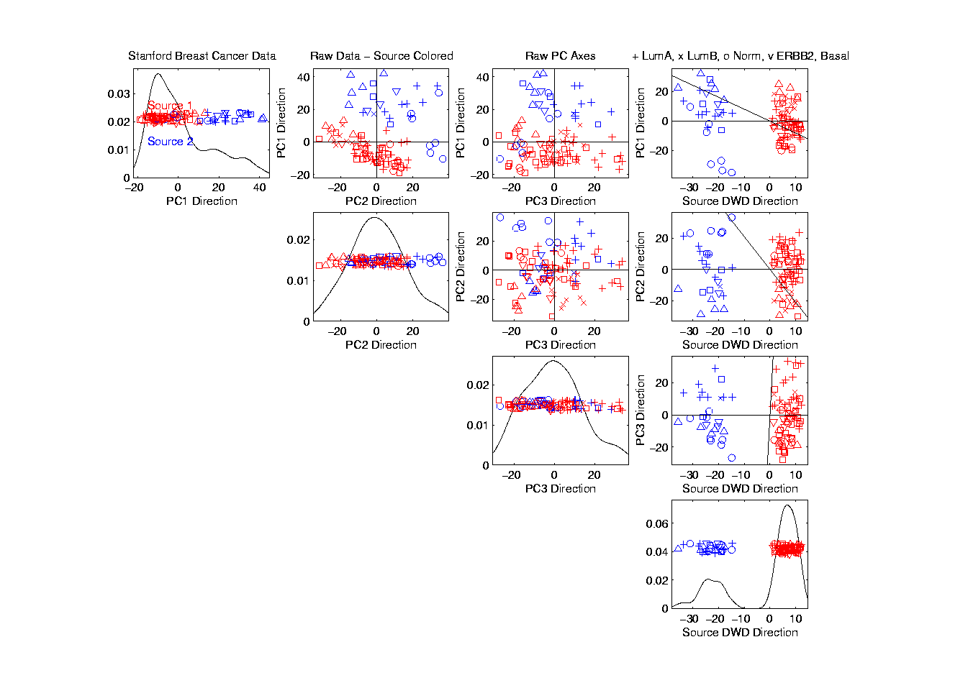
Source Batch Adj: PC 1-3 & DWD direction
Replace PC4
By DWD
Direction
Note Much Farther
Apart Than in PC1

Slide 65
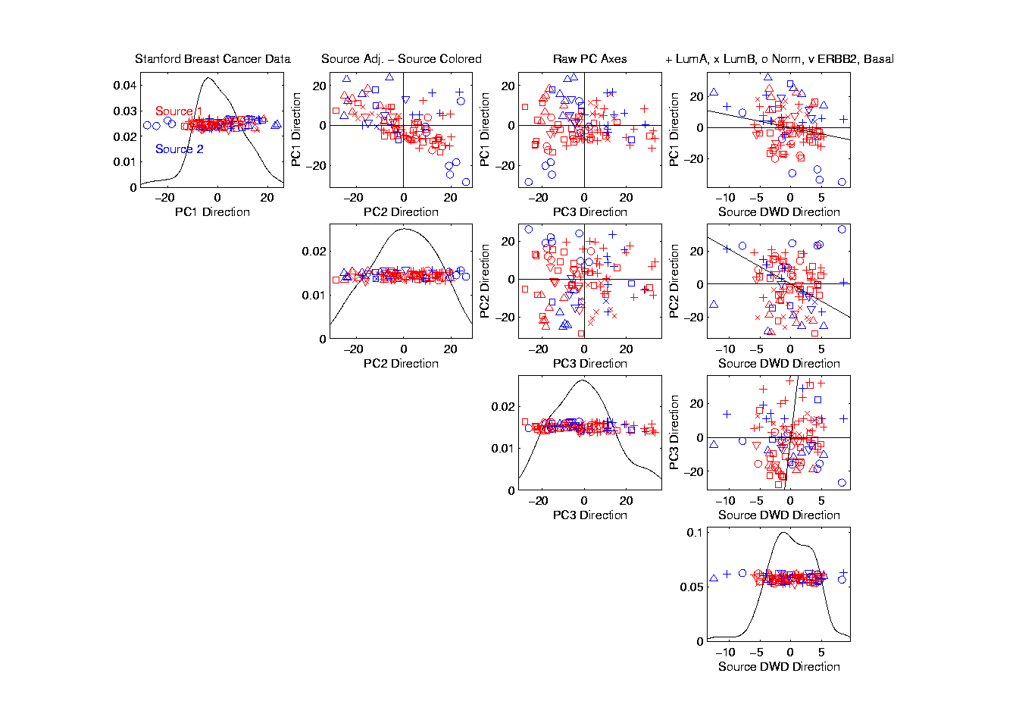
Source Batch Adj: DWD Source Adjustment
Slide Data
In DWD
Direction
Note How Subtypes
Come Together
Until Means
Are the Same

Slide 66
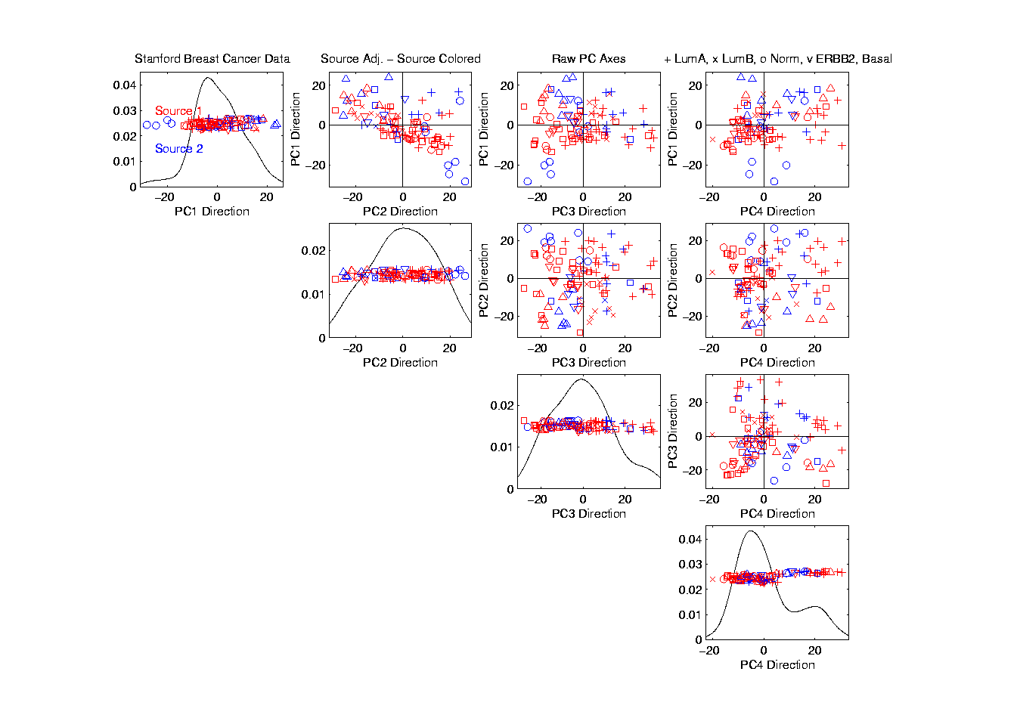
Source Batch Adj: Source Adj’d, PCA view
Return PC4

Slide 67
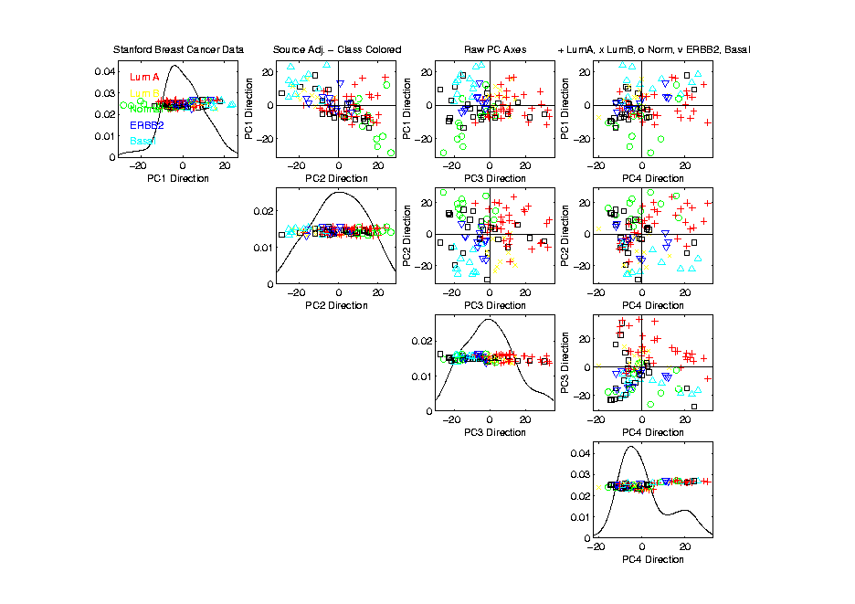
Source Batch Adj: Source Adj’d, Class Colored
Subtype Colors
Shows Very
Successful
Adjustment

Slide 68
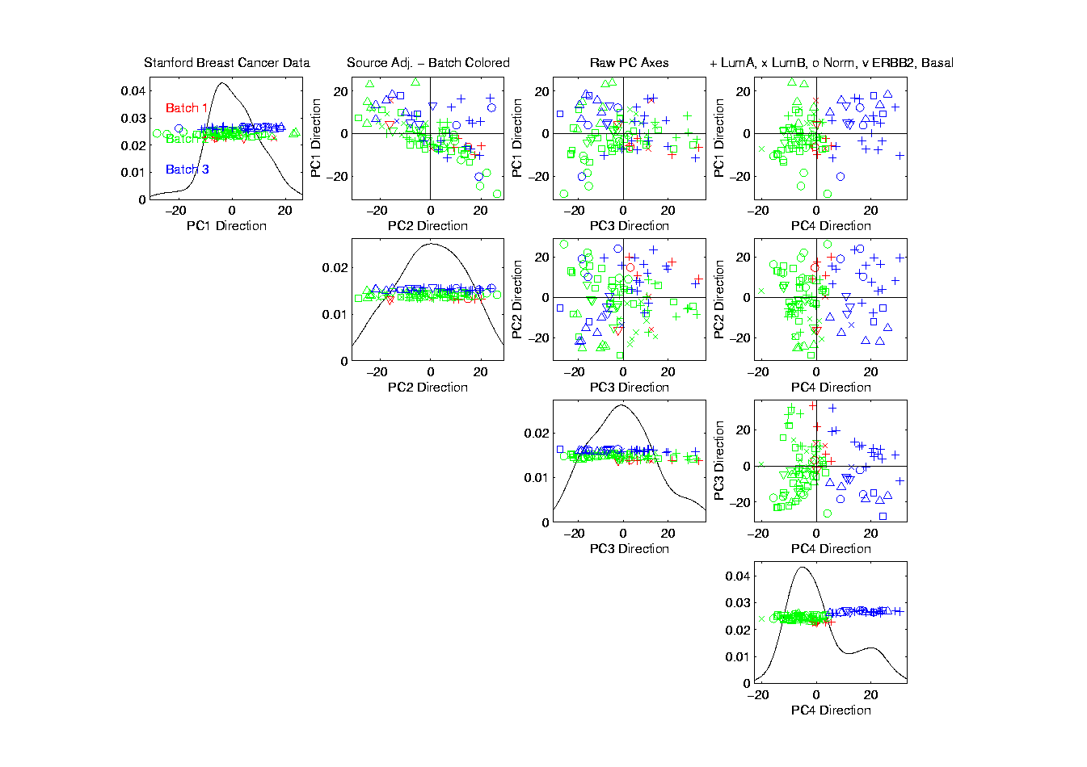
Source Batch Adj: Source Adj’d, Batch Colored
Next Consider
Batch Colors

Slide 69
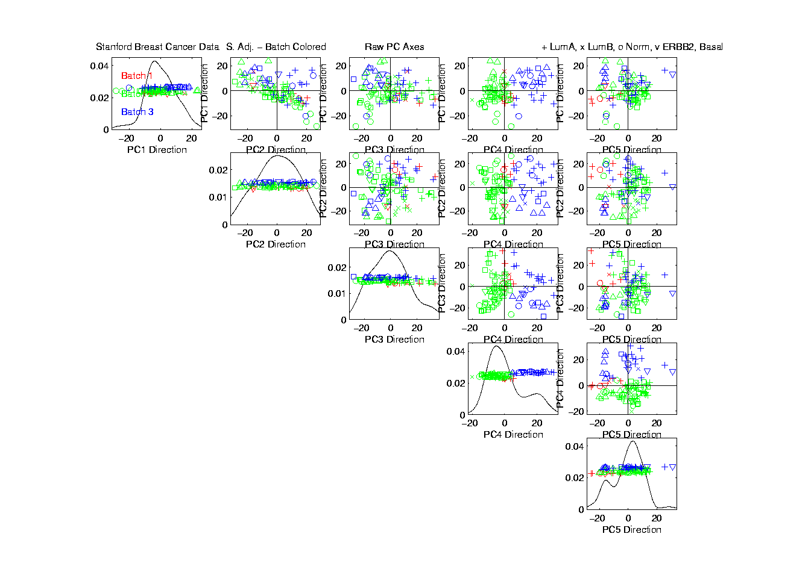
Source Batch Adj: Source Adj’d, 5 PCs
Don’t Want to Replace PC4
With DWD, Since Will Miss
Effect of Adjustment,
So Add PC5 (to Replace)

Slide 70
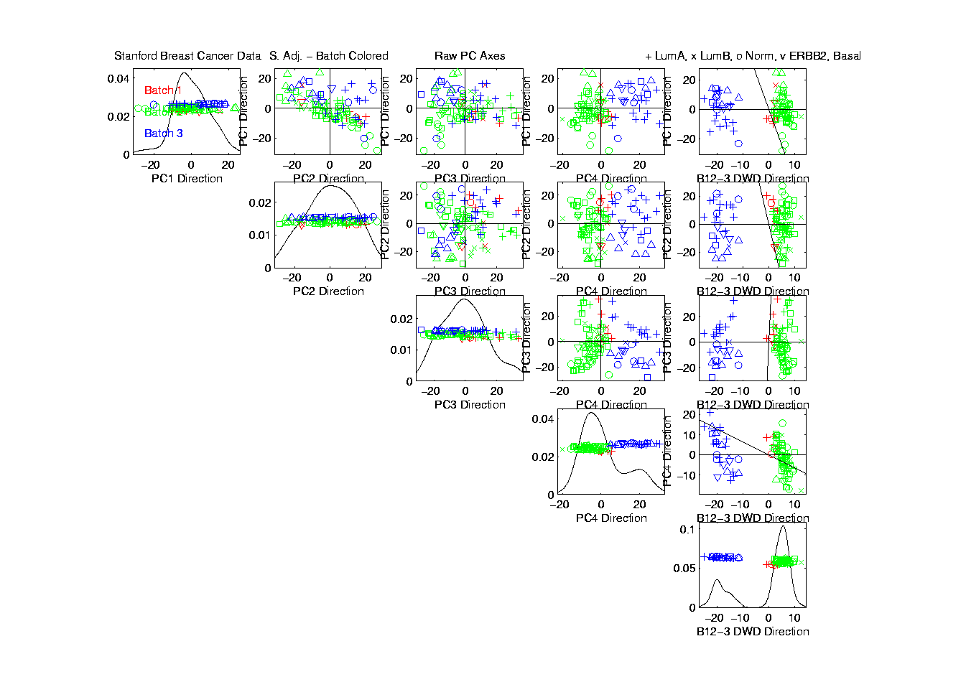
Source Batch Adj: S. Adj’d, Batch 1,2 vs. 3 DWD
Replace PC5 With DWD Trained
on Blue vs. (Green & Red)

Slide 71

Source Batch Adj: S. & B1,2 vs. 3 Adjusted
Slide Data
In DWD
Direction
Good Impact
On PC4

Slide 72

Source Batch Adj: S. & B1,2 vs. 3 Adj’d, 5 PCs
Return to PC5

Slide 73

Source Batch Adj: S. & B Adj’d, B1 vs. 2 DWD
DWD Trained on
(Green & Blue) vs. Red

Slide 74

Source Batch Adj: S. & B Adj’d, B1 vs. 2 Adj’d
Slide Data
In DWD
Direction

Slide 75

Source Batch Adj: S. & B Adj’d, 5 PC view
Return
To PC5

Slide 76

Source Batch Adj: S. & B Adj’d, 4 PC view
Go Back To
4 PCs View

Slide 77

Source Batch Adj: S. & B Adj’d, Class Colors
Return Subtype Colors
Note Subtypes Distinguished,
i.e. Successful Adjustment
After adjusting, These Are
No Longer PC Directions

Slide 78

Source Batch Adj: S. & B Adj’d, Adj’d PCA
Recompute PC Axes
PC1 & 2 Now About Biology

Slide 79

DWD does not solve all problems
Only handles means, not differing variation
Alternative: Shabalin et al (2008)

Slide 80
Interesting Benchmark Data Set
NCI 60 Cell Lines
Interesting benchmark, since same cells
Data Web available:
http://discover.nci.nih.gov/datasetsNature2000.jsp
Both cDNA and Affymetrix Platforms
Different from Breast Cancer Data
Which had no common samples
See Liu et al. (2009)

Slide 81
Interesting Benchmark Data Set
NCI 60 Cell Lines
Interesting benchmark, since same cells
Previously Studied, (1/18/2024)
Illustrating Limitations of PCA Views
Used DWD Dir’ns to Focus on Types

Slide 82

NCI 60: Can we find classes Using PCA view?
Notes:
82

Slide 83

NCI 60: Views using DWD Dir’ns (focus on biology)
Now
Study
Where
This
Data
Came
From
Notes:
83

Slide 84
Recall DWD Appl’n: Visualization
Recall PCA limitations
DWD uses class info
Hence can “better separate known classes”
Did this for pairs of classes
(DWD just on those, ignore others)
Carefully choose pairs in NCI 60 data
Showed Effectiveness of DWD Visualization

Slide 85
Recall DWD Appl’n: Visualization
Now Study Provenance of NCI 60 Data
Gene Expression Experiment
Same Samples On 2 Microarray Platforms
Affymetrix (Boston)
CDNA (Stanford, Chuck Perou)
Which is “Better”?
Measuring the “Same” thing?
Can Put on Same Scale?
Benito, et al. (2004)
60 Cancer
Cell Lines

Slide 86
Next Time
Better Integrate these with the above

Slide 87

NCI 60: Raw Data, Platform Colored
Common Samples
Connected by
Dashed Lines
Huge Platform
Differences
Fortunately
Systematic

Slide 88

NCI 60: Raw Data
Use Common Colors

Slide 89

NCI 60: Raw Data, Before DWD Adjustment
Slide Points Down
Along Diagonal
(to make space)
Color Blue
For “Before”

Slide 90

NCI 60: Before & After DWD adjustment
Add On Red
Points for
“After” DWD
Show Blue → Red
Difference as
Black Lines

Slide 91

NCI 60: Before & After, new scales
Rescale Axes to
Focus on Red Only

Slide 92

NCI 60: After DWD
Turn Off
All But Red

Slide 93

NCI 60: DWD adjusted data
Slide Down to Middle

Slide 94

NCI 60: Before Column Mean Adjustment
Slide Further Down
To Become “Before”
For Next Step

Slide 95

NCI 60: Before & After Column Mean Adjustment
Impacts Variation
In PC1 Direction
Subtract Trait Means
(i.e. Means of Columns)

Slide 96

NCI 60: Before & After Col. Mean Adj., Rescaled
Rescale Axes to
Focus on Red Only

Slide 97

NCI 60: After DWD & Column Mean Adj.
Turn Off
All But Red

Slide 98

NCI 60: DWD & Column Mean Adjusted
Slide Down to Middle

Slide 99

NCI 60: Before Column Stand. Dev. Adjustment
Slide Further Down
To Become “Before”
For Next Step

Slide 100

NCI 60: Before and After Column S.D. Adjustment
Standardize Columns
(Divide Columns by SD)
Reduces Blue Variation Everywhere

Slide 101

NCI 60: Before and After Col. S.D. Adj., Rescaled
Rescale Axes to
Focus on Red Only

Slide 102

NCI 60: After Column Stand. Dev. adjustment
Turn Off
All But Red

Slide 103

NCI 60: Fully Adjusted Data
Slide Down to Middle

Slide 104

NCI 60: Fully Adjusted Data, Platform Colored
Return Original Colors
Next Study Clusters
Using “Brushing”

Slide 105

NCI 60: Fully Adjusted Data, Melanoma Cluster
BREAST.MDAMB435
BREAST.MDN
MELAN.MALME3M
MELAN.SKMEL2
MELAN.SKMEL5
MELAN.SKMEL28
MELAN.M14
MELAN.UACC62
MELAN.UACC257
Known Mislabellings

Slide 106

NCI 60: Fully Adjusted Data, Leukemia Cluster
LEUK.CCRFCEM
LEUK.K562
LEUK.MOLT4
LEUK.HL60
LEUK.RPMI8266
LEUK.SR

Slide 107

Why not adjust using SVM?
Major Problem: Proj’d Distrib’al Shape
Triangular Dist’ns (opposite skewed)
Does not allow sensible rigid shift

Slide 108

Why not adjust using SVM?
Nicely Fixed by DWD
Projected Dist’ns near Gaussian
Sensible to shift

Slide 109
Why not adjust by means?
DWD is complicated: value added?
Because it is “cool”
Recall Improves SVM for HDLSS
Good Empirical Success
Routinely Used in Perou Lab
Many Comparisons Done
Similar Lessons from Wistar
Proven Statistical Power

Slide 110
Why not adjust by means?
But Why Not PAM (~Mean Difference)?
Simpler is Better
Why not means, i.e. point cloud centerpoints?
Elegant Answer: Liu et al (2009)

Slide 111
Why not adjust by means?
But Why Not PAM (~Mean Difference)?
Simpler is Better
Why not means, i.e. point cloud centerpoints?
Drawback to PAM:
Poor Handling of Unbalanced Biological Subtypes
DWD more Resistant to Unbalance

Slide 112
Why not adjust by means?
Toy Example:
Gaussian Clusters
Two batches (denoted: + o)
Two subtypes (red and blue)
Goal: bring together
+ ←→ o and also + ←→ o
Challenge: unequal biological ratios within batches

Slide 113

Twiddle ratios of subtypes
2-d Toy
Example
Balanced
Mixture
Adjusted Along
DWD Direction
Adjusted Along
MD Direction

Slide 114

Twiddle ratios of subtypes
2-d Toy
Example
Unbalanced
Mixture
(Through
“decimation”)

Slide 115

Twiddle ratios of subtypes
2-d Toy
Example
Unbalanced
Mixture
(Diminishing
Discriminatory
Power)

Slide 116

Twiddle ratios of subtypes
2-d Toy
Example
Unbalanced
Mixture

Slide 117

Twiddle ratios of subtypes
2-d Toy
Example
Unbalanced
Mixture

Slide 118

Twiddle ratios of subtypes
2-d Toy
Example
Unbalanced
Mixture
Note: Losing
Distinction
To Be Studied

Slide 119

Twiddle ratios of subtypes
2-d Toy
Example
Unbalanced
Mixture

Slide 120
Why not adjust by means?
DWD robust against non-proportional subtypes…
Mathematical Statistical Question:
Are there mathematics behind this?
Notes:
120

Slide 121
Carry Away Concept
OODA is more than a “framework”
It Provides a Focal Point
Highlights Pivotal Choices:
What should be the Data Objects?
How should they be Represented?

