Slide 1
Topological Data Analysis (TDA)
Object Oriented Data Analysis

Slide 2
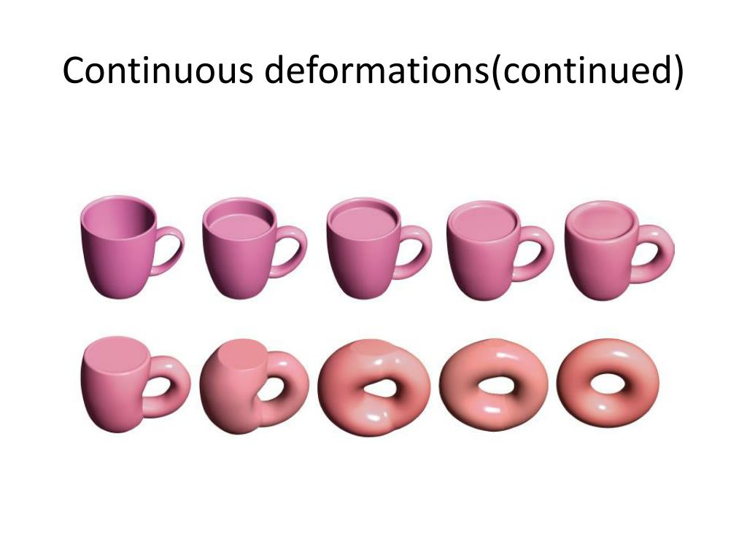
Topology in a nutshell
Recall: Topology is the study of the properties of geometric objects that are preserved under continuous deformation.
Ex: connected components, holes, cavities.

Slide 3
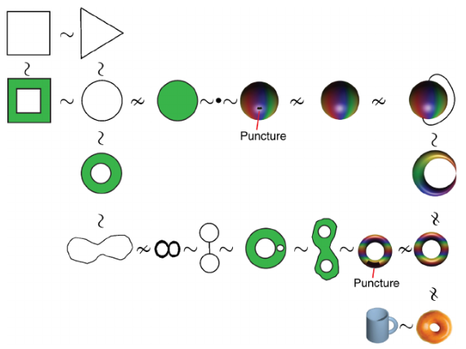
Topological analysis of population activity in visual cortex (Singh et al. 2008)

Slide 4
Persistent Homology
Persistent homology is the main tool in TDA
A homology of a topological space X is set of groups (homology groups) containing topological invariants (i.e. all holes, cavities, connected components) of X.
Homology groups can be used to categorize and count the number of each type of topological feature.
Idea: study the persistence of topological features ( connected components, holes, etc.) over a filtration of the topological space.
Three holes
One connected component

Slide 5




Persistent Homology
Towards computing homology from finite approximations (Robins 1999)
Considered problem of extrapolating the homology of a topological space from a finite sample.
Introduced the concept of persistent homology groups.
Topological persistence and simplification (Edelsbrunner, Letscher, Zomorodian 2000)
Independently introduced persistent homology
Developed a fast algorithm for computing persistent homology groups
Introduced the persistence diagram

Slide 6
Homology Groups (in 3-dimensions)
The 0th dimensional homology group (H0) counts the number of path connected components.
For k > 0, each Kth Homology group counts “holes” with kth dimensional boundaries.
H1 – counts loops
H2 – counts cavities (3-d “holes”)
In persistent homology we are interested in how the size of these groups change across scales of some filtration.

Slide 7
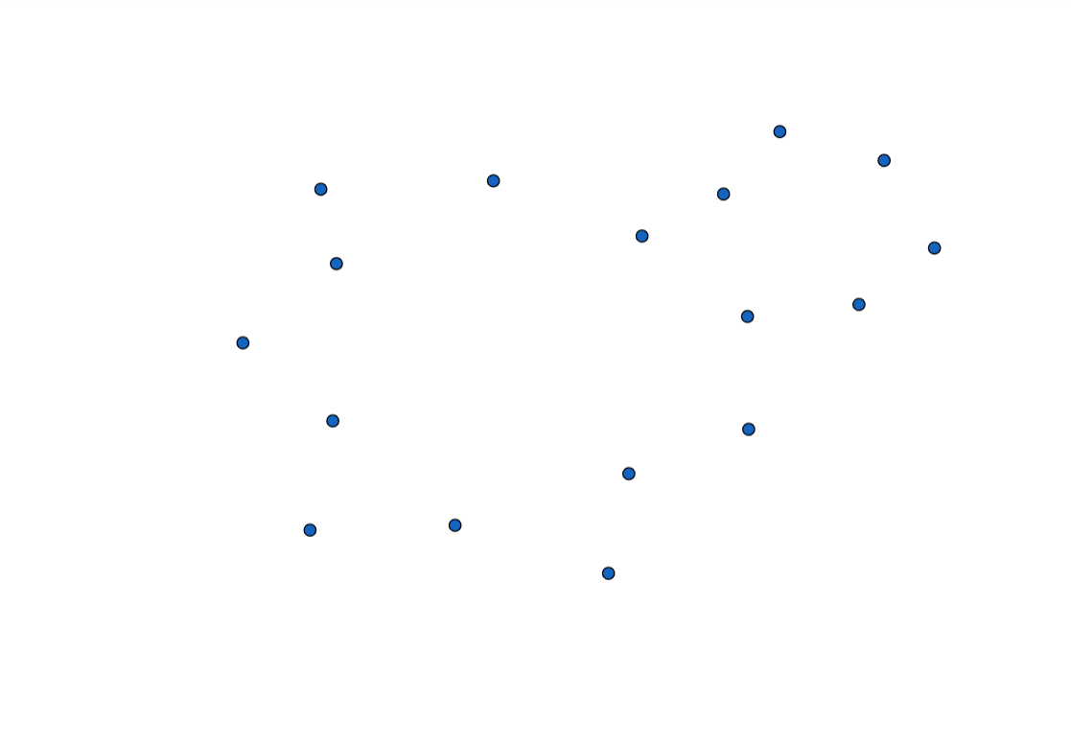
Example: Expanding Balls Filtration
Given a set of points in 2-dimensions
Filtration function: radius of neighborhoods around points.
dim(H0) = 17

Slide 8
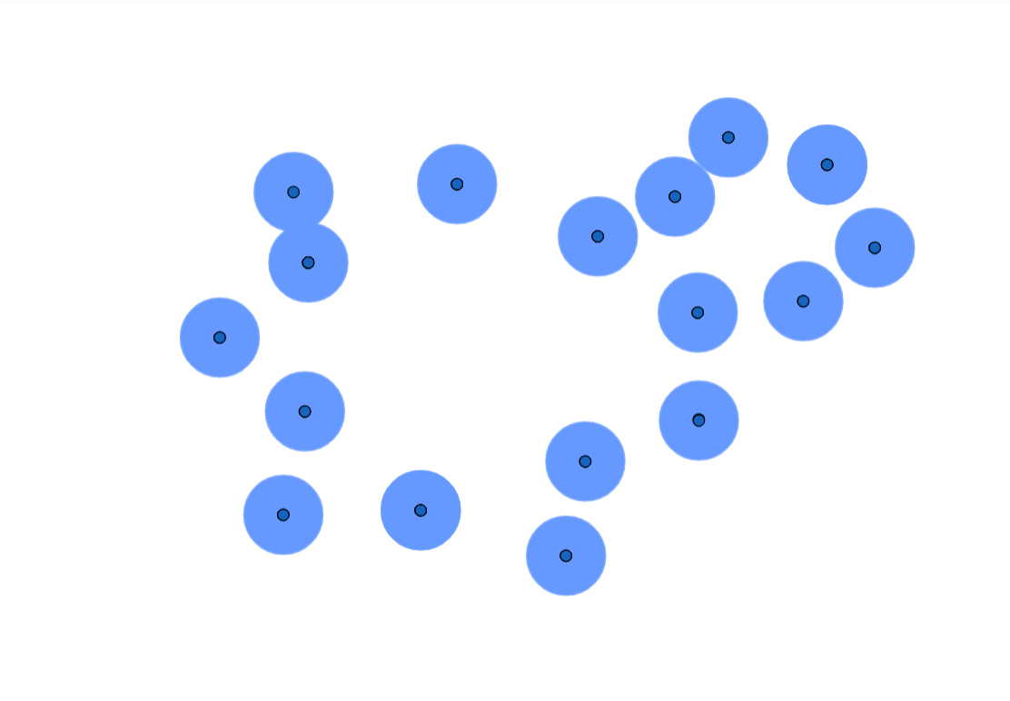
Example: Expanding Balls Filtration
Given a set of points in 2-dimensions
Filtration function: radius of neighborhoods around points.
dim(H0) = 16

Slide 9
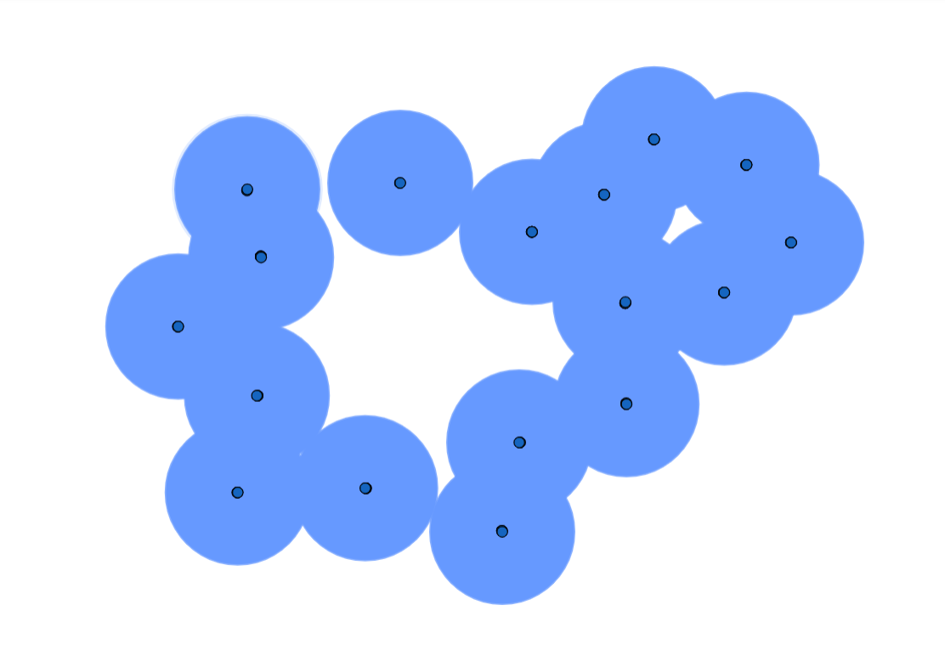
Example: Expanding Balls Filtration
Given a set of points in 2-dimensions
Filtration function: radius of neighborhoods around points.
dim(H0) = 1 dim(H1) = 1

Slide 10
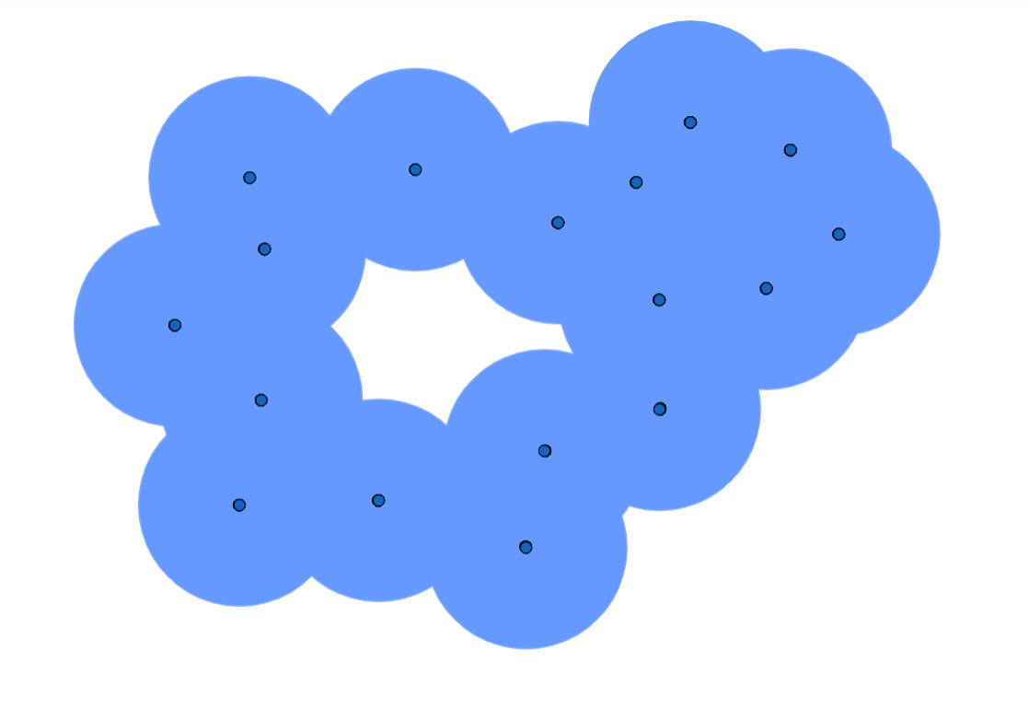
Example: Expanding Balls Filtration
Given a set of points in 2-dimensions
Filtration function: radius of neighborhoods around points.
dim(H0) = 1 dim(H1) = 1

Slide 11
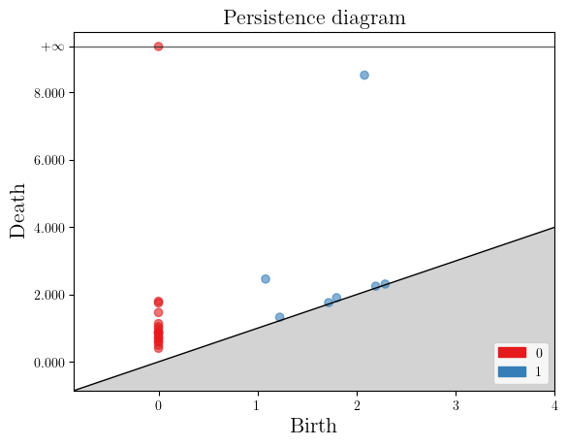
Persistence Diagram
r = 0
r = 0.5
r = 2
r = 4

Slide 12
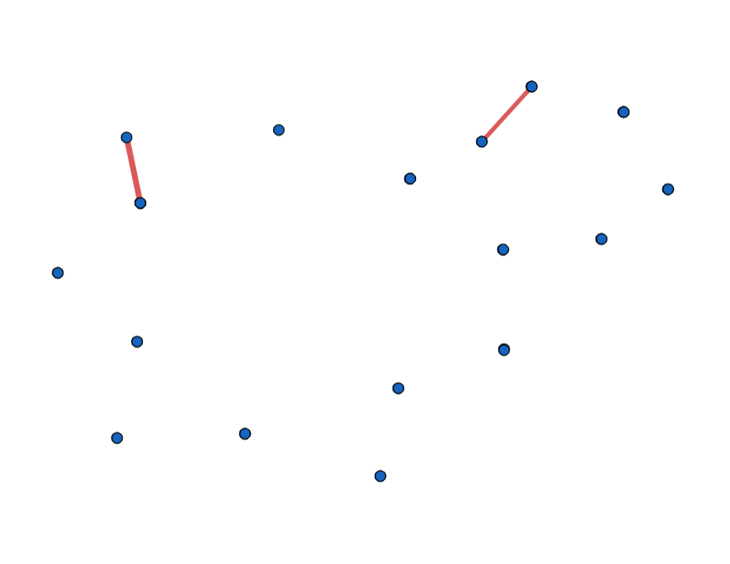
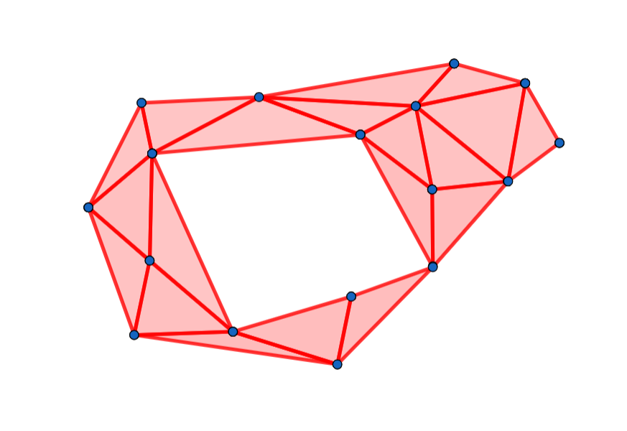
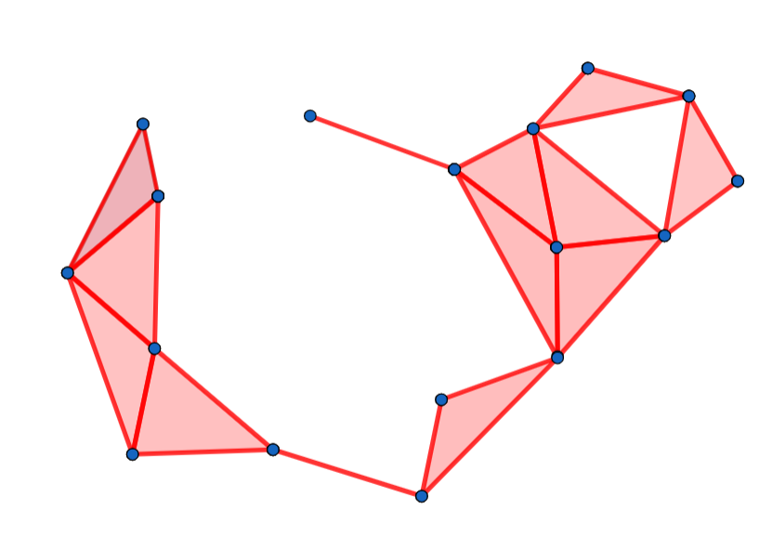
Complex Representation

Slide 13
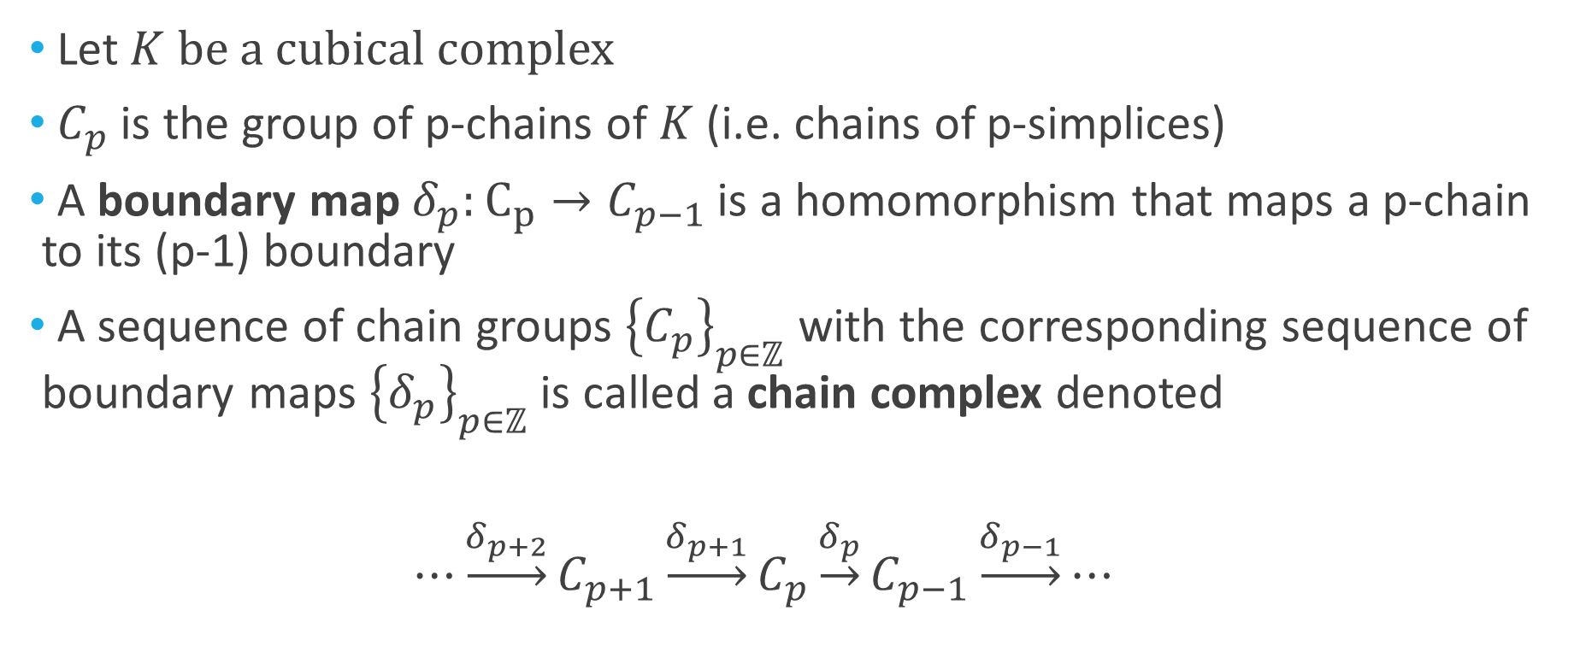
Chain Complexes
Let$K$ be a cubical complex
${ C}_{p}$ is the group of p-chains of $K$ (i.e. chains of p-simplices)
A boundary map${ δ}_{p}:C_{p}→C_{p−1}$ is a homomorphism that maps a p-chain to its (p-1) boundary
A sequence of chain groups ${\left\{C_{p}\right\}}_{p∈ℤ}$ with the corresponding sequence of boundary maps ${\left\{δ_{p}\right\}}_{p∈ℤ}$ is called a chain complex denoted
$⋯\underset{→}{δ_{p+2}}C_{p+1}\underset{→}{δ_{p+1}}C_{p}\underset{→}{δ_{p}}C_{p−1}\underset{→}{δ_{p−1}}⋯$

Slide 14
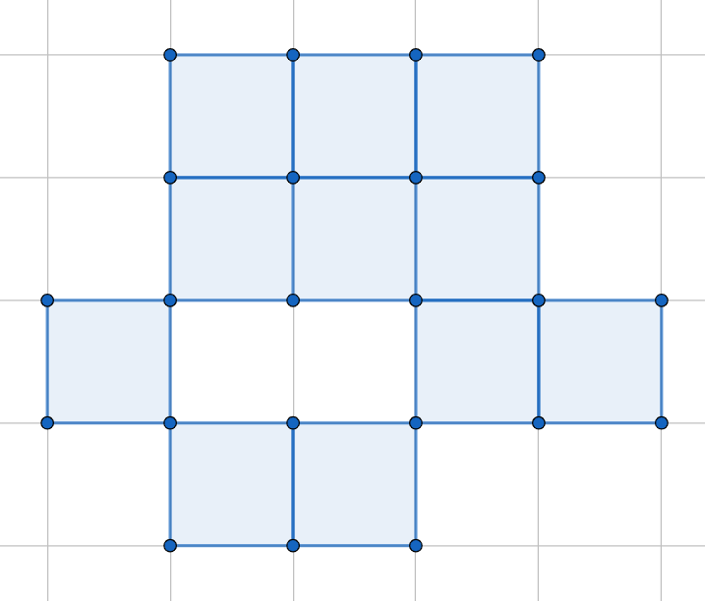
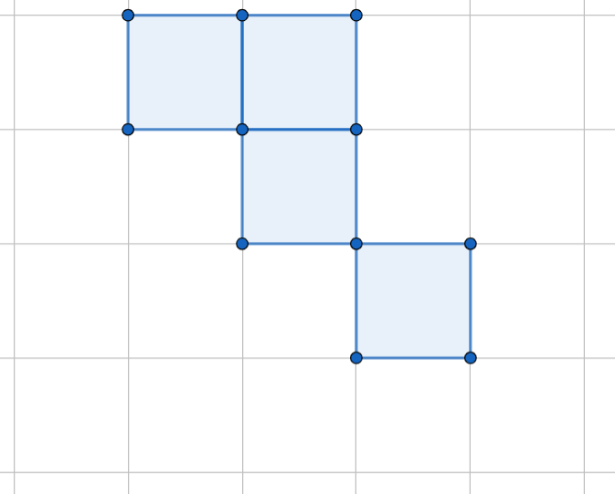
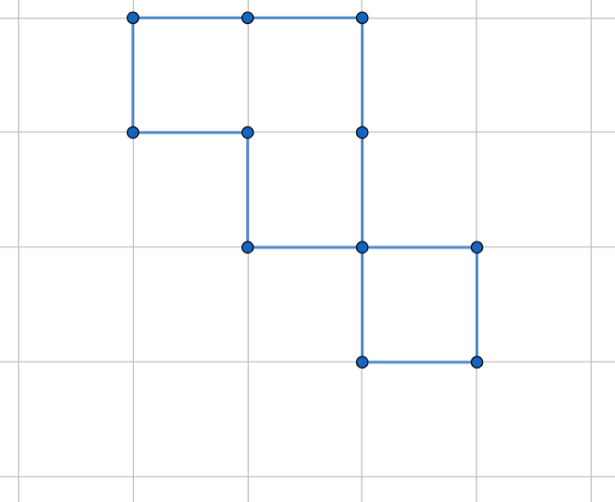
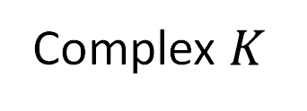

Complex $K$
1-Chain
(boundary)
2-Chain
$$δ_{2}$$

Slide 15
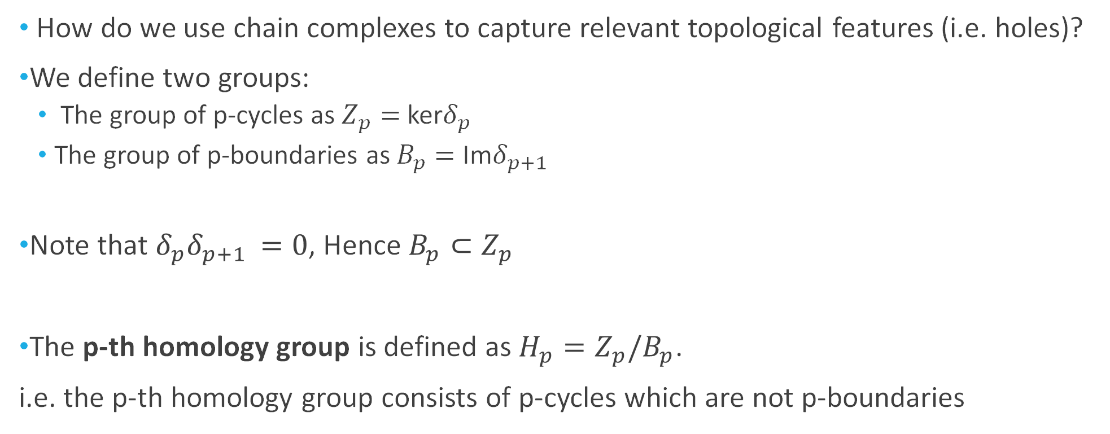
Defining Homology Groups
How do we use chain complexes to capture relevant topological features (i.e. holes)?
We define two groups:
The group of p-cycles as $Z_{p}=$ ker$δ_{p}$
The group of p-boundaries as $B_{p}=$ Im$δ_{p+1}$
Note that $δ_{p}δ_{p+1 }=0$, Hence $B_{p}⊂Z_{p}$
The p-th homology group is defined as $H_{p}=Z_{p}/B_{p}$.
i.e. the p-th homology group consists of p-cycles which are not p-boundaries

Slide 16
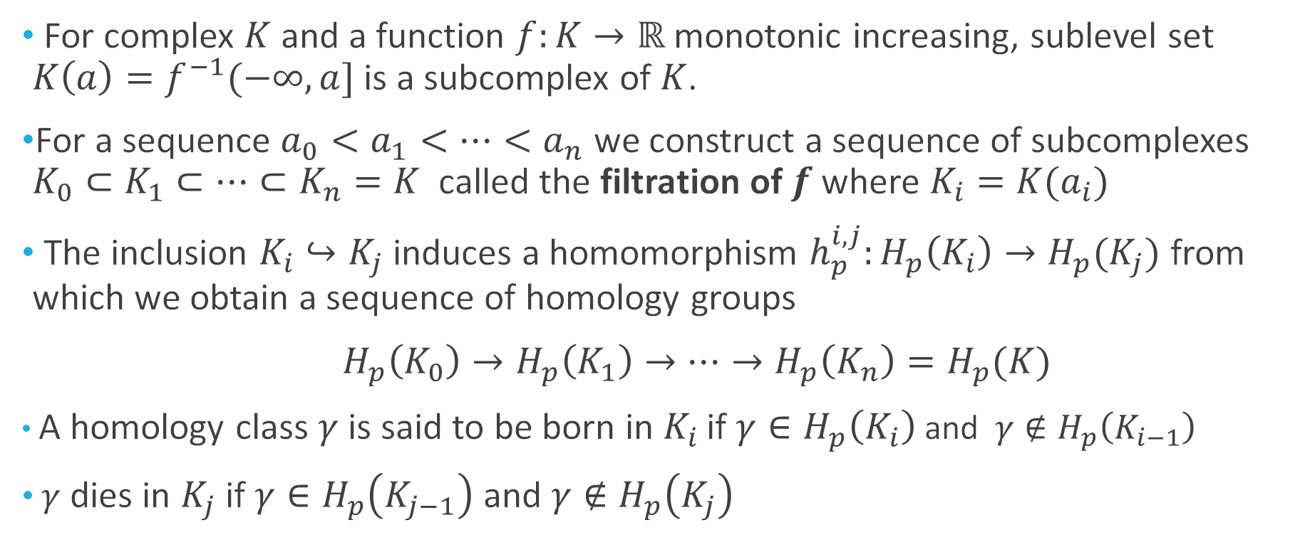
Persistent Homology
For complex $K$ and a function $f:K→ℝ$ monotonic increasing, sublevel set $K\left(a\right)=f^{−1}(−∞,a]$ is a subcomplex of $K$.
For a sequence $a_{0}<a_{1}<⋯<a_{n}$ we construct a sequence of subcomplexes $K_{0}⊂K_{1}⊂⋯⊂K_{n}=K$ called the filtration of $f$where $K_{i}=K(a_{i})$
The inclusion $K_{i}↪K_{j}$ induces a homomorphism $h_{p}^{i,j}:H_{p}\left(K_{i}\right)→H_{p}(K_{j})$ from which we obtain a sequence of homology groups
$H_{p}\left(K_{0}\right)→H_{p}\left(K_{1}\right)→⋯→H_{p}\left(K_{n}\right)=H_{p}(K)$
A homology class $γ$ is said to be born in $K_{i}$ if $γ∈H_{p}\left(K_{i}\right)$and $γ∉H_{p}\left(K_{i−1}\right)$
$γ$ dies in $K_{j}$ if $γ∈H_{p}\left(K_{j−1}\right)$ and $γ∉H_{p}\left(K_{j}\right)$

Slide 17
Applications of TDA
Classical Application:
Data objects: points in n-dimensional space
Goal: determine the underlying topology implied by the set of points.
High persistence = “real” topological feature
Low persistence = noise
OODA viewpoint:
Data objects: persistence diagrams
Goal: utilize topological differences to find interesting directions in the data space.
Applicable to collections of point clouds, sets of images, graph structured data objects.

Slide 18
Analyzing Collections of Persistence Diagrams
Probability measures on the space of persistence diagrams (Mileyko, Mukherjee, and Harer 2011)
The space of persistence diagrams equipped with the Wasserstein metric ( or bottleneck distance) is a complete and separable metric space.
Can define probability measures on space of persistence diagrams which support expectations and variance.
Fréchet Means for Distributions of Persistence Diagrams (Turner, Mileyko, Mukherjee, and Harer 2014)
Characterizes Fréchet means and variances and provides an algorithm for estimating them.

Slide 19
Analyzing Collections of Persistence Diagrams
Working in the Space of Persistence diagrams can be computationally expensive.
Wasserstein distance computation time O(n^3)
Not feasible when:
Large collection of persistence diagrams
Each persistence diagram contains many points
Alternative: Vector representations

Slide 20
Vector Representations of Persistence Diagrams
Common Vector Representations:
Persistence landscapes
Persistence images
Betti Function
Persistence Curves/Silhouettes
Rank Functions
simple statistical summaries ( i.e. mean persistence, average birth/death etc.)
Usual machine learning methods can be applied while still exploiting “coordinate free” aspects.

Slide 21
Application: Cell Spatial Data from Breast Cancer Tumor Biopsy

Slide 22
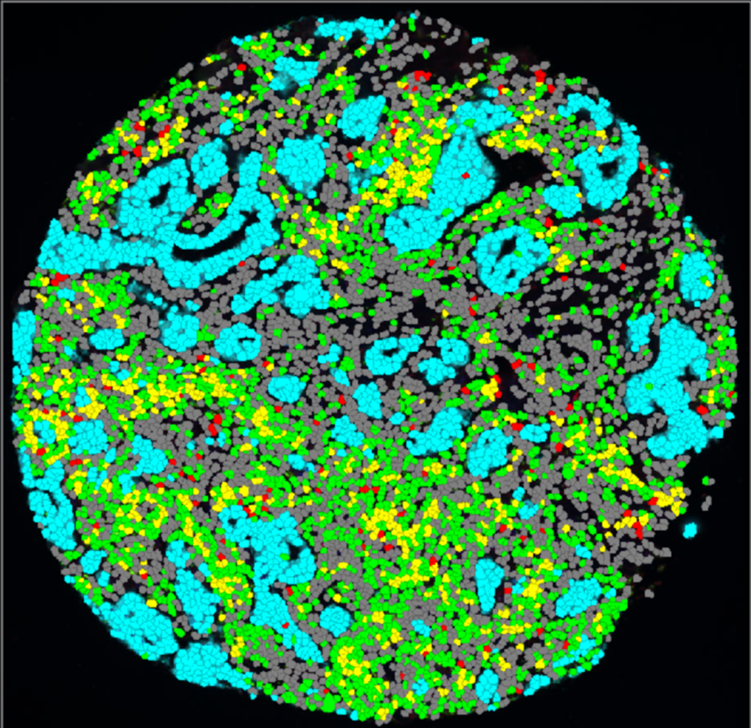
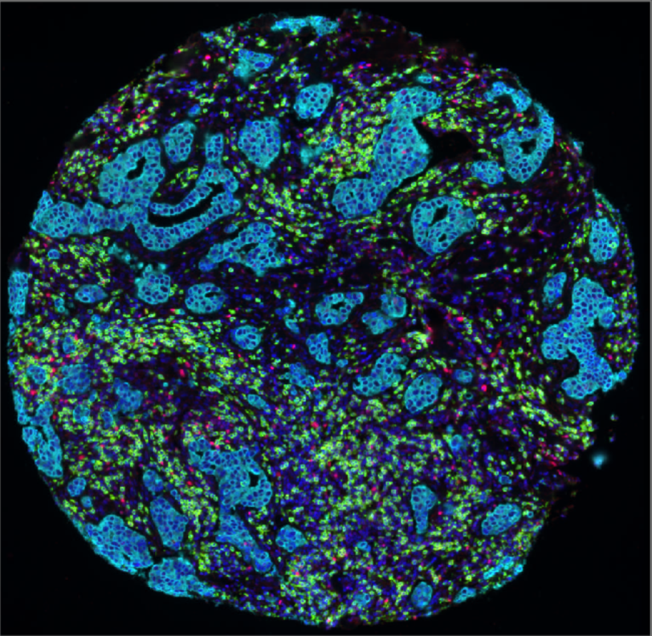
Data: Immunofluorescent (IF) Tissue Micro-Array (TMA) Cores
Multiplex IF Images with 4 Color Channels: Hoechst(Nucleus)
Cytokeratin(Tumor cells)
CD8(Lymphocyte)
FoxP3 (Lymphocyte)
Hoechst is used for cell detection.
Classification is based on the channel intensity of the other 3 color channels
Cell Classification:
Tumor Cell
CD8
FoxP3
Both CD8 and FoxP3
Unclassified

Slide 23
Cubical Complexes
Given an underlying grid we can build a complex which consists of vertices, edges, and squares.
An edge (square) can only be included in the complex if the adjacent vertices (edges) are included in the complex.

Slide 24
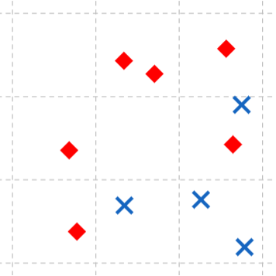
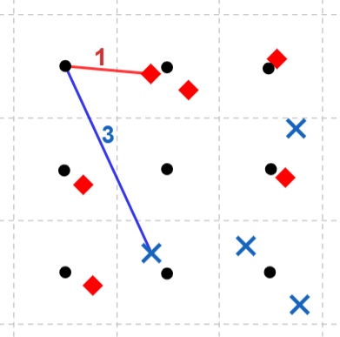
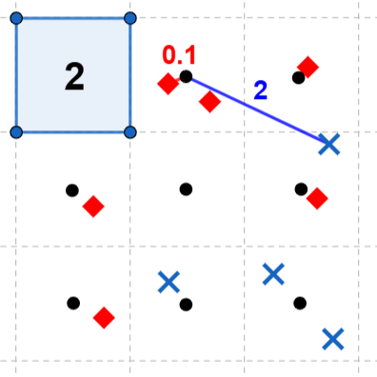
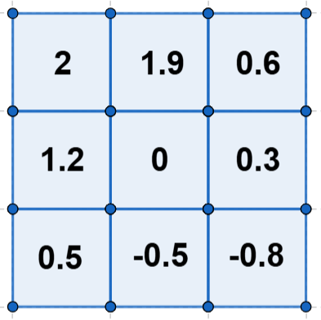
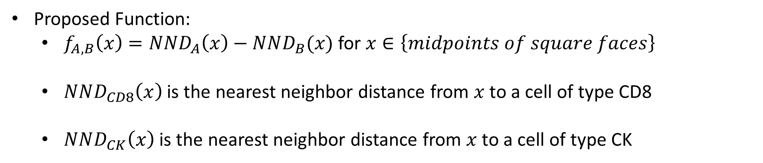
Proposed Function for Filtration
Proposed Function:
$f_{A, B}\left(x\right)=NND_{A}\left(x\right)−NND_{B}(x)$ for $x∈\left\{midpoints of square faces\right\}$
$NND_{CD8}\left(x\right)$ is the nearest neighbor distance from $x$ to a cell of type CD8
$NND_{CK}\left(x\right)$ is the nearest neighbor distance from $x$ to a cell of type CK
….

Slide 25
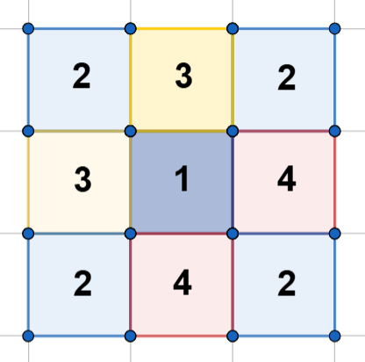
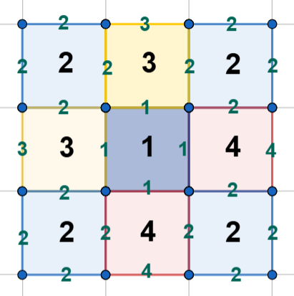
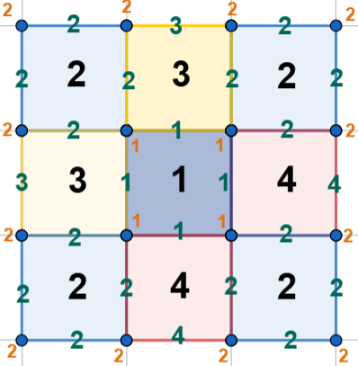
Faces assigned filtration values
Edges assigned minimum value of adjacent faces.
Vertices assigned minimum value of adjacent edges.

Slide 26
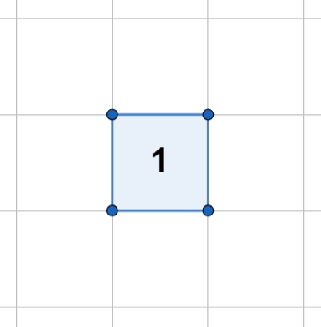
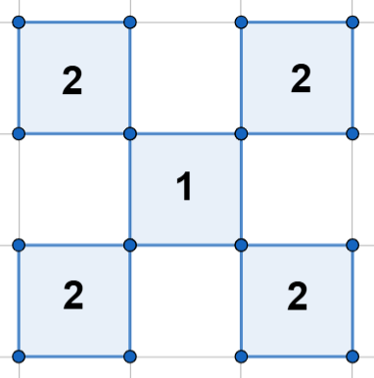
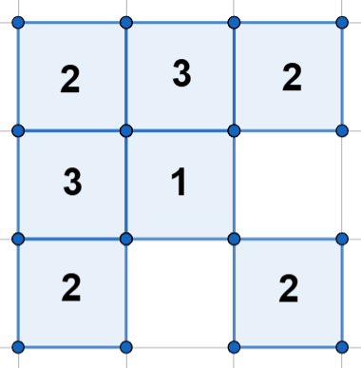
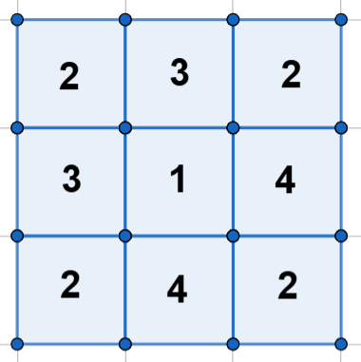




$$K_{1}=f^{−1}(−∞,1]$$
$$K_{2}=f^{−1}(−∞,2]$$
$$K_{3}=f^{−1}(−∞,3]$$
$$K_{4}=f^{−1}(−∞,4]$$

Slide 27
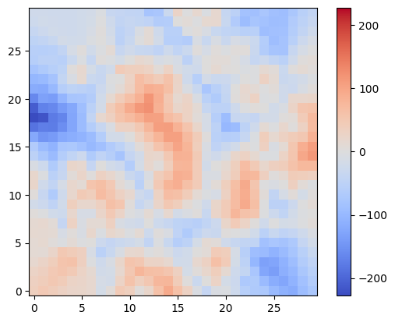
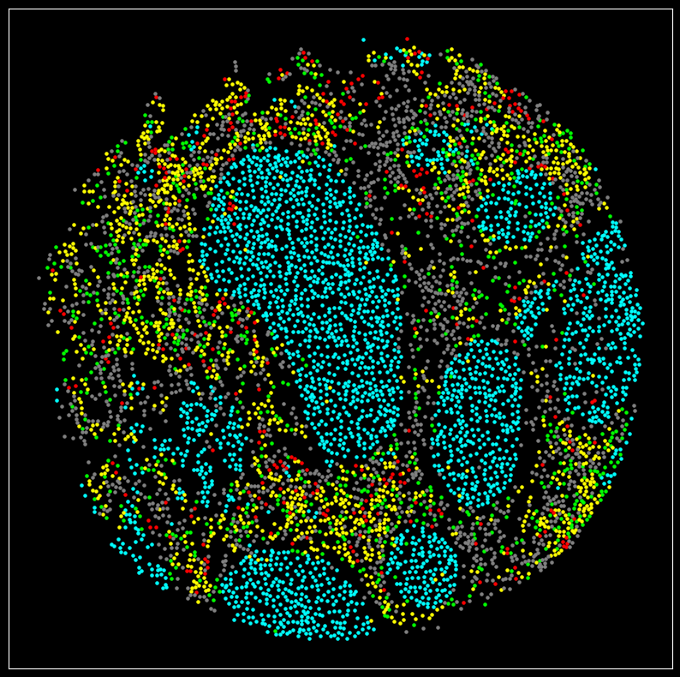
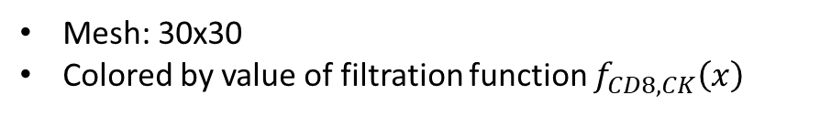
Tumor Cell
CD8
FoxP3
Both CD8 and FoxP3
Unclassified
Mesh: 30x30
Colored by value of filtration function $f_{CD8,CK}\left(x\right)$

Slide 28
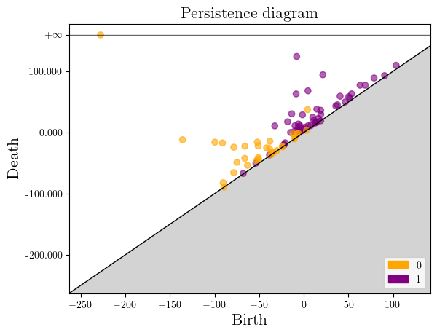
Mesh: 30x30
Colored by value of filtration function $f_{CD8,CK}\left(x\right)$

Slide 29
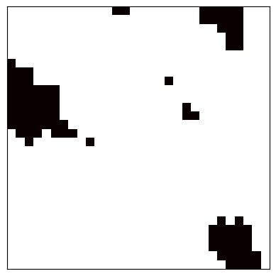
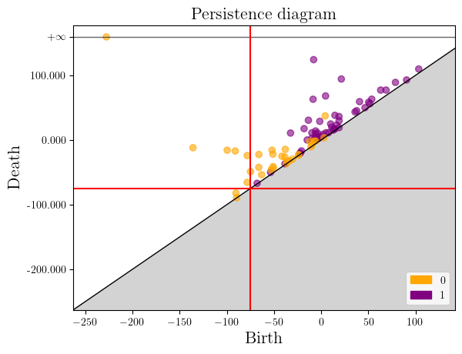

$f_{CD8,CK}\left(x\right)$<-75

Slide 30
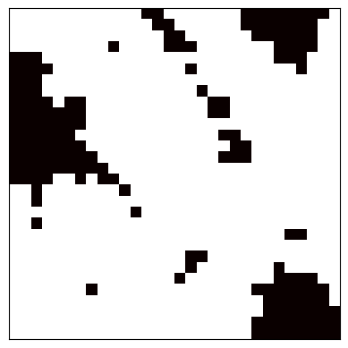
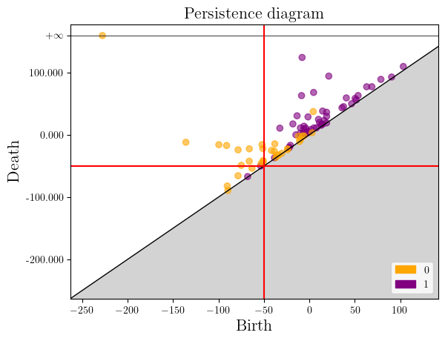

$f_{CD8,CK}\left(x\right)$< -50

Slide 31
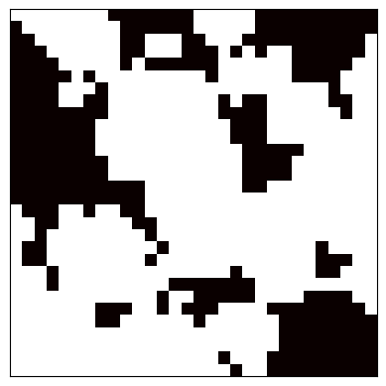
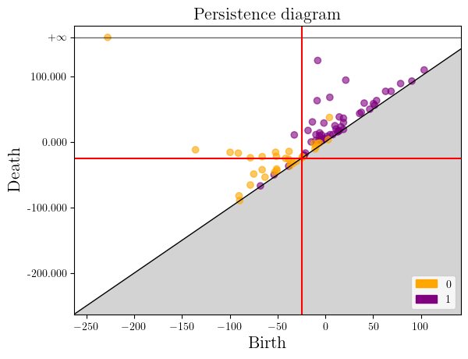

$f_{CD8,CK}\left(x\right)$< -25

Slide 32
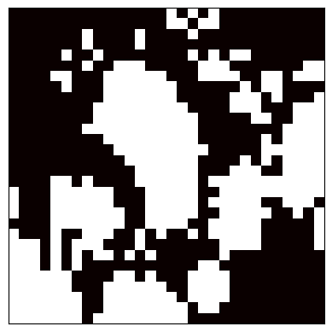
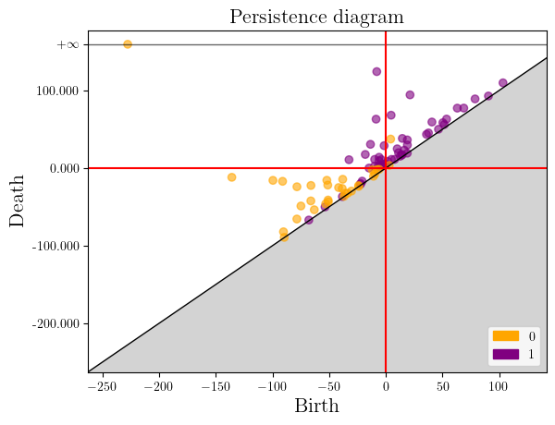

$f_{CD8,CK}\left(x\right)$< 0

Slide 33
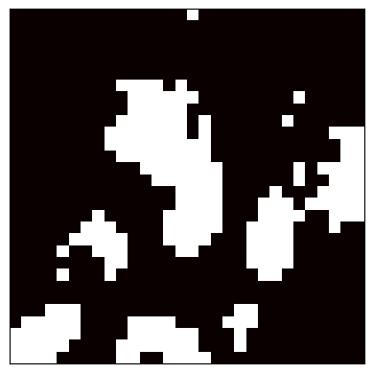
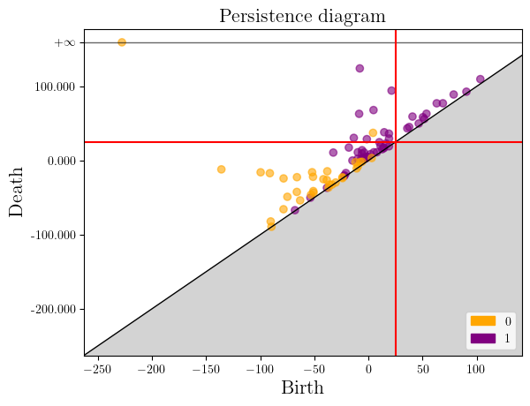

$f_{CD8,CK}\left(x\right)$< 25

Slide 34
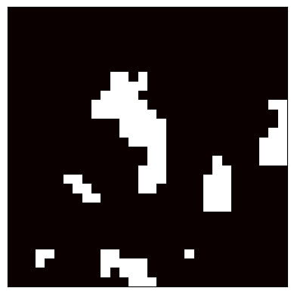
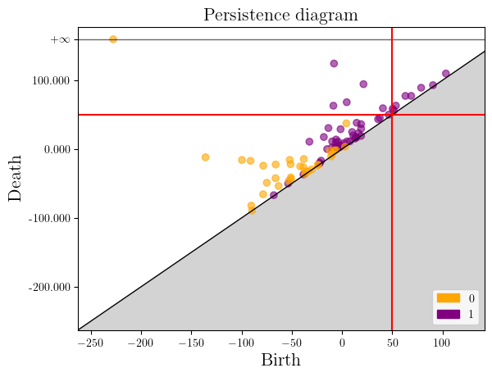

$f_{CD8,CK}\left(x\right)$< 50

Slide 35
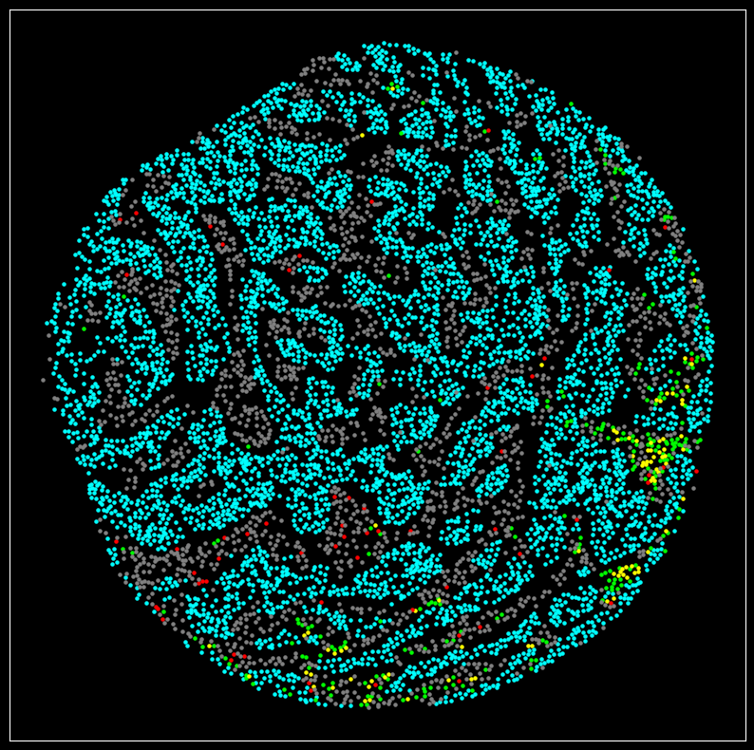
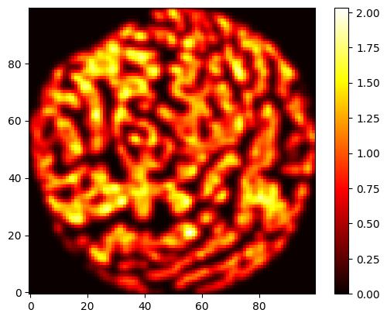
Tumor Cell
CD8
FoxP3
Both CD8 and FoxP3
Unclassified
Filtration function: Kernel density estimate of tumor cell density

Slide 36
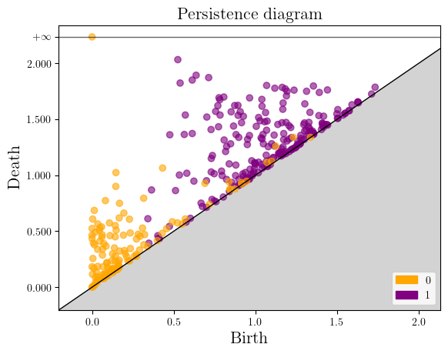
Filtration function: Kernel density estimate of tumor cell density

Slide 37



Compute H1 and H0 persistence diagrams
Rank function representation
Compute Kernel density estimate of tumor cell density on a 100 x 100 grid.
Concatenate and perform PCA
Rank function representation
Compute the difference between the distance to a CK+ cell and a CD8+ cell on 100 x 100 grid.

Slide 38
Survival Analysis with PC Scores
Variable | Univariate HR (95% CI) | P-value | Multivariate HR (95% CI)* | P-value
PC1 Scores | 1.40 (1.21, 1.62) | 8.89x10^-6 | 1.26 (1.07, 1.48) | 0.0059
PC2 Scores | 0.96 (0.84, 1.11) | 0.607 | 0.95 (0.82, 1.10) | 0.4828
PC3 Scores | 1.25 (1.07, 1.46) | 0.0053 | 1.45 (1.23, 1.71) | 1.26x10^-5
PC4 Scores | 0.92 (0.80, 1.05) | 0.217 | 0.96 (0.83, 1.12) | 0.614
*Adjusted for age, grade, stage, ER status, PR status, HER2 status.

Slide 39






Low PC1 Scores (worse outcome)

Slide 40






High PC1 Scores (better outcome)

Slide 41






Low PC3 Scores (worse outcome)

Slide 42






High PC3 Scores (better outcome)

Slide 43
Other Applications
Persistent Homology Analysis of Brain Artery Trees (Bendich et al. 2016)
Applied persistent homology to tree-structured data obtained from 3-d imaging of brain arteries.
Found significant correlation with age and sex.
Bump hunting by topological data analysis (Sommerfield et al. 2017)
TDA approach for finding and validating statistical significance of local modes in a data set.
Uses kernel density bandwidth for sub-level set filtration.
Database of Original & Non-Theoretical Uses of Topology (DONUT)
Database of TDA applications
Currently contains 535 papers

