Slide 1
Statistics – O. R. 881 Object Oriented Data Analysis
Steve Marron
Dept. of Statistics and Operations Research
University of North Carolina

Slide 2
Administrative Info
Details on Course Web Page
https://marron.web.unc.edu/course-home-page-stor-881-object-oriented-data-analysis-spring-2024/
Or access from Canvas page
Or:
Google: “Marrons teaching material”
Choose This Course

Slide 3
Administrative Info
Available on that Course Web Page:
Will Post Daily Power Points
Also Keep Running List of References

Slide 4
Who are we?
Varying Levels of Expertise
2nd Year Graduate (MS & PhD) Students
…
Faculty Level Researchers
Various Backgrounds
Statistics / Biostat
Computer Science – Imaging
Bioinformatics – Genetics
Pharmacy
Others…

Slide 5
Course Expectations
Grading Based on Both:
“Participant Presentations”
i. e. 5 minute talks
By Enrolled Students
Hopefully Others
Minimal Homework

Slide 6
Class Meeting Style
When you don’t understand something
Many others probably join you
So please fire away with questions
Discussion usually enlightening for others
If needed, I’ll tell you to shut up
(essentially never happens)

Slide 7
Course Context
Currently Fashionable Topic:
Big Data Science

Slide 8
Course Context
Currently Fashionable Topic:
Big Data Science

Slide 9
Course Context
Currently Fashionable Topic:
Big Data Science
Many Important Issues.
But More Challenging (& Important?):
Complex Data
( )

Slide 10
Object Oriented Data Analysis
What is it?
A Sound-Bite Explanation:
What is the “atom of the statistical analysis”?
1st Course: Numbers
Multivariate Analysis Course : Vectors
Functional Data Analysis: Curves

Slide 11
Functional Data Analysis
Currently active field in statistics, see:
Ramsay & Silverman (2005) {Book}
Ramsay & Silverman (2002) {Book}
Ramsay, J. O. (2005) {Website}

Slide 12
Object Oriented Data Analysis
What is it?
A Sound-Bite Explanation:
What is the “atom of the statistical analysis”?
1st Course: Numbers
Multivariate Analysis Course : Vectors
Functional Data Analysis: Curves
More generally: Data Objects

Slide 13
Object Oriented Data Analysis
Data Object Types
Curves (Functional Data Analysis)
Spectra (Non-Negative!)
Images
Shapes
Trees
Movies (Functional MRI)
$⋮$

Slide 14
Object Oriented Data Analysis
Current Motivation (of OODA terminology):
In Complicated Data Analyses
Fundamental (Non-Obvious) Question Is:
“What Should We Take as Data Objects?”
Key to Focusing Needed Analyses

Slide 15
Object Oriented Data Analysis
Reviewer for Annals of Applied Statistics:
Why not just say:
“Experimental Units”?
Useful for some situations
But misses different representations
E.g. log transformations …

Slide 16
Object Oriented Data Analysis
Older Published References:
Wang and Marron (2007)
Marron and Alonso (2014)

Slide 17
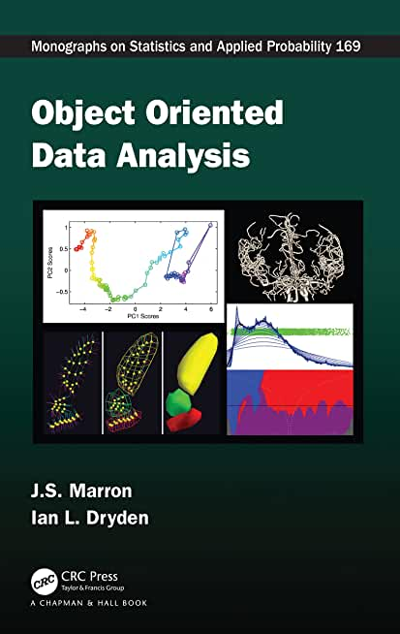
Object Oriented Data Analysis
Textbook:
Object Oriented Data Analysis
Marron and Dryden (2021)

Slide 18
Current Sections in Textbook
Today:
Chapters 1 & 2
Section 3.2
Next Class:
Section 3.1

Slide 19
Object Oriented Data Analysis
What is Actually Done?
Major Statistical Tasks:
Understanding Population Structure
Classification (i. e. Discrimination)
Clustering
Time Series of Data Objects
“Vertical Integration” of Datatypes
How Data Objects
Relate to Each Other

Slide 20
A Taste of OODA Examples
Spanish Male Mortality Curves
For Each Year/Age = # Died / Total #
≈ Prob. Of Dying
Text, Sec. 1.1

Slide 21
A Taste of OODA Examples
May Hide
Important
Structure
Spanish Male Mortality Curves
Challenge: Very Small For Young
Solution: Log Scale (Object Choice)
Factor > 10

Slide 22
A Taste of OODA Examples
Spanish Male Mortality Curves
Enhancement: Color by Year
1908
1931
1964
1987
2002

Slide 23
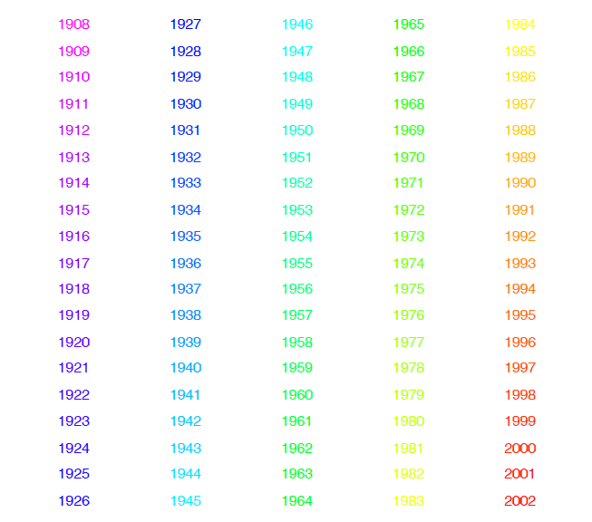
Spanish Male Mortality Curves
Color Code
(Years)
Notes:
23

Slide 24
A Taste of OODA Examples
Spanish Male Mortality Curves
Enhancement: Color by Year
(Highlights
Time
Structure)
Note: Big
Improvement
Over Time!

Slide 25
A Taste of OODA Examples
Spanish Male Mortality Curves
Mean (Contains Many Age Parts)
Dangerous to be Born
Childhood Fairly Safe
Start Risky Behavior
Older People Die Off
Age Blips???
Periodic? Decadal!
Age Rounding Effect

Slide 26
A Taste of OODA Examples
Spanish Male Mortality Curves
Mean (Contains Many Age Parts)
Residuals About Mean
Overall Improvement
Better for Young than Old
A Very bad year???

Slide 27
A Taste of OODA Examples
Spanish Male Mortality Curves
1st Mode of Variation
Finds “Overall Improvement”
= Rank 1 Approx’n
Most Change Fairly Rapid (1945-1965)
Smooth Histogram =
Kernel Density Est.
Will Study Later
Corresponding
Coefficients
Multiples of
Same Curve

Slide 28
A Taste of OODA Examples
Spanish Male Mortality Curves
1st Mode of Variation
= Rank 1 Approx’n
Age Rounding Blips Go Up and Down
Records Improved → Contrast

Slide 29
A Taste of OODA Examples
Spanish Male Mortality Curves
1918 Flu Pandemic
Spanish Civil War

Slide 30
A Taste of OODA Examples
Spanish Male Mortality Curves
2nd Mode of Variation
= Rank 1 Approx’n
Contrast Between 20-45s and Rest
Big Changes
Over Time!!

Slide 31
A Taste of OODA Examples
Spanish Male Mortality Curves
Flu Pandemic, Civil War
Intro of Automobile,
Improved Safety

Slide 32
A Taste of OODA Examples
Spanish Male Mortality Curves
Simultaneous view of both modes:
Scatterplot
Overall Improvement
Modulated By
Age Effects
(Much Smaller
Magnitude)

Slide 33
A Taste of OODA Examples
Spanish Male Mortality Curves
Interesting Variation: Switzerland
{Quite Different Culture, History}
Similar
Age
Effects
No Age
Decadal
Rounding!

Slide 34
A Taste of OODA Examples
Spanish Male Mortality Curves
Interesting Variation: Switzerland
Similar
Overall
Improvement
No Age
Decadal
Rounding!

Slide 35
A Taste of OODA Examples
Spanish Male Mortality Curves
Interesting Variation: Switzerland
Felt Flu
Pandemic
Similar
20-45 Year
Old Grouping
& Automobile
Impact
No War
Effects

Slide 36
A Taste of OODA Examples
Phase and Amplitude Curves
Raw
Data
Text, Sec. 2.1
Ampl’de
Varia’n
Interesting
Modes of
Variation!
Phase
Varia’n
Warps

Slide 37
A Taste of OODA Examples
Shapes in Image Analysis (3-d)
Example Motivated by Radiation Treatment of Prostate Cancer, Chaney et al. (2004)
Manual Segmentation (Male Bladder)
Text, Sec. 1.2

Slide 38
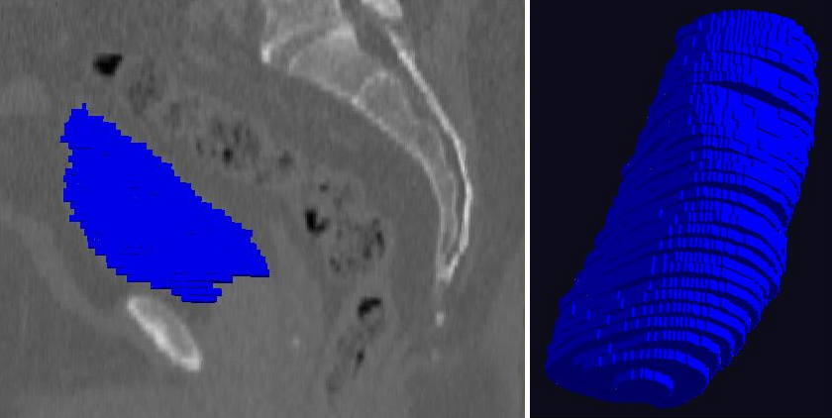
A Taste of OODA Examples
Shapes in Image Analysis (3-d)
Manual Segmentation (Male Bladder)
Rectum
Prostate

Slide 39
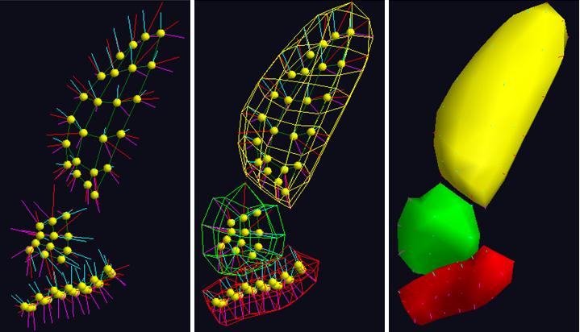
A Taste of OODA Examples
Shapes in Image Analysis (3-d)
Skeletal Shape Representation
Challenge: Data Objects Lie on Manifold
Discretization
Of Medial
Sheet
Implied
Boundary
Filled
Panels
and
Light
Source
Colored
Spokes to
Boundary

Slide 40
A Taste of OODA Examples
Shapes in Image Analysis (3-d)
Analysis of Variation (Princ. Geod. Anal.)
$$μ+2×{PC}_{1}$$
$$μ+2×{PC}_{2}$$
$$μ+2×{PC}_{3}$$

Slide 41
A Taste of OODA Examples
Shapes in Image Analysis (3-d)
Analysis of Variation (Princ. Geod. Anal.)
$$μ$$
$$μ$$
$$μ$$

Slide 42
A Taste of OODA Examples
Shapes in Image Analysis (3-d)
Analysis of Variation (Princ. Geod. Anal.)
$$μ−2×{PC}_{1}$$
$$μ−2×{PC}_{2}$$
$$μ−2×{PC}_{3}$$

Slide 43
A Taste of OODA Examples
Note: Different Display of Modes of Variation
Shapes in Image Analysis (3-d)
Analysis of Variation (Princ. Geod. Anal.)
Mode 1: Rectum
Mode 2: Twisting
Mode 3: Bladder
$$μ−2×{PC}_{1}$$
$$μ−2×{PC}_{2}$$
$$μ−2×{PC}_{3}$$

Slide 44
A Taste of OODA Examples
Tree Structured Data Objects
Brain Artery Data
Marron’s
Brain
Bullitt & Aylward (2002)
Text, Sec. 2.2

Slide 45
A Taste of OODA Examples
Tree Structured Data Objects
Brain Artery Data
Marron’s
Brain

Slide 46
A Taste of OODA Examples
Tree Structured Data Objects
Brain Artery Data
Marron’s
Brain

Slide 47
A Taste of OODA Examples
Tree Structured Data Objects
Brain Artery Data
Marron’s
Brain

Slide 48
A Taste of OODA Examples
Tree Structured Data Objects
Brain Artery Data
Marron’s
Brain

Slide 49
A Taste of OODA Examples
Tree Structured Data Objects
Brain Artery Data
Marron’s
Brain

Slide 50
A Taste of OODA Examples
Tree Structured Data Objects
Brain Artery Data,
Analyze Sample of $n=100$
Average?
Variation About Average???
Modes of Variation???
,
, ... ,

Slide 51
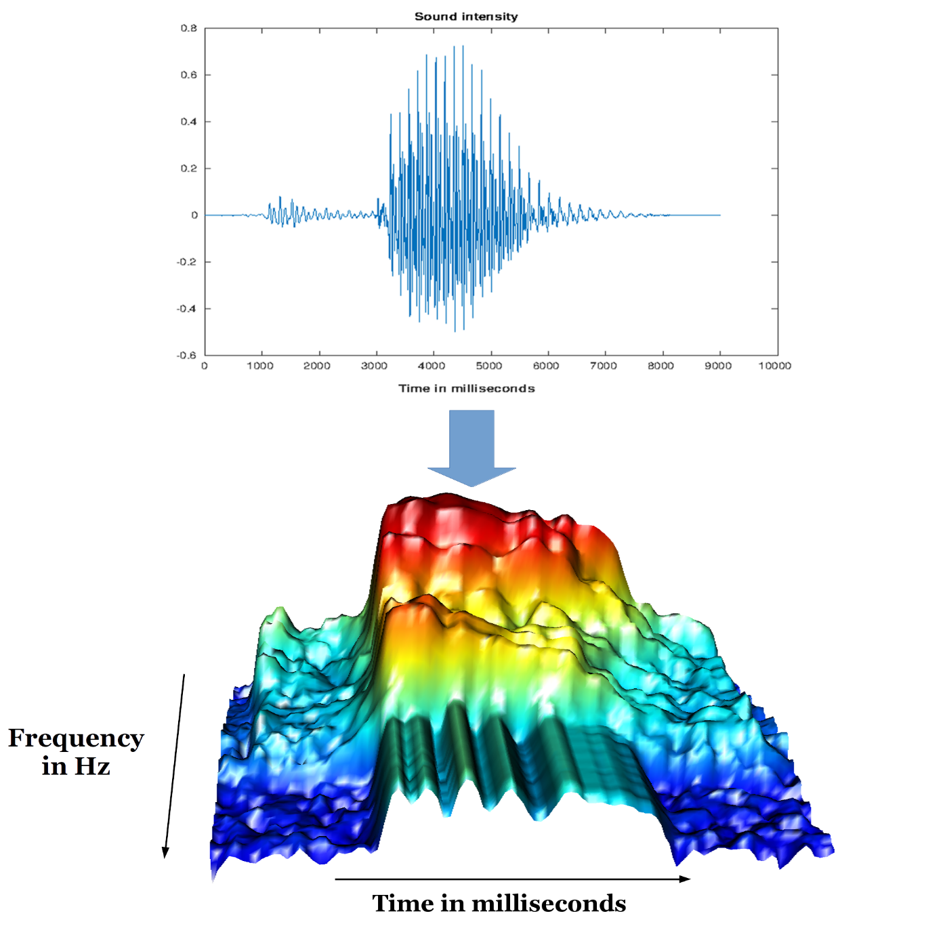
A Taste of OODA Examples
Sounds
as Data
Objects
Sonogram
Pigoli et al. (2015)
Text, Sec. 2.3

Slide 52
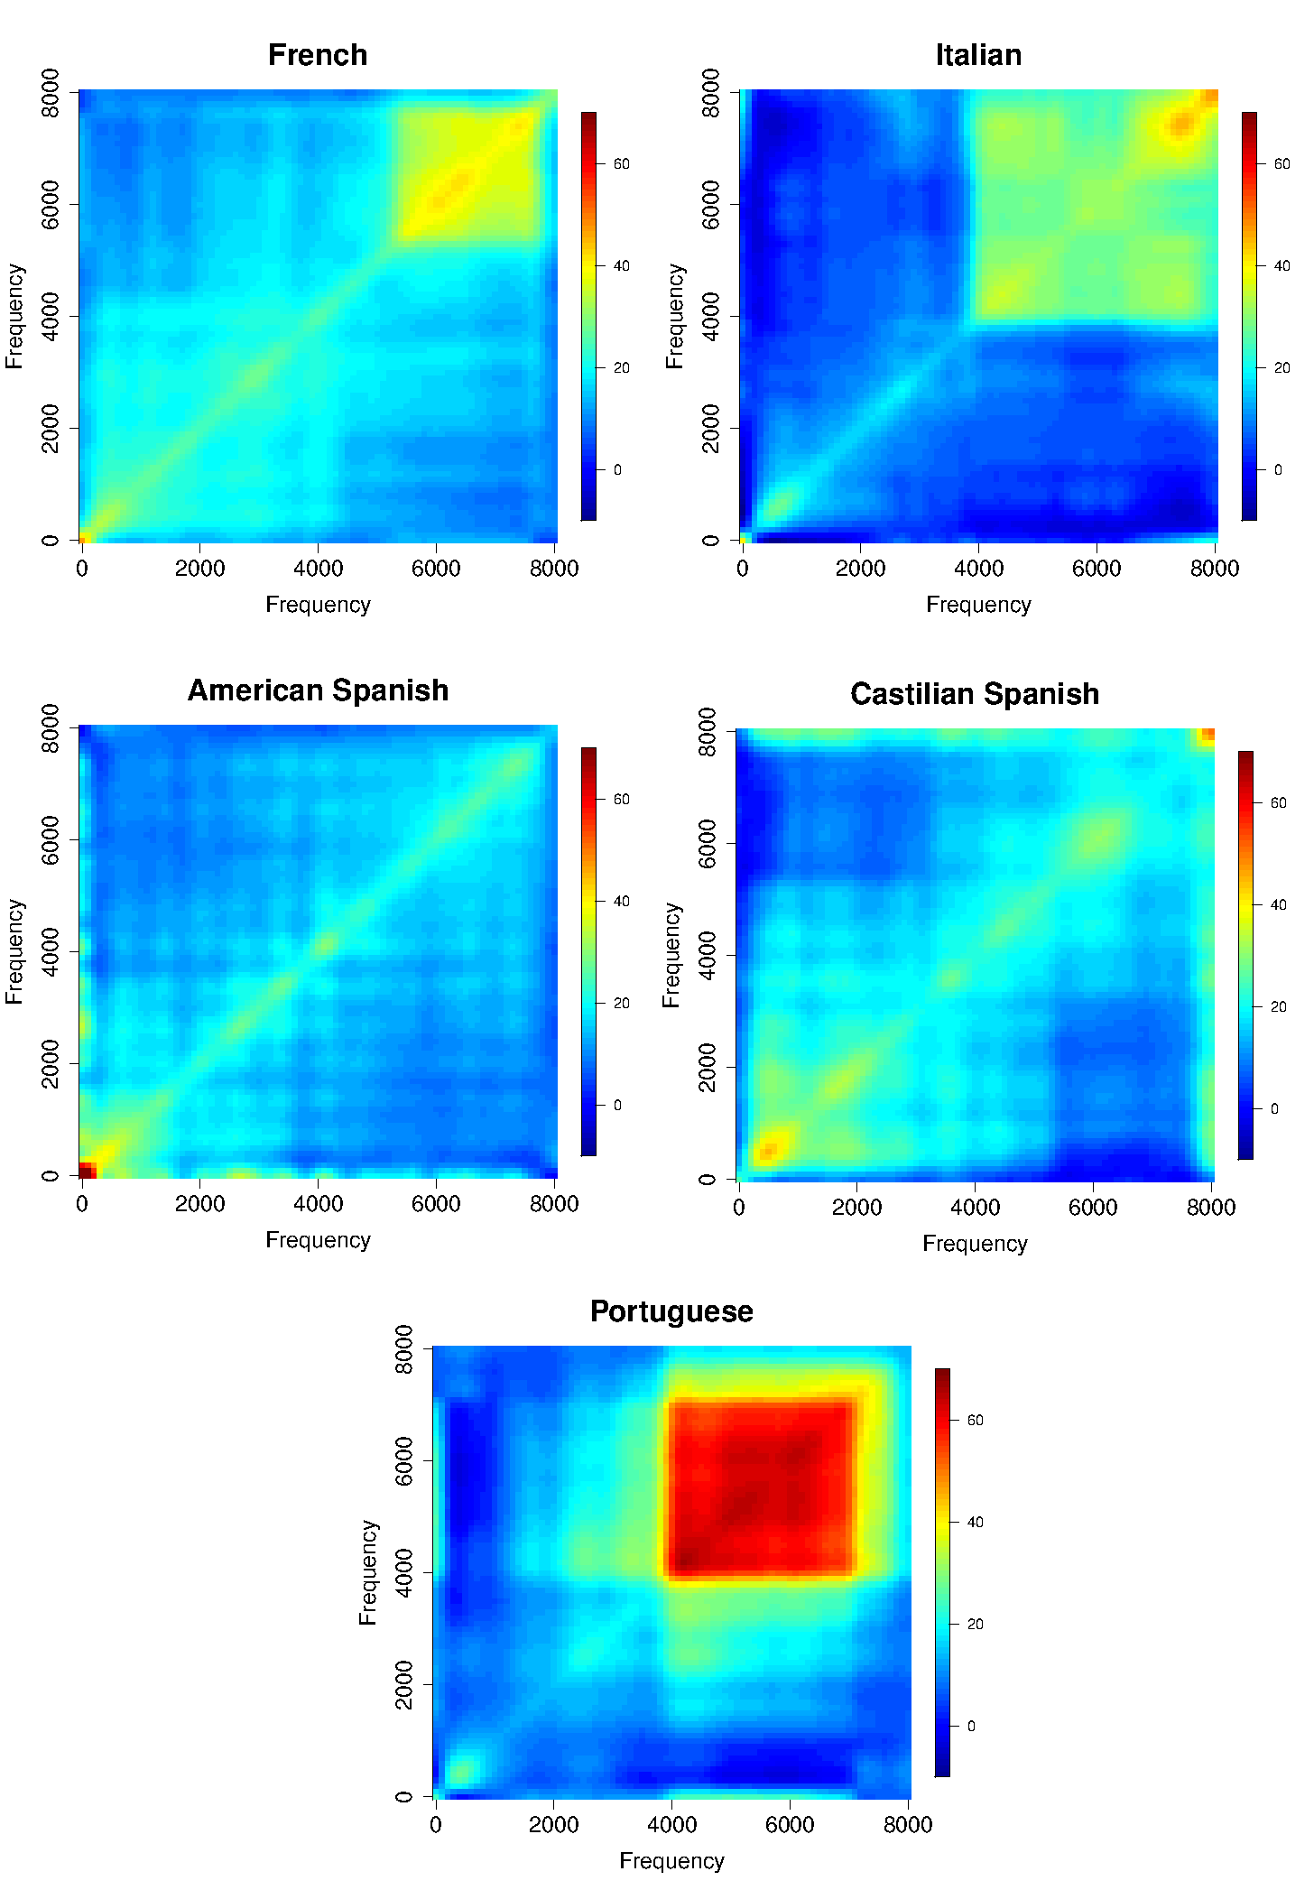
A Taste of OODA Examples
Sounds
as Data
Objects
Analysis
Of Dialects

Slide 53
A Taste of OODA Examples
Faces as Data Objects
Raw Data
Benito et al. (2017)
Text, Sec. 2.4
Data Objects:
Rasterized
Vectors of Pixel
Gray Levels

Slide 54
A Taste of OODA Examples
Projections on “Separating” Line
Faces as Data Objects
Classify
Males vs.
Females
A Mode of Variation

Slide 55
A Taste of OODA Examples
Functional Magnetic Resonance Imaging
3-d Maps of
Brain Activity
Collected
Over Time
Often While
Performing
Some “Task”

Slide 56
A Taste of OODA Examples
Functional Magnetic Resonance Imaging
3-d Maps of
Brain Activity
Collected
Over Time
Data Objects?
Heat Map at
One Time?
Time Series at
One Location?

Slide 57
Object Oriented Data Analysis
What is it?
A Sound-Bite Explanation:
What is the “atom of the statistical analysis”?
1st Course: Numbers
Multivariate Analysis Course : Vectors
Functional Data Analysis: Curves
More generally: Data Objects

Slide 58
Object Oriented Data Analysis
Three Major Phases of OODA:
I. Object Definition
“What are the Data Objects?”
Exploratory Analysis
“What Is Data Structure / Drivers?”
III. Confirmatory Analysis / Validation
Is it Really There (vs. Noise Artifact)?

Slide 59
Object Oriented Data Analysis
Three Major Phases of OODA:
I. Object Definition
“What are the Data Objects?”
Generally Not Widely Appreciated
But Highlighted in OODA

Slide 60
Object Oriented Data Analysis
Three Major Phases of OODA:
Exploratory Analysis
“What Is Data Structure / Drivers?”
Understood by Some in Statistics
Classical Reference: Tukey (1977)
Better Understood in Machine Learning

Slide 61
Object Oriented Data Analysis
Three Major Phases of OODA:
III. Confirmatory Analysis / Validation
Is it Really There (vs. Noise Artifact)?
Primary Focus of Modern “Statistics”
E.g. STOR & Biostat PhD Curriculum
Less Considered In Machine Learning

Slide 62
Object Oriented Data Analysis
Three Major Phases of OODA:
I. Object Definition
“What are the Data Objects?”
Background Notation, etc.

Slide 63
Choice of Data Objects
Two Main Parts:
Data Object Definition
(e.g. Mortality Data,
which curves???)

Slide 64
Data Object Definition
E.g. Mortality Data,
Studied Mortality vs. Age (over years)
But could have
chosen: vs. Year
(over ages)
{tried both, this
is more fun}

Slide 65
Choice of Data Objects
Two Main Parts:
Data Object Definition
(e.g. Mortality Data,
which curves???)
Data Object Representation
(e.g. Mortality Data)

Slide 66
Data Object Representation
E.g. Mortality Data,
Recall log scale more informative
(for this data set)

Slide 67
Basics of OODA
Text, Sec. 2.3
Convenient Organizational Structure:
Data Matrix
$$\left[\begin{matrix}{\tilde{x}}_{1,1} & ⋯ & {\tilde{x}}_{1,n} \\ ⋮ & ⋱ & ⋮ \\ {\tilde{x}}_{d,1} & ⋯ & {\tilde{x}}_{d,n}\end{matrix}\right]$$
Tilde ($\sim$) Denotes Random Quantities

Slide 68
Basics of OODA
Convenient Organizational Structure:
Data Matrix
$$\tilde{X}=\left[\begin{matrix}{\tilde{x}}_{1,1} & ⋯ & {\tilde{x}}_{1,n} \\ ⋮ & ⋱ & ⋮ \\ {\tilde{x}}_{d,1} & ⋯ & {\tilde{x}}_{d,n}\end{matrix}\right]$$
Matrices as Bold Capitals

Slide 69
Basics of OODA
Convenient Organizational Structure:
Data Matrix
$$\tilde{X}=\left[\begin{matrix}{\tilde{x}}_{1,1} & ⋯ & {\tilde{x}}_{1,n} \\ ⋮ & ⋱ & ⋮ \\ {\tilde{x}}_{d,1} & ⋯ & {\tilde{x}}_{d,n}\end{matrix}\right]$$
Statistical Standard: $n$ for sample size
Other Fields: Other choices found
Terrible choice: $m$ and $n$ ?!?

Slide 70
Notation
Many statisticians prefer “$p$”, not “$d$”
(perhaps for “parameters”
or “predictors”)
I will use “$d$” for “dimension”
(with idea that it is more
broadly understandable)

Slide 71
Basics of OODA
Convenient Organizational Structure:
Data Matrix
$$\tilde{X}=\left[\begin{matrix}{\tilde{x}}_{1,1} & ⋯ & {\tilde{x}}_{1,n} \\ ⋮ & ⋱ & ⋮ \\ {\tilde{x}}_{d,1} & ⋯ & {\tilde{x}}_{d,n}\end{matrix}\right]$$
Convention Here:
Columns are Data Objects
(Indexed by $j=1,⋯,n$)

Slide 72
Basics of OODA
Notation:
Data Object Vectors:
$\tilde{X}=\left[\begin{matrix}{\tilde{x}}_{1,1} & ⋯ & {\tilde{x}}_{1,n} \\ ⋮ & ⋱ & ⋮ \\ {\tilde{x}}_{d,1} & ⋯ & {\tilde{x}}_{d,n}\end{matrix}\right]=\left[\begin{matrix}{\tilde{x}}_{1} & ⋯ & {\tilde{x}}_{n}\end{matrix}\right]$
Vectors, Bold Lowercase: ${\tilde{x}}_{j}=\left(\begin{matrix}{\tilde{x}}_{1,j} \\ ⋮ \\ {\tilde{x}}_{d,j}\end{matrix}\right)∈ℝ^{d}$
Again Tilde Denotes Random Quantities

Slide 73
Basics of OODA
Convenient Organizational Structure:
Data Matrix
$$\tilde{X}=\left[\begin{matrix}{\tilde{x}}_{1,1} & ⋯ & {\tilde{x}}_{1,n} \\ ⋮ & ⋱ & ⋮ \\ {\tilde{x}}_{d,1} & ⋯ & {\tilde{x}}_{d,n}\end{matrix}\right]$$
E.g. Mortality Data
Each Column
Contains
One Curve
As a
Function
of Age

Slide 74
Basics of OODA
Convenient Organizational Structure:
Data Matrix
$$\tilde{X}=\left[\begin{matrix}{\tilde{x}}_{1,1} & ⋯ & {\tilde{x}}_{1,n} \\ ⋮ & ⋱ & ⋮ \\ {\tilde{x}}_{d,1} & ⋯ & {\tilde{x}}_{d,n}\end{matrix}\right]$$
Convention Here:
Columns are Data Objects
(Indexed by $j=1,⋯,n$)

Slide 75
Basics of OODA
Convenient Organizational Structure:
Data Matrix
$$\tilde{X}=\left[\begin{matrix}{\tilde{x}}_{1,1} & ⋯ & {\tilde{x}}_{1,n} \\ ⋮ & ⋱ & ⋮ \\ {\tilde{x}}_{d,1} & ⋯ & {\tilde{x}}_{d,n}\end{matrix}\right]$$
Terminology:
Numbers in Rows are called “Traits”
(Indexed by $i=1,⋯,d$)
Machine Learning: “Features”,
But Rows are Not Feature Vectors

Slide 76
Basics of OODA
Common Synonyms:
 | Number | Synonyms
Data Objects | $$n$$ | Observations, Individuals, Sample Elements, Biological Samples, Experimental Units
Traits | $$d$$ | Variables, Features, Descriptors

Slide 77
Basics of OODA
Return to Organizational Structure:
Data Matrix
$$\tilde{X}=\left[\begin{matrix}{\tilde{x}}_{1,1} & ⋯ & {\tilde{x}}_{1,n} \\ ⋮ & ⋱ & ⋮ \\ {\tilde{x}}_{d,1} & ⋯ & {\tilde{x}}_{d,n}\end{matrix}\right]$$
Convention Here:
Columns are Data Objects
Caution: Not Always Done!

Slide 78
Basics of OODA
Row vs. Column Choice by Areas:
Columns as Data Objects:
Linear Algebra (column vectors)
Bioinformatics (from Excel restrictions)
Rows as Data Objects:
Statistical Data Bases
Linear Models

Slide 79
Basics of OODA
Row vs. Column Choice by Software:
Columns as Data Objects:
Matlab
Rows as Data Objects:
R & Python
SAS & others

Slide 80
Rule of Thumb
Early in a Discussion of Linear Analysis,
Agree to Whether Rows or Columns
Are The Data Objects

Slide 81
Object Oriented Data Analysis
Three Major Phases of OODA:
I. Object Definition
“What are the Data Objects?”
Exploratory Analysis
“What Is Data Structure / Drivers?”
III. Confirmatory Analysis / Validation
Is it Really There (vs. Noise Artifact)?

Slide 82
Object Oriented Data Analysis
Three Major Phases of OODA:
Exploratory Analysis
“What Is Data Structure / Drivers?”
Important Aspect:
Data Visualization
(Look at Data, Even For Big Data???)

Slide 83
Visualization
How do we look at data?
Start with data objects in Euclidean Space,
$$ℝ^{d}=\left\{\left(\begin{matrix}x_{1} \\ ⋮ \\ x_{d}\end{matrix}\right):x_{1},⋯,x_{d}∈ℝ\right\}$$
Will later study other spaces

Slide 84
Visualization
Personal Opinion:
Most Modern Data Analysts
Don’t Look at Data Well Enough
Will Try to Provide You With Tools For This

Slide 85
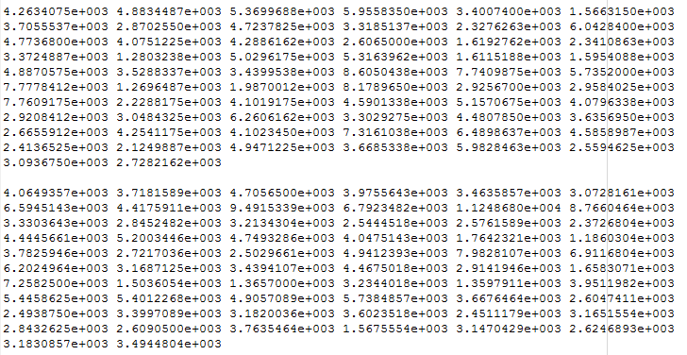
Visualization
Terrible Approach: Look at .txt file

Slide 86
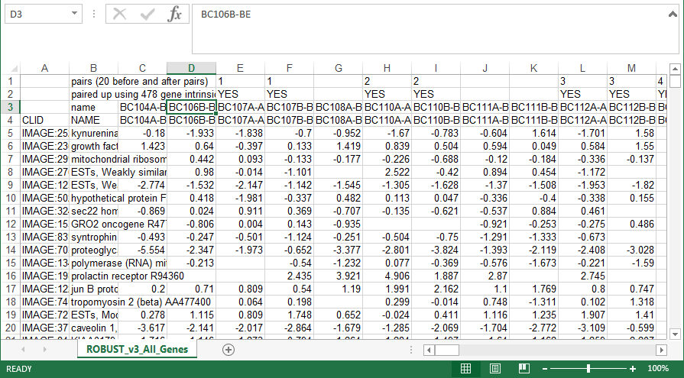
Visualization
Almost as bad: Look at .xls file

Slide 87
Visualization
How do we look at Euclidean data?
1-d: histograms, etc.
2-d: scatterplots
3-d: spinning point clouds

Slide 88
Visualization
How do we look at Euclidean data?
Higher Dimensions?
Workhorse Idea: Projections

Slide 89
Projection
General Definition (in a metric space):
Given a point $x$ and a set $S$, $S$
The Projection of $x$ onto $S$ is:
the closest point in $S$ to $x$
$x$
Best
Representation
of $x$ in $S$

Slide 90
Illustration of Multivariate View: Raw Data
Notes:
EgView1p1RawData.ps

Slide 91
Illustration of Multivariate View: Highlight One
Think of $\left(\begin{matrix}x_{1} \\ x_{2} \\ x_{3}\end{matrix}\right)$
Notes:
EgView1p2RawDataHiLite1.ps

Slide 92
Illustration of Multivariate View: Gene 1 Express’n
$x_{1}$
Notes:
EgView1p3RawDataHL1CoordX.ps

Slide 93
Illustration of Multivariate View: Gene 2 Express’n
$x_{2}$
Notes:
EgView1p3RawDataHL1CoordY.ps

Slide 94
Illustration of Multivariate View: Gene 3 Express’n
$x_{3}$
Notes:
EgView1p3RawDataHL1CoordZ.ps

Slide 95
Illust’n of Multivar. View: 1-d Projection, X-axis
Notes:
EgView1p21proj3DX.ps

Slide 96
Illust’n of Multivar. View: X-Projection, 1-d view
Will use this type of 1-d view
a lot, so study carefully
Notes:
EgView1p31Proj1dX.ps

Slide 97
Illust’n of Multivar. View: X-Projection, 1-d view
X Coordinates
Are Projections
Notes:
EgView1p31Proj1dX.ps

Slide 98
Illust’n of Multivar. View: X-Projection, 1-d view
Y Coordinates Show
Order in Data Set
(or Random)
Variation Avoids Overplotting
Notes:
EgView1p31Proj1dX.ps

Slide 99
Illust’n of Multivar. View: X-Projection, 1-d view
Smooth histogram =
Kernel Density Estimate
Will Study in Detail Later
Notes:
EgView1p31Proj1dX.ps

Slide 100
Illust’n of Multivar. View: 1-d Projection, Y-axis
Notes:
EgView1p22proj3DY.ps

Slide 101
Illust’n of Multivar. View: Y-Projection, 1-d view
Notes:
EgView1p32Proj1dY.ps

Slide 102
Illust’n of Multivar. View: 1-d Projection, Z-axis
Notes:
EgView1p23proj3DZ.ps

Slide 103
Illust’n of Multivar. View: Z-Projection, 1-d view
Notes:
EgView1p33Proj1dZ.ps

Slide 104
Illust’n of Multivar. View: 2-d Proj’n, XY-plane
Notes:
EgView1p24proj3DXY.ps

Slide 105
Illust’n of Multivar. View: XY-Proj’n, 2-d view
Notes:
EgView1p34proj2DXY.ps

Slide 106
Illust’n of Multivar. View: 2-d Proj’n, XZ-plane
Notes:
EgView1p25proj3DXZ.ps

Slide 107
Illust’n of Multivar. View: XZ-Proj’n, 2-d view
Notes:
EgView1p35proj2DXZ.ps

Slide 108
Illust’n of Multivar. View: 2-d Proj’n, YZ-plane
Notes:
EgView1p26proj3DYZ.ps

Slide 109
Illust’n of Multivar. View: YZ-Proj’n, 2-d view
Notes:
EgView1p36proj2DYZ.ps

Slide 110
Illust’n of Multivar. View: all 3 planes
Think:
Front
Top
Side
Views
Notes:
EgView1p27proj3Dall.ps

Slide 111
Illust’n of Multivar. View: Diagonal 1-d proj’ns
Notes:
EgView1p37proj1Ddiag.ps

Slide 112
Illust’n of Multivar. View: Add off-diagonals
Notes:
EgView1p38proj1n2Dcolor.ps

Slide 113
Illust’n of Multivar. View: Typical View
Notes:
EgView1p39ScatPlot.ps

Slide 114
Illust’n of Multivar. View: Typical View
Note Linkage of Axes
Notes:
EgView1p39ScatPlot.ps

Slide 115
Illust’n of Multivar. View: Typical View
Note Linkage of Axes
Notes:
EgView1p39ScatPlot.ps

Slide 116
Illust’n of Multivar. View: Typical View
Note Linkage of Axes
Notes:
EgView1p39ScatPlot.ps

Slide 117
Illust’n of Multivar. View: Typical View
Note Correspondence
of Points
Notes:
EgView1p39ScatPlot.ps

Slide 118
Illust’n of Multivar. View: Typical View
Note Correspondence
of Points
Notes:
EgView1p39ScatPlot.ps

Slide 119
Illust’n of Multivar. View: Typical View
And “Trait by
Trait” Since
Axes are Traits
Note: often put
transpose plots
below diagonal
Called “Scatterplot Matrix” View
Notes:
EgView1p39ScatPlot.ps

Slide 120
Homework 1
Make a 3-d Trait by Trait Scatterplot Matrix
of the Apple – Banana – Pear Data
On the Canvas Assignments / HW1 page
Use your choice of software
Explain Data Set Name
Post Graphic & Explanation on Canvas page
Due: Jan. 25,
12:30PM

Slide 121
Homework Policy
Fine to collaborate with others
In fact this is encouraged
About “understanding” not “testing”
But everybody please turn in something

