Slide 1
Statistics – O. R. 881
Object Oriented Data Analysis
Steve Marron
Dept. of Statistics and Operations Research
University of North Carolina

Slide 2
Current Sections in Textbook
Today:
Section 6.5, 6.3, 17.1
Next Class:
Sections 7.1, 7.2 , 1.2, 5.2, 8.4

Slide 3
Participant Presentations
Starting Next Tuesday:
1:35 Sara Peterson
Notes:
Can Use USB Device
Or Your Computer (with HDMI)
Or Remote Log-In, Set Up Before Class
Have Title Page With:
  Your Name
  Your Affiliation
Check Website
For Schedule

Slide 4
Participant Presentations
Auditors
Included
Please Sign Up:
Name
Email (Onyen is fine, or …)
Are You ENRolled?
Dept. & Advisor (Lab?)
Tentative Title (“????” Is OK)
When:
  Next Week, Early, Oct., Nov., Late
Please Save
My Time
Needed To
Contact
Individuals

Slide 5
Last Class: Transformations
Recall Log for
Mortality and
RNAseq Data
Useful Method for Data Analysis
Apply to Marginal Distributions
(i.e. to Individual Variables)
Idea: Put Data on Right Scale
Common Example:
  Data Orders of Magnitude Different
  Log₁₀ Puts Data on More Analyzable Scale

Slide 6
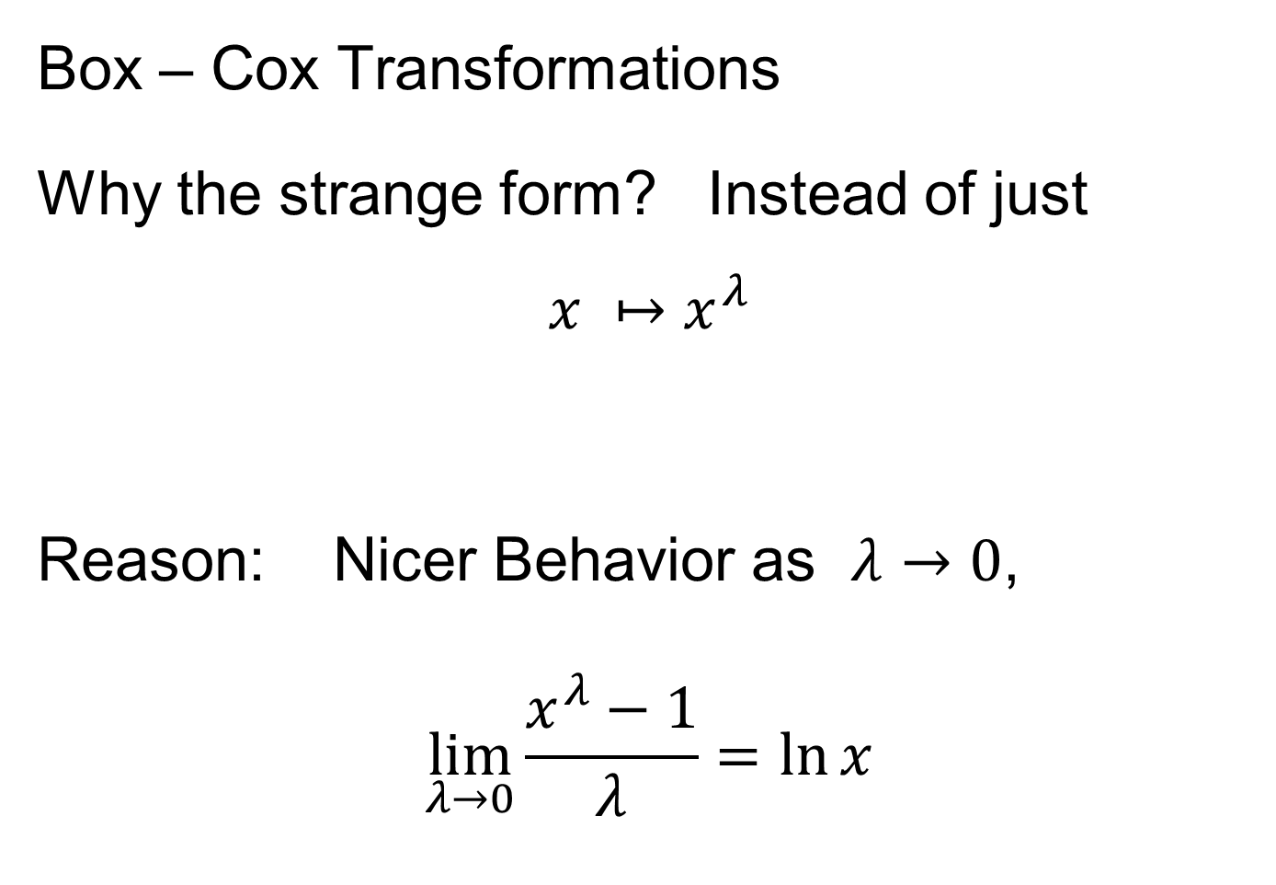
Last Class: Transformations
Box – Cox Transformations
Why the strange form? Instead of just
$$x ↦x^{λ}$$
Reason: Nicer Behavior as $λ→0$,
$$\lim_{λ→0}{\frac{x^{λ}−1}{λ}}=\ln{x}$$
Try It Out
in HW 3

Slide 7
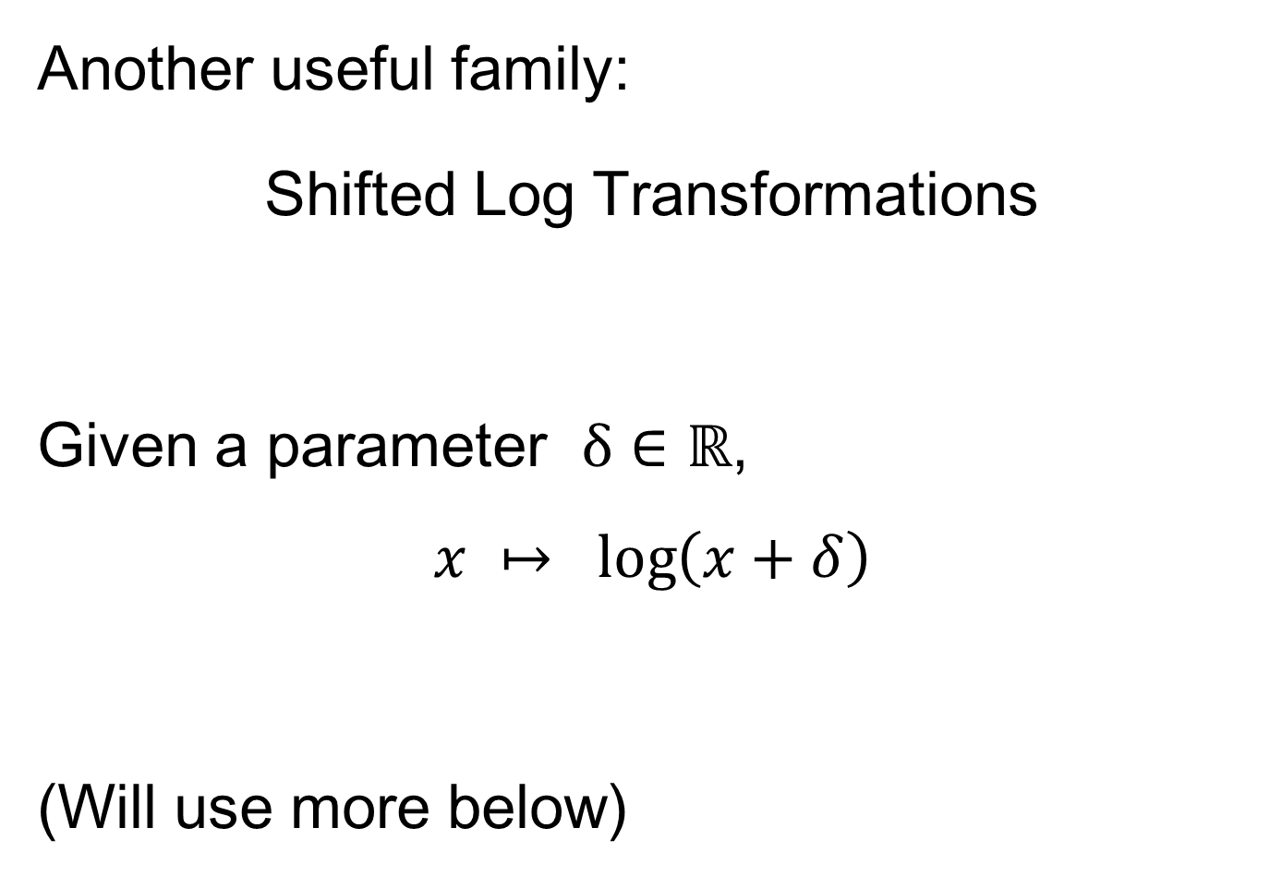
Last Class: Transformations
Another useful family:
Shifted Log Transformations
Given a parameter $δ∈ℝ$,
$$x ↦ \log\left(x+δ\right)$$
(Will use more below)

Slide 8
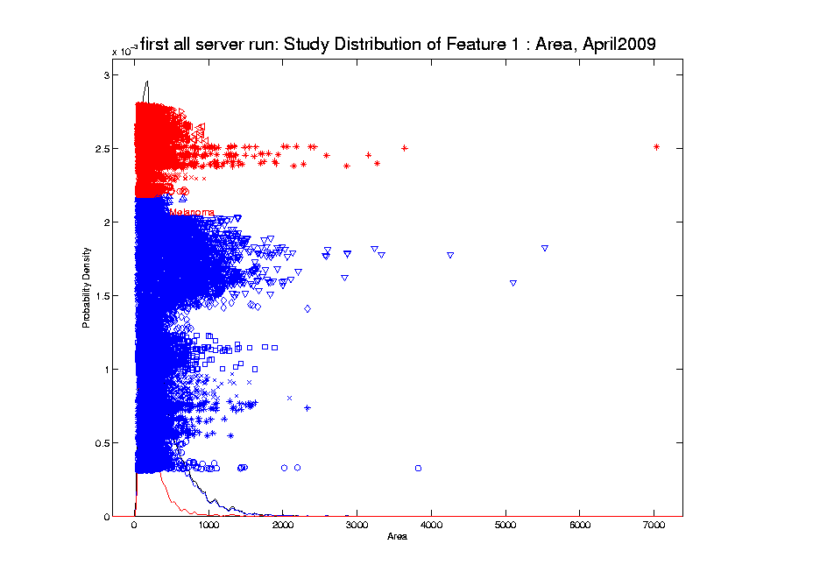
Last Class: Transformations
Few Large Values Can Dominate Analysis

Slide 9
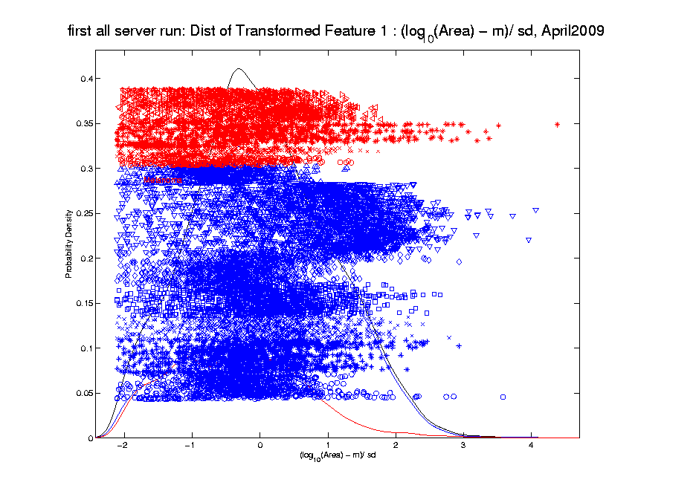
Last Class: Transformations
Log Scale Gives All More Appropriate Weight
Note:
Orders
Of
Magnitude
Log₁₀ most
Interpretable

Slide 10

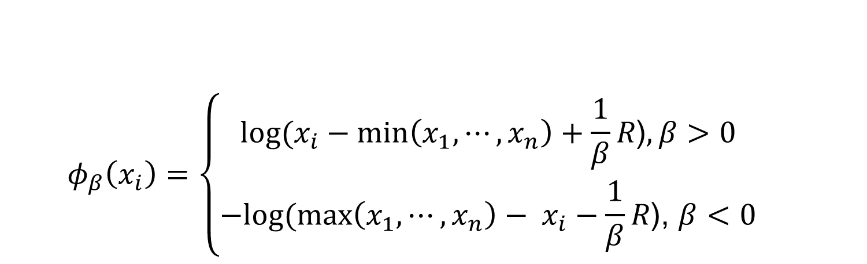
Last Class: Automatic Trans.
  $$φ_{β}\left(x_{i}\right)=\left\{\begin{aligned}log⁡(x_{i}−min\left(x_{1}, ⋯,x_{n}\right)+\frac{1}{β}R\text{)}, β>0 \\ −log⁡(\max\left(x_{1}, ⋯,x_{n}\right)− x_{i}−\frac{1}{β}R\text{)}\text{, }β<0\end{aligned}\right.$$
Family of transformation functions
Comments
  Single family for both positive and negative skewness
  Parameter value selection is independent of data magnitude
  As $β→0$: transformation + standardization $→$
  $→$ standardization only
Notes:
Finally incorporating all the elements we have discussed the new parameterized family of transformation functions
For beta is positive, transformation for positive skewness
For beta is negative, transformation for negative skewness
And the parameter value selection is independent of data magnitude

Slide 11
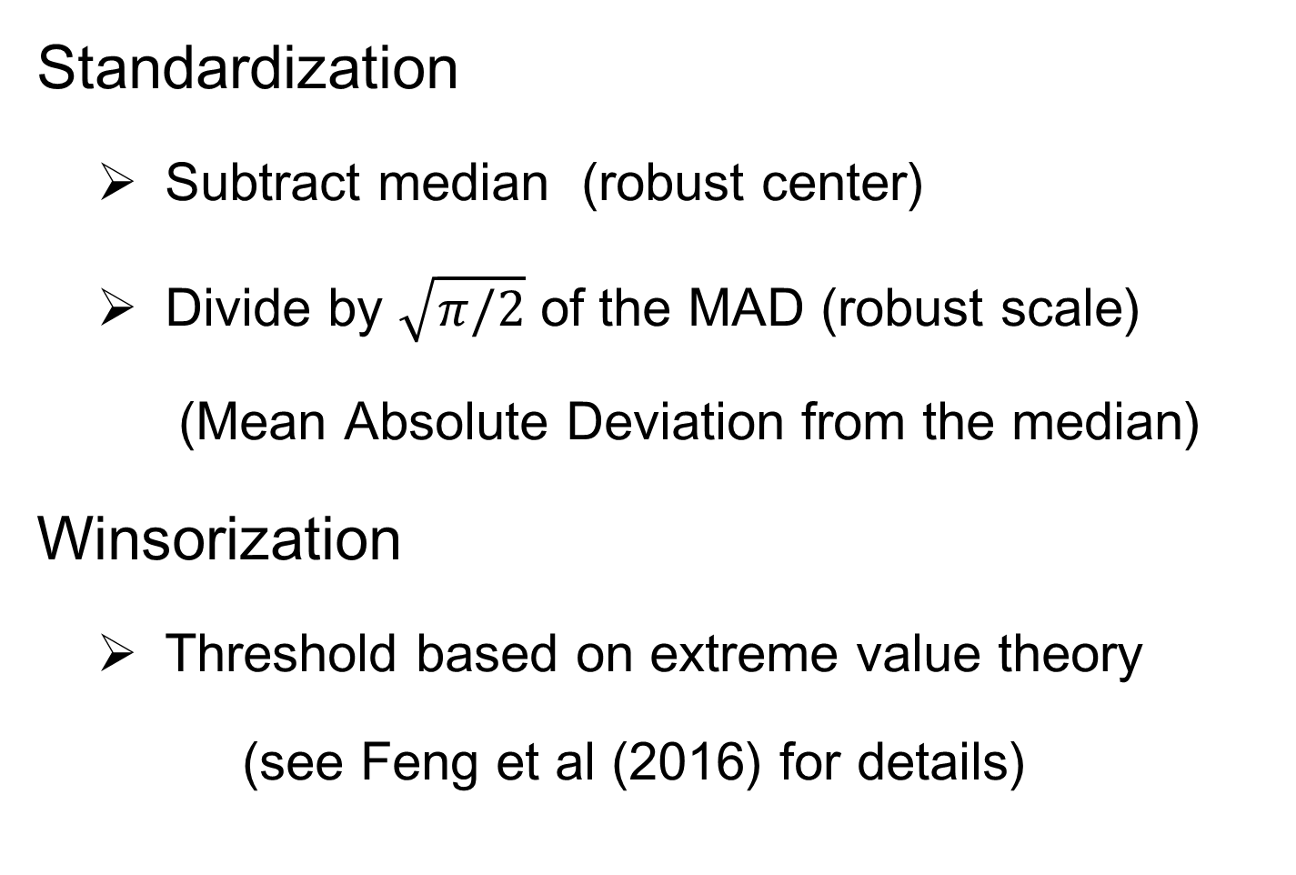
Last Class: Automatic Trans.
Standardization
  Subtract median (robust center)
  Divide by $\sqrt{π/2}$ of the MAD (robust scale)
  (Mean Absolute Deviation from the median)
Winsorization
  Threshold based on extreme value theory
  (see Feng et al (2016) for details)
Notes:
After the shift log transformation, we need to deal with potential influential values by winsorization,
Before that we need a robust standardization ( and I will talk about it later)
To make standardization robust, we will use some robust statistics that is subtracting the median and divide based on the mean absolute deviation from median (not MAD which might be 0)

Slide 12
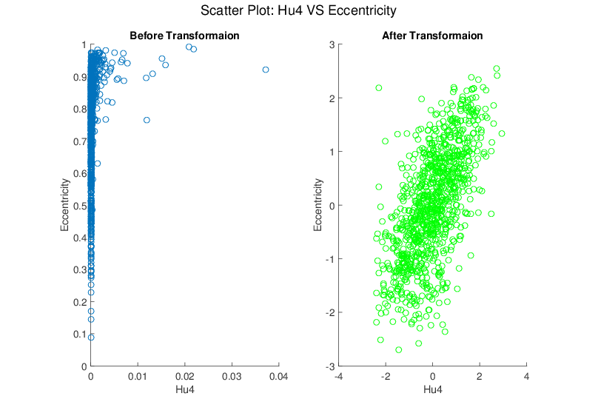
Last Class: Melanoma Data
Much Nicer Distributions
Notes:
Besides, although the transformation targets at marginal dist
We see improvement of bivariate normality in many real data sets for example here.

Slide 13
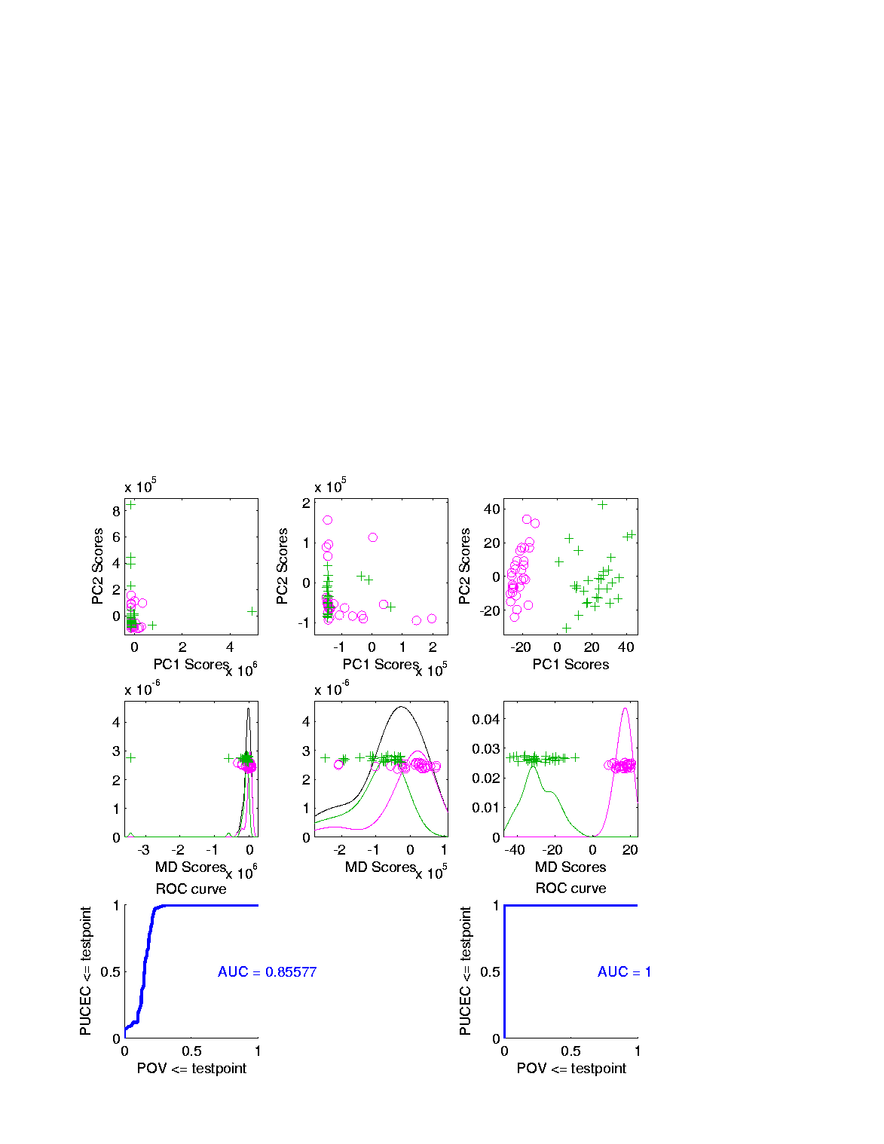
Last Class: Revisit Gene Exp.
Ovarian (o) & Uterine (+) Cancer Cases
Add In Automatic
Log Transformed PCA
Proj’ns on Mean
Difference Dir’n
Note Much
Better

Slide 14
Last Class: Revisit Gene Exp.
ROC Curve
Much Better
For Log
Transformations

Slide 15
Last Class: Heat-Map Views
Main Idea:
Look at Full Data Matrix
As an Image (Rectangular Array of “Pixels”)
Coding Values with Colors (Gray Levels)
Text: Sec. 6.1

Slide 16
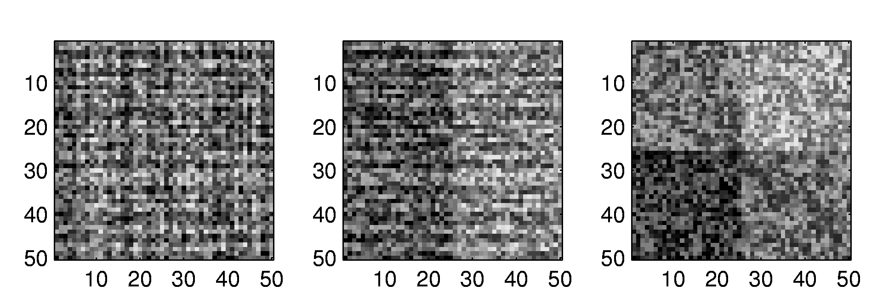
Last Class: Heat-Map Views
Some Principles:
Ordering Rows and Columns Really Matters
Clustering Columns & Rows is Crucial
Population Structure
Invisible w/ Random Order

Slide 17
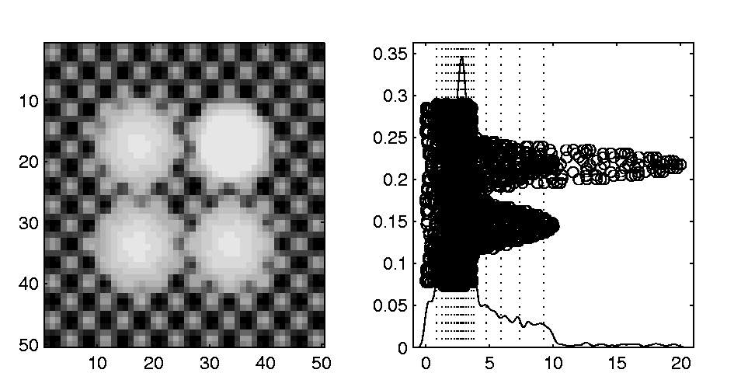
Last Class: Heat-Map Views
Can Look at Either
Original Or Log View
Natural Approach (to Skewed Dist’n):
Quantile Scaling (= #s in Each Bin)
Same Toy Example
Non-Equally Spaced Bins
Far More
Contrast
Good or Bad?
Peaks Less
Prominent

Slide 18
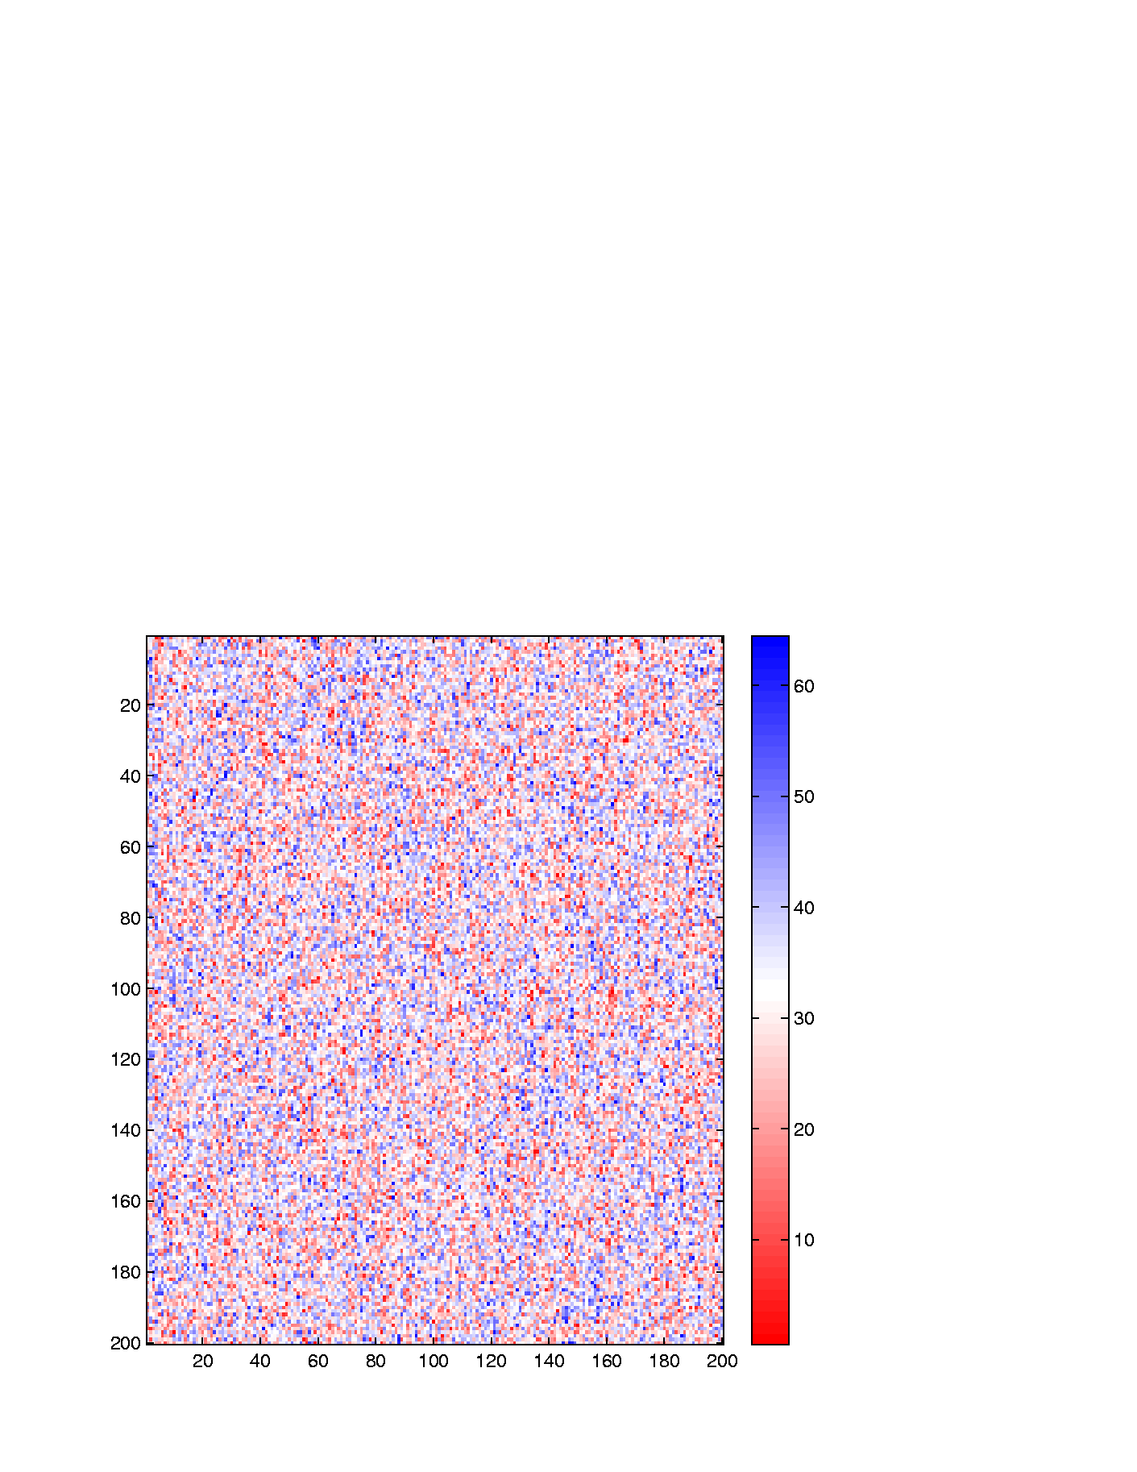
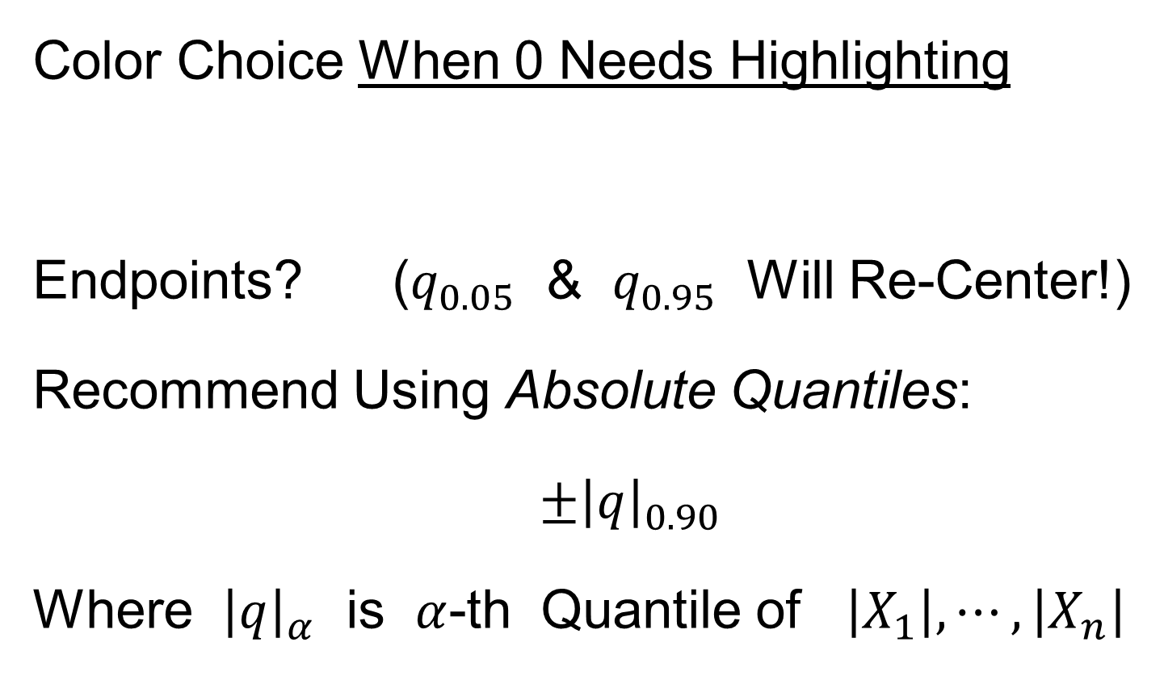
Last Class: Heat-Map Views
Caution: Many
Packages Do This!
Color Choice When 0 Needs Highlighting
Endpoints? ($q_{0.05}$ & $q_{0.95}$ Will Re-Center!)
Recommend Using Absolute Quantiles:
$±{\left|q\right|}_{0.90}$
Where ${\left|q\right|}_{α}$ is $α$-th Quantile of $\left|X_{1}\right|,⋯,\left|X_{n}\right|$

Slide 19
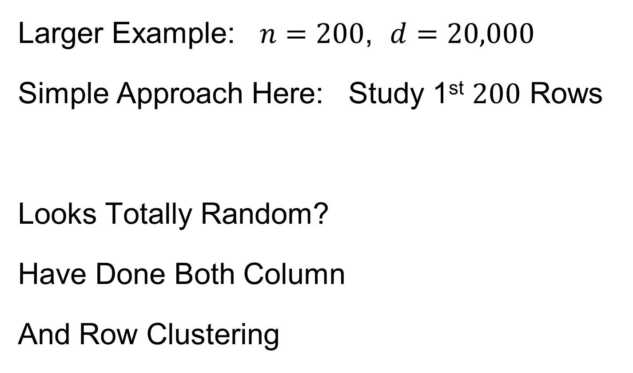
Last Class: Heat-Map Views
Will See OK
For This Data
Larger Example: $n=200$, $d=20,000$
Simple Approach Here: Study 1st $200$ Rows
Looks Totally Random?
Have Done Both Column
And Row Clustering

Slide 20
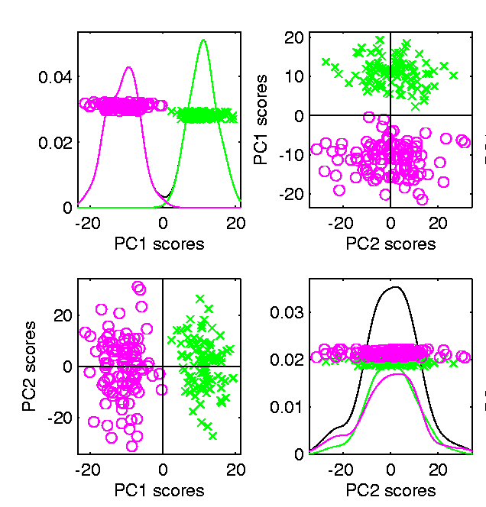

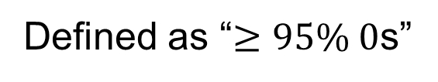
Last Class: Heat-Map Views
Larger Example: $n=200$, $d=20,000$
Revisit With Scatterplot Matrix View
Conclude: Heat
Map Worse
Than Scatterplot
In This Case
Colored 1st 100 & 2nd 100
Clear Cluster Structure
Hidden by Noise in
Heatmap View!
Is This Real (or Artifact)?
$N(−0.04,1)$ & $N(0.04,1)$

Slide 21
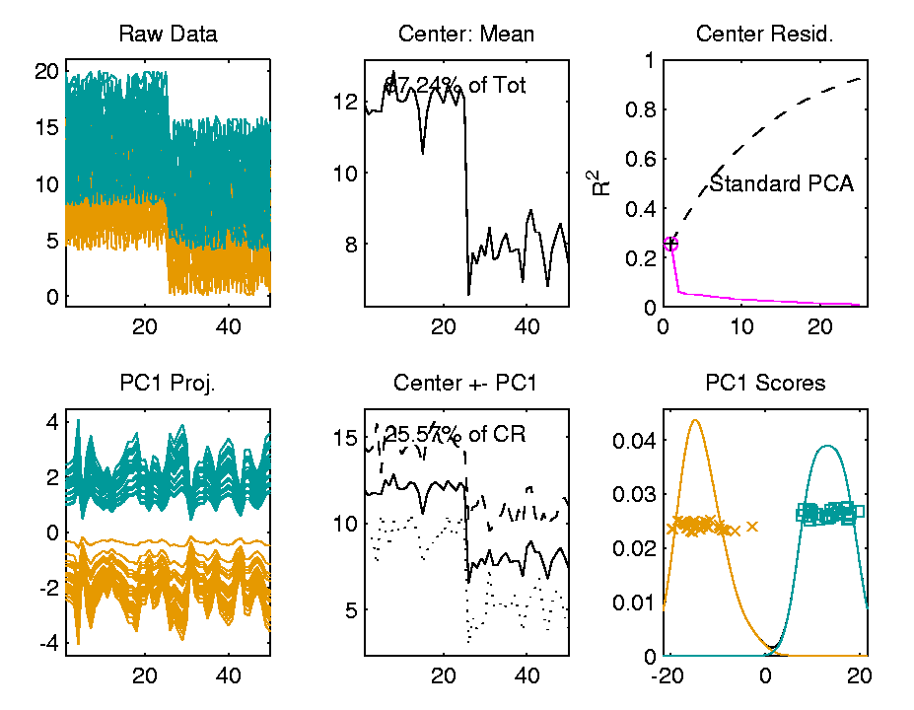

Last Class: Heat-Map Views
For Opposite Answer Consider Another
Data Set ($n=d=50$) with Curve View:
Very Noisy
1st 25 Features
>> 2nd 25
Two Clear
Clusters
Understand Pop’n
Structure???

Slide 22
Last Class: Heat-Map Views
Data Source is Above Example:
Gives Quicker Impression of Structure
More Natural View Than Curves
2 Clusters
1st Features Larger

Slide 23
Last Class: Heat-Map Views
“Every Dog Has His Day”
Idea:
Any Data Analytic Method Somebody Likes Has Some Situations Where It Is “Best”
& Of Course Others Where It Is Poor
(Will See This Again)

Slide 24
Scatterplot Views
All Based on Projections
Now Consider Other Directions
Beyond PCA
Text: Sec. 6.5

Slide 25
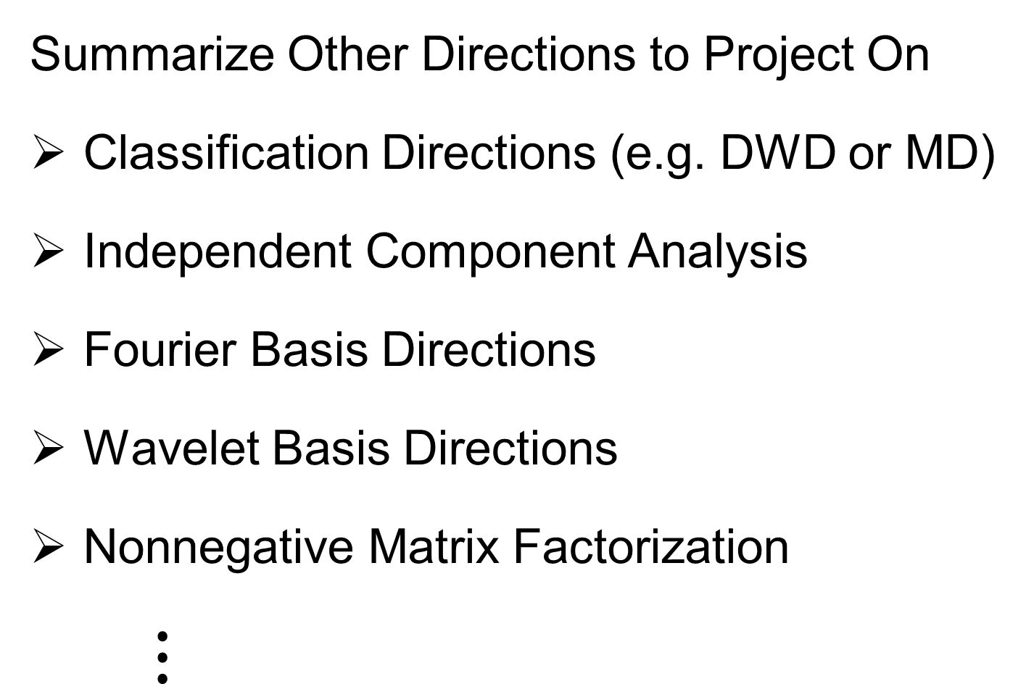
Scatterplot Views
Summarize Other Directions to Project On
Classification Directions (e.g. DWD or MD)
Independent Component Analysis
Fourier Basis Directions
Wavelet Basis Directions
Nonnegative Matrix Factorization
$⋮$
Might
Discuss
Later

Slide 26
Scatterplot Views
Summarize Other Directions to Project On
Known Modes of Variation
Izem & Kingsolver (2007), Izem & Marron (2007)
Maximal Smoothness Directions
Gaydos et. al (2013), Kingsolver et. al (2015), Zhang et al. (2014)
Maximal Data Piling
(Will Explore Later)

Slide 27


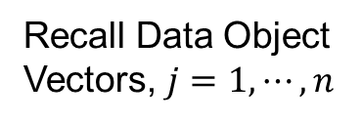
Centering
Text: Sec. 6.3, 17.1.1
Recall (from 1-11-24) Notation:
Data Matrix:
$\tilde{X}=\left[\begin{matrix}{\tilde{x}}_{1,1} & ⋯ & {\tilde{x}}_{1,n} \\ ⋮ & ⋱ & ⋮ \\ {\tilde{x}}_{d,1} & ⋯ & {\tilde{x}}_{d,n}\end{matrix}\right]$
Tilde ($\sim$) Denotes Random Quantities
Matrices as Bold Capitals
Recall Data Object
Vectors, $j=1,⋯,n$
Recall traits,
$i=1,⋯,d$

Slide 28
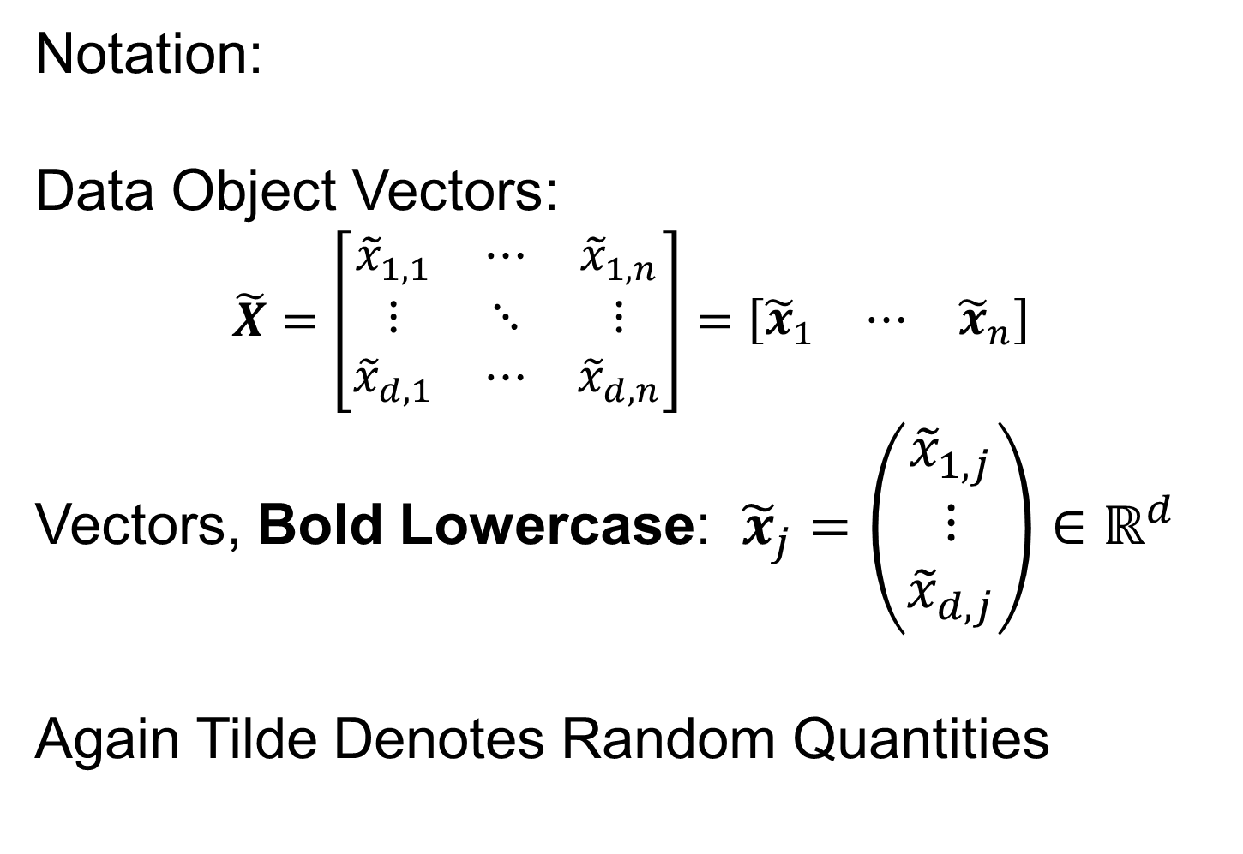
Centering
Notation:
Data Object Vectors:
$\tilde{X}=\left[\begin{matrix}{\tilde{x}}_{1,1} & ⋯ & {\tilde{x}}_{1,n} \\ ⋮ & ⋱ & ⋮ \\ {\tilde{x}}_{d,1} & ⋯ & {\tilde{x}}_{d,n}\end{matrix}\right]=\left[\begin{matrix}{\tilde{x}}_{1} & ⋯ & {\tilde{x}}_{n}\end{matrix}\right]$
Vectors, Bold Lowercase: ${\tilde{x}}_{j}=\left(\begin{matrix}{\tilde{x}}_{1,j} \\ ⋮ \\ {\tilde{x}}_{d,j}\end{matrix}\right)∈ℝ^{d}$
Again Tilde Denotes Random Quantities

Slide 29

Centering
Data Matrix:
$\tilde{X}=\left[\begin{matrix}{\tilde{x}}_{1,1} & ⋯ & {\tilde{x}}_{1,n} \\ ⋮ & ⋱ & ⋮ \\ {\tilde{x}}_{d,1} & ⋯ & {\tilde{x}}_{d,n}\end{matrix}\right]$
Column Object Mean:
$${\overline{x}}_{co}=\left(\begin{matrix}{\overline{x}}_{1,A} \\ ⋮ \\ {\overline{x}}_{d,A}\end{matrix}\right)$$
where ${\overline{x}}_{i,A}=\frac{1}{n}\sum_{j=1}^{n}{{\tilde{X}}_{i,j}}$
Objects are Vectors
So Mean Vector Objects
Hence “Object Mean”
Avoid Row-Column
Ambiguity Using
Object Oriented
Nomenclature
Finally Stress “Column”
Could Call This
the “Row Mean”

Slide 30

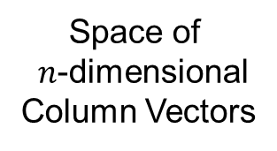
Centering
Data Matrix:
$\tilde{X}=\left[\begin{matrix}{\tilde{x}}_{1,1} & ⋯ & {\tilde{x}}_{1,n} \\ ⋮ & ⋱ & ⋮ \\ {\tilde{x}}_{d,1} & ⋯ & {\tilde{x}}_{d,n}\end{matrix}\right]$
Additional Notion: Row Trait Mean
${\overline{x}}_{RT}^{t}=\left(\begin{matrix}{\overline{x}}_{A,1} & ⋯ & {\overline{x}}_{A,n}\end{matrix}\right)$ for ${\overline{x}}_{RT}∈ℝ^{n}$
where ${\overline{x}}_{A,j}=\frac{1}{d}\sum_{i=1}^{d}{{\tilde{X}}_{i,j}}$
transpose
Disambiguates
“Row Mean” vs.
“Column Mean”
Space of
$n$-dimensional
Column Vectors

Slide 31
Detailed Look at PCA
Text: Chapter 17
Now Study “Folklore” More Carefully
BackGround
History
(as noted on 1/13/22)
Early Use: Pearson (1901)
Name “PCA”: Hotelling (1935)

Slide 32
Detailed Look at PCA
Now Study “Folklore” More Carefully
BackGround
History
Underpinnings
(Mathematical & Computational)
Good Overall Reference: Jolliffe (2002)

Slide 33
PCA: Rediscovery – Renaming
Statistics:
Principal Component Analysis (PCA)
Social Sciences:
Factor Analysis (PCA is a subset)
Probability / Electrical Eng:
Karhunen – Loeve expansion
Applied Mathematics:
Proper Orthogonal Decomposition (POD)
Geo-Sciences:
Empirical Orthogonal Functions (EOF)

Slide 34
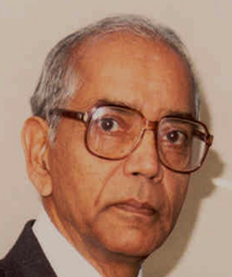
An Interesting Historical Note
The 1st (?) application of PCA to Functional Data Analysis:
Rao (1958)
1st Paper with “Curves as Data Objects” viewpoint

Slide 35
Factor Analysis
Finds Modes of Variation
Different Terminology:
“Directions of Variation”,
i.e. “Loadings Vectors”
Are Called
Latent Factors

Slide 36

Factor Analysis
Central Assumption:
$$\tilde{x}\sim L∙S^{t}+N\left(0, σ^{2}I\right)$$
Compute Maximum Likelihood Estimates
Of Rank $r$ Approximation, Based on:
$L_{d,r}$ and $S_{n,r}$
And of $σ^{2}$

Slide 37
Detailed Look at PCA
Three Important (& Interesting) Viewpoints:
Mathematics
Numerics
Statistics
Goal: Study Interrelationships

Slide 38
Detailed Look at PCA
Three Important (& Interesting) Viewpoints:
Mathematics
Numerics
Statistics
1st: Review Linear Alg. and Multivar. Prob.

Slide 39
Course Background I
Linear Algebra
Please Check Familiarity
No? Read Up in Linear Algebra Text
Or Wikipedia?

Slide 40


Course Background I
Linear Algebra Key Concepts
Vector
Scalar
Vector Space (Subspace)
Basis
Dimension
Unit Vector Basis in $ℝ^{d}$
Linear Combo as Matrix Multiplication
$$\left\{\left(\begin{matrix}\begin{matrix}1 \\ 0\end{matrix} \\ \begin{matrix}⋮ \\ 0\end{matrix}\end{matrix}\right),⋯,\left(\begin{matrix}\begin{matrix}0 \\ ⋮\end{matrix} \\ \begin{matrix}0 \\ 1\end{matrix}\end{matrix}\right)\right\}$$

Slide 41
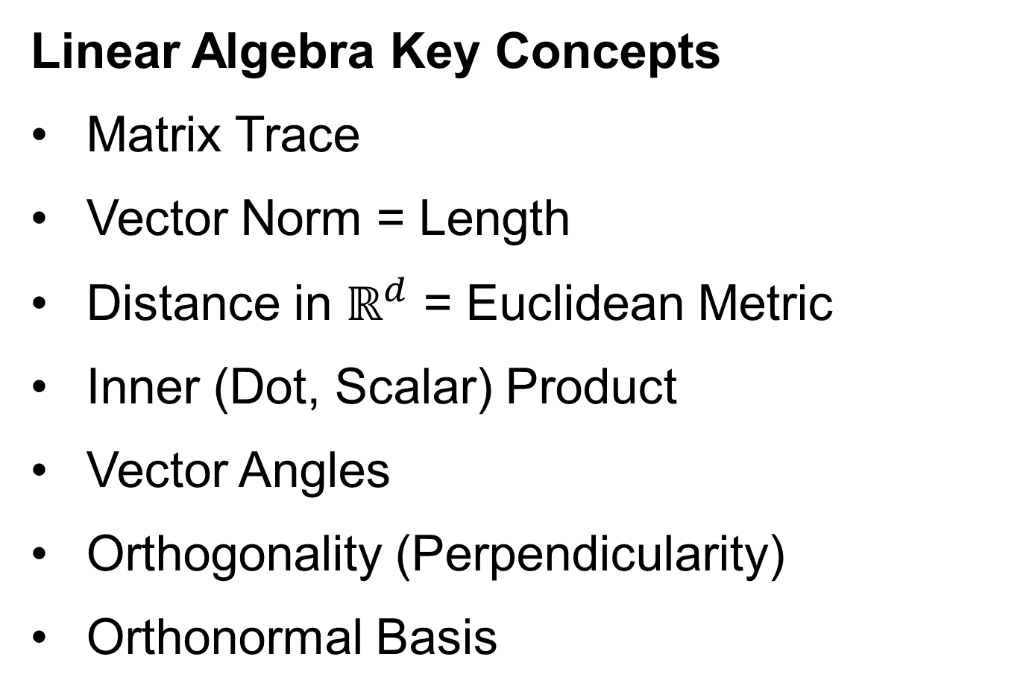
Course Background I
Linear Algebra Key Concepts
Matrix Trace
Vector Norm = Length
Distance in $ℝ^{d}$ = Euclidean Metric
Inner (Dot, Scalar) Product
Vector Angles
Orthogonality (Perpendicularity)
Orthonormal Basis

Slide 42
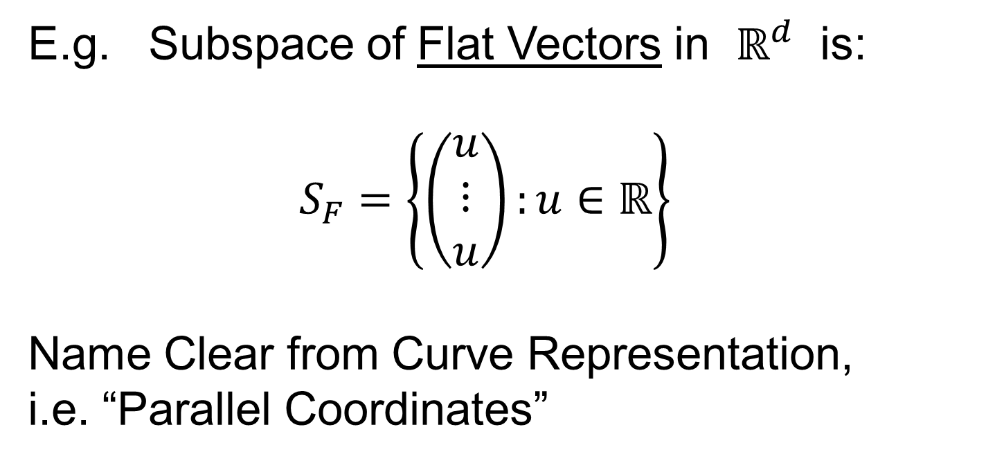
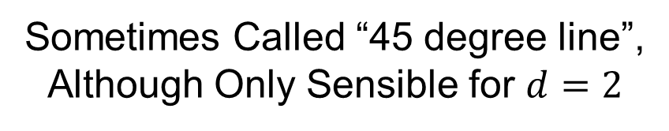
Linear Algebra of Centering
E.g. Subspace of Flat Vectors in $ℝ^{d}$ is:
$$S_{F}=\left\{\left(\begin{matrix}u \\ ⋮ \\ u\end{matrix}\right):u∈ℝ\right\}$$
Name Clear from Curve Representation,
i.e. “Parallel Coordinates”
Recall
Meaning
Sometimes Called “45 degree line”,
Although Only Sensible for $d=2$

Slide 43
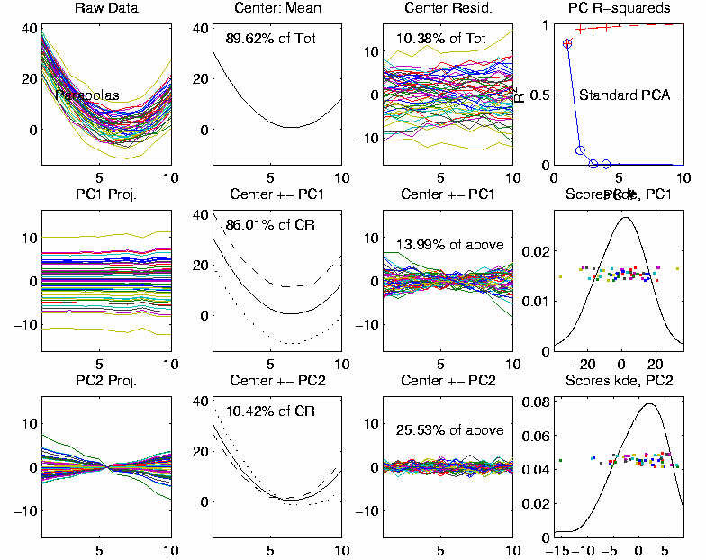
Linear Algebra of Centering
Recall
Shifted
Parabolas
Example
Nearly Flat
Mode of Variation
Flat Mode is
Frequently
Important

Slide 44

Linear Algebra of Centering
E.g. Subspace of Flat Vectors in $ℝ^{d}$ is:
$$S_{F}=\left\{\left(\begin{matrix}u \\ ⋮ \\ u\end{matrix}\right):u∈ℝ\right\}$$
Averages as Projection:
$$P_{S_{F}}\left(\begin{matrix}x_{1} \\ ⋮ \\ x_{d}\end{matrix}\right)=\left(\begin{matrix}\overline{x} \\ ⋮ \\ \overline{x}\end{matrix}\right)$$

Slide 45

Homework 4
Part (a): Show that the set of flat vectors $S_{F}$ is a subspace.
Part (b): Show that:
$$P_{S_{F}}\left(\begin{matrix}x_{1} \\ ⋮ \\ x_{d}\end{matrix}\right)=\left(\begin{matrix}\overline{x} \\ ⋮ \\ \overline{x}\end{matrix}\right)$$
(Hints On Canvas page)
Due: Feb. 15,
12:30AM

Slide 46

Linear Algebra of Centering
Much Richer Investigation of Centering
Appears in Section 17.1.1 of the Text
Main Point: Projections in the Matrix Space:
$ℝ^{d×n}=\left\{\left[\begin{matrix}x_{1,1} & ⋯ & x_{1,n} \\ ⋮ & ⋱ & ⋮ \\ x_{d,1} & ⋯ & x_{d,n}\end{matrix}\right]:x_{i,j}∈ℝ\right\}$
Note: NOT $ℝ^{dn}$

Slide 47
Course Background I
Linear Algebra Key Concepts
Singular Value Decomposition
(SVD)
Usually poorly taught in linear algebra,
but fundamental in many ways

Slide 48





Review of Linear Algebra (Cont.)
SVD Full Representation:
=
Intuition: For $X$ as Linear Operator ($ℝ^{d}→ℝ^{n}$):
Represent as:
$$V_{n×n}^{t}$$
$$X_{d×n}$$
$$U_{d×d}$$
$$S_{d×n}$$
Isometry (~Rotation)
Coordinate Rescaling
Isometry (~Rotation)

Slide 49
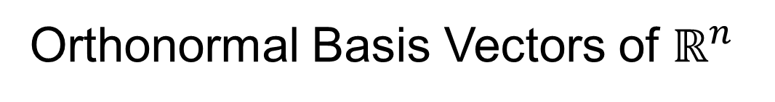
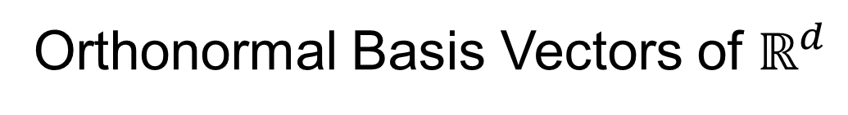
Review of Linear Algebra (Cont.)
SVD Full Representation:
=
$$V_{n×n}^{t}$$
$$X_{d×n}$$
$$U_{d×d}$$
$$S_{d×n}$$
Orthonormal Basis Vectors of $ℝ^{d}$
Diagonal Matrix of Singular Values
Orthonormal Basis Vectors of $ℝ^{n}$

Slide 50
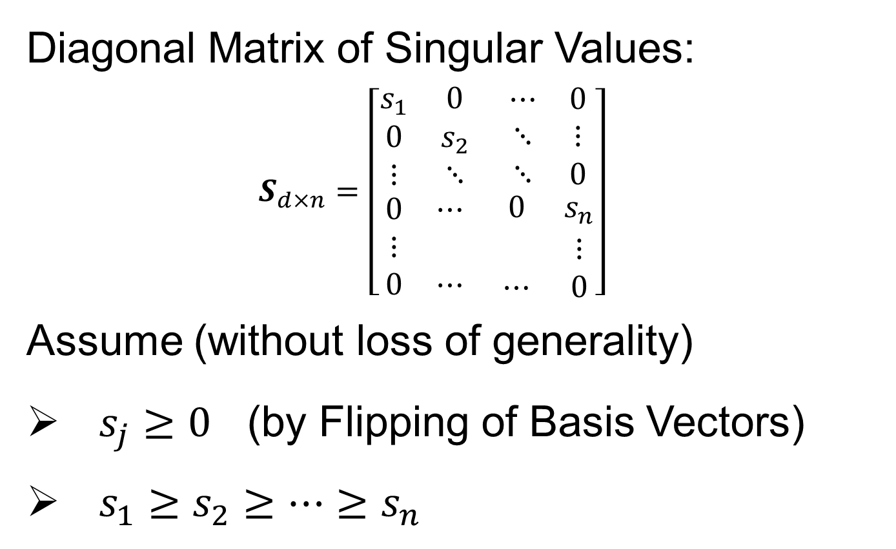
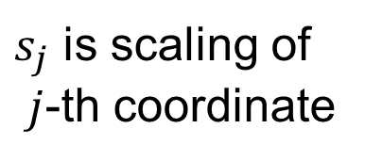

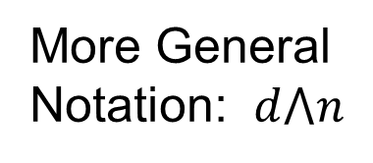
Review of Linear Algebra (Cont.)
Diagonal Matrix of Singular Values:
$$S_{d×n}=\left[\begin{matrix}\begin{matrix}s_{1} & 0 \\ 0 & s_{2} \\ ⋮ & ⋱\end{matrix} & \begin{matrix}⋯ & 0 \\ ⋱ & ⋮ \\ ⋱ & 0\end{matrix} \\ \begin{matrix}0 & ⋯ \\ ⋮ & \\ 0 & ⋯\end{matrix} & \begin{matrix}0 & s_{n} \\ & ⋮ \\ ⋯ & 0\end{matrix}\end{matrix}\right]$$
Assume (without loss of generality)
$s_{j}≥0$ (by Flipping of Basis Vectors)
$s_{1}≥s_{2}≥⋯≥s_{n}$
$s_{j}$ is scaling of
$j$-th coordinate
Uses Visual Case
Here: $d>n$
More General
Notation: $d⋀n$

Slide 51
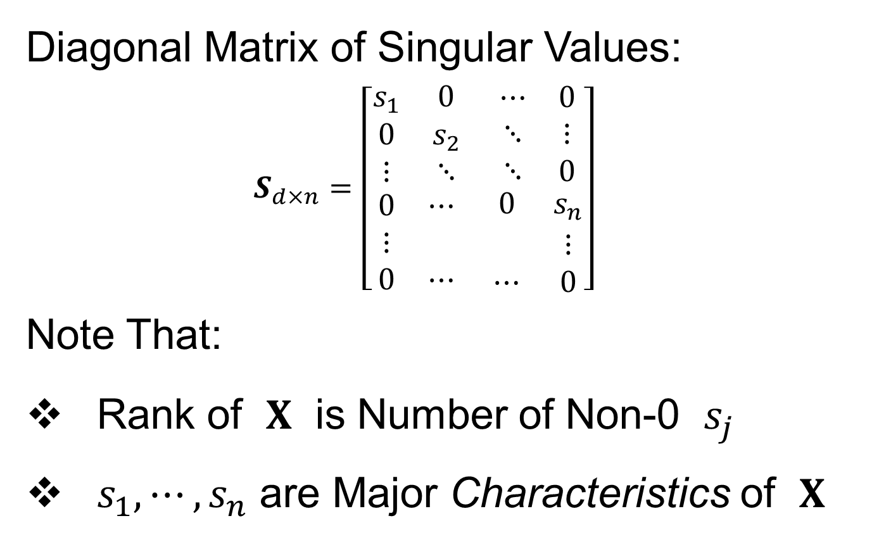
Review of Linear Algebra (Cont.)
Diagonal Matrix of Singular Values:
$$S_{d×n}=\left[\begin{matrix}\begin{matrix}s_{1} & 0 \\ 0 & s_{2} \\ ⋮ & ⋱\end{matrix} & \begin{matrix}⋯ & 0 \\ ⋱ & ⋮ \\ ⋱ & 0\end{matrix} \\ \begin{matrix}0 & ⋯ \\ ⋮ & \\ 0 & ⋯\end{matrix} & \begin{matrix}0 & s_{n} \\ & ⋮ \\ ⋯ & 0\end{matrix}\end{matrix}\right]$$
Note That:
Rank of $X$ is Number of Non-0 $s_{j}$
$s_{1},⋯,s_{n}$ are Major Characteristics of $X$

Slide 52
Review of Linear Algebra (Cont.)
SVD Full Representation:
=
Also Useful Are Smaller Representations
$$V_{n×n}^{t}$$
$$X_{d×n}$$
$$U_{d×d}$$
$$S_{d×n}$$

Slide 53


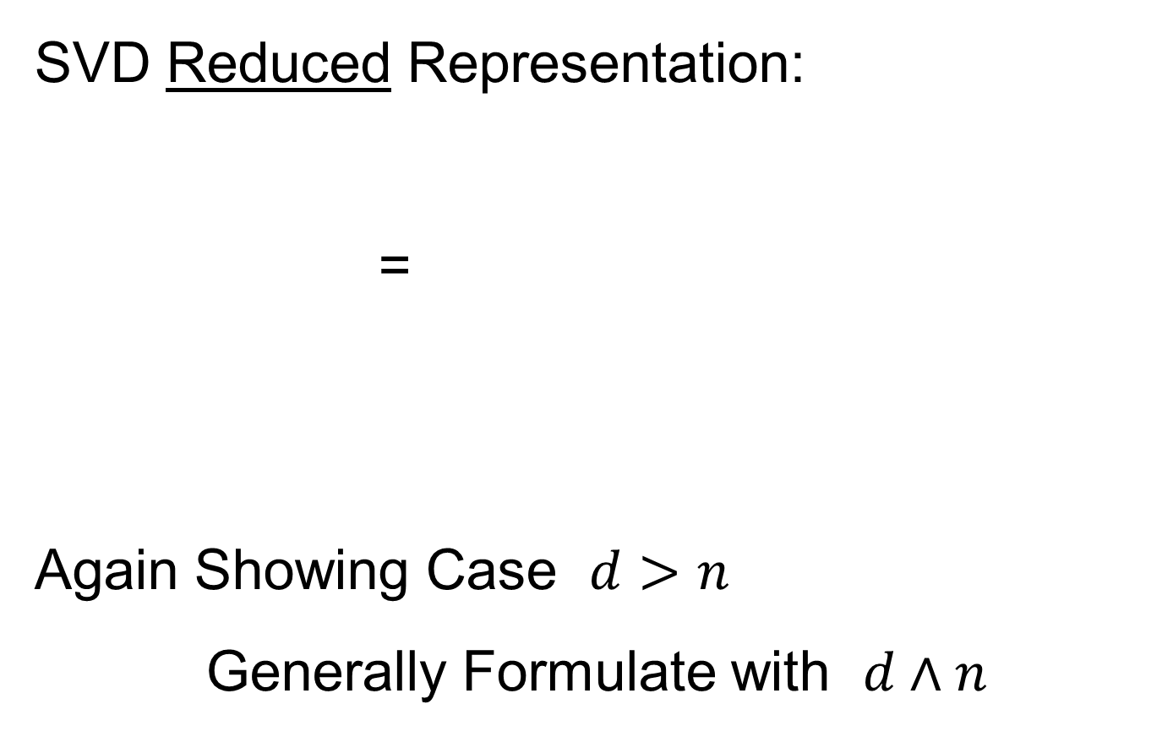
Review of Linear Algebra (Cont.)
SVD Reduced Representation:
=
Again Showing Case $d>n$
Generally Formulate with $d∧n$
$$S_{n×n}$$
$$V_{n×n}^{t}$$
$$X_{d×n}$$
$$U_{d×n}$$

Slide 54

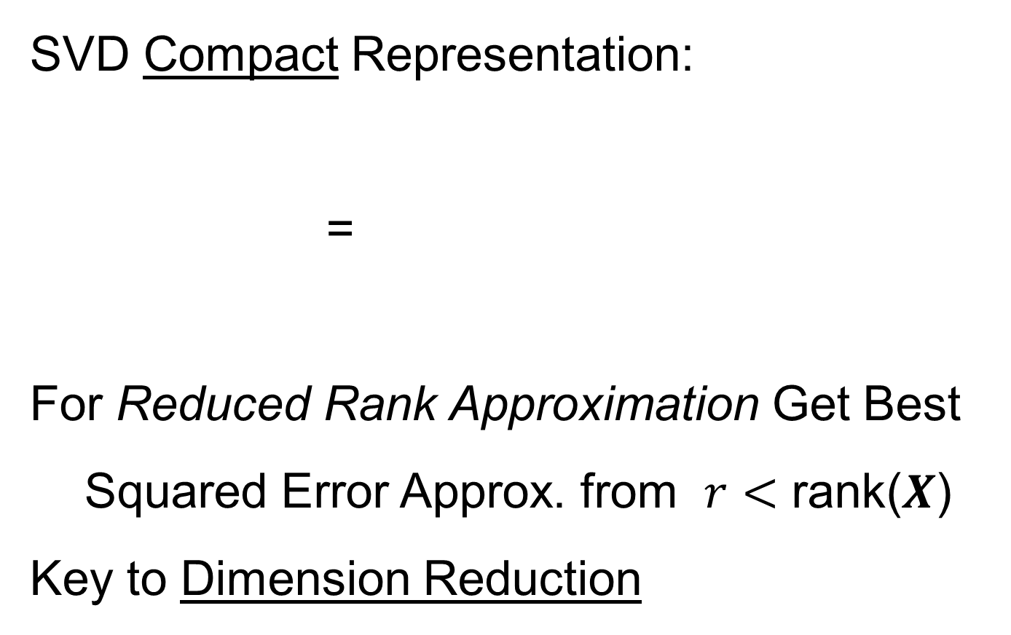


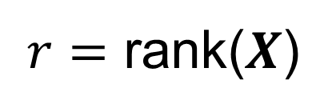
Review of Linear Algebra (Cont.)
SVD Compact Representation:
=
For Reduced Rank Approximation Get Best Squared Error Approx. from $r<$ rank($X$)
Key to Dimension Reduction
$$S_{r×r}$$
$$V_{r×n}^{t}$$
$$X_{d×n}$$
$$U_{d×r}$$
$r=$ rank($X$)

Slide 55


Covariance Matrices
Notation: Data Matrix
$$\tilde{X}=\left[\begin{matrix}{\tilde{x}}_{1,1} & ⋯ & {\tilde{x}}_{1,n} \\ ⋮ & ⋱ & ⋮ \\ {\tilde{x}}_{d,1} & ⋯ & {\tilde{x}}_{d,n}\end{matrix}\right]$$
Indexed by Rows $i=1,⋯,d$ Cols $j=1,⋯,n$
Empirical Covariance:
$$\hat{Σ}=\left[\begin{matrix}\frac{1}{n}\sum_{j=1}^{n}{{\left({\tilde{x}}_{1,j}−{\overline{x}}_{1,A}\right)}^{2}} & ⋯ & \frac{1}{n}\sum_{j=1}^{n}{\left({\tilde{x}}_{1,j}−{\overline{x}}_{1,A}\right)\left({\tilde{x}}_{d,j}−{\overline{x}}_{1,A}\right)} \\ ⋮ & ⋱ & ⋮ \\ \frac{1}{n}\sum_{j=1}^{n}{\left({\tilde{x}}_{d,j}−{\overline{x}}_{d,A}\right)\left({\tilde{x}}_{1,j}−{\overline{x}}_{1,A}\right)} & ⋯ & \frac{1}{n}\sum_{j=1}^{n}{{\left({\tilde{x}}_{d,j}−{\overline{x}}_{d,A}\right)}^{2}}\end{matrix}\right]$$
Are Data
Objects
Essentially Inner
Products of Rows
Use $\frac{1}{n}$ (MLE) form for simplicity

Slide 56
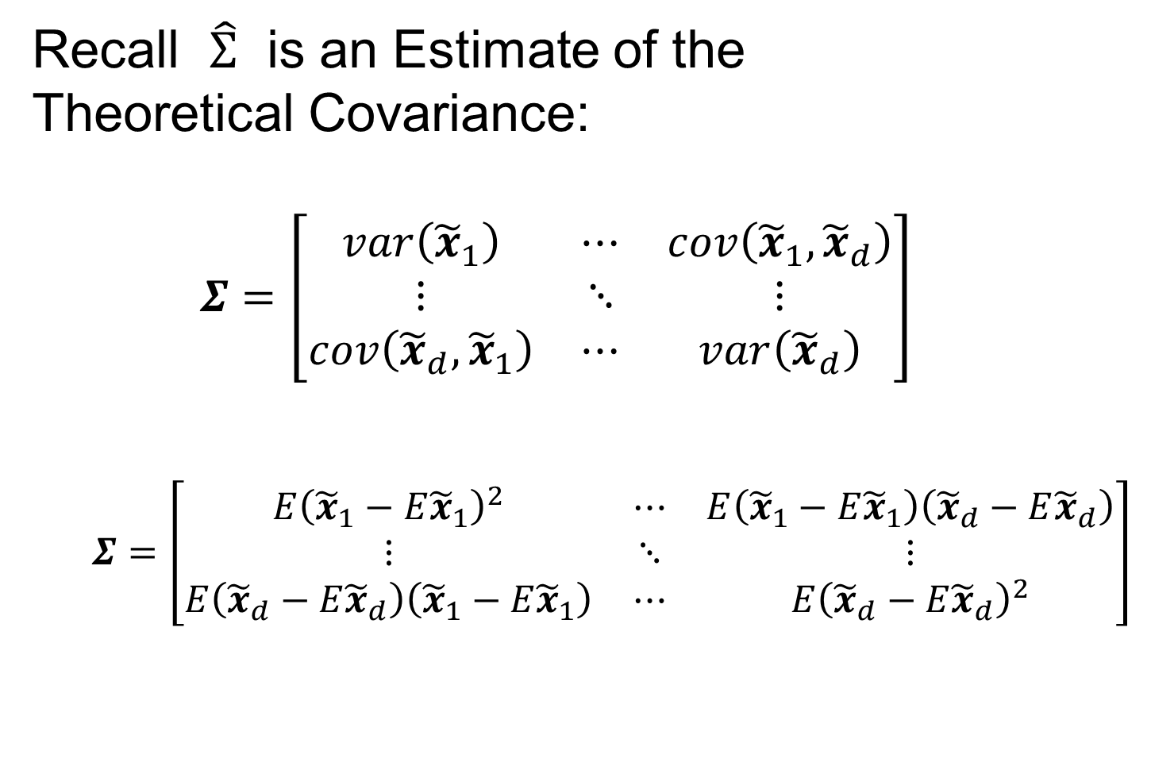
Covariance Matrices
Recall $\hat{Σ}$ is an Estimate of the
Theoretical Covariance:
$$Σ=\left[\begin{matrix}var\left({\tilde{x}}_{1}\right) & ⋯ & cov\left({\tilde{x}}_{1},{\tilde{x}}_{d}\right) \\ ⋮ & ⋱ & ⋮ \\ cov\left({\tilde{x}}_{d},{\tilde{x}}_{1}\right) & ⋯ & var\left({\tilde{x}}_{d}\right)\end{matrix}\right]$$
$$Σ=\left[\begin{matrix}E{\left({\tilde{x}}_{1}−E{\tilde{x}}_{1}\right)}^{2} & ⋯ & E\left({\tilde{x}}_{1}−E{\tilde{x}}_{1}\right)\left({\tilde{x}}_{d}−E{\tilde{x}}_{d}\right) \\ ⋮ & ⋱ & ⋮ \\ E\left({\tilde{x}}_{d}−E{\tilde{x}}_{d}\right)\left({\tilde{x}}_{1}−E{\tilde{x}}_{1}\right) & ⋯ & E{\left({\tilde{x}}_{d}−E{\tilde{x}}_{d}\right)}^{2}\end{matrix}\right]$$

Slide 57



Covariance Matrices
Compact Representation of $\hat{Σ}$ Comes From
Centered & $\sqrt{n}$ Scaled Version of Data:
$$\breve{X}=\left[\begin{matrix}\frac{1}{\sqrt{n}}\left({\tilde{x}}_{1,1}−{\overline{x}}_{1,A}\right) & ⋯ & \frac{1}{\sqrt{n}}\left({\tilde{x}}_{1,n}−{\overline{x}}_{1,A}\right) \\ ⋮ & ⋱ & ⋮ \\ \frac{1}{\sqrt{n}}\left({\tilde{x}}_{d,1}−{\overline{x}}_{d,A}\right) & ⋯ & \frac{1}{\sqrt{n}}\left({\tilde{x}}_{d,n}−{\overline{x}}_{d,A}\right)\end{matrix}\right]$$
Recall Average for Row $i=1,⋯,d$ is
$${\overline{x}}_{i,A}=\frac{1}{n}\sum_{j=1}^{n}{{\tilde{x}}_{i,j}}$$
Entries of Column
Object Mean Vector
$\hat{Σ}$ Entries Are Inner
Products of Rows
Over $i,i^{′}=1,⋯,d$
Achieved By Product $\breve{X}{\breve{X}}^{t}$

Slide 58

Covariance Matrices
Compact Representation of Covariance:
$$\hat{Σ}=\breve{X}{\breve{X}}^{t}$$
Called “Outer Product”
(Complementary to “Inner Product”,
$\left\langle x,y\right\rangle =x^{t}y$)

Slide 59

PCA as an Optimization Problem
Find Direction of Greatest Variability:
Centered At Mean

Slide 60


PCA as an Optimization Problem
Find Direction of Greatest Variability:
Approach to
Calculation:
And Optimize Over $u$, such that $\left\|u\right\|=1$
Start with
Candidate
Direction $u$

Slide 61


PCA as Optimization (Cont.)
Again Start With Data Matrix
$$\tilde{X}=\left[\begin{matrix}{\tilde{x}}_{1,1} & ⋯ & {\tilde{x}}_{1,n} \\ ⋮ & ⋱ & ⋮ \\ {\tilde{x}}_{d,1} & ⋯ & {\tilde{x}}_{d,n}\end{matrix}\right]$$
Columns as Data Objects, Indexed $j=1,⋯,n$
${\tilde{x}}_{j}=\left(\begin{matrix}{\tilde{x}}_{1,j} \\ ⋮ \\ {\tilde{x}}_{d,j}\end{matrix}\right)$
Same
Notation
as Above
With Column Object Mean Vector
${\overline{x}}_{CO}=\left(\begin{matrix}{\overline{x}}_{1,A} \\ ⋮ \\ {\overline{x}}_{d,A}\end{matrix}\right)$

Slide 62


PCA as Optimization (Cont.)
Given a Candidate Direction $u∈ℝ^{d}$,
Projections of Centered Data Onto $u$ are:
$$P_{u}\left({\tilde{x}}_{j}−{\overline{x}}_{CO}\right)=\left\langle {\tilde{x}}_{j}−{\overline{x}}_{CO},u\right\rangle u, j=1,⋯,n$$
Quantify Variation in the Direction $u$:
$$\frac{1}{n}\sum_{j=1}^{n}{{\left\|P_{u}\left({\tilde{x}}_{j}−{\overline{x}}_{CO}\right)\right\|}^{2}}$$
Recall $\left\|u\right\|=1$
Sample
Variance
of Scores

Slide 63

PCA as Optimization (Cont.)
Quantify Variation in the Direction $u$:
$$\frac{1}{n}\sum_{j=1}^{n}{{\left\|P_{u}\left({\tilde{x}}_{j}−{\overline{x}}_{CO}\right)\right\|}^{2}}=$$
$$=\frac{1}{n}\sum_{j=1}^{n}{{\left(u{\left({\tilde{x}}_{j}−{\overline{x}}_{CO}\right)}^{t}u\right)}^{t}u{\left({\tilde{x}}_{j}−{\overline{x}}_{CO}\right)}^{t}u}=$$
$$=u^{t}\left(\frac{1}{n}\sum_{j=1}^{n}{\left({\tilde{x}}_{j}−{\overline{x}}_{CO}\right){\left({\tilde{x}}_{j}−{\overline{x}}_{CO}\right)}^{t}}\right)u=$$
$$=u^{t}\breve{X}{\breve{X}}^{t}u=$$
$$=u^{t}\hat{Σ}u$$
Looks Like “Products
Of Rows” From Above
Cov. Matrix Repr’n

Slide 64


PCA as Optimization (Cont.)
Quantify Variation in the Direction $u$:
$$\frac{1}{n}\sum_{j=1}^{n}{{\left\|P_{u}\left({\tilde{x}}_{j}−{\overline{x}}_{CO}\right)\right\|}^{2}}=u^{t}\hat{Σ}u$$
Quadratic Form in the
Sample Covariance Matrix $\hat{Σ}$
Simple Solution Comes from the Eigenvalue Representation of $\hat{Σ}$:
$$\hat{Σ}=BDB^{t}$$
Orthonormal
Basis of $ℝ^{d}$
Diagonal Matrix of Eigenvalues

Slide 65

PCA as Optimization (Cont.)
Find Direction $u$ to Maximize:
$u^{t}\hat{Σ}u=u^{t}BDB^{t}u$,
Where $D=\left[\begin{matrix}\begin{matrix}λ_{1} & 0 & ⋯ \\ 0 & λ_{2} & ⋱ \\ ⋮ & ⋱ & ⋱\end{matrix} & \begin{matrix}0 \\ ⋮ \\ 0\end{matrix} \\ \begin{matrix}0 & ⋯ & 0\end{matrix} & λ_{d}\end{matrix}\right]$
For Eigenvalues $λ_{1}≥λ_{2}≥⋯≥λ_{d}$

Slide 66


PCA as Optimization (Cont.)
Find Direction $u$ to Maximize:
$u^{t}\hat{Σ}u=u^{t}BDB^{t}u$,
And Where $B=\left[\begin{matrix}v_{1} & ⋯ & v_{d}\end{matrix}\right]$,
For $d×1$ Eigenvectors $v_{i}$,
Indexed by $i=1,⋯,d$
Now Define $w=\left(\begin{matrix}w_{1} \\ ⋮ \\ w_{d}\end{matrix}\right)=B^{t}u$
Orthonormal
Basis Vectors
Change of
Variable
(still have
$\left\|w\right\|=1$)

Slide 67

PCA as Optimization (Cont.)
Thus Need Direction $w$ to Maximize:
$$u^{t}\hat{Σ}u=w^{t}Dw=$$
$$=\sum_{i=1}^{d}{λ_{i}{w_{i}}^{2}}$$
Since $λ_{1}≥λ_{2}≥⋯≥λ_{d}$,
Max Is At $w=\left(\begin{matrix}\begin{matrix}1 \\ 0\end{matrix} \\ \begin{matrix}⋮ \\ 0\end{matrix}\end{matrix}\right)=B^{t}u$, i.e. $u=v_{1}$

Slide 68

PCA as Optimization (Cont.)
So Direction $u$ to Maximize:
$u^{t}\hat{Σ}u=u^{t}BDB^{t}u$,
Is First Eigenvector, $v_{1}$, of Sample Cov., $\hat{Σ}$

Slide 69

PCA as Optimization (Cont.)
Notes:
Projecting onto Subspace $⊥$ to $v_{1}$,
Gives $v_{2}$ as Next Direction
Continue Through $v_{3},⋯,v_{d}$

Slide 70

PCA as Optimization (Cont.)
Another Viewpoint of Eigenanalysis:
Recall Outer Product Representation
$$\hat{Σ}=\breve{X}{\breve{X}}^{t}$$
And Singular Value Decomposition
$$\breve{X}=\breve{U}\breve{S}{\breve{V}}^{t}$$
Resulting In
$$\hat{Σ}=\breve{U}\breve{S}{\breve{V}}^{t}{\left(\breve{U}\breve{S}{\breve{V}}^{t}\right)}^{t}=\breve{U}{\breve{S}}^{2}{\breve{U}}^{t}$$

Slide 71




PCA as Optimization (Cont.)
Relate Eigenanalysis of$\hat{Σ}$ and SVD of $\breve{X}$:
$$\hat{Σ}=\breve{U}\breve{S}{\breve{V}}^{t}{\left(\breve{U}\breve{S}{\breve{V}}^{t}\right)}^{t}=\breve{U}{\breve{S}}^{2}{\breve{U}}^{t}$$
Can Think of PCA Either as SVD Or Eigen-An.
Same Rotation Matrix $\breve{U}$ for Both
EigenValues $λ_{i}={s_{i}}^{2}$, $i=1,⋯,d$
Of $\breve{X}$, Centered, Scaled Version of $X$

Slide 72




PCA as Optimization (Cont.)
Terminology Relates to SVD View
For $r$ = Rank of $\breve{X}$:
$$\breve{X}=\breve{U}\breve{S}{\breve{V}}^{t}$$
$d×n$ (Centered, Scaled) Data Matrix
$d×r$ Matrix of (Scaled) Loadings
$r×r$ Matrix of (Scaled) Scores

Slide 73

PCA as Optimization (Cont.)
Connection to Modes of Variation:
Define:
(Scaled) Loadings Matrix, $\breve{U}=\left[\begin{matrix}u_{1} & ⋯ & u_{r}\end{matrix}\right]$
(Scaled) Scores Matrix, $\breve{S}{\breve{V}}^{t}=\left[\begin{matrix}s_{1}v_{1}^{t} \\ ⋮ \\ s_{r}v_{r}^{t}\end{matrix}\right]$

Slide 74

PCA as Optimization (Cont.)
Connection to Modes of Variation:
Thus:
$$\breve{X}=\breve{U}\breve{S}{\breve{V}}^{t}=\sum_{k=1}^{r}{u_{k}s_{k}v_{k}^{t}}$$
(Scaled) Modes of Variation
Rank 1 Matrices

Slide 75

PCA Data Representation
Idea: Expand Data Matrix
in Terms of Inner Prod’ts & Eigenvectors
Recall Notation:
$$\breve{X}=\frac{1}{\sqrt{n}}{\left({\tilde{x}}_{1}−{\overline{x}}_{CO},⋯,{\tilde{x}}_{n}−{\overline{x}}_{CO}\right)}_{d×n}$$
(Mean Centered & Scaled Data)

Slide 76



PCA Data Representation
Idea: Expand Data Matrix
in Terms of Inner Prod’ts & Eigenvectors
Recall Notation:
$$\breve{X}=\frac{1}{\sqrt{n}}{\left({\tilde{x}}_{1}−{\overline{x}}_{CO},⋯,{\tilde{x}}_{n}−{\overline{x}}_{CO}\right)}_{d×n}$$
Spectral Representation (centered data):
$${\breve{X}}_{d×n}=\sum_{k=1}^{r}{u_{k}\left(s_{k}v_{k}^{t}\right)}$$
Recall: Loadings Vector $∈ℝ^{d}$
Scores Vector $∈ℝ^{n}$

Slide 77


PCA Data Represent’n (Cont.)
$1$ by $n$ matrix of $1$s
Now Using:
$$\tilde{X}={\overline{x}}_{CO}1_{1,n}+\sqrt{n}\breve{X}$$
Spectral Representation (Raw Data):
$$\tilde{X}={\overline{x}}_{CO}1_{1,n}+\sqrt{n}\sum_{k=1}^{r}{u_{k}\left(s_{k}v_{k}^{t}\right)}$$
Where:
Entries of $u_{k}$ $\left(d×1\right)$ are Loadings
Entries of $c_{k}^{t}=\sqrt{n}s_{k}v_{k}^{t}$ $\left(1×n\right)$ are Scores

Slide 78

PCA Data Represent’n (Cont.)
Can Focus on Individual Data Object Vectors:
$${\tilde{x}}_{i}={\overline{x}}_{CO}+\sum_{k=1}^{r}{u_{k}c_{i,k}}$$
($i=1,⋯,n$ Col. of Above Full Matrix Rep’n)
Terminology: $c_{i,k}$ are Called “PCs”
and are also Called Scores

Slide 79

PCA Data Represent’n (Cont.)
More Terminology:
Scores, $c_{i,k}$ are Coefficients in Spectral Representation:
$${\tilde{x}}_{i}={\overline{x}}_{CO}+\sum_{k=1}^{r}{u_{k}c_{i,k}}$$
Loadings are Entries $u_{ij}$ of Eigenvectors:
$$u_{k}=\left(\begin{matrix}u_{1,k} \\ ⋮ \\ u_{d,k}\end{matrix}\right)$$

Slide 80

Connect Math to Graphics
2-d Toy Example
From Much Earlier Class Meeting
2-d Curves as Data In Object Space
Simple, Visualizable Feature Space

Slide 81



Connect Math to Graphics
2-d Toy Example
1st Eigenvector, $u_{1}$
1st Mode of Variation, $u_{1} c_{1}^{t}$

Slide 82



Connect Math to Graphics
2-d Toy Example
2nd Eigenvector, $u_{2}$
2nd Mode of Variation,$u_{2}{ c}_{2}^{t}$

Slide 83

PCA Data Represent’n (Cont.)
Recall: PCA Scatterplot Matrix Views
Provide a Rotation of Data,
Where Axes Are Directions of Max. Variation
By Plotting $c_{1,k},⋯,c_{n,k}$ on axis $k$

Slide 84


PCA Data Represent’n (Cont.)
E.g. Recall Raw Data,
Slightly
Mean
Shifted
Gaussian
Data

Slide 85



PCA Data Represent’n (Cont.)
PCA Rotation: Scatterplot Matrix View
$c_{1,1},⋯,c_{n,1}$
$c_{1,2},⋯,c_{n,2}$

Slide 86

PCA Data Represent’n (Cont.)
PCA Rotates to Directions of Max. Variation

Slide 87

PCA Data Represent’n (Cont.)
PCA Rotates to Directions of Max. Variation

Slide 88

PCA Data Represent’n (Cont.)
Reduced Rank Approximation:
$${\tilde{x}}_{i}≈{\overline{x}}_{CO}+\sum_{k=1}^{m}{u_{k}c_{i,k}}$$
Reconstruct Using Only $m (≪d)$ Terms
(Assuming Decreasing Eigenvalues)

Slide 89

PCA Data Represent’n (Cont.)
Reduced Rank Approximation:
$${\tilde{x}}_{i}≈{\overline{x}}_{CO}+\sum_{k=1}^{m}{u_{k}c_{i,k}}$$
Reconstruct Using Only $m (≪d)$ Terms
(Assuming Decreasing Eigenvalues)
Gives: Rank $m$ Approximation of Data
Key to PCA Dimension Reduction
And PCA for Data Compression (~ .jpeg)

Slide 90

PCA Data Represent’n (Cont.)
Choice of $m$ in Reduced Rank Approxim’n:
Generally Very Slippery Problem
Not Recommended:
Arbitrary Choice
E.g. % Variation Explained 90%? 95%?

Slide 91


PCA Data Represent’n (Cont.)
Choice of $m$ in Reduced Rank Approxim’n:
Generally Very Slippery Problem
SCREE Plot:
Find Knee in Power Spectrum

Slide 92

PCA Data Represent’n (Cont.)
SCREE Plot Drawbacks:
What is a Knee?
What if There are Several?
(Recall Lung
Cancer Data)

Slide 93
PCA Data Represent’n (Cont.)
SCREE Plot Drawbacks:
What is a Knee?
What if There are Several?
Knees Depend on Scaling (Power? log?)
Personal Suggestions:
Find Auxiliary Cutoffs (Inter-Rater Variation)
Use the Full Range

