Slide 1
Statistics – O. R. 881
Object Oriented Data Analysis
Steve Marron
Dept. of Statistics and Operations Research
University of North Carolina

Slide 2
Current Sections in Textbook
Today:
Sections 8.1, 8.2, 8.3
Next Class:
Sections 8.6 , 8.7, 7.3, 10.1.2, 9.1

Slide 3
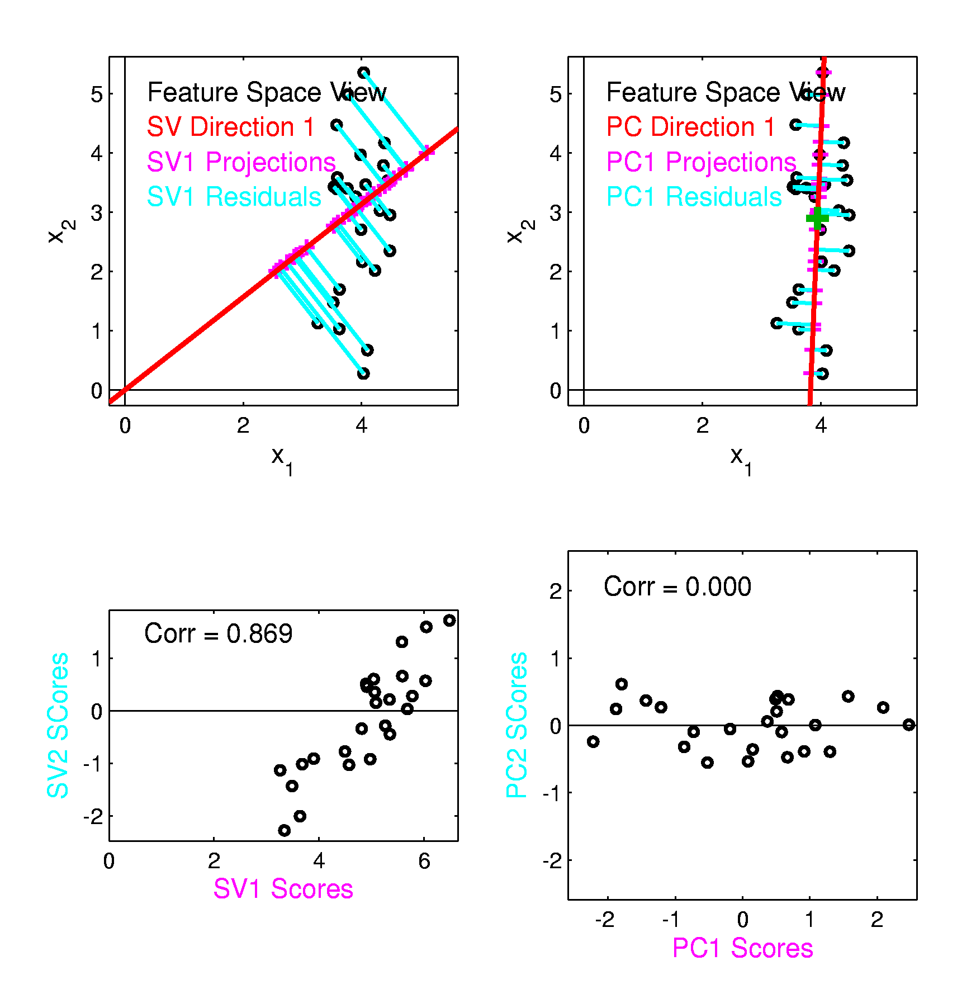
Last Class PCA vs. SVD
Consequences
Of Centering:
PCA Scores Are
Uncorrelated
Not SVD Scores

Slide 4
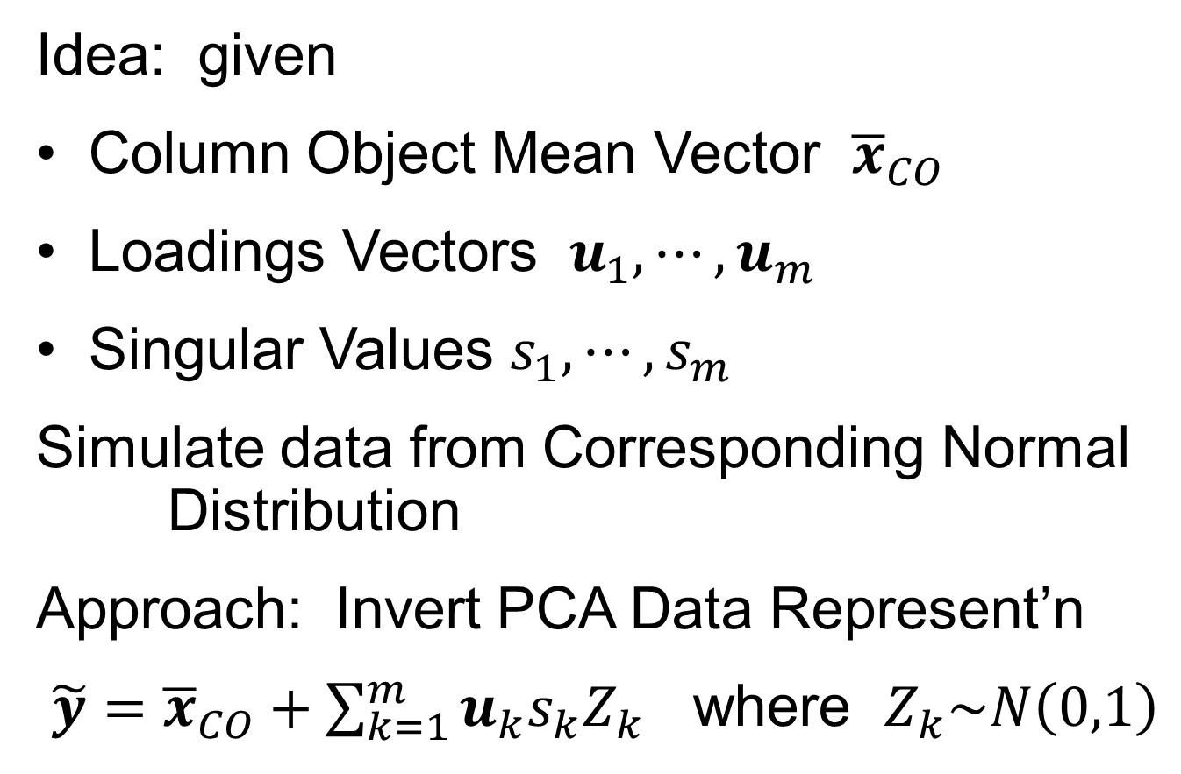
Last Class: PCA Simulation
Idea: given
Column Object Mean Vector ${\overline{x}}_{CO}$
Loadings Vectors $u_{1},⋯,u_{m}$
Singular Values $s_{1},⋯,s_{m}$
Simulate data from Corresponding Normal Distribution
Approach: Invert PCA Data Represent’n
$\tilde{y}={\overline{x}}_{CO}+\sum_{k=1}^{m}{u_{k}s_{k}Z_{k}}$ where $Z_{k}\sim N\left(0,1\right)$

Slide 5
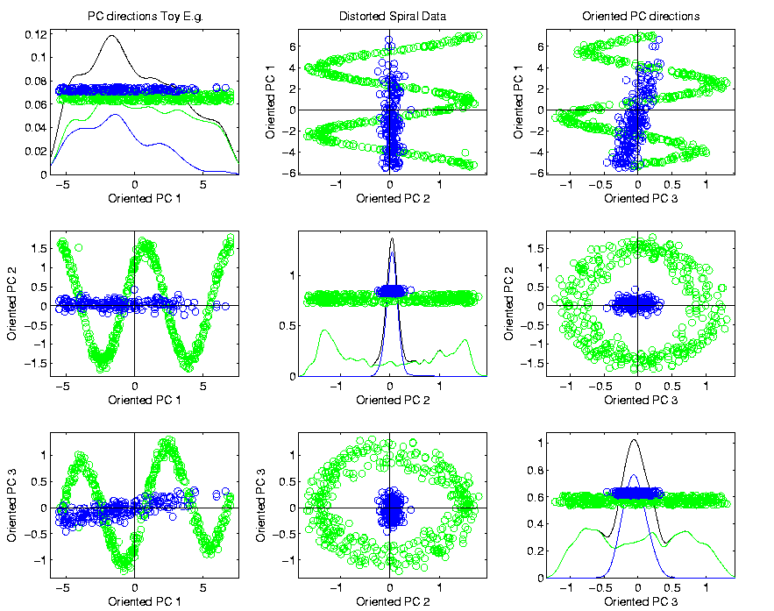
Last Class PCA & Displays
Toy Example (2 colored “clusters” in data)

Slide 6

Last Class PCA & Displays
Toy Example (1 point moved)
Important
Point:
Constant
Axes

Slide 7
Last Class: Distance Methods
Main Idea:
Approach to Data Lying in Complicated Space
(PCA Makes No Sense In Nonlinear Spaces)
However, Often Have Notion of “Distance”
I.e. Metric on Metric Space
So Base Analysis on Distances
Text: Chp. 7

Slide 8

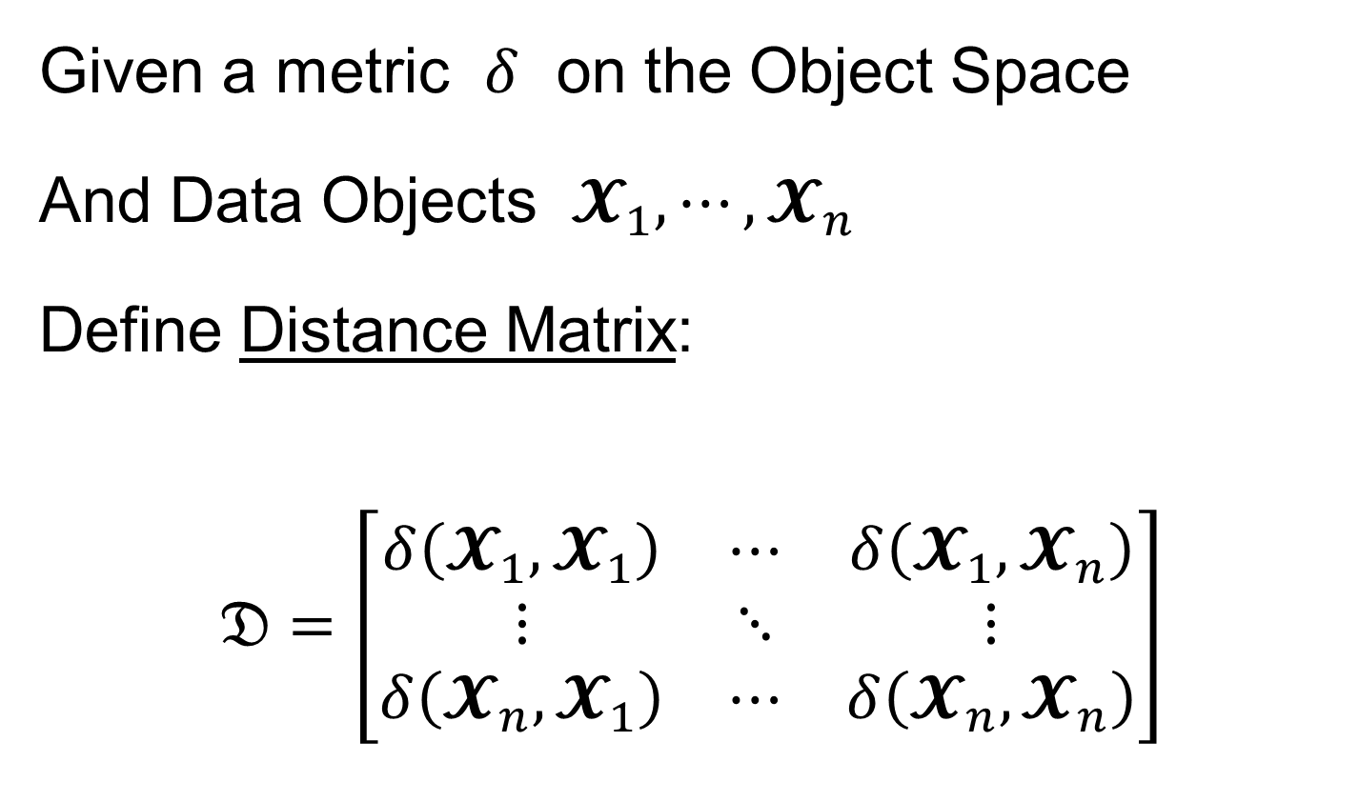
Last Class: Distance Methods
Given a metric $δ$ on the Object Space
And Data Objects $𝓧_{1},⋯,𝓧_{n}$
Define Distance Matrix:
$$𝔇=\left[\begin{matrix}δ\left(𝓧_{1},𝓧_{1}\right) & ⋯ & δ\left(𝓧_{1},𝓧_{n}\right) \\ ⋮ & ⋱ & ⋮ \\ δ\left(𝓧_{n},𝓧_{1}\right) & ⋯ & δ\left(𝓧_{n},𝓧_{n}\right)\end{matrix}\right]$$
Script $𝓧$ Denotes
Arbitrary Data Objects

Slide 9
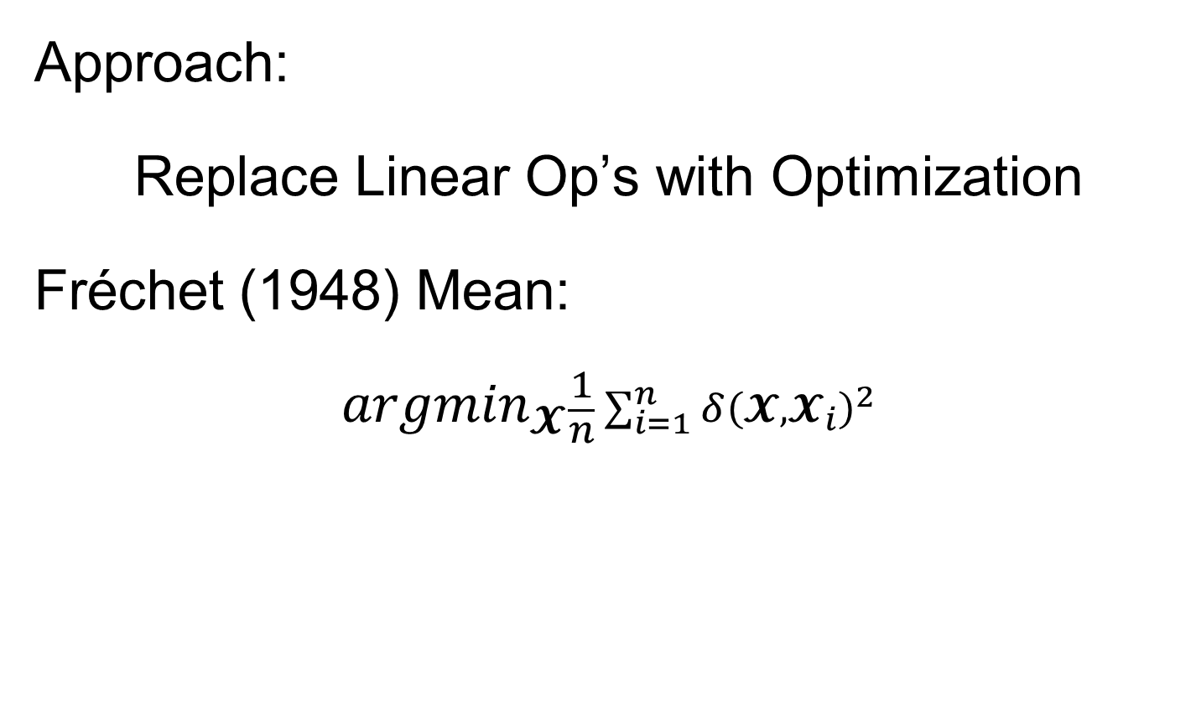
Last Class: Distance Methods
Approach:
Replace Linear Op’s with Optimization
Fréchet (1948) Mean:
$${argmin}_{𝓧}\frac{1}{n}\sum_{i=1}^{n}{{δ\left(𝓧,𝓧_{i}\right)}^{2}}$$
Start With Candidate Point
Move Around to Min
Sum of Squared Dist’s

Slide 10
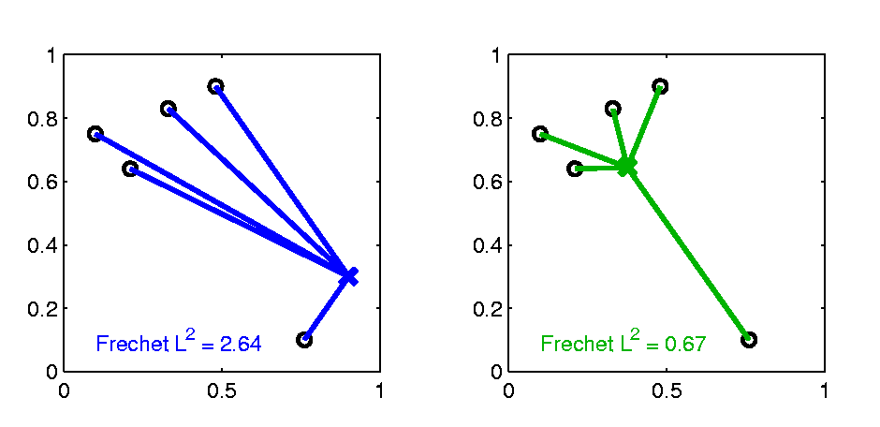

Last Class: Distance Methods
Fréchet Sample Mean, $ℝ^{2}$ Toy Example
(Use Metric $δ=δ_{2}$)
Min Looks Like
Sample Mean???
Note: Outlier Pulls Mean Out of
Convex Hull Of Other 4 Points
Recall “Center
Of Mass”
Interpretretation
Known Problem with Mean: Not Robust Against Outliers

Slide 11
Last Class: Distance Methods
Fréchet Means & Medians Allow Many Variations
Usually Studied in “Robust Statistics”
Might Look Deeper Later On (Text Chapter 16)
“Every Dog Has His Day”

Slide 12
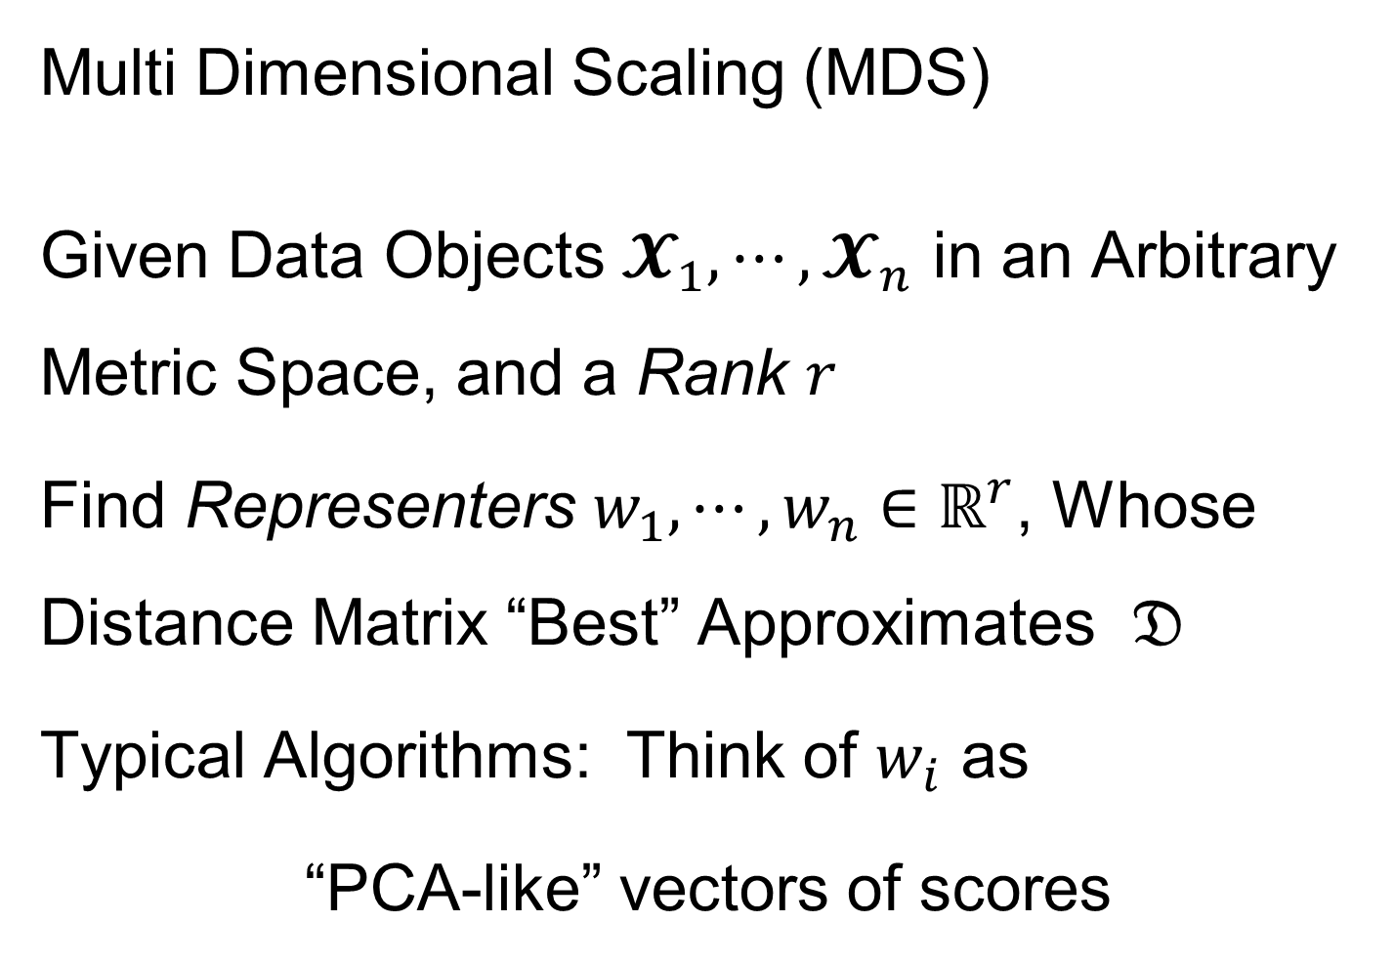
Last Class: Distance Methods
Note: This
Representation
Is Called
“Auto-Encoder”
In AI literature
Multi Dimensional Scaling (MDS)
Given Data Objects $𝓧_{1},⋯,𝓧_{n}$ in an Arbitrary Metric Space, and a Rank $r$
Find Representers $w_{1},⋯,w_{n}∈ℝ^{r}$, Whose Distance Matrix “Best” Approximates $𝔇$
Typical Algorithms: Think of $w_{i}$ as
“PCA-like” vectors of scores

Slide 13
Last Class: Shapes As Data Objects
Several Different Notions of Shape
Oldest and Best Known (in Statistics):
Landmark Based
Text, Sec. 1.2, 5.2

Slide 14





Last Class: Landmark Shape
Start by Representing Shapes by
Landmarks (points in $ℝ^{2}$ or $ℝ^{3}$)
$$\left(x_{1},y_{1}\right)$$
$$\left[\begin{matrix}\begin{matrix}x_{1} \\ y_{1}\end{matrix} \\ \begin{matrix}x_{2} \\ y_{2}\end{matrix} \\ \begin{matrix}x_{3} \\ y_{3}\end{matrix}\end{matrix}\right]∈ℝ^{6}$$
$$\left(x_{2},y_{2}\right)$$
$$\left(x_{3},y_{3}\right)$$
Trait (Feature) Vector

Slide 15
Last Class: Landmark Shape
Approach: Identify objects that are:
Translations
Rotations
Scalings
of each other
Mathematics: Equivalence Relation
Results in: Equivalence Classes (i.e. Orbits)
Which become the Data Objects

Slide 16
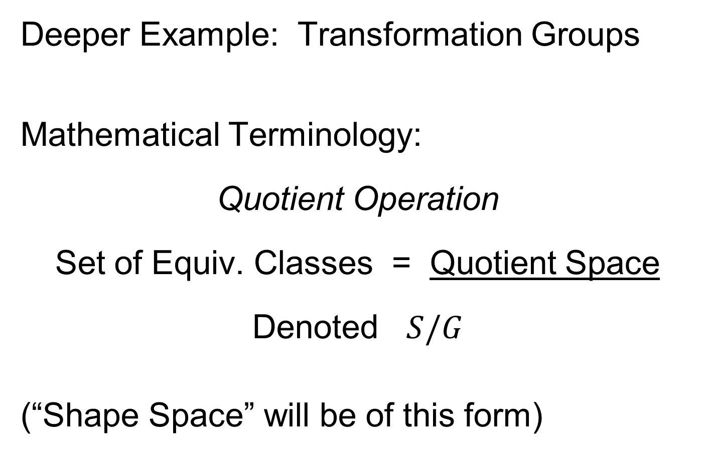
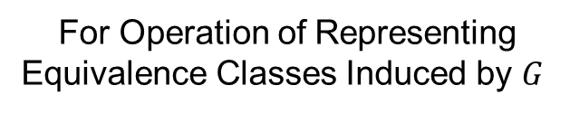
Last Class: Equivalence Relations
Deeper Example: Transformation Groups
Mathematical Terminology:
Quotient Operation
Set of Equiv. Classes = Quotient Space
Denoted $S/G$
(“Shape Space” will be of this form)
For Operation of Representing
Equivalence Classes Induced by $G$

Slide 17
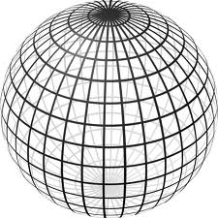

Last Class: Landmark Shape
Triangle Shape Space: Represent as Sphere
$ℝ^{6}$ → $ℝ^{4}$ → $ℝ^{3}$ →
scaling
(thanks to Wikipedia)

Slide 18
Last Class: Image Analysis
First Generation Problems:
Denoising
Segmentation
Registration
(all about single images,
still interesting challenges)

Slide 19
Last Class: Image Analysis
Second Generation Problems:
Populations of Images
  Understanding Population Variation
  Discrimination (a.k.a. Classification)
Complex Data Structures (& Spaces)
HDLSS Statistics
Text,
Chp. 11
Will Study,
Text Sec. 14.2
High Dimension, Low Sample Size

Slide 20
Last Class: Image Analysis
Common Goal in Image Analysis:
Focus on Shapes Within Images
I.e. Shapes Become the Data Objects
E.g. Organs Within a Medical Image

Slide 21
Last Class: Shape Repr’ns
Major Approaches for Shape Data Objects:
Landmark Representations
Boundary Representations
Skeletal Representations

Slide 22
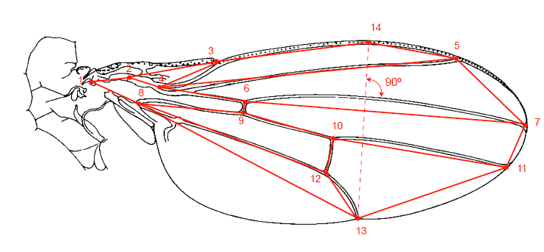
Last Class: Landmark Repr’ns
Landmarks for Fly Wing Data:
Thanks to George Gilchrist

Slide 23
Last Class: Shape Rep’ns
Major Approaches for Shape Data Objects:
Landmark Representations
Boundary Representations
Skeletal Representations

Slide 24
Last Class: Boundary Rep’ns
Traditional Major Sets of Ideas:
Triangular Meshes
  Survey: Owen (1998)
Active Shape Models
  Cootes, et al (1993)
Fourier Boundary Representations
  Keleman, et al (1997 & 1999)

Slide 25
Last Class: Shape Repr’ns
Major Approaches for Shape Data Objects:
Landmark Representations
Boundary Representations
Skeletal Representations

Slide 26
Skeletal Representations
Main Idea:
Represent Objects as:
Discretized skeletons (medial atoms)
Plus spokes from center to edge
Which imply a boundary
Very accessible early reference:
Yushkevich, et al (2001)
Volume Gives Better Representation
In 3d than Boundary Surface

Slide 27
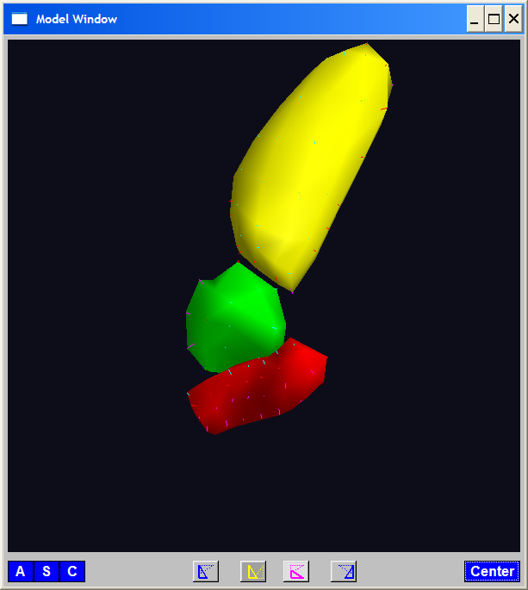
A Challenging Example
Text, Sec. 1.2
Male Pelvis
  Bladder – Prostate – Rectum

Slide 28
A Challenging Example
Male Pelvis
  Bladder – Prostate – Rectum
Attached to the Bladder
Common Area for Cancer in Males

Slide 29
A Challenging Example
Male Pelvis
  Bladder – Prostate – Rectum
Common Area for Cancer in Males
Useful Approach: Radiation
Challenge: Design Treatment
Hit Prostate
Miss Bladder & Rectum
Over Many Days

Slide 30
A Challenging Example
Radiation Treatment in Male Pelvis
  Bladder – Prostate – Rectum
  Central Question:
  How do they move over time (days)?
Work with 3-d CT
(“Computed Tomography”,
= 3d version of X-ray)

Slide 31
A Challenging Example
Radiation Treatment in Male Pelvis
  Bladder – Prostate – Rectum
  Central Question:
  How do they move over time (days)?
Work with 3-d CT
  Very Challenging to Segment
  Find boundary of each object?
  Represent each Object?

Slide 32
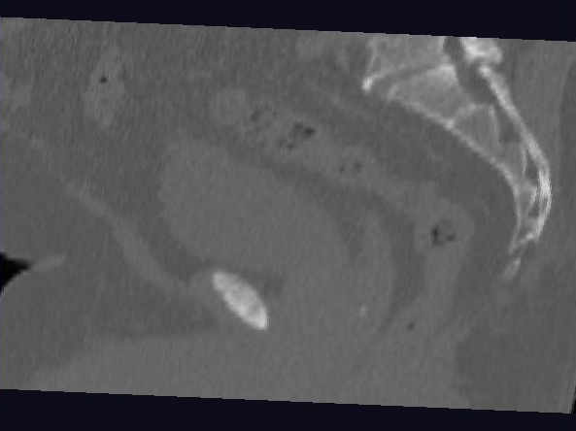
Male Pelvis – Raw Data
One CT Slice
(in 3d image)
Like X-ray:
White = Dense
(Bone)
Black = Gas

Slide 33
Male Pelvis – Raw Data
One CT Slice
(in 3d image)
Tail Bone

Slide 34
Male Pelvis – Raw Data
One CT Slice
(in 3d image)
Tail Bone
Rectum

Slide 35
Male Pelvis – Raw Data
One CT Slice
(in 3d image)
Tail Bone
Rectum
Bladder

Slide 36
Male Pelvis – Raw Data
One CT Slice
(in 3d image)
Tail Bone
Rectum
Bladder
Prostate

Slide 37
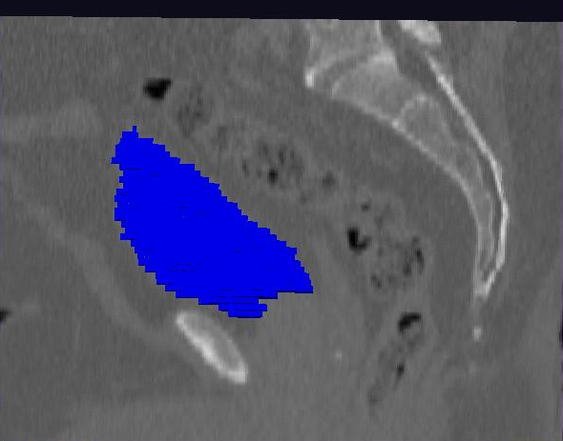
Male Pelvis – Raw Data
Bladder:
manual segmentation
Slice by slice
Reassembled

Slide 38
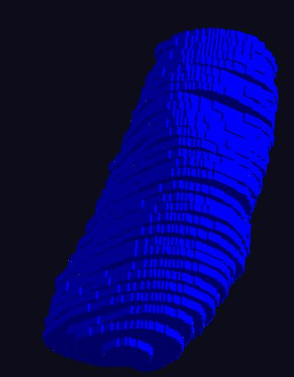
Male Pelvis – Raw Data
Bladder:
Slices:
Reassembled in 3d
How to represent?
Thanks: Ja-Yeon Jeong
Called Binary
Representation

Slide 39
Object Representation
Above Shape Approaches:
Landmarks (hard to find)
Boundary Rep’ns (no correspondence)
Skeletal Representations

Slide 40
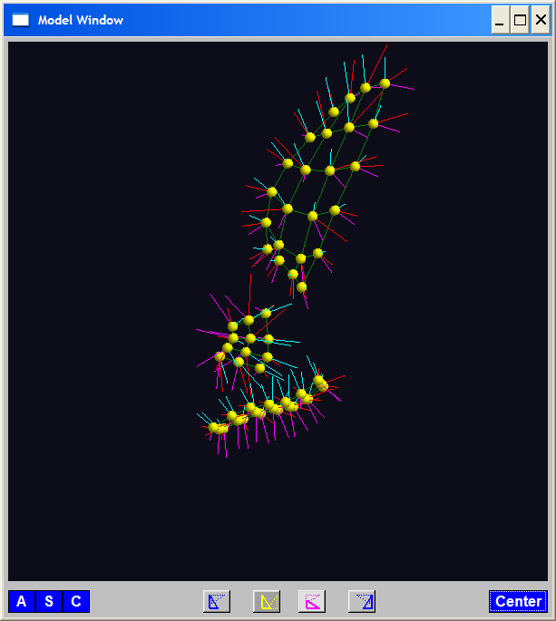
Skeletal Representations
3-d S-Rep Example: From Ja-Yeon Jeong
Bladder – Prostate - Rectum
Atoms (yellow dots)
Notes:
OODA.ppt

Slide 41
Skeletal Representations
3-d S-Rep Example: From Ja-Yeon Jeong
Bladder – Prostate - Rectum
Atoms - Spokes (line segments)
Notes:
OODA.ppt

Slide 42
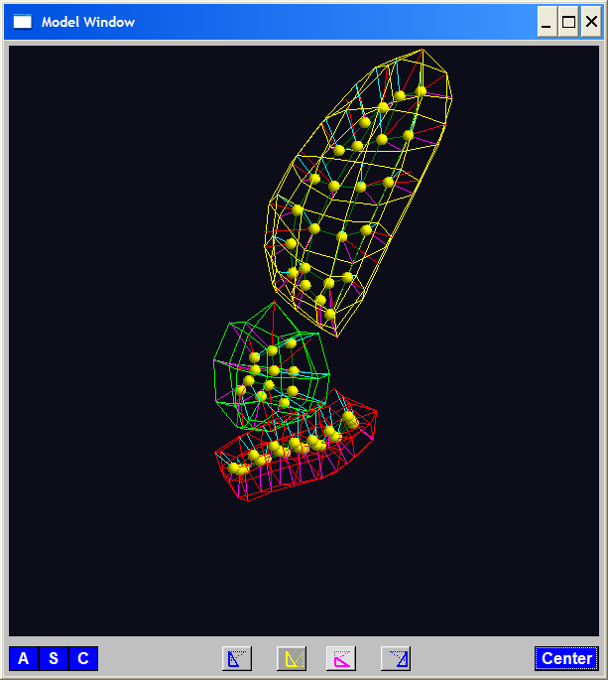
Skeletal Representations
3-d S-Rep Example: From Ja-Yeon Jeong
Bladder – Prostate - Rectum
Atoms - Spokes - Implied Boundary
Notes:
OODA.ppt

Slide 43
Skeletal Representations
3-d S-Rep Example: From Ja-Yeon Jeong
Bladder – Prostate - Rectum
Atoms - Spokes - Implied Boundary
Notes:
OODA.ppt

Slide 44
Skeletal Representations
Detailed discussion of mathematics of S-reps:
Siddiqi & Pizer (2007)
More Applications of S-reps in Imaging:
Pizer & Marron (2017), Pizer et al. (2020)
Notes:
fletcher_thesis.pdf

Slide 45
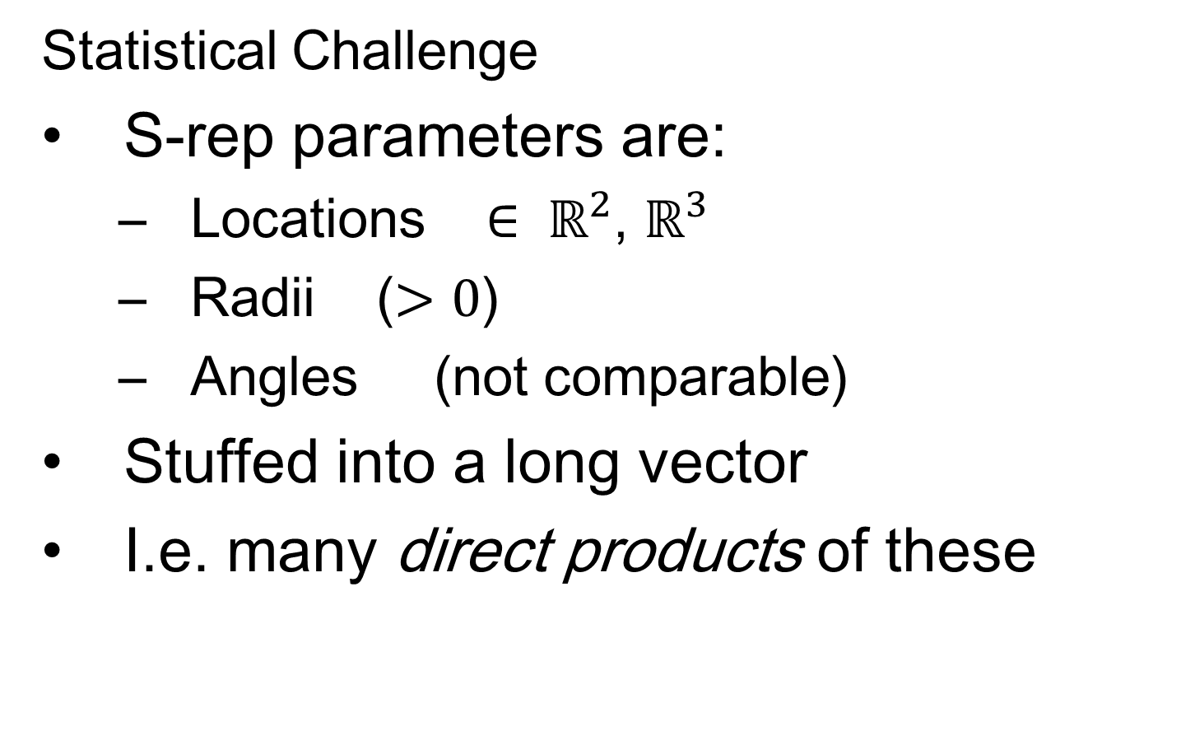
Skeletal Representations
Statistical Challenge
S-rep parameters are:
  Locations $∈ ℝ^{2}$, $ℝ^{3}$
  Radii ($>0$)
  Angles (not comparable)
Stuffed into a long vector
I.e. many direct products of these

Slide 46
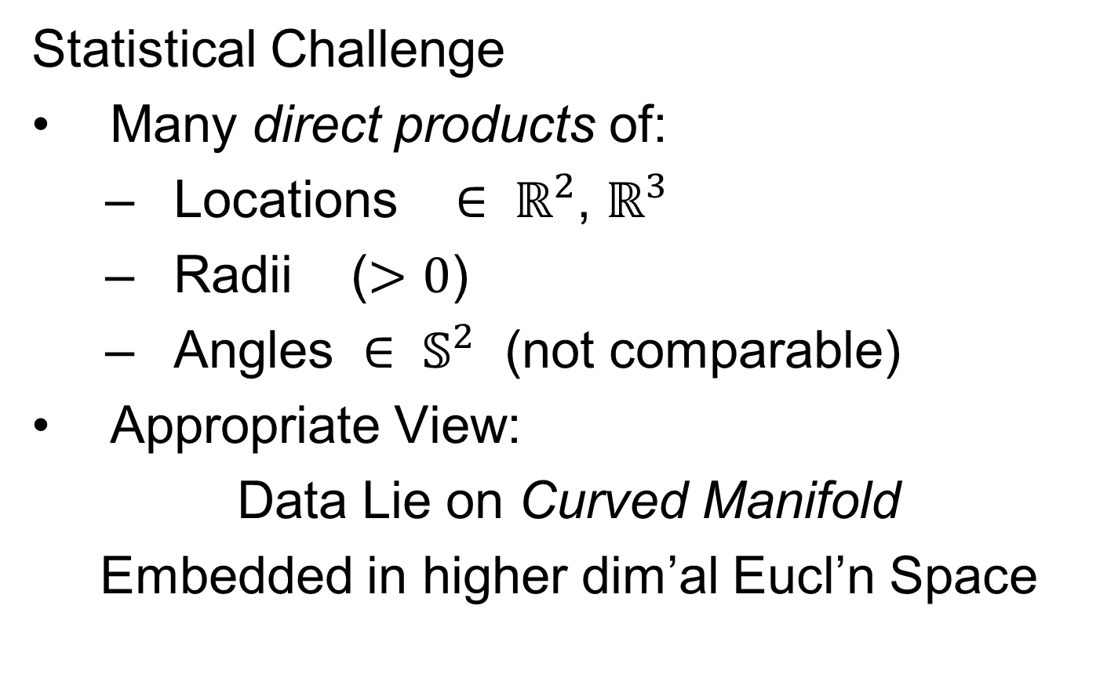
Skeletal Representations
Statistical Challenge
Many direct products of:
  Locations $∈ ℝ^{2}$, $ℝ^{3}$
  Radii ($>0$)
  Angles $∈ 𝕊^{2}$ (not comparable)
Appropriate View:
Data Lie on Curved Manifold
Embedded in higher dim’al Eucl’n Space

Slide 47
3-d s-reps
S-rep model fitting
Easy, when starting from binary (blue)
But very expensive (30 – 40 minutes technician’s time)
Want automatic approach
Challenging, because of poor contrast, noise, …
Need to borrow information across training sample
Use Bayes approach: prior & likelihood → posterior
(A surrogate for “anatomical knowledge”)

Slide 48
3-d s-reps
S-rep model fitting
Easy, when starting from binary (blue)
But very expensive (30 – 40 minutes technician’s time)
Want automatic approach
Challenging, because of poor contrast, noise, …
Need to borrow information across training sample
Use Bayes approach: prior & likelihood → posterior
~Conjugate Gaussians
(Embarassingly Straightforward?)

Slide 49
3-d s-reps
S-rep model fitting
Easy, when starting from binary (blue)
But very expensive (30 – 40 minutes technician’s time)
Want automatic approach
Challenging, because of poor contrast, noise, …
Need to borrow information across training sample
Use Bayes approach: prior & likelihood → posterior
~Conjugate Gaussians, but there are issues:
  Major HLDSS challenges
  Manifold aspect of data
Handle With Variation on PCA
Careful Handling Very Useful

Slide 50
3-d s-reps
S-rep model fitting
Very Successful
Jeong (2009, UNC CS PhD Dissertation)

Slide 51
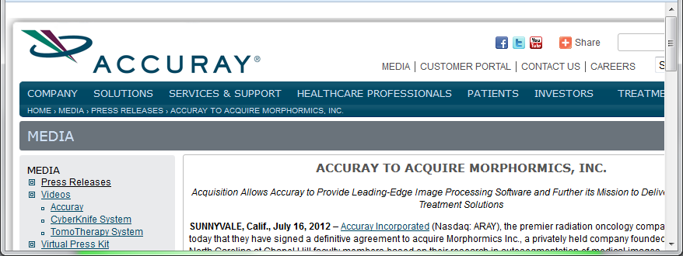
3-d s-reps
S-rep model fitting
Very Successful
Jeong (2009)
Basis of Startup Company: Morphormics
Since Purchased
By Accuray

Slide 52
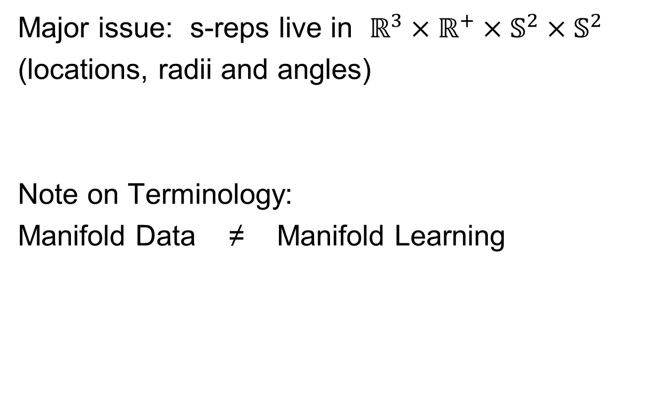
Data Lying On a Manifold
Major issue: s-reps live in $ℝ^{3}×ℝ^{+}×𝕊^{2}×𝕊^{2}$
(locations, radii and angles)
Note on Terminology:
Manifold Data ≠ Manifold Learning
Text, Chp. 8

Slide 53
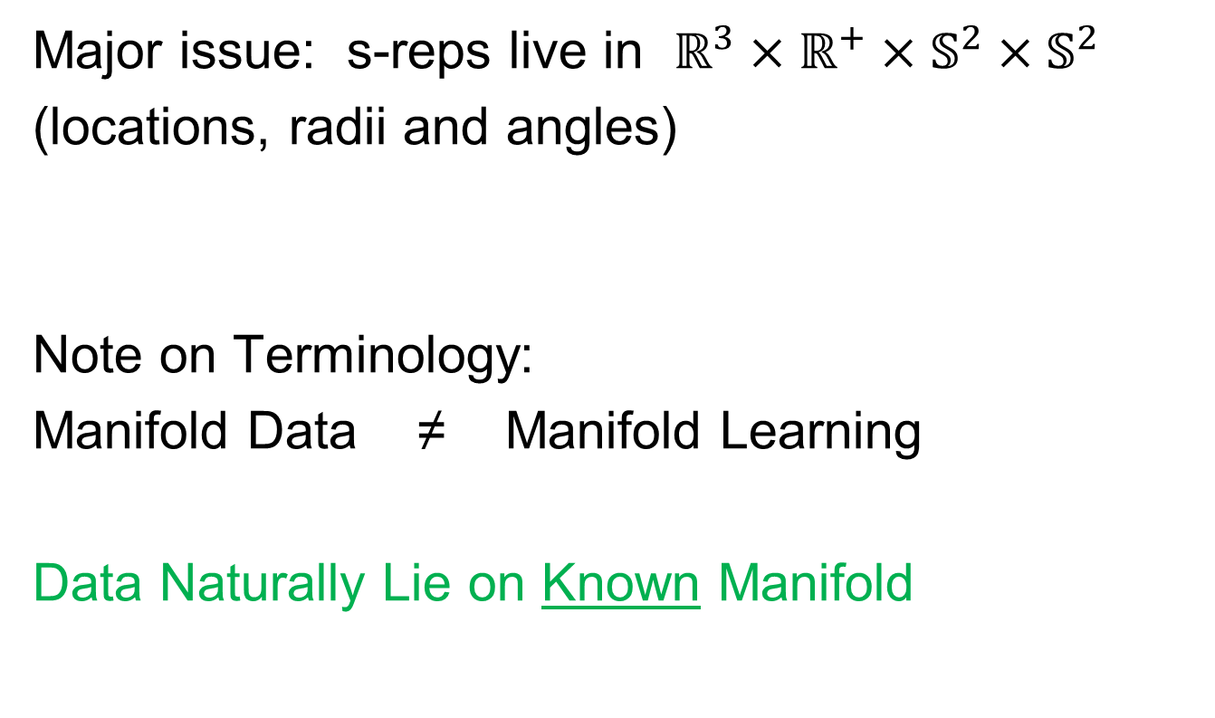
Data Lying On a Manifold
Major issue: s-reps live in $ℝ^{3}×ℝ^{+}×𝕊^{2}×𝕊^{2}$
(locations, radii and angles)
Note on Terminology:
Manifold Data ≠ Manifold Learning
Data Naturally Lie on Known Manifold

Slide 54
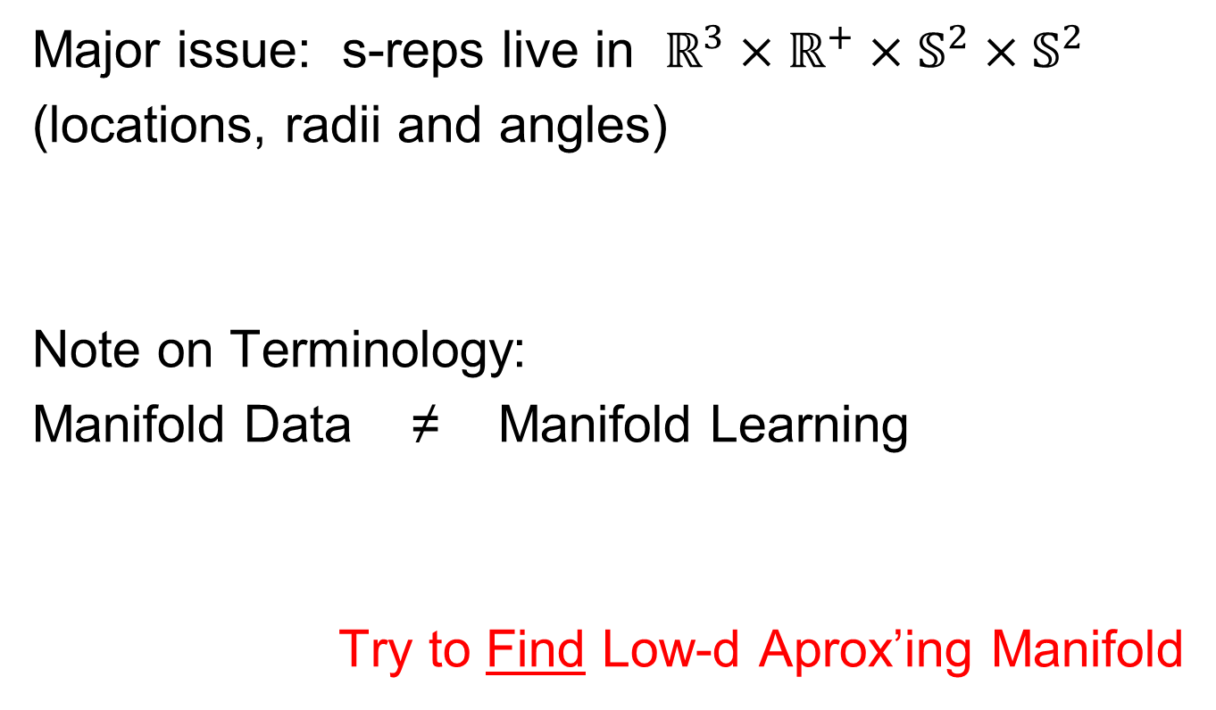
Data Lying On a Manifold
Major issue: s-reps live in $ℝ^{3}×ℝ^{+}×𝕊^{2}×𝕊^{2}$
(locations, radii and angles)
Note on Terminology:
Manifold Data ≠ Manifold Learning
Try to Find Low-d Aprox’ing Manifold

Slide 55
Manifold Learning
Tenenbaum, et al (2000)
Canonical Example:
Photographs (2-d) of Statue (3-d)
Different Viewpoints
Different Light Source Locations
Digitization of Photos is “Low-Dimensional”
But Not in a Subspace (Findable by PCA)
In a manifold (curved
surface) sense

Slide 56
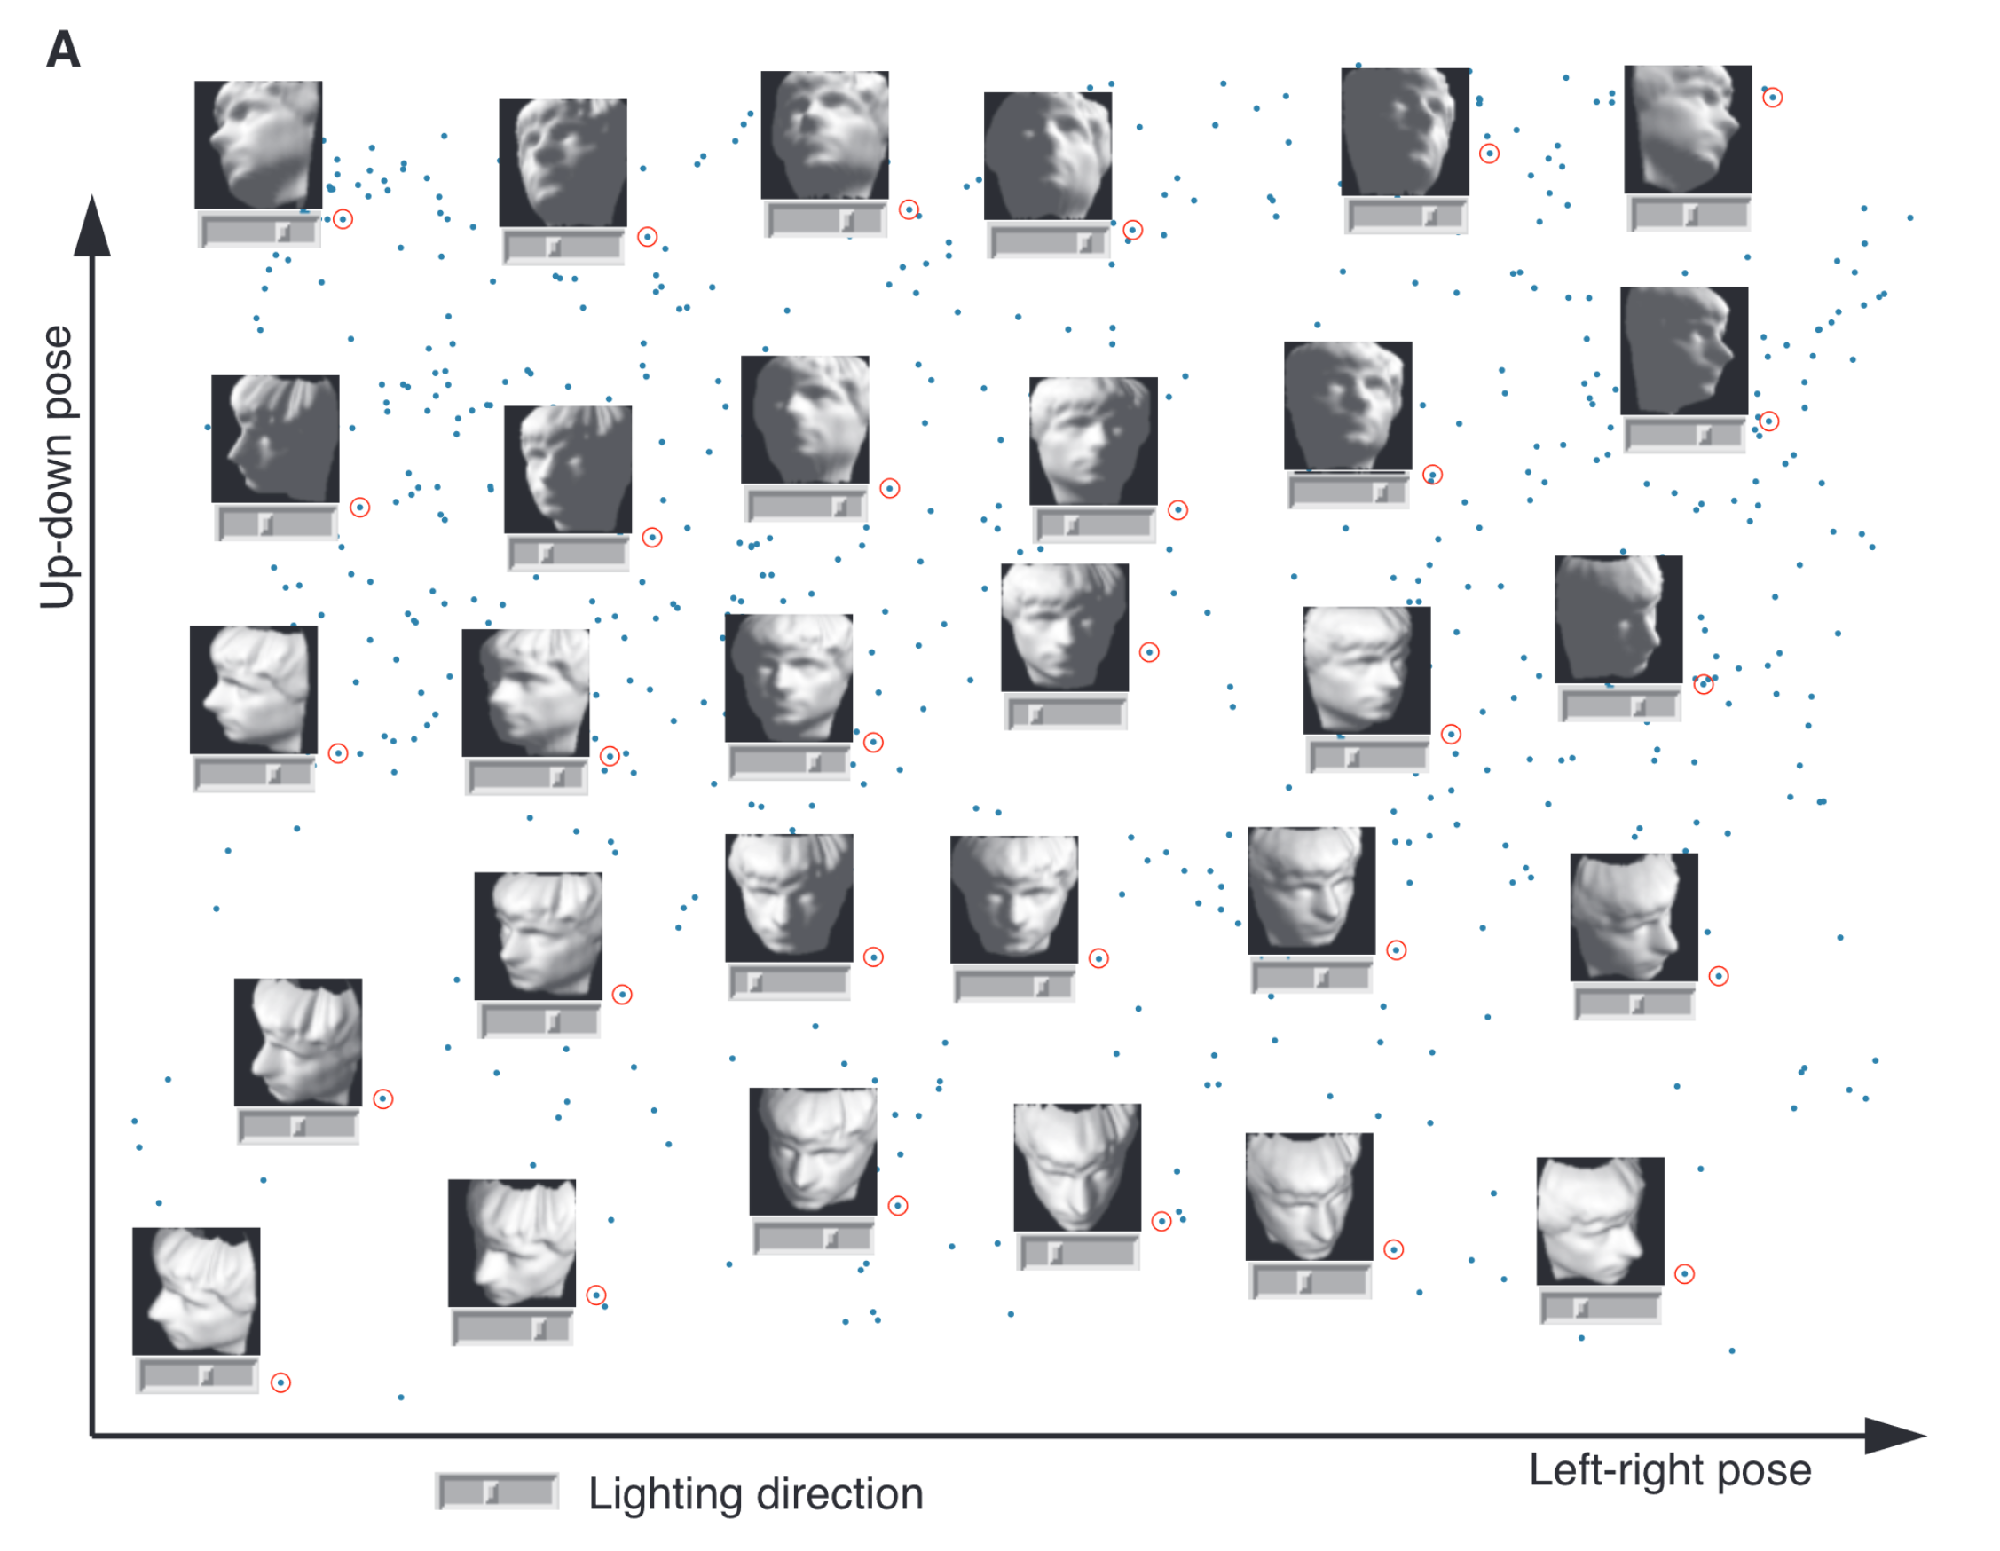
Manifold Learning
Tenenbaum, et al (2000)
Reveals
Two
Interesting
Modes Of
Variation

Slide 57
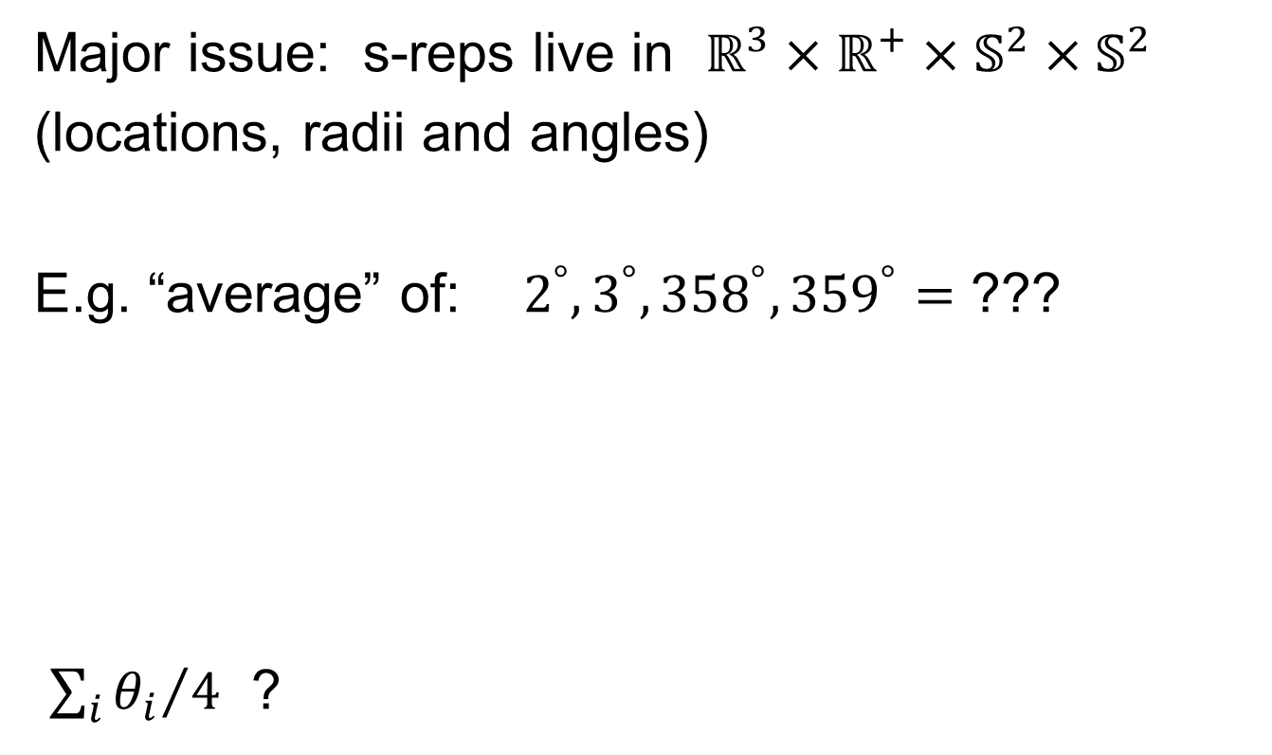
Data Lying On a Manifold
Major issue: s-reps live in $ℝ^{3}×ℝ^{+}×𝕊^{2}×𝕊^{2}$
(locations, radii and angles)
E.g. “average” of: $2^{°}, 3^{°}, {358}^{°}, {359}^{°}=$ ???
${\sum_{i}{θ_{i}}}/4$ ?

Slide 58
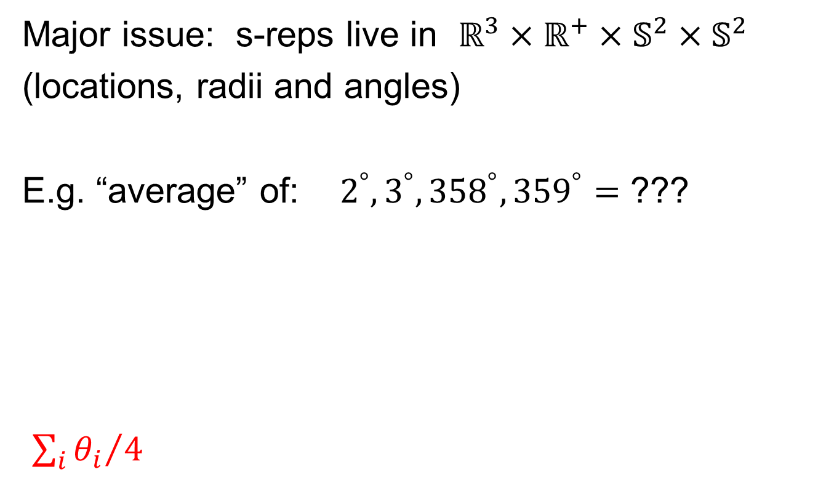
Data Lying On a Manifold
Major issue: s-reps live in $ℝ^{3}×ℝ^{+}×𝕊^{2}×𝕊^{2}$
(locations, radii and angles)
E.g. “average” of: $2^{°}, 3^{°}, {358}^{°}, {359}^{°}=$ ???
${\sum_{i}{θ_{i}}}/4$
x
x
x
x

Slide 59
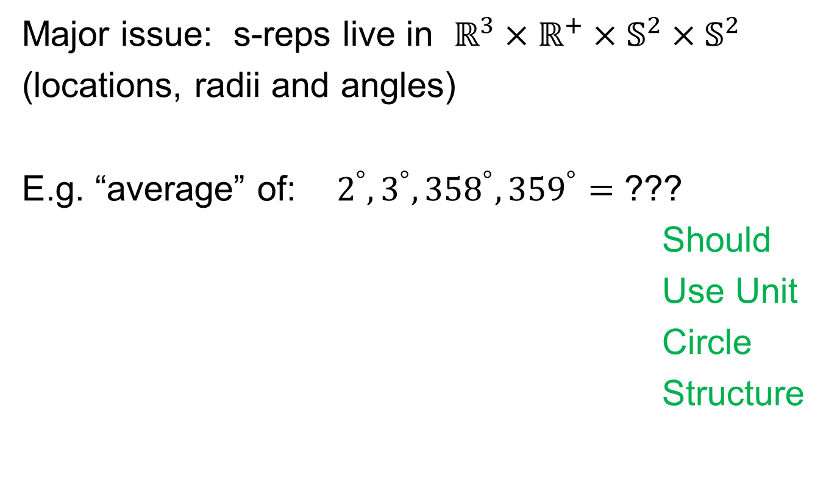
Data Lying On a Manifold
Major issue: s-reps live in $ℝ^{3}×ℝ^{+}×𝕊^{2}×𝕊^{2}$
(locations, radii and angles)
E.g. “average” of: $2^{°}, 3^{°}, {358}^{°}, {359}^{°}=$ ???
Should
Use Unit
Circle
Structure
x
x
x
x

Slide 60
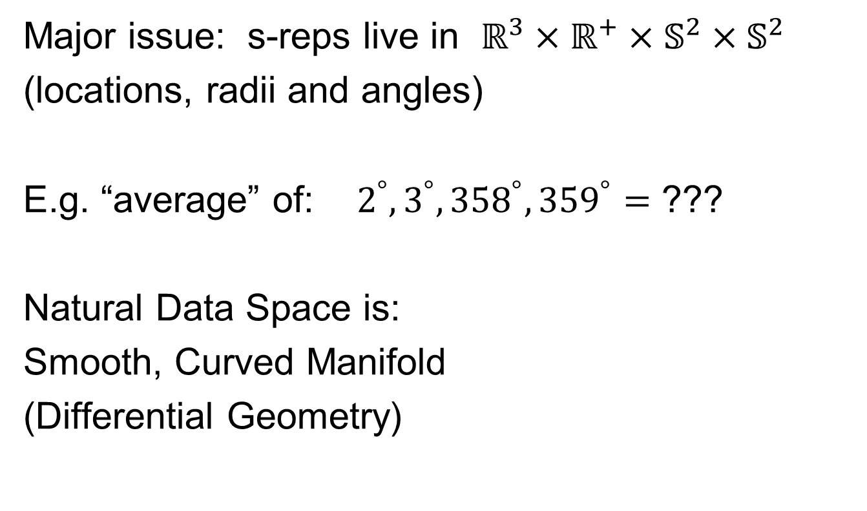
Data Lying On a Manifold
Major issue: s-reps live in $ℝ^{3}×ℝ^{+}×𝕊^{2}×𝕊^{2}$
(locations, radii and angles)
E.g. “average” of: $2^{°}, 3^{°}, {358}^{°}, {359}^{°}=$ ???
Natural Data Space is:
Smooth, Curved Manifold
(Differential Geometry)

Slide 61
Manifold Feature Spaces
Standard Statistical Example:
Directional Data (aka Circular Data)
Idea: Angles as Data Objects
Wind Directions
Magnetic Compass Headings
Cracks in Mines
Text, Sec. 8.1

Slide 62
Manifold Feature Spaces
Standard Statistical Example:
Directional Data (aka Circular Data)
Classical References:
Mardia & Jupp (2009), Fisher (1995),
Jammalamadaka & Sen Gupta (2001)

Slide 63
Manifold Feature Spaces
Standard Statistical Example:
Directional Data (aka Circular Data)
Reasonable View:
Points on Unit Circle

Slide 64
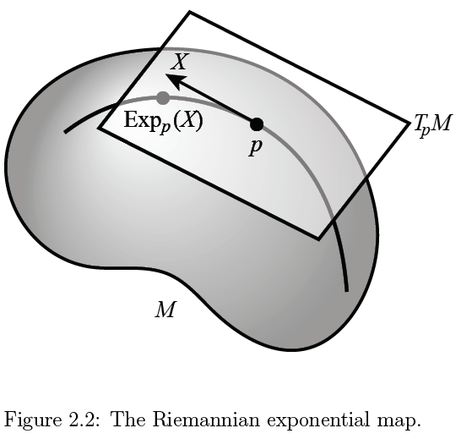
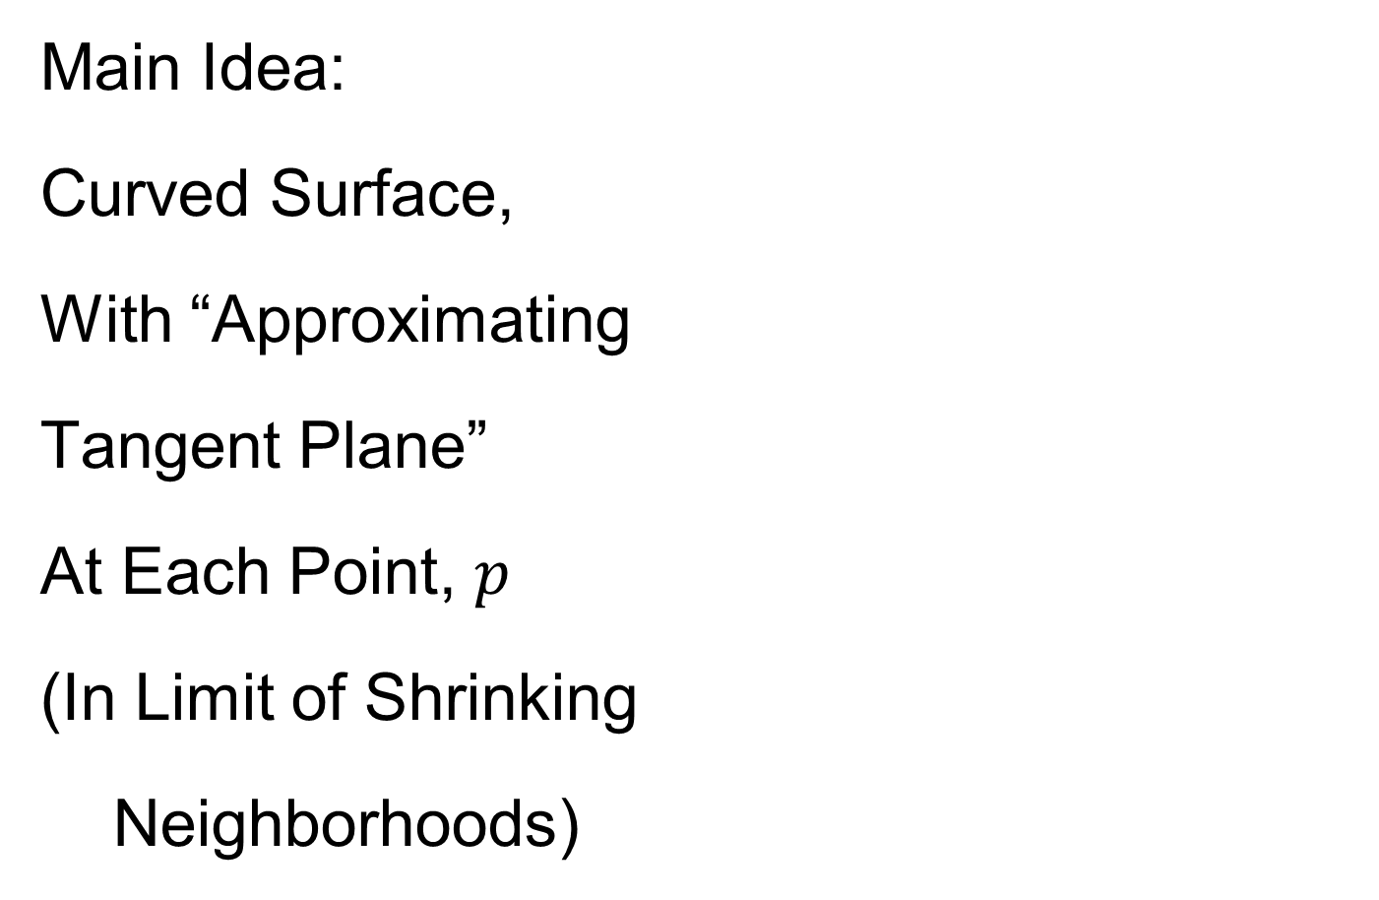
Manifold Feature Spaces
Main Idea:
Curved Surface,
With “Approximating
Tangent Plane”
At Each Point, $p$
(In Limit of Shrinking
Neighborhoods)
Text, Sec. 8.2

Slide 65

Manifold Feature Spaces
Important Mappings:
Plane → Surface:
$\exp_{p}$

Slide 66
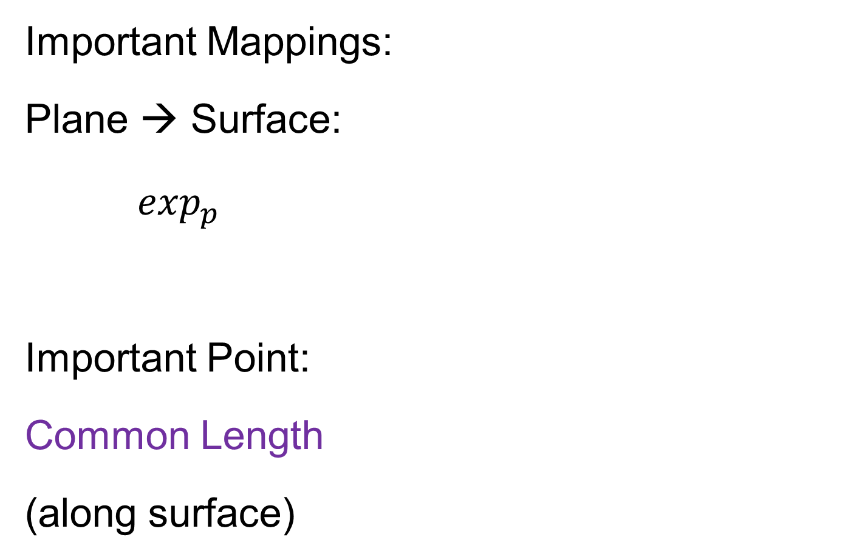
Manifold Feature Spaces
Important Mappings:
Plane → Surface:
$\exp_{p}$
Important Point:
Common Length
(along surface)

Slide 67

Manifold Feature Spaces
Important Mappings:
Plane → Surface:
$\exp_{p}$
Surface → Plane
$\log_{p}$

Slide 68
Manifold Feature Spaces
Log & Exp Memory Device:
Complex Numbers
Exponential:
Tangent Plane → Manifold
(Note: Common Length)

Slide 69
Manifold Feature Spaces
Log & Exp Memory Device:
Complex Numbers
Exponential:
Tangent Plane → Manifold
Logarithm:
Manifold → Tangent Plane

Slide 70
Manifold Feature Spaces
Important Mappings:
Plane → Surface:
$\exp_{p}$
Surface → Plane
$\log_{p}$
(matrix versions)

Slide 71

Manifold Feature Spaces
Natural Choice of $p$
For Data Analysis
A “Centerpoint”
Hard To Use:
$\overline{X}=\frac{1}{n}\sum_{i=1}^{n}{X_{i}}$

Slide 72

Manifold Feature Spaces
Extrinsic Centerpoint
Compute:
$\overline{X}=\frac{1}{n}\sum_{i=1}^{n}{X_{i}}$
Anyway
And Project Back
To Manifold

Slide 73
Manifold Feature Spaces
Intrinsic Centerpoint
Work “Really
Inside” The
Manifold

Slide 74
Manifold Feature Spaces
Recall Useful Center in Metric Spaces
Fréchet Mean
Fréchet (1948)
Works in Any Metric Space (e.g. Manifolds)

Slide 75
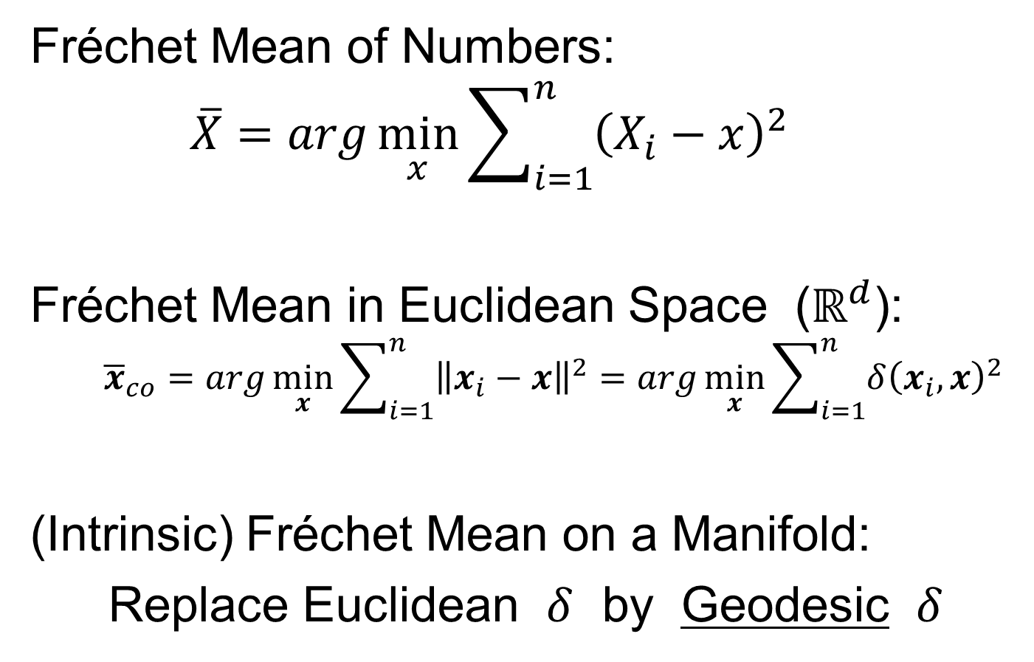
Manifold Feature Spaces
Fréchet Mean of Numbers:
$$\overline{X}=arg\min_{x}{\sum_{i=1}^{n}{{\left(X_{i}−x\right)}^{2}}}$$
Fréchet Mean in Euclidean Space ($ℝ^{d}$):
$${\overline{x}}_{co}=arg\min_{x}{\sum_{i=1}^{n}{{\left\|x_{i}−x\right\|}^{2}}}=arg\min_{x}{\sum_{i=1}^{n}{{δ\left(x_{i},x\right)}^{2}}}$$
(Intrinsic) Fréchet Mean on a Manifold:
Replace Euclidean $δ$ by Geodesic $δ$

Slide 76
Manifold Feature Spaces
Geodesics:
Idea:
March Along Manifold Without Turning
(Defined in Tangent Planes)

Slide 77
Manifold Feature Spaces
Geodesics:
Idea:
March Along Manifold Without Turning
(Defined in Tangent Planes)
E.g. Surface of the Earth: Great Circle
E.g. Lines of Longitude (Not Latitude…)

Slide 78
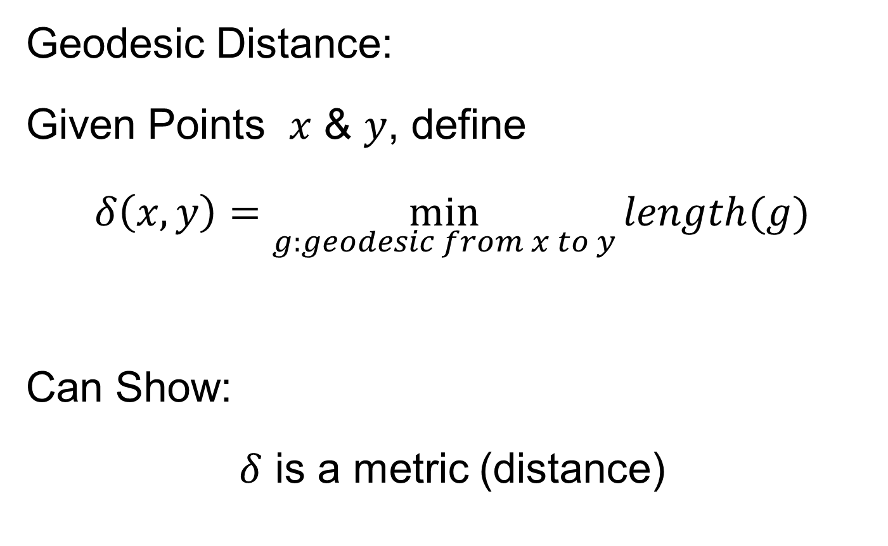
Manifold Feature Spaces
Geodesic Distance:
Given Points $x$ & $y$, define
$$δ\left(x,y\right)=\min_{g:geodesic from x to y}{length(g)}$$
Can Show:
$δ$ is a metric (distance)

Slide 79
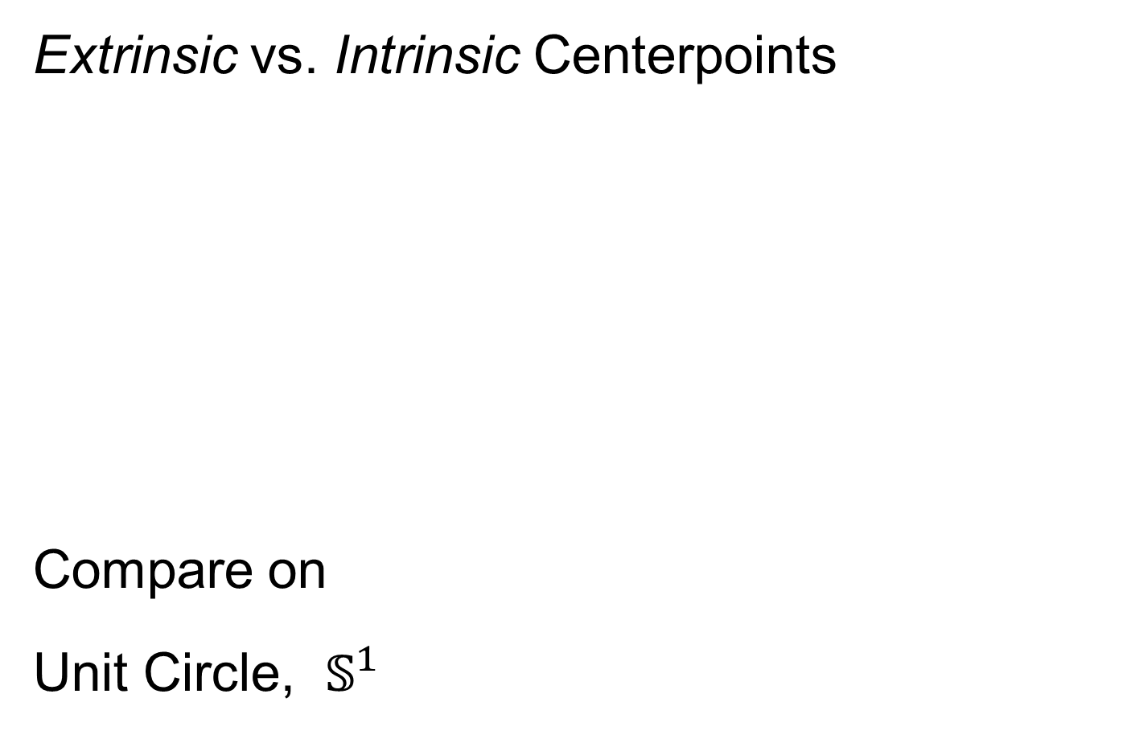
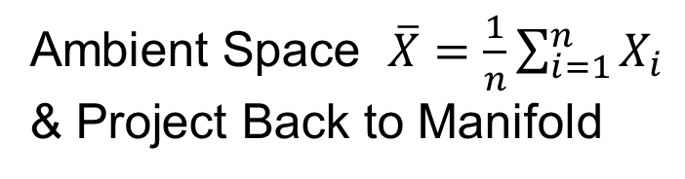
Manifold Feature Spaces
Extrinsic vs. Intrinsic Centerpoints
Compare on
Unit Circle, $𝕊^{1}$
Ambient Space $\overline{X}=\frac{1}{n}\sum_{i=1}^{n}{X_{i}}$
& Project Back to Manifold
E.g. Fréchet Mean

Slide 80
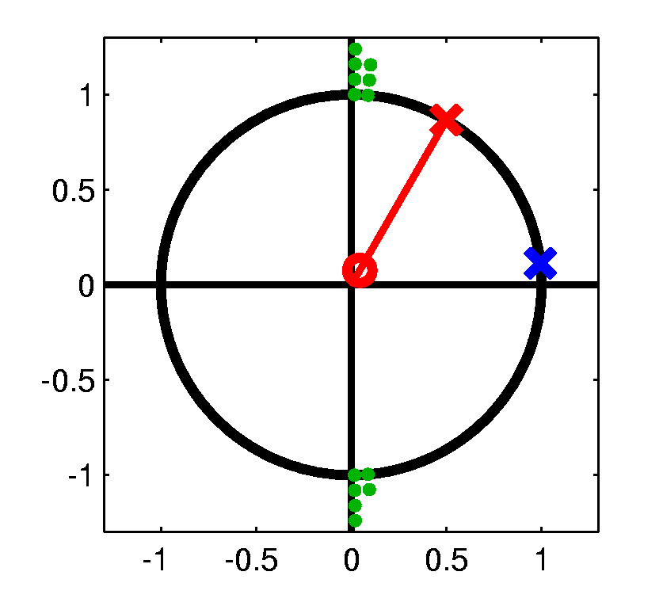
Manifold Feature Spaces
Extrinsic vs. Intrinsic Centerpoints
Often Similar
Note Big Difference!
Which is Better?

Slide 81
Manifold Feature Spaces
Extrinsic vs. Intrinsic Centerpoints
Which is Better?
Intrinsic “More Like Mean”?
Intrinsic More Stable
Shifting a Green Down
Extrinsic More Stable
Shifting Greens Left

Slide 82
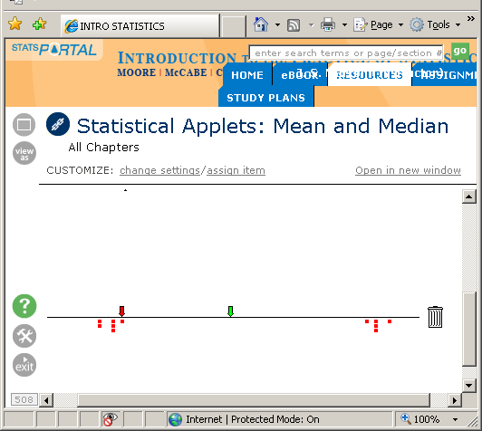
Manifold Feature Spaces
Extrinsic vs. Intrinsic Centerpoints
Which is Better?
Problem as Hard as
“Center” of Bimodal
Distribution
Median
Mean

Slide 83
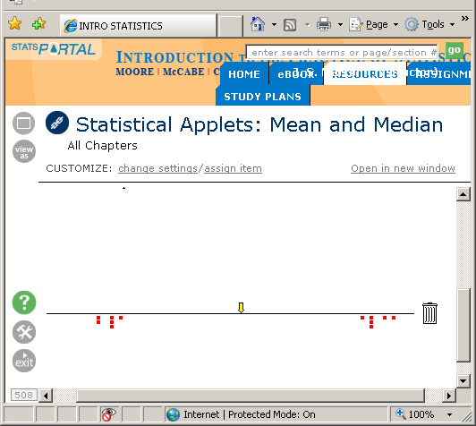
Manifold Feature Spaces
Extrinsic vs. Intrinsic Centerpoints
Which is Better?
Problem as Hard as
“Center” of Bimodal
Distribution

Slide 84

Manifold Feature Spaces
Extrinsic vs. Intrinsic Centerpoints
Which is Better?
Problem as Hard as
“Center” of Bimodal
Distribution

Slide 85
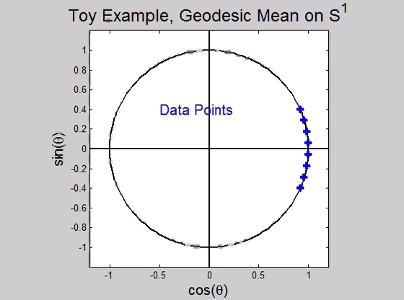
Manifold Feature Spaces
Directional Data Examples of Fréchet Mean:
Not always easily interpretable

Slide 86
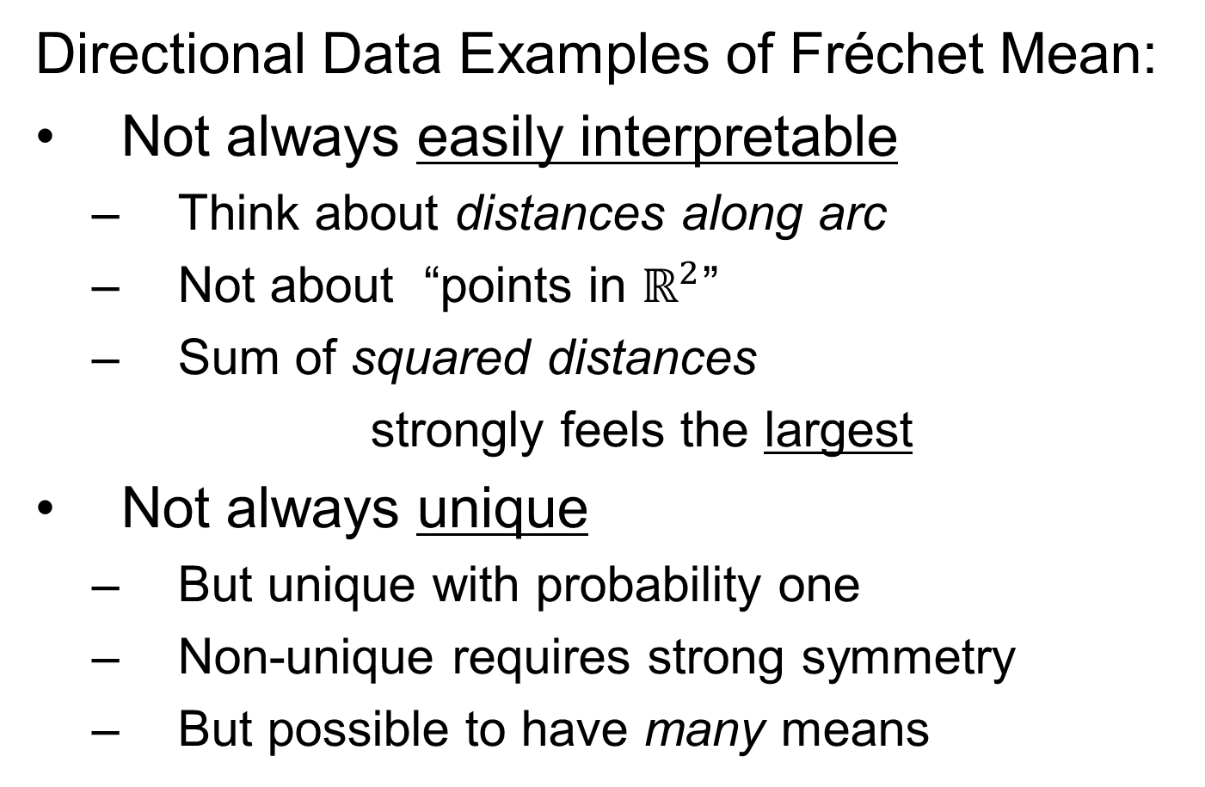
Manifold Feature Spaces
Directional Data Examples of Fréchet Mean:
Not always easily interpretable
  Think about distances along arc
  Not about “points in $ℝ^{2}$”
  Sum of squared distances
  strongly feels the largest
Not always unique
  But unique with probability one
  Non-unique requires strong symmetry
  But possible to have many means

Slide 87
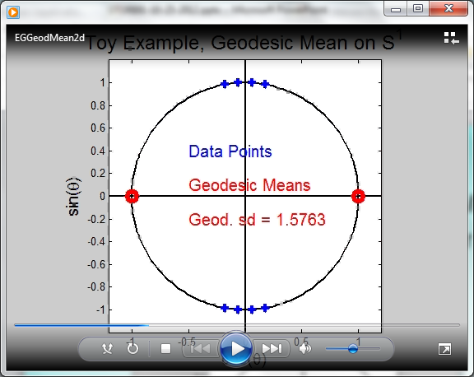
Manifold Feature Spaces
Directional Data Examples of Fréchet Mean:
Not always sensible notion of center

Slide 88
Manifold Feature Spaces
Directional Data Examples of Fréchet Mean:
Not always sensible notion of center
  Sometimes prefer top & bottom?
  At end: farthest points from data
Not continuous Function of Data
  Jump from 1 – 2
  Jump from 2 – 8
All False for Euclidean Mean
But all happen generally for Manifold Data
(for positively curved space)

Slide 89
Manifold Feature Spaces
Notions of Center on Manifolds:
“Extrinsic” vs. “Intrinsic”
“Every Dog has Its Day”
For Further Discussion, See:
Patrangenaru & Ellingson (2016)

Slide 90
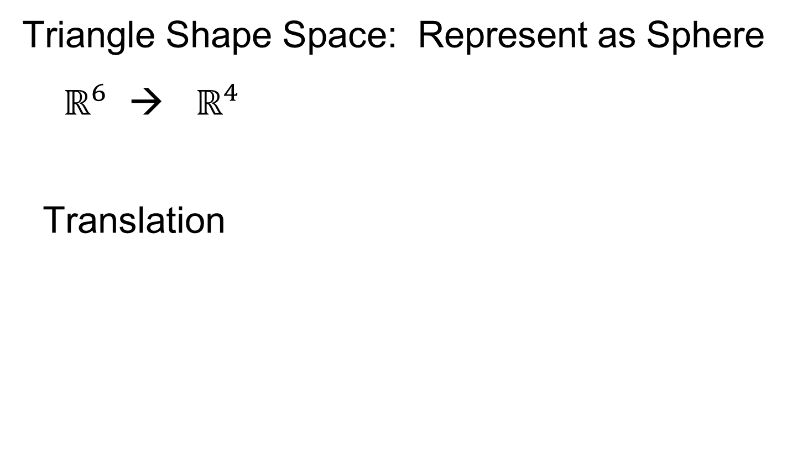
Manifold Feature Spaces
Directional Data Examples of Fréchet Mean:
Also of interest is Fréchet Variance:
$${\hat{σ}}^{2}=\min_{\underline{x}}{\frac{1}{n}\sum_{i=1}^{n}{{d\left({\underline{X}}_{i},\underline{x}\right)}^{2}}}$$
Works like Euclidean sample variance
Note values in movie, reflecting spread in data
Note theoretical version:
$$σ^{2}=\min_{\underline{x}}{E_{\underline{X}}}{d\left(\underline{X},\underline{x}\right)}^{2}$$
Useful for Laws of Large Numbers, etc.

Slide 91
PCA for s-reps
Text: Sec. 8.3
PCA on manifold spaces?
(e.g. on Lie Groups / Symmetric Spaces)
T. Fletcher: Principal Geodesic Analysis
(2004 UNC CS PhD Dissertation
& Fletcher et al. (2004))

Slide 92
PCA for s-reps
PCA on manifold spaces?
(e.g. on Lie Groups / Symmetric Spaces)
T. Fletcher: Principal Geodesic Analysis
Idea: replace “linear summary of data”
With “geodesic summary of data”…

Slide 93




PGA for s-reps, Bladder-Prostate-Rectum
Bladder – Prostate – Rectum, 1 person, 17 days
PG 1 PG 2 PG 3
(analysis by Ja Yeon Jeong)

Slide 94
PGA for s-reps, Bladder-Prostate-Rectum
Bladder – Prostate – Rectum, 1 person, 17 days
PG 1 PG 2 PG 3
(analysis by Ja Yeon Jeong)

Slide 95



PGA for s-reps, Bladder-Prostate-Rectum
Bladder – Prostate – Rectum, 1 person, 17 days
PG 1 PG 2 PG 3
(analysis by Ja Yeon Jeong)

Slide 96

PCA Extensions for Data on Manifolds
Fletcher (Principal Geodesic Anal.)
  Best fit of geodesic to data

Slide 97
PCA Extensions for Data on Manifolds
Fletcher (Principal Geodesic Anal.)
  Best fit of geodesic to data
  Constrained to go through geodesic mean

Slide 98


PCA Extensions for Data on Manifolds
Fletcher (Principal Geodesic Anal.)
  Best fit of geodesic to data
  Constrained to go through geodesic mean
Happens
Naturally
in $ℝ^{d}$
Mean
Contained
in Best
Fit Line

Slide 99

PCA Extensions for Data on Manifolds
Fletcher (Principal Geodesic Anal.)
  Best fit of geodesic to data
  Constrained to go through geodesic mean
Extreme
3 Point
Examples
Equator is Best Fitting Geodesic in All Frames
Yet Fréchet Mean(s) Often Far Away
By Sungkyu Jung

Slide 100


Challenge for Principal Geodesic Analysis
Data
On $S^{2}$
(Sphere)
Scattered
Along
Equator
Somehow
Single
Mode of
Variation

Slide 101

Challenge for Principal Geodesic Analysis
Data
On $S^{2}$
Geodesic
Mean(s)

Slide 102

Challenge for Principal Geodesic Analysis
Data
On $S^{2}$
Geodesic
Mean(s)
Tangent Plane

Slide 103

Challenge for Principal Geodesic Analysis
Data
On $S^{2}$
Geodesic
Mean(s)
Tangent Plane
Projections ($log$)
Requires 2
Modes of
Variation

Slide 104



PCA Extensions for Data on Manifolds
Fletcher (Principal Geodesic Anal.)
  Best fit of geodesic to data
  Constrained to go through geodesic mean
Huckemann, Hotz & Munk (Geod. PCA)
Huckemann et al (2011)

Slide 105
PCA Extensions for Data on Manifolds
Fletcher (Principal Geodesic Anal.)
  Best fit of geodesic to data
  Constrained to go through geodesic mean
Huckemann, Hotz & Munk (Geod. PCA)
  Best fit of any geodesic to data

Slide 106

PCA Extensions for Data on Manifolds
Fletcher (Principal Geodesic Anal.)
  Best fit of geodesic to data
  Constrained to go through geodesic mean
Huckemann, Hotz & Munk (Geod. PCA)
  Best fit of any geodesic to data
Counterexample:
Data follows Tropic of Capricorn
Realizations of Spoke in
Blad.-Prost.-Rect. Simulator

Slide 107
PCA Extensions for Data on Manifolds
Fletcher (Principal Geodesic Anal.)
  Best fit of geodesic to data
  Constrained to go through geodesic mean
Huckemann, Hotz & Munk (Geod. PCA)
  Best fit of any geodesic to data
Jung, Foskey & Marron (Princ. Arc Anal.)
Jung et al (2011)

Slide 108
PCA Extensions for Data on Manifolds
Fletcher (Principal Geodesic Anal.)
  Best fit of geodesic to data
  Constrained to go through geodesic mean
Huckemann, Hotz & Munk (Geod. PCA)
  Best fit of any geodesic to data
Jung, Foskey & Marron (Princ. Arc Anal.)
  Best fit of any circle to data
  (motivated by conformal maps)

Slide 109


PCA Extensions for Data on Manifolds
Note:
“Backwards
Mean” of $S^{1}$
Projections
Gives Better
“Center”
“Bad” Since
Require 2
Modes to
Represent
Data

Slide 110
Principal Arc Analysis
Jung, Foskey & Marron (2011)
  Best fit of any circle to data
  Can give better fit than geodesics

Slide 111
Principal Arc Analysis
Jung, Foskey & Marron (2011)
  Best fit of any circle to data
  Can give better fit than geodesics
  Observed for simulated s-rep example

Slide 112
Participant Presentation
1:35 Sara Peterson:
Joint Dimension Reduction for Integrated Tumor/Model Pairs
Next Class:
Teresa McGhee

