Slide 1
Statistics – O. R. 881
Object Oriented Data Analysis
Steve Marron
Dept. of Statistics and Operations Research
University of North Carolina

Slide 2
Current Sections in Textbook
Today:
Section 8.6, 8.7, 7.3.5, 10.1.2, 8.5, 9.1
Next Class:
Section 9.1, 2.1, 9.2

Slide 3
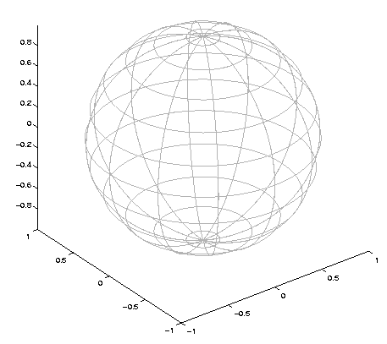


Last Class: Princ. Nest. Spheres
Move plane
To Minimize
$\sum_{i}{{resid}_{i}^{2}}$
Keep signed
${resid}_{i}$ as
PNS-$d$ scores
$$𝕊^{d}$$
And Projections as Rank $d−1$ Approximations

Slide 4
Last Class: CPNS
From Pizer et al. (2017, 2020) Impact on Segmentation:
PGA Segmentation: used ~20 comp’s
CPNS Segmentation: only need ~13
Resulted in visually better fits to data
Recall Bladder-Prostate-Rectum Data

Slide 5
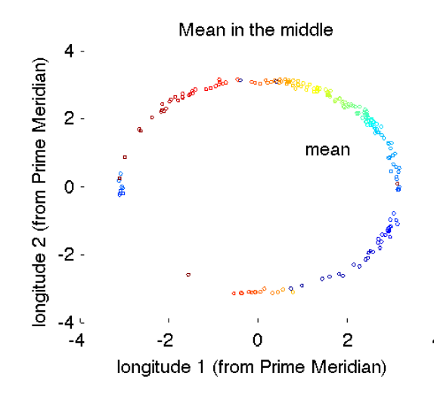
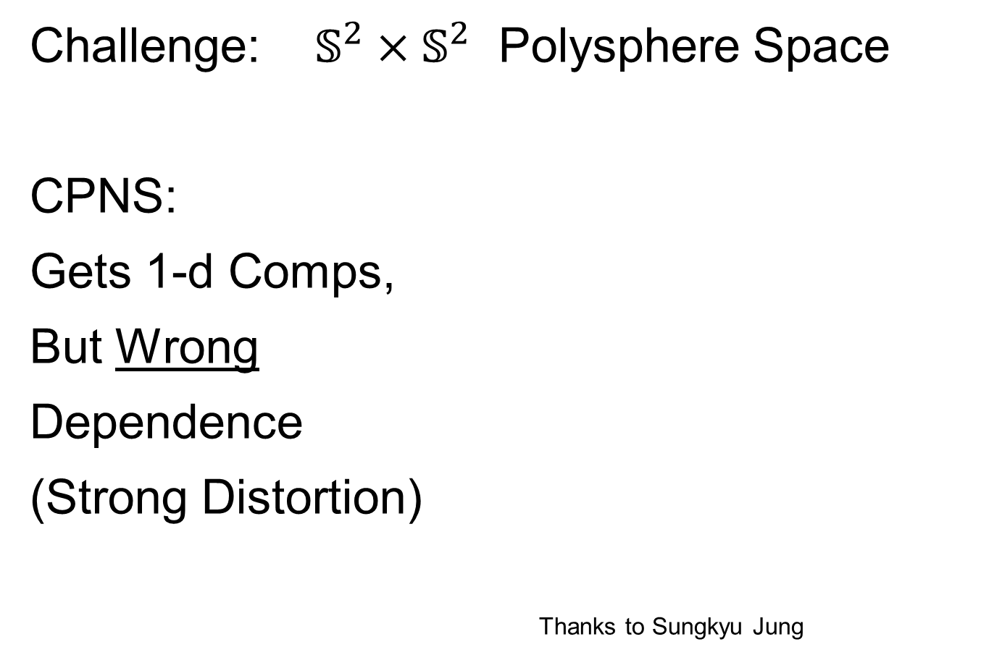
Last Class: s-rep Space
Challenge: $𝕊^{2}×𝕊^{2}$ Polysphere Space
CPNS:
Gets 1-d Comps,
But Wrong
Dependence
(Strong Distortion)
Thanks to Sungkyu Jung

Slide 6
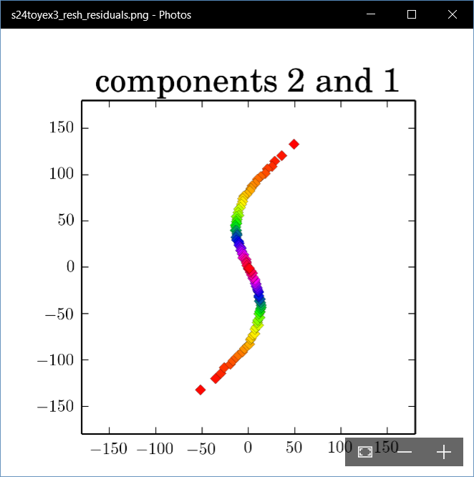
Last Class: Polysphere PCA
Deeper New Methodology: PPCA
For Polysphere
~Toy Example
Pretty Good But
Still Some
Distortion
Thanks to B. Eltzner

Slide 7
Last Class: Torus Spaces
Vectors of Angles as Data Objects
Natural Examples Include:
Structural Chemistry
(Sequences of Bond Angles)
Meteorology
(Wind Directions at Multiple Sites)
Astronomy
(Sunspots Moving Over Time)

Slide 8
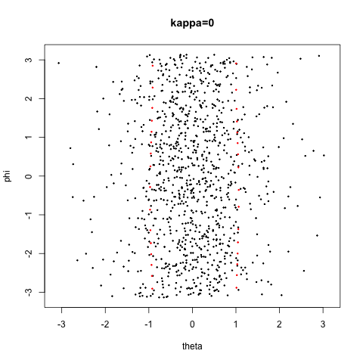
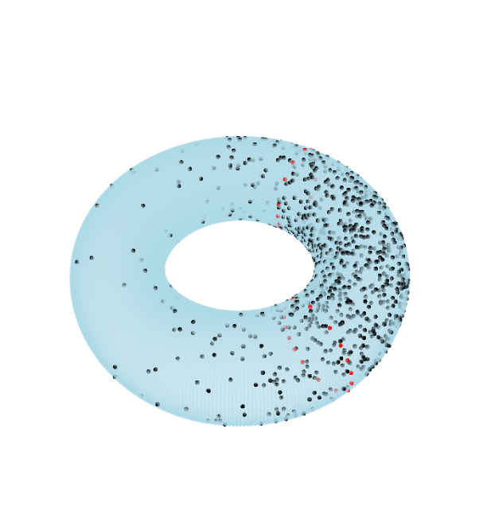

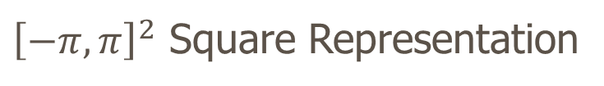
Last Class: Torus Space Views
Toy Example in $𝕋^{2}$
${\left[−π,π\right]}^{2}$ Square Representation
Donut Representation
Edges are Identified
Use Different Radii
To View Topology
Thanks to Eduardo García-Portugués

Slide 9
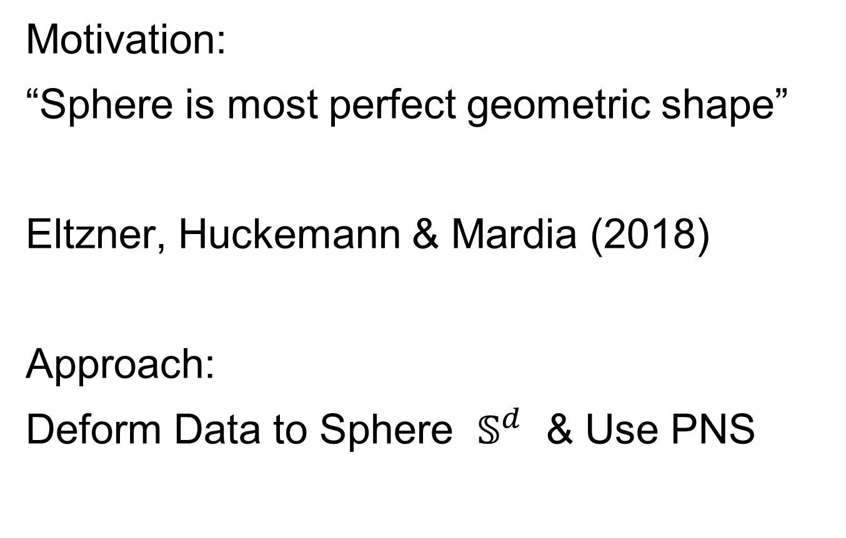
Last Class: Torus PCA
Motivation:
“Sphere is most perfect geometric shape”
Eltzner, Huckemann & Mardia (2018)
Approach:
Deform Data to Sphere $𝕊^{d}$ & Use PNS

Slide 10
Last Class: Torus PCA
Eltzner, Huckemann & Mardia (2018)
Approach:
Deform Data to Sphere & Use PNS
Major Challenges:
Find A Good Cutpoint
Heavy Distortion
Approach: Specifically
Minimize Distortion

Slide 11
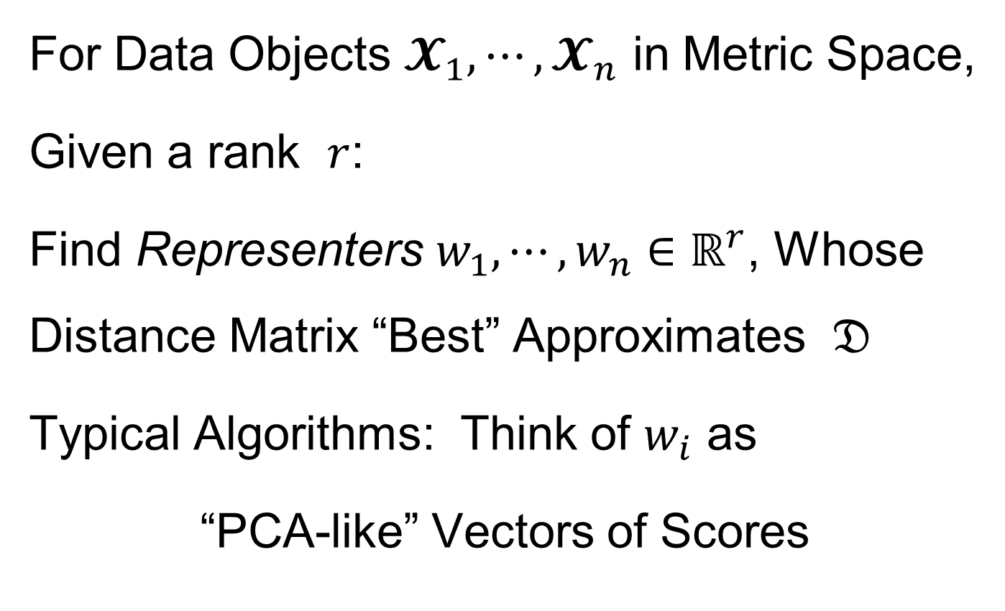
Last Class: MDS
For Data Objects $𝓧_{1},⋯,𝓧_{n}$ in Metric Space,
Given a rank $r$:
Find Representers $w_{1},⋯,w_{n}∈ℝ^{r}$, Whose Distance Matrix “Best” Approximates $𝔇$
Typical Algorithms: Think of $w_{i}$ as
“PCA-like” Vectors of Scores
Note: This Representation Is
Called “Auto-Encoder” In AI literature

Slide 12
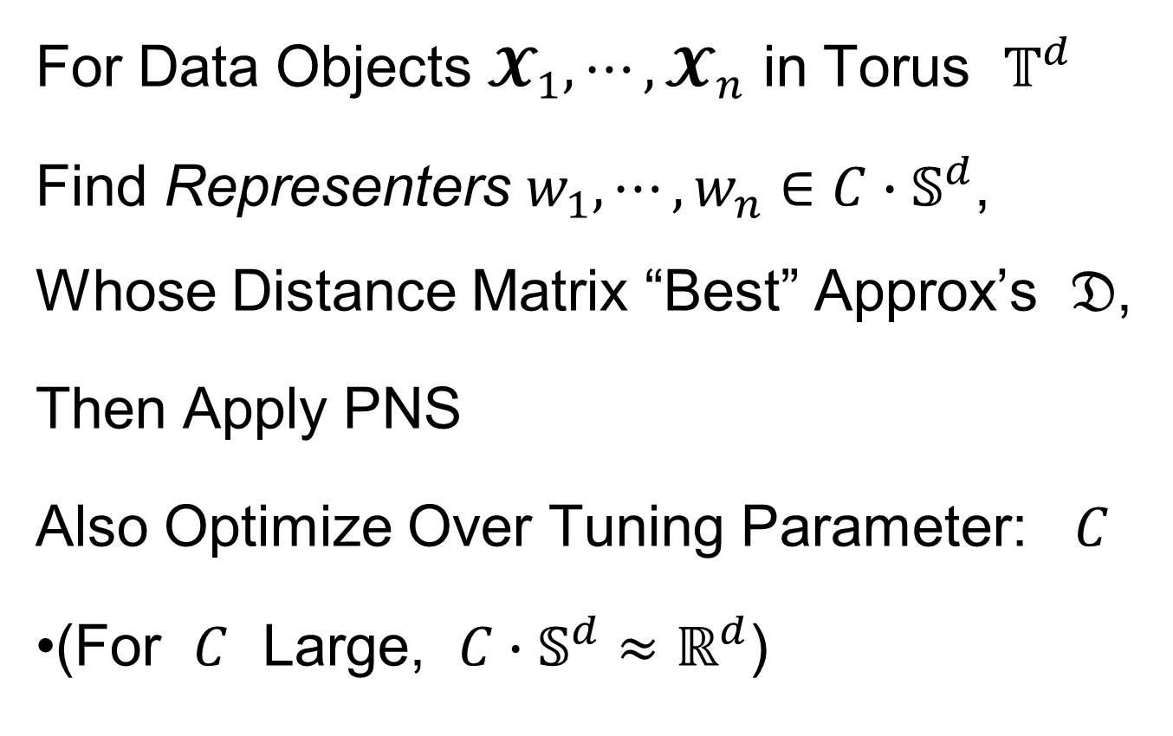
Last Class: MDS
For Data Objects $𝓧_{1},⋯,𝓧_{n}$ in Torus $𝕋^{d}$
Find Representers $w_{1},⋯,w_{n}∈{C∙𝕊}^{d}$, Whose Distance Matrix “Best” Approx’s $𝔇$,
Then Apply PNS
Also Optimize Over Tuning Parameter: $C$
(For $C$ Large, ${C∙𝕊}^{d}≈ℝ^{d}$)

Slide 13
Last Class: Backwards PCA
Text: Sec. 8.6
Key Idea:
Replace usual forwards view of PCA
With a backwards approach to PCA

Slide 14
Last Class: Backwards PCA
Euclidean Settings:
Forwards PCA = Backwards PCA
(Pythagorean Theorem,
ANOVA Decomposition)
So Not Interesting
But Very Different in Non-Euclidean Settings
(Backwards is Better !?!)

Slide 15
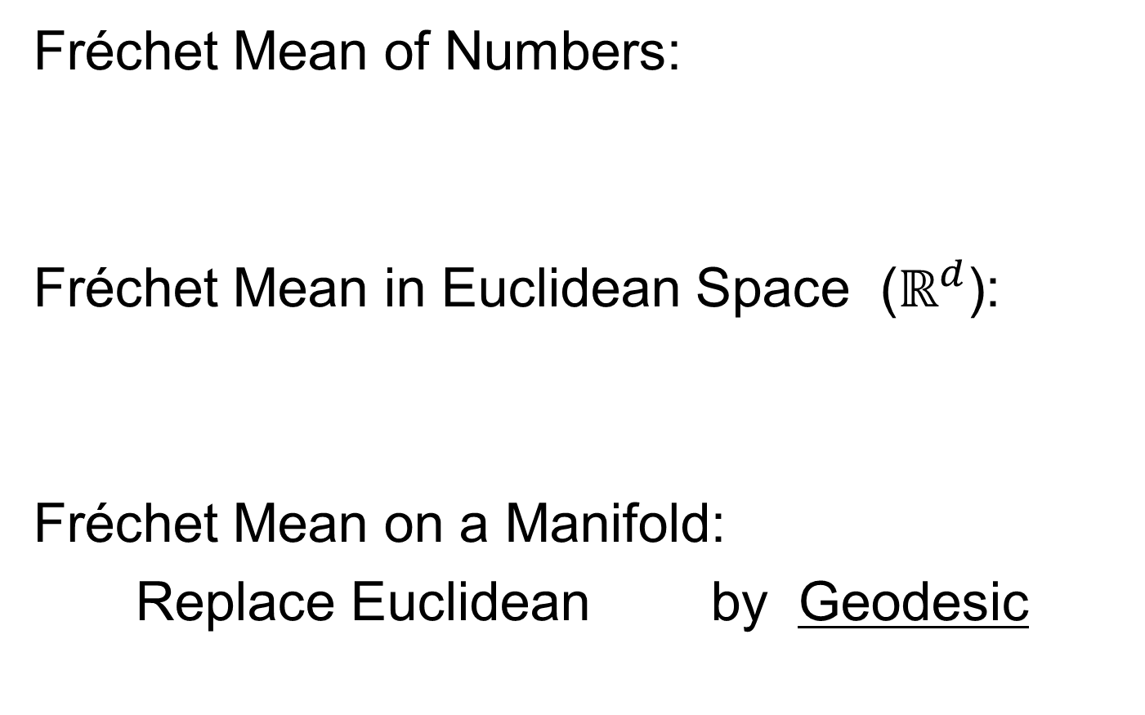
Last Class: Interesting Question
How generally applicable is
Backwards approach to PCA?
An Application:
Nonnegative Matrix Factorization
= PCA in Positive Orthant
Think $X ≈LS$
With ≥ 0 Constraints (on both $L$ & $S$)

Slide 16
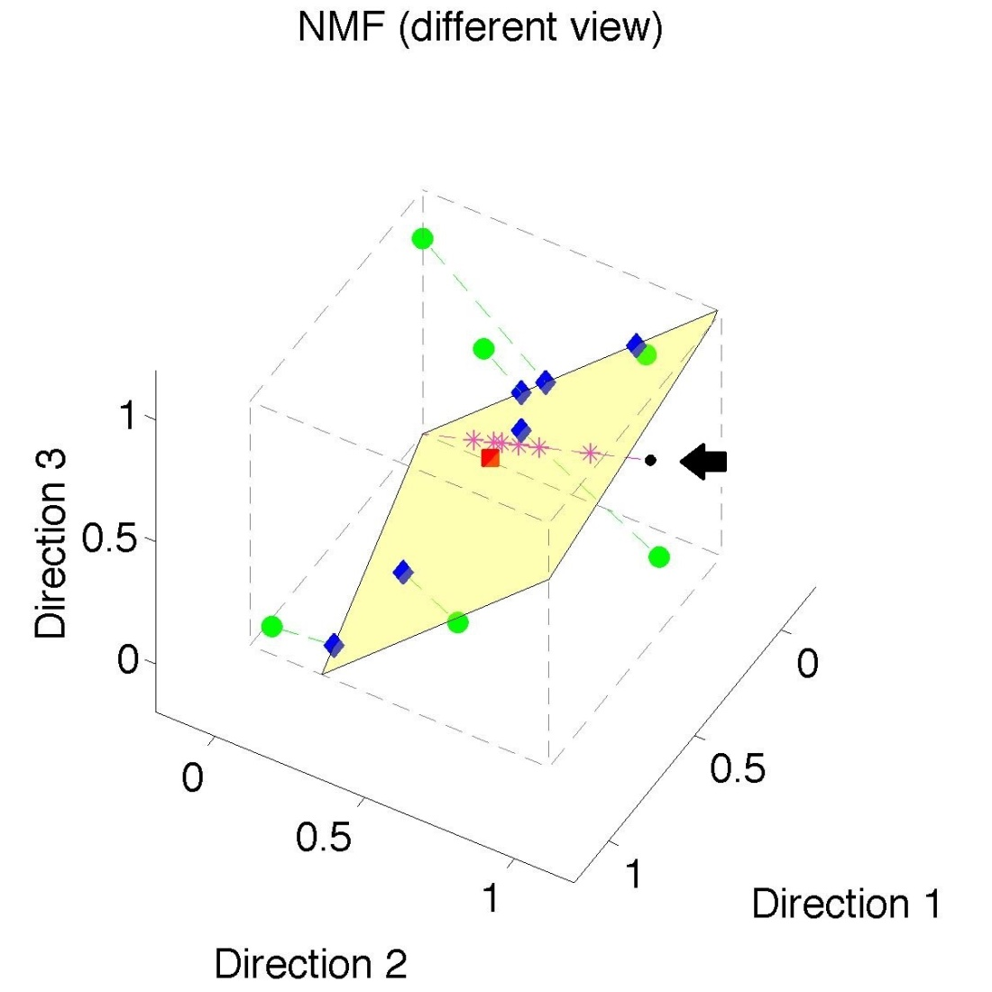
Last Class: Nonneg. Mat. Factor’n
Standard NMF
But Note
Not Nested
No “Multi-scale”
Analysis Possible
(Scores Plot?!?)

Slide 17
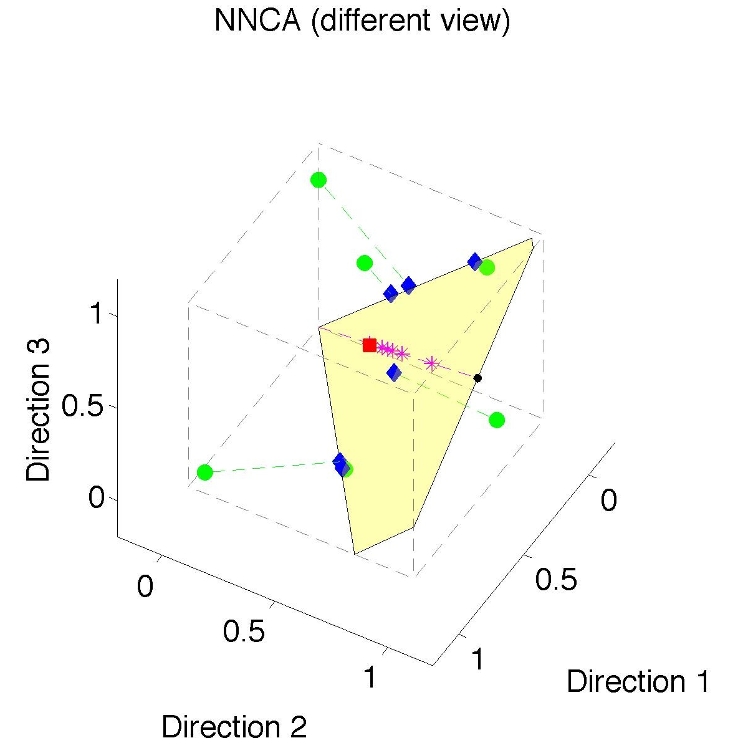
Last Class: Nonneg. Nested Cones
Same Toy
Data Set
Rank 1
Approx.
Properly
Nested

Slide 18
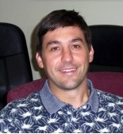


An Interesting Question
How generally applicable is
Backwards approach to PCA?
Another Application:
HDLSS Robust PCA
L¹ Backwards PCA:
Brooks, Dulá, Boone (2013)

Slide 19
An Interesting Question
How generally applicable is
Backwards approach to PCA?
Potential Application: Principal Curves
Hastie & Stuetzle, (1989)
(Foundation of Manifold Learning)

Slide 20
Manifold Learning
Goal: Find lower dimensional manifold that well approximates (high-dimensional) data
ISOmap
Tenenbaum, et al (2000)
Local Linear Embedding
Roweis & Saul (2000)

Slide 21
Manifold Learning
Tenenbaum, et al (2000)
Canonical Example:
Photographs (2-d) of Statue (3-d)
Different Viewpoints
Different Light Source Locations
Digitization of Photos is “Low-Dimensional”
But Not in a Subspace (Findable by PCA)
In a manifold (curved
surface) sense

Slide 22
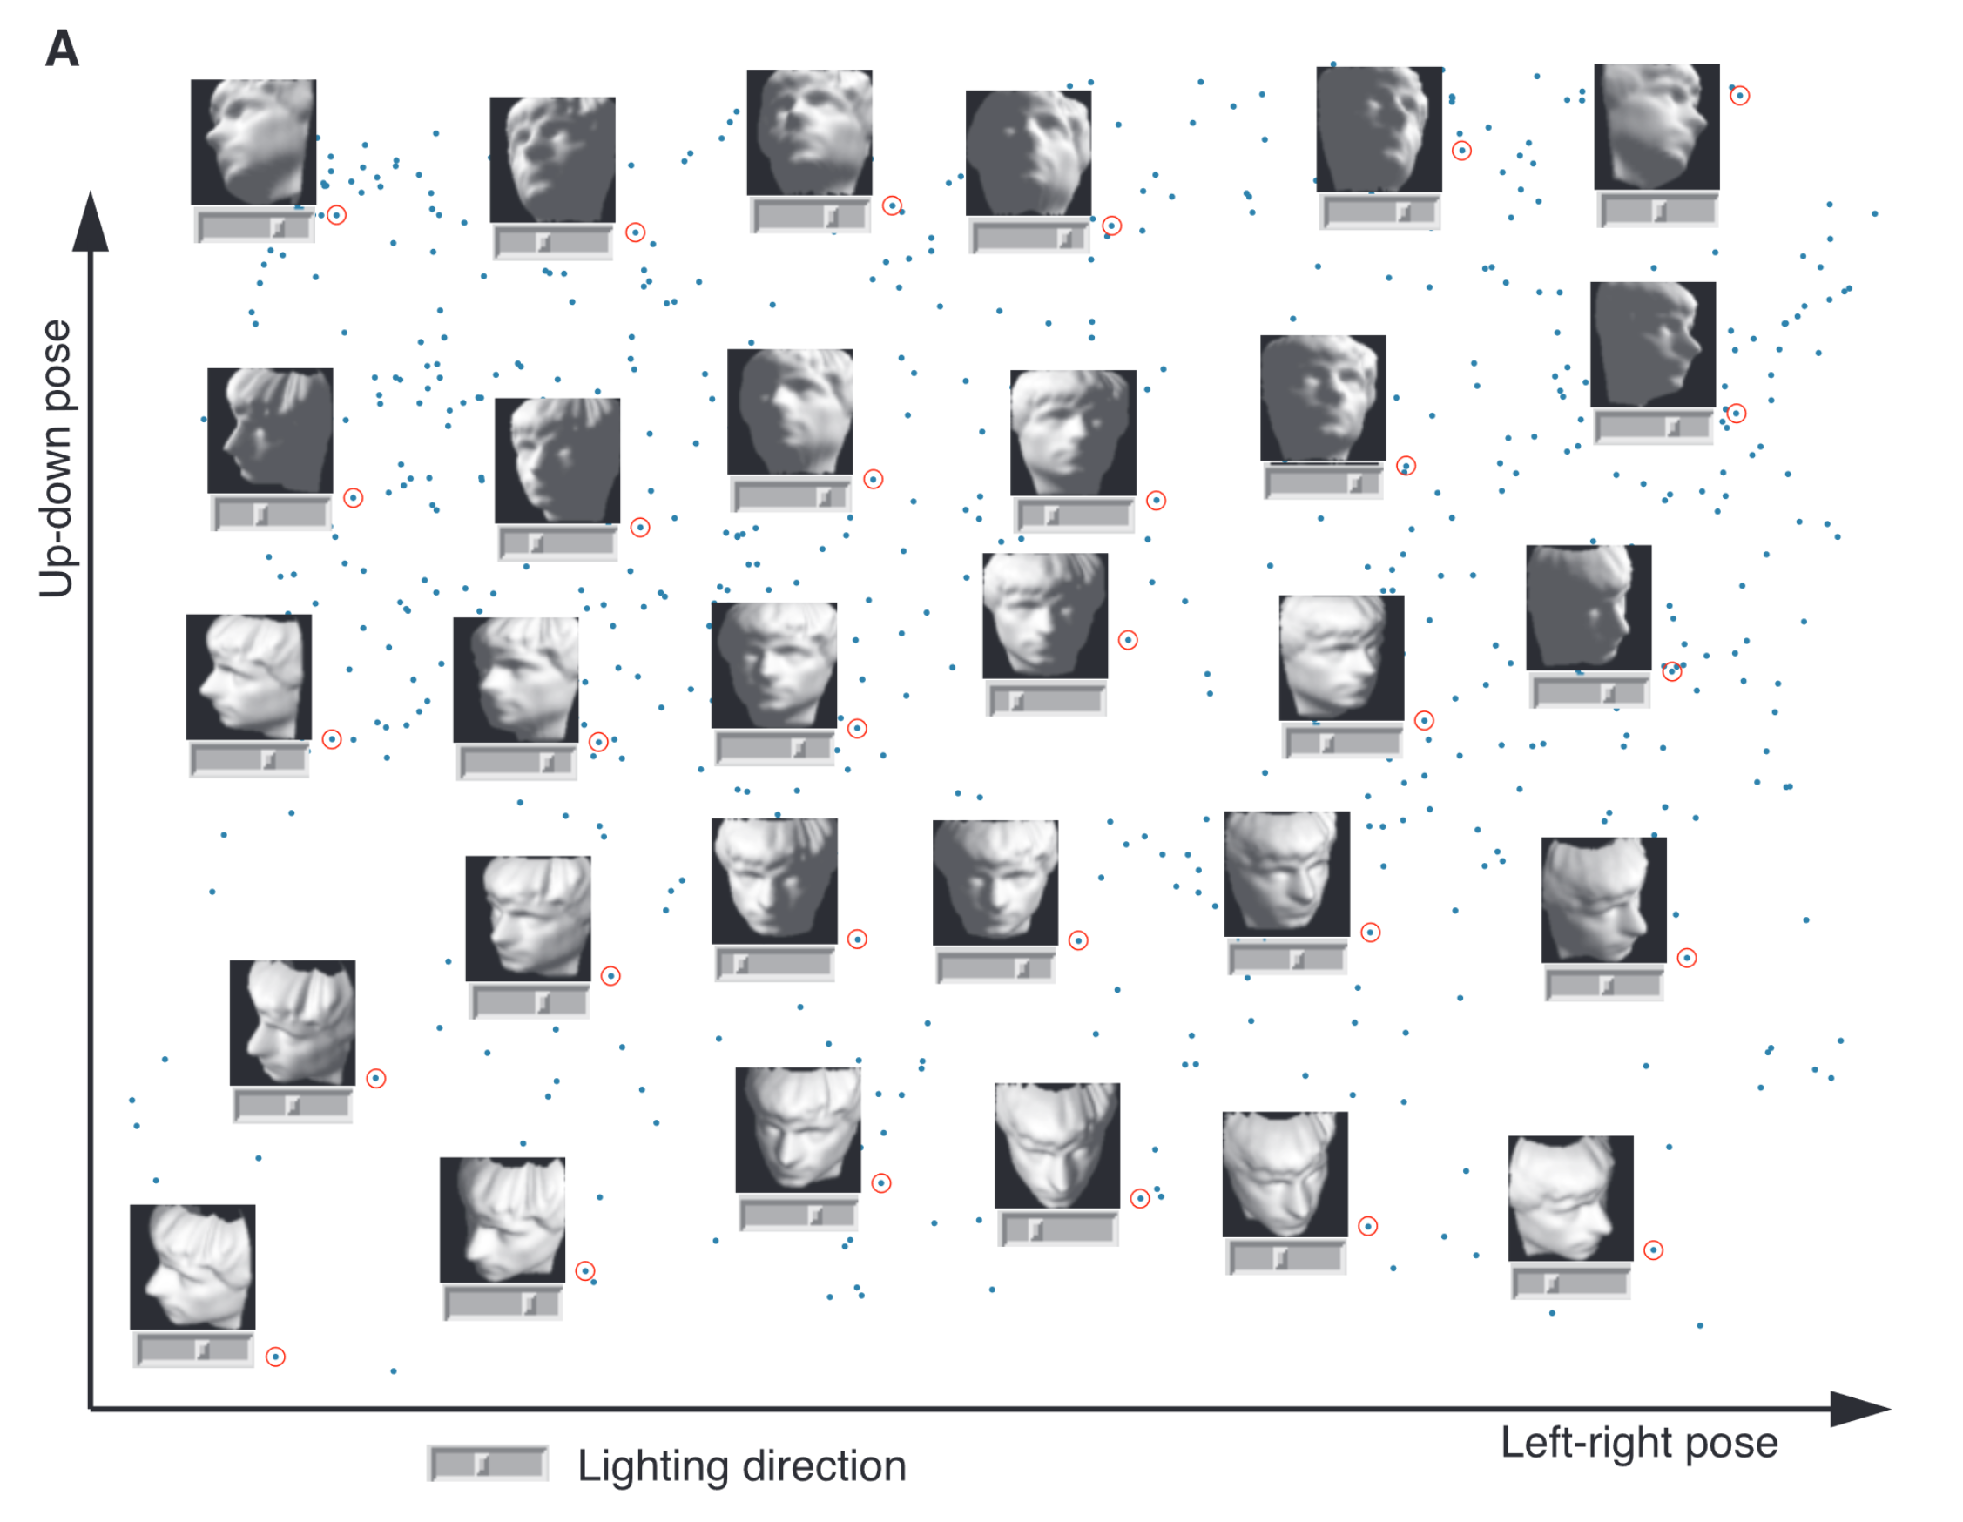
Manifold Learning
Tenenbaum, et al (2000)
Reveals
Two
Interesting
Modes Of
Variation

Slide 23
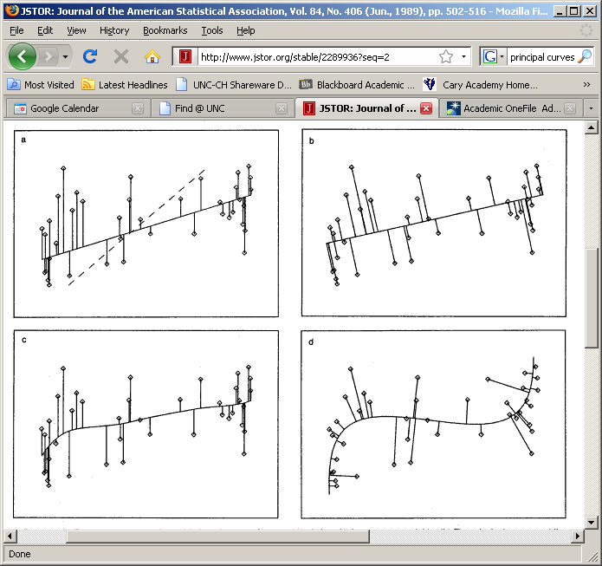
1st Principal Curve
Linear Reg’n
Usual Smooth

Slide 24
1st Principal Curve
Linear Reg’n
Proj’s Reg’n
Usual Smooth

Slide 25
1st Principal Curve
Linear Reg’n
Proj’s Reg’n
Usual Smooth
Princ’l Curve

Slide 26
Manifold Learning
How generally applicable is
Backwards approach to PCA?
Potential Application: Principal Curves
Perceived Major Challenge:
How to find 2nd Principal Curve?

Slide 27
Manifold Learning
Key Component:
Principal Surfaces
LeBlanc & Tibshirani (1996)
Challenge:
Can have any dimensional surface,
But how to nest???
Proposal: Backwards Approach

Slide 28
An Interesting Observation
In non-Euclidean cases,
Backwards PCA seems easier?
Why is that?
E.g. PNS, NNCA

Slide 29
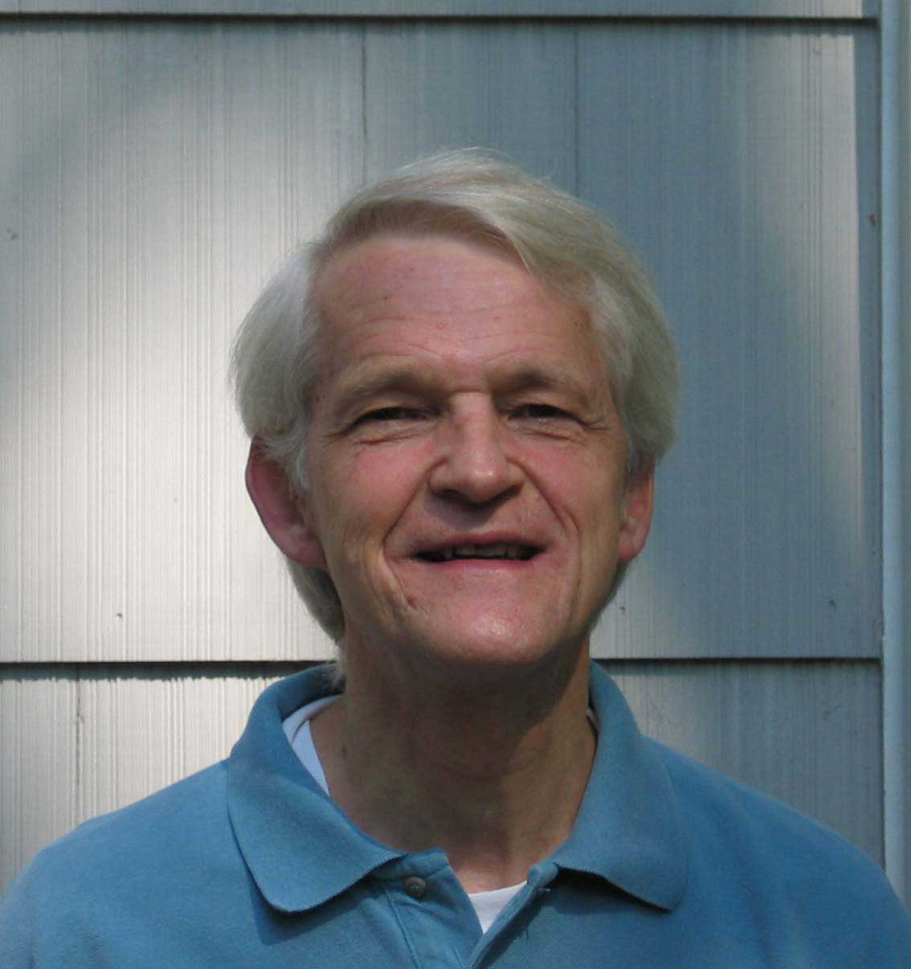
An Interesting Question
Why does backwards PC seem easier?
An Attractive Answer:
James Damon, UNC Mathematics
Geometry
Singularity
Theory

Slide 30
An Interesting Question
Why does backwards PC seem easier?
An Attractive Answer:
James Damon, UNC Mathematics
Damon and Marron (2014)

Slide 31
An Interesting Question
Why does backwards PC seem easier?
An Attractive Answer:
James Damon, UNC Mathematics
Key Idea: Express Backwards PCA as
Nested Series of Constraints

Slide 32

General View of Backwards PCA
Define Nested Spaces via Constraints
Satisfying More Constraints $⇒$
$⇒$ Smaller Subspaces

Slide 33
General View of Backwards PCA
Define Nested Spaces via Constraints
E.g. SVD
(Singular Value Decomposition =
= Not Mean Centered PCA)
(notationally very clean)

Slide 34
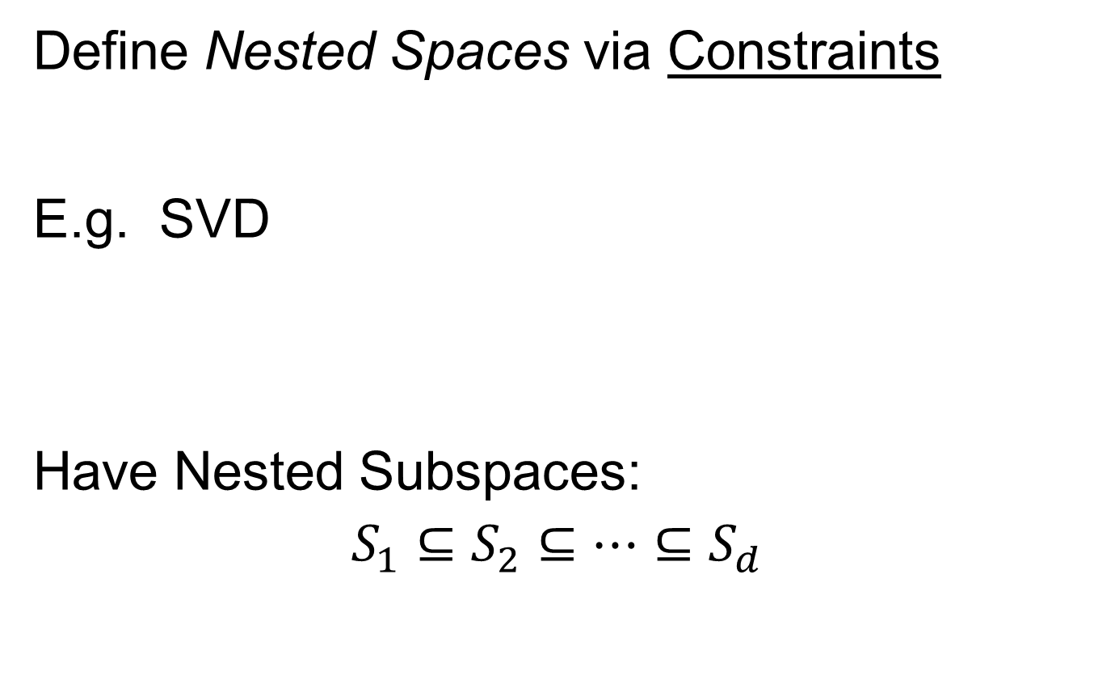
General View of Backwards PCA
Define Nested Spaces via Constraints
E.g. SVD
Have Nested Subspaces:
$$S_{1}⊆S_{2}⊆⋯⊆S_{d}$$

Slide 35


General View of Backwards PCA
Define Nested Spaces via Constraints
E.g. SVD $S_{k}=\left\{x :x=\sum_{j=1}^{k}{c_{j}u_{j}}\right\}$
$k$-th SVD Subspace
Scores
Loading Vectors (Basis Elements)

Slide 36
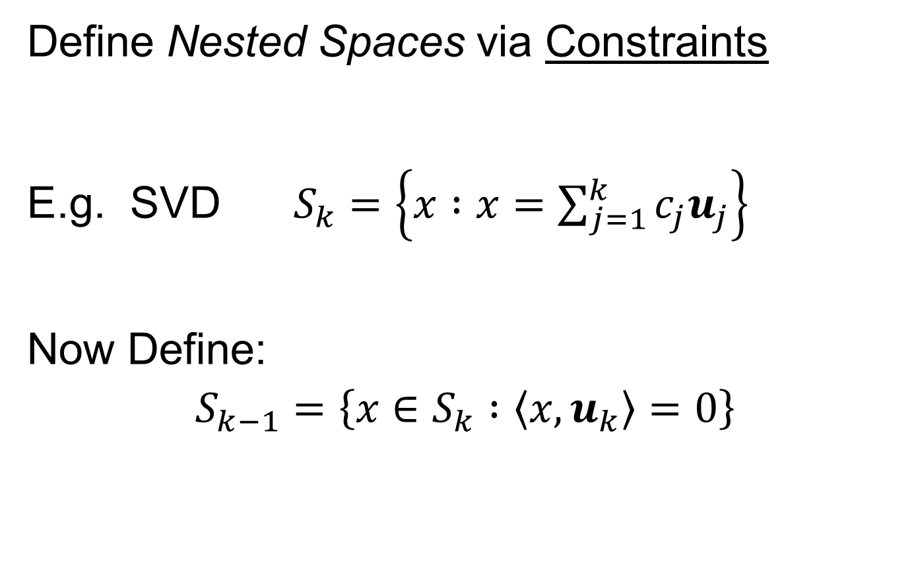
General View of Backwards PCA
Define Nested Spaces via Constraints
E.g. SVD $S_{k}=\left\{x :x=\sum_{j=1}^{k}{c_{j}u_{j}}\right\}$
Now Define:
$$S_{k−1}=\left\{x∈S_{k} :\left\langle x,u_{k}\right\rangle =0\right\}$$
Constraint Gives Nested Reduction of Dim’n

Slide 37
General View of Backwards PCA
Define Nested Spaces via Constraints
Backwards PCA
Reduce Using Affine Constraints

Slide 38
General View of Backwards PCA
Define Nested Spaces via Constraints
Backwards PCA
Principal Nested Spheres
Use Affine Constraints (Planar Slices)
In Ambient Space

Slide 39
General View of Backwards PCA
Define Nested Spaces via Constraints
Backwards PCA
Principal Nested Spheres
Principal Surfaces
Spline Constraint Within Previous?
{Been Done Already???}

Slide 40
General View of Backwards PCA
Define Nested Spaces via Constraints
Backwards PCA
Principal Nested Spheres
Principal Surfaces
Other Manifold Data Spaces
Sub-Manifold Constraints??
(Algebraic Geometry)

Slide 41
Covariance Matrices as Data Objects
Motivation: Diffusion Tensor Imaging (DTI)
Variation on Magnetic Resonance Imaging
Major Goal: Map Brain Connectivity
By Finding “Fibers”
Text: Sec 8.7
Basser et al. (1994)

Slide 42
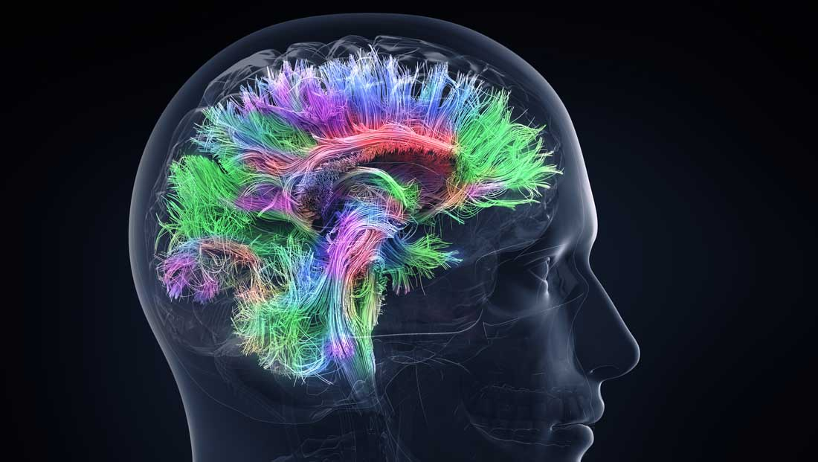
Covariance Matrices as Data Objects
Map Connectivity with Fiber Tracking
Thanks to DANA.ORG

Slide 43
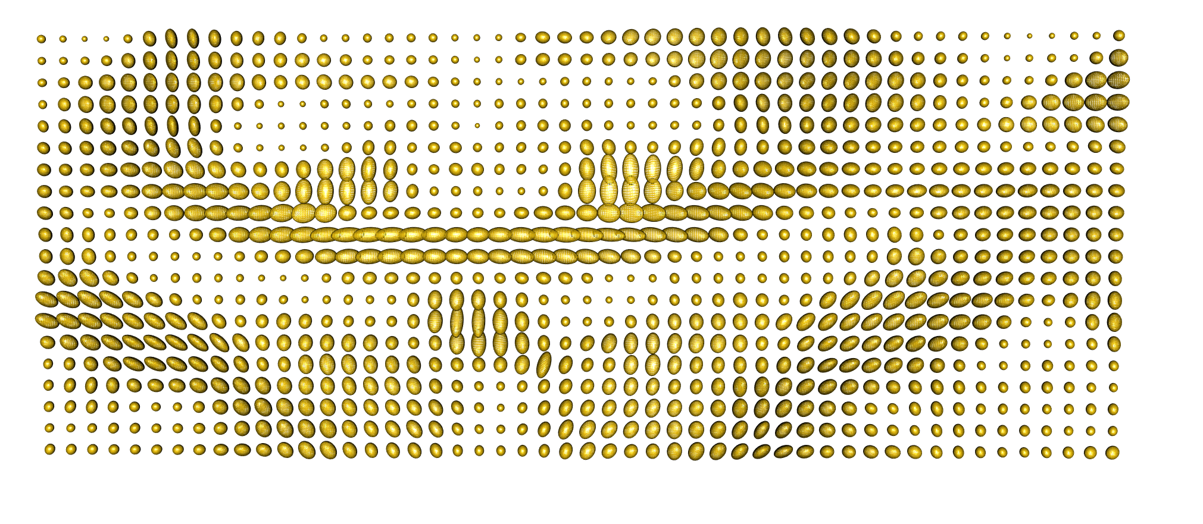
Covariance Matrices as Data Objects
DTI Approach: At 3-d “voxel grid”
Study Variation of Local Water Motion
Expressed as Covariance Matrices
Level Sets of
Corresponding
Gaussians
One Slice, from One Person’s Brain

Slide 44



Covariance Matrices as Data Objects
Variation Expressed as Covariance Matrices
Low Variation $≈$ Solid Region
Spherical $≈$ Pure Fluid
Stretched $≈$ Fiber
One Slice, from One Person’s Brain

Slide 45
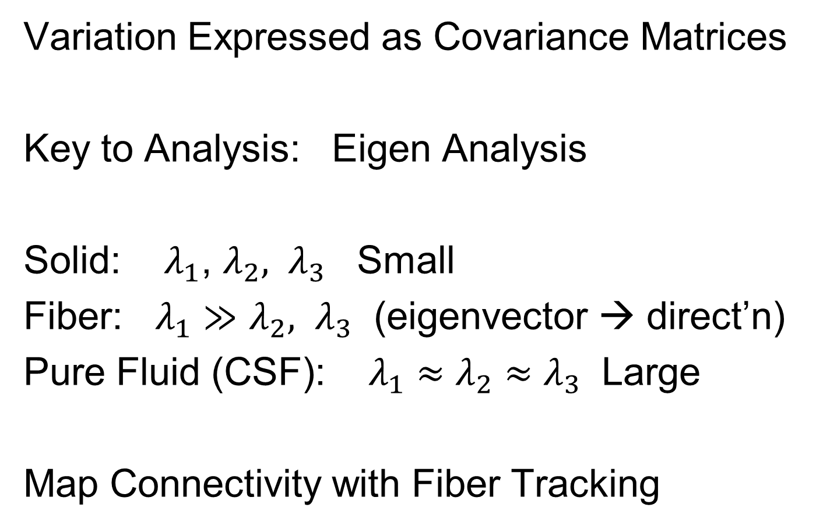
Covariance Matrices as Data Objects
Variation Expressed as Covariance Matrices
Key to Analysis: Eigen Analysis
Solid: $λ_{1}$, $λ_{2}, λ_{3}$ Small
Fiber: $λ_{1}≫$ $λ_{2}, λ_{3}$ (eigenvector → direct’n)
Pure Fluid (CSF): $λ_{1}≈$ $λ_{2}≈λ_{3}$ Large
Map Connectivity with Fiber Tracking

Slide 46
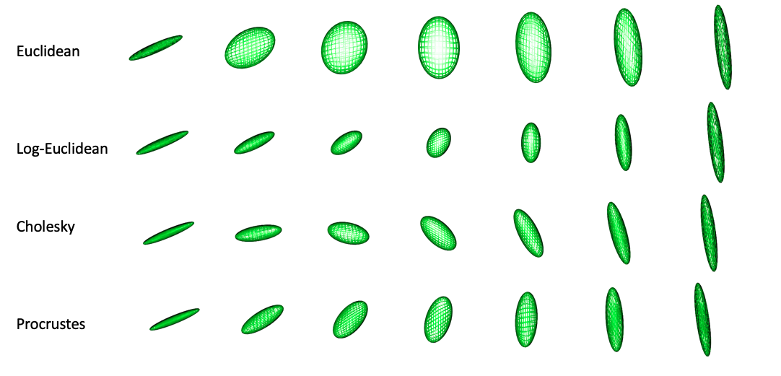
Covariance Matrices as Data Objects
Text: Sec 7.3.5
Important Point: Choice of Metric Matters
Geodesic from this fiber
To this fiber
For Interpolation of Fibers Want “Straight Line Path” (Geodesic)
Geodesic With Respect to Euclidean Distance = Frobenius Norm
Leaves Space of Fibers in a Strong Way
Clearly Need a
Better Metric

Slide 47
Covariance Matrices as Data Objects
Important Point: Choice of Metric Matters
Even Wildly Different Paths!

Slide 48
Covariance Matrices as Data Objects
Note on Metrics:
Each Induces a Manifold Structure
On the Set of Full Rank Covariance Matrices
Each Lower Rank also as a Manifold

Slide 49
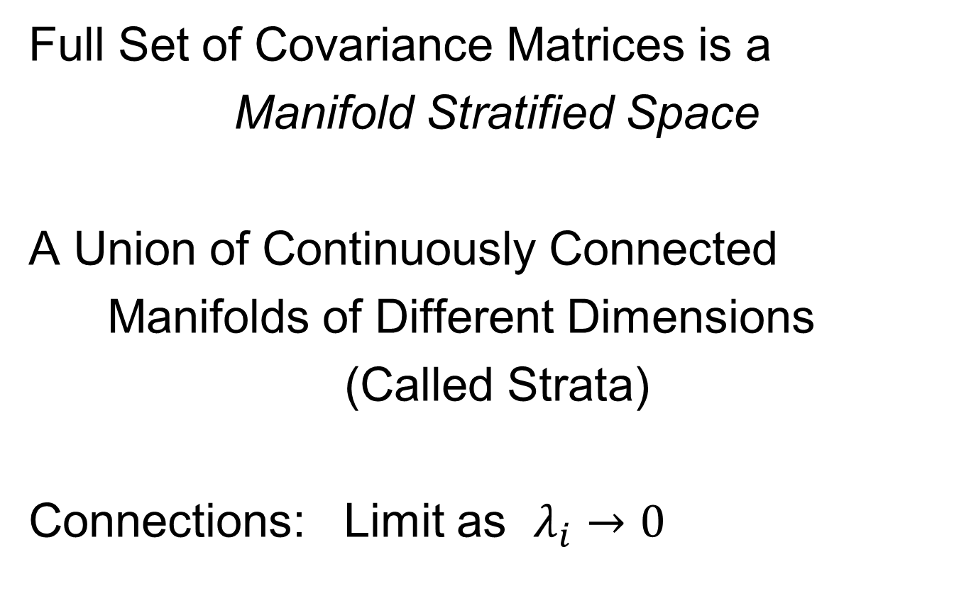
Covariance Matrices as Data Objects
Full Set of Covariance Matrices is a
Manifold Stratified Space
A Union of Continuously Connected
Manifolds of Different Dimensions
(Called Strata)
Connections: Limit as $λ_{i}→0$

Slide 50
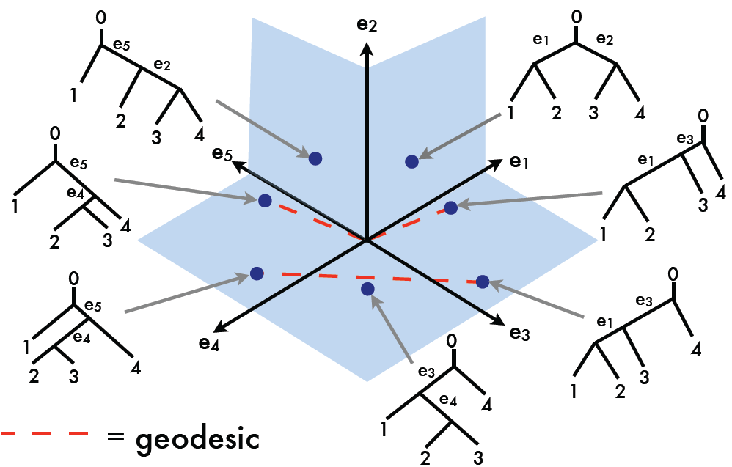
Manifold Stratified Spaces
Text: Sec 10.1.2
Another Important Example:
Phylogenetic Tree Space
Thanks to Megan Owen

Slide 51
Manifold Stratified Spaces
Another Example:
Projective Geometry
Important in Image Analysis
Good Source:
Patrangenaru & Ellingson (2016)
Chapters 21 and 22
Manifold Stratifications
Handle Occlusions

Slide 52
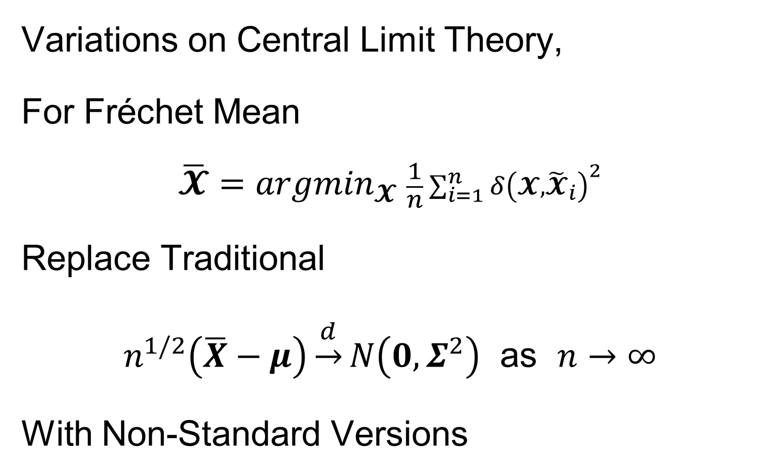
Non-Euclidean Probability Theory
Text, Sec. 8.5
Variations on Central Limit Theory,
For Fréchet Mean
$$\overline{𝓧}={argmin}_{𝓧} \frac{1}{n}\sum_{i=1}^{n}{{δ\left(𝓧,{\tilde{𝓧}}_{i}\right)}^{2}}$$
Replace Traditional
$n^{1/2}\left(\overline{X}−μ\right)\underset{→}{d}N\left(0,Σ^{2}\right)$ as $n→∞$
With Non-Standard Versions
Fun Variations: Different Rates of Convergence
Use Tangent Plane for Linear Ops
Sensible for Shrinking Neighborhoods

Slide 53
Non-Euclidean Probability Theory
Variations on Central Limit Theory,
Major Manifold References:
Terras (1985)
Patrangenaru & Ellingson (2015) Chp. 5
PNS Backwards Mean:
Huckemann & Eltzner (2019)
Better Than Fréchet Mean?

Slide 54
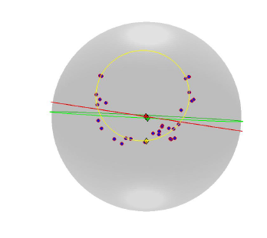

Principal Nested Spheres
Main Goal:
Extend Principal Arc Analysis ($𝕊^{2}$ to $𝕊^{k}$)
Fréchet Mean =
Center of Mass
PNS Backwards Mean

Slide 55
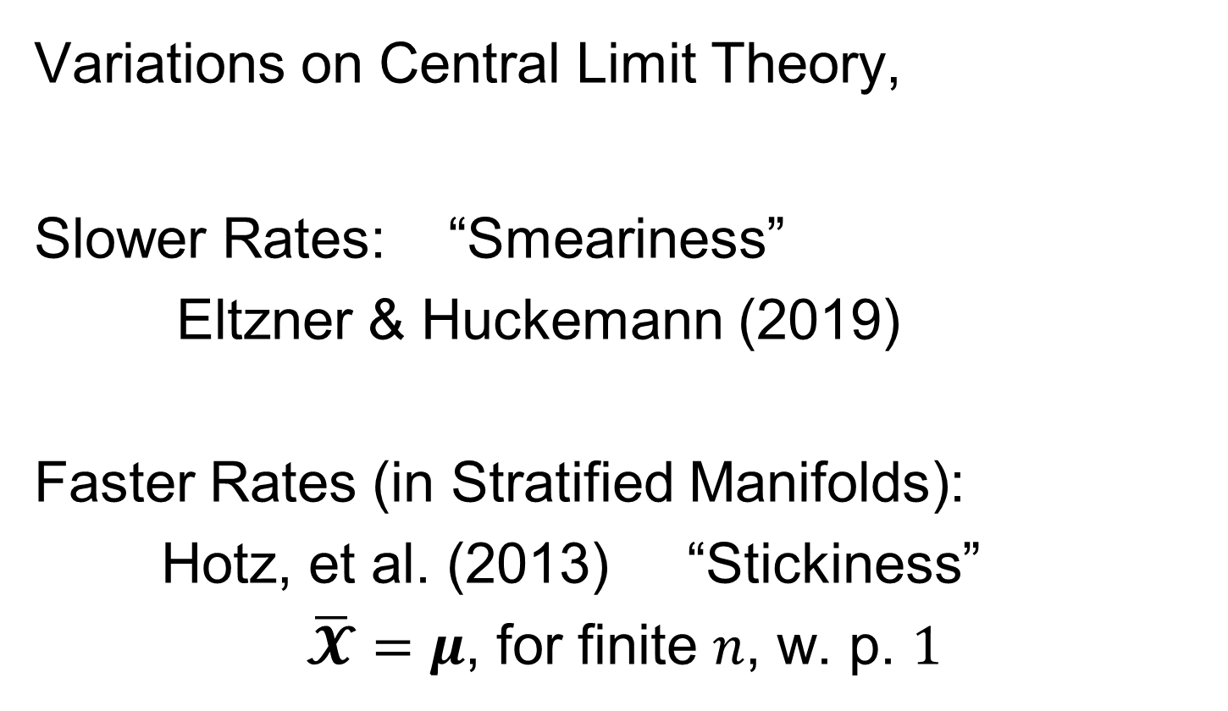
Non-Euclidean Probability Theory
Variations on Central Limit Theory,
Slower Rates: “Smeariness”
Eltzner & Huckemann (2019)
Faster Rates (in Stratified Manifolds):
Hotz, et al. (2013) “Stickiness”
$\overline{𝓧}=μ$, for finite $n$, w. p. $1$

Slide 56
OODA Big Picture
Text: Chp. 9
New Topic:
Curve Registration
(Amplitude – Phase Variation)
Main Reference:
Srivastava et al (2011)
Interesting Aside: Never Published
Beyond ArXiv, yet 198 Google Citations

Slide 57
Curve Registration
Text: Chp. 9
Main Reference:
Srivastava et al (2011)
Source for Deeper Mathematics:
Srivastava and Klassen (2016)

Slide 58
Collaborators
Anuj Srivastava (Florida State U.)
Wei Wu (Florida State U.)
Derek Tucker (Sandia National Lab)
Xiaosun Lu (U. N. C.)
Inge Koch (U. Adelaide)
Peter Hoffmann (U. Adelaide)
J. O. Ramsay (McGill U.)
Laura Sangalli (Milano Polytech.)

Slide 59
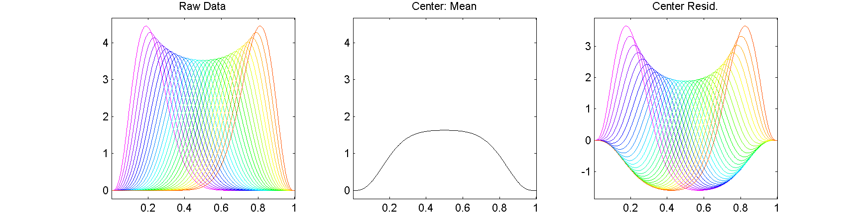
Motivating Example
Functional Data Analysis
i.e. Curves as Data Objects
Shifted Betas Example
How Amenable To
Classical PCA?

Slide 60
Motivating Example
Shifted Betas Example
Mean Not
Representative!
Centering Creates
Distortion?

Slide 61
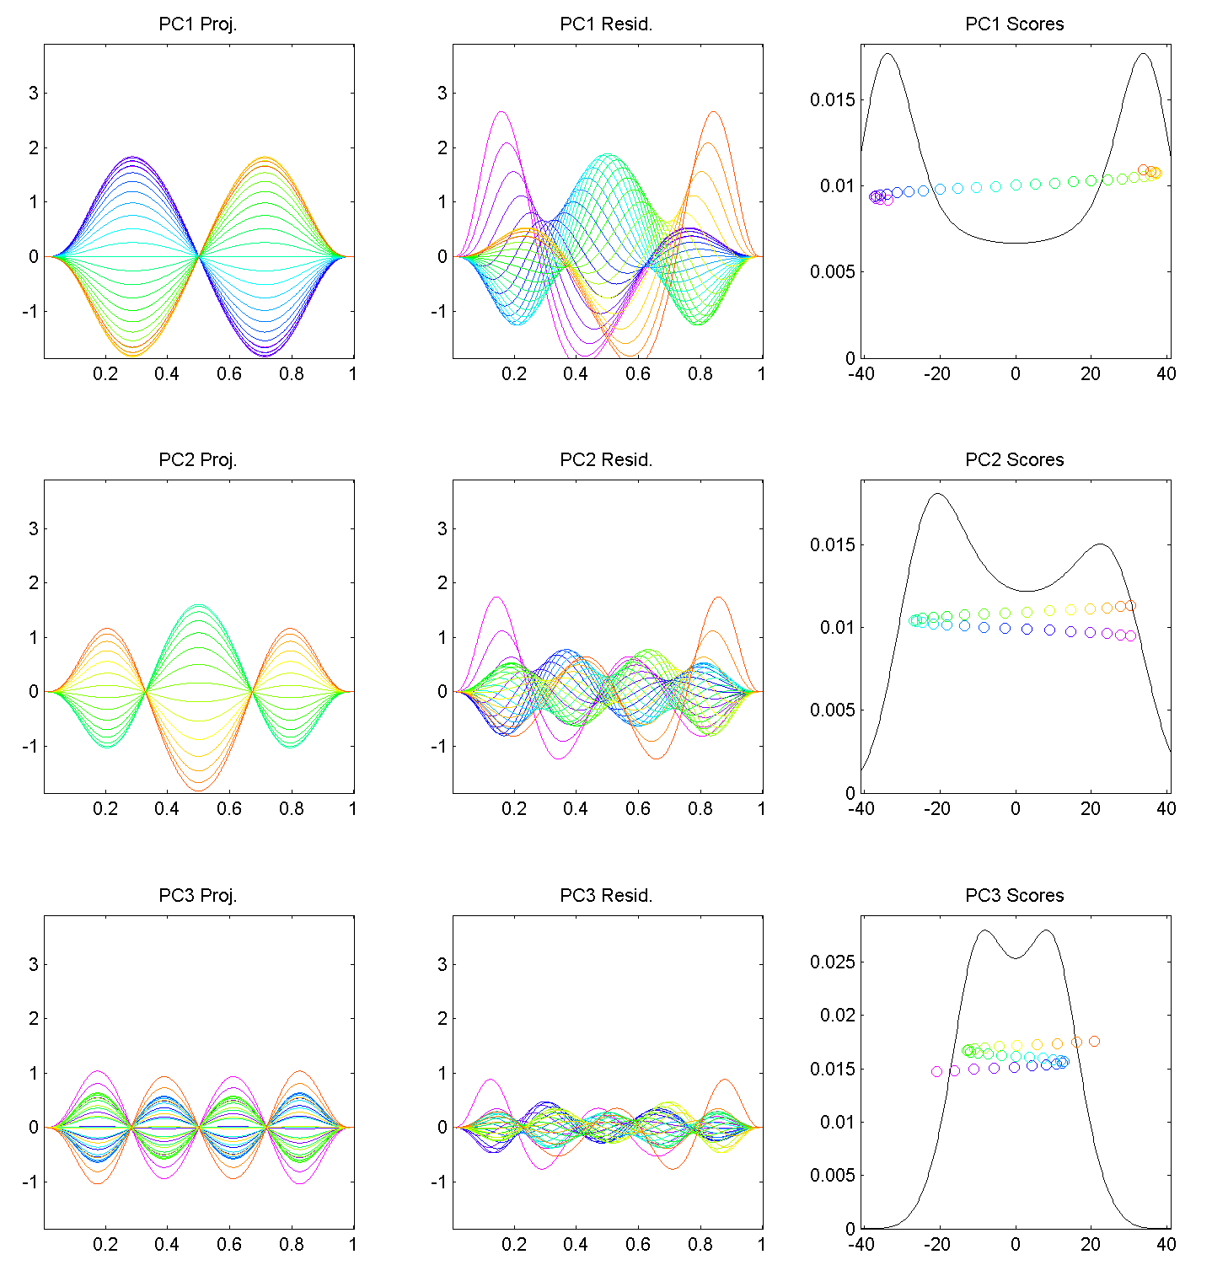
Motivating Example
Shifted Betas
Example PCA
Hard to Interpret 1st Mode
Yet Scores Seem Sensible
Conclusion: PCA
Modes of Variation
Yield Poor Insights
About Phase
Similar for Other Modes
Looks Like Harmonics
From Fourier Theory
Is There a Sturm-
Liouville Theory?

Slide 62
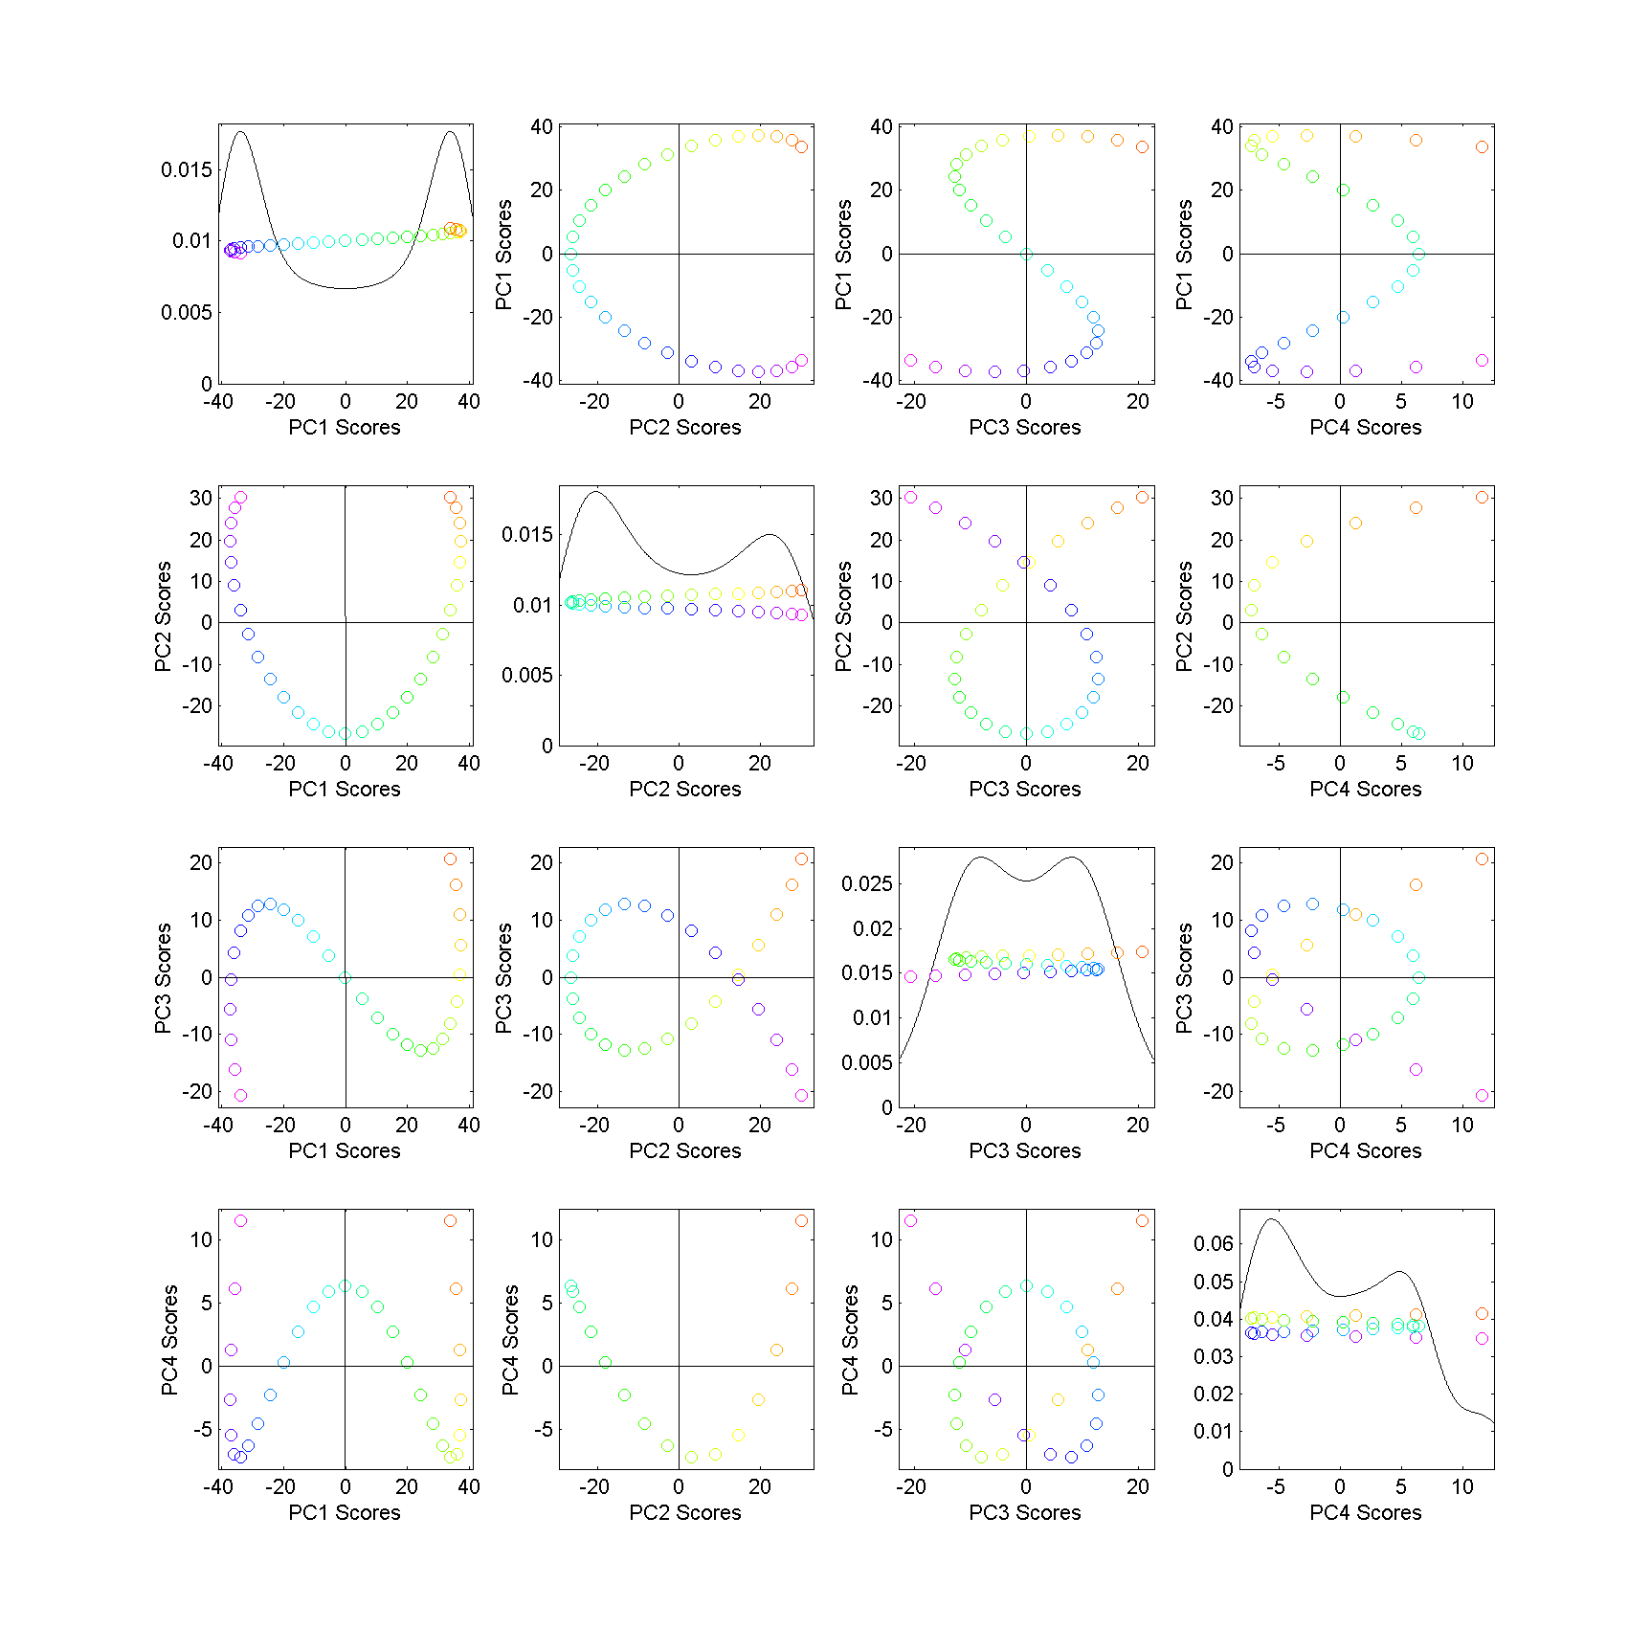
Motivating Example
Shifted
Betas
Example
PCA
Scores
Interesting
Patterns!
Variation
Follows
Single Curve
Bending
All Around
Very Poor Signal
Compression!

Slide 63
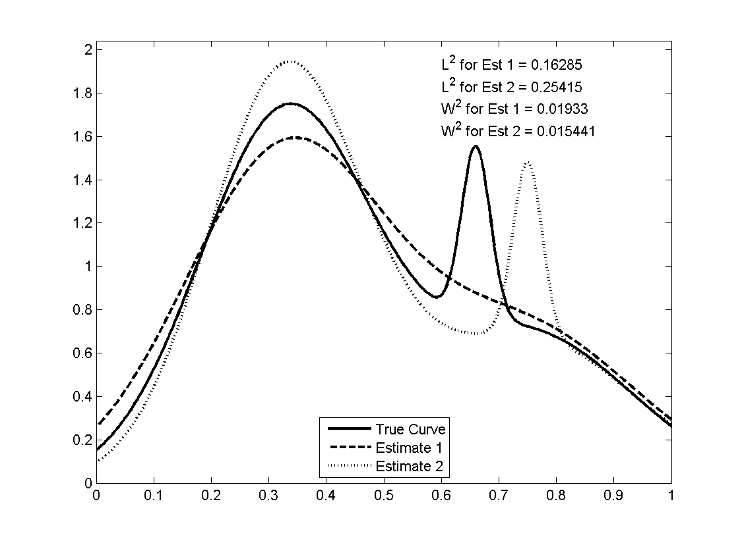
Motivating Example
Shifted Betas Example
Alternate
Approach:
Wasserstein
Distance
Based on
Optimal
Transport
Recall Earlier Example

Slide 64
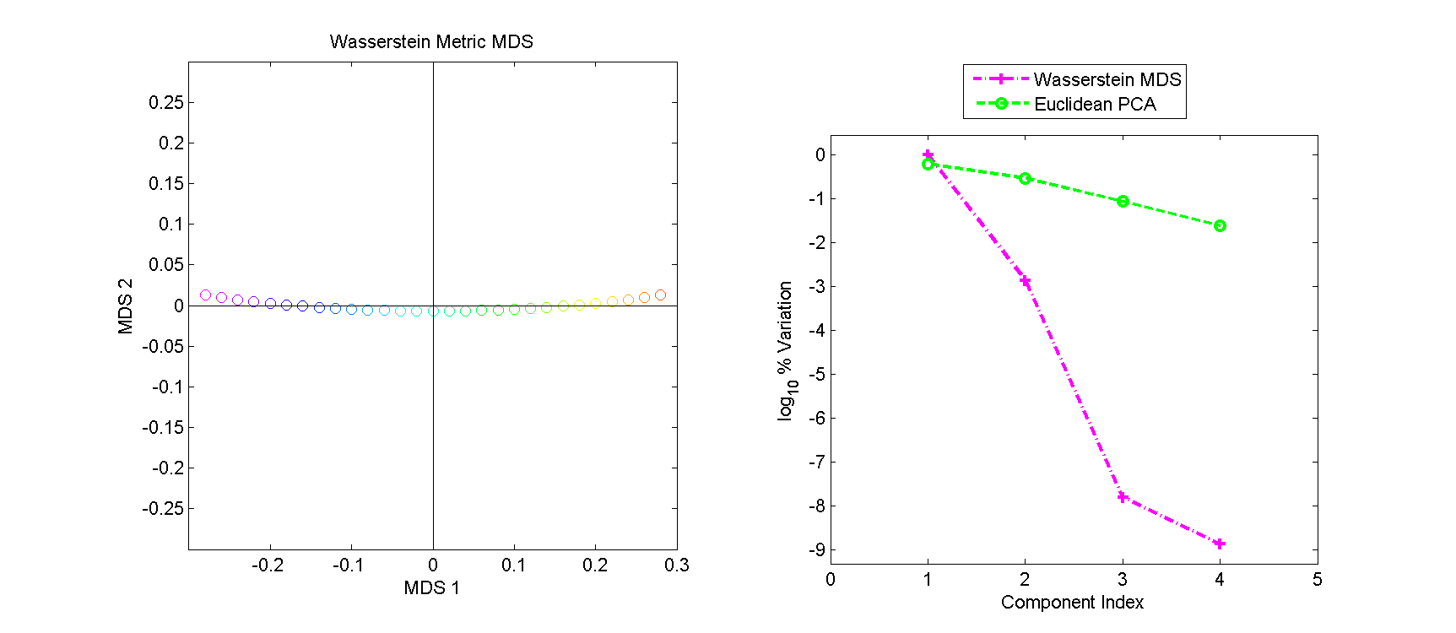
Motivating Example
Shifted Betas Example
Alternate Analysis: Wasserstein MDS
Gives Much More
Interpretable Scores
Small Amplitude Variation
Large Phase Variation
Challenge: Only
Scores, No Modes

Slide 65
Motivating Example
Shifted Betas Example
Alternate Analysis: Wasserstein MDS
Log₁₀ Scree Plot
Gives Much Better
Signal Compression
Conventional PCA
Spreads Power
Across Spectrum
Log₁₀ Scaling Very Revealing

Slide 66
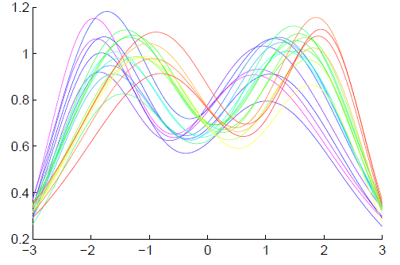
General Amp - Phase Context
Functional Data Analysis
Curves as Data Objects
Toy Example:

Slide 67
General Amp - Phase Context
Functional Data Analysis
Curves as Data Objects
Toy Example:
How Can We
Understand
Variation?

Slide 68
General Amp - Phase Context
Functional Data Analysis
Curves as Data Objects
Toy Example:
How Can We
Understand
Variation?

Slide 69
General Amp - Phase Context
Functional Data Analysis
Curves as Data Objects
Toy Example:
How Can We
Understand
Variation?

Slide 70
General Amp - Phase Context
Insightful
Decomposition

Slide 71
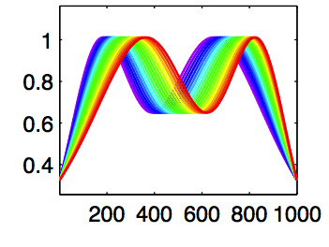
General Amp - Phase Context
Insightful
Decomposition
Horiz’l
Var’n

Slide 72
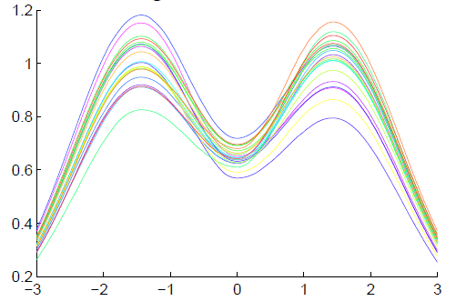
General Amp - Phase Context
Insightful
Decomposition
Vertical Variation
Horiz’l
Var’n

Slide 73
Challenge
Fairly Large Literature
Many (Diverse) Past Attempts
Limited Success (in General)
Surprisingly Slippery
(even mathematical formulation)

Slide 74
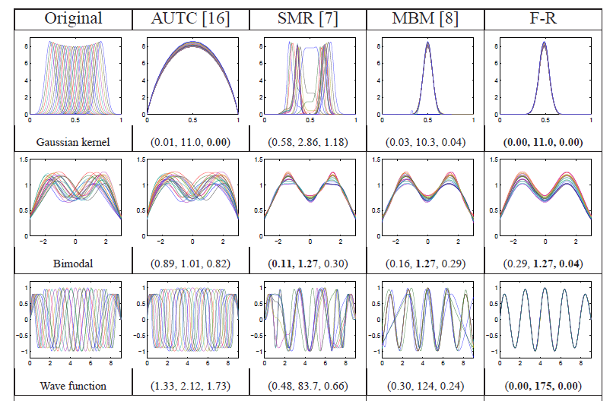
Challenge (Illustrated)
Thanks to Wei Wu

Slide 75
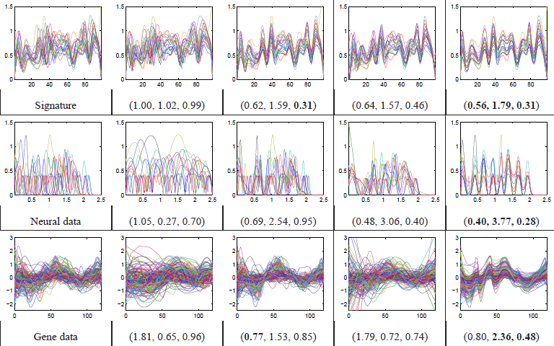
Challenge (Illustrated)
Thanks to Wei Wu

Slide 76
General Amp - Phase Context
Appropriate
Mathematical
Framework?
Vertical Variation
Horiz’l
Var’n

Slide 77
Time Warping
Foundational Concept for Curve Registration
Think Stretch & Compress Horizontal Axis
Mathematical Basis:
Diffeomorphisms

Slide 78
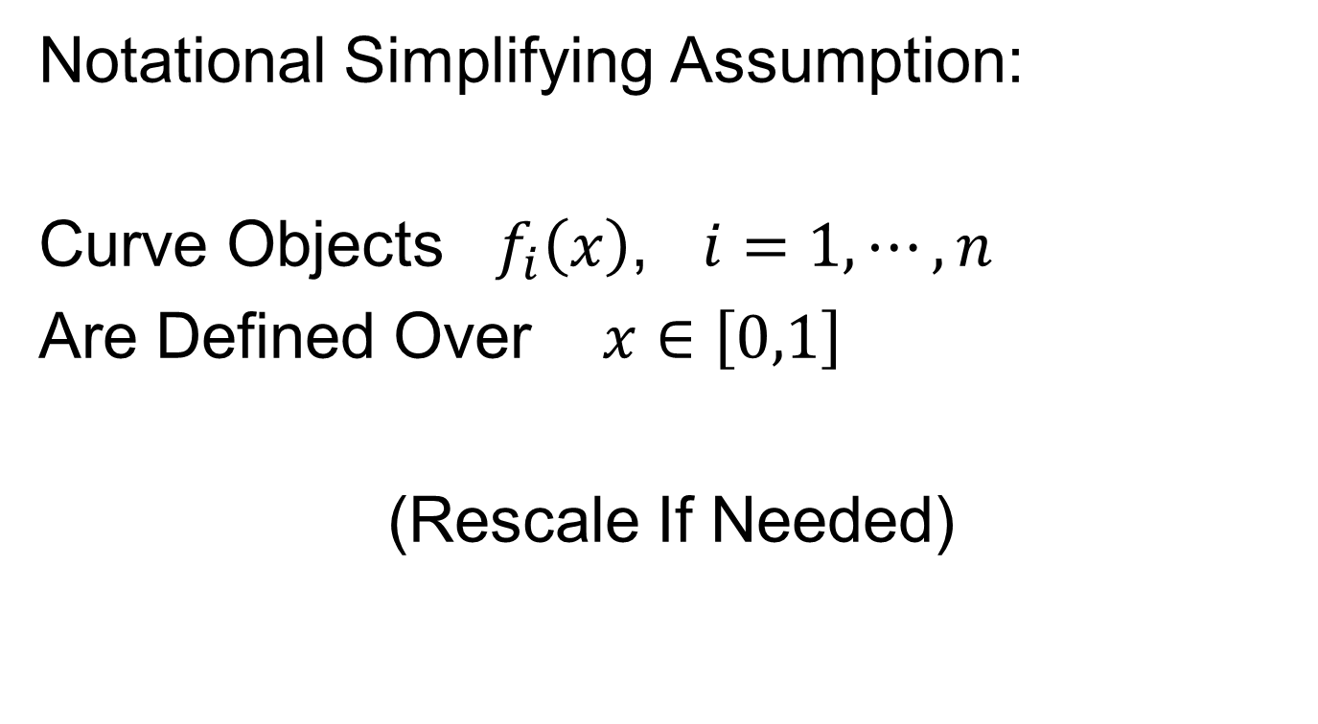
Time Warping
Notational Simplifying Assumption:
Curve Objects $f_{i}\left(x\right)$, $i=1,⋯,n$
Are Defined Over $x∈\left[0,1\right]$
(Rescale If Needed)

Slide 79

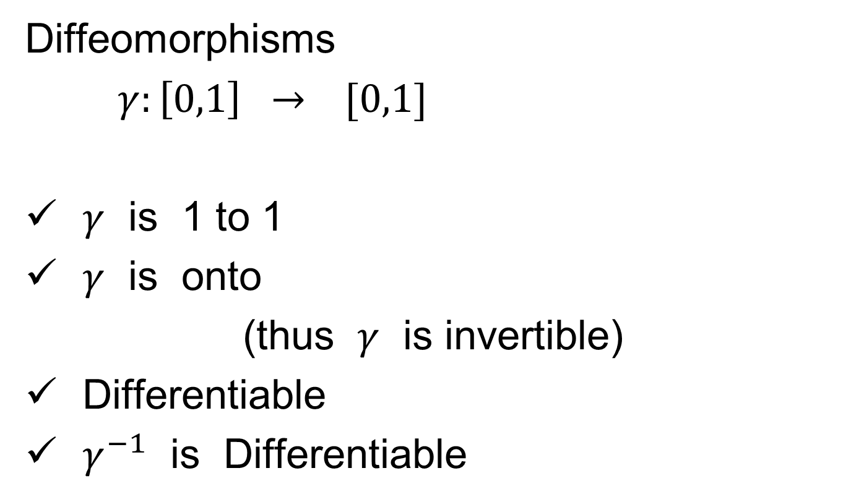

Time Warping
Let $Γ$ be the Set of All Strictly
Increasing Diffeomorphisms
Diffeomorphisms
$γ:\left[0,1\right] → [0,1]$
$γ$ is 1 to 1
$γ$ is onto
(thus $γ$ is invertible)
Differentiable
$γ^{−1}$ is Differentiable
Achieve by taking $γ$ strictly increasing

Slide 80
Time Warping Intuition
Elastically Stretch & Compress Axis

Slide 81
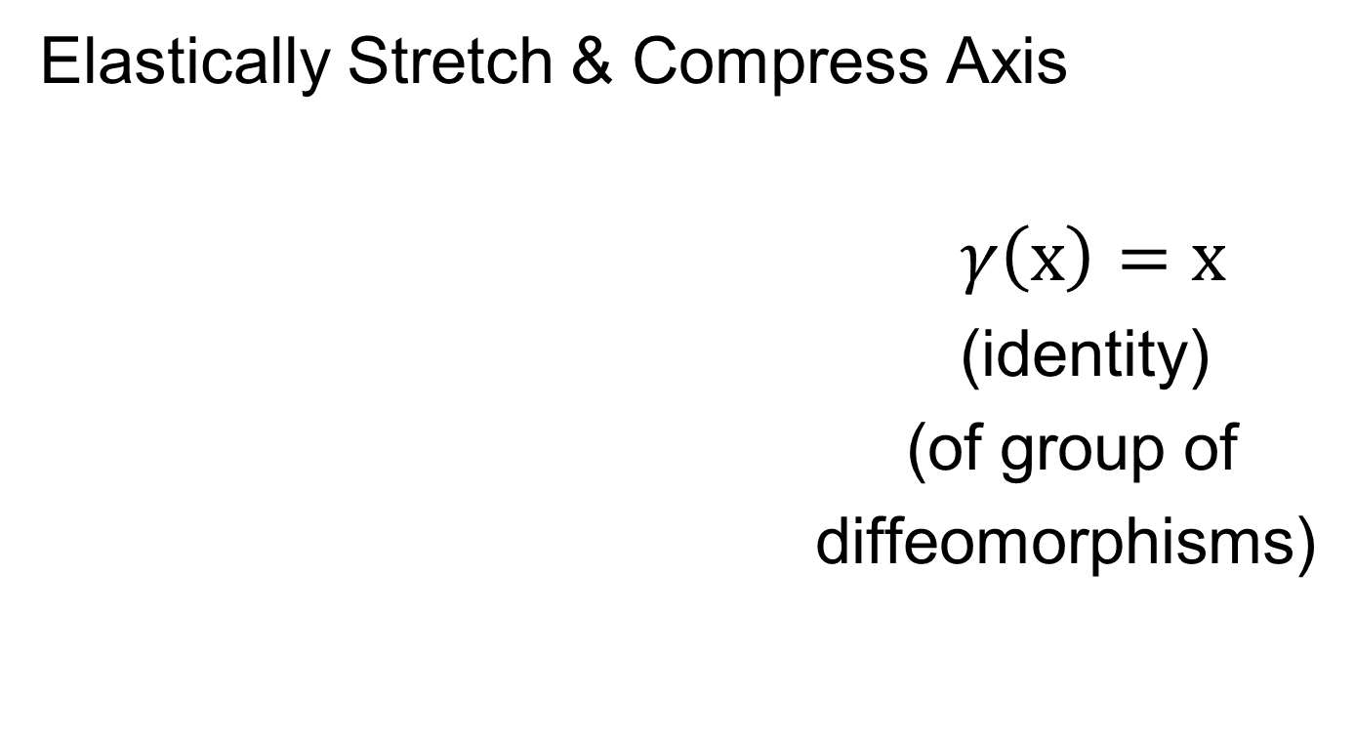
Time Warping Intuition
Elastically Stretch & Compress Axis
$γ\left(x\right)=x$
(identity)
(of group of
diffeomorphisms)

Slide 82

Time Warping Intuition
Elastically Stretch & Compress Axis
$γ\left(x\right)$

Slide 83

Time Warping Intuition
Elastically Stretch & Compress Axis
$γ\left(x\right)$

Slide 84

Time Warping Intuition
Elastically Stretch & Compress Axis
$γ\left(x\right)$

Slide 85
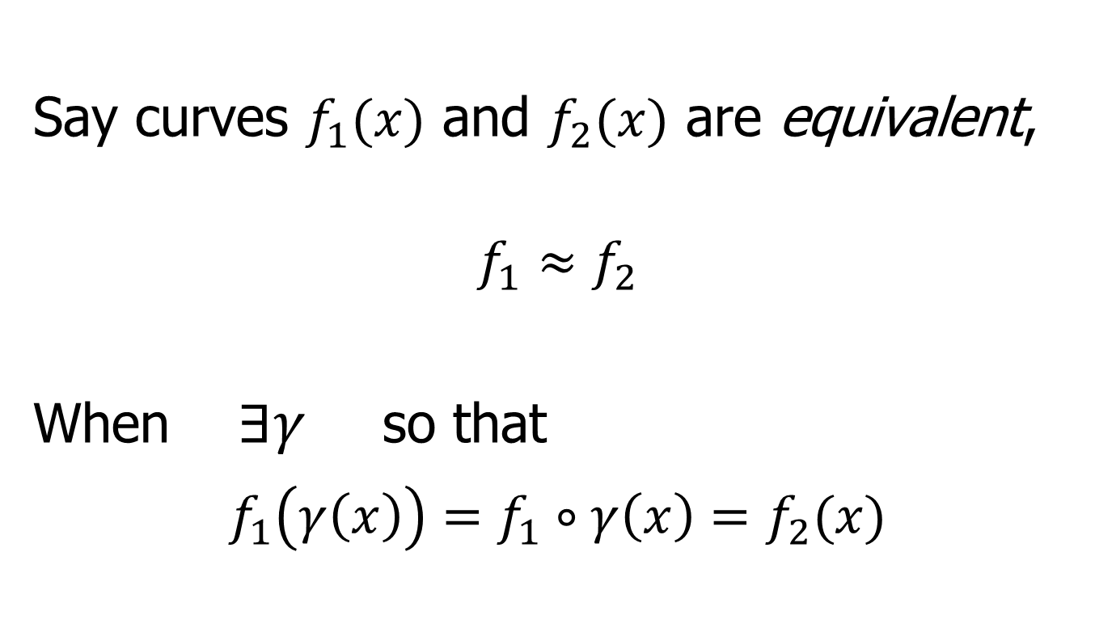
Time Warping Intuition
Say curves $f_{1}(x)$ and $f_{2}(x)$ are equivalent,
$$f_{1}≈f_{2}$$
When $∃γ$ so that
$$f_{1}\left(γ\left(x\right)\right)=f_{1}∘γ\left(x\right)=f_{2}(x)$$
Stretch & Compress Before Plugging In

Slide 86


Time Warping Intuition
Toy Example: Starting Curve, $f\left(x\right)$

Slide 87


Time Warping Intuition
Toy Example: Warping Functions $γ_{i}(x)$

Slide 88


Time Warping Intuition
Toy Example: Time Warped Curves, $f\left(γ(x)\right)$

Slide 89
Curve Registration
What are the
Data Objects?
Vertical Variation
Horiz’l
Var’n

Slide 90
Recall Landmark Shape Analysis
Approach: Identify objects that are:
Translations
Rotations
Scalings
of each other
Mathematics: Equivalence Relation
Results in: Equivalence Classes
Which become the Data Objects

Slide 91
Recall Landmark Shape Analysis
Equivalence Classes become Data Objects
a.k.a. “Orbits”
Mathematics: Called “Quotient Space”
, , , , , ,

Slide 92

Curve Registration
What are the Data Objects?
Equivalence Classes from “Time Warpings”
$γ:\left[0,1\right] → [0,1]$ (smooth)
More Precisely: Diffeomorphisms

Slide 93

Data Objects I
Equivalence Classes as Data Objects
(Set of All
Warps of
Given Curve)
Notation: $\left[f\right]=\left\{f∘γ: γ∈Γ\right\}$
for a “representor” $f\left(x\right)$

Slide 94

Time Warping Intuition
Toy Example: Equivalent Curves, $\left[f\left(x\right)\right]$

Slide 95

Curve Registration
Toy Example: Non-Equivalent Curves
Cannot
Warp
Into
Each
Other

Slide 96
Data Objects I
Equivalence Classes as Data Objects
(Set of All
Warps of
Given Curve)
Next Task:
Find Appropriate Metric

Slide 97
Metrics in Curve Space
Find Metric on Equivalence Classes
Start with Warp Invariant Metric on Curves
& Extend

Slide 98
Next Time
Insert “General Strategy” near top of last slide

Slide 99
Participant Presentation
1:35 Victoria Sagasta Pereira:
MMM
Next Class: (Nobody Scheduled)

