Slide 1
Statistics – O. R. 881 Object Oriented Data Analysis
Steve Marron
Dept. of Statistics and Operations Research
University of North Carolina

Slide 2
Current Sections in Textbook
Today:
Sections 9.2, 17.2
Next Class:
Sections 17.2

Slide 3
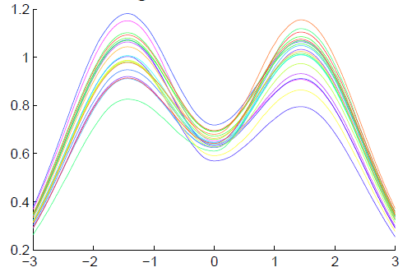
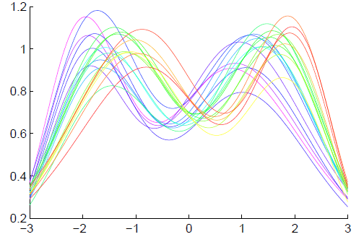
Last Class: General Amp – Pha.
Appropriate
Mathematical
Framework?
Vertical Variation
Horiz’l
Var’n

Slide 4
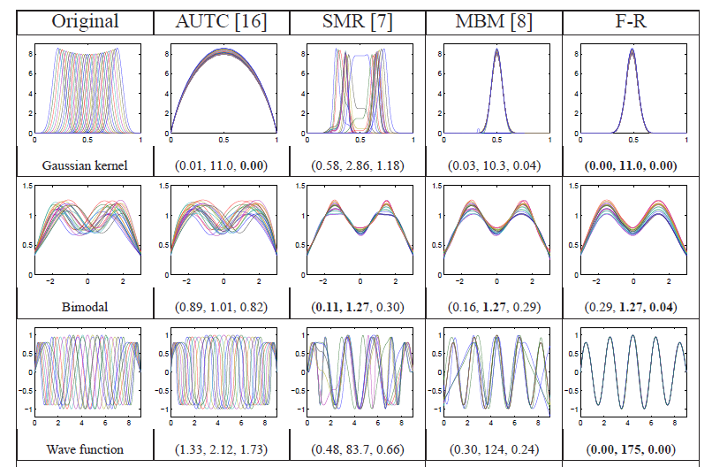
Previous Class: Challenge
Thanks to Wei Wu

Slide 5
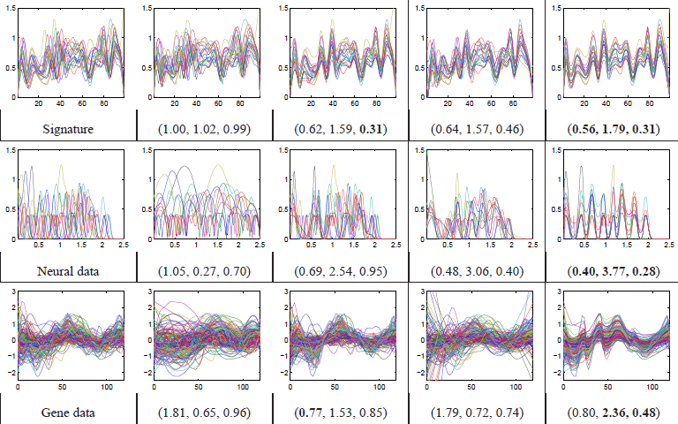
Previous Class: Challenge
Thanks to Wei Wu

Slide 6
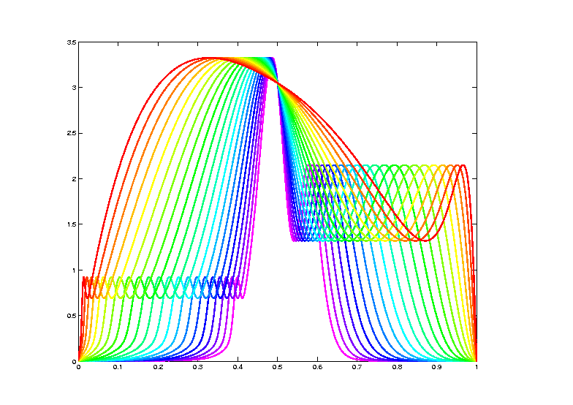
Last Class: Data Objects I
Equivalence Classes as Data Objects
(Set of All
Warps of
Given Curve)
Notation: $\left[f\right]=\left\{f∘γ: γ∈Γ\right\}$
for a “representor” $f\left(x\right)$

Slide 7
Last Class: Metrics in Curve Sp.
General Strategy:
Find Metric on Equivalence Classes
Start with Warp Invariant Metric on Curves
& Extend

Slide 8
Last Class: Metrics in Curve Sp.
$$\inf_{γ}\left\|f_{1}−\left(f_{2}∘γ\right)\right\|≠\inf_{γ}\left\|f_{2}−\left(f_{1}∘γ\right)\right\|$$
Note:
Very
Different
L² norms
Thanks to
Xiaosun Lu
But There is a
Good Answer,
Explained Later

Slide 9
Last Class: Metrics in Curve Sp
Warp Invariant Metric $δ_{FR}$
Developed in context of:
Likelihood Geometry
Fisher – Rao Metric:
$$δ_{FR}\left(f_{1},f_{2}\right)=δ_{FR}\left(f_{1}∘γ,f_{2}∘γ\right)$$
Rao (1945)
Deeper Theory:
Amari (1985)

Slide 10
Last Class: Metrics in Curve Sp
Square Root Velocity Function (SRVF)
$$q_{f}\left(t\right)=\frac{\dot{f}\left(t\right)}{\sqrt{\left|\dot{f}\left(t\right)\right|}}$$
$$f\left(t\right)=f\left(0\right)+\int_{0}^{t}{q_{f}\left(s\right)\left|q_{f}\left(s\right)\right|ds}$$

Slide 11
Last Class: Metrics in Curve Sp
Fisher – Rao (Psuedo-)Metric:
Computation Based on SRVF:
$$δ_{FR}\left(f_{1},f_{2}\right)={\left\|q_{f_{1}}−q_{f_{2}}\right\|}_{2}$$
I.e. work with SRVF,
since much easier to compute.

Slide 12
Last Class: Mean in Quot’t Space
Given Equivalence Class Data Objects:
$$\left[f_{1}\right], \left[f_{2}\right], ⋯,\left[f_{n}\right]$$
The Karcher Mean is:
$$\left[μ\right]={argmin}_{\left[f\right]}\sum_{i=1}^{n}{{δ_{A}\left(\left[f\right],\left[f_{i}\right]\right)}^{2}}$$

Slide 13
Last Class: Mean in Quot’t Space
“Most Representative” $μ_{n}$ in$\left[μ\right]$
Given a candidate $μ$
Consider warps to each $f_{i}$
Choose $μ_{n}$ to make
Karcher mean of warps = Identity
(under Fisher Rao metric)

Slide 14
Last Class: More Data Objects
Final Curve Warps:
Warp Each Data Curve, $f_{1}, ⋯,f_{n}$
To Template Mean, $μ_{n}$
Denote Warp Functions $γ_{1}, ⋯,γ_{n}$
Gives (Roughly Speaking):
Vertical Components $f_{1}∘γ_{1}, ⋯,f_{n}∘γ_{n}$
(Aligned Curves)
Horizontal Components $γ_{1}, ⋯,γ_{n}$
Data Objects I

Slide 15
Last Class: More Data Objects
Data Objects II
Final Curve Warps:
Warp Each Data Curve, $f_{1}, ⋯,f_{n}$
To Template Mean, $μ_{n}$
Denote Warp Functions $γ_{1}, ⋯,γ_{n}$
Gives (Roughly Speaking):
Vertical Components $f_{1}∘γ_{1}, ⋯,f_{n}∘γ_{n}$
(Aligned Curves)
Horizontal Components $γ_{1}, ⋯,γ_{n}$
~ Kendall’s Shapes

Slide 16
Last Class: More Data Objects
Final Curve Warps:
Warp Each Data Curve, $f_{1}, ⋯,f_{n}$
To Template Mean, $μ_{n}$
Denote Warp Functions $γ_{1}, ⋯,γ_{n}$
Gives (Roughly Speaking):
Vertical Components $f_{1}∘γ_{1}, ⋯,f_{n}∘γ_{n}$
(Aligned Curves)
Horizontal Components $γ_{1}, ⋯,γ_{n}$
Data Objects III
~ Chang’s Transfo’s

Slide 17
Last Class: Funct’l Data Anal.
Insightful
Decomposition
Vertical Variation
Horiz’l
Var’n

Slide 18
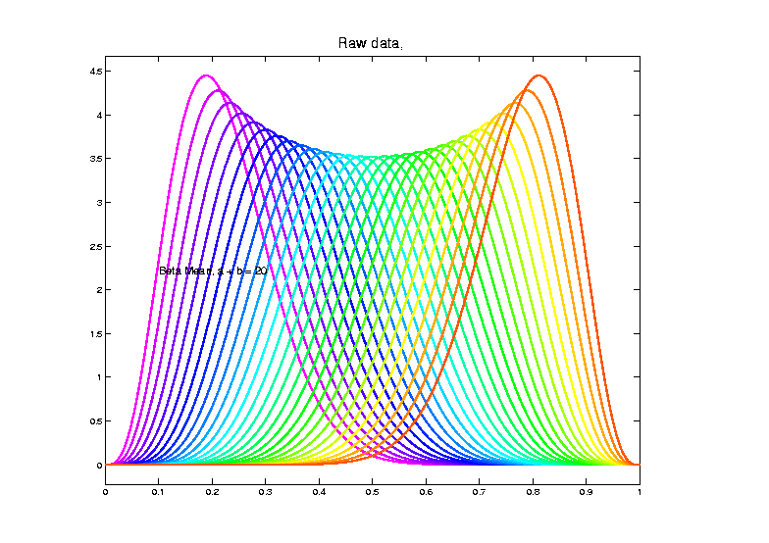
Last Class: Shifted Betas E.g.
Raw
Data
Both
Horizontal
And
Vertical
Variation

Slide 19
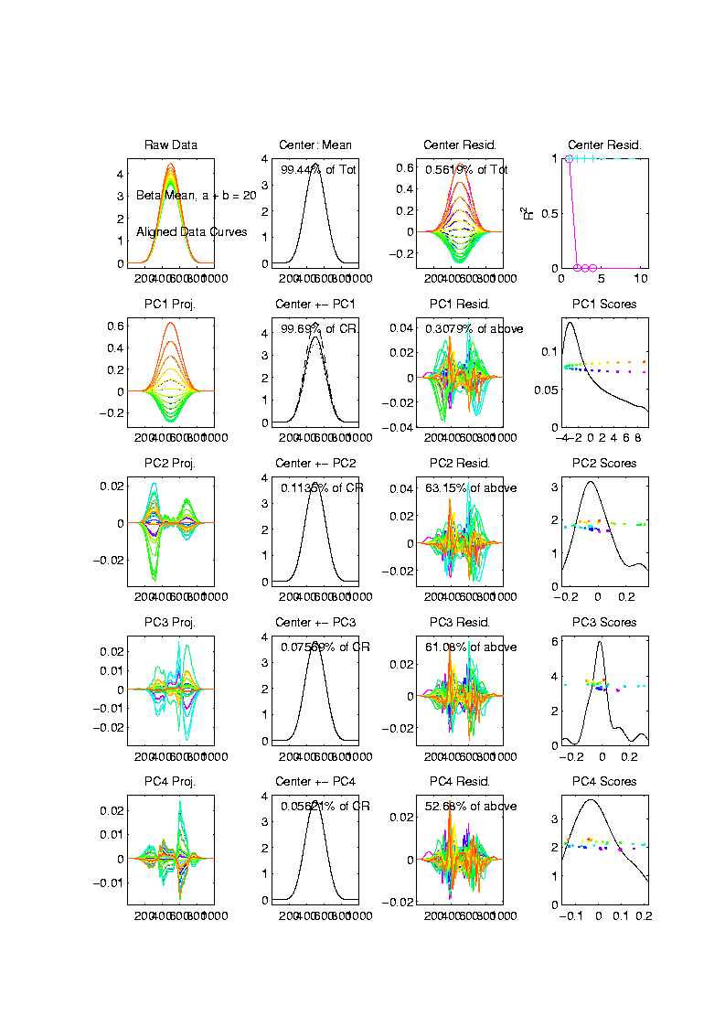
Last Class: Shifted Betas E.g.
Aligned
Curve
PCA
Projections
All Var’n
In 1st
Component

Slide 20
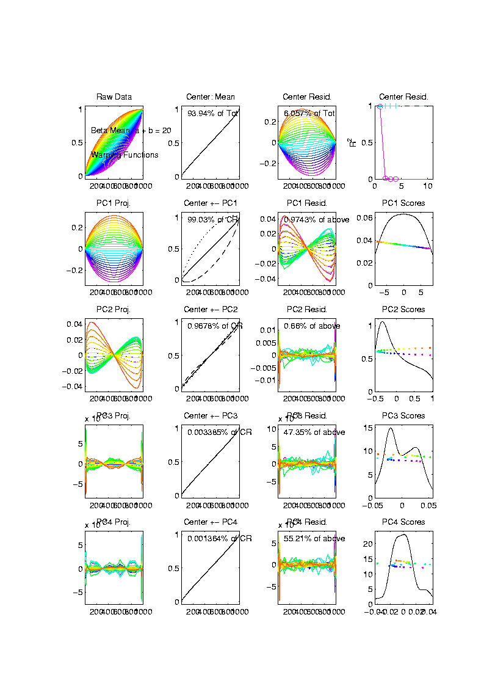
Last Class: Shifted Betas E.g.
Warps,
PC
Projections

Slide 21
Last Class: Shifted Betas E.g.
Warps,
PC
Projections
Rest is
Not
Important

Slide 22
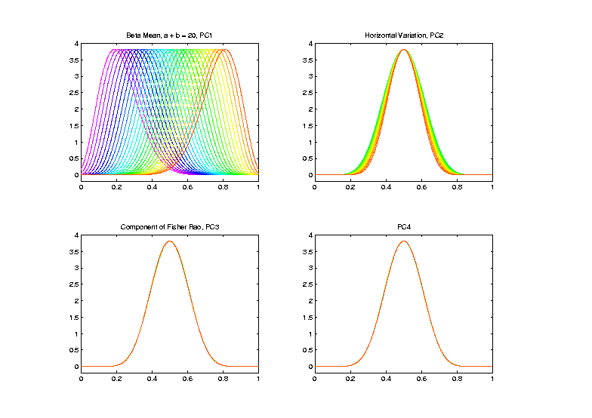
Last Class: Shifted Betas E.g.
Warp
Compon’ts
(+ Mean)
Applied to
Template
Mean

Slide 23
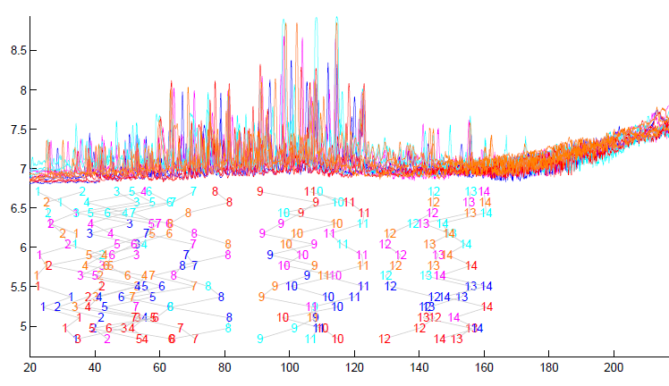
Last Class: TIC testbed
Special Feature: Answer Key of Known Peaks
Goal:
Find
Warps
To Align
These

Slide 24
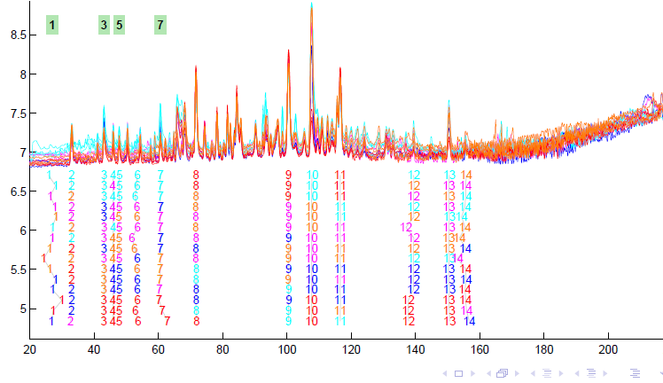
Last Class: TIC testbed
Fisher – Rao Alignment

Slide 25
Last Class: Refined Calculat’ns
Text, Sec. 9.2
More Recent Development:
Better Exploit Manifold Data Space:
SRVF${(γ}_{i})∈S^{d}$
Principal Nested Spheres
Reference: Yu et al (2017)
Since $γ$:$\left[0,1\right]$ → $\left[0,1\right]$
is a diffeomorphism
So for $q_{γ}=\frac{\dot{γ}}{\sqrt{\left|\dot{γ}\right|}}$,
${\left\|q_{γ}\right\|}_{2}^{2}=\int_{0}^{1}{\dot{γ}\left(x\right)dx}=1$

Slide 26
Last Class: PNS on SRVF Sph
Toy Example
Parametrized
By Values
At 1/3 And 2/3

Slide 27
Last Class: PNS on SRVF Sph
Toy Example
View As Points
Tangent Plane PC 1
PNS 1
Boundary of
Nonnegative
Orthant

Slide 28
Last Class: PNS on SRVF Sph
Toy Example
Curves from
Tangent Plane PC 1
Note: Some Are
No Longer Warps!

Slide 29
Last Class: PNS on SRVF Sph
Toy Example
View As Points
PNS 1
Good 1-d
Approx.

Slide 30
PNS on SRVF Sphere
Real Data Analysis: Blood Glucose Curves
Interpolation to Handle Missing Data,
And Non-Equally Spaced Times

Slide 31
PNS on SRVF Sphere
Real Data Analysis: Blood Glucose Curves
Results of Fisher Rao Decomposition

Slide 32
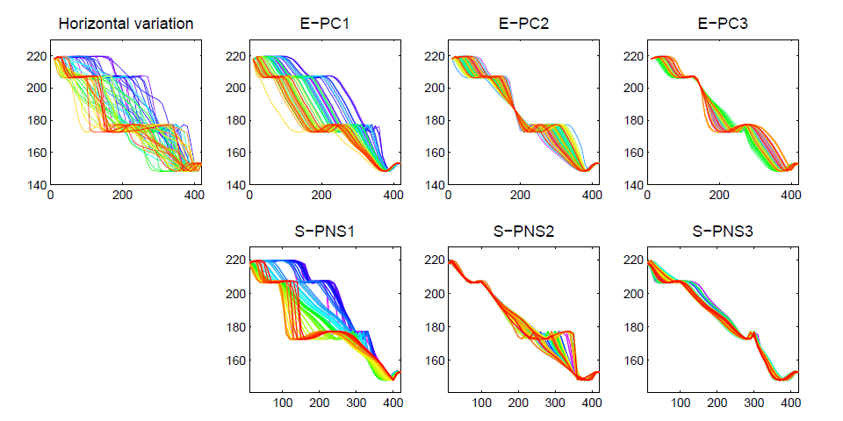
PNS on SRVF Sphere
Real Data Analysis: Blood Glucose Curves

Slide 33
PNS on SRVF Sphere
Real Data Analysis: Blood Glucose Curves
Understand PNS 1 Mode
Of Variation, Using
Equally Spaced Scores

Slide 34
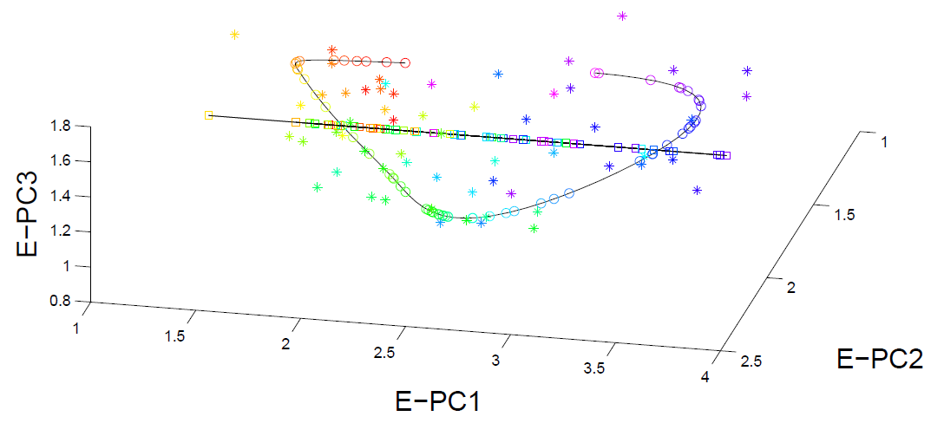
PNS on SRVF Sphere
Real Data Analysis: Blood Glucose Curves

Slide 35
Juggling Data
Michael Newton – U. Wisconsin
Data from Ramsay et al (2014)
(Vertical Location vs. Time)
While Juggling
Thanks of Theravive.com

Slide 36
Juggling Data
Time
Traces
Cut Into
Time
Blocks:
(Data
Objects)

Slide 37
Juggling Data
Ampitude – Phase Variation Decomposition
(Analysis from Lu & Marron (2014))

Slide 38
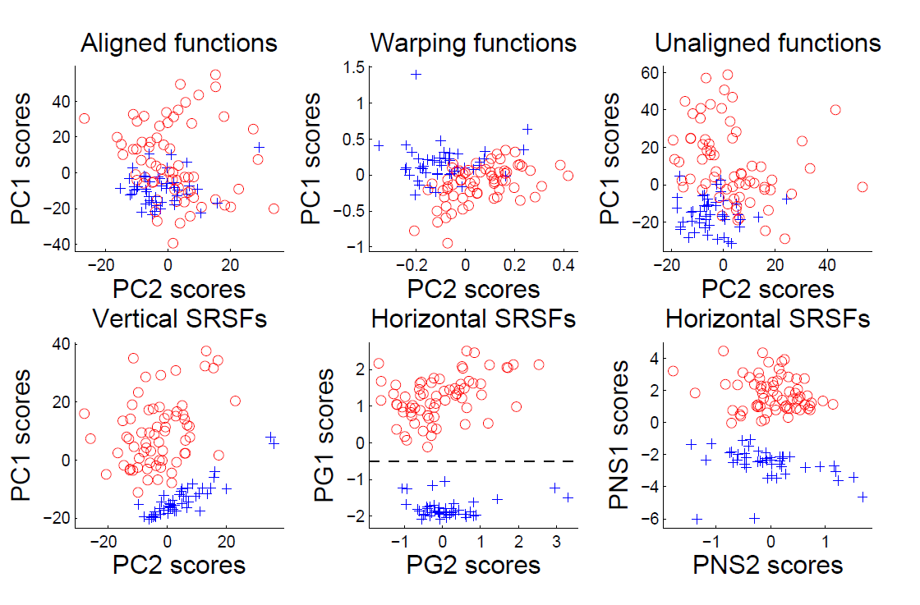
Juggling Data
Clustering In Phase Variation Space:

Slide 39
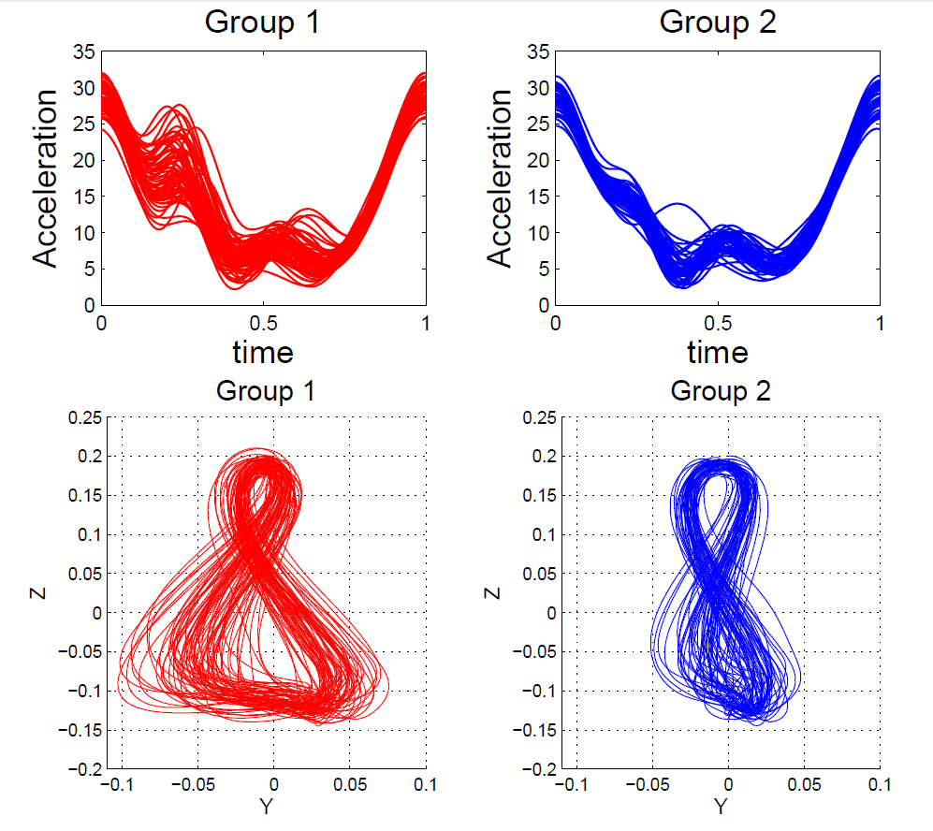
Juggling Data
Interpretation
of Clusters

Slide 40
References for Much More
Big Picture Survey:
Marron et al (2015)
Results of a Competition:
Marron et al (2014)

Slide 41
Overview
Curve Registration is Slippery
Thus, Careful Mathematics is Useful
Fisher-Rao Approach:
Gets the Math Right
Intuitively Sensible
Computable
Generalizable
Worth the Complication

Slide 42
Return to Big Picture
Main statistical goals of OODA:
Understanding population structure
Low dim’al Projections, PCA …
Classification (i. e. Discrimination)
Understanding 2+ populations
Time Series of Data Objects
Chemical Spectra, Mortality Data
“Vertical Integration” of Data Types

Slide 43
Data Integration
Text, Sec. 17.2
Modern Data Collections Often Involve
Multiple Data Types
Important Analytical Task:
Understand How These Work Together
(And Work Separately)

Slide 44
Data Integration
Important Example: Cancer Research
Late 1990s – early 2000s
Microarrays for gene expression
Hype: “Will Cure Cancer”
Hmm, afraid not…
Response:
Have $$$, so measure much more…

Slide 45
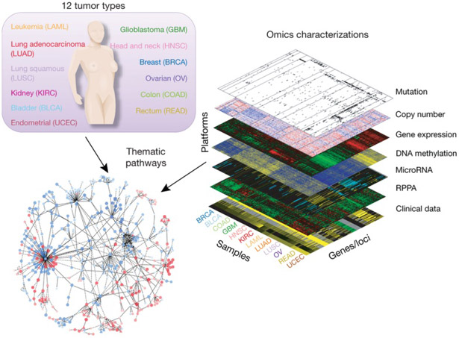
Data Integration
Deep Example:
The
Cancer
Genome
Atlas
(TCGA)
Figure : The Cancer Genome Atlas Research Network, Weinstein, J.N., Collisson, E.A., Mills, G.B., Shaw, K.M., Ozenberger, B.A., Ellrott, K., Shmulevich, I., Sander, C., and Stuart, J.M. (2013)
The Cancer Genome Atlas Pan-Cancer analysis project.

Slide 46
Data Integration
Modern Data Collections Often Involve
Multiple Data Types
Important Analytical Task:
Understand How These Work Together
(And Work Separately)

Slide 47
Data Integration
The Cancer Genome Atlas (TCGA)
Additional Statistical Challenge:
Data Heterogeneity (Think Batch Effects)
$∵$ Massive Cross-Lab Collaboration
Needed Because of Diversity of Cancer
(not 1 Disease, But 100s or 1000s?)

Slide 48
Data Integration
Common Data Structure:
Multi-Block Analysis
Synomyns:
Data Fusion
Multi-View (Machine Learning)
Multi-Modal Data
Functional Factor Models

Slide 49
Data Integration
Multi-Block Data Structure
Blocks are $\left(B\right)$ Data Matrices
Convention:
Columns as Data Objects
I.e. Common Patients,
Experimental Units…

Slide 50
Data Integration
$B=2$ Block Notation
(Can Be Different)
$d_{1},d_{2}=$number of variables
(i.e. features)
$$d_{1}$$
$$n$$
$n =$number of cases
(i.e. subjects or samples)
$$d_{2}$$
$$n$$
(Must Be Same)

Slide 51
Data Integration
Insightful Goal:
Modes of Variation
As in PCA
(Recall Spanish Mortality Data)

Slide 52
A Taste of OODA Examples
Spanish Male Mortality Curves
Enhancement: Color by Year
1908
1931
1964
1987
2002

Slide 53
A Taste of OODA Examples
Spanish Male Mortality Curves
1918 Flu Pandemic
Spanish Civil War
1st Mode of
Variation

Slide 54
A Taste of OODA Examples
Spanish Male Mortality Curves
Flu Pandemic, Civil War
2nd Mode of
Variation
Intro of Automobile,
Improved Safety

Slide 55
Data Integration
Insightful Goal:
Modes of Variation
As in PCA
But Replace Maximal Variation
With Maximal Commonality
(& Maybe Maximal Difference)

Slide 56
Review of Linear Algebra (Cont.)
SVD Full Representation:
=
$$V_{n×n}^{t}$$
$$X_{d×n}$$
$$U_{d×d}$$
$$S_{d×n}$$
Orthonormal Basis Vectors of $ℝ^{d}$
Diagonal Matrix of Singular Values
Orthonormal Basis Vectors of $ℝ^{n}$

Slide 57
Review of Linear Algebra (Cont.)
SVD Compact Representation:
=
For Reduced Rank Approximation Get Best Squared Error Approx. from $r<$ rank($X$)
Key to Dimension Reduction
$$S_{r×r}$$
$$V_{r×n}^{t}$$
$$X_{d×n}$$
$$U_{d×r}$$
$r=$ rank($X$)

Slide 58
Data Integration
Centering: Common Assumption is
Column Object Mean Centered
(Subtract Column Mean Vectors)
Alternate View:
For Each Row,
Subtract Scalar Mean

Slide 59
An Aside on Centering
Several Types:
Column Object Mean Centering
Not in
Text
Subtract Column
Object Mean
Vector in $ℝ^{d}$

Slide 60
An Aside on Centering
Several Types:
Column Object Mean Centering
Row Trait Mean Centering
Subtract Row
Trait Mean
Vector in $ℝ^{n}$

Slide 61
An Aside on Centering
Several Types:
Column Object Mean Centering
Row Trait Mean Centering
Grand Mean Centering
For $\tilde{X}=\left(\begin{matrix}{\tilde{x}}_{1,1} & ⋯ & {\tilde{x}}_{1,n} \\ ⋮ & ⋱ & ⋮ \\ {\tilde{x}}_{d,1} & ⋯ & {\tilde{x}}_{d,n}\end{matrix}\right)$, let ${\overline{x}}_{GM}=\frac{1}{dn}\sum_{i=1}^{d}{\sum_{j=1}^{n}{{\tilde{x}}_{i,j}}}$

Slide 62
An Aside on Centering
Several Types:
Column Object Mean Centering
Row Trait Mean Centering
Grand Mean Centering
Double Mean Centering (Apply Both)
Not as Intuitively Simple as One Might Think
Prothero et al. (2021)

Slide 63
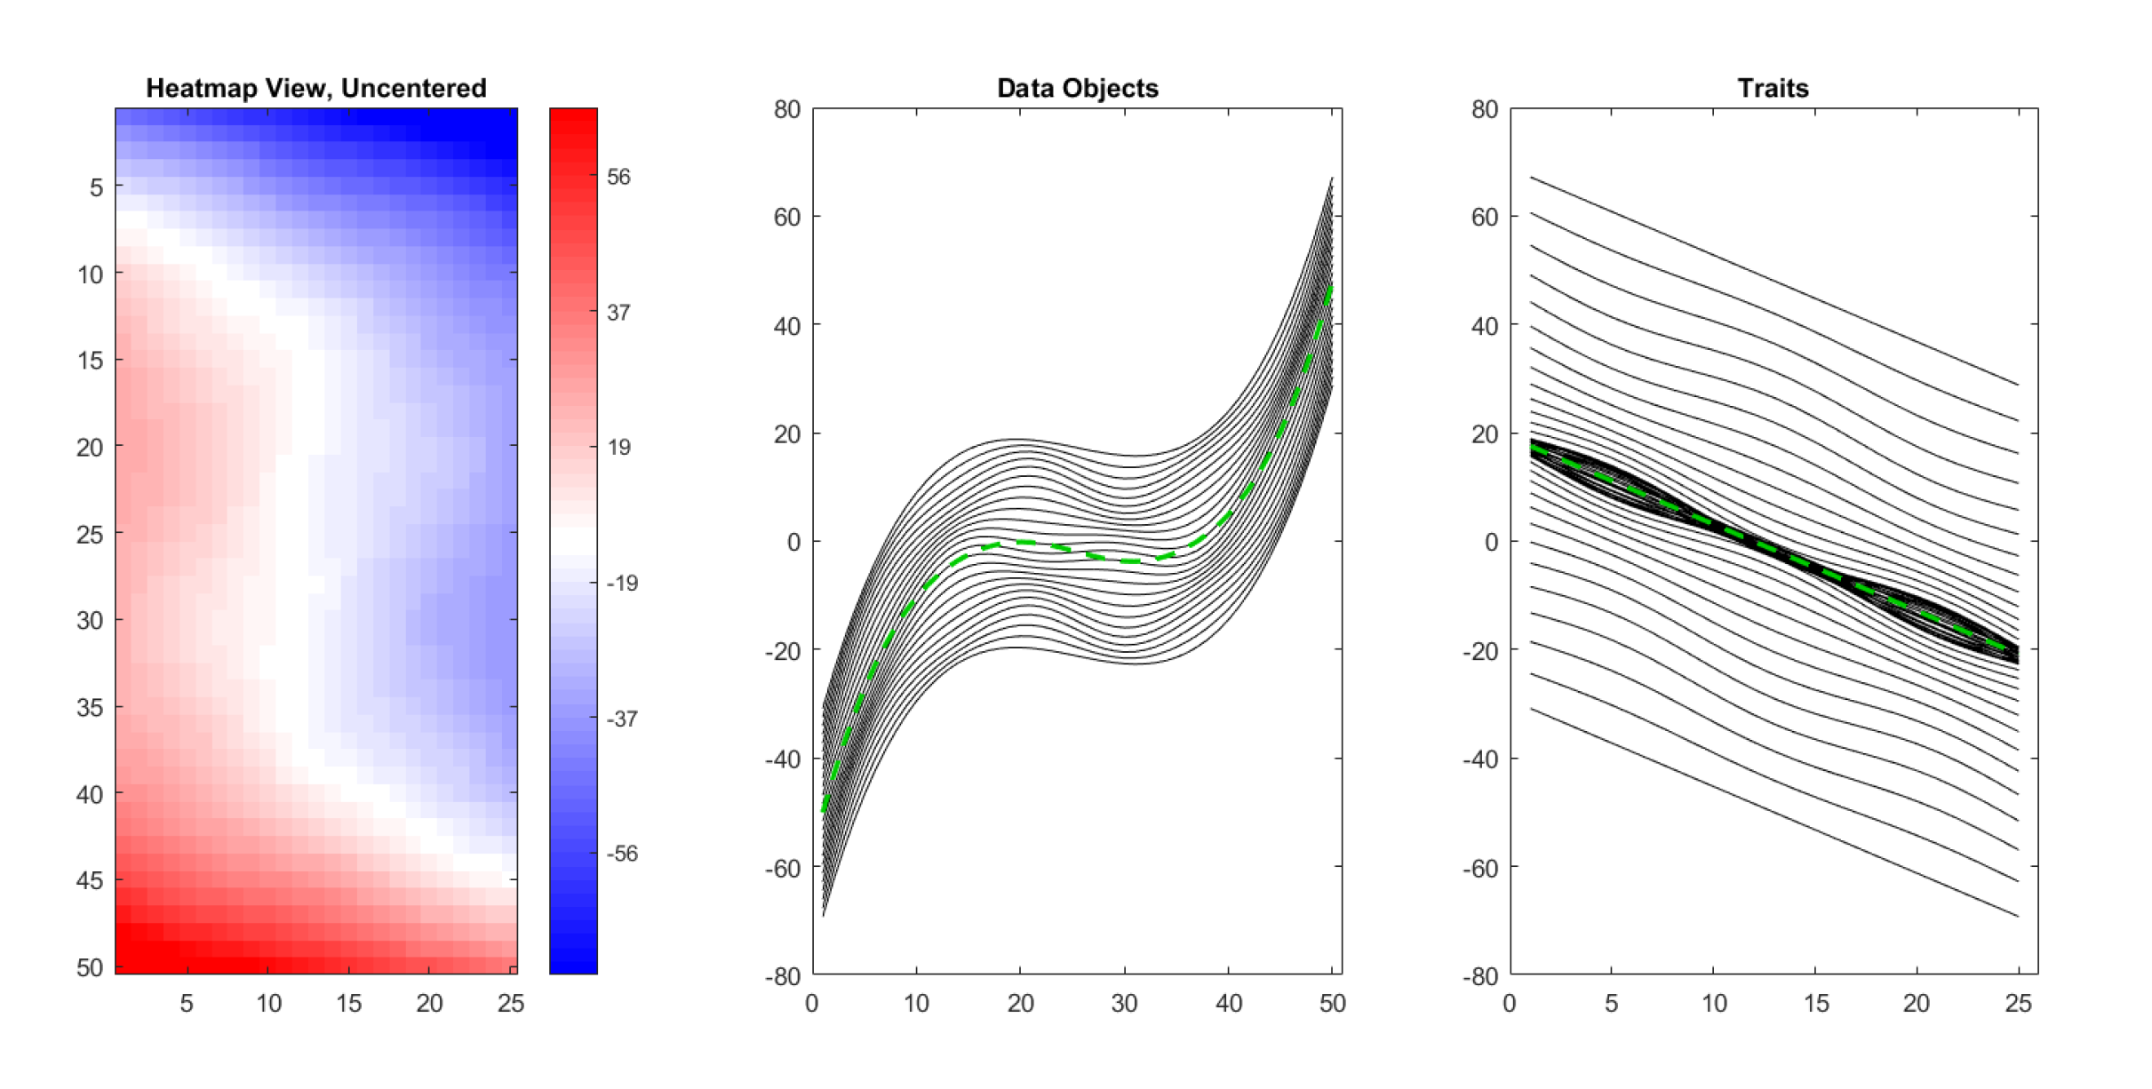
An Aside on Centering
Toy Data Set With 3 Views (Uncentered)
~Sigmoids Moving
Up and Down With
Linear Spacing
Similar to Dual Space
In Optimization
Will Become
Important Soon
~Lines Moving
Up and Down With
Sigmoid Spacing

Slide 64
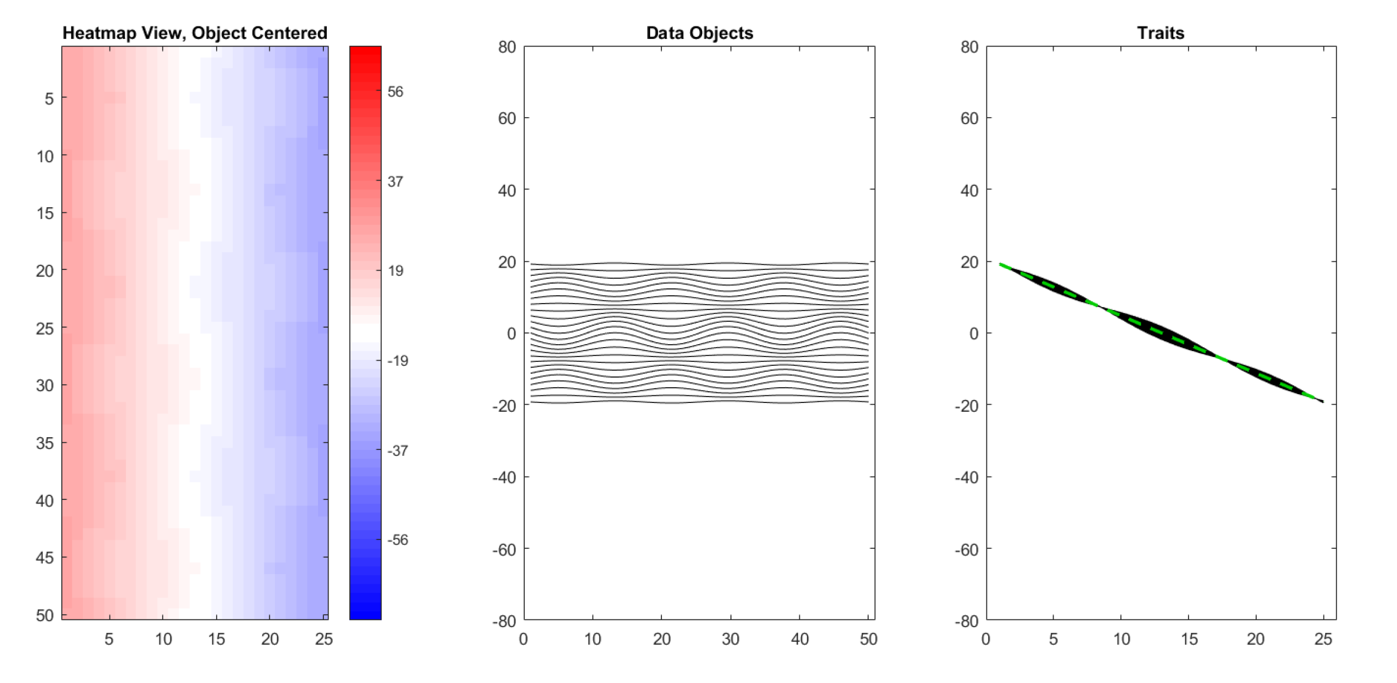
An Aside on Centering
Toy Data Set With 3 Views (Object Centered)
Variation, Which
Followed Sigmoid,
Has Disappeared
This Remainder Is
Nearly Flat Mode
Of Variation
~Sigmoid Shape
Is Now Gone

Slide 65
An Aside on Centering
Toy Data Set With 3 Views (Uncentered)

Slide 66
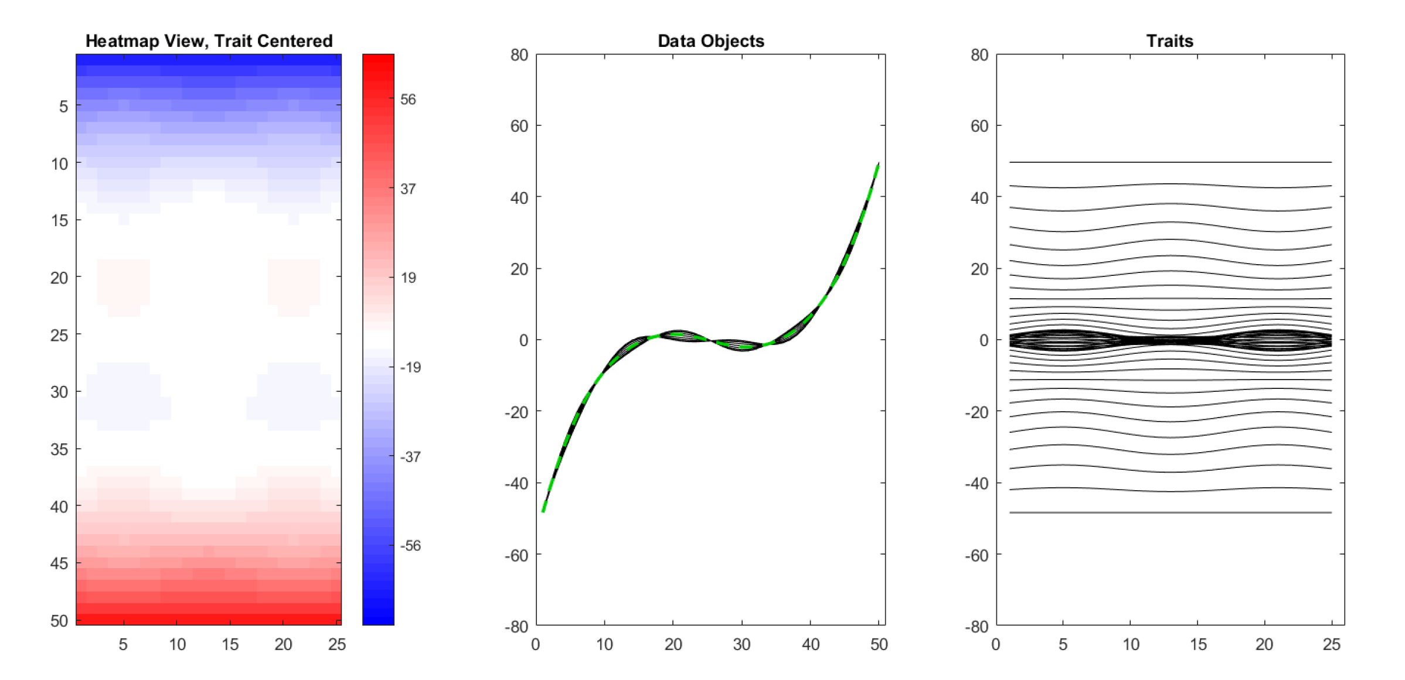
An Aside on Centering
Toy Data Set With 3 Views (Trait Centered)
Linear Slope
Has Disappeared
Note: Row Trait
Mean Centering
Has Removed
The Flat Mode
Of Variation
Which Was Most
Of This Variabiliy
Flat Line Following
Sigmoid

Slide 67
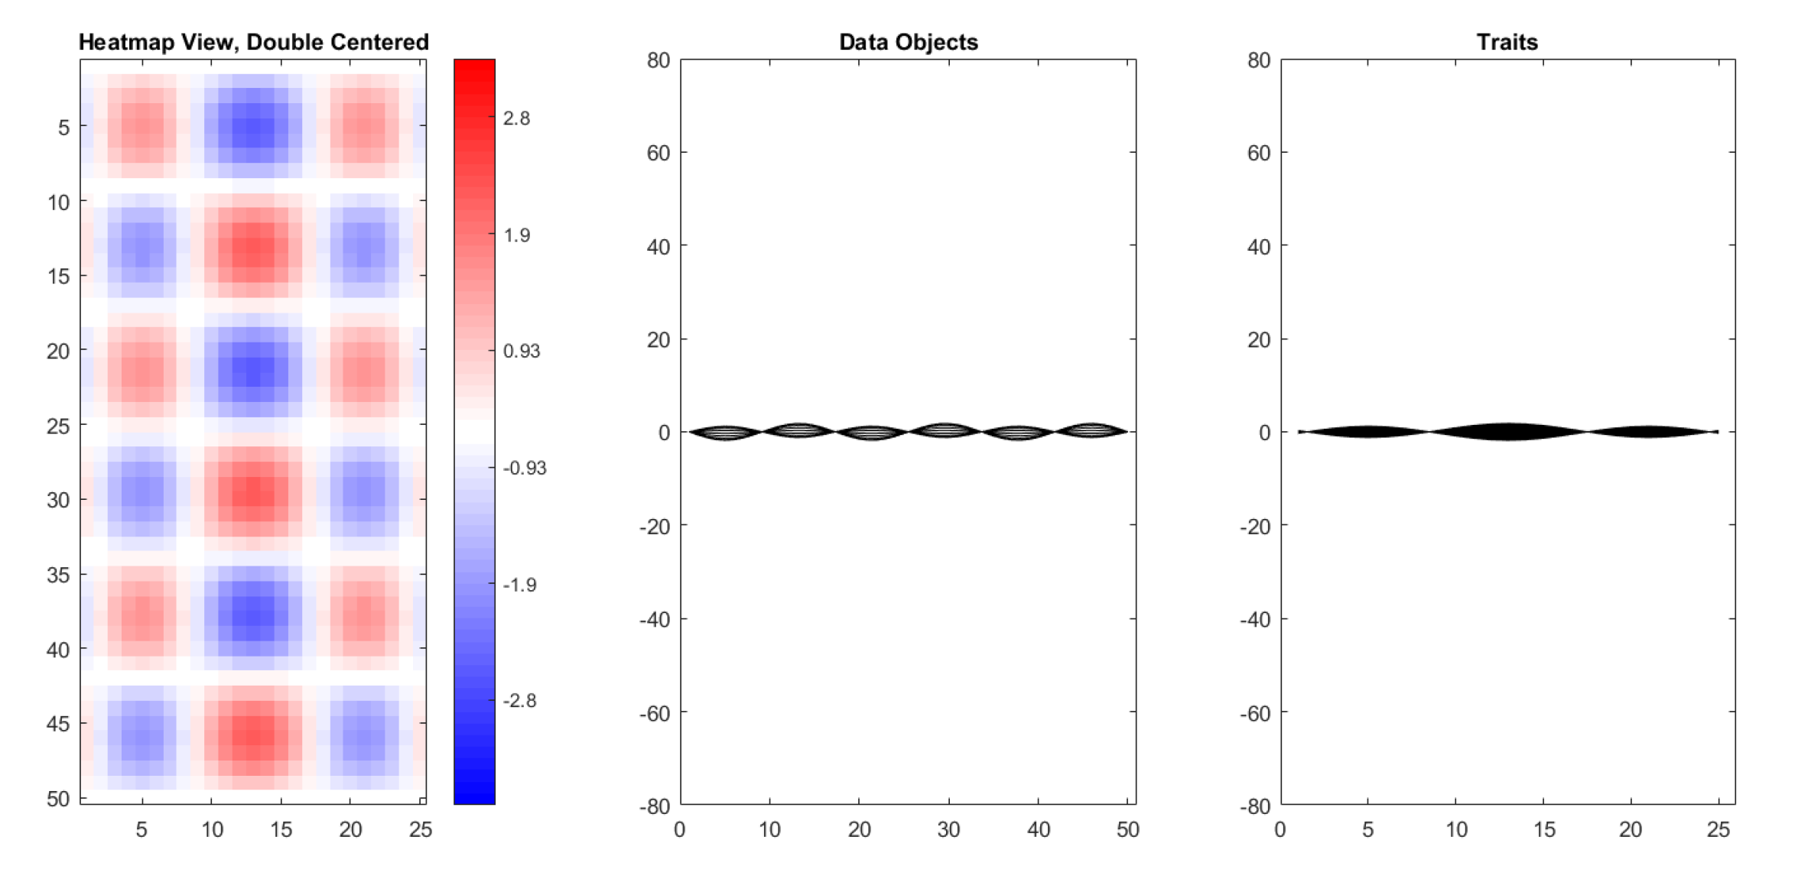
An Aside on Centering
Toy Data Set With 3 Views (Double Centered)
Most Variation Has Disappeared
Reveals Additional Structure
With Much Smaller Scale
Shows Trait Mean Centering Can
Remove A Large Amount of Variation

Slide 68
An Aside on Centering
Several Types:
Column Object Mean Centering
Row Trait Mean Centering
Grand Mean Centering
Double Mean Centering (Apply Both)
Not as Intuitively Simple as One Might Think

Slide 69
An Aside on Centering
Algebra is Simple, but Geometry is Slippery
Challenge: Dual Space Hard to Comprehend
Toy Example:
$n=25$ points in $ℝ^{2}$ ($d=2$)
Also Visualize in Dual Space:
$2$ Points in $ℝ^{25}$
How to Visualize?
Projection!

Slide 70
An Aside on Centering
Recall From HW 4:
Subspace of Flat Vectors in $ℝ^{d}$ is:
$$S_{F}=\left\{\left(\begin{matrix}u \\ ⋮ \\ u\end{matrix}\right):u∈ℝ\right\}$$
Name Clear from Curve Representation,
i.e. Parallel Coordinates View of Vectors

Slide 71
An Aside on Centering
Recall From HW 4:
Averages Are Projections on $S_{F}⊆ℝ^{d}$:
$$P_{S_{F}}\left(\begin{matrix}x_{1} \\ ⋮ \\ x_{d}\end{matrix}\right)=\left(\begin{matrix}\overline{x} \\ ⋮ \\ \overline{x}\end{matrix}\right)$$
Similarly Column Object Mean Centered Data
Matrix Is Projection Onto Orthogonal Space
$$S_{F}^{⊥}=\left\{x∈ℝ^{d}:x^{t}\left(\begin{matrix}1 \\ ⋮ \\ 1\end{matrix}\right)=0\right\}$$

Slide 72
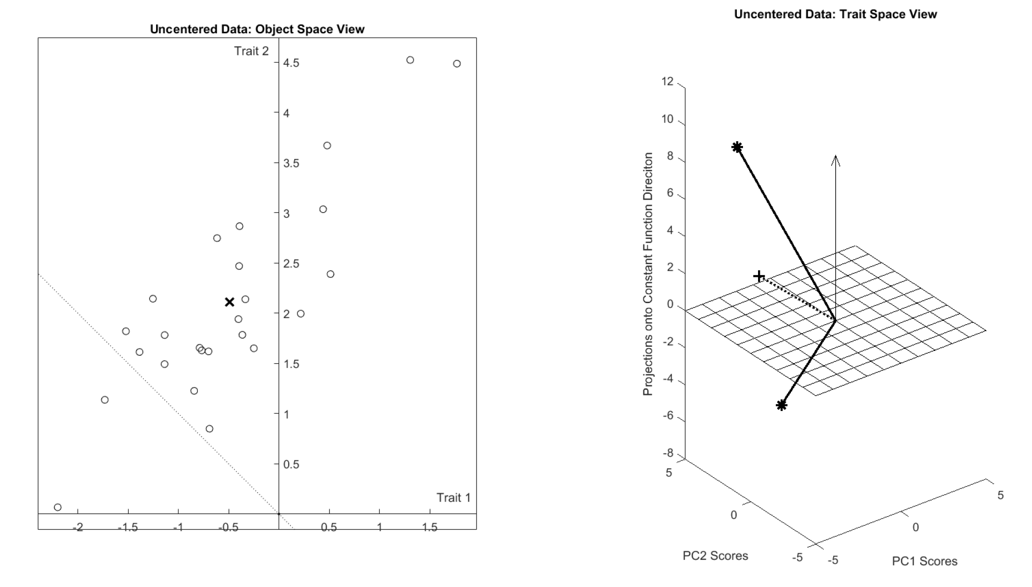
An Aside on Centering
Visualization of Toy Data
$$ℝ^{2}$$
$$ℝ^{25}$$
$$S_{F}$$
$$S_{F}^{⊥}$$
$${\overline{x}}_{RT}$$
$${\overline{x}}_{CO}$$
Rank 2 PC Approx’n of $S_{F}^{⊥}$

Slide 73
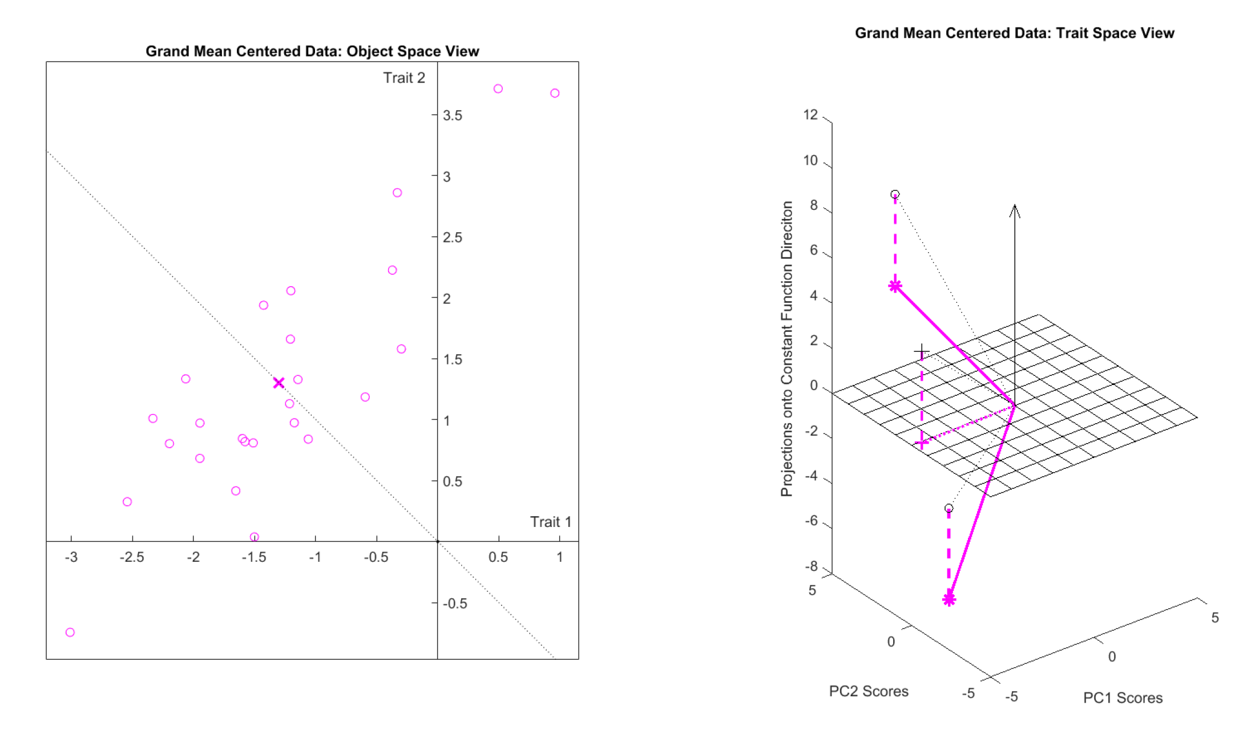
An Aside on Centering
Visualization of Grand Mean Centering
$$ℝ^{2}$$
$$ℝ^{25}$$
Move in $S_{F}$ Direction
Until Center is in $S_{F}^{⊥}$
Move in $S_{F}$ Direction
Until Center is in $S_{F}^{⊥}$

Slide 74
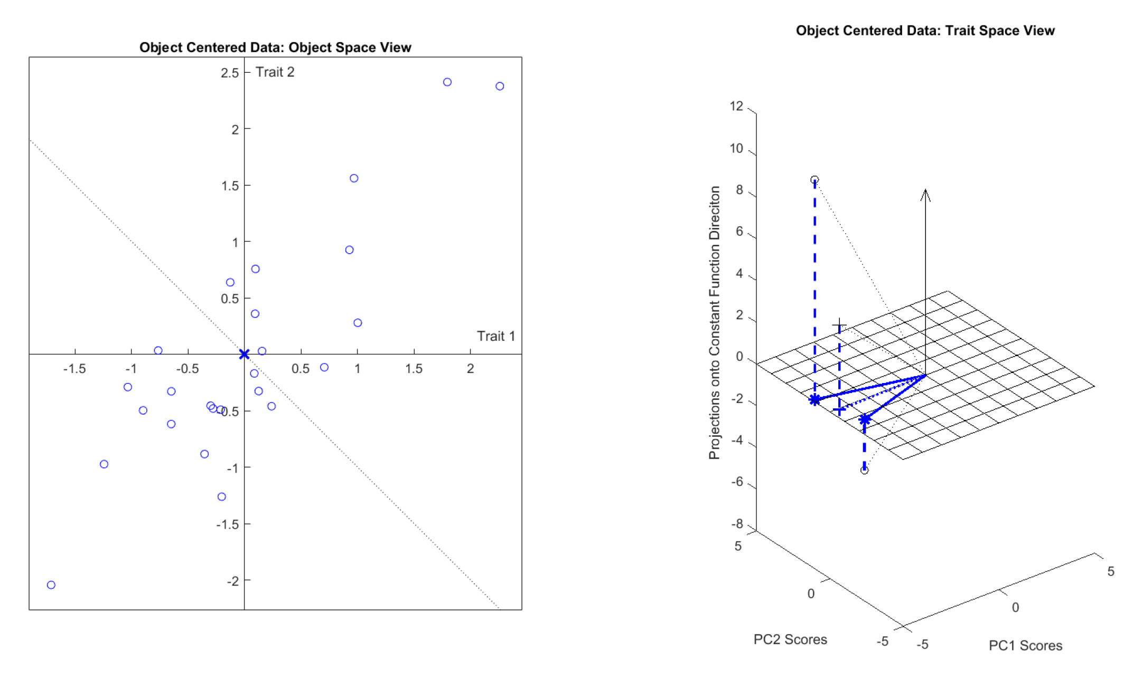
An Aside on Centering
Visualization of Object Centering
$$ℝ^{2}$$
$$ℝ^{25}$$
Data Projected to $S_{F}^{⊥}$
${\overline{x}}_{CO}$ Shifted to 0

Slide 75
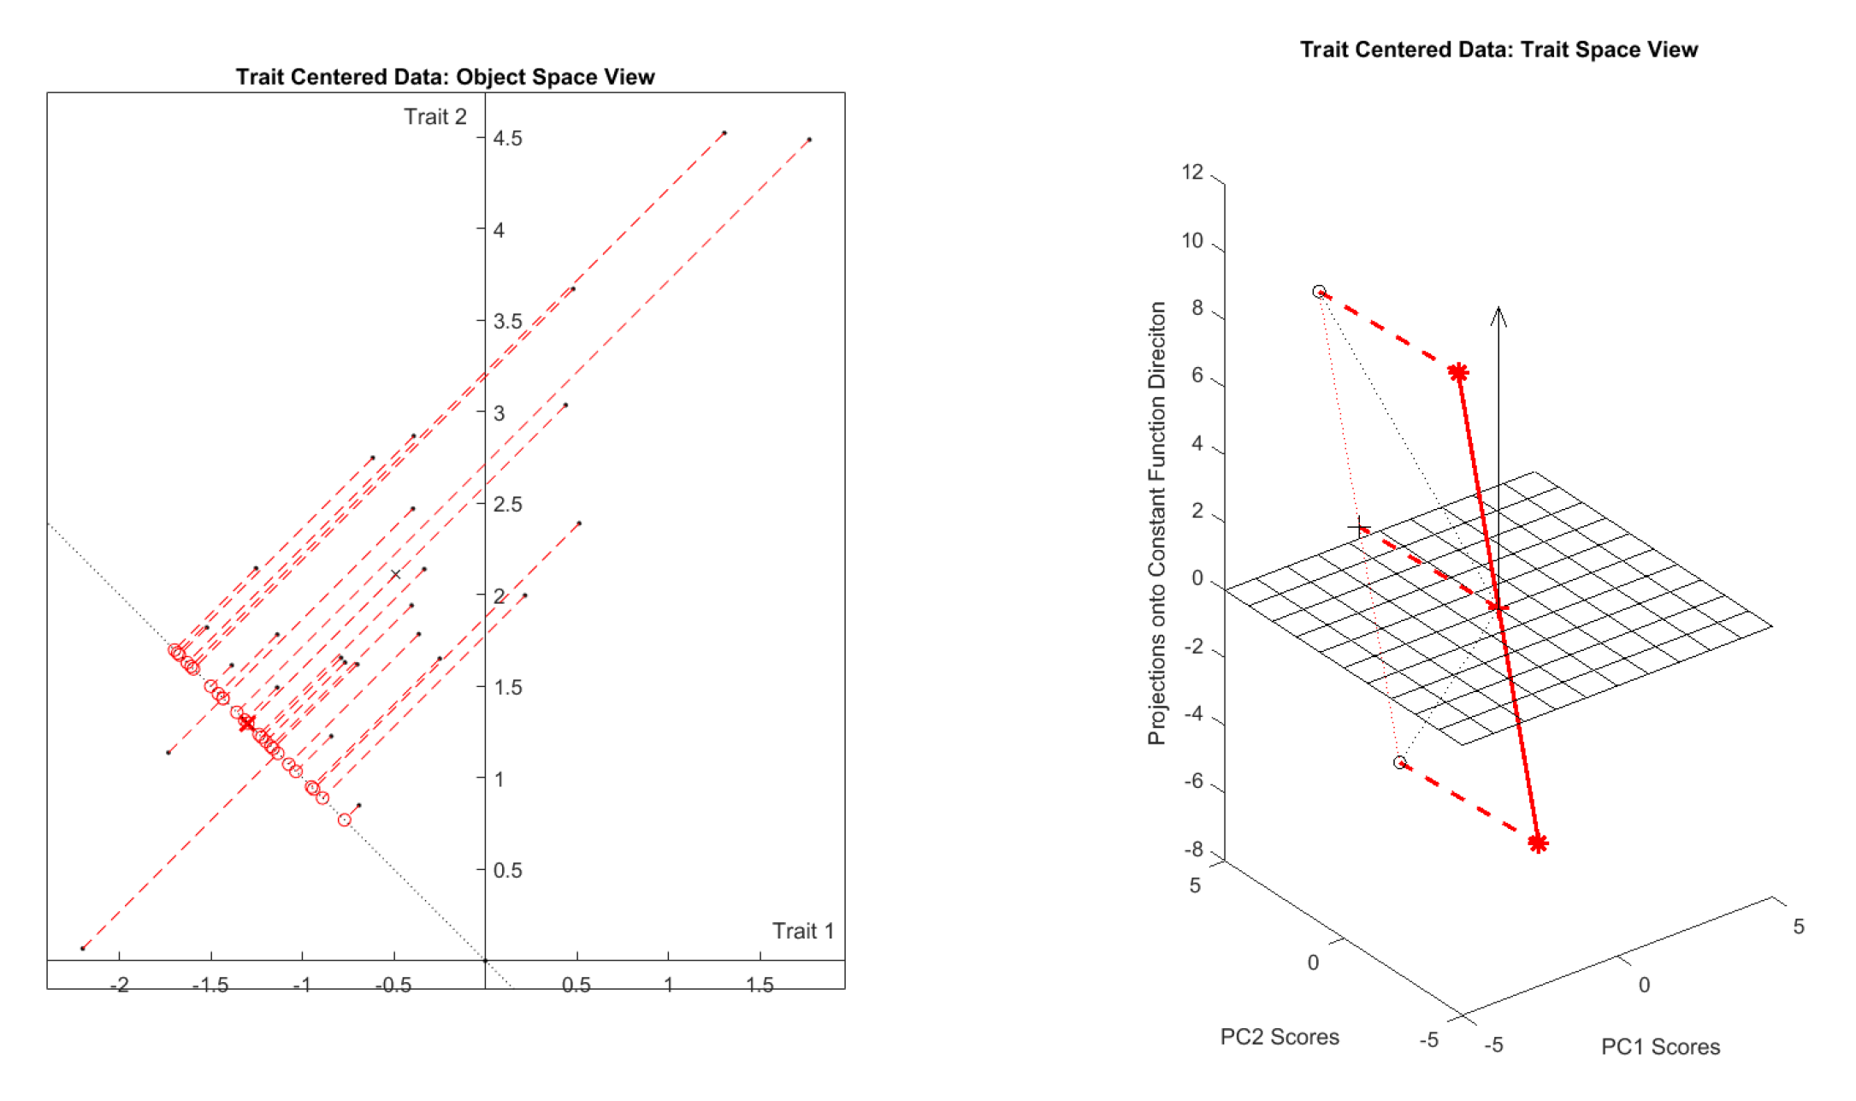
An Aside on Centering
Visualization of Trait Centering
$$ℝ^{2}$$
$$ℝ^{25}$$
Data Projected to $S_{F}^{⊥}$
${\overline{x}}_{CO}$ Shifted to 0

Slide 76
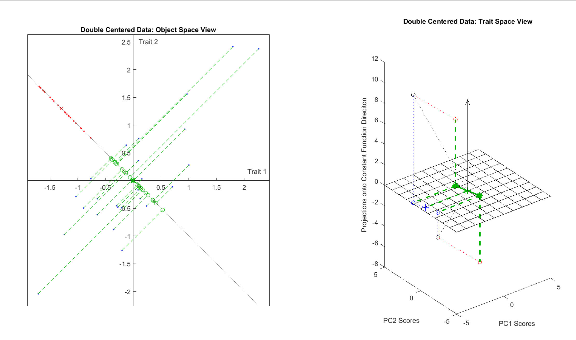
An Aside on Centering
Visualization of Double Centering
$$ℝ^{2}$$
$$ℝ^{25}$$
Shifted & Projected
Shifted & Projected

Slide 77
An Aside on Centering
Several Types:
Column Object Mean Centering
Row Trait Mean Centering
Grand Mean Centering
Double Mean Centering (Apply Both)
Not as Intuitively Simple as One Might Think

Slide 78
Data Integration
Centering: Common Assumption is
Column Object Mean Centered
(Subtract Column Mean Vectors)
Alternate View:
For Each Row,
Subtract Scalar Mean

Slide 79
Data Integration
Recall Tilde Denotes Random Quantities
Useful Notation:
For Data Blocks ${\tilde{X}}^{(b)}$, indexed by $b=1,⋯,B$
Write Estimated Sample Covariance Matrix:
$${\hat{Σ}}^{(b)}={\check{X}}^{(b)}{{\check{X}}^{(b)}}^{t}$$
Based on the Scaled, Object Centered Data:
$${\check{X}}^{(b)}=\frac{1}{\sqrt{n}}\left({\tilde{X}}^{(b)}−{\overline{x}}_{CO}^{(b)}1_{1,n}\right)$$
Matrix of $n$ data objects of dim $d_{b}$
Recall $d_{b}×d_{b}$ Matrix
Recall $d_{b}×n$ Matrix

Slide 80
Data Integration
Useful Notation (in Case $B=2$):
Joint Sample Covariance Matrix:
$$\left[\begin{matrix}{\hat{Σ}}^{(1)} & {\hat{Σ}}^{(1,2)} \\ {\hat{Σ}}^{(2,1)} & {\hat{Σ}}^{(2)}\end{matrix}\right]$$
where:
$${\hat{Σ}}^{(b,b^{′})}={\check{X}}^{(b)}{{\check{X}}^{(b^{′})}}^{t}$$
Matrix of Sample Covariances
$d_{b}×d_{b^{′}}$ Matrix
Called Cross-Covariance

Slide 81
Data Integration
Major Approaches (to Modes of Variation):
Partial Least Squares
Canonical Correlations
JIVE & DIVAS

Slide 82
Partial Least Squares
Text: Sec, 17.2.1
Name PLS Coined By:
Wold (1975, 1985)
Good Overview:
Wegelin (2000)
Caution: $∃$ Many Variations

Slide 83
Partial Least Squares
Simple Version:
Find Directions of Maximal Covariance
Using SVD of Cross-Covariance Matrix:
$${\hat{Σ}}^{(1,2)}=\tilde{U}\tilde{D}{\tilde{V}}^{t}$$
As with PCA, Columns of $\tilde{U}$ & $\tilde{V}$
Give orthonormal dir’ns in $ℝ^{d_{1}}$ & $ℝ^{d_{2}}$
Hence are Loadings Vectors

Slide 84
Partial Least Squares
Compute Scores:
Inner Products With Centered Data
${\tilde{S}}^{(1)}={\tilde{U}}^{t}\left({\tilde{X}}^{(1)}−{\overline{x}}_{CO}^{(1)}1_{1,n}\right)$
${\tilde{S}}^{(2)}={\tilde{V}}^{t}\left({\tilde{X}}^{(2)}−{\overline{x}}_{CO}^{(2)}1_{1,n}\right)$
View as Projections or Regressions
Loadings and Scores give Modes of Variation

Slide 85
Partial Least Squares
Caution:
Columns of ${\tilde{S}}^{(1)}$ & ${\tilde{S}}^{(2)}$ are not orthogonal
Can Seriously Impact Scores Scatterplots
Wold’s Version of PLS:
Orthogonal Scores Vectors
At price of Non-Orthogonal Loadings
(i.e. Direction Vectors)

Slide 86
Partial Least Squares
Wold’s Motivation:
Starts with PCA Regression
Idea: In Multiple Linear Regression
$y=Xβ+ε$
When Design Matrix $X$ is Poorly Conditioned,
Replace by 1st Few PCs
E. g. Has
Co-Linearities
Often Called Latent Variables
Provides Stable Least Squares

Slide 87
Partial Least Squares
Drawback to PCA Regression:
Directions Maximize Variation in $X$
Ignoring Response $y$
Wold’s Improvement:
Instead Maximize Covariance with $y$
Orthogonal Scores Sensible
(Even Though Needs Iterative Computation)
Parallel to Visualization Idea:
PCA Ignores Class Labels

Slide 88
Partial Least Squares
Aside: “PLS Regression” Seems to Dominate Searches for:
“Partial Least Squares”
Despite Value for Calculating
Modes of Variation

Slide 89
Participant Presentation
1:35 Hyeon Lee:
Tree PCA
Next Class: Katelyn McInerney

