Slide 1
Statistics – O. R. 881
Object Oriented Data Analysis
Steve Marron
Dept. of Statistics and Operations Research
University of North Carolina

Slide 2
Current Sections in Textbook
Today:
Section 14.2
Next Class:
Section 17.2

Slide 3
Next Time
Fix Chapters

Slide 4
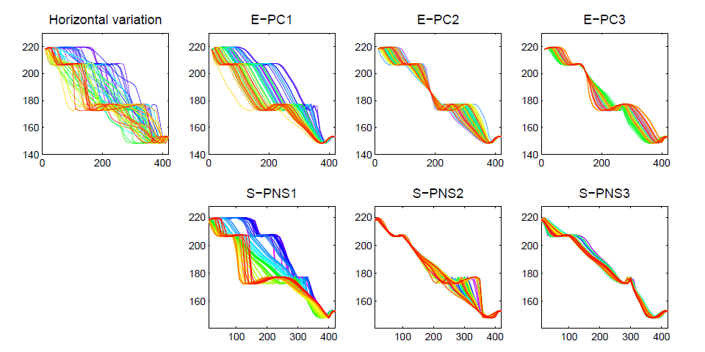
Last Class: PNS on SRVFs
Real Data Analysis: Blood Glucose Curves

Slide 5
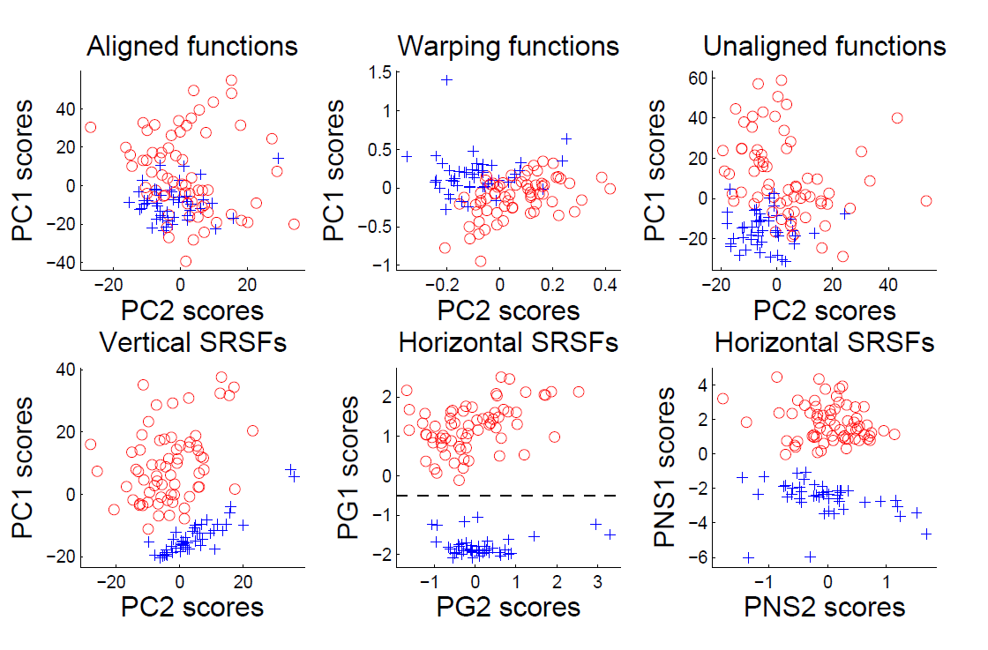
Last Class: Juggling Data
Clustering In Phase Variation Space:

Slide 6
Last Class: Data Integration
Text, Sec. 17.2
Modern Data Collections Often Involve
Multiple Data Types
Important Analytical Task:
Understand How These Work Together
(And Work Separately)

Slide 7

Data Integration
Multi-Block Data Structure
Blocks are $\left(B\right)$ Data Matrices
Convention:
Columns as Data Objects
I.e. Common Patients,
Experimental Units…

Slide 8
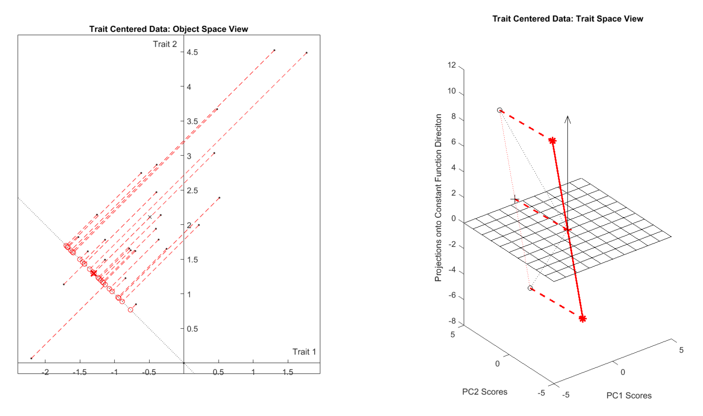
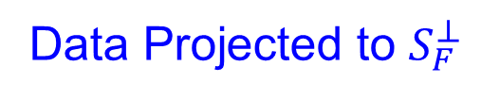



Last Class: Centering
Visualization of Trait Centering
$$ℝ^{2}$$
$$ℝ^{25}$$
Data Projected to $S_{F}^{⊥}$
${\overline{x}}_{CO}$ Shifted to 0

Slide 9
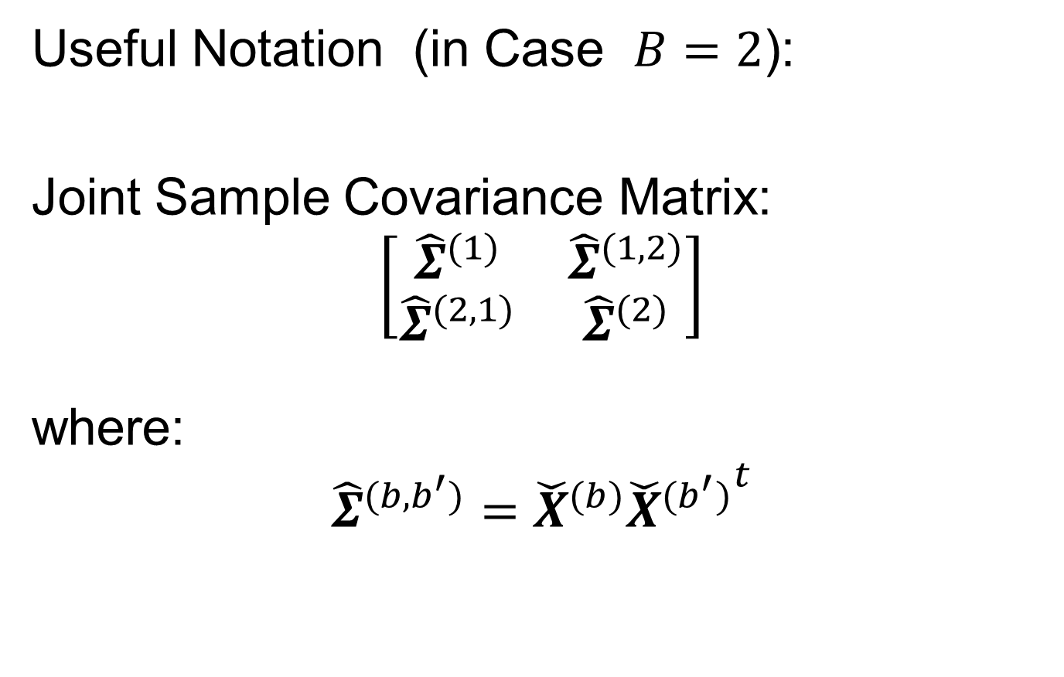

Last Class: Data Integration
Useful Notation (in Case $B=2$):
Joint Sample Covariance Matrix:
$$\left[\begin{matrix}{\hat{Σ}}^{(1)} & {\hat{Σ}}^{(1,2)} \\ {\hat{Σ}}^{(2,1)} & {\hat{Σ}}^{(2)}\end{matrix}\right]$$
where:
$${\hat{Σ}}^{(b,b^{′})}={\check{X}}^{(b)}{{\check{X}}^{(b^{′})}}^{t}$$
$d_{b}×d_{b^{′}}$ Matrix
Called Cross-Covariance

Slide 10
Last Class: Data Integration
Major Approaches (to Modes of Variation):
Partial Least Squares
Canonical Correlations
JIVE & DIVAS

Slide 11
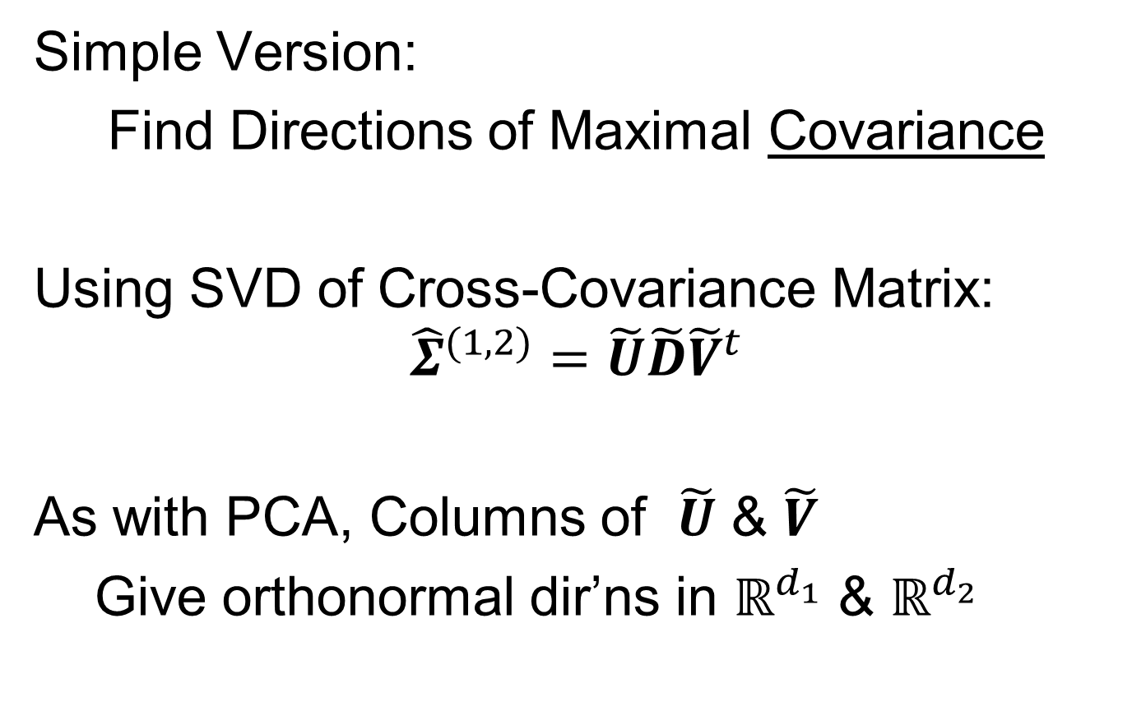
Last Class: Part. Least Squares
Simple Version:
Find Directions of Maximal Covariance
Using SVD of Cross-Covariance Matrix:
$${\hat{Σ}}^{(1,2)}=\tilde{U}\tilde{D}{\tilde{V}}^{t}$$
As with PCA, Columns of $\tilde{U}$ & $\tilde{V}$
Give orthonormal dir’ns in $ℝ^{d_{1}}$ & $ℝ^{d_{2}}$
Hence are Loadings Vectors

Slide 12
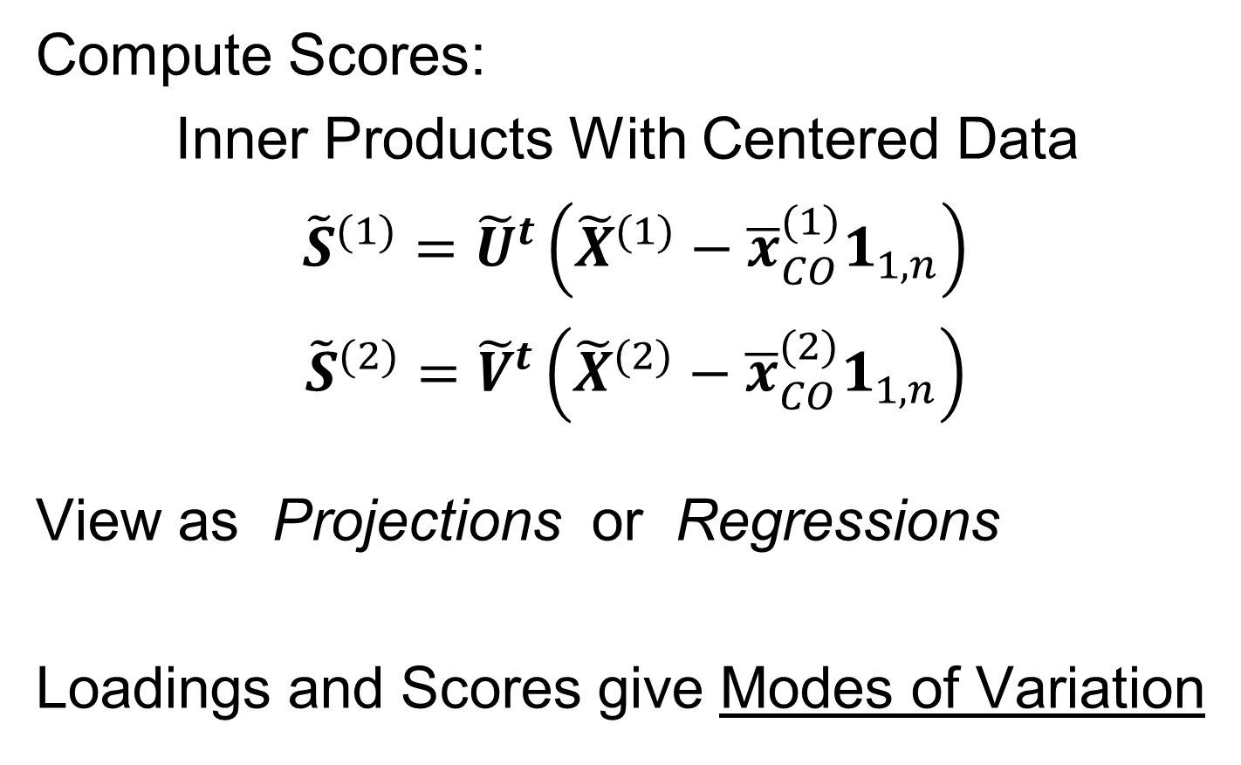
Last Class: Part. Least Squares
Compute Scores:
Inner Products With Centered Data
${\tilde{S}}^{(1)}={\tilde{U}}^{t}\left({\tilde{X}}^{(1)}−{\overline{x}}_{CO}^{(1)}1_{1,n}\right)$
${\tilde{S}}^{(2)}={\tilde{V}}^{t}\left({\tilde{X}}^{(2)}−{\overline{x}}_{CO}^{(2)}1_{1,n}\right)$
View as Projections or Regressions
Loadings and Scores give Modes of Variation

Slide 13
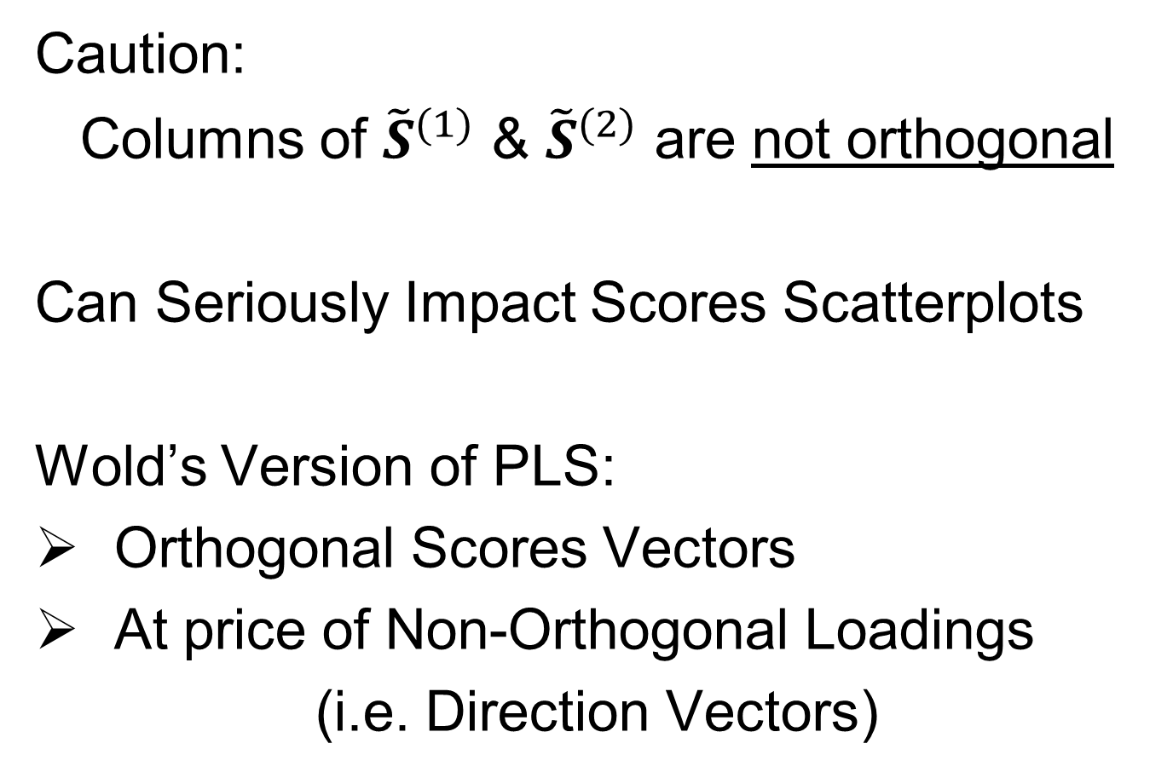
Last Class: Part. Least Squares
Caution:
Columns of ${\tilde{S}}^{(1)}$ & ${\tilde{S}}^{(2)}$ are not orthogonal
Can Seriously Impact Scores Scatterplots
Wold’s Version of PLS:
Orthogonal Scores Vectors
At price of Non-Orthogonal Loadings
(i.e. Direction Vectors)

Slide 14
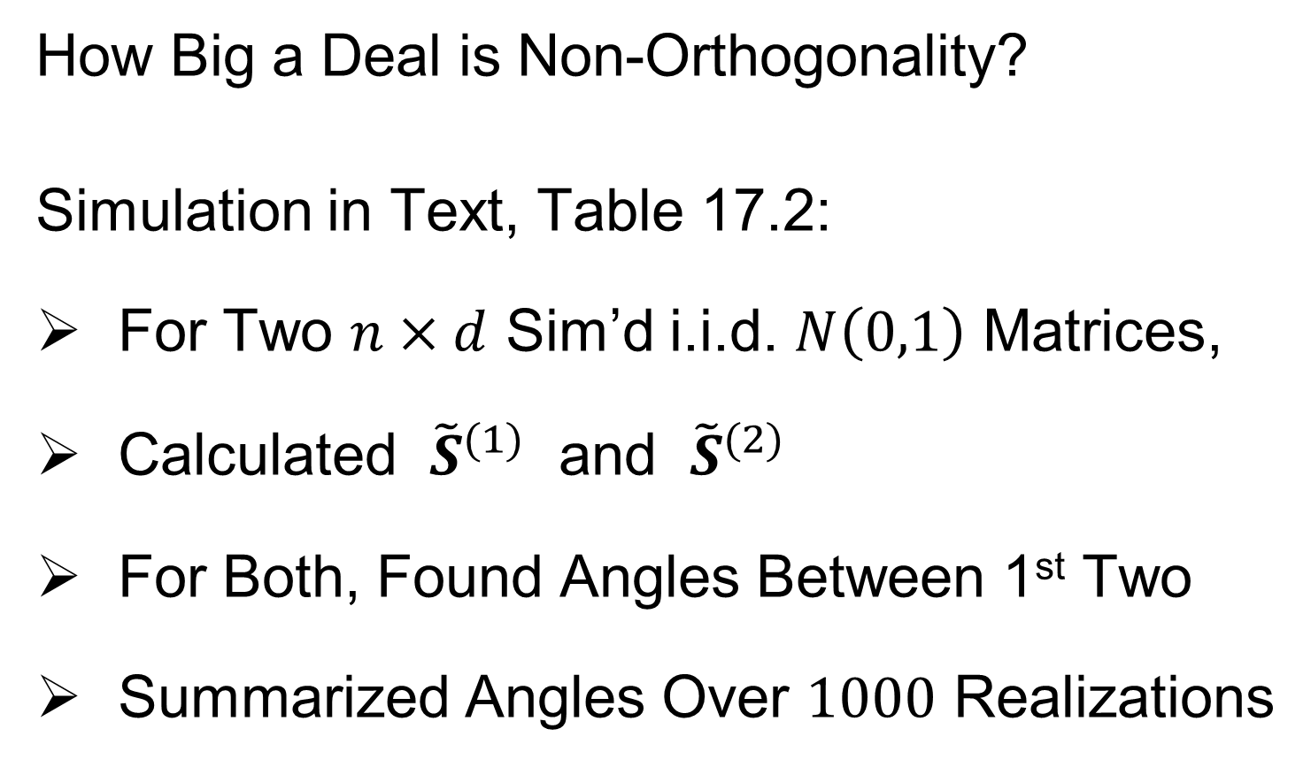
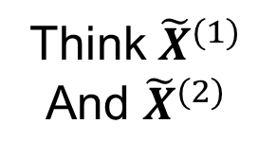
Partial Least Squares
How Big a Deal is Non-Orthogonality?
Simulation in Text, Table 17.2:
For Two $n×d$ Sim’d i.i.d. $N\left(0,1\right)$ Matrices,
Calculated ${\tilde{S}}^{(1)}$ and ${\tilde{S}}^{(2)}$
For Both, Found Angles Between 1st Two
Summarized Angles Over $1000$ Realizations
Think ${\tilde{X}}^{(1)}$
And ${\tilde{X}}^{(2)}$

Slide 15
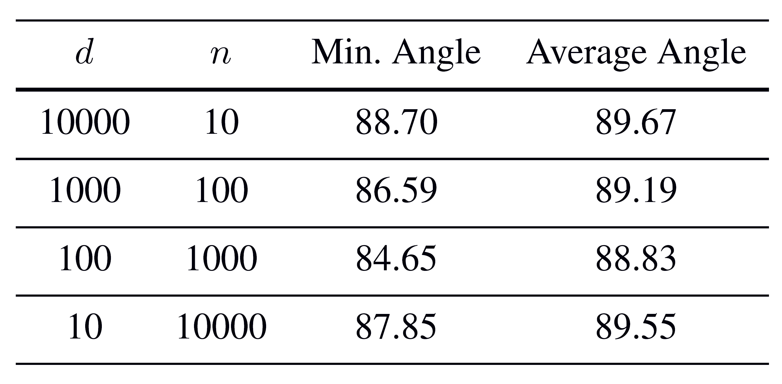

Partial Least Squares
How Big a Deal is Non-Orthogonality?
Simulation in Text, Table 17.2
Angles Between 1st Two Scores Vectors:
Will Soon See Reason For This
All Close to ${90}^{°}$
Closer Near
Extremes

Slide 16
Data Integration
Major Approaches (to Modes of Variation):
Partial Least Squares
Canonical Correlations
JIVE & DIVAS

Slide 17
Canonical Correlations
Text: Sec, 17.2.2
Hotelling (1936):
Canonical Correlation Analysis (CCA)
Main Idea: Dir’ns to Maximize Correlation
(versus Covariance for PLS)
Founder of UNC STOR

Slide 18
Canonical Correlations
CCA Computation:
Change of Variable & SVD
Details in Section 17.2.2 of Text
Gives Orthogonal Scores, but Not Loadings

Slide 19
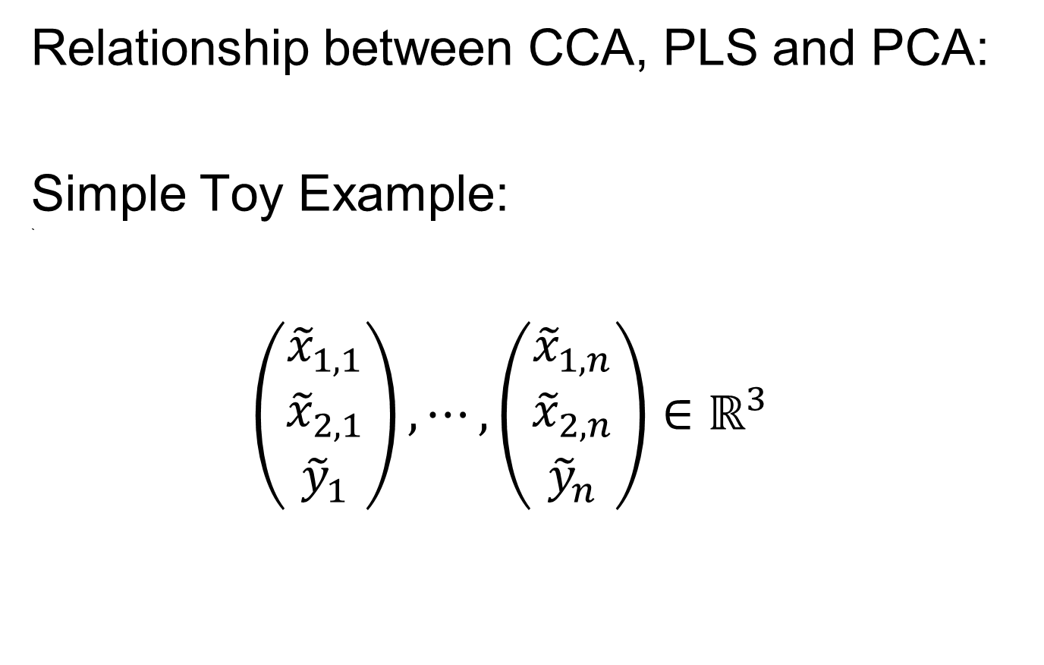
Canonical Correlations
Relationship between CCA, PLS and PCA:
Simple Toy Example:
`
$$\left(\begin{matrix}{\tilde{x}}_{1,1} \\ {\tilde{x}}_{2,1} \\ {\tilde{y}}_{1}\end{matrix}\right),⋯,\left(\begin{matrix}{\tilde{x}}_{1,n} \\ {\tilde{x}}_{2,n} \\ {\tilde{y}}_{n}\end{matrix}\right)∈ℝ^{3}$$

Slide 20
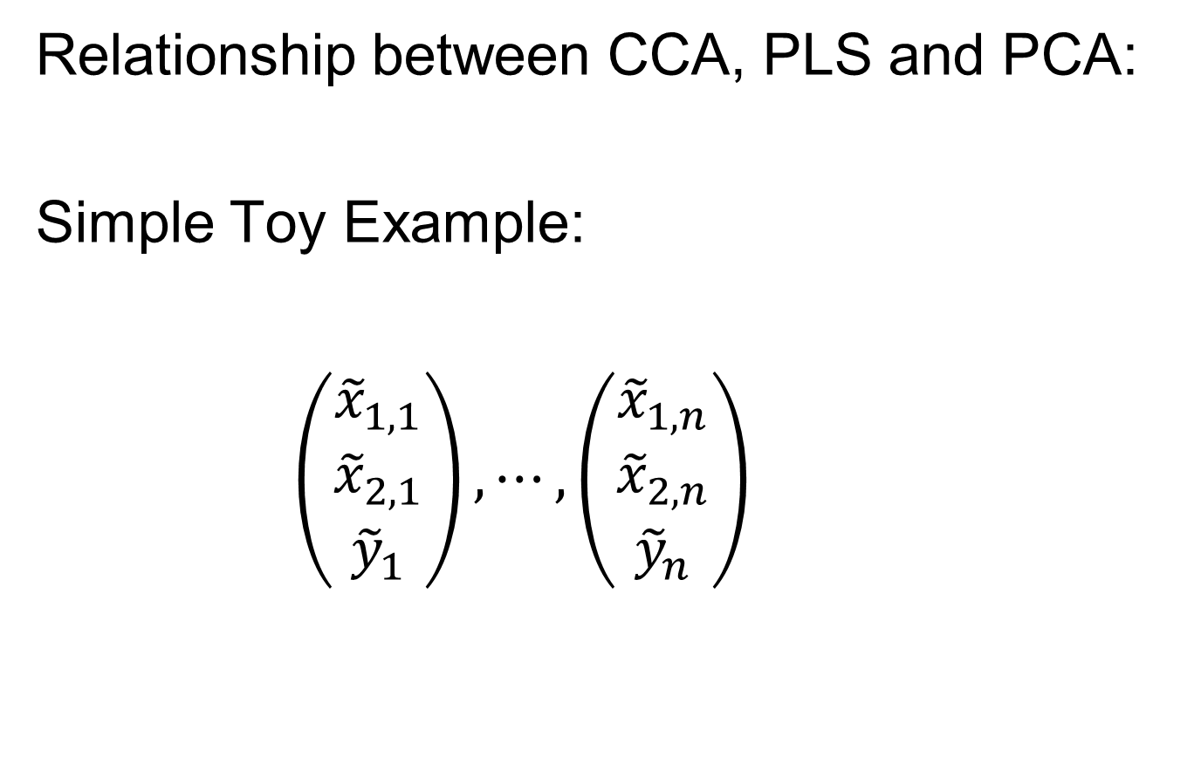
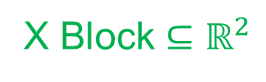
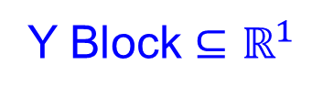
Canonical Correlations
Relationship between CCA, PLS and PCA:
Simple Toy Example:
$\left(\begin{matrix}{\tilde{x}}_{1,1} \\ {\tilde{x}}_{2,1} \\ {\tilde{y}}_{1}\end{matrix}\right),⋯,\left(\begin{matrix}{\tilde{x}}_{1,n} \\ {\tilde{x}}_{2,n} \\ {\tilde{y}}_{n}\end{matrix}\right)$
X Block $⊆ℝ^{2}$
Y Block $⊆ℝ^{1}$

Slide 21
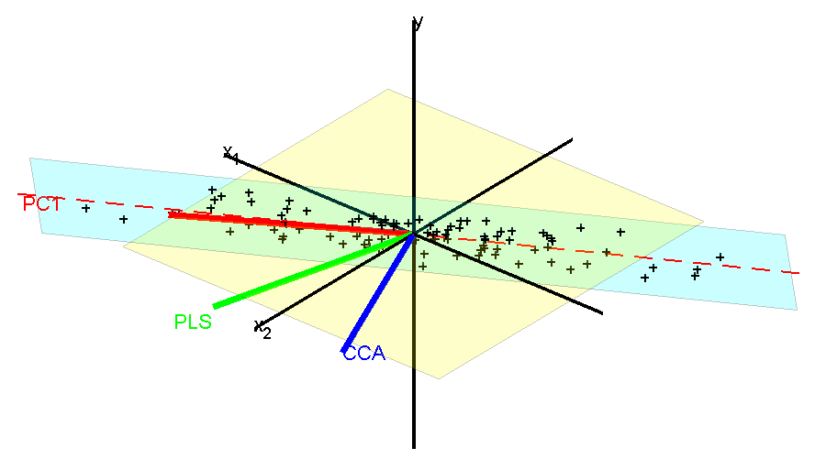
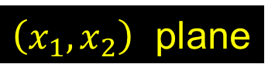
Canonical Correlations
Relationship between CCA, PLS and PCA:
Dashed Red is Intersection
~ PC1 Direction
Data Lie In Cyan Plane
$\left(x_{1},x_{2}\right)$ plane

Slide 22
Next Time
Make movie version

Slide 23
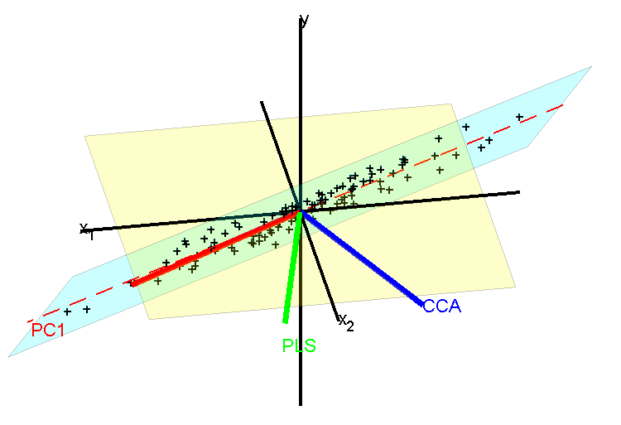

Canonical Correlations
Relationship between CCA, PLS and PCA:
Top Edge
Bottom Edge
Direction in x-plane
With max y correlation
Note Direction $⊥$ Intersection

Slide 24
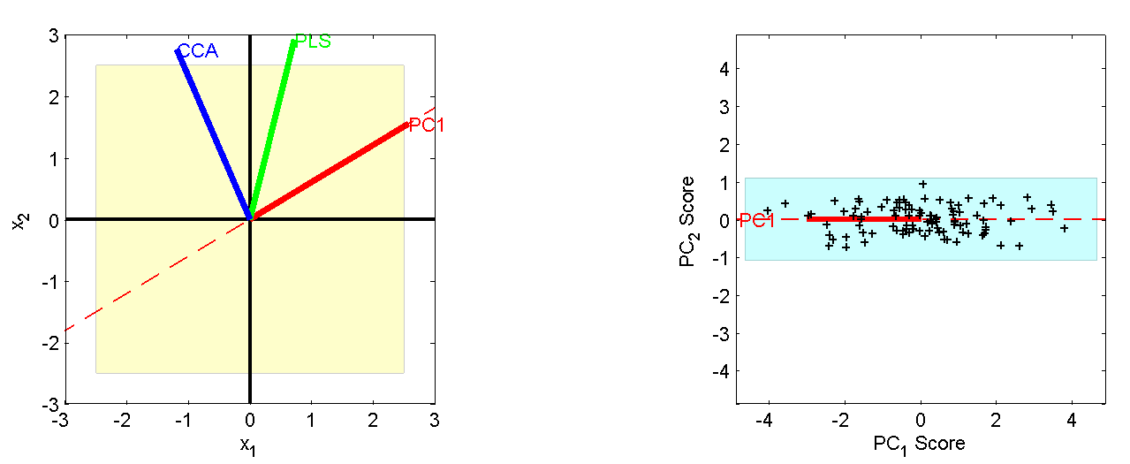
Canonical Correlations
Relationship between CCA, PLS and PCA:
Projection on x₁ - x₂ plane
Projection on PC₁ - PC₂ plane
Highlights
PC1 & CCA
Very Different
PLS Is a
Compromise
Since PLS
Feels Both
Corr & Var

Slide 25
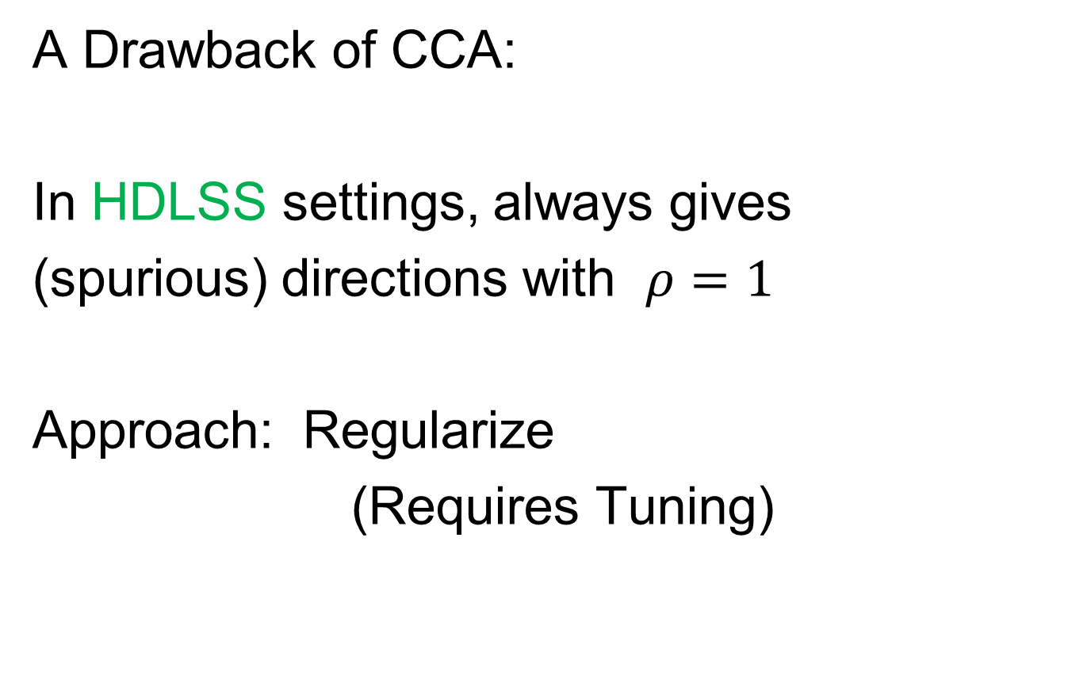
Canonical Correlations
A Drawback of CCA:
In HDLSS settings, always gives
(spurious) directions with $ρ=1$
Approach: Regularize
(Requires Tuning)

Slide 26
Data Integration
Major Approaches (to Modes of Variation):
Partial Least Squares
Canonical Correlations
JIVE & DIVAS

Slide 27
JIVE
Text: Sec, 17.2.3
But Very Superficial,
Will Do Much More Here
Joint and Individual Variation Explained
Lock, Hoadley, Marron & Nobel (2013)
Joint Modes of Variation
Key Contribution: Individual Modes
Scores Only Maximally Correlated
Same Scores
Major Contrast with CCA
With Mathematical Definition

Slide 28
JIVE
Joint and Individual Variation Explained
Lock, Hoadley, Marron & Nobel (2013)
Joint Modes of Variation
Key Contribution: Individual Modes
Angle Based JIVE (AJIVE)
Feng, Jiang, Hannig & Marron (2018)
Non-Iterative Linear Algebra Calculation
Uses Intuitive Principal Angle Analysis
Same Scores

Slide 29

AJIVE Analytical Goals
Explore & Quantify Variation
Through Joint Variation
via Common Scores
(Signatures Among Cases)
Focus Away from PCA Directions in $ℝ^{d}$
Now On Scores in $ℝ^{n}$, Not Loadings
(As in PLS & CCA)
Since Commonality is Among Cases
Dual Space Linear Algebra,
Not Primal Space

Slide 30
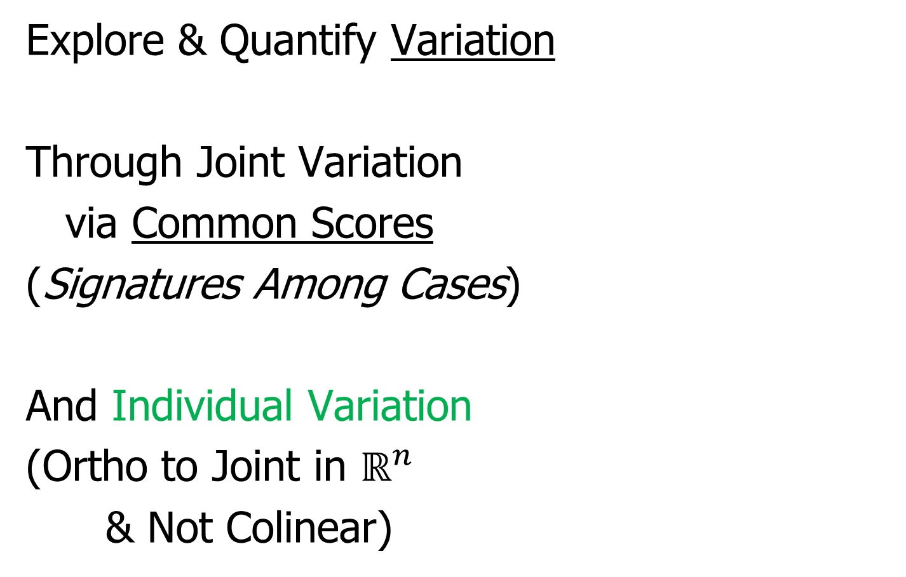
AJIVE Analytical Goals
Explore & Quantify Variation
Through Joint Variation
via Common Scores
(Signatures Among Cases)
And Individual Variation
(Ortho to Joint in $ℝ^{n}$
& Not Colinear)

Slide 31
AJIVE Analytical Goals
Then Understand Drivers
Of Variation Using:
Joint Loadings
Recall Modes of Variation
Are Rank 1 Matrices
= Loadings x Scores

Slide 32
AJIVE Analytical Goals
Then Understand Drivers
Of Variation Using:
Joint Loadings
Individual Loadings
Both Computed as
Projections Onto Scores
Best Rank 1
Approximations
Can Consider As Regression

Slide 33
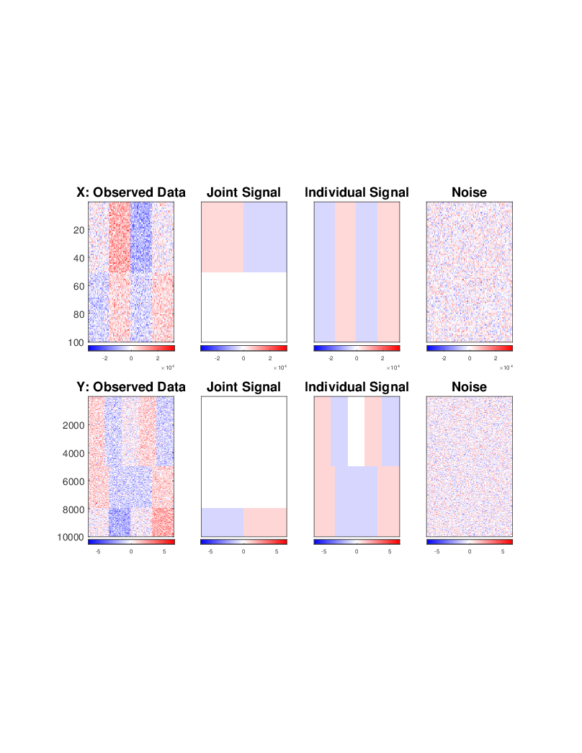
AJIVE Toy Example
“Heat Map” View
Based on Color Bar
Red for > 0
White for = 0
Blue for < 0
Intensity shows magnitude

Slide 34
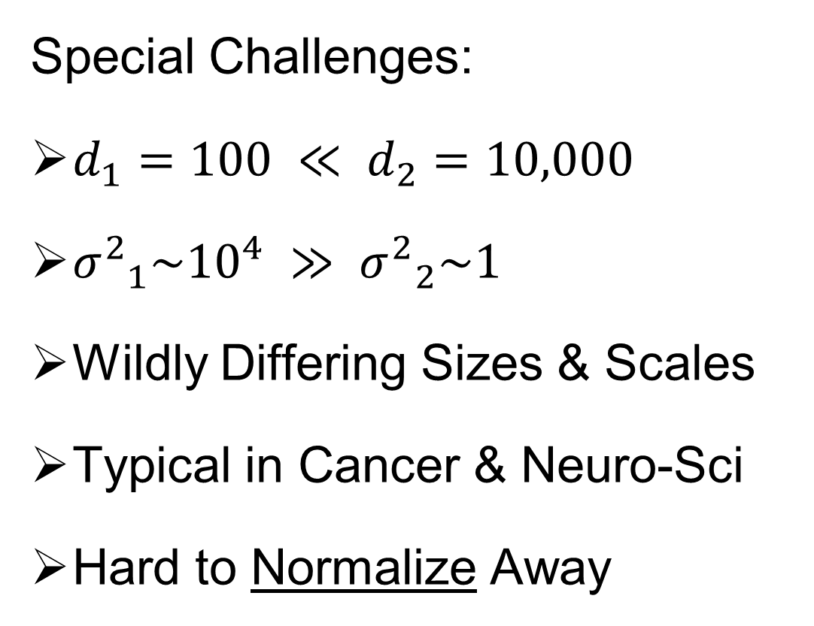
AJIVE Toy Example
Note: X and Y Labels Is Limiting to $B=2$ Two Block Case
Special Challenges:
$d_{1}=100 ≪ d_{2}=10,000$
${σ^{2}}_{1}\sim {10}^{4} ≫ {σ^{2}}_{2}\sim 1$
Wildly Differing Sizes & Scales
Typical in Cancer & Neuro-Sci
Hard to Normalize Away

Slide 35
AJIVE Toy Example
Underlying Components
(Additive
Signals +
+ Noise)
=
+
+
=
+
+

Slide 36
AJIVE Toy Example
Underlying Components:
Joint – Rank 1
Same
“Subject
Signal”
(linear combo)
=
+
+
=
+
+

Slide 37
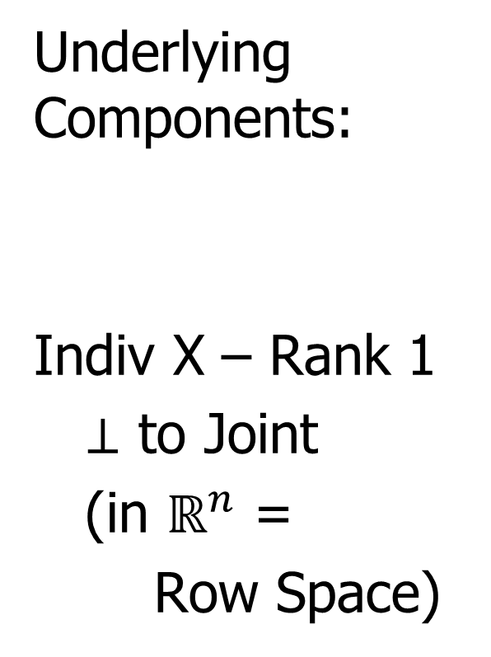
AJIVE Toy Example
Underlying Components:
Indiv X – Rank 1
$⊥$ to Joint
(in $ℝ^{n}$ =
Row Space)
=
+
+
=
+
+

Slide 38

AJIVE Toy Example
Orthogonality of Rows Comes From:
$$\left(\begin{matrix}\begin{matrix}1 & ⋯ & 1\end{matrix} & \begin{matrix}−1 & ⋯ & −1\end{matrix}\end{matrix}\right)\left(\begin{matrix}\begin{matrix}\begin{matrix}−1 \\ ⋮ \\ −1\end{matrix} \\ \begin{matrix}1 \\ ⋮ \\ 1\end{matrix}\end{matrix} \\ \begin{matrix}\begin{matrix}−1 \\ ⋮ \\ −1\end{matrix} \\ \begin{matrix}1 \\ ⋮ \\ 1\end{matrix}\end{matrix}\end{matrix}\right)=0$$

Slide 39
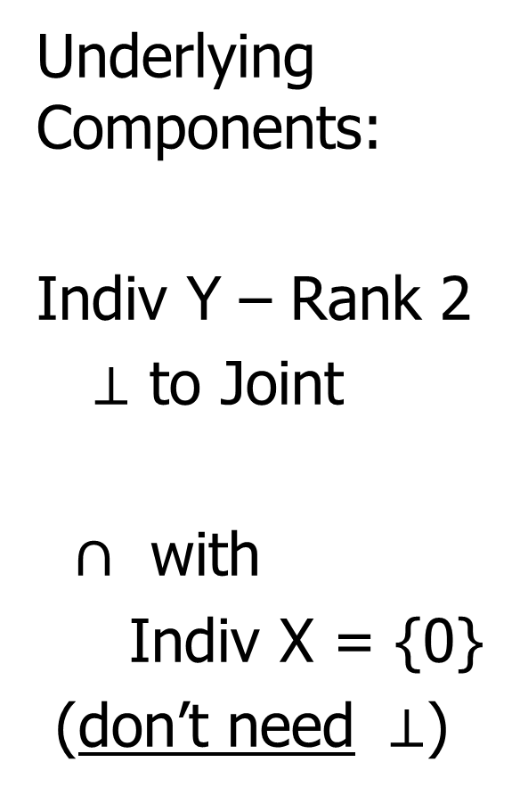
AJIVE Toy Example
Underlying Components:
Indiv Y – Rank 2
$⊥$ to Joint
$∩$ with
Indiv X = {0}
(don’t need $⊥$)
=
+
+
=
+
+

Slide 40
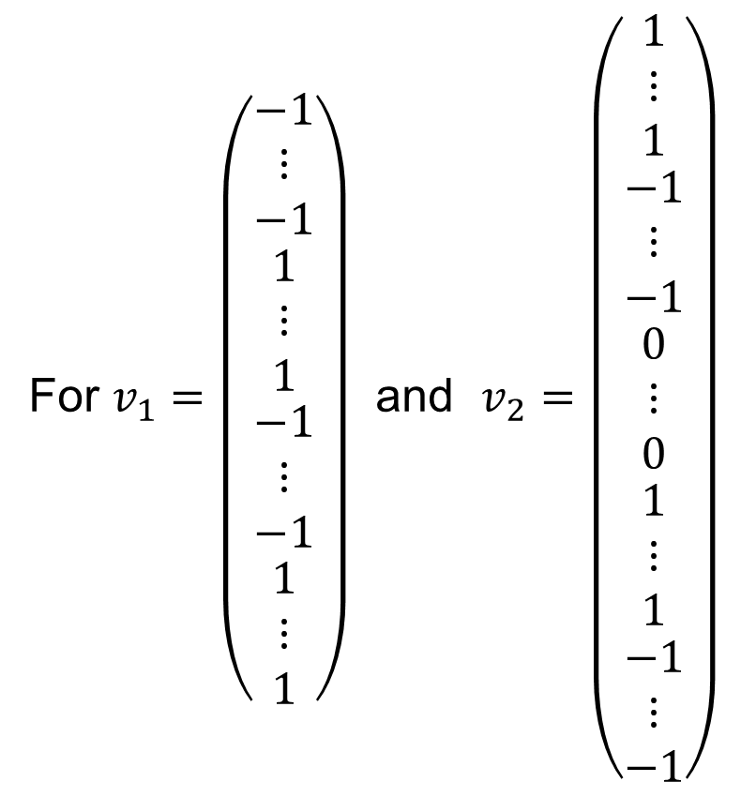
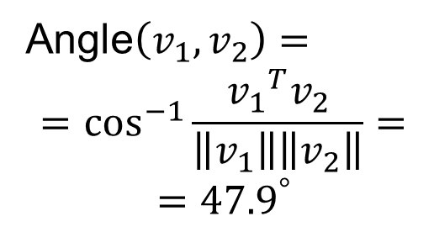
AJIVE Toy Example
To Check Non-Orthogonality:
For $v_{1}=\left(\begin{matrix}\begin{matrix}\begin{matrix}−1 \\ ⋮ \\ −1\end{matrix} \\ \begin{matrix}1 \\ ⋮ \\ 1\end{matrix}\end{matrix} \\ \begin{matrix}\begin{matrix}−1 \\ ⋮ \\ −1\end{matrix} \\ \begin{matrix}1 \\ ⋮ \\ 1\end{matrix}\end{matrix}\end{matrix}\right)$ and $v_{2}=\left(\begin{matrix}\begin{matrix}1 \\ ⋮ \\ 1\end{matrix} \\ \begin{matrix}\begin{matrix}−1 \\ ⋮ \\ −1\end{matrix} \\ \begin{matrix}0 \\ ⋮ \\ 0\end{matrix} \\ \begin{matrix}1 \\ ⋮ \\ 1\end{matrix}\end{matrix} \\ \begin{matrix}−1 \\ ⋮ \\ −1\end{matrix}\end{matrix}\right)$
Angle$\left(v_{1},v_{2}\right)=$
$$=\cos^{−1}{\frac{{v_{1}}^{T}v_{2}}{\left\|v_{1}\right\|\left\|v_{2}\right\|}}=$$
$$={47.9}^{°}$$

Slide 41
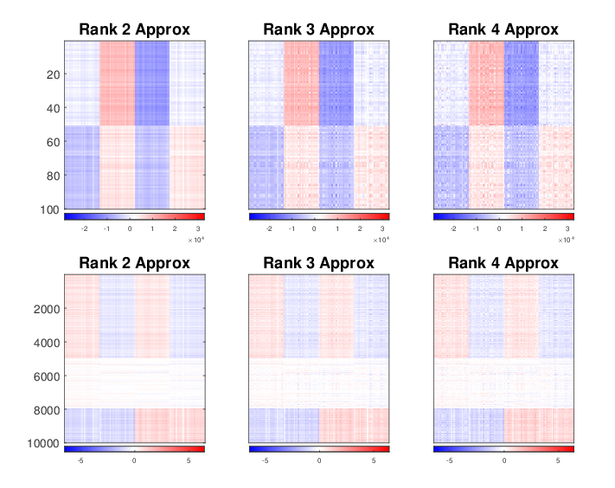

AJIVE Toy Example
Since Large Variance in X Block
Concatenate & SVD:
Only (Joint $∪$ X – Indiv), Lose Sep. & Y – Indiv

Slide 42
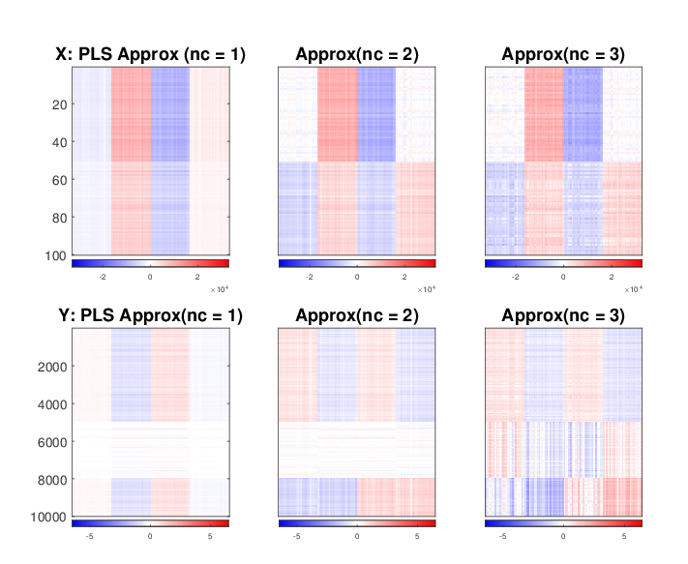
AJIVE Toy Example
Partial Least Squares:
Decent Rank 2 Approx., but no Indiv. Comp.
Y – Indiv. Complely Gone (Var. Too Low)

Slide 43
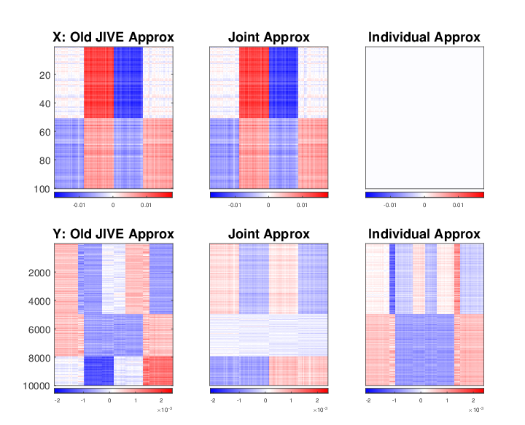
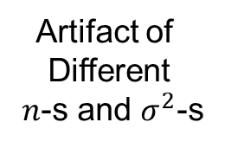
AJIVE Toy Example
Artifact of
Different
$n$-s and $σ^{2}$-s
Early JIVE (Lock et al, 2013):
Good 2-d Approx. – Missed Joint-Ind Decomp.

Slide 44
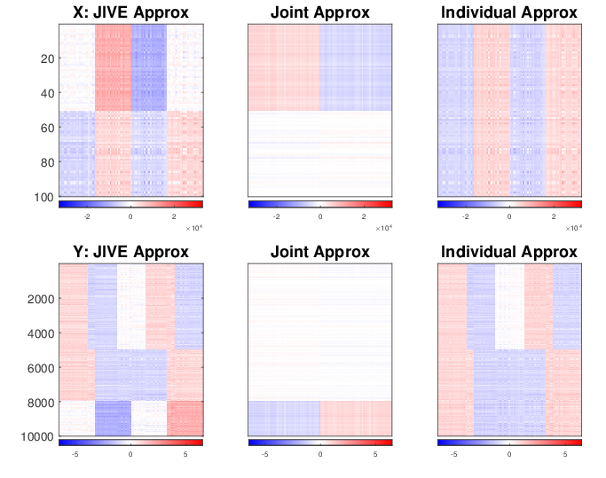
AJIVE Toy Example
Current AJIVE: Excellent Decomposition (Both Joint and Individual)

Slide 45
AJIVE Analysis of FMRI Data
Functional Magnetic Resonance Imaging
Approach:
Measure “Brain Activity”
Over Both Location & Time
Via Blood Flow
Data Objects???

Slide 46



AJIVE Analysis of FMRI Data
Functional Magnetic Resonance Imaging
2015 SAMSI Program
On Neuroscience
Qunqun Yu Benjamin Risk
Yu, et al. (2017)

Slide 47
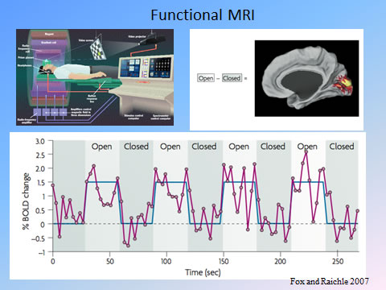
AJIVE Analysis of FMRI Data
Data
Objects?
3d- Movie?
Time Series
At Voxels?
Thanks to fmri.ucsd.edu

Slide 48

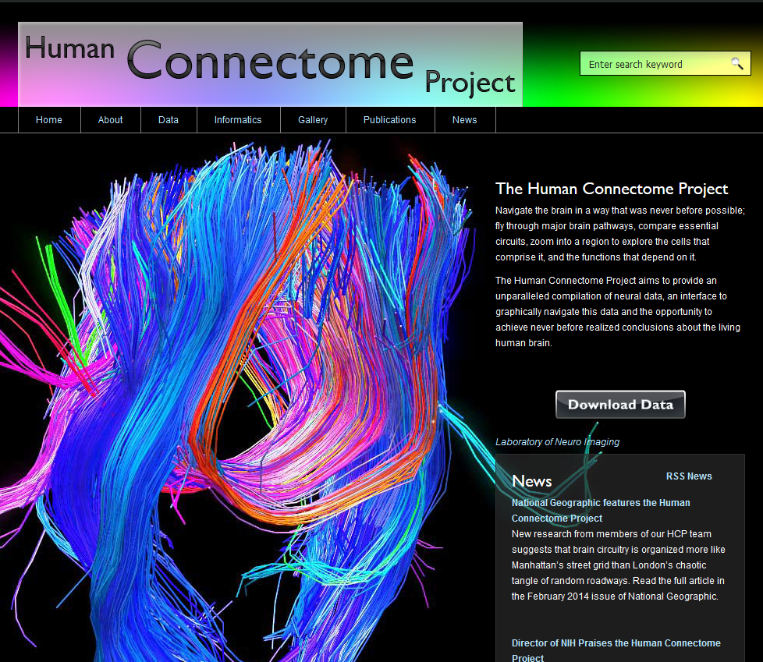
AJIVE Analysis of FMRI Data
Study Data From:
Posted Data With Huge
Amount of Pre-Processing
E.g. Registration

Slide 49
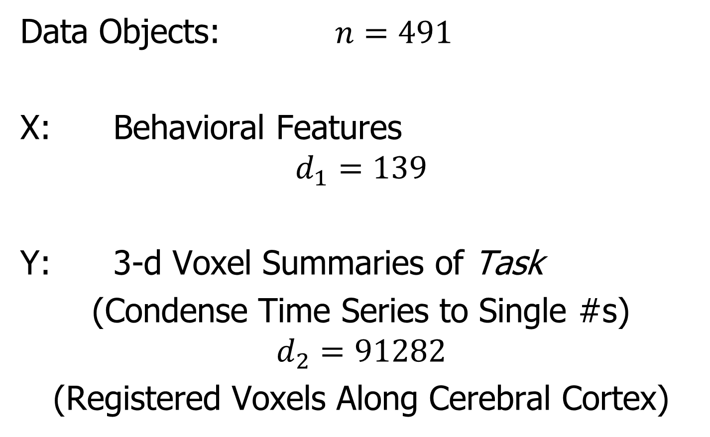
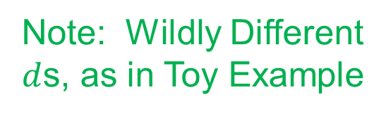
AJIVE Analysis of FMRI Data
Data Objects: $n=491$
X: Behavioral Features
$$d_{1}=139$$
Y: 3-d Voxel Summaries of Task
(Condense Time Series to Single #s)
$$d_{2}=91282$$
(Registered Voxels Along Cerebral Cortex)
Note: Wildly Different
$d$s, as in Toy Example

Slide 50
AJIVE Analysis of FMRI Data
Focus of Analysis:
Loadings (Drivers)
  Behavioral Features
  Lit Up Brain Regions
Since Scores All Gaussian
(Normal Population)
Which Work
Together?
Which Work
Separately?

Slide 51
AJIVE Analysis of FMRI Data
View Entries of Eigenvectors
Separate
PC1 of
Behavior
Feature
Loadings
Important
Groups

Slide 52
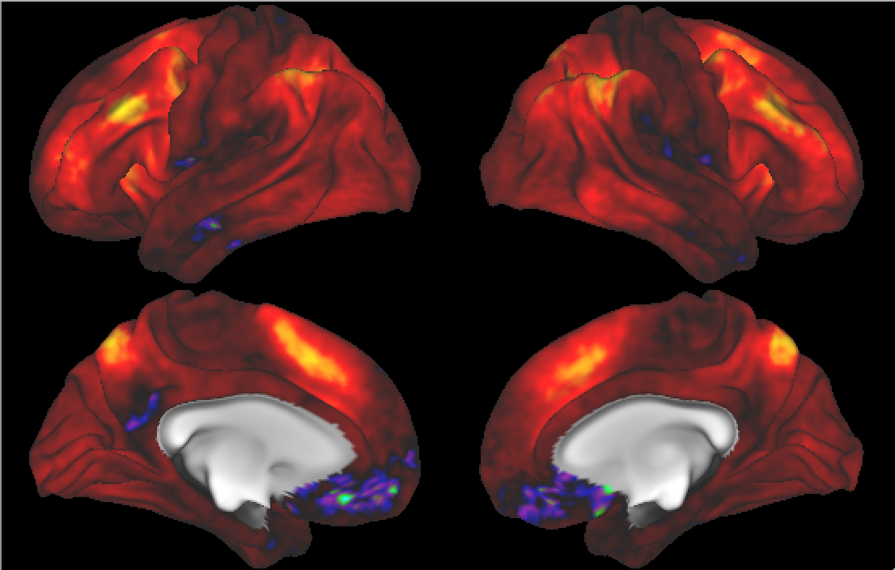

AJIVE Analysis of FMRI Data
Separate PC1 of Image Loadings
All Up
& Down
Together
(Flat Mode)
View Entries of Eigenvectors
Also Some
Hot Spots?
Mostly Uses Only Hot Colors

Slide 53
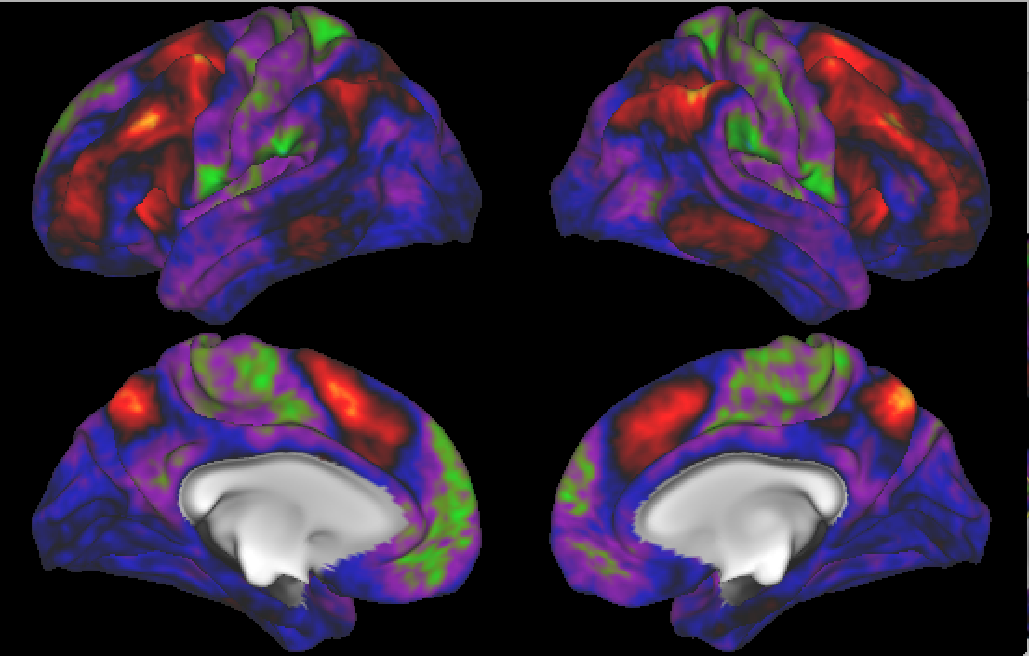
AJIVE Analysis of FMRI Data
Separate PC2 of Image Loadings
Interesting
Structure
???
And Same
Hot Spots?

Slide 54
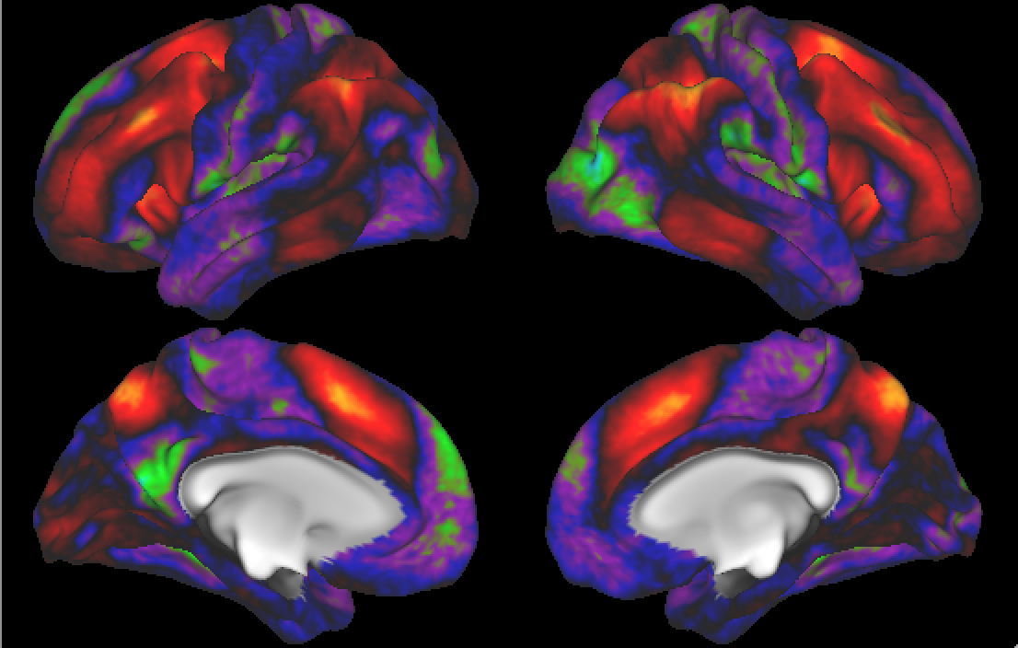
AJIVE Analysis of FMRI Data
Previous Mapping of Regions of Interest
Hot Spots
Are
Working
Memory
Related

Slide 55
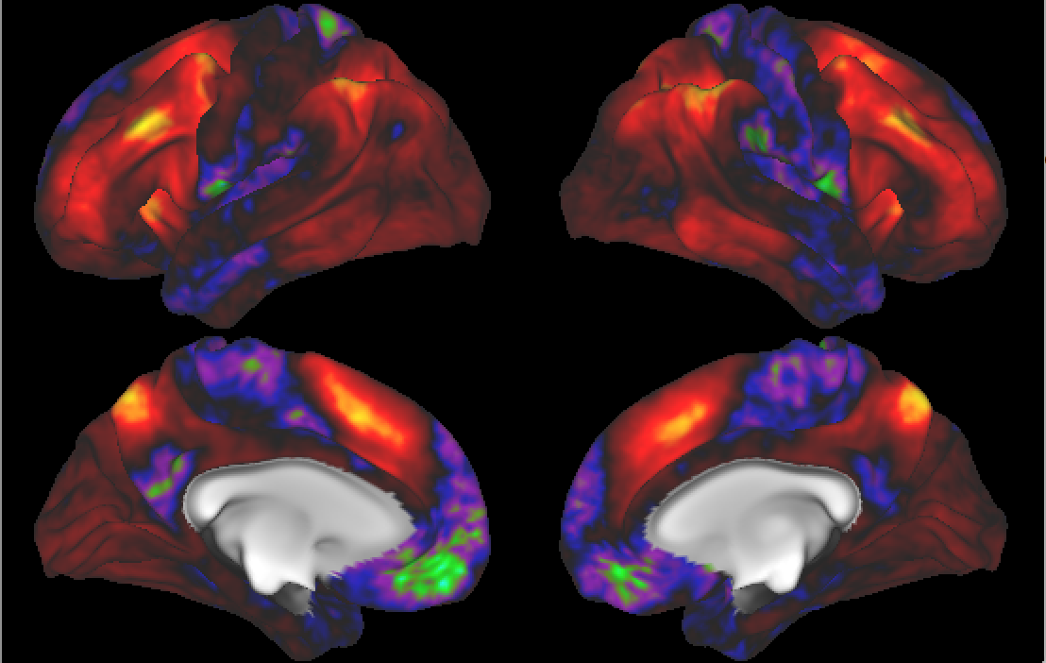
AJIVE Analysis of FMRI Data
Joint PC1 of Image Loadings
Using
Behavior
Combines
Hot Spots
From
Separate
PC1 & 2

Slide 56
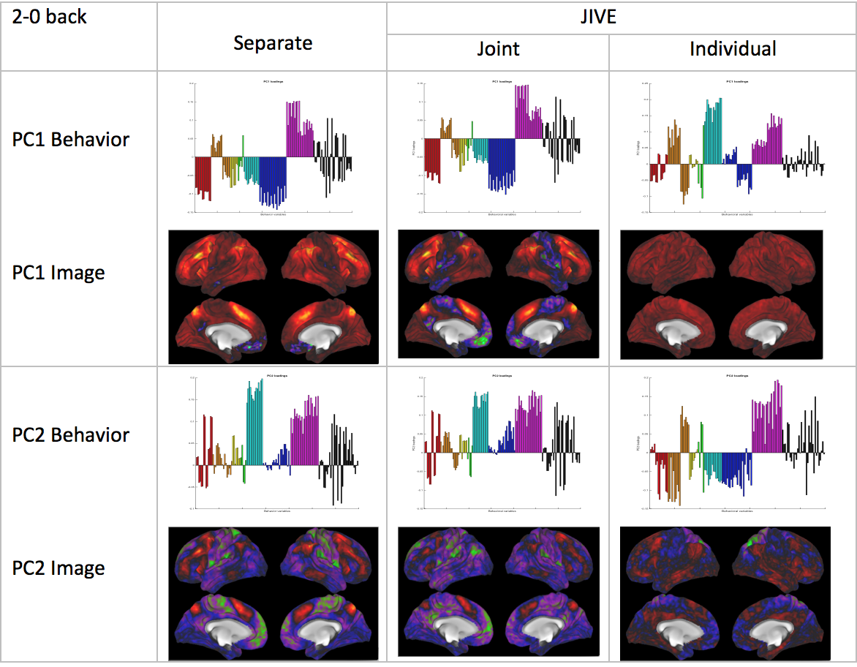
AJIVE Analysis of FMRI Data
Overall
Comparison

Slide 57
AJIVE Analysis of FMRI Data
Overall
Comparison
Earlier Showed
And Also

Slide 58
AJIVE Analysis of FMRI Data
Overall
Comparison
Sep. Beh. PC1
Assoc. w. Image
Joint Im. PC1
Concentrates
Relevant Parts
Of Sep.
PC1 & PC2

Slide 59
AJIVE Analysis of FMRI Data
Overall
Comparison
Flat Mode not
Assoc. w/
Behavior
New 2nd Mode
Of Joint Var’n
Behavior
~ Sep. PC2

Slide 60
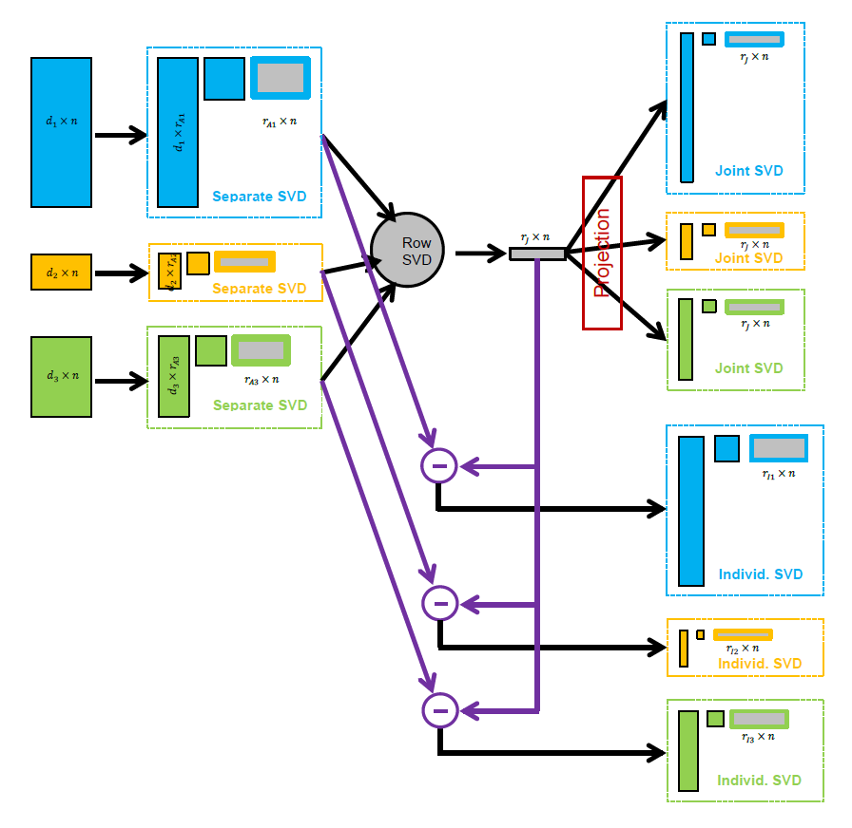
AJIVE Algorithm
Overview
Step 1

Slide 61
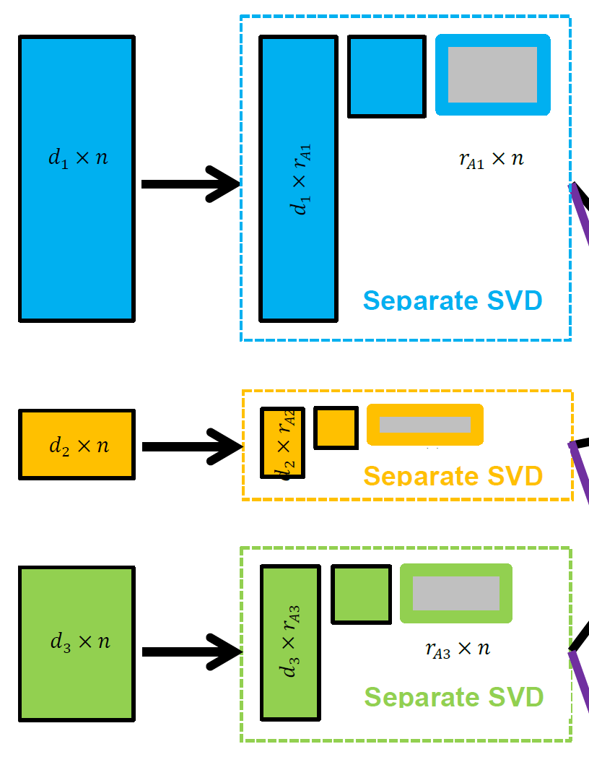

AJIVE Algorithm
Step 1:
Initial Low Rank
Approximations
Separate SVDs
Ranks: $r_{A1},r_{A2},$ $r_{A3}$
Motivation 1: Avoid Noise
Impacting Analysis
Motivation 2: Go Forward
With Scale Free Scores

Slide 62

AJIVE Algorithm
Step 1:
Initial Low Rank
Approximations
Separate SVDs
Ranks: $r_{A1},r_{A2},$ $r_{A3}$
Illustrate with Previous Toy Example

Slide 63
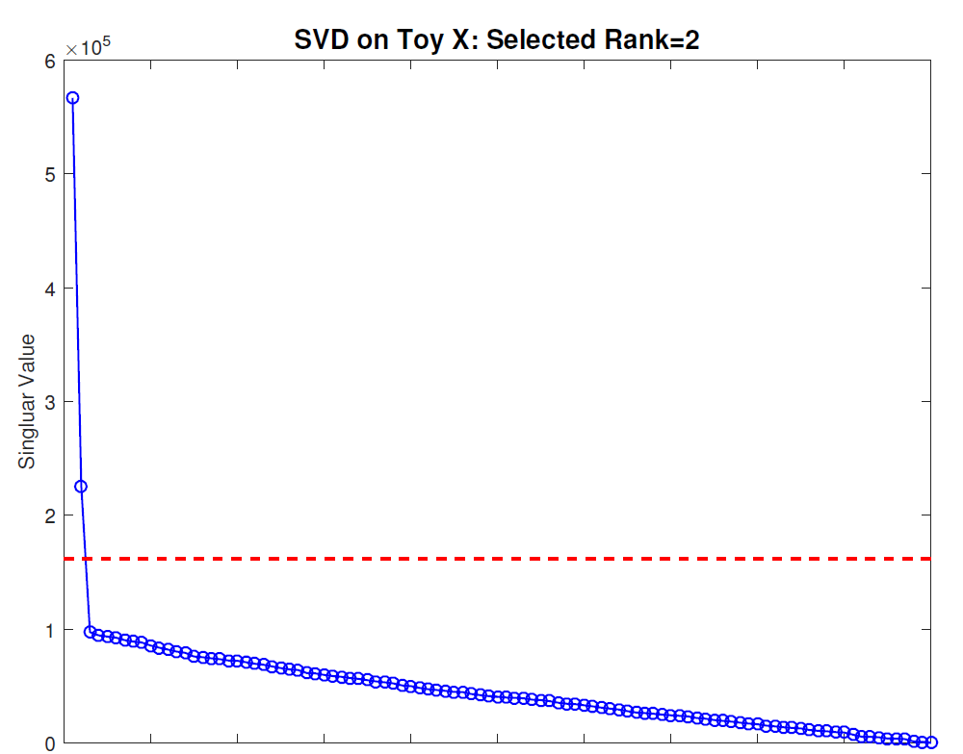
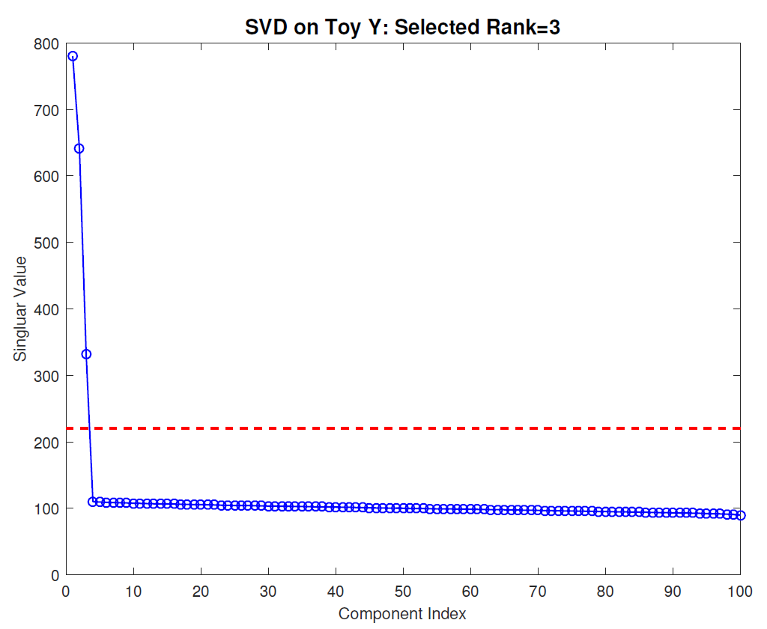



AJIVE Algorithm
Scree Block 1
Chose $r_{A1}=2$
Step 1:
Initial Low Rank
Approximations
Separate SVDs
Ranks: $r_{A1},r_{A2},$ $r_{A3}$
Source of Candidates:
Scree Plots
Scree Block 2
Chose $r_{A2}=3$

Slide 64
AJIVE Algorithm
Step 1:
Initial Low Rank
Approximations
Separate SVDs
Ranks: $r_{A1},r_{A2},$ $r_{A3}$
Source of Candidates:
Scree Plots
Assessment of Ranks:
Wedin Bounds
Random Subspaces
Diagnostic Plots
Directional Bounds
Solved by DIVAS

Slide 65
AJIVE Algorithm
Overview
Step 2

Slide 66


AJIVE Algorithm
Step 2:
Find Joint Scores
Rank $r_{J}$ SVD of
Concatenated
Scores
For $B=2$:
Called Principal
Angle Analysis
Main Product:
Scores Common
To All Data Blocks

Slide 67




Aside: Principal Angle Analysis
Idea: Relate Subspaces $S_{1}$, $S_{2}$ of $ℝ^{n}$
Using Minimal Angles
$$θ_{1}=0$$
$$θ_{2}$$
Key JIVE concept:
Linear Algebra In
Trait Space, $ℝ^{n}$
And Iterate Orthogonally
PAA Computation: ~Concatenate & SVD

Slide 68
AJIVE Algorithm
Overview
Step 3

Slide 69


AJIVE Algorithm
Step 3:
Find Individual
Scores
By Orthogonal
Basis Subtraction
Guarantees
Joint $⊥$ Individual

Slide 70
AJIVE Algorithm
Overview
Step 4

Slide 71

AJIVE Algorithm
Step 4:
Reproject Data
To Get Both
Joint and
Individual
Decompositions
Again Best Rank 1
Approximations

Slide 72
Participant Presentation
1:35 Katelyn McInerney :
Object Oriented Perspective on Genome Type
Next Class: Andrew Walker

