Slide 1
Statistics – O. R. 881
Object Oriented Data Analysis
Steve Marron
Dept. of Statistics and Operations Research
University of North Carolina

Slide 2
Current Sections in Textbook
Today:
Section 14.2, 14.1
Next Class:
Sections 14.1, 12.1

Slide 3
Last Class: DIVAS
Improvements Over AJIVE:
Partially Shared Blocks
Improved Initial Rank Choice
Inference Via Random Direction Bounds
Iterative Search Algorithm
Give Better and More Precise Inference

Slide 4
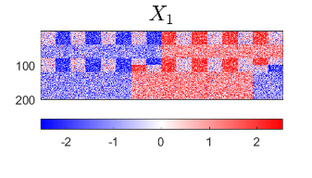
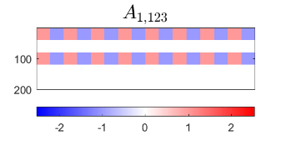
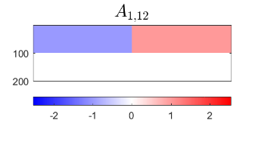
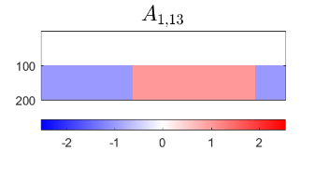
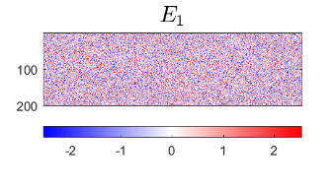
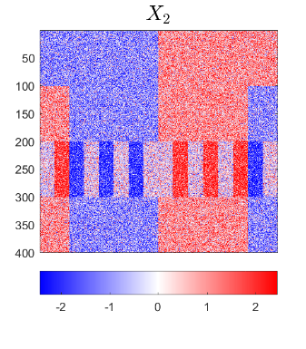
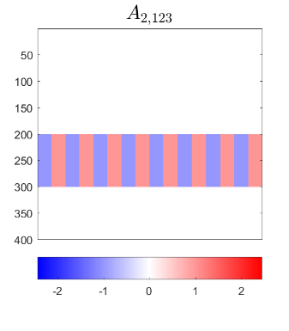
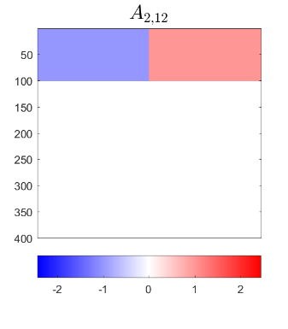
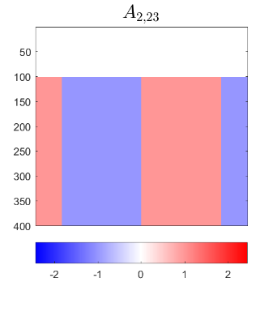
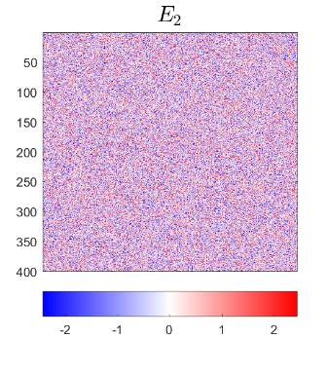
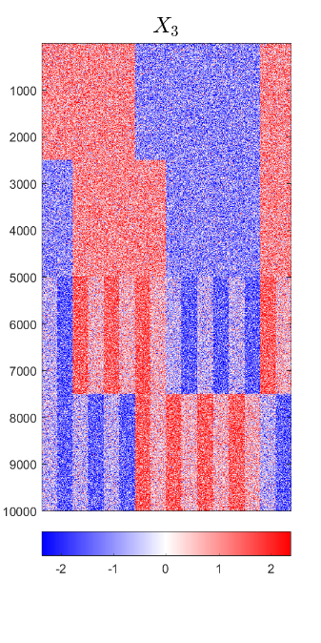
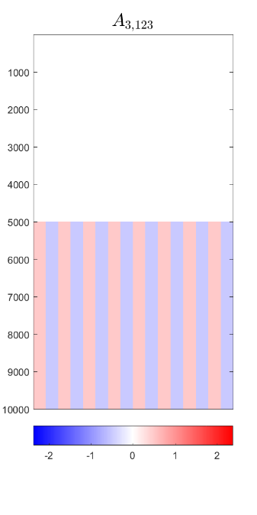
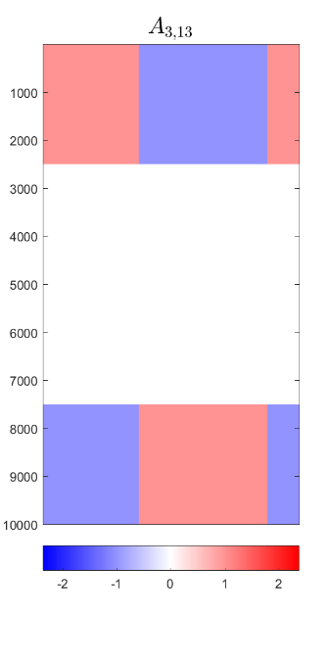
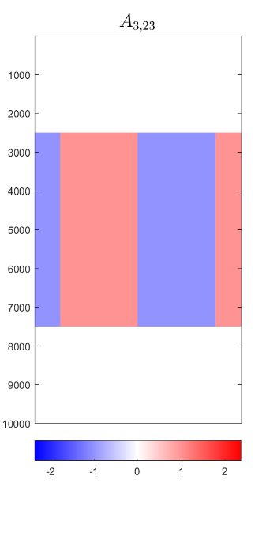
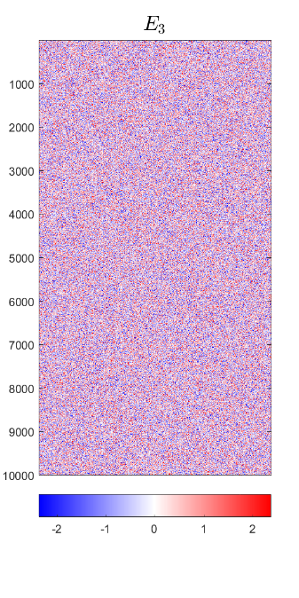
Last Class: DIVAS – 3 Block
Input to DIVAS: Sum of ALL
IID Gaussian Noise

Slide 5
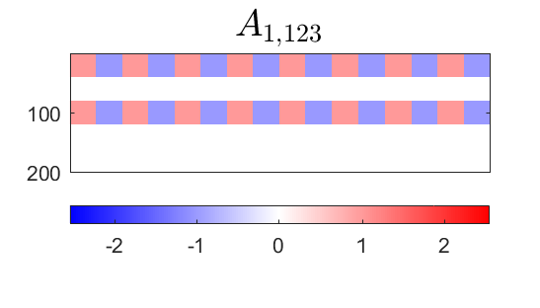
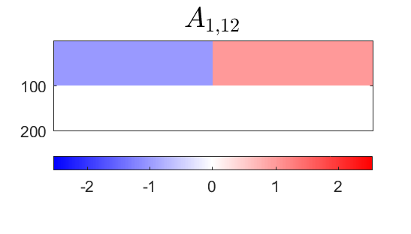
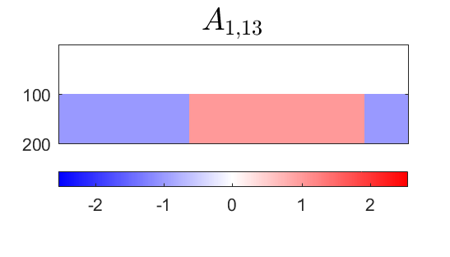
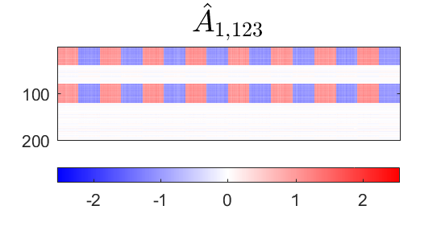

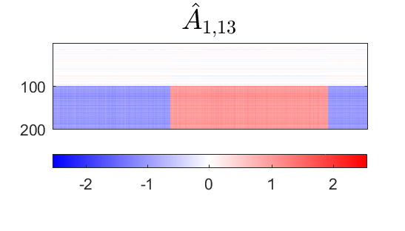
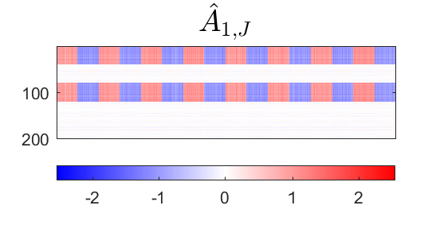
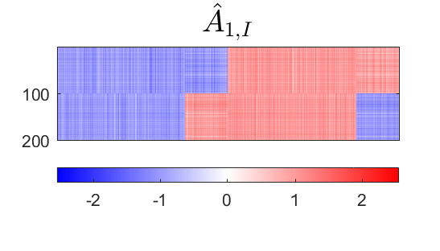


Last Class: DIVAS – 3 Block
Deeper Look at Estimation of 1st Block, i.e. $A_{1}$
Target
DIVAS
AJIVE
Large Angles $≈$ Worse Estimation
2.76°
5.01°
1.71°
4.23°
7.89°
7.14°

Slide 6
Last Class: DIVAS on TCGA
Breast Cancer
Gene Expression (GE) [16615 x 616]
Copy Number (CN) [24174 x 616]
Protein Exp. (RPPA) [187 x 616]
Mutation Status (MU) [18256 x 616]

Slide 7
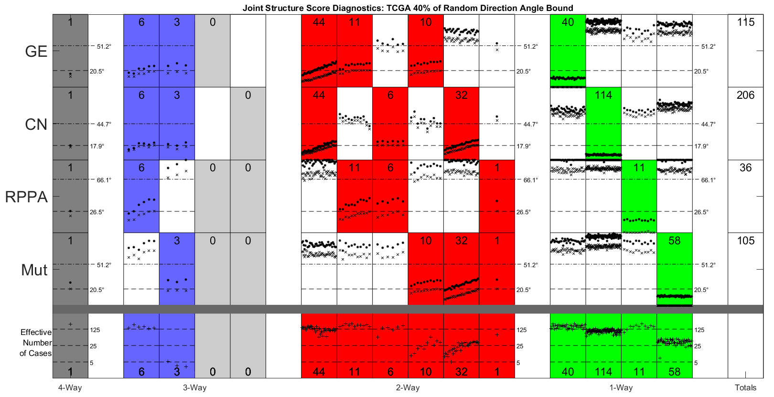
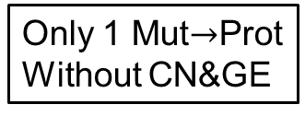


Last Class: DIVAS on TCGA
GE or CN$→$ Proteins
Statistical Significance Summary
Lots of Mut&CN Variation
Major CN$→$GE Variation
Only 1 Mut$→$Prot
Without CN&GE
Only Barely
Significant

Slide 8
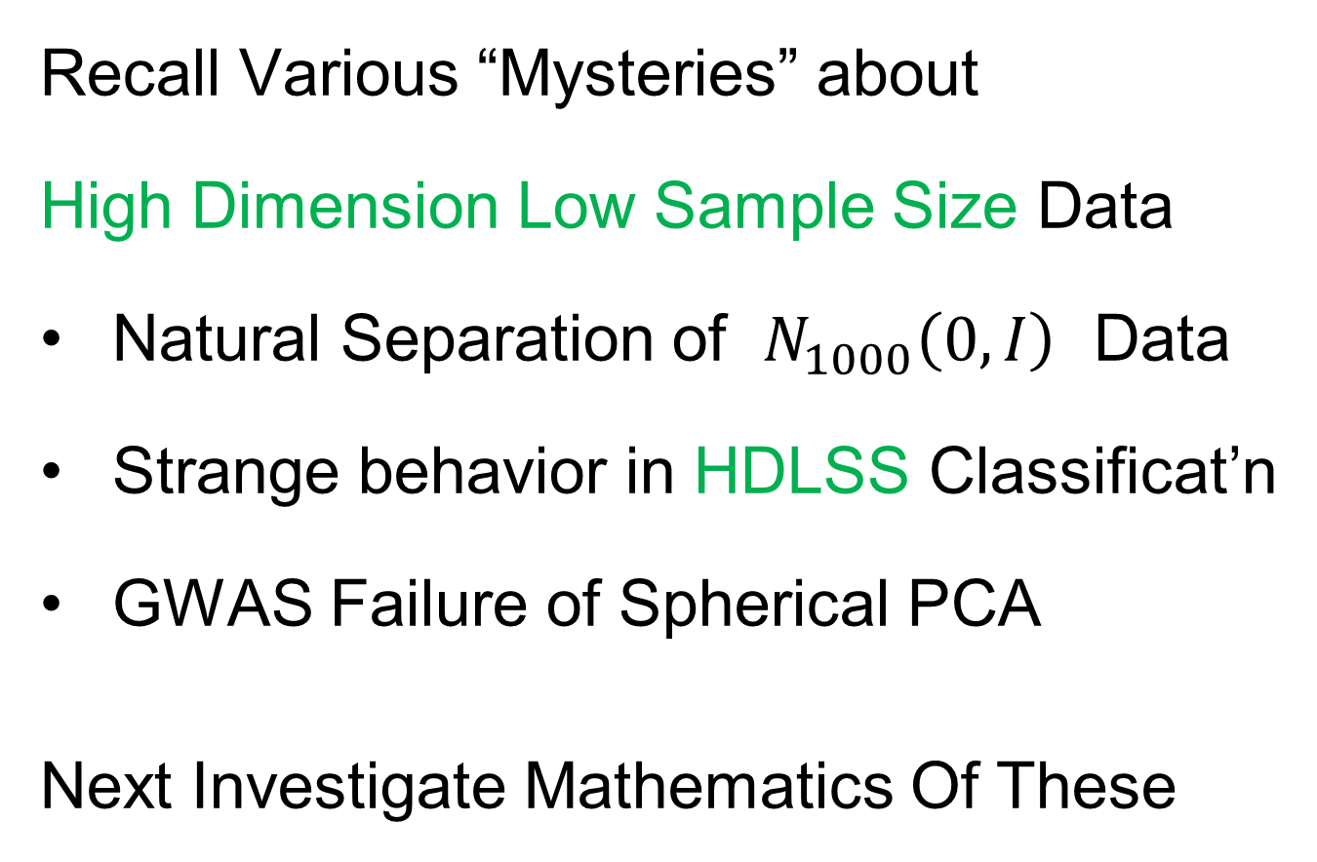
Last Class: HDLSS Asymptotics
Text: Sec. 14.2
Recall Various “Mysteries” about
High Dimension Low Sample Size Data
Natural Separation of $N_{1000}\left(0,I\right)$ Data
Strange behavior in HDLSS Classificat’n
GWAS Failure of Spherical PCA
Next Investigate Mathematics Of These
Notes:
8

Slide 9
Last Class: HDLSS Asymptotics
Modern Mathematical Statistics:
Based on asymptotic analysis
Real Reasons:
  Approximation provides insights
  Can find simple underlying structure
  In complex situations
Thus various flavors are fine:
$$\lim_{n→∞}{} \lim_{d→∞}{} \lim_{n,d→∞}{} \lim_{σ→0}{}$$
Even desirable! (find additional insights)
Notes:
9

Slide 10
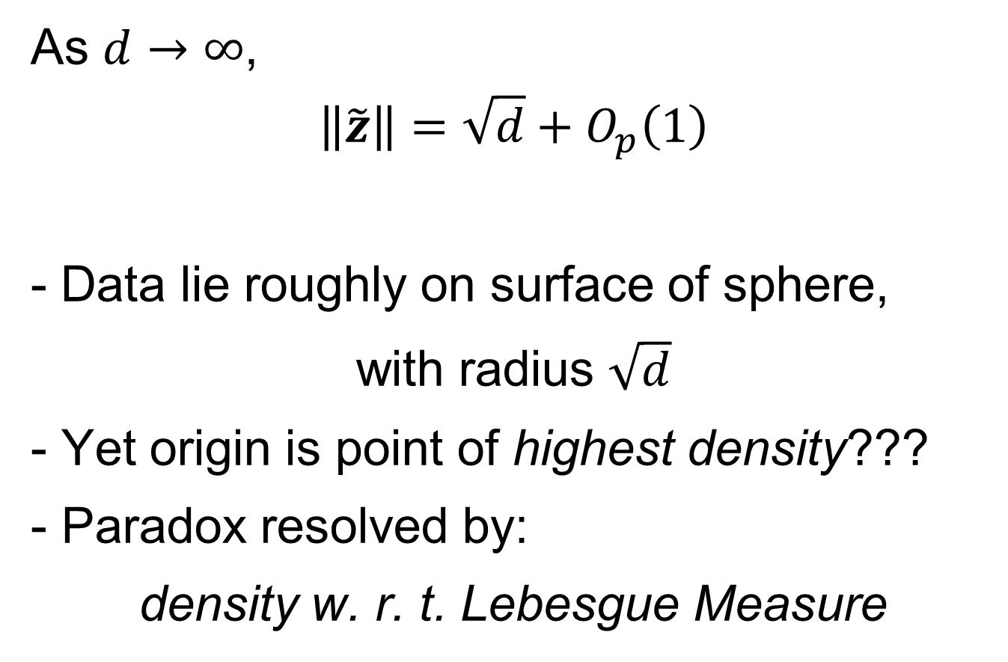
Last Class: HDLSS Paradoxes
As $d→∞$,
$$\left\|\tilde{z}\right\|=\sqrt{d}+O_{p}\left(1\right)$$
Data lie roughly on surface of sphere,
with radius $\sqrt{d}$
- Yet origin is point of highest density???
- Paradox resolved by:
density w. r. t. Lebesgue Measure
Notes:
10

Slide 11
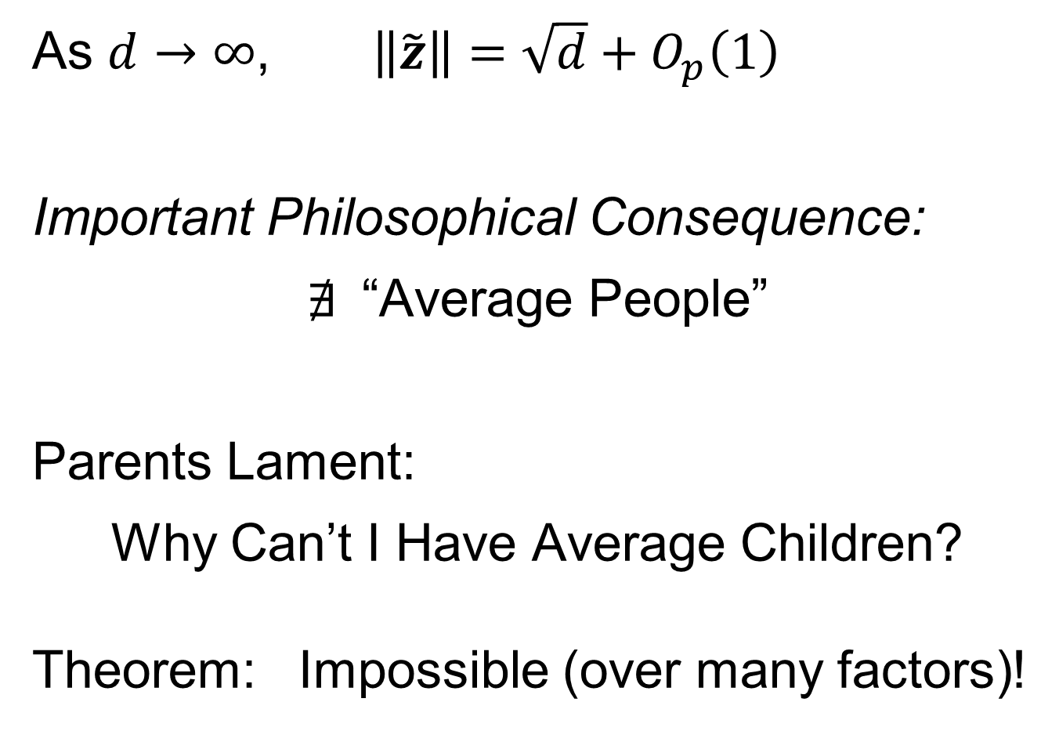
Last Class: HDLSS Paradoxes
As $d→∞$, $\left\|\tilde{z}\right\|=\sqrt{d}+O_{p}\left(1\right)$
Important Philosophical Consequence:
$∄$“Average People”
Parents Lament:
Why Can’t I Have Average Children?
Theorem: Impossible (over many factors)!
Notes:
11

Slide 12
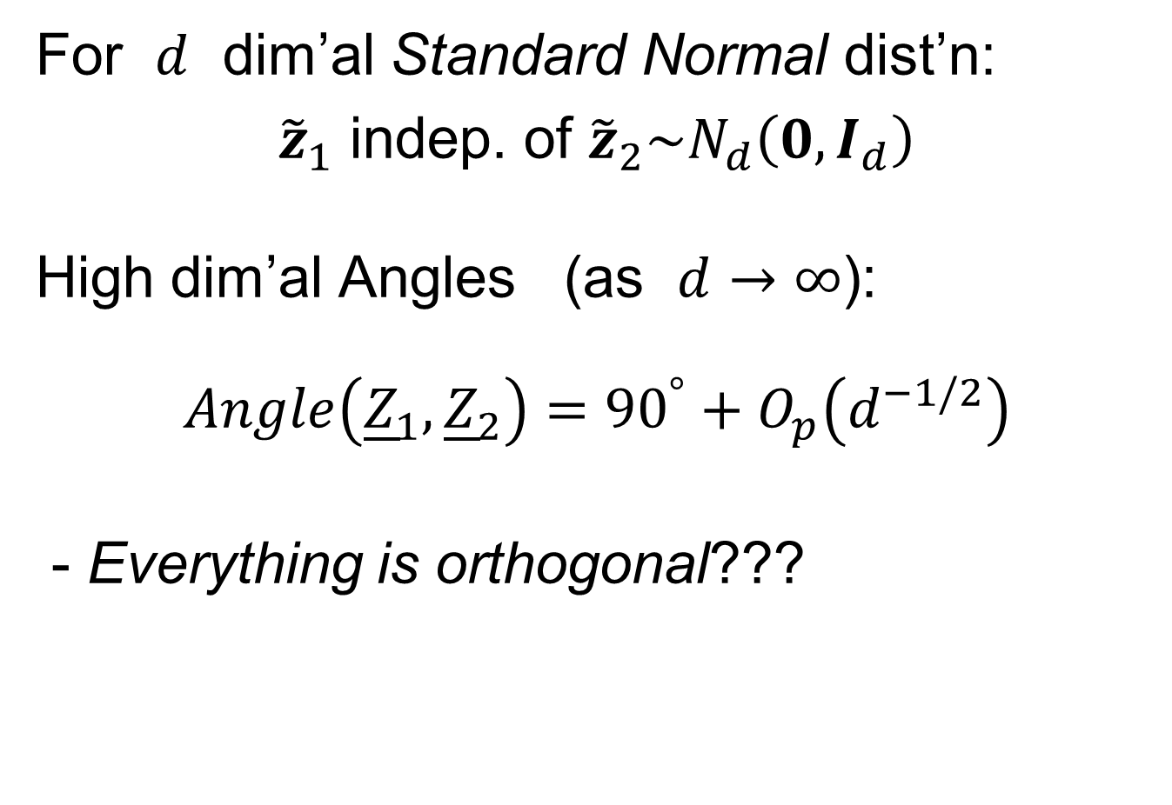




Last Class: HDLSS Paradoxes
For $d$ dim’al Standard Normal dist’n:
${\tilde{z}}_{1}$ indep. of ${\tilde{z}}_{2}\sim N_{d}\left(0,I_{d}\right)$
High dim’al Angles (as $d→∞$):
$$Angle\left({\underline{Z}}_{1},{\underline{Z}}_{2}\right)={90}^{°}+O_{p}\left(d^{−1/2}\right)$$
- Everything is orthogonal???
$\sqrt{2d}$
Note Pythagorean Theorem:
$\sqrt{d}$
${90}^{°}$
$\sqrt{d}$

Slide 13
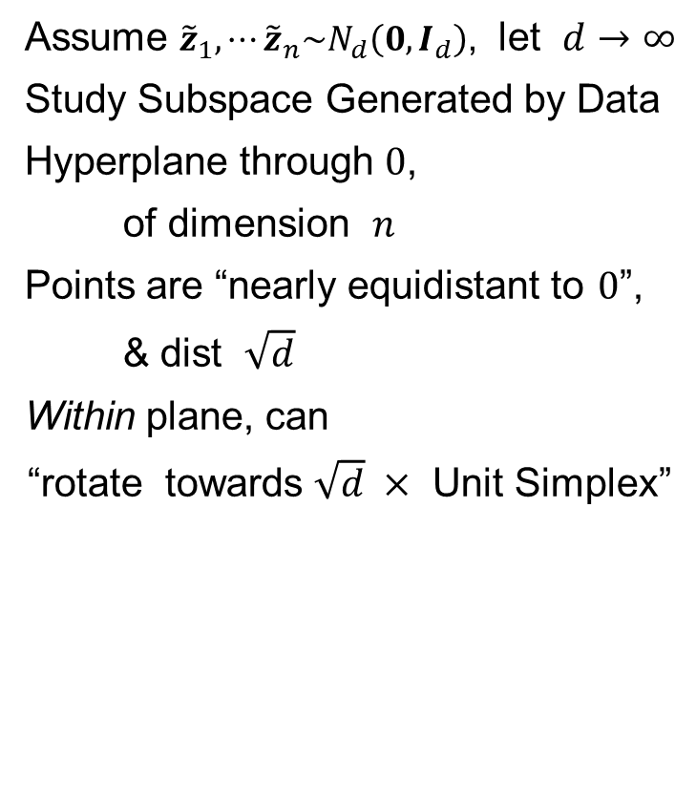
Last Class: HDLSS Asy’s: Geo. Rep’n
Assume ${\tilde{z}}_{1},⋯{\tilde{z}}_{n}\sim N_{d}\left(0,I_{d}\right)$, let $d→∞$
Study Subspace Generated by Data
Hyperplane through $0$,
of dimension $n$
Points are “nearly equidistant to $0$”,
& dist $\sqrt{d}$
Within plane, can
“rotate towards $\sqrt{d} ×$ Unit Simplex”
Hall, Marron & Neeman (2005)

Slide 14


Unit Simplex in $ℝ^{d}$
Convex Combinations of Unit Vectors
$\left(\begin{matrix}\begin{matrix}0 \\ 1 \\ 0\end{matrix} \\ ⋮ \\ 0\end{matrix}\right)$
$\left(\begin{matrix}\begin{matrix}1 \\ 0\end{matrix} \\ \begin{matrix}⋮ \\ 0\end{matrix}\end{matrix}\right)$
Simplex = $\left\{\left(\begin{matrix}x_{1} \\ ⋮ \\ x_{d}\end{matrix}\right):\sum_{i=1}^{d}{x_{i}=1,x_{i}≥0}\right\}$

Slide 15
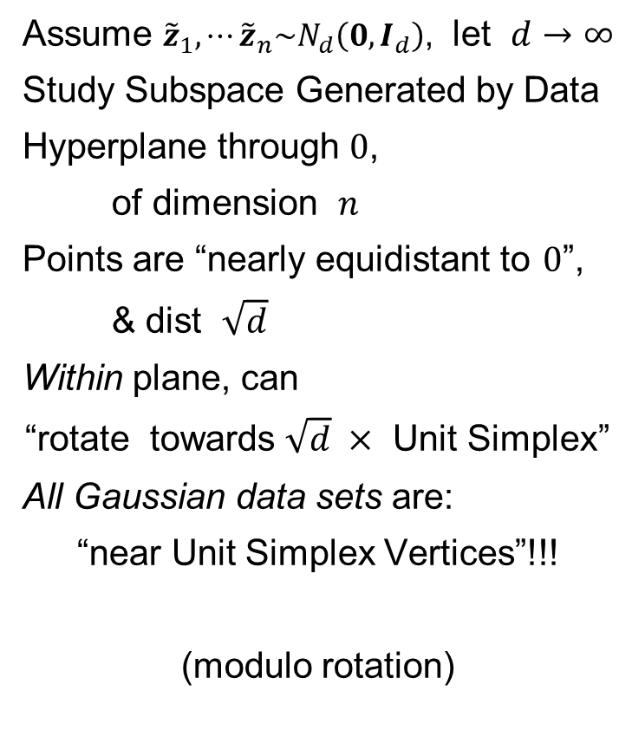
HDLSS Asy’s: Geometrical Represent’n
Assume ${\tilde{z}}_{1},⋯{\tilde{z}}_{n}\sim N_{d}\left(0,I_{d}\right)$, let $d→∞$
Study Subspace Generated by Data
Hyperplane through $0$,
of dimension $n$
Points are “nearly equidistant to $0$”,
& dist $\sqrt{d}$
Within plane, can
“rotate towards $\sqrt{d} ×$ Unit Simplex”
All Gaussian data sets are:
“near Unit Simplex Vertices”!!!
(modulo rotation)
Hall, Marron & Neeman (2005)

Slide 16
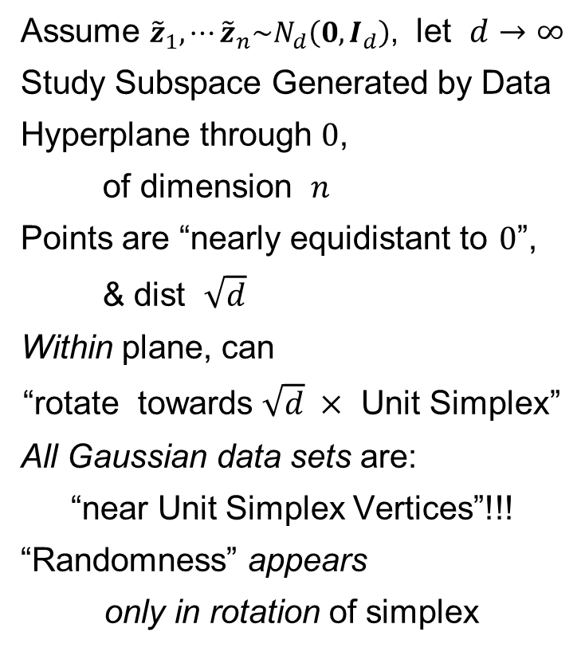
HDLSS Asy’s: Geometrical Represent’n
Assume ${\tilde{z}}_{1},⋯{\tilde{z}}_{n}\sim N_{d}\left(0,I_{d}\right)$, let $d→∞$
Study Subspace Generated by Data
Hyperplane through $0$,
of dimension $n$
Points are “nearly equidistant to $0$”,
& dist $\sqrt{d}$
Within plane, can
“rotate towards $\sqrt{d} ×$ Unit Simplex”
All Gaussian data sets are:
“near Unit Simplex Vertices”!!!
“Randomness” appears
only in rotation of simplex
Hall, Marron & Neeman (2005)

Slide 17
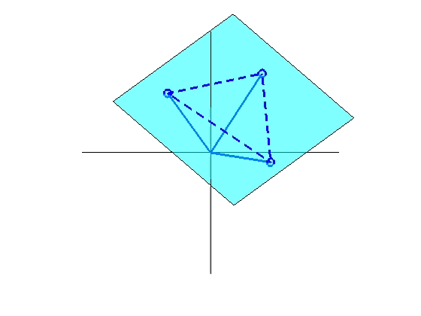
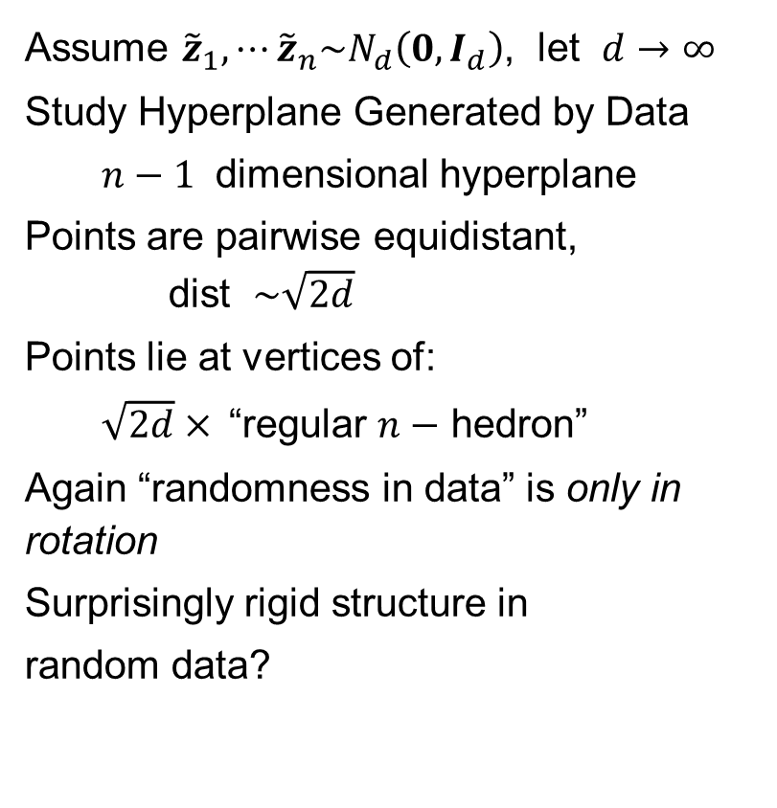
HDLSS Asy’s: Geometrical Represent’n
Assume ${\tilde{z}}_{1},⋯{\tilde{z}}_{n}\sim N_{d}\left(0,I_{d}\right)$, let $d→∞$
Study Hyperplane Generated by Data
$n−1$ dimensional hyperplane
Points are pairwise equidistant, dist $\sim \sqrt{2d}$
Points lie at vertices of:
$\sqrt{2d}×$“regular $n−$ hedron”
Again “randomness in data” is only in rotation
Surprisingly rigid structure in
random data?

Slide 18
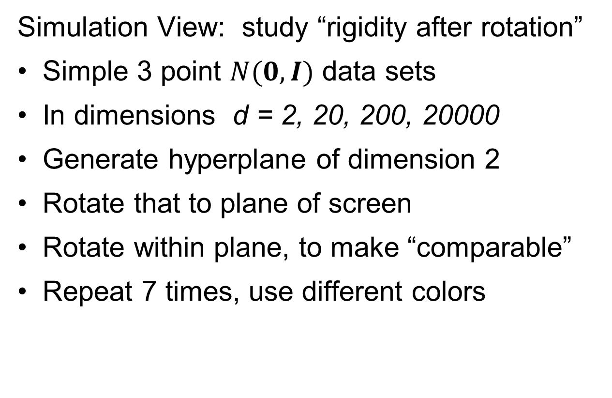
HDLSS Asy’s: Geometrical Represen’tion
Simulation View: study “rigidity after rotation”
Simple 3 point $N(0,I)$ data sets
In dimensions d = 2, 20, 200, 20000
Generate hyperplane of dimension 2
Rotate that to plane of screen
Rotate within plane, to make “comparable”
Repeat 7 times, use different colors

Slide 19
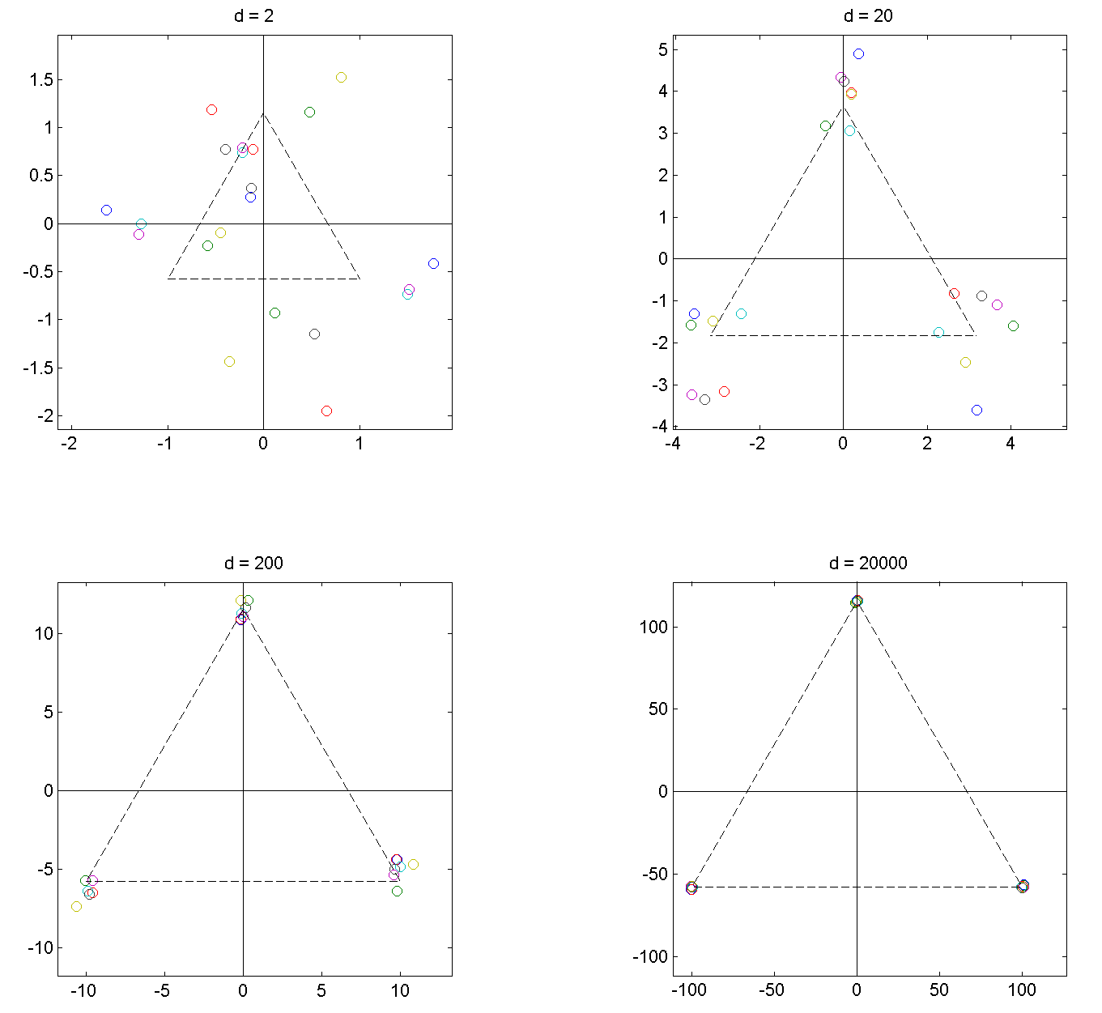
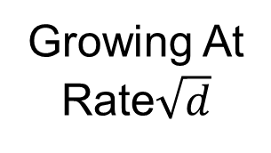
HDLSS Asy’s: Geometrical Represen’tion
Simulation View: Shows “Rigidity after Rotation”
Note
Expanding
Scales
Growing At
Rate$\sqrt{d}$

Slide 20
HDLSS Asy’s: Geometrical Represen’tion
View from Probability Theory:
These phenomena named
Concentration of Measure
Key References:
Talagrand (1991, 1995)
Ledoux (2005)

Slide 21
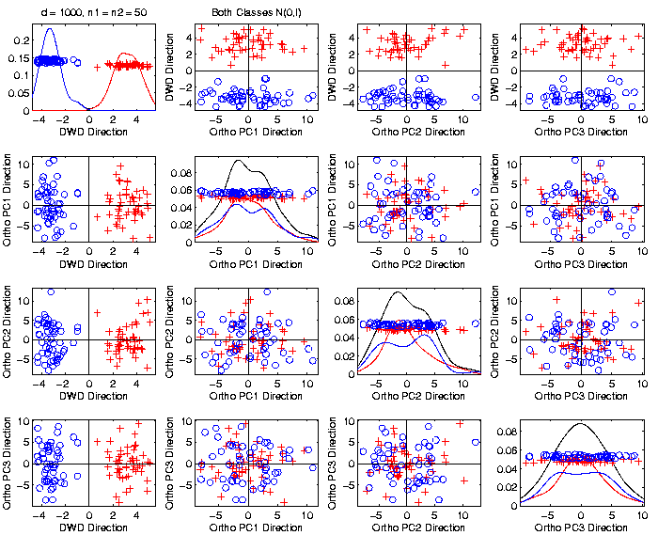
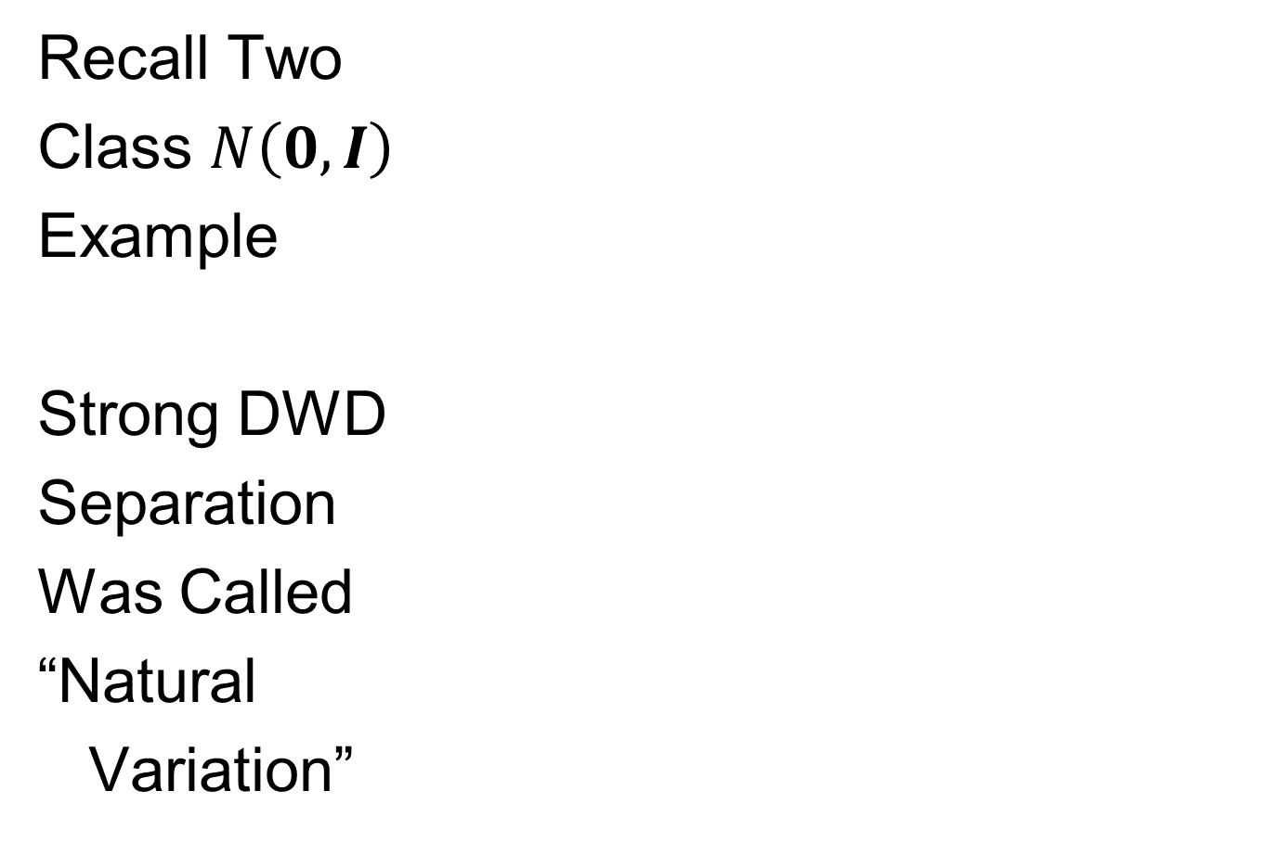
An Interesting HDLSS Explanation
Recall Two
Class $N\left(0,I\right)$
Example
Strong DWD
Separation
Was Called
“Natural
Variation”

Slide 22
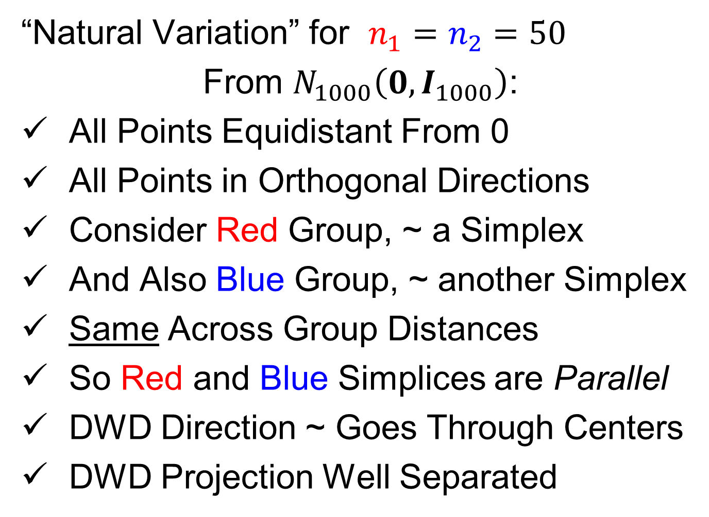
An Interesting HDLSS Explanation
“Natural Variation” for $n_{1}=n_{2}=50$
From $N_{1000}\left(0,I_{1000}\right)$:
All Points Equidistant From 0
All Points in Orthogonal Directions
Consider Red Group, ~ a Simplex
And Also Blue Group, ~ another Simplex
Same Across Group Distances
So Red and Blue Simplices are Parallel
DWD Direction ~ Goes Through Centers
DWD Projection Well Separated

Slide 23
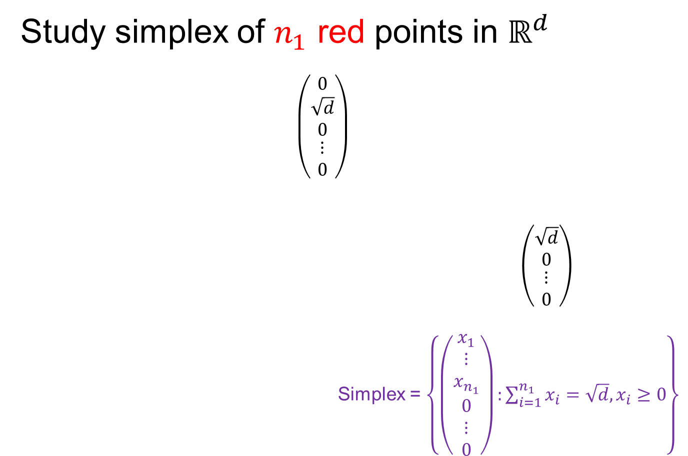
An Interesting HDLSS Explanation
Study simplex of $n_{1}$ red points in $ℝ^{d}$
$\left(\begin{matrix}\begin{matrix}0 \\ \sqrt{d} \\ 0\end{matrix} \\ ⋮ \\ 0\end{matrix}\right)$
$\left(\begin{matrix}\begin{matrix}\sqrt{d} \\ 0\end{matrix} \\ \begin{matrix}⋮ \\ 0\end{matrix}\end{matrix}\right)$
Simplex = $\left\{\left(\begin{matrix}\begin{matrix}x_{1} \\ ⋮ \\ x_{n_{1}}\end{matrix} \\ \begin{matrix}0 \\ ⋮ \\ 0\end{matrix}\end{matrix}\right):\sum_{i=1}^{n_{1}}{x_{i}=\sqrt{d},x_{i}≥0}\right\}$

Slide 24
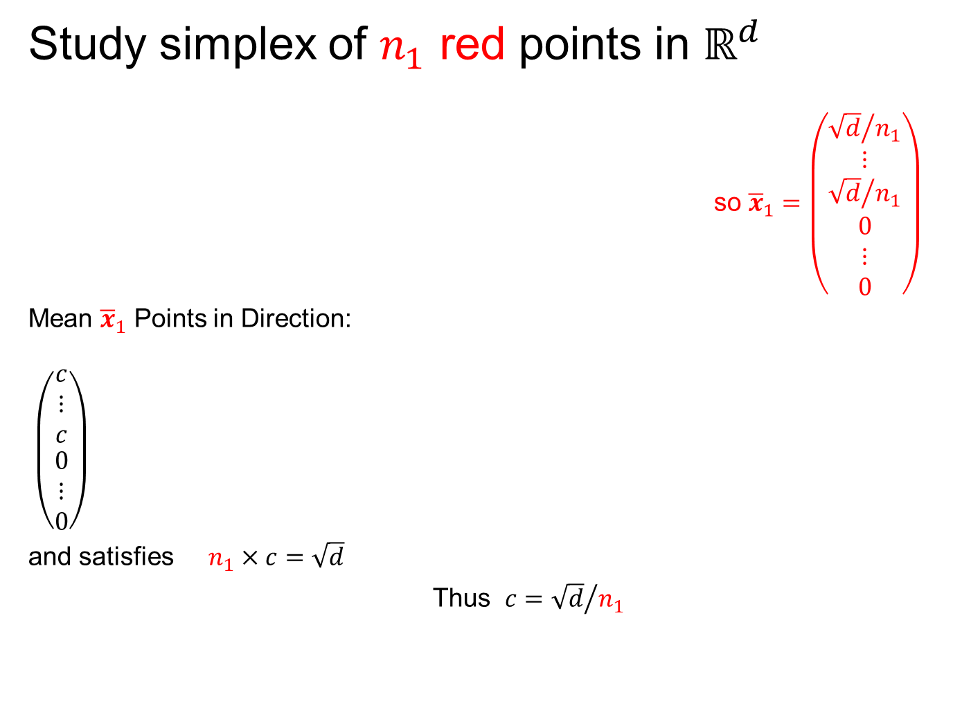
An Interesting HDLSS Explanation
Study simplex of $n_{1}$ red points in $ℝ^{d}$
so ${\overline{x}}_{1}=\left(\begin{matrix}\begin{matrix}{\sqrt{d}}/{n_{1}} \\ ⋮ \\ {\sqrt{d}}/{n_{1}}\end{matrix} \\ \begin{matrix}0 \\ ⋮ \\ 0\end{matrix}\end{matrix}\right)$
Mean ${\overline{x}}_{1}$ Points in Direction:
$\left(\begin{matrix}\begin{matrix}c \\ ⋮ \\ c\end{matrix} \\ \begin{matrix}0 \\ ⋮ \\ 0\end{matrix}\end{matrix}\right)$
and satisfies $n_{1}×c=\sqrt{d}$
Thus $c={\sqrt{d}}/{n_{1}}$
Think Projection on Flat Direction

Slide 25
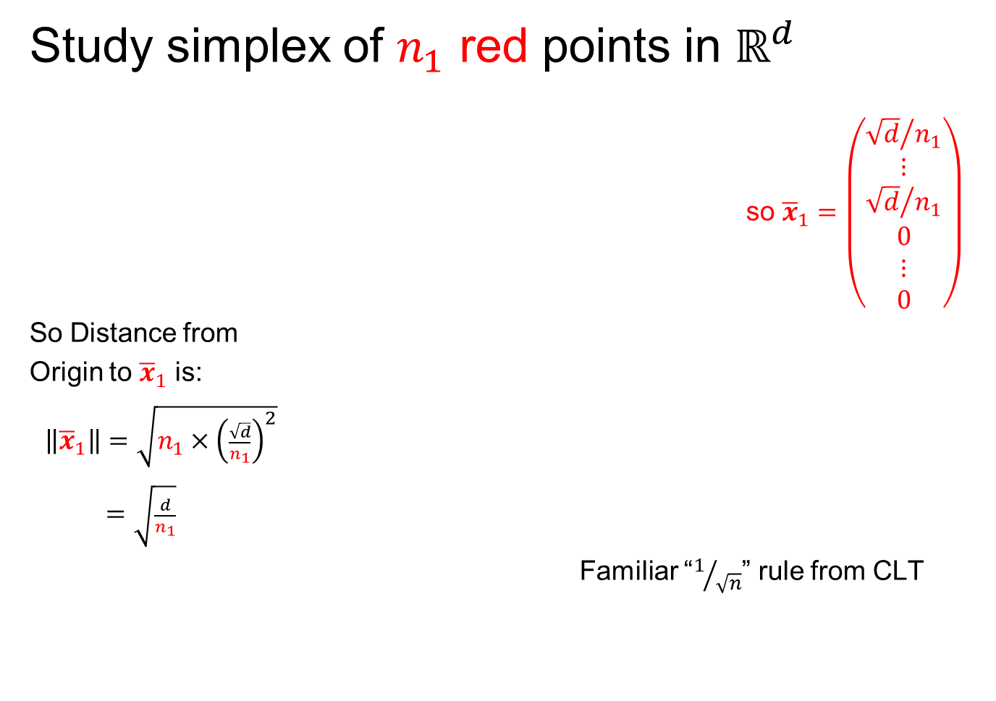
An Interesting HDLSS Explanation
Study simplex of $n_{1}$ red points in $ℝ^{d}$
so ${\overline{x}}_{1}=\left(\begin{matrix}\begin{matrix}{\sqrt{d}}/{n_{1}} \\ ⋮ \\ {\sqrt{d}}/{n_{1}}\end{matrix} \\ \begin{matrix}0 \\ ⋮ \\ 0\end{matrix}\end{matrix}\right)$
So Distance from
Origin to ${\overline{x}}_{1}$ is:
$\left\|{\overline{x}}_{1}\right\|=\sqrt{n_{1}×{\left(\frac{\sqrt{d}}{n_{1}}\right)}^{2}}$
$=\sqrt{\frac{d}{n_{1}}}$
Familiar “$1/{\sqrt{n}}$” rule from CLT

Slide 26
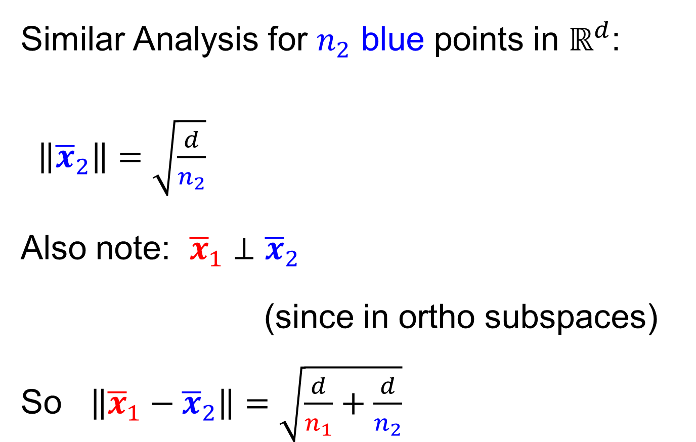
An Interesting HDLSS Explanation
Similar Analysis for $n_{2}$ blue points in $ℝ^{d}$:
$\left\|{\overline{x}}_{2}\right\|=\sqrt{\frac{d}{n_{2}}}$
Also note: ${\overline{x}}_{1}⊥{\overline{x}}_{2}$
(since in ortho subspaces)
So $\left\|{\overline{x}}_{1}−{\overline{x}}_{2}\right\|=\sqrt{\frac{d}{n_{1}}+\frac{d}{n_{2}}}$

Slide 27

An Interesting HDLSS Explanation
Recall Two
Class $N\left(0,I\right)$
Example
Plug In
These
Numbers

Slide 28
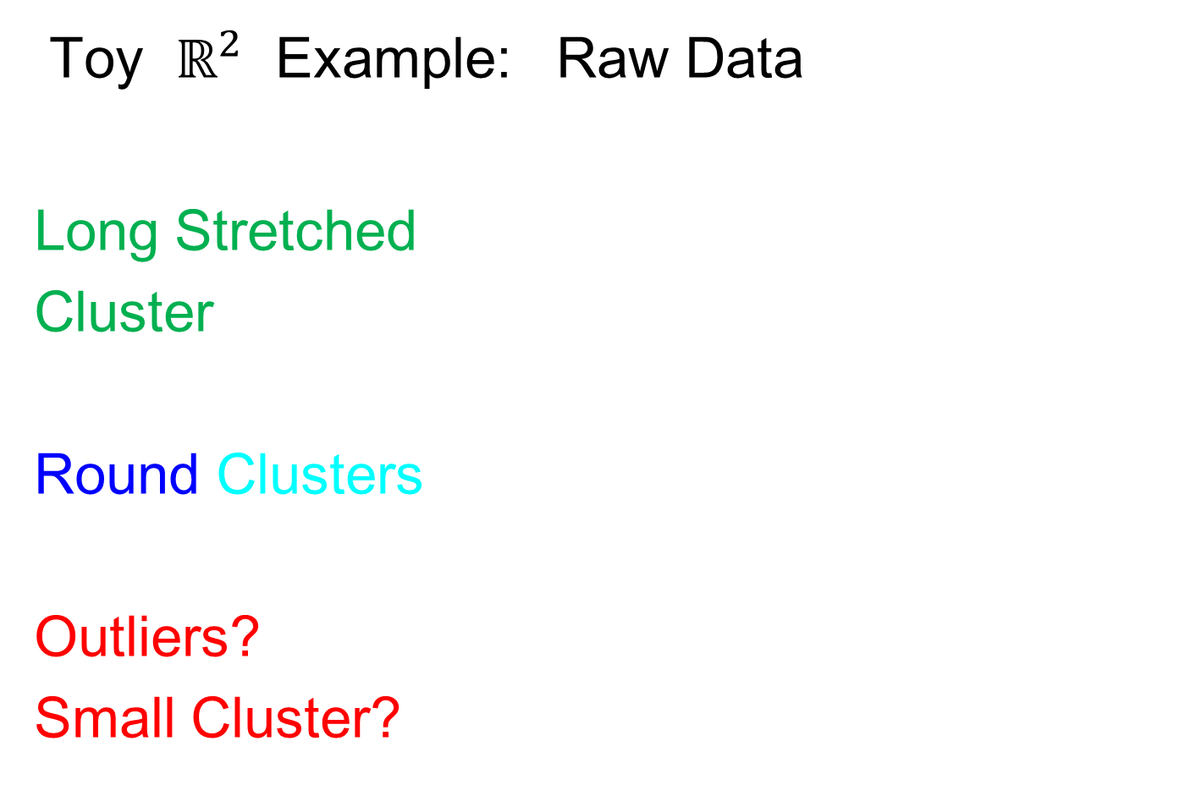
An Interesting HDLSS Explanation
Evaluate $\left\|\overline{x_{1}}−\overline{x_{2}}\right\|=\sqrt{\frac{d}{n_{1}}+\frac{d}{n_{2}}}$
$=\sqrt{\frac{1000}{50}+\frac{1000}{50}}$
$≈6.3$

Slide 29

An Interesting HDLSS Explanation
Recall Two
Class $N\left(0,I\right)$
Example
$\left\|\overline{x_{1}}−\overline{x_{2}}\right\|$
$≈6.3$
What about this big SD?

Slide 30
HDLSS Asy’s: History & Assumptions
On Geometrical Representation
Major Papers:
Hall, Marron and Neeman (2005)
Ahn, Marron, Muller & Chi (2007)
Yata & Aoshima (2009, 2010a, 2010b, 2012, 2013)

Slide 31
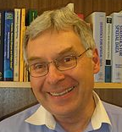

HDLSS Asy’s: History & Assumptions
Hall, Marron and Neeman (2005)

Slide 32
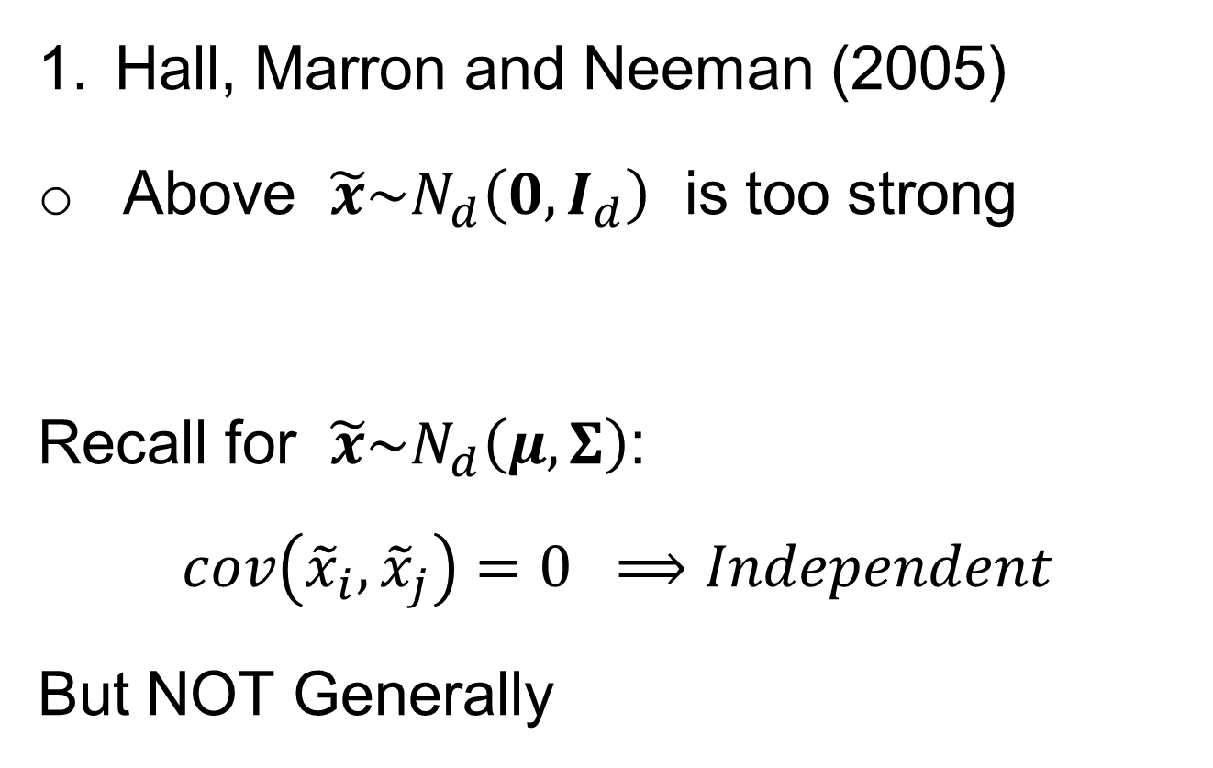

HDLSS Asy’s: History & Assumptions
Hall, Marron and Neeman (2005)
Above $\tilde{x}\sim N_{d}\left(0,I_{d}\right)$ is too strong
Recall for $\tilde{x}\sim N_{d}\left(μ,Σ\right)$:
$$cov\left({\tilde{x}}_{i},{\tilde{x}}_{j}\right)=0 ⟹Independent$$
But NOT Generally
$$\left(\begin{matrix}\begin{matrix}{\tilde{x}}_{1} \\ {\tilde{x}}_{2} \\ ⋮\end{matrix} \\ \begin{matrix}{\tilde{x}}_{i} \\ ⋮ \\ {\tilde{x}}_{d}\end{matrix}\end{matrix}\right)$$
Assumes Independent Entries
A Strong Assumption, Not
Just Gaussian Marginals

Slide 33

0 Covariance is not independence
Simple Example:
Random Variables $\tilde{x}$ and $\tilde{y}$
Make both Gaussian $\tilde{x},\tilde{y} \sim N\left(0,1\right)$
(Note: Not Using Multivariate Gaussian)

Slide 34


0 Covariance is not independence
Simple Example:
Random Variables $\tilde{x}$ and $\tilde{y}$
Make both Gaussian $\tilde{x},\tilde{y} \sim N\left(0,1\right)$
With strong dependence
Yet $0$ covariance
Given $c>0$, define $\tilde{y} =\left\{\begin{matrix}\tilde{x} & \left|\tilde{x}\right|>c \\ −\tilde{x} & \left|\tilde{x}\right|≤c\end{matrix}\right.$
Find $c$ to make
this happen
Very Strong Dependence

Slide 35


0 Covariance is not independence
Simple Example:
Can Lower This
By Increasing $c$

Slide 36

0 Covariance is not independence
Simple Example:
Have Overshot So
Search Between

Slide 37


0 Covariance is not independence
Simple Example, $c$ to make $cov\left(\tilde{x},\tilde{y}\right)=0$
Yet Strongly Dependent!

Slide 38

0 Covariance is not independence
Simple Example:
Distribution is degenerate
Supported on diagonal lines
Not abs. cont. w.r.t. 2-d Lebesgue meas.
For small $c$, have $cov\left(\tilde{x},\tilde{y}\right)>0$
For large $c$, have $cov\left(\tilde{x},\tilde{y}\right)<0$
By continuity, $∃ c$ with $cov\left(\tilde{x},\tilde{y}\right)=0$

Slide 39

0 Covariance is not independence
Result:
Joint distribution of $\tilde{x}$ and $\tilde{y}$:
  Has Gaussian marginals
  Has $cov\left(\tilde{x},\tilde{y}\right)=0$
  Yet strong dependence of $\tilde{x}$ and $\tilde{y}$
  Thus not multivariate Gaussian
Shows Multivariate Gaussian means more
than Gaussian Marginals
Critique: Not a
Distribution That
Naturally Arises

Slide 40

0 Covariance is not independence
More Natural Example:
Scale Mixture of Normals
E.g. ${\tilde{x}}_{i}\sim 0.5N_{d}\left(\underline{0},I_{d}\right)+0.5N_{d}\left(\underline{0},{100∗I}_{d}\right)$
Note Strong Dependence:
Single Large Coord. $⟹$ Others Large
Yet All Covariances are 0

Slide 41

Homework 6
For a random vector, with the scale mixture of Normals distribution,
$$\left(\begin{matrix}X_{1} \\ X_{2}\end{matrix}\right)\sim \frac{1}{2}N_{2}\left(\left(\begin{matrix}0 \\ 0\end{matrix}\right),3I_{2}\right)+\frac{1}{2}N_{2}\left(\left(\begin{matrix}0 \\ 0\end{matrix}\right),4I_{2}\right)$$
show that the (theoretical) covariance matrix is
$$Σ=\frac{25}{2}I_{2}=\left[\begin{matrix}\frac{25}{2} & 0 \\ 0 & \frac{25}{2}\end{matrix}\right]$$
(Hints on Canvas Page)
Due: Mar. 21,
12:30PM

Slide 42

HDLSS Asy’s: History & Assumptions
Hall, Marron and Neeman (2005)
Above $\tilde{x}\sim N_{d}\left(0,I_{d}\right)$ is too strong
Really Only Need:
Law of Large Numbers
Averages $→$ Population Mean
$$\left(\begin{matrix}\begin{matrix}{\tilde{x}}_{1} \\ {\tilde{x}}_{2} \\ ⋮\end{matrix} \\ \begin{matrix}{\tilde{x}}_{i} \\ ⋮ \\ {\tilde{x}}_{d}\end{matrix}\end{matrix}\right)$$
Assumes Independent Entries

Slide 43


HDLSS Asy’s: History & Assumptions
Hall, Marron and Neeman (2005)
Above $\tilde{x}\sim N_{d}\left(0,I_{d}\right)$ is too strong
Instead Assume $ρ$ Mixing Condition
$$\left(\begin{matrix}\begin{matrix}{\tilde{x}}_{1} \\ {\tilde{x}}_{2} \\ ⋮\end{matrix} \\ \begin{matrix}{\tilde{x}}_{i} \\ ⋮ \\ {\tilde{x}}_{d}\end{matrix}\end{matrix}\right)$$
Less Dependence for
Farther Away Entries

Slide 44

Mixing Conditions
Idea From Probability Theory:
Recall Standard Asymptotic Results, as $n→∞:$
Law of Large Numbers,
$$\overline{x}→μ$$
(“Weak” = in prob., “Strong” = a.s.)

Slide 45

Mixing Conditions
Idea From Probability Theory:
Recall Standard Asymptotic Results, as $n→∞:$
Law of Large Numbers,
$$\overline{x}→μ$$
Central Limit Theorem,
$$\overline{x}≈μ+\frac{σ}{\sqrt{n}}N\left(0,I\right)$$

Slide 46
Mixing Conditions
Idea From Probability Theory:
Law of Large Numbers,
Central Limit Theorem,
Both have Technical Assumptions
(Usually Ignore ???)

Slide 47

Mixing Conditions
Idea From Probability Theory:
Law of Large Numbers,
Central Limit Theorem,
Both have Technical Assumptions
E.g. ${\tilde{x}}_{1},⋯,{\tilde{x}}_{n}$ Independent and Ident. Dist’d

Slide 48
Mixing Conditions
Idea From Probability Theory:
Mixing Conditions:
Explore Weaker Assumptions, to Still Get
Law of Large Numbers,
Central Limit Theorem

Slide 49


Mixing Conditions
Mixing Conditions:
A Whole Area in Probability Theory
$∃$ a Large Literature
A Comprehensive Reference
Bradley (2005, update of 1986 version)
Newer Reference: White (2014)

Slide 50

Mixing Conditions
Mixing Condition Used Here:
Rho – Mixing
For Random Variables ${\left\{{\tilde{z}}_{j}\right\}}_{−∞}^{+∞}$, Define
$$ρ\left(m\right)=\sup_{j,f,g}\left|corr(f,g)\right|,$$
Where $f∈ℑ_{−∞}^{j}$, $g∈ℑ_{m+j}^{+∞}$

Slide 51

Mixing Conditions
Mixing Condition Used Here:
Rho – Mixing
For Random Variables ${\left\{{\tilde{z}}_{j}\right\}}_{−∞}^{+∞}$, Define
$$ρ\left(m\right)=\sup_{j,f,g}\left|corr(f,g)\right|,$$
Where $f∈ℑ_{−∞}^{j}$, $g∈ℑ_{m+j}^{+∞}$
For Sigma-Fields Generated by:
${\tilde{z}}_{−∞},⋯,{\tilde{z}}_{j}$

Slide 52

Mixing Conditions
Mixing Condition Used Here:
Rho – Mixing
For Random Variables ${\left\{{\tilde{z}}_{j}\right\}}_{−∞}^{+∞}$, Define
$$ρ\left(m\right)=\sup_{j,f,g}\left|corr(f,g)\right|,$$
Where $f∈ℑ_{−∞}^{j}$, $g∈ℑ_{m+j}^{+∞}$
For Sigma-Fields Generated by:
${\tilde{z}}_{−∞},⋯,{\tilde{z}}_{j}$
${\tilde{z}}_{m+j},⋯,{\tilde{z}}_{∞}$

Slide 53

Mixing Conditions
Mixing Condition Used Here:
Rho – Mixing
For Random Variables ${\left\{{\tilde{z}}_{j}\right\}}_{−∞}^{+∞}$, Define
$$ρ\left(m\right)=\sup_{j,f,g}\left|corr(f,g)\right|,$$
Where $f∈ℑ_{−∞}^{j}$, $g∈ℑ_{m+j}^{+∞}$
For Sigma-Fields Generated by:
${\tilde{z}}_{−∞},⋯,{\tilde{z}}_{j}$
${\tilde{z}}_{m+j},⋯,{\tilde{z}}_{∞}$
Note: Gap of Lag $m$

Slide 54

Mixing Conditions
Mixing Condition Used Here:
Rho – Mixing
For Random Variables ${\left\{{\tilde{z}}_{j}\right\}}_{−∞}^{+∞}$, Define
$$ρ\left(m\right)=\sup_{j,f,g}\left|corr(f,g)\right|,$$
Where $f∈ℑ_{−∞}^{j}$, $g∈ℑ_{m+j}^{+∞}$
Assume: $\lim_{m→∞}{ρ\left(m\right)=0}$
Idea: Uncorrelated at Far Lags

Slide 55
HDLSS Asy’s: History & Assumptions
Hall, Marron and Neeman (2005)
Above $\tilde{x}\sim N_{d}\left(0,I_{d}\right)$ is too strong
Instead Assume $ρ$ Mixing Condition
$$\left(\begin{matrix}\begin{matrix}{\tilde{x}}_{1} \\ {\tilde{x}}_{2} \\ ⋮\end{matrix} \\ \begin{matrix}{\tilde{x}}_{i} \\ ⋮ \\ {\tilde{x}}_{d}\end{matrix}\end{matrix}\right)$$
Far Apart Entries Uncorrelated

Slide 56

HDLSS Asy’s: History & Assumptions
Hall, Marron and Neeman (2005)
Publication History:
Rejected by Biometrika
“$ρ$-Mixing Along Vector Not Practical”
Hence Published in JRSS-B

Slide 57
HDLSS Asy’s: History & Assumptions
Hall, Marron and Neeman (2005)
Later Realization:
This Mixing is Very Natural in
Genome Wide Association Studies
1st such: Klein et al (2005)

Slide 58

GWAS Data Analysis
Genome Wide Association Study
Data Objects: Vectors of Genetic Variants, at known chromosome locations
(Called SNPs)
Discrete (takes on 2 or 3 values)
Dimension $d$ as large as ~5 million
(can be reduced, e.g. $d\sim 20000)$

Slide 59

GWAS Data Analysis
Genome Wide Association Study
Data Objects: Vectors of Genetic Variants, at known chromosome locations
(Called SNPs)
Sexual Reproduction $⇒$ $ρ$ - Mixing
Actually Very Natural “In Practice”

Slide 60
HDLSS Asy’s: History & Assumptions
On Geometrical Representation
Major Papers:
Hall, Marron and Neeman (2005)
Ahn, Marron, Muller & Chi (2007)
Yata & Aoshima (2009, 2010a, 2010b, 2012, 2013)

Slide 61
HDLSS Asy’s: History & Assumptions
Ahn, Marron, Muller & Chi (2007)
Assume 2nd Moments
Assume no eigenvalues too large
Via “Epsilon Statistic”,
Basis of Hypothesis Test for “Sphericity”
Of Normal Distribution
John (1976)

Slide 62

HDLSS Asy’s: History & Assumptions
Ahn, Marron, Muller & Chi (2007)
Assume 2nd Moments
Assume no eigenvalues too large
Then $\left\|{\tilde{x}}_{i}−{\tilde{x}}_{j}\right\|=O_{p}\left(1\right)×\sqrt{d}$
Not so strong as before:
$$\left\|{\tilde{z}}_{i}−{\tilde{z}}_{j}\right\|=\sqrt{2d}+O_{p}\left(1\right)$$
But Published in Biometrika

Slide 63


HDLSS Asy’s: History & Assumptions
Ahn, Marron, Muller & Chi (2007)
How Weak Is $\left\|{\tilde{x}}_{i}−{\tilde{x}}_{j}\right\|=O_{p}\left(1\right)×\sqrt{d}$ ?
John Kent Example:
Normal Scale Mixture
${\tilde{x}}_{i}\sim 0.5N_{d}\left(\underline{0},I_{d}\right)+0.5N_{d}\left(\underline{0},{100∗I}_{d}\right)$
Don’t get: $\left\|{\tilde{x}}_{i}−{\tilde{x}}_{j}\right\|=C×\sqrt{d}+O_{p}\left(1\right)$

Slide 64

HDLSS Asy’s: History & Assumptions
John Kent Example:
Normal Scale Mixture
${\tilde{x}}_{i}\sim 0.5N_{d}\left(\underline{0},I_{d}\right)+0.5N_{d}\left(\underline{0},{100∗I}_{d}\right)$
Can only say: $\left\|{\tilde{x}}_{i}\right\|=O_{p}\left(d^{1/2}\right)$ $\left(=\left\{\begin{matrix}d^{1/2} & w.p.\frac{1}{2} \\ 10d^{1/2} & w.p.\frac{1}{2}\end{matrix}\right. \right)$
not deterministic
Conclude: Geometrical Representation Needs Additional Condition

Slide 65


HDLSS Asy’s: History & Assumptions
Yata & Aoshima (2009, 2010a, 2010b, 2012, 2013)

Slide 66

HDLSS Asy’s: History & Assumptions
Yata & Aoshima (2009, 2010a, 2010b, 2012, 2013)
4th Moment Assumption
Deeper Covariance Assumptions
Gives Full Geometrical Representation
$$\left\|{\tilde{z}}_{i}−{\tilde{z}}_{j}\right\|=\sqrt{2d}+O_{p}\left(1\right)$$

Slide 67
HDLSS Geometrical Representation
Personal Favorite Conditions:
Tricky Point: Classical Mixing Conditions
Require Notion of Time Ordering
Not Always Clear, e.g. Gene Expression

Slide 68


HDLSS Geometric Representation
Conditions for Geo. Rep’n:
Condition from Jung & Marron (2009):
$\tilde{x}\sim \left(0_{d},Σ_{d}\right)$ where $Σ_{d}=U_{d}Λ_{d}U_{d}^{t}$
Note: Not Gaussian (Allows Discrete)

Slide 69


HDLSS Geometric Representation
Conditions for Geo. Rep’n:
Condition from Jung & Marron (2009):
$\tilde{x}\sim \left(0_{d},Σ_{d}\right)$ where $Σ_{d}=U_{d}Λ_{d}U_{d}^{t}$
Define: $Z_{d}={Λ_{d}}^{−1/2}U_{d}^{t}X_{d}$
Standardized Version
Only Mean $0$, Covariance $I$

Slide 70

HDLSS Geometric Representation
Conditions for Geo. Rep’n:
Condition from Jung & Marron (2009):
$\tilde{x}\sim \left(0_{d},Σ_{d}\right)$ where $Σ_{d}=U_{d}Λ_{d}U_{d}^{t}$
Define: $Z_{d}={Λ_{d}}^{−1/2}U_{d}^{t}X_{d}$
Assume: Ǝ a permutation, $π_{d}$
So that $π_{d}Z_{d}$ is ρ-mixing

Slide 71
HDLSS Math. Stat. of PCA
HDLSS Analysis of PCA
from Jung & Marron (2009)

Slide 72
HDLSS Math. Stat. of PCA
Consistency & Strong Inconsistency
(Study Properties of PCA,
In Estimating Eigen-Directions & -Values)
[Assume Data are Mean Centered]

Slide 73


HDLSS Math. Stat. of PCA
Consistency & Strong Inconsistency:
Spike Covariance Model, Paul (2007)
For Eigenvalues:
$λ_{1,d}=d^{α},λ_{2,d}=⋯=λ_{d,d}=1$

Slide 74

HDLSS Math. Stat. of PCA
Consistency & Strong Inconsistency:
Spike Covariance Model, Paul (2007)
For Eigenvalues:
$λ_{1,d}=d^{α},λ_{2,d}=⋯=λ_{d,d}=1$
Note: Critical Parameter
Will Study $\lim_{d→∞}{}$

Slide 75

HDLSS Math. Stat. of PCA
Consistency & Strong Inconsistency:
Spike Covariance Model, Paul (2007)
For Eigenvalues:
$λ_{1,d}=d^{α},λ_{2,d}=⋯=λ_{d,d}=1$
Denote 1st Eigenvector: $u_{1,d}$
Turns out: Direction Doesn’t Matter

Slide 76

HDLSS Math. Stat. of PCA
Consistency & Strong Inconsistency:
Spike Covariance Model, Paul (2007)
For Eigenvalues:
$λ_{1,d}=d^{α},λ_{2,d}=⋯=λ_{d,d}=1$
Denote 1st Eigenvector: $u_{1,d}$
How Good are Empirical Versions,
as Estimates? ${\hat{λ}}_{1,d},⋯,{\hat{λ}}_{d,d}, {\hat{u}}_{1,d}$

Slide 77

HDLSS Math. Stat. of PCA
Consistency (big enough spike):
For $α>1$,
$$Angle\left(u_{1,d},{\hat{u}}_{1,d}\right)→0$$
Strong Inconsistency (spike not big enough):
For $α<1$,
$$Angle\left(u_{1,d},{\hat{u}}_{1,d}\right)→{90}^{°}$$

Slide 78

HDLSS Math. Stat. of PCA
Intuition: Random Noise $\sim d^{1/2}$
For $α>1$ (Recall on Scale of Variance),
Spike Pops Out of Pure Noise Sphere
For $α<1$,
Spike Contained in Pure Noise Sphere
And Random Directions are Orthogonal

Slide 79

HDLSS Math. Stat. of PCA
Consistency of eigenvalues?
$$\frac{{\hat{λ}}_{1,d}}{λ_{1,d}} \underset{→}{L} \frac{χ_{n}^{2}}{n}$$
Eigenvalues Inconsistent
But Known Distribution
Consistent When $n→∞$ as Well
Consistency
Needs = 1

Slide 80

HDLSS Math. Stat. of PCA
Careful look at:
PCA Consistency - $α>1$ spike
(Reality Check, Suggested by Reviewer)

Slide 81

HDLSS Math. Stat. of PCA
Careful look at:
PCA Consistency - $α>1$ spike
Independent of Sample Size,
So true for $n=1$(!?!)
Reviewers Conclusion: Absurd
(???)
Shows assumption too strong for practice

Slide 82

HDLSS Math. Stat. of PCA
HDLSS
PCA
Often
Finds
Signal,
Not Pure
Noise

Slide 83

HDLSS Math. Stat. of PCA
Recall
RNAseq
Example
$d\sim 1700$
$n=180$

Slide 84

Functional Data Analysis
Manually
Brushed
Clusters
Clear
Alternate
Splicing
Not
Noise!

Slide 85

HDLSS Math. Stat. of PCA
Recall Theoretical Separation:
Strong Inconsistency - $α<1$ spike
Consistency - $α>1$ spike

Slide 86

HDLSS Math. Stat. of PCA
Recall Theoretical Separation:
Strong Inconsistency - $α<1$ spike
Consistency - $α>1$ spike
Mathematically Driven Conclusion:
Real Data Signals Are This Strong

Slide 87

HDLSS Math. Stat. of PCA
Another Interesting Objection:
Should not Study Angles in PCA
Recall, for $α>1$ Consistency:
$$Angle(u_{1,d},{\hat{u}}_{1,d})→0$$
For $α<1$ Strong Inconsistency:
$$Angle(u_{1,d},{\hat{u}}_{1,d})→{90}^{°}$$

Slide 88

HDLSS Math. Stat. of PCA
Another Interesting Objection:
Should not Study Angles in PCA
Because PC Scores (i.e. projections)
Not Consistent
For Scores ${\hat{s}}_{i,j}=P_{{\hat{u}}_{j}}x_{i}$
What we study in PCA scatterplots

Slide 89


HDLSS Math. Stat. of PCA
Another Interesting Objection:
Should not Study Angles in PCA
Because PC Scores (i.e. projections)
Not Consistent
For Scores ${\hat{s}}_{i,j}=P_{{\hat{u}}_{j}}x_{i}$ and $s_{i,j}=P_{u_{j}}x_{i}$
Can Show $\frac{{\hat{s}}_{i,j}}{s_{i,j}}→R_{j}≠1$ (Random!)
Due to Dan Shen

Slide 90
HDLSS Math. Stat. of PCA
PC Scores (i.e. projections)
Not Consistent
So how can PCA find Useful Signals in Data?

Slide 91
HDLSS Math. Stat. of PCA
HDLSS
PCA
Often
Finds
Signal,
Not Pure
Noise

Slide 92


HDLSS Math. Stat. of PCA
PC Scores (i.e. projections)
Not Consistent
So how can PCA find Useful Signals in Data?
Key is “Proportional Errors” $\frac{{\hat{s}}_{i,j}}{s_{i,j}}→R_{j}≠1$
Same Realization, for $i=1,⋯,n$

Slide 93

HDLSS Math. Stat. of PCA
PC Scores (i.e. projections)
Not Consistent
So how can PCA find Useful Signals in Data?
Key is “Proportional Errors” $\frac{{\hat{s}}_{i,j}}{s_{i,j}}→R_{j}≠1$
Axes have Inconsistent Scales,
But Relationships are Still Useful

Slide 94
HDLSS Math. Stat. of PCA
Numbers
On Axes
Are Wrong
But
Relationships
Are Right

Slide 95

HDLSS Deep Open Problem
In PCA Consistency:
Strong Inconsistency - $α<1$ spike
Consistency - $α>1$ spike
What happens at boundary ($α=1$)???

Slide 96

HDLSS Deep Open Problem
Result
In PCA Consistency:
Strong Inconsistency - $α<1$ spike
Consistency - $α>1$ spike
What happens at boundary ($α=1$)???
Ǝ interesting Limit Distn’s
Jung, Sen & Marron (2012)

Slide 97

HDLSS & Sparsity
Shen et al (2013)
Context: PCA, with many 0 entries in
direction vector $u_{1}$
Assumptions:
Spike Index $α$ (as above: $λ_{1}\sim d^{α}$)
Sparsity Index $β$:
# non-0 entries ~ $d^{β}$

Slide 98

HDLSS & Sparsity
PCA Context:
Spike Index $α$ (as above: $λ_{1}\sim d^{α}$)
Sparsity Index $β$: # non-0 entries ~ $d^{β}$
Compare:
Conventional Sample PCA
Sparse PCA: Shen & Huang (2008)
Over Parameters $α$ and $β$

Slide 99
1
0≤ α < β ≤1
0.7
β
0≤ α = β ≤1
Sparsity Index
α>1
0 ≤ β ≤1
0.5
0.3
0≤β<α≤1
0.1
0
0
0.2
0.4
0.6
0.8
1
Jung and Marron
α
Spike Index
Regular PCA: Inconsistent & Consistent

Slide 100
1
0≤ α < β ≤1
0.7
β
0≤ α = β ≤1
Sparsity Index
α>1
0 ≤ β ≤1
0.5
0.3
0≤β<α≤1
0.1
0
0
0.2
0.4
0.6
0.8
1
Jung and Marron
α
Spike Index
Sparse PCA: Inconsistent & New Consistency Region

Slide 101
HDLSS & Sparsity
Sparse PCA Opens Up Whole New
Region of Consistency

Slide 102

HDLSS & Other Asymptotics
Shen et al (2016)
Explores PCA Consistency under all of:
Classical: $d$ fixed, $n→∞$
Portnoy: $d, n→∞$, $d≪n$
Random Matrices: $d, n→∞$, $d \sim n$
HDMSS: $d, n→∞$, $d≫n$
HDLSS: $d→∞$, $n$ fixed

Slide 103
(A) Single Spike - Example 1.1
(B) Multi Spike - Example 1.2
Consistency
1
1
Sample Index
α + γ >1
γ
α + γ >1, γ >0
Sample Index (Johnstone and Lu (2009))
γ
Strong Inconsistency
0≤ α + γ <1
0≤ α + γ <1
(0,0)
Strong Inconsistency
1
Consistency
(0,0)
Strong Inconsistency
1
α
α
Subspace Consistency
Spike Index (Jung and Marron (2009))
Spike Index (Jung and Marron (2009))

Slide 104
(A) Single Spike - Example 1.1
(B) Multi Spike - Example 1.2
Consistency
1
1
Sample Index
α + γ >1
γ
α + γ >1, γ >0
Sample Index (Johnstone and Lu (2009))
γ
Strong Inconsistency
0≤ α + γ <1
0≤ α + γ <1
(0,0)
Strong Inconsistency
1
Consistency
(0,0)
Strong Inconsistency
1
α
α
Subspace Consistency
Spike Index (Jung and Marron (2009))
Spike Index (Jung and Marron (2009))

Slide 105
Participant Presentation
1:35 Shiying Li:
Optimal Transport-Based Embeddings
Next Class: Gilbert Giri

