Slide 1
Statistics – O. R. 881
Object Oriented Data Analysis
Steve Marron
Dept. of Statistics and Operations Research
University of North Carolina

Slide 2
Current Sections in Textbook
Today:
Sections 15.2, 15.3, 15.4
Next Class:
Sections 16.1, 16.2

Slide 3
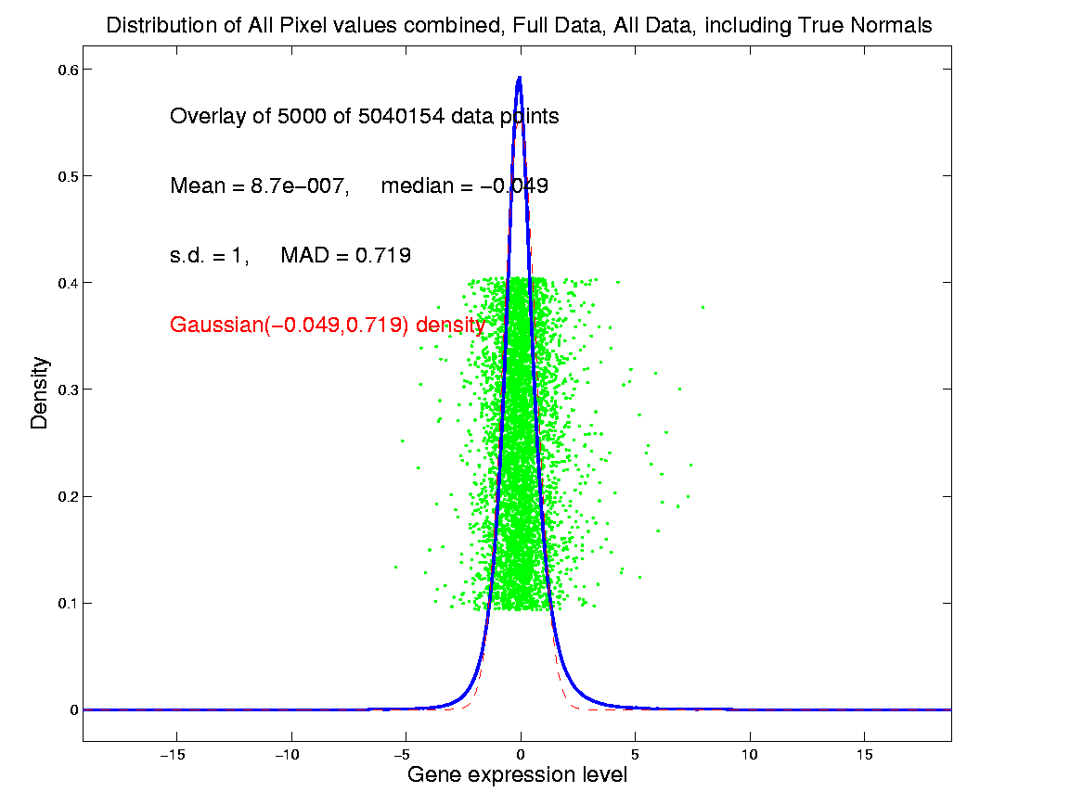
Last Class: SigClust Estimation of Background Noise
Hope: Most
Entries are
“Pure Noise,
(Gaussian)”
A Few (<< ¼)
Are Biological
Signal –
Outliers

Slide 4
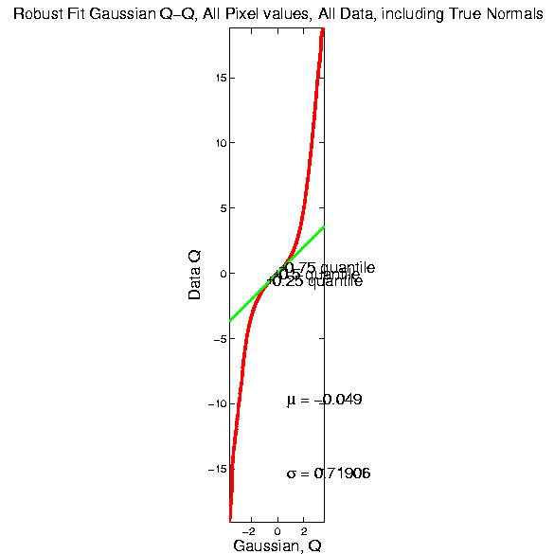
Last Class: SigClust Estimation of Background Noise

Slide 5
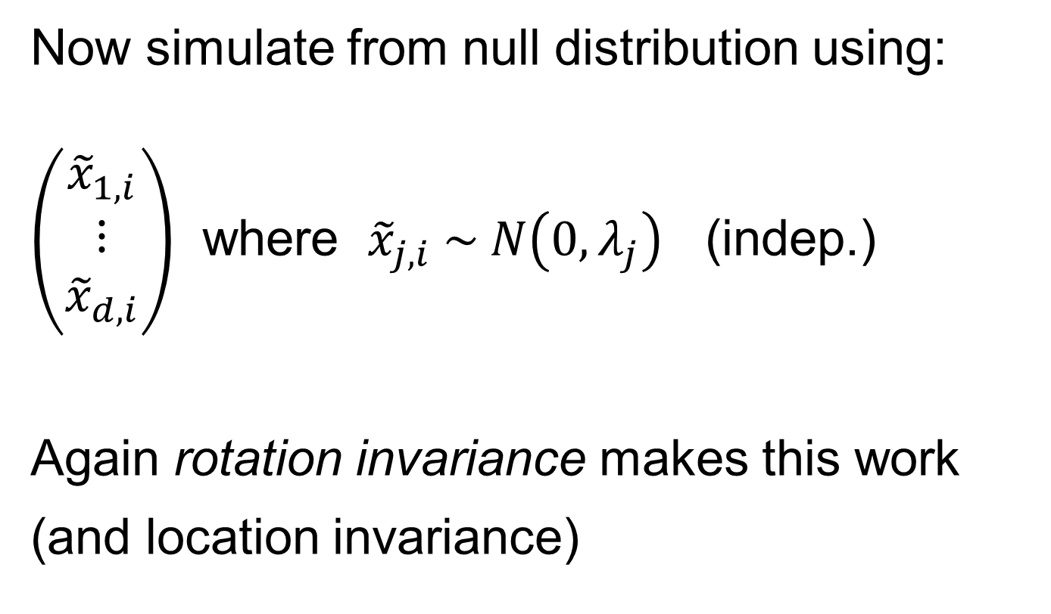
Last Class: SigClust Gaussian null distribution - Simulation
Now simulate from null distribution using:
$\left(\begin{matrix}{\tilde{x}}_{1,i} \\ ⋮ \\ {\tilde{x}}_{d,i}\end{matrix}\right)$ where ${\tilde{x}}_{j,i} \sim N\left(0,λ_{j}\right)$ (indep.)
Again rotation invariance makes this work
(and location invariance)

Slide 6
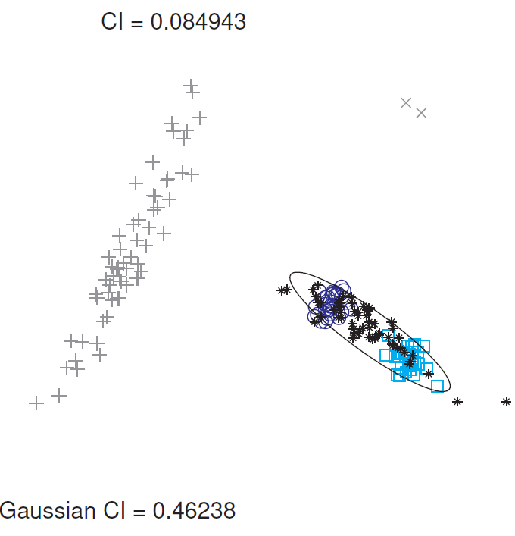
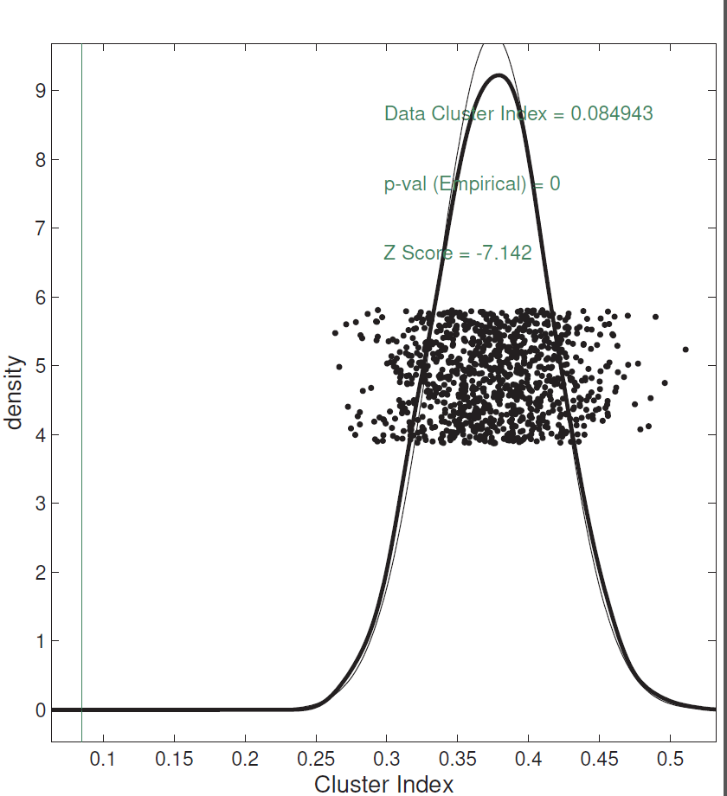
Last Class: SigClust Examples
Investigate Two Round Clusters
= Actual Data CI
Gray Out
(Ignore)
Others
Compare for Significance
Fit Gaussian to Data
Conclude Clusters
Strongly Significant
Simulate from Gaussian
Record in Diagnostic Plot

Slide 7
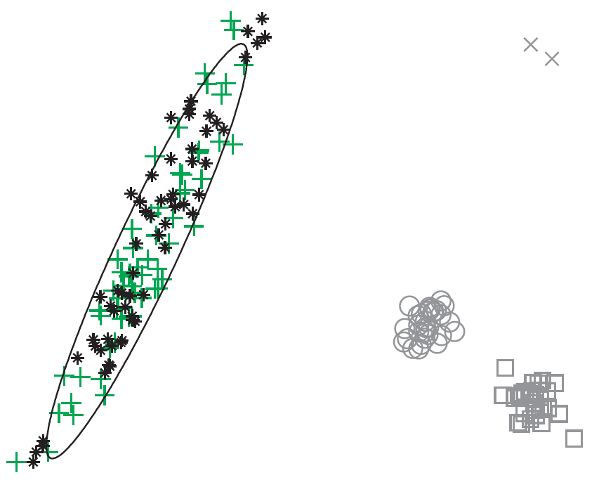
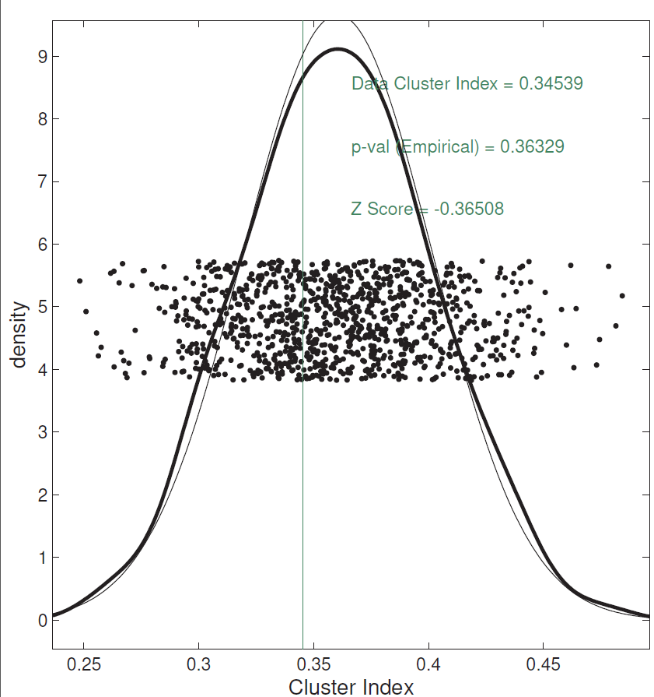
Last Class: SigClust Examples
Try to Split Long Green Cluster
Can NOT Conclude
Two Clusters,
Accept Gaussian Null

Slide 8
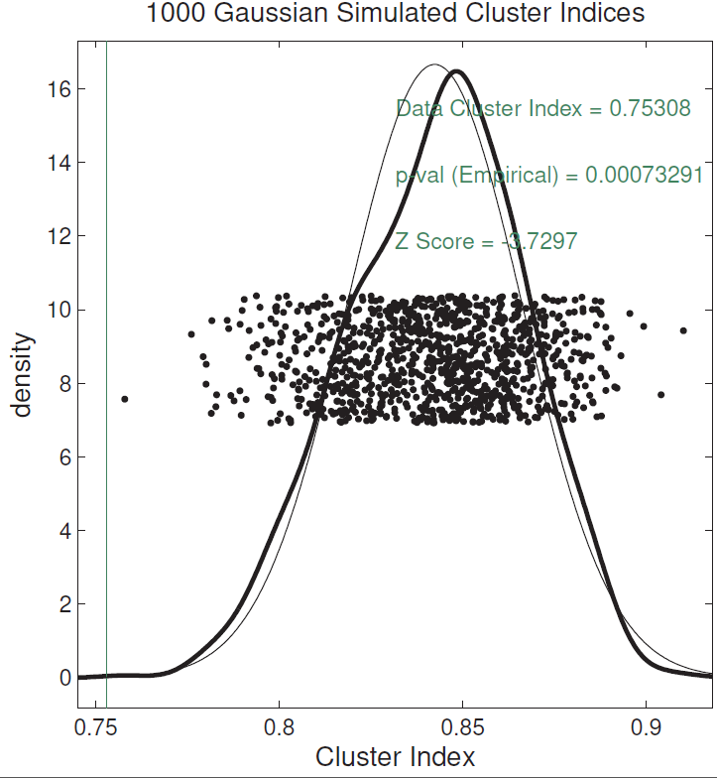
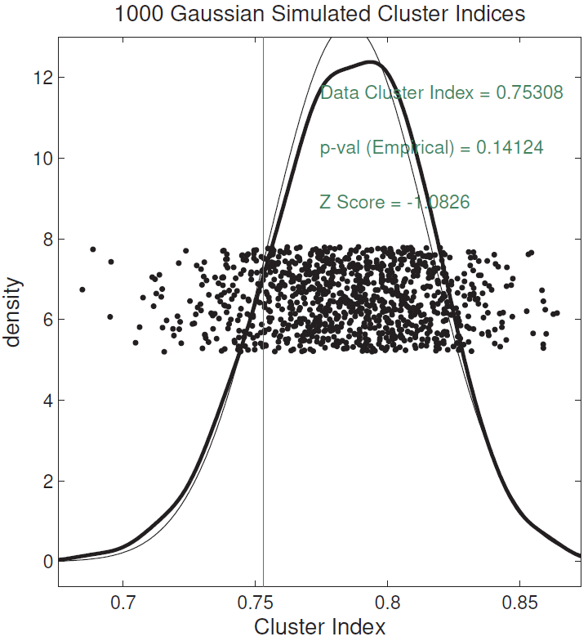
Last Class: SigClust Examples
Split KIRC Cases?
Yes, using Soft
Thresholded Cov. Est.
No, Using Sample Cov. Est.
Too Conservative

Slide 9
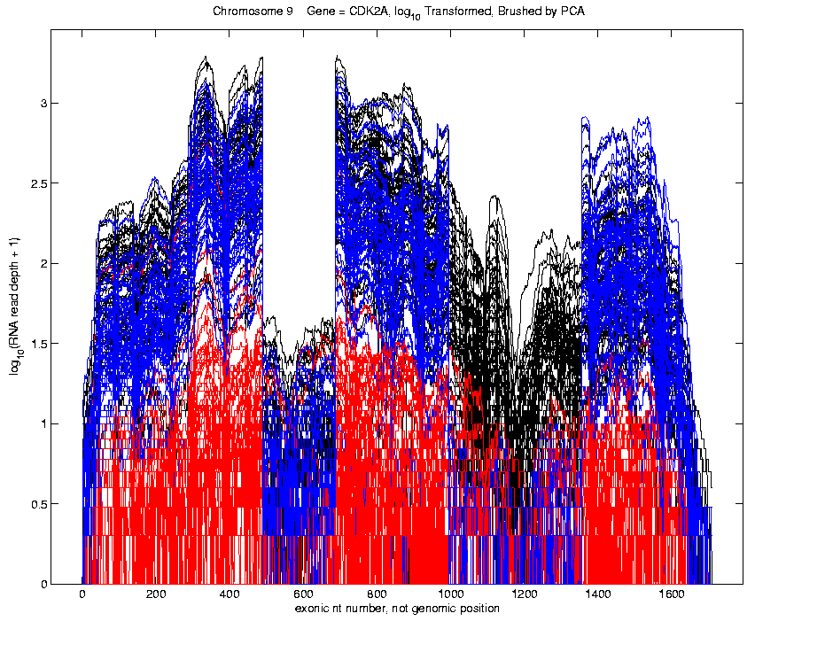
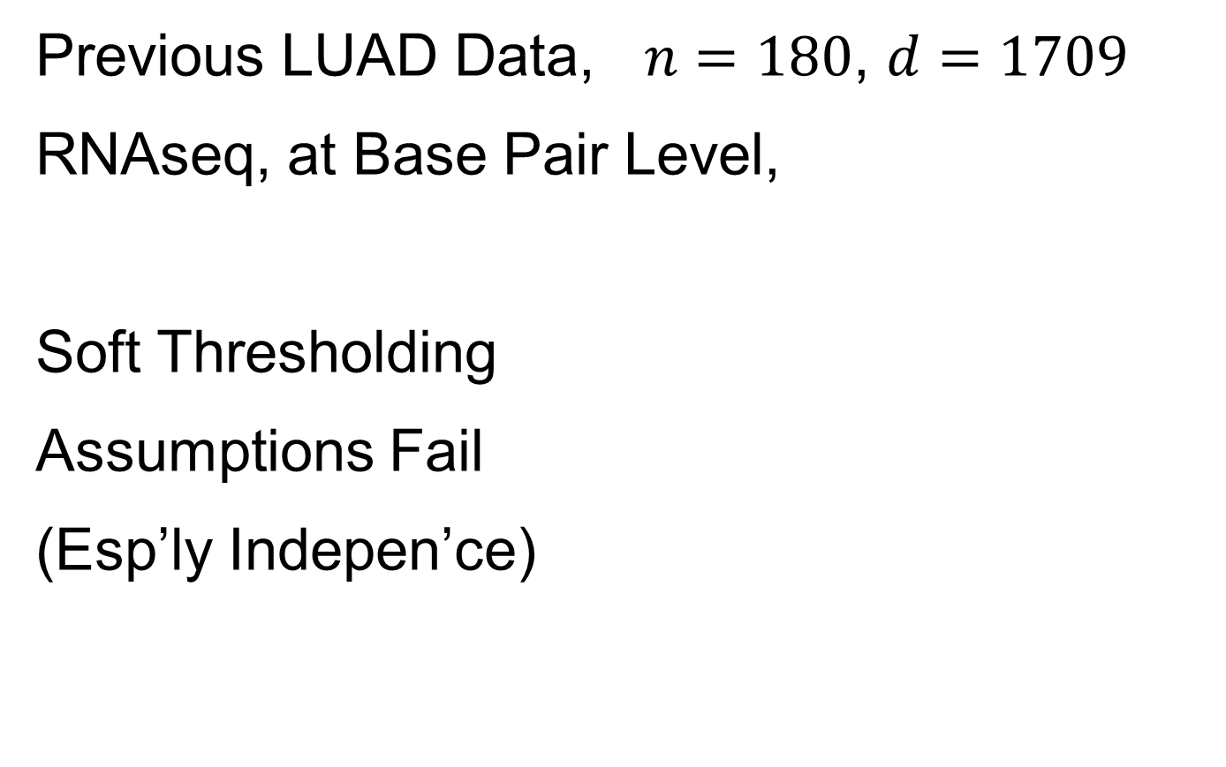
Last Class: SigClust Examples
Previous LUAD Data, $n=180$, $d=1709$
RNAseq, at Base Pair Level,
Soft Thresholding
Assumptions Fail
(Esp’ly Indepen’ce)

Slide 10
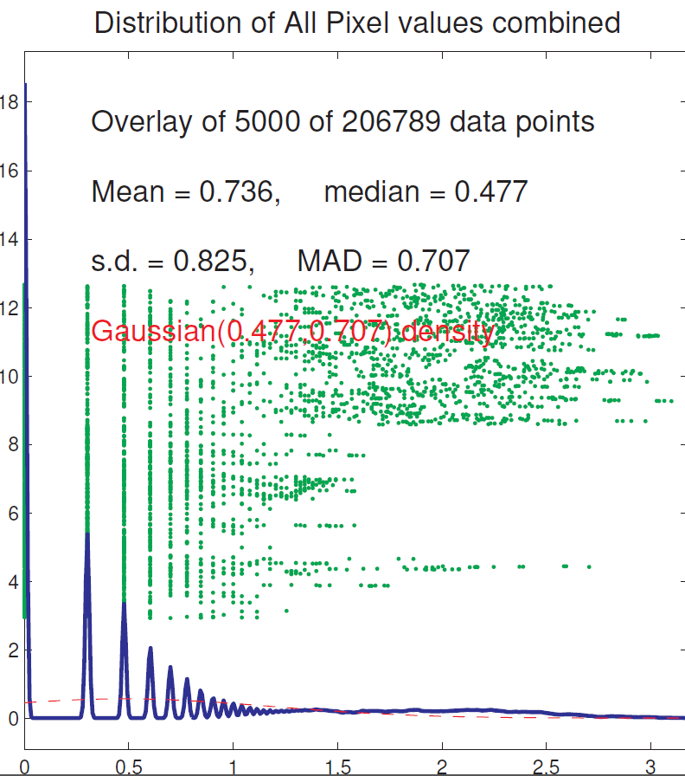
Last Class: SigClust Examples
Previous LUAD Data, Diagnostic
Far From
Few Large Pixels
& Gaussian
Background Noise
Use Sample Cov. Est.
Not Soft Threshold

Slide 11
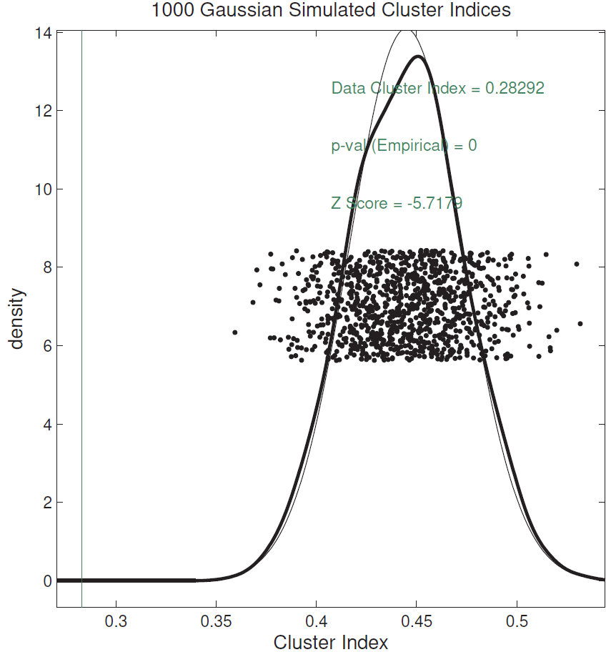
Last Class: SigClust Examples
Previous LUAD Data, Conclusion
Can Split LUAD
Strong Evidence
For Clusters
(Recall Seen in PCA)

Slide 12
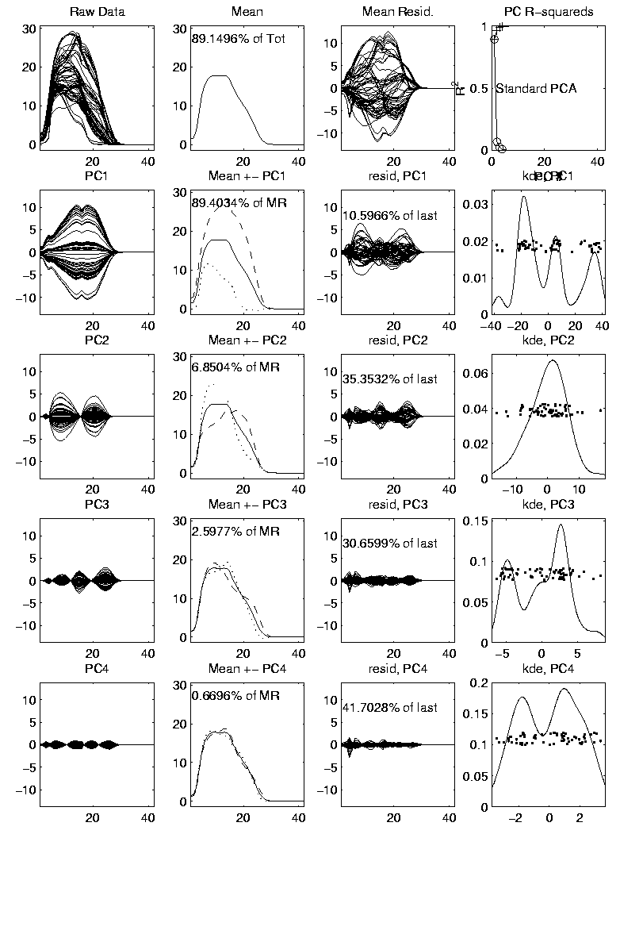

Last Class: Mass Flux Data
Mean Captures
Mountain Shape
PCA of Mass Flux Data:
PC1 is
Height
Variation
Impression
Enhanced
By Smooth
Histogram
Are Clusters “Really There”?
Shows Up Well
In Mean $±$ Panel
Discovery?
Noise Artifact?
Scores
Suggest
3 Clusters

Slide 13
Last Class: Mass Flux Data
Return to Investigation of PC1 Clusters:
Can see 3 bumps in smooth histogram
Main Question:
Important structure
or
sampling variability?
Approach: SiZer
(SIgnificance of ZERo crossings of deriv.)

Slide 14
Last Class: Statist’l Smoothing
In 1 Dimension, 2 Major Settings:
Density Estimation
“Histograms”
Nonparametric Regression
“Scatterplot Smoothing”

Slide 15
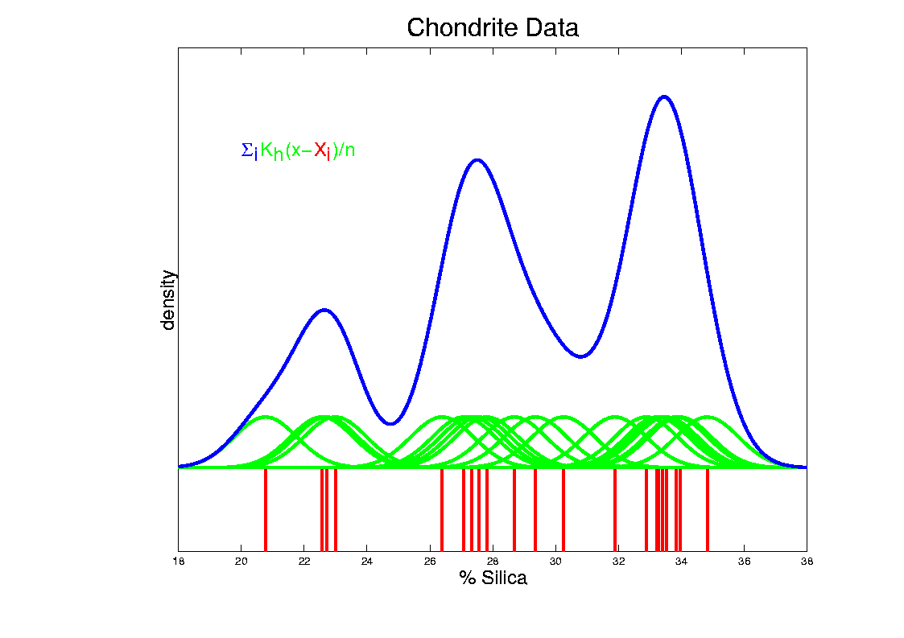
Last Class: Kernel Density Est.
Chondrite Data:
Sum pieces to estimate density
Suggests 3 modes (rock sources)

Slide 16
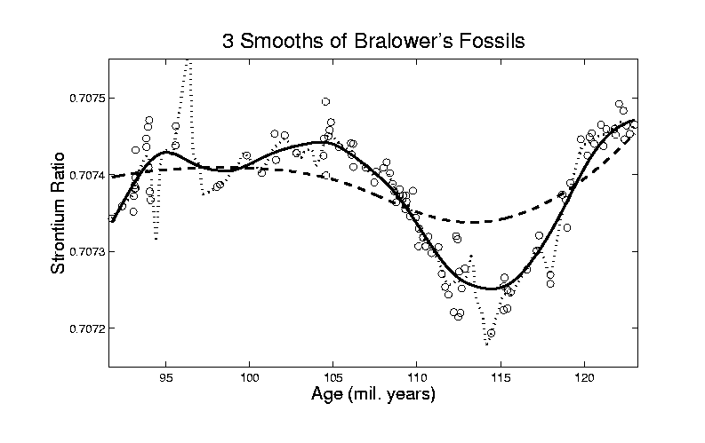
Last Class: Scatterplot Smoo.
E.g. Bralower Fossil Data – some smooths

Slide 17
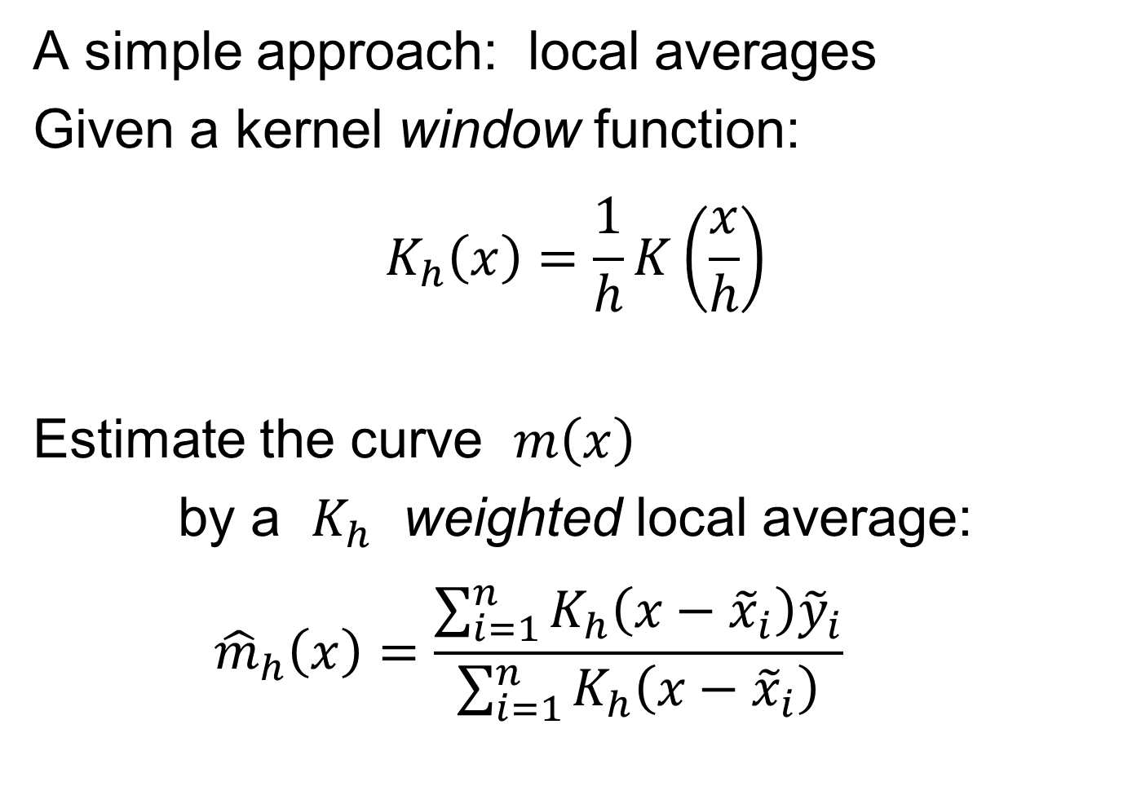
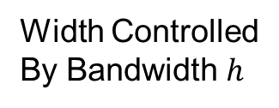
Last Class: Scatterplot Smoo.
A simple approach: local averages
Given a kernel window function:
$$K_{h}\left(x\right)=\frac{1}{h}K\left(\frac{x}{h}\right)$$
Estimate the curve $m\left(x\right)$
by a $K_{h}$ weighted local average:
$${\hat{m}}_{h}\left(x\right)=\frac{\sum_{i=1}^{n}{K_{h}\left(x−{\tilde{x}}_{i}\right){\tilde{y}}_{i}}}{\sum_{i=1}^{n}{K_{h}\left(x−{\tilde{x}}_{i}\right)}}$$
Same Form As
Kernel Density
Width Controlled
By Bandwidth $h$
Makes
Weights
Sum to 1

Slide 18
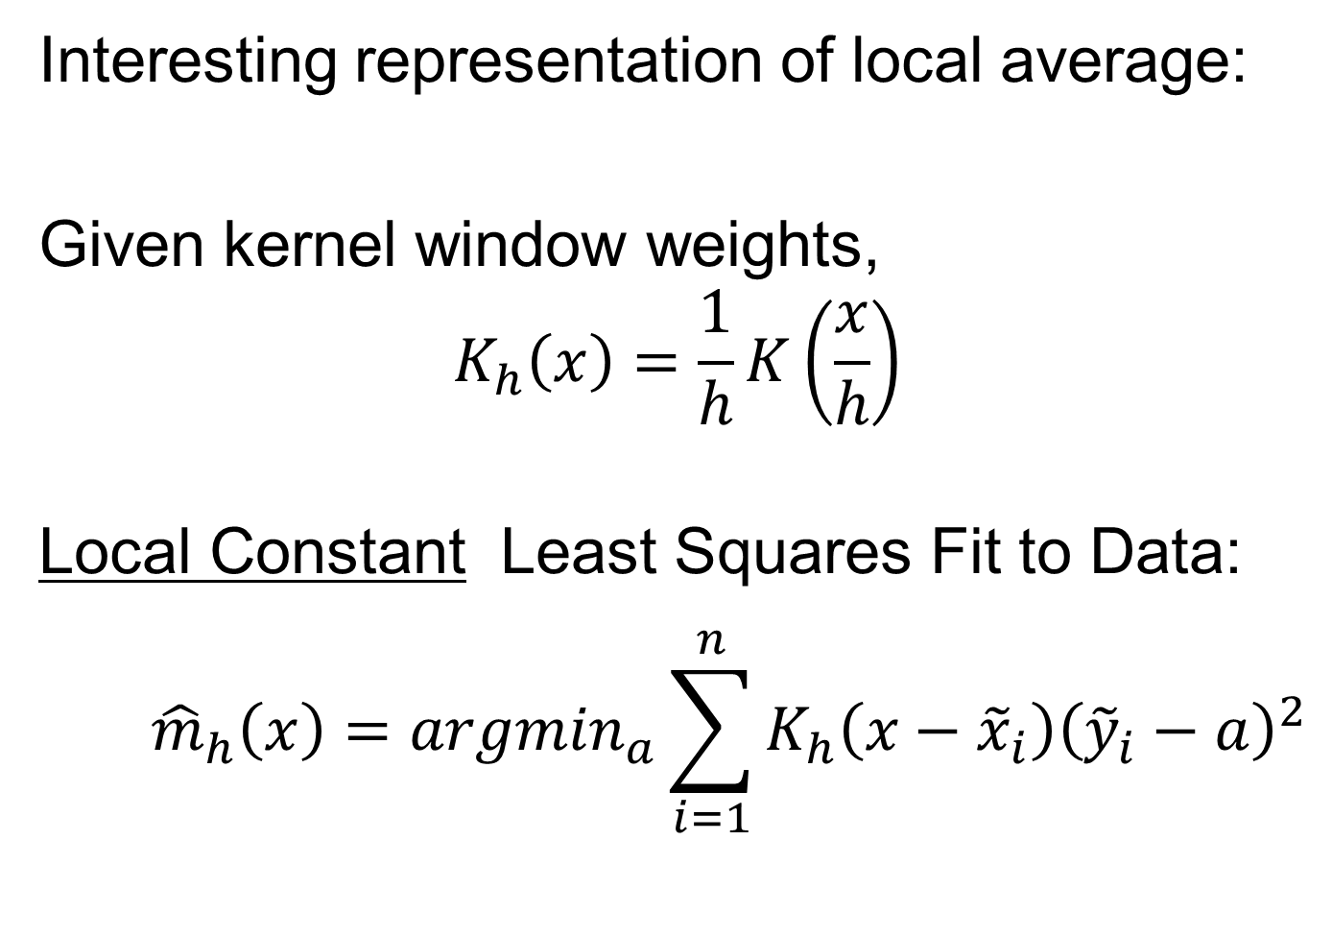
Last Class: Scatterplot Smoo.
Interesting representation of local average:
Given kernel window weights,
$$K_{h}\left(x\right)=\frac{1}{h}K\left(\frac{x}{h}\right)$$
Local Constant Least Squares Fit to Data:
$${\hat{m}}_{h}\left(x\right)={argmin}_{a}\sum_{i=1}^{n}{K_{h}\left(x−{\tilde{x}}_{i}\right){\left({\tilde{y}}_{i}−a\right)}^{2}}$$
Kernel Weighted Fréchet Mean

Slide 19
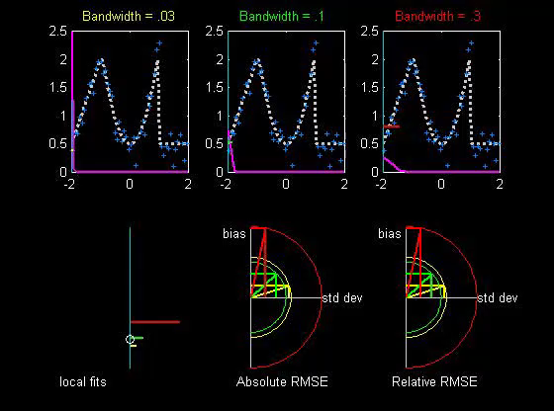

Scatterplot Smoothing
Local Constant Fits (visually):
“Moving Average”
Window width $h$ is critical (~ k.d.e.)
Goldilocks
Smoothing
Levels
Too Small
About Right
Too Big
Recommended
For Manual
Window Choice
Graphics Relevant to Smoothing Theory
Thanks to
Brad Davis

Slide 20
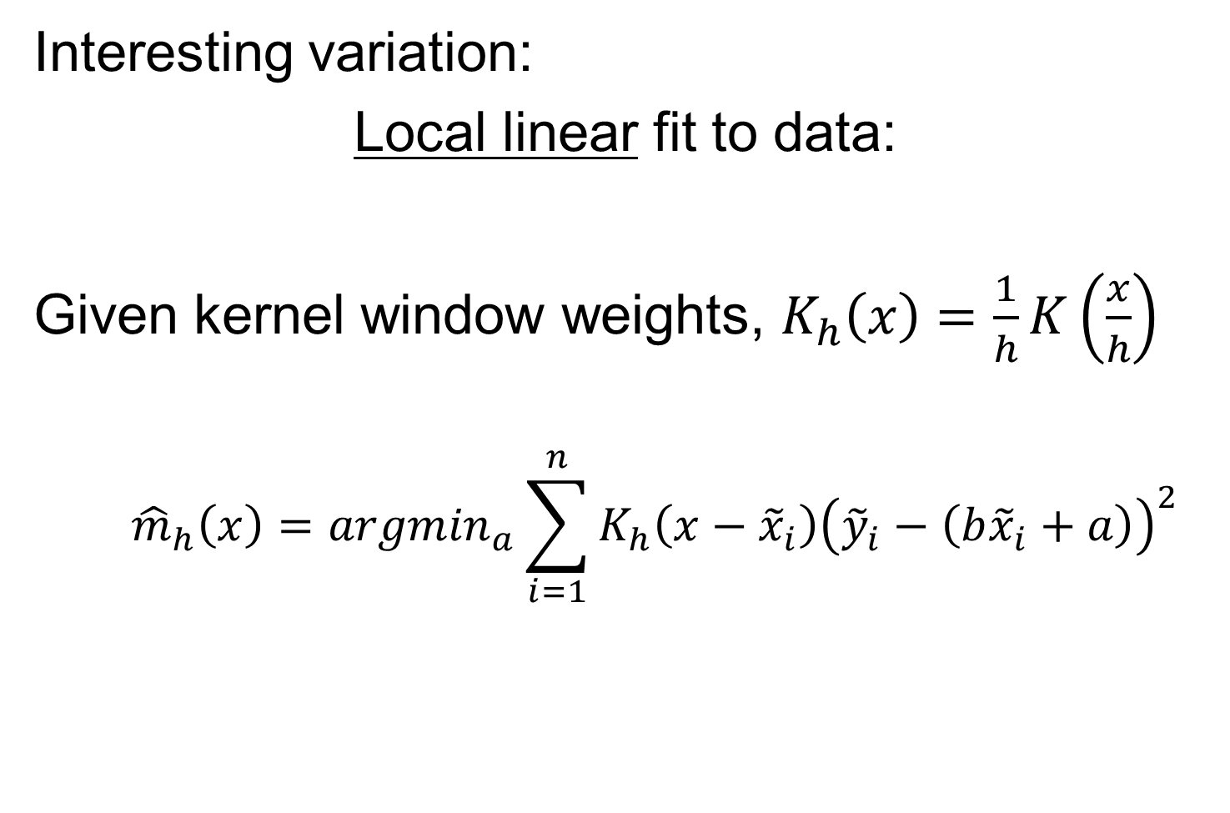
Scatterplot Smoothing
Interesting variation:
Local linear fit to data:
Given kernel window weights, $K_{h}\left(x\right)=\frac{1}{h}K\left(\frac{x}{h}\right)$
$${\hat{m}}_{h}\left(x\right)={argmin}_{a}\sum_{i=1}^{n}{K_{h}\left(x−{\tilde{x}}_{i}\right){\left({\tilde{y}}_{i}−\left(b{\tilde{x}}_{i}+a\right)\right)}^{2}}$$
Only Keep
Intercept
Kernel Weighted Least Squares Fit
Local Linear Value Added?

Slide 21
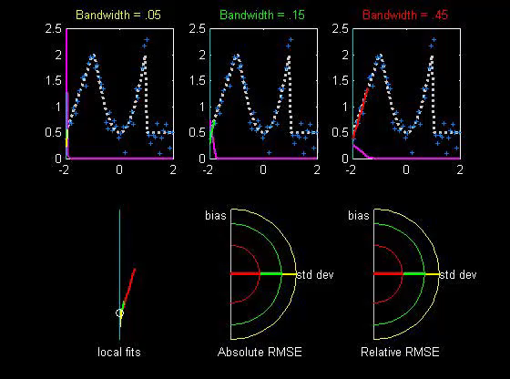


Scatterplot Smoothing
Local Linear Fits (visually):
“Intercept of Moving Fit Line”
Window width $h$ is critical (~ k.d.e.)
Main Difference at Boundary
And for Not Equally Spaced $x_{i}$

Slide 22
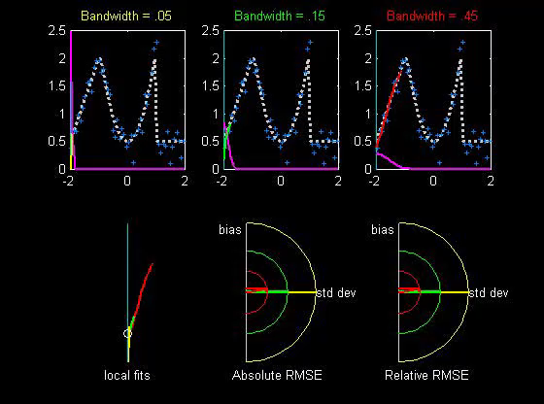

Scatterplot Smoothing
Another variation:
“Intercept of Moving Polynomial Fit”
Window width $h$ is critical (~ k.d.e.)
Higher Degree Gives More Flexible Fit

Slide 23
Scatterplot Smoothing
Local Polynomial Smoothing
What is best polynomial degree?
Once again controversial…
Advocates for all of 0, 1, 2, 3.
Depends on personal weighting of factors involved
Good reference:
  Fan & Gijbels (1995)
Personal choice: degree 1, local linear

Slide 24
Scatterplot Smoothing
E.g. Bralower Fossils – local linear smooths
Goldilocks Smoothing
Parameter Selection
Undersmoothed, Feels Sampling Variation
Oversmoothed,
Misses Important
Structure
Is This Valley Real?
About Right? Seems Good Balance?
Nicely Follows
Deep Valley

Slide 25
Scatterplot Smoothing
Smooths of Bralower Fossil Data:
Oversmoothed misses structure
Undersmoothed feels sampling noise?
About right shows 2 valleys:
  One seems clear
  Is other one really there?
  Same question as above…
Needs “Statistical Inference”,
i.e. Confirmatory Analysis

Slide 26
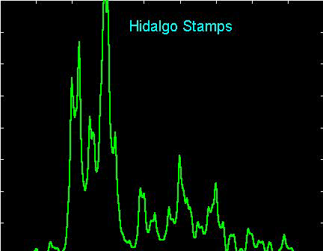
Kernel Density Estimation
Choice of bandwidth (window width)?
Very important to performance
Fundamental Issue:
Which modes are “really there”?

Slide 27
Kernel Density Estimation
Choice of bandwidth (window width)?
Very important to performance
Data Based Choice?
Controversial Issue
Many recommendations
Suggested Reference:
Jones, Marron & Sheather (1996)
Never a consensus…

Slide 28
Kernel Density Estimation
Choice of bandwidth (window width)?
Alternate Choice:
  Consider all of them!
  I.e. look at whole spectrum of smooths
  Can see different structure
  At different smoothing levels
  Connection to Scale Space
E.g. Stamps data
  How many modes?
  All answers are there….

Slide 29
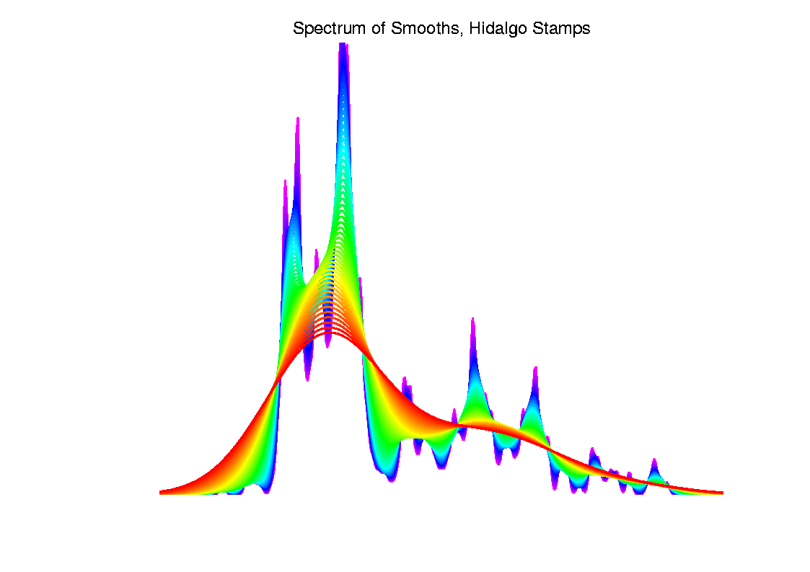
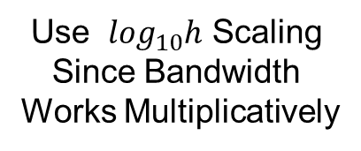
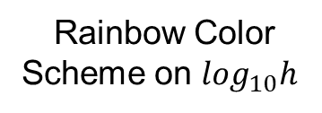
Kernel Density Estimation
Rainbow Color
Scheme on $\log_{10}h$
1 Mode
Use $\log_{10}h$ Scaling
Since Bandwidth
Works Multiplicatively
2 Modes
5 Modes
7 Modes
More …

Slide 30
Statistical Smoothing
Fundamental Question
For both of
Density Estimation: “Histograms”
Regression: “Scatterplot Smoothing”
Which bumps are “really there”?
vs. “artifacts of sampling noise”?

Slide 31
SiZer Background
Scale Space – Idea from Computer Vision
Goal: Teach Computers to “See”
Modern Research:
Extract “Information” from Images
Early Theoretical work

Slide 32
SiZer Background
Scale Space – Idea from Computer Vision
Conceptual basis:
Oversmoothing = “view from afar”
(macroscopic)
Undersmoothing = “zoomed in view”
(microscopic)
Main idea: all smooths contain useful information, so study “full spectrum”
(i. e. all smoothing levels)
Recommended reference: Lindeberg (1994)

Slide 33
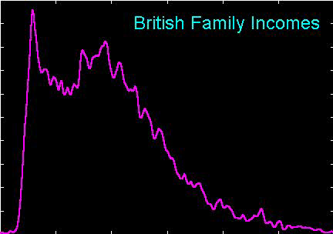
SiZer Background
Fun Scale Space Views
(of Family Incomes Data)

Slide 34
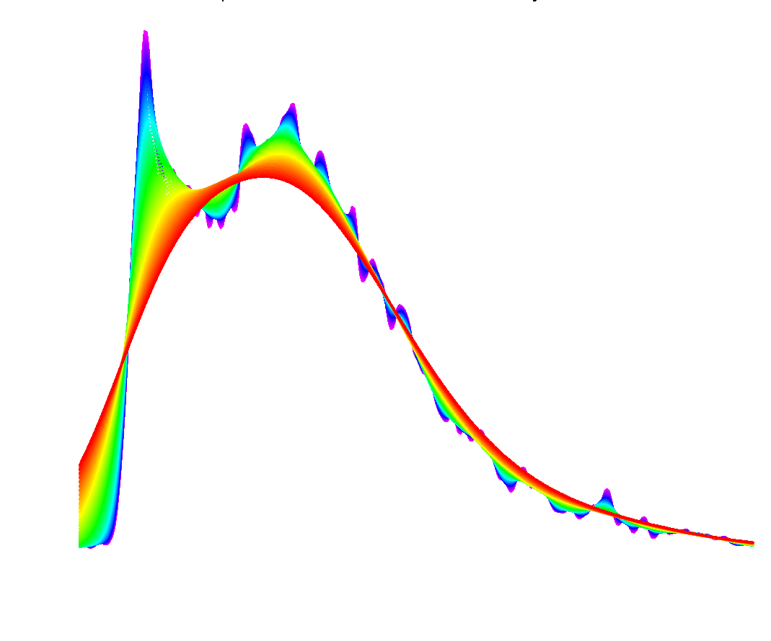

SiZer Background
Fun Scale Space Views (Incomes Data)
Spectrum Overlay
$∃$ Many Parametric Models
All Unimodal
Bimodality is Persistent, So Real???
Bimodality is a Major Discovery
PhD Dissertation, U. Bonn:
Confirmed Bimodality
By Stratification

Slide 35
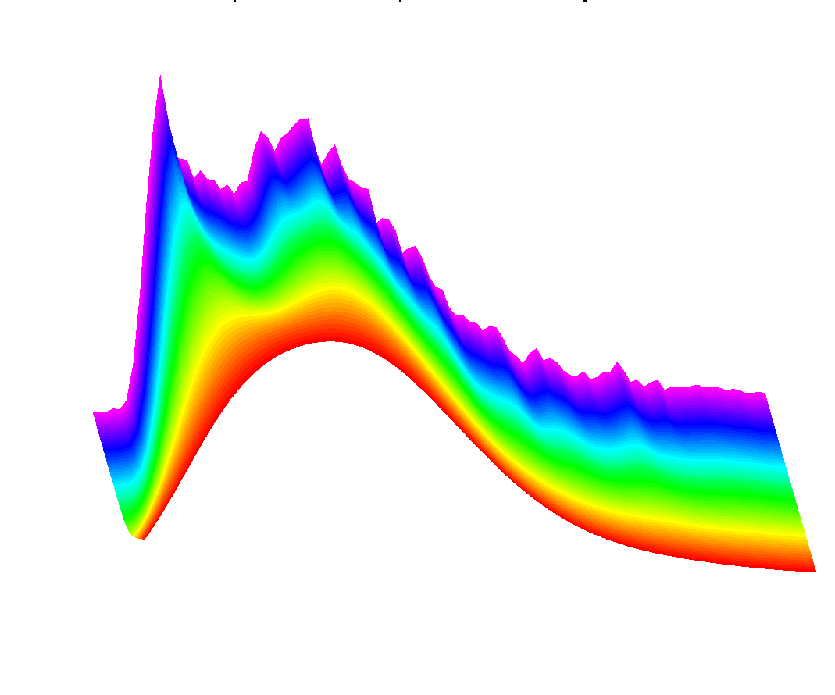

SiZer Background
Fun Scale Space Views (Incomes Data)
Surface View
$\log_{10}h$ Scaling
Important Here

Slide 36
SiZer Background
Fun Scale Space Views
(of Family Incomes Data)
Note:
The scale space viewpoint makes
Data Dased Bandwidth Selection
Much less important
(than I once thought….)

Slide 37
SiZer Background
SiZer:
Significance of Zero crossings, of the derivative, in scale space
Combines:
  needed statistical inference
  novel visualization
To get: a powerful exploratory + confirmatory data analysis method
Main references:
Chaudhuri & Marron (1999)
Hannig & Marron (2006)

Slide 38
SiZer Background
Basic idea: a bump is characterized by:
an increase
followed by a decrease
Generalization:
Many features of interest captured
by sign of the slope of the smooth
Foundation of SiZer:
Statistical inference on slopes,
over scale space

Slide 39
SiZer Background
SiZer Visual presentation:
Color map over scale space:
Blue: slope significantly upwards
(derivative CI above 0)
Red: slope significantly downwards
(derivative CI below 0)
Purple: slope insignificant
(derivative CI contains 0)
Color Scheme
Motivated by
Economic Data
For Climatology Data: Reverse Colors, Erästö & Holmström (2005)

Slide 40
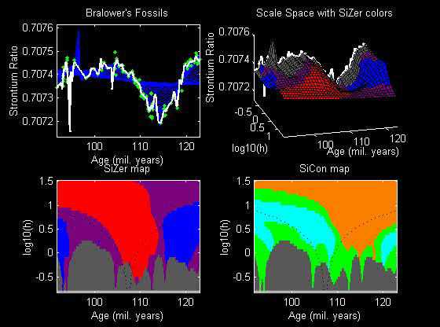
SiZer Background
SiZer analysis of Fossils data:

Slide 41
SiZer Background
SiZer analysis of Fossils data:
Upper Left: Scatterplot, family of smooths, 1 highlighted
Upper Right: Scale space rep’n of family, with SiZer colors
Lower Left: SiZer map, more easy to view
Lower Right: SiCon map – replace slope by curvature
Slider (in movie viewer) highlights different smoothing levels

Slide 42
SiZer Background
SiZer analysis of Fossils data (cont.):
Oversmoothed (top of SiZer map):
Decreases at left, not on right
Medium smoothed (middle of SiZer map):
Main valley significant, and left most increase
Smaller valley not statistically significant
Undersmoothed (bottom of SiZer map):
“noise wiggles” not significant
Additional SiZer color: gray - not enough data for inference

Slide 43
SiZer Background
SiZer analysis of Fossils data (cont.):
Common Question: Which is right?
Decreases on left, then flat
(top of SiZer map)
Up, then down, then up again
(middle of SiZer map)
No significant features
(bottom of SiZer map)
Answer: All are right
Just different scales of view,
i.e. levels of resolution of data

Slide 44
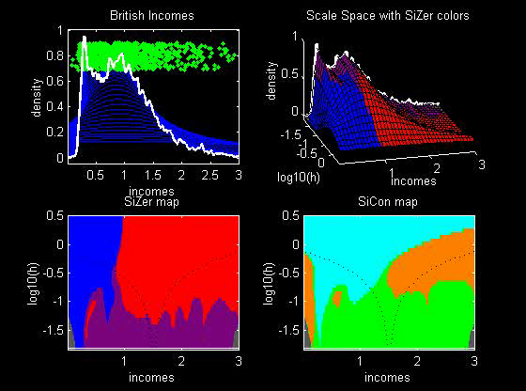
SiZer Background
SiZer analysis of British Incomes data:

Slide 45
SiZer Background
SiZer analysis of British Incomes data:
Oversmoothed: Only one mode
Medium smoothed: Two modes, statistically significant
Confirmed by Schmitz & Marron, (1992)
Undersmoothed: many noise wiggles, not significant
Again: all are correct,
just different scales

Slide 46
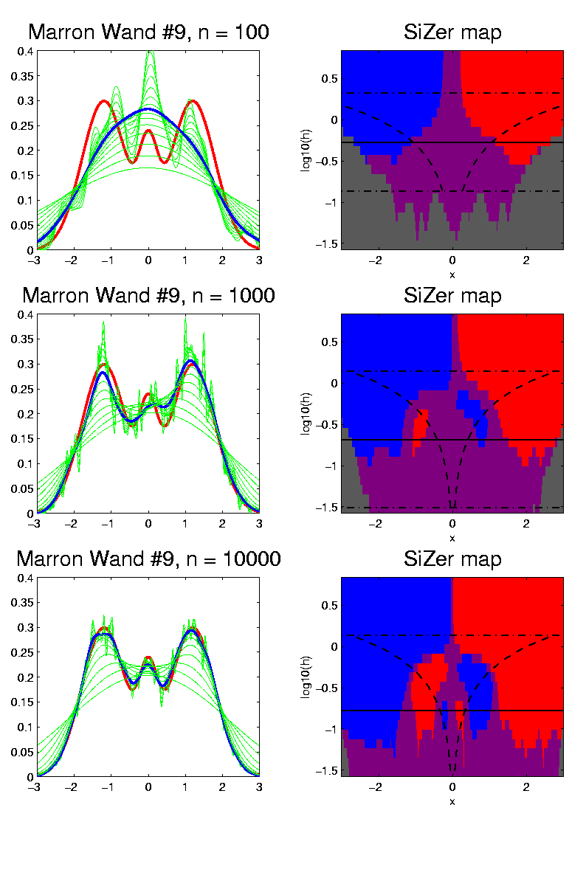

SiZer Background
E.g. - Marron & Wand (1992) Trimodal #9
Increasing $n$
Only 1 Signif’t Mode
Now 2 Signif’t Modes
Finally all 3 Modes

Slide 47
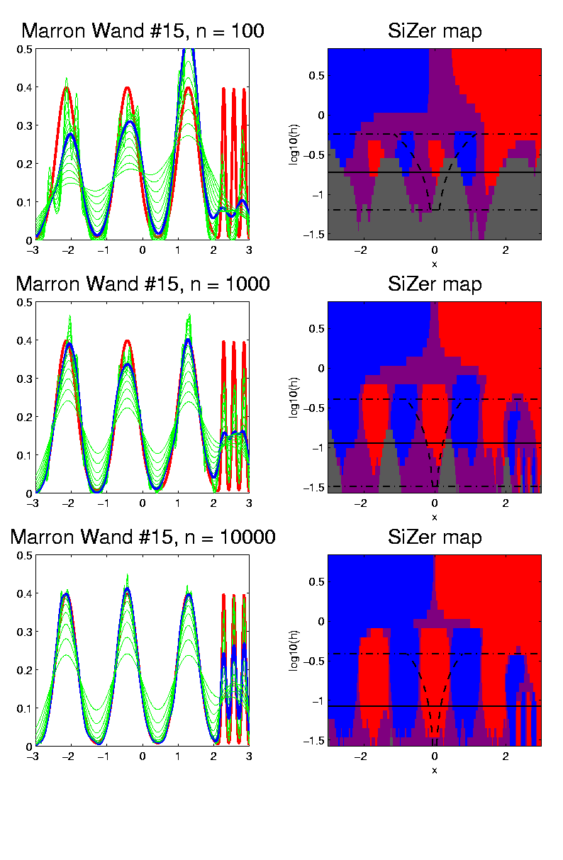

SiZer Background
E.g. - Marron & Wand Discrete Comb #15
Increasing $n$
Coarse Bumps Only
Now Fine bumps too
Someday: “draw” local
Bandwidth on SiZer map

Slide 48
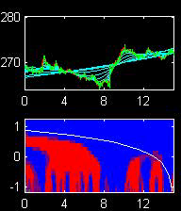
SiZer Background
Finance "tick data":
(time, price) of single stock transactions
Idea: "on line" version of SiZer
for viewing and understanding trends

Slide 49
SiZer Background
Finance "tick data":
(time, price) of single stock transactions
Idea: "on line" version of SiZer
for viewing and understanding trends
Notes:
trends depend heavily on scale
double points and more
background color transition
(flop over at top)

Slide 50
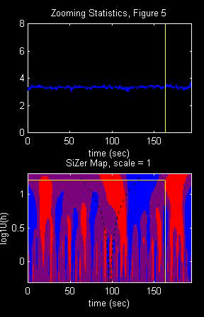
SiZer Background
Internet traffic data analysis:
SiZer analysis of
time series of
packet times
at internet hub (UNC)
Hannig, Marron,
and Riedi (2001)
Notes:
50

Slide 51
SiZer Background
Internet traffic data analysis:
SiZer analysis of
time series of packet times
at internet hub (UNC)
across very wide range of scales
needs more pixels than screen allows
thus do zooming view
(zoom in over time)
  zoom in to yellow bd’ry in next frame
  readjust vertical axis
Notes:
51

Slide 52
SiZer Background
Internet traffic data analysis (cont.)
Insights from SiZer analysis:
Coarse scales:
amazing amount of significant structure
Evidence of self-similar fractal type process?
Fewer significant features at small scales
But they exist, so not Poisson process
Poisson approximation OK at small scale???
Smooths (top part) stable at large scales?
Notes:
52

Slide 53
Dependent SiZer
Rondonotti, Marron, and Park (2007)
SiZer compares data with white noise
Inappropriate in time series
Dependent SiZer compares data with an assumed model
Visual Goodness of Fit test
Notes:
53

Slide 54
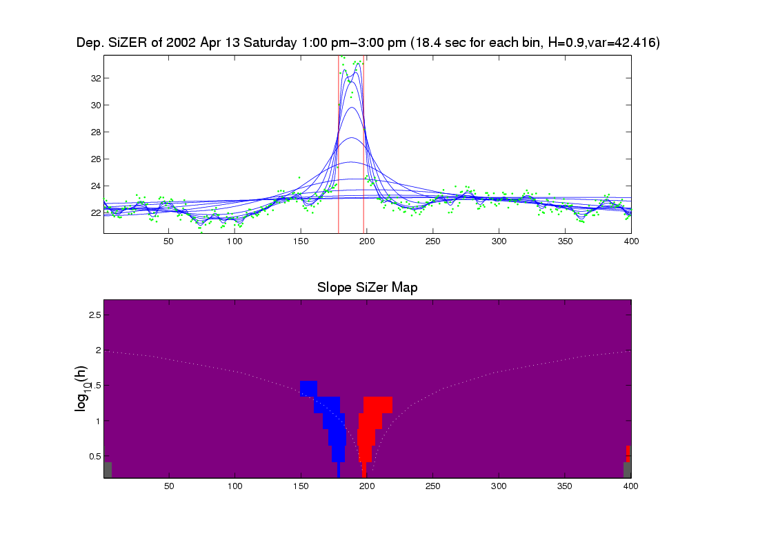
Dep’ent SiZer : 2002 Apr 13 Sat 1 pm – 3 pm
Internet Traffic At
UNC Main Link
2 hour span
Notes:
54

Slide 55
Dep’ent SiZer : 2002 Apr 13 Sat 1 pm – 3 pm
Big Spike in Traffic
Is “Really There”
Notes:
55

Slide 56
Dep’ent SiZer : 2002 Apr 13 Sat 1 pm – 3 pm
Zoom in for
Closer Look
Notes:
56

Slide 57
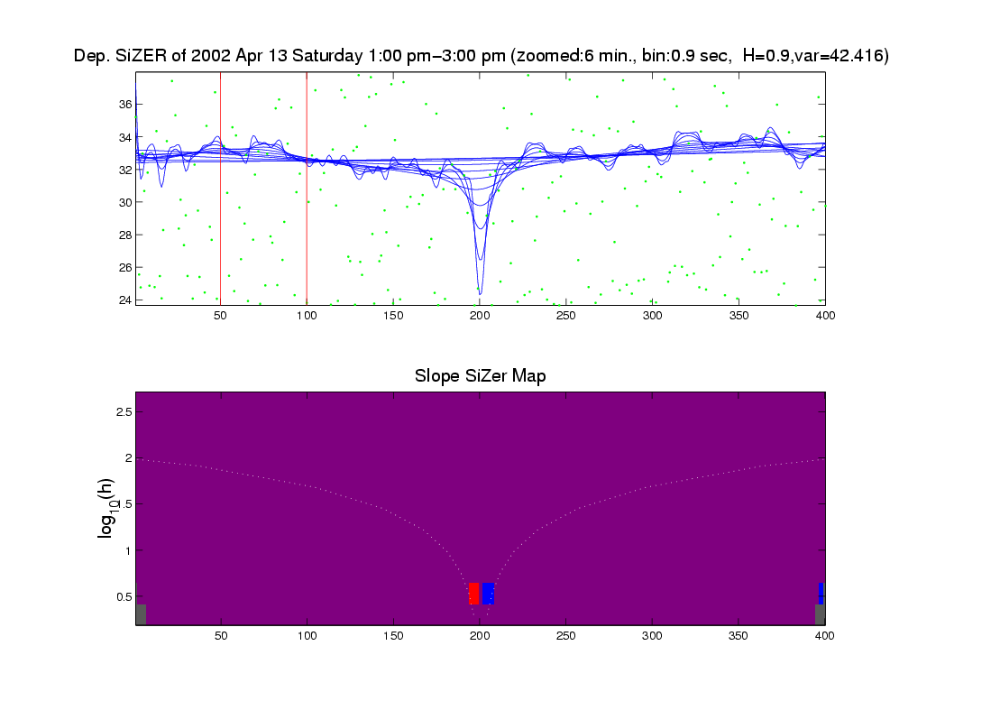
Zoomed view (to red region, i.e. “flat top”)
Strange “Hole in Middle”
Is “Really There”
Notes:
57

Slide 58
Zoomed view (to red region, i.e. “flat top”)
Zoom in for
Closer Look
Notes:
58

Slide 59
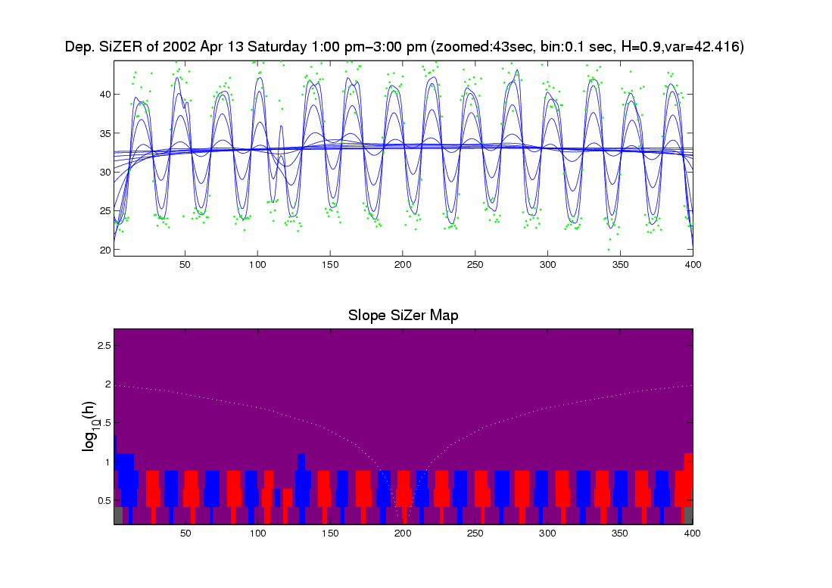
Further Zoom: finds very periodic behavior!
SiZer found interesting structure, but depends on scale
Notes:
59

Slide 60
Possible Physical Explanation
IP “Port Scan”
Common device of hackers
Searching for “break in points”
Send query to every possible (within UNC) domain:
  IP address
  Port Number
Replies can indicate system weaknesses
Internet Traffic is hard to model
Notes:
60

Slide 61
SiZer Background
Historical Note & Acknowledgements:
Scale Space: S. M. Pizer
SiZer: Probal Chaudhuri
Main References:
Chaudhuri & Marron (1999)
Chaudhuri & Marron (2000)
Hannig & Marron (2006)

Slide 62
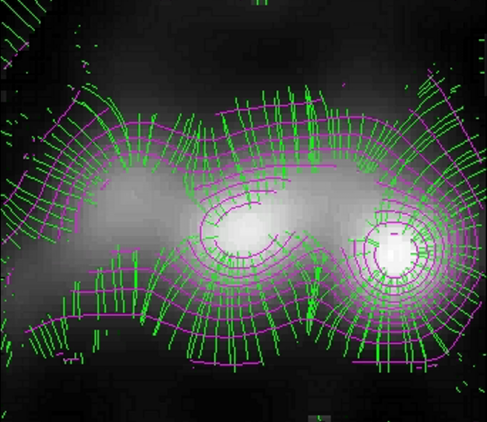
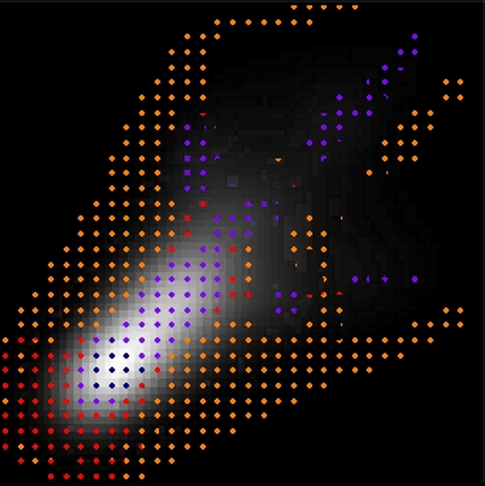
SiZer Background
Extension to 2-d:
Significance in Scale Space
Main Challenge: Visualization
References:
Godtliebsen et al (2002, 2004, 2006)
What Is Up and Down?
Significant
Gradients
& Contours
Significant
Curvature

Slide 63
SiZer Overview
Would you like to try smoothing & SiZer?
Marron Software Website as Before
In “Smoothing” Directory:
  kdeSM.m
  nprSM.m
  sizerSM.m
Recall: “>> help sizerSM” for usage

Slide 64
PCA to find clusters
Return to PCA of Mass Flux Data:
Big Question:
Are The
3 Clusters
Really There?
Notes:
MassFlux1d1p1.ps

Slide 65
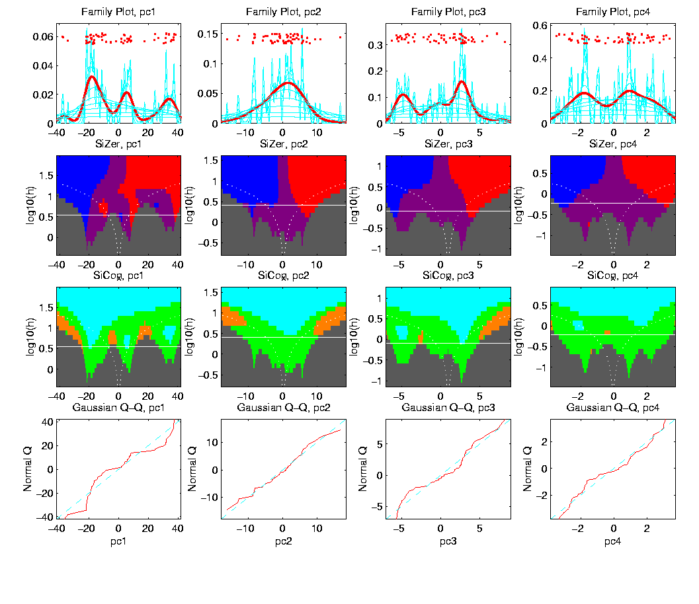
PCA to find clusters
SiZer analysis of Mass Flux, PC1
Notes:
MassFlux1d1p1s.ps

Slide 66
PCA to find clusters
SiZer analysis of Mass Flux, PC1
All 3
Signif’t
Notes:
MassFlux1d1p1s.ps

Slide 67
PCA to find clusters
SiZer analysis of Mass Flux, PC1
Also in
Curvature
Notes:
MassFlux1d1p1s.ps

Slide 68
PCA to find clusters
SiZer analysis of Mass Flux, PC1
And in
Other
Comp’s
Notes:
MassFlux1d1p1s.ps

Slide 69
PCA to find clusters
SiZer analysis of Mass Flux, PC1
Conclusion:
Found 3 significant clusters!
Worth deeper investigation
Correspond to 3 known “cloud types”

Slide 70
Statistical Smoothing
Usefulness of SiZer :
Detailed & Insightful Analysis of 1 Dataset
To Analyze Many Data Sets
Need Automatic Choice
Reference:
Jones, et al. (1996)
Also Recall Goldilocks Visual Approach
Too Small, Too Big, Just Right

Slide 71
Q-Q plots
An aside:
Fitting probability distributions to data
Does Gaussian distribution “fit”???
If not, why not?
Fit in some part of the distribution?
(e.g. in the middle only?)

Slide 72
Q-Q plots
Approaches to:
Fitting probability distributions to data
Histograms
Kernel Density Estimates
Drawbacks: often not best view
(for determining goodness of fit)
Recall Representation
Of Probability
Distributions as
Data Objects
Densities
Cumulatives
Quantiles!!!

Slide 73
Q-Q plots
Consider Testbed of 4 Toy Examples:
non-Gaussian!
non-Gaussian(?)
Gaussian
Gaussian?
(Will use these names several times)

Slide 74
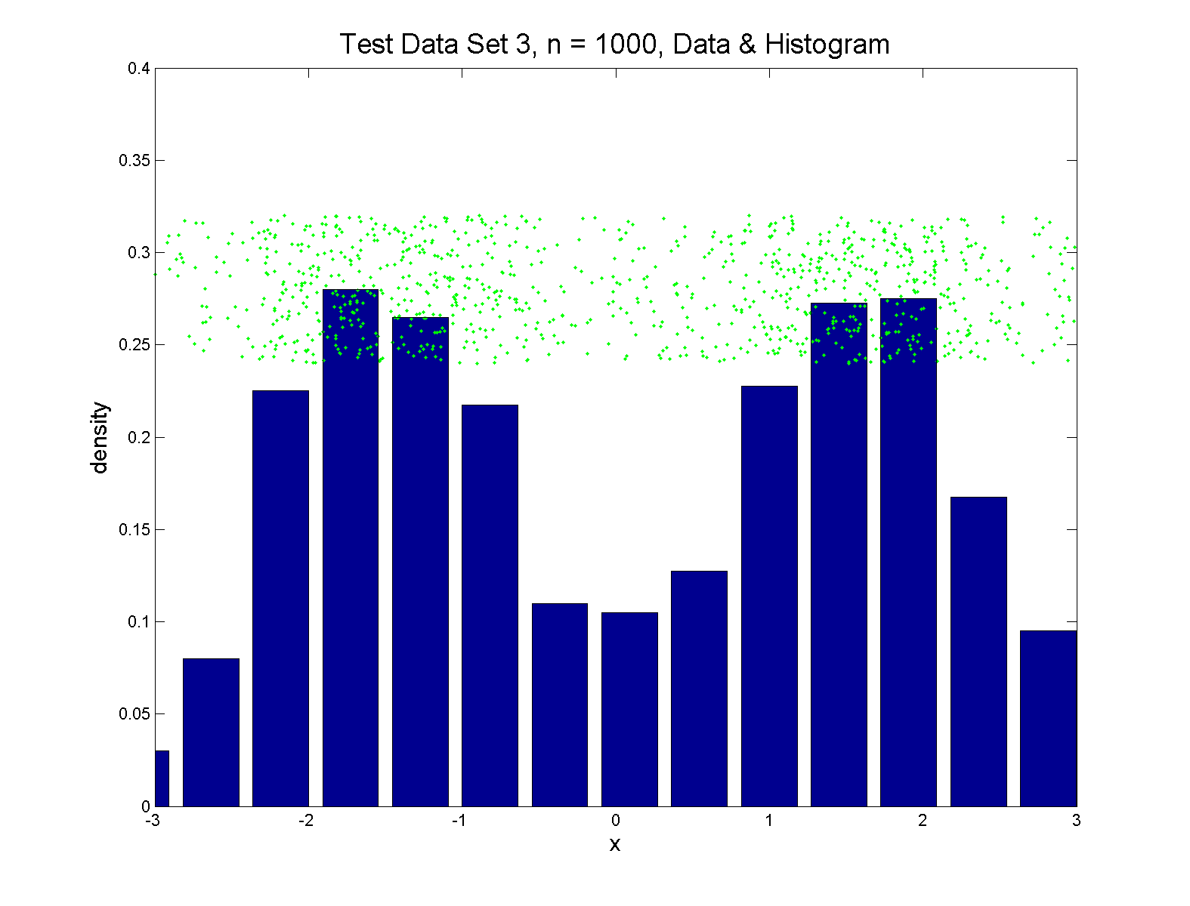
Q-Q plots
Simple Toy Example, non-Gaussian!
Bimodal

Slide 75
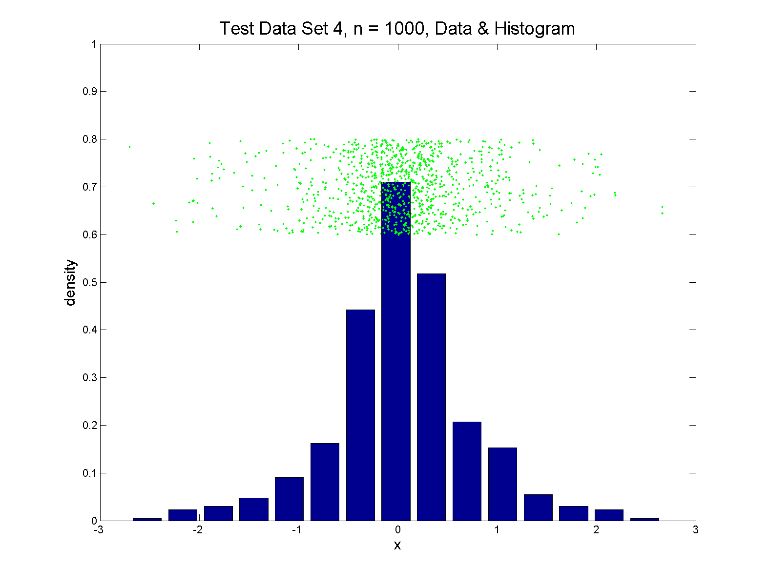
Q-Q plots
Simple Toy Example, non-Gaussian(?)
Unimodal, But Strong Kurtosis

Slide 76
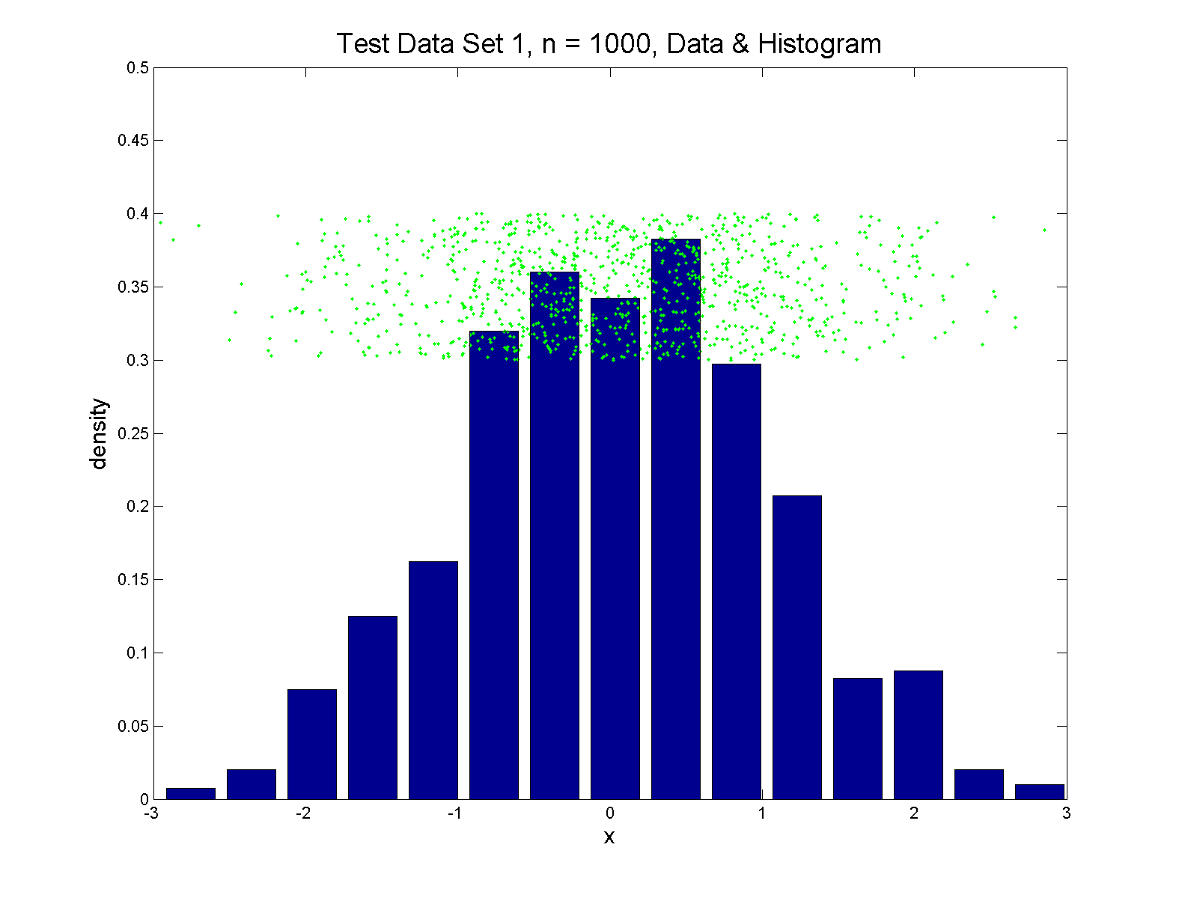
Q-Q plots
Simple Toy Example, Gaussian

Slide 77


Q-Q plots
Simple Toy Example, Gaussian?
Much Bigger $n$

Slide 78
Q-Q plots
Notes:
Bimodal → see non-Gaussian with histo
Other cases: hard to see
Conclude:
Histogram poor at assessing Gauss’ity

Slide 79
Q-Q plots
Standard approach to checking Gaussianity
QQ – plots
Background:
Graphical Goodness of Fit
Fisher (1983)

Slide 80

Q-Q plots
Background: Graphical Goodness of Fit
Basis:
Cumulative Distribution Function (CDF)
$$F\left(x\right)=P\left\{X≤x\right\}$$
Probability quantile notation:
for "probability” $p$ and "quantile" $q$
$p=F\left(q\right)$ $q=F^{−1}\left(p\right)$

Slide 81

Q-Q plots
Probability quantile notation:
for "probability” $p$ and "quantile" $q$
$p=F\left(q\right)$ $q=F^{−1}\left(p\right)$
Thus $F^{−1}$ is called the quantile function

Slide 82

Q-Q plots
Two types of CDF:
Theoretical
$$p=F\left(q\right)=P\left\{X≤q\right\}$$
Empirical, based on data $X_{1},⋯,X_{n}$
$$\hat{p}=\hat{F}\left(q\right)=\frac{\#\left\{i:X_{i}≤q\right\}}{n}$$

Slide 83




Q-Q plots
Direct Visualizations:
Empirical CDF plot:
plot $\hat{p}=\frac{i}{n}, i=1,⋯,n$
vs. grid of $\hat{q}$ (sorted data) values
Quantile plot (inverse):
plot $\hat{q}$
vs. $\hat{p}$
Variations:
$$\hat{p}=\frac{2i−1}{2n}$$
$$\hat{p}=\frac{i}{n+1}$$
Good Uniform
Likelihood Prop’s
Both Avoid $Φ^{−1}\left(1\right)=∞$

Slide 84

Q-Q plots
Comparison Visualizations:
(compare a theoretical with an empirical)
P-P plot:
plot $\hat{p}$ vs. $p$
for a grid of $q$ values
Note: Have essentially already used this:
Called it the “ROC Curve”

Slide 85

ROC Curve
Slide
Cutoff
To
Trace
Out
Curve
Recall from 1/25/24

Slide 86

ROC Curve
Slide
Cutoff
To
Trace
Out
Curve

Slide 87



ROC Curve
Slide
Cutoff
To
Trace
Out
Curve
Plot $\hat{p}$ vs. $p$
For Grid of $q$ Values

Slide 88

ROC Curve – CDF View
Next
Add
Cum.
Dist.
Funct.

Slide 89

ROC Curve – CDF View
Slide
Cutoff
To
Trace
Out
Curve

Slide 90

ROC Curve – CDF View
Slide
Cutoff
To
Trace
Out
Curve

Slide 91

ROC Curve – CDF View
Slide
Cutoff
To
Trace
Out
Curve

Slide 92

ROC Curve – CDF View
Slide
Cutoff
To
Trace
Out
Curve

Slide 93

ROC Curve – CDF View
Slide
Cutoff
To
Trace
Out
Curve

Slide 94

Q-Q plots
Comparison Visualizations:
(compare a theoretical with an empirical)
P-P plot:
plot $\hat{p}$ vs. $p$
for a grid of $q$ values
Q-Q plot:
plot $\hat{q}$ vs. $q$
for a grid of $p$ values

Slide 95


Q-Q plots
Replace
Grid
of $q$
Values
With
Grid
of $p$
Values

Slide 96

Q-Q plots
Slide
Cutoff
To
Trace
Out
Curve

Slide 97

Q-Q plots
Slide
Cutoff
To
Trace
Out
Curve

Slide 98

Q-Q plots
Slide
Cutoff
To
Trace
Out
Curve

Slide 99

Q-Q plots
Slide
Cutoff
To
Trace
Out
Curve

Slide 100

Q-Q plots
Slide
Cutoff
To
Trace
Out
Curve

Slide 101


Q-Q plots
Illustrative graphic (toy data set):
From $N\left(0,1\right)$ Distribution

Slide 102

Q-Q plots
Illustrative graphic (toy data set):
Generated $n=5$ data points

Slide 103
Q-Q plots
Illustrative graphic (toy data set):

Slide 104
Q-Q plots
Illustrative graphic (toy data set):
Empirical Qs near Theoretical Qs
when
Q-Q curve is near 45⁰ line
(general use of Q-Q plots)

Slide 105
Alternate Viewpoints
P-P Plot = ROC Curve:
Study Differences Between Data Sets
Focus on Main Body of Distributions
Q-Q Plot: For Checking
Empirical Distribution
vs.
Theoretical Distribution
Focus on Tails

Slide 106
Alternate Terminology
P-P Plot = ROC Curve
Q-Q Plot
Related Measures:
Precision & Recall
Motivated by Information Retrieval
In the World of Data Bases

Slide 107
Participant Presentation
1:35 Kyung Rok Kim
???
Next Class: Ameer Qaqish

