Slide 1
Statistics – O. R. 881
Object Oriented Data Analysis
Steve Marron
Dept. of Statistics and Operations Research
University of North Carolina

Slide 2
Current Sections in Textbook
Today:
Sections 16.2, 11.1
Next Class:
Sections 11.1, 11.2

Slide 3
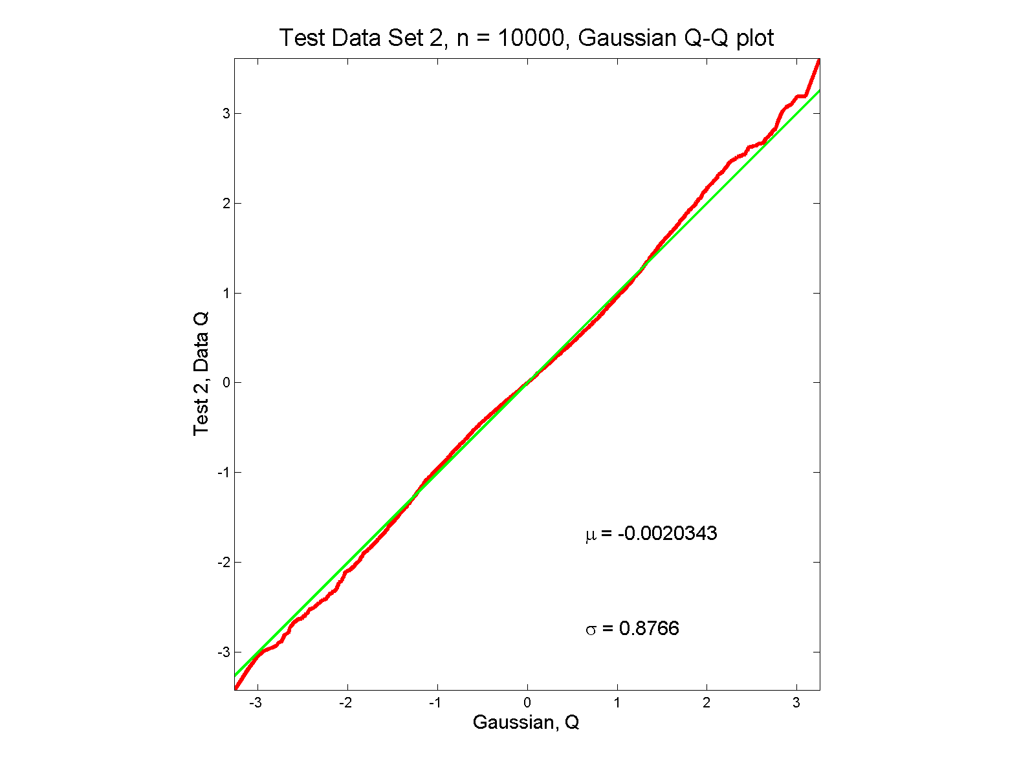
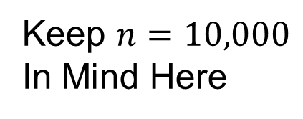
Last Class: Q-Q plots
Gaussian? Departures from line?
Keep $n=10,000$
In Mind Here

Slide 4
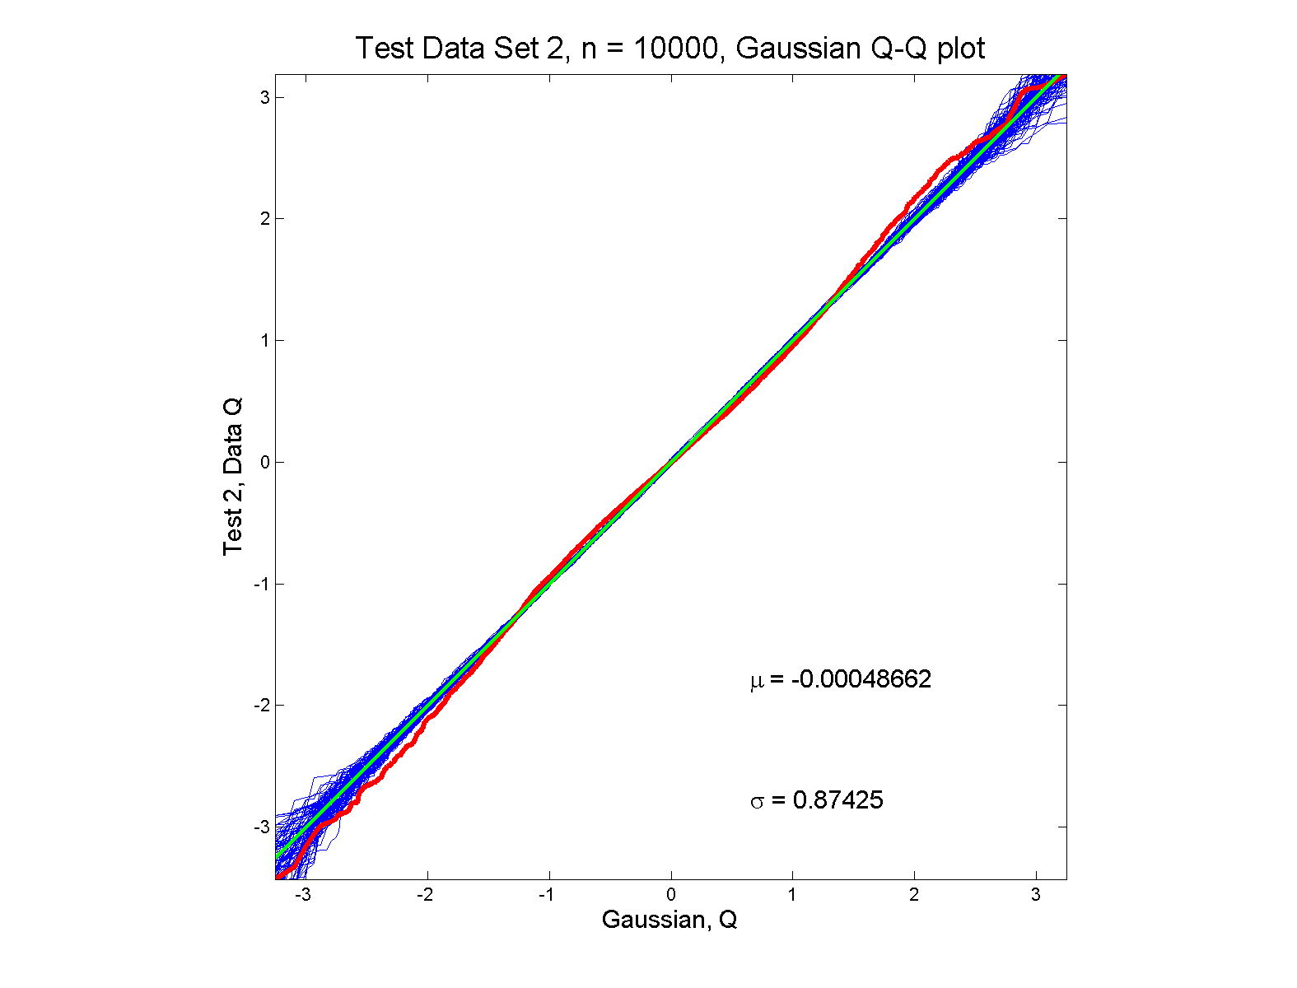
Last Class: Q-Q Envelope plots
Gaussian? departures from line?

Slide 5
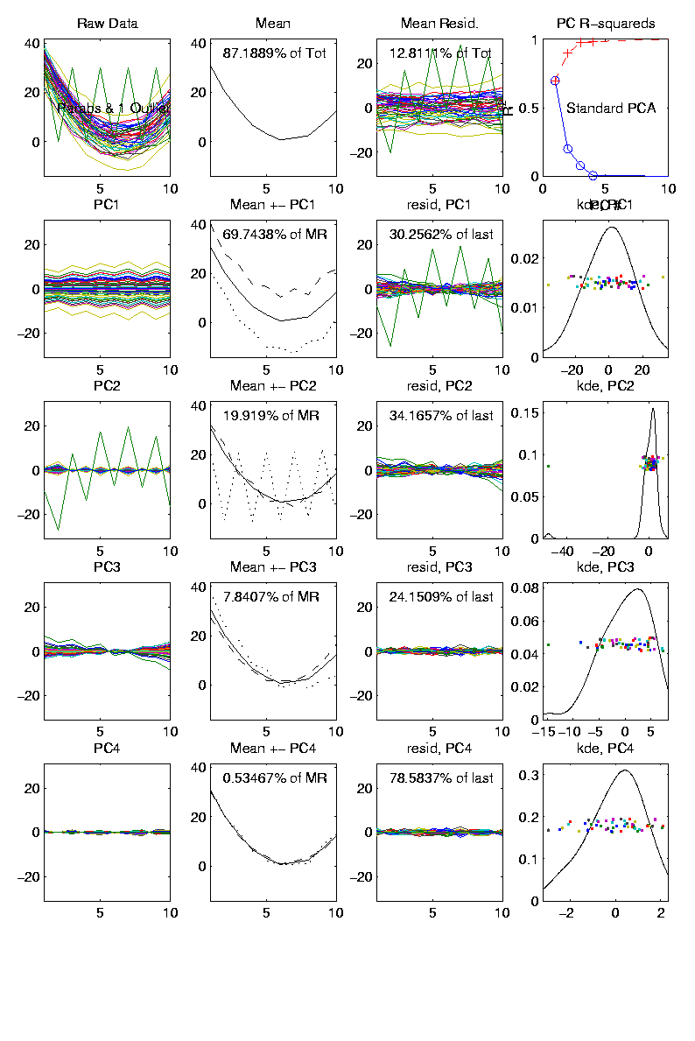
Last Class: Outliers in PCA
PCA for
Deeper
Toy E.g.
Data:

Slide 6
Last Class: Outliers in PCA
Standard Statistical Approaches to Dealing with Influential Outliers:
Outlier Deletion:
Kick out “bad data”
Robust Statistical methods:
Work with full data set,
but downweight “bad data”
Reduce influence, instead of “deleting”
(Think Median)

Slide 7

Last Class: Robust PCA
What is multivariate median?
There are several!
(“median” generalizes in different ways)
Coordinate-wise median
Often worst
Not rotation invariant
(2-d data uniform on “L”)
Can lie on convex hull of data
(same example)
Thus can be poor notion of “center”
$$\left(\begin{matrix}median\left(X_{i,1}\right) \\ ⋮ \\ median\left(X_{d,1}\right)\end{matrix}\right)$$

Slide 8
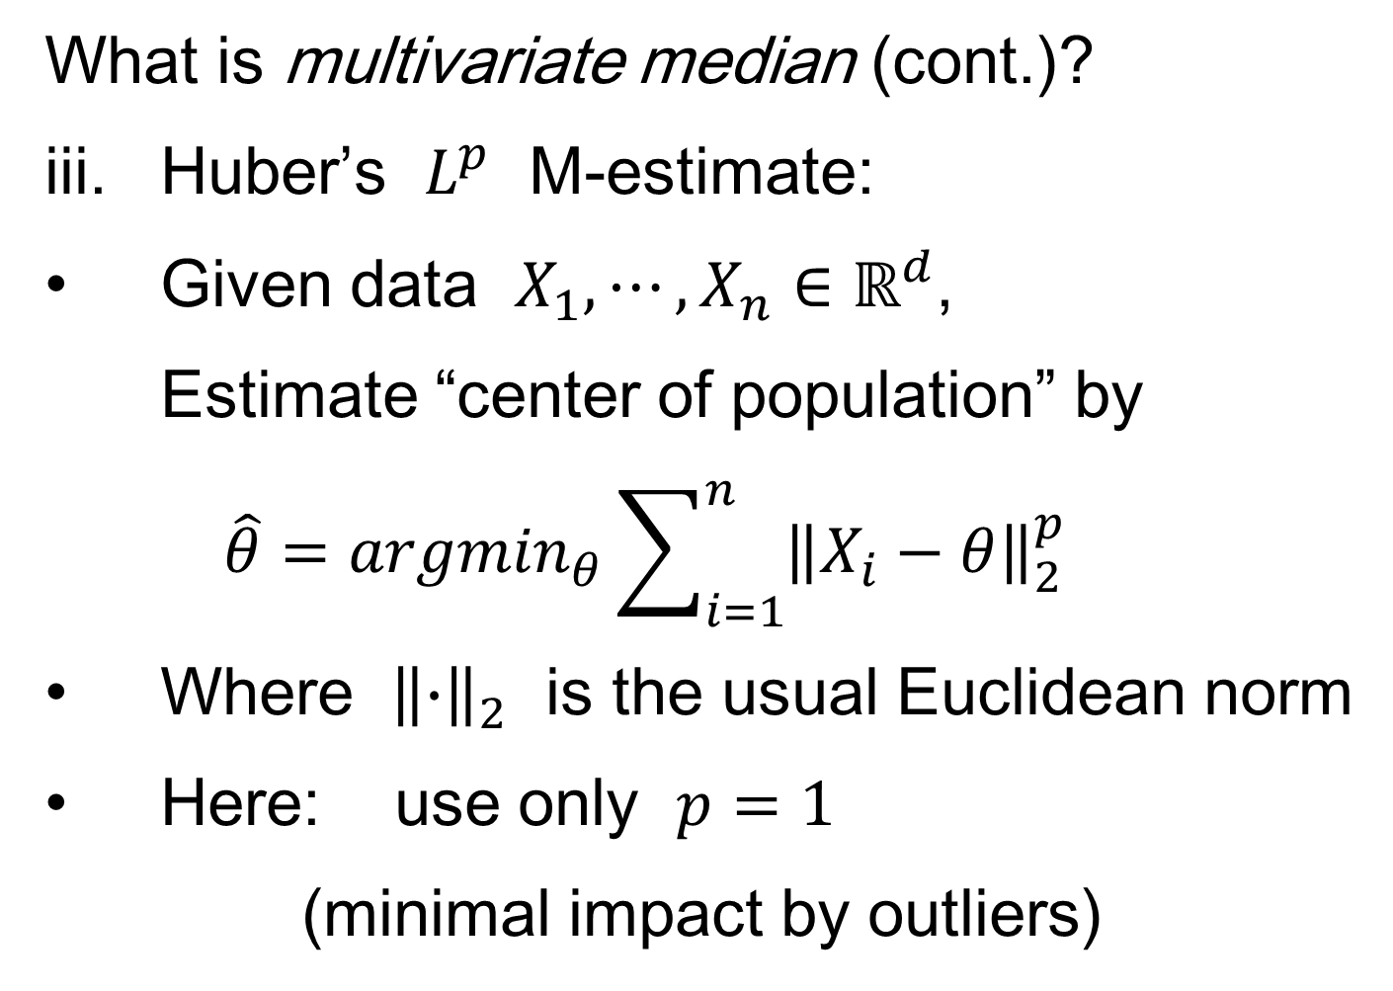
Last Class: Robust PCA
What is multivariate median (cont.)?
iii. Huber’s $L^{p}$ M-estimate:
Given data $X_{1},⋯,X_{n}∈ℝ^{d}$,
Estimate “center of population” by
$$\hat{θ}={argmin}_{θ}\sum_{i=1}^{n}{{\left\|X_{i}−θ\right\|}_{2}^{p}}$$
Where ${\left\|∙\right\|}_{2}$ is the usual Euclidean norm
Here: use only $p=1$
(minimal impact by outliers)

Slide 9
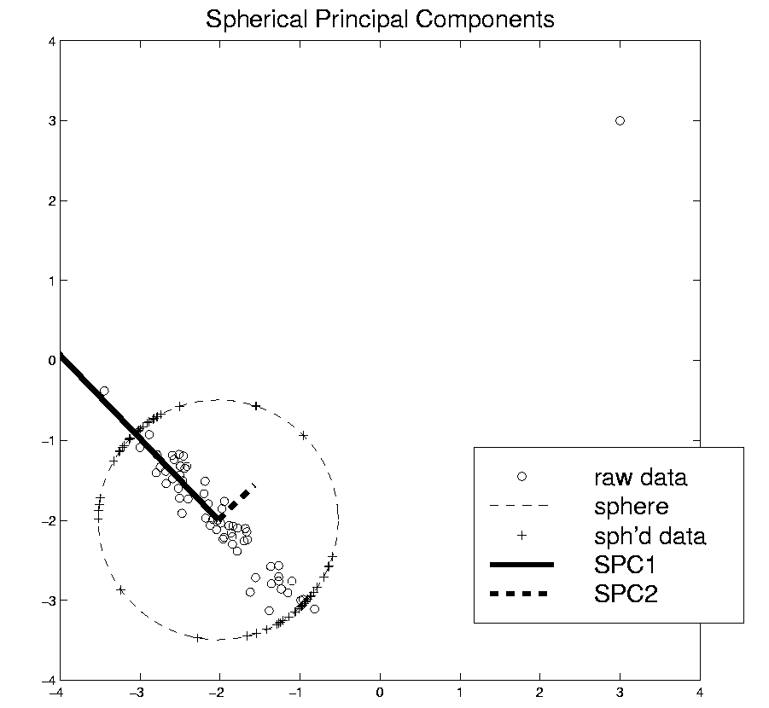
Last Class: Robust PCA
Robust PCA 3:
Spherical
PCA
Locantore et al (1999)

Slide 10
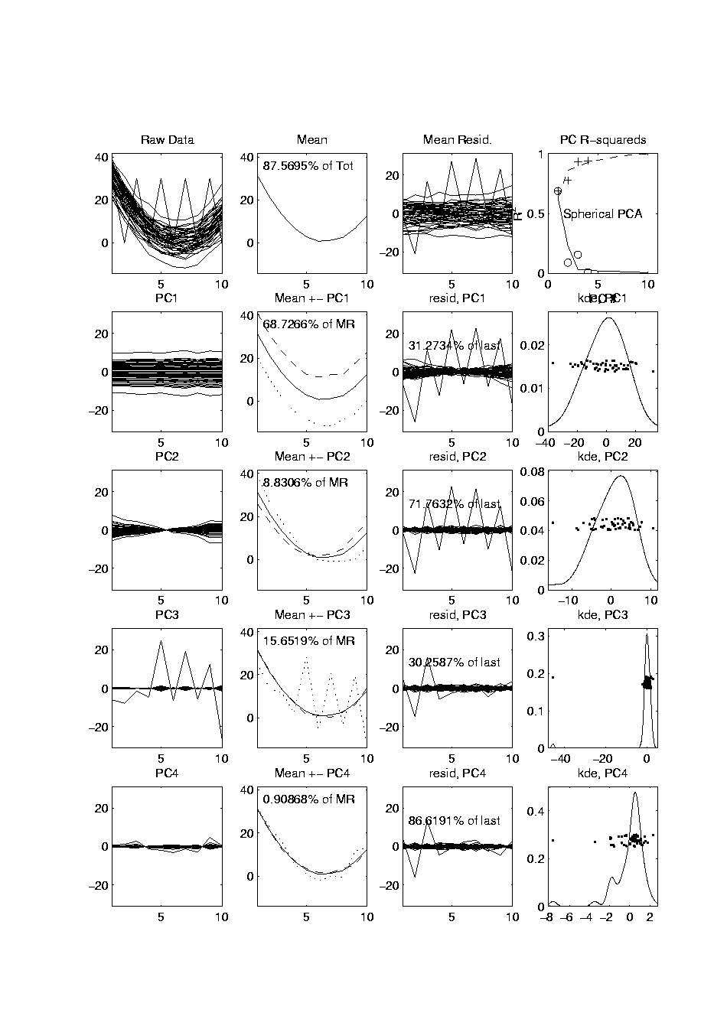
Last Class: Robust PCA
Mean Looks
Smoother
Spherical PCA for Toy Example:
Now do
Spherical
PCA
Better result?
PC1 Nearly Flat
Lines are Eigenvalues on Sphere
Circles Show Original Variances
PC2 is Tilt (NOT Outlier)
Outlier Demoted to PC3
Notes:
10

Slide 11
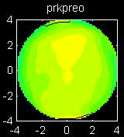
Last Class: Cornea Data
Text: Sec. 16.2.1
Cornea Data:
Raw Data
Decompose
Into
Modes of
Variation?

Slide 12
Last Class: Cornea Data
Data Representation - Zernike Basis
Descriptor Space is Vector Space of Zernike Coefficients
So Perform PCA There, For Modes of Var’n
Works In Polar Coordinates
Tensor Product of Fourier (Angles) &
Special Jacobi (Radii) Bases
Challenge: Elliminate
Singularity at Origin
Born & Wolf (1980), Schwiegerling, et al. (1995)

Slide 13
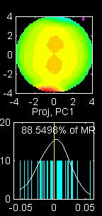
Last Class: PCA of Cornea Data
PC1 Movie:

Slide 14
Last Class: PCA of Cornea Data
PC1 (First Mode) Summary:
Mean (1st image): mild vert’l astigmatism
known pop’n structure called “with the rule”
Main dir’n: “more curved” & “less curved”
Corresponds to first optometric measure
(89% of variat’n, in Mean Resid. SS sense)
Also: “stronger astig’m” & “no astig’m”
Found corr’n between astig’m and curv’re
Scores (cyan): Apparent Gaussian dist’n

Slide 15
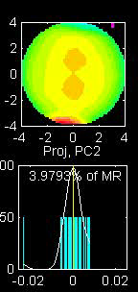
PCA of Cornea Data
PC2 Movie:

Slide 16
PCA of Cornea Data
PC2 Movie:
Mean: same as above
Common centerpoint of point cloud
Are studying “directions from mean”
Images along direction vector:
Looks terrible???
Why?

Slide 17
PCA of Cornea Data
PC2 Movie:
Reason made clear in Scores Plot (cyan):
Single outlying data object drives PC dir’n
A known problem with PCA
Recall finds direction with “max variation”
In sense of variance
Easily dominated by single large observat’n

Slide 18
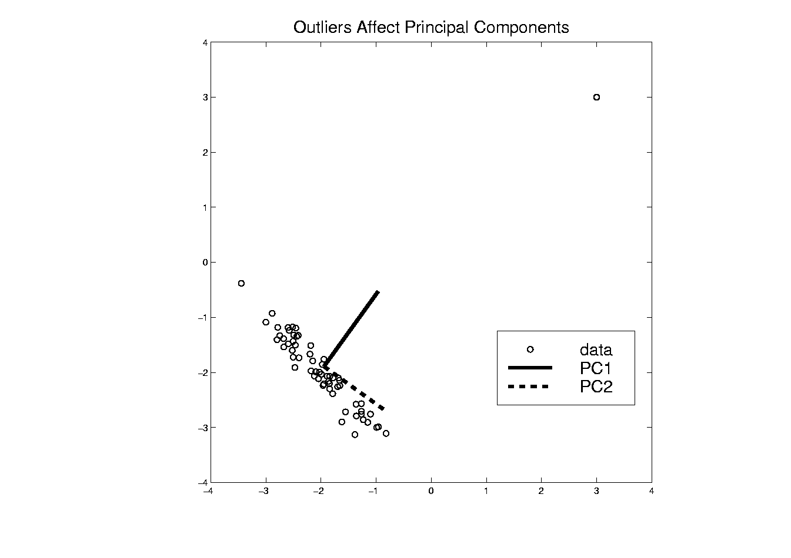
PCA of Cornea Data
Toy Example: Single Outlier Driving PCA

Slide 19
PCA of Cornea Data
PC2 Affected by Outlier:
How bad is this problem?
View 1: Statistician: Arrggghh!!!!
Outliers are very dangerous
Can give arbitrary and meaningless dir’ns

Slide 20
PCA of Cornea Data
PC2 Affected by Outlier:
How bad is this problem?
View 2: Ophthalmologist: No Problem
Driven by “edge effects” (see raw data)
Artifact of “light reflection” data gathering
(“eyelid blocking”, and drying effects)
Routinely “visually ignore” those anyway
Found interesting (& well known) dir’n:
steeper superior vs steeper inferior

Slide 21
Cornea Data
Cornea Data:
Raw Data
Which one
is the outlier?
Will say more
later …

Slide 22
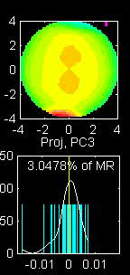
PCA of Cornea Data
PC3 Movie

Slide 23
PCA of Cornea Data
PC3 Movie (ophthalmologist’s view):
Edge Effect Outlier is present
But focusing on “central region” shows changing dir’n of astig’m (3% of MR SS)
“with the rule” (vertical) vs. “against the rule” (horizontal)
most astigmatism is “with the rule”
most of rest is “against the rule”
(known folklore)

Slide 24
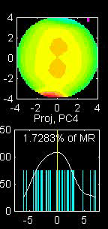
PCA of Cornea Data
PC4 movie

Slide 25
PCA of Cornea Data
Continue with ophthalmologists view…
PC4 movie version:
Other direction of astigmatism???
Location (i.e. “registration”) effect???
Harder to interpret …
OK, since only 1.7% of MR SS
Substantially less than for PC2 & PC3

Slide 26
PCA of Cornea Data
Ophthalmologists View (cont.)
Overall Impressions / Conclusions:
Useful decomposition of population variation
Useful insight into population structure

Slide 27

PCA of Cornea Data
Now return to Statistician’s View:
How can we handle these outliers?
Even though not fatal here, can be for other examples…
Simple Toy
Example
(in 2d):

Slide 28
Outliers in PCA
Example Cornea Data:
Can find PC2 outlier (by looking through data (careful!))

Slide 29
Outliers in PCA
Example
Cornea Data
Which One Is
The Outlier?

Slide 30
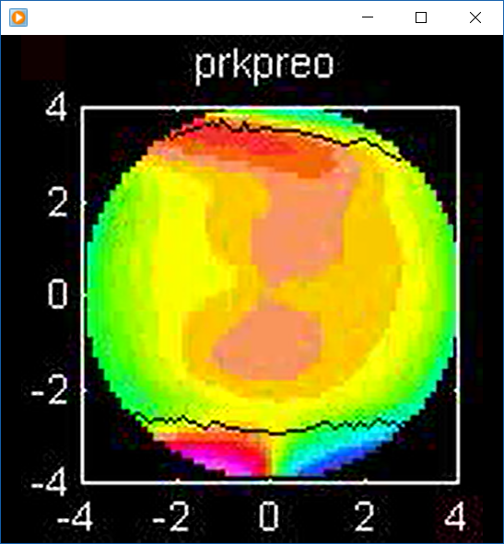
Outliers in PCA
Example
Cornea Data
Which One Is
The Outlier?
Not This

Slide 31
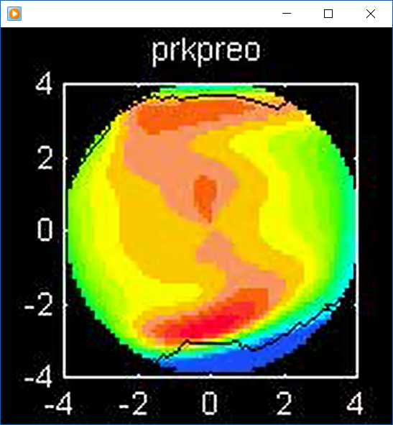
Outliers in PCA
Example
Cornea Data
Which One Is
The Outlier?
Another Wild One

Slide 32
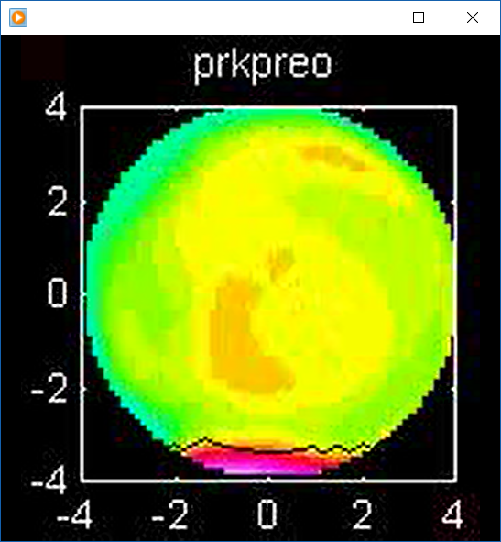
Outliers in PCA
Example
Cornea Data
Which One Is
The Outlier?
Might Think This

Slide 33
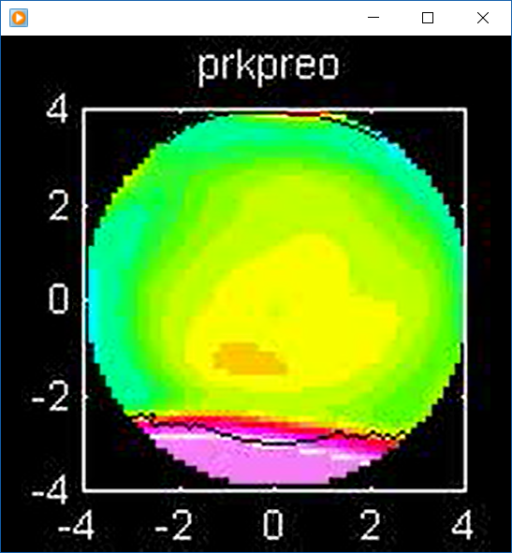
Outliers in PCA
Example
Cornea Data
Which One Is
The Outlier?
But In Fact Is This

Slide 34
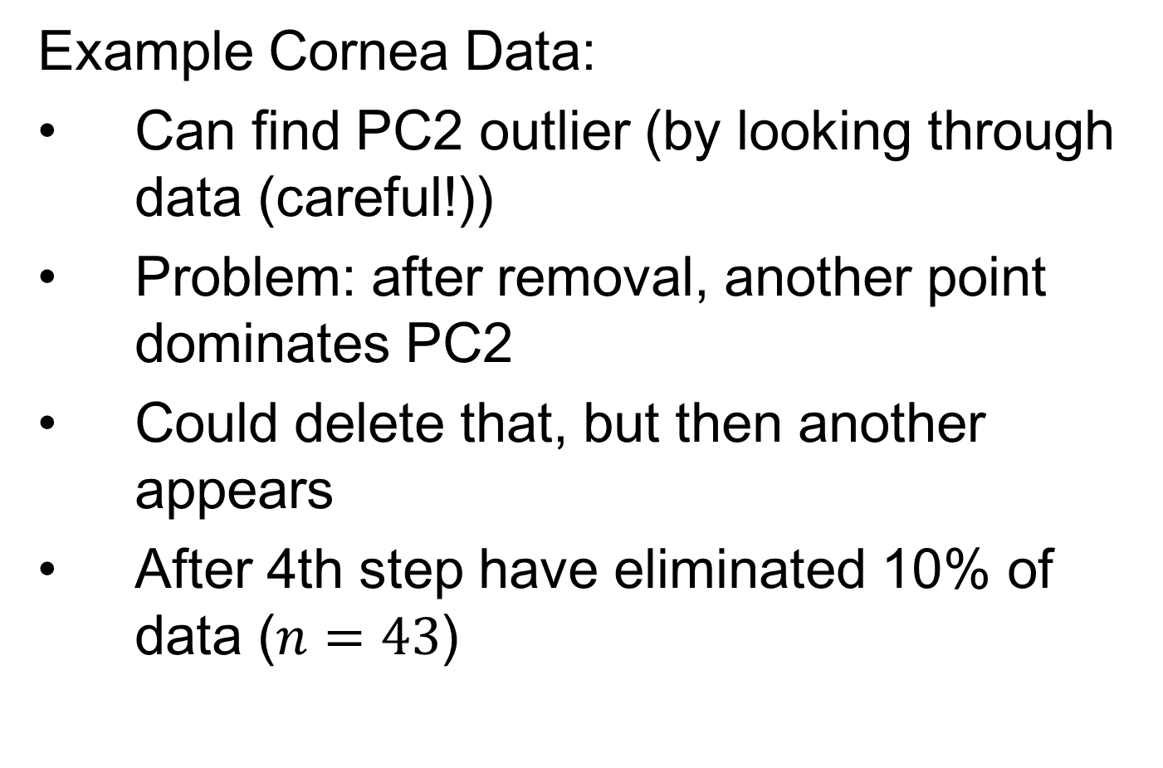
Outliers in PCA
Example Cornea Data:
Can find PC2 outlier (by looking through data (careful!))
Problem: after removal, another point dominates PC2
Could delete that, but then another appears
After 4th step have eliminated 10% of data ($n=43$)

Slide 35
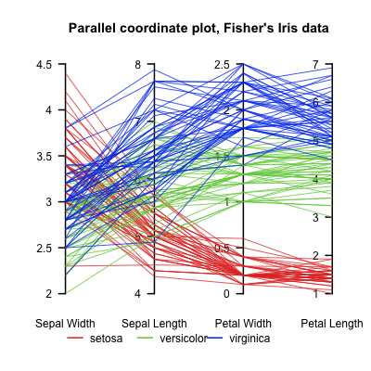

Aside On Visualization
Recall Multivariate Data Visualization Tool:
Parallel Coordinates
E.g. Fisher Iris Data
$d=4$
Named Variables
(thanks to Wikipedia)
Notes:
35

Slide 36
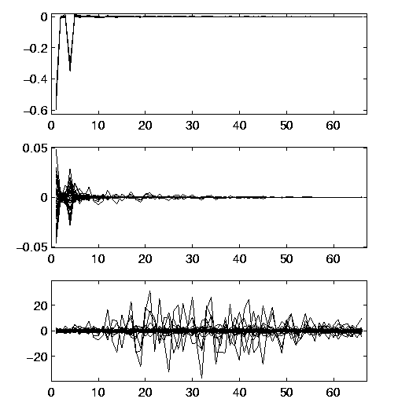
Robust PCA
Useful View: Parallel Coordinates Plot
X-axis:
Zernike
Coefficient
Number
Y-axis:
Coefficient
Notes:
36

Slide 37
Robust PCA
Cornea Data, Parallel Coordinates Plot:
Top Plot: Zernike
Coefficients
Notes:
37

Slide 38
Robust PCA
Cornea Data, Parallel Coordinates Plot:
Top Plot: Zernike
Coefficients
All n = 43 Very
Similar
.
Notes:
38

Slide 39
Robust PCA
Cornea Data, Parallel Coordinates Plot:
Top Plot: Zernike
Coefficients
All n = 43 Very
Similar
Most Action in few
Low Freq. Coeffs.
Notes:
39

Slide 40
Robust PCA
Cornea Data, Parallel Coordinates Plot
Middle Plot: (Zernike Coefficients – median)
Most Variation in lowest frequencies
E.g. as in Fourier compression of smooth signals
Projecting on sphere will destroy this
By magnifying high frequency behavior
Bottom Plot: discussed later
Point-Wise Median
Actually Sensible Here
Notes:
40

Slide 41
Robust PCA
Spherical PCA Problem :
Magnification of High Freq. Coeff’s
Solution : Elliptical Analysis
Main idea: project data onto suitable ellipse, not sphere
Which ellipse? (in general, this is problem that PCA solves!)
Simplification: Consider ellipses parallel to coordinate axes
Notes:
41

Slide 42
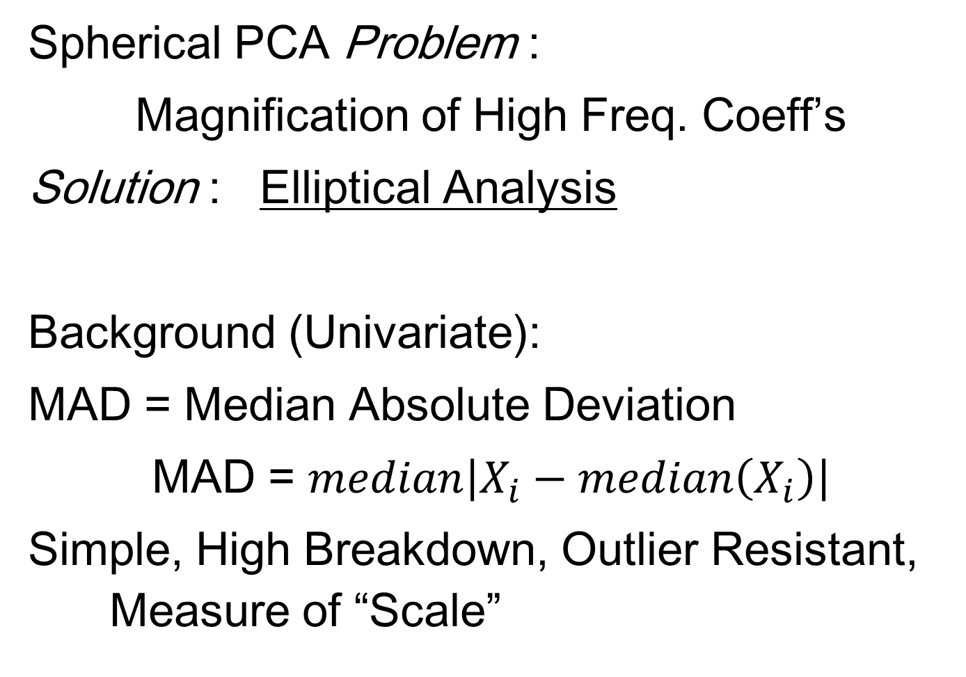
Robust PCA
Spherical PCA Problem :
Magnification of High Freq. Coeff’s
Solution : Elliptical Analysis
Background (Univariate):
MAD = Median Absolute Deviation
MAD = $median\left|X_{i}−median\left(X_{i}\right)\right|$
Simple, High Breakdown, Outlier Resistant, Measure of “Scale”
Notes:
42

Slide 43
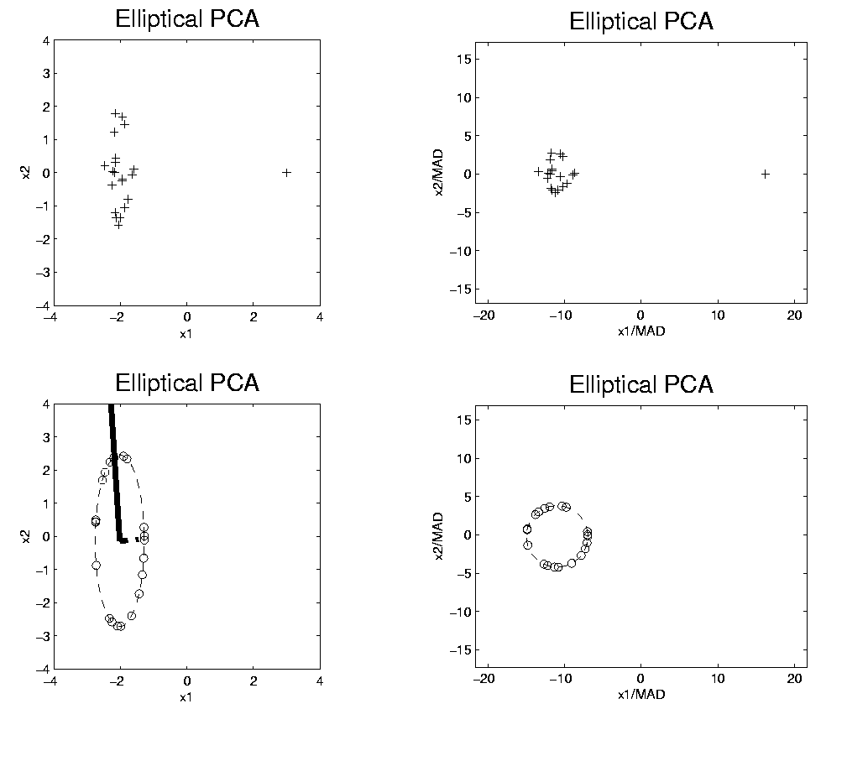
Robust PCA
Rescale
Coords
Challenge: Spherical
Projection Will Lose
Some Vertical Var’n
Spherical PCA
Unscale
Coords

Slide 44
Robust PCA
Elliptical Analysis (cont.):
Simple Implementation,
via coordinate axis rescaling
Divide each axis by MAD
Project Data to sphere (in transformed space)
Return to original space (mul’ply by orig’l MAD) for analysis
Do PCA on Projections

Slide 45
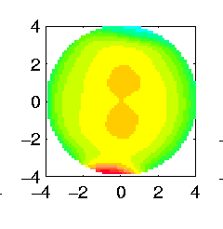
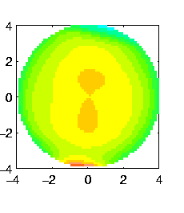

Robust PCA
Elliptical Estimate of “center”:
Do M-estimation in transformed space
(then transform back)
Results for cornea data:
Sample Mean Spherical Center Elliptical Center
Elliptical clearly best
Nearly no edge effect

Slide 46
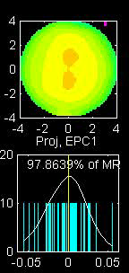
Robust PCA
Elliptical PCA for cornea data:
Original PC1, Elliptical PC1

Slide 47
Robust PCA
Elliptical PCA for cornea data:
Original PC1, Elliptical PC1
Still finds overall curvature & correlated astigmatism
Minor edge effects almost completely gone

Slide 48
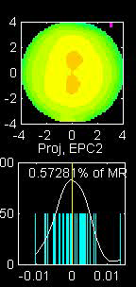
Robust PCA
Elliptical PCA for cornea data:
Original PC2, Elliptical PC2

Slide 49
Robust PCA
Elliptical PCA for cornea data:
Original PC1, Elliptical PC1
Still finds overall curvature & correlated astigmatism
Minor edge effects almost completely gone
Original PC2, Elliptical PC2
Huge edge effects dramatically reduced
Still finds steeper superior vs. inferior

Slide 50
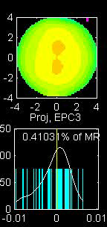
Robust PCA
Elliptical PCA for cornea data:
Original PC3, Elliptical PC3

Slide 51
Robust PCA
Elliptical PCA for Cornea Data (cont.):
Original PC3, Elliptical PC3
-Edge effects greatly diminished
But some of against the rule astigmatism also lost
Price paid for robustness

Slide 52
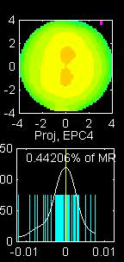
Robust PCA
Elliptical PCA for cornea data:
Original PC4, Elliptical PC4

Slide 53
Robust PCA
Elliptical PCA for Cornea Data (cont.):
Original PC3, Elliptical PC3
-Edge effects greatly diminished
But some of against the rule astigmatism also lost
Price paid for robustness
Original PC4, Elliptical PC4
Now looks more like variation on astigmatism???

Slide 54
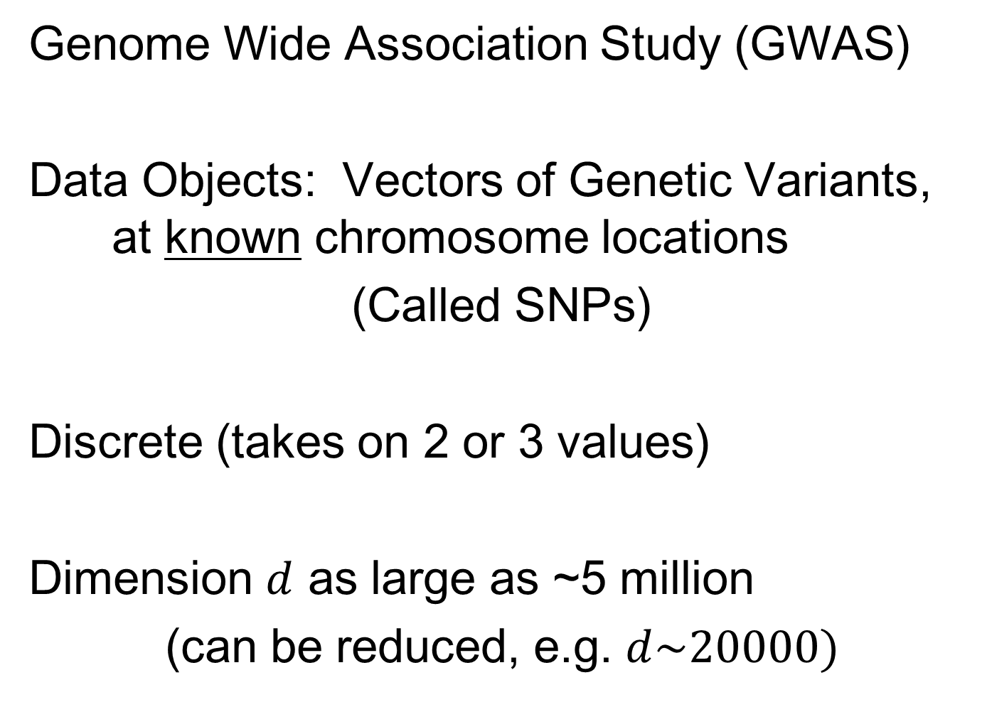
GWAS Data Analysis
Genome Wide Association Study (GWAS)
Data Objects: Vectors of Genetic Variants, at known chromosome locations
(Called SNPs)
Discrete (takes on 2 or 3 values)
Dimension $d$ as large as ~5 million
(can be reduced, e.g. $d\sim 20000)$
Text: Sec. 16.2.2
How can we visualize such data?

Slide 55
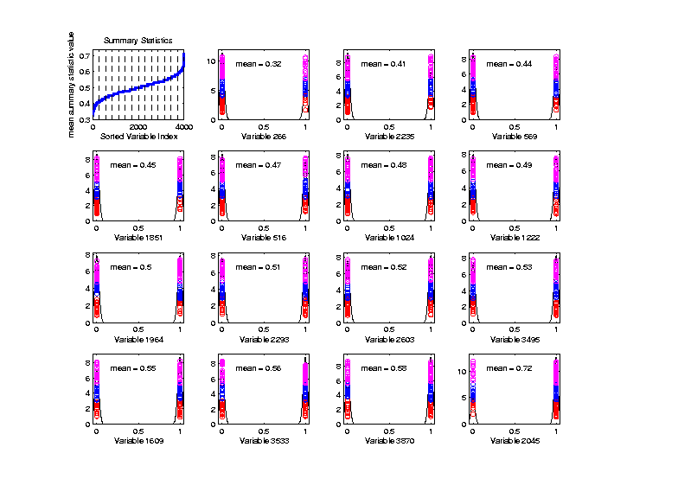
Big Picture View of PCA
Common Fallacy:
PCA only useful for Gaussian data
Clearly NOT
Gaussian
n = 100, d = 4000
Toy Example:
Each Marginal
Binary

Slide 56
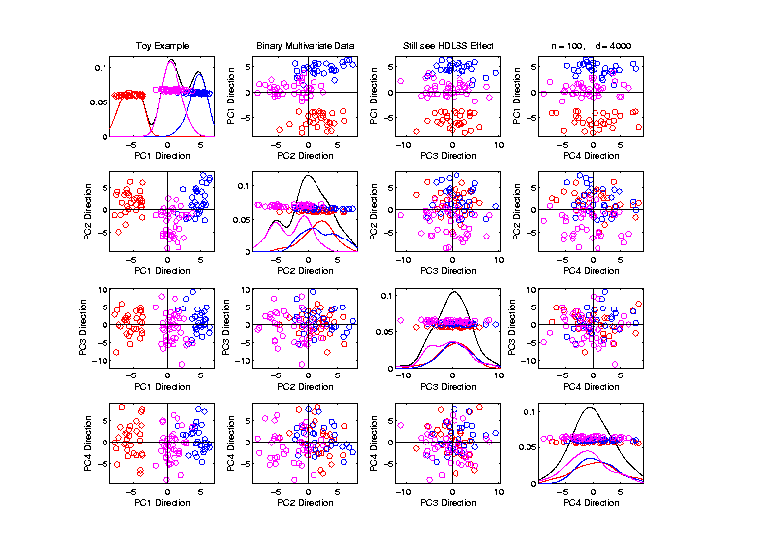
Big Picture View of PCA
Common Fallacy:
PCA only useful for Gaussian data
But PCA
Reveals
Trimodal
Structure

Slide 57

GWAS Data Analysis
Genome Wide Association Study (GWAS)
Cystic Fibrosis Study: Wright et al (2011)
Interesting Feature:
Some Subjects are Close Relatives
(e.g. ~half SNPs are same)

Slide 58
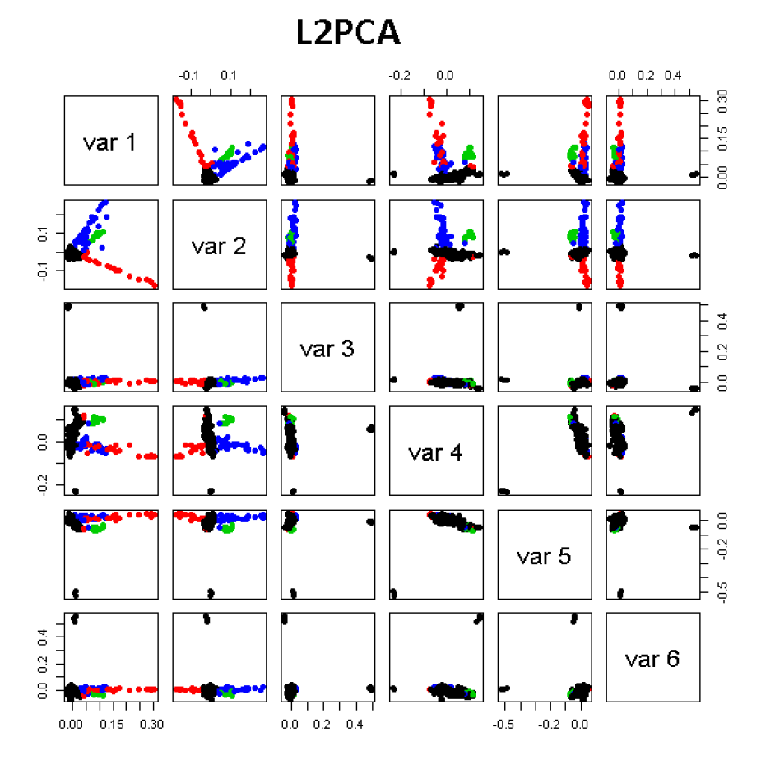
GWAS Data Analysis
PCA View
Clear Ethnic
Groups

Slide 59
GWAS Data Analysis
PCA View
Clear Ethnic
Groups
And Several
Outliers!
Eliminate With
Spherical PCA?

Slide 60
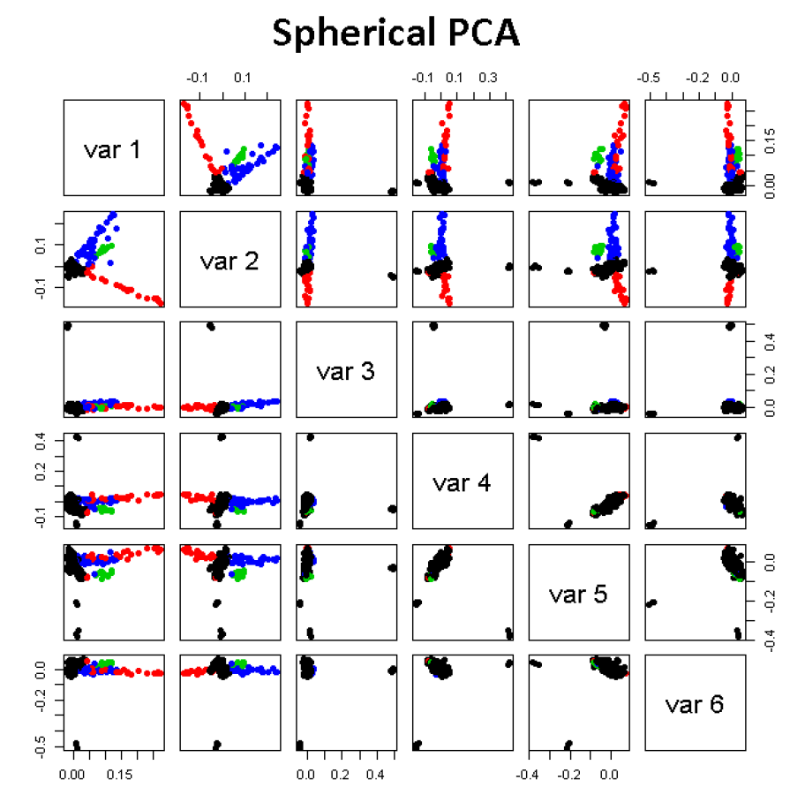

GWAS Data Analysis
Spherical
PCA
Looks Same?!?
What is
going on?
Hint: $d=20,000$

Slide 61

HDLSS Asymptotics
Recall Various “Mysteries” about
High Dimension Low Sample Size Data
Natural Separation of $N_{1000}\left(0,I\right)$ Data
Notes:
61

Slide 62
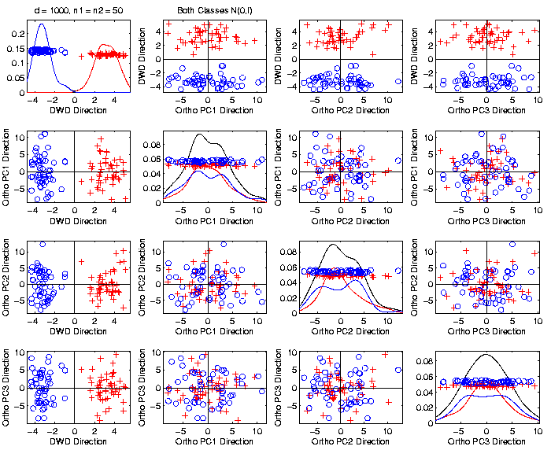
Caution
Toy 2-Class
Example
Separation
Is Natural
Sampling
Variation

Slide 63
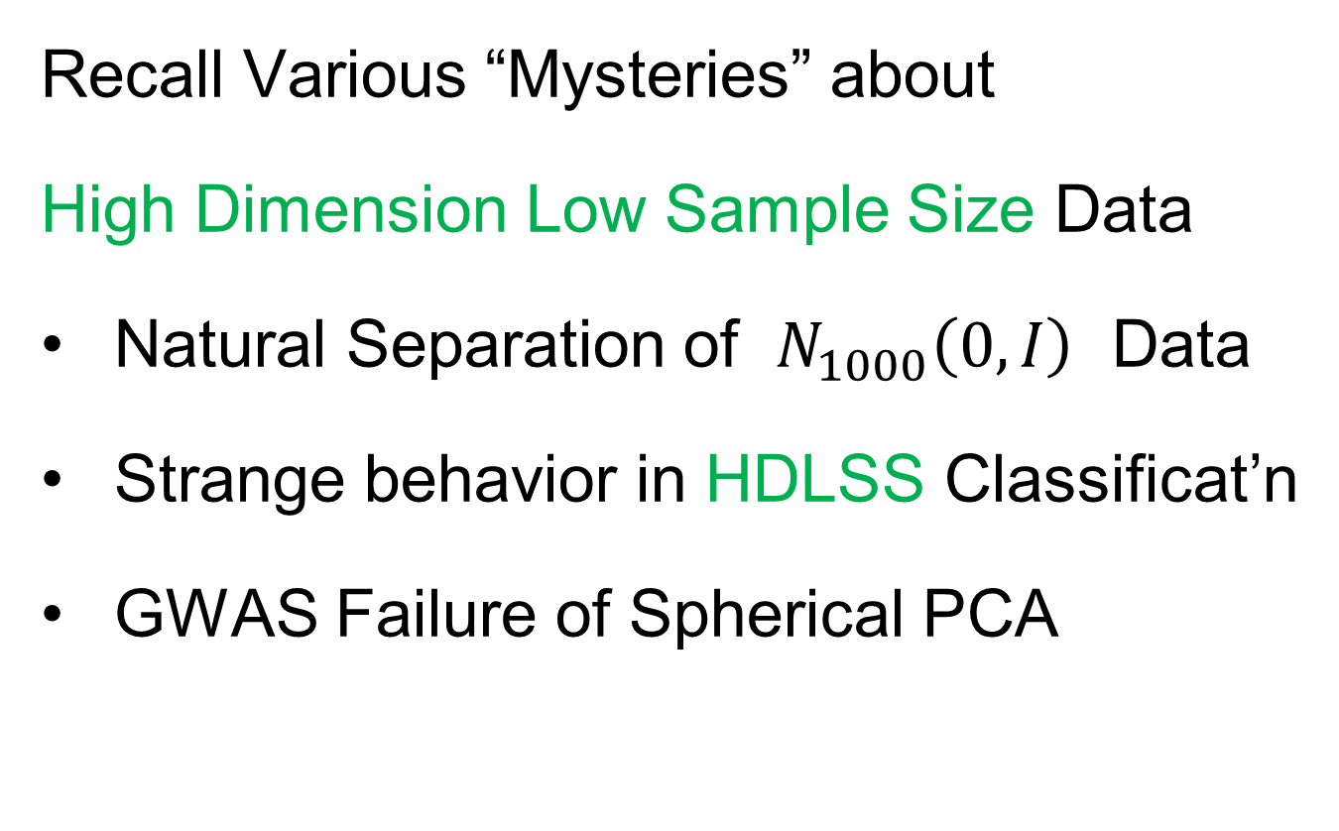
HDLSS Asymptotics
Recall Various “Mysteries” about
High Dimension Low Sample Size Data
Natural Separation of $N_{1000}\left(0,I\right)$ Data
Strange behavior in HDLSS Classificat’n
GWAS Failure of Spherical PCA
Notes:
63

Slide 64
HDLSS Robust PCA
Recall Robust PCA via Spherical Projection

Slide 65
HDLSS Robust PCA
Recall Robust PCA via Spherical Projection
Useful Theory:
Zhou and Marron (2015) showed:
No Outliers: Similar Performance
Outliers: Spherical PCA is Generally Better

Slide 66
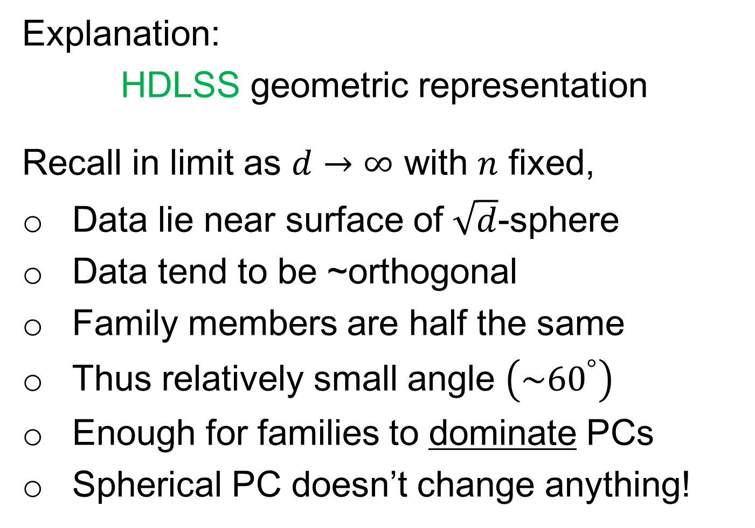
Failure of Sph’l PCA for GWAS Outliers
Explanation:
HDLSS geometric representation
Recall in limit as $d→∞$ with $n$ fixed,
Data lie near surface of $\sqrt{d}$-sphere
Data tend to be ~orthogonal
Family members are half the same
Thus relatively small angle $\left(\sim {60}^{°}\right)$
Enough for families to dominate PCs
Spherical PC doesn’t change anything!

Slide 67
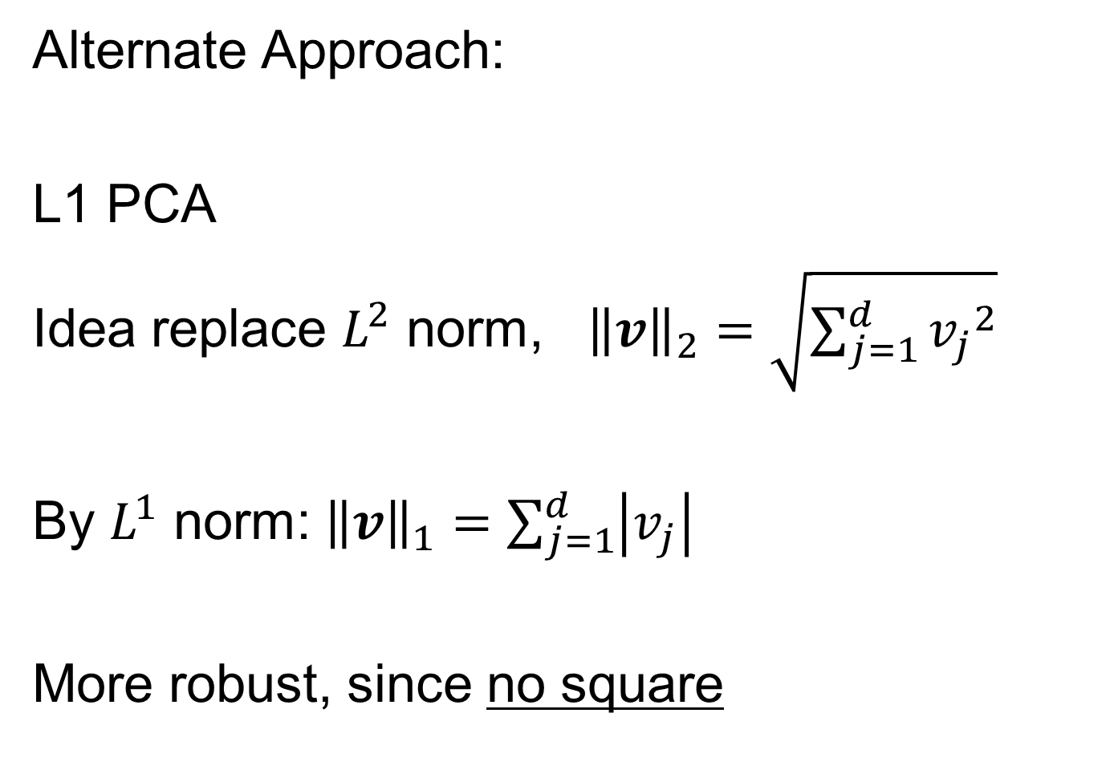
GWAS Data Analysis
Alternate Approach:
L1 PCA
Idea replace $L^{2}$ norm, ${\left\|v\right\|}_{2}=\sqrt{\sum_{j=1}^{d}{{v_{j}}^{2}}}$
By $L^{1}$ norm: ${\left\|v\right\|}_{1}=\sum_{j=1}^{d}{\left|v_{j}\right|}$
More robust, since no square

Slide 68
L1 Statistics
E.g. Conventional PCA in 2-d
Replace
Best L2 Fit

Slide 69
L1 Statistics
E.g. Conventional PCA in 2-d
Replace
Best L2 Fit
With
Best L1 Fit

Slide 70
L1 Statistics
E.g. Conventional PCA in 2-d
Best L1 Fit
Advantages:
Robust Against Outliers
Good “Sparsity” Properties

Slide 71
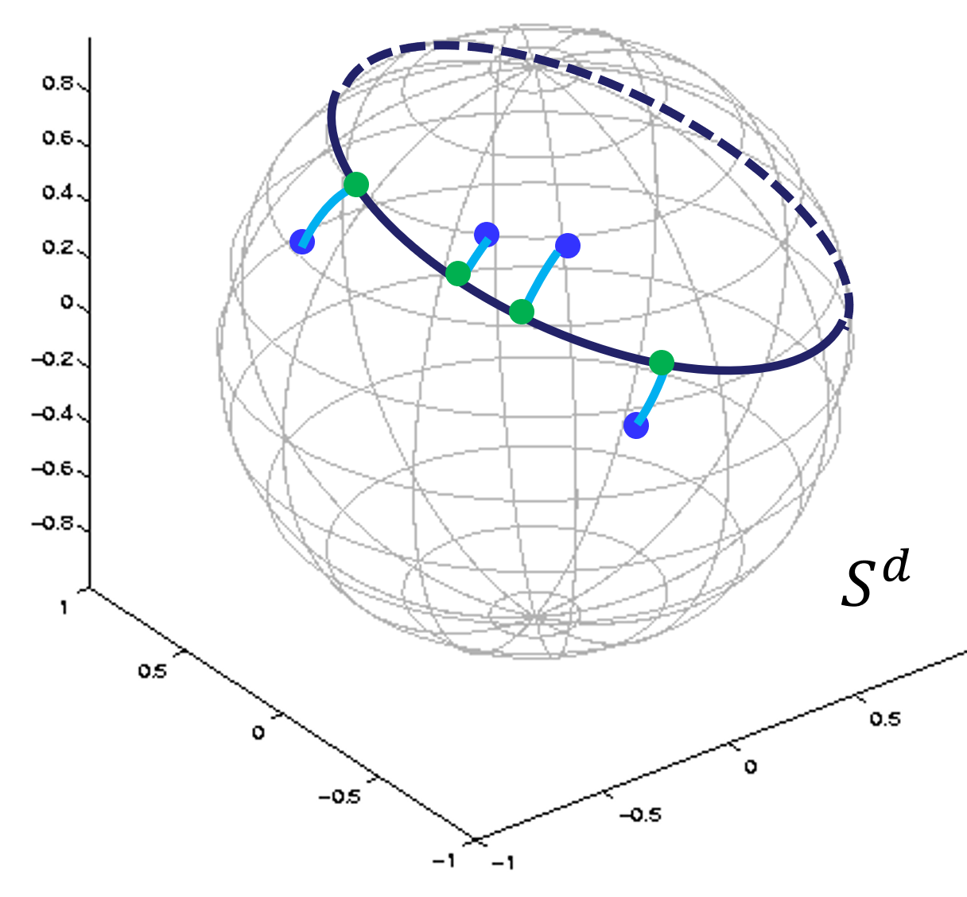



L1 PCA
Recall Backwards PCA From
Principal Nested Spheres
Calculation:
Clever Backwards Algorithm
Brooks, Dulá, Boone (2013)

Slide 72
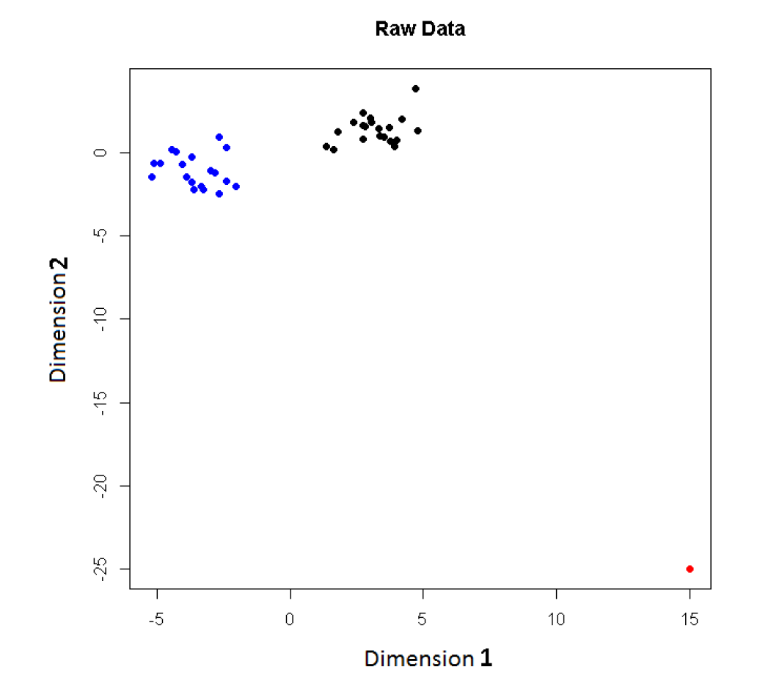
L1 PCA
Challenge:
L1 Projections
Hard to
Interpret
2-d Toy
Example
Note
Outlier

Slide 73
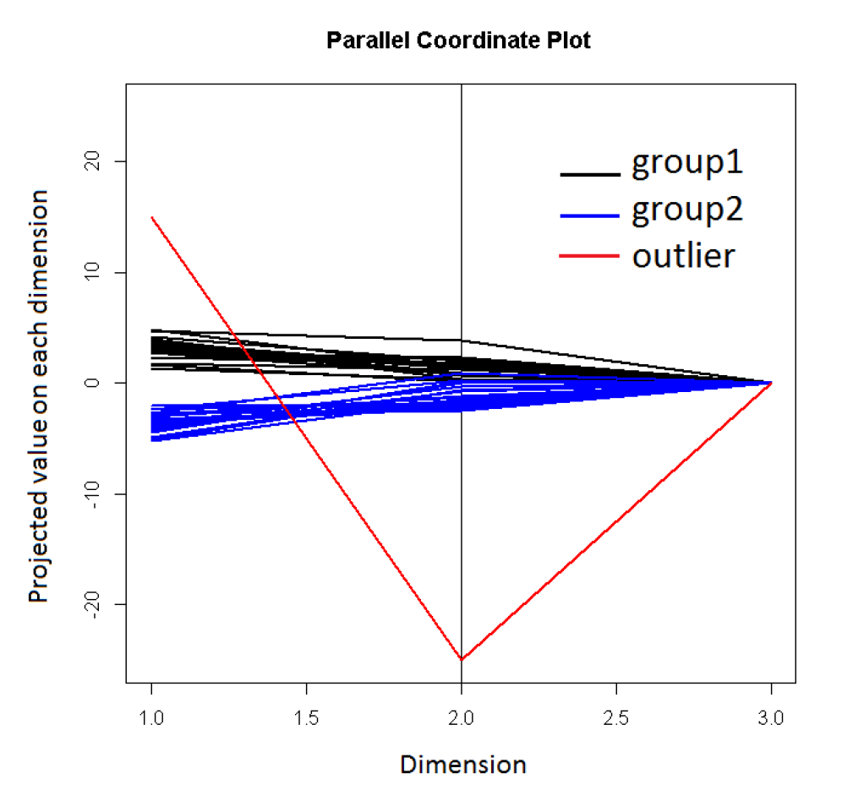
L1 PCA
3rd Coordinate With
Very Small Variation
Challenge:
L1 Projections
Hard to
Interpret
Parallel
Coordinate
View
Clusters Mostly
In Dimension 1
Outlier (+,-)

Slide 74
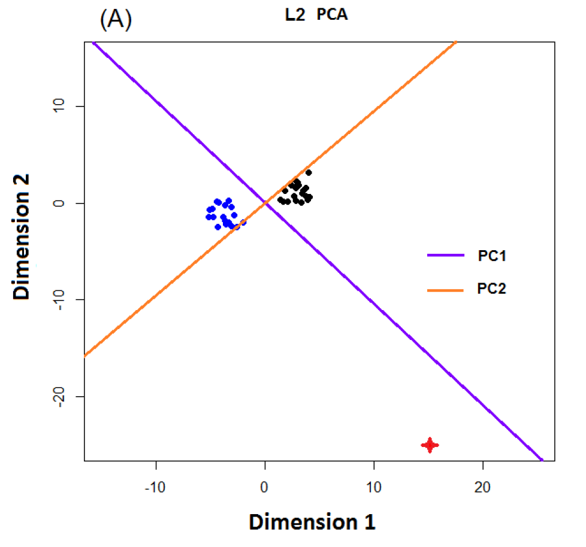
L1 PCA
Conventional
L2 PCA
Outlier Pulls
Off PC1
Direction

Slide 75
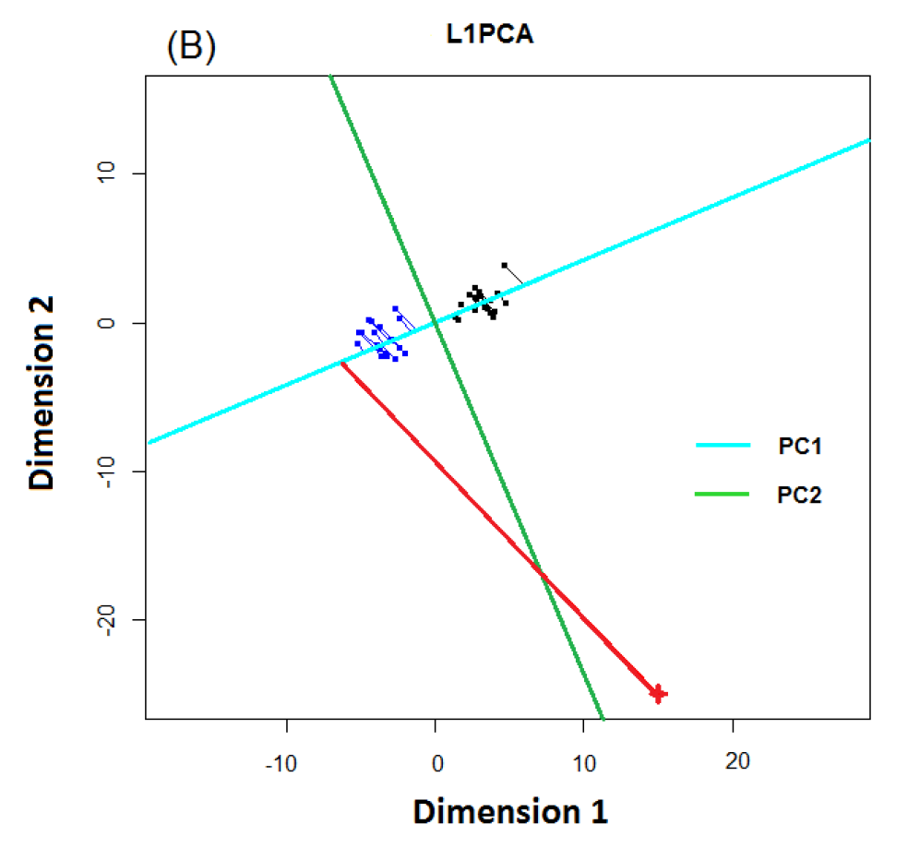
L1 PCA
L1 PCA
Much Better
PC1 Direction

Slide 76
L1 PCA
L1 PCA
Much Better
PC1 Direction
But Very Strange
Projections
(i.e. Little
Data Insight)

Slide 77
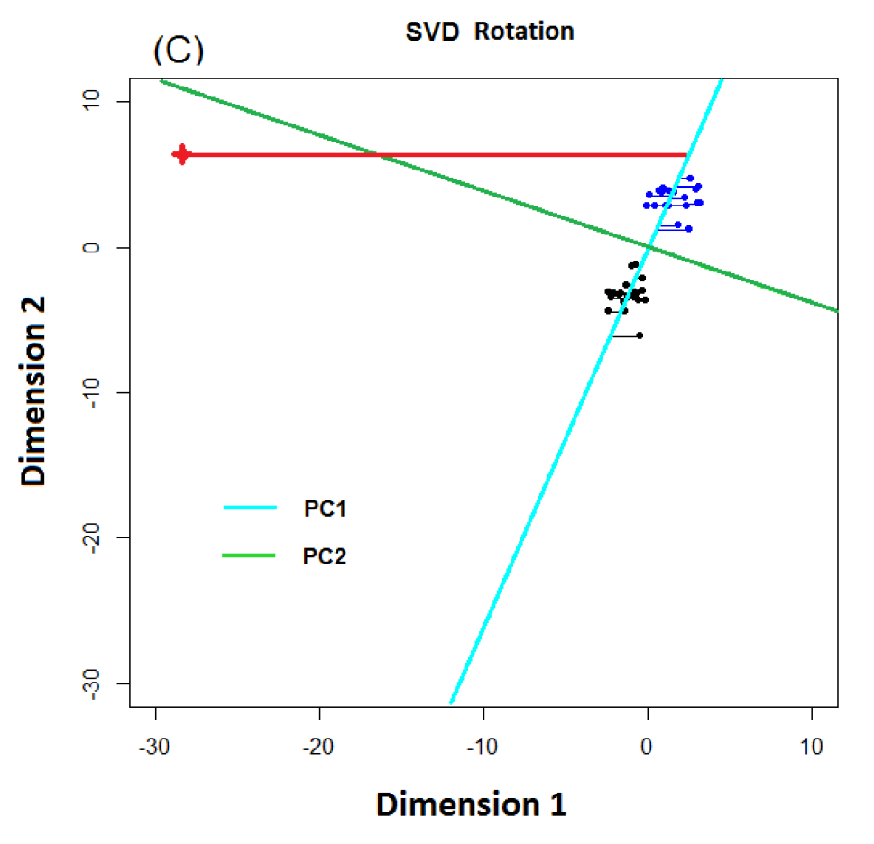
L1 PCA
L1 PCA
Reason:
SVD Rotation
Before L1
Computation
Note: L1 Methods
Not Rotation Invariant

Slide 78

L1 PCA
Challenge: L1 Projections Hard to Interpret
(i.e. Little Data Insight)
Solution:
Compute PC Directions Using L1
Compute Projections (Scores) Using L2
Called “Visual L1 PCA” (VL1PCA)
Zhou & Marron (2016)

Slide 79
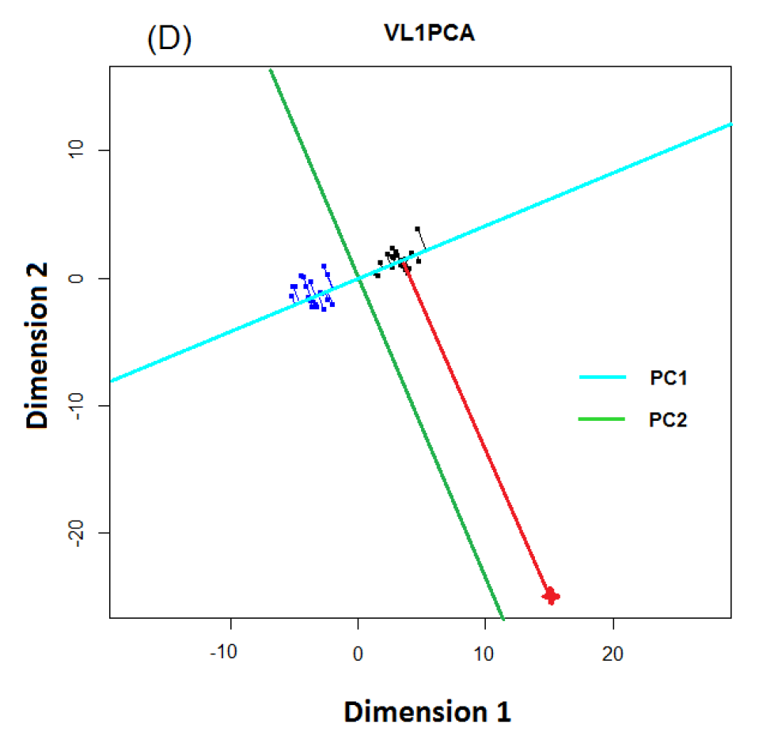
L1 PCA
VL1 PCA
Excellent PC
Directions
Interpretable
Scores

Slide 80
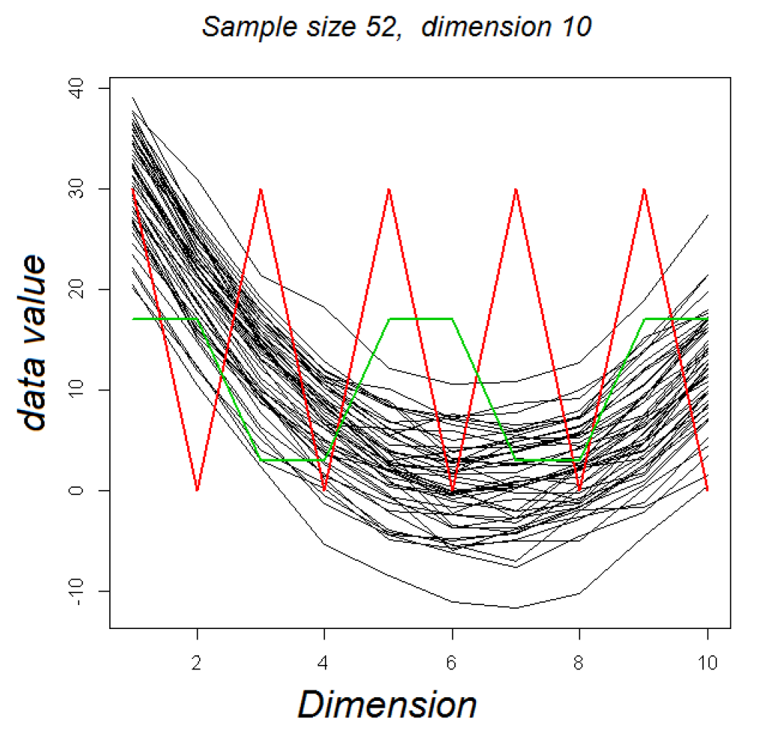
VL1 PCA
10-d Toy Example:
Parabolas
From Before
With Two
Outliers
Half Frequency
So Orthogonal

Slide 81
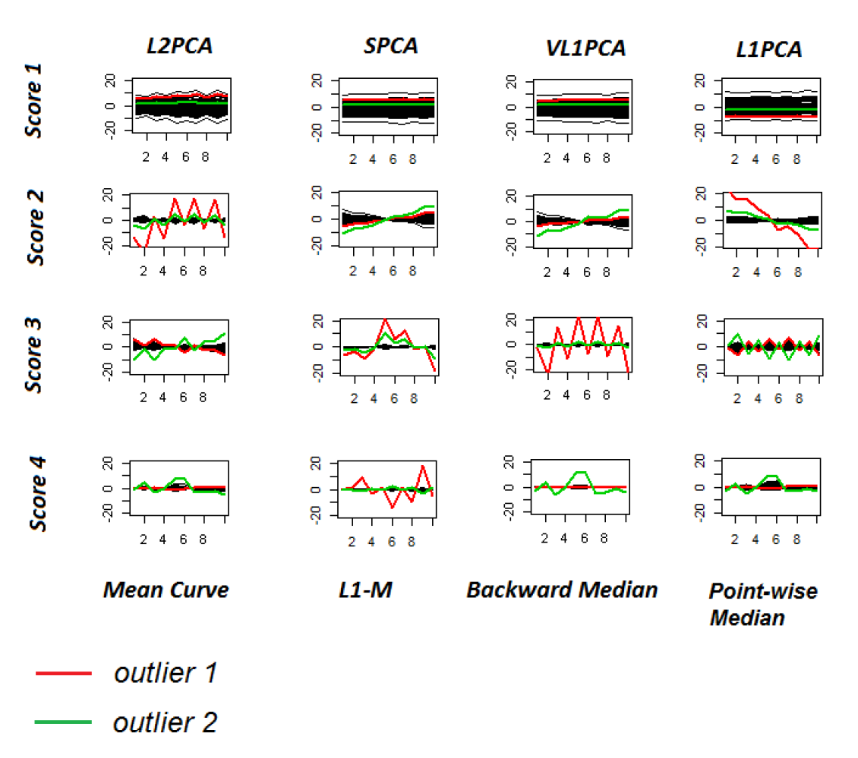
VL1 PCA
10-d Toy Example:
L2PCA
Strongly
Impacted
(In All
Components)
Outlier Impact

Slide 82
VL1 PCA
10-d Toy Example:
SCPA &
VL1PCA
Nicely
Robust
(Vl1PCA
Slightly
Better)
Recover Tilt in PC2
Better Outlier Rep’n

Slide 83
VL1 PCA
10-d Toy Example:
L1PCA
Hard To
Interpret
Nonintuitive Vis’n

Slide 84

GWAS Data
L1 PCA
No Longer
Feels Outliers
But Still
Highlights
Individuals

Slide 85

GWAS Data
VL1 PCA
Best Focus
On Ethnic
Groups

Slide 86
GWAS Data
VL1 PCA
Best Focus
On Ethnic
Groups
Seems To
Find Unlabelled
Clusters

Slide 87
Return to Big Picture
Main statistical goals of OODA:
Understanding population structure
  Low dim’al Projections, PCA …
Classification (i. e. Discrimination)
  Understanding 2+ populations
Time Series of Data Objects
  Chemical Spectra, Mortality Data
“Vertical Integration” of Data Types

Slide 88
Classification - Discrimination
Background: Two Class (Binary) version:
Using “training data” from
Class +1 and Class -1
Develop a “rule” for
assigning new data to a Class
Canonical Example: Disease Diagnosis
New Patients are “Healthy” or “Ill”
Determine based on measurements
Text, Chp 11

Slide 89
Classification - Discrimination
Important Distinction:
Classification vs. Clustering
Classification:
Class labels are known,
Goal: understand differences
Clustering:
Goal: Find class labels (to be similar)
Both are about clumps of similar data,
but much different goals

Slide 90
Classification - Discrimination
Important Distinction:
Classification vs. Clustering
Useful terminology:
Classification: supervised learning
Clustering: unsupervised learning

Slide 91
Classification - Discrimination
Terminology:
For statisticians, these are synonyms

Slide 92
Classification - Discrimination
Terminology:
For statisticians, these are synonyms
For biologists, classification means:
Constructing taxonomies
And sorting organisms into them
(maybe this is why discrimination
was used, until politically incorrect…)
Kingdom
Phylum
Class
Order
Genus
Species

Slide 93
Classification (i.e. discrimination)
There are a number of:
Approaches
Philosophies
Schools of Thought
Too often cast as:
Statistics vs. EE - CS

Slide 94
Classification (i.e. discrimination)
EE – CS variations:
Pattern Recognition
Artificial Intelligence
Neural Networks (Deep Learning)
Data Mining
Machine Learning

Slide 95
Classification (i.e. discrimination)
Early Differing Viewpoints:
Statistics
Model Classes with Probability Distribut’ns
Use to study class diff’s & find rules
EE – CS
Data are just Sets of Numbers
Optimize Separation Rules
Current thought: combine these

Slide 96
Classification (i.e. discrimination)
Important Overview Reference:
Duda, Hart and Stork (2001)
Too much about neural nets???
Pizer disagrees…
Update of Duda & Hart (1973)

Slide 97

Classification (i.e. discrimination)
For a more classical statistical view:
McLachlan (2004).
Gaussian Likelihood theory, etc.
Not well tuned to HDLSS data
Notes:
97

Slide 98

Classification Basics
Generally Number of Classes is $K$
Important Case: $K=2$
Binary Classification
Convenient Class Labels: $+1$ and $−1$
(Turns Out to Give Elegant Notation)
Notes:
HDLSStmbRaw.ps

Slide 99
Classification Basics
Binary Classification
Start with Training Data:
$$\left(x_{1},y_{1}\right),⋯,\left(x_{n},y_{n}\right)$$
Where $x_{i}∈ℝ^{d}$, $y_{i}∈\left\{+1,−1\right\}$ for $i=1,⋯,n$
Notes:
HDLSStmbRaw.ps

Slide 100
Classification Basics
Binary Classification
Goal: Use Training Data
$$\left(x_{1},y_{1}\right),⋯,\left(x_{n},y_{n}\right)$$
To Classify New Case: $\left(x_{0},y_{0}\right)$
I.e. Use $x_{0}∈ℝ^{d}$ to Predict $y_{0}∈\left\{+1,−1\right\}$
Notes:
HDLSStmbRaw.ps

Slide 101
Classification Basics
Statistical Approach:
Model $\left({\tilde{x}}_{1},{\tilde{y}}_{1}\right),⋯,\left({\tilde{x}}_{n},{\tilde{y}}_{n}\right)$ as i.i.d. from
Probability Density $f\left(x,y\right)$
General Classification Rule: $c:ℝ^{d}→\left\{+1,−1\right\}$
Use tildes to denote
random variables
Notes:
HDLSStmbRaw.ps

Slide 102
Classification Basics
Performance Measure of a Rule $c\left(x\right)$:
Bayes Risk $=P\left\{c\left(\tilde{x}\right)≠\tilde{y}\right\}$
Risk = Expected Loss (0 for right, 1 for wrong)
Notes:
HDLSStmbRaw.ps

Slide 103
Classification Basics
Bayes Risk Optimal Rule:
$$c_{LR}\left(x\right)=\left\{\begin{matrix}+1, & \frac{f\left(x,+1\right)}{f\left(x,−1\right)}≥1 \\ −1, & \frac{f\left(x,+1\right)}{f\left(x,−1\right)}<1\end{matrix}\right.$$
Called Likelihood Ratio Rule
Note: Need to Know $f$
(Can Consider Estimation)
Provides an
Important
Upper Bound
Notes:
HDLSStmbRaw.ps

Slide 104
Classification Basics
Very Simple, Yet Appealing, Method:
Nearest Neighbor
Use Label of Nearest Neighbor:
$$c\left(x\right)=y_{j^{∗}},$$
where $j^{∗}={argmin}_{j=1,⋯,n} δ\left(x_{j},x \right)$
Problem: High Variation
Notes:
HDLSStmbRaw.ps

Slide 105
Classification Basics
Important Class of Methods:
$k$ - Nearest Neighbors
Idea: Vote Among $k$ Nearest Neighbors of $x$
Challenge: Choice of $k$
Too Small: High Variation
Too Large: Creates Bias
Essentially a
Smoothing Problem
Notes:
HDLSStmbRaw.ps

Slide 106
Classification Basics
Important General Class:
Linear Classifiers
Given a Direction $w∈ℝ^{d}$ (i.e. ${\left\|w\right\|}_{2}=1$)
And an Intercept $β∈ℝ$,
Let $c_{w,β}\left(x\right)=1−2∙1_{\left\{w^{t}x<β\right\}}$
Separating Surface:
Hyperplane with Normal $w$ and Intercept $β$
Indicator Function
Notes:
HDLSStmbRaw.ps

Slide 107

Classification Basics
Personal Viewpoint: Point Clouds
(In
Feature
Space)
Notes:
HDLSStmbRaw.ps

Slide 108
Classification Basics
Simple and Natural Linear Classifier:
Mean Difference
a.k.a.
Centroid Method
Find “skewer through two meatballs”

Slide 109

Classification Basics
For Simple Toy Example:
Project
On MD
& Split
at Center
(Assume Equal Numbers for Simplicity)
Notes:
HDLSStmbMdif.ps

Slide 110
Classification Basics
Note, for Shifts of the Standard Normal
MD is Bayes Risk Optimal
Since Likelihood Ratio Solution
(Either Theoretical or Estimated)

Slide 111

Classification Basics
Why not use PCA?
Reasonable
Result?
Doesn’t use
class labels…
Good?
Bad?
Notes:
HDLSStmbPCA.ps

Slide 112

Classification Basics
Harder Example (slanted clouds):
Notes:
HDLSSod1Raw.ps

Slide 113

Classification Basics
PCA for slanted clouds:
PC1 terrible
PC2 better?
Still misses
right dir’n
Doesn’t use
Class Labels
Notes:
HDLSSod1PCA.ps

Slide 114

Classification Basics
Mean Difference for slanted clouds:
A little
better?
Still misses
right dir’n
Want to
account for
covariance
Notes:
HDLSSod1Mdif.ps

Slide 115
Classification Basics
Mean Difference & Covariance,
Simplest Approach:
Rescale (standardize) coordinate axes
i. e. replace (full) data matrix:
$$X=\left(\begin{matrix}x_{11} & ⋯ & x_{1n} \\ ⋮ & ⋱ & ⋮ \\ x_{d1} & ⋯ & x_{dn}\end{matrix}\right) → \left(\begin{matrix}\frac{1}{s_{1}} & ⋯ & 0 \\ ⋮ & ⋱ & ⋮ \\ 0 & ⋯ & \frac{1}{s_{d}}\end{matrix}\right)X=\left(\begin{matrix}\frac{x_{11}}{s_{1}} & ⋯ & \frac{x_{1n}}{s_{1}} \\ ⋮ & ⋱ & ⋮ \\ \frac{x_{d1}}{s_{d}} & ⋯ & \frac{x_{dn}}{s_{d}}\end{matrix}\right)$$
Then do Mean Difference
Called “Naïve Bayes Approach”
Name Seems to Be From Above MD Optimality

Slide 116
Classification Basics
Naïve Bayes Reference:
Domingos & Pazzani (1997)
Most sensible contexts:
Non-comparable data
E.g. different units

Slide 117
Classification Basics
Problem with Naïve Bayes:
Only adjusts
Variances
Not Covariances
Doesn’t solve
this problem
Notes:
HDLSSod1Raw.ps

Slide 118

Classification Basics
Better Solution: Linear Discriminant Analysis
Gets the
right dir’n
How does
it work?
Notes:
HDLSSod1FLD.ps

Slide 119
Participant Presentation
1:35 No Presentation Today
Next Class: Qichen Wang

