Slide 1
Statistics – O. R. 881
Object Oriented Data Analysis
Steve Marron
Dept. of Statistics and Operations Research
University of North Carolina

Slide 2
Current Sections in Textbook
Today:
Section 11.3, 11.4
Next Class:
Sections 11.4

Slide 3
Last Class: Max’al Data Piling
General Case: $n_{+}$,$n_{−}$ in $ℝ^{d}$ with $d≥n_{+}+n_{−}$
Can show (Ahn & Marron 2010):
Most dir’ns in intersection collapse all to 0
But there is a great circle of directions,
Where Classes collapse to different points
Distance is max’ed in 2 direct’ns: $±v_{MDP}$
Called Maximal Data Piling direction(s)
Unique (up to $±$) in subspace of data

Slide 4
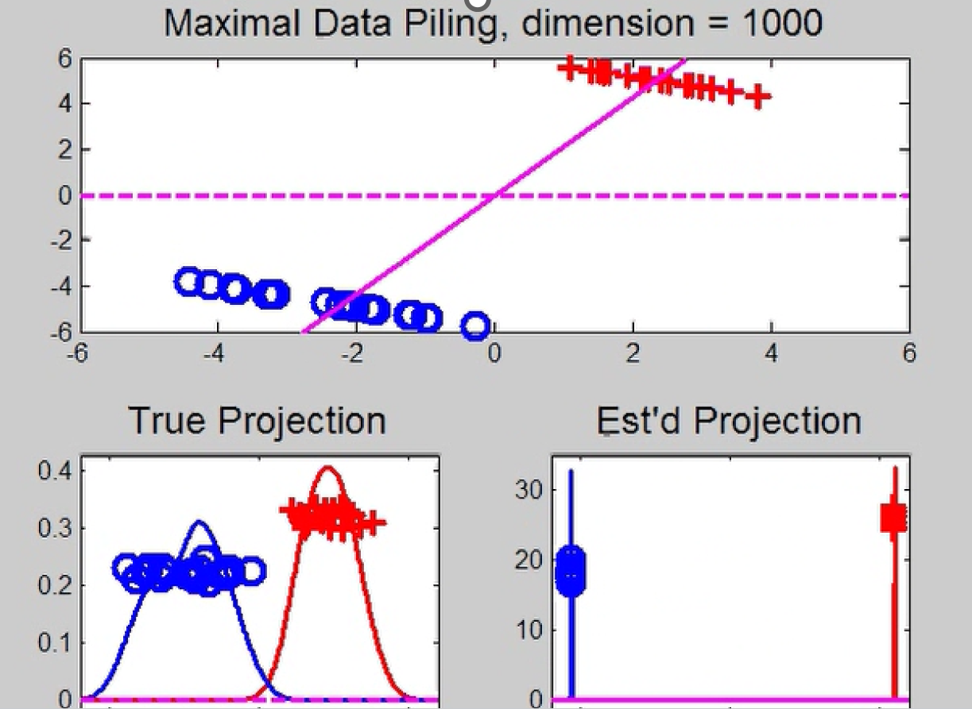
Last Class: Max’al Data Piling
Movie Through Increasing Dimensions

Slide 5
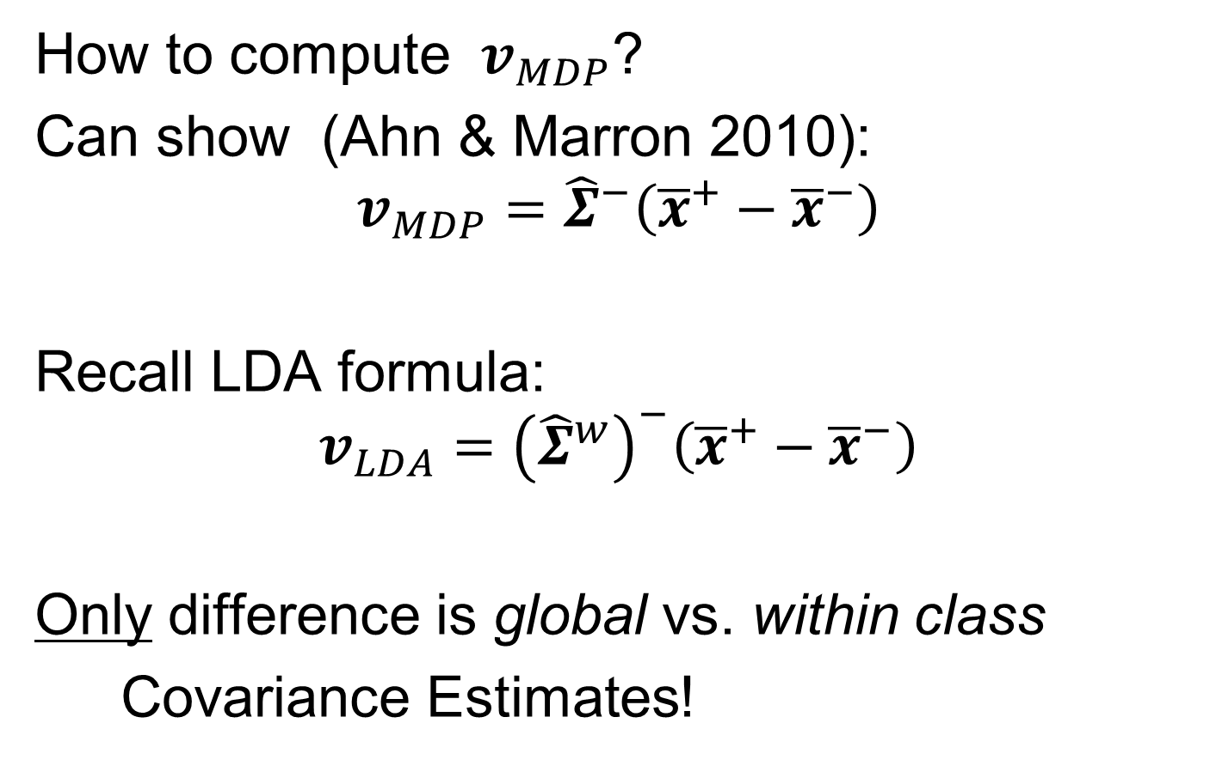
Last Class: Max’al Data Piling
How to compute $v_{MDP}$?
Can show (Ahn & Marron 2010):
$$v_{MDP}={\hat{Σ}}^{−}\left({\overline{x}}^{+}−{\overline{x}}^{−}\right)$$
Recall LDA formula:
$$v_{LDA}={\left({\hat{Σ}}^{w}\right)}^{−}\left({\overline{x}}^{+}−{\overline{x}}^{−}\right)$$
Only difference is global vs. within class
Covariance Estimates!

Slide 6
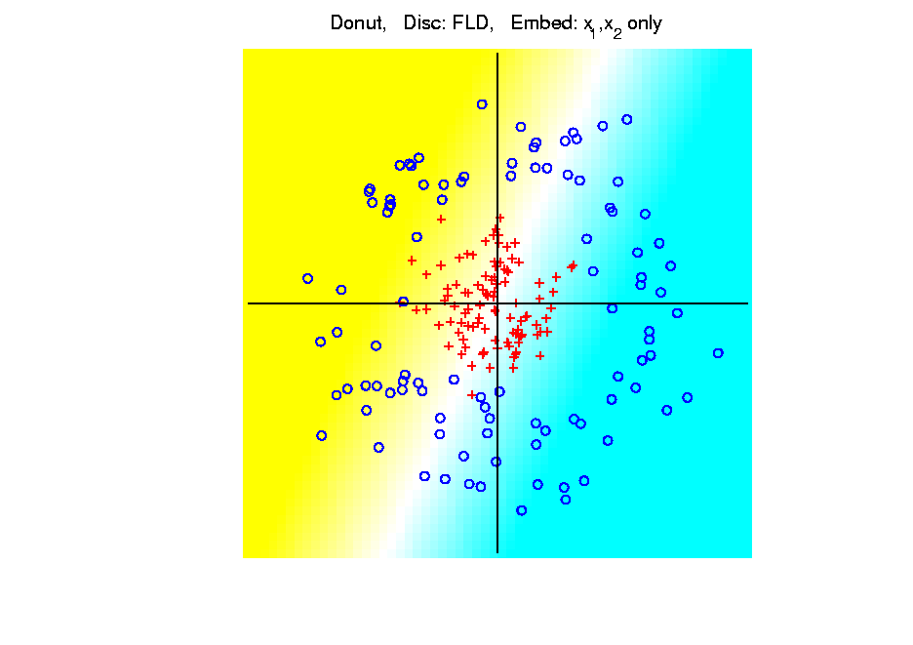
Last Class: Kernel Embedding
Polynomial Embedding, Toy Example 3:
Donut
LDA
Original
Data
Very
Bad
Notes:
PEod1Raw.ps

Slide 7
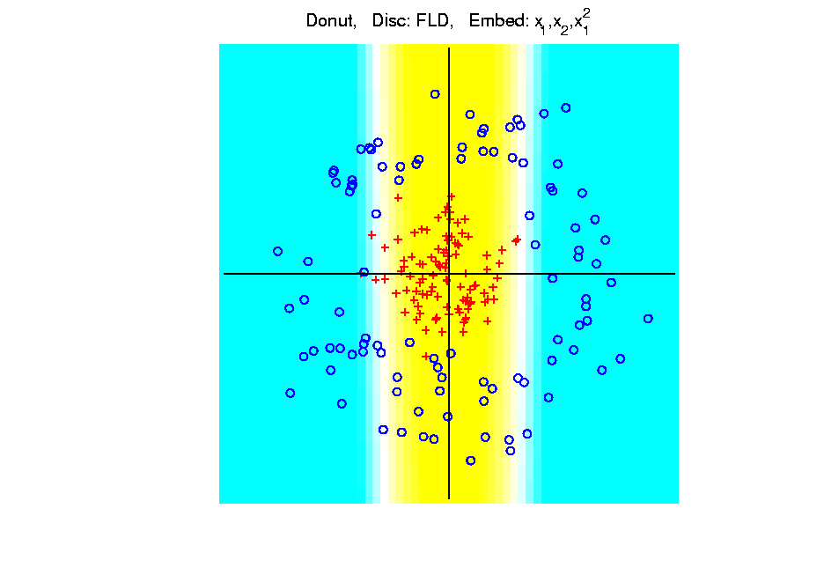
Last Class: Kernel Embedding
Polynomial Embedding, Toy Example 3:
Donut
LDA
Somewhat
Better
(Parabolic Fold)
Notes:
PEod1Raw.ps

Slide 8
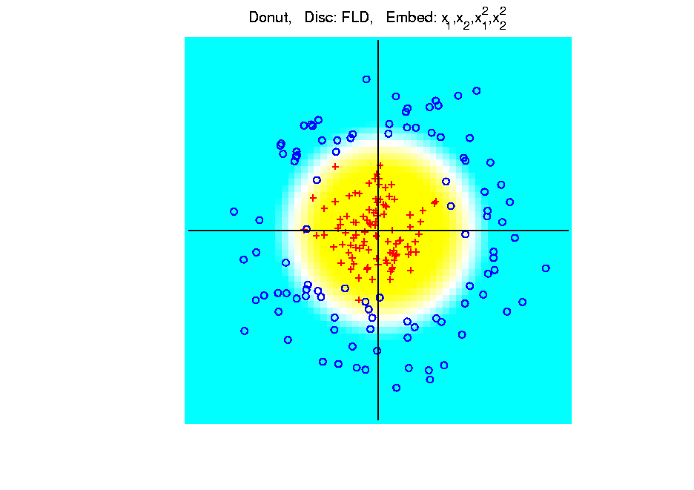
Last Class: Kernel Embedding
Polynomial Embedding, Toy Example 3:
Donut
LDA
Good
Performance
(Slice of
Paraboloid)
Notes:
PEod1Raw.ps

Slide 9
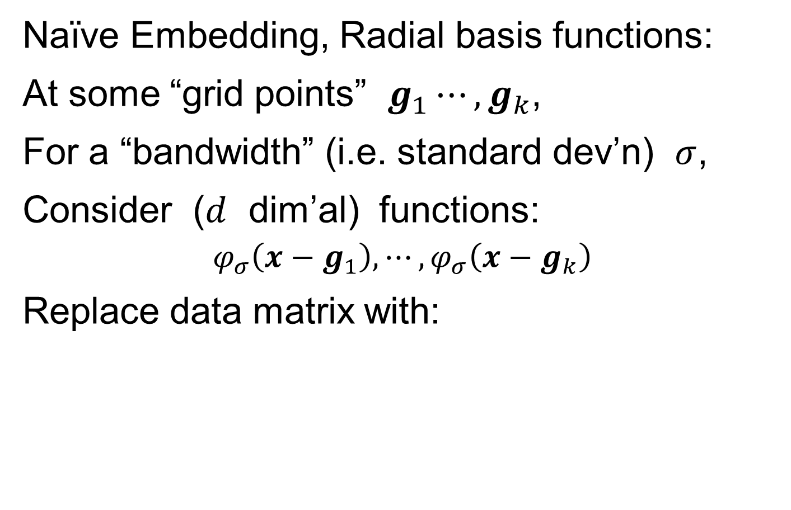
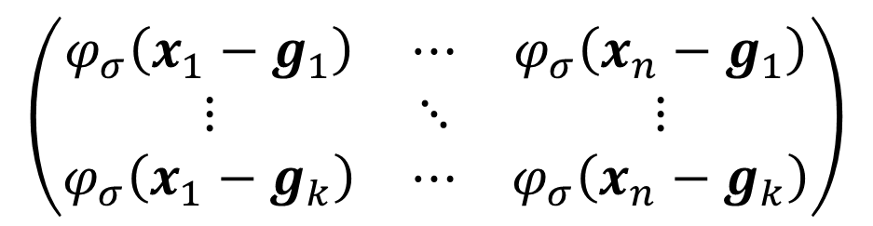
Last Class: Kernel Embedding
Naïve Embedding, Radial basis functions:
At some “grid points” $g_{1}⋯,g_{k}$,
For a “bandwidth” (i.e. standard dev’n) $σ$,
Consider ($d$ dim’al) functions:
$$φ_{σ}\left(x−g_{1}\right),⋯,φ_{σ}\left(x−g_{k}\right)$$
Replace data matrix with:
$$\left(\begin{matrix}φ_{σ}\left(x_{1}−g_{1}\right) & ⋯ & φ_{σ}\left(x_{n}−g_{1}\right) \\ ⋮ & ⋱ & ⋮ \\ φ_{σ}\left(x_{1}−g_{k}\right) & ⋯ & φ_{σ}\left(x_{n}−g_{k}\right)\end{matrix}\right)$$

Slide 10
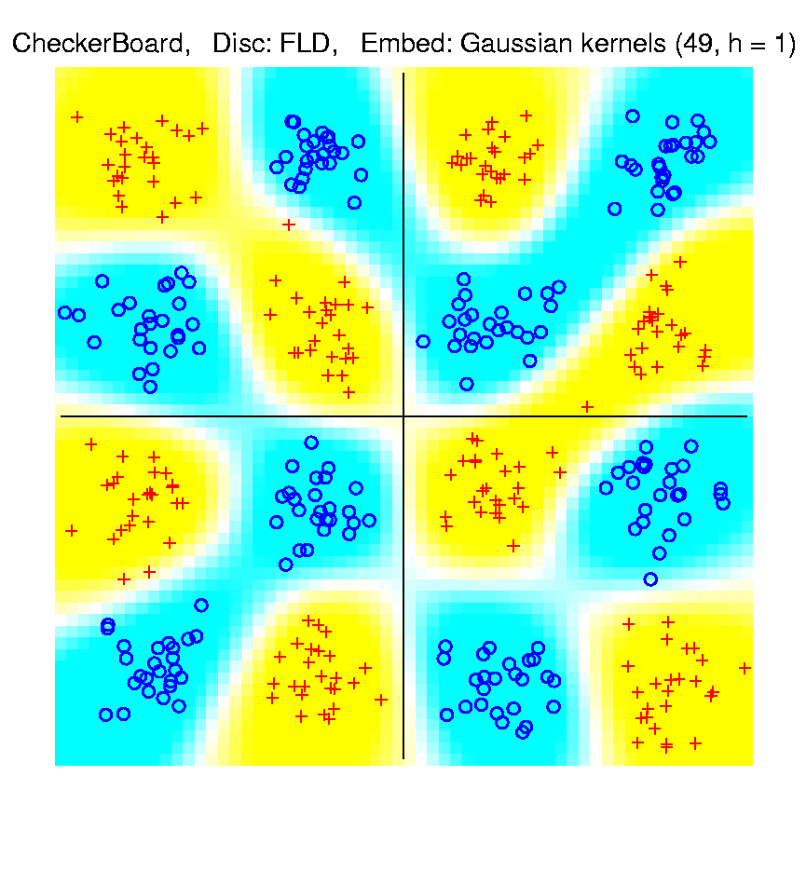
Last Class: Kernel Embedding
Toy Example 4: Checkerboard
Radial
Basis
Embedding
+ LDA
Is
Excellent!
Notes:
PEod1Raw.ps

Slide 11
Kernel Embedding
Drawbacks to naïve embedding:
Equally spaced grid too big in high $d$
Not computationally tractable $\left(g^{d}\right)$
Approach:
Evaluate only at data points
Not on full grid
But where data live

Slide 12
Kernel Embedding
Other types of embedding:
Explicit
Implicit
Will be studied soon, after
introduction to Support Vector Machines…

Slide 13
Kernel Embedding
Other types of embedding:
Explicit
Implicit
Important Issue: Bandwidth Selection:
Ahn (2010)

Slide 14
Kernel Embedding
$∃$ generalizations of this idea to other types of analysis
& some clever computational ideas.
E.g. “Kernel based, nonlinear Principal Components Analysis”
Ref: Schölkopf et al (1997)

Slide 15
Kernel PCA
Main Idea: PCA in Kernel Space
At some “grid points” $g_{1}⋯,g_{k}$,
Eg. Radial Function (Gaussian) Kernel
With Window Width (s. d.) $σ$
$$\left(\begin{matrix}φ_{σ}\left(x_{1}−g_{1}\right) & ⋯ & φ_{σ}\left(x_{n}−g_{1}\right) \\ ⋮ & ⋱ & ⋮ \\ φ_{σ}\left(x_{1}−g_{k}\right) & ⋯ & φ_{σ}\left(x_{n}−g_{k}\right)\end{matrix}\right)$$

Slide 16
Kernel PCA
Main Idea: PCA in Kernel Space
Hurdle: Visualization
At “grid of points” $g_{1}⋯,g_{k}$, Compute Scores
Visualize with Heat Map

Slide 17
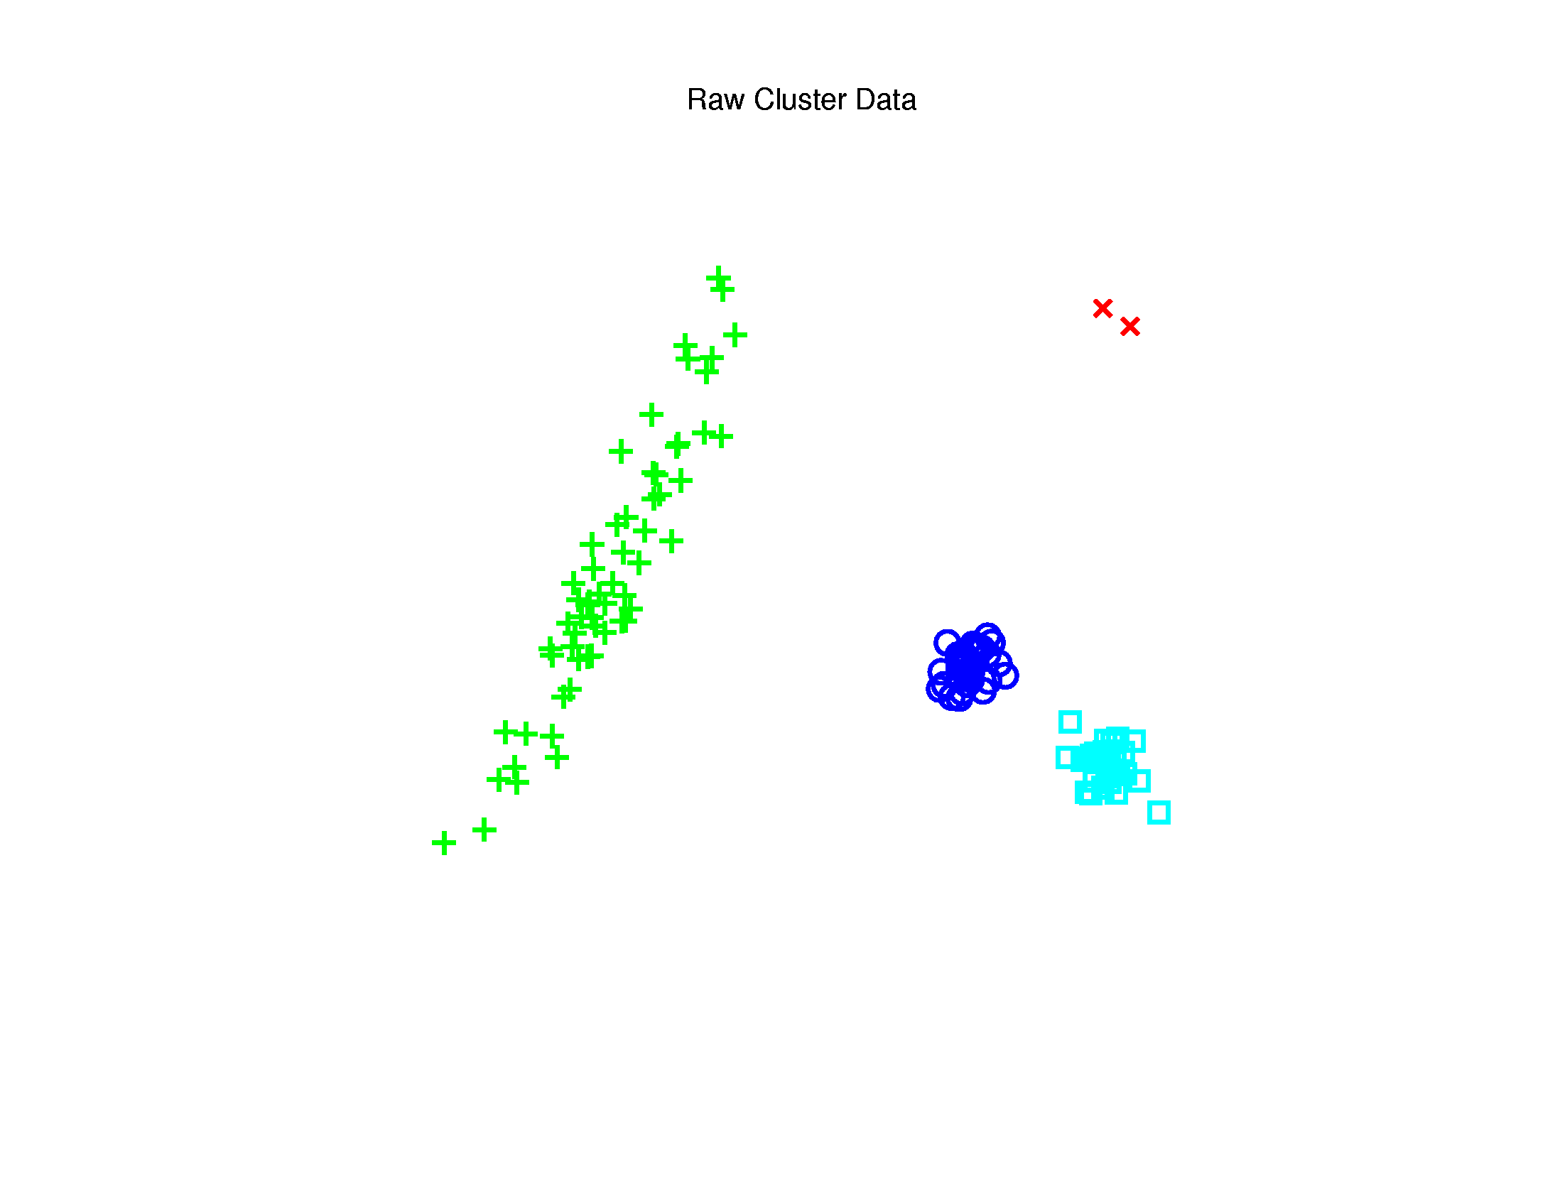
Kernel PCA
Toy $ℝ^{2}$ Example: Raw Data
Long Stretched
Cluster
Round Clusters
Outliers?
Small Cluster?

Slide 18
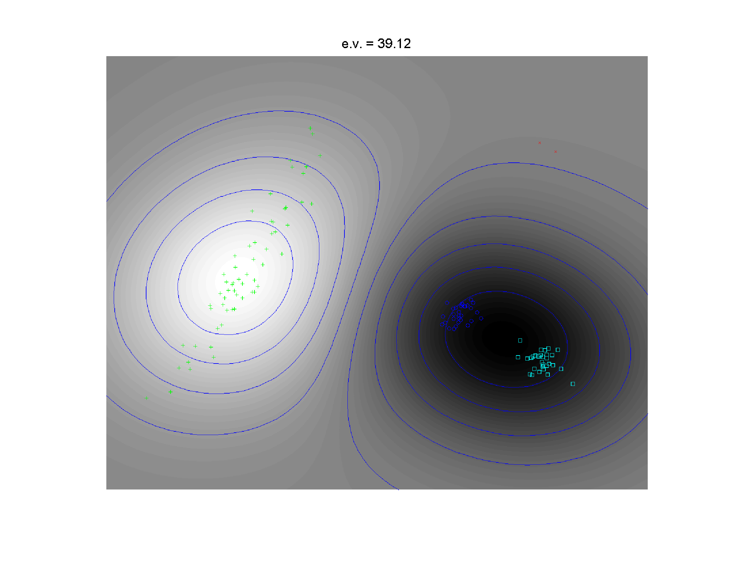

Kernel PCA
1st Component
Finds Coarse
Scale Green
vs. Blues
At Rectangular Grid of Pixels, i.e. $g_{j}$
Gray Level Map of Kernel Space PC Scores
Contours of Scores Surface

Slide 19
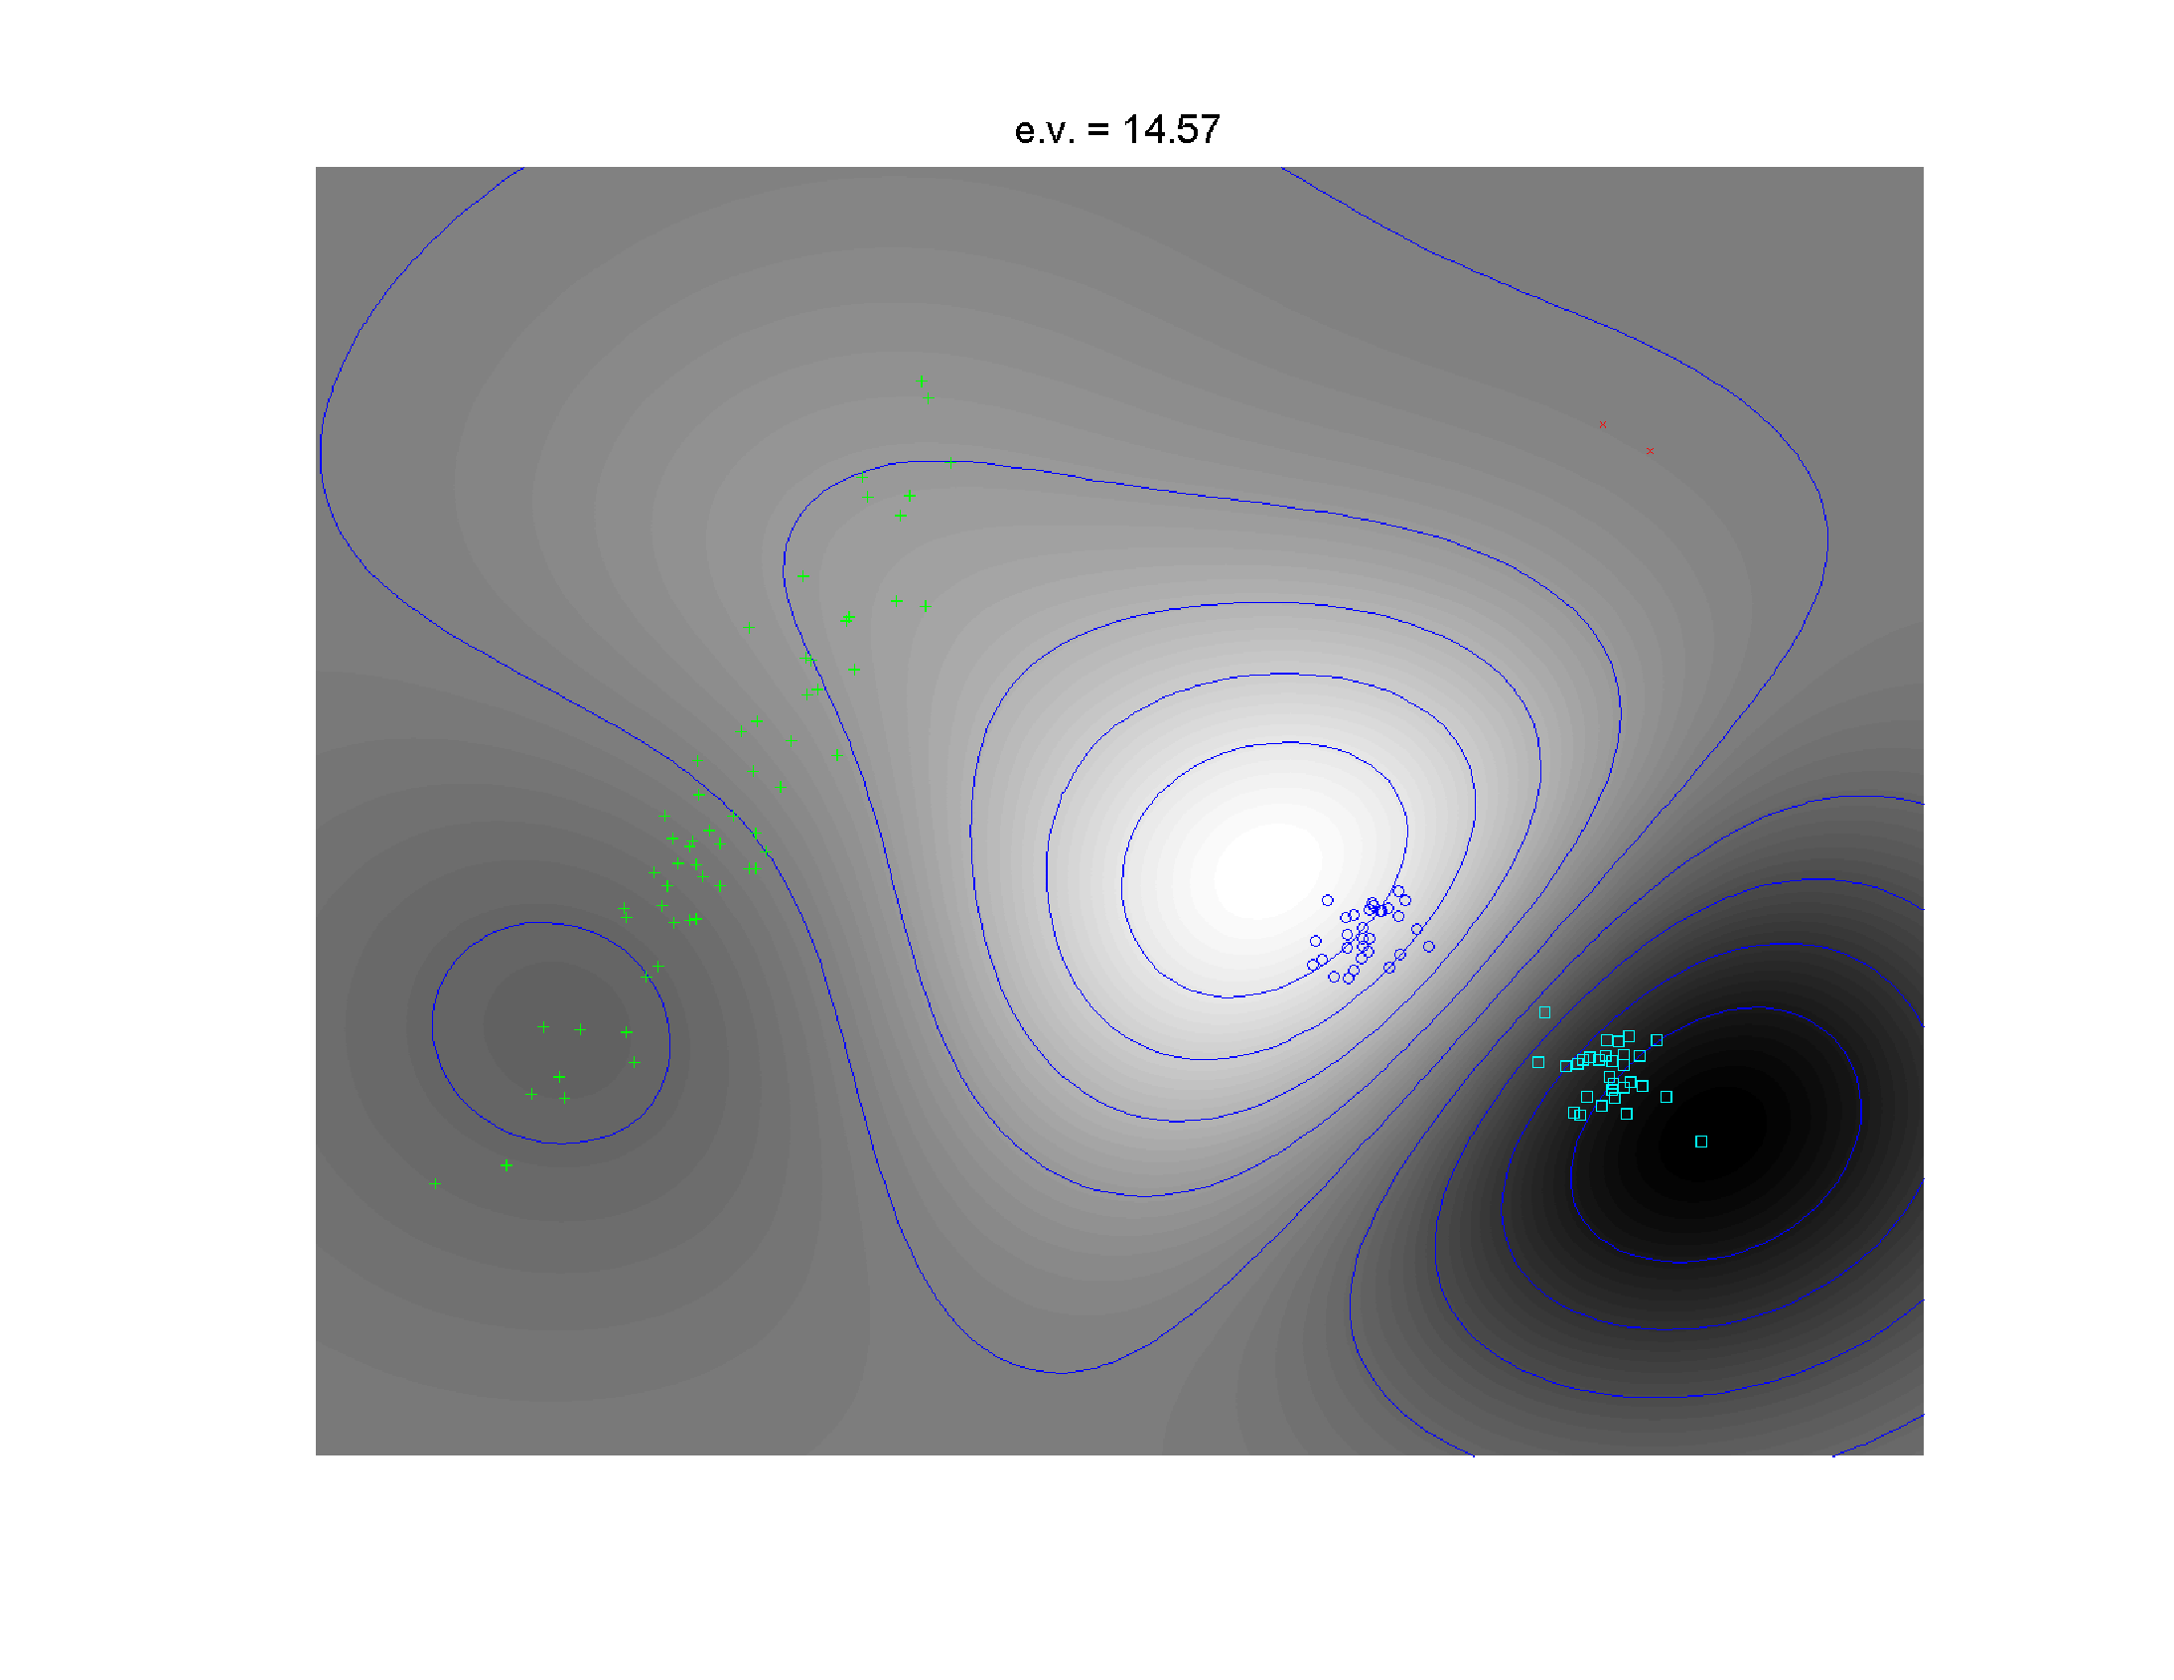
Kernel PCA
2nd Component
Separates
Blue & Cyan
Strong
Locality!

Slide 20
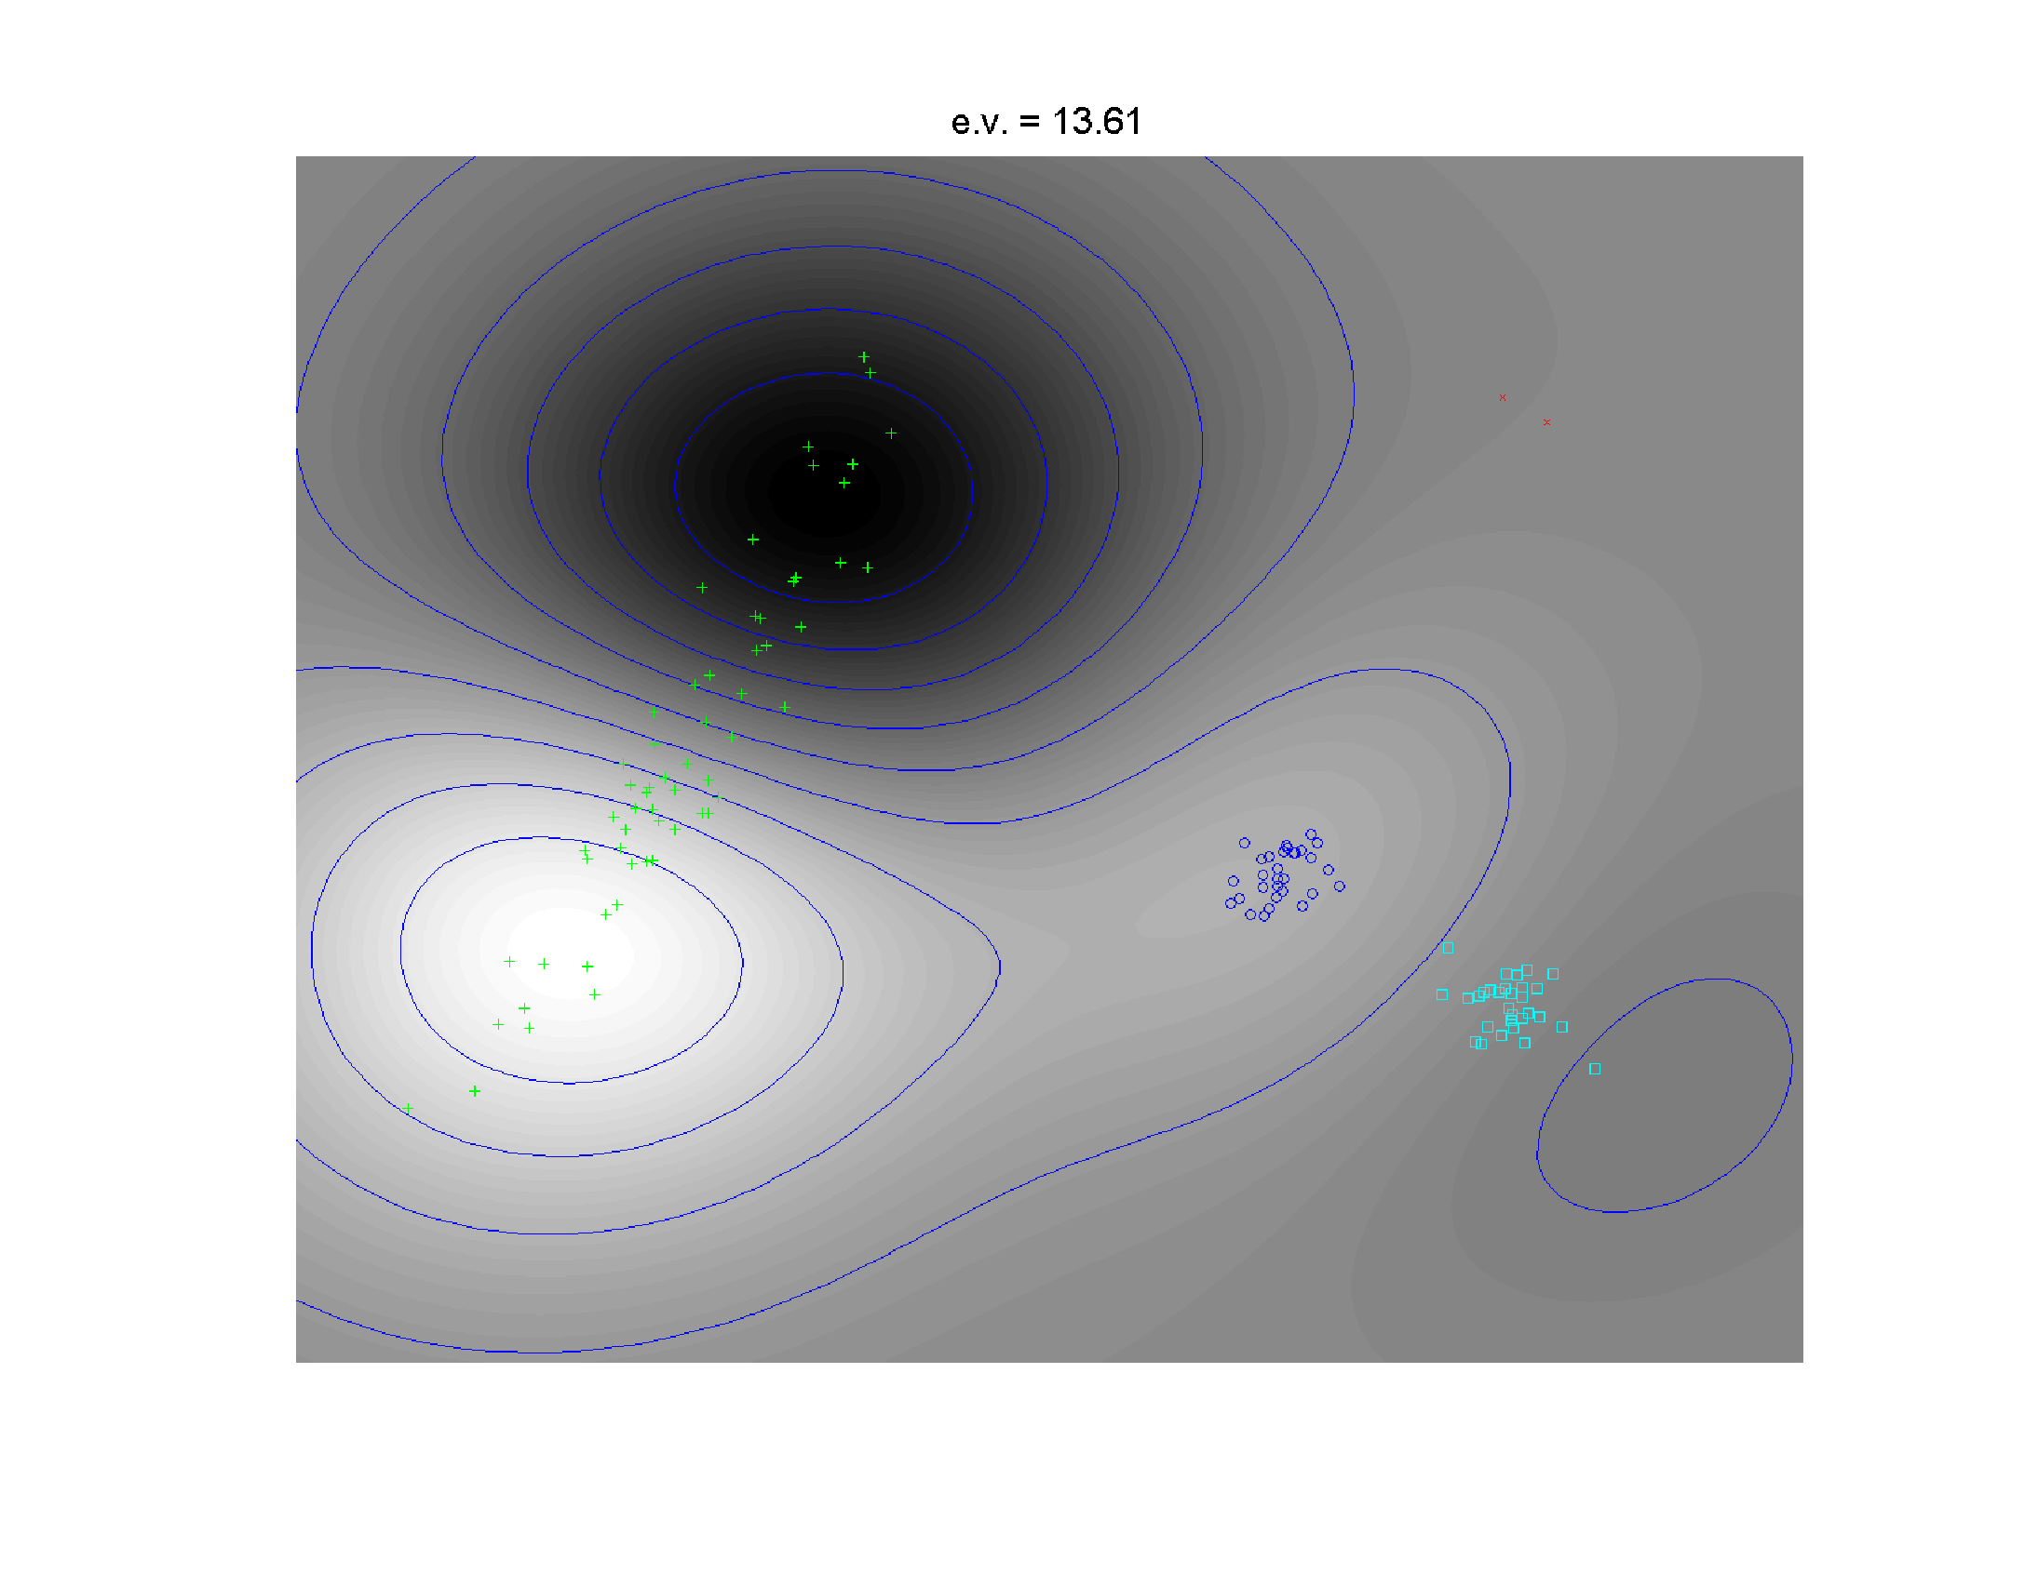
Kernel PCA
3rd Component
Splits
Greens

Slide 21
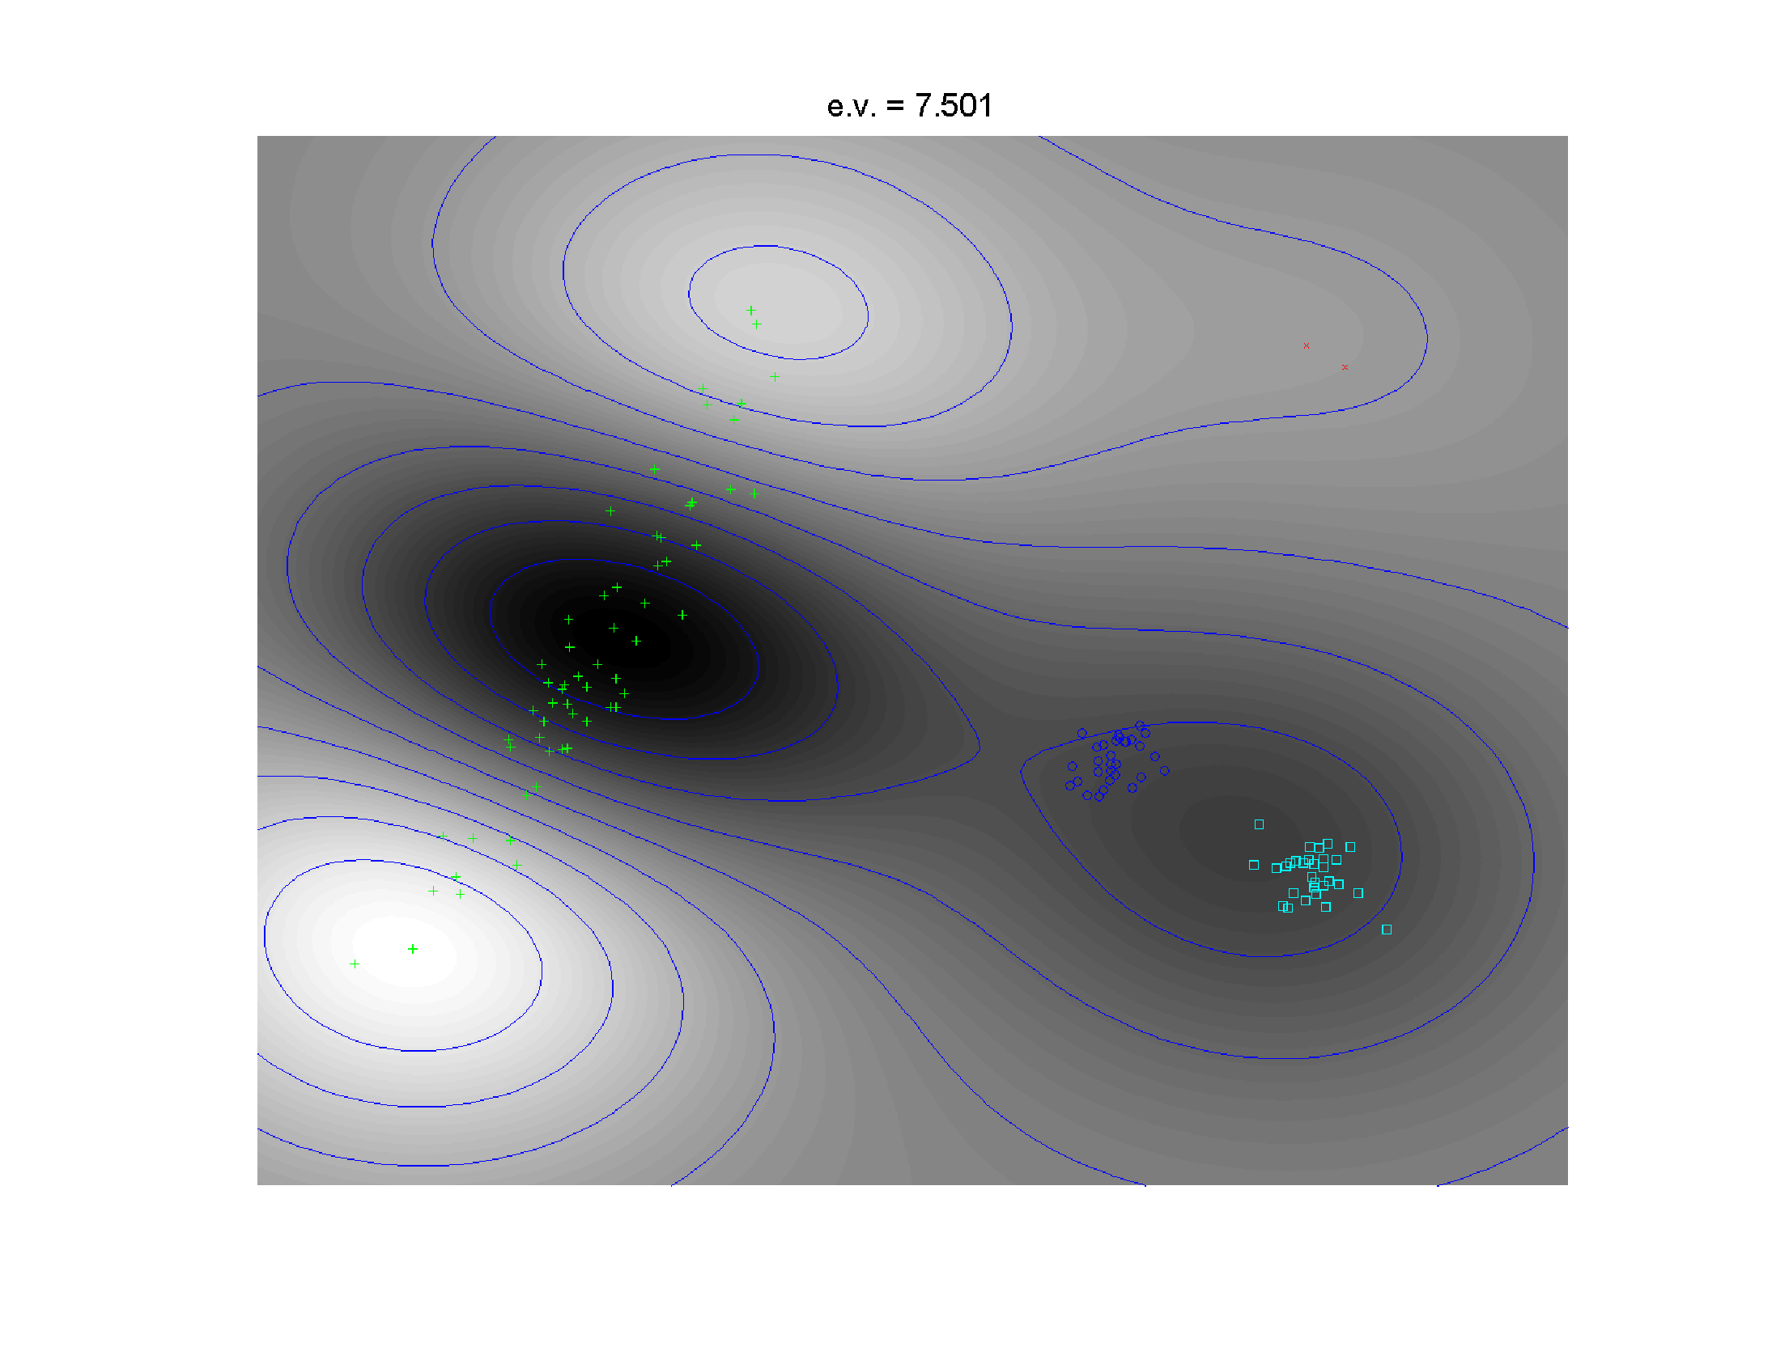
Kernel PCA
4th Component
Higher
Harmonic
Of Greens

Slide 22
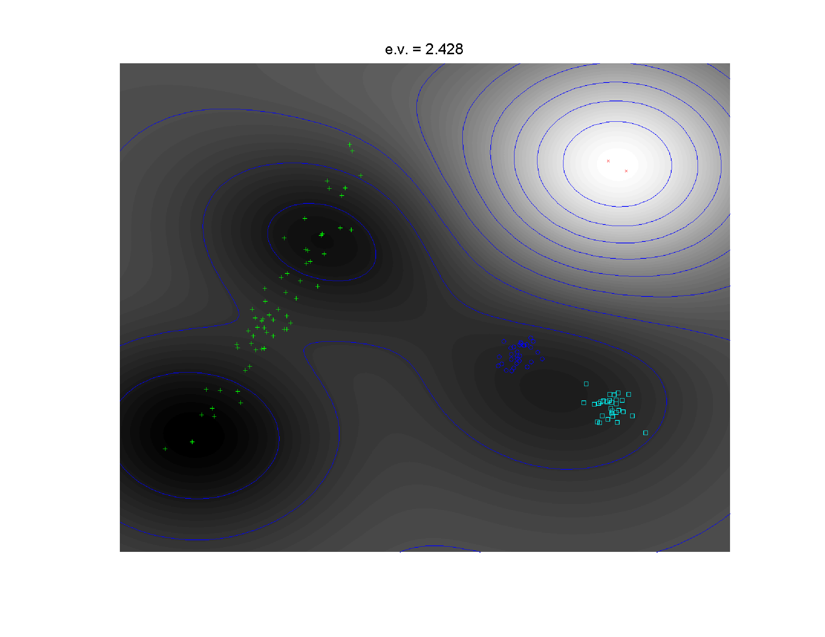
Kernel PCA
5th Component
Finally Find
Outliers

Slide 23
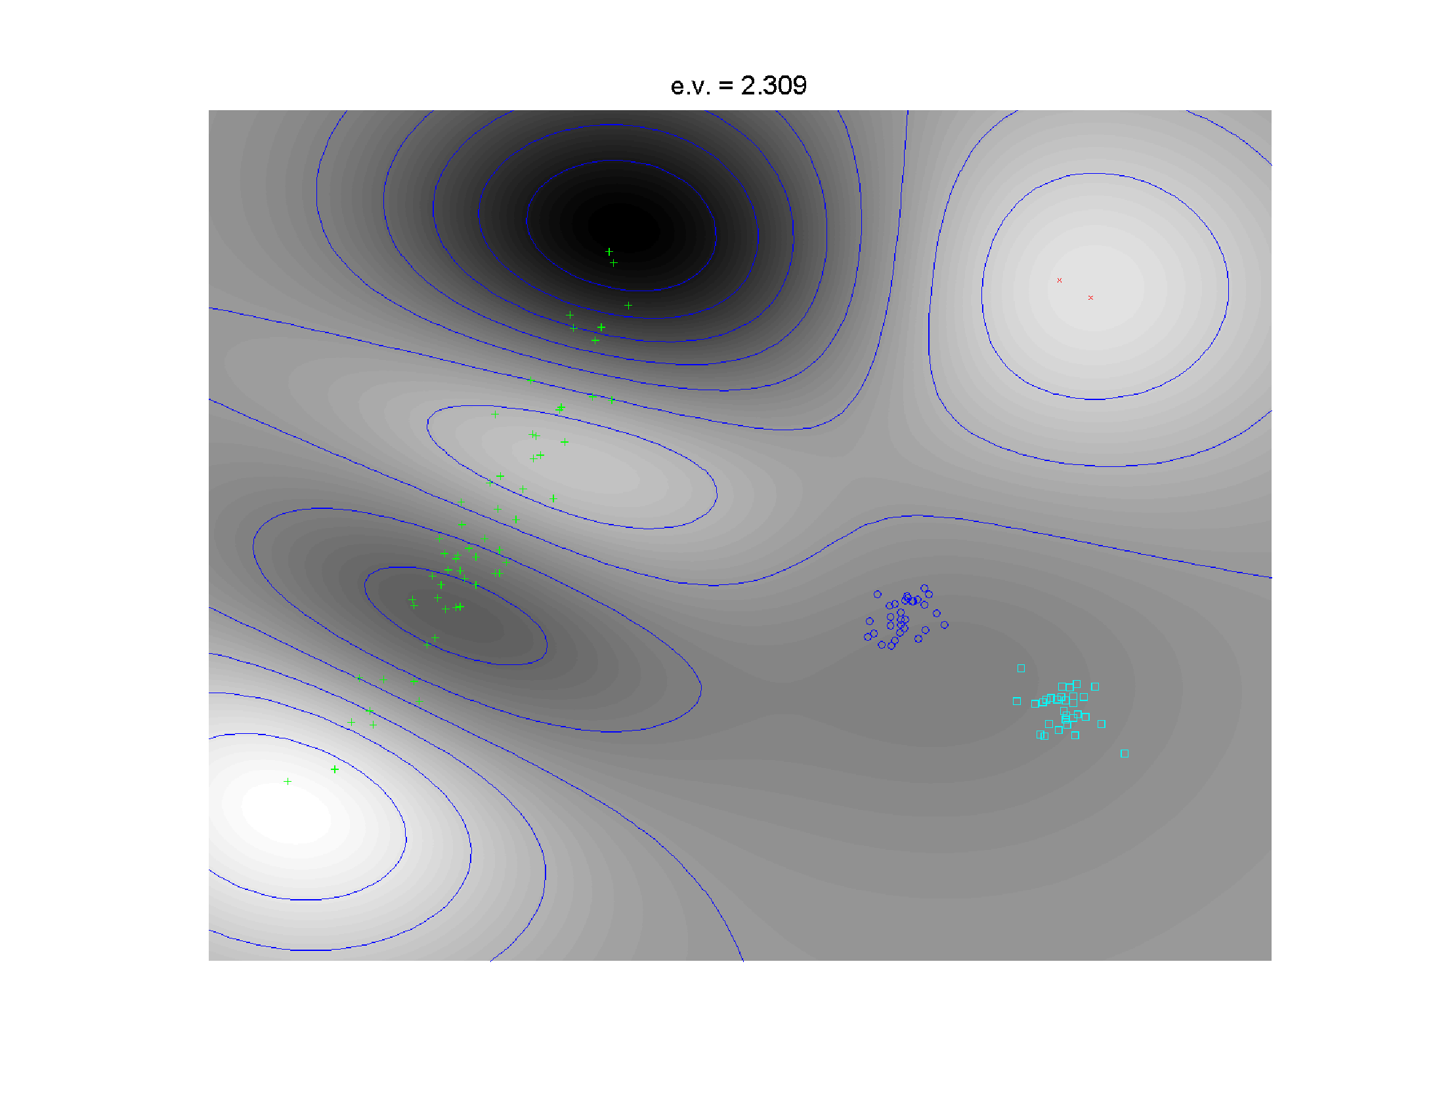
Kernel PCA
6th Component
Even Higher
Harmonic
Of Greens

Slide 24
Kernel PCA
Summary:
Insightful Decomposition of Variation
Elegantly Integrated With Locality
Why Not More Widely Used?
Needs Visualization in $ℝ^{d}$

Slide 25
Kernel PCA
Caution:
Results Depend on Window Width
(will study later)

Slide 26
Kernel PCA
Why Not More Widely Used?
Needs Visualization in $ℝ^{d}$

Slide 27
Kernel PCA
Why Not More Widely Used?
Needs Visualization in $ℝ^{d}$
Clever Solution:
t-SNE Visualization
t-distributed Stochastic Neighbor Embedding
Maaten & Hinton (2008)
Pronunciation:
“tee – snee”
or
“tisnee”
Since from
T-distribution

Slide 28
t-SNE Visualization
Main Idea:
Data
Kernel Space
MDS Type Representers
Induces Kernel
PCA Type Locality
Gaussian Kernel
Transformation
Cauchy Kernel
Transformation
Pushes Away
Farther Points
Optimization: Make
Close As Possible
Recall Multi Dimensional
Scaling = Auto-Encoder

Slide 29
t-SNE Visualization
Cauchy Probability Distribution
$$f_{X}\left(x\right)=\frac{1}{π\left(x^{2}+1\right)}$$
Very Heavy Tails!
$$var\left(X\right)=∞$$
$EX=\frac{1}{π}\int_{−∞}^{∞}{\frac{x}{x^{2}+1}dx}$ is undefined!
Very Different Transformation from Gaussian
Also “Student’s t
Distribution with 1
degree of freedom”
Hence the Name
So No Central Limit
Theorem Or Even
Law of Large Numbers

Slide 30
t-SNE Visualization
Tuning Parameter: “Perplexity”
Roughly a Smoothing Parameter
~ Nearest Neighbor Type
(So Bigger In Sparser Regions)

Slide 31
t-SNE Visualization
Same Toy $ℝ^{2}$ Example
4(?) Quite
Diverse
Clusters

Slide 32
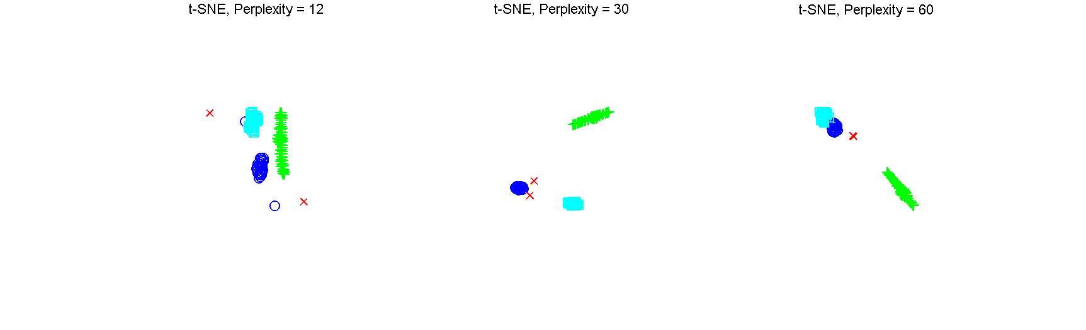
t-SNE Visualization
Perplexity = 30 (Default)
Keeps Local
Structure
But Global
Rearangement
And Outlier
Cluster is Split

Slide 33
t-SNE Visualization
Perplexity = 12 (Small ?)
Structure
Added to
Clusters?
Outliers Even
More Split
Stray Points

Slide 34
t-SNE Visualization
Perplexity = 60 (Big ?)
Gets 2 Outliers
But
Combines
Clusters

Slide 35
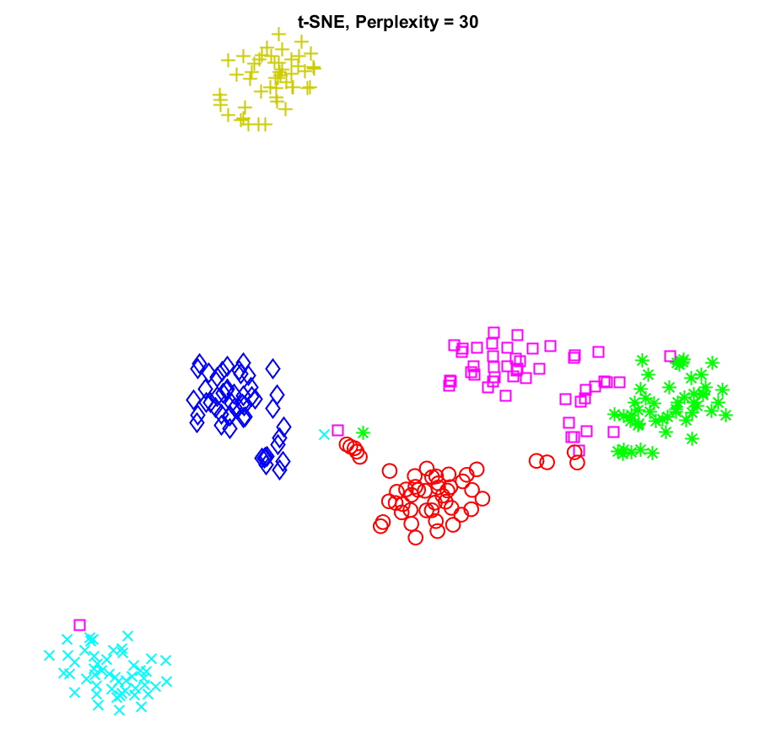
t-SNE Visualization
PanCan Data (Previous 6 Cancer Types)
Generally Strong Separation
Of Known Cancer Types
But a Few
Misclusterings

Slide 36
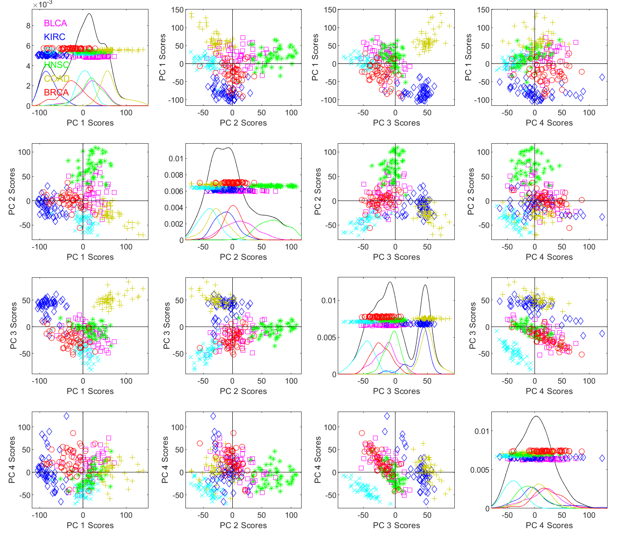
t-SNE Visualization
PanCan Data Recall PCA
Needs
More
Dimensions
To Even
See Quite
Separate
Clusters
Much
Smaller
Gaps
Between
Types
Since
PCA
Only
Feels
Overall
Variation
Why
Recommend
More Than
2 PCA
Directions

Slide 37
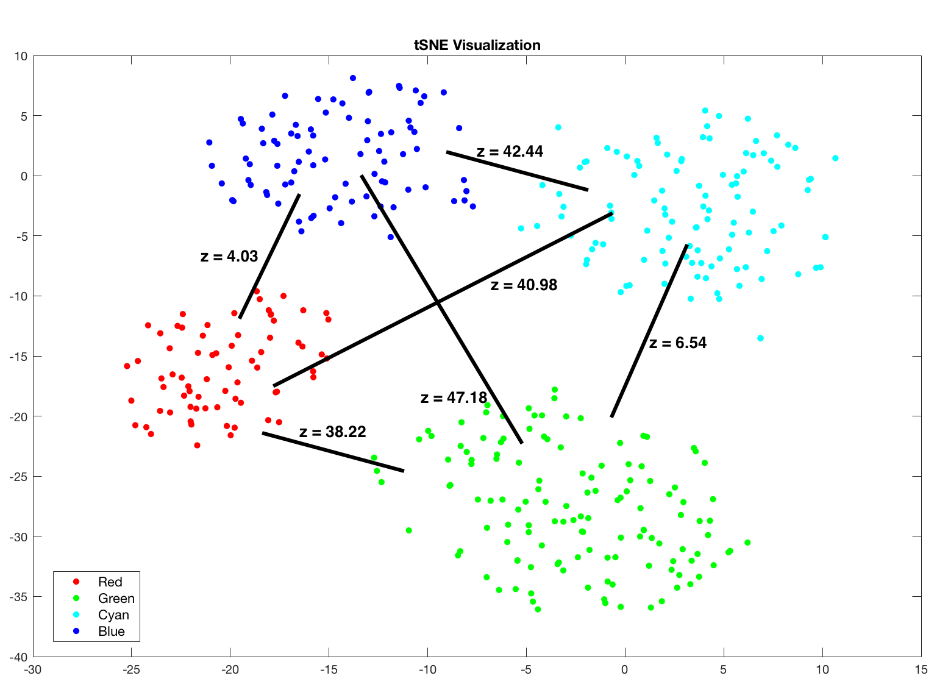
t-SNE Visualization
Osteo-Arthritis Data
Text, Figure 11.10
Good Visual Separation
DiProPerm Z-scores
Weaker
Separation
Stronger
Separation
Careful As To
What t-SNE
Gaps Tell Us

Slide 38
Kernel Embedding
T Distribution With 1
Degree of Freedom
Summary of This Variation:
t-SNE Cluster Visualization
(t distributed Stochastic Neighbor Embedding)
Maaten & Hinton (2008)
Idea: Gaussian Kernel PCA (Front End)
“Inverted” with Cauchy Kernel PCA
As With MDS: Find “Representers”
Heavy Tails of
Cauchy “Pulls
Apart” Clusters

Slide 39
Kernel Embedding
Another Variation:
“Generalized Principal Components Analysis”
Ref: Vidal et al (2016)
Main Idea:
Find “Interesting Subsets” Using PCA
Recompute PCA Visualization There
(Sometimes Called “Drill Down”)
A Common
Visualization
Approach
Automated
& Formalized
Here, Using
Optimization

Slide 40
Support Vector Machines
Motivation:
Find a linear classification method that “works well” for embedded data
Note: Embedded data are
very non-Gaussian
Classical Statistics: “Use Prob. Dist’n”
Looks Hopeless
Text, Sec. 11.3
Not Even
Absolutely
Continuous
With Respect
To Lebesgue
Measure

Slide 41
Support Vector Machines
Motivation:
Find a linear classification method that “works well” for embedded data
Note: Embedded data are
very non-Gaussian
Suggests value of
really new approach

Slide 42
Support Vector Machines
Classical References:
Vapnik (1982)
Boser, Guyon & Vapnik (1992)
Vapnik (1995)

Slide 43
Support Vector Machines
Recommended tutorial:
Burges (1998)
Early Monographs:
Cristianini & Shawe-Taylor (2000)
Schölkopf & Smola (2002)
More Recent Monographs:
Hastie et al (2001, 2005)
Bishop (2006)

Slide 44
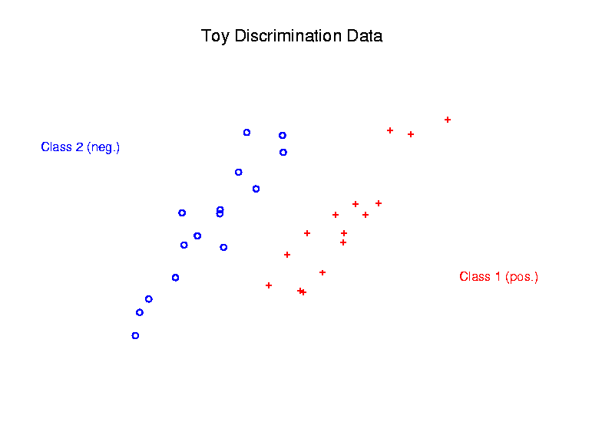
Support Vector Machines
Graphical View, using Toy Example:

Slide 45
Support Vector Machines
Graphical View, using Toy Example:
Find separating plane
To maximize distances from data to plane

Slide 46
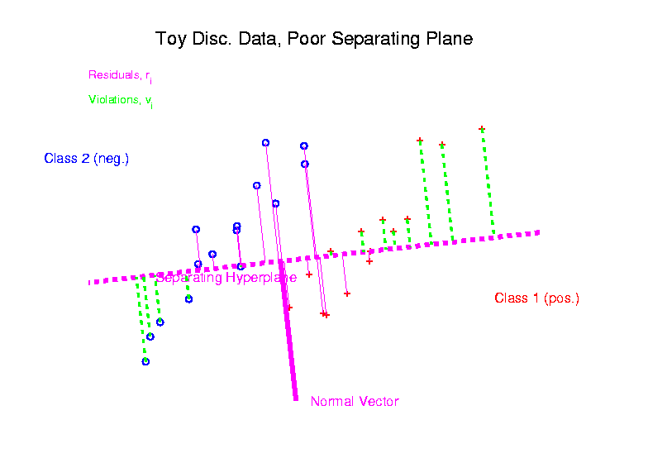
Support Vector Machines
Graphical View, using Toy Example:

Slide 47
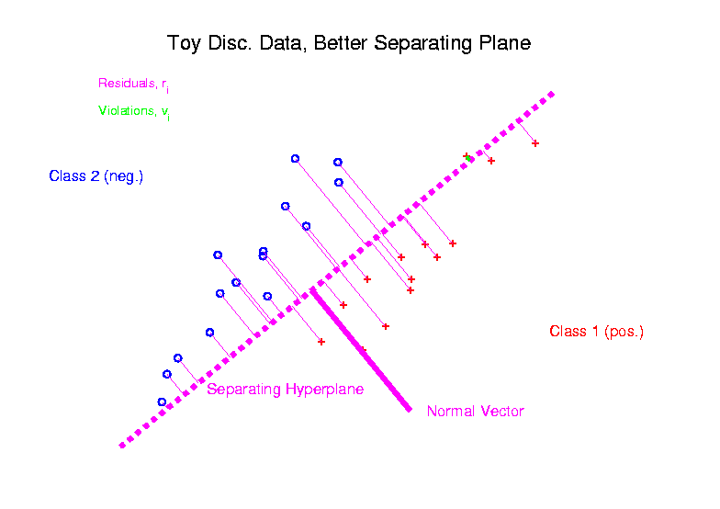
Support Vector Machines
Graphical View, using Toy Example:

Slide 48
Support Vector Machines
Graphical View, using Toy Example:
Find separating plane
To maximize distances from data to plane

Slide 49
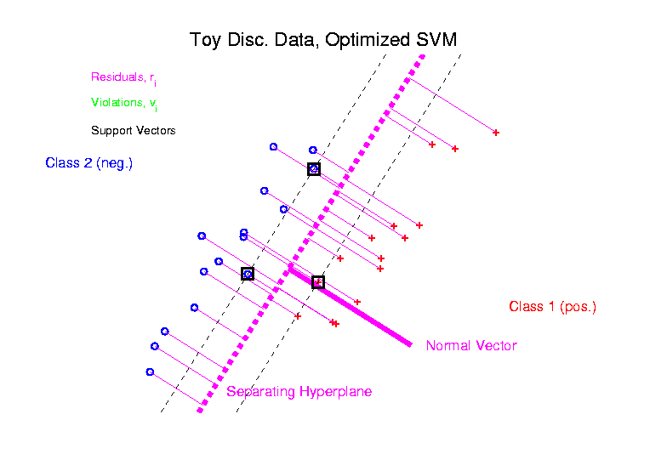
Support Vector Machines
Graphical View, using Toy Example:

Slide 50
Support Vector Machines
Graphical View, using Toy Example:
Find separating plane
To maximize distances from data to plane
In particular smallest distance
Data points closest are called
support vectors
Gap between is called margin
Caution: For some “margin” is different
Hence the Name

Slide 51
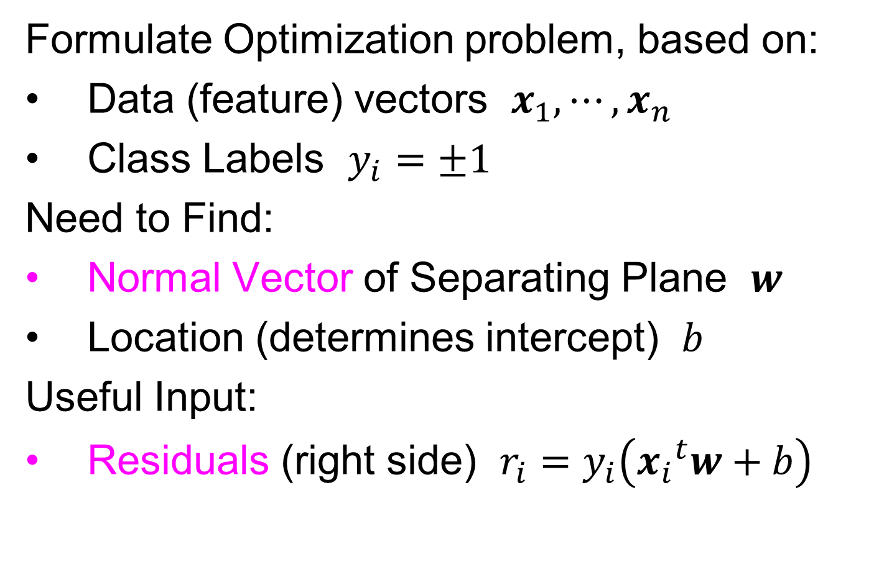

SVMs, Optimization Viewpoint
Formulate Optimization problem, based on:
Data (feature) vectors $x_{1},⋯,x_{n}$
Class Labels $y_{i}=±1$
Need to Find:
Normal Vector of Separating Plane $w$
Location (determines intercept) $b$
Useful Input:
Residuals (right side) $r_{i}=y_{i}\left({x_{i}}^{t}w+b\right)$
$y_{i}=±1$ Notation Very Useful Here

Slide 52
SVMs, Optimization Viewpoint
Simple Case: Separable Classes
There Is A
Separating
Plane
Want “Best”
Separating Plane

Slide 53
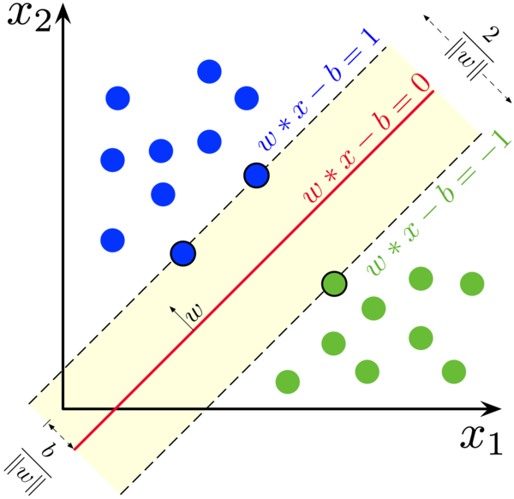


SVMs, Optimization Viewpoint
Given a Separating Direction $w$,
Choose $b$ To Give The “Middle Plane”
Between
Support
Vectors
Define the Margin Using $\left\|w\right\|$ (length)
Note: $w$ is no
longer just a
direction, but
also captures
gap between
classes
(Thanks to
Wikipedia)`

Slide 54


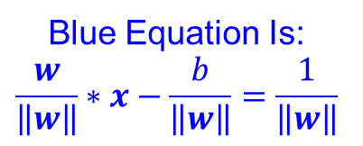
SVMs, Optimization Viewpoint
Choose $\left\|w\right\|$ to Put Support Vectors on
“Margin Lines”
SVM Goal: Maximize $\frac{1}{\left\|w\right\|}$, i.e. Minimize $\left\|w\right\|$
So Margin
Is $\frac{2}{\left\|w\right\|}$
Blue Equation Is:
$$\frac{w}{\left\|w\right\|}∗x−\frac{b}{\left\|w\right\|}=\frac{1}{\left\|w\right\|}$$

Slide 55
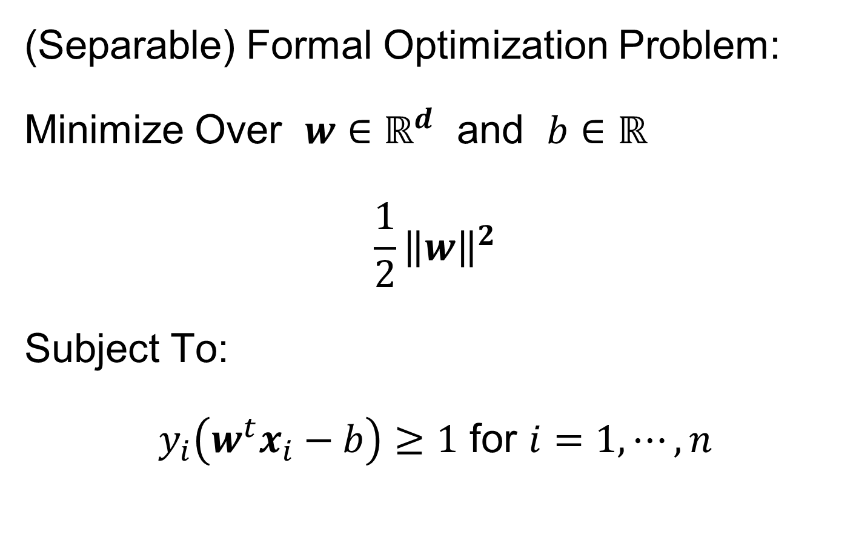

SVMs, Optimization Viewpoint
(Separable) Formal Optimization Problem:
Minimize Over $w∈ℝ^{d}$ and $b∈ℝ$
$$\frac{1}{2}{\left\|w\right\|}^{2}$$
Subject To:
$y_{i}\left(w^{t}x_{i}−b\right)≥1$ for $i=1,⋯,n$
Hard
Margin
SVM
Constrains Data to Be Outside Margin
$y_{i}=±1$ Notation Again Very Useful

Slide 56
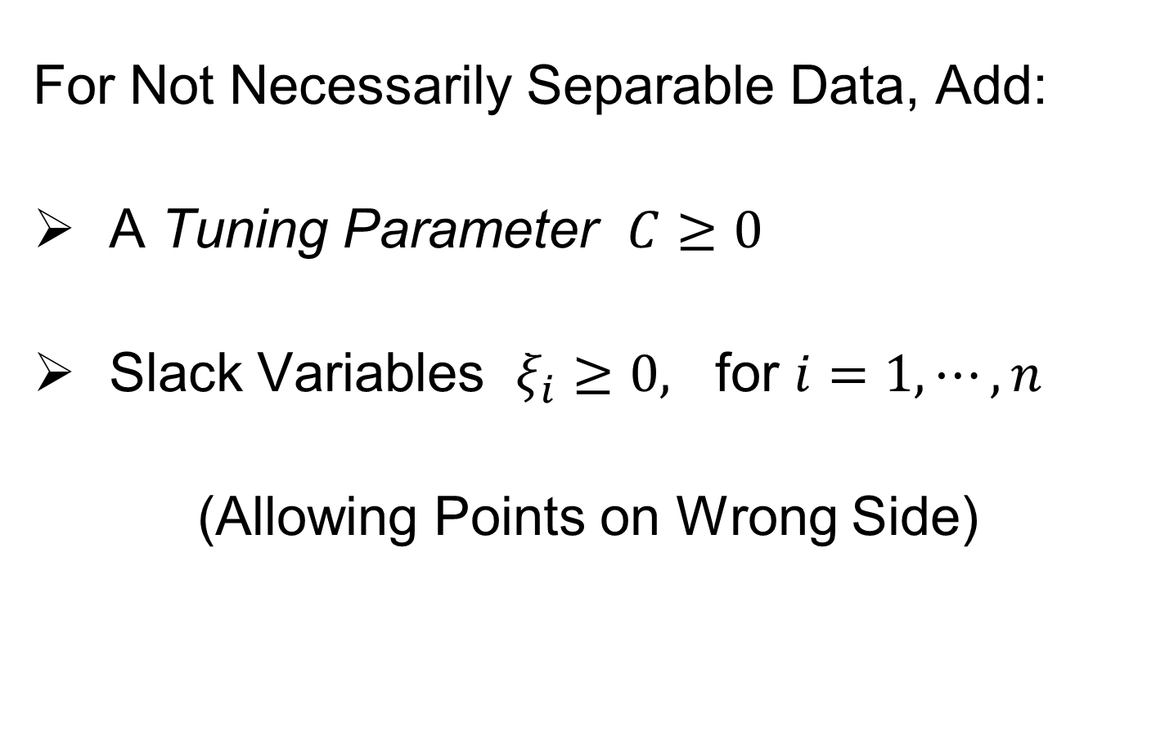
SVMs, Optimization Viewpoint
For Not Necessarily Separable Data, Add:
A Tuning Parameter $C≥0$
Slack Variables $ξ_{i}≥0,$ for $i=1,⋯,n$
(Allowing Points on Wrong Side)

Slide 57
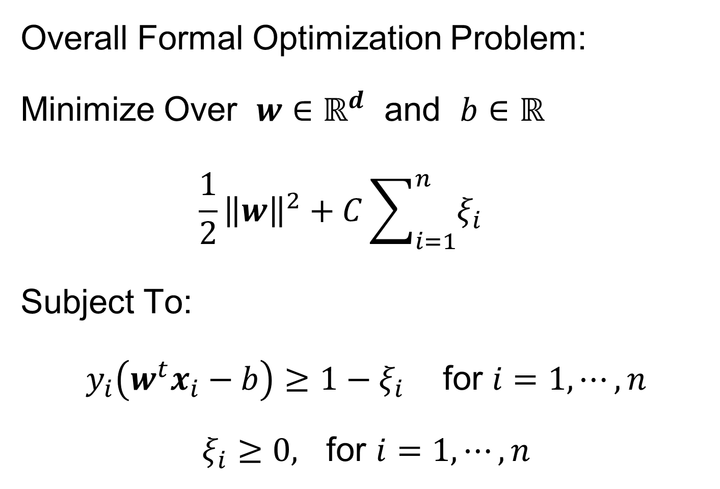

SVMs, Optimization Viewpoint
Overall Formal Optimization Problem:
Minimize Over $w∈ℝ^{d}$ and $b∈ℝ$
$$\frac{1}{2}{\left\|w\right\|}^{2}+C\sum_{i=1}^{n}{ξ_{i}}$$
Subject To:
$y_{i}\left(w^{t}x_{i}−b\right)≥1−ξ_{i}$ for $i=1,⋯,n$
$ξ_{i}≥0,$ for $i=1,⋯,n$
Soft
Margin
SVM
Relax Margin by $ξ_{i}$
At Corresponding Cost

Slide 58
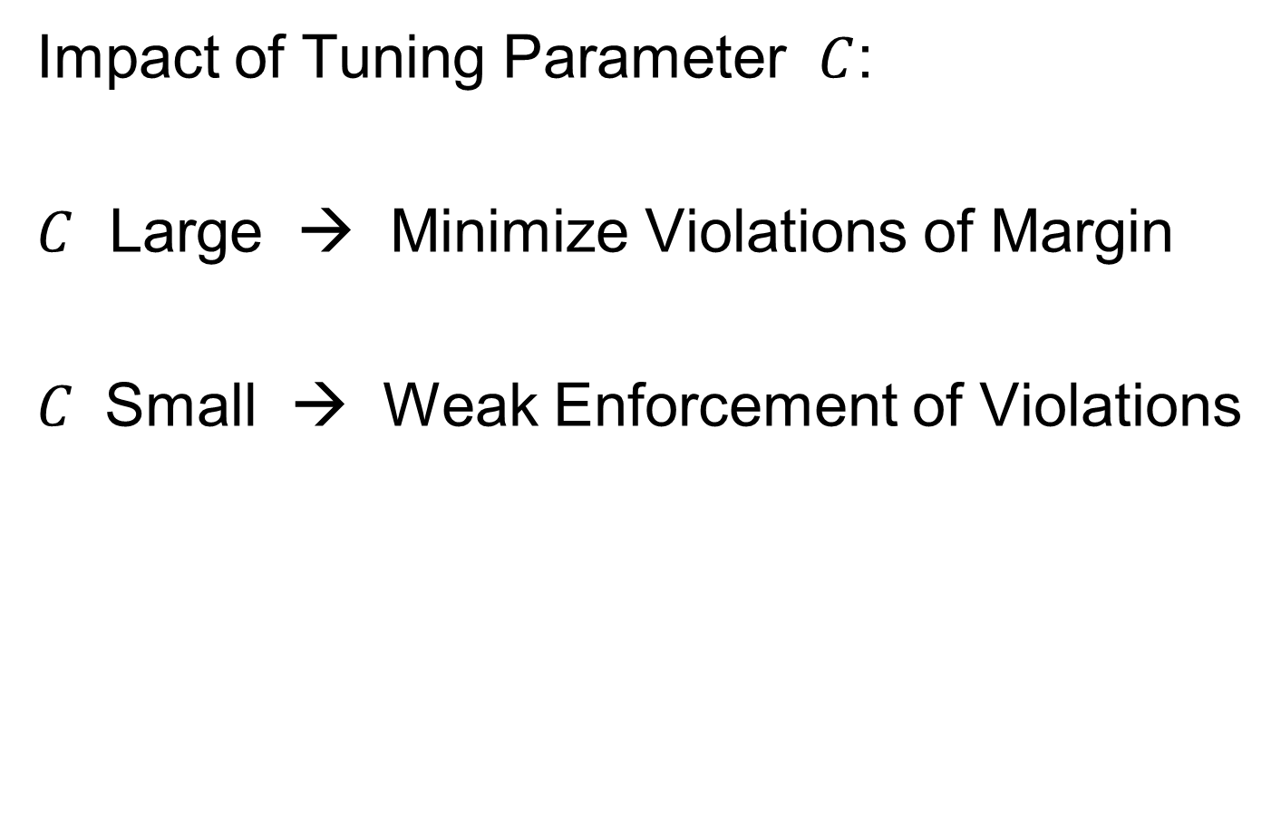
SVMs, Optimization Viewpoint
Impact of Tuning Parameter $C$:
$C$ Large → Minimize Violations of Margin
$C$ Small → Weak Enforcement of Violations

Slide 59
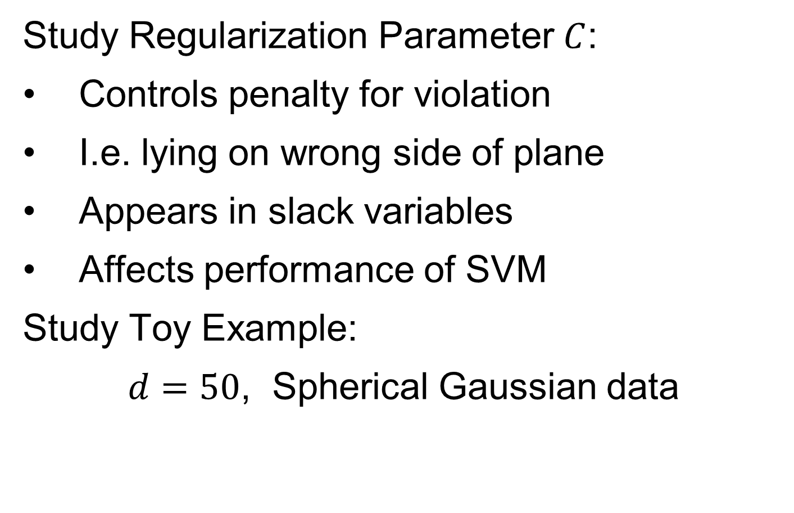
SVMs, Tuning Parameter
Study Regularization Parameter $C$:
Controls penalty for violation
I.e. lying on wrong side of plane
Appears in slack variables
Affects performance of SVM
Study Toy Example:
$d=50$, Spherical Gaussian data

Slide 60
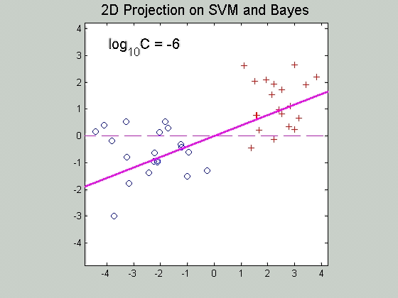

SVMs, Tuning Parameter
Toy Example: $d=50$, Sph’l Gaussian data
Often No
Change
Followed
By Rapid
Change
Nicely
Separable
Example
2-d Subspace
Generated by
Bayes Rule
And SVM

Slide 61
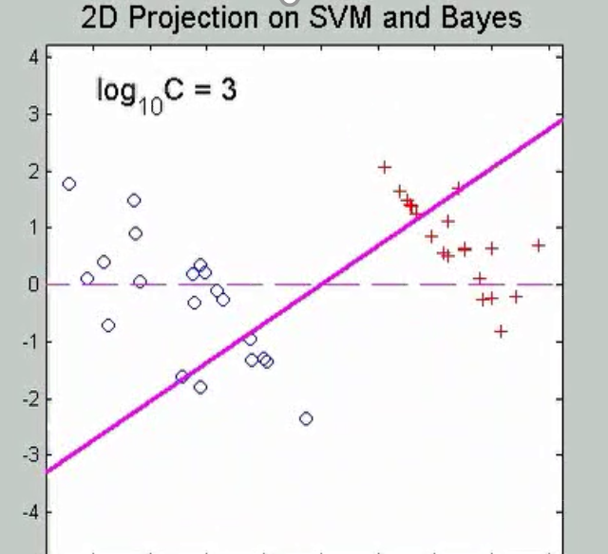
SVMs, Tuning Parameter
Toy Example: $d=50$, Sph’l Gaussian data
For Large Values of C
Lots of Data Piling
Large Angle to Optimal
Thus Less Generalizable
(For This Data Set)
But Big
Margin
Called Hard Margin SVM

Slide 62
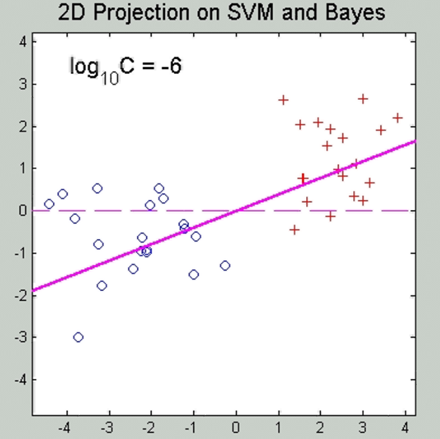

SVMs, Tuning Parameter
Toy Example: $d=50$, Sph’l Gaussian data
For Small Values of C
No Apparent Data Piling
Smaller Angle to Optimal
So More Generalizable
Yet Smaller
Margin $\frac{1}{\left\|w\right\|}$
Connection to MD?
Add MD Axis to Plot

Slide 63
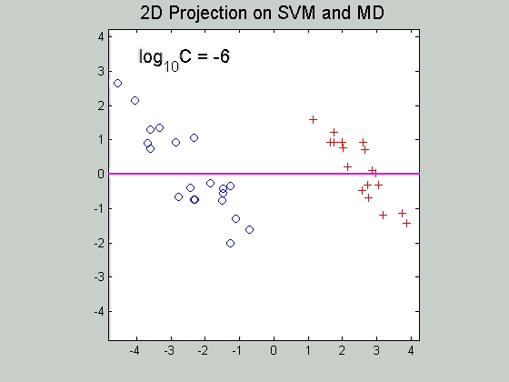

SVMs, Tuning Parameter
Toy Example: $d=50$, Sph’l Gaussian data
Put MD on horizontal axis
Note:
For C Small
SVM Dir’n =
= MD Dir’n

Slide 64
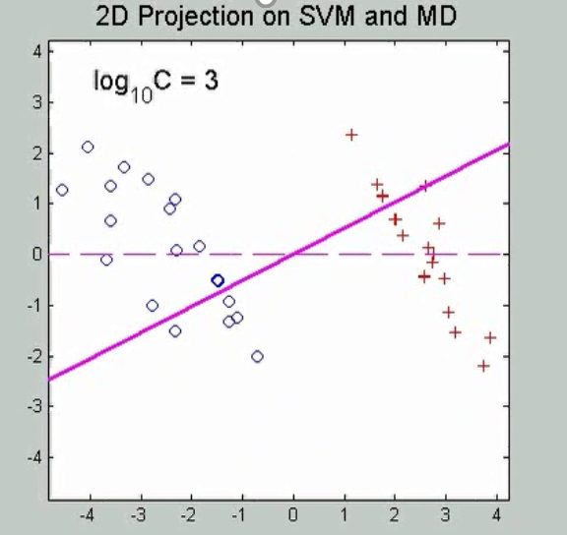
SVMs, Tuning Parameter
Toy Example: $d=50$, Sph’l Gaussian data
Put MD on horizontal axis
For Large Values of C
SVM not MD
Hard Margin SVM
Clearly Different
Yet Same for Small C!
(For This Data Set)

Slide 65
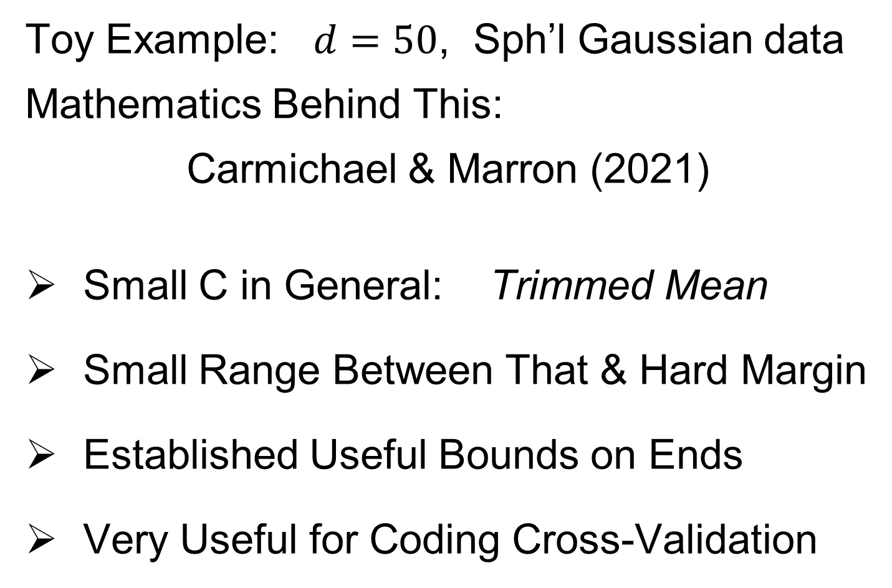
SVMs, Tuning Parameter
Toy Example: $d=50$, Sph’l Gaussian data
Mathematics Behind This:
Carmichael & Marron (2021)
Small C in General: Trimmed Mean
Small Range Between That & Hard Margin
Established Useful Bounds on Ends
Very Useful for Coding Cross-Validation

Slide 66
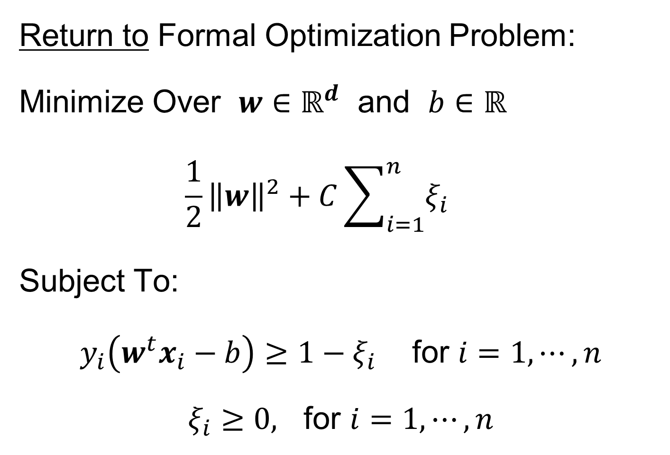
SVMs, Optimization Viewpoint
Return to Formal Optimization Problem:
Minimize Over $w∈ℝ^{d}$ and $b∈ℝ$
$$\frac{1}{2}{\left\|w\right\|}^{2}+C\sum_{i=1}^{n}{ξ_{i}}$$
Subject To:
$y_{i}\left(w^{t}x_{i}−b\right)≥1−ξ_{i}$ for $i=1,⋯,n$
$ξ_{i}≥0,$ for $i=1,⋯,n$
Relax Margin by $ξ_{i}$
At Corresponding Cost

Slide 67
SVMs, Optimization Viewpoint
Lagrange Multipliers primal formulation (separable case):
Minimize:
$L_{P}\left(w,b,α\right)=\frac{1}{2}{\left\|w\right\|}^{2}−\sum_{i=1}^{n}{α_{i}}\left(y_{i}\left(x_{i}∙w+b\right)−1\right)$
Where $α_{1},⋯,α_{n}$ are Lagrange multipliers
Notation: “dot product” = inner product
Elsewhere: $u∙v= \left\langle u,v\right\rangle =u^{t}v$

Slide 68
SVMs, Optimization Viewpoint
Lagrange Multipliers primal formulation (separable case):
Minimize:
$L_{P}\left(w,b,α\right)=\frac{1}{2}{\left\|w\right\|}^{2}−\sum_{i=1}^{n}{α_{i}}\left(y_{i}\left(x_{i}∙w+b\right)−1\right)$
Where $α_{1},⋯,α_{n}$ are Lagrange multipliers
Dual Lagrangian version:
Maximize: $L_{D}=\sum_{i}{α_{i}}−\frac{1}{2}\sum_{i,j}{α_{i}α_{j}y_{i}}y_{j}x_{i}∙x_{j}$
Get classification function:
c$\left(x\right)=\sum_{i=1}^{n}{α_{i}y_{i}x∙x_{i}+b}$

Slide 69
SVMs, Optimization Viewpoint
Get classification function:
c$\left(x\right)=\sum_{i=1}^{n}{α_{i}y_{i}x∙x_{i}+b}$
Choose Class:
+1, when $c\left(x\right)>0$
-1, when $c\left(x\right)<0$
Note: linear function of $x$
i.e. have found separating hyperplane

Slide 70
SVMs, Computation
Major Computational Point:
Classifier only depends on data through inner products!
$$c\left(x\right)=\sum_{i=1}^{n}{α_{i}y_{i}x∙x_{i}+b}$$

Slide 71
SVMs, Computation
Major Computational Point:
Classifier only depends on data through inner products!
Thus enough to only store inner products
Creates big savings in optimization
Especially for HDLSS data
But also creates variations in kernel embedding (interpretation?!?)
This is almost always done in practice

Slide 72
SVMs, Comput’n & Embedding
For an “Embedding Map”, $Φ\left(x\right)$
e.g.
Explicit Embedding:
Maximize:
$$L_{D}=\sum_{i}{α_{i}}−\frac{1}{2}\sum_{i,j}{α_{i}α_{j}y_{i}}y_{j}Φ\left(x_{i}\right)∙Φ\left(x_{j}\right)$$
Get classification function:
$$c\left(x\right)=\sum_{i=1}^{n}{α_{i}y_{i}Φ\left(x\right)∙Φ\left(x_{i}\right)+b}$$
Straightforward application of embedding
But loses inner product advantage
$$Φ\left(x\right)=\left(\begin{matrix}x \\ x^{2}\end{matrix}\right)$$

Slide 73

SVMs, Comput’n & Embedding
Implicit Embedding:
Maximize:
$$L_{D}=\sum_{i}{α_{i}}−\frac{1}{2}\sum_{i,j}{α_{i}α_{j}y_{i}}y_{j}𝓚\left(x_{i},x_{j}\right)$$

Slide 74
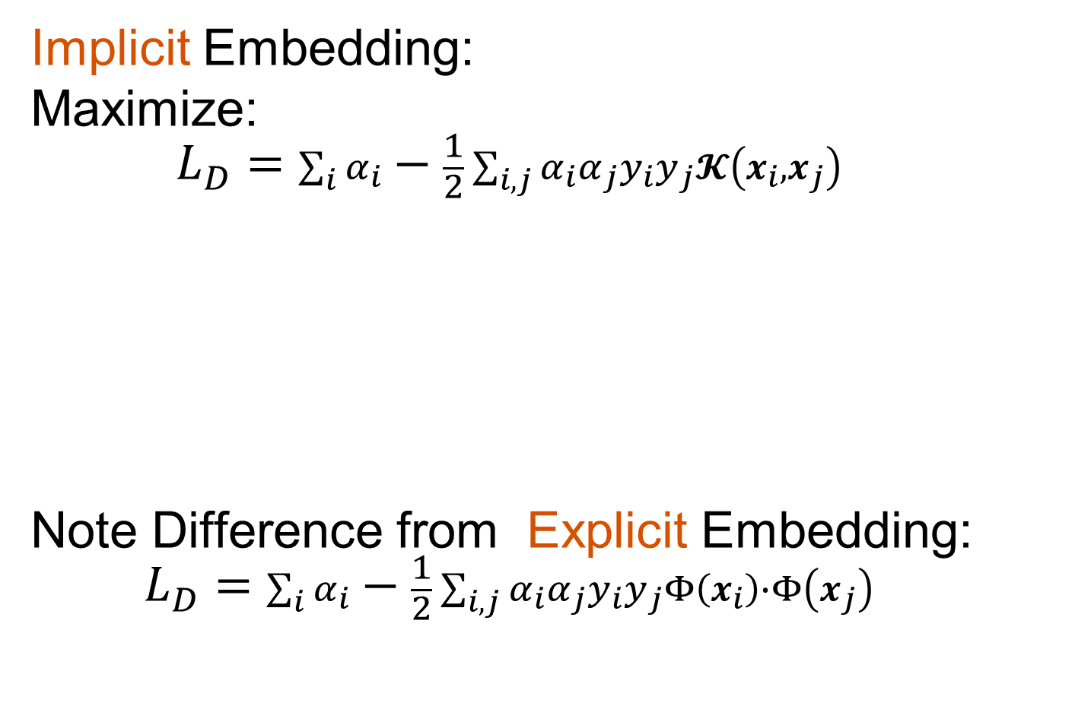
SVMs, Comput’n & Embedding
Implicit Embedding:
Maximize:
$$L_{D}=\sum_{i}{α_{i}}−\frac{1}{2}\sum_{i,j}{α_{i}α_{j}y_{i}}y_{j}𝓚\left(x_{i},x_{j}\right)$$
Note Difference from Explicit Embedding:
$$L_{D}=\sum_{i}{α_{i}}−\frac{1}{2}\sum_{i,j}{α_{i}α_{j}y_{i}}y_{j}Φ\left(x_{i}\right)∙Φ\left(x_{j}\right)$$

Slide 75
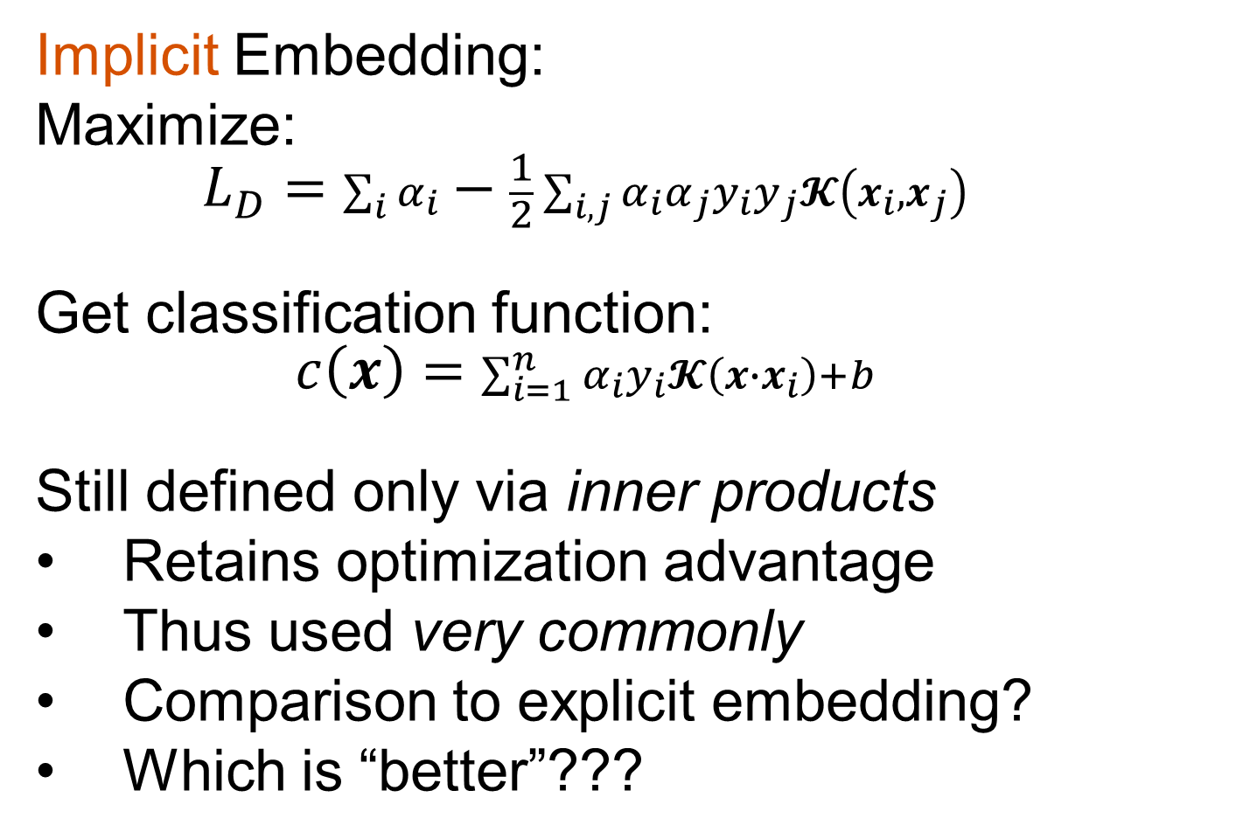
SVMs, Comput’n & Embedding
Implicit Embedding:
Maximize:
$$L_{D}=\sum_{i}{α_{i}}−\frac{1}{2}\sum_{i,j}{α_{i}α_{j}y_{i}}y_{j}𝓚\left(x_{i},x_{j}\right)$$
Get classification function:
$$c\left(x\right)=\sum_{i=1}^{n}{α_{i}y_{i}𝓚\left(x∙x_{i}\right)+b}$$
Still defined only via inner products
Retains optimization advantage
Thus used very commonly
Comparison to explicit embedding?
Which is “better”???

Slide 76
SVMs, Comput’n & Embedding
Implicit vs. Explicit Embedding:
Implicit defined only via inner products
Retains optimization advantage
Thus used very commonly
Which is “better”???

Slide 77
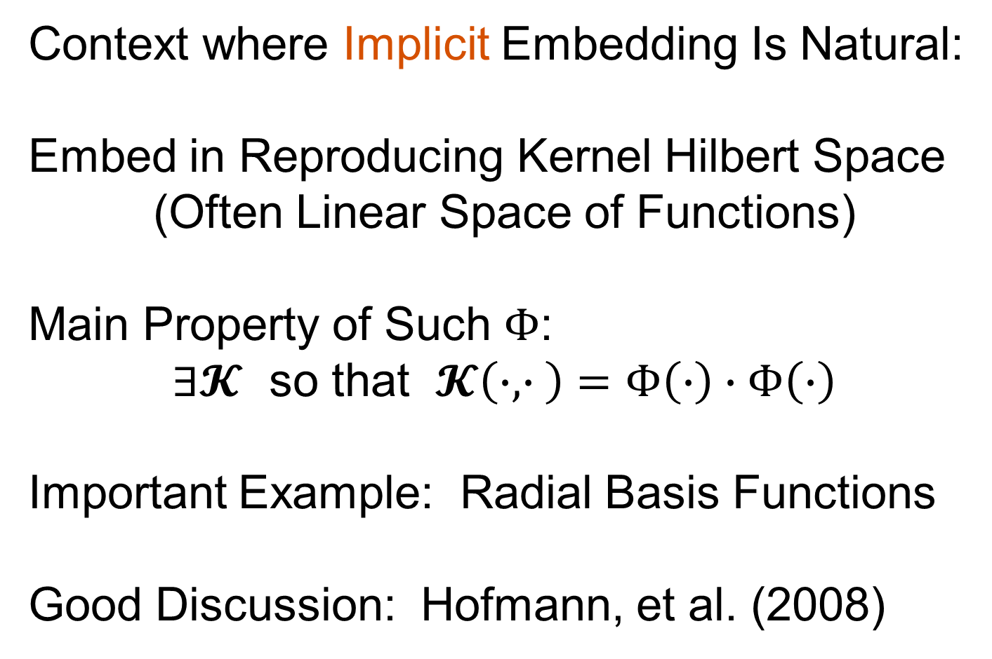
SVMs, Comput’n & Embedding
Context where Implicit Embedding Is Natural:
Embed in Reproducing Kernel Hilbert Space
(Often Linear Space of Functions)
Main Property of Such $Φ$:
$∃𝓚$ so that $𝓚\left(∙,∙ \right)=Φ\left(∙\right)∙Φ\left(∙\right)$
Important Example: Radial Basis Functions
Good Discussion: Hofmann, et al. (2008)

Slide 78
SVMs & Robustness
Usually not severely affected by outliers,
But a possible weakness:
Can have very influential points
Toy E.g., only 2 points drive SVM

Slide 79
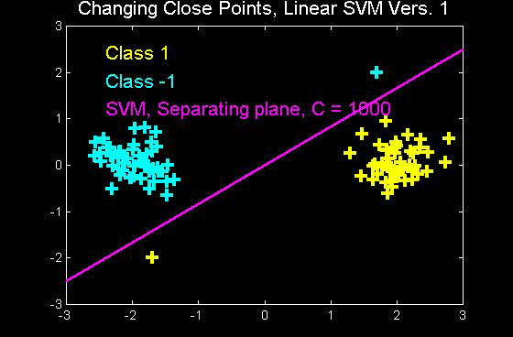
SVMs & Robustness
Can have very influential points

Slide 80
SVMs & Robustness
Usually not severely affected by outliers,
But a possible weakness:
Can have very influential points
Toy E.g., only 2 points drive SVM
Notes:
Huge range of chosen hyperplanes
But all are “pretty good discriminators”
Only happens when whole range is OK???
Good or bad?

Slide 81

SVMs & Robustness
Effect of violators:

Slide 82

SVMs & Robustness
Effect of violators:
Separates All But 1
Point in Each Class
Violations
Relatively
Small

Slide 83

SVMs & Robustness
Effect of violators:
Separating Plane
Strongly Impacted
Outliers
Farther
Apart

Slide 84

SVMs & Robustness
Effect of violators:
Worse for Outliers
More Spread

Slide 85
Support Vector Machines
Important Extension:
Multi-Class SVMs
Hsu & Lin (2002)
Lee, Lin, & Wahba (2002)
Defined for “implicit” version
“Direction Based” variation???

Slide 86
Support Vector Machines
SVM Tuning Parameter Selection:
Joachims (2000)
Wahba et al. (1999, 2003)
Basic Idea: Cross-Validation
Leave Some Out – Train – Assess
Then Average Error Rates

Slide 87


Distance Weighted Discrim’n
Improvement of SVM for HDLSS Data
Toy e.g.
$d=50$
indep. $N\left(0,1\right)$
$μ_{1}=±2$
$n_{+}=n_{−}=20$
(similar to
earlier movies)
Text, Sec. 11.4

Slide 88

Distance Weighted Discrim’n
Toy e.g.: Maximal Data Piling Direction
- Perfect
Separation
- Gross
Overfitting
- Large Angle
- Poor
Gen’ability
MDP
Feels Small Scale
Noise Artifacts

Slide 89

Distance Weighted Discrim’n
Toy e.g.: Hard Margin SVM Direction
- Bigger Gap
- Smaller Angle
- Better
Gen’ability
- Feels support
vectors too
strongly???
- Ugly subpops?
- Improvement?
Similarly Feels Small
Scale Noise Artifacts

Slide 90

Distance Weighted Discrim’n
Toy e.g.: Distance Weighted Discrimination
- Addresses
these issues
- Smaller Angle
- Better
Gen’ability
- Nice subpops
- Replaces
min dist. by
avg. dist.

Slide 91

Distance Weighted Discrim’n
Based on Optimization Problem:
For “Residuals”:

Slide 92
Distance Weighted Discrim’n
Based on Optimization Problem:
Uses “poles” to push plane away from data

Slide 93
Participant Presentation
1:35 Jason Hu
???
Next Class: Charles Zhao

