Slide 1
Statistics – O. R. 881 Object Oriented Data Analysis
Steve Marron
Dept. of Statistics and Operations Research
University of North Carolina

Slide 2
Current Sections in Textbook
Today:
Sections 11.4, 11.5, 6.5
Next Class:
Section 10.1

Slide 3
Last Class: Batch and Source Adj.
Try Out Real Data:
Stanford Breast Cancer Data
From Perou et al (2000)
$d=1753$ “Intrinsic” Genes
$n=107$ Breast Cancer Patients
Discovered With Clustering: Subtypes

Slide 4
Last Class: Source Adj: Source Colors
Color By Ink Used
to Print Chips
Bad News, Since
This Dominates PC1
Squishing PC1
Not So Good
Since PC2
Also Involved
Yet Want to Find
Cancer Subtypes

Slide 5
Last Class: PC 1-3 & DWD direction
Replace PC4
By DWD
Direction
Note Much Farther
Apart Than in PC1

Slide 6
Last Class: DWD Source Adjustment
Slide Data
In DWD
Direction
Note How Subtypes
Come Together
Until Means
Are the Same

Slide 7
Last Class: S. & B Adj’d, Adj’d PCA
Recompute PC Axes
PC1 & 2 Now About Biology

Slide 8
Last Class: NCI 60: Raw Data
Common Samples
Connected by
Dashed Lines
Huge Platform
Differences
Fortunately
Systematic

Slide 9
Last Class: NCI 60: Fully Adjusted Data
BREAST.MDAMB435
BREAST.MDN
MELAN.MALME3M
MELAN.SKMEL2
MELAN.SKMEL5
MELAN.SKMEL28
MELAN.M14
MELAN.UACC62
MELAN.UACC257
Known Mislabellings

Slide 10
Last Class: Why not means?
But Why Not PAM (~Mean Difference)?
Simpler is Better
Why not means, i.e. point cloud centerpoints?
Elegant Answer: Liu et al (2009)

Slide 11
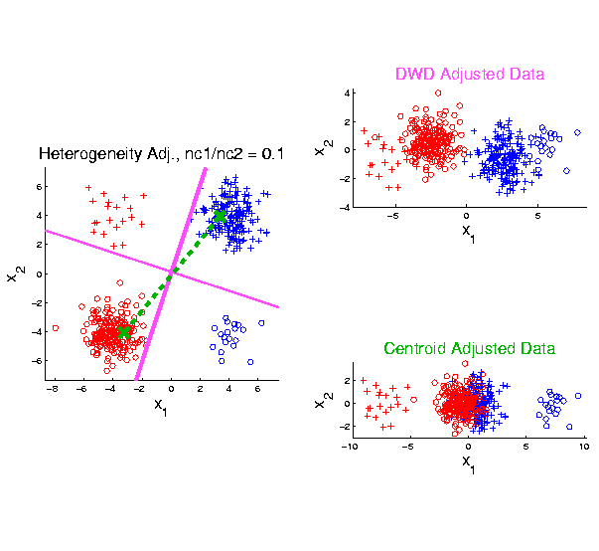
Last Class: ratios of subtypes
2-d Toy
Example
Unbalanced
Mixture
Note: Losing
Distinction
To Be Studied

Slide 12
HDLSS Data Combo Mathematics
Liu (2007) Dissertation Results:
Simple Unbalanced Cluster Model
Growing at rate $d^{α}$ as $d→∞$
Answers depend on $α$
Visualization of setting….

Slide 13
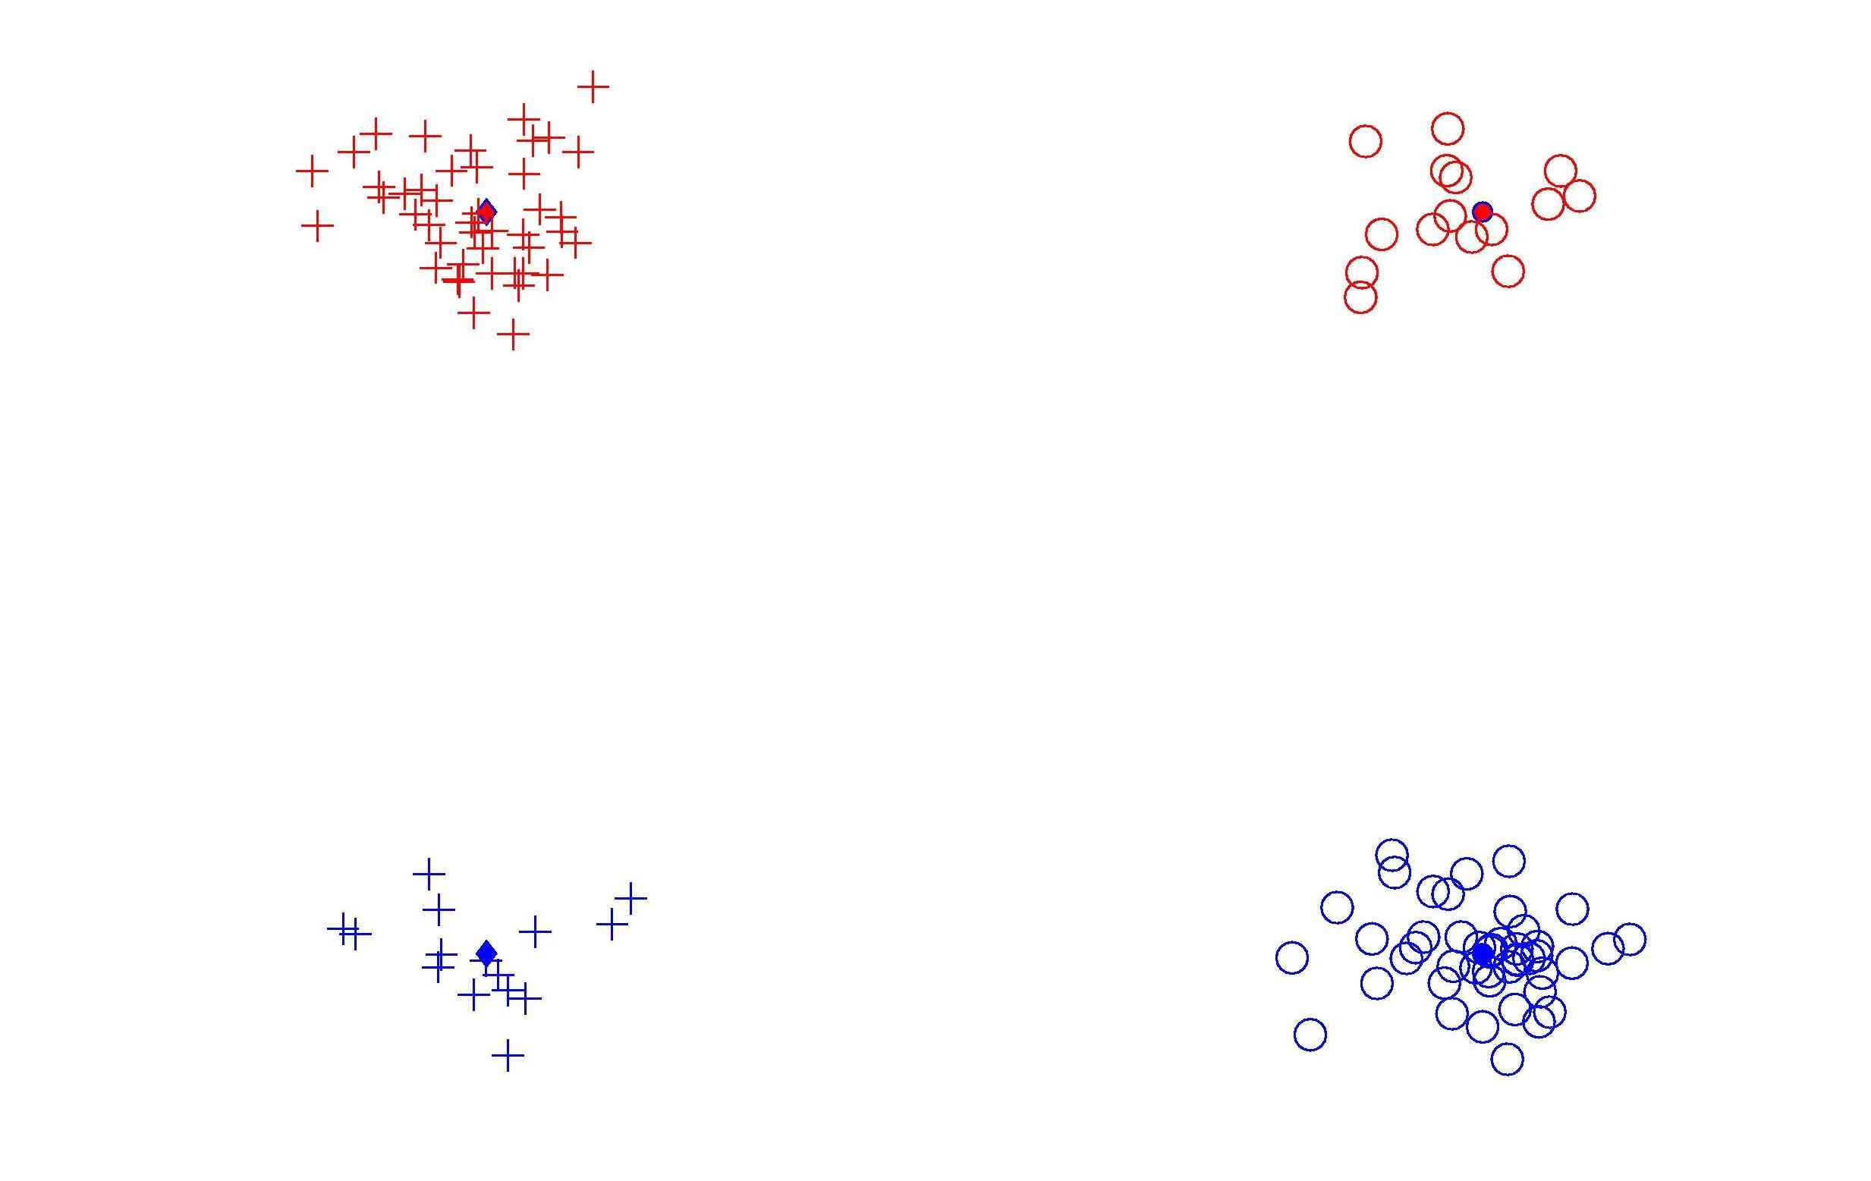
HDLSS Data Combo Mathematics

Slide 14
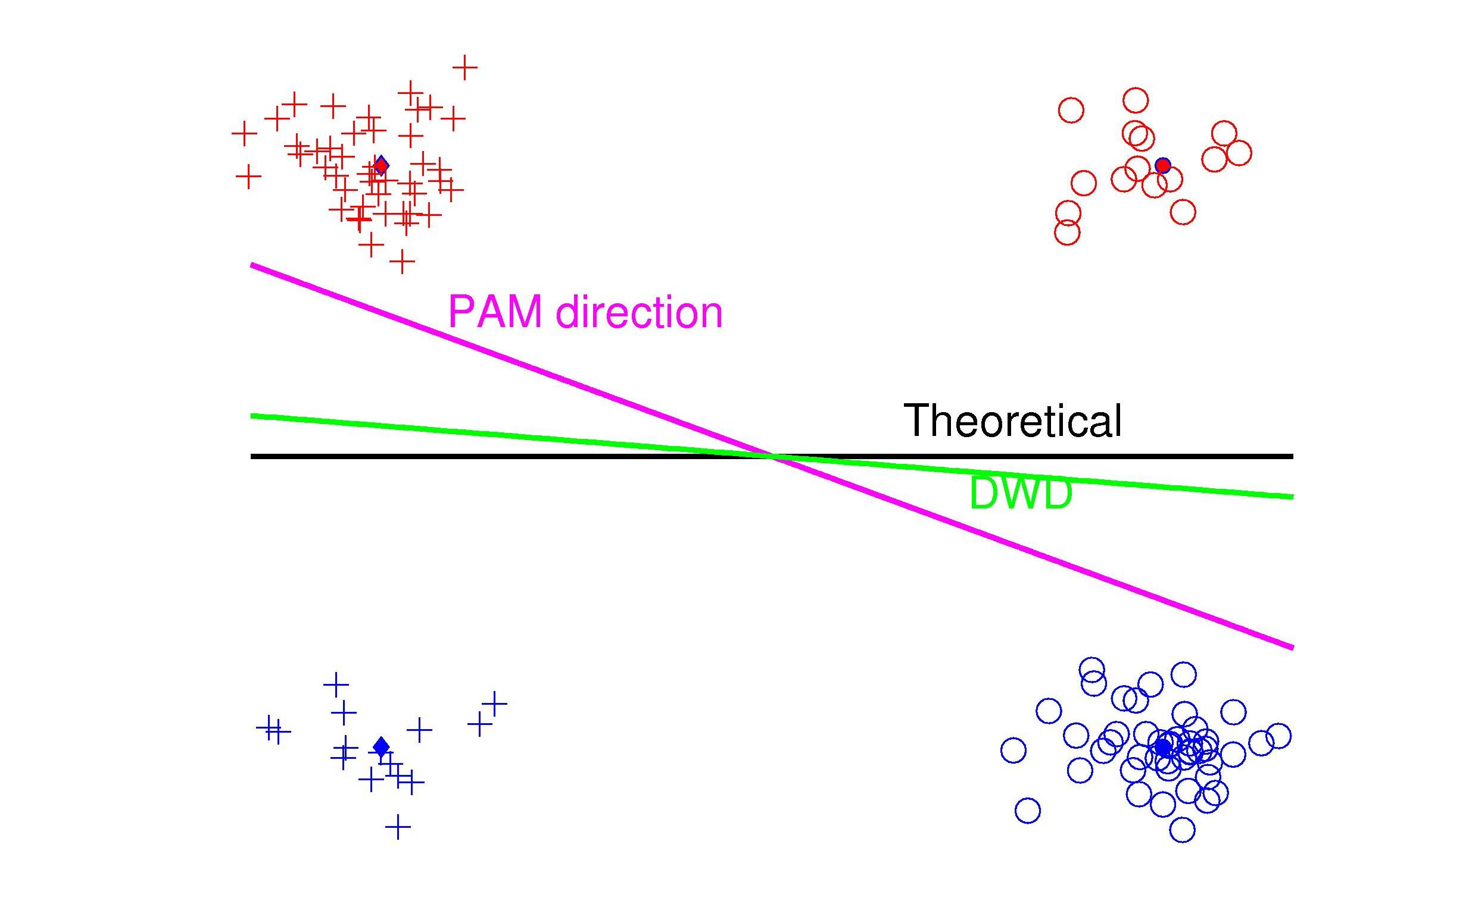
HDLSS Data Combo Mathematics

Slide 15
HDLSS Data Combo Mathematics
Asymptotic Results (as $d→∞$)
Let $r$ denote ratio between subgroup sizes
Let $α$ quantify class difference:
$$\left\|X−Y\right\|\sim d^{α}$$

Slide 16
HDLSS Data Combo Mathematics
Asymptotic Results (as $d→∞$):
For $α>\frac{1}{2}$, PAM Inconsistent
Angle(PAM,Truth) $→ C_{r}≥0$
For $α<\frac{1}{2}$, PAM Strongly Inconsistent
Angle(PAM,Truth) $→ {90}^{°}$

Slide 17
HDLSS Data Combo Mathematics
Asymptotic Results (as $d→∞$):
For $α>\frac{1}{2}$, DWD Inconsistent
Angle(DWD,Truth) $→ C_{r}^{∗}≥0$
For $α<\frac{1}{2}$, DWD Strongly Inconsistent
Angle(DWD,Truth) $→ {90}^{°}$

Slide 18
HDLSS Data Combo Mathematics
Value of $C_{r}$ and $C_{r}^{∗}$, for sample size ratio $r$:
$C_{r}^{∗}=C_{r}=0$, only when $r=1$
Otherwise for $r≠1$, both are Inconsistent
$$C_{r}=\cos^{−1}\left(\frac{r+1}{\sqrt{2r^{2}+2}}\right)$$
$$C_{r}^{∗}=\cos^{−1}\left(\frac{\sqrt[3]{r}+1}{\sqrt{2r^{2/3}+2}}\right)$$

Slide 19
HDLSS Data Combo Mathematics
Comparison between PAM and DWD?
I.e. between $C_{r}$ and $C_{r}^{∗}$?

Slide 20
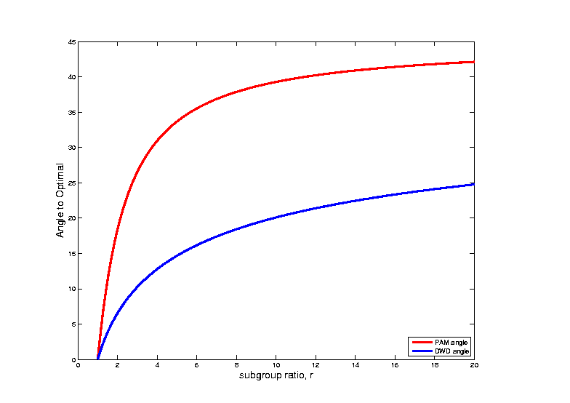
HDLSS Data Combo Mathematics
Comparison between PAM and DWD?

Slide 21
Generalized DWD
Wang and Zou (2018)
Main Idea: Add a Scale Parameter $q$ to DWD
$$\min_{w,b}{\sum_{i=1}^{n}{\frac{1}{r_{i}^{q}}}}$$
Robustness Against Unbalanced Subtypes
Notes:
21

Slide 22
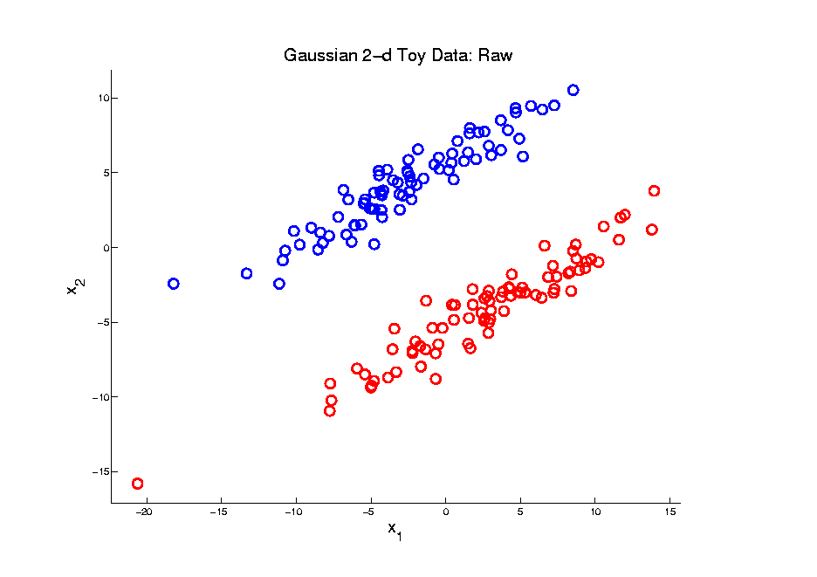
Generalized DWD
Toy Example
Notes:
22

Slide 23
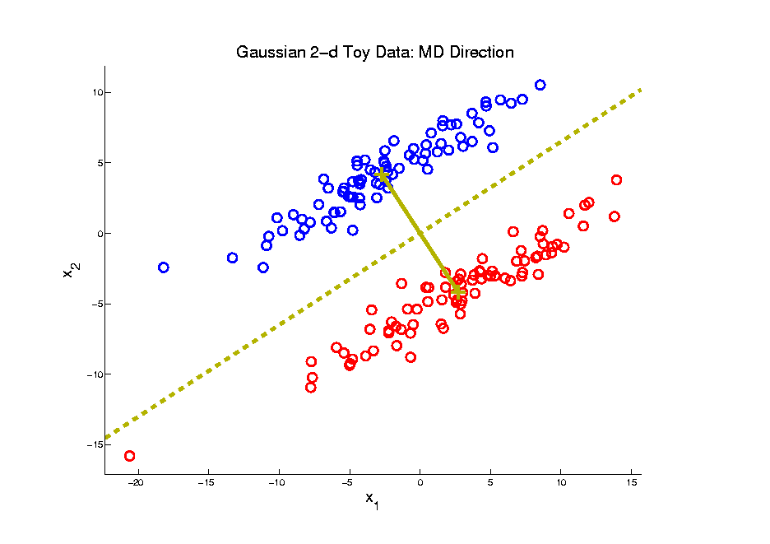
Generalized DWD
MD
Pay Attention To
These Colors
Notes:
23

Slide 24
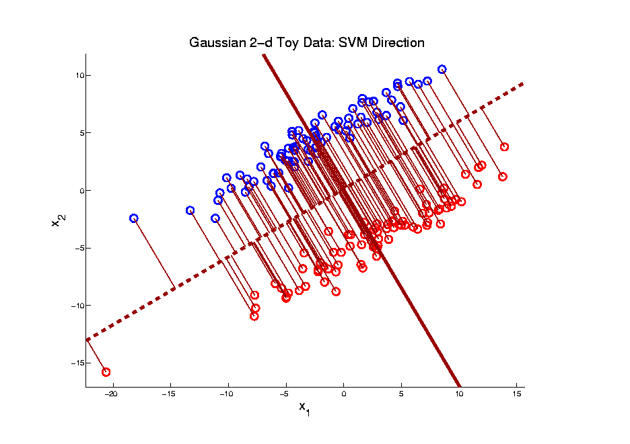
Generalized DWD
SVM
Will Use For
Comparison
Notes:
24

Slide 25
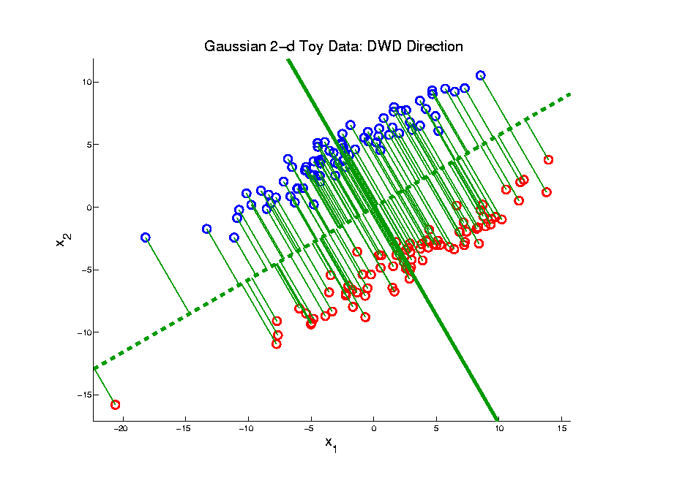
Generalized DWD
DWD
Notes:
25

Slide 26
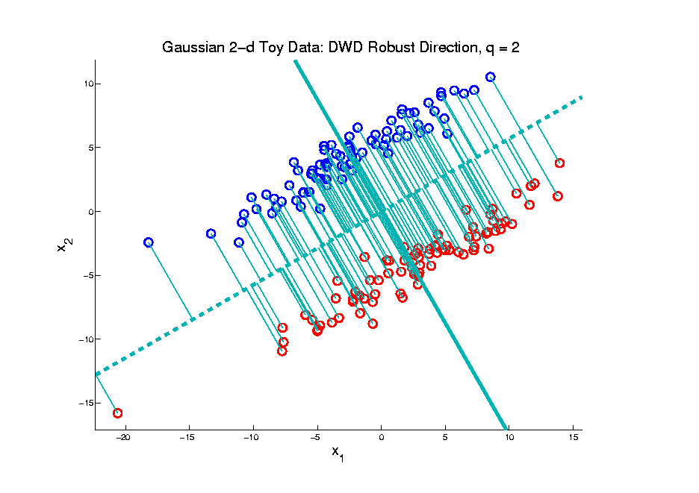
Generalized DWD
Gen. DWD, $q=2$
Notes:
26

Slide 27
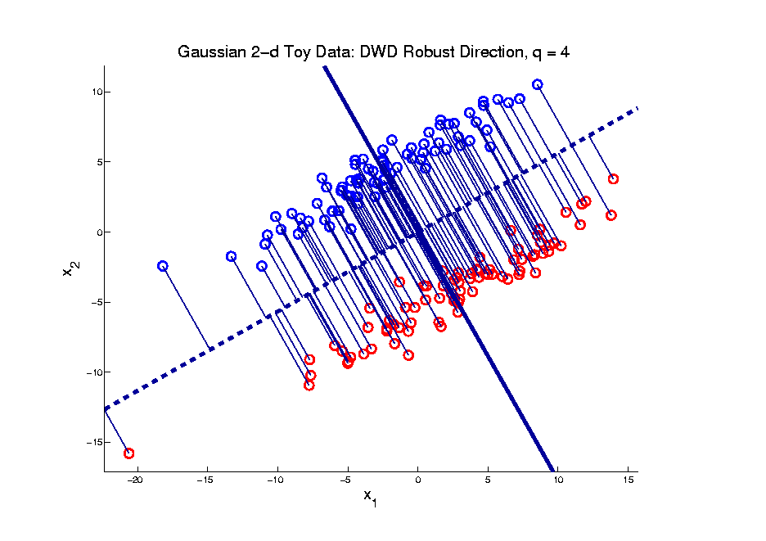
Generalized DWD
Gen. DWD, $q=4$
Notes:
27

Slide 28
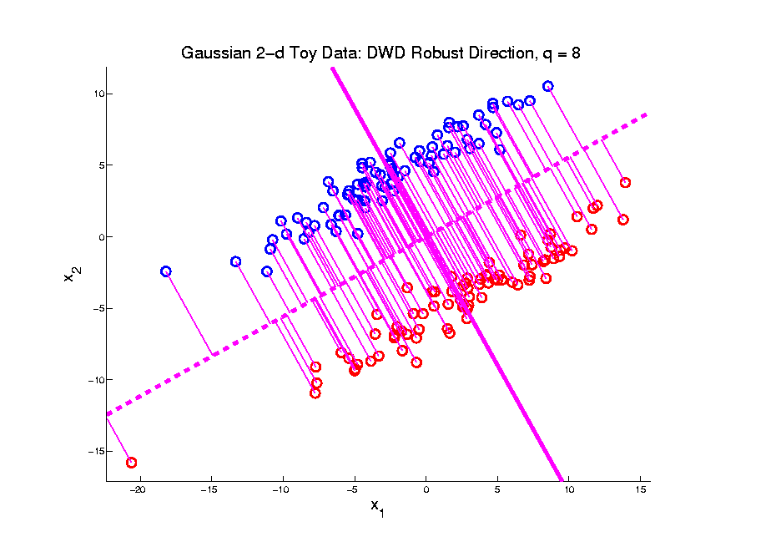
Generalized DWD
Gen. DWD, $q=8$
All Methods Very Similar
For This Toy Example
Notes:
28

Slide 29
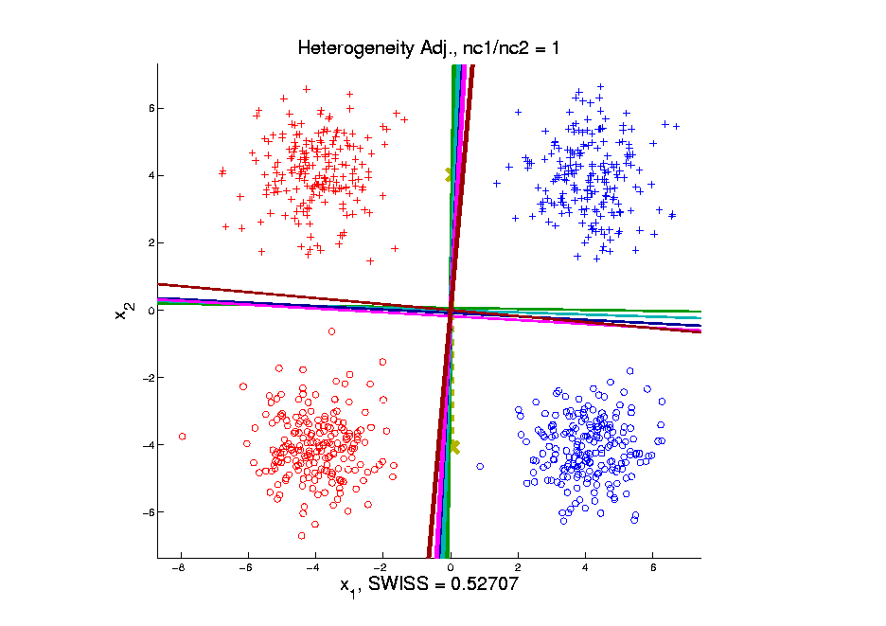
Generalized DWD
Balanced Subtypes
All Still Look
Rather Similar
SVM & High $q$
Slightly Worse?
Notes:
29

Slide 30
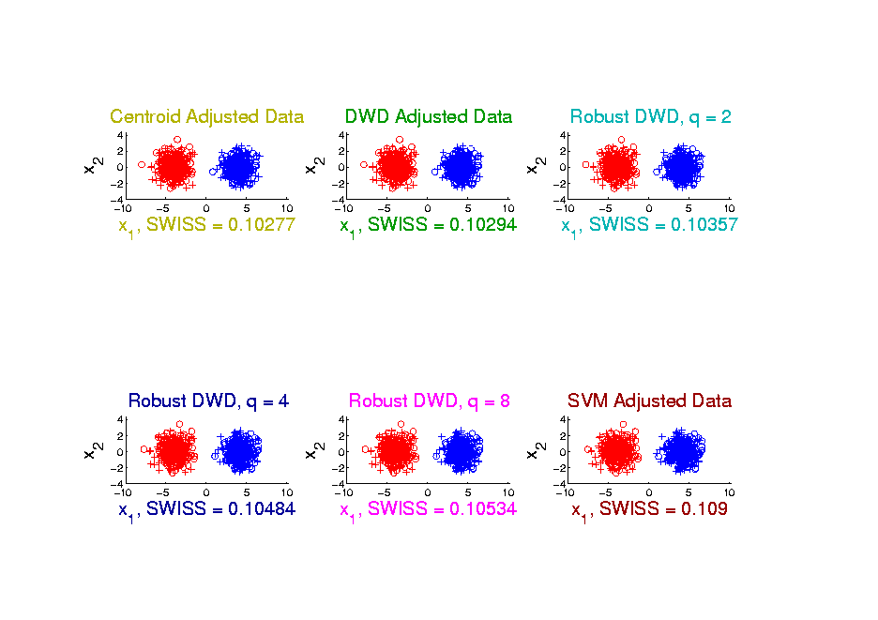
Generalized DWD
SWISS Comparison
Indeed All Similar: SWISS Difference Only In 3rd Decimal Place
MD Slightly Best
SVM Slightly Worst
Notes:
30

Slide 31
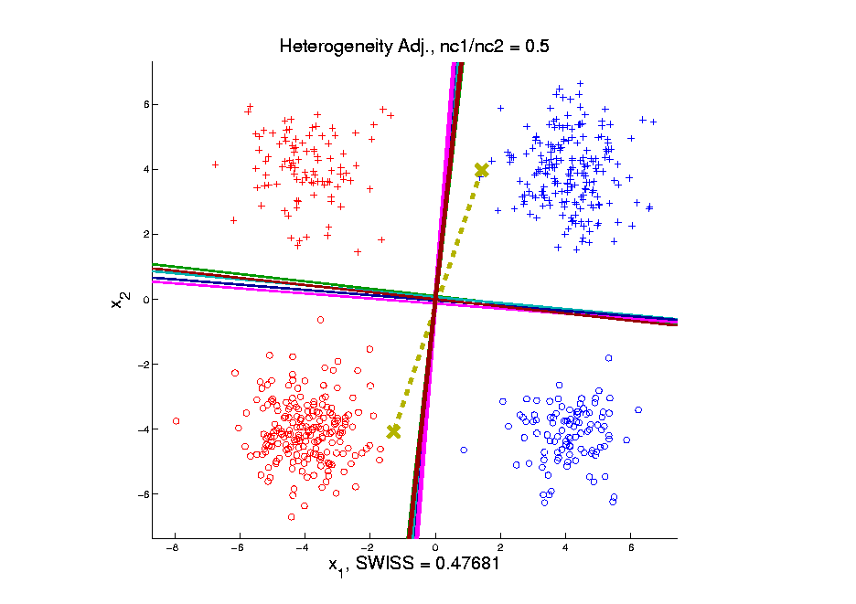
Generalized DWD
Somewhat Unbalanced Subtypes
MD Clearly
Feels Unbalance
Others All Appear
More Robust
Against Unbalance
& Similar to Each Other
DWD, $q=8$ Slightly
More Robust???
Notes:
31

Slide 32
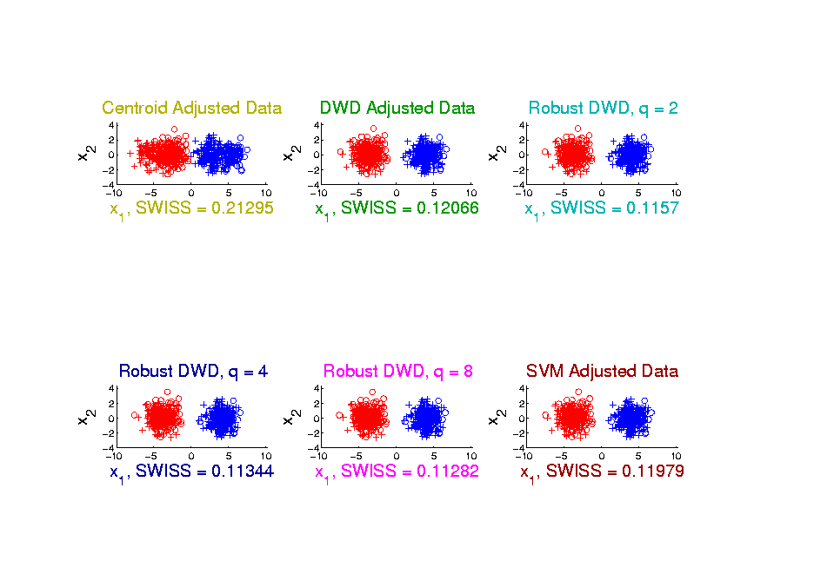
Generalized DWD
SWISS Comparison
MD Much Less Robust
DWD, $q=8$ Indeed
Slightly More Robust
Notes:
32

Slide 33
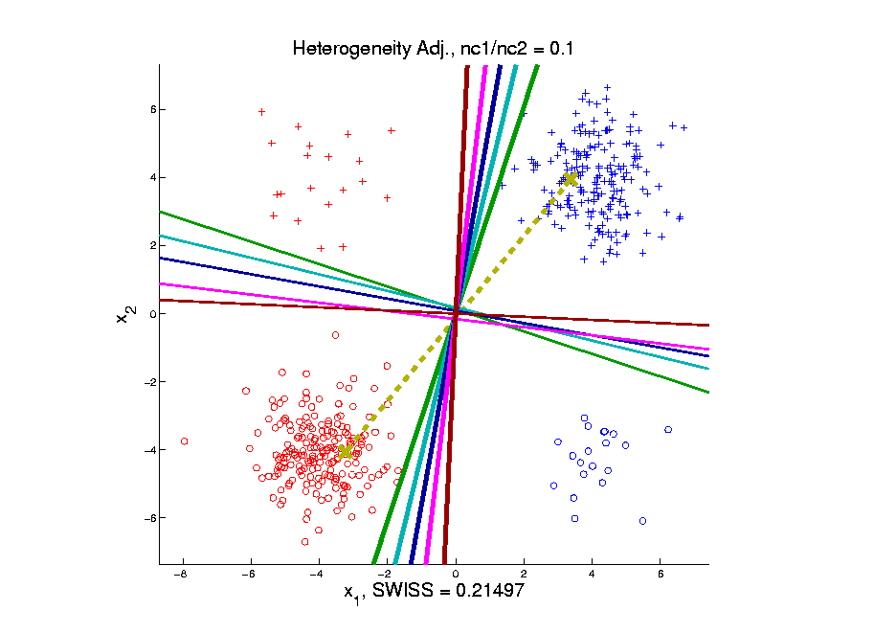
Generalized DWD
Very Unbalanced Subtypes
MD Clearly
Very Poor
Others More Robust
& Now Different
$q=8$ Not Far
From SVM
Notes:
33

Slide 34
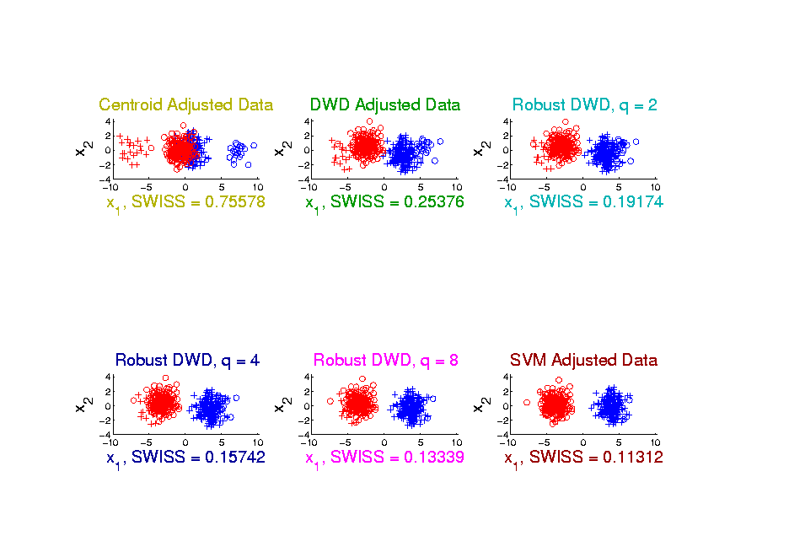
Generalized DWD
SWISS Comparison
Sequential Improvement in Others
MD Terrible
SVM Best for
Strong Unbalance
Every Dog Has Its Day
Notes:
34

Slide 35
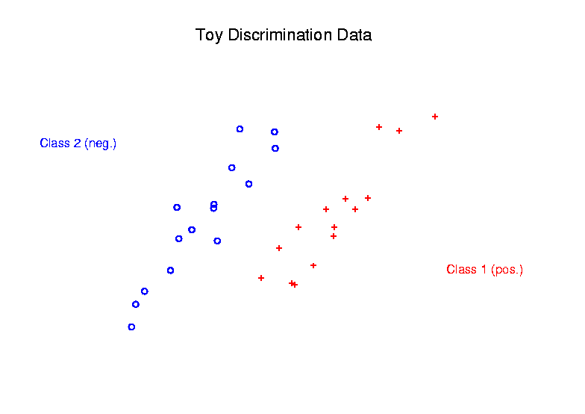
Radial DWD
Main Idea:
Linear Classifiers Good When Each Class Lives in a Distinct Region
Notes:
35

Slide 36
Radial DWD
Main Idea:
Linear Classifiers Good When Each Class Lives in a Distinct Region
Hard When All Members Of One Class Are Outliers in a Random Direction
Notes:
36

Slide 37
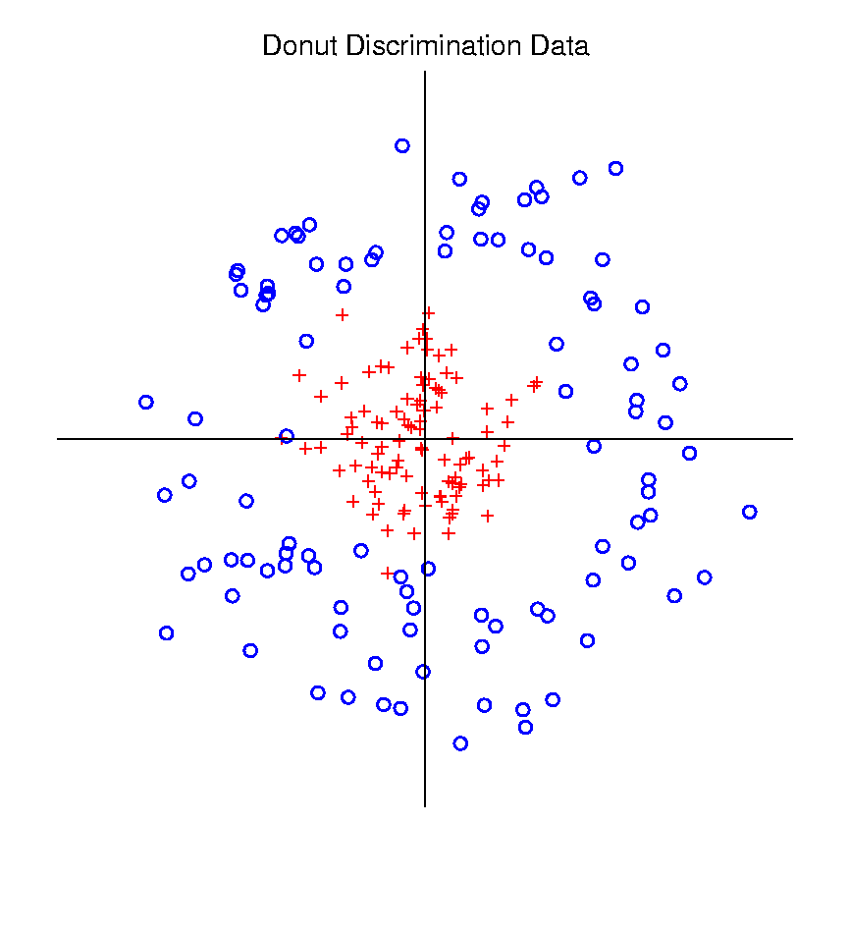
Radial DWD
Hard When All Members Of One Class Are Outliers in a Random Direction
Think HDLSS
Version of
Notes:
37

Slide 38
Radial DWD
Hard When All Members Of One Class Are Outliers in a Random Direction
E.g. Normal Cases
& Randomly Degraded
Notes:
38

Slide 39
Radial DWD
Reference:
Xiong, Dittmer & Marron (2016)
Notes:
39

Slide 40
Radial DWD
Motivating Example: Virus Hunting
Based on DNA
DNA in Sample is Amplified & Cut Up
Matched to Known Virus Genome
Data Objects: Counts $x=\left(\begin{matrix}x_{1} \\ ⋮ \\ x_{d}\end{matrix}\right)$
Notes:
40

Slide 41
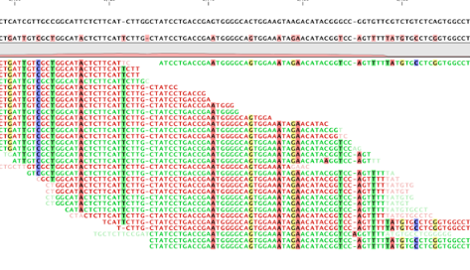
Virus Hunting
“Reads” Matched to Virus Genome & Counted to give $x_{1},⋯,x_{d}$
Notes:
41

Slide 42
Virus Hunting
Challenge 1:
Highly Variable DNA Amplification
Solution:
Standardize by Dividing by Total
Notes:
42

Slide 43
Virus Hunting
Standardize by Dividing by Total
Consequence:
Data Objects lie on Unit Simplex
$$\left\{x=\left(\begin{matrix}x_{1} \\ ⋮ \\ x_{d}\end{matrix}\right):x_{1},⋯x_{d}≥0,\sum_{j=1}^{d}{x_{j}}=1\right\}$$
Called Compositional Data
Notes:
43

Slide 44
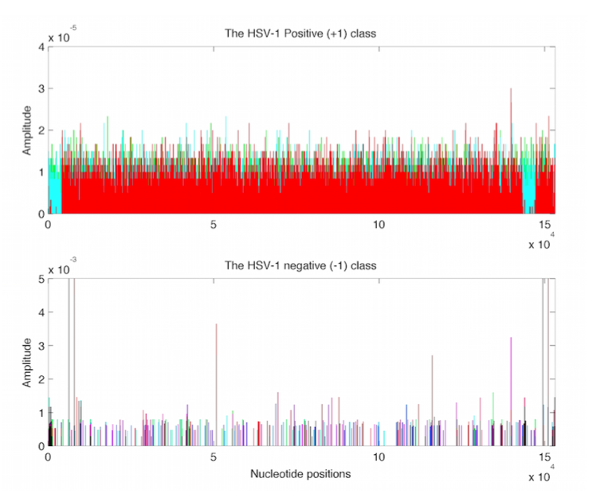
Virus Hunting
Look at
Data:
Mostly
Non-0
Near Simplex Center
Almost
All 0
Near Simplex Corners
Notes:
44

Slide 45
Virus Hunting
Look at
Data:
Note:
Heights
Orders of
Magnitude
-5 << -3
Different
Notes:
45

Slide 46
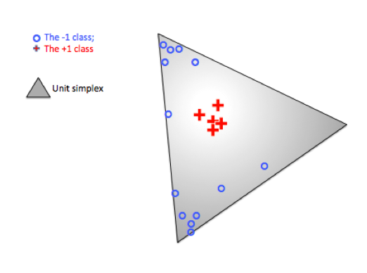
Radial DWD
Thought
Model:
+ Class
Near Center
- Class At
Random
Corners
Note: $∃$ Many ($d$) Corners
Notes:
46

Slide 47
Radial DWD
Consider Training Data
+ Class in Center
- Class Really in
Multiple Corners
Notes:
47

Slide 48
Radial DWD
Consider Training Data
Classify Using
Separating Plane
Notes:
48

Slide 49
Radial DWD
Consider Training Data
But What About
Test Point In A
Different Corner
???
Notes:
49

Slide 50
Radial DWD
Approach:
Replace Separating Plane
With Separating Sphere
Find Parameters
Via DWD-like
Optimization
Enables Finding Corners
With No Training Data
Notes:
50

Slide 51
Virus Hunting
Real Data Result:
Train + (+)
Train – (o)
Test + (*)
Related (*)
Test - (x)
Notes:
51

Slide 52
Virus Hunting
Compare With Other Classifiers
Includes Above Radial DWD
Notes:
52

Slide 53
Virus Hunting
Compare With Other Classifiers
Linear Methods All Poor
Notes:
53

Slide 54
Virus Hunting
Compare With Other Classifiers
Even Kernel SVM Fails!!!
Reason:
Test Data
Lies In
Corners
With No
Training
Data
Notes:
54

Slide 55
Radial DWD
Verify With Simulation Study
Note: Very Similar Behavior!
Notes:
55

Slide 56
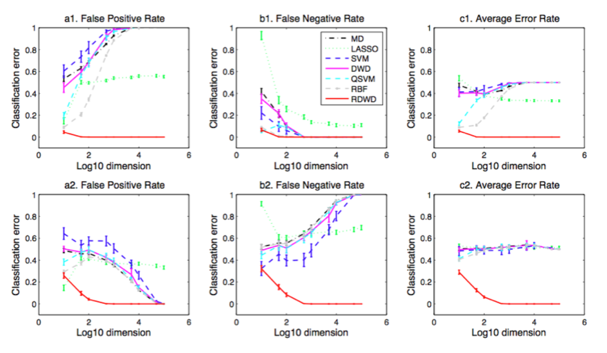
Radial DWD
Verify With Simulation Study
Stunning Test Classificat’n Rates as $d$ grows!
Notes:
56

Slide 57
Other Important Classifiers
Boosting
Main Idea: Combine “Weak Learners”
Into Single More Powerful Method
Freund & Shapire (1995)
Freund et al. (1999)
Friedman et al. (2000)
Text Sec. 11.5
Notes:
57

Slide 58
Other Important Classifiers
Boosting
Random Forests
Main Idea: Avoid “Local Mins” in Trees
by Aggregation of Random Variants
Breiman et al. (1984)
Breiman (2001)
Notes:
58

Slide 59
Other Important Classifiers
Boosting
Random Forests
Neural Networks
Currently Popular for Great Results
Major Challenge: Interpretability
Benjio et al. (2013)
Goodfellow et al. (2016)
Not Always True
Over-Advertised in 1990s
Come-back Due to Bigger Data &
Much More Powerful Computers
Notes:
59

Slide 60
Other Important Classifiers
Boosting
Random Forests
Neural Networks
Every Dog Has His Day
Notes:
60

Slide 61
Independent Component Analysis
Personal Viewpoint:
Directions
(e.g. PCA, DWD)
Text, Sec. 6.5

Slide 62
Independent Component Analysis
Personal Viewpoint:
Directions that maximize independence

Slide 63
Independent Component Analysis
Personal Viewpoint:
Directions that maximize independence
Motivating Context: Signal Processing
“Blind Source Separation”

Slide 64
Independent Component Analysis
References:
Cardoso (1993) (1st paper)
Lee (1998) (early book, not recco’ed)
Hyvärinen & Oja (1998)
(excellent short tutorial)
Hyvärinen, Karhunen & Oja (2001)
(detailed monograph)

Slide 65
ICA, Motivating Example
“Cocktail party problem”

Slide 66
ICA, Motivating Example
“Cocktail party problem”:
Hear several simultaneous conversations
Would like to
separate them

Slide 67
ICA, Motivating Example
“Cocktail party problem”:
Hear several simultaneous conversations
Would like to
separate them
Model for “conversations”: time series
and

Slide 68
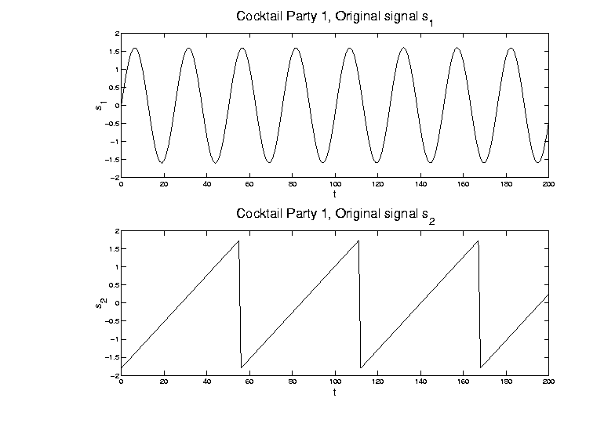
ICA, Motivating Example
Model for “conversations”: time series

Slide 69
ICA, Motivating Example
Mixed version of signals
And also a 2nd mixture:

Slide 70
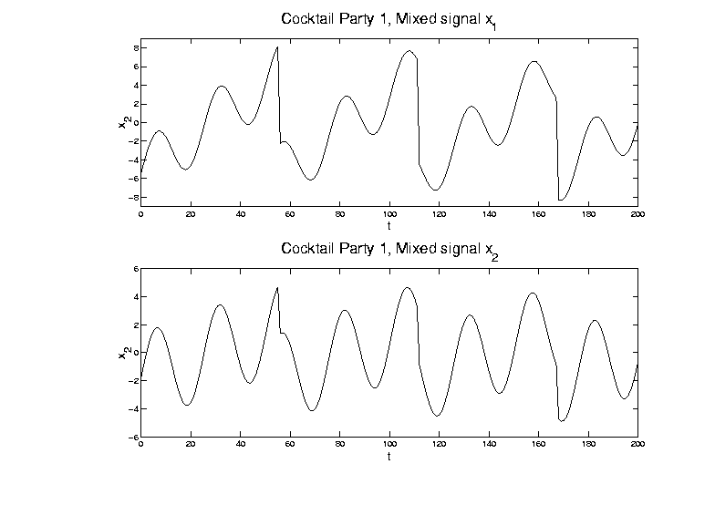
ICA, Motivating Example
Mixed version of signals:

Slide 71
ICA, Motivating Example
Goal: Recover signal
From data
For unknown mixture matrix
where for all

Slide 72
ICA, Motivating Example
Goal is to find separating weights
so that for all

Slide 73
ICA, Motivating Example
Goal is to find separating weights
so that for all
Problem: would be fine,
but is unknown

Slide 74
ICA, Motivating Example
Solutions for Cocktail Party Problem:
PCA (on population of 2-d vectors)
= matrix of eigenvectors

Slide 75
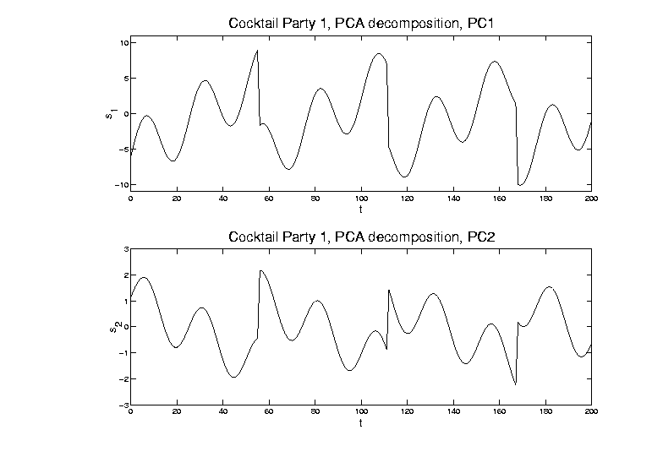
ICA, Motivating Example
PCA (on population of 2-d vectors)
Maximal
Variance
Minimal
Variance

Slide 76
ICA, Motivating Example
Solutions for Cocktail Party Problem:
PCA (on population of 2-d vectors)
[direction of maximal variation
doesn’t solve this problem]
ICA (will describe method later)

Slide 77
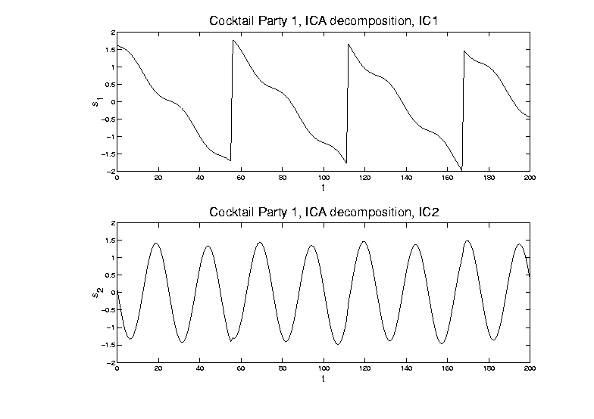
ICA, Motivating Example
ICA (will describe method later)

Slide 78
ICA, Motivating Example
Solutions for Cocktail Party Problem:
PCA (on population of 2-d vectors)
[direction of maximal variation
doesn’t solve this problem]
ICA (will describe method later)
[Independent Components do solve it]
[modulo sign changes and identification]

Slide 79
ICA, Motivating Example
Recall original time series:

Slide 80
ICA, Motivating Example
Relation to OODA: recall data matrix

Slide 81
ICA, Motivating Example
Relation to OODA: recall data matrix
Signal Processing: focus on rows
( time series, indexed by )
OODA: focus on columns as data objects
( data vectors)

Slide 82
ICA, Motivating Example
Relation to OODA: recall data matrix
Signal Processing: focus on rows
( time series, indexed by )
OODA: focus on columns as data objects
( data vectors)
Note: 2 viewpoints like “duals” for PCA

Slide 83
ICA, Motivating Example
Scatterplot View (signal processing): Study
Signals

Slide 84
ICA, Motivating Example
Study Signals

Slide 85
ICA, Motivating Example
Scatterplot View (signal processing): Study
Signals
Corresponding Scatterplot

Slide 86
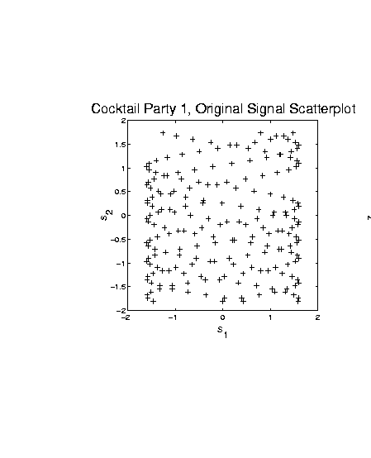
ICA, Motivating Example
Signals - Corresponding Scatterplot

Slide 87
ICA, Motivating Example
Scatterplot View (signal processing): Study
Signals
Corresponding Scatterplot
Data

Slide 88
ICA, Motivating Example
Study Data

Slide 89
ICA, Motivating Example
Scatterplot View (signal processing): Study
Signals
Corresponding Scatterplot
Data
Corresponding Scatterplot

Slide 90
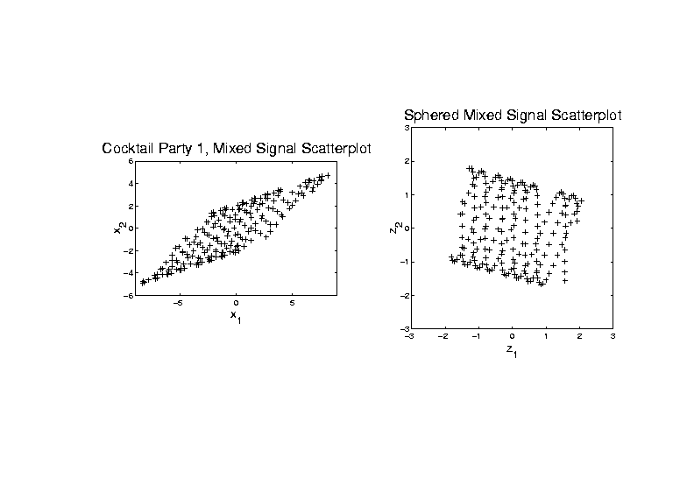
ICA, Motivating Example
Data - Corresponding Scatterplot

Slide 91
ICA, Motivating Example
Scatterplot View (signal processing): Plot
Signals & Scat’plot
Data & Scat’plot
Scatterplots give hint how ICA is possible
Affine transformation
Stretches indep’t signals into dep’t
Inversion is key to ICA
(even w/ unknown)

Slide 92
ICA, Motivating Example
Signals - Corresponding Scatterplot
Note: Independent
Since Known Value
Of s₁ Does Not
Change Distribution
of s₂

Slide 93
ICA, Motivating Example
Data - Corresponding Scatterplot
Note: Dependent
Since Known Value
Of x₁ Changes
Distribution of x₂

Slide 94
ICA, Motivating Example
Why not PCA?
Finds direction of greatest variation

Slide 95
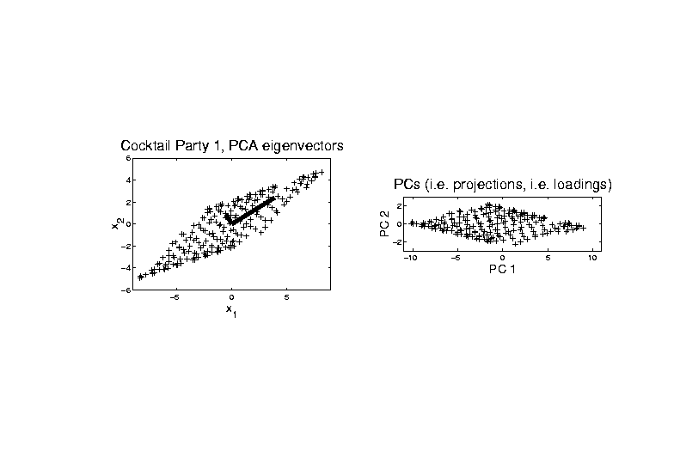
ICA, Motivating Example
PCA - Finds direction of greatest variation

Slide 96
ICA, Motivating Example
Why not PCA?
Finds direction of greatest variation
Which is wrong for signal separation

Slide 97
ICA, Motivating Example
PCA - Wrong for signal separation

Slide 98
ICA, Motivating Example
Why not PCA?
Finds direction of greatest variation
Which is wrong for signal separation

Slide 99
ICA, Algorithm
ICA Step 1:
sphere the data
(shown on right in scatterplot view)

Slide 100
ICA, Algorithm
ICA Step 1: sphere the data

Slide 101
ICA, Algorithm
ICA Step 1:
“sphere the data”
(shown on right in scatterplot view)
i.e. find linear transf’n to make
mean = , cov =
i.e. work with

Slide 102
ICA, Algorithm
ICA Step 1:
“sphere the data”
(shown on right in scatterplot view)
i.e. find linear transf’n to make
mean = , cov =
i.e. work with
requires of full rank
(at least , i.e. no HDLSS)

Slide 103
ICA, Algorithm
ICA Step 1:
“sphere the data”
(shown on right in scatterplot view)
i.e. find linear transf’n to make
mean = , cov =
i.e. work with
requires of full rank
(at least , i.e. no HDLSS)
search for independent, beyond
linear and quadratic structure

Slide 104
ICA, Algorithm
ICA Step 2:
Find dir’ns that make (sphered) data
independent as possible

Slide 105
ICA, Algorithm
ICA Step 2:
Find dir’ns that make (sphered) data
independent as possible
Recall “independence” means:
joint distribution is product of marginals
In cocktail party example:

Slide 106
ICA, Algorithm
ICA Step 2: Cocktail party example

Slide 107
ICA, Algorithm
ICA Step 2:
Find dir’ns that make (sphered) data
independent as possible
Recall “independence” means:
joint distribution is product of marginals
In cocktail party example:
Happens only when support parallel to axes
Otherwise have blank areas,
but marginals are non-zero

Slide 108
ICA, Algorithm
Parallel Idea (and key to algorithm):
Find directions that maximize
non-Gaussianity

Slide 109
ICA, Algorithm
Parallel Idea (and key to algorithm):
Find directions that maximize
non-Gaussianity
Based on assumption: starting from
independent coordinates
Note: “most” projections are Gaussian
(since projection is “linear combo”)

Slide 110
ICA, Algorithm
Parallel Idea (and key to algorithm):
Find directions that maximize
non-Gaussianity
Based on assumption: starting from
independent coordinates
Note: “most” projections are Gaussian
(since projection is “linear combo”)
Mathematics behind this:
Diaconis and Freedman (1984)

Slide 111
ICA, Algorithm
Worst case for ICA: Gaussian
Then sphered data are independent
So have independence in all (ortho) dir’ns
Thus can’t find useful directions
Gaussian distribution is characterized by:
Independent & spherically symmetric

Slide 112
ICA, Algorithm
Criteria for non-Gaussianity / independence:
Kurtosis
(4th order cumulant)
Negative Entropy
Mutual Information
Nonparametric Maximum Likelihood
“Infomax” in Neural Networks
Interesting connections between these

Slide 113
ICA, Algorithm
Matlab Algorithm (optimizing any of above):
“FastICA”
Numerical gradient search method
Can find directions iteratively

Slide 114
ICA, Algorithm
Matlab Algorithm (optimizing any of above):
“FastICA”
Numerical gradient search method
Can find directions iteratively
Or by simultaneous optimization
(note: PCA does both, but not ICA)

Slide 115
ICA, Algorithm
Matlab Algorithm (optimizing any of above):
“FastICA”
Numerical gradient search method
Can find directions iteratively
Or by simultaneous optimization
(note: PCA does both, but not ICA)
Appears fast, with good defaults
Careful about local optima
(Recco: several random restarts)

Slide 116
ICA, Algorithm
FastICA Notational Summary:
First sphere data:
Apply ICA: Find to make
rows of “indep’t”
Can transform back to:
original data scale:

Slide 117
ICA, Algorithm
Careful look at identifiability
Seen already in above example
Could rotate “square of data” in several ways, etc.

Slide 118
ICA, Algorithm
Careful look at identifiability

Slide 119
ICA, Algorithm
Identifiability: Swap Flips

Slide 120
ICA, Algorithm
Identifiability problem 1:
Generally can’t order rows of (& )
(seen as swap above)
Since for a “permutation matrix”
(pre-multiplication by “swaps rows”)
(post-multiplication by “swaps columns”)
For each column, i.e.
i.e.

Slide 121
ICA, Algorithm
Identifiability problem 1:
Generally can’t order rows of (& )
Since for a “permutation matrix”
For each column,
So and are also ICA solut’ns
(i.e. )
FastICA: appears to order in terms of “how non-Gaussian”

Slide 122
ICA, Algorithm
Identifiability problem 2:
Can’t find scale of elements of
(seen as flips above)
Since for a (full rank) diagonal matrix
(pre-multipl’n by is scalar mult’n of rows)
(post-multipl’n by is scalar mult’n of col’s)
Again for each col’n,
i.e.
So and are also ICA solutions

Slide 123
ICA, Algorithm
Signal Processing Scale identification:
(Hyvärinen and Oja, 1999)
Choose scale so each signal
has “unit average energy”:
(preserves energy along rows of data matrix)
Explains “same scales” in
Cocktail Party Example

Slide 124
ICA & Non-Gaussianity
Explore main ICA principle:
For indep., non-Gaussian,
standardized, r.v.’s:
Projections farther from coordinate axes are more Gaussian

Slide 125
ICA & Non-Gaussianity
Explore main ICA principle:
Projections farther from coordinate axes are more Gaussian:
For the dir’n vector ,
where
(thus ),
have , for large and

Slide 126
ICA & Non-Gaussianity
Illustrative examples (d = 100, n = 500)
Uniform Marginals
Exponential Marginals
Bimodal Marginals
Study over range of values of k

Slide 127
ICA & Non-Gaussianity
Illustrative example - Uniform marginals

Slide 128
ICA & Non-Gaussianity
Illustrative examples (d = 100, n = 500)
Uniform Marginals
k = 1: very poor fit
(Uniform far from Gaussian)
k = 2: much closer?
(Triangular closer to Gaussian)
k = 4: very close,
but still have stat’ly sig’t difference
k >= 6: all diff’s could be sampling var’n

Slide 129
ICA & Non-Gaussianity
Illustrative example - Exponential Marginals

Slide 130
ICA & Non-Gaussianity
Illustrative examples (d = 100, n = 500)
Exponential Marginals
still have convergence to Gaussian,
but slower
(“skewness” has stronger
impact than “kurtosis”)
now need k >= 25 to see no difference

Slide 131
ICA & Non-Gaussianity
Illustrative example - Bimodal Marginals

Slide 132
ICA & Non-Gaussianity
Illustrative examples (d = 100, n = 500)
Bimodal Marginals
Convergence to Gaussian,
Surprisingly fast
Quite close for k = 9

Slide 133
ICA & Non-Gaussianity
Summary:
For indep., non-Gaussian,
standardized, r.v.’s: ,
Projections farther from coordinate axes
are more Gaussian

Slide 134
ICA & Non-Gaussianity
Projections farther from coordinate axes
are more Gaussian
Conclusions:
Expect most proj’ns are Gaussian
Non-G’n proj’ns (ICA target) are special
Is a given sample really “random”???
(could test???)
High dim’al space is a strange place

Slide 135
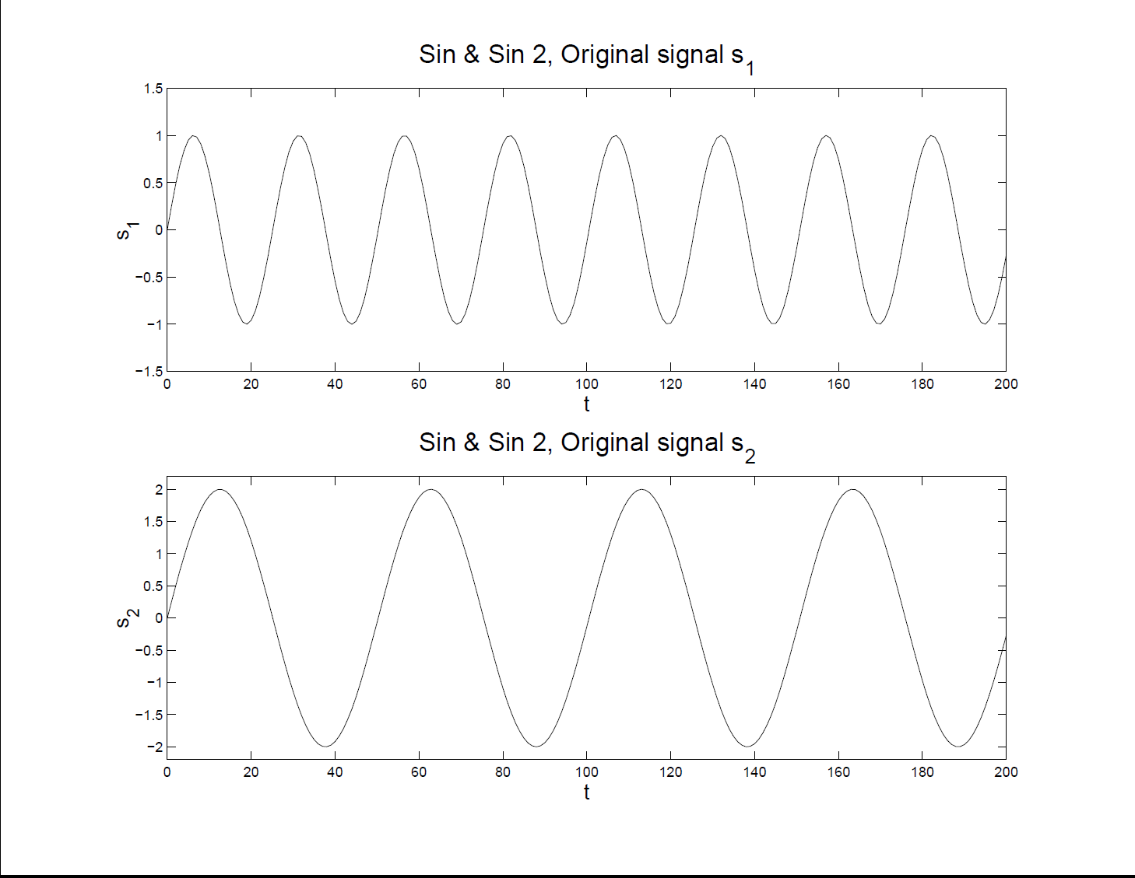
More ICA Examples
Two Sine Waves – Original Signals

Slide 136
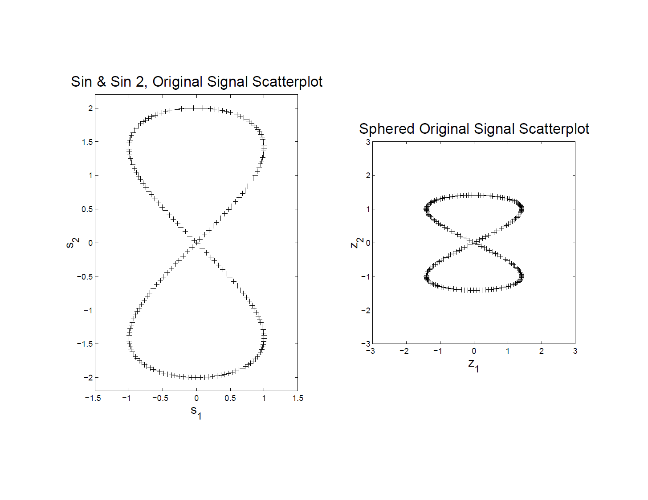
More ICA Examples
Two Sine Waves – Original Scatterplot
Far
From
Indep’t
!!!

Slide 137
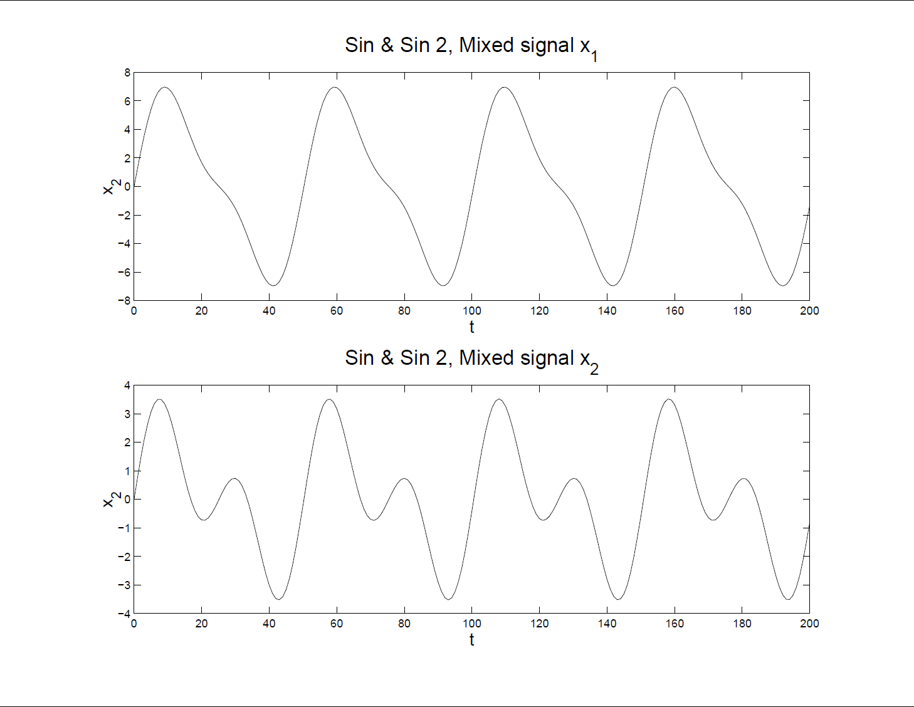
More ICA Examples
Two Sine Waves – Mixed Input Data

Slide 138
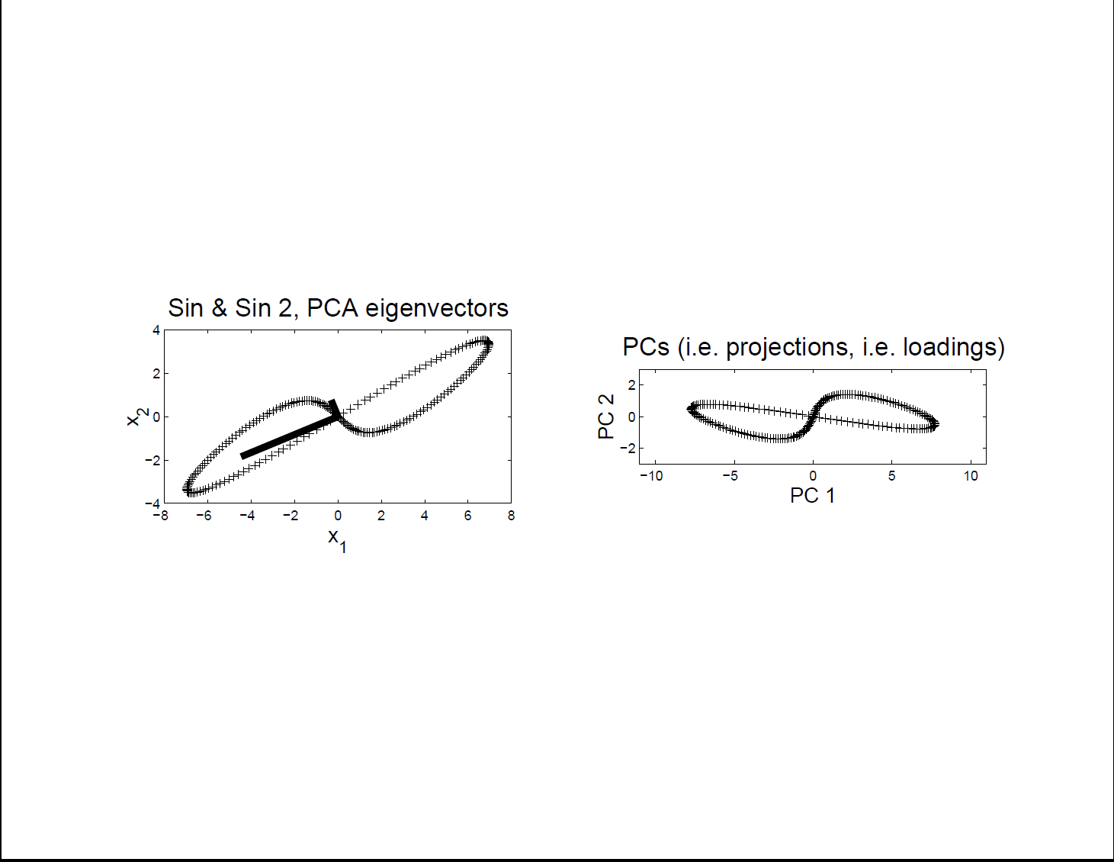
More ICA Examples
Two Sine Waves – Scatterplot & PCA
Clearly
Wrong
Recovery

Slide 139
More ICA Examples
Two Sine Waves – Scatterplot for ICA
Looks
Very
Good

Slide 140
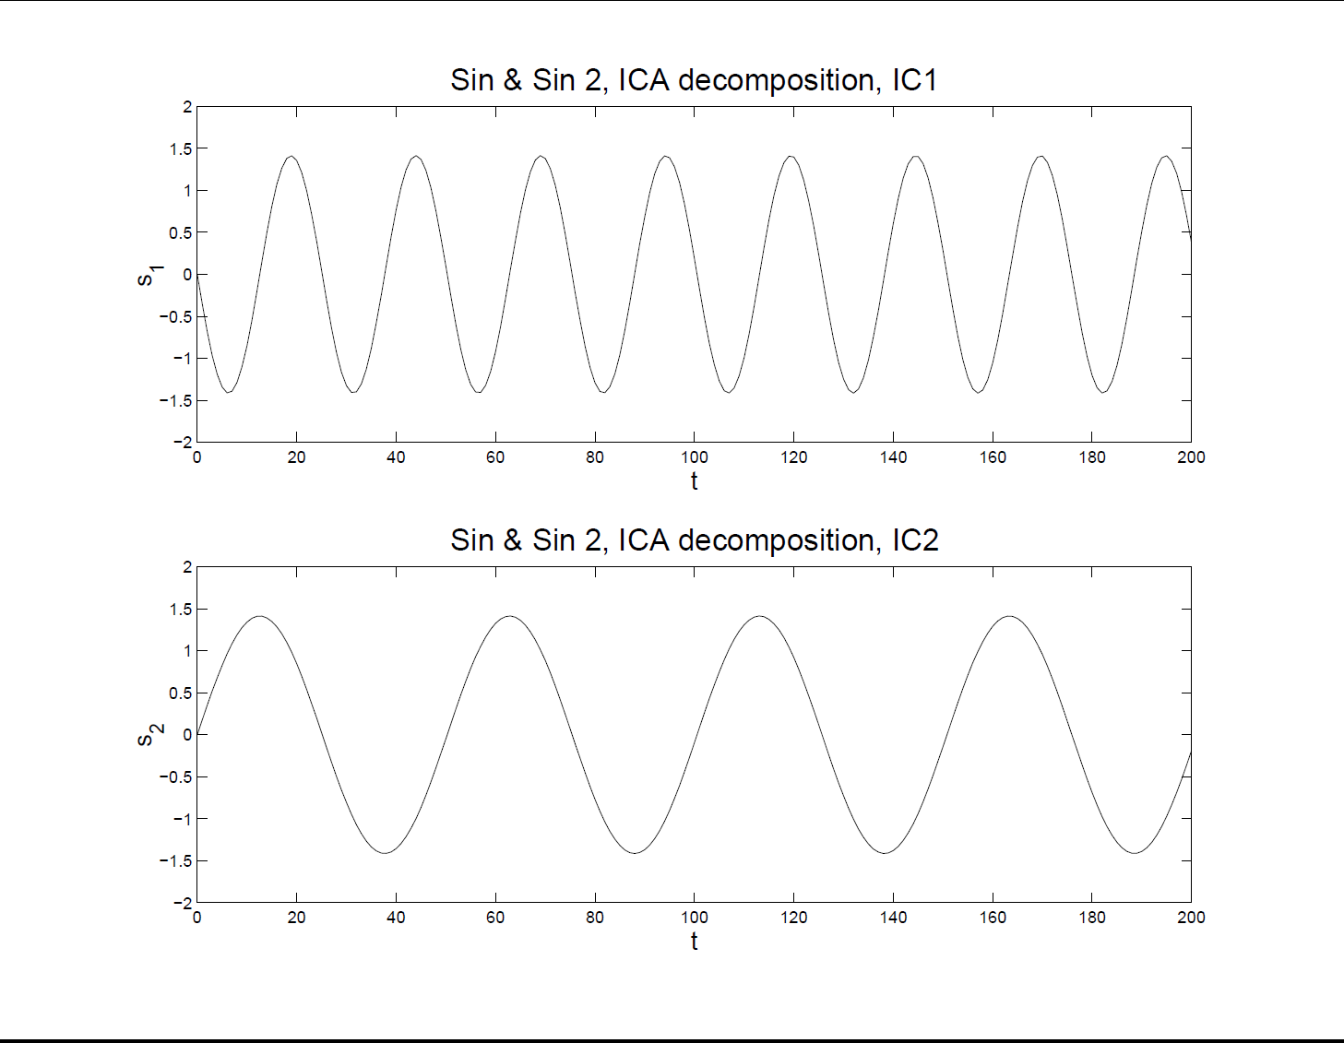
More ICA Examples
Two Sine Waves – ICA Reconstruction
Excellent,
Despite
Non-Indep’t
Scatteplot

Slide 141
More ICA Examples
Sine and Gaussian
Try Another Pair of Signals
More Like “Signal + Noise”

Slide 142
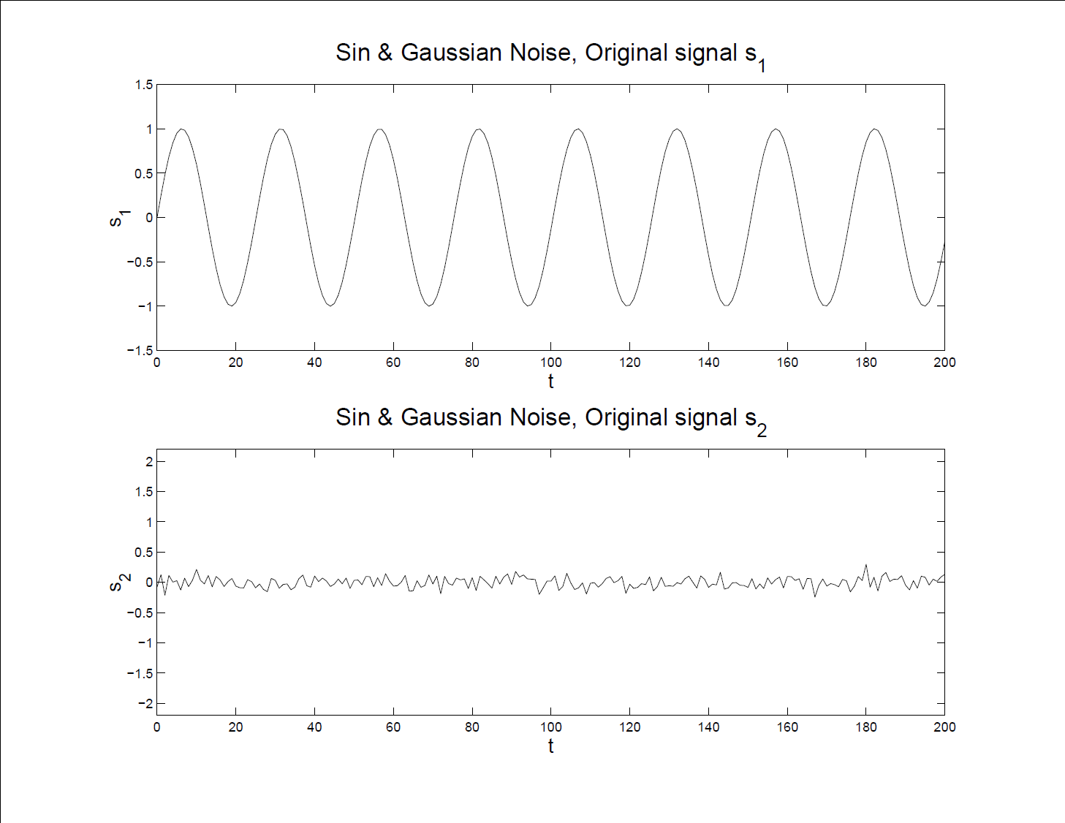
More ICA Examples
Sine and Gaussian – Original Signals

Slide 143
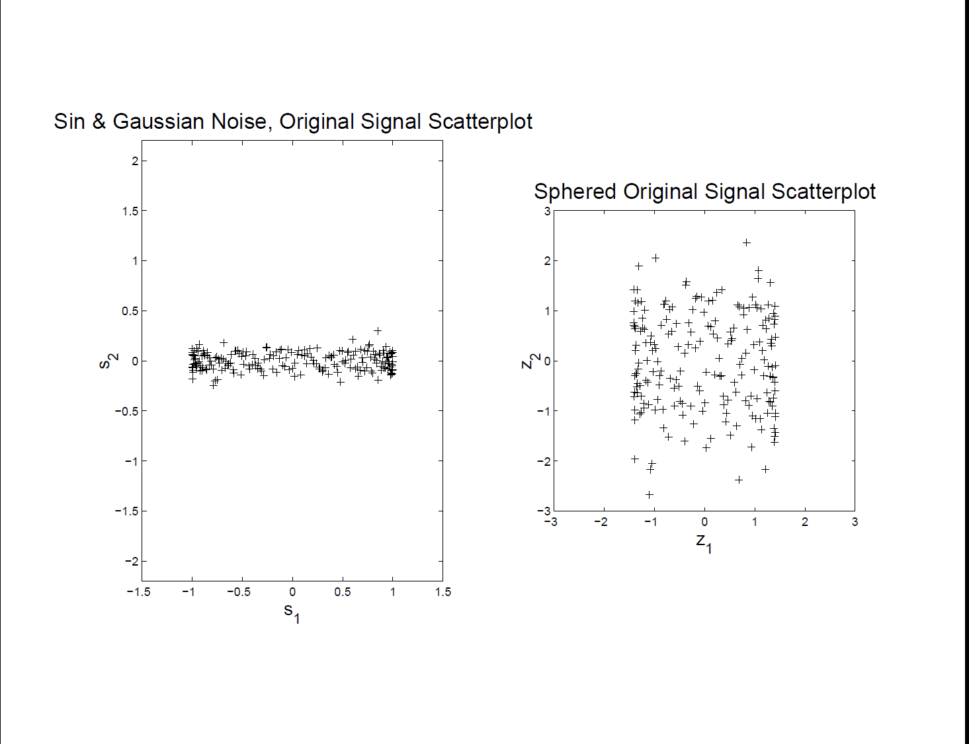
More ICA Examples
Sine and Gaussian – Original Scatterplot
Well
Set
For
ICA

Slide 144
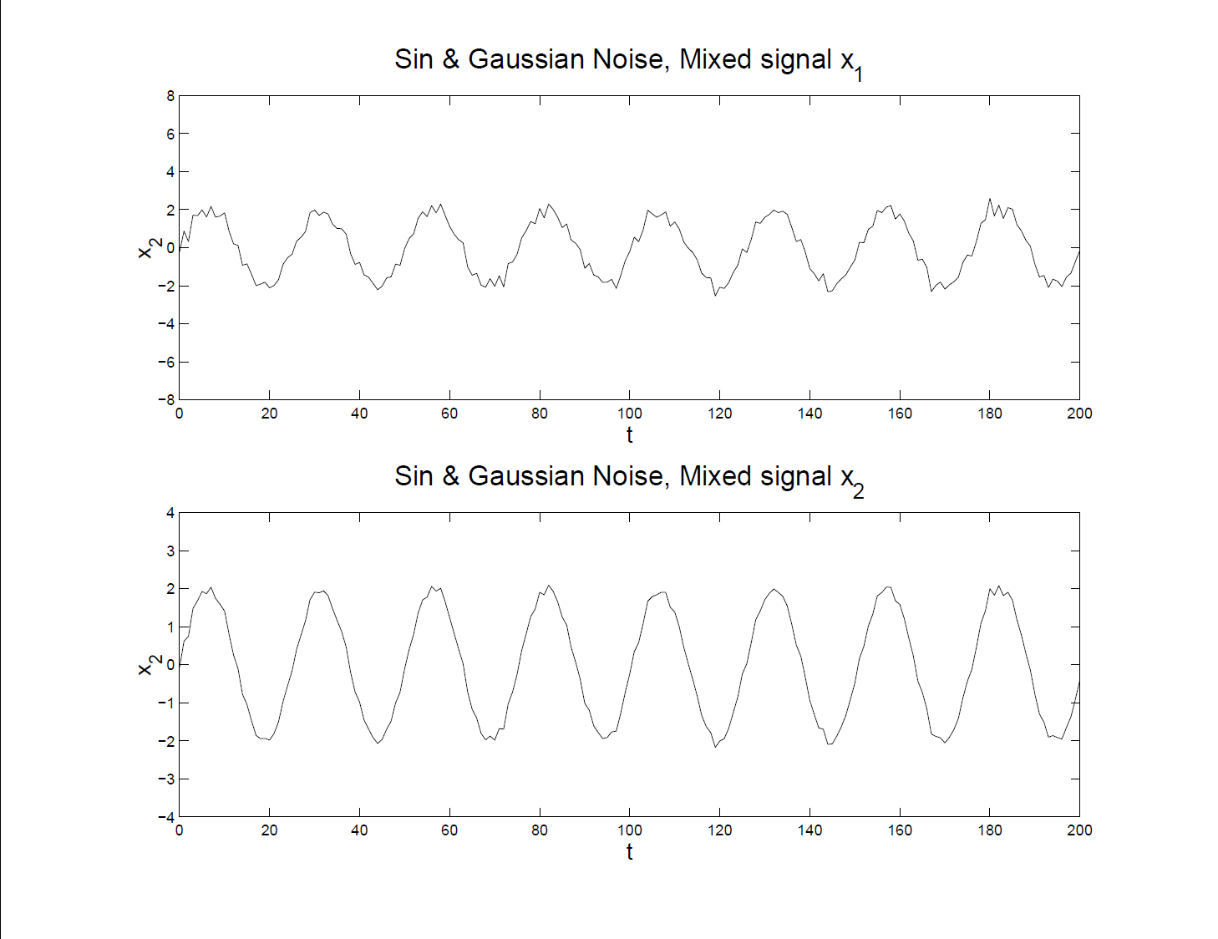
More ICA Examples
Sine and Gaussian – Mixed Input Data

Slide 145
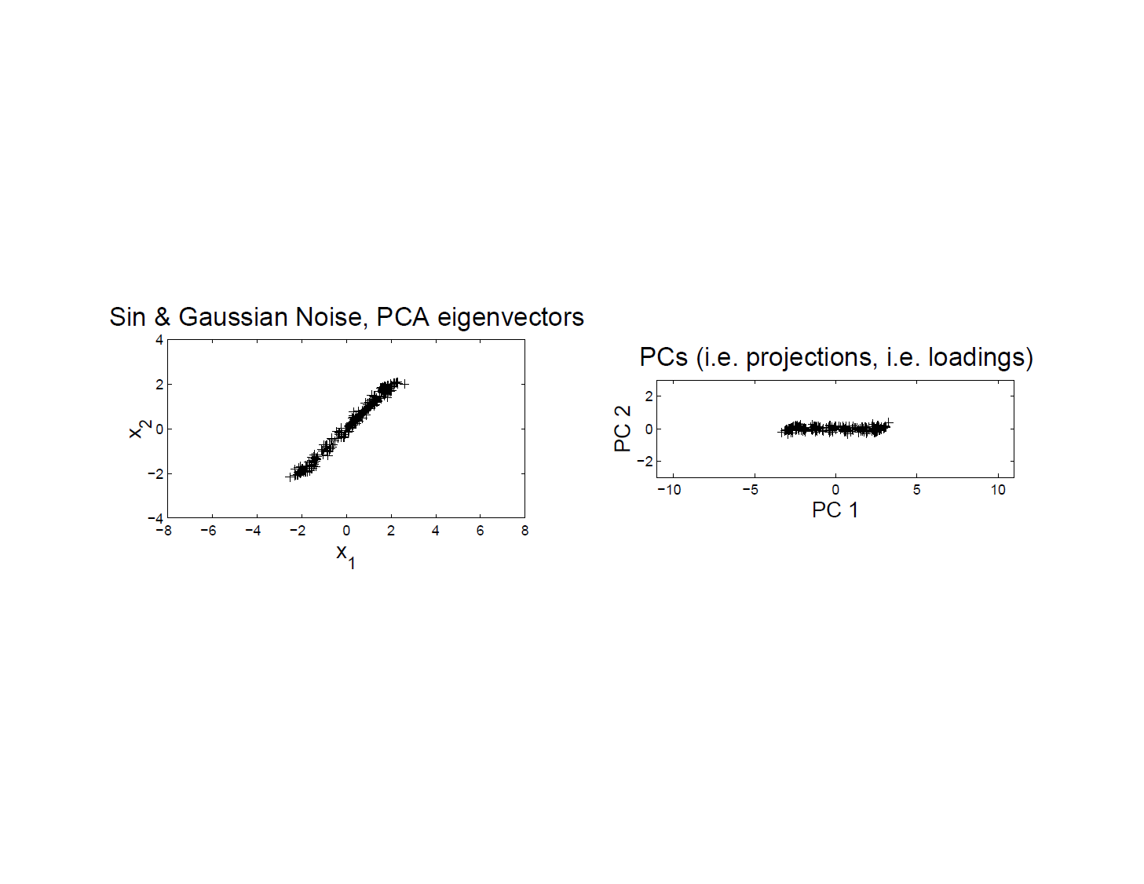
More ICA Examples
Sine and Gaussian – Scatterplot & PCA

Slide 146
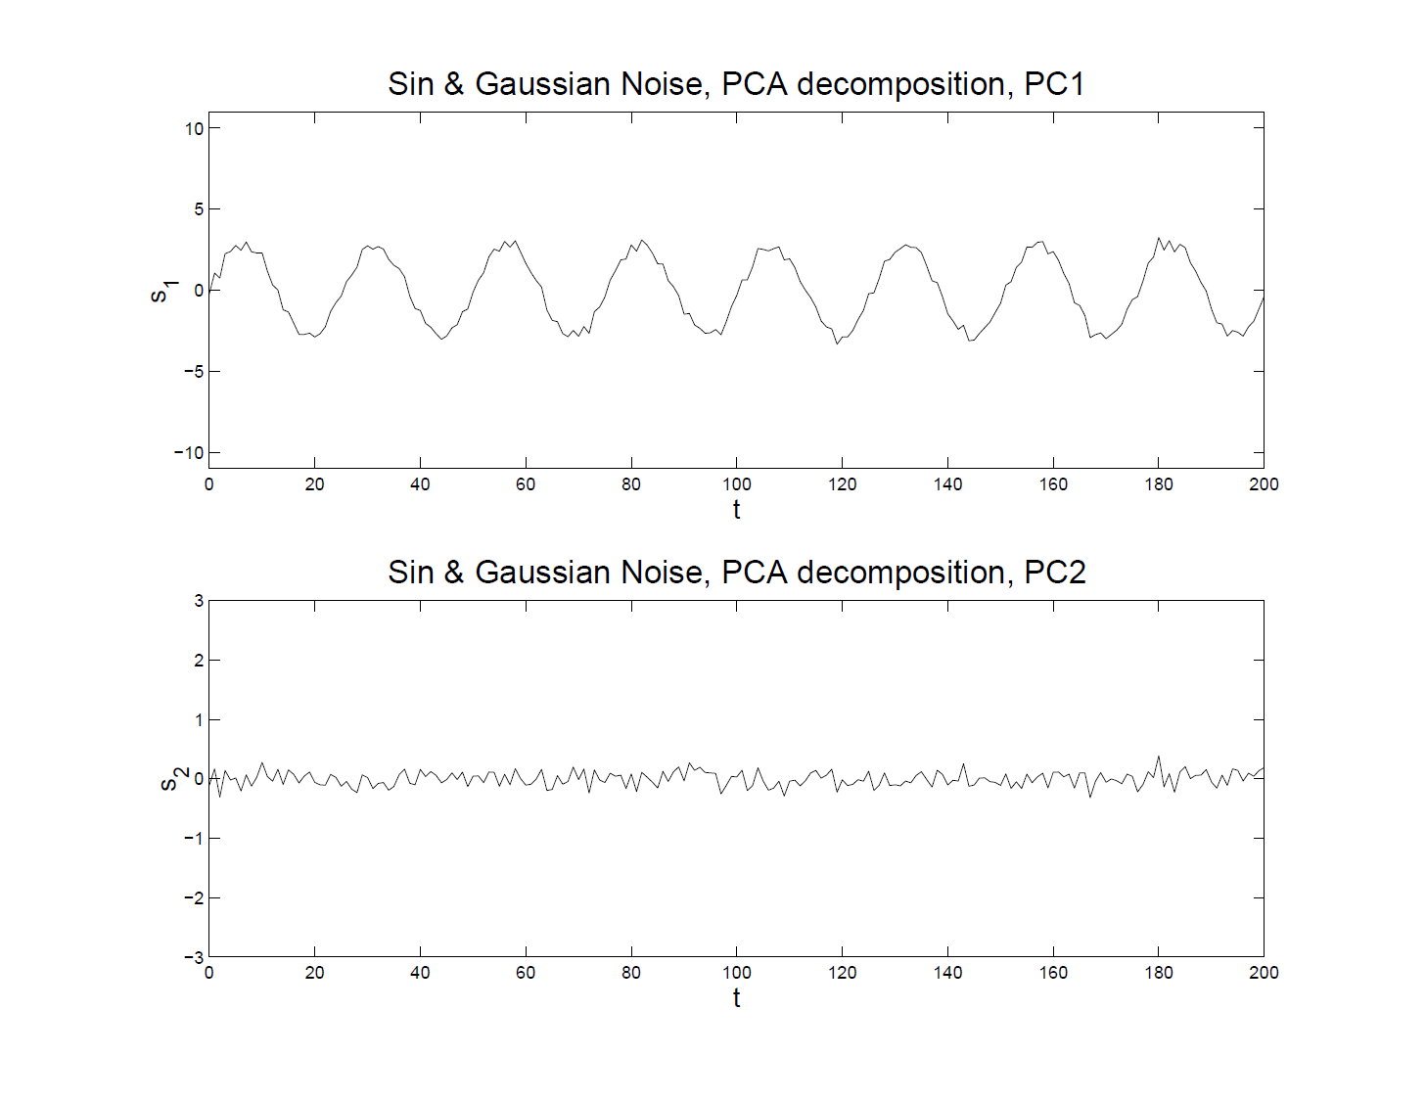
More ICA Examples
Sine and Gaussian – PCA Reconstruction
Got Sine
Wave
+
Noise

Slide 147
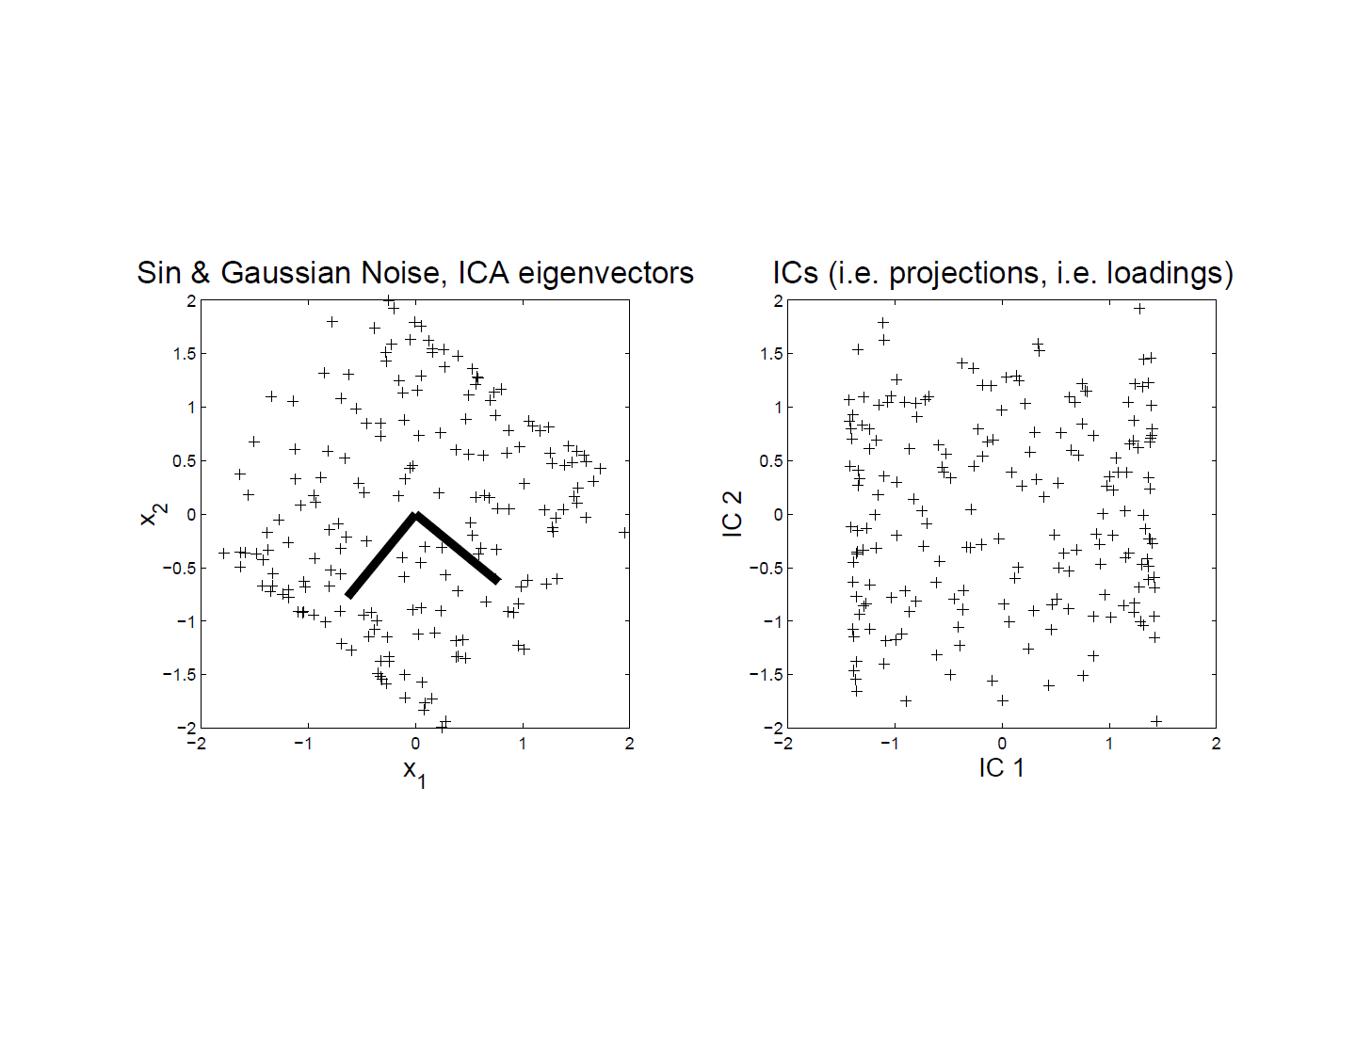
More ICA Examples
Sine and Gaussian – Scatterplot ICA

Slide 148
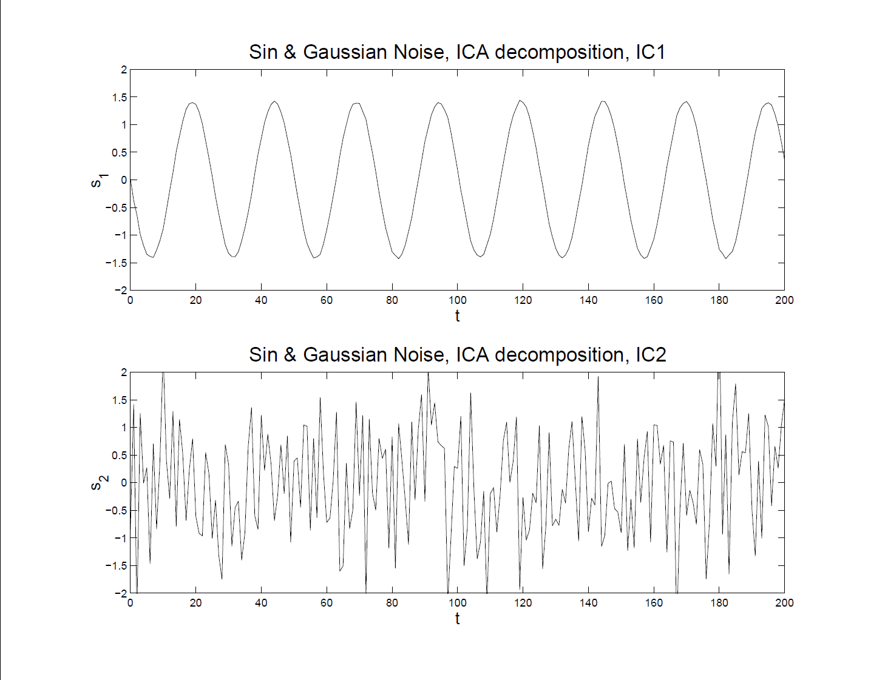
More ICA Examples
Sine and Gaussian – ICA Reconstruction

Slide 149
More ICA Examples
Both Gaussian
Try Another Pair of Signals
Understand Assumption of
One Not Gaussian

Slide 150
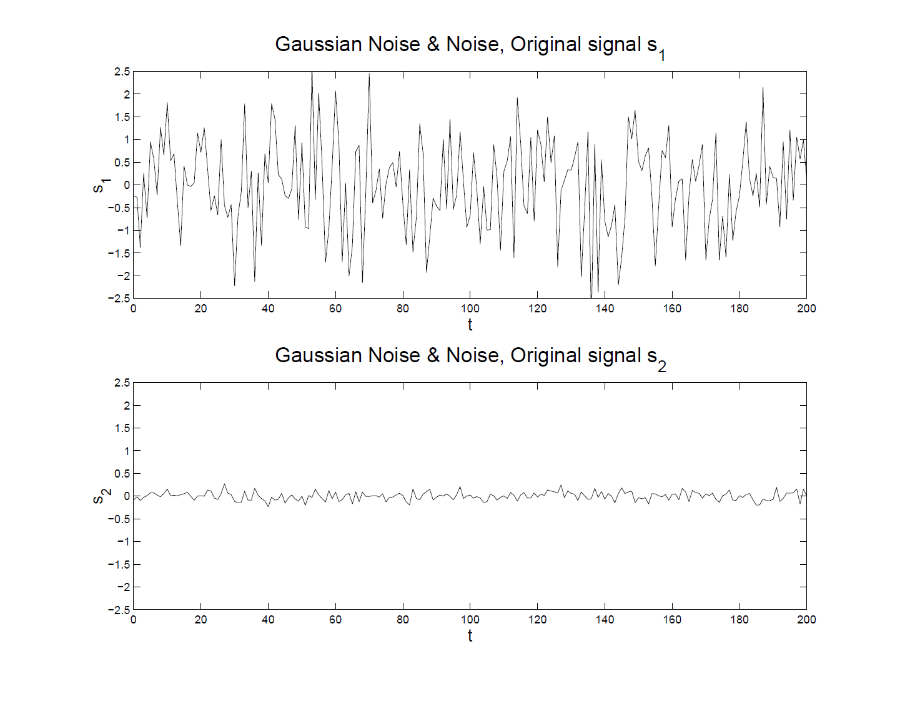
More ICA Examples
Both Gaussian – Original Signals

Slide 151
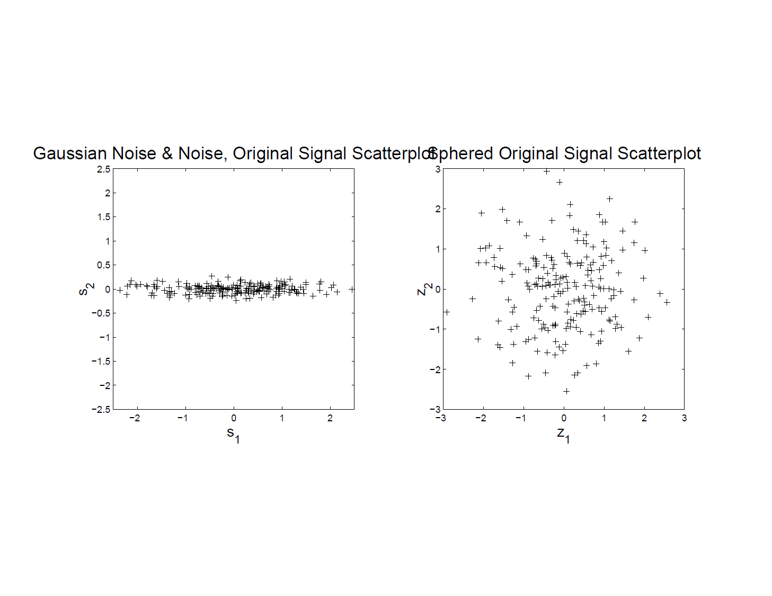
More ICA Examples
Both Gaussian – Original Scatterplot
Caution:
Indep’t
In All
Directions!

Slide 152
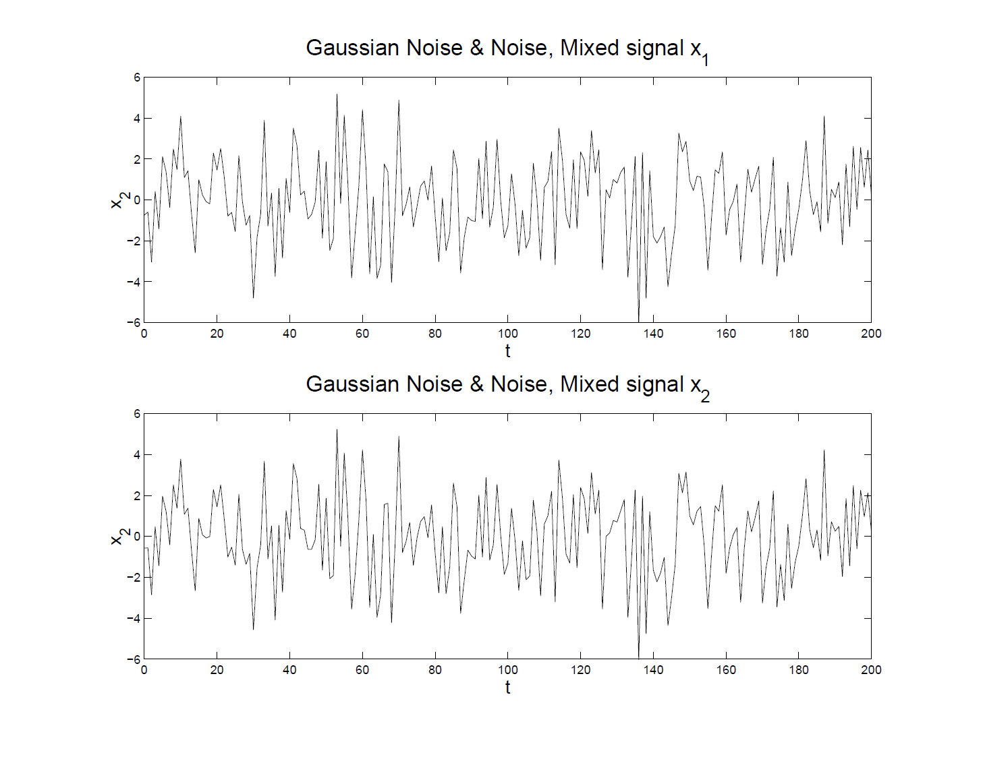
More ICA Examples
Both Gaussian – Mixed Input Data

Slide 153
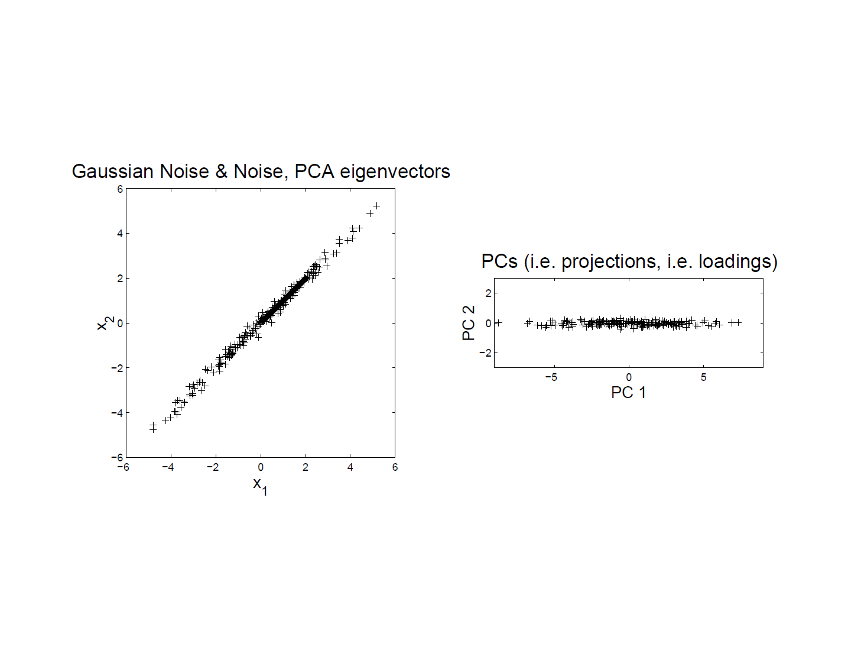
More ICA Examples
Both Gaussian – PCA Scatterplot
Exploits
Variation
To Give
Good
Diredtions

Slide 154
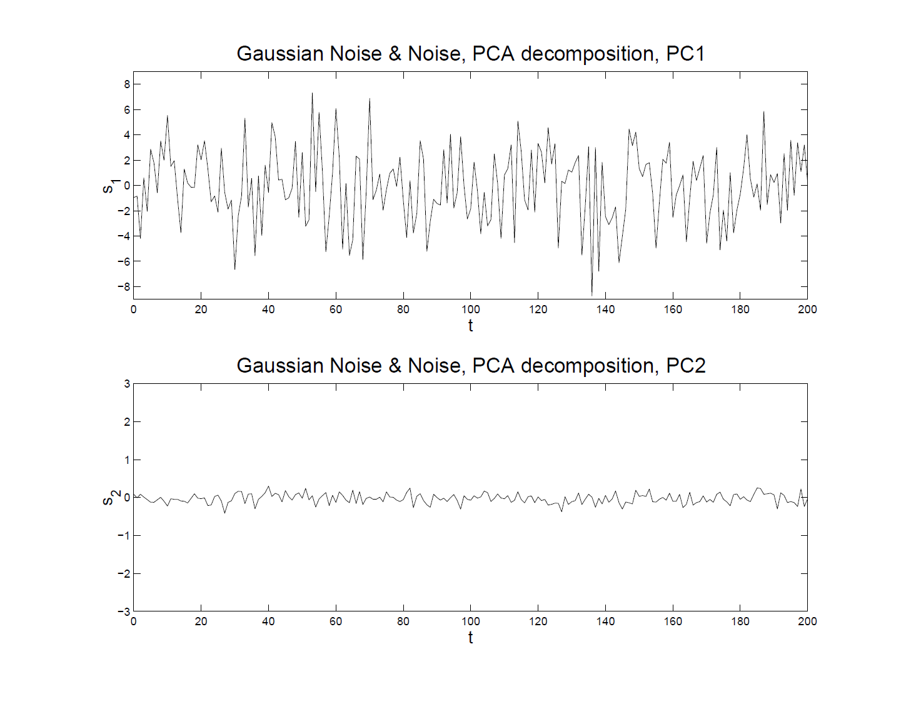
More ICA Examples
Both Gaussian – PCA Reconstruction
Looks
Good?

Slide 155
More ICA Examples
Both Gaussian – Original Signals
Check
Against
Original

Slide 156
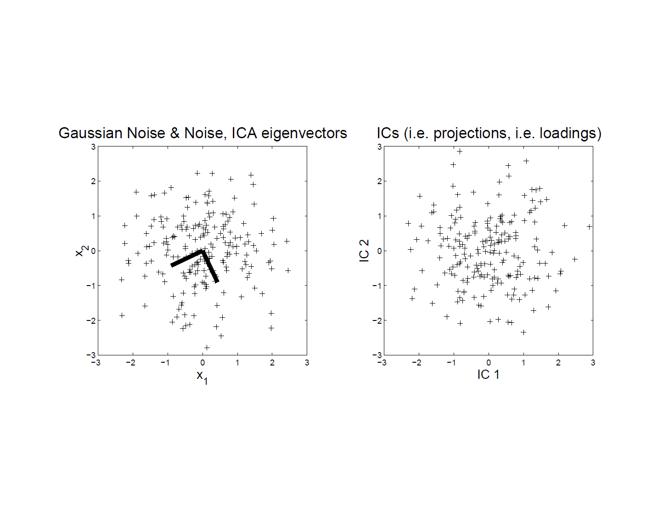
More ICA Examples
Both Gaussian – ICA Scatterplot
No Clear
Good
Rotation?

Slide 157
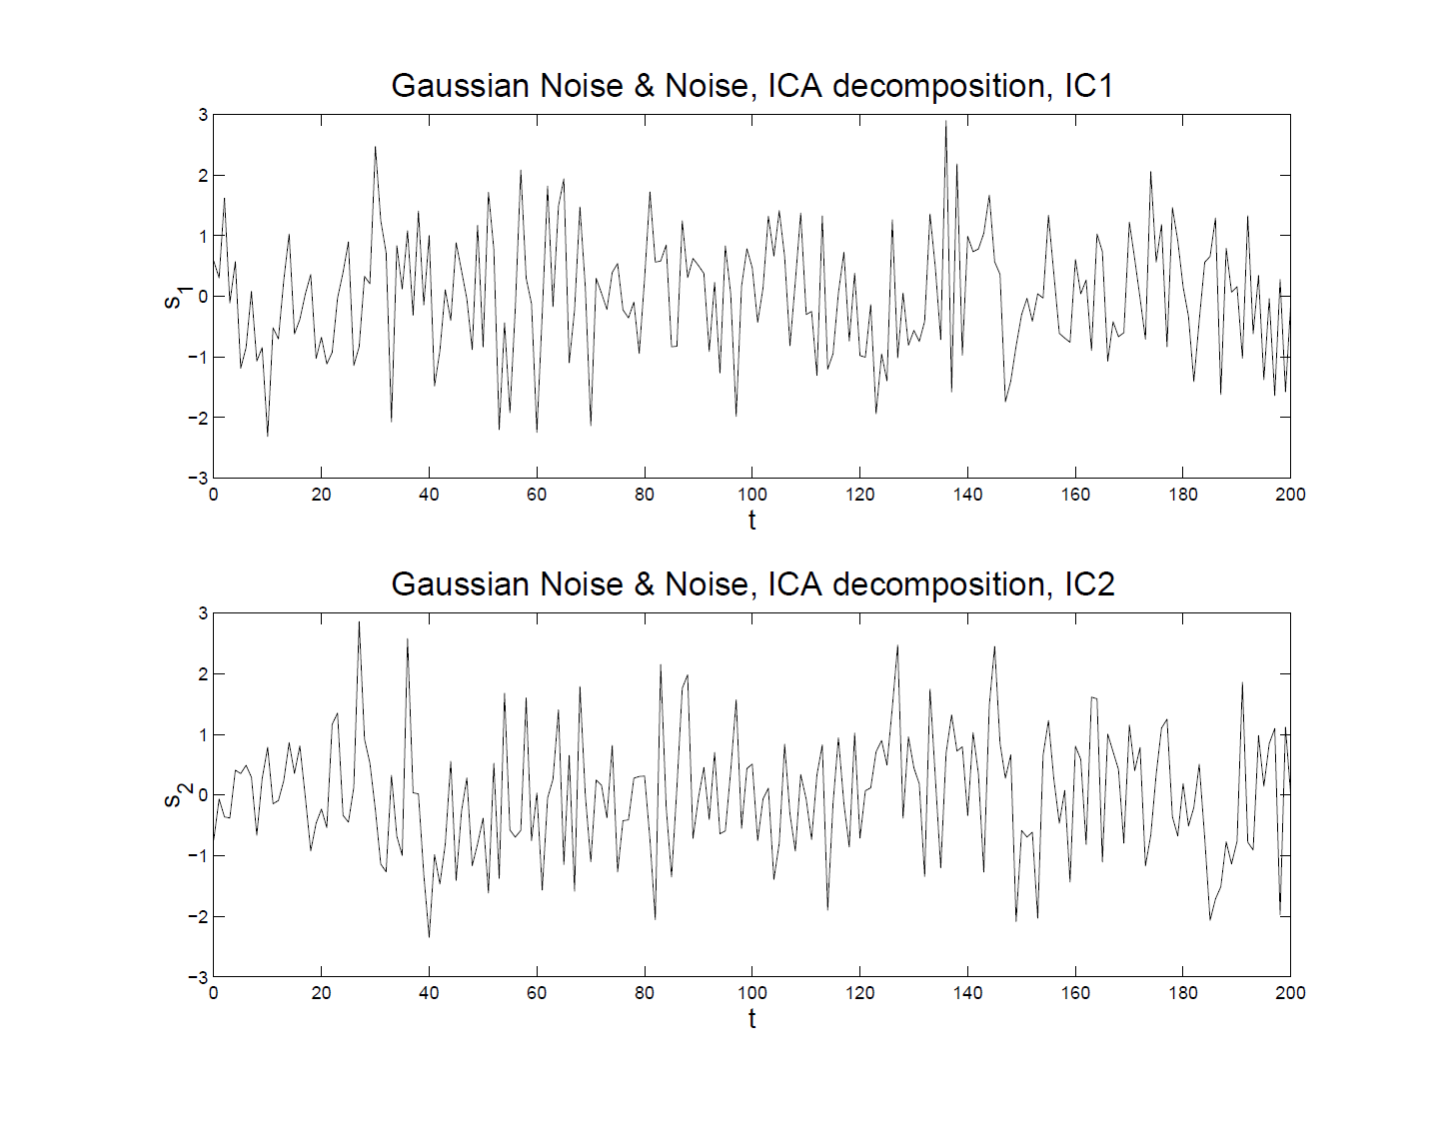
More ICA Examples
Both Gaussian – ICA Reconstruction
Is It
Bad?

Slide 158
More ICA Examples
Both Gaussian – Original Signals
Check
Against
Original

Slide 159
Participant Presentation
1:35 Yu Chen
FMRI Clustering
Next Class: Ashley Buck

