Slide 1
IMSI – NeuroSci & Data Int’n Group
Data Integration Via JIVE & DIVAS
J. S. Marron
Dept. of Statistics and Operations Research
University of North Carolina
July 13, 2023

Slide 2
JIVE - DIVAS Motivation
Traditional Data:
Organized as Matrix
(Single Data Block)
Increasingly Common:
Multi-Block Data
(From Same Cases)

Slide 3
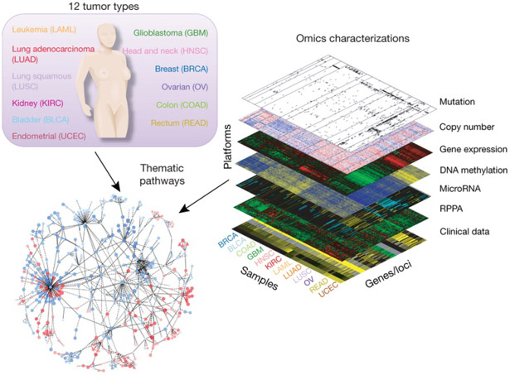
DIVAS Motivation
The Cancer
Genome
Atlas
Multiple Blocks
People Common
Across Blocks
Figure : The Cancer Genome Atlas Research Network, Weinstein, J.N., Collisson, E.A., Mills, G.B., Shaw, K.M., Ozenberger, B.A., Ellrott, K., Shmulevich, I., Sander, C., and Stuart, J.M. (2013)
The Cancer Genome Atlas Pan-Cancer analysis project.

Slide 4
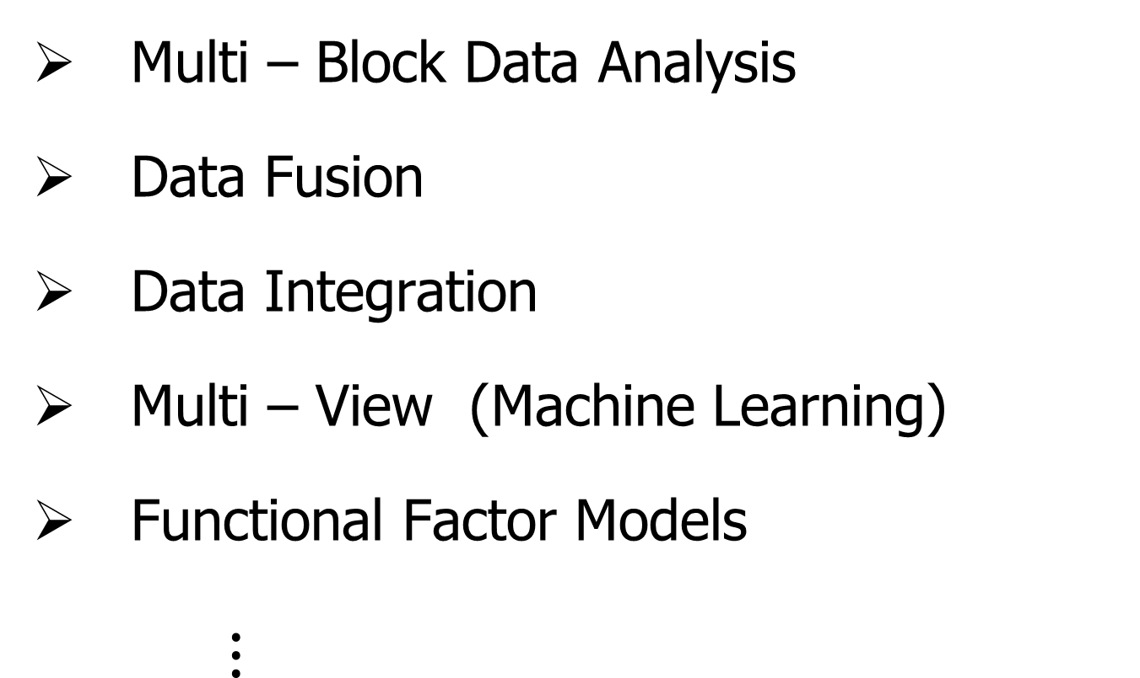
Multi – Block Synonyms
Multi – Block Data Analysis
Data Fusion
Data Integration
Multi – View (Machine Learning)
Functional Factor Models
$⋮$

Slide 5
Acronyms
JIVE:
Joint and Individual Variation Explained
Important Precursor of
DIVAS:
Data Integration Via Analysis of Subspaces

Slide 6
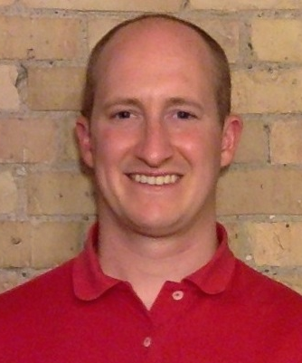



JIVE Collaborators
Eric Lock
Qing Feng
Andrew Nobel
Jan Hannig

Slide 7
JIVE Data Structure
Organizational Model
for Single Data Set:
Matrix
Convention in this talk:
“Columns as Data Objects”
(Atoms of the Statistical Analysis,
i.e. Experimental Units, or Data Vectors)

Slide 8
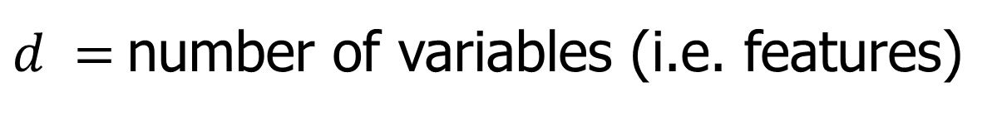


JIVE Data Structure
Organizational Model
for Single Data Set:
Matrix
Convention in this talk:
“Columns as Data Objects”
$$d$$
$$n$$
$d =$number of variables (i.e. features)
$n =$number of cases (i.e. subjects or samples)

Slide 9
JIVE Data Structure
Organizational Model
for Single Data Set: ←
Matrix
Convention in this talk:
Data Are “Object Mean Centered”
i.e. Mean Vector is 0

Slide 10
JIVE Data Structure
Organizational Model
for Single Data Set:
Matrix
Convention in this talk:
Data Are “Object Mean Centered”
i.e. Mean Vector is 0
i.e. Mean of Entries in Each Row is 0

Slide 11
JIVE Data Structure
JIVE Organizational Model:
Multiple Matrices
(Data Types, i.e. “Blocks”)
With common
Columns as Data Objects

Slide 12
JIVE Data Structure
JIVE Organizational Model:
Multiple Matrices
(Data Types, i.e. “Blocks”)
With common
Columns as Data Objects
1st consider only 2 blocks

Slide 13
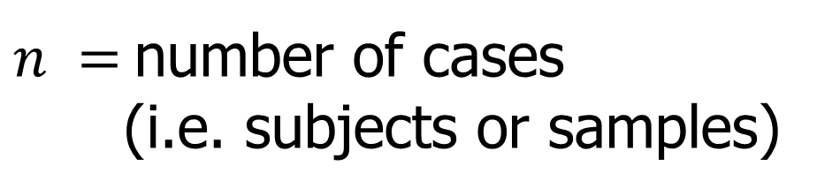
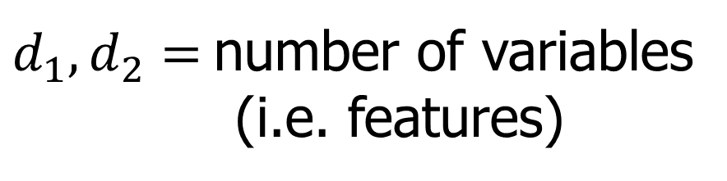



JIVE Data Structure
JIVE Organizational Model:
Multiple Matrices:
$d_{1},d_{2}=$number of variables
(i.e. features)
$$d_{1}$$
$$n$$
$n =$number of cases
(i.e. subjects or samples)
$$d_{2}$$
$$n$$

Slide 14
JIVE Analytic Goals
Explore & Quantify Variation
In spirit of PCA
(Principal Component Analysis)

Slide 15









PCA Underpinnings
For Col. Object Mean Centered Data Matrix:
Apply Singular Value Decomposition
$$r$$
$$r$$
$$=$$
$$r$$
$$n$$
Product of All Three Is
Rank 1 Matrix Called
“Mode of Variation”
$$d$$
$$d$$
$$n$$
$$r$$
Loadings
x Scores

Slide 16
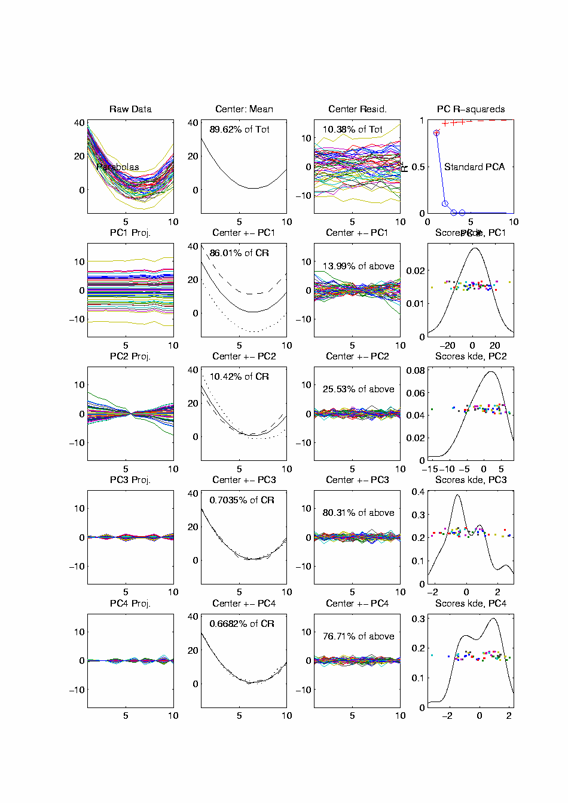

PCA Toy Eg. - Functional Data Analysis
$n=50,$
$d=10$
Data
Vectors
Note Mode
of Variation:
All Up vs.
All Down
Loading
Vectors
x
Scores
Scores

Slide 17
Functional Data Analysis, 10-d Toy EG 1

Slide 18
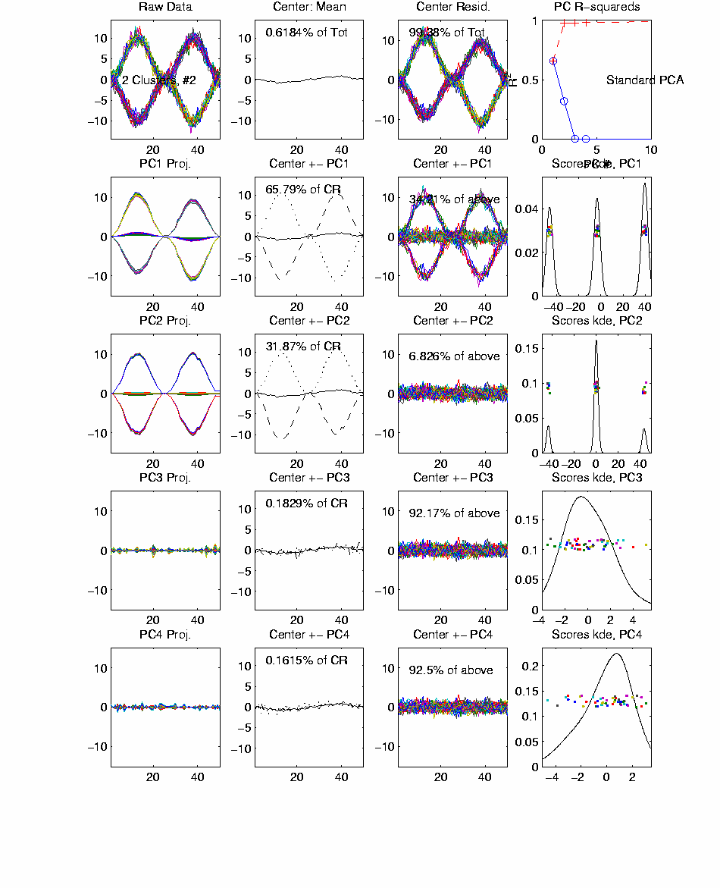
Functional Data Analysis, 50-d Toy EG 2

Slide 19
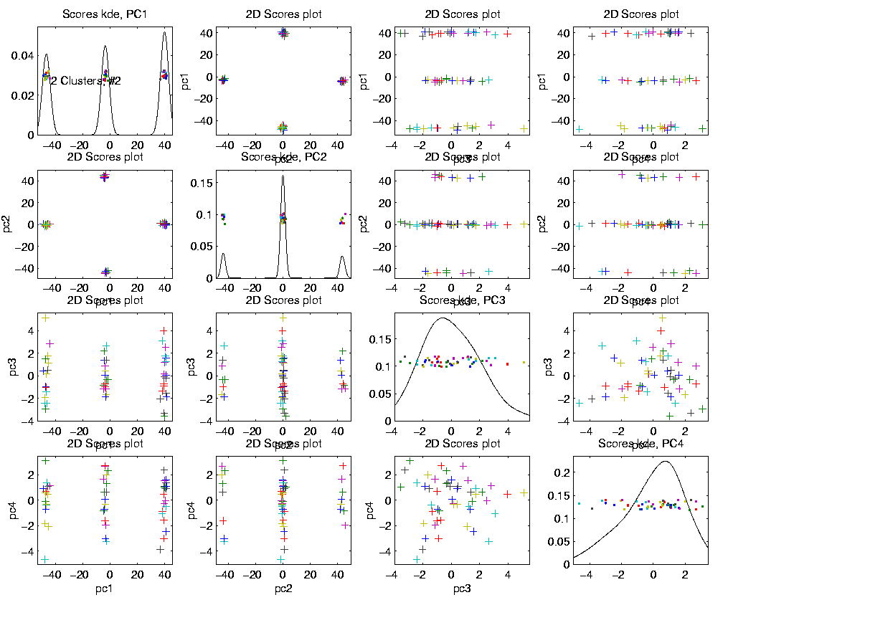
Functional Data Analysis, 50-d Toy EG 2
Scores Show
Relations
Between
Data Objects

Slide 20
Functional Data Analysis, 50-d Toy EG 2
Note: Clean Directions
Are a Consequence of
Separated Eigenvalues

Slide 21
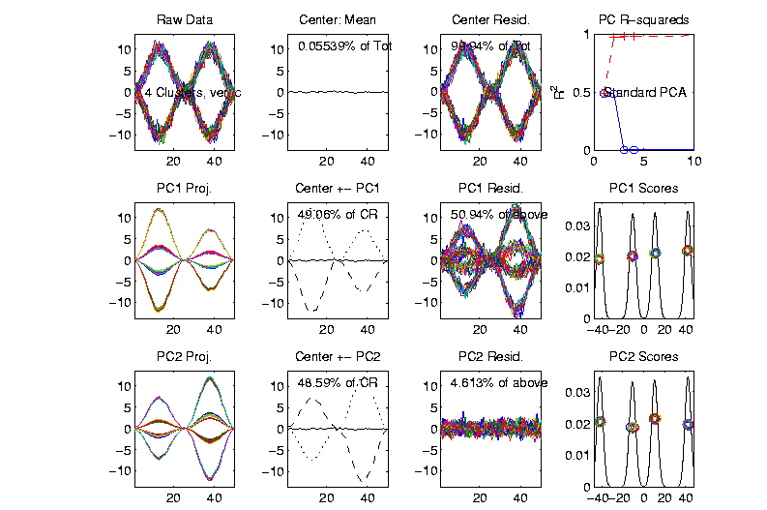
Functional Data Analysis, 50-d Toy EG 2
First 2
Eigenvalues
Now Similar
Related
Example
Rotated
(Linear
Combo)
Directions
Hard to
Interpret
Gives Random Rotation

Slide 22
JIVE Analytic Goals
For 2+ Data Blocks
Explore & Quantify Variation
In spirit of PCA
(Principal Component Analysis)
Unions of Columns
As Data Objects

Slide 23
JIVE Analytic Goals
Explore & Quantify Variation
Through Joint Variation
via Common Scores
(Signatures Among Cases)

Slide 24
JIVE Analytic Goals
Explore & Quantify Variation
Through Joint Variation
via Common Scores
(Signatures Among Cases)
And Individual Variation
(Ortho to Joint & Not Colinear)

Slide 25
JIVE Analytic Goals
Understand Drivers
Using Loadings
Joint Loadings

Slide 26
JIVE Analytic Goals
Understand Drivers
Using Loadings
Joint Loadings
Individual Loadings

Slide 27
JIVE Algorithm
Overview of Steps
Low Rank Reduction (SVD)
Principal Angle Analysis & Threshold
→ Common Normalized Scores
Projections to get Modes of Variation
Joint & Individual Scores and Loadings

Slide 28


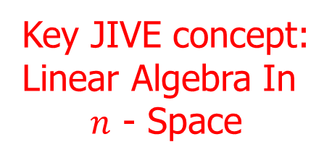

Principal Angle Analysis
Idea: Relate Subspaces $S_{1}$, $S_{2}$ of $ℝ^{n}$
Using Minimal Angles
$$θ_{1}=0$$
$$θ_{2}$$
Key JIVE concept:
Linear Algebra In
$n$ - Space
And Iterate Orthogonally
PAA Computation: ~Concatenate & SVD

Slide 29
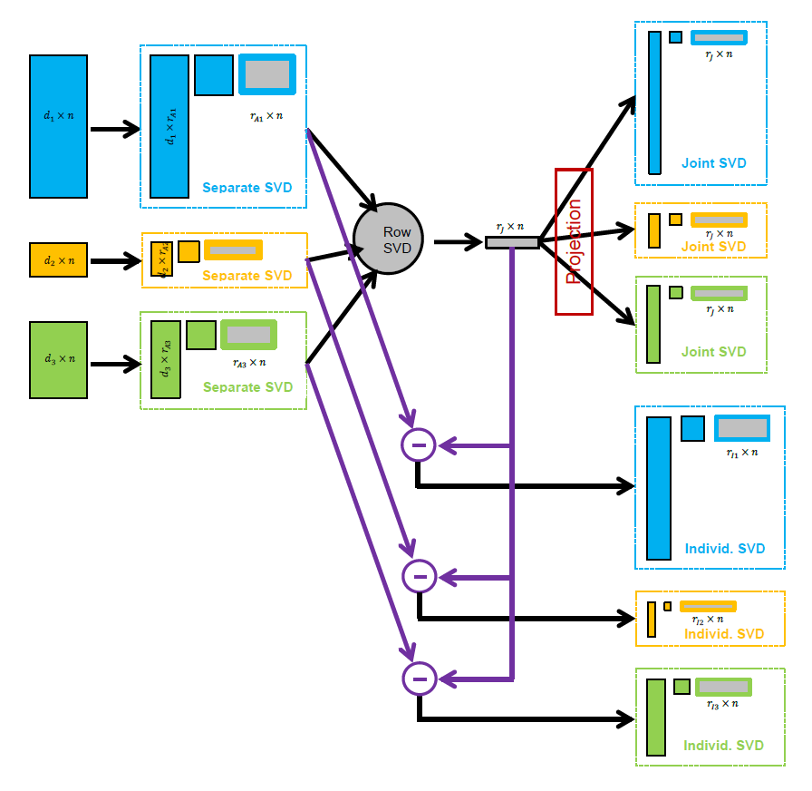
JIVE Algorithm
Overview
Step 1

Slide 30
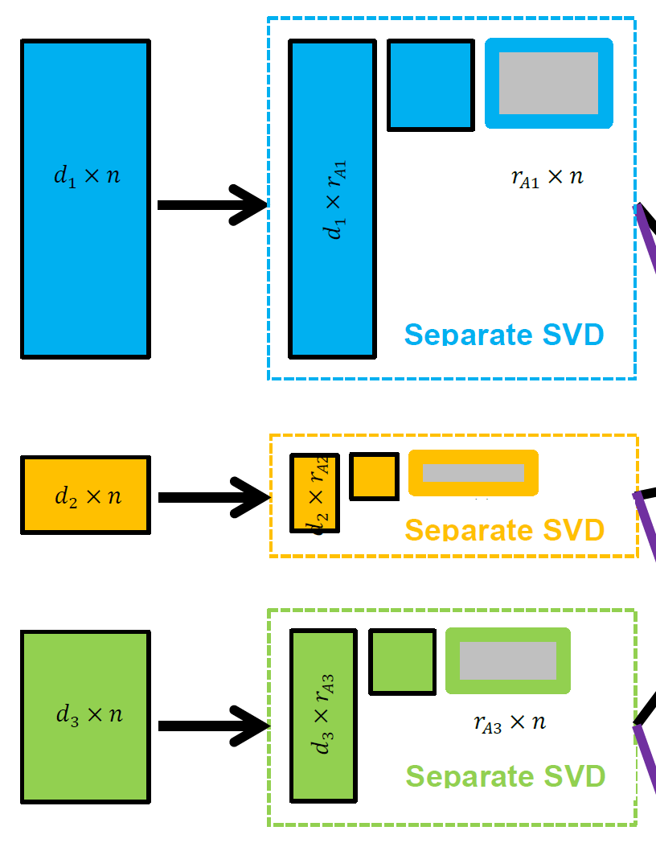

JIVE Algorithm
Step 1:
Initial Low Rank
Approximations
Separate SVDs
Ranks: $r_{A1},r_{A2},$ $r_{A3}$

Slide 31
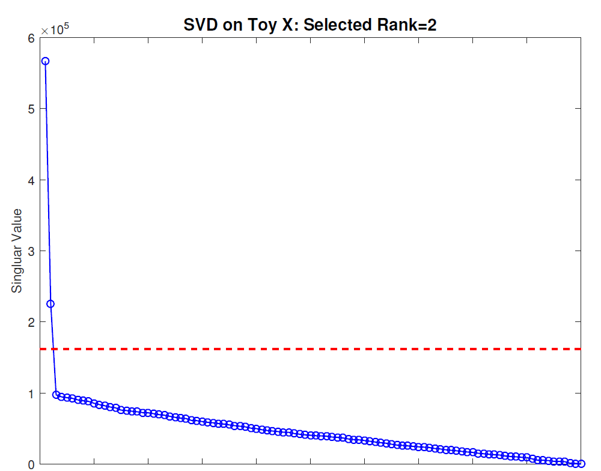
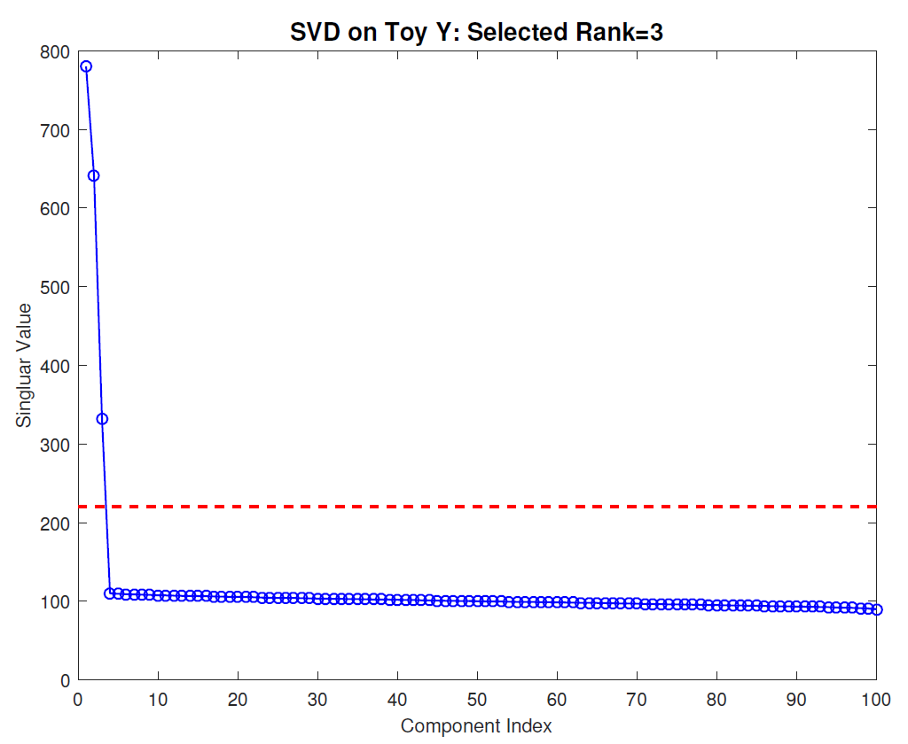
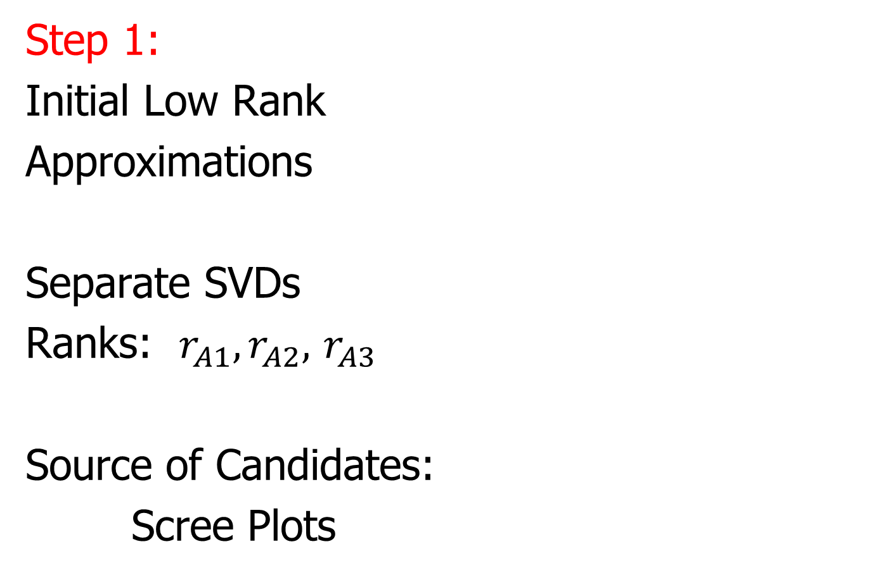
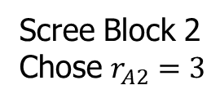
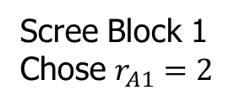
JIVE Algorithm
Scree Block 1
Chose $r_{A1}=2$
Step 1:
Initial Low Rank
Approximations
Separate SVDs
Ranks: $r_{A1},r_{A2},$ $r_{A3}$
Source of Candidates:
Scree Plots
Scree Block 2
Chose $r_{A2}=3$

Slide 32
JIVE Algorithm
Step 1:
Initial Low Rank
Approximations
Separate SVDs
Ranks: $r_{A1},r_{A2},$ $r_{A3}$
Source of Candidates:
Scree Plots
Assessment of Ranks:
Wedin Bounds
Random Subspaces
Diagnostic Plots
A Motivation of DIVAS

Slide 33
JIVE Algorithm
Overview
Step 2

Slide 34
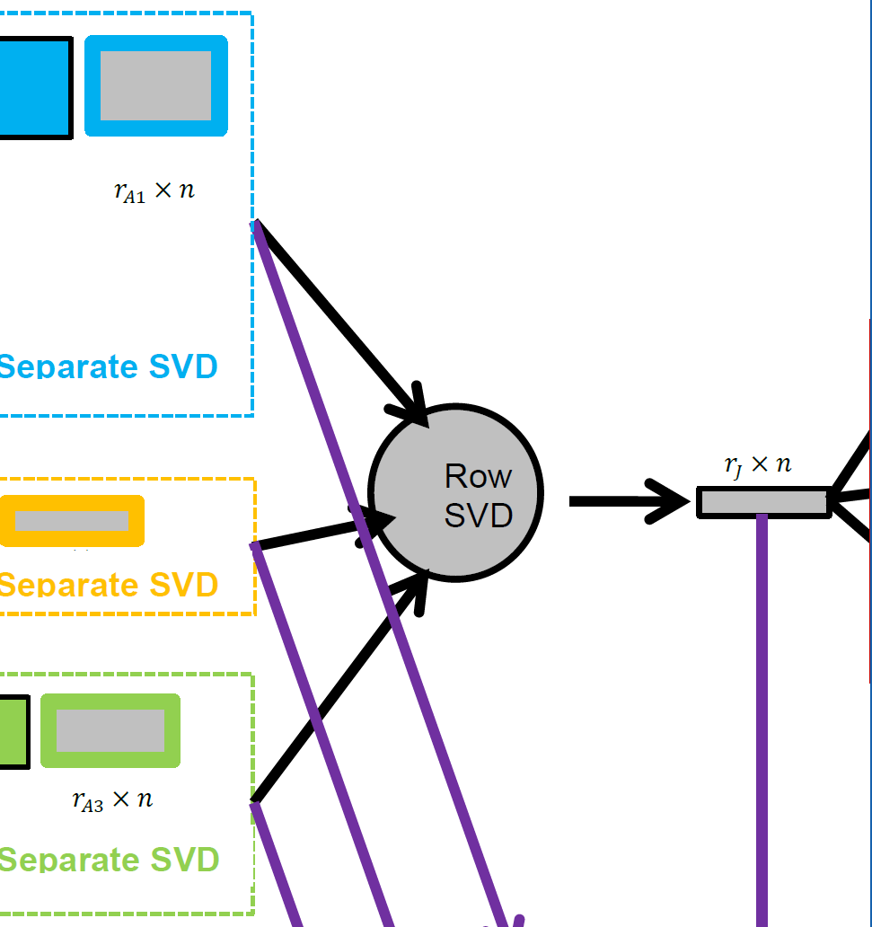
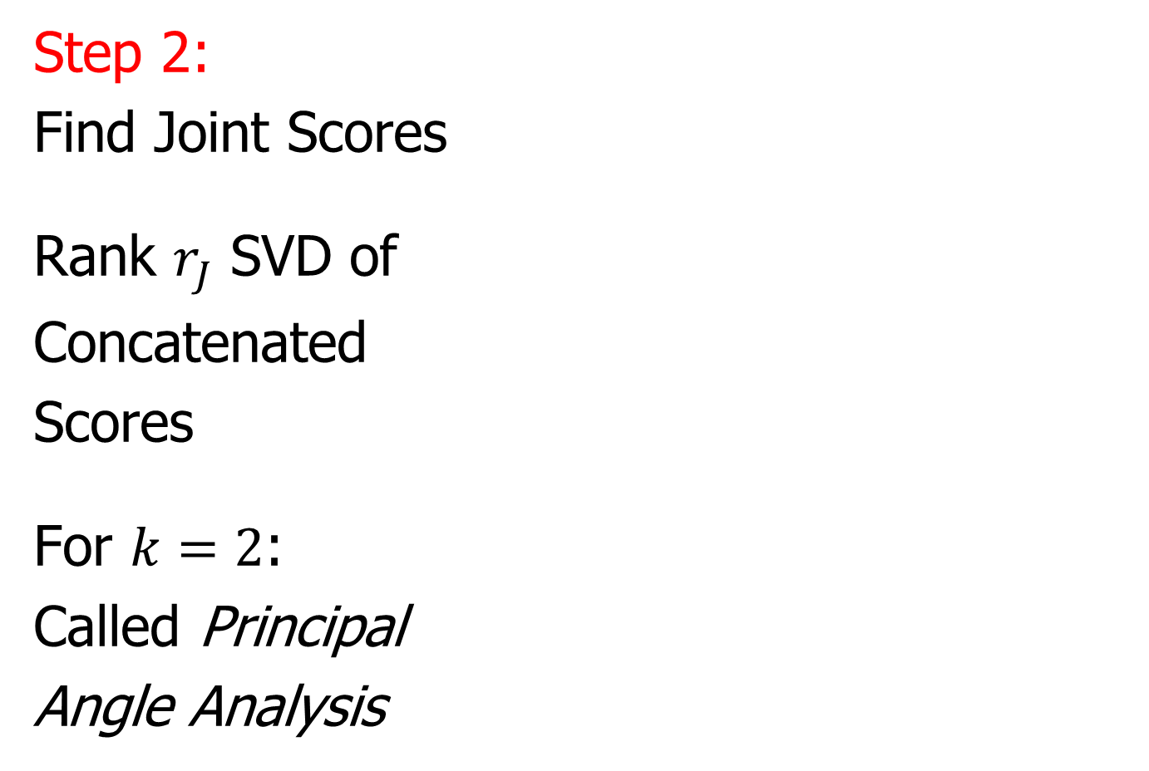
JIVE Algorithm
Step 2:
Find Joint Scores
Rank $r_{J}$ SVD of
Concatenated
Scores
For $k=2$:
Called Principal
Angle Analysis
Solves Scaling
Problem of JIVE

Slide 35

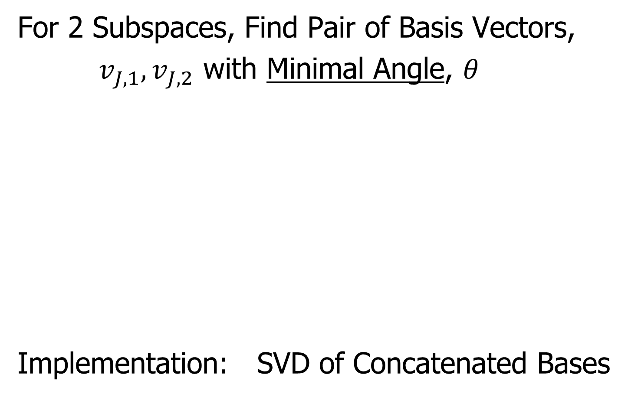
Aside: Principal Angle Analysis
For 2 Subspaces, Find Pair of Basis Vectors,
$v_{J,1},v_{J,2}$ with Minimal Angle, $θ$
Implementation: SVD of Concatenated Bases
$$θ$$

Slide 36
JIVE Algorithm
Overview
Step 3

Slide 37
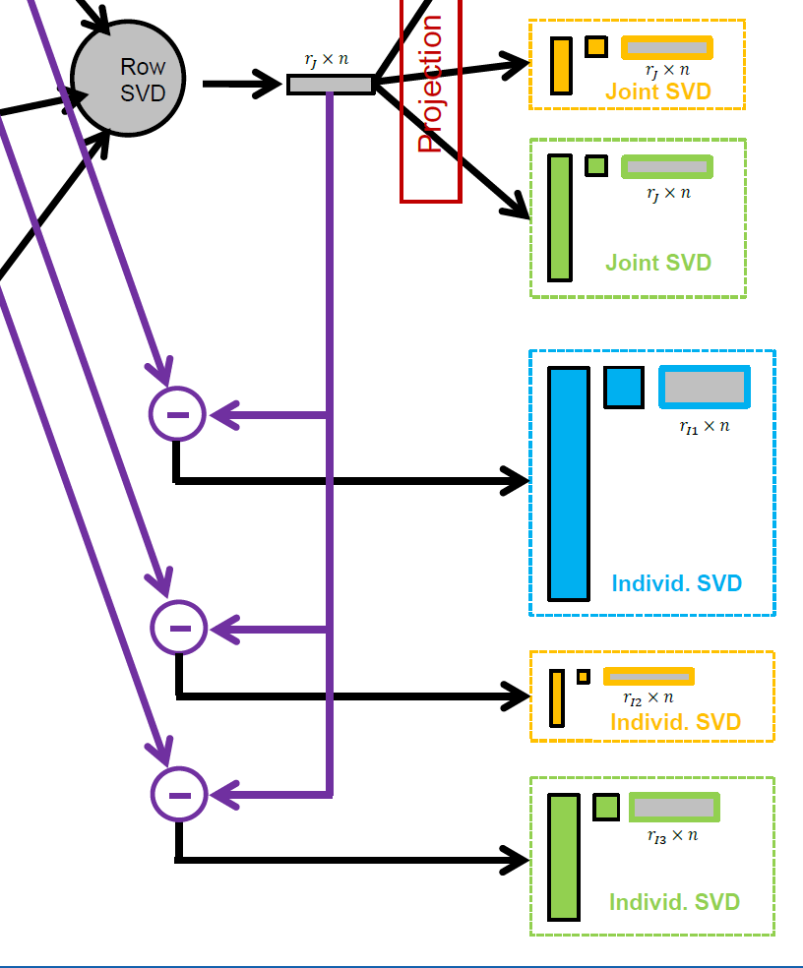
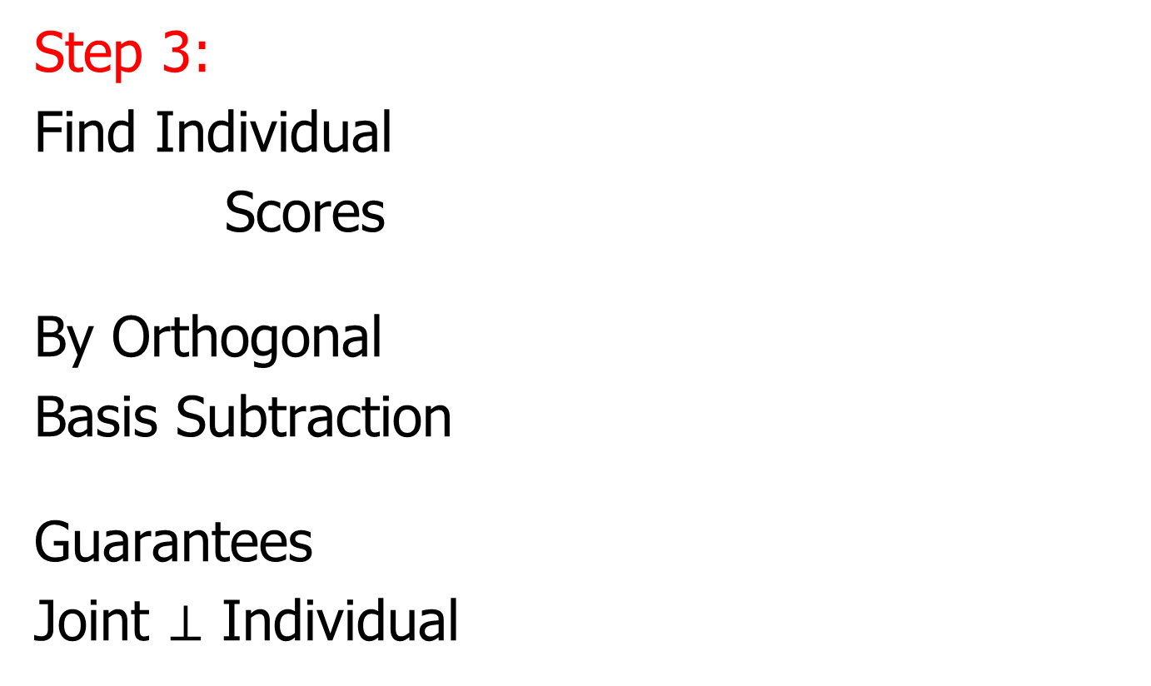
JIVE Algorithm
Step 3:
Find Individual
Scores
By Orthogonal
Basis Subtraction
Guarantees
Joint $⊥$ Individual

Slide 38
JIVE Algorithm
Overview
Step 4

Slide 39
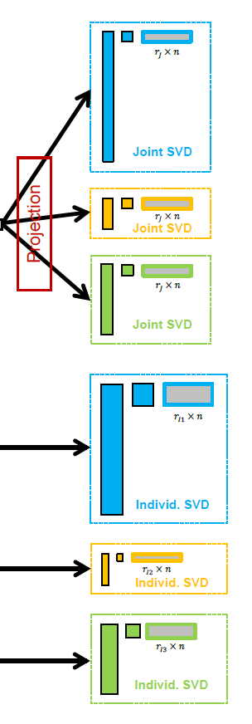
JIVE Algorithm
Step 4:
Reproject Data
To Get Both
Joint and
Individual
Decompositions

Slide 40
JIVE Algorithm
Output Options (for Differing Purposes):
Common Normalized Scores
Block Specific Scores (Joint & Indiv.)
Full Matrices

Slide 41
JIVE Algorithm
Output Options (for Differing Purposes):
Common Normalized Scores
Block Specific Scores (Joint & Indiv.)
Full Matrices

Slide 42
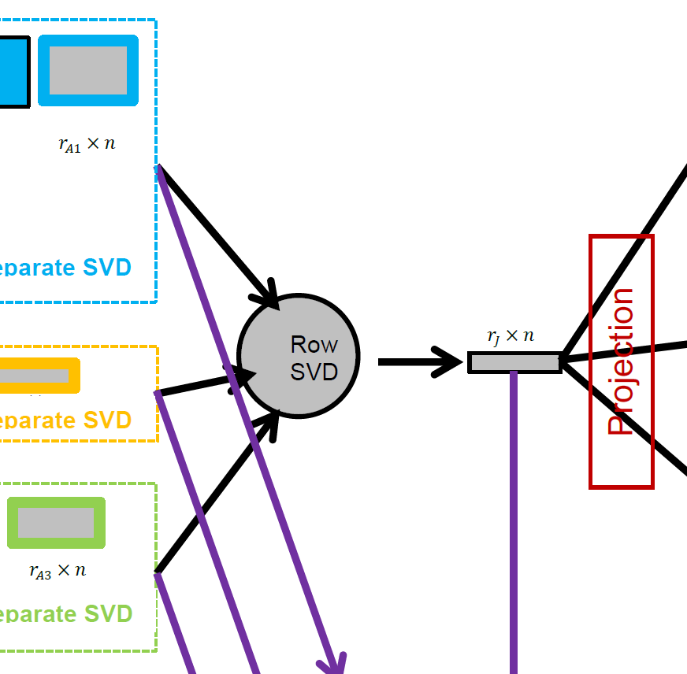
JIVE Algorithm
Common Normalized Scores
  Same for Each Block
  Finds Joint Behavior
  Useful: Scatterplots
  Can Have Common
  Loadings By Projecting
  Gives Interpretation
  of Driving Features
E.g. FMRI Neuro Science Data

Slide 43
JIVE Algorithm
Output Options (for Differing Purposes):
Common Normalized Scores
Block Specific Scores (Joint & Indiv.)
Full Matrices

Slide 44

JIVE Algorithm
Block Specific Scores
(Joint & Indiv.)
  SVD Re-Ordered Basis
  Includes Magnitudes (SVs)
  Compact $r_{∗}×n$ Representation
  E.g. Input for Classification
  Interpretation via Loadings

Slide 45
JIVE Algorithm
Output Options (for Differing Purposes):
Common Normalized Scores
Block Specific Scores (Joint & Indiv.)
Full Matrices

Slide 46
JIVE Algorithm
Full Matrices
  Size of Original Data
  Allows Heat Map View
  And Network Analysis

Slide 47
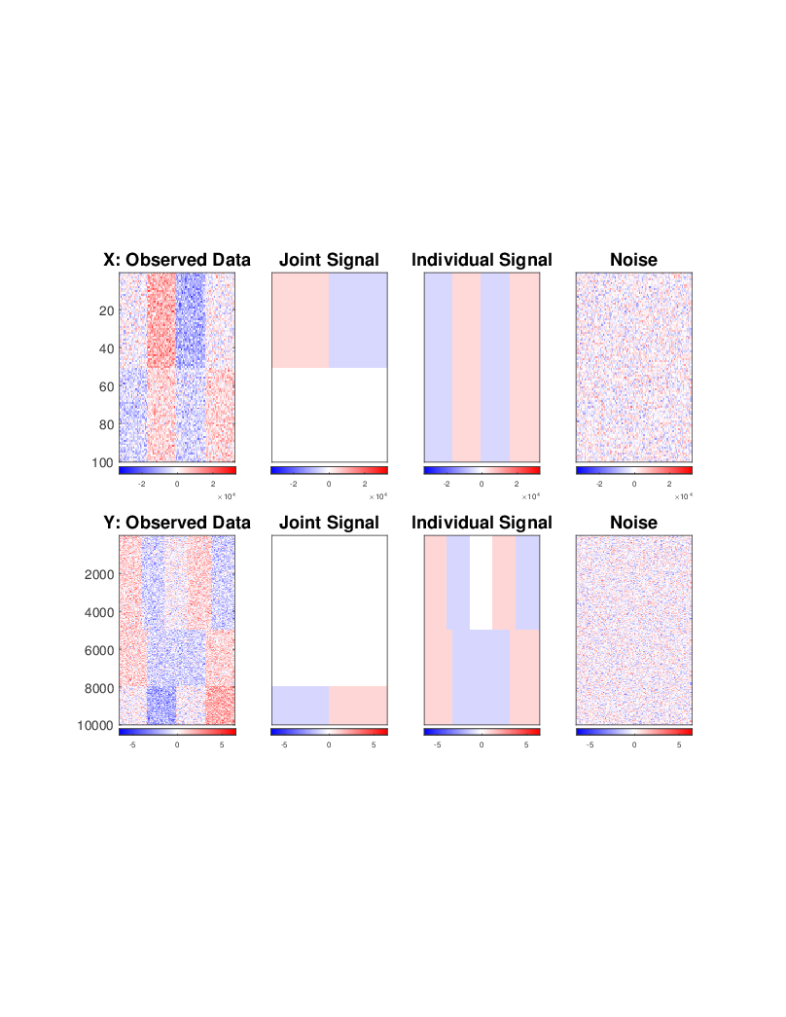
JIVE Toy Example
“Heat Map” View
Based on Color Bar
Red for > 0
White for = 0
Blue for < 0
Intensity shows magnitude

Slide 48
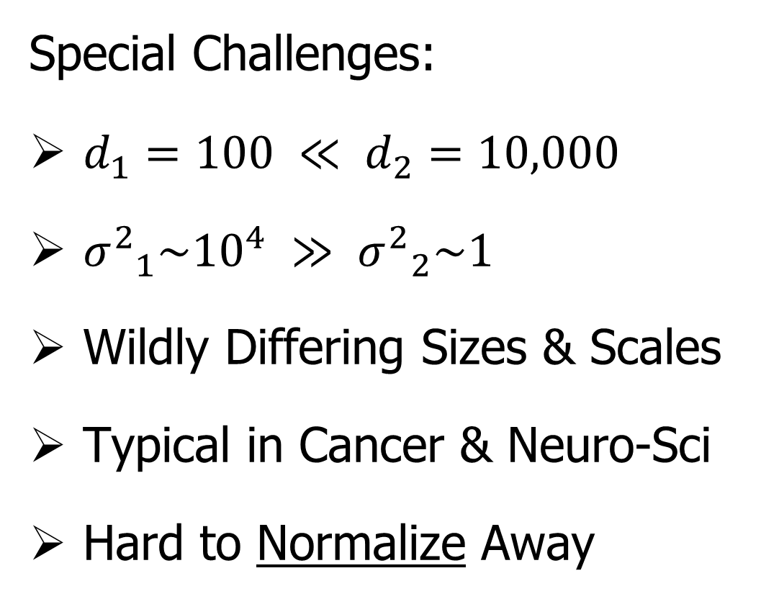
JIVE Toy Example
Special Challenges:
$d_{1}=100 ≪ d_{2}=10,000$
${σ^{2}}_{1}\sim {10}^{4} ≫ {σ^{2}}_{2}\sim 1$
Wildly Differing Sizes & Scales
Typical in Cancer & Neuro-Sci
Hard to Normalize Away

Slide 49
JIVE Toy Example
Underlying Components
(Additive
Signals +
+ Noise)

Slide 50
JIVE Toy Example
Underlying Components:
Joint – Rank 1
Same
“Subject
Signal”
(linear combo)

Slide 51
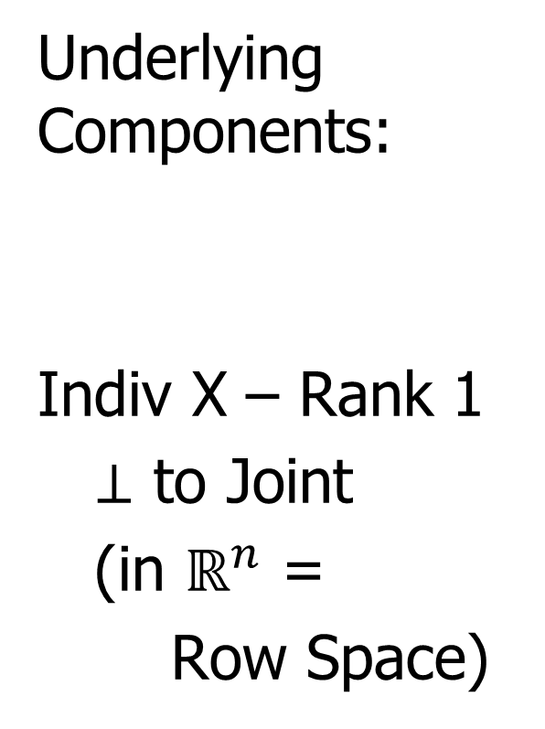
JIVE Toy Example
Underlying Components:
Indiv X – Rank 1
$⊥$ to Joint
(in $ℝ^{n}$ =
Row Space)

Slide 52
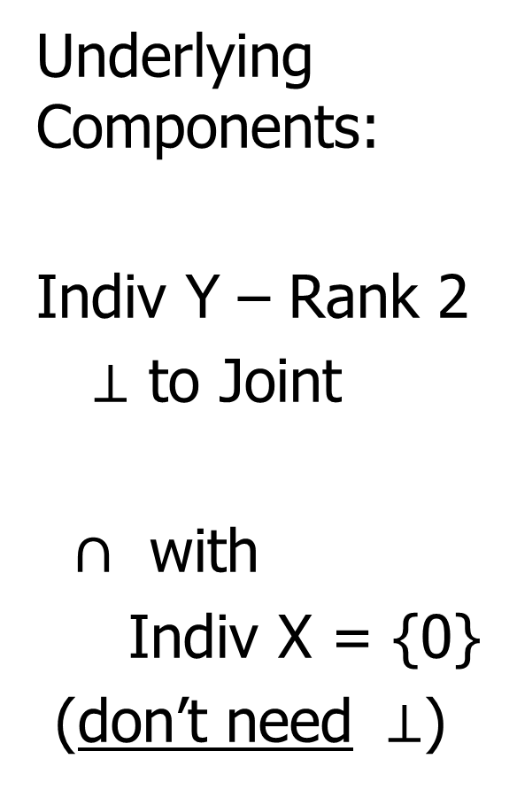
JIVE Toy Example
Underlying Components:
Indiv Y – Rank 2
$⊥$ to Joint
$∩$ with
Indiv X = {0}
(don’t need $⊥$)

Slide 53
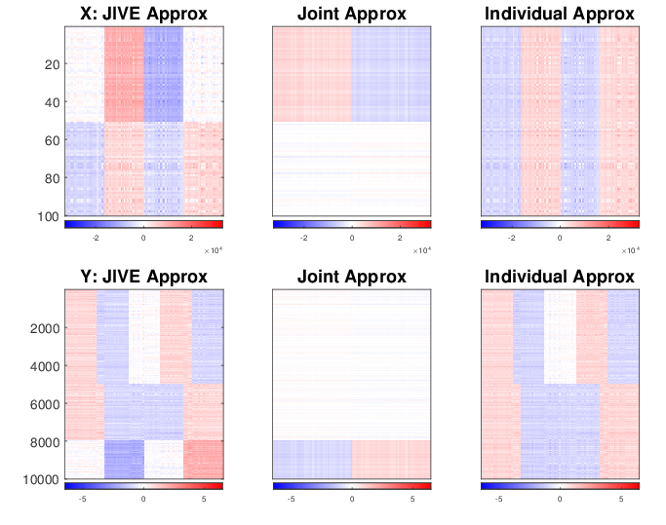
JIVE Toy Example
AJIVE: Excellent Decomposition (Both Joint and Individual)

Slide 54
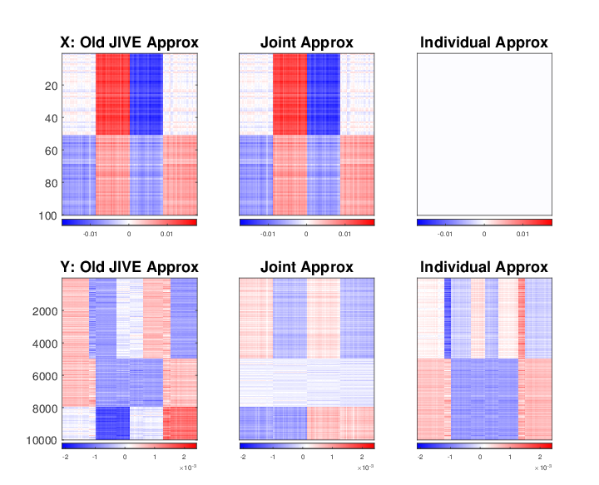
JIVE Toy Example (Original JIVE)
Early JIVE (Lock et al, 2013):
Good 2-d Approx. – Missed Joint-Ind Decomp.

Slide 55
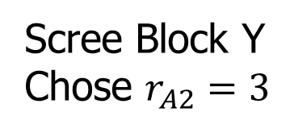
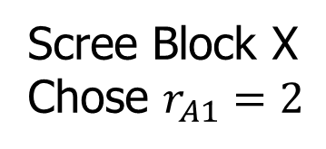
JIVE Toy Example
A Look Under the Hood: Recall Scree Plots
Easy in this Simple Case
Scree Block X
Chose $r_{A1}=2$
Scree Block Y
Chose $r_{A2}=3$

Slide 56
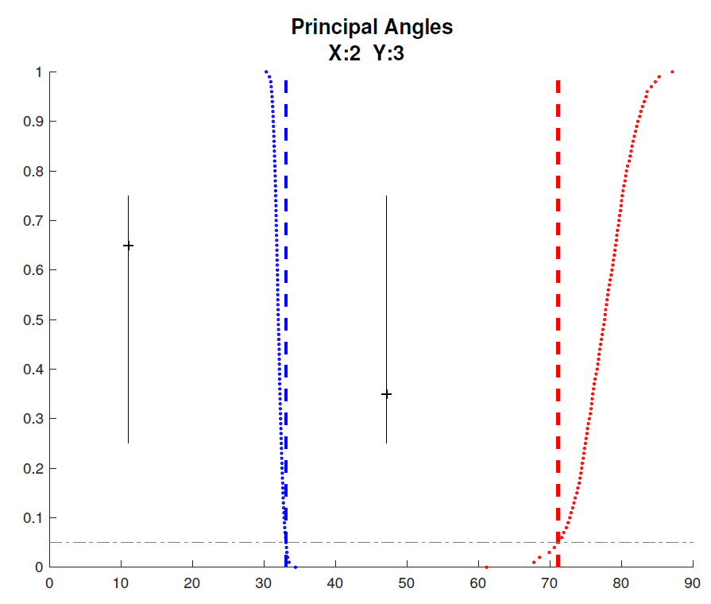

JIVE Toy Example
Well Chosen Initial Ranks, $r_{A1}=2$, $r_{A2}=3$
Diagnostic Plot:
1st Principal Angle
(Joint + noise)
Conclude
Neither Is
Random
Conclude
Larger
Not Joint
2nd Principal Angle
(Small Indiv. + )
Random Subspaces
Distribution & Quantile
Wedin Bound Estimates
Distribution & Quantile

Slide 57
JIVE Toy Example
Relatively Small
Angle Between
Row Spaces

Slide 58
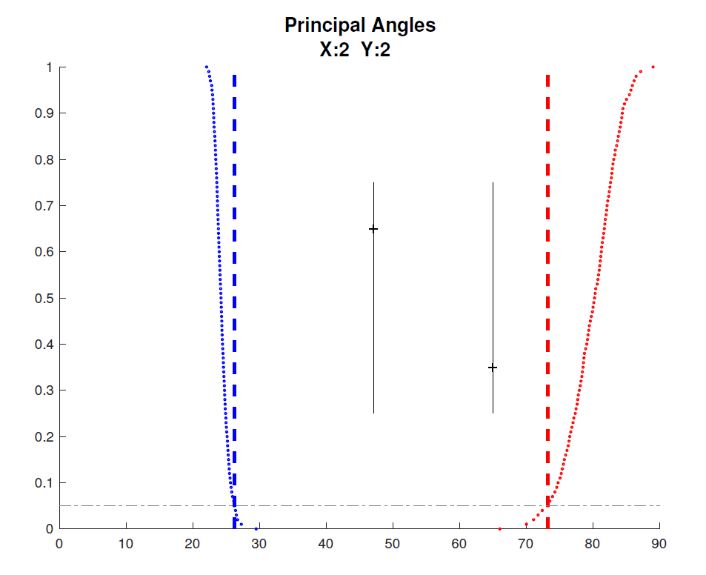

JIVE Toy Example
Choose $r_{A2}=2$, Too Small (Lose Info)
Diagnostic Plot:
Both Principal Angles
Larger (Lost Info)
Neither is Random
Neither is Joint
Since Joint Signal in Y
Relatively Small

Slide 59
JIVE Toy Example
Relatively
Less Signal
In Y Joint
Component

Slide 60
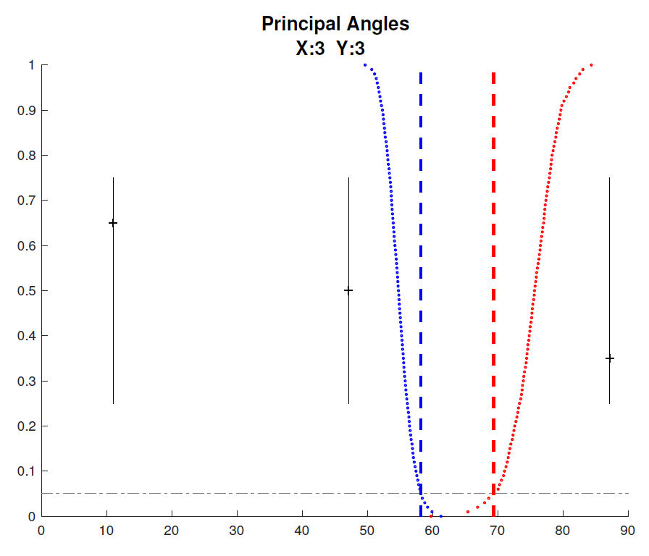


JIVE Toy Example
Choose $r_{A1}=3$, Too Big (Feels Noise)
Diagnostic Plot:
Now 3 Principal Angles
3rd Could be Random
(OK, Since True $r_{A1}=2$)
2nd Could be Joint
(Consequence of Poor
Wedin Approximation)

Slide 61
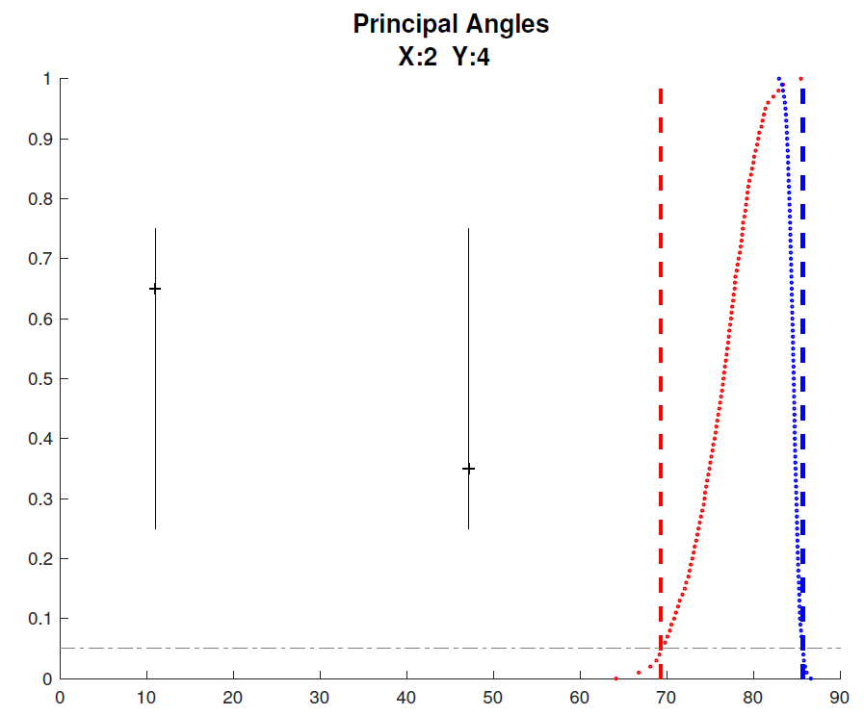


JIVE Toy Example
Choose $r_{A2}=4$, Too Big (Feels Noise)
Diagnostic Plot:
Wedin Bound Useless
$>$Random Subspace Bound
Due to High Noise
Neither Angle Random
Both Could Be Joint
Not Much Info Here

Slide 62





DIVAS / JIVE Collaborators
Jan Hannig
Meilei Jiang
Xi Yang
Iain Carmichael
Jack Prothero

Slide 63
DIVAS Improves JIVE
Partially Shared Blocks

Slide 64


DIVAS Improves JIVE
Partially Shared Blocks
JIVE
$$≈$$
$$+$$
Input
Data
Joint
Comp.
Indiv.
Comp.

Slide 65


DIVAS Improves JIVE
Partially Shared Blocks
DIVAS
$$≈$$
$$+$$
$$+$$
$$+$$
$$+$$
Input
Data
Joint
Comp.
Partial
Sharing
Indiv.
Comp.

Slide 66
DIVAS Improves JIVE
Partially Shared Blocks
Better Initial Low Rank Approx. (SVD)
  Using Marcenko-Pastur & Shrinkage
  Inference from Random Direction Bounds
  Iterative Search Approach
Gives Better Statistical Inference

Slide 67

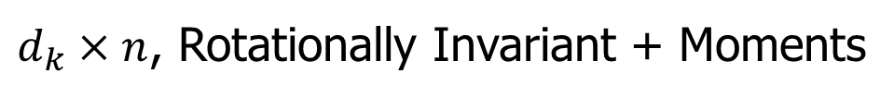
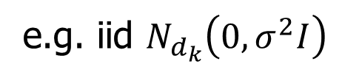
DIVAS Improves JIVE
Statistical Inference Assumptions:
= $+ ε$
Low
Rank
Signal
Data
Block
$d_{k}×n$, Rotationally Invariant + Moments
e.g. iid $N_{d_{k}}\left(0,σ^{2}I\right)$

Slide 68
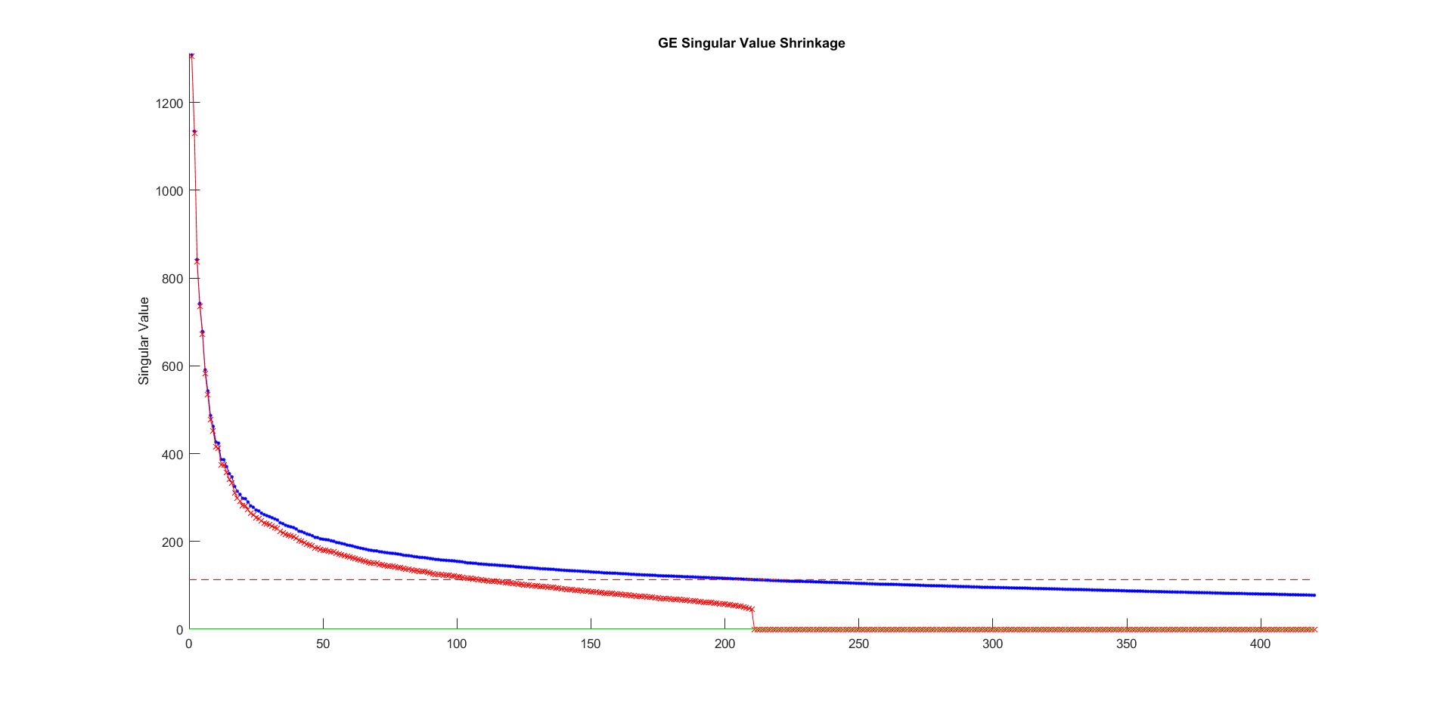
DIVAS Improves JIVE
2a. Marcenko-Pastur & Shrinkage
E.g. Gene Expression
Data Block
Shabalin-Nobel
&
Gavish-Donoho
Shrinkage

Slide 69
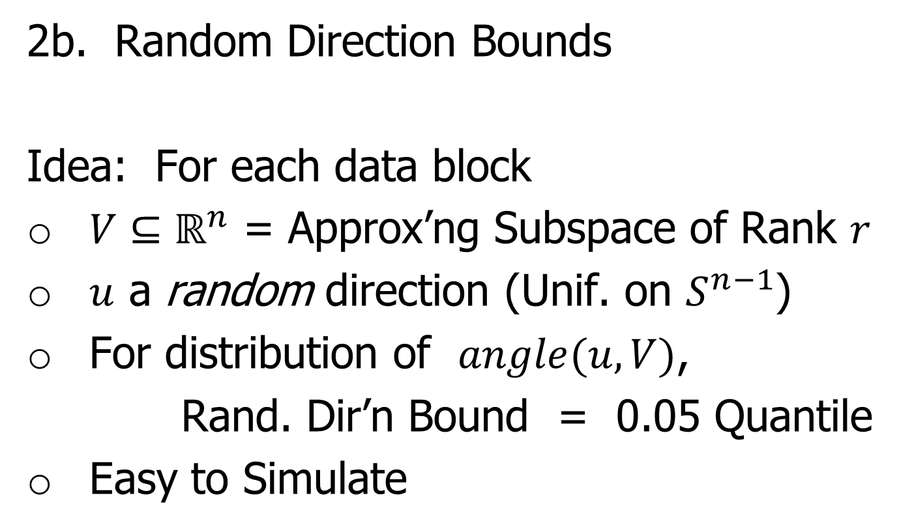
DIVAS Improves JIVE
2b. Random Direction Bounds
Idea: For each data block
$V⊆ℝ^{n}$ = Approx’ng Subspace of Rank $r$
$u$ a random direction (Unif. on $S^{n−1}$)
For distribution of $angle(u,V)$,
Rand. Dir’n Bound = 0.05 Quantile
Easy to Simulate

Slide 70
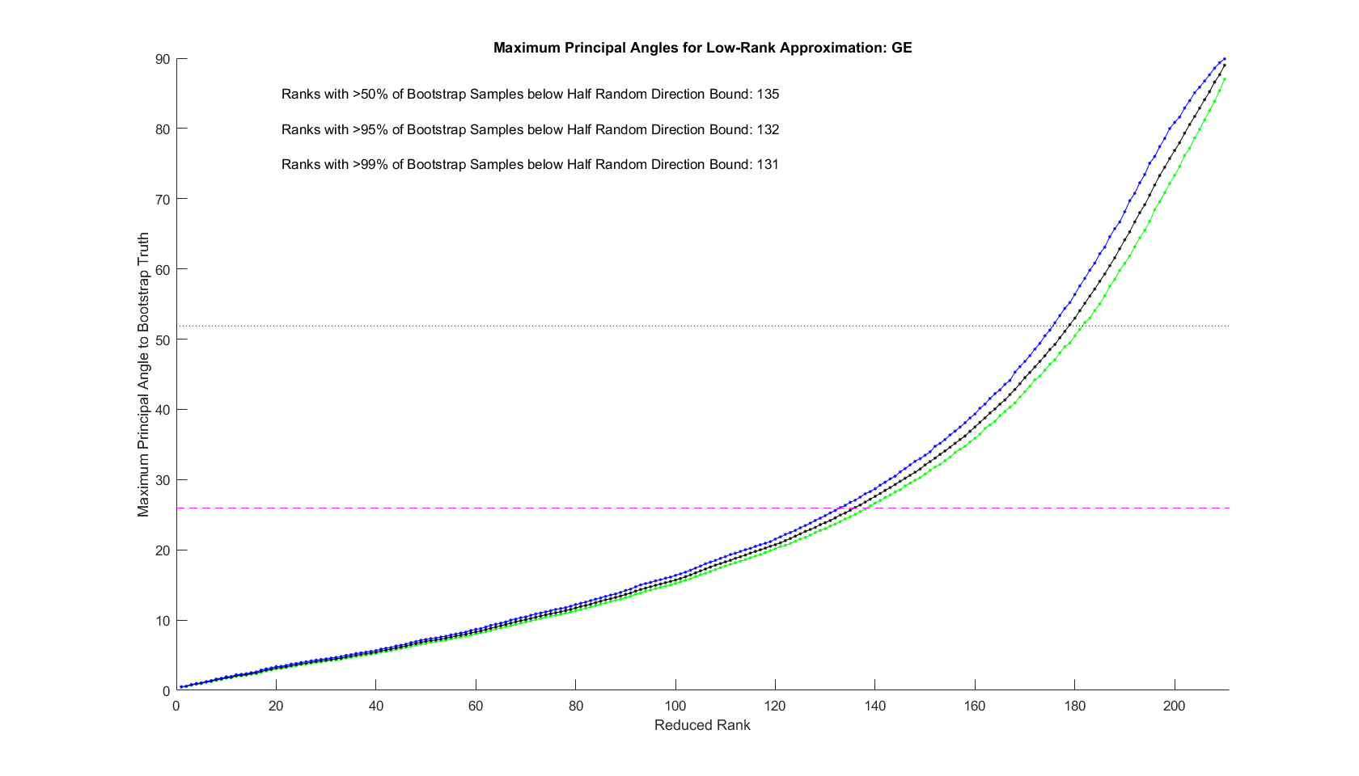
DIVAS Improves JIVE
2b. Random Direction Bounds
E.g. Gene Expression
Data Block

Slide 71
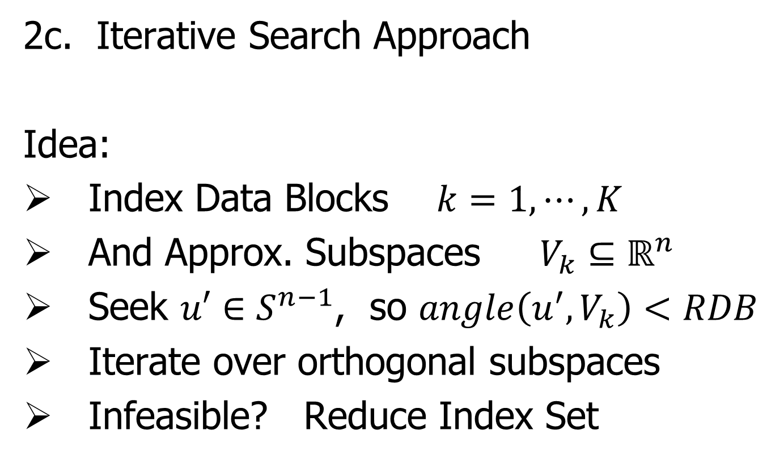
DIVAS Improves JIVE
2c. Iterative Search Approach
Idea:
Index Data Blocks $k=1,⋯,K$
And Approx. Subspaces $V_{k}⊆ℝ^{n}$
Seek ${u′∈S}^{n−1}$, so $angle\left(u^{′},V_{k}\right)<RDB$
Iterate over orthogonal subspaces
Infeasible? Reduce Index Set

Slide 72
DIVAS on TCGA Data
Breast Cancer
Gene Expression (GE) [16615 x 616]
Copy Number (CN) [24174 x 616]
Protein Exp. (RPPA) [187 x 616]
Mutation Status (MU) [18256 x 616]

Slide 73

DIVAS on TCGA Data
Color Coded Share Types
Counts of
Directions
in Each
Statistical Significance Summary

Slide 74



Functional Magnetic Resonance Imaging
2015 SAMSI Program
On Neuroscience
Qunqun Yu Benjamin Risk

Slide 75

Functional Magnetic Resonance Imaging
Data
Objects?
3d- Movie?
Time Series
At Voxels?
Thanks to fmri.ucsd.edu

Slide 76


Functional Magnetic Resonance Imaging
Study Data From:

Slide 77

Functional Magnetic Resonance Imaging
Data Objects: $n=491$
X: Behavioral Features
$$d=139$$
Y: 3-d Voxel Summaries of Task
(Condense Time Series to Single #s)
$$d=91282$$
(Registered Voxels Along Cerebral Cortex)

Slide 78
Functional Magnetic Resonance Imaging
Focus of Analysis:
Loadings (Drivers)
  Behavioral Features
  Lit Up Brain Regions
Since Scores All Gaussian
(Normal Population)
Which Work
Together?
Which Work
Separately?

Slide 79
Functional Magnetic Resonance Imaging
View Entries of Eigenvectors
Separate
PC1 of
Behavior
Feature
Loadings
Important
Groups

Slide 80


Functional Magnetic Resonance Imaging
View Entries of Eigenvectors
Separate PC1 of Image Loadings
All Up
& Down
Together
Also Some
Hot Spots?

Slide 81

Functional Magnetic Resonance Imaging
Separate PC2 of Image Loadings
Interesting
Structure
???
And Same
Hot Spots?

Slide 82

Functional Magnetic Resonance Imaging
Previous Mapping of Regions of Interest
Hot Spots
Are
Working
Memory
Related

Slide 83

Functional Magnetic Resonance Imaging
Joint PC1 of Image Loadings
Using
Behavior
Combines
Hot Spots
From
Separate
PC1 & 2

Slide 84

Functional Magnetic Resonance Imaging
Overall
Comparison
Sep. Beh. PC1
Assoc. w. Image
Joint Im. PC1
Concentrates
Relevant Parts
Of Sep.
PC1 & PC2

Slide 85
Functional Magnetic Resonance Imaging
Overall
Comparison
Overall Heat
Var’n not
Assoc. w/
Behavior
New 2nd Mode
Of Joint Var’n
Behavior
~ Sep. PC2

