Slide 1
Matlab Software
To Do Analyses as in Marron’s Talks
Matlab Available from UNC Site License
Download Software:
Google “Marron Software”

Slide 2
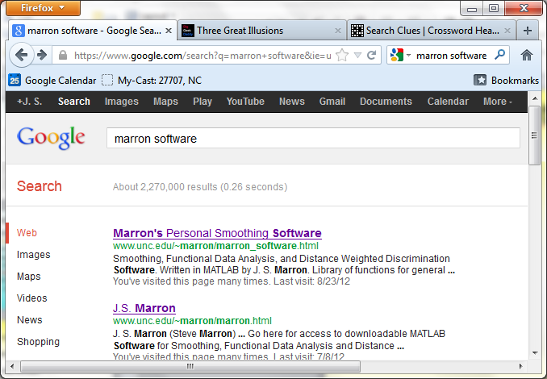
Matlab Software
Choose

Slide 3
Matlab Software
Download .zip File, & Expand to 3 Directories

Slide 4
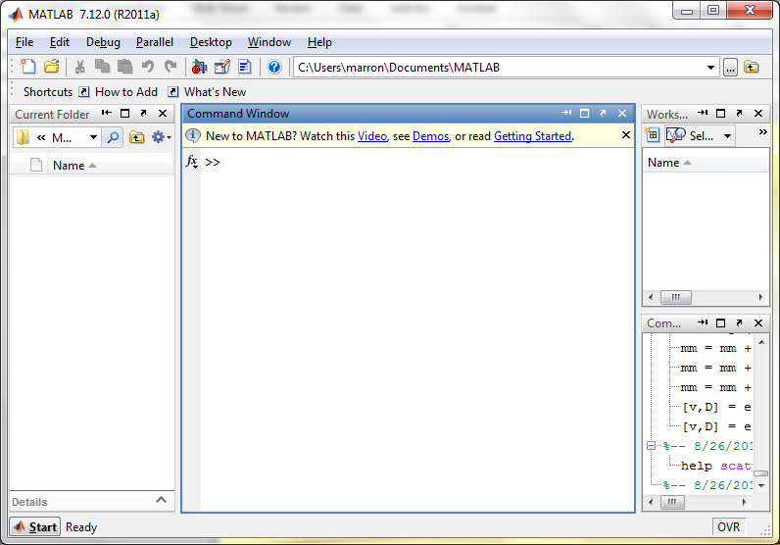
Matlab Software
Put these is Matlab Path

Slide 5
Matlab Software
Put these is Matlab Path

Slide 6
Matlab Basics
Matlab has Modalities:
Interpreted (Type Commands)
Batch (Run “Script Files”)

Slide 7
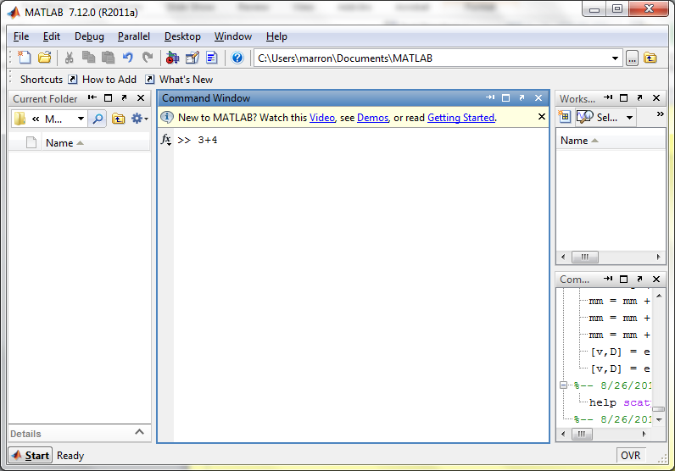
Matlab Basics
Matlab in Interpreted Mode:

Slide 8
Matlab Basics
Matlab in Interpreted Mode:

Slide 9
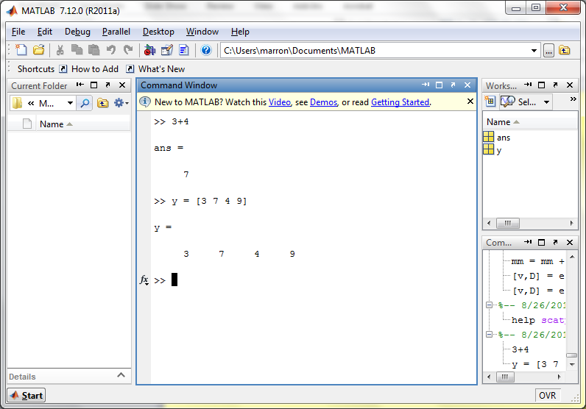
Matlab Basics
Matlab in Interpreted Mode:

Slide 10
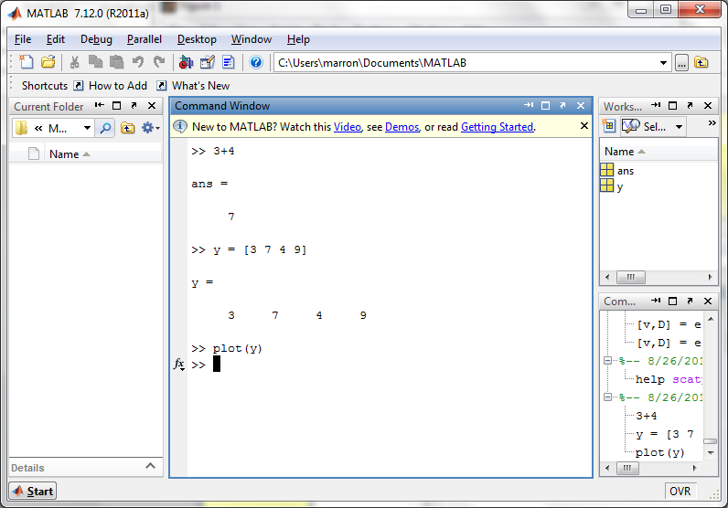
Matlab Basics
Matlab in Interpreted Mode:

Slide 11
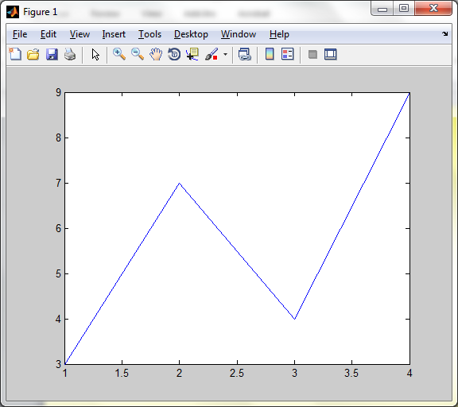
Matlab Basics
Matlab in Interpreted Mode:

Slide 12
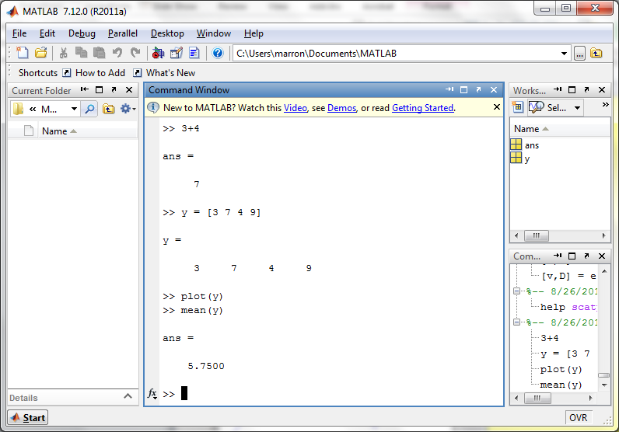
Matlab Basics
Matlab in Interpreted Mode:

Slide 13
Matlab Basics
Matlab in Interpreted Mode:
For description of a function:
>> help [function name]

Slide 14
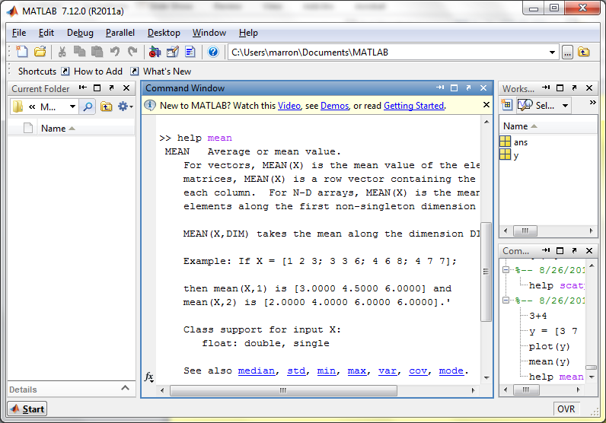
Matlab Basics
Matlab in Interpreted Mode:

Slide 15
Matlab Basics
Matlab in Interpreted Mode:
To Find Functions:
>> help [category name]
e.g.
>> help stats

Slide 16
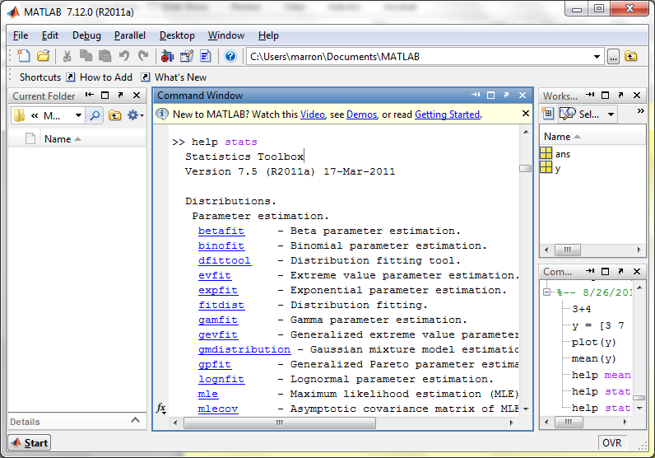
Matlab Basics
Matlab in Interpreted Mode:

Slide 17
Matlab Basics
Matlab has Modalities:
Interpreted (Type Commands)
Batch (Run “Script Files”)
For Serious Scientific Computing:
Always Run Scripts

Slide 18
Matlab Basics
Matlab Script File:
Just a List of Matlab Commands
Matlab Executes Them in Order
Why Bother (Why Not Just Type Commands)?
Reproducibility
(Can Find Mistakes & Use Again Much Later)

Slide 19
Matlab Script Files
An Example:
Recall “Brushing Analysis” of
Next Generation Sequencing Data

Slide 20
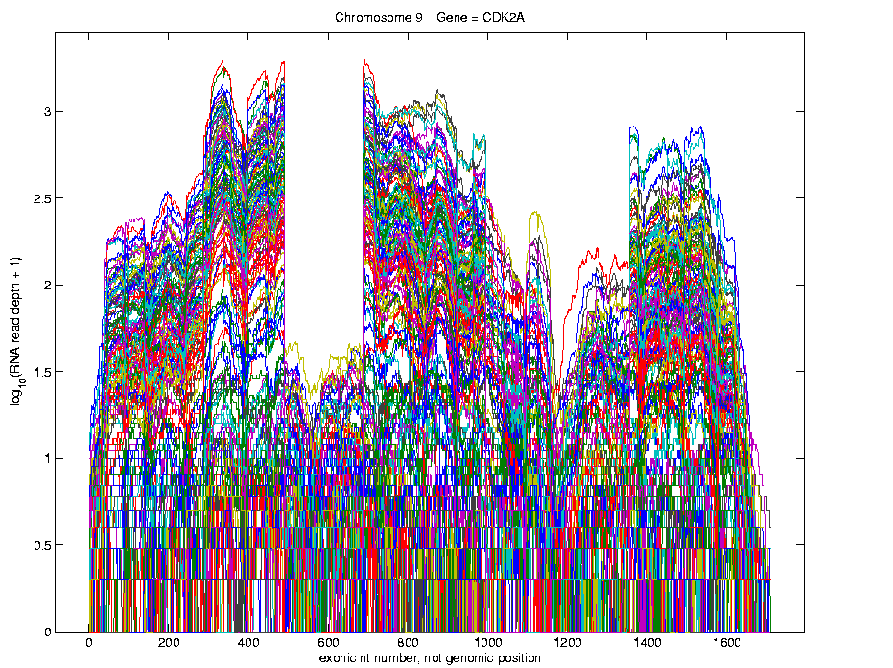
Functional Data Analysis
Simple
1st
View:
Curve
Overlay
(log
scale)

Slide 21
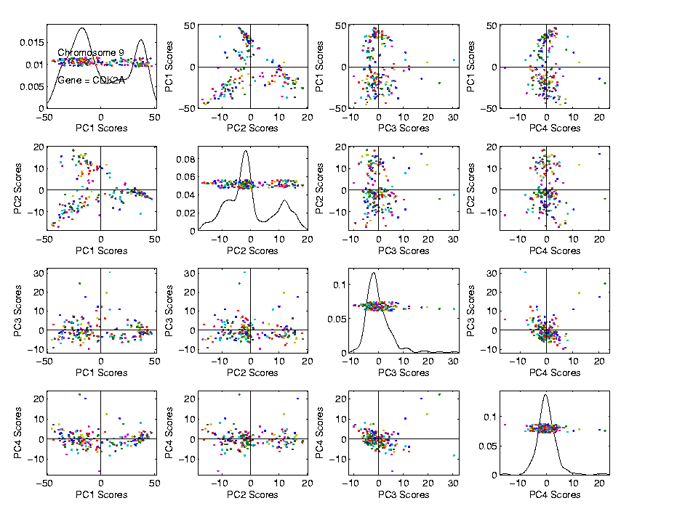
Functional Data Analysis
Often
Useful
Population
View:
PCA
Scores

Slide 22
Functional Data Analysis
Suggestion
Of
Clusters
???

Slide 23
Functional Data Analysis
Suggestion
Of
Clusters
Which
Are
These?

Slide 24
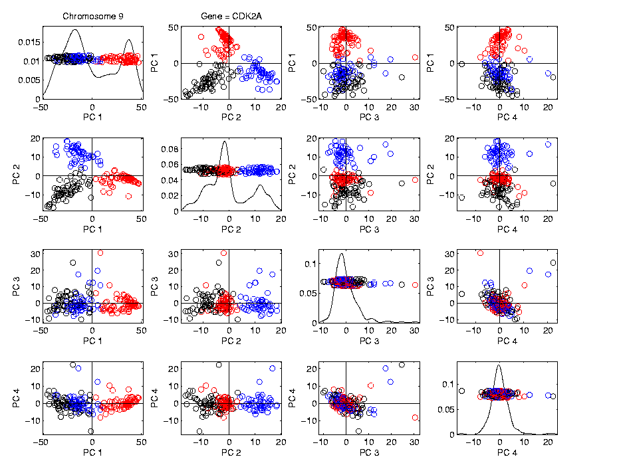
Functional Data Analysis
Manually
“Brush”
Clusters

Slide 25
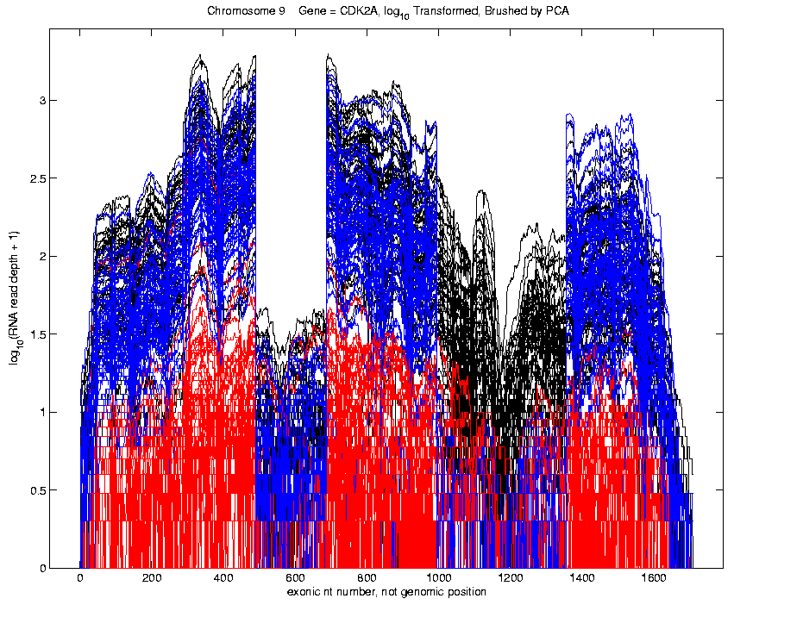
Functional Data Analysis
Manually
Brush
Clusters
Clear
Alternate
Splicing

Slide 26
Matlab Script Files
An Example:
Recall “Brushing Analysis” of
Next Generation Sequencing Data
Analysis In Script File:
VisualizeNextGen2011.m
Matlab Script File Suffix

Slide 27
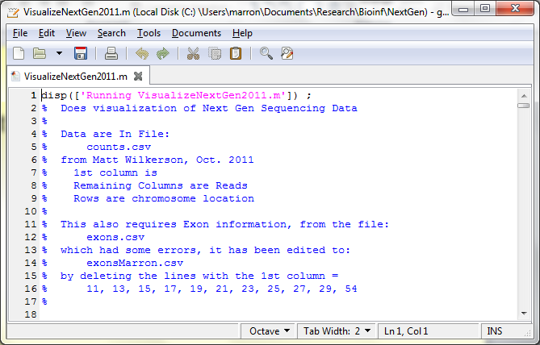
Matlab Script Files
String of Text

Slide 28
Matlab Script Files
Command to Display String to Screen

Slide 29
Matlab Script Files
Notes About Data (Maximizes Reproducibility)

Slide 30
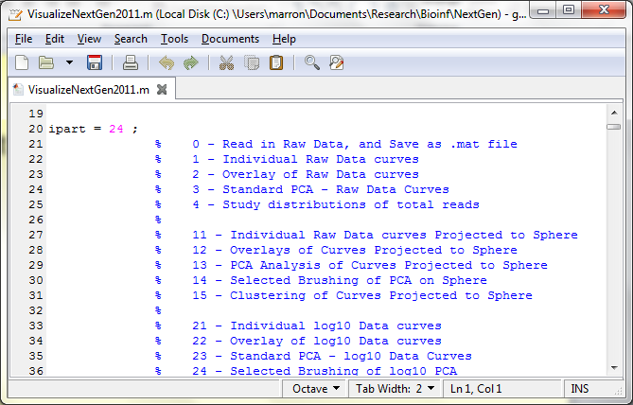
Matlab Script Files
Have Index for Each Part of Analysis

Slide 31
Matlab Script Files
So Keep Everything Done (Max’s Reprod’ity)

Slide 32
Matlab Script Files
Note Some Are Graphics Shown (Can Repeat)

Slide 33
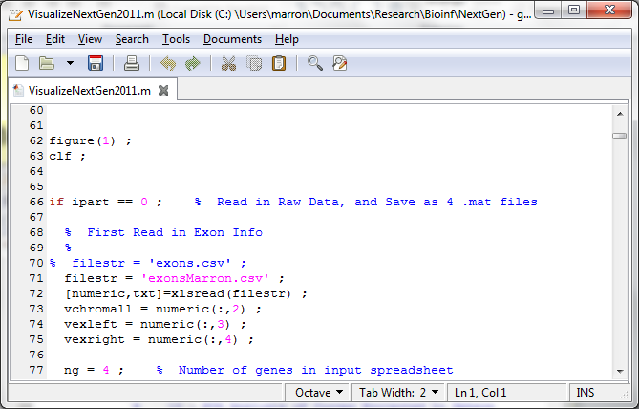
Matlab Script Files
Set Graphics to Default

Slide 34
Matlab Script Files
Put Different Program Parts in IF-Block

Slide 35
Matlab Script Files
Comment Out Currently Unused Commands

Slide 36
Matlab Script Files
Read Data from Excel File

Slide 37
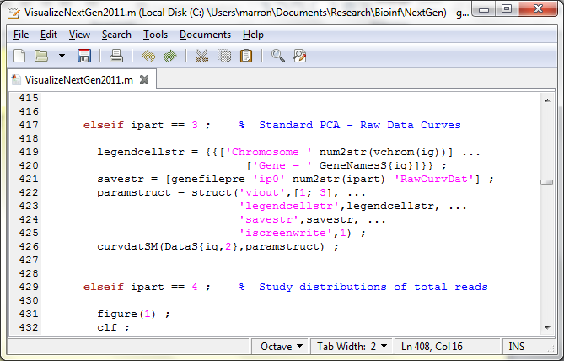
Matlab Script Files
For Generic Functional Data Analysis:

Slide 38
Matlab Script Files
Input Data Matrix

Slide 39
Matlab Script Files
Structure, with Other Settings

Slide 40
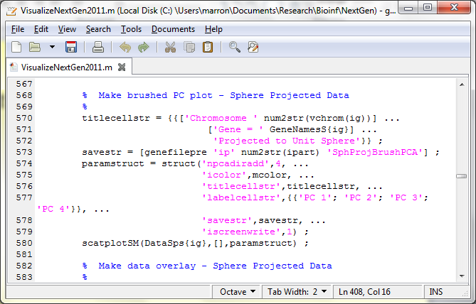
Matlab Script Files
Make Scores Scatterplot

Slide 41
Matlab Script Files
Uses Careful Choice of Color Matrix

Slide 42
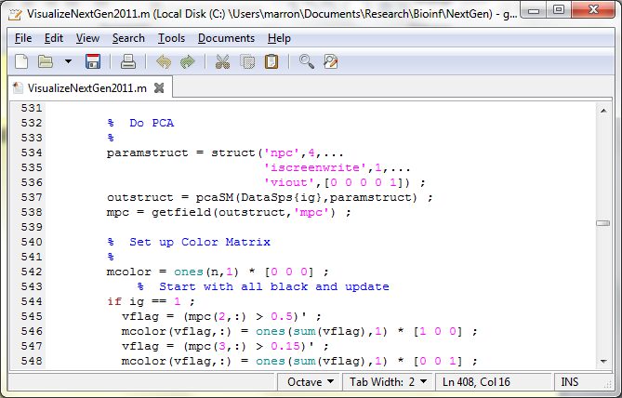
Matlab Script Files
Start with PCA

Slide 43
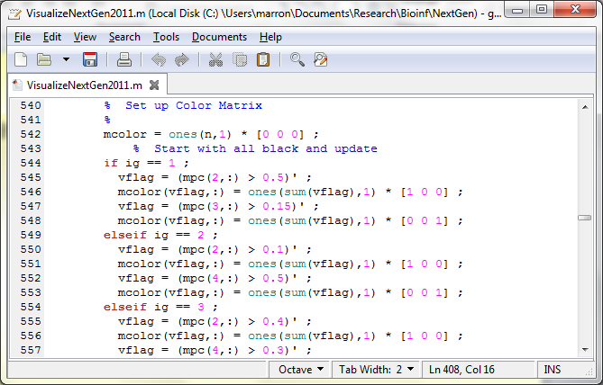
Matlab Script Files
Then Create Color Matrix

Slide 44
Matlab Script Files
Black Red Blue

Slide 45
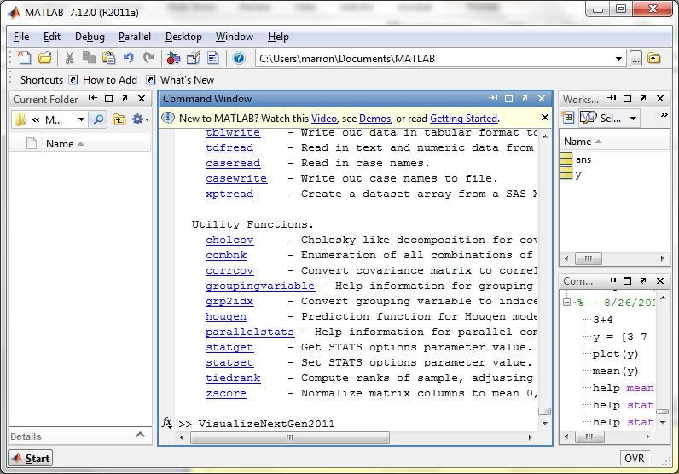
Matlab Script Files
Run Script Using Filename as a Command

