Slide 1
Statistics – O. R. 891
Object Oriented Data Analysis
J. S. Marron
Dept. of Statistics and Operations Research
University of North Carolina

Slide 2
Participant Presentations
Now:
Scheduled
Posted on Course Web Page
(Google: “stor 891 marron”)

Slide 3
Participant Presentations
Now:
Scheduled
Posted on Course Web Page
(Google: “stor 891 marron”)
Please Send (Tentative) Titles

Slide 4
Guest Lectures
Due to my Travels
On Topics I Would Include
By Person Who Did Actual Work
Announced on Course Web Page

Slide 5
Guest Lectures
Oct. 9: Susan Wei
DiProPerm High Dimensional Hypothesis Testing
Oct. 11: Dan Shen
HDLSS Sparse PCA & Big Picture PCA Asymptotics
Oct. 16: Xiaosun Lu
Cell-Well Data Objects & Fisher Rao Curve Warping
Oct. 18: Fall Break

Slide 6
Review of Linear Algebra (Cont.)
Eigenvalue Decomp. Solves Matrix Problems:
Inversion:
Square Root:
is Positive (Nonn’ve, i.e. Semi) Definite all

Slide 7
Review of Multivar. Prob. (Cont.)
Outer Product Representation:
,
Where:

Slide 8
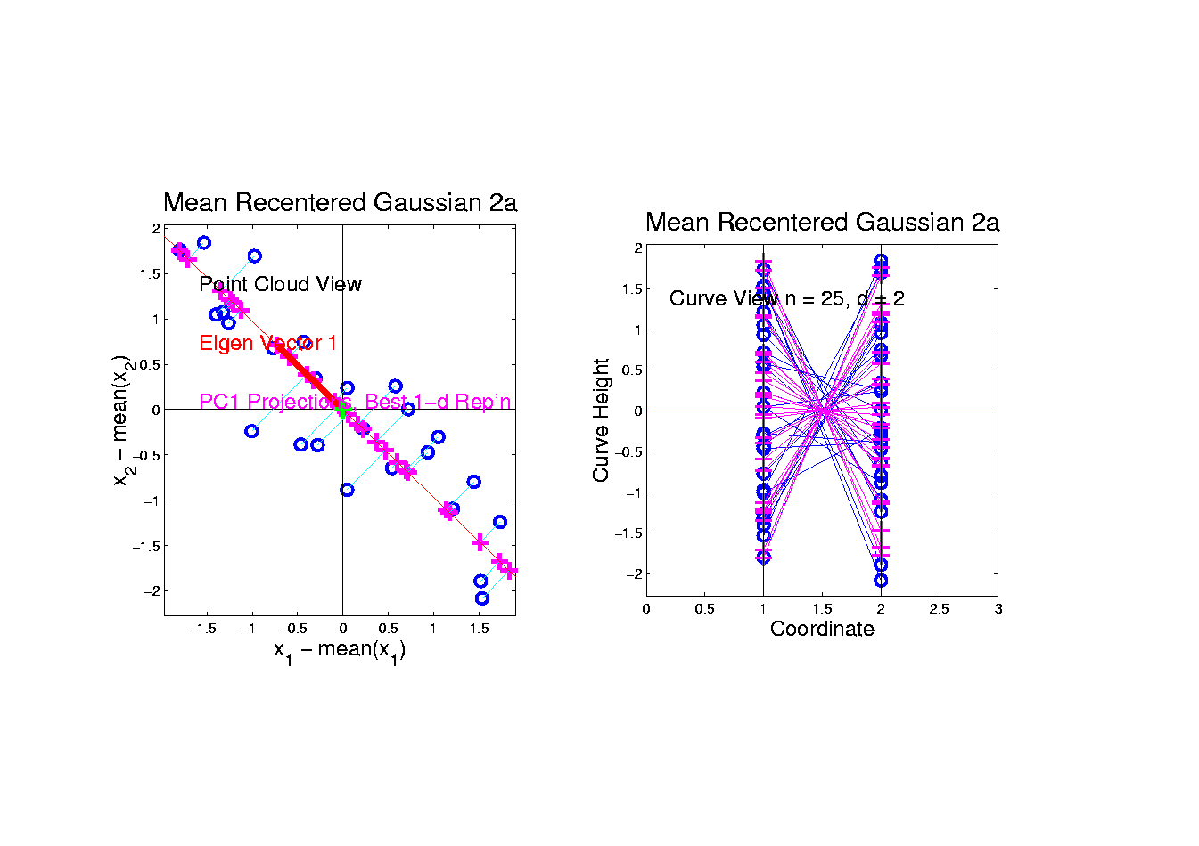
PCA as an Optimization Problem
Find Direction of Greatest Variability:
Raw Data
Projections
Direction
Vector

Slide 9
PCA as Optimization (Cont.)
Now since is an Orthonormal Basis Matrix,
and
So the Rotation Gives a Distribution of the (Unit) Energy of Over the Eigen-Directions
And is Max’d (Over ), by Putting all Energy in the “Largest Direction”, i.e. ,
Where “Eigenvalues are Ordered”,

Slide 10
Connect Math to Graphics (Cont.)
2-d Toy Example
Feature Space Object Space
Centered Data PC1 Projection Residual
Best 1-d Approx’s of Data

Slide 11
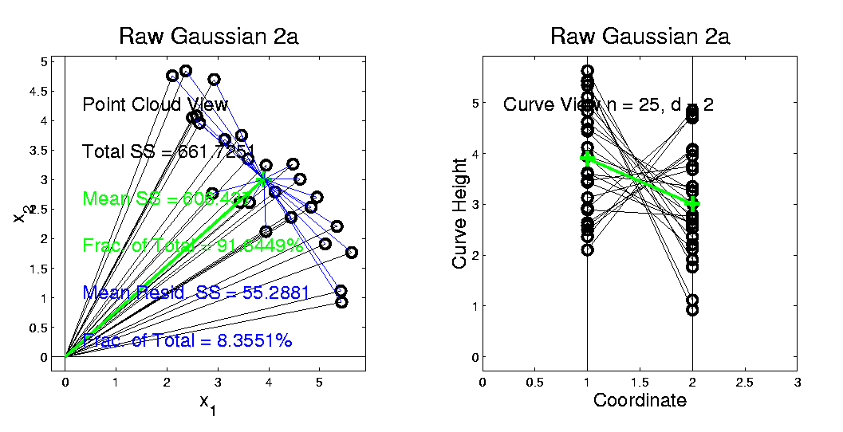
Connect Math to Graphics (Cont.)
2-d Toy Example
Feature Space Object Space
Residuals from Mean = Data – Mean
Most of Variation = 92% is Mean Variation SS
Remaining Variation = 8% is Resid. Var. SS

Slide 12
PCA Redist’n of Energy (Cont.)
Eigenvalues Provide Atoms of SS Decompos’n
Useful Plots are:
Power Spectrum: vs.
log Power Spectrum: vs.
Cumulative Power Spectrum: vs.
Note PCA Gives SS’s for Free (As Eigenval’s),
But Watch Factors of
Notes:
12

Slide 13
PCA Data Represent’n (Cont.)
Reduced Rank Representation:
Reconstruct Using Only Terms
(Assuming Decreasing Eigenvalues)
Gives: Rank Approximation of Data
Key to PCA Dimension Reduction

Slide 14
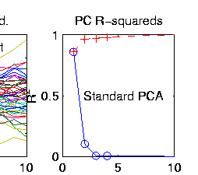
PCA Data Represent’n (Cont.)
Choice of in Reduced Rank Represent’n:
Generally Very Slippery Problem
SCREE Plot (Kruskal 1964):
Find Knee in Power Spectrum

Slide 15
PCA Data Represent’n (Cont.)
SCREE Plot Drawbacks:
What is a Knee?
What if There are Several?
Knees Depend on Scaling (Power? log?)
Personal Suggestions:
Find Auxiliary Cutoffs (Inter-Rater Variation)
Use the Full Range (ala Scale Space)

Slide 16
PCA Simulation
Idea: given
Mean Vector
Eigenvectors
Eigenvalues
Simulate data from Corresponding Normal Distribution

Slide 17
PCA Simulation
Idea: given
Mean Vector
Eigenvectors
Eigenvalues
Simulate data from Corresponding Normal Distribution
Approach: Invert PCA Data Represent’n
where

Slide 18
PCA & Graphical Displays
Small caution on PC directions & plotting:
PCA directions (may) have sign flip
Mathematically no difference
Numerically caused artifact of round off
Can have large graphical impact

Slide 19
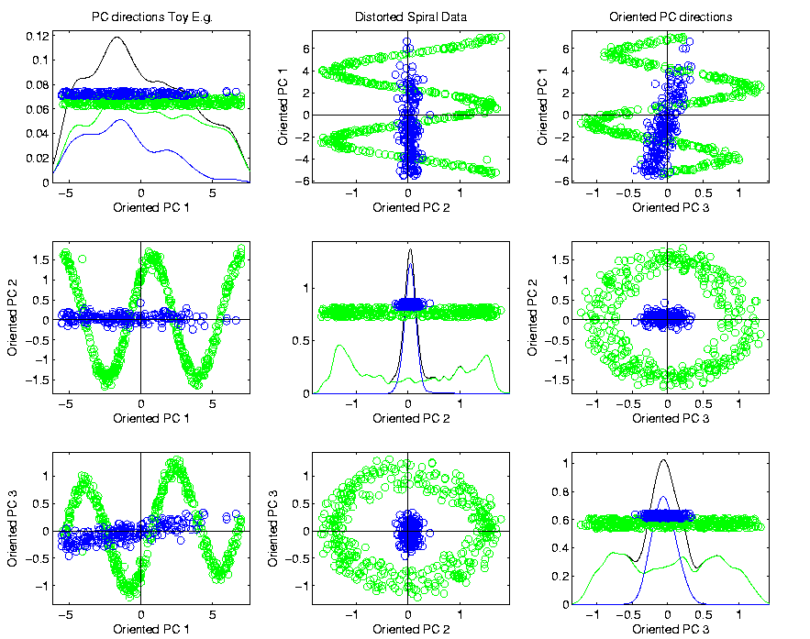
PCA & Graphical Displays
Toy Example (2 colored “clusters” in data)

Slide 20

PCA & Graphical Displays
Toy Example (1 point moved)

Slide 21
PCA & Graphical Displays
Toy Example (1 point moved)
Important
Point:
Constant
Axes

Slide 22
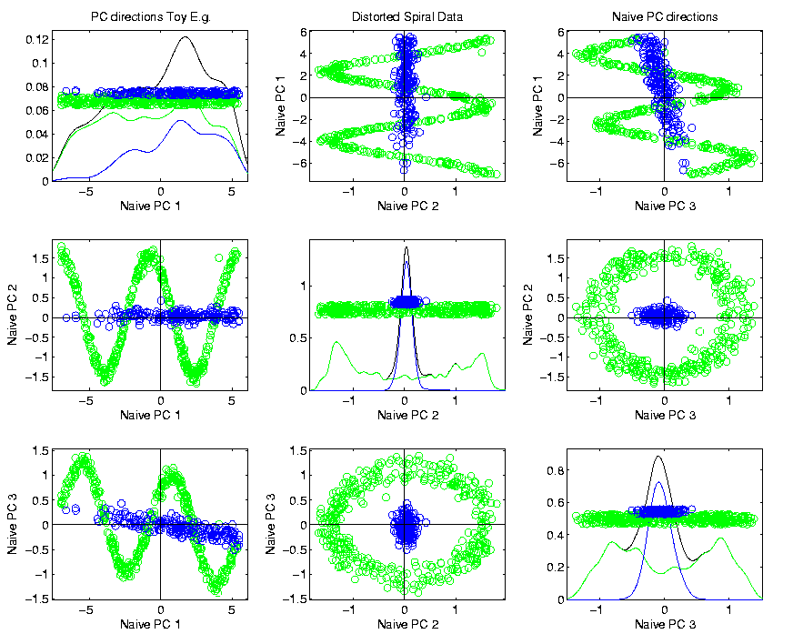
PCA & Graphical Displays
Original Data (arbitrary PC flip)

Slide 23
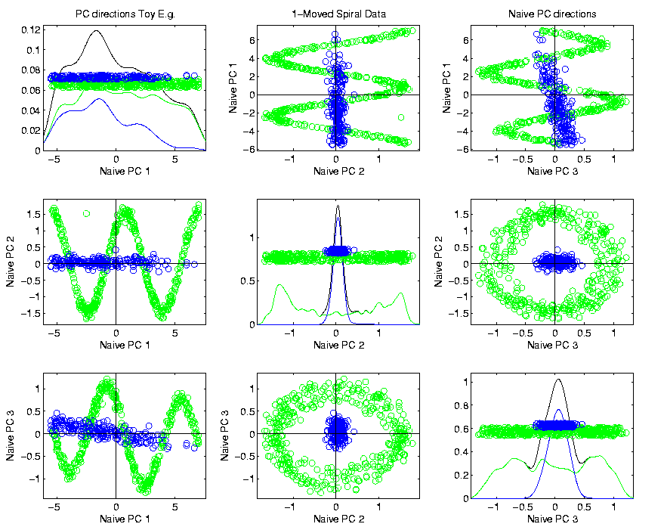
PCA & Graphical Displays
Point Moved Data (arbitrary PC flip)
Much
Harder
To See
Moving
Point

Slide 24
PCA & Graphical Displays
How to “fix directions”?
Personal approach:
Use ± 1 flip that gives:
Max(Proj(X_{i})) > |Min(Proj(X_{i}))|
(assumes 0 centered)

Slide 25
Alternate PCA Computation
Issue: for HDLSS data (recall )
May be Quite Large,

Slide 26
Alternate PCA Computation
Issue: for HDLSS data (recall )
May be Quite Large,
Thus Slow to Work with, and to Compute
What About a Shortcut?

Slide 27
Alternate PCA Computation
Issue: for HDLSS data (recall )
May be Quite Large,
Thus Slow to Work with, and to Compute
What About a Shortcut?
Approach: Singular Value Decomposition
(of (centered, scaled) Data Matrix )

Slide 28
Alternate PCA Computation
Singular Value Decomposition:

Slide 29
Alternate PCA Computation
Singular Value Decomposition:
Where:
is Unitary
is Unitary
is diag’l matrix of singular val’s

Slide 30
Alternate PCA Computation
Singular Value Decomposition:
Where:
is Unitary
is Unitary
is diag’l matrix of singular val’s
Assume: decreasing singular values

Slide 31
Alternate PCA Computation
Singular Value Decomposition:
Recall Relation to Eigen-Analysis of

Slide 32
Alternate PCA Computation
Singular Value Decomposition:
Recall Relation to Eigen-Analysis of
Thus have Same Eigenvector Matrix

Slide 33
Alternate PCA Computation
Singular Value Decomposition:
Recall Relation to Eigen-Analysis of
Thus have Same Eigenvector Matrix
And Eigenval’s are Squares of Singular Val’s

Slide 34
Alternate PCA Computation
Singular Value Decomposition,
Computational Advantage (for Rank ):
Use Compact Form, only need to find
e-vec’s s-val’s scores

Slide 35
Alternate PCA Computation
Singular Value Decomposition,
Computational Advantage (for Rank ):
Use Compact Form, only need to find
e-vec’s s-val’s scores
Other Components not Useful

Slide 36
Alternate PCA Computation
Singular Value Decomposition,
Computational Advantage (for Rank ):
Use Compact Form, only need to find
e-vec’s s-val’s scores
Other Components not Useful
So can be much faster for

Slide 37
Alternate PCA Computation
Another Variation: Dual PCA
Idea: Useful to View Data Matrix

Slide 38
Alternate PCA Computation
Another Variation: Dual PCA
Idea: Useful to View Data Matrix as
Col’ns as Data Objects

Slide 39
Alternate PCA Computation
Another Variation: Dual PCA
Idea: Useful to View Data Matrix as Both
Col’ns as Data Objects
&
Rows as Data Objects

Slide 40
Alternate PCA Computation
Aside on Row-Column Data Object Choice:
Col’ns as Data Objects
&
Rows as Data Objects

Slide 41
Alternate PCA Computation
Aside on Row-Column Data Object Choice:
Personal Choice: (~Matlab,Linear Algebra)
Col’ns as Data Objects
&
Rows as Data Objects

Slide 42
Alternate PCA Computation
Aside on Row-Column Data Object Choice:
Personal Choice: (~Matlab,Linear Algebra)
Another Choice: (~SAS,R, Linear Models)
Variables
Col’ns as Data Objects
&
Rows as Data Objects

Slide 43
Alternate PCA Computation
Aside on Row-Column Data Object Choice:
Personal Choice: (~Matlab,Linear Algebra)
Another Choice: (~SAS,R, Linear Models)
Careful When Discussing!
Col’ns as Data Objects
&
Rows as Data Objects

Slide 44
Alternate PCA Computation
Dual PCA Computation:
Same as above, but replace
with

Slide 45
Alternate PCA Computation
Dual PCA Computation:
Same as above, but replace
with
So can almost replace
with

Slide 46
Alternate PCA Computation
Dual PCA Computation:
Same as above, but replace
with
So can almost replace
with
Then use SVD, , to get:

Slide 47
Alternate PCA Computation
Dual PCA Computation:
Same as above, but replace
with
So can almost replace
with
Then use SVD, , to get:
Note: Same Eigenvalues

Slide 48
Alternate PCA Computation
Appears to be cool symmetry:
Primal ←→ Dual
Loadings ←→ Scores
←→

Slide 49
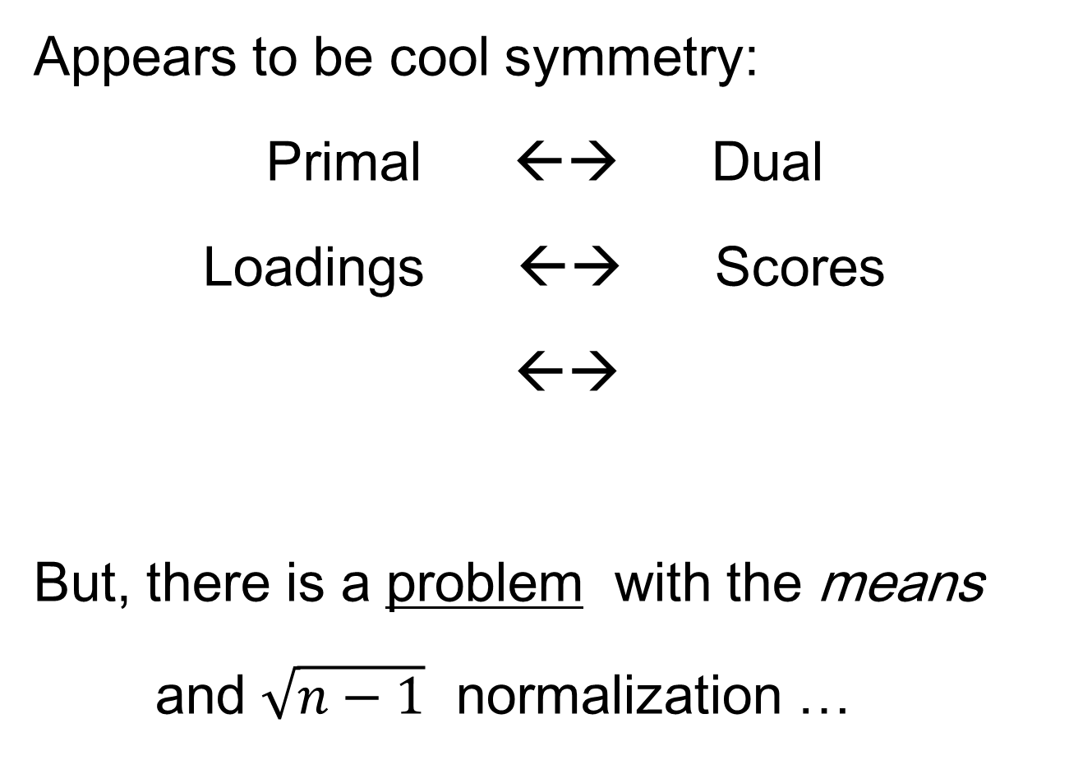
Alternate PCA Computation
Appears to be cool symmetry:
Primal ←→ Dual
Loadings ←→ Scores
←→
But, there is a problem with the means
and $\sqrt{n−1}$ normalization …

Slide 50
Functional Data Analysis
Recall from 1st Class Meeting:
Spanish Mortality Data

Slide 51
Functional Data Analysis
Interesting Data Set:
Mortality Data
For Spanish Males (thus can relate to history)
Each curve is a single year
x coordinate is age
Note: Choice made of Data Object
(could also study age as curves,
x coordinate = time)

Slide 52
Functional Data Analysis
Important Issue:
What are the Data Objects?
Curves (years) : Mortality vs. Age
Curves (Ages) : Mortality vs. Year
Note: Rows vs. Columns of Data Matrix

Slide 53
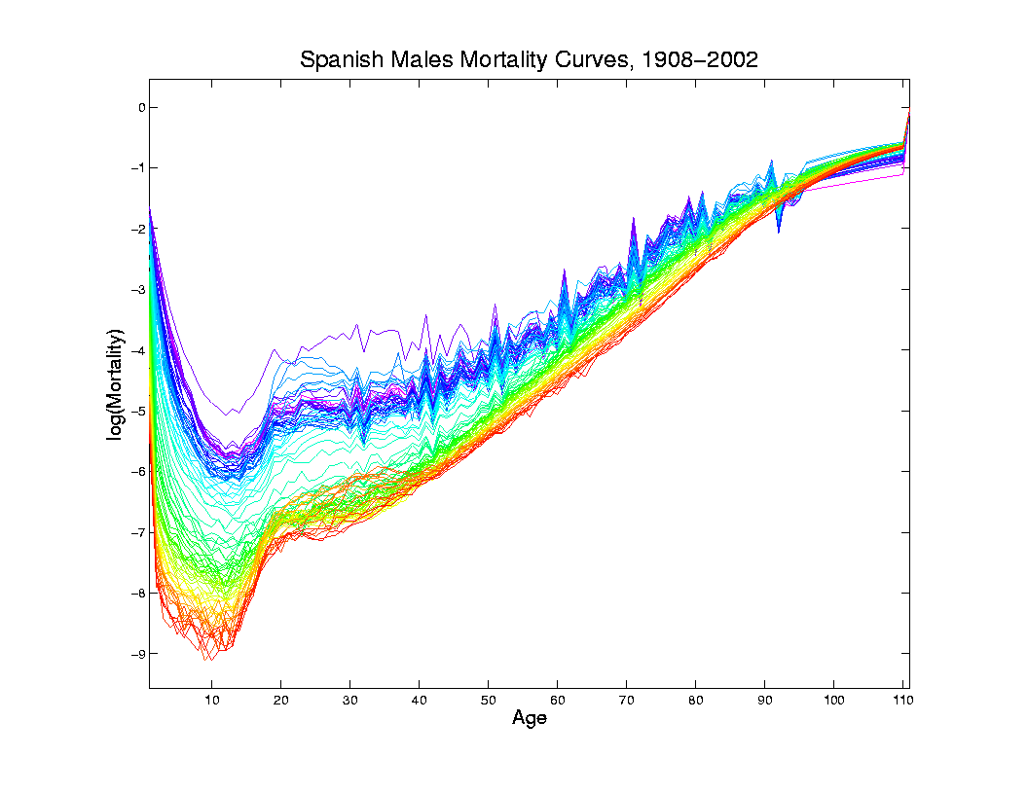
Mortality Time Series
Improved
Coloring:
Rainbow
Representing
Year:
Magenta
= 1908
Red = 2002

Slide 54
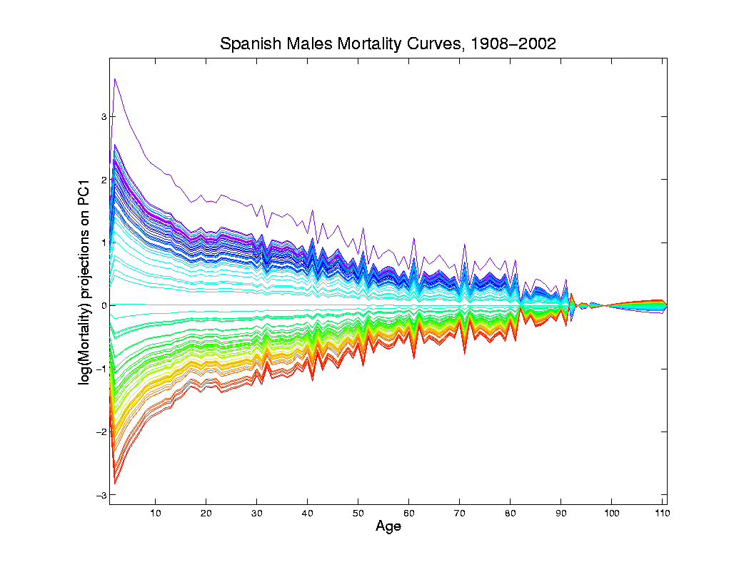
Mortality Time Series
Object Space View of Projections
Onto PC1
Direction
Main Mode
Of Variation:
Constant
Across Ages

Slide 55
Mortality Time Series
Shows Major
Improvement
Over Time
(medical technology,
etc.)
And Change
In Age
Rounding Blips

Slide 56
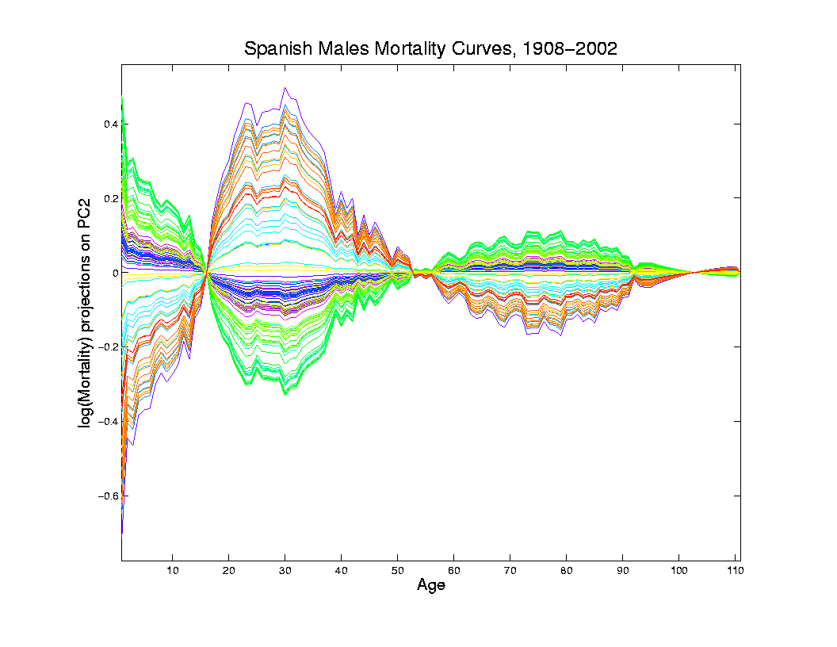
Mortality Time Series
Object Space View of Projections
Onto PC2
Direction
2nd Mode
Of Variation:
Difference
Between
20-45 & Rest

Slide 57
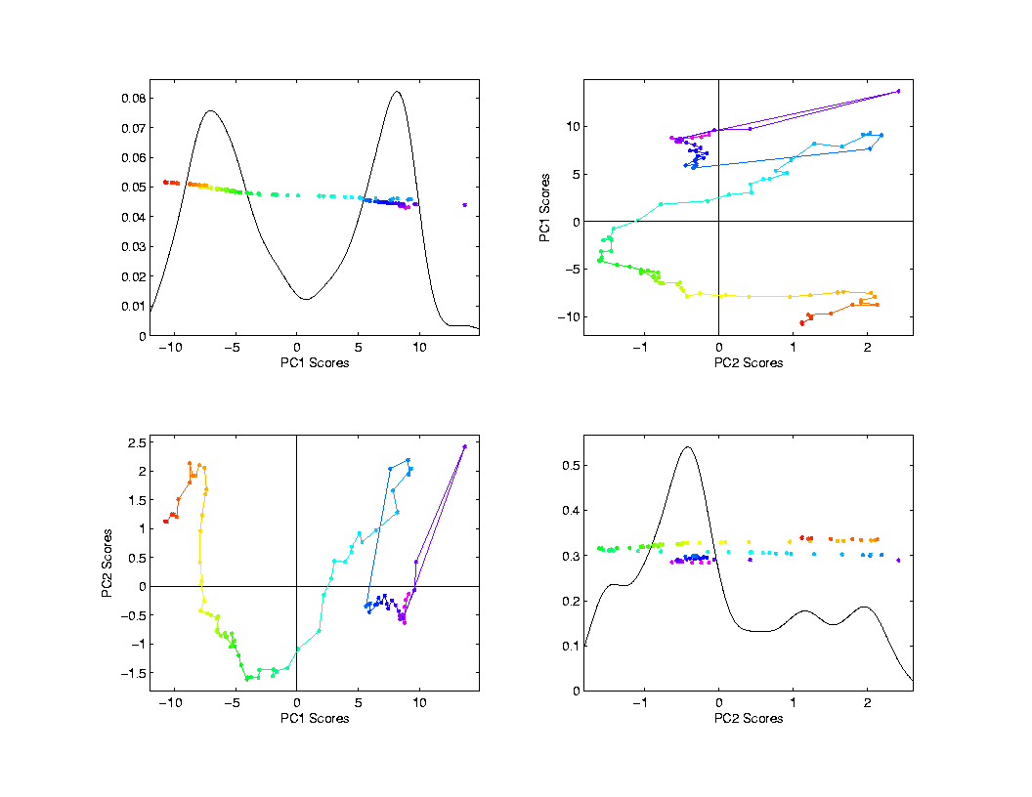
Mortality Time Series
Scores Plot
Feature
(Point Cloud)
Space View
Connecting
Lines
Highlight
Time Order
Good View of
Historical
Effects

Slide 58
Demography Data
Dual PCA
Idea: Rows and Columns trade places
Terminology: from optimization
Insights come from studying “primal” & “dual” problems

Slide 59
Primal / Dual PCA
Consider
“Data Matrix”
Notes:
59

Slide 60
Primal / Dual PCA
Consider
“Data Matrix”
Primal Analysis:
Columns are data vectors
Notes:
60

Slide 61
Primal / Dual PCA
Consider
“Data Matrix”
Dual Analysis:
Rows are data vectors
Notes:
61

Slide 62
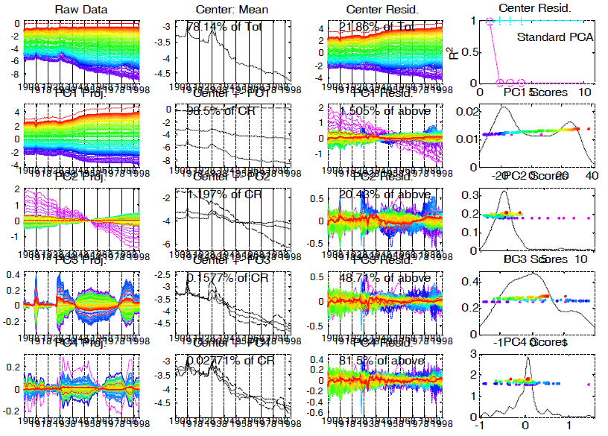
Demography Data
Dual
PCA
Notes:
62

Slide 63
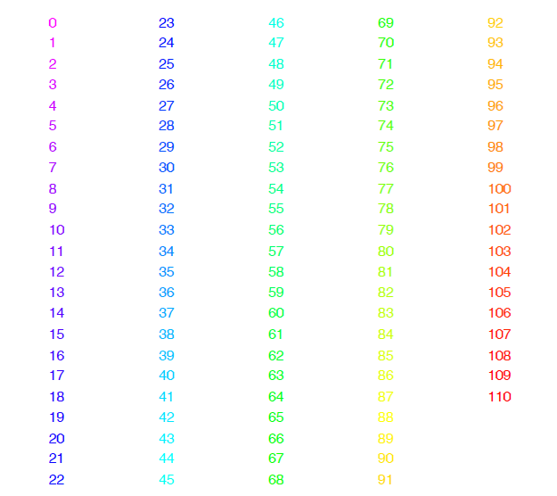
Demography Data
Color Code
(Ages)
Notes:
63

Slide 64
Demography Data
Older People
More At Risk
Of Dying
Notes:
64

Slide 65
Demography Data
Improvement
Over Time
On Average
Notes:
65

Slide 66
Demography Data
Improvement
Over Time
On Average
Except
Flu Pandemic
& Civil War
Notes:
66

Slide 67
Demography Data
PC1: Reflects
Mortality
Higher for
Older People
Notes:
67

Slide 68
Demography Data
PC2: Younger
People
Benefitted
Most From
Improved
Health
Notes:
68

Slide 69
Demography Data
PC3: How
To Interpret?
Notes:
69

Slide 70
Demography Data
Use:
Mean + Max
Mean - Min
Notes:
70

Slide 71
Demography Data
Use:
Mean + Max
Mean – Min
Flu Pandemic
Civil War
Auto Deaths
Notes:
71

Slide 72
Demography Data
PC3 Intepretation:
Mid-Age
Cohort
Notes:
72

Slide 73
Primal / Dual PCA
Which is “Better”?
Same Info,
Displayed
Differently
Here: Prefer
Primal
Notes:
73

Slide 74
Primal / Dual PCA
Which is “Better”?
Same Info,
Displayed
Differently
Here: Prefer
Primal, As Indicated by Graphics Quality
Notes:
74

Slide 75
Primal / Dual PCA
Which is “Better”?
In General:
Either Can Be Best
Try Both and Choose
Or Use “Natural Choice” of
Data Object
Notes:
75

Slide 76
Primal / Dual PCA
Important Early Version:
BiPlot Display
Overlay Primal & Dual PCAs
Not Easy to Interpret
Gabriel, K. R. (1971)
Notes:
76

Slide 77
Alternate PCA Computation
Appears to be cool symmetry:
Primal ←→ Dual
Loadings ←→ Scores
←→
But, there is a problem with the means
and $\sqrt{n−1}$ normalization …

Slide 78
Primal - Dual PCA
Note different “mean vectors”:
Primal Mean =
Mean of Col. Vec’s:

Slide 79
Primal - Dual PCA
Note different “mean vectors”:
Primal Mean =
Mean of Col. Vec’s:
Dual Mean =
Mean of Row Vec’s:

Slide 80
Primal - Dual PCA
Note different “mean vectors”:
Primal Mean =
Mean of Col. Vec’s:
Dual Mean =
Mean of Row Vec’s:
Which Mean Is
Important Difference

Slide 81
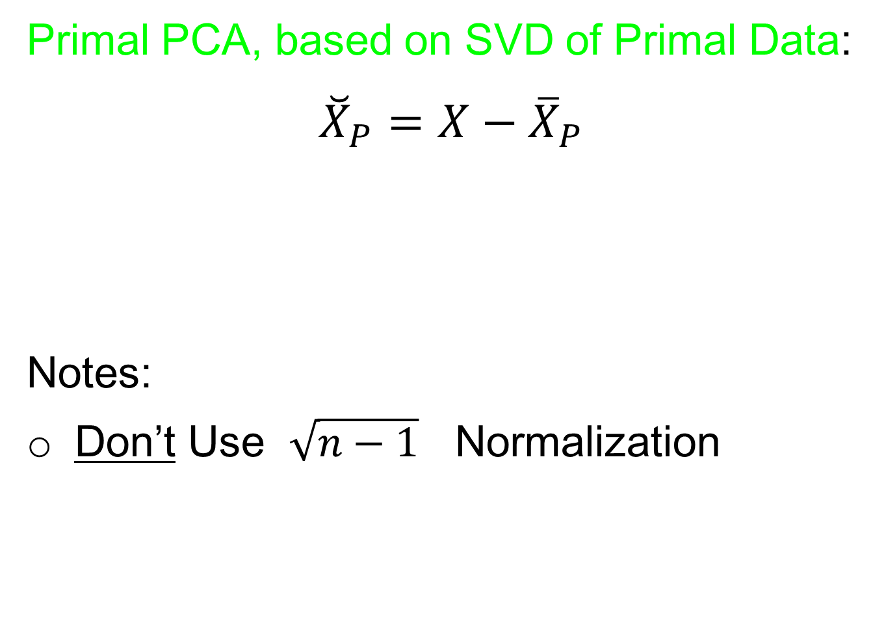
Primal - Dual PCA
Primal PCA, based on SVD of Primal Data:
$${\breve{X}}_{P}=X−{\overline{X}}_{P}$$
Notes:
Don’t Use $\sqrt{n−1}$ Normalization

Slide 82

Primal - Dual PCA
Primal PCA, based on SVD of Primal Data:
$${\breve{X}}_{P}=X−{\overline{X}}_{P}$$
Notes:
Don’t Use $\sqrt{n−1}$ Normalization
Hence Use Different Notation

Slide 83
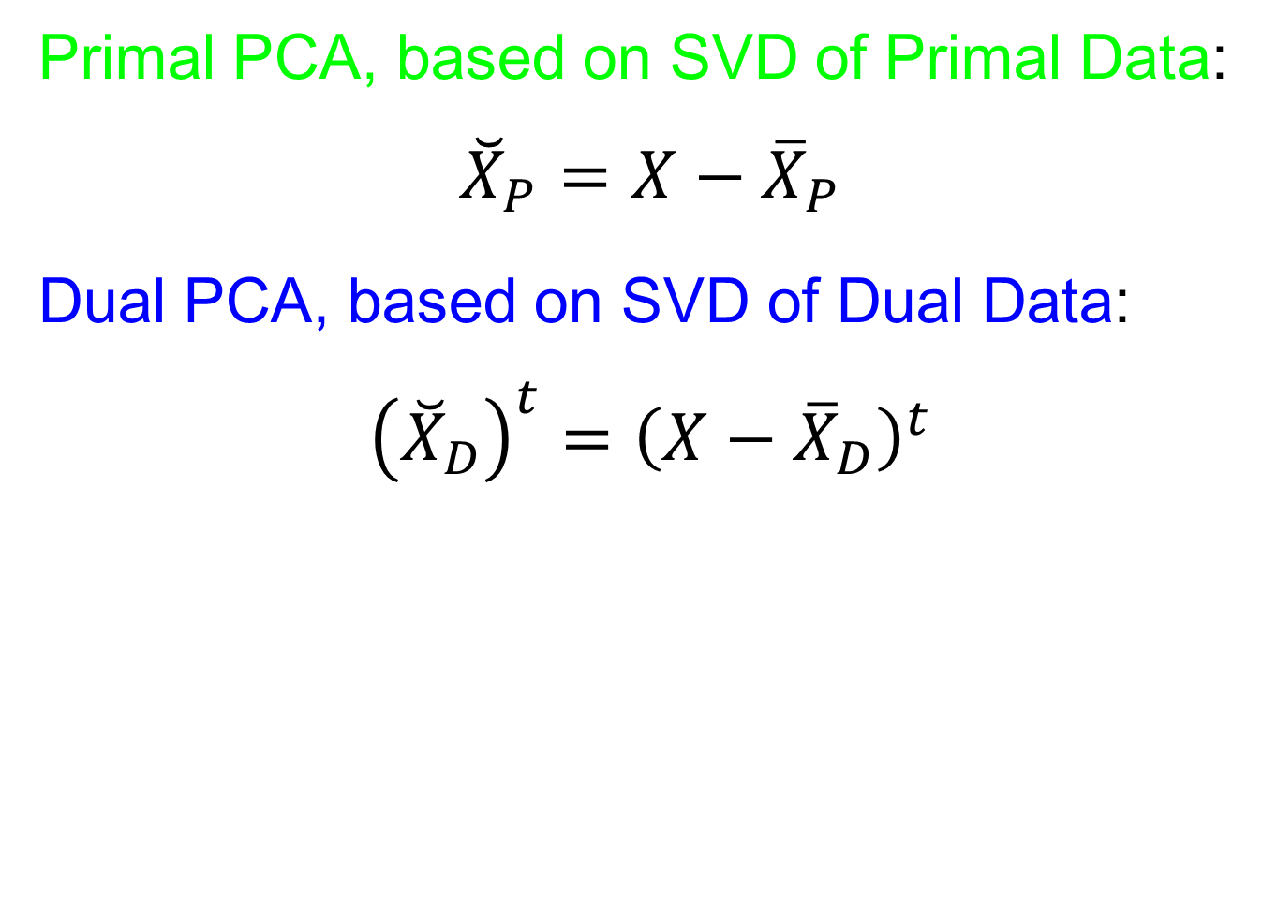
Primal - Dual PCA
Primal PCA, based on SVD of Primal Data:
$${\breve{X}}_{P}=X−{\overline{X}}_{P}$$
Dual PCA, based on SVD of Dual Data:
$${\left({\breve{X}}_{D}\right)}^{t}={\left(X−{\overline{X}}_{D}\right)}^{t}$$

Slide 84
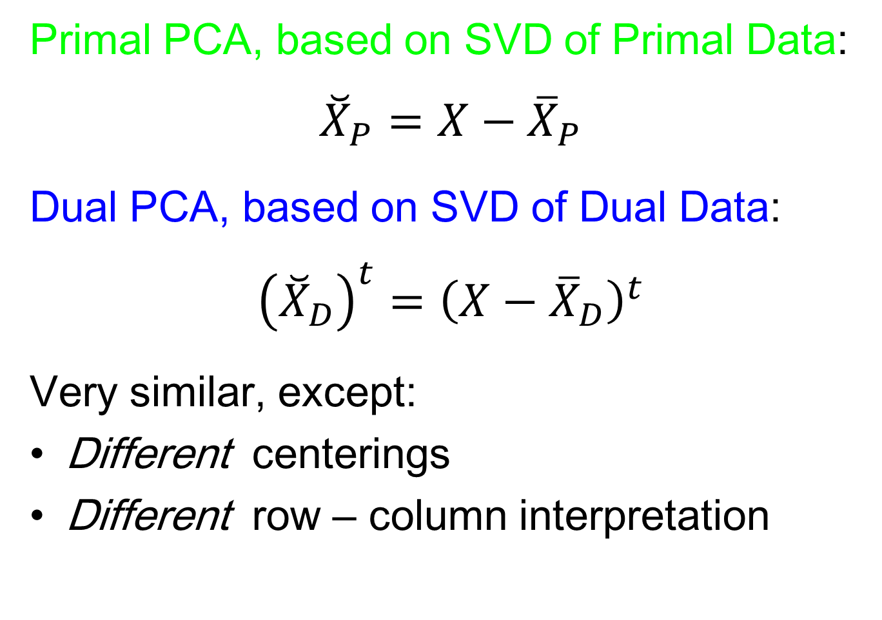
Primal - Dual PCA
Primal PCA, based on SVD of Primal Data:
$${\breve{X}}_{P}=X−{\overline{X}}_{P}$$
Dual PCA, based on SVD of Dual Data:
$${\left({\breve{X}}_{D}\right)}^{t}={\left(X−{\overline{X}}_{D}\right)}^{t}$$
Very similar, except:
Different centerings
Different row – column interpretation

Slide 85
Primal - Dual PCA
Toy Example 1:
Random Sums of Curves, (Primal Space):
* Constant Shift
* Linear
* Quadratic
Cubic
(i.i.d. Gaussian, Mean 0)
Notes:
85

Slide 86
Primal - Dual PCA
Toy Example 1:
Random Sums of Curves, (Primal Space):
* Constant Shift
* Linear
* Quadratic
Cubic
(Chosen as Orthonormal Basis)
Notes:
86

Slide 87
Primal - Dual PCA
Toy Example 1:
Random Sums of Curves, (Primal Space):
* Constant Shift
* Linear
* Quadratic
Cubic
(Chosen as Orthonormal Basis)
Coefficients Give Different Magnitudes
(So PCA Gives These, Not Linear Combo)
Notes:
87

Slide 88
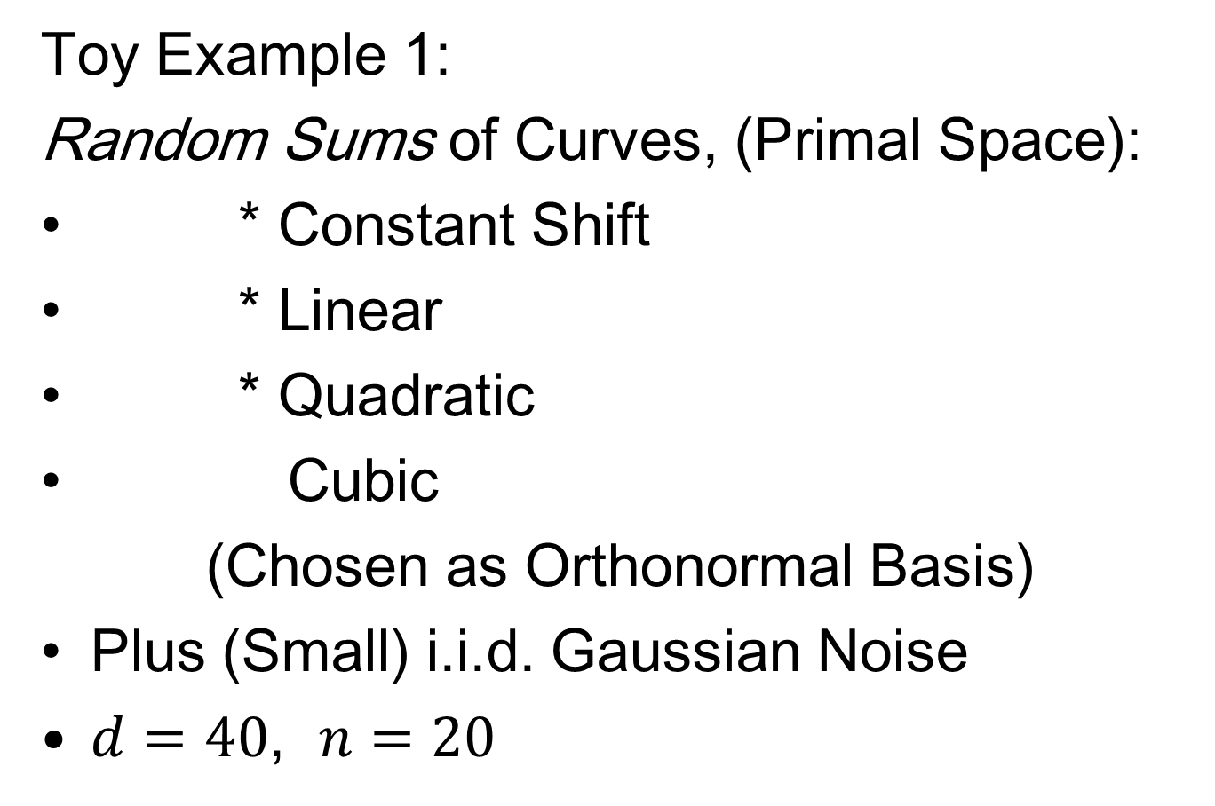
Primal - Dual PCA
Toy Example 1:
Random Sums of Curves, (Primal Space):
* Constant Shift
* Linear
* Quadratic
Cubic
(Chosen as Orthonormal Basis)
Plus (Small) i.i.d. Gaussian Noise
$d=40$, $n=20$
Notes:
88

Slide 89
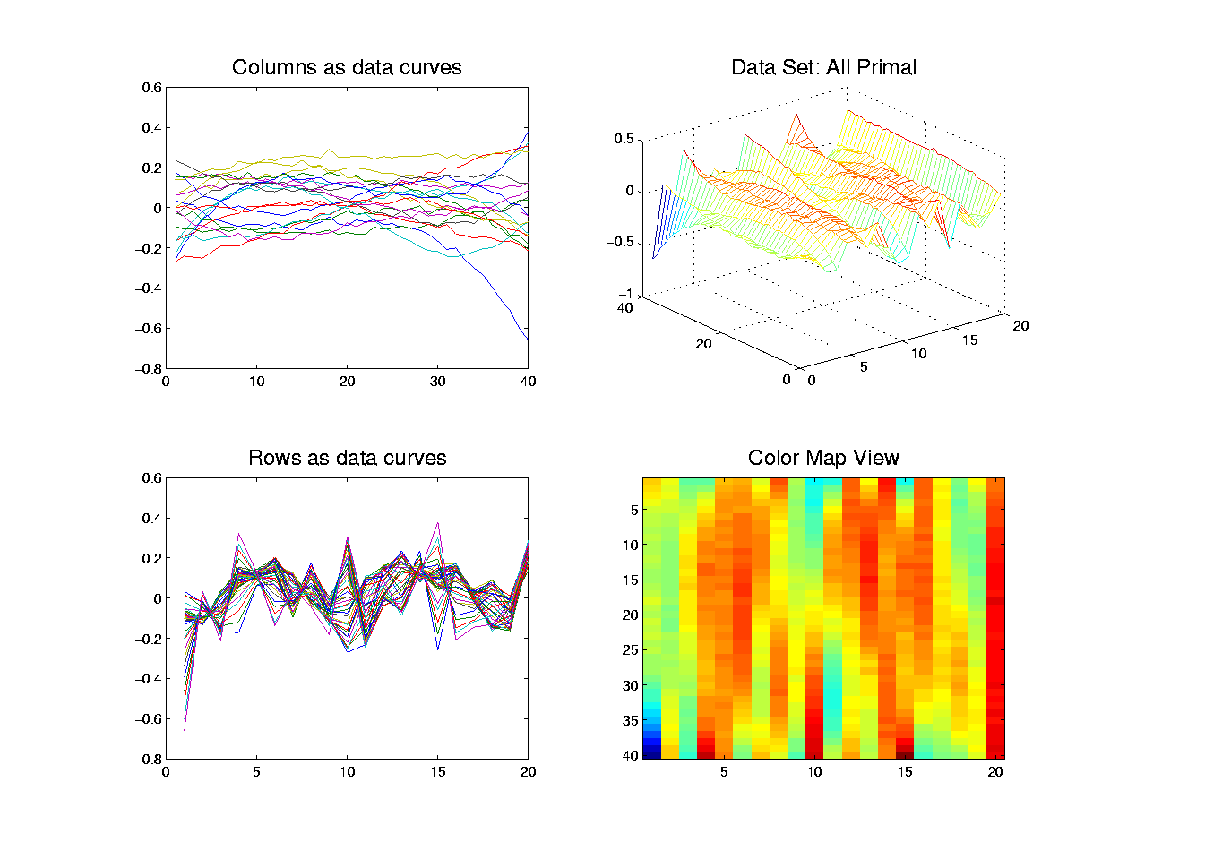
Primal - Dual PCA
Toy Example 1: Raw Data
Primal
Space
Curves
(Smooth +
Gaussian)

Slide 90
Primal - Dual PCA
Toy Example 1: Raw Data
Dual
Space
Curves
(Much
Rougher)

Slide 91
Primal - Dual PCA
Toy Example 1: Raw Data
Full Matrix
View:
As (Wire)
Mesh Plot

Slide 92
Primal - Dual PCA
Toy Example 1: Raw Data
Full Matrix
View:
As (Wire)
Mesh Plot
Note:
Colors
As Heights

Slide 93
Primal - Dual PCA
Toy Example 1: Raw Data
Full Matrix
View:
As Image,
With
Height
Color
Coding

Slide 94
Primal - Dual PCA
Toy Example 1: Raw Data
Full Matrix
View:
Which is
Better???

Slide 95
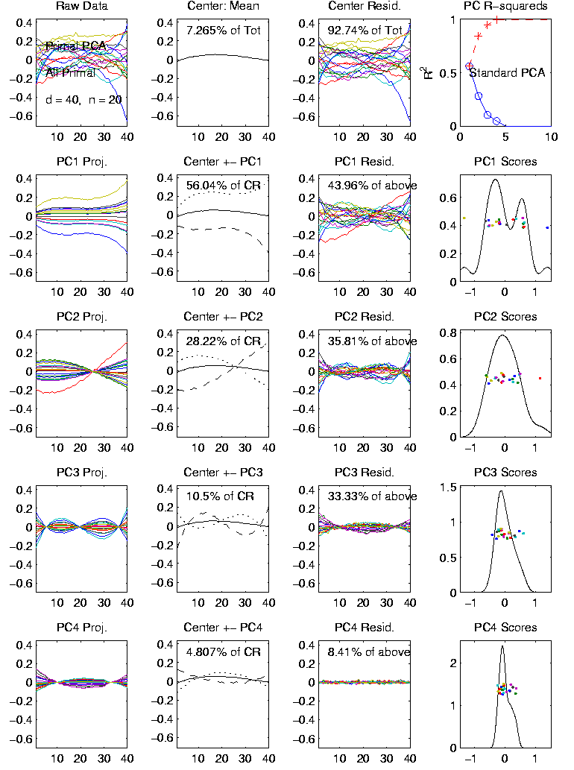
Primal - Dual PCA
Toy Example 1:
Primal PCA
Column Curves
as Data

Slide 96
Primal - Dual PCA
Toy Example 1:
Primal PCA
Mean is Negligible

Slide 97
Primal - Dual PCA
Toy Example 1:
Primal PCA
Can See 4 Strong
Components
(Differing Order)

Slide 98
Primal - Dual PCA
Toy Example 1:
Primal PCA
Signal Beyond
4 Dimensions
Very Small

Slide 99
Primal - Dual PCA
Toy Example 1:
Primal PCA
Polynomials:
Constant Shift?
Linear?
Quadratic????
(Lot’s of Noise)

Slide 100
Primal - Dual PCA
Toy Example 1:
Primal PCA
Polynomials:
Constant Shift
Linear
Quadratic
Cubic

Slide 101
Primal - Dual PCA
Toy Example 1:
Primal PCA
Polynomials:
Constant Shift
Linear
Quadratic
Cubic
(Swap Since Mean
had Quad. Power)

Slide 102
Primal - Dual PCA
Toy Example 1:
Primal PCA
Scores Look
Random,
Since Drawn
From Gaussian

Slide 103
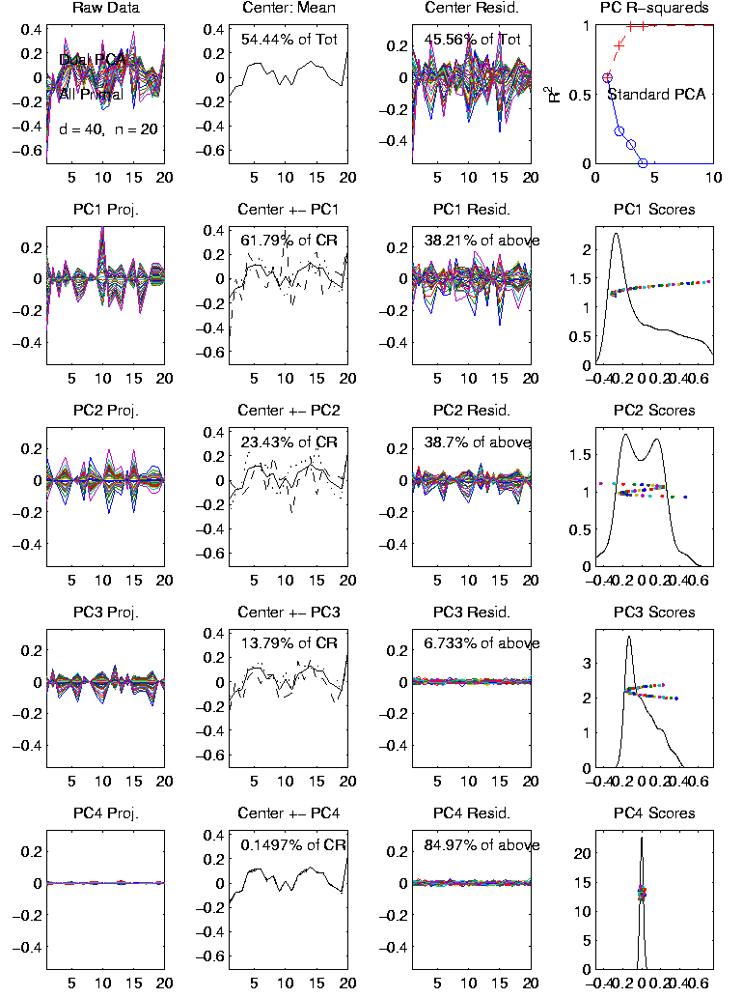
Primal - Dual PCA
Toy Example 1:
Dual PCA
Row Curves
as Data

Slide 104
Primal - Dual PCA
Toy Example 1:
Dual PCA
Mean is 54% of
Total Variation!
(Since Smooth
Curves Tend to
Stay High, or Low)

Slide 105
Primal - Dual PCA
Toy Example 1:
Dual PCA
Eigenvectors
Look Random

Slide 106
Primal - Dual PCA
Toy Example 1:
Dual PCA
Eigenvectors
Look Random
Scores Look
Smooth

Slide 107
Primal - Dual PCA
Toy Example 1:
Dual PCA
Recall:
Primal e.v. ←→
←→ Dual Scores
(and vice versa)

Slide 108
Primal - Dual PCA
Toy Example 1:
Dual PCA
But Only 3 Major
Components

Slide 109
Primal - Dual PCA
Toy Example 1:
Dual PCA
But Only 3 Major
Components
(Since Dual Mean
Captured 1 Comp.,
the Const. Shift,
recall ~ 56% in primal)

Slide 110
Primal - Dual PCA
Toy Example 1:
Primal PCA
PC1 Fraction of
Sum of Squares

Slide 111
Primal - Dual PCA
Toy Example 1:
Primal PCA vs. Dual PCA
Mean Centering is an Important Issue

Slide 112
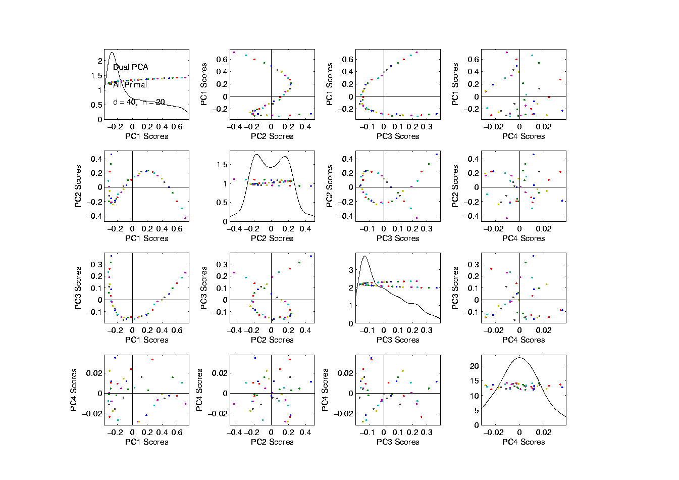
Primal - Dual PCA
Toy Example 1: Dual PCA – Scatterplot
First 3 PCs
Very Smooth
Notes:
112

Slide 113
Primal - Dual PCA
Toy Example 1: Dual PCA – Scatterplot
First 3 PCs
Very Smooth
Reminiscent
Structure?
(Recall
Spectral
Data)
Notes:
113

Slide 114
Primal - Dual PCA
Toy Example 1: Dual PCA – Scatterplot
First 3 PCs
Very Smooth
Last Very
Random?
Notes:
114

Slide 115
Primal - Dual PCA
Toy Example 1: Dual PCA – Scatterplot
First 3 PCs
Very Smooth
Last Very
Random?
(Note:
Small but
Magnified)
Notes:
115

Slide 116
Primal - Dual PCA
A 3rd Type of Analysis:
Called “SVD Decomposition”
Notes:
116

Slide 117
Primal - Dual PCA
A 3rd Type of Analysis:
Called “SVD Decomposition”
Main Point: Subtract Neither Mean
Viewed as a Serious Competitor
Notes:
117

Slide 118
Primal - Dual PCA
A 3rd Type of Analysis:
Called “SVD Decomposition”
Main Point: Subtract Neither Mean
Viewed as a Serious Competitor
Advantage: Gives Best Mean Square Approximation of Data Matrix
Notes:
118

Slide 119
Primal - Dual PCA
A 3rd Type of Analysis:
Called “SVD Decomposition”
Main Point: Subtract Neither Mean
Viewed as a Serious Competitor
Advantage: Gives Best Mean Square Approximation of Data Matrix
Vs. Primal PCA: Best About Col. Mean
Notes:
119

Slide 120
Primal - Dual PCA
A 3rd Type of Analysis:
Called “SVD Decomposition”
Main Point: Subtract Neither Mean
Viewed as a Serious Competitor
Advantage: Gives Best Mean Square Approximation of Data Matrix
Vs. Primal PCA: Best About Col. Mean
Vs. Dual PCA: best about Row Mean
Notes:
120

Slide 121
Primal - Dual PCA
A 3rd Type of Analysis:
Called “SVD Decomposition”
Main Point: Subtract Neither Mean
Viewed as a Serious Competitor
Advantage: Gives Best Mean Square Approximation of Data Matrix
Vs. Primal PCA: Best About Col. Mean
Vs. Dual PCA: best about Row Mean
Difference in Means is Critical!
Notes:
121

Slide 122
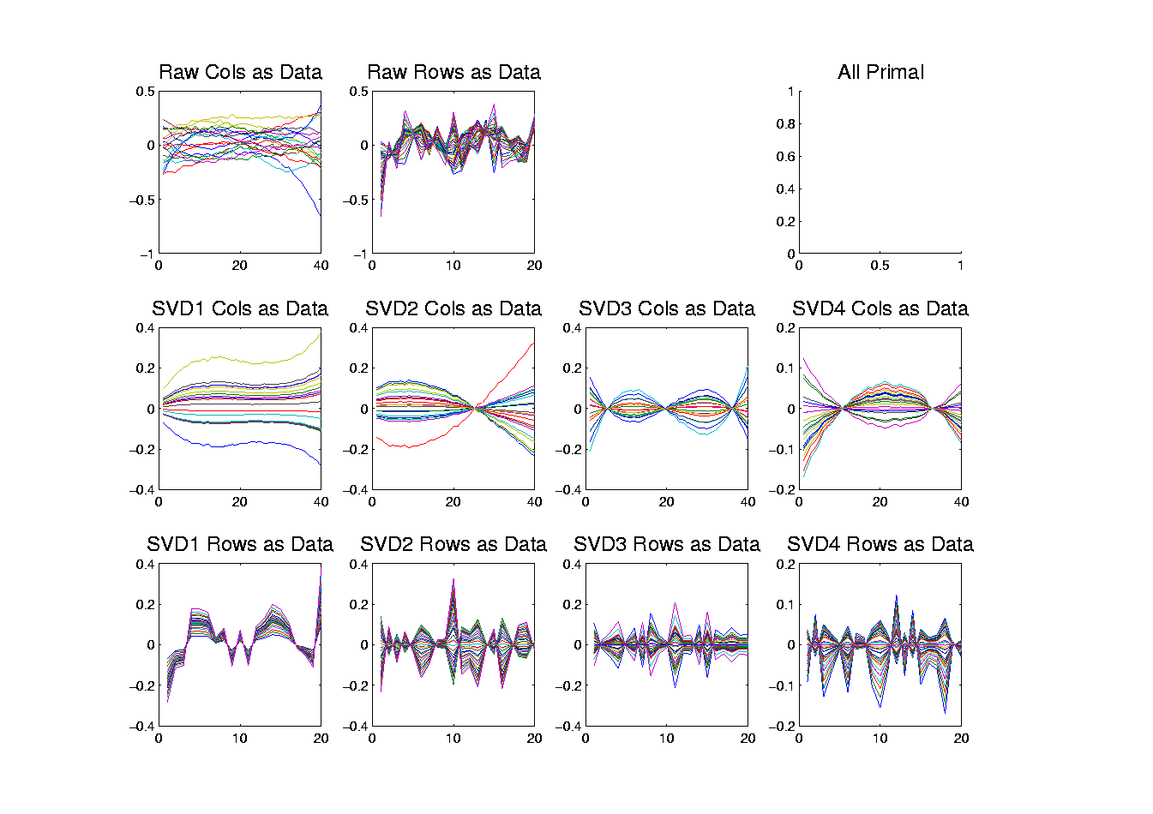
Primal - Dual PCA
Toy Example 1: SVD – Curves view
Column
Components
Similar to
Primal PCA
Notes:
122

Slide 123
Primal - Dual PCA
Toy Example 1: SVD – Curves view
Row
Components
Are “Offset” of
Dual PCA
(1st Looks
Like Dual
Mean,
etc.)
Notes:
123

Slide 124
Primal - Dual PCA
Toy Example 1:
Dual PCA
(Reminder
From Above)

Slide 125
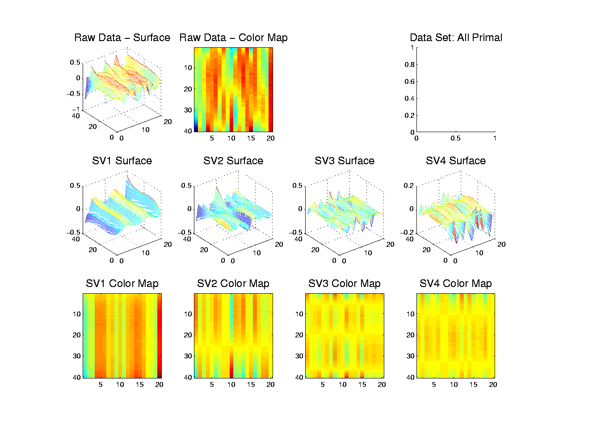
Primal - Dual PCA
Toy Example 1: SVD – Mesh-Image View
Study Views
In Pairs
Notes:
125

Slide 126
Primal - Dual PCA
Toy Example 1: SVD – Mesh-Image View
Decomposition
Into Modes of
Variation
Constant
x Gaussian
Notes:
126

Slide 127
Primal - Dual PCA
Toy Example 1: SVD – Mesh-Image View
Decomposition
Into Modes of
Variation
Const x Gauss
Linear x Gauss
Notes:
127

Slide 128
Primal - Dual PCA
Toy Example 1: SVD – Mesh-Image View
Decomposition
Into Modes of
Variation
Const x Gauss
Linear x Gauss
Parab. x Gauss
Notes:
128

Slide 129
Primal - Dual PCA
Toy Example 1: SVD – Mesh-Image View
Decomposition
Into Modes of
Variation
Const x Gauss
Linear x Gauss
Parab. x Gauss
Cubic x Gauss
Notes:
129

Slide 130
Primal - Dual PCA
Toy Example 1: SVD – Mesh-Image View
Why is
Ordering
Wrong?
Notes:
130

Slide 131
Primal - Dual PCA
Toy Example 1:
Why is SVD mode ordering “wrong”???
Well, not expected…
Key is need orthogonality
Notes:
131

Slide 132
Primal - Dual PCA
Toy Example 1:
Why is SVD mode ordering “wrong”???
Well, not expected…
Key is need orthogonality
Present in space of column curves
But only approximate in row Gaussians
Notes:
132

Slide 133
Primal - Dual PCA
Toy Example 1:
Why is SVD mode ordering “wrong”???
Well, not expected…
Key is need orthogonality
Present in space of column curves
But only approximate in row Gaussians
The implicit orthogonalization of SVD (both rows and columns) gave mixture of the poly’s.
Notes:
133

Slide 134
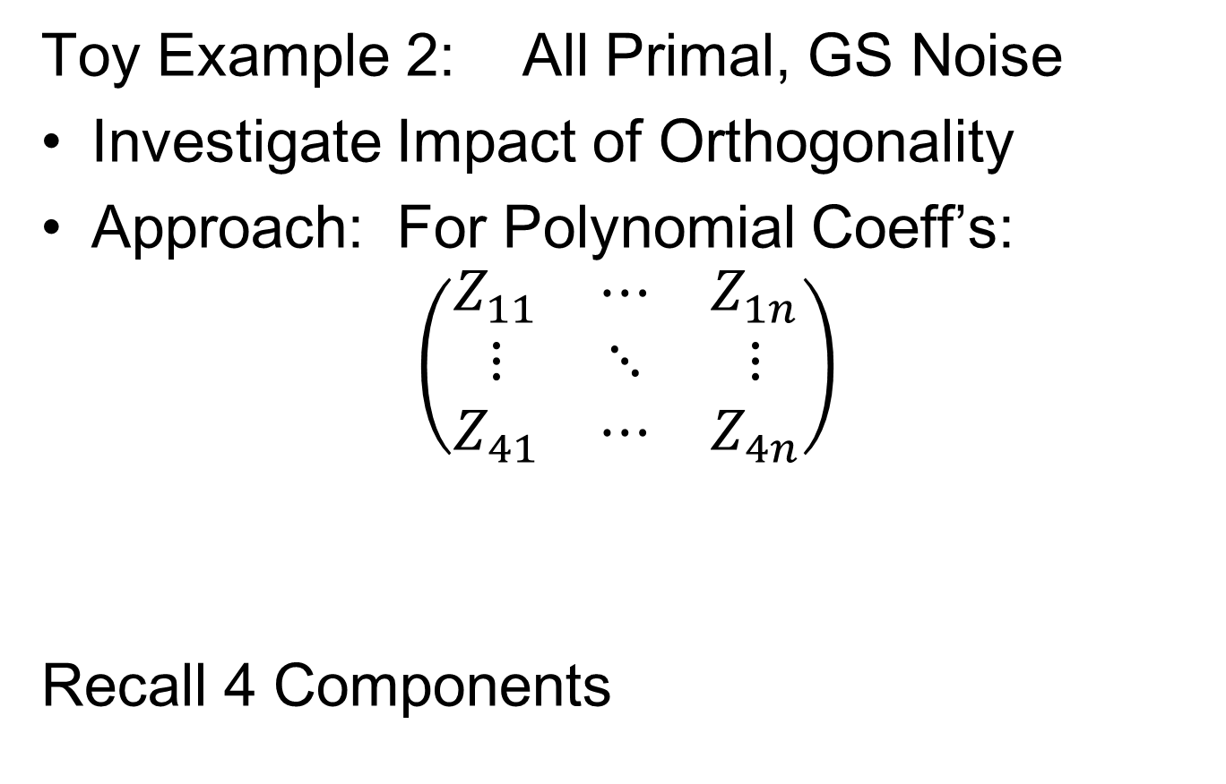
Primal - Dual PCA
Toy Example 2: All Primal, GS Noise
Investigate Impact of Orthogonality
Approach: For Polynomial Coeff’s:
$$\left(\begin{matrix}Z_{11} & ⋯ & Z_{1n} \\ ⋮ & ⋱ & ⋮ \\ Z_{41} & ⋯ & Z_{4n}\end{matrix}\right)$$
Recall 4 Components
Notes:
134

Slide 135
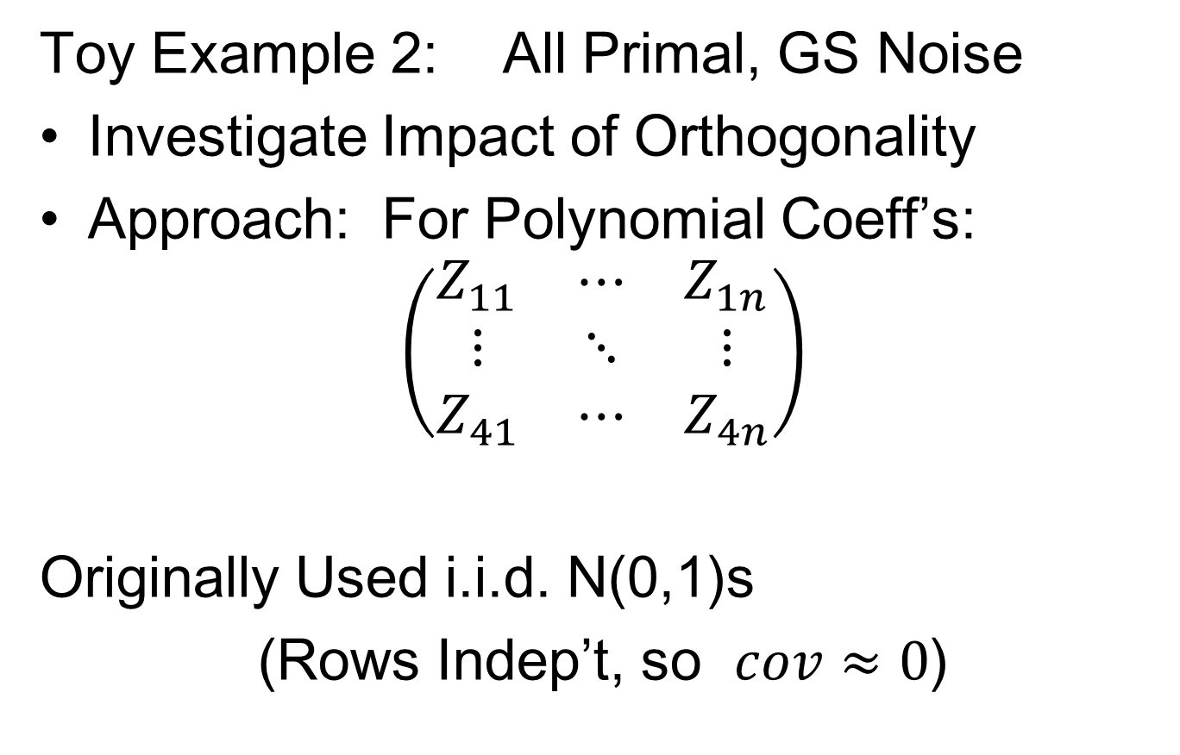
Primal - Dual PCA
Toy Example 2: All Primal, GS Noise
Investigate Impact of Orthogonality
Approach: For Polynomial Coeff’s:
$$\left(\begin{matrix}Z_{11} & ⋯ & Z_{1n} \\ ⋮ & ⋱ & ⋮ \\ Z_{41} & ⋯ & Z_{4n}\end{matrix}\right)$$
Originally Used i.i.d. N(0,1)s
(Rows Indep’t, so $cov≈0$)
Notes:
135

Slide 136
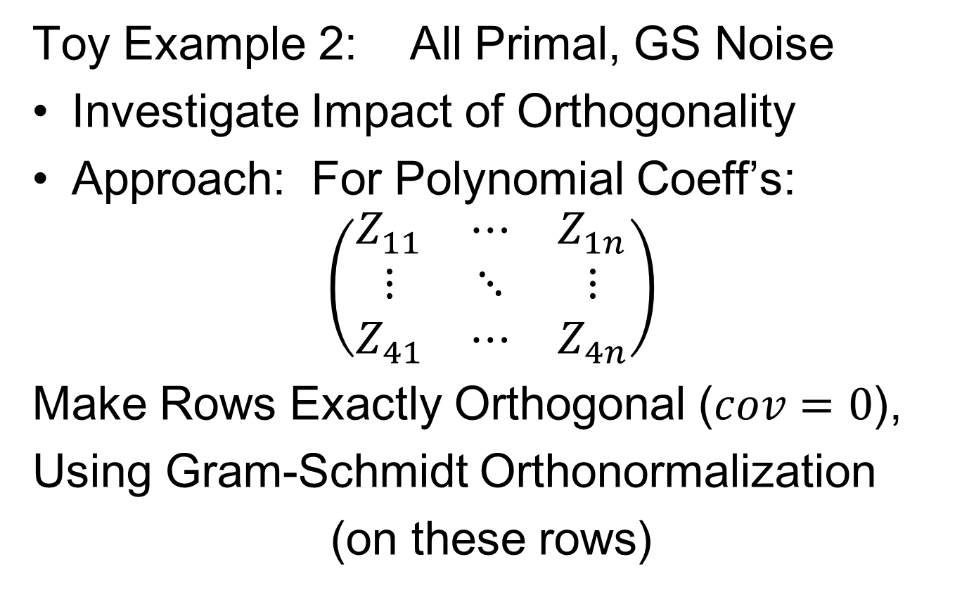
Primal - Dual PCA
Toy Example 2: All Primal, GS Noise
Investigate Impact of Orthogonality
Approach: For Polynomial Coeff’s:
$$\left(\begin{matrix}Z_{11} & ⋯ & Z_{1n} \\ ⋮ & ⋱ & ⋮ \\ Z_{41} & ⋯ & Z_{4n}\end{matrix}\right)$$
Make Rows Exactly Orthogonal ($cov=0$),
Using Gram-Schmidt Orthonormalization
(on these rows)
Notes:
136

Slide 137
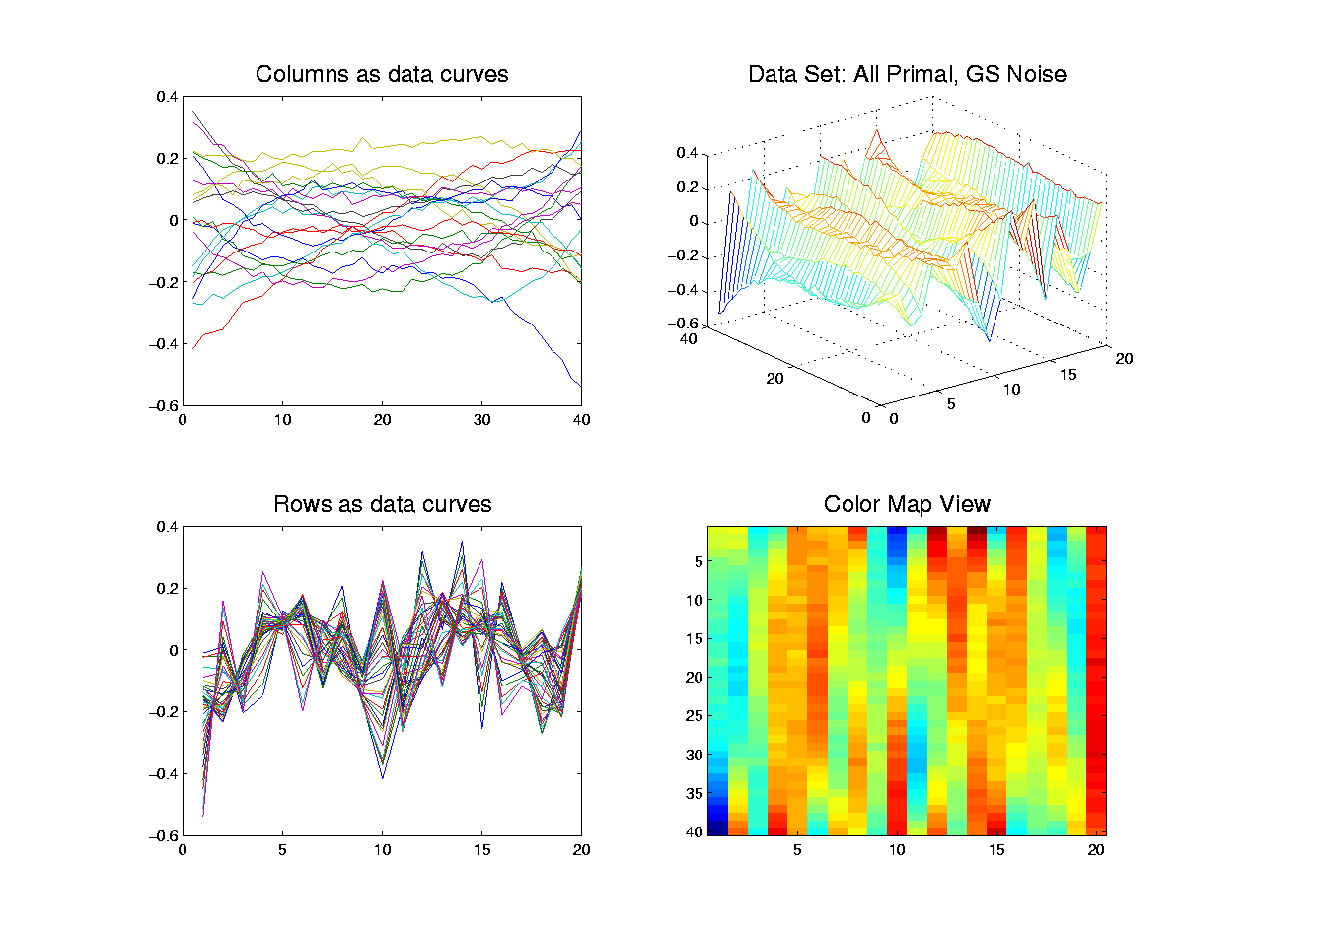
Primal - Dual PCA
Toy Example 2: Raw Data
Notes:
137

Slide 138
Primal - Dual PCA
Compare with Earlier Toy Example 1
Notes:
138

Slide 139
Primal - Dual PCA
Toy Example 2: All Primal, GS Noise
Visual impression:
Amazingly similar to original data
(used same seeds of random # generators)
Notes:
139

Slide 140
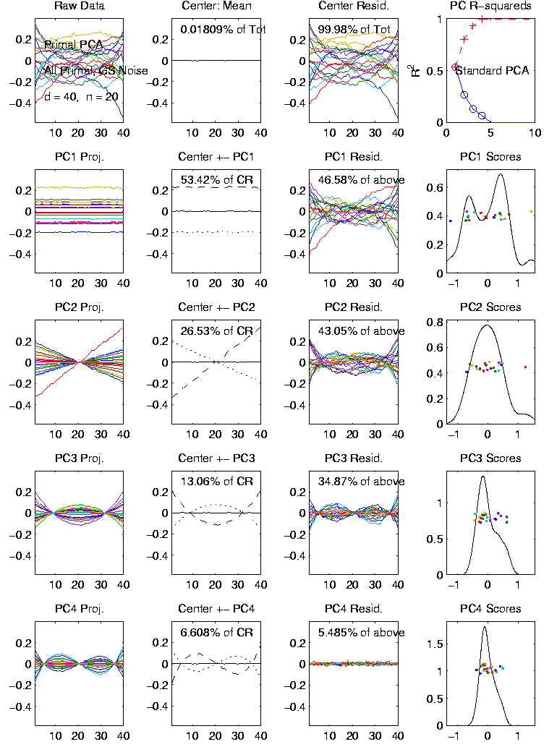
Primal - Dual PCA
Toy Example 2:
Primal PCA
Column Curves
as Data
Note: Excellent
Recovery of
Orthonormal Basis
Notes:
140

Slide 141
Primal - Dual PCA
Toy Example 2:
Primal PCA
Column Curves
as Data
Shows Explanation
(of Components
Wrong Order)
was Correct
Notes:
141

Slide 142
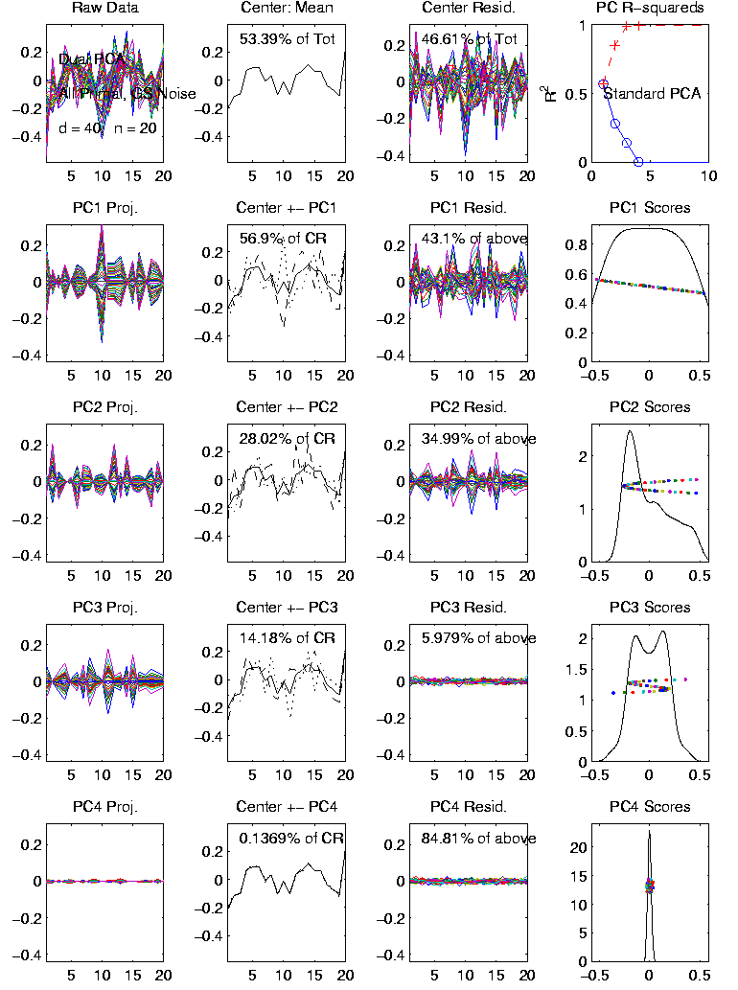
Primal - Dual PCA
Toy Example 2:
Dual PCA
Row Curves
as Data
Still have Big Mean
But Scores Look
Much Better
(Expected Poly’s)
Notes:
142

Slide 143
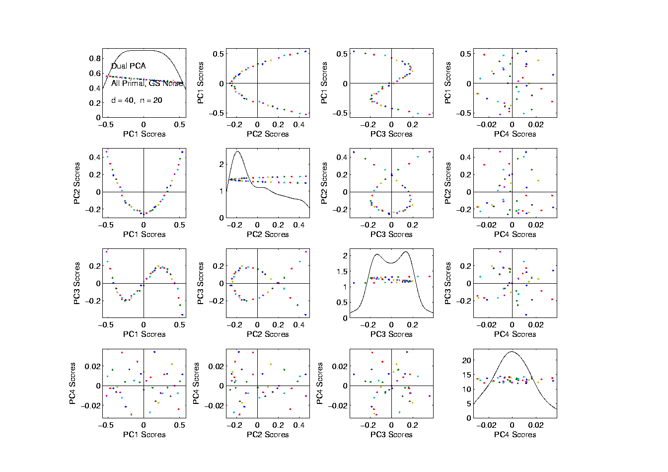
Primal - Dual PCA
Toy Example 2: Dual PCA – Scatterplot
Polys Beautifully
Symmetric
More Like Chem.
Spectra
Shows GS
Made the Diff.
4th Component
Just Noise
Notes:
143

Slide 144
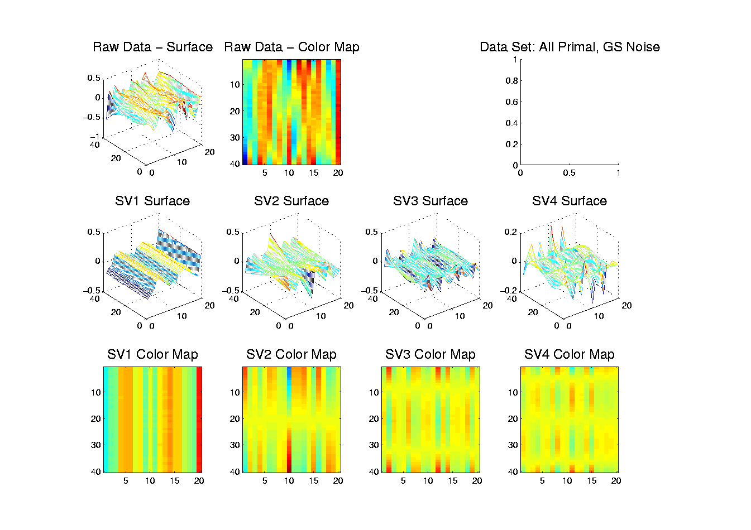
Primal - Dual PCA
Toy Example 2: SVD – Matrix-Image
Similar Good
Effects
Again Have
All 4 Comp’s
In Good Order
Better to Not
Subtract
Mean?
Notes:
144

