Slide 1
Statistics – O. R. 891
Object Oriented Data Analysis
J. S. Marron
Dept. of Statistics and Operations Research
University of North Carolina

Slide 2
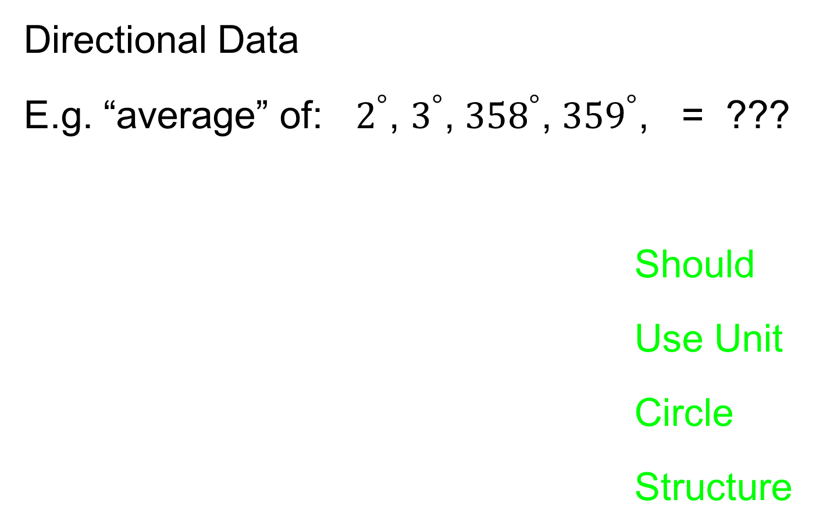
Manifold Feature Spaces
Directional Data
E.g. “average” of: $2^{°}$, $3^{°}$, ${358}^{°}$, ${359}^{°}$, = ???
Should
Use Unit
Circle
Structure
x
x
x
x

Slide 3
Manifold Feature Spaces
Fréchet Mean in General:
Big Advantage:
Works in Any Metric Space

Slide 4
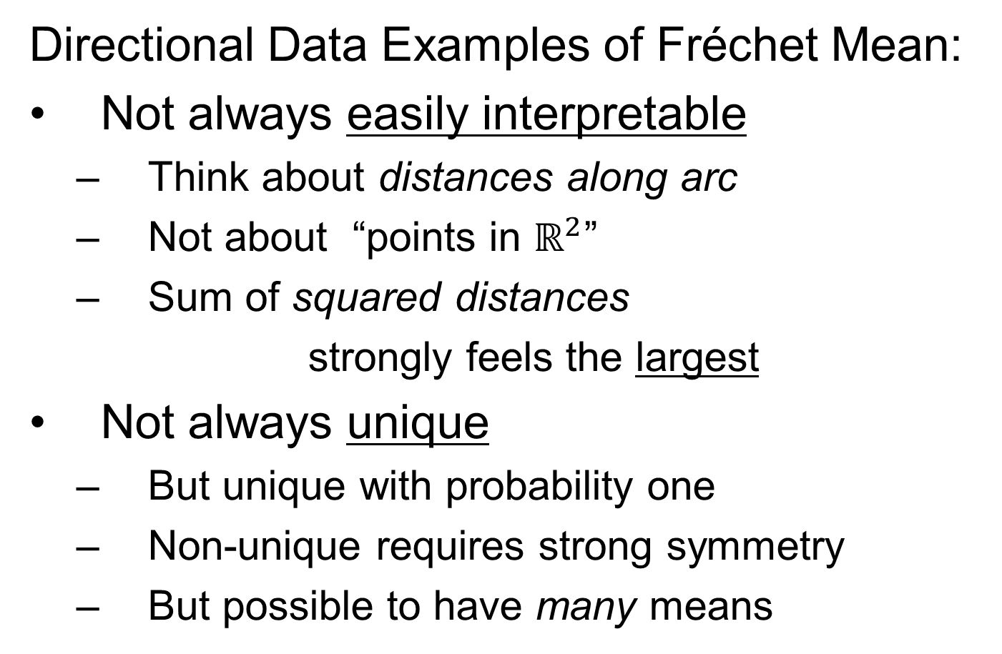
Manifold Feature Spaces
Directional Data Examples of Fréchet Mean:
Not always easily interpretable
  Think about distances along arc
  Not about “points in $ℝ^{2}$”
  Sum of squared distances
  strongly feels the largest
Not always unique
  But unique with probability one
  Non-unique requires strong symmetry
  But possible to have many means

Slide 5
Manifold Feature Spaces
Directional Data Examples of Fréchet Mean:
Also of interest is Fréchet Variance:
Works like Euclidean sample variance
Note values in movie, reflecting spread in data
Note theoretical version:
Useful for Laws of Large Numbers, etc.

Slide 6
OODA in Image Analysis
First Generation Problems:
Denoising
Segmentation
Registration
(all about single images,
still interesting challenges)

Slide 7
OODA in Image Analysis
Second Generation Problems:
Populations of Images
  Understanding Population Variation
  Discrimination (a.k.a. Classification)
Complex Data Structures (& Spaces)
HDLSS Statistics

Slide 8
Image Object Representation
Major Approaches for Image Data Objects:
Landmark Representations
Boundary Representations
Medial Representations

Slide 9
Boundary Representations
Main Drawback:
Correspondence
For OODA (on vectors of parameters):
Need to “match up points”
Easy to find triangular mesh
  Lots of research on this driven by gamers
Challenge to match mesh across objects
  There are some interesting ideas…
Notes:
9

Slide 10
Medial Representations
Main Idea:
Represent Objects as:
Discretized skeletons (medial atoms)
Plus spokes from center to edge
Which imply a boundary
Very accessible early reference:
Yushkevich, et al (2001)

Slide 11
A Challenging Example
Male Pelvis
  Bladder – Prostate – Rectum
  How do they move over time (days)?
  Critical to Radiation Treatment (cancer)
Work with 3-d CT
  Very Challenging to Segment
  Find boundary of each object?
  Represent each Object?

Slide 12
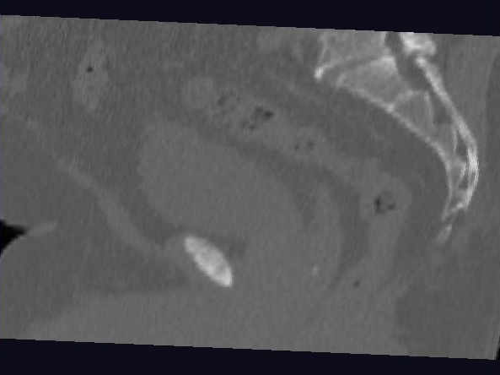
Male Pelvis – Raw Data
One CT Slice
(in 3d image)
Tail Bone
Rectum
Bladder
Prostate

Slide 13
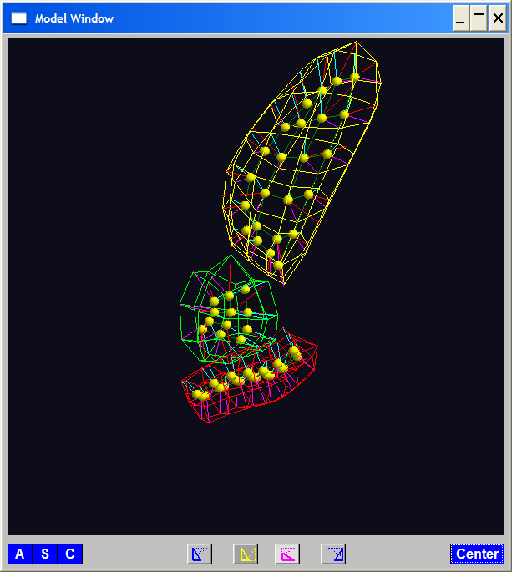
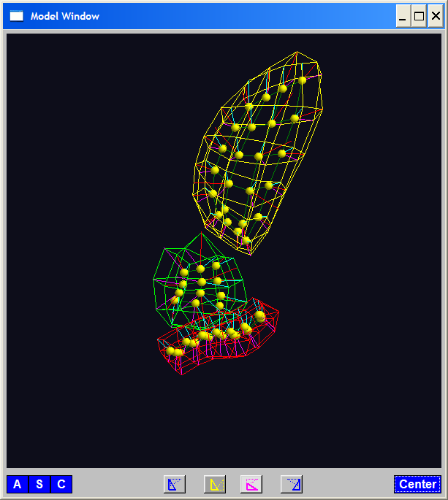
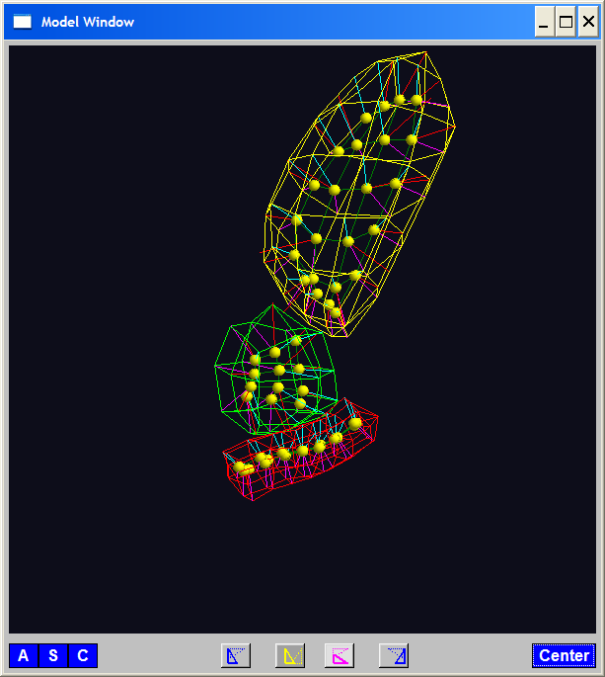
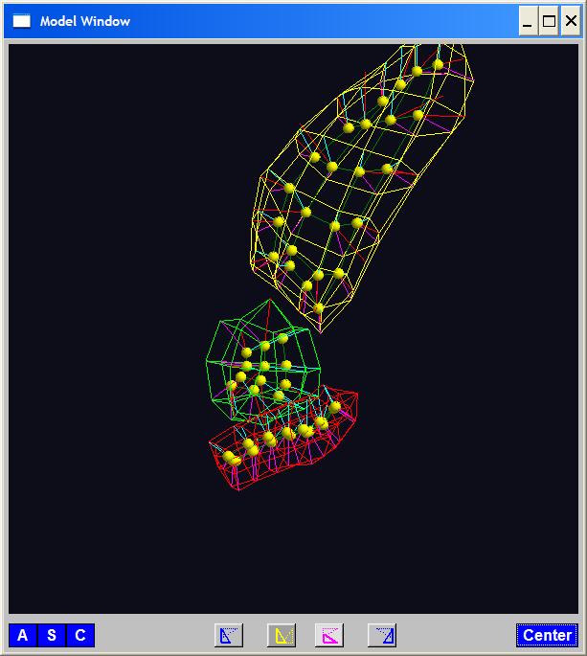
PGA for m-reps, Bladder-Prostate-Rectum
Bladder – Prostate – Rectum, 1 person, 17 days
PG 1 PG 2 PG 3
(analysis by Ja Yeon Jeong)

Slide 14
PGA for m-reps, Bladder-Prostate-Rectum
Bladder – Prostate – Rectum, 1 person, 17 days
PG 1 PG 2 PG 3
(analysis by Ja Yeon Jeong)

Slide 15
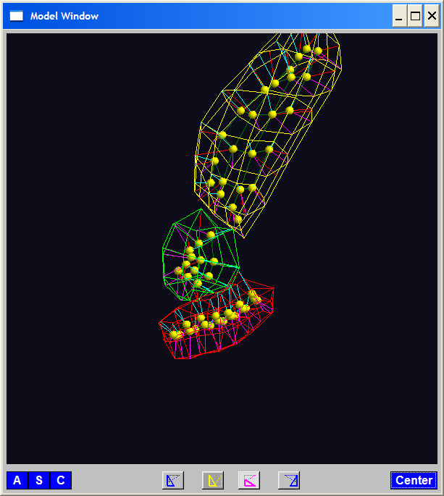
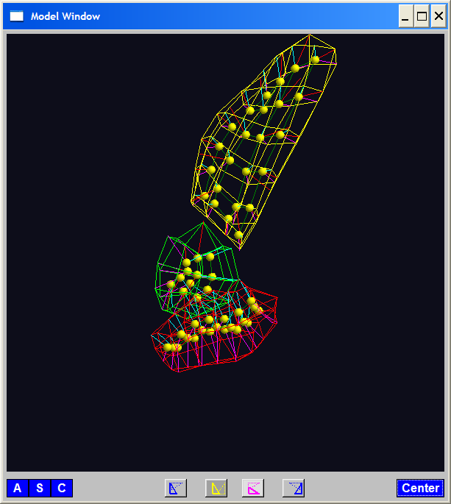
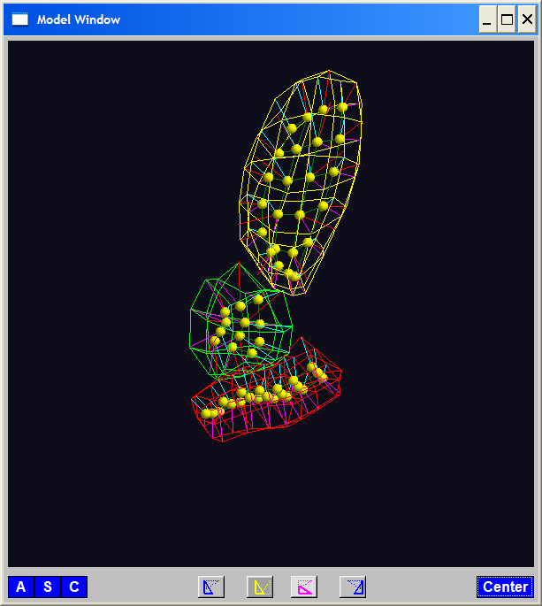
PGA for m-reps, Bladder-Prostate-Rectum
Bladder – Prostate – Rectum, 1 person, 17 days
PG 1 PG 2 PG 3
(analysis by Ja Yeon Jeong)

Slide 16
PCA Extensions for Data on Manifolds
Fletcher (Principal Geodesic Anal.)
  Best fit of geodesic to data
  Constrained to go through geodesic mean

Slide 17
PCA Extensions for Data on Manifolds
Fletcher (Principal Geodesic Anal.)
  Best fit of geodesic to data
  Constrained to go through geodesic mean
Counterexample:
Data on sphere, along equator

Slide 18
PCA Extensions for Data on Manifolds
Fletcher (Principal Geodesic Anal.)
  Best fit of geodesic to data
  Constrained to go through geodesic mean
Huckemann, Hotz & Munk (Geod. PCA)
  Best fit of any geodesic to data

Slide 19
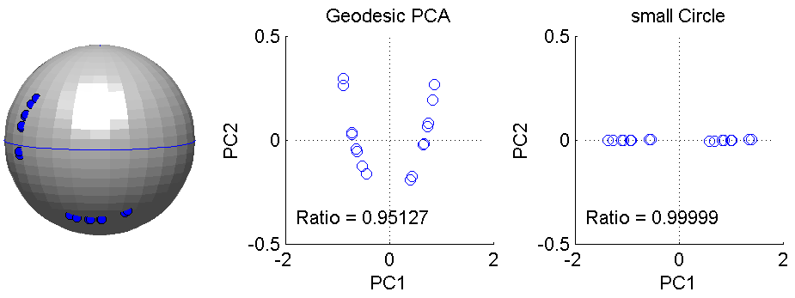
PCA Extensions for Data on Manifolds
Fletcher (Principal Geodesic Anal.)
  Best fit of geodesic to data
  Constrained to go through geodesic mean
Huckemann, Hotz & Munk (Geod. PCA)
  Best fit of any geodesic to data
Counterexample:
Data follows Tropic of Capricorn

Slide 20
PCA Extensions for Data on Manifolds
Fletcher (Principal Geodesic Anal.)
  Best fit of geodesic to data
  Constrained to go through geodesic mean
Huckemann, Hotz & Munk (Geod. PCA)
  Best fit of any geodesic to data
Jung, Foskey & Marron (Princ. Arc Anal.)

Slide 21
PCA Extensions for Data on Manifolds
Fletcher (Principal Geodesic Anal.)
  Best fit of geodesic to data
  Constrained to go through geodesic mean
Huckemann, Hotz & Munk (Geod. PCA)
  Best fit of any geodesic to data
Jung, Foskey & Marron (Princ. Arc Anal.)
  Best fit of any circle to data
  (motivated by conformal maps)

Slide 22
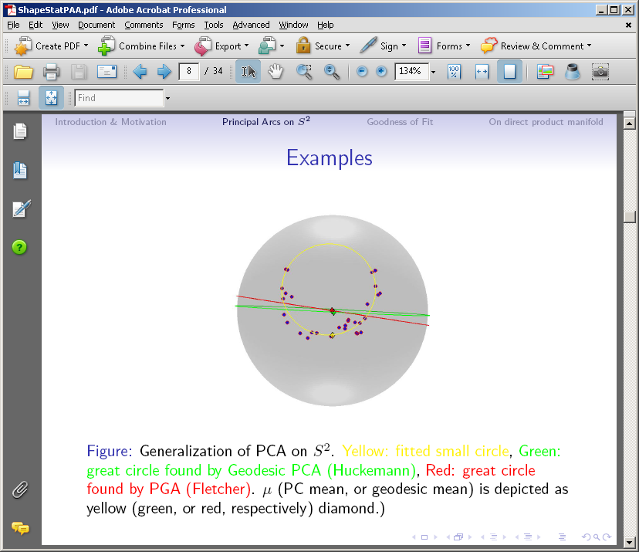
PCA Extensions for Data on Manifolds

Slide 23
Principal Arc Analysis
Jung, Foskey & Marron (2011)
  Best fit of any circle to data
  Can give better fit than geodesics

Slide 24
Principal Arc Analysis
Jung, Foskey & Marron (2011)
  Best fit of any circle to data
  Can give better fit than geodesics
  Observed for simulated m-rep example

Slide 25

Challenge being addressed

Slide 26

Composite Nested Spheres
Idea: Use Principal Arc Analysis
Over Large Products of $S^{2}$

Slide 27
Landmark Based Shape Analysis
Kendall
Bookstein
Dryden &
Mardia
(recall major monographs)

Slide 28
Landmark Based Shape Analysis
Kendall
Bookstein
Dryden &
Mardia
Digit 3 Data

Slide 29
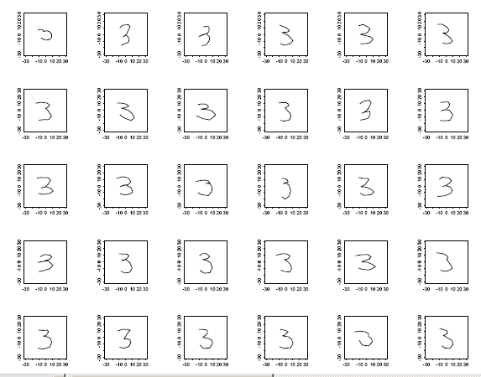
Landmark Based Shape Analysis
Kendall
Bookstein
Dryden &
Mardia
Digit 3 Data

Slide 30
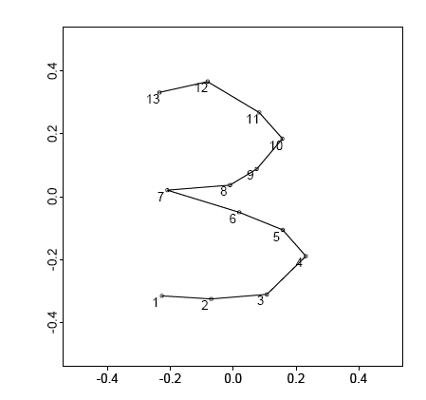
Landmark Based Shape Analysis
Kendall
Bookstein
Dryden &
Mardia
Digit 3 Data
(digitized to 13 landmarks)

Slide 31
Landmark Based Shape Analysis
Key Step: mod out
Translation
Scaling
Rotation

Slide 32
Landmark Based Shape Analysis
Key Step: mod out
Translation
Scaling
Rotation
Result:
Data Objects ←→
←→ points on Manifold ( ~ S^{2k-4})

Slide 33
Landmark Based Shape Analysis
Currently popular approaches to PCA on S^{k}:
Early: PCA on projections
(Tangent Plane Analysis)

Slide 34
Landmark Based Shape Analysis
Currently popular approaches to PCA on S^{k}:
Early: PCA on projections
Fletcher: Geodesics through mean

Slide 35
Landmark Based Shape Analysis
Currently popular approaches to PCA on S^{k}:
Early: PCA on projections
Fletcher: Geodesics through mean
Huckemann, et al: Any Geodesic

Slide 36
Landmark Based Shape Analysis
Currently popular approaches to PCA on S^{k}:
Early: PCA on projections
Fletcher: Geodesics through mean
Huckemann, et al: Any Geodesic
New Approach:
Principal Nested Sphere Analysis
Jung, Dryden & Marron (2012)

Slide 37
Principal Nested Spheres Analysis
Main Goal:
Extend Principal Arc Analysis (S² to S^{k})

Slide 38
Principal Nested Spheres Analysis
Key Idea:
Replace usual forwards view of PCA
With a backwards approach to PCA

Slide 39
Terminology
Multiple linear regression:

Slide 40
Terminology
Multiple linear regression:
Stepwise approaches:
Forwards: Start small, iteratively add variables to model

Slide 41
Terminology
Multiple linear regression:
Stepwise approaches:
Forwards: Start small, iteratively add variables to model
Backwards: Start with all, iteratively remove variables from model

Slide 42
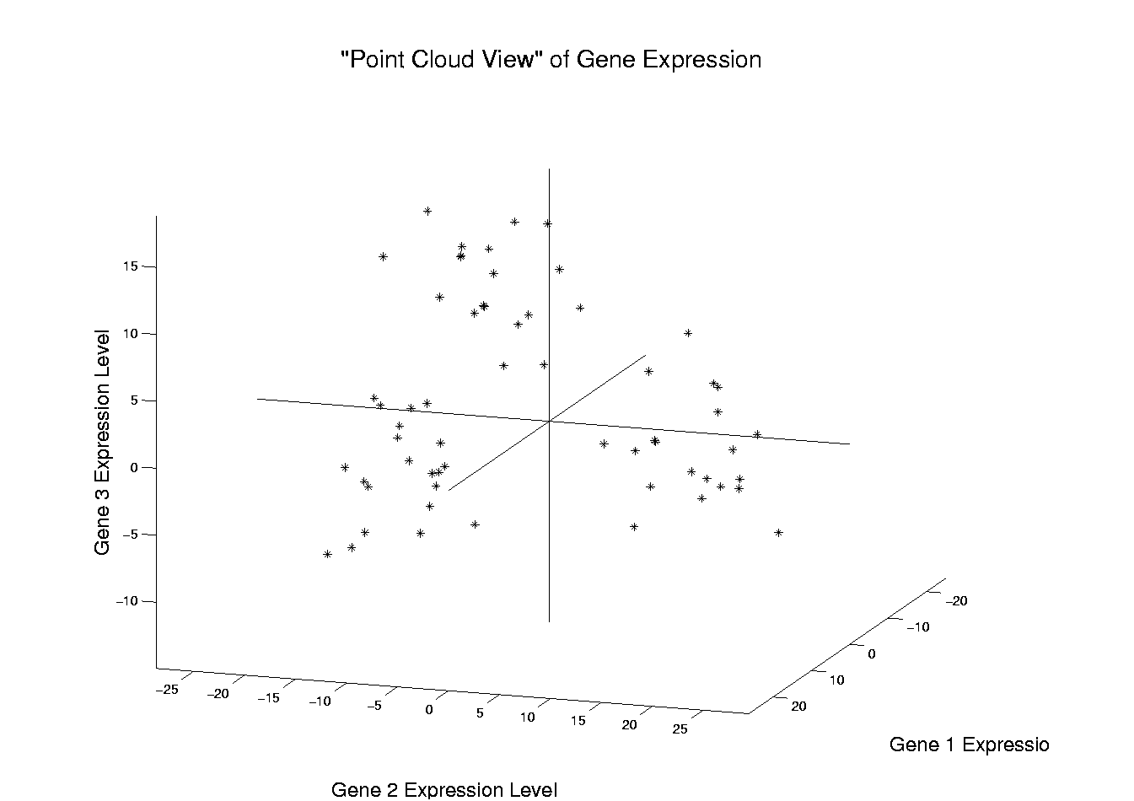
Illust’n of PCA View: Recall Raw Data
Notes:
EgView1p1RawData.ps

Slide 43
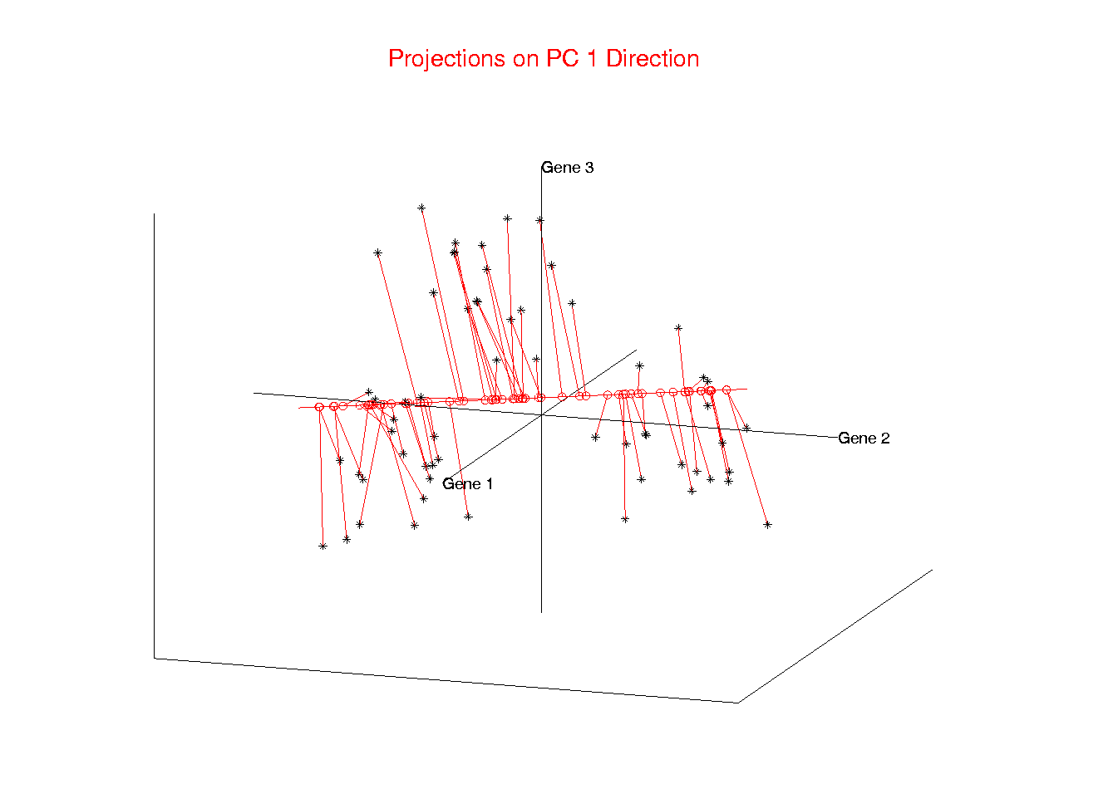
Illust’n of PCA View: PC1 Projections
Notes:
EgView1p51proj3dPC1.ps

Slide 44
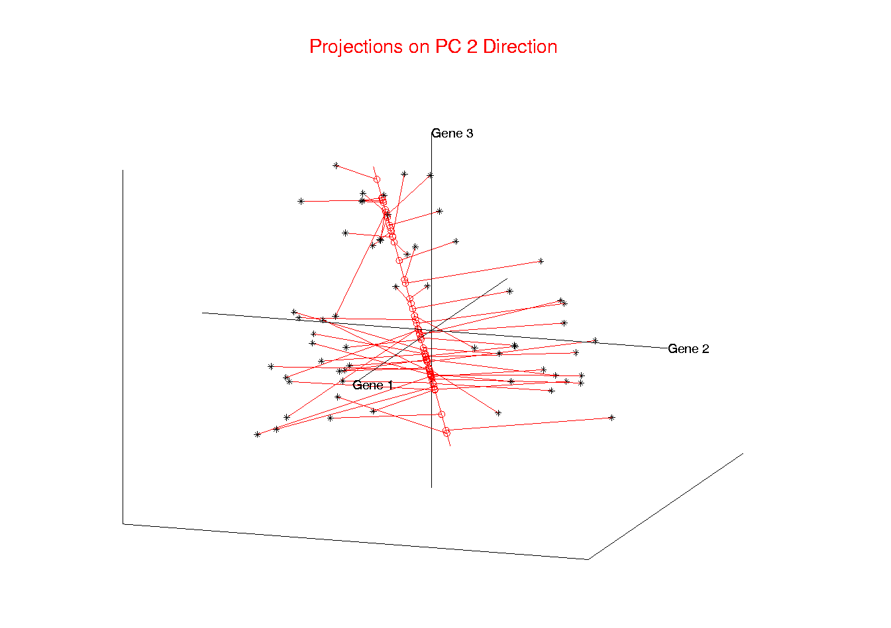
Illust’n of PCA View: PC2 Projections
Notes:
EgView1p52proj3dPC2.ps

Slide 45
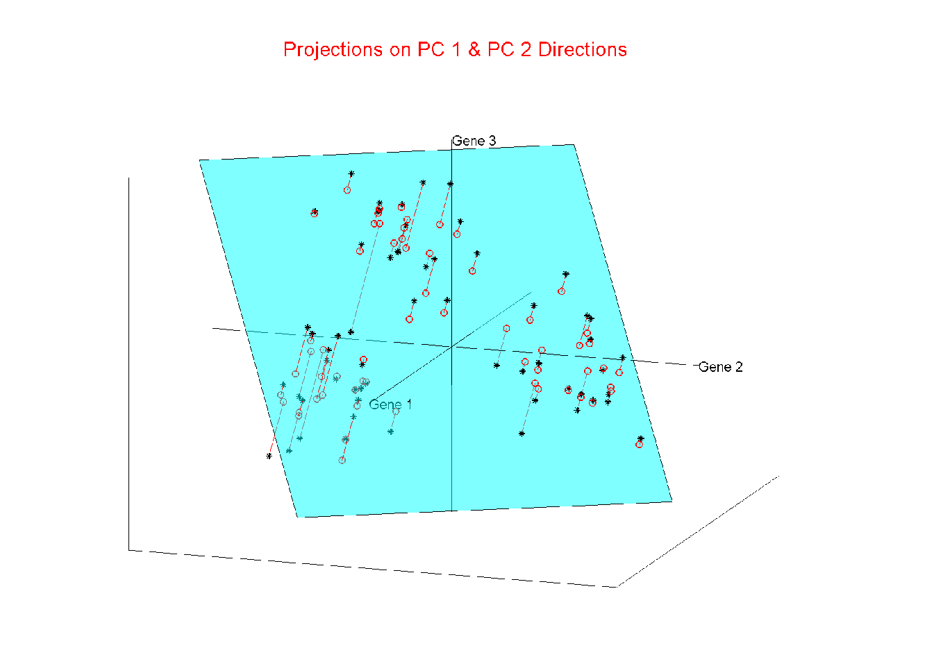
Illust’n of PCA View: Projections on PC1,2 plane
Notes:
EgView1p54proj3dPC12.ps

Slide 46
Principal Nested Spheres Analysis
Replace usual forwards view of PCA
Data → PC1 (1-d approx)

Slide 47
Principal Nested Spheres Analysis
Replace usual forwards view of PCA
Data → PC1 (1-d approx)
→ PC2 (1-d approx of Data-PC1)
→ PC1 U PC2 (2-d approx)

Slide 48
Principal Nested Spheres Analysis
Replace usual forwards view of PCA
Data → PC1 (1-d approx)
→ PC2 (1-d approx of Data-PC1)
→ PC1 U PC2 (2-d approx)
→ PC1 U … U PCr
(r-d approx)

Slide 49
Principal Nested Spheres Analysis
With a backwards approach to PCA
Data → PC1 U … U PCr (r-d approx)

Slide 50
Principal Nested Spheres Analysis
With a backwards approach to PCA
Data → PC1 U … U PCr (r-d approx)
→ PC1 U … U PC(r-1)

Slide 51
Principal Nested Spheres Analysis
With a backwards approach to PCA
Data → PC1 U … U PCr (r-d approx)
→ PC1 U … U PC(r-1)
→ PC1 U PC2 (2-d approx)

Slide 52
Principal Nested Spheres Analysis
With a backwards approach to PCA
Data → PC1 U … U PCr (r-d approx)
→ PC1 U … U PC(r-1)
→ PC1 U PC2 (2-d approx)
→ PC1 (1-d approx)

Slide 53
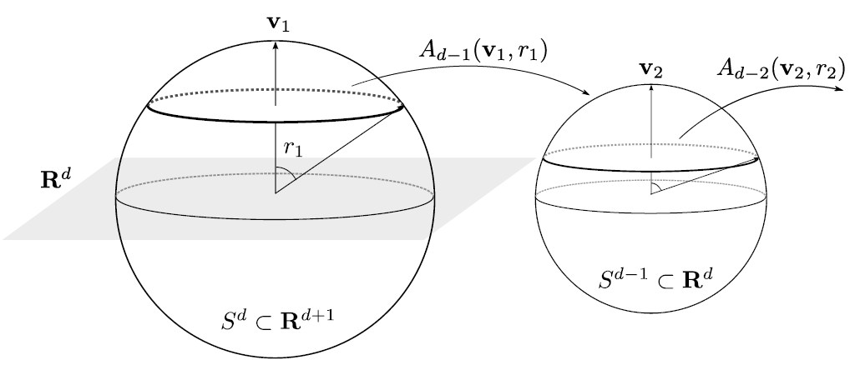
Principal Nested Spheres Analysis
Top Down Nested (small) spheres

Slide 54
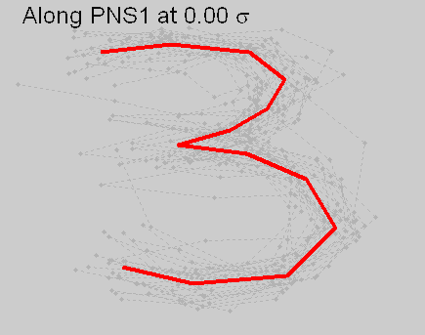
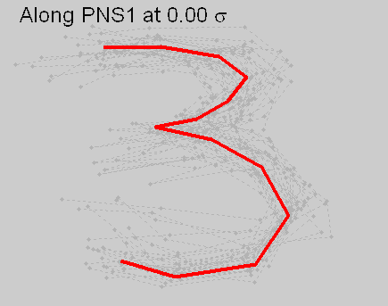




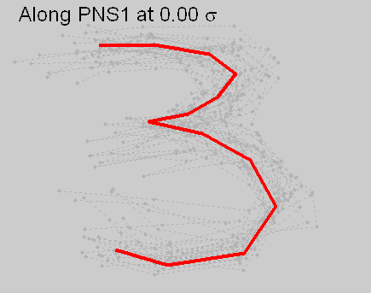

Digit 3 data: Principal variations of shape
Princ. geodesics by PNS
Principal arcs by PNS

Slide 55
An Interesting Question
How generally applicable is
Backwards approach to PCA?
Discussion:
Jung et al (2010)
Pizer et al (2012)

Slide 56
An Interesting Question
How generally applicable is
Backwards approach to PCA?
Anywhere this is already being done???

Slide 57
An Interesting Question
How generally applicable is
Backwards approach to PCA?
Potential Application: Principal Curves
Hastie & Stuetzle, (1989)
(Foundation of Manifold Learning)

Slide 58
Manifold Learning
Goal: Find lower dimensional manifold that well approximates data
ISOmap
Tennenbaum (2000)
Local Linear Embedding
Roweis & Saul (2000)

Slide 59
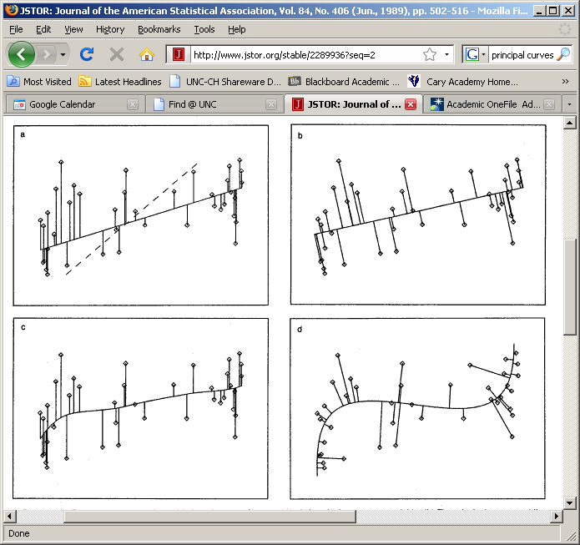
1st Principal Curve
Linear Reg’n
Usual Smooth

Slide 60
1st Principal Curve
Linear Reg’n
Proj’s Reg’n
Usual Smooth

Slide 61
1st Principal Curve
Linear Reg’n
Proj’s Reg’n
Usual Smooth
Princ’l Curve

Slide 62
An Interesting Question
How generally applicable is
Backwards approach to PCA?
Potential Application: Principal Curves
Perceived Major Challenge:
How to find 2nd Principal Curve?
Backwards approach???

Slide 63
An Interesting Question
Key Component:
Principal Surfaces
LeBlanc & Tibshirani (1994)

Slide 64
An Interesting Question
How generally applicable is
Backwards approach to PCA?
Another Potential Application:
Nonnegative Matrix Factorization
= PCA in Positive Orthant
(early days)

Slide 65

An Interesting Question
How generally applicable is
Backwards approach to PCA?
Nonnegative Matrix Factorization
Discussed in Guest Lecture:
Tuesday, November 13
Lingsong Zhang
Thanks to stat.purdue.edu

Slide 66
An Interesting Question
How generally applicable is
Backwards approach to PCA?
Another Potential Application:
Trees as Data
(early days)

Slide 67
An Interesting Question
How generally applicable is
Backwards approach to PCA?
An Attractive Answer

Slide 68

An Interesting Question
How generally applicable is
Backwards approach to PCA?
An Attractive Answer:
James Damon, UNC Mathematics
Geometry
Singularity
Theory

Slide 69
An Interesting Question
How generally applicable is
Backwards approach to PCA?
An Attractive Answer:
James Damon, UNC Mathematics
Key Idea: Express Backwards PCA as
Nested Series of Constraints

Slide 70

General View of Backwards PCA
Define Nested Spaces via Constraints
Satisfying More Constraints $⇒$
$⇒$ Smaller Subspaces

Slide 71
General View of Backwards PCA
Define Nested Spaces via Constraints
E.g. SVD
(Singular Value Decomposition =
= Not Mean Centered PCA)
(notationally very clean)

Slide 72
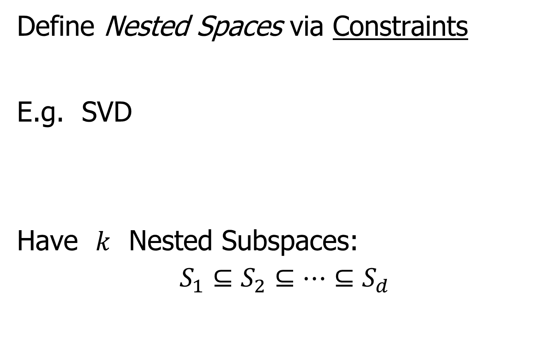
General View of Backwards PCA
Define Nested Spaces via Constraints
E.g. SVD
Have $k$ Nested Subspaces:
$$S_{1}⊆S_{2}⊆⋯⊆S_{d}$$

Slide 73

General View of Backwards PCA
Define Nested Spaces via Constraints
E.g. SVD $S_{k}=\left\{x :x=\sum_{j=1}^{k}{c_{j}\vec{u_{j}}}\right\}$
$k$-th SVD Subspace
Scores
Loading Vectors

Slide 74
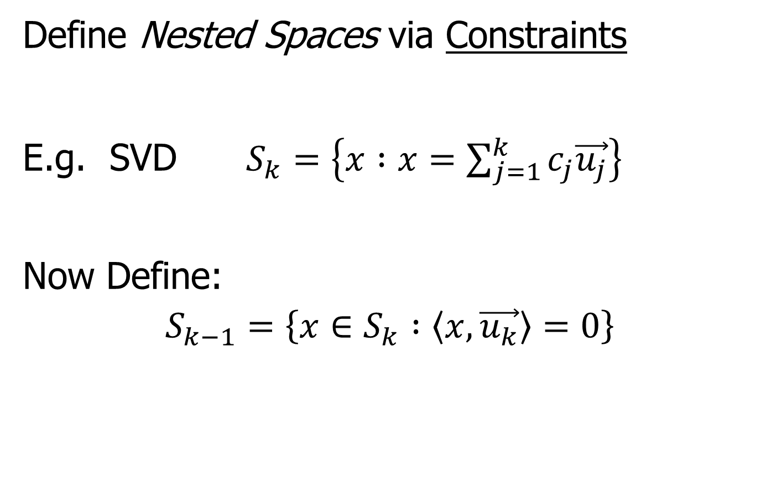
General View of Backwards PCA
Define Nested Spaces via Constraints
E.g. SVD $S_{k}=\left\{x :x=\sum_{j=1}^{k}{c_{j}\vec{u_{j}}}\right\}$
Now Define:
$$S_{k−1}=\left\{x∈S_{k} :\left\langle x,\vec{u_{k}}\right\rangle =0\right\}$$

Slide 75
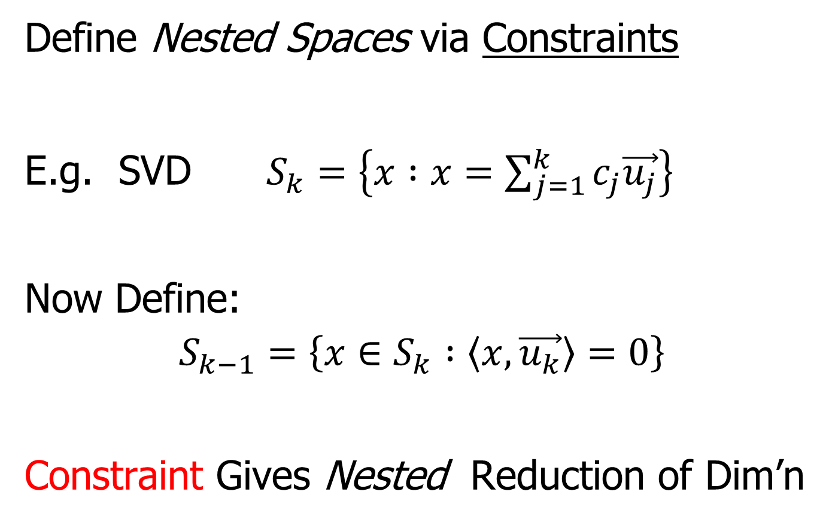
General View of Backwards PCA
Define Nested Spaces via Constraints
E.g. SVD $S_{k}=\left\{x :x=\sum_{j=1}^{k}{c_{j}\vec{u_{j}}}\right\}$
Now Define:
$$S_{k−1}=\left\{x∈S_{k} :\left\langle x,\vec{u_{k}}\right\rangle =0\right\}$$
Constraint Gives Nested Reduction of Dim’n

Slide 76
General View of Backwards PCA
Define Nested Spaces via Constraints
Backwards PCA
Reduce Using Affine Constraints

Slide 77
General View of Backwards PCA
Define Nested Spaces via Constraints
Backwards PCA
Principal Nested Spheres
Use Affine Constraints (Planar Slices)
In Ambient Space

Slide 78
General View of Backwards PCA
Define Nested Spaces via Constraints
Backwards PCA
Principal Nested Spheres
Principal Surfaces
Spline Constraint Within Previous?

Slide 79
General View of Backwards PCA
Define Nested Spaces via Constraints
Backwards PCA
Principal Nested Spheres
Principal Surfaces
Spline Constraint Within Previous?
{Been Done Already???}

Slide 80
General View of Backwards PCA
Define Nested Spaces via Constraints
Backwards PCA
Principal Nested Spheres
Principal Surfaces
Other Manifold Data Spaces
Sub-Manifold Constraints??
(Algebraic Geometry)

Slide 81
General View of Backwards PCA
Define Nested Spaces via Constraints
Backwards PCA
Principal Nested Spheres
Principal Surfaces
Other Manifold Data Spaces
Tree Spaces
Suitable Constraints???

Slide 82
General View of Backwards PCA
Why does Backwards Work Better?

Slide 83
General View of Backwards PCA
Why does Backwards Work Better?
Natural to Sequentially Add Constraints
(I.e. Add Constraints,
Using Information in Data)

Slide 84
General View of Backwards PCA
Why does Backwards Work Better?
Natural to Sequentially Add Constraints
Hard to Start With Complete Set,
And Sequentially Remove

