Slide 1
Statistics – O. R. 891
Object Oriented Data Analysis
J. S. Marron
Dept. of Statistics and Operations Research
University of North Carolina

Slide 2
PCA Extensions for Data on Manifolds
Fletcher (Principal Geodesic Anal.)
  Best fit of geodesic to data
  Constrained to go through geodesic mean
Huckemann, Hotz & Munk (Geod. PCA)
  Best fit of any geodesic to data
Jung, Foskey & Marron (Princ. Arc Anal.)
  Best fit of any circle to data
  (motivated by conformal maps)

Slide 3
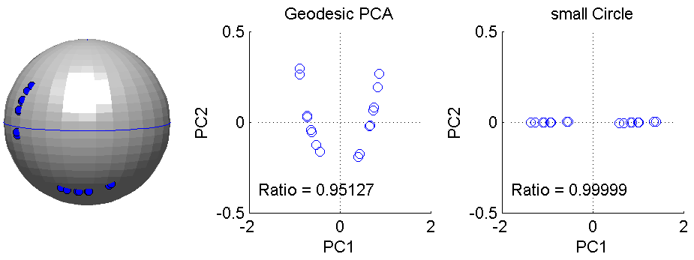
Principal Arc Analysis
Jung, Foskey & Marron (2011)
  Best fit of any circle to data
  Can give better fit than geodesics
  Observed for simulated m-rep example

Slide 4
Landmark Based Shape Analysis
Currently popular approaches to PCA on S^{k}:
Early: PCA on projections
Fletcher: Geodesics through mean
Huckemann, et al: Any Geodesic
New Approach:
Principal Nested Sphere Analysis
Jung, Dryden & Marron (2012)

Slide 5
Principal Nested Spheres Analysis
Replace usual forwards view of PCA
Data → PC1 (1-d approx)
→ PC2 (1-d approx of Data-PC1)
→ PC1 U PC2 (2-d approx)
→ PC1 U … U PCr
(r-d approx)

Slide 6
Principal Nested Spheres Analysis
With a backwards approach to PCA
Data → PC1 U … U PCr (r-d approx)
→ PC1 U … U PC(r-1)
→ PC1 U PC2 (2-d approx)
→ PC1 (1-d approx)

Slide 7
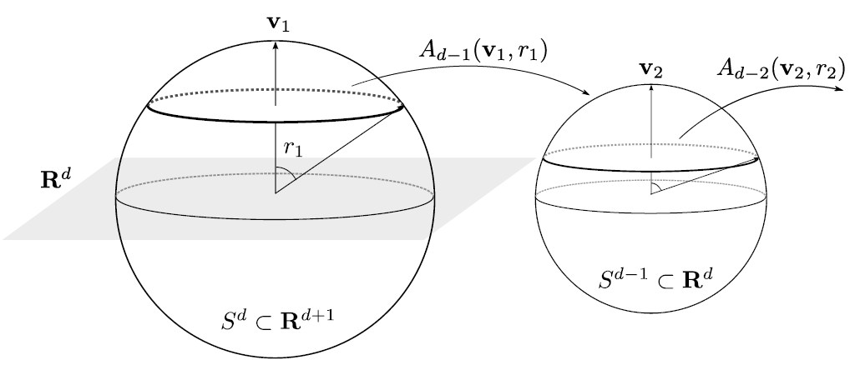
Principal Nested Spheres Analysis
Top Down Nested (small) spheres

Slide 8

Composite Principal Nested Spheres
Idea: Use Principal Arc Analysis
Over Large Products of $S^{2}$ and $ℝ^{d}$

Slide 9
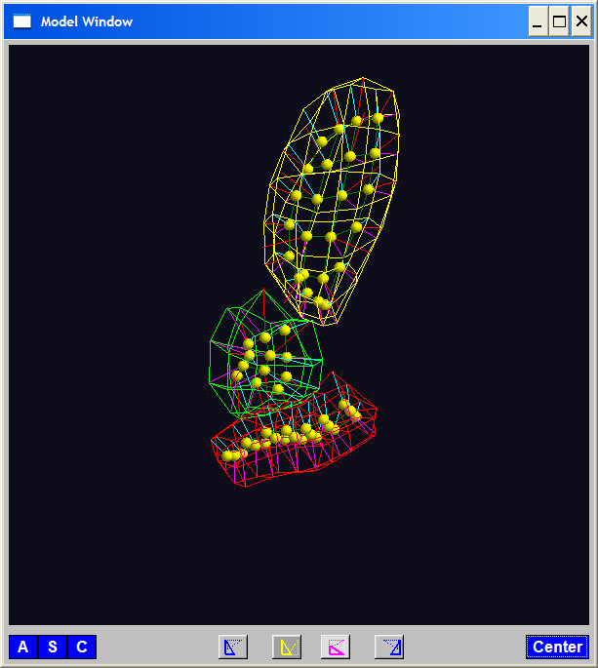
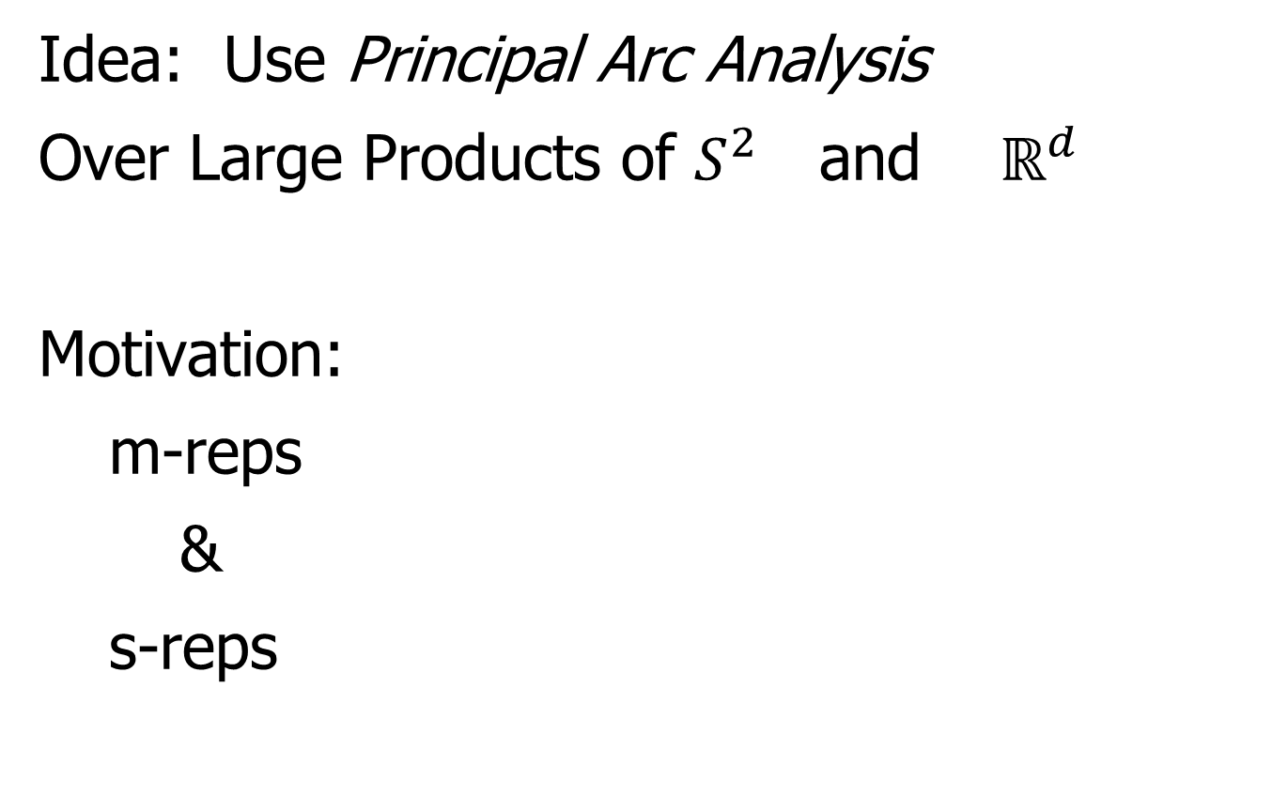
Composite Principal Nested Spheres
Idea: Use Principal Arc Analysis
Over Large Products of $S^{2}$ and $ℝ^{d}$
Motivation:
m-reps
&
s-reps

Slide 10

Composite Principal Nested Spheres
Idea: Use Principal Arc Analysis
Over Large Products of $S^{2}$ and $ℝ^{d}$
Approach: Use Principal Arc Analysis
to Linearize $S^{2}$ Components

Slide 11
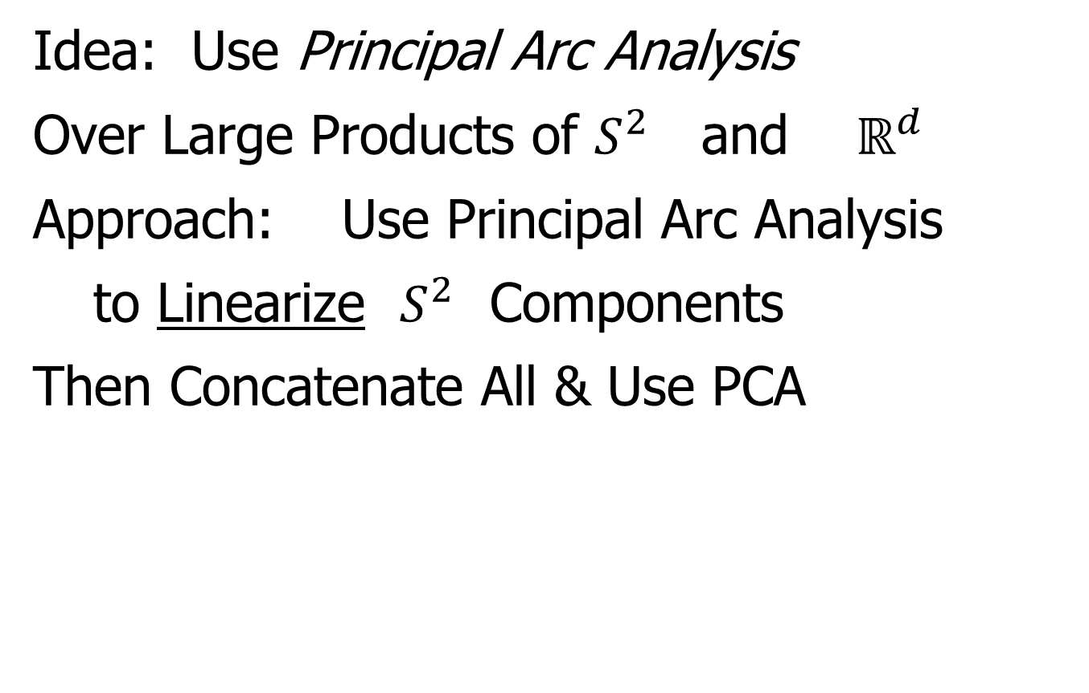
Composite Principal Nested Spheres
Idea: Use Principal Arc Analysis
Over Large Products of $S^{2}$ and $ℝ^{d}$
Approach: Use Principal Arc Analysis
to Linearize $S^{2}$ Components
Then Concatenate All & Use PCA

Slide 12
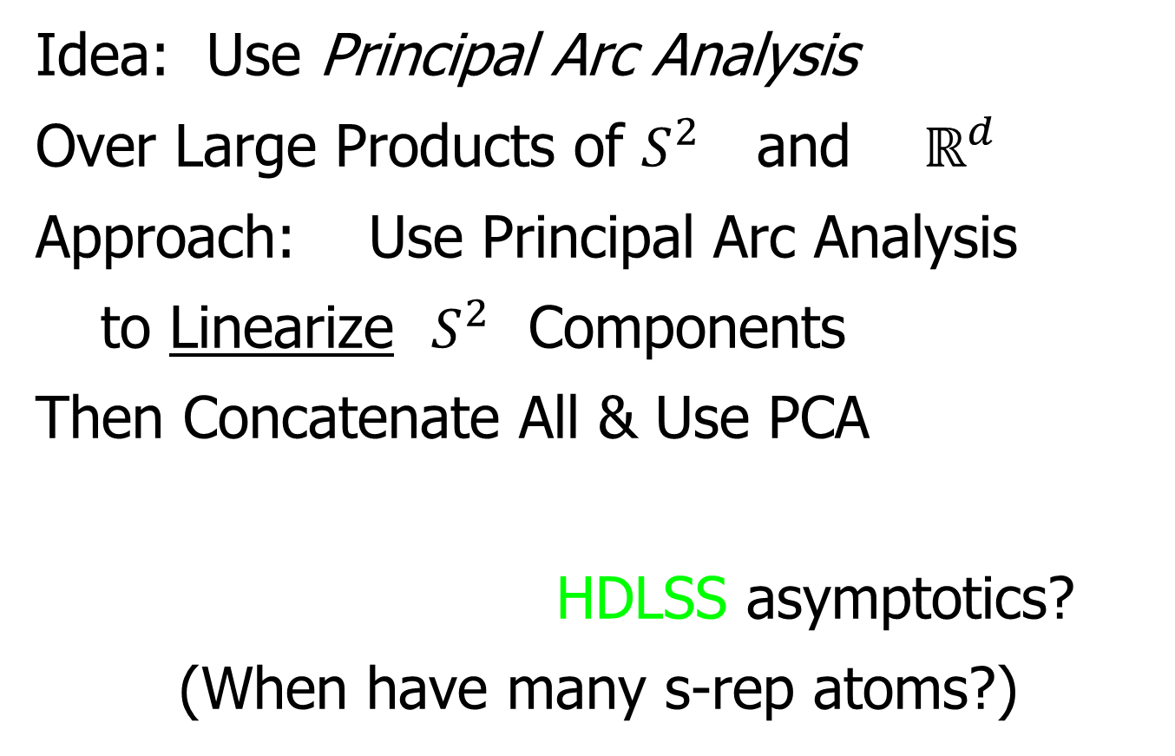
Composite Principal Nested Spheres
Idea: Use Principal Arc Analysis
Over Large Products of $S^{2}$ and $ℝ^{d}$
Approach: Use Principal Arc Analysis
to Linearize $S^{2}$ Components
Then Concatenate All & Use PCA
HDLSS asymptotics?
(When have many s-rep atoms?)

Slide 13

Composite Principal Nested Spheres
HDLSS asymptotics?
Simple Case: $S^{2}×S^{2}×⋯×S^{2}$
$d$

Slide 14

Composite Principal Nested Spheres
HDLSS asymptotics?
Simple Case: $S^{2}×S^{2}×⋯×S^{2}$
Study $\lim_{d→∞}{}$
Get Geometric Representation?

Slide 15
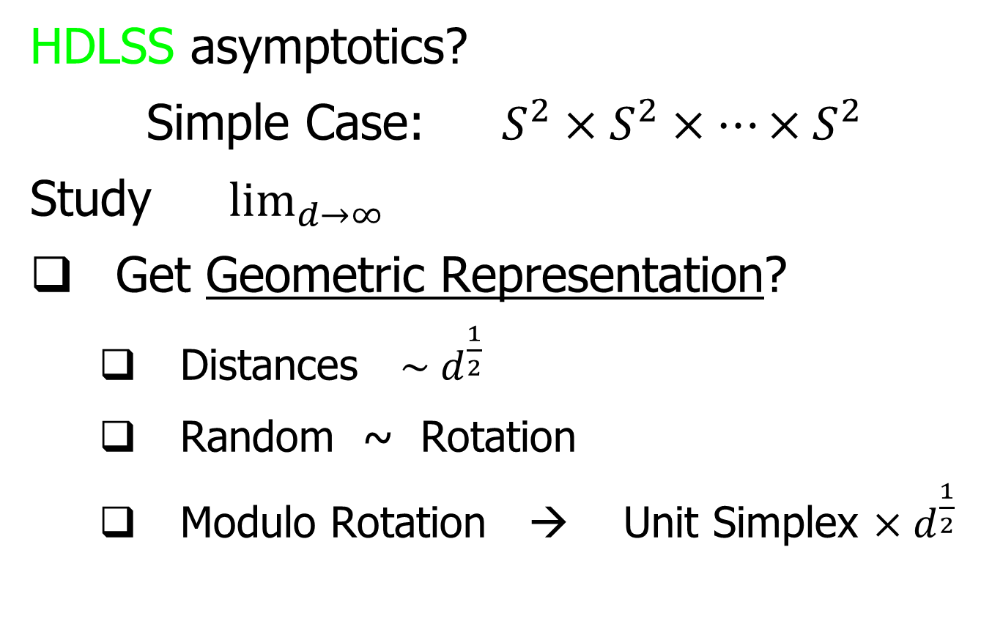
Composite Principal Nested Spheres
HDLSS asymptotics?
Simple Case: $S^{2}×S^{2}×⋯×S^{2}$
Study $\lim_{d→∞}{}$
Get Geometric Representation?
  Distances $\sim d^{\frac{1}{2}}$
  Random ~ Rotation
  Modulo Rotation → Unit Simplex $×d^{\frac{1}{2}}$

Slide 16
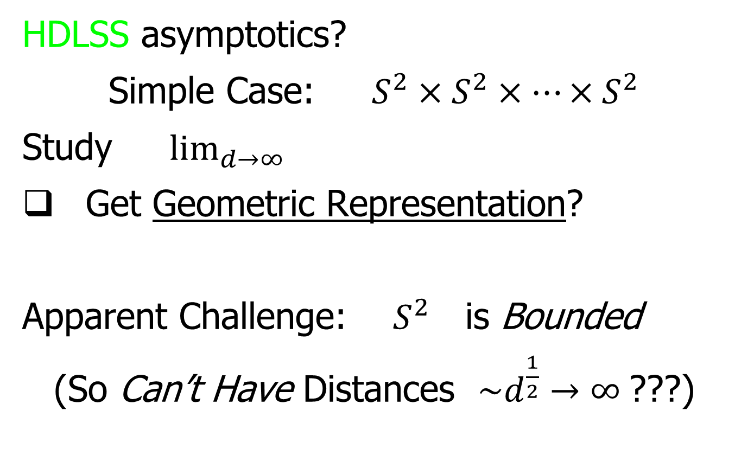
Composite Principal Nested Spheres
HDLSS asymptotics?
Simple Case: $S^{2}×S^{2}×⋯×S^{2}$
Study $\lim_{d→∞}{}$
Get Geometric Representation?
Apparent Challenge: $S^{2}$ is Bounded
(So Can’t Have Distances ${\sim d}^{\frac{1}{2}}→∞$???)

Slide 17

Composite Principal Nested Spheres
HDLSS asymptotics?
Even Simpler (But Bounded) Case: $\left[0,1\right]×\left[0,1\right]×⋯×\left[0,1\right]$
Unit Cube in $ℝ^{d},$Study $\lim_{d→∞}{}$

Slide 18

Composite Principal Nested Spheres
HDLSS asymptotics?
Even Simpler (But Bounded) Case: $\left[0,1\right]×\left[0,1\right]×⋯×\left[0,1\right]$
Unit Cube in $ℝ^{d},$Study $\lim_{d→∞}{}$
Diagonal Length = $d^{\frac{1}{2}}$

Slide 19
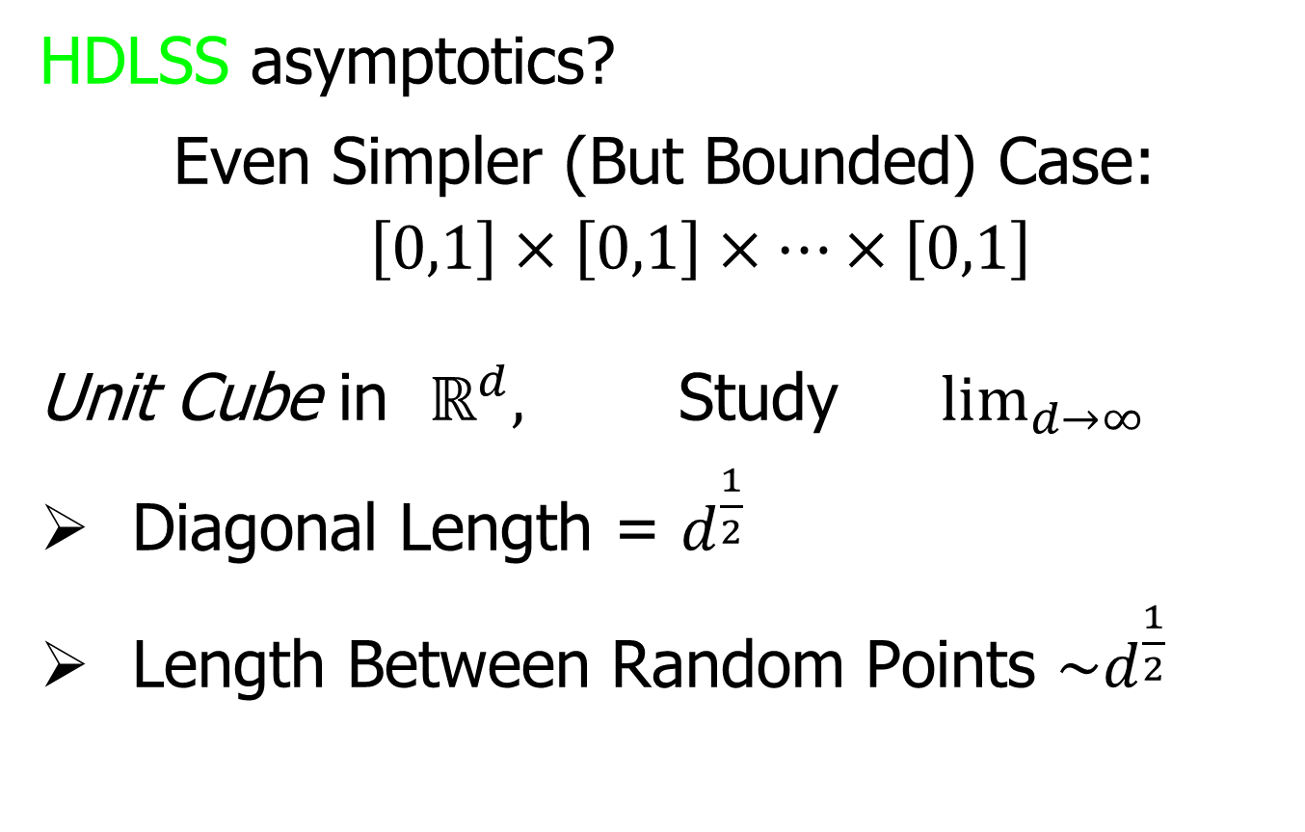
Composite Principal Nested Spheres
HDLSS asymptotics?
Even Simpler (But Bounded) Case: $\left[0,1\right]×\left[0,1\right]×⋯×\left[0,1\right]$
Unit Cube in $ℝ^{d},$Study $\lim_{d→∞}{}$
Diagonal Length = $d^{\frac{1}{2}}$
Length Between Random Points $\sim d^{\frac{1}{2}}$

Slide 20
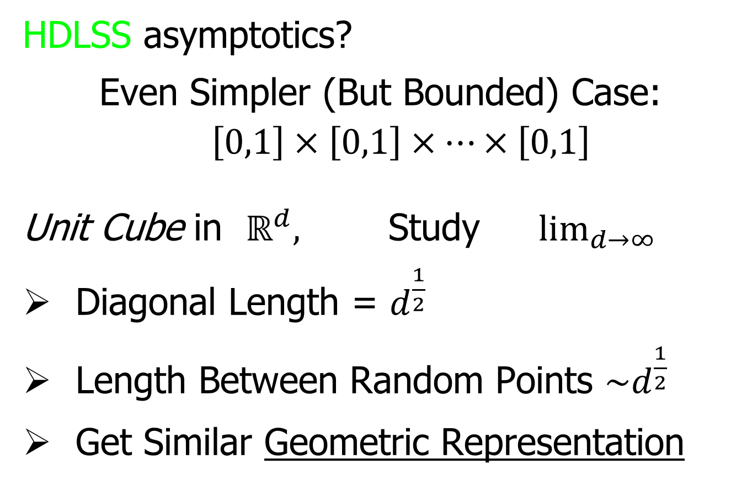
Composite Principal Nested Spheres
HDLSS asymptotics?
Even Simpler (But Bounded) Case: $\left[0,1\right]×\left[0,1\right]×⋯×\left[0,1\right]$
Unit Cube in $ℝ^{d},$Study $\lim_{d→∞}{}$
Diagonal Length = $d^{\frac{1}{2}}$
Length Between Random Points $\sim d^{\frac{1}{2}}$
Get Similar Geometric Representation

Slide 21
Composite Principal Nested Spheres
HDLSS asymptotics?
Simple Case: $S^{2}×S^{2}×⋯×S^{2}$
Study $\lim_{d→∞}{}$
Get Geometric Representation?

Slide 22

Composite Principal Nested Spheres
HDLSS asymptotics?
Simple Case: $S^{2}×S^{2}×⋯×S^{2}$
Study $\lim_{d→∞}{}$
Get Geometric Representation?
Yes, Sen et al (2008)

Slide 23
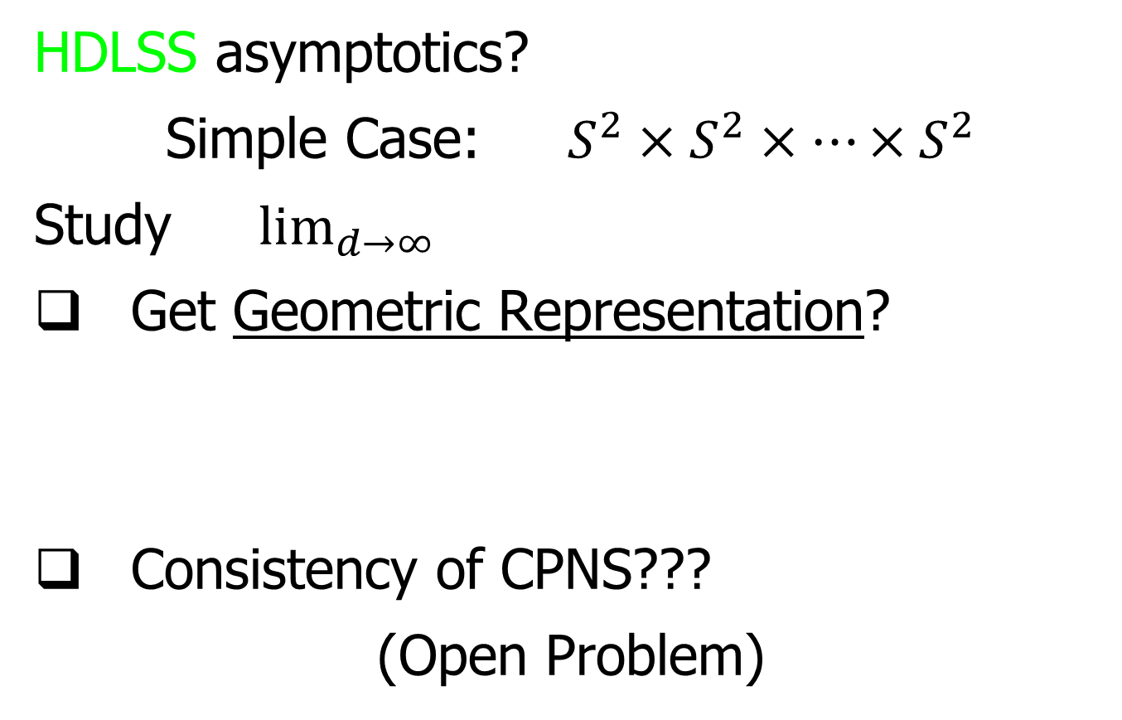
Composite Principal Nested Spheres
HDLSS asymptotics?
Simple Case: $S^{2}×S^{2}×⋯×S^{2}$
Study $\lim_{d→∞}{}$
Get Geometric Representation?
Consistency of CPNS???
(Open Problem)

Slide 24
An Interesting Question
How generally applicable is
Backwards approach to PCA?
Potential Application: Principal Curves
Perceived Major Challenge:
How to find 2nd Principal Curve?
Backwards approach???

Slide 25
An Interesting Question
How generally applicable is
Backwards approach to PCA?
An Attractive Answer:
James Damon, UNC Mathematics
Key Idea: Express Backwards PCA as
Nested Series of Constraints

Slide 26
General View of Backwards PCA
Why does Backwards Work Better?
Natural to Sequentially Add Constraints
Hard to Start With Complete Set,
And Sequentially Remove

Slide 27
Variation on Landmark Based Shape
Recall Main Idea:
Represent Shapes as Coordinates
“Mod Out” Transl’n, Rotat’n, Scale

Slide 28
Variation on Landmark Based Shape
Typical Viewpoint:
Variation in Shape is Goal
Other Variation+ is Nuisance
Recall Main Idea:
Represent Shapes as Coordinates
“Mod Out” Transl’n, Rotat’n, Scale

Slide 29
Variation on Landmark Based Shape
Typical Viewpoint:
Variation in Shape is Goal
Other Variation+ is Nuisance
Interesting Alternative:
Study Variation in Transformation
Treat Shape as Nuisance

Slide 30
Variation on Landmark Based Shape
Context: Study of Tectonic Plates
Movement of Earth’s Crust (over time)
Take Motions as Data Objects
Interesting Alternative:
Study Variation in Transformation
Treat Shape as Nuisance

Slide 31
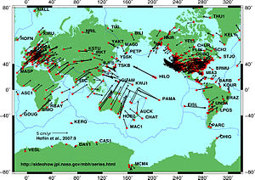
Variation on Landmark Based Shape
Context: Study of Tectonic Plates
Movement of Earth’s Crust (over time)
Take Motions as Data Objects
Royer & Chang (1991)
Thanks to Wikipedia

Slide 32
Non - Euclidean Data Spaces
What is “Strongly Non-Euclidean” Case?
Trees as Data

Slide 33
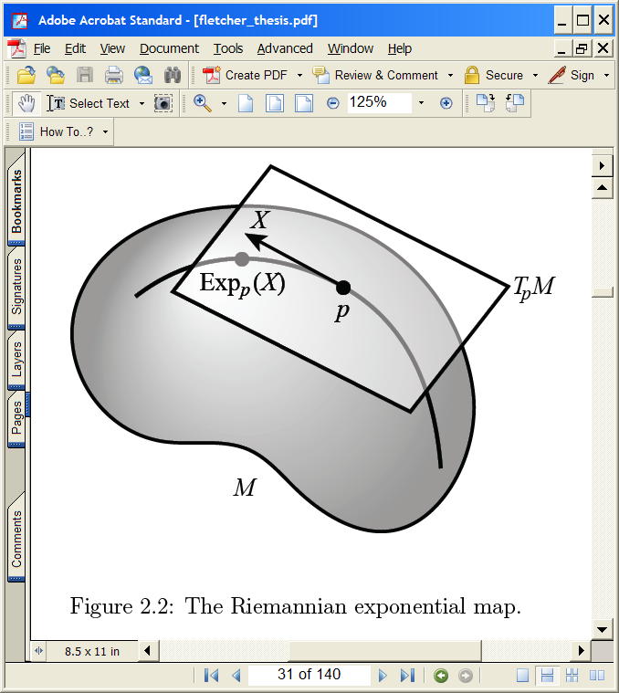
Non - Euclidean Data Spaces
What is “Strongly Non-Euclidean” Case?
Trees as Data
Special Challenge:
No Tangent Plane
Must Re-Invent
Data Analysis

Slide 34
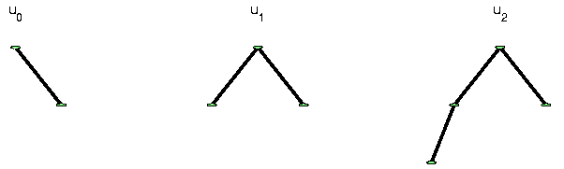
Strongly Non-Euclidean Spaces
Trees as Data Objects
Thanks to Burcu Aydin
Notes:
FIGp8correct.eps

Slide 35
Strongly Non-Euclidean Spaces
Trees as Data Objects
From Graph Theory:
Graph is set of nodes and edges
Thanks to Burcu Aydin
Notes:
FIGp8correct.eps

Slide 36
Strongly Non-Euclidean Spaces
Trees as Data Objects
From Graph Theory:
Graph is set of nodes and edges
Tree has root and direction
Thanks to Burcu Aydin
Notes:
FIGp8correct.eps

Slide 37
Strongly Non-Euclidean Spaces
Trees as Data Objects
From Graph Theory:
Graph is set of nodes and edges
Tree has root and direction
Data Objects: set of trees
Thanks to Burcu Aydin
Notes:
FIGp8correct.eps

Slide 38
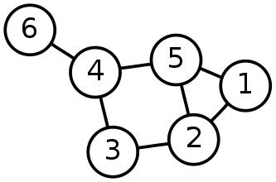
Strongly Non-Euclidean Spaces
General Graph:
Thanks to Sean Skwerer

Slide 39
Strongly Non-Euclidean Spaces
Special Case Called “Tree”
Directed
Acyclic
5
3
4
1
2
0

Slide 40
Strongly Non-Euclidean Spaces
Special Case Called “Tree”
Directed
Acyclic
5
3
4
1
2
Graphical note:
Sometimes “grow up”
Others “grow down”
0

Slide 41
Strongly Non-Euclidean Spaces
Special Case Called “Tree”
Directed
Acyclic
5
3
4
1
2
Terminology:
Root
0

Slide 42
Strongly Non-Euclidean Spaces
Special Case Called “Tree”
Directed
Acyclic
5
3
4
Terminology:
Children
Of
Parent
1
2
0

Slide 43
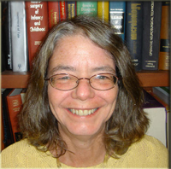
Strongly Non-Euclidean Spaces
Motivating Example:
From Dr. Elizabeth Bullitt
  Dept. of Neurosurgery, UNC

Slide 44
Strongly Non-Euclidean Spaces
Motivating Example:
From Dr. Elizabeth Bullitt
  Dept. of Neurosurgery, UNC
Blood Vessel Trees in Brains
Segmented from MRAs

Slide 45
Strongly Non-Euclidean Spaces
Motivating Example:
From Dr. Elizabeth Bullitt
  Dept. of Neurosurgery, UNC
Blood Vessel Trees in Brains
Segmented from MRAs
Study population of trees
Forest of Trees

Slide 46
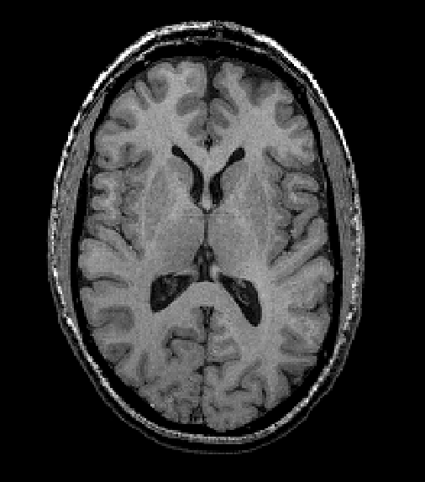
Blood vessel tree data
Marron’s brain:
MRI (T1) view
Single Slice
From 3-d Image

Slide 47
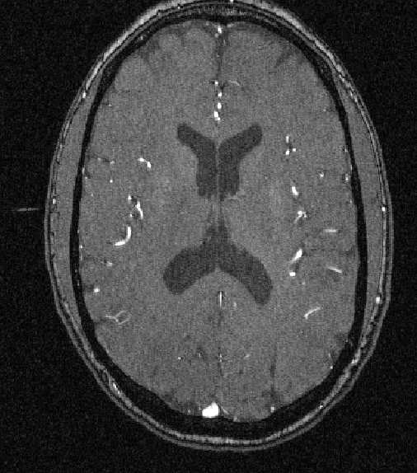
Blood vessel tree data
Marron’s brain:
MRA view
“A” for “Angiography”
Finds blood vessels
(show up as white)
Track through 3d

Slide 48

Blood vessel tree data
Marron’s brain:
MRA view
“A” for “Angiography”
Finds blood vessels
(show up as white)
Track through 3d

Slide 49

Blood vessel tree data
Marron’s brain:
MRA view
“A” for “Angiography”
Finds blood vessels
(show up as white)
Track through 3d

Slide 50
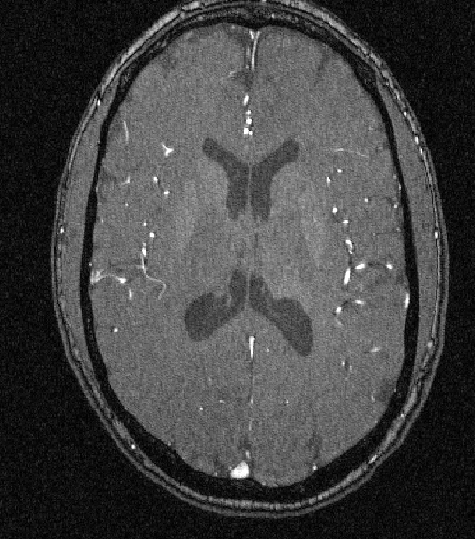
Blood vessel tree data
Marron’s brain:
MRA view
“A” for “Angiography”
Finds blood vessels
(show up as white)
Track through 3d

Slide 51
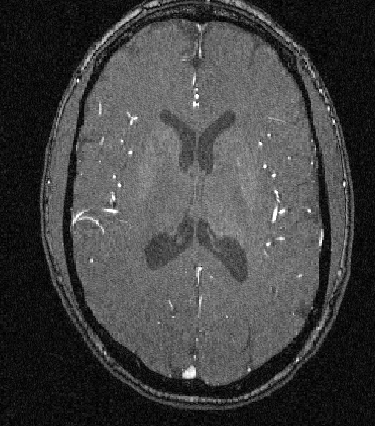
Blood vessel tree data
Marron’s brain:
MRA view
“A” for “Angiography”
Finds blood vessels
(show up as white)
Track through 3d

Slide 52

Blood vessel tree data
Marron’s brain:
MRA view
“A” for “Angiography”
Finds blood vessels
(show up as white)
Track through 3d

Slide 53
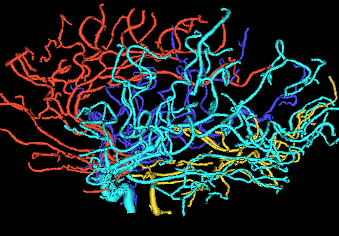
Blood vessel tree data
Marron’s brain:
From MRA
Segment tree
of vessel segments
Using tube tracking
Bullitt and Aylward (2002)

Slide 54
Blood vessel tree data
Marron’s brain:
From MRA
Reconstruct trees
in 3d
Rotate to view

Slide 55
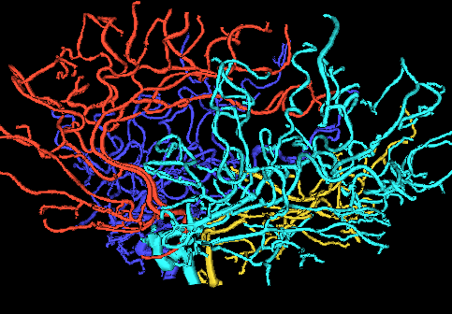
Blood vessel tree data
Marron’s brain:
From MRA
Reconstruct trees
in 3d
Rotate to view

Slide 56
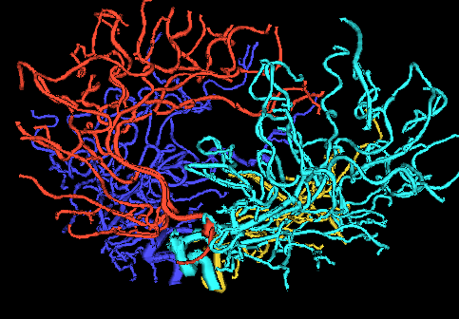
Blood vessel tree data
Marron’s brain:
From MRA
Reconstruct trees
in 3d
Rotate to view

Slide 57
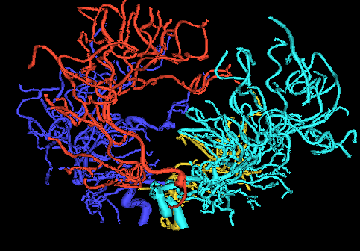
Blood vessel tree data
Marron’s brain:
From MRA
Reconstruct trees
in 3d
Rotate to view

Slide 58
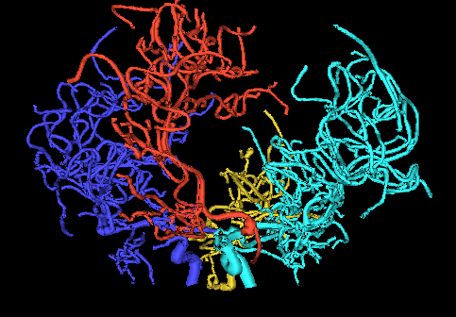
Blood vessel tree data
Marron’s brain:
From MRA
Reconstruct trees
in 3d
Rotate to view

Slide 59
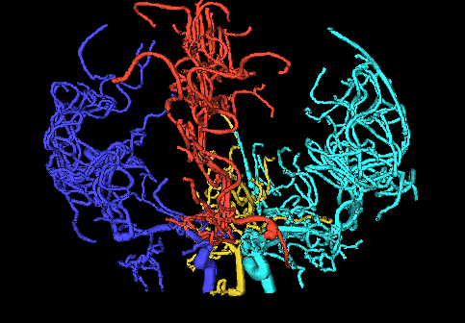
Blood vessel tree data
Marron’s brain:
From MRA
Reconstruct trees
in 3d
Rotate to view

Slide 60
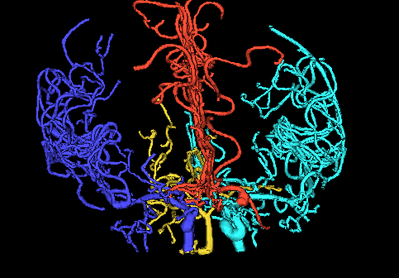
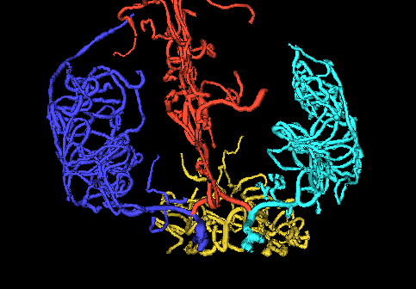
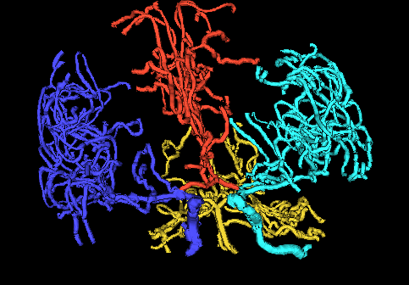
Blood vessel tree data
,
, ... ,
Now look over many people (data objects)
Structure of population (understand variation?)
PCA in strongly non-Euclidean Space???

Slide 61
Blood vessel tree data
,
, ... ,
Examples of Potential Specific Goals

Slide 62
Blood vessel tree data
,
, ... ,
Examples of Potential Specific Goals
(not accessible by traditional methods)
Predict Stroke Tendency (Collateral Circulation)

Slide 63
Blood vessel tree data
,
, ... ,
Examples of Potential Specific Goals
(not accessible by traditional methods)
Predict Stroke Tendency (Collateral Circulation)
Screen for Loci of Pathology

Slide 64
Blood vessel tree data
,
, ... ,
Examples of Potential Specific Goals
(not accessible by traditional methods)
Predict Stroke Tendency (Collateral Circulation)
Screen for Loci of Pathology
Explore how age affects connectivity

Slide 65
Blood vessel tree data
,
, ... ,
Examples of Potential Specific Goals
(not accessible by traditional methods)
Predict Stroke Tendency (Collateral Circulation)
Screen for Loci of Pathology
Explore how age affects connectivity

Slide 66
Blood vessel tree data
Big Picture: 3 Approaches
Purely Combinatorial
Euclidean Orthant
Dyck Path

Slide 67
Blood vessel tree data
Big Picture: 3 Approaches
Purely Combinatorial
Euclidean Orthant
Dyck Path

Slide 68
Purely Combinatorial
People:
Haonan Wang
Burcu Aydin
Gabor Pataki
Stephen Aylward
Alim Ladha
Yuan Wang

Slide 69
Blood vessel tree data
,
, ... ,
Possible foci of analysis:
Connectivity structure only (topology)
Location, size, orientation of segments
Structure within each vessel segment

Slide 70
Blood vessel tree data
Initial Focus:
Topology only
Already challenging

Slide 71
Blood vessel tree data
Initial Focus:
Topology only
Already challenging
Later address additional challenges
By adding attributes
(locations, thicknesses, curvature, …)
To tree nodes
And extend analysis

Slide 72
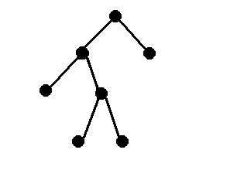
Blood vessel tree data
Topological Representation:
Each Vessel Segment (up to 1st Split)
is a node

Slide 73
Blood vessel tree data
Topological Representation:
Each Vessel Segment (up to 1st Split)
is a node
Split Segments are child nodes

Slide 74
Blood vessel tree data
Topological Representation:
Each Vessel Segment (up to 1st Split)
is a node
Split Segments are child nodes
Connecting lines show relationship

Slide 75
Blood vessel tree data
Correspondence (which node on left???):
Vessel Thickness
Larger Median Radius on Left

Slide 76
Blood vessel tree data
Recall from above:
Marron’s brain:
Focus on back
Connectivity (topology) only
(also consider right & left)

Slide 77
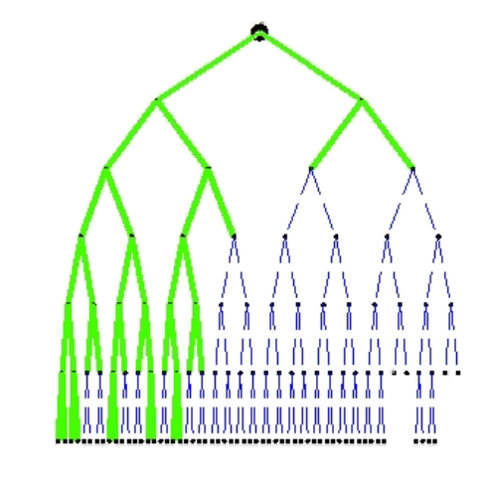
Blood vessel tree data
Present Focus:
Topology only
Raw data as trees
Marron’s
reduced tree
Back tree only

Slide 78
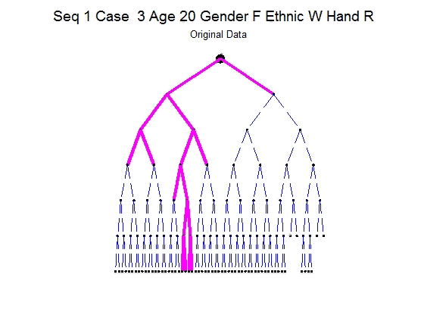
Blood vessel tree data
Topology only
E.g. Back Trees
Full Population
Study as movie
Understand variation?

Slide 79
Blood vessel tree data
Correspondence (which node on left???):
Vessel Thickness
Larger Median Radius on Left
II. Descendants
Most Descendants on Left

Slide 80
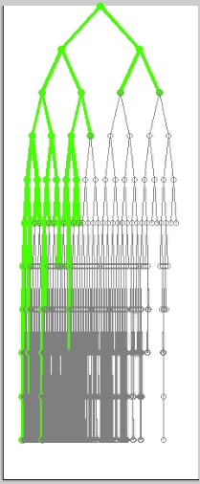
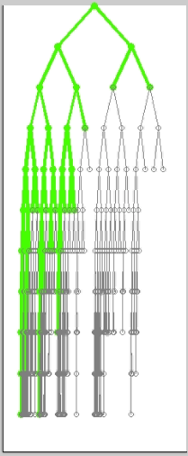
Blood vessel tree data
Marron’s Back Thickness Descendant
Trees
Look
Similar

Slide 81
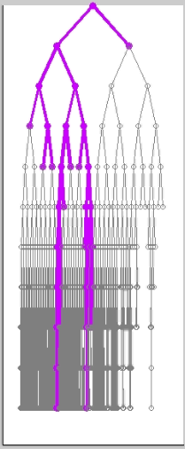
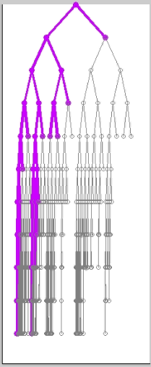
Blood vessel tree data
Case 34 Back Thickness Descendant
Trees
Quite
Different

Slide 82
Blood vessel tree data
Case 34 Back Thickness Descendant
Aside:
What Are
Gray Parts???

Slide 83
Graphical Concept: Support Tree
The union of all trees in data set T.

Slide 84
Graphical Concept: Support Tree
The union of all trees in data set T.
Consists of the nodes that exist in T and their “weights”.
Weight of a node, w(v,T) is the number of trees it occurs in the data set.

Slide 85
Graphical Concept: Support Tree
The union of all trees in data set T.
Consists of the nodes that exist in T and their “weights”.
Weight of a node, w(v,T) is the number of trees it occurs in the data set.
Used in Comparison of Thickness & Descendant Correspondences

Slide 86
Blood vessel tree data
Case 34 Back Thickness Descendant
Support Trees

Slide 87
Blood vessel tree data
Case 34 Back Thickness Descendant
Support Trees
Note:
Descendant
Less Bushy

Slide 88
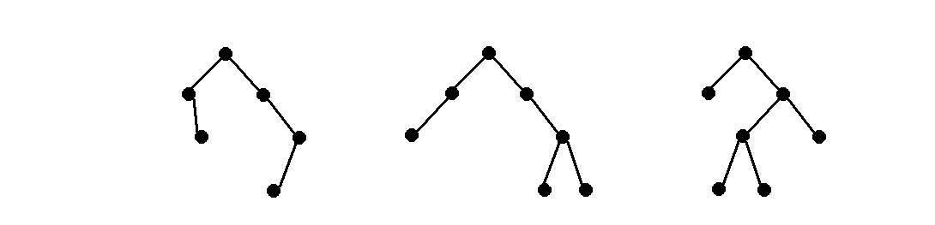
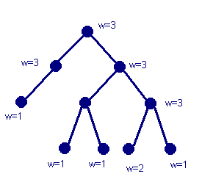
Support Tree Example
Data trees:
Support tree:

Slide 89
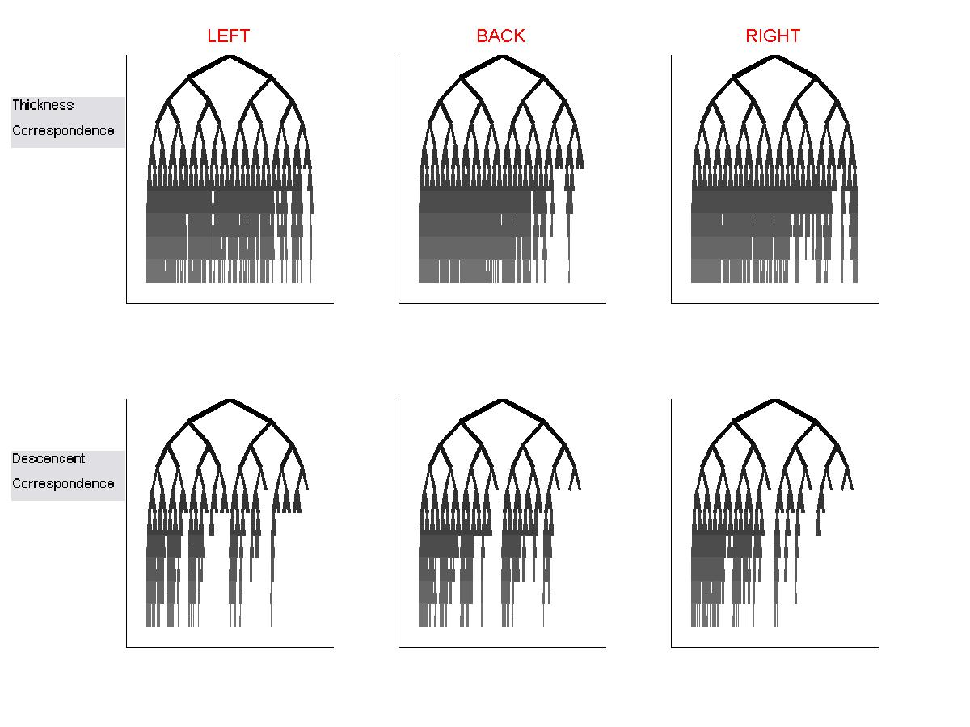
Graphical Concept: Support Tree
Thickness:
More
Spread
Descendant:
More
Compact

Slide 90
Graphical Concept: Support Tree
Comparison of Correspondences:
Thickness Corr. gives bushier trees
(shows more population structure)

Slide 91
Graphical Concept: Support Tree
Comparison of Correspondences:
Thickness Corr. gives bushier trees
(shows more population structure)
Descendant Corr. suggests compact rep’n
(easier to decompose, e.g. “PCA”?)

Slide 92
Graphical Concept: Support Tree
Comparison of Correspondences:
Thickness Corr. gives bushier trees
(shows more population structure)
Descendant Corr. suggests compact rep’n
(easier to decompose, e.g. “PCA”?)

Slide 93
Strongly Non-Euclidean Spaces
Statistics on Population of Tree-Structured Data Objects?

Slide 94
Strongly Non-Euclidean Spaces
Statistics on Population of Tree-Structured Data Objects?
Mean???
Analog of PCA???

Slide 95
Strongly Non-Euclidean Spaces
Statistics on Population of Tree-Structured Data Objects?
Mean???
Analog of PCA???
Strongly non-Euclidean, since:
Space of trees not a linear space
Not even approximately linear
(no tangent plane)

Slide 96
Mildly Non-Euclidean Spaces
Useful View of Manifold Data: Tangent Space
Center:
Frechét Mean
Reason for
terminology
“mildly non
Euclidean”
Notes:
fletcher_thesis.pdf

Slide 97
Strongly Non-Euclidean Spaces
Mean of Population of Tree-Structured Data Objects?
Natural approach: Fréchet mean

Slide 98
Strongly Non-Euclidean Spaces
Mean of Population of Tree-Structured Data Objects?
Natural approach: Fréchet mean
Requires a metric (distance)
on tree space

