Slide 1
Statistics – O. R. 891
Object Oriented Data Analysis
J. S. Marron
Dept. of Statistics and Operations Research
University of North Carolina

Slide 2
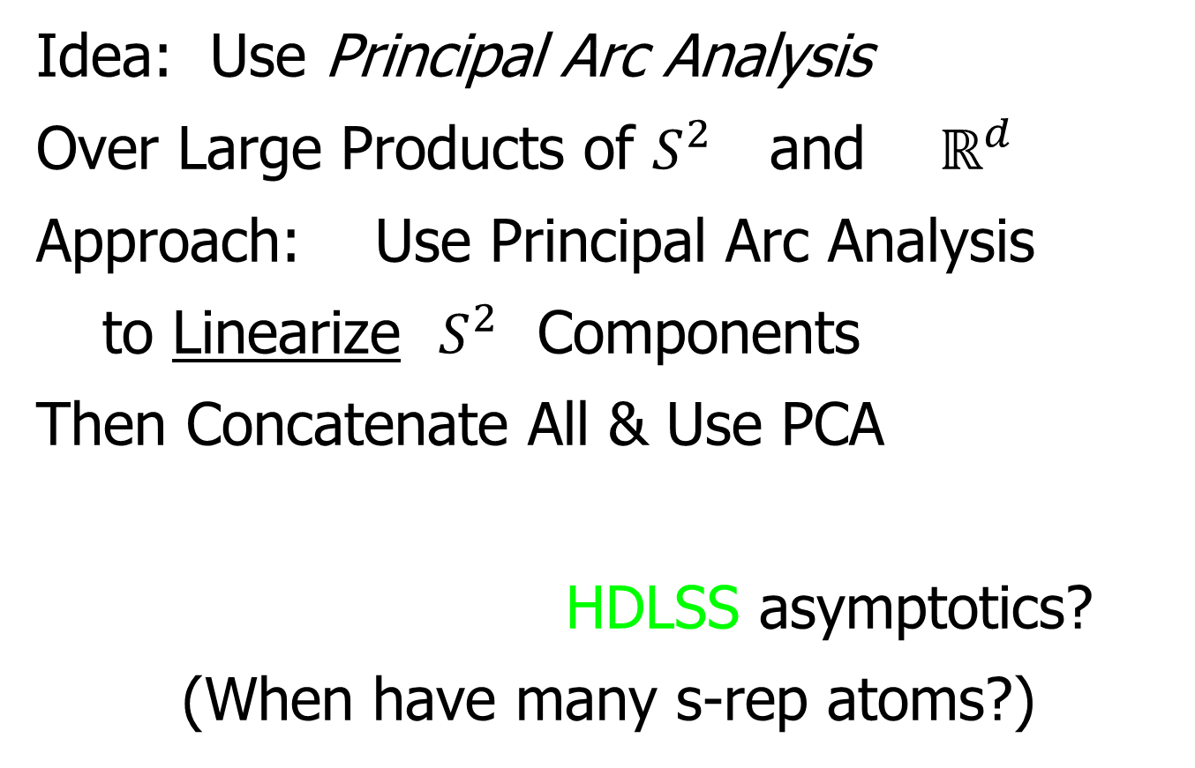
Composite Principal Nested Spheres
Idea: Use Principal Arc Analysis
Over Large Products of $S^{2}$ and $ℝ^{d}$
Approach: Use Principal Arc Analysis
to Linearize $S^{2}$ Components
Then Concatenate All & Use PCA
HDLSS asymptotics?
(When have many s-rep atoms?)

Slide 3
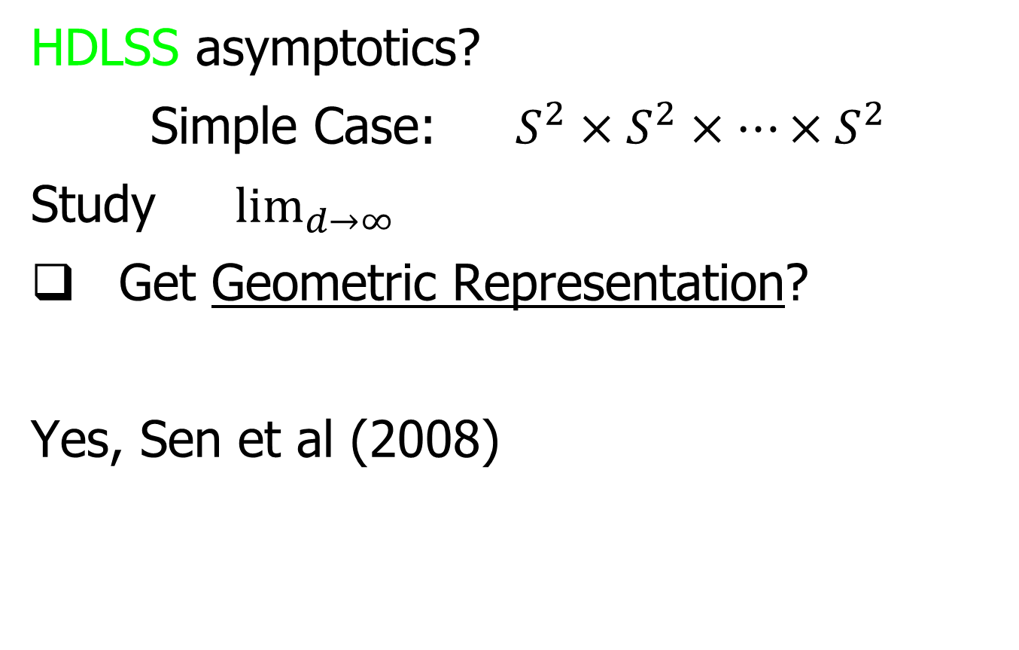
Composite Principal Nested Spheres
HDLSS asymptotics?
Simple Case: $S^{2}×S^{2}×⋯×S^{2}$
Study $\lim_{d→∞}{}$
Get Geometric Representation?
Yes, Sen et al (2008)

Slide 4
Variation on Landmark Based Shape
Context: Study of Tectonic Plates
Movement of Earth’s Crust (over time)
Take Motions as Data Objects
Interesting Alternative:
Study Variation in Transformation
Treat Shape as Nuisance

Slide 5
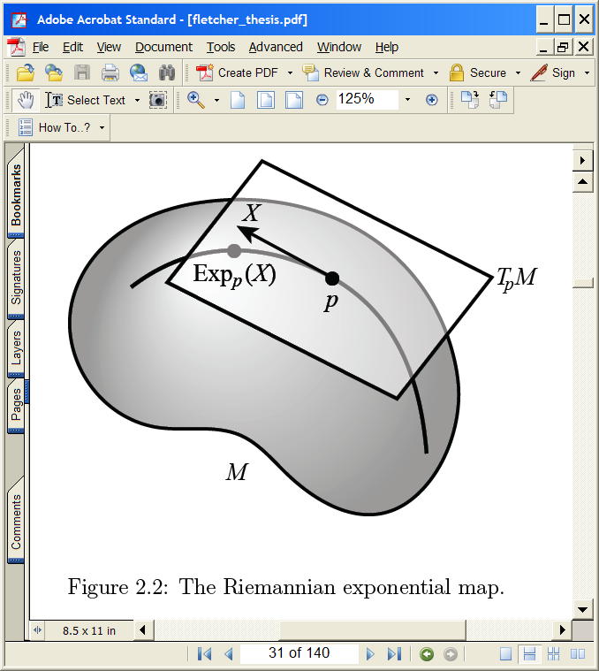
Non - Euclidean Data Spaces
What is “Strongly Non-Euclidean” Case?
Trees as Data
Special Challenge:
No Tangent Plane
Must Re-Invent
Data Analysis

Slide 6
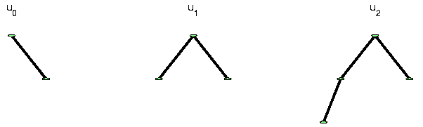
Strongly Non-Euclidean Spaces
Trees as Data Objects
From Graph Theory:
Graph is set of nodes and edges
Tree has root and direction
Data Objects: set of trees
Thanks to Burcu Aydin
Notes:
FIGp8correct.eps

Slide 7
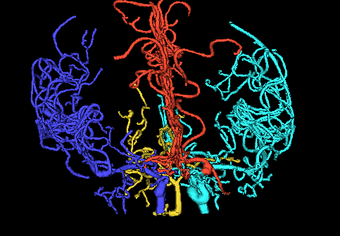
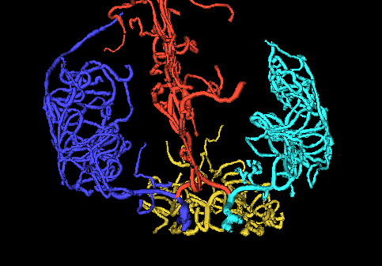
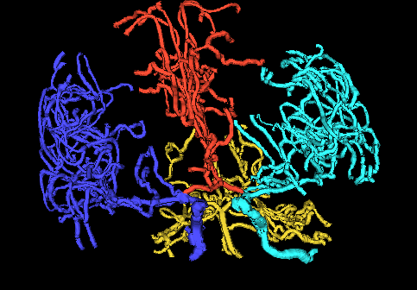
Blood vessel tree data
,
, ... ,
Examples of Potential Specific Goals
(not accessible by traditional methods)
Predict Stroke Tendency (Collateral Circulation)
Screen for Loci of Pathology
Explore how age affects connectivity

Slide 8
Blood vessel tree data
Big Picture: 3 Approaches
Purely Combinatorial
Euclidean Orthant
Dyck Path

Slide 9
Blood vessel tree data
,
, ... ,
Possible foci of analysis:
Connectivity structure only (topology)
Location, size, orientation of segments
Structure within each vessel segment

Slide 10
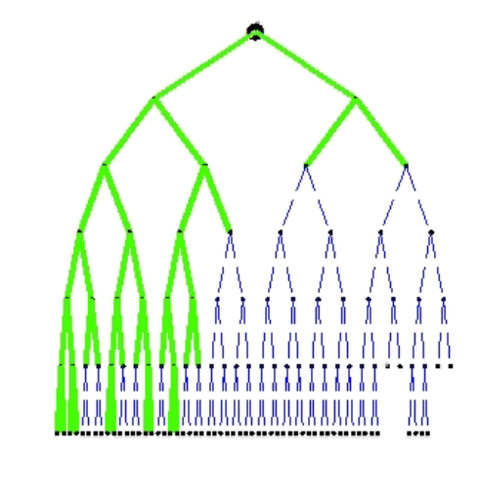
Blood vessel tree data
Present Focus:
Topology only
Raw data as trees
Marron’s
reduced tree
Back tree only

Slide 11
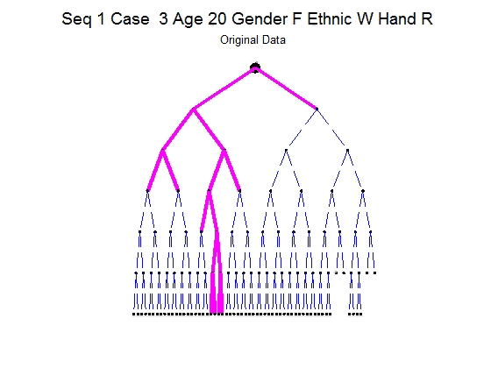
Blood vessel tree data
Topology only
E.g. Back Trees
Full Population
Study as movie
Understand variation?

Slide 12
Blood vessel tree data
Correspondence (which node on left???):
Vessel Thickness
Larger Median Radius on Left
II. Descendants
Most Descendants on Left

Slide 13
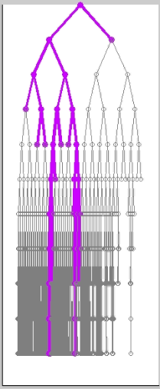
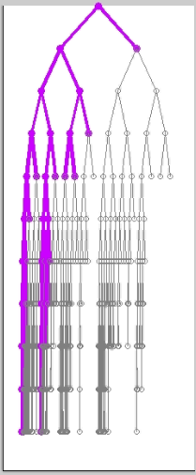
Blood vessel tree data
Case 34 Back Thickness Descendant
Aside:
What Are
Gray Parts???

Slide 14
Graphical Concept: Support Tree
The union of all trees in data set T.
Consists of the nodes that exist in T and their “weights”.
Weight of a node, w(v,T) is the number of trees it occurs in the data set.
Used in Comparison of Thickness & Descendant Correspondences

Slide 15
Blood vessel tree data
Case 34 Back Thickness Descendant
Support Trees

Slide 16
Blood vessel tree data
Case 34 Back Thickness Descendant
Support Trees
Note:
Descendant
Less Bushy

Slide 17
Graphical Concept: Support Tree
Comparison of Correspondences:
Thickness Corr. gives bushier trees
(shows more population structure)
Descendant Corr. suggests compact rep’n
(easier to decompose, e.g. “PCA”?)

Slide 18
Graphical Concept: Support Tree
Comparison of Correspondences:
Thickness Corr. gives bushier trees
(shows more population structure)
Descendant Corr. suggests compact rep’n
(easier to decompose, e.g. “PCA”?)

Slide 19
Strongly Non-Euclidean Spaces
Statistics on Population of Tree-Structured Data Objects?
Mean???
Analog of PCA???
Strongly non-Euclidean, since:
Space of trees not a linear space
Not even approximately linear
(no tangent plane)

Slide 20
Mildly Non-Euclidean Spaces
Useful View of Manifold Data: Tangent Space
Center:
Frechét Mean
Reason for
terminology
“mildly non
Euclidean”
Notes:
fletcher_thesis.pdf

Slide 21
Strongly Non-Euclidean Spaces
Mean of Population of Tree-Structured Data Objects?
Natural approach: Fréchet mean

Slide 22
Strongly Non-Euclidean Spaces
Mean of Population of Tree-Structured Data Objects?
Natural approach: Fréchet mean
Requires a metric (distance)
on tree space

Slide 23
Strongly Non-Euclidean Spaces
Appropriate metrics on tree space:
Wang and Marron (2007)
Depends on:
  Tree structure
  And nodal attributes
Won’t go further here
But gives appropriate Fréchet mean

Slide 24
Strongly Non-Euclidean Spaces
Appropriate metrics on tree space:
Wang and Marron (2007)
For topology only (studied here):
  Use Hamming Distance, Hamming (1950)
  Just number of nodes not in common
Gives appropriate Fréchet mean

Slide 25
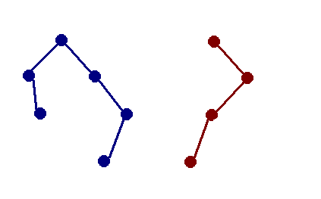
Hamming Distance
The number of nodes in the symmetric difference of two trees.
An example:

Slide 26
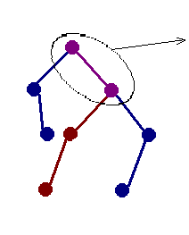
Hamming Distance
The two trees drawn on top of each other:
Common nodes: 2
Nodes only in blue tree: 4
Nodes only in red tree: 2
So, distance: 4+2=6
Thanks to Burcu Aydin

Slide 27
Strongly Non-Euclidean Spaces
PCA in Combinatorial Tree Space?

Slide 28
Strongly Non-Euclidean Spaces
PCA in Combinatorial Tree Space?
Recall Conventional PCA:
Directions that explain structure in data

Slide 29
Strongly Non-Euclidean Spaces
PCA in Combinatorial Tree Space?
Recall Conventional PCA:
Directions that explain structure in data
Data are points in point cloud
1-d and 2-d projections allow insights
about population structure

Slide 30
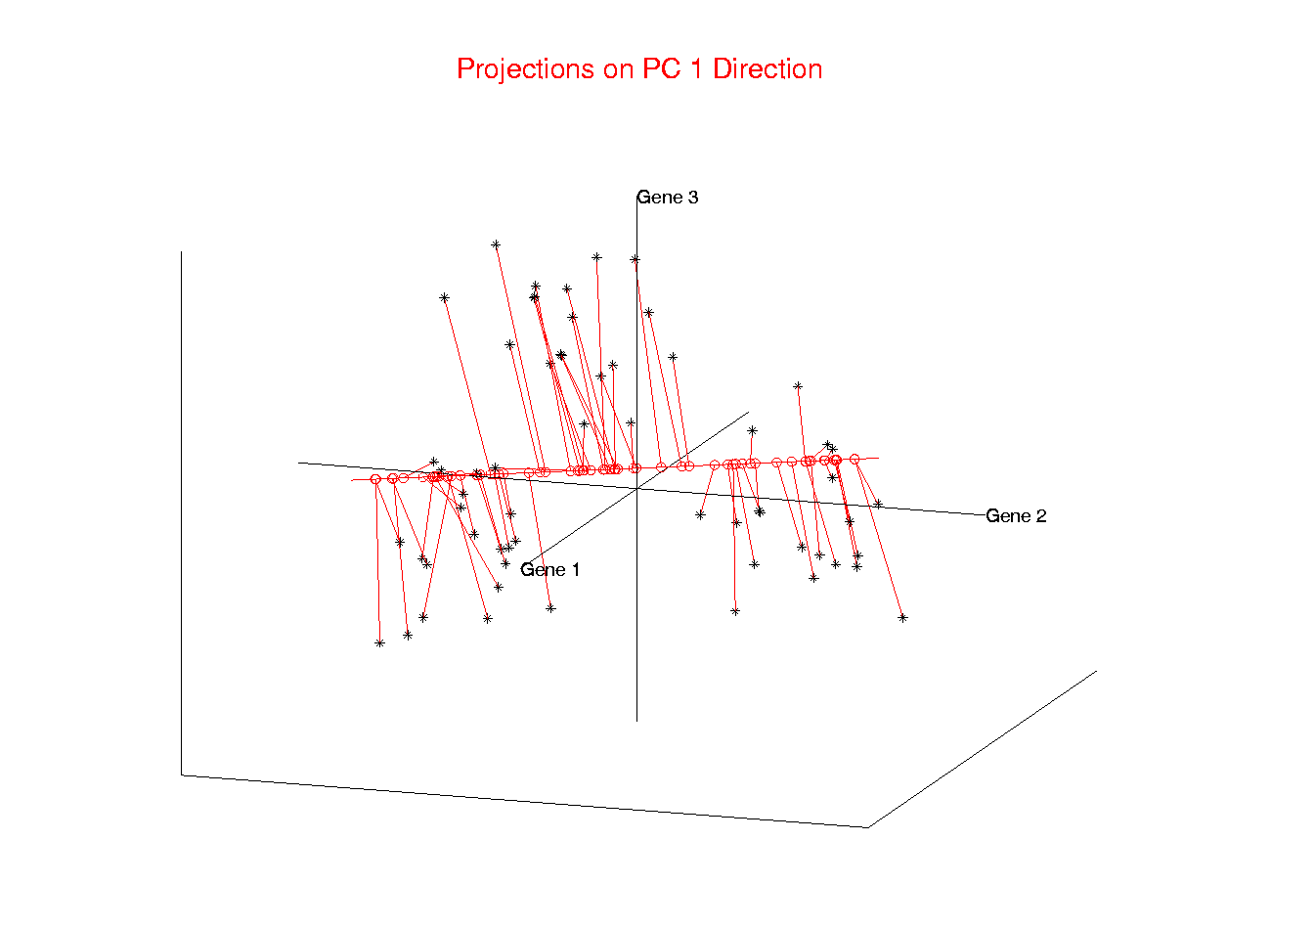
Illust’n of PCA View: PC1 Projections
Notes:
EgView1p51proj3dPC1.ps

Slide 31
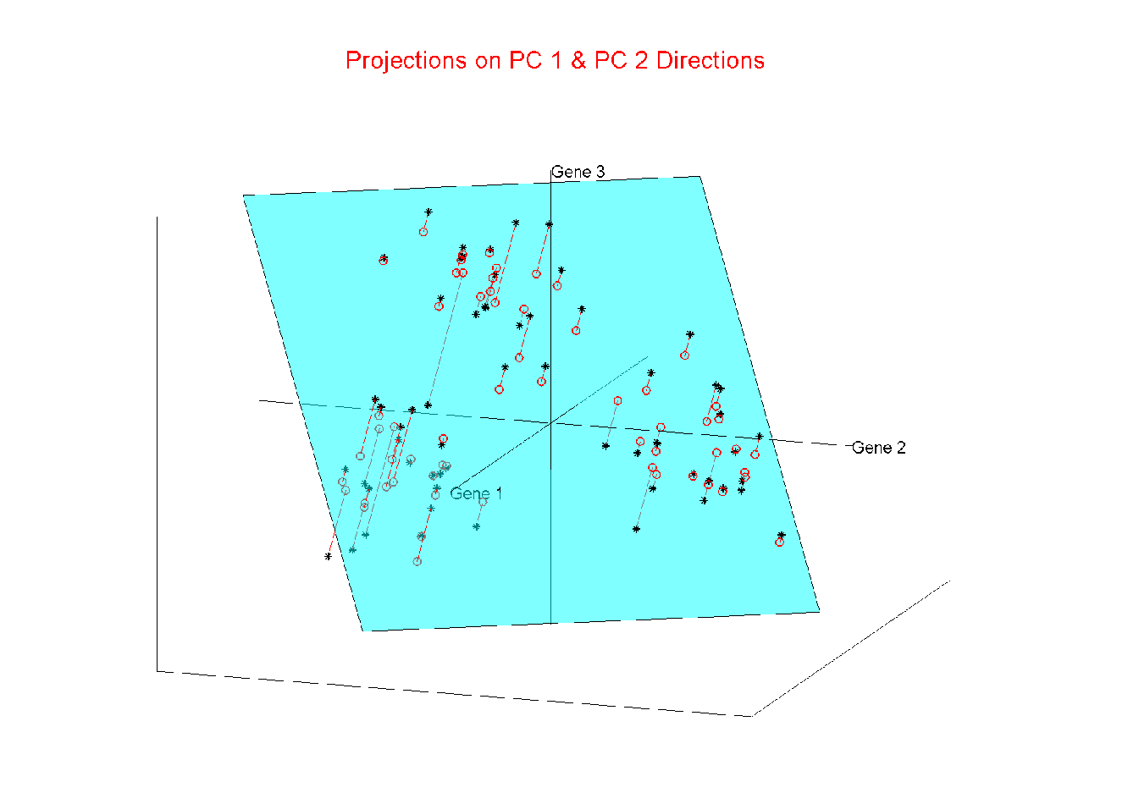
Illust’n of PCA View: Projections on PC1,2 plane
Notes:
EgView1p54proj3dPC12.ps

Slide 32
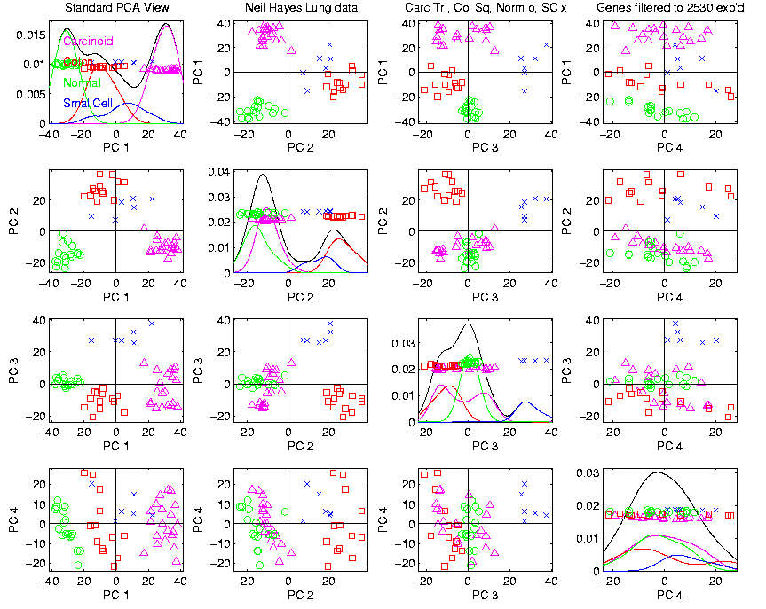
PCA view: Lung Cancer Microarray Data

Slide 33
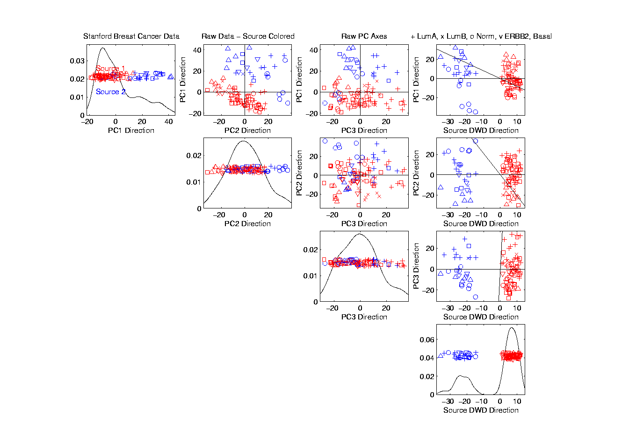
Source Batch Adj: PC 1-3 & DWD direction

Slide 34
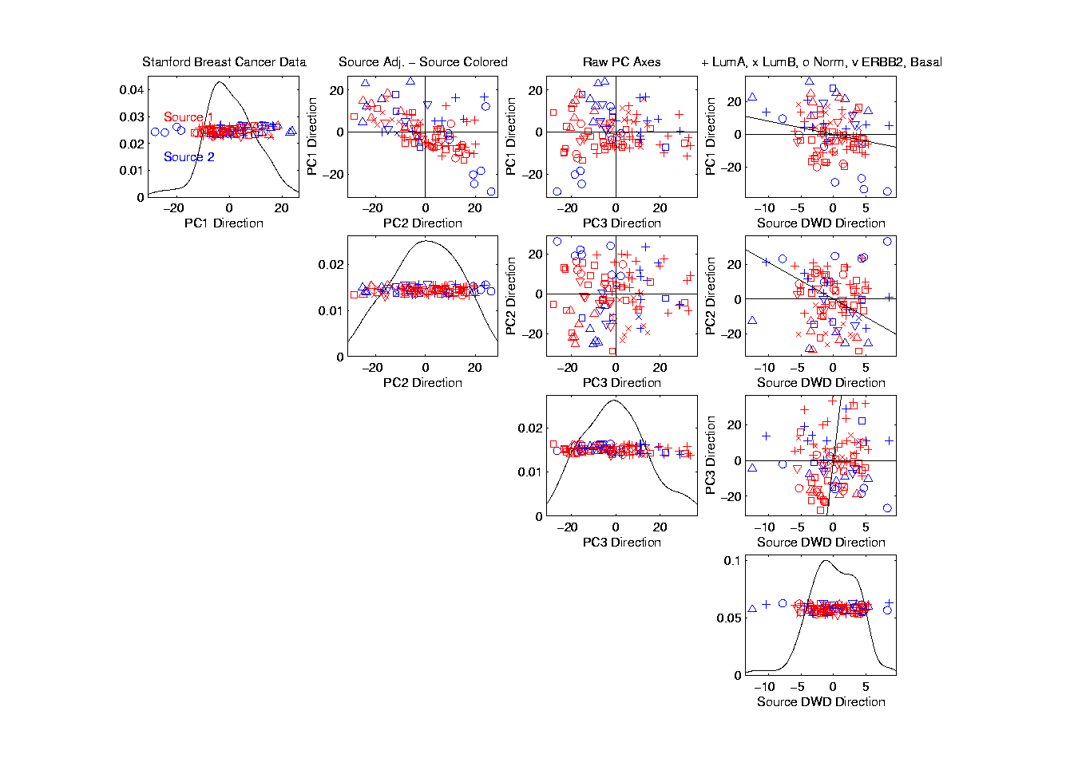
Source Batch Adj: DWD Source Adjustment

Slide 35
Strongly Non-Euclidean Spaces
PCA on Tree Space?

Slide 36
Strongly Non-Euclidean Spaces
PCA on Tree Space?
Key Idea (Jim Ramsay):
Replace 1-d subspace
that best approximates data
By 1-d representation
that best approximates data

Slide 37
Strongly Non-Euclidean Spaces
PCA on Tree Space?
Key Idea (Jim Ramsay):
Replace 1-d subspace
that best approximates data
By 1-d representation
that best approximates data
Wang and Marron (2007) define notion of
Treeline (in structure space)

Slide 38
Strongly Non-Euclidean Spaces
PCA on Tree Space: Treeline
Best 1-d representation of data

Slide 39
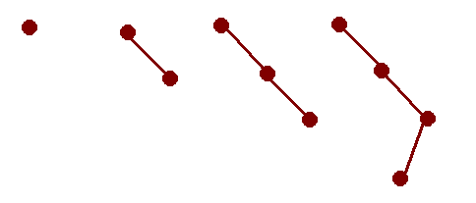
Strongly Non-Euclidean Spaces
PCA on Tree Space: Treeline
Best 1-d representation of data
Basic idea:
From some starting tree

Slide 40
Strongly Non-Euclidean Spaces
PCA on Tree Space: Treeline
Best 1-d representation of data
Basic idea:
From some starting tree
Grow only in 1 “direction”

Slide 41
Definition of Projection
of a data tree t_{i} onto treeline L

Slide 42
Definition of Projection
of a data tree t_{i} onto treeline L is the closest point on L to the data tree:

Slide 43
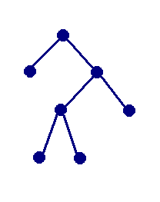
Example of projection
Suppose we have the data tree:
And the treeline:
Thanks to Burcu Aydin
Which point on the treeline is the closest to the data tree?

Slide 44
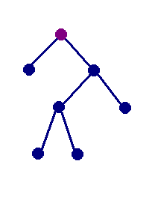
Example of projection
u₀: d(u₀,t) = 6

Slide 45
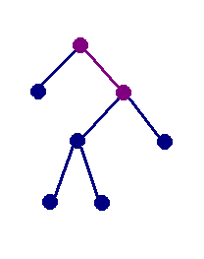
Example of projection
u₀: d(u₀,t) = 6
u₁: d(u₁,t)=5

Slide 46
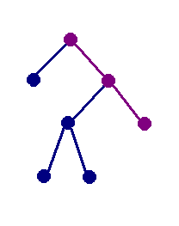
Example of projection
u₀: d(u₀,t) = 6
u₁: d(u₁,t)=5
u₂: d(u₂,t)=4

Slide 47
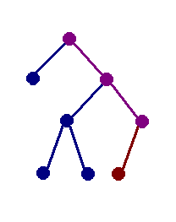
Example of projection
u₀: d(u₀,t) = 6
u₁: d(u₁,t)=5
u₂: d(u₂,t)=4
u₃: d(u₃,t)=5

Slide 48
Example of projection
u₀: d(u₀,t) = 6
u₁: d(u₁,t)=5
u₂: d(u₂,t)=4
u₃: d(u₃,t)=5
Closest!

Slide 49
Example of projection
Useful statistical summary: Score
Length of Projection (analog of PC in PCA)

Slide 50
Example of projection
Useful statistical summary: Score
Length of Projection (analog of PC in PCA)
Above Example:
The data tree:
Its projection:

Slide 51
Example of projection
Useful statistical summary: Score
Length of Projection (analog of PC in PCA)
Above Example:
Score (~PCA Coeff.) for this tree = 3
The data tree:
Its projection:

Slide 52
Best Tree Line
The treeline that gives the smallest sum of distances:

Slide 53
Strongly Non-Euclidean Spaces
PCA on Tree Space: Treeline
Best 1-d representation of data

Slide 54
Strongly Non-Euclidean Spaces
PCA on Tree Space: Treeline
Best 1-d representation of data
Challenge: Hard to compute
In particular: to solve optimization problem

Slide 55
Strongly Non-Euclidean Spaces
PCA on Tree Space: Treeline
Best 1-d representation of data
Challenge: Hard to compute
In particular: to solve optimization problem
Wang and Marron (2007)
Maximum 4 vessel trees
Hard to tackle serious trees
(e.g. blood vessel trees)

Slide 56
Strongly Non-Euclidean Spaces
PCA on Tree Space: Treeline
Challenge: Hard to compute
Solution: Aydin, et al (2009)
(linear time algorithm)
(based on clever
reformulation of problem)

Slide 57
PCA for blood vessel tree data
PCA on Tree Space: Treelines
Interesting to compare:
Population of Left Trees
Population of Right Trees
Population of Back Trees

Slide 58
PCA for blood vessel tree data
PCA on Tree Space: Treelines
Interesting to compare:
Population of Left Trees
Population of Right Trees
Population of Back Trees
And to study 1st, 2nd, 3rd & 4th treelines

Slide 59
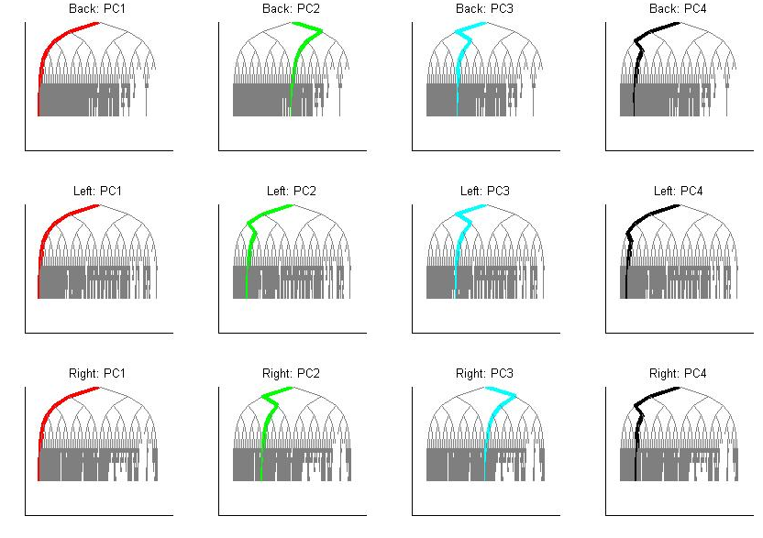
PCA for blood vessel tree data
Study
“Directions”
1, 2, 3, 4
For sub-
populations
B, L, R
(Thickness)

Slide 60
PCA for blood vessel tree data
Notes on Treeline Directions:
PC1 always to left
(Expected from Correspondence)

Slide 61
PCA for blood vessel tree data
Notes on Treeline Directions:
PC1 always to left
BACK has most variation to right (PC2)
(Expect More Symmetric than Left or Right)

Slide 62
PCA for blood vessel tree data
Notes on Treeline Directions:
PC1 always to left
BACK has most variation to right (PC2)
LEFT has more varia’n to 2nd level (PC2)
RIGHT has more var’n to 1st level (PC2)

Slide 63
PCA for blood vessel tree data
Notes on Treeline Directions:
PC1 always to left
BACK has most variation to right (PC2)
LEFT has more varia’n to 2nd level (PC2)
RIGHT has more var’n to 1st level (PC2)
See these in the data?

Slide 64
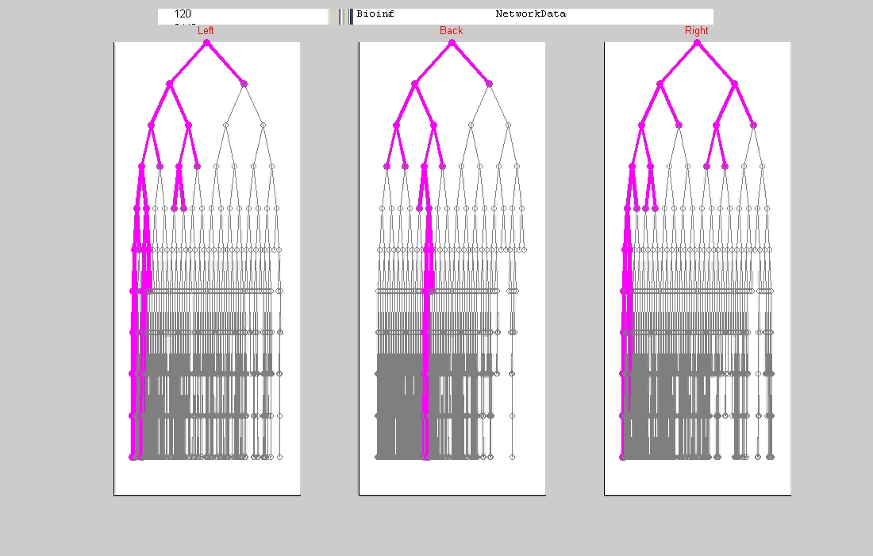
PCA for blood vessel tree data
(Thickness)
Notes:
PC1 - left
BACK - right
LEFT 2nd lev
RIGHT 1st lev
See these??

Slide 65
PCA for blood vessel tree data
Revisit PC
“Directions”
(Thickness
Corr.)
Compare to
Descendant?

Slide 66
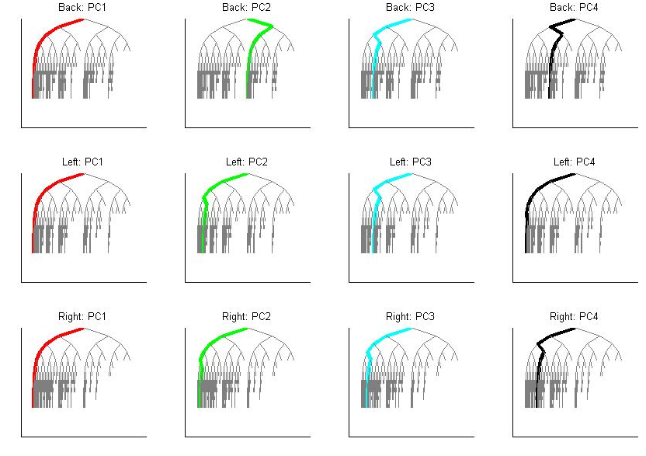
PCA for blood vessel tree data
Descendant
Corr.
Similar
Lessons
But Effects
Stronger
Better
Repres’n?

Slide 67
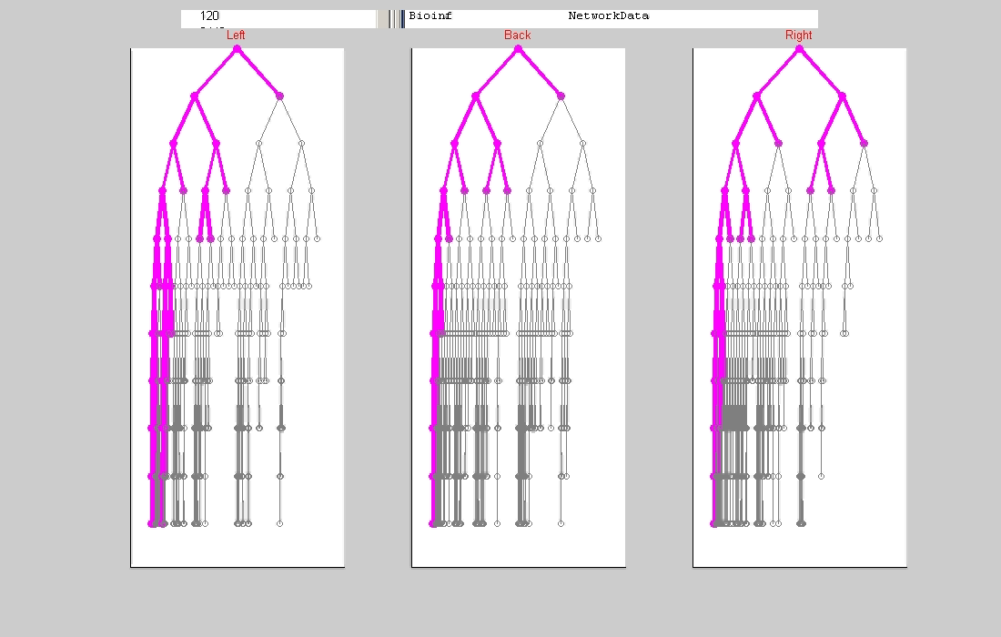
PCA for blood vessel tree data
(Descendant)
Notes:
PC1 - left
BACK - right
LEFT 2nd lev
RIGHT 1st lev
See stronger
Lessons?

Slide 68
Strongly Non-Euclidean Spaces
PCA on Tree Space: Treeline
Next represent data as projections

Slide 69
Strongly Non-Euclidean Spaces
PCA on Tree Space: Treeline
Next represent data as projections
Define as closest point in tree line
(same as Euclidean PCA)

Slide 70
Strongly Non-Euclidean Spaces
PCA on Tree Space: Treeline
Next represent data as projections
Define as closest point in tree line
(same as Euclidean PCA)
Have corresponding score
(length of projection along line)

Slide 71
Strongly Non-Euclidean Spaces
PCA on Tree Space: Treeline
Next represent data as projections
Define as closest point in tree line
(same as Euclidean PCA)
Have corresponding score
(length of projection along line)
And analog of residual
(distance from data point to projection)

Slide 72
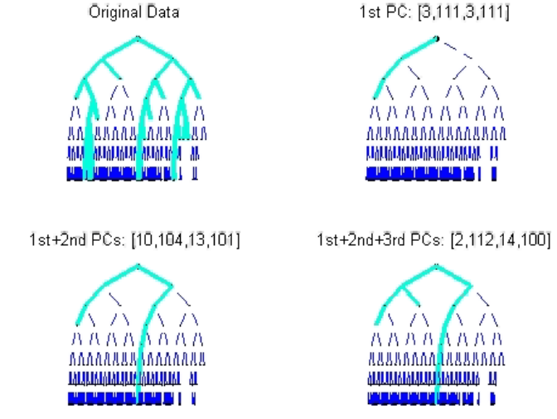
PCA for blood vessel tree data
Raw Data

Slide 73
PCA for blood vessel tree data
Raw Data & Treelines, PC1

Slide 74
PCA for blood vessel tree data
Raw Data & Treelines, PC1, PC2, PC3:

Slide 75
PCA for blood vessel tree data
Raw Data & Treelines, PC1, PC2, PC3:
Projections

Slide 76
PCA for blood vessel tree data
Raw Data & Treelines, PC1, PC2, PC3:
Projections, Scores

Slide 77
PCA for blood vessel tree data
Raw Data & Treelines, PC1, PC2, PC3:
Projections, Scores, Residuals

Slide 78
PCA for blood vessel tree data
Raw Data & Treelines, PC1, PC2, PC3:
Cumulative Scores, Residuals

Slide 79
PCA for blood vessel tree data
Raw Data & Treelines, PC1, PC2, PC3:
Cumulative Scores, Residuals

Slide 80
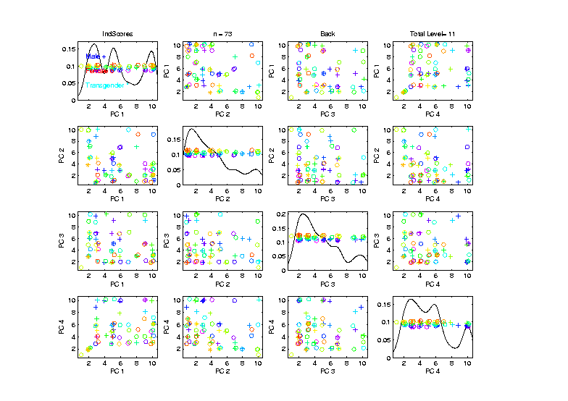
PCA for blood vessel tree data
Individual (each PC separately) Scores Plot

Slide 81
PCA for blood vessel tree data
Identify this person

Slide 82
PCA for blood vessel tree data
Identify this person PC Scores: 8,9,3,5

Slide 83
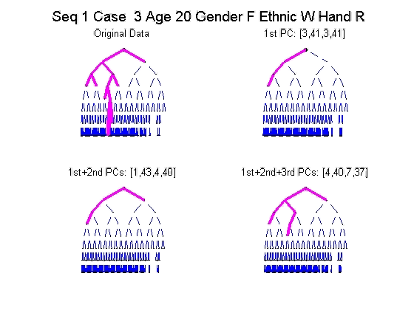
PCA for blood vessel tree data
Identify this person (PC Scores: 8,9,3,5):
Red = older
0 = Female
Note:
color ~ age

Slide 84
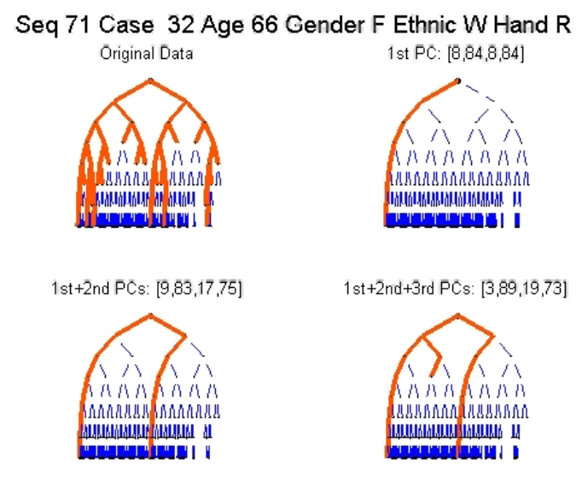
PCA for blood vessel tree data
Identify this person (PC Scores: 8,9,3,5):
Red = older
0 = Female
Note:
color ~ age

Slide 85
PCA for blood vessel tree data
Identify this person (PC scores 1,10,1,1)

Slide 86
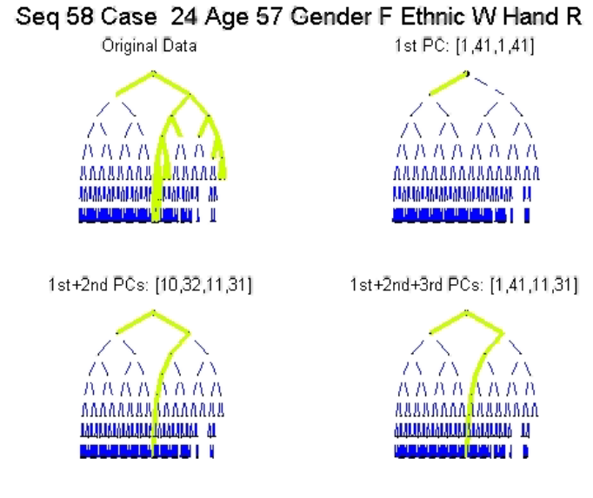
PCA for blood vessel tree data
Identify this person (PC scores 1,10,1,1)

Slide 87
PCA for blood vessel tree data
Explain strange (low score) correlation?

Slide 88
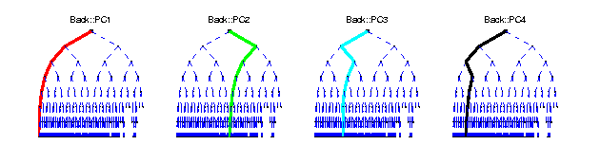
PCA for blood vessel tree data
Explain strange (low score) correlation?
Revisit Treelines:
Small PC1 Score ←→ Small PC3 Score
Small PC1 Score ←→ Small PC4 Score

Slide 89
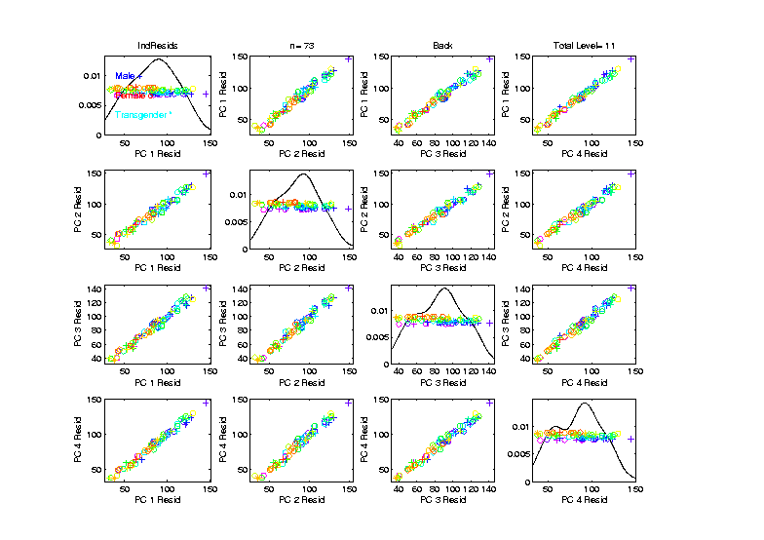
PCA for blood vessel tree data
Individual (each PC sep’ly) Residuals Plot

Slide 90
PCA for blood vessel tree data
Individual (each PC sep’ly) Residuals Plot
Very strongly correlated

Slide 91
PCA for blood vessel tree data
Individual (each PC sep’ly) Residuals Plot
Very strongly correlated
Shows much variation not explained by PCs
(data are very rich)

Slide 92
PCA for blood vessel tree data
Individual (each PC sep’ly) Residuals Plot
Very strongly correlated
Shows much variation not explained by PCs
(data are very rich)
Note age coloring useful
Younger (bluer) → more variation
Older (redder) → less variation

Slide 93
PCA for blood vessel tree data
Important Data Analytic Goals:
Understand impact of age (colors)
Understand impact of gender (symbols)
Understand handedness (too few)
Understand ethnicity (too few)
See these in PCA?

Slide 94
PCA for blood vessel tree data
Data Analytic Goals: Age, Gender
See
these?
No…

