Slide 1
Statistics – O. R. 891
Object Oriented Data Analysis
J. S. Marron
Dept. of Statistics and Operations Research
University of North Carolina

Slide 2
Blood vessel tree data
Big Picture: 3 Approaches
Purely Combinatorial
Euclidean Orthant
Dyck Path

Slide 3
Phylogenetic Trees
Important Reference:
Billera L, Holmes S, & Vogtmann K (2001)
Put Large Field on Firm Mathematical Basis

Slide 4
Euclidean Orthant Approach
Setting: Connectivity & Length
Background: Phylogenetic Trees
Major Restriction: Need common leaves
Big Payoff: Data space nearly Euclidean
sort of Euclidean

Slide 5
Geodesic Paths
  Given 2 trees,
  Shortest path
  Some math:
  Can show unique in this space
  Both geodesics & shortest paths

Slide 6
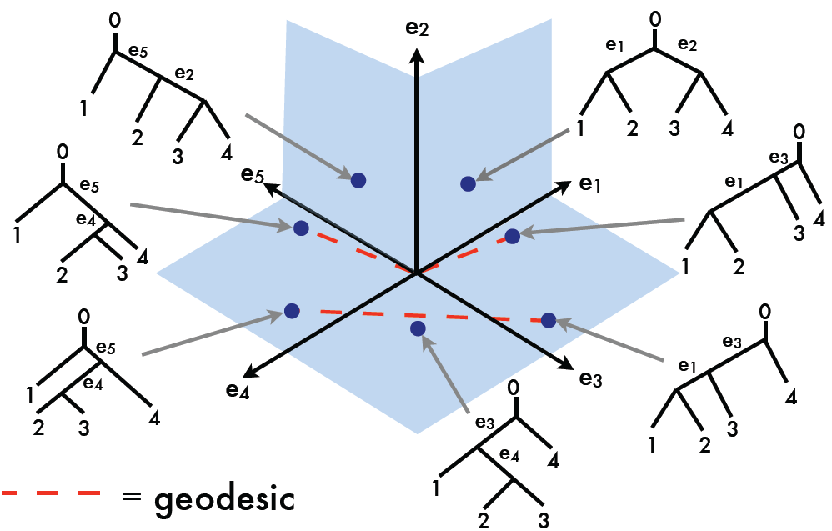
Geodesic Examples, T-4
Very
Interesting
Geometry
Thanks to Megan Owen

Slide 7
Geodesic Examples, T-4
Recall:
Manifold
Stratified
Space
Thanks to Megan Owen

Slide 8
Geodesic Examples, T-4
Recall:
Manifold
Stratified
Space
2-d Strata
(Orthants)
Thanks to Megan Owen

Slide 9
Geodesic Examples, T-4
Recall:
Manifold
Stratified
Space
2-d Strata
(Orthants)
Glued With
1-d Strata
(Lines)
Thanks to Megan Owen

Slide 10
Geodesic Examples, T-4
Recall:
Manifold
Stratified
Space
0-d Stratum
(Origin =
Star Tree)
Thanks to Megan Owen

Slide 11
Geodesic Examples, T-4
3-Orthant
Geodesic
(angle
< 180º)
Thanks to Megan Owen

Slide 12
Geodesic Examples, T-4
Cone Path
Geodesic
(angle
> 180º)
Thanks to Megan Owen

Slide 13
Geodesic Examples, T-4
Endpoints
In Same
Orthants
Thanks to Megan Owen

Slide 14
Geodesic Paths
  Given 2 trees,
  Shortest path between is called the
  geodesic
  Fast Computation (polynomial time):
Owen M &, Provan JS (2011)

Slide 15
The Geodesic Path Algorithm
  Owen & Provan (2011)’s polynomial algorithm for finding geodesics between n-trees

Slide 16
The Geodesic Path Algorithm
  Owen & Provan (2011)’s polynomial algorithm for finding geodesics between n-trees:
    Start with the cone path connecting the two trees through the origin (“star tree”).

Slide 17
Geodesic Paths in Tree Space
Thanks to Sean Skwerer

Slide 18
The Geodesic Path Algorithm
  Owen & Provan (2011)’s polynomial algorithm for finding geodesics between n-trees:
    Start with the cone path connecting the two trees through the origin (“star tree”).
    Successively “slide” the path into successively larger sets of orthants, each time decreasing the length of the path.

Slide 19
Geodesic Paths in Tree Space

Slide 20
Geodesic Paths in Tree Space

Slide 21
The Geodesic Path Algorithm
  Owen & Provan (2011)’s polynomial algorithm for finding geodesics between n-trees:
    Start with the cone path connecting the two trees through the origin (“star tree”).
    Successively “slide” the path into successively larger sets of orthants, each time decreasing the length of the path.
    Stop when shortest path is found.

Slide 22
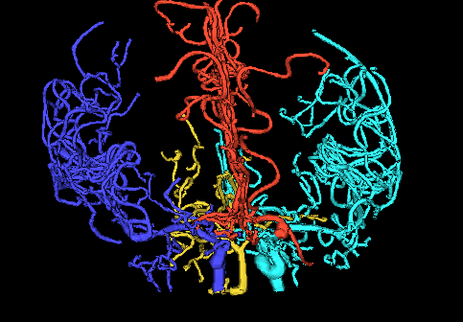
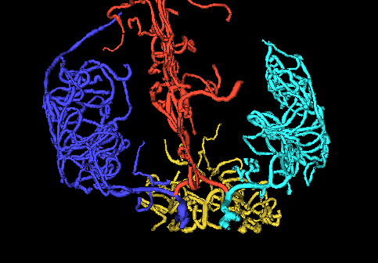
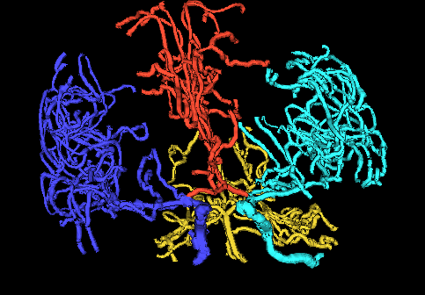
Geodesics for Artery Trees
,
, ... ,

Slide 23
Geodesics for Artery Trees
To illustrate geodesics
Study trees along geodesic,
From Case 2
To Case 3
Common Edges

Slide 24
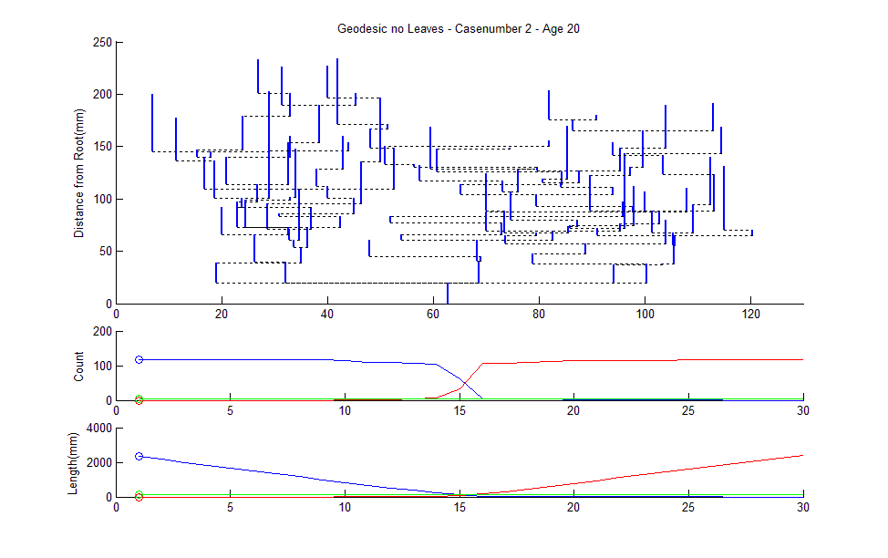
March Along 2 to 3 Geodesic
Thanks to Sean Skwerer

Slide 25
March Along 2 to 3 Geodesic
Leaf Node
Numbers
Thanks to Sean Skwerer

Slide 26
March Along 2 to 3 Geodesic
Interior
Edge
Lengths
Thanks to Sean Skwerer

Slide 27
March Along 2 to 3 Geodesic
Distance From Root
Thanks to Sean Skwerer

Slide 28
March Along 2 to 3 Geodesic
Show Interior Edges
Midway Between
Children
Thanks to Sean Skwerer

Slide 29
March Along 2 to 3 Geodesic
Unfortunate Consequence: Crossing Branches
General Problem Embedding 3-d Trees in 2-d
Thanks to Sean Skwerer

Slide 30
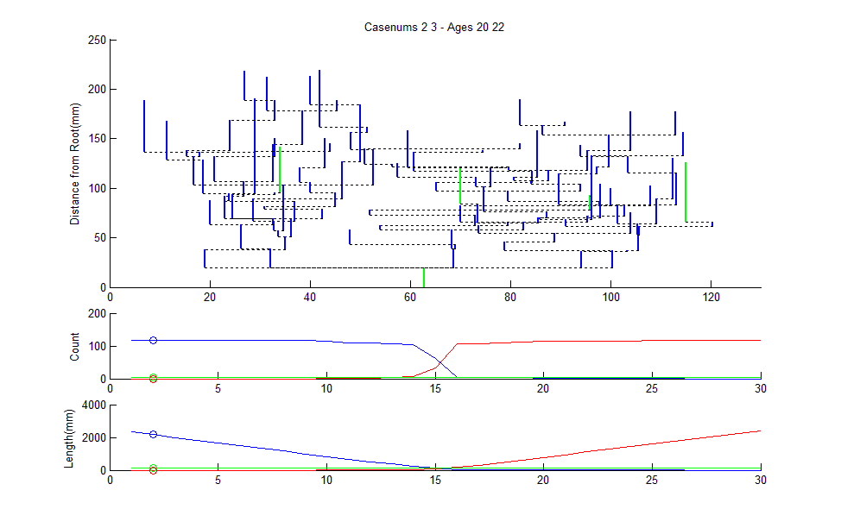
March Along 2 to 3 Geodesic

Slide 31
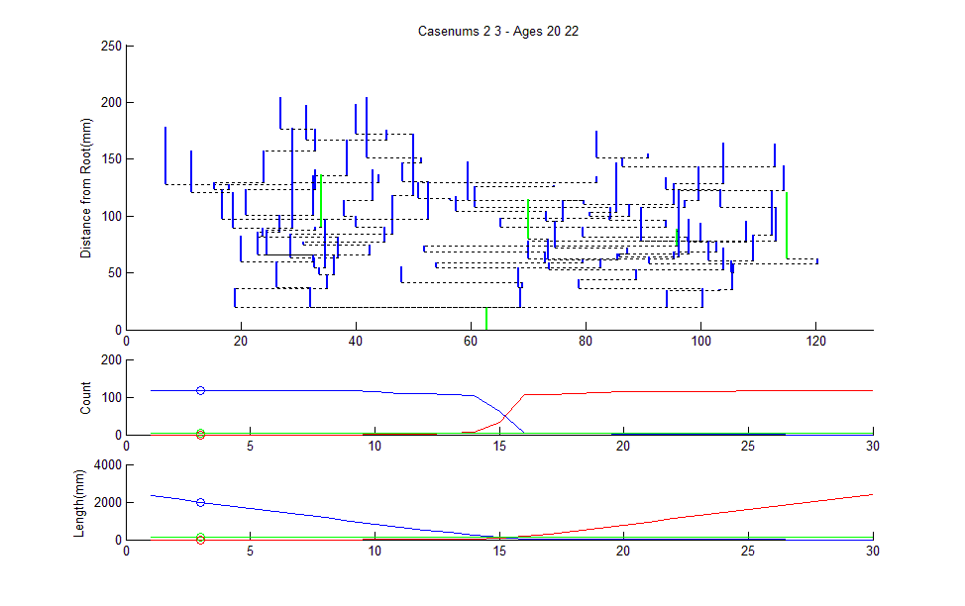
March Along 2 to 3 Geodesic

Slide 32
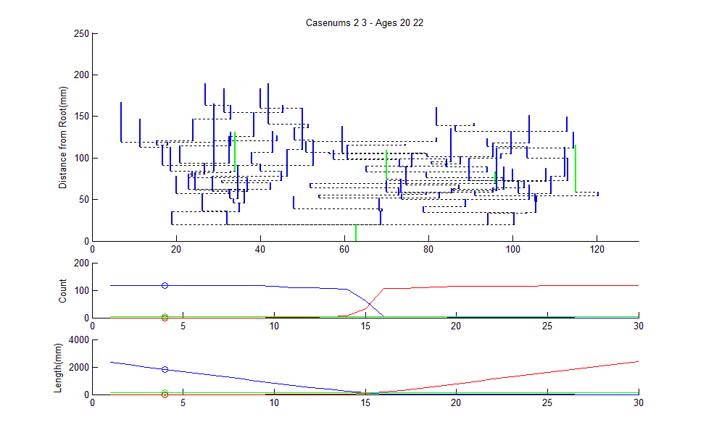
March Along 2 to 3 Geodesic

Slide 33
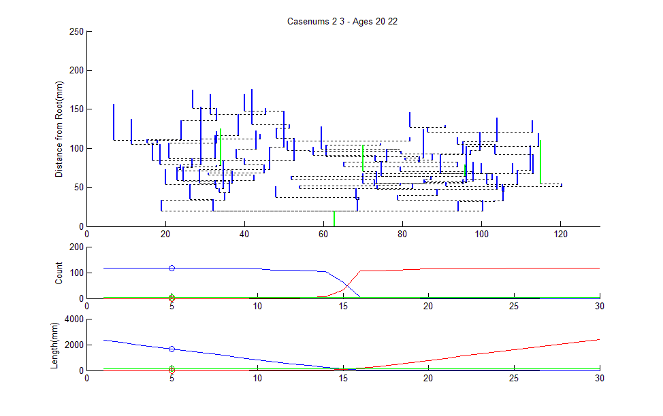
March Along 2 to 3 Geodesic

Slide 34
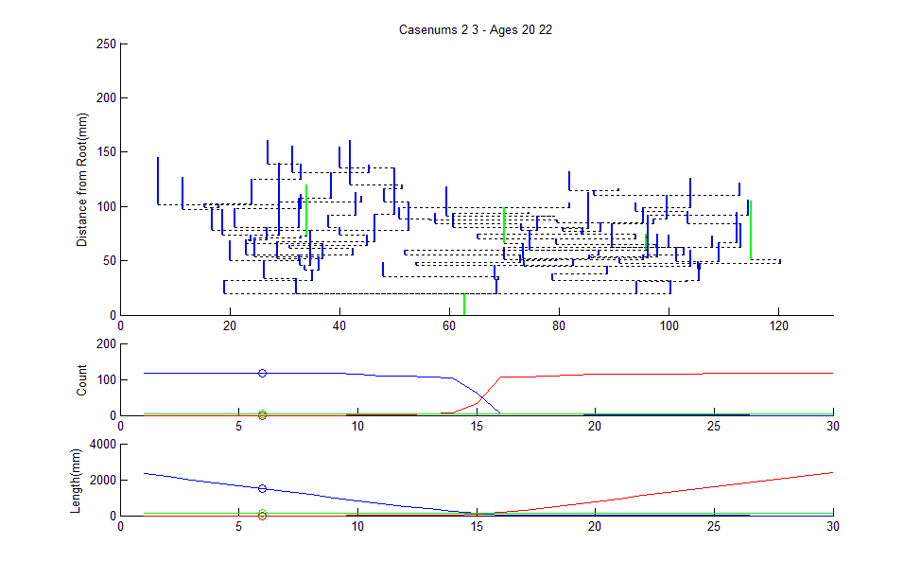
March Along 2 to 3 Geodesic

Slide 35
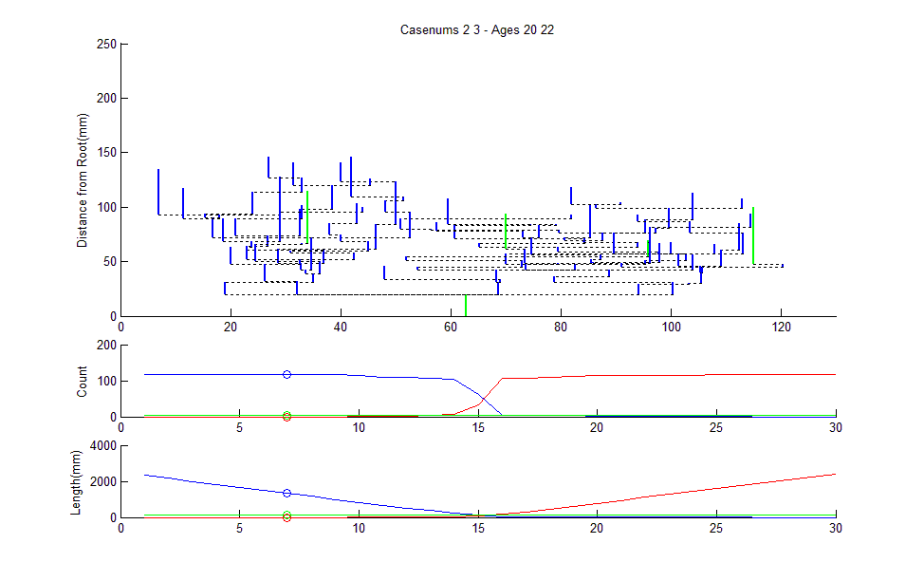
March Along 2 to 3 Geodesic

Slide 36
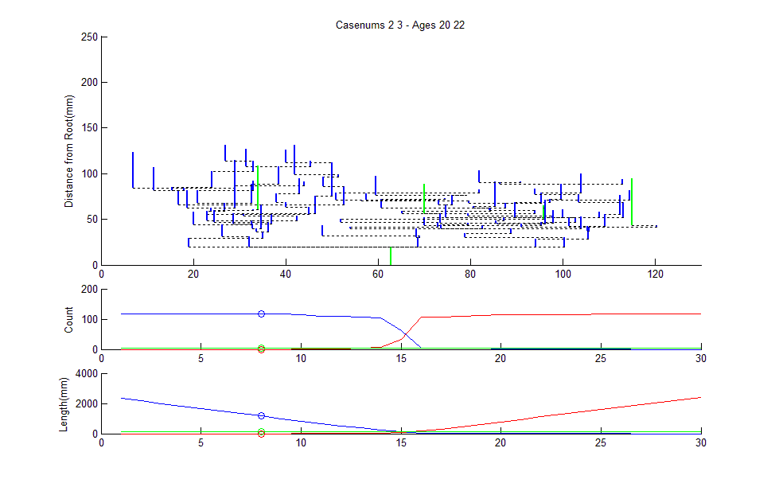
March Along 2 to 3 Geodesic

Slide 37

March Along 2 to 3 Geodesic

Slide 38
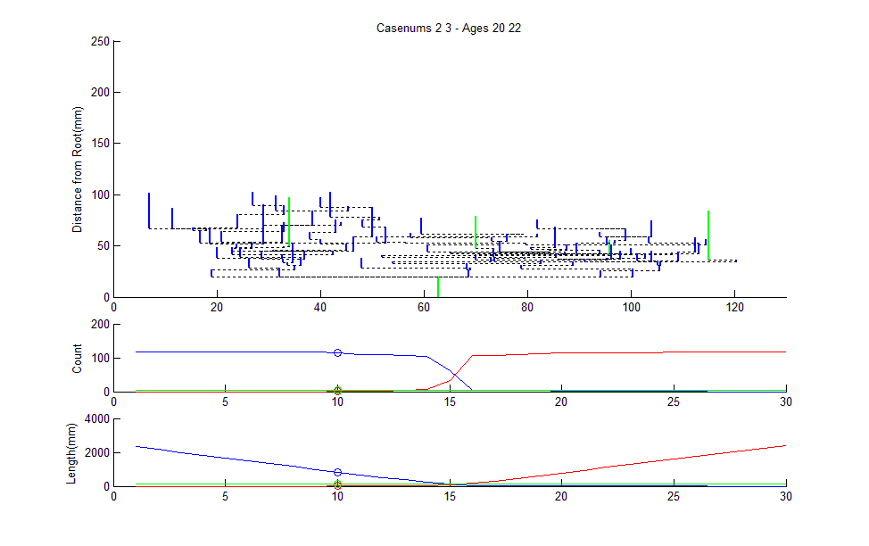
March Along 2 to 3 Geodesic

Slide 39
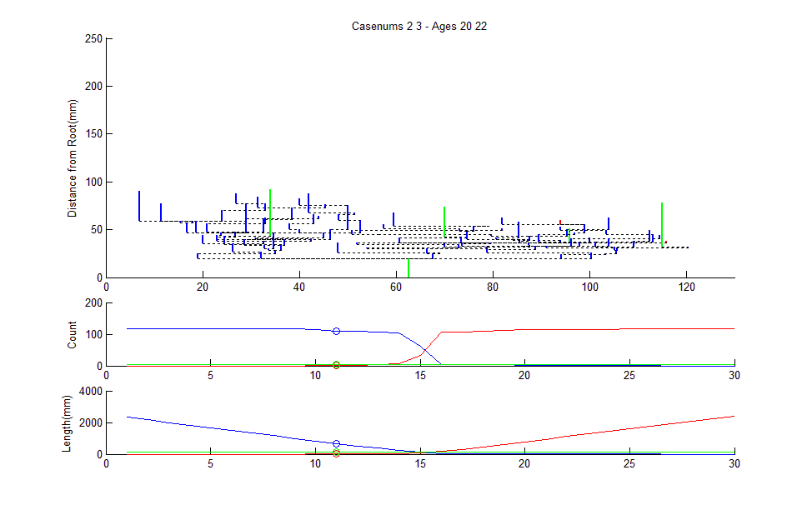
March Along 2 to 3 Geodesic

Slide 40
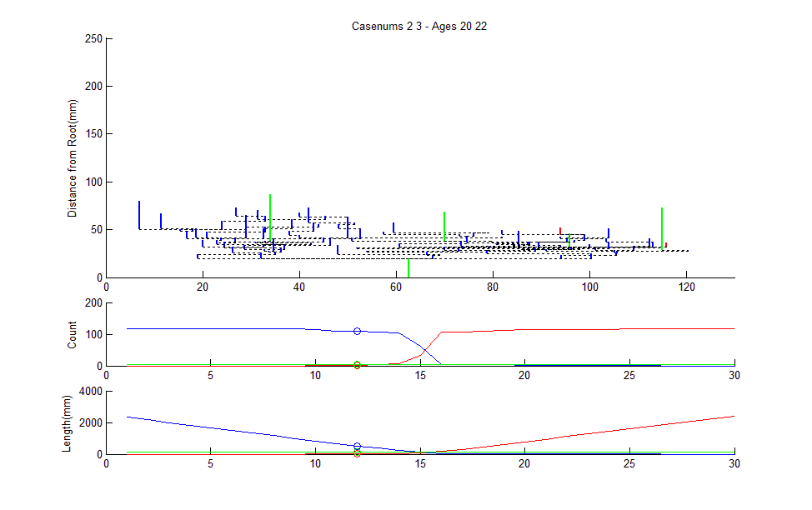
March Along 2 to 3 Geodesic

Slide 41
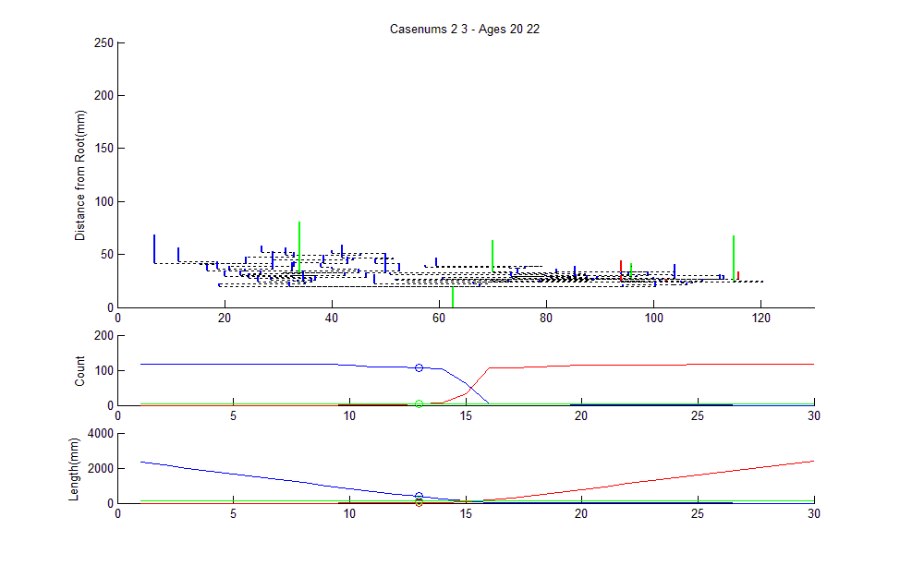
March Along 2 to 3 Geodesic

Slide 42
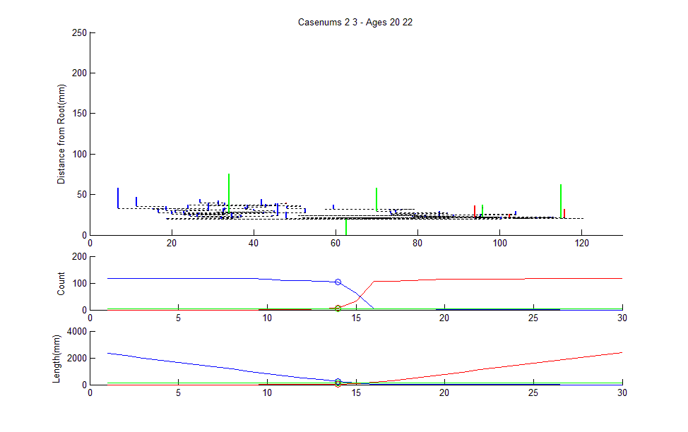
March Along 2 to 3 Geodesic

Slide 43
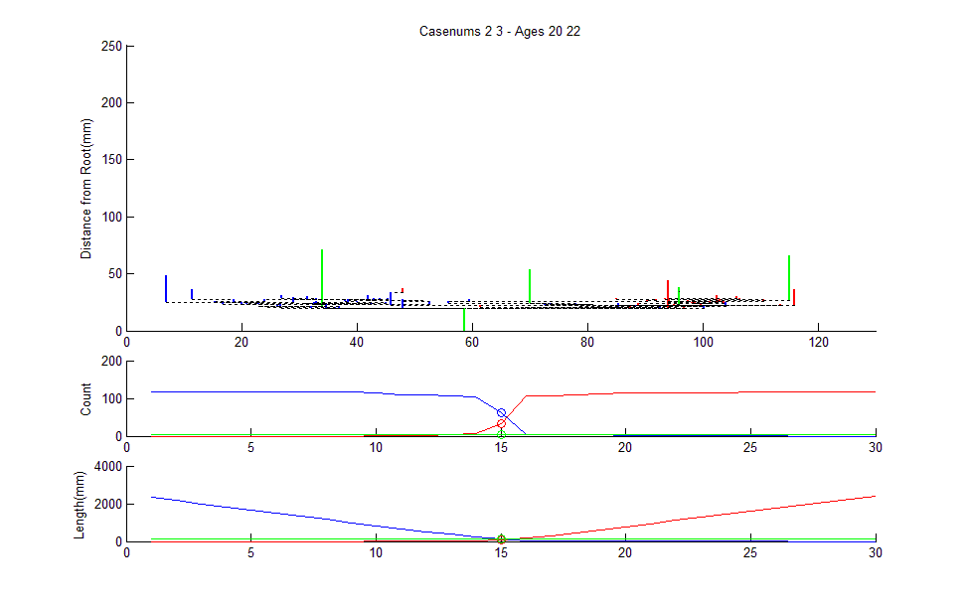
March Along 2 to 3 Geodesic

Slide 44
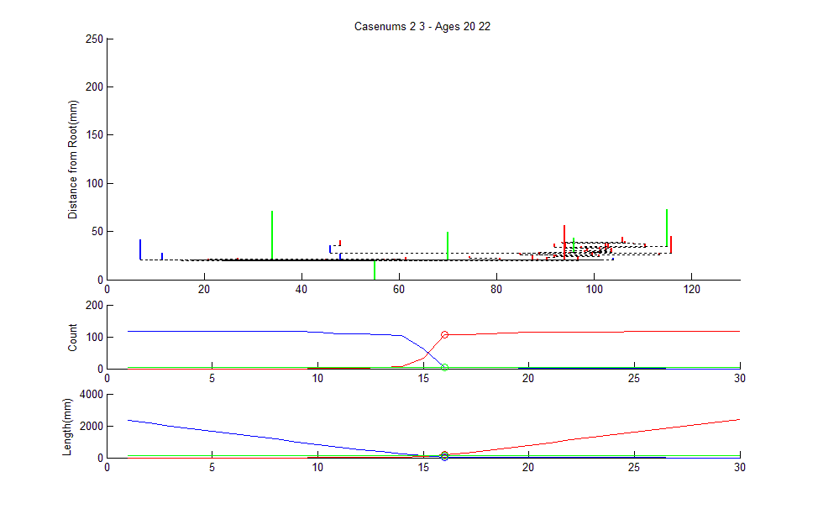
March Along 2 to 3 Geodesic

Slide 45
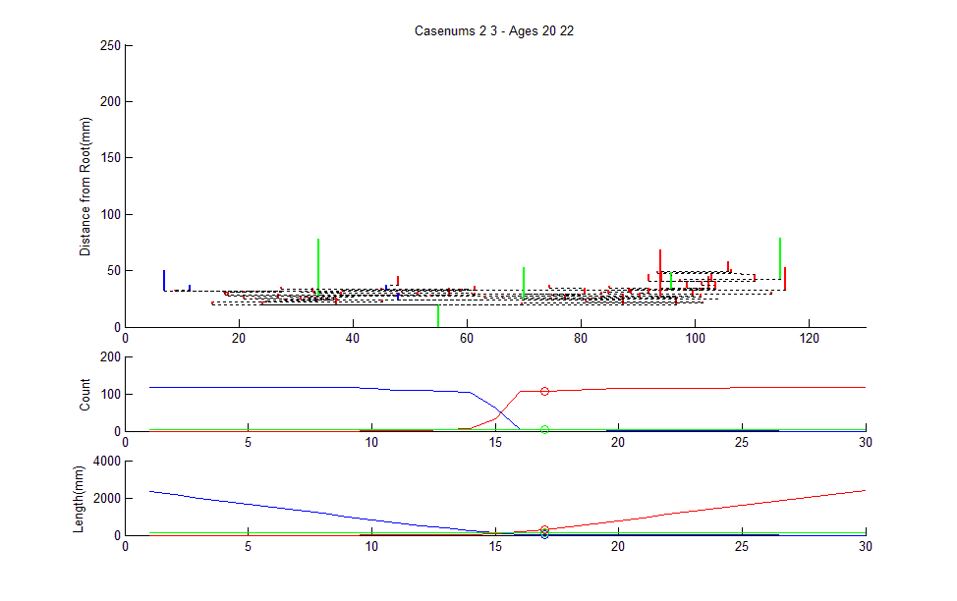
March Along 2 to 3 Geodesic

Slide 46
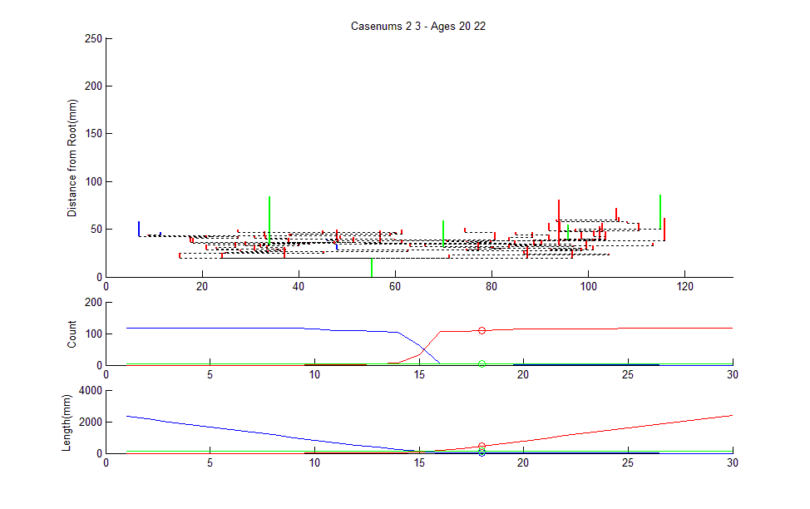
March Along 2 to 3 Geodesic

Slide 47
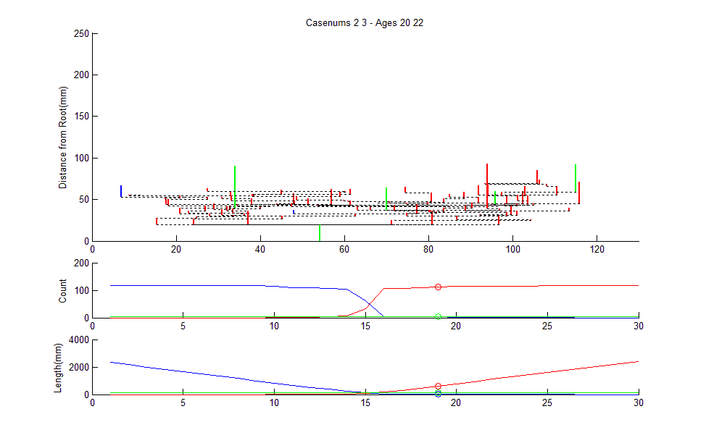
March Along 2 to 3 Geodesic

Slide 48
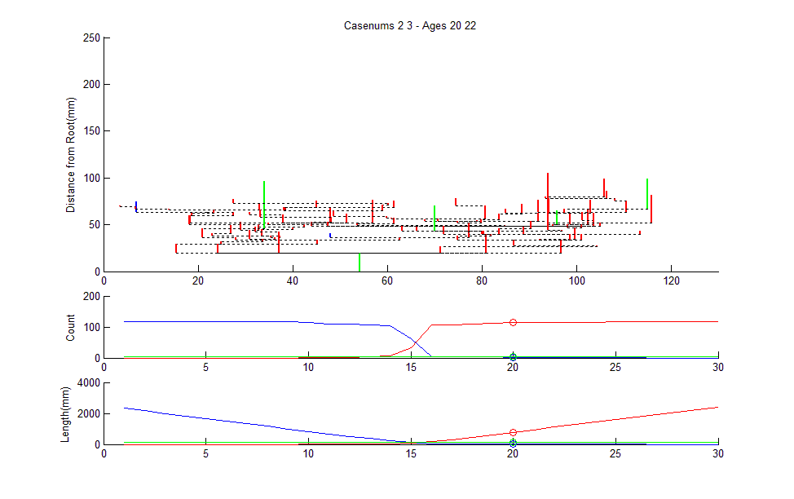
March Along 2 to 3 Geodesic

Slide 49
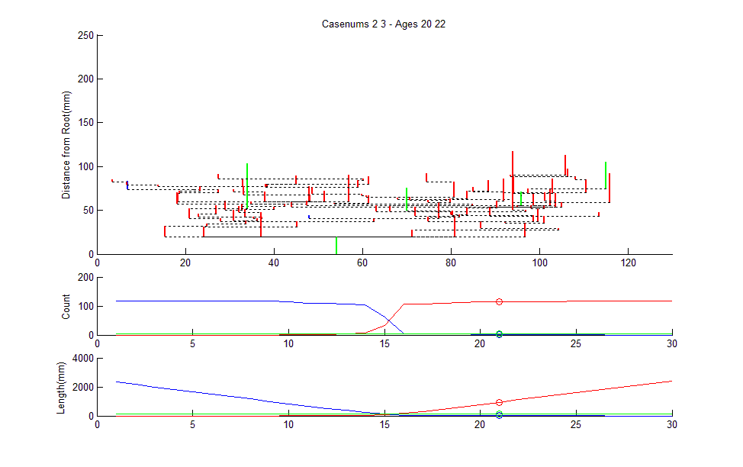
March Along 2 to 3 Geodesic

Slide 50
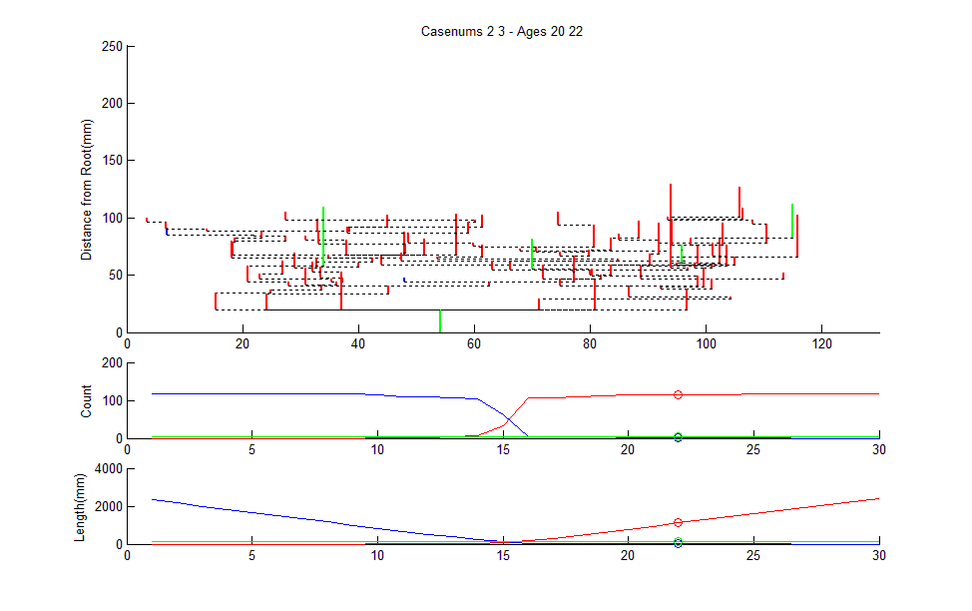
March Along 2 to 3 Geodesic

Slide 51
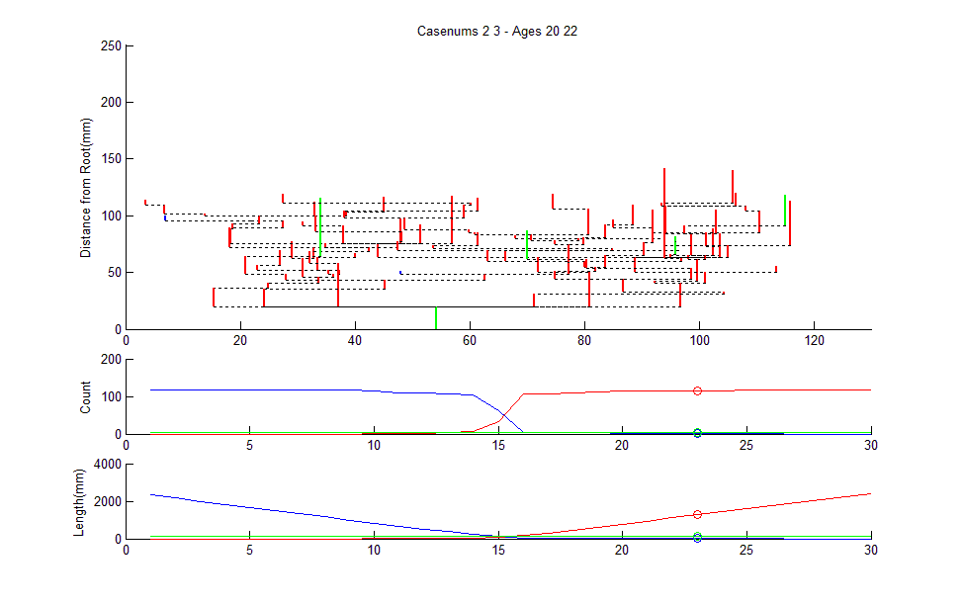
March Along 2 to 3 Geodesic

Slide 52
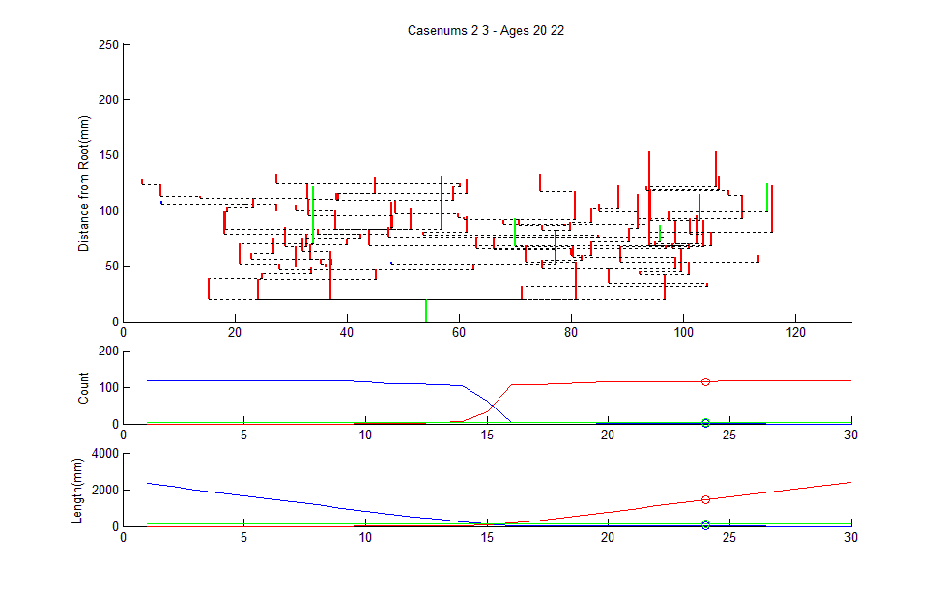
March Along 2 to 3 Geodesic

Slide 53
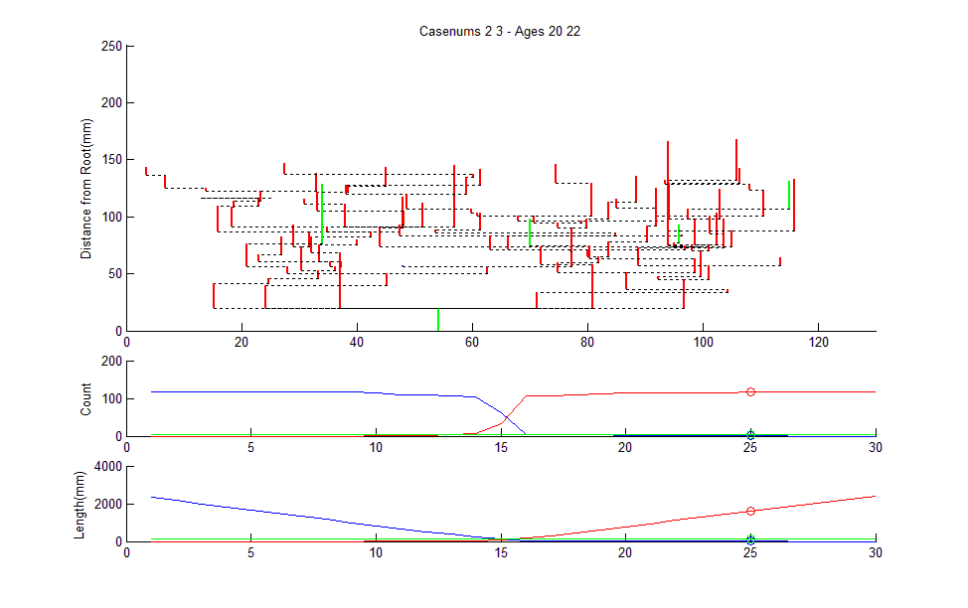
March Along 2 to 3 Geodesic

Slide 54
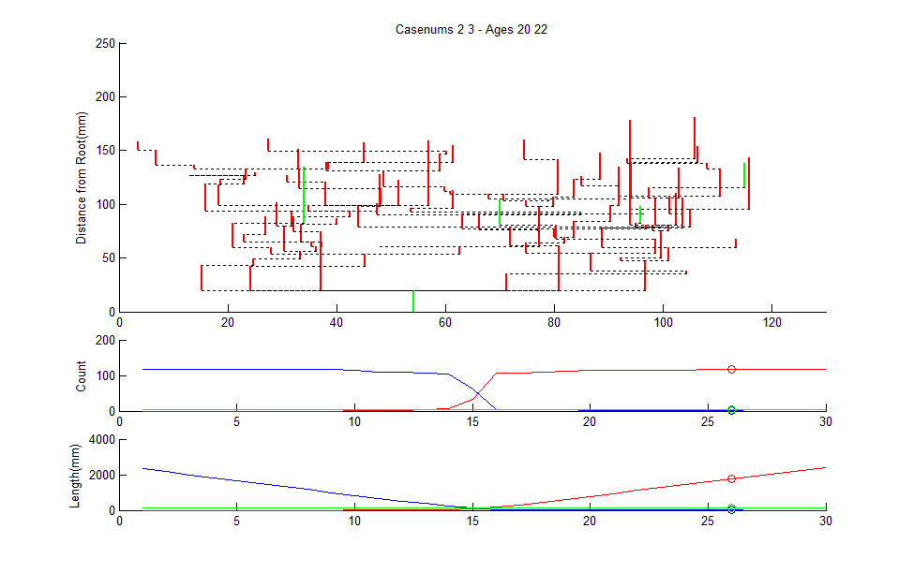
March Along 2 to 3 Geodesic

Slide 55
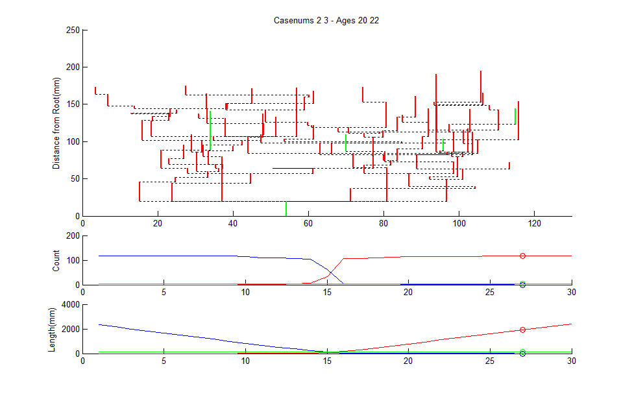
March Along 2 to 3 Geodesic

Slide 56
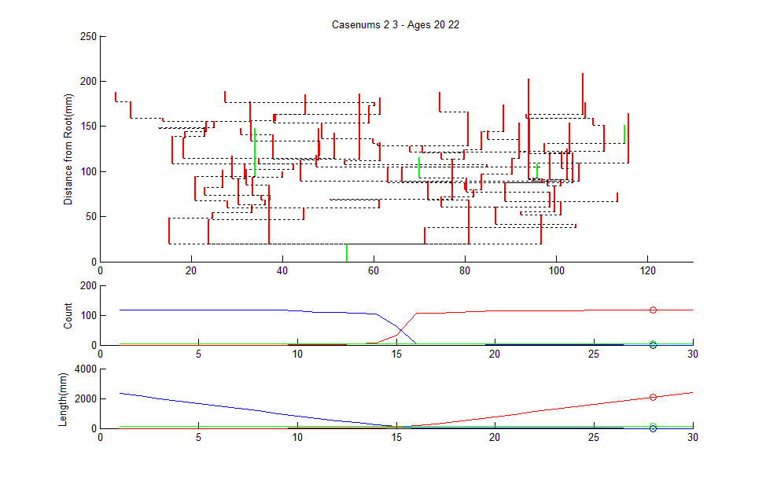
March Along 2 to 3 Geodesic

Slide 57
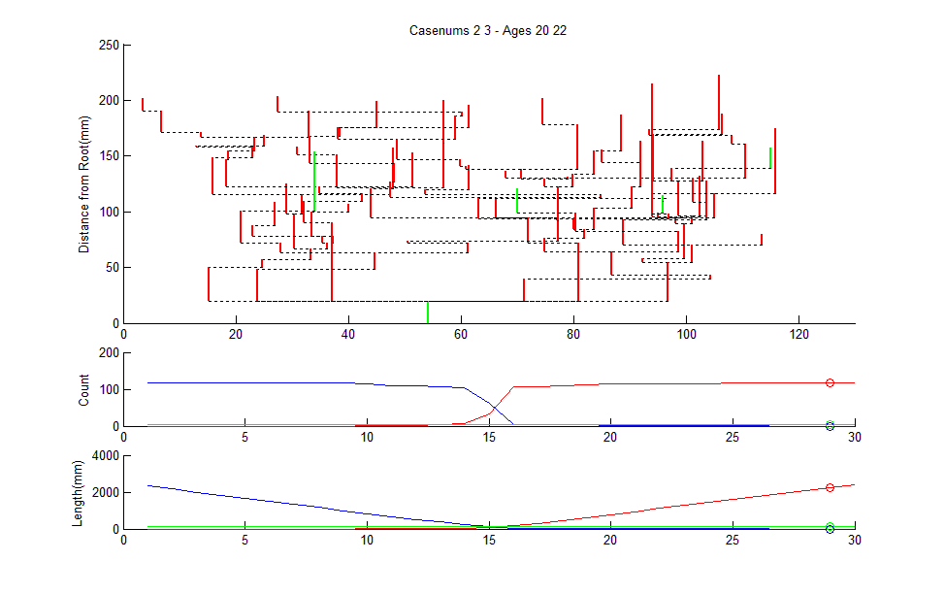
March Along 2 to 3 Geodesic

Slide 58
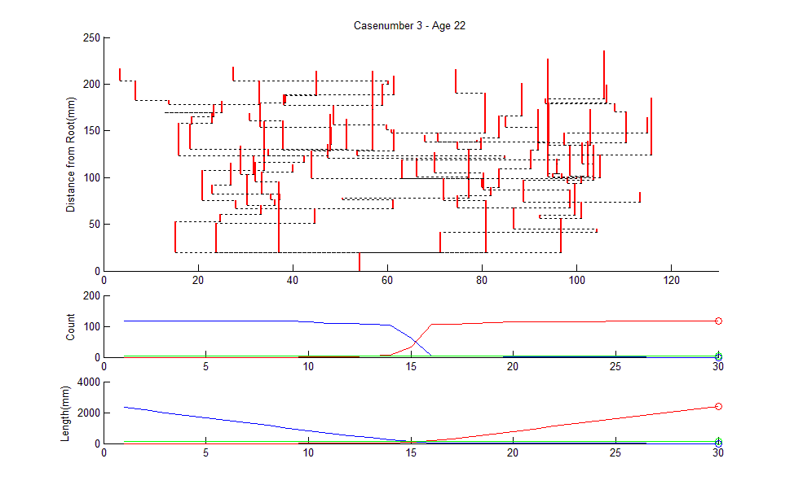
March Along 2 to 3 Geodesic

Slide 59
March Along 2 to 3 Geodesic
Count of # of Nodes

Slide 60
March Along 2 to 3 Geodesic
Count of # of Nodes, as Function of Geodesic Step

Slide 61
March Along 2 to 3 Geodesic
Also Total Branch Length

Slide 62
Geodesics for Artery Trees
Summarize Lessons:
Very few Common Edges (only 5)
Most edges swap out

Slide 63
Geodesics for Artery Trees
Summarize Lessons:
Very few Common Edges (only 5)
Most edges swap out
Edges get much shorter (bottom plot)
Recall this Later

Slide 64
Geodesics for Artery Trees
Summarize Lessons:
Very few Common Edges (only 5)
Most edges swap out
Edges get much shorter (bottom plot)
Recall this Later
# of edges roughly constant (middle plot)

Slide 65
Metric in Euclidean Orthant Space
Given 2 trees

Slide 66
Metric in Euclidean Orthant Space
Given 2 trees:
Can (quickly) find geodesic between

Slide 67
Metric in Euclidean Orthant Space
Given 2 trees:
Can (quickly) find geodesic between
Use length of path as “distance”
Can check “metric” properties

Slide 68
Metric in Euclidean Orthant Space
Given 2 trees:
Can (quickly) find geodesic between
Use length of path as “distance”
Can check “metric” properties
Non-neg definite ( ≥ 0 & = …)
Symmetric
Triangle Inequality

Slide 69
Metric in Euclidean Orthant Space
Given 2 trees:
Can (quickly) find geodesic between
Use length of path as “distance”
Can check “metric” properties
Called “Geodesic Distance”

Slide 70
Metric in Euclidean Orthant Space
Consequences of metric:
Useful for statistical analyses

Slide 71
Metric in Euclidean Orthant Space
Consequences of metric:
Useful for statistical analyses
Fréchet (Geodesic) Mean

Slide 72
Metric in Euclidean Orthant Space
Consequences of metric:
Useful for statistical analyses
Fréchet (Geodesic) Mean
Multi-Dimensional Scaling

Slide 73
Fréchet Mean
Given data:
Define:

Slide 74
Fréchet Mean
Recall properties:
In Euclidean space gives usual mean
(easy exercise)
Works in any metric space
Modifications give “robust means”
Also called
  Geodesic mean
  Intrinsic mean
  Barycenter

Slide 75
Fréchet Mean
Given data:
Define:
Major Challenge in Euclidean Orthant Space

Slide 76
Fréchet Mean
Given data:
Define:
Major Challenge in Euclidean Orthant Space:
Fast Computation

Slide 77
Fréchet Mean
Given data:
Define:
Major Challenge in Euclidean Orthant Space:
Fast Computation
Because of combinatorial complexity

Slide 78
Fréchet Mean
Useful Notation (for Objective Function):
Define the Fréchet Sum of Squared Distances:

Slide 79
Fréchet Mean
Useful Notation (for Objective Function):
Define the Fréchet Sum of Squared Distances:
So Fréchet mean becomes:

Slide 80
Sturm Algorithm
Simple approach
To computation of Fréchet mean
Sturm (2003)

Slide 81
Sturm Algorithm
Simple approach:
Based on fast geodesic computation
Available for any pair of data points

Slide 82
Sturm Algorithm
Simple approach:
Based on fast geodesic computation
Available for any pair of data points
Iterate to find

Slide 83
Sturm Algorithm
Raw Data
X₁
X₂
X₃
X₄

Slide 84
Sturm Algorithm
Raw Data
1st Sturm step
(1/2 way along
geodesic)
X₁
X₂
X₃
X₄

Slide 85
Sturm Algorithm
Raw Data
1st Sturm step
2nd Sturm step
(1/3 way along
geodesic)
X₁
X₂
X₃
X₄

Slide 86
Sturm Algorithm
Raw Data
1st Sturm step
2nd Sturm step
3rd Sturm step
(1/4 way along
geodesic)
X₁
X₂
X₃
X₄

Slide 87
Sturm Algorithm
Raw Data
1st Sturm step
2nd Sturm step
3rd Sturm step
In Euclidean Space,
can show:
convergence to
in n-1 steps
X₁
X₂
X₃
X₄

Slide 88
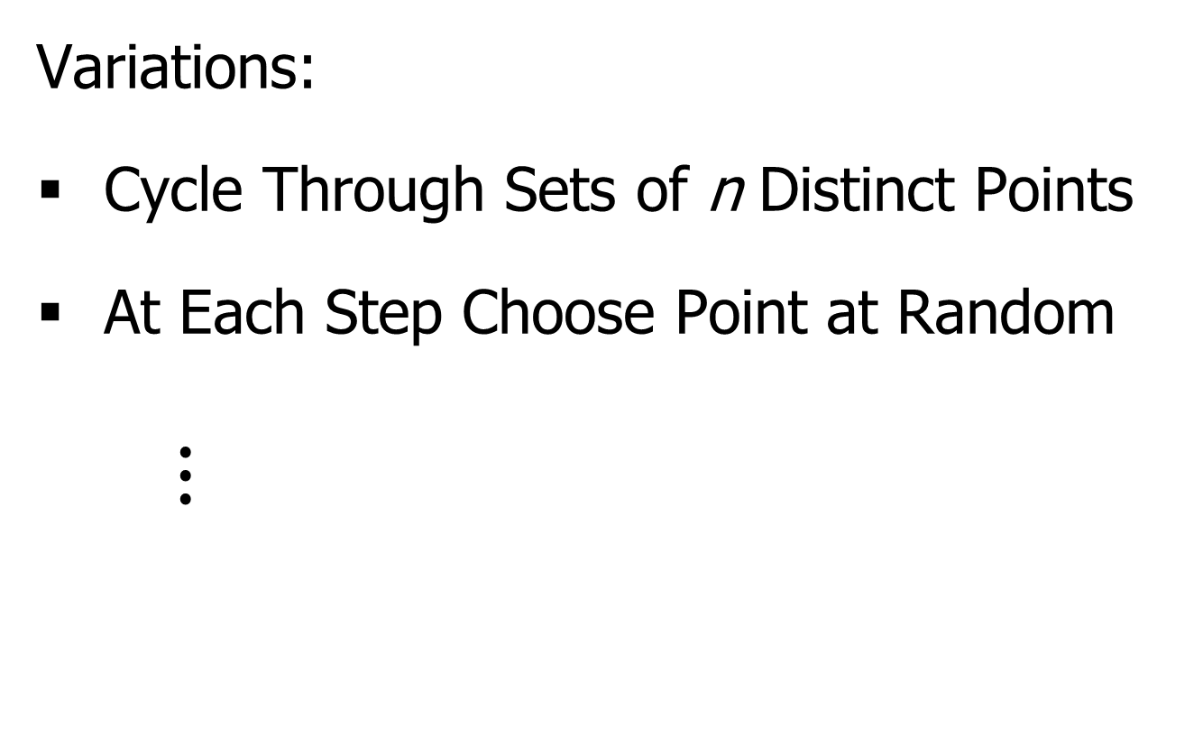
Sturm Algorithm
Variations:
Cycle Through Sets of n Distinct Points
At Each Step Choose Point at Random
$⋮$

Slide 89
Sturm Algorithm
Application to brain artery data:
Didn’t converge after 50,000 steps
(for n = 85 trees, d = 128 leaves)
(thanks to Megan Owen)

Slide 90
Sturm Algorithm
Application to brain artery data:
Didn’t converge after 50,000 steps
(for n = 85 trees, d = 128 leaves)
Trees live in diverse orthants
Not well “traversed” by Sturm Algorithm
Will revisit this in a moment

Slide 91
Fréchet Mean in T-3
Now study “very simple” special case, T-3
Only 3 topological cases:
e₁ > 0, e₂ = e₃ = 0 e₂ > 0, e₁ = e₃ = 0 e₃ > 0, e₁ = e₂ = 0
0
0
0
1
2
3
3
2
1
3
1
2

Slide 92
Fréchet Mean in T-3
Now study “very simple” special case, T-3
Interesting Structure determined by
Just one of 3 lengths:
e₁ e₂ e₃

Slide 93
Fréchet Mean in T-3
So each tree is a point on “3-spider”:
e₁
e₂ e₃

Slide 94
Fréchet Mean in T-3
Two versions of mean:
Empirical – Based on Data
Theoretical – Based on Prob. Dist’n, P
Both need geodesic metric d

Slide 95
Fréchet Mean in T-3
Metric (distance) on “3-spider”:
e₁
Length of
Geodesic
e₂ e₃

Slide 96
Fréchet Mean in T-3
Probability Distribution on “3-spider”:
e₁
Mixture, with
Propor’ns w₁ w₂ w₃
And Components
P₁ P₂ P₃
e₂ e₃

Slide 97
Fréchet Mean in T-3
Probability Distribution on “3-spider”:
e₁
Define three “wt’d
leg-wise means”:
e₂ e₃

Slide 98
Fréchet Mean in T-3
Can show: For (e.g.) m₂ > m₁ + m₃
e₁
Geodesic mean
is on e₂ and =
m₂ – (m₁ + m₃)
e₂ e₃

Slide 99
Fréchet Mean in T-3
Can show: When no m_{i} is dominant
e₁
Geodesic mean = 0
the “Star Tree”
e₂ e₃

Slide 100
Fréchet Mean in T-3
Note: For no dominant m_{i}
e₁
Can “perturb P”
And still have
Geodesic mean = 0
e₂ e₃

Slide 101
Fréchet Mean in T-3
Note: For no dominant m_{i}
Can “perturb P” and still have
Geodesic mean = 0
Very unusual behavior

Slide 102
Fréchet Mean in T-3
Note: For no dominant m_{i}
Can “perturb P” and still have
Geodesic mean = 0
Very unusual behavior:
Not true in Euclidean space
(where mean “non-robust”)
(very sensitive to perturbations)

Slide 103
Fréchet Mean in T-3
Note: For no dominant m_{i}
Can “perturb P” and still have
Geodesic mean = 0
Very unusual behavior:
Not true in Euclidean space
(where mean “non-robust”)
(very sensitive to perturbations)
Phenomenon is called stickiness

Slide 104
Sticky Means
Reference:
Hotz, et al (2012)

Slide 105
Sturm Algorithm
Application to brain artery data:
Didn’t converge after 50,000 steps
(for n = 85 trees, d = 128 leaves)

Slide 106
Sturm Algorithm
Application to brain artery data:
Didn’t converge after 50,000 steps
How good was it?

Slide 107
Sturm Algorithm
Application to brain artery data:
Didn’t converge after 50,000 steps
How good was it?
(Thanks to Megan Owen)

Slide 108
Sturm Algorithm
Application to brain artery data:
Didn’t converge after 50,000 steps
How good was it?
So tree at origin (“star tree”) is best seen

Slide 109
Sturm Algorithm
Application to brain artery data:
Didn’t converge after 50,000 steps
How good was it?
So tree at origin (“star tree”) is best seen
Very consistent with stickiness at origin

