Slide 1
Statistics – O. R. 891 Object Oriented Data Analysis
J. S. Marron
Dept. of Statistics and Operations Research
University of North Carolina

Slide 2
Blood vessel tree data
Big Picture: 3 Approaches
Purely Combinatorial
Euclidean Orthant
Dyck Path

Slide 3
Euclidean Orthant Smoothing
Application of Iterative Pairwise Smoothing
Idea: Use geodesic midpoint (avg of pair):
Level 1: S_{1,i} = avg(X_{i} , X_{i+1}) …
Level 2: S_{2,i} = avg(S_{1,i} , S_{1,i+1}) …
etc.
Thanks to Sean Skwerer

Slide 4
Multi-Dimensional Scaling
Idea: Variation of PCA
Not based on covariance matrix
Instead on pairwise distances
Solves STRAIN optimization problem
Works on any metric space
Matrix of Euclidean Distances → PCA

Slide 5
Multi-Dimensional Scaling
Application: Brain Artery Trees
Pairwise Geodesic Distances
Color code for age (as before)
Displays distribution
Include Star tree (best guess at mean)

Slide 6
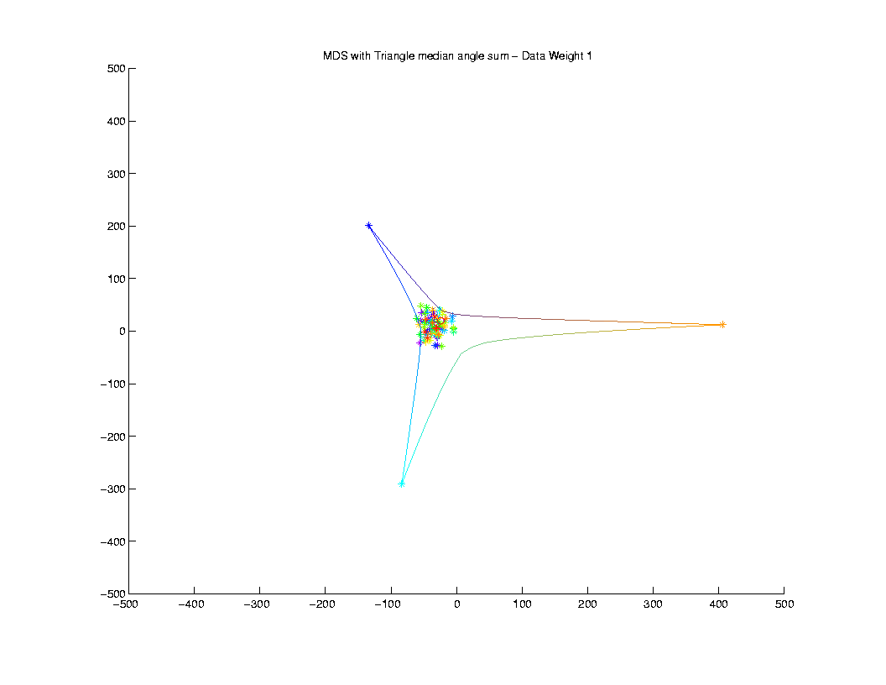
Multi-Dimensional Scaling
Pretty
Small
Angle
Sum

Slide 7
Concept to Watch
Manifold Stratified Spaces
People (in Statistics):
Vic Patrangenaru, Statistics, Florida S. U.
Ezra Miller, Mathematics, Duke U.
Stephan Huckemann, U. Göttingen
More Precise Mathematics:
“Whitney Stratification”

Slide 8
Independent Component Analysis
Personal Viewpoint:
Directions
(e.g. PCA, DWD)

Slide 9
Independent Component Analysis
Personal Viewpoint:
Directions that maximize independence

Slide 10
Independent Component Analysis
Personal Viewpoint:
Directions that maximize independence
Motivating Context: Signal Processing
“Blind Source Separation”

Slide 11
Independent Component Analysis
References:
Cardoso (1993) (1st paper)
Lee (1998) (early book, not recco’ed)
Hyvärinen & Oja (1998)
(excellent short tutorial)
Hyvärinen, Karhunen & Oja (2001)
(detailed monograph)

Slide 12
ICA, Motivating Example
“Cocktail party problem”

Slide 13
ICA, Motivating Example
“Cocktail party problem”:
Hear several simultaneous conversations
Would like to
separate them

Slide 14
ICA, Motivating Example
“Cocktail party problem”:
Hear several simultaneous conversations
Would like to
separate them
Model for “conversations”: time series
and

Slide 15
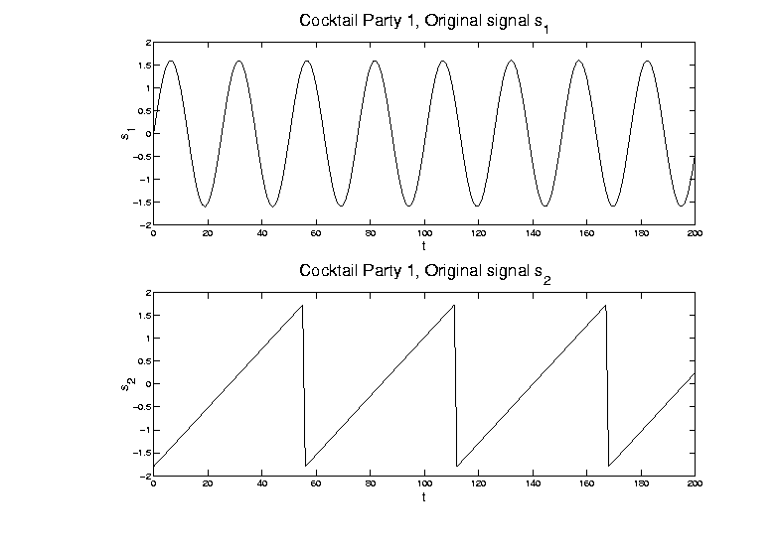
ICA, Motivating Example
Model for “conversations”: time series

Slide 16
ICA, Motivating Example
Mixed version of signals
And also a 2nd mixture:

Slide 17
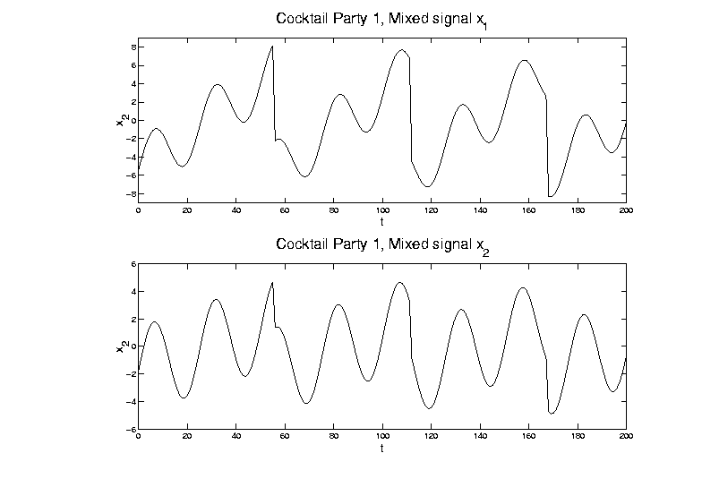
ICA, Motivating Example
Mixed version of signals:

Slide 18
ICA, Motivating Example
Goal: Recover signal
From data
For unknown mixture matrix
where for all

Slide 19
ICA, Motivating Example
Goal is to find separating weights
so that for all

Slide 20
ICA, Motivating Example
Goal is to find separating weights
so that for all
Problem: would be fine,
but is unknown

Slide 21
ICA, Motivating Example
Solutions for Cocktail Party Problem:
PCA (on population of 2-d vectors)
= matrix of eigenvectors

Slide 22
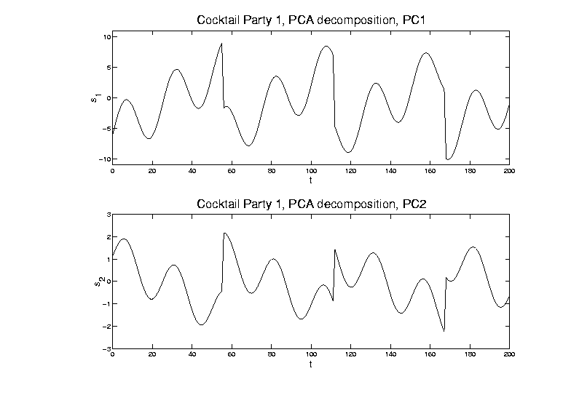
ICA, Motivating Example
PCA (on population of 2-d vectors)

Slide 23
ICA, Motivating Example
Solutions for Cocktail Party Problem:
PCA (on population of 2-d vectors)
[direction of maximal variation
doesn’t solve this problem]
ICA (will describe method later)

Slide 24
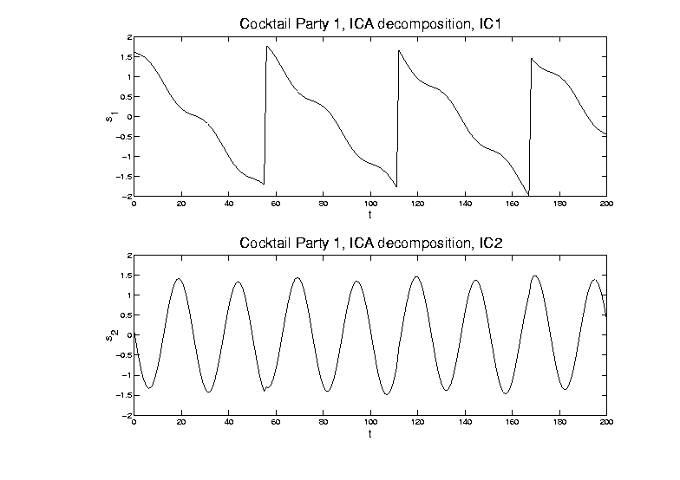
ICA, Motivating Example
ICA (will describe method later)

Slide 25
ICA, Motivating Example
Solutions for Cocktail Party Problem:
PCA (on population of 2-d vectors)
[direction of maximal variation
doesn’t solve this problem]
ICA (will describe method later)
[Independent Components do solve it]
[modulo sign changes and identification]

Slide 26
ICA, Motivating Example
Recall original time series:

Slide 27
ICA, Motivating Example
Relation to FDA: recall data matrix

Slide 28
ICA, Motivating Example
Relation to FDA: recall data matrix
Signal Processing: focus on rows
( time series, for )
Functional Data Analysis: focus on columns
( data vectors)

Slide 29
ICA, Motivating Example
Relation to FDA: recall data matrix
Signal Processing: focus on rows
( time series, for )
Functional Data Analysis: focus on columns
( data vectors)
Note: 2 viewpoints like “duals” for PCA

Slide 30
ICA, Motivating Example
Scatterplot View (signal processing): Study
Signals

Slide 31
ICA, Motivating Example
Study Signals

Slide 32
ICA, Motivating Example
Scatterplot View (signal processing): Study
Signals
Corresponding Scatterplot

Slide 33
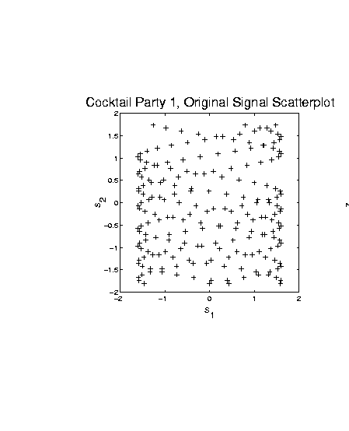
ICA, Motivating Example
Signals - Corresponding Scatterplot

Slide 34
ICA, Motivating Example
Scatterplot View (signal processing): Study
Signals
Corresponding Scatterplot
Data

Slide 35
ICA, Motivating Example
Study Data

Slide 36
ICA, Motivating Example
Scatterplot View (signal processing): Study
Signals
Corresponding Scatterplot
Data
Corresponding Scatterplot

Slide 37
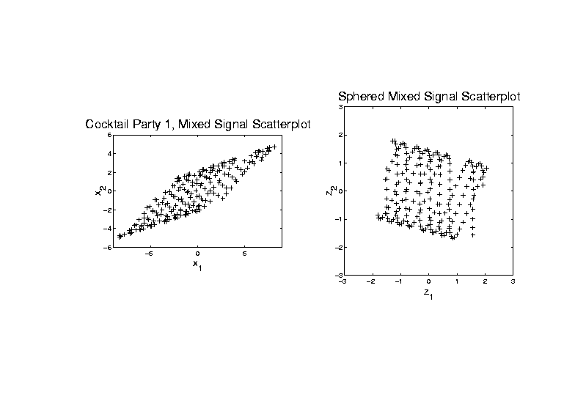
ICA, Motivating Example
Data - Corresponding Scatterplot

Slide 38
ICA, Motivating Example
Scatterplot View (signal processing): Plot
Signals & Scat’plot
Data & Scat’plot
Scatterplots give hint how ICA is possible
Affine transformation
Stretches indep’t signals into dep’t
Inversion is key to ICA
(even w/ unknown)

Slide 39
ICA, Motivating Example
Why not PCA?
Finds direction of greatest variation

Slide 40
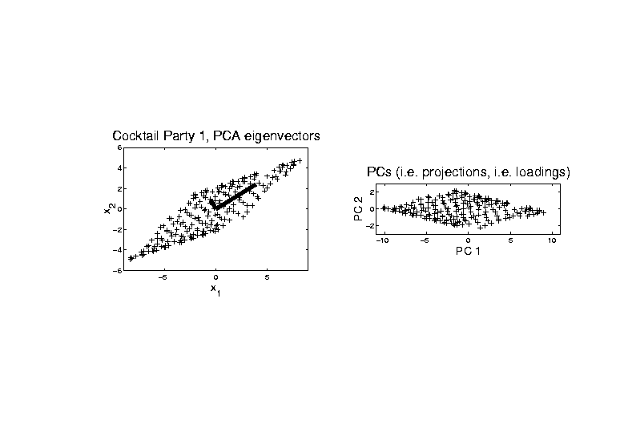
ICA, Motivating Example
PCA - Finds direction of greatest variation

Slide 41
ICA, Motivating Example
Why not PCA?
Finds direction of greatest variation
Which is wrong for signal separation

Slide 42
ICA, Motivating Example
PCA - Wrong for signal separation

Slide 43
ICA, Motivating Example
Why not PCA?
Finds direction of greatest variation
Which is wrong for signal separation

Slide 44
ICA, Algorithm
ICA Step 1:
sphere the data
(shown on right in scatterplot view)

Slide 45
ICA, Algorithm
ICA Step 1: sphere the data

Slide 46
ICA, Algorithm
ICA Step 1:
“sphere the data”
(shown on right in scatterplot view)
i.e. find linear transf’n to make
mean = , cov =
i.e. work with

Slide 47
ICA, Algorithm
ICA Step 1:
“sphere the data”
(shown on right in scatterplot view)
i.e. find linear transf’n to make
mean = , cov =
i.e. work with
requires of full rank
(at least , i.e. no HDLSS)

Slide 48
ICA, Algorithm
ICA Step 1:
“sphere the data”
(shown on right in scatterplot view)
i.e. find linear transf’n to make
mean = , cov =
i.e. work with
requires of full rank
(at least , i.e. no HDLSS)
search for independent, beyond
linear and quadratic structure

Slide 49
ICA, Algorithm
ICA Step 2:
Find dir’ns that make (sphered) data
independent as possible

Slide 50
ICA, Algorithm
ICA Step 2:
Find dir’ns that make (sphered) data
independent as possible
Recall “independence” means:
joint distribution is product of marginals
In cocktail party example:

Slide 51
ICA, Algorithm
ICA Step 2: Cocktail party example

Slide 52
ICA, Algorithm
ICA Step 2:
Find dir’ns that make (sphered) data
independent as possible
Recall “independence” means:
joint distribution is product of marginals
In cocktail party example:
Happens only when support parallel to axes
Otherwise have blank areas,
but marginals are non-zero

Slide 53
ICA, Algorithm
Parallel Idea (and key to algorithm):
Find directions that maximize
non-Gaussianity

Slide 54
ICA, Algorithm
Parallel Idea (and key to algorithm):
Find directions that maximize
non-Gaussianity
Based on assumption: starting from
independent coordinates
Note: “most” projections are Gaussian
(since projection is “linear combo”)

Slide 55
ICA, Algorithm
Parallel Idea (and key to algorithm):
Find directions that maximize
non-Gaussianity
Based on assumption: starting from
independent coordinates
Note: “most” projections are Gaussian
(since projection is “linear combo”)
Mathematics behind this:
Diaconis and Freedman (1984)

Slide 56
ICA, Algorithm
Worst case for ICA: Gaussian
Then sphered data are independent
So have independence in all (ortho) dir’ns
Thus can’t find useful directions
Gaussian distribution is characterized by:
Independent & spherically symmetric

Slide 57
ICA, Algorithm
Criteria for non-Gaussianity / independence:
Kurtosis
(4th order cumulant)
Negative Entropy
Mutual Information
Nonparametric Maximum Likelihood
“Infomax” in Neural Networks
Interesting connections between these

Slide 58
ICA, Algorithm
Matlab Algorithm (optimizing any of above):
“FastICA”
Numerical gradient search method
Can find directions iteratively

Slide 59
ICA, Algorithm
Matlab Algorithm (optimizing any of above):
“FastICA”
Numerical gradient search method
Can find directions iteratively
Or by simultaneous optimization
(note: PCA does both, but not ICA)

Slide 60
ICA, Algorithm
Matlab Algorithm (optimizing any of above):
“FastICA”
Numerical gradient search method
Can find directions iteratively
Or by simultaneous optimization
(note: PCA does both, but not ICA)
Appears fast, with good defaults
Careful about local optima
(Recco: several random restarts)

Slide 61
ICA, Algorithm
FastICA Notational Summary:
First sphere data:
Apply ICA: Find to make
rows of “indep’t”
Can transform back to:
original data scale:

Slide 62
ICA, Algorithm
Careful look at identifiability
Seen already in above example
Could rotate “square of data” in several ways, etc.

Slide 63
ICA, Algorithm
Careful look at identifiability

Slide 64
ICA, Algorithm
Identifiability: Swap Flips

Slide 65
ICA, Algorithm
Identifiability problem 1:
Generally can’t order rows of (& )
(seen as swap above)
Since for a “permutation matrix”
(pre-multiplication by “swaps rows”)
(post-multiplication by “swaps columns”)
For each column,
i.e.

Slide 66
ICA, Algorithm
Identifiability problem 1:
Generally can’t order rows of (& )
Since for a “permutation matrix”
For each column,
So and are also ICA solut’ns
(i.e. )
FastICA: appears to order in terms of “how non-Gaussian”

Slide 67
ICA, Algorithm
Identifiability problem 2:
Can’t find scale of elements of
(seen as flips above)
Since for a (full rank) diagonal matrix
(pre-multipl’n by is scalar mult’n of rows)
(post-multipl’n by is scalar mult’n of col’s)
For each col’n,
i.e.
So and are also ICA solutions

Slide 68
ICA, Algorithm
Signal Processing Scale identification:
(Hyvärinen and Oja, 1999)
Choose scale so each signal
has “unit average energy”:
(preserves energy along rows of data matrix)
Explains “same scales” in
Cocktail Party Example

Slide 69
ICA & Non-Gaussianity
Explore main ICA principle:
For indep., non-Gaussian,
standardized, r.v.’s:
Projections farther from coordinate axes are more Gaussian

Slide 70
ICA & Non-Gaussianity
Explore main ICA principle:
Projections farther from coordinate axes are more Gaussian:
For the dir’n vector ,
where
(thus ),
have , for large and

Slide 71
ICA & Non-Gaussianity
Illustrative examples (d = 100, n = 500)
Uniform Marginals
Exponential Marginals
Bimodal Marginals
Study over range of values of k

Slide 72
ICA & Non-Gaussianity
Illustrative example - Uniform marginals

Slide 73
ICA & Non-Gaussianity
Illustrative examples (d = 100, n = 500)
Uniform Marginals
k = 1: very poor fit
(Uniform far from Gaussian)
k = 2: much closer?
(Triangular closer to Gaussian)
k = 4: very close,
but still have stat’ly sig’t difference
k >= 6: all diff’s could be sampling var’n

Slide 74
ICA & Non-Gaussianity
Illustrative example - Exponential Marginals

Slide 75
ICA & Non-Gaussianity
Illustrative examples (d = 100, n = 500)
Exponential Marginals
still have convergence to Gaussian,
but slower
(“skewness” has stronger
impact than “kurtosis”)
now need k >= 25 to see no difference

Slide 76
ICA & Non-Gaussianity
Illustrative example - Bimodal Marginals

Slide 77
ICA & Non-Gaussianity
Illustrative examples (d = 100, n = 500)
Bimodal Marginals
Convergence to Gaussian,
Surprisingly fast
Quite close for k = 9

Slide 78
ICA & Non-Gaussianity
Summary:
For indep., non-Gaussian,
standardized, r.v.’s: ,
Projections farther from coordinate axes
are more Gaussian

Slide 79
ICA & Non-Gaussianity
Projections farther from coordinate axes
are more Gaussian
Conclusions:
Expect most proj’ns are Gaussian
Non-G’n proj’ns (ICA target) are special
Is a given sample really “random”???
(could test???)
High dim’al space is a strange place

Slide 80
More ICA
Wish I had time for:
More toy examples
Explore local min’rs & random starts
Deep look at kurtosis (as “non-linearity”)
Connection to Projection Pursuit
ICA to find outliers in HDLSS space

