Slide 1
Statistics – O. R. 891 Object Oriented Data Analysis
J. S. Marron
Dept. of Statistics and Operations Research
University of North Carolina

Slide 2
Participant Presentations
Please Sign Up:
Name
Email (Onyen is fine, or …)
Are You ENRolled?
Tentative Title (???? Is OK)
When:
Thurs., Early, Oct., Nov., Late

Slide 3
PCA to find clusters
SiZer analysis of Mass Flux, PC1
Notes:
MassFlux1d1p1s.ps

Slide 4
Reclassification of Major Genes
Notes:
CellCycTh200ScatPlot.ps

Slide 5
Return to Big Picture
Main statistical goals of OODA:
Understanding population structure
Low dim’al Projections, PCA, PGA, …
Classification (i. e. Discrimination)
Understanding 2+ populations
Time Series of Data Objects
Chemical Spectra, Mortality Data
“Vertical Integration” of Data Types

Slide 6
Classification - Discrimination
Background: Two Class (Binary) version:
Using “training data” from
Class +1 and Class -1
Develop a “rule” for
assigning new data to a Class
Canonical Example: Disease Diagnosis
New Patients are “Healthy” or “Ill”
Determined based on measurements

Slide 7
Classification Basics
Better Solution: Fisher Linear Discrimination
Gets the
right dir’n
How does
it work?
Notes:
HDLSSod1FLD.ps

Slide 8
Classical Discrimination
Above derivation of FLD was:
Nonstandard
Not in any textbooks(?)
Nonparametric (don’t need Gaussian data)
I.e. Used no probability distributions
More Machine Learning than Statistics

Slide 9
Classical Discrimination
Gaussian Likelihood Ratio Discrim’n (cont.)
No longer have separ’g hyperplane repr’n
(instead regions determined by quadratics)
(fairly complicated case-wise calculations)
Graphical display: for each point, color as:
Yellow if assigned to Class +1
Cyan if assigned to Class -1
(intensity is strength of assignment)

Slide 10
Classical Discrimination
GLR for Donut – Works well (good quadratic)
Notes:
PEdonGLRe1.ps

Slide 11
Classical Discrimination
FLD Generalization II (Gen. I was GLR)
Different prior probabilities
Main idea:
Give different weights to 2 classes
I.e. assume not a priori equally likely
Development is “straightforward”
Modified likelihood
Change intercept in FLD
Won’t explore further here

Slide 12
Classical Discrimination
FLD Generalization III
Principal Discriminant Analysis
Idea: FLD-like approach to > 2 classes

Slide 13
Classical Discrimination
FLD Generalization III
Principal Discriminant Analysis
Idea: FLD-like approach to > 2 classes
Assumption: Class covariance matrices are the same (similar)
(but not Gaussian, same situation as for FLD)

Slide 14
Classical Discrimination
FLD Generalization III
Principal Discriminant Analysis
Idea: FLD-like approach to > 2 classes
Assumption: Class covariance matrices are the same (similar)
(but not Gaussian, same situation as for FLD)
Main idea:
Quantify “location of classes” by their means

Slide 15
Classical Discrimination
Principal Discriminant Analysis (cont.)
Simple way to find “interesting directions” among the means:
PCA on set of means

Slide 16
Classical Discrimination
Principal Discriminant Analysis (cont.)
Simple way to find “interesting directions” among the means:
PCA on set of means
i.e. Eigen-analysis of “between class covariance matrix”
Where
Aside: can show: overall

Slide 17
Classical Discrimination
Principal Discriminant Analysis (cont.)
But PCA only works like Mean Difference,
Expect can improve by
taking covariance into account.
(Recall Improvement of FLD)

Slide 18
Classical Discrimination
Principal Discriminant Analysis (cont.)
But PCA only works like Mean Difference,
Expect can improve by
taking covariance into account.
Blind application of above ideas suggests eigen-analysis of:

Slide 19
Classical Discrimination
Principal Discriminant Analysis (cont.)
There are:
smarter ways to compute
(“generalized eigenvalue”)
other representations
(this solves optimization prob’s)

Slide 20
Classical Discrimination
Principal Discriminant Analysis (cont.)
There are:
smarter ways to compute
(“generalized eigenvalue”)
other representations
(this solves optimization prob’s)
Special case: 2 classes,
reduces to standard FLD
Good reference for more: Section 3.8 of:
Duda, Hart & Stork (2001)

Slide 21
Classical Discrimination
Summary of Classical Ideas:
Among “Simple Methods”
MD and FLD sometimes similar
Sometimes FLD better
So FLD is preferred

Slide 22
Classical Discrimination
Summary of Classical Ideas:
Among “Simple Methods”
MD and FLD sometimes similar
Sometimes FLD better
So FLD is preferred
Among Complicated Methods
GLR is best
So always use that?

Slide 23
Classical Discrimination
Summary of Classical Ideas:
Among “Simple Methods”
MD and FLD sometimes similar
Sometimes FLD better
So FLD is preferred
Among Complicated Methods
GLR is best
So always use that?
Caution:
Story changes for HDLSS settings

Slide 24
HDLSS Discrimination
Main HDLSS issues:
Sample Size, n < Dimension, d

Slide 25
HDLSS Discrimination
Main HDLSS issues:
Sample Size, n < Dimension, d
Singular covariance matrix
So can’t use matrix inverse

Slide 26
HDLSS Discrimination
Main HDLSS issues:
Sample Size, n < Dimension, d
Singular covariance matrix
So can’t use matrix inverse
I.e. can’t standardize (sphere) the data
(requires root inverse covariance)
Can’t do classical multivariate analysis

Slide 27
HDLSS Discrimination
An approach to non-invertible covariances:

Slide 28
HDLSS Discrimination
An approach to non-invertible covariances:
Replace by generalized inverses
Sometimes called pseudo inverses
Note: there are several

Slide 29
HDLSS Discrimination
An approach to non-invertible covariances:
Replace by generalized inverses
Sometimes called pseudo inverses
Note: there are several
Here use Moore Penrose inverse
As used by Matlab (pinv.m)

Slide 30
HDLSS Discrimination
An approach to non-invertible covariances:
Replace by generalized inverses
Sometimes called pseudo inverses
Note: there are several
Here use Moore Penrose inverse
As used by Matlab (pinv.m)
Often provides useful results
(but not always)

Slide 31
HDLSS Discrimination
Application of Generalized Inverse to FLD:
Direction (Normal) Vector:
Intercept:

Slide 32
HDLSS Discrimination
Application of Generalized Inverse to FLD:
Direction (Normal) Vector:
Intercept:
Have replaced by

Slide 33
HDLSS Discrimination
Toy Example: Increasing Dimension
data vectors:
Entry 1:
Class +1: Class –1:
Other Entries:
All Entries Independent
Look through dimensions,

Slide 34
HDLSS Discrimination
Increasing Dimension Example
Proj. on
Opt’l Dir’n
Proj. on
FLD Dir’n
Proj. on
both Dir’ns

Slide 35
HDLSS Discrimination
Add a 2nd Dimension (noise)
Same Proj. on
Opt’l Dir’n
Axes same
as dir’ns
Now See 2
Dim’ns

Slide 36
HDLSS Discrimination
Add a 3rd Dimension (noise)
Project on
2-d subspace
generated
by optimal
dir’n & by
FLD dir’n

Slide 37
HDLSS Discrimination
Movie Through Increasing Dimensions

Slide 38
HDLSS Discrimination
FLD in Increasing Dimensions:
Low dimensions (d = 2-9):
Visually good separation
Small angle between FLD and Optimal
Good generalizability
Medium Dimensions (d = 10-26):
Visual separation too good?!?
Larger angle between FLD and Optimal
Worse generalizability
Feel effect of sampling noise

Slide 39
HDLSS Discrimination
FLD in Increasing Dimensions:
High Dimensions (d=27-37):
Much worse angle
Very poor generalizability
But very small within class variation
Poor separation between classes
Large separation / variation ratio

Slide 40
HDLSS Discrimination
FLD in Increasing Dimensions:
At HDLSS Boundary (d=38):
38 = degrees of freedom
(need to estimate 2 class means)
Within class variation = 0 ?!?
Data pile up, on just two points
Perfect separation / variation ratio?
But only feels microscopic noise aspects
So likely not generalizable
Angle to optimal very large

Slide 41
HDLSS Discrimination
FLD in Increasing Dimensions:
Just beyond HDLSS boundary (d=39-70):
Improves with higher dimension?!?
Angle gets better
Improving generalizability?
More noise helps classification?!?

Slide 42
HDLSS Discrimination
FLD in Increasing Dimensions:
Far beyond HDLSS boun’ry (d=70-1000):
Quality degrades
Projections look terrible
(populations overlap)
And Generalizability falls apart, as well
Math’s worked out by Bickel & Levina (2004)
Problem is estimation of d x d covariance matrix

Slide 43
HDLSS Discrimination
Simple Solution:
Mean Difference (Centroid) Method
Recall not classically recommended
Usually no better than FLD
Sometimes worse
But avoids estimation of covariance
Means are very stable
Don’t feel HDLSS problem

Slide 44
HDLSS Discrimination
Mean Difference (Centroid) Method
Same
Data,
Movie
over
dim’s

Slide 45
HDLSS Discrimination
Mean Difference (Centroid) Method
Far more stable over dimensions
Because is likelihood ratio solution
(for known variance - Gaussians)
Doesn’t feel HDLSS boundary
Eventually becomes too good?!?
Widening gap between clusters?!?
Careful: angle to optimal grows
So lose generalizability (since noise inc’s)
HDLSS data present some odd effects…

Slide 46
Maximal Data Piling
Strange FLD effect at HDLSS boundary:
Data Piling:
For each class,
all data
project to
single
value

Slide 47
Maximal Data Piling
What is happening?
Hard to imagine
Since our intuition is 3-dim’al
Came from our ancestors…

Slide 48
Maximal Data Piling
What is happening?
Hard to imagine
Since our intuition is 3-dim’al
Came from our ancestors…
Try to understand data piling with
some simple examples

Slide 49
Maximal Data Piling
Simple example (Ahn & Marron 2009):
in

Slide 50
Maximal Data Piling
Simple example (Ahn & Marron 2009):
in
Let be the hyperplane:
Generated by Class +1
Which has dimension = 1
I.e. line containing the 2 points

Slide 51
Maximal Data Piling
Simple example (Ahn & Marron 2009):
in
Let be the hyperplane:
Generated by Class +1
Which has dimension = 1
I.e. line containing the 2 points
Similarly, let be the hyperplane
Generated by Class -1

Slide 52
Maximal Data Piling
Simple example: in
Let be
Parallel shifts of
So that they pass through the origin
Still have dimension 1
But now are subspaces

Slide 53
Maximal Data Piling
Simple example: in
Notes:
C:\Documents and Settings\J S Marron\My Documents\Research\ComplexPopn\MaxDataPiling\dppic2_2.pdf

Slide 54
Maximal Data Piling
Simple example: in
Construction 1:
Let be
Subspace generated by
Two dimensional
Shown as cyan plane

Slide 55
Maximal Data Piling
Simple example: in
Construction 1 (cont.):
Let be
Direction orthogonal to
One dimensional

Slide 56
Maximal Data Piling
Simple example: in
Construction 1 (cont.):
Let be
Direction orthogonal to
One dimensional
Makes Class +1 Data project to one point

Slide 57
Maximal Data Piling
Simple example: in
Construction 1 (cont.):
Let be
Direction orthogonal to
One dimensional
Makes Class +1 Data project to one point
And Class -1 Data project to one point

Slide 58
Maximal Data Piling
Simple example: in
Construction 1 (cont.):
Let be
Direction orthogonal to
One dimensional
Makes Class +1 Data project to one point
And Class -1 Data project to one point
Called Maximal Data Piling Direction

Slide 59
Maximal Data Piling
Simple example: in
Construction 2:
Let be
Subspaces orthogonal to
(respectively)
Projection collapses Class +1
Projection collapses Class -1
Both are 2-d (planes)

Slide 60
Maximal Data Piling
Simple example: in
Construction 2 (cont.):
Let intersection of be
Same Maximal Data Piling Direction
Projection collapses both
Class +1 and Class -1
Intersection of 2-d (planes) is 1-d dir’n

Slide 61
Maximal Data Piling
General Case: in with
Let be
Hyperplanes generated by Classes
Of Dimensions (resp.)
Let be
Parallel subspaces
I.e. shifts to origin
Of Dimensions (resp.)

Slide 62
Maximal Data Piling
General Case: in with
Let be
Orthogonal Hyperplanes
Of Dim’ns (resp.)
Where
Proj’n in Dir’ns Collapse Class +1
Proj’n in Dir’ns Collapse Class -1
Expect intersection

Slide 63
Maximal Data Piling
General Case: in with
Can show (Ahn & Marron 2009):
Most dir’ns in intersection collapse all to 0
But there is a great circle of directions,
Where Classes collapse to different points
(Gap changes along great circle,
including sign flips)

Slide 64
Maximal Data Piling
General Case: in with
Can show (Ahn & Marron 2009):
Most dir’ns in intersection collapse all to 0
But there is a great circle of directions,
Where Classes collapse to different points
Distance is max’ed in 2 direct’ns: $±v_{MDP}$
Called Maximal Data Piling direction(s)

Slide 65
Maximal Data Piling
General Case: in with
Can show (Ahn & Marron 2009):
Most dir’ns in intersection collapse all to 0
But there is a great circle of directions,
Where Classes collapse to different points
Distance is max’ed in 2 direct’ns: $±v_{MDP}$
Called Maximal Data Piling direction(s)
Unique (up to $±$) in subspace of data

Slide 66
Maximal Data Piling
Movie Through Increasing Dimensions

Slide 67
Maximal Data Piling
MDP in Increasing Dimensions:
Sub HDLSS dimensions (d = 1-37):
Looks similar to FLD?!?
Reason for this?
At HDLSS Boundary (d = 38):
Again similar to FLD…

Slide 68
Maximal Data Piling
FLD in Increasing Dimensions:
For HDLSS dimensions (d = 39-1000):
Always have data piling
Gap between grows for larger n
Even though noise increases?
Angle (gen’bility) first improves, d = 39–180
Then worsens, d = 200-1000
Eventually noise dominates
Trade-off is where gap near optimal diff’nce

Slide 69
Maximal Data Piling
How to compute ?
Can show (Ahn & Marron 2009):
Recall FLD formula:
Only difference is global vs. within class
Covariance Estimates!

Slide 70
Maximal Data Piling
Historical Note:
Discovery of MDP
Came from a programming error
Forgetting to use within class covariance
In FLD…

Slide 71
Maximal Data Piling
Visual similarity of & ?
Can show (Ahn & Marron 2009), for d < n:
I.e. directions are the same!
How can this be?
Note lengths are different…
Study from transformation viewpoint

Slide 72
Maximal Data Piling
Recall
Transfo’
view of
FLD:

Slide 73
Maximal Data Piling
Include
Corres-
ponding
MDP
Transfo’:
Both give
Same
Result!

Slide 74
Maximal Data Piling
Details:
FLD,
sep’ing plane
normal vector
Within Class,
PC1
PC2
Global,
PC1
PC2

Slide 75
Maximal Data Piling
Acknowledgement:
This viewpoint
I.e. insight into why FLD = MDP
(for low dim’al data)
Suggested by Daniel Peña

Slide 76
Maximal Data Piling
Fun e.g:
rotate
from PCA
to MDP
dir’ns

Slide 77
Maximal Data Piling
MDP for other class labellings:
Always exists
Separation bigger for natural clusters
Could be used for clustering
Consider all directions
Find one that makes largest gap
Very hard optimization problem
Over 2^{n-2} possible directions

Slide 78
Maximal Data Piling
A point of terminology (Ahn & Marron 2009):
MDP is “maximal” in 2 senses:
# of data piled
Size of gap
(within subspace
gen’d by data)

Slide 79
Maximal Data Piling
Recurring, over-arching, issue:
HDLSS space is a weird place

Slide 80
Maximal Data Piling
Usefulness for Classification?
First Glance: Terrible, not generalizable
HDLSS View: Maybe OK?
Simulation Result:
Good Performance for
Autocorrelated Errors
Reason: not known

Slide 81
Kernel Embedding
Aizerman, Braverman and Rozoner (1964)
Motivating idea:
Extend scope of linear discrimination,
By adding nonlinear components to data
(embedding in a higher dim’al space)
Better use of name:
nonlinear discrimination?

Slide 82
Kernel Embedding
Toy Examples:
In 1d, linear separation splits the domain
into only 2 parts

Slide 83
Kernel Embedding
But in the “quadratic
embedded domain”,
linear separation
can give 3 parts

Slide 84
Kernel Embedding
But in the quadratic embedded domain
Linear separation can give 3 parts
original data space lies in 1d manifold
very sparse region of
curvature of manifold gives:
better linear separation
can have any 2 break points
(2 points line)

Slide 85
Kernel Embedding
Stronger effects for
higher order
polynomial embedding:
E.g. for cubic,
linear separation
can give 4 parts
(or fewer)

Slide 86
Kernel Embedding
Stronger effects - high. ord. poly. embedding:
original space lies in 1-d manifold,
even sparser in
higher d curvature gives:
improved linear separation
can have any 3 break points
(3 points plane)?
Note: relatively few
“interesting separating planes”

Slide 87
Kernel Embedding
General View: for original data matrix:
add rows:
i.e. embed in
Higher
Dimensional
space

Slide 88
Kernel Embedding
Embedded Fisher Linear Discrimination:
Choose Class 1, for any when:
in embedded space.
Image of class boundaries in original space is nonlinear
Allows more complicated class regions
Can also do Gaussian Lik. Rat. (or others)
Compute image by classifying points from original space

Slide 89
Kernel Embedding
Visualization for Toy Examples:
Have Linear Disc. In Embedded Space
Study Effect in Original Data Space
Via Implied Nonlinear Regions
Approach:
Use Test Set in Original Space
(dense equally spaced grid)
Apply embedded discrimination Rule
Color Using the Result

Slide 90
Kernel Embedding
Polynomial Embedding, Toy Example 1:
Parallel Clouds
Notes:
PEod1Raw.ps

Slide 91
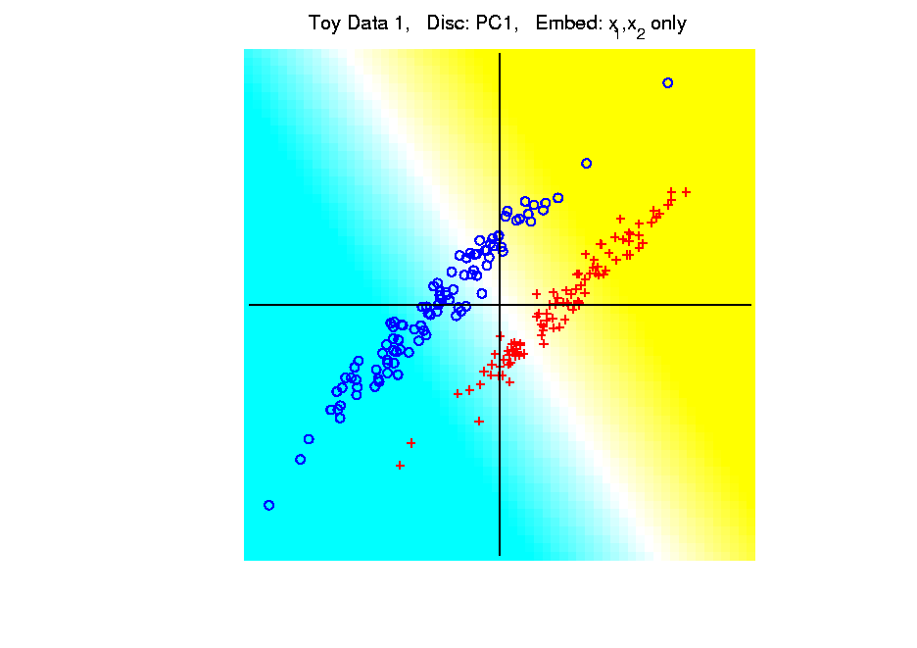
Kernel Embedding
Polynomial Embedding, Toy Example 1:
Parallel Clouds
PC1
Original
Data
Notes:
PEod1Raw.ps

Slide 92
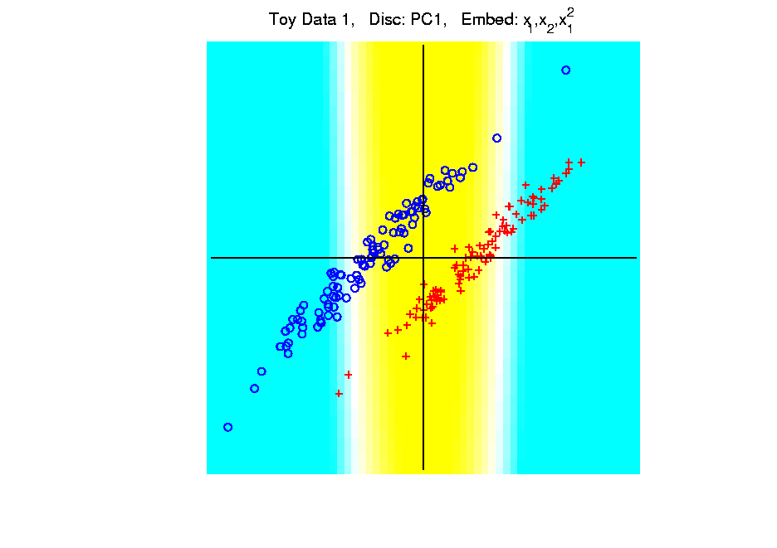
Kernel Embedding
Polynomial Embedding, Toy Example 1:
Parallel Clouds
PC1
Notes:
PEod1Raw.ps

Slide 93
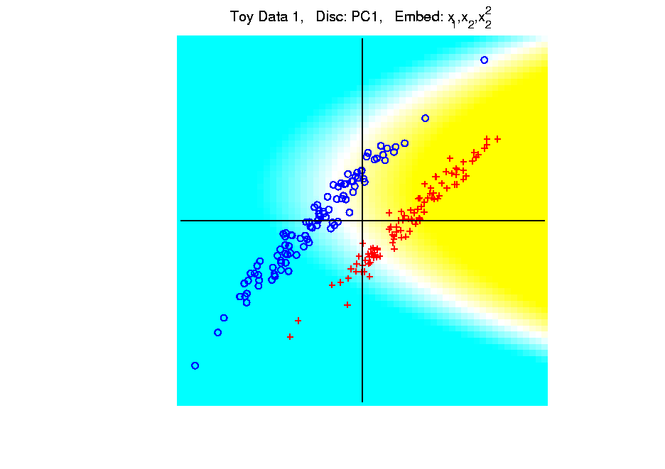
Kernel Embedding
Polynomial Embedding, Toy Example 1:
Parallel Clouds
PC1
Notes:
PEod1Raw.ps

Slide 94
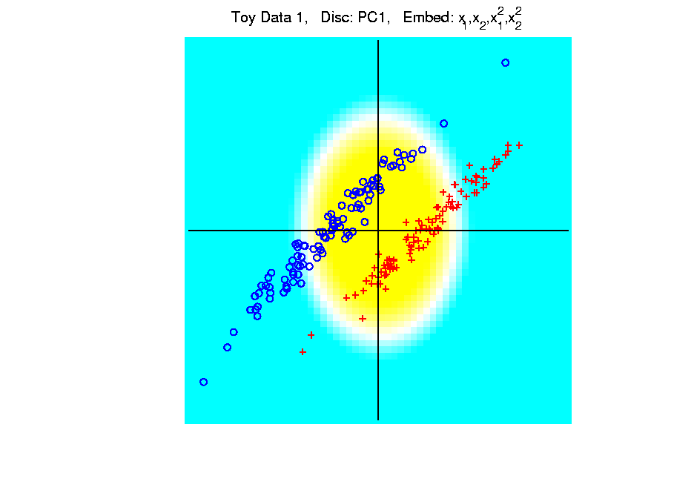
Kernel Embedding
Polynomial Embedding, Toy Example 1:
Parallel Clouds
PC1
Notes:
PEod1Raw.ps

Slide 95
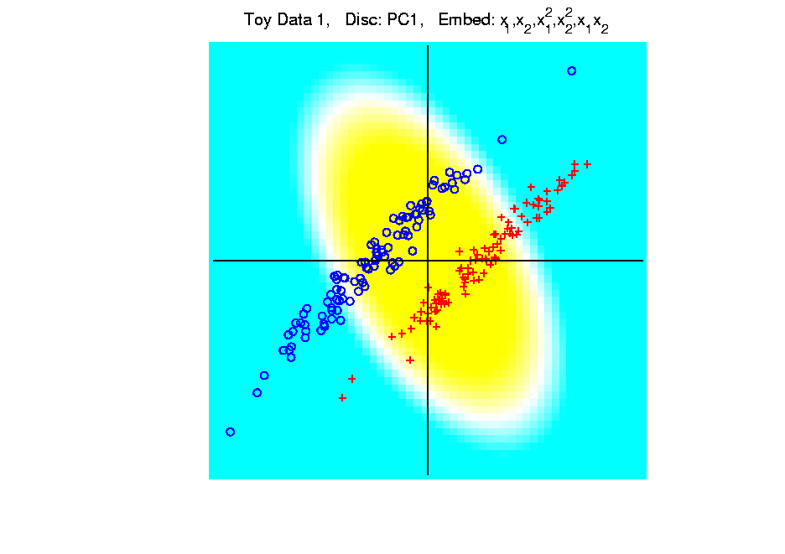
Kernel Embedding
Polynomial Embedding, Toy Example 1:
Parallel Clouds
PC1
Notes:
PEod1Raw.ps

Slide 96
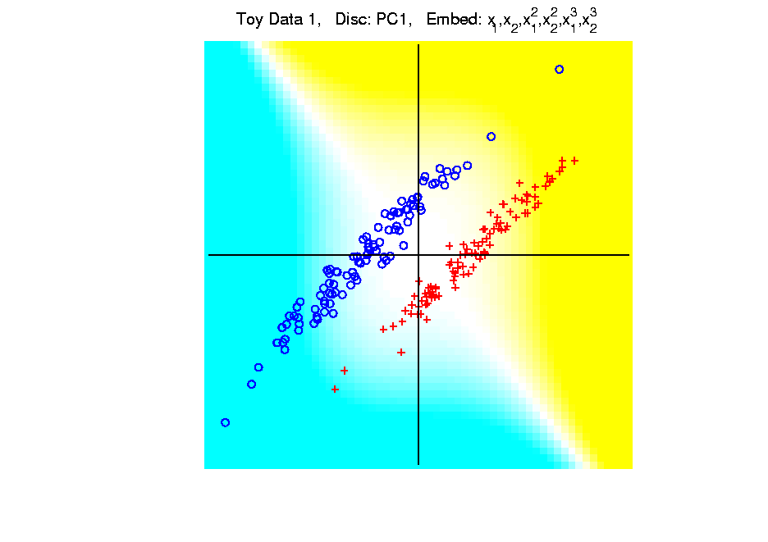
Kernel Embedding
Polynomial Embedding, Toy Example 1:
Parallel Clouds
PC1
Note:
Embedding
Always Bad
Don’t Want
Greatest
Variation
Notes:
PEod1Raw.ps

Slide 97
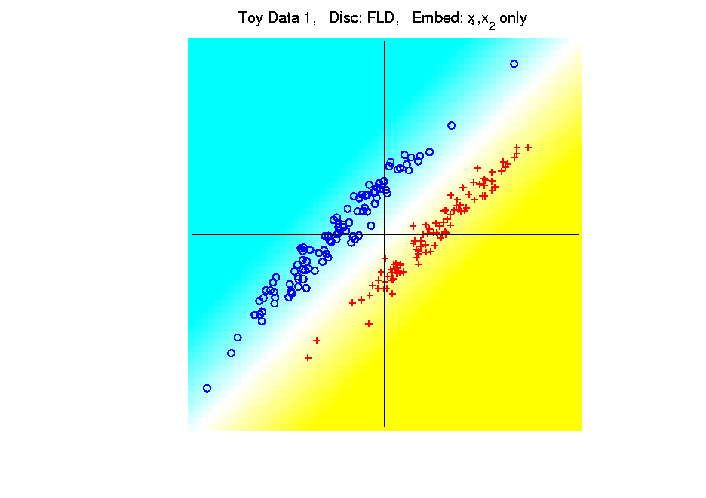
Kernel Embedding
Polynomial Embedding, Toy Example 1:
Parallel Clouds
FLD
Original
Data
Notes:
PEod1Raw.ps

Slide 98
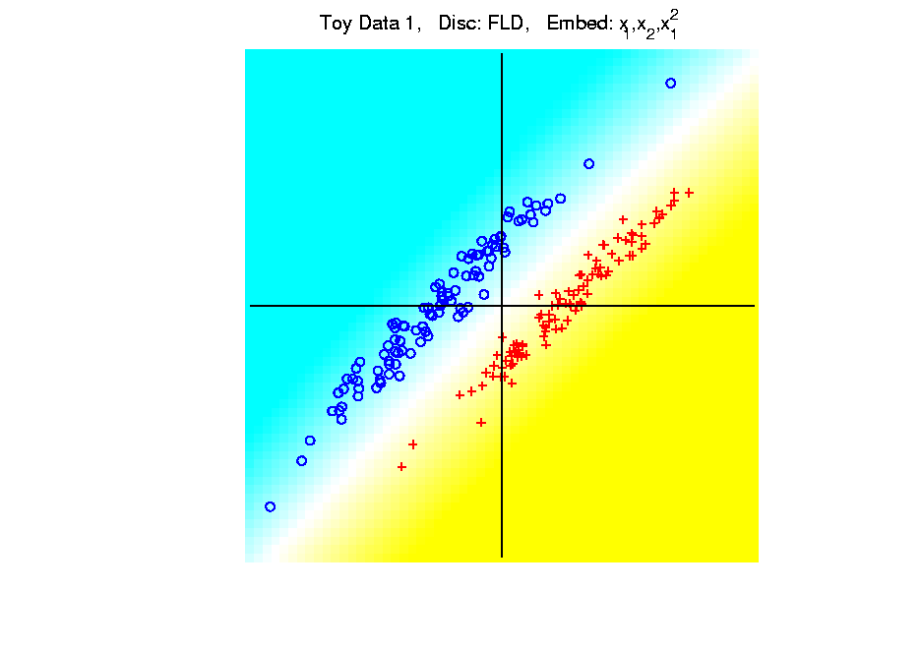
Kernel Embedding
Polynomial Embedding, Toy Example 1:
Parallel Clouds
FLD
Notes:
PEod1Raw.ps

Slide 99
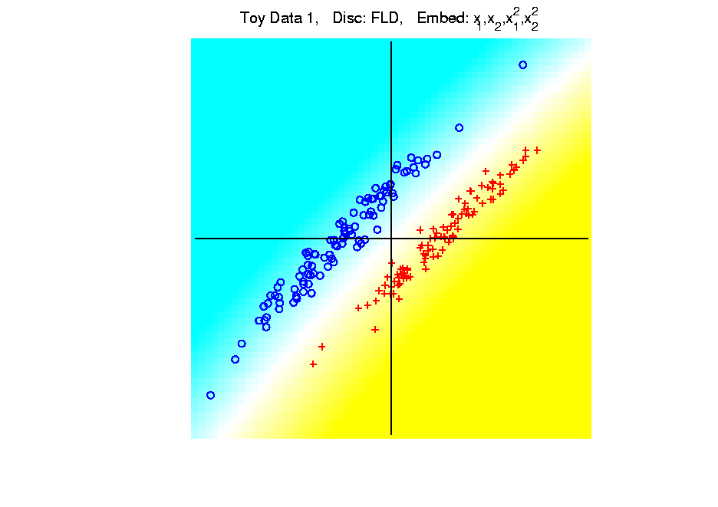
Kernel Embedding
Polynomial Embedding, Toy Example 1:
Parallel Clouds
FLD
Notes:
PEod1Raw.ps

Slide 100
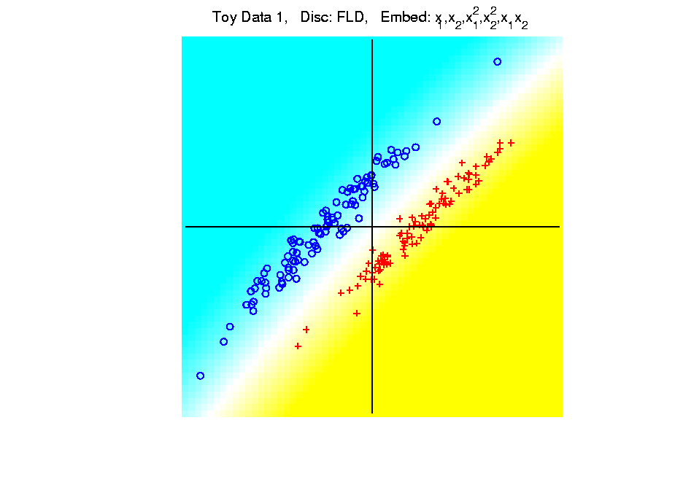
Kernel Embedding
Polynomial Embedding, Toy Example 1:
Parallel Clouds
FLD
Notes:
PEod1Raw.ps

Slide 101
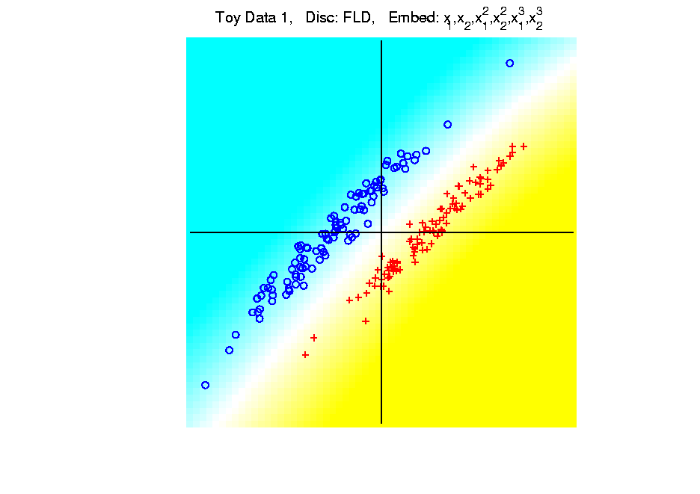
Kernel Embedding
Polynomial Embedding, Toy Example 1:
Parallel Clouds
FLD
All Stable
& Very Good
Notes:
PEod1Raw.ps

Slide 102
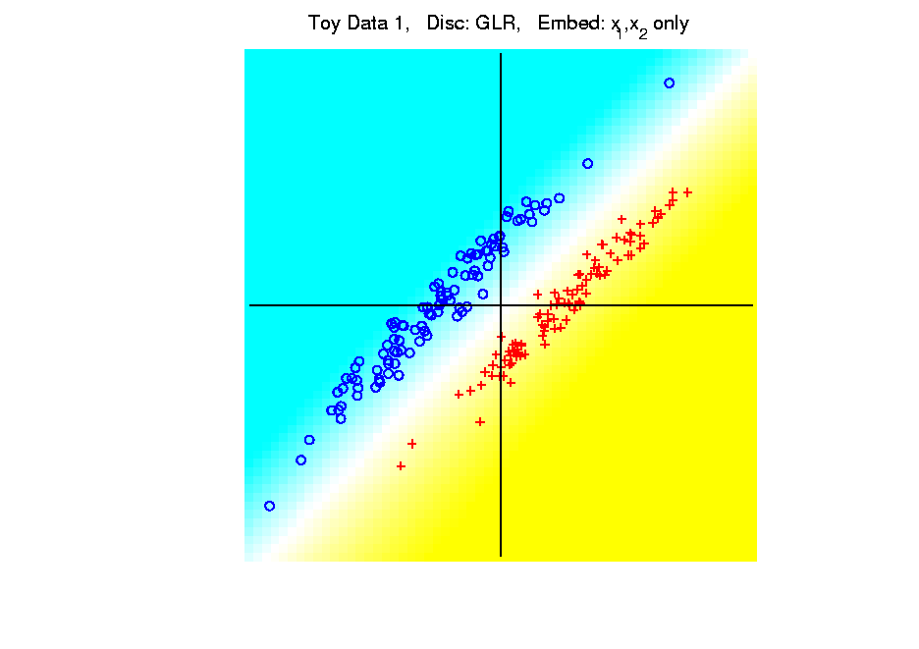
Kernel Embedding
Polynomial Embedding, Toy Example 1:
Parallel Clouds
GLR
Original
Data
Notes:
PEod1Raw.ps

Slide 103
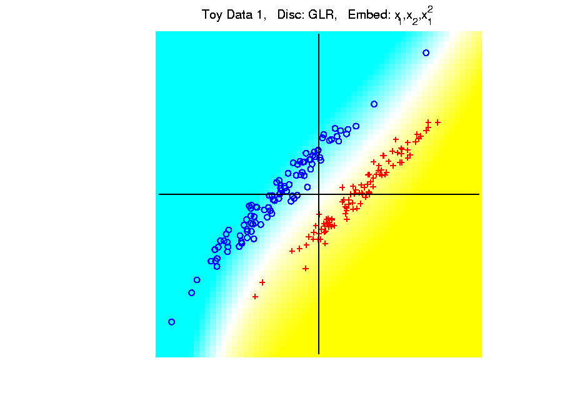
Kernel Embedding
Polynomial Embedding, Toy Example 1:
Parallel Clouds
GLR
Notes:
PEod1Raw.ps

Slide 104
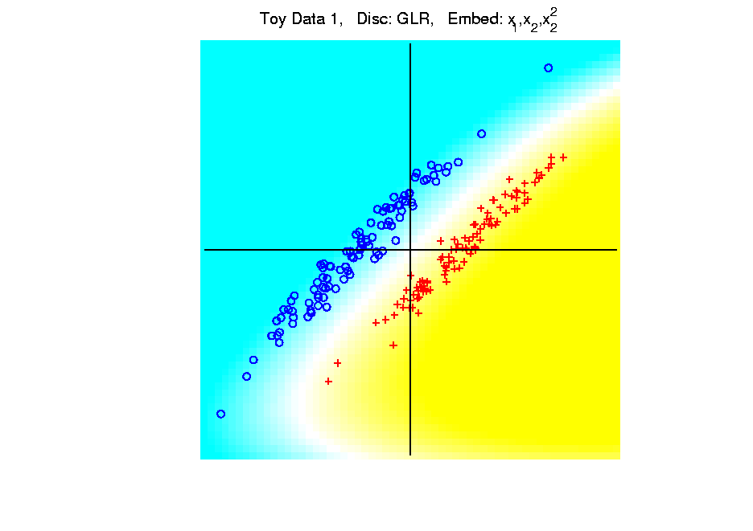
Kernel Embedding
Polynomial Embedding, Toy Example 1:
Parallel Clouds
GLR
Notes:
PEod1Raw.ps

Slide 105
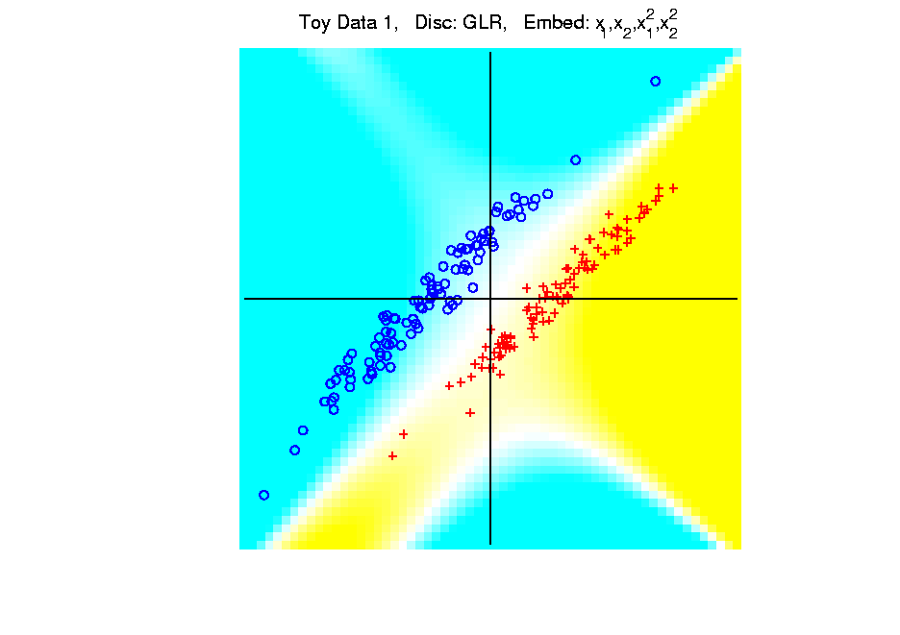
Kernel Embedding
Polynomial Embedding, Toy Example 1:
Parallel Clouds
GLR
Notes:
PEod1Raw.ps

Slide 106
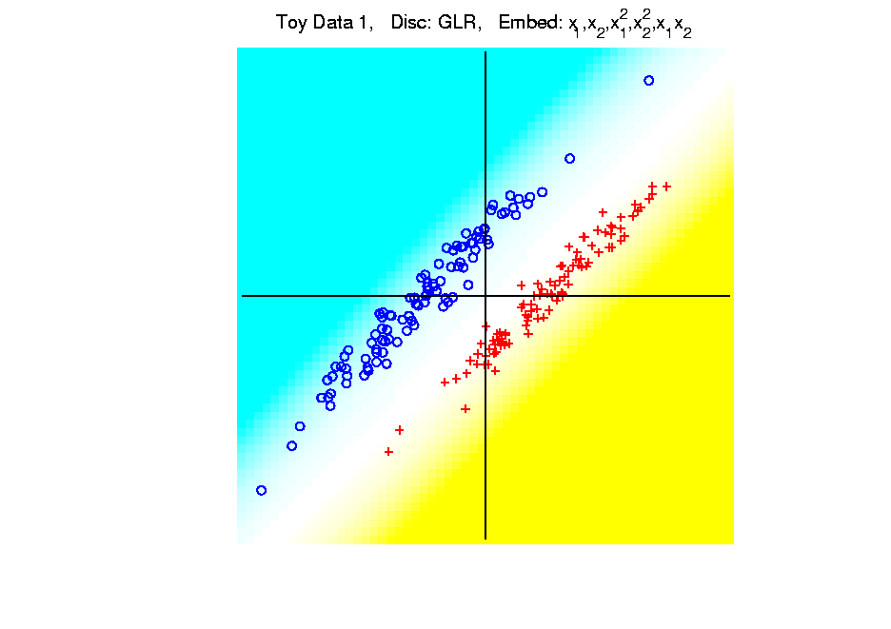
Kernel Embedding
Polynomial Embedding, Toy Example 1:
Parallel Clouds
GLR
Notes:
PEod1Raw.ps

Slide 107
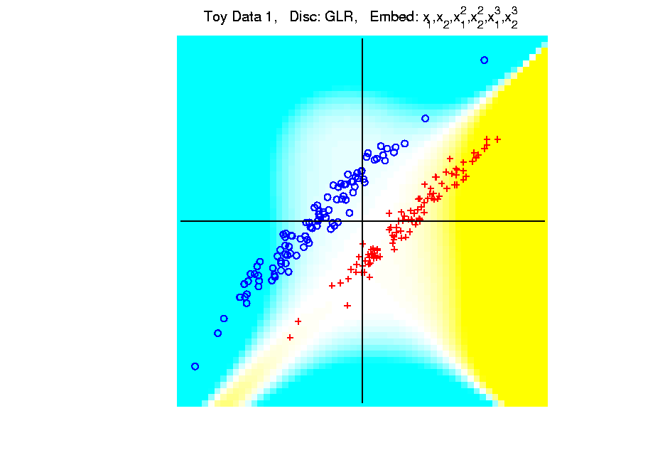
Kernel Embedding
Polynomial Embedding, Toy Example 1:
Parallel Clouds
GLR
Unstable
Subject to
Overfitting
Notes:
PEod1Raw.ps

Slide 108
Kernel Embedding
Polynomial Embedding, Toy Example 2:
Split X
Notes:
PEod1Raw.ps

Slide 109
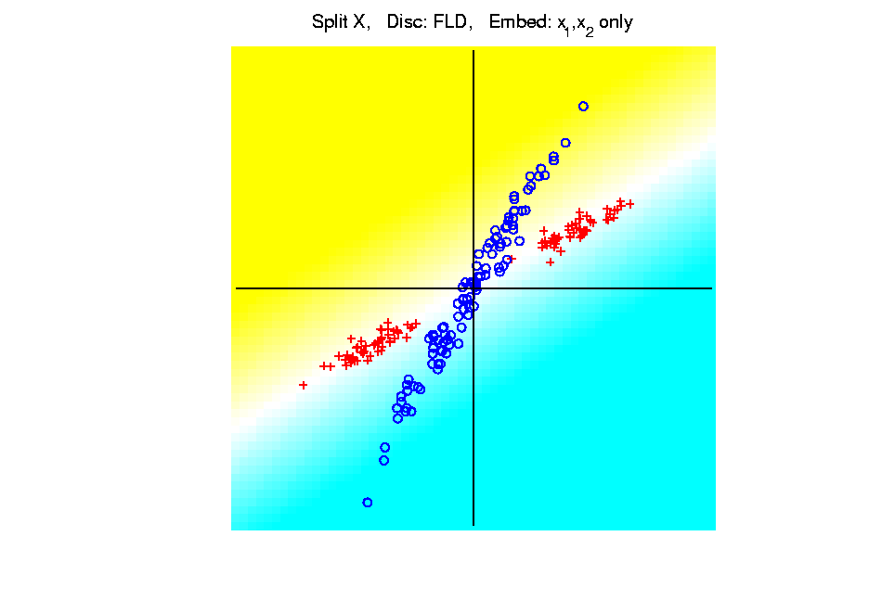
Kernel Embedding
Polynomial Embedding, Toy Example 2:
Split X
FLD
Original
Data
Notes:
PEod1Raw.ps

Slide 110
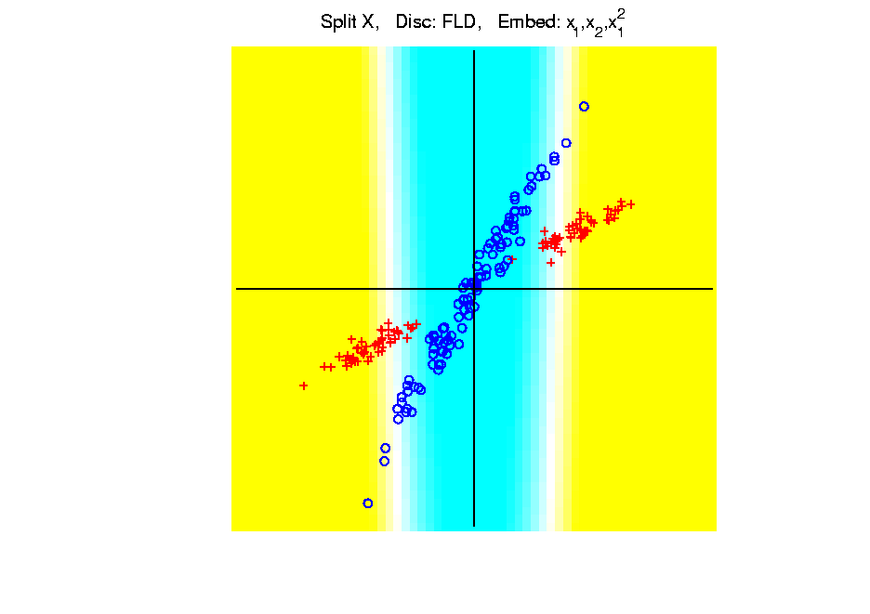
Kernel Embedding
Polynomial Embedding, Toy Example 2:
Split X
FLD
Slightly
Better
Notes:
PEod1Raw.ps

Slide 111
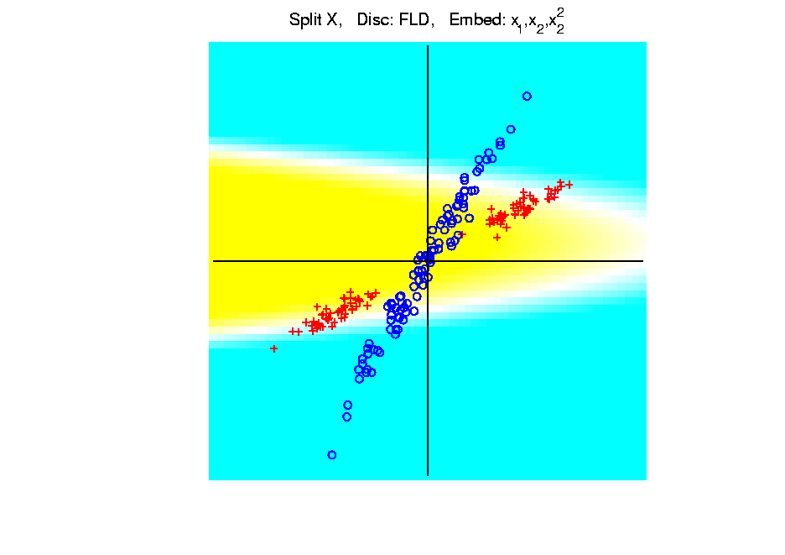
Kernel Embedding
Polynomial Embedding, Toy Example 2:
Split X
FLD
Notes:
PEod1Raw.ps

Slide 112
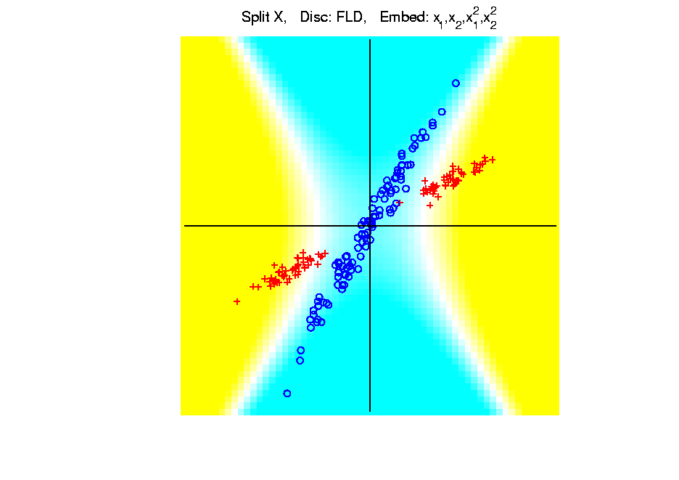
Kernel Embedding
Polynomial Embedding, Toy Example 2:
Split X
FLD
Very Good
Effective
Hyperbola
Notes:
PEod1Raw.ps

Slide 113
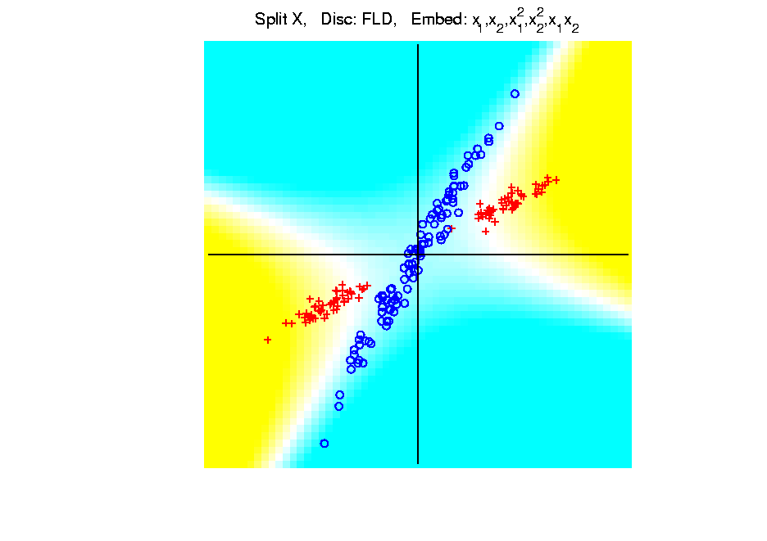
Kernel Embedding
Polynomial Embedding, Toy Example 2:
Split X
FLD
Notes:
PEod1Raw.ps

Slide 114
Kernel Embedding
Polynomial Embedding, Toy Example 2:
Split X
FLD
Robust
Against
Overfitting
Notes:
PEod1Raw.ps

Slide 115
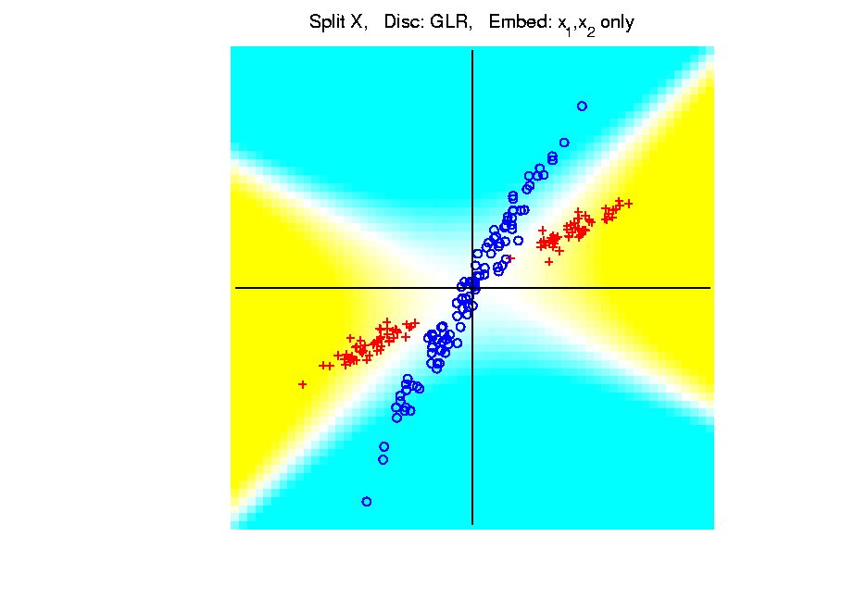
Kernel Embedding
Polynomial Embedding, Toy Example 2:
Split X
GLR
Original
Data
Looks
Very
Good
Notes:
PEod1Raw.ps

Slide 116
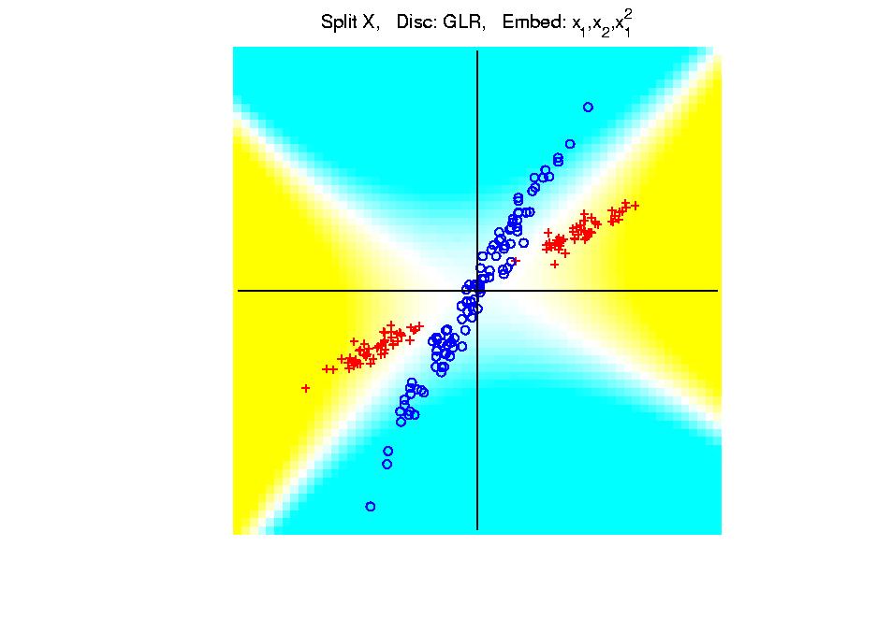
Kernel Embedding
Polynomial Embedding, Toy Example 2:
Split X
GLR
Notes:
PEod1Raw.ps

Slide 117
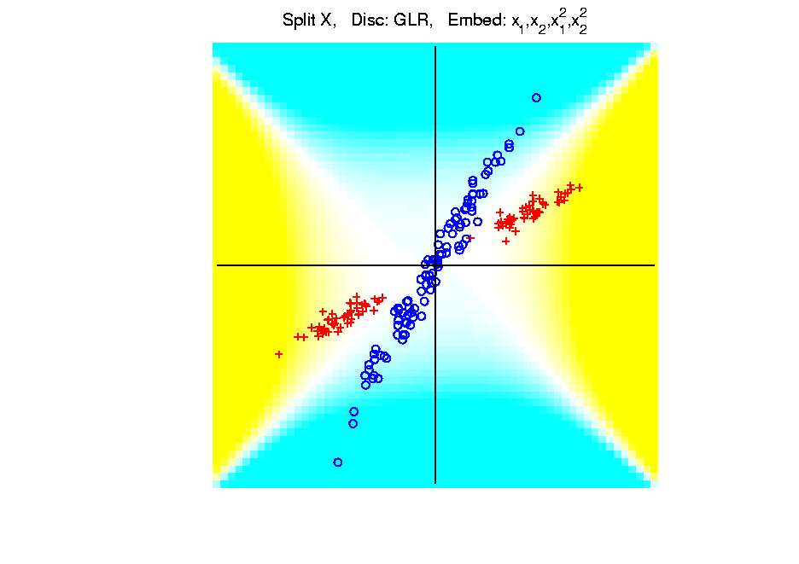
Kernel Embedding
Polynomial Embedding, Toy Example 2:
Split X
GLR
Reasonably
Stable
Never Ellipse
Around Blues
Notes:
PEod1Raw.ps

Slide 118
Kernel Embedding
Polynomial Embedding, Toy Example 3:
Donut
Notes:
PEod1Raw.ps

Slide 119
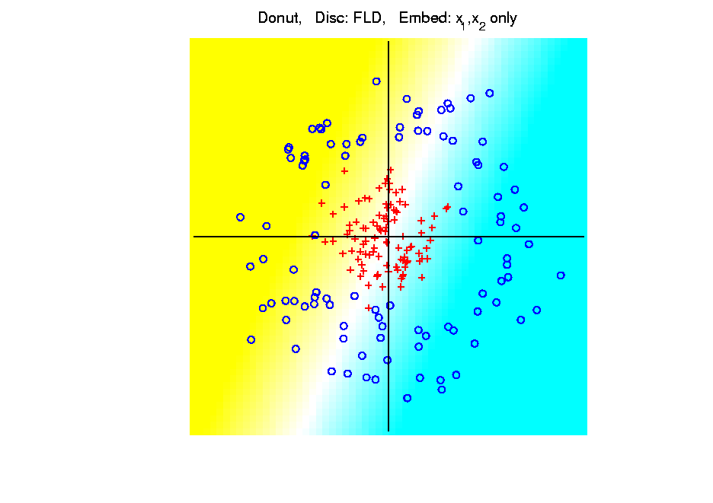
Kernel Embedding
Polynomial Embedding, Toy Example 3:
Donut
FLD
Original
Data
Very
Bad
Notes:
PEod1Raw.ps

Slide 120
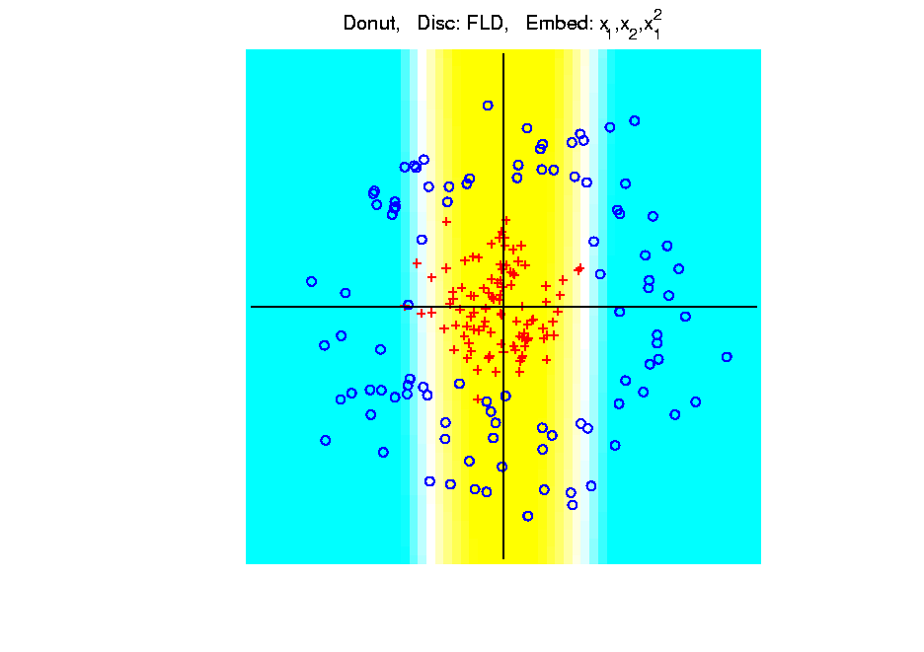
Kernel Embedding
Polynomial Embedding, Toy Example 3:
Donut
FLD
Somewhat
Better
(Parabolic Fold)
Notes:
PEod1Raw.ps

Slide 121
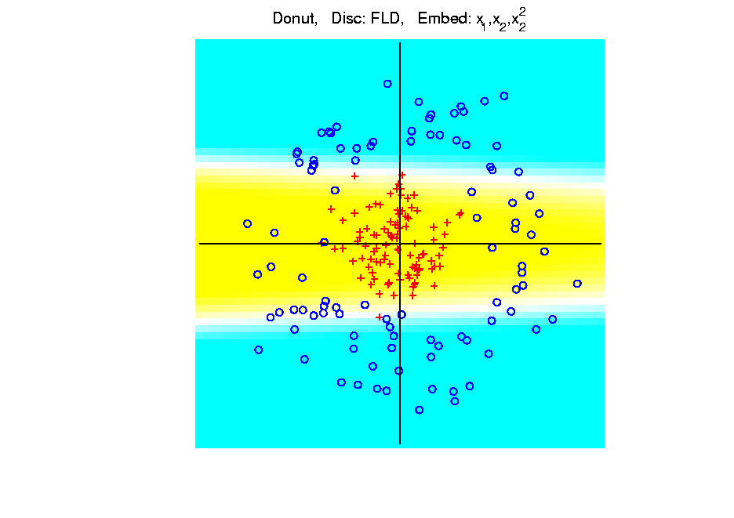
Kernel Embedding
Polynomial Embedding, Toy Example 3:
Donut
FLD
Somewhat
Better
(Other Fold)
Notes:
PEod1Raw.ps

Slide 122
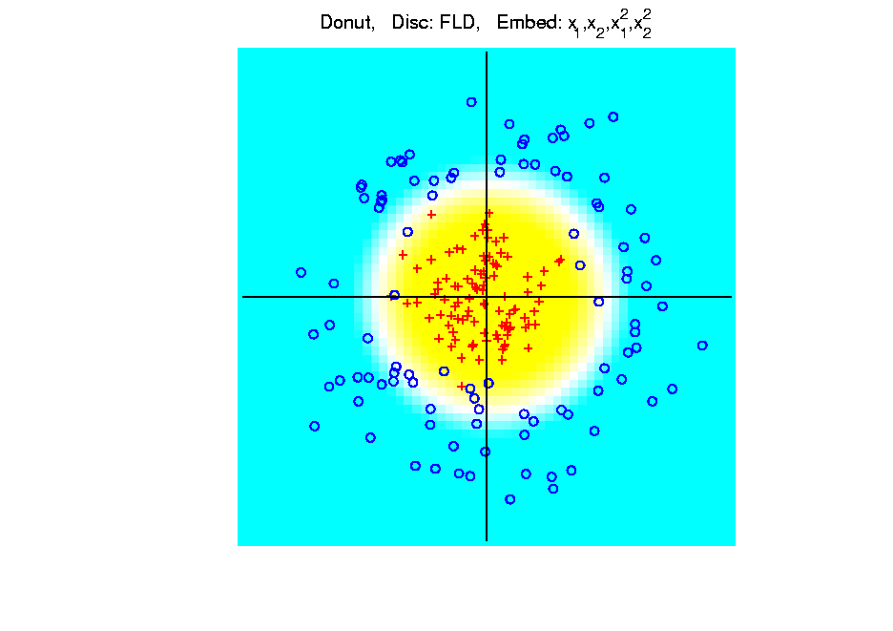
Kernel Embedding
Polynomial Embedding, Toy Example 3:
Donut
FLD
Good
Performance
(Slice of
Paraboloid)
Notes:
PEod1Raw.ps

Slide 123
Kernel Embedding
Polynomial Embedding, Toy Example 3:
Donut
FLD
Notes:
PEod1Raw.ps

Slide 124
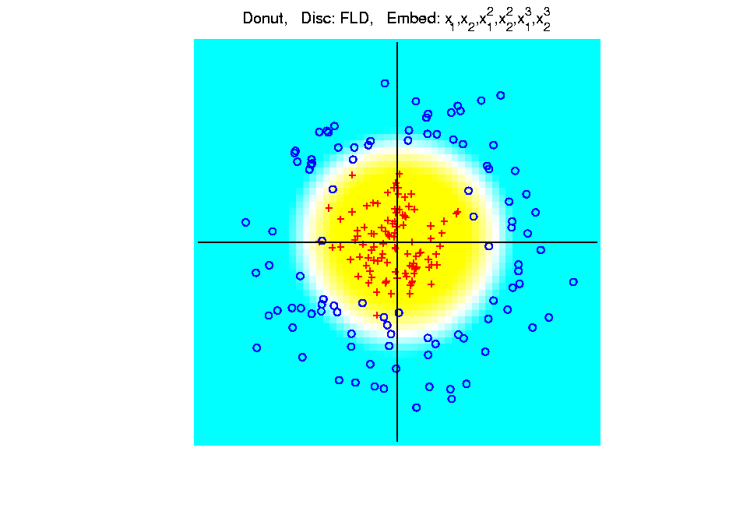
Kernel Embedding
Polynomial Embedding, Toy Example 3:
Donut
FLD
Robust
Against
Overfitting
Notes:
PEod1Raw.ps

Slide 125
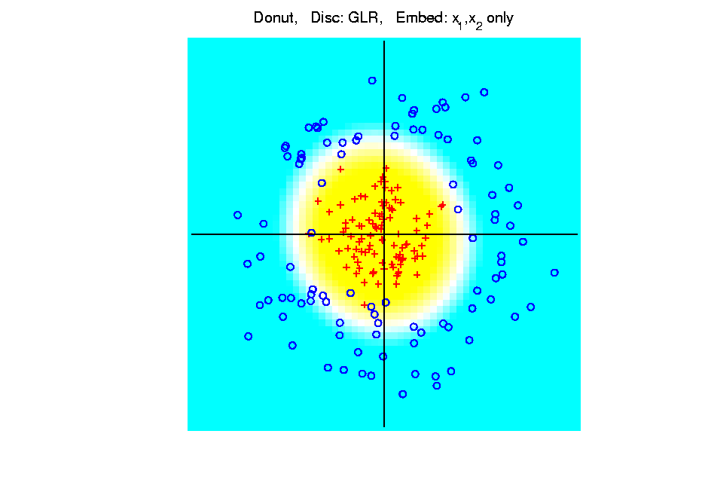
Kernel Embedding
Polynomial Embedding, Toy Example 3:
Donut
GLR
Original
Data
Best With
No Embedding?
Notes:
PEod1Raw.ps

Slide 126
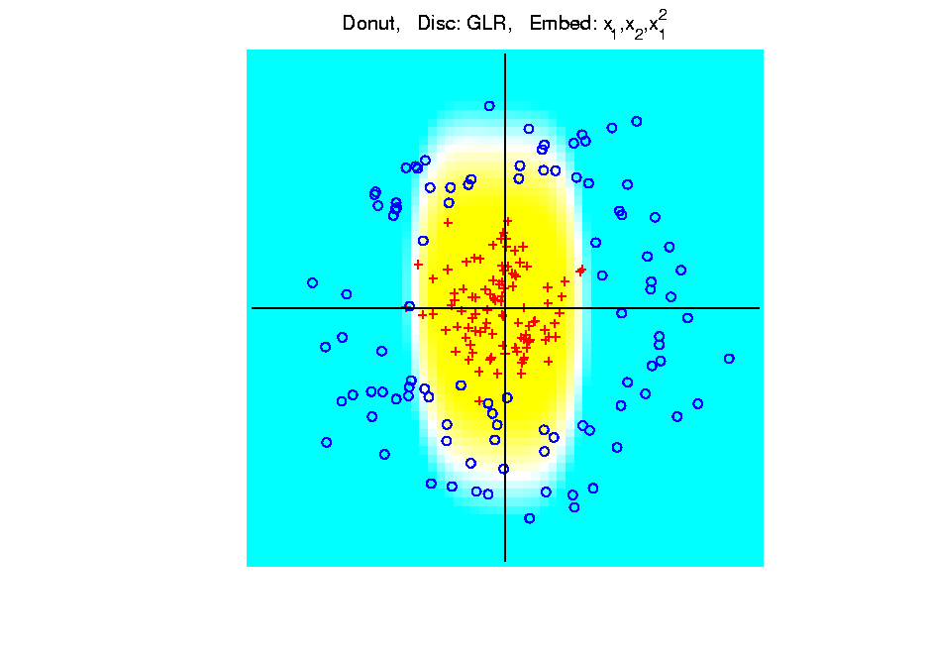
Kernel Embedding
Polynomial Embedding, Toy Example 3:
Donut
GLR
Notes:
PEod1Raw.ps

Slide 127
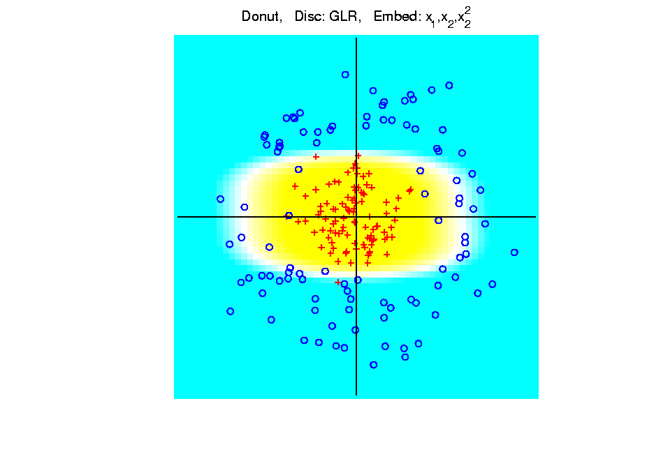
Kernel Embedding
Polynomial Embedding, Toy Example 3:
Donut
GLR
Notes:
PEod1Raw.ps

Slide 128
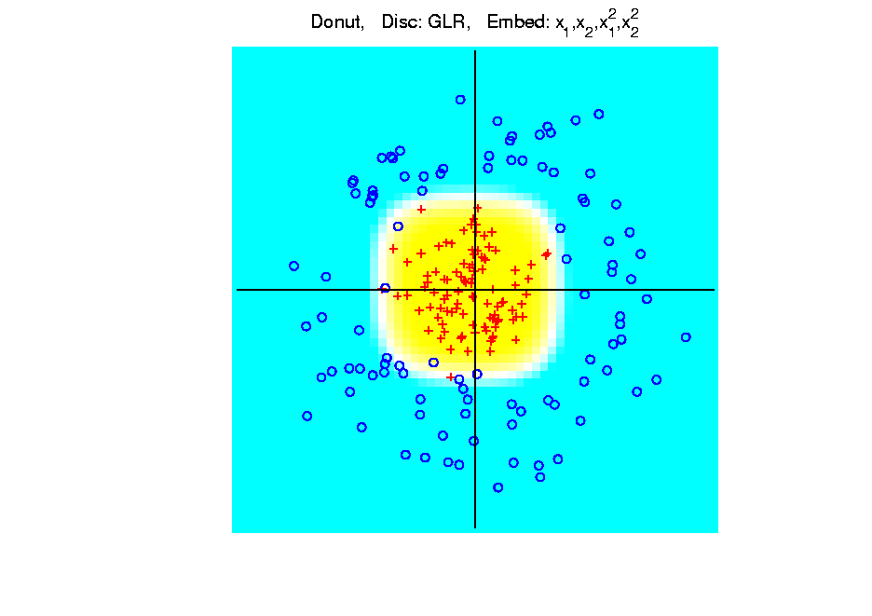
Kernel Embedding
Polynomial Embedding, Toy Example 3:
Donut
GLR
Notes:
PEod1Raw.ps

Slide 129
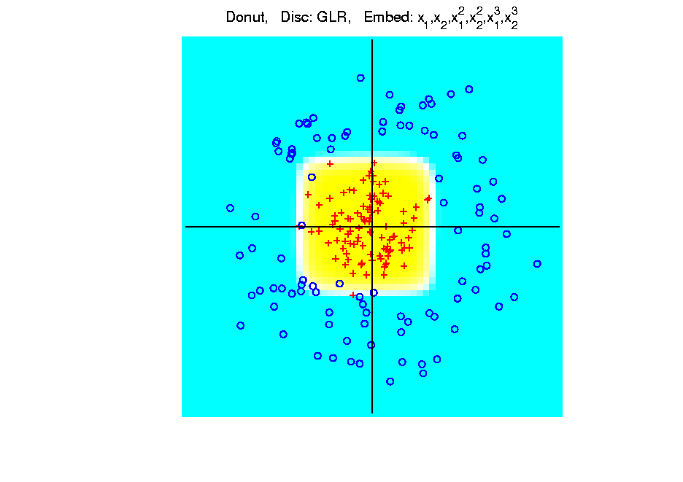
Kernel Embedding
Polynomial Embedding, Toy Example 3:
Donut
GLR
Overfitting
Gives Square
Shape?
Notes:
PEod1Raw.ps

Slide 130
Kernel Embedding
Drawbacks to polynomial embedding:
too many extra terms create spurious structure
i.e. have “overfitting”
HDLSS problems typically get worse

Slide 131
Kernel Embedding
Hot Topic Variation: “Kernel Machines”
Idea: replace polynomials by
other nonlinear functions

Slide 132
Kernel Embedding
Hot Topic Variation: “Kernel Machines”
Idea: replace polynomials by
other nonlinear functions
e.g. 1: sigmoid functions from neural nets

Slide 133
Kernel Embedding
Hot Topic Variation: “Kernel Machines”
Idea: replace polynomials by
other nonlinear functions
e.g. 1: sigmoid functions from neural nets
e.g. 2: radial basis functions
Gaussian kernels
Related to “kernel density estimation”
(recall: smoothed histogram)

Slide 134
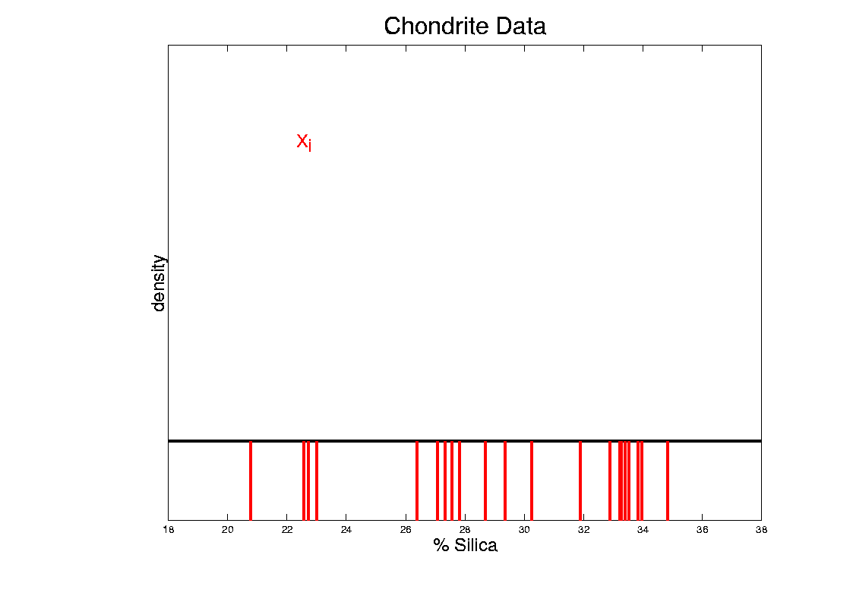
Kernel Density Estimation
Chondrite Data:
Represent points by red bars
Where are data “more dense”?
Notes:
134

Slide 135
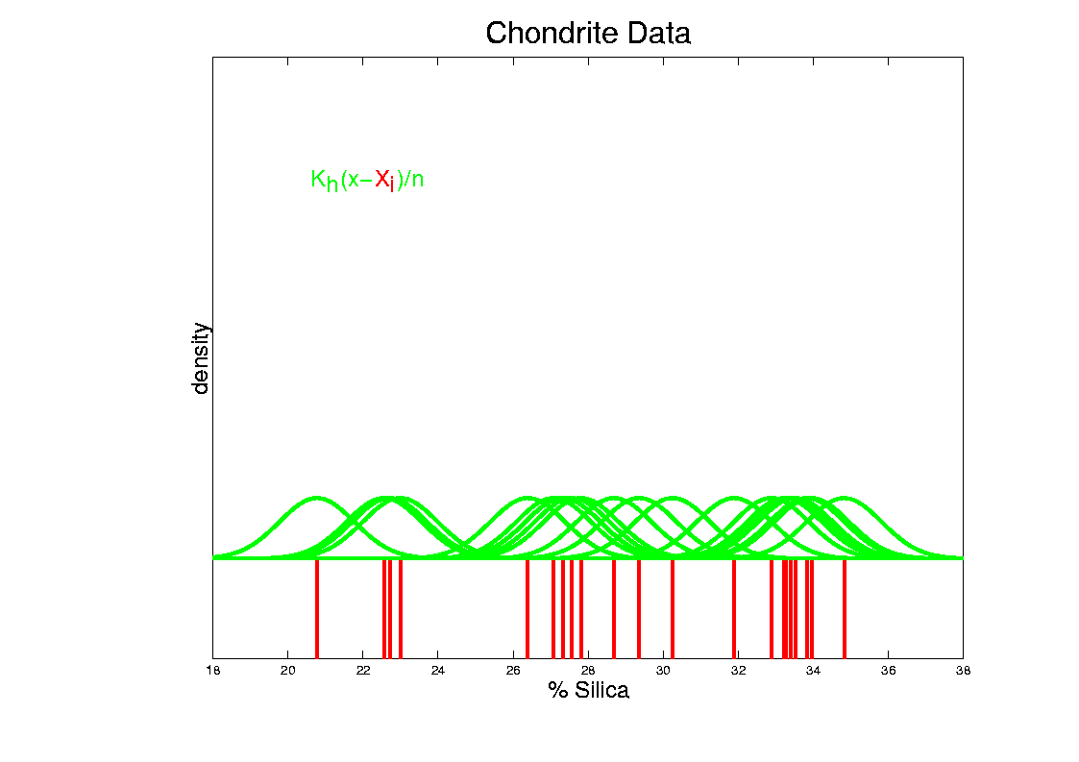
Kernel Density Estimation
Chondrite Data:
Put probability mass 1/n at each point
Smooth piece of “density”
Notes:
135

Slide 136
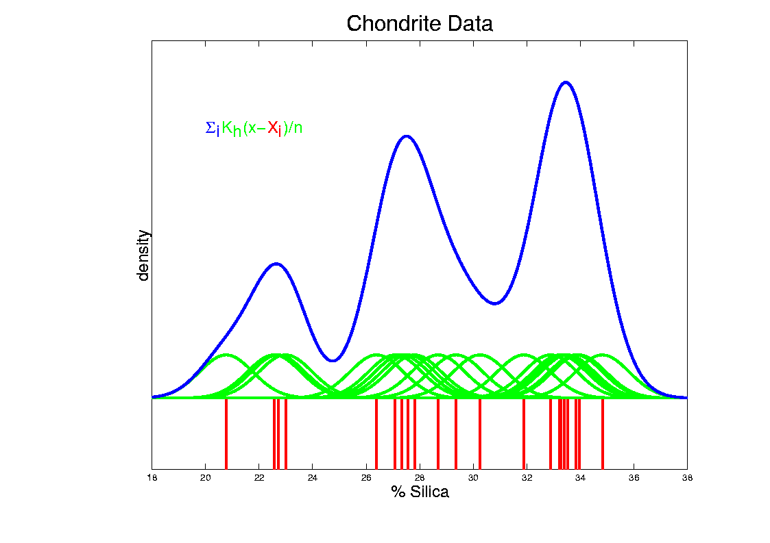
Kernel Density Estimation
Chondrite Data:
Sum pieces to estimate density
Suggests 3 modes (rock sources)
Notes:
136

Slide 137
Kernel Embedding
Radial Basis Functions:
Note: there are several ways to embed

Slide 138
Kernel Embedding
Radial Basis Functions:
Note: there are several ways to embed:
Naïve Embedding (equally spaced grid)
(Will take a look at this,
for illustration purposes)

Slide 139
Kernel Embedding
Radial Basis Functions:
Note: there are several ways to embed:
Naïve Embedding (equally spaced grid)
Explicit Embedding (evaluate at data)

Slide 140
Kernel Embedding
Radial Basis Functions:
Note: there are several ways to embed:
Naïve Embedding (equally spaced grid)
Explicit Embedding (evaluate at data)
Implicit Emdedding (inner prod. based)
(everybody currently does the latter)

Slide 141
Kernel Embedding
Naïve Embedding, Radial basis functions:

Slide 142
Kernel Embedding
Naïve Embedding, Radial basis functions:
At some “grid points” ,
For a “bandwidth” (i.e. standard dev’n) ,

Slide 143
Kernel Embedding
Naïve Embedding, Radial basis functions:
At some “grid points” ,
For a “bandwidth” (i.e. standard dev’n) ,
Consider ( dim’al) functions:

Slide 144
Kernel Embedding
Naïve Embedding, Radial basis functions:
At some “grid points” ,
For a “bandwidth” (i.e. standard dev’n) ,
Consider ( dim’al) functions:
Replace data matrix with:

Slide 145
Kernel Embedding
Naïve Embedding, Radial basis functions:
For discrimination:
Work in radial basis space,
With new data vector ,
represented by:

Slide 146
Kernel Embedding
Naïve Embedd’g, Toy E.g. 1: Parallel Clouds
Good
at data
Poor
outside

Slide 147
Kernel Embedding
Naïve Embedd’g, Toy E.g. 2: Split X
OK at
data
Strange
outside

Slide 148
Kernel Embedding
Naïve Embedd’g, Toy E.g. 3: Donut
Mostly
good

Slide 149
Kernel Embedding
Naïve Embedd’g, Toy E.g. 3: Donut
Mostly
good
Slight
mistake
for one
kernel

Slide 150
Kernel Embedding
Naïve Embedding, Radial basis functions:
Toy Example, Main lessons:
Generally good in regions with data,
Unpredictable where data are sparse

Slide 151
Kernel Embedding
Toy Example 4: Checkerboard
Very
Challenging!
Linear
Method?
Polynomial
Embedding?
Notes:
PEod1Raw.ps

Slide 152
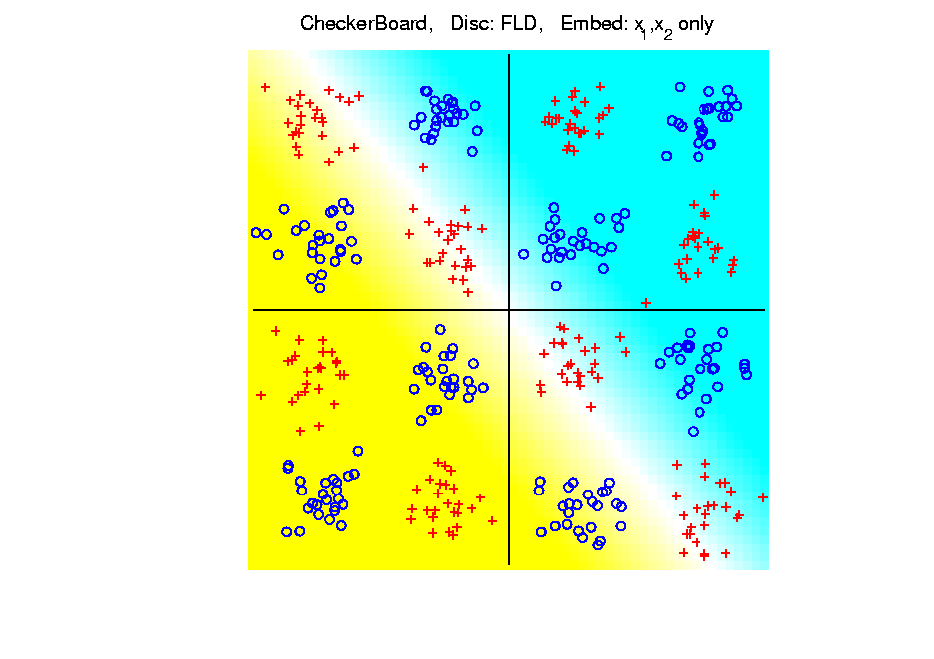
Kernel Embedding
Toy Example 4: Checkerboard
Very
Challenging!
FLD
Linear Is
Hopeless
Notes:
PEod1Raw.ps

Slide 153
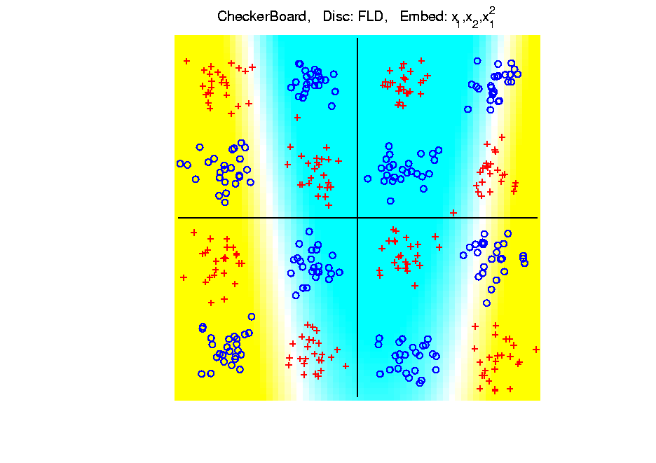
Kernel Embedding
Toy Example 4: Checkerboard
Very
Challenging!
FLD
Notes:
PEod1Raw.ps

Slide 154
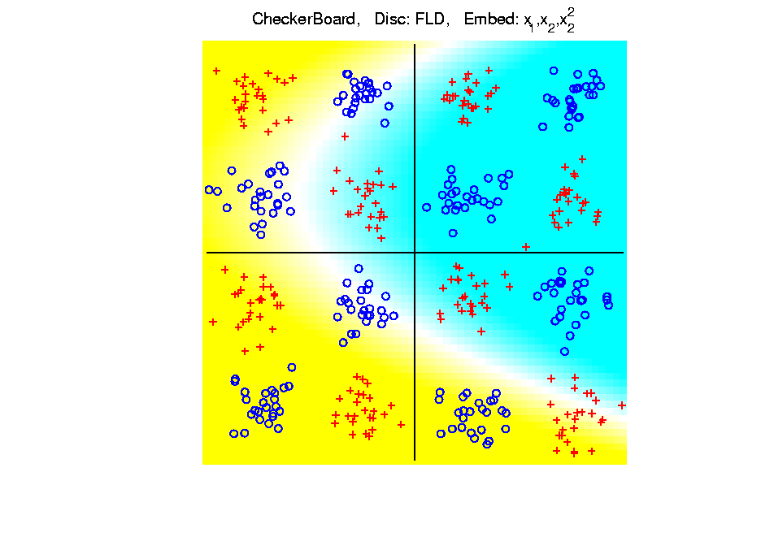
Kernel Embedding
Toy Example 4: Checkerboard
Very
Challenging!
FLD
Notes:
PEod1Raw.ps

Slide 155
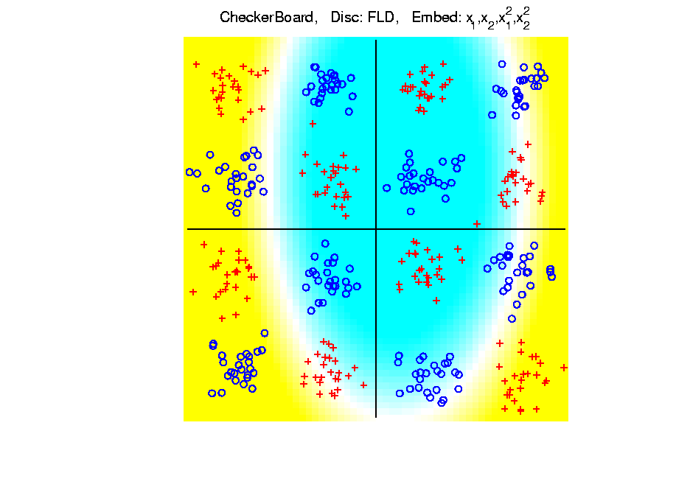
Kernel Embedding
Toy Example 4: Checkerboard
Very
Challenging!
FLD
Notes:
PEod1Raw.ps

Slide 156
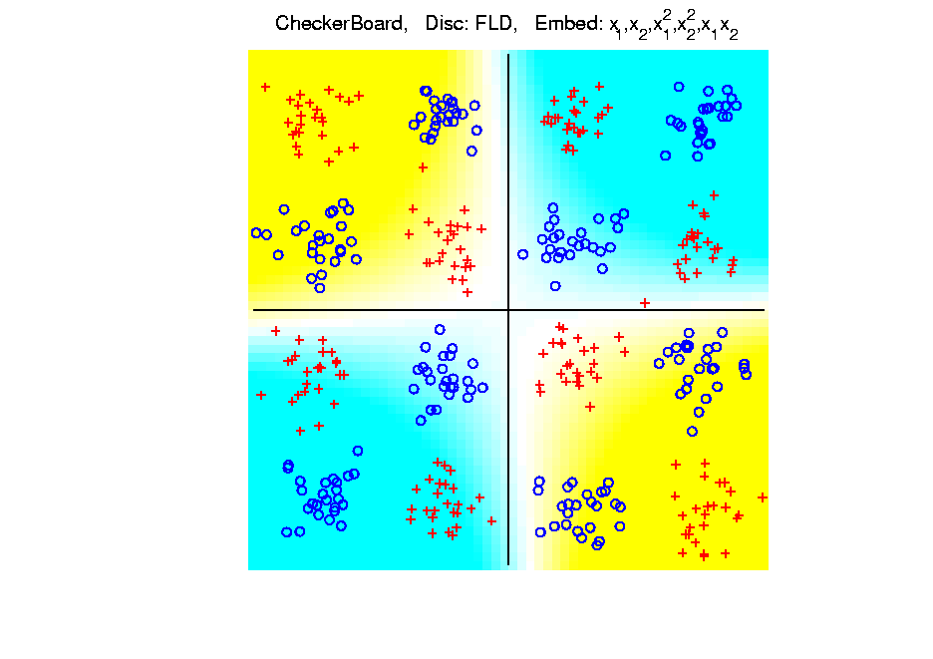
Kernel Embedding
Toy Example 4: Checkerboard
Very
Challenging!
FLD
Notes:
PEod1Raw.ps

Slide 157
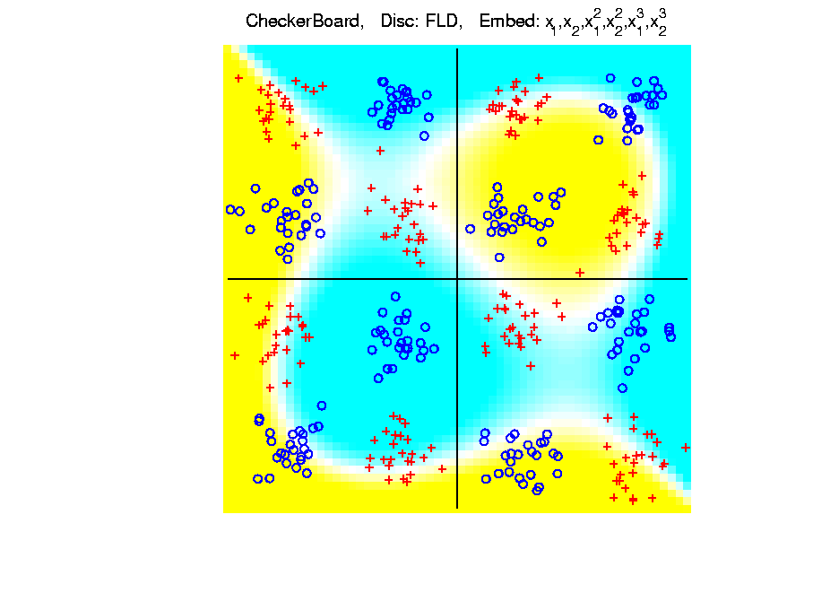
Kernel Embedding
Toy Example 4: Checkerboard
Very
Challenging!
FLD
Embedding
Gets Better
But Still
Not Great
Notes:
PEod1Raw.ps

Slide 158
Kernel Embedding
Toy Example 4: Checkerboard
Very
Challenging!
Polynomials
Don’t Have
Needed
Flexiblity
Notes:
PEod1Raw.ps

Slide 159
Kernel Embedding
Toy Example 4: Checkerboard
Radial
Basis
Embedding
+ FLD
Is
Excellent!
Notes:
PEod1Raw.ps

Slide 160
Kernel Embedding
Drawbacks to naïve embedding:
Equally spaced grid too big in high d
Not computationally tractable (g^{d})
Approach:
Evaluate only at data points
Not on full grid
But where data live

Slide 161
Kernel Embedding
Other types of embedding:
Explicit
Implicit
Will be studied soon, after
introduction to Support Vector Machines…

Slide 162
Kernel Embedding
generalizations of this idea to other types of analysis
& some clever computational ideas.
E.g. “Kernel based, nonlinear Principal Components Analysis”
Ref: Schölkopf, Smola and Müller (1998)

