Slide 1
Statistics – O. R. 891
Object Oriented Data Analysis
J. S. Marron
Dept. of Statistics and Operations Research
University of North Carolina

Slide 2
Participant Presentations
10 Minutes Each
Please Sign Up:
Name
Email (Onyen is fine, or …)
Are You ENRolled?
Tentative Title (???? Is OK)
When:
  Thurs., Early, Oct., Nov., Late

Slide 3
HDLSS Discrimination
An approach to non-invertible covariances:
Replace by generalized inverses
Sometimes called pseudo inverses
Note: there are several
Here use Moore Penrose inverse
As used by Matlab (pinv.m)
Often provides useful results
(but not always)

Slide 4
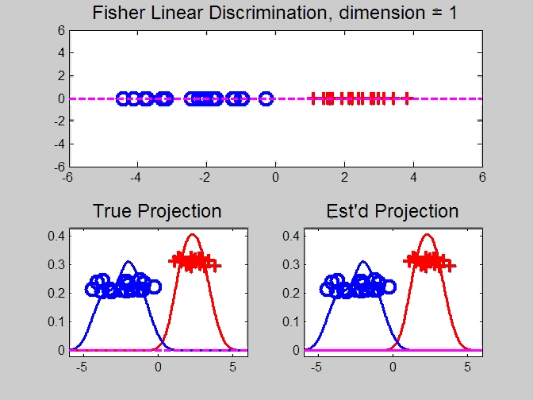
HDLSS Discrimination
Movie Through Increasing Dimensions

Slide 5
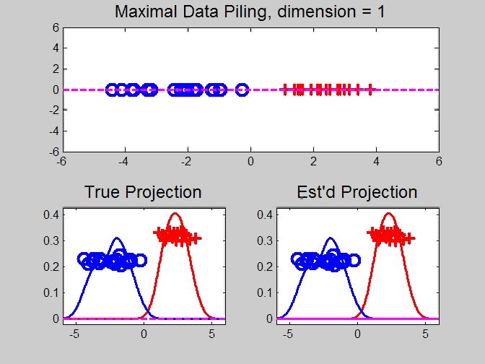
Maximal Data Piling
Movie Through Increasing Dimensions

Slide 6
Kernel Embedding
Aizerman, Braverman and Rozoner (1964)
Motivating idea:
Extend scope of linear discrimination,
By adding nonlinear components to data
(embedding in a higher dim’al space)
Better use of name:
nonlinear discrimination?

Slide 7
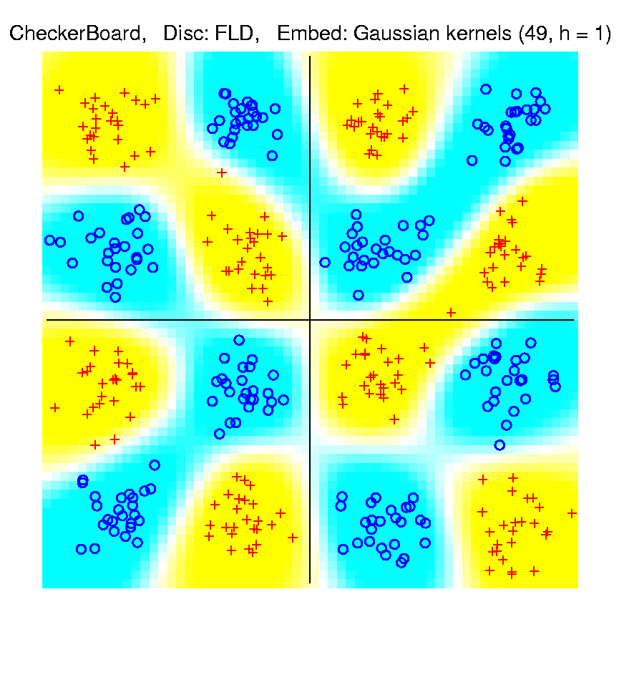
Kernel Embedding
Toy Example 4: Checkerboard
Radial
Basis
Embedding
+ FLD
Is
Excellent!
Notes:
PEod1Raw.ps

Slide 8
Kernel Embedding
Other types of embedding:
Explicit
Implicit
Will be studied soon, after
introduction to Support Vector Machines…

Slide 9
Kernel Embedding
generalizations of this idea to other types of analysis
& some clever computational ideas.
E.g. “Kernel based, nonlinear Principal Components Analysis”
Ref: Schölkopf, Smola and Müller (1998)

Slide 10
Support Vector Machines
Motivation:
Find a linear method that “works well”
for embedded data
Note: Embedded data are
very non-Gaussian
Classical Statistics: “Use Prob. Dist’n”
Looks Hopeless

Slide 11
Support Vector Machines
Motivation:
Find a linear method that “works well”
for embedded data
Note: Embedded data are
very non-Gaussian
Suggests value of
really new approach

Slide 12
Support Vector Machines
Classical References:
Vapnik (1982)
Boser, Guyon & Vapnik (1992)
Vapnik (1995)

Slide 13
Support Vector Machines
Recommended tutorial:
Burges (1998)

Slide 14
Support Vector Machines
Recommended tutorial:
Burges (1998)
Recommended Monographs:
Cristianini & Shawe-Taylor (2000)
Schölkopf & Alex Smola (2002)

Slide 15
Support Vector Machines
Graphical View, using Toy Example:

Slide 16
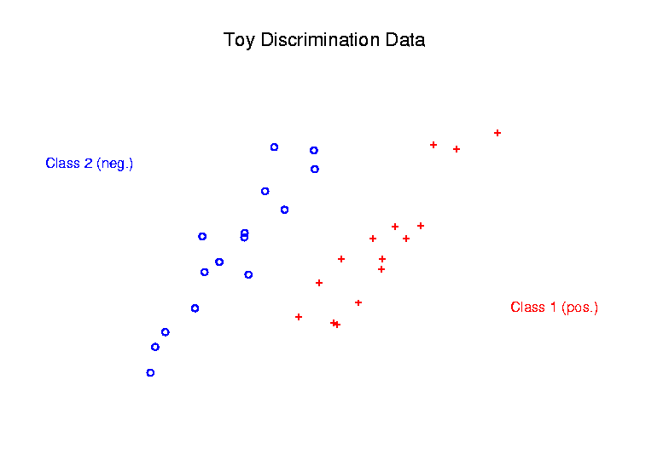
Support Vector Machines
Graphical View, using Toy Example:

Slide 17
Support Vector Machines
Graphical View, using Toy Example:
Find separating plane

Slide 18
Support Vector Machines
Graphical View, using Toy Example:
Find separating plane
To maximize distances from data to plane

Slide 19
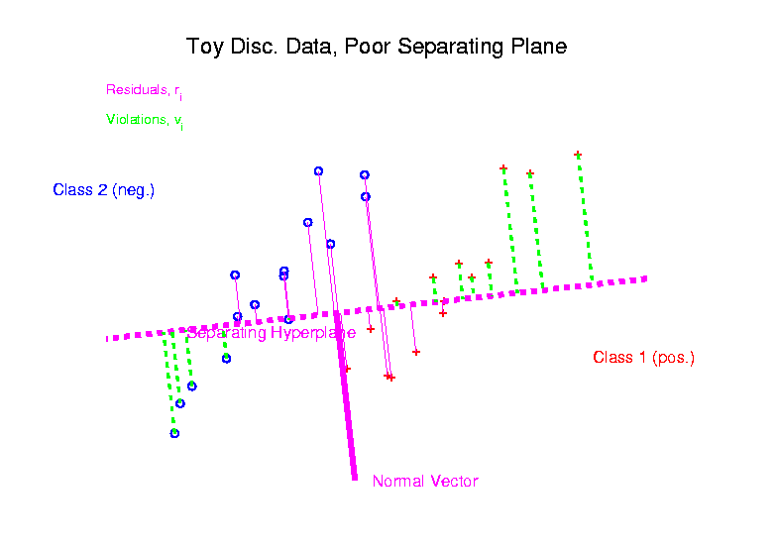
Support Vector Machines
Graphical View, using Toy Example:

Slide 20
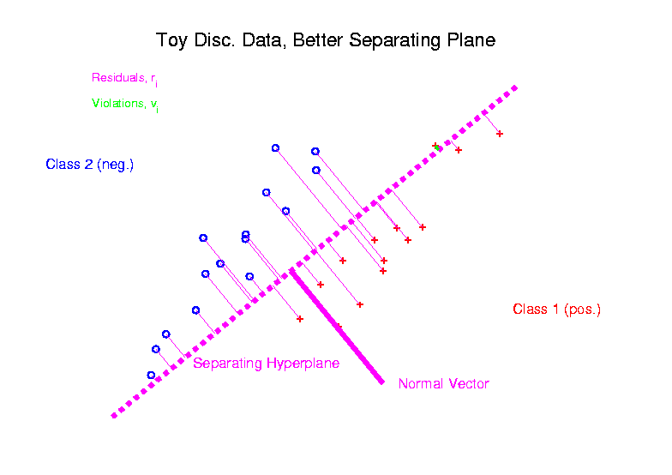
Support Vector Machines
Graphical View, using Toy Example:

Slide 21
Support Vector Machines
Graphical View, using Toy Example:
Find separating plane
To maximize distances from data to plane
In particular smallest distance

Slide 22
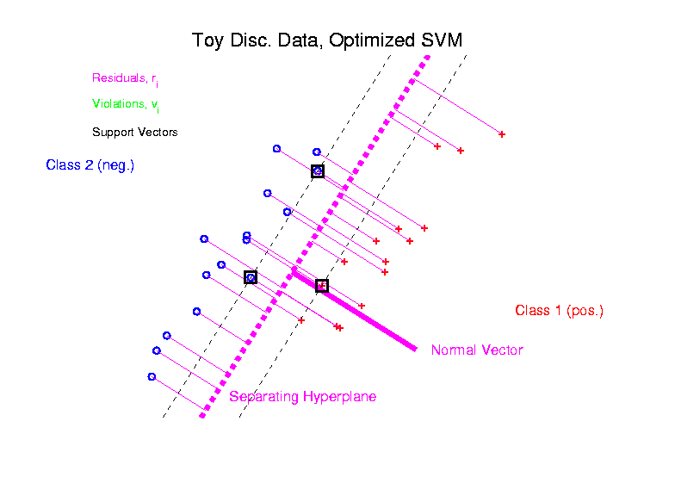
Support Vector Machines
Graphical View, using Toy Example:

Slide 23
Support Vector Machines
Graphical View, using Toy Example:
Find separating plane
To maximize distances from data to plane
In particular smallest distance
Data points closest are called
support vectors
Gap between is called margin

Slide 24
Support Vector Machines
Graphical View, using Toy Example:
Find separating plane
To maximize distances from data to plane
In particular smallest distance
Data points closest are called
support vectors
Gap between is called margin
Caution: For some “margin” is different

Slide 25
SVMs, Optimization Viewpoint
Formulate Optimization problem, based on:
Data (feature) vectors
Class Labels

Slide 26
SVMs, Optimization Viewpoint
Formulate Optimization problem, based on:
Data (feature) vectors
Class Labels
Normal Vector
Location (determines intercept)

Slide 27
SVMs, Optimization Viewpoint
Formulate Optimization problem, based on:
Data (feature) vectors
Class Labels
Normal Vector
Location (determines intercept)
Residuals (right side)
Residuals (wrong side)

Slide 28
SVMs, Optimization Viewpoint
Formulate Optimization problem, based on:
Data (feature) vectors
Class Labels
Normal Vector
Location (determines intercept)
Residuals (right side)
Residuals (wrong side)
Solve (convex problem) by quadratic programming

Slide 29
SVMs, Optimization Viewpoint
Lagrange Multipliers primal formulation (separable case):
Minimize:
Where are Lagrange multipliers

Slide 30
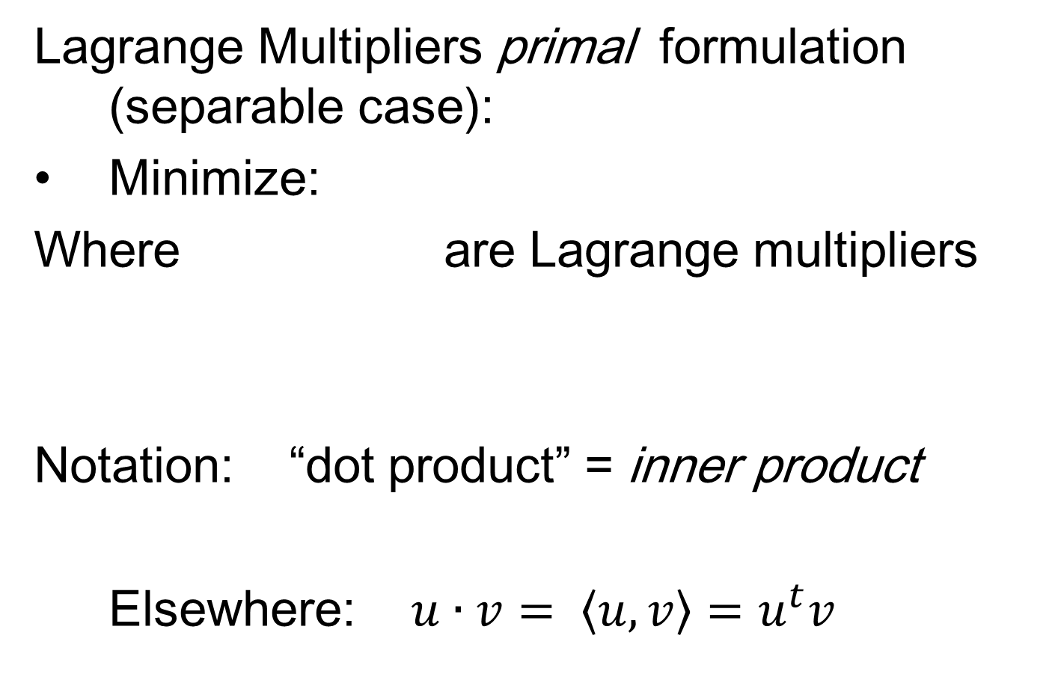
SVMs, Optimization Viewpoint
Lagrange Multipliers primal formulation (separable case):
Minimize:
Where are Lagrange multipliers
Notation: “dot product” = inner product
Elsewhere: $u∙v= \left\langle u,v\right\rangle =u^{t}v$

Slide 31
SVMs, Optimization Viewpoint
Lagrange Multipliers primal formulation (separable case):
Minimize:
Where are Lagrange multipliers
Dual Lagrangian version:
Maximize:

Slide 32
SVMs, Optimization Viewpoint
Lagrange Multipliers primal formulation (separable case):
Minimize:
Where are Lagrange multipliers
Dual Lagrangian version:
Maximize:
Get classification function:

Slide 33
SVMs, Optimization Viewpoint
Get classification function:

Slide 34

SVMs, Optimization Viewpoint
Get classification function:
Choose Class:
+1, when $f\left(x\right)>0$
-1, when $f\left(x\right)<0$

Slide 35
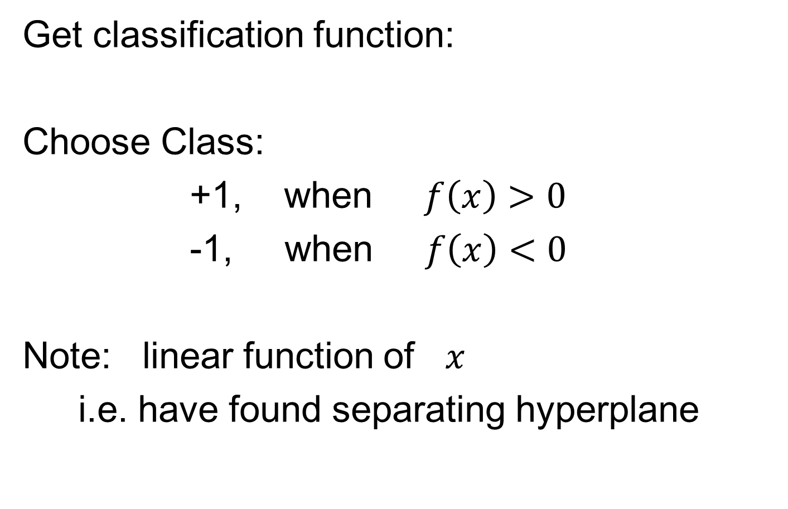
SVMs, Optimization Viewpoint
Get classification function:
Choose Class:
+1, when $f\left(x\right)>0$
-1, when $f\left(x\right)<0$
Note: linear function of $x$
i.e. have found separating hyperplane

Slide 36
SVMs, Computation
Major Computational Point:
Classifier only depends on data through inner products!

Slide 37
SVMs, Computation
Major Computational Point:
Classifier only depends on data through inner products!
Thus enough to only store inner products

Slide 38
SVMs, Computation
Major Computational Point:
Classifier only depends on data through inner products!
Thus enough to only store inner products
Creates big savings in optimization
Especially for HDLSS data

Slide 39
SVMs, Computation
Major Computational Point:
Classifier only depends on data through inner products!
Thus enough to only store inner products
Creates big savings in optimization
Especially for HDLSS data
But also creates variations in kernel embedding (interpretation?!?)

Slide 40
SVMs, Computation
Major Computational Point:
Classifier only depends on data through inner products!
Thus enough to only store inner products
Creates big savings in optimization
Especially for HDLSS data
But also creates variations in kernel embedding (interpretation?!?)
This is almost always done in practice

Slide 41
SVMs, Comput’n & Embedding
For an “Embedding Map”,
e.g.
Explicit Embedding

Slide 42
SVMs, Comput’n & Embedding
For an “Embedding Map”,
e.g.
Explicit Embedding:
Maximize:

Slide 43
SVMs, Comput’n & Embedding
For an “Embedding Map”,
e.g.
Explicit Embedding:
Maximize:
Get classification function:

Slide 44
SVMs, Comput’n & Embedding
For an “Embedding Map”,
e.g.
Explicit Embedding:
Maximize:
Get classification function:
Straightforward application of embedding
But loses inner product advantage

Slide 45
SVMs, Comput’n & Embedding
Implicit Embedding:
Maximize:

Slide 46
SVMs, Comput’n & Embedding
Implicit Embedding:
Maximize:
Note Difference from Explicit Embedding:

Slide 47
SVMs, Comput’n & Embedding
Implicit Embedding:
Maximize:
Get classification function:
Still defined only via inner products

Slide 48
SVMs, Comput’n & Embedding
Implicit Embedding:
Maximize:
Get classification function:
Still defined only via inner products
Retains optimization advantage
Thus used very commonly

Slide 49
SVMs, Comput’n & Embedding
Implicit Embedding:
Maximize:
Get classification function:
Still defined only via inner products
Retains optimization advantage
Thus used very commonly
Comparison to explicit embedding?
Which is “better”???

Slide 50
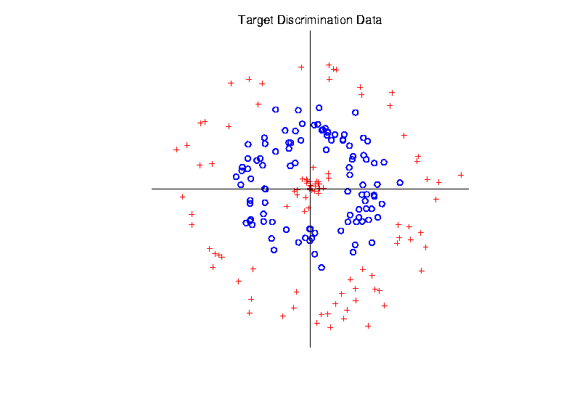
Support Vector Machines
Target Toy Data set:

Slide 51
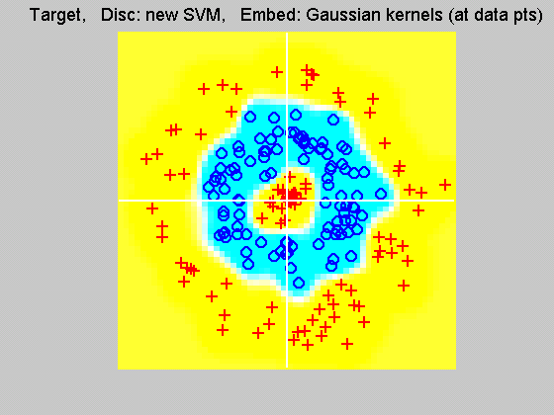
Support Vector Machines
Explicit Embedding, window σ = 0.1:
Gaussian
Kernel,
i.e.
Radial
Basis
Function

Slide 52
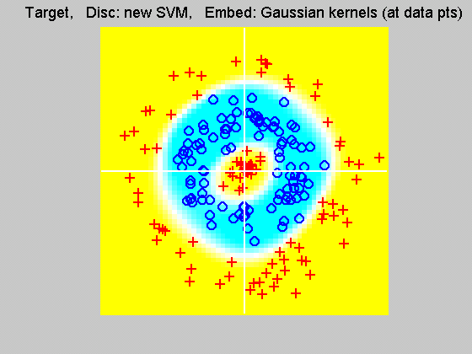
Support Vector Machines
Explicit Embedding, window σ = 1:
Pretty Big
Change
(Factor
of 10)

Slide 53
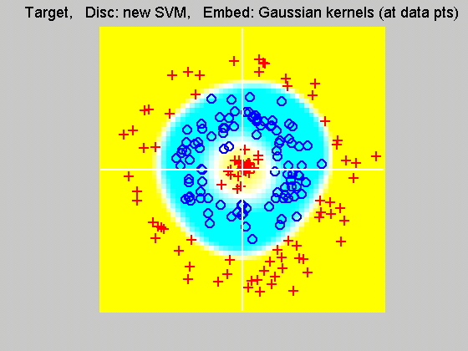
Support Vector Machines
Explicit Embedding, window σ = 10:
Not Quite
As Good
???

Slide 54
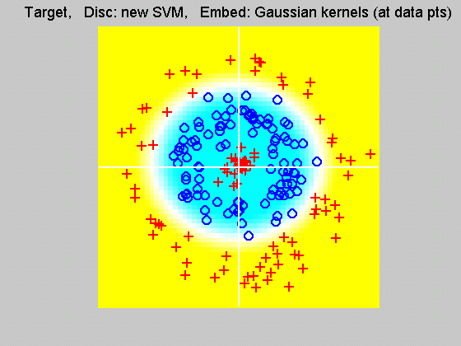
Support Vector Machines
Explicit Embedding, window σ = 100:
Note: Lost Center
(Over- Smoothed)

Slide 55
Support Vector Machines
Notes on Explicit Embedding:
Too small → Poor generalizability
Too big → miss important regions

Slide 56
Support Vector Machines
Notes on Explicit Embedding:
Too small → Poor generalizability
Too big → miss important regions
Classical lessons from kernel smoothing

Slide 57
Support Vector Machines
Notes on Explicit Embedding:
Too small → Poor generalizability
Too big → miss important regions
Classical lessons from kernel smoothing
Surprisingly large “reasonable region”
I.e. parameter less critical (sometimes?)

Slide 58
Support Vector Machines
Interesting Alternative Viewpoint:
Study Projections
In Kernel Space
(Never done in Machine Learning World)

Slide 59
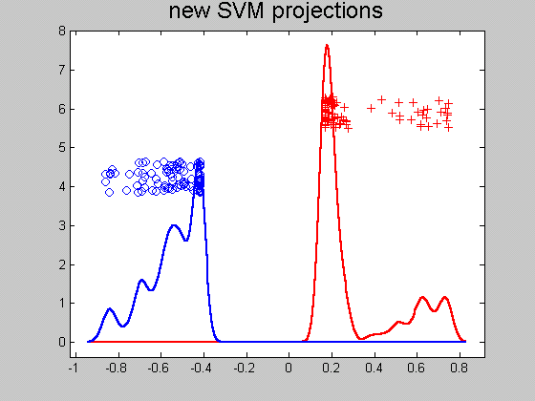
Support Vector Machines
Kernel space projection, window σ = 0.1:
Note:
Data
Piling
At
Margin

Slide 60
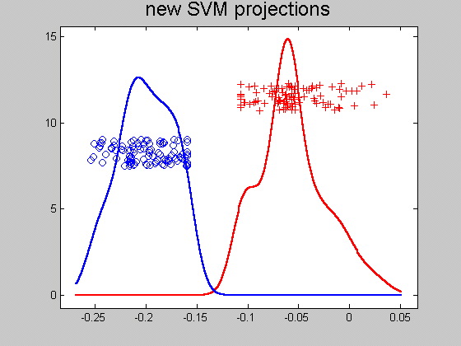
Support Vector Machines
Kernel space projection, window σ = 1:
Excellent
Separation
(but less
than σ = 0.1)

Slide 61
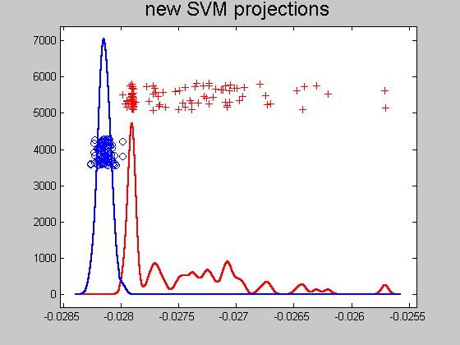
Support Vector Machines
Kernel space projection, window σ = 10:
Still Good
(But Some
Overlap)

Slide 62
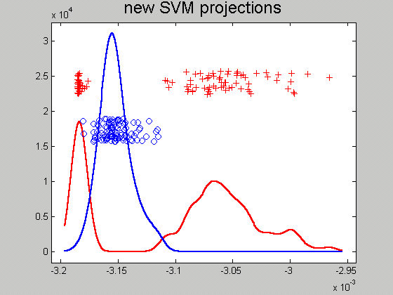
Support Vector Machines
Kernel space projection, window σ = 100:
Some Reds
On Wrong
Side
(Missed
Center)

Slide 63
Support Vector Machines
Notes on Kernel space projection:
Too small →
  Great separation
  But recall, poor generalizability

Slide 64
Support Vector Machines
Notes on Kernel space projection:
Too small →
  Great separation
  But recall, poor generalizability
Too big → no longer separable

Slide 65
Support Vector Machines
Notes on Kernel space projection:
Too small →
  Great separation
  But recall, poor generalizability
Too big → no longer separable
As above:
  Classical lessons from kernel smoothing
  Surprisingly large “reasonable region”
  I.e. parameter less critical (sometimes?)
Also explore projections (in kernel space)

Slide 66
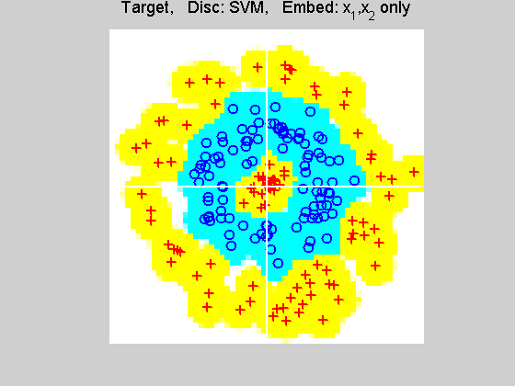
Support Vector Machines
Implicit Embedding, window σ = 0.1:

Slide 67
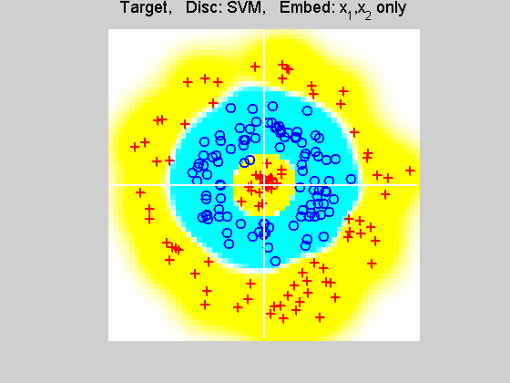
Support Vector Machines
Implicit Embedding, window σ = 0.5:

Slide 68
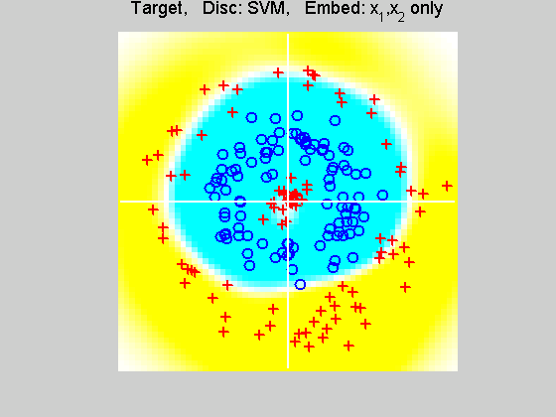
Support Vector Machines
Implicit Embedding, window σ = 1:

Slide 69
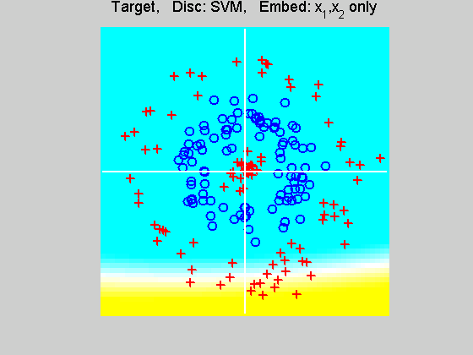
Support Vector Machines
Implicit Embedding, window σ = 10:

Slide 70
Support Vector Machines
Notes on Implicit Embedding:
Similar Large vs. Small lessons
Range of “reasonable results”
Seems to be smaller
(note different range of windows)

Slide 71
Support Vector Machines
Notes on Implicit Embedding:
Similar Large vs. Small lessons
Range of “reasonable results”
Seems to be smaller
(note different range of windows)
Much different “edge” behavior
Interesting topic for future work…

Slide 72
SVMs & Robustness
Usually not severely affected by outliers,
But a possible weakness:
Can have very influential points
Toy E.g., only 2 points drive SVM

Slide 73
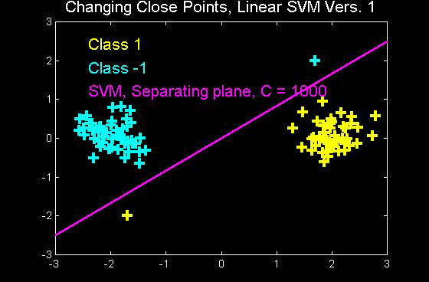
SVMs & Robustness
Can have very influential points

Slide 74
SVMs & Robustness
Usually not severely affected by outliers,
But a possible weakness:
Can have very influential points
Toy E.g., only 2 points drive SVM
Notes:
Huge range of chosen hyperplanes

Slide 75
SVMs & Robustness
Usually not severely affected by outliers,
But a possible weakness:
Can have very influential points
Toy E.g., only 2 points drive SVM
Notes:
Huge range of chosen hyperplanes
But all are “pretty good discriminators”

Slide 76
SVMs & Robustness
Usually not severely affected by outliers,
But a possible weakness:
Can have very influential points
Toy E.g., only 2 points drive SVM
Notes:
Huge range of chosen hyperplanes
But all are “pretty good discriminators”
Only happens when whole range is OK???
Good or bad?

Slide 77
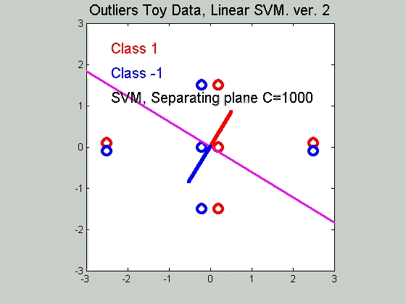
SVMs & Robustness
Effect of violators:

Slide 78
SVMs & Robustness
Effect of violators:
Depends on distance to plane
Weak for violators nearby
Strong as they move away
Can have major impact on plane
Also depends on tuning parameter C

Slide 79
SVMs, Computation
Caution: available algorithms are not created equal
Toy Example:
Gunn’s Matlab code
Todd’s Matlab code

Slide 80
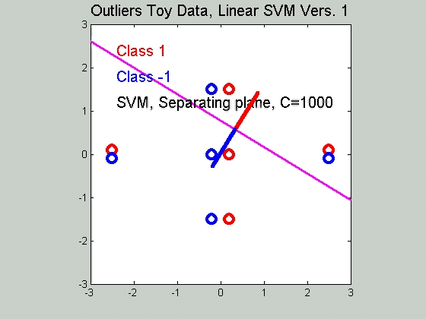
SVMs, Computation
Toy Example: Gunn’s Matlab code

Slide 81
SVMs, Computation
Toy Example: Todd’s Matlab code

Slide 82
SVMs, Computation
Caution: available algorithms are not created equal
Toy Example:
Gunn’s Matlab code
Todd’s Matlab code
Serious errors in Gunn’s version, does not find real optimum…

Slide 83
SVMs, Tuning Parameter
Recall Regularization Parameter C:
Controls penalty for violation
I.e. lying on wrong side of plane
Appears in slack variables
Affects performance of SVM
Toy Example:
d = 50, Spherical Gaussian data

Slide 84
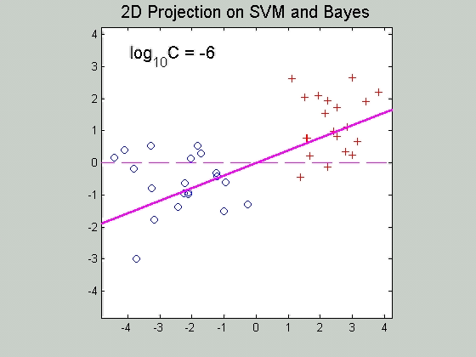
SVMs, Tuning Parameter
Toy Example: d = 50, Sph’l Gaussian data

Slide 85
SVMs, Tuning Parameter
Toy Example:
d = 50, Spherical Gaussian data
X=Axis: Opt. Dir’n Other: SVM Dir’n

Slide 86
SVMs, Tuning Parameter
Toy Example:
d = 50, Spherical Gaussian data
X=Axis: Opt. Dir’n Other: SVM Dir’n
Small C:
  Where is the margin?
  Small angle to optimal (generalizable)

Slide 87
SVMs, Tuning Parameter
Toy Example:
d = 50, Spherical Gaussian data
X=Axis: Opt. Dir’n Other: SVM Dir’n
Small C:
  Where is the margin?
  Small angle to optimal (generalizable)
Large C:
  More data piling
  Larger angle (less generalizable)
  Bigger gap (but maybe not better???)

Slide 88
SVMs, Tuning Parameter
Toy Example:
d = 50, Spherical Gaussian data
X=Axis: Opt. Dir’n Other: SVM Dir’n
Small C:
  Where is the margin?
  Small angle to optimal (generalizable)
Large C:
  More data piling
  Larger angle (less generalizable)
  Bigger gap (but maybe not better???)
Between: Very small range

Slide 89
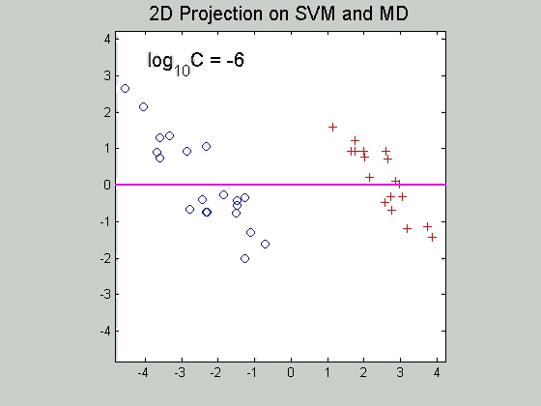
SVMs, Tuning Parameter
Toy Example: d = 50, Sph’l Gaussian data
Put MD on horizontal axis

Slide 90
SVMs, Tuning Parameter
Toy Example:
d = 50, Spherical Gaussian data
Careful look at small C:
Put MD on horizontal axis

Slide 91
SVMs, Tuning Parameter
Toy Example:
d = 50, Spherical Gaussian data
Careful look at small C:
Put MD on horizontal axis
Shows SVM and MD same for C small
  Mathematics behind this?

Slide 92
SVMs, Tuning Parameter
Toy Example:
d = 50, Spherical Gaussian data
Careful look at small C:
Put MD on horizontal axis
Shows SVM and MD same for C small
  Mathematics behind this?
Separates for large C
  No data piling for MD

Slide 93
Support Vector Machines
Important Extension:
Multi-Class SVMs
Hsu & Lin (2002)
Lee, Lin, & Wahba (2002)
Defined for “implicit” version
“Direction Based” variation???

Slide 94
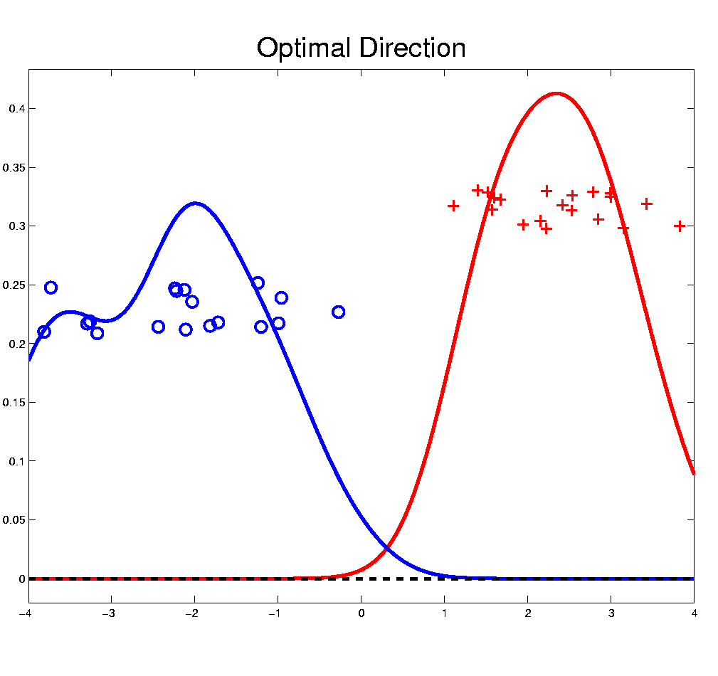
Distance Weighted Discrim’n
Improvement of SVM for HDLSS Data
Toy e.g.
(similar to
earlier movie)

Slide 95
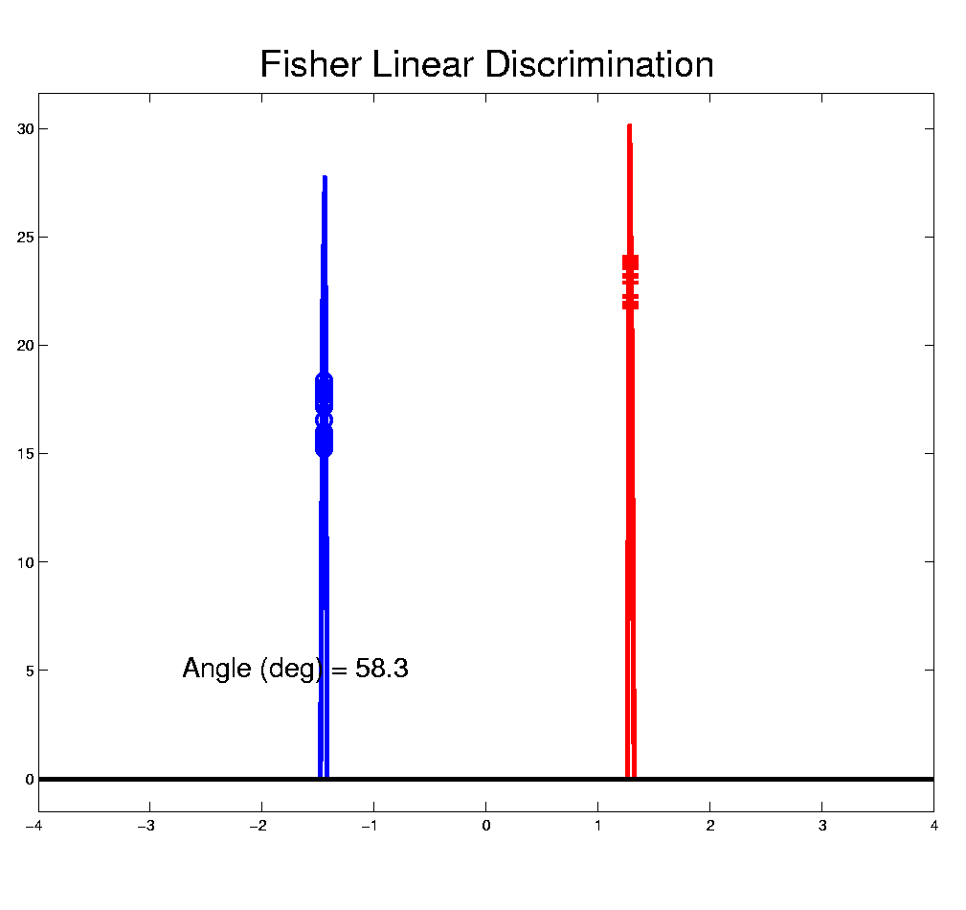
Distance Weighted Discrim’n
Toy e.g.: Maximal Data Piling Direction
- Perfect
Separation
- Gross
Overfitting
- Large Angle
- Poor
Gen’ability
MDP

Slide 96
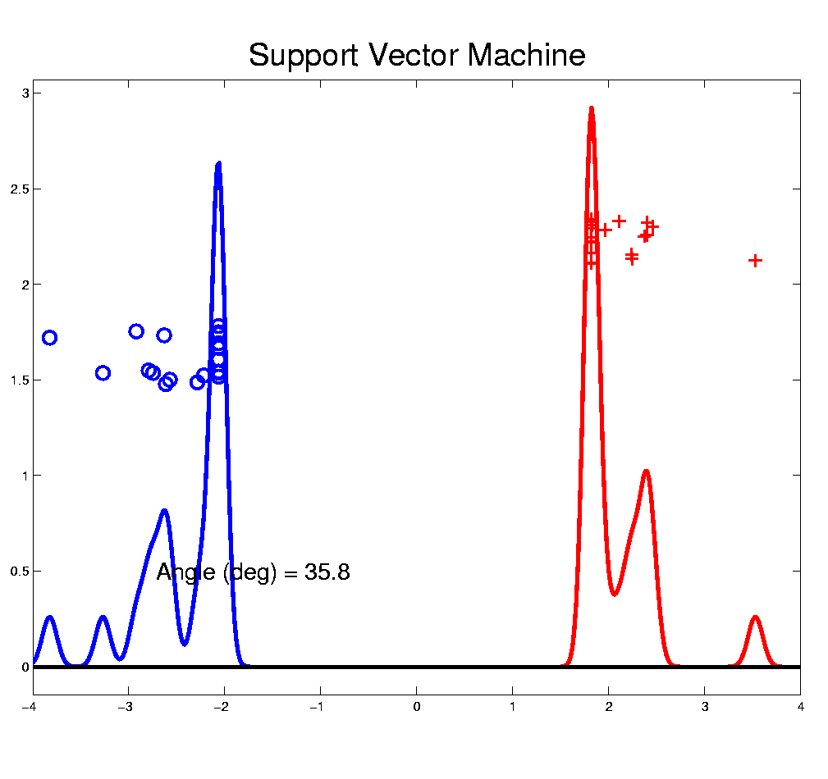
Distance Weighted Discrim’n
Toy e.g.: Support Vector Machine Direction
- Bigger Gap
- Smaller Angle
- Better
Gen’ability
- Feels support
vectors too
strongly???
- Ugly subpops?
- Improvement?

Slide 97
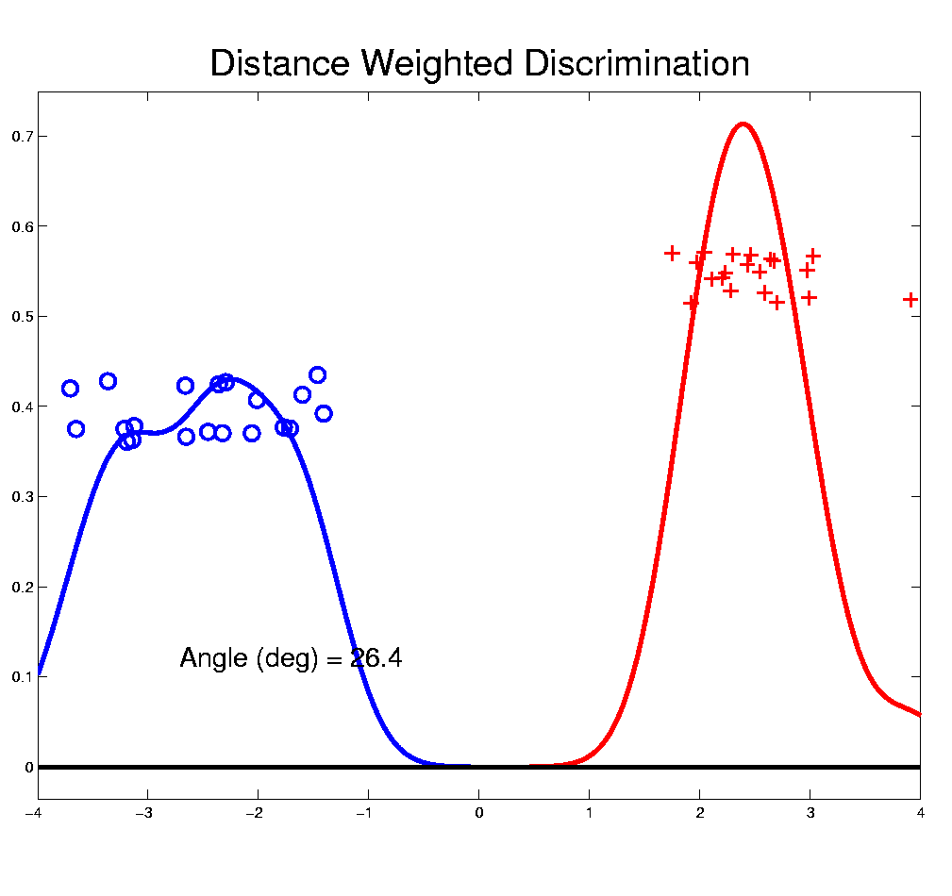
Distance Weighted Discrim’n
Toy e.g.: Distance Weighted Discrimination
- Addresses
these issues
- Smaller Angle
- Better
Gen’ability
- Nice subpops
- Replaces
min dist. by
avg. dist.

Slide 98
Distance Weighted Discrim’n
Based on Optimization Problem:
Uses “poles” to push plane away from data

Slide 99
Distance Weighted Discrim’n
Based on Optimization Problem:
More precisely:
Work in appropriate penalty for violations

Slide 100
Distance Weighted Discrim’n
Based on Optimization Problem:
More precisely:
Work in appropriate penalty for violations
Optimization Method:
Second Order Cone Programming

Slide 101
Distance Weighted Discrim’n
Based on Optimization Problem:
More precisely:
Work in appropriate penalty for violations
Optimization Method:
Second Order Cone Programming
“Still convex” gen’n of quad’c program’g
Allows fast greedy solution
Can use available fast software
(SDP3, Michael Todd, et al)

Slide 102
Distance Weighted Discrim’n
References for more on DWD:
Current paper:
Marron, Todd and Ahn (2007)
Links to more papers:
Ahn (2007)
R Implementation of DWD:
CRAN 2011
SDPT3 Software:
Toh (2007)
Notes:
102

Slide 103
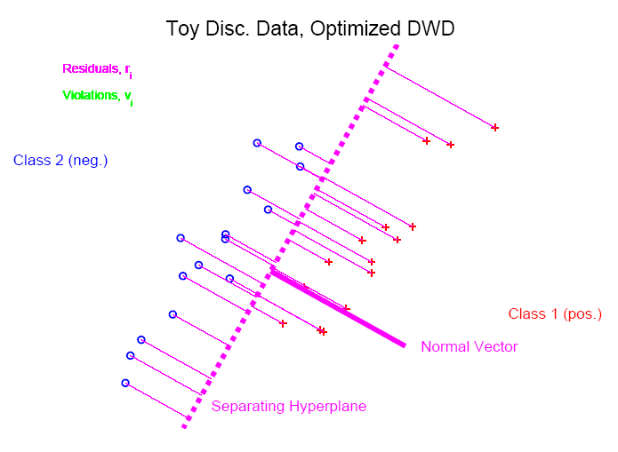
Distance Weighted Discrim’n
2-d Visualization:
Pushes Plane
Away From
Data
All Points
Have Some
Influence

Slide 104
Support Vector Machines
Graphical View, using Toy Example:

Slide 105
Support Vector Machines
Graphical View, using Toy Example:

Slide 106
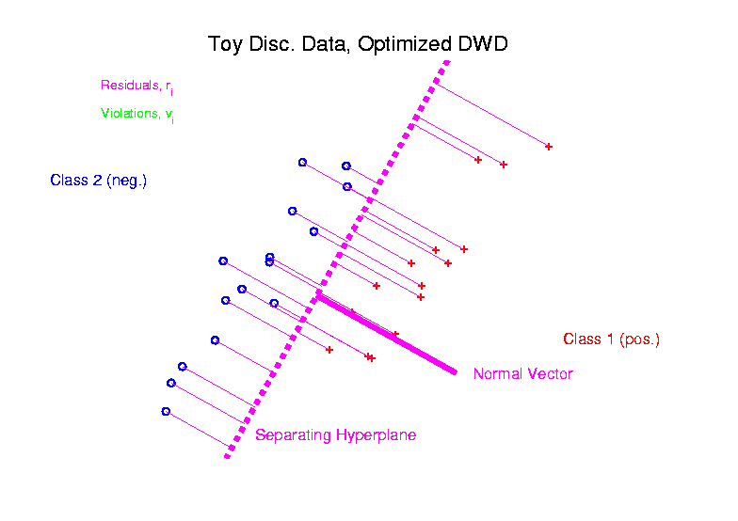
Distance Weighted Discrim’n
Graphical View, using Toy Example:

Slide 107
Batch and Source Adjustment
Recall from Class Notes 8/28/12
For Stanford Breast Cancer Data (C. Perou)
Analysis in Benito, et al (2004) Bioinformatics, 20, 105-114.
https://genome.unc.edu/pubsup/dwd/
Adjust for Source Effects
  Different sources of mRNA
Adjust for Batch Effects
  Arrays fabricated at different times

Slide 108
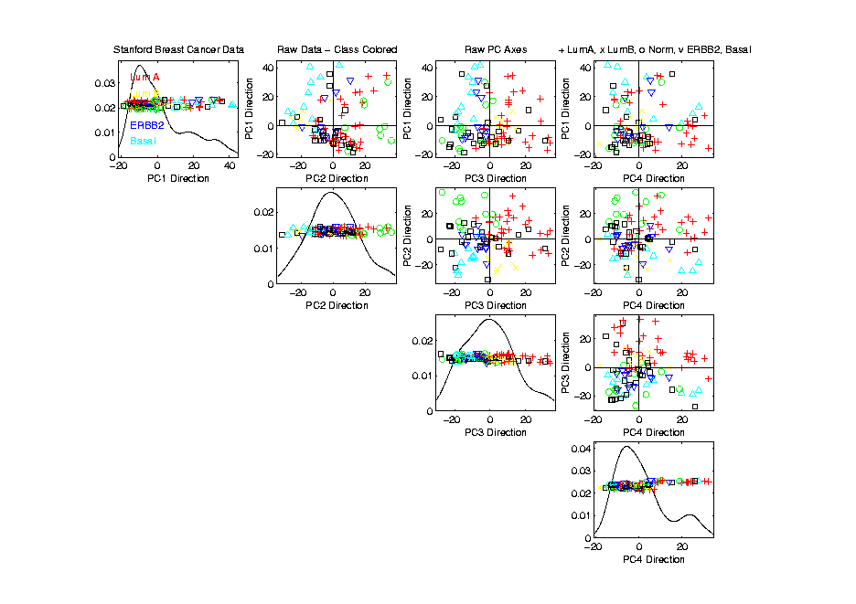
Source Batch Adj: Biological Class Col. & Symbols

Slide 109
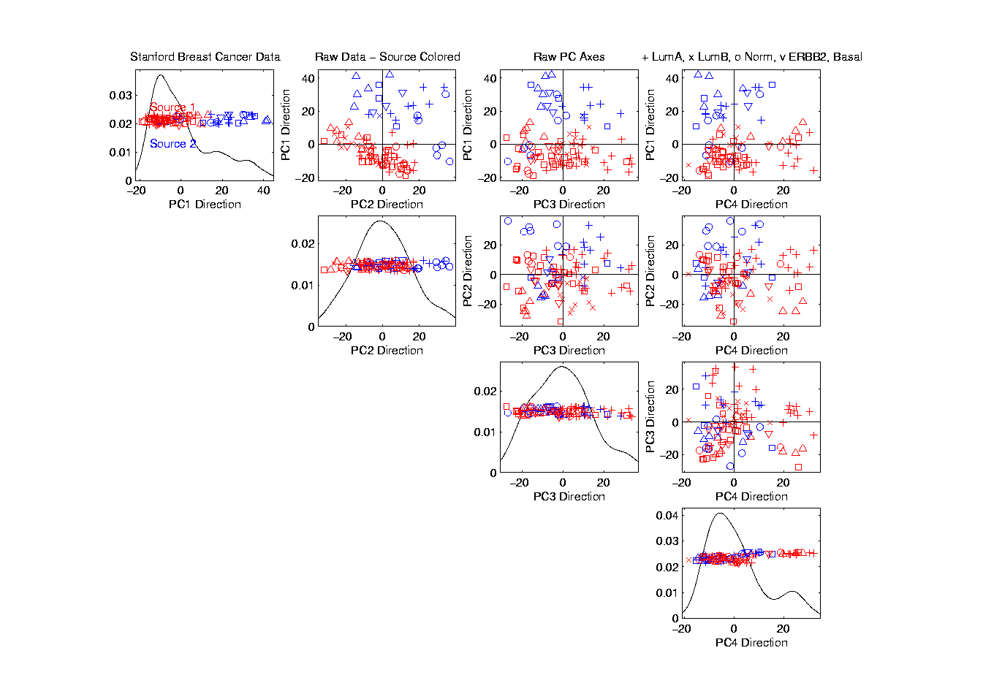
Source Batch Adj: Source Colors

Slide 110
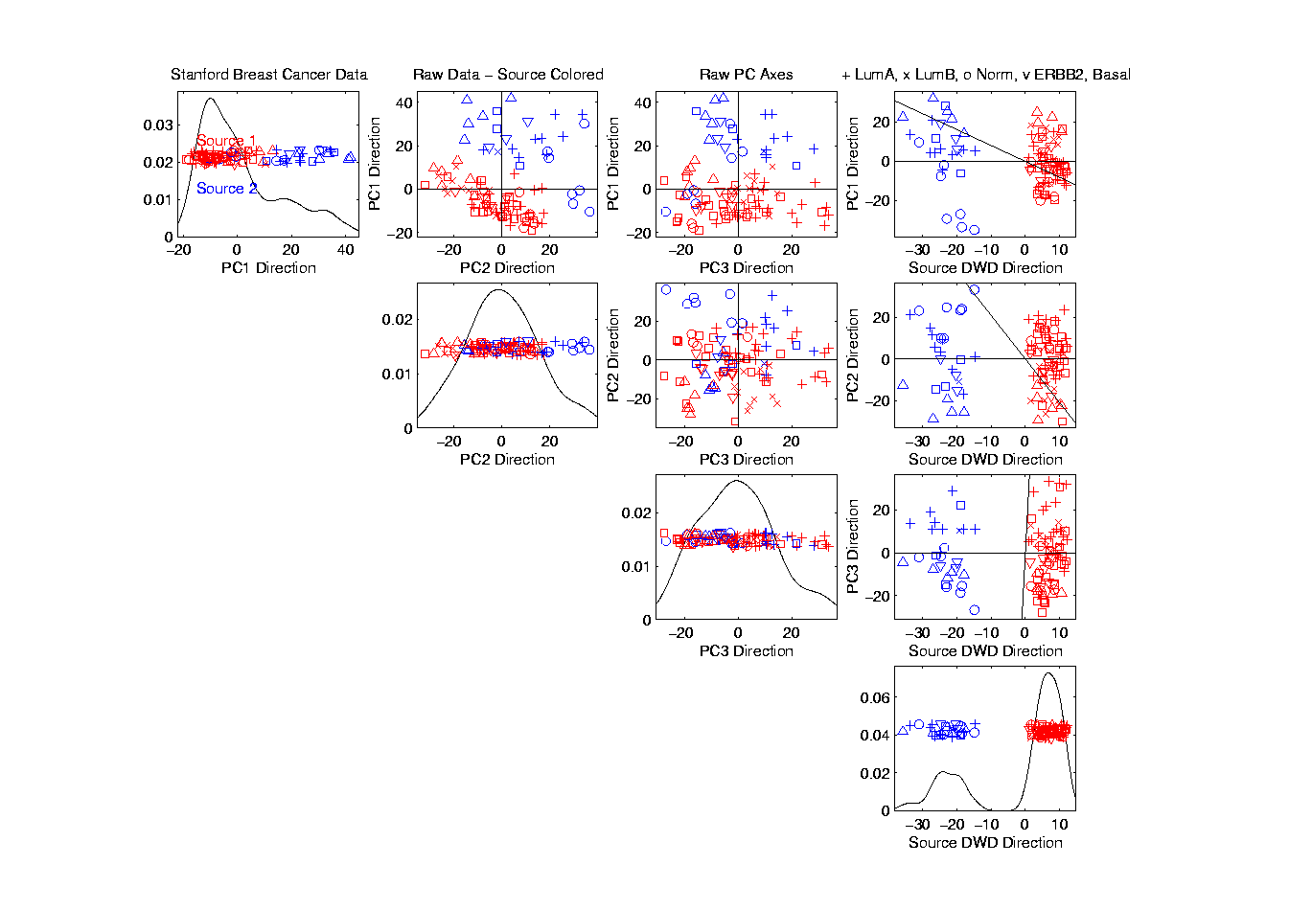
Source Batch Adj: PC 1-3 & DWD direction

Slide 111
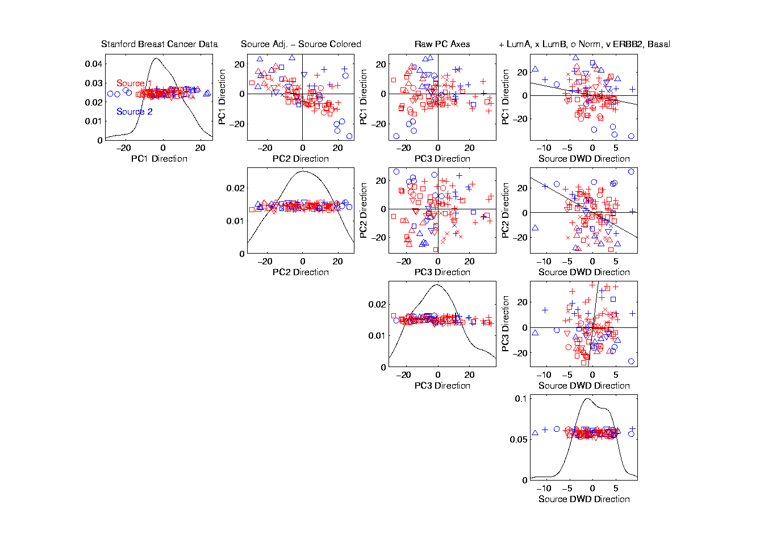
Source Batch Adj: DWD Source Adjustment

Slide 112
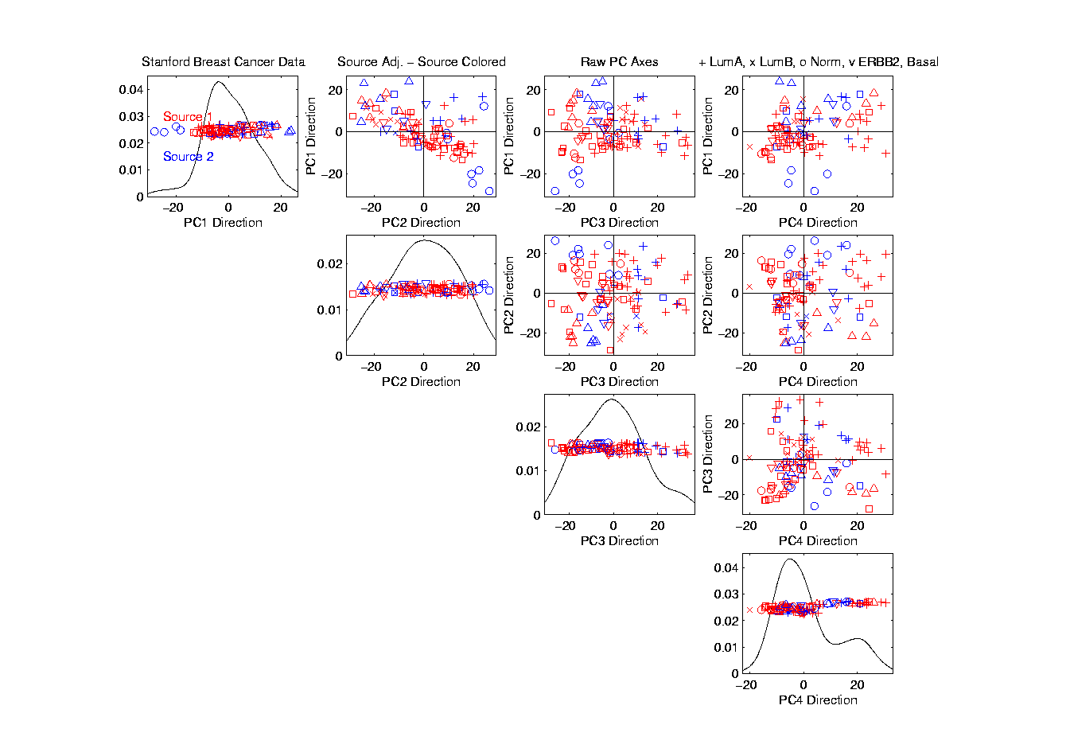
Source Batch Adj: Source Adj’d, PCA view

Slide 113
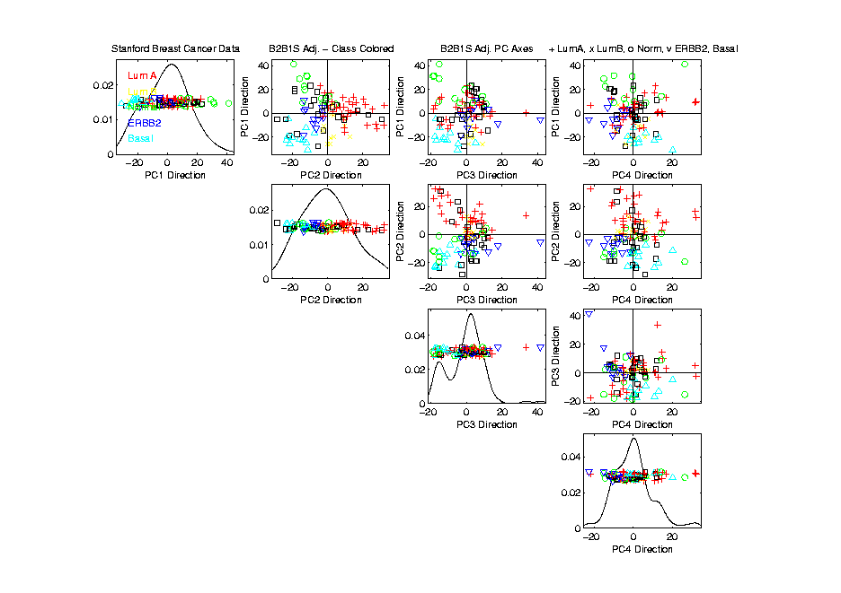
Source Batch Adj: S. & B Adj’d, Adj’d PCA

Slide 114
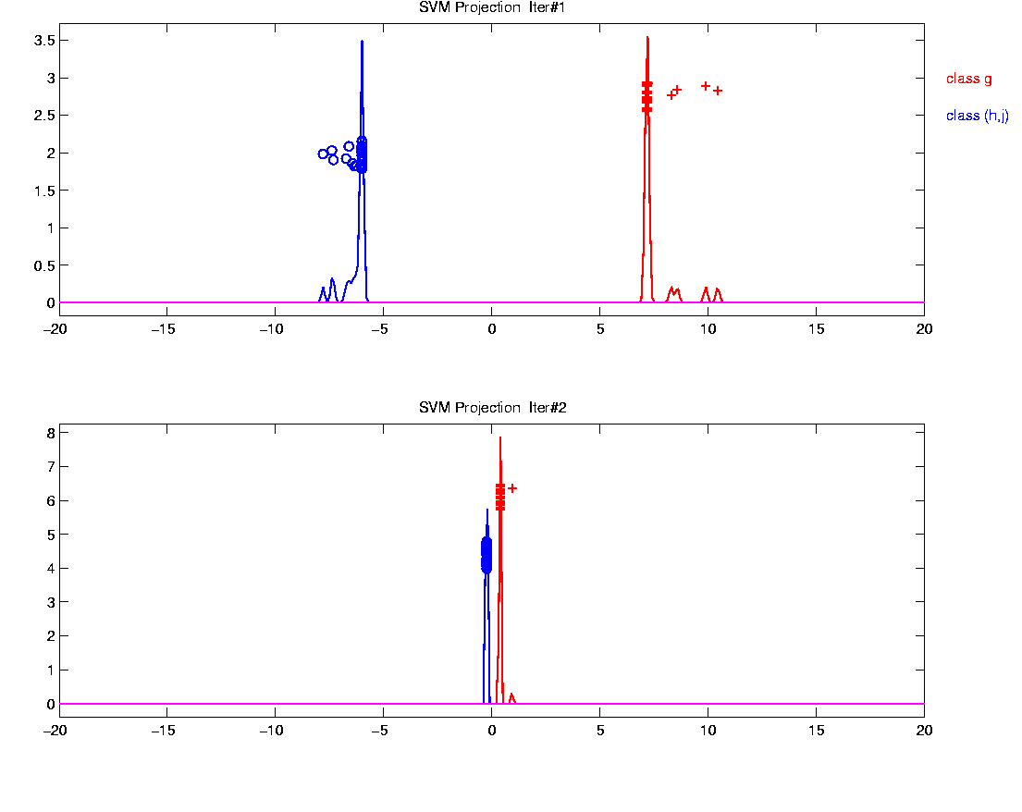
Why not adjust using SVM?
Major Problem: Proj’d Distrib’al Shape
Triangular Dist’ns (opposite skewed)
Does not allow sensible rigid shift

Slide 115
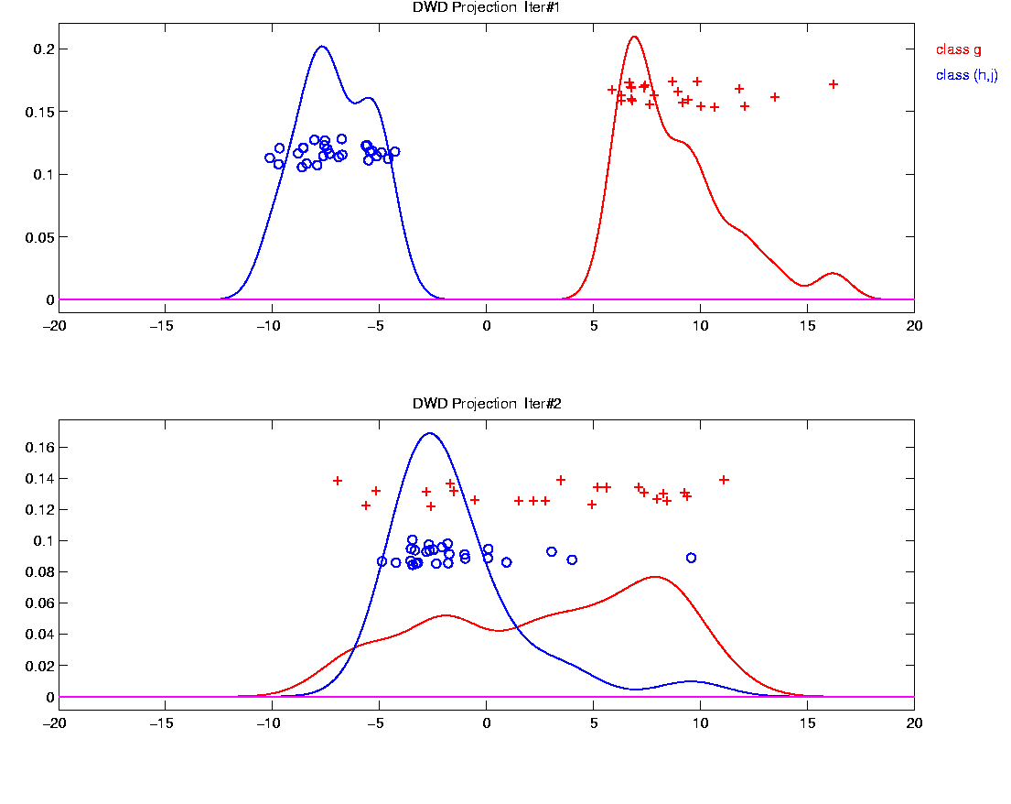
Why not adjust using SVM?
Nicely Fixed by DWD
Projected Dist’ns near Gaussian
Sensible to shift

Slide 116
Why not adjust by means?
DWD is complicated: value added?

Slide 117
Why not adjust by means?
DWD is complicated: value added?
Because it is “cool”
  Recall Improves SVM for HDLSS

Slide 118
Why not adjust by means?
DWD is complicated: value added?
Because it is “cool”
  Recall Improves SVM for HDLSS
Good Empirical Success
  Routinely Used in Perou Lab
  Many Comparisons Done
  Similar Lessons from Wistar

Slide 119
Why not adjust by means?
DWD is complicated: value added?
Because it is “cool”
  Recall Improves SVM for HDLSS
Good Empirical Success
  Routinely Used in Perou Lab
  Many Comparisons Done
  Similar Lessons from Wistar
Proven Statistical Power

Slide 120
Why not adjust by means?
But Why Not PAM (~Mean Difference)?
Simpler is Better
Why not means, i.e. point cloud centerpoints?

Slide 121
Why not adjust by means?
But Why Not PAM (~Mean Difference)?
Simpler is Better
Why not means, i.e. point cloud centerpoints?
Elegant Answer: Xuxin Liu

Slide 122
Why not adjust by means?
But Why Not PAM (~Mean Difference)?
Simpler is Better
Why not means, i.e. point cloud centerpoints?
Drawback to PAM:
Poor Handling of Unbalanced Biological Subtypes
DWD more Resistant to Unbalance

Slide 123
Why not adjust by means?
Toy Example:
  Gaussian Clusters
  Two batches (denoted: + o)

Slide 124
Why not adjust by means?
Toy Example:
  Gaussian Clusters
  Two batches (denoted: + o)
  Two subtypes (red and blue)

Slide 125
Why not adjust by means?
Toy Example:
  Gaussian Clusters
  Two batches (denoted: + o)
  Two subtypes (red and blue)
  Goal: bring together
  + ←→ o and also + ←→ o

Slide 126
Why not adjust by means?
Toy Example:
  Gaussian Clusters
  Two batches (denoted: + o)
  Two subtypes (red and blue)
  Goal: bring together
  + ←→ o and also + ←→ o
  Challenge: unequal biological ratios within batches

Slide 127
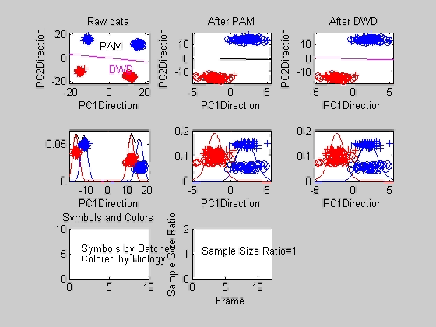
Twiddle ratios of subtypes

Slide 128
Why not adjust by means?
Lessons from DWD vs. PAM Example:
Both very good for ratio ~ 0.7 – 1.0
PAM weakens for ratio < 0.7
DWD robust until ratio < 0.4
PAM has some use, until ratio < 0.2
DWD has some use, until ratio < 0.05
Both methods eventually fail

Slide 129
Why not adjust by means?
DWD robust against non-proportional subtypes…
Mathematical Statistical Question:
Are there mathematics behind this?
(will answer later…)
Notes:
129

Slide 130
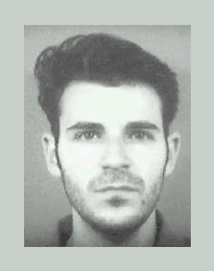
DWD in Face Recognition
Face Images as Data
(with M. Benito & D. Peña)
Male – Female Difference?
Discrimination Rule?
Represented as long vector of pixel gray levels
Registration is critical

Slide 131
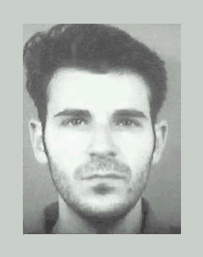
DWD in Face Recognition, (cont.)
Registered Data
Shifts and scale
Manually chosen
To align eyes and mouth
Still large variation
See males vs. females???

Slide 132
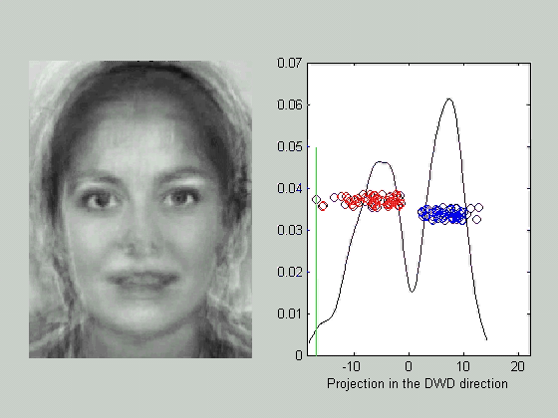
DWD in Face Recognition , (cont.)
DWD Direction
Good separation
Images “make sense”
Garbage at ends?
(extrapolation effects?)

