Slide 1
Statistics – O. R. 891 Object Oriented Data Analysis
J. S. Marron
Dept. of Statistics and Operations Research
University of North Carolina

Slide 2
Clustering
Idea: Given data
Assign each object to a class
Of similar objects
Completely data driven
I.e. assign labels to data
“Unsupervised Learning”
Contrast to Classification (Discrimination)
With predetermined classes
“Supervised Learning”

Slide 3
SWISS Score
Another Application of CI (Cluster Index)
Cabanski et al (2010)
Idea: Use CI in bioinformatics to
“measure quality of data preprocessing”
Philosophy: Clusters Are Scientific Goal
So Want to Accentuate Them

Slide 4
Clustering
A Very Large Area
K-Means is Only One Approach
Has its Drawbacks
(Many Toy Examples of This)
Ǝ Many Other Approaches
Important (And Broad) Class
Hierarchical Clustering

Slide 5
SigClust
Statistical Significance of Clusters
in HDLSS Data
When is a cluster “really there”?
Liu et al (2007)

Slide 6
Statistical Significance of Clusters
Basis of SigClust Approach:
What defines: A Cluster?
A Gaussian distribution (Sarle & Kou 1993)
So define SigClust test based on:
2-means cluster index (measure) as statistic
Gaussian null distribution
Currently compute by simulation
Possible to do this analytically???

Slide 7
SigClust Gaussian null distribut’n
3rd Key Idea: Factor Analysis Model
Model Covariance as: Biology + Noise
Where
is “fairly low dimensional”
is estimated from background noise

Slide 8
SigClust Gaussian null distribut’n
Estimation of Background Noise :
Reasonable model (for each gene):
Expression = Signal + Noise
“noise” is roughly Gaussian
“noise” terms essentially independent
(across genes)

Slide 9
SigClust Gaussian null distribut’n
Estimation of Background Noise :
For all expression values (as numbers)
Use robust estimate of scale
Median Absolute Deviation (MAD)
(from the median)
Rescale to put on same scale as s. d.:

Slide 10
SigClust Estimation of Background Noise
Hope: Most
Entries are
“Pure Noise,
(Gaussian)”
A Few (< ¼)
Are Biological
Signal –
Outliers
How to Check?

Slide 11
Q-Q plots
An aside:
Fitting probability distributions to data
Does Gaussian distribution “fit”???
If not, why not?
Fit in some part of the distribution?
(e.g. in the middle only?)

Slide 12
Q-Q plots
Approaches to:
Fitting probability distributions to data
Histograms
Kernel Density Estimates
Drawbacks: often not best view
(for determining goodness of fit)

Slide 13
Q-Q plots
Consider Testbed of 4 Toy Examples:
non-Gaussian!
non-Gaussian(?)
Gaussian
Gaussian?
(Will use these names several times)

Slide 14
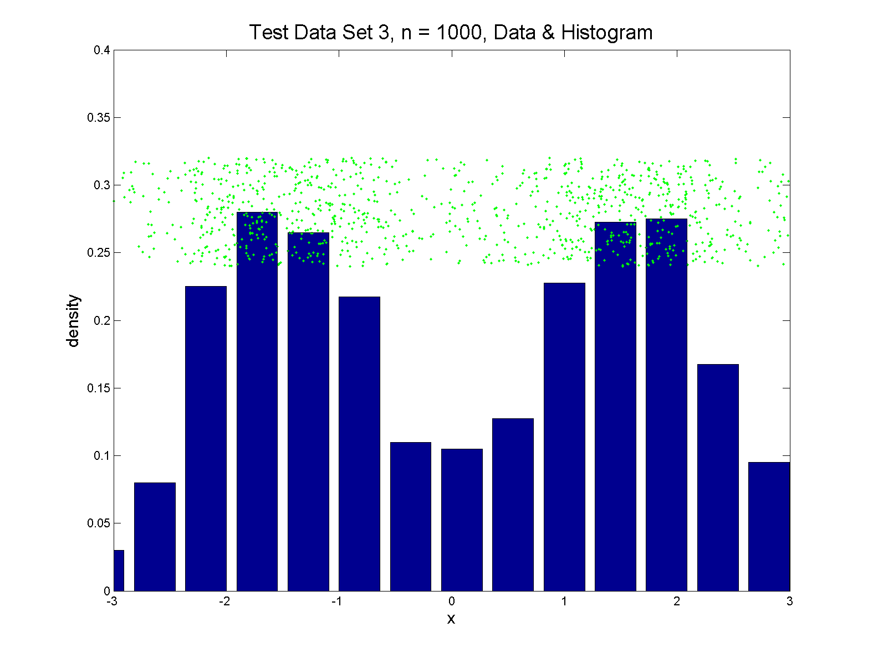
Q-Q plots
Simple Toy Example, non-Gaussian!

Slide 15
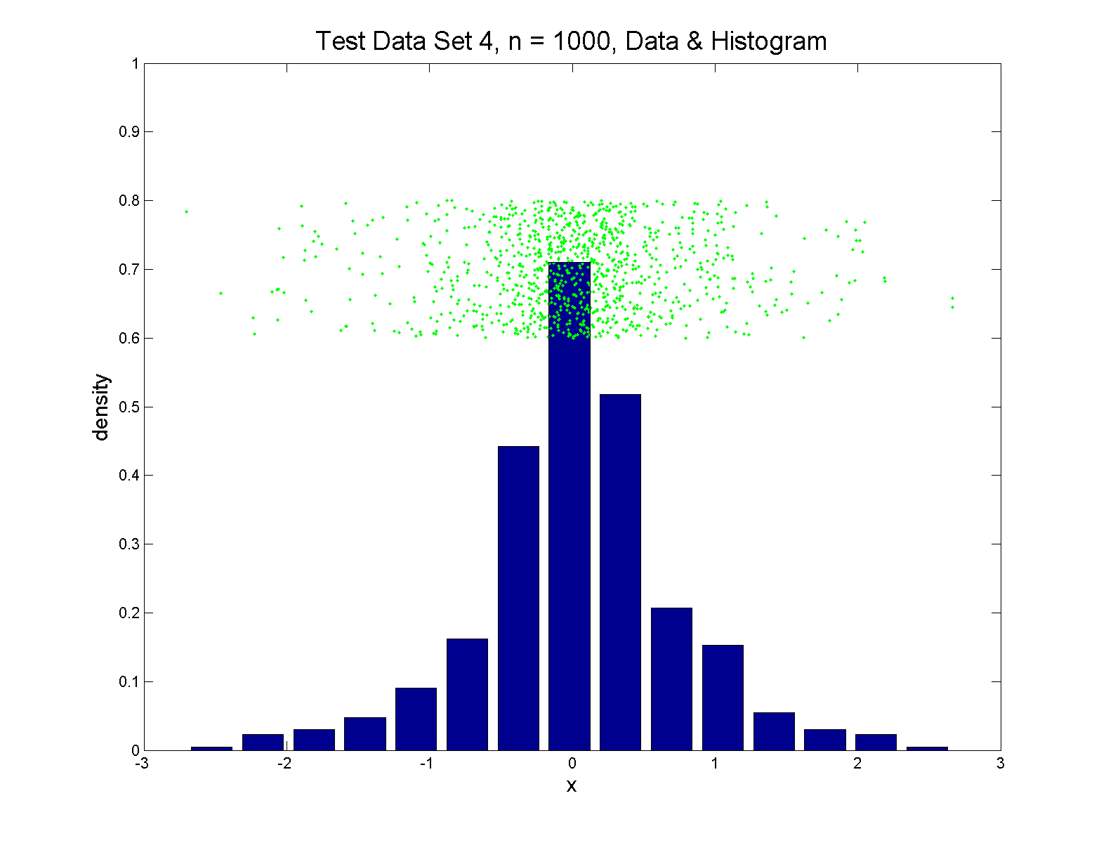
Q-Q plots
Simple Toy Example, non-Gaussian(?)

Slide 16
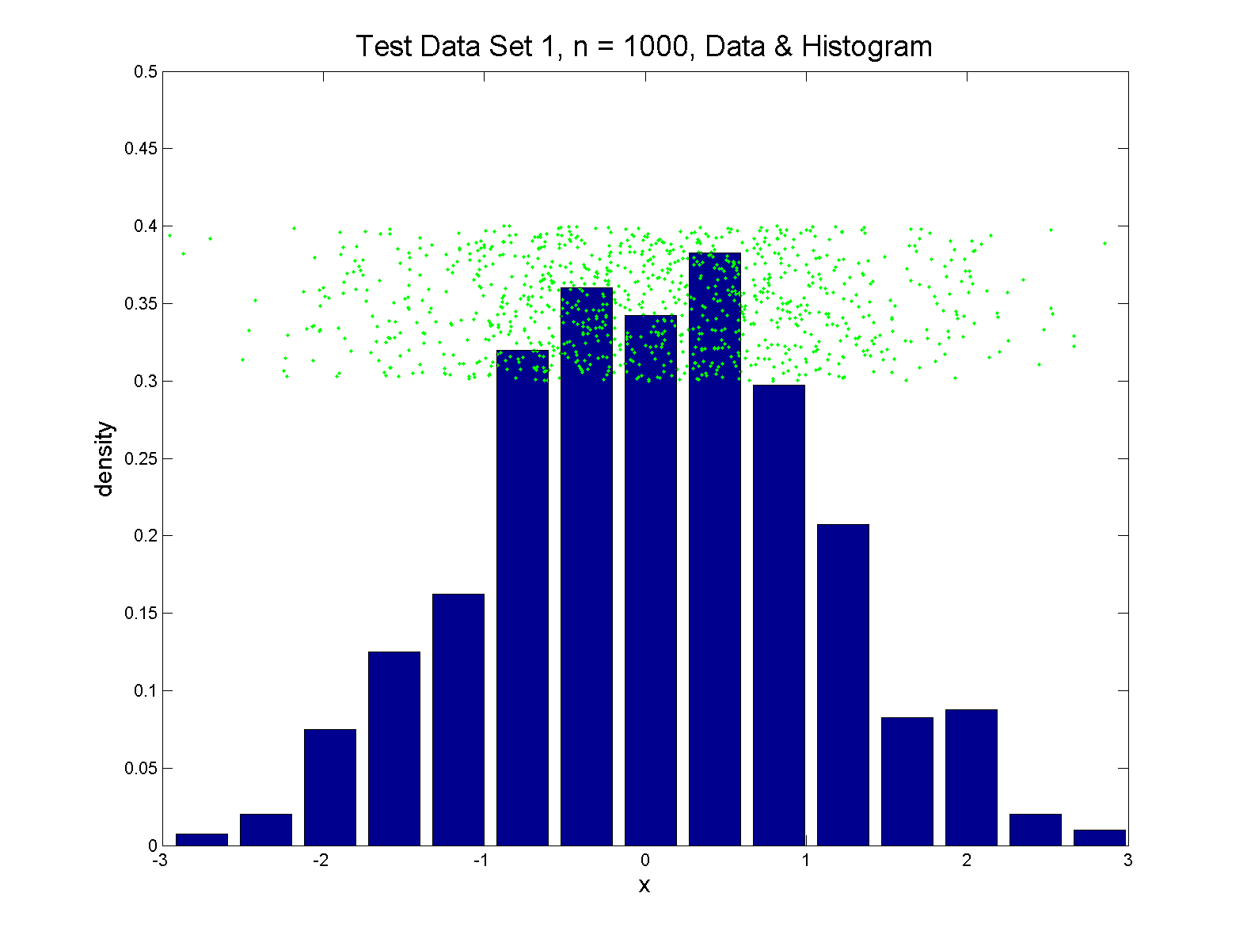
Q-Q plots
Simple Toy Example, Gaussian

Slide 17
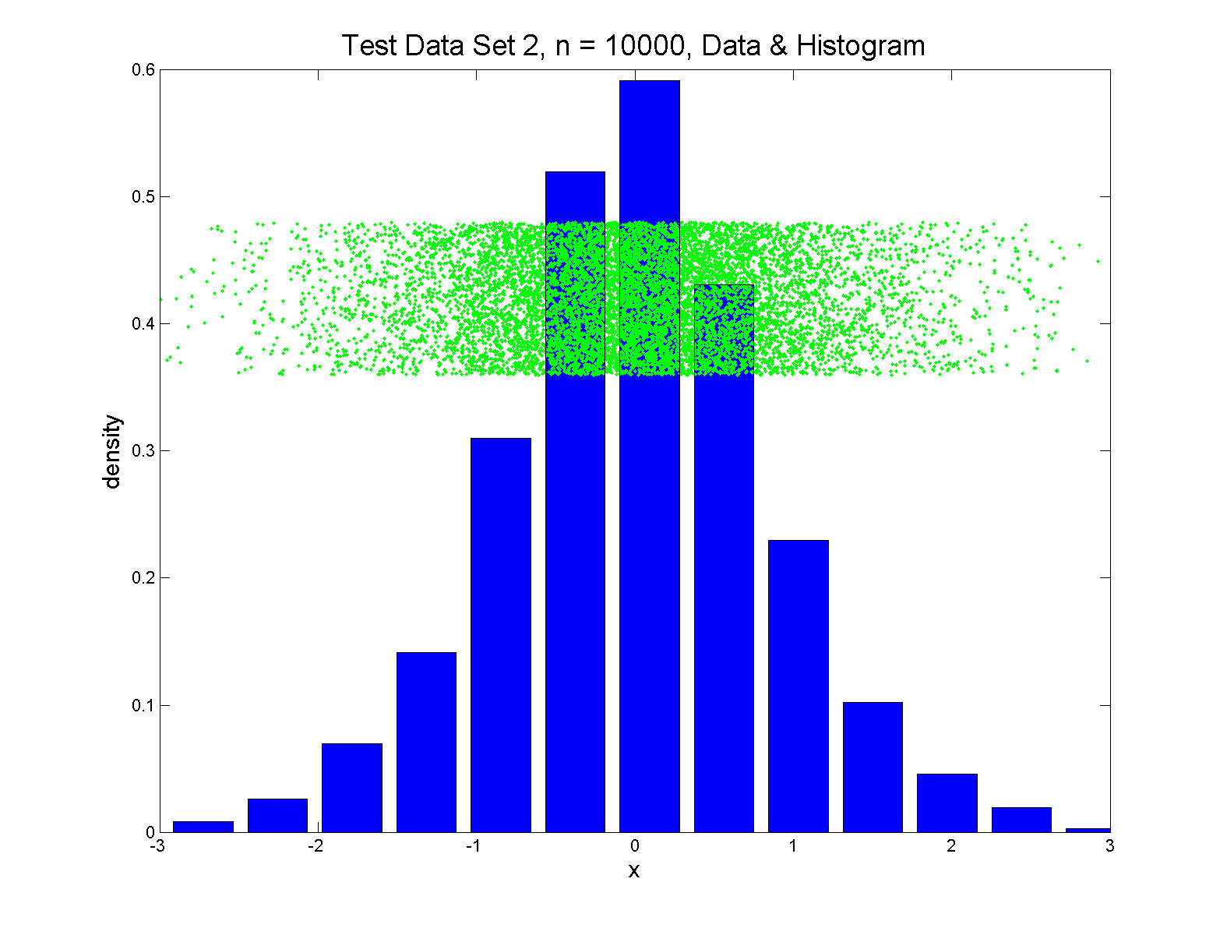
Q-Q plots
Simple Toy Example, Gaussian?

Slide 18
Q-Q plots
Notes:
Bimodal → see non-Gaussian with histo
Other cases: hard to see
Conclude:
Histogram poor at assessing Gauss’ity

Slide 19
Q-Q plots
Standard approach to checking Gaussianity
QQ – plots
Background:
Graphical Goodness of Fit
Fisher (1983)

Slide 20
Q-Q plots
Illustrative graphic (toy data set):

Slide 21
Q-Q plots
Illustrative graphic (toy data set):
Empirical Qs near Theoretical Qs
when
Q-Q curve is near 45⁰ line
(general use of Q-Q plots)

Slide 22
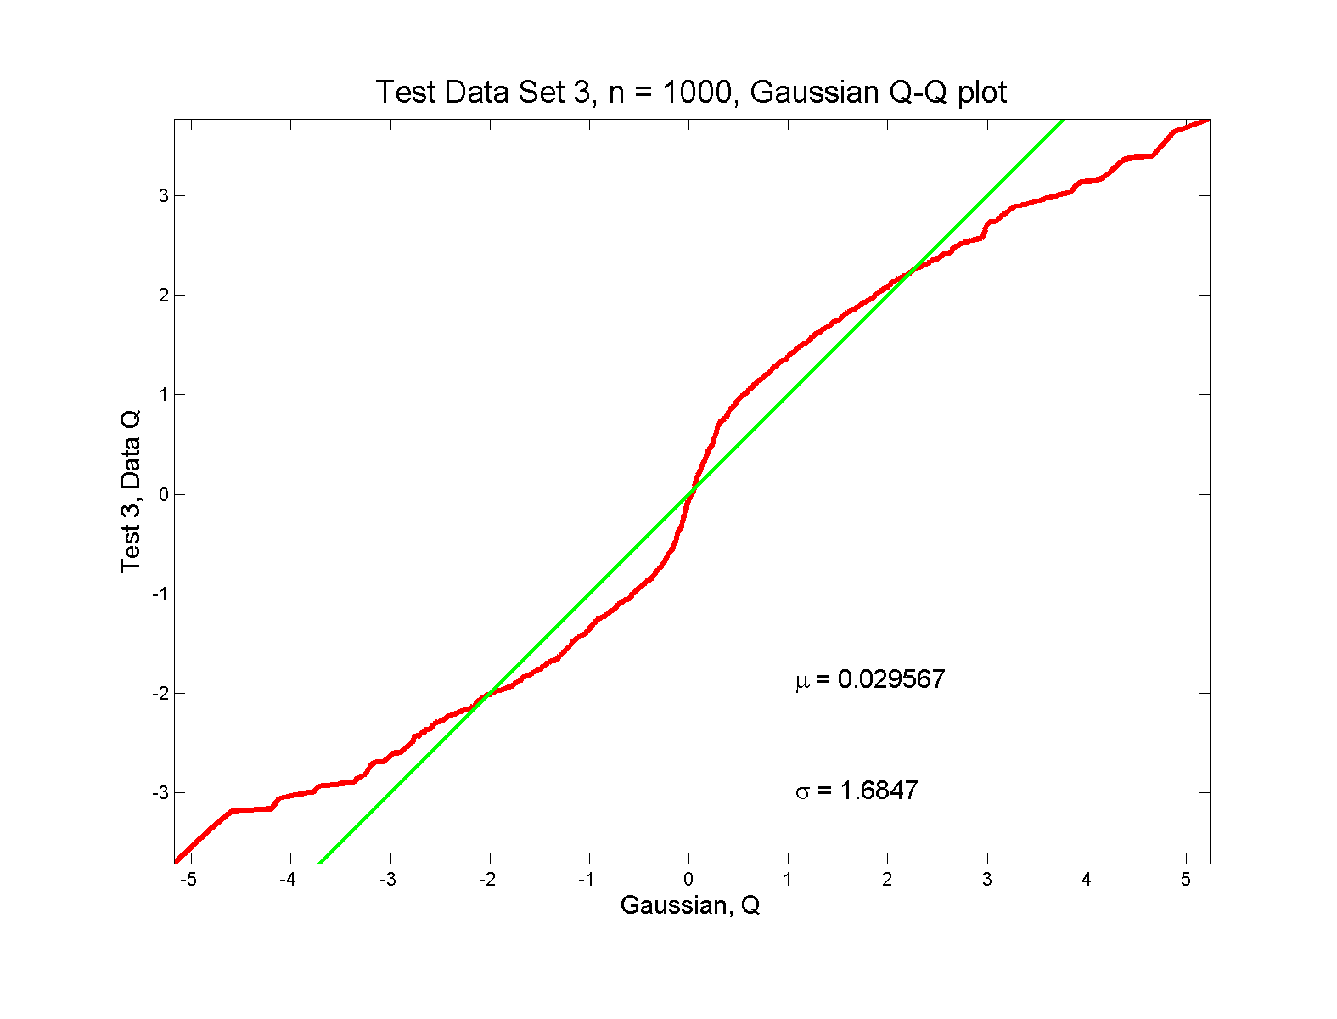
Q-Q plots
non-Gaussian! departures from line?

Slide 23
Q-Q plots
non-Gaussian! departures from line?
Seems different from line?
2 modes turn into wiggles?
Less strong feature
Been proposed to study modality

Slide 24
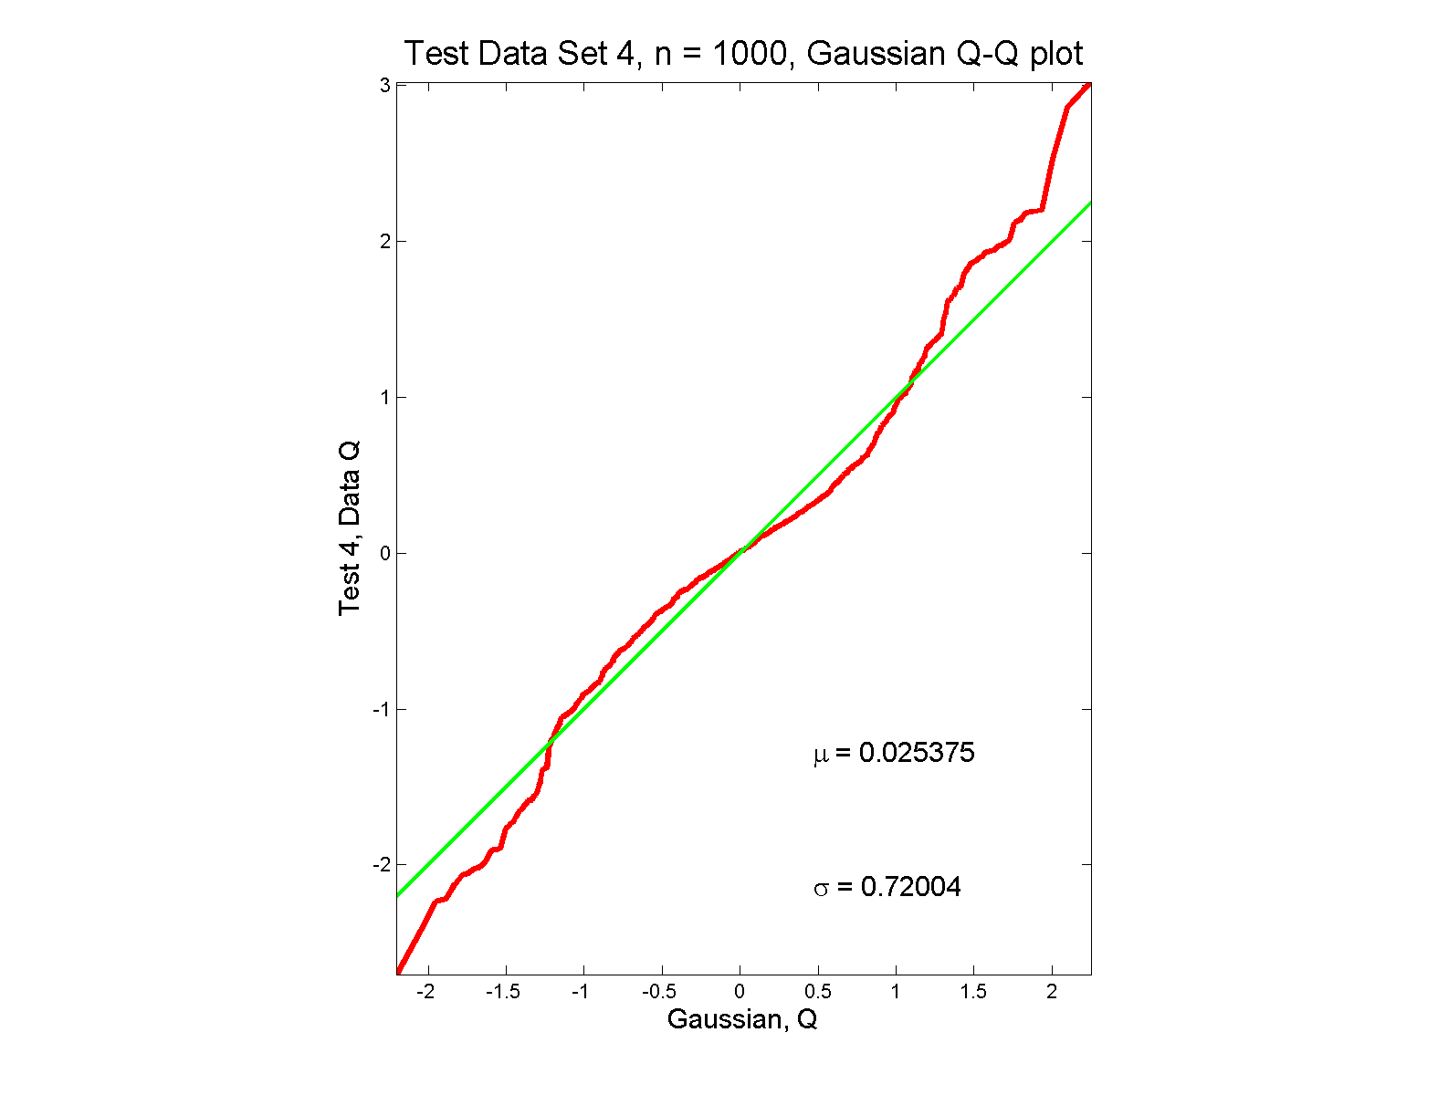
Q-Q plots
non-Gaussian (?) departures from line?

Slide 25
Q-Q plots
non-Gaussian (?) departures from line?
Seems different from line?
Harder to say this time?
What is signal & what is noise?
Need to understand sampling variation

Slide 26
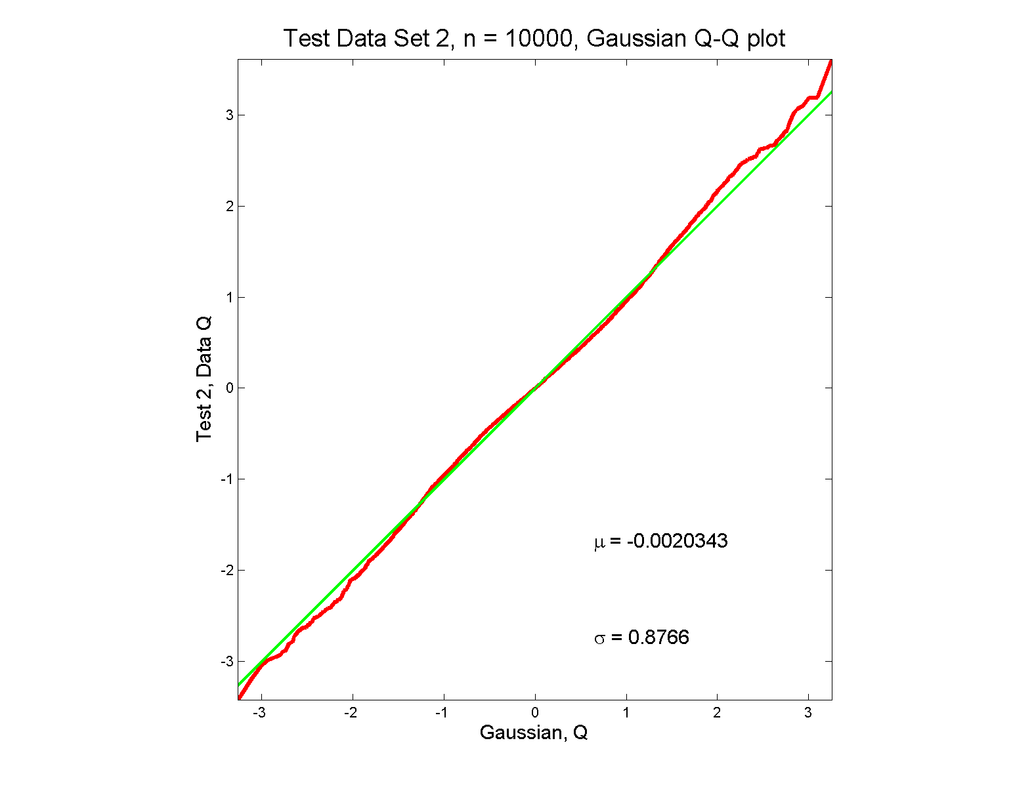
Q-Q plots
Gaussian? departures from line?

Slide 27
Q-Q plots
Gaussian? departures from line?
Looks much like?
Wiggles all random variation?
But there are n = 10,000 data points…
How to assess signal & noise?
Need to understand sampling variation

Slide 28
Q-Q plots
Need to understand sampling variation
Approach: Q-Q envelope plot

Slide 29
Q-Q plots
Need to understand sampling variation
Approach: Q-Q envelope plot
Simulate from Theoretical Dist’n
Samples of same size

Slide 30
Q-Q plots
Need to understand sampling variation
Approach: Q-Q envelope plot
Simulate from Theoretical Dist’n
Samples of same size
About 100 samples gives
“good visual impression”

Slide 31
Q-Q plots
Need to understand sampling variation
Approach: Q-Q envelope plot
Simulate from Theoretical Dist’n
Samples of same size
About 100 samples gives
“good visual impression”
Overlay resulting 100 QQ-curves
To visually convey natural sampling variation

Slide 32
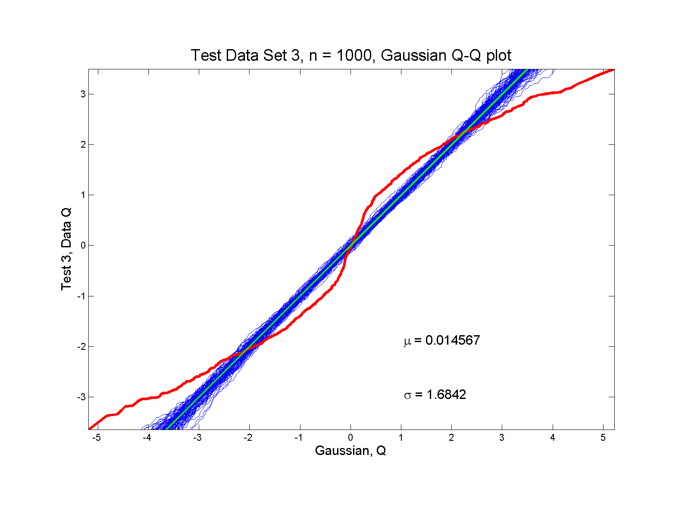
Q-Q plots
non-Gaussian! departures from line?

Slide 33
Q-Q plots
non-Gaussian! departures from line?
Envelope Plot shows:
Departures are significant
Clear these data are not Gaussian
Q-Q plot gives clear indication

Slide 34
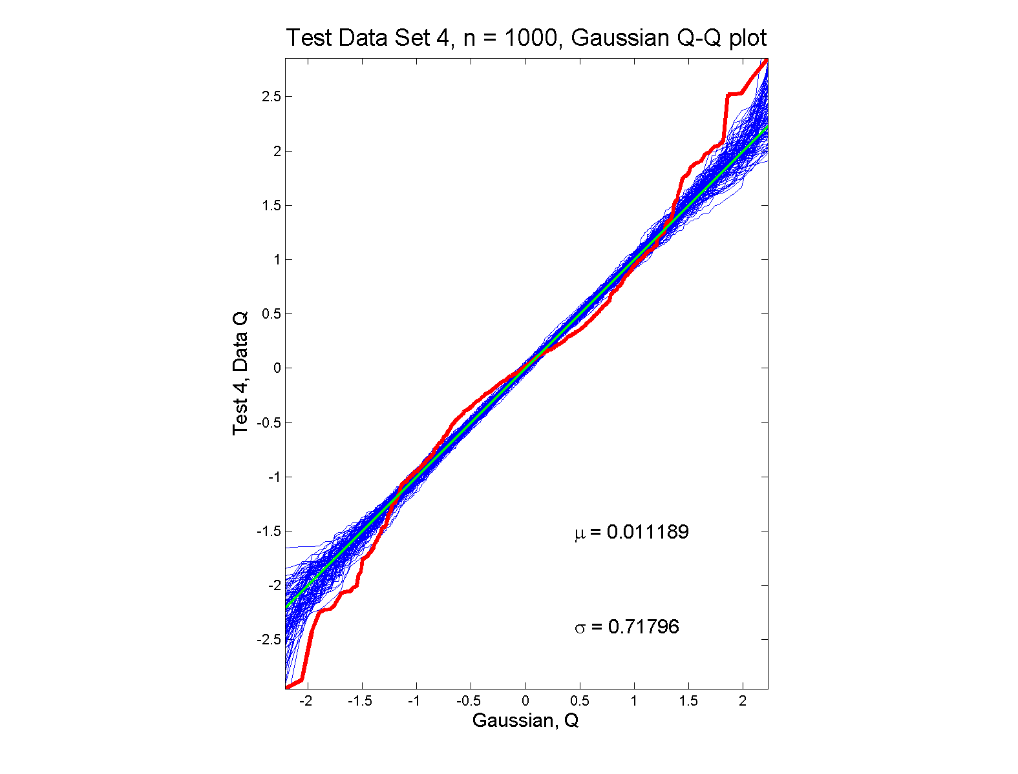
Q-Q plots
non-Gaussian (?) departures from line?

Slide 35
Q-Q plots
non-Gaussian (?) departures from line?
Envelope Plot shows:
Departures are significant
Clear these data are not Gaussian
Recall not so clear from e.g. histogram
Q-Q plot gives clear indication
Envelope plot reflects sampling variation

Slide 36
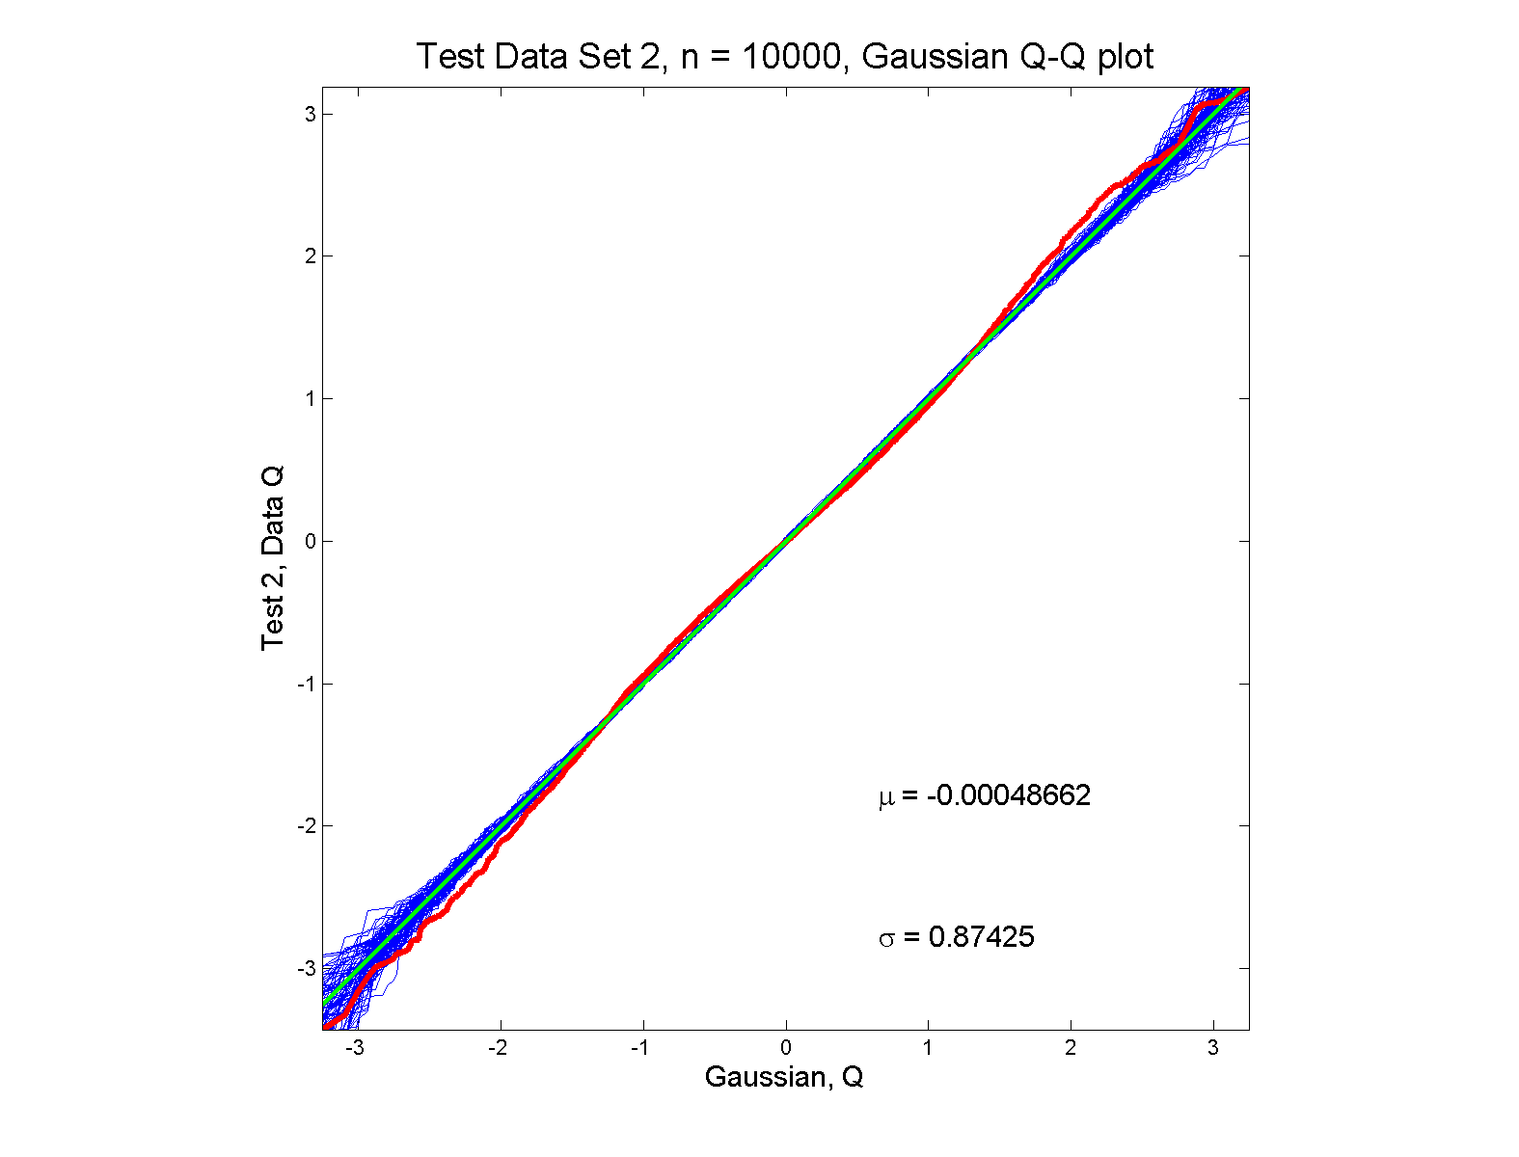
Q-Q plots
Gaussian? departures from line?

Slide 37
Q-Q plots
Gaussian? departures from line?
Harder to see
But clearly there
Conclude non-Gaussian
Really needed n = 10,000 data points…
(why bigger sample size was used)
Envelope plot reflects sampling variation

Slide 38
Q-Q plots
What were these distributions?
Non-Gaussian!
0.5 N(-1.5,0.75²) + 0.5 N(1.5,0.75²)
Non-Gaussian (?)
0.4 N(0,1) + 0.3 N(0,0.5²) + 0.3 N(0,0.25²)
Gaussian
Gaussian?
0.7 N(0,1) + 0.3 N(0,0.5²)

Slide 39
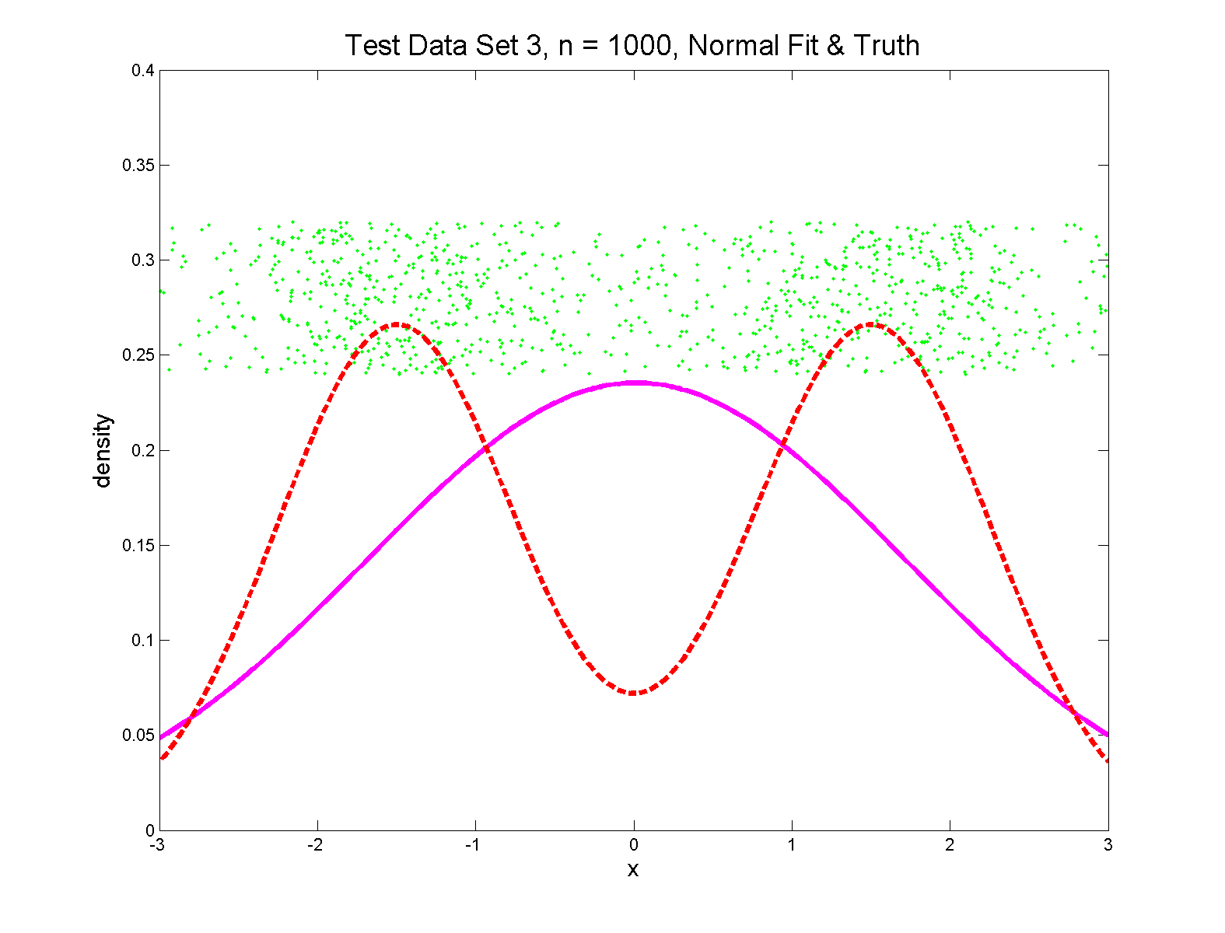
Q-Q plots
Non-Gaussian! .5 N(-1.5,0.75²) + 0.5 N(1.5,0.75²)

Slide 40
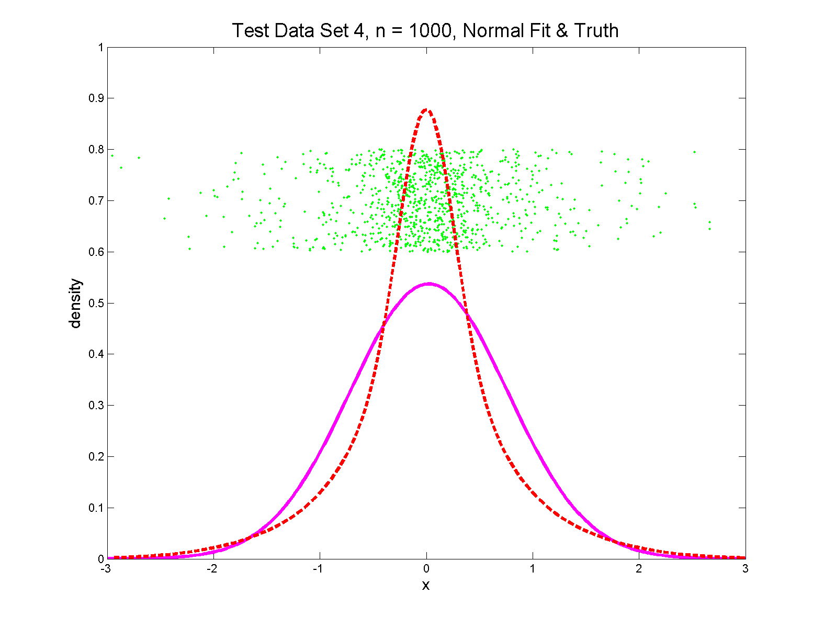
Q-Q plots
Non-Gaussian (?) 0.4 N(0,1) + 0.3 N(0,0.5²) + 0.3 N(0,0.25²)

Slide 41
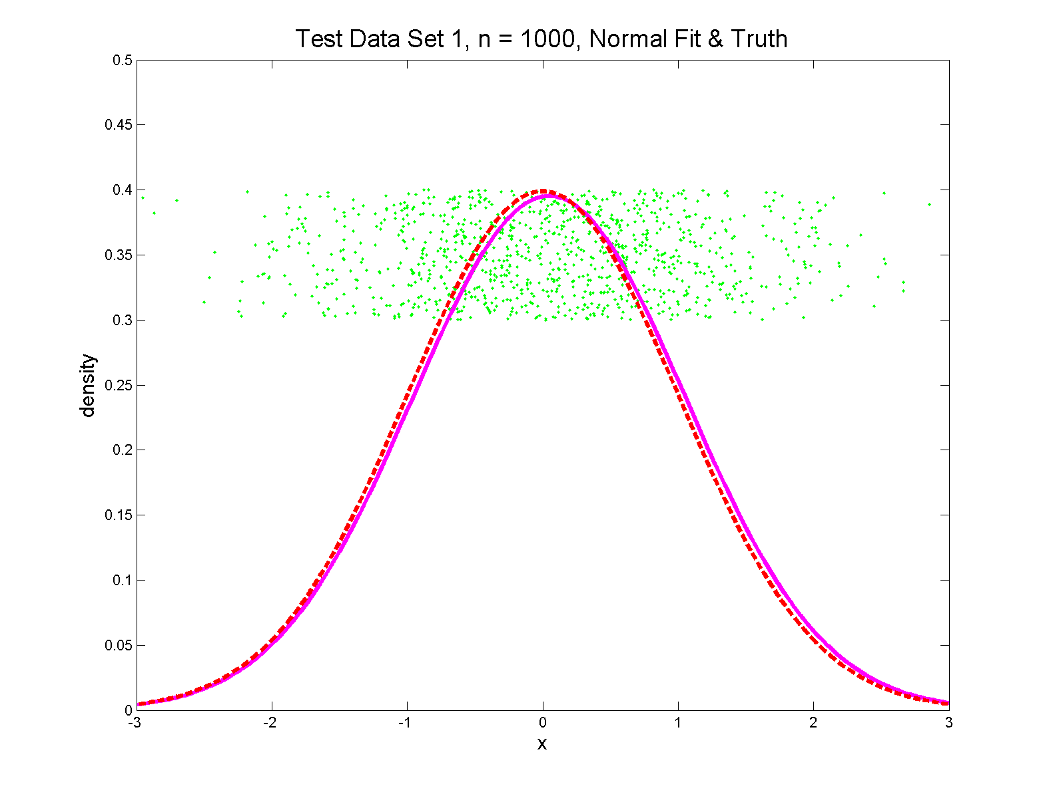
Q-Q plots
Gaussian

Slide 42
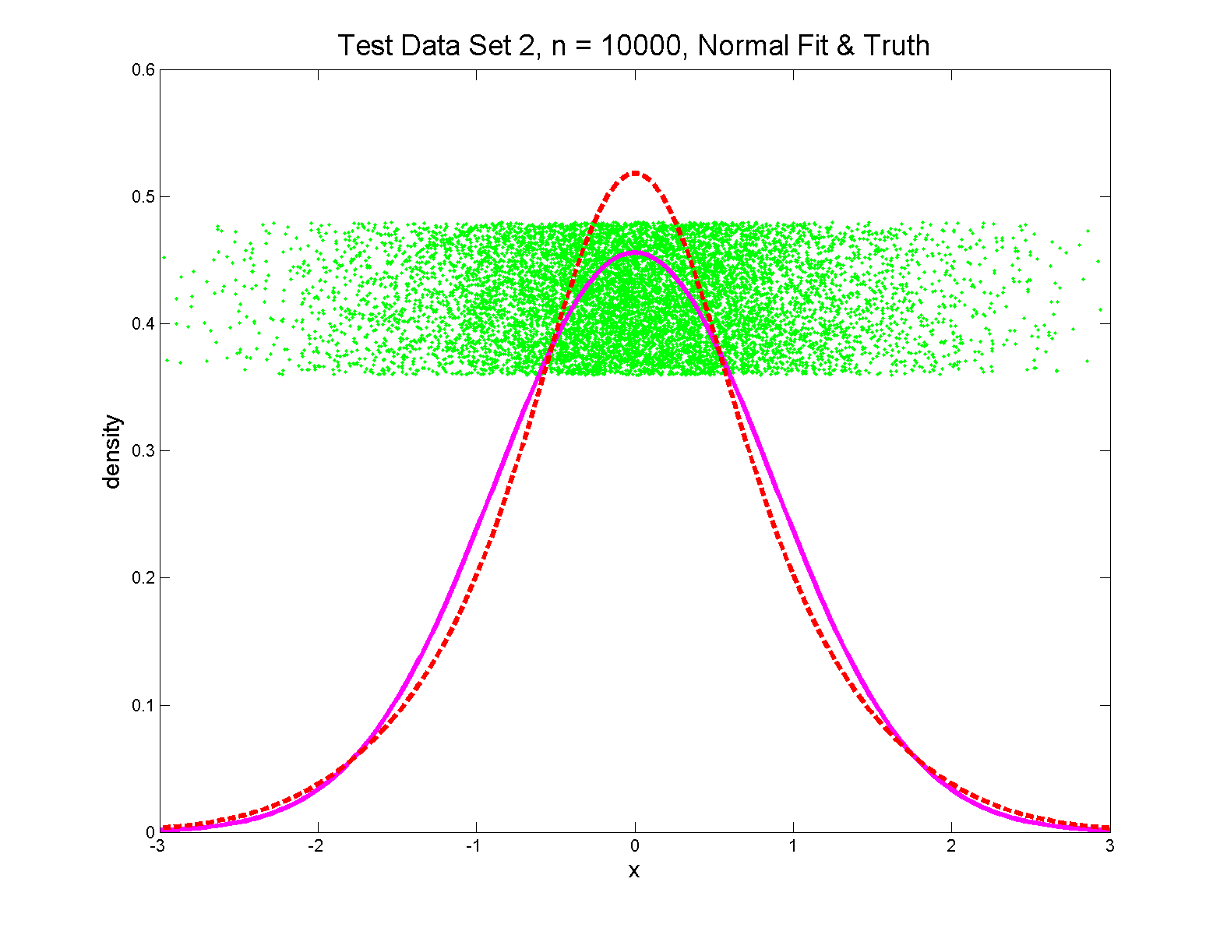
Q-Q plots
Gaussian? 0.7 N(0,1) + 0.3 N(0,0.5²)

Slide 43
Q-Q plots
Variations on Q-Q Plots:
For theoretical distribution:

Slide 44
Q-Q plots
Variations on Q-Q Plots:
For theoretical distribution:
Solving for gives
Where is the Standard Normal Quantile

Slide 45
Q-Q plots
Variations on Q-Q Plots:
Solving for gives
So Q-Q plot against Standard Normal
is linear
With slope and intercept

Slide 46
Q-Q plots
Variations on Q-Q Plots:
Can replace Gaussian with other dist’ns
Can compare 2 theoretical distn’s
Can compare 2 empirical distn’s
(i.e. 2 sample version of Q-Q Plot)

Slide 47
SigClust Estimation of Background Noise

Slide 48
SigClust Estimation of Background Noise
Overall distribution has strong kurtosis
Shown by height of kde relative to
MAD based Gaussian fit
Mean and Median both ~ 0
SD ~ 1, driven by few large values
MAD ~ 0.7, driven by bulk of data

Slide 49
SigClust Estimation of Background Noise
Central part of distribution
“seems to look Gaussian”
But recall density does not provide
useful diagnosis of Gaussianity
Better to look at Q-Q plot

Slide 50
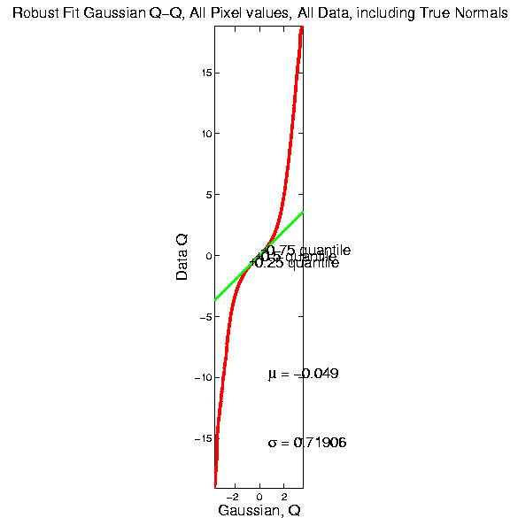
SigClust Estimation of Background Noise

Slide 51
SigClust Estimation of Background Noise
Distribution clearly not Gaussian
Except near the middle
Q-Q curve is very linear there
(closely follows 45º line)
Suggests Gaussian approx. is good there
And that MAD scale estimate is good
(Always a good idea to do such diagnostics)

Slide 52
SigClust Estimation of Background Noise

Slide 53
SigClust Estimation of Background Noise
Checks that estimation of matters
Show sample s.d. is indeed too large
As expected
Variation assessed by Q-Q envelope plot
Shows variation negligible
Not surprising with n ~ 5 million

Slide 54
SigClust Gaussian null distribut’n
Estimation of Biological Covariance :
Keep only “large” eigenvalues
Defined as
So for null distribution, use eigenvalues:

Slide 55
SigClust Estimation of Eigenval’s

Slide 56
SigClust Estimation of Eigenval’s
All eigenvalues > !
Suggests biology is very strong here!
I.e. very strong signal to noise ratio
Have more structure than can analyze
(with only 533 data points)
Data are very far from pure noise
So don’t actually use Factor Anal. Model
Instead end up with estim’d eigenvalues

Slide 57
SigClust Estimation of Eigenval’s
Do we need the factor model?
Explore this with another data set
(with fewer genes)
This time:
n = 315 cases
d = 306 genes

Slide 58
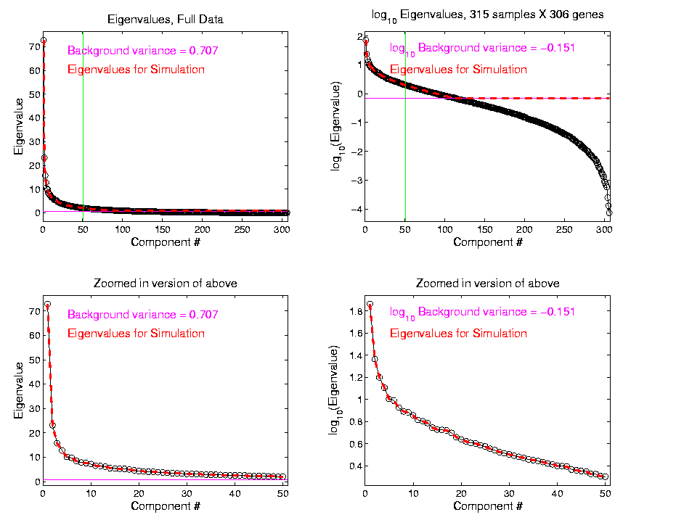
SigClust Estimation of Eigenval’s

Slide 59
SigClust Estimation of Eigenval’s
Try another data set, with fewer genes
This time:
First ~110 eigenvalues >
Rest are negligible
So threshold smaller ones at

Slide 60
SigClust Gaussian null distribution - Simulation
Now simulate from null distribution using:
where (indep.)
Again rotation invariance makes this work
(and location invariance)

Slide 61
SigClust Gaussian null distribution - Simulation
Then compare data CI,
With simulated null population CIs
Spirit similar to DiProPerm
But now significance happens for
smaller values of CI

Slide 62
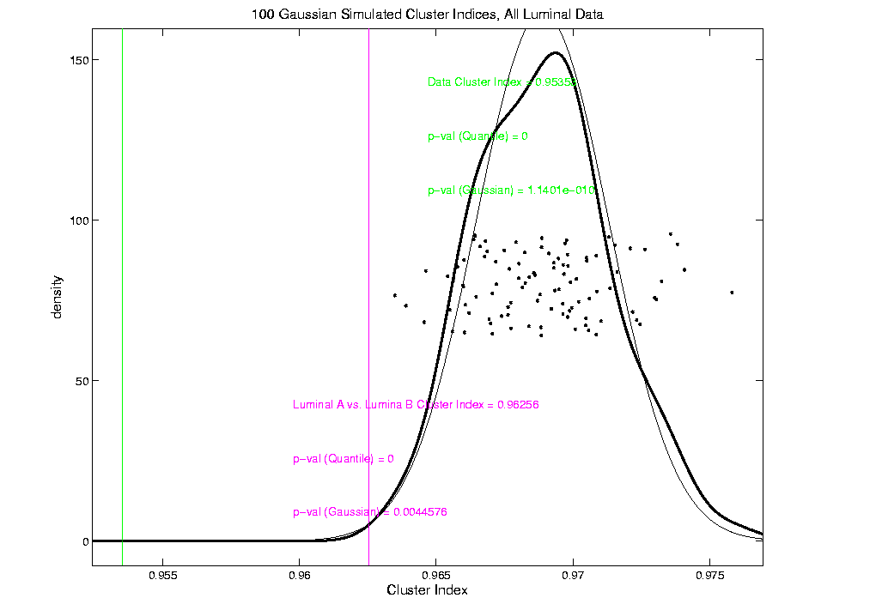
An example (details to follow)
P-val = 0.0045

Slide 63
SigClust Modalities
Two major applications:
Test significance of given clusterings
(e.g. for those found in heat map)
(Use given class labels)

Slide 64
SigClust Modalities
Two major applications:
Test significance of given clusterings
(e.g. for those found in heat map)
(Use given class labels)
Test if known cluster can be further split
(Use 2-means class labels)

Slide 65
SigClust Real Data Results
Analyze Perou 500 breast cancer data
(large cross study combined data set)
Current folklore: 5 classes
Luminal A
Luminal B
Normal
Her 2
Basal

Slide 66
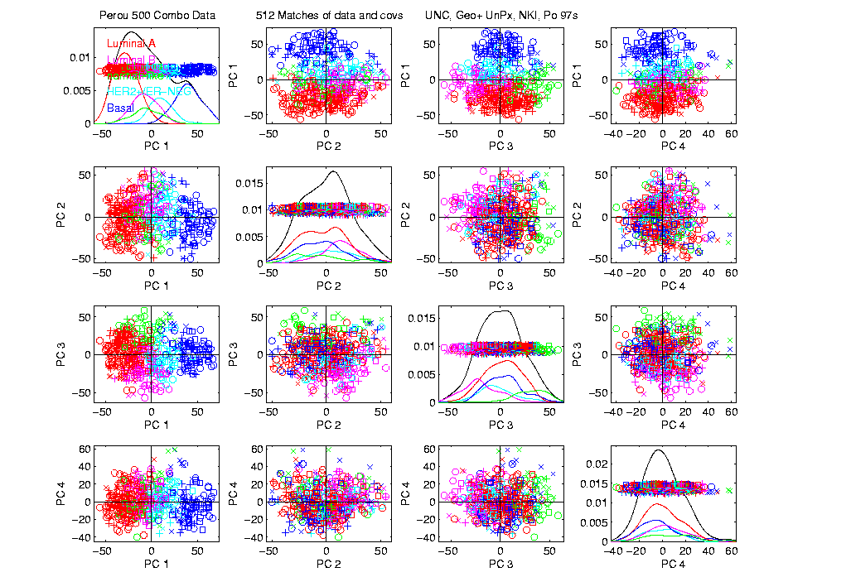
Perou 500 PCA View – real clusters???

Slide 67
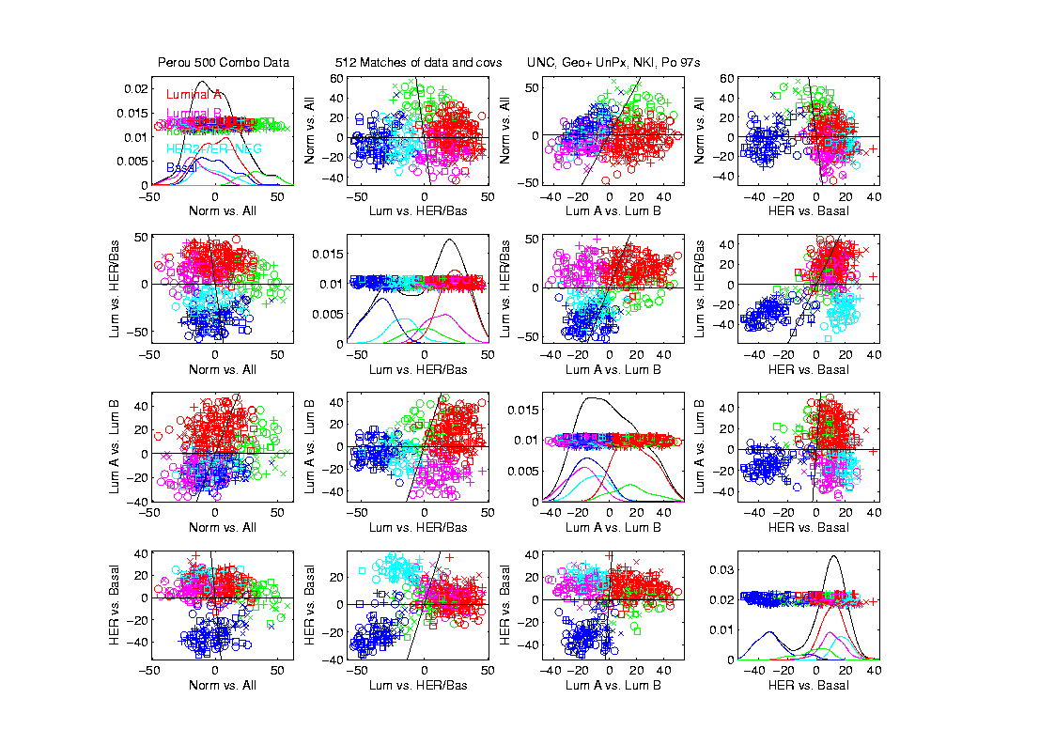
Perou 500 DWD Dir’ns View – real clusters???

Slide 68
Perou 500 – Fundamental Question
Are Luminal A &
Luminal B really
distinct clusters?
Famous for
Far Different
Survivability

Slide 69
SigClust Results for Luminal A vs. Luminal B
P-val = 0.0045

Slide 70
SigClust Results for Luminal A vs. Luminal B
Get p-values from:
Empirical Quantile
From simulated sample CIs

Slide 71
SigClust Results for Luminal A vs. Luminal B
Get p-values from:
Empirical Quantile
From simulated sample CIs
Fit Gaussian Quantile
Don’t “believe these”
But useful for comparison
Especially when Empirical Quantile = 0

Slide 72
SigClust Results for Luminal A vs. Luminal B
Test significance of given clusterings
Empirical p-val = 0
Definitely 2 clusters
Gaussian fit p-val = 0.0045
same strong evidence
Conclude these really are two clusters

Slide 73
SigClust Results for Luminal A vs. Luminal B
Test if known cluster can be further split
Empirical p-val = 0
definitely 2 clusters
Gaussian fit p-val = 10⁻¹⁰
Stronger evidence than above
Such comparison is value of Gaussian fit
Makes sense (since CI is min possible)
Conclude these really are two clusters

Slide 74
SigClust Real Data Results
Summary of Perou 500 SigClust Results:
Lum & Norm vs. Her2 & Basal, p-val = 10⁻¹⁹
Luminal A vs. B, p-val = 0.0045
Her 2 vs. Basal, p-val = 10⁻¹⁰
Split Luminal A, p-val = 10⁻⁷
Split Luminal B, p-val = 0.058
Split Her 2, p-val = 0.10
Split Basal, p-val = 0.005

Slide 75
SigClust Real Data Results
Summary of Perou 500 SigClust Results:
All previous splits were real
Most not able to split further
Exception is Basal, already known
Chuck Perou has good intuition!
(insight about signal vs. noise)
How good are others???

Slide 76
SigClust Real Data Results
Experience with Other Data Sets: Similar
Smaller data sets: less power
Gene filtering: more power
Lung Cancer: more distinct clusters

Slide 77
SigClust Real Data Results
Some Personal Observations
Experienced Analysts Impressively Good
SigClust can save them time
SigClust can help them with skeptics
SigClust essential for non-experts

Slide 78
SigClust Mathematical Statistics
Have HDLSS first asymptotic results
Too complicated to state here
Main idea: “consistency”
But not as n → ∞
Instead as d → ∞, with n fixed
(emerging new area, both here,
and in other contexts)

Slide 79
SigClust Simulations
Results show reasonable 1st approx’n
But improvements are possible
E.g. in variance estimation
(interesting open problem)
Usual problem is loss of power
So current results OK, just conservative

Slide 80
SigClust Open Problems
Improved Variance Estimation
More attention to Local Minima in 2-means Clustering
Theoretical Null Distributions
Inference for k > 2 means Clustering
Multiple Comparison Issues

Slide 81
Detailed Look at PCA
Now Study “Folklore” More Carefully
BackGround
History
Underpinnings
(Mathematical & Computational)
Good Overall Reference: Jolliffe (2002)

Slide 82
PCA: Rediscovery – Renaming
Statistics:
Principal Component Analysis (PCA)

Slide 83
PCA: Rediscovery – Renaming
Statistics:
Principal Component Analysis (PCA)
Social Sciences:
Factor Analysis (PCA is a subset)

Slide 84
PCA: Rediscovery – Renaming
Statistics:
Principal Component Analysis (PCA)
Social Sciences:
Factor Analysis (PCA is a subset)
Probability / Electrical Eng:
Karhunen – Loeve expansion

Slide 85
PCA: Rediscovery – Renaming
Statistics:
Principal Component Analysis (PCA)
Social Sciences:
Factor Analysis (PCA is a subset)
Probability / Electrical Eng:
Karhunen – Loeve expansion
Applied Mathematics:
Proper Orthogonal Decomposition (POD)

Slide 86
PCA: Rediscovery – Renaming
Statistics:
Principal Component Analysis (PCA)
Social Sciences:
Factor Analysis (PCA is a subset)
Probability / Electrical Eng:
Karhunen – Loeve expansion
Applied Mathematics:
Proper Orthogonal Decomposition (POD)
Geo-Sciences:
Empirical Orthogonal Functions (EOF)

Slide 87
An Interesting Historical Note
The 1st (?) application of PCA to Functional Data Analysis

Slide 88
An Interesting Historical Note
The 1st (?) application of PCA to Functional Data Analysis:
Rao, C. R. (1958) Some statistical methods for comparison of growth curves, Biometrics, 14, 1-17.

Slide 89
An Interesting Historical Note
The 1st (?) application of PCA to Functional Data Analysis:
Rao, C. R. (1958) Some statistical methods for comparison of growth curves, Biometrics, 14, 1-17.
1st Paper with “Curves as Data” viewpoint

Slide 90
Detailed Look at PCA
Three Important (& Interesting) Viewpoints:
Mathematics
Numerics
Statistics
Goal: Study Interrelationships

Slide 91
Detailed Look at PCA
Three Important (& Interesting) Viewpoints:
Mathematics
Numerics
Statistics
1st: Review Linear Alg. and Multivar. Prob.

Slide 92
Review of Linear Algebra
Vector Space:
set of “vectors”, ,
and “scalars” (coefficients),

Slide 93
Review of Linear Algebra
Vector Space:
set of “vectors”, ,
and “scalars” (coefficients),
“closed” under “linear combination”
( in space)

Slide 94
Review of Linear Algebra
Vector Space:
set of “vectors”, ,
and “scalars” (coefficients),
“closed” under “linear combination”
( in space)
e.g.
,
“ dim Euclid’n space”

Slide 95
Review of Linear Algebra (Cont.)
Subspace:
Subset that is Again a Vector Space
i.e. Closed under Linear Combination

Slide 96
Review of Linear Algebra (Cont.)
Subspace:
Subset that is Again a Vector Space
i.e. Closed under Linear Combination
e.g. Lines through the Origin
e.g. Planes through the Origin

Slide 97
Review of Linear Algebra (Cont.)
Subspace:
Subset that is Again a Vector Space
i.e. Closed under Linear Combination
e.g. Lines through the Origin
e.g. Planes through the Origin
Note: Planes not Through the Origin
are not Subspaces
(Do not Contain )

Slide 98
Review of Linear Algebra (Cont.)
Subspace:
Subset that is Again a Vector Space
i.e. Closed under Linear Combination
e.g. Lines through the Origin
e.g. Planes through the Origin
e.g. Subsp. “Generated By” a Set of Vectors (all Linear Combos of them =
= Containing Hyperplane
through Origin)

Slide 99
Review of Linear Algebra (Cont.)
Basis of Subspace: Set of Vectors that:
Span, i.e. Everything is a Lin. Com. of them
are Linearly Indep’t, i.e. Lin. Com. is Unique

Slide 100
Review of Linear Algebra (Cont.)
Basis of Subspace: Set of Vectors that:
Span, i.e. Everything is a Lin. Com. of them
are Linearly Indep’t, i.e. Lin. Com. is Unique
e.g. “Unit Vector Basis”
Since

Slide 101
Review of Linear Algebra (Cont.)
Basis Matrix, of subspace of
Given a basis, ,
create matrix of columns:

Slide 102
Review of Linear Algebra (Cont.)
Then linear combo is a matrix multiplicat’n:
where

Slide 103
Review of Linear Algebra (Cont.)
Then linear combo is a matrix multiplicat’n:
where
Note: Right Multiplication Gives:
Linear Combination of Column Vectors

Slide 104
Review of Linear Algebra (Cont.)
Then linear combo is a matrix multiplicat’n:
where
Check sizes:

Slide 105
Review of Linear Algebra (Cont.)
Aside on Matrix Multiplication: (linear transformat’n)
For matrices
,
Define the Matrix Product

Slide 106
Review of Linear Algebra (Cont.)
Aside on Matrix Multiplication: (linear transformat’n)
For matrices
,
Define the Matrix Product
(Inner Products of Rows, With Columns, )

Slide 107
Review of Linear Algebra (Cont.)
Aside on Matrix Multiplication: (linear transformat’n)
For matrices
,
Define the Matrix Product
(Inner Products of Rows, With Columns, )
(Composition of Linear Transformations)

Slide 108
Review of Linear Algebra (Cont.)
Aside on Matrix Multiplication: (linear transformat’n)
For matrices
,
Define the Matrix Product
(Inner Products of Rows, With Columns, )
(Composition of Linear Transformations)
Often Useful to Check Sizes:

Slide 109
Review of Linear Algebra (Cont.)
Aside on Matrix Multiplication: (linear transformat’n)
For matrices
,
Define the Matrix Product
(Inner Products of Rows, With Columns, )
(Composition of Linear Transformations)
Often Useful to Check Sizes:

Slide 110
Review of Linear Algebra (Cont.)
Matrix Trace:
For a Square Matrix
Define

Slide 111
Review of Linear Algebra (Cont.)
Matrix Trace:
For a Square Matrix
Define
Trace Commutes with Matrix Multiplication:

Slide 112
Review of Linear Algebra (Cont.)
Dimension of Subspace (a Notion of “Size”):
Number of Elements in a Basis (Unique)

Slide 113
Review of Linear Algebra (Cont.)
Dimension of Subspace (a Notion of “Size”):
Number of Elements in a Basis (Unique)
(Use Basis Above)
e.g. dim of a line is 1
e.g. dim of a plane is 2

Slide 114
Review of Linear Algebra (Cont.)
Dimension of Subspace (a Notion of “Size”):
Number of Elements in a Basis (Unique)
(Use Basis Above)
e.g. dim of a line is 1
e.g. dim of a plane is 2
Dimension is “Degrees of Freedom”
(in Statistical Uses, e.g. ANOVA)

Slide 115
Review of Linear Algebra (Cont.)
Norm of a Vector:
in ,

Slide 116
Review of Linear Algebra (Cont.)
Norm of a Vector:
in ,
Idea: length of the vector

Slide 117
Review of Linear Algebra (Cont.)
Norm of a Vector:
in ,
Idea: length of the vector
Note: strange properties for high ,
e.g. “length of diagonal of unit cube” =

Slide 118
Review of Linear Algebra (Cont.)
Norm of a Vector (cont.):
Length Normalized Vector:
(has Length 1, thus on Surf. of Unit Sphere
& is a Direction Vector)

Slide 119
Review of Linear Algebra (Cont.)
Norm of a Vector (cont.):
Length Normalized Vector:
(has Length 1, thus on Surf. of Unit Sphere
& is a Direction Vector)
Define Distance as:

Slide 120
Review of Linear Algebra (Cont.)
Inner (Dot, Scalar) Product:
for Vectors and

Slide 121
Review of Linear Algebra (Cont.)
Inner (Dot, Scalar) Product:
for Vectors and ,
Related to Norm, via

Slide 122
Review of Linear Algebra (Cont.)
Inner (Dot, Scalar) Product (cont.):
measures “angle between and ” as:

Slide 123
Review of Linear Algebra (Cont.)
Inner (Dot, Scalar) Product (cont.):
measures “angle between and ” as:
key to Orthogonality, i.e. Perpendicul’ty:
if and only if

Slide 124
Review of Linear Algebra (Cont.)
Orthonormal Basis :
All Orthogonal to each other,
i.e. , for
All have Length 1,
i.e. , for

Slide 125
Review of Linear Algebra (Cont.)
Orthonormal Basis (cont.):
Spectral Representation:
where

Slide 126
Review of Linear Algebra (Cont.)
Orthonormal Basis (cont.):
Spectral Representation:
where
(Coefficient is Inner Product, Cool Notation)

Slide 127
Review of Linear Algebra (Cont.)
Orthonormal Basis (cont.):
Spectral Representation:
where
Check:

Slide 128
Review of Linear Algebra (Cont.)
Orthonormal Basis (cont.):
Spectral Representation:
where
Check:
Matrix Notation: where i.e.
For the Basis Matrix

Slide 129
Review of Linear Algebra (Cont.)
Orthonormal Basis (cont.):
Spectral Representation:
where
Check:
Matrix Notation: where i.e.
is called transform of
(e.g. Fourier or Wavelet)

Slide 130
Review of Linear Algebra (Cont.)
Parseval identity, for
in subsp. gen’d by o. n. basis :

Slide 131
Review of Linear Algebra (Cont.)
Parseval identity, for
in subsp. gen’d by o. n. basis :
Pythagorean theorem
“Decomposition of Energy”
ANOVA - sums of squares

Slide 132
Review of Linear Algebra (Cont.)
Parseval identity, for
in subsp. gen’d by o. n. basis :
Pythagorean theorem
“Decomposition of Energy”
ANOVA - sums of squares
Transform, , has same length as ,
i.e. “rotation in ”

Slide 133
Review of Linear Algebra (Cont.)
Projection of a Vector onto a Subspace :
Idea: Member of that is Closest to
(i.e. “Best Approx’n”)

Slide 134
Review of Linear Algebra (Cont.)
Projection of a Vector onto a Subspace :
Idea: Member of that is Closest to
(i.e. “Best Approx’n”)
Find that Solves:
(“Least Squares”)

Slide 135
Review of Linear Algebra (Cont.)
Projection of a Vector onto a Subspace :
Idea: Member of that is Closest to
(i.e. “Best Approx’n”)
Find that Solves:
(“Least Squares”)
For Inner Product (Hilbert) Space:
Exists and is Unique

Slide 136
Review of Linear Algebra (Cont.)
Projection of a Vector onto a Subspace (cont.):
General Solution in : for Basis Matrix ,

Slide 137
Review of Linear Algebra (Cont.)
Projection of a Vector onto a Subspace (cont.):
General Solution in : for Basis Matrix ,
So Proj’n Operator is Matrix Mult’n:
(thus projection is another linear operation)

Slide 138
Review of Linear Algebra (Cont.)
Projection of a Vector onto a Subspace (cont.):
General Solution in : for Basis Matrix ,
So Proj’n Operator is Matrix Mult’n:
(thus projection is another linear operation)
(note same operation underlies least squares)

Slide 139
Review of Linear Algebra (Cont.)
Projection using Orthonormal Basis :
Basis Matrix is Orthonormal:

Slide 140
Review of Linear Algebra (Cont.)
Projection using Orthonormal Basis :
Basis Matrix is Orthonormal:
So =
= Recon(Coeffs of “in Dir’n”)
(Recall Right Mult’n)

Slide 141
Review of Linear Algebra (Cont.)
Projection using Orthonormal Basis (cont.):
For Orthogonal Complement, ,
and

Slide 142
Review of Linear Algebra (Cont.)
Projection using Orthonormal Basis (cont.):
For Orthogonal Complement, ,
and
Parseval Inequality:

Slide 143
Review of Linear Algebra (Cont.)
(Real) Unitary Matrices: with
Orthonormal Basis Matrix
(So All of Above Applies)

Slide 144
Review of Linear Algebra (Cont.)
(Real) Unitary Matrices: with
Orthonormal Basis Matrix
(So All of Above Applies)
Note Transform’n is: Distance Preserving

Slide 145
Review of Linear Algebra (Cont.)
(Real) Unitary Matrices: with
Orthonormal Basis Matrix
(So All of Above Applies)
Note Transform’n is: Distance Preserving
Lin. Trans. (Mult. by ) is ~ Rotation
But also Includes “Mirror Images”

Slide 146
Review of Linear Algebra (Cont.)
Singular Value Decomposition (SVD):
For a Matrix
Find

Slide 147
Review of Linear Algebra (Cont.)
Singular Value Decomposition (SVD):
For a Matrix
Find a Diagonal Matrix ,
with Entries
called Singular Values

Slide 148
Review of Linear Algebra (Cont.)
Singular Value Decomposition (SVD):
For a Matrix
Find a Diagonal Matrix ,
with Entries
called Singular Values
And Unitary (Rotation) Matrices ,
(recall )

Slide 149
Review of Linear Algebra (Cont.)
Singular Value Decomposition (SVD):
For a Matrix
Find a Diagonal Matrix ,
with Entries
called Singular Values
And Unitary (Rotation) Matrices ,
(recall )
So That

Slide 150
Review of Linear Algebra (Cont.)
Intuition behind Singular Value Decomposition:
For a “linear transf’n” (via matrix multi’n)

Slide 151
Review of Linear Algebra (Cont.)
Intuition behind Singular Value Decomposition:
For a “linear transf’n” (via matrix multi’n)
First rotate

Slide 152
Review of Linear Algebra (Cont.)
Intuition behind Singular Value Decomposition:
For a “linear transf’n” (via matrix multi’n)
First rotate
Second rescale coordinate axes (by )

Slide 153
Review of Linear Algebra (Cont.)
Intuition behind Singular Value Decomposition:
For a “linear transf’n” (via matrix multi’n)
First rotate
Second rescale coordinate axes (by )
Third rotate again

Slide 154
Review of Linear Algebra (Cont.)
Intuition behind Singular Value Decomposition:
For a “linear transf’n” (via matrix multi’n)
First rotate
Second rescale coordinate axes (by )
Third rotate again
i.e. have diagonalized the transformation

Slide 155
Review of Linear Algebra (Cont.)
SVD Compact Representation:
Useful Labeling:
Singular Values in Increasing Order

Slide 156
Review of Linear Algebra (Cont.)
SVD Compact Representation:
Useful Labeling:
Singular Values in Increasing Order
Note: singular values = 0 can be omitted
(Since do “0-Stretching”)

Slide 157
Review of Linear Algebra (Cont.)
SVD Compact Representation:
Useful Labeling:
Singular Values in Increasing Order
Note: singular values = 0 can be omitted
Let = # of positive singular values

Slide 158
Review of Linear Algebra (Cont.)
SVD Compact Representation:
Useful Labeling:
Singular Values in Increasing Order
Note: singular values = 0 can be omitted
Let = # of positive singular values
Then:
Where are truncations of

Slide 159
Review of Linear Algebra (Cont.)
SVD Full Representation:
=
Graphics Display Assumes

Slide 160
Review of Linear Algebra (Cont.)
SVD Full Representation:
=
Full Rank Basis Matrix

Slide 161
Review of Linear Algebra (Cont.)
SVD Full Representation:
=
Full Rank Basis Matrix
All 0s in Bottom

Slide 162
Review of Linear Algebra (Cont.)
SVD Reduced Representation:
=
These Columns Get 0ed Out

Slide 163
Review of Linear Algebra (Cont.)
SVD Reduced Representation:
=

Slide 164
Review of Linear Algebra (Cont.)
SVD Reduced Representation:
=
Also, Some of These May be 0

Slide 165
Review of Linear Algebra (Cont.)
SVD Compact Representation:
=

Slide 166
Review of Linear Algebra (Cont.)
SVD Compact Representation:
=
These Get 0ed Out

Slide 167
Review of Linear Algebra (Cont.)
SVD Compact Representation:
=

