Slide 1
Statistics – O. R. 891 Object Oriented Data Analysis
J. S. Marron
Dept. of Statistics and Operations Research
University of North Carolina

Slide 2
Manifold Feature Spaces
Directional Data
E.g. “average” of: $2^{°}$, $3^{°}$, ${358}^{°}$, ${359}^{°}$, = ???
Should
Use Unit
Circle
Structure
x
x
x
x

Slide 3
Manifold Feature Spaces
Fréchet Mean in General:
Big Advantage:
Works in Any Metric Space

Slide 4
Manifold Feature Spaces
Directional Data Examples of Fréchet Mean:
Not always easily interpretable
Think about distances along arc
Not about “points in $ℝ^{2}$”
Sum of squared distances
strongly feels the largest
Not always unique
But unique with probability one
Non-unique requires strong symmetry
But possible to have many means

Slide 5
Manifold Feature Spaces
Directional Data Examples of Fréchet Mean:
Also of interest is Fréchet Variance:
Works like Euclidean sample variance
Note values in movie, reflecting spread in data
Note theoretical version:
Useful for Laws of Large Numbers, etc.

Slide 6
OODA in Image Analysis
First Generation Problems:
Denoising
Segmentation
Registration
(all about single images,
still interesting challenges)

Slide 7
OODA in Image Analysis
Second Generation Problems:
Populations of Images
Understanding Population Variation
Discrimination (a.k.a. Classification)
Complex Data Structures (& Spaces)
HDLSS Statistics

Slide 8
Image Object Representation
Major Approaches for Image Data Objects:
Landmark Representations
Boundary Representations
Medial Representations

Slide 9
Boundary Representations
Main Drawback:
Correspondence
For OODA (on vectors of parameters):
Need to “match up points”
Easy to find triangular mesh
Lots of research on this driven by gamers
Challenge to match mesh across objects
There are some interesting ideas…
Notes:
9

Slide 10
Medial Representations
Main Idea:
Represent Objects as:
Discretized skeletons (medial atoms)
Plus spokes from center to edge
Which imply a boundary
Very accessible early reference:
Yushkevich, et al (2001)

Slide 11
A Challenging Example
Male Pelvis
Bladder – Prostate – Rectum
How do they move over time (days)?
Critical to Radiation Treatment (cancer)
Work with 3-d CT
Very Challenging to Segment
Find boundary of each object?
Represent each Object?

Slide 12
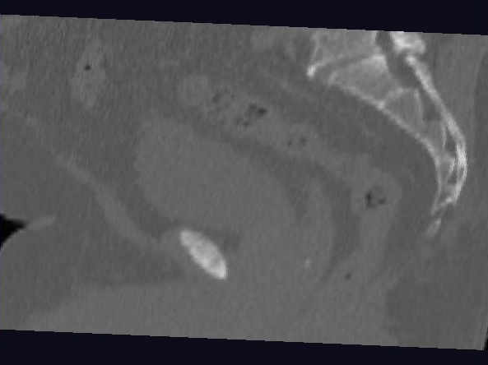
Male Pelvis – Raw Data
One CT Slice
(in 3d image)
Tail Bone
Rectum
Bladder
Prostate

Slide 13
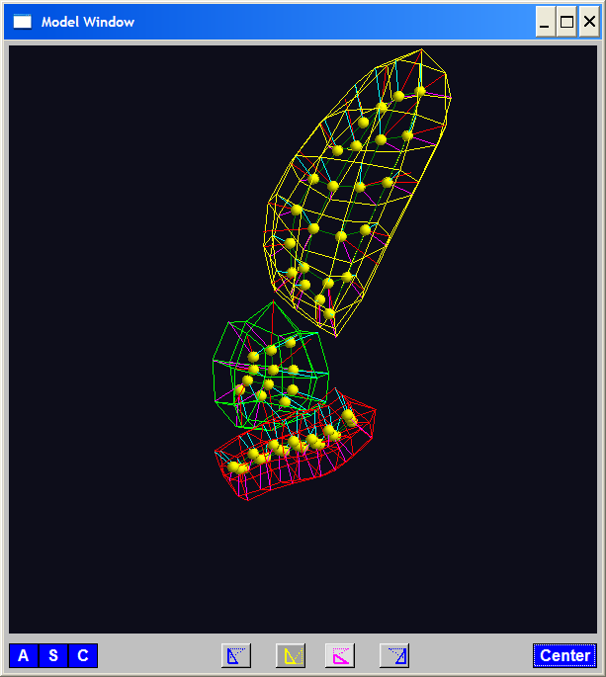
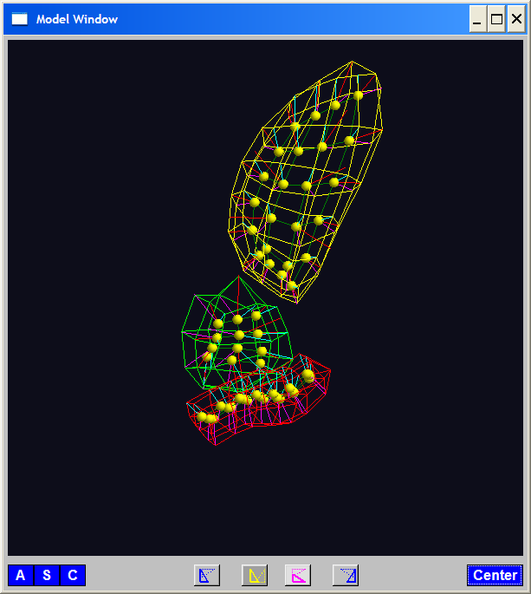
PGA for m-reps, Bladder-Prostate-Rectum
Bladder – Prostate – Rectum, 1 person, 17 days
PG 1 PG 2 PG 3
(analysis by Ja Yeon Jeong)

Slide 14
PGA for m-reps, Bladder-Prostate-Rectum
Bladder – Prostate – Rectum, 1 person, 17 days
PG 1 PG 2 PG 3
(analysis by Ja Yeon Jeong)

Slide 15
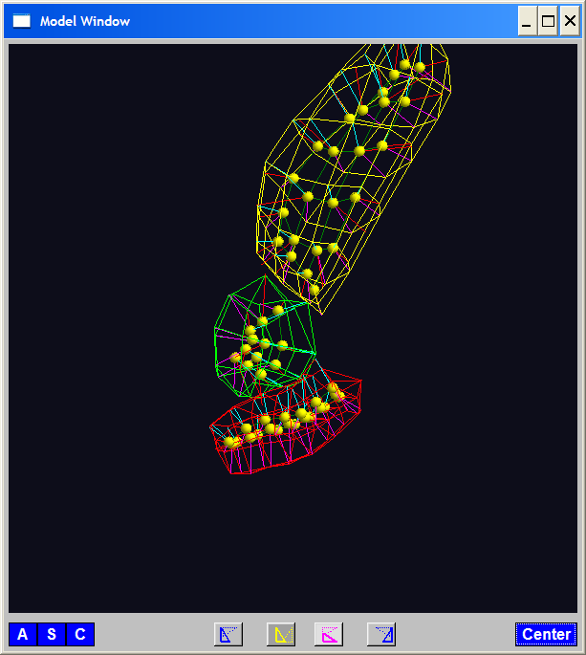
PGA for m-reps, Bladder-Prostate-Rectum
Bladder – Prostate – Rectum, 1 person, 17 days
PG 1 PG 2 PG 3
(analysis by Ja Yeon Jeong)

Slide 16
PCA Extensions for Data on Manifolds
Fletcher (Principal Geodesic Anal.)
Best fit of geodesic to data
Constrained to go through geodesic mean

Slide 17
PCA Extensions for Data on Manifolds
Fletcher (Principal Geodesic Anal.)
Best fit of geodesic to data
Constrained to go through geodesic mean
Counterexample:
Data on sphere, along equator

Slide 18
PCA Extensions for Data on Manifolds
Fletcher (Principal Geodesic Anal.)
Best fit of geodesic to data
Constrained to go through geodesic mean
Huckemann, Hotz & Munk (Geod. PCA)
Best fit of any geodesic to data

Slide 19
PCA Extensions for Data on Manifolds
Fletcher (Principal Geodesic Anal.)
Best fit of geodesic to data
Constrained to go through geodesic mean
Huckemann, Hotz & Munk (Geod. PCA)
Best fit of any geodesic to data
Counterexample:
Data follows Tropic of Capricorn

Slide 20
PCA Extensions for Data on Manifolds
Fletcher (Principal Geodesic Anal.)
Best fit of geodesic to data
Constrained to go through geodesic mean
Huckemann, Hotz & Munk (Geod. PCA)
Best fit of any geodesic to data
Jung, Foskey & Marron (Princ. Arc Anal.)

Slide 21
PCA Extensions for Data on Manifolds
Fletcher (Principal Geodesic Anal.)
Best fit of geodesic to data
Constrained to go through geodesic mean
Huckemann, Hotz & Munk (Geod. PCA)
Best fit of any geodesic to data
Jung, Foskey & Marron (Princ. Arc Anal.)
Best fit of any circle to data
(motivated by conformal maps)

Slide 22
PCA Extensions for Data on Manifolds

Slide 23
Principal Arc Analysis
Jung, Foskey & Marron (2011)
Best fit of any circle to data
Can give better fit than geodesics

Slide 24
Principal Arc Analysis
Jung, Foskey & Marron (2011)
Best fit of any circle to data
Can give better fit than geodesics
Observed for simulated m-rep example

Slide 25
Challenge being addressed

Slide 26
Composite Nested Spheres
Idea: Use Principal Arc Analysis
Over Large Products of $S^{2}$

Slide 27
Landmark Based Shape Analysis
Kendall
Bookstein
Dryden &
Mardia
(recall major monographs)

Slide 28
Landmark Based Shape Analysis
Kendall
Bookstein
Dryden &
Mardia
Digit 3 Data

Slide 29
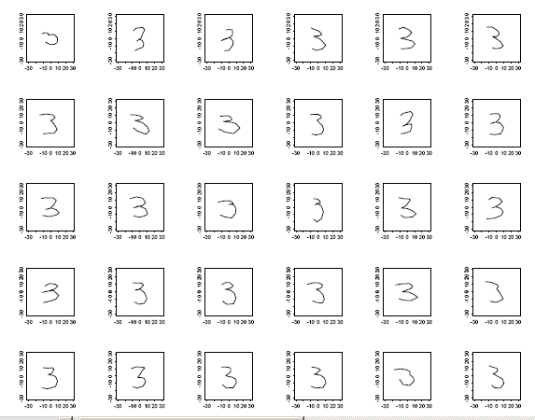
Landmark Based Shape Analysis
Kendall
Bookstein
Dryden &
Mardia
Digit 3 Data

Slide 30
Landmark Based Shape Analysis
Kendall
Bookstein
Dryden &
Mardia
Digit 3 Data
(digitized to 13 landmarks)

Slide 31
Landmark Based Shape Analysis
Key Step: mod out
Translation
Scaling
Rotation

Slide 32
Landmark Based Shape Analysis
Key Step: mod out
Translation
Scaling
Rotation
Result:
Data Objects ←→
←→ points on Manifold ( ~ S^{2k-4})

Slide 33
Landmark Based Shape Analysis
Currently popular approaches to PCA on S^{k}:
Early: PCA on projections
(Tangent Plane Analysis)

Slide 34
Landmark Based Shape Analysis
Currently popular approaches to PCA on S^{k}:
Early: PCA on projections
Fletcher: Geodesics through mean

Slide 35
Landmark Based Shape Analysis
Currently popular approaches to PCA on S^{k}:
Early: PCA on projections
Fletcher: Geodesics through mean
Huckemann, et al: Any Geodesic

Slide 36
Landmark Based Shape Analysis
Currently popular approaches to PCA on S^{k}:
Early: PCA on projections
Fletcher: Geodesics through mean
Huckemann, et al: Any Geodesic
New Approach:
Principal Nested Sphere Analysis
Jung, Dryden & Marron (2012)

Slide 37
Principal Nested Spheres Analysis
Main Goal:
Extend Principal Arc Analysis (S² to S^{k})

Slide 38
Principal Nested Spheres Analysis
Key Idea:
Replace usual forwards view of PCA
With a backwards approach to PCA

Slide 39
Terminology
Multiple linear regression:

Slide 40
Terminology
Multiple linear regression:
Stepwise approaches:
Forwards: Start small, iteratively add variables to model

Slide 41
Terminology
Multiple linear regression:
Stepwise approaches:
Forwards: Start small, iteratively add variables to model
Backwards: Start with all, iteratively remove variables from model

Slide 42
Illust’n of PCA View: Recall Raw Data
Notes:
EgView1p1RawData.ps

Slide 43
Illust’n of PCA View: PC1 Projections
Notes:
EgView1p51proj3dPC1.ps

Slide 44
Illust’n of PCA View: PC2 Projections
Notes:
EgView1p52proj3dPC2.ps

Slide 45
Illust’n of PCA View: Projections on PC1,2 plane
Notes:
EgView1p54proj3dPC12.ps

Slide 46
Principal Nested Spheres Analysis
Replace usual forwards view of PCA
Data → PC1 (1-d approx)

Slide 47
Principal Nested Spheres Analysis
Replace usual forwards view of PCA
Data → PC1 (1-d approx)
→ PC2 (1-d approx of Data-PC1)
→ PC1 U PC2 (2-d approx)

Slide 48
Principal Nested Spheres Analysis
Replace usual forwards view of PCA
Data → PC1 (1-d approx)
→ PC2 (1-d approx of Data-PC1)
→ PC1 U PC2 (2-d approx)
→ PC1 U … U PCr
(r-d approx)

Slide 49
Principal Nested Spheres Analysis
With a backwards approach to PCA
Data → PC1 U … U PCr (r-d approx)

Slide 50
Principal Nested Spheres Analysis
With a backwards approach to PCA
Data → PC1 U … U PCr (r-d approx)
→ PC1 U … U PC(r-1)

Slide 51
Principal Nested Spheres Analysis
With a backwards approach to PCA
Data → PC1 U … U PCr (r-d approx)
→ PC1 U … U PC(r-1)
→ PC1 U PC2 (2-d approx)

Slide 52
Principal Nested Spheres Analysis
With a backwards approach to PCA
Data → PC1 U … U PCr (r-d approx)
→ PC1 U … U PC(r-1)
→ PC1 U PC2 (2-d approx)
→ PC1 (1-d approx)

Slide 53
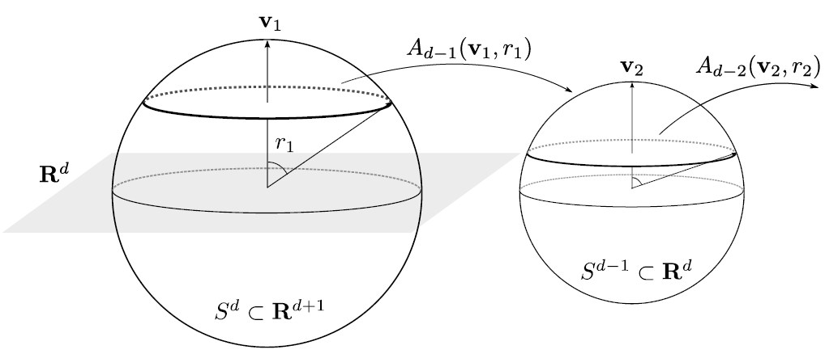
Principal Nested Spheres Analysis
Top Down Nested (small) spheres

Slide 54
Digit 3 data: Principal variations of shape
Princ. geodesics by PNS
Principal arcs by PNS

Slide 55
An Interesting Question
How generally applicable is
Backwards approach to PCA?
Discussion:
Jung et al (2010)
Pizer et al (2012)

Slide 56
An Interesting Question
How generally applicable is
Backwards approach to PCA?
Anywhere this is already being done???

Slide 57
An Interesting Question
How generally applicable is
Backwards approach to PCA?
Potential Application: Principal Curves
Hastie & Stuetzle, (1989)
(Foundation of Manifold Learning)

Slide 58
Manifold Learning
Goal: Find lower dimensional manifold that well approximates data
ISOmap
Tennenbaum (2000)
Local Linear Embedding
Roweis & Saul (2000)

Slide 59
1st Principal Curve
Linear Reg’n
Usual Smooth

Slide 60
1st Principal Curve
Linear Reg’n
Proj’s Reg’n
Usual Smooth

Slide 61
1st Principal Curve
Linear Reg’n
Proj’s Reg’n
Usual Smooth
Princ’l Curve

Slide 62
An Interesting Question
How generally applicable is
Backwards approach to PCA?
Potential Application: Principal Curves
Perceived Major Challenge:
How to find 2nd Principal Curve?
Backwards approach???

Slide 63
An Interesting Question
Key Component:
Principal Surfaces
LeBlanc & Tibshirani (1994)

Slide 64
An Interesting Question
How generally applicable is
Backwards approach to PCA?
Another Potential Application:
Nonnegative Matrix Factorization
= PCA in Positive Orthant
(early days)

Slide 65
An Interesting Question
How generally applicable is
Backwards approach to PCA?
Nonnegative Matrix Factorization
Discussed in Guest Lecture:
Tuesday, November 13
Lingsong Zhang
Thanks to stat.purdue.edu

Slide 66
An Interesting Question
How generally applicable is
Backwards approach to PCA?
Another Potential Application:
Trees as Data
(early days)

Slide 67
An Interesting Question
How generally applicable is
Backwards approach to PCA?
An Attractive Answer

Slide 68
An Interesting Question
How generally applicable is
Backwards approach to PCA?
An Attractive Answer:
James Damon, UNC Mathematics
Geometry
Singularity
Theory

Slide 69
An Interesting Question
How generally applicable is
Backwards approach to PCA?
An Attractive Answer:
James Damon, UNC Mathematics
Key Idea: Express Backwards PCA as
Nested Series of Constraints

Slide 70
General View of Backwards PCA
Define Nested Spaces via Constraints
Satisfying More Constraints $⇒$
$⇒$ Smaller Subspaces

Slide 71
General View of Backwards PCA
Define Nested Spaces via Constraints
E.g. SVD
(Singular Value Decomposition =
= Not Mean Centered PCA)
(notationally very clean)

Slide 72
General View of Backwards PCA
Define Nested Spaces via Constraints
E.g. SVD
Have $k$ Nested Subspaces:
$$S_{1}⊆S_{2}⊆⋯⊆S_{d}$$

Slide 73
General View of Backwards PCA
Define Nested Spaces via Constraints
E.g. SVD $S_{k}=\left\{x :x=\sum_{j=1}^{k}{c_{j}\vec{u_{j}}}\right\}$
$k$-th SVD Subspace
Scores
Loading Vectors

Slide 74
General View of Backwards PCA
Define Nested Spaces via Constraints
E.g. SVD $S_{k}=\left\{x :x=\sum_{j=1}^{k}{c_{j}\vec{u_{j}}}\right\}$
Now Define:
$$S_{k−1}=\left\{x∈S_{k} :\left\langle x,\vec{u_{k}}\right\rangle =0\right\}$$

Slide 75
General View of Backwards PCA
Define Nested Spaces via Constraints
E.g. SVD $S_{k}=\left\{x :x=\sum_{j=1}^{k}{c_{j}\vec{u_{j}}}\right\}$
Now Define:
$$S_{k−1}=\left\{x∈S_{k} :\left\langle x,\vec{u_{k}}\right\rangle =0\right\}$$
Constraint Gives Nested Reduction of Dim’n

Slide 76
General View of Backwards PCA
Define Nested Spaces via Constraints
Backwards PCA
Reduce Using Affine Constraints

Slide 77
General View of Backwards PCA
Define Nested Spaces via Constraints
Backwards PCA
Principal Nested Spheres
Use Affine Constraints (Planar Slices)
In Ambient Space

Slide 78
General View of Backwards PCA
Define Nested Spaces via Constraints
Backwards PCA
Principal Nested Spheres
Principal Surfaces
Spline Constraint Within Previous?

Slide 79
General View of Backwards PCA
Define Nested Spaces via Constraints
Backwards PCA
Principal Nested Spheres
Principal Surfaces
Spline Constraint Within Previous?
{Been Done Already???}

Slide 80
General View of Backwards PCA
Define Nested Spaces via Constraints
Backwards PCA
Principal Nested Spheres
Principal Surfaces
Other Manifold Data Spaces
Sub-Manifold Constraints??
(Algebraic Geometry)

Slide 81
General View of Backwards PCA
Define Nested Spaces via Constraints
Backwards PCA
Principal Nested Spheres
Principal Surfaces
Other Manifold Data Spaces
Tree Spaces
Suitable Constraints???

Slide 82
General View of Backwards PCA
Why does Backwards Work Better?

Slide 83
General View of Backwards PCA
Why does Backwards Work Better?
Natural to Sequentially Add Constraints
(I.e. Add Constraints,
Using Information in Data)

Slide 84
General View of Backwards PCA
Why does Backwards Work Better?
Natural to Sequentially Add Constraints
Hard to Start With Complete Set,
And Sequentially Remove

Slide 85
Variation on Landmark Based Shape
Recall Main Idea:
Represent Shapes as Coordinates
“Mod Out” Transl’n, Rotat’n, Scale

Slide 86
Variation on Landmark Based Shape
Typical Viewpoint:
Variation in Shape is Goal
Other Variation+ is Nuisance
Recall Main Idea:
Represent Shapes as Coordinates
“Mod Out” Transl’n, Rotat’n, Scale

Slide 87
Variation on Landmark Based Shape
Typical Viewpoint:
Variation in Shape is Goal
Other Variation+ is Nuisance
Interesting Alternative:
Study Variation in Transformation
Treat Shape as Nuisance

Slide 88
Variation on Landmark Based Shape
Context: Study of Tectonic Plates
Movement of Earth’s Crust (over time)
Take Motions as Data Objects
Interesting Alternative:
Study Variation in Transformation
Treat Shape as Nuisance

Slide 89
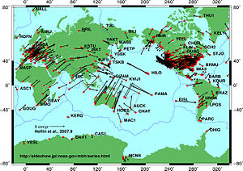
Variation on Landmark Based Shape
Context: Study of Tectonic Plates
Movement of Earth’s Crust (over time)
Take Motions as Data Objects
Royer & Chang (1991)
Thanks to Wikipedia

Slide 90
Non - Euclidean Data Spaces
What is “Strongly Non-Euclidean” Case?
Trees as Data

Slide 91
Non - Euclidean Data Spaces
What is “Strongly Non-Euclidean” Case?
Trees as Data
Special Challenge:
No Tangent Plane
Must Re-Invent
Data Analysis

Slide 92
Strongly Non-Euclidean Spaces
Trees as Data Objects
Thanks to Burcu Aydin
Notes:
FIGp8correct.eps

Slide 93
Strongly Non-Euclidean Spaces
Trees as Data Objects
From Graph Theory:
Graph is set of nodes and edges
Thanks to Burcu Aydin
Notes:
FIGp8correct.eps

Slide 94
Strongly Non-Euclidean Spaces
Trees as Data Objects
From Graph Theory:
Graph is set of nodes and edges
Tree has root and direction
Thanks to Burcu Aydin
Notes:
FIGp8correct.eps

Slide 95
Strongly Non-Euclidean Spaces
Trees as Data Objects
From Graph Theory:
Graph is set of nodes and edges
Tree has root and direction
Data Objects: set of trees
Thanks to Burcu Aydin
Notes:
FIGp8correct.eps

Slide 96
Strongly Non-Euclidean Spaces
General Graph:
Thanks to Sean Skwerer

Slide 97
Strongly Non-Euclidean Spaces
Special Case Called “Tree”
Directed
Acyclic
5
3
4
1
2
Graphical note:
Sometimes “grow up”
Others “grow down”
0

Slide 98
Strongly Non-Euclidean Spaces
Motivating Example:
From Dr. Elizabeth Bullitt
Dept. of Neurosurgery, UNC
Blood Vessel Trees in Brains
Segmented from MRAs
Study population of trees
Forest of Trees

Slide 99
Blood vessel tree data
Marron’s brain:
MRI view
Single Slice
From 3-d Image

Slide 100
Blood vessel tree data
Marron’s brain:
MRA view
“A” for “Angiography”
Finds blood vessels
(show up as white)
Track through 3d

Slide 101
Blood vessel tree data
Marron’s brain:
MRA view
“A” for “Angiography”
Finds blood vessels
(show up as white)
Track through 3d

Slide 102
Blood vessel tree data
Marron’s brain:
MRA view
“A” for “Angiography”
Finds blood vessels
(show up as white)
Track through 3d

Slide 103
Blood vessel tree data
Marron’s brain:
MRA view
“A” for “Angiography”
Finds blood vessels
(show up as white)
Track through 3d

Slide 104
Blood vessel tree data
Marron’s brain:
MRA view
“A” for “Angiography”
Finds blood vessels
(show up as white)
Track through 3d

Slide 105
Blood vessel tree data
Marron’s brain:
MRA view
“A” for “Angiography”
Finds blood vessels
(show up as white)
Track through 3d

Slide 106
Blood vessel tree data
Marron’s brain:
From MRA
Segment tree
of vessel segments
Using tube tracking
Bullitt and Aylward (2002)

Slide 107
Blood vessel tree data
Marron’s brain:
From MRA
Reconstruct trees
in 3d
Rotate to view

Slide 108
Blood vessel tree data
Marron’s brain:
From MRA
Reconstruct trees
in 3d
Rotate to view

Slide 109
Blood vessel tree data
Marron’s brain:
From MRA
Reconstruct trees
in 3d
Rotate to view

Slide 110
Blood vessel tree data
Marron’s brain:
From MRA
Reconstruct trees
in 3d
Rotate to view

Slide 111
Blood vessel tree data
Marron’s brain:
From MRA
Reconstruct trees
in 3d
Rotate to view

Slide 112
Blood vessel tree data
Marron’s brain:
From MRA
Reconstruct trees
in 3d
Rotate to view

Slide 113
Blood vessel tree data
,
, ... ,
Now look over many people (data objects)
Structure of population (understand variation?)
PCA in strongly non-Euclidean Space???

Slide 114
Blood vessel tree data
,
, ... ,
Examples of Potential Specific Goals

Slide 115
Blood vessel tree data
,
, ... ,
Examples of Potential Specific Goals
(not accessible by traditional methods)
Predict Stroke Tendency (Collateral Circulation)

Slide 116
Blood vessel tree data
,
, ... ,
Examples of Potential Specific Goals
(not accessible by traditional methods)
Predict Stroke Tendency (Collateral Circulation)
Screen for Loci of Pathology

Slide 117
Blood vessel tree data
,
, ... ,
Examples of Potential Specific Goals
(not accessible by traditional methods)
Predict Stroke Tendency (Collateral Circulation)
Screen for Loci of Pathology
Explore how age affects connectivity

Slide 118
Blood vessel tree data
,
, ... ,
Examples of Potential Specific Goals
(not accessible by traditional methods)
Predict Stroke Tendency (Collateral Circulation)
Screen for Loci of Pathology
Explore how age affects connectivity

Slide 119
Blood vessel tree data
Big Picture: 3 Approaches
Purely Combinatorial
Euclidean Orthant
Dyck Path

