Slide 1
ASA Statistics in Imaging Section
Integrated Analysis of Pathology Images and Genetics
J. S. Marron
Dept. of Statistics and Operations Research
University of North Carolina
January 17, 2020

Slide 2
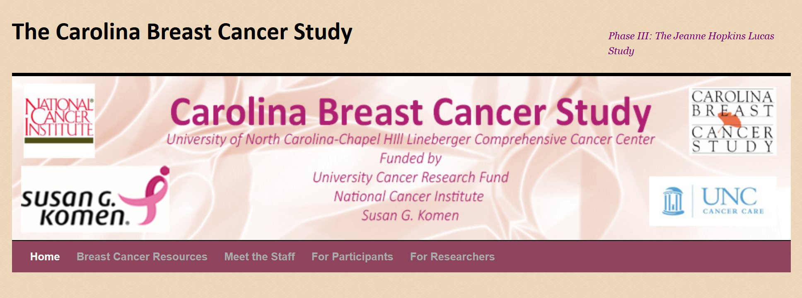
Carolina Breast Cancer Study
Thanks to: Iain Carmichael (Deep Learning, AJIVE)
Melissa Troester (Head, CBCS)
Joseph Geradts, Benjamin Calhoun (Pathology)
Katie Hoadley, Chuck Perou (Genomics)

Slide 3
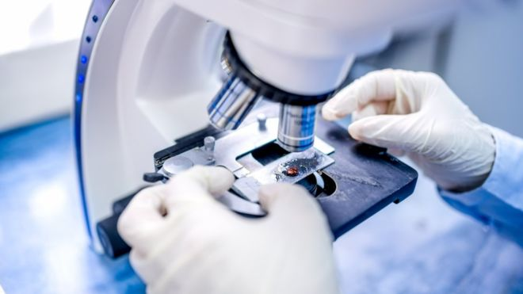
Carolina Breast Cancer Study
Clinical Diagnosis of Cancer:
Pathologist Views Tissue Under Microscope,
Tissue Stained with Hematoxylin & Eosin (H&E)
Thanks to BBC.CO.UK
and Reseachgate.net

Slide 4
Carolina Breast Cancer Study
Analysis Goal:
Understand How Images & Genomics
Work Together
Work Separately
Approach: AJIVE
Clinical Diagnostic Standard
Deep Insight &
New Treatments
As of Jan. 2020: ~70
Drugs Approved for
Breast Cancer Therapy

Slide 5
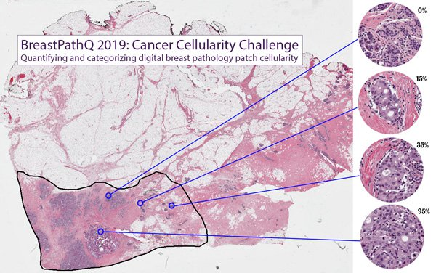
Carolina Breast Cancer Study
Tissue Micro Array Data:
Extract Small
(1mm diam.)
“Cores”
Thanks to SPIE.ORG

Slide 6
Carolina Breast Cancer Study
Experimental Design: $n=1191$ people
For Each:
1 – 4 TMA Cores
PAM 50 Gene Expression:

Slide 7
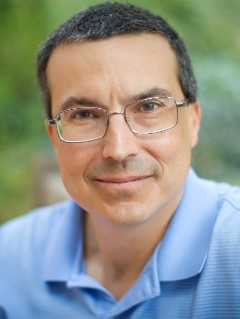
Carolina Breast Cancer Study
PAM 50 Gene Expression:
Set of 50 Genes
Measured mRNA Expression Level
Good at Separating SubTypes
Basal
Her2
Luminal A
Luminal B
Early Technology, More Recent
RNAseq → 10,000s Genes
Perou Discovery:
No Benefit From
Chemo-Therapy

Slide 8
Carolina Breast Cancer Study
Deep Learning Image Representation
Each Core:
Randomly
Select 100
$224×224$
Patches

Slide 9
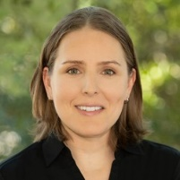
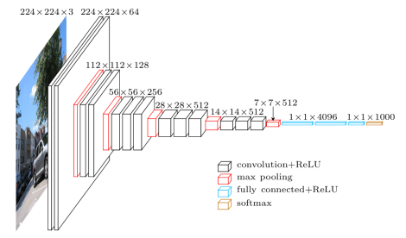
Carolina Breast Cancer Study
Deep Learning Image Representation
Reduce Each Patch to 512 Features
Using Transfer Learning From VGG16:
(Trained on Many
Natural Images,
“Image Net”)
Thanks to pyimagesearch.com
Heather Couture
Marc Niethammer

Slide 10
Carolina Breast Cancer Study
Deep Learning Image Representation
For Each Core:
Aggregate Patches by Averaging
(Damps Out “Location” Information)
Then Average Cores For Each Person

Slide 11
Data Integration Approach
Analysis Method
For How Images and Genomics Relate:
JIVE
(Joint and Individual Variation Explained)

Slide 12
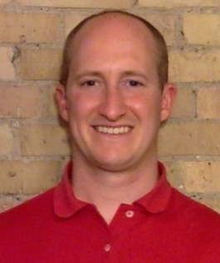
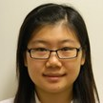
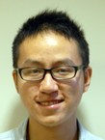
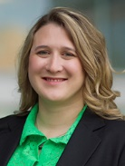
JIVE Collaborators
Eric Lock
Andrew Nobel
Katie Hoadley
Qing Feng
Meilei Jiang
Jan Hannig

Slide 13
JIVE Data Structure
Organizational Model
for Single Data Set:
Matrix
Convention in this talk:
“Columns as Data Objects”
(Atoms of the Statistical Analysis,
i.e. Experimental Units, or Data Vectors)

Slide 14
JIVE Data Structure
Organizational Model
for Single Data Set:
Matrix
Convention in this talk:
“Columns as Data Objects”
$$d$$
$$n$$
$d =$number of variables (i.e. features)
$n =$number of cases (i.e. subjects or samples)

Slide 15
JIVE Data Structure
Organizational Model
for Single Data Set: ←
Matrix
Convention in this talk:
Data Are “Column Object Centered”
i.e. Mean Vector is 0

Slide 16
JIVE Data Structure
Organizational Model
for Single Data Set:
Matrix
Convention in this talk:
Data Are “Column Object Centered”
i.e. Mean Vector is 0
i.e. Mean of Entries in Each Row is 0

Slide 17
JIVE Data Structure
JIVE Organizational Model:
Multiple Matrices
(Data Types, i.e. “Blocks”)
With common
Columns as Data Objects

Slide 18
JIVE Data Structure
JIVE Organizational Model:
Multiple Matrices
(Data Types, i.e. “Blocks”)
With common
Columns as Data Objects
1st consider only 2 blocks

Slide 19
JIVE Data Structure
JIVE Organizational Model:
Multiple Matrices:
$d_{1},d_{2}=$number of variables
(i.e. features)
$$d_{1}$$
$$n$$
$n =$number of cases
(i.e. subjects or samples)
$$d_{2}$$
$$n$$

Slide 20
JIVE Analytic Goals
Explore & Quantify Variation
(At Person Level for CBCS)
In spirit of PCA
(Principal Component Analysis)

Slide 21
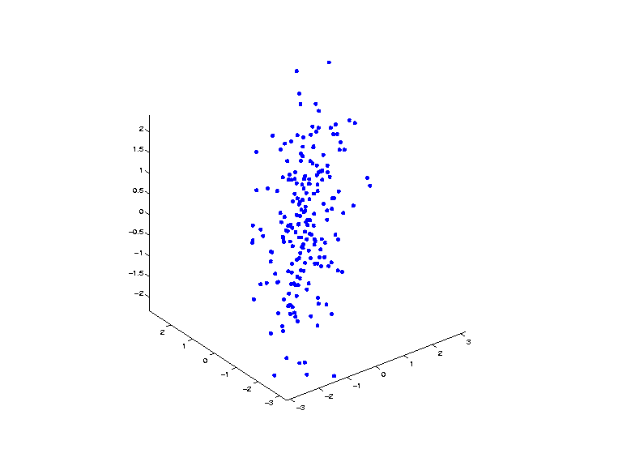
Demo PCA in $ℝ^{3}$
Raw Toy Data Set in $ℝ^{3}$

Slide 22
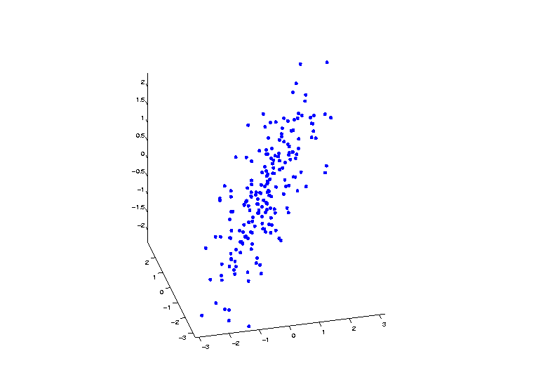
Demo PCA in $ℝ^{3}$
Raw Toy Data Set in $ℝ^{3}$

Slide 23
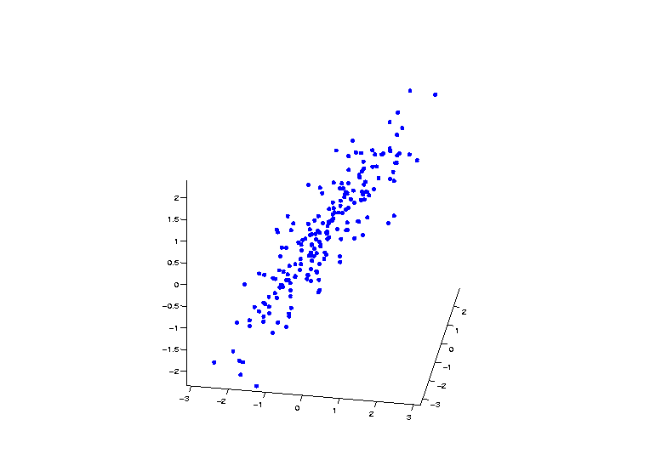
Demo PCA in $ℝ^{3}$
Raw Toy Data Set in $ℝ^{3}$

Slide 24
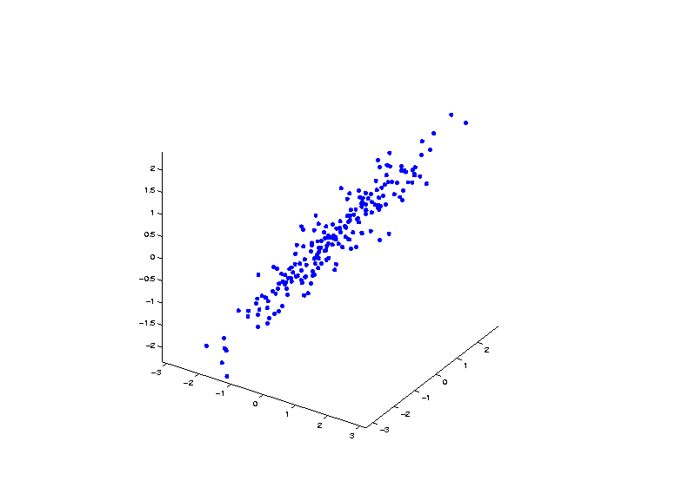
Demo PCA in $ℝ^{3}$
Raw Toy Data Set in $ℝ^{3}$

Slide 25
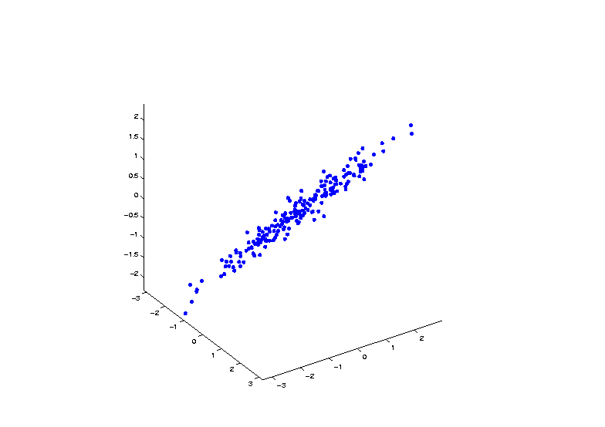
Demo PCA in $ℝ^{3}$
Raw Toy Data Set in $ℝ^{3}$

Slide 26
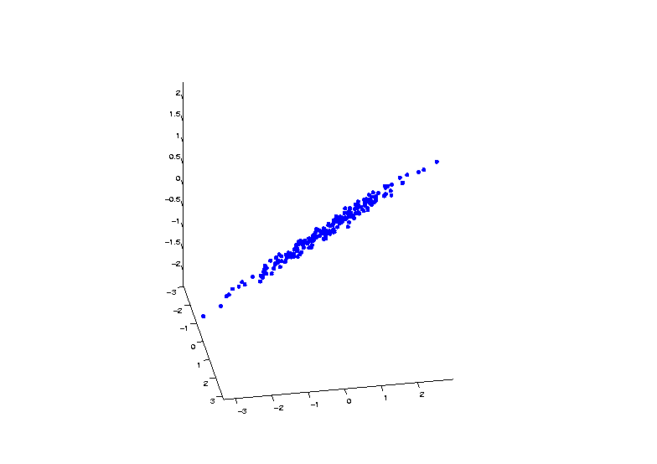
Demo PCA in $ℝ^{3}$
Raw Toy Data Set in $ℝ^{3}$

Slide 27
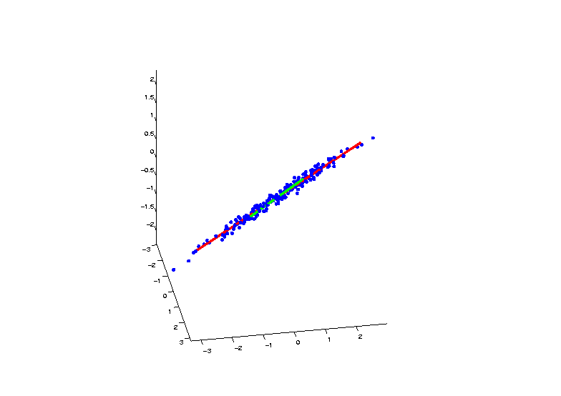
Demo PCA in $ℝ^{3}$
PCA Eigenvectors Give Useful Coordinates

Slide 28
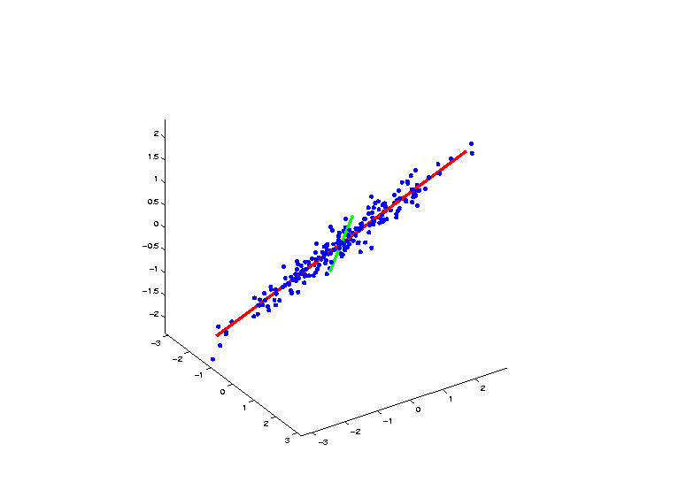
Demo PCA in $ℝ^{3}$
PCA Eigenvectors Give Useful Coordinates

Slide 29
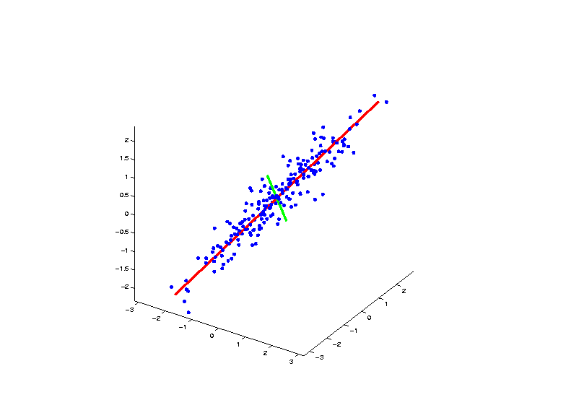
Demo PCA in $ℝ^{3}$
PCA Eigenvectors Give Useful Coordinates

Slide 30
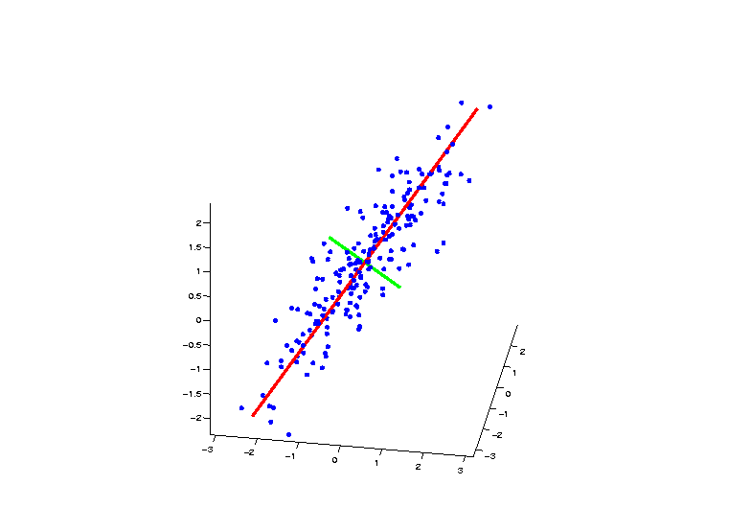
Demo PCA in $ℝ^{3}$
PCA Eigenvectors Give Useful Coordinates

Slide 31
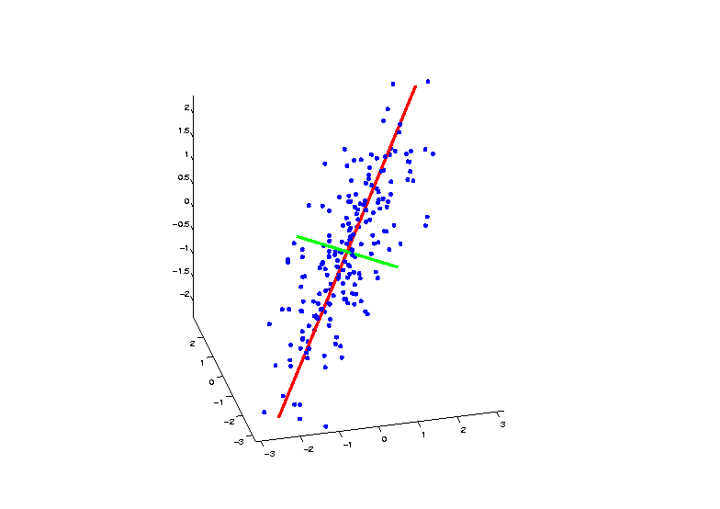
Demo PCA in $ℝ^{3}$
PCA Eigenvectors Give Useful Coordinates

Slide 32
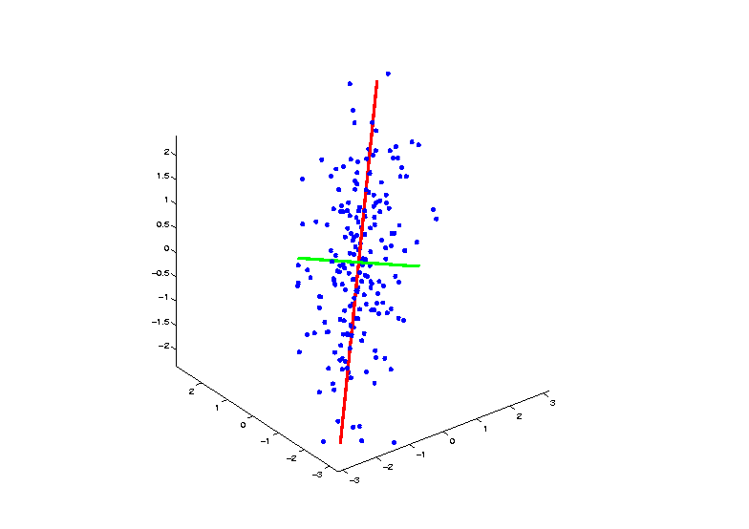
Demo PCA in $ℝ^{3}$
PCA Eigenvectors Give Useful Coordinates

Slide 33
PCA Underpinnings
For Col. Object Mean Centered Data Matrix:
Apply Singular Value Decomposition
$$r$$
$$r$$
$$=$$
$$r$$
$$n$$
$$d$$
$$d$$
$$n$$
$$r$$
Loadings
x Scores

Slide 34
PCA Toy Eg. - Functional Data Analysis
$n=50,$
$d=10$
Data
Vectors
Note Mode
of Variation:
All Up vs.
All Down
Loading
Vectors
x
Scores
Scores

Slide 35
JIVE for CBCS
Joint Variation:
Loadings & Scores
Individual Variation:
Loadings & Scores
Useful Visualizations of Variation:
Images: Study Those With Extreme Scores
Gene Expression: Study Loadings

Slide 36
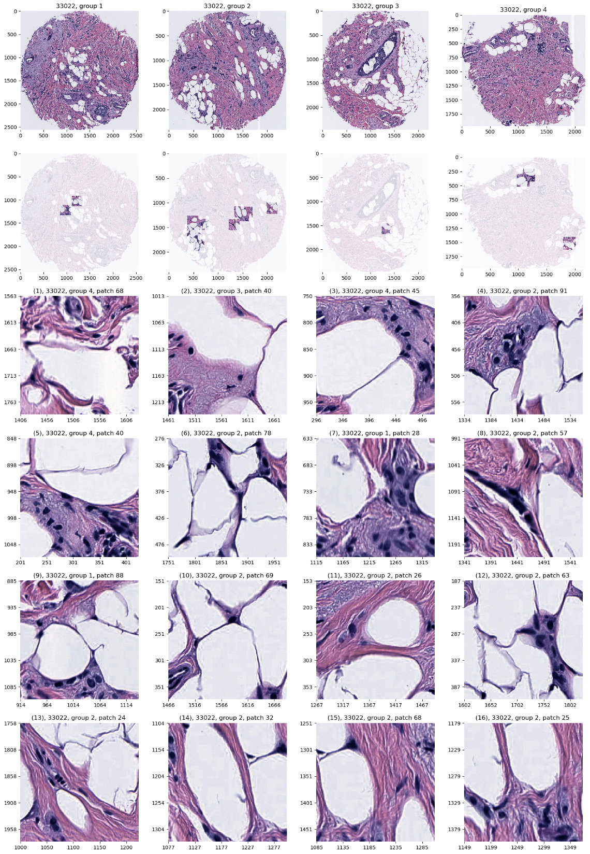
Carolina Breast Cancer Study
JIVE: Common Normalized Scores 1
Look at Extremes
Negative End
Top Person
Top 16 Patches
Fat Cells & Stroma

Slide 37
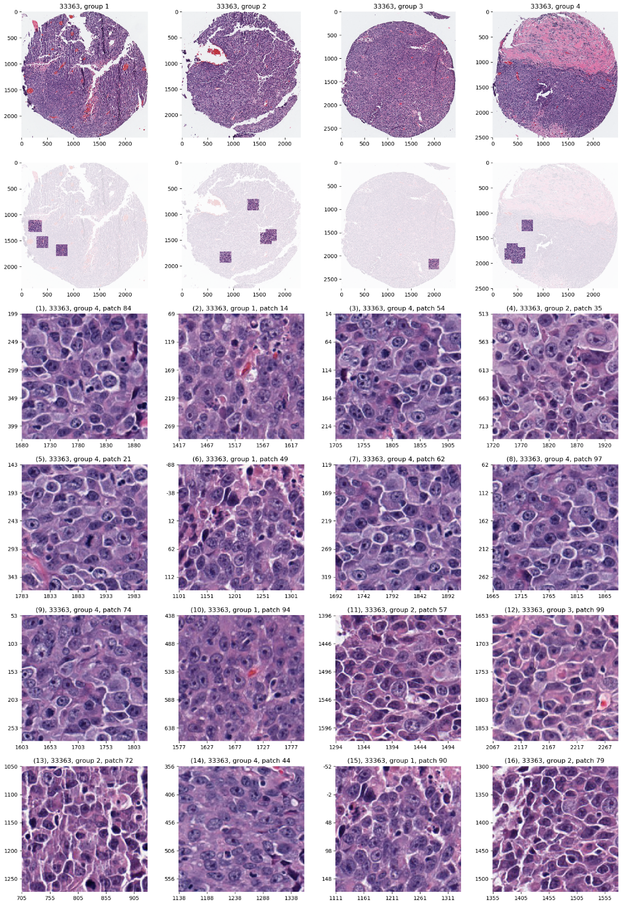
Carolina Breast Cancer Study
JIVE: Common Normalized Scores 1
Look at Extremes
Positive End
Top Person
Top 16 Patches
Highly “Cellular”
Markedly Atypical Cells

Slide 38
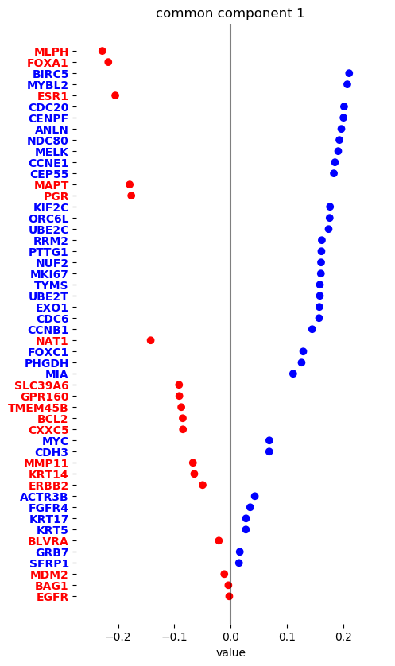
Carolina Breast Cancer Study
JIVE: Gene Expression
Common Normalized
Loadings 1
Very Consistent w/ Image
“High Proliferation” Genes
“Low Prolif.” – Lum A Genes

Slide 39
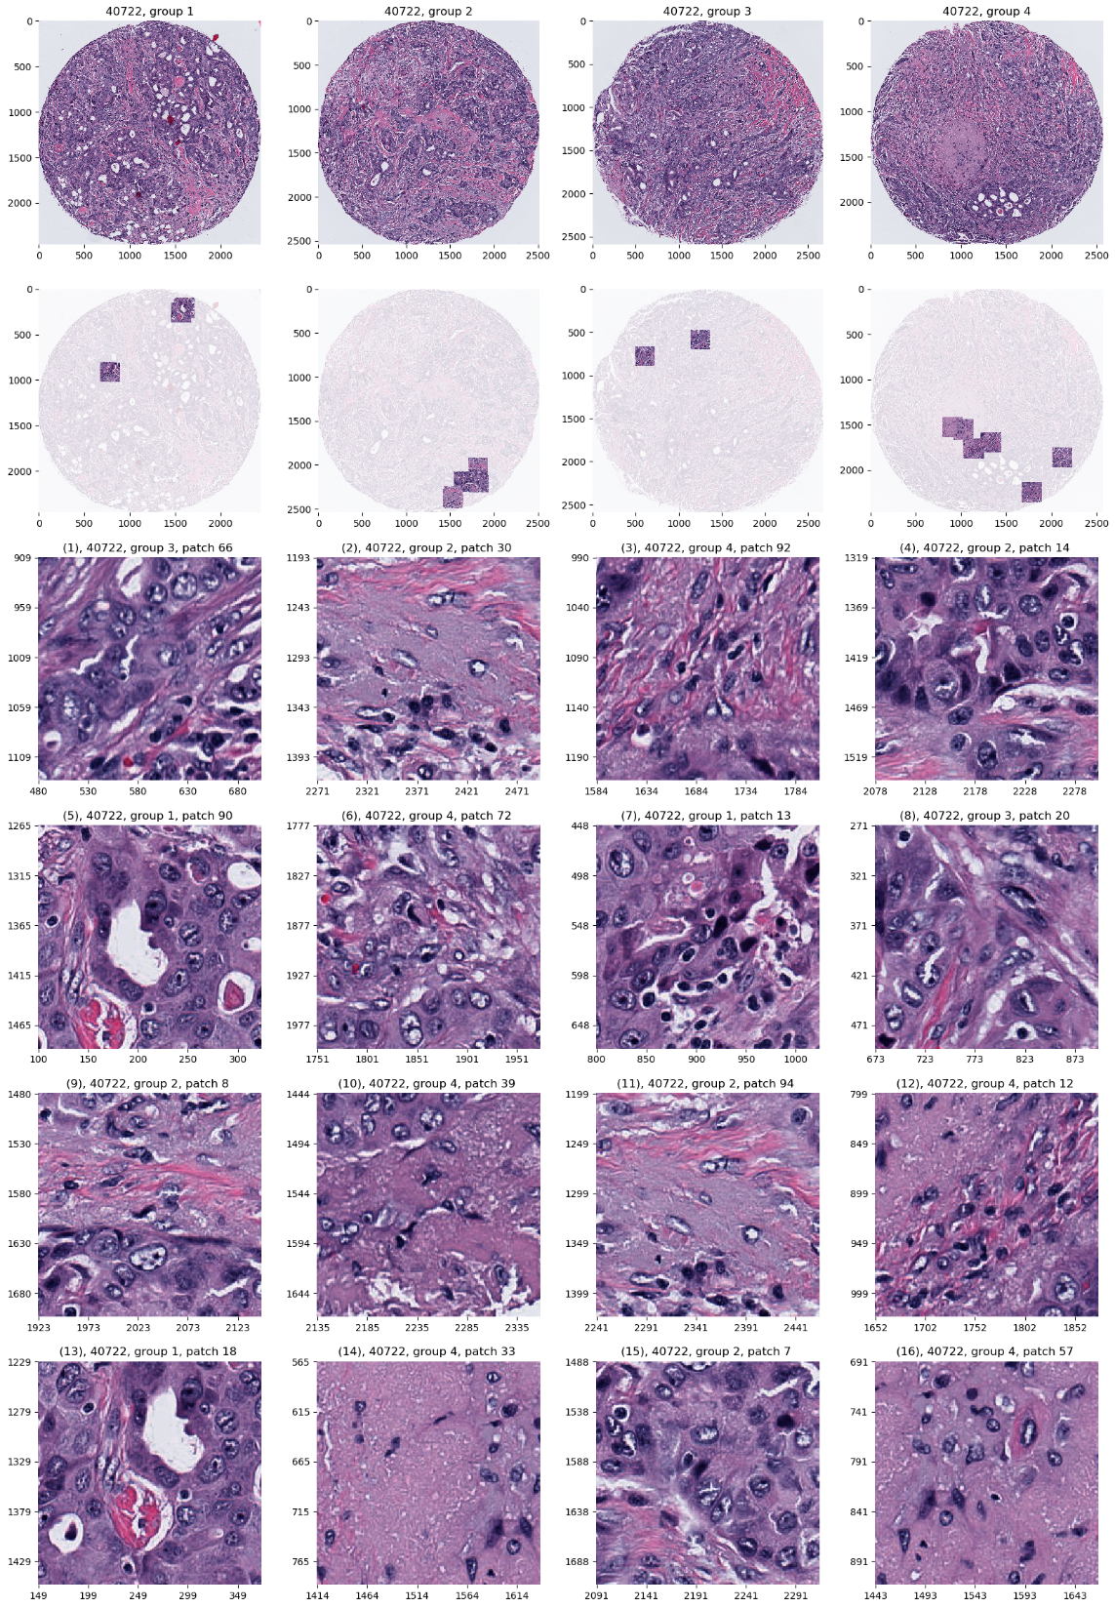
Carolina Breast Cancer Study
JIVE: Common Normalized Scores 2
Look at Extremes
Negative, Top
Top 16 Patches
High Nuclear Grade
Atypical Cells

Slide 40
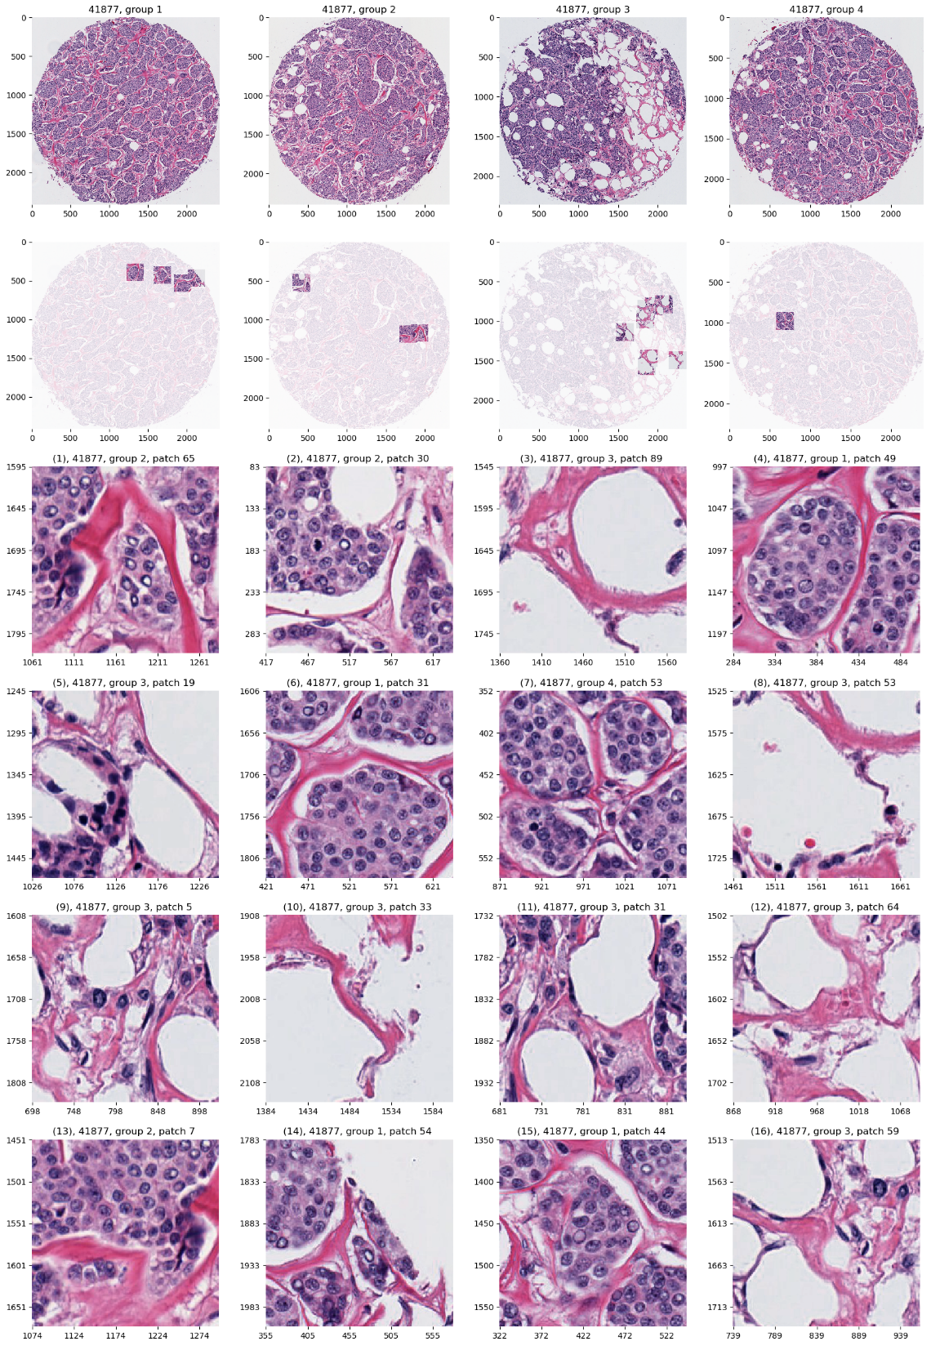
Carolina Breast Cancer Study
JIVE: Common Normalized Scores 1
Look at Extremes
Positive, Top
Top 16 Patches
Lower Nuclear Grade
Stroma, Sclerosis

Slide 41
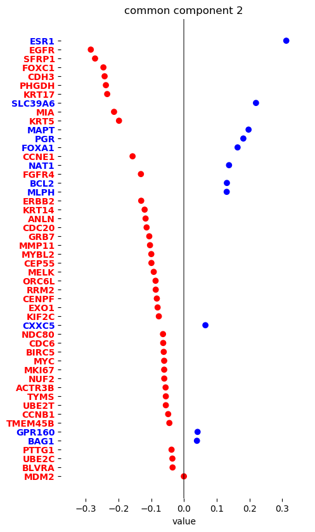
Carolina Breast Cancer Study
JIVE: Gene Expression
Common Normalized
Loadings 2
Very Consistent w/ Image
Luminal Subtype Genes
Basal Subtype Genes

Slide 42
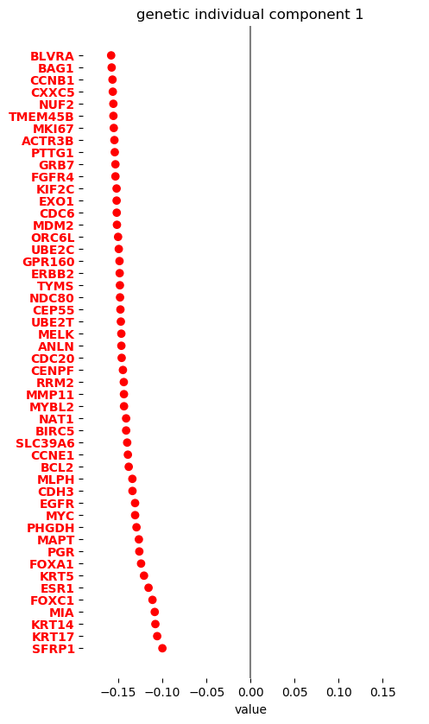
Carolina Breast Cancer Study
JIVE, Genes, Individual 1
Overall Up & Down
Together
Not Subtype Related!

Slide 43
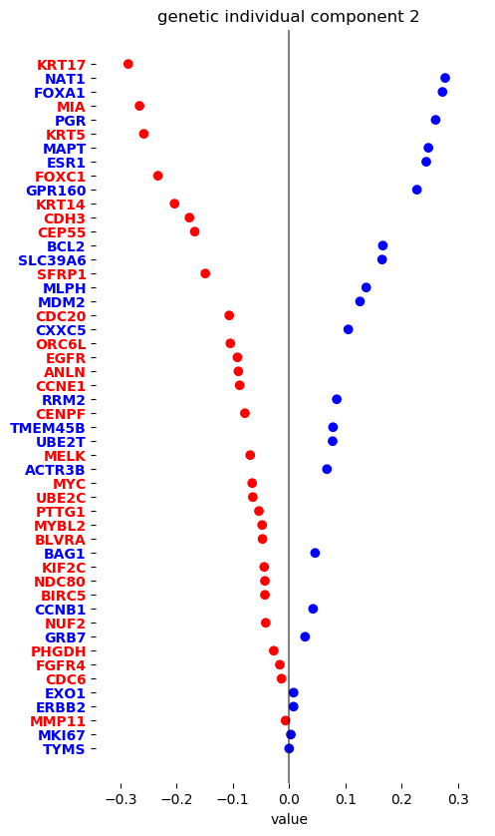
Carolina Breast Cancer Study
JIVE, Genes, Individual 2
Luminal vs. Basal
“Contrast”?
“Unbalanced Types”?

Slide 44
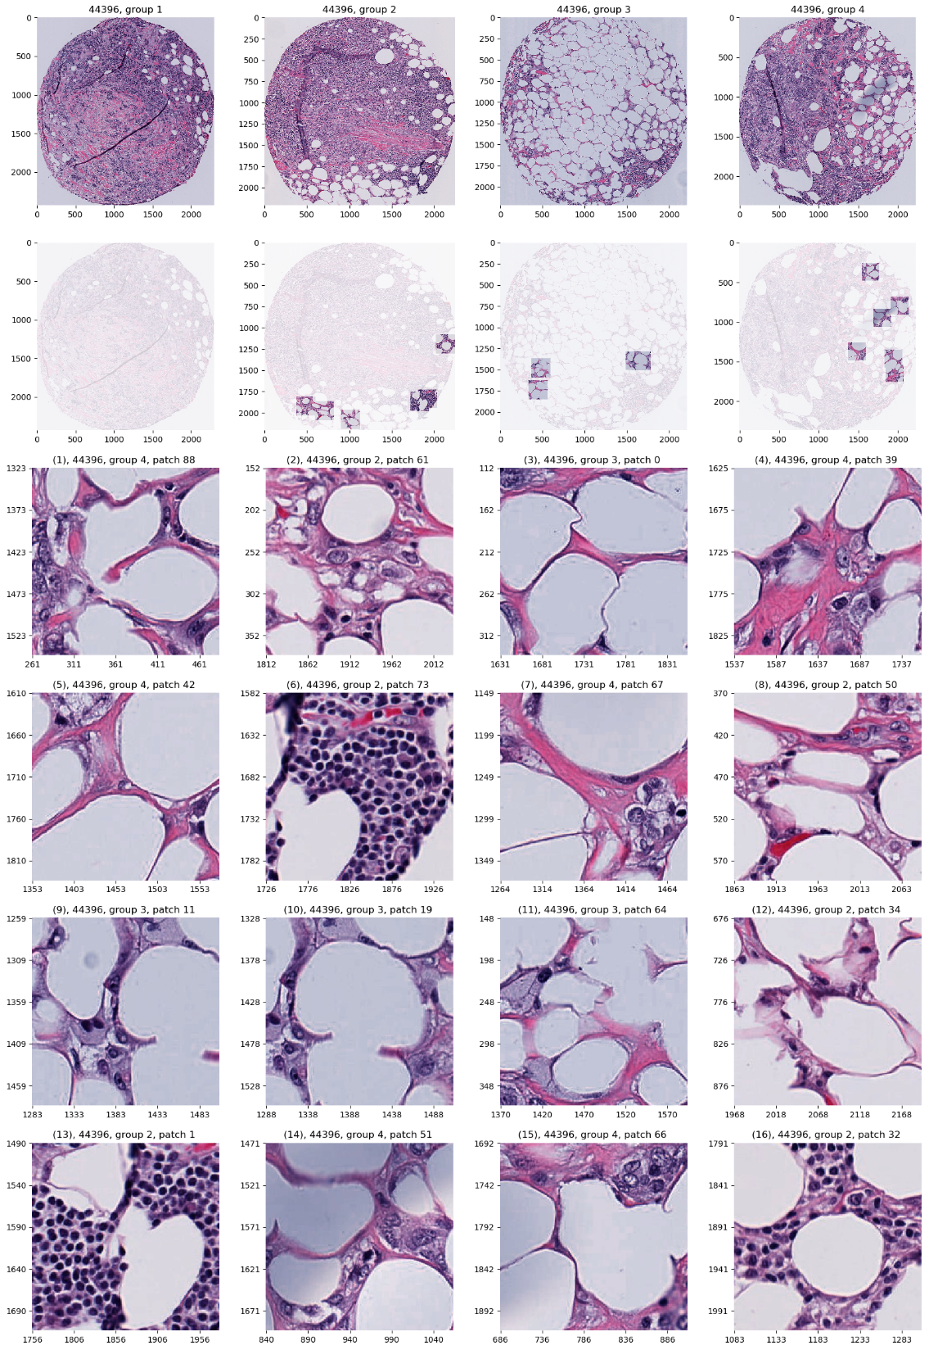
Carolina Breast Cancer Study
JIVE, Images, Individual 1
Negative
Mostly Fat Cells
Few Nuclei

Slide 45
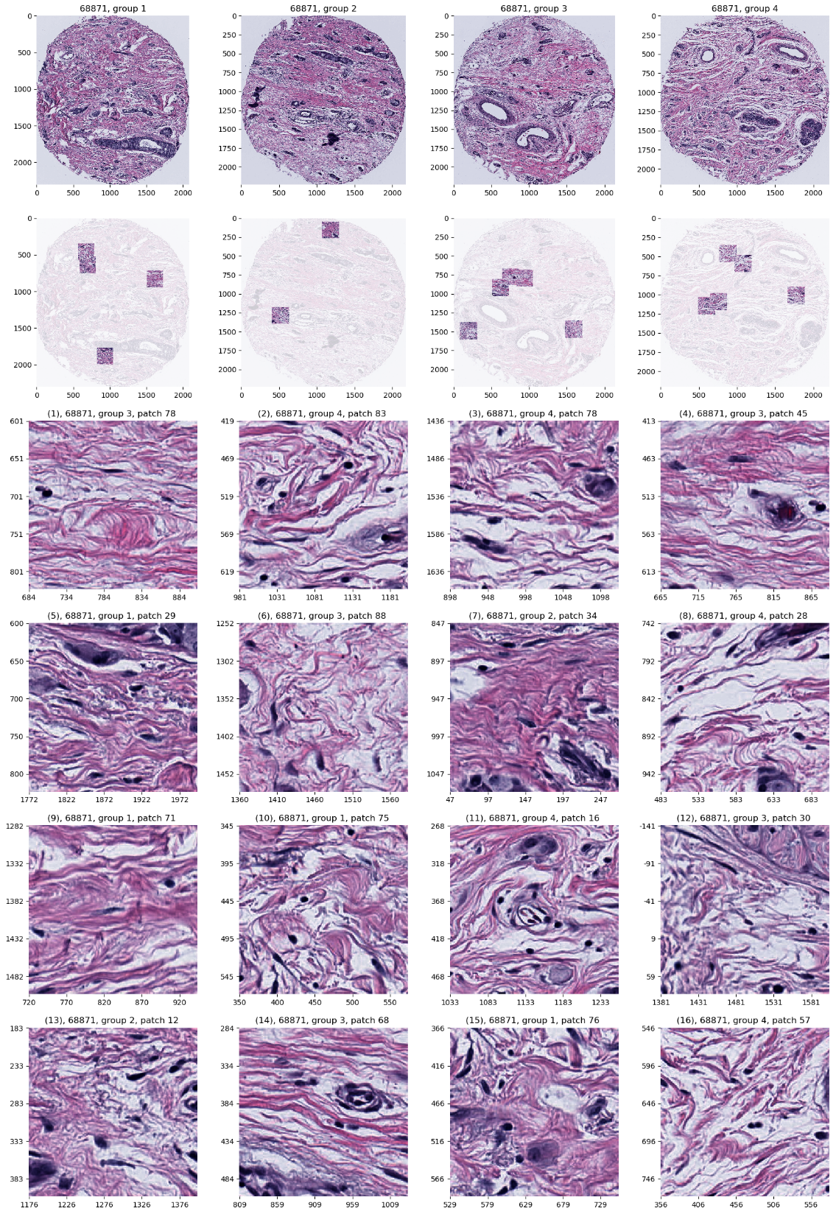
Carolina Breast Cancer Study
JIVE, Images, Individual 1
Positive
Reactive Stroma,
Few Nuclei
Little Gene Connected

Slide 46
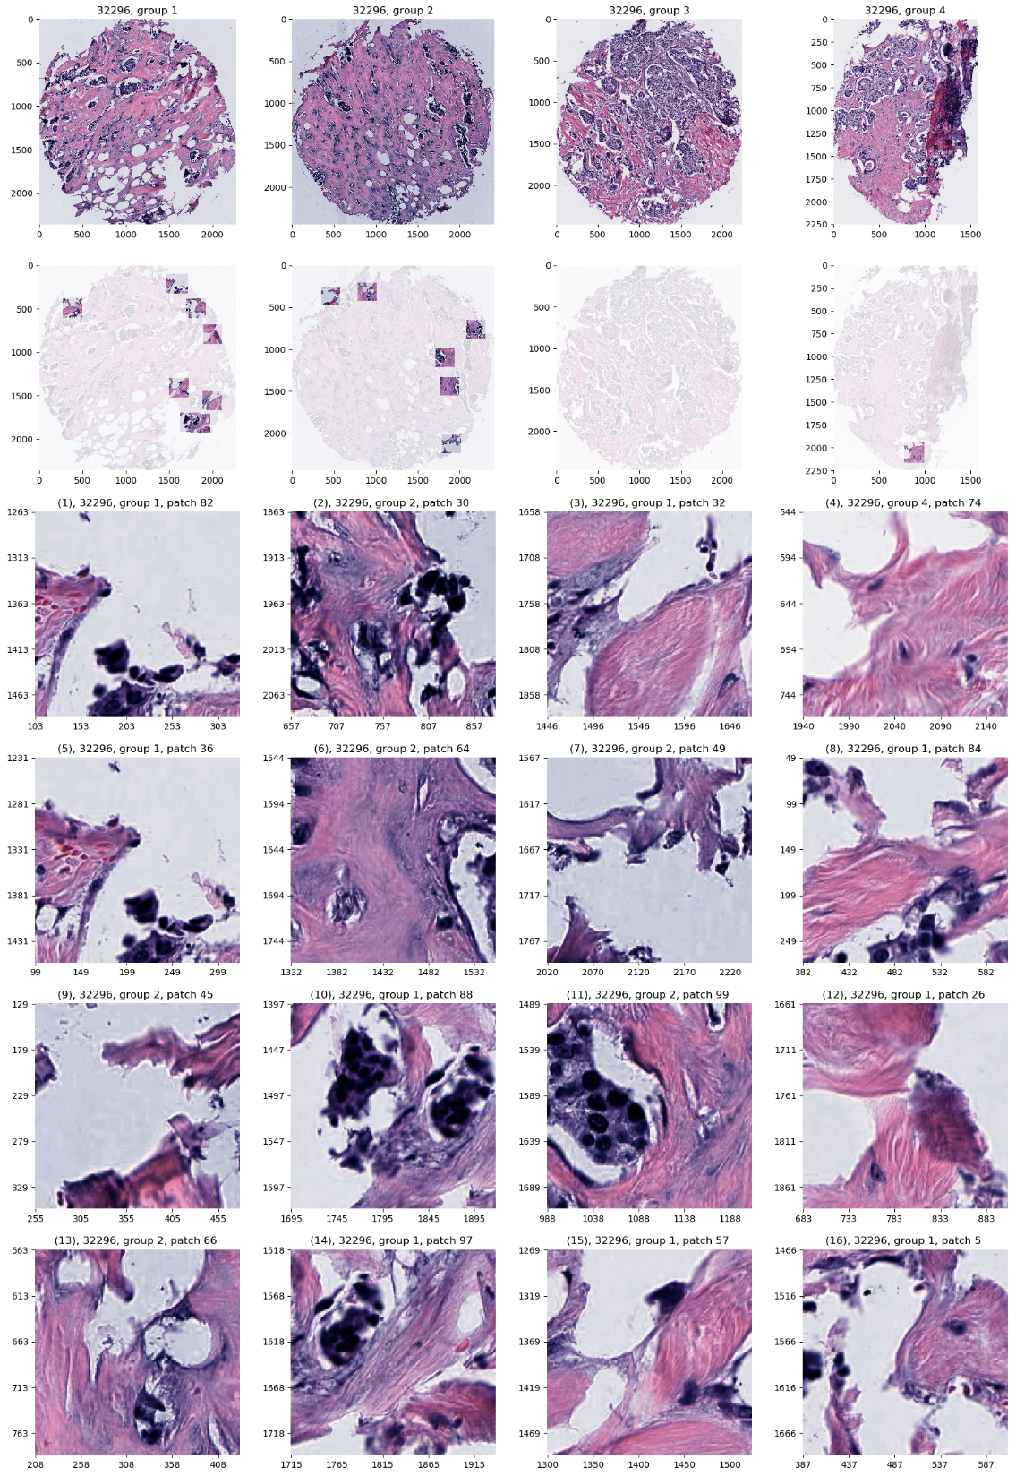
Carolina Breast Cancer Study
JIVE, Images, Individual 2
Negative
Mucinous & Micro-
Papillary Carcinoma
Not PAM50 Related

Slide 47
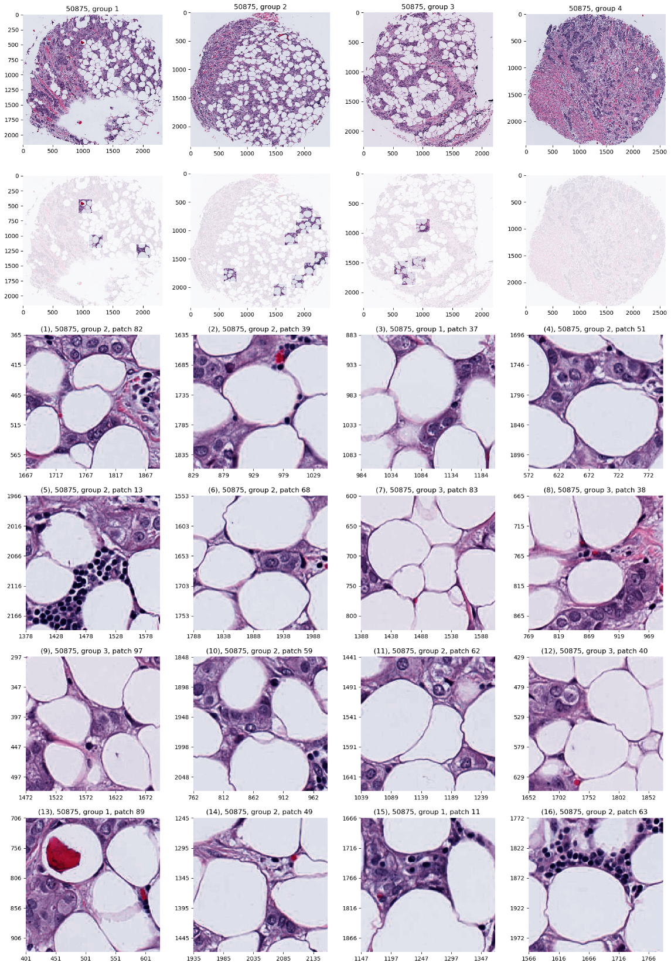
Carolina Breast Cancer Study
JIVE, Images, Individual 2
Positive
Fat Cells
Common Endpoint?
“Center”?

Slide 48
Reference
Results Drawn Approximately From:
Carmichael, I., Calhoun, B. C., Hoadley, K. A., Troester, M. A., Geradts, J., Couture, H. D., ... & Marron, J. S. (2019). Joint and individual analysis of breast cancer histologic images and genomic covariates.
(Submitted to Annals of Applied Statistics)
https://arxiv.org/pdf/1912.00434.pdf

Slide 49
Big Picture: Synonyms
Multi – Block Data Analysis
Data Fusion
Data Integration
Multi – View (Machine Learning)
$$⋮$$
Usually Only Joint
Not Individual

Slide 50
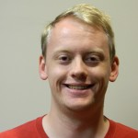
JIVE: Next Generation
DIVAS
Data Integration Via Analysis of Subspaces
Jack Prothero Jan Hannig Quoc Tranh-Dinh

Slide 51
DIVAS Improves JIVE
Partially Shared Blocks

Slide 52
DIVAS Improves JIVE
Partially Shared Blocks
JIVE
$$≈$$
$$+$$
Input
Data
Joint
Comp.
Indiv.
Comp.

Slide 53
DIVAS Improves JIVE
Partially Shared Blocks
DIVAS
$$≈$$
$$+$$
$$+$$
$$+$$
$$+$$
Input
Data
Joint
Comp.
Partial
Sharing
Indiv.
Comp.

Slide 54
DIVAS Improves JIVE
Partially Shared Blocks
Better Initial Low Rank Approx. (SVD)
Using Marcenko-Pastur & Shrinkage
Inference from Random Direction Bounds
Iterative Search Approach
Gives Better Statistical Inference

Slide 55
DIVAS Improves JIVE
Statistical Inference Assumptions:
= $+ ε$
Low
Rank
Approx.
Data
Block
$d_{k}×n$, Rotationally Invariant Variance
e.g. iid Errors

Slide 56
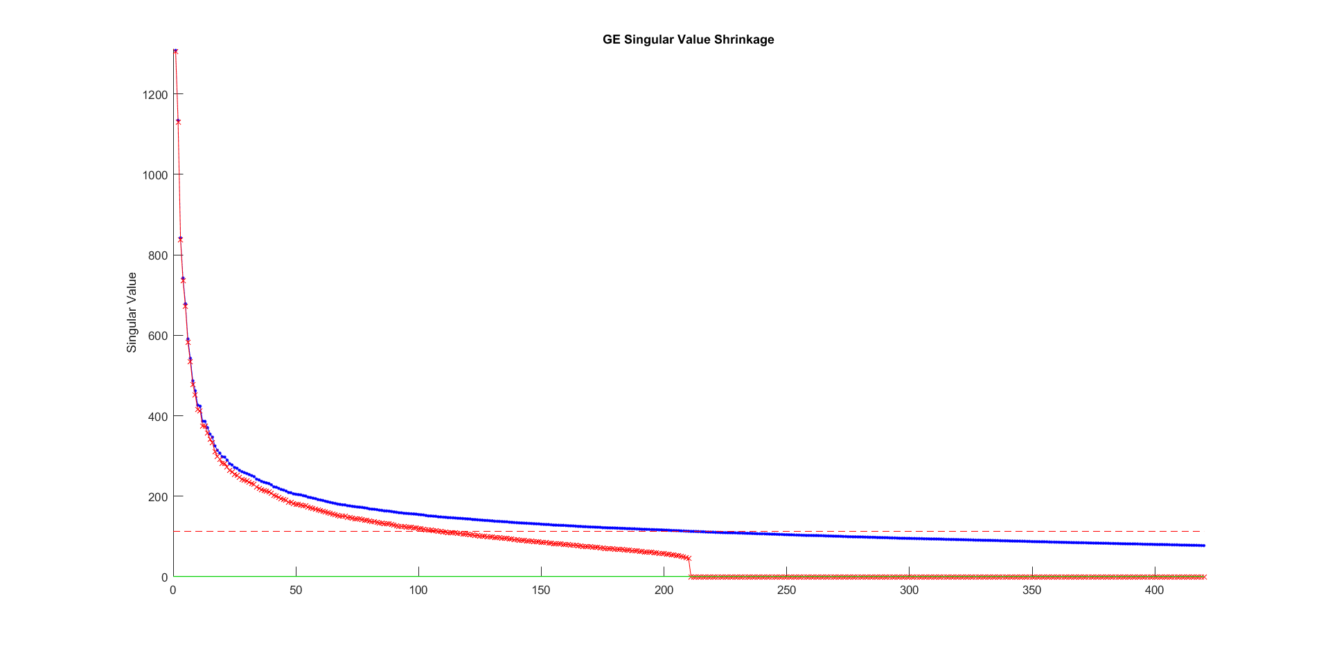
DIVAS Improves JIVE
2a. Marcenko-Pastur & Shrinkage
E.g. Gene Expression
Data Block
Shabalin-Nobel
&
Gavish-Donoho
Shrinkage

Slide 57
DIVAS Improves JIVE
2b. Random Direction Bounds
Idea: For each data block
$V⊆ℝ^{n}$ = Approx’ng Subspace of Rank $r$
$u$ a random direction (Unif. on $S^{n}$)
For distribution of $angle(u,V)$,
Rand. Dir’n Bound = 0.05 Quantile
Easy to Simulate

Slide 58
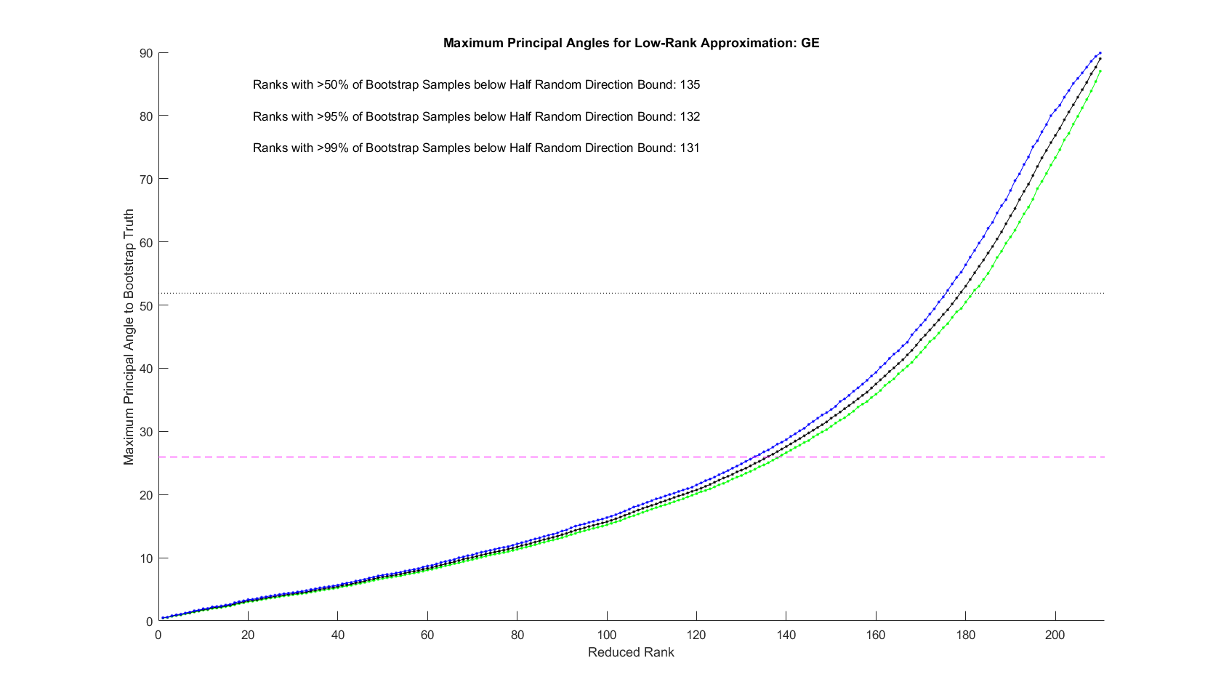
DIVAS Improves JIVE
2b. Random Direction Bounds
E.g. Gene Expression
Data Block

Slide 59
DIVAS Improves JIVE
2c. Iterative Search Approach
Idea:
Index Data Blocks $k=1,⋯,K$
And Approx. Subspaces $V_{k}⊆ℝ^{n}$
Seek ${u′∈S}^{n}$, so $angle\left(u^{′},V_{k}\right)<RDB$
Iterate over orthogonal subspaces
Infeasible? Reduce Index Set

Slide 60
DIVAS on TCGA Data
Breast Cancer
Gene Expression (GE) [16615 x 616]
Copy Number (CN) [24174 x 616]
Protein Exp. (RPPA) [187 x 616]
Mutation Status (MU) [18256 x 616]

Slide 61
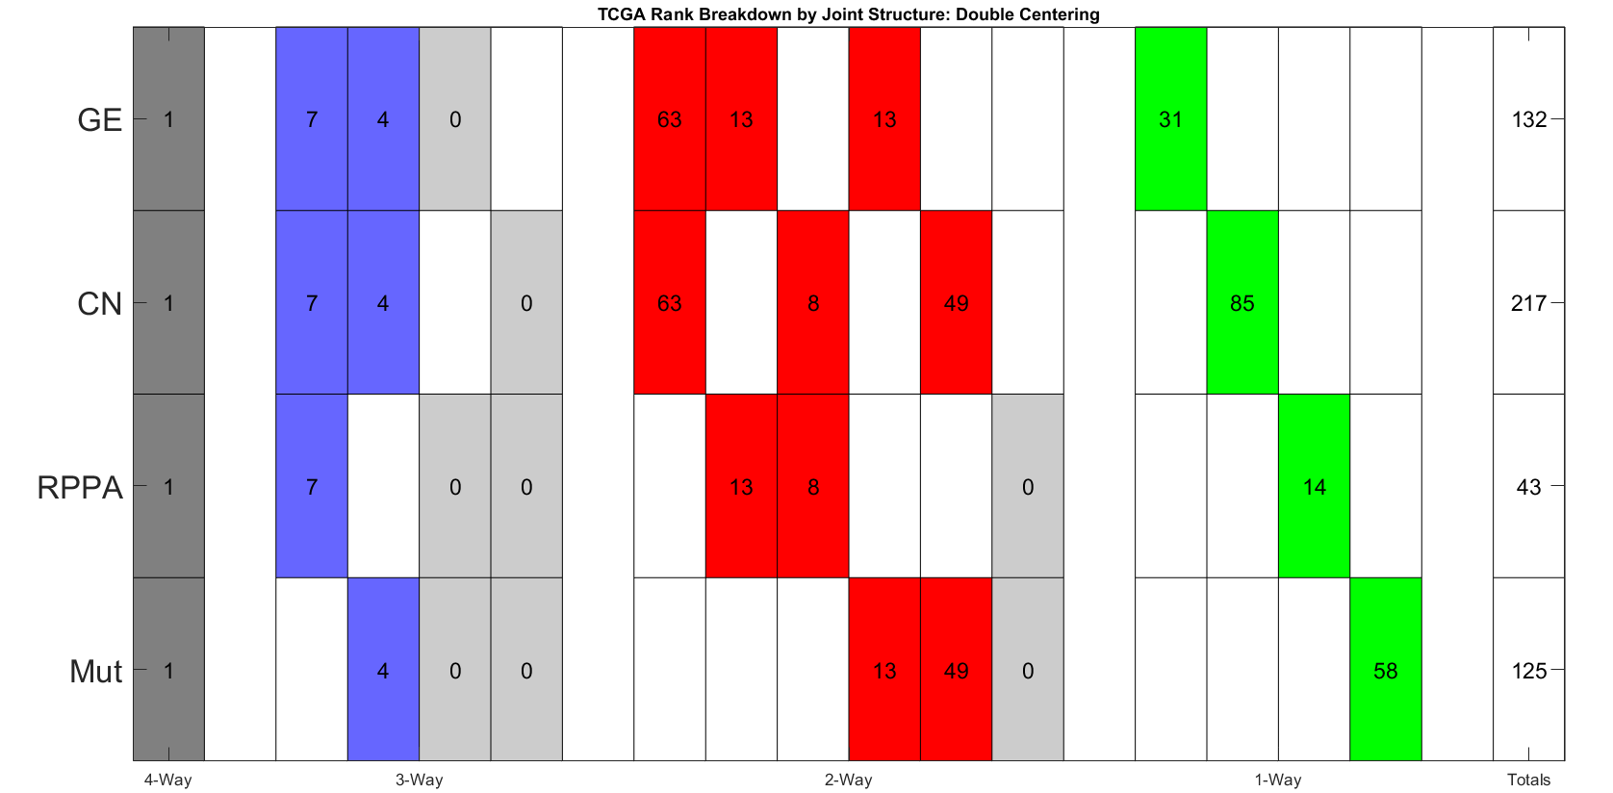
DIVAS on TCGA Data
Single 4-way mode, as in AJIVE Analysis
CN$→$GE$→$Protein Common
Statistical Significance Summary
Mut$→$CN$→$GE Sensible
No Mut$→$Protein
Without CN&GE

Slide 62
DIVAS on TCGA Data
Major CN$→$GE Variation
GE or CN$→$ Proteins
Statistical Significance Summary
Lots of Mut&CN Variation
No Mut$→$Protein
Without CN&GE

Slide 63
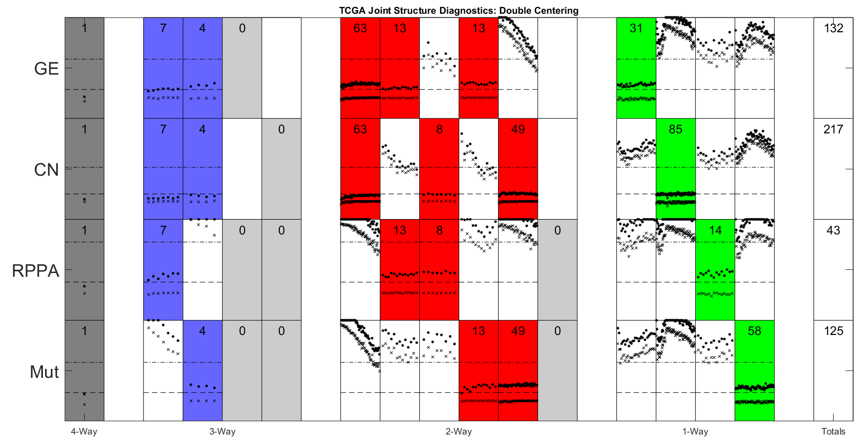
DIVAS on TCGA Data
Angle Based Diagnostic

