Slide 1
S. C. Big Data Health Sciences Conference
Object Oriented Data Analysis
J. S. Marron
Dept. of Statistics and Operations Research, University of North Carolina
February 6, 2020

Slide 2
How does Statistics relate to Data Science?
From My Elementary Courses:
Gaining Insight from Numbers
Similar to “Data Science” Definitions
The Science of Managing Uncertainty
Where Probability Modeling Is Vital
This is Why Statistics is Fundamental

Slide 3
More Currently Popular Terminology
Big Data
Isn’t It Just Statistics?
Yes, But More Needed Too
Maybe Bigger Challenge:
Complex Data
Optimization:
Machine Learning

Slide 4

An Idea Worth Spreading?
Well Understood Concept:
Great science now done by teams
with complementary skill sets
Biology
Chemistry
Engineering
Quantitative Work
Common Current Idea:
1 Team member
$$⋮$$

Slide 5
An Idea Worth Spreading?
Extension of this:
Great Quantitative Work needs teams
with complementary skill sets
Statistics
Imaging
Optimization
Data Base
…
Big
Data

Slide 6
An Idea Worth Spreading?
Proposed New Approach:
Team Data Science
Teams with Complimentary Skillsets
Education of Team Members:
  Bring Valued (Deep) Skill
  Know Enough to Communicate
  Give Opportunities to Practice

Slide 7
Object Oriented Data Analysis
What is the “atom” of a statistical analysis?
1st Course: Numbers
Multivariate Analysis Course : Vectors
Functional Data Analysis: Curves
More generally: Data Objects

Slide 8
Object Oriented Data Analysis
Original Thought:
OODA = Mathematical Framework
(containing wide variety
of interesting cases)

Slide 9
Object Oriented Data Analysis
Original Thought:
OODA = Mathematical Framework
Current View:
OODA = Focal Point
{For discussions (interdisciplinary)
about tackling serious analyses}

Slide 10
Object Oriented Data Analysis
Original Thought:
OODA = Mathematical Framework
Current View:
OODA = Focal Point
What should be the Data Objects?

Slide 11
Principal Component Analysis
More Than Dimensionality Reduction:
Visualization
  Relationships Between Objects (Scores)

Slide 12
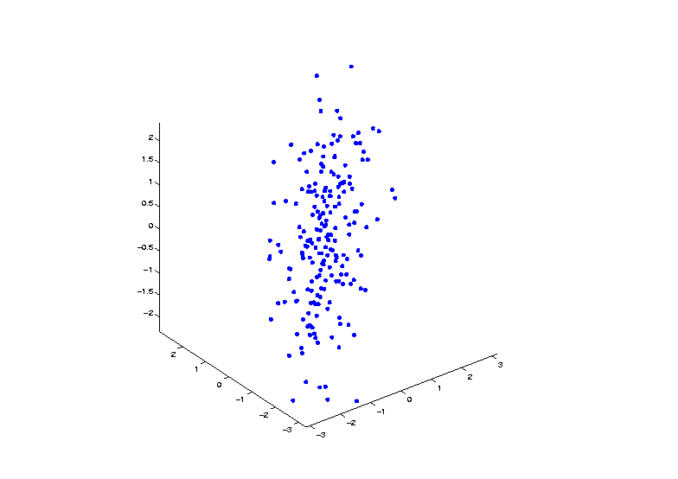


Demo PCA in $ℝ^{3}$
Raw Toy Data Set in $ℝ^{3}$

Slide 13
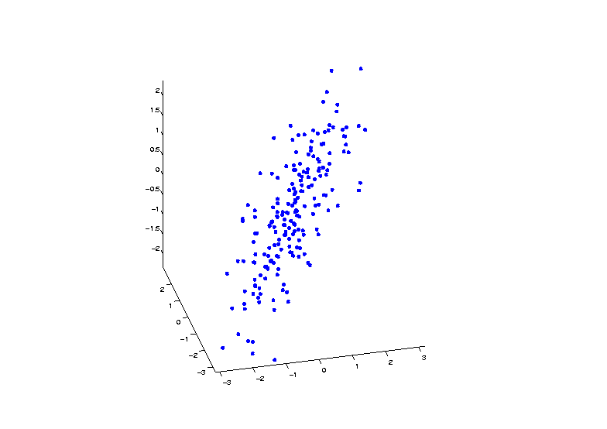
Demo PCA in $ℝ^{3}$
Raw Toy Data Set in $ℝ^{3}$

Slide 14
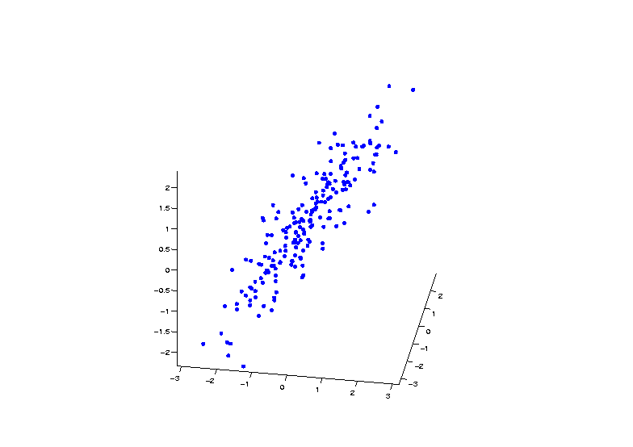
Demo PCA in $ℝ^{3}$
Raw Toy Data Set in $ℝ^{3}$

Slide 15
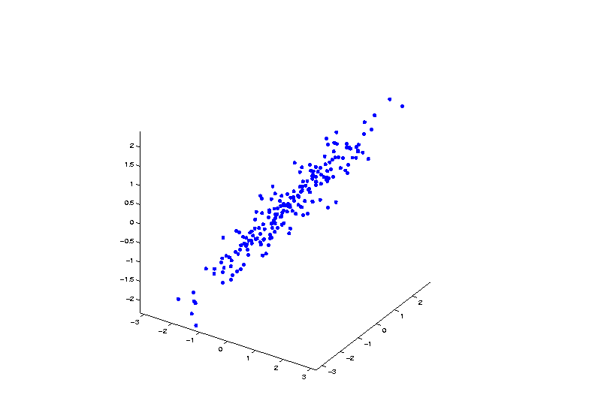
Demo PCA in $ℝ^{3}$
Raw Toy Data Set in $ℝ^{3}$

Slide 16
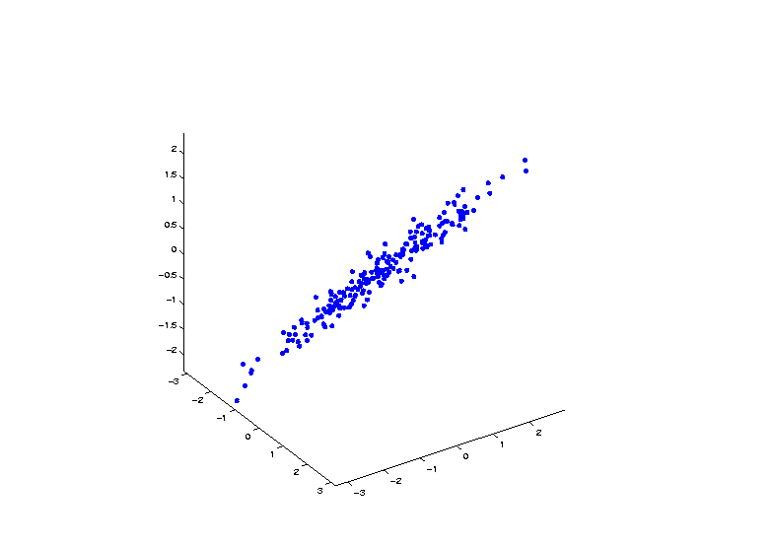
Demo PCA in $ℝ^{3}$
Raw Toy Data Set in $ℝ^{3}$

Slide 17
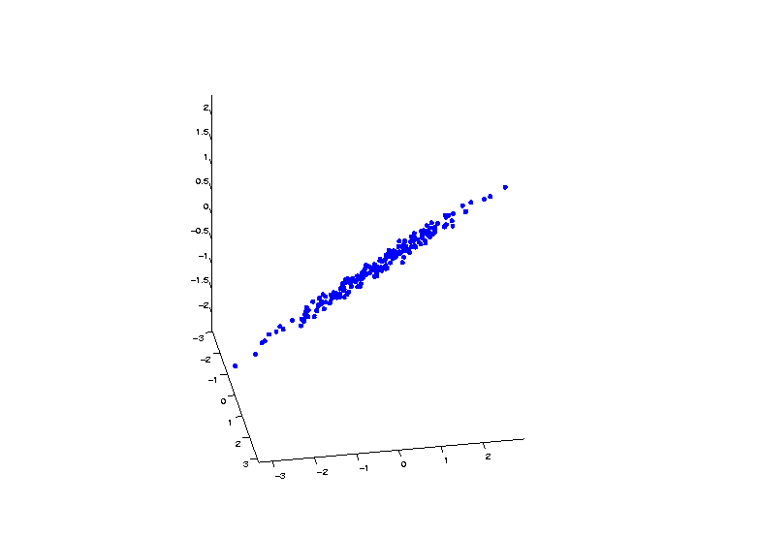
Demo PCA in $ℝ^{3}$
Raw Toy Data Set in $ℝ^{3}$

Slide 18
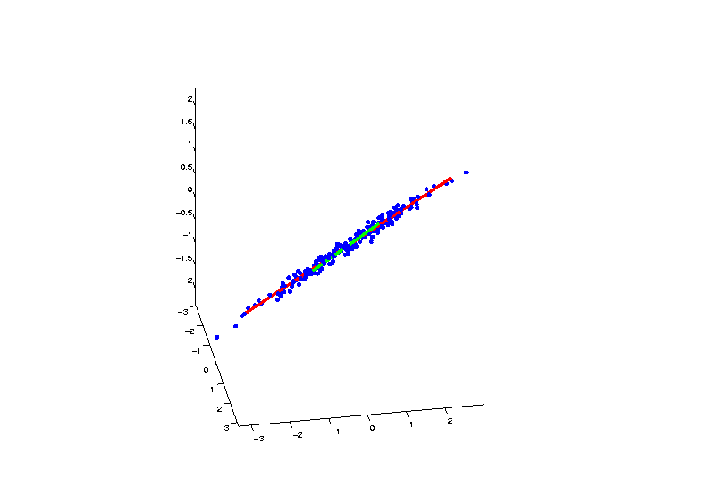
Demo PCA in $ℝ^{3}$
PCA Eigenvectors Give Useful Coordinates

Slide 19
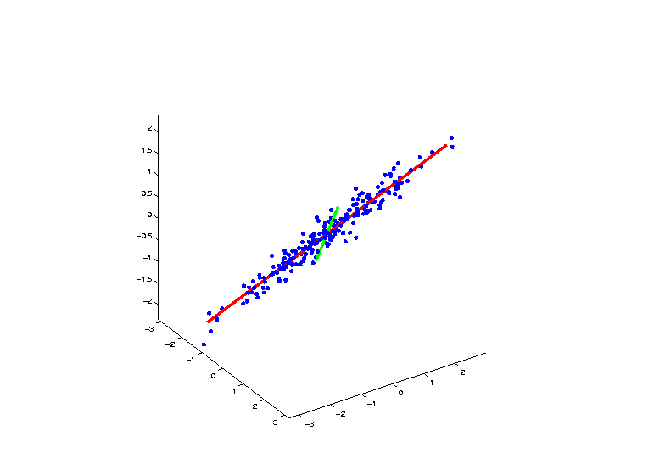
Demo PCA in $ℝ^{3}$
PCA Eigenvectors Give Useful Coordinates

Slide 20
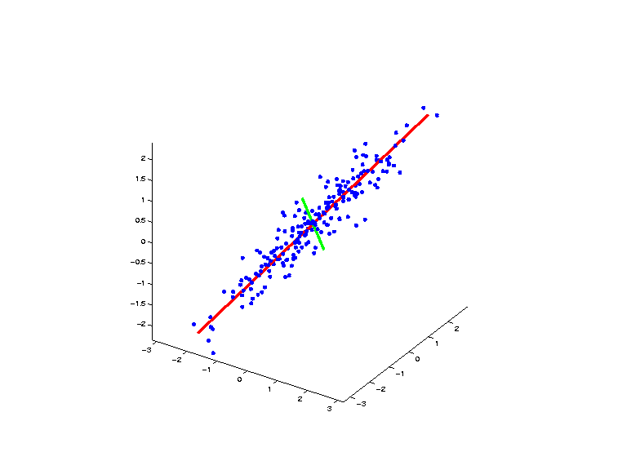
Demo PCA in $ℝ^{3}$
PCA Eigenvectors Give Useful Coordinates

Slide 21
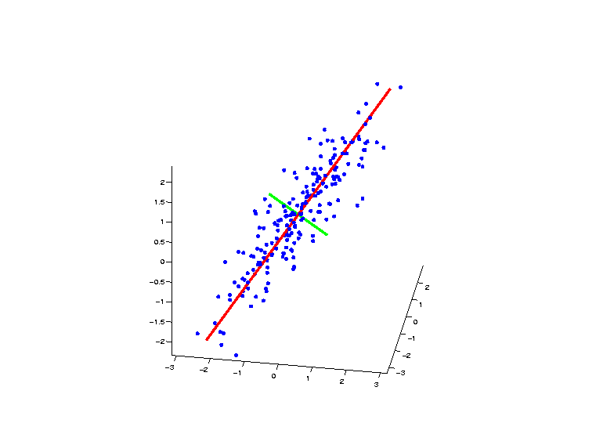
Demo PCA in $ℝ^{3}$
PCA Eigenvectors Give Useful Coordinates

Slide 22
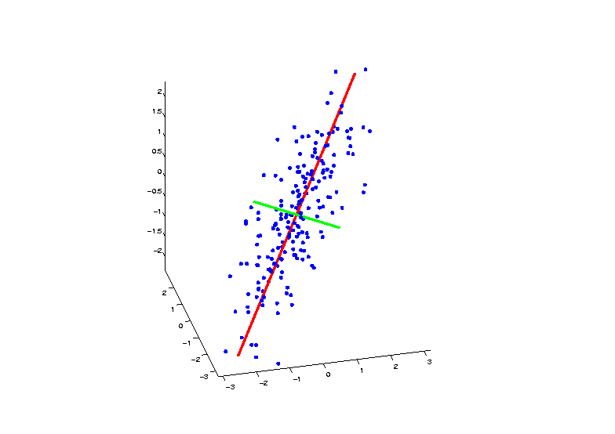
Demo PCA in $ℝ^{3}$
PCA Eigenvectors Give Useful Coordinates

Slide 23
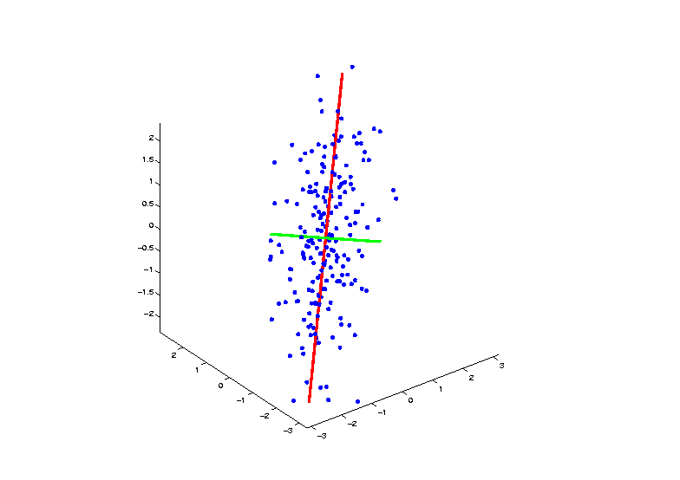
Demo PCA in $ℝ^{3}$
PCA Eigenvectors Give Useful Coordinates

Slide 24
Functional Data Analysis
Interesting Real Data Example
Genetics (Cancer Research)
RNAseq (Next Gener’n Sequen’g)
Deep look at “gene components”
Microarrays: Single number (per gene)
RNAseq: Thousands of measurements

Slide 25
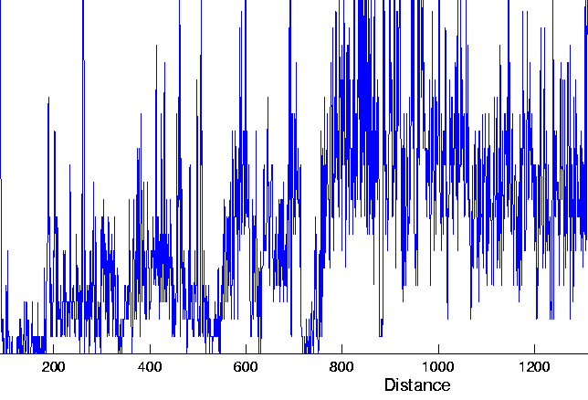
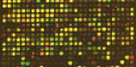
Functional Data Analysis
Interesting Real Data Example
Genetics (Cancer Research)
RNAseq (Next Gener’n Sequen’g)
Deep look at “gene components”

Slide 26
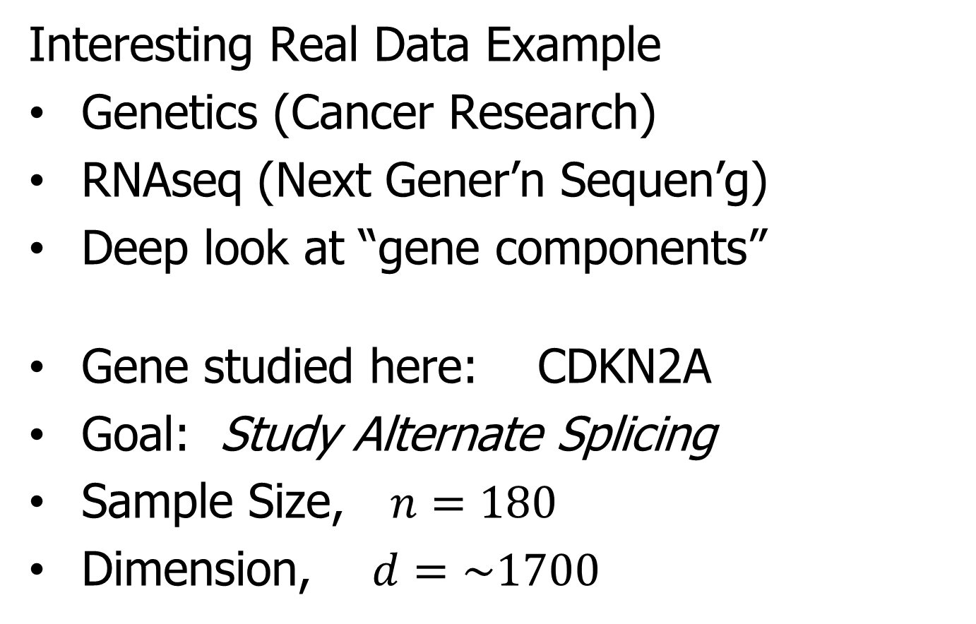
Functional Data Analysis
Interesting Real Data Example
Genetics (Cancer Research)
RNAseq (Next Gener’n Sequen’g)
Deep look at “gene components”
Gene studied here: CDKN2A
Goal: Study Alternate Splicing
Sample Size, $n=180$
Dimension, $d=\sim 1700$

Slide 27
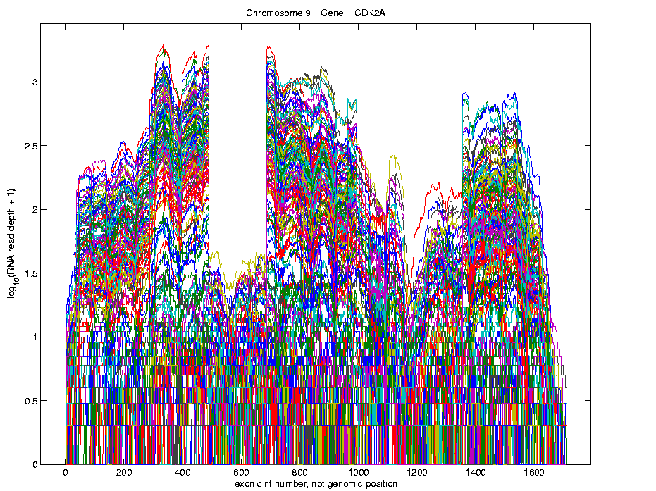
Functional Data Analysis
Simple
1st
View:
Curve
Overlay
(log
scale)
Thanks to
Matt Wilkerson

Slide 28
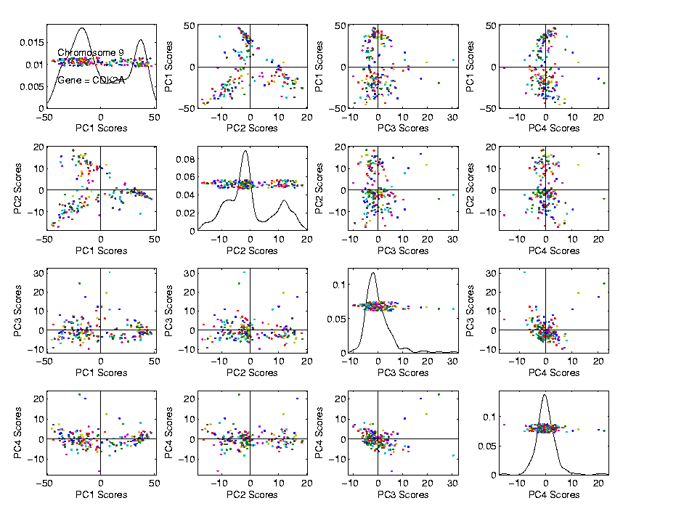
Functional Data Analysis
Often
Useful
Population
View:
PCA
Scores

Slide 29
Functional Data Analysis
Suggestion
Of
Clusters
???

Slide 30
Functional Data Analysis
Suggestion
Of
Clusters
Which
Are
These?

Slide 31
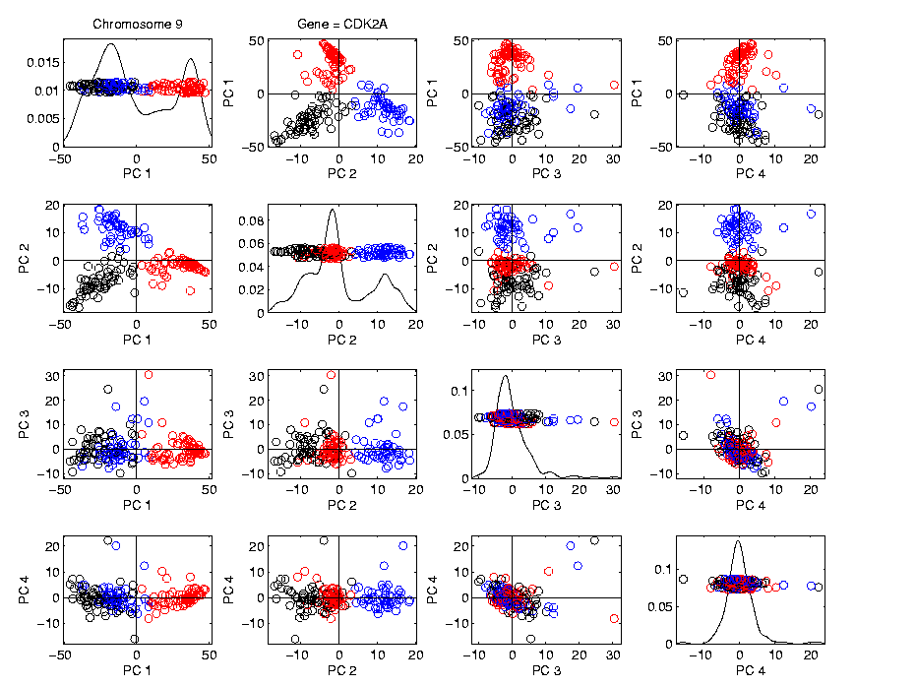
Functional Data Analysis
Manually
Brush
Clusters

Slide 32
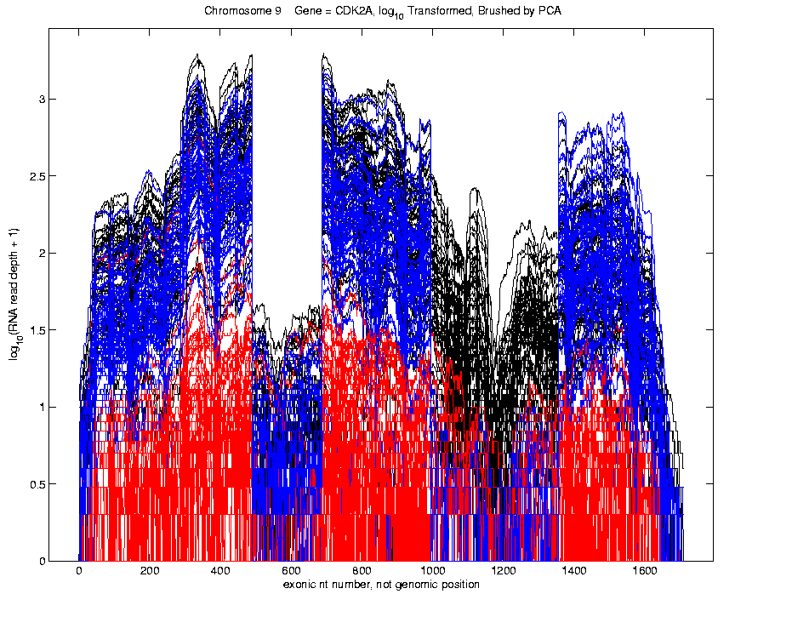
Functional Data Analysis
Manually
Brush
Clusters
Clear
Alternate
Splicing

Slide 33
Functional Data Analysis
Consequences of this Visualization:
Lead to Full Genome Screening Method
SigFuge
Important Component: SigClust
(Which Clusters are Really There?)
Found New Splices
(Now Been Biologically Verified)

Slide 34
Object Oriented Data Analysis
What is the “atom” of a statistical analysis?
1st Course: Numbers
Multivariate Analysis Course : Vectors
Functional Data Analysis: Curves
More generally: Data Objects

Slide 35
Personal Motivating Contexts
Interdisciplinary Areas:
Cancer Genetics
Medical Image Analysis
Evolutionary Biology
Drug Discovery

Slide 36
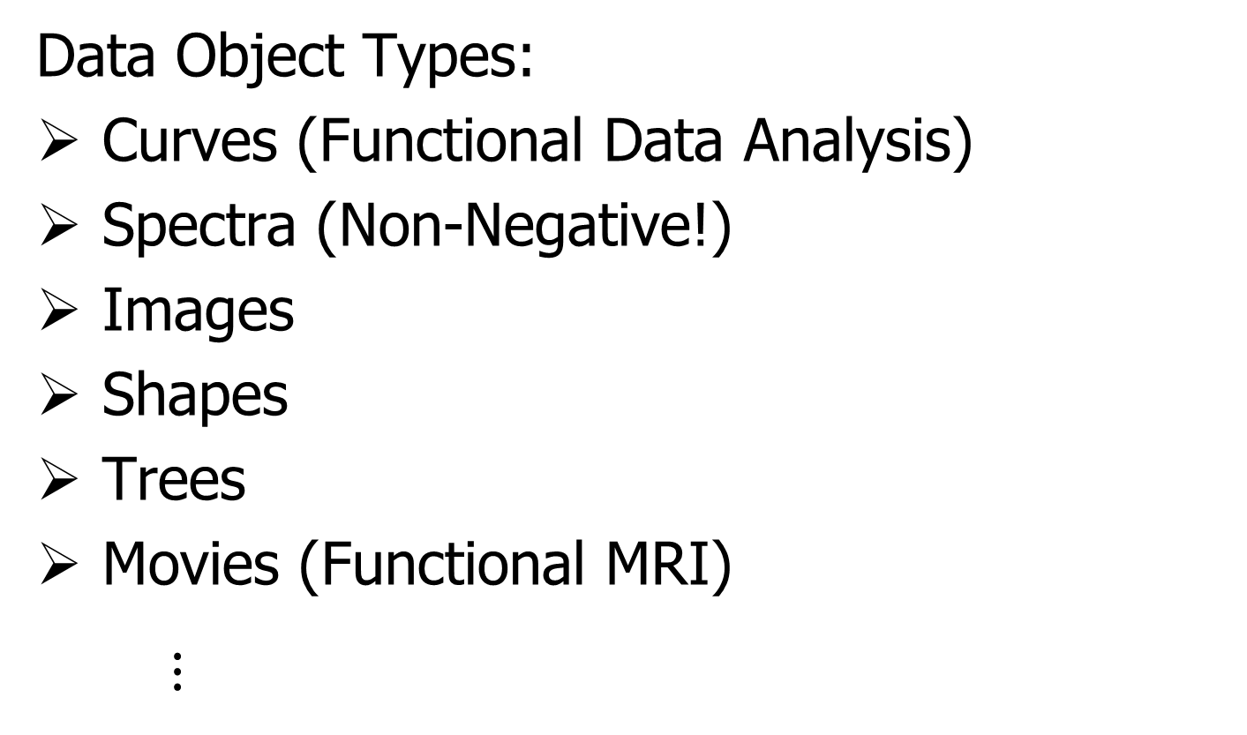
Some Special Cases of OODA
Data Object Types:
Curves (Functional Data Analysis)
Spectra (Non-Negative!)
Images
Shapes
Trees
Movies (Functional MRI)
$⋮$

Slide 37
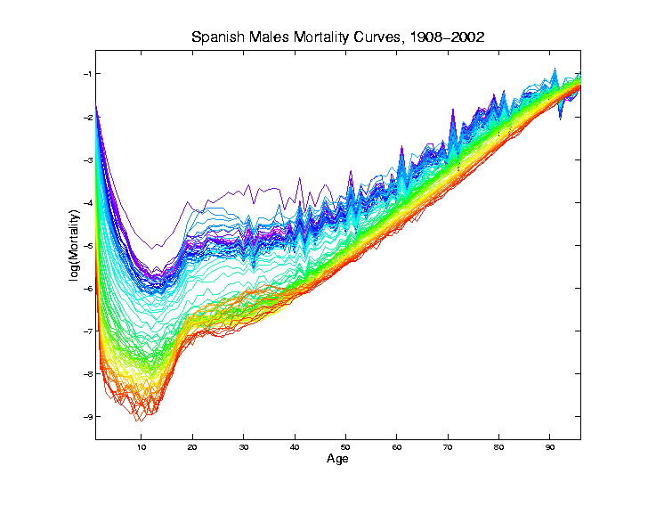
Curves as Data Objects (FDA)
Generally Euclidean: Use standard methods

Slide 38
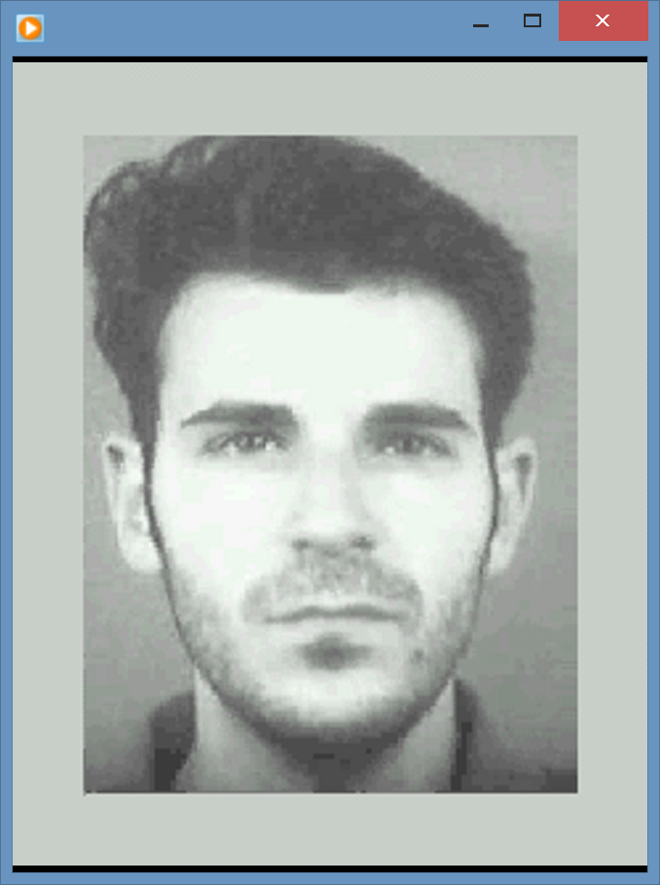
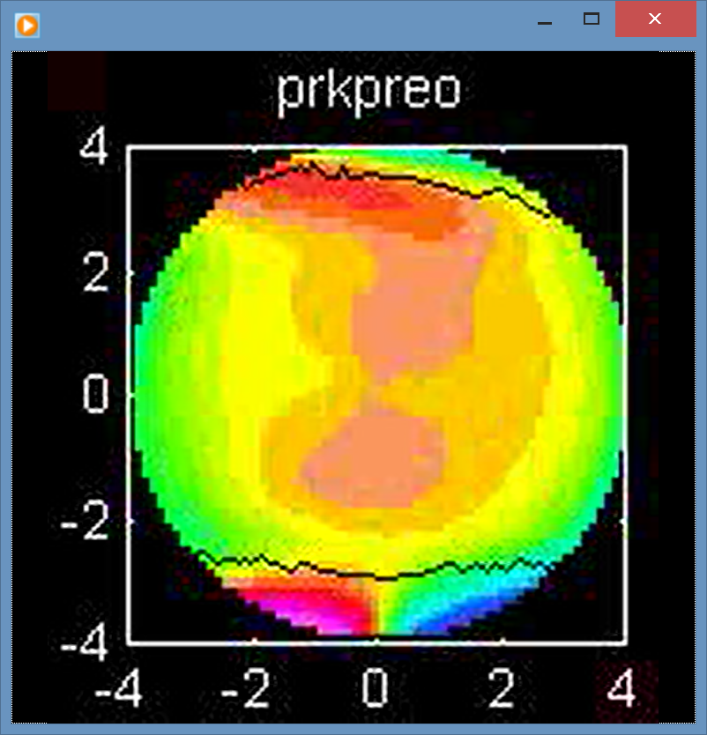
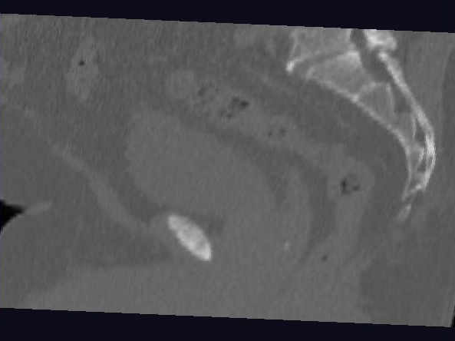
Images as Data Objects
Challenge: High Dimension, Low Sample Size

Slide 39
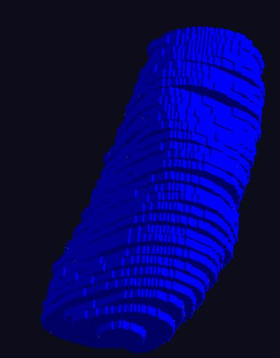
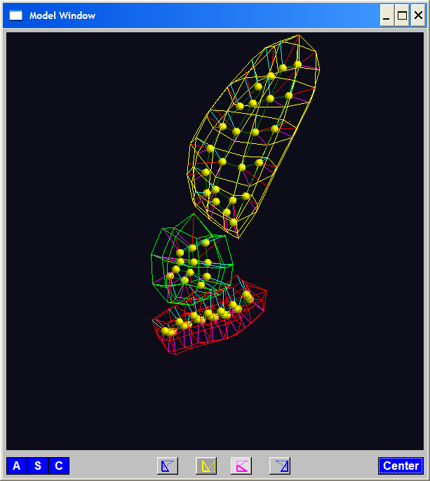
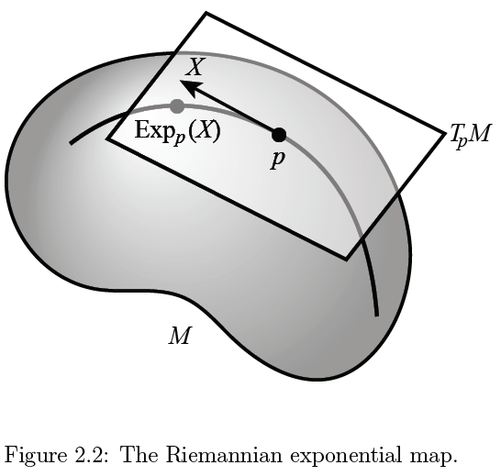
Shapes as Data Objects
Challenge: Data Lie in (Curved) Manifold

Slide 40
Shapes as Data Objects
Challenge: Data Lie in (Curved) Manifold
{Tackle With Differential Geometry}
Important General Development:
Backwards PCA

Slide 41
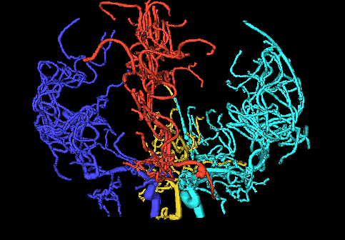
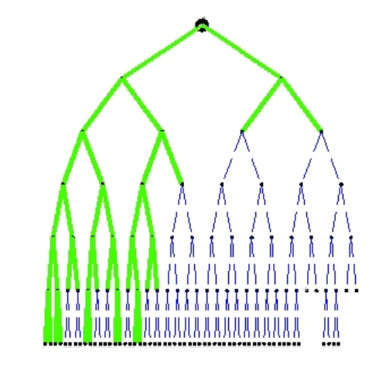
Trees as Data Objects
Challenge: More Complicated Data Space
Manifold Stratified Space

Slide 42
Trees as Data Objects
Challenge: More Complicated Data Space
Manifold Stratified Space
Surprisingly (?!?) Useful Approach:
Topological Data Analysis
Persistent Homology

Slide 43


Advertisement
Short Course on OODA & TDA
International Biometrics Conference
Seoul July 2020
Moo K. Chung, U. Wisc.
Yuan Wang, U. S. C.

Slide 44
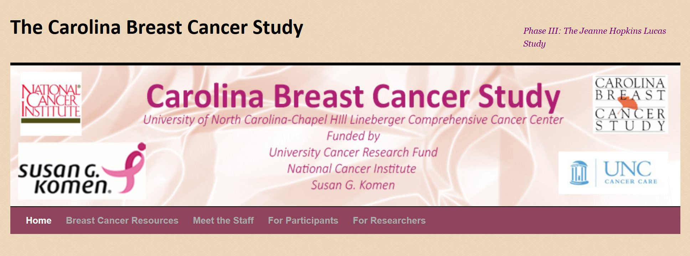

Carolina Breast Cancer Study
Thanks to: Iain Carmichael (Deep Learning, AJIVE)
Melissa Troester (Head, CBCS)
Joseph Geradts, Benjamin Calhoun (Pathology)
Katie Hoadley, Chuck Perou (Genomics)

Slide 45
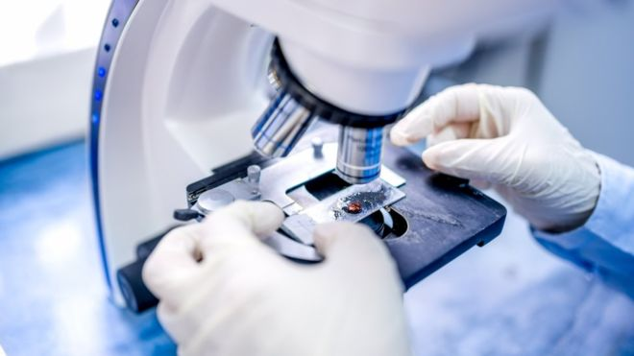
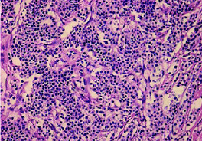
Carolina Breast Cancer Study
Clinical Diagnosis of Cancer:
Pathologist Views Tissue Under Microscope,
Tissue Stained with Hematoxylin & Eosin (H&E)
Thanks to BBC.CO.UK
and Reseachgate.net

Slide 46
Carolina Breast Cancer Study
Analysis Goal:
Understand How Images & Genomics
Work Together
Work Separately
Approach: JIVE
Clinical Diagnostic Standard
Deep Insight &
New Treatments
As of Jan. 2020: ~70
Drugs Approved for
Breast Cancer Therapy

Slide 47
JIVE
Joint & Individual Variation Explained
(Angle Based)

Slide 48

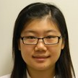


JIVE Collaborators
Eric Lock
Qing Feng
Andrew Nobel
Jan Hannig

Slide 49
JIVE Data Structure
JIVE Organizational Model:
Multiple Matrices
(Data Types, i.e. “Blocks”)
With common
Columns as Data Objects

Slide 50
JIVE Analytic Goals
Explore & Quantify Variation
In spirit of PCA
(Principal Component Analysis)

Slide 51
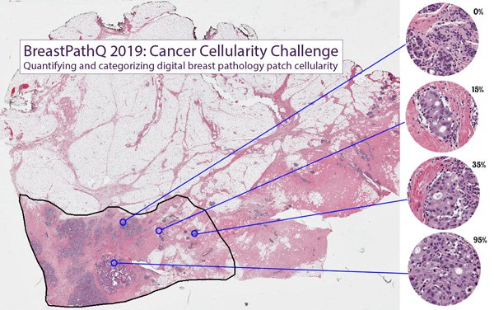
Carolina Breast Cancer Study
Tissue Micro Array Data:
Extract Small
(1mm diam.)
“Cores”
Thanks to SPIE.ORG

Slide 52
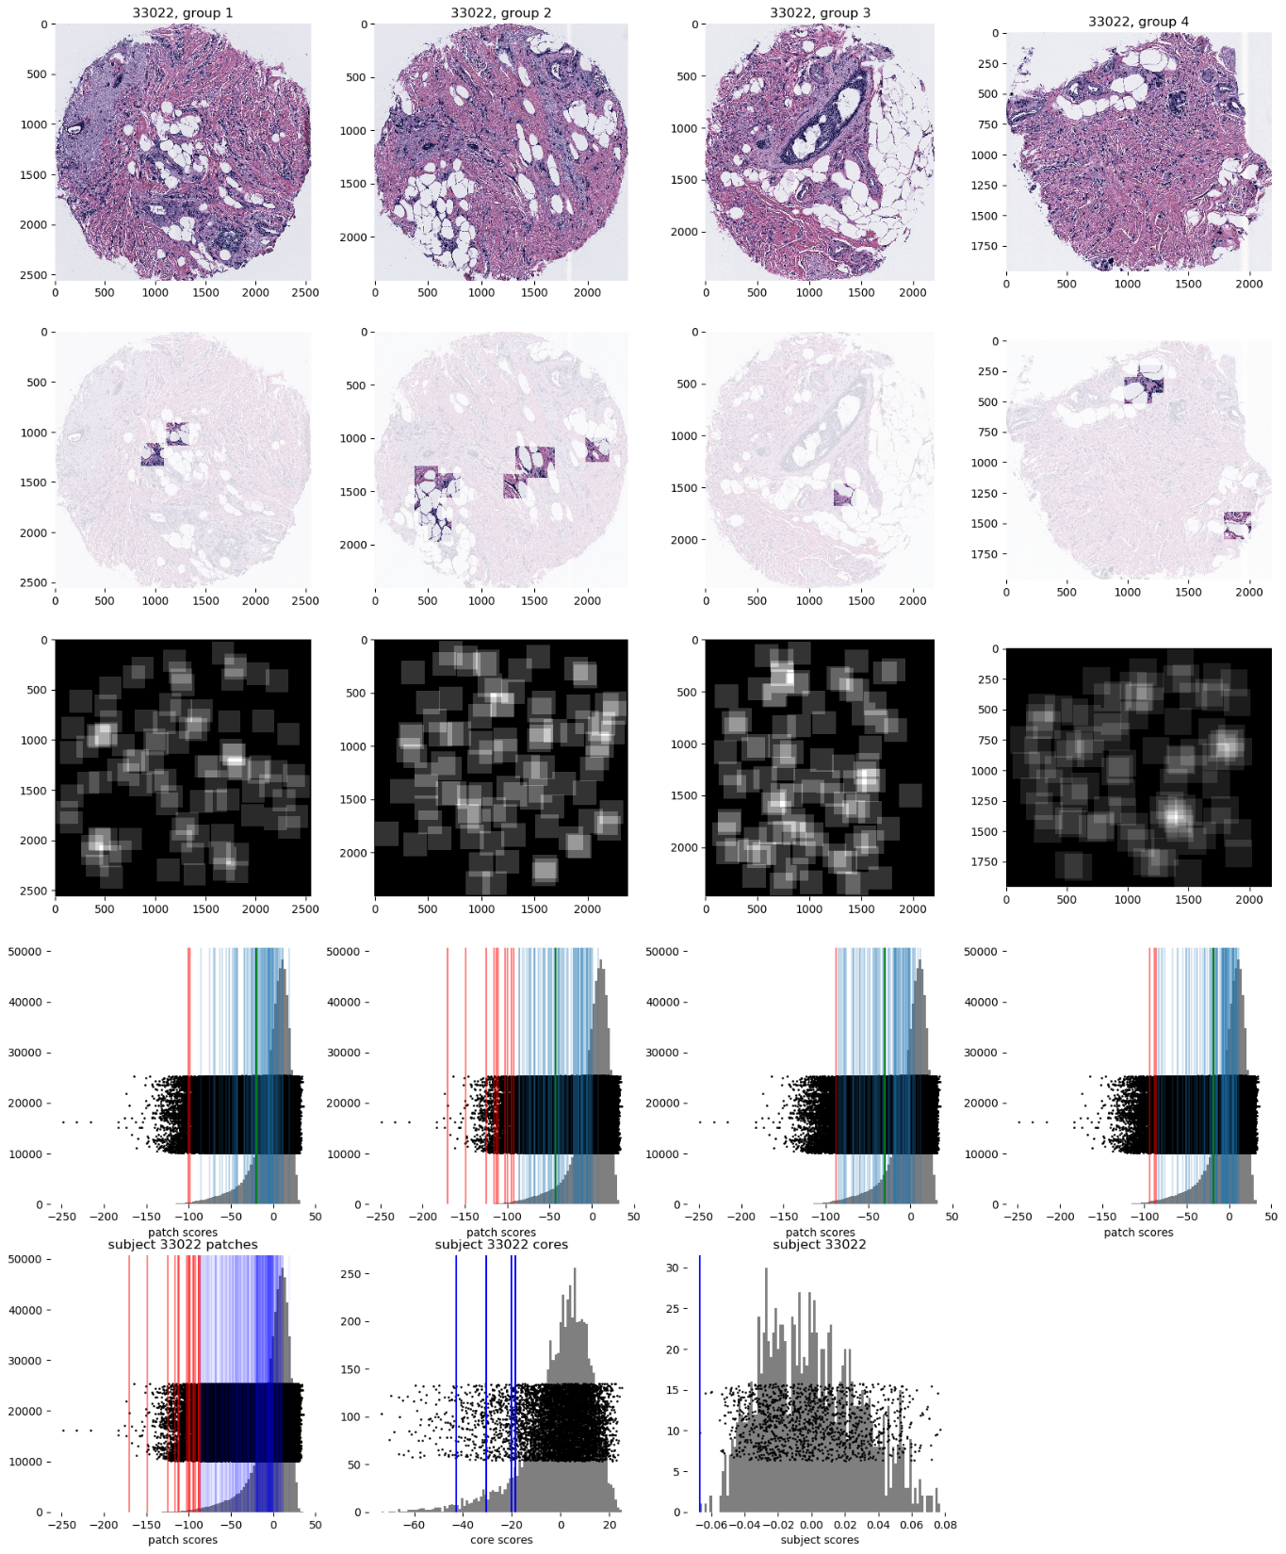

Carolina Breast Cancer Study
Experimental Design: $n=1191$ people
For Each:
1 – 4 TMA Cores
PAM 50 Gene Expression:

Slide 53

Carolina Breast Cancer Study
PAM 50 Gene Expression:
Set of 50 Genes
Measured mRNA Expression Level
Good at Separating SubTypes
  Basal
  Her2
  Luminal A
  Luminal B
Early Technology, More Recent
RNAseq → 10,000s Genes
Perou Discovery:
No Benefit From
Chemo-Therapy

Slide 54
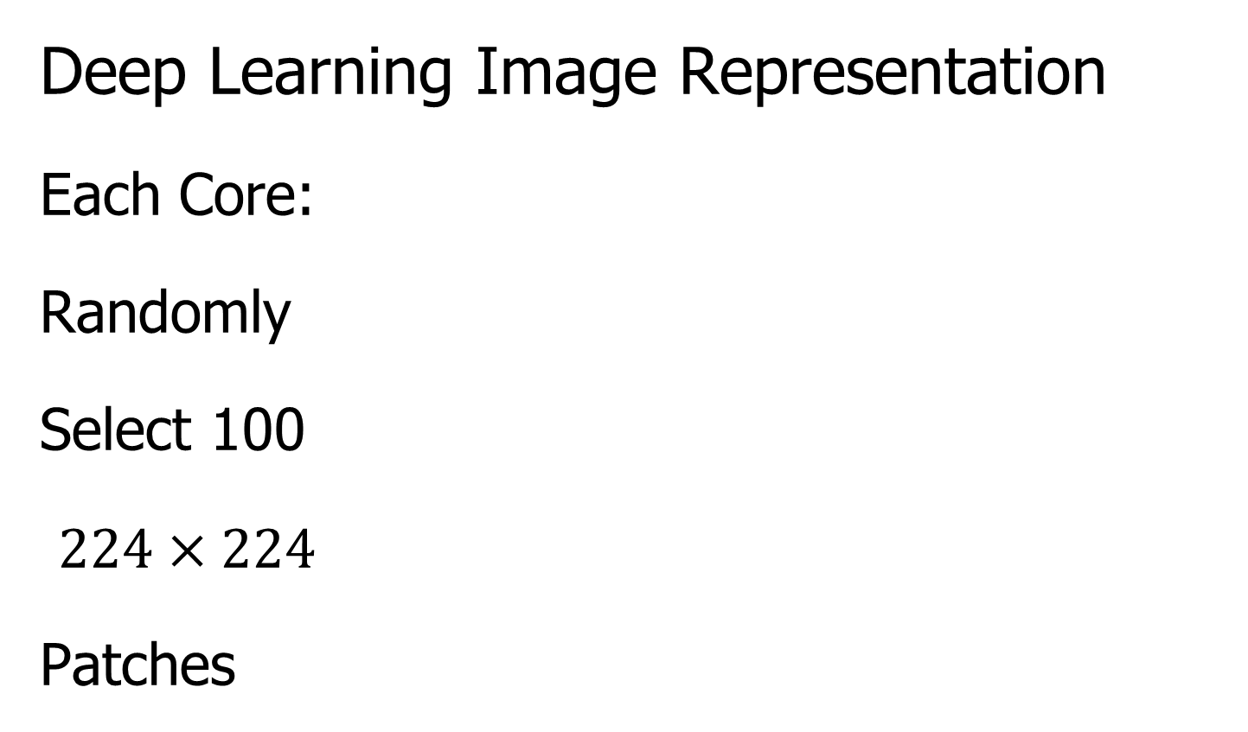
Carolina Breast Cancer Study
Deep Learning Image Representation
Each Core:
Randomly
Select 100
$224×224$
Patches

Slide 55
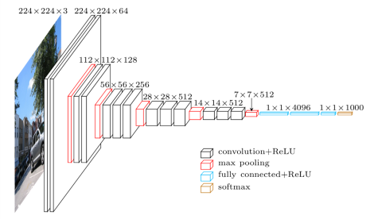
Carolina Breast Cancer Study
Deep Learning Image Representation
Reduce Each Patch to 512 Features
Using Transfer Learning From VGG16:
(Trained on Many
Natural Images)
Thanks to pyimagesearch.com

Slide 56
Carolina Breast Cancer Study
Deep Learning Image Representation
For Each Core:
Aggregate Patches by Averaging
(Damps Out “Location” Information)
Then Average Cores For Each Person

Slide 57
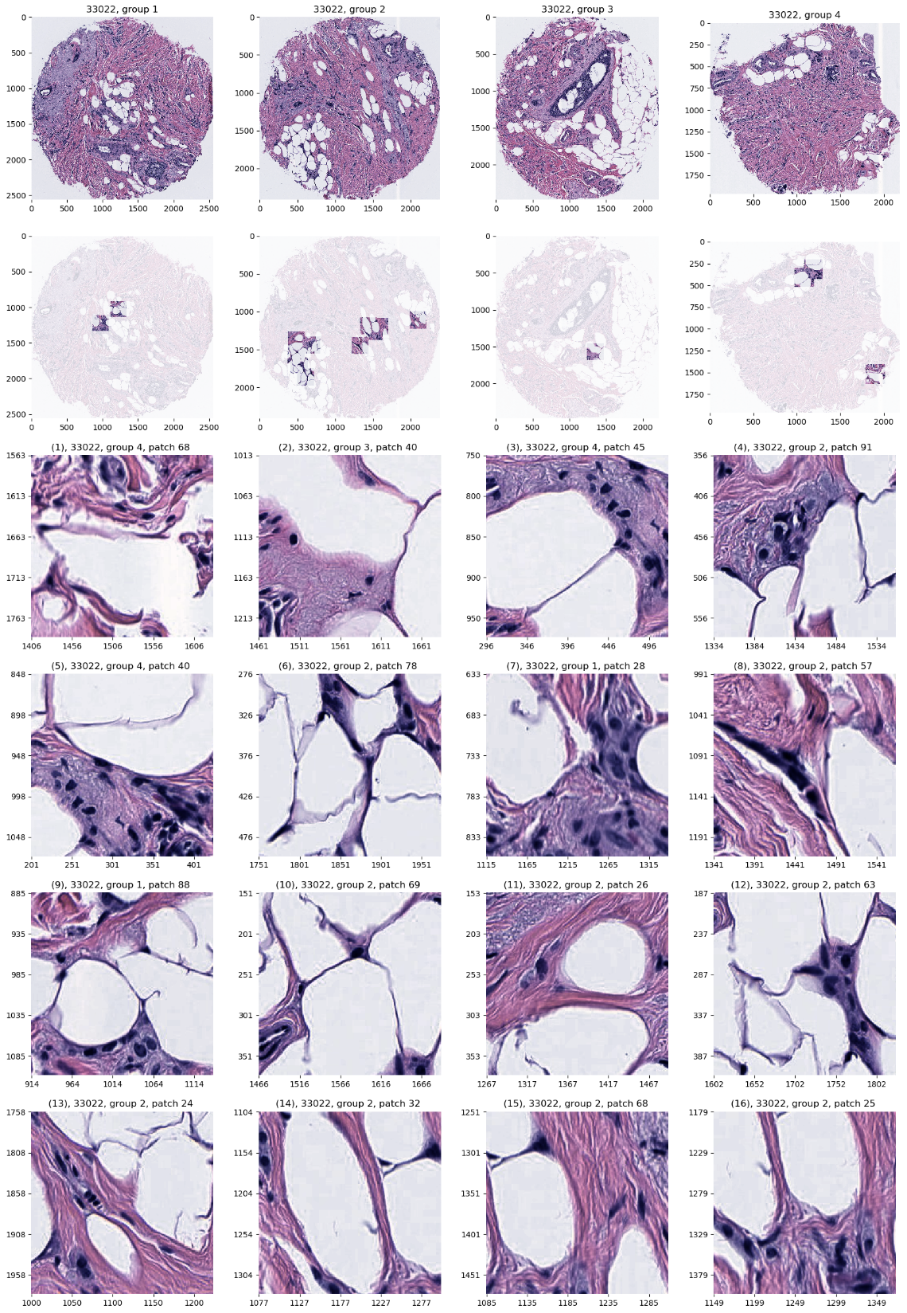
Carolina Breast Cancer Study
JIVE: Common Normalized Scores 1
Look at Extremes
Negative End
Top Person
Top 16 Patches
Fat Cells & Stroma

Slide 58
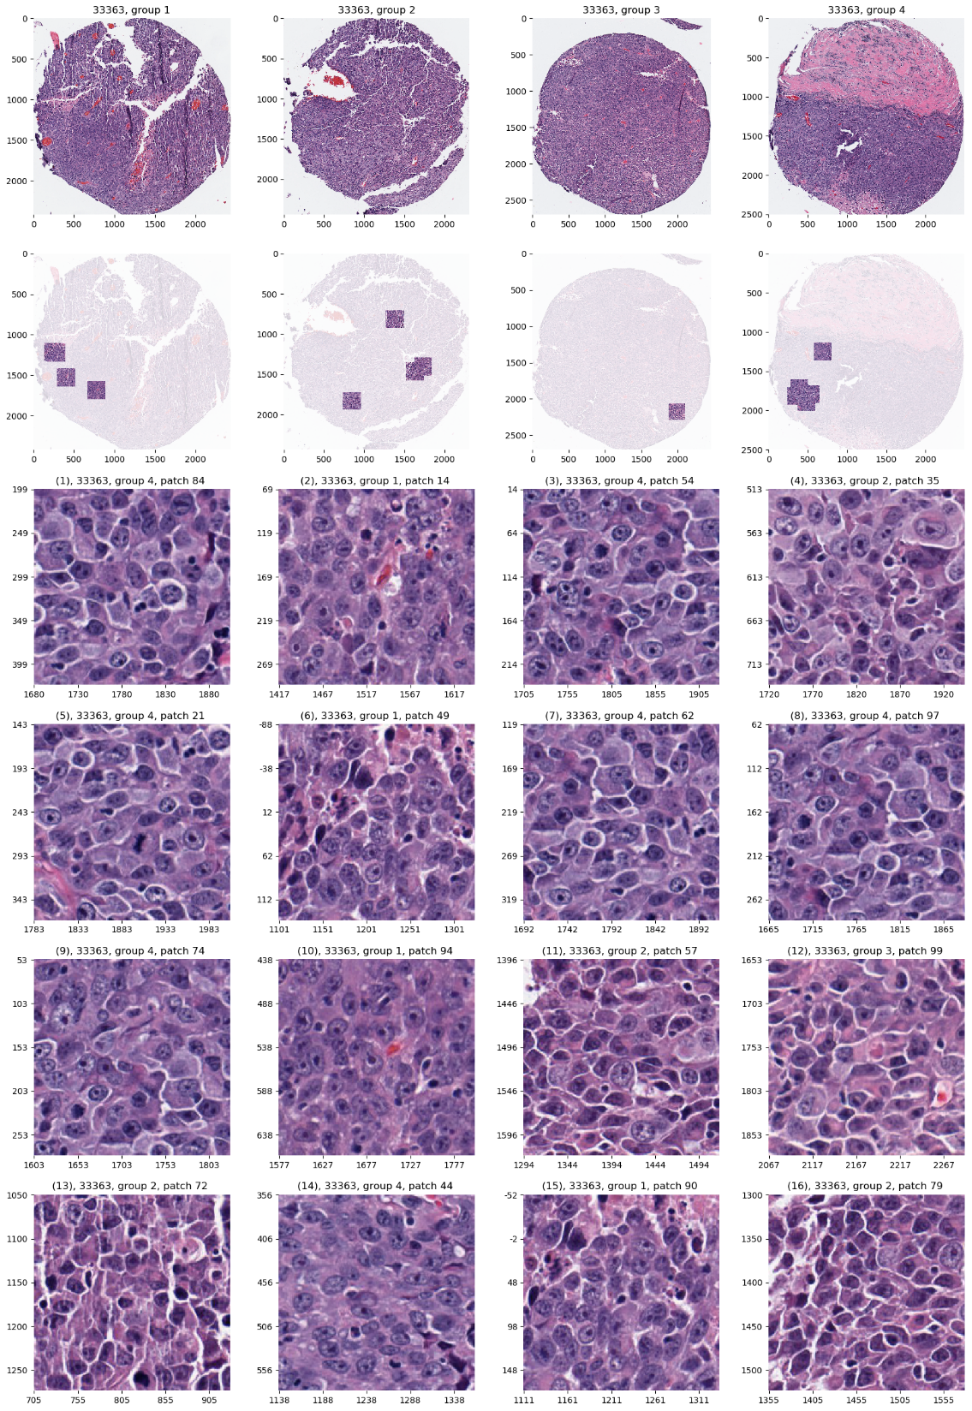
Carolina Breast Cancer Study
JIVE: Common Normalized Scores 1
Look at Extremes
Positive End
Top Person
Top 16 Patches
Highly “Cellular”
Markedly Atypical Cells

Slide 59
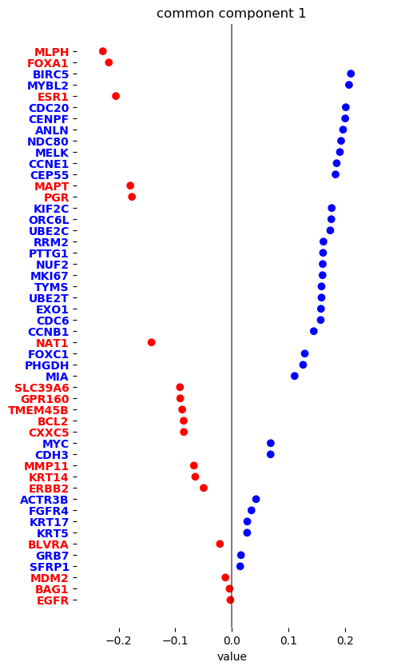
Carolina Breast Cancer Study
JIVE: Gene Expression
Common Normalized
Loadings 1
Very Consistent w/ Image
“High Proliferation” Genes
“Low Prolif.” – Lum A Genes

Slide 60
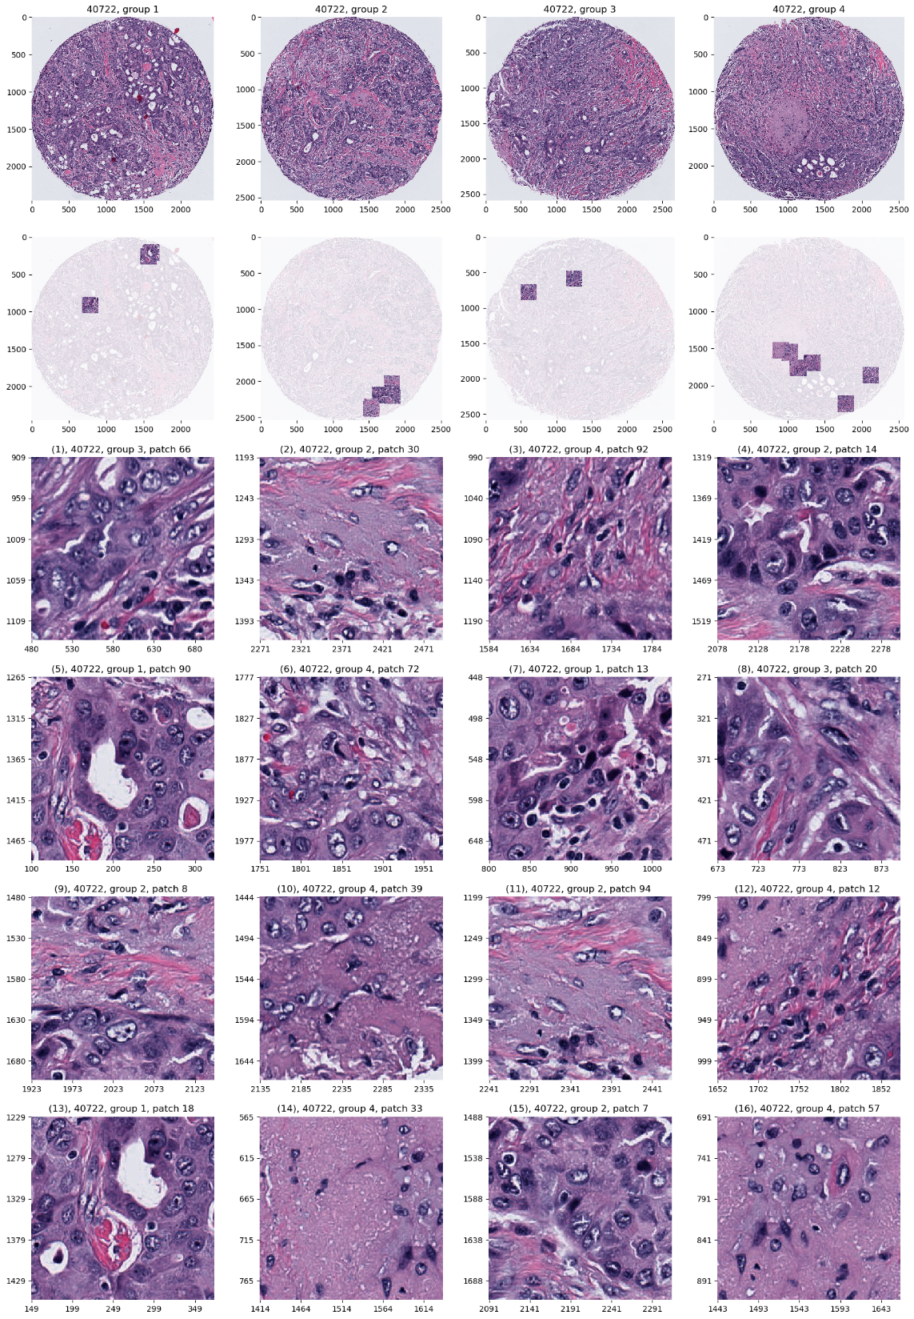
Carolina Breast Cancer Study
JIVE: Common Normalized Scores 2
Look at Extremes
Negative, Top
Top 16 Patches
High Nuclear Grade
Atypical Cells

Slide 61
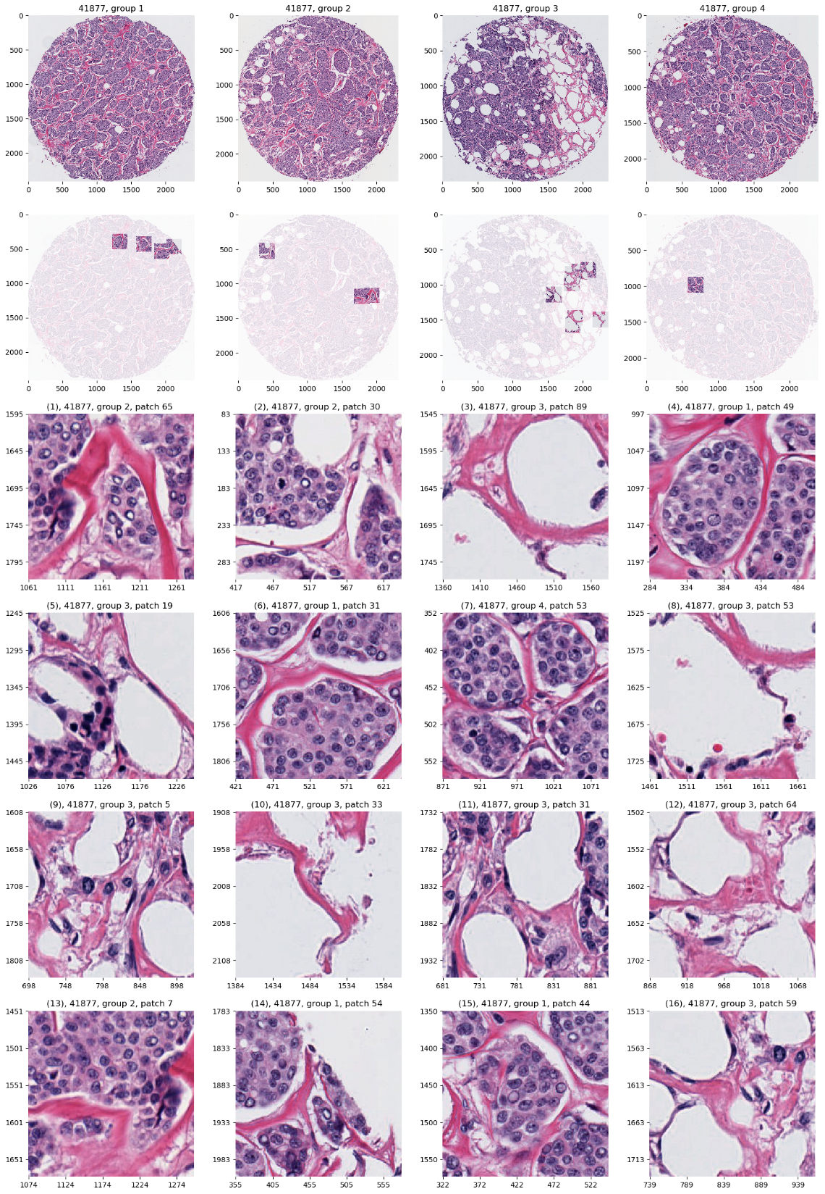
Carolina Breast Cancer Study
JIVE: Common Normalized Scores 1
Look at Extremes
Positive, Top
Top 16 Patches
Lower Nuclear Grade
Stroma, Sclerosis

Slide 62
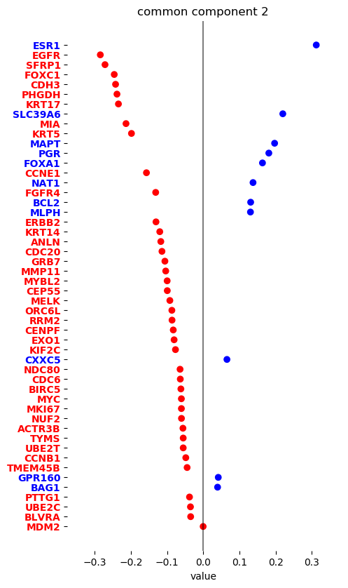
Carolina Breast Cancer Study
JIVE: Gene Expression
Common Normalized
Loadings 2
Very Consistent w/ Image
Luminal Subtype Genes
Basal Subtype Genes

Slide 63
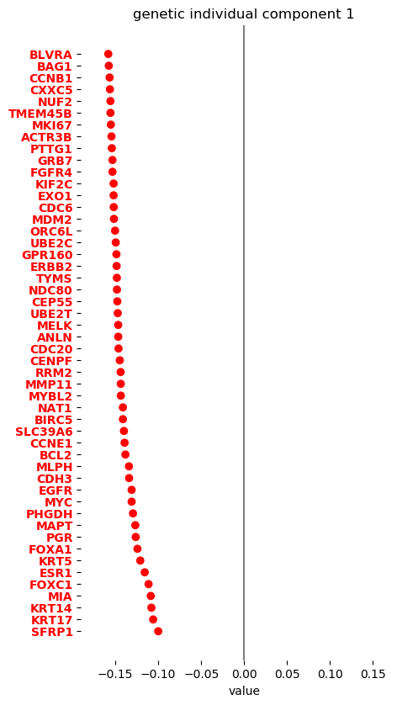
Carolina Breast Cancer Study
JIVE, Genes, Individual 1
Overall Up & Down
Together
Not Subtype Related!

Slide 64
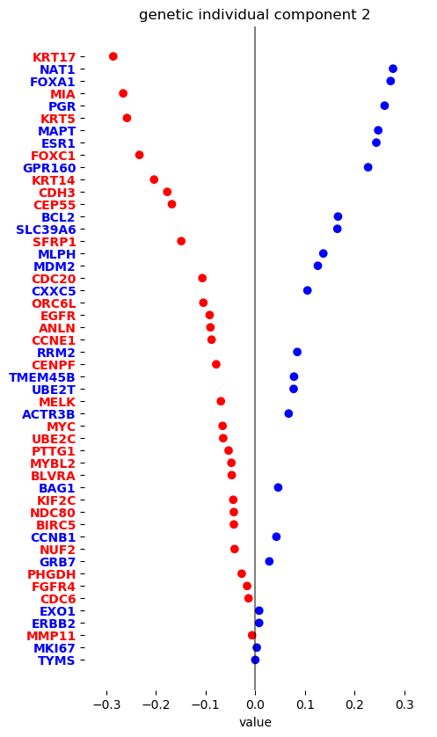
Carolina Breast Cancer Study
JIVE, Genes, Individual 2
Luminal vs. Basal
“Contrast”?
“Unbalanced Types”?

Slide 65
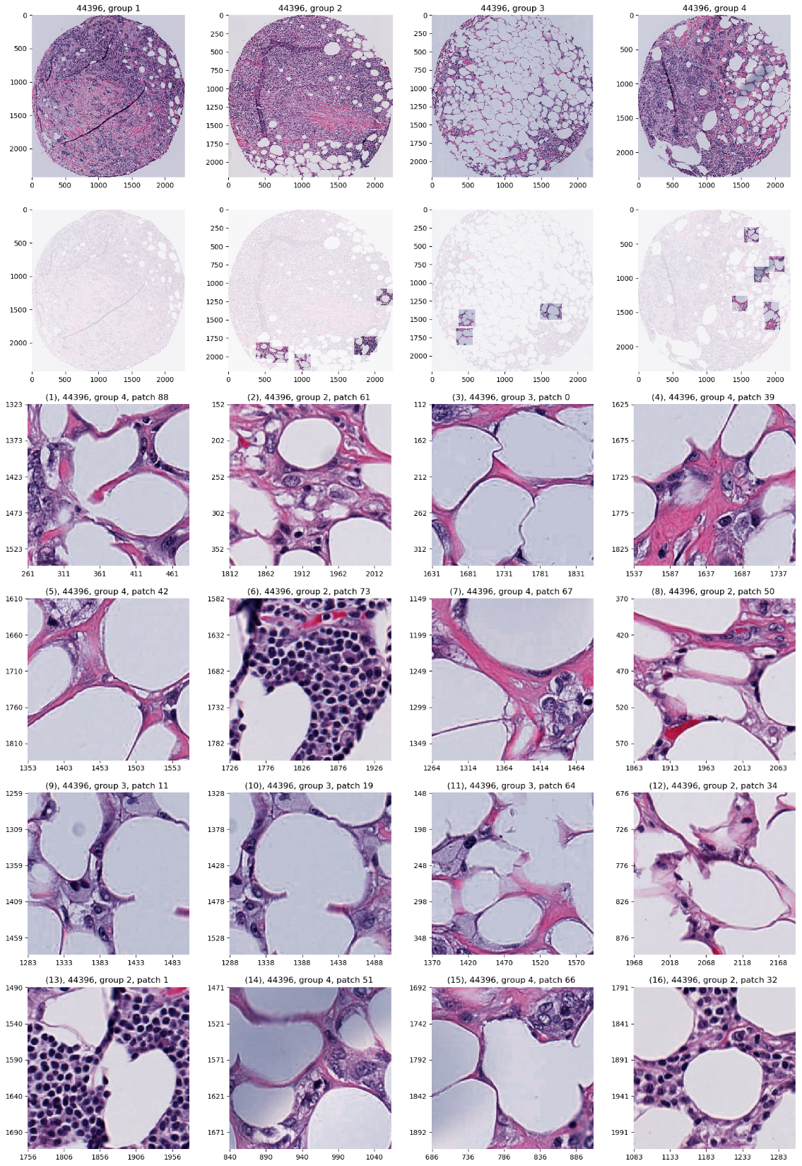
Carolina Breast Cancer Study
JIVE, Images, Individual 1
Negative
Mostly Fat Cells
Few Nuclei

Slide 66
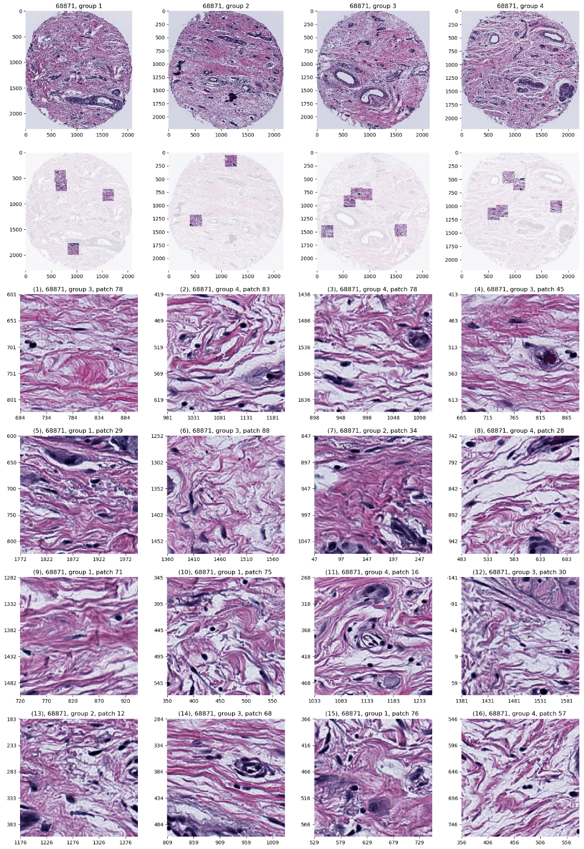
Carolina Breast Cancer Study
JIVE, Images, Individual 1
Positive
Reactive Stroma,
Few Nuclei
Little Gene Connected

Slide 67
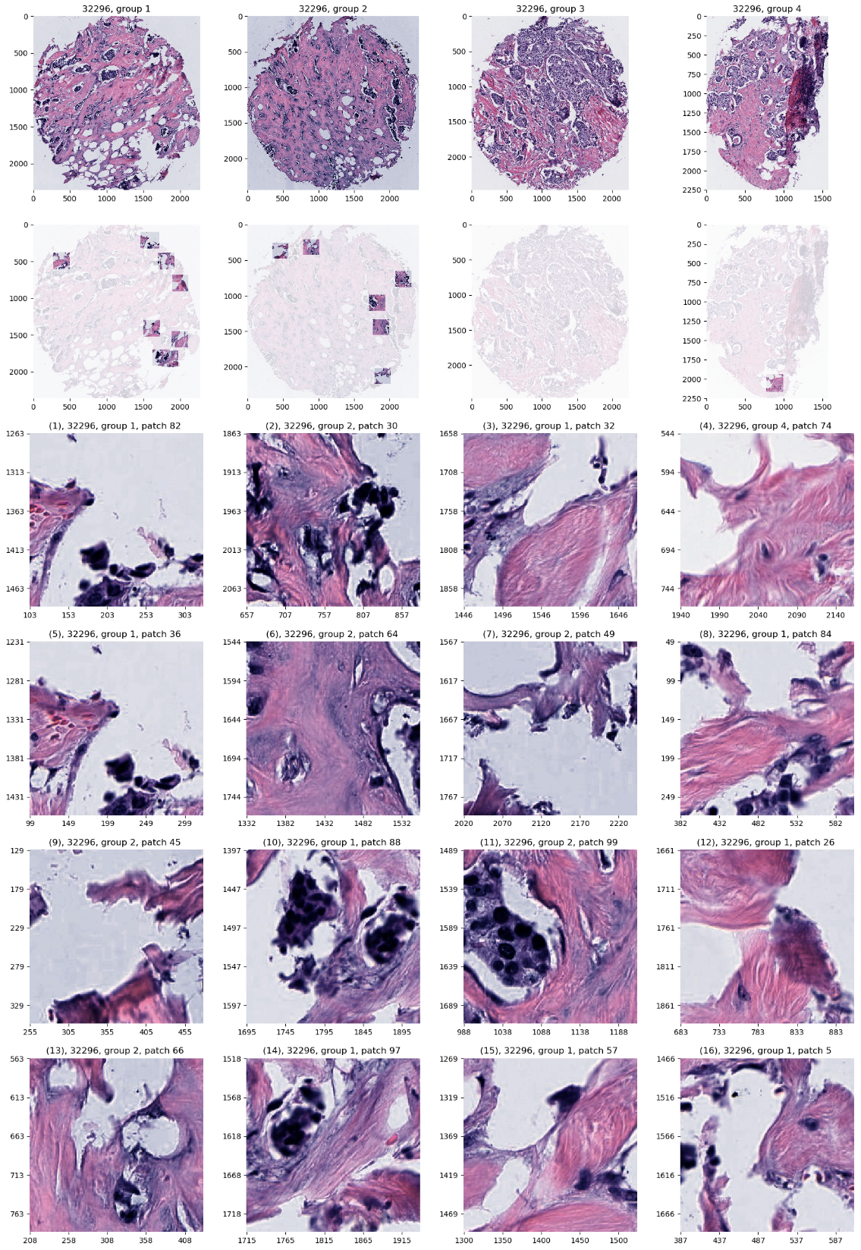
Carolina Breast Cancer Study
JIVE, Images, Individual 2
Negative
Mucinous & Micro-
Papillary Carcinoma
Not PAM50 Related

Slide 68

Carolina Breast Cancer Study
JIVE, Images, Individual 2
Positive
Fat Cells
Common Endpoint?
“Center”?

Slide 69
Next Generation Data Integration
Data Integration Via Subspace Analysis
(DIVAS)

Slide 70





DIVAS / JIVE Collaborators
Jan Hannig
Meilei Jiang
Xi Yang
Iain Carmichael
Jack Prothero

Slide 71
DIVAS Improves JIVE
Partially Shared Blocks

Slide 72


DIVAS Improves JIVE
Partially Shared Blocks
JIVE
$$≈$$
$$+$$
Input
Data
Joint
Comp.
Indiv.
Comp.

Slide 73


DIVAS Improves JIVE
Partially Shared Blocks
DIVAS
$$≈$$
$$+$$
$$+$$
$$+$$
$$+$$
Input
Data
Joint
Comp.
Partial
Sharing
Indiv.
Comp.

Slide 74

DIVAS Motivation
The Cancer
Genome
Atlas
Multiple Blocks
People Common
Across Blocks
Figure : The Cancer Genome Atlas Research Network, Weinstein, J.N., Collisson, E.A., Mills, G.B., Shaw, K.M., Ozenberger, B.A., Ellrott, K., Shmulevich, I., Sander, C., and Stuart, J.M. (2013)
The Cancer Genome Atlas Pan-Cancer analysis project.

Slide 75
DIVAS on TCGA Data
Breast Cancer
Gene Expression (GE) [16615 x 616]
Copy Number (CN) [24174 x 616]
Protein Exp. (RPPA) [187 x 616]
Mutation Status (MU) [18256 x 616]

Slide 76




DIVAS on TCGA Data
Single 4-way mode, as in AJIVE Analysis
CN$→$GE$→$Protein Common
Statistical Significance Summary
Mut$→$CN$→$GE Sensible
No Mut$→$Protein
Without CN&GE

Slide 77



DIVAS on TCGA Data
Major CN$→$GE Variation
GE or CN$→$ Proteins
Statistical Significance Summary
Lots of Mut&CN Variation
No Mut$→$Protein
Without CN&GE

Slide 78
Carry Away Concept
OODA is more than a “framework”
It Provides a Focal Point
Highlights Pivotal Choices:
What should be the Data Objects?
How should they be Represented?

