Slide 1
Place Name
Significance in Scale Space
J. S. Marron
Dept. of Statistics and Operations Research
February 8, 2015

Slide 2
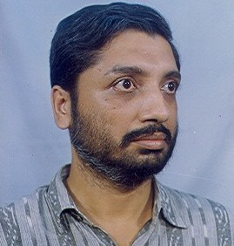

Joint Work With
Probal Chaudhuri
Indian Statistical Institute,
Kolkata
Fred Godtliebsen
University of Tromsø,
Norway

Slide 3
Context: Statistical Smoothing
- Find Unexpected Structure in Data
Setting 1: Density Estimation (Histograms)
Setting 2: Regression (Scatterplots)

Slide 4

Density Estimation
a. Mathematical Formulation
- Estimate Density $f\left(x\right)$ using
$X_{1},⋯,X_{n}$ i.i.d from $f\left(x\right)$

Slide 5
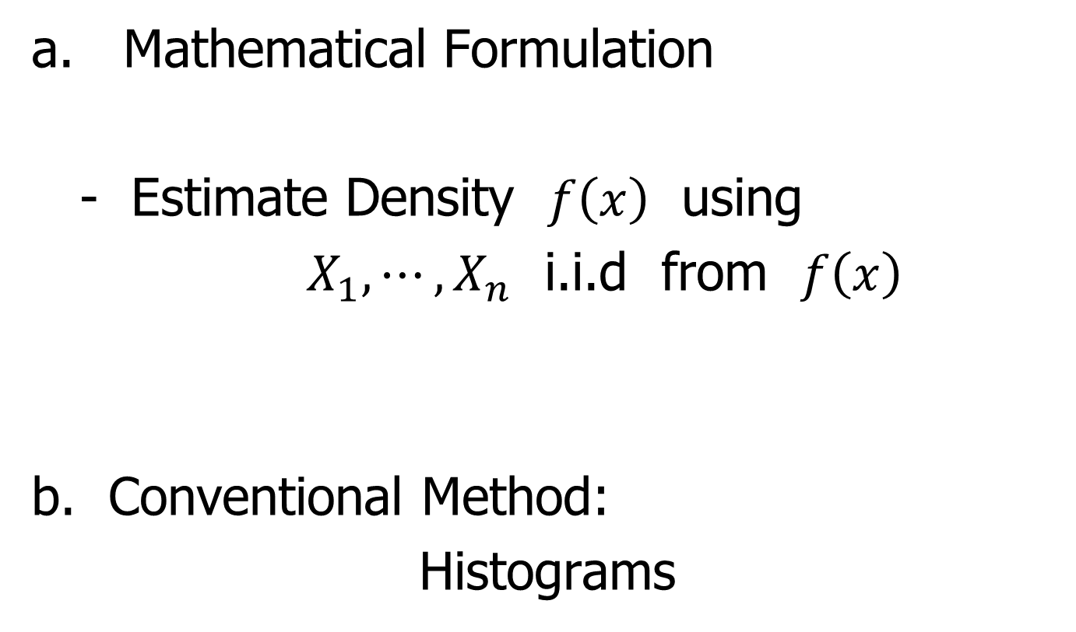
Density Estimation
a. Mathematical Formulation
- Estimate Density $f\left(x\right)$ using
$X_{1},⋯,X_{n}$ i.i.d from $f\left(x\right)$
b. Conventional Method:
Histograms

Slide 6
Density Estimation
Example:
British Family Incomes
1985
From survey ~ 7000

Slide 7
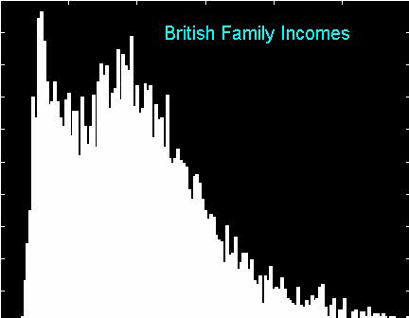
Histograms
Challenge 1:
Binwidth

Slide 8
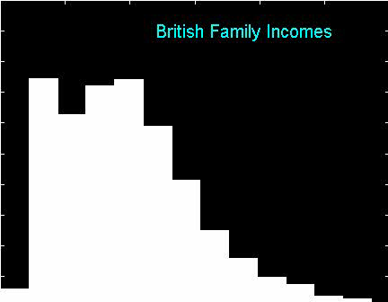
Histograms
Challenge 2:
Bin Location

Slide 9
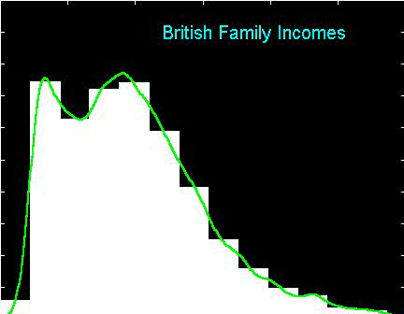
Histograms
Challenge 2:
Bin Location
Diagnostic

Slide 10
Histograms
Challenge 2:
Bin Location
Diagnostic
Use This For
Estimation???

Slide 11

Kernel Density Estimation
$$\hat{f}\left(x\right)=\frac{1}{nh}\sum_{i=1}^{n}{K\left(\frac{x−X_{i}}{h}\right)}$$
Bandwidth $h$
Kernel $K$

Slide 12
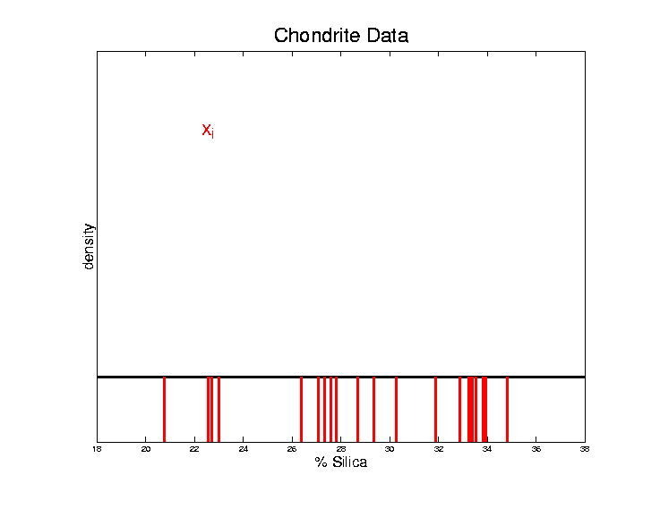

Kernel Density Estimation
$$\hat{f}\left(x\right)=\frac{1}{nh}\sum_{i=1}^{n}{K\left(\frac{x−X_{i}}{h}\right)}$$
Bandwidth $h$
Kernel $K$

Slide 13
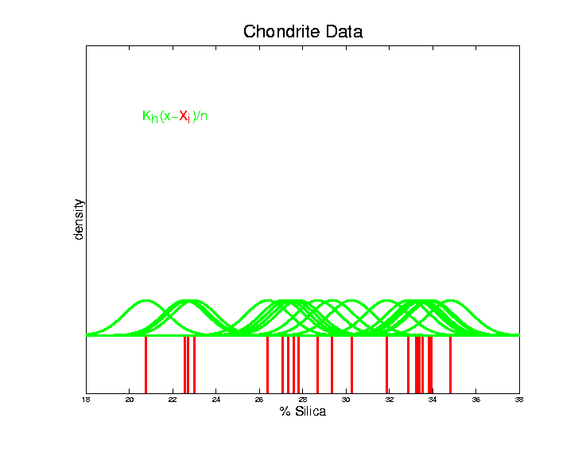

Kernel Density Estimation
$$\hat{f}\left(x\right)=\frac{1}{nh}\sum_{i=1}^{n}{K\left(\frac{x−X_{i}}{h}\right)}$$
Bandwidth $h$
Kernel $K$

Slide 14
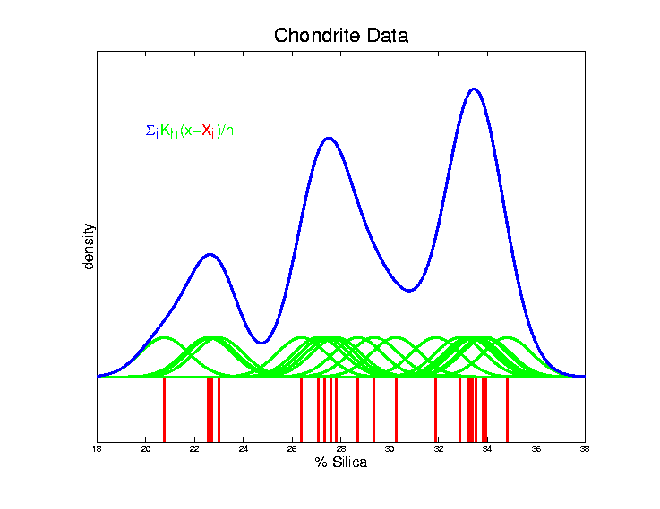

Kernel Density Estimation
$$\hat{f}\left(x\right)=\frac{1}{nh}\sum_{i=1}^{n}{K\left(\frac{x−X_{i}}{h}\right)}$$
Bandwidth $h$
Kernel $K$

Slide 15
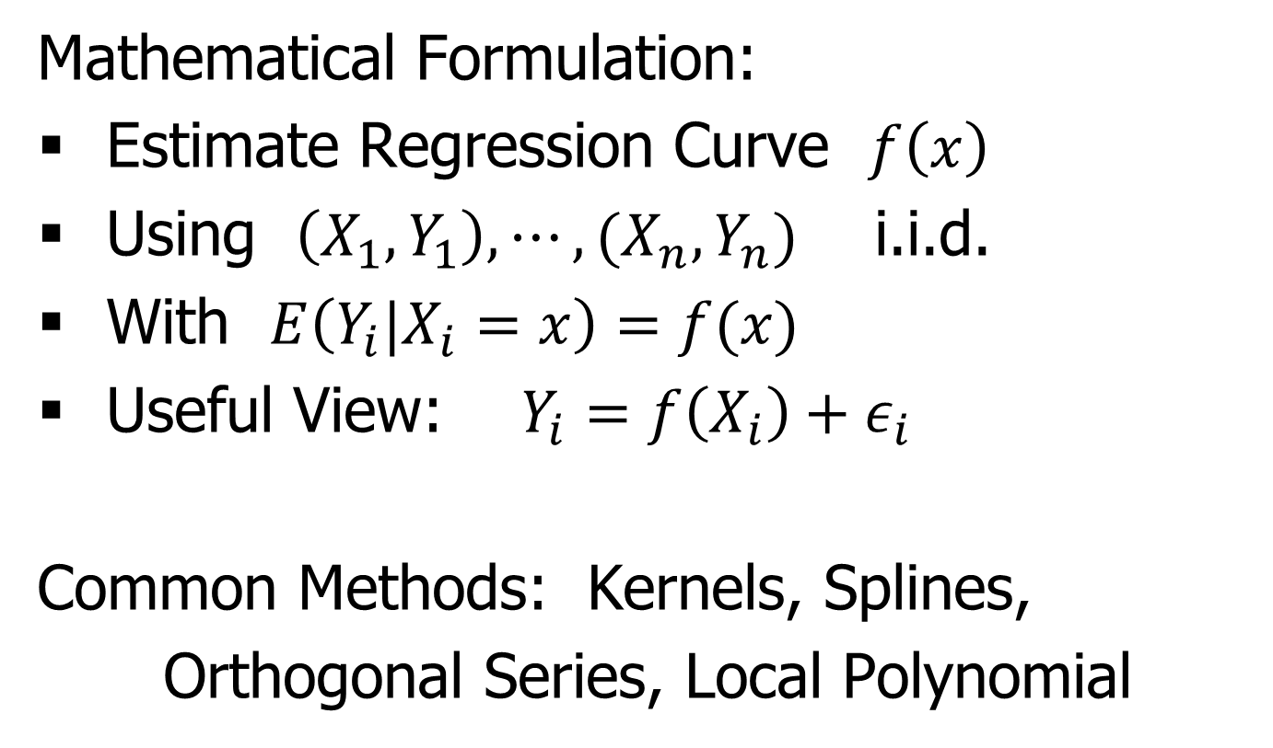
Nonparametric Regression
Mathematical Formulation:
Estimate Regression Curve $f\left(x\right)$
Using $\left(X_{1},Y_{1}\right),⋯,(X_{n},Y_{n})$ i.i.d.
With $E\left(Y_{i}|X_{i}=x\right)=f(x)$
Useful View: $Y_{i}=f\left(X_{i}\right)+ε_{i}$
Common Methods: Kernels, Splines,
Orthogonal Series, Local Polynomial

Slide 16
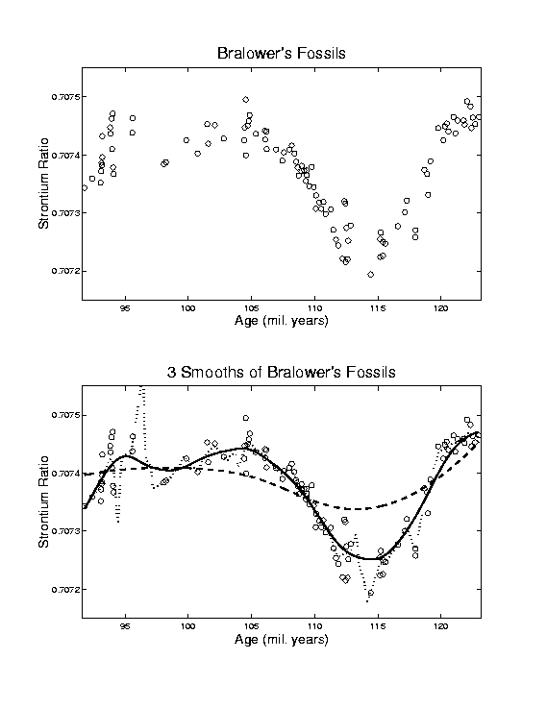
Nonparametric Regression Example

Slide 17
Nonparametric Regression Example

Slide 18
Central Question
Which “features” are “really there”?
Early Answer:
Data based bandwidth selection
Better Answer: Scale Space & SiZer

Slide 19
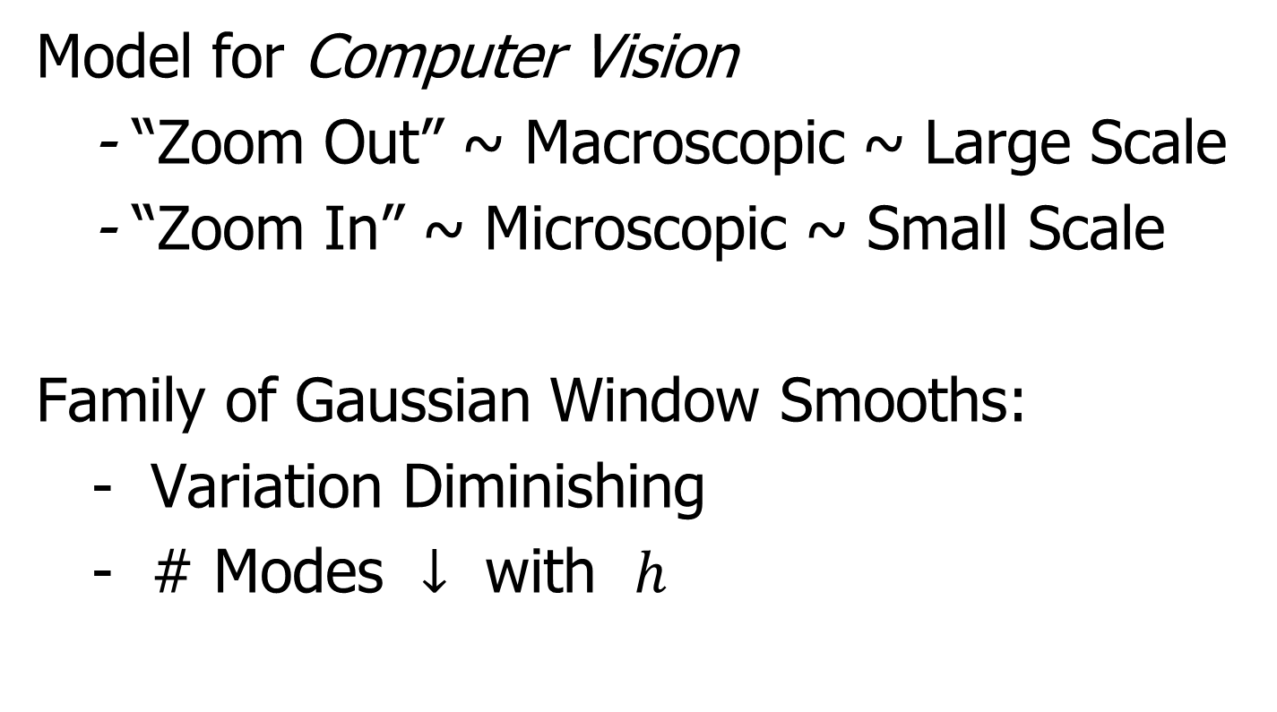
Scale Space
Model for Computer Vision
- “Zoom Out” ~ Macroscopic ~ Large Scale
- “Zoom In” ~ Microscopic ~ Small Scale
Family of Gaussian Window Smooths:
- Variation Diminishing
- # Modes $↓$ with $h$

Slide 20
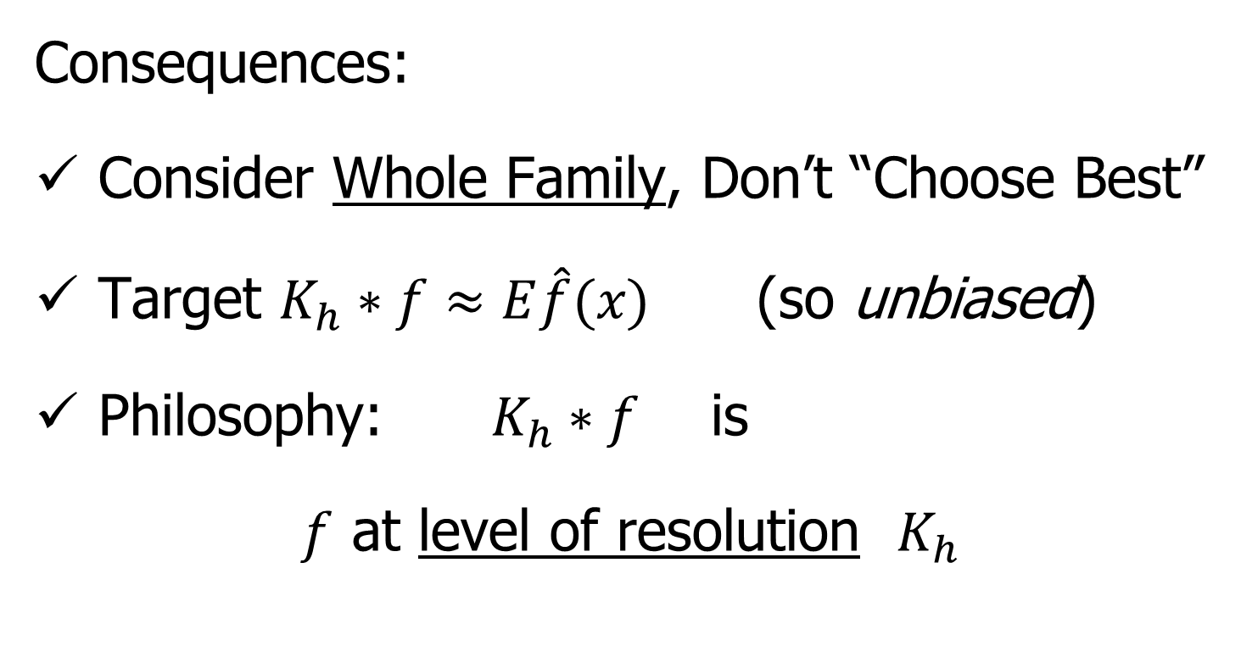
Scale Space
Consequences:
Consider Whole Family, Don’t “Choose Best”
Target $K_{h}∗f≈E\hat{f}(x)$ (so unbiased)
Philosophy: $K_{h}∗f$ is
$f$ at level of resolution $K_{h}$

Slide 21
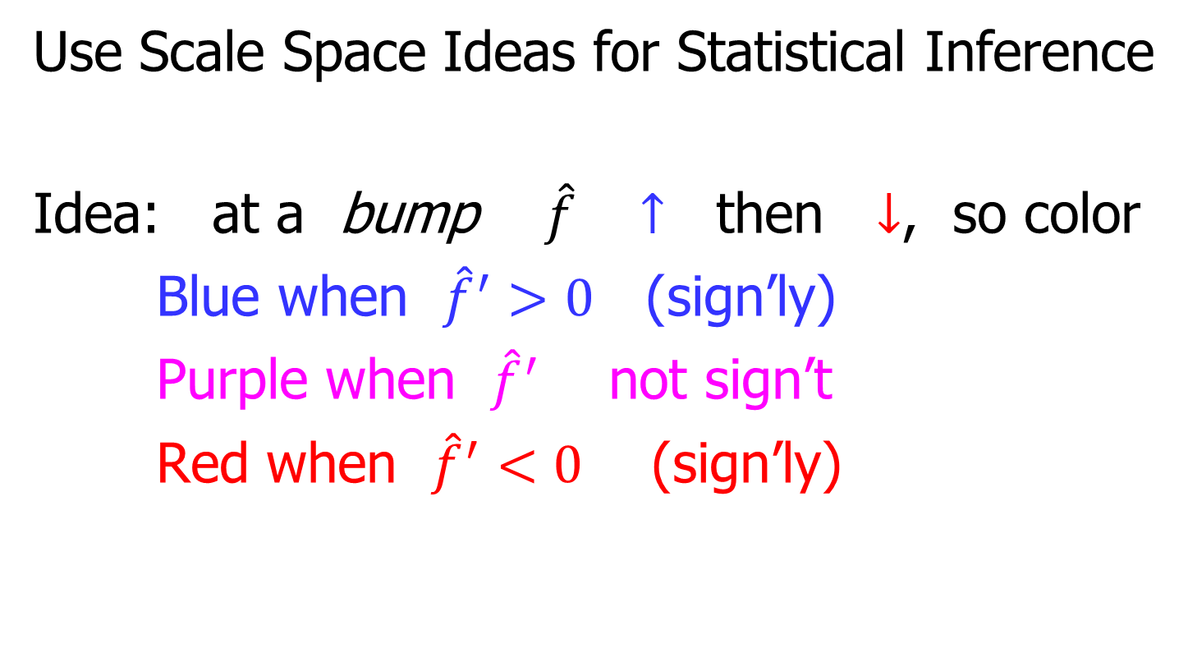
SIginficant ZERo crossings of the derivative
Use Scale Space Ideas for Statistical Inference
Idea: at a bump $\hat{f}$ $↑$ then $↓$, so color
Blue when ${\hat{f}}^{′}>0$ (sign’ly)
Purple when ${\hat{f}}^{′}$ not sign’t
Red when ${\hat{f}}^{′}<0$ (sign’ly)

Slide 22
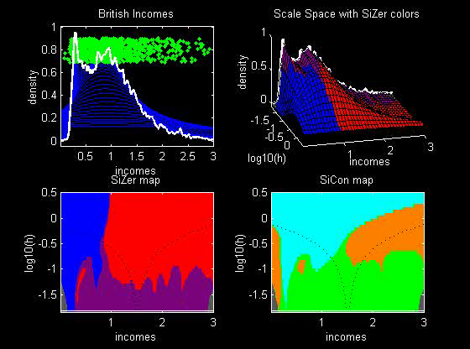
SIginficant ZERo crossings of the derivative
Incomes
Data
2 Modes
Are
Really
There!

Slide 23
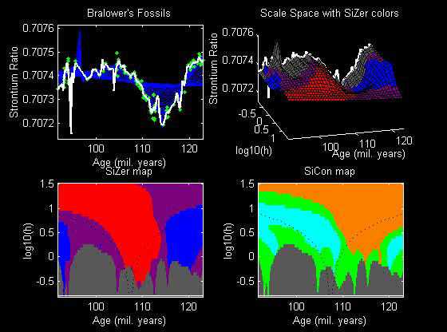
SIginficant ZERo crossings of the derivative
Fossils
Data

Slide 24
SiZer Challenge
Simultaneous Inference
Idea:
5% of Usual CI’s “don’t cover true value”

Slide 25
SiZer Challenge
Simultaneous Inference
Original (Crude) Approximation:
Independent Blocks
Better Version: Large Deviation Theory
Hannig & Marron (2006) JASA

Slide 26
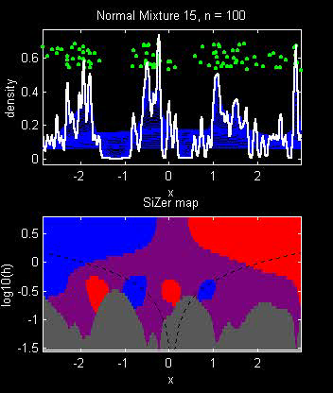

SiZer Simulation – Normal Mixture
$$n=100$$
3 Bumps?

Slide 27
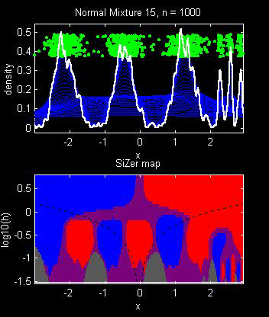

SiZer Simulation – Normal Mixture
$$n=1000$$
6 Bumps
Need
Different
Scales

Slide 28
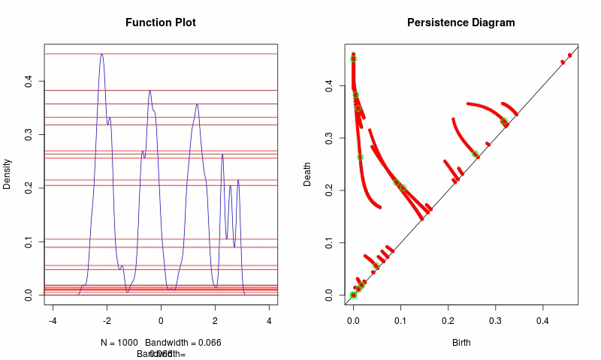
SiZer & Persistent Homology
Max Sommerfeld Graphics

Slide 29
Significance in Scale Space
Goal: Extend SiZer to 2-d
Bivariate Densities
Noisy Images

Slide 30
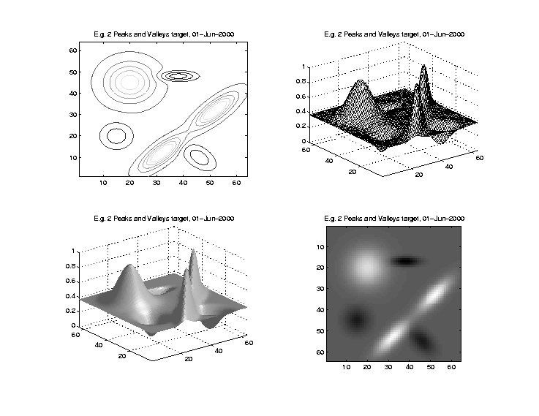
Significance in Scale Space
Visuali-
zations

Slide 31
Significance in Scale Space
Visuali-
zations
Use
Gray
Levels

Slide 32
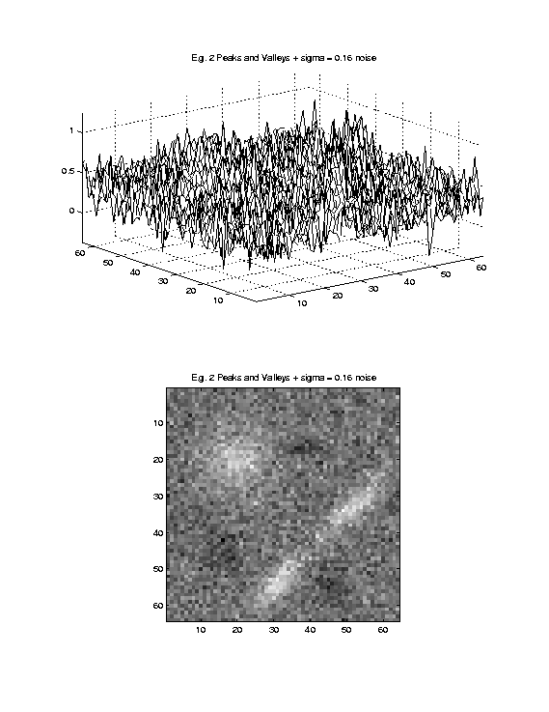
Significance in Scale Space
Signal
+
Noise

Slide 33
Significance in Scale Space
Signal
+
Noise

Slide 34
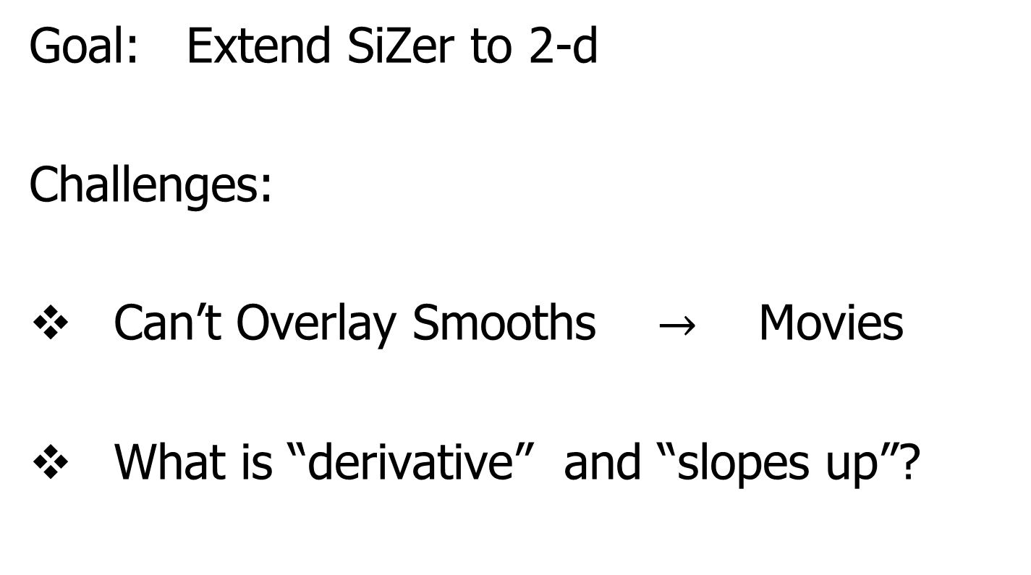
Significance in Scale Space
Goal: Extend SiZer to 2-d
Challenges:
Can’t Overlay Smooths $→$ Movies
What is “derivative” and “slopes up”?

Slide 35
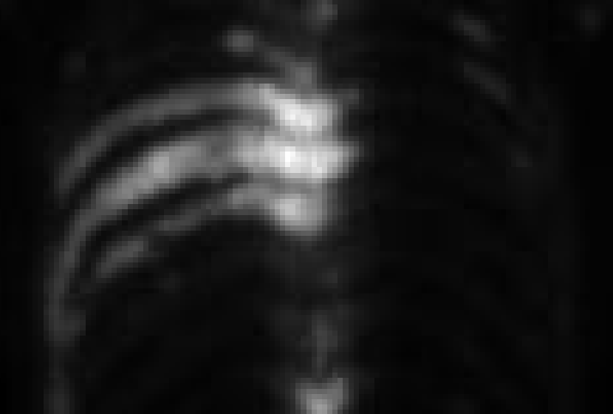
SSS Example: Gamma Camera

Slide 36
SSS Example: Gamma Camera
Phantom
(Radiation
from
artificial
structure)

Slide 37
SSS Example: Gamma Camera
Phantom
Zoom in
For Better
Contrast

Slide 38
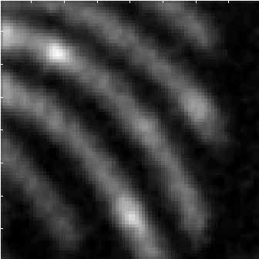
SSS Example: Gamma Camera
Family
Of
Smooths
(Scale
Space)

Slide 39
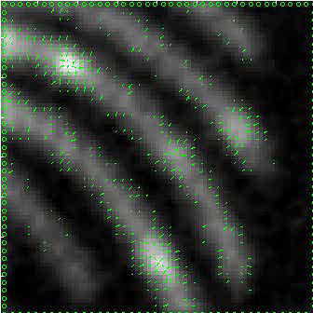
SSS Example: Gamma Camera
Statistically
Significant
Gradient
(Matrix
of
Arrows)

Slide 40
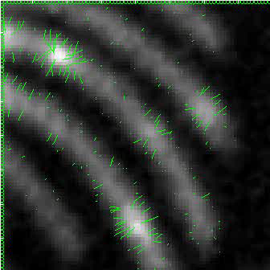
SSS Example: Gamma Camera
Statistically
Significant
Gradient
Streamlines

Slide 41
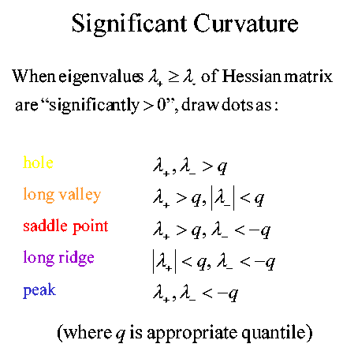
SSS Example: Gamma Camera
Statistically
Significant
Hessian
Eigenvalues
(Colored Dots)

Slide 42
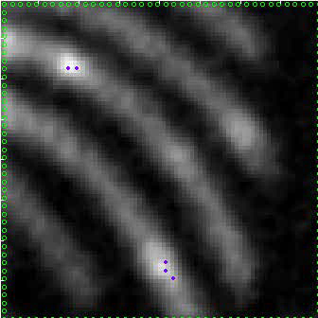
SSS Example: Gamma Camera
Statistically
Significant
Hessian
Eigenvalues
(Colored Dots)

Slide 43

SSS Example: Gamma Camera
Statistically
Significant
Hessian
Eigenvalues
Dots & Arrows

Slide 44
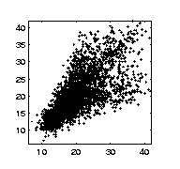
SSS Example: Melbourne Temperatures
Daily
Maxima

Slide 45
SSS Example: Melbourne Temperatures
Daily
Maxima
Significant
Arm???

Slide 46
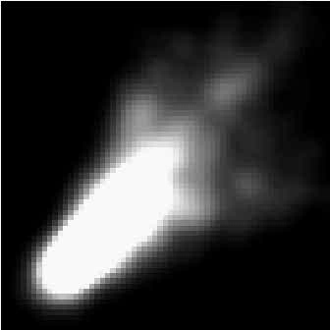
SSS Example: Melbourne Temperatures
Scale
Space

Slide 47
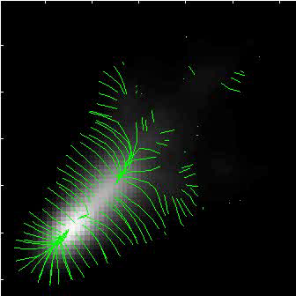
SSS Example: Melbourne Temperatures
Streamlines

Slide 48
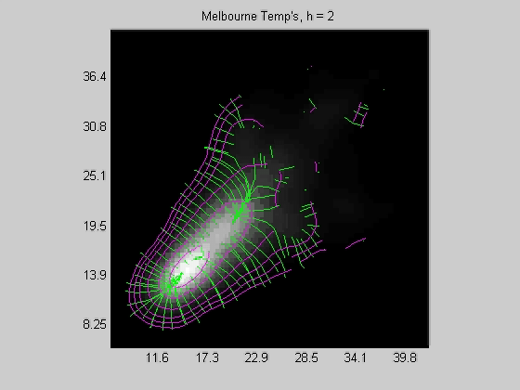
SSS Example: Melbourne Temperatures
Streamlines
&
Contours

