Slide 1
Statistics – O. R. 881
Object Oriented Data Analysis
Steve Marron
Dept. of Statistics and Operations Research
University of North Carolina

Slide 2
Administrative Info
Details on Course Web Page
https://marron.web.unc.edu/stor-881-object-oriented-data-analysis-fall-2019/
Or:
  Google: “Marrons teaching material”
  Choose This Course

Slide 3
Administrative Info
Available on that Web Page:
Will Post Daily Power Points
Also Keep Running List of References

Slide 4
Who are we?
Varying Levels of Expertise
  2nd Year Graduate (MS & PhD) Students
  …
  Faculty Level Researchers
Various Backgrounds
  Statistics / Biostat
  Computer Science – Imaging
  Bioinformatics – Genetics
  Pharmacy
  Others…

Slide 5
Course Expectations
Grading Based on:
“Participant Presentations”
5 – 10 minute talks
By Enrolled Students
Hopefully Others

Slide 6
Class Meeting Style
When you don’t understand something
Many others probably join you
So please fire away with questions
Discussion usually enlightening for others
If needed, I’ll tell you to shut up
(essentially never happens)

Slide 7
Course Context
Currently Fashionable Topic:
Big Data Science

Slide 8
Course Context
Currently Fashionable Topic:
Big Data Science

Slide 9
Course Context
Currently Fashionable Topic:
Big Data Science
Many Important Issues.
But More Challenging (& Important?):
Complex Data
( )

Slide 10
Object Oriented Data Analysis
What is it?
A Sound-Bite Explanation:
What is the “atom of the statistical analysis”?
1st Course: Numbers
Multivariate Analysis Course : Vectors
Functional Data Analysis: Curves

Slide 11


Functional Data Analysis
Currently active field in statistics, see:
Ramsay & Silverman (2005) {Book}
Ramsay & Silverman (2002) {Book}
Ramsay, J. O. (2005) {Website}

Slide 12
Object Oriented Data Analysis
What is it?
A Sound-Bite Explanation:
What is the “atom of the statistical analysis”?
1st Course: Numbers
Multivariate Analysis Course : Vectors
Functional Data Analysis: Curves
More generally: Data Objects

Slide 13
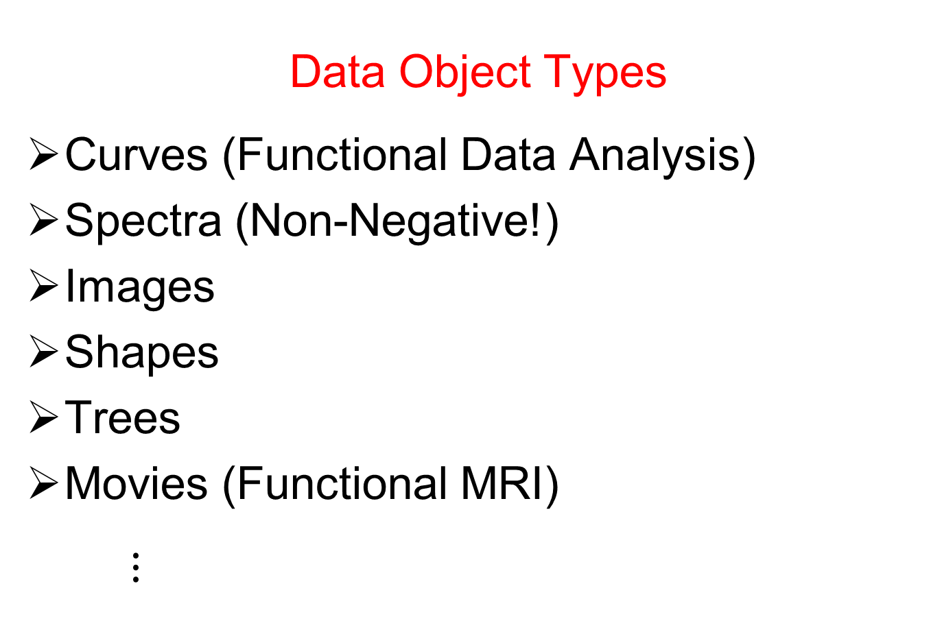
Object Oriented Data Analysis
Data Object Types
Curves (Functional Data Analysis)
Spectra (Non-Negative!)
Images
Shapes
Trees
Movies (Functional MRI)
$⋮$

Slide 14
Object Oriented Data Analysis
Current Motivation (of OODA terminology):
In Complicated Data Analyses
Fundamental (Non-Obvious) Question Is:
“What Should We Take as Data Objects?”
Key to Focusing Needed Analyses

Slide 15
Object Oriented Data Analysis
Reviewer for Annals of Applied Statistics:
Why not just say:
“Experimental Units”?
Useful for some situations
But misses different representations
E.g. log transformations …

Slide 16


Object Oriented Data Analysis
Currently Published References:
Wang and Marron (2007)
Marron and Alonso (2014)

Slide 17

Object Oriented Data Analysis
Publication in Progress:
Object Oriented Data Analysis
Book with Ian Dryden
Latest Draft Available on
Course Web Page
Comments Welcome
(Email Preferred)

Slide 18
Object Oriented Data Analysis
What is Actually Done?
Major Statistical Tasks:
Understanding Population Structure
Classification (i. e. Discrimination)
Time Series of Data Objects
“Vertical Integration” of Datatypes

Slide 19
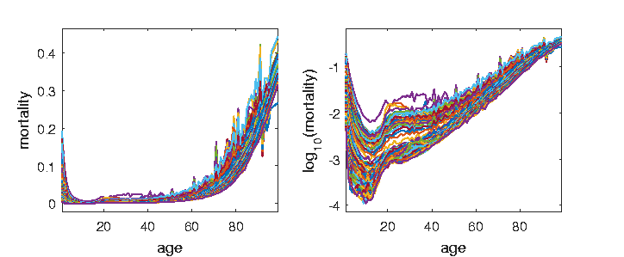
A Taste of OODA Examples
Spanish Male Mortality Curves
For Each Year/Age = # Died / Total #
≈ Prob. Of Dying

Slide 20
A Taste of OODA Examples
May Hide
Important
Structure
Spanish Male Mortality Curves
Challenge: Very Small For Young
Solution: Log Scale (Object Choice)

Slide 21
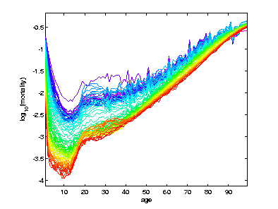
A Taste of OODA Examples
Spanish Male Mortality Curves
Enhancement: Color by Year
1908
1931
1964
1987
2002

Slide 22
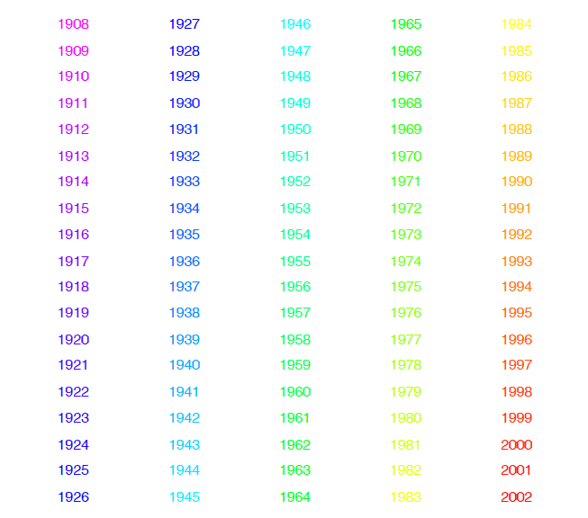
Mortality Time Series
Color Code
(Years)
Notes:
22

Slide 23
A Taste of OODA Examples
Spanish Male Mortality Curves
Enhancement: Color by Year
(Highlights
Time
Structure)
Note: Big
Improvement
Over Time!

Slide 24
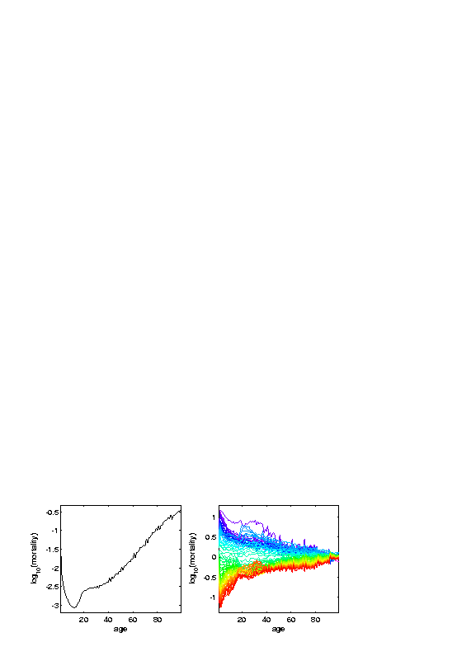
A Taste of OODA Examples
Spanish Male Mortality Curves
Mean (Contains Many Age Parts)
Dangerous to be Born
Childhood Fairly Safe
Start Risky Behavior
Older People Die Off
Age Blips???
Periodic? Decadal!
Age Rounding Effect

Slide 25
A Taste of OODA Examples
Spanish Male Mortality Curves
Mean (Contains Many Age Parts)
Residuals About Mean
Overall Improvement
Better for Young than Old
A Very bad year???

Slide 26
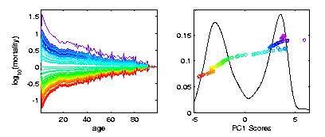
A Taste of OODA Examples
Spanish Male Mortality Curves
1st Mode of Variation
Finds “Overall Improvement”
= Rank 1 Approx’n
Most Change Fairly Rapid (1945-1965)
Smooth Histogram =
Kernel Density Est.
Will Study Later
Corresponding
Coefficients
Multiples of
Same Curve

Slide 27
A Taste of OODA Examples
Spanish Male Mortality Curves
1st Mode of Variation
= Rank 1 Approx’n
Age Rounding Blips Go Up and Down
Records Improved → Contrast

Slide 28
A Taste of OODA Examples
Spanish Male Mortality Curves
1918 Flu Pandemic
Spanish Civil War

Slide 29
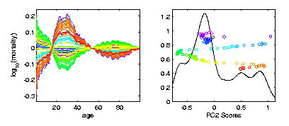
A Taste of OODA Examples
Spanish Male Mortality Curves
2nd Mode of Variation
= Rank 1 Approx’n
Contrast Between 20-45s and Rest
Big Changes
Over Time!!

Slide 30
A Taste of OODA Examples
Spanish Male Mortality Curves
Flu Pandemic, Civil War
Intro of Automobile,
Improved Safety

Slide 31
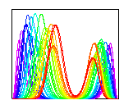
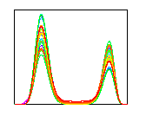

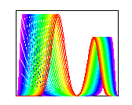
A Taste of OODA Examples
Phase and Amplitude Curves
Raw
Data
Ampl’de
Varia’n
Interesting
Modes of
Variation!
Phase
Varia’n
Warps

Slide 32
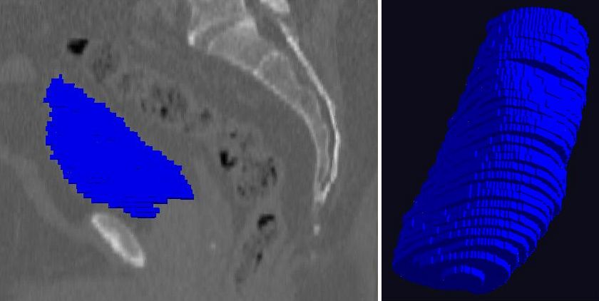
A Taste of OODA Examples
Shapes in Image Analysis (3-d)
Manual Segmentation (Male Bladder)

Slide 33
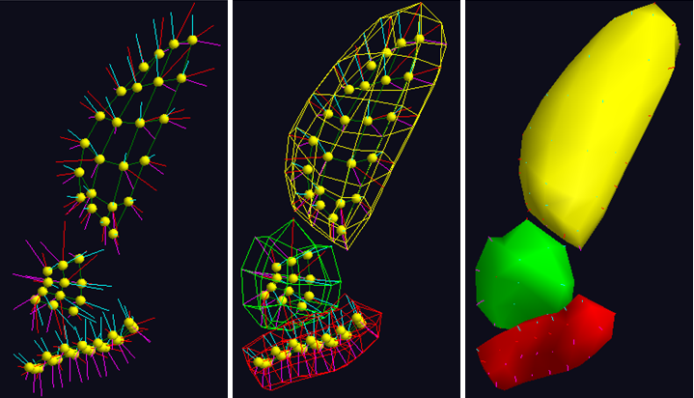
A Taste of OODA Examples
Shapes in Image Analysis (3-d)
Skeletal Shape Representation
Challenge: Data Objects Lie on Manifold

Slide 34
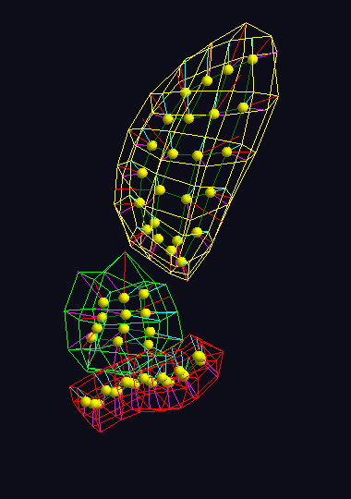
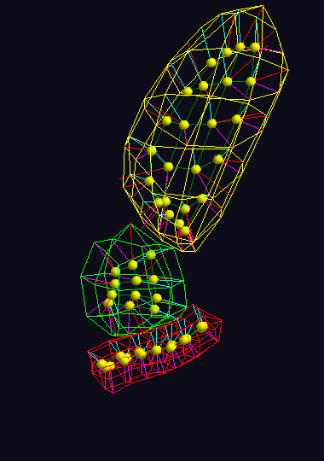
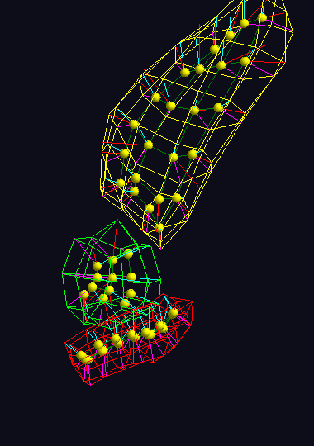



A Taste of OODA Examples
Shapes in Image Analysis (3-d)
Analysis of Variation (Princ. Geod. Anal.)
$$μ+2×{PC}_{1}$$
$$μ+2×{PC}_{1}$$
$$μ+2×{PC}_{1}$$

Slide 35
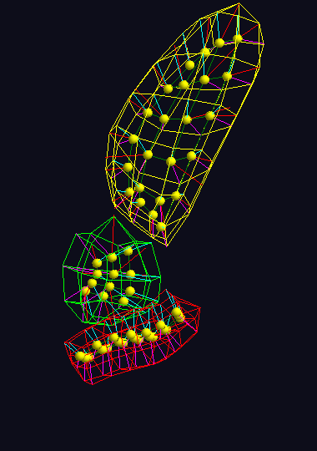

A Taste of OODA Examples
Shapes in Image Analysis (3-d)
Analysis of Variation (Princ. Geod. Anal.)
$$μ$$
$$μ$$
$$μ$$

Slide 36
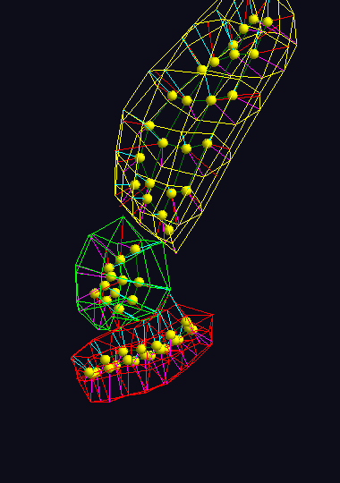
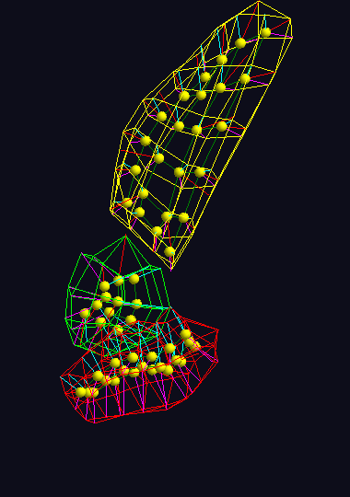
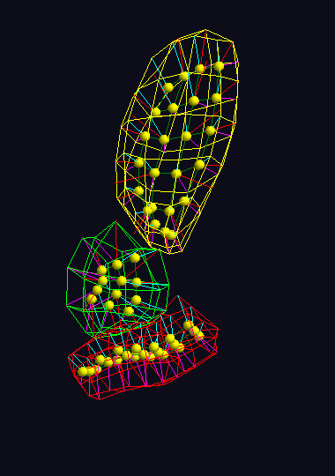



A Taste of OODA Examples
Shapes in Image Analysis (3-d)
Analysis of Variation (Princ. Geod. Anal.)
$$μ−2×{PC}_{1}$$
$$μ−2×{PC}_{1}$$
$$μ−2×{PC}_{1}$$

Slide 37
A Taste of OODA Examples
Note: Different Display of Modes of Variation
Shapes in Image Analysis (3-d)
Analysis of Variation (Princ. Geod. Anal.)
Mode 1: Rectum
Mode 2: Twisting
Mode 3: Bladder
$$μ−2×{PC}_{1}$$
$$μ−2×{PC}_{1}$$
$$μ−2×{PC}_{1}$$

Slide 38
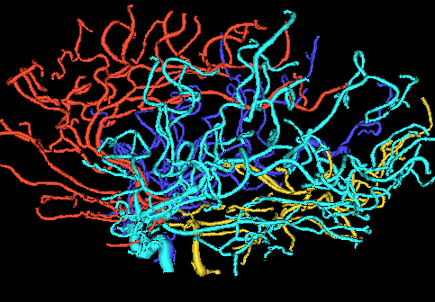
A Taste of OODA Examples
Tree Structured Data Objects
Brain Artery Data
Marron’s
Brain

Slide 39
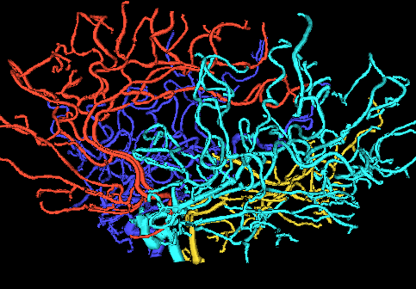
A Taste of OODA Examples
Tree Structured Data Objects
Brain Artery Data
Marron’s
Brain

Slide 40
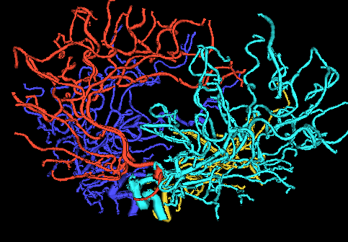
A Taste of OODA Examples
Tree Structured Data Objects
Brain Artery Data
Marron’s
Brain

Slide 41
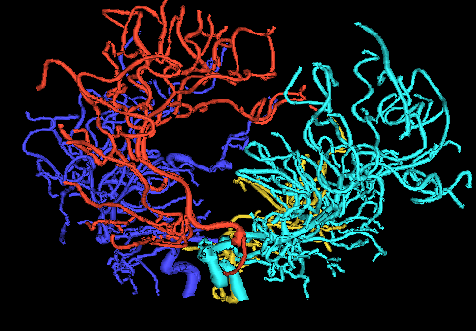
A Taste of OODA Examples
Tree Structured Data Objects
Brain Artery Data
Marron’s
Brain

Slide 42
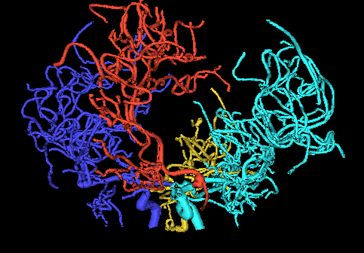
A Taste of OODA Examples
Tree Structured Data Objects
Brain Artery Data
Marron’s
Brain

Slide 43
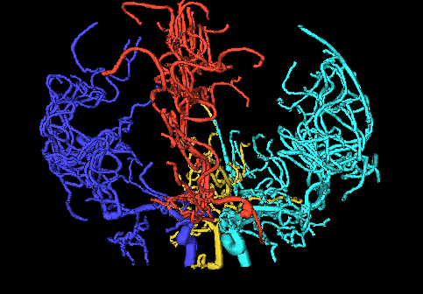
A Taste of OODA Examples
Tree Structured Data Objects
Brain Artery Data
Marron’s
Brain

Slide 44
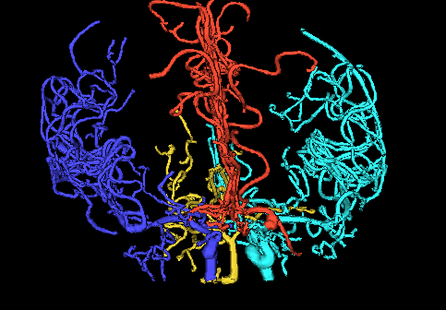
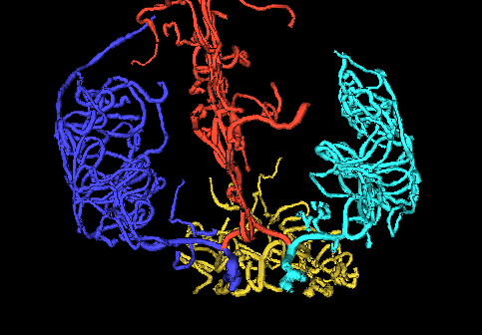
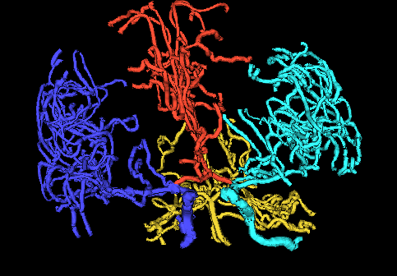
A Taste of OODA Examples
Tree Structured Data Objects
Brain Artery Data,
Analyze Sample of n=100
Average? Variation About Average???
Modes of Variation???
,
, ... ,

Slide 45
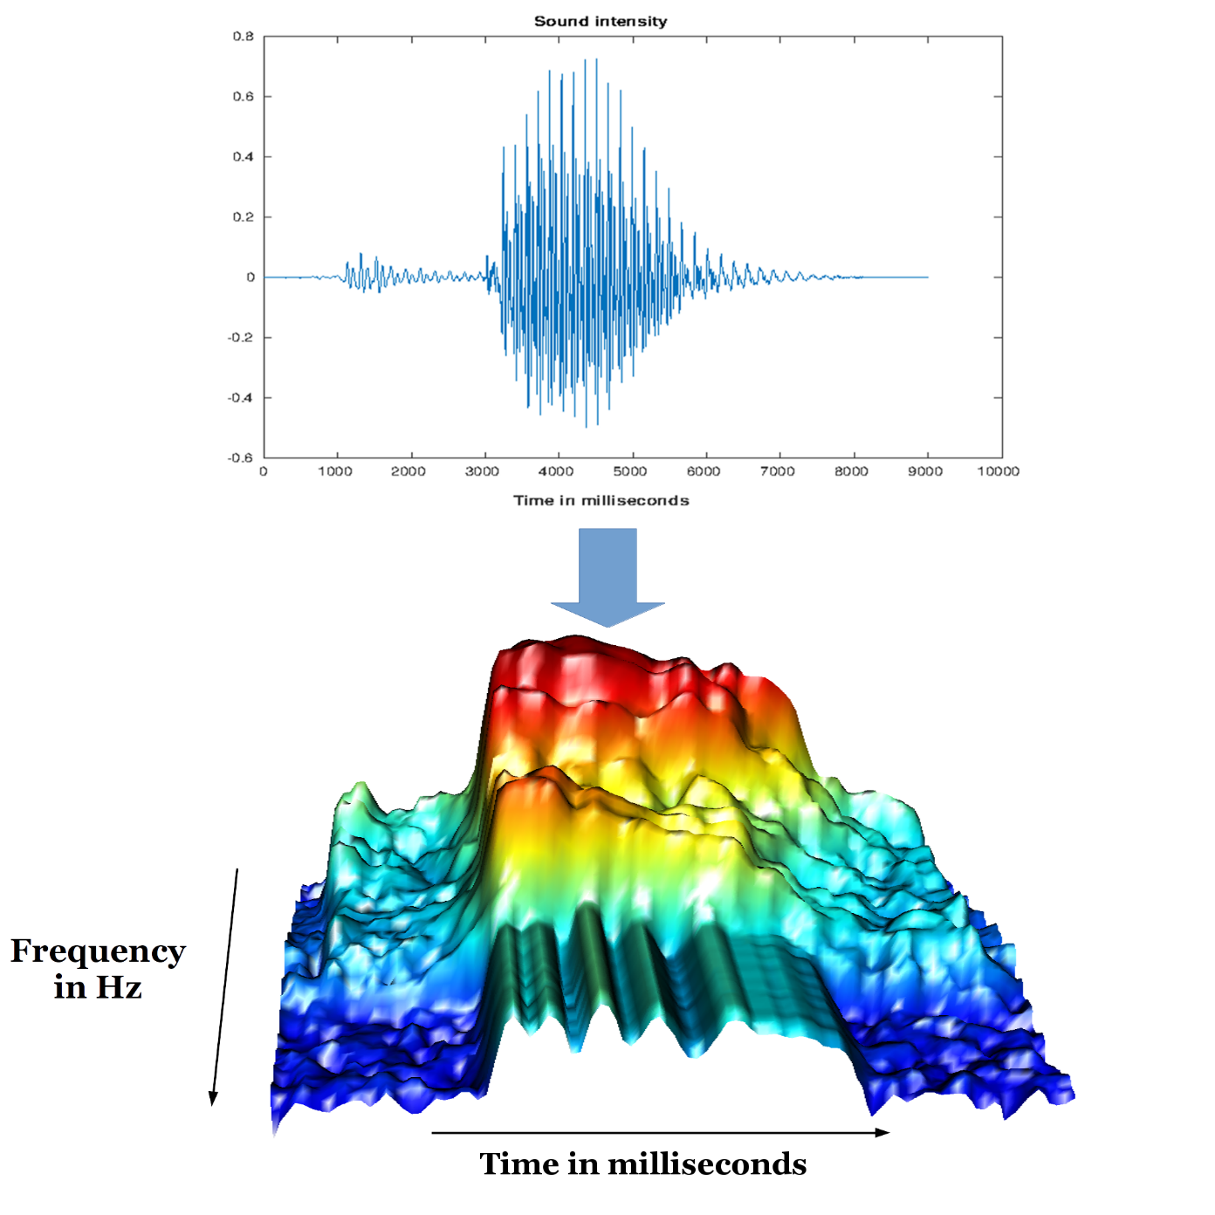
A Taste of OODA Examples
Sounds
as Data
Objects
Sonogram
Pigoli et al. (2015)

Slide 46
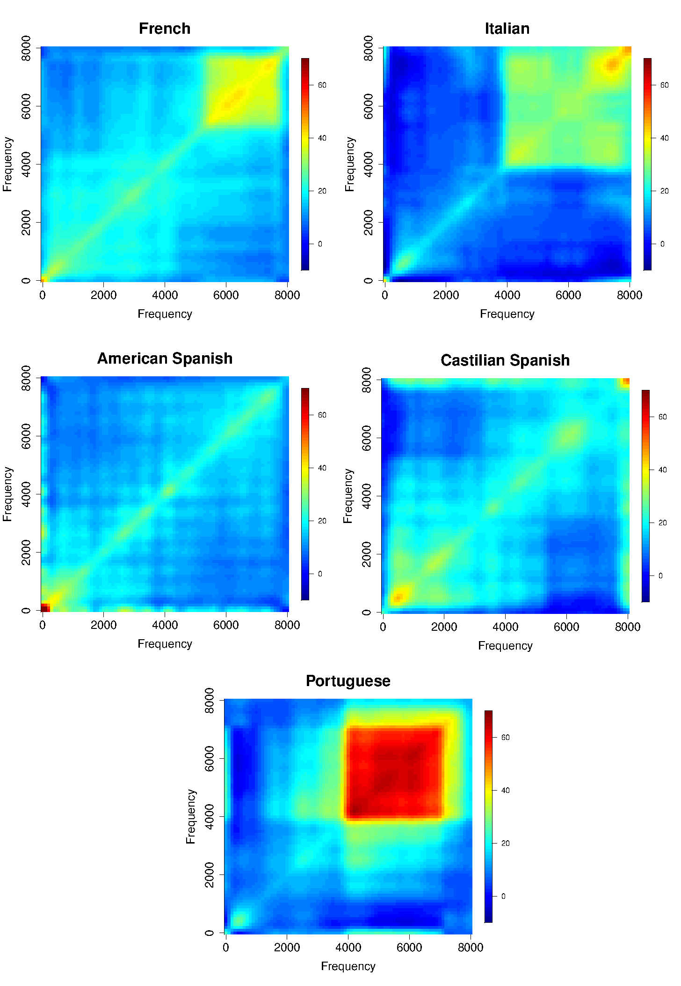
A Taste of OODA Examples
Sounds
as Data
Objects
Analysis
Of Dialects

Slide 47

A Taste of OODA Examples
Faces as Data Objects
Raw Data
Benito et al. (2017)

Slide 48
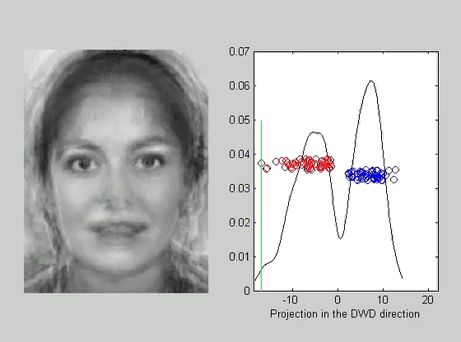
A Taste of OODA Examples
Faces as Data Objects
Classify
Males vs.
Females

Slide 49
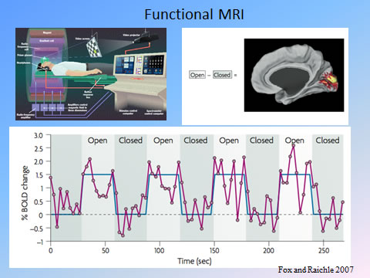
A Taste of OODA Examples
Functional Magnetic Resonance Imaging
3-d Maps of
Brain Activity
Collected
Over Time
Often While
Performing
Some “Task”

Slide 50
A Taste of OODA Examples
Functional Magnetic Resonance Imaging
3-d Maps of
Brain Activity
Collected
Over Time
Data Objects?
Heat Map at
One Time?
Time Series at
One Location?

Slide 51
Object Oriented Data Analysis
What is it?
A Sound-Bite Explanation:
What is the “atom of the statistical analysis”?
1st Course: Numbers
Multivariate Analysis Course : Vectors
Functional Data Analysis: Curves
More generally: Data Objects

Slide 52
Object Oriented Data Analysis
Three Major Phases of OODA:
I. Object Definition
“What are the Data Objects?”
Exploratory Analysis
“What Is Data Structure / Drivers?”
III. Confirmatory Analysis / Validation
Is it Really There (vs. Noise Artifact)?

Slide 53
Object Oriented Data Analysis
Three Major Phases of OODA:
I. Object Definition
“What are the Data Objects?”
Generally Not Widely Appreciated
But Highlighted in OODA

Slide 54
Object Oriented Data Analysis
Three Major Phases of OODA:
Exploratory Analysis
“What Is Data Structure / Drivers?”
Understood by Some in Statistics
Classical Reference: Tukey (1977)
Better Understood in Machine Learning

Slide 55
Object Oriented Data Analysis
Three Major Phases of OODA:
III. Confirmatory Analysis / Validation
Is it Really There (vs. Noise Artifact)?
Primary Focus of Modern “Statistics”
E.g. STOR & Biostat PhD Curriculum
Less Considered In Machine Learning

Slide 56
Object Oriented Data Analysis
Three Major Phases of OODA:
I. Object Definition
“What are the Data Objects?”
Background Notation, etc.

Slide 57
Choice of Data Objects
Two Main Parts:
Data Object Definition
(e.g. Mortality Data,
which curves???)

Slide 58
Data Object Definition
E.g. Mortality Data,
Studied Mortality vs. Age (over years)
But could have
chosen: vs. Year
(over ages)
{tried both, this
is more fun}

Slide 59
Choice of Data Objects
Two Main Parts:
Data Object Definition
(e.g. Mortality Data,
which curves???)
Data Object Representation
(e.g. Mortality Data)

Slide 60
Data Object Representation
E.g. Mortality Data,
Recall log scale more informative
(for this data set)

Slide 61

Basics of OODA
Convenient Organizational Structure:
Data Matrix
$$\left[\begin{matrix}x_{11} & ⋯ & x_{1n} \\ ⋮ & ⋱ & ⋮ \\ x_{d1} & ⋯ & x_{dn}\end{matrix}\right]$$
Statistical Standard: $n$ for sample size
Other Fields: Other choices found
Terrible choice: $m$ and $n$ ?!?

Slide 62
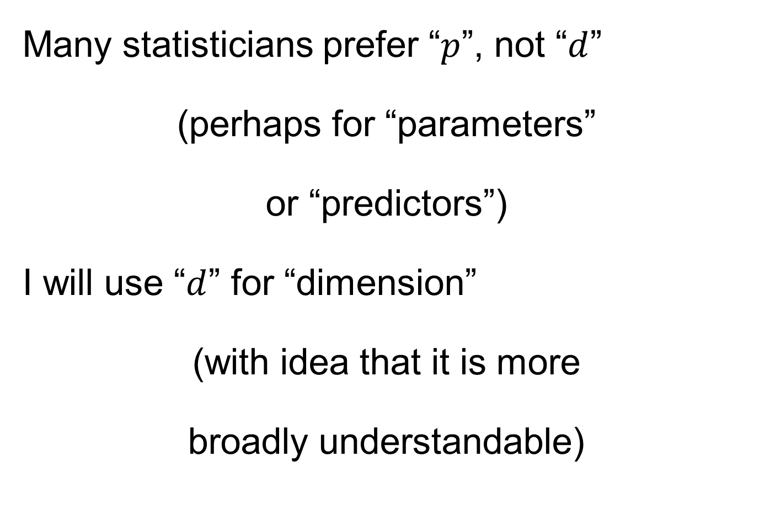
Notation
Many statisticians prefer “$p$”, not “$d$”
(perhaps for “parameters”
or “predictors”)
I will use “$d$” for “dimension”
(with idea that it is more
broadly understandable)

Slide 63

Basics of OODA
Convenient Organizational Structure:
Data Matrix
$$\left[\begin{matrix}x_{11} & ⋯ & x_{1n} \\ ⋮ & ⋱ & ⋮ \\ x_{d1} & ⋯ & x_{dn}\end{matrix}\right]$$
Convention Here:
Columns are Data Objects
(Indexed by $j=1,⋯,n$)

Slide 64

Basics of OODA
Convenient Organizational Structure:
Data Matrix
$$\left[\begin{matrix}x_{11} & ⋯ & x_{1n} \\ ⋮ & ⋱ & ⋮ \\ x_{d1} & ⋯ & x_{dn}\end{matrix}\right]$$
E.g. Mortality Data
Each Column
Contains
One Curve
As a
Function
of Age

Slide 65
Basics of OODA
Convenient Organizational Structure:
Data Matrix
$$\left[\begin{matrix}x_{11} & ⋯ & x_{1n} \\ ⋮ & ⋱ & ⋮ \\ x_{d1} & ⋯ & x_{dn}\end{matrix}\right]$$
Convention Here:
Columns are Data Objects
(Indexed by $j=1,⋯,n$)

Slide 66

Basics of OODA
Convenient Organizational Structure:
Data Matrix
$$\left[\begin{matrix}x_{11} & ⋯ & x_{1n} \\ ⋮ & ⋱ & ⋮ \\ x_{d1} & ⋯ & x_{dn}\end{matrix}\right]$$
Terminology:
Numbers in Rows are called “Features”
(Indexed by $i=1,⋯,d$)

Slide 67
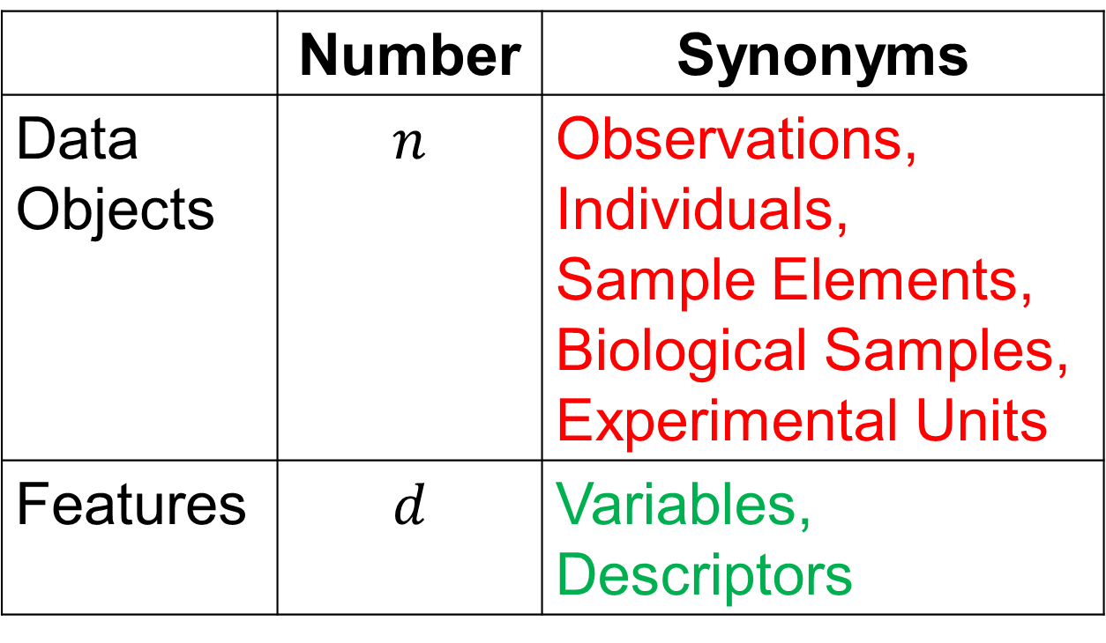
Basics of OODA
Common Synonyms:
 | Number | Synonyms
Data Objects | $$n$$ | Observations, Individuals, Sample Elements, Biological Samples, Experimental Units
Features | $$d$$ | Variables, Descriptors

Slide 68
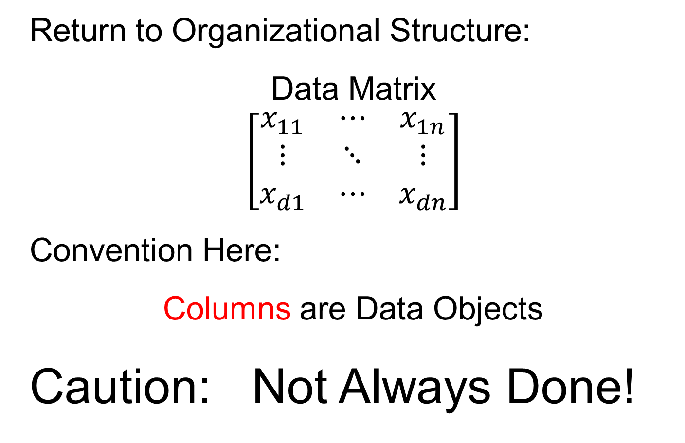
Basics of OODA
Return to Organizational Structure:
Data Matrix
$$\left[\begin{matrix}x_{11} & ⋯ & x_{1n} \\ ⋮ & ⋱ & ⋮ \\ x_{d1} & ⋯ & x_{dn}\end{matrix}\right]$$
Convention Here:
Columns are Data Objects
Caution: Not Always Done!

Slide 69
Basics of OODA
Row vs. Column Choice by Areas:
Columns as Data Objects:
Linear Algebra (column vectors)
Bioinformatics (from Excel restrictions)
Rows as Data Objects:
Statistical Data Bases
Linear Models

Slide 70
Basics of OODA
Row vs. Column Choice by Software:
Columns as Data Objects:
Matlab
Rows as Data Objects:
R & Python
SAS & others

Slide 71
Object Oriented Data Analysis
Three Major Phases of OODA:
I. Object Definition
“What are the Data Objects?”
Exploratory Analysis
“What Is Data Structure / Drivers?”
III. Confirmatory Analysis / Validation
Is it Really There (vs. Noise Artifact)?

Slide 72
Object Oriented Data Analysis
Three Major Phases of OODA:
Exploratory Analysis
“What Is Data Structure / Drivers?”
Important Aspect:
Data Visualization
(Look at Simple Examples)

Slide 73
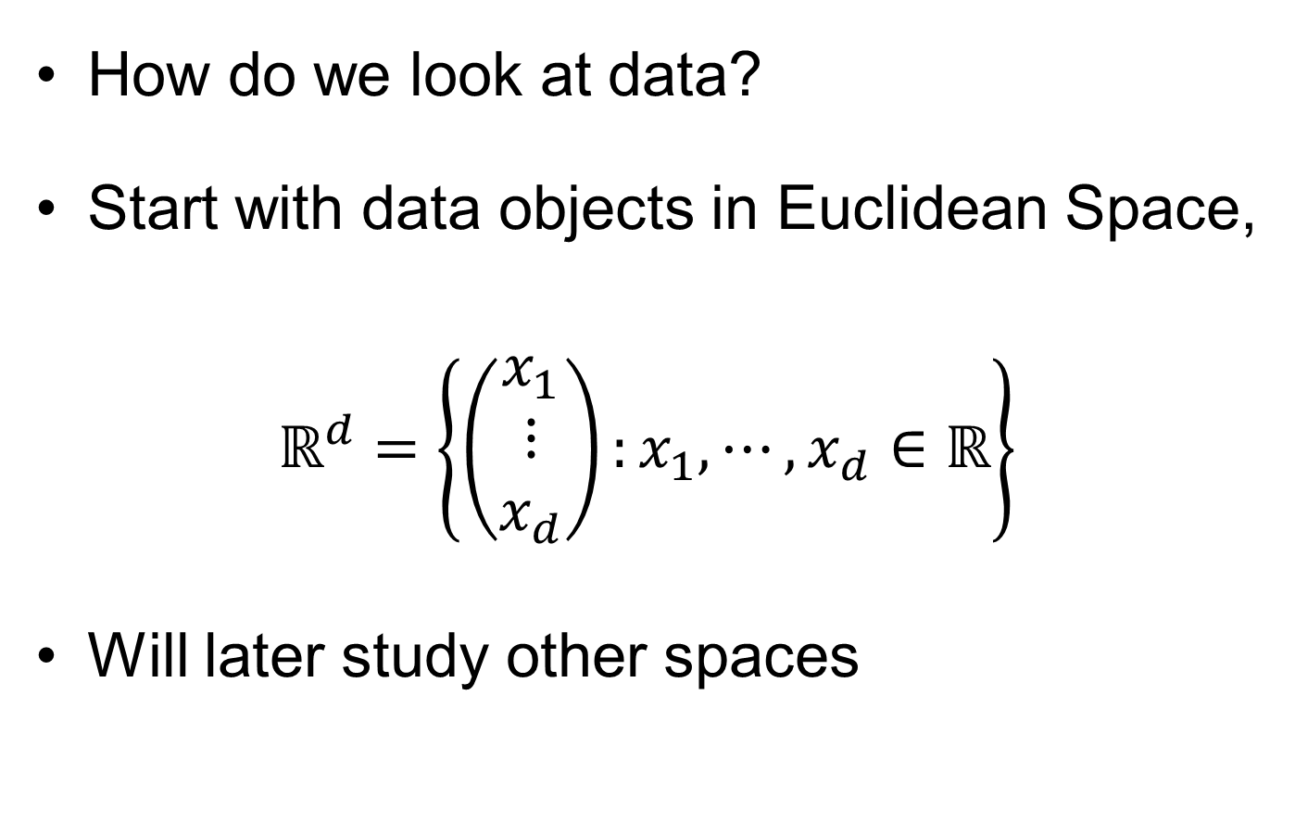
Visualization
How do we look at data?
Start with data objects in Euclidean Space,
$$ℝ^{d}=\left\{\left(\begin{matrix}x_{1} \\ ⋮ \\ x_{d}\end{matrix}\right):x_{1},⋯,x_{d}∈ℝ\right\}$$
Will later study other spaces

Slide 74
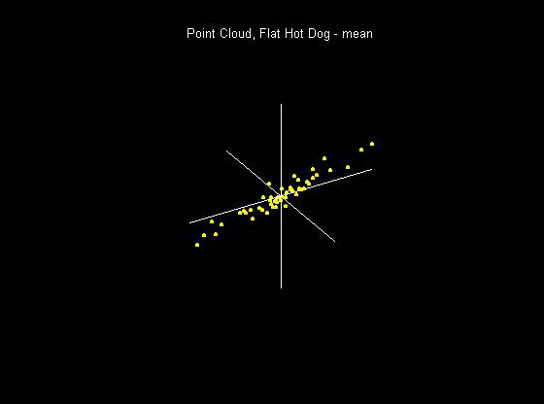
Visualization
How do we look at Euclidean data?
1-d: histograms, etc.
2-d: scatterplots
3-d: spinning point clouds

Slide 75
Visualization
How do we look at Euclidean data?
Higher Dimensions?
Workhorse Idea: Projections

Slide 76
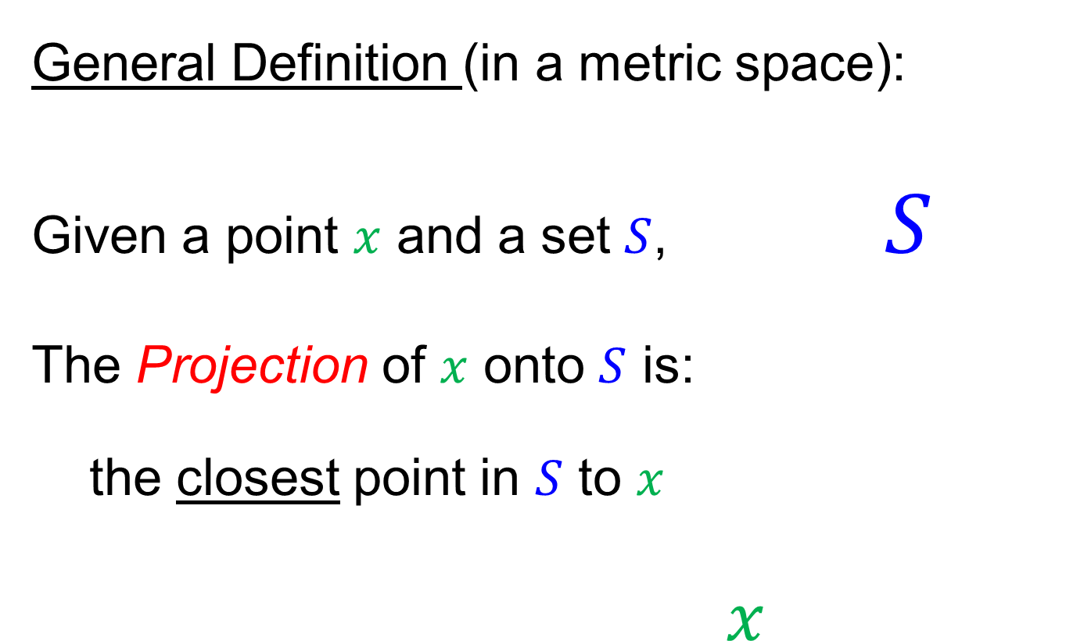
Projection
General Definition (in a metric space):
Given a point $x$ and a set $S$, $S$
The Projection of $x$ onto $S$ is:
the closest point in $S$ to $x$
$x$

Slide 77
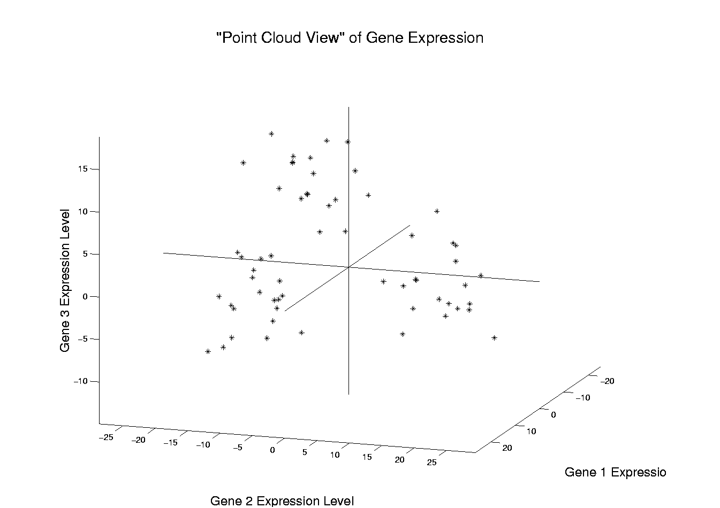
Illustration of Multivariate View: Raw Data
Notes:
EgView1p1RawData.ps

Slide 78
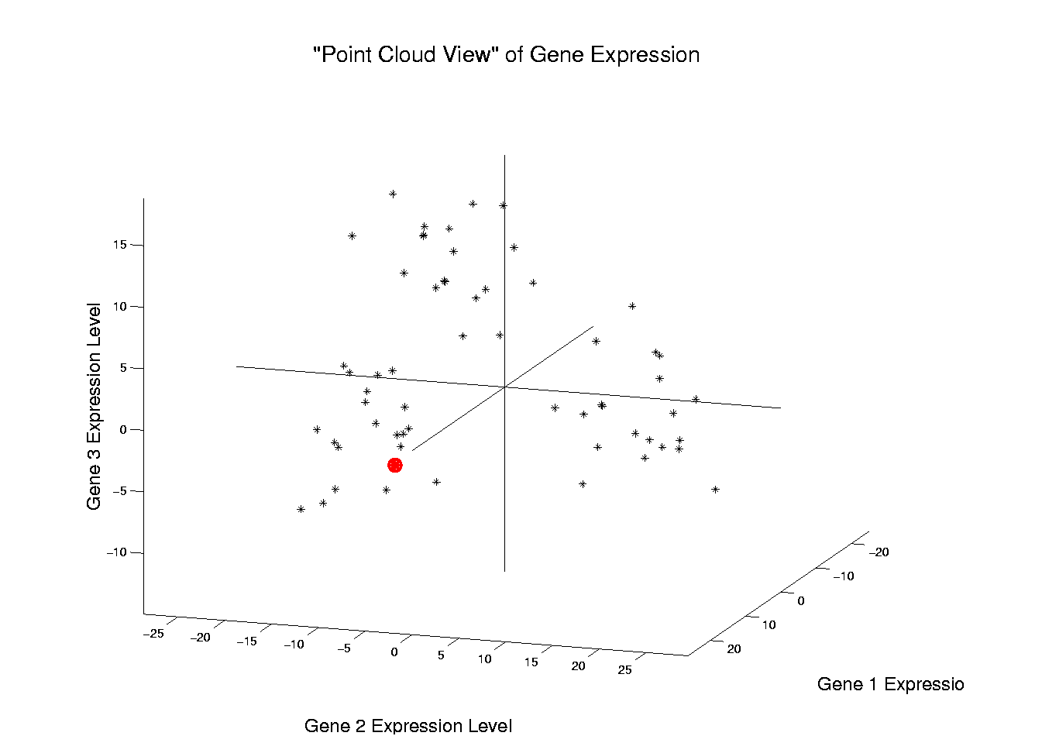
Illustration of Multivariate View: Highlight One
Notes:
EgView1p2RawDataHiLite1.ps

Slide 79
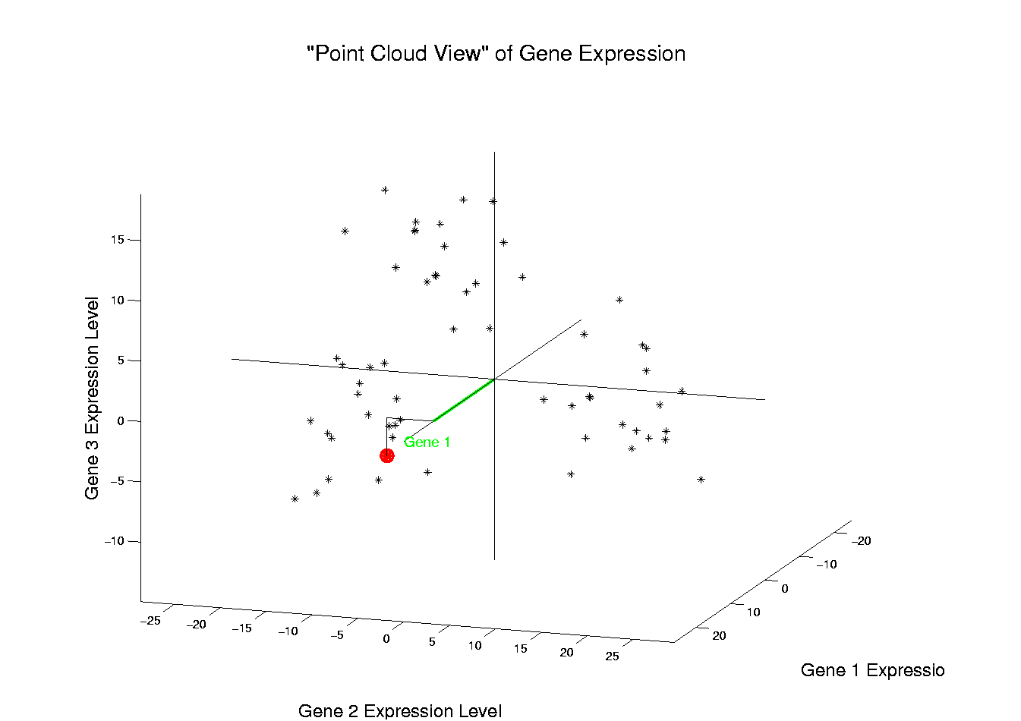
Illustration of Multivariate View: Gene 1 Express’n
Notes:
EgView1p3RawDataHL1CoordX.ps

Slide 80
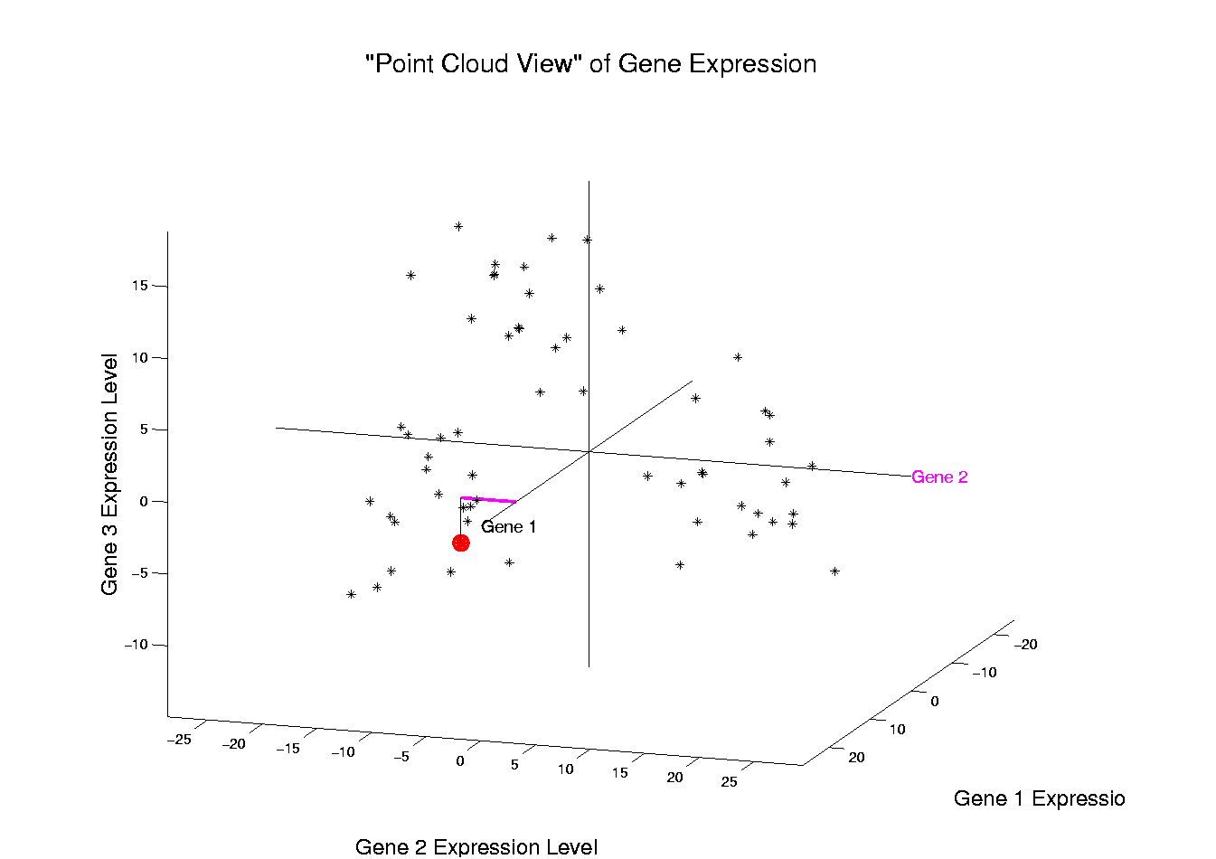
Illustration of Multivariate View: Gene 2 Express’n
Notes:
EgView1p3RawDataHL1CoordY.ps

Slide 81
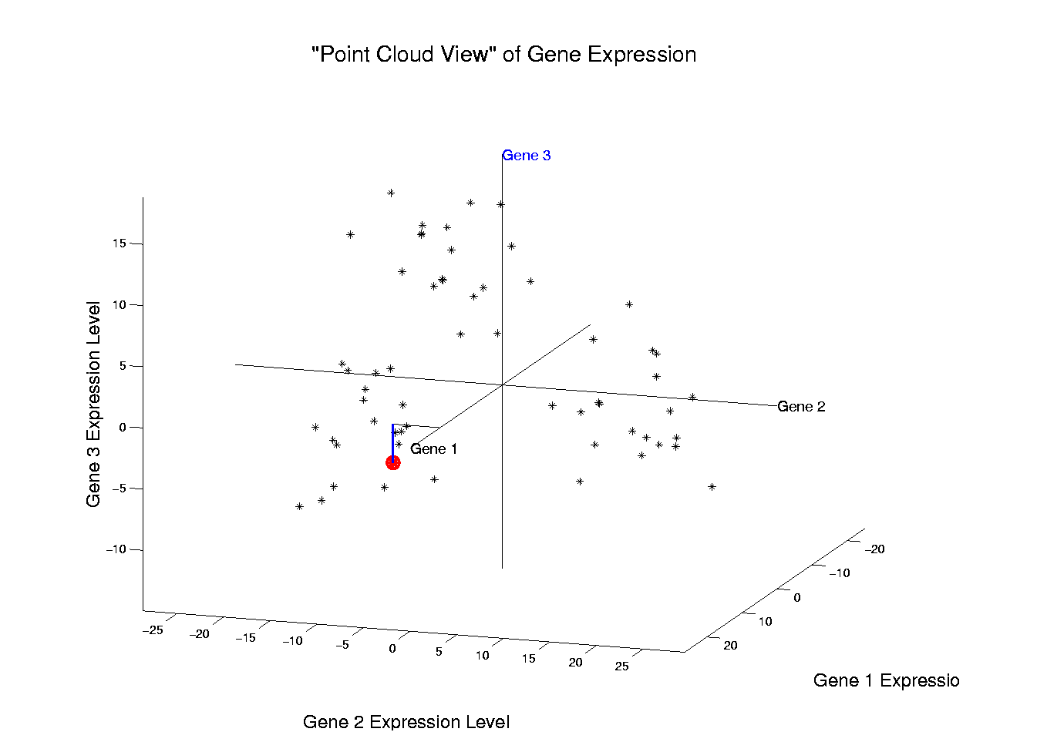
Illustration of Multivariate View: Gene 3 Express’n
Notes:
EgView1p3RawDataHL1CoordZ.ps

Slide 82
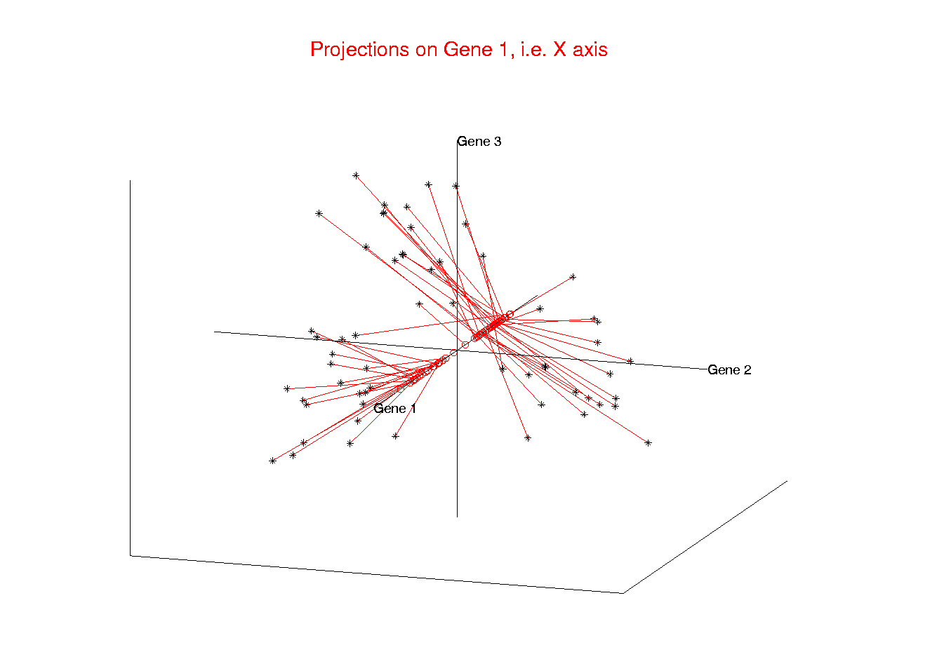
Illust’n of Multivar. View: 1-d Projection, X-axis
Notes:
EgView1p21proj3DX.ps

Slide 83
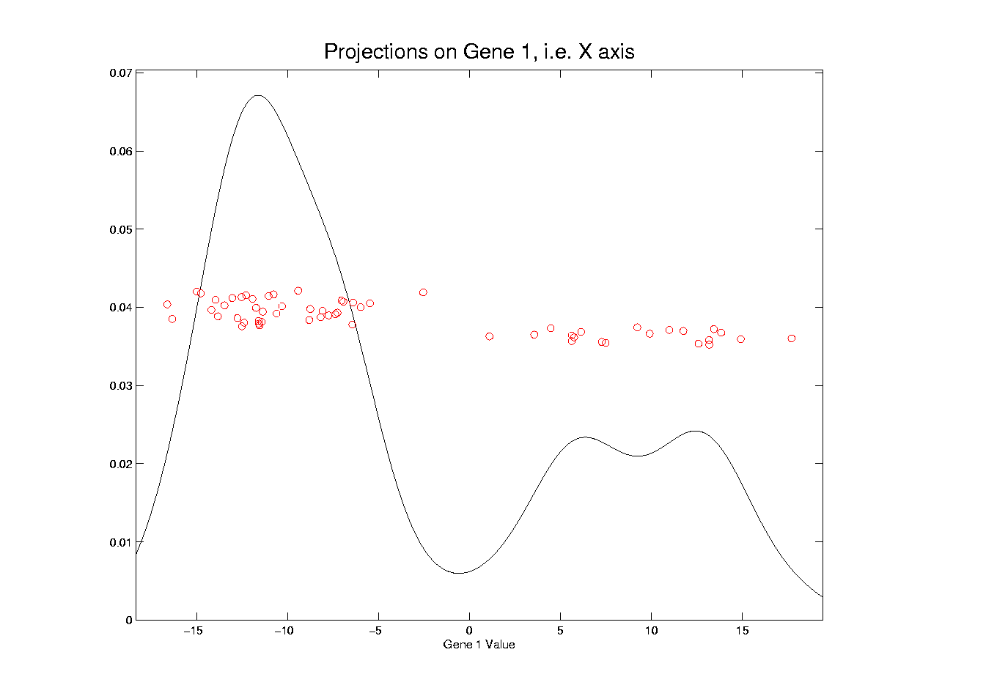
Illust’n of Multivar. View: X-Projection, 1-d view
Notes:
EgView1p31Proj1dX.ps

Slide 84
Illust’n of Multivar. View: X-Projection, 1-d view
X Coordinates
Are Projections
Notes:
EgView1p31Proj1dX.ps

Slide 85
Illust’n of Multivar. View: X-Projection, 1-d view
Y Coordinates Show
Order in Data Set
(or Random)
Notes:
EgView1p31Proj1dX.ps

Slide 86
Illust’n of Multivar. View: X-Projection, 1-d view
Smooth histogram =
Kernel Density Estimate
Will Study in Detail Later
Notes:
EgView1p31Proj1dX.ps

Slide 87
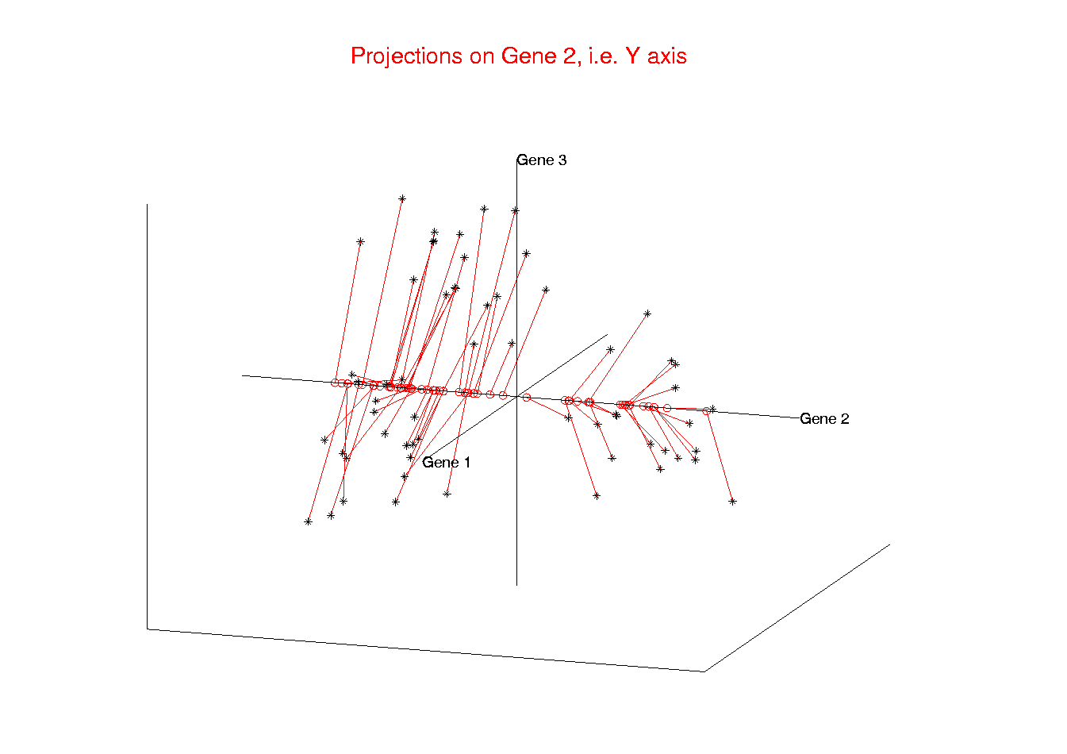
Illust’n of Multivar. View: 1-d Projection, Y-axis
Notes:
EgView1p22proj3DY.ps

Slide 88

Illust’n of Multivar. View: Y-Projection, 1-d view
Notes:
EgView1p32Proj1dY.ps

Slide 89

Illust’n of Multivar. View: 1-d Projection, Z-axis
Notes:
EgView1p23proj3DZ.ps

Slide 90

Illust’n of Multivar. View: Z-Projection, 1-d view
Notes:
EgView1p33Proj1dZ.ps

Slide 91

Illust’n of Multivar. View: 2-d Proj’n, XY-plane
Notes:
EgView1p24proj3DXY.ps

Slide 92

Illust’n of Multivar. View: XY-Proj’n, 2-d view
Notes:
EgView1p34proj2DXY.ps

Slide 93

Illust’n of Multivar. View: 2-d Proj’n, XZ-plane
Notes:
EgView1p25proj3DXZ.ps

Slide 94

Illust’n of Multivar. View: XZ-Proj’n, 2-d view
Notes:
EgView1p35proj2DXZ.ps

Slide 95

Illust’n of Multivar. View: 2-d Proj’n, YZ-plane
Notes:
EgView1p26proj3DYZ.ps

Slide 96

Illust’n of Multivar. View: YZ-Proj’n, 2-d view
Notes:
EgView1p36proj2DYZ.ps

Slide 97

Illust’n of Multivar. View: all 3 planes
Think:
Front
Top
Side
Views
Notes:
EgView1p27proj3Dall.ps

Slide 98

Illust’n of Multivar. View: Diagonal 1-d proj’ns
Notes:
EgView1p37proj1Ddiag.ps

Slide 99

Illust’n of Multivar. View: Add off-diagonals
Notes:
EgView1p38proj1n2Dcolor.ps

Slide 100

Illust’n of Multivar. View: Typical View
Notes:
EgView1p39ScatPlot.ps

Slide 101
Illust’n of Multivar. View: Typical View
Note Linkage of Axes
Notes:
EgView1p39ScatPlot.ps

Slide 102
Illust’n of Multivar. View: Typical View
Note Linkage of Axes
Notes:
EgView1p39ScatPlot.ps

Slide 103
Illust’n of Multivar. View: Typical View
Note Linkage of Axes
Notes:
EgView1p39ScatPlot.ps

Slide 104
Illust’n of Multivar. View: Typical View
Note Correspondence
of Points
Notes:
EgView1p39ScatPlot.ps

Slide 105
Illust’n of Multivar. View: Typical View
Note Correspondence
of Points
Notes:
EgView1p39ScatPlot.ps

Slide 106
Projection
Important Point
There are many “directions of interest” on which projection is useful
An important set of directions:
Principal Components

Slide 107
Principal Components
Find Directions of:
“Maximal (projected) Variation”
Compute Sequentially
On Orthogonal Subspaces
Will take careful look at mathematics later

Slide 108
Principal Components
For simple,
3-d toy data,
recall raw
data view:
Notes:
108

Slide 109

Principal Components
PCA just
gives rotated
coordinate
system:
Notes:
109

Slide 110

Principal Components
Early References:
Pearson (1901)
Hotelling (1933)
Founder of UNC Statistics Dept.
Notes:
110

Slide 111
Illust’n of PCA View: Recall Raw Data
Notes:
EgView1p1RawData.ps

Slide 112
Illust’n of PCA View: Recall Gene by Gene Views
Notes:
EgView1p27proj3Dall.ps

Slide 113

Illust’n of PCA View: PC1 Projections
Notes:
EgView1p51proj3dPC1.ps

Slide 114
Illust’n of PCA View: PC1 Projections
Note Different Axis
Chosen to
Maximize Spread
Notes:
EgView1p51proj3dPC1.ps

Slide 115

Illust’n of PCA View: PC1 Projections, 1-d View
Notes:
EgView1p61Proj1dPC1.ps

Slide 116

Illust’n of PCA View: PC2 Projections
Notes:
EgView1p52proj3dPC2.ps

Slide 117

Illust’n of PCA View: PC2 Projections, 1-d View
Notes:
EgView1p62Proj1dPC2.ps

Slide 118

Illust’n of PCA View: PC3 Projections
Notes:
EgView1p53proj3dPC3.ps

Slide 119

Illust’n of PCA View: PC3 Projections, 1-d View
Notes:
EgView1p63Proj1dPC3.ps

Slide 120

Illust’n of PCA View: Projections on PC1,2 plane
Notes:
EgView1p54proj3dPC12.ps

Slide 121

Illust’n of PCA View: PC1 & 2 Proj’n Scatterplot
Notes:
EgView1p64proj2dPC12.ps

Slide 122

Illust’n of PCA View: Projections on PC1,3 plane
Notes:
EgView1p55proj3dPC13.ps

Slide 123

Illust’n of PCA View: PC1 & 3 Proj’n Scatterplot
Notes:
EgView1p65proj2dPC13.ps

Slide 124

Illust’n of PCA View: Projections on PC2,3 plane
Notes:
EgView1p56proj3dPC23.ps

Slide 125

Illust’n of PCA View: PC2 & 3 Proj’n Scatterplot
Notes:
EgView1p66proj2dPC23.ps

Slide 126

Illust’n of PCA View: All 3 PC Projections
Notes:
EgView1p57proj3dPCall.ps

Slide 127

Illust’n of PCA View: Matrix with 1-d proj’ns on diag.
Notes:
EgView1p67proj1dPCAdiag.ps

Slide 128

Illust’n of PCA: Add off-diagonals to matrix
Notes:
EgView1p68proj1n2dPCAcolor.ps

Slide 129

Illust’n of PCA View: Typical View
Useful “3-d” Interpretation
Front View
Side View
Top View
Notes:
EgView1p69PCAScatPlot.ps

Slide 130
Comparison of Views
Highlight 3 clusters
Gene by Gene View
  Clusters appear in all 3 scatterplots
  But never very separated
PCA View
  1st shows three distinct clusters
  Better separated than in gene view
  Clustering concentrated in 1st scatterplot
Effect is small, since only 3-d

Slide 131

Illust’n of PCA View: Gene by Gene View
Note Colors Enhance
Impressions of Clusters
Notes:
EgView1p71GeneViewClustColor.ps

Slide 132

Illust’n of PCA View: PCA View
Notes:
EgView1p72PCAViewClustColor.ps

Slide 133
Illust’n of PCA View: PCA View
Clusters are “more distinct”
Since more “air space”
In between
Notes:
EgView1p72PCAViewClustColor.ps

Slide 134

Another Comparison of Views
Much higher dimension, $d=4000$
Gene by Gene View
Simulation:
$n=30$ N(0.1,1) (marginals)
$n=30$ N(-0.1,1) (marginals)
- Independent Entries

Slide 135

Another Comparison: Gene by Gene View
Notes:
EgView2p1dat1GeneView.ps

Slide 136
Another Comparison: Gene by Gene View
Very Small Differences
Between Means
Notes:
EgView2p1dat1GeneView.ps

Slide 137

Another Comparison of Views
Much higher dimension, $d=4000$
Gene by Gene View
  Clusters very nearly the same
  Very slight difference in means

Slide 138

Another Comparison: PCA View
Notes:
EgView2p2dat1PCAView.ps

Slide 139

Another Comparison of Views
Much higher dimension, $d=4000$
Gene by Gene View
  Clusters very nearly the same
  Very slight difference in means
PCA View
  Huge difference in 1st PC Direction
  Magnification of clustering
  Lesson: Alternate views can show much more
  (especially in high dimensions, i.e. for many genes)
  Shows PC view is very useful`

