Slide 1
Participant Presentations
Please Sign Up:
Name
Email (Onyen is fine, or …)
Are You ENRolled?
Dept. & Advisor (Lab?)
Tentative Title (“????” Is OK)
When:
Next Week, Early, Oct., Nov., Late

Slide 2
Big Picture Data Visualization
For a Matrix of Data:
$${\left(\begin{matrix}x_{11} & ⋯ & x_{1n} \\ ⋮ & ⋱ & ⋮ \\ x_{d1} & ⋯ & x_{dn}\end{matrix}\right)}_{d×n}$$
Three Useful (& Important) Visualizations
Curve Objects
Relationships Between Objects
Marginal Distributions (1-d each “variable”)

Slide 3
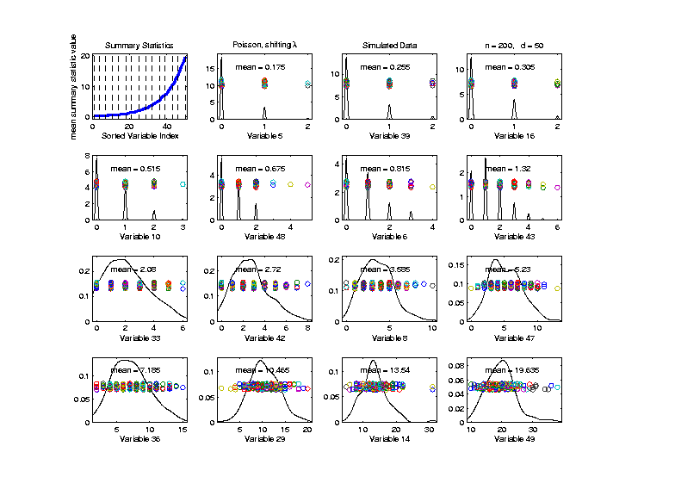
Marginal Distribution Plots
Toy Example: $n=200$, $d=50$,
i.i.d. Poisson, with parameters $λ=0.2,⋯,20$
Sort Variables
On Sample
Mean
Summary
Plot with
Equal
Spacing

Slide 4
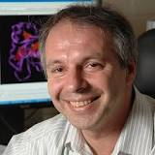
Marg. Dist. Plot Data Example
Drug Discovery Data
$n = 262$, Chemical Compounds
$d = 2489$, Chemical “Descriptors”
Discrete Response:
0 – blue 0, 1 – red +
(Thanks to Alex Tropsha Lab)

Slide 5
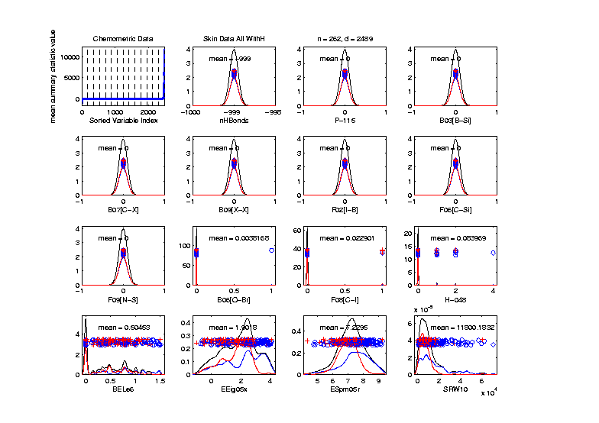
Marg. Dist. Plot Data Example
Drug Discovery – Sort on Means
Note: Many
With No
Variation???

Slide 6
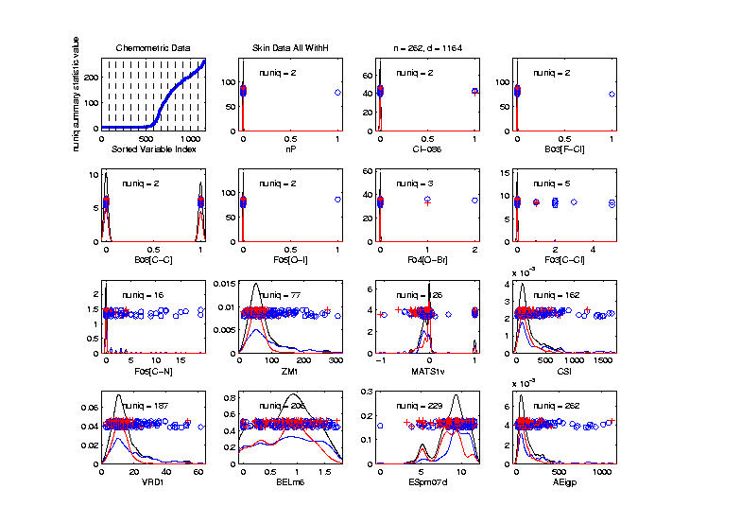
Marg. Dist. Plot Data Example
Drug Discovery - Sort On Number Unique
Shows
Many
Binary
Few Truly
Continuous

Slide 7
Marg. Dist. Plot Data Example
Common Practice:
Delete “Mostly 0” Variables (little information)
More Careful Look, Borysov et al (2016)
These Can Contain Useful Info
(Especially When So Many)
Not Clear What This Means!
Defined as “$≥95\% 0$s”

Slide 8
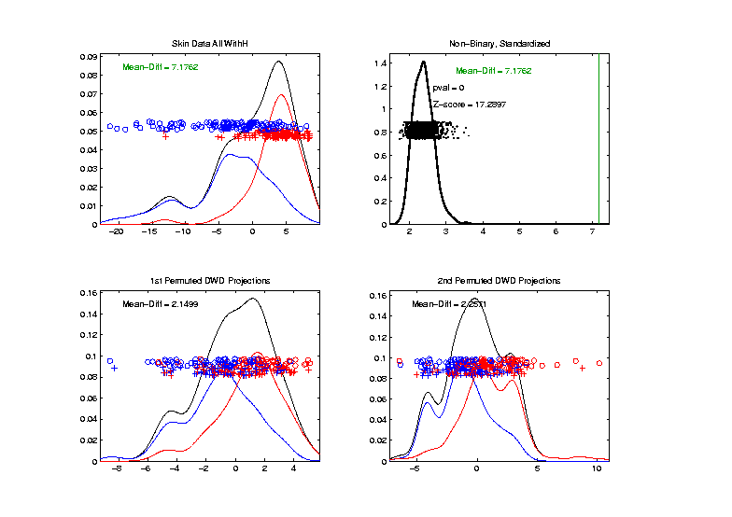
Inference for Drug Discovery Data
DiProPerm test of Blue vs. Red
Non-Binary – Standardized
Z = 17.3
Stronger
Reflects
More Info
In Data

Slide 9
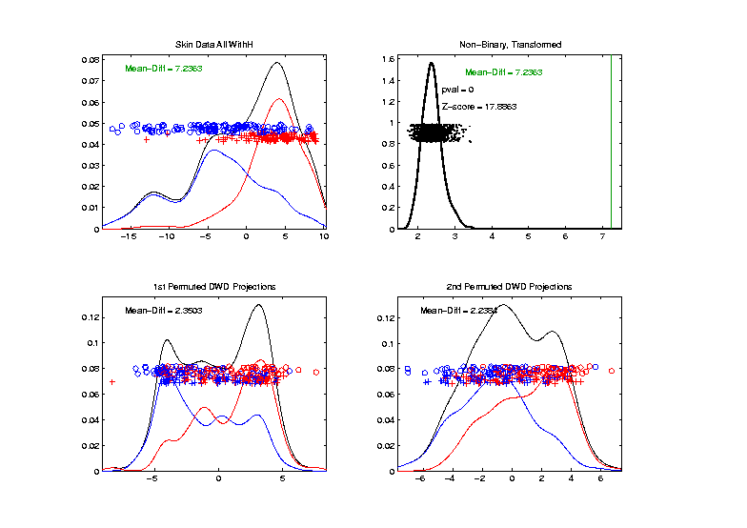
Inference for Drug Discovery Data
Introduced
Very Soon
DiProPerm test of Blue vs. Red
Non-Binary – Shifted Log Transforms
Z = 17.9
Slightly
Stronger

Slide 10
Limitation of PCA
Strongly Feels Scaling of Each Variable
Consequence:
May want to standardize each variable
(i.e. subtract $\overline{X}$, divide by $s$)
Also called Whitening
Equivalent Approach:
Base PCA on Correlation Matrix
Called Correlation PCA

Slide 11
Correlation PCA
Why use correlation matrix?
Makes features “unit free”
e.g. Height, Weight, Age, $, …
Are “directions in point cloud” meaningful or useful?
Will unimportant directions dominate?

Slide 12
Correlation PCA
Personal Thoughts on Correlation PCA:
Can be very useful
(especially with noncommensurate units)
Not always, can hide important structure
Illustrate with example

Slide 13
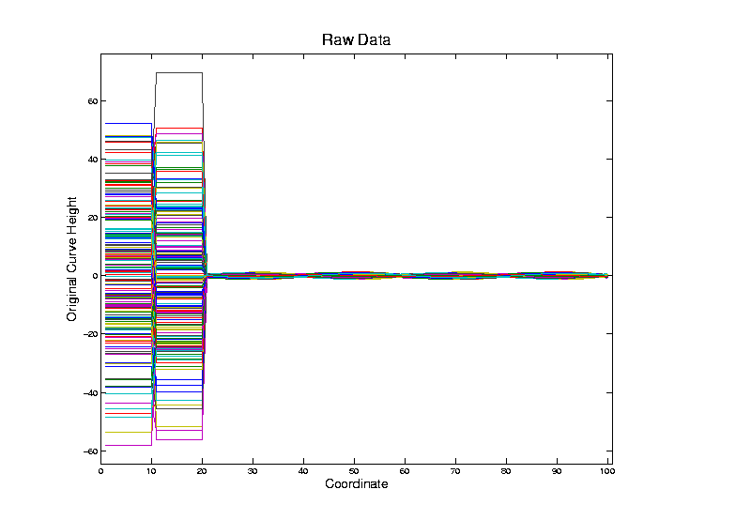
Correlation PCA
Toy Example Contrasting Cov. vs. Corr.

Slide 14
Correlation PCA
Toy Example Contrasting Cov. vs. Corr.
Big Var’n
Part

Slide 15
Correlation PCA
Toy Example Contrasting Cov. vs. Corr.
Big Var’n
Part
Small
Var’n
Part

Slide 16
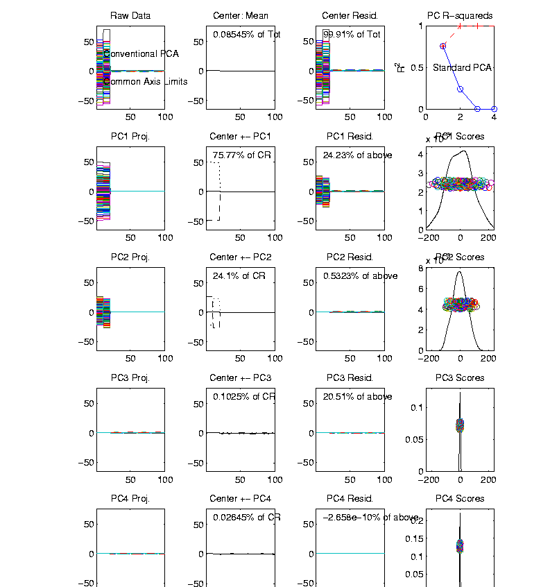
Correlation PCA
Toy Example Contrasting Cov. vs. Corr.
1st Comp:
Nearly Flat

Slide 17
Correlation PCA
Toy Example Contrasting Cov. vs. Corr.
1st Comp:
Nearly Flat
2nd Comp:
Contrast
Note: Another
Case Where
This View Is
Very Informative

Slide 18
Correlation PCA
Toy Example Contrasting Cov. vs. Corr.
1st Comp:
Nearly Flat
2nd Comp:
Contrast
3rd & 4th:
Very Small

Slide 19
Correlation PCA
Toy Example Contrasting Cov. vs. Corr.
1st Comp:
Nearly Flat
2nd Comp:
Contrast
3rd & 4th:
Look Very
Small Since
Common Axes

Slide 20
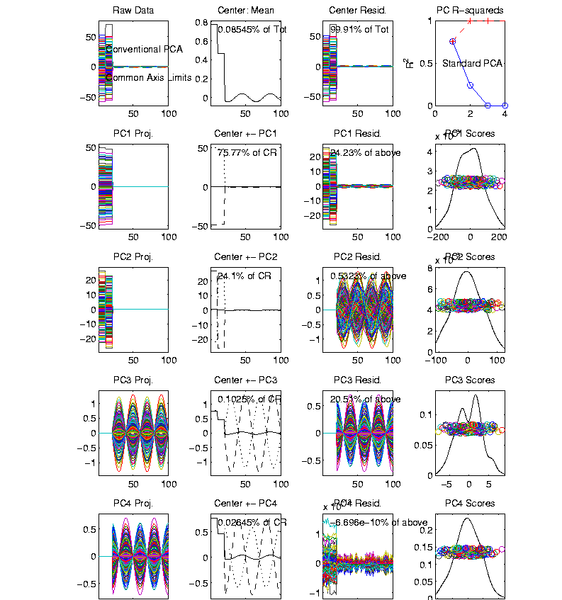
Correlation PCA
Toy Example Contrasting Cov. vs. Corr.
Use Rescaled
Axes (Typical
Default)
Now Can
See Mean

Slide 21
Correlation PCA
Toy Example Contrasting Cov. vs. Corr.
Use Rescaled
Axes (Typical
Default)
All Comp’s
Visible
(sin & cos)

Slide 22
Correlation PCA
Toy Example Contrasting Cov. vs. Corr.
Use Rescaled
Axes (Typical
Default)
All Comp’s
Visible
Good or
Bad ???

Slide 23
Correlation PCA
Toy Example Contrasting Cov. vs. Corr.

Slide 24
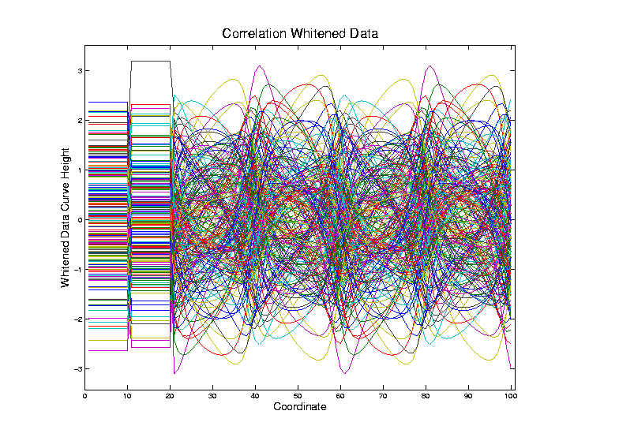
Correlation PCA
Toy Example Contrasting Cov. vs. Corr.
Correlation
“Whitened”
Version
Each Coord.
Rescaled
By Its S.D.

Slide 25
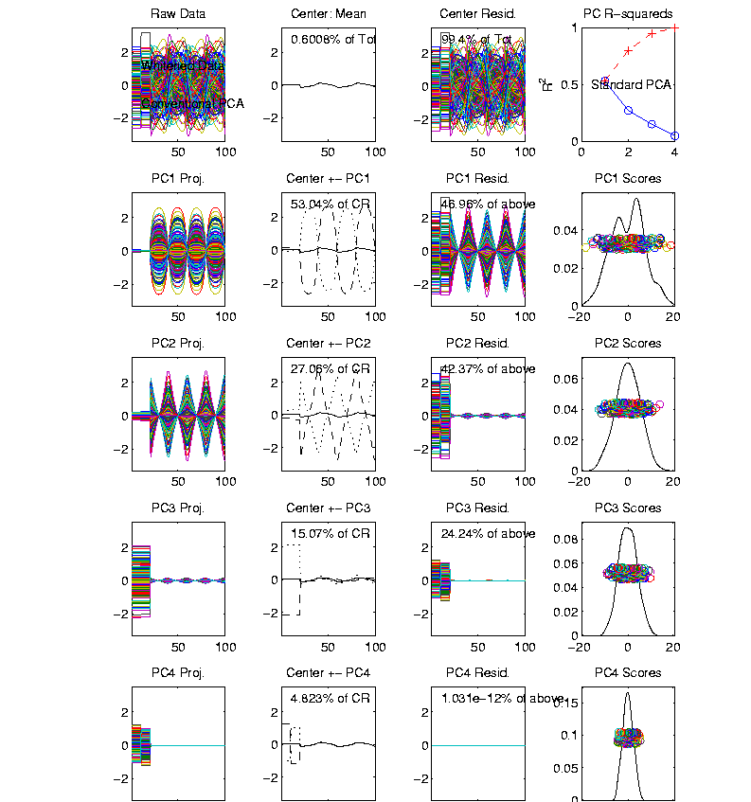
Correlation PCA
Toy Example Contrasting Cov vs. Corr.
Correlation
“Whitened”
Version
All Much
Different

Slide 26
Correlation PCA
Toy Example Contrasting Cov. vs. Corr.
Correlation
“Whitened”
Version
All Much
Different
Which Is
“Right” ???

Slide 27
Correlation PCA
Personal Thoughts on Correlation PCA:
Can be very useful
(especially with noncommensurate units)
Not always, can hide important structure
To make choice:
Decide whether whitening is useful
My personal use of correlat’n PCA is rare
Other people use it most of the time

Slide 28
Transformations
Recall Log for
Mortality and
RNAseq Data
Useful Method for Data Analysts
Apply to Marginal Distributions
(i.e. to Individual Variables)
Idea: Put Data on Right Scale
Common Example:
Data Orders of Magnitude Different
Log₁₀ Puts Data on More Analyzable Scale

Slide 29
Transformations
Famous Family:
Box – Cox Transformations
Box & Cox (1964)
Given a parameter $λ∈ℝ$,
$$x ↦ \frac{x^{λ}−1}{λ}$$

Slide 30
Transformations
Box – Cox Transformations
Why this strange form? Instead of just
$$x ↦x^{λ}$$
Reason: Nicer Behavior as $λ→0$,
$$\lim_{λ→0}{\frac{x^{λ}−1}{λ}}=\ln{x}$$
Try It Out Using
L’Hopital’s Rule

Slide 31
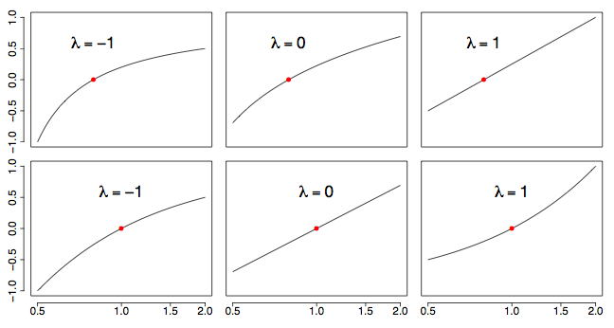
Transformations
Box – Cox Transformations
(vs. $x$)
(vs. $\ln{x}$)
(graphics from http://onlinestatbook.com/2/transformations/box-cox.html)

Slide 32
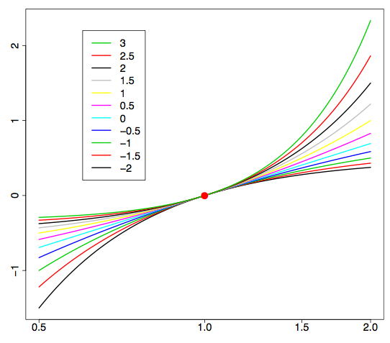
Transformations
Box – Cox Transformations (vs. $\ln{x}$)
(graphics from http://onlinestatbook.com/2/transformations/box-cox.html)

Slide 33
Transformations
Another useful family:
Shifted Log Transformations
Given a parameter $δ∈ℝ$,
$$x ↦ \log\left(x+δ\right)$$
(Will use more below)

Slide 34
Transformations
Example: Melanoma Data Analysis
Miedema, et al (2012)

Slide 35
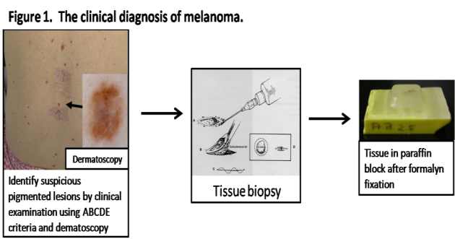
Introduction
Background
Clinical diagnosis

Slide 36
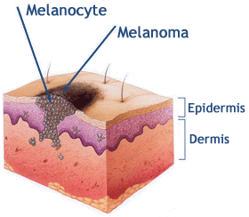
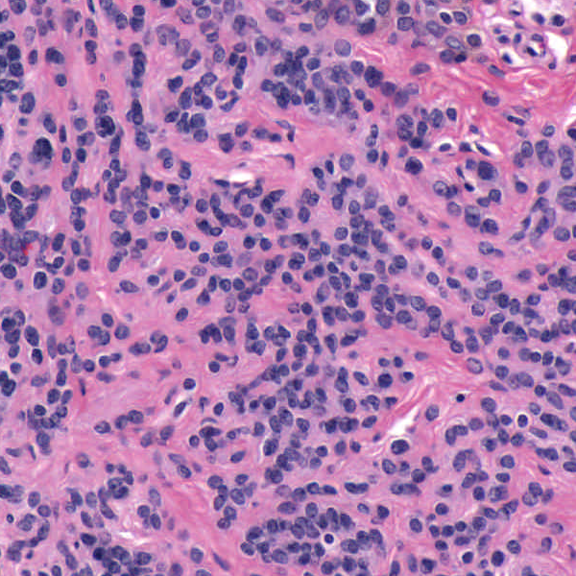
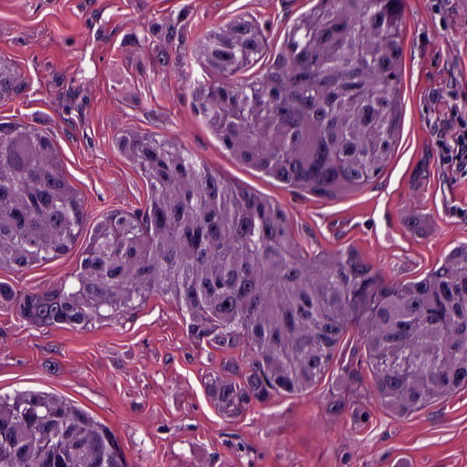
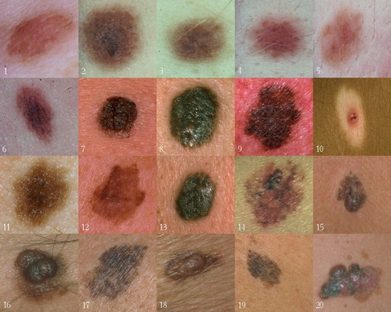
Background
Goal
Image Analysis of Histology Slides
Image: www.melanoma.ca
Benign
Melanoma
1 in 75 North Americans will develop a
malignant melanoma in their lifetime.
Initial goal: Automatically segment nuclei.
Challenge: Dense packing of nuclei.
Ultimately: Cancer grading and patient survival.
Image: melanoma.blogsome.com

Slide 37
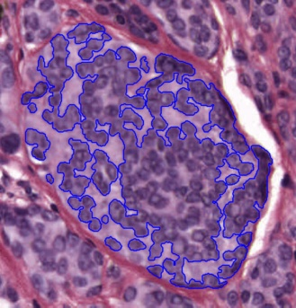
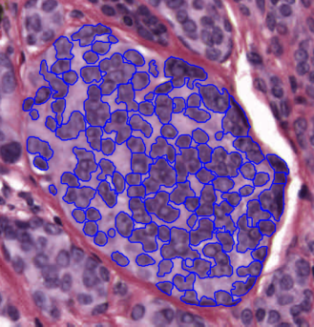
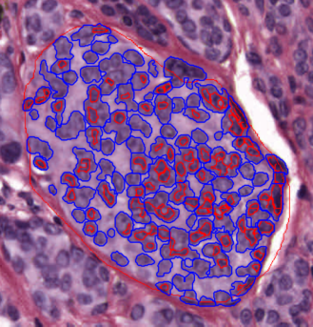
Segmentation
Cell Nuclei from Histology
Cutting Cell Clusters
Without subdivision
With subdivision
Our segmentation
Commercial seg.
Not perfect, but improved over standard algorithm (rq. validation).

Slide 38
Feature Extraction
Features from Cell Nuclei
Feature Extraction
Extract various features based on color and morphology
Example “high-level” concepts:
Stain intensity
Nuclear area
Density of nuclei
Regularity of nuclear shape
Called “Hand Crafted Features”
Currently Obsolete: Replaced by Deep Learning Features
But Transformation Point (of this) Still Applies

Slide 39
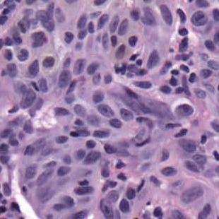
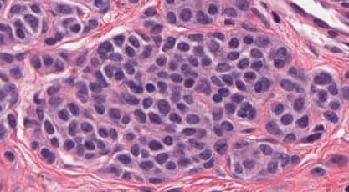
Feature Extraction
Features from Cell Nuclei
Original Image
Conventional Nevus
Superficial Spreading Melanoma

Slide 40
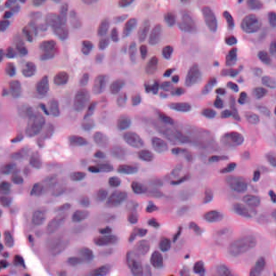
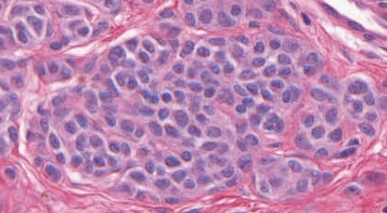
Feature Extraction
Features from Cell Nuclei
Restained Image
1. Color Normalization,
Addresses Different Staining & Fading
Conventional Nevus
Superficial Spreading Melanoma

Slide 41
Feature Extraction
Features from Cell Nuclei
Masked Region
2. Focus on “Region of Interest”
Conventional Nevus
Conventional Nevus
Superficial Spreading Melanoma
Superficial Spreading Melanoma
Masks generated by pathologist

Slide 42
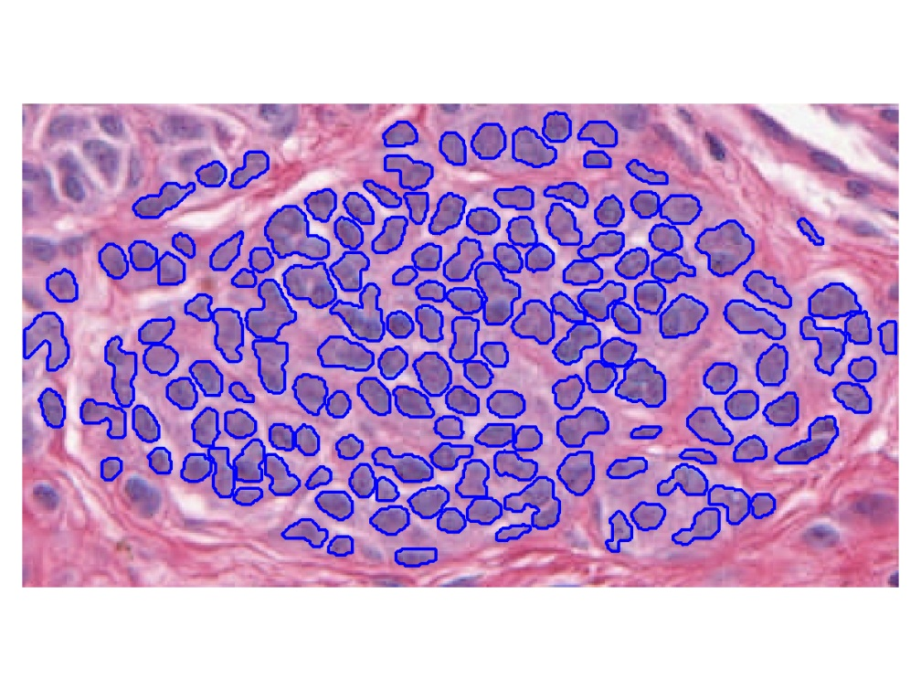
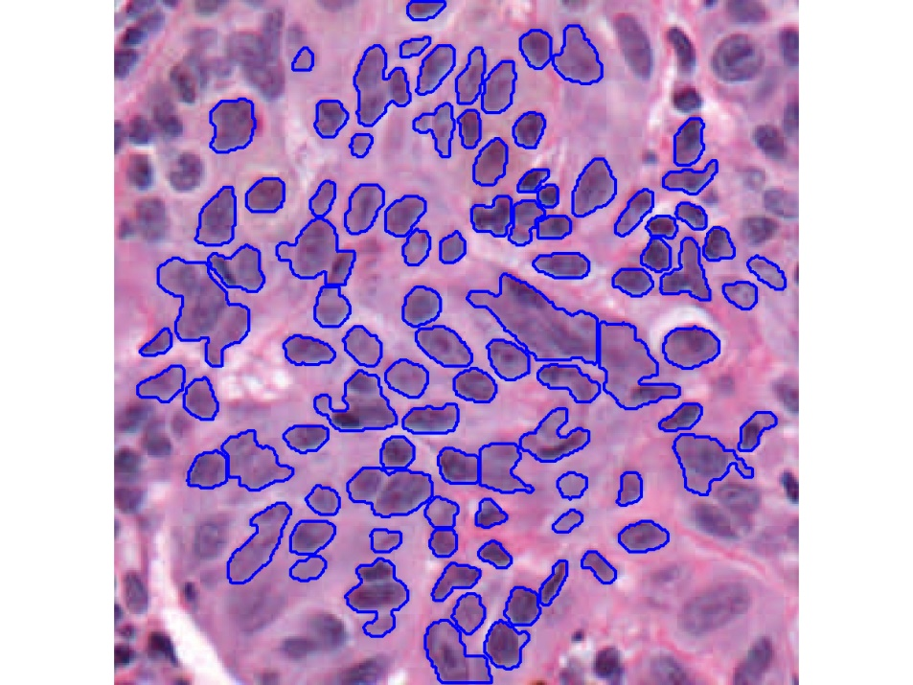
Feature Extraction
Features from Cell Nuclei
Segmented Nuclei
3. Nuclei “Segmentation”
Find “Boundaries”
Conventional Nevus
Superficial Spreading Melanoma

Slide 43
Feature Extraction
Features from Cell Nuclei
Labeled Nuclei
4. Highlight Nuclei
Conventional Nevus
Superficial Spreading Melanoma

Slide 44
Feature Extraction
Features from Cell Nuclei
Nuclear Regions
5. Expand to Generate Cell Regions
Conventional Nevus
Superficial Spreading Melanoma
Generated by growing nuclei out from boundary
Used for various color and density features:
Region Stain 2, Region Area Ratio, etc.

Slide 45
Feature Extraction
Features from Cell Nuclei
Delaunay Triangulation
6. Delauney Triangulation Quantifies Relations
Conventional Nevus
Superficial Spreading Melanoma
Triangulation of nuclear centers
Used for various density features:
Mean Delaunay, Max. Delaunay, etc.

Slide 46
Transformations
Statistical Challenge:
Some Features Spread Over Several Orders of Magnitude
Few Big Values Can Dominate Analysis

Slide 47
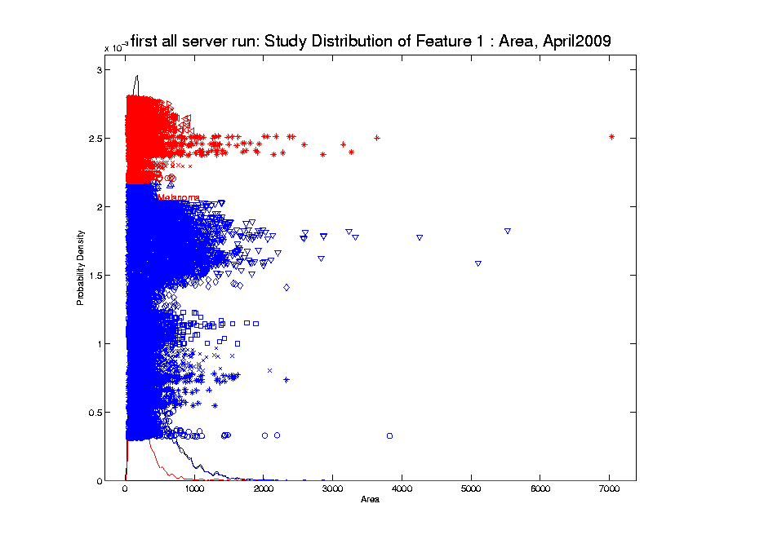
Transformations
Few Large Values Can Dominate Analysis

Slide 48
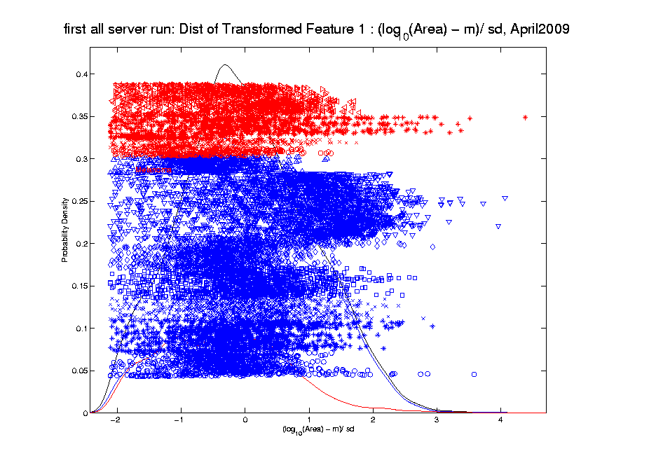
Transformations
Log Scale Gives All More Appropriate Weight
Note:
Orders
Of
Magnitude
Log₁₀ most
Interpretable

Slide 49
Transformations
Note That Order Matters:
Log Transform First
Standardize ($∙−\overline{X}$ / $s$) Second
Since Mean, $\overline{X}$, and Standard Deviation, $s$
Hard to Interpret for Skewed Data
Most Sensible for ~ Gaussian Data

Slide 50
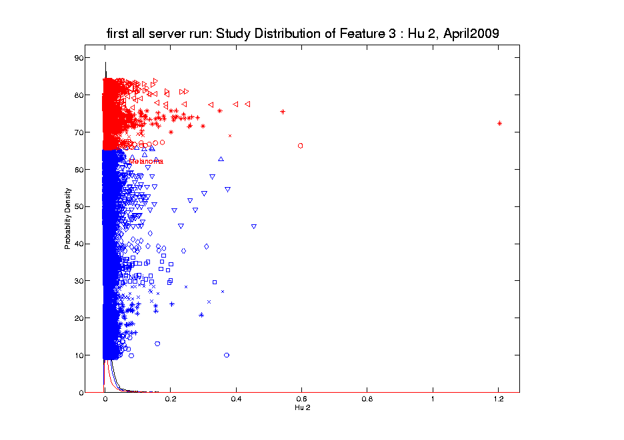
Transformations
Another Feature with Large Values
Problem
For This
Feature:
0 Values
(no log)

Slide 51
Transformations
Another Feature with Large Values
Approach:
Shifted
Log:
$$log\left(∙+δ\right)$$
Need to
Tune

Slide 52
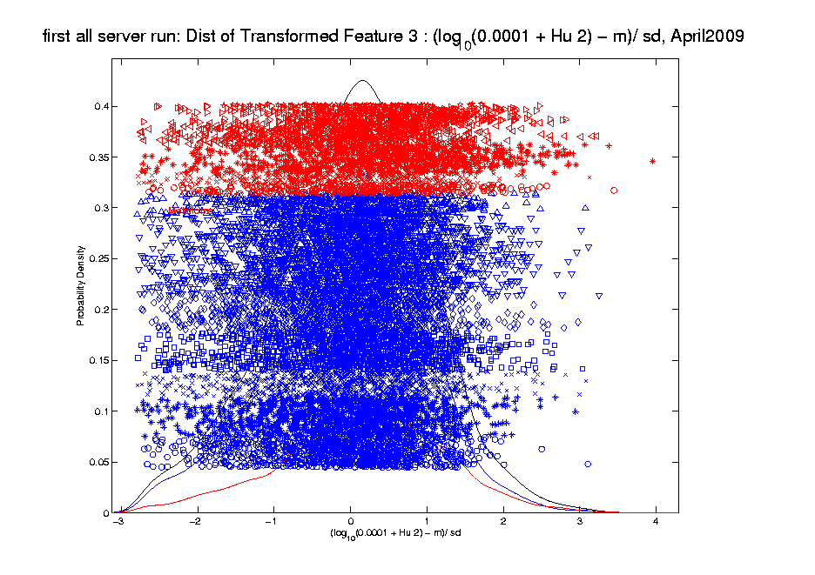
Transformations
Much Nicer Distribution

Slide 53
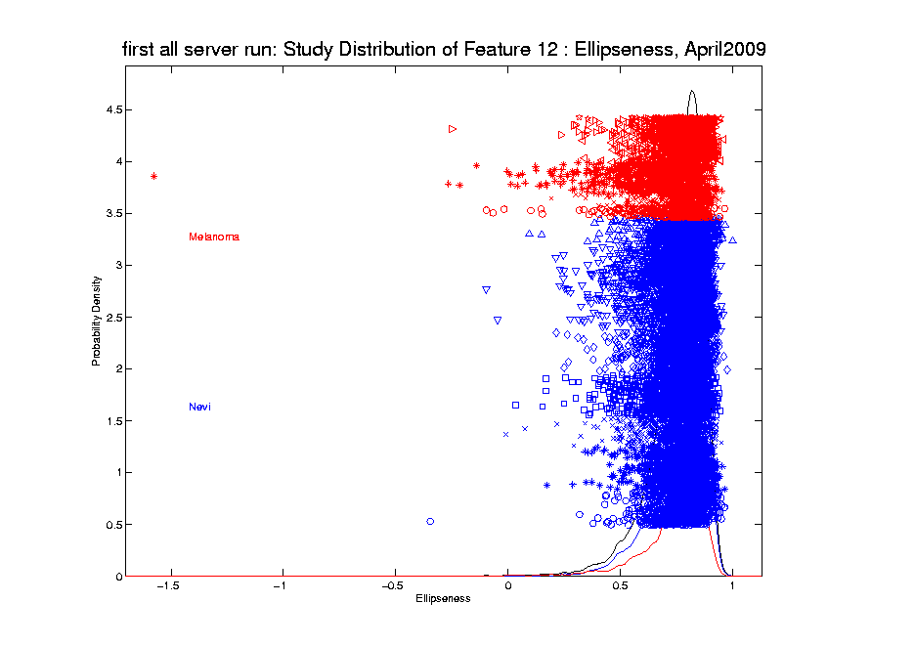
Transformations
Different Direction (Negative) of Skewness

Slide 54
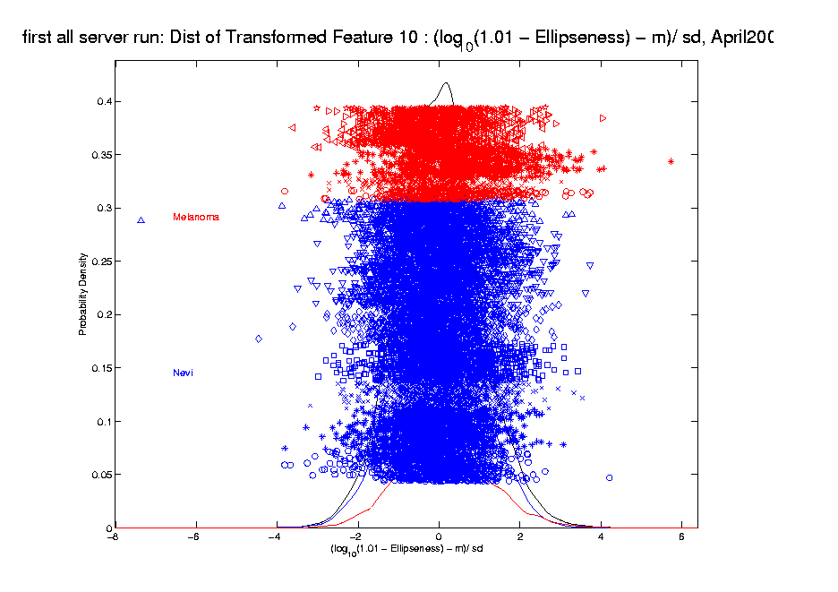
Transformations
Use Log Difference Transformation

Slide 55
Transformations
Major Challenge:
Hard to Visually Choose
Transformation of Many Variables
Motivates Automatic Transformation
Approach: Feng et al (2016)
Notes:
For a high dimensional data set, automation is important!
The parameterizations of the shift parameter strongly depend on knowledge of the data e.g. data range, data distribution, so user intervention is usually required. However, modern high-output data sets usually have a very large number of variables, i.e. features, so there is a strong need to automate the selection of shift parameter
What is the challenge here?
First challenge comes from tuning the shift parameter value
variables may range from different magnitude
It depends on the data magnitude (to make valid log function)
You have different optimal shift parameter value for different variables given a target
How to handle positive and negative skewness at same time
2. Address outliers which are also quite different from variable to variable

Slide 56
Automatic Transformations
Approach: Shifted log transform
Challenges Addressed:
Tune the shift parameter for each variable
$\log\left(∙+δ\right)$: Independent of data magnitude
Handle both positive and negative skewness
Address influential data points
Notes:
For a high dimensional data set, automation is important!
The parameterizations of the shift parameter strongly depend on knowledge of the data e.g. data range, data distribution, so user intervention is usually required. However, modern high-output data sets usually have a very large number of variables, i.e. features, so there is a strong need to automate the selection of shift parameter
What is the challenge here?
First challenge comes from tuning the shift parameter value
variables may range from different magnitude
It depends on the data magnitude (to make valid log function)
You have different optimal shift parameter value for different variables given a target
How to handle positive and negative skewness at same time
2. Address outliers which are also quite different from variable to variable

Slide 57
Automatic Transformations
Outline
A new parameterized transformation function
Appropriate reparametrization of $\log\left(∙+δ\right)$
Standardization and Winsorization
Selection of $δ$
Notes:
Based on these challenges we propose an automatic transformation scheme
The new scheme consists of three parts
1. A new parametrized family of transformation functions
This re-parametrization facilitate the automation by making the selection of shift tuning parameter independent of data magnitude.
Beside, it put transformation function for handling both positive and negative skewness in the same family
2. A robust way for standardization and also an option for winsorizing the influential points (winsorization means that given a vector of data values and a threshold, when the absolute data values are larger than the threshold, you will pull these values back to the threshold)
3. The parameter value selection
How to use an algorithm for optimal value

Slide 58
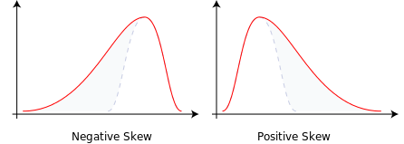
Automatic Transformations
Form of Transformation Function
Based on 1-d data set: $x_{1}, ⋯,x_{n}$
For positive skewness want: $\log\left(x_{i}\right)$
For negative skewness want: $−\log\left(−x_{i}\right)$
Preserves Order of Data
But Need Valid Inputs!
i.e. $\log{x}$ needs $x>0$
Handle with Shift $η$
Notes:
We start with the new re-parametrized function and we will start from the very basic
Deal both positive and negative skewness + maintain the order of data values
Given a feature vector in the data set, we need to first calculate its skewness
Based on the sign of the skewness we will have different log transformation (applying convex transformation function will increase the skewness and concave will decrease)
For negative one, we add negative sign to keep the same order of the data values

Slide 59
Automatic Transformations
Transformation Function
Modified log transforms
Positive skewness
$log⁡(x_{i}−min\left(x_{1}, ⋯,x_{n}\right)+η$)
Negative skewness
$−log⁡(\max\left(x_{1}, ⋯,x_{n}\right)− x_{i}+η$)
These are $≥0$
So Shift $η>0$ Controls Distortion by log
Notes:
One big concern is that logarithm functions require positive inputs
Therefore it is important to modify the functions for both positive and negative cases to be valid for any element value.
Substract the minimal value and add a positive shift parameter
use max value to minus each data value and add with a positive shift parameter

Slide 60
Automatic Transformations
Transformation Function
Modified log transforms
Positive skewness
$log⁡(x_{i}−min\left(x_{1}, ⋯,x_{n}\right)+η$)
Negative skewness
$−log⁡(\max\left(x_{1}, ⋯,x_{n}\right)− x_{i}+η$)
Note: For $g\left(t\right)=\log{t}$, $g^{′′}\left(t\right)=\frac{−1}{t^{2}}≈0$ for Large $t$
So Transformation $≈$ Linear for Large $η$
Notes:
One big concern is that logarithm functions require positive inputs
Therefore it is important to modify the functions for both positive and negative cases to be valid for any element value.
Substract the minimal value and add a positive shift parameter
use max value to minus each data value and add with a positive shift parameter

Slide 61
Automatic Transformations
Reparametrization (Nicer Format):
Based on Range of Data, $R=\max_{i}{x_{i}}−\min_{i}{x_{i}}$
For Positive Skewness: $β=\frac{R}{η}$
For Negative Skewness: $β=\frac{−R}{η}$
This Gives $β∈\left(−∞,+∞\right)$
Where Sign Determines Skewness Type
Notes:
Thus, we further parametrize the parameter eta in terms of the multiples of the range
of the feature vectors
This makes the selection of parameter values beta independent of the data magnitude
The beta ranges from negative inf to positive inf
Now we note that the functions for pos and negative are both symmetric around zero
Thus we can take advantage of it and combine them into one family of functions.

Slide 62
Automatic Transformations
Reparametrization (Nicer Format):
Use Shifted Log With: $η=\left|\frac{1}{β}\right|R$
Note: $β∈\left(−∞,+∞\right)$ Gives Transformation:
Nearly Linear for $β≈0$
Strongly Un-Right Skews for Large $β>0$
Strongly Un-Left Skews for $β≪0$
Notes:
Thus, we further parametrize the parameter eta in terms of the multiples of the range
of the feature vectors
This makes the selection of parameter values beta independent of the data magnitude
The beta ranges from negative inf to positive inf
Now we note that the functions for pos and negative are both symmetric around zero
Thus we can take advantage of it and combine them into one family of functions.

Slide 63
Automatic Transformations
Reparametrized Transformation function
Positive skewness
$log⁡(x_{i}−min\left(x_{1}, ⋯,x_{n}\right)+\left|\frac{1}{β}\right|R$)
Negative skewness
$−log⁡(\max\left(x_{1}, ⋯,x_{n}\right)− x_{i}+\left|\frac{1}{β}\right|R$)
Notes:
Thus, we further parametrize the parameter eta in terms of the multiples of the range
of the feature vectors
This makes the selection of parameter values beta independent of the data magnitude
The beta ranges from negative inf to positive inf
Now we note that the functions for pos and negative are both symmetric around zero
Thus we can take advantage of it and combine them into one family of functions.

Slide 64
Automatic Transformations
$$φ_{β}\left(x_{i}\right)=\left\{\begin{aligned}log⁡(x_{i}−min\left(x_{1}, ⋯,x_{n}\right)+\frac{1}{β}R\text{)}, β>0 \\ −log⁡(\max\left(x_{1}, ⋯,x_{n}\right)− x_{i}−\frac{1}{β}R\text{)}\text{, }β<0\end{aligned}\right.$$
Family of transformation functions
Comments
Single family for both positive and negative skewness
Parameter value selection is independent of data magnitude
As $β→0$: transformation + standardization $→$
$→$ standardization only
Notes:
Finally incorporating all the elements we have discussed the new parameterized family of transformation functions
For beta is positive, transformation for positive skewness
For beta is negative, transformation for negative skewness
And the parameter value selection is independent of data magnitude

Slide 65
Automatic Transformations
Standardization
Subtract median (robust center)
Divide by $\sqrt{π/2}$ of the MAD (robust scale)
(Mean Absolute Deviation from the median)
Winsorization
Threshold based on extreme value theory
(see Feng et al (2016) for details)
Notes:
After the shift log transformation, we need to deal with potential influential values by winsorization,
Before that we need a robust standardization ( and I will talk about it later)
To make standardization robust, we will use some robust statistics that is subtracting the median and divide based on the mean absolute deviation from median (not MAD which might be 0)

Slide 66
Automatic Transformations
Select parameter value $β$
Evaluation: Anderson – Darling test statistics
Often Useful Weighting of Tails
Powerful for Important Departures from Normality
Anderson – Darling (1952), Discussion / Comparison: Stephens (1974)
Algorithm: grid search
Search a value minimizing AD test statistics
Can be computed in parallel
Notes:
Here we a process for transformation which is controlled by the parameter beta
The last step is to deicide the optimal value of beta
To do that, we first need a criteria
A-D test stat is used which measures the distance between the empirical distribution function (EDF) of the transformed data and the cumulative distribution function (CDF) of the standard normal.
It give appropriate weight to the tails using a weighted L2 metric. It is more powerful for detecting
Given the evaluation, we adopt the grid search algorithm for minimizing the A-D test stat.
One major reason for using it is due to the simplicity of computing the stat and complexity of optimizing it. Besides, grid search is useful if the number of parameter to optimize is not large. Another advantage is that the computation of A-D test stat is independent with each other and thus is easy to be computed in parallel.

Slide 67
Melanoma Data
Much Nicer Distributions
Notes:
We applied our automatic transformation on the same melanoma data

Slide 68
Melanoma Data
Q-Q plot Views (will study in detail later)
(before, after, ${45}^{°}$ line)
Notes:
Use QQ Plot to compare normality

Slide 69
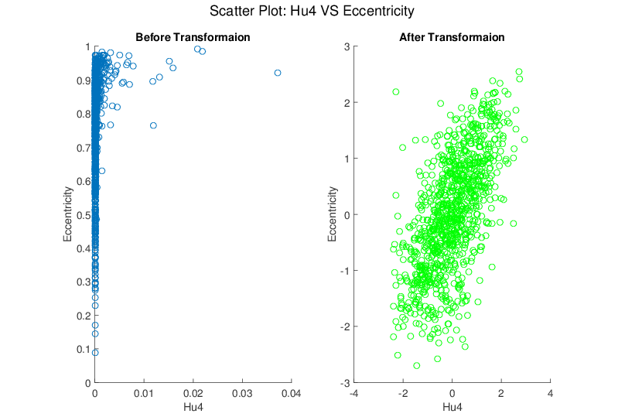
Melanoma Data
Much Nicer Distributions
Notes:
Besides, although the transformation targets at marginal dist
We see improvement of bivariate normality in many real data sets for example here.

Slide 70
Limitations
Not Useful for:
Binary Variables
Symmetric but highly kurtotic distribution
Notes:
No benefit for binary variables.
not useful in modifying a symmetric, but highly kurtotic distribution.

Slide 71
Recall Matlab Software
Again Recall Posted Software for OODA

Slide 72
Automatic Shifted Log Trans.
Matlab Software:
AutoTransQF.m
In General Directory

Slide 73
Revisit Gene Expression
Recall Above
Cancer Data
Focus On:
Ovarian &
Uterine Types

Slide 74
Revisit Gene Expression
Ovarian (o) & Uterine (+) Cancer Cases
Raw Data PCA
Zoom In
Proj’ns on Mean
Difference Dir’n
Zoom In

Slide 75
Revisit Gene Expression
Ovarian (o) & Uterine (+) Cancer Cases
Slide
Over
To Look
At Log
Trans.

Slide 76
Revisit Gene Expression
Ovarian (o) & Uterine (+) Cancer Cases
Add In Automatic
Log Transformed PCA
Proj’ns on Mean
Difference Dir’n
Note Much
Better

Slide 77
Revisit Gene Expression
Ovarian (o) & Uterine (+) Cancer Cases
Quantification
Of Better
Separation???

Slide 78
Revisit Gene Expression
Quantify
Separation
Of Groups
Using
ROC Curves

Slide 79
ROC Curve
Challenge:
Measure “Goodness of Separation”
Approach from Signal Detection:
Receiver Operator Characteristic
(ROC) Curve
Developed in WWII, History in
Green and Swets (1966)

Slide 80
ROC Curve
Challenge:
Measure “Goodness of Separation”
Approach from Signal Detection:
Receiver Operator Characteristic
(ROC) Curve
Good Modern Treatment:
DeLong, DeLong & Clarke-Pearson (1988)

Slide 81
ROC Curve
Challenge:
Measure “Goodness of Separation”
Idea: For Range of Cutoffs
Plot:
Prop’n +1’s Smaller than Cutoff
Vs.
Prop’n -1s Smaller than Cutoff

Slide 82
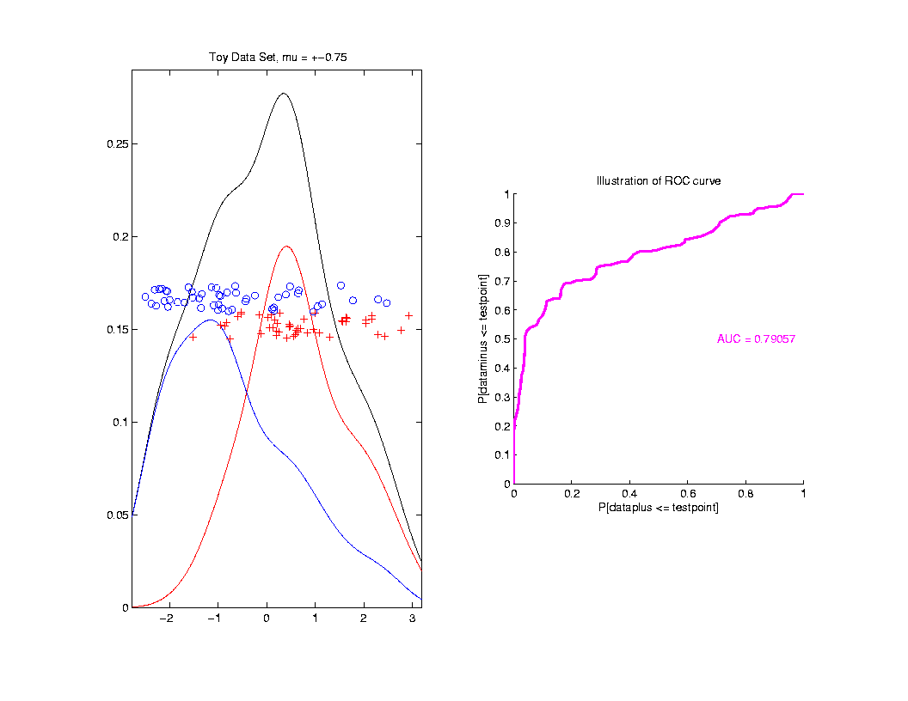
ROC Curve
Aim:
Quantify
“Overlap”
Approach
Consider
Series
Of Cutoffs

Slide 83
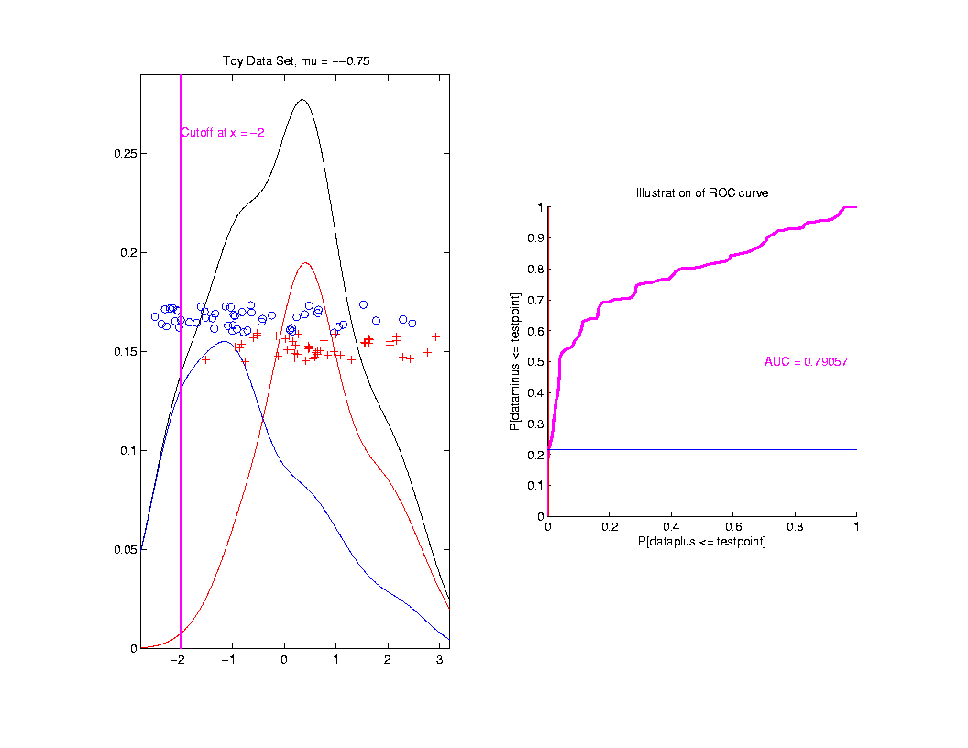
ROC Curve
Approach
Consider
Series
Of Cutoffs

Slide 84
ROC Curve
X-coord
Is Prop’n
Of Reds
Smaller

Slide 85
ROC Curve
X-coord
Is Prop’n
Of Reds
Smaller
Y-coord
Is Prop’n
Of Blues
Smaller

Slide 86
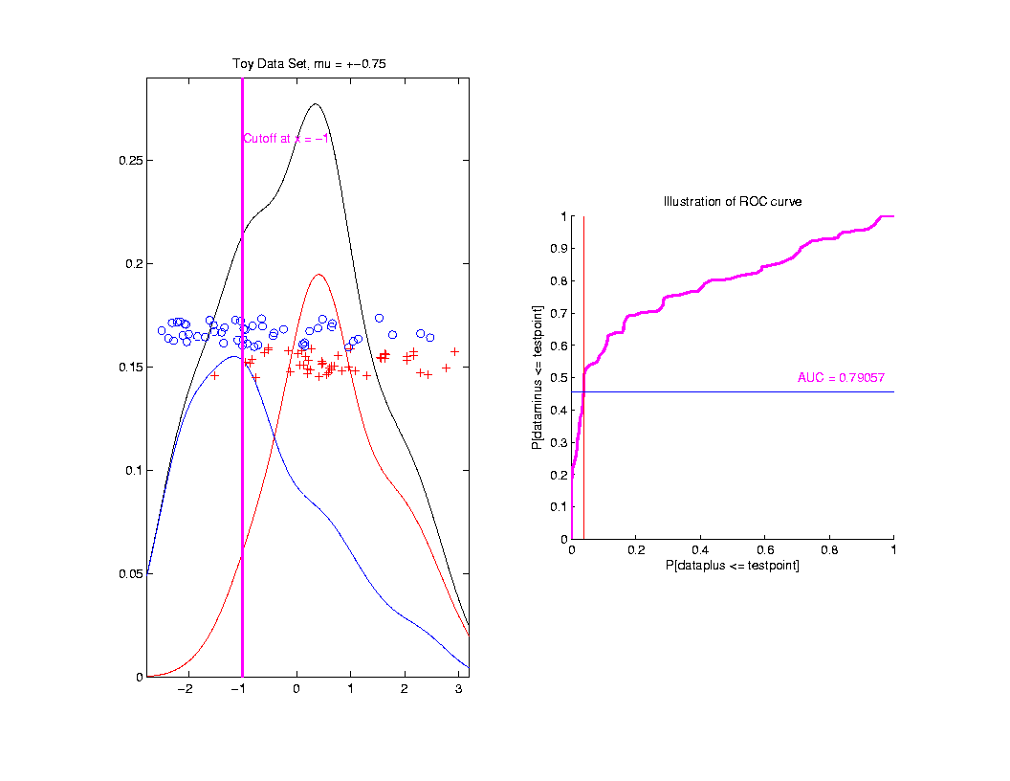
ROC Curve
Slide
Cutoff
To
Trace
Out
Curve

Slide 87
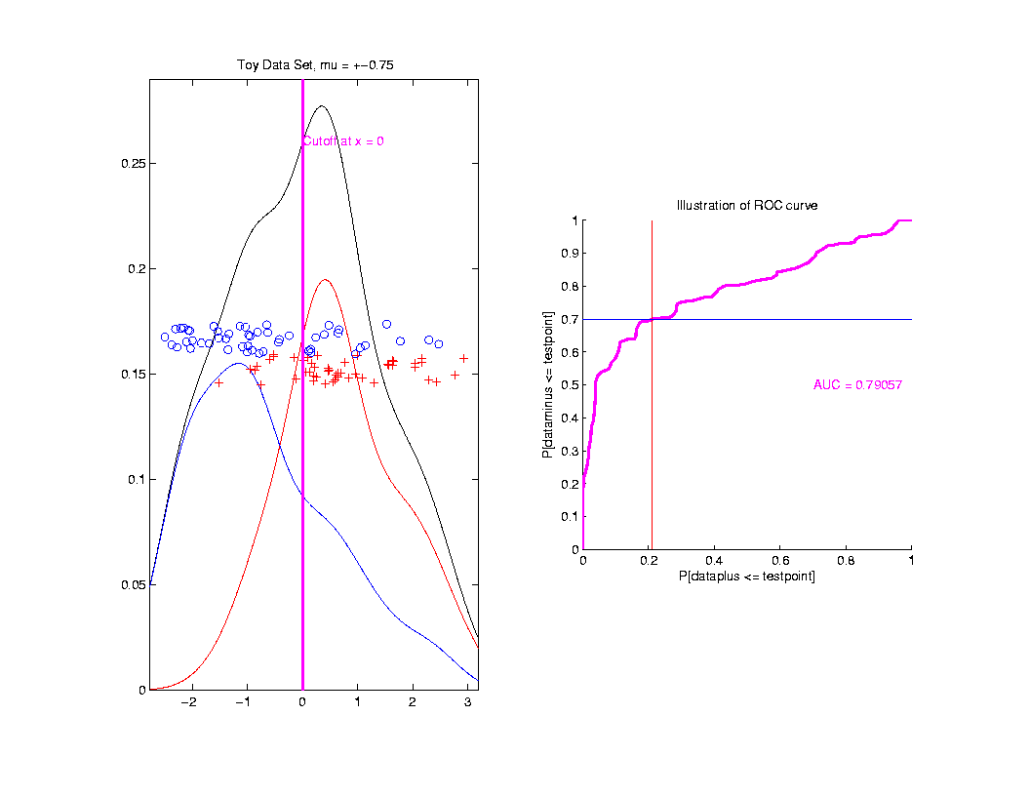
ROC Curve
Slide
Cutoff
To
Trace
Out
Curve

Slide 88
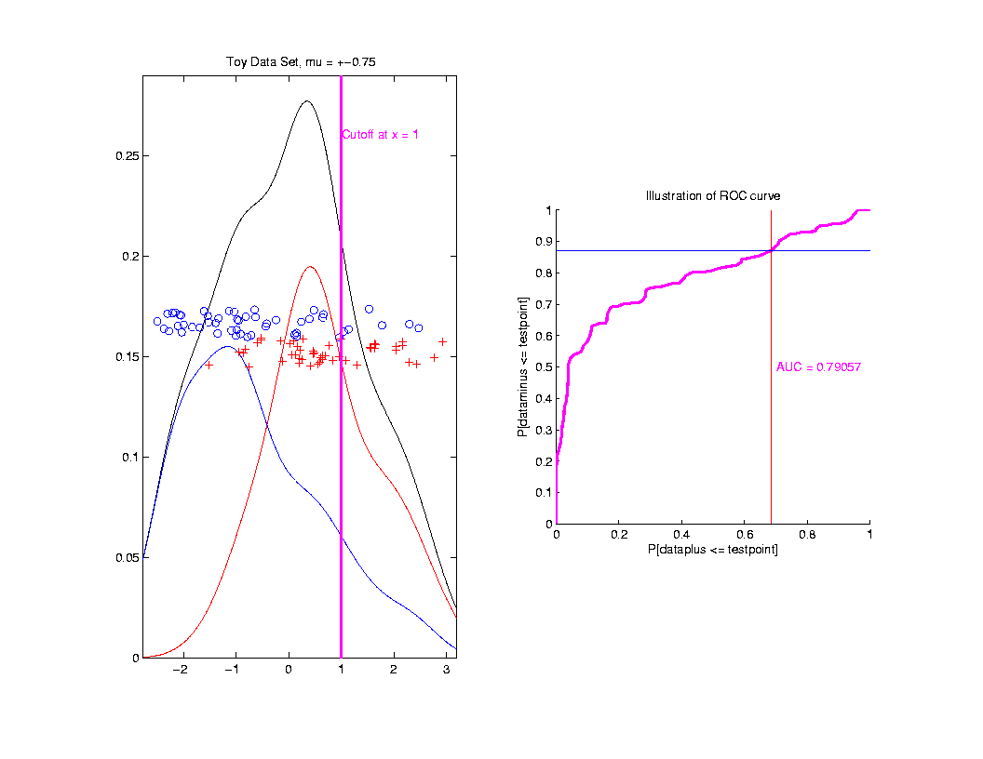
ROC Curve
Slide
Cutoff
To
Trace
Out
Curve

Slide 89
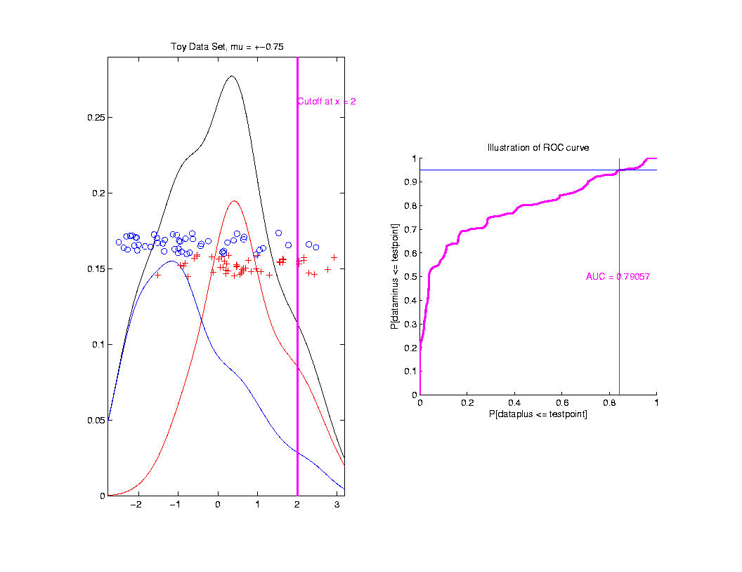
ROC Curve
Slide
Cutoff
To
Trace
Out
Curve

Slide 90
ROC Curve
Better
Separation
Is “More
To Upper
Left”

Slide 91
ROC Curve
Summarize
& Compare
Using
Area
Under
Curve
(AUC)

Slide 92
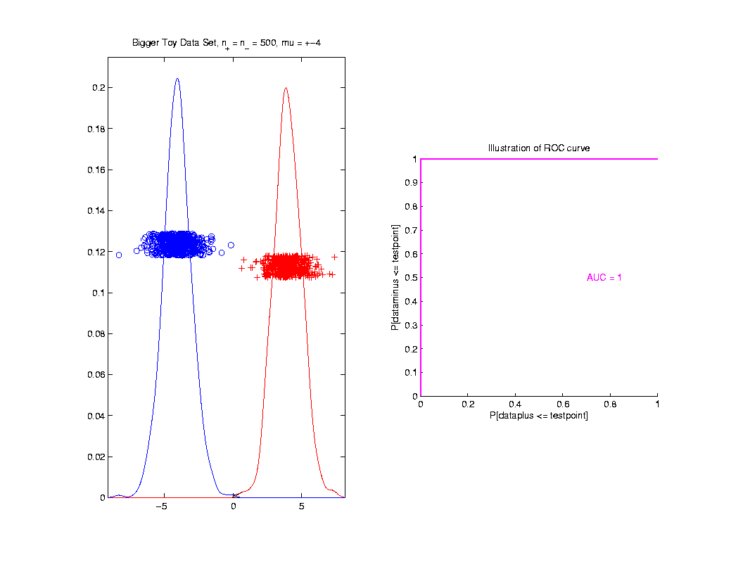
ROC Curve
Toy
Example
Perfect
Separation

Slide 93
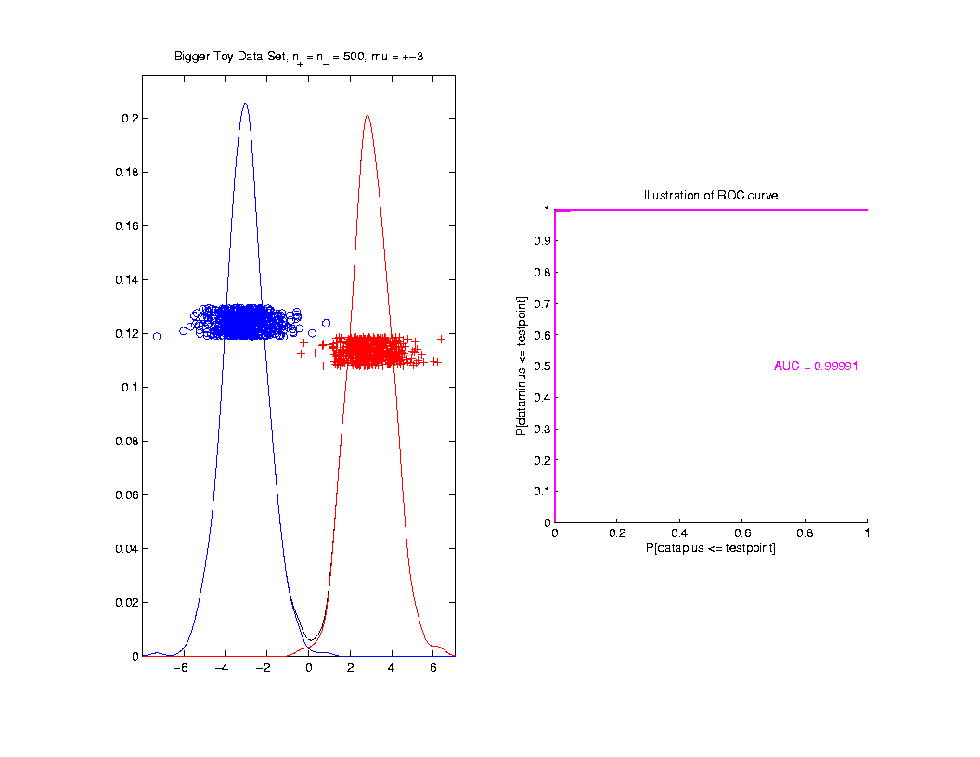
ROC Curve
Toy
Example
Very
Slight
Overlap

Slide 94
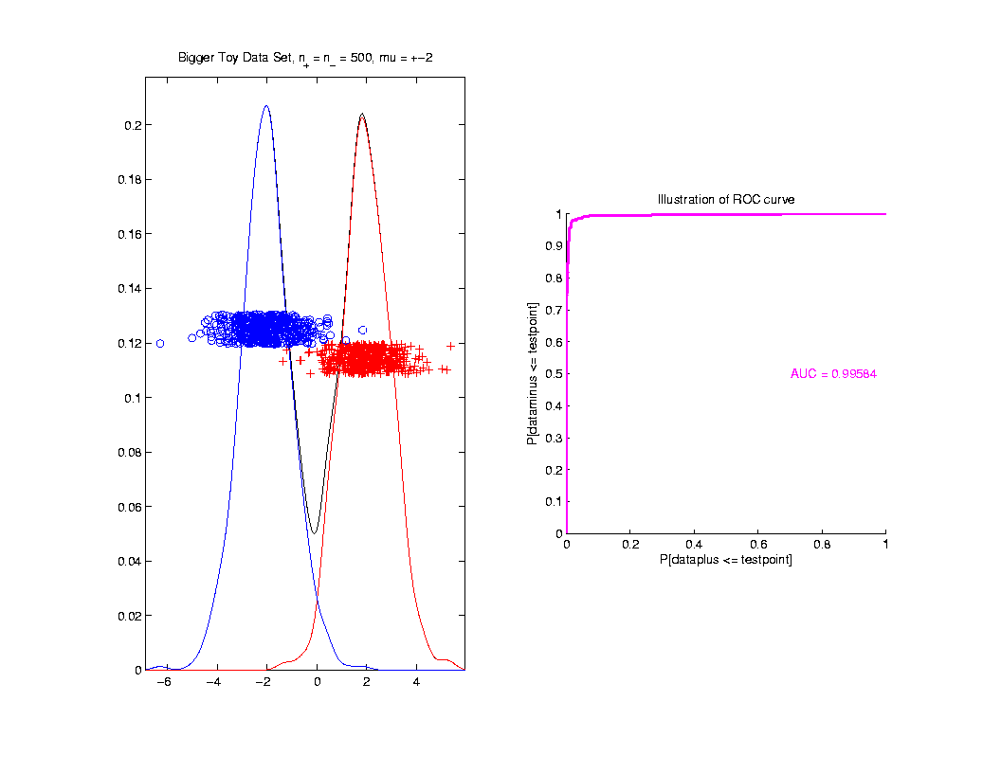
ROC Curve
Toy
Example
Little
More
Overlap

Slide 95
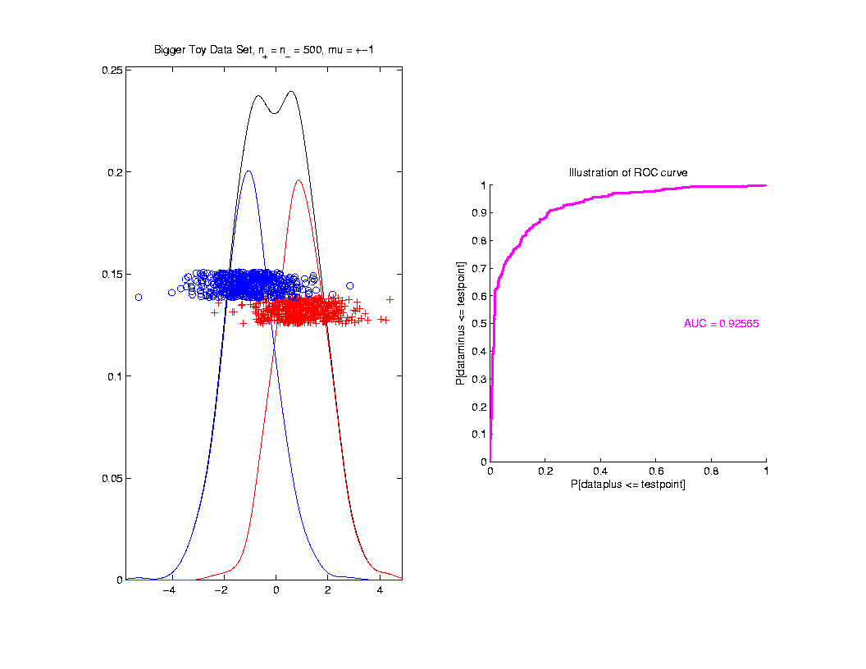
ROC Curve
Toy
Example
More
Overlap

Slide 96
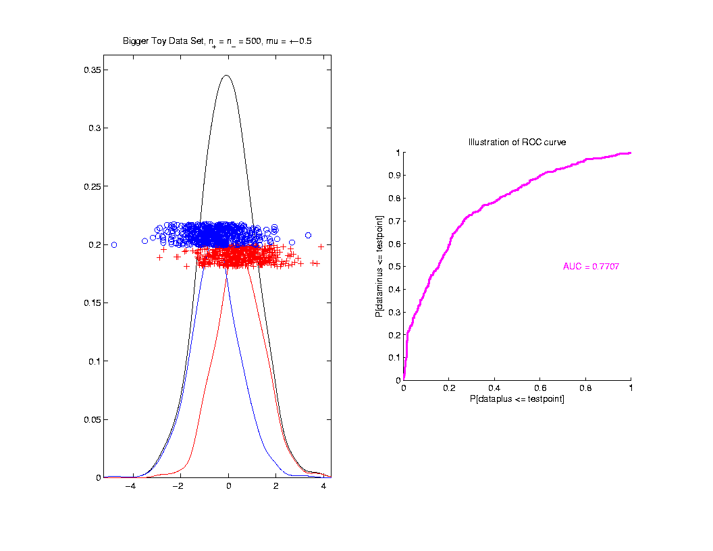
ROC Curve
Toy
Example
Much
More
Overlap

Slide 97
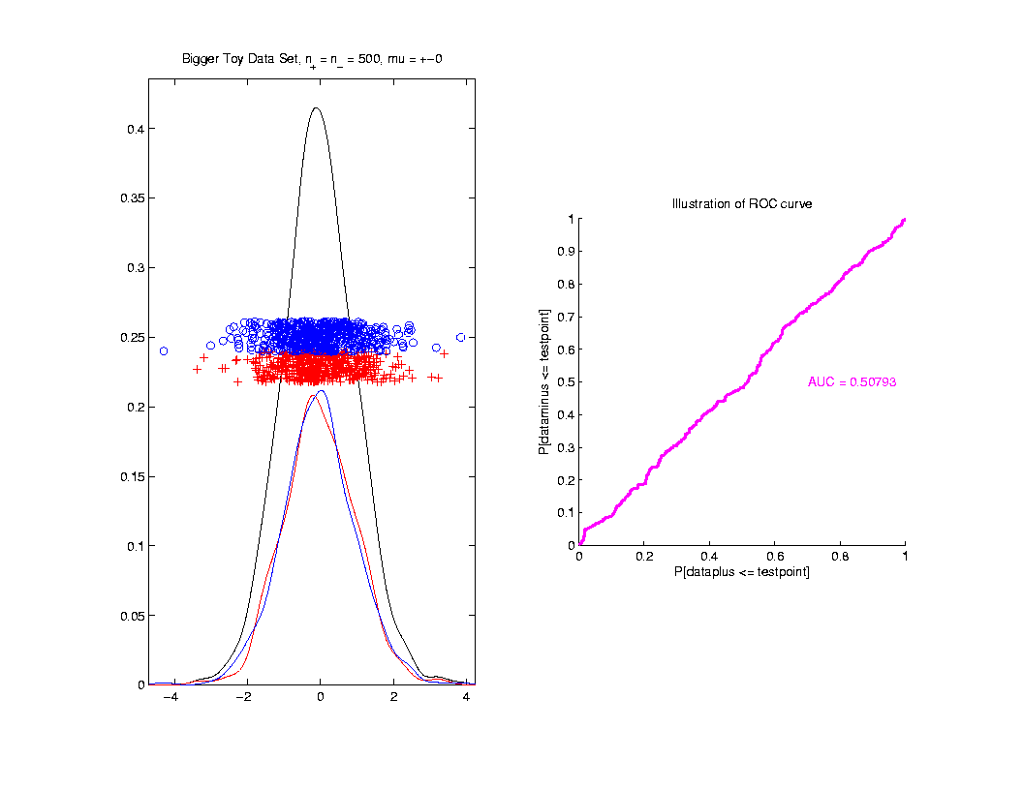
ROC Curve
Toy
Example
Complete
Overlap

Slide 98
ROC Curve
Toy
Example
Complete
Overlap
AUC ≈ 0.5 Reflects “Coin Tossing”

Slide 99
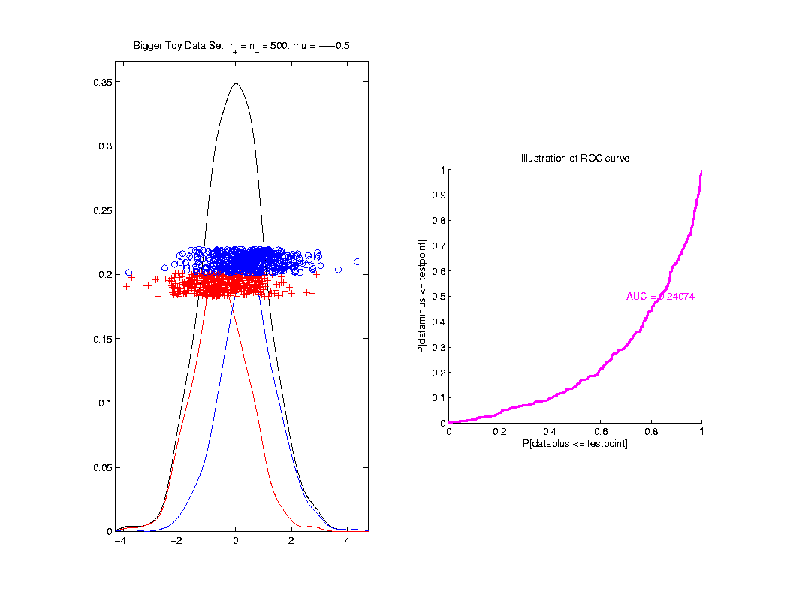
ROC Curve
Toy
Example
Can
Reflect
“Worse
Than Coin
Tossing”

Slide 100
ROC Curve
Interpretation of AUC:
Very Context Dependent
Radiology:
“> 70% has Predictive Usefulness”
Varies Field by Field
Bigger is Better

Slide 101
Revisit Gene Expression
ROC Curve
Much Better
For Log
Transformations

