Slide 1
Participant Presentations
Starting This Thursday:
11: 35 Benjamin Leinwand
11:40 Keerthi Anand
Notes:
Can Use USB Device
Or Remote Log-In, Set Up Before Class
Have Title Page With:
  Your Name
  Your Affiliation
Check Website
For Schedule

Slide 2
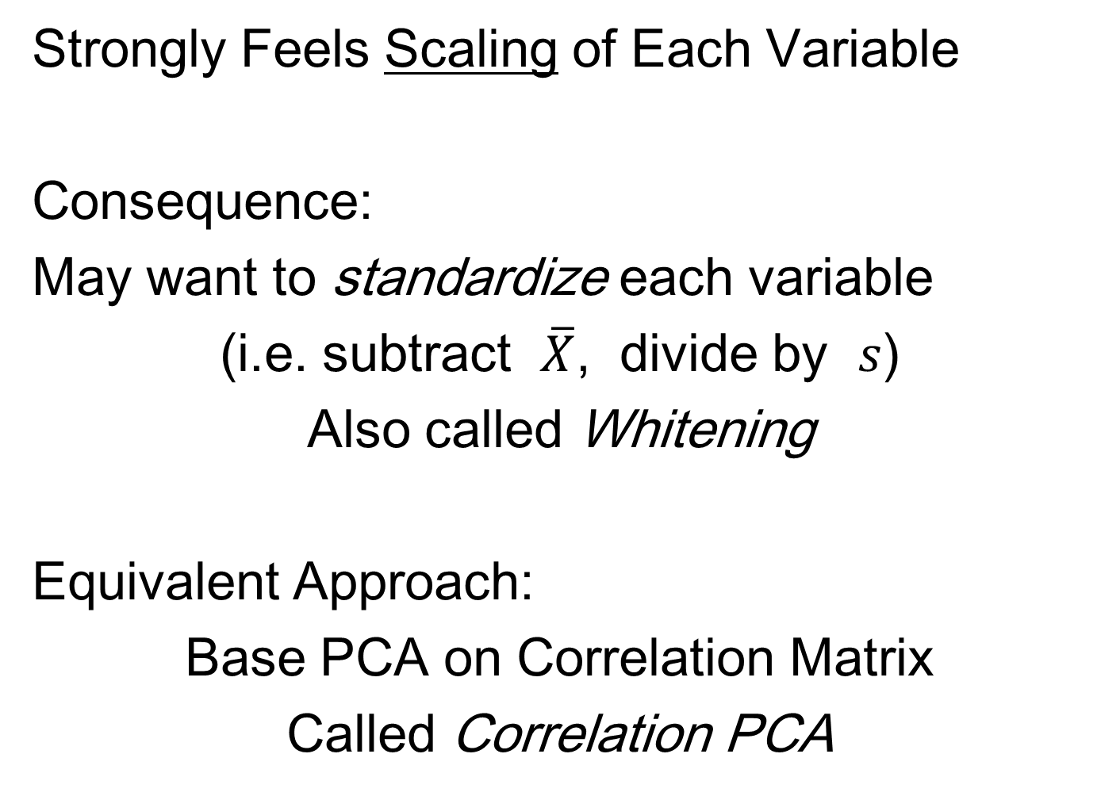
Limitation of PCA
Strongly Feels Scaling of Each Variable
Consequence:
May want to standardize each variable
(i.e. subtract $\overline{X}$, divide by $s$)
Also called Whitening
Equivalent Approach:
Base PCA on Correlation Matrix
Called Correlation PCA

Slide 3
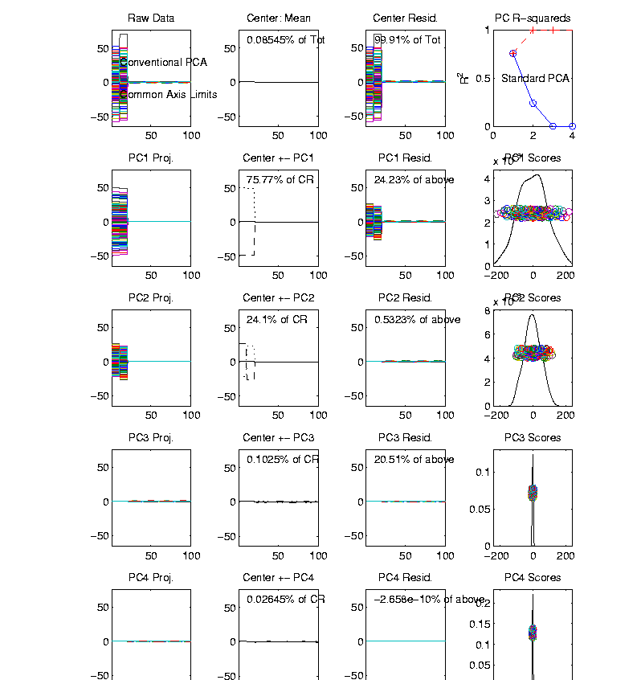
Correlation PCA
Toy Example Contrasting Cov. vs. Corr.
1st Comp:
Nearly Flat
2nd Comp:
Contrast
3rd & 4th:
Look Very
Small Since
Common Axes

Slide 4
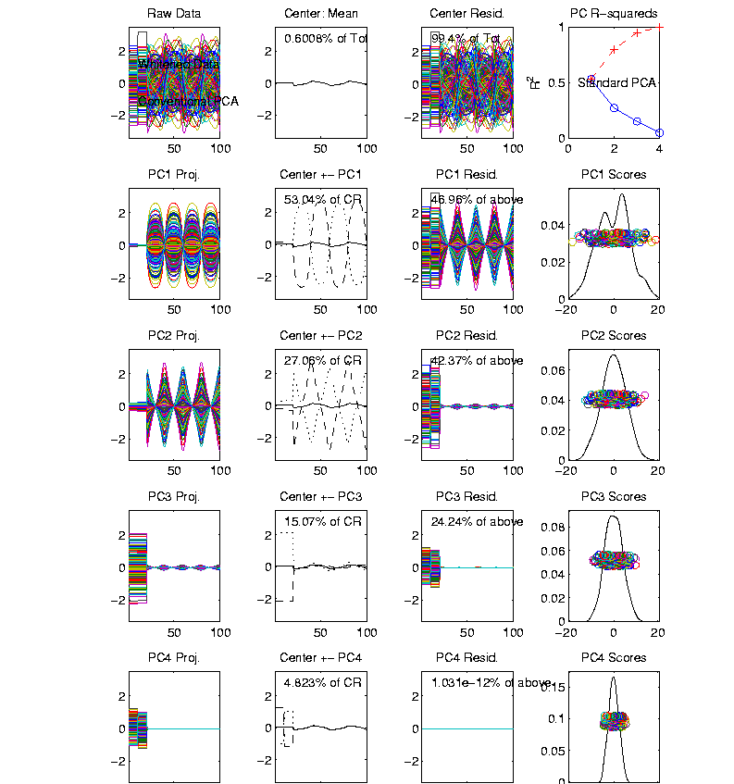
Correlation PCA
Toy Example Contrasting Cov. vs. Corr.
Correlation
“Whitened”
Version
All Much
Different
Which Is
“Right” ???

Slide 5
Transformations
Recall Log for
Mortality and
RNAseq Data
Useful Method for Data Analysis
Apply to Marginal Distributions
(i.e. to Individual Variables)
Idea: Put Data on Right Scale
Common Example:
  Data Orders of Magnitude Different
  Log₁₀ Puts Data on More Analyzable Scale

Slide 6
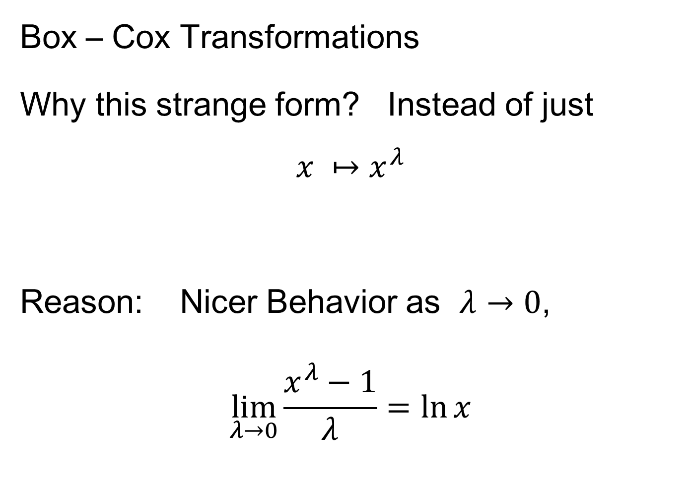
Transformations
Box – Cox Transformations
Why this strange form? Instead of just
$$x ↦x^{λ}$$
Reason: Nicer Behavior as $λ→0$,
$$\lim_{λ→0}{\frac{x^{λ}−1}{λ}}=\ln{x}$$
Try It Out Using
L’Hopital’s Rule

Slide 7
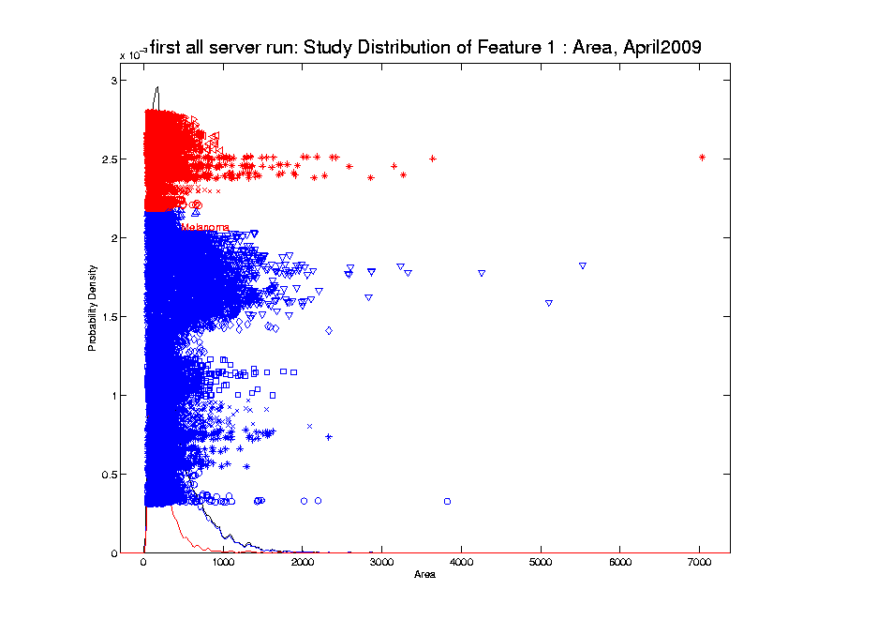
Transformations
Few Large Values Can Dominate Analysis

Slide 8
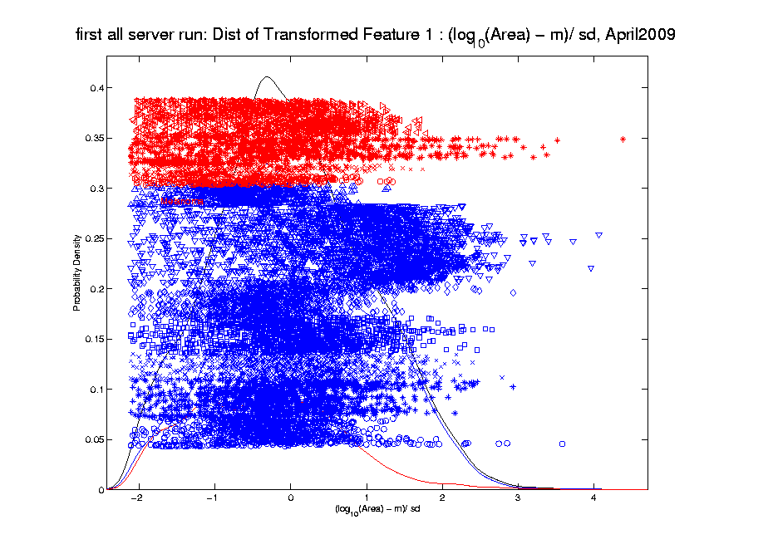
Transformations
Log Scale Gives All More Appropriate Weight
Note:
Orders
Of
Magnitude
Log₁₀ most
Interpretable

Slide 9

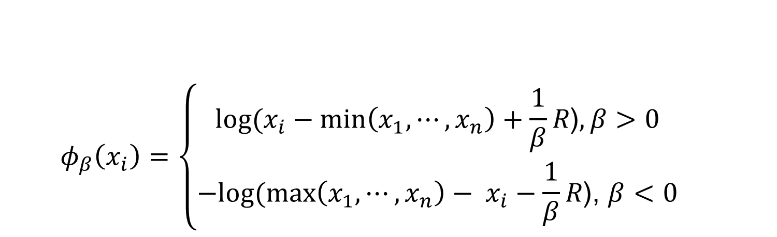
Automatic Transformations
  $$φ_{β}\left(x_{i}\right)=\left\{\begin{aligned}log⁡(x_{i}−min\left(x_{1}, ⋯,x_{n}\right)+\frac{1}{β}R\text{)}, β>0 \\ −log⁡(\max\left(x_{1}, ⋯,x_{n}\right)− x_{i}−\frac{1}{β}R\text{)}\text{, }β<0\end{aligned}\right.$$
Family of transformation functions
Comments
  Single family for both positive and negative skewness
  Parameter value selection is independent of data magnitude
  As $β→0$: transformation + standardization $→$
  $→$ standardization only
Notes:
Finally incorporating all the elements we have discussed the new parameterized family of transformation functions
For beta is positive, transformation for positive skewness
For beta is negative, transformation for negative skewness
And the parameter value selection is independent of data magnitude

Slide 10
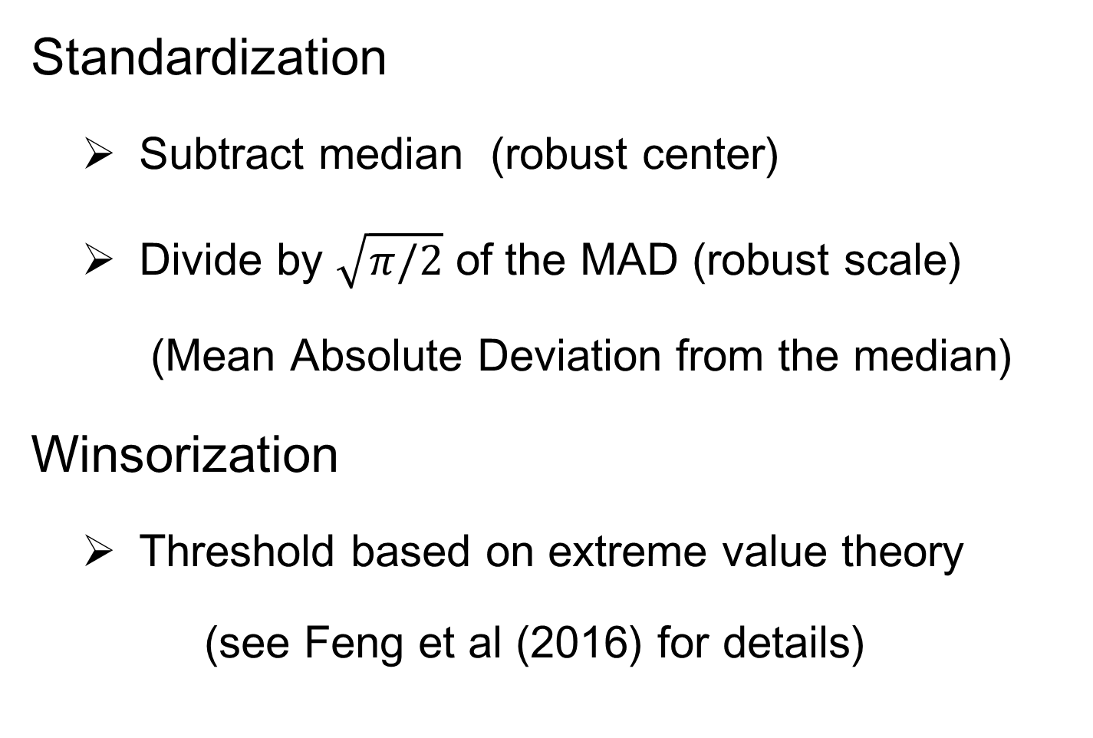
Automatic Transformations
Standardization
  Subtract median (robust center)
  Divide by $\sqrt{π/2}$ of the MAD (robust scale)
  (Mean Absolute Deviation from the median)
Winsorization
  Threshold based on extreme value theory
  (see Feng et al (2016) for details)
Notes:
After the shift log transformation, we need to deal with potential influential values by winsorization,
Before that we need a robust standardization ( and I will talk about it later)
To make standardization robust, we will use some robust statistics that is subtracting the median and divide based on the mean absolute deviation from median (not MAD which might be 0)

Slide 11
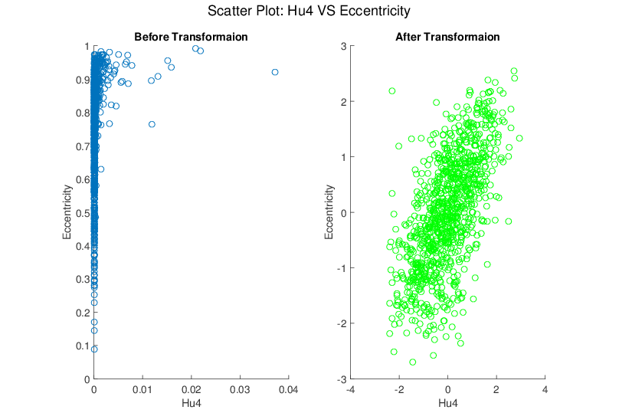
Melanoma Data
Much Nicer Distributions
Notes:
Besides, although the transformation targets at marginal dist
We see improvement of bivariate normality in many real data sets for example here.

Slide 12
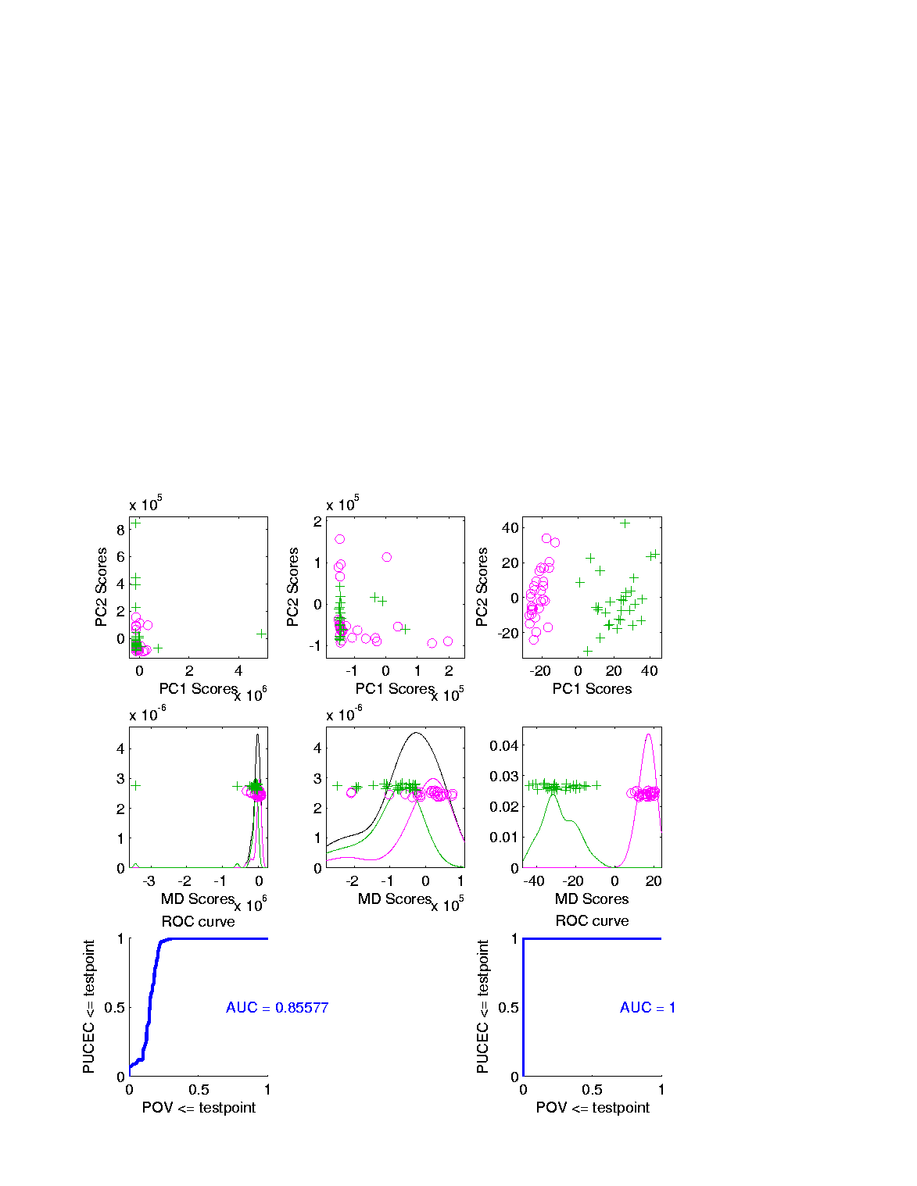
Revisit Gene Expression
Ovarian (o) & Uterine (+) Cancer Cases
Add In Automatic
Log Transformed PCA
Proj’ns on Mean
Difference Dir’n
Note Much
Better

Slide 13
Revisit Gene Expression
ROC Curve
Much Better
For Log
Transformations

Slide 14
Data Visualization
Overview of Visualization Methods:
Curve Views (FDA)
Scatterplot Matrices (Shows Relationships)
Marginal Distributions
Heat-Map Views

Slide 15
Heat-Map Views
Main Idea:
Look at Full Data Matrix
As an Image (Rectangular Array of “Pixels”)
Coding Values with Colors (Gray Levels)

Slide 16
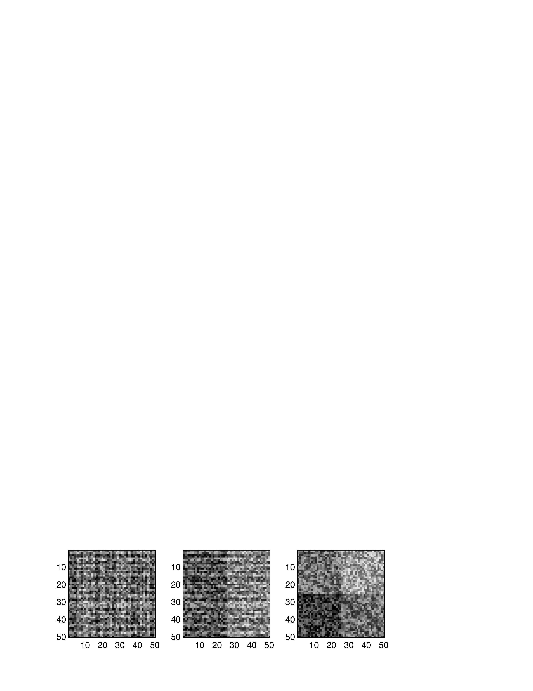
Heat-Map Views
Some Principles:
For Nonnegative Data (i. e. all $x_{i,j}≥0$)
Gray Level is Informative (& Not Distracting)
Actually Gray Level Is Also Good For:
“No Pivotal Value (e.g. 0) To HighLight”
Some Advocate a RAINBOW
Gives “Greater Range”???
Borland & Taylor (2007) Disagree
Over Perceptual Interpretation
(What Is Equally Spaced ???)

Slide 17
Heat-Map Views
Some Principles:
Ordering Rows and Columns Really Matters
Clustering Columns Highlights Relationships
Clustering “Knobs”:
Hierarchical with
Euclidean Distance
& Average Linkage

Slide 18
Heat-Map Views
Some Principles:
Ordering Rows and Columns Really Matters
Clustering Columns & Rows is Crucial
Population Structure
Invisible w/ Random Order

Slide 19
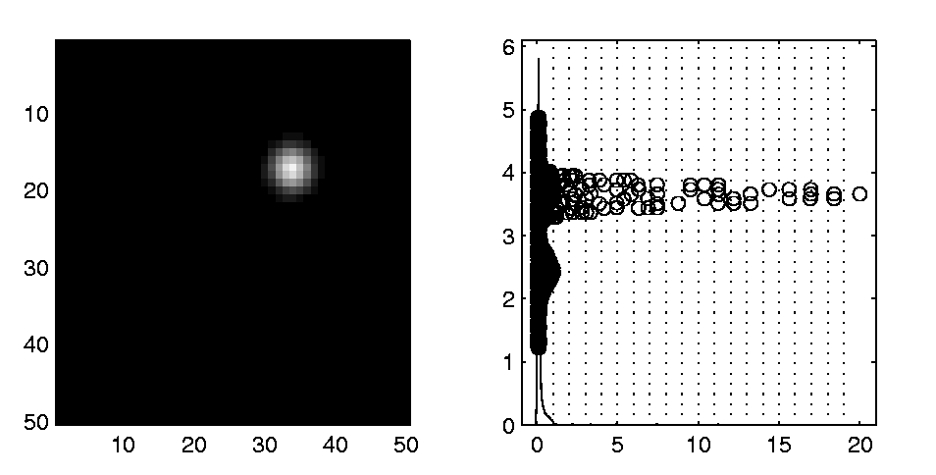
Heat-Map Views
Dist’n of Values, with Usual
Jitter Plot + Smooth Histo
Some Principles:
Color Scale is Also Critical
Equal Bin Spacing
Toy Example
Many Small
Values & Few
Large Ones
Results in Very
Poor Contrast

Slide 20
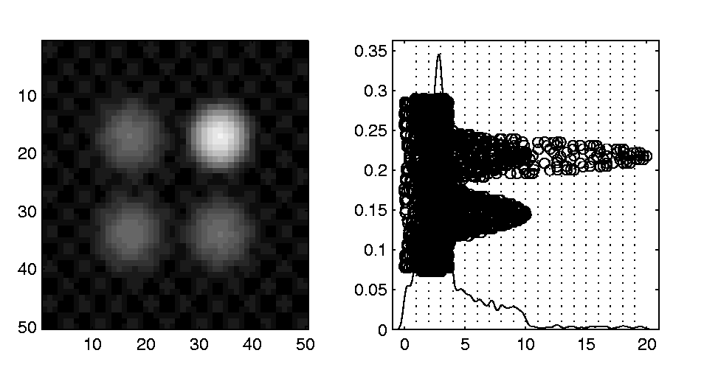
Heat-Map Views
Natural Approach (to Skewed Dist’n):
Log Transformation
Much Better
Scaling, Using
More of the
Color Range
Same Toy Example
Much Better
Contrast, Now
See 4 Peaks

Slide 21
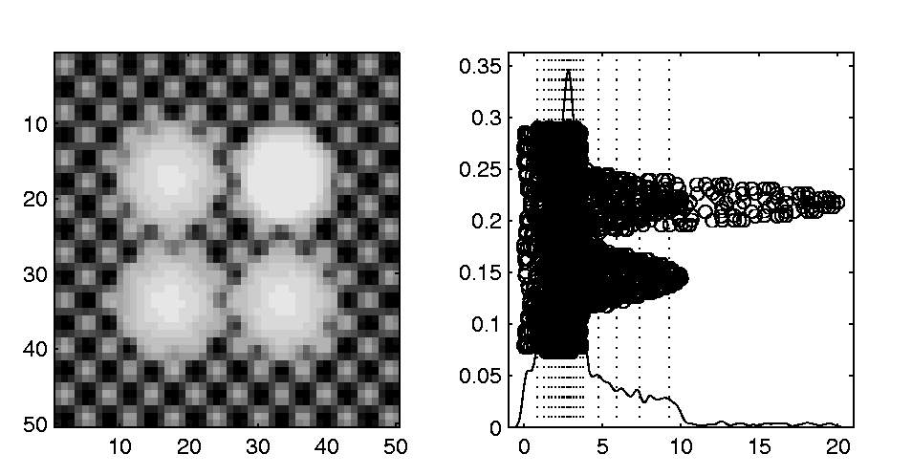
Heat-Map Views
Can Look at Either
Original Or Log View
Natural Approach (to Skewed Dist’n):
Quantile Scaling (= #s in Each Bin)
Same Toy Example
Non-Equally Spaced Bins
Far More
Contrast
Good or Bad?
Peaks Less
Prominent

Slide 22
Heat-Map Views
“Best” Choice of Color Scaling:
Context Dependent
Equally Spaced (Most Interpretable?)
Log Spacing (Can Be Very Useful)
Quantile Spacing (Also Useful)
Should Look At Several & Decide

Slide 23
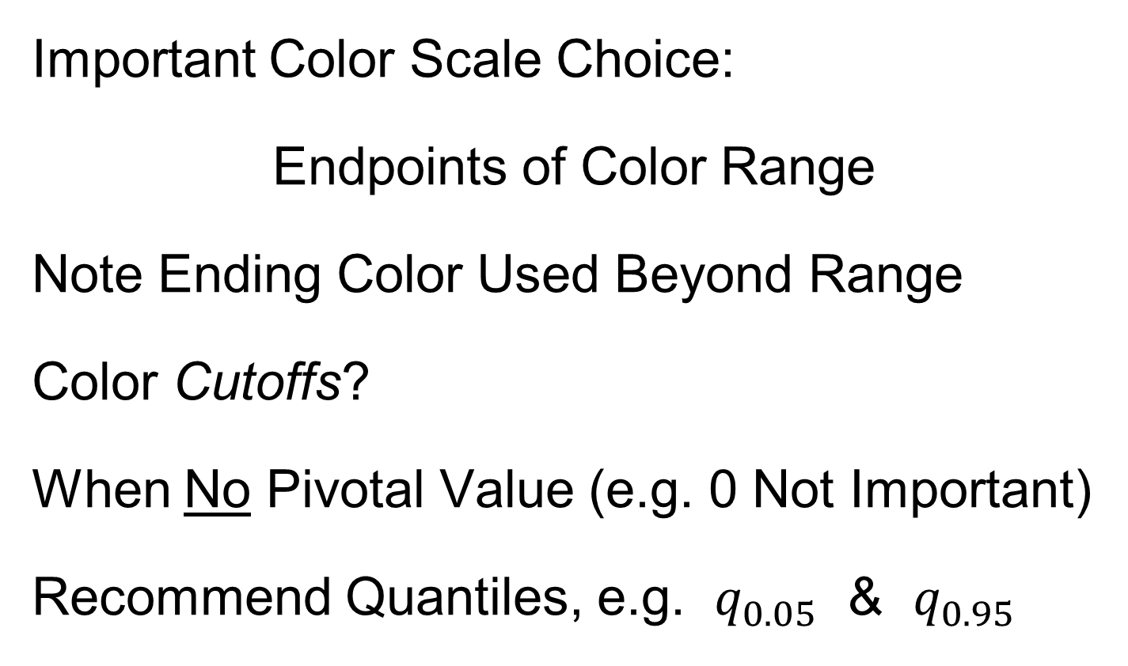
Heat-Map Views
Important Color Scale Choice:
Endpoints of Color Range
Note Ending Color Used Beyond Range
Color Cutoffs?
When No Pivotal Value (e.g. 0 Not Important)
Recommend Quantiles, e.g. $q_{0.05}$ & $q_{0.95}$
Often Worth
Twiddling These

Slide 24
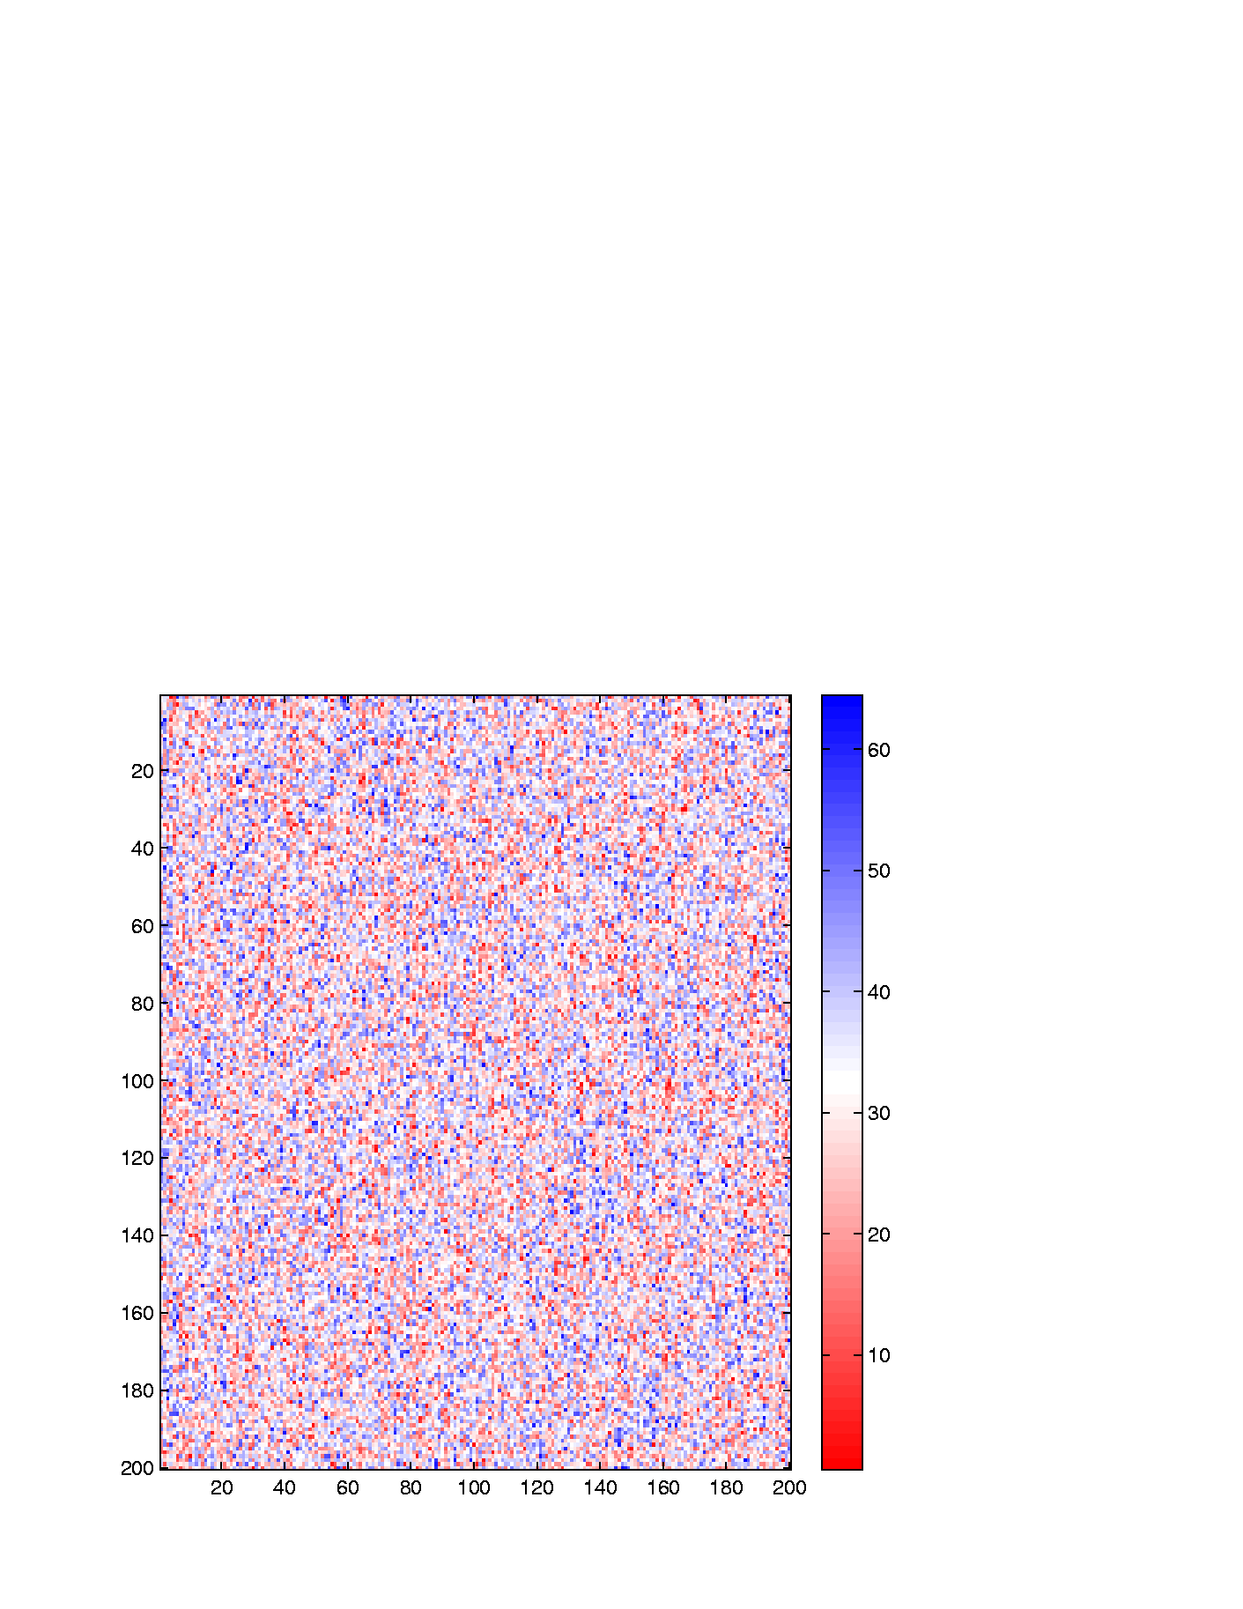
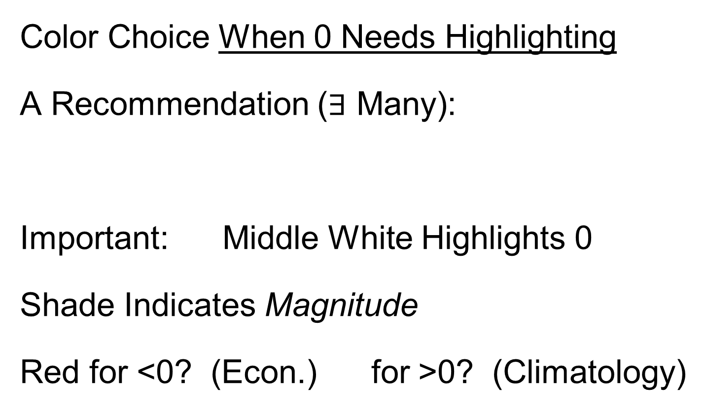
Heat-Map Views
Color Choice When 0 Needs Highlighting
A Recommendation ($∃$ Many):
Important: Middle White Highlights 0
Shade Indicates Magnitude
Red for <0? (Econ.) for >0? (Climatology)

Slide 25
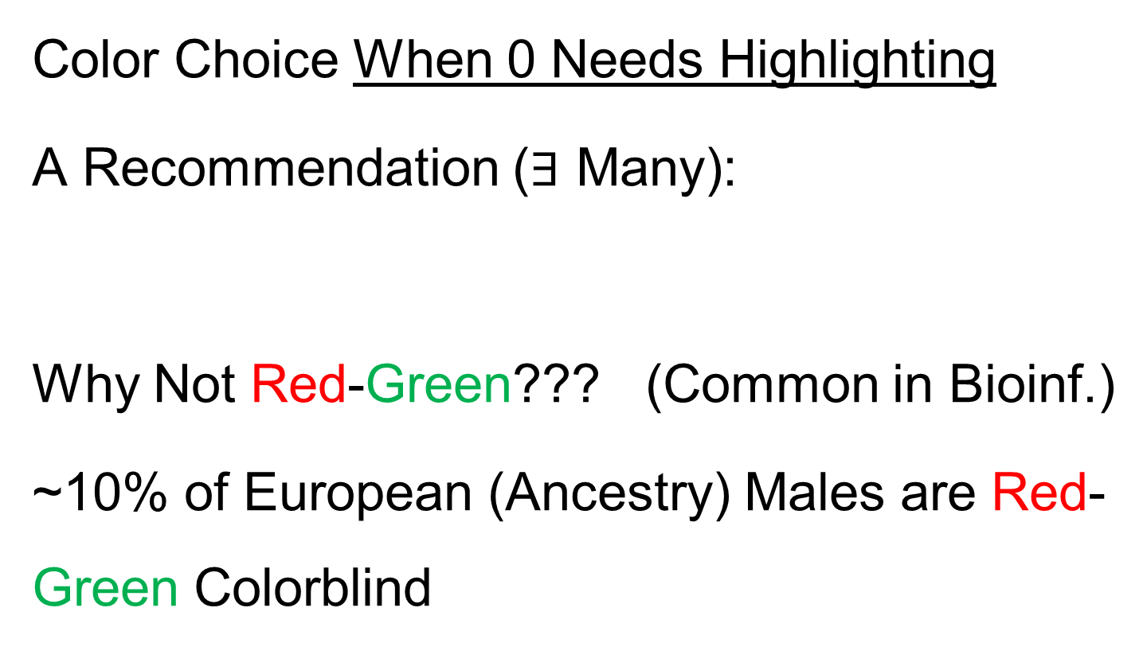
Heat-Map Views
Color Choice When 0 Needs Highlighting
A Recommendation ($∃$ Many):
Why Not Red-Green??? (Common in Bioinf.)
~10% of European (Ancestry) Males are Red-Green Colorblind
Most Other Choices as Good as This

Slide 26
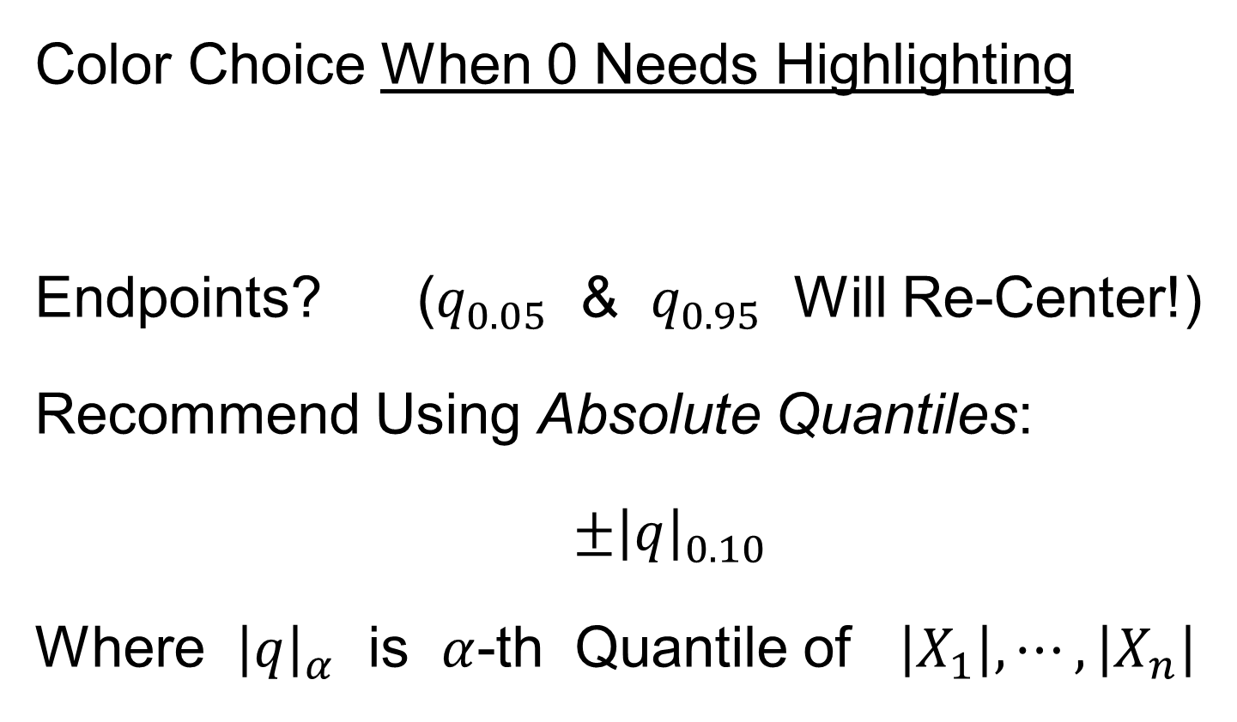
Heat-Map Views
Caution: Many
Packages Do This!
Color Choice When 0 Needs Highlighting
Endpoints? ($q_{0.05}$ & $q_{0.95}$ Will Re-Center!)
Recommend Using Absolute Quantiles:
$±{\left|q\right|}_{0.10}$
Where ${\left|q\right|}_{α}$ is $α$-th Quantile of $\left|X_{1}\right|,⋯,\left|X_{n}\right|$

Slide 27
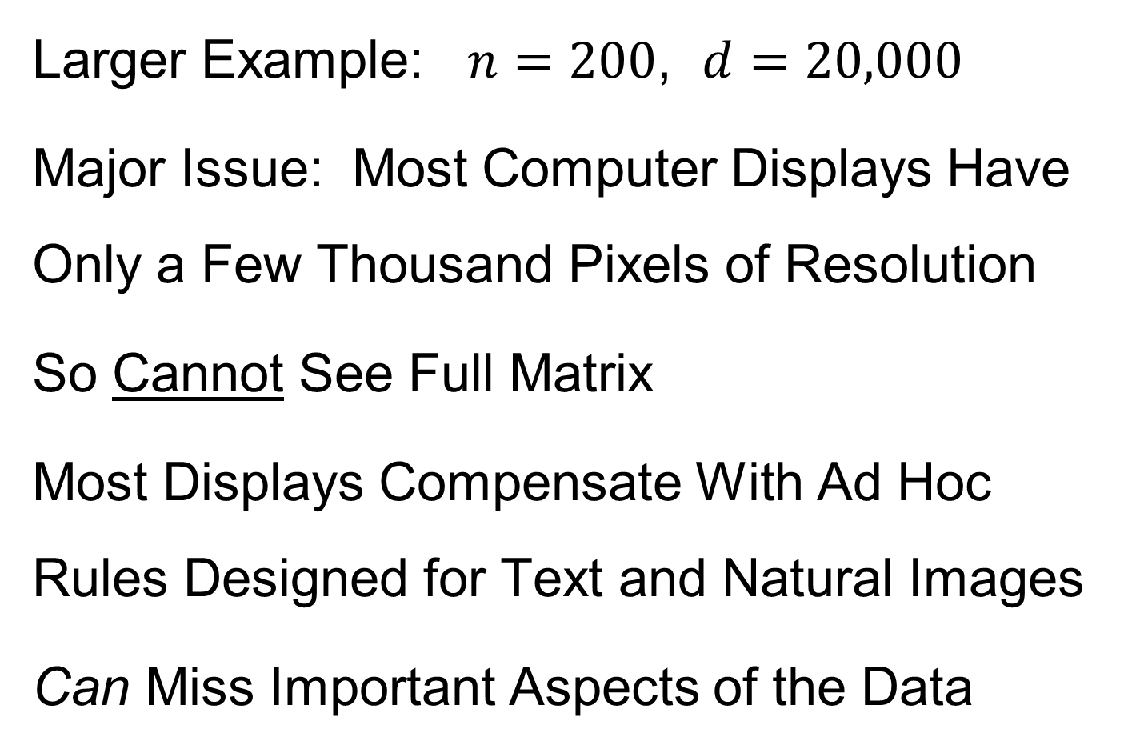
Heat-Map Views
Larger Example: $n=200$, $d=20,000$
Major Issue: Most Computer Displays Have Only a Few Thousand Pixels of Resolution
So Cannot See Full Matrix
Most Displays Compensate With Ad Hoc Rules Designed for Text and Natural Images
Can Miss Important Aspects of the Data

Slide 28
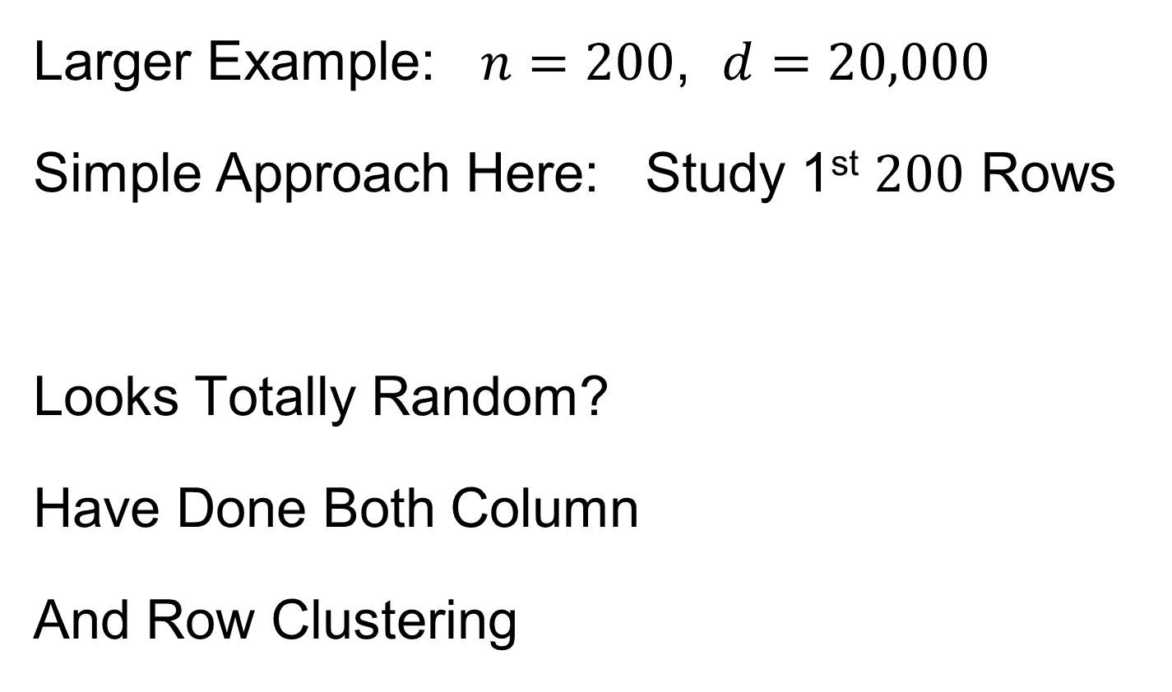
Heat-Map Views
Will See OK
For This Data
Larger Example: $n=200$, $d=20,000$
Simple Approach Here: Study 1st $200$ Rows
Looks Totally Random?
Have Done Both Column
And Row Clustering

Slide 29
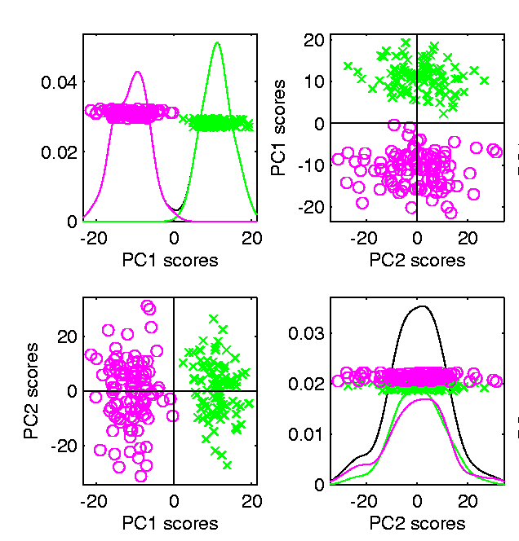

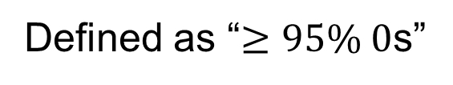
Heat-Map Views
Larger Example: $n=200$, $d=20,000$
Revisit With Scatterplot Matrix View
Conclude: Heat
Map Worse
Than Scatterplot
In This Case
Colored 1st 100 & 2nd 100
Clear Cluster Structure
Hidden by Noise in
Heatmap View!
Is This Real (or Artifact)?
$N(−0.04,1)$ & $N(0.04,1)$

Slide 30
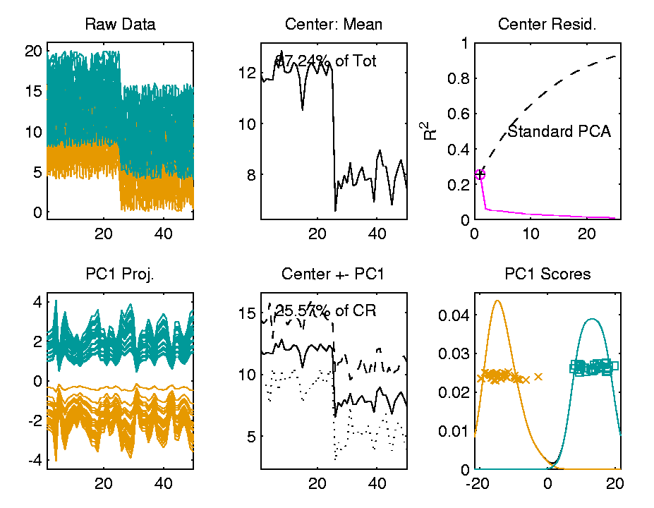

Heat-Map Views
For Opposite Answer Consider Another
Data Set ($n=d=50$) with Curve View:
Very Noisy
1st 25 Features
>> 2nd 25
Two Clear
Clusters
Understand Pop’n
Structure???

Slide 31
Heat-Map Views
Data Source is Above Example:
Gives Quicker Impression of Structure
More Natural View Than Curves
2 Clusters
1st Features Larger

Slide 32
Heat-Map Views
One More Point (From This Example):
Than Both Separated
Mean +/- Curves
Easier to Understand

Slide 33
Heat-Map Views
Which Data View Is “Best”???
Heat Maps?
Curves?
Scatterplots?

Slide 34
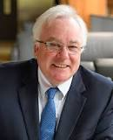
Heat-Map Views
Which Data View Is “Best”???
Simon Sheather Quote:
“Every Dog Has His Day”

Slide 35
Heat-Map Views
“Every Dog Has His Day”
Idea:
Any Data Analytic Method Somebody Likes Has Some Situations Where It Is “Best”
& Of Course Others Where It Is Poor
(Will See This Again)

Slide 36
Heat-Map Views
Some Overview Papers:
History:
Wilkinson & Friendly (2009)
Criticism of Common Color Choices:
Borland & Taylor (2007)

Slide 37
Scatterplot Views
All Based on Projections
Now Consider Other Directions
Beyond PCA

Slide 38
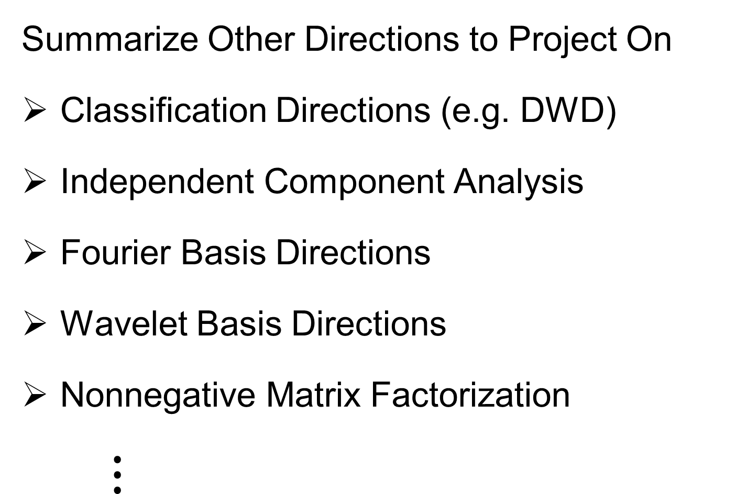
Scatterplot Views
Summarize Other Directions to Project On
Classification Directions (e.g. DWD)
Independent Component Analysis
Fourier Basis Directions
Wavelet Basis Directions
Nonnegative Matrix Factorization
$⋮$
Might
Discuss
Later

Slide 39
Scatterplot Views
Summarize Other Directions to Project On
Known Modes of Variation
Izem & Kingsolver (2007), Izem & Marron (2007)
Maximal Smoothness Directions
Gaydos et. al (2013), Kingsolver et. al (2015), Zhang et al. (2014)
Maximal Data Piling
(Will Explore Later)

Slide 40
Distance Methods
Main Idea:
Approach to Data Lying in Complicated Space
(PCA Makes No Sense In Nonlinear Spaces)
However, Often Have Notion of “Distance”
I.e. Metric on Metric Space
So Base Analysis on Distances

Slide 41
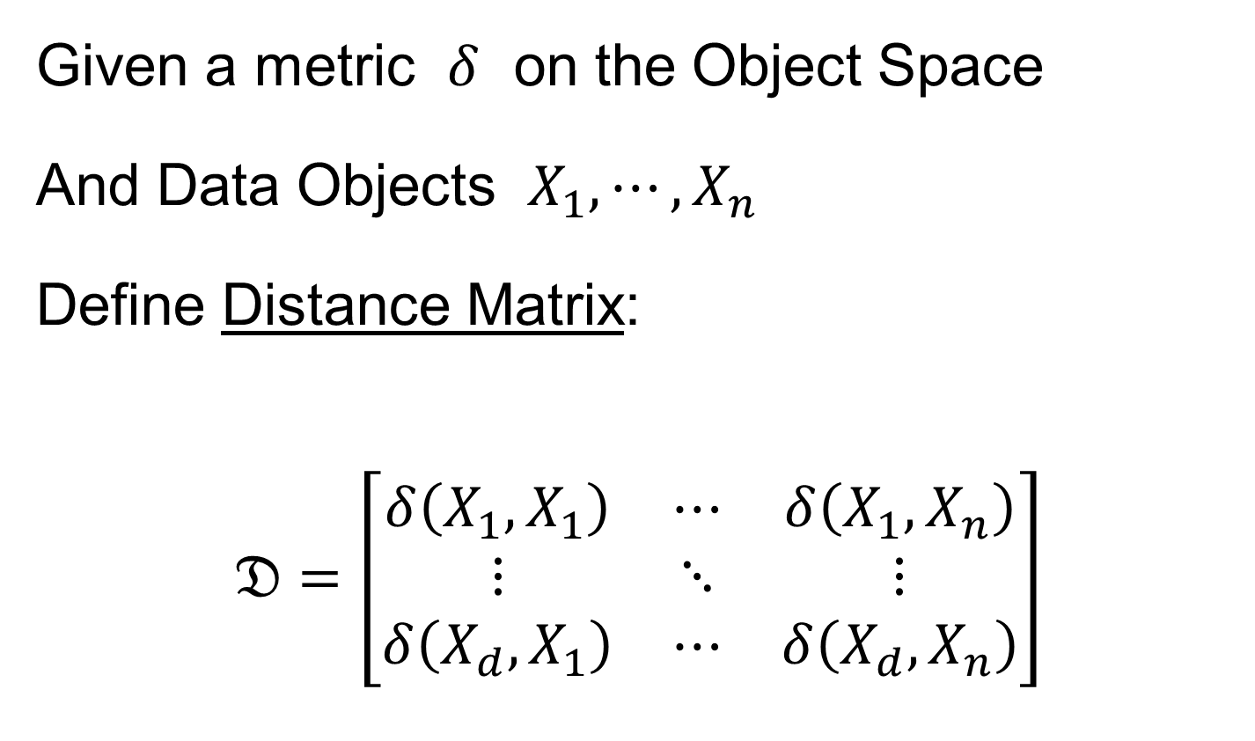
Distance Methods
Given a metric $δ$ on the Object Space
And Data Objects $X_{1},⋯,X_{n}$
Define Distance Matrix:
$$𝔇=\left[\begin{matrix}δ\left(X_{1},X_{1}\right) & ⋯ & δ\left(X_{1},X_{n}\right) \\ ⋮ & ⋱ & ⋮ \\ δ\left(X_{d},X_{1}\right) & ⋯ & δ\left(X_{d},X_{n}\right)\end{matrix}\right]$$

Slide 42
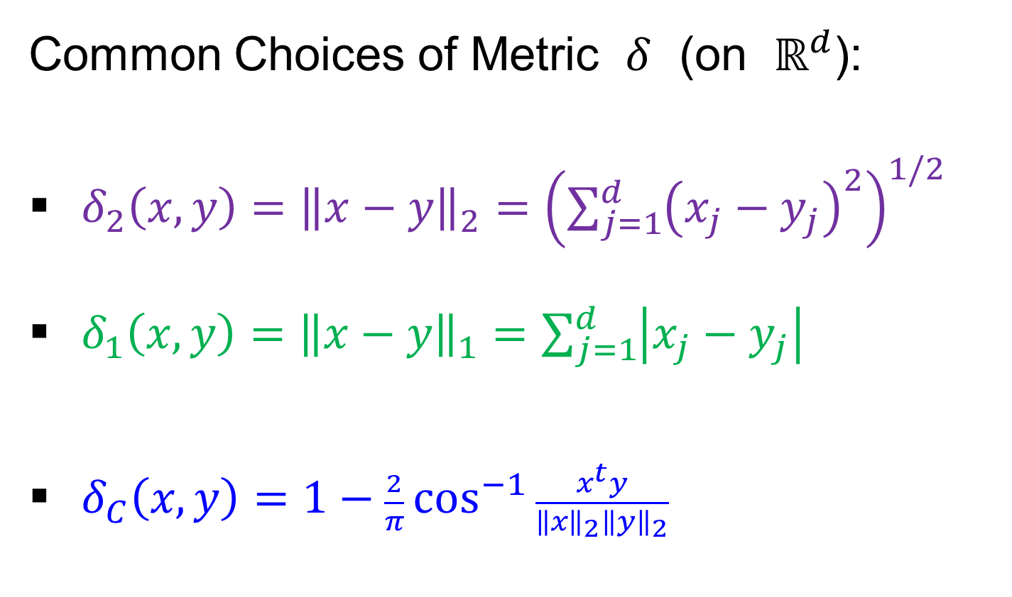
Distance Methods
Common Choices of Metric $δ$ (on $ℝ^{d}$):
$δ_{2}\left(x,y\right)={\left\|x−y\right\|}_{2}={\left(\sum_{j=1}^{d}{{\left(x_{j}−y_{j}\right)}^{2}}\right)}^{1/2}$
$δ_{1}\left(x,y\right)={\left\|x−y\right\|}_{1}=\sum_{j=1}^{d}{\left|x_{j}−y_{j}\right|}$
$δ_{C}\left(x,y\right)=1−\frac{2}{π}\cos^{−1}{\frac{x^{t}y}{{\left\|x\right\|}_{2}{\left\|y\right\|}_{2}}}$
Classical & Corresponds to Intuition
Very Good at Downweighting Outliers
Think Polar Coordinates, Focus on Angular Component and Ignore Radii

Slide 43
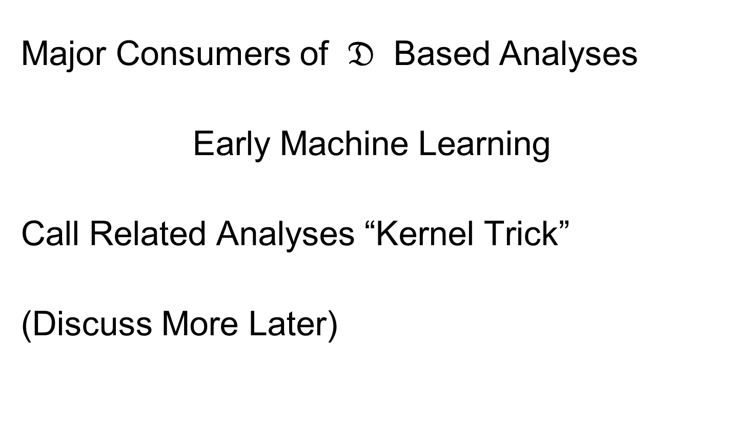
Distance Methods
Major Consumers of $𝔇$ Based Analyses
Early Machine Learning
Call Related Analyses “Kernel Trick”
(Discuss More Later)

Slide 44
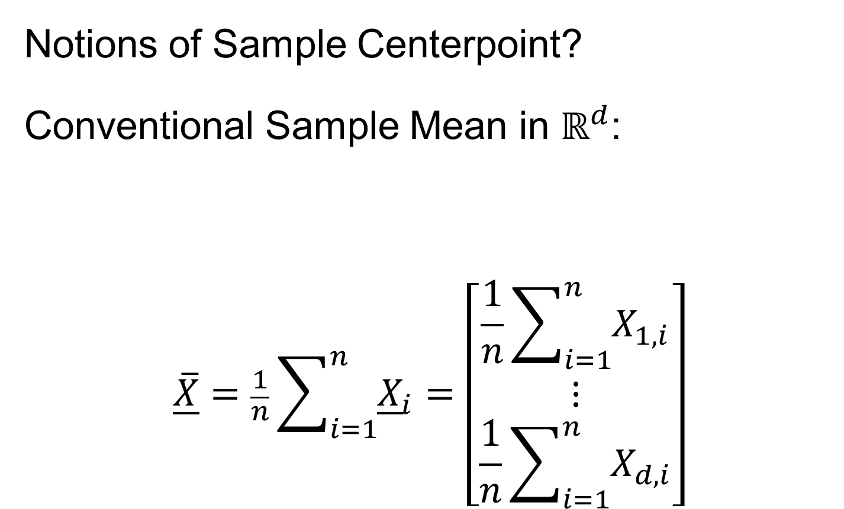
Distance Methods
Notions of Sample Centerpoint?
Conventional Sample Mean in $ℝ^{d}$:
$$\overline{\underline{X}}=\frac{1}{n}\sum_{i=1}^{n}{{\underline{X}}_{i}}=\left[\begin{matrix}\frac{1}{n}\sum_{i=1}^{n}{X_{1,i}} \\ ⋮ \\ \frac{1}{n}\sum_{i=1}^{n}{X_{d,i}}\end{matrix}\right]$$
Note: Uses Linear Operations,
Not Available in General

Slide 45
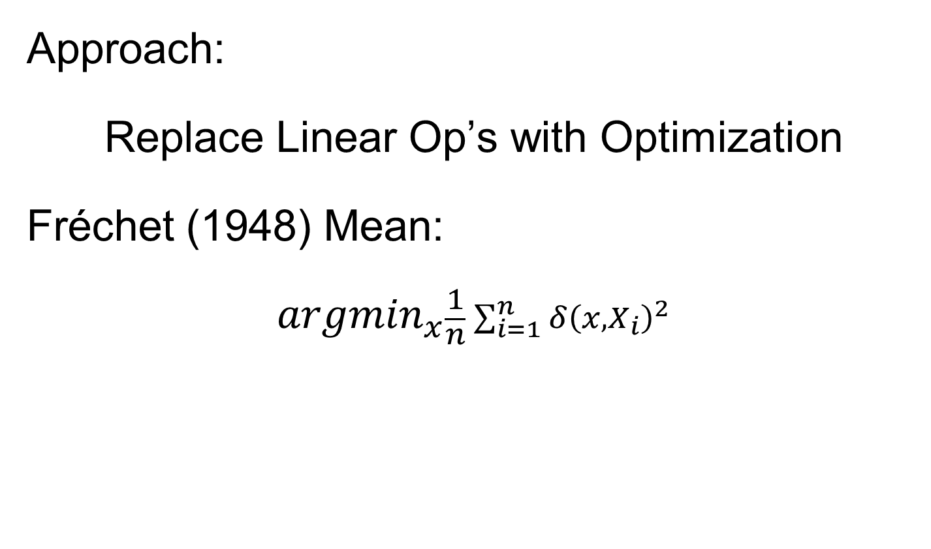
Distance Methods
Approach:
Replace Linear Op’s with Optimization
Fréchet (1948) Mean:
$${argmin}_{x}\frac{1}{n}\sum_{i=1}^{n}{{δ\left(x,X_{i}\right)}^{2}}$$
Start With Candidate Point
Move Around to Min
Sum of Squared Dist’s

Slide 46
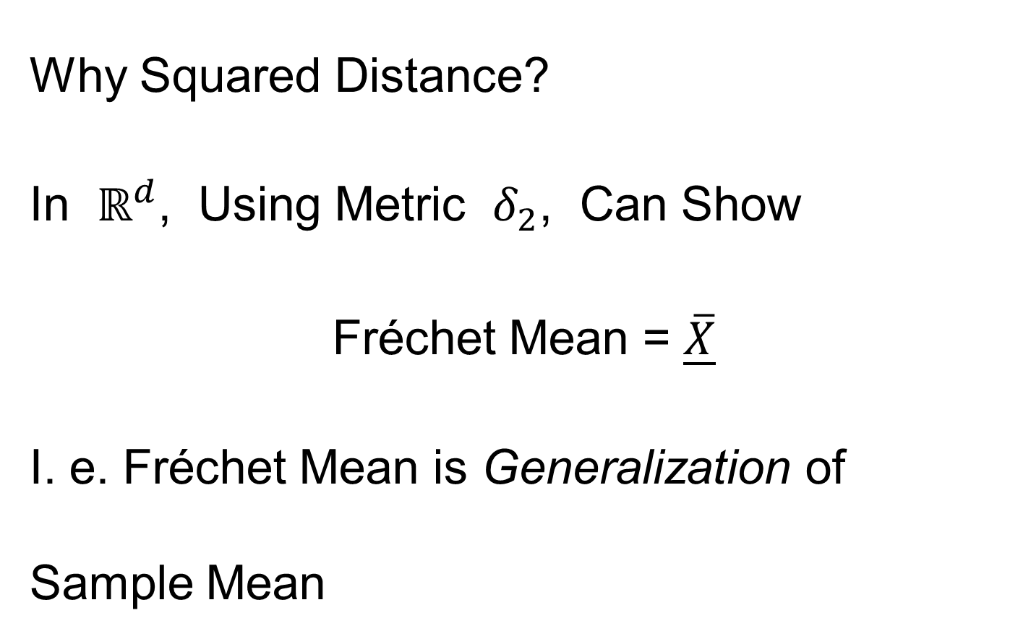
Distance Methods
Why Squared Distance?
In $ℝ^{d}$, Using Metric $δ_{2}$, Can Show
Fréchet Mean = $\overline{\underline{X}}$
I. e. Fréchet Mean is Generalization of Sample Mean

Slide 47
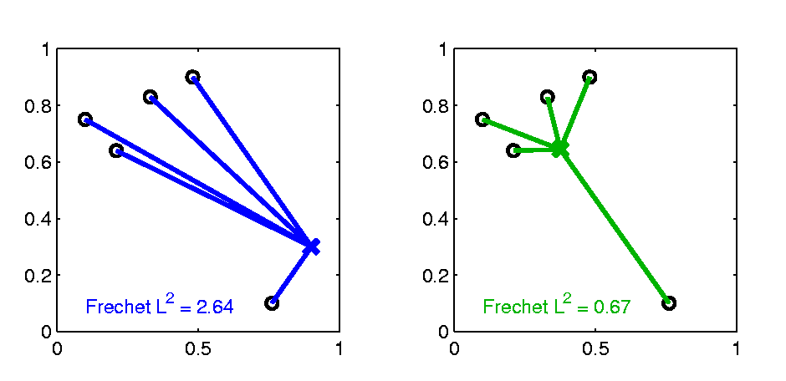

Distance Methods
Fréchet Sample Mean, $ℝ^{2}$ Toy Example
Move Around to Min
Sum of Squared Dist’s
Start With Candidate Point

Slide 48
Distance Methods
Fréchet Sample Mean, $ℝ^{2}$ Toy Example
Min Looks Like
Sample Mean???
Note: Outlier Pulls Mean Out of
Convex Hull Of Other 4 Points
Recall “Center
Of Mass”
Interpretretation
Known Problem with Mean: Not Robust Against Outliers

Slide 49

Distance Methods
Robust Variation: Fréchet (1948) Median:
$${argmin}_{x}\frac{1}{n}\sum_{i=1}^{n}{δ\left(x,X_{i}\right)}$$
Again Start With Candidate Point
Move Around to Min
Sum of Distances

Slide 50


Distance Methods
Fréchet Sample Median, $ℝ^{2}$ Toy Example
Better Robustness!
Move Around to Min
Sum of Squared Dist’s
Start With Candidate Point

Slide 51
Distance Methods
Fréchet Sample Median, $ℝ^{2}$ Toy Example
Better Robustness?
Note: Median Now Inside
Convex Hull Of Other 4 Points

Slide 52
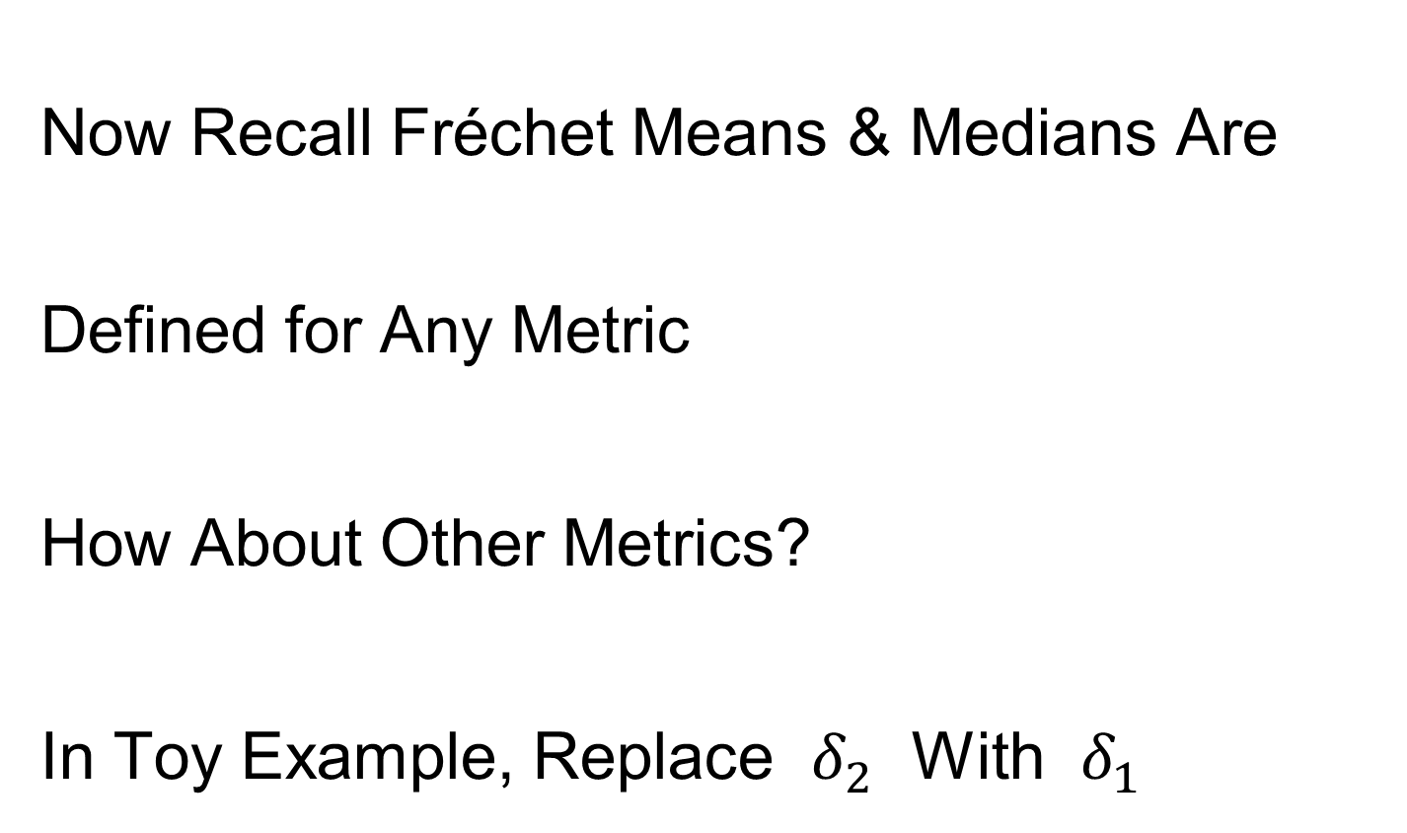
Distance Methods
Now Recall Fréchet Means & Medians Are Defined for Any Metric
How About Other Metrics?
In Toy Example, Replace $δ_{2}$ With $δ_{1}$

Slide 53
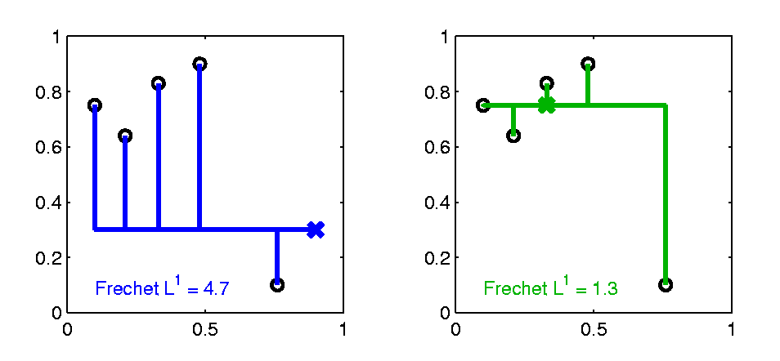

Distance Methods
$δ_{1}$ Fréchet Sample Median, $ℝ^{2}$ Toy Example
Distance Depends on
Coordinates, Called
“Manhattan Distance”
Result Is Also
Very Robust

Slide 54
Distance Methods
Fréchet Means & Medians Allow Many Variations
Usually Studied in “Robust Statistics”
Plan to Look Deeper Later On
“Every Dog Has His Day”

Slide 55
Distance Methods
Recall General Approach:
Replace Linear Op’s with Optimization
Distance Based Version of PCA?

Slide 56
Distance Methods
Multi Dimensional Scaling (MDS)
Name & Psychometric References:
Torgersen (1952, 1958), Gower (1966)
Earlier Versions of Ideas:
Eckart & Young (1936), Young and Householder (1938)

Slide 57
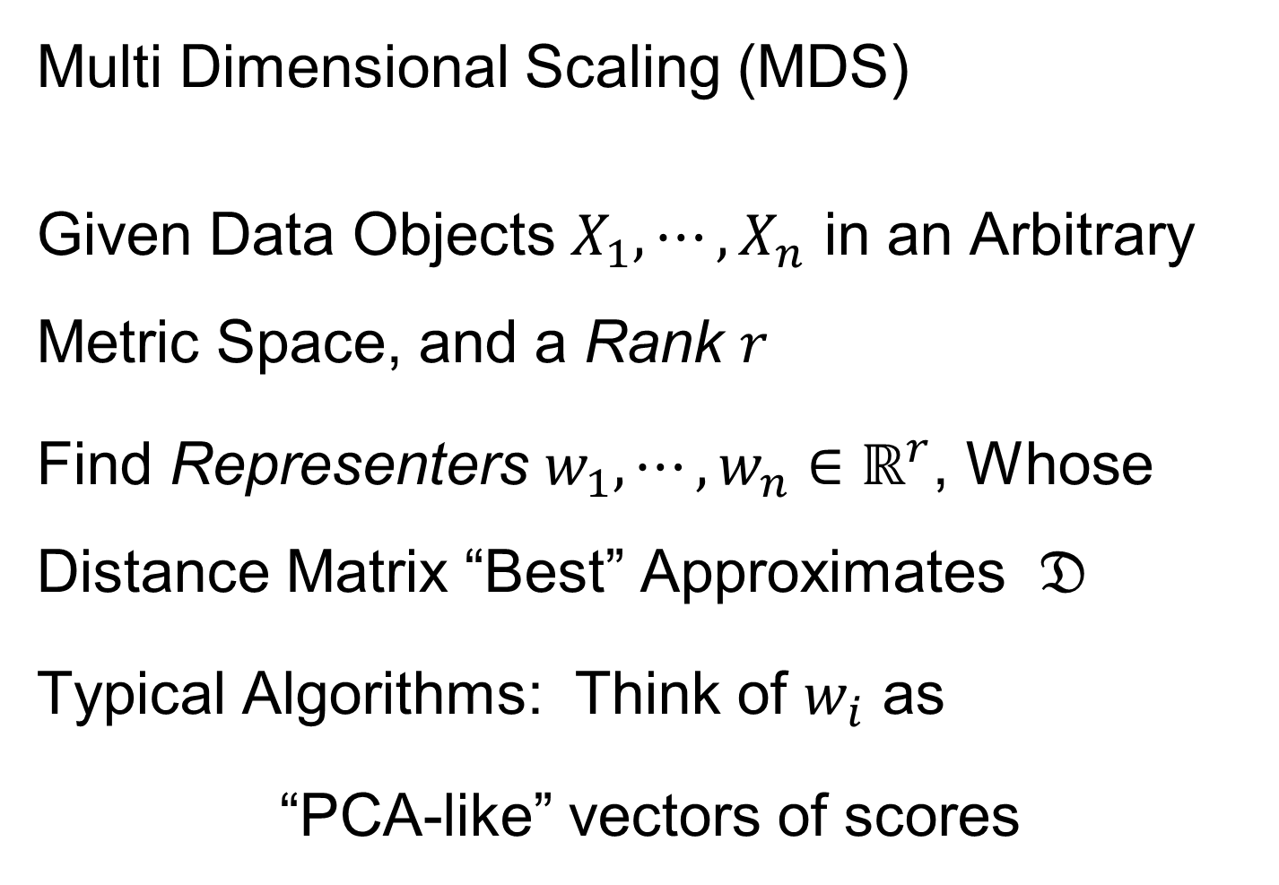
Distance Methods
Multi Dimensional Scaling (MDS)
Given Data Objects $X_{1},⋯,X_{n}$ in an Arbitrary Metric Space, and a Rank $r$
Find Representers $w_{1},⋯,w_{n}∈ℝ^{r}$, Whose Distance Matrix “Best” Approximates $𝔇$
Typical Algorithms: Think of $w_{i}$ as
“PCA-like” vectors of scores

Slide 58
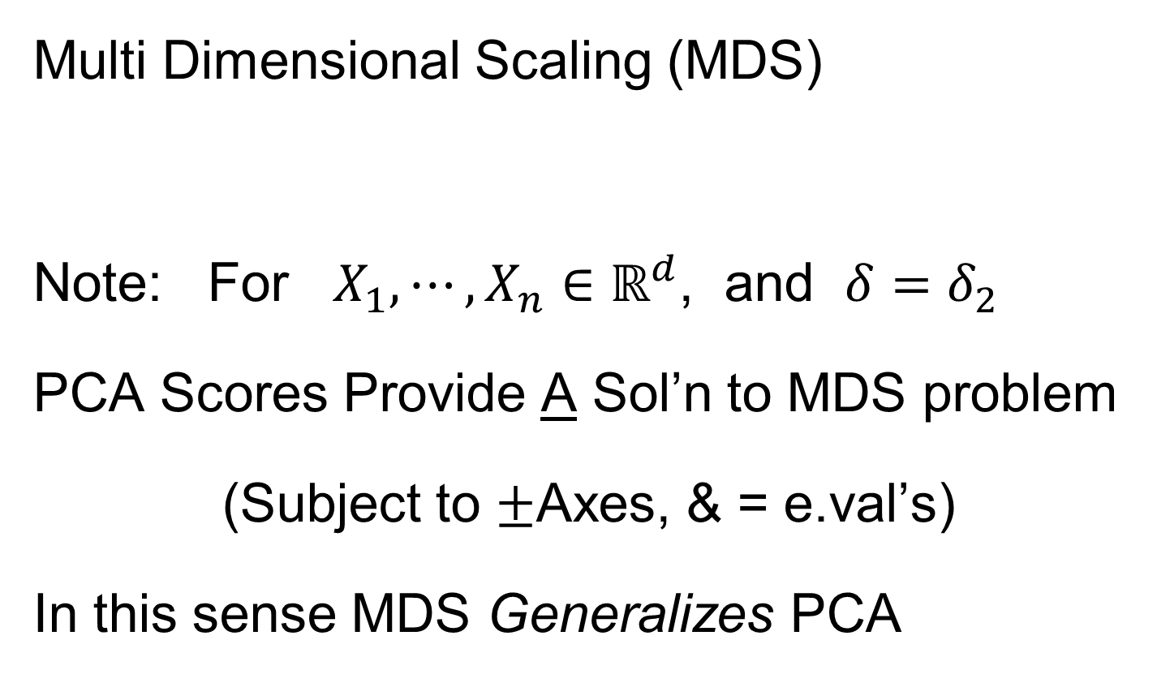
Distance Methods
Multi Dimensional Scaling (MDS)
Note: For $X_{1},⋯,X_{n}∈ℝ^{d}$, and $δ=δ_{2}$
PCA Scores Provide A Sol’n to MDS problem
(Subject to $±$Axes, & = e.val’s)
In this sense MDS Generalizes PCA

Slide 59
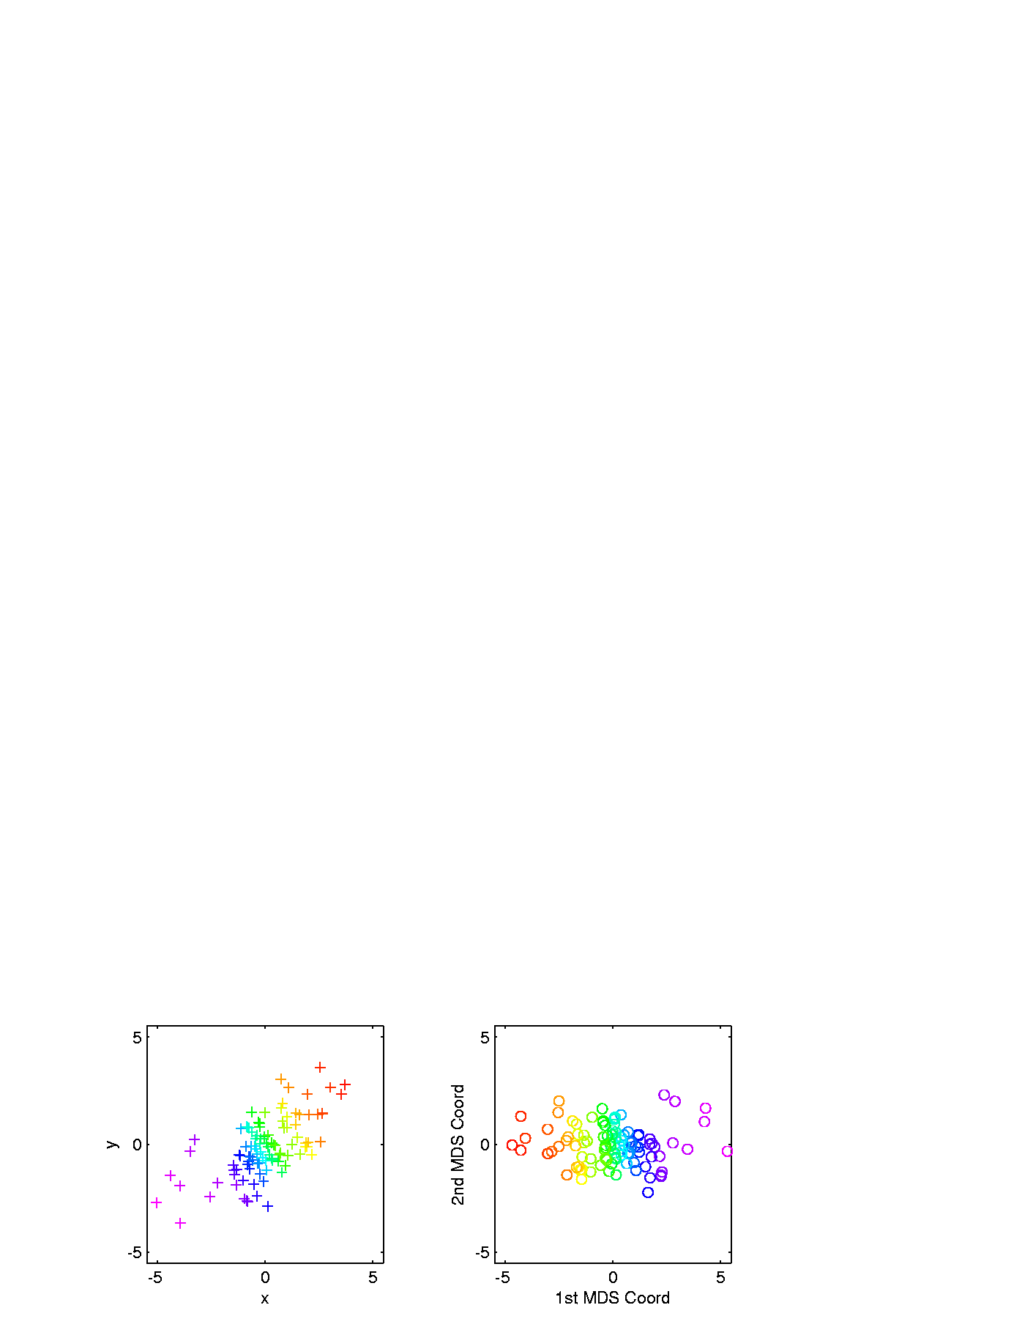
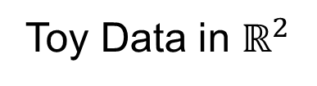
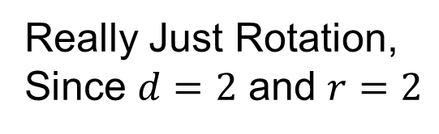
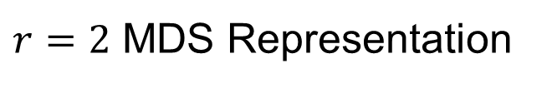
Distance Methods
Multi Dimensional Scaling (MDS)
Toy Data in $ℝ^{2}$
$r=2$ MDS Representation
Really Just Rotation,
Since $d=2$ and $r=2$
Follows PC1 Axis (Flipped)

Slide 60
Distance Methods
Drawbacks of MDS relative to PCA
Only Gives Scores (Interpret Relationships)
But No Loadings (Explore Drivers)
Nor Modes of Variation
Can Have Serious Distortions (Nonlin. Case)

Slide 61

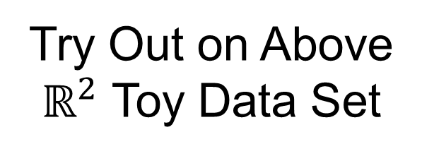
Distance Methods
Less Attractive Approach to $𝔇$ Based PCA:
Treat Columns of $𝔇$ as Data Objects
And Do Euclidean PCA on Those
Try Out on Above
$ℝ^{2}$ Toy Data Set

Slide 62


Distance Methods
Columns of $𝔇$ as Data Objects
1st PC Looks
Sensible
As Do 1st & 3rd
But 2nd Suffers From
Strong Distortion???
Called “Horseshoe”
& Under Study

Slide 63

Big Picture
Object Oriented Data Analysis
Have done detailed study of Data Objects
In Euclidean Space, $ℝ^{d}$
Next: OODA in Non-Euclidean Spaces

Slide 64
Shapes As Data Objects
Several Different Notions of Shape
Oldest and Best Known (in Statistics):
Landmark Based

Slide 65

Shapes As Data Objects
Landmark Based Shape Analysis:
Kendall et al. (1999)
Bookstein (1991)
Dryden & Mardia (2016)
(Note: these are summarizing
Monographs, $∃$ many papers)

Slide 66
Shapes As Data Objects
Landmark Based Shape Analysis:
Kendall et al. (1999)
Bookstein (1991)
Dryden & Mardia (2016)
Recommended as Most Accessible

Slide 67
Landmark Based Shape Analysis
Start by Representing Shapes
Data Object

Slide 68





Landmark Based Shape Analysis
Start by Representing Shapes by
Landmarks (points in $ℝ^{2}$ or $ℝ^{3}$)
$$\left(x_{1},y_{1}\right)$$
$$\left[\begin{matrix}\begin{matrix}x_{1} \\ y_{1}\end{matrix} \\ \begin{matrix}x_{2} \\ y_{2}\end{matrix} \\ \begin{matrix}x_{3} \\ y_{3}\end{matrix}\end{matrix}\right]∈ℝ^{6}$$
$$\left(x_{2},y_{2}\right)$$
$$\left(x_{3},y_{3}\right)$$
Feature Vector

Slide 69
Landmark Based Shape Analysis
Clearly different shapes:

Slide 70
Landmark Based Shape Analysis
Clearly different shapes:
But what about: ?

Slide 71
Landmark Based Shape Analysis
Clearly different shapes:
But what about: ?
(just translation and rotation of ,
but different points in R⁶)

Slide 72
Landmark Based Shape Analysis
Note: Shape should be same over different:
Translations

Slide 73
Landmark Based Shape Analysis
Note: Shape should be same over different:
Translations
Rotations

Slide 74
Landmark Based Shape Analysis
Note: Shape should be same over different:
Translations
Rotations
Scalings

Slide 75
Landmark Based Shape Analysis
Approach: Identify objects that are:
Translations
Rotations
Scalings
of each other

Slide 76
Landmark Based Shape Analysis
Approach: Identify objects that are:
Translations
Rotations
Scalings
of each other
Mathematics: Equivalence Relation

Slide 77
Equivalence Relations
Useful Mathematical Device
Weaker generalization of “=” for a set
Main consequence:
  Partitions Set Into Equivalence Classes
  For “=”, Equivalence Classes Are Singletons

Slide 78

Equivalence Relations
Common Example: Modulo Arithmetic
(E.g. Clock Arithmetic, mod 12)
3 hours after 11:00 is 2:00 …
Hours are equivalence classes:
{1} = {1:00, 13:00, …}
{2} = {2:00, 14:00, …}
$$⋮$$

Slide 79

Equivalence Relations
Common Example: Modulo Arithmetic
(E.g. Clock Arithmetic, mod 12)
For $a, b, c ∈ ℤ$, Say $a≡b (mod c)$
When $\left(b −a\right)$ is divisible by $c$
Clock e.g. $14−2=12$, so $14≡2 (mod 12)$
i.e. 14:00 is “identified with” 2:00

Slide 80

Equivalence Relations
For $a, b, c ∈ ℤ$, Say $a≡b (mod c)$
When $\left(b −a\right)$ is divisible by $c$
E.g. Binary Arithmetic, mod $2$
Equivalence classes:
$\left\{0\right\}=\left\{⋯,−2,0,2,4,⋯\right\}$
$$\left\{1\right\}=\left\{⋯,−1,1,3,5,⋯\right\}$$
(just evens and odds)

Slide 81

Equivalence Relations
Another Example: Vector Subspaces of $ℝ^{2}$
E.g. Say $\left(\begin{matrix}x_{1} \\ y_{1}\end{matrix}\right)≈\left(\begin{matrix}x_{2} \\ y_{2}\end{matrix}\right)$ when $y_{1}=y_{2}$
Equiv. Classes are indexed by $y∈ℝ^{1},$
And are: $\left\{y\right\}=\left\{\left(\begin{matrix}x \\ y\end{matrix}\right)∈ℝ^{2}:x∈ℝ^{1}\right\}$
i.e. Horizontal lines (same $y$ coordinate)

Slide 82
Equivalence Relations
Deeper Example: Transformation Groups
Based on Group Theory

Slide 83

Equivalence Relations
Deeper Example: Transformation Groups
For $g∈G$, operating on a set $S$
Say $s_{1}≈s_{2}$ when $∃$ $g$ where $g\left(s_{1}\right)=s_{2}$
Equivalence Classes:
$$\left\{s_{i}\right\}=\left\{s_{j}∈S:s_{j}=g\left(s_{i}\right), for some g∈G\right\}$$
Terminology: Also called orbits

Slide 84

Equivalence Relations
Deeper Example: Group Transformations
Above Examples Are Special Cases
Modulo Arithmetic
$$G= \left\{g:ℤ→ℤ :g\left(z\right)=z+kc, for k∈ℤ\right\}$$
(Orbits are $\left\{0\right\},\left\{1\right\},⋯,\left\{c−1\right\}$)

Slide 85

Equivalence Relations
Deeper Example: Group Transformations
Above Examples Are Special Cases
Modulo Arithmetic
Vector Subspace of $ℝ^{2}$
$$G=\left\{g:ℝ^{2}{→ℝ}^{2} :g\left(\begin{matrix}x \\ y\end{matrix}\right)=\left(\begin{matrix}x′ \\ y\end{matrix}\right), x′∈ℝ\right\}$$
(Orbits are horizontal lines, shifts of $ℝ$)

Slide 86

Equivalence Relations
Deeper Example: Group Transformations
Above Examples Are Special Cases
Modulo Arithmetic
Vector Subspace of $ℝ^{2}$
General Vector Subspace $V$
$G$ maps $V$ into $V$
(Orbits are Shifts of $V$, indexed by $V^{⊥}$)

Slide 87

Equivalence Relations
Deeper Example: Group Transformations
Above Examples Are Special Cases
Modulo Arithmetic
Vector Subspace of $ℝ^{2}$
General Vector Subspace $V$
Shape: $G=$ Group of “Similarities”
(translations, rotations, scalings)

Slide 88

Equivalence Relations
Deeper Example: Group Transformations
Mathematical Terminology:
Quotient Operation
Set of Equiv. Classes = Quotient Space
Denoted $S/G$

Slide 89
Landmark Based Shape Analysis
Approach: Identify objects that are:
Translations
Rotations
Scalings
of each other
Group of Transformations

Slide 90
Landmark Based Shape Analysis
Approach: Identify objects that are:
Translations
Rotations
Scalings
of each other
Mathematics: Equivalence Relation
Results in: Equivalence Classes
Which become the Data Objects

Slide 91
Landmark Based Shape Analysis
Equivalence Classes become Data Objects
Mathematics: Called “Quotient Space”
Intuitive Representation: Manifold
(curved surface)

Slide 92
Landmark Based Shape Analysis
Triangle Shape Space: Represent as Sphere

Slide 93

Landmark Based Shape Analysis
Triangle Shape Space: Represent as Sphere
$ℝ^{6}$ → $ℝ^{4}$
Translation

Slide 94

Landmark Based Shape Analysis
Triangle Shape Space: Represent as Sphere
$ℝ^{6}$ → $ℝ^{4}$ → $ℝ^{3}$
rotation

Slide 95


Landmark Based Shape Analysis
Triangle Shape Space: Represent as Sphere
$ℝ^{6}$ → $ℝ^{4}$ → $ℝ^{3}$ →
scaling
(thanks to Wikipedia)

Slide 96
Landmark Based Shape Analysis
Triangle Shape Space: Represent as Sphere
Equilateral
Triangles
Hemispheres
Are
Reflections
Co-Linear
Point Triples

Slide 97
OODA in Image Analysis
First Generation Problems:
Denoising
Segmentation
Registration
(all about single images,
still interesting challenges)

Slide 98
OODA in Image Analysis
Second Generation Problems:
Populations of Images
  Understanding Population Variation
  Discrimination (a.k.a. Classification)
Complex Data Structures (& Spaces)
HDLSS Statistics
High Dimension, Low Sample Size

Slide 99
Image Object Representation
Major Approaches for Image Data Objects:
Landmark Representations
Boundary Representations
Skeletal Representations

Slide 100

Landmark Representations
Landmarks for Fly Wing Data:
Thanks to George Gilchrist

Slide 101
Landmark Representations
Major Drawback of Landmarks:
Need to always find each landmark
Need same relationship
I.e. Landmarks need to correspond
Often fails for medical images
E.g. How many corresponding landmarks on a set of kidneys, livers or brains???

Slide 102
Boundary Representations
Traditional Major Sets of Ideas:
Triangular Meshes
  Survey: Owen (1998)
Active Shape Models
  Cootes, et al (1993)
Fourier Boundary Representations
  Keleman, et al (1997 & 1999)

Slide 103

Boundary Representations
Example of triangular mesh rep’n:
From:www.geometry.caltech.edu/pubs.html

Slide 104
Boundary Representations
Main Drawback:
Correspondence
For OODA (on vectors of parameters):
Need to “match up points”
Notes:
104

Slide 105
Boundary Representations
Main Drawback:
Correspondence
For OODA (on vectors of parameters):
Need to “match up points”
Easy to find triangular mesh
  Lots of research on this driven by gamers
Notes:
105

Slide 106
Boundary Representations
Main Drawback:
Correspondence
For OODA (on vectors of parameters):
Need to “match up points”
Easy to find triangular mesh
  Lots of research on this driven by gamers
Challenge to match mesh across objects
  There are some interesting ideas…
Notes:
106

Slide 107
Boundary Representations
Correspondence for Mesh Objects:
Active Shape Models (PCA – like)
Notes:
107

Slide 108
Boundary Representations
Correspondence for Mesh Objects:
Active Shape Models (PCA – like)
Automatic Landmark Choice
Cates, et al (2007)
Based on Optimization Problem:
Good Correspondence & Separation
(Formulate via Entropy)
Notes:
108

Slide 109
Skeletal Representations
Main Idea:
Represent Objects as:
Discretized skeletons (medial atoms)
Plus spokes from center to edge
Which imply a boundary
Very accessible early reference:
Yushkevich, et al (2001)

Slide 110

Skeletal Representations
2-d S-Rep Example:
Corpus Callosum
(Yushkevich)
Notes:
CCMsciznormRaw.avi

Slide 111

Skeletal Representations
2-d S-Rep Example:
Corpus Callosum
(Yushkevich)
Atoms
Notes:
CCMsciznormRaw.avi

Slide 112
Skeletal Representations
2-d S-Rep Example:
Corpus Callosum
(Yushkevich)
Atoms
Spokes
Notes:
CCMsciznormRaw.avi

Slide 113
Skeletal Representations
2-d S-Rep Example:
Corpus Callosum
(Yushkevich)
Atoms
Spokes
Implied
Boundary
Notes:
CCMsciznormRaw.avi

Slide 114

A Challenging Example
Male Pelvis
  Bladder – Prostate – Rectum

Slide 115
A Challenging Example
Male Pelvis
  Bladder – Prostate – Rectum
Attached to the Bladder
Common Area for Cancer in Males

Slide 116
A Challenging Example
Male Pelvis
  Bladder – Prostate – Rectum
Common Area for Cancer in Males
Useful Approach: Radiation
Challenge: Design Treatment
Hit Prostate
Miss Bladder & Rectum
Over Many Days

Slide 117
A Challenging Example
Radiation Treatment in Male Pelvis
  Bladder – Prostate – Rectum
  Central Question:
  How do they move over time (days)?
Work with 3-d CT
(“Computed Tomography”,
= 3d version of X-ray)

Slide 118
A Challenging Example
Radiation Treatment in Male Pelvis
  Bladder – Prostate – Rectum
  Central Question:
  How do they move over time (days)?
Work with 3-d CT
  Very Challenging to Segment
  Find boundary of each object?
  Represent each Object?

Slide 119

Male Pelvis – Raw Data
One CT Slice
(in 3d image)
Like X-ray:
White = Dense
(Bone)
Black = Gas

Slide 120
Male Pelvis – Raw Data
One CT Slice
(in 3d image)
Tail Bone

Slide 121
Male Pelvis – Raw Data
One CT Slice
(in 3d image)
Tail Bone
Rectum

Slide 122
Male Pelvis – Raw Data
One CT Slice
(in 3d image)
Tail Bone
Rectum
Bladder

Slide 123
Male Pelvis – Raw Data
One CT Slice
(in 3d image)
Tail Bone
Rectum
Bladder
Prostate

Slide 124

Male Pelvis – Raw Data
Bladder:
manual segmentation
Slice by slice
Reassembled

Slide 125

Male Pelvis – Raw Data
Bladder:
Slices:
Reassembled in 3d
How to represent?
Thanks: Ja-Yeon Jeong

Slide 126
Object Representation
Above Shape Approaches:
Landmarks (hard to find)
Boundary Rep’ns (no correspondence)
Skeletal Representations

Slide 127

Skeletal Representations
3-d S-Rep Example: From Ja-Yeon Jeong
Bladder – Prostate - Rectum
Atoms (yellow dots)
Notes:
OODA.ppt

Slide 128
Skeletal Representations
3-d S-Rep Example: From Ja-Yeon Jeong
Bladder – Prostate - Rectum
Atoms - Spokes (line segments)
Notes:
OODA.ppt

Slide 129

Skeletal Representations
3-d S-Rep Example: From Ja-Yeon Jeong
Bladder – Prostate - Rectum
Atoms - Spokes - Implied Boundary
Notes:
OODA.ppt

Slide 130
Skeletal Representations
3-d S-Rep Example: From Ja-Yeon Jeong
Bladder – Prostate - Rectum
Atoms - Spokes - Implied Boundary
Notes:
OODA.ppt

Slide 131

Skeletal Representations
3-d S-reps: there are several variations
Two choices:
From
Fletcher
(2004)
Notes:
fletcher_thesis.pdf

Slide 132
Skeletal Representations
Detailed discussion of mathematics of S-reps:
Siddiqi & Pizer (2008)
More Applications of S-reps in Imaging:
Pizer & Marron (2017)
Notes:
fletcher_thesis.pdf

Slide 133

Skeletal Representations
Statistical Challenge
S-rep parameters are:
  Locations $∈ ℝ^{2}$, $ℝ^{3}$
  Radii ($>0$)
  Angles (not comparable)
Stuffed into a long vector
I.e. many direct products of these

Slide 134

Skeletal Representations
Statistical Challenge
Many direct products of:
  Locations $∈ ℝ^{2}$, $ℝ^{3}$
  Radii ($>0$)
  Angles (not comparable)
Appropriate View:
Data Lie on Curved Manifold
Embedded in higher dim’al Eucl’n Space

Slide 135
3-d s-reps
S-rep model fitting
Easy, when starting from binary (blue)
But very expensive (30 – 40 minutes technician’s time)
Want automatic approach
Challenging, because of poor contrast, noise, …
Need to borrow information across training sample
Use Bayes approach: prior & likelihood → posterior
(A surrogate for “anatomical knowledge”)

Slide 136
3-d s-reps
S-rep model fitting
Easy, when starting from binary (blue)
But very expensive (30 – 40 minutes technician’s time)
Want automatic approach
Challenging, because of poor contrast, noise, …
Need to borrow information across training sample
Use Bayes approach: prior & likelihood → posterior
~Conjugate Gaussians
(Embarassingly Straightforward?)

Slide 137
3-d s-reps
S-rep model fitting
Easy, when starting from binary (blue)
But very expensive (30 – 40 minutes technician’s time)
Want automatic approach
Challenging, because of poor contrast, noise, …
Need to borrow information across training sample
Use Bayes approach: prior & likelihood → posterior
~Conjugate Gaussians, but there are issues:
  Major HLDSS challenges
  Manifold aspect of data
Handle With Variation on PCA
Careful Handling Very Useful

Slide 138
3-d s-reps
S-rep model fitting
Very Successful
Jeong (2009)

Slide 139

3-d s-reps
S-rep model fitting
Very Successful
Jeong (2009)
Basis of Startup Company: Morphormics
Since Purchased
By Accuray

Slide 140
Mildly Non-Euclidean Spaces
Statistical Analysis of S-rep Data
Recall: Many direct products of:
Locations
Radii
Angles
Useful View: Data Objects on Curved Manifold
Data in non-Euclidean Space
But only mildly non-Euclidean

Slide 141

Data Lying On a Manifold
Major issue: s-reps live in $ℝ^{3}×ℝ^{+}×S^{2}×S^{2}$
(locations, radii and angles)
Note on Terminology:
Manifold Data ≠ Manifold Learning

Slide 142

Data Lying On a Manifold
Major issue: s-reps live in $ℝ^{3}×ℝ^{+}×S^{2}×S^{2}$
(locations, radii and angles)
Note on Terminology:
Manifold Data ≠ Manifold Learning
Data Naturally Lie on Known Manifold

Slide 143

Data Lying On a Manifold
Major issue: s-reps live in $ℝ^{3}×ℝ^{+}×S^{2}×S^{2}$
(locations, radii and angles)
Note on Terminology:
Manifold Data ≠ Manifold Learning
Try to Find Low-d Aprox’ing Manifold

Slide 144

Data Lying On a Manifold
Major issue: s-reps live in $ℝ^{3}×ℝ^{+}×S^{2}×S^{2}$
(locations, radii and angles)
E.g. “average” of: $2^{°}, 3^{°}, {358}^{°}, {359}^{°}=$ ???
${\sum_{i}{θ_{i}}}/4$ ?

Slide 145

Data Lying On a Manifold
Major issue: s-reps live in $ℝ^{3}×ℝ^{+}×S^{2}×S^{2}$
(locations, radii and angles)
E.g. “average” of: $2^{°}, 3^{°}, {358}^{°}, {359}^{°}=$ ???
${\sum_{i}{θ_{i}}}/4$
x
x
x
x

Slide 146

Data Lying On a Manifold
Major issue: s-reps live in $ℝ^{3}×ℝ^{+}×S^{2}×S^{2}$
(locations, radii and angles)
E.g. “average” of: $2^{°}, 3^{°}, {358}^{°}, {359}^{°}=$ ???
Should
Use Unit
Circle
Structure
x
x
x
x

Slide 147

Data Lying On a Manifold
Major issue: s-reps live in $ℝ^{3}×ℝ^{+}×S^{2}×S^{2}$
(locations, radii and angles)
E.g. “average” of: $2^{°}, 3^{°}, {358}^{°}, {359}^{°}=$ ???
Natural Data Space is:
Smooth, Curved Manifold
(Differential Geometry)

Slide 148
Manifold Feature Spaces
Standard Statistical Example:
Directional Data (aka Circular Data)
Idea: Angles as Data Objects
Wind Directions
Magnetic Compass Headings
Cracks in Mines

Slide 149
Manifold Feature Spaces
Standard Statistical Example:
Directional Data (aka Circular Data)
Classical References:
Mardia (2014), Fisher (1995),
Jammalamadaka & Sen Gupta (2001)

Slide 150
Manifold Feature Spaces
Standard Statistical Example:
Directional Data (aka Circular Data)
Reasonable View:
Points on Unit Circle

Slide 151


Manifold Feature Spaces
Main Idea:
Curved Surface,
With “Approximating
Tangent Plane”
At Each Point, $p$
(In Limit of Shrinking
Neighborhoods)

Slide 152

Manifold Feature Spaces
Important Mappings:
Plane → Surface:
$\exp_{p}$

Slide 153

Manifold Feature Spaces
Important Mappings:
Plane → Surface:
$\exp_{p}$
Important Point:
Common Length
(along surface)

Slide 154

Manifold Feature Spaces
Important Mappings:
Plane → Surface:
$\exp_{p}$
Surface → Plane
$\log_{p}$

Slide 155
Manifold Feature Spaces
Log & Exp Memory Device:
Complex Numbers
Exponential:
Tangent Plane → Manifold
(Note: Common Length)

Slide 156
Manifold Feature Spaces
Log & Exp Memory Device:
Complex Numbers
Exponential:
Tangent Plane → Manifold
Logarithm:
Manifold → Tangent Plane

Slide 157
Manifold Feature Spaces
Important Mappings:
Plane → Surface:
$\exp_{p}$
Surface → Plane
$\log_{p}$
(matrix versions)

Slide 158

Manifold Feature Spaces
Natural Choice of $p$
For Data Analysis
A “Centerpoint”
Hard To Use:
$\overline{X}=\frac{1}{n}\sum_{i=1}^{n}{X_{i}}$

Slide 159

Manifold Feature Spaces
Extrinsic Centerpoint
Compute:
$\overline{X}=\frac{1}{n}\sum_{i=1}^{n}{X_{i}}$
Anyway
And Project Back
To Manifold

Slide 160
Manifold Feature Spaces
Intrinsic Centerpoint
Work “Really
Inside” The
Manifold

