Slide 1
Participant Presentations
Today:
1: 35 Benjamin Leinwand
1:40 Keerthi Anand
Notes:
Can Use USB Device
Or Remote Log-In, Set Up Before Class
Have Title Page With:
Your Name
Your Affiliation
Check Website
For Schedule

Slide 2
Data Visualization
Overview of Visualization Methods:
Curve Views (FDA)
Scatterplot Matrices (Shows Relationships)
Marginal Distributions
Heat-Map Views

Slide 3
Heat-Map Views
Some Principles:
Ordering Rows and Columns Really Matters
Clustering Columns & Rows is Crucial
Population Structure
Invisible w/ Random Order

Slide 4
Heat-Map Views
Dist’n of Values, with Usual
Jitter Plot + Smooth Histo
Some Principles:
Color Scale is Also Critical
Equal Bin Spacing
Toy Example
Many Small
Values & Few
Large Ones
Results in Very
Poor Contrast

Slide 5
Heat-Map Views
Natural Approach (to Skewed Dist’n):
Log Transformation
Much Better
Scaling, Using
More of the
Color Range
Same Toy Example
Much Better
Contrast, Now
See 4 Peaks

Slide 6
Heat-Map Views
Can Look at Either
Original Or Log View
Natural Approach (to Skewed Dist’n):
Quantile Scaling (= #s in Each Bin)
Same Toy Example
Non-Equally Spaced Bins
Far More
Contrast
Good or Bad?
Peaks Less
Prominent

Slide 7
Heat-Map Views
Color Choice When 0 Needs Highlighting
A Recommendation ($∃$ Many):
Important: Middle White Highlights 0
Shade Indicates Magnitude
Red for <0? (Econ.) for >0? (Climatology)

Slide 8
Heat-Map Views
Will See OK
For This Data
Larger Example: $n=200$, $d=20,000$
Simple Approach Here: Study 1st $200$ Rows
Looks Totally Random?
Have Done Both Column
And Row Clustering

Slide 9
Heat-Map Views
Larger Example: $n=200$, $d=20,000$
Revisit With Scatterplot Matrix View
Conclude: Heat
Map Worse
Than Scatterplot
In This Case
Colored 1st 100 & 2nd 100
Clear Cluster Structure
Hidden by Noise in
Heatmap View!
Is This Real (or Artifact)?
$N(−0.04,1)$ & $N(0.04,1)$

Slide 10
Heat-Map Views
Which Data View Is “Best”???
Simon Sheather Quote:
“Every Dog Has His Day”

Slide 11
Scatterplot Views
Summarize Other Directions to Project On
Classification Directions (e.g. DWD)
Independent Component Analysis
Fourier Basis Directions
Wavelet Basis Directions
Nonnegative Matrix Factorization
$⋮$
Might
Discuss
Later

Slide 12
Distance Methods
Given a metric $δ$ on the Object Space
And Data Objects $X_{1},⋯,X_{n}$
Define Distance Matrix:
$$𝔇=\left[\begin{matrix}δ\left(X_{1},X_{1}\right) & ⋯ & δ\left(X_{1},X_{n}\right) \\ ⋮ & ⋱ & ⋮ \\ δ\left(X_{d},X_{1}\right) & ⋯ & δ\left(X_{d},X_{n}\right)\end{matrix}\right]$$

Slide 13
Distance Methods
Fréchet Sample Mean, $ℝ^{2}$ Toy Example
Move Around to Min
Sum of Squared Dist’s
Start With Candidate Point

Slide 14
Distance Methods
Fréchet Sample Mean, $ℝ^{2}$ Toy Example
Min Looks Like
Sample Mean???
Note: Outlier Pulls Mean Out of
Convex Hull Of Other 4 Points
Recall “Center
Of Mass”
Interpretretation
Known Problem with Mean: Not Robust Against Outliers

Slide 15
Distance Methods
$δ_{1}$ Fréchet Sample Median, $ℝ^{2}$ Toy Example
Distance Depends on
Coordinates, Called
“Manhattan Distance”
Result Is Also
Very Robust

Slide 16
Distance Methods
Recall General Approach:
Replace Linear Op’s with Optimization
Distance Based Version of PCA?

Slide 17
Distance Methods
Multi Dimensional Scaling (MDS)
Name & Psychometric References:
Torgersen (1952, 1958), Gower (1966)
Earlier Versions of Ideas:
Eckart & Young (1936), Young and Householder (1938)

Slide 18
Big Picture
Object Oriented Data Analysis
Have done detailed study of Data Objects
In Euclidean Space, $ℝ^{d}$
Next: OODA in Non-Euclidean Spaces

Slide 19
Shapes As Data Objects
Several Different Notions of Shape
Oldest and Best Known (in Statistics):
Landmark Based

Slide 20
Shapes As Data Objects
Landmark Based Shape Analysis:
Kendall et al. (1999)
Bookstein (1991)
Dryden & Mardia (2016)
Recommended as Most Accessible

Slide 21
Landmark Based Shape Analysis
Start by Representing Shapes by
Landmarks (points in $ℝ^{2}$ or $ℝ^{3}$)
$$\left(x_{1},y_{1}\right)$$
$$\left[\begin{matrix}\begin{matrix}x_{1} \\ y_{1}\end{matrix} \\ \begin{matrix}x_{2} \\ y_{2}\end{matrix} \\ \begin{matrix}x_{3} \\ y_{3}\end{matrix}\end{matrix}\right]∈ℝ^{6}$$
$$\left(x_{2},y_{2}\right)$$
$$\left(x_{3},y_{3}\right)$$
Feature Vector

Slide 22
Landmark Based Shape Analysis
Approach: Identify objects that are:
Translations
Rotations
Scalings
of each other

Slide 23
Landmark Based Shape Analysis
Approach: Identify objects that are:
Translations
Rotations
Scalings
of each other
Mathematics: Equivalence Relation

Slide 24
Equivalence Relations
Deeper Example: Group Transformations
Mathematical Terminology:
Quotient Operation
Set of Equiv. Classes = Quotient Space
Denoted $S/G$

Slide 25
Landmark Based Shape Analysis
Approach: Identify objects that are:
Translations
Rotations
Scalings
of each other
Group of Transformations

Slide 26
Landmark Based Shape Analysis
Approach: Identify objects that are:
Translations
Rotations
Scalings
of each other
Mathematics: Equivalence Relation
Results in: Equivalence Classes (i.e. Orbits)
Which become the Data Objects

Slide 27
Landmark Based Shape Analysis
Equivalence Classes become Data Objects
Mathematics: Called “Quotient Space”
Intuitive Representation: Manifold
(curved surface)

Slide 28
Landmark Based Shape Analysis
Triangle Shape Space: Represent as Sphere

Slide 29
Landmark Based Shape Analysis
Triangle Shape Space: Represent as Sphere
$ℝ^{6}$ → $ℝ^{4}$
Translation

Slide 30
Landmark Based Shape Analysis
Triangle Shape Space: Represent as Sphere
$ℝ^{6}$ → $ℝ^{4}$ → $ℝ^{3}$
rotation

Slide 31
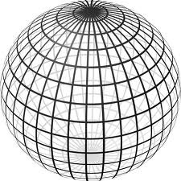
Landmark Based Shape Analysis
Triangle Shape Space: Represent as Sphere
$ℝ^{6}$ → $ℝ^{4}$ → $ℝ^{3}$ →
scaling
(thanks to Wikipedia)

Slide 32
Landmark Based Shape Analysis
Triangle Shape Space: Represent as Sphere
Equilateral
Triangles
Hemispheres
Are
Reflections
Co-Linear
Point Triples

Slide 33
OODA in Image Analysis
First Generation Problems:
Denoising
Segmentation
Registration
(all about single images,
still interesting challenges)

Slide 34
OODA in Image Analysis
Second Generation Problems:
Populations of Images
Understanding Population Variation
Discrimination (a.k.a. Classification)
Complex Data Structures (& Spaces)
HDLSS Statistics
High Dimension, Low Sample Size

Slide 35
Image Object Representation
Major Approaches for Image Data Objects:
Landmark Representations
Boundary Representations
Skeletal Representations

Slide 36
Landmark Representations
Landmarks for Fly Wing Data:
Thanks to George Gilchrist

Slide 37
Landmark Representations
Major Drawback of Landmarks:
Need to always find each landmark
Need same relationship
I.e. Landmarks need to correspond
Often fails for medical images
E.g. How many corresponding landmarks on a set of kidneys, livers or brains???

Slide 38
Boundary Representations
Traditional Major Sets of Ideas:
Triangular Meshes
Survey: Owen (1998)
Active Shape Models
Cootes, et al (1993)
Fourier Boundary Representations
Keleman, et al (1997 & 1999)

Slide 39
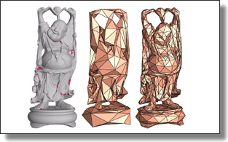
Boundary Representations
Example of triangular mesh rep’n:
From:www.geometry.caltech.edu/pubs.html

Slide 40
Boundary Representations
Main Drawback:
Correspondence
For OODA (on vectors of parameters):
Need to “match up points”
Notes:
40

Slide 41
Boundary Representations
Main Drawback:
Correspondence
For OODA (on vectors of parameters):
Need to “match up points”
Easy to find triangular mesh
Lots of research on this driven by gamers
Notes:
41

Slide 42
Boundary Representations
Main Drawback:
Correspondence
For OODA (on vectors of parameters):
Need to “match up points”
Easy to find triangular mesh
Lots of research on this driven by gamers
Challenge to match mesh across objects
There are some interesting ideas…
Notes:
42

Slide 43
Boundary Representations
Correspondence for Mesh Objects:
Active Shape Models (PCA – like)
Notes:
43

Slide 44
Boundary Representations
Correspondence for Mesh Objects:
Active Shape Models (PCA – like)
Automatic Landmark Choice
Cates, et al (2007)
Based on Optimization Problem:
Good Correspondence & Separation
(Formulate via Entropy)
Notes:
44

Slide 45
Skeletal Representations
Main Idea:
Represent Objects as:
Discretized skeletons (medial atoms)
Plus spokes from center to edge
Which imply a boundary
Very accessible early reference:
Yushkevich, et al (2001)

Slide 46
Skeletal Representations
2-d S-Rep Example:
Corpus Callosum
(Yushkevich)
Notes:
CCMsciznormRaw.avi

Slide 47
Skeletal Representations
2-d S-Rep Example:
Corpus Callosum
(Yushkevich)
Atoms
Notes:
CCMsciznormRaw.avi

Slide 48
Skeletal Representations
2-d S-Rep Example:
Corpus Callosum
(Yushkevich)
Atoms
Spokes
Notes:
CCMsciznormRaw.avi

Slide 49
Skeletal Representations
2-d S-Rep Example:
Corpus Callosum
(Yushkevich)
Atoms
Spokes
Implied
Boundary
Notes:
CCMsciznormRaw.avi

Slide 50
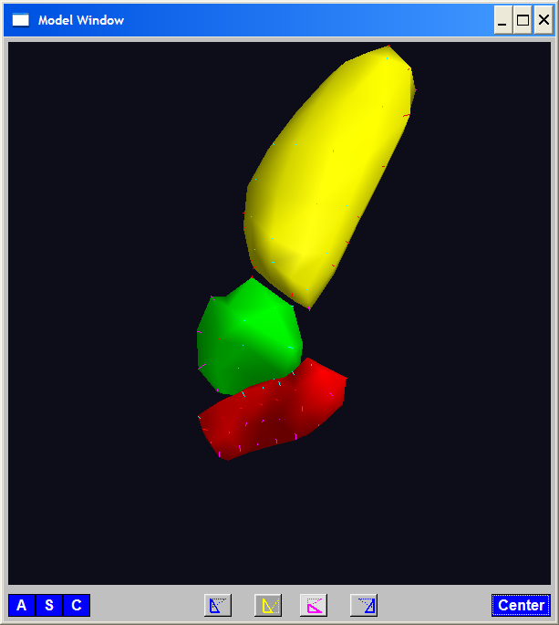
A Challenging Example
Male Pelvis
Bladder – Prostate – Rectum

Slide 51
A Challenging Example
Male Pelvis
Bladder – Prostate – Rectum
Attached to the Bladder
Common Area for Cancer in Males

Slide 52
A Challenging Example
Male Pelvis
Bladder – Prostate – Rectum
Common Area for Cancer in Males
Useful Approach: Radiation
Challenge: Design Treatment
Hit Prostate
Miss Bladder & Rectum
Over Many Days

Slide 53
A Challenging Example
Radiation Treatment in Male Pelvis
Bladder – Prostate – Rectum
Central Question:
How do they move over time (days)?
Work with 3-d CT
(“Computed Tomography”,
= 3d version of X-ray)

Slide 54
A Challenging Example
Radiation Treatment in Male Pelvis
Bladder – Prostate – Rectum
Central Question:
How do they move over time (days)?
Work with 3-d CT
Very Challenging to Segment
Find boundary of each object?
Represent each Object?

Slide 55
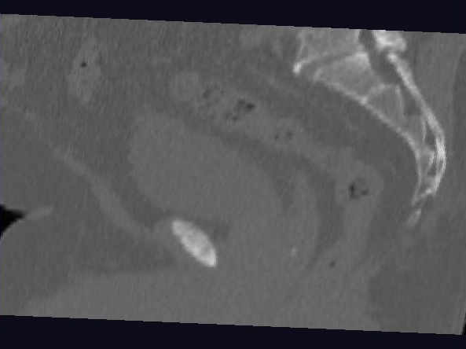
Male Pelvis – Raw Data
One CT Slice
(in 3d image)
Like X-ray:
White = Dense
(Bone)
Black = Gas

Slide 56
Male Pelvis – Raw Data
One CT Slice
(in 3d image)
Tail Bone

Slide 57
Male Pelvis – Raw Data
One CT Slice
(in 3d image)
Tail Bone
Rectum

Slide 58
Male Pelvis – Raw Data
One CT Slice
(in 3d image)
Tail Bone
Rectum
Bladder

Slide 59
Male Pelvis – Raw Data
One CT Slice
(in 3d image)
Tail Bone
Rectum
Bladder
Prostate

Slide 60
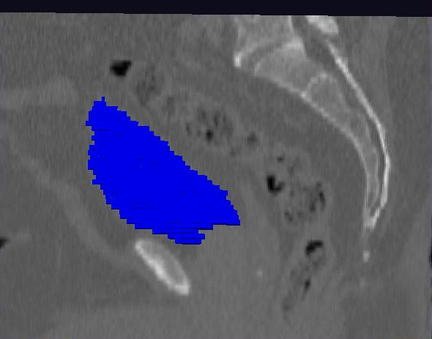
Male Pelvis – Raw Data
Bladder:
manual segmentation
Slice by slice
Reassembled

Slide 61
Male Pelvis – Raw Data
Bladder:
Slices:
Reassembled in 3d
How to represent?
Thanks: Ja-Yeon Jeong

Slide 62
Object Representation
Above Shape Approaches:
Landmarks (hard to find)
Boundary Rep’ns (no correspondence)
Skeletal Representations

Slide 63
Skeletal Representations
3-d S-Rep Example: From Ja-Yeon Jeong
Bladder – Prostate - Rectum
Atoms (yellow dots)
Notes:
OODA.ppt

Slide 64
Skeletal Representations
3-d S-Rep Example: From Ja-Yeon Jeong
Bladder – Prostate - Rectum
Atoms - Spokes (line segments)
Notes:
OODA.ppt

Slide 65
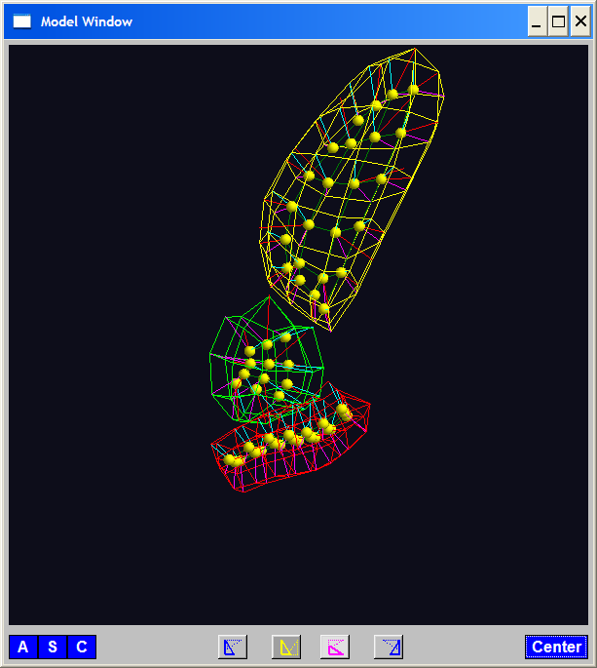
Skeletal Representations
3-d S-Rep Example: From Ja-Yeon Jeong
Bladder – Prostate - Rectum
Atoms - Spokes - Implied Boundary
Notes:
OODA.ppt

Slide 66
Skeletal Representations
3-d S-Rep Example: From Ja-Yeon Jeong
Bladder – Prostate - Rectum
Atoms - Spokes - Implied Boundary
Notes:
OODA.ppt

Slide 67
Skeletal Representations
3-d S-reps: there are several variations
Two choices:
From
Fletcher
(2004)
Notes:
fletcher_thesis.pdf

Slide 68
Skeletal Representations
Detailed discussion of mathematics of S-reps:
Siddiqi & Pizer (2008)
More Applications of S-reps in Imaging:
Pizer & Marron (2017)
Notes:
fletcher_thesis.pdf

Slide 69
Skeletal Representations
Statistical Challenge
S-rep parameters are:
Locations $∈ ℝ^{2}$, $ℝ^{3}$
Radii ($>0$)
Angles (not comparable)
Stuffed into a long vector
I.e. many direct products of these

Slide 70
Skeletal Representations
Statistical Challenge
Many direct products of:
Locations $∈ ℝ^{2}$, $ℝ^{3}$
Radii ($>0$)
Angles (not comparable)
Appropriate View:
Data Lie on Curved Manifold
Embedded in higher dim’al Eucl’n Space

Slide 71
3-d s-reps
S-rep model fitting
Easy, when starting from binary (blue)
But very expensive (30 – 40 minutes technician’s time)
Want automatic approach
Challenging, because of poor contrast, noise, …
Need to borrow information across training sample
Use Bayes approach: prior & likelihood → posterior
(A surrogate for “anatomical knowledge”)

Slide 72
3-d s-reps
S-rep model fitting
Easy, when starting from binary (blue)
But very expensive (30 – 40 minutes technician’s time)
Want automatic approach
Challenging, because of poor contrast, noise, …
Need to borrow information across training sample
Use Bayes approach: prior & likelihood → posterior
~Conjugate Gaussians
(Embarassingly Straightforward?)

Slide 73
3-d s-reps
S-rep model fitting
Easy, when starting from binary (blue)
But very expensive (30 – 40 minutes technician’s time)
Want automatic approach
Challenging, because of poor contrast, noise, …
Need to borrow information across training sample
Use Bayes approach: prior & likelihood → posterior
~Conjugate Gaussians, but there are issues:
Major HLDSS challenges
Manifold aspect of data
Handle With Variation on PCA
Careful Handling Very Useful

Slide 74
3-d s-reps
S-rep model fitting
Very Successful
Jeong (2009)

Slide 75
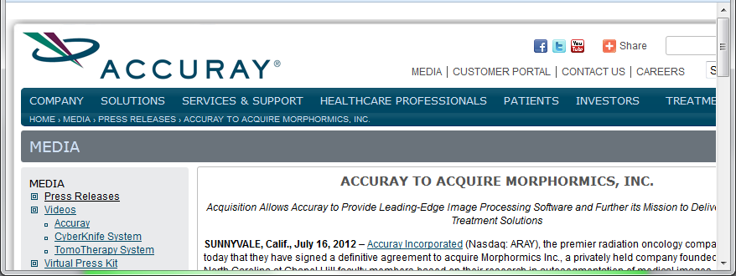
3-d s-reps
S-rep model fitting
Very Successful
Jeong (2009)
Basis of Startup Company: Morphormics
Since Purchased
By Accuray

Slide 76
Mildly Non-Euclidean Spaces
Statistical Analysis of S-rep Data
Recall: Many direct products of:
Locations
Radii
Angles
Useful View: Data Objects on Curved Manifold
Data in non-Euclidean Space
But only mildly non-Euclidean

Slide 77
Data Lying On a Manifold
Major issue: s-reps live in $ℝ^{3}×ℝ^{+}×S^{2}×S^{2}$
(locations, radii and angles)
Note on Terminology:
Manifold Data ≠ Manifold Learning

Slide 78
Data Lying On a Manifold
Major issue: s-reps live in $ℝ^{3}×ℝ^{+}×S^{2}×S^{2}$
(locations, radii and angles)
Note on Terminology:
Manifold Data ≠ Manifold Learning
Data Naturally Lie on Known Manifold

Slide 79
Data Lying On a Manifold
Major issue: s-reps live in $ℝ^{3}×ℝ^{+}×S^{2}×S^{2}$
(locations, radii and angles)
Note on Terminology:
Manifold Data ≠ Manifold Learning
Try to Find Low-d Aprox’ing Manifold

Slide 80
Data Lying On a Manifold
Major issue: s-reps live in $ℝ^{3}×ℝ^{+}×S^{2}×S^{2}$
(locations, radii and angles)
E.g. “average” of: $2^{°}, 3^{°}, {358}^{°}, {359}^{°}=$ ???
${\sum_{i}{θ_{i}}}/4$ ?

Slide 81
Data Lying On a Manifold
Major issue: s-reps live in $ℝ^{3}×ℝ^{+}×S^{2}×S^{2}$
(locations, radii and angles)
E.g. “average” of: $2^{°}, 3^{°}, {358}^{°}, {359}^{°}=$ ???
${\sum_{i}{θ_{i}}}/4$
x
x
x
x

Slide 82
Data Lying On a Manifold
Major issue: s-reps live in $ℝ^{3}×ℝ^{+}×S^{2}×S^{2}$
(locations, radii and angles)
E.g. “average” of: $2^{°}, 3^{°}, {358}^{°}, {359}^{°}=$ ???
Should
Use Unit
Circle
Structure
x
x
x
x

Slide 83
Data Lying On a Manifold
Major issue: s-reps live in $ℝ^{3}×ℝ^{+}×S^{2}×S^{2}$
(locations, radii and angles)
E.g. “average” of: $2^{°}, 3^{°}, {358}^{°}, {359}^{°}=$ ???
Natural Data Space is:
Smooth, Curved Manifold
(Differential Geometry)

Slide 84
Manifold Feature Spaces
Standard Statistical Example:
Directional Data (aka Circular Data)
Idea: Angles as Data Objects
Wind Directions
Magnetic Compass Headings
Cracks in Mines

Slide 85
Manifold Feature Spaces
Standard Statistical Example:
Directional Data (aka Circular Data)
Classical References:
Mardia (2014), Fisher (1995),
Jammalamadaka & Sen Gupta (2001)

Slide 86
Manifold Feature Spaces
Standard Statistical Example:
Directional Data (aka Circular Data)
Reasonable View:
Points on Unit Circle

Slide 87
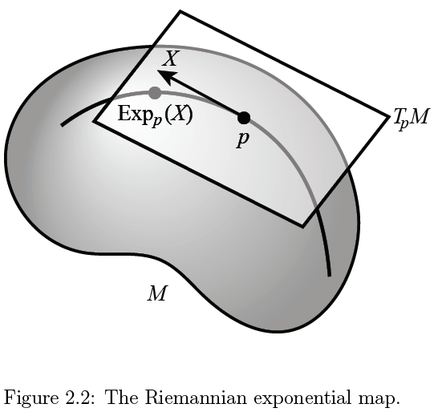
Manifold Feature Spaces
Main Idea:
Curved Surface,
With “Approximating
Tangent Plane”
At Each Point, $p$
(In Limit of Shrinking
Neighborhoods)

Slide 88
Manifold Feature Spaces
Important Mappings:
Plane → Surface:
$\exp_{p}$

Slide 89
Manifold Feature Spaces
Important Mappings:
Plane → Surface:
$\exp_{p}$
Important Point:
Common Length
(along surface)

Slide 90
Manifold Feature Spaces
Important Mappings:
Plane → Surface:
$\exp_{p}$
Surface → Plane
$\log_{p}$

Slide 91
Manifold Feature Spaces
Log & Exp Memory Device:
Complex Numbers
Exponential:
Tangent Plane → Manifold
(Note: Common Length)

Slide 92
Manifold Feature Spaces
Log & Exp Memory Device:
Complex Numbers
Exponential:
Tangent Plane → Manifold
Logarithm:
Manifold → Tangent Plane

Slide 93
Manifold Feature Spaces
Important Mappings:
Plane → Surface:
$\exp_{p}$
Surface → Plane
$\log_{p}$
(matrix versions)

Slide 94
Manifold Feature Spaces
Natural Choice of $p$
For Data Analysis
A “Centerpoint”
Hard To Use:
$\overline{X}=\frac{1}{n}\sum_{i=1}^{n}{X_{i}}$

Slide 95
Manifold Feature Spaces
Extrinsic Centerpoint
Compute:
$\overline{X}=\frac{1}{n}\sum_{i=1}^{n}{X_{i}}$
Anyway
And Project Back
To Manifold

Slide 96
Manifold Feature Spaces
Intrinsic Centerpoint
Work “Really
Inside” The
Manifold

Slide 97
Manifold Feature Spaces
Recall Useful Center in Metric Spaces
Fréchet Mean
Fréchet (1948)
Works in Any Metric Space (e.g. Manifolds)

Slide 98
Manifold Feature Spaces
Fréchet Mean of Numbers:
$$\overline{X}=arg\min_{x}{\sum_{i=1}^{n}{{\left(X_{i}−x\right)}^{2}}}$$
Fréchet Mean in Euclidean Space ($ℝ^{d}$):
$$\overline{\underline{X}}=arg\min_{x}{\sum_{i=1}^{n}{{\left\|{\underline{X}}_{i}−\underline{x}\right\|}^{2}}}=arg\min_{x}{\sum_{i=1}^{n}{{d\left({\underline{X}}_{i},\underline{x}\right)}^{2}}}$$
(Intrinsic) Fréchet Mean on a Manifold:
Replace Euclidean $d$ by Geodesic $d$

Slide 99
Manifold Feature Spaces
Geodesics:
Idea:
March Along Manifold Without Turning
(Defined in Tangent Plane)

Slide 100
Manifold Feature Spaces
Geodesics:
Idea:
March Along Manifold Without Turning
(Defined in Tangent Plane)
E.g. Surface of the Earth: Great Circle
E.g. Lines of Longitude (Not Latitude…)

Slide 101
Manifold Feature Spaces
Geodesic Distance:
Given Points $x$ & $y$, define
$$d\left(x,y\right)=\min_{g:geodesic from x to y}{length(g)}$$
Can Show:
$d$ is a metric (distance)

Slide 102
Manifold Feature Spaces
Fréchet Mean of Numbers:
$$\overline{X}=arg\min_{x}{\sum_{i=1}^{n}{{\left(X_{i}−x\right)}^{2}}}$$
Fréchet Mean in Euclidean Space ($ℝ^{d}$):
$$\overline{\underline{X}}=arg\min_{x}{\sum_{i=1}^{n}{{\left\|{\underline{X}}_{i}−\underline{x}\right\|}^{2}}}=arg\min_{x}{\sum_{i=1}^{n}{{d\left({\underline{X}}_{i},\underline{x}\right)}^{2}}}$$
(Intrinsic) Fréchet Mean on a Manifold:
Replace Euclidean $d$ by Geodesic $d$

Slide 103
Manifold Feature Spaces
Extrinsic vs. Intrinsic Centerpoints
Compare on
Unit Circle, $S^{1}$
Ambient Space $\overline{X}=\frac{1}{n}\sum_{i=1}^{n}{X_{i}}$
& Project Back to Manifold
E.g. Fréchet Mean

Slide 104
Manifold Feature Spaces
Extrinsic vs. Intrinsic Centerpoints
Often Similar
Note Big Difference!
Which is Better?

Slide 105
Manifold Feature Spaces
Extrinsic vs. Intrinsic Centerpoints
Which is Better?
Intrinsic “More Like Mean”?
Intrinsic More Stable
Shifting a Green Down
Extrinsic More Stable
Shifting Greens Left

Slide 106
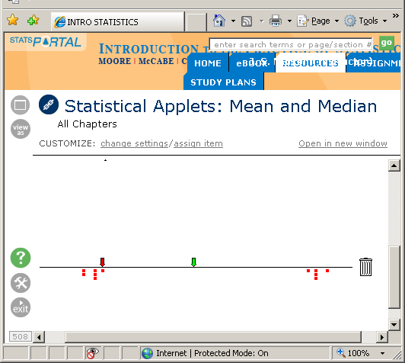
Manifold Feature Spaces
Extrinsic vs. Intrinsic Centerpoints
Which is Better?
Problem as Hard as
“Center” of Bimodal
Distribution
Median
Mean

Slide 107
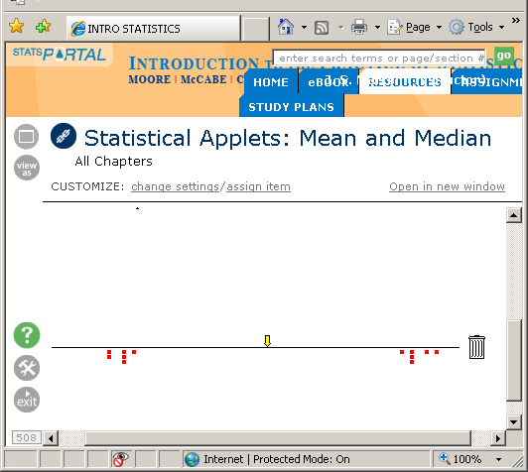
Manifold Feature Spaces
Extrinsic vs. Intrinsic Centerpoints
Which is Better?
Problem as Hard as
“Center” of Bimodal
Distribution

Slide 108
Manifold Feature Spaces
Extrinsic vs. Intrinsic Centerpoints
Which is Better?
Problem as Hard as
“Center” of Bimodal
Distribution

Slide 109
Manifold Feature Spaces
Directional Data Examples of Fréchet Mean:
Not always easily interpretable

Slide 110
Manifold Feature Spaces
Directional Data Examples of Fréchet Mean:
Not always easily interpretable
Think about distances along arc
Not about “points in $ℝ^{2}$”
Sum of squared distances
strongly feels the largest
Not always unique
But unique with probability one
Non-unique requires strong symmetry
But possible to have many means

Slide 111
Participant Presentations
Benjamin Leinwand
Longitudinal Brain Scans
Keerthi Anand
Blind Source Separation

