Slide 1
Participant Presentation
Speaker Responsibility:
Don’t Let Me Overshoot the Time

Slide 2
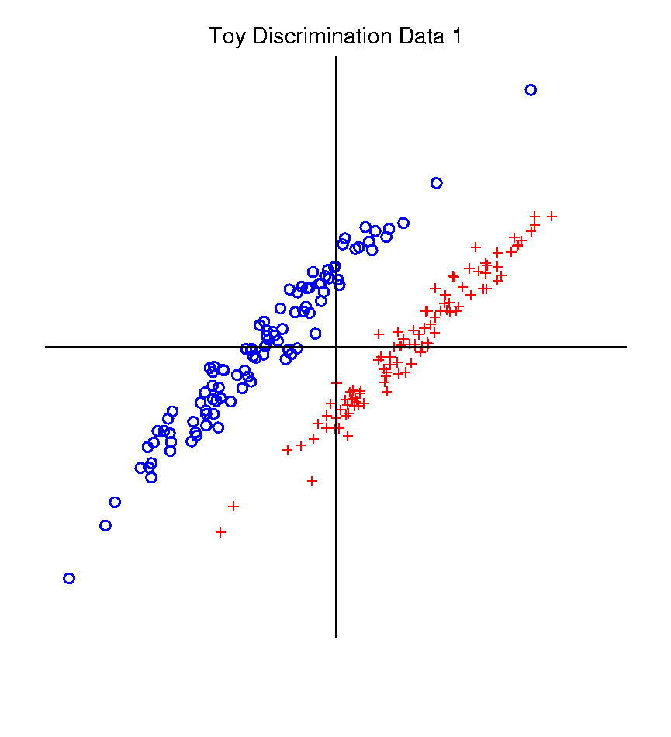
Classical Discrimination
Graphical Display of Classifiers
Use Yellow for Grid
Points Assigned
to Plus Class
Use Cyan for Grid
Points Assigned
to Minus Class
Notes:
PEod1FLDe1.ps

Slide 3
Classical Discrimination
Summary of FLD vs. GLR:
Tilted Point Clouds Data
FLD good
GLR good
Donut Data
FLD bad
GLR good
X Data
FLD bad
GLR OK, not great
Classical Conclusion: GLR generally better
(will see a different answer for HDLSS data)

Slide 4
Classical Discrimination
Principal Discriminant Analysis (cont.)
But PCA only works like Mean Difference,
Expect can improve by
taking covariance into account.
Blind application of above ideas suggests eigen-analysis of: ${Σ^{w}}^{−1}Σ^{B}$

Slide 5
HDLSS Discrimination
Main HDLSS issues:
Sample Size, $n$ < Dimension, $d$
Singular covariance matrix
So can’t use matrix inverse
I.e. can’t standardize (sphere) the data
(requires root inverse covariance)
Can’t do classical multivariate analysis

Slide 6
HDLSS Discrimination
An approach to non-invertible covariances:
Replace by generalized inverses
Sometimes called pseudo inverses
Note: there are several
Here use Moore Penrose inverse
As used by Matlab (pinv.m)
Often provides useful results
(but not always)

Slide 7
HDLSS Discrimination
Application of Generalized Inverse to FLD:
Direction (Normal) Vector:
$${\underline{n}}_{FLD}={\left({\hat{Σ}}^{w}\right)}^{−}\left({\underline{\overline{X}}}^{+}−{\underline{\overline{X}}}^{−}\right)$$
Intercept:
$$μ_{FLD}=\left(\frac{1}{2}{\underline{\overline{X}}}^{+}+\frac{1}{2}{\underline{\overline{X}}}^{−}\right)$$
Have replaced ${\left({\hat{Σ}}^{w}\right)}^{−1}$ by ${\left({\hat{Σ}}^{w}\right)}^{−}$

Slide 8
HDLSS Discrimination
Movie Through Increasing Dimensions

Slide 9
HDLSS Discrimination
Mean Difference (Centroid) Method
Same
Data,
Movie
over
dim’s

Slide 10
Maximal Data Piling
Strange FLD effect at HDLSS boundary:
Data Piling:
For each class,
all data
project to
single
value

Slide 11
Maximal Data Piling
Simple example (Ahn & Marron 2010):
$n_{+}=n_{−}=2$ in $ℝ^{3}$
Let ${ \tilde{H}}_{+}$ be the hyperplane:
Generated by Class +1
Which has dimension = 1
I.e. line containing the 2 points
Similarly, let ${\tilde{H}}_{−}$ be the hyperplane
Generated by Class -1

Slide 12
Maximal Data Piling
Simple example: $n_{+}=n_{−}=2$ in $ℝ^{3}$
Notes:
C:\Documents and Settings\J S Marron\My Documents\Research\ComplexPopn\MaxDataPiling\dppic2_2.pdf

Slide 13
Maximal Data Piling
Simple example: $n_{+}=n_{−}=2$ in $ℝ^{3}$
Construction 2 (cont.):
Let intersection of ${H_{+}}^{⊥}$ & ${H_{−}}^{⊥}$ be ${\underline{v}}_{MDP}$
Same Maximal Data Piling Direction
Projection collapses both
Class +1 and Class -1
Intersection of 2-d (planes) is 1-d dir’n

Slide 14
Maximal Data Piling
General Case: $n_{+}$,$n_{−}$ in $ℝ^{d}$ with $d≥n_{+}+n_{−}$
Let ${\tilde{H}}_{+}$ & ${\tilde{H}}_{−}$ be
Hyperplanes generated by Classes
Of Dimensions $n_{+}−1$, $n_{−}−1$ (resp.)
Let $H_{+}$ & $H_{−}$ be
Parallel subspaces
I.e. shifts to origin
Of Dimensions $n_{+}−1$, $n_{−}−1$ (resp.)

Slide 15
Maximal Data Piling
General Case: $n_{+}$,$n_{−}$ in $ℝ^{d}$ with $d≥n_{+}+n_{−}$
Let ${H_{+}}^{⊥}$ & ${H_{−}}^{⊥}$ be
Orthogonal Subspaces
Of Dim’ns $d−n_{+}+1$, $d−n_{−}+$1 (resp.)
Where
Proj’n in ${H_{+}}^{⊥}$ Dir’ns Collapse Class +1
Proj’n in ${H_{−}}^{⊥}$ Dir’ns Collapse Class -1
Expect $d−n_{+}−n_{−}+2$ intersection

Slide 16
Maximal Data Piling
General Case: $n_{+}$,$n_{−}$ in $ℝ^{d}$ with $d≥n_{+}+n_{−}$
Can show (Ahn & Marron 2010):
Most dir’ns in intersection collapse all to 0
But there is a great circle of directions
(within subspace generated by data)

Slide 17
Maximal Data Piling
General Case: $n_{+}$,$n_{−}$ in $ℝ^{d}$ with $d≥n_{+}+n_{−}$
Can show (Ahn & Marron 2010):
Most dir’ns in intersection collapse all to 0
But there is a great circle of directions,
Where Classes collapse to different points
(Gap changes along great circle,
including sign flips)

Slide 18
Maximal Data Piling
General Case: $n_{+}$,$n_{−}$ in $ℝ^{d}$ with $d≥n_{+}+n_{−}$
Can show (Ahn & Marron 2010):
Most dir’ns in intersection collapse all to 0
But there is a great circle of directions,
Where Classes collapse to different points
Distance is max’ed in 2 direct’ns: $±v_{MDP}$
Called Maximal Data Piling direction(s)
Unique (up to $±$) in subspace of data

Slide 19
Maximal Data Piling
Movie Through Increasing Dimensions

Slide 20
Maximal Data Piling
MDP in Increasing Dimensions:
Sub HDLSS dimensions (d = 1-37):
Looks similar to FLD?!?
Reason for this?
At HDLSS Boundary (d = 38):
Again similar to FLD…

Slide 21
Maximal Data Piling
FLD in Increasing Dimensions:
For HDLSS dimensions (d = 39-1000):
Always have data piling
Gap between grows for larger n
Even though noise increases?
Angle (gen’bility) first improves, d = 39–180
Then worsens, d = 200-1000
Eventually noise dominates
Trade-off is where gap near optimal diff’nce

Slide 22
Maximal Data Piling
How to compute ${\underline{v}}_{MDP}$?
Can show (Ahn & Marron 2010):
$${\underline{v}}_{MDP}={\hat{Σ}}^{−1}\left({\underline{\overline{X}}}^{+}−{\underline{\overline{X}}}^{−}\right)$$
Recall FLD formula:
$${\underline{v}}_{FLD}={\left({\hat{Σ}}^{w}\right)}^{−1}\left({\underline{\overline{X}}}^{+}−{\underline{\overline{X}}}^{−}\right)$$
Only difference is global vs. within class
Covariance Estimates!

Slide 23
Maximal Data Piling
Historical Note:
Discovery of MDP
Came from a programming error
Forgetting to use within class covariance
In FLD…

Slide 24
Maximal Data Piling
Visual similarity of ${\underline{v}}_{MDP}$ & ${\underline{v}}_{FLD}$?
Can show (Ahn & Marron 2010),
for $d≤n−2$:
$${{\underline{v}}_{MDP}}/{\left\|{\underline{v}}_{MDP}\right\|}={{\underline{v}}_{FLD}}/{\left\|{\underline{v}}_{FLD}\right\|}$$
I.e. directions are the same!
How can this be?
Note lengths are different…
Study from transformation viewpoint

Slide 25
Maximal Data Piling
Recall
Transfo’
view of
FLD:

Slide 26
Maximal Data Piling
Include
Corres-
ponding
MDP
Transfo’:
Both give
Same
Result!

Slide 27
Maximal Data Piling
Details:
FLD & MDP:
Separating Plane
Normal Vector
Computed in Each
Transformed Space,
Shown in Original
Space

Slide 28
Maximal Data Piling
Details:
FLD & MDP:
Separating Plane
Normal Vector
Within Class:
PC1
PC2
Computed for Each
Class Separately

Slide 29
Maximal Data Piling
Details:
FLD & MDP:
Separating Plane
Normal Vector
Within Class:
PC1
PC2
Global:
PC1
PC2
Computed
Globally

Slide 30
Maximal Data Piling
Acknowledgement:
This viewpoint
I.e. insight into why FLD = MDP
(for low dim’al data)
Suggested by Daniel Peña

Slide 31
Maximal Data Piling
Fun e.g:
rotate
from PCA
to MDP
dir’ns

Slide 32
Maximal Data Piling
MDP for other class labellings:
Always exists
Separation bigger for natural clusters
Could be used for clustering
Consider all directions
Find one that makes largest gap
Very hard optimization problem
Over 2^{n-2} possible directions

Slide 33
Maximal Data Piling
How to compute ${\underline{v}}_{MDP}$?
Can show (Ahn & Marron 2010):
$${\underline{v}}_{MDP}={\hat{Σ}}^{−1}\left({\underline{\overline{X}}}^{+}−{\underline{\overline{X}}}^{−}\right)$$
Recall FLD formula:
$${\underline{v}}_{FLD}={\left({\hat{Σ}}^{w}\right)}^{−1}\left({\underline{\overline{X}}}^{+}−{\underline{\overline{X}}}^{−}\right)$$
Only difference is global vs. within class
Covariance Estimates!
Return to This for Deeper Look

Slide 34
Maximal Data Piling
Visual similarity of ${\underline{v}}_{MDP}$ & ${\underline{v}}_{FLD}$?
Can show (Ahn & Marron 2010), for $d<n$:
$${{\underline{v}}_{MDP}}/{\left\|{\underline{v}}_{MDP}\right\|}={{\underline{v}}_{FLD}}/{\left\|{\underline{v}}_{FLD}\right\|}$$
I.e. directions are the same!
How can this be?
Note lengths are different…
Study from optimization viewpoint

Slide 35
Maximal Data Piling
Alternate approach: Optimization Viewpoint
Find a direction vector, $\underline{v}$ ($\left\|\underline{v}\right\|=1$), to
$\max_{\underline{v}}{\frac{{\left(\overline{P_{\underline{v}}X^{+}}−\overline{P_{\underline{v}}X^{−}}\right)}^{2}}{V_{\underline{v}}^{+}+V_{\underline{v}}^{−}}}$
Where for $⨀$ = +,-
$\overline{P_{\underline{v}}X^{⨀}}=Avg\left({\underline{v}}^{t}X^{⨀}\right)$ = Average Proj’n
$V_{\underline{v}}^{⨀}=var({\underline{v}}^{t}X^{⨀})$ = Variance of Proj’ns
Between Class
Variation
Within Class
Variation

Slide 36
Maximal Data Piling
Alternate approach: Optimization Viewpoint
Find a direction vector, $\underline{v}$ ($\left\|\underline{v}\right\|=1$), to
$\max_{\underline{v}}{\frac{{\left(\overline{P_{\underline{v}}X^{+}}−\overline{P_{\underline{v}}X^{−}}\right)}^{2}}{V_{\underline{v}}^{+}+V_{\underline{v}}^{−}}}$
Case 1: $d≤n−2$
Solutions are:
${\underline{v}}_{FLD}∝{\left({\hat{Σ}}^{w}\right)}^{−}\left({\underline{\overline{X}}}^{+}−{\underline{\overline{X}}}^{−}\right)$
${\underline{v}}_{MDP}∝{\hat{Σ}}^{−}\left({\underline{\overline{X}}}^{+}−{\underline{\overline{X}}}^{−}\right)$
E.g. Sec. 3.8.2 of
Duda et al (2001)
Common
Practice In
Literature:
Assume
This, But
Not Make It
Very Clear

Slide 37
Maximal Data Piling
$\max_{\underline{v}}{\frac{{\left(\overline{P_{\underline{v}}X^{+}}−\overline{P_{\underline{v}}X^{−}}\right)}^{2}}{V_{\underline{v}}^{+}+V_{\underline{v}}^{−}}}$
Case 2: $d≥n−1$
Solution is:
${\underline{v}}_{MDP}={\hat{Σ}}^{−}\left({\underline{\overline{X}}}^{+}−{\underline{\overline{X}}}^{−}\right)$
But not:
${\underline{v}}_{FLD}={\left({\hat{Σ}}^{w}\right)}^{−}\left({\underline{\overline{X}}}^{+}−{\underline{\overline{X}}}^{−}\right)$
Point
Not Made
Anywhere
Else???

Slide 38
Maximal Data Piling
A point of terminology (Ahn & Marron 2010):
MDP is “maximal” in 2 senses:
# of data piled
Size of gap
(within subspace
gen’d by data)

Slide 39
Maximal Data Piling
Recurring, over-arching, issue:
HDLSS space is a weird place

Slide 40
Maximal Data Piling
Usefulness for Classification?
First Glance: Terrible, not generalizable
HDLSS View: Maybe OK?
Simulation Result:
Good Performance for
Autocorrelated Errors
Every Dog
Has His Day
Reason: Induces Stretch in Data - Miao (2015)

Slide 41
Kernel Embedding
Aizerman, Braverman and Rozoner (1964)
Motivating idea:
Extend scope of linear discrimination,
By adding nonlinear components to data
(embedding in a higher dim’al space)
Better use of name:
nonlinear discrimination?

Slide 42
Kernel Embedding
Toy Examples:
In 1d, linear separation splits the domain
$\left\{x:x∈ℝ\right\}$ into only 2 parts

Slide 43
Kernel Embedding
But in the “quadratic
embedded domain”,
$\left\{\left(x,x^{2}\right):x∈ℝ\right\}⊂ℝ^{2}$
linear separation
can give 3 parts

Slide 44
Kernel Embedding
But in the quadratic embedded domain
$\left\{\left(x,x^{2}\right):x∈ℝ\right\}⊂ℝ^{2}$
Linear separation can give 3 parts
original data space lies in 1d manifold
very sparse region of $ℝ^{2}$
curvature of manifold gives:
better linear separation
can have any 2 break points
(2 points $⟹$ line)

Slide 45
Kernel Embedding
Stronger effects for
higher order
polynomial embedding:
E.g. for cubic,
$\left\{\left(x,x^{2},x^{3}\right):x∈ℝ\right\}⊂ℝ^{3}$
linear separation
can give 4 parts
(or fewer)

Slide 46
Kernel Embedding
Stronger effects - high. ord. poly. embedding:
original space lies in 1-d manifold,
even sparser in $ℝ^{3}$
higher d curvature gives:
improved linear separation
can have any 3 break points
(3 points $⟹$ plane)?
Note: relatively few
“interesting separating planes”

Slide 47
Kernel Embedding
General View: for original data matrix:
$$\left(\begin{matrix}x_{11} & ⋯ & x_{1n} \\ ⋮ & ⋱ & ⋮ \\ x_{d1} & ⋯ & x_{dn}\end{matrix}\right)$$
add rows:
i.e. embed in
Higher
Dimensional
space
$$\left(\begin{matrix}\begin{matrix}x_{11} \\ ⋮ \\ x_{d1}\end{matrix} & & \begin{matrix}x_{1n} \\ ⋮ \\ x_{dn}\end{matrix} \\ \begin{matrix}x_{11}^{2} \\ ⋮ \\ x_{d1}^{2}\end{matrix} & ⋯ & \begin{matrix}x_{1n}^{2} \\ ⋮ \\ x_{dn}^{2}\end{matrix} \\ \begin{matrix}x_{11}x_{21} \\ ⋮\end{matrix} & & \begin{matrix}x_{1d}x_{2d} \\ ⋮\end{matrix}\end{matrix}\right)$$

Slide 48
Kernel Embedding
Embedded Fisher Linear Discrimination:
Choose Class +1, for any ${\underline{x}}^{0}∈ℝ^{d}$ when:
$${{\underline{x}}^{0}}^{t}{{\hat{Σ}}^{w}}^{−1}\left({\underline{\overline{X}}}^{(+)}−{\underline{\overline{X}}}^{(−)}\right)≥\frac{1}{2}{{{\left({\underline{\overline{X}}}^{(+)}+{\underline{\overline{X}}}^{(−)}\right)}^{t}\hat{Σ}}^{w}}^{−1}\left({\underline{\overline{X}}}^{(+)}−{\underline{\overline{X}}}^{(−)}\right)$$
in embedded space.
Image of class boundaries in original space is nonlinear
Allows more complicated class regions
Can also do Gaussian Lik. Rat. (or others)
Compute image by classifying points from original space

Slide 49
Kernel Embedding
Visualization for Toy Examples:
Have Linear Disc. In Embedded Space
Study Effect in Original Data Space
Via Implied Nonlinear Regions
Challenge: Hard to Explicitly Compute

Slide 50
Kernel Embedding
Visualization for Toy Examples:
Have Linear Disc. In Embedded Space
Study Effect in Original Data Space
Via Implied Nonlinear Regions
Approach:
Use Test Set in Original Space
(dense equally spaced grid)
Apply embedded discrimination Rule
Color Using the Result

Slide 51
Kernel Embedding
Recall Classifier Display Device:
Parallel Clouds
Use Yellow for Grid
Points Assigned
to Plus Class
Use Cyan for Grid
Points Assigned
to Minus Class
Notes:
PEod1Raw.ps

Slide 52
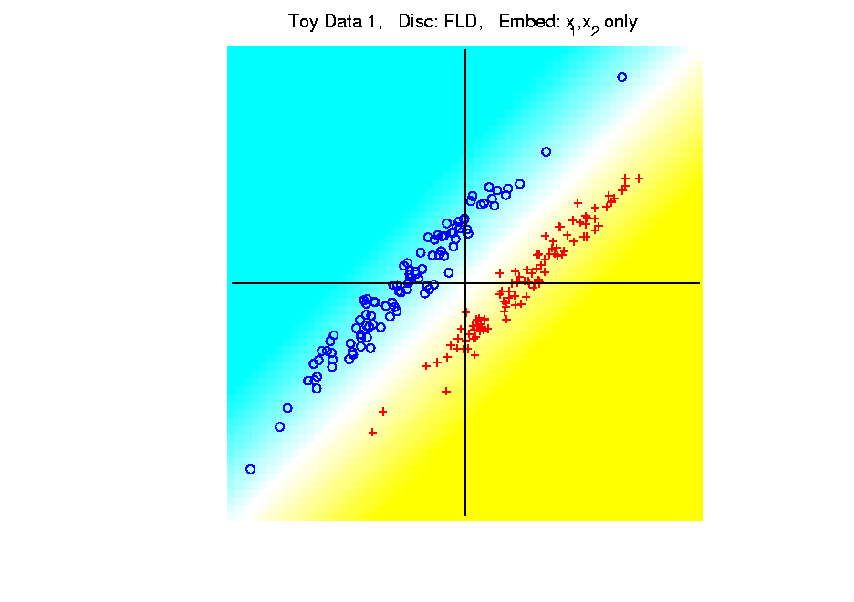
Kernel Embedding
Polynomial Embedding, Toy Example 1:
Parallel Clouds
FLD
Original
Data
Notes:
PEod1Raw.ps

Slide 53
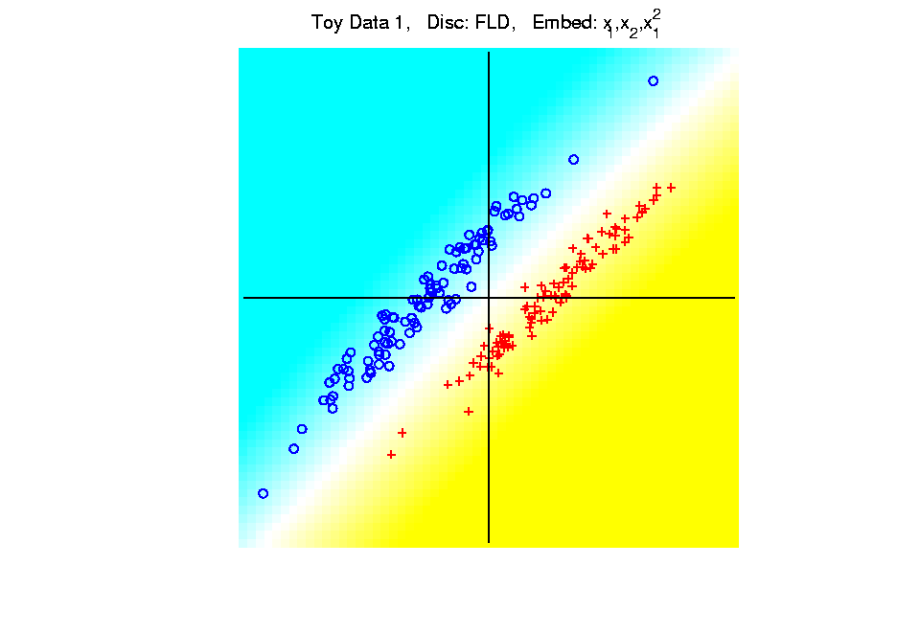
Kernel Embedding
Polynomial Embedding, Toy Example 1:
Parallel Clouds
FLD
Notes:
PEod1Raw.ps

Slide 54
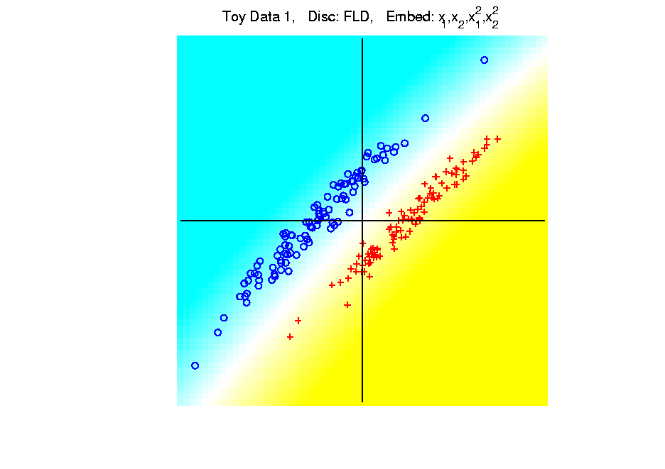
Kernel Embedding
Polynomial Embedding, Toy Example 1:
Parallel Clouds
FLD
Notes:
PEod1Raw.ps

Slide 55
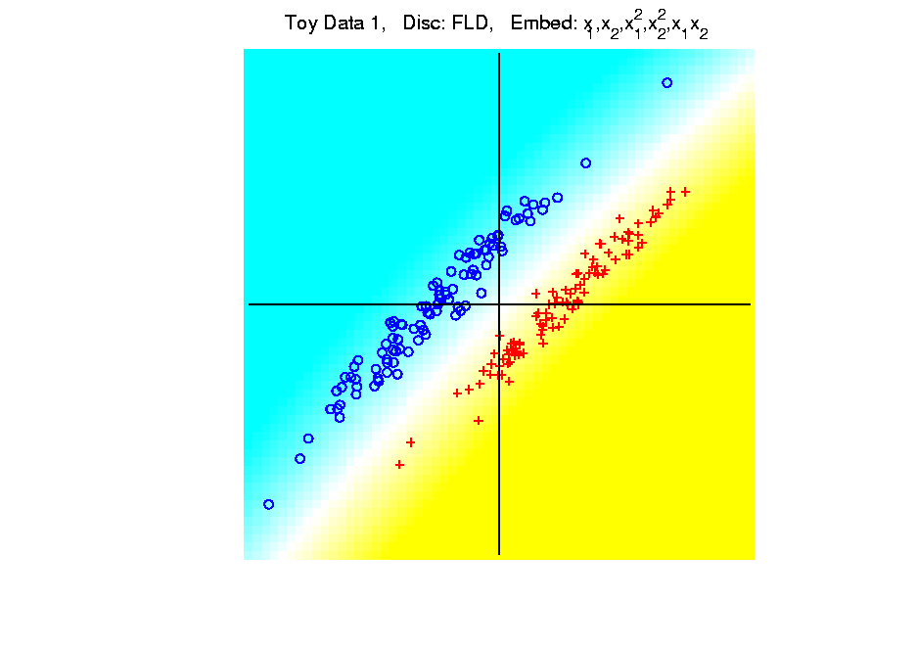
Kernel Embedding
Polynomial Embedding, Toy Example 1:
Parallel Clouds
FLD
Notes:
PEod1Raw.ps

Slide 56
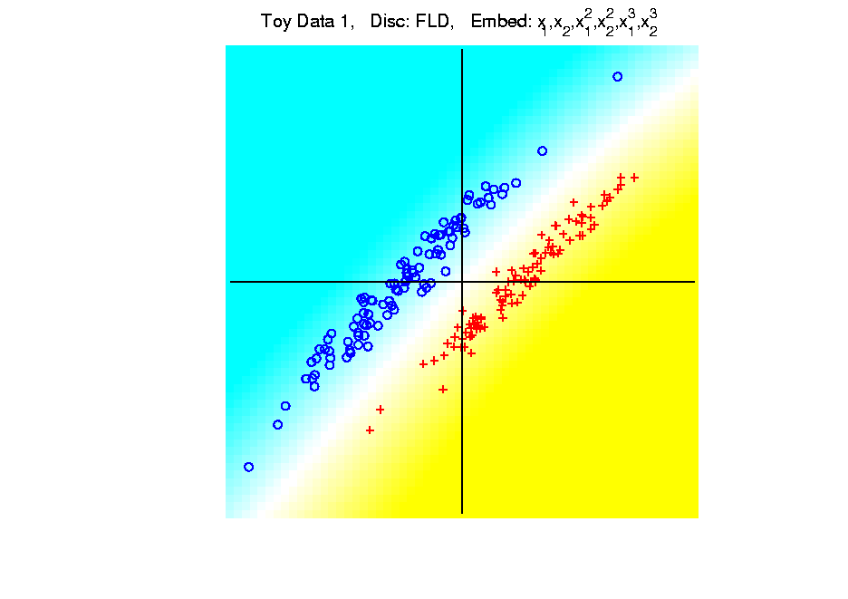
Kernel Embedding
Polynomial Embedding, Toy Example 1:
Parallel Clouds
FLD
All Stable
& Very Good
Since No Better
Separation in
Embedded Space
Notes:
PEod1Raw.ps

Slide 57
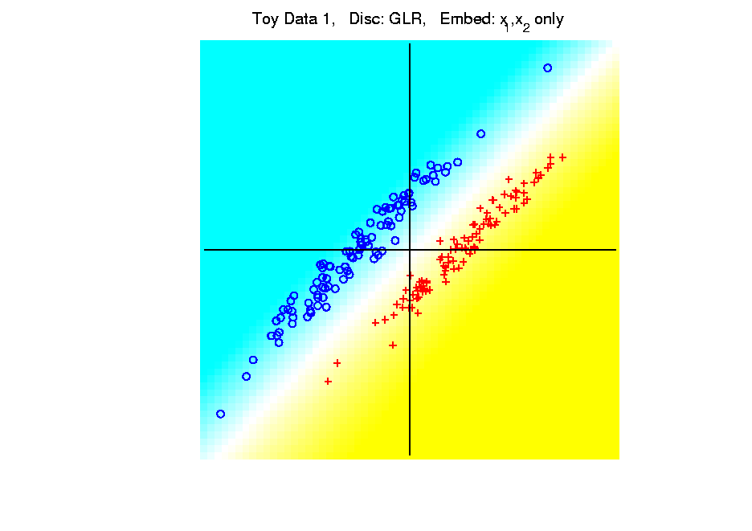
Kernel Embedding
Polynomial Embedding, Toy Example 1:
Parallel Clouds
GLR
Original
Data
Notes:
PEod1Raw.ps

Slide 58
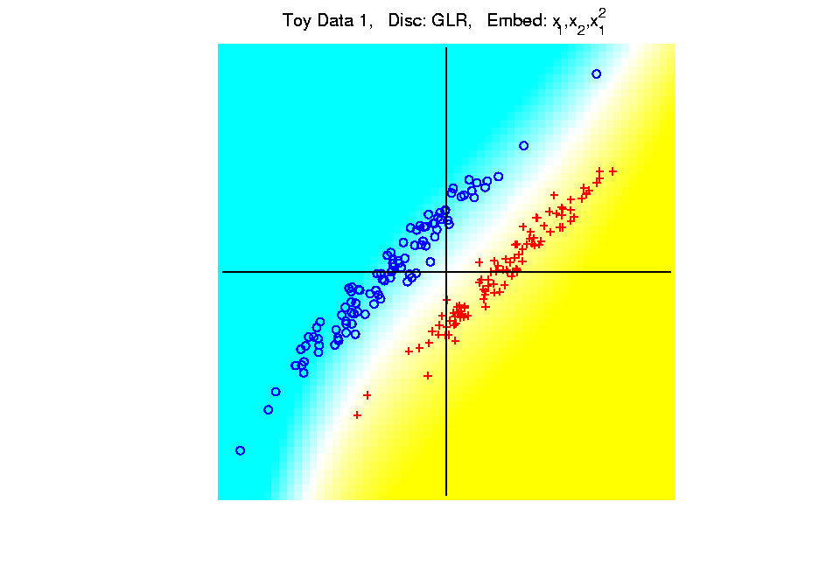
Kernel Embedding
Polynomial Embedding, Toy Example 1:
Parallel Clouds
GLR
Notes:
PEod1Raw.ps

Slide 59
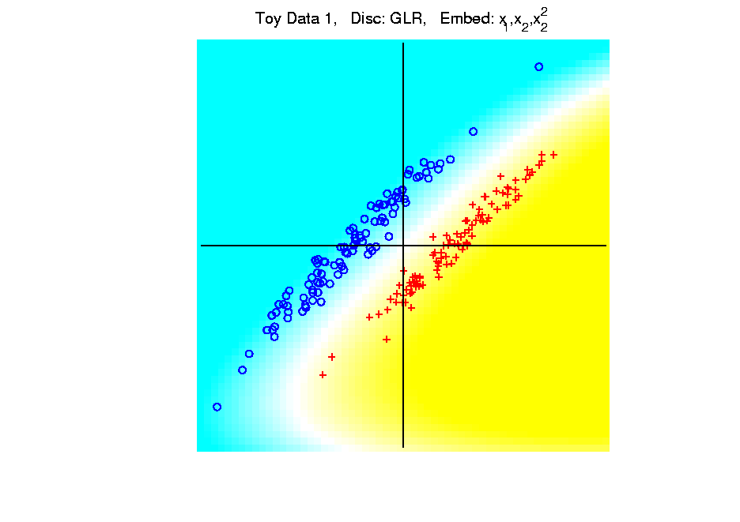
Kernel Embedding
Polynomial Embedding, Toy Example 1:
Parallel Clouds
GLR
Notes:
PEod1Raw.ps

Slide 60
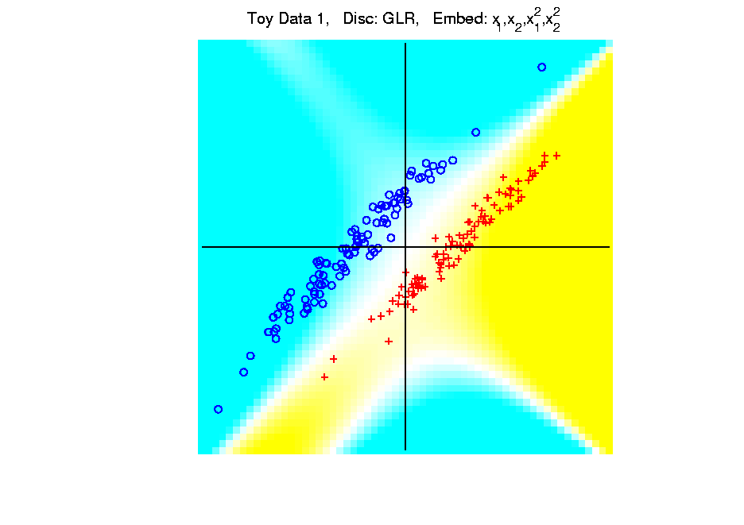
Kernel Embedding
Polynomial Embedding, Toy Example 1:
Parallel Clouds
GLR
Notes:
PEod1Raw.ps

Slide 61
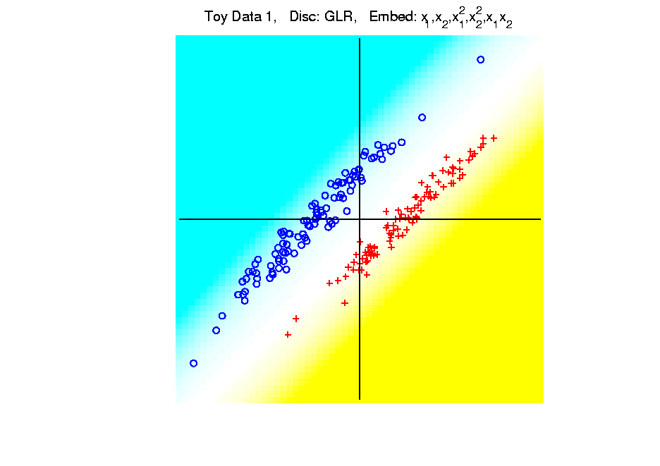
Kernel Embedding
Polynomial Embedding, Toy Example 1:
Parallel Clouds
GLR
Notes:
PEod1Raw.ps

Slide 62
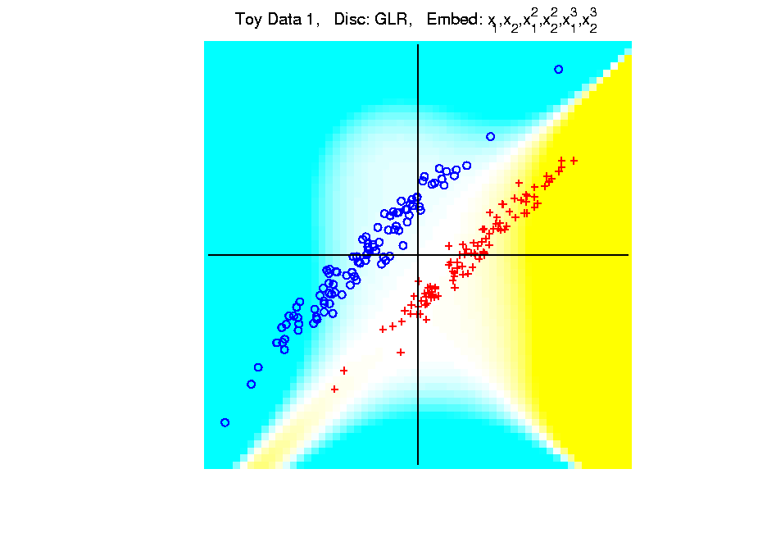
Kernel Embedding
Polynomial Embedding, Toy Example 1:
Parallel Clouds
GLR
Unstable
Subject to
Overfitting
Too Much Flexibility
In Embedded Space
Notes:
PEod1Raw.ps

Slide 63
Kernel Embedding
Polynomial Embedding, Toy Example 2:
Split X
Very Challenging
For Linear
Approaches
Notes:
PEod1Raw.ps

Slide 64
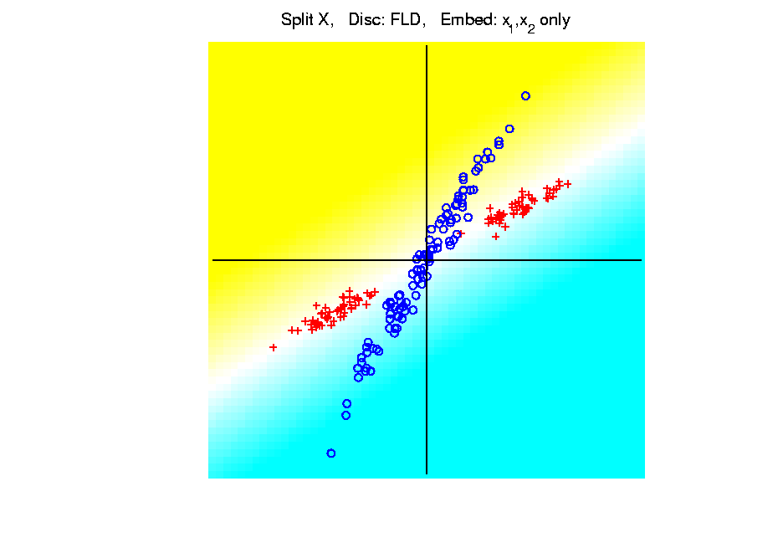
Kernel Embedding
Polynomial Embedding, Toy Example 2:
Split X
FLD
Original
Data
Notes:
PEod1Raw.ps

Slide 65
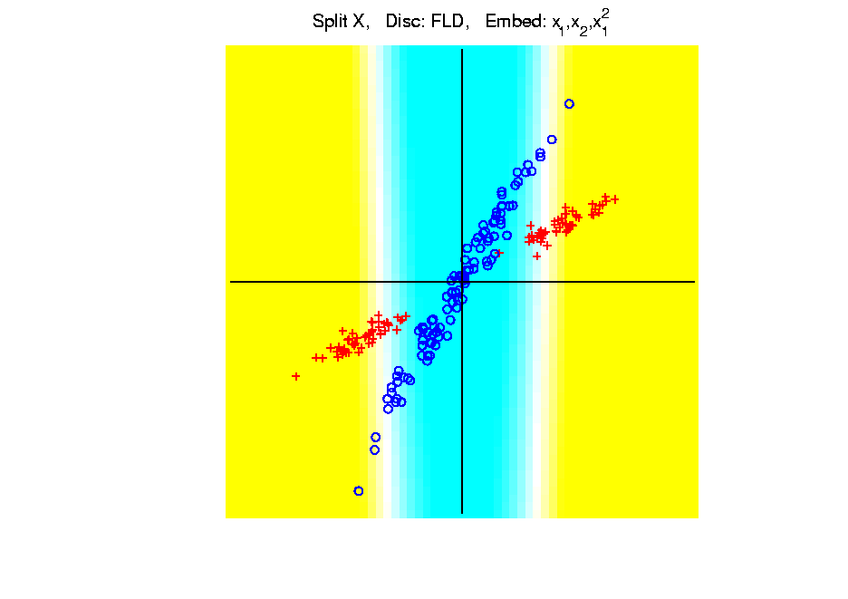
Kernel Embedding
Polynomial Embedding, Toy Example 2:
Split X
FLD
Slightly
Better
Notes:
PEod1Raw.ps

Slide 66
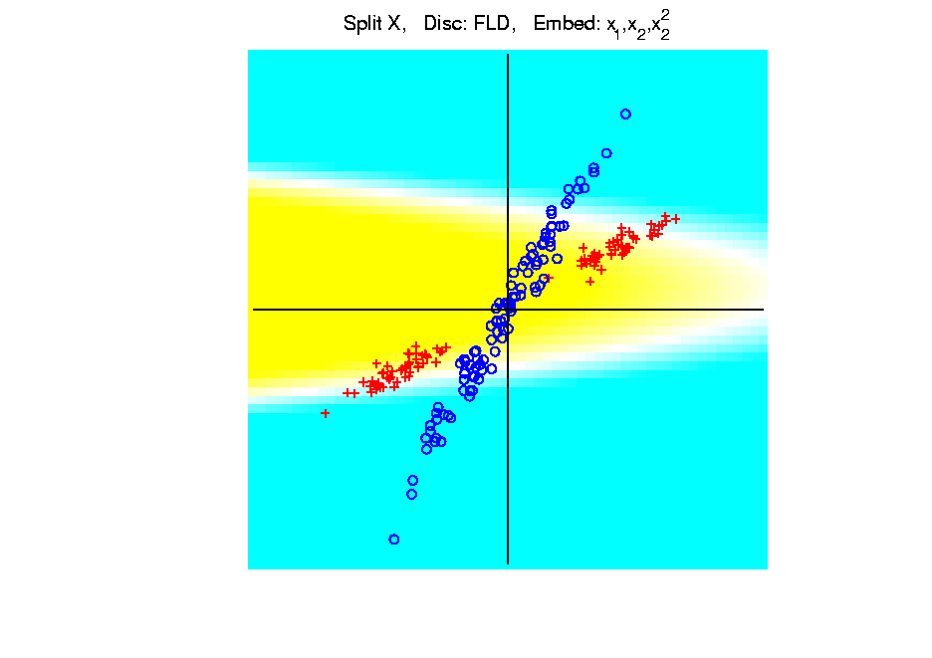
Kernel Embedding
Polynomial Embedding, Toy Example 2:
Split X
FLD
Notes:
PEod1Raw.ps

Slide 67
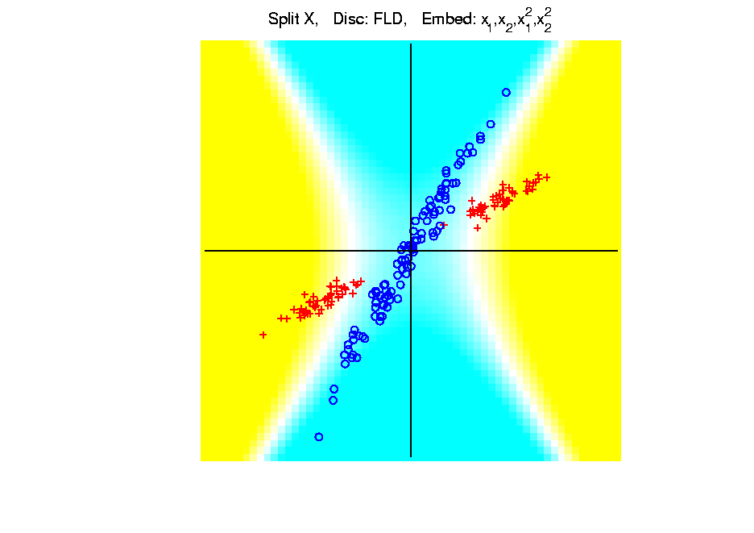
Kernel Embedding
Polynomial Embedding, Toy Example 2:
Split X
FLD
Very Good
Effective
Hyperbola
Notes:
PEod1Raw.ps

Slide 68
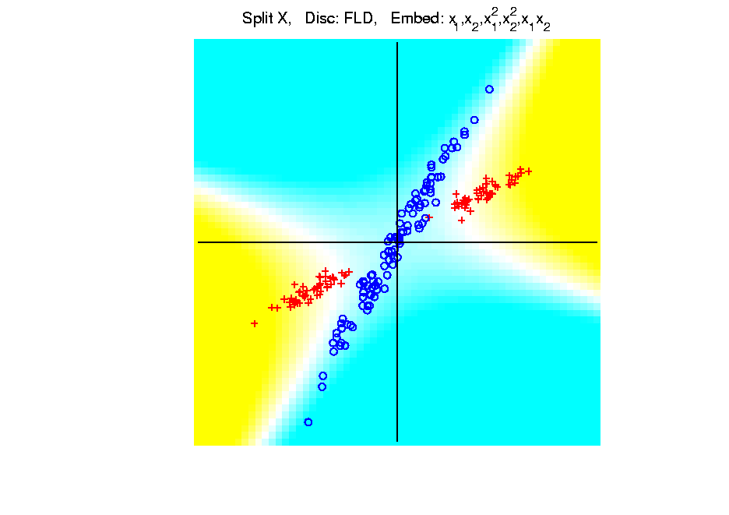
Kernel Embedding
Polynomial Embedding, Toy Example 2:
Split X
FLD
Notes:
PEod1Raw.ps

Slide 69
Kernel Embedding
Polynomial Embedding, Toy Example 2:
Split X
FLD
Robust
Against
Overfitting
Notes:
PEod1Raw.ps

Slide 70
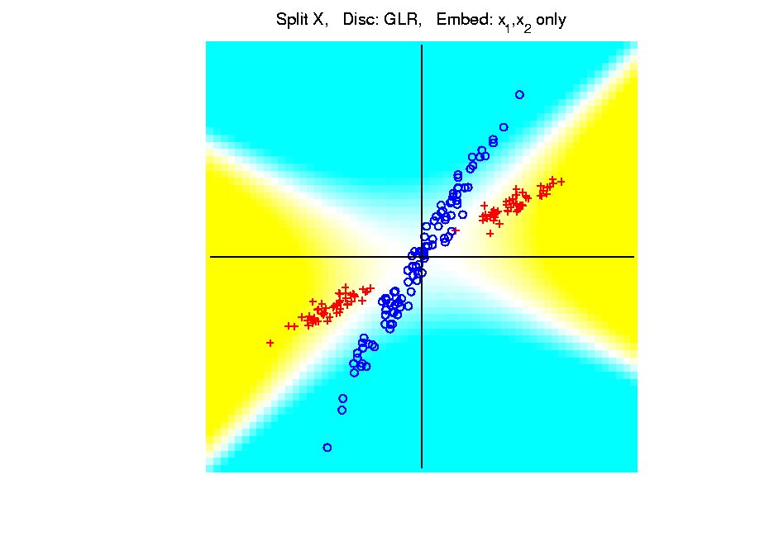
Kernel Embedding
Polynomial Embedding, Toy Example 2:
Split X
GLR
Original
Data
Looks
Very
Good
Notes:
PEod1Raw.ps

Slide 71
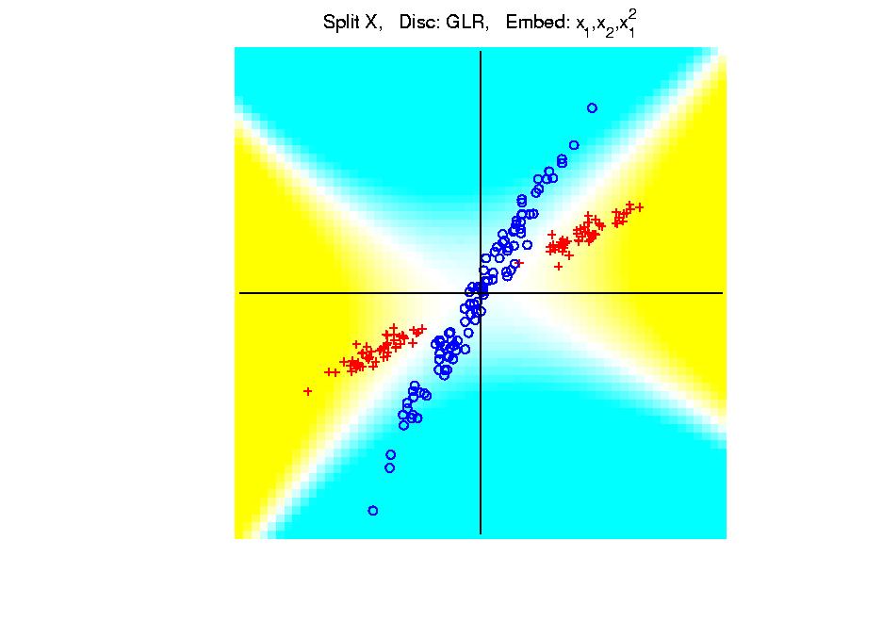
Kernel Embedding
Polynomial Embedding, Toy Example 2:
Split X
GLR
Notes:
PEod1Raw.ps

Slide 72
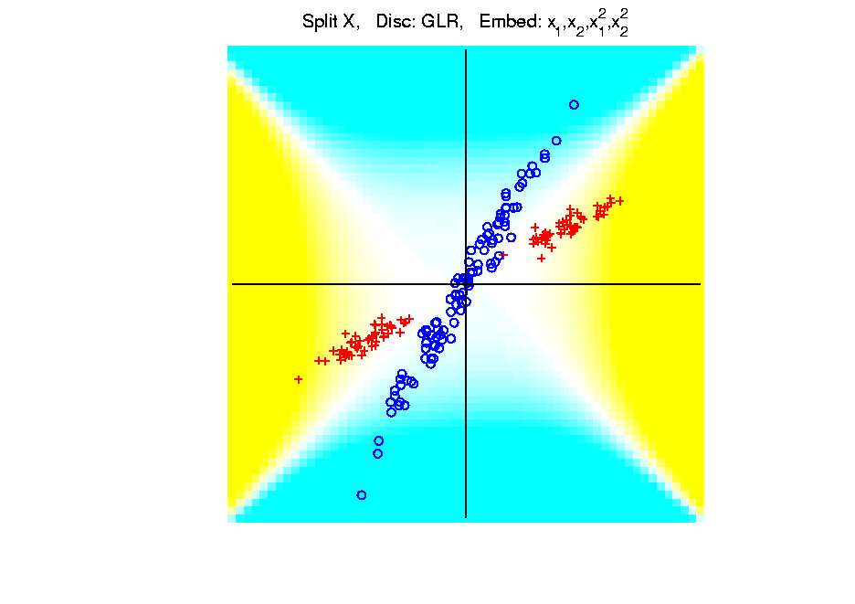
Kernel Embedding
Polynomial Embedding, Toy Example 2:
Split X
GLR
Reasonably
Stable
Never Ellipse
Around Blues
Notes:
PEod1Raw.ps

Slide 73
Kernel Embedding
Polynomial Embedding, Toy Example 3:
Donut
Very Challenging
For Any Linear
Approach
Notes:
PEod1Raw.ps

Slide 74
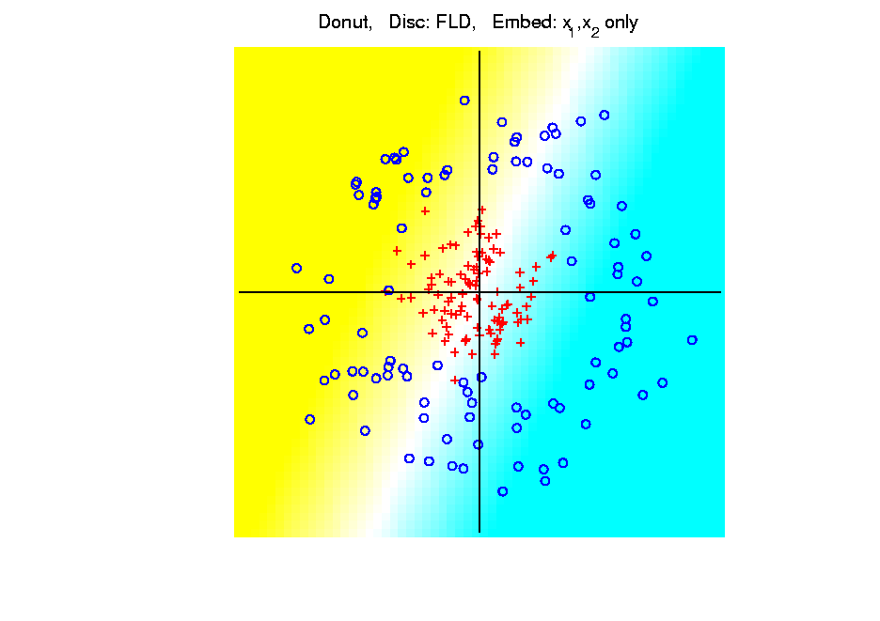
Kernel Embedding
Polynomial Embedding, Toy Example 3:
Donut
FLD
Original
Data
Very
Bad
Notes:
PEod1Raw.ps

Slide 75
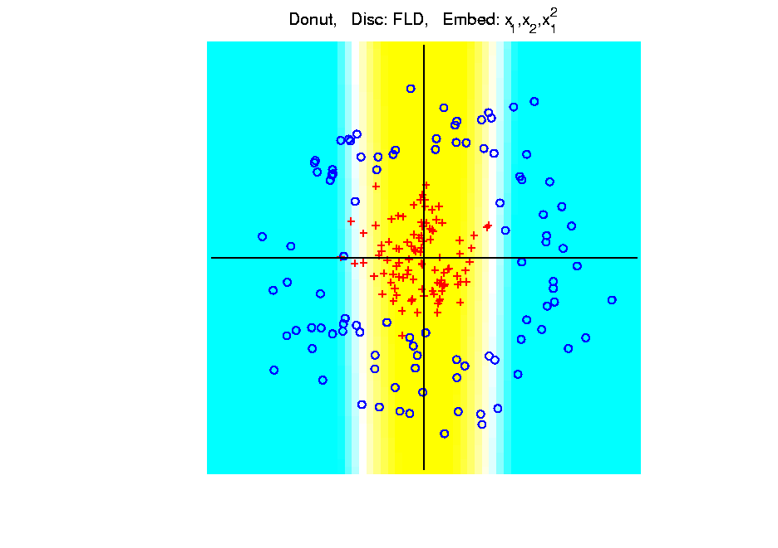
Kernel Embedding
Polynomial Embedding, Toy Example 3:
Donut
FLD
Somewhat
Better
(Parabolic Fold)
Notes:
PEod1Raw.ps

Slide 76
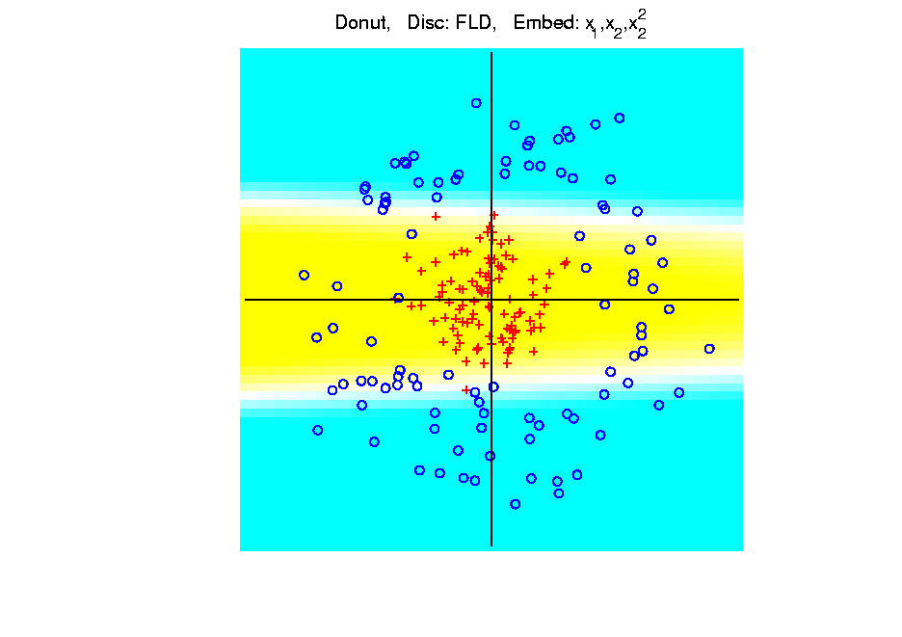
Kernel Embedding
Polynomial Embedding, Toy Example 3:
Donut
FLD
Somewhat
Better
(Other Fold)
Notes:
PEod1Raw.ps

Slide 77
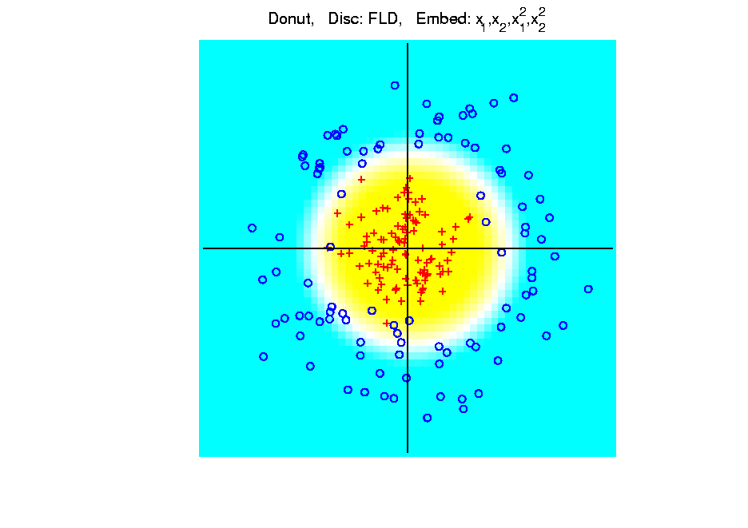
Kernel Embedding
Polynomial Embedding, Toy Example 3:
Donut
FLD
Good
Performance
(Slice of
Paraboloid)
Notes:
PEod1Raw.ps

Slide 78
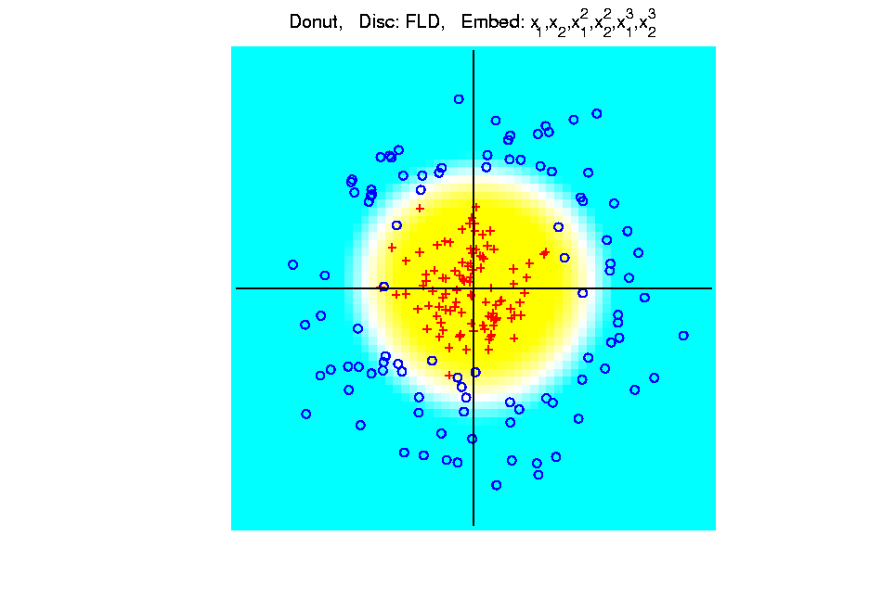
Kernel Embedding
Polynomial Embedding, Toy Example 3:
Donut
FLD
Robust
Against
Overfitting
Notes:
PEod1Raw.ps

Slide 79
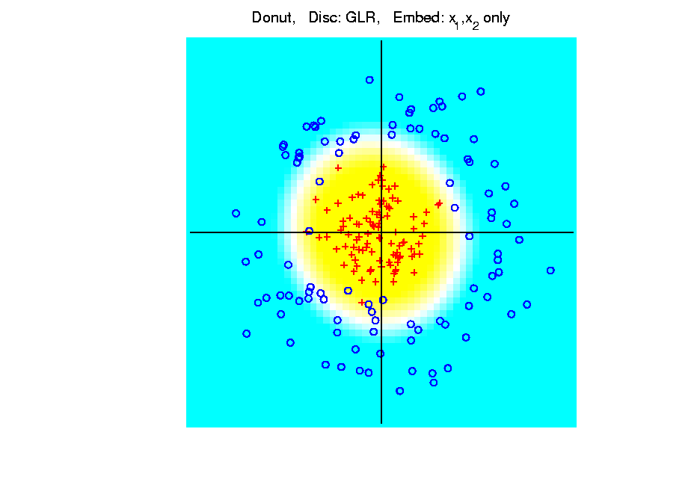
Kernel Embedding
Polynomial Embedding, Toy Example 3:
Donut
GLR
Original
Data
Best With
No Embedding?
Notes:
PEod1Raw.ps

Slide 80
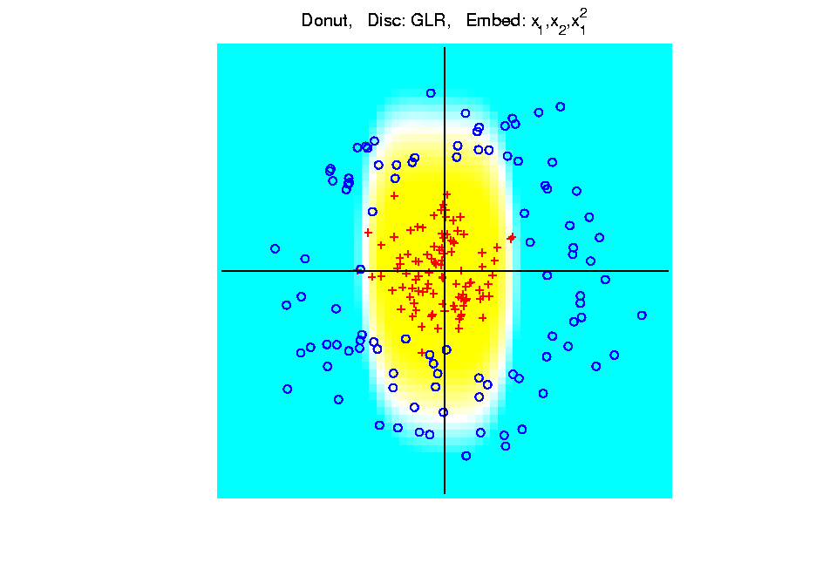
Kernel Embedding
Polynomial Embedding, Toy Example 3:
Donut
GLR
Notes:
PEod1Raw.ps

Slide 81
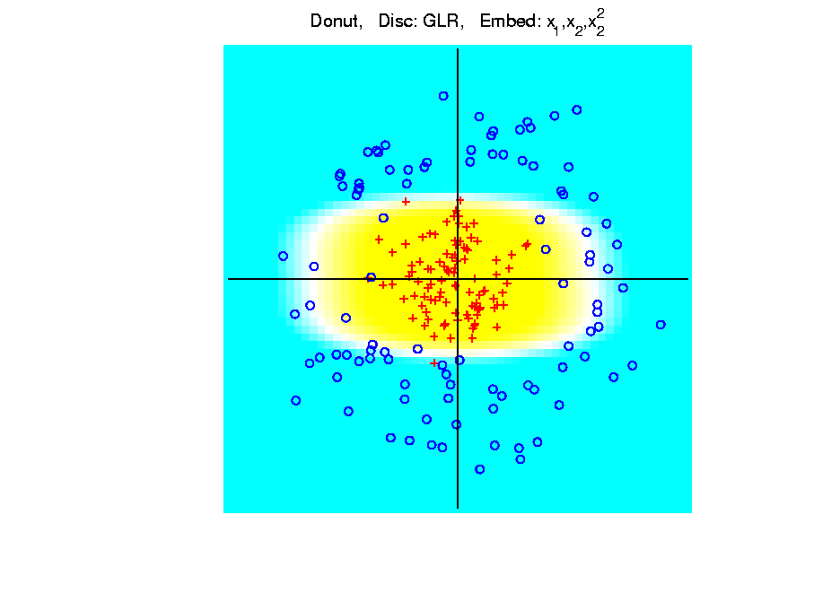
Kernel Embedding
Polynomial Embedding, Toy Example 3:
Donut
GLR
Notes:
PEod1Raw.ps

Slide 82
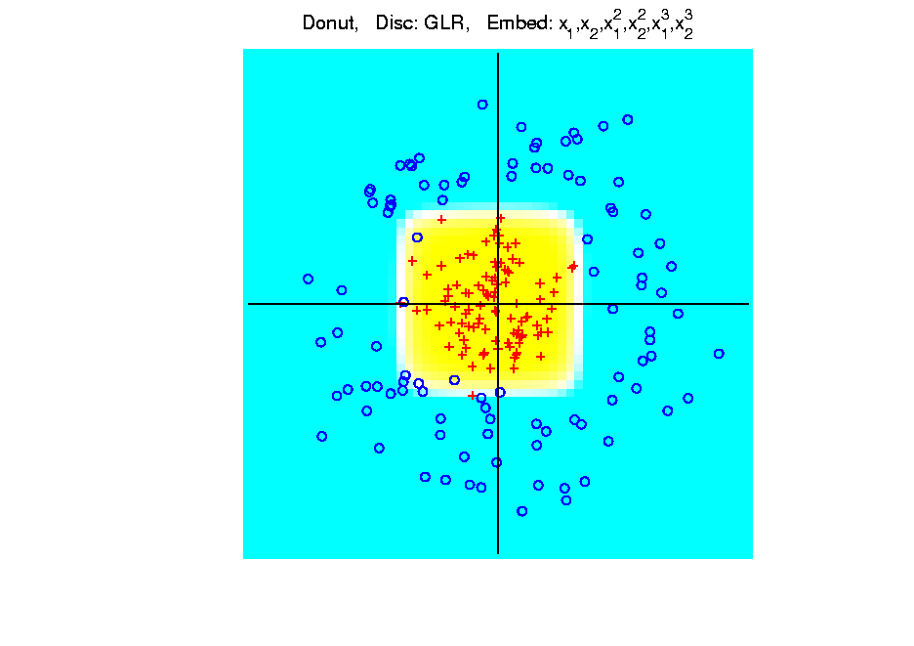
Kernel Embedding
Polynomial Embedding, Toy Example 3:
Donut
GLR
Overfitting
Gives Square
Shape?
Notes:
PEod1Raw.ps

Slide 83
Kernel Embedding
Drawbacks to polynomial embedding:
Too many extra terms create spurious structure
i.e. have “overfitting”
Too much flexibility
HDLSS problems typically get worse
Iain D Carmichael <idc9@uw.edu>
Iain D Carmichael <idc9@uw.edu>

Slide 84
Kernel Embedding
Important Variation: “Kernel Machines”
Idea: replace polynomials by
other nonlinear functions
e.g. 1: sigmoid functions from neural nets
e.g. 2: radial basis functions
Gaussian kernels
Related to “kernel density estimation”
(study more later)

Slide 85
Kernel Embedding
Radial Basis Functions:
Note: there are several ways to embed:
Naïve Embedding (equally spaced grid)
Explicit Embedding (evaluate at data)
Implicit Embedding (inner prod. based)
(everybody currently does the latter)

Slide 86
Kernel Embedding
Naïve Embedding, Radial basis functions:
At some “grid points” ${\underline{g}}_{1}⋯,{\underline{g}}_{k}$,
For a “bandwidth” (i.e. standard dev’n) $σ$,
Consider ($d$ dim’al) functions:
$$φ_{σ}\left(\underline{x}−{\underline{g}}_{1}\right),⋯,φ_{σ}\left(\underline{x}−{\underline{g}}_{k}\right)$$
$N_{d}\left(0,σ^{2}I\right)$ Probability Density

Slide 87
Kernel Embedding
Naïve Embedding, Radial basis functions:
At some “grid points” ${\underline{g}}_{1}⋯,{\underline{g}}_{k}$,
For a “bandwidth” (i.e. standard dev’n) $σ$,
Consider ($d$ dim’al) functions:
$$φ_{σ}\left(\underline{x}−{\underline{g}}_{1}\right),⋯,φ_{σ}\left(\underline{x}−{\underline{g}}_{k}\right)$$
Replace data matrix with:
$$\left(\begin{matrix}φ_{σ}\left({\underline{X}}_{1}−{\underline{g}}_{1}\right) & ⋯ & φ_{σ}\left({\underline{X}}_{n}−{\underline{g}}_{1}\right) \\ ⋮ & ⋱ & ⋮ \\ φ_{σ}\left({\underline{X}}_{1}−{\underline{g}}_{k}\right) & ⋯ & φ_{σ}\left({\underline{X}}_{n}−{\underline{g}}_{k}\right)\end{matrix}\right)$$

Slide 88
Kernel Embedding
Naïve Embedding, Radial basis functions:
For discrimination: work in radial basis space, With new data vector ${\underline{X}}_{0}$,
represented by: $\left(\begin{matrix}φ_{σ}\left({\underline{X}}_{0}−{\underline{g}}_{1}\right) \\ ⋮ \\ φ_{σ}\left({\underline{X}}_{0}−{\underline{g}}_{k}\right)\end{matrix}\right)$

Slide 89
Kernel Embedding
Naïve Embedd’g, Toy E.g. 1: Parallel Clouds
Good
at data
Poor
outside

Slide 90
Kernel Embedding
Naïve Embedd’g, Toy E.g. 2: Split X
OK at
data
Strange
outside

Slide 91
Kernel Embedding
Naïve Embedd’g, Toy E.g. 3: Donut
Mostly
good
Slight
mistake
for one
kernel

Slide 92
Kernel Embedding
Naïve Embedding, Radial basis functions:
Toy Example, Main lessons:
Generally good in regions with data,
Unpredictable where data are sparse

Slide 93
Kernel Embedding
Toy Example 4: Checkerboard
Very
Challenging!
Linear
Method?
Polynomial
Embedding?
Notes:
PEod1Raw.ps

Slide 94
Participant Presentation
Chalmer Tomlinson:
Longitudinal Autism
Samuel Rosin:
Horseshoe Effect in Microbiome Data

