Slide 1
Participant Presentations
Please Send Title:
Jose Sanchez
David Bang
Dhruv Patel
Wei Gu
Bohan Li
Siqi Xiang
Nicolas Wolczynski
Mingyi Wang

Slide 2
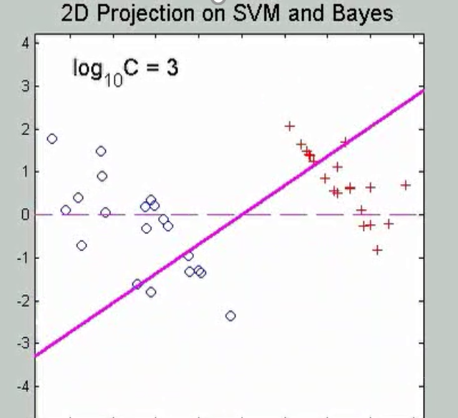

SVMs, Tuning Parameter
Toy Example: $d=50$, Sph’l Gaussian data
For Large Values of C
Lots of Data Piling
Large Angle to Optimal
Thus Less Generalizable
(For This Data Set)
Called Hard Margin SVM

Slide 3
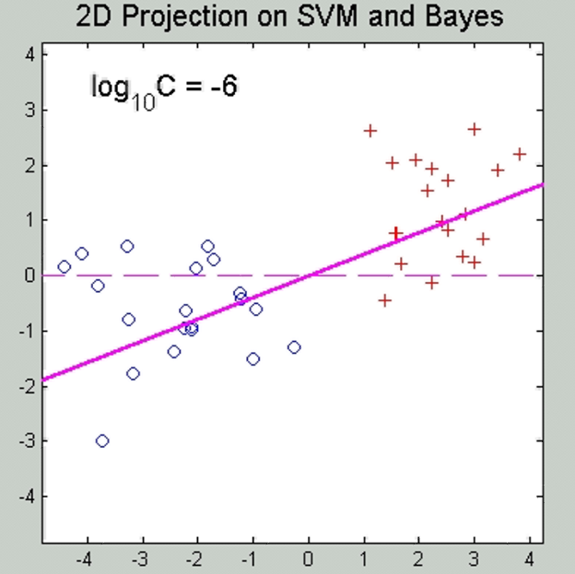
SVMs, Tuning Parameter
Toy Example: $d=50$, Sph’l Gaussian data
For Small Values of C
No Apparent Data Piling
Smaller Angle to Optimal
So More Generalizable
Connection to MD?
Add MD Axis to Plot

Slide 4
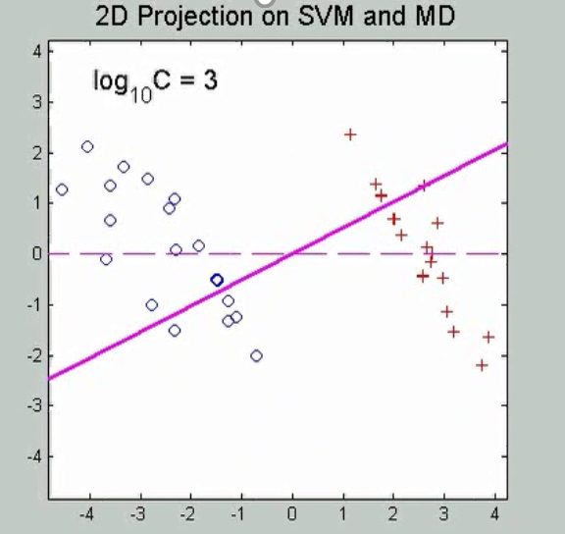

SVMs, Tuning Parameter
Toy Example: $d=50$, Sph’l Gaussian data
Put MD on horizontal axis
For Large Values of C
SVM not MD
Hard Margin SVM
Clearly Different
Yet Same for Small C!
(For This Data Set)

Slide 5
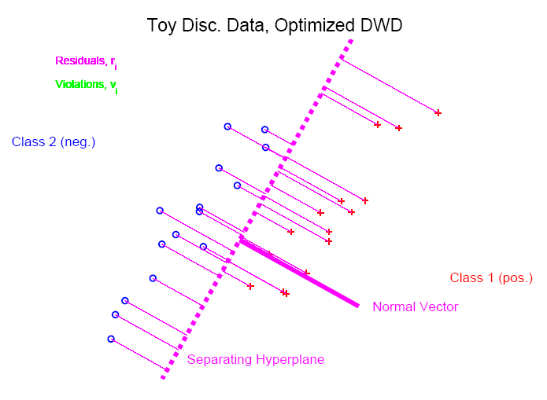
Distance Weighted Discrim’n
Based on Optimization Problem:
For “Residuals”:

Slide 6
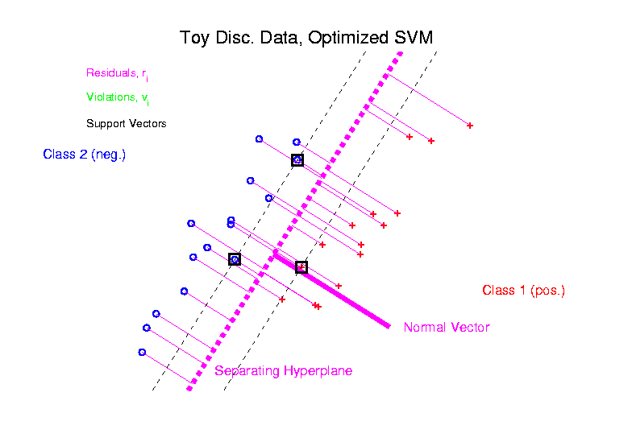
Support Vector Machines
Graphical View, using Toy Example:

Slide 7
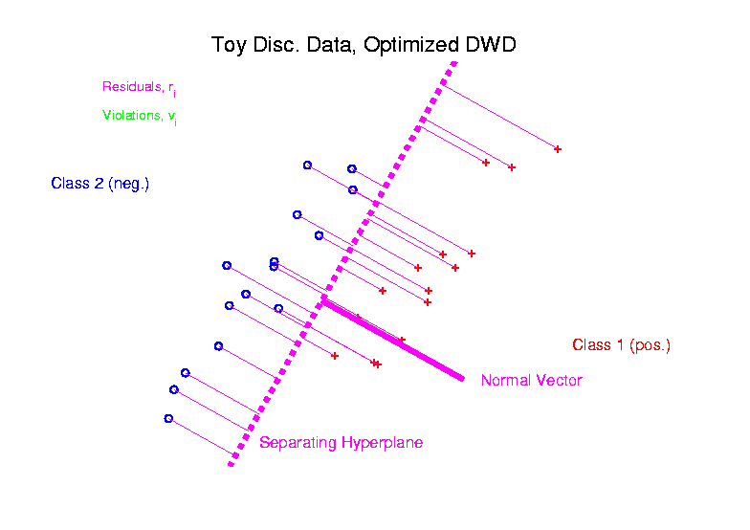
Distance Weighted Discrim’n
Graphical View, using Toy Example:

Slide 8
HDLSS Discrim’n Simulations
Main idea:
Comparison of
SVM (Support Vector Machine)
DWD (Distance Weighted Discrimination)
MD (Mean Difference, a.k.a. Centroid)
Linear versions, across dimensions
Notes:
8

Slide 9
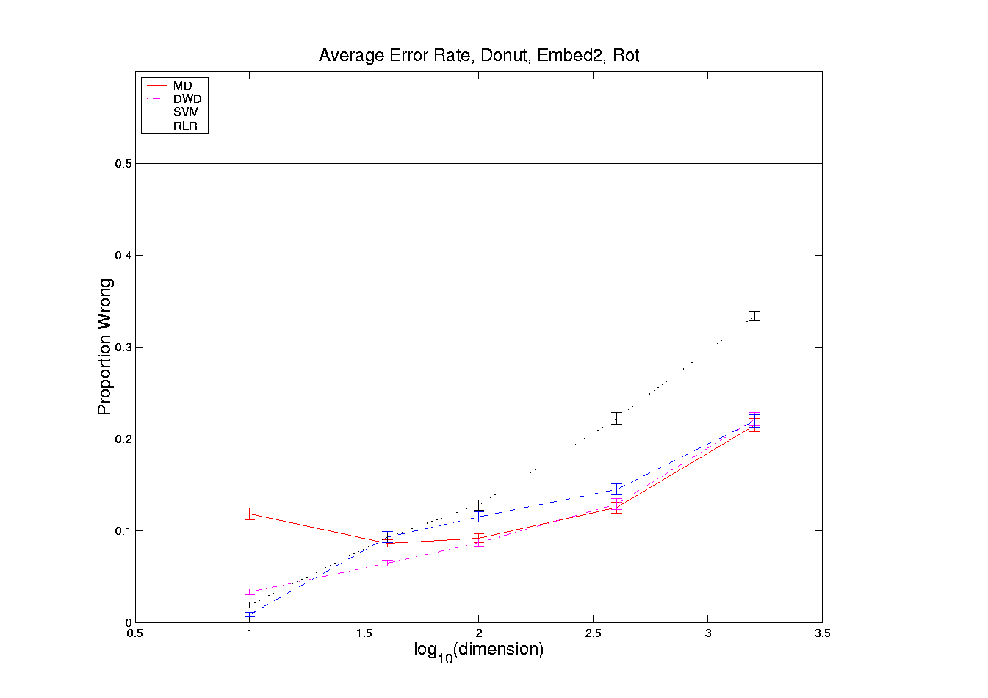
HDLSS Discrim’n Simulations
Nested Spheres:
Notes:
DWD1figHBig.ps

Slide 10
HDLSS Discrim’n Simulations
Conclusions:
Everything (sensible) is best sometimes
DWD often very near best
MD weak beyond Gaussian
Caution about simulations (and examples):
Very easy to cherry pick best ones
Good practice in Machine Learning
  “Ignore method proposed, but read
  paper for useful comparison of others”
Every Dog Has His Day

Slide 11
HDLSS Discrim’n Simulations
Can we say more about:
All methods come together
in very high dimensions???
Mathematical Statistical Question:
Mathematics behind this???
Notes:
11

Slide 12
Batch and Source Adjustment
  Important Application
  of
  Distance Weighted Discrimination

Slide 13
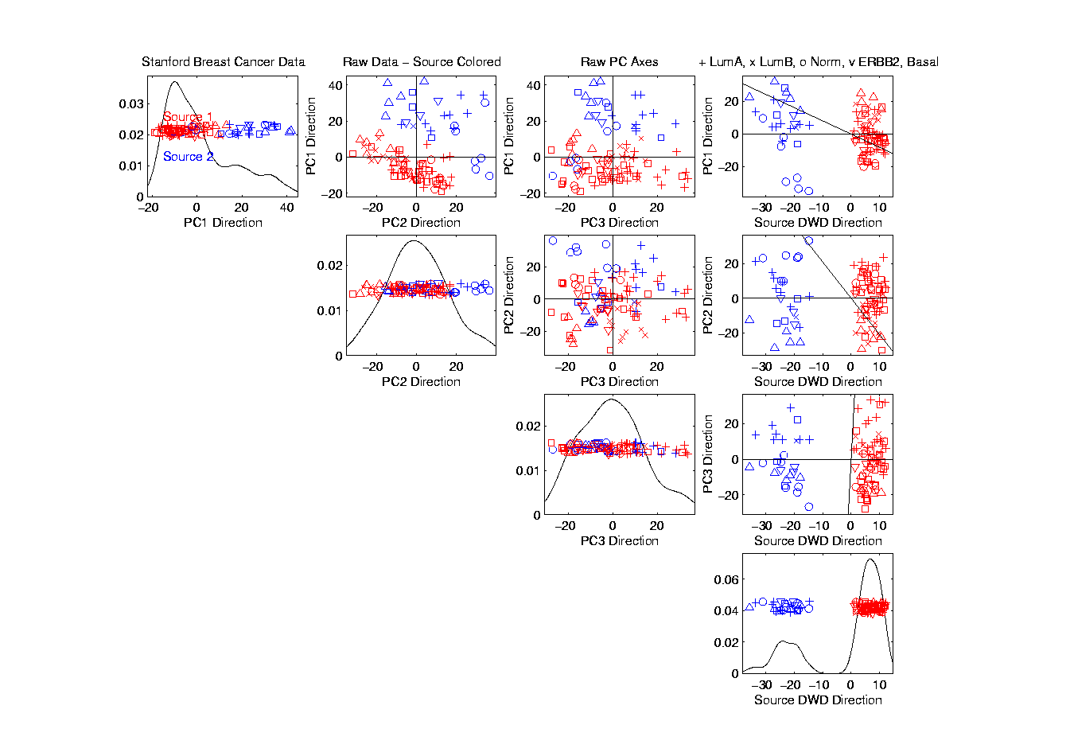
Source Batch Adj: PC 1-3 & DWD direction

Slide 14
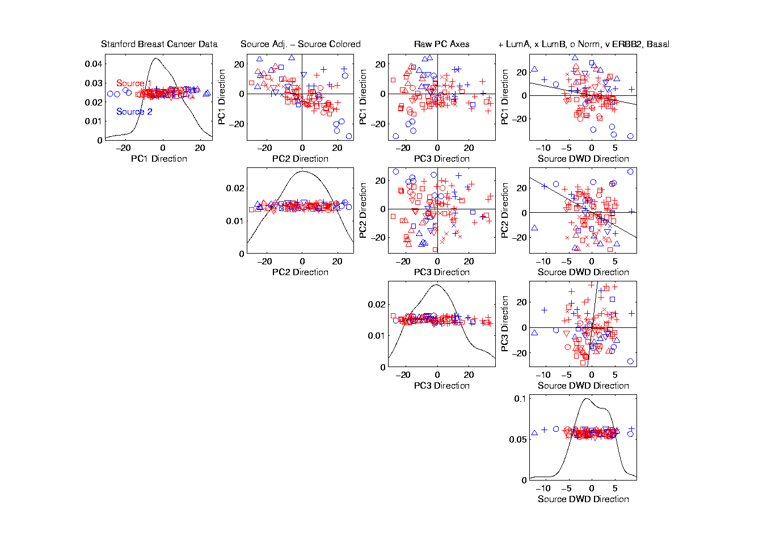
Source Batch Adj: DWD Source Adjustment

Slide 15
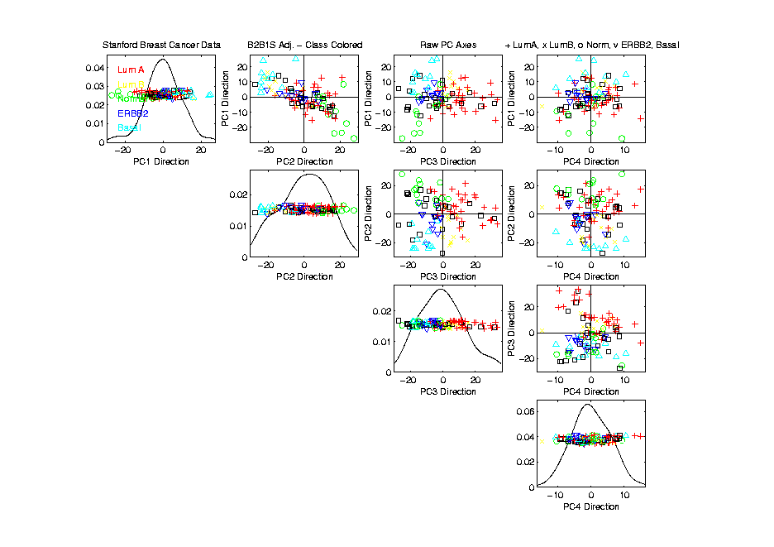
Source Batch Adj: S. & B Adj’d, Class Colors

Slide 16
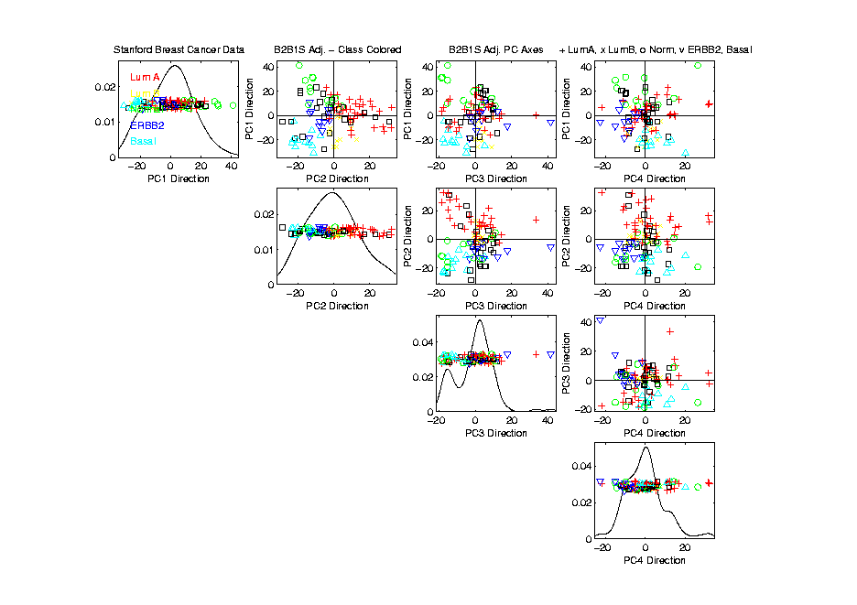
Source Batch Adj: S. & B Adj’d, Adj’d PCA

Slide 17
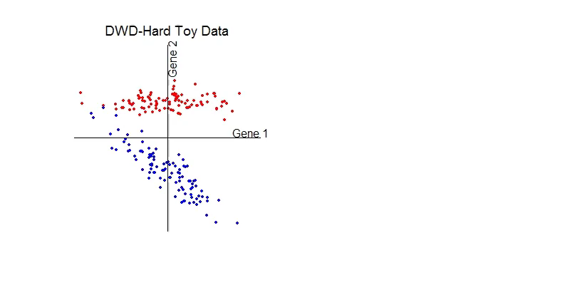
DWD does not solve all problems
Only handles means, not differing variation
Alternative: Shabalin et al (2008)

Slide 18
Interesting Benchmark Data Set
NCI 60 Cell Lines
  Interesting benchmark, since same cells
  Data Web available:
  http://discover.nci.nih.gov/datasetsNature2000.jsp
  Both cDNA and Affymetrix Platforms
Different from Breast Cancer Data
  Which had no common samples
See Liu et al. (2009)

Slide 19
Interesting Benchmark Data Set
NCI 60 Cell Lines
  Interesting benchmark, since same cells
Previously Studied, (8/27/2019)
Illustrating Limitations of PCA Views
Used DWD Dir’ns to Focus on Types

Slide 20
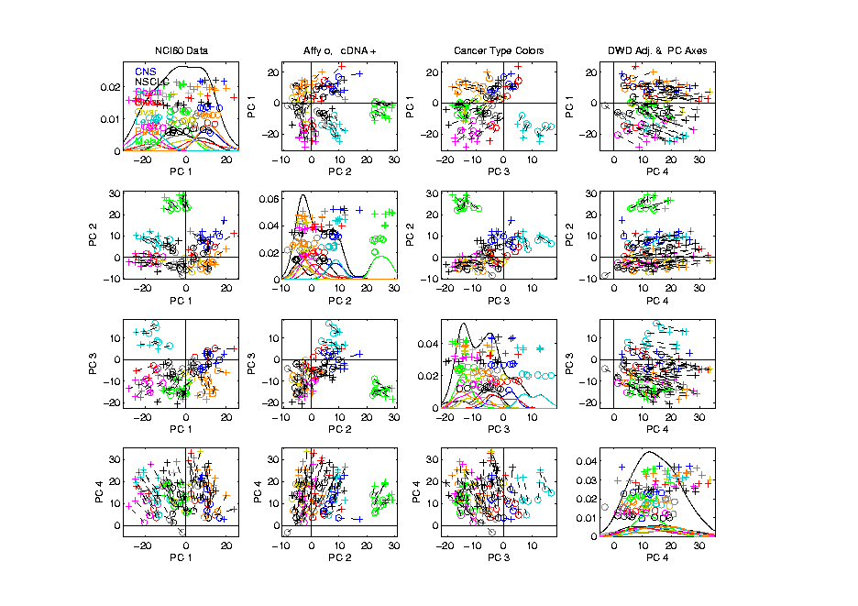
NCI 60: Can we find classes
Using PCA view?
Notes:
20

Slide 21
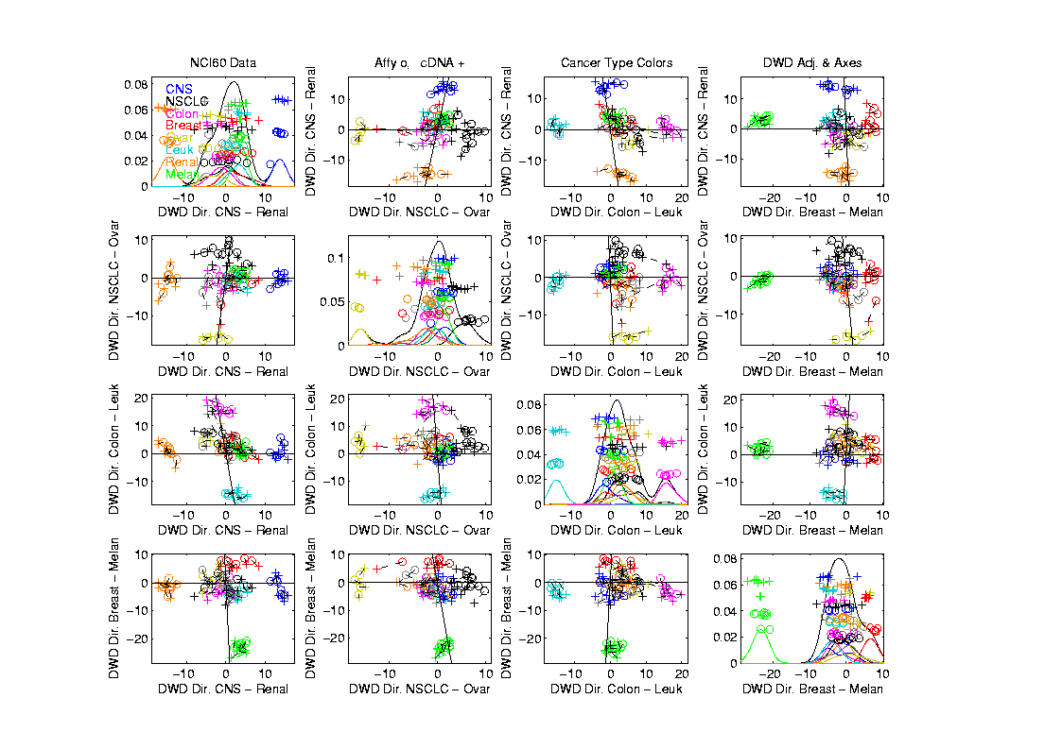
NCI 60: Views using DWD Dir’ns (focus on biology)
Now
Study
Where
This
Data
Came
From
Notes:
21

Slide 22
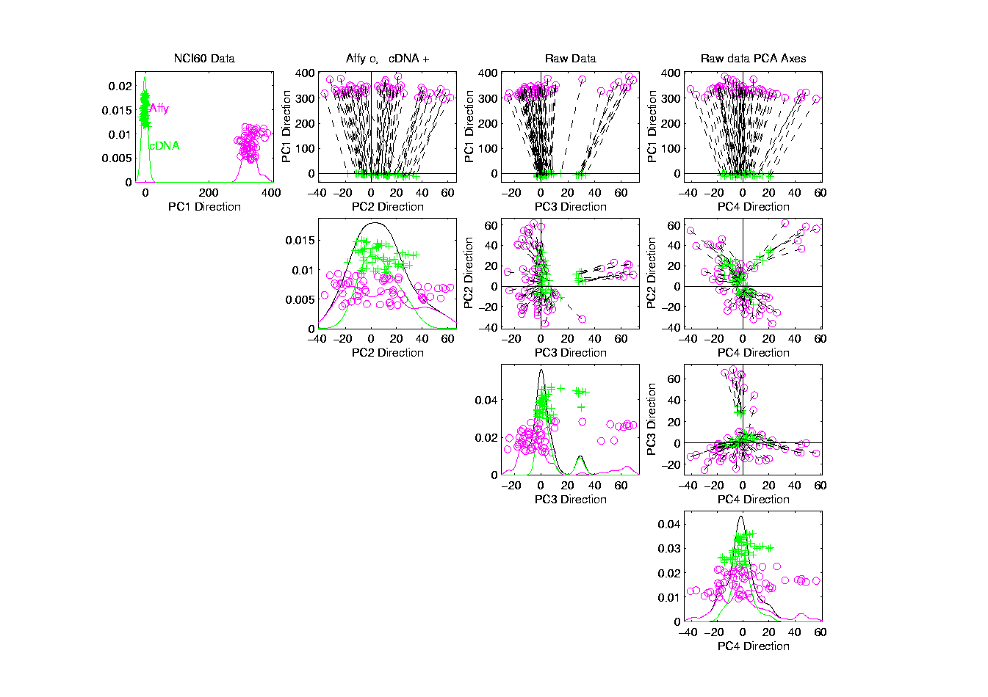
NCI 60: Raw Data, Platform Colored

Slide 23
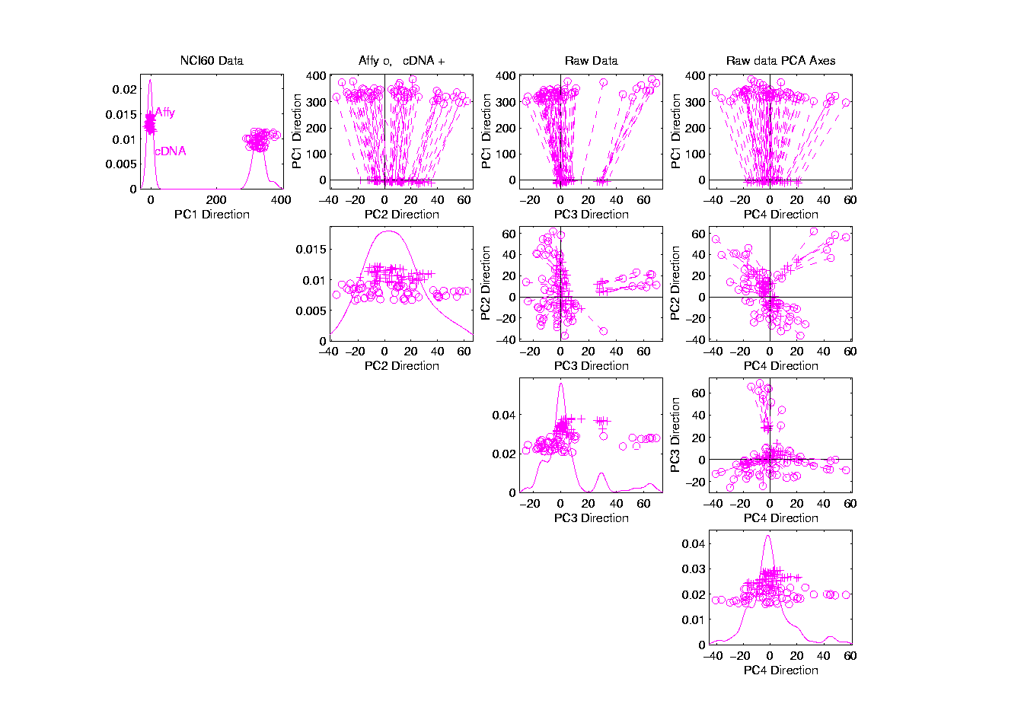
NCI 60: Raw Data

Slide 24
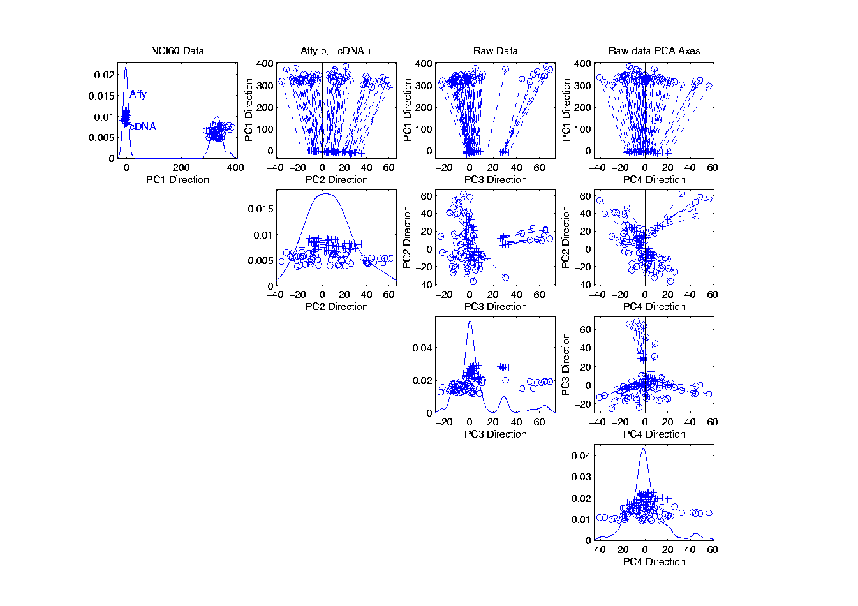
NCI 60: Raw Data, Before DWD Adjustment

Slide 25
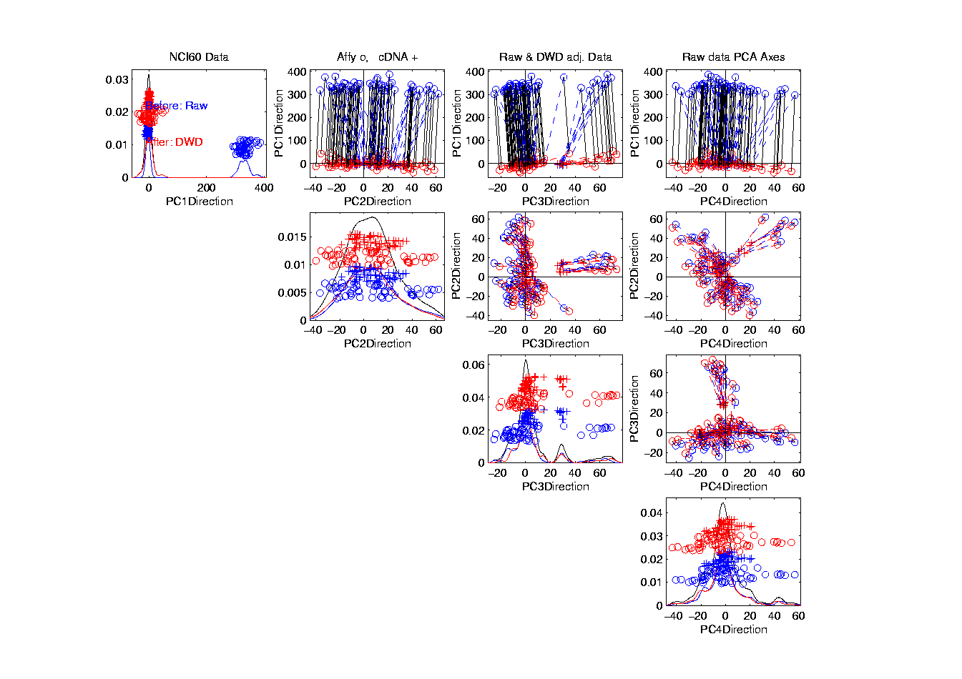
NCI 60: Before & After DWD adjustment

Slide 26
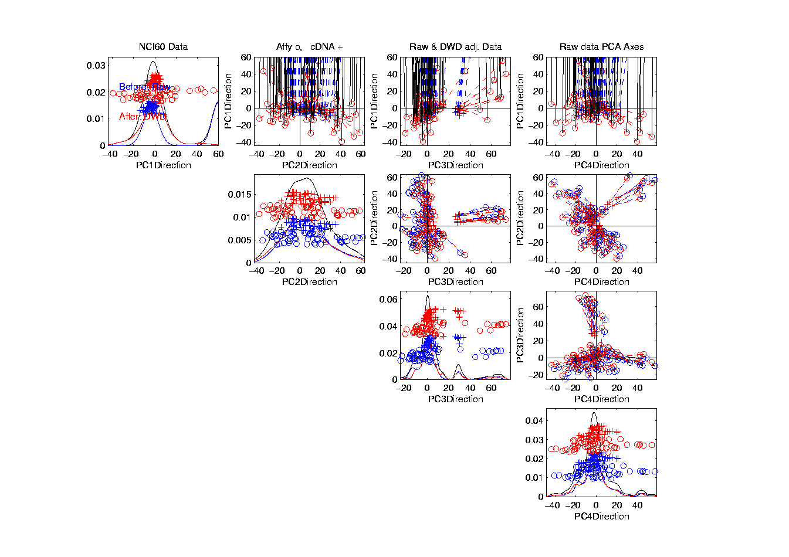
NCI 60: Before & After, new scales

Slide 27
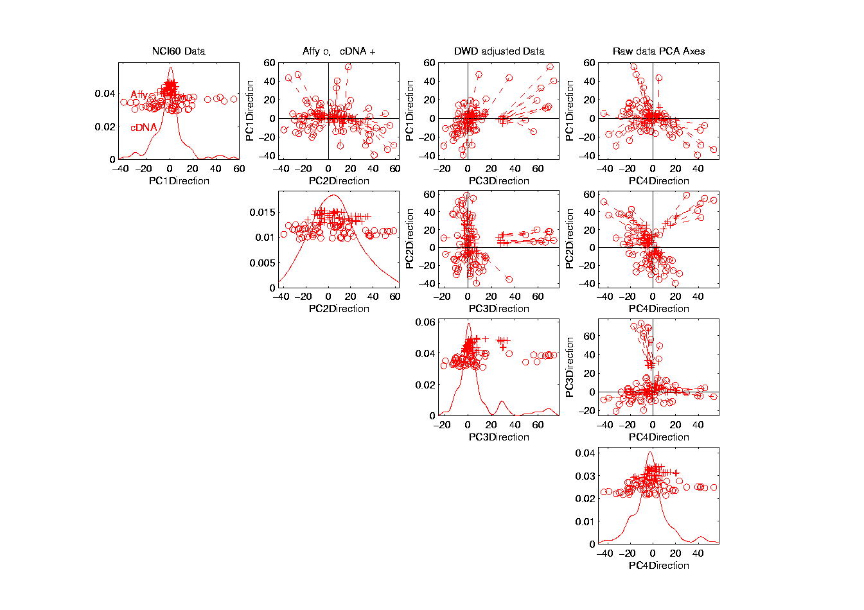
NCI 60: After DWD

Slide 28
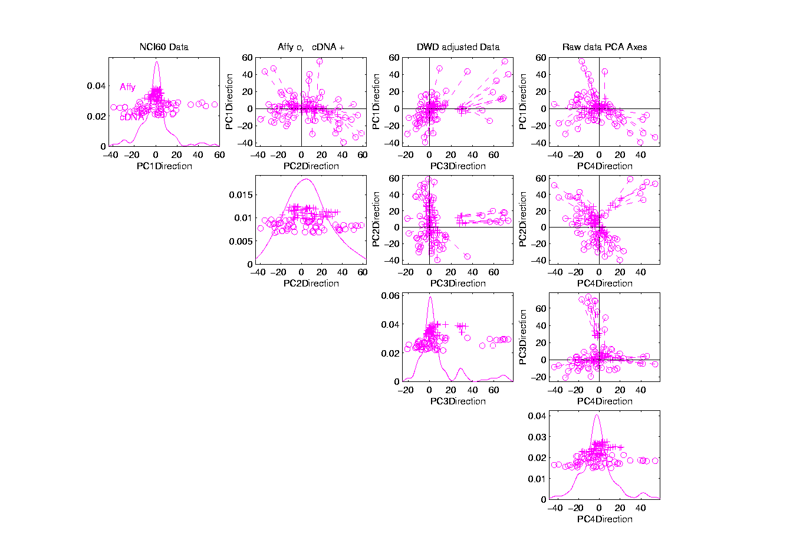
NCI 60: DWD adjusted data

Slide 29
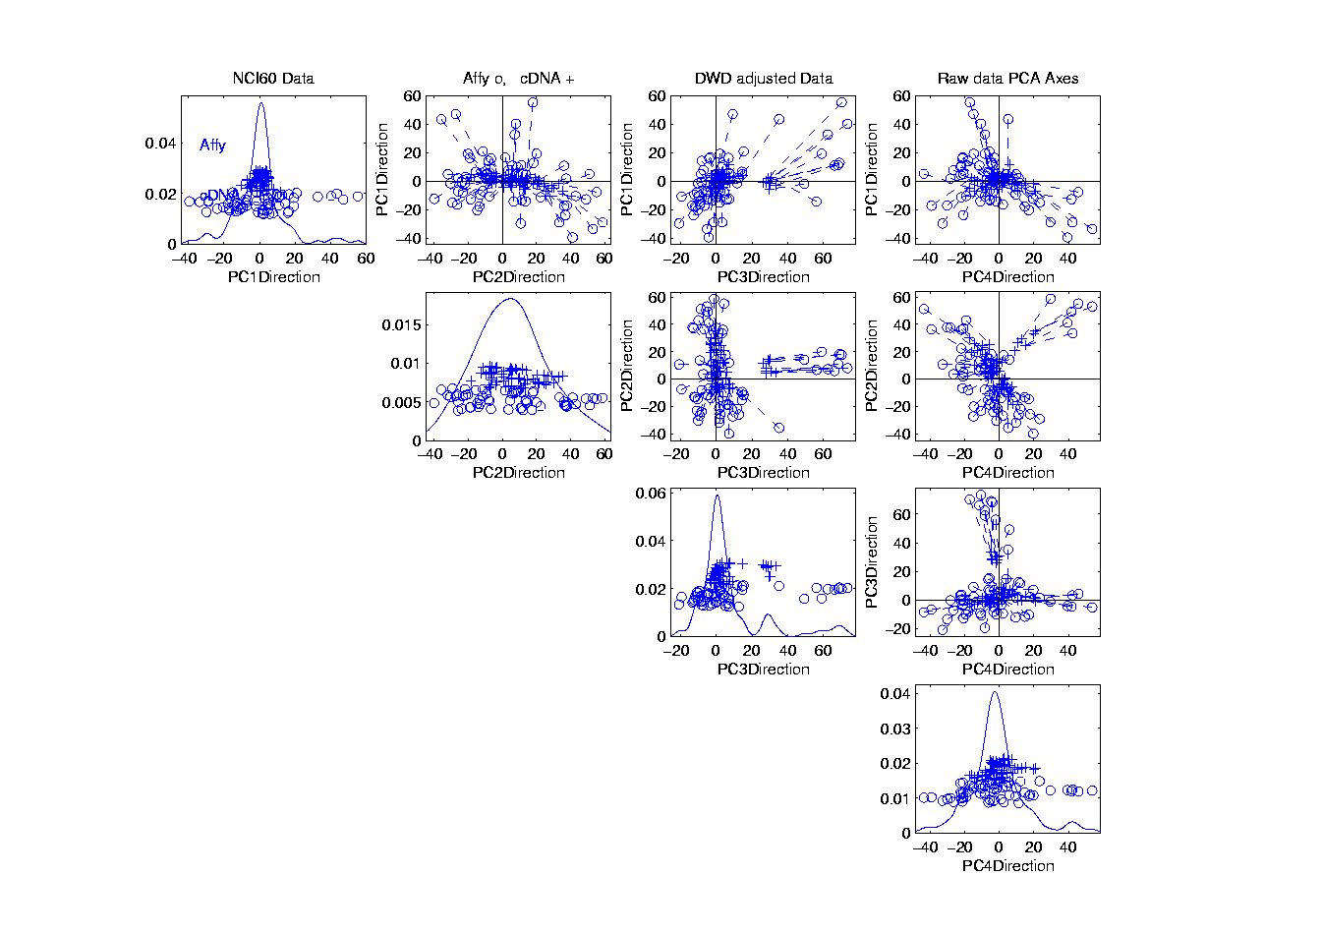
NCI 60: Before Column Mean Adjustment

Slide 30
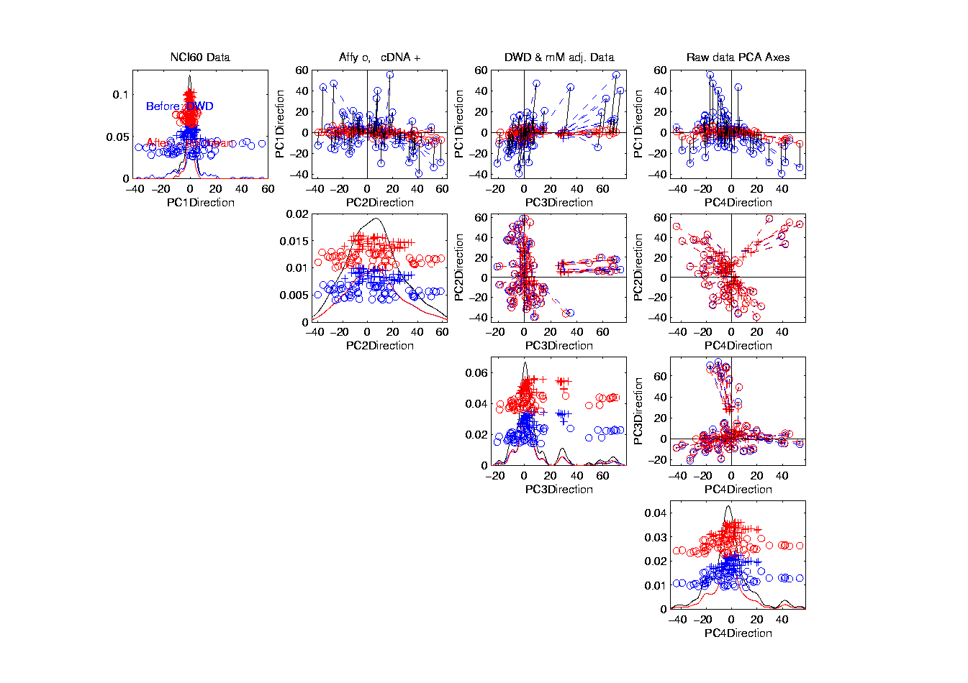
NCI 60: Before & After Column Mean Adjustment

Slide 31
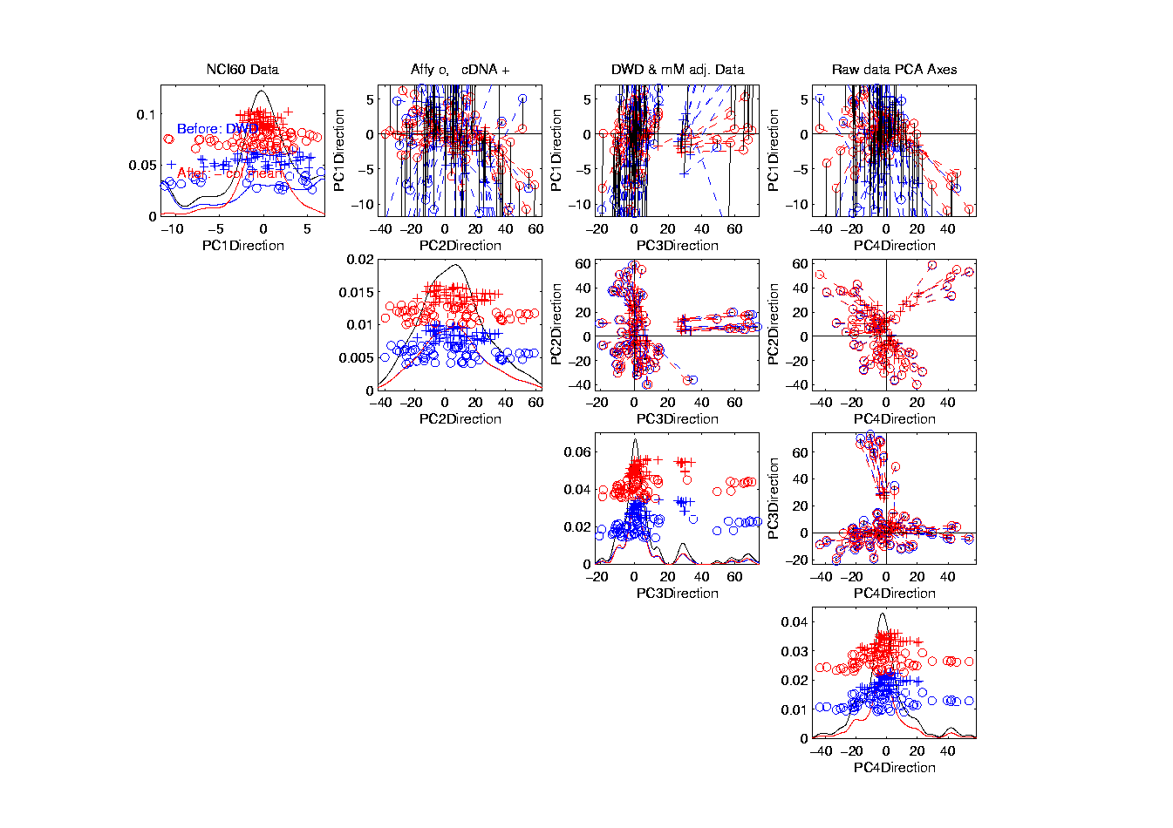
NCI 60: Before & After Col. Mean Adj., Rescaled

Slide 32
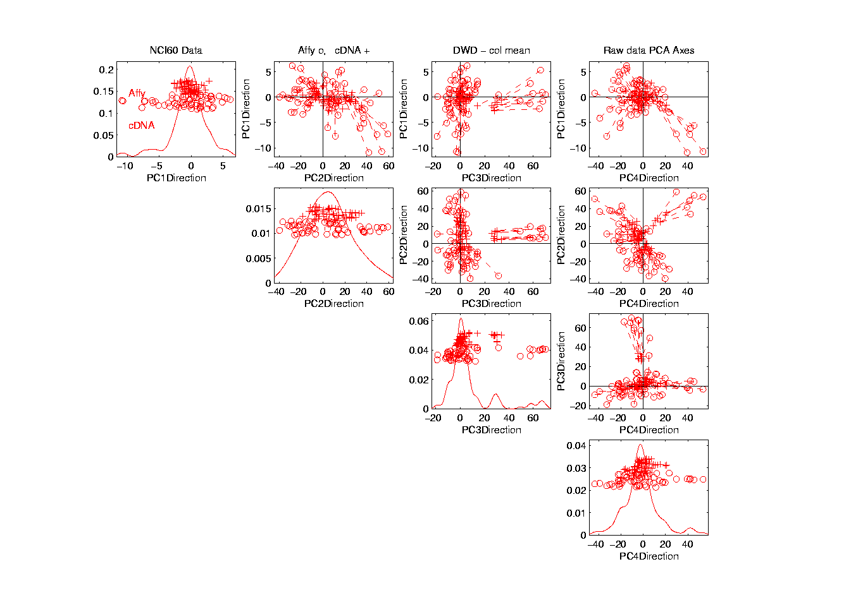
NCI 60: After DWD & Column Mean Adj.

Slide 33
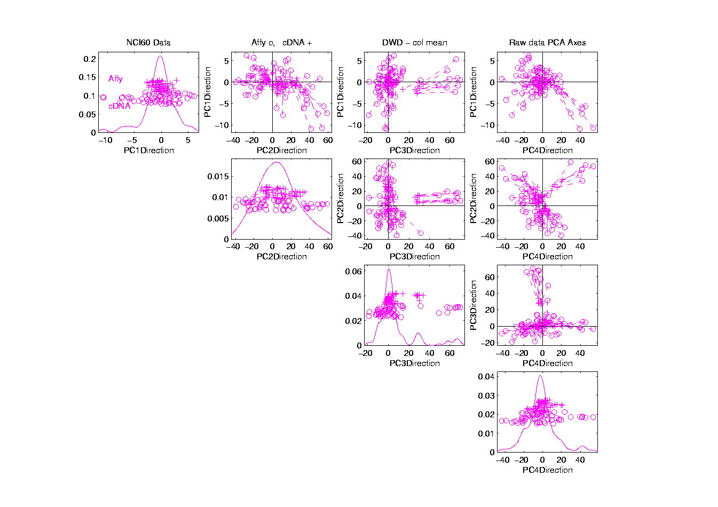
NCI 60: DWD & Column Mean Adjusted

Slide 34
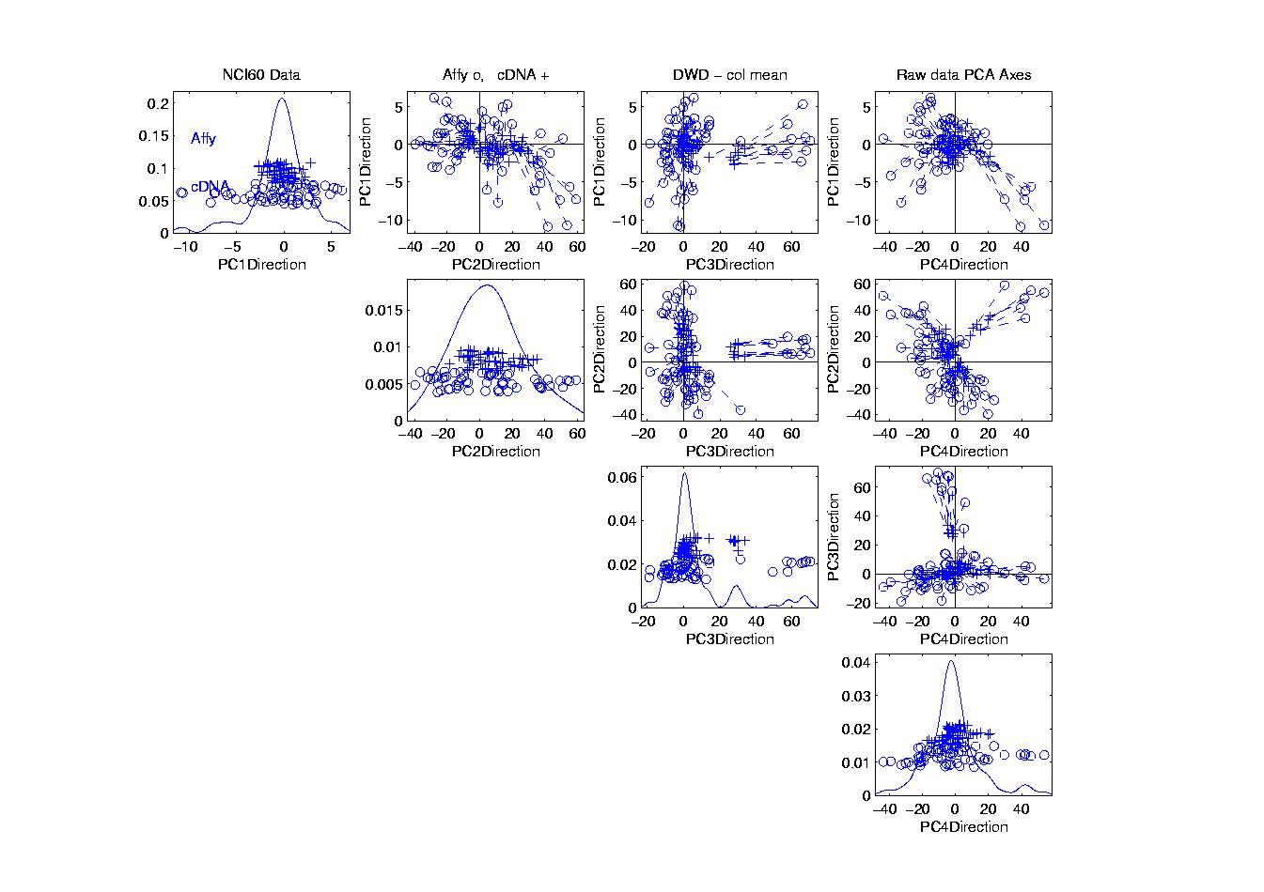
NCI 60: Before Column Stand. Dev. Adjustment

Slide 35
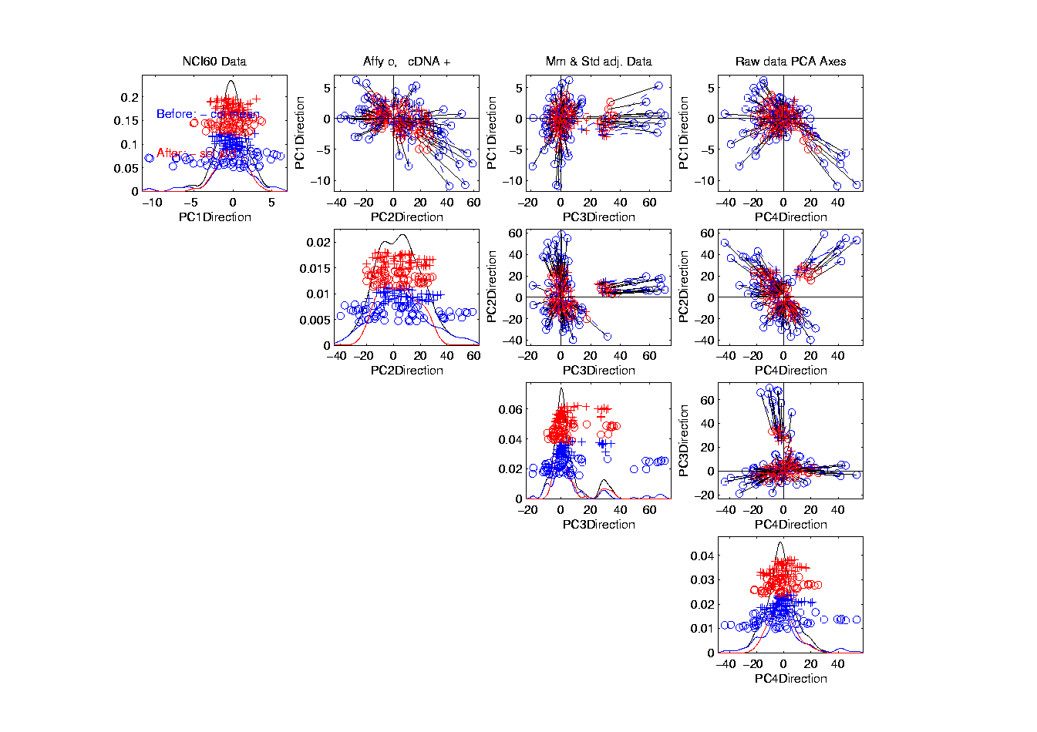
NCI 60: Before and After Column S.D. Adjustment

Slide 36
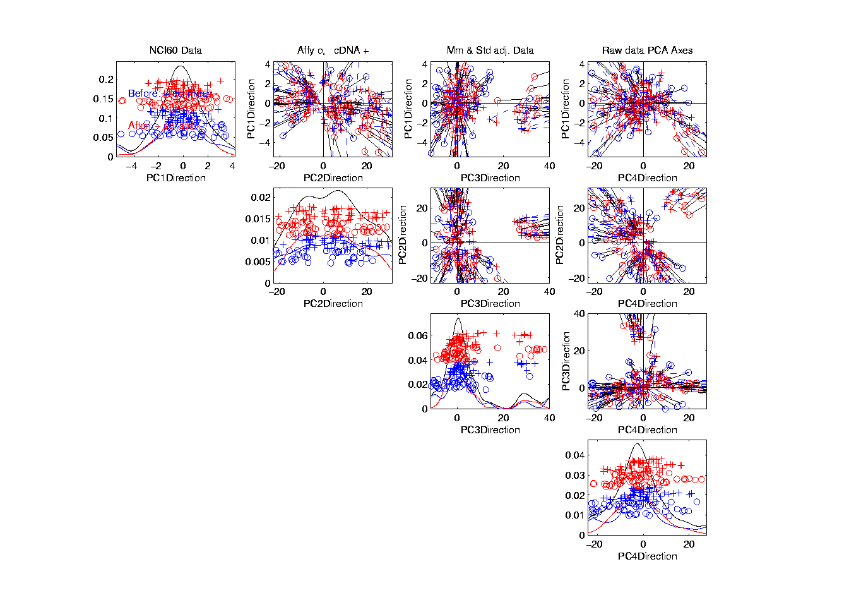
NCI 60: Before and After Col. S.D. Adj., Rescaled

Slide 37
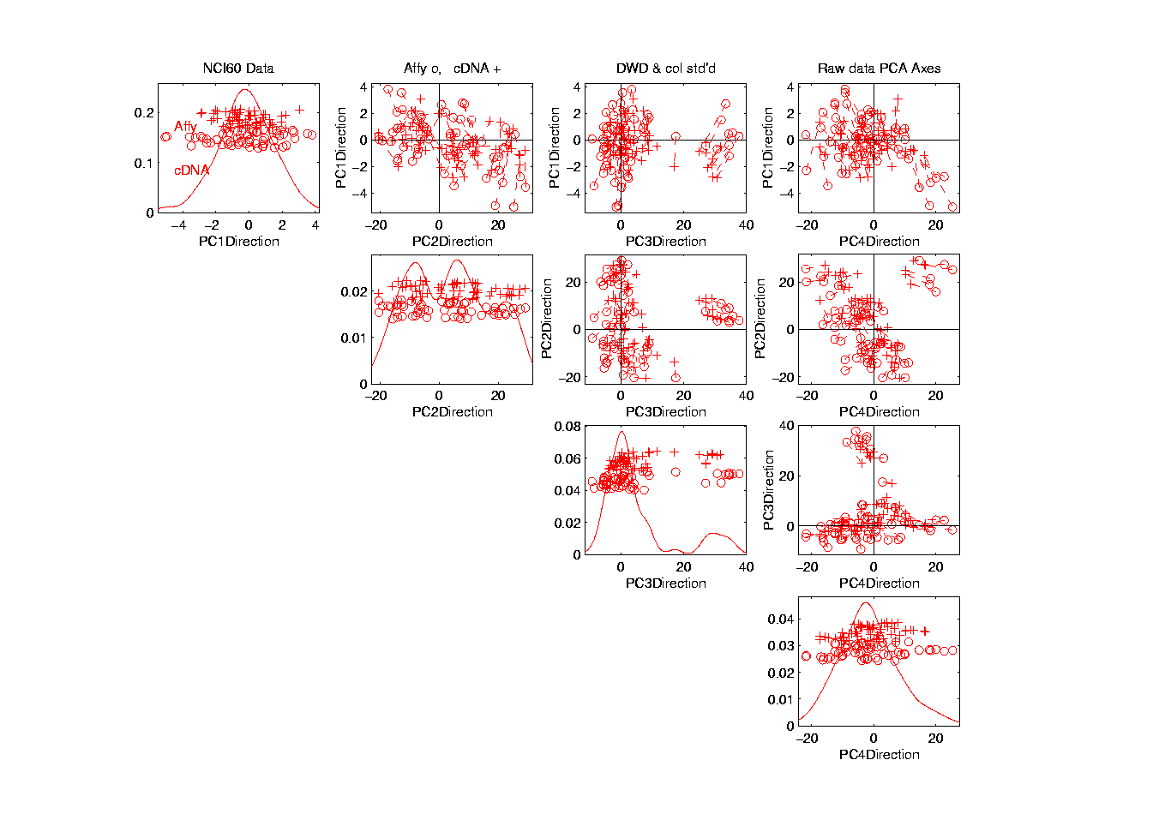
NCI 60: After Column Stand. Dev. adjustment

Slide 38

NCI 60: Fully Adjusted Data

Slide 39
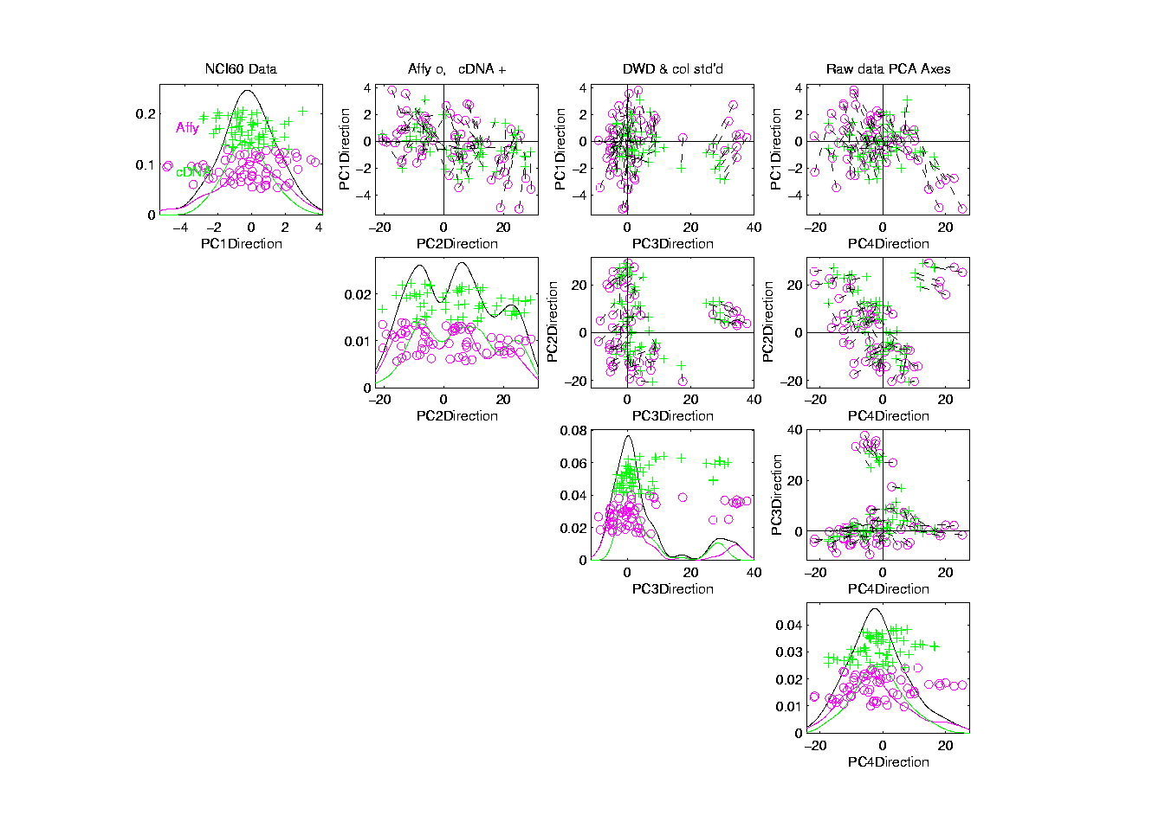
NCI 60: Fully Adjusted Data, Platform Colored
Next Study Clusters
Using “Brushing”

Slide 40
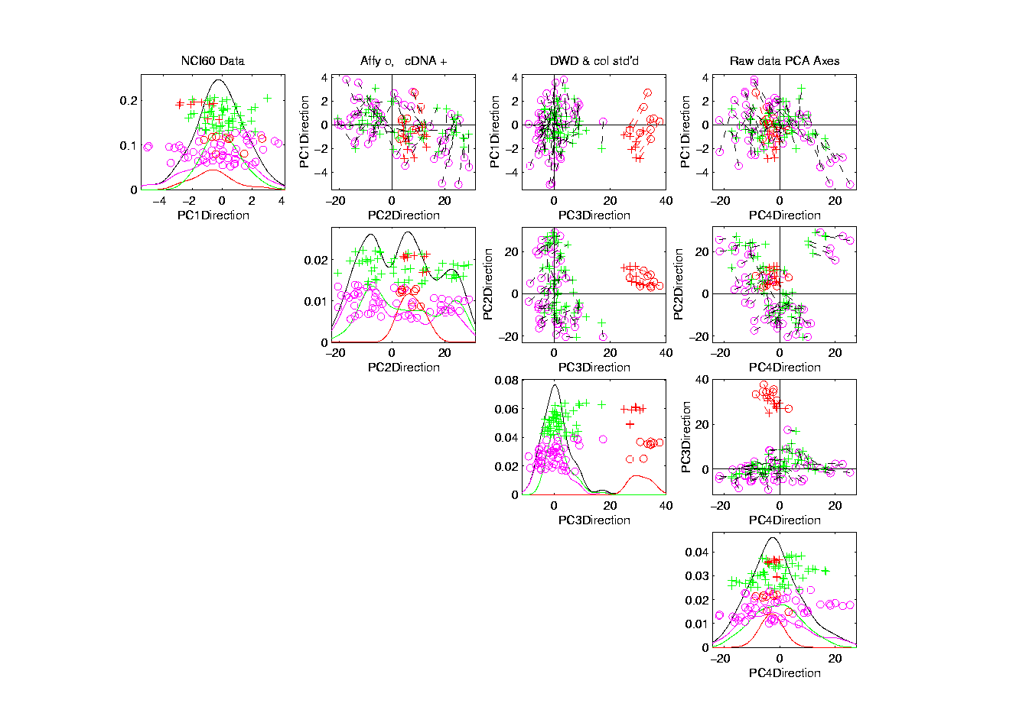
NCI 60: Fully Adjusted Data, Melanoma Cluster
BREAST.MDAMB435
BREAST.MDN
MELAN.MALME3M
MELAN.SKMEL2
MELAN.SKMEL5
MELAN.SKMEL28
MELAN.M14
MELAN.UACC62
MELAN.UACC257
Known Mislabellings

Slide 41
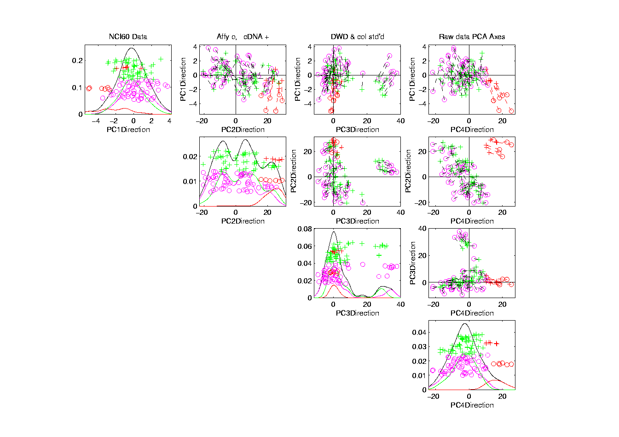
NCI 60: Fully Adjusted Data, Leukemia Cluster
LEUK.CCRFCEM
LEUK.K562
LEUK.MOLT4
LEUK.HL60
LEUK.RPMI8266
LEUK.SR

Slide 42
Recall DWD Appl’n: Visualization
Recall PCA limitations
DWD uses class info
Hence can “better separate known classes”
Did this for pairs of classes
(DWD just on those, ignore others)
Carefully choose pairs in NCI 60 data
Shows Effectiveness of Adjustment

Slide 43
NCI 60: Can we find classes
Using PCA view?
Notes:
43

Slide 44
NCI 60: Views using DWD Dir’ns (focus on biology)

Slide 45
DWD Visualization of NCI 60 Data
Recall most cancer types clearly distinct
(Renal, CNS, Ovar, Leuk, Colon, Melan)
Using these carefully chosen directions
Others less clear cut
  NSCLC (at least 3 subtypes)
  Breast (4 published subtypes)
DWD adjustment was very effective
(very few black connectors visible)

Slide 46
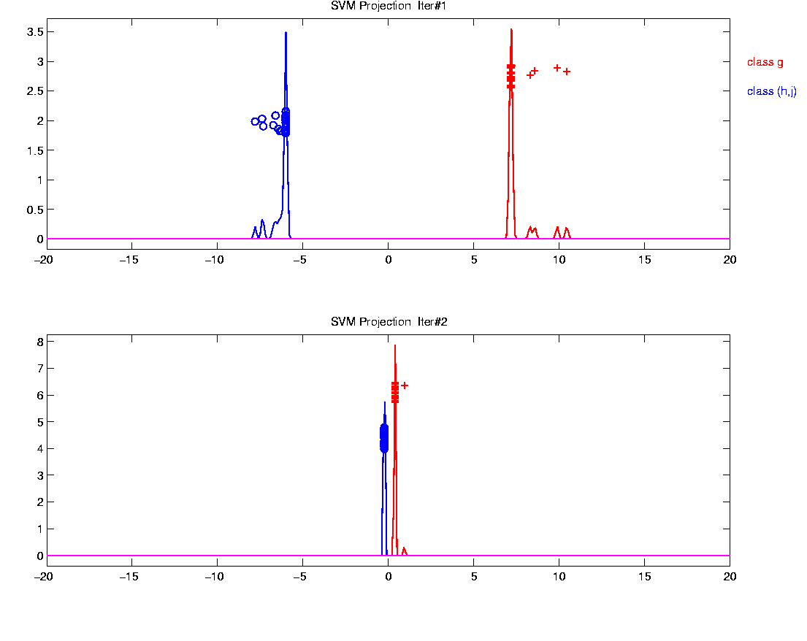
Why not adjust using SVM?
Major Problem: Proj’d Distrib’al Shape
Triangular Dist’ns (opposite skewed)
Does not allow sensible rigid shift

Slide 47
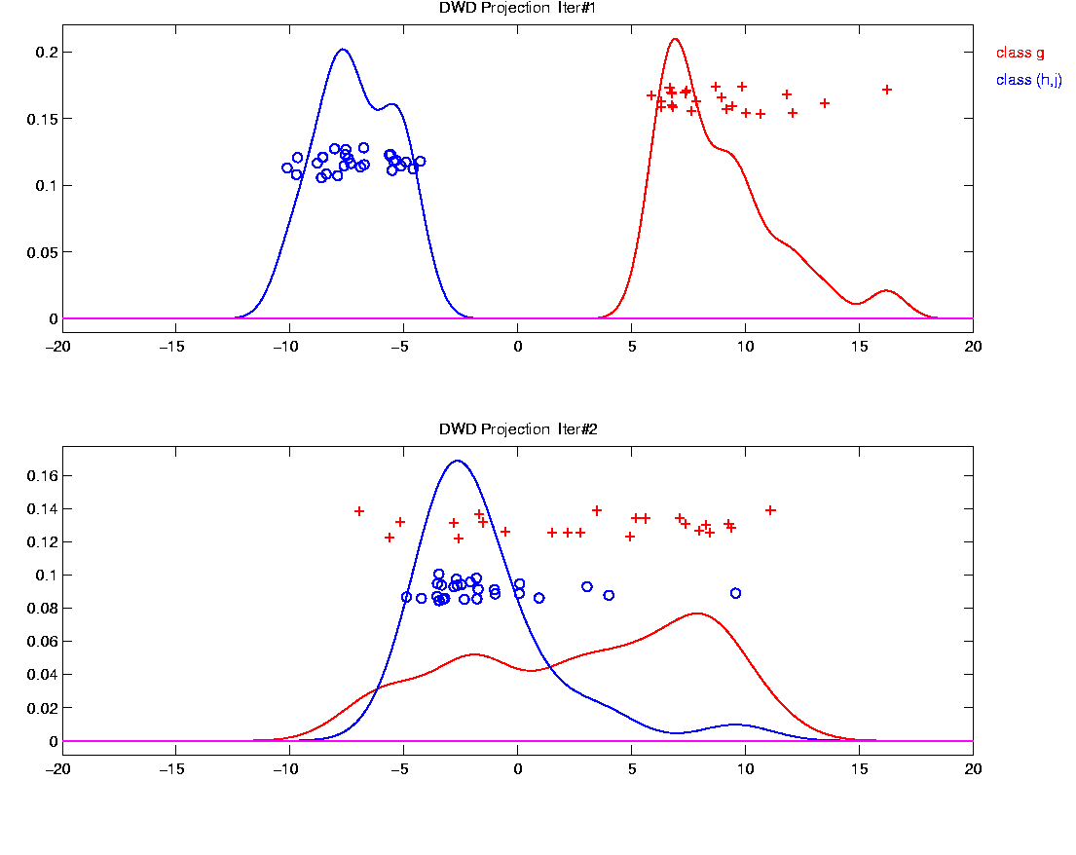
Why not adjust using SVM?
Nicely Fixed by DWD
Projected Dist’ns near Gaussian
Sensible to shift

Slide 48
Why not adjust by means?
DWD is complicated: value added?
Because it is “cool”
  Recall Improves SVM for HDLSS
Good Empirical Success
  Routinely Used in Perou Lab
  Many Comparisons Done
  Similar Lessons from Wistar
Proven Statistical Power

Slide 49
Why not adjust by means?
But Why Not PAM (~Mean Difference)?
Simpler is Better
Why not means, i.e. point cloud centerpoints?
Elegant Answer: Liu et al (2009)

Slide 50
Why not adjust by means?
But Why Not PAM (~Mean Difference)?
Simpler is Better
Why not means, i.e. point cloud centerpoints?
Drawback to PAM:
Poor Handling of Unbalanced Biological Subtypes
DWD more Resistant to Unbalance

Slide 51
Why not adjust by means?
Toy Example:
  Gaussian Clusters
  Two batches (denoted: + o)
  Two subtypes (red and blue)
  Goal: bring together
  + ←→ o and also + ←→ o
  Challenge: unequal biological ratios within batches

Slide 52
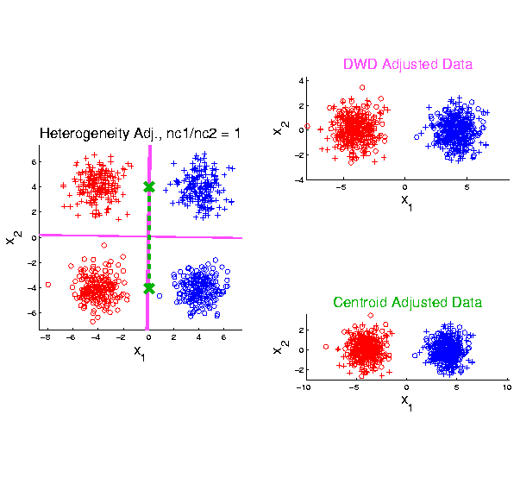
Twiddle ratios of subtypes
2-d Toy
Example
Balanced
Mixture

Slide 53
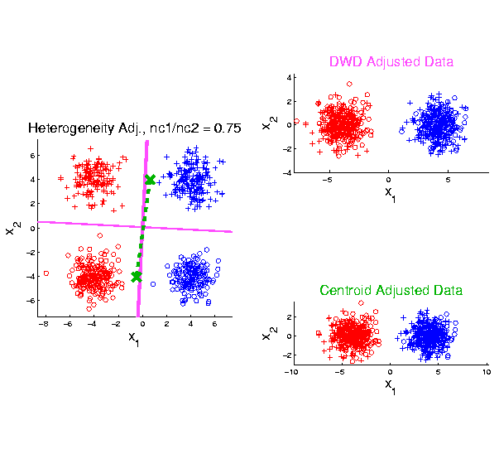
Twiddle ratios of subtypes
2-d Toy
Example
Unbalanced
Mixture
(Through
“decimation”)

Slide 54
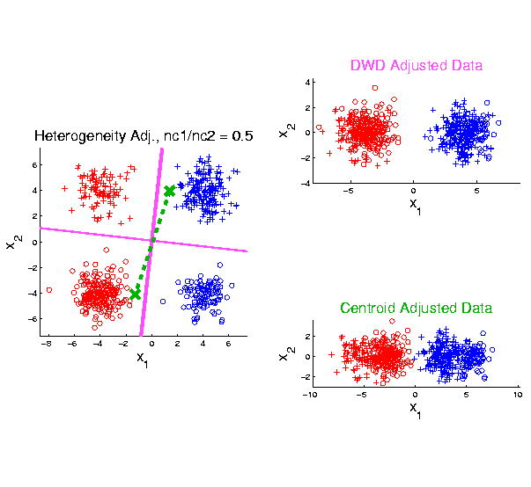
Twiddle ratios of subtypes
2-d Toy
Example
Unbalanced
Mixture
(Diminishing
Discriminatory
Power)

Slide 55
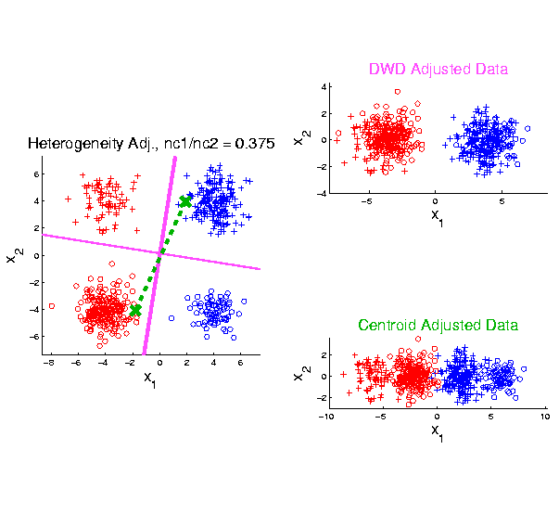
Twiddle ratios of subtypes
2-d Toy
Example
Unbalanced
Mixture

Slide 56
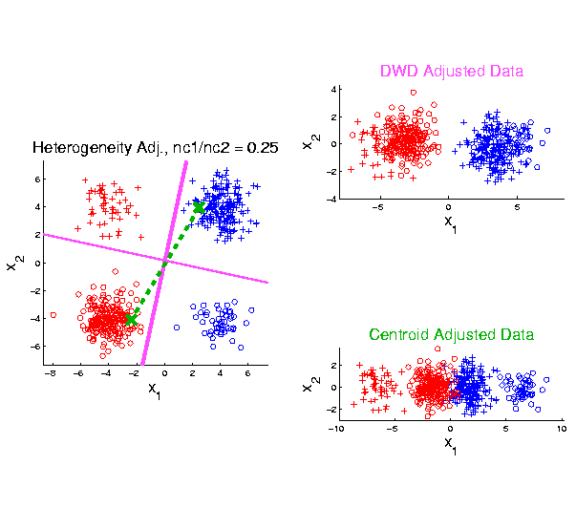
Twiddle ratios of subtypes
2-d Toy
Example
Unbalanced
Mixture

Slide 57
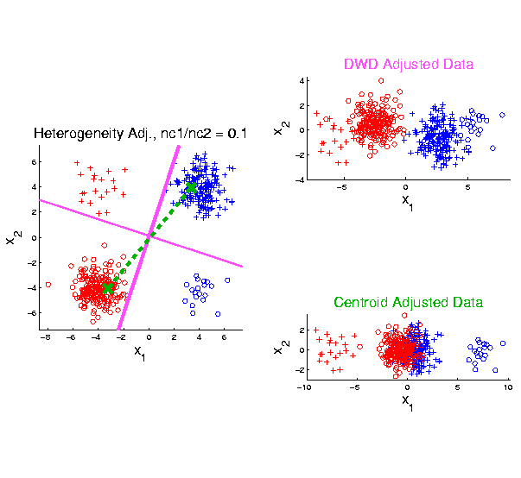
Twiddle ratios of subtypes
2-d Toy
Example
Unbalanced
Mixture
Note: Losing
Distinction
To Be Studied

Slide 58
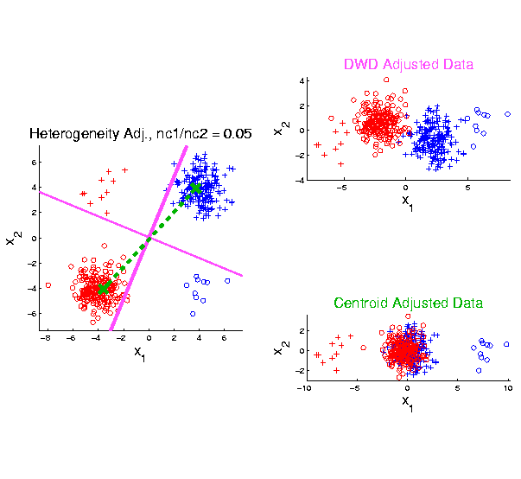
Twiddle ratios of subtypes
2-d Toy
Example
Unbalanced
Mixture

Slide 59
Why not adjust by means?
DWD robust against non-proportional subtypes…
Mathematical Statistical Question:
Are there mathematics behind this?
Notes:
59

Slide 60
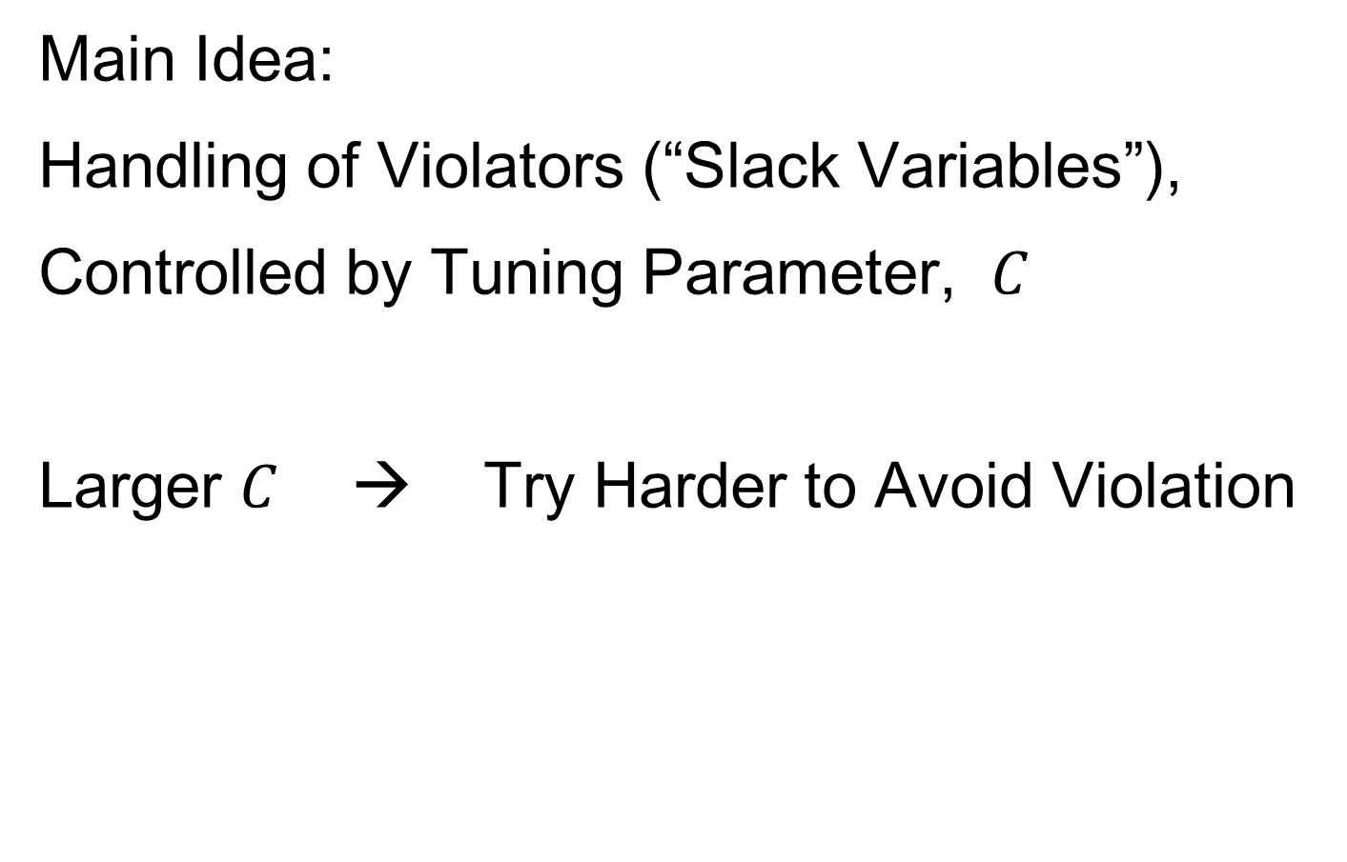
SVM & DWD Tuning Parameter
Main Idea:
Handling of Violators (“Slack Variables”),
Controlled by Tuning Parameter, $C$
Larger $C$ → Try Harder to Avoid Violation
Notes:
60

Slide 61
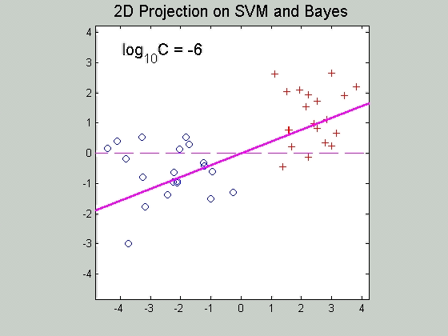

SVM Tuning Parameter
Recall Movie over $C$ for SVM:
Notes:
61

Slide 62
SVM & DWD Tuning Parameter
Possible Approaches:
Visually Tuned
(Can be Effective,
But Takes Time,
Requires Expertise)
Notes:
62

Slide 63
SVM & DWD Tuning Parameter
Possible Approaches:
Visually Tuned
Simple Defaults
DWD: 100 / median pairwise distance
(Surprisingly Useful, Simple Answer)
Notes:
63

Slide 64
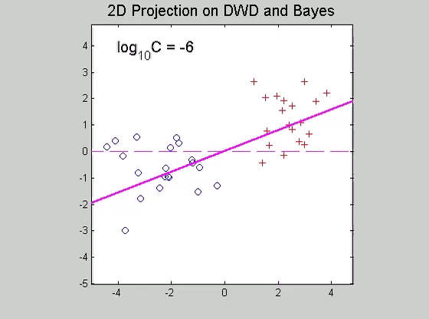
SVM & DWD Tuning Parameter
Simple Default DWD:
100 / median pairwise distance
Notes:
64

Slide 65
SVM & DWD Tuning Parameter
Possible Approaches:
Visually Tuned
Simple Defaults
DWD: 100 / median pairwise distance
(Surprisingly Useful, Simple Answer)
SVM: 1000
(Works Well Sometimes, Not Others)
Notes:
65

Slide 66
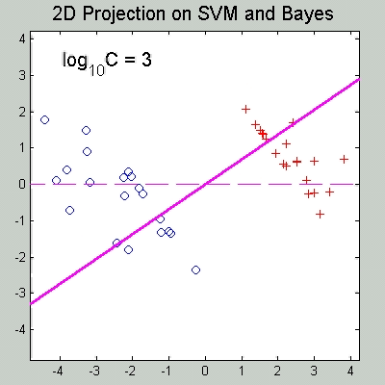
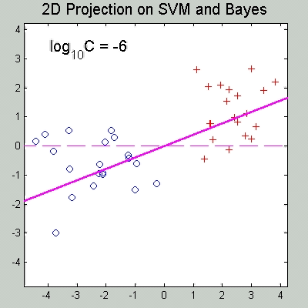
SVM & DWD Tuning Parameter
Simple Default, SVM: 1000
{from Carmichael & Marron (2017)}
Hard Margin SVM
vs. Trimmed Mean Diff.
Notes:
66

Slide 67
SVM & DWD Tuning Parameter
Possible Approaches:
Visually Tuned
Simple Defaults
(Works Well for DWD,
Less Effective for SVM)
Notes:
67

Slide 68

SVM & DWD Tuning Parameter
Possible Approaches:
Visually Tuned
Simple Defaults
Cross Validation
Measure Classification Error Rate
Leaving Some Out (to Avoid Overfitting)
Choose $C$ to Minimize Error Rate
Notes:
68

Slide 69
SVM & DWD Tuning Parameter
Possible Approaches:
Visually Tuned
Simple Defaults
Cross Validation
(Very Popular – Useful for SVM,
But Comes at Computational Cost)
Notes:
69

Slide 70
SVM & DWD Tuning Parameter
Possible Approaches:
Visually Tuned
Simple Defaults
Cross Validation
Scale Space
(Work with Full Range of Choices,
Will Explore More Soon)
Notes:
70

Slide 71

Outliers in PCA
Deep Toy Example:

Slide 72

Outliers in PCA
Deep Toy Example:
Why is green curve an outlier?
Never leaves range of other data
But Euclidean distance to others very large
relative to other distances
Also major difference in terms of shape
And even smoothness
Important lesson:
$∃$ many directions in $ℝ^{d}$

Slide 73

Outliers in PCA
Much like
earlier
Parabolas
Example
But with
1 “outlier”
thrown in

Slide 74

Outliers in PCA
PCA for
Deeper
Toy E.g.
Data:

Slide 75
Outliers in PCA
Deeper Toy Example:
At first glance, mean and PC1 look similar to no outlier version
PC2 clearly driven completely by outlier
PC2 scores plot (on right) gives clear outlier diagnostic
Outlier does not appear in other directions
Previous PC2, now appears as PC3
Power (scree plot) now “spread farther”

Slide 76
Outliers in PCA
Closer Look at Deeper Toy Example:
Mean “influenced” a little, by the outlier
Appearance of “corners” at every other coordinate
PC1 substantially “influenced” by the outlier
Clear “wiggles”

Slide 77
Outliers in PCA
What can (should?) be done about outliers?
Context 1: Outliers are important aspects of the population
  They need to be highlighted in the analysis
  Although could separate into subpopulations
Context 2: Outliers are “bad data”, of no interest
  recording errors? Other mistakes?
  Then should avoid distorted view of PCA

Slide 78
Outliers in PCA
Two Differing Goals for Outliers:
Avoid Major Influence on Analysis
Find Interesting Data Points
(e.g. In-liers)
Wilkinson (2017)

Slide 79
Outliers in PCA
Two Differing Goals for Outliers:
Avoid Major Influence on Analysis
Find Interesting Data Points
FDA Version: Mean & Shape Outliers
Dai & Genton (2016, 2017)

Slide 80
Outliers in PCA
Standard Statistical Approaches to Dealing with Influential Outliers:
Outlier Deletion:
Kick out “bad data”
Robust Statistical methods:
Work with full data set,
but downweight “bad data”
Reduce influence, instead of “deleting”
(Think Median)

Slide 81

Outliers in PCA
Alternate approach:
Robust Statistical Methods
Recall main idea:
Downweight (instead of delete) outliers
$∃$ a large literature. Good intro’s
(from different viewpoints) are:
Huber (2011)
Hampel, et al (2011)
Staudte & Sheather (2011)
Clarke (2018)

Slide 82
Outliers in PCA
Simple robustness concept: breakdown point
how much of data “moved to ”
will “destroy estimate”?
Usual mean has breakdown 0
Median has breakdown ½ (best possible)
Conclude:
Median much more robust than mean
Median uses all data
Median gets good breakdown from
“equal vote”

Slide 83

Outliers in PCA
Mean has
breakdown 0
Single
Outlier
Pulls Mean
Outside
range
of data

Slide 84
Outliers in PCA
Controversy:
Is median’s “equal vote” scheme good or bad?
Huber:
Outliers contain some information,
So should only control “influence”
(e.g. median)
Hampel, et. al.:
Outliers contain no useful information
Should be assigned weight 0
(not done by median)
Using “proper robust method”
(not simply deleted)

Slide 85
Outliers in PCA
Robustness Controversy (cont.):
Both are “right” (depending on context)
Source of major (unfortunately bitter) debate!

Slide 86

Robust PCA
What is multivariate median?
There are several!
(“median” generalizes in different ways)
Coordinate-wise median
Often worst
Not rotation invariant
(2-d data uniform on “L”)
$$\left(\begin{matrix}median\left(X_{i,1}\right) \\ ⋮ \\ median\left(X_{d,1}\right)\end{matrix}\right)$$

Slide 87

Robust PCA
Coordinate-wise median
Not rotation invariant
Thus poor notion of “center”

Slide 88
Robust PCA
Coordinate-wise median
Can lie on convex hull of data
Thus poor notion of “center”

Slide 89
Robust PCA
What is multivariate median?
There are several!
(“median” generalizes in different ways)
Coordinate-wise median
Often worst
Not rotation invariant
(2-d data uniform on “L”)
Can lie on convex hull of data
(same example)
Thus can be poor notion of “center”
$$\left(\begin{matrix}median\left(X_{i,1}\right) \\ ⋮ \\ median\left(X_{d,1}\right)\end{matrix}\right)$$

Slide 90

Robust PCA
What is multivariate median (cont.)?
ii. Simplicial depth (a. k. a. “data depth”):
Liu (1990)
“Paint Thickness” of $d+1$ dim “simplices” with corners at data
Nice idea
Good invariance properties
Slow to compute

Slide 91

Robust PCA
What is multivariate median (cont.)?
iii. Huber’s $L^{p}$ M-estimate:
Given data $X_{1},⋯,X_{n}∈ℝ^{d}$,
Estimate “center of population” by
$$\hat{θ}={argmin}_{θ}\sum_{i=1}^{n}{{\left\|X_{i}−θ\right\|}_{2}^{p}}$$
Where ${\left\|∙\right\|}_{2}$ is the usual Euclidean norm
Here: use only $p=1$
(minimal impact by outliers)

Slide 92

Robust PCA
Huber’s $L^{p}$ M-estimate (cont):
Estimate “center of population” by
$$\hat{θ}={argmin}_{θ}\sum_{i=1}^{n}{{\left\|X_{i}−θ\right\|}_{2}^{p}}$$
Case $p=2$:
Can show $\hat{θ}=\overline{X}$ (sample mean)
(also called “Fréchet Mean”, …)
Again Here: use only $p=1$
(minimal impact by outliers)

Slide 93

Robust PCA
$L^{1}$ M-estimate (cont.):
A view of minimizer: Study solution of
$$\underline{0}=\left(\begin{matrix}⋮ \\ \frac{∂}{∂θ_{j}}\sum_{i=1}^{n}{{\left\|X_{i}−θ\right\|}_{2}} \\ ⋮\end{matrix}\right)=$$
$$=\sum_{i=1}^{n}{\frac{X_{i}−θ}{{\left\|X_{i}−θ\right\|}_{2}}}$$

Slide 94


Robust PCA
$L^{1}$ M-estimate (cont.):
A view of minimizer: Study solution of
$$\underline{0}=\sum_{i=1}^{n}{\frac{X_{i}−θ}{{\left\|X_{i}−θ\right\|}_{2}}}$$
A useful viewpoint is based on:
$P_{Sph(θ,1)}$ = “Proj’n of data onto sphere
centered at $θ$ with radius $1$”
And representation: $P_{Sph(θ,1)}X_{i}=θ+\frac{X_{i}−θ}{{\left\|X_{i}−θ\right\|}_{2}}$

Slide 95

Robust PCA
$L^{1}$ M-estimate (cont.):
Thus the solution of
$$0=\sum_{i=1}^{n}{\frac{X_{i}−θ}{{\left\|X_{i}−θ\right\|}_{2}}}=\sum_{i=1}^{n}{\left(P_{Sph(θ,1)}X_{i}−θ\right)}$$
is the solution of:
$$0=avg\left\{P_{Sph(θ,1)}X_{i}−θ:i=1,⋯,n\right\}$$
So $\hat{θ}$ is location where projected data are centered at $\hat{θ}$
“Slide sphere around until mean (of projected data) is at center”

Slide 96

Robust PCA
$L^{1}$ M-estimate (cont.):
Data are
+ signs

Slide 97

Robust PCA
M-estimate (cont.):
Data are
+ signs
Sample Mean, $\overline{X}$
outside “hot dog”
of data

Slide 98

Robust PCA
M-estimate (cont.):
Candidate
Sphere Center, $θ$

Slide 99

Robust PCA
M-estimate (cont.):
Candidate
Sphere Center, $θ$
Projections
Of Data

Slide 100

Robust PCA
M-estimate (cont.):
Candidate
Sphere Center, $θ$
Projections
Of Data
Mean of
Projections

Slide 101
Robust PCA
M-estimate (cont.):
“Slide sphere
around until
mean (of
projected data)
is at center”

Slide 102

Robust PCA
M-estimate (cont.):
Additional literature:
Called “geometric median” (long before Huber) by: Haldane (1948)
Shown unique for $d>1$ by: Milasevic and Ducharme (1987)
Useful iterative algorithm: Gower (1974)
(see also Sec. 3.2 of Huber (2011)).

Slide 103

Robust PCA
Now have robust measure of “center”,
how about
“spread”?
I.e. how
can we
do robust
PCA?

Slide 104
Robust PCA
Now have robust measure of “center”,
how about
“spread”?
Parabs e.g.
from above
With an
“outlier” (???)
Added in

Slide 105
Robust PCA
Now have robust measure of “center”,
how about
“spread”?
Small Impact on Mean

Slide 106
Robust PCA
Now have robust measure of “center”,
how about
“spread”?
Small Impact on Mean
More on PC1 Dir’n

Slide 107
Robust PCA
Now have robust measure of “center”,
how about
“spread”?
Small Impact on Mean
More on PC1 Dir’n
Dominates Residuals
Thus PC2 Dir’n
& PC2 scores

Slide 108
Robust PCA
Now have robust measure of “center”,
how about
“spread”?
Small Impact on Mean
More on PC1 Dir’n
Dominates Residuals
Thus PC2 Dir’n
& PC2 scores
Tilt now in PC3
Viualization is very
Useful diagnostic

Slide 109
Robust PCA
Now have robust measure of “center”,
how about
“spread”?
How
can we
do robust
PCA?

Slide 110
Robust PCA
Approaches to Robust PCA:
Robust Estimation of Covariance Matrix
Projection Pursuit
Spherical PCA

Slide 111

Robust PCA
Robust PCA 1: Robust Estimation of Covariance Matrix
A. Component-wise Robust Covariances:
Major problem:
Hard to get non-negative definiteness
Minimum Volume Ellipsoid:
Rousseeuw & Leroy (2005)
Requires $n>d$ (in available software)
Needed for simple definition of affine invariant

Slide 112
Robust PCA
Robust PCA 2: Projection Pursuit
Idea: focus on
“finding direction of greatest variability”
Reference: Li and Chen (1985)
Problems:
Robust estimates of “spread” are nonlinear
Results in many local optima

Slide 113

Robust PCA
Robust PCA 2: Projection Pursuit (cont.)
Problems:
Results in many local optima
Makes search problem very challenging
Especially in very high dimensions
Most examples have $d=4,5$
Guoying Li:
“I’ve heard of $d=20$,
but 60 seems too big”

Slide 114

Robust PCA
Robust PCA 3:
Spherical
PCA
Locantore et al (1999)

Slide 115
Robust PCA
Robust PCA 3: Spherical PCA
Idea: use “projection to sphere” idea from M-estimation
In particular project data to centered sphere
“Hot Dog” of data becomes “Ice Caps”
Easily found by PCA (on proj’d data)
Outliers pulled in to reduce influence
Radius of sphere unimportant
Notes:
115

Slide 116
Participant Presentation
Seoyoon Cho:
Relationship Between Mullen Score and Nutritions

