Slide 1
Participant Presentations
Please Send Title:
Wei Gu
Bohan Li
Siqi Xiang
Mingyi Wang

Slide 2
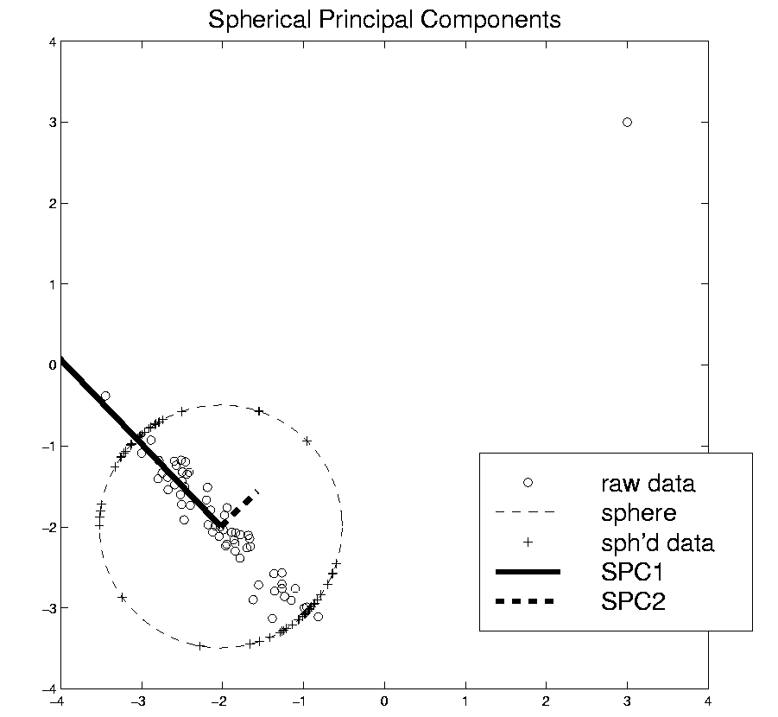
Robust PCA
Robust PCA 3:
Spherical
PCA
Locantore et al (1999)

Slide 3

Robust PCA
Robust PCA 3: Spherical PCA
Independent Derivation & Alternate Name:
PCA of Spatial Signs
1st Paper:
Möttönen & Oja (1995)
Complete Description:
Oja (2010)
Notes:
3

Slide 4
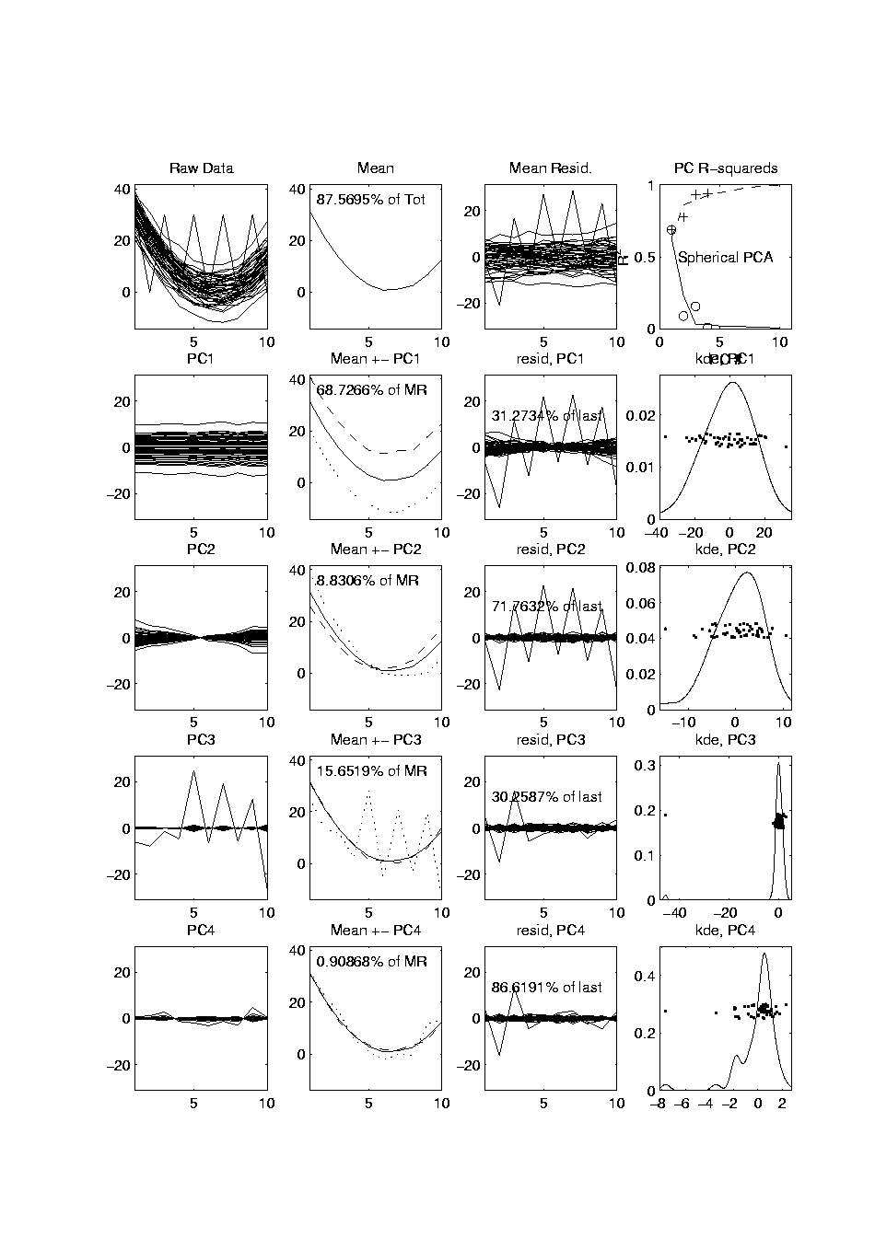
Robust PCA
Mean Looks
Smoother
Spherical PCA for Toy Example:
Now do
Spherical
PCA
Better result?
PC1 Nearly Flat
Lines are Eigenvalues on Sphere
Circles Show Original Variances
PC2 is Tilt (NOT Outlier)
Outlier Demoted to PC3
Notes:
4

Slide 5
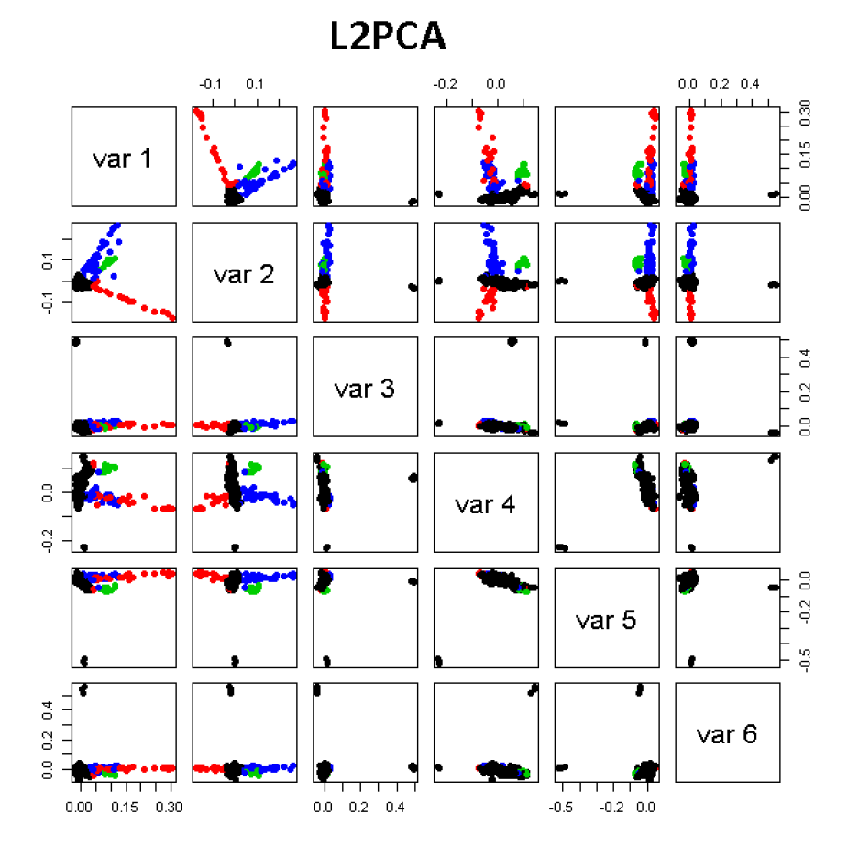
GWAS Data Analysis
PCA View
Clear Ethnic
Groups
And Several
Outliers!
Eliminate With
Spherical PCA?

Slide 6
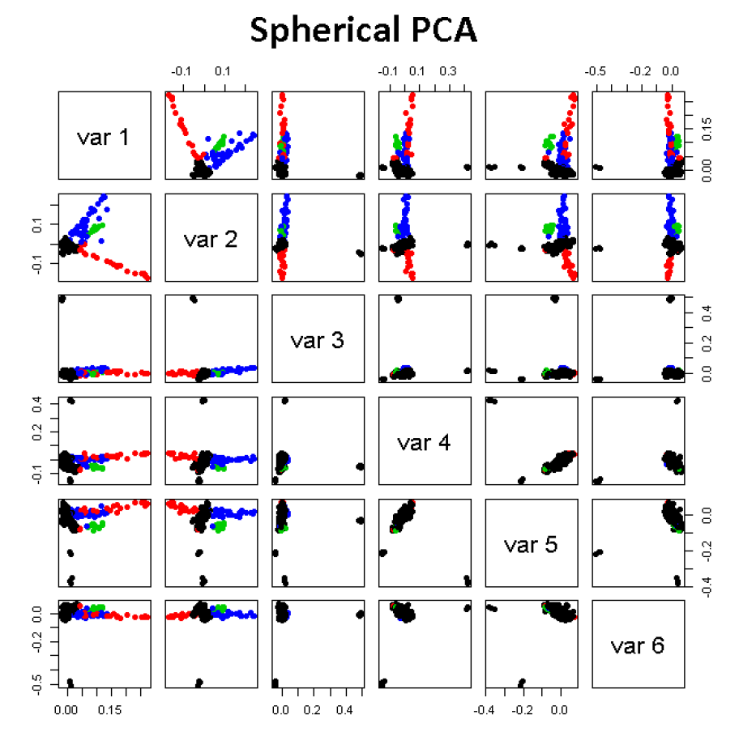
GWAS Data Analysis
Spherical
PCA
Looks Same?!?
What is
going on?
Will Explain
Later

Slide 7
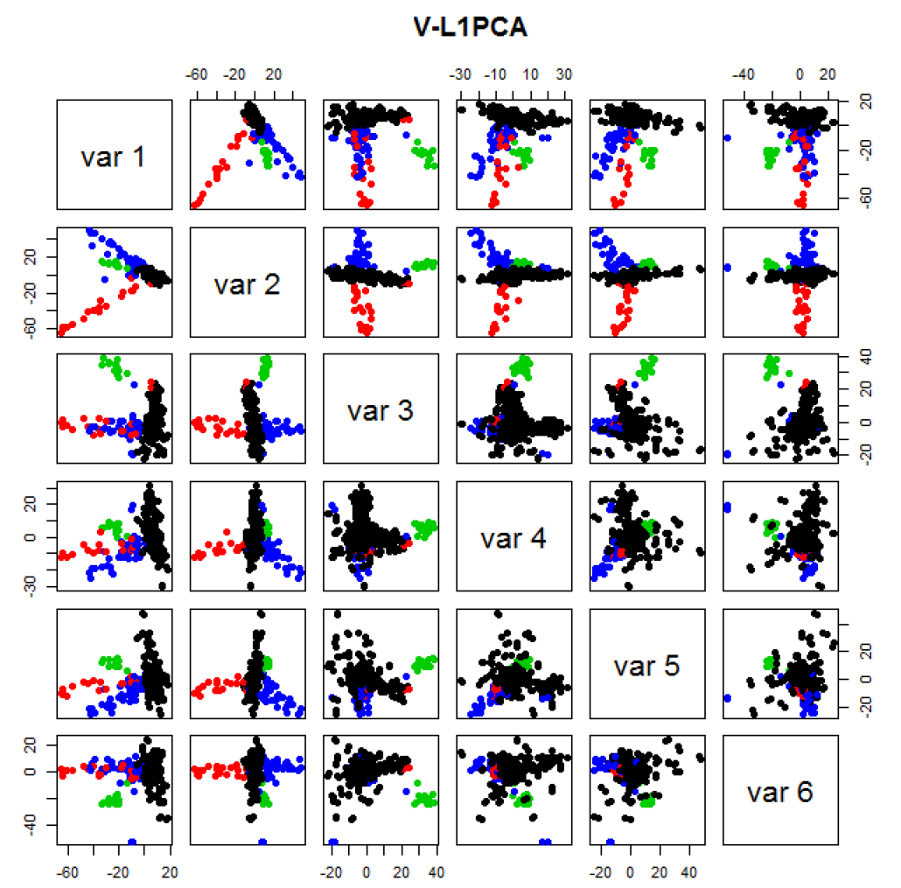
GWAS Data
VL1 PCA
Best Focus
On Ethnic
Groups
Seems To
Find Unlabelled
Clusters

Slide 8
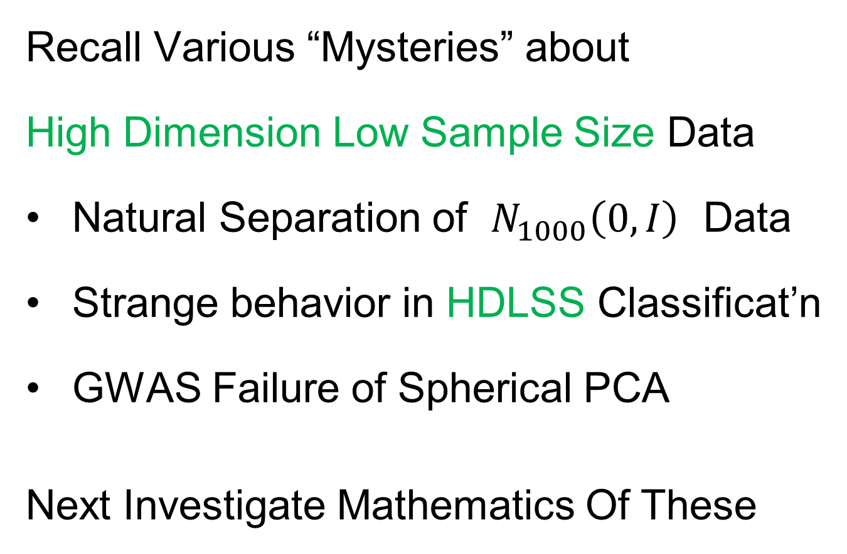
HDLSS Asymptotics
Recall Various “Mysteries” about
High Dimension Low Sample Size Data
Natural Separation of $N_{1000}\left(0,I\right)$ Data
Strange behavior in HDLSS Classificat’n
GWAS Failure of Spherical PCA
Next Investigate Mathematics Of These
Notes:
8

Slide 9
HDLSS Asymptotics
Modern Mathematical Statistics:
Based on asymptotic analysis
Real Reasons:
  Approximation provides insights
  Can find simple underlying structure
  In complex situations
Thus various flavors are fine:
$$\lim_{n→∞}{} \lim_{d→∞}{} \lim_{n,d→∞}{} \lim_{σ→0}{}$$
Even desirable! (find additional insights)
Notes:
9

Slide 10
HDLSS Asymptotics
Personal Observations:
HDLSS world is…
Surprising (many times!)
[Think I’ve got it, and then …]
Mathematically Beautiful (?)
Practically Relevant

Slide 11
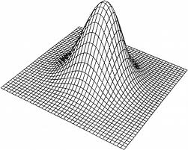
HDLSS Asymptotics: Simple Paradoxes
For $d$ dimensional Standard Normal dist’n:
$$\underline{Z}=\left(\begin{matrix}Z_{1} \\ ⋮ \\ Z_{d}\end{matrix}\right)\sim N_{d}\left(0,I_{d}\right)$$
Where are the Data?
Near Peak of Density?
Thanks to: psycnet.apa.org

Slide 12
HDLSS Asymptotics: Simple Paradoxes
For $d$ dimensional Standard Normal dist’n:
$$\underline{Z}=\left(\begin{matrix}Z_{1} \\ ⋮ \\ Z_{d}\end{matrix}\right)\sim N_{d}\left(0,I_{d}\right)$$
Euclidean Distance to Origin (as $d→∞$)
(measure how close to peak)

Slide 13
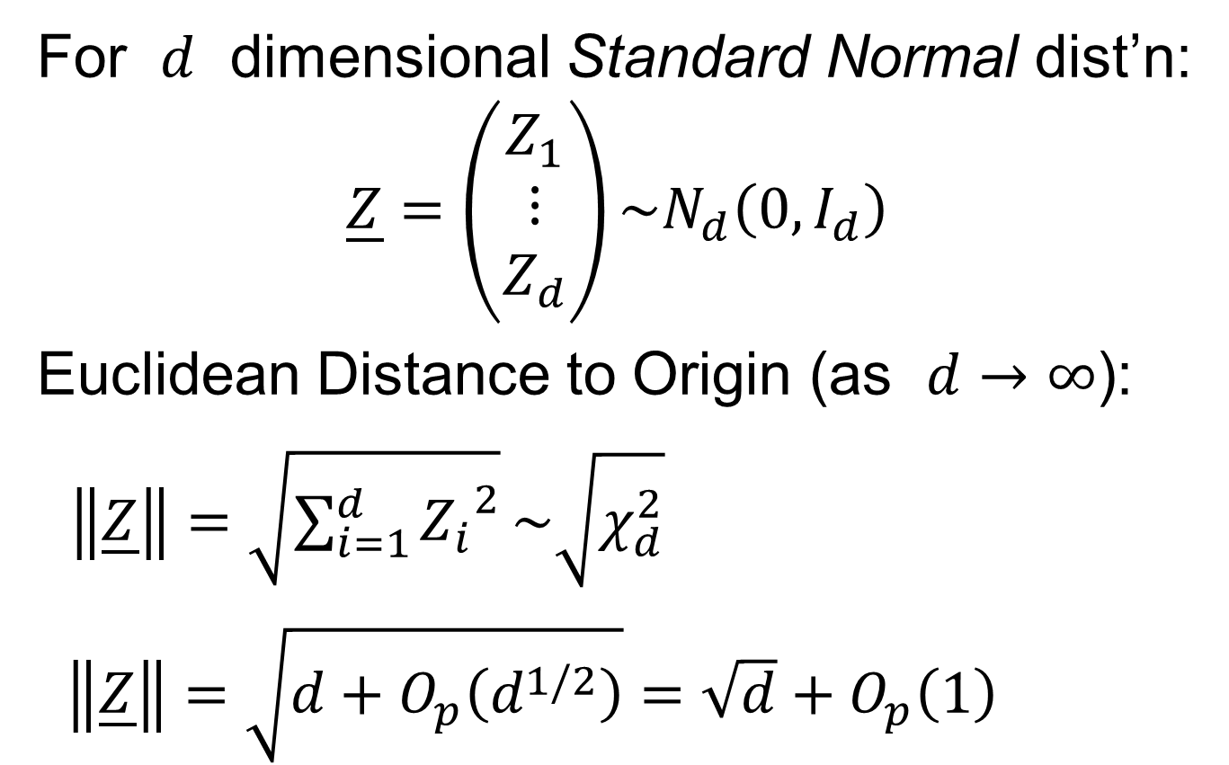
HDLSS Asymptotics: Simple Paradoxes
For $d$ dimensional Standard Normal dist’n:
$$\underline{Z}=\left(\begin{matrix}Z_{1} \\ ⋮ \\ Z_{d}\end{matrix}\right)\sim N_{d}\left(0,I_{d}\right)$$
Euclidean Distance to Origin (as $d→∞$):
$\left\|\underline{Z}\right\|=\sqrt{\sum_{i=1}^{d}{{Z_{i}}^{2}}}\sim \sqrt{χ_{d}^{2}}$
$\left\|\underline{Z}\right\|=\sqrt{d+O_{p}\left(d^{1/2}\right)}=\sqrt{d}+O_{p}\left(1\right)$

Slide 14
HDLSS Asymptotics: Simple Paradoxes
As $d→∞$,
$$\left\|\underline{Z}\right\|=\sqrt{d}+O_{p}\left(1\right)$$
Data lie roughly on surface of sphere,
with radius $\sqrt{d}$
- Yet origin is point of highest density???
- Paradox resolved by:
density w. r. t. Lebesgue Measure
Notes:
14

Slide 15
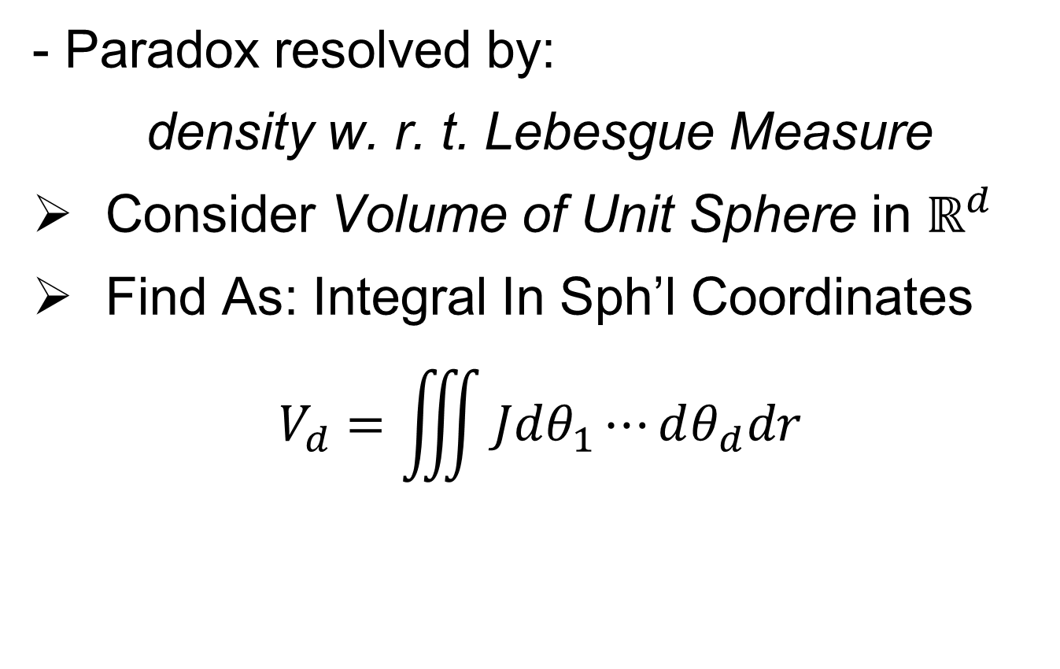
HDLSS Asymptotics: Simple Paradoxes
- Paradox resolved by:
density w. r. t. Lebesgue Measure
Consider Volume of Unit Sphere in $ℝ^{d}$
Find As: Integral In Sph’l Coordinates
$$V_{d}=\iiint{Jdθ_{1}⋯dθ_{d}dr}$$
Notes:
15

Slide 16
HDLSS Asymptotics: Simple Paradoxes
- Paradox resolved by:
density w. r. t. Lebesgue Measure
Consider Volume of Unit Sphere in $ℝ^{d}$
Find As: Integral In Sph’l Coordinates
$$V_{d}=\iiint{Jdθ_{1}⋯dθ_{d}dr}$$
Look At Integrand w.r.t. $r$
Can Show: Puts ~ All Weight Near $r=1$
Notes:
16

Slide 17
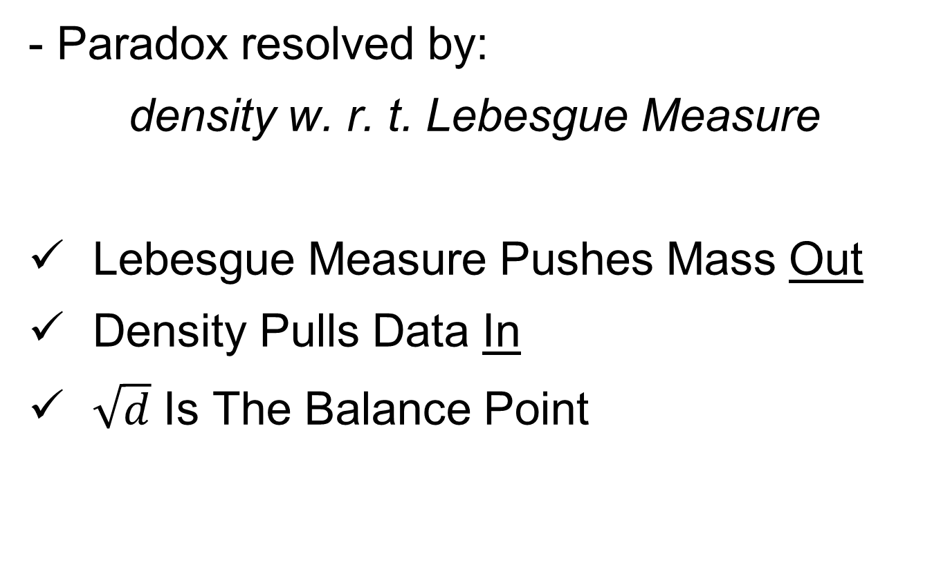
HDLSS Asymptotics: Simple Paradoxes
- Paradox resolved by:
density w. r. t. Lebesgue Measure
Lebesgue Measure Pushes Mass Out
Density Pulls Data In
$\sqrt{d}$ Is The Balance Point
Notes:
17

Slide 18
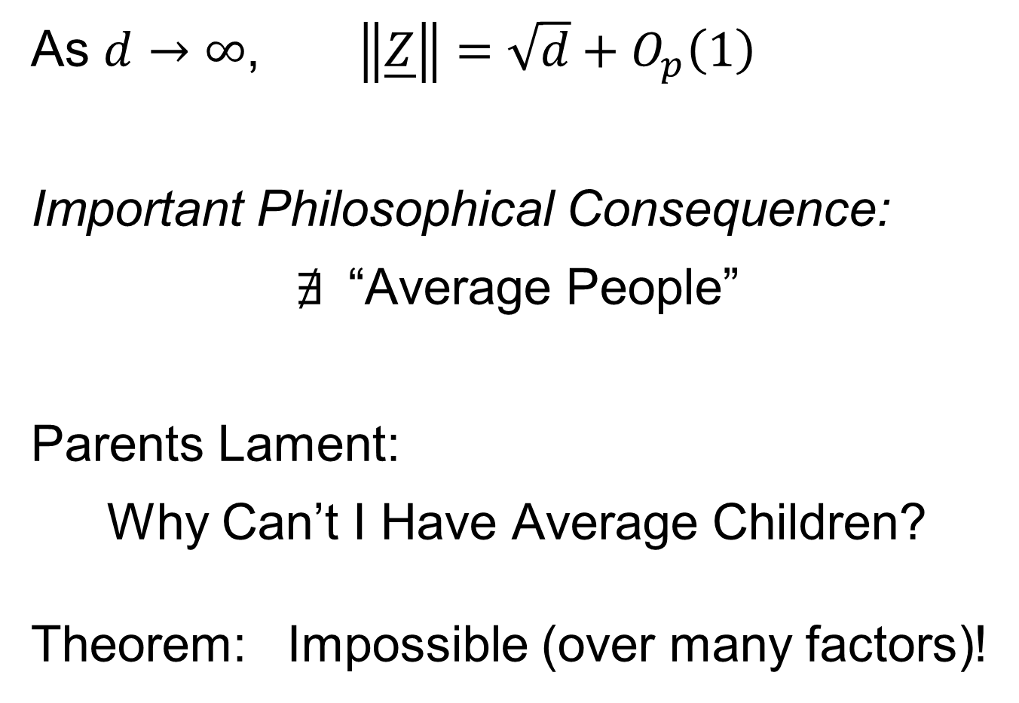
HDLSS Asymptotics: Simple Paradoxes
As $d→∞$, $\left\|\underline{Z}\right\|=\sqrt{d}+O_{p}\left(1\right)$
Important Philosophical Consequence:
$∄$“Average People”
Parents Lament:
Why Can’t I Have Average Children?
Theorem: Impossible (over many factors)!
Notes:
18

Slide 19
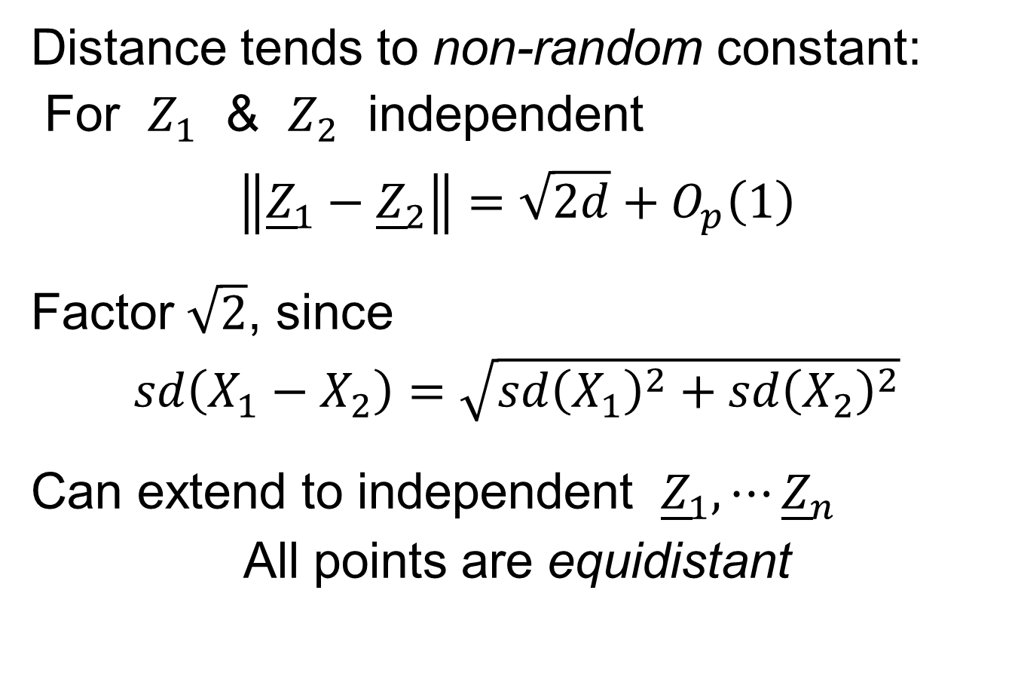
HDLSS Asymptotics: Simple Paradoxes
Distance tends to non-random constant:
For $Z_{1}$ & $Z_{2}$ independent
$$\left\|{\underline{Z}}_{1}−{\underline{Z}}_{2}\right\|=\sqrt{2d}+O_{p}\left(1\right)$$
Factor $\sqrt{2}$, since
$sd\left(X_{1}−X_{2}\right)=\sqrt{{sd\left(X_{1}\right)}^{2}+{sd\left(X_{2}\right)}^{2}}$
Can extend to independent ${\underline{Z}}_{1},⋯{\underline{Z}}_{n}$
All points are equidistant
(We can only perceive 3 dimensions)
Notes:
19

Slide 20
HDLSS Asymptotics: Simple Paradoxes
Recall Reason Why
Perceptual System from Ancestors
They Needed to Find Food
Food Exists in 3-d World
(We can only perceive 3 dimensions)
Notes:
20

Slide 21
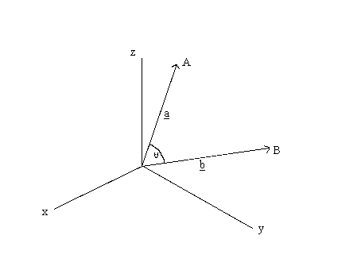
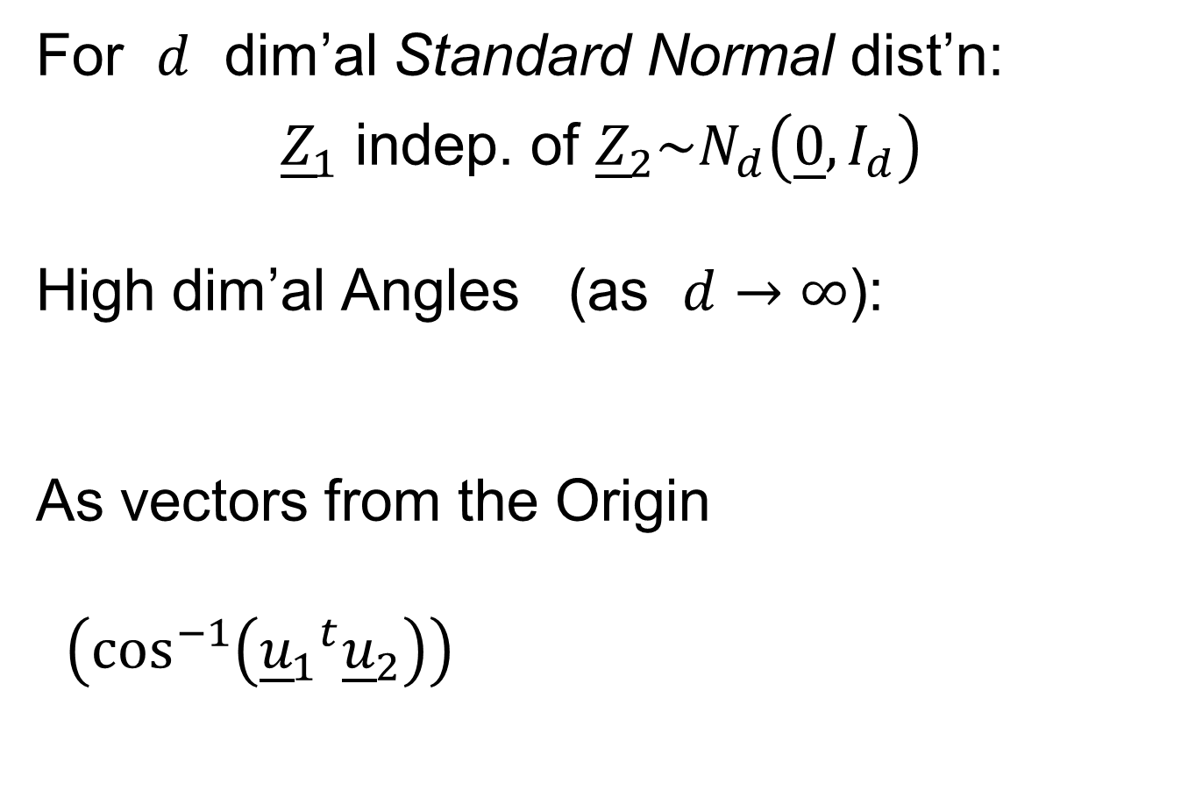
HDLSS Asymptotics: Simple Paradoxes
For $d$ dim’al Standard Normal dist’n:
${\underline{Z}}_{1}$ indep. of ${\underline{Z}}_{2}\sim N_{d}\left(\underline{0},I_{d}\right)$
High dim’al Angles (as $d→∞$):
As vectors from the Origin
$\left(\cos^{−1}\left({{\underline{u}}_{1}}^{t}{\underline{u}}_{2}\right)\right)$
Thanks to: members.tripod.com

Slide 22
HDLSS Asymptotics: Simple Paradoxes
For $d$ dim’al Standard Normal dist’n:
${\underline{Z}}_{1}$ indep. of ${\underline{Z}}_{2}\sim N_{d}\left(\underline{0},I_{d}\right)$
High dim’al Angles (as $d→∞$):
$$Angle\left({\underline{Z}}_{1},{\underline{Z}}_{2}\right)={90}^{°}+O_{p}\left(d^{−1/2}\right)$$
- Everything is orthogonal???

Slide 23

HDLSS Asy’s: Geometrical Represent’n
Assume ${\underline{Z}}_{1},⋯{\underline{Z}}_{n}\sim N_{d}\left(\underline{0},I_{d}\right)$, let $d→∞$
Study Subspace Generated by Data
Hall, Marron & Neeman (2005)

Slide 24

HDLSS Asy’s: Geometrical Represent’n
Assume ${\underline{Z}}_{1},⋯{\underline{Z}}_{n}\sim N_{d}\left(\underline{0},I_{d}\right)$, let $d→∞$
Study Subspace Generated by Data
Hyperplane through $0$,
of dimension $n$
Hall, Marron & Neeman (2005)

Slide 25

HDLSS Asy’s: Geometrical Represent’n
Assume ${\underline{Z}}_{1},⋯{\underline{Z}}_{n}\sim N_{d}\left(\underline{0},I_{d}\right)$, let $d→∞$
Study Subspace Generated by Data
Hyperplane through $0$,
of dimension $n$
Points are “nearly equidistant to $0$”,
& dist $\sqrt{d}$
Hall, Marron & Neeman (2005)

Slide 26
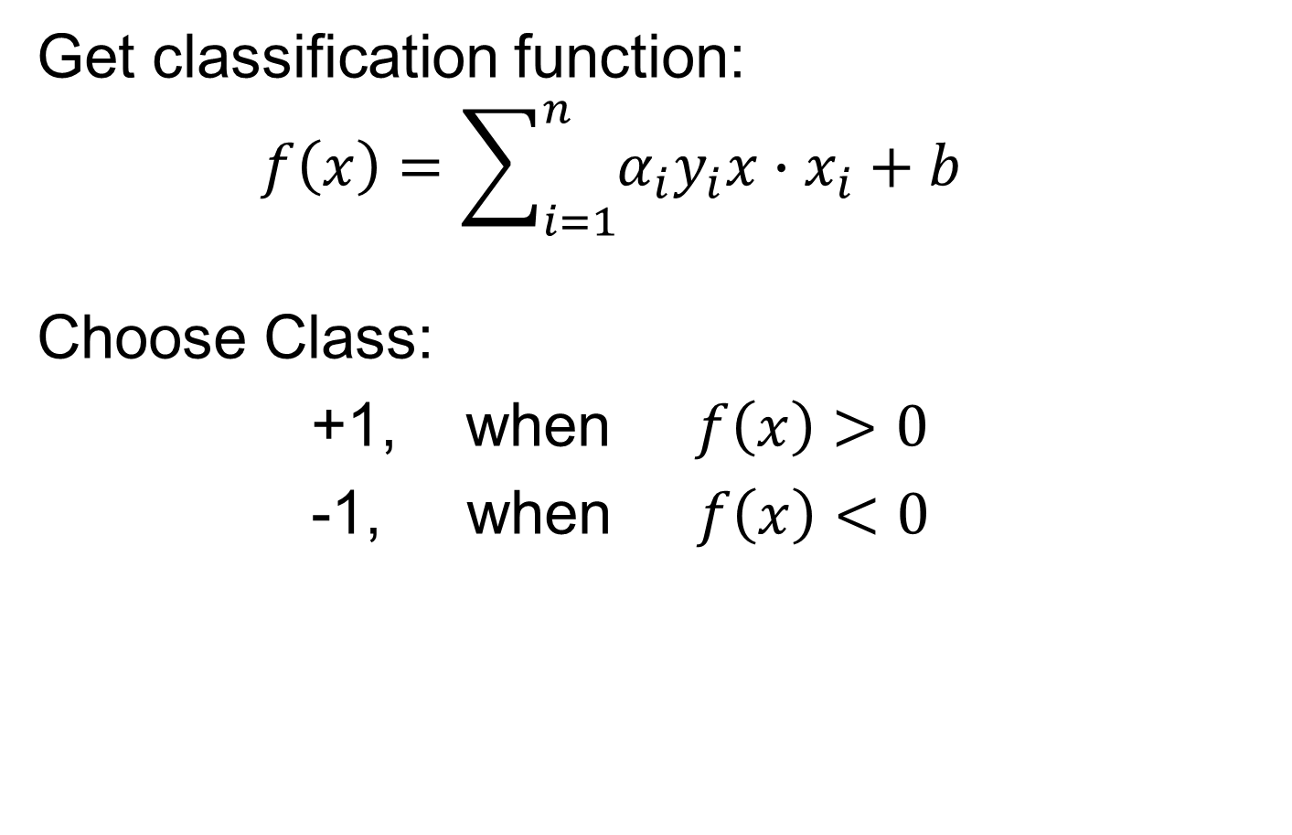
HDLSS Asy’s: Geometrical Represent’n
Assume ${\underline{Z}}_{1},⋯{\underline{Z}}_{n}\sim N_{d}\left(\underline{0},I_{d}\right)$, let $d→∞$
Study Subspace Generated by Data
Hyperplane through $0$,
of dimension $n$
Points are “nearly equidistant to $0$”,
& dist $\sqrt{d}$
Within plane, can
“rotate towards $\sqrt{d} ×$ Unit Simplex”
Hall, Marron & Neeman (2005)

Slide 27

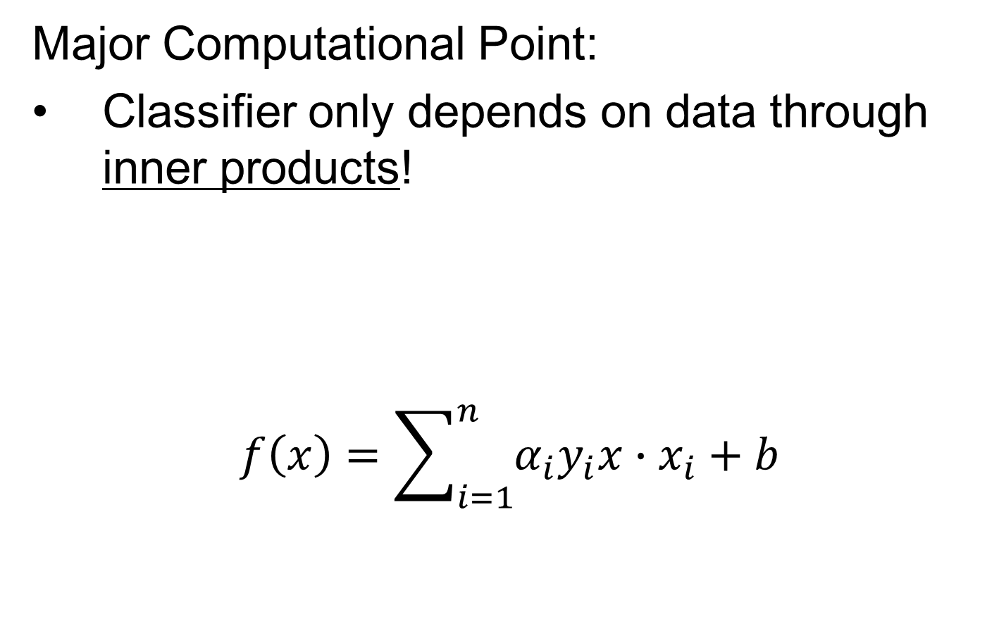
Unit Simplex in $ℝ^{d}$
Convex Combinations of Unit Vectors
$\left(\begin{matrix}\begin{matrix}0 \\ 1 \\ 0\end{matrix} \\ ⋮ \\ 0\end{matrix}\right)$
$\left(\begin{matrix}\begin{matrix}1 \\ 0\end{matrix} \\ \begin{matrix}⋮ \\ 0\end{matrix}\end{matrix}\right)$
Simplex = $\left\{\left(\begin{matrix}x_{1} \\ ⋮ \\ x_{n_{1}}\end{matrix}\right):\sum_{i=1}^{d}{x_{i}=1,x_{i}≥0}\right\}$

Slide 28
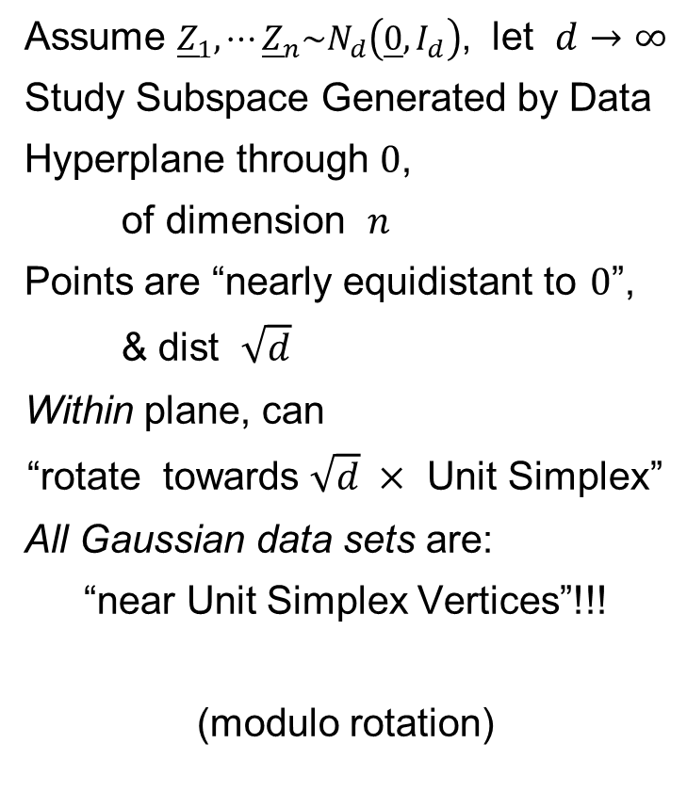
HDLSS Asy’s: Geometrical Represent’n
Assume ${\underline{Z}}_{1},⋯{\underline{Z}}_{n}\sim N_{d}\left(\underline{0},I_{d}\right)$, let $d→∞$
Study Subspace Generated by Data
Hyperplane through $0$,
of dimension $n$
Points are “nearly equidistant to $0$”,
& dist $\sqrt{d}$
Within plane, can
“rotate towards $\sqrt{d} ×$ Unit Simplex”
All Gaussian data sets are:
“near Unit Simplex Vertices”!!!
(modulo rotation)
Hall, Marron & Neeman (2005)

Slide 29
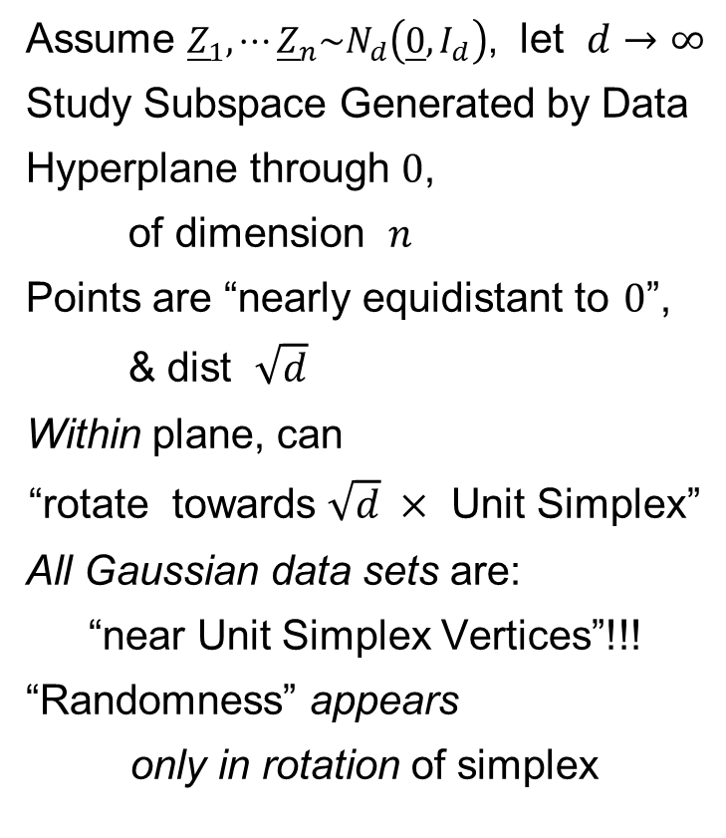
HDLSS Asy’s: Geometrical Represent’n
Assume ${\underline{Z}}_{1},⋯{\underline{Z}}_{n}\sim N_{d}\left(\underline{0},I_{d}\right)$, let $d→∞$
Study Subspace Generated by Data
Hyperplane through $0$,
of dimension $n$
Points are “nearly equidistant to $0$”,
& dist $\sqrt{d}$
Within plane, can
“rotate towards $\sqrt{d} ×$ Unit Simplex”
All Gaussian data sets are:
“near Unit Simplex Vertices”!!!
“Randomness” appears
only in rotation of simplex
Hall, Marron & Neeman (2005)

Slide 30
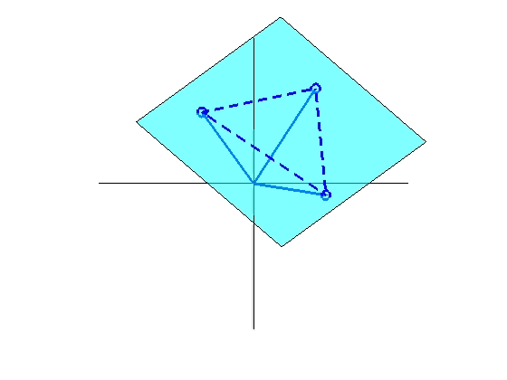
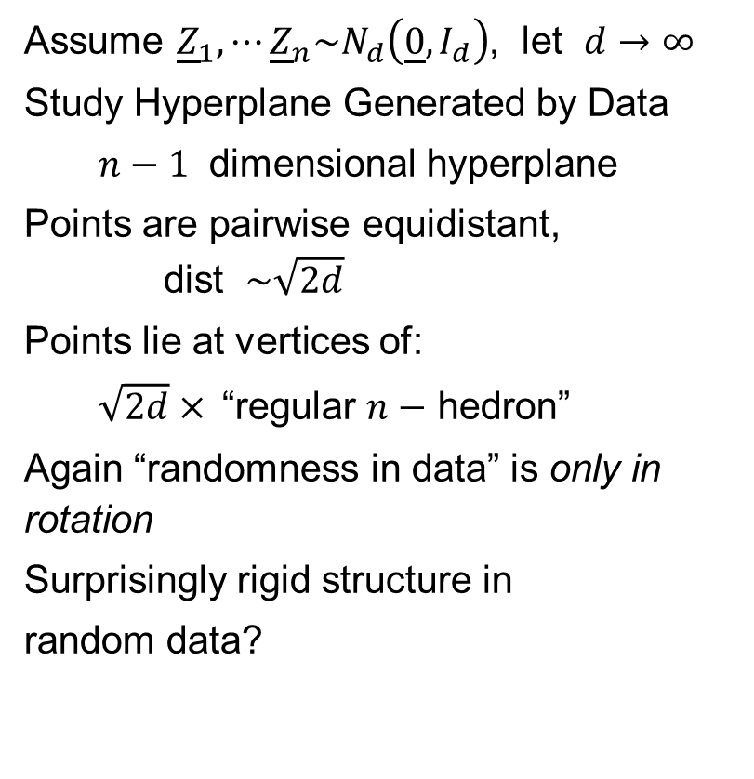
HDLSS Asy’s: Geometrical Represent’n
Assume ${\underline{Z}}_{1},⋯{\underline{Z}}_{n}\sim N_{d}\left(\underline{0},I_{d}\right)$, let $d→∞$
Study Hyperplane Generated by Data
$n−1$ dimensional hyperplane
Points are pairwise equidistant, dist $\sim \sqrt{2d}$
Points lie at vertices of:
$\sqrt{2d}×$“regular $n−$ hedron”
Again “randomness in data” is only in rotation
Surprisingly rigid structure in
random data?

Slide 31
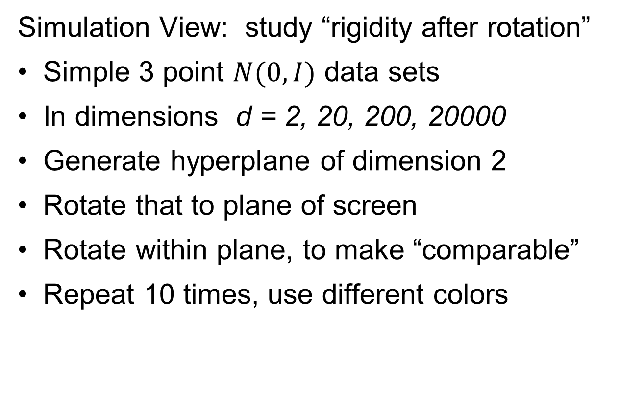
HDLSS Asy’s: Geometrical Represen’tion
Simulation View: study “rigidity after rotation”
Simple 3 point $N(0,I)$ data sets
In dimensions d = 2, 20, 200, 20000
Generate hyperplane of dimension 2
Rotate that to plane of screen
Rotate within plane, to make “comparable”
Repeat 10 times, use different colors

Slide 32
HDLSS Asy’s: Geometrical Represen’tion
Simulation View: Shows “Rigidity after Rotation”

Slide 33
HDLSS Asy’s: Geometrical Represen’tion
View from Probability Theory:
These phenomena named
Concentration of Measure
Key References:
Talagrand (1991, 1995)
Ledoux (2005)

Slide 34
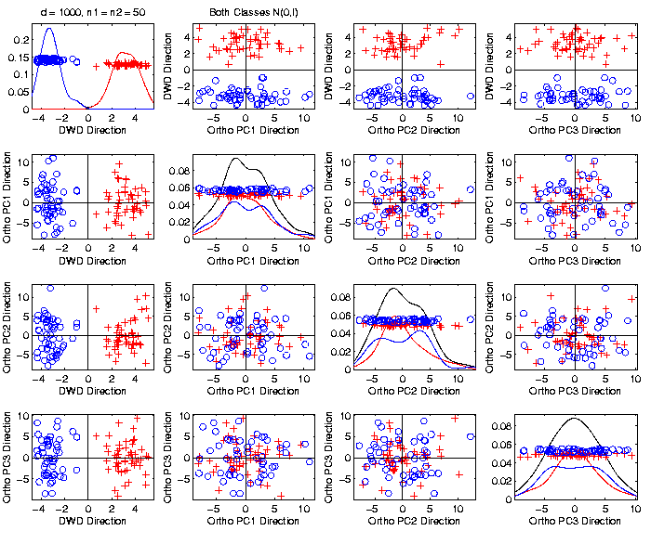
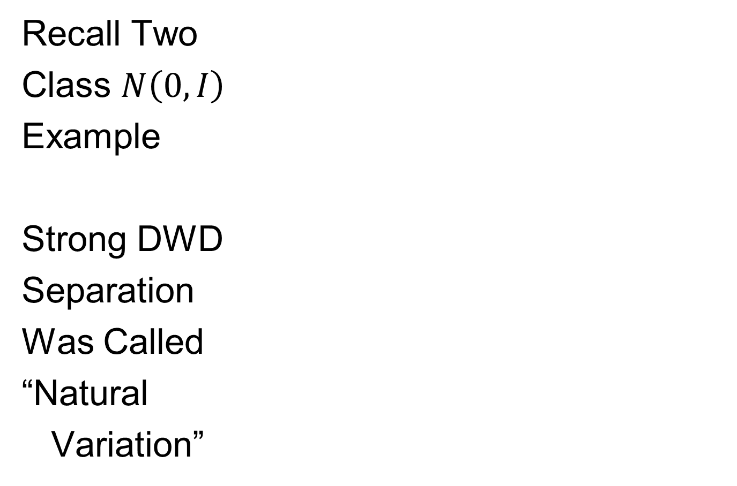
An Interesting HDLSS Explanation
Recall Two
Class $N\left(0,I\right)$
Example
Strong DWD
Separation
Was Called
“Natural
Variation”

Slide 35
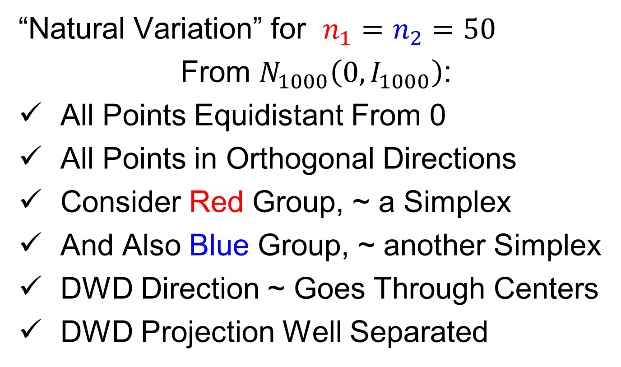
An Interesting HDLSS Explanation
“Natural Variation” for $n_{1}=n_{2}=50$
From $N_{1000}\left(0,I_{1000}\right)$:
All Points Equidistant From 0
All Points in Orthogonal Directions
Consider Red Group, ~ a Simplex
And Also Blue Group, ~ another Simplex
DWD Direction ~ Goes Through Centers
DWD Projection Well Separated

Slide 36
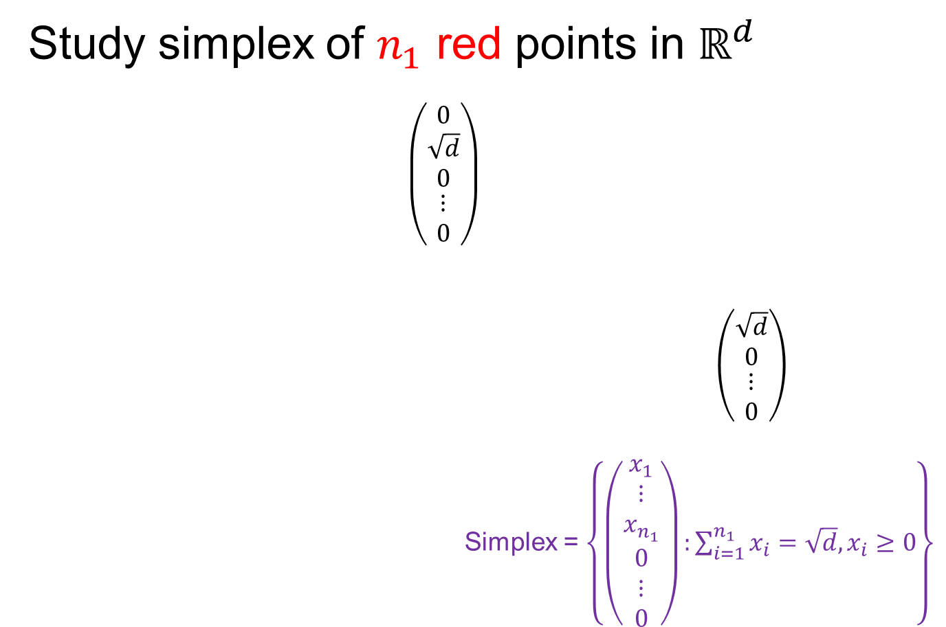
An Interesting HDLSS Explanation
Study simplex of $n_{1}$ red points in $ℝ^{d}$
$\left(\begin{matrix}\begin{matrix}0 \\ \sqrt{d} \\ 0\end{matrix} \\ ⋮ \\ 0\end{matrix}\right)$
$\left(\begin{matrix}\begin{matrix}\sqrt{d} \\ 0\end{matrix} \\ \begin{matrix}⋮ \\ 0\end{matrix}\end{matrix}\right)$
Simplex = $\left\{\left(\begin{matrix}\begin{matrix}x_{1} \\ ⋮ \\ x_{n_{1}}\end{matrix} \\ \begin{matrix}0 \\ ⋮ \\ 0\end{matrix}\end{matrix}\right):\sum_{i=1}^{n_{1}}{x_{i}=\sqrt{d},x_{i}≥0}\right\}$

Slide 37
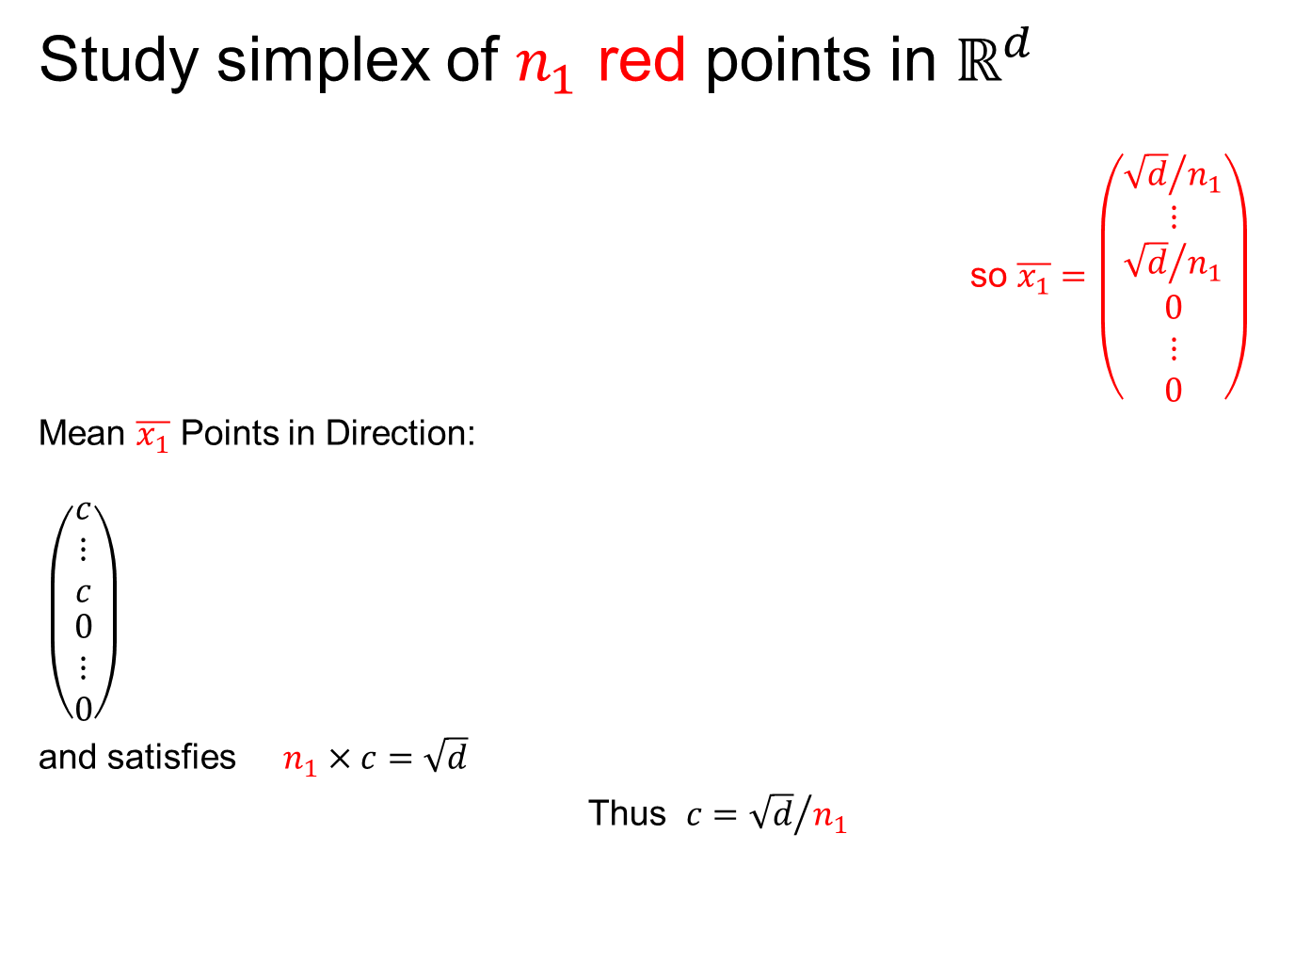
An Interesting HDLSS Explanation
Study simplex of $n_{1}$ red points in $ℝ^{d}$
so $\overline{x_{1}}=\left(\begin{matrix}\begin{matrix}{\sqrt{d}}/{n_{1}} \\ ⋮ \\ {\sqrt{d}}/{n_{1}}\end{matrix} \\ \begin{matrix}0 \\ ⋮ \\ 0\end{matrix}\end{matrix}\right)$
Mean $\overline{x_{1}}$ Points in Direction:
$\left(\begin{matrix}\begin{matrix}c \\ ⋮ \\ c\end{matrix} \\ \begin{matrix}0 \\ ⋮ \\ 0\end{matrix}\end{matrix}\right)$
and satisfies $n_{1}×c=\sqrt{d}$
Thus $c={\sqrt{d}}/{n_{1}}$

Slide 38
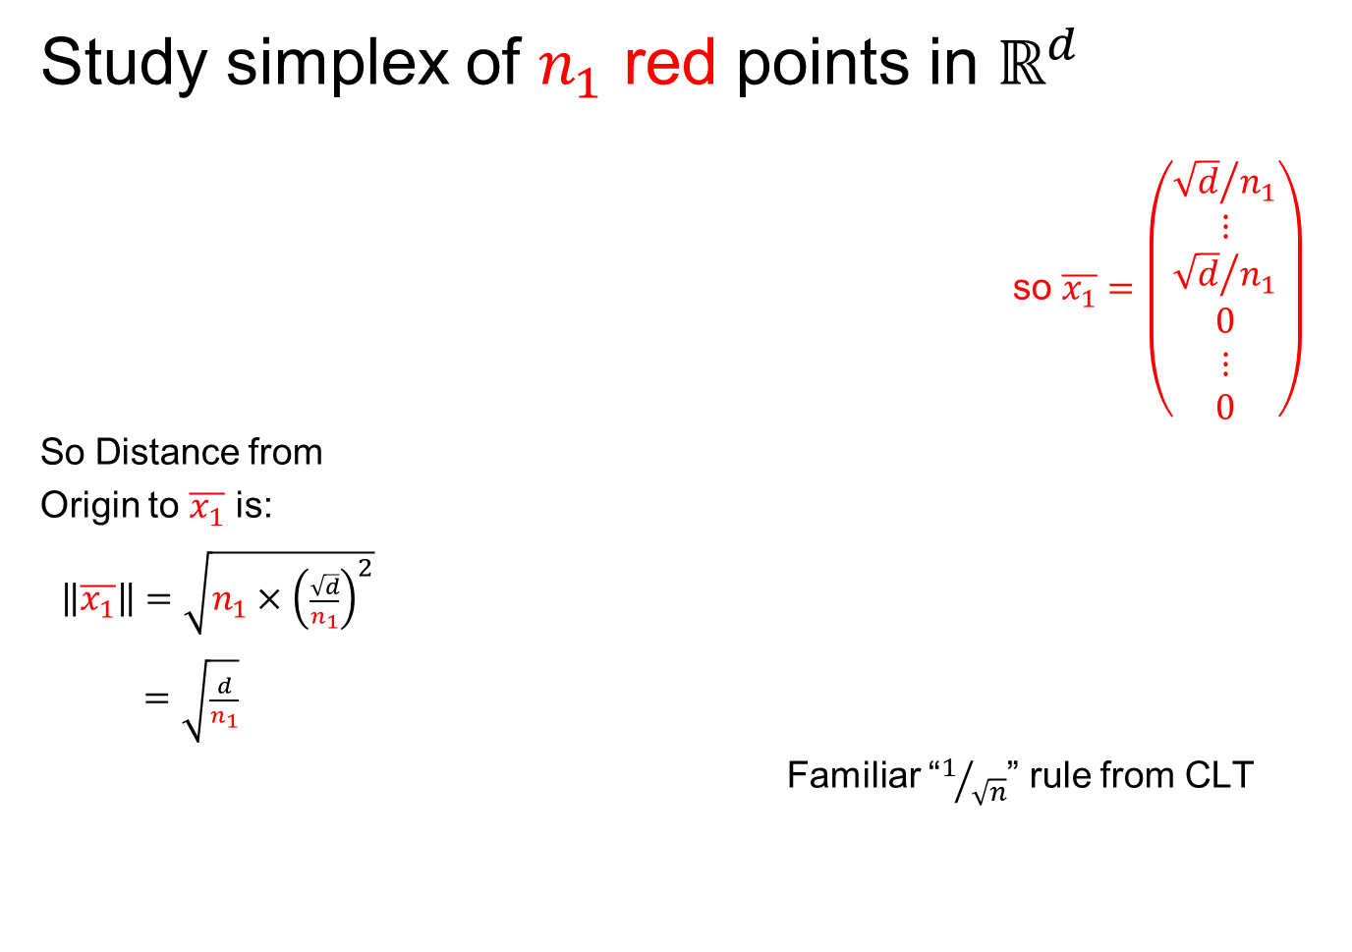
An Interesting HDLSS Explanation
Study simplex of $n_{1}$ red points in $ℝ^{d}$
so $\overline{x_{1}}=\left(\begin{matrix}\begin{matrix}{\sqrt{d}}/{n_{1}} \\ ⋮ \\ {\sqrt{d}}/{n_{1}}\end{matrix} \\ \begin{matrix}0 \\ ⋮ \\ 0\end{matrix}\end{matrix}\right)$
So Distance from
Origin to $\overline{x_{1}}$ is:
$\left\|\overline{x_{1}}\right\|=\sqrt{n_{1}×{\left(\frac{\sqrt{d}}{n_{1}}\right)}^{2}}$
$=\sqrt{\frac{d}{n_{1}}}$
Familiar “$1/{\sqrt{n}}$” rule from CLT

Slide 39
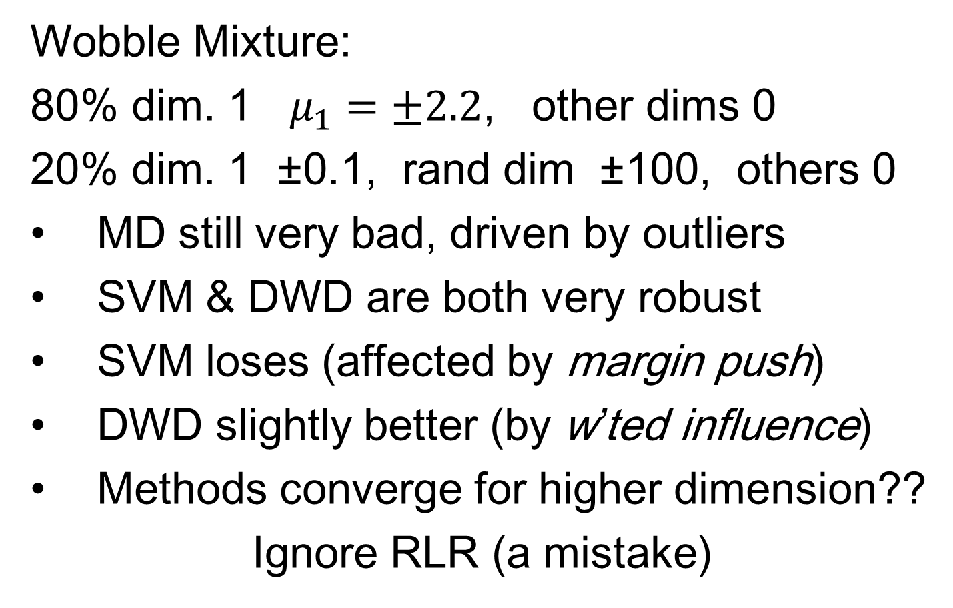
An Interesting HDLSS Explanation
Similar Analysis for $n_{2}$ blue points in $ℝ^{d}$:
$\left\|\overline{x_{2}}\right\|=\sqrt{\frac{d}{n_{2}}}$
Also note: $\overline{x_{1}}⊥\overline{x_{2}}$
(since in ortho subspaces)
So $\left\|\overline{x_{1}}−\overline{x_{2}}\right\|=\sqrt{\frac{d}{n_{1}}+\frac{d}{n_{2}}}$

Slide 40

An Interesting HDLSS Explanation
Recall Two
Class $N\left(0,I\right)$
Example
Plug In
These
Numbers

Slide 41
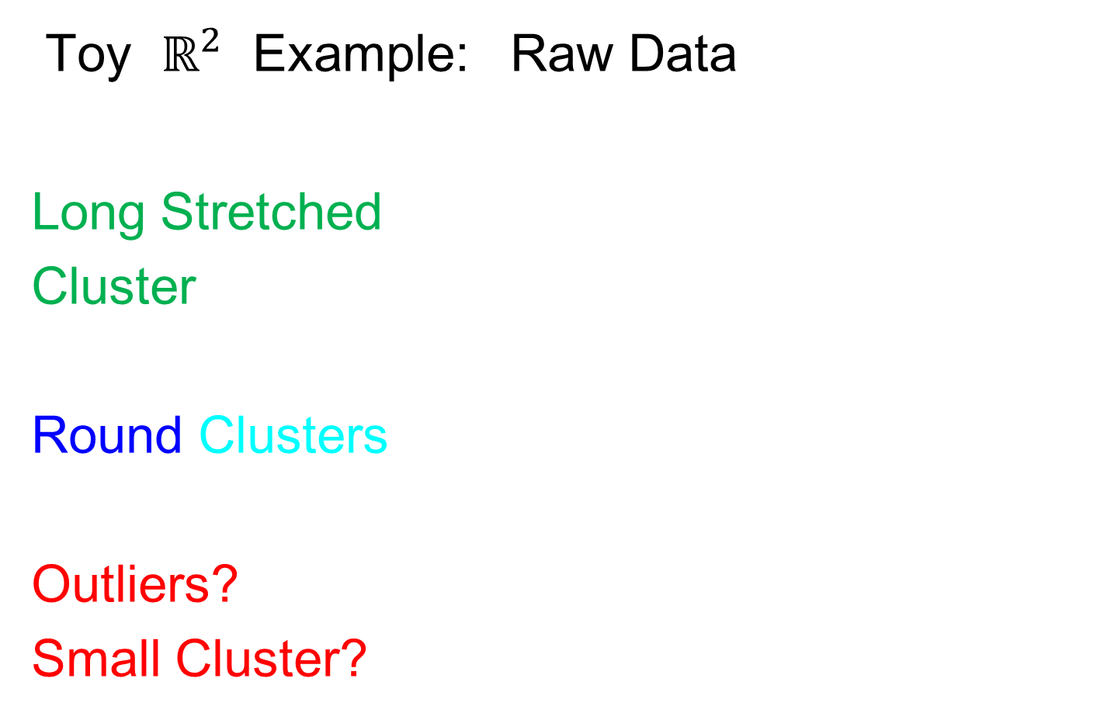
An Interesting HDLSS Explanation
Evaluate $\left\|\overline{x_{1}}−\overline{x_{2}}\right\|=\sqrt{\frac{d}{n_{1}}+\frac{d}{n_{2}}}$
$=\sqrt{\frac{1000}{50}+\frac{1000}{50}}$
$≈6.3$

Slide 42

An Interesting HDLSS Explanation
Recall Two
Class $N\left(0,I\right)$
Example
$\left\|\overline{x_{1}}−\overline{x_{2}}\right\|$
$≈6.3$

Slide 43
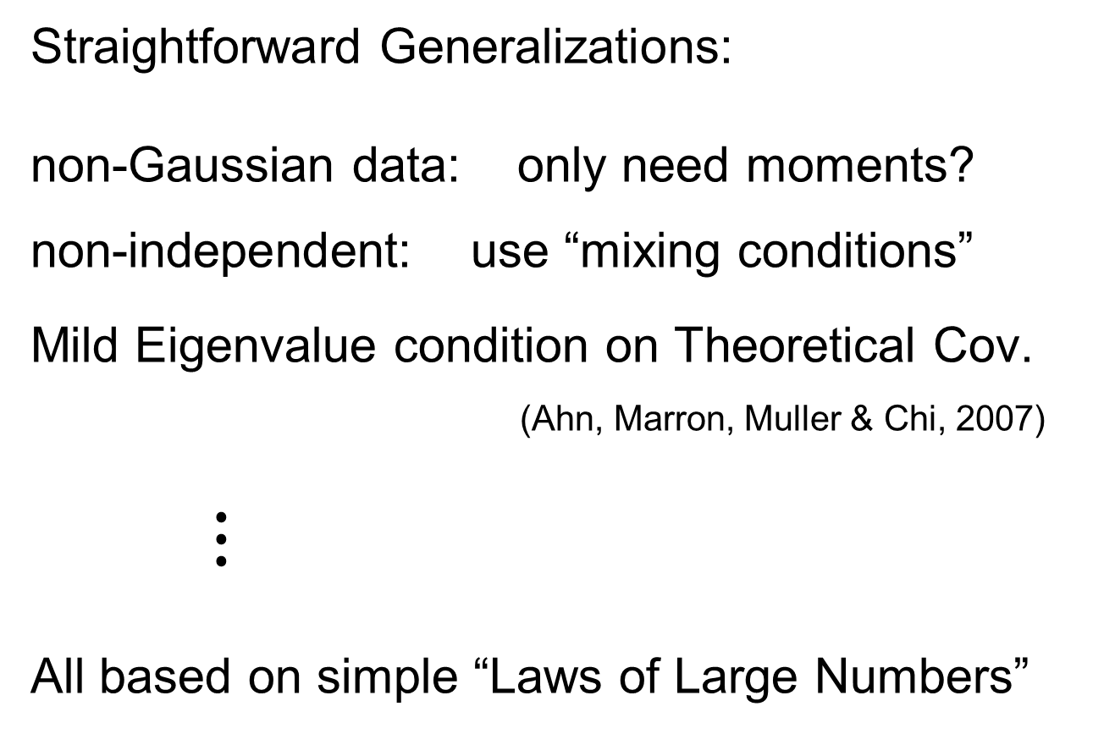
HDLSS Asy’s: Geometrical Represen’tion
Straightforward Generalizations:
non-Gaussian data: only need moments?
non-independent: use “mixing conditions”
Mild Eigenvalue condition on Theoretical Cov.
(Ahn, Marron, Muller & Chi, 2007)
$⋮$
All based on simple “Laws of Large Numbers”

Slide 44
2nd Paper on HDLSS Asymptotics
Ahn, Marron, Muller & Chi (2007)
  Assume 2nd Moments
  Assume no eigenvalues too large

Slide 45
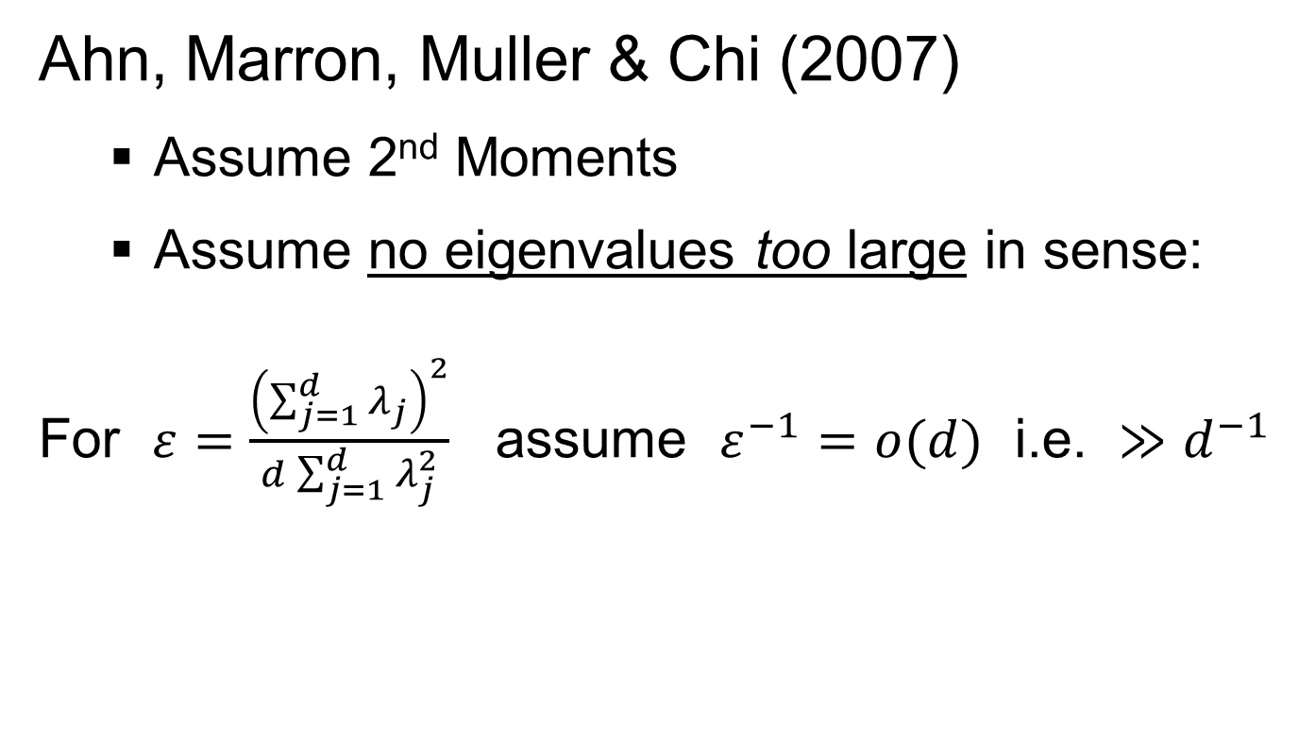
2nd Paper on HDLSS Asymptotics
Ahn, Marron, Muller & Chi (2007)
  Assume 2nd Moments
  Assume no eigenvalues too large in sense:
For $ε=\frac{{\left(\sum_{j=1}^{d}{λ_{j}}\right)}^{2}}{d\sum_{j=1}^{d}{λ_{j}^{2}}}$ assume $ε^{−1}=o(d)$ i.e. $≫d^{−1}$

Slide 46
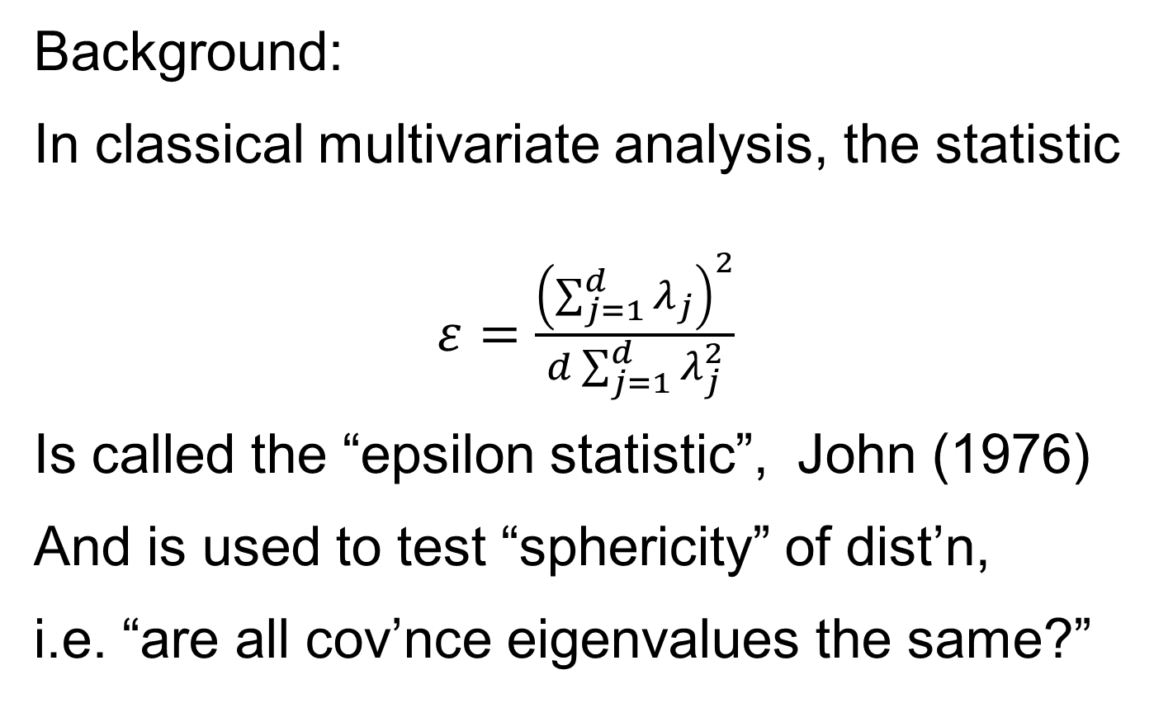
2nd Paper on HDLSS Asymptotics
Background:
In classical multivariate analysis, the statistic
$ε=\frac{{\left(\sum_{j=1}^{d}{λ_{j}}\right)}^{2}}{d\sum_{j=1}^{d}{λ_{j}^{2}}}$
Is called the “epsilon statistic”, John (1976)
And is used to test “sphericity” of dist’n,
i.e. “are all cov’nce eigenvalues the same?”
Likelihood
Ratio Stat.

Slide 47
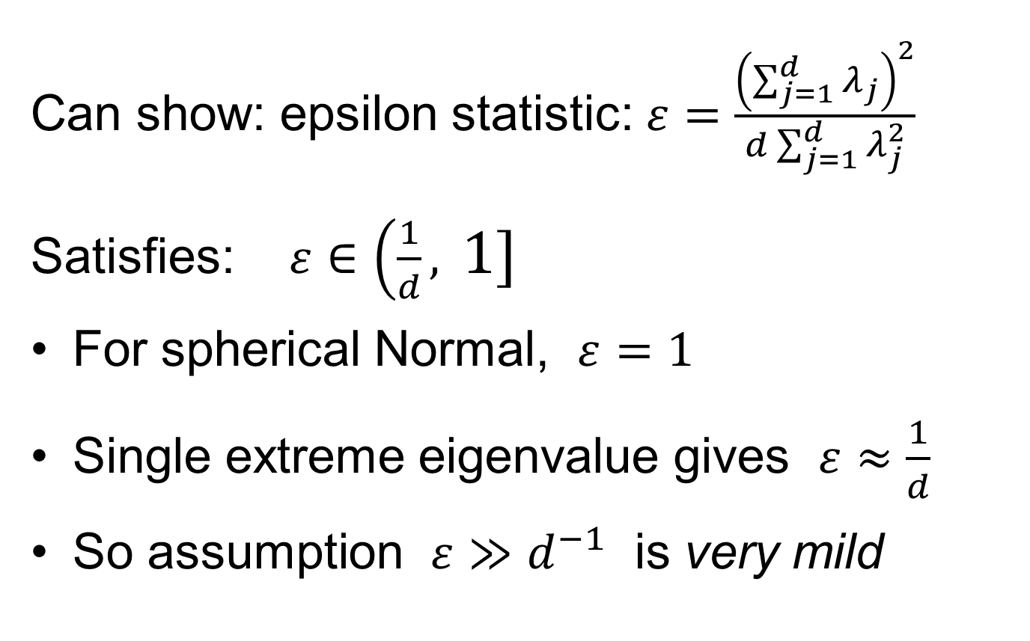
2nd Paper on HDLSS Asymptotics
Can show: epsilon statistic: $ε=\frac{{\left(\sum_{j=1}^{d}{λ_{j}}\right)}^{2}}{d\sum_{j=1}^{d}{λ_{j}^{2}}}$
Satisfies: $ε∈\left(\frac{1}{d},\right.\left. 1\right]$
For spherical Normal, $ε=1$
Single extreme eigenvalue gives $ε≈\frac{1}{d}$
So assumption $ε≫d^{−1}$ is very mild

Slide 48
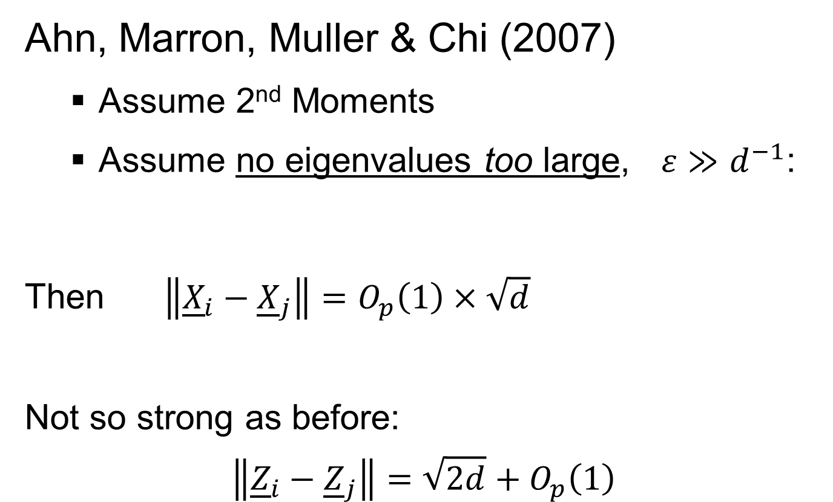
2nd Paper on HDLSS Asymptotics
Ahn, Marron, Muller & Chi (2007)
  Assume 2nd Moments
  Assume no eigenvalues too large, $ε≫d^{−1}$:
Then $\left\|{\underline{X}}_{i}−{\underline{X}}_{j}\right\|=O_{p}\left(1\right)×\sqrt{d}$
Not so strong as before:
$$\left\|{\underline{Z}}_{i}−{\underline{Z}}_{j}\right\|=\sqrt{2d}+O_{p}\left(1\right)$$

Slide 49

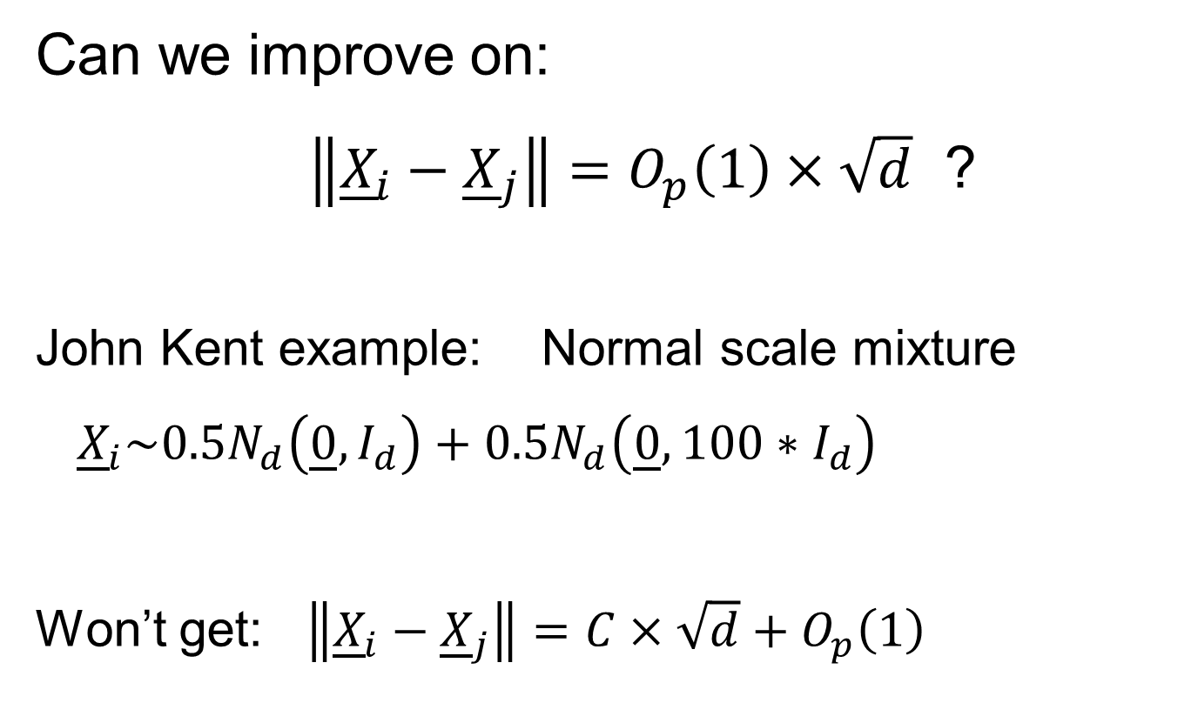
2nd Paper on HDLSS Asymptotics
Can we improve on:
$\left\|{\underline{X}}_{i}−{\underline{X}}_{j}\right\|=O_{p}\left(1\right)×\sqrt{d}$ ?
John Kent example: Normal scale mixture
${\underline{X}}_{i}\sim 0.5N_{d}\left(\underline{0},I_{d}\right)+0.5N_{d}\left(\underline{0},{100∗I}_{d}\right)$
Won’t get: $\left\|{\underline{X}}_{i}−{\underline{X}}_{j}\right\|=C×\sqrt{d}+O_{p}\left(1\right)$

Slide 50
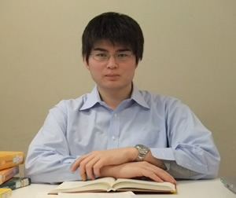
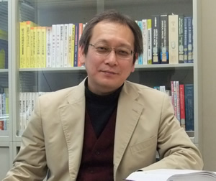
3rd Paper on HDLSS Asymptotics
Get Geometrical Representation using
4th Moment Assumption
Stronger Covariance Matrix (only) Assum’n
Yata & Aoshima (2012)

Slide 51
0 Covariance is not independence
Key to Why Eigenvalues Alone Are Not Enough for Geometric Representation

Slide 52
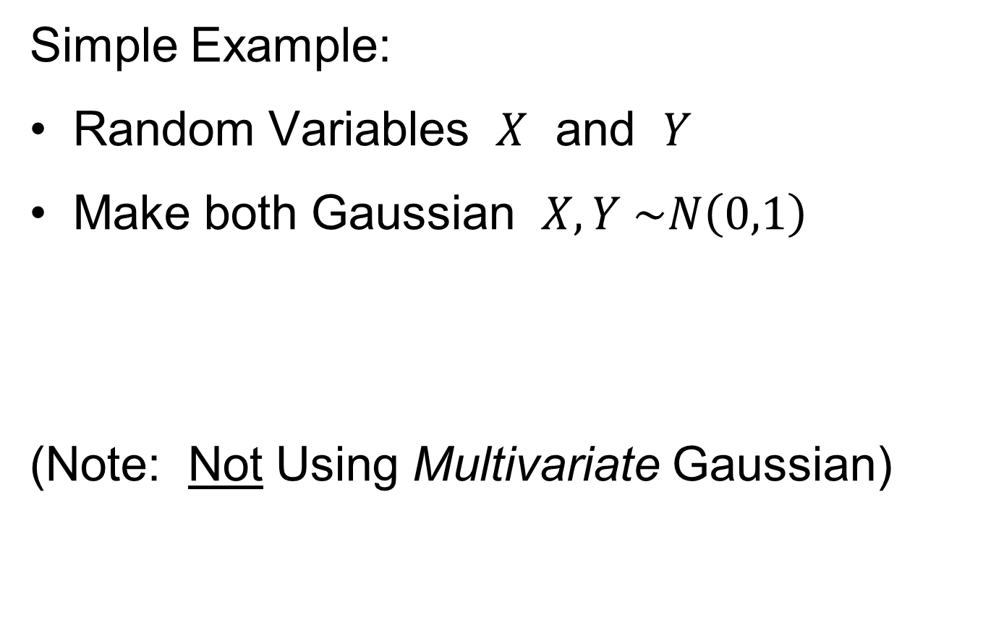
0 Covariance is not independence
Simple Example:
Random Variables $X$ and $Y$
Make both Gaussian $X, Y \sim N\left(0,1\right)$
(Note: Not Using Multivariate Gaussian)

Slide 53
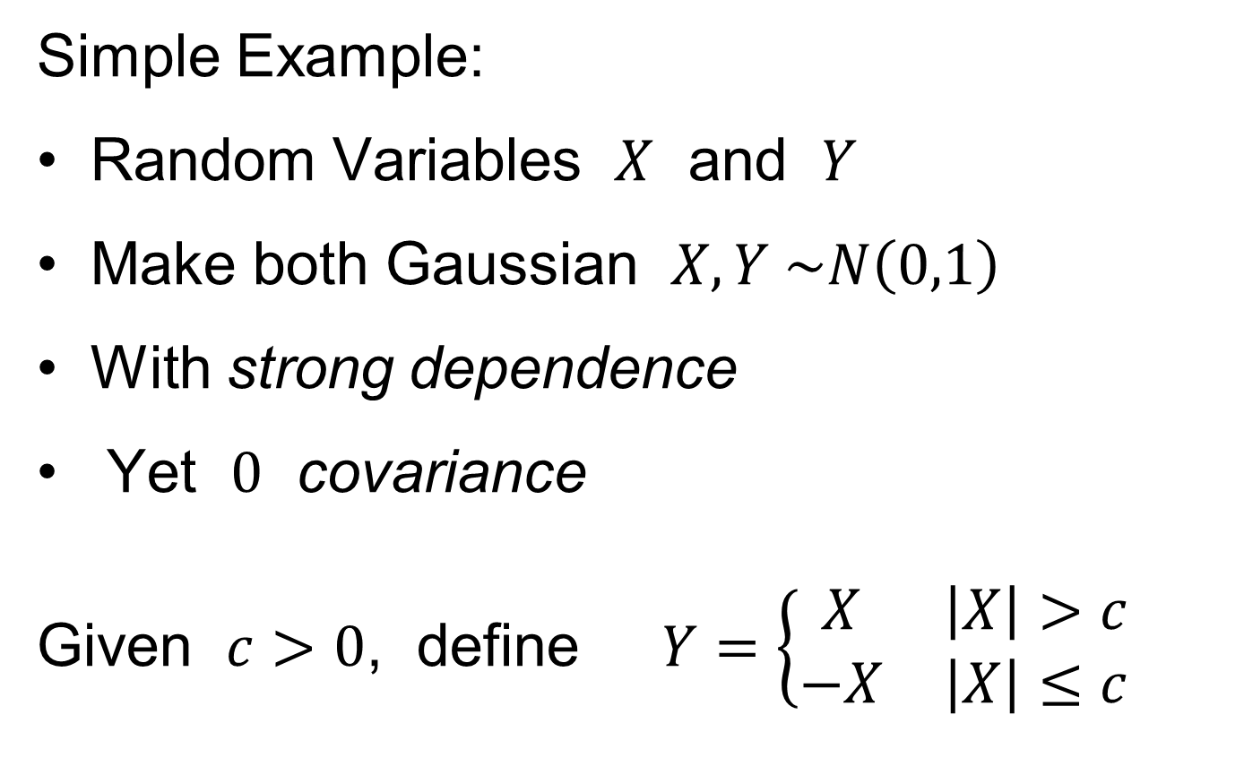

0 Covariance is not independence
Simple Example:
Random Variables $X$ and $Y$
Make both Gaussian $X, Y \sim N\left(0,1\right)$
With strong dependence
Yet $0$ covariance
Given $c>0$, define $Y=\left\{\begin{matrix}X & \left|X\right|>c \\ −X & \left|X\right|≤c\end{matrix}\right.$
Find $c$ to make
this happen

Slide 54
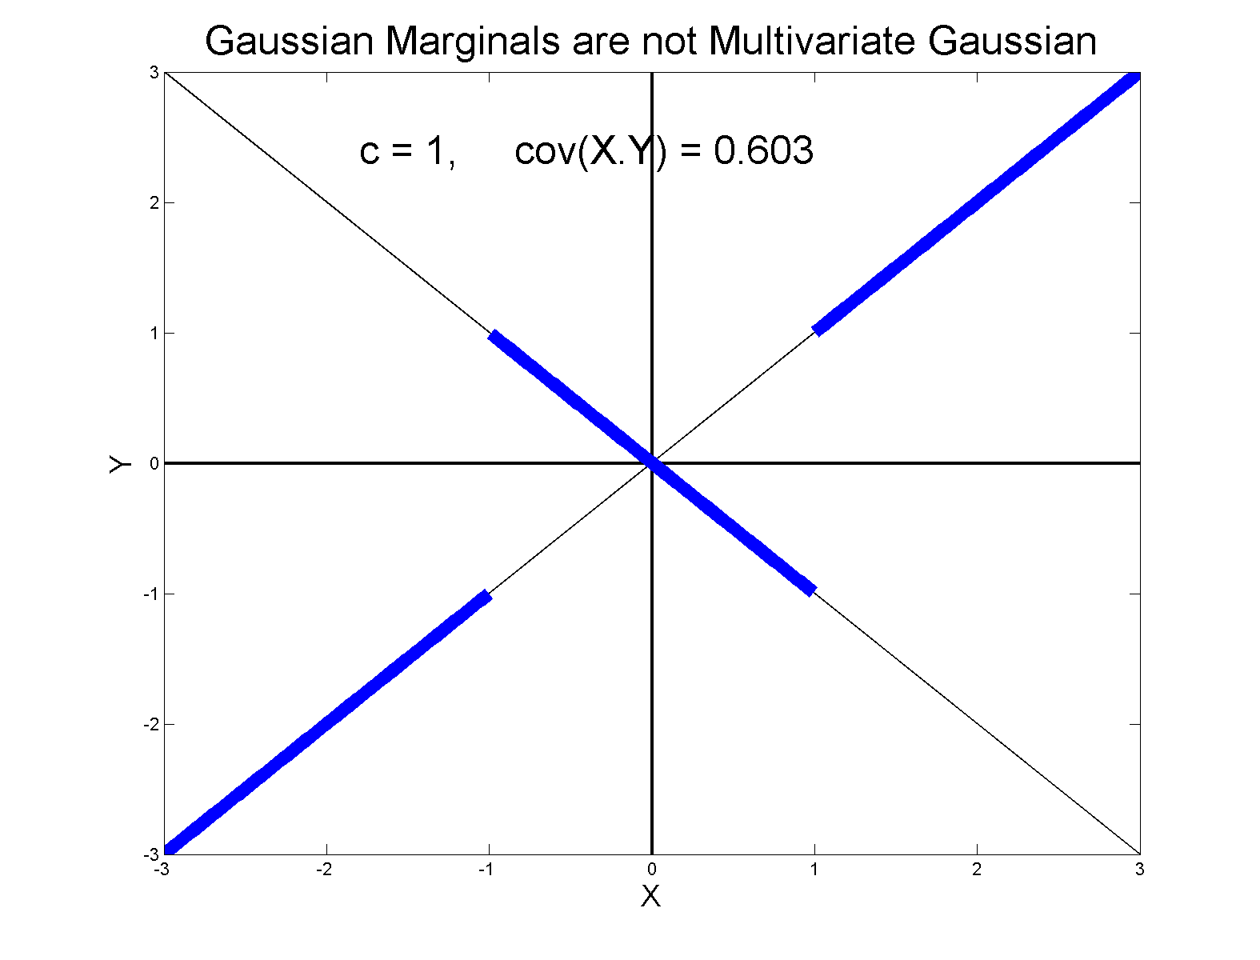

0 Covariance is not independence
Simple Example:
Can Lower This
By Increasing $c$

Slide 55
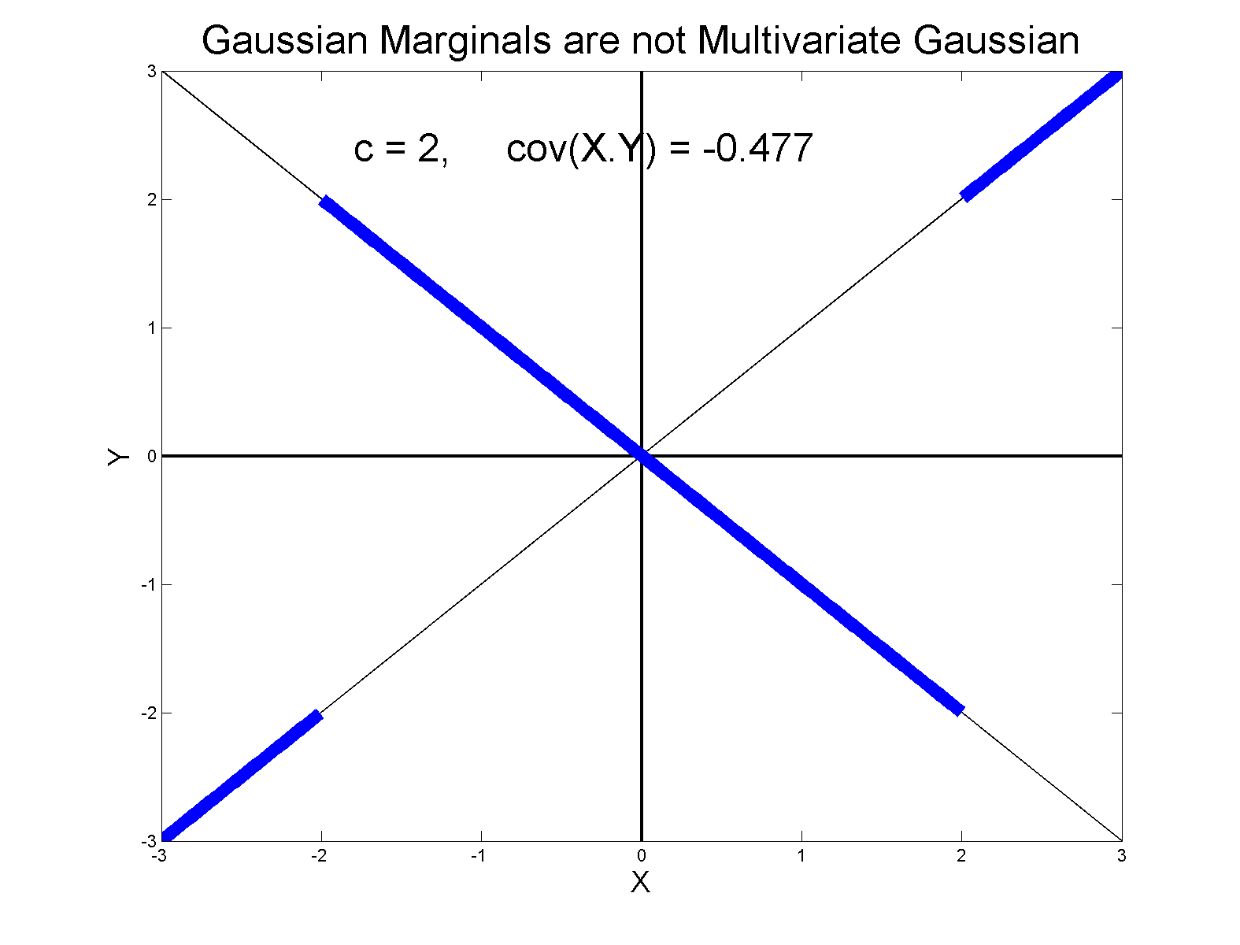
0 Covariance is not independence
Simple Example:
Have Overshot So
Search Between

Slide 56
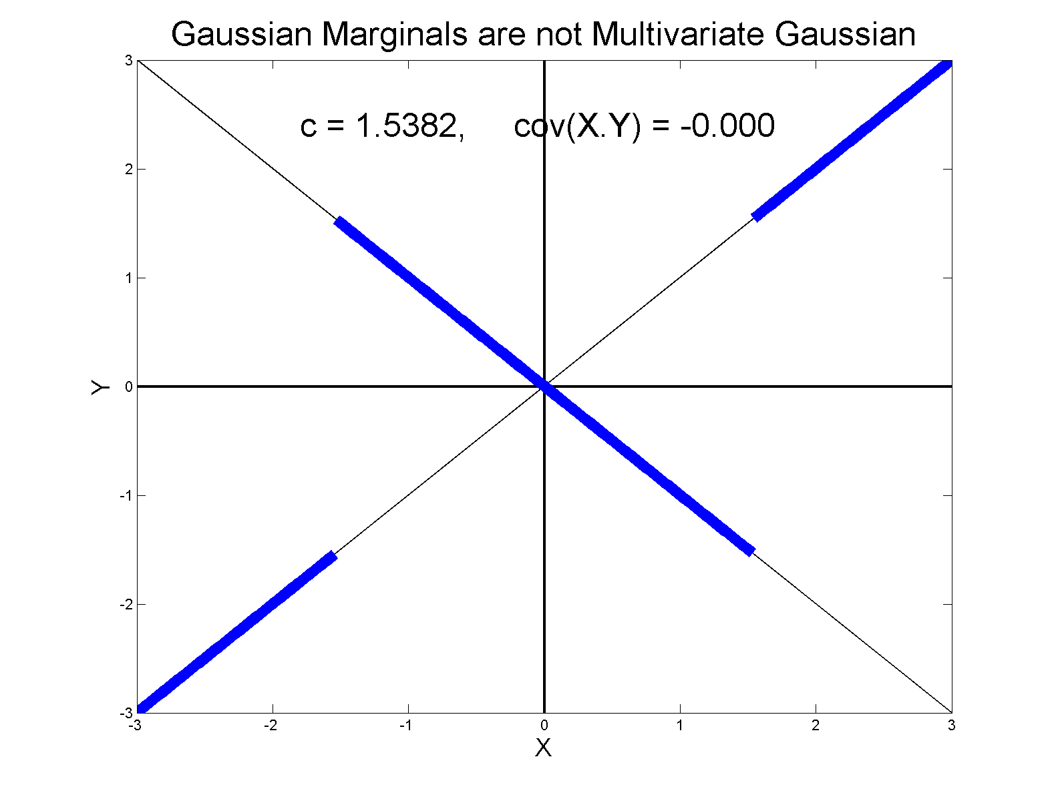
0 Covariance is not independence
Simple Example, c to make cov(X,Y) = 0
Yet Strongly Dependent!

Slide 57
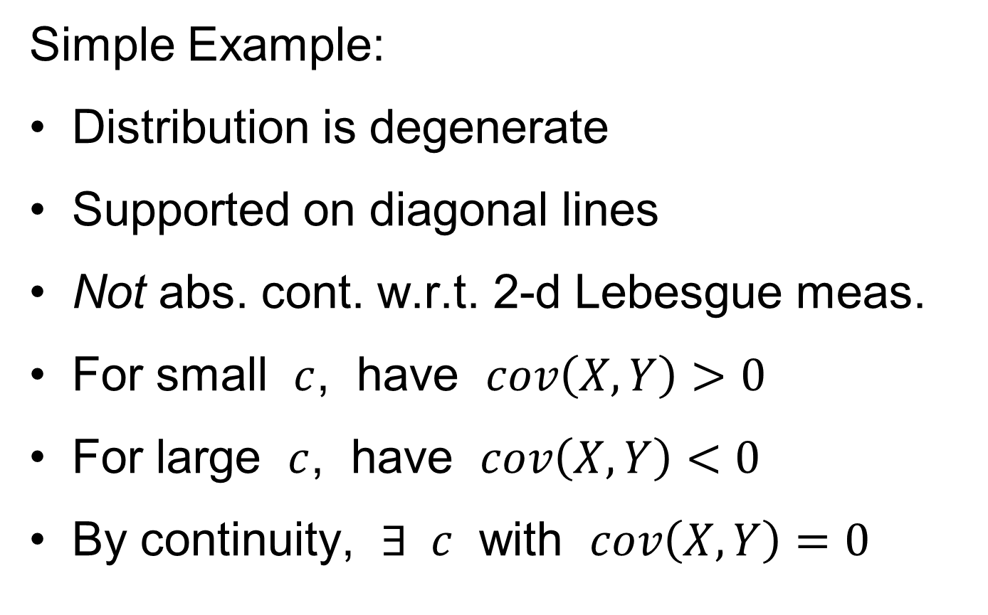
0 Covariance is not independence
Simple Example:
Distribution is degenerate
Supported on diagonal lines
Not abs. cont. w.r.t. 2-d Lebesgue meas.
For small $c$, have $cov\left(X,Y\right)>0$
For large $c$, have $cov\left(X,Y\right)<0$
By continuity, $∃ c$ with $cov\left(X,Y\right)=0$

Slide 58
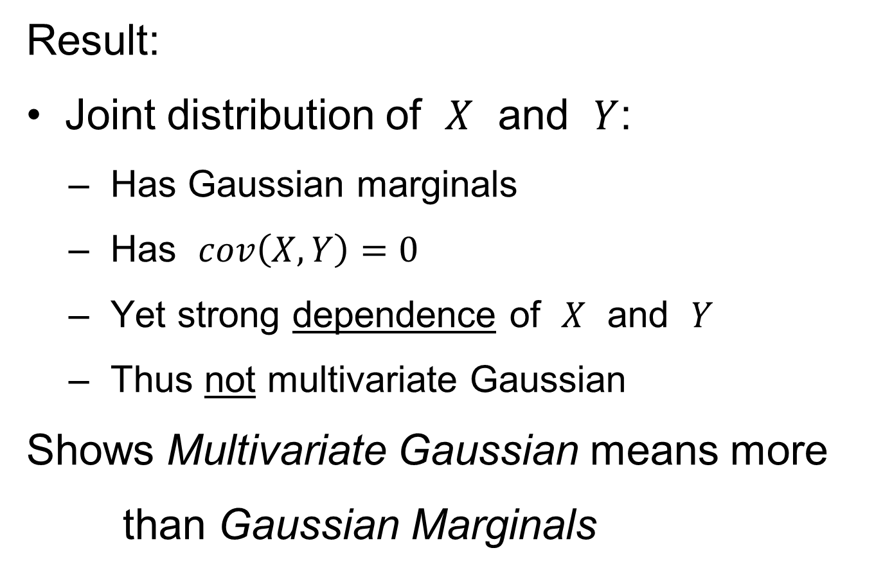
0 Covariance is not independence
Result:
Joint distribution of $X$ and $Y$:
  Has Gaussian marginals
  Has $cov\left(X,Y\right)=0$
  Yet strong dependence of $X$ and $Y$
  Thus not multivariate Gaussian
Shows Multivariate Gaussian means more
than Gaussian Marginals

Slide 59
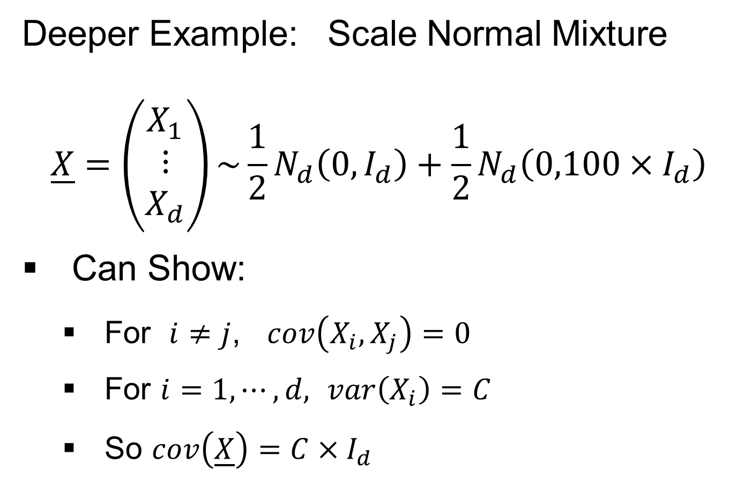
0 Covariance is not independence
Deeper Example: Scale Normal Mixture
$$\underline{X}=\left(\begin{matrix}X_{1} \\ ⋮ \\ X_{d}\end{matrix}\right)\sim {\frac{1}{2}N}_{d}\left(0,I_{d}\right)+\frac{1}{2}N_{d}\left(0,100×I_{d}\right)$$
Can Show:
  For $i≠j$, $cov\left(X_{i},X_{j}\right)=0$
  For $i=1,⋯,d,$ $var\left(X_{i}\right)=C$
  So $cov\left(\underline{X}\right)=C×I_{d}$

Slide 60

0 Covariance is not independence
Deeper Example: Scale Normal Mixture
$$\underline{X}=\left(\begin{matrix}X_{1} \\ ⋮ \\ X_{d}\end{matrix}\right)\sim {\frac{1}{2}N}_{d}\left(0,I_{d}\right)+\frac{1}{2}N_{d}\left(0,100×I_{d}\right)$$
Can Show $cov\left(\underline{X}\right)=C×I_{d}$
Yet $X_{1},⋯,X_{d}$ are Strongly Dependent
(When one is large, others tend to be too)

Slide 61

0 Covariance is not independence
Parallel Conclusion:
Joint distribution of $X_{1},⋯,X_{d}$:
  Has $cov\left(X_{i},X_{j}\right)=0$
  Yet strong dependence of $X$ and $Y$
Shows covariance matrix $\sim I ⇏$
$⇏$ Independence
Yet for Gaussian Distributions have “$⇒$”

Slide 62

HDLSS Math. Stat. of PCA
Conditions for Geo. Rep’n & PCA Consist.:
John Kent example:
$$\underline{X}\sim 0.5N_{d}\left(\underline{0},I_{d}\right)+0.5N_{d}\left(\underline{0},{100∗I}_{d}\right)$$
Can only say: $\left\|\underline{X}\right\|=O_{p}\left(d^{1/2}\right)$ $\left(=\left\{\begin{matrix}d^{1/2} & w.p.\frac{1}{2} \\ 10d^{1/2} & w.p.\frac{1}{2}\end{matrix}\right. \right)$
not deterministic
Conclude: For Geo. Rep’n need Additional Condition
Reasonable Approach: Mixing Conditions

Slide 63

Mixing Conditions
Idea From Probability Theory:
Recall Standard Asymptotic Results, as $n→∞:$
Law of Large Numbers,
$$\overline{X}→μ$$
(“Weak” = in prob., “Strong” = a.s.)

Slide 64

Mixing Conditions
Idea From Probability Theory:
Recall Standard Asymptotic Results, as $n→∞:$
Law of Large Numbers,
$$\overline{X}→μ$$
Central Limit Theorem,
$$\overline{X}≈μ+\frac{σ}{\sqrt{n}}N\left(0,1\right)$$

Slide 65
Mixing Conditions
Idea From Probability Theory:
Law of Large Numbers,
Central Limit Theorem,
Both have Technical Assumptions
(Usually Ignore ???)

Slide 66

Mixing Conditions
Idea From Probability Theory:
Law of Large Numbers,
Central Limit Theorem,
Both have Technical Assumptions
E.g. $X_{1},⋯,X_{n}$ Independent and Ident. Dist’d

Slide 67
Mixing Conditions
Idea From Probability Theory:
Mixing Conditions:
Explore Weaker Assumptions, to Still Get
Law of Large Numbers,
Central Limit Theorem

Slide 68


Mixing Conditions
Mixing Conditions:
A Whole Area in Probability Theory
$∃$ a Large Literature
A Comprehensive Reference
Bradley (2005, update of 1986 version)
Newer Reference: White (2014)

Slide 69

Mixing Conditions
Mixing Condition Used Here:
Rho – Mixing
For Random Variables ${\left\{Z_{j}\right\}}_{−∞}^{+∞}$, Define
$$ρ\left(m\right)=\sup_{j,f,g}\left|corr(f,g)\right|,$$
Where $f∈ℑ_{−∞}^{j}$, $g∈ℑ_{m+j}^{+∞}$

Slide 70

Mixing Conditions
Mixing Condition Used Here:
Rho – Mixing
For Random Variables ${\left\{Z_{j}\right\}}_{−∞}^{+∞}$, Define
$$ρ\left(m\right)=\sup_{j,f,g}\left|corr(f,g)\right|,$$
Where $f∈ℑ_{−∞}^{j}$, $g∈ℑ_{m+j}^{+∞}$
For Sigma-Fields Generated by:
$Z_{−∞},⋯,Z_{j}$

Slide 71
Mixing Conditions
Mixing Condition Used Here:
Rho – Mixing
For Random Variables ${\left\{Z_{j}\right\}}_{−∞}^{+∞}$, Define
$$ρ\left(m\right)=\sup_{j,f,g}\left|corr(f,g)\right|,$$
Where $f∈ℑ_{−∞}^{j}$, $g∈ℑ_{m+j}^{+∞}$
For Sigma-Fields Generated by:
$Z_{−∞},⋯,Z_{j}$
$Z_{m+j},⋯,Z_{∞}$

Slide 72

Mixing Conditions
Mixing Condition Used Here:
Rho – Mixing
For Random Variables ${\left\{Z_{j}\right\}}_{−∞}^{+∞}$, Define
$$ρ\left(m\right)=\sup_{j,f,g}\left|corr(f,g)\right|,$$
Where $f∈ℑ_{−∞}^{j}$, $g∈ℑ_{m+j}^{+∞}$
For Sigma-Fields Generated by:
$Z_{−∞},⋯,Z_{j}$
$Z_{m+j},⋯,Z_{∞}$
Note: Gap of Lag $m$

Slide 73
Mixing Conditions
Mixing Condition Used Here:
Rho – Mixing
For Random Variables ${\left\{Z_{j}\right\}}_{−∞}^{+∞}$, Define
$$ρ\left(m\right)=\sup_{j,f,g}\left|corr(f,g)\right|,$$
Where $f∈ℑ_{−∞}^{j}$, $g∈ℑ_{m+j}^{+∞}$
Assume: $\lim_{m→∞}{ρ\left(m\right)=0}$
Idea: Uncorrelated at Far Lags

Slide 74



HDLSS Geometric Representation
Conditions for Geo. Rep’n:
Hall, Marron and Neeman (2005):
Assume Entries of Data Vectors
Are $ρ$-mixing

Slide 75
HDLSS Geometric Representation
Conditions for Geo. Rep’n:
Hall, Marron and Neeman (2005):
Drawback: Strong Assumption
(???)
In JRSS-B, since Biometrika Rejected

Slide 76
HDLSS Geometric Representation
Conditions for Geo. Rep’n:
Hall, Marron and Neeman (2005):
Later Realization:
This Mixing is Very Natural in
Genome Wide Association Studies
1st such: Klein et al (2005)

Slide 77

Recall GWAS Data Analysis
Genome Wide Association Study (GWAS)
Data Objects: Vectors of Genetic Variants, at known chromosome locations
(Called SNPs)
Discrete (takes on 2 or 3 values)
Dimension $d$ as large as ~5 million
(can be reduced, e.g. $d\sim 20000)$

Slide 78
HDLSS Geometric Representation
Conditions for Geo. Rep’n:
Series of Technical Improvements:
Ahn, Marron, Muller & Chi (2007)
Yata & Aoshima (2009, 2010a, 2010b, 2012, 2013)
(Fully Covariance Based,
No Mixing)

Slide 79
HDLSS Geometric Representation
Conditions for Geo. Rep’n:
Tricky Point: Classical Mixing Conditions
Require Notion of Time Ordering
Not Always Clear, e.g. Gene Expression

Slide 80
HDLSS Geometric Representation
Conditions for Geo. Rep’n:
Condition from Jung & Marron (2009):
where
Note: Not Gaussian (Allows Discrete)

Slide 81
HDLSS Geometric Representation
Conditions for Geo. Rep’n:
Condition from Jung & Marron (2009):
where
Define:
Standardized Version

Slide 82
HDLSS Geometric Representation
Conditions for Geo. Rep’n:
Condition from Jung & Marron (2009):
where
Define:
Assume: Ǝ a permutation,
So that is ρ-mixing

Slide 83

HDLSS Math. Stat. of PCA
HDLSS Analysis of PCA
from Jung & Marron (2009)

Slide 84
HDLSS Math. Stat. of PCA
Consistency & Strong Inconsistency
(Study Properties of PCA,
In Estimating Eigen-Directions & -Values)
[Assume Data are Mean Centered]

Slide 85


HDLSS Math. Stat. of PCA
Consistency & Strong Inconsistency:
Spike Covariance Model, Paul (2007)
For Eigenvalues:
$λ_{1,d}=d^{α},λ_{2,d}=⋯=λ_{d,d}=1$

Slide 86

HDLSS Math. Stat. of PCA
Consistency & Strong Inconsistency:
Spike Covariance Model, Paul (2007)
For Eigenvalues:
$λ_{1,d}=d^{α},λ_{2,d}=⋯=λ_{d,d}=1$
Note: Critical Parameter
Will Study $\lim_{d→∞}{}$

Slide 87

HDLSS Math. Stat. of PCA
Consistency & Strong Inconsistency:
Spike Covariance Model, Paul (2007)
For Eigenvalues:
$λ_{1,d}=d^{α},λ_{2,d}=⋯=λ_{d,d}=1$
Denote 1st Eigenvector: ${\underline{u}}_{1}$
Turns out: Direction Doesn’t Matter

Slide 88

HDLSS Math. Stat. of PCA
Consistency & Strong Inconsistency:
Spike Covariance Model, Paul (2007)
For Eigenvalues:
$λ_{1,d}=d^{α},λ_{2,d}=⋯=λ_{d,d}=1$
Denote 1st Eigenvector: ${\underline{u}}_{1}$
How Good are Empirical Versions,
as Estimates? ${\hat{λ}}_{1,d},⋯,{\hat{λ}}_{d,d}, {\hat{\underline{u}}}_{1}$

Slide 89

HDLSS Math. Stat. of PCA
Consistency (big enough spike):
For $α>1$,
$$Angle\left(u_{1},{\hat{u}}_{1}\right)→0$$
Strong Inconsistency (spike not big enough):
For $α<1$,
$$Angle\left(u_{1},{\hat{u}}_{1}\right)→{90}^{°}$$

Slide 90

HDLSS Math. Stat. of PCA
Intuition: Random Noise $\sim d^{1/2}$
For $α>1$ (Recall on Scale of Variance),
Spike Pops Out of Pure Noise Sphere
For $α<1$,
Spike Contained in Pure Noise Sphere

Slide 91

HDLSS Math. Stat. of PCA
Consistency of eigenvalues?
Eigenvalues Inconsistent
But Known Distribution
Consistent when $n→∞$ as Well

Slide 92
Participant Presentation
Jose Sanchez:
Stability of filtrations in Topological Data Analysis
Yonggang Sha:
Statistical Analysis of Multiple Myeloma Microarray Data

