Slide 1
Statistical Smoothing
2 Major Settings:
Density Estimation
“Histograms”
Nonparametric Regression
“Scatterplot Smoothing”

Slide 2
Scatterplot Smoothing
E.g. Bralower Fossil Data – some smooths

Slide 3
Scatterplot Smoothing
Smooths of Bralower Fossil Data:
Oversmoothed misses structure
Undersmoothed feels sampling noise?
About right shows 2 valleys:
One seems clear
Is other one really there?
Same question as above…
Needs “Statistical Inference”,
i.e. Confirmatory Analysis

Slide 4
SiZer Background
Scale Space – Idea from Computer Vision
Conceptual basis:
Oversmoothing = “view from afar”
(macroscopic)
Undersmoothing = “zoomed in view”
(microscopic)
Main idea: all smooths contain useful information, so study “full spectrum”
(i. e. all smoothing levels)
Recommended reference: Lindeberg (1994)

Slide 5
SiZer Background
Fun Scale Space Views (Incomes Data)
Surface View

Slide 6
SiZer Background
SiZer Visual presentation:
Color map over scale space:
Blue: slope significantly upwards
(derivative CI above 0)
Red: slope significantly downwards
(derivative CI below 0)
Purple: slope insignificant
(derivative CI contains 0)

Slide 7
SiZer Background
SiZer analysis of Fossils data:

Slide 8
SiZer Background
SiZer analysis of British Incomes data:

Slide 9
SiZer Background
E.g. - Marron & Wand (1992) Trimodal #9
Increasing $n$
Only 1 Signif’t Mode
Now 2 Signif’t Modes
Finally all 3 Modes

Slide 10
SiZer Background
E.g. - Marron & Wand Discrete Comb #15
Increasing $n$
Coarse Bumps Only
Now Fine bumps too
Someday: “draw” local
Bandwidth on SiZer map

Slide 11
SiZer Background
Finance "tick data":
(time, price) of single stock transactions
Idea: "on line" version of SiZer
for viewing and understanding trends

Slide 12
SiZer Background
Finance "tick data":
(time, price) of single stock transactions
Idea: "on line" version of SiZer
for viewing and understanding trends
Notes:
trends depend heavily on scale
double points and more
background color transition
(flop over at top)

Slide 13
SiZer Background
Internet traffic data analysis:
SiZer analysis of
time series of
packet times
at internet hub (UNC)
Hannig, Marron,
and Riedi (2001)
Notes:
13

Slide 14
SiZer Background
Internet traffic data analysis:
SiZer analysis of
time series of packet times
at internet hub (UNC)
across very wide range of scales
needs more pixels than screen allows
thus do zooming view
(zoom in over time)
zoom in to yellow bd’ry in next frame
readjust vertical axis
Notes:
14

Slide 15
SiZer Background
Internet traffic data analysis (cont.)
Insights from SiZer analysis:
Coarse scales:
amazing amount of significant structure
Evidence of self-similar fractal type process?
Fewer significant features at small scales
But they exist, so not Poisson process
Poisson approximation OK at small scale???
Smooths (top part) stable at large scales?
Notes:
15

Slide 16
Dependent SiZer
Rondonotti, Marron, and Park (2007)
SiZer compares data with white noise
Inappropriate in time series
Dependent SiZer compares data with an assumed model
Visual Goodness of Fit test
Notes:
16

Slide 17
Dep’ent SiZer : 2002 Apr 13 Sat 1 pm – 3 pm
Internet Traffic At
UNC Main Link
2 hour span
Notes:
17

Slide 18
Dep’ent SiZer : 2002 Apr 13 Sat 1 pm – 3 pm
Big Spike in Traffic
Is “Really There”
Notes:
18

Slide 19
Dep’ent SiZer : 2002 Apr 13 Sat 1 pm – 3 pm
Zoom in for
Closer Look
Notes:
19

Slide 20
Zoomed view (to red region, i.e. “flat top”)
Strange “Hole in Middle”
Is “Really There”
Notes:
20

Slide 21
Zoomed view (to red region, i.e. “flat top”)
Zoom in for
Closer Look
Notes:
21

Slide 22
Further Zoom: finds very periodic behavior!
SiZer found interesting structure, but depends on scale
Notes:
22

Slide 23
Possible Physical Explanation
IP “Port Scan”
Common device of hackers
Searching for “break in points”
Send query to every possible (within UNC domain):
IP address
Port Number
Replies can indicate system weaknesses
Internet Traffic is hard to model
Notes:
23

Slide 24
SiZer Background
Historical Note & Acknowledgements:
Scale Space: S. M. Pizer
SiZer: Probal Chaudhuri
Main References:
Chaudhuri & Marron (1999)
Chaudhuri & Marron (2000)
Hannig & Marron (2006)

Slide 25
SiZer Background
Extension to 2-d:
Significance in Scale Space
Main Challenge: Visualization
References:
Godtliebsen et al (2002, 2004, 2006)

Slide 26
SiZer Overview
Would you like to try smoothing & SiZer?
Marron Software Website as Before
In “Smoothing” Directory:
kdeSM.m
nprSM.m
sizerSM.m
Recall: “>> help sizerSM” for usage

Slide 27
PCA to find clusters
Return to PCA of Mass Flux Data:
Big Question:
Are The
3 Clusters
Really There?
Notes:
MassFlux1d1p1.ps

Slide 28
PCA to find clusters
SiZer analysis of Mass Flux, PC1
Notes:
MassFlux1d1p1s.ps

Slide 29
PCA to find clusters
SiZer analysis of Mass Flux, PC1
All 3
Signif’t
Notes:
MassFlux1d1p1s.ps

Slide 30
PCA to find clusters
SiZer analysis of Mass Flux, PC1
Also in
Curvature
Notes:
MassFlux1d1p1s.ps

Slide 31
PCA to find clusters
SiZer analysis of Mass Flux, PC1
And in
Other
Comp’s
Notes:
MassFlux1d1p1s.ps

Slide 32
PCA to find clusters
SiZer analysis of Mass Flux, PC1
Conclusion:
Found 3 significant clusters!
Worth deeper investigation
Correspond to 3 known “cloud types”

Slide 33
Statistical Smoothing
Usefulness of SiZer :
Detailed & Insightful Analysis of 1 Dataset
To Analyze Many Data Sets
Need Automatic Choice
Reference:
Jones, et al. (1996)
Also Recall Goldilocks Visual Approach
Too Small, Too Big, Just Right

Slide 34
Q-Q plots
An aside:
Fitting probability distributions to data
Does Gaussian distribution “fit”???
If not, why not?
Fit in some part of the distribution?
(e.g. in the middle only?)

Slide 35
Q-Q plots
Approaches to:
Fitting probability distributions to data
Histograms
Kernel Density Estimates
Drawbacks: often not best view
(for determining goodness of fit)

Slide 36
Q-Q plots
Consider Testbed of 4 Toy Examples:
non-Gaussian!
non-Gaussian(?)
Gaussian
Gaussian?
(Will use these names several times)

Slide 37
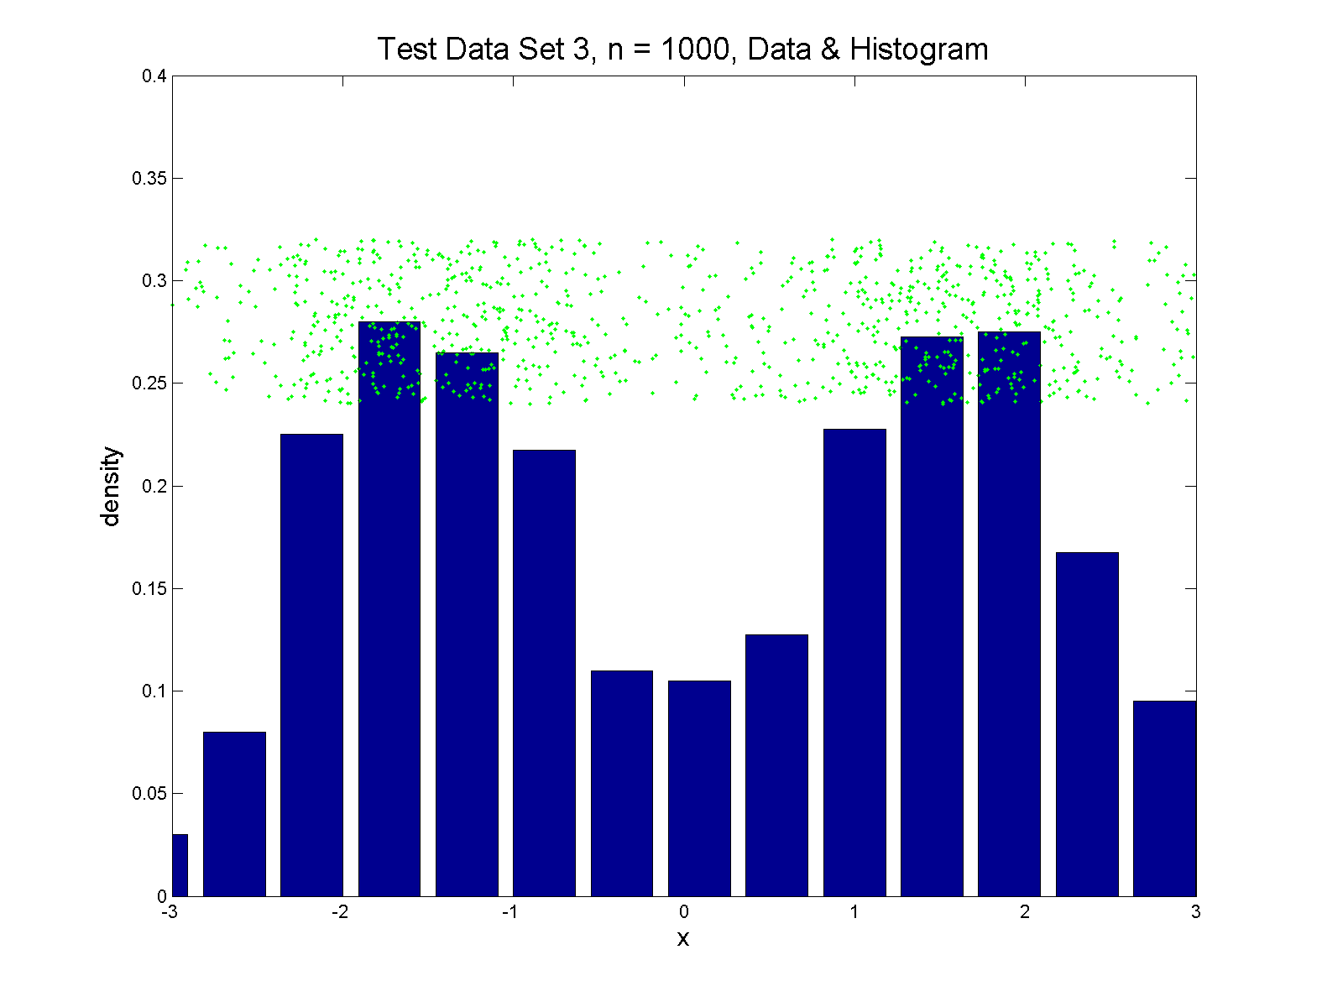
Q-Q plots
Simple Toy Example, non-Gaussian!

Slide 38
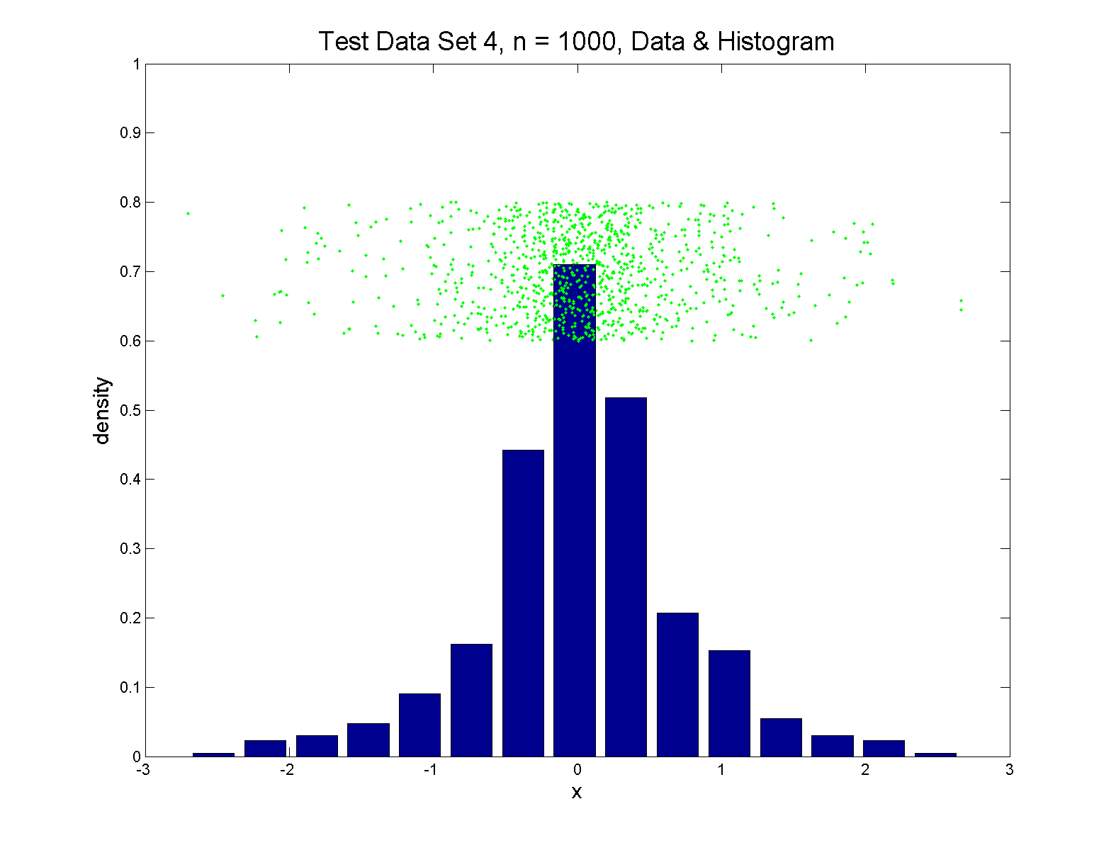
Q-Q plots
Simple Toy Example, non-Gaussian(?)

Slide 39
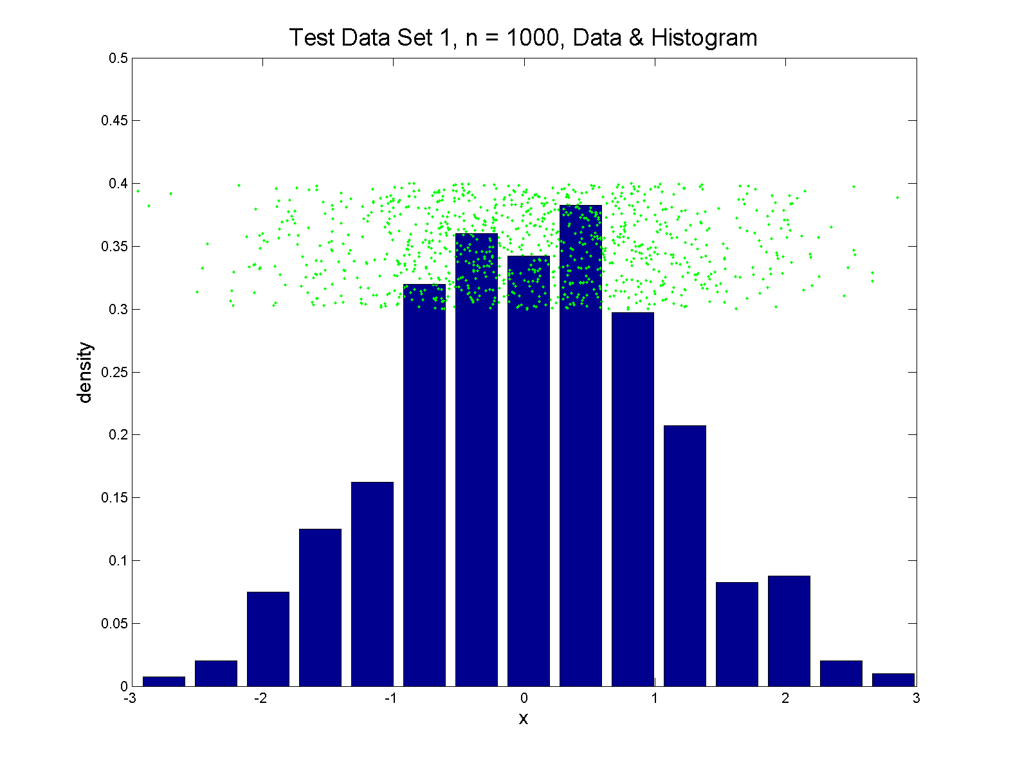
Q-Q plots
Simple Toy Example, Gaussian

Slide 40
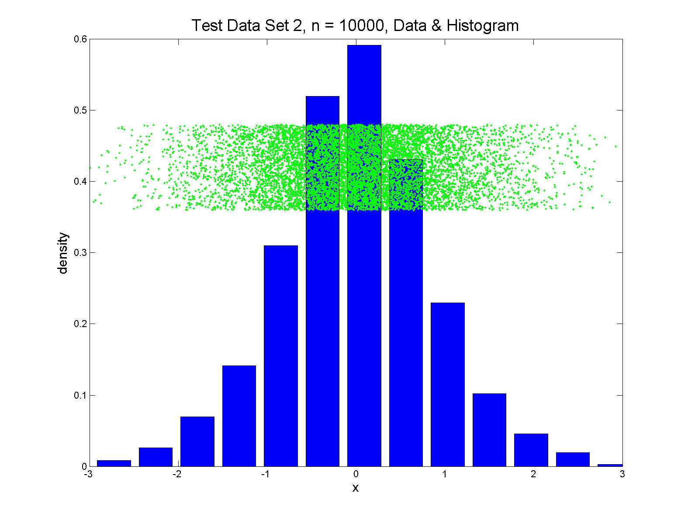
Q-Q plots
Simple Toy Example, Gaussian?

Slide 41
Q-Q plots
Notes:
Bimodal → see non-Gaussian with histo
Other cases: hard to see
Conclude:
Histogram poor at assessing Gauss’ity

Slide 42
Q-Q plots
Standard approach to checking Gaussianity
QQ – plots
Background:
Graphical Goodness of Fit
Fisher (1983)

Slide 43
Q-Q plots
Background: Graphical Goodness of Fit
Basis:
Cumulative Distribution Function (CDF)
$$F\left(x\right)=P\left\{X≤x\right\}$$
Probability quantile notation:
for "probability” $p$ and "quantile" $q$
$p=F\left(q\right)$ $q=F^{−1}\left(p\right)$

Slide 44
Q-Q plots
Probability quantile notation:
for "probability” $p$ and "quantile" $q$
$p=F\left(q\right)$ $q=F^{−1}\left(p\right)$
Thus $F^{−1}$ is called the quantile function

Slide 45
Q-Q plots
Two types of CDF:
Theoretical
$$p=F\left(q\right)=P\left\{X≤q\right\}$$
Empirical, based on data $X_{1},⋯,X_{n}$
$$\hat{p}=\hat{F}\left(q\right)=\frac{\#\left\{i:X_{i}≤q\right\}}{n}$$

Slide 46
Q-Q plots
Direct Visualizations:
Empirical CDF plot:
plot $\hat{p}=\frac{i}{n}, i=1,⋯,n$
vs. grid of $\hat{q}$ (sorted data) values
Quantile plot (inverse):
plot $\hat{q}$
vs. $\hat{p}$

Slide 47
Q-Q plots
Comparison Visualizations:
(compare a theoretical with an empirical)
P-P plot:
plot $\hat{p}$ vs. $p$
for a grid of $q$ values
Note: Have essentially already used this:
Called it the “ROC Curve”

Slide 48
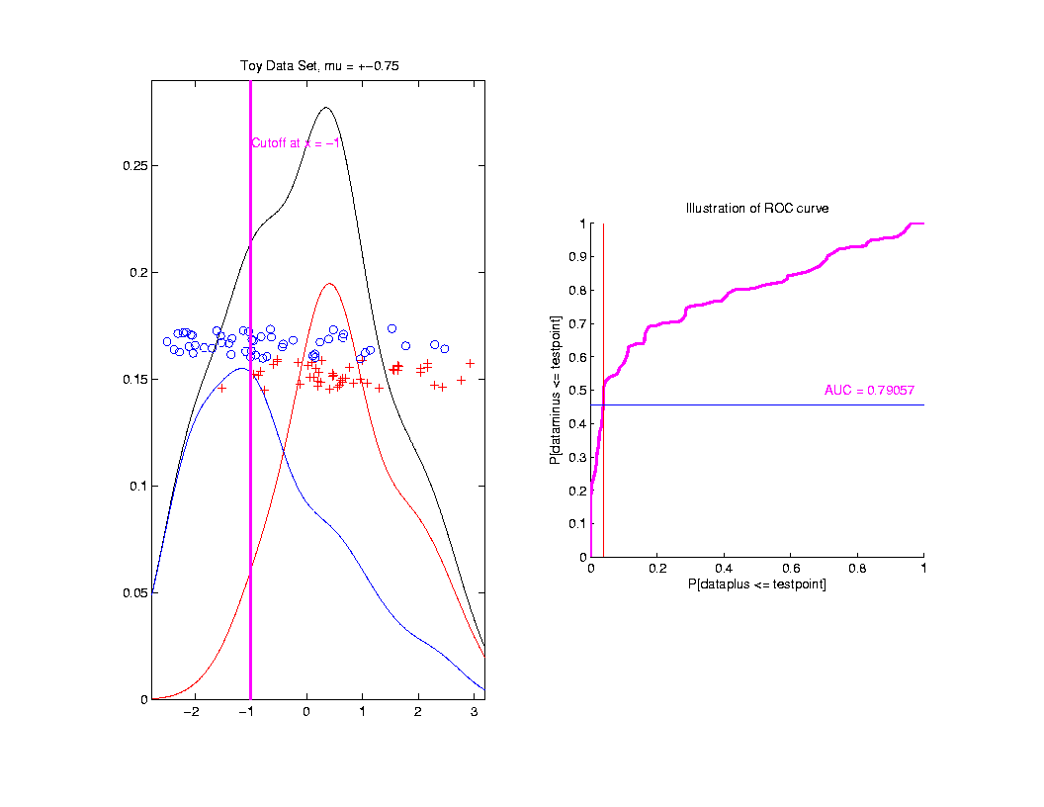
ROC Curve
Slide
Cutoff
To
Trace
Out
Curve
Recall from 9/12/19

Slide 49
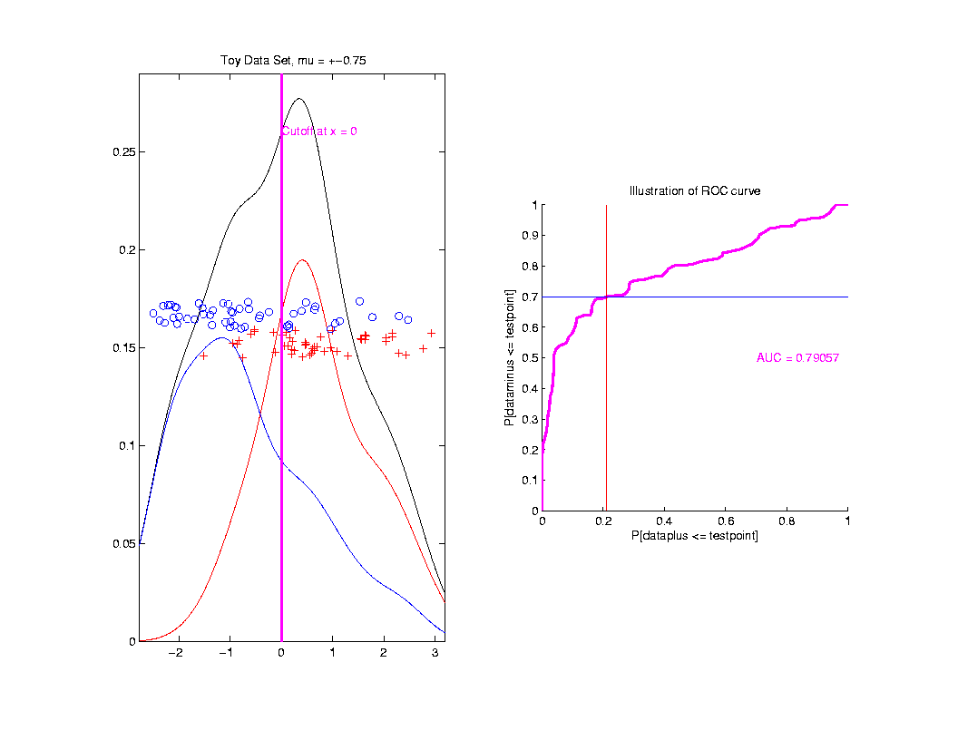
ROC Curve
Slide
Cutoff
To
Trace
Out
Curve

Slide 50
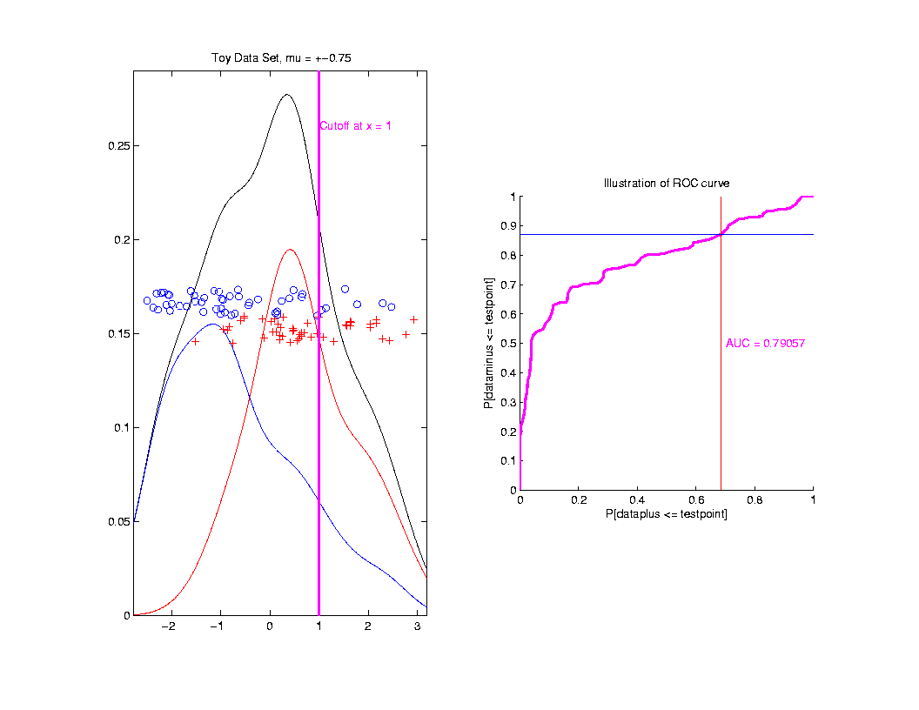
ROC Curve
Slide
Cutoff
To
Trace
Out
Curve
Plot $\hat{p}$ vs. $p$
For Grid of $q$ Values

Slide 51
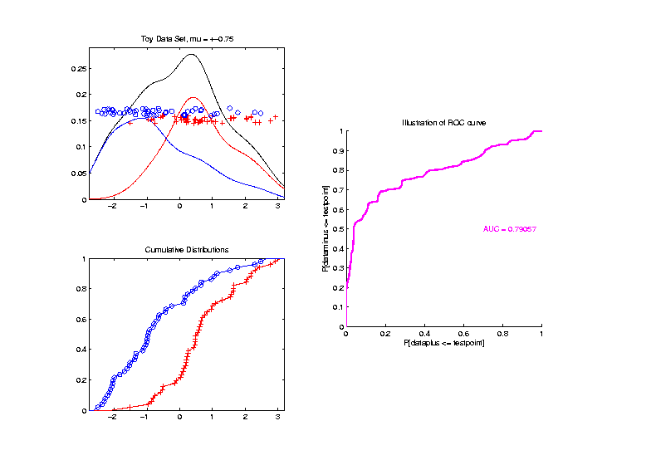
ROC Curve – CDF View
Next
Add
Cum.
Dist.
Funct.

Slide 52
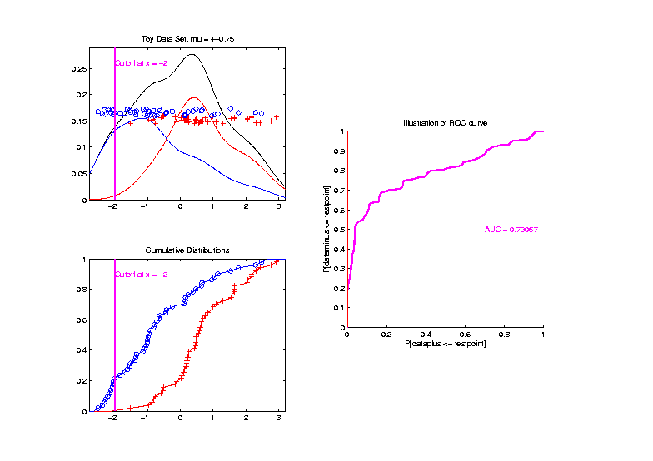
ROC Curve – CDF View
Slide
Cutoff
To
Trace
Out
Curve

Slide 53
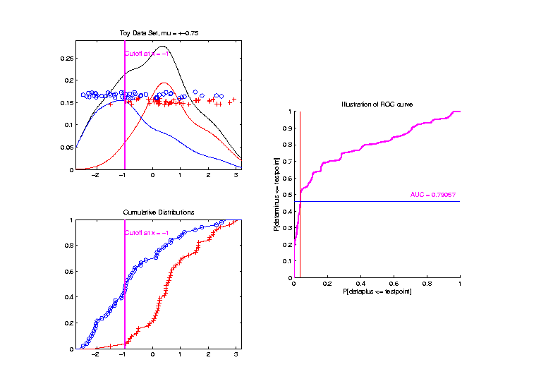
ROC Curve – CDF View
Slide
Cutoff
To
Trace
Out
Curve

Slide 54
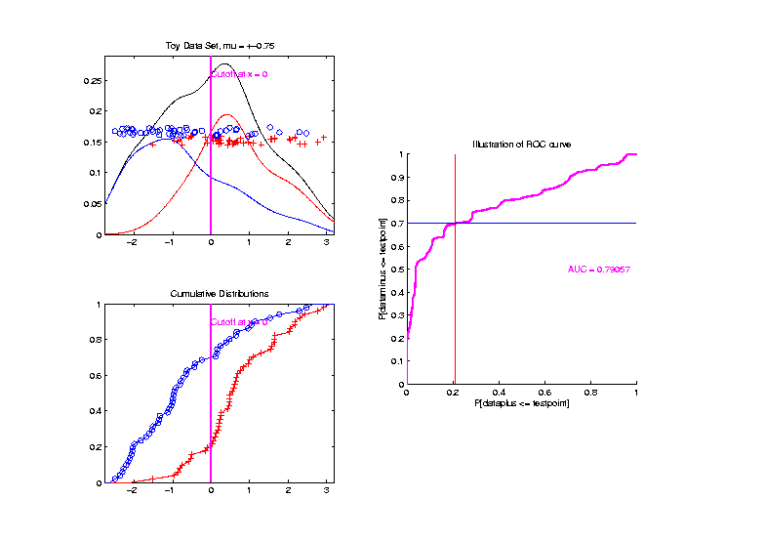
ROC Curve – CDF View
Slide
Cutoff
To
Trace
Out
Curve

Slide 55
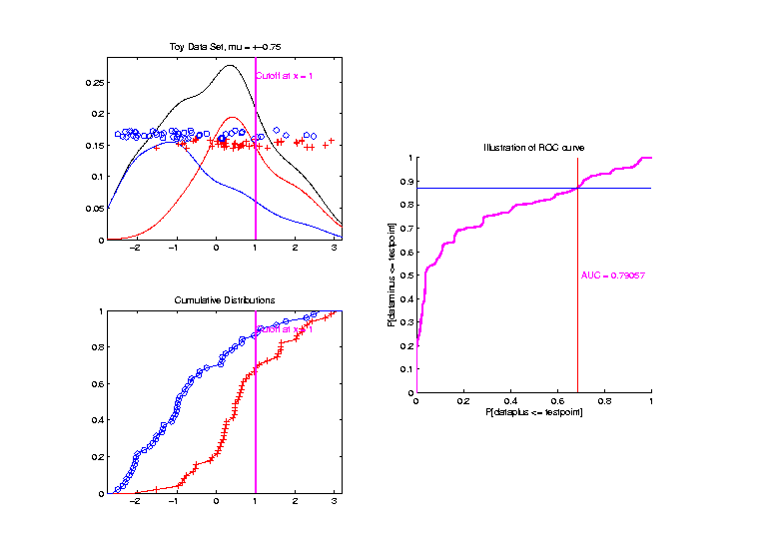
ROC Curve – CDF View
Slide
Cutoff
To
Trace
Out
Curve

Slide 56
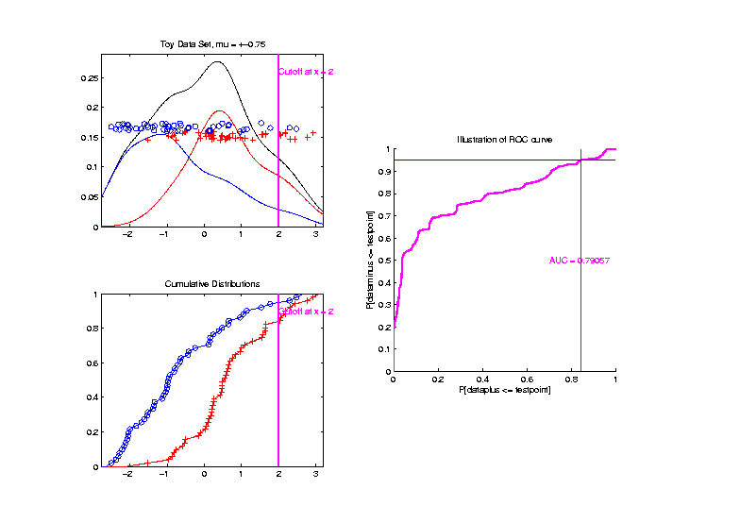
ROC Curve – CDF View
Slide
Cutoff
To
Trace
Out
Curve

Slide 57
Q-Q plots
Comparison Visualizations:
(compare a theoretical with an empirical)
P-P plot:
plot $\hat{p}$ vs. $p$
for a grid of $q$ values
Q-Q plot:
plot $\hat{q}$ vs. $q$
for a grid of $p$ values

Slide 58
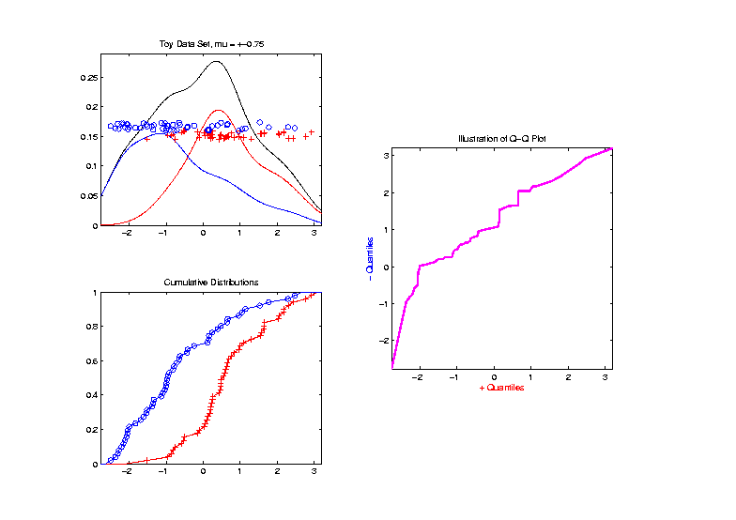
Q-Q plots
Replace
Grid
of $q$
Values
With
Grid
of $p$
Values

Slide 59
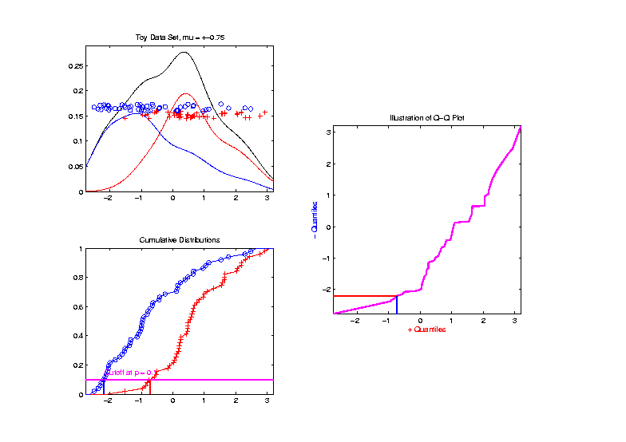
Q-Q plots
Slide
Cutoff
To
Trace
Out
Curve

Slide 60
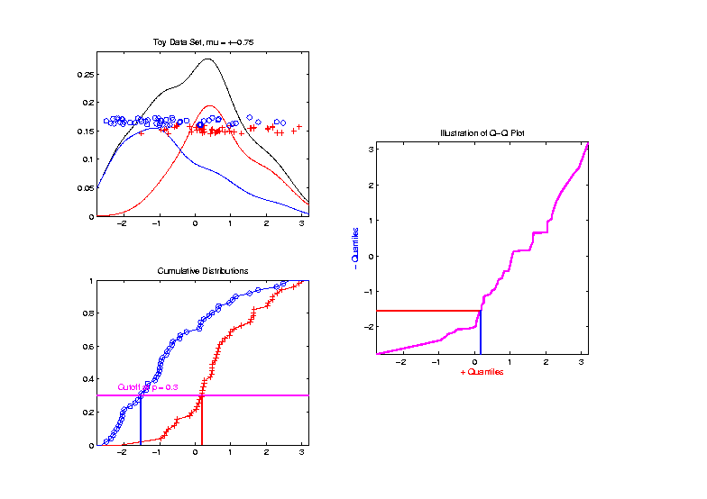
Q-Q plots
Slide
Cutoff
To
Trace
Out
Curve

Slide 61
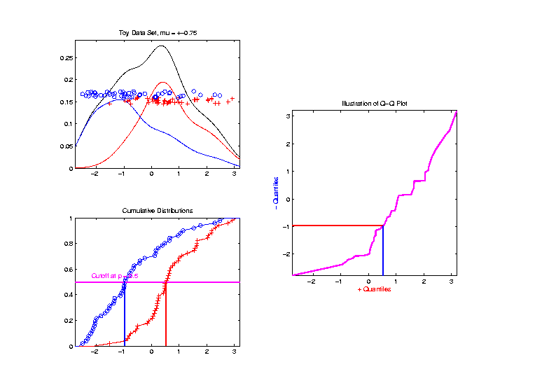
Q-Q plots
Slide
Cutoff
To
Trace
Out
Curve

Slide 62
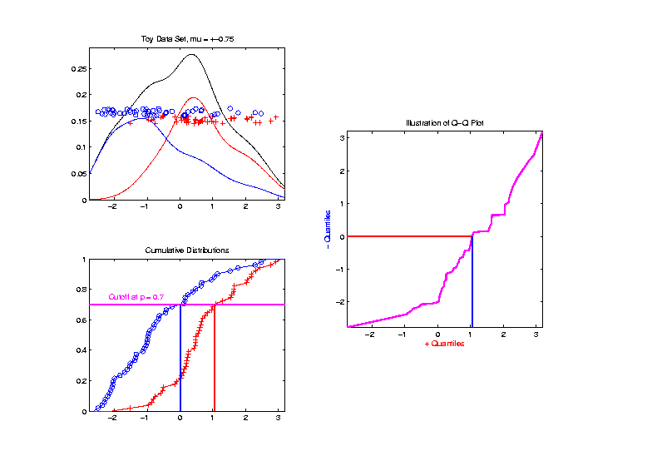
Q-Q plots
Slide
Cutoff
To
Trace
Out
Curve

Slide 63
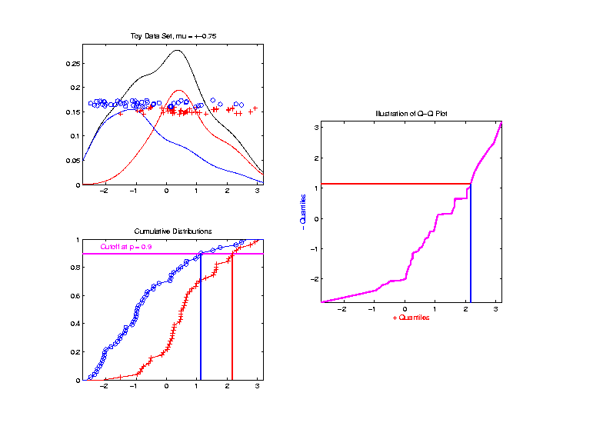
Q-Q plots
Slide
Cutoff
To
Trace
Out
Curve

Slide 64
Q-Q plots
Illustrative graphic (toy data set):
From $N\left(0,1\right)$ Distribution

Slide 65
Q-Q plots
Illustrative graphic (toy data set):
Generated $n=5$ data points

Slide 66
Q-Q plots
Illustrative graphic (toy data set):

Slide 67
Q-Q plots
Illustrative graphic (toy data set):
Empirical Qs near Theoretical Qs
when
Q-Q curve is near 45⁰ line
(general use of Q-Q plots)

Slide 68
Alternate Viewpoints
P-P Plot = ROC Curve:
Study Differences Between Data Sets
Focus on Main Body of Distributions
Q-Q Plot: For Checking
Empirical Distribution
vs.
Theoretical Distribution
Focus on Tails

Slide 69
Alternate Terminology
P-P Plot = ROC Curve
Q-Q Plot
Related Measures:
Precision & Recall
Motivated by Information Retrieval
In the World of Data Bases

Slide 70
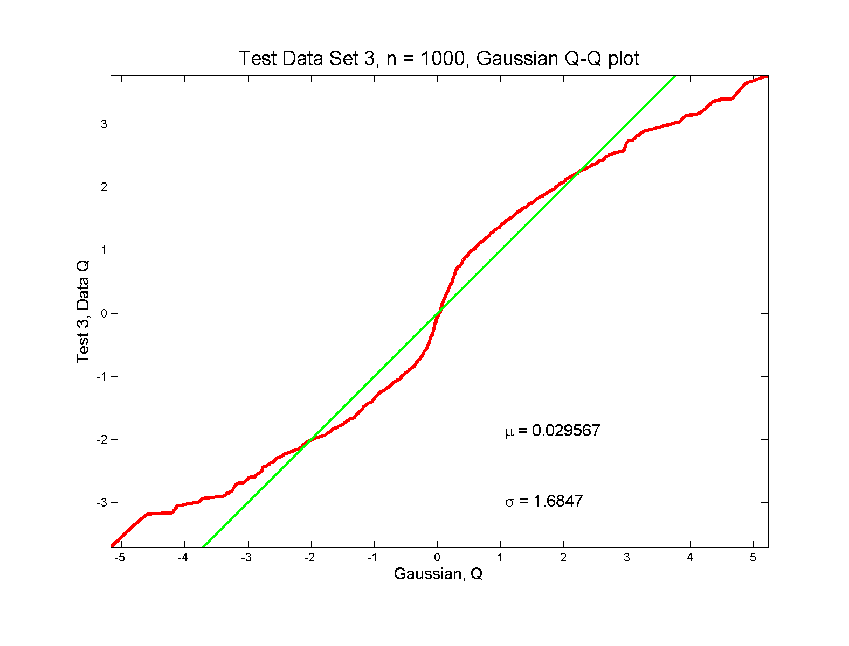
Q-Q plots
non-Gaussian! departures from line?

Slide 71
Q-Q plots
non-Gaussian! departures from line?
Seems different from line?
2 modes turn into wiggles?
Less strong feature
Been proposed to study modality

Slide 72
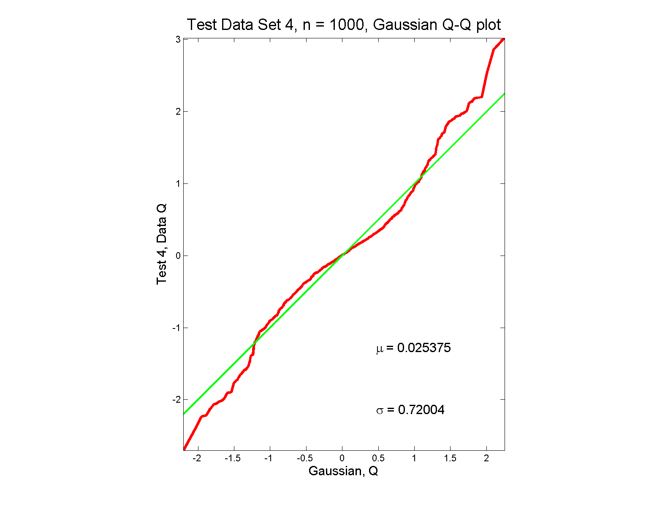
Q-Q plots
non-Gaussian (?) departures from line?

Slide 73
Q-Q plots
non-Gaussian (?) departures from line?
Seems different from line?
Harder to say this time?
What is signal & what is noise?
Need to understand sampling variation

Slide 74
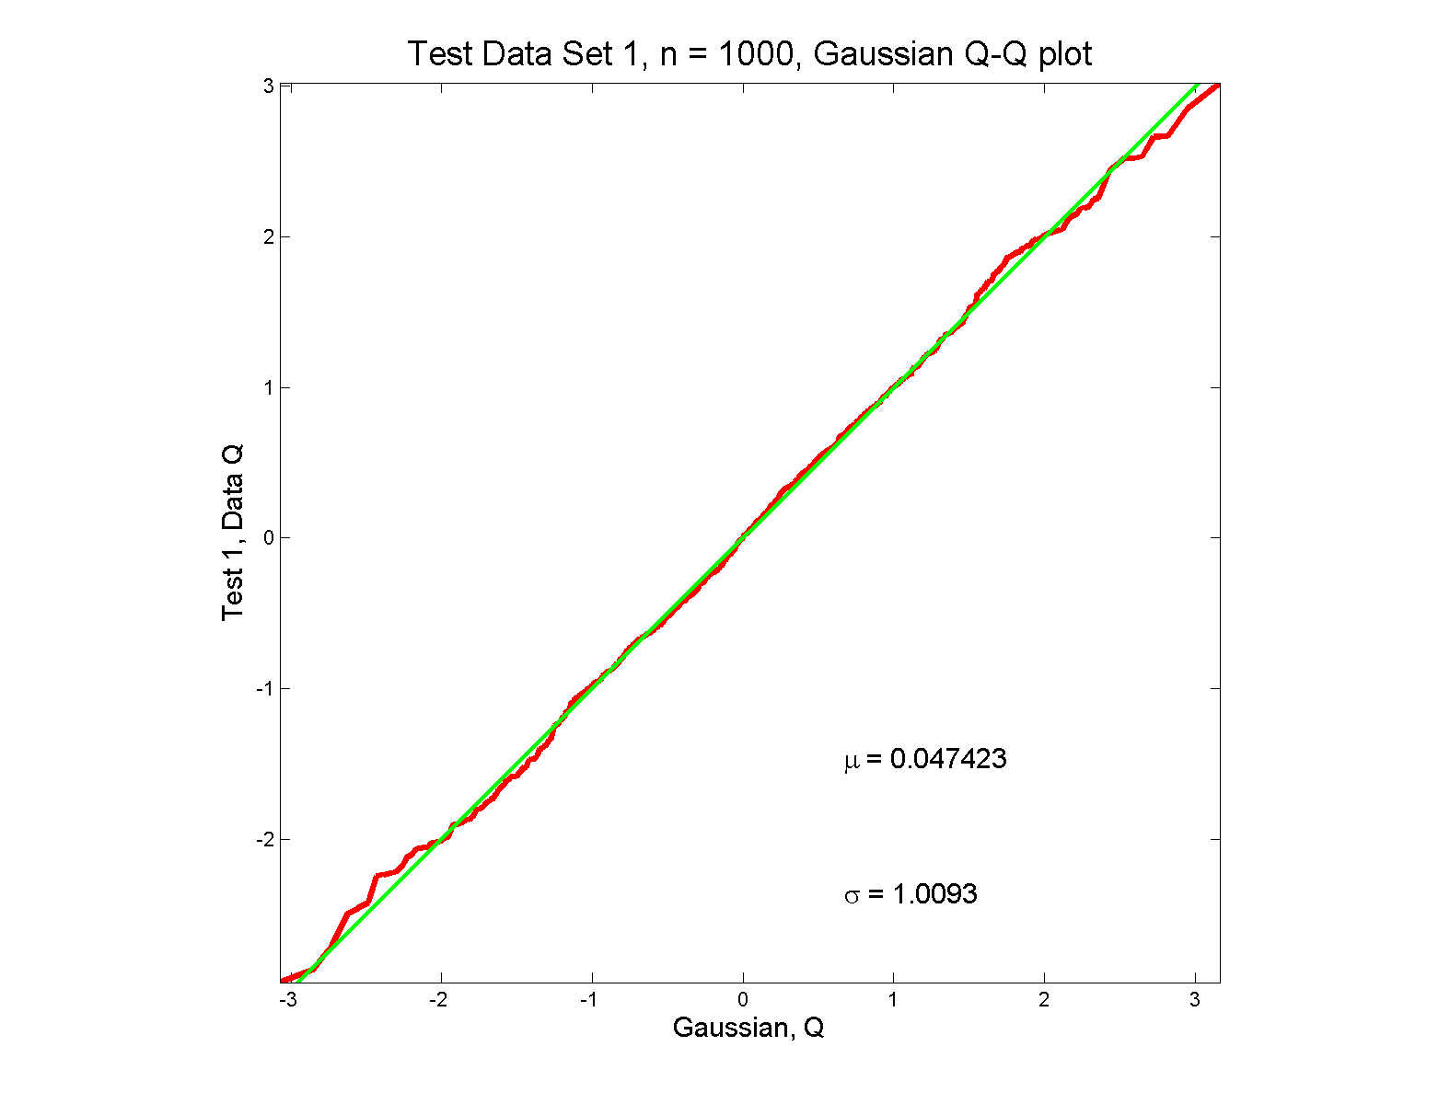
Q-Q plots
Gaussian: Departures from line?

Slide 75
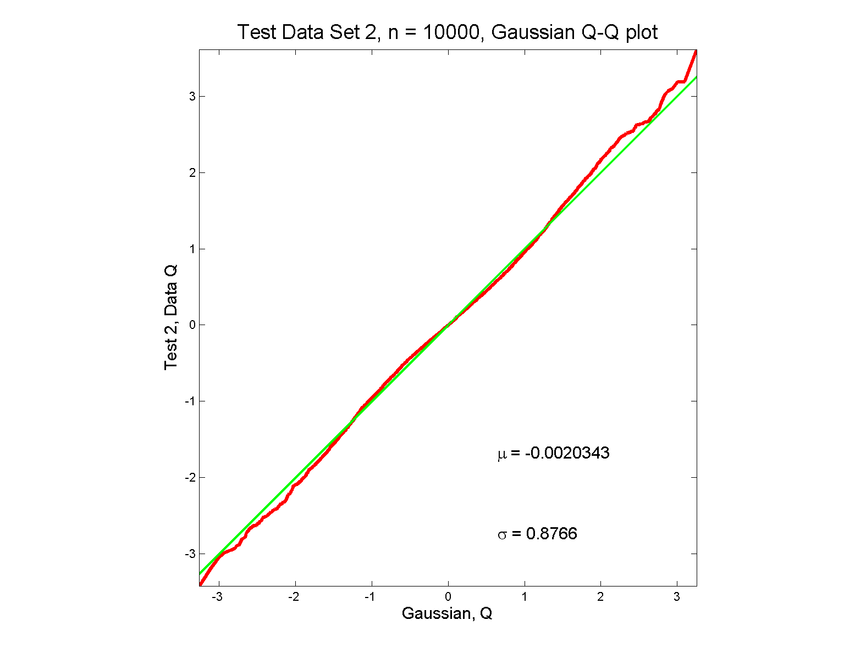
Q-Q plots
Gaussian? Departures from line?
Keep $n=10,000$
In Mind Here

Slide 76
Q-Q plots
Gaussian? departures from line?
Looks much like?
Wiggles all random variation?
But there are n = 10,000 data points…
How to assess signal & noise?
Need to understand sampling variation

Slide 77
Q-Q plots
Need to understand sampling variation
Approach: Q-Q envelope plot
Simulate from Theoretical Dist’n
Samples of same size
About 100 samples gives
“good visual impression”
Overlay resulting 100 QQ-curves
To visually convey natural sampling variation

Slide 78
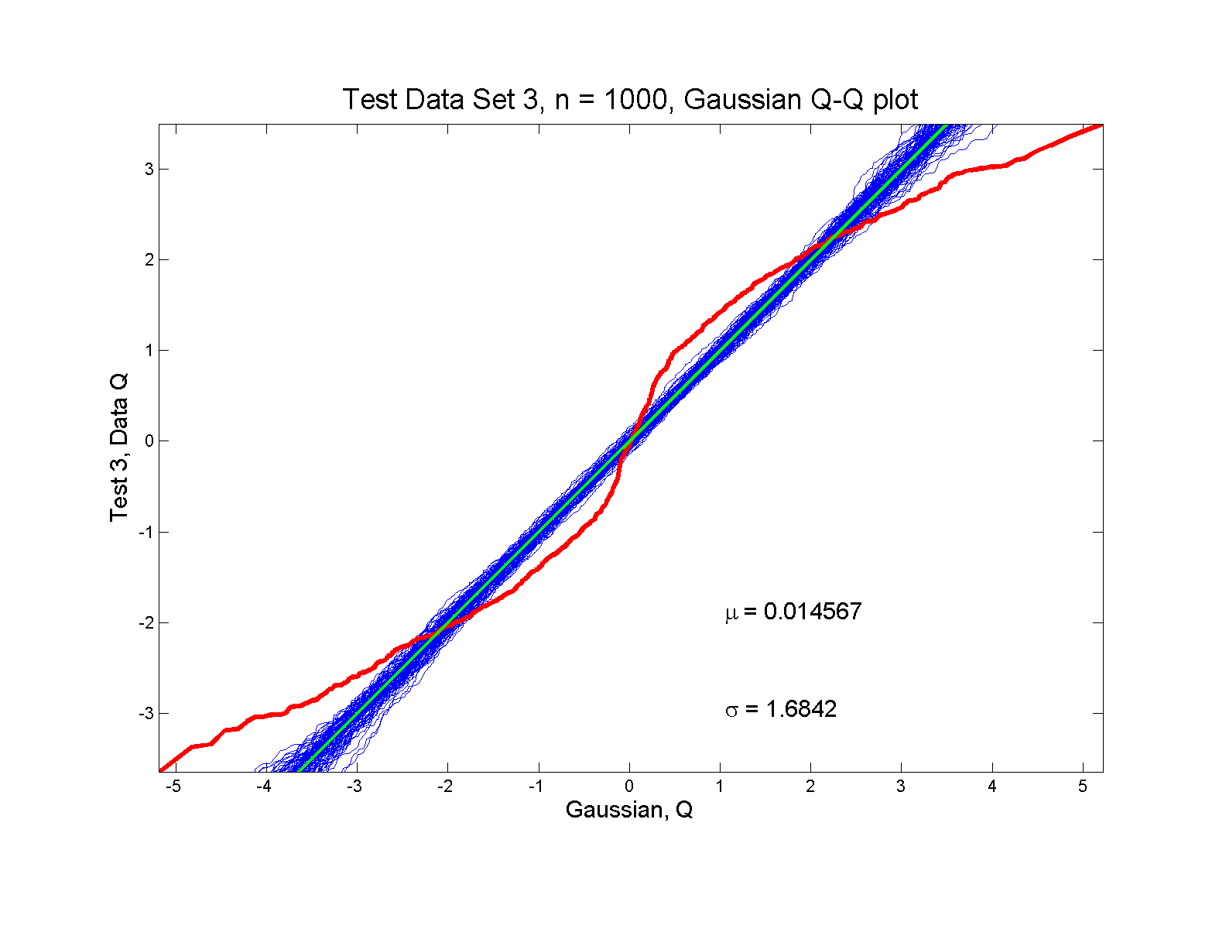
Q-Q plots
non-Gaussian! departures from line?

Slide 79
Q-Q plots
non-Gaussian! departures from line?
Envelope Plot shows:
Departures are significant
Clear these data are not Gaussian
Q-Q plot gives clear indication

Slide 80
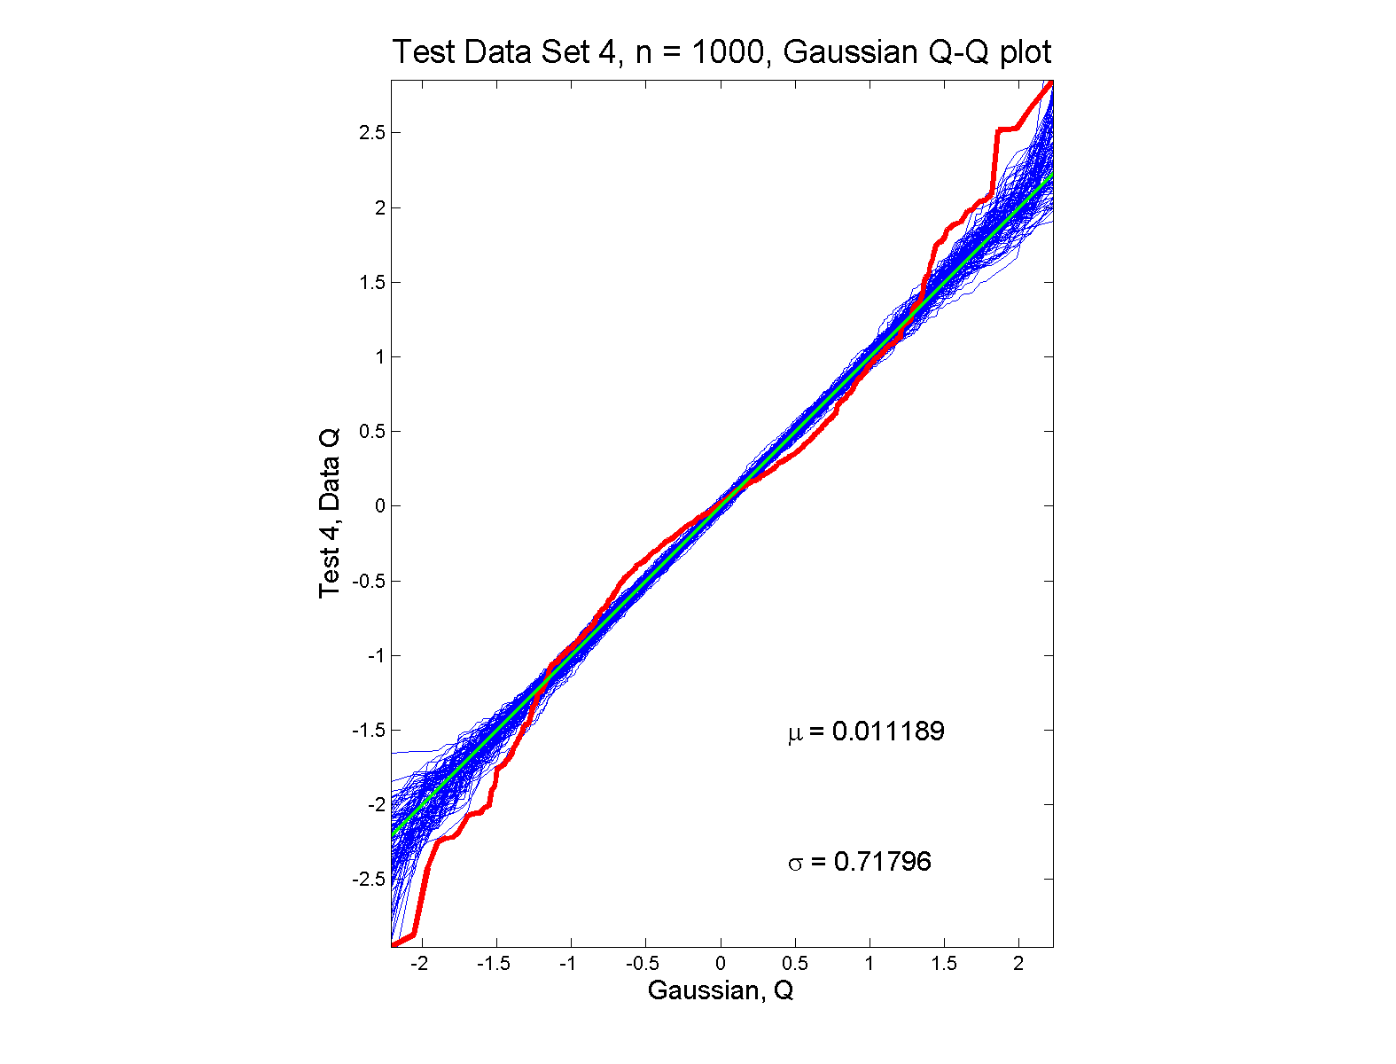
Q-Q plots
non-Gaussian (?) departures from line?

Slide 81
Q-Q plots
non-Gaussian (?) departures from line?
Envelope Plot shows:
Departures are significant
Clear these data are not Gaussian
Recall not so clear from e.g. histogram
Q-Q plot gives clear indication
Envelope plot reflects sampling variation

Slide 82
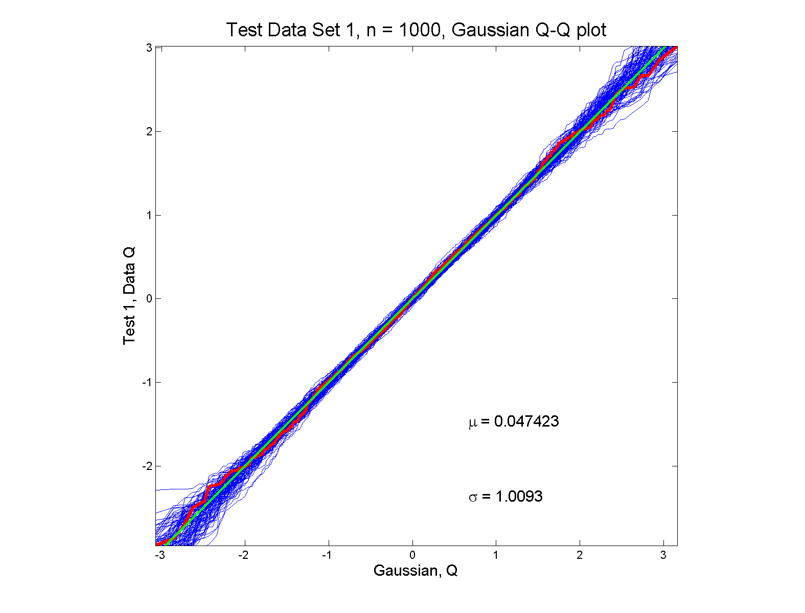
Q-Q plots
Gaussian: Stays Within Envelope
As Expected,
Since This Is
Null Hypothesis

Slide 83
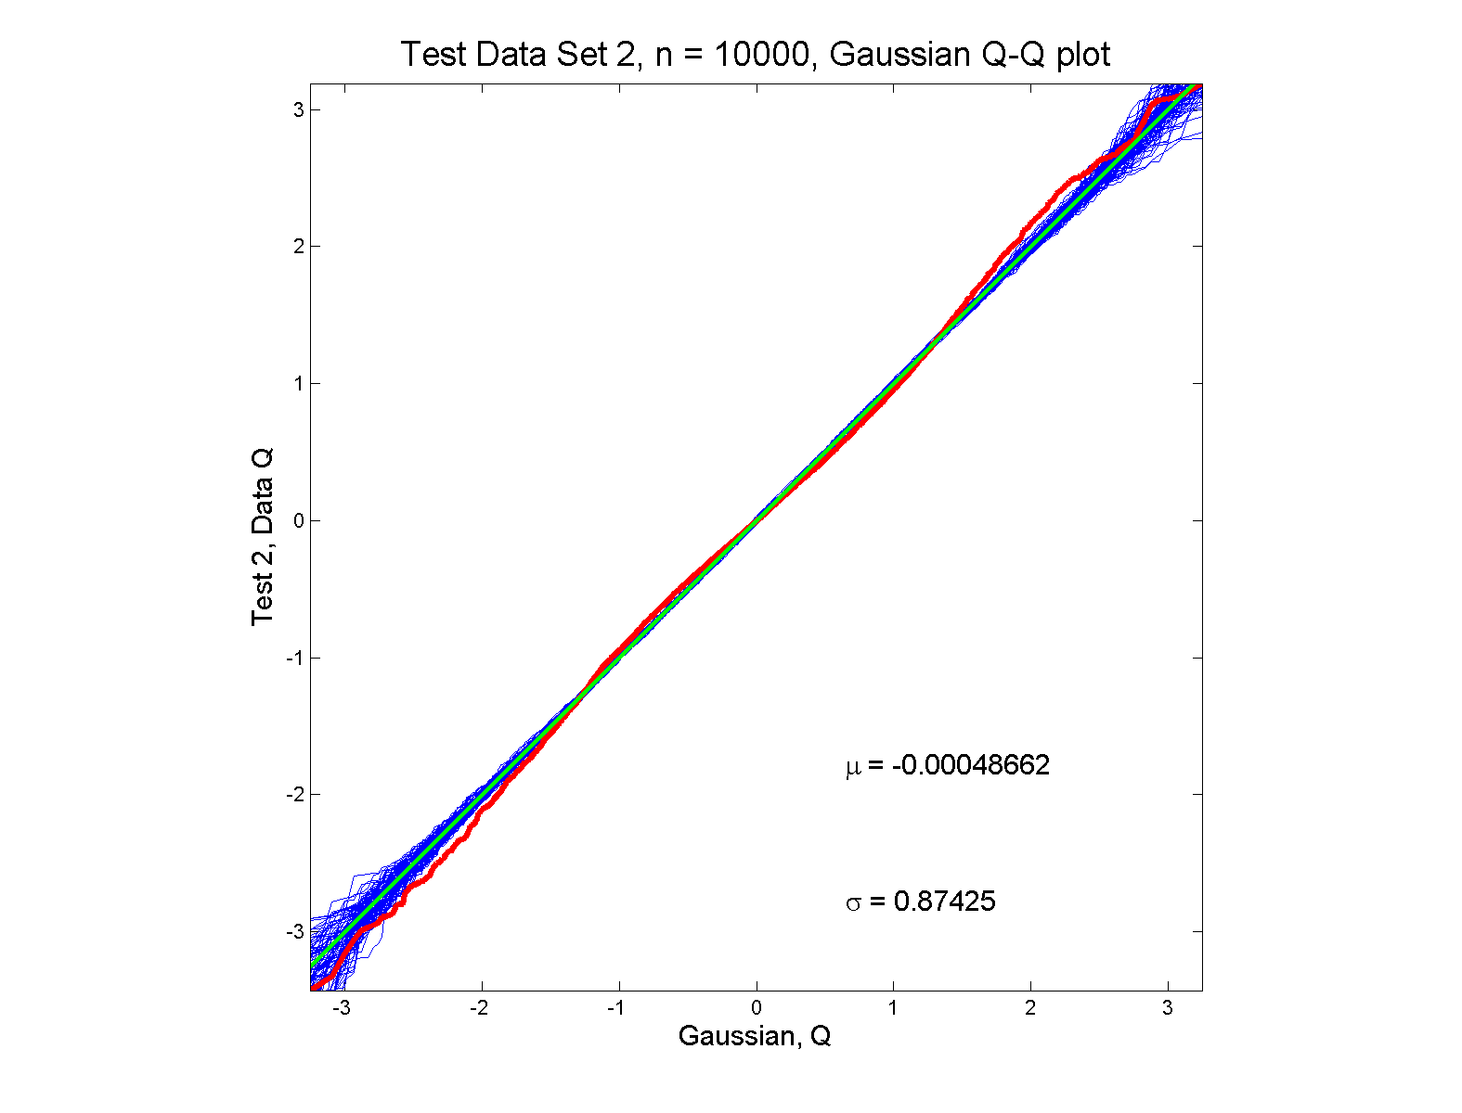
Q-Q plots
Gaussian? departures from line?

Slide 84
Q-Q plots
Gaussian? departures from line?
Harder to see
But clearly there
Conclude non-Gaussian
Really needed n = 10,000 data points…
(why bigger sample size was used)
Envelope plot reflects sampling variation

Slide 85
Q-Q plots
What were these distributions?
Non-Gaussian!
0.5 N(-1.5,0.75²) + 0.5 N(1.5,0.75²)
Non-Gaussian (?)
0.4 N(0,1) + 0.3 N(0,0.5²) + 0.3 N(0,0.25²)
Gaussian
Gaussian?
0.7 N(0,1) + 0.3 N(0,0.5²)

Slide 86
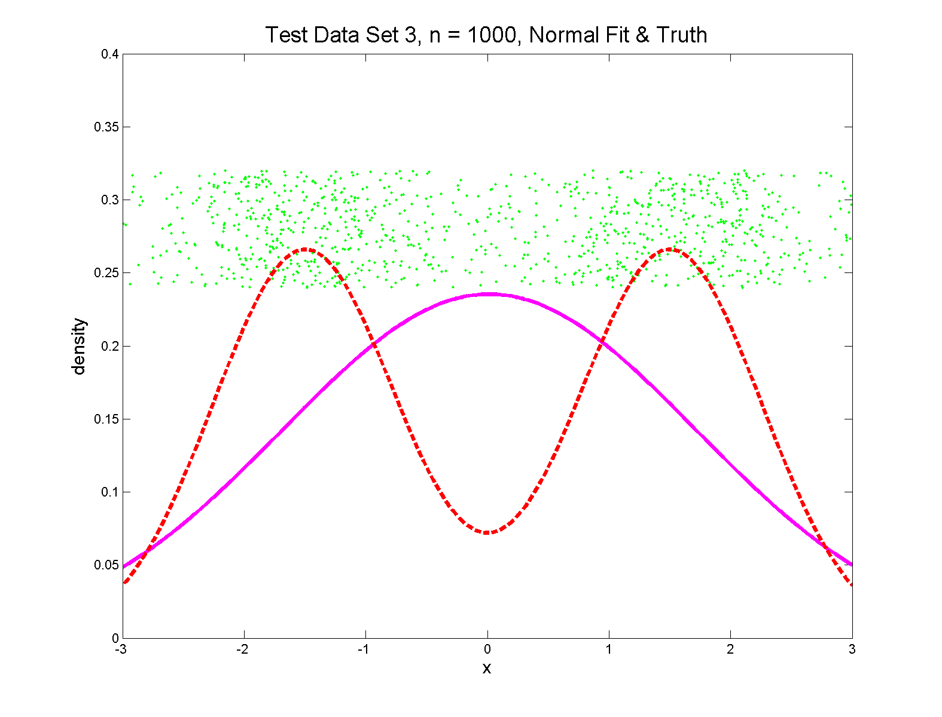
Q-Q plots
Non-Gaussian! .5 N(-1.5,0.75²) + 0.5 N(1.5,0.75²)
True Density
Fit $N\left(\hat{μ},σ^{2}\right)$ Density

Slide 87
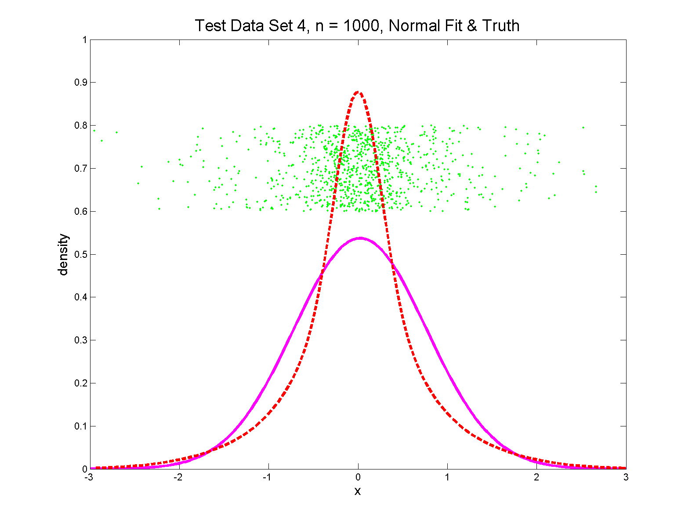
Q-Q plots
Non-Gaussian (?) 0.4 N(0,1) + 0.3 N(0,0.5²) + 0.3 N(0,0.25²)

Slide 88
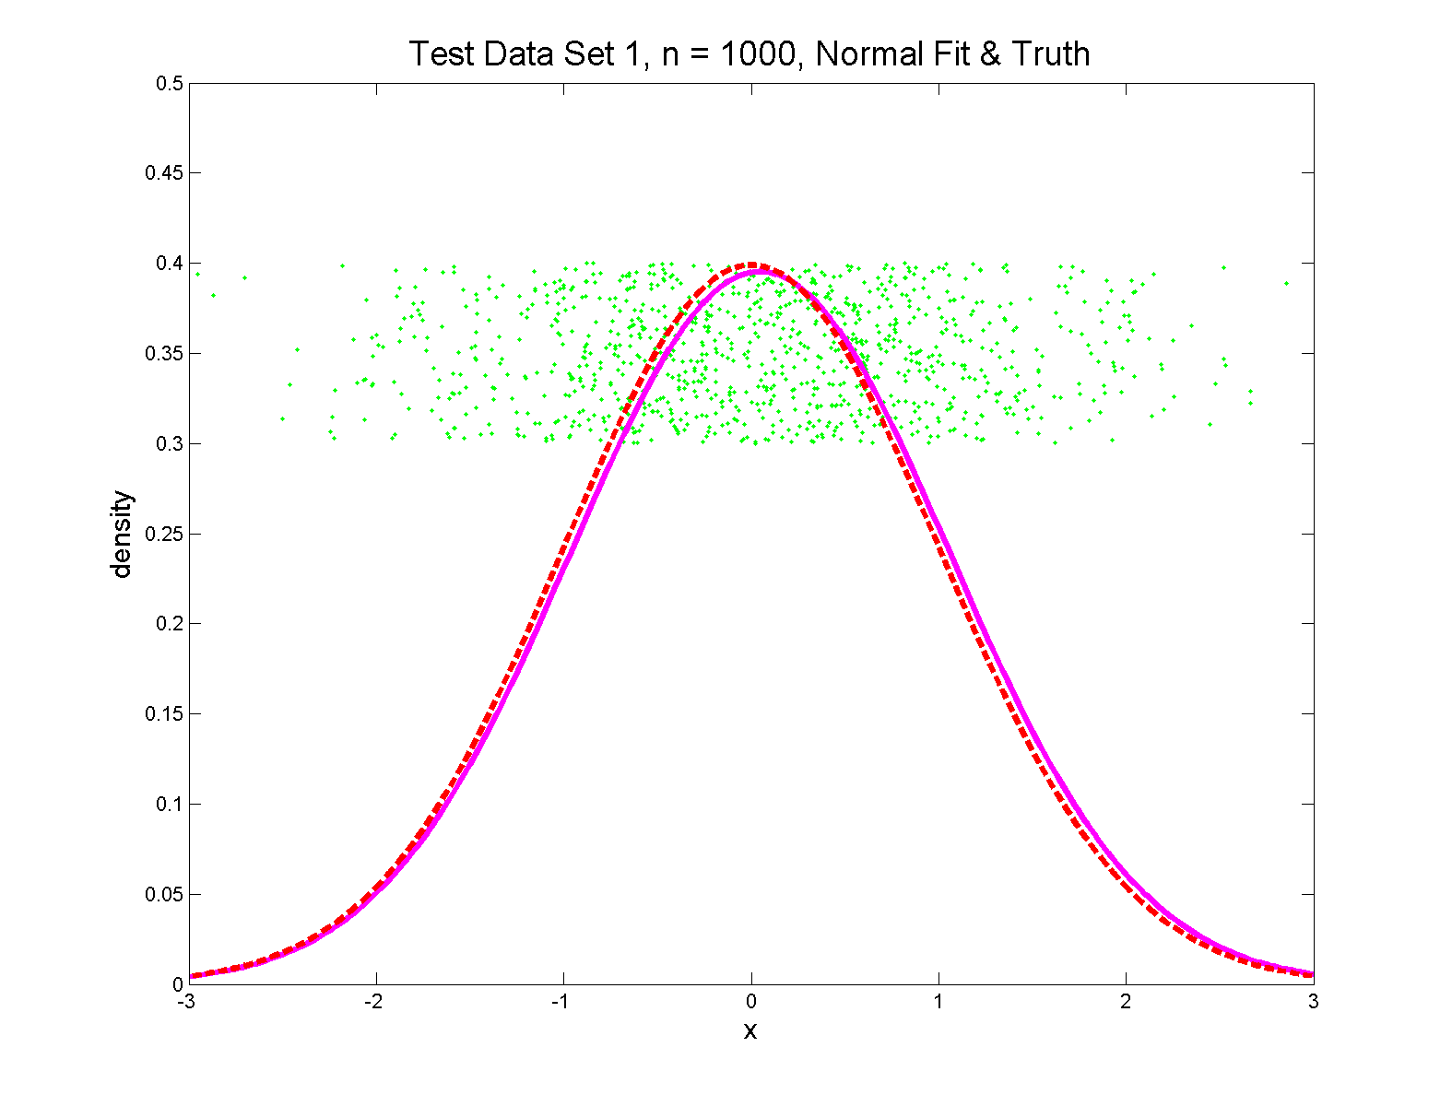
Q-Q plots
Gaussian

Slide 89
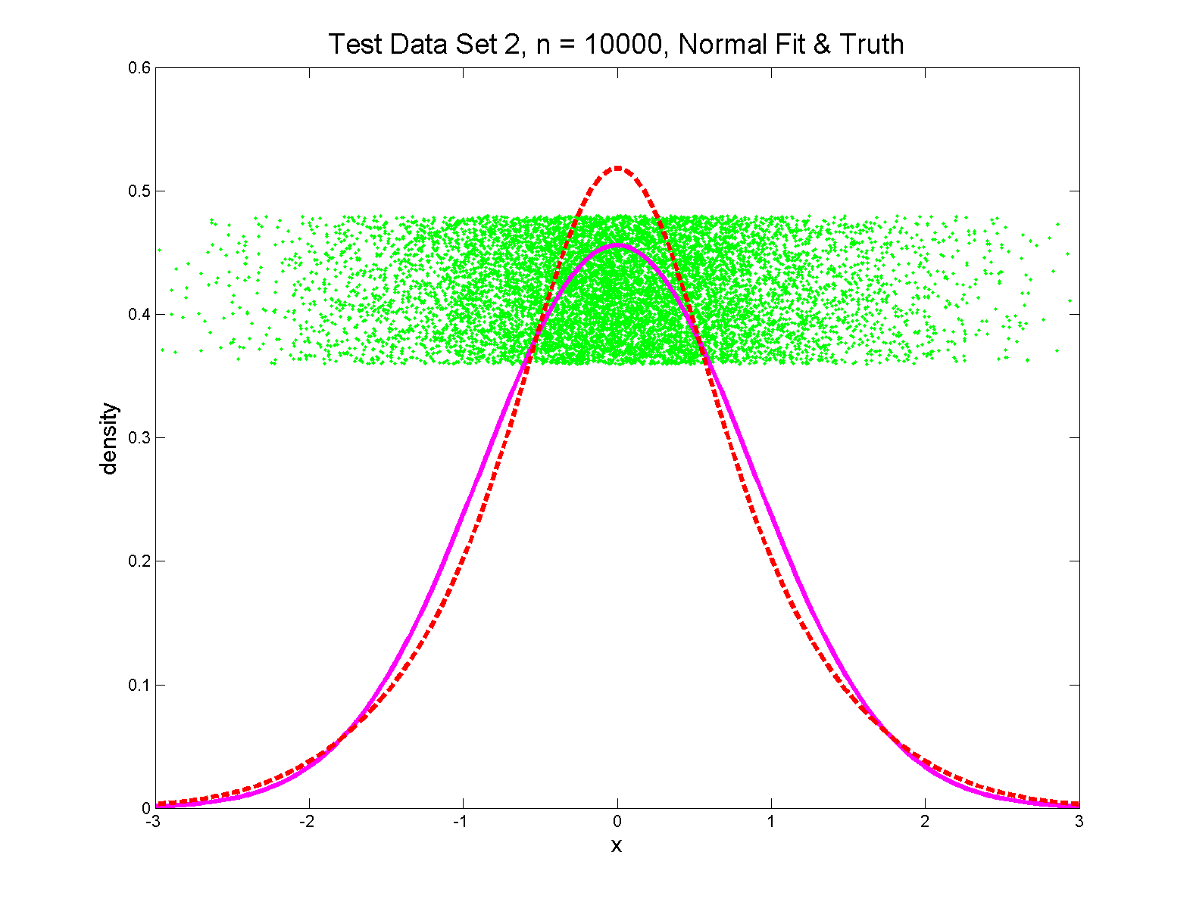
Q-Q plots
Gaussian? 0.7 N(0,1) + 0.3 N(0,0.5²)

Slide 90
Q-Q Envelope Plots
Marron’s Matlab Software:
qqLM.m
In General Directory

Slide 91
Participant Presentation
Wongkyung Jang:
OODA in Human-Computer Interaction
Bohan Li:
Introduction to Word Segmentation
Andrew Marron:
Kidney Function Methylation Data

