Slide 1
Clustering
Idea: Given data ${\underline{X}}_{1},⋯,{\underline{X}}_{n}$
Assign each object to a class
Of similar objects
Completely data driven
I.e. assign labels to data
“Unsupervised Learning”
Contrast to Classification (Discrimination)
With predetermined given class labels
“Supervised Learning”

Slide 2
K-means Clustering
Common Variation:
Put on scale of proportions (i.e. in [0,1])
By dividing “within class SS”
by “overall SS”
Gives Cluster Index:
$$CI\left(C_{1},⋯,C_{K}\right)=\frac{\sum_{j=1}^{K}{\sum_{i∈C_{j}}{{\left\|{\underline{X}}_{i}−{\overline{\underline{X}}}_{j}\right\|}^{2}}}}{\sum_{i=1}^{n}{{\left\|{\underline{X}}_{i}−\overline{\underline{X}}\right\|}^{2}}}$$

Slide 3
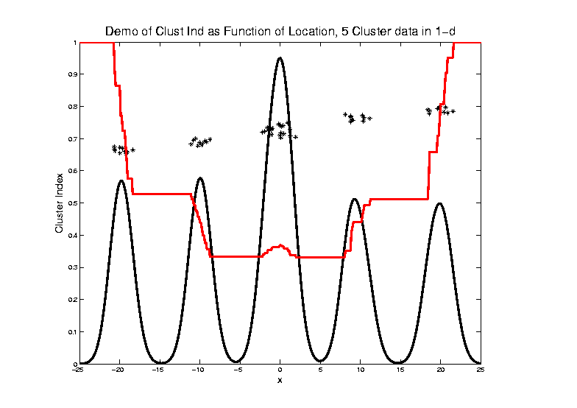
2-means Clustering
Curve Shows CI for Many
Reasonable Clusterings

Slide 4
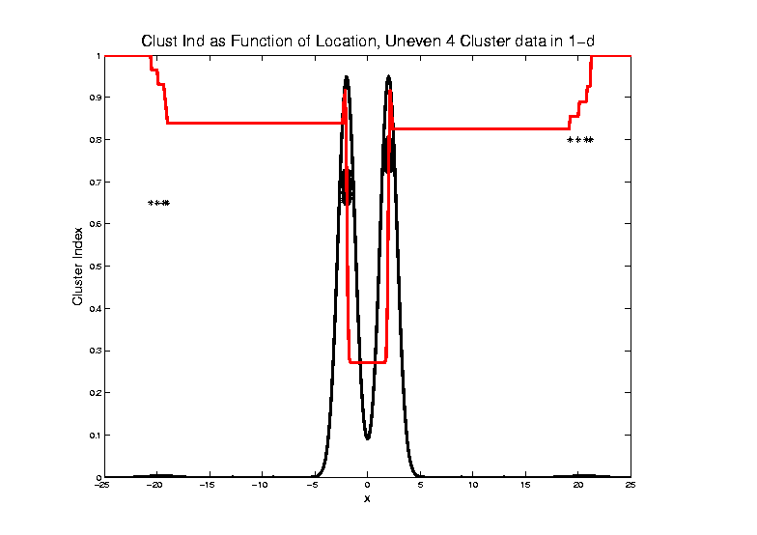
2-means Clustering

Slide 5
2-means Clustering
Study CI, using simple 1-d examples
Over changing Classes (moving b’dry)
Multi-modal data → interesting effects
Local mins can be hard to find
i.e. iterative procedures can “get stuck”
(even in 1 dimension, with K = 2)
Common, But Slippery,
Approach: Many
Random Restarts

Slide 6
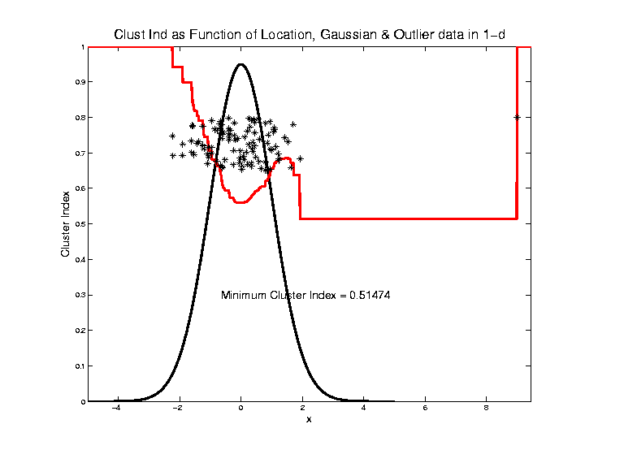
2-means Clustering
Global CI
Minimum
Now Here

Slide 7
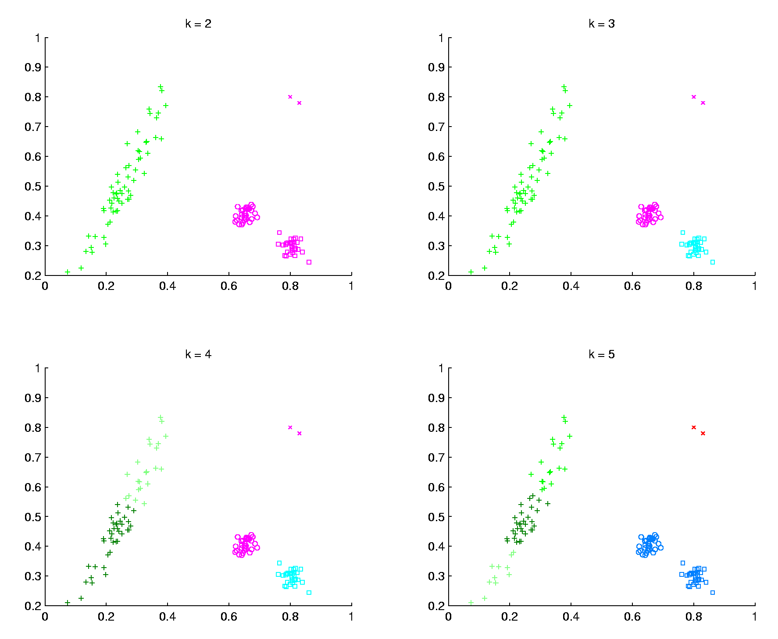
K-Means Clustering
2-d Toy Example
$k=2$, Groups
All Small Ones
$k=3$, Splits
Round Ones
K-Means Can Be Slippery
$k=4$, Splits
Long Cluster
Local Minimum?
$k=5$, Splits
Outliers, Not
Round Ones?

Slide 8
SWISS Score
Another Application of CI (Cluster Index)
Cabanski et al (2010)
Idea: Use CI in bioinformatics to
“measure quality of data preprocessing”
Philosophy: Clusters Are Scientific Goal
So Want to Accentuate Them

Slide 9
SWISS Score
Toy Examples (2-d):
Which are “More Clustered?”

Slide 10
SWISS Score
Toy Examples (2-d):
Which are “More Clustered?”

Slide 11
SWISS Score
K-Class SWISS:
Instead of using K-Class CI
Use Average of Pairwise SWISS Scores
(Preserves [0,1] Range)

Slide 12
SWISS Score
Avg. Pairwise SWISS – Toy Examples

Slide 13
SWISS Score
Additional Feature:
Ǝ Hypothesis Tests:
H₁: SWISS₁ < 1
H₁: SWISS₁ < SWISS₂
Permutation Based
See Cabanski et al (2010)

Slide 14
Clustering
A Very Large Area
K-Means is Only One Approach
Has its Drawbacks
(Many Toy Examples of This)
Ǝ Many Other Approaches
Important (And Broad) Class
Hierarchical Clustering

Slide 15
Hierarchical Clustering
Idea: Consider Either:
Bottom Up Aggregation:
One by One Combine Data
Top Down Splitting:
All Data in One Cluster & Split
Through Entire Data Set, to get Dendogram

Slide 16
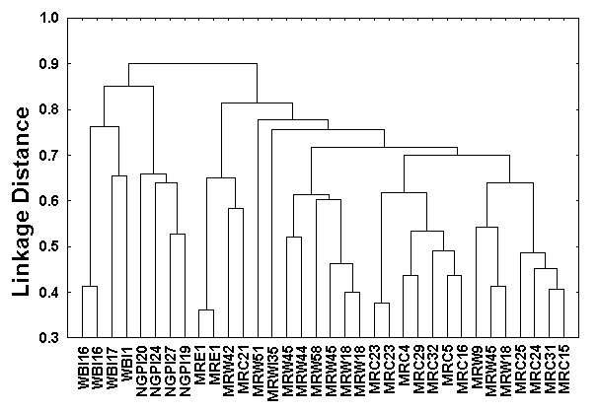
Hierarchical Clustering
Aggregate or Split, to get Dendogram
Thanks to US EPA: water.epa.gov

Slide 17
Hierarchical Clustering
Aggregate or Split, to get Dendogram
While Result
Is Same,
There Are
Computational
Considerations

Slide 18
Hierarchical Clustering
Vertical Axis in Dendogram:
Based on:
Distance Metric
(Ǝ many, e.g. $L^{2}$, $L^{1}$, $L^{∞}$, …)
Linkage Function
(Reflects Clustering Type)
A Lot of “Art” Involved

Slide 19
Hierarchical Clustering
Dendogram Interpretation
Branch
Length
Reflects
Cluster
Strength

Slide 20
Hierarchical Clustering
2-d Toy Example
Recall From Before
(When Studying
Kernel PCA)
Long Thin Cluster
Close Round Clusters
Outliers or Clusters???

Slide 21
Hierarchical Clustering
2-d Toy Example, Euclidean Distance
Ward’s Linkage (Cut at 4 Clusters)
Likes
Balanced
Splits

Slide 22
Hierarchical Clustering
2-d Toy Example, Euclidean Distance
Linkages: Distances Between Clusters
Based on Pairwise Distances

Slide 23
Hierarchical Clustering
2-d Toy Example, Euclidean Distance
Complete Linkage (Cut at 4 Clusters)
Idea: Cluster Distance = Max Pairwise Dist.

Slide 24
Hierarchical Clustering
2-d Toy Example, Euclidean Distance
Complete Linkage (Cut at 4 Clusters)
Clusters
Avoid Far Away
Members

Slide 25
Hierarchical Clustering
2-d Toy Example, Euclidean Distance
Average Linkage (Cut at 4 Clusters)
Idea: Cluster Distance = Avg. Pairwise Dist.

Slide 26
Hierarchical Clustering
2-d Toy Example, Euclidean Distance
Average Linkage (Cut at 4 Clusters)
Allows Outliers
To Split Off
But Still Groups
Round Clusters

Slide 27
Hierarchical Clustering
2-d Toy Example, Euclidean Distance
Single Linkage (Cut at 4 Clusters)
Idea: Cluster Distance = Min Pairwise Dist.

Slide 28
Hierarchical Clustering
2-d Toy Example, Euclidean Distance
Single Linkage (Cut at 4 Clusters)
Gives Intuitively
Natural Result
Good 2-d
Performance

Slide 29
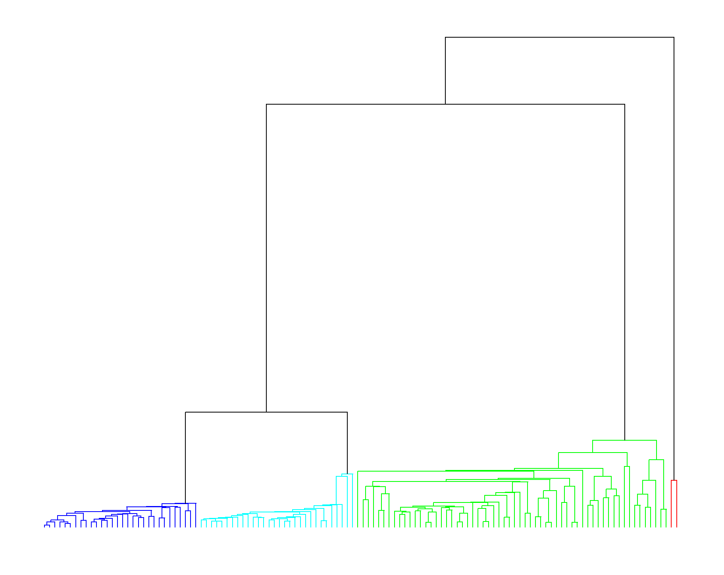
Hierarchical Clustering
2-d Toy Example, Euclidean Distance
Single Linkage Dendrogram
Reveals
Ordering
Of Clusters

Slide 30
Hierarchical Clustering
2-d Toy Example, Euclidean Distance
Single Linkage (Cut at 3 Clusters)
Groups
Closest
Clusters

Slide 31
Hierarchical Clustering
2-d Toy Example, Euclidean Distance
Single Linkage (Cut at 5 Clusters)
Splits Long Cluster
But Finds Gap,
Not Cut In Half

Slide 32
Hierarchical Clustering
2-d Toy Example, $L^{1}$ Distance
Single Linkage (Cut at 4 Clusters)
Rather Similar
For This 2-d
Example

Slide 33
Hierarchical Clustering
2-d Toy Example, Spearman Distance
Single Linkage (Cut at 4 Clusters)
Yuck!
Distances Matter

Slide 34
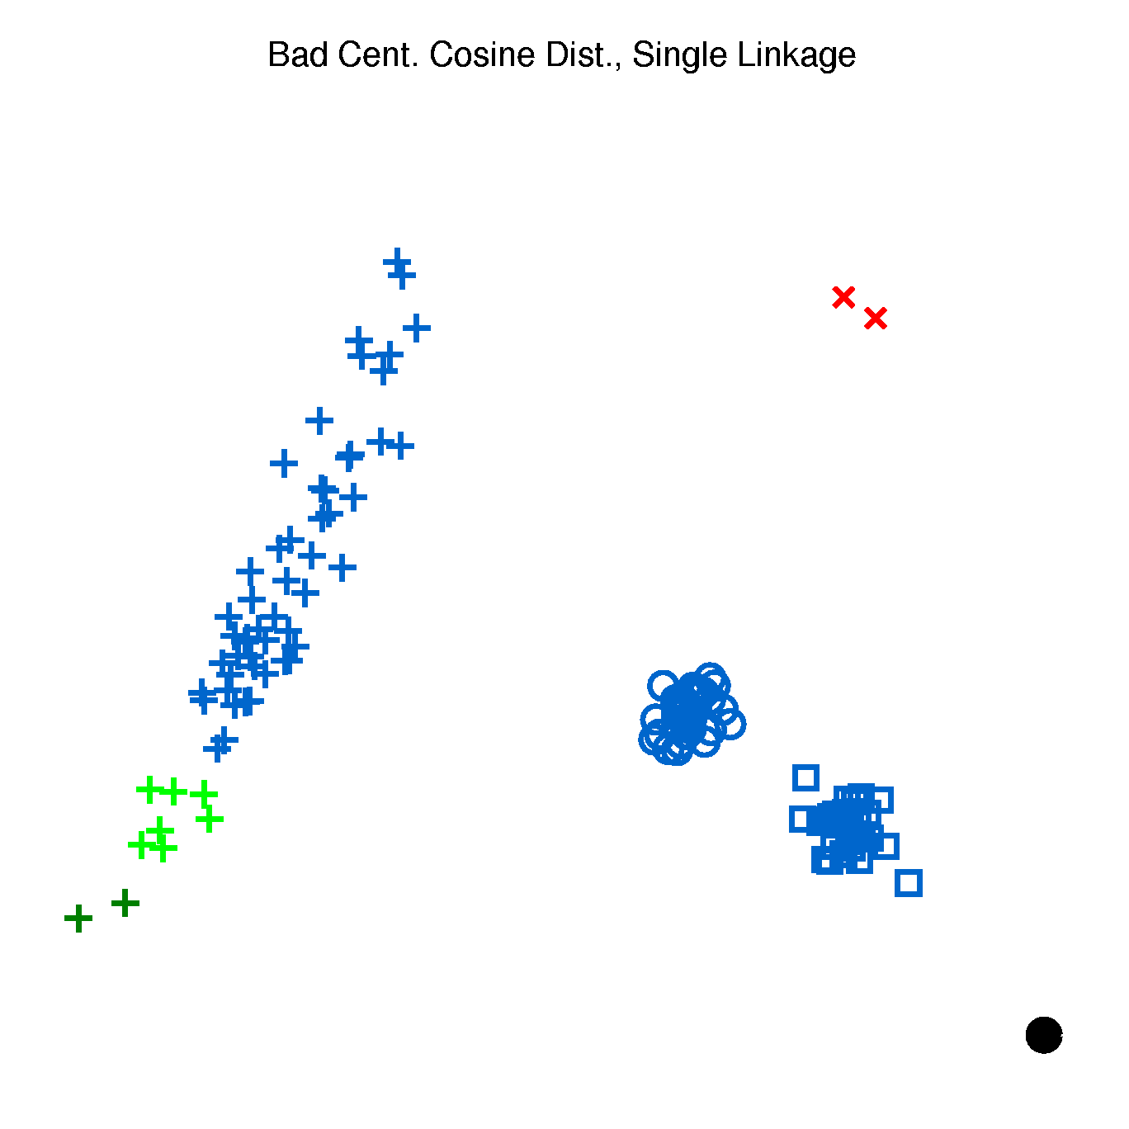
Hierarchical Clustering
2-d Toy Example, Cosine Distance
Single Linkage (Cut at 4 Clusters)
Think “Angle In
Polar Coordinates”
Depends On Center
Poor Choice

Slide 35
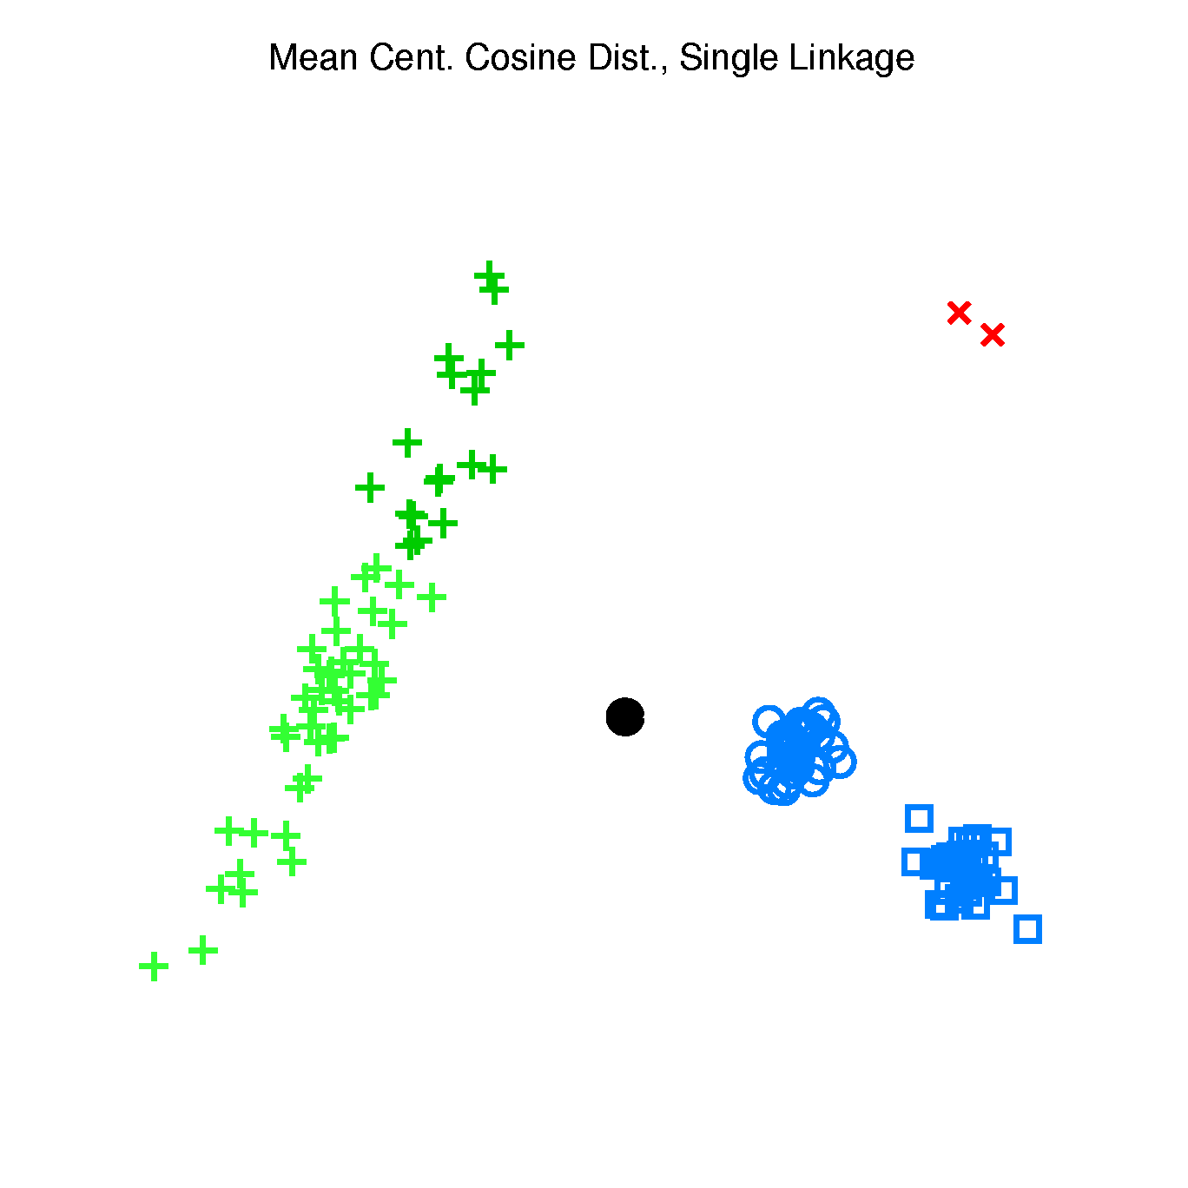
Hierarchical Clustering
2-d Toy Example, Cosine Distance
Single Linkage (Cut at 4 Clusters)
Better When
Centering At
Mean
Still Not Great

Slide 36
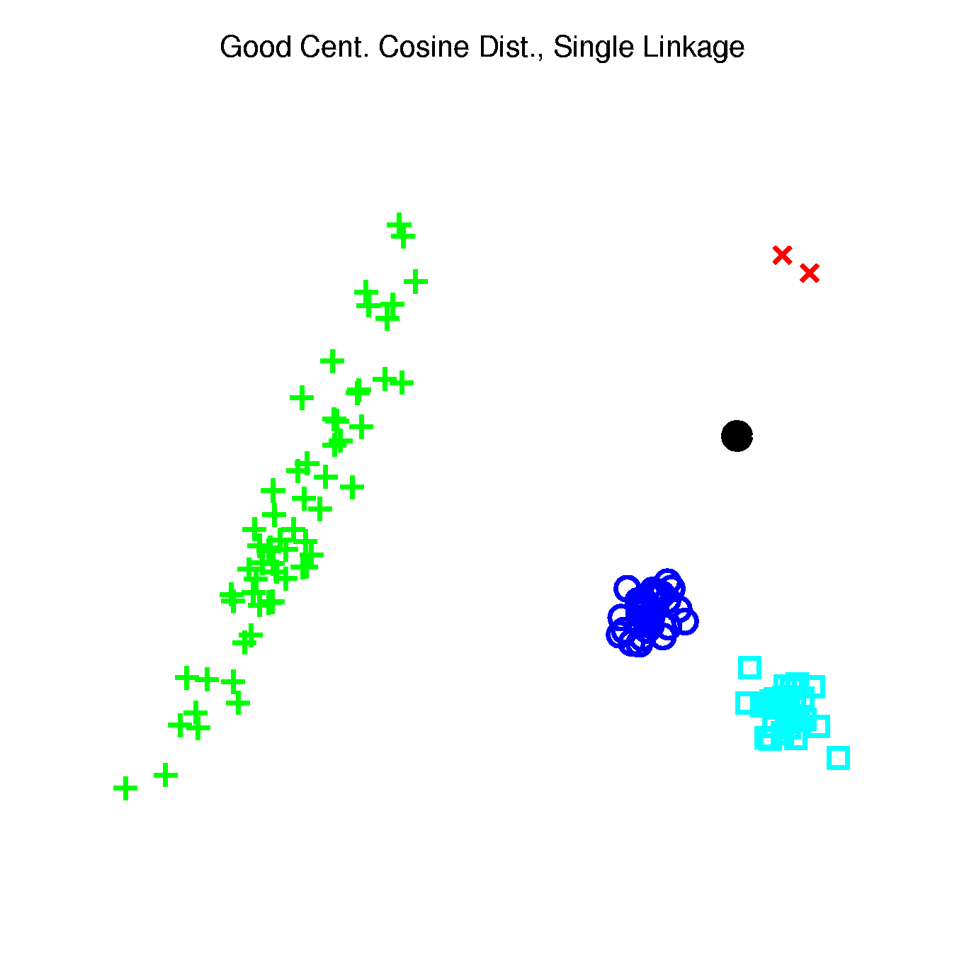
Hierarchical Clustering
2-d Toy Example, Cosine Distance
Single Linkage (Cut at 4 Clusters)
Careful Choice
Gives Good
Result
Think Sectors in
Polar Coordinates

Slide 37
Hierarchical Clustering
2-d Toy Example, Cosine Distance
Single Linkage (Cut at 4 Clusters)
Revisit Mean
Centering
With Sectors

Slide 38
Hierarchical Clustering
2-d Toy Example, Cosine Distance
Single Linkage (Cut at 4 Clusters)
Revisit Bad
Centering
With Sectors

Slide 39
Hierarchical Clustering
Higher Dimensions, $d=500$, $n=30$, $N(0,I)$
Recall HDLSS Geometry
All Points $\sim \sqrt{d}$ From Origin
All Points $\sim \sqrt{2d}$ From Each Other
All Angles $\sim {90}^{°}$
(Expect A Different Story?)

Slide 40
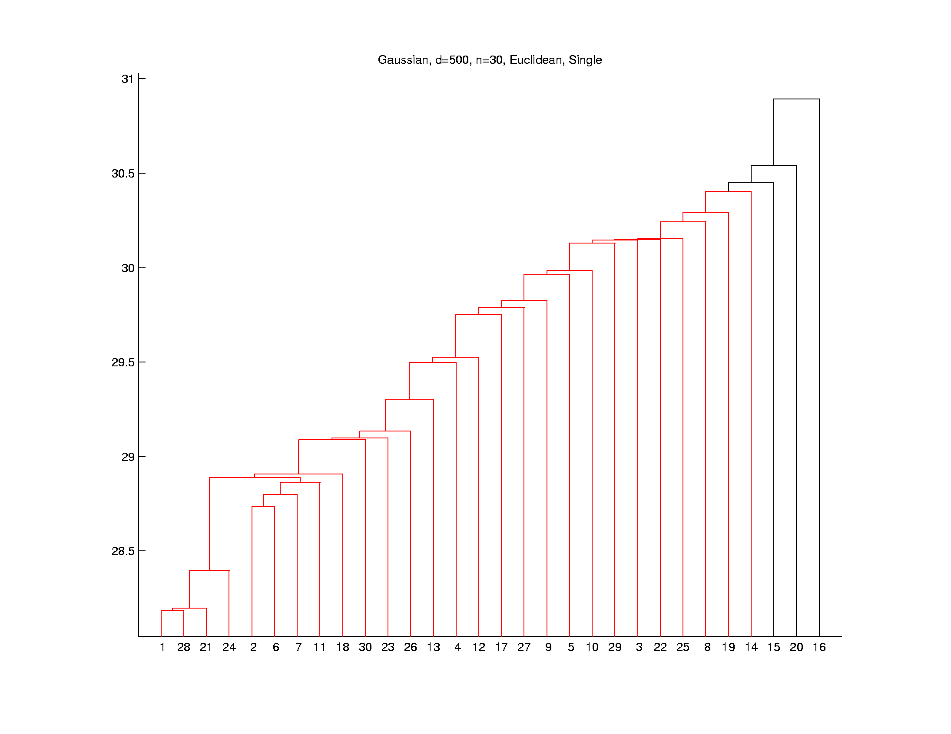
Hierarchical Clustering
Higher Dimensions, $d=500$, $n=30$, $N(0,I)$
Euclidean Dist.
Single Linkage
Peels Off
Points One
At A Time
Usually Less
Useful
Explore These
Farthest Three

Slide 41
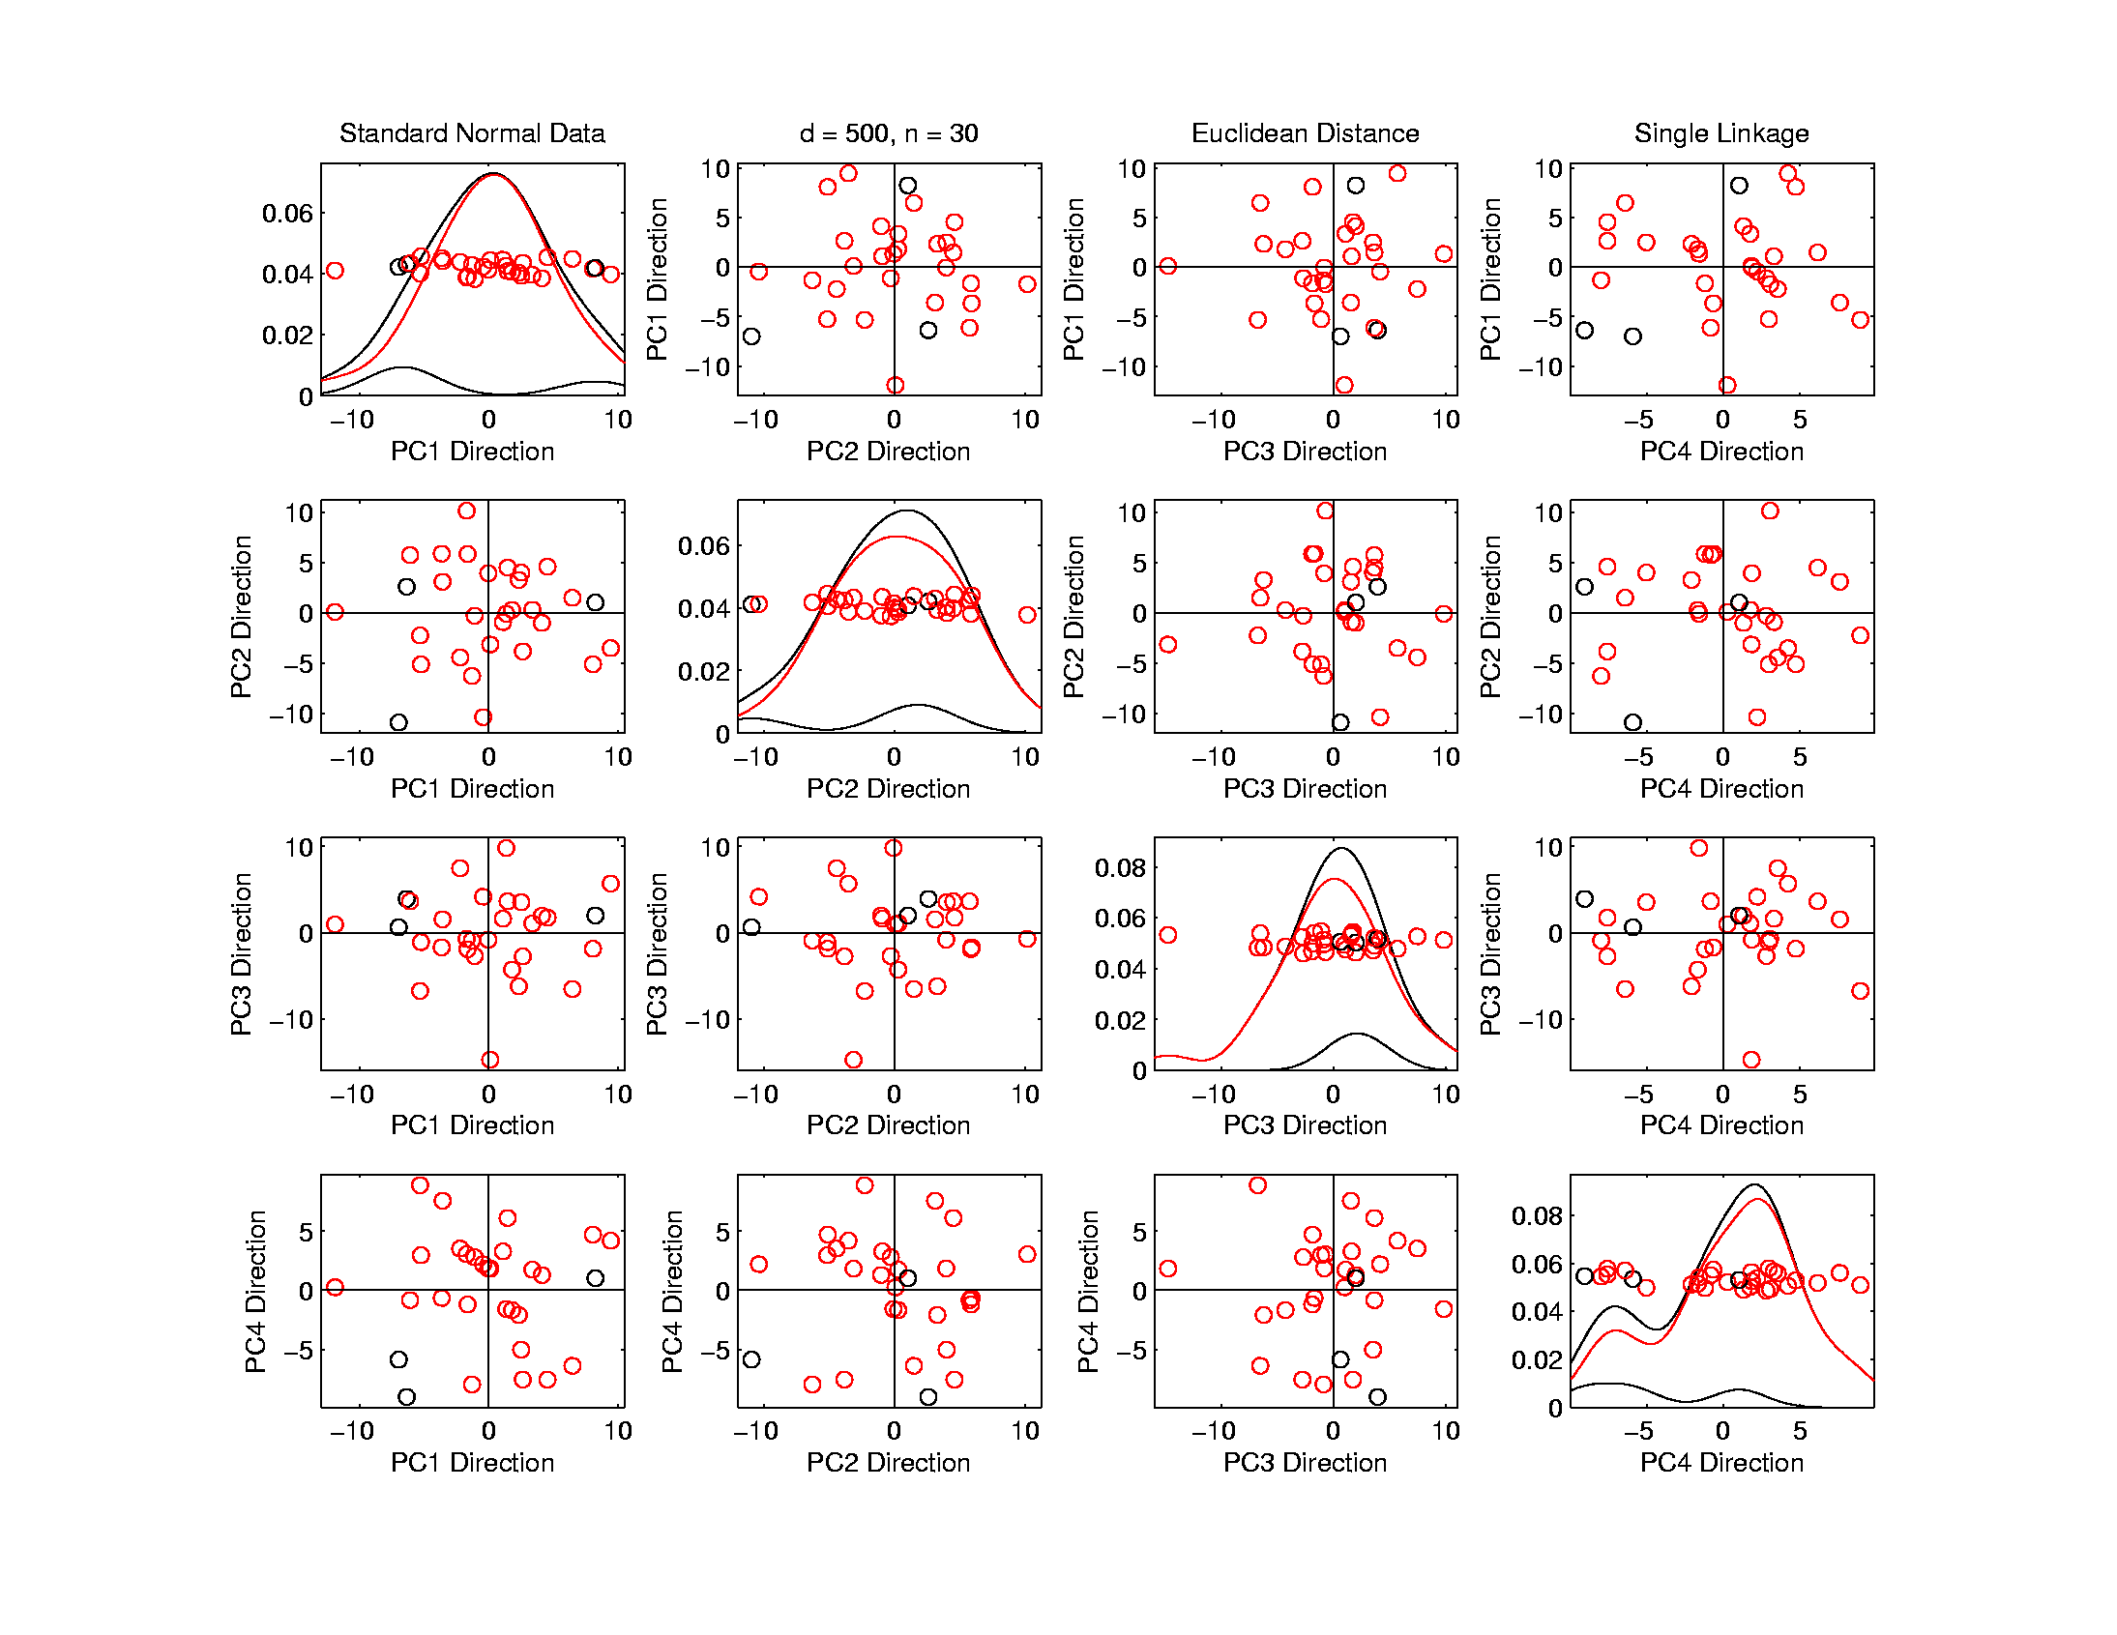
Hierarchical Clustering
Higher Dimensions, $d=500$, $n=30$, $N(0,I)$
Euclidean Dist.
Single Linkage
Visualize
With PCA
Blacks Are
Outliers?
No Clear Patterns?
“Larger Variation”
Dir’ns Feel Groups

Slide 42
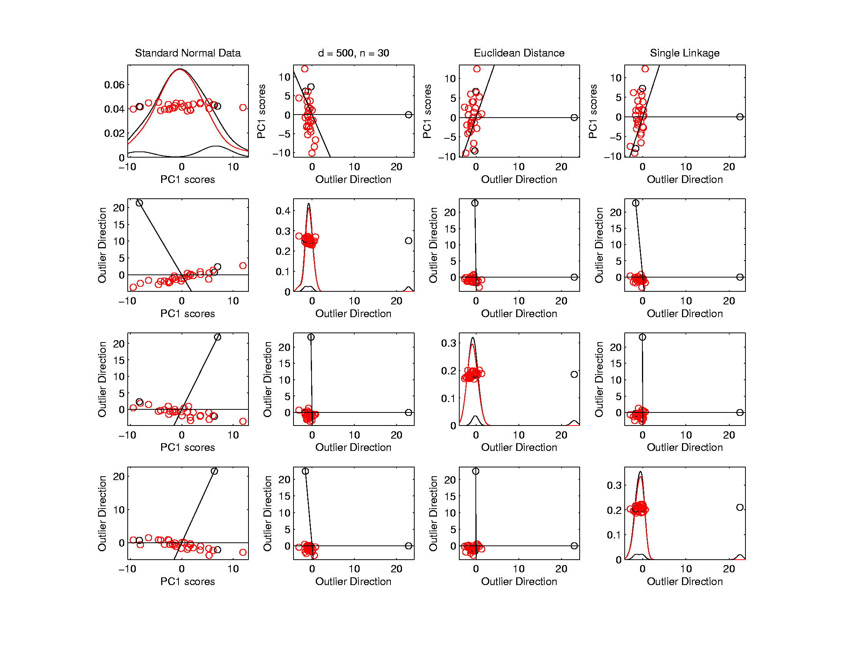
Hierarchical Clustering
Higher Dimensions, $d=500$, $n=30$, $N(0,I)$
Euclidean Dist.
Single Linkage
Use Outlier
Data Dir’ns
Better
Impression
Of Outliers
Recall HDLSS Space Is Very Big
$∃$ Many Interesting Directions Besides PCs

Slide 43
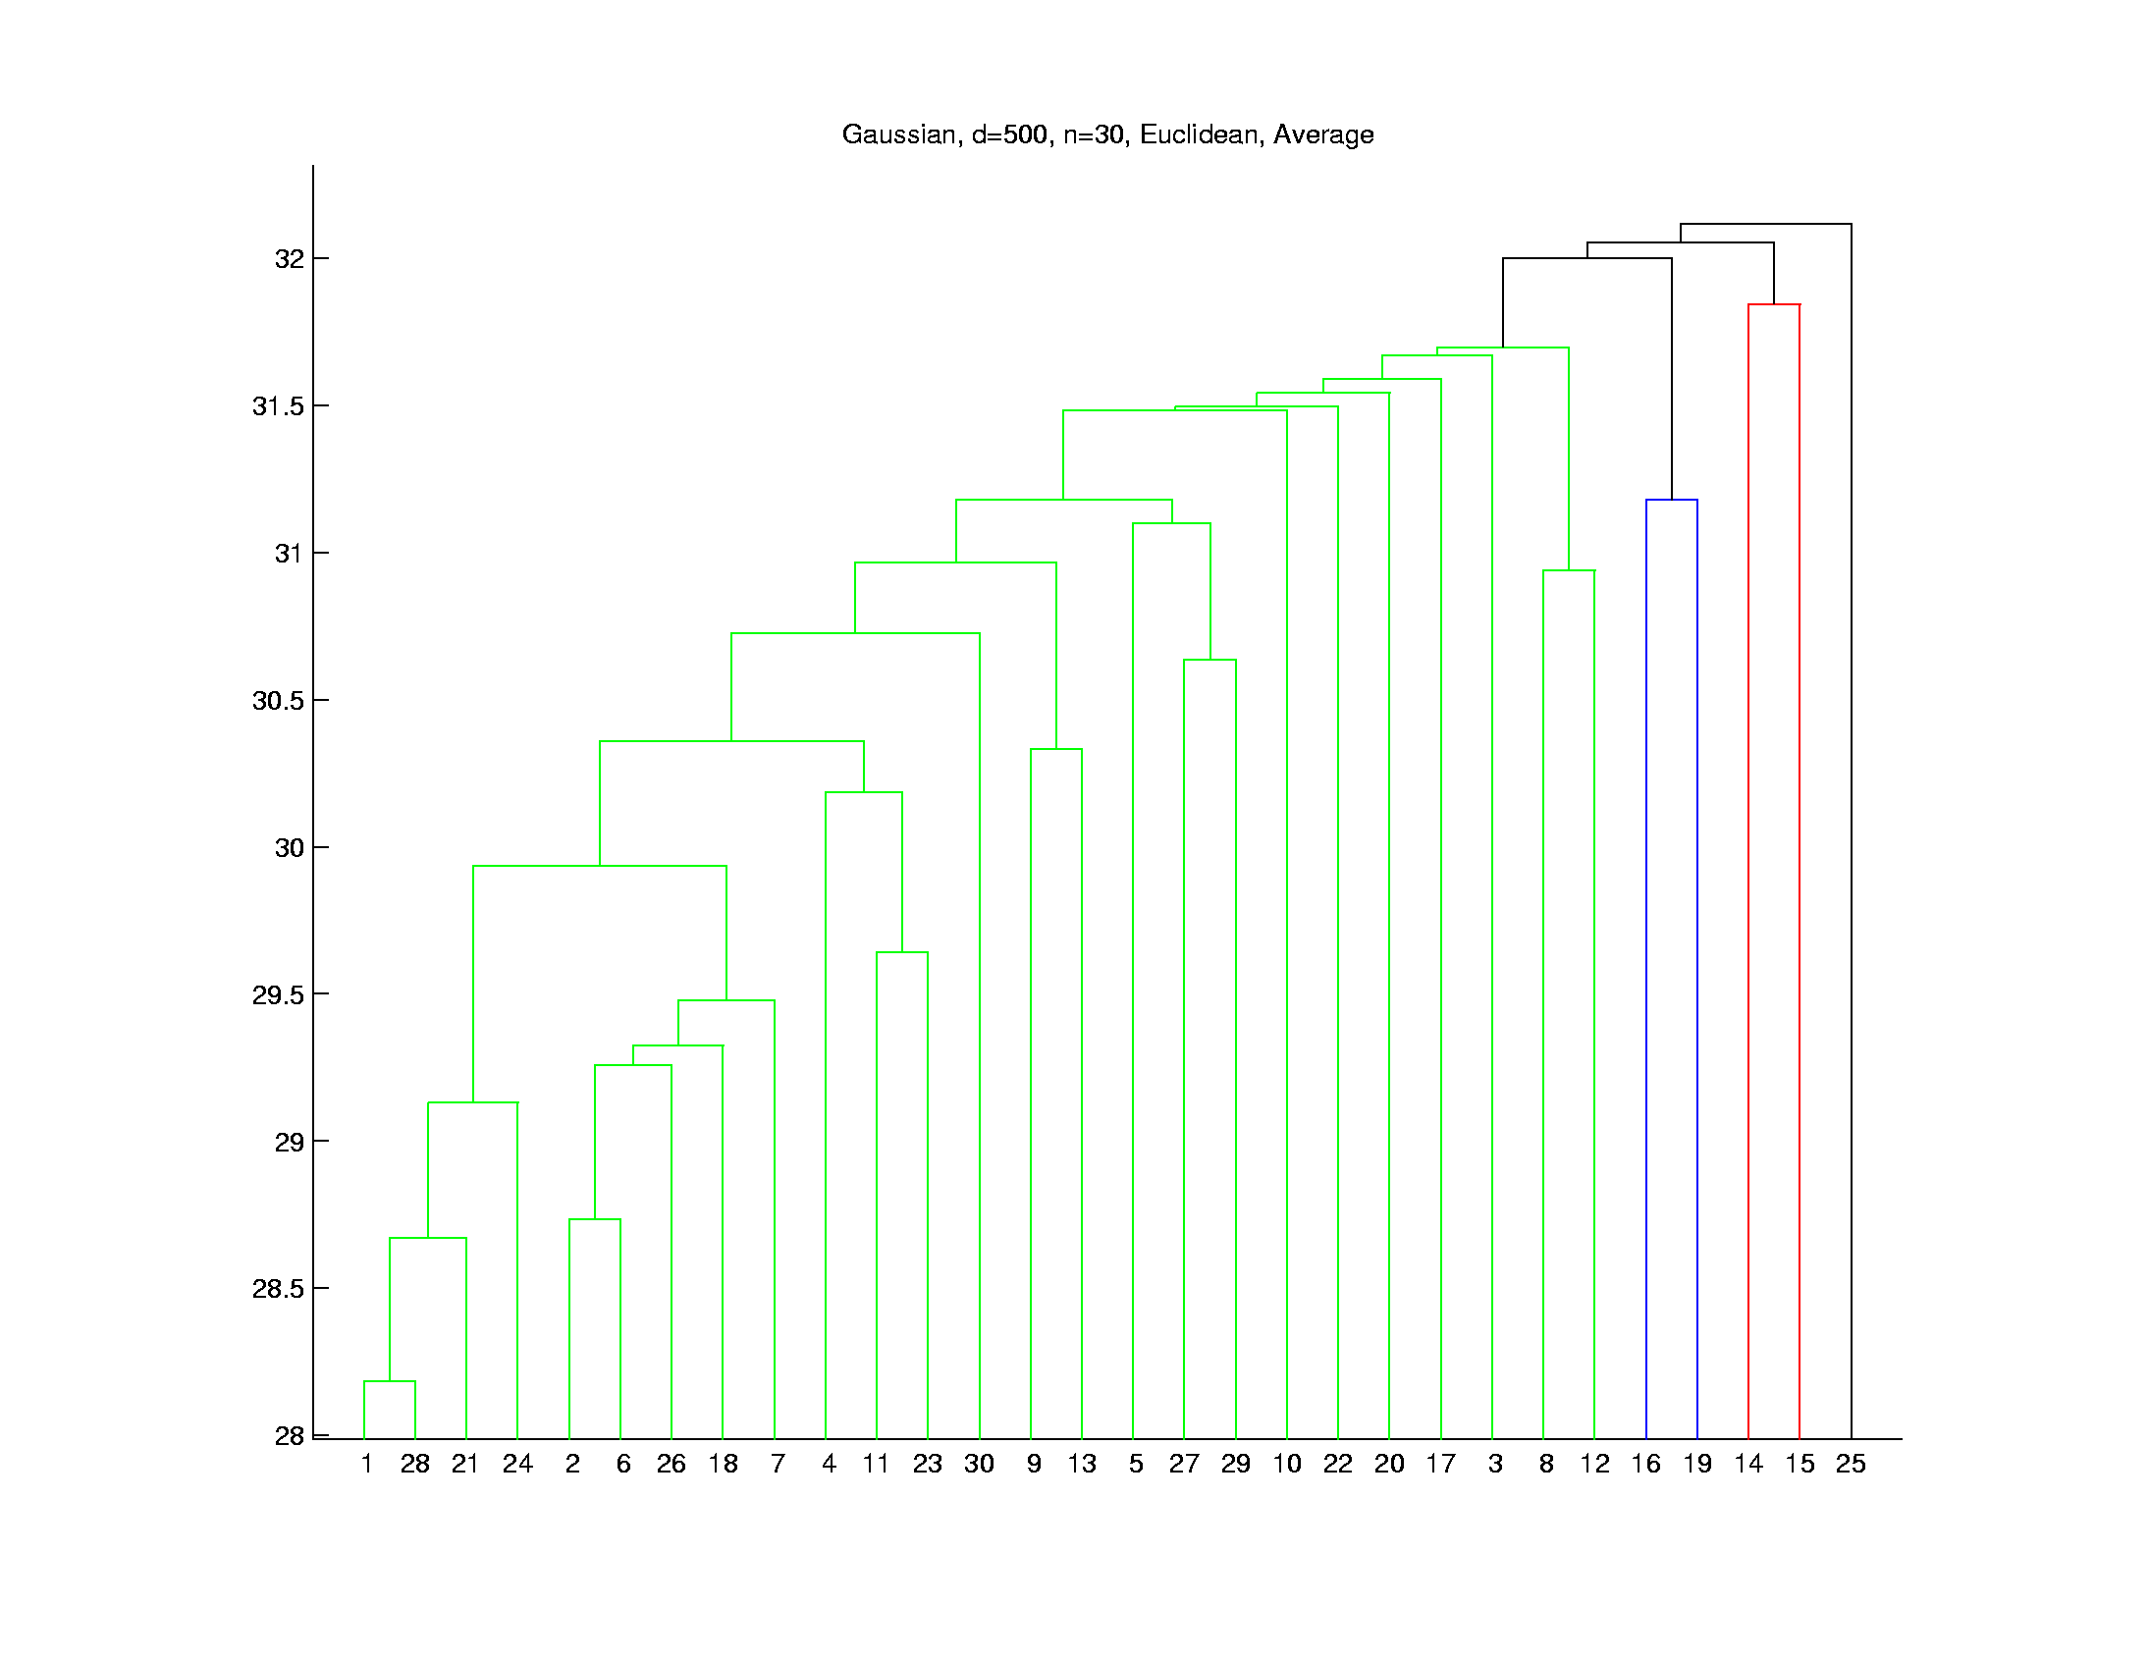
Hierarchical Clustering
Higher Dimensions, $d=500$, $n=30$, $N(0,I)$
Euclidean Dist.
Average Linkage
Get More
Grouping,
Lower
Singletons

Slide 44
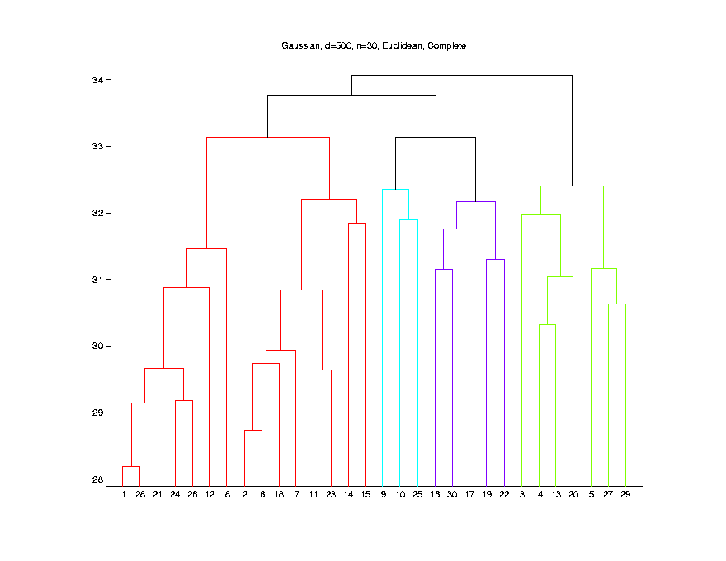
Hierarchical Clustering
Higher Dimensions, $d=500$, $n=30$, $N(0,I)$
Euclidean Dist.
Complete Linkage
Much More
Grouping,
Singletons
Much Lower

Slide 45
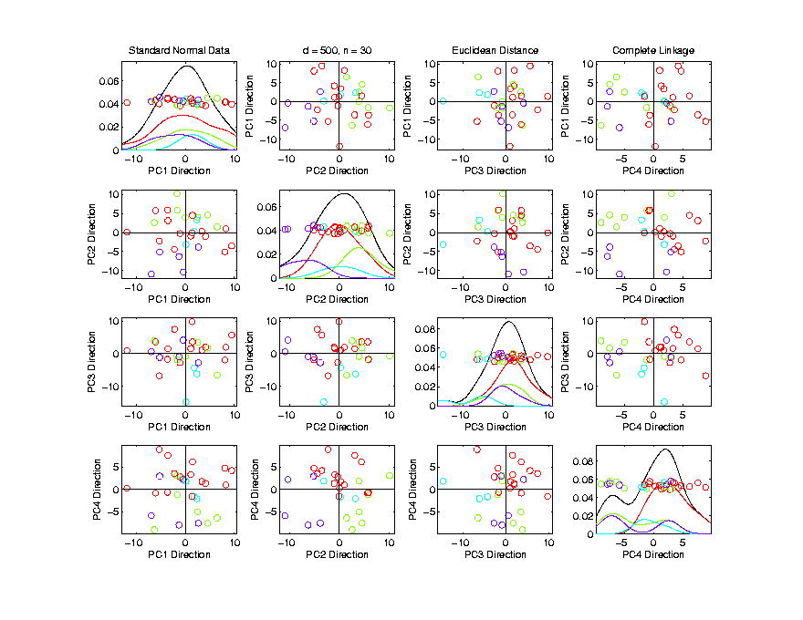
Hierarchical Clustering
Higher Dimensions, $d=500$, $n=30$, $N(0,I)$
Euclidean Dist.
Complete Linkage
Explore
With PCA
Some Patterns Visible
But Mostly in Higher PCs

Slide 46
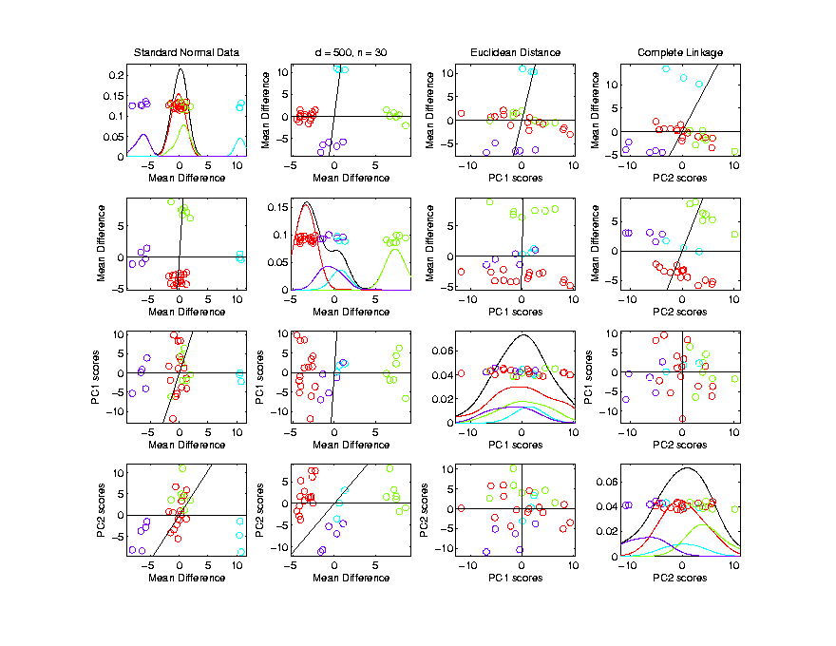
Hierarchical Clustering
Higher Dimensions, $d=500$, $n=30$, $N(0,I)$
Euclidean Dist.
Complete Linkage
Visualize
With MDs
Good Separation
MD spread
$≪$PC spread

Slide 47
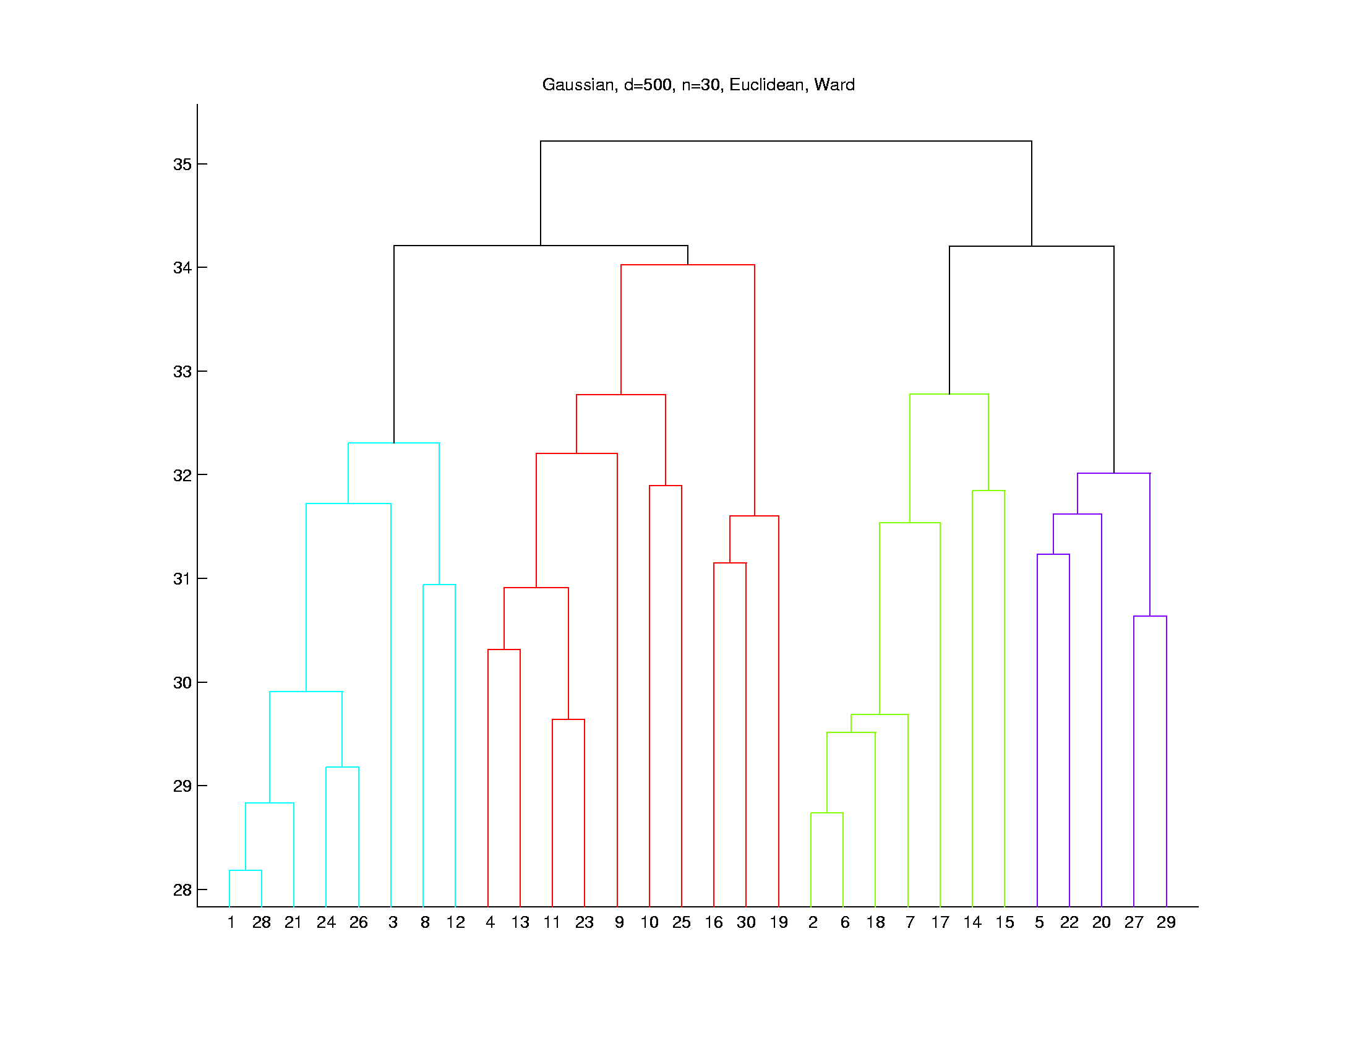
Hierarchical Clustering
Higher Dimensions, $d=500$, $n=30$, $N(0,I)$
Euclidean Dist.
Ward’s Linkage
Likes
Balanced
Cluster
Sizes

Slide 48
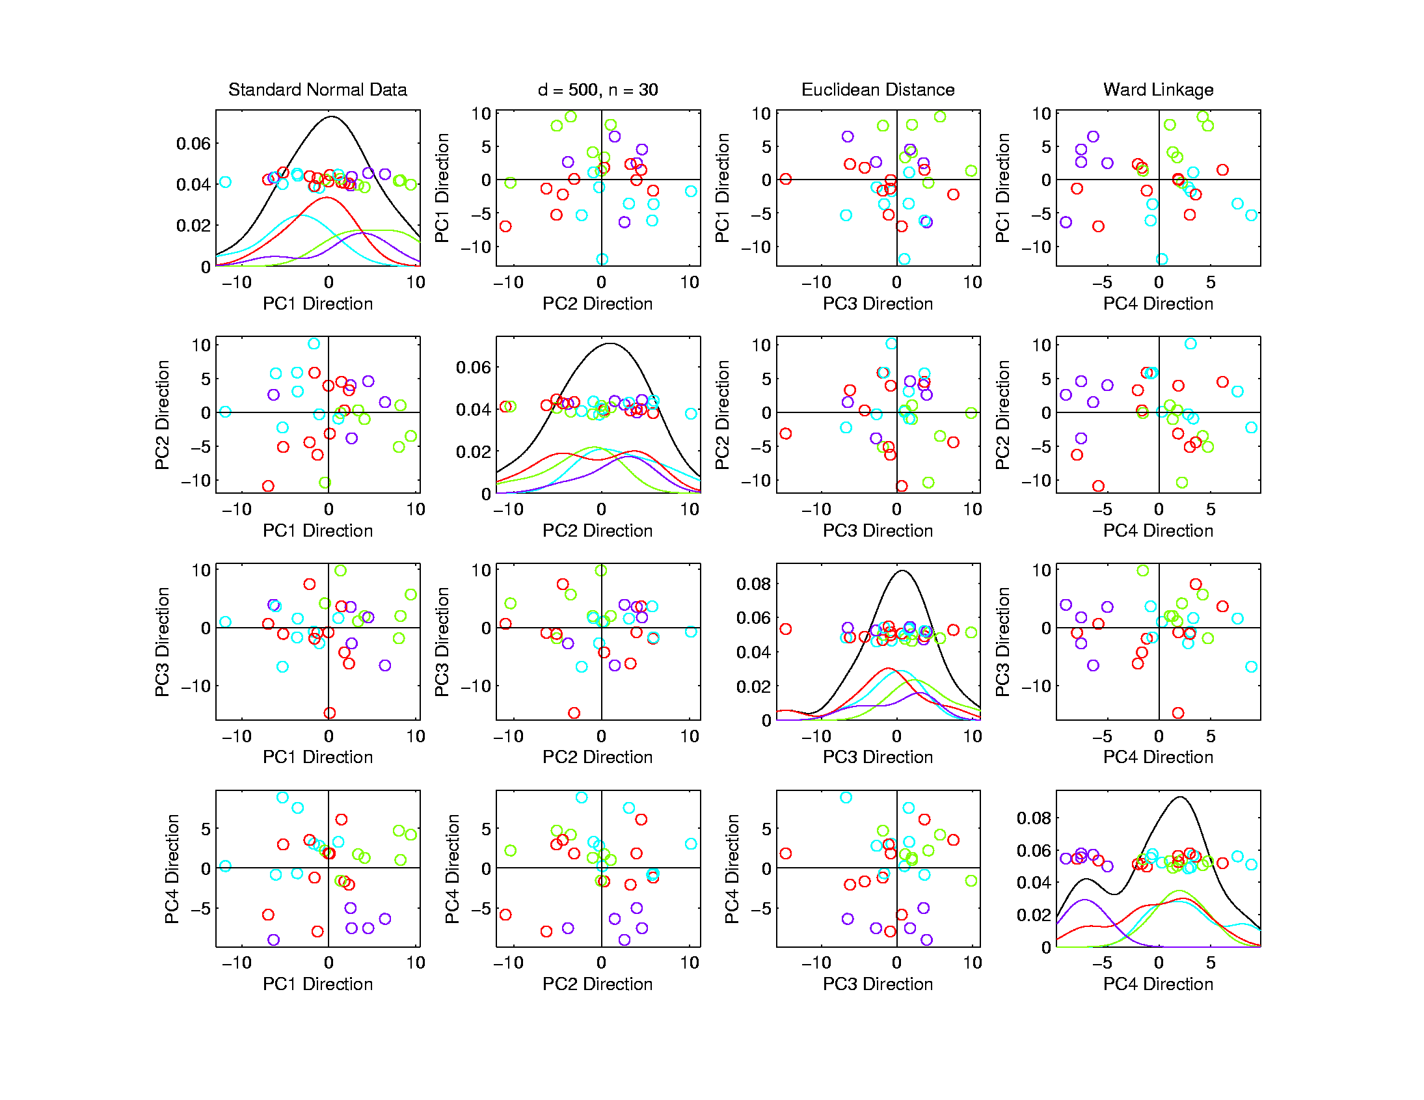
Hierarchical Clustering
Higher Dimensions, $d=500$, $n=30$, $N(0,I)$
Euclidean Dist.
Ward’s Linkage
Once Again
Not Very
Apparent
In PCA???

Slide 49
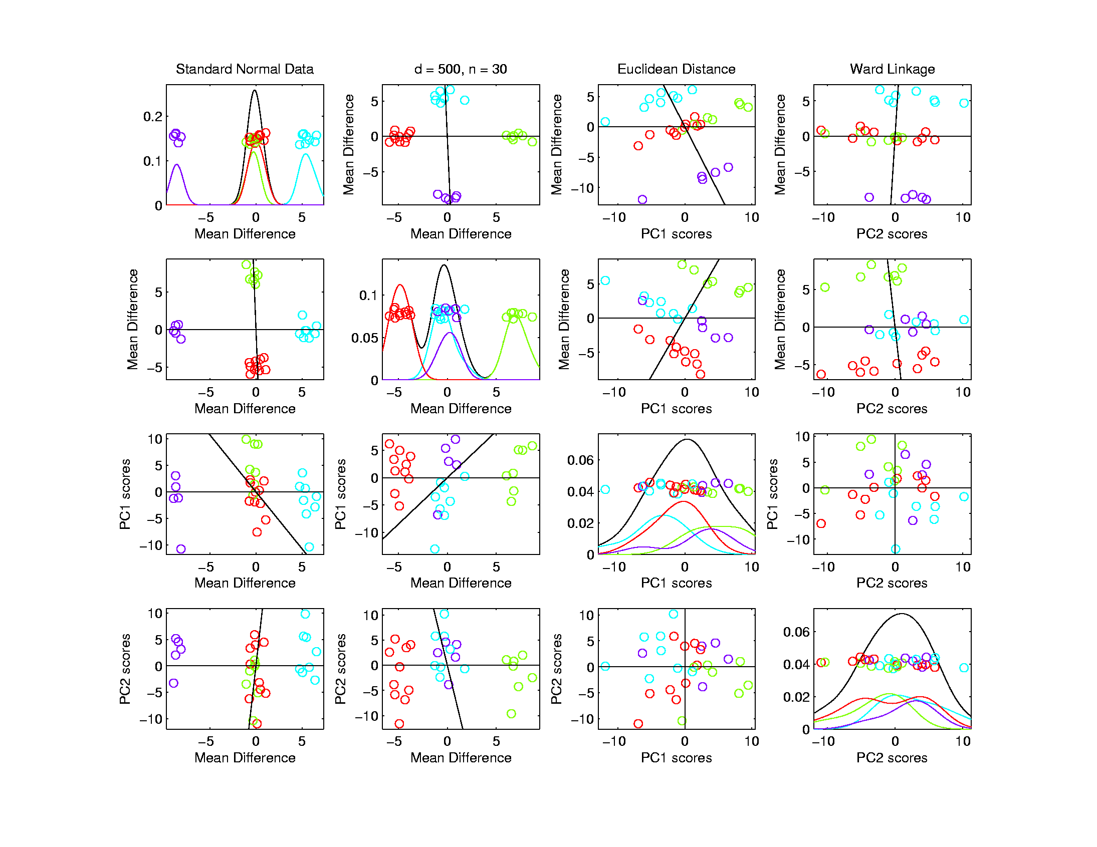
Hierarchical Clustering
Higher Dimensions, $d=500$, $n=30$, $N(0,I)$
Euclidean Dist.
Ward’s Linkage
Visualize
With Mean
Differences
Great Separation,
Slightly BetterThan Complete

Slide 50
Hierarchical Clustering
Linkage Observations:
Single Linkage
Useful in Low d
Peels Off Singleton’s in High d
Average Linkage
Generally In Between
Ward’s Linkage
Likes Balanced Cluster Sizes
Often Useful in High d
Every Dog Has His Day
Complete Linkage
Is Close, But Not
Quite as Good

Slide 51
SigClust
Statistical Significance of Clusters
in HDLSS Data
When is a cluster “really there”?
(Simpler Version of “What is $K$?”)
Liu et al (2007), Huang et al (2014)

Slide 52
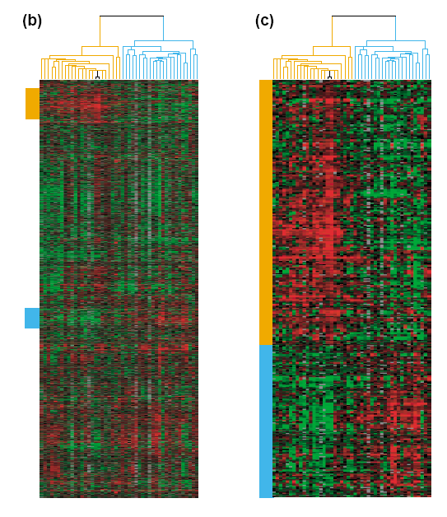
Common Genomic Analytic Approach: Clustering
From: Perou et al (2000)
d = 1161 genes
Zoomed to “relevant”
Gene subsets

Slide 53
Interesting Statistical Problem
For HDLSS data:
When clusters seem to appear
E.g. found by clustering method
How do we know they are really there?
Question asked by Neil Hayes
Define appropriate statistical significance?
Can we calculate it?

Slide 54
First Approaches: Hypo Testing
e.g. Direction, Projection, Permutation
Hypothesis test of:
Significant difference between sub-populations
Recall from 8/29/19

Slide 55
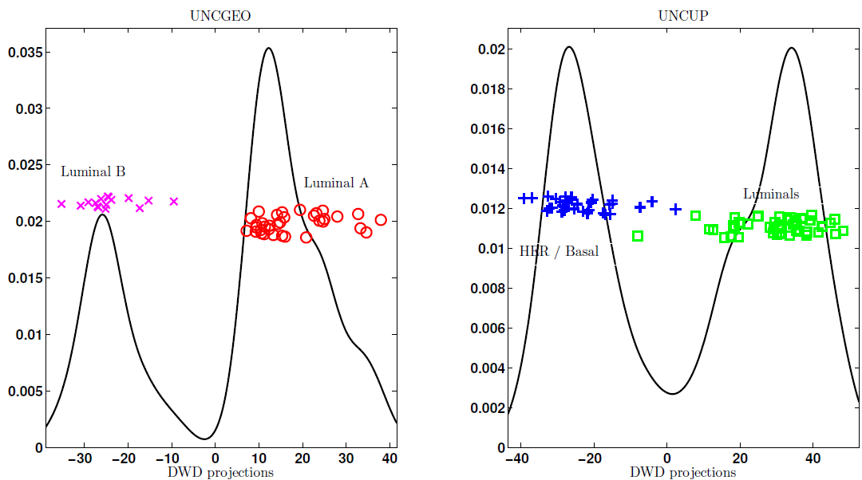
DiProPerm Hypothesis Test
Two
Examples
Which Is
“More
Distinct”?
Visually Better Separation?
Thanks to Katie Hoadley

Slide 56
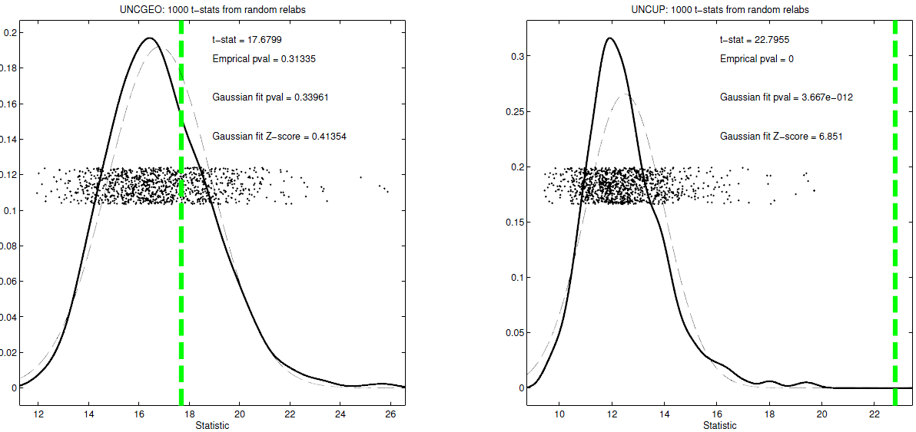
DiProPerm Hypothesis Test
Two
Examples
Which Is
“More
Distinct”?
Stronger Statistical Significance!
Thanks to Katie Hoadley
Due to Larger Sample Sizes

Slide 57
First Approaches: Hypo Testing
e.g. Direction, Projection, Permutation
Hypothesis test of:
Significant difference between sub-populations
Effective and Accurate
I.e. Sensitive and Specific
There exist several such tests
But critical point is:
What result implies about clusters

Slide 58
Clarifying Simple Example
Why Population Difference Tests cannot indicate clustering
Andrew Nobel Observation
For Gaussian Data (Clearly 1 Cluster!)
Assign Extreme Labels
(e.g. by clustering)
Subpopulations are signif’ly different

Slide 59
Simple Gaussian Example
Contrast: Random Labelled T-stat
Clearly only 1 Cluster in this Example
But Extreme Relabelling looks different
Extreme T-stat strongly significant
T-test indicates 2 clusters in data

Slide 60
Simple Gaussian Example
Results:
Random relabelling T-stat is not significant
But extreme T-stat is strongly significant
This comes from clustering operation
Conclude sub-populations are different
Now see that:
Not the same as clusters really there
Need a new approach to study clusters

Slide 61
Statistical Significance of Clusters
Basis of SigClust Approach:
What defines: A Single Cluster?
A Gaussian distribution (Sarle & Kou 1993)
So define SigClust test based on:
2-means cluster index (measure) as statistic
Gaussian null distribution
Currently compute by simulation
Possible to do this analytically???

Slide 62
SigClust Statistic – 2-Means Cluster Index
Measure of non-Gaussianity:
2-means Cluster Index
Familiar Criterion from k-means Clustering
Within Class Sum of Squared Distances to Class Means
Prefer to divide (normalize) by Overall Sum of Squared Distances to Mean
Puts on scale of proportions

Slide 63
SigClust Statistic – 2-Means Cluster Index
Measure of non-Gaussianity:
2-means Cluster Index:
$$CI\left(C_{1},⋯,C_{K}\right)=\frac{\sum_{j=1}^{K}{\sum_{i∈C_{j}}{{\left\|{\underline{X}}_{i}−{\overline{\underline{X}}}_{j}\right\|}^{2}}}}{\sum_{i=1}^{n}{{\left\|{\underline{X}}_{i}−\overline{\underline{X}}\right\|}^{2}}}$$
“Within Class Var’n” / “Total Var’n”
Class Index Sets
Class Means

Slide 64
SigClust Gaussian null distribut’n
Which Gaussian (for null)?
Standard (sphered) normal?
No, not realistic
Rejection not strong evidence for clustering
Could also get that from a-spherical Gaussian
Need Gaussian more like data:
Need Full $N_{d}\left(μ,Σ\right)$ model
Challenge: Parameter Estimation
Especially in HDLSS Context

Slide 65
SigClust Gaussian null distribut’n
Challenge: Parameter Estimation
Case 1: $n<d$ (Conventional)
Consider $\hat{μ}$ and $\hat{Σ}$
Case 2: Random Matrix or HDLSS
${\hat{Σ}}^{−1}$ is Very Slippery
Need Better Approach

Slide 66
SigClust Gaussian null distribut’n
Estimated Mean, $μ$ (of Gaussian dist’n)?
1st Key Idea: Can ignore this
By appealing to shift invariance of CI
When Data are (rigidly) shifted
CI remains the same
So enough to simulate with mean 0
Other uses of invariance ideas?

Slide 67
SigClust Gaussian null distribut’n
Challenge: how to estimate cov. Matrix $Σ$?
Number of parameters: $\frac{d\left(d+1\right)}{2}$
E.g. Perou 500 data:
Dimension $d=9674$
so $\frac{d\left(d+1\right)}{2}=46,797,975$
But Sample Size $n=533$
Impossible in HDLSS settings????
Way around this problem?

Slide 68
SigClust Gaussian null distribut’n
2nd Key Idea: Mod Out Rotations
Replace full Cov. by diagonal matrix
As done in PCA eigen-analysis
$$Σ=MDM^{t}$$
But then “not like data”???
OK, since k-means clustering (i.e. CI) is
rotation invariant
(assuming e.g. Euclidean Distance)

Slide 69
SigClust Gaussian null distribut’n
2nd Key Idea: Mod Out Rotations
Only need to estimate diagonal matrix
But still have HDLSS problems?
E.g. Perou 500 data:
Dimension $d=9674$
Sample Size $n=533$
Still need to estimate $d=9674$ param’s

Slide 70
SigClust Gaussian null distribut’n
3rd Key Idea: Factor Analysis Model
Model Covariance as: Biology + Noise
$$Σ=Σ_{B}+{σ_{N}}^{2}×I$$
Where
$Σ_{B}$ is “fairly low dimensional”
${σ_{N}}^{2}$ is estimated from background noise

Slide 71
SigClust Gaussian null distribut’n
Estimation of Background Noise ${σ_{N}}^{2}$:
Reasonable model (for each gene):
Expression = Signal + Noise
“noise” is roughly Gaussian
“noise” terms essentially independent
(across genes)

Slide 72
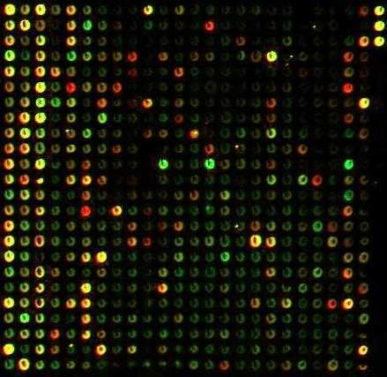
SigClust Gaussian null distribut’n
Estimation of Background Noise ${σ_{N}}^{2}$:
Model OK, since
data come from
light intensities
at colored spots

Slide 73
SigClust Gaussian null distribut’n
Estimation of Background Noise ${σ_{N}}^{2}$:
For all expression values (as numbers)
(Each Entry of $d×n$ Data matrix)

Slide 74
SigClust Gaussian null distribut’n
Estimation of Background Noise ${σ_{N}}^{2}$:
For all expression values (as numbers)
Use robust estimate of scale
Median Absolute Deviation (MAD)
(from the median)
$${median}_{i}\left|X_{i}−{median}_{i^{′}}\left(X_{i^{′}}\right)\right|$$

Slide 75
SigClust Gaussian null distribut’n
Estimation of Background Noise ${σ_{N}}^{2}$:
For all expression values (as numbers)
Use robust estimate of scale
Median Absolute Deviation (MAD)
(from the median)
Rescale to put on same scale as s. d.:
$$\hat{σ}=\frac{{MAD}_{data}}{{MAD}_{N\left(0,1\right)}}$$

Slide 76
SigClust Estimation of Background Noise
n = 533, d = 9456

Slide 77
Participant Presentation
Pavlos Zoubouloglou:
Geodesic PCA in the Wasserstein Space
Taylor Petty:
Forensic DNA Testing

