Slide 1
Statistics – O. R. 881
Object Oriented Data Analysis
Start
Recording
Steve Marron
Dept. of Statistics and Operations Research
University of North Carolina

Slide 2
Administrative Info
Details on Course Web Page
https://marron.web.unc.edu/course-home-page-stor-881-object-oriented-data-analysis-spring-2022/
Or access from Sakai page
Or:
  Google: “Marrons teaching material”
  Choose This Course

Slide 3
Current Sections in Textbook
Today:
Sections 3.1, 4.1
Next Class:
Section 4.1

Slide 4
Course Context
Currently Fashionable Topic:
Big Data Science
Many Important Issues.
But More Challenging (& Important?):
Complex Data
( )

Slide 5
Object Oriented Data Analysis
What is it?
A Sound-Bite Explanation:
What is the “atom of the statistical analysis”?
1st Course: Numbers
Multivariate Analysis Course : Vectors
Functional Data Analysis: Curves
More generally: Data Objects

Slide 6
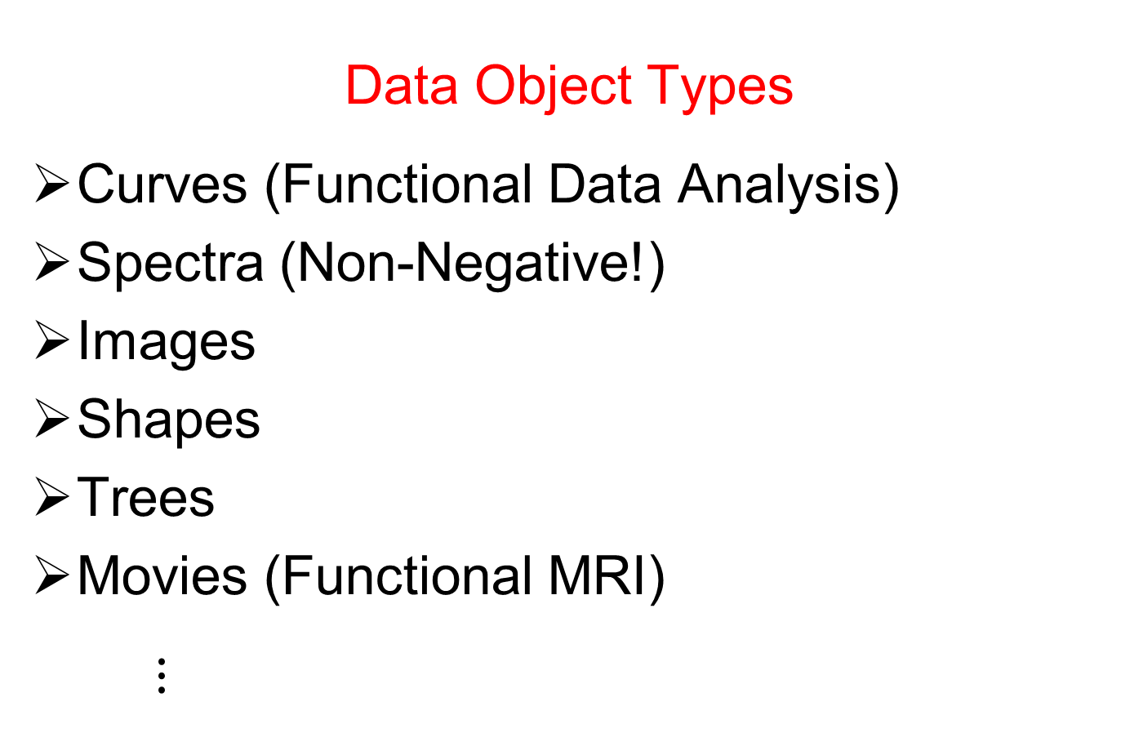
Object Oriented Data Analysis
Data Object Types
Curves (Functional Data Analysis)
Spectra (Non-Negative!)
Images
Shapes
Trees
Movies (Functional MRI)
$⋮$

Slide 7
Object Oriented Data Analysis
Current Motivation (of OODA terminology):
In Complicated Data Analyses
Fundamental (Non-Obvious) Question Is:
“What Should We Take as Data Objects?”
Key to Focusing Needed Analyses

Slide 8
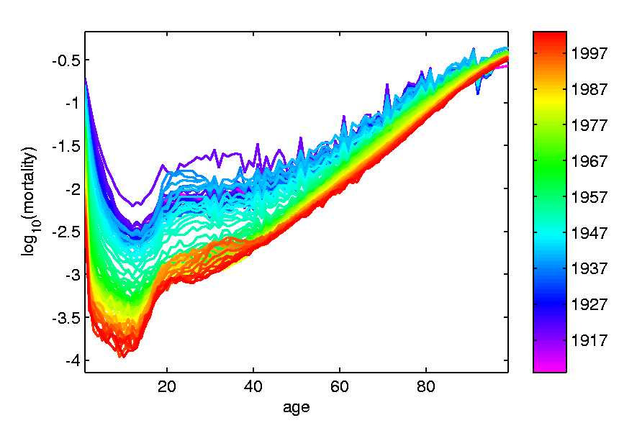
A Taste of OODA Examples
Spanish Male Mortality Curves
Enhancement: Color by Year
1908
1931
1964
1987
2002

Slide 9
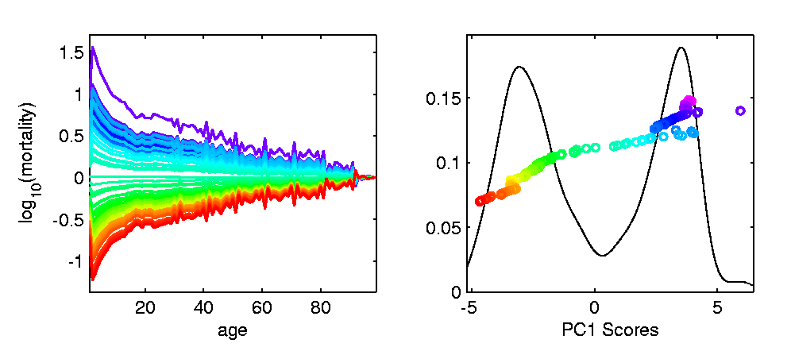
A Taste of OODA Examples
Spanish Male Mortality Curves
1918 Flu Pandemic
Spanish Civil War
1st Mode of
Variation

Slide 10
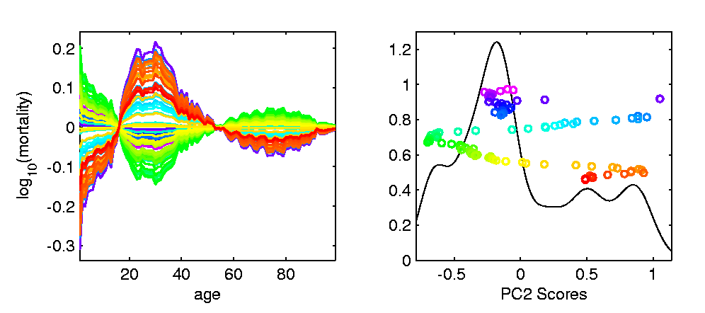
A Taste of OODA Examples
Spanish Male Mortality Curves
Flu Pandemic, Civil War
2nd Mode of
Variation
Intro of Automobile,
Improved Safety

Slide 11

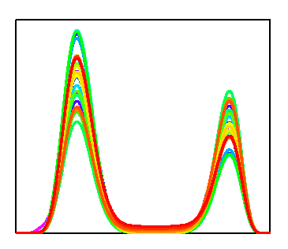


A Taste of OODA Examples
Phase and Amplitude Curves
Raw
Data
Ampl’de
Varia’n
Interesting
Modes of
Variation!
Phase
Varia’n
Warps

Slide 12
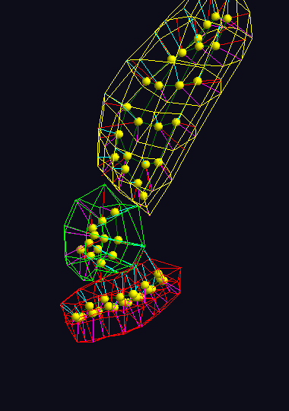
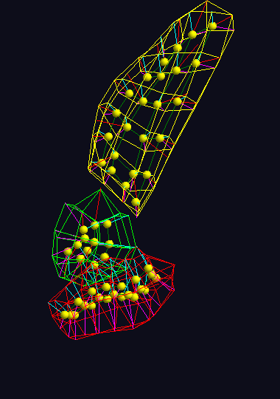
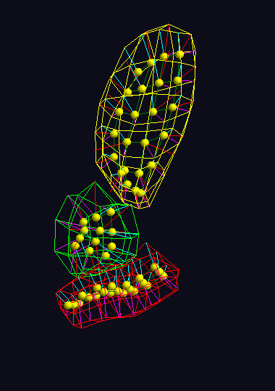



A Taste of OODA Examples
Note: Different Display of Modes of Variation
Shapes in Image Analysis (3-d)
Analysis of Variation (Princ. Geod. Anal.)
Mode 1: Rectum
Mode 2: Twisting
Mode 3: Bladder
$$μ−2×{PC}_{1}$$
$$μ−2×{PC}_{1}$$
$$μ−2×{PC}_{1}$$

Slide 13
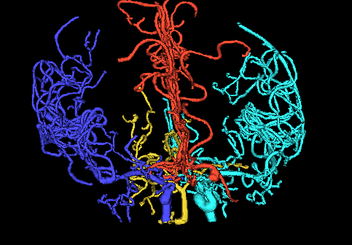
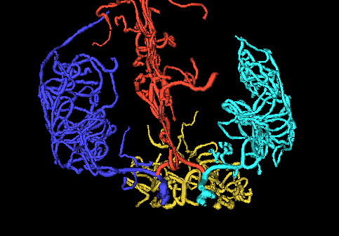
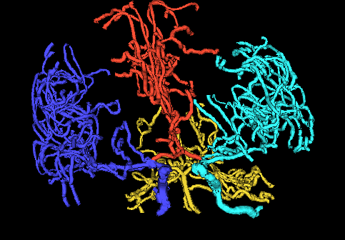
A Taste of OODA Examples
Tree Structured Data Objects
Brain Artery Data,
Analyze Sample of n=100
Average? Variation About Average???
Modes of Variation???
,
, ... ,

Slide 14
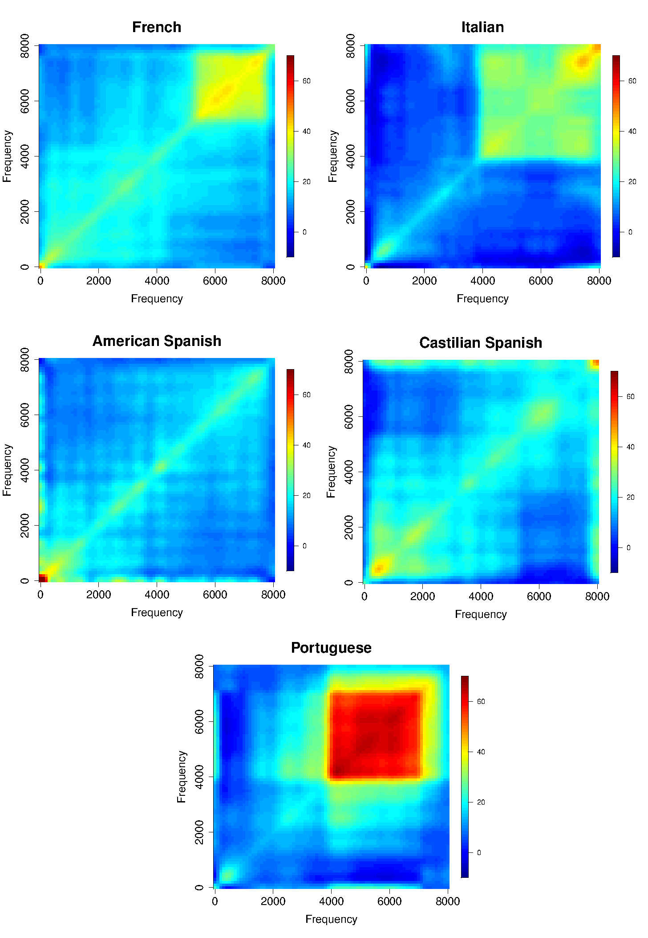
A Taste of OODA Examples
Sounds
as Data
Objects
Analysis
Of Dialects

Slide 15
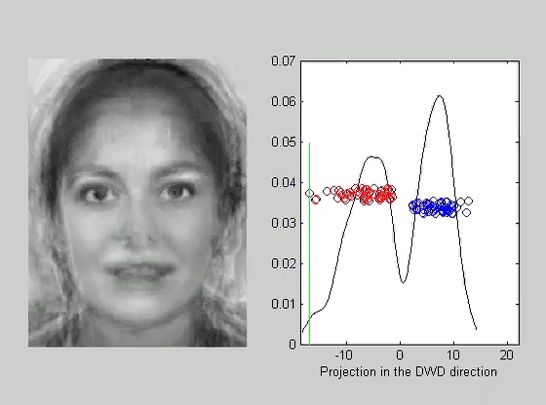
A Taste of OODA Examples
Faces as Data Objects
Classify
Males vs.
Females

Slide 16
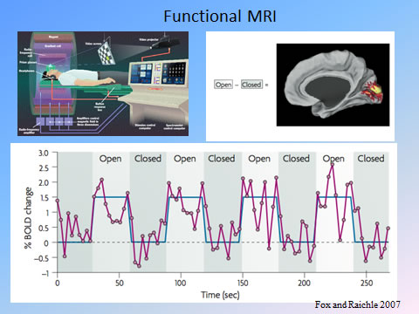
A Taste of OODA Examples
Functional Magnetic Resonance Imaging
3-d Maps of
Brain Activity
Collected
Over Time
Data Objects?
Heat Map at
One Time?
Time Series at
One Location?

Slide 17
Object Oriented Data Analysis
Three Major Phases of OODA:
I. Object Definition
“What are the Data Objects?”
Exploratory Analysis
“What Is Data Structure / Drivers?”
III. Confirmatory Analysis / Validation
Is it Really There (vs. Noise Artifact)?

Slide 18

Basics of OODA
Convenient Organizational Structure:
Data Matrix
$$\left[\begin{matrix}x_{11} & ⋯ & x_{1n} \\ ⋮ & ⋱ & ⋮ \\ x_{d1} & ⋯ & x_{dn}\end{matrix}\right]$$
Convention Here:
Columns are Data Objects
(Indexed by $j=1,⋯,n$)

Slide 19

Basics of OODA
Convenient Organizational Structure:
Data Matrix
$$\left[\begin{matrix}x_{11} & ⋯ & x_{1n} \\ ⋮ & ⋱ & ⋮ \\ x_{d1} & ⋯ & x_{dn}\end{matrix}\right]$$
Terminology:
Numbers in Rows are called “Traits”
(Indexed by $i=1,⋯,d$)
OODA Continually Evolving
Note: Post-Text
Terminology

Slide 20
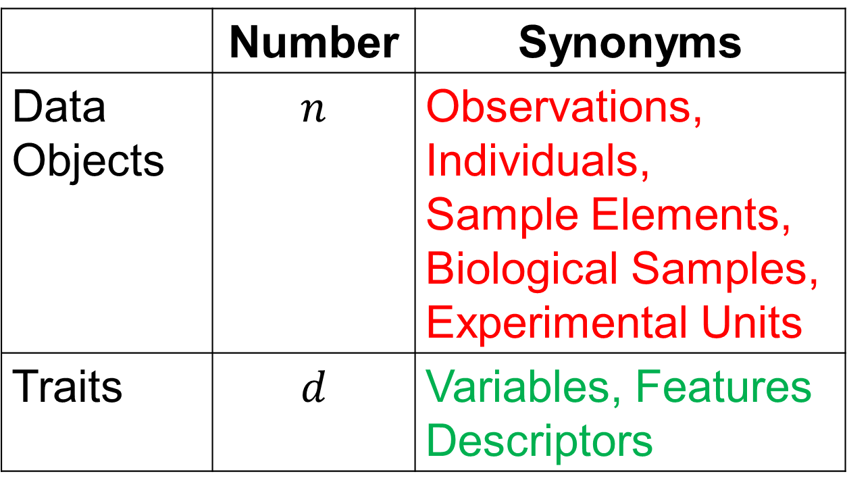
Basics of OODA
Common Synonyms:
 | Number | Synonyms
Data Objects | $$n$$ | Observations, Individuals, Sample Elements, Biological Samples, Experimental Units
Traits | $$d$$ | Variables, Features Descriptors

Slide 21
Object Oriented Data Analysis
Three Major Phases of OODA:
I. Object Definition
“What are the Data Objects?”
Exploratory Analysis
“What Is Data Structure / Drivers?”
III. Confirmatory Analysis / Validation
Is it Really There (vs. Noise Artifact)?

Slide 22
Object Oriented Data Analysis
Three Major Phases of OODA:
Exploratory Analysis
“What Is Data Structure / Drivers?”
Important Aspect:
Data Visualization
(Look at Simple Examples)

Slide 23
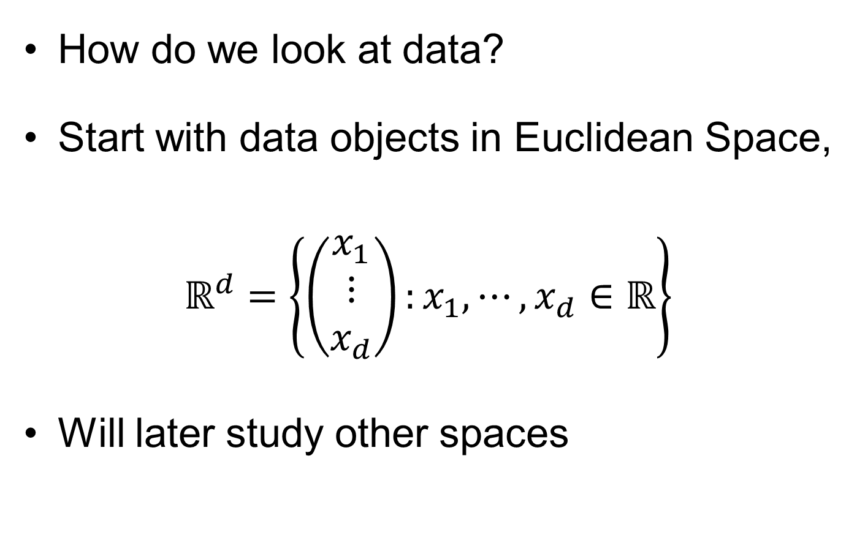
Visualization
How do we look at data?
Start with data objects in Euclidean Space,
$$ℝ^{d}=\left\{\left(\begin{matrix}x_{1} \\ ⋮ \\ x_{d}\end{matrix}\right):x_{1},⋯,x_{d}∈ℝ\right\}$$
Will later study other spaces

Slide 24
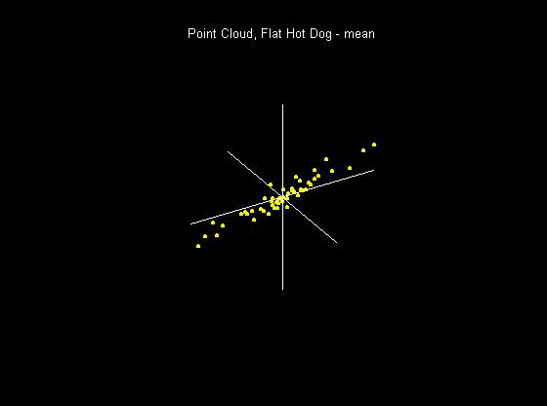
Visualization
How do we look at Euclidean data?
1-d: histograms, etc.
2-d: scatterplots
3-d: spinning point clouds

Slide 25
Visualization
How do we look at Euclidean data?
Higher Dimensions?
Workhorse Idea: Projections

Slide 26
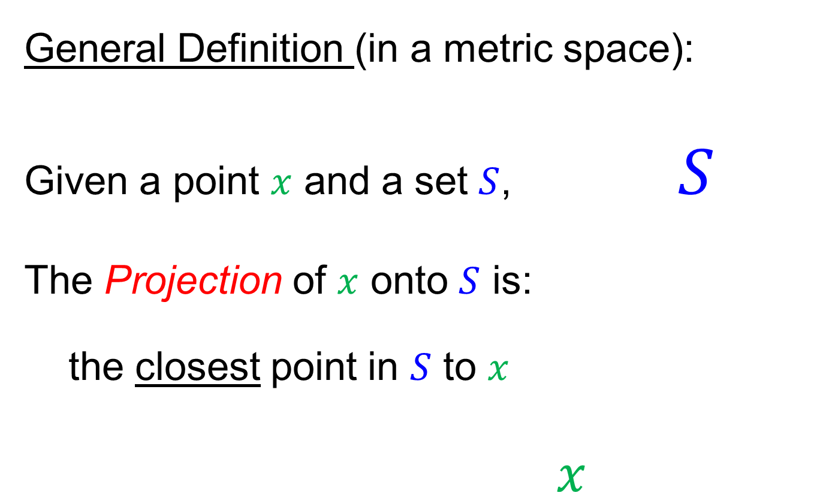
Projection
General Definition (in a metric space):
Given a point $x$ and a set $S$, $S$
The Projection of $x$ onto $S$ is:
the closest point in $S$ to $x$
$x$

Slide 27
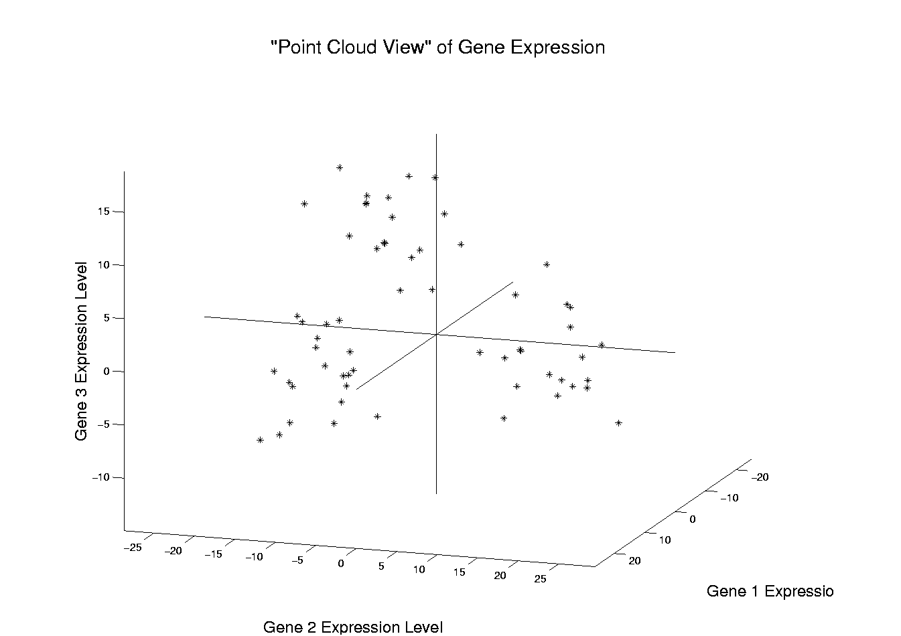
Illustration of Multivariate View: Raw Data
Notes:
EgView1p1RawData.ps

Slide 28
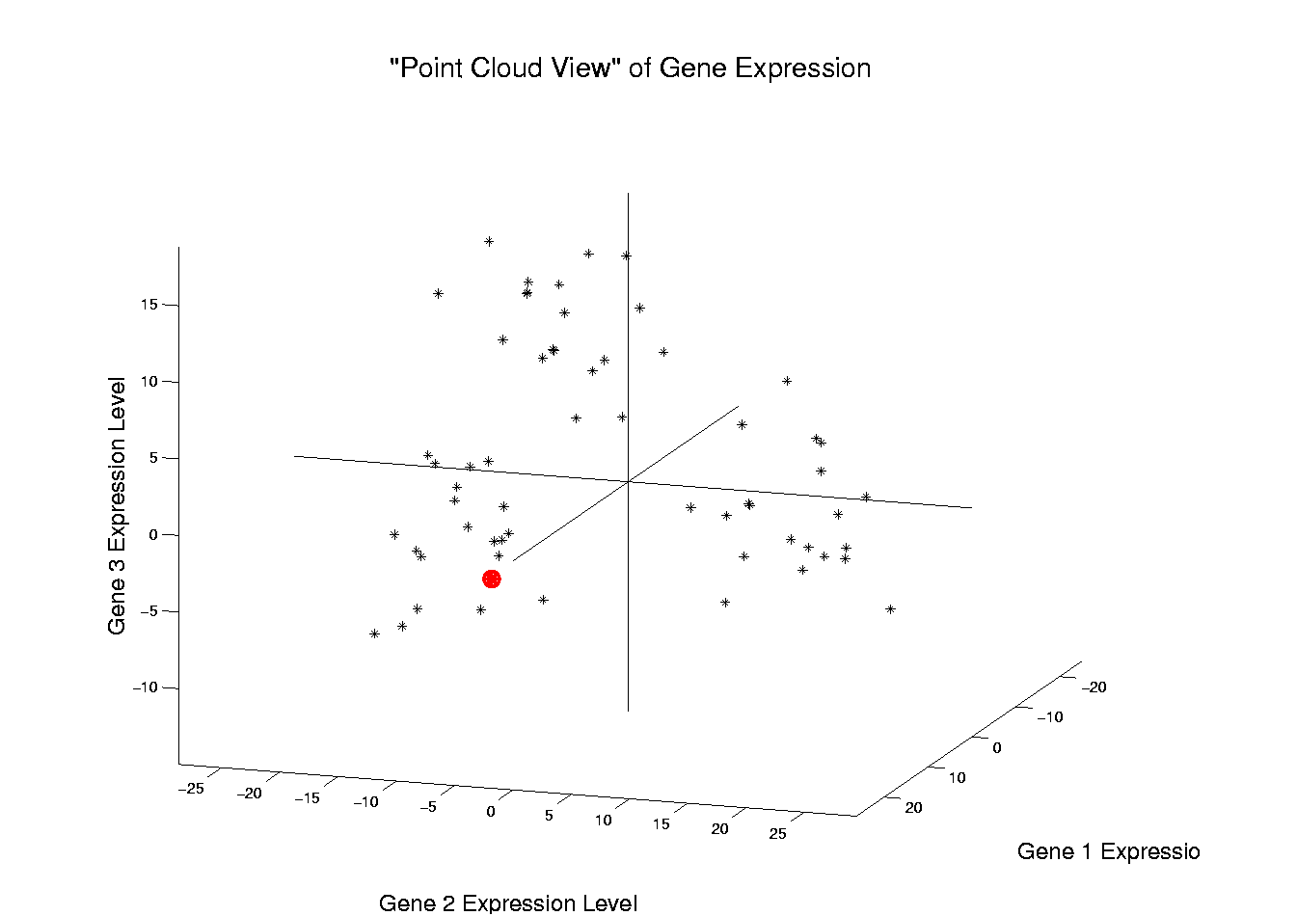
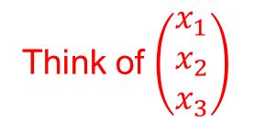
Illustration of Multivariate View: Highlight One
Think of $\left(\begin{matrix}x_{1} \\ x_{2} \\ x_{3}\end{matrix}\right)$
Notes:
EgView1p2RawDataHiLite1.ps

Slide 29
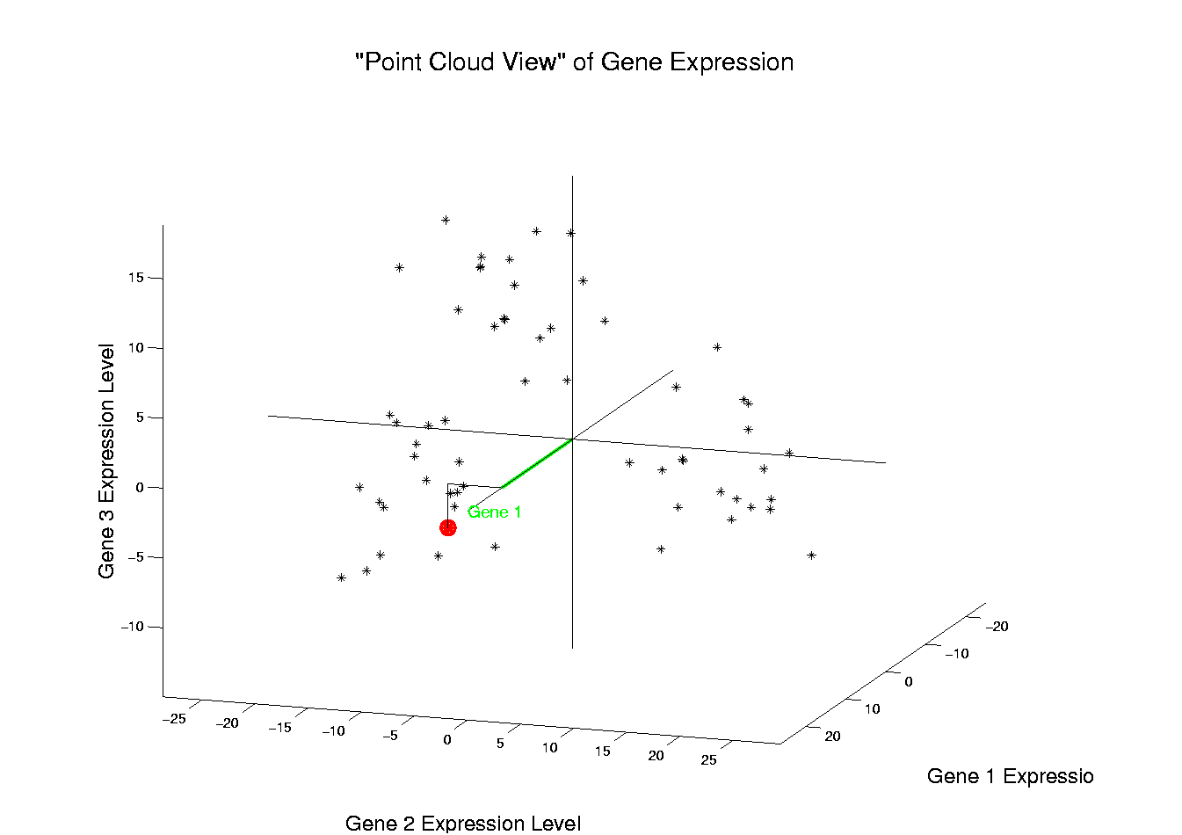

Illustration of Multivariate View: Gene 1 Express’n
$x_{1}$
Notes:
EgView1p3RawDataHL1CoordX.ps

Slide 30
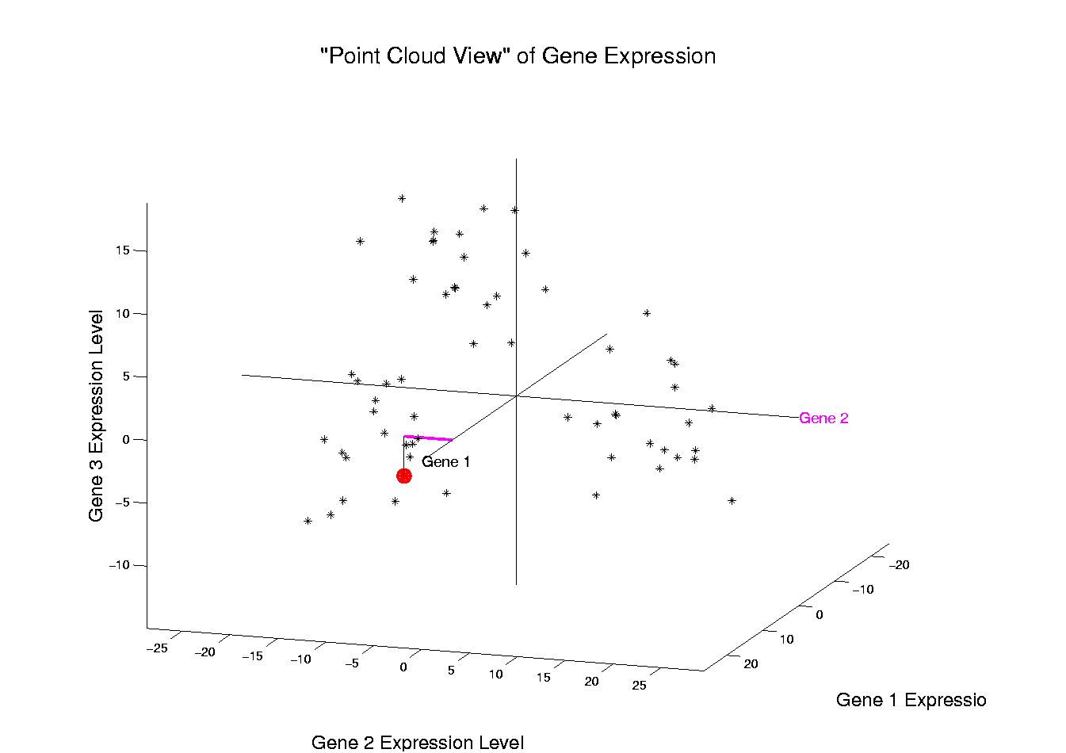

Illustration of Multivariate View: Gene 2 Express’n
$x_{2}$
Notes:
EgView1p3RawDataHL1CoordY.ps

Slide 31
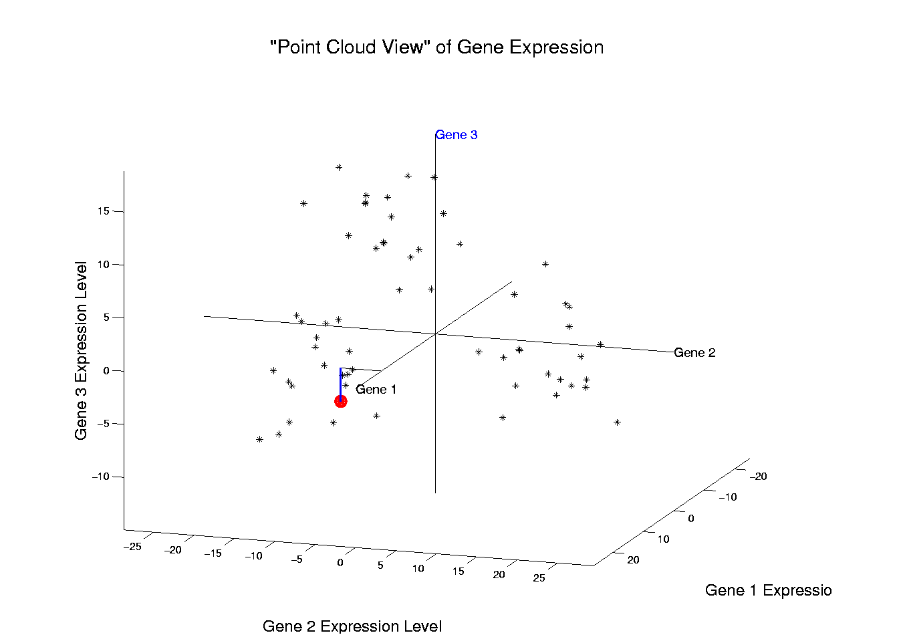

Illustration of Multivariate View: Gene 3 Express’n
$x_{3}$
Notes:
EgView1p3RawDataHL1CoordZ.ps

Slide 32
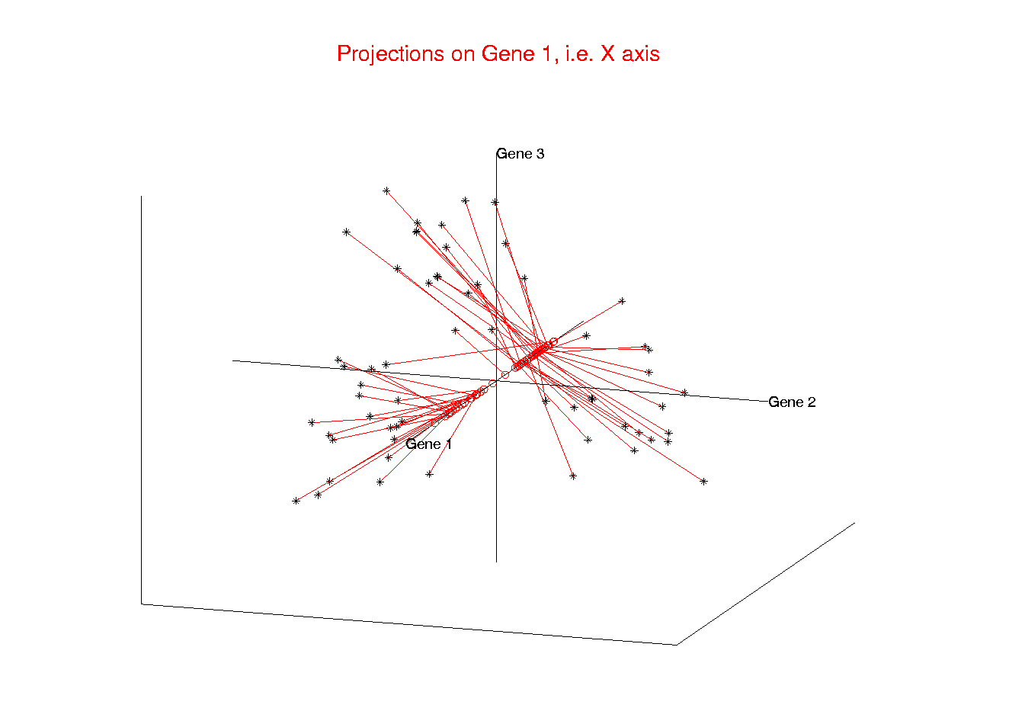
Illust’n of Multivar. View: 1-d Projection, X-axis
Notes:
EgView1p21proj3DX.ps

Slide 33
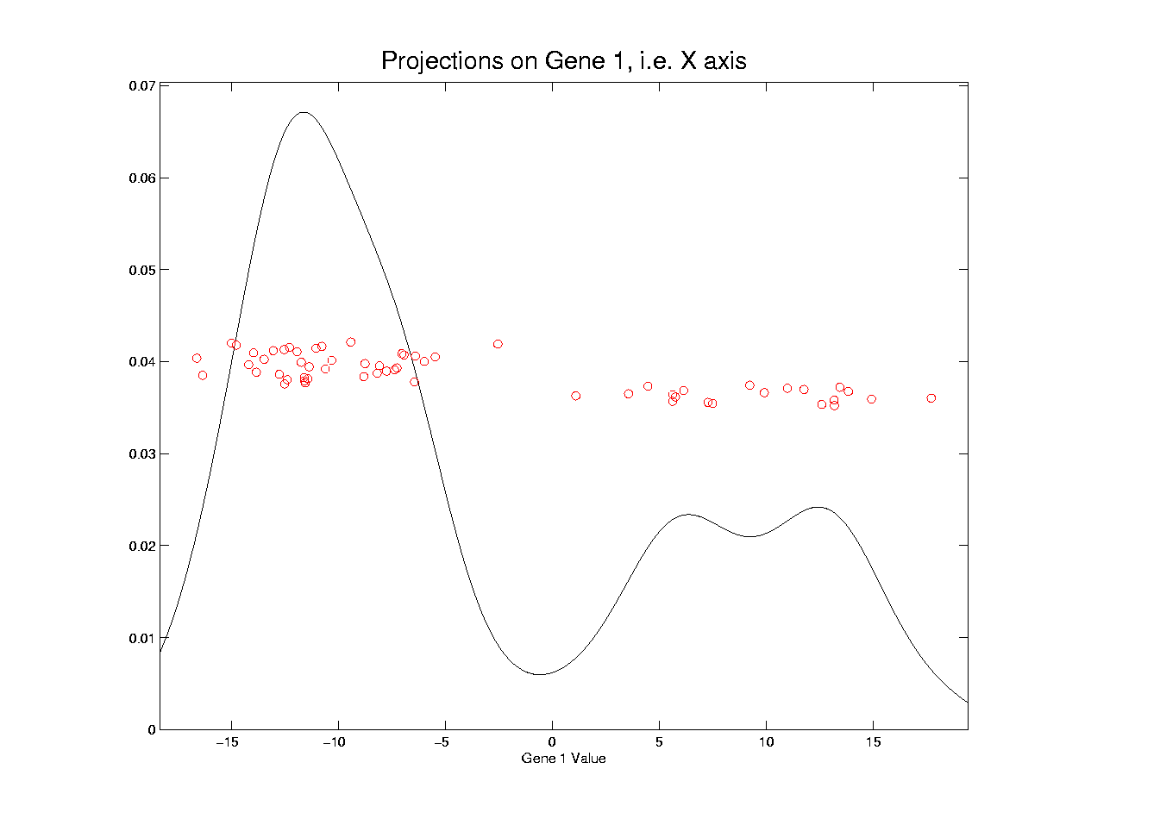
Illust’n of Multivar. View: X-Projection, 1-d view
Will use this type of 1-d view
a lot, so study carefully
Notes:
EgView1p31Proj1dX.ps

Slide 34
Illust’n of Multivar. View: X-Projection, 1-d view
X Coordinates
Are Projections
Notes:
EgView1p31Proj1dX.ps

Slide 35
Illust’n of Multivar. View: X-Projection, 1-d view
Y Coordinates Show
Order in Data Set
(or Random)
Notes:
EgView1p31Proj1dX.ps

Slide 36
Illust’n of Multivar. View: X-Projection, 1-d view
Smooth histogram =
Kernel Density Estimate
Will Study in Detail Later
Notes:
EgView1p31Proj1dX.ps

Slide 37
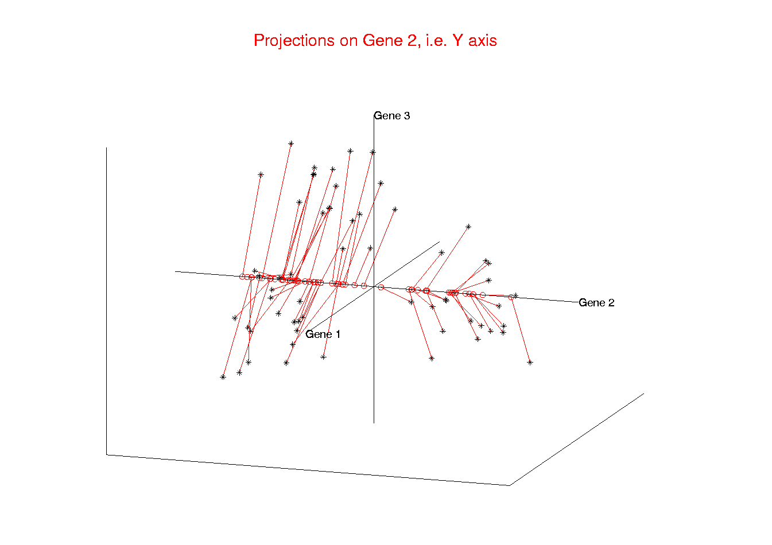
Illust’n of Multivar. View: 1-d Projection, Y-axis
Notes:
EgView1p22proj3DY.ps

Slide 38
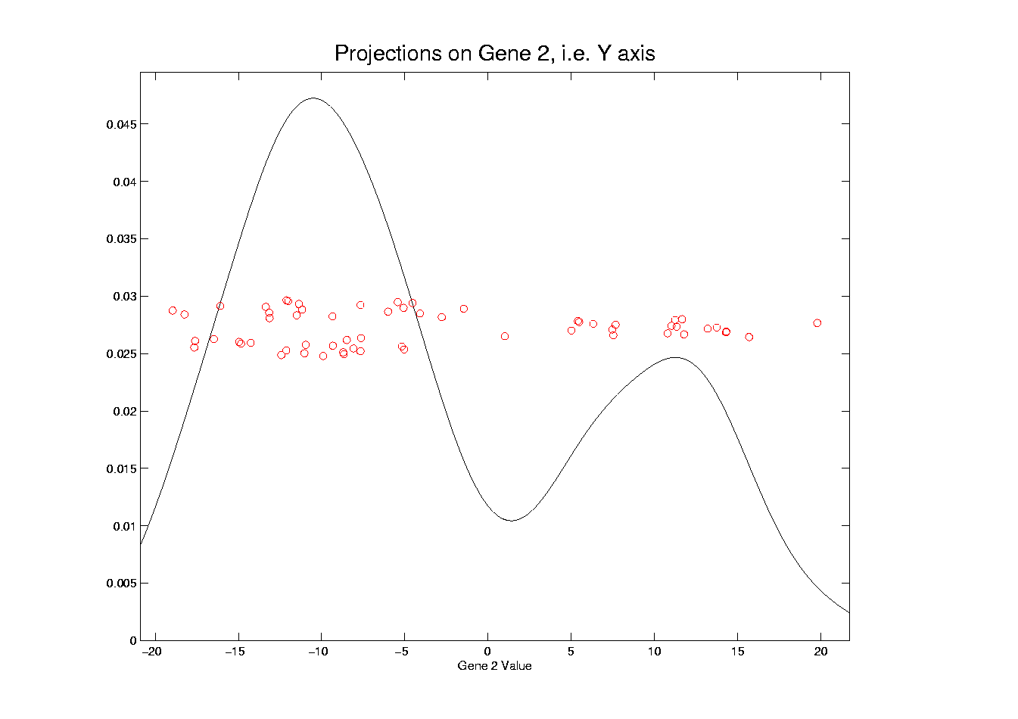
Illust’n of Multivar. View: Y-Projection, 1-d view
Notes:
EgView1p32Proj1dY.ps

Slide 39
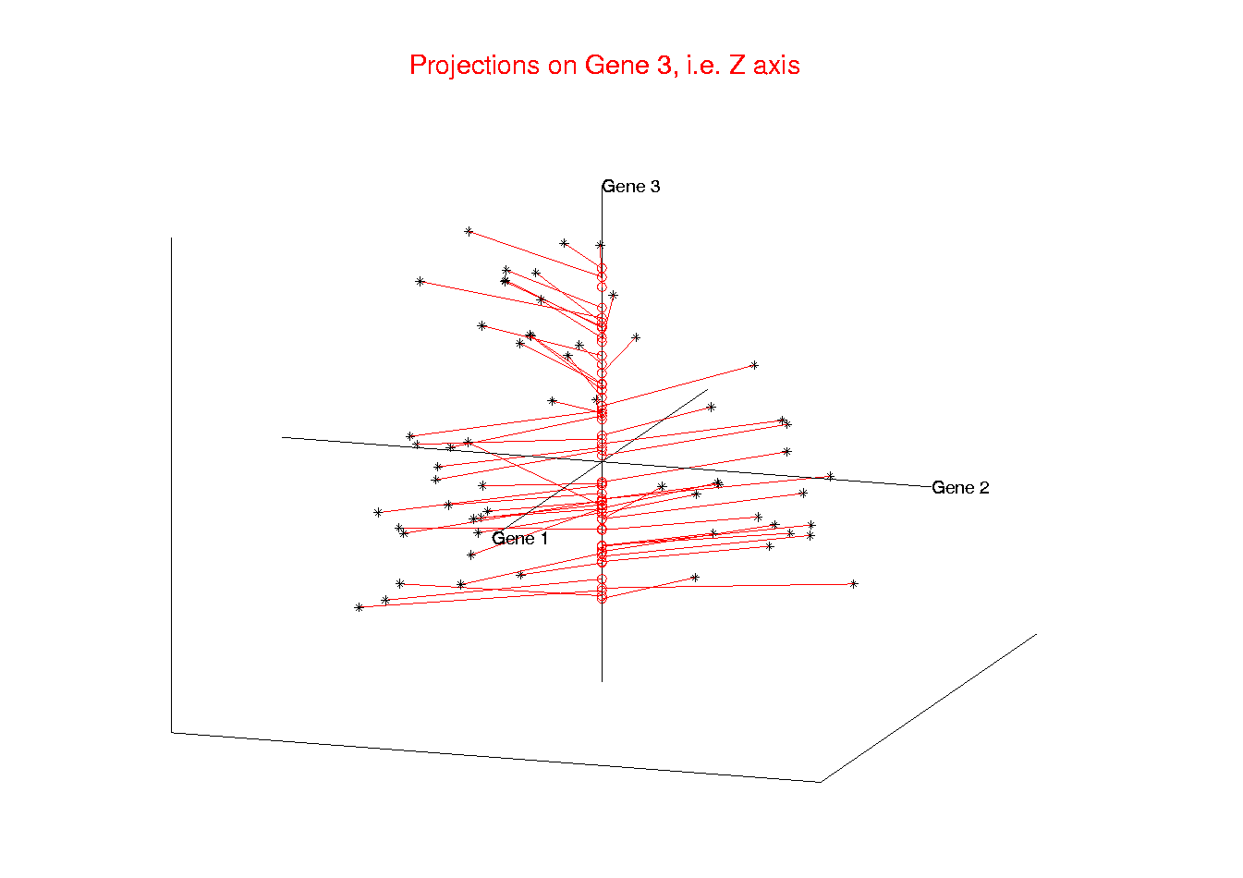
Illust’n of Multivar. View: 1-d Projection, Z-axis
Notes:
EgView1p23proj3DZ.ps

Slide 40
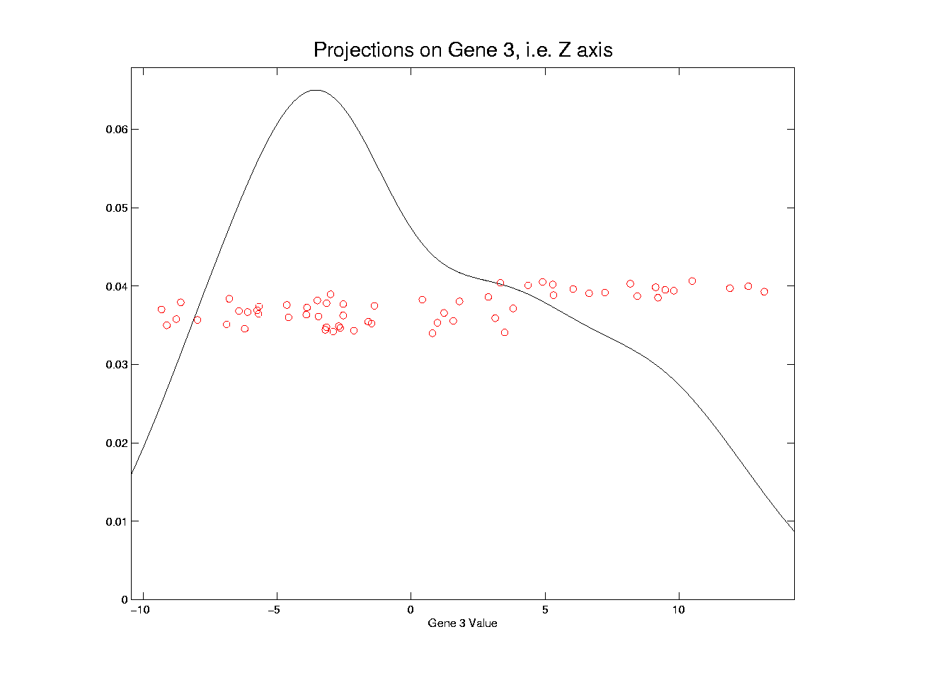
Illust’n of Multivar. View: Z-Projection, 1-d view
Notes:
EgView1p33Proj1dZ.ps

Slide 41
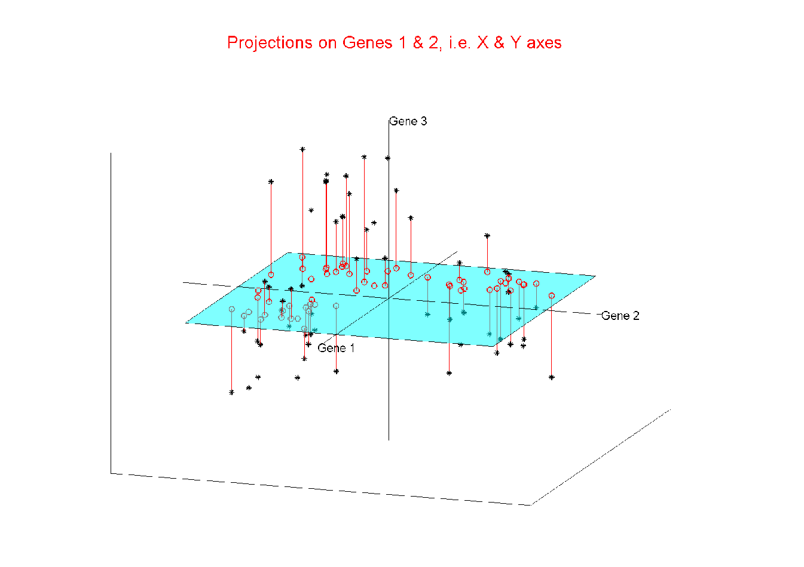
Illust’n of Multivar. View: 2-d Proj’n, XY-plane
Notes:
EgView1p24proj3DXY.ps

Slide 42
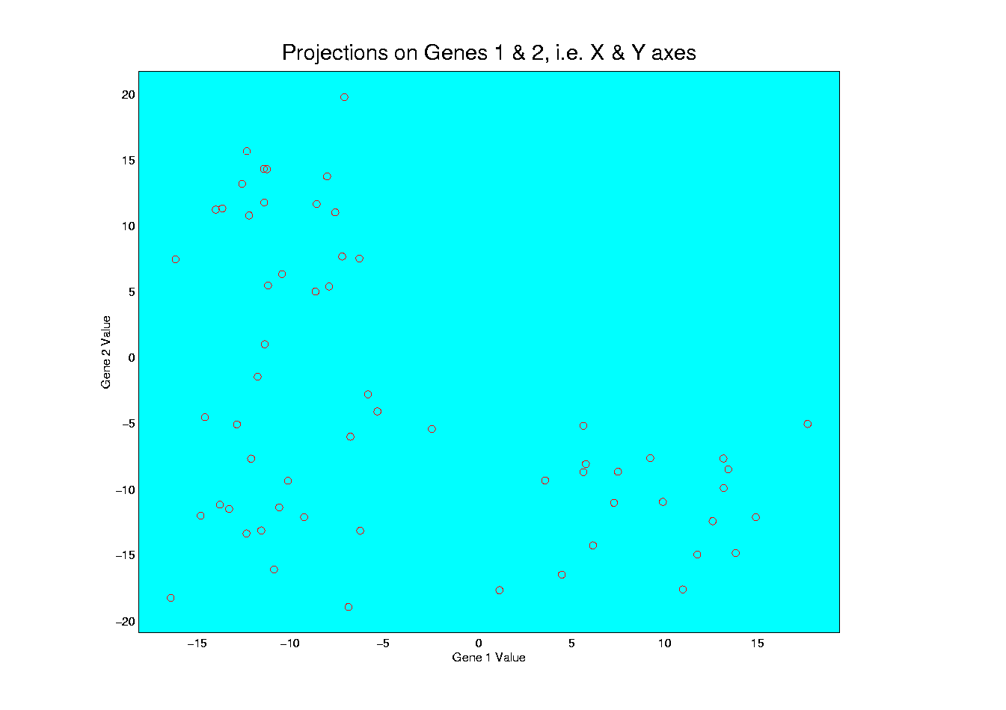
Illust’n of Multivar. View: XY-Proj’n, 2-d view
Notes:
EgView1p34proj2DXY.ps

Slide 43
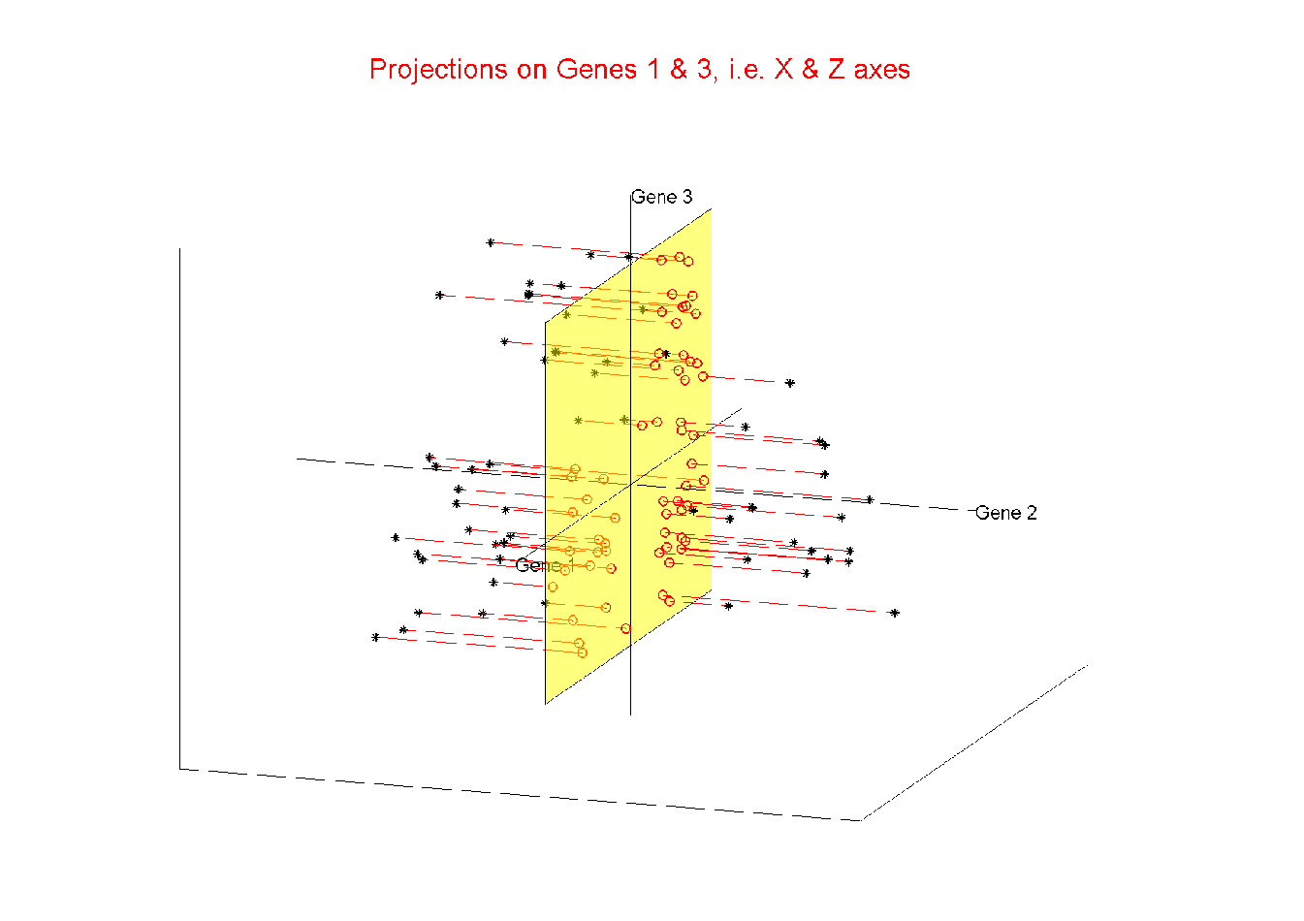
Illust’n of Multivar. View: 2-d Proj’n, XZ-plane
Notes:
EgView1p25proj3DXZ.ps

Slide 44
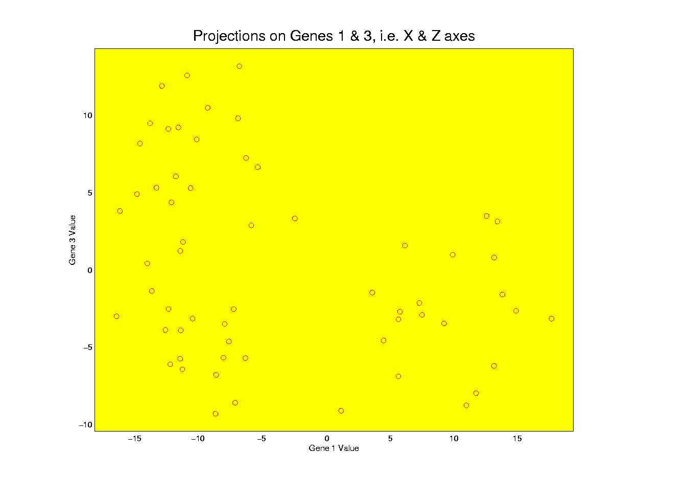
Illust’n of Multivar. View: XZ-Proj’n, 2-d view
Notes:
EgView1p35proj2DXZ.ps

Slide 45
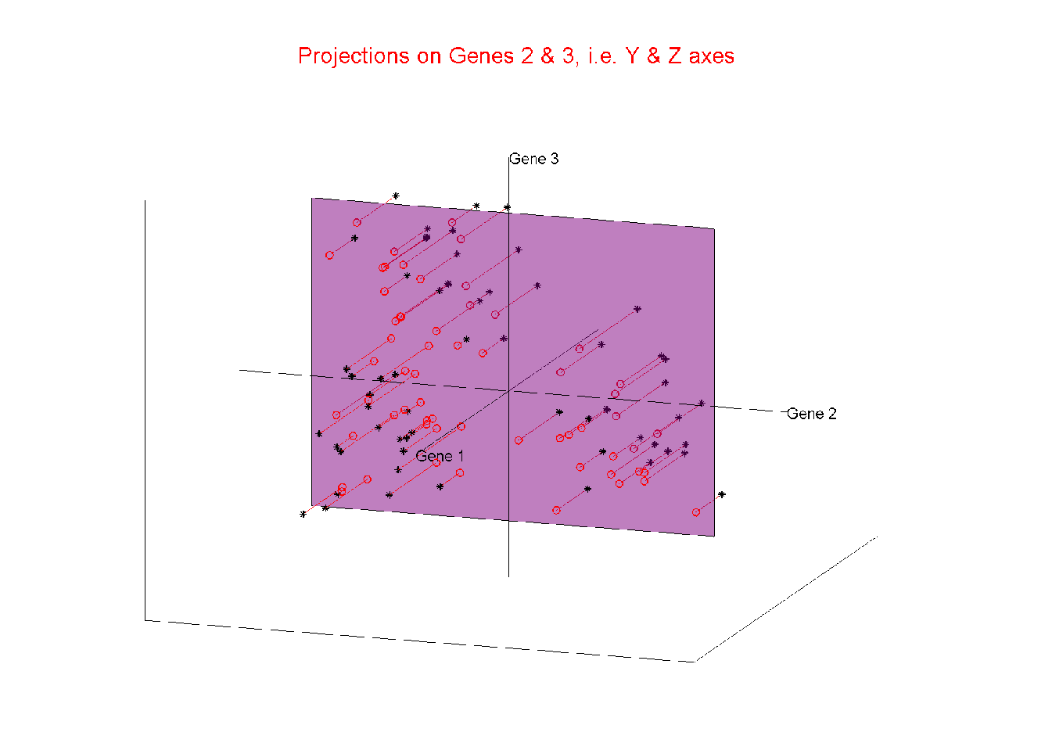
Illust’n of Multivar. View: 2-d Proj’n, YZ-plane
Notes:
EgView1p26proj3DYZ.ps

Slide 46
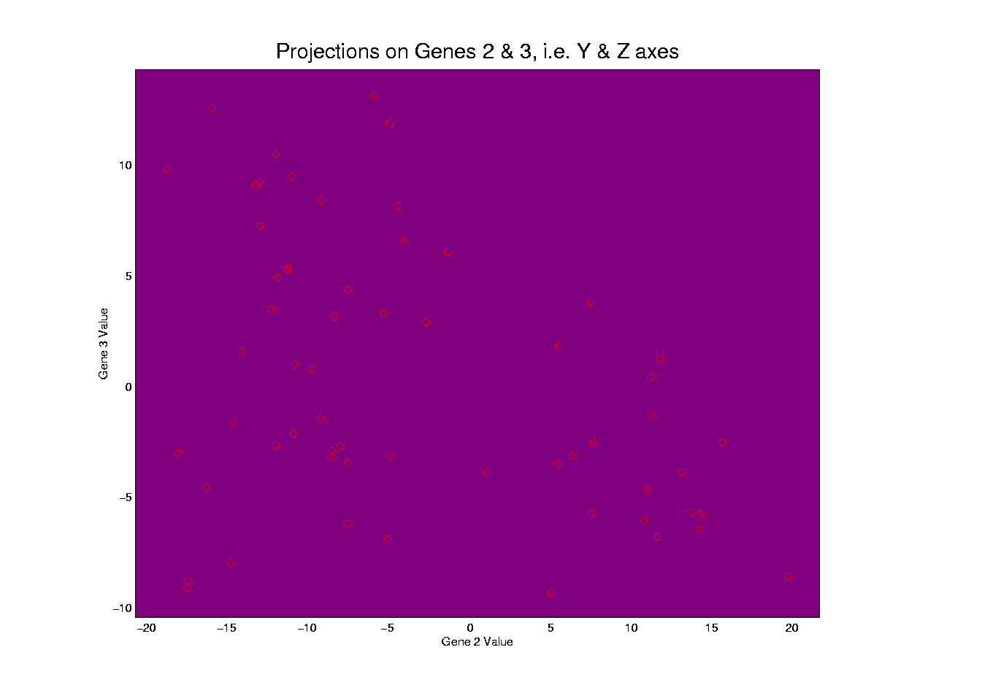
Illust’n of Multivar. View: YZ-Proj’n, 2-d view
Notes:
EgView1p36proj2DYZ.ps

Slide 47
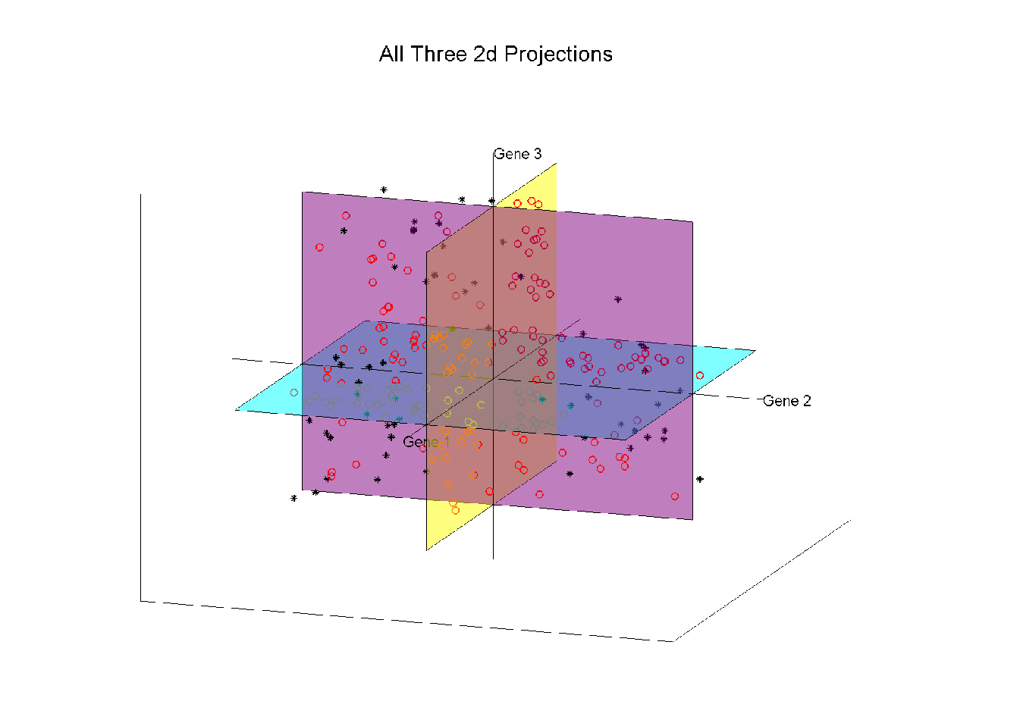
Illust’n of Multivar. View: all 3 planes
Think:
Front
Top
Side
Views
Notes:
EgView1p27proj3Dall.ps

Slide 48
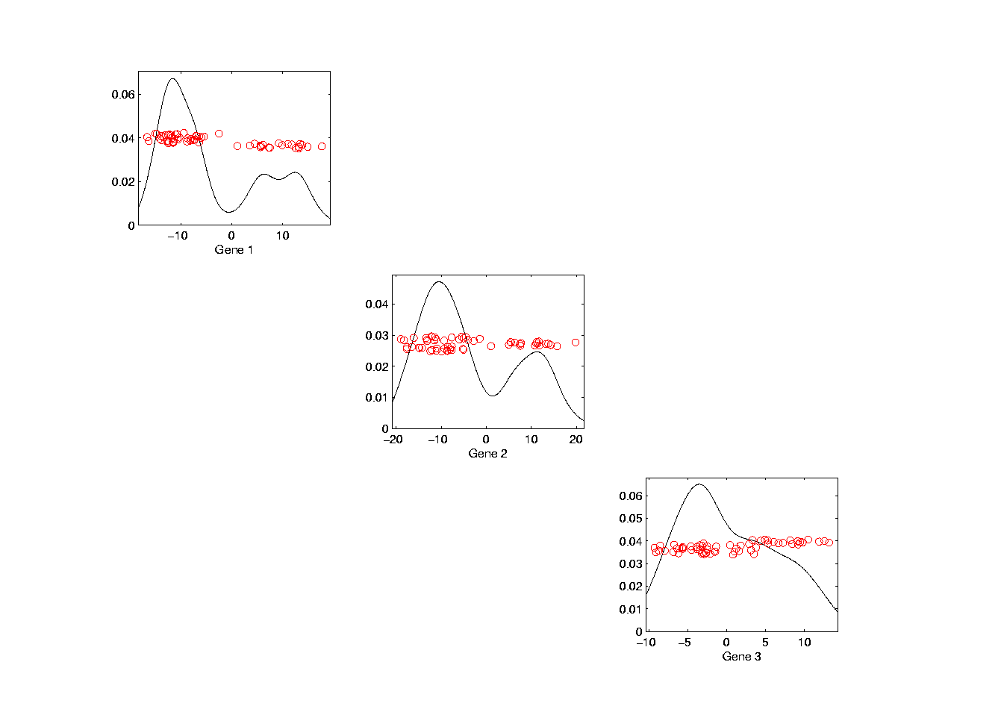
Illust’n of Multivar. View: Diagonal 1-d proj’ns
Notes:
EgView1p37proj1Ddiag.ps

Slide 49
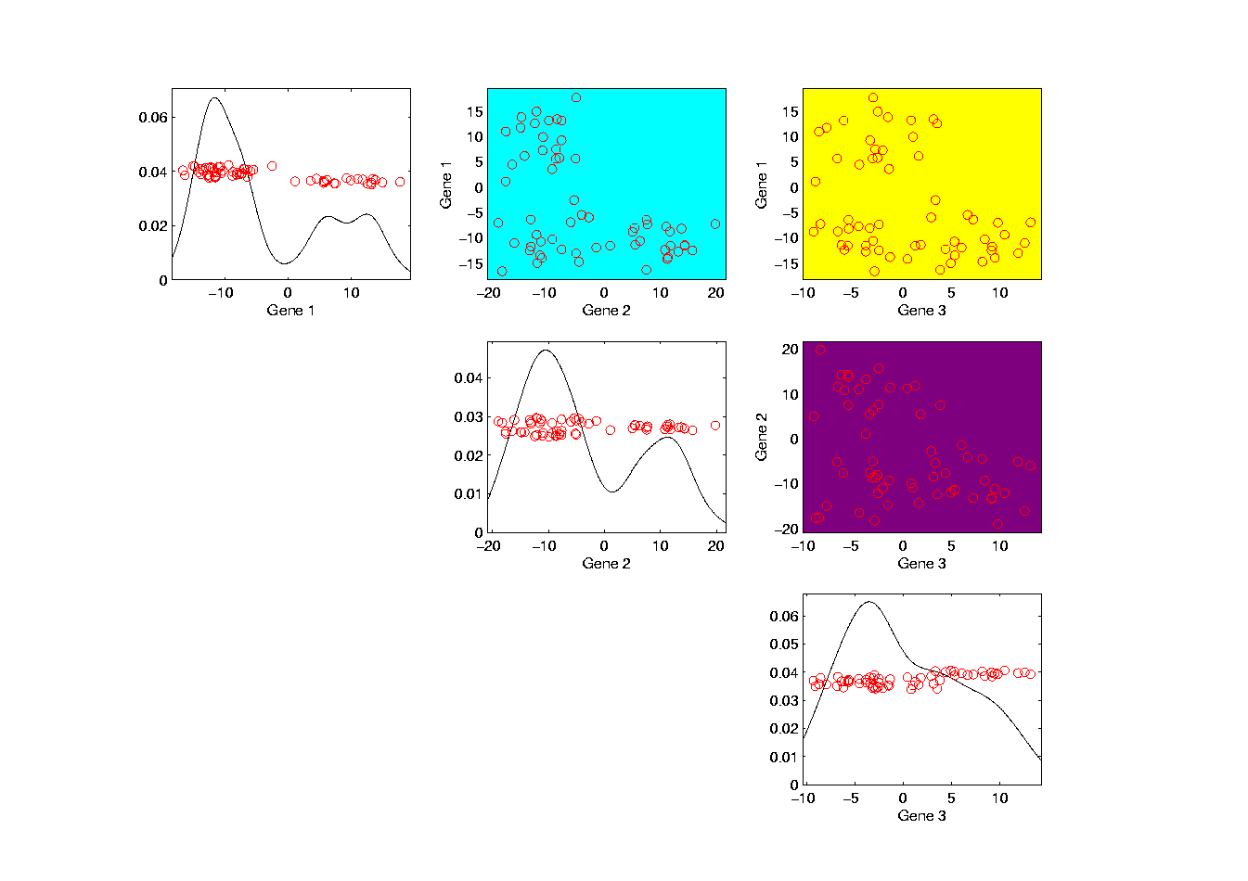
Illust’n of Multivar. View: Add off-diagonals
Notes:
EgView1p38proj1n2Dcolor.ps

Slide 50
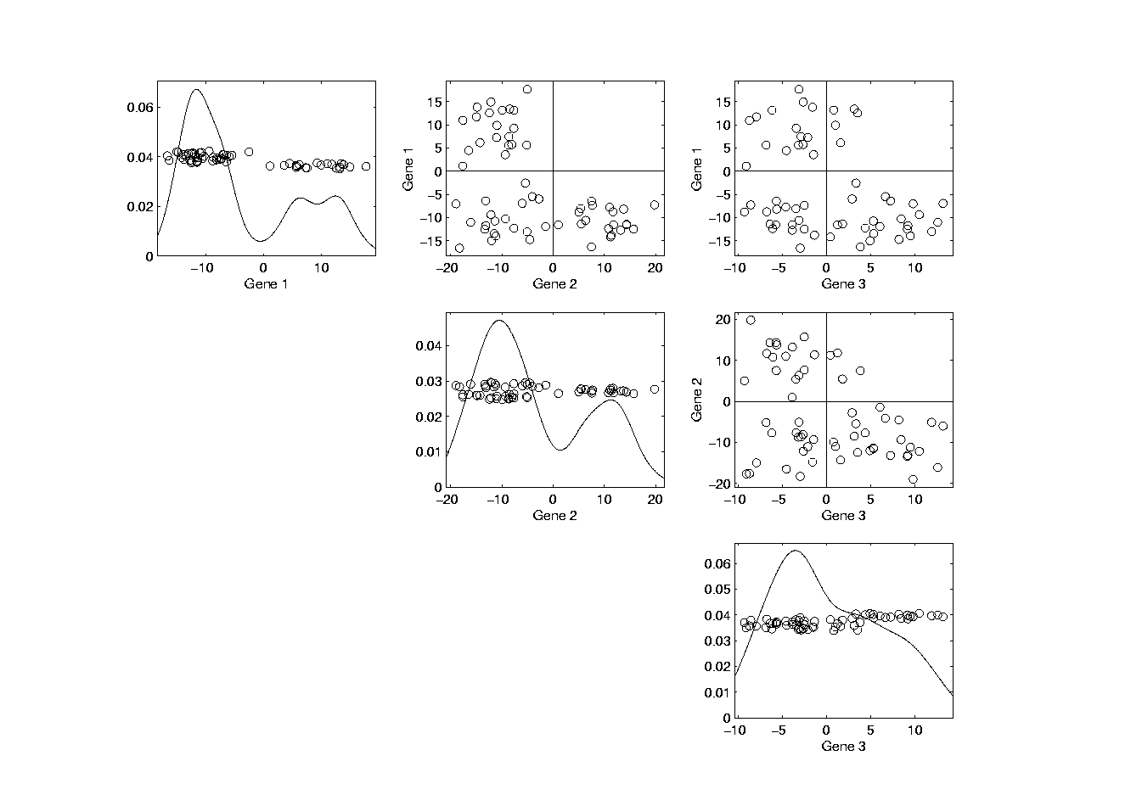
Illust’n of Multivar. View: Typical View
Notes:
EgView1p39ScatPlot.ps

Slide 51
Illust’n of Multivar. View: Typical View
Note Linkage of Axes
Notes:
EgView1p39ScatPlot.ps

Slide 52
Illust’n of Multivar. View: Typical View
Note Linkage of Axes
Notes:
EgView1p39ScatPlot.ps

Slide 53
Illust’n of Multivar. View: Typical View
Note Linkage of Axes
Notes:
EgView1p39ScatPlot.ps

Slide 54
Illust’n of Multivar. View: Typical View
Note Correspondence
of Points
Notes:
EgView1p39ScatPlot.ps

Slide 55
Illust’n of Multivar. View: Typical View
Note Correspondence
of Points
Notes:
EgView1p39ScatPlot.ps

Slide 56
Illust’n of Multivar. View: Typical View
And “Trait by
Trait” Since
Axes are Traits
Note: often put
transpose plots
below diagonal
Called “Scatterplot Matrix” View
Notes:
EgView1p39ScatPlot.ps

Slide 57
Homework 1
Make a 3-d Trait by Trait Scatterplot Matrix
of the Apple – Banana – Pear Data
On the Sakai Assignment / HW1 page
Use your choice of software
Explain Data Set Name
Post Graphic & Explanation on Sakai page
Due: Jan. 27,
11:00AM

Slide 58
Homework Policy
Fine to collaborate with others
In fact this is encouraged
About “understanding” not “testing”
But everybody please turn in something

Slide 59
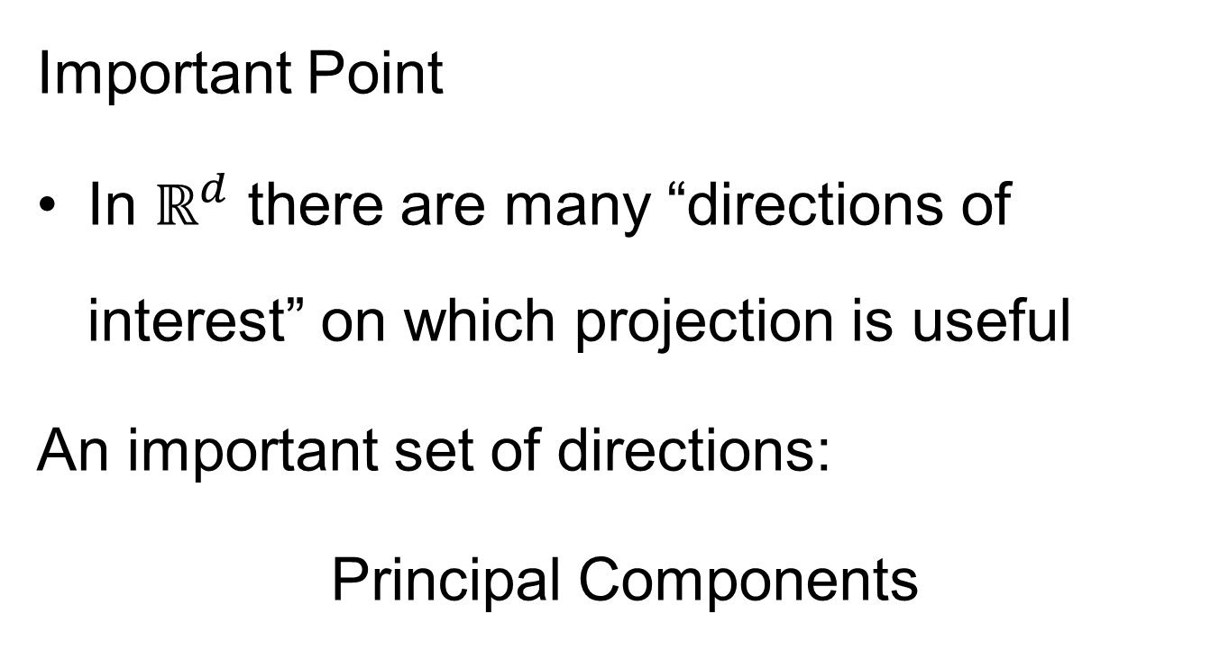
Projection
Important Point
In $ℝ^{d}$ there are many “directions of interest” on which projection is useful
An important set of directions:
Principal Components

Slide 60
Principal Components
Find Directions of:
“Maximal (Projected) Variation”
Compute Sequentially
On Orthogonal Subspaces
Will take careful look at mathematics later
Results in Useful
“Modes of Variation”

Slide 61
Principal Components
For simple,
3-d toy data,
recall raw
data view:
Notes:
61

Slide 62
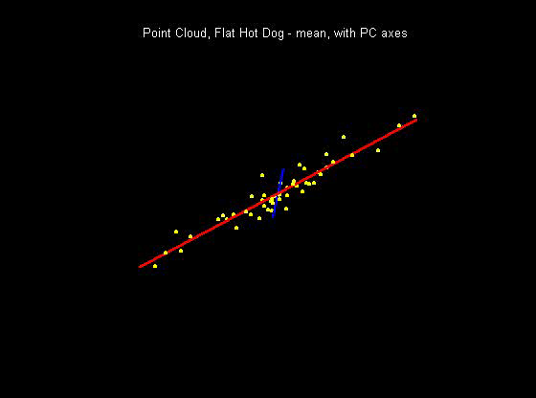
Principal Components
PCA just
gives rotated
coordinate
system:
Notes:
62

Slide 63
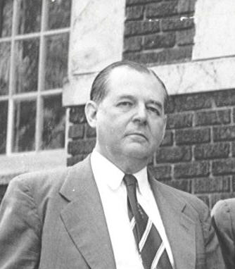
Principal Components
Early References:
Pearson (1901)
Hotelling (1933)
Founder of UNC Statistics Dept.
Notes:
63

Slide 64
Illust’n of PCA View: Recall Raw Data
Notes:
EgView1p1RawData.ps

Slide 65
Illust’n of PCA View: Recall Trait by Trait Views
Notes:
EgView1p27proj3Dall.ps

Slide 66
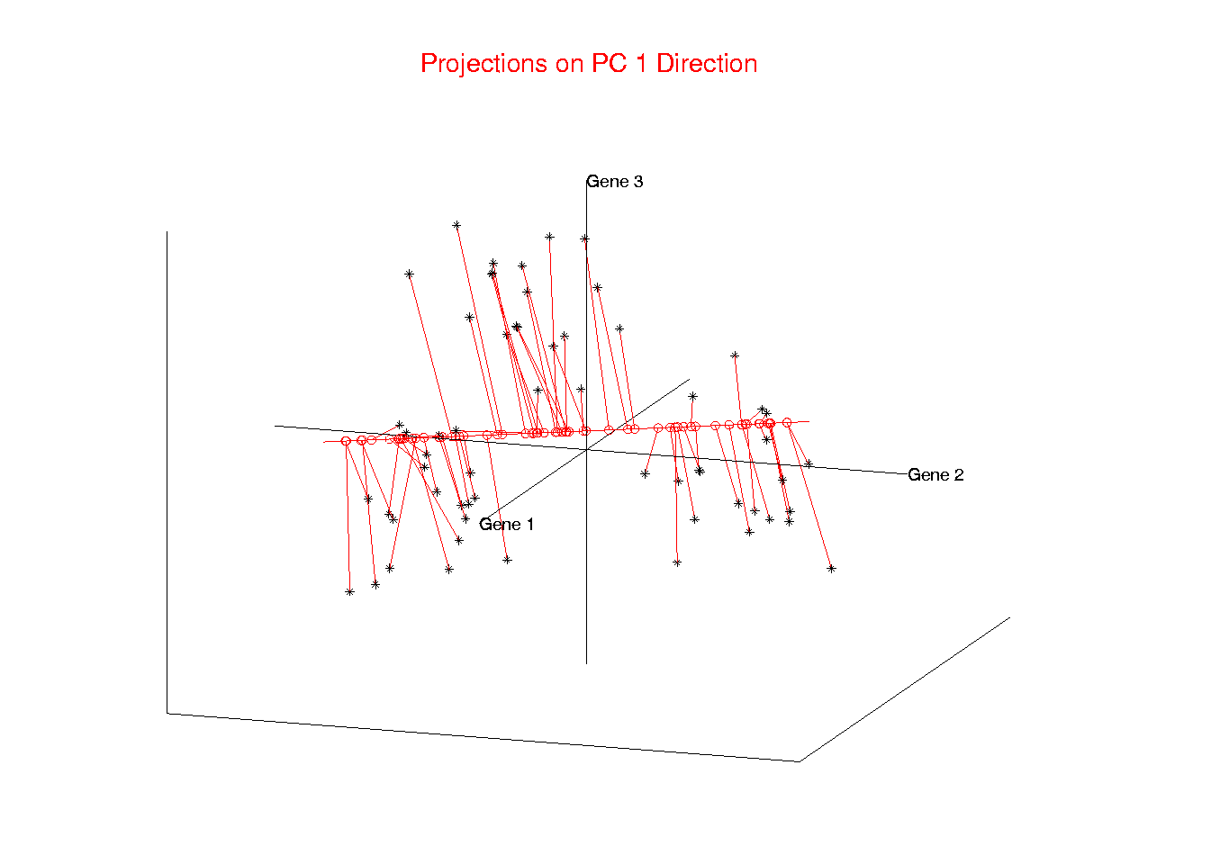
Illust’n of PCA View: PC1 Projections
Notes:
EgView1p51proj3dPC1.ps

Slide 67
Illust’n of PCA View: PC1 Projections
Note Different Axis
Chosen to
Maximize Spread
Notes:
EgView1p51proj3dPC1.ps

Slide 68
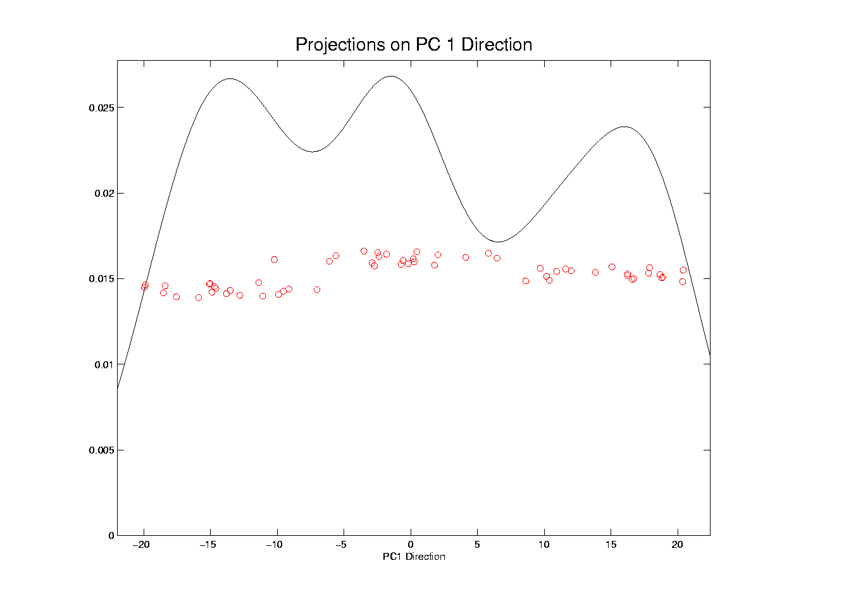
Illust’n of PCA View: PC1 Projections, 1-d View
Notes:
EgView1p61Proj1dPC1.ps

Slide 69
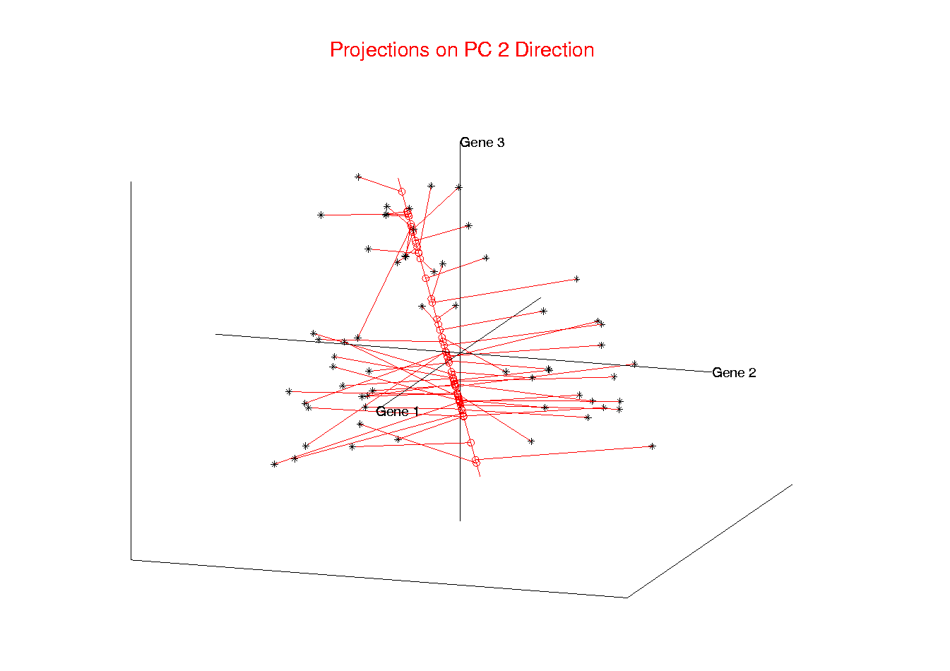
Illust’n of PCA View: PC2 Projections
Notes:
EgView1p52proj3dPC2.ps

Slide 70
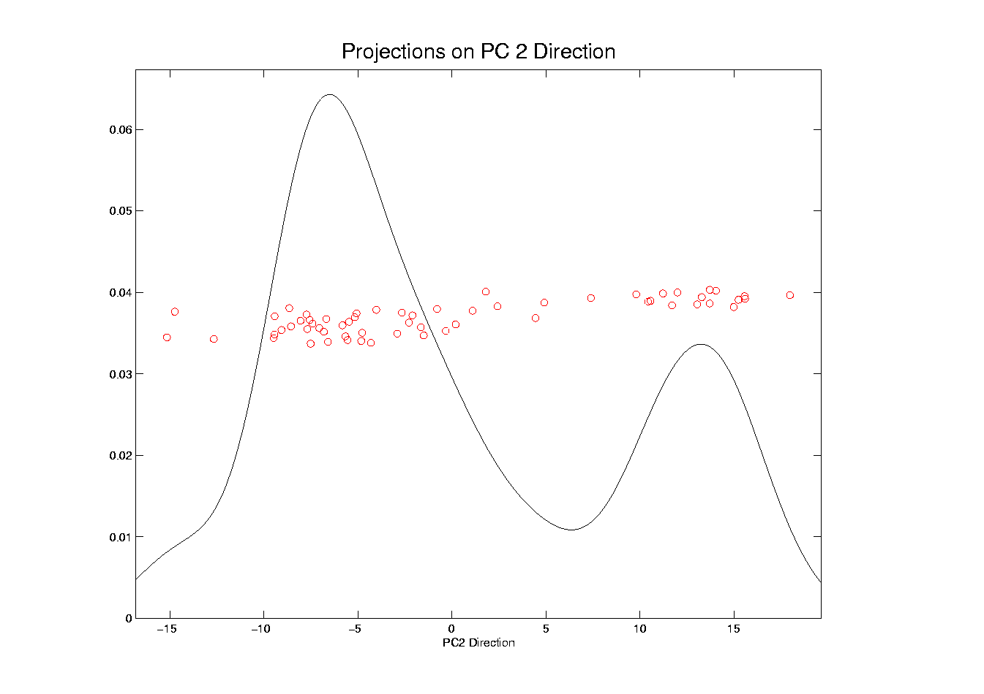
Illust’n of PCA View: PC2 Projections, 1-d View
Notes:
EgView1p62Proj1dPC2.ps

Slide 71
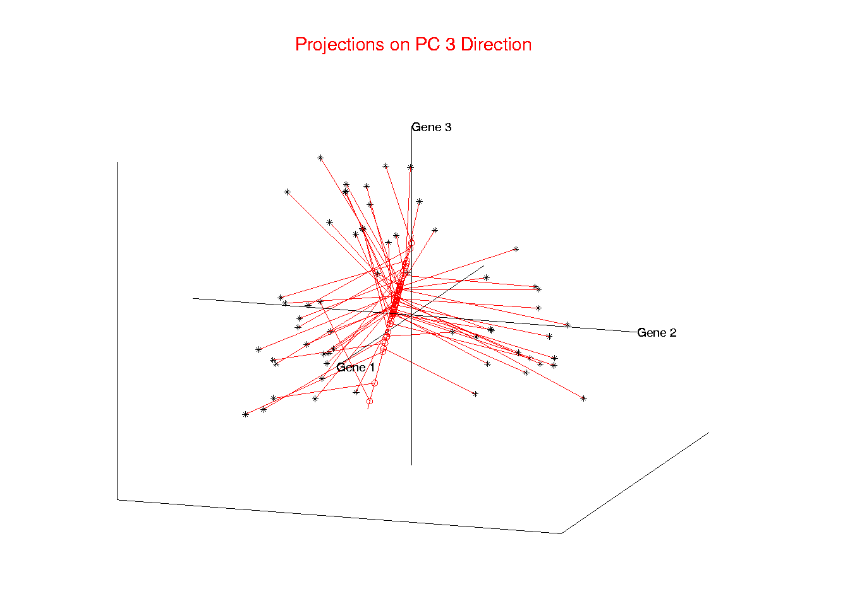
Illust’n of PCA View: PC3 Projections
Notes:
EgView1p53proj3dPC3.ps

Slide 72

Illust’n of PCA View: PC3 Projections, 1-d View
Notes:
EgView1p63Proj1dPC3.ps

Slide 73

Illust’n of PCA View: Projections on PC1,2 plane
Notes:
EgView1p54proj3dPC12.ps

Slide 74

Illust’n of PCA View: PC1 & 2 Proj’n Scatterplot
Notes:
EgView1p64proj2dPC12.ps

Slide 75

Illust’n of PCA View: Projections on PC1,3 plane
Notes:
EgView1p55proj3dPC13.ps

Slide 76

Illust’n of PCA View: PC1 & 3 Proj’n Scatterplot
Notes:
EgView1p65proj2dPC13.ps

Slide 77

Illust’n of PCA View: Projections on PC2,3 plane
Notes:
EgView1p56proj3dPC23.ps

Slide 78

Illust’n of PCA View: PC2 & 3 Proj’n Scatterplot
Notes:
EgView1p66proj2dPC23.ps

Slide 79

Illust’n of PCA View: All 3 PC Projections
Notes:
EgView1p57proj3dPCall.ps

Slide 80

Illust’n of PCA View: Matrix with 1-d proj’ns on diag.
Notes:
EgView1p67proj1dPCAdiag.ps

Slide 81

Illust’n of PCA: Add off-diagonals to matrix
Notes:
EgView1p68proj1n2dPCAcolor.ps

Slide 82

Illustration of PCA Scatterplot Matrix
Useful “3-d” Interpretation
Front View
Side View
Top View
Notes:
EgView1p69PCAScatPlot.ps

Slide 83
Comparison of Views
Highlight 3 Clusters
  In Previous 3-d Example
  Using Colors

Slide 84

Illust’n of PCA View: Trait by Trait View
Note Colors Enhance
Impressions of Clusters
Notes:
EgView1p71GeneViewClustColor.ps

Slide 85
Comparison of Views
Highlight 3 clusters (in previous 3-d example)
Trait by Trait View (above scatterplot matrix)
  Clusters appear in all 3 scatterplots
  But never very separated

Slide 86

Illust’n of PCA View: PCA View
No Clusters in 3rd
Direction is Good,
Since Important
Aspects Appear
In Earlier Comp’ts
Clusters are “more distinct”
Since more “air space”
In between
Notes:
EgView1p72PCAViewClustColor.ps

Slide 87
Comparison of Views
Highlight 3 clusters (in previous 3-d example)
Trait by Trait View (above scatterplot matrix)
  Clusters appear in all 3 scatterplots
  But never very separated
PCA View
  1st shows three distinct clusters
  Better separated than in gene view
  Clustering concentrated in 1st scatterplot
Effect is small, since only 3-d

Slide 88

Another Comparison of Views
Much higher dimension, $d=4000$
Trait by Trait View
Simulation:
$n_{+}=30$ N(0.1,1) (marginals)
$n_{−}=30$ N(-0.1,1) (marginals)
- Independent Entries

Slide 89

Another Comparison: Trait by Trait View
1st three of 4000 directions
Notes:
EgView2p1dat1GeneView.ps

Slide 90
Another Comparison: Trait by Trait View
Very Small Differences
Between Means
Notes:
EgView2p1dat1GeneView.ps

Slide 91

Another Comparison of Views
Much higher dimension, $d=4000$
Trait by Trait View
  Clusters very nearly the same
  Very slight difference in means

Slide 92

Another Comparison: PCA View
Notes:
EgView2p2dat1PCAView.ps

Slide 93

Another Comparison of Views
Much higher dimension, $d=4000$
Trait by Trait View
  Clusters very nearly the same
  Very slight difference in means
PCA View
  Huge difference in 1st PC Direction
  Magnification of clustering
  Lesson: Alternate views can show much more
  (especially in high dimensions, i.e. for many genes)
  Shows PC view can be very useful
Why so big???

Slide 94


Another Comparison: PCA View
Another Viewpoint:
Consider Vectors
$\vec{μ_{+}}=\left(\begin{matrix}+0.1 \\ ⋮ \\ +0.1\end{matrix}\right)$
$\vec{μ_{−}}=\left(\begin{matrix}−0.1 \\ ⋮ \\ −0.1\end{matrix}\right)$
Difference points in direction $\left(\begin{matrix}1 \\ ⋮ \\ 1\end{matrix}\right)$
Notes:
EgView2p2dat1PCAView.ps

Slide 95

Another Comparison: PCA View
High Dimensional
Space Is Slippery!
Interesting Issue:
How close is $\left(\begin{matrix}1 \\ ⋮ \\ 1\end{matrix}\right)$ to coordinate axes in $ℝ^{d}$?
Angle $= \cos^{−1}\left[\left(\begin{matrix}\frac{1}{\sqrt{d}} & ⋯ & \frac{1}{\sqrt{d}}\end{matrix}\right)\left(\begin{matrix}1 \\ 0 \\ \begin{matrix}⋮ \\ 0\end{matrix}\end{matrix}\right)\right]$
Which for $d=4000$ is ${89.1}^{°}$
Notes:
EgView2p2dat1PCAView.ps

Slide 96
Homework 2
For the Rotated Apple-Banana-Pear Data
Make a trait by trait scatterplot matrix.
Make a PC scores scatterplot matrix.
Explain difference between those
Data and details again on
Sakai / Assignments
Due: Jan. 27,
11:00AM

Slide 97
Object Oriented Data Analysis
Three Major Phases of OODA:
I. Object Definition
“What are the Data Objects?”
Exploratory Analysis
“What Is Data Structure / Drivers?”
III. Confirmatory Analysis / Validation
Is it Really There (vs. Noise Artifact)?

Slide 98
Basics of OODA
Useful Conceptual Framework:
Object Space ←→ Trait Space
Text, Sec. 3.1.2
(Where data
objects live)
(How they are
represented)

Slide 99

Basics of OODA
Object Space ←→ Trait Space
Curves $ℝ^{d}$
Images $ℝ^{d×d}$
Shapes Manifolds
Trees Graph Space
Movies

Slide 100


Basics of OODA
Object Space ←→ Trait Space
Simple $d=2$ Toy Example:
Enables Visualization of BOTH Spaces

Slide 101

Basics of OODA
Simple $d=2$ Toy Example:
Each Curve is a Point

Slide 102


Basics of OODA
Simple $d=2$ Toy Example:
Each Curve is a Point
Mean is shown as well (part of analysis)
Can Compute
Mean in $ℝ^{2}$
Or Equivalently Pointwise in Object Space

Slide 103


Basics of OODA
Simple $d=2$ Toy Example:
Best Rank 1 Approximation (PC 1)
As Curves
and as Points

Slide 104

Basics of OODA
Simple $d=2$ Toy Example:
Computed as Projections onto
Eigen-direction centered at Mean

Slide 105

Basics of OODA
Simple $d=2$ Toy Example:
Interpretation:
1st Mode of Variation

Slide 106


Basics of OODA
Simple $d=2$ Toy Example:
Second Best Rank 1 Approximation (PC 2)
As Curves
and as Points

Slide 107

Basics of OODA
Simple $d=2$ Toy Example:
Computed as Projections onto
Eigen-direction centered at Mean

Slide 108

Basics of OODA
Simple $d=2$ Toy Example:
Interpretation:
2nd Mode of Variation

Slide 109

Basics of OODA
Decomposition into Modes of Variation
Note Much More
Variation Here
Than Here

Slide 110
Basics of OODA
Decomposition into Modes of Variation
Sum of Squares
After Mean
Centering
Variance (not s.d.)
To Reflect Energy
Just as in ANOVA
Usual Quantification: Variance of Each, Expressed as %
98.3% of
Variation
1.7% of
Variation

Slide 111

Scree Plot
Text, Sec. 3.1.3
Idea: Visually Summarize Dist’n of Variance
Sometimes Also Useful
To Display Cumulative
98.3% of
Variation
1.7% of
Variation

Slide 112
Scree Plot
More Examples
Spanish Male
Mortality Data
2-d Toy Data

Slide 113

Scree Plot
Recall Spanish Male Mortality Data

Slide 114

Scree Plot
Recall Spanish Male Mortality Decomposition
95.8% of Variation
2.7% of
Variation
Don’t Believe It?
Check Axes!

Slide 115
Scree Plot
More Examples
95.8% of Variation
Spanish Male
Mortality Data
2-d Toy Data
2.7% of
Variation

Slide 116
Scree Plot
More Examples
Spanish Male
Mortality Data
2-d Toy Data
10-d Toy Data
Genetic Data
(Will Show Data Later)

Slide 117
Scree Plot
More Examples
Illustrates Common Use of Scree:
Separate “Signal” From “Noise”
Spanish Male
Mortality Data
2-d Toy Data
Look for “Elbow” (or “Knee”)
10-d Toy Data
Genetic Data
Common for Strong – Low d Signal + Noise

Slide 118
Scree Plot
More Examples
Spanish Male
Mortality Data
2-d Toy Data
Much More Common for Complex Data
Where Signal Appears in Many Comp’s
Really Not Much
Elbow or Knee!
10-d Toy Data
Genetic Data

Slide 119

Scree Plot
Etymology of term Scree:
Geological Feature
Pile Up of Rock
Fragments
(from Wikipedia)
Cattell (1966)

