Slide 1
Statistics – O. R. 881 Object Oriented Data Analysis
Start
Recording
Steve Marron
Dept. of Statistics and Operations Research
University of North Carolina

Slide 2
Administrative Info
Details on Course Web Page
https://marron.web.unc.edu/course-home-page-stor-881-object-oriented-data-analysis-spring-2022/
Or access from Sakai page
Or:
Google: “Marrons teaching material”
Choose This Course

Slide 3
Current Sections in Textbook
Today:
Sections 3.3, 4.1, 13.1
Next Class:
Sections 13.1, 18.1, 5.1

Slide 4
Participant Presentations
Please Prepare to Sign Up (on Thursday):
Name
Email (Onyen is fine, or …)
Are You ENRolled?
Dept. & Advisor (Lab?)
Tentative Title (“????” Is OK)
When:
Next Week, Early, March, April, Late

Slide 5
Course Context
Currently Fashionable Topic:
Big Data Science
Many Important Issues.
But More Challenging (& Important?):
Complex Data
( )

Slide 6
Comparison of Views
Highlight 3 clusters
Gene by Gene View
Clusters appear in all 3 scatterplots
But never very separated
PCA View
1st shows three distinct clusters
Better separated than in gene view
Clustering concentrated in 1st scatterplot
Effect is small, since only 3-d

Slide 7
Illust’n of PCA View: Gene by Gene View
Note Colors Enhance
Impressions of Clusters
Notes:
EgView1p71GeneViewClustColor.ps

Slide 8
Illust’n of PCA View: PCA View
No Clusters in 3rd
Direction is Good,
Since Important
Aspects Appear
In Earlier Comp’ts
Clusters are “more distinct”
Since more “air space”
In between
Notes:
EgView1p72PCAViewClustColor.ps

Slide 9
Object Oriented Data Analysis
Three Major Phases of OODA:
I. Object Definition
“What are the Data Objects?”
Exploratory Analysis
“What Is Data Structure / Drivers?”
III. Confirmatory Analysis / Validation
Is it Really There (vs. Noise Artifact)?

Slide 10
Basics of OODA
Useful Conceptual Framework:
Object Space ←→ Trait Space
(Where data
objects live)
(How they are
represented)

Slide 11
Basics of OODA
Simple $d=2$ Toy Example:
Each Curve is a Point

Slide 12
Basics of OODA
Simple $d=2$ Toy Example:
Best Rank 1 Approximation (PC 1)
As Curves
and as Points

Slide 13
Basics of OODA
Simple $d=2$ Toy Example:
Interpretation:
2nd Mode of Variation

Slide 14
Basics of OODA
Decomposition into Modes of Variation
Sum of Squares
After Mean
Centering
Variance (not s.d.)
To Reflect Energy
Just as in ANOVA
Usual Quantification: Variance of Each, Expressed as %
98.3% of
Variation
1.7% of
Variation

Slide 15
Scree Plot
Idea: Visually Summarize Dist’n of Variance
Sometimes Also Useful
To Display Cumulative
98.3% of
Variation
1.7% of
Variation

Slide 16
Scree Plot
More Examples
Spanish Male
Mortality Data
2-d Toy Data
10-d Toy Data
Genetic Data

Slide 17
Basics of OODA
Recall Decomposition into Modes of Variation
& Elsewhere
As Well
Just What
Are They?

Slide 18
Basics of OODA
Text, Sec. 3.1.4
Definition of Mode of Variation
(of a sample of data objects)
A Set of Members of the Object Space That:
Summarize One Component of Variation
Is in Some Sense “One Dimensional”
(e.g. Indexed by a Single Real Parameter)

Slide 19
Basics of OODA
Recall Decomposition into Modes of Variation
Multiples Of A Single Curve

Slide 20
Basics of OODA
Recall Spanish Male Mortality Data
Multiples Of A Single Curve

Slide 21
Basics of OODA
Recall Amplitude Phase Example
1-d Families of Curves

Slide 22
Basics of OODA
Recall Bladder Prostate Rectum Data
1-d Set of Members of Object Space

Slide 23
Basics of OODA
Recall Faces as Data Objects
1-d Set of
Members of
Object Space,
So Also a “Mode Of
Variation”

Slide 24
Object Oriented Data Analysis
Three Major Phases of OODA:
I. Object Definition
“What are the Data Objects?”
Exploratory Analysis
“What Is Data Structure / Drivers?”
III. Confirmatory Analysis / Validation
Is it Really There (vs. Noise Artifact)?
Deeper Look at
Visualization

Slide 25
Representing Vectors as Curves
Visualization of Vectors as Data Objects:
$\left(\begin{matrix}x_{1} \\ ⋮ \\ x_{d}\end{matrix}\right)$

Slide 26
Representing Vectors as Curves
Visualization of Vectors as Data Objects:
$\left(\begin{matrix}x_{1} \\ ⋮ \\ x_{d}\end{matrix}\right)$
Called Parallel Coordinate View
by Inselberg (1985, 2005)
Connect with piece-wise lines

Slide 27
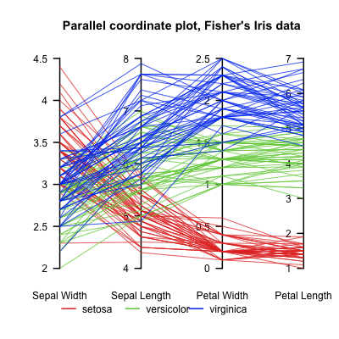
Parallel Coordinates
Proposed for Multivariate Data Visualization:
by Inselberg (1985, 2005)
E.g. Fisher Iris Data
d = 4
Named Variables
(thanks to Wikipedia)
Notes:
27

Slide 28
Parallel Coordinates
Proposed for Multivariate Data Visualization:
by Inselberg (1985, 2005)
E.g. Fisher Iris Data
d = 4
Named Variables
Curves are Data Objects
Vectors → Curves
Notes:
28

Slide 29
Representing Vectors as Curves
Summary of Approaches:
Parallel Coordinates
Fourier Basis
Orthogonal Polynomials
B-Splines
Wavelet Bases
Text, Sec. 3.3
Notes:
29

Slide 30
Representing Curves as Vectors
Summary of Approaches:
Parallel Coordinates
Fourier Basis
Orthogonal Polynomials
B-Splines
Wavelet Bases
Foundation of
Functional Data Analysis
Useful Duality: Vectors $↔$ Curves
Notes:
30

Slide 31
Prob. Dist’ns as Data Objects
Text, Sec. 3.3.1
How to Represent?
Several Common Choices:
$$F\left(x\right)=\int_{−∞}^{x}{f\left(t\right)dt}$$
$$Q\left(p\right)=F^{−1}(p)$$

Slide 32
Prob. Dist’ns as Data Objects
Graphical Relationships:

Slide 33
Prob. Dist’ns as Data Objects
Graphical Relationships:

Slide 34
Prob. Dist’ns as Data Objects
Graphical Relationships:

Slide 35
Prob. Dist’ns as Data Objects
How to Represent?
Several Common Choices:
Density:
Good Intuition of Prob. Mass
Cumulative:
Can Read Off Probs.
Quantile:
Best Modes of Variation

Slide 36
Prob. Dist’ns as Data Objects
Toy Example, Density Representation
$n=100$ Gaussian Densities
Varying Mean
Varying s.d.s
Interesting
Modes of
Variation???

Slide 37
Prob. Dist’ns as Data Objects
Energy Spread
Widely Across
The Spectrum
Toy Example, Density Representation
Try
Standard
PCA
Unintuitive
Modes of
Variation
Which Don’t
Explain Much
Variation

Slide 38
Prob. Dist’ns as Data Objects
Energy Entirely
Expressed In
Just 2 Modes
Toy Example, Quantile Representation
Try
Standard
PCA
0 1
1st Mode Is
Mean Var’n
0 1
Both Much More Interpretable!
2nd Mode Is
S.D. Var’n
0 1

Slide 39
Prob. Dist’ns as Data Objects
For More Discussion of the Usefulness of Quantile Representations of Dist’ns, see
Parzen (2004)

Slide 40
Prob. Dist’ns as Data Objects
How to Represent?
Alternative Choices:
Aitchison (1982)
Hron et al. (2016)
Menagfolio et al. (2018)

Slide 41
E.g. Curves As Data
“Tilted Parabolas” Example
10-d family of (digitized) curves
Object space: bundles of curves
Object space = $ℝ^{10}$
(harder to visualize as point cloud,
but keep point cloud in mind)
PCA: reveals “population structure”
Text, Sec. 4.1.1

Slide 42
Functional Data Analysis, Tilted Parabolas Data
Terminology:
“Modes of Variation” “Scores Plots”
Notes:
EGCD1Parabs.ps

Slide 43
Functional Data Analysis, Tilted Parabolas Data
OODA Conceptual Framework
Object
Space
Views
Trait
Space
Views
Notes:
EGCD1Parabs.ps

Slide 44
Functional Data Analysis, Tilted Parabolas Data
Notes:
EGCD1Parabs.ps

Slide 45
Functional Data Analysis, Tilted Parabolas Data
Note Scree Plot, Already Shown Above,
To Illustrate Distribution of Variation
Notes:
EGCD1Parabs.ps

Slide 46
Scree Plot
More Examples
Spanish Male
Mortality Data
2-d Toy Data
10-d Toy Data
Genetic Data

Slide 47
E.g. Tilted Parabolas Data
PCA: reveals “population structure”
Mean → Parabolic Structure
PC1 → Vertical Shift
PC2 → Tilt
higher PCs → Gaussian (spherical)
Decomposition into modes of variation

Slide 48
E.g. Curves As Data
Two Cluster Example
10-d curves again

Slide 49
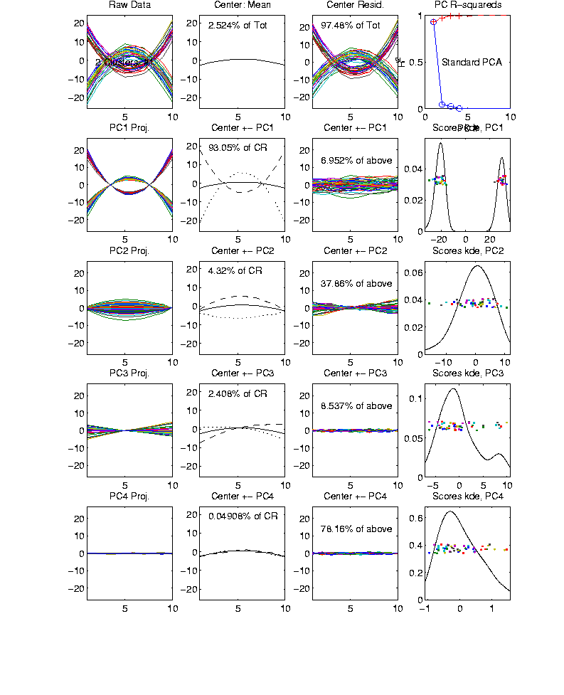
Functional Data Analysis, 10-d Toy EG 2
Notes:
EGCD1Clust2.ps

Slide 50
E.g. Curves As Data
Two Cluster Example
10-d curves again
Two big clusters
Revealed by 1-d scores plot (right side)
Note: Cluster Difference is not orthogonal
to Vertical Shift
PCA: reveals “population structure”

Slide 51
E.g. Curves As Data
“Twin Arches” Example
50-d curves
Text, Sec. 4.1.2

Slide 52
Functional Data Analysis, Twin Arches
Notes:
EGCD1Clust4a.ps

Slide 53
Functional Data Analysis, Twin Arches
Notes:
EGCD1Clust4aDP2d.ps

Slide 54
E.g. Curves As Data
Twin Arches Example
50-d curves
Pop’n structure hard to see in 1-d
2-d projections make structure clear
Joint Dist’ns More than Marginals
PCA: reveals “population structure”

Slide 55
Real Data Curve Objects
Text, Sec. 4.1.3
Lung Cancer Data Example
Genetics (Cancer Research)
RNAseq (Next Gener’n Sequen’g)
Deep look at “gene components”
Microarrays: Single number (per gene)
RNAseq: Thousands of measurements
I. Object Definition

Slide 56
Real Data Curve Objects
Lung Cancer Data Example
Genetics (Cancer Research)
RNAseq (Next Gener’n Sequen’g)
Deep look at “gene components”
Gene studied here: CDKN2A
Goal: Study Alternate Splicing
Sample Size, $n = 180$
Dimension, $d = 1709$

Slide 57
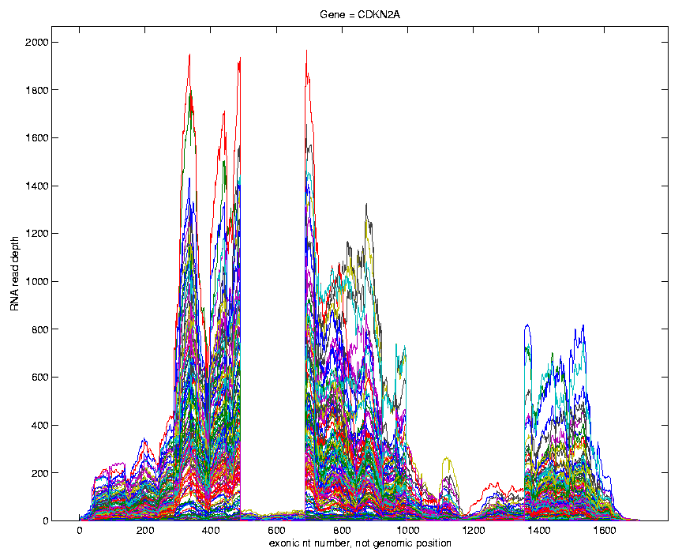
Lung Cancer Curve Objects
Simple
1st
View:
Curve
Overlay
(counts
scale)
Note: Data Set
Structure May
Be Hidden In
Low Areas
I. Object Representation

Slide 58
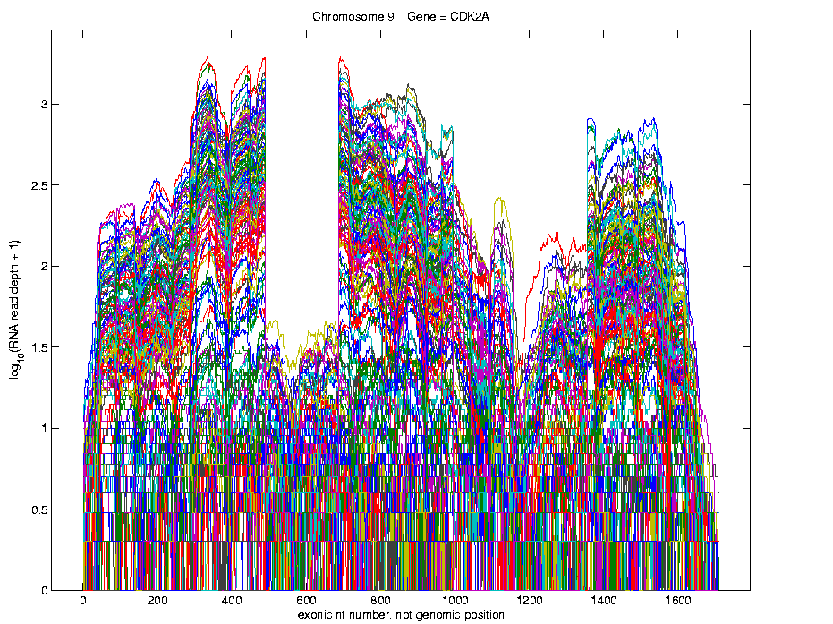
Lung Cancer Curve Objects
Simple
1st
View:
Curve
Overlay
(log
scale)
I. Object Representation

Slide 59
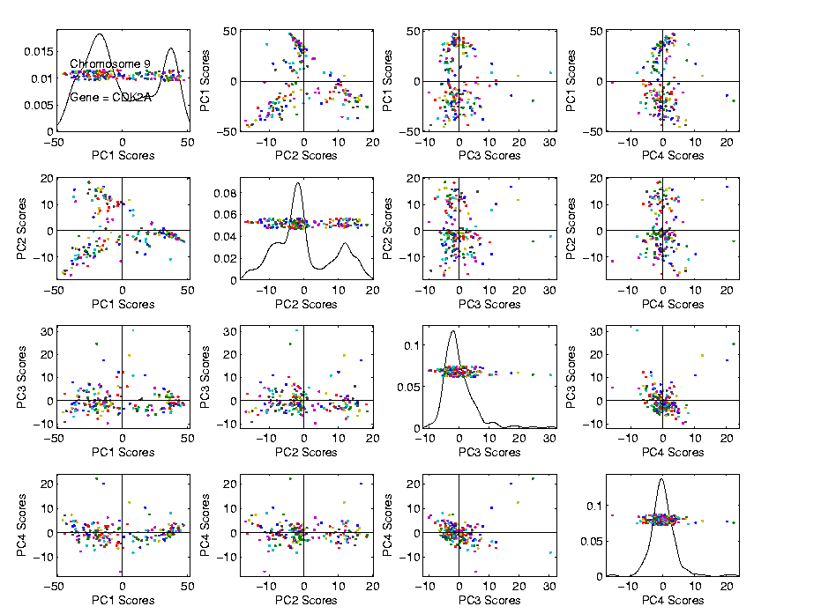
Lung Cancer Curve Objects
Visualization in Scores Space
Often
Useful
Population
View:
PCA
Scores

Slide 60
Lung Cancer Curve Objects
Suggestion
Of
Clusters
???
Suggested
By Smooth
Histograms

Slide 61
Lung Cancer Curve Objects
Suggestion
Of
Clusters
Which
Are
These?

Slide 62
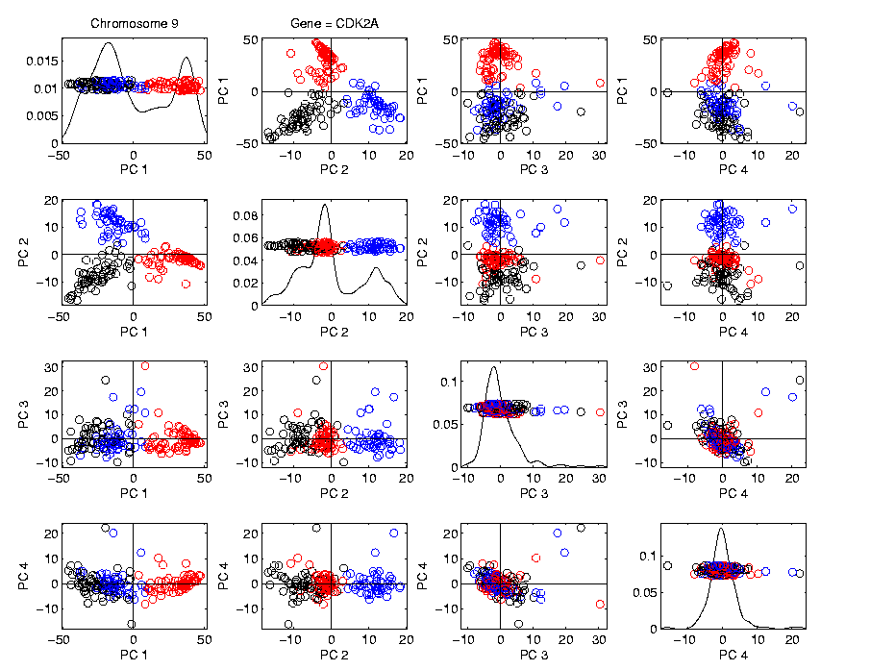
Lung Cancer Curve Objects
Visualization in Scores Space, Next Look in Object Space
Manually
“Brush”
Clusters
II. Exploratory
Analysis

Slide 63
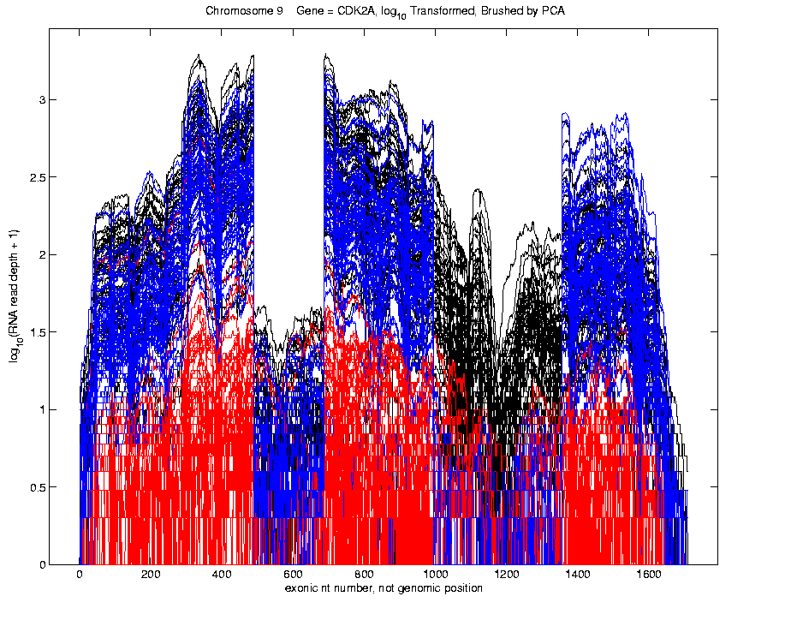
Lung Cancer Curve Objects
Manually
Brush
Clusters
Clear
Alternate
Splicing

Slide 64
Lung Cancer Curve Objects
Important Points
PCA found Important Structure
In High Dimensional Data Analysis
$$d = 1709$$
(Will Come Back To This Point)

Slide 65
Lung Cancer Curve Objects
Consequences:
Led to Development of SigFuge
Whole Genome Scan Found Interesting Genes
Wet Lab Experiment Verified Discoveries
Published in Kimes, et al (2014)

Slide 66
Lung Cancer Curve Objects
Interesting Question:
When are clusters really there?
(will study later)
III. Confirmatory Analysis

Slide 67
Lung Cancer Curve Objects
Manually
Brush
Clusters
Clear
Alternate
Splicing

Slide 68
Scree Plot
This was data illustrating
fallacy of “knee-finding”
for finding # of PCs
More Examples
Spanish Male
Mortality Data
2-d Toy Data
10-d Toy Data
Genetic Data

Slide 69
Matlab Software
OODA Software

Slide 70
Introductory Slides
Slides 64 – 108 of 8-29-2019 Notes
of Previous OODA Course:
https://marronwebfiles.sites.oasis.unc.edu/Teaching/OODA-STOR881-Fall2019/STOR881-08-29-2019.pptx
Link also accessible in current HW 1
Includes Above Example of Lung Cancer Data

Slide 71
Scatterplot Matrix Graphics
Matlab Software:
scatplotSM.m
In General Directory

Slide 72
FDA Modes of Variation
Matlab Software:
curvdatSM.m
In General Directory

Slide 73
Limitation of PCA
PCA can provide useful projection directions
But can’t “see everything”…
Reason:
PCA finds dir’ns of maximal variation
Which may obscure interesting structure

Slide 74
Limitation of PCA
Toy Example:
Apple – Banana – Pear
Obscured by “noisy dimensions”
1st 3 PC directions only show noise
Study some rotations, to find structure

Slide 75
Limitation of PCA, Toy E.g.

Slide 76
Limitation of PCA
Toy Example:
Rotation shows Apple – Banana – Pear
Example constructed as:
1st make these in 3-d
Add 3 dimensions of high s.d. noise
Carefully watch axis labels

Slide 77
Limitation of PCA
Main Point:
May be Important Data Structure
Not Visible in 1st Few PCs

Slide 78
Limitation of PCA, E.g.
Interesting Data Set: NCI-60
NCI = National Cancer Institute
60 Cell Lines (cancer treatment targets)
For Different Cancer Types
Measured “Gene Expression”
= “Gene Activity”
Several Thousand Genes (Simultaneously)
Data Objects = Vectors of Gene Exp’n
Lots of Preprocessing (study later)
Example from:
Liu et al (2009)

Slide 79
NCI 60 Data
Important Aspect: 8 Cancer Types
Renal Cancer
Non Small Cell Lung Cancer
Central Nervous System Cancer
Ovarian Cancer
Leukemia Cancer
Colon Cancer
Breast Cancer
Melanoma (Skin)
Notes:
79

Slide 80
PCA Visualization of NCI 60 Data
Can we find classes:
(Renal, CNS, Ovar, Leuk, Colon, Melan)
Using PC directions??
First try “unsupervised view”
I.e. switch off class colors
Then turn on colors, to identify clusters
I.e. look at “supervised view”
II. Exploratory
Analysis
Notes:
80

Slide 81
NCI 60: Can we find classes Using PCA view?
Notes:
81

Slide 82
NCI 60: Can we find classes Using PCA view?
Notes:
82

Slide 83
PCA Visualization of NCI 60 Data
Maybe need to look at more PCs?
Study array of such PCA projections:
Notes:
83

Slide 84
NCI 60: Can we find classes Using PCA 5-8?
Notes:
84

Slide 85
NCI 60: Can we find classes Using PCA 5-8?
Notes:
85

Slide 86
NCI 60: Can we find classes Using PCA 9-12?
Notes:
86

Slide 87
NCI 60: Can we find classes Using PCA 9-12?
Notes:
87

Slide 88
NCI 60: Can we find classes Using PCA 1-4 vs. 5-8?
Notes:
88

Slide 89
NCI 60: Can we find classes Using PCA 1-4 vs. 5-8?
Notes:
89

Slide 90
NCI 60: Can we find classes Using PCA 1-4 vs. 9-12?
Notes:
90

Slide 91
NCI 60: Can we find classes Using PCA 5-8 vs. 9-12?
Notes:
91

Slide 92
PCA Visualization of NCI 60 Data
Can we find classes using PC directions??
Found some, but not others
Nothing after 1st five - six PCs
Rest seem to have other drivers
Are There Better Directions?
PCA only “feels” maximal variation
Ignores Class Labels
How Can We Use Class Labels?
Notes:
92

Slide 93
Visualization of NCI 60 Data
How Can We Use Class Labels?
Approach:
Find Directions to “Best Separate” Classes
In Disjoint Pairs (thus 4 Directions)
Use DWD:
Distance Weighted Discrimination
Defined (& Motivated) Later
Project All Data on These 4 Directions
Notes:
93

Slide 94
NCI 60: Views using DWD Dir’ns (focus on biology)
Notes:
94

Slide 95
DWD Visualization of NCI 60 Data
Most cancer types clearly distinct
(Renal, CNS, Ovar, Leuk, Colon, Melan)
Using these carefully chosen directions
Others less clear cut
NSCLC (at least 3 subtypes)
Breast (4 published subtypes)

Slide 96
DWD Visualization
Recall PCA limitations
DWD uses class info
Hence can “better separate known classes”
Do this for pairs of classes
(DWD just on those, ignore others)
Carefully choose pairs in NCI 60 data
Note DWD Directions Not Orthogonal
(PCA orthogonality may be
too strong a constraint)

Slide 97
NCI 60: Views using DWD Dir’ns (focus on biology)

Slide 98
PCA Visualization of NCI 60 Data
Can we find classes using PC directions??
Found some, but not others
Not so distinct as in DWD view
Nothing after 1st five PCs
Rest seem to be noise driven
Orthogonality too strong a constraint???
Interesting dir’ns are nearly orthogonal
(will see why later)
Notes:
98

Slide 99
Object Oriented Data Analysis
Three Major Phases of OODA:
I. Object Definition
“What are the Data Objects?”
Exploratory Analysis
“What Is Data Structure / Drivers?”
III. Confirmatory Analysis / Validation
Is it Really There (vs. Noise Artifact)?

Slide 100
Caution
Text, Sec. 4.1.2
DWD Separation Can Be Deceptive
Since DWD is Really Good at Separation
Important Concept:
Statistical Inference is Essential

Slide 101
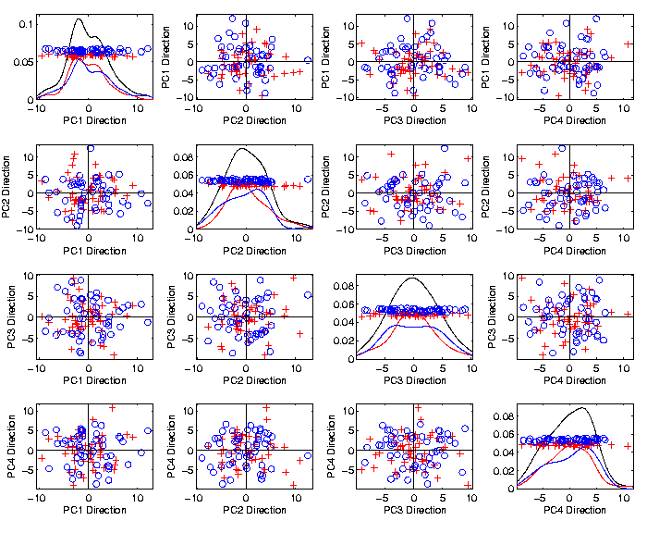
Caution
Toy 2-Class
Example
See
Structure?
Careful,
Only PC1-4

Slide 102
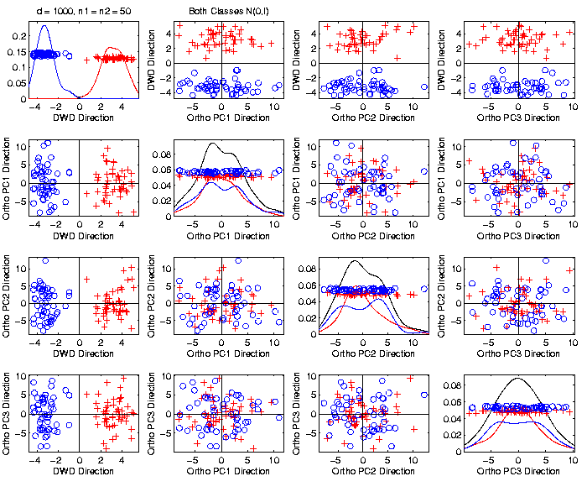
Caution
Toy 2-Class
Example
DWD &
Ortho PCA
Finds Big
Separation

Slide 103
Caution
Toy 2-Class
Example
Not in 1ST
3 PCs
Since
Smaller Scale

Slide 104
Caution
Toy 2-Class
Example
Actually
Both
Classes
Are $N\left(0,I\right)$
$$d=1000$$

Slide 105
Caution
Toy 2-Class
Example
Separation
Is Natural
Sampling
Variation
(Will Study in Detail Later)

Slide 106
Caution
Main Lesson Again:
DWD Separation Can Be Deceptive
Since DWD is Really Good at Separation
Important Concept:
Statistical Inference is Essential
III. Confirmatory Analysis

Slide 107
DiProPerm Hypothesis Test
Text, Sec. 13.1
Context: 2 – sample means
H₀: μ₊₁ = μ₋₁ vs. H₁: μ₊₁ ≠ μ₋₁
(in High Dimensions)
$∃$ A Large Literature. Some Highlights:
Bai & Sarandasa (2006)
Chen & Qin (2010)
Srivastava et al (2013)
Cai et al (2014)

Slide 108
DiProPerm Hypothesis Test
Context: 2 – sample means
H₀: μ₊₁ = μ₋₁ vs. H₁: μ₊₁ ≠ μ₋₁
(in High Dimensions)
Approach taken here:
Wei et al (2013)
Focus on Visualization via Projection
(Thus Test Related to Exploration)

Slide 109
DiProPerm Hypothesis Test
Context: 2 – sample means
H₀: μ₊₁ = μ₋₁ vs. H₁: μ₊₁ ≠ μ₋₁
Challenges:
Distributional Assumptions
Parameter Estimation
HDLSS space is slippery

Slide 110
DiProPerm Hypothesis Test
Context: 2 – sample means
H₀: μ₊₁ = μ₋₁ vs. H₁: μ₊₁ ≠ μ₋₁
Challenges:
Distributional Assumptions
Parameter Estimation
Suggested Approach:
Permutation test
(A flavor of classical “non-parametrics”)

Slide 111
DiProPerm Hypothesis Test
Suggested Approach:
Find a DIrection
(separating classes)
PROject the data
(reduces to 1 dim)
PERMute
(class labels, to assess significance,
with recomputed direction)

Slide 112
DiProPerm Hypothesis Test
Toy 2-Class Example
Separated DWD
Projections
(Again $N\left(0,I\right)$, $d=1000$)

Slide 113
DiProPerm Hypothesis Test
Toy 2-Class Example
Separated DWD
Projections
Measure Separation of Classes Using:
Mean Difference = 6.209

Slide 114
DiProPerm Hypothesis Test
Toy 2-Class Example
Separated DWD
Projections
Measure Separation of Classes Using:
Mean Difference = 6.209
Record as Vertical Line

Slide 115
DiProPerm Hypothesis Test
Toy 2-Class Example
Separated DWD
Projections
Measure Separation of Classes Using:
Mean Difference = 6.209
Statistically Significant???

Slide 116
DiProPerm Hypothesis Test
Toy 2-Class Example
Permuted
Class Labels

Slide 117
DiProPerm Hypothesis Test
Toy 2-Class Example
Permuted
Class Labels
Recompute DWD
& Projections

Slide 118
DiProPerm Hypothesis Test
Toy 2-Class Example
Measure Class
Separation
Using Mean
Difference
= 6.26

Slide 119
DiProPerm Hypothesis Test
Toy 2-Class Example
Measure Class
Separation
Using Mean
Difference
= 6.26
Record as Dot

Slide 120
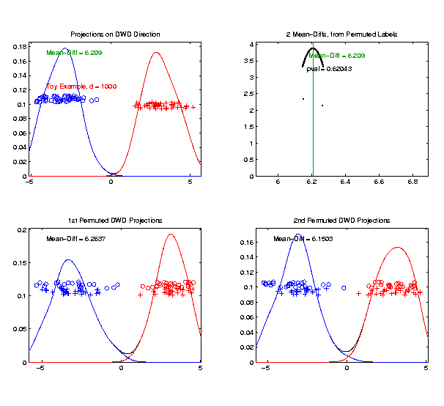
DiProPerm Hypothesis Test
Toy 2-Class Example
Generate 2nd
Permutation

Slide 121
DiProPerm Hypothesis Test
Toy 2-Class Example
Measure Class
Separation
Using Mean
Difference
= 6.15

Slide 122
DiProPerm Hypothesis Test
Toy 2-Class Example
Record as
Second Dot

Slide 123
DiProPerm Hypothesis Test
.
.
.
Repeat This 1,000 Times
To Generate Null Distribution

Slide 124
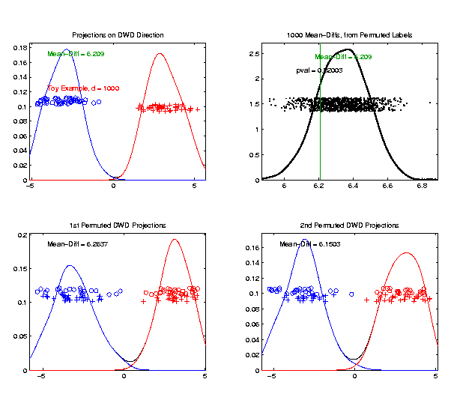
DiProPerm Hypothesis Test
Toy 2-Class Example
Generate Null
Distribution

Slide 125
DiProPerm Hypothesis Test
Toy 2-Class Example
Generate Null
Distribution
Compare With
Original Value

Slide 126
DiProPerm Hypothesis Test
Toy 2-Class Example
Generate Null
Distribution
Compare With
Original Value
Take Proportion
Larger as P-Value

Slide 127
DiProPerm Hypothesis Test
Toy 2-Class Example
Generate Null
Distribution
Compare With
Original Value
Not Significant

Slide 128
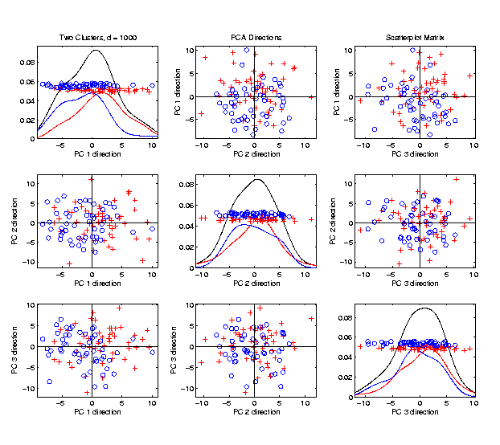
DiProPerm Hypothesis Test
$J$ = vector of 1s
Another Example
$N_{1000}\left(+0.05∗J,I\right)$
$N_{1000}\left(−0.05∗J,I\right)$
PCA View

Slide 129
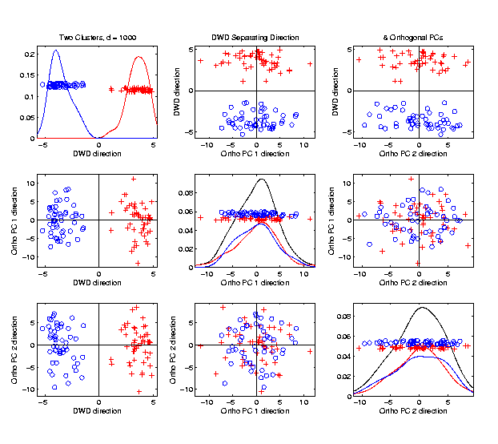
DiProPerm Hypothesis Test
Another Example
$N_{1000}\left(+0.05∗J,I\right)$
$N_{1000}\left(−0.05∗J,I\right)$
DWD View
(Similar
to $N\left(0,I\right)$?)

Slide 130
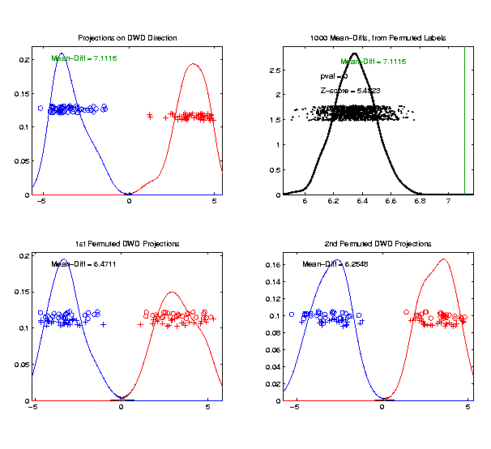
DiProPerm Hypothesis Test
Another Example
$N_{1000}\left(+0.05∗J,I\right)$
$N_{1000}\left(−0.05∗J,I\right)$
DiProPerm Now
Quite Significant

Slide 131
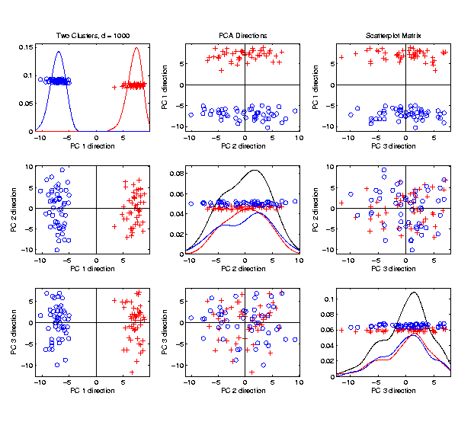
DiProPerm Hypothesis Test
Stronger Example
$N_{1000}\left(+0.2∗J,I\right)$
$N_{1000}\left(−0.2∗J,I\right)$
Even PCA
Shows Class
Difference

Slide 132
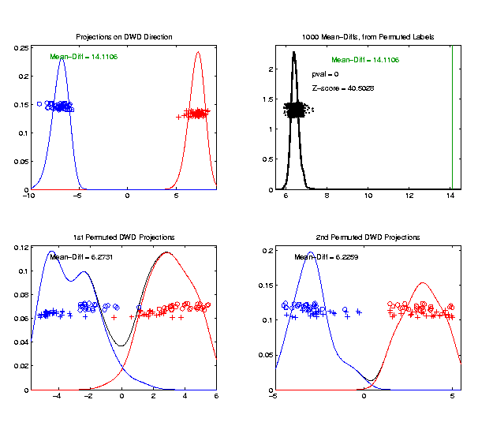
DiProPerm Hypothesis Test
Stronger Example
$N_{1000}\left(+0.2∗J,I\right)$
$N_{1000}\left(−0.2∗J,I\right)$
DiProPerm Very
Significant

Slide 133
DiProPerm Hypothesis Test
Stronger Example
$N_{1000}\left(+0.2∗J,I\right)$
$N_{1000}\left(−0.2∗J,I\right)$
DiProPerm Very
Significant
Z-Score Allows
Comparison
>> 5.4 above

