Slide 1
Statistics – O. R. 881 Object Oriented Data Analysis
Start
Recording
Steve Marron
Dept. of Statistics and Operations Research
University of North Carolina

Slide 2
Current Sections in Textbook
Today:
Sections 13.1, 18.1, 5.1
Next Class:
Sections 5.2, 5.3

Slide 3
Participant Presentations
Please Sign Up:
Name
Email (Onyen is fine, or …)
Are You ENRolled?
Dept. & Advisor (Lab?)
Tentative Title (“????” Is OK)
When:
Next Week, Early, March, April, Late

Slide 4
Prob. Dist’ns as Data Objects
How to Represent?
Several Common Choices:
$$F\left(x\right)=\int_{−∞}^{x}{f\left(t\right)dt}$$
$$Q\left(p\right)=F^{−1}(p)$$

Slide 5
Prob. Dist’ns as Data Objects
Energy Spread
Widely Across
The Spectrum
Toy Example, Density Representation
Try
Standard
PCA
Unintuitive
Modes of
Variation
Which Don’t
Explain Much
Variation

Slide 6
Prob. Dist’ns as Data Objects
Energy Entirely
Expressed In
Just 2 Modes
Toy Example, Quantile Representation
Try
Standard
PCA
1st Mode Is
Mean Var’n
Both Much More Interpretable!
2nd Mode Is
S.D. Var’n

Slide 7
Functional Data Analysis, Twin Arches
Notes:
EGCD1Clust4a.ps

Slide 8
Functional Data Analysis, Twin Arches
Notes:
EGCD1Clust4aDP2d.ps

Slide 9
E.g. Curves As Data
Twin Arches Example
50-d curves
Pop’n structure hard to see in 1-d
2-d projections make structure clear
Joint Dist’ns More than Marginals
PCA: reveals “population structure”

Slide 10
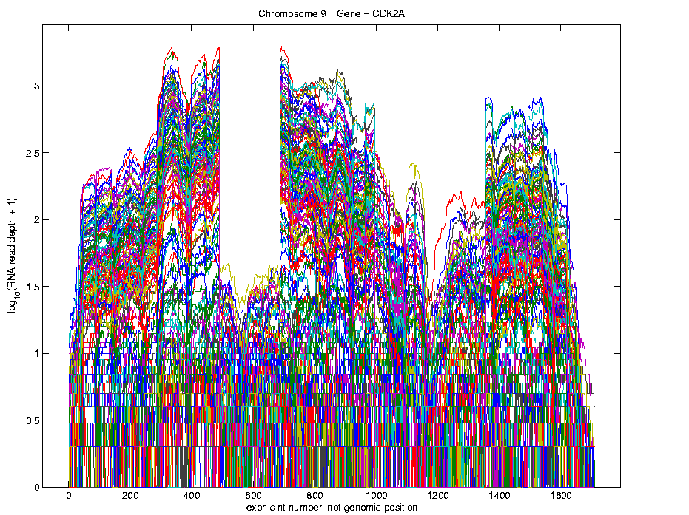
Lung Cancer Curve Objects
Simple
1st
View:
Curve
Overlay
(log
scale)
I. Object Representation

Slide 11
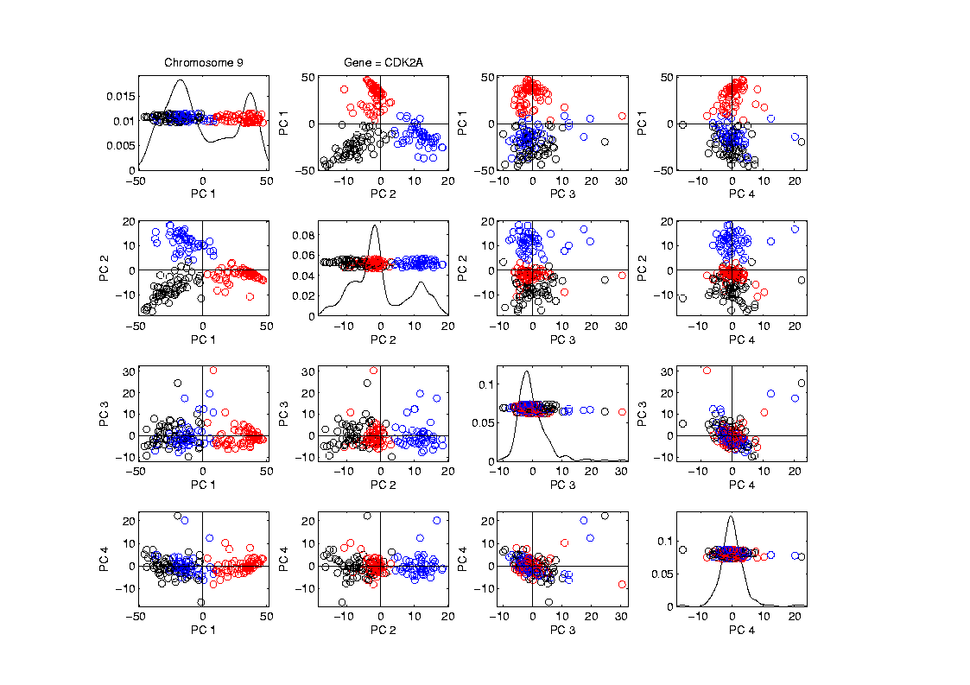
Lung Cancer Curve Objects
Visualization in Feature Space, Next Look in Object Space
Manually
“Brush”
Clusters
II. Exploratory
Analysis

Slide 12
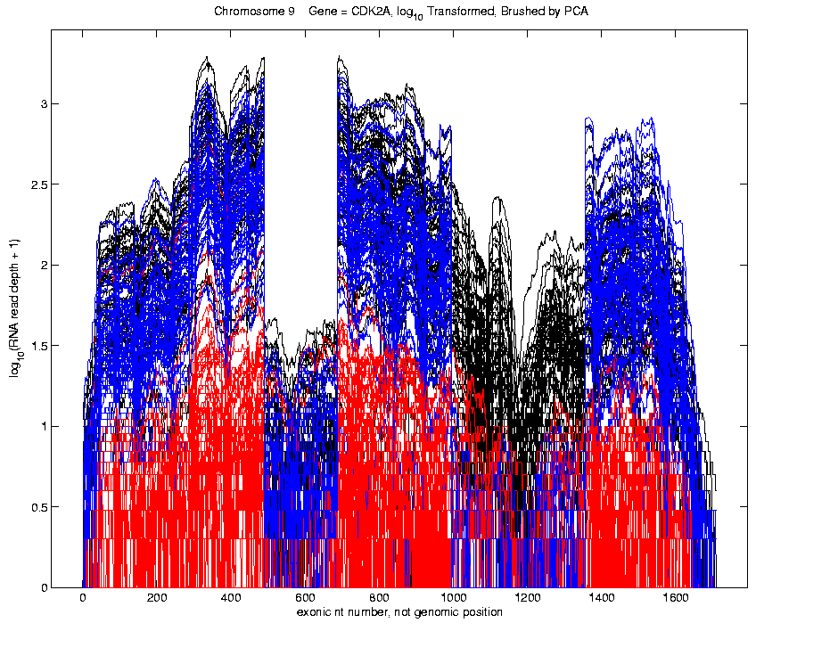
Lung Cancer Curve Objects
Visualization in Object Space
Manually
Brush
Clusters
Clear
Alternate
Splicing
II. Exploratory
Analysis

Slide 13
Limitation of PCA
PCA can provide useful projection directions
But can’t “see everything”…
Reason:
PCA finds dir’ns of maximal variation
Which may obscure interesting structure

Slide 14
Limitation of PCA
Toy Example:
Apple – Banana – Pear
Obscured by “noisy dimensions”
1st 3 PC directions only show noise
Study some rotations, to find structure

Slide 15
Limitation of PCA, E.g.
Interesting Data Set: NCI-60
NCI = National Cancer Institute
60 Cell Lines (cancer treatment targets)
For Different Cancer Types
Measured “Gene Expression”
= “Gene Activity”
Several Thousand Genes (Simultaneously)
Data Objects = Vectors of Gene Exp’n
Lots of Preprocessing (study later)
Example from:
Liu et al (2009)

Slide 16
NCI 60 Data
Important Aspect: 8 Cancer Types
Renal Cancer
Non Small Cell Lung Cancer
Central Nervous System Cancer
Ovarian Cancer
Leukemia Cancer
Colon Cancer
Breast Cancer
Melanoma (Skin)
Notes:
16

Slide 17
PCA Visualization of NCI 60 Data
Can we find classes:
(Renal, CNS, Ovar, Leuk, Colon, Melan)
Using PC directions??
First try “unsupervised view”
I.e. switch off class colors
Then turn on colors, to identify clusters
I.e. look at “supervised view”
II. Exploratory
Analysis
Notes:
17

Slide 18
NCI 60: Can we find classes Using PCA view?
Notes:
18

Slide 19
NCI 60: Can we find classes Using PCA view?
Notes:
19

Slide 20
PCA Visualization of NCI 60 Data
Maybe need to look at more PCs?
Study array of such PCA projections:
Notes:
20

Slide 21
NCI 60: Can we find classes Using PCA 5-8?
Notes:
21

Slide 22
NCI 60: Can we find classes Using PCA 5-8?
Notes:
22

Slide 23
NCI 60: Can we find classes Using PCA 9-12?
Notes:
23

Slide 24
NCI 60: Can we find classes Using PCA 9-12?
Notes:
24

Slide 25
NCI 60: Can we find classes Using PCA 1-4 vs. 5-8?
Notes:
25

Slide 26
NCI 60: Can we find classes Using PCA 1-4 vs. 5-8?
Notes:
26

Slide 27
NCI 60: Can we find classes Using PCA 1-4 vs. 9-12?
Notes:
27

Slide 28
NCI 60: Can we find classes Using PCA 5-8 vs. 9-12?
Notes:
28

Slide 29
PCA Visualization of NCI 60 Data
Can we find classes using PC directions??
Found some, but not others
Nothing after 1st five - six PCs
Rest seem to have other drivers
Are There Better Directions?
PCA only “feels” maximal variation
Ignores Class Labels
How Can We Use Class Labels?
Notes:
29

Slide 30
Visualization of NCI 60 Data
How Can We Use Class Labels?
Approach:
Find Directions to “Best Separate” Classes
In Disjoint Pairs (thus 4 Directions)
Use DWD:
Distance Weighted Discrimination
Defined (& Motivated) Later
Project All Data on These 4 Directions
Notes:
30

Slide 31
NCI 60: Views using DWD Dir’ns (focus on biology)
Notes:
31

Slide 32
DWD Visualization of NCI 60 Data
Most cancer types clearly distinct
(Renal, CNS, Ovar, Leuk, Colon, Melan)
Using these carefully chosen directions
Others less clear cut
NSCLC (at least 3 subtypes)
Breast (4 published subtypes)

Slide 33
DWD Visualization
Recall PCA limitations
DWD uses class info
Hence can “better separate known classes”
Do this for pairs of classes
(DWD just on those, ignore others)
Carefully choose pairs in NCI 60 data
Note DWD Directions Not Orthogonal
(PCA orthogonality may be
too strong a constraint)

Slide 34
NCI 60: Views using DWD Dir’ns (focus on biology)
Note: Off-Diagonal Plots Are No Longer
Transposes
Construction of Non-Orthogonal
Views Discussed
In Text, Fig. 6.14

Slide 35
PCA Visualization of NCI 60 Data
Can we find classes using PC directions??
Found some, but not others
Not so distinct as in DWD view
Nothing after 1st five PCs
Rest seem to be noise driven
Orthogonality too strong a constraint???
Interesting dir’ns are nearly orthogonal
(will see why later)
Notes:
35

Slide 36
Object Oriented Data Analysis
Three Major Phases of OODA:
I. Object Definition
“What are the Data Objects?”
Exploratory Analysis
“What Is Data Structure / Drivers?”
III. Confirmatory Analysis / Validation
Is it Really There (vs. Noise Artifact)?

Slide 37
Caution
Text, Sec. 4.1.2
DWD Separation Can Be Deceptive
Since DWD is Really Good at Separation
Important Concept:
Statistical Inference is Essential

Slide 38
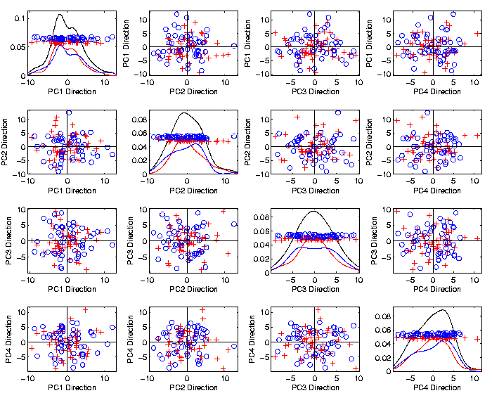
Caution
Toy 2-Class
Example
See
Structure?
Careful,
Only PC1-4

Slide 39
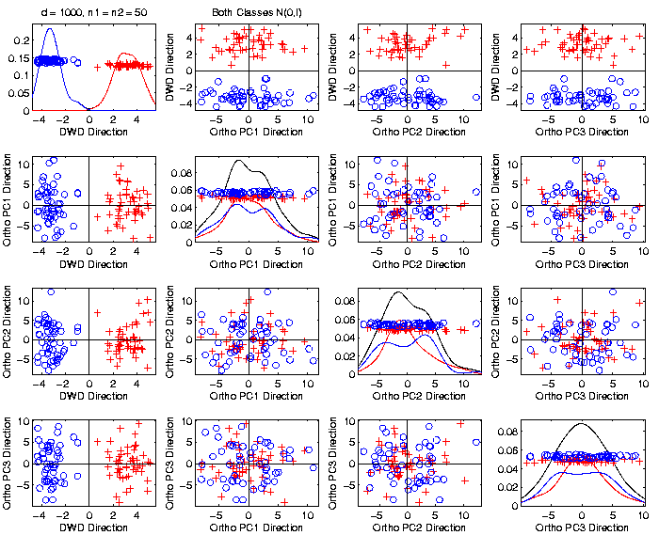
Caution
Toy 2-Class
Example
DWD &
Ortho PCA
Finds Big
Separation

Slide 40
Caution
Toy 2-Class
Example
Not in 1ST
3 PCs
Since
Smaller Scale

Slide 41
Caution
Toy 2-Class
Example
Actually
Both
Classes
Are $N\left(0,I\right)$
$$d=1000$$

Slide 42
Caution
Toy 2-Class
Example
Separation
Is Natural
Sampling
Variation
(Will Study in Detail Later)

Slide 43
Caution
Main Lesson Again:
DWD Separation Can Be Deceptive
Since DWD is Really Good at Separation
Important Concept:
Statistical Inference is Essential
III. Confirmatory Analysis

Slide 44
DiProPerm Hypothesis Test
Text, Sec. 13.1
Context: 2 – sample means
H₀: μ₊₁ = μ₋₁ vs. H₁: μ₊₁ ≠ μ₋₁
(in High Dimensions)
$∃$ A Large Literature. Some Highlights:
Bai & Sarandasa (2006)
Chen & Qin (2010)
Srivastava et al (2013)
Cai et al (2014)

Slide 45
DiProPerm Hypothesis Test
Context: 2 – sample means
H₀: μ₊₁ = μ₋₁ vs. H₁: μ₊₁ ≠ μ₋₁
(in High Dimensions)
Approach taken here:
Wei et al (2013)
Focus on Visualization via Projection
(Thus Test Related to Exploration)

Slide 46
DiProPerm Hypothesis Test
Context: 2 – sample means
H₀: μ₊₁ = μ₋₁ vs. H₁: μ₊₁ ≠ μ₋₁
Challenges:
Distributional Assumptions
Parameter Estimation
HDLSS space is slippery

Slide 47
DiProPerm Hypothesis Test
Context: 2 – sample means
H₀: μ₊₁ = μ₋₁ vs. H₁: μ₊₁ ≠ μ₋₁
Challenges:
Distributional Assumptions
Parameter Estimation
Suggested Approach:
Permutation test
(A flavor of classical “non-parametrics”)

Slide 48
DiProPerm Hypothesis Test
Suggested Approach:
Find a DIrection
(separating classes)
PROject the data
(reduces to 1 dim)
PERMute
(class labels, to assess significance,
with recomputed direction)

Slide 49
DiProPerm Hypothesis Test
Toy 2-Class Example
Separated DWD
Projections
(Again $N\left(0,I\right)$, $d=1000$)

Slide 50
DiProPerm Hypothesis Test
Toy 2-Class Example
Separated DWD
Projections
Measure Separation of Classes Using:
Mean Difference = 6.209

Slide 51
DiProPerm Hypothesis Test
Toy 2-Class Example
Separated DWD
Projections
Measure Separation of Classes Using:
Mean Difference = 6.209
Record as Vertical Line

Slide 52
DiProPerm Hypothesis Test
Toy 2-Class Example
Separated DWD
Projections
Measure Separation of Classes Using:
Mean Difference = 6.209
Statistically Significant???

Slide 53
DiProPerm Hypothesis Test
Toy 2-Class Example
Permuted
Class Labels

Slide 54
DiProPerm Hypothesis Test
Toy 2-Class Example
Permuted
Class Labels
Recompute DWD
& Projections

Slide 55
DiProPerm Hypothesis Test
Toy 2-Class Example
Measure Class
Separation
Using Mean
Difference
= 6.26

Slide 56
DiProPerm Hypothesis Test
Toy 2-Class Example
Measure Class
Separation
Using Mean
Difference
= 6.26
Record as Dot

Slide 57
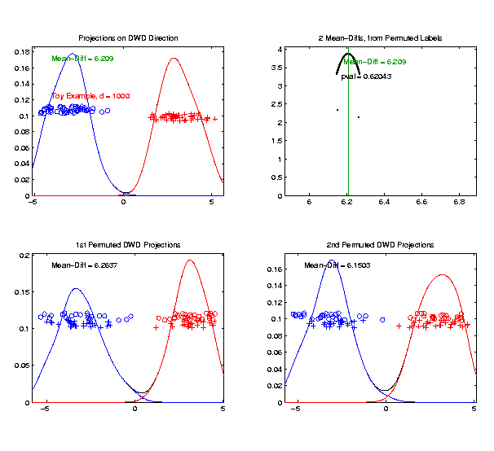
DiProPerm Hypothesis Test
Toy 2-Class Example
Generate 2nd
Permutation

Slide 58
DiProPerm Hypothesis Test
Toy 2-Class Example
Measure Class
Separation
Using Mean
Difference
= 6.15

Slide 59
DiProPerm Hypothesis Test
Toy 2-Class Example
Record as
Second Dot

Slide 60
DiProPerm Hypothesis Test
.
.
.
Repeat This 1,000 Times
To Generate Null Distribution

Slide 61
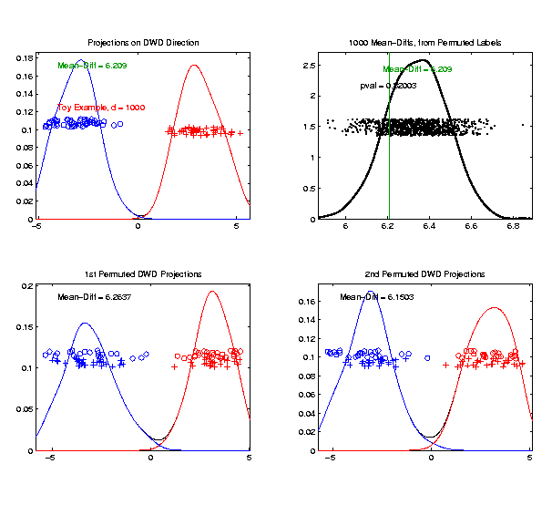
DiProPerm Hypothesis Test
Toy 2-Class Example
Generate Null
Distribution

Slide 62
DiProPerm Hypothesis Test
Toy 2-Class Example
Generate Null
Distribution
Compare With
Original Value

Slide 63
DiProPerm Hypothesis Test
Toy 2-Class Example
Generate Null
Distribution
Compare With
Original Value
Take Proportion
Larger as P-Value

Slide 64
DiProPerm Hypothesis Test
Toy 2-Class Example
Generate Null
Distribution
Compare With
Original Value
Not Significant

Slide 65
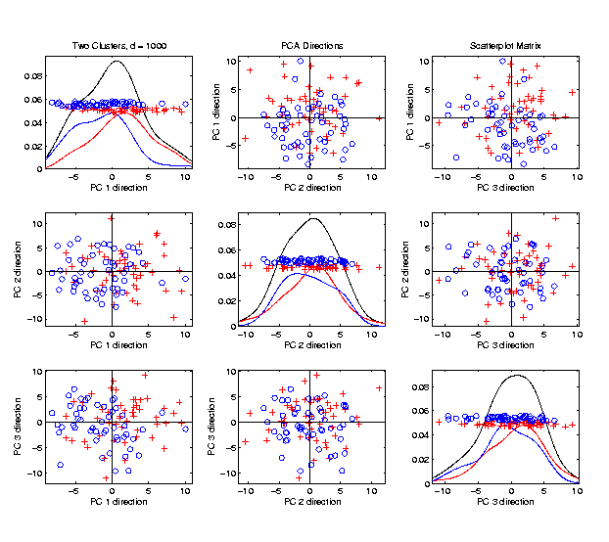
DiProPerm Hypothesis Test
$J$ = vector of 1s
Another Example
$N_{1000}\left(+0.05∗J,I\right)$
$N_{1000}\left(−0.05∗J,I\right)$
PCA View

Slide 66
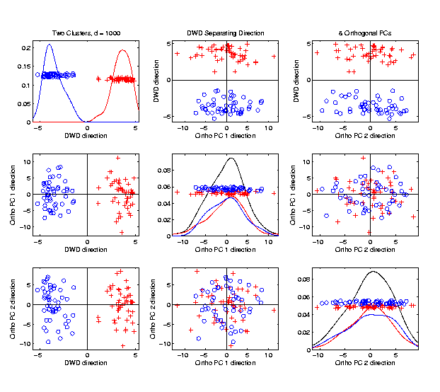
DiProPerm Hypothesis Test
Another Example
$N_{1000}\left(+0.05∗J,I\right)$
$N_{1000}\left(−0.05∗J,I\right)$
DWD View
(Similar
to $N\left(0,I\right)$?)

Slide 67
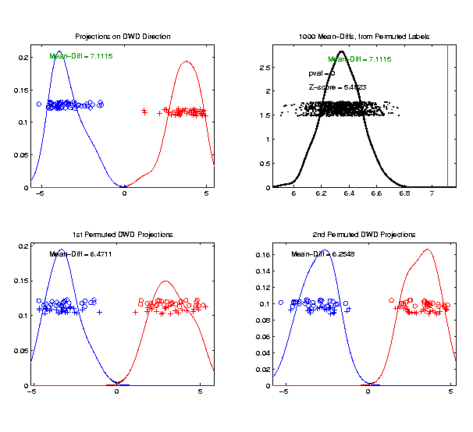
DiProPerm Hypothesis Test
Prop’n > is 0, but more precise is “p-value < 0.001”
Another Example
$N_{1000}\left(+0.05∗J,I\right)$
$N_{1000}\left(−0.05∗J,I\right)$
DiProPerm Now
Quite Significant

Slide 68
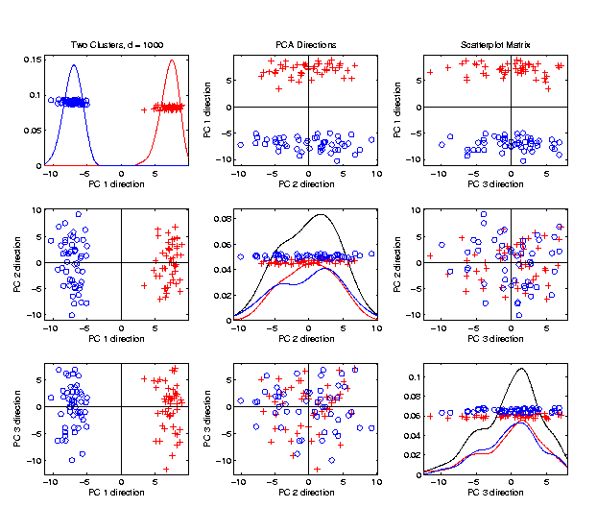
DiProPerm Hypothesis Test
Stronger Example
$N_{1000}\left(+0.2∗J,I\right)$
$N_{1000}\left(−0.2∗J,I\right)$
Even PCA
Shows Class
Difference

Slide 69
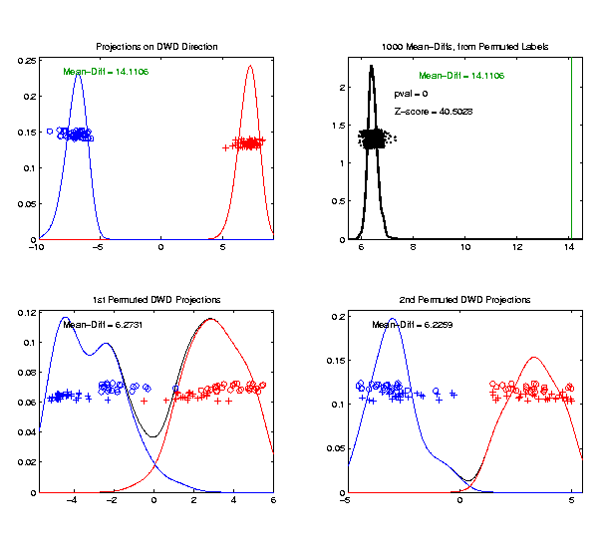
DiProPerm Hypothesis Test
Stronger Example
$N_{1000}\left(+0.2∗J,I\right)$
$N_{1000}\left(−0.2∗J,I\right)$
DiProPerm Very
Significant

Slide 70
DiProPerm Hypothesis Test
=(MD – Xbar) / s
Stronger Example
$N_{1000}\left(+0.2∗J,I\right)$
$N_{1000}\left(−0.2∗J,I\right)$
DiProPerm Very
Significant
Z-Score Allows
Comparison
>> 5.4 above

Slide 71
DiProPerm Hypothesis Test
Text, Sec. 13.1
Deeper Look at Important Concept:
Statistical Inference is Essential
Slippery Visualization Comparisons:
Autism Data Example
Breast Cancer Data Example

Slide 72
DiProPerm Hypothesis Test
Real Data Example: Autism
Caudate Shape
(sub-cortical brain structure)
Shape summarized by 3-d locations of 1032 corresponding points
E.g. 1a: Autistic vs. Typically Developing
E.g. 1b: Development Delayed vs. Typ. Dev.
(Thanks to Josh Cates)
Cates et al. (2007)

Slide 73
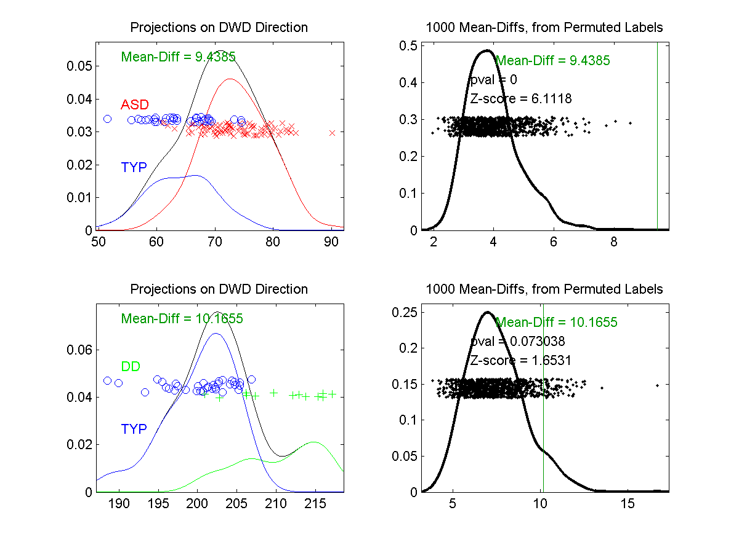
DiProPerm Hypothesis Test
Example 1: Autism Data
Autism
Spectrum
Disorder
Typically
Developing
Develop’ly
Delayed
E.g. 1a
Some Difference,
But “Not Very Strong”?
E.g. 1b
Looks “Stronger”?

Slide 74
DiProPerm Hypothesis Test
Example 1: Autism Data
Actually Strongly
Stat’ly Significant
Not Quite
Stat’ly Significant
Visual Impression Can Be Slippery

Slide 75
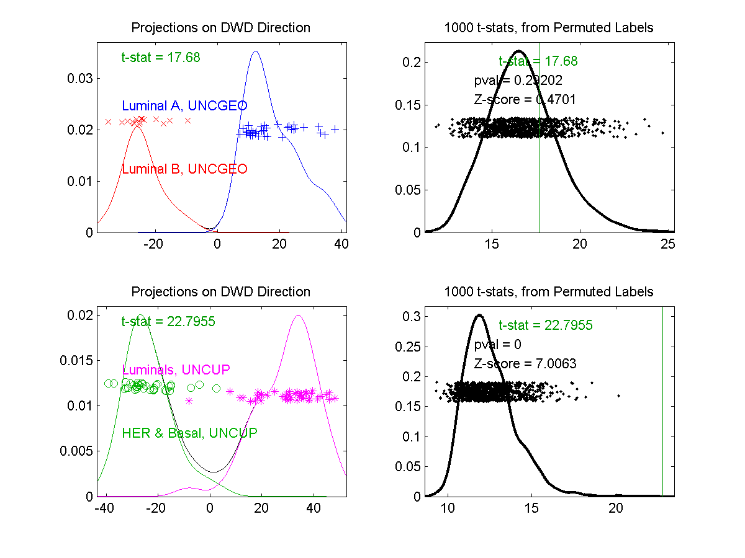
DiProPerm Hypothesis Test
Example 2: Breast Cancer Data
Again 2
Comp’sons
Top Looks Like
“Strong Diff.”?
Bottom “More
Overlapped”?

Slide 76
DiProPerm Hypothesis Test
Example 2: Breast Cancer Data
Yet DiProPerm
Gives Opposite
Result!

Slide 77
DiProPerm Hypothesis Test
What is going on?
Is Visualization Useless?
Key Point:
Sample Sizes
Smaller Sample Size ←→ Weaker Inference
E.g. 1a | 88 vs. 34 | Strongly Stat’ly Significant
E.g. 1b | 13 vs. 34 | Not Stat’ly Significant
E.g. 2a | 16 vs. 34 | Not Stat’ly Significant
E.g. 2b | 36 vs. 44 | Strongly Stat’ly Significant

Slide 78
DiProPerm Hypothesis Test
Main Lessons:
Important to Do Inference
Intuition Can Be Slippery
Note: Cherry Picked These From
Larger Set of Examples
Opposite Results Not That Common

Slide 79
Matlab Software
Recall OODA Software

Slide 80
DiProPerm in Matlab
Matlab Software:
DiProPermXY.m
In General Directory

Slide 81
Object Oriented Data Analysis
Three Major Phases of OODA:
I. Object Definition
“What are the Data Objects?”
Exploratory Analysis
“What Is Data Structure / Drivers?”
III. Confirmatory Analysis / Validation
Is it Really There (vs. Noise Artifact)?

Slide 82
Object Oriented Data Analysis
Nomenclature Clash?
Computer Science View:
Object Oriented Programming:
Programming that supports encapsulation, inheritance, and polymorphism
(from Google: define object oriented programming,
my favorite: www.innovatia.com/software/papers/com.htm)
Text, Sec. 18.1

Slide 83
Object Oriented Data Analysis
Some statistical history:
John Chambers Idea (1960s - ):
Object Oriented approach to statistical computation
Developed as software package S
Basis of S-plus (commerical product)
And of R (free-ware, current favorite of Chambers)
Reference for more on this:
Venables & Ripley (2013)
Notes:
83

Slide 84
Object Oriented Data Analysis
Another take: J. O. Ramsay
http://www.psych.mcgill.ca/faculty/ramsay/ramsay.html
“Functional Data Objects”
(closer to C. S. meaning)
Personal Objection:
“Functional” in mathematics is:
“Function that operates on functions”

Slide 85
Object Oriented Data Analysis
More Terminology:
SAMSI Program (2010-2011):
OODA → Analysis of Object Oriented Data
→ Analysis of Object Data
Leland Wilkinson
Notes:
85

Slide 86
Object Oriented Data Analysis
More Terminology:
SAMSI Program (2010-2011):
OODA → Analysis of Object Oriented Data
→ Analysis of Object Data
“Object Data Analysis” Terminology Used in
Patrangenaru and Ellingson (2019)
Notes:
86

Slide 87
Object Oriented Data Analysis
Three Major Phases of OODA:
I. Object Definition
“What are the Data Objects?”
Exploratory Analysis
“What Is Data Structure / Drivers?”
III. Confirmatory Analysis / Validation
Is it Really There (vs. Noise Artifact)?

Slide 88
Big Picture Data Visualization
For a Matrix of Data:
$${\left(\begin{matrix}x_{11} & ⋯ & x_{1n} \\ ⋮ & ⋱ & ⋮ \\ x_{d1} & ⋯ & x_{dn}\end{matrix}\right)}_{d×n}$$

Slide 89
Big Picture Data Visualization
For a Matrix of Data:
$${\left(\begin{matrix}x_{11} & ⋯ & x_{1n} \\ ⋮ & ⋱ & ⋮ \\ x_{d1} & ⋯ & x_{dn}\end{matrix}\right)}_{d×n}$$
With Columns as Data Objects
(recall not everybody does this,
e.g. rows are data objects in R & SAS)

Slide 90
Big Picture Data Visualization
For a Matrix of Data:
$${\left(\begin{matrix}x_{11} & ⋯ & x_{1n} \\ ⋮ & ⋱ & ⋮ \\ x_{d1} & ⋯ & x_{dn}\end{matrix}\right)}_{d×n}$$
Three Useful (& Important) Visualizations
(Not Widely Understood)
(Most Analysts Don’t Look Enough at Data)

Slide 91
Big Picture Data Visualization
For a Matrix of Data:
$${\left(\begin{matrix}x_{11} & ⋯ & x_{1n} \\ ⋮ & ⋱ & ⋮ \\ x_{d1} & ⋯ & x_{dn}\end{matrix}\right)}_{d×n}$$
Three Useful (& Important) Visualizations
Curve Objects

Slide 92
Big Picture Data Visualization
For a Matrix of Data:
$${\left(\begin{matrix}x_{11} & ⋯ & x_{1n} \\ ⋮ & ⋱ & ⋮ \\ x_{d1} & ⋯ & x_{dn}\end{matrix}\right)}_{d×n}$$
Three Useful (& Important) Visualizations
Curve Objects
Relationships Between Objects
(e.g. scatterplot matrices)

Slide 93
Big Picture Data Visualization
For a Matrix of Data:
$${\left(\begin{matrix}x_{11} & ⋯ & x_{1n} \\ ⋮ & ⋱ & ⋮ \\ x_{d1} & ⋯ & x_{dn}\end{matrix}\right)}_{d×n}$$
Three Useful (& Important) Visualizations
Curve Objects
Relationships Between Objects
Marginal Distributions (1-d each “variable”)

Slide 94
Marginal Distribution Plots
Ideas:
For Each Variable
Study 1-d Distributions
Simultaneous Views:
Jitter Plots
Smooth Histograms (Kernel Density Est’s)

Slide 95
Marginal Distribution Plots
View:
4 x 4 Grid
Since Comfortable Number
Lose Detail for More
For $d>16$:
Choose Representative Subset
(Since often too many to look at all)
Text, Sec. 5.1

Slide 96
Marginal Distribution Plots
Representative Subset of Variables:
Sort Variables on a Data Summary
E.g Mean, S.D., Skewness, Median, …
Usually Take Nearly Equally Spaced Grid
Sometimes Specify Variables
E.g. All Largest (or Smallest) Summaries

Slide 97
Marginal Distribution Plots
Note Often Useful for:
Object Determination / Representation
Which Variables to Include?
How to Scale Variables?
Need to Transform (e.g. log) Variables?

Slide 98
Marginal Distribution Plots
Toy Example: $n=200$, $d=50$,
i.i.d. Poisson, with parameters $λ=0.2,⋯,20$
Logarithmically Spaced
Each Row

Slide 99
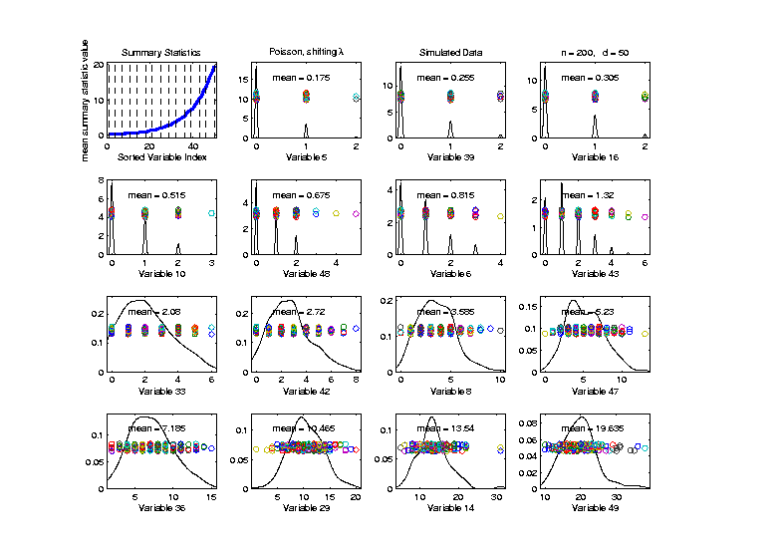
Marginal Distribution Plots
Toy Example: $n=200$, $d=50$,
i.i.d. Poisson, with parameters $λ=0.2,⋯,20$
Sort Variables
On Sample
Mean
Summary
Plot with
Equal
Spacing

Slide 100
Marginal Distribution Plots
Toy Example: $n=200$, $d=50$,
i.i.d. Poisson, with parameters $λ=0.2,⋯,20$
Sort Variables
On Sample
Mean
Dashed Lines
Correspond
To 1-d Distn’s

Slide 101
Marginal Distribution Plots
Toy Example: $n=200$, $d=50$,
i.i.d. Poisson, with parameters $λ=0.2,⋯,20$
Sort Variables
On Sample
Mean
Wide Range
Of Poissons

Slide 102
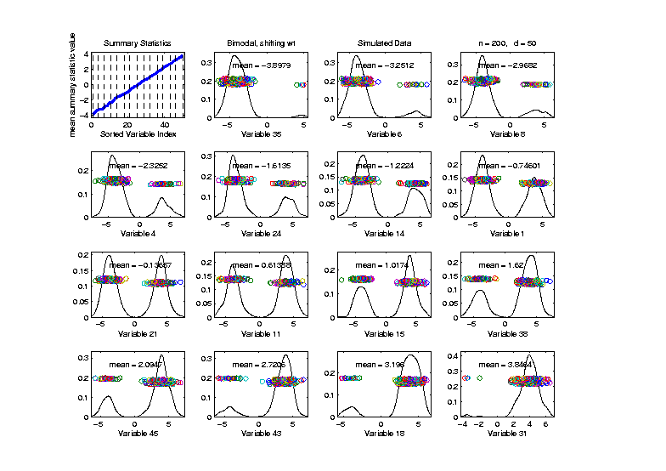
Marginal Distribution Plots
Toy Example: Normal Mean Mixture
$$ωN\left(4,1\right)+\left(1−ω\right)N\left(−4,1\right)$$
Sort on
Mean
Useful
Ordering

Slide 103
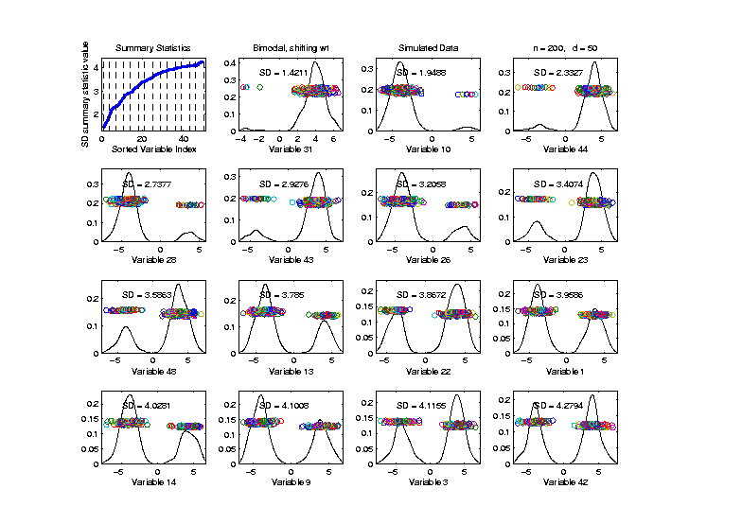
Marginal Distribution Plots
Toy Example: Normal Mean Mixture
$$ωN\left(4,1\right)+\left(1−ω\right)N\left(−4,1\right)$$
Sort on
Standard
Deviation
Less Useful
Ordering

Slide 104
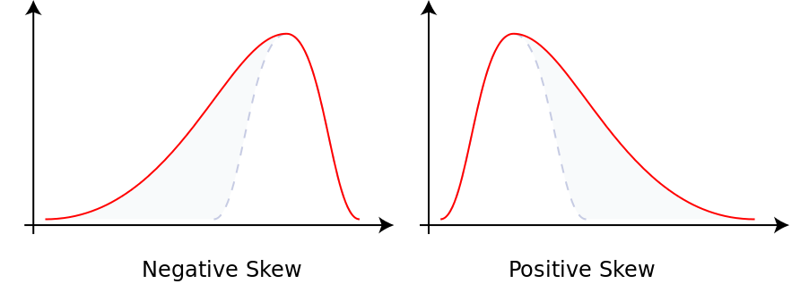
Marginal Distribution Plots
Additional Summaries: Skewness
Measure Asymmetry
Left Skewed Right Skewed
(Thanks to Wikipedia)

Slide 105
Marginal Distribution Plots
Additional Summaries: Skewness
Quantification: Based on “Moments”
$$E\left[{\left(\frac{X−μ}{σ}\right)}^{3}\right]=\frac{E\left[{\left(X−μ\right)}^{3}\right]}{{\left(E\left[{\left(X−μ\right)}^{2}\right]\right)}^{3/2}}$$
“Central 3rd Moment” (Also Rescaled)
Note: 0 at Gaussian

Slide 106
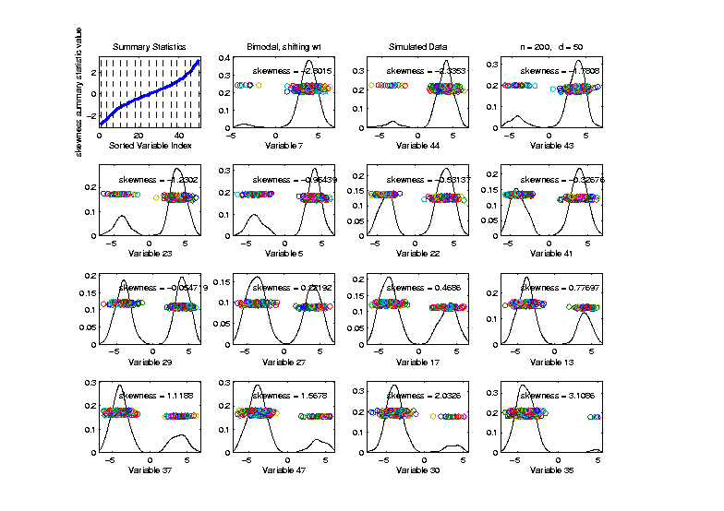
Marginal Distribution Plots
Toy Example: Normal Mean Mixture
$$ωN\left(4,1\right)+\left(1−ω\right)N\left(−4,1\right)$$
Sort on
Skewness
Useful
Ordering

Slide 107
Marginal Distribution Plots
Additional Summaries: Kurtosis
4-th Moment Summary
$$E\left[{\left(\frac{X−μ}{σ}\right)}^{4}\right]−3=\frac{E\left[{\left(X−μ\right)}^{4}\right]}{{\left(E\left[{\left(X−μ\right)}^{2}\right]\right)}^{2}}−3$$
Centered (and Scaled) 4th Moment

Slide 108
Marginal Distribution Plots
Additional Summaries: Kurtosis
4-th Moment Summary
$$E\left[{\left(\frac{X−μ}{σ}\right)}^{4}\right]−3=\frac{E\left[{\left(X−μ\right)}^{4}\right]}{{\left(E\left[{\left(X−μ\right)}^{2}\right]\right)}^{2}}−3$$
Makes 0 at Gaussian
Think of Departures From Gaussian
(not always done)

Slide 109
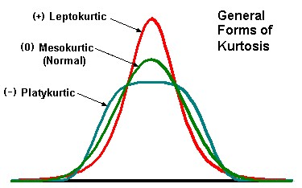
Marginal Distribution Plots
Additional Summaries: Kurtosis
4-th Moment Summary
Nice Graphic
(from mvpprograms.com)

Slide 110
Marginal Distribution Plots
Additional Summaries: Kurtosis
4-th Moment Summary
Positive Big at Peak
And Tails
(with controlled
variance)

Slide 111
Marginal Distribution Plots
Additional Summaries: Kurtosis
4-th Moment Summary
Negative Big in Flanks

Slide 112
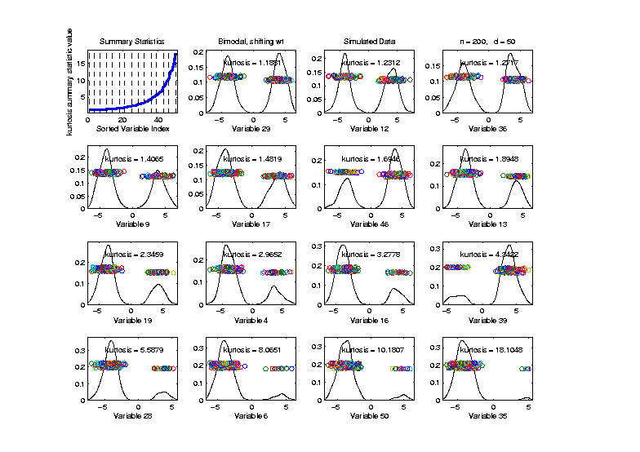
Marginal Distribution Plots
Toy Example: Normal Mean Mixture
$$ωN\left(4,1\right)+\left(1−ω\right)N\left(−4,1\right)$$
Sort on
Kurtosis
Less Useful
Ordering

Slide 113
Marginal Distribution Plots
Some Useful Summaries:
Mean, SD, Skewness, Kurtosis
# Unique, # Most Frequent, # 0s
Robust Measures
L-statistics
Entropy
Continuity Measure
$⋮$

