Slide 1
Statistics – O. R. 881 Object Oriented Data Analysis
Start
Recording
Steve Marron
Dept. of Statistics and Operations Research
University of North Carolina

Slide 2
Current Sections in Textbook
Today:
Sections 5.1.2, 5.2, 5.3
Next Class:
Sections 5.3, 6.1

Slide 3
Participant Presentations
Online Participants:
Please Send
An Email.
Including Auditors
Please Sign Up:
Name
Email (Onyen is fine, or …)
Are You ENRolled?
Dept. & Advisor (Lab?)
Tentative Title (“????” Is OK)
When:
Next Week, Early, Oct., Nov., Late

Slide 4
Limitation of PCA, E.g.
Interesting Data Set: NCI-60
NCI = National Cancer Institute
60 Cell Lines (cancer treatment targets)
For Different Cancer Types
Measured “Gene Expression”
= “Gene Activity”
Several Thousand Genes (Simultaneously)
Data Objects = Vectors of Gene Exp’n
Lots of Preprocessing (study later)
Example from:
Liu et al (2009)

Slide 5
NCI 60 Data
Important Aspect: 8 Cancer Types
Renal Cancer
Non Small Cell Lung Cancer
Central Nervous System Cancer
Ovarian Cancer
Leukemia Cancer
Colon Cancer
Breast Cancer
Melanoma (Skin)
Notes:
5

Slide 6
NCI 60: Can we find classes Using PCA view?
Notes:
6

Slide 7
NCI 60: Views using DWD Dir’ns (focus on biology)
Notes:
7

Slide 8
NCI 60: Views using DWD Dir’ns (focus on biology)
Main Lessons:
PCA Finds Dir’ns of Maximal Variation
Often Shows Interesting Sturcture
But No Guarantees
Other Directions Also Important & Useful
Distance Weight Discrimination Targets
Subgroup Differences
Notes:
8

Slide 9
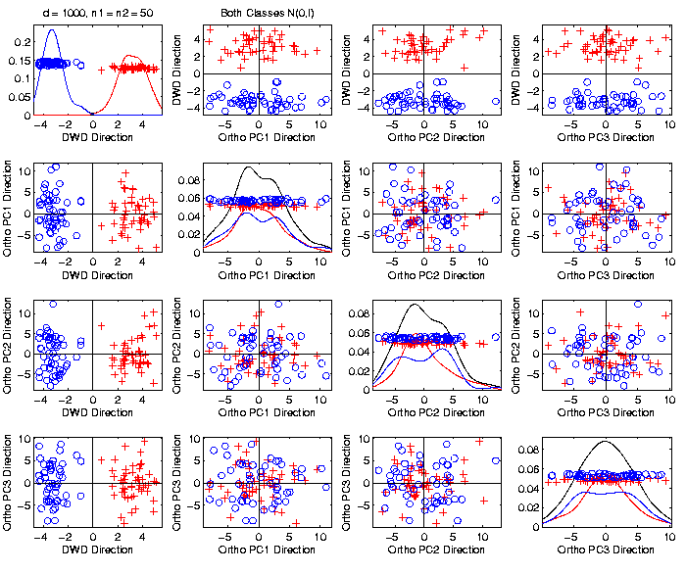
Caution
Toy 2-Class
Example
Actually
Both
Classes
Are $N\left(0,I\right)$
$$d=1000$$

Slide 10
Caution
Toy 2-Class
Example
Separation
Is Natural
Sampling
Variation
(Will Study in Detail Later)

Slide 11
Caution
Main Lesson Again:
DWD Separation Can Be Deceptive
Since DWD is Really Good at Separation
Important Concept:
Statistical Inference is Essential
III. Confirmatory Analysis

Slide 12
DiProPerm Hypothesis Test
Suggested Approach:
Find a DIrection
(separating classes)
PROject the data
(reduces to 1 dim)
PERMute
(class labels, to assess significance,
with recomputed direction)

Slide 13
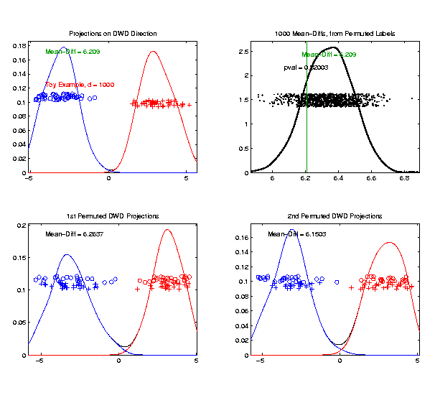
DiProPerm Hypothesis Test
Toy 2-Class Example
Generate Null
Distribution
Compare With
Original Value

Slide 14
DiProPerm Hypothesis Test
Toy 2-Class Example
Generate Null
Distribution
Compare With
Original Value
Take Proportion
Larger as P-Value

Slide 15
DiProPerm Hypothesis Test
Toy 2-Class Example
Generate Null
Distribution
Compare With
Original Value
Not Significant

Slide 16
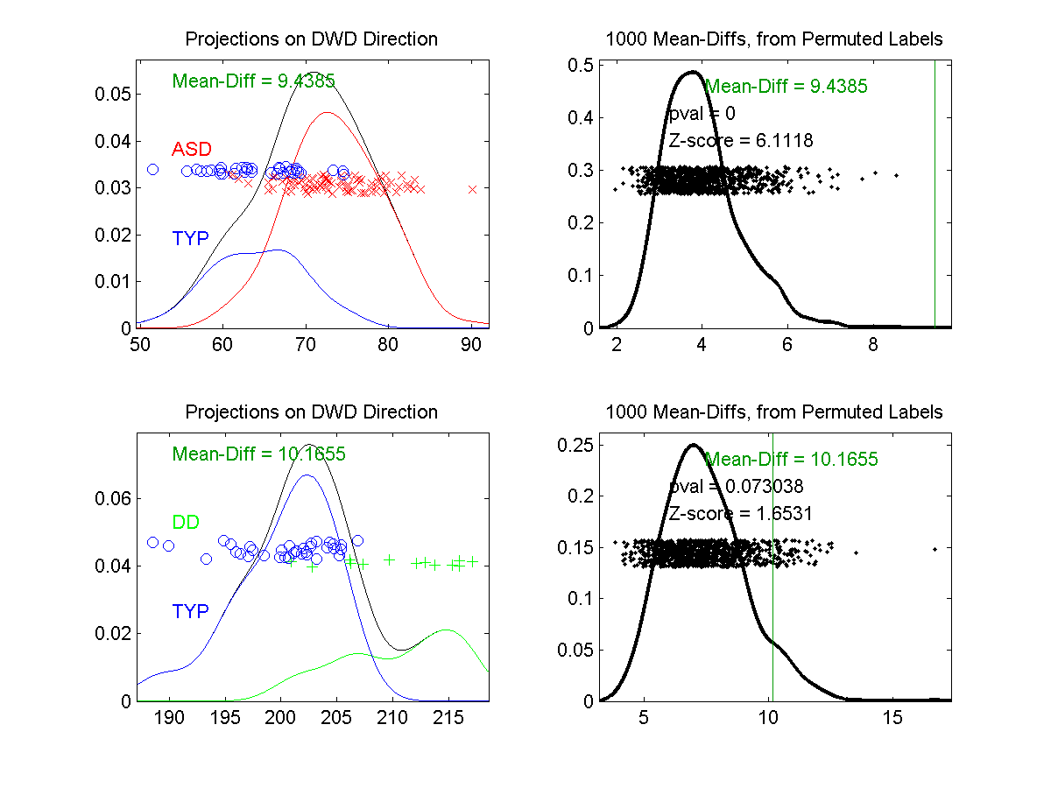
DiProPerm Hypothesis Test
Example 1: Autism Data
Actually Strongly
Stat’ly Significant
Not Quite
Stat’ly Significant
Visual Impression Can Be Slippery

Slide 17
Marginal Distribution Plots
Ideas:
For Each Variable (i.e. Trait)
Study 1-d Distributions
Simultaneous Views:
Jitter Plots
Smooth Histograms (Kernel Density Est’s)

Slide 18
Marginal Distribution Plots
View:
4 x 4 Grid
Since Comfortable Number
Lose Detail for More
For $d>16$:
Choose Representative Subset
(Since often too many to look at all)
Text, Sec. 5.1

Slide 19
Marginal Distribution Plots
Representative Subset of Variables:
Sort Variables on a Data Summary
E.g Mean, S.D., Skewness, Median, …
Usually Take Nearly Equally Spaced Grid
Sometimes Specify Variables
E.g. All Largest (or Smallest) Summaries

Slide 20
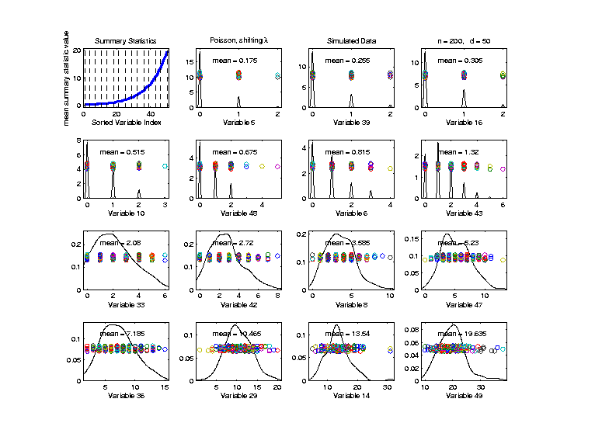
Marginal Distribution Plots
Toy Example: $n=200$, $d=50$,
i.i.d. Poisson, with parameters $λ=0.2,⋯,20$
Sort Variables
On Sample
Mean
Summary
Plot with
Equal
Spacing

Slide 21
Marginal Distribution Plots
Spanish Male Mortality Data
Recall Value of Log Transform
Now Focus on Marginals
Text, Sec. 5.1.1
E. g. Just These Values
Or Just These

Slide 22
Marginal Distribution Plots
Spanish Male Mortality Data (Raw)
Note Many
Skewed
Marginals
Poor “Use
of Range”

Slide 23
Marginal Distribution Plots
Spanish Male Mortality Data (log₁₀ scale)
Much Less
Skewness
Now Focus
On (Important)
Bimodality
Much Better
“Use of Range”

Slide 24
Marg. Dist. Plot Data Example
Drug Discovery Data
$n = 262$, Chemical Compounds
$d = 2489$, Chemical “Descriptors”
Discrete Response:
0 – blue 0, 1 – red +
Text, Sec. 5.1.2
(Thanks to Alex Tropsha Lab)

Slide 25
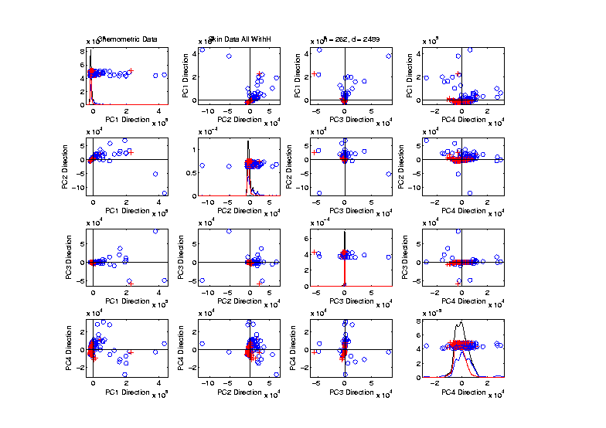
Marg. Dist. Plot Data Example
Drug Discovery – PCA Scatterplot
Dominated
By Few
Large
Compounds
Not Good
Blue - Red
Separation

Slide 26
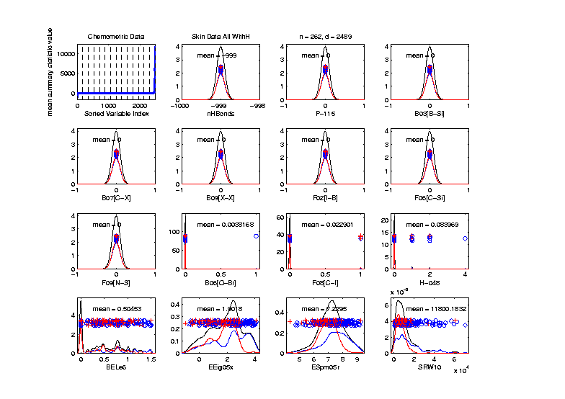
Marg. Dist. Plot Data Example
Drug Discovery – Sort on Means
Very Few
Are Crazy
Big
Will They
Dominate
PCA???

Slide 27
Marg. Dist. Plot Data Example
Drug Discovery – Sort on Means
Note: Many
With No
Variation???

Slide 28
Marg. Dist. Plot Data Example
Drug Discovery – Sort on Means
Suspicious
Value ???

Slide 29
Marg. Dist. Plot Data Example
Drug Discovery – Sort on Means
Note:
Sub-Densities
Highlight
Blue – Red
Differences

Slide 30
Marg. Dist. Plot Data Example
Drug Discovery – Sort on Means
Note:
Variable
(i.e. Trait)
Names

Slide 31
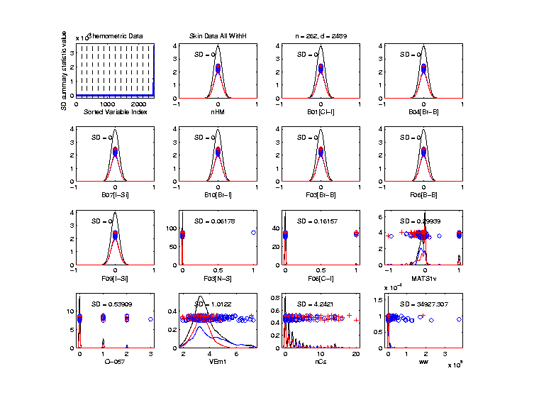
Marg. Dist. Plot Data Example
Drug Discovery – Sort on Standard Deviation
Very Large
Number of
0-Variation
Variables
(No Useful
Info…)

Slide 32
Marg. Dist. Plot Data Example
Drug Discovery – Sort on Means
Investigate Weird -999 Values
Note: Sometimes Such Values Are Used To Code Missing Values
(And Nobody Remembers to Say So)
(Not Too Bad Until Big Values Added In)

Slide 33
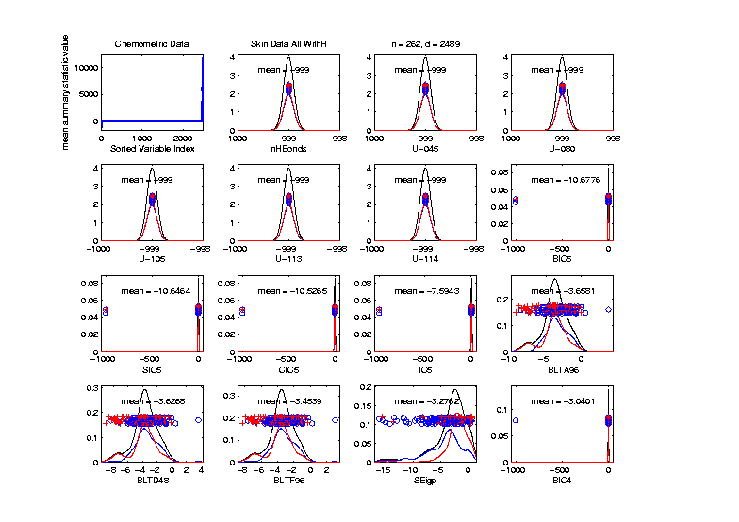
Marg. Dist. Plot Data Example
Drug Discovery – Sort on Means
Investigate Weird -999 Values, Via Mean
Look at
Smallest
Mean Values
(All Dashed
Bars On Left)

Slide 34
Marg. Dist. Plot Data Example
Drug Discovery – Sort on Means
Investigate Weird -999 Values, Via Mean,
Smallest
6 Variables
Are All -999

Slide 35
Marg. Dist. Plot Data Example
Drug Discovery – Sort on Means
Investigate Weird -999 Values, Via Mean,
Smallest
6 Variables
Are All -999
Other Have
Some -999

Slide 36
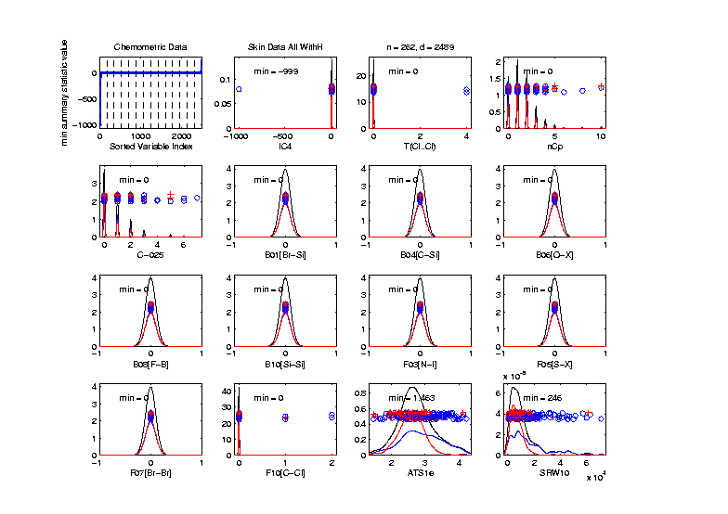
Marg. Dist. Plot Data Example
Drug Discovery
Focus on -999 Values, Using Minimum,
Equally
Spaced
Not Too
Many Such
Variables

Slide 37
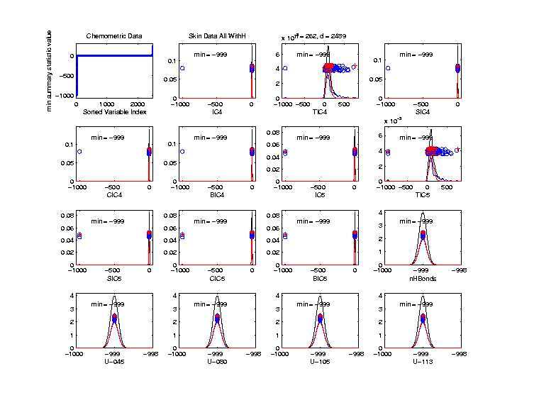
Marg. Dist. Plot Data Example
Drug Discovery
Focus More on -999 Values, Using Minimum,
Smallest 15
(Again All
Dashed
Bars On
Left)

Slide 38
Marg. Dist. Plot Data Example
Drug Discovery
Explicit Screening Found:
Out of $d = 2489$ Variables
$1315$ Had 0 Variance
$16$ Had some –999
So Deleted All Of The Above
Remaining Data Set Had $d = 1164$

Slide 39
Marg. Dist. Plot Data Example
Drug Discovery - Full Data PCA from Above
(Include
To Show
Contrast)

Slide 40
Marg. Dist. Plot Data Example
Drug Discovery - PCA After Variable Deletion
Looks Very
Similar!

Slide 41
Marg. Dist. Plot Data Example
Drug Discovery - PCA After Variable Deletion
Makes Sense
For 0-Var
Variables

Slide 42
Marg. Dist. Plot Data Example
Drug Discovery - PCA After Variable Deletion
-999s Have
No Impact
Since Others
Much Bigger!

Slide 43
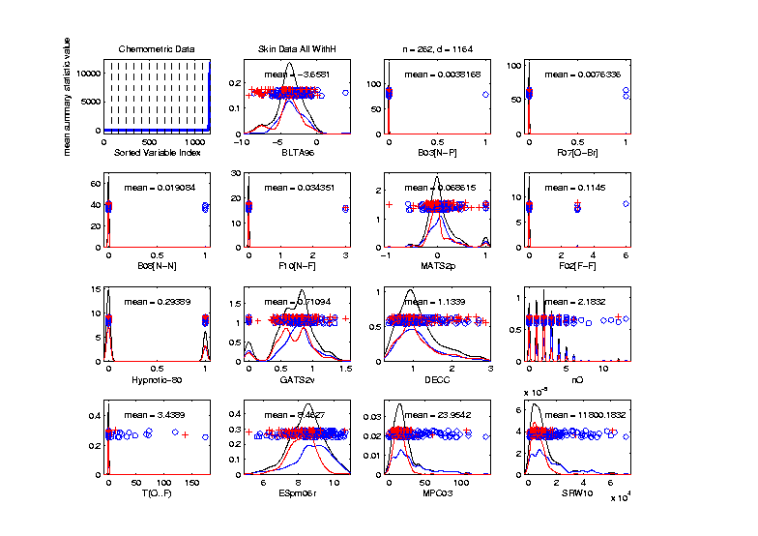
Marg. Dist. Plot Data Example
Drug Discovery - After Variable Deletion
Sort Marginals On Means, Equally Spaced
Still Have
Massive
Variation
In Types

Slide 44
Marg. Dist. Plot Data Example
Drug Discovery - After Variable Deletion
Sort Marginals On Means, Equally Spaced
Still Have
Very Few
That Are
Very Big

Slide 45
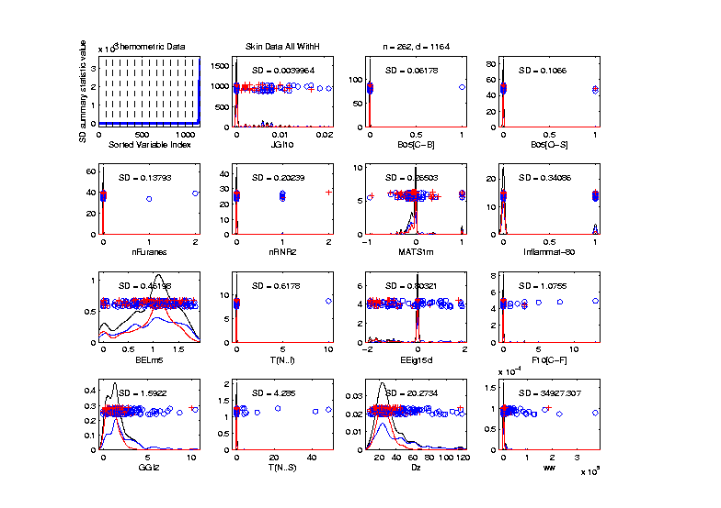
Marg. Dist. Plot Data Example
Drug Discovery - Sort Marginals On SDs,
Equally Spaced To Study Variation
Very Wide
Range
Standardization
May Be Useful

Slide 46
Marg. Dist. Plot Data Example
Drug Discovery - Sort Marginals On SDs,
Equally Spaced To Study Variation
Now See
Some
Very Small
How Many?

Slide 47
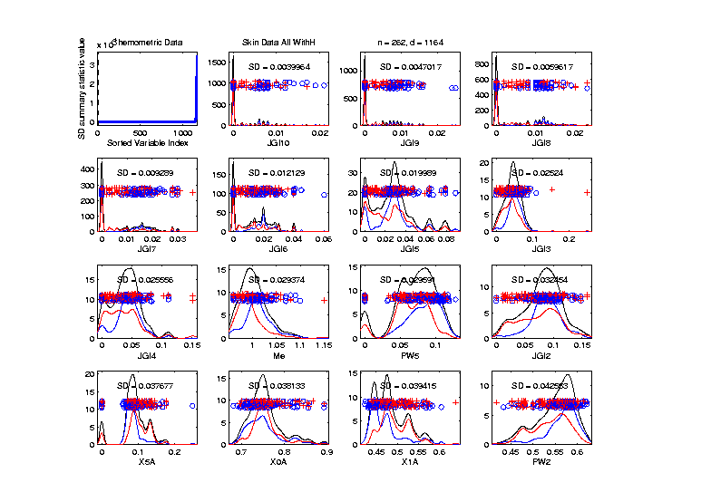
Marg. Dist. Plot Data Example
Drug Discovery - Sort Marginals On SDs,
Smallest
Several
Very Small
Variables
Some Very
Skewed???

Slide 48
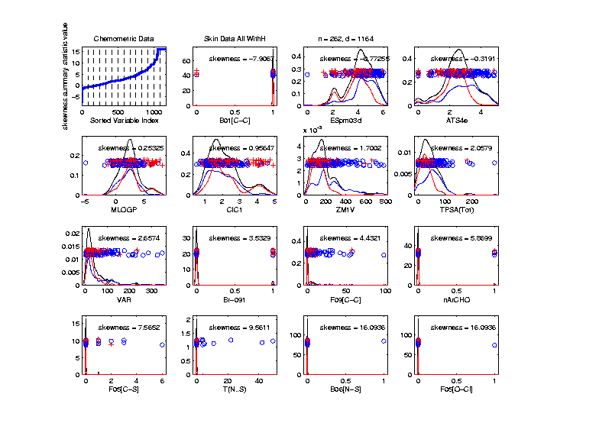
Marg. Dist. Plot Data Example
Drug Discovery - Sort On Skewness
Wide Range
(Consider
Transform-
ation)
0-1s Very
Prominent

Slide 49
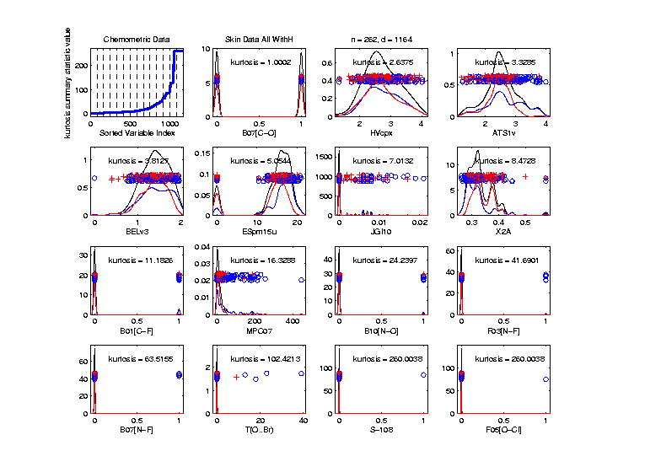
Marg. Dist. Plot Data Example
Drug Discovery - Sort On Kurtosis
Again Very
Wide Range
Again 0-1s
Are Major
Players
So Focus on 0-1 Variables

Slide 50
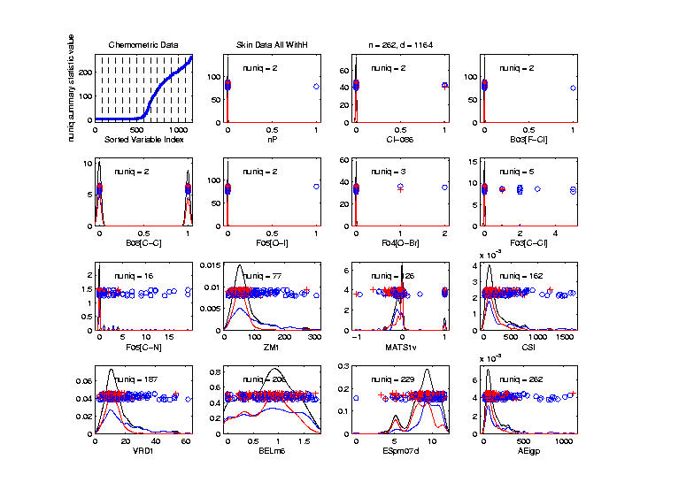
Marg. Dist. Plot Data Example
Drug Discovery - Sort On Number Unique
Shows
Many
Binary

Slide 51
Marg. Dist. Plot Data Example
Drug Discovery - Sort On Number Unique
Shows
Many
Binary
Few Truly
Continuous

Slide 52
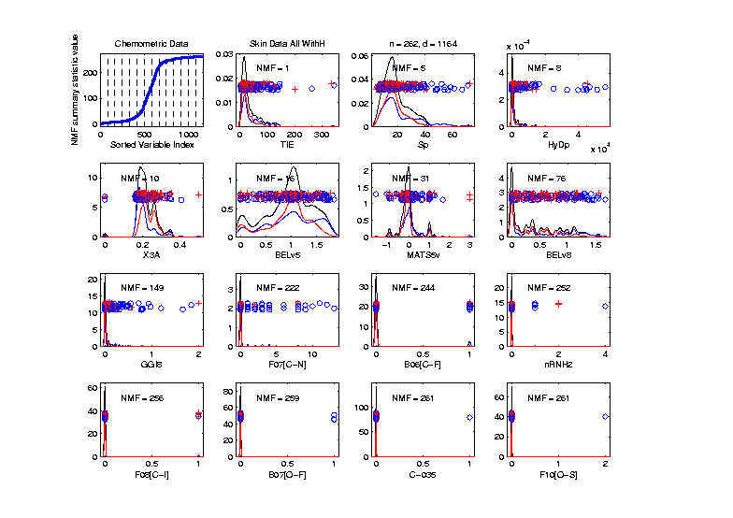
Marg. Dist. Plot Data Example
Drug Discovery - Sort On Number of Most Frequent
Shows Many
Have a Very
Common
Value
(Often 0)

Slide 53
Marg. Dist. Plot Data Example
Explicit Screening Found:
$d = 364$ Binary Variables
Consider Those Only
Do PCA
Try Variable Screening

Slide 54
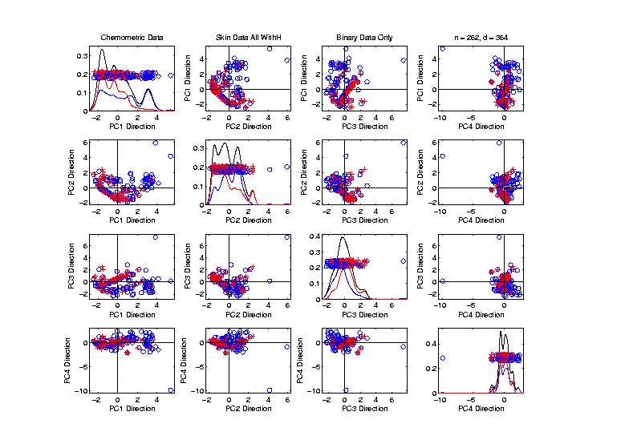
Marg. Dist. Plot Data Example
Drug Discovery - PCA on Binary Variables
Interesting
Structure?

Slide 55
Marg. Dist. Plot Data Example
Drug Discovery - PCA on Binary Variables
Interesting
Structure?
Clusters?

Slide 56
Marg. Dist. Plot Data Example
Drug Discovery - PCA on Binary Variables
Interesting
Structure?
Clusters?
Stronger
Red vs. Blue

Slide 57
Marg. Dist. Plot Data Example
Drug Discovery - PCA on Binary Variables
Interesting
Structure?
Can See
“Activity
Cliffs”
Maggiora (2006)

Slide 58
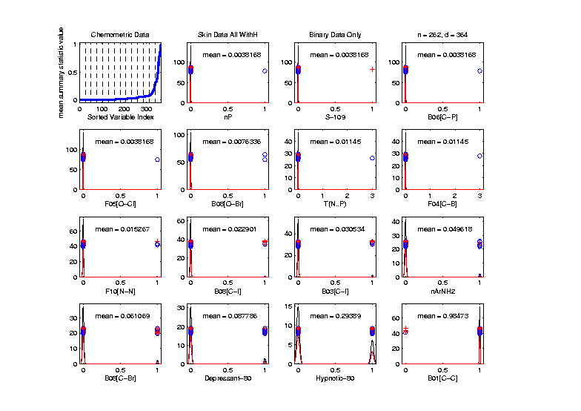
Marg. Dist. Plot Data Example
Drug Discovery - Binary Variables, Mean Sort
Shows
Many Are
Mostly 0s

Slide 59
Marg. Dist. Plot Data Example
Common Practice:
Delete “Mostly 0” Variables (little information)
More Careful Look, Borysov et al (2016)
These Can Contain Useful Info
(Especially When So Many)
Not Clear What This Means!
Defined as “$≥95\% 0$s”

Slide 60
Marg. Dist. Plot Data Example
Explicit Screening Found:
$d = 800$Non-Binary Variables
Now Focus on Those Only
Standardize Variables
(Subtract Mean, Divide By SD)
An Approach to Wildly
Different Variable Scaling

Slide 61
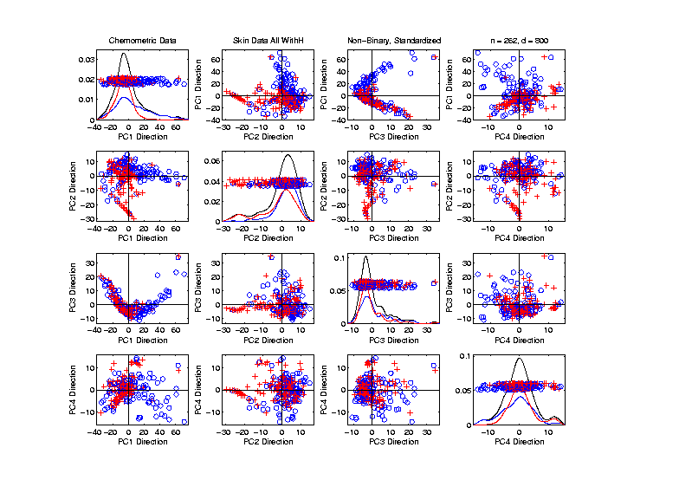
Marg. Dist. Plot Data Example
Drug Discovery - PCA on non-Binary Variables
Interesting
Structure?

Slide 62
Marg. Dist. Plot Data Example
Drug Discovery - PCA on non-Binary Variables
Interesting
Structure?
Suggests
Subtypes

Slide 63
Marg. Dist. Plot Data Example
Drug Discovery - PCA on non-Binary Variables
Interesting
Structure?
Suggests
Subtypes
Reds Only?

Slide 64
Marg. Dist. Plot Data Example
Drug Discovery - PCA on non-Binary Variables
Again
Suggestion
Of “Activity
Cliffs”
Maggiora (2006)

Slide 65
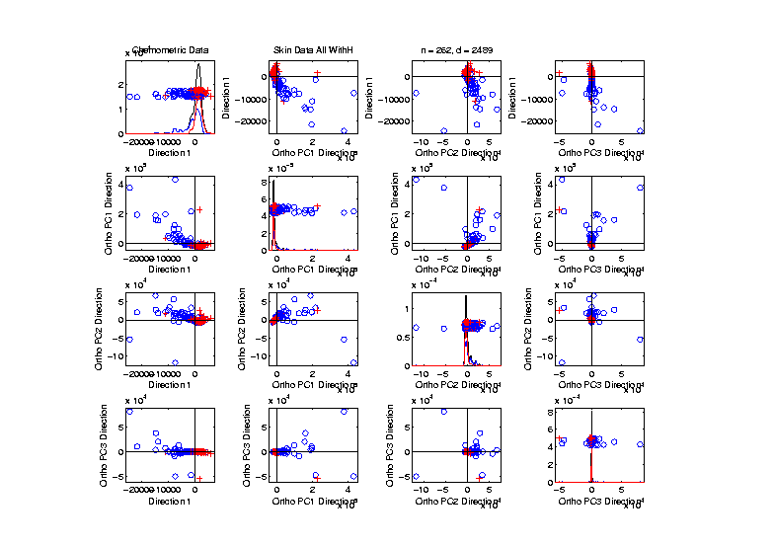
Inference for Drug Discovery Data
Raw Data – DWD & Ortho PCs Scatterplot
Some
Blue - Red
Separation
But Dominated
By Few Large
Compounds
Now Do Confimatory Analysis

Slide 66
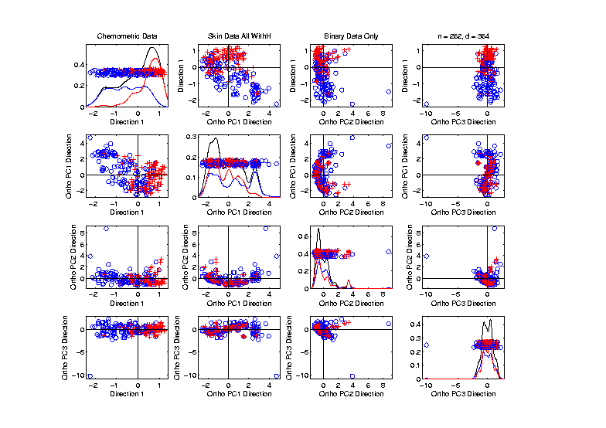
Inference for Drug Discovery Data
Binary Data – DWD & Ortho PCs Scatterplot
Better
Blue - Red
Separation
And
Visualization

Slide 67
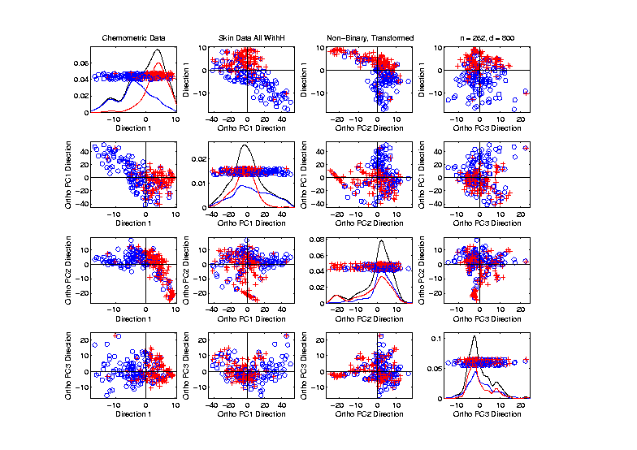
Inference for Drug Discovery Data
Standard’d Non-Binary Data – DWD & OPCA
Better
Blue - Red
Separation
???
Very Useful
Visualization

Slide 68
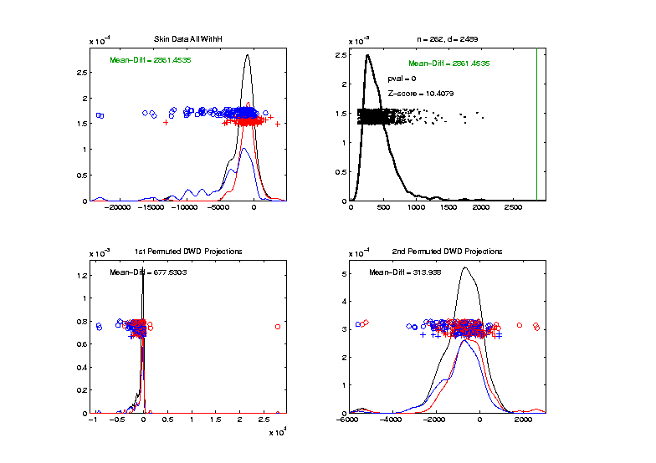
Inference for Drug Discovery Data
DiProPerm test of Blue vs. Red
Full Raw Data
Z = 10.4
Reasonable
Difference
Note Strange
Permutations

Slide 69
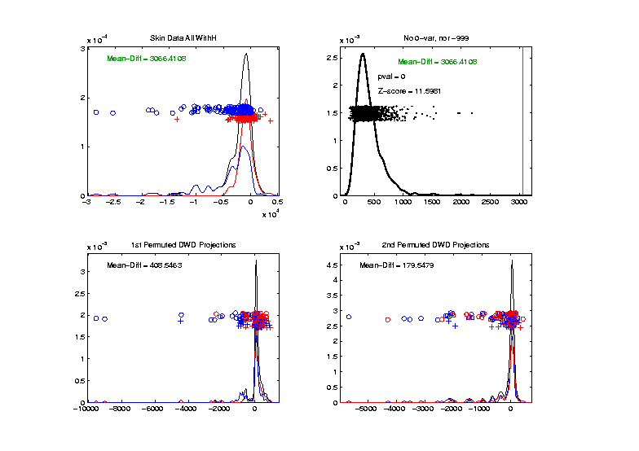
Inference for Drug Discovery Data
DiProPerm test of Blue vs. Red
Delete var = 0 & -999 Variables
Z = 11.6
Slightly
Stronger
No Visual Diff.
Yet DiProPerm
Finds Some
Or Is Difference Within
Simulation Variation???

Slide 70
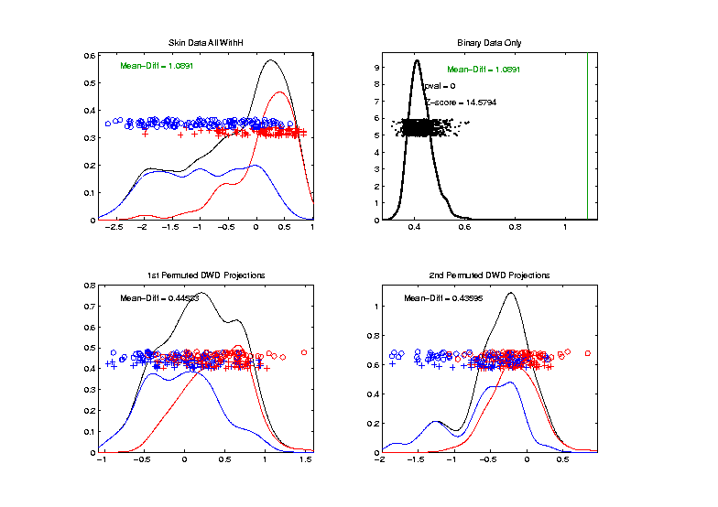
Inference for Drug Discovery Data
DiProPerm test of Blue vs. Red
Binary Variables Only
Z = 14.6
More Than
Raw Data
Much Nicer
Permutations

Slide 71
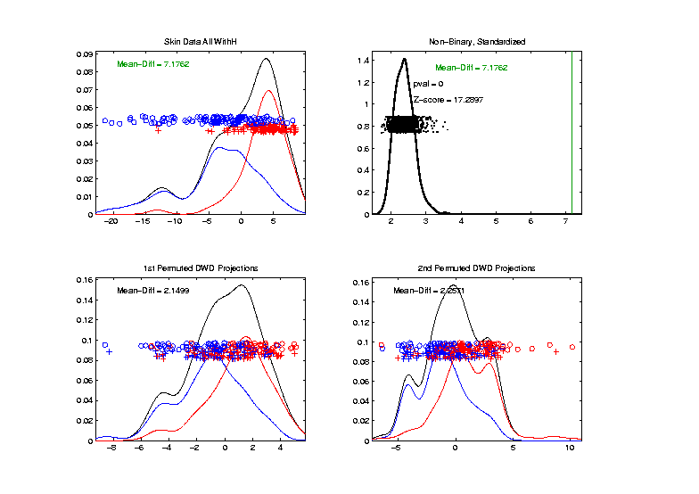
Inference for Drug Discovery Data
DiProPerm test of Blue vs. Red
Non-Binary – Standardized
Z = 17.3
Stronger
Reflects
More Info
In Data

Slide 72
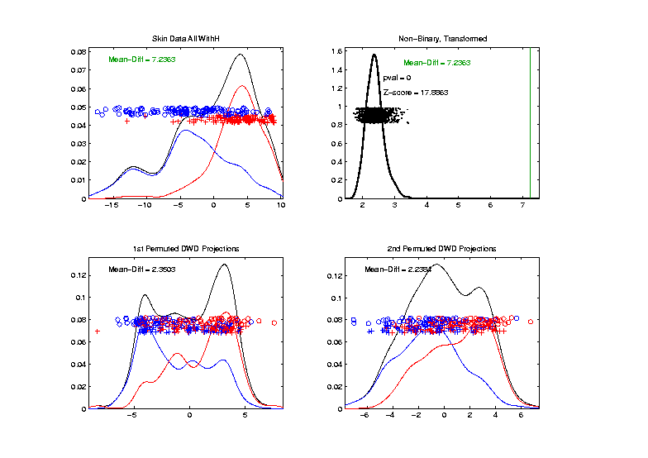
Inference for Drug Discovery Data
Introduced
Very Soon
DiProPerm test of Blue vs. Red
Non-Binary – Shifted Log Transforms
Z = 17.9
Slightly
Stronger

Slide 73
Matlab Software
Recall OODA Software

Slide 74
Marginal Distribution Plots
Matlab Software:
MargDistPlotSM.m
In General Directory

Slide 75
Object Oriented Data Analysis
Three Major Phases of OODA:
I. Object Definition
“What are the Data Objects?”
Exploratory Analysis
“What Is Data Structure / Drivers?”
III. Confirmatory Analysis / Validation
Is it Really There (vs. Noise Artifact)?

Slide 76
Limitation of PCA
Strongly Feels Scaling of Each Variable
Consequence:
May want to standardize each variable
(i.e. subtract $\overline{X}$, divide by $s$)
Also called Whitening
Equivalent Approach:
Base PCA on Correlation Matrix
Called Correlation PCA
Instead of Usual
Covariance Matrix

Slide 77
Correlation PCA
Why use correlation matrix?
Makes variables (traits) “unit free”
e.g. Height, Weight, Age, $, …
Are “directions in point cloud” meaningful or useful?
Will unimportant directions dominate?
Text Section 5.2

Slide 78
Correlation PCA
A related (& better known?) variation of PCA:
Replace cov. matrix with correlation matrix
I.e. do eigen analysis of
Where

Slide 79
Correlation PCA
Personal Thoughts on Correlation PCA:
Can be very useful
(especially with noncommensurate units)
Not always, can hide important structure
To make choice:
Decide whether whitening is useful
My personal use of correlat’n PCA is rare
Other people use it most of the time

Slide 80
Correlation PCA
Personal Thoughts on Correlation PCA:
Can be very useful
(especially with noncommensurate units)
Not always, can hide important structure
Illustrate with example

Slide 81
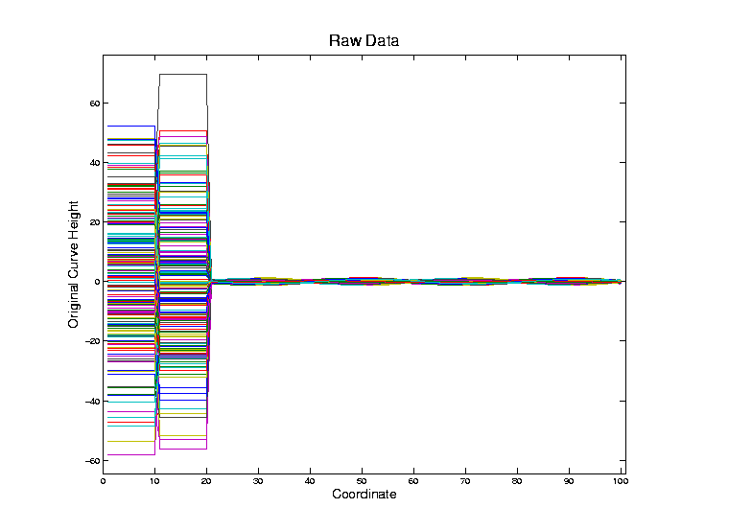
Correlation PCA
Toy Example Contrasting Cov. vs. Corr.

Slide 82
Correlation PCA
Toy Example Contrasting Cov. vs. Corr.
Big Var’n
Part

Slide 83
Correlation PCA
Toy Example Contrasting Cov. vs. Corr.
Big Var’n
Part
Small
Var’n
Part

Slide 84
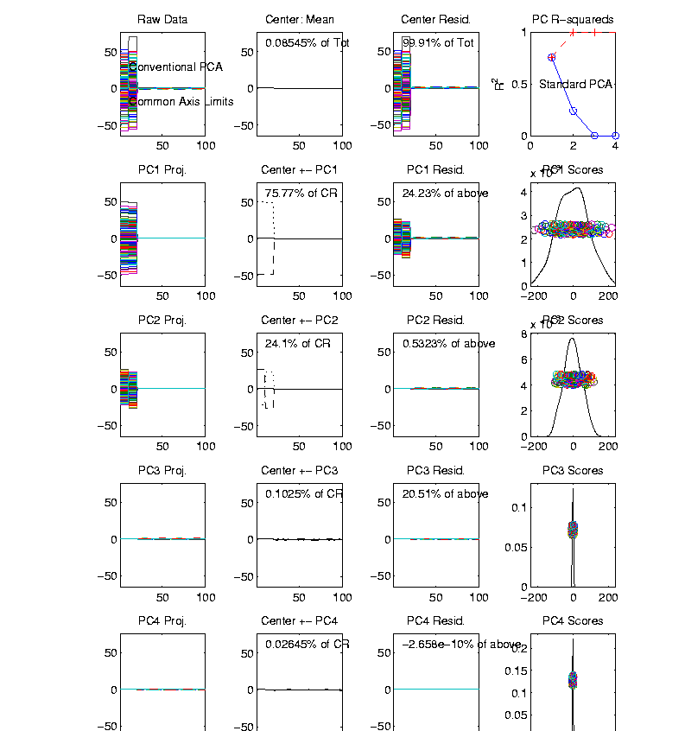
Correlation PCA
Toy Example Contrasting Cov. vs. Corr.
1st Comp:
Nearly Flat
Look at PCA Modes of Variation

Slide 85
Correlation PCA
Toy Example Contrasting Cov. vs. Corr.
1st Comp:
Nearly Flat
2nd Comp:
Contrast
Note: Another
Case Where
This View Is
Very Informative

Slide 86
Correlation PCA
Toy Example Contrasting Cov. vs. Corr.
1st Comp:
Nearly Flat
2nd Comp:
Contrast
3rd & 4th:
Very Small

Slide 87
Correlation PCA
Toy Example Contrasting Cov. vs. Corr.
1st Comp:
Nearly Flat
2nd Comp:
Contrast
3rd & 4th:
Look Very
Small Since
Common Axes

Slide 88
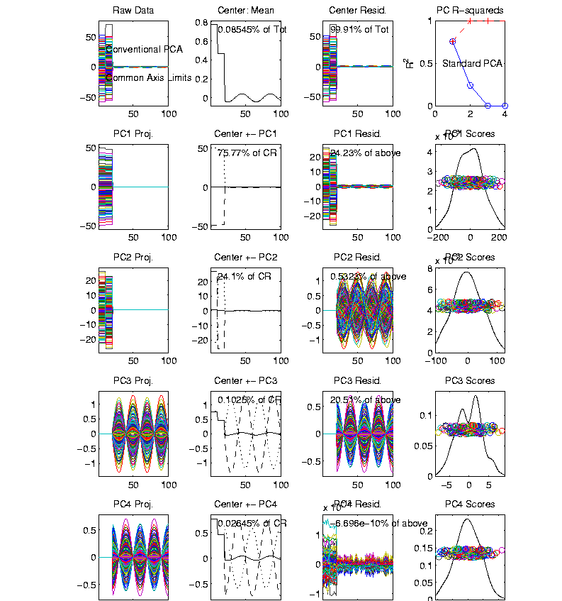
Correlation PCA
Toy Example Contrasting Cov. vs. Corr.
Use Rescaled
Axes (Typical
Default)
Now Can
See Mean

Slide 89
Correlation PCA
Toy Example Contrasting Cov. vs. Corr.
Use Rescaled
Axes (Typical
Default)
All Comp’s
Visible
(sin & cos)

Slide 90
Correlation PCA
Toy Example Contrasting Cov. vs. Corr.
Use Rescaled
Axes (Typical
Default)
All Comp’s
Visible
Good or
Bad ???

Slide 91
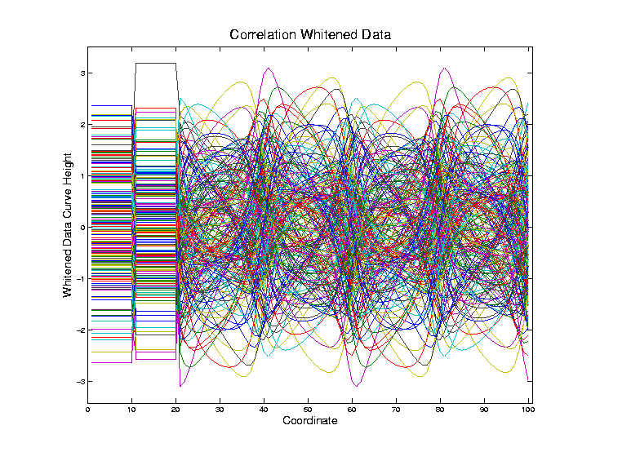
Correlation PCA
Toy Example Contrasting Cov. vs. Corr.
Correlation
“Whitened”
Version
Each Coord.
Rescaled
By Its S.D.

Slide 92
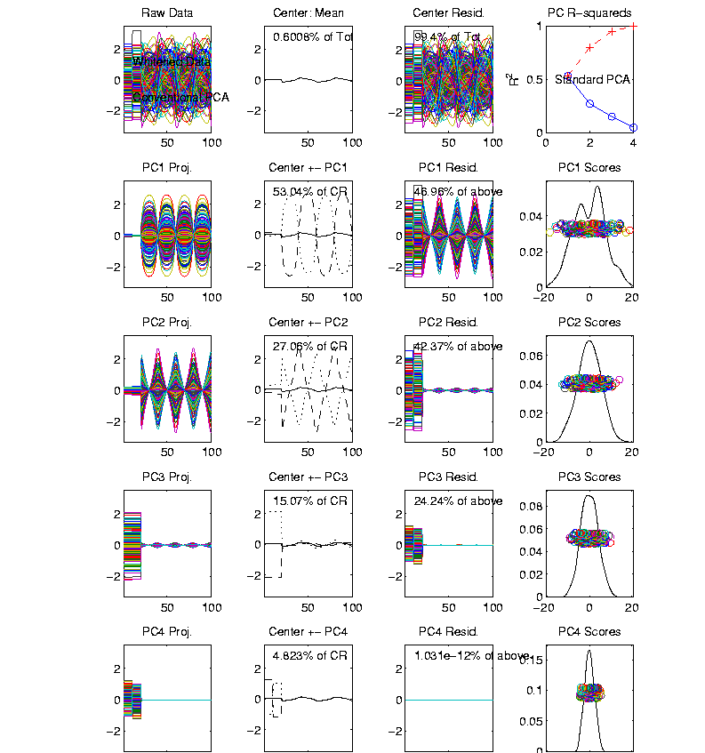
Correlation PCA
Toy Example Contrasting Cov vs. Corr.
Correlation
“Whitened”
Version
All Much
Different

Slide 93
Correlation PCA
Toy Example Contrasting Cov. vs. Corr.
Correlation
“Whitened”
Version
All Much
Different
Which Is
“Right” ???

Slide 94
Transformations
Text: Sec. 5.3
Useful Method for Data Analysis
Apply to Marginal Distributions
(i.e. to Individual Variables)
Idea: Put Data on Right Scale
Common Example:
Data Orders of Magnitude Different
Log₁₀ Puts Data on More Analyzable Scale
Recall Log for
Mortality and
RNAseq Data

Slide 95
Transformations
Famous Family:
Box – Cox Transformations
Box & Cox (1964)
Given a parameter $λ∈ℝ$,
$$x ↦ \frac{x^{λ}−1}{λ}$$

Slide 96
Transformations
Box – Cox Transformations
Why this strange form? Instead of just
$$x ↦x^{λ}$$
Reason: Nicer Behavior as $λ→0$,
$$\lim_{λ→0}{\frac{x^{λ}−1}{λ}}=\ln{x}$$

Slide 97
Homework 3
Verify that, for $x>0$, and $λ∈ℝ$,
$$\lim_{λ→0}{\frac{x^{λ}−1}{λ}}=\ln{x}$$
Turn in Answer on Sakai, Either
Word Processd or Write & Photo
Due: Feb. 8,
11:00AM

Slide 98
Transformations
Box – Cox Transformations
(vs. $x$)
(graphics from http://onlinestatbook.com/2/transformations/box-cox.html)

Slide 99
Transformations
Box – Cox Transformations
(vs. $x$)
(vs. $\ln{x}$)
(graphics from http://onlinestatbook.com/2/transformations/box-cox.html)

Slide 100
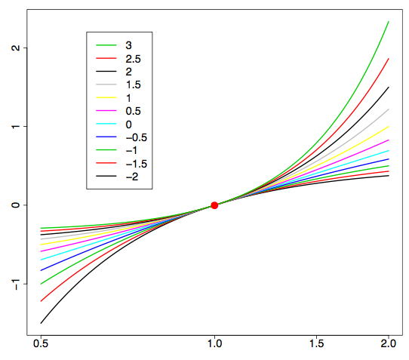
Transformations
Box – Cox Transformations (vs. $\ln{x}$)
(graphics from http://onlinestatbook.com/2/transformations/box-cox.html)

Slide 101
Transformations
Another useful family:
Shifted Log Transformations
Given a parameter $δ∈ℝ$,
$$x ↦ \log\left(x+δ\right)$$
(Will use more below)

