Slide 1
Statistics – O. R. 881 Object Oriented Data Analysis
Start
Recording
Steve Marron
Dept. of Statistics and Operations Research
University of North Carolina

Slide 2
Current Sections in Textbook
Today:
Section 6.3, 17.1
Next Class:
Sections 7.1, 7.2

Slide 3
Participant Presentations
Starting Next Tuesday:
12:10 Panos Andreou
Notes:
Please do in Person
Can Use USB Device
Or Remote Log-In, Set Up Before Class
Have Title Page With:
Your Name
Your Affiliation
Check Website
For Schedule

Slide 4
Participant Presentations
Online Participants:
Please Send
An Email.
Including Auditors
Please Sign Up:
Name
Email (Onyen is fine, or …)
Are You ENRolled?
Dept. & Advisor (Lab?)
Tentative Title (“????” Is OK)
When:
Next Week, Early, Oct., Nov., Late
Please Save
My Time
Needed To
Contact
Individuals

Slide 5
Transformations
Recall Log for
Mortality and
RNAseq Data
Useful Method for Data Analysis
Apply to Marginal Distributions
(i.e. to Individual Variables)
Idea: Put Data on Right Scale
Common Example:
Data Orders of Magnitude Different
Log₁₀ Puts Data on More Analyzable Scale

Slide 6
Transformations
Box – Cox Transformations
Why the strange form? Instead of just
$$x ↦x^{λ}$$
Reason: Nicer Behavior as $λ→0$,
$$\lim_{λ→0}{\frac{x^{λ}−1}{λ}}=\ln{x}$$
Try It Out
in HW 3

Slide 7
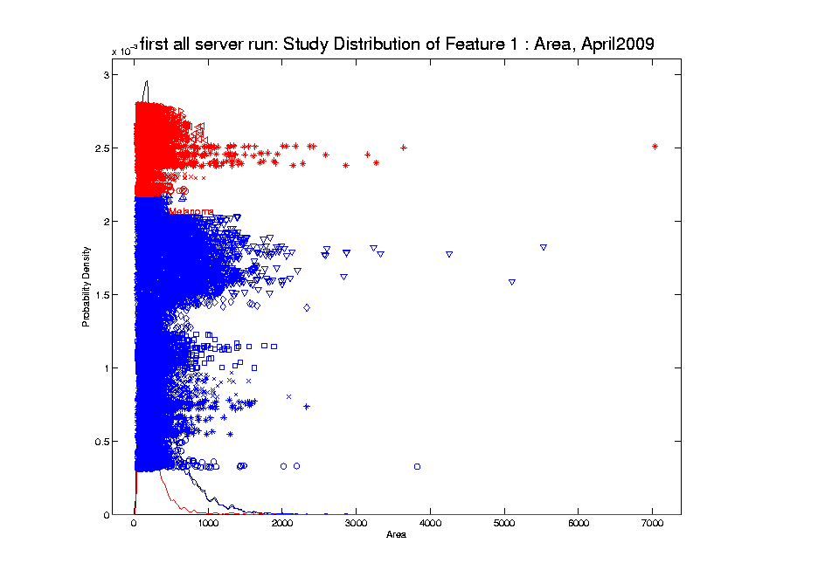
Transformations
Few Large Values Can Dominate Analysis

Slide 8
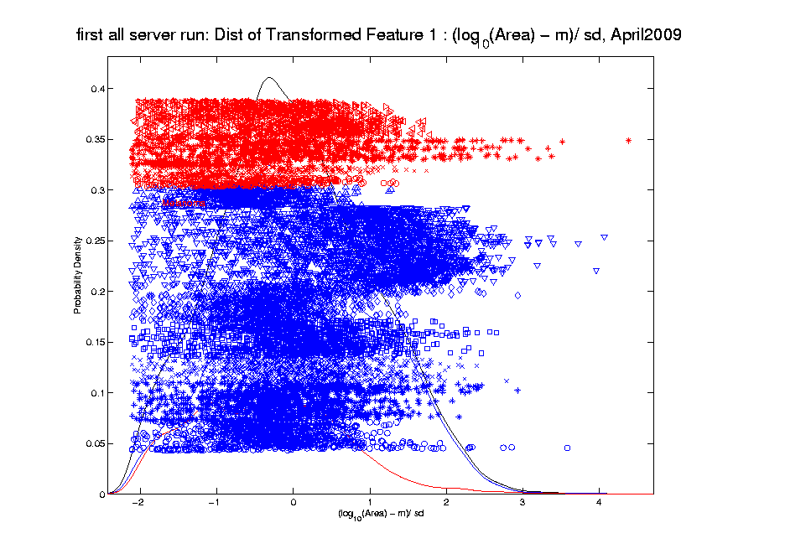
Transformations
Log Scale Gives All More Appropriate Weight
Note:
Orders
Of
Magnitude
Log₁₀ most
Interpretable

Slide 9
Automatic Transformations
$$φ_{β}\left(x_{i}\right)=\left\{\begin{aligned}log⁡(x_{i}−min\left(x_{1}, ⋯,x_{n}\right)+\frac{1}{β}R\text{)}, β>0 \\ −log⁡(\max\left(x_{1}, ⋯,x_{n}\right)− x_{i}−\frac{1}{β}R\text{)}\text{, }β<0\end{aligned}\right.$$
Family of transformation functions
Comments
Single family for both positive and negative skewness
Parameter value selection is independent of data magnitude
As $β→0$: transformation + standardization $→$
$→$ standardization only
Notes:
Finally incorporating all the elements we have discussed the new parameterized family of transformation functions
For beta is positive, transformation for positive skewness
For beta is negative, transformation for negative skewness
And the parameter value selection is independent of data magnitude

Slide 10
Automatic Transformations
Standardization
Subtract median (robust center)
Divide by $\sqrt{π/2}$ of the MAD (robust scale)
(Mean Absolute Deviation from the median)
Winsorization
Threshold based on extreme value theory
(see Feng et al (2016) for details)
Notes:
After the shift log transformation, we need to deal with potential influential values by winsorization,
Before that we need a robust standardization ( and I will talk about it later)
To make standardization robust, we will use some robust statistics that is subtracting the median and divide based on the mean absolute deviation from median (not MAD which might be 0)

Slide 11
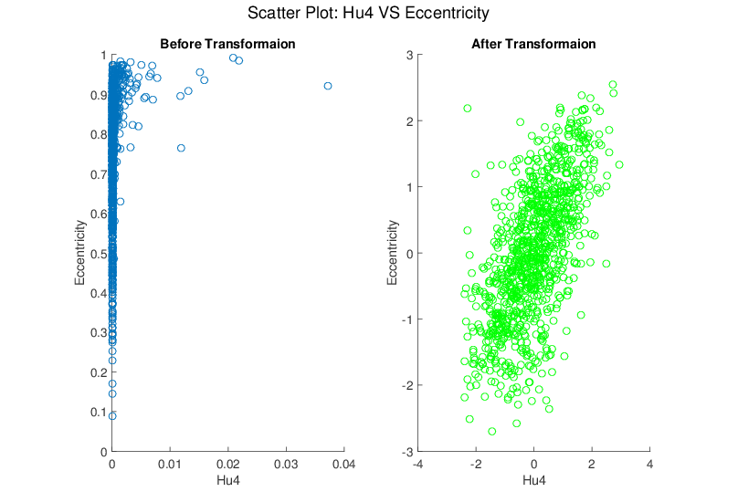
Melanoma Data
Much Nicer Distributions
Notes:
Besides, although the transformation targets at marginal dist
We see improvement of bivariate normality in many real data sets for example here.

Slide 12
Revisit Gene Expression
Ovarian (o) & Uterine (+) Cancer Cases
Add In Automatic
Log Transformed PCA
Proj’ns on Mean
Difference Dir’n
Note Much
Better

Slide 13
Revisit Gene Expression
ROC Curve
Much Better
For Log
Transformations

Slide 14
Heat-Map Views
Main Idea:
Look at Full Data Matrix
As an Image (Rectangular Array of “Pixels”)
Coding Values with Colors (Gray Levels)
Text: Sec. 6.1

Slide 15
Heat-Map Views
Some Principles:
Ordering Rows and Columns Really Matters
Clustering Columns & Rows is Crucial
Population Structure
Invisible w/ Random Order

Slide 16
Heat-Map Views
Can Look at Either
Original Or Log View
Natural Approach (to Skewed Dist’n):
Quantile Scaling (= #s in Each Bin)
Same Toy Example
Non-Equally Spaced Bins
Far More
Contrast
Good or Bad?
Peaks Less
Prominent

Slide 17
Heat-Map Views
Caution: Many
Packages Do This!
Color Choice When 0 Needs Highlighting
Endpoints? ($q_{0.05}$ & $q_{0.95}$ Will Re-Center!)
Recommend Using Absolute Quantiles:
$±{\left|q\right|}_{0.10}$
Where ${\left|q\right|}_{α}$ is $α$-th Quantile of $\left|X_{1}\right|,⋯,\left|X_{n}\right|$

Slide 18
Recall Real Data Curve Objects
Lung Cancer Data Example
Genetics (Cancer Research)
RNAseq (Next Gener’n Sequen’g)
Deep look at “gene components”
Gene studied here: CDKN2A
Goal: Study Alternate Splicing
Sample Size, $n = 180$
Dimension, $d = 1709$

Slide 19
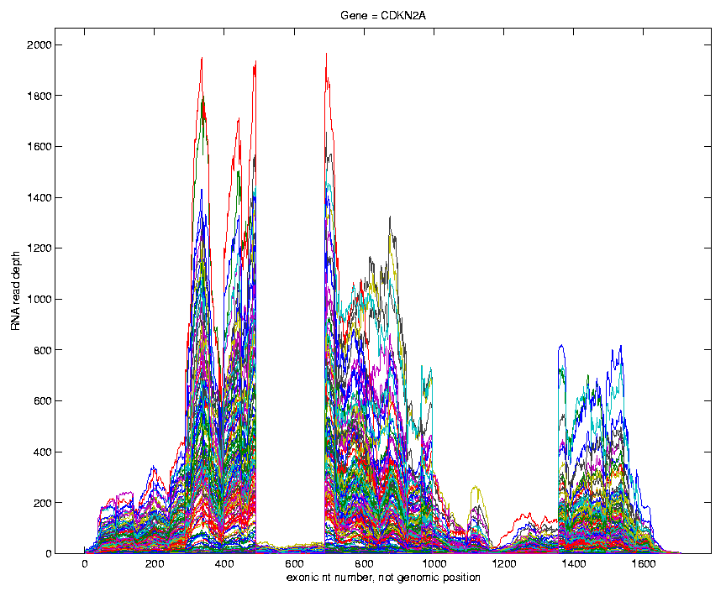
Recall Lung Cancer Curve Objects
Simple
1st
View:
Curve
Overlay
(counts
scale)
Note: Data Set
Structure May
Be Hidden In
Low Areas
I. Object Representation

Slide 20
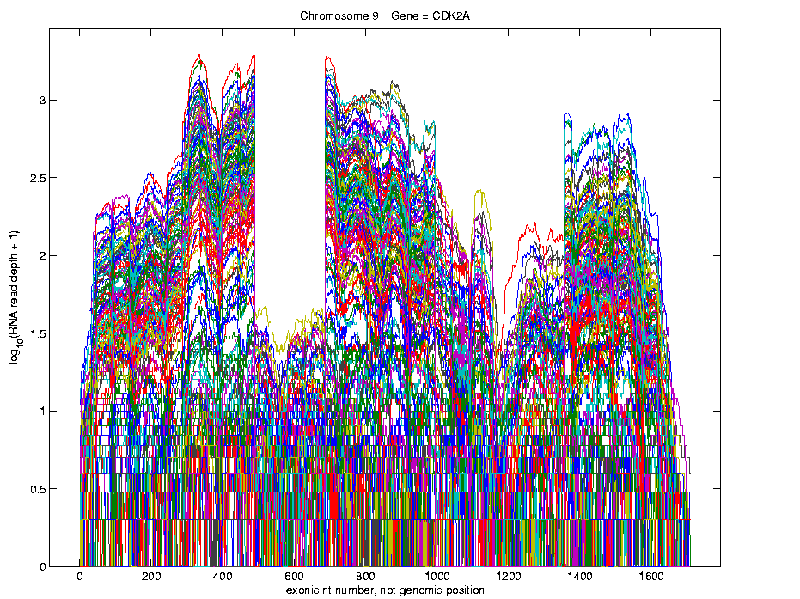
Recall Lung Cancer Curve Objects
Simple
1st
View:
Curve
Overlay
(log
scale)
I. Object Representation

Slide 21
Recall Lung Cancer Curve Objects
Heatmap View of $\log_{10}(∙+1)$ Counts
Interesting
Structure?
Distribution of Colors

Slide 22
Recall Lung Cancer Curve Objects
Better
Sort?
Centered (Rows & Columns) Version
Harder to
Intrepret?
Distribution of Colors

Slide 23
Recall Lung Cancer Curve Objects
A Better Sorting
Interpretation?
Distribution of Colors
Conclude Heatmap Worse
Than Modes of Variation Here

Slide 24
Heat-Map Views
Larger Example: $n=200$, $d=20,000$
Major Issue: Most Computer Displays Have Only a Few Thousand Pixels of Resolution
So Cannot See Full Matrix
Most Displays Compensate With Ad Hoc Rules Designed for Text and Natural Images
Can Miss Important Aspects of the Data

Slide 25
Heat-Map Views
Will See OK
For This Data
Larger Example: $n=200$, $d=20,000$
Simple Approach Here: Study 1st $200$ Rows
Looks Totally Random?
Have Done Both Column
And Row Clustering

Slide 26
Heat-Map Views
Larger Example: $n=200$, $d=20,000$
Revisit With Scatterplot Matrix View
Conclude: Heat
Map Worse
Than Scatterplot
In This Case
Colored 1st 100 & 2nd 100
Clear Cluster Structure
Hidden by Noise in
Heatmap View!
Is This Real (or Artifact)?
$N(−0.04,1)$ & $N(0.04,1)$

Slide 27
Heat-Map Views
For Opposite Answer Consider Another
Data Set ($n=d=50$) with Curve View:
Very Noisy
1st 25 Features
>> 2nd 25
Two Clear
Clusters
Understand Pop’n
Structure???

Slide 28
Heat-Map Views
Data Source is Above Example:
Gives Quicker Impression of Structure
More Natural View Than Curves
2 Clusters
1st Features Larger

Slide 29
Heat-Map Views
One More Point (From This Example):
Than Both Separated
Mean +/- Curves
Easier to Understand

Slide 30
Heat-Map Views
Which Data View Is “Best”???
Heat Maps?
Curves?
Scatterplots?

Slide 31
Heat-Map Views
Which Data View Is “Best”???
Simon Sheather Quote:
“Every Dog Has His Day”

Slide 32
Heat-Map Views
“Every Dog Has His Day”
Idea:
Any Data Analytic Method Somebody Likes Has Some Situations Where It Is “Best”
& Of Course Others Where It Is Poor
(Will See This Again)

Slide 33
Heat-Map Views
Some Overview Papers:
History:
Wilkinson & Friendly (2009)
Criticism of Common Color Choices:
Borland & Taylor (2007)

Slide 34
Scatterplot Views
All Based on Projections
Now Consider Other Directions
Beyond PCA
Text: Sec. 6.5

Slide 35
Scatterplot Views
Summarize Other Directions to Project On
Classification Directions (e.g. DWD or MD)
Independent Component Analysis
Fourier Basis Directions
Wavelet Basis Directions
Nonnegative Matrix Factorization
$⋮$
Might
Discuss
Later

Slide 36
Scatterplot Views
Summarize Other Directions to Project On
Known Modes of Variation
Izem & Kingsolver (2007), Izem & Marron (2007)
Maximal Smoothness Directions
Gaydos et. al (2013), Kingsolver et. al (2015), Zhang et al. (2014)
Maximal Data Piling
(Will Explore Later)

Slide 37
Centering
Text: Sec. 6.3, 17.1.1
Notation:
Data Matrix:
$\tilde{X}=\left[\begin{matrix}{\tilde{x}}_{1,1} & ⋯ & {\tilde{x}}_{1,n} \\ ⋮ & ⋱ & ⋮ \\ {\tilde{x}}_{d,1} & ⋯ & {\tilde{x}}_{d,n}\end{matrix}\right]$
Tilde ($\sim$) Denotes Random Quantities
Matrices as Bold Capitals
Recall Data Object
Vectors, $j=1,⋯,n$
Recall traits,
$i=1,⋯,d$

Slide 38
Centering
Notation:
Data Object Vectors:
$\tilde{X}=\left[\begin{matrix}{\tilde{x}}_{1,1} & ⋯ & {\tilde{x}}_{1,n} \\ ⋮ & ⋱ & ⋮ \\ {\tilde{x}}_{d,1} & ⋯ & {\tilde{x}}_{d,n}\end{matrix}\right]=\left[\begin{matrix}{\tilde{x}}_{1} & ⋯ & {\tilde{x}}_{n}\end{matrix}\right]$
Vectors, Bold Lowercase: ${\tilde{x}}_{j}=\left(\begin{matrix}{\tilde{x}}_{1,j} \\ ⋮ \\ {\tilde{x}}_{d,j}\end{matrix}\right)∈ℝ^{d}$
Again Tilde Denotes Random Quantities

Slide 39
Centering
Data Matrix:
$\tilde{X}=\left[\begin{matrix}{\tilde{x}}_{1,1} & ⋯ & {\tilde{x}}_{1,n} \\ ⋮ & ⋱ & ⋮ \\ {\tilde{x}}_{d,1} & ⋯ & {\tilde{x}}_{d,n}\end{matrix}\right]$
Column Object Mean:
$${\overline{x}}_{co}=\left(\begin{matrix}{\overline{x}}_{1,A} \\ ⋮ \\ {\overline{x}}_{d,A}\end{matrix}\right)$$
where ${\overline{x}}_{i,A}=\frac{1}{n}\sum_{j=1}^{n}{{\tilde{X}}_{i,j}}$
Avoid Row-Column
Ambiguity Using
Object Oriented
Nomenclature
Could Call This
the “Row Mean”

Slide 40
Centering
Data Matrix:
$\tilde{X}=\left[\begin{matrix}{\tilde{x}}_{1,1} & ⋯ & {\tilde{x}}_{1,n} \\ ⋮ & ⋱ & ⋮ \\ {\tilde{x}}_{d,1} & ⋯ & {\tilde{x}}_{d,n}\end{matrix}\right]$
Additional Notion: Row Trait Mean
${\overline{x}}_{RT}^{t}=\left(\begin{matrix}{\overline{x}}_{A,1} & ⋯ & {\overline{x}}_{A,n}\end{matrix}\right)$ for ${\overline{x}}_{RT}∈ℝ^{n}$
where ${\overline{x}}_{A,j}=\frac{1}{d}\sum_{i=1}^{d}{{\tilde{X}}_{i,j}}$
transpose
Disambiguates
“Row Mean” vs.
“Column Mean”
Space of
$n$-dimensional
Column Vectors

Slide 41
Detailed Look at PCA
Text: Chapter 17
Now Study “Folklore” More Carefully
BackGround
History
(as noted on 1/13/22)
Early Use: Pearson (1901)
Name “PCA”: Hotelling (1935)

Slide 42
Detailed Look at PCA
Now Study “Folklore” More Carefully
BackGround
History
Underpinnings
(Mathematical & Computational)
Good Overall Reference: Jolliffe (2002)

Slide 43
PCA: Rediscovery – Renaming
Statistics:
Principal Component Analysis (PCA)
Social Sciences:
Factor Analysis (PCA is a subset)
Probability / Electrical Eng:
Karhunen – Loeve expansion
Applied Mathematics:
Proper Orthogonal Decomposition (POD)
Geo-Sciences:
Empirical Orthogonal Functions (EOF)

Slide 44
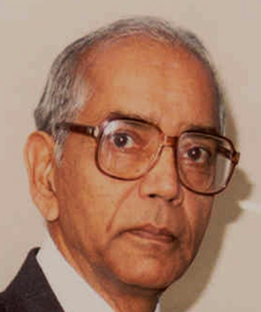
An Interesting Historical Note
The 1st (?) application of PCA to Functional Data Analysis:
Rao (1958)
1st Paper with “Curves as Data Objects” viewpoint

Slide 45
Detailed Look at PCA
Three Important (& Interesting) Viewpoints:
Mathematics
Numerics
Statistics
Goal: Study Interrelationships

Slide 46
Detailed Look at PCA
Three Important (& Interesting) Viewpoints:
Mathematics
Numerics
Statistics
1st: Review Linear Alg. and Multivar. Prob.

Slide 47
Course Background I
Linear Algebra
Please Check Familiarity
No? Read Up in Linear Algebra Text
Or Wikipedia?

Slide 48
Course Background I
Linear Algebra Key Concepts
Vector
Scalar
Vector Space (Subspace)
Basis
Dimension
Unit Vector Basis in $ℝ^{d}$
Linear Combo as Matrix Multiplication
$$\left\{\left(\begin{matrix}\begin{matrix}1 \\ 0\end{matrix} \\ \begin{matrix}⋮ \\ 0\end{matrix}\end{matrix}\right),⋯,\left(\begin{matrix}\begin{matrix}0 \\ ⋮\end{matrix} \\ \begin{matrix}0 \\ 1\end{matrix}\end{matrix}\right)\right\}$$

Slide 49
Course Background I
Linear Algebra Key Concepts
Matrix Trace
Vector Norm = Length
Distance in $ℝ^{d}$ = Euclidean Metric
Inner (Dot, Scalar) Product
Vector Angles
Orthogonality (Perpendicularity)
Orthonormal Basis

Slide 50
Linear Algebra of Centering
E.g. Subspace of Flat Vectors in $ℝ^{d}$ is:
$$S_{F}=\left\{\left(\begin{matrix}u \\ ⋮ \\ u\end{matrix}\right):u∈ℝ\right\}$$
Name Clear from Curve Representation,
i.e. “Parallel Coordinates”
Recall
Meaning
Sometimes Called “45 degree line”,
Although Only Sensible for $d=2$

Slide 51
Linear Algebra of Centering
Recall
Shifted
Parabolas
Example
Nearly Flat
Mode of Variation
Flat Mode is
Frequently
Important

Slide 52
Linear Algebra of Centering
E.g. Subspace of Flat Vectors in $ℝ^{d}$ is:
$$S_{F}=\left\{\left(\begin{matrix}u \\ ⋮ \\ u\end{matrix}\right):u∈ℝ\right\}$$
Averages as Projection:
$$P_{S_{F}}\left(\begin{matrix}x_{1} \\ ⋮ \\ x_{d}\end{matrix}\right)=\left(\begin{matrix}\overline{x} \\ ⋮ \\ \overline{x}\end{matrix}\right)$$

Slide 53
Homework 4
Part (a): Show that the set of flat vectors $S_{F}$ is a subspace.
Part (b): Show that:
$$P_{S_{F}}\left(\begin{matrix}x_{1} \\ ⋮ \\ x_{d}\end{matrix}\right)=\left(\begin{matrix}\overline{x} \\ ⋮ \\ \overline{x}\end{matrix}\right)$$
(Hints On Sakai page)
Due: Feb. 15,
11:00AM

Slide 54
Linear Algebra of Centering
Much Richer Investigation of Centering
Appears in Section 17.1.1 of the Text
Main Point: Projections in the Matrix Space:
$ℝ^{dxn}=\left\{\left[\begin{matrix}x_{1,1} & ⋯ & x_{1,n} \\ ⋮ & ⋱ & ⋮ \\ x_{d,1} & ⋯ & x_{d,n}\end{matrix}\right]:x_{i,j}∈ℝ\right\}$
Note: NOT $ℝ^{dn}$

Slide 55
Course Background I
Linear Algebra Key Concepts
Singular Value Decomposition
(SVD)
Usually poorly taught in linear algebra,
but fundamental in many ways

Slide 56
Review of Linear Algebra (Cont.)
SVD Full Representation:
=
Intuition: For $X$ as Linear Operator ($ℝ^{d}→ℝ^{n}$):
Represent as:
$$V_{n×n}^{t}$$
$$X_{d×n}$$
$$U_{d×d}$$
$$S_{d×n}$$
Isometry (~Rotation)
Coordinate Rescaling
Isometry (~Rotation)

Slide 57
Review of Linear Algebra (Cont.)
SVD Full Representation:
=
$$V_{n×n}^{t}$$
$$X_{d×n}$$
$$U_{d×d}$$
$$S_{d×n}$$
Orthonormal Basis Vectors of $ℝ^{d}$
Diagonal Matrix of Singular Values
Orthonormal Basis Vectors of $ℝ^{n}$

Slide 58
Review of Linear Algebra (Cont.)
Diagonal Matrix of Singular Values:
$$S_{d×n}=\left[\begin{matrix}\begin{matrix}s_{1} & 0 \\ 0 & s_{2} \\ ⋮ & ⋱\end{matrix} & \begin{matrix}⋯ & 0 \\ ⋱ & ⋮ \\ ⋱ & 0\end{matrix} \\ \begin{matrix}0 & ⋯ \\ ⋮ & \\ 0 & ⋯\end{matrix} & \begin{matrix}0 & s_{n} \\ & ⋮ \\ ⋯ & 0\end{matrix}\end{matrix}\right]$$
Assume (without loss of generality)
$s_{j}≥0$ (by Flipping of Basis Vectors)
$s_{1}≥s_{n}≥⋯≥s_{n}$
$s_{j}$ is scaling of
$j$-th coordinate
Uses Visual Case
Here: $d>n$
More General
Notation: $d⋀n$

Slide 59
Review of Linear Algebra (Cont.)
Diagonal Matrix of Singular Values:
$$S_{d×n}=\left[\begin{matrix}\begin{matrix}s_{1} & 0 \\ 0 & s_{2} \\ ⋮ & ⋱\end{matrix} & \begin{matrix}⋯ & 0 \\ ⋱ & ⋮ \\ ⋱ & 0\end{matrix} \\ \begin{matrix}0 & ⋯ \\ ⋮ & \\ 0 & ⋯\end{matrix} & \begin{matrix}0 & s_{n} \\ & ⋮ \\ ⋯ & 0\end{matrix}\end{matrix}\right]$$
Note That:
Rank of $X$ is Number of Non-0 $s_{j}$
$s_{1},⋯,s_{n}$ are Major Characteristics of $X$

Slide 60
Review of Linear Algebra (Cont.)
SVD Full Representation:
=
Also Useful Are Smaller Representations
$$V_{n×n}^{t}$$
$$X_{d×n}$$
$$U_{d×d}$$
$$S_{d×n}$$

Slide 61
Review of Linear Algebra (Cont.)
SVD Reduced Representation:
=
Again Showing Case $d>n$
Generally Formulate with $d∧n$
$$S_{n×n}$$
$$V_{n×n}^{t}$$
$$X_{d×n}$$
$$U_{d×n}$$

Slide 62
Review of Linear Algebra (Cont.)
SVD Compact Representation:
=
For Reduced Rank Approximation Get Best Squared Error Approx. from $r<$ rank($X$)
Key to Dimension Reduction
$$S_{r×r}$$
$$V_{r×n}^{t}$$
$$X_{d×n}$$
$$U_{d×r}$$
$r=$ rank($X$)

Slide 63
Covariance Matrices
Notation: Data Matrix
$$\tilde{X}=\left[\begin{matrix}{\tilde{x}}_{1,1} & ⋯ & {\tilde{x}}_{1,n} \\ ⋮ & ⋱ & ⋮ \\ {\tilde{x}}_{d,1} & ⋯ & {\tilde{x}}_{d,n}\end{matrix}\right]$$
Indexed by Rows $i=1,⋯,d$ Cols $j=1,⋯,n$
Empirical Covariance:
$$\hat{Σ}=\left[\begin{matrix}\frac{1}{n}\sum_{j=1}^{n}{{\left({\tilde{x}}_{1,j}−{\overline{x}}_{1,A}\right)}^{2}} & ⋯ & \frac{1}{n}\sum_{j=1}^{n}{\left({\tilde{x}}_{1,j}−{\overline{x}}_{1,A}\right)\left({\tilde{x}}_{d,j}−{\overline{x}}_{1,A}\right)} \\ ⋮ & ⋱ & ⋮ \\ \frac{1}{n}\sum_{j=1}^{n}{\left({\tilde{x}}_{d,j}−{\overline{x}}_{d,A}\right)\left({\tilde{x}}_{1,j}−{\overline{x}}_{1,A}\right)} & ⋯ & \frac{1}{n}\sum_{j=1}^{n}{{\left({\tilde{x}}_{d,j}−{\overline{x}}_{d,A}\right)}^{2}}\end{matrix}\right]$$
Are Data
Objects
Essentially Inner
Products of Rows
Use $\frac{1}{n}$ (MLE) form for simplicity

Slide 64
Covariance Matrices
Recall $\hat{Σ}$ is an Estimate of the
Theoretical Covariance:
$$Σ=\left[\begin{matrix}var\left(X_{1}\right) & ⋯ & cov\left(X_{1},X_{d}\right) \\ ⋮ & ⋱ & ⋮ \\ cov\left(X_{d},X_{1}\right) & ⋯ & var\left(X_{d}\right)\end{matrix}\right]$$
$$Σ=\left[\begin{matrix}E{\left(X_{1}−EX_{1}\right)}^{2} & ⋯ & E\left(X_{1}−EX_{1}\right)\left(X_{d}−EX_{d}\right) \\ ⋮ & ⋱ & ⋮ \\ E\left(X_{d}−EX_{d}\right)\left(X_{1}−EX_{1}\right) & ⋯ & E{\left(X_{d}−EX_{d}\right)}^{2}\end{matrix}\right]$$

Slide 65
Covariance Matrices
Compact Representation of $\hat{Σ}$ Comes From
Centered & $\sqrt{n}$ Scaled Version of Data:
$$\breve{X}=\left[\begin{matrix}\frac{1}{\sqrt{n}}\left({\tilde{x}}_{1,1}−{\overline{x}}_{1,A}\right) & ⋯ & \frac{1}{\sqrt{n}}\left({\tilde{x}}_{1,n}−{\overline{x}}_{1,A}\right) \\ ⋮ & ⋱ & ⋮ \\ \frac{1}{\sqrt{n}}\left({\tilde{x}}_{d,1}−{\overline{x}}_{d,A}\right) & ⋯ & \frac{1}{\sqrt{n}}\left({\tilde{x}}_{d,n}−{\overline{x}}_{d,A}\right)\end{matrix}\right]$$
Recall Average for Row $i=1,⋯,d$ is
$${\overline{x}}_{i,A}=\frac{1}{n}\sum_{j=1}^{n}{{\tilde{x}}_{i,j}}$$
Entries of Column
Object Mean Vector
$\hat{Σ}$ Entries Are Inner
Products of Rows
Over $i,i^{′}=1,⋯,d$
Achieved By Product $\breve{X}{\breve{X}}^{t}$

Slide 66
Covariance Matrices
Compact Representation of Covariance:
$$\hat{Σ}=\tilde{X}{\tilde{X}}^{t}$$
Called “Outer Product”
(Complementary to “Inner Product”,
$\left\langle x,y\right\rangle =x^{t}y$)

Slide 67
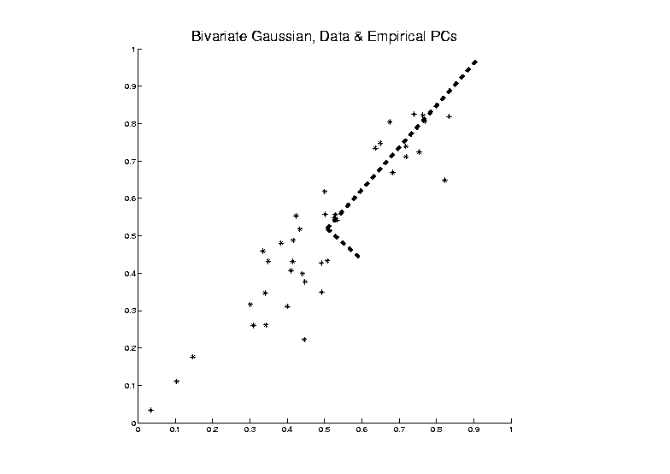
PCA as an Optimization Problem
Find Direction of Greatest Variability:
Centered At Mean

Slide 68
PCA as an Optimization Problem
Find Direction of Greatest Variability:
Approach to
Calculation:
And Optimize Over $u$, such that $\left\|u\right\|=1$
Start with
Candidate
Direction $u$

Slide 69
PCA as Optimization (Cont.)
Again Start With Data Matrix
$$\tilde{X}=\left[\begin{matrix}{\tilde{x}}_{1,1} & ⋯ & {\tilde{x}}_{1,n} \\ ⋮ & ⋱ & ⋮ \\ {\tilde{x}}_{d,1} & ⋯ & {\tilde{x}}_{d,n}\end{matrix}\right]$$
Columns as Data Objects, Indexed $j=1,⋯,n$
${\tilde{x}}_{j}=\left(\begin{matrix}{\tilde{x}}_{1,j} \\ ⋮ \\ {\tilde{x}}_{d,j}\end{matrix}\right)$
Same
Notation
as Above
With Column Object Mean Vector
${\overline{x}}_{CO}=\left(\begin{matrix}{\overline{x}}_{1,A} \\ ⋮ \\ {\overline{x}}_{1,A}\end{matrix}\right)$

Slide 70
PCA as Optimization (Cont.)
Given a Candidate Direction $u∈ℝ^{d}$,
Projections of Centered Data Onto $u$ are:
$$P_{u}\left({\tilde{x}}_{j}−{\overline{x}}_{CO}\right)=\left\langle {\tilde{x}}_{j}−{\overline{x}}_{CO},u\right\rangle u, j=1,⋯,n$$
Quantify Variation in the Direction $u$:
$$\frac{1}{n}\sum_{j=1}^{n}{{\left\|P_{u}\left({\tilde{x}}_{j}−{\overline{x}}_{CO}\right)\right\|}^{2}}$$
Recall $\left\|u\right\|=1$
Sample
Variance
of Scores

Slide 71
PCA as Optimization (Cont.)
Quantify Variation in the Direction $u$:
$$\frac{1}{n}\sum_{j=1}^{n}{{\left\|P_{u}\left({\tilde{x}}_{j}−{\overline{x}}_{CO}\right)\right\|}^{2}}=$$
$$=\frac{1}{n}\sum_{j=1}^{n}{{\left(u{\left({\tilde{x}}_{j}−{\overline{x}}_{CO}\right)}^{t}u\right)}^{t}u{\left({\tilde{x}}_{j}−{\overline{x}}_{CO}\right)}^{t}u}=$$
$$=u^{t}\left(\frac{1}{n}\sum_{j=1}^{n}{\left({\tilde{x}}_{j}−{\overline{x}}_{CO}\right){\left({\tilde{x}}_{j}−{\overline{x}}_{CO}\right)}^{t}}\right)u=$$
$$=u^{t}\breve{X}{\breve{X}}^{t}u=$$
$$=u^{t}\hat{Σ}u$$
Looks Like “Products
Of Rows” From Above
Cov. Matrix Repr’n

Slide 72
PCA as Optimization (Cont.)
Quantify Variation in the Direction $u$:
$$\frac{1}{n}\sum_{j=1}^{n}{{\left\|P_{u}\left({\tilde{x}}_{j}−{\overline{x}}_{CO}\right)\right\|}^{2}}=u^{t}\hat{Σ}u$$
Quadratic Form in the
Sample Covariance Matrix $\hat{Σ}$
Simple Solution Comes from the Eigenvalue Representation of $\hat{Σ}$:
$$\hat{Σ}=BDB^{t}$$
Orthonormal
Basis of $ℝ^{d}$
Diagonal Matrix of Eigenvalues

