Slide 1
Statistics – O. R. 881 Object Oriented Data Analysis
Start
Recording
Steve Marron
Dept. of Statistics and Operations Research
University of North Carolina

Slide 2
Current Sections in Textbook
Today:
Sections 17.1, 7.1
Next Class:
Sections 7.2, 8.3

Slide 3
Participant Presentations
Starting Tuesday:
12:10 Panos Andreou
Notes:
Please do in Person
Can Use USB Device
Or Remote Log-In, Set Up Before Class
Have Title Page With:
Your Name
Your Affiliation

Slide 4
Participant Presentations
Starting Tuesday:
12:10 Panos Andreou
Notes:
Please do in Person
Bring Your Laptop
Log In To Zoom (with Sound Off)
Have Title Page With:
Your Name
Your Affiliation
Check Website
For Schedule

Slide 5
Heat-Map Views
Will See OK
For This Data
Larger Example: $n=200$, $d=20,000$
Simple Approach Here: Study 1st $200$ Rows
Looks Totally Random?
Have Done Both Column
And Row Clustering

Slide 6
Heat-Map Views
Larger Example: $n=200$, $d=20,000$
Revisit With Scatterplot Matrix View
Conclude: Heat
Map Worse
Than Scatterplot
In This Case
Colored 1st 100 & 2nd 100
Clear Cluster Structure
Hidden by Noise in
Heatmap View!
Is This Real (or Artifact)?
$N(−0.04,1)$ & $N(0.04,1)$

Slide 7
Heat-Map Views
For Opposite Answer Consider Another
Data Set ($n=d=50$) with Curve View:
Very Noisy
1st 25 Features
>> 2nd 25
Two Clear
Clusters
Understand Pop’n
Structure???

Slide 8
Heat-Map Views
Data Source is Above Example:
Gives Quicker Impression of Structure
More Natural View Than Curves
2 Clusters
1st Features Larger

Slide 9
Heat-Map Views
“Every Dog Has His Day”
Idea:
Any Data Analytic Method Somebody Likes Has Some Situations Where It Is “Best”
& Of Course Others Where It Is Poor
(Will See This Again)

Slide 10
Centering
Data Matrix:
$\tilde{X}=\left[\begin{matrix}{\tilde{x}}_{1,1} & ⋯ & {\tilde{x}}_{1,n} \\ ⋮ & ⋱ & ⋮ \\ {\tilde{x}}_{d,1} & ⋯ & {\tilde{x}}_{d,n}\end{matrix}\right]$
Column Object Mean:
$${\overline{x}}_{co}=\left(\begin{matrix}{\overline{x}}_{1,A} \\ ⋮ \\ {\overline{x}}_{d,A}\end{matrix}\right)$$
where ${\overline{x}}_{i,A}=\frac{1}{n}\sum_{j=1}^{n}{{\tilde{x}}_{i,j}}$
Avoid Row-Column
Ambiguity Using
Object Oriented
Nomenclature
Could Call This
the “Row Mean”

Slide 11
Centering
Data Matrix:
$\tilde{X}=\left[\begin{matrix}{\tilde{x}}_{1,1} & ⋯ & {\tilde{x}}_{1,n} \\ ⋮ & ⋱ & ⋮ \\ {\tilde{x}}_{d,1} & ⋯ & {\tilde{x}}_{d,n}\end{matrix}\right]$
Additional Notion: Row Trait Mean
${\overline{x}}_{RT}^{t}=\left(\begin{matrix}{\overline{x}}_{A,1} & ⋯ & {\overline{x}}_{A,n}\end{matrix}\right)$ for ${\overline{x}}_{RT}∈ℝ^{n}$
where ${\overline{x}}_{A,j}=\frac{1}{d}\sum_{i=1}^{d}{{\tilde{X}}_{i,j}}$
transpose
Disambiguates
“Row Mean” vs.
“Column Mean”
Space of
$n$-dimensional
Column Vectors

Slide 12
Detailed Look at PCA
Three Important (& Interesting) Viewpoints:
Mathematics
Numerics
Statistics
Goal: Study Interrelationships

Slide 13
PCA: Rediscovery – Renaming
Statistics:
Principal Component Analysis (PCA)
Social Sciences:
Factor Analysis (PCA is a subset)
Probability / Electrical Eng:
Karhunen – Loeve expansion
Applied Mathematics:
Proper Orthogonal Decomposition (POD)
Geo-Sciences:
Empirical Orthogonal Functions (EOF)

Slide 14
Review of Linear Algebra (Cont.)
SVD Full Representation:
=
$$V_{n×n}^{t}$$
$$X_{d×n}$$
$$U_{d×d}$$
$$S_{d×n}$$
Orthonormal Basis Vectors of $ℝ^{d}$
Diagonal Matrix of Singular Values
Orthonormal Basis Vectors of $ℝ^{n}$

Slide 15
Review of Linear Algebra (Cont.)
SVD Compact Representation:
=
For Reduced Rank Approximation Get Best Squared Error Approx. from $r<$ rank($X$)
Key to Dimension Reduction
$$S_{r×r}$$
$$V_{r×n}^{t}$$
$$X_{d×n}$$
$$U_{d×r}$$
$r=$ rank($X$)

Slide 16
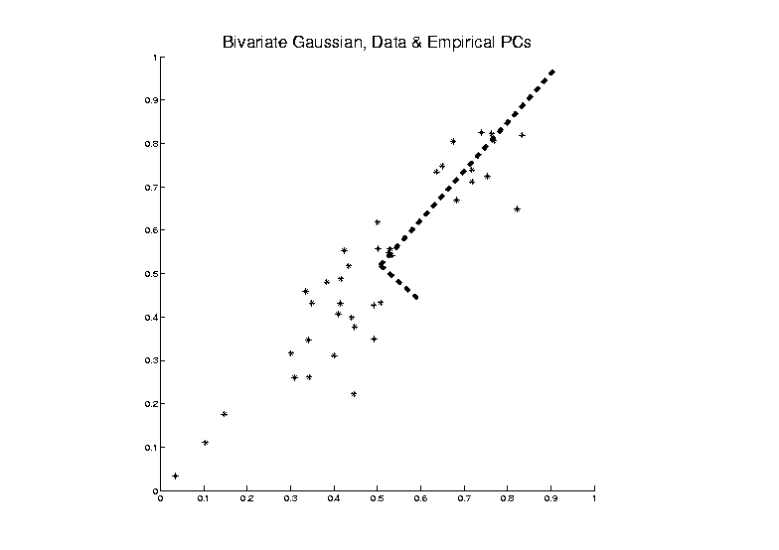
PCA as an Optimization Problem
Find Direction of Greatest Variability:
Approach to
Calculation:
And Optimize Over $u$, such that $\left\|u\right\|=1$
Start with
Candidate
Direction $u$

Slide 17
PCA as Optimization (Cont.)
Given a Candidate Direction $u∈ℝ^{d}$,
Projections of Centered Data Onto $u$ are:
$$P_{u}\left({\tilde{x}}_{j}−{\overline{x}}_{CO}\right)=\left\langle {\tilde{x}}_{j}−{\overline{x}}_{CO},u\right\rangle u, j=1,⋯,n$$
Quantify Variation in the Direction $u$:
$$\frac{1}{n}\sum_{j=1}^{n}{{\left\|P_{u}\left({\tilde{x}}_{j}−{\overline{x}}_{CO}\right)\right\|}^{2}}$$
Recall $\left\|u\right\|=1$
Sample
Variance
of Scores

Slide 18
PCA as Optimization (Cont.)
Quantify Variation in the Direction $u$:
$$\frac{1}{n}\sum_{j=1}^{n}{{\left\|P_{u}\left({\tilde{x}}_{j}−{\overline{x}}_{CO}\right)\right\|}^{2}}=$$
$$=\frac{1}{n}\sum_{j=1}^{n}{{\left(u{\left({\tilde{x}}_{j}−{\overline{x}}_{CO}\right)}^{t}u\right)}^{t}u{\left({\tilde{x}}_{j}−{\overline{x}}_{CO}\right)}^{t}u}=$$
$$=u^{t}\left(\frac{1}{n}\sum_{j=1}^{n}{\left({\tilde{x}}_{j}−{\overline{x}}_{CO}\right){\left({\tilde{x}}_{j}−{\overline{x}}_{CO}\right)}^{t}}\right)u=$$
$$=u^{t}\breve{X}{\breve{X}}^{t}u=$$
$$=u^{t}\hat{Σ}u$$
Looks Like “Products
Of Rows” From Above
Cov. Matrix Repr’n

Slide 19
PCA as Optimization (Cont.)
Quantify Variation in the Direction $u$:
$$\frac{1}{n}\sum_{j=1}^{n}{{\left\|P_{u}\left({\tilde{x}}_{j}−{\overline{x}}_{CO}\right)\right\|}^{2}}=u^{t}\hat{Σ}u$$
Quadratic Form in the
Sample Covariance Matrix $\hat{Σ}$
Simple Solution Comes from the Eigenvalue Representation of $\hat{Σ}$:
$$\hat{Σ}=BDB^{t}$$
Orthonormal
Basis of $ℝ^{d}$
Diagonal Matrix of Eigenvalues

Slide 20
PCA as Optimization (Cont.)
Find Direction $u$ to Maximize:
$u^{t}\hat{Σ}u=u^{t}BDB^{t}u$,
Where $D=\left[\begin{matrix}\begin{matrix}λ_{1} & 0 & ⋯ \\ 0 & λ_{2} & ⋱ \\ ⋮ & ⋱ & ⋱\end{matrix} & \begin{matrix}0 \\ ⋮ \\ 0\end{matrix} \\ \begin{matrix}0 & ⋯ & 0\end{matrix} & λ_{d}\end{matrix}\right]$
For Eigenvalues $λ_{1}≥λ_{2}≥⋯≥λ_{d}$

Slide 21
PCA as Optimization (Cont.)
Find Direction $u$ to Maximize:
$u^{t}\hat{Σ}u=u^{t}BDB^{t}u$,
And Where $B=\left[\begin{matrix}v_{1} & ⋯ & v_{d}\end{matrix}\right]$,
For $d×1$ Eigenvectors $v_{i}$,
Indexed by $i=1,⋯,d$
Now Define $w=\left(\begin{matrix}w_{1} \\ ⋮ \\ w_{d}\end{matrix}\right)=B^{t}u$
Orthonormal
Basis Vectors
Change of
Variable
(still have
$\left\|w\right\|=1$)

Slide 22
PCA as Optimization (Cont.)
Thus Need Direction $w$ to Maximize:
$$u^{t}\hat{Σ}u=w^{t}Dw=$$
$$=\sum_{i=1}^{d}{λ_{i}{w_{i}}^{2}}$$
Since $λ_{1}≥λ_{2}≥⋯≥λ_{d}$,
Max Is At $w=\left(\begin{matrix}\begin{matrix}1 \\ 0\end{matrix} \\ \begin{matrix}⋮ \\ 0\end{matrix}\end{matrix}\right)=B^{t}u$, i.e. $u=v_{1}$

Slide 23
PCA as Optimization (Cont.)
So Direction $u$ to Maximize:
$u^{t}\hat{Σ}u=u^{t}BDB^{t}u$,
Is First Eigenvector, $v_{1}$, of Sample Cov., $\hat{Σ}$

Slide 24
PCA as Optimization (Cont.)
Notes:
Projecting onto Subspace $⊥$ to $v_{1}$,
Gives $v_{2}$ as Next Direction
Continue Through $v_{3},⋯,v_{d}$

Slide 25
PCA as Optimization (Cont.)
Another Viewpoint of Eigenanalysis:
Recall Outer Product Representation
$$\hat{Σ}=\breve{X}{\breve{X}}^{t}$$
And Singular Value Decomposition
$$\breve{X}=\breve{U}\breve{S}{\breve{V}}^{t}$$
Resulting In
$$\hat{Σ}=\breve{U}\breve{S}{\breve{V}}^{t}{\left(\breve{U}\breve{S}{\breve{V}}^{t}\right)}^{t}=\breve{U}{\breve{S}}^{2}{\breve{U}}^{t}$$

Slide 26
PCA as Optimization (Cont.)
Relate Eigenanalysis of$\hat{Σ}$ and SVD of $\breve{X}$:
$$\hat{Σ}=\breve{U}\breve{S}{\breve{V}}^{t}{\left(\breve{U}\breve{S}{\breve{V}}^{t}\right)}^{t}=\breve{U}{\breve{S}}^{2}{\breve{U}}^{t}$$
Can Think of PCA Either as SVD Or Eigen-An.
Same Rotation Matrix $\breve{U}$ for Both
EigenValues $λ_{i}={s_{i}}^{2}$, $i=1,⋯,d$

Slide 27
PCA as Optimization (Cont.)
Terminology Relates to SVD View
For $r$ = Rank of $\breve{X}$:
$$\breve{X}=\breve{U}\breve{S}{\breve{V}}^{t}$$
$d×n$ (Centered, Scaled) Data Matrix
$d×r$ Matrix of (Scaled) Loadings
$r×r$ Matrix of (Scaled) Scores

Slide 28
PCA as Optimization (Cont.)
Connection to Modes of Variation:
Define:
(Scaled) Loadings Matrix, $\breve{U}=\left[\begin{matrix}u_{1} & ⋯ & u_{r}\end{matrix}\right]$
(Scaled) Scores Matrix, $\breve{S}{\breve{V}}^{t}=\left[\begin{matrix}s_{1}v_{1}^{t} \\ ⋮ \\ s_{r}v_{r}^{t}\end{matrix}\right]$

Slide 29
PCA as Optimization (Cont.)
Connection to Modes of Variation:
Thus:
$$\breve{X}=\breve{U}\breve{S}{\breve{V}}^{t}=\sum_{k=1}^{r}{u_{k}s_{k}v_{k}^{t}}$$
(Scaled) Modes of Variation
Rank 1 Matrices

Slide 30
PCA Data Representation
Idea: Expand Data Matrix
in Terms of Inner Prod’ts & Eigenvectors
Recall Notation:
$$\breve{X}=\frac{1}{\sqrt{n}}{\left({\tilde{x}}_{1}−{\overline{x}}_{CO},⋯,{\tilde{x}}_{n}−{\overline{x}}_{CO}\right)}_{d×n}$$
(Mean Centered & Scaled Data)

Slide 31
PCA Data Representation
Idea: Expand Data Matrix
in Terms of Inner Prod’ts & Eigenvectors
Recall Notation:
$$\breve{X}=\frac{1}{\sqrt{n}}{\left({\tilde{x}}_{1}−{\overline{x}}_{CO},⋯,{\tilde{x}}_{n}−{\overline{x}}_{CO}\right)}_{d×n}$$
Spectral Representation (centered data):
$${\breve{X}}_{d×n}=\sum_{k=1}^{r}{u_{k}\left(s_{k}v_{k}^{t}\right)}$$
Recall: Loadings Vector $∈ℝ^{d}$
Scores Vector $∈ℝ^{n}$

Slide 32
PCA Data Represent’n (Cont.)
$1$ by $n$ matrix of $1$s
Now Using:
$$\tilde{X}={\overline{x}}_{CO}1_{1,n}+\sqrt{n}\breve{X}$$
Spectral Representation (Raw Data):
$$\tilde{X}={\overline{x}}_{CO}1_{1,n}+\sqrt{n}\sum_{k=1}^{r}{u_{k}\left(s_{k}v_{k}^{t}\right)}$$
Where:
Entries of $u_{k}$ $\left(d×1\right)$ are Loadings
Entries of $c_{k}^{t}=\sqrt{n}s_{k}v_{k}^{t}$ $\left(1×n\right)$ are Scores

Slide 33
PCA Data Represent’n (Cont.)
Can Focus on Individual Data Object Vectors:
$${\tilde{x}}_{i}={\overline{x}}_{CO}+\sum_{k=1}^{r}{u_{k}c_{i,k}}$$
($i=1,⋯,n$Part of Above Full Matrix Rep’n)
Terminology: $c_{i,k}$ are Called “PCs”
and are also Called Scores

Slide 34
PCA Data Represent’n (Cont.)
More Terminology:
Scores, $c_{i,k}$ are Coefficients in Spectral Representation:
$${\tilde{x}}_{i}={\overline{x}}_{CO}+\sum_{k=1}^{r}{u_{k}c_{i,k}}$$
Loadings are Entries $u_{ij}$ of Eigenvectors:
$$u_{k}=\left(\begin{matrix}u_{1,k} \\ ⋮ \\ u_{d,k}\end{matrix}\right)$$

Slide 35
Connect Math to Graphics
2-d Toy Example
From Much Earlier Class Meeting
2-d Curves as Data In Object Space
Simple, Visualizable Feature Space

Slide 36
Connect Math to Graphics
2-d Toy Example
1st Eigenvector, $u_{1}$
1st Mode of Variation, $u_{1} c_{1}^{t}$

Slide 37
Connect Math to Graphics
2-d Toy Example
2nd Eigenvector, $u_{2}$
2nd Mode of Variation,$u_{2}{ c}_{2}^{t}$

Slide 38
PCA Data Represent’n (Cont.)
Recall: PCA Scatterplot Matrix Views
Provide a Rotation of Data,
Where Axes Are Directions of Max. Variation
By Plotting $c_{1,k},⋯,c_{n,k}$ on axis $k$

Slide 39
PCA Data Represent’n (Cont.)
E.g. Recall Raw Data,
Slightly
Mean
Shifted
Gaussian
Data

Slide 40
PCA Data Represent’n (Cont.)
PCA Rotation: Scatterplot Matrix View
$c_{1,1},⋯,c_{n,1}$
$c_{1,2},⋯,c_{n,2}$

Slide 41
PCA Data Represent’n (Cont.)
PCA Rotates to Directions of Max. Variation

Slide 42
PCA Data Represent’n (Cont.)
PCA Rotates to Directions of Max. Variation

Slide 43
PCA Data Represent’n (Cont.)
Reduced Rank Approximation:
$${\tilde{x}}_{i}≈{\overline{x}}_{CO}+\sum_{k=1}^{m}{u_{k}c_{i,k}}$$
Reconstruct Using Only $m (≪d)$ Terms
(Assuming Decreasing Eigenvalues)

Slide 44
PCA Data Represent’n (Cont.)
Reduced Rank Approximation:
$${\tilde{x}}_{i}≈{\overline{x}}_{CO}+\sum_{k=1}^{m}{u_{k}c_{i,k}}$$
Reconstruct Using Only $m (≪d)$ Terms
(Assuming Decreasing Eigenvalues)
Gives: Rank $m$ Approximation of Data
Key to PCA Dimension Reduction
And PCA for Data Compression (~ .jpeg)

Slide 45
PCA Data Represent’n (Cont.)
Choice of $m$ in Reduced Rank Approxim’n:
Generally Very Slippery Problem
Not Recommended:
Arbitrary Choice
E.g. % Variation Explained 90%? 95%?

Slide 46
PCA Data Represent’n (Cont.)
Choice of $m$ in Reduced Rank Approxim’n:
Generally Very Slippery Problem
SCREE Plot (Kruskal 1964):
Find Knee in Power Spectrum

Slide 47
PCA Data Represent’n (Cont.)
SCREE Plot Drawbacks:
What is a Knee?
What if There are Several?
(Recall Lung
Cancer Data)

Slide 48
PCA Data Represent’n (Cont.)
SCREE Plot Drawbacks:
What is a Knee?
What if There are Several?
Knees Depend on Scaling (Power? log?)
Personal Suggestions:
Find Auxiliary Cutoffs (Inter-Rater Variation)
Use the Full Range

Slide 49
PCA Redistribution of Energy
Now for Scree Plots (Upper Right of FDA Anal.)
Carefully Look At:
Intuition
Relation to Eigenanalysis
Numerical Calculation

Slide 50
PCA Redist’n of Energy (Cont.)
ANOVA Mean Decomposition (of $X_{1},⋯,X_{n}∈ℝ$)
Total Variation =
= Mean Variation + Mean Residual Variation
$\sum_{i=1}^{n}{{\left\|X_{i}\right\|}^{2}}$= $\sum_{i=1}^{n}{{\left\|\overline{X}\right\|}^{2}}+\sum_{i=1}^{n}{{\left\|X_{i}−\overline{X}\right\|}^{2}}$
Mathematics: Pythagorean Theorem
Intuition Quantified via Sums of Squares
(Squares More Intuitive Than Absolutes)

Slide 51
PCA Redist’n of Energy (Cont.)
$$\frac{1}{n}\sum_{i=1}^{n}{{\left\|{\tilde{x}}_{i}−{\overline{x}}_{CO}\right\|}^{2}}=tr\left(BDB^{t}\right)=tr\left(BB^{t}D\right)=tr\left(D\right)=\sum_{j=1}^{d}{λ_{j}}$$
Eigenvalues Provide Atoms of SS Decompos’n
Useful Plots are:
Power Spectrum: $λ_{j}$ vs. $j$
log Power Spectrum: $log\left(λ_{j}\right)$ vs. $j$
Cumulative Power Spectrum: $\sum_{j^{′}=1}^{j}{λ_{j′}}$ vs. $j$
Note PCA Gives SS’s for Free (As Eigenval’s),
But Watch Factors of $\sqrt{n}$
“Scree Plot”
Notes:
51

Slide 52
PCA Redist’n of Energy (Cont.)
Note, have already considered some of these Useful Plots:
Power Spectrum (as %s)
Cumulative Power Spectrum (%)
Recall Common Terminology:
Power Spectrum is Called
“Scree Plot”
Kruskal (1964) Cattell (1966)
(all but name “scree”) (1st Appearance of name???)
Notes:
52

Slide 53
PCA vs. SVD
Sometimes “SVD Analysis of Data”
= Uncentered PCA = PCA Centered at 0

Slide 54
PCA vs. SVD
Sometimes “SVD Analysis of Data”
= Uncentered PCA = PCA Centered at 0
Consequence: Skip this step

Slide 55
PCA vs. SVD
Sometimes “SVD Analysis of Data”
= Uncentered PCA = PCA Centered at 0
Useful view point: For Data Matrix $\tilde{X}$
Ignore scaled, centered $\breve{X}=\frac{1}{\sqrt{n}}\left(\tilde{X}−{\overline{x}}_{CO}1_{1,n}\right)$
Instead do SVD of $\tilde{X}$
(in contrast to SVD of $\breve{X}$
i.e. Eigenanalysis of $\hat{Σ}=\breve{X}{\breve{X}}^{t}$)

Slide 56
PCA vs. SVD
Sometimes “SVD Analysis of Data”
= Uncentered PCA = PCA Centered at 0
Eigen-analysis of $\tilde{X}{\tilde{X}}^{t}$
Intuition:
Find Directions of Maximal Variation
From the Origin, (NOT from ${\overline{x}}_{CO}$)

Slide 57
PCA vs. SVD
Sometimes “SVD Analysis of Data”
= Uncentered PCA = PCA Centered at 0
Investigate with Similar Toy Example

Slide 58
PCA vs. SVD
2-d Toy Example
Direction of “Maximal Variation”???

Slide 59
PCA vs. SVD
2-d Toy Example
Direction of “Maximal Variation”???
PC1 Solution (Mean Centered)
Very Good!

Slide 60
PCA vs. SVD
2-d Toy Example
Direction of “Maximal Variation”???
SV1 Solution (Origin Centered)
Poor Rep’n

Slide 61
PCA vs. SVD
2-d Toy Example
Look in Orthogonal Direction:
PC2 Solution (Mean Centered) Very Good!

Slide 62
PCA vs. SVD
2-d Toy Example
Look in Orthogonal Direction:
SV2 Solution (Origin Centered) Off Map!

Slide 63
PCA vs. SVD
2-d Toy Example
SV2 Solution Larger Scale View:
Not Representative of Data

Slide 64
PCA vs. SVD
Similar 2-d
Toy Example
Now
Compare
Scores

Slide 65
PCA vs. SVD
Consequences
Of Centering:
PCA Scores Are
Mean Centered
Not SVD Scores

Slide 66
PCA vs. SVD
Consequences
Of Centering:
PCA Scores Are
Uncorrelated
Not SVD Scores

Slide 67
PCA vs. SVD
Sometimes “SVD Analysis of Data”
= Uncentered PCA
Investigated with Toy Examples:
Conclusions:
PCA Generally Better
Unless “Origin Is Important”
Deeper Look: Zhang et al (2007)

Slide 68
Different Views of PCA
Solves several optimization problems:
Direction to maximize SS of 1-d proj’d data
Notes:
68

Slide 69
Different Views of PCA
2-d Toy Example
Max SS of Projected Data
Notes:
69

Slide 70
Different Views of PCA
Solves several optimization problems:
Direction to maximize SS of 1-d proj’d data
Direction to minimize SS of residuals
Notes:
70

Slide 71
Different Views of PCA
2-d Toy Example
Max SS of Projected Data
Min SS of Residuals
Notes:
71

Slide 72
Different Views of PCA
Solves several optimization problems:
Direction to maximize SS of 1-d proj’d data
Direction to minimize SS of residuals
(same, by Pythagorean Theorem)
“Best fit line” to data in “orthogonal sense”
(vs. regression of Y on X = vertical sense
& regression of X on Y = horizontal sense)
Notes:
72

Slide 73
Different Views of PCA
2-d Toy Example
Max SS of Projected Data
Min SS of Residuals
Best Fit Line
Notes:
73

Slide 74
Different Views of PCA
Toy Example Comparison of Fit Lines:
PC1
Regression of Y on X
Regression of X on Y
Notes:
74

Slide 75
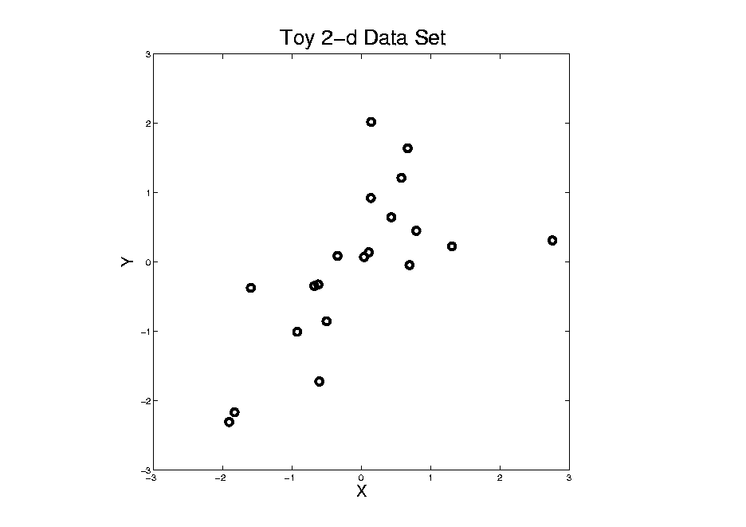
Different Views of PCA
Normal
Data
ρ = 0.3
Notes:
75

Slide 76
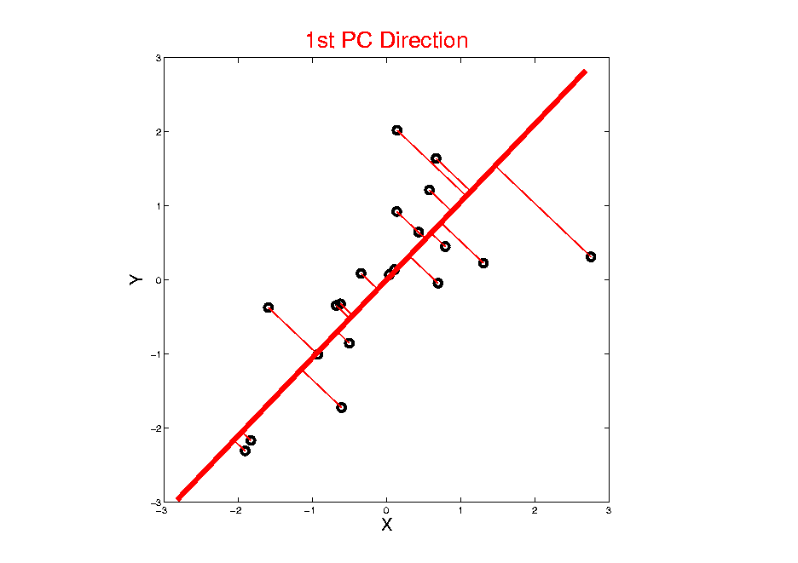
Different Views of PCA
Projected
Residuals
Notes:
76

Slide 77
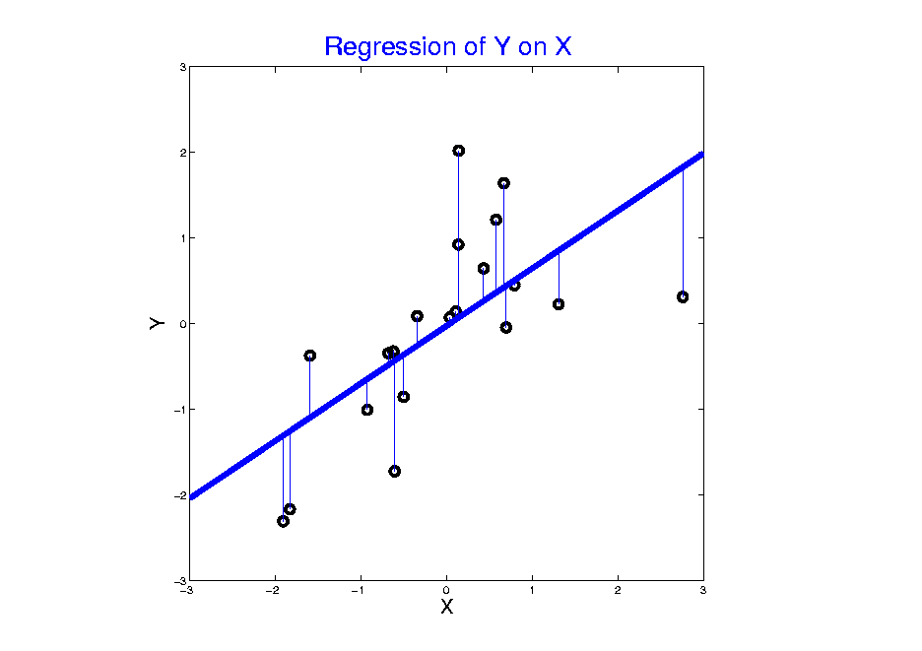
Different Views of PCA
Vertical
Residuals
(X predicts Y)
Note: Smaller Slope, Called
“Regression from Mean”
Notes:
77

Slide 78
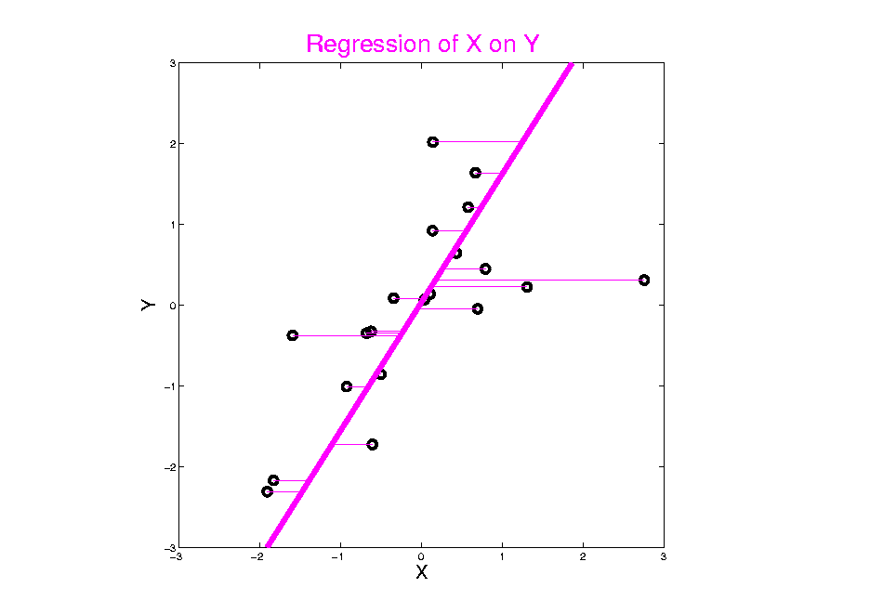
Different Views of PCA
Horizontal
Residuals
(Y predicts X)
Notes:
78

Slide 79
Different Views of PCA
Projected
Residuals
(Balanced
Treatment)
Notes:
79

Slide 80
Different Views of PCA
Toy Example Comparison of Fit Lines:
PC1
Regression of Y on X
Regression of X on Y
Note: Big Difference Prediction Matters
Notes:
80

Slide 81
Different Views of PCA
Solves several optimization problems:
Direction to maximize SS of 1-d proj’d data
Direction to minimize SS of residuals
(same, by Pythagorean Theorem)
“Best fit line” to data in “orthogonal sense”
(vs. regression of Y on X = vertical sense
& regression of X on Y = horizontal sense)
Use one that makes sense…
Notes:
81

Slide 82
PCA Simulation
Idea: given
Column Object Mean Vector ${\overline{x}}_{CO}$
Loadings Vectors $u_{1},⋯,u_{m}$
Singular Values $s_{1},⋯,s_{m}$
Simulate data from Corresponding Normal Distribution
Approach: Invert PCA Data Represent’n
$\tilde{y}={\overline{x}}_{CO}+\sum_{k=1}^{m}{u_{k}s_{k}Z_{k}}$ where $Z_{k}\sim N\left(0,1\right)$

Slide 83
PCA & Graphical Displays
Small caution on PC directions & plotting:
PCA directions (may) have sign flip
Mathematically no difference
Numerically caused artifact of round off
Can have large graphical impact

Slide 84
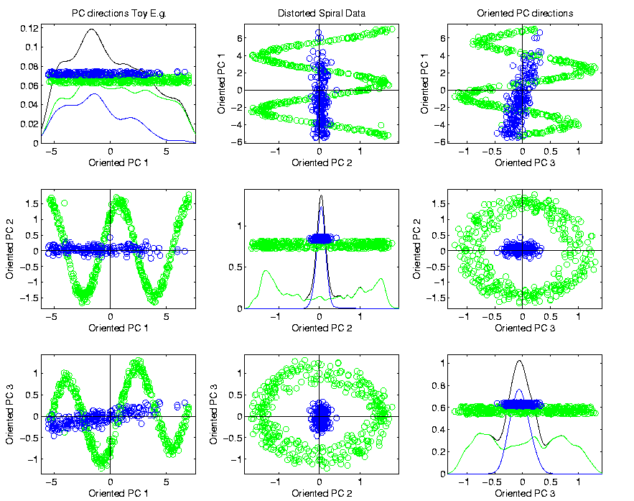
PCA & Graphical Displays
Toy Example (2 colored “clusters” in data)
Blues Form
Central Shaft
Sin and Cos
Waves
Indicate
Spiral

Slide 85
PCA & Graphical Displays
Toy Example (2 colored “clusters” in data)

Slide 86
PCA & Graphical Displays
Toy Example (1 point moved)
Important
Point:
Constant
Axes

Slide 87
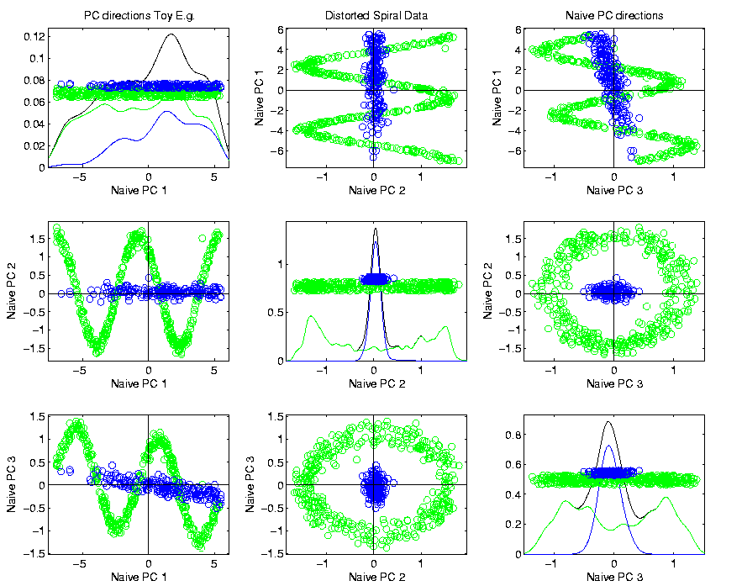
PCA & Graphical Displays
Original Data (arbitrary PC flip)

Slide 88
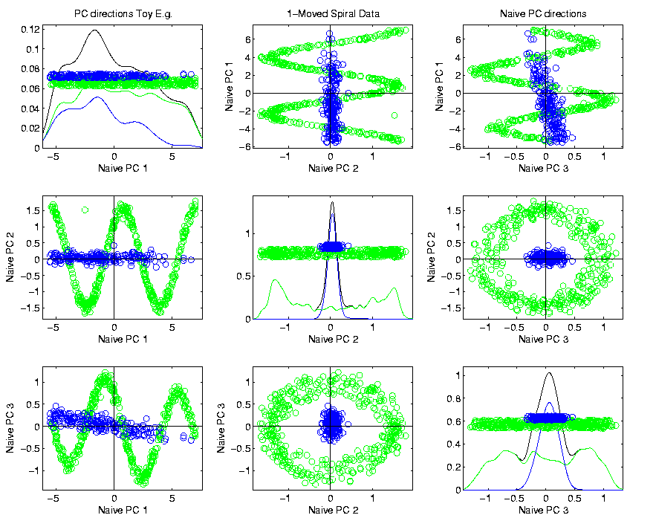
PCA & Graphical Displays
Point Moved Data (arbitrary PC flip)
Much
Harder
To See
Moving
Point

Slide 89
PCA & Graphical Displays
How to “fix directions”?
One Option:
Use ± 1 flip that gives:
$$\max_{i=1,⋯,n}{Proj\left({\tilde{x}}_{i}\right)}>\left|\min_{i=1,⋯,n}{Proj\left({\tilde{x}}_{i}\right)}\right|$$
(assumes 0 centered)

Slide 90
PCA & Graphical Displays
How to “fix directions”?
An alternate approach:
Use ± 1 flip that makes the projection vector
$u=\left(\begin{matrix}u_{1} \\ ⋮ \\ u_{d}\end{matrix}\right)$ “point most towards” $\left(\begin{matrix}1 \\ ⋮ \\ 1\end{matrix}\right)$
i.e. makes $\sum_{j=1}^{d}{u_{j}}>0$
Fails when Row Trait Mean
Has Been Subtracted Out
Recall: “Flat Direction”
Inner Product with Flat Dir’n

Slide 91
Distance Methods
Main Idea:
Approach to Data Lying in Complicated Space
(PCA Makes No Sense In Nonlinear Spaces)
However, Often Have Notion of “Distance”
I.e. Metric on Metric Space
So Base Analysis on Distances
Text: Chp. 7

Slide 92
Distance Methods
Given a metric $δ$ on the Object Space
And Data Objects $𝓧_{1},⋯,𝓧_{n}$
Define Distance Matrix:
$$𝔇=\left[\begin{matrix}δ\left(𝓧_{1},𝓧_{1}\right) & ⋯ & δ\left(𝓧_{1},𝓧_{n}\right) \\ ⋮ & ⋱ & ⋮ \\ δ\left(𝓧_{d},𝓧_{1}\right) & ⋯ & δ\left(𝓧_{d},𝓧_{n}\right)\end{matrix}\right]$$
Script $𝓧$ Denotes
Arbitrary Data Objects

Slide 93
Distance Methods
Common Choices of Metric $δ$ (on $ℝ^{d}$):
$δ_{2}\left(x,y\right)={\left\|x−y\right\|}_{2}={\left(\sum_{j=1}^{d}{{\left(x_{j}−y_{j}\right)}^{2}}\right)}^{1/2}$
$δ_{1}\left(x,y\right)={\left\|x−y\right\|}_{1}=\sum_{j=1}^{d}{\left|x_{j}−y_{j}\right|}$
$δ_{C}\left(x,y\right)=1−\frac{2}{π}\cos^{−1}{\frac{x^{t}y}{{\left\|x\right\|}_{2}{\left\|y\right\|}_{2}}}$
Classical & Corresponds to Intuition
Very Good at Downweighting Outliers
Think Polar Coordinates, Focus on Angular Component and Ignore Radii

