Slide 1
Statistics – O. R. 881 Object Oriented Data Analysis
Start
Recording
Steve Marron
Dept. of Statistics and Operations Research
University of North Carolina

Slide 2
Current Sections in Textbook
Today:
Sections 7.1, 7.2, 1.2, 5.2
Next Class:
Sections 8.1, 8.2, 8.3

Slide 3
Participant Presentations
Today:
12:10 Panos Andreou
Notes:
Please do in Person
Bring Your Laptop
Log In To Zoom (with Sound Off)
Have Title Page With:
Your Name
Your Affiliation
Check Website
For Schedule

Slide 4
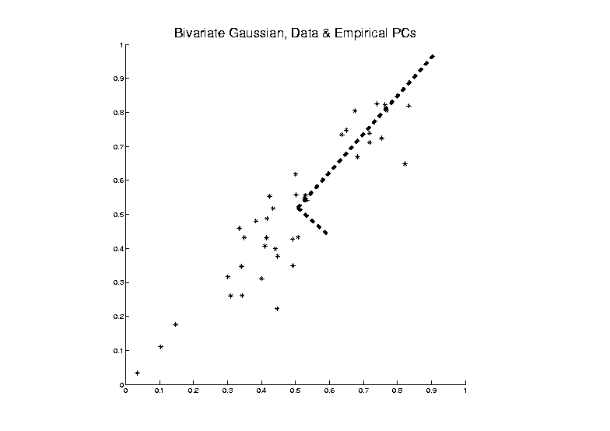
PCA as an Optimization Problem
Find Direction of Greatest Variability:
Approach to
Calculation:
And Optimize Over $u$, such that $\left\|u\right\|=1$
Start with
Candidate
Direction $u$

Slide 5
PCA as Optimization (Cont.)
So Direction $u$ to Maximize:
$u^{t}\hat{Σ}u=u^{t}BDB^{t}u$,
Is First Eigenvector, $v_{1}$, of Sample Cov., $\hat{Σ}$

Slide 6
PCA Data Represent’n (Cont.)
Can Focus on Individual Data Object Vectors:
$${\tilde{x}}_{i}={\overline{x}}_{CO}+\sum_{k=1}^{r}{u_{k}c_{i,k}}$$
($i=1,⋯,n$Part of Above Full Matrix Rep’n)
Terminology: $c_{i,k}$ are Called “PCs”
and are also Called Scores

Slide 7
Connect Math to Graphics
2-d Toy Example
1st Eigenvector, $u_{1}$
1st Mode of Variation, $u_{1} c_{1}^{t}$

Slide 8
PCA Data Represent’n (Cont.)
Reduced Rank Approximation:
$${\tilde{x}}_{i}≈{\overline{x}}_{CO}+\sum_{k=1}^{m}{u_{k}c_{i,k}}$$
Reconstruct Using Only $m (≪d)$ Terms
(Assuming Decreasing Eigenvalues)
Gives: Rank $m$ Approximation of Data
Key to PCA Dimension Reduction
And PCA for Data Compression (~ .jpeg)

Slide 9
PCA Redist’n of Energy (Cont.)
$$\frac{1}{n}\sum_{i=1}^{n}{{\left\|{\tilde{x}}_{i}−{\overline{x}}_{CO}\right\|}^{2}}=tr\left(BDB^{t}\right)=tr\left(BB^{t}D\right)=tr\left(D\right)=\sum_{j=1}^{d}{λ_{j}}$$
Eigenvalues Provide Atoms of SS Decompos’n
Useful Plots are:
Power Spectrum: $λ_{j}$ vs. $j$
log Power Spectrum: $log\left(λ_{j}\right)$ vs. $j$
Cumulative Power Spectrum: $\sum_{j^{′}=1}^{j}{λ_{j′}}$ vs. $j$
Note PCA Gives SS’s for Free (As Eigenval’s),
But Watch Factors of $\sqrt{n}$
“Scree Plot”
Notes:
9

Slide 10
PCA vs. SVD
Consequences
Of Centering:
PCA Scores Are
Uncorrelated
Not SVD Scores

Slide 11
PCA Simulation
Idea: given
Column Object Mean Vector ${\overline{x}}_{CO}$
Loadings Vectors $u_{1},⋯,u_{m}$
Singular Values $s_{1},⋯,s_{m}$
Simulate data from Corresponding Normal Distribution
Approach: Invert PCA Data Represent’n
$\tilde{y}={\overline{x}}_{CO}+\sum_{k=1}^{m}{u_{k}s_{k}Z_{k}}$ where $Z_{k}\sim N\left(0,1\right)$

Slide 12
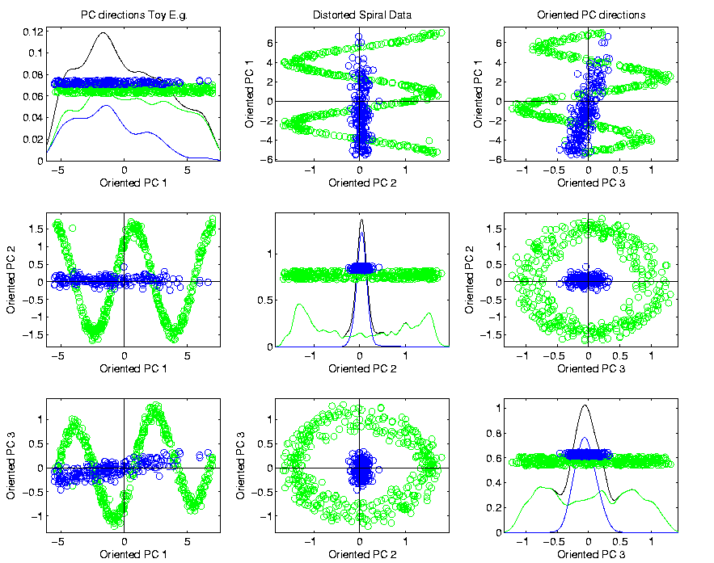
PCA & Graphical Displays
Toy Example (2 colored “clusters” in data)

Slide 13
PCA & Graphical Displays
Toy Example (1 point moved)
Important
Point:
Constant
Axes

Slide 14
Distance Methods
Main Idea:
Approach to Data Lying in Complicated Space
(PCA Makes No Sense In Nonlinear Spaces)
However, Often Have Notion of “Distance”
I.e. Metric on Metric Space
So Base Analysis on Distances
Text: Chp. 7

Slide 15
Distance Methods
Given a metric $δ$ on the Object Space
And Data Objects $𝓧_{1},⋯,𝓧_{n}$
Define Distance Matrix:
$$𝔇=\left[\begin{matrix}δ\left(𝓧_{1},𝓧_{1}\right) & ⋯ & δ\left(𝓧_{1},𝓧_{n}\right) \\ ⋮ & ⋱ & ⋮ \\ δ\left(𝓧_{d},𝓧_{1}\right) & ⋯ & δ\left(𝓧_{d},𝓧_{n}\right)\end{matrix}\right]$$
Script $𝓧$ Denotes
Arbitrary Data Objects

Slide 16
Distance Methods
Common Choices of Metric $δ$ (on $ℝ^{d}$):
$δ_{2}\left(x,y\right)={\left\|x−y\right\|}_{2}={\left(\sum_{j=1}^{d}{{\left(x_{j}−y_{j}\right)}^{2}}\right)}^{1/2}$
$δ_{1}\left(x,y\right)={\left\|x−y\right\|}_{1}=\sum_{j=1}^{d}{\left|x_{j}−y_{j}\right|}$
$δ_{C}\left(x,y\right)=1−\frac{2}{π}\cos^{−1}{\frac{x^{t}y}{{\left\|x\right\|}_{2}{\left\|y\right\|}_{2}}}$
Classical & Corresponds to Intuition
Very Good at Downweighting Outliers
Think Polar Coordinates, Focus on Angular Component and Ignore Radii

Slide 17
Distance Methods
Major Consumers of $𝔇$ Based Analyses
Early Machine Learning
Call Related Analyses “Kernel Trick”
(Discuss More Later)

Slide 18
Distance Methods
Notions of Sample Centerpoint?
Conventional Sample Mean in $ℝ^{d}$:
$${\overline{x}}_{co}=\frac{1}{n}\sum_{i=1}^{n}{x_{i}}=\left(\begin{matrix}\frac{1}{n}\sum_{i=1}^{n}{x_{1,i}} \\ ⋮ \\ \frac{1}{n}\sum_{i=1}^{n}{x_{d,i}}\end{matrix}\right)$$
Text Sec. 7.1
Note: Uses Linear Operations,
Not Available in General

Slide 19
Distance Methods
Approach:
Replace Linear Op’s with Optimization
Fréchet (1948) Mean:
$${argmin}_{𝓧}\frac{1}{n}\sum_{i=1}^{n}{{δ\left(𝓧,𝓧_{i}\right)}^{2}}$$
Start With Candidate Point
Move Around to Min
Sum of Squared Dist’s

Slide 20
Distance Methods
Why Squared Distance?
In $ℝ^{d}$, Using Metric $δ_{2}$, Can Show
Fréchet Mean = ${\overline{x}}_{co}$
I. e. Fréchet Mean is Generalization of Sample Mean

Slide 21
Distance Methods
Fréchet Sample Mean, $ℝ^{2}$ Toy Example
(Use Metric $δ=δ_{2}$)
Move Around to Min
Sum of Squared Dist’s
Start With Candidate Point

Slide 22
Distance Methods
Fréchet Sample Mean, $ℝ^{2}$ Toy Example
(Use Metric $δ=δ_{2}$)
Min Looks Like
Sample Mean???
Note: Outlier Pulls Mean Out of
Convex Hull Of Other 4 Points
Recall “Center
Of Mass”
Interpretretation
Known Problem with Mean: Not Robust Against Outliers

Slide 23
Distance Methods
Robust Variation: Fréchet (1948) Median:
$${argmin}_{𝓧}\frac{1}{n}\sum_{i=1}^{n}{δ\left(𝓧,𝓧_{i}\right)}$$
Again Start With Candidate Point
Move Around to Min
Sum of Distances

Slide 24
Distance Methods
Fréchet Sample Median, $ℝ^{2}$ Toy Example
(Use Metric $δ=δ_{2}$)
Move Around to Min
Sum of Distances
Start With Candidate Point

Slide 25
Distance Methods
Fréchet Sample Median, $ℝ^{2}$ Toy Example
(Use Metric $δ=δ_{2}$)
Better Robustness?
Note: Median Now Inside
Convex Hull Of Other 4 Points

Slide 26
Distance Methods
Now Recall Fréchet Means & Medians Are Defined for Any Metric
How About Other Metrics?
In Toy Example, Replace $δ_{2}$ With $δ_{1}$

Slide 27
Distance Methods
$δ_{1}$ Fréchet Sample Median, $ℝ^{2}$ Toy Example
(Now Use Metric $δ=δ_{1}$)
Distance Depends on
Coordinates, Called
“Manhattan Distance”
Result Is Also
Rather Robust
Note: This is the
Coordinate-wise
Median

Slide 28
Distance Methods
Fréchet Means & Medians Allow Many Variations
Usually Studied in “Robust Statistics”
Might Look Deeper Later On (Text Chapter 16)
“Every Dog Has His Day”

Slide 29
Distance Methods
Recall General Approach:
Replace Linear Op’s with Optimization
Distance Based Version of PCA?
Text Sec. 7.2

Slide 30
Distance Methods
Multi Dimensional Scaling (MDS)
Name & Psychometric References:
Torgersen (1952, 1958), Gower (1966)
Earlier Versions of Ideas:
Eckart & Young (1936), Young and Householder (1938)

Slide 31
Distance Methods
Note: This
Representation
Is Called
“Auto-Encoder”
In AI literture
Multi Dimensional Scaling (MDS)
Given Data Objects $𝓧_{1},⋯,𝓧_{n}$ in an Arbitrary Metric Space, and a Rank $r$
Find Representers $w_{1},⋯,w_{n}∈ℝ^{r}$, Whose Distance Matrix “Best” Approximates $𝔇$
Typical Algorithms: Think of $w_{i}$ as
“PCA-like” vectors of scores

Slide 32
Distance Methods
Multi Dimensional Scaling (MDS)
Note: For $𝓧_{1},⋯,𝓧_{n}∈ℝ^{d}$, and $δ=δ_{2}$
PCA Scores Provide A Sol’n to MDS problem
(Subject to $±$Axes, & = e.val’s)
In this sense MDS Generalizes PCA

Slide 33
Distance Methods
Multi Dimensional Scaling (MDS)
Toy Data in $ℝ^{2}$
$r=2$ MDS Representation
Really Just “Rotation”,
Since $d=2$ and $r=2$
Track Corresponding
Points with Colors
Follows PC1 Axis (Flipped)

Slide 34
Distance Methods
Drawbacks of MDS relative to PCA
Only Gives Scores (Interpret Relationships)
But No Loadings (Explore Drivers)
Nor Modes of Variation
Can Have Serious Distortions (Nonlin. Case)
Which Can be “Good” or “Bad”

Slide 35
Distance Methods
Distortions “Good” or “Bad”???
Choice of Metric is Crucial in MDS:
E.g. Gaussian Data Wrapped Around Sphere
Data Lie on $S^{2}⊆ℝ^{3}$
“Appropriate” Metric?
Called
“Embedding
Space”
Fundamental Point:
One Major Mode of Variation

Slide 36
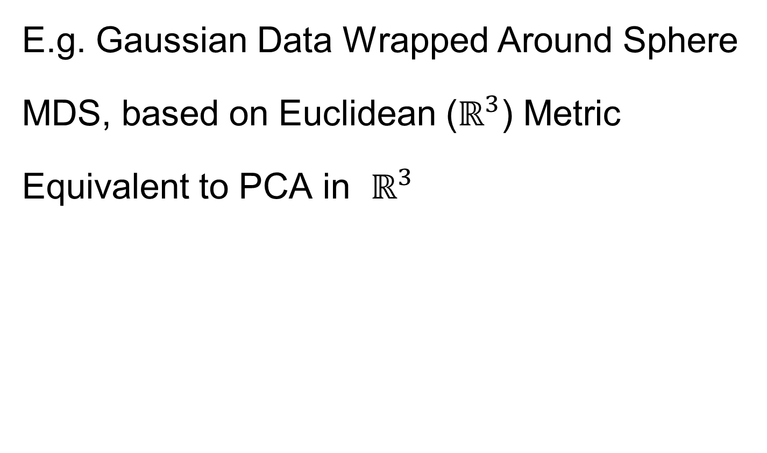
Distance Methods
E.g. Gaussian Data Wrapped Around Sphere
MDS, based on Euclidean ($ℝ^{3}$) Metric
Equivalent to PCA in $ℝ^{3}$
Bad News:
Needs 2 PCs (Modes of Variation) to
Model Data

Slide 37
Distance Methods
E.g. Gaussian Data Wrapped Around Sphere
Better Distance Choice: “Geodesic Distance”
Measured Along Surface of Sphere
MDS Based on
Geodesic Distance
Major Variation
Described with 1 Mode

Slide 38
Distance Methods
Less Attractive Approach to $𝔇$ Based PCA:
Treat Columns of $𝔇$ as Data Objects
And Do Euclidean PCA on Those
Survey in Duin and Pekalska (2005)
Try Out on Above
$ℝ^{2}$ Toy Data Set

Slide 39
Distance Methods
Columns of $𝔇$ as Data Objects
1st PC Looks
Sensible
As Do 1st & 3rd
But 2nd Suffers From
Strong Distortion???
Again Single Mode
Requires 2 Comp’s

Slide 40
Distance Methods
Columns of $𝔇$ as Data Objects
Called
“Horseshoe Effect”
Serious Problem
in Microbiome
Literature:
“MDS” called “PCoA”
See Morton, et al. (2017)

Slide 41
Distance Methods
Columns of $𝔇$ as Data Objects
Called
“Horseshoe Effect”
Elegant Analysis:
Diaconis et al. (2008)
Main Idea llustrated
In Text: Fig. 7.8

Slide 42
Big Picture
Object Oriented Data Analysis
Have done detailed study of Data Objects
In Euclidean Space, $ℝ^{d}$
Next: OODA in Non-Euclidean Spaces

Slide 43
Shapes As Data Objects
Several Different Notions of Shape
Oldest and Best Known (in Statistics):
Landmark Based
Text, Sec. 1.2, 5.2

Slide 44
Shapes As Data Objects
Landmark Based Shape Analysis:
Bookstein (1991)
Kendall et al. (1999)
Dryden & Mardia (2016)
(Note: these are summarizing
Monographs, $∃$ many papers)
Recommended
For Accessibility

Slide 45
Landmark Based Shape Analysis
Start by Representing Shapes
Data Object

Slide 46
Landmark Based Shape Analysis
Start by Representing Shapes by
Landmarks (points in $ℝ^{2}$ or $ℝ^{3}$)
$$\left(x_{1},y_{1}\right)$$
$$\left[\begin{matrix}\begin{matrix}x_{1} \\ y_{1}\end{matrix} \\ \begin{matrix}x_{2} \\ y_{2}\end{matrix} \\ \begin{matrix}x_{3} \\ y_{3}\end{matrix}\end{matrix}\right]∈ℝ^{6}$$
$$\left(x_{2},y_{2}\right)$$
$$\left(x_{3},y_{3}\right)$$
Trait (Feature) Vector

Slide 47
Landmark Based Shape Analysis
Clearly different shapes:

Slide 48
Landmark Based Shape Analysis
Clearly different shapes:
But what about: ?

Slide 49
Landmark Based Shape Analysis
Clearly different shapes:
But what about: ?
(just translation and rotation of ,
but different points in R⁶)

Slide 50
Landmark Based Shape Analysis
Note: Shape should be same over different:
Translations

Slide 51
Landmark Based Shape Analysis
Note: Shape should be same over different:
Translations
Rotations

Slide 52
Landmark Based Shape Analysis
Note: Shape should be same over different:
Translations
Rotations
Scalings (maybe)

Slide 53
Landmark Based Shape Analysis
Approach: Identify objects that are:
Translations
Rotations
Scalings (maybe)
of each other

Slide 54
Landmark Based Shape Analysis
Approach: Identify objects that are:
Translations
Rotations
Scalings (maybe)
of each other
Mathematics: Equivalence Relation

Slide 55
Equivalence Relations
Useful Mathematical Device
Weaker generalization of “=” for a set
Main consequence:
Partitions Set Into Equivalence Classes
For “=”, Equivalence Classes Are Singletons

Slide 56
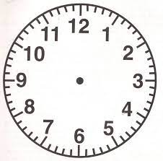
Equivalence Relations
Common Example: Modulo Arithmetic
(E.g. Clock Arithmetic, mod 12)
3 hours after 11:00 is 2:00 …
Hours are equivalence classes:
{1} = {1:00, 13:00, …}
{2} = {2:00, 14:00, …}
$$⋮$$

Slide 57
Equivalence Relations
Common Example: Modulo Arithmetic
(E.g. Clock Arithmetic, mod 12)
For $a, b, c ∈ ℤ$, Say $a≡b (mod c)$
When $\left(b −a\right)$ is divisible by $c$
Clock e.g. $14−2=12$, so $14≡2 (mod 12)$
i.e. 14:00 is “identified with” 2:00

Slide 58
Equivalence Relations
For $a, b, c ∈ ℤ$, Say $a≡b (mod c)$
When $\left(b −a\right)$ is divisible by $c$
E.g. Binary Arithmetic, mod $2$
Equivalence classes:
$\left\{0\right\}=\left\{⋯,−2,0,2,4,⋯\right\}$
$$\left\{1\right\}=\left\{⋯,−1,1,3,5,⋯\right\}$$
(just evens and odds)

Slide 59
Equivalence Relations
Another Example: Vector Subspaces of $ℝ^{2}$
E.g. Say $\left(\begin{matrix}x_{1} \\ y_{1}\end{matrix}\right)≈\left(\begin{matrix}x_{2} \\ y_{2}\end{matrix}\right)$ when $y_{1}=y_{2}$
Equiv. Classes are indexed by $y∈ℝ^{1},$
And are: $\left\{y\right\}=\left\{\left(\begin{matrix}x \\ y\end{matrix}\right)∈ℝ^{2}:x∈ℝ^{1}\right\}$
i.e. Horizontal lines (same $y$ coordinate)

Slide 60
Equivalence Relations
Deeper Example: Transformation Groups
Set of Transformations
(e.g. Translations, Rotations, …)
Group Operation = Composition

Slide 61
Equivalence Relations
Deeper Example: Transformation Groups
For $g∈G$, operating on a set $S$
Say $s_{1}≈s_{2}$ when $∃$ $g$ where $g\left(s_{1}\right)=s_{2}$
Equivalence Classes:
$$\left\{s_{i}\right\}=\left\{s_{j}∈S:s_{j}=g\left(s_{i}\right), for some g∈G\right\}$$
Terminology: Also called orbits

Slide 62
Equivalence Relations
Deeper Example: Transformation Groups
Above Examples Are Special Cases
Modulo Arithmetic
$$G= \left\{g:ℤ→ℤ :g\left(z\right)=z+kc, for k∈ℤ\right\}$$
(Orbits are $\left\{0\right\},\left\{1\right\},⋯,\left\{c−1\right\}$)

Slide 63
Equivalence Relations
Deeper Example: Transformation Groups
Above Examples Are Special Cases
Modulo Arithmetic
Vector Subspace of $ℝ^{2}$
$$G=\left\{g:ℝ^{2}{→ℝ}^{2} :g\left(\begin{matrix}x \\ y\end{matrix}\right)=\left(\begin{matrix}x′ \\ y\end{matrix}\right), x′∈ℝ\right\}$$
(Orbits are horizontal lines, shifts of $ℝ$)

Slide 64
Equivalence Relations
Deeper Example: Transformation Groups
Above Examples Are Special Cases
Modulo Arithmetic
Vector Subspace of $ℝ^{2}$
General Vector Subspace $V$
$G$ maps $V$ into $V$
(Orbits are Shifts of $V$, indexed by $V^{⊥}$)

Slide 65
Equivalence Relations
Deeper Example: Transformation Groups
Above Examples Are Special Cases
Modulo Arithmetic
Vector Subspace of $ℝ^{2}$
General Vector Subspace $V$
Shape: $G=$ Group of “Similarities”
(translations, rotations, scalings)

Slide 66
Equivalence Relations
Deeper Example: Transformation Groups
Mathematical Terminology:
Quotient Operation
Set of Equiv. Classes = Quotient Space
Denoted $S/G$
(“Shape Space” will be of this form)
For Operation of Representing
Equivalence Classes Induced by $G$

Slide 67
Landmark Based Shape Analysis
Approach: Identify objects that are:
Translations
Rotations
Scalings
of each other
Group of Transformations

Slide 68
Landmark Based Shape Analysis
Approach: Identify objects that are:
Translations
Rotations
Scalings
of each other
Mathematics: Equivalence Relation
Results in: Equivalence Classes (i.e. Orbits)
Which become the Data Objects

Slide 69
Landmark Based Shape Analysis
Equivalence Classes become Data Objects
Mathematics: Called “Quotient Space”
Intuitive Representation: Manifold
(curved surface)

Slide 70
Landmark Based Shape Analysis
Triangle Shape Space: Represent as Sphere

Slide 71
Landmark Based Shape Analysis
Triangle Shape Space: Represent as Sphere
$ℝ^{6}$ → $ℝ^{4}$
Translation

Slide 72
Landmark Based Shape Analysis
Triangle Shape Space: Represent as Sphere
$ℝ^{6}$ → $ℝ^{4}$ → $ℝ^{3}$
rotation

Slide 73
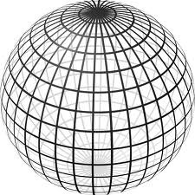
Landmark Based Shape Analysis
Triangle Shape Space: Represent as Sphere
$ℝ^{6}$ → $ℝ^{4}$ → $ℝ^{3}$ →
scaling
(thanks to Wikipedia)

Slide 74
Landmark Based Shape Analysis
Triangle Shape Space: Represent as Sphere
Equilateral
Triangles
Hemispheres
Are
Reflections
Co-Linear
Point Triples
Deeper Discussion in
Sec. 4.3.4, of Dryden
and Mardia (2016)

Slide 75
Variation on Landmark Based Shape
Typical Viewpoint:
Variation in Shape is Goal
Other Variation+ is Nuisance
Recall Main Idea:
Represent Shapes as Coordinates
“Mod Out” Transl’n, Rotat’n, Scale
Shapes (Equiv. Classes) as Data Objects

Slide 76
Variation on Landmark Based Shape
Typical Viewpoint:
Variation in Shape is Goal
Other Variation+ is Nuisance
Interesting Alternative:
Study Variation in Transformation
Treat Shape as Nuisance
To be
Modded
Out!

Slide 77
Variation on Landmark Based Shape
Context: Study of Tectonic Plates
Movement of Earth’s Crust (over time)
Take Motions as Data Objects
Interesting Alternative:
Study Variation in Transformation
Treat Shape as Nuisance

Slide 78
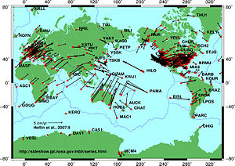
Variation on Landmark Based Shape
Context: Study of Tectonic Plates
Movement of Earth’s Crust (over time)
Take Motions as Data Objects
Chang (1988)
Royer & Chang (1991)
Thanks to Wikipedia

Slide 79
Landmark Based Shape Analysis
Kendall
Bookstein
Dryden &
Mardia
(recall major monographs)

Slide 80
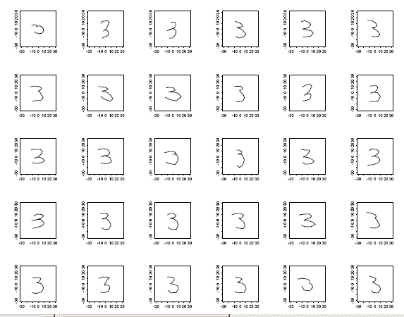
Landmark Based Shape Analysis
Kendall
Bookstein
Dryden &
Mardia
Digit 3 Data
Handwritten (by different people)
Goal: Automatic Recognition
Current Approach: Deep Learning, Early Attempt Was…

Slide 81
Landmark Based Shape Analysis
Kendall
Bookstein
Dryden &
Mardia
Digit 3 Data
(digitized to 13 landmarks)

Slide 82
Landmark Based Shape Analysis
Kendall
Bookstein
Dryden &
Mardia
Digit 3 Data

Slide 83
Landmark Based Shape Analysis
Key Step: mod out
Translation
Scaling
Rotation
Result:
Data Objects ←→
←→ points on Manifold ( ~ $S^{2k−4}$)
Interesting Question:
Modes of Variation on $S^{d}$

Slide 84
OODA in Image Analysis
First Generation Problems:
Denoising
Segmentation
Registration
(all about single images,
still interesting challenges)

Slide 85
OODA in Image Analysis
Second Generation Problems:
Populations of Images
Understanding Population Variation
Discrimination (a.k.a. Classification)
Complex Data Structures (& Spaces)
HDLSS Statistics
Text,
Chp. 11
Will Study,
Text Sec. 14.2
High Dimension, Low Sample Size

Slide 86
OODA in Image Analysis
Common Goal in Image Analysis:
Focus on Shapes Within Images
I.e. Shapes Become the Data Objects
E.g. Organs Within a Medical Image

Slide 87
Shape Representations
Major Approaches for Shape Data Objects:
Landmark Representations
Boundary Representations
Skeletal Representations

Slide 88
Landmark Representations
Landmarks for Fly Wing Data:
Thanks to George Gilchrist

