Slide 1
Statistics – O. R. 881 Object Oriented Data Analysis
Start
Recording
Steve Marron
Dept. of Statistics and Operations Research
University of North Carolina

Slide 2
Current Sections in Textbook
Today:
Sections 8.1, 8.2, 8.3
Next Class:
Sections 8.6

Slide 3
Distance Methods
Main Idea:
Approach to Data Lying in Complicated Space
(PCA Makes No Sense In Nonlinear Spaces)
However, Often Have Notion of “Distance”
I.e. Metric on Metric Space
So Base Analysis on Distances
Text: Chp. 7

Slide 4
Distance Methods
Given a metric $δ$ on the Object Space
And Data Objects $𝓧_{1},⋯,𝓧_{n}$
Define Distance Matrix:
$$𝔇=\left[\begin{matrix}δ\left(𝓧_{1},𝓧_{1}\right) & ⋯ & δ\left(𝓧_{1},𝓧_{n}\right) \\ ⋮ & ⋱ & ⋮ \\ δ\left(𝓧_{d},𝓧_{1}\right) & ⋯ & δ\left(𝓧_{d},𝓧_{n}\right)\end{matrix}\right]$$
Script $𝓧$ Denotes
Arbitrary Data Objects

Slide 5
Distance Methods
Approach:
Replace Linear Op’s with Optimization
Fréchet (1948) Mean:
$${argmin}_{𝓧}\frac{1}{n}\sum_{i=1}^{n}{{δ\left(𝓧,𝓧_{i}\right)}^{2}}$$
Start With Candidate Point
Move Around to Min
Sum of Squared Dist’s

Slide 6
Distance Methods
Fréchet Sample Mean, $ℝ^{2}$ Toy Example
(Use Metric $δ=δ_{2}$)
Min Looks Like
Sample Mean???
Note: Outlier Pulls Mean Out of
Convex Hull Of Other 4 Points
Recall “Center
Of Mass”
Interpretretation
Known Problem with Mean: Not Robust Against Outliers

Slide 7
Distance Methods
Fréchet Means & Medians Allow Many Variations
Usually Studied in “Robust Statistics”
Might Look Deeper Later On (Text Chapter 16)
“Every Dog Has His Day”

Slide 8
Distance Methods
Note: This
Representation
Is Called
“Auto-Encoder”
In AI literture
Multi Dimensional Scaling (MDS)
Given Data Objects $𝓧_{1},⋯,𝓧_{n}$ in an Arbitrary Metric Space, and a Rank $r$
Find Representers $w_{1},⋯,w_{n}∈ℝ^{r}$, Whose Distance Matrix “Best” Approximates $𝔇$
Typical Algorithms: Think of $w_{i}$ as
“PCA-like” vectors of scores

Slide 9
Shapes As Data Objects
Several Different Notions of Shape
Oldest and Best Known (in Statistics):
Landmark Based
Text, Sec. 1.2, 5.2

Slide 10
Landmark Based Shape Analysis
Start by Representing Shapes by
Landmarks (points in $ℝ^{2}$ or $ℝ^{3}$)
$$\left(x_{1},y_{1}\right)$$
$$\left[\begin{matrix}\begin{matrix}x_{1} \\ y_{1}\end{matrix} \\ \begin{matrix}x_{2} \\ y_{2}\end{matrix} \\ \begin{matrix}x_{3} \\ y_{3}\end{matrix}\end{matrix}\right]∈ℝ^{6}$$
$$\left(x_{2},y_{2}\right)$$
$$\left(x_{3},y_{3}\right)$$
Trait (Feature) Vector

Slide 11
Landmark Based Shape Analysis
Approach: Identify objects that are:
Translations
Rotations
Scalings
of each other
Mathematics: Equivalence Relation
Results in: Equivalence Classes (i.e. Orbits)
Which become the Data Objects

Slide 12
Equivalence Relations
Deeper Example: Transformation Groups
Mathematical Terminology:
Quotient Operation
Set of Equiv. Classes = Quotient Space
Denoted $S/G$
(“Shape Space” will be of this form)
For Operation of Representing
Equivalence Classes Induced by $G$

Slide 13
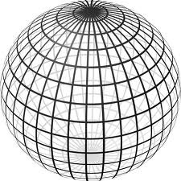
Landmark Based Shape Analysis
Triangle Shape Space: Represent as Sphere
$ℝ^{6}$ → $ℝ^{4}$ → $ℝ^{3}$ →
scaling
(thanks to Wikipedia)

Slide 14
OODA in Image Analysis
First Generation Problems:
Denoising
Segmentation
Registration
(all about single images,
still interesting challenges)

Slide 15
OODA in Image Analysis
Second Generation Problems:
Populations of Images
Understanding Population Variation
Discrimination (a.k.a. Classification)
Complex Data Structures (& Spaces)
HDLSS Statistics
Text,
Chp. 11
Will Study,
Text Sec. 14.2
High Dimension, Low Sample Size

Slide 16
OODA in Image Analysis
Common Goal in Image Analysis:
Focus on Shapes Within Images
I.e. Shapes Become the Data Objects
E.g. Organs Within a Medical Image

Slide 17
Shape Representations
Major Approaches for Shape Data Objects:
Landmark Representations
Boundary Representations
Skeletal Representations

Slide 18
Landmark Representations
Landmarks for Fly Wing Data:
Thanks to George Gilchrist

Slide 19
Landmark Representations
Major Drawback of Landmarks:
Need to always find each landmark
Need same relationship
I.e. Landmarks need to correspond
Often fails for medical images
E.g. How many corresponding landmarks on a set of kidneys, livers or brains???
Much More on Math’s of Landmark
Shape Analysis in Text, Sec. 8.4

Slide 20
Shape Representations
Major Approaches for Shape Data Objects:
Landmark Representations
Boundary Representations
Skeletal Representations

Slide 21
Boundary Representations
Traditional Major Sets of Ideas:
Triangular Meshes
Survey: Owen (1998)
Active Shape Models
Cootes, et al (1993)
Fourier Boundary Representations
Keleman, et al (1997 & 1999)

Slide 22
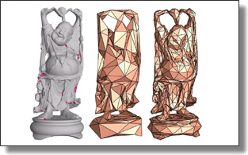
Boundary Representations
Example of triangular mesh rep’n:
From:www.geometry.caltech.edu/pubs.html

Slide 23
Boundary Representations
Main Drawback:
Correspondence
For OODA (on vectors of parameters):
Need to “match up points”
Easy to find triangular mesh
Lots of research on this driven by gamers
Challenge to match mesh across objects
There are some interesting ideas…
Notes:
23

Slide 24
Boundary Representations
Correspondence for Mesh Objects:
Active Shape Models (PCA – like)
Cootes, et al (1993)
Automatic Landmark Choice
Cates, et al (2007)
Based on Optimization Problem:
Good Correspondence & Separation
(Formulate via Entropy)
Used in Analysis of
Childhood Development
Data In Earlier Class
Notes:
24

Slide 25
Shape Representations
Major Approaches for Shape Data Objects:
Landmark Representations
Boundary Representations
Skeletal Representations

Slide 26
Skeletal Representations
Main Idea:
Represent Objects as:
Discretized skeletons (medial atoms)
Plus spokes from center to edge
Which imply a boundary
Very accessible early reference:
Yushkevich, et al (2001)
Volume Gives Better Representation
In 3d than Boundary Surface

Slide 27
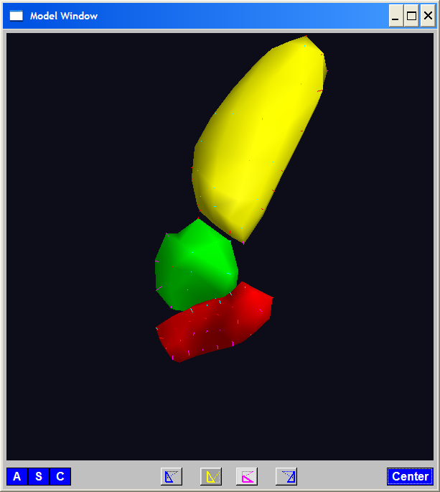
A Challenging Example
Text, Sec. 1.2
Male Pelvis
Bladder – Prostate – Rectum

Slide 28
A Challenging Example
Male Pelvis
Bladder – Prostate – Rectum
Attached to the Bladder
Common Area for Cancer in Males

Slide 29
A Challenging Example
Male Pelvis
Bladder – Prostate – Rectum
Common Area for Cancer in Males
Useful Approach: Radiation
Challenge: Design Treatment
Hit Prostate
Miss Bladder & Rectum
Over Many Days

Slide 30
A Challenging Example
Radiation Treatment in Male Pelvis
Bladder – Prostate – Rectum
Central Question:
How do they move over time (days)?
Work with 3-d CT
(“Computed Tomography”,
= 3d version of X-ray)

Slide 31
A Challenging Example
Radiation Treatment in Male Pelvis
Bladder – Prostate – Rectum
Central Question:
How do they move over time (days)?
Work with 3-d CT
Very Challenging to Segment
Find boundary of each object?
Represent each Object?

Slide 32
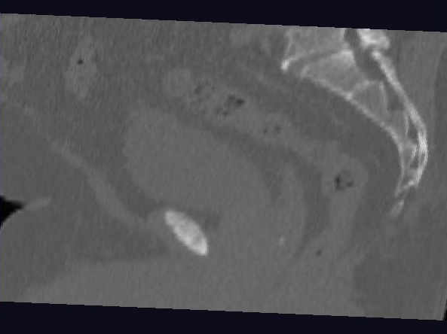
Male Pelvis – Raw Data
One CT Slice
(in 3d image)
Like X-ray:
White = Dense
(Bone)
Black = Gas

Slide 33
Male Pelvis – Raw Data
One CT Slice
(in 3d image)
Tail Bone

Slide 34
Male Pelvis – Raw Data
One CT Slice
(in 3d image)
Tail Bone
Rectum

Slide 35
Male Pelvis – Raw Data
One CT Slice
(in 3d image)
Tail Bone
Rectum
Bladder

Slide 36
Male Pelvis – Raw Data
One CT Slice
(in 3d image)
Tail Bone
Rectum
Bladder
Prostate

Slide 37
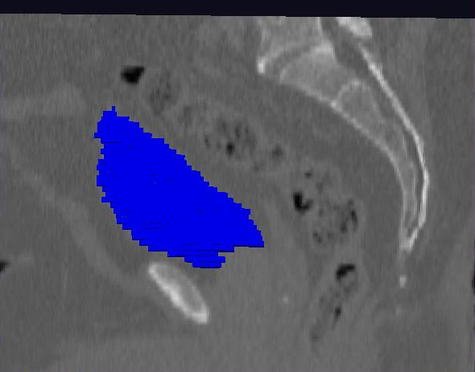
Male Pelvis – Raw Data
Bladder:
manual segmentation
Slice by slice
Reassembled

Slide 38
Male Pelvis – Raw Data
Bladder:
Slices:
Reassembled in 3d
How to represent?
Thanks: Ja-Yeon Jeong

Slide 39
Object Representation
Above Shape Approaches:
Landmarks (hard to find)
Boundary Rep’ns (no correspondence)
Skeletal Representations

Slide 40
Skeletal Representations
3-d S-Rep Example: From Ja-Yeon Jeong
Bladder – Prostate - Rectum
Atoms (yellow dots)
Notes:
OODA.ppt

Slide 41
Skeletal Representations
3-d S-Rep Example: From Ja-Yeon Jeong
Bladder – Prostate - Rectum
Atoms - Spokes (line segments)
Notes:
OODA.ppt

Slide 42
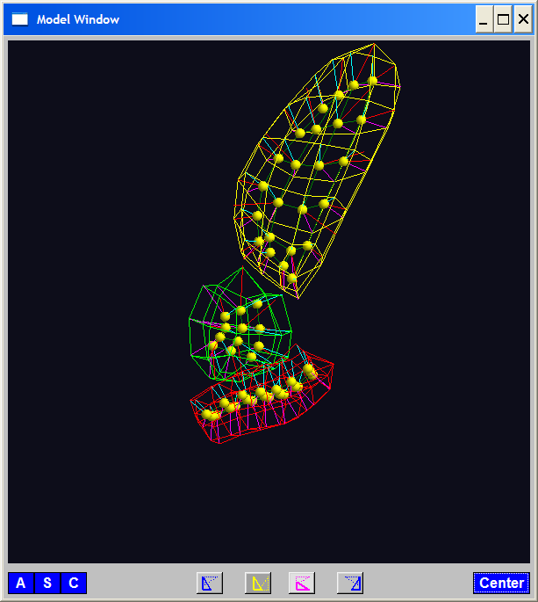
Skeletal Representations
3-d S-Rep Example: From Ja-Yeon Jeong
Bladder – Prostate - Rectum
Atoms - Spokes - Implied Boundary
Notes:
OODA.ppt

Slide 43
Skeletal Representations
3-d S-Rep Example: From Ja-Yeon Jeong
Bladder – Prostate - Rectum
Atoms - Spokes - Implied Boundary
Notes:
OODA.ppt

Slide 44
Skeletal Representations
3-d S-reps: there are several variations
Two choices:
From
Fletcher
(2004)
Notes:
fletcher_thesis.pdf

Slide 45
Skeletal Representations
Detailed discussion of mathematics of S-reps:
Siddiqi & Pizer (2007)
More Applications of S-reps in Imaging:
Pizer & Marron (2017), Pizer et al. (2020)
Notes:
fletcher_thesis.pdf

Slide 46
Skeletal Representations
Statistical Challenge
S-rep parameters are:
Locations $∈ ℝ^{2}$, $ℝ^{3}$
Radii ($>0$)
Angles (not comparable)
Stuffed into a long vector
I.e. many direct products of these

Slide 47
Skeletal Representations
Statistical Challenge
Many direct products of:
Locations $∈ ℝ^{2}$, $ℝ^{3}$
Radii ($>0$)
Angles (not comparable)
Appropriate View:
Data Lie on Curved Manifold
Embedded in higher dim’al Eucl’n Space

Slide 48
3-d s-reps
S-rep model fitting
Easy, when starting from binary (blue)
But very expensive (30 – 40 minutes technician’s time)
Want automatic approach
Challenging, because of poor contrast, noise, …
Need to borrow information across training sample
Use Bayes approach: prior & likelihood → posterior
(A surrogate for “anatomical knowledge”)

Slide 49
3-d s-reps
S-rep model fitting
Easy, when starting from binary (blue)
But very expensive (30 – 40 minutes technician’s time)
Want automatic approach
Challenging, because of poor contrast, noise, …
Need to borrow information across training sample
Use Bayes approach: prior & likelihood → posterior
~Conjugate Gaussians
(Embarassingly Straightforward?)

Slide 50
3-d s-reps
S-rep model fitting
Easy, when starting from binary (blue)
But very expensive (30 – 40 minutes technician’s time)
Want automatic approach
Challenging, because of poor contrast, noise, …
Need to borrow information across training sample
Use Bayes approach: prior & likelihood → posterior
~Conjugate Gaussians, but there are issues:
Major HLDSS challenges
Manifold aspect of data
Handle With Variation on PCA
Careful Handling Very Useful

Slide 51
3-d s-reps
S-rep model fitting
Very Successful
Jeong (2009, UNC CS PhD Dissertation)
Newer Approach:
Nick Tapp-Hughes

Slide 52
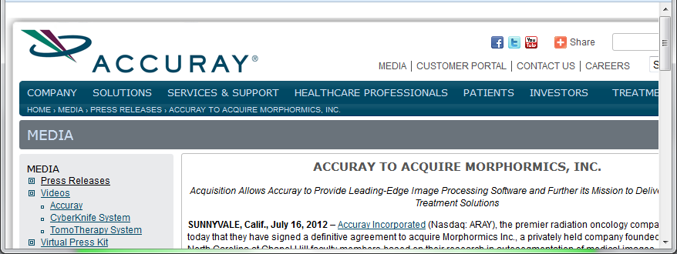
3-d s-reps
S-rep model fitting
Very Successful
Jeong (2009)
Basis of Startup Company: Morphormics
Since Purchased
By Accuray

Slide 53
Data Lying On a Manifold
Major issue: s-reps live in $ℝ^{3}×ℝ^{+}×S^{2}×S^{2}$
(locations, radii and angles)
Note on Terminology:
Manifold Data ≠ Manifold Learning

Slide 54
Data Lying On a Manifold
Major issue: s-reps live in $ℝ^{3}×ℝ^{+}×S^{2}×S^{2}$
(locations, radii and angles)
Note on Terminology:
Manifold Data ≠ Manifold Learning
Data Naturally Lie on Known Manifold

Slide 55
Data Lying On a Manifold
Major issue: s-reps live in $ℝ^{3}×ℝ^{+}×S^{2}×S^{2}$
(locations, radii and angles)
Note on Terminology:
Manifold Data ≠ Manifold Learning
Try to Find Low-d Aprox’ing Manifold

Slide 56
Data Lying On a Manifold
Major issue: s-reps live in $ℝ^{3}×ℝ^{+}×S^{2}×S^{2}$
(locations, radii and angles)
E.g. “average” of: $2^{°}, 3^{°}, {358}^{°}, {359}^{°}=$ ???
${\sum_{i}{θ_{i}}}/4$ ?

Slide 57
Data Lying On a Manifold
Major issue: s-reps live in $ℝ^{3}×ℝ^{+}×S^{2}×S^{2}$
(locations, radii and angles)
E.g. “average” of: $2^{°}, 3^{°}, {358}^{°}, {359}^{°}=$ ???
${\sum_{i}{θ_{i}}}/4$
x
x
x
x

Slide 58
Data Lying On a Manifold
Major issue: s-reps live in $ℝ^{3}×ℝ^{+}×S^{2}×S^{2}$
(locations, radii and angles)
E.g. “average” of: $2^{°}, 3^{°}, {358}^{°}, {359}^{°}=$ ???
Should
Use Unit
Circle
Structure
x
x
x
x

Slide 59
Data Lying On a Manifold
Major issue: s-reps live in $ℝ^{3}×ℝ^{+}×S^{2}×S^{2}$
(locations, radii and angles)
E.g. “average” of: $2^{°}, 3^{°}, {358}^{°}, {359}^{°}=$ ???
Natural Data Space is:
Smooth, Curved Manifold
(Differential Geometry)

Slide 60
Manifold Feature Spaces
Standard Statistical Example:
Directional Data (aka Circular Data)
Idea: Angles as Data Objects
Wind Directions
Magnetic Compass Headings
Cracks in Mines
Text, Sec. 8.1

Slide 61
Manifold Feature Spaces
Standard Statistical Example:
Directional Data (aka Circular Data)
Classical References:
Mardia (2014), Fisher (1995),
Jammalamadaka & Sen Gupta (2001)

Slide 62
Manifold Feature Spaces
Standard Statistical Example:
Directional Data (aka Circular Data)
Reasonable View:
Points on Unit Circle

Slide 63
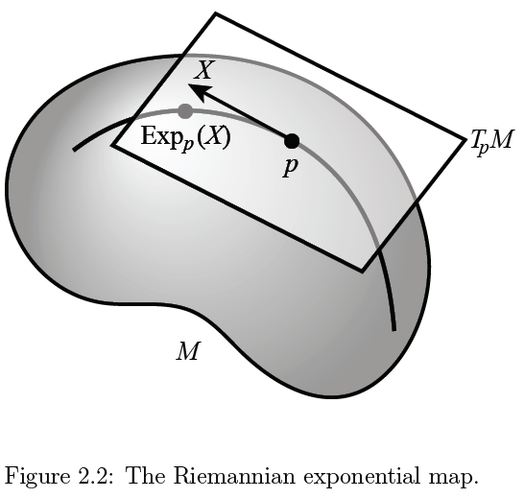
Manifold Feature Spaces
Main Idea:
Curved Surface,
With “Approximating
Tangent Plane”
At Each Point, $p$
(In Limit of Shrinking
Neighborhoods)

Slide 64
Manifold Feature Spaces
Important Mappings:
Plane → Surface:
$\exp_{p}$

Slide 65
Manifold Feature Spaces
Important Mappings:
Plane → Surface:
$\exp_{p}$
Important Point:
Common Length
(along surface)

Slide 66
Manifold Feature Spaces
Important Mappings:
Plane → Surface:
$\exp_{p}$
Surface → Plane
$\log_{p}$

Slide 67
Manifold Feature Spaces
Log & Exp Memory Device:
Complex Numbers
Exponential:
Tangent Plane → Manifold
(Note: Common Length)

Slide 68
Manifold Feature Spaces
Log & Exp Memory Device:
Complex Numbers
Exponential:
Tangent Plane → Manifold
Logarithm:
Manifold → Tangent Plane

Slide 69
Manifold Feature Spaces
Important Mappings:
Plane → Surface:
$\exp_{p}$
Surface → Plane
$\log_{p}$
(matrix versions)

Slide 70
Manifold Feature Spaces
Natural Choice of $p$
For Data Analysis
A “Centerpoint”
Hard To Use:
$\overline{X}=\frac{1}{n}\sum_{i=1}^{n}{X_{i}}$

Slide 71
Manifold Feature Spaces
Extrinsic Centerpoint
Compute:
$\overline{X}=\frac{1}{n}\sum_{i=1}^{n}{X_{i}}$
Anyway
And Project Back
To Manifold

Slide 72
Manifold Feature Spaces
Intrinsic Centerpoint
Work “Really
Inside” The
Manifold

Slide 73
Manifold Feature Spaces
Recall Useful Center in Metric Spaces
Fréchet Mean
Fréchet (1948)
Works in Any Metric Space (e.g. Manifolds)

Slide 74
Manifold Feature Spaces
Fréchet Mean of Numbers:
$$\overline{X}=arg\min_{x}{\sum_{i=1}^{n}{{\left(X_{i}−x\right)}^{2}}}$$
Fréchet Mean in Euclidean Space ($ℝ^{d}$):
$${\overline{x}}_{co}=arg\min_{x}{\sum_{i=1}^{n}{{\left\|x_{i}−x\right\|}^{2}}}=arg\min_{x}{\sum_{i=1}^{n}{{δ\left(x_{i},x\right)}^{2}}}$$
(Intrinsic) Fréchet Mean on a Manifold:
Replace Euclidean $δ$ by Geodesic $δ$

Slide 75
Manifold Feature Spaces
Geodesics:
Idea:
March Along Manifold Without Turning
(Defined in Tangent Planes)

Slide 76
Manifold Feature Spaces
Geodesics:
Idea:
March Along Manifold Without Turning
(Defined in Tangent Planes)
E.g. Surface of the Earth: Great Circle
E.g. Lines of Longitude (Not Latitude…)

Slide 77
Manifold Feature Spaces
Geodesic Distance:
Given Points $x$ & $y$, define
$$δ\left(x,y\right)=\min_{g:geodesic from x to y}{length(g)}$$
Can Show:
$δ$ is a metric (distance)

Slide 78
Manifold Feature Spaces
Extrinsic vs. Intrinsic Centerpoints
Compare on
Unit Circle, $S^{1}$
Ambient Space $\overline{X}=\frac{1}{n}\sum_{i=1}^{n}{X_{i}}$
& Project Back to Manifold
E.g. Fréchet Mean

Slide 79
Manifold Feature Spaces
Extrinsic vs. Intrinsic Centerpoints
Often Similar
Note Big Difference!
Which is Better?

Slide 80
Manifold Feature Spaces
Extrinsic vs. Intrinsic Centerpoints
Which is Better?
Intrinsic “More Like Mean”?
Intrinsic More Stable
Shifting a Green Down
Extrinsic More Stable
Shifting Greens Left

Slide 81
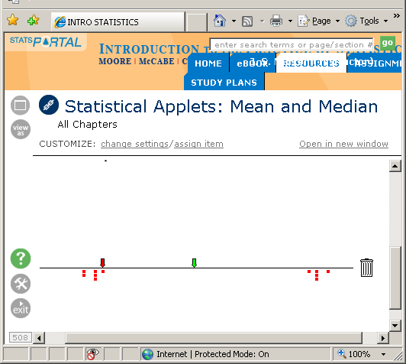
Manifold Feature Spaces
Extrinsic vs. Intrinsic Centerpoints
Which is Better?
Problem as Hard as
“Center” of Bimodal
Distribution
Median
Mean

Slide 82
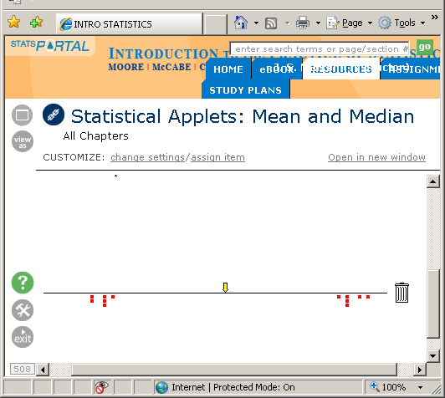
Manifold Feature Spaces
Extrinsic vs. Intrinsic Centerpoints
Which is Better?
Problem as Hard as
“Center” of Bimodal
Distribution

Slide 83
Manifold Feature Spaces
Extrinsic vs. Intrinsic Centerpoints
Which is Better?
Problem as Hard as
“Center” of Bimodal
Distribution

Slide 84
Manifold Feature Spaces
Directional Data Examples of Fréchet Mean:
Not always easily interpretable

Slide 85
Manifold Feature Spaces
Directional Data Examples of Fréchet Mean:
Not always easily interpretable
Think about distances along arc
Not about “points in $ℝ^{2}$”
Sum of squared distances
strongly feels the largest
Not always unique
But unique with probability one
Non-unique requires strong symmetry
But possible to have many means

Slide 86
Manifold Feature Spaces
Directional Data Examples of Fréchet Mean:
Not always sensible notion of center

Slide 87
Manifold Feature Spaces
Directional Data Examples of Fréchet Mean:
Not always sensible notion of center
Sometimes prefer top & bottom?
At end: farthest points from data
Not continuous Function of Data
Jump from 1 – 2
Jump from 2 – 8
All False for Euclidean Mean
But all happen generally for Manifold Data
(for positively curved space)

Slide 88
Manifold Feature Spaces
Notions of Center on Manifolds:
“Extrinsic” vs. “Intrinsic”
“Every Dog has Its Day”
For Further Discussion, See:
Patrangenaru & Ellingson (2016)

Slide 89
Manifold Feature Spaces
Directional Data Examples of Fréchet Mean:
Also of interest is Fréchet Variance:
$${\hat{σ}}^{2}=\min_{\underline{x}}{\frac{1}{n}\sum_{i=1}^{n}{{d\left({\underline{X}}_{i},\underline{x}\right)}^{2}}}$$
Works like Euclidean sample variance
Note values in movie, reflecting spread in data
Note theoretical version:
$$σ^{2}=\min_{\underline{x}}{E_{\underline{X}}}{d\left(\underline{X},\underline{x}\right)}^{2}$$
Useful for Laws of Large Numbers, etc.

Slide 90
Participant Presentation
12:00 Elyse Borgert:
Persistent topology of protein space

